Slide 1
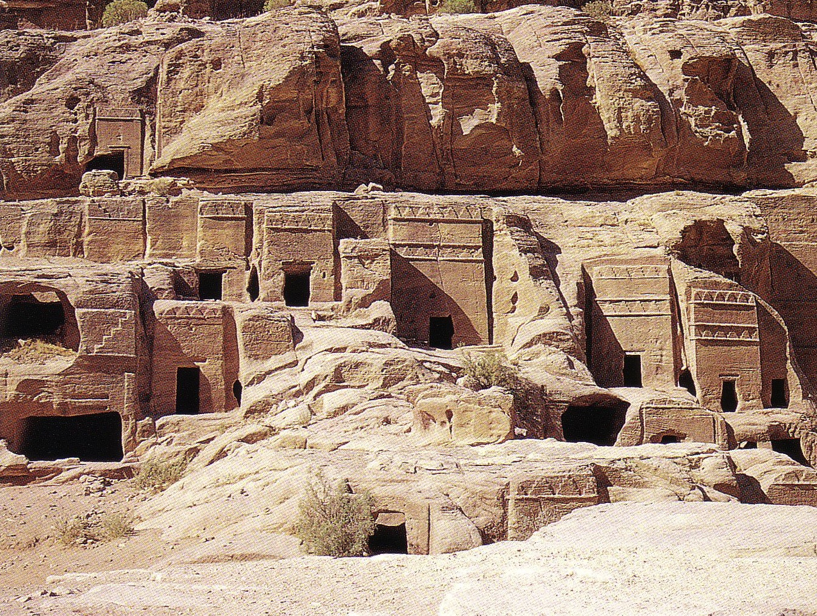
THE NABATEANS
Dr. Rick Griffith • Jordan Evangelical Theological Seminary • BibleStudyDownloads.org

Slide 2
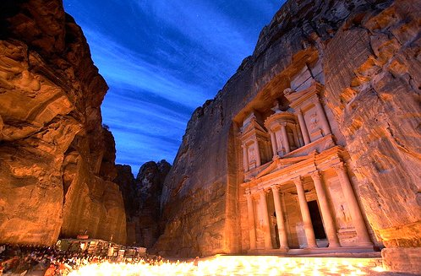
Jordan’s City of Petra is one of the 7 New Wonders of the World
Music: "Helwa Already Baladi" (My Country is Beautiful) Singer: Dalidá

Slide 3
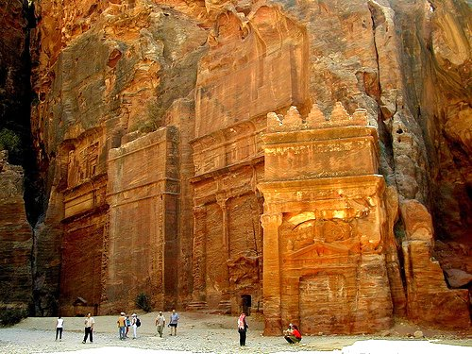
For 600 years it was thought that this city, in the middle of the desert of Jordan, was not real but only legendary like the Atlantis and Troy

Slide 4
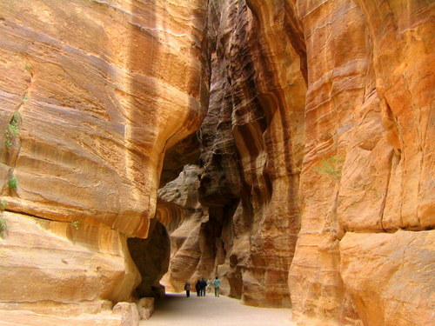
The Swiss explorer who managed to find it in the 19th century had to travel through impressive paths as this among mountains of stone.

Slide 5
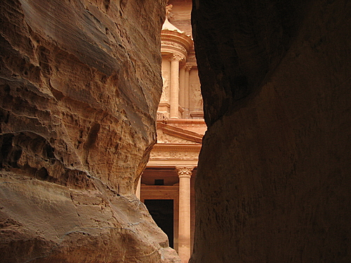
Imagine his emotions when, upon arriving for the first time, he saw this scene!

Slide 6
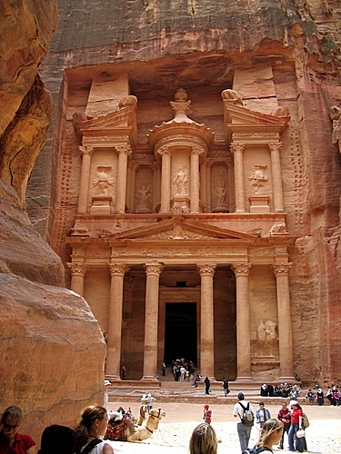
The Palace of Petra, a temple in Greek style (Hellenic), is also called "The Treasury" and is 42 meters high

Slide 7
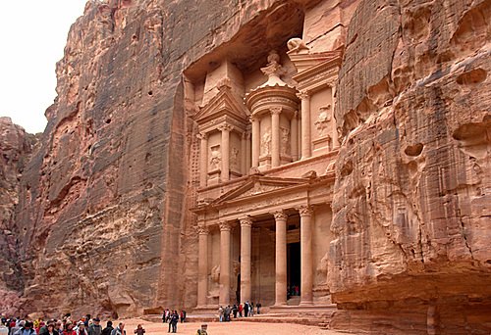
It was carved completely in calcareous rock.

Slide 8
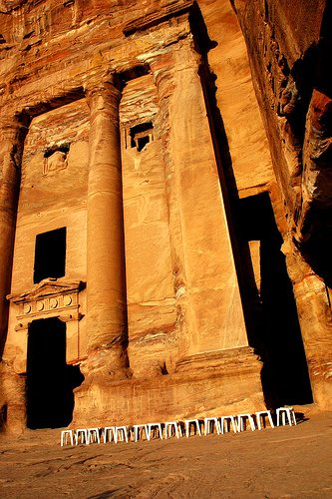
But the palace
is only one among
the many magnificent
constructions in Petra,
all carved in
calcareous rock.

Slide 9
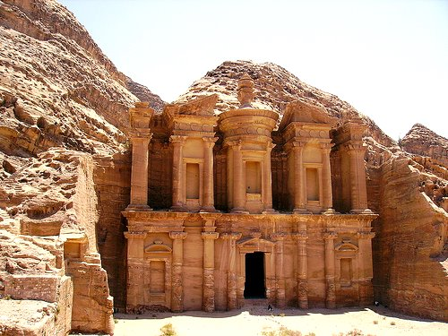
Petra was constructed in the 6th century BC by the Nabateans during the Persian Empire.

Slide 10
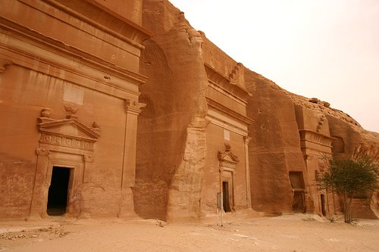
The Nabateans were Bedouins that lived on the commerce of spices, like incense, myrrh and aromatic plants.

Slide 11
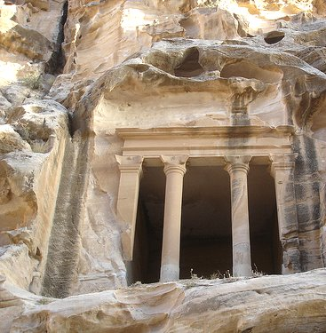
By the year AD 60 Petra was conquered and became part of the Roman Empire.

Slide 12
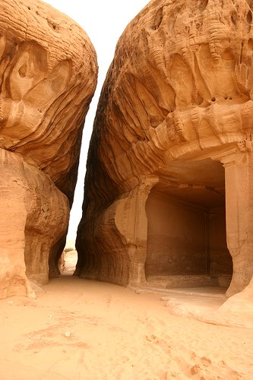
Through the years,
the wind has left
its contribution,
carving the most
beautiful forms
in the mountains of
calcareous rock.

Slide 13
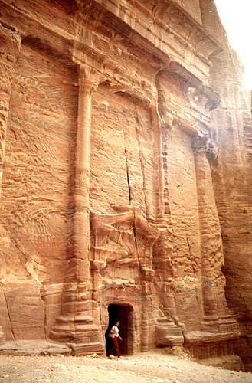
Petra was utilized for the final scene of the movies Indiana Jones and The Last Crusade

Slide 14
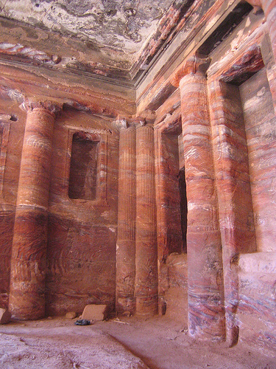
Note the details
in the interior carvings

Slide 15
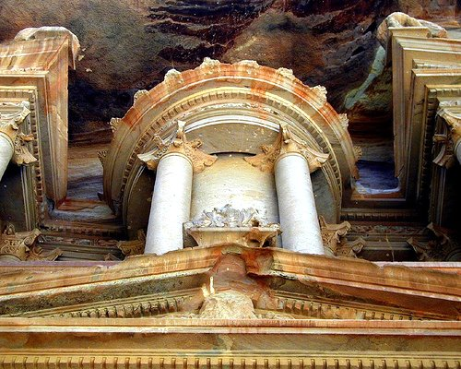
The colors in the stones are natural.

Slide 16
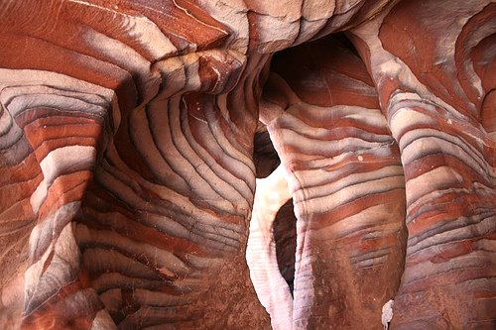
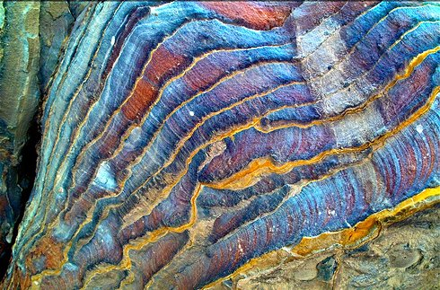
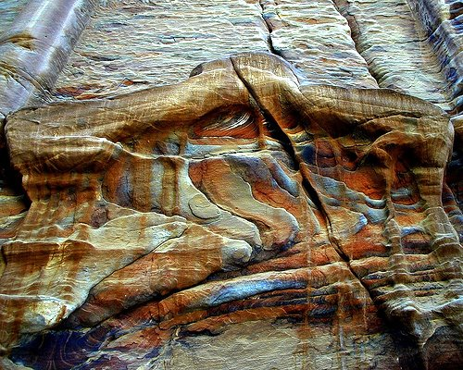
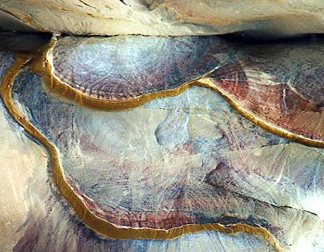
The natural colored geological composition of the sand is favorable for "natural paintings" such as these.

Slide 17
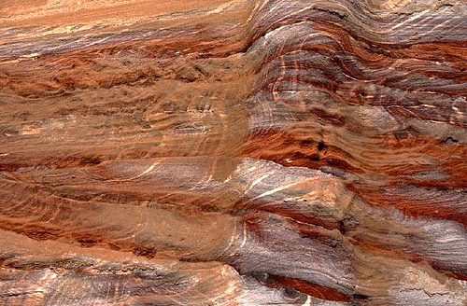
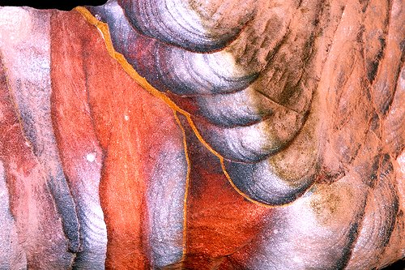
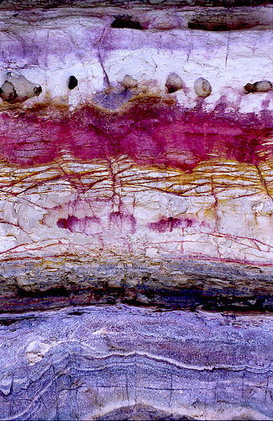
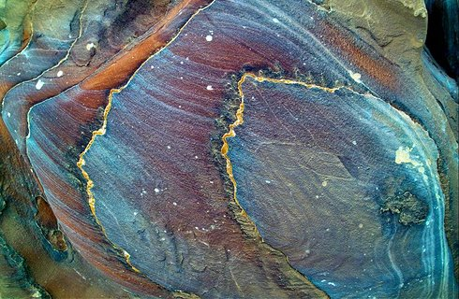
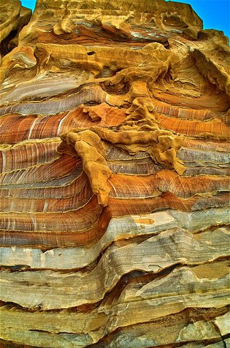
These formations found in the walls of some mountains take one’s breath away!

Slide 18
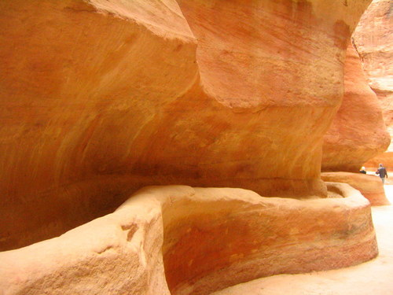
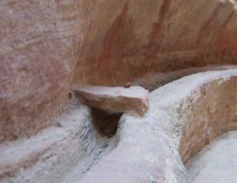
The Nabateans also carved a sophisticated hydraulic system with tunnels and tanks of water to bring water to Petra

Slide 19
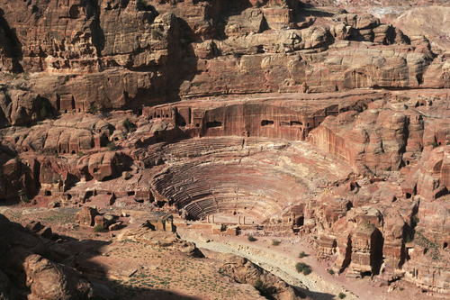
This theater, in Greek-Roman style, sat 4,000 spectators.

Slide 20
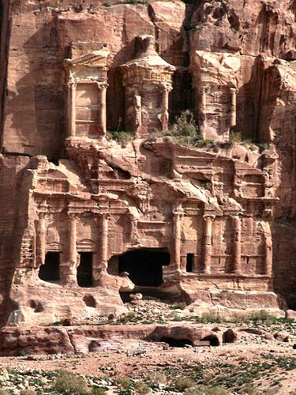
In AD 551 a second great earthquake destroyed almost all the city, so Petra was never again inhabited.

Slide 21
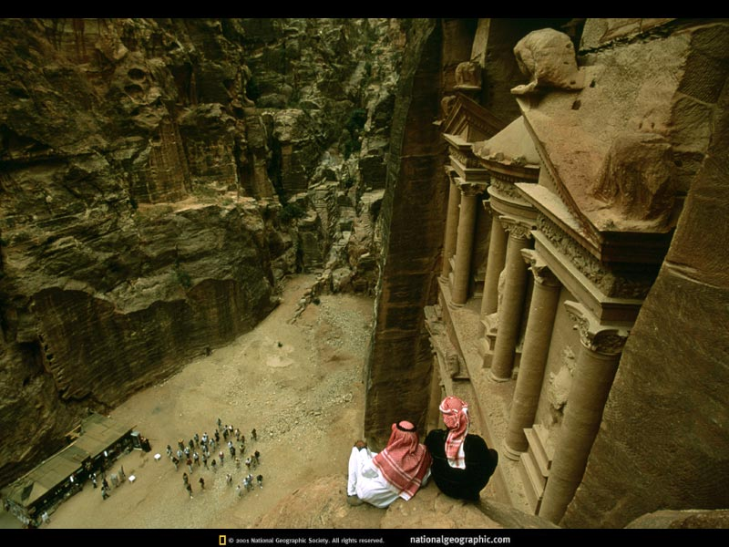
Jordan’s City of Petra is one of the 7 New Wonders of the World

Slide 22
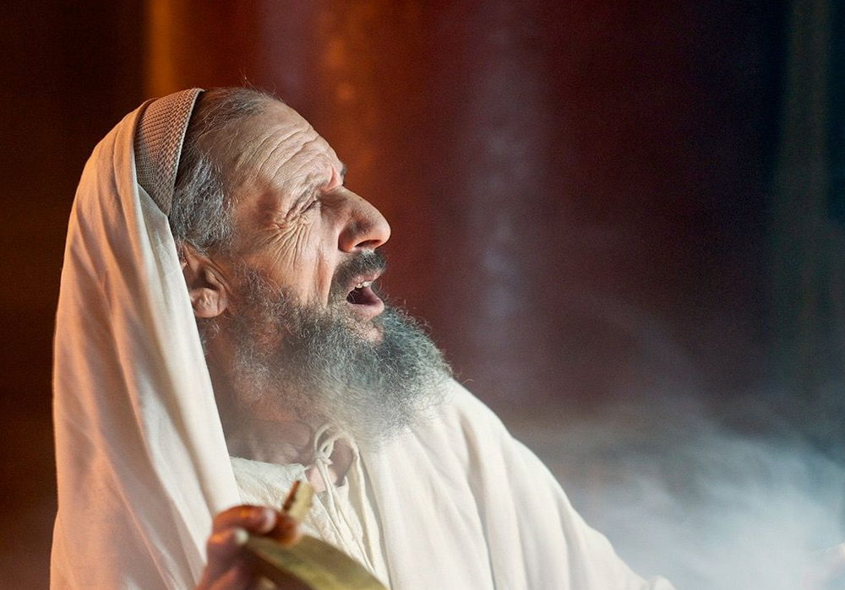
"The vision of Obadiah" (Obadiah 1 NIV).
No king = No Time Period
Notes:
Unlike all of the prophets except Joel, Obadiah does not give the name of the king while he prophesied. This makes it tough to know when he wrote.

Slide 23
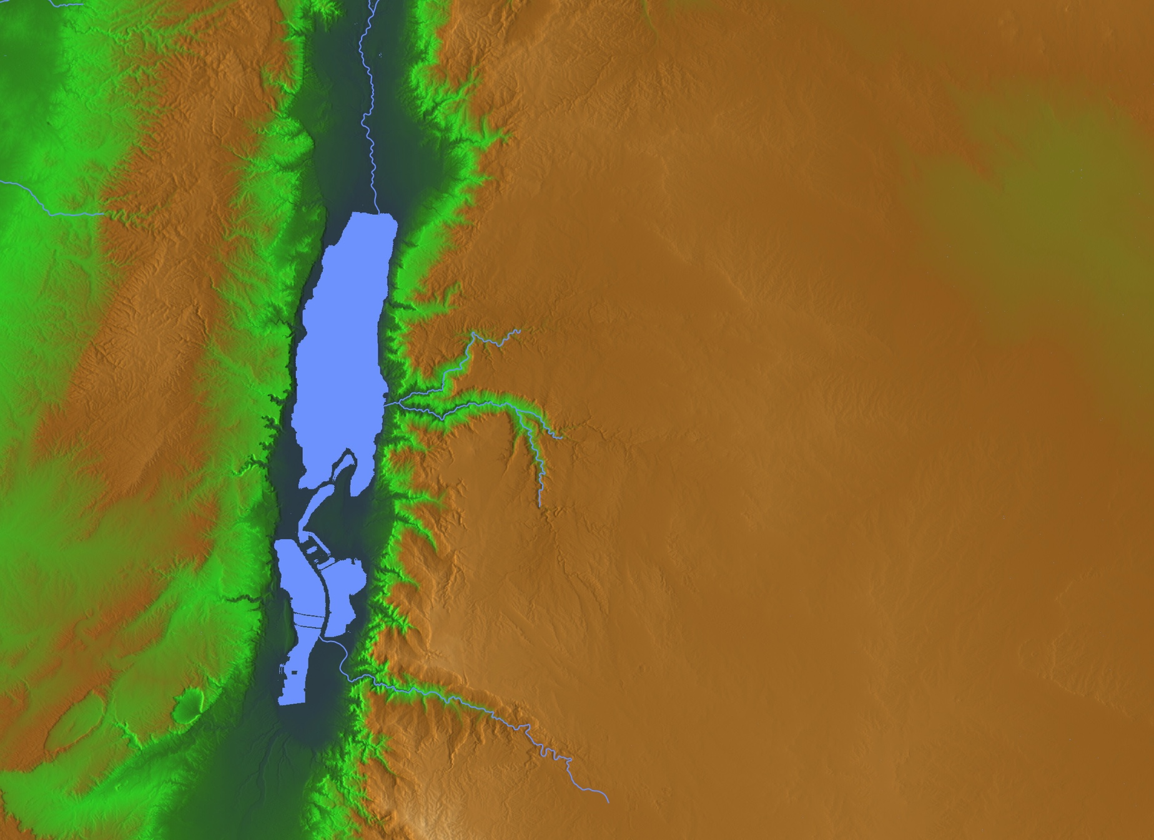
"This is what the Sovereign LORD says about Edom" (Obadiah 1b NIV).
ISRAEL
EDOM

Slide 24
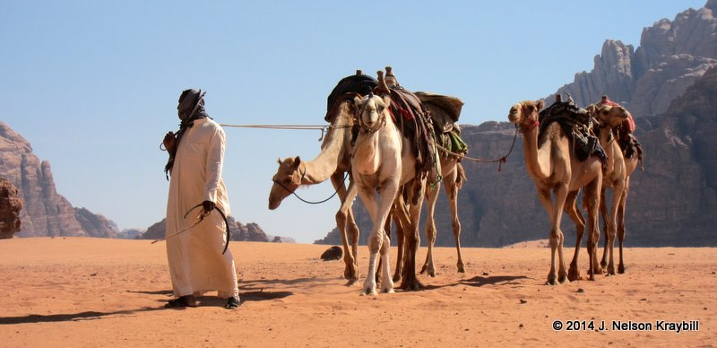
"We have heard a message from the LORD: An envoy was sent to the nations to say, 'Rise, and let us go against her for battle'—" (Obadiah 1c NIV).
Notes:
God invites the nations to come and judge Edom (1b) [which occurred as the Nabateans, Jews under John Hyrcanus, and Romans under Titus all contributed to the annihilation of the Edomites].

Slide 25
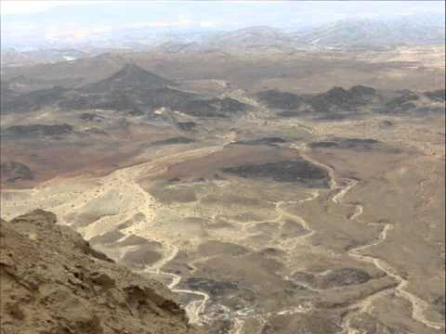
"See, I will make you small among the nations; you will be utterly despised" (Obadiah 2 NIV).

Slide 26
"The pride of your heart has deceived you, you who live in the clefts of the rock, in your lofty dwelling, who say in your heart, 'Who will bring me down to the ground?'" (Obadiah 3)
598c
Notes:
The LORD describes Edom's destruction aided by deceptive allies and involving a humiliating slaughter and plundering (1b-9). Note the Fulfillment: The Nabateans around 500 BC were invited to an Edomite banquet but deceived, slaughtered and plundered the Edomites.
God describes Edomite destruction by the nations as being brought low in humiliation from arrogant dwellings high in the rocks and as a fallen eagle (1b-4).

Slide 27
Geographical Setting
444
598d
Jacob
Israel
Esau
Edom
Notes:
God blessed both Jacob and Esau to become fathers of the respective nations of Israel and Edom.
____________
Common-174
OS-01-Gen21-36-slide 97
OS-31-Obadiah-75

Slide 28
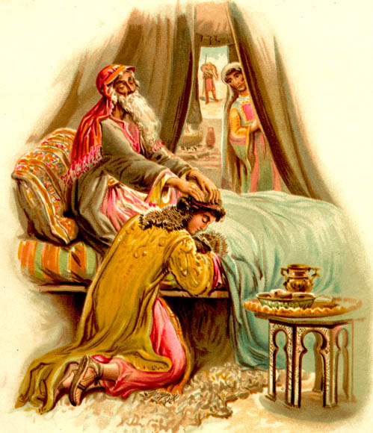
Genesis 27:1-40
God chose Jacob, not Esau

Slide 29
Purpose
597
The book of Obadiah has a twofold purpose:
to delineate God's judgment on Edom for its lack of brotherly concern for Judah
to set forth the final triumph of right in the Day of the LORD

Slide 30
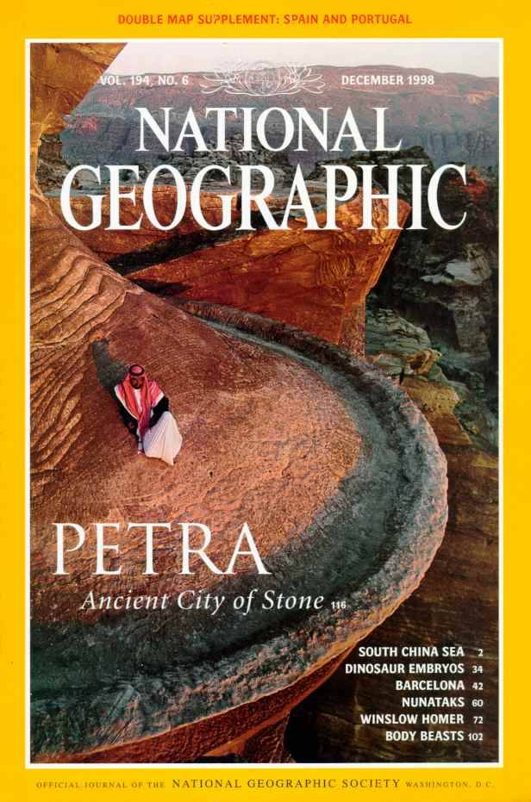
National Geographic has several articles on Petra back to 1907
Here's Dec. 1998

Slide 31
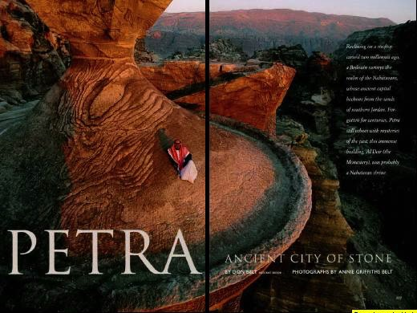
Petra Article Front Page

Slide 32
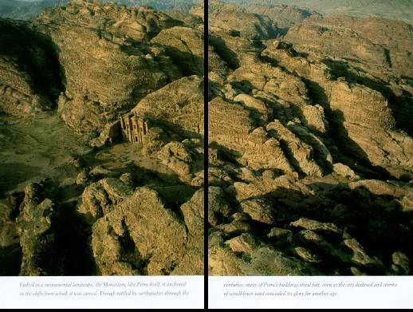
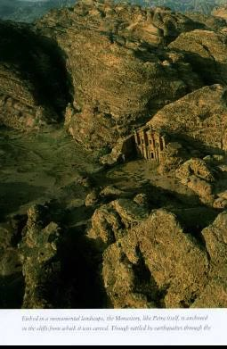
Imagine living in this terrain!

Slide 33
The Siq (pronounced "seek")
598c
The only entrance to Petra
Water Course

Slide 34
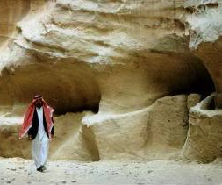
Water channels were buried for centuries

Slide 35
Exit of the Siq
598b

Slide 36
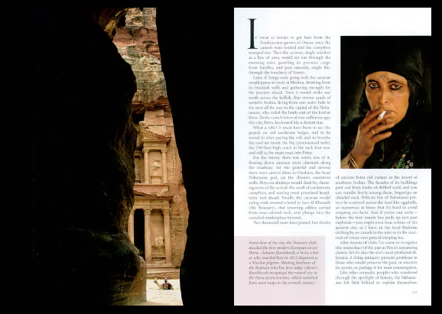
Dark Siq Exit

Slide 37
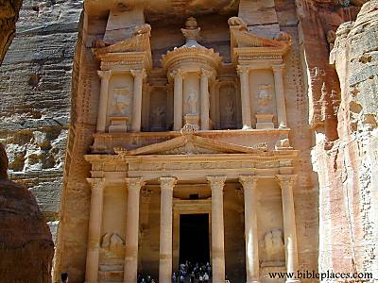
The Treasury
598b

Slide 38
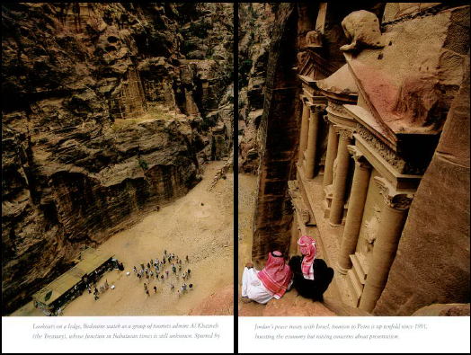
From atop the Treasury

Slide 39
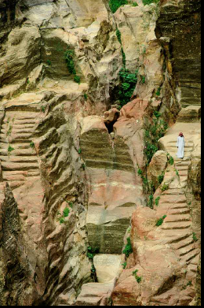
Nabataean engineers ingeniously collected the mere 6 inches of annual rainfall.

Slide 40
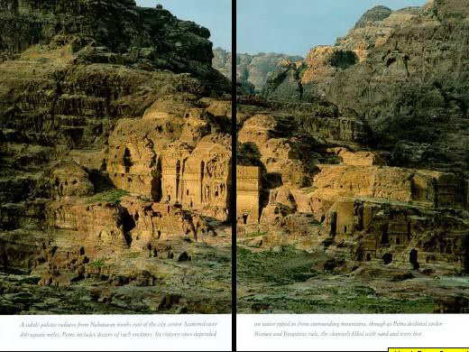
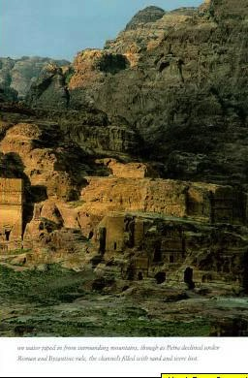
Nabatean tombs east of the city center

Slide 41
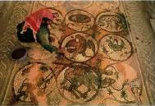
Byzantine Church Mosaic (5th century)

Slide 42
"The pride of your heart has deceived you, you who live in the clefts of the rock, in your lofty dwelling, who say in your heart, 'Who will bring me down to the ground?'" (Obadiah 3)
598c

Slide 43
Colonnade Envisioned
598c

Slide 44
Colonnade Realized
598c

Slide 45
Nymphaleon

Slide 46
Nymphaleon

Slide 47
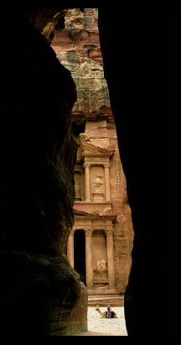
Who Lived at Petra?
Horites (Gen. 14:6): Pre-1850 (“hill country of Seir”)
Edomites (Amos 1:12): 1850-552 BC (“Sela” Heb. “rock”)
Nabataeans (not in Bible) 552 BC-AD 106 (“Petra” Gr. “rock”)
Romans (post-NT) Post-AD 106 (“Hadriana”)

Slide 48
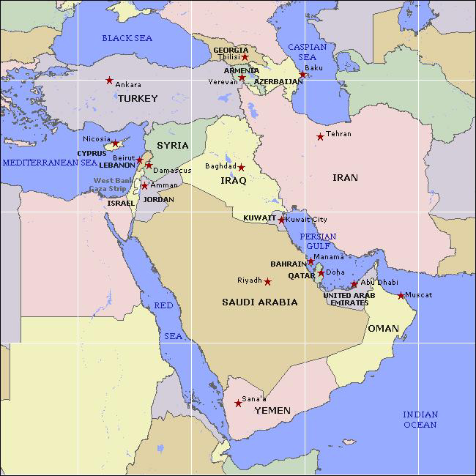
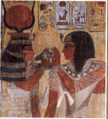
Egypt to Mesopotamia Trade

Slide 49
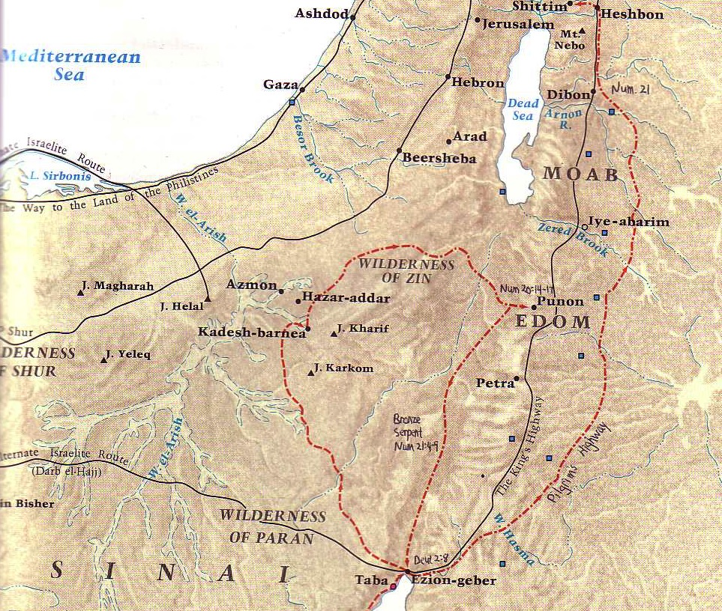
The King's Highway
54
Petra
Barry Beitzel, Moody Atlas of Bible Lands, 87

Slide 50
The Spice Trade
Petra

Slide 51
“Though you soar like the eagle and make your nest among the stars, from there I will bring you down,” declares the LORD.
Obadiah 4 (NIV)

Slide 52
"Though you soar like the eagle and make your nest among the stars, from there I will bring you down,” declares the LORD (Obadiah 4 NIV).

Slide 53
"If thieves came at night and robbed you (what a disaster awaits you!), they would not take everything. Those who harvest grapes always leave a few for the poor. But your enemies will wipe you out completely!” (Obadiah 5 NLT).

Slide 54
How does God respond to
PRIDE
????

Slide 55
—Main Idea of Obadiah—
God humbles the proud but exalts the humble

Slide 56
Calls to Humility
594
God judges the prideful who try to destroy his people.
God "does unto you" as you have "done unto others" (v. 15).
The eventual and final fate of Edom is the fate of all the wicked – death.
The eventual and final reward of God's people is life abundant.

Slide 57
"The LORD Almighty has a day in store for all the proud and lofty, for all that is exalted (and they will be humbled)."
Isaiah 2:12 (NIV)

Slide 58
and whoever humbles himself will be exalted."
"For whoever exalts himself will be humbled
Matthew 23:12 (NIV)

Slide 59
"But he gives us more grace. That is why Scripture says: 'God opposes the proud but gives grace to the humble.'"
James 4:6 (NIV)

Slide 60
Humility does not mean you think less of yourself.
It means you think of yourself less.
—Ken Blanchard—
In what area of your life do you need to curb pride?

Slide 62
OT Backgrounds link at BibleStudyDownloads.org
Get this presentation for free!
Notes:
NT Survey (ns)

