Slide 1
The Moabites
Dr. Rick Griffith • Jordan Evangelical Theological Seminary • BibleStudyDownloads.org

Slide 2
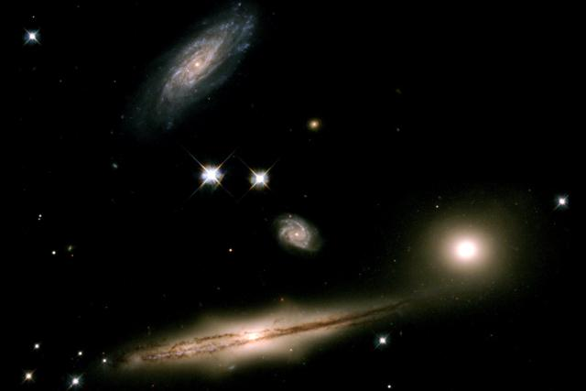
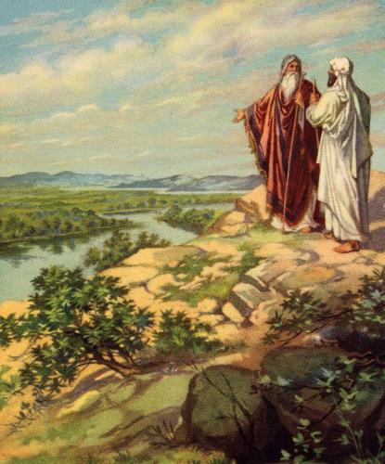
Origin of Moabites
17
Noah
Shem
7 Generations
Terah
Abraham and Lot
Abraham
Nahor
Haran
Lot
Milcah
Iscah
Eldest
Daughter
Youngest
Daughter
Moab
Ben-Ammi

Slide 3
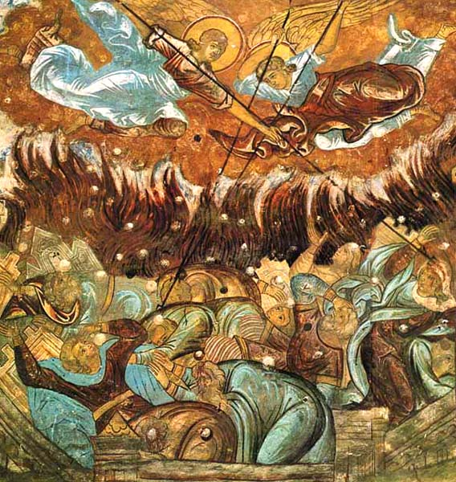
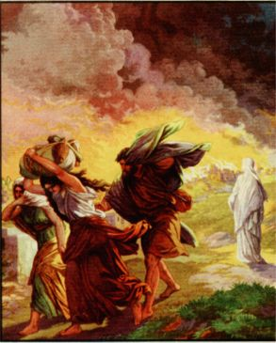
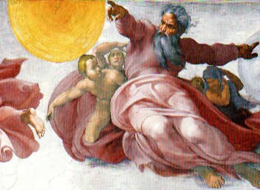
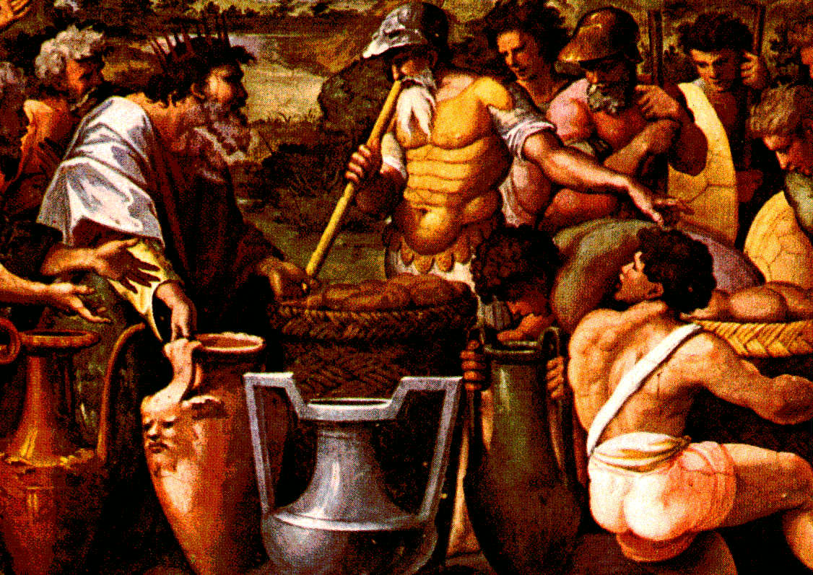
Moab's Beginnings
Genesis 13:8-9
⁸ So Abram said to Lot, "Let's not have any quarreling between you and me, or between your herdsmen and mine, for we are brothers.
⁹ Is not the whole land before you? Let's part company. If you go to the left, I'll go to the right; if you go to the right, I'll go to the left."
Notes:
Abraham's servants argued with Lot's servants.
So, Abraham gave him the choice of where to live.
Lot chose the immoral city of Sodom which God destroyed.
Lot's wife died as a salt pillar, but his two daughters lived.

Slide 4
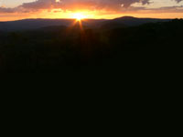
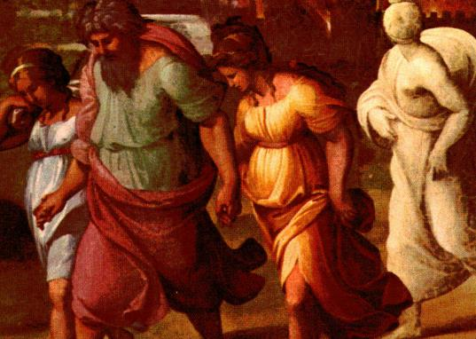


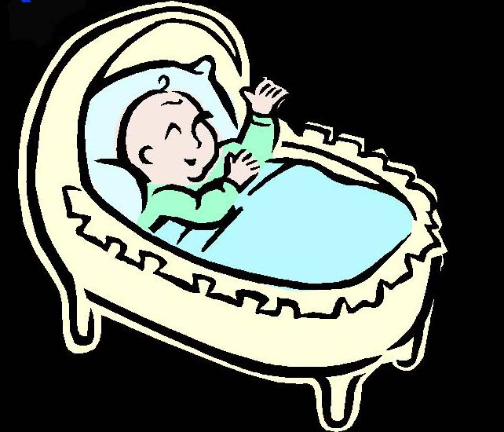
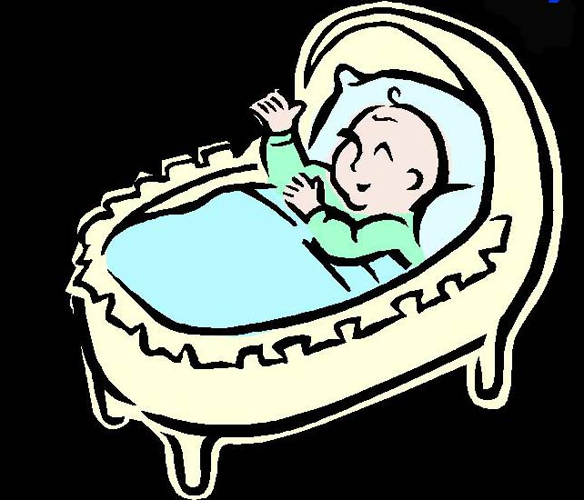
Genesis 19:36-38
98
my name is Moab
my name is Ben-Ammi
Genesis 19:36-38
³⁶ So both of Lot's daughters became pregnant by their father.
³⁷ The older daughter had a son, and she named him Moab, he is the father of the Moabites today.
³⁸ The younger daughter also had a son, and she named him Ben-Ammi; he is the father of the Ammonites of today.
Notes:
But these daughters feared that they would never have children.
• So, they concocted a plan to sleep with their father.
• The plan worked in consecutive days.
• The result was that both daughters got pregnant.
• The babies were two cousins.
• One was Moab.
• The other was Ben-Ammi.
These boys became the fathers of the Moabites and Ammonites.

Slide 5

Contents
1. Genealogy
2. Geography
3. History
4. Religion
5. Reflection & Application
6. Sources & Bibliography

Slide 6

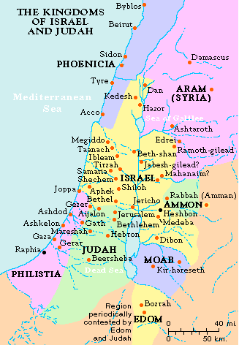
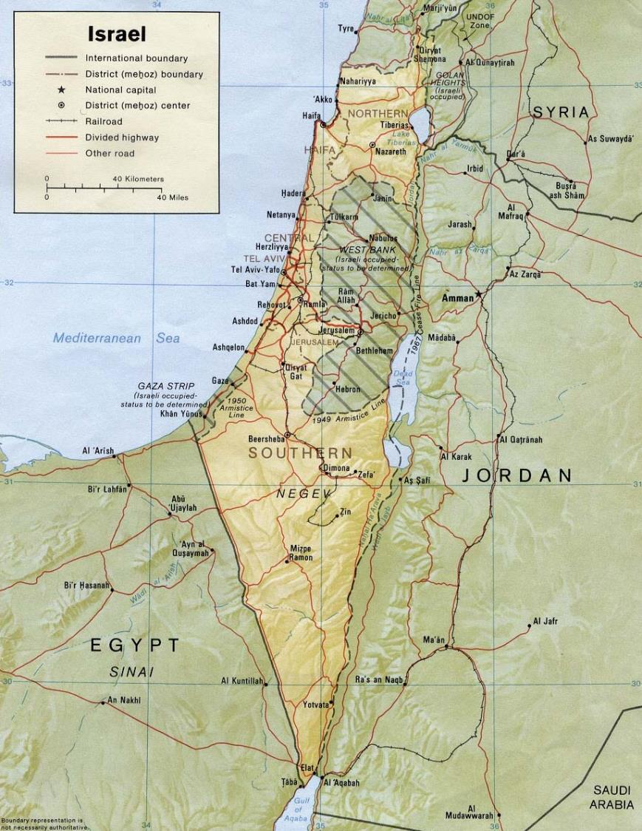
Location of Moab
2. Geography
100

Slide 7
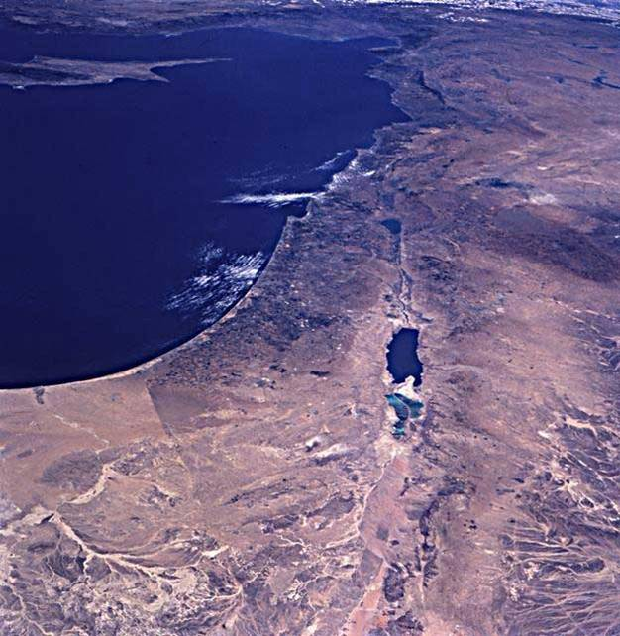
A View from Space
100
Jerusalem
Mt. Nebo
Dead Sea
Moab

Slide 8
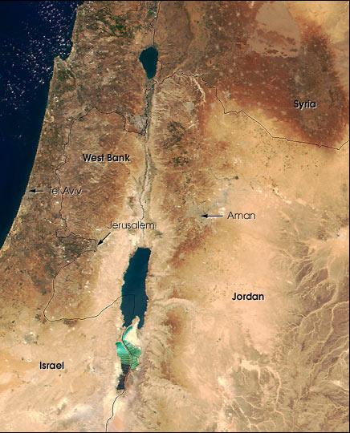
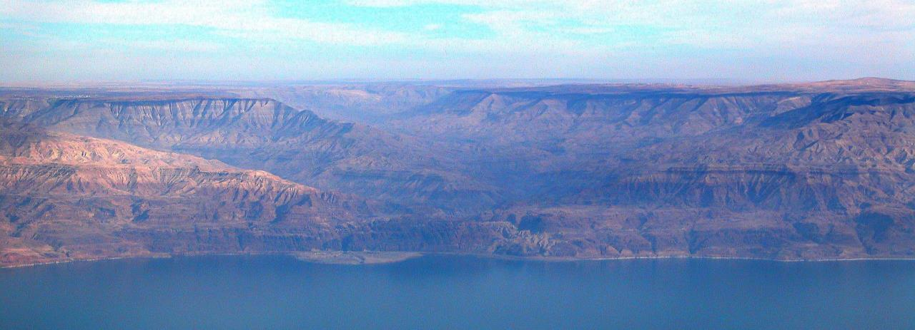
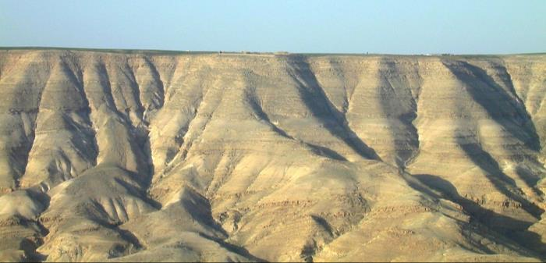
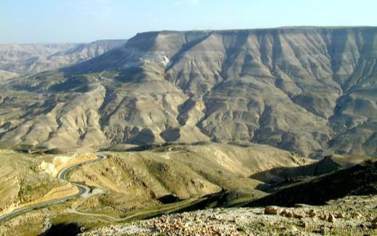
The Arnon Gorge
100
Looking North
Northern Plateau
Wadi al Majib (Arnon Gorge)
Looking South
Moab Proper
(Central Plateau)

Slide 9
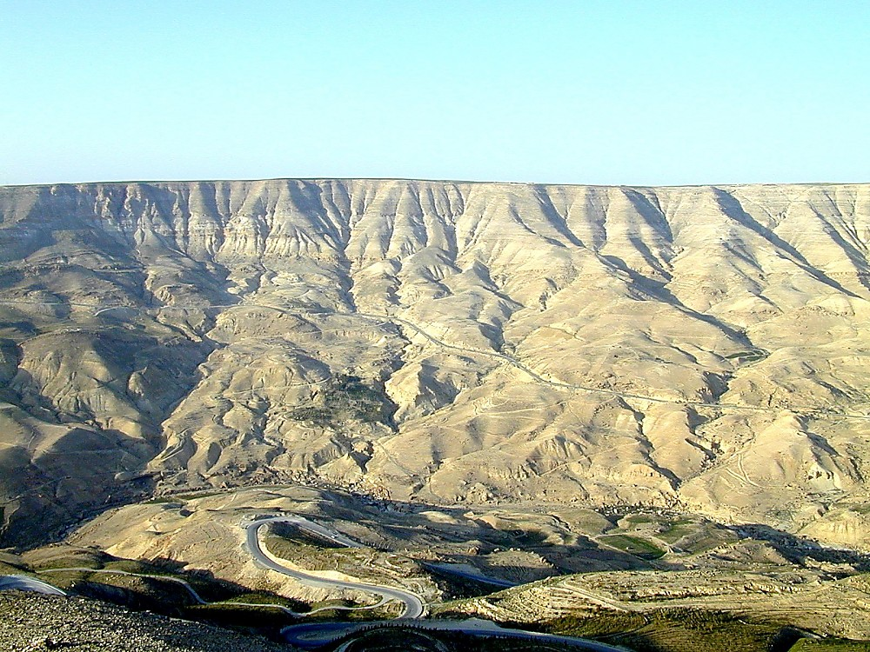

Arnon River view to north
Arnon River view to north
Notes:
Jeremiah 48:20 (NIV) “Moab is disgraced, for she is shattered. Wail and cry out! Announce by the Arnon that Moab is destroyed.”

Slide 10
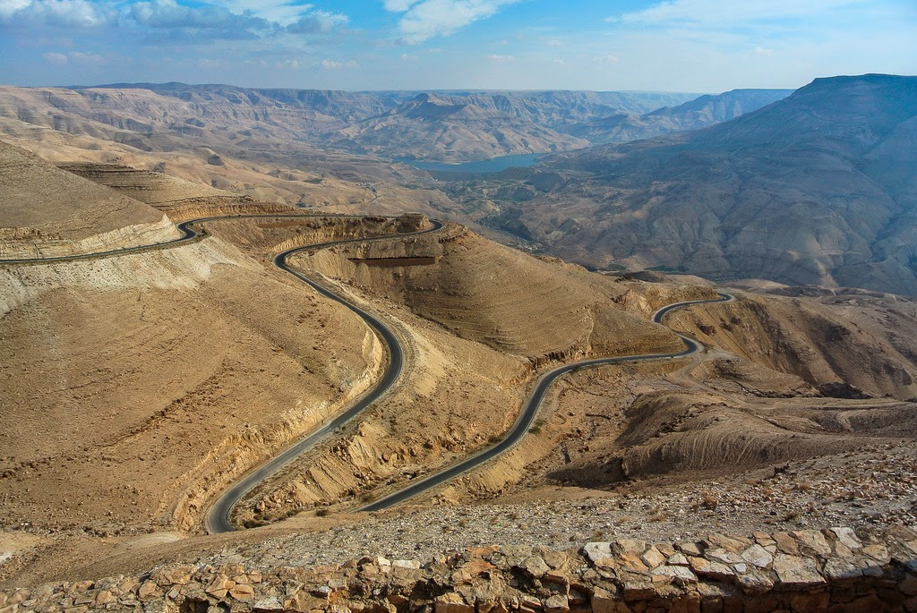
Arnon River view to north
Plateaus on Both Sides

Slide 11
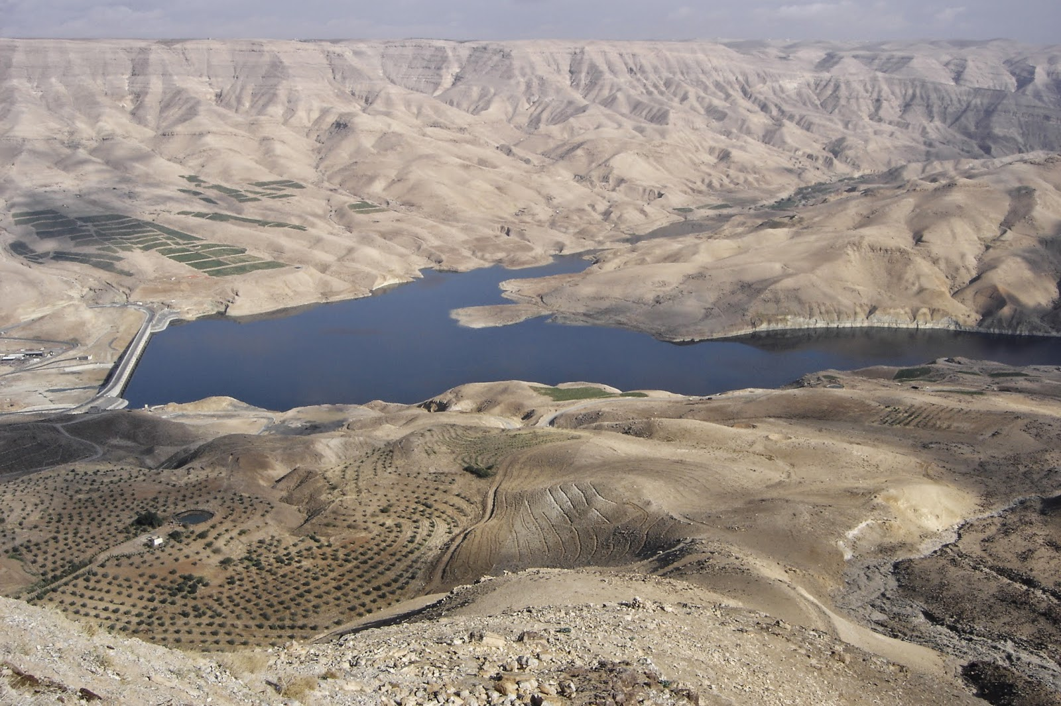
Arnon River view to north
New Dam on the Arnon River

Slide 12
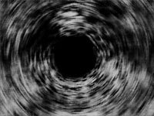
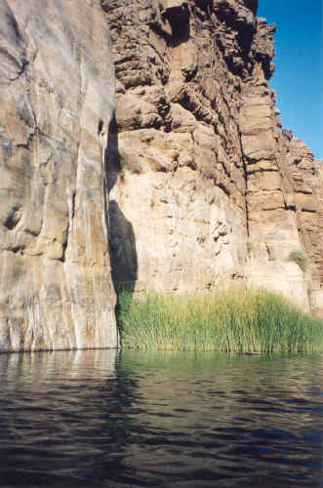
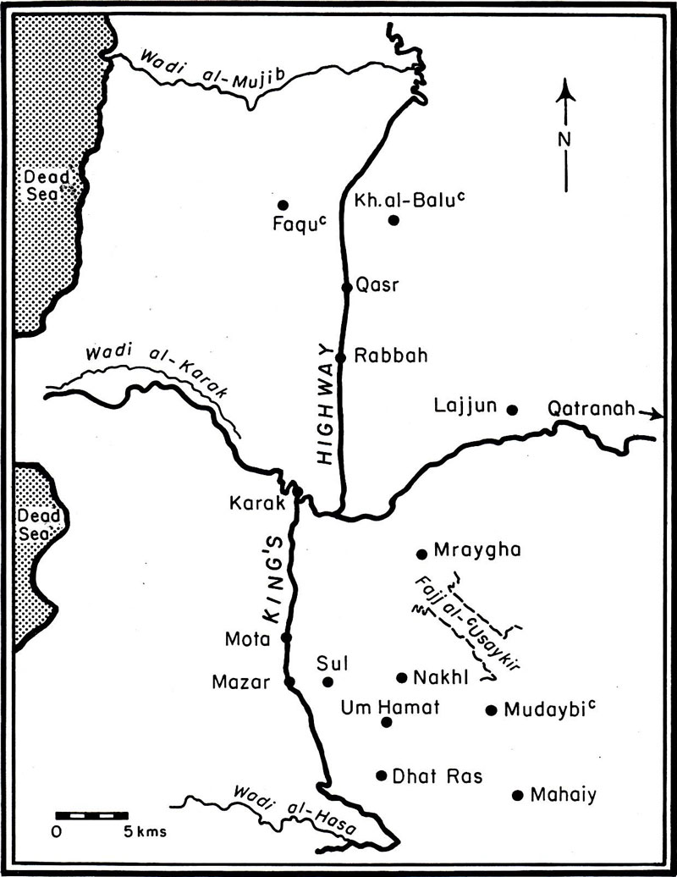
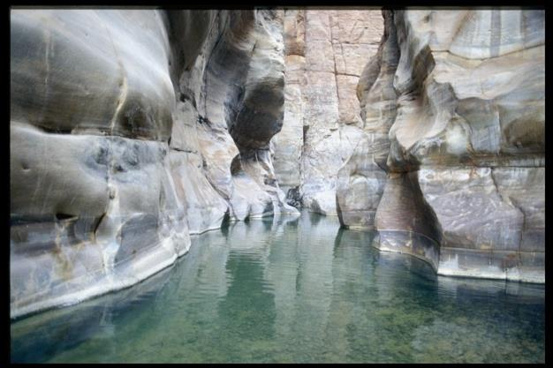
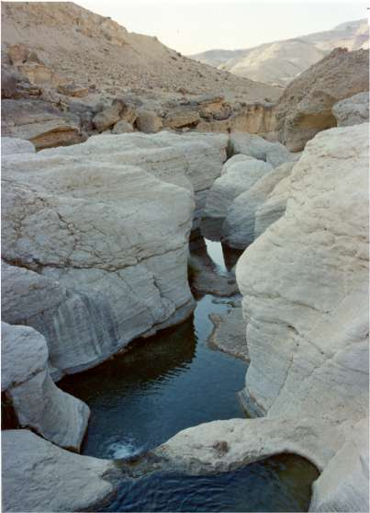
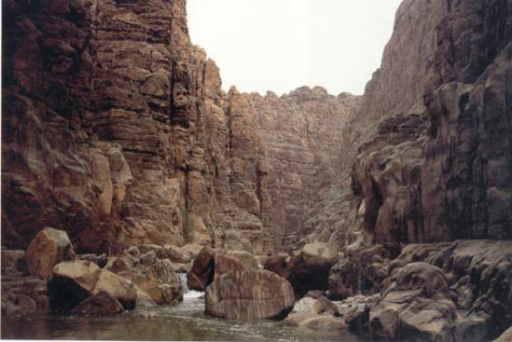
Down in the Gorgeous Gorge
100

Slide 13
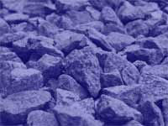
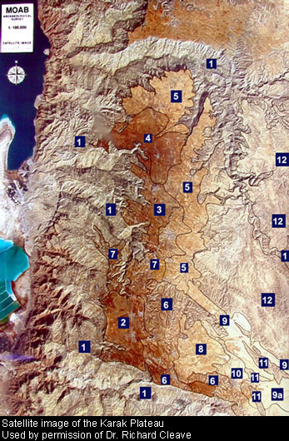
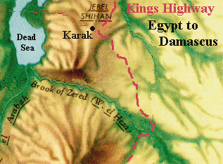
Southern Boundaries
100

Slide 14
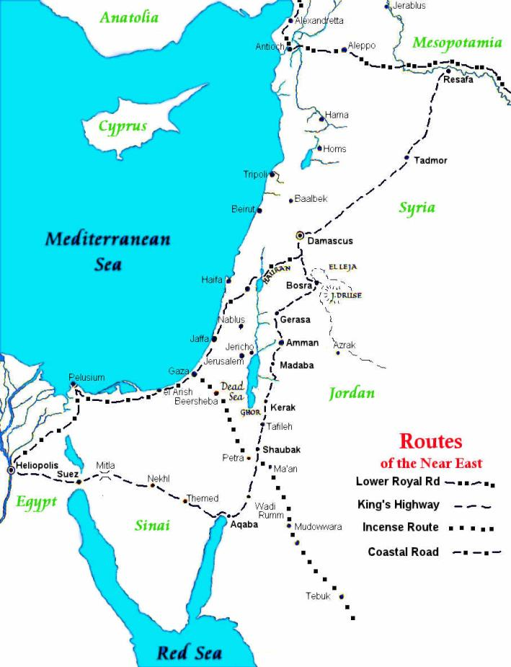
3. History
King's Highway
100
This was the route Moses wished to follow as he led his people north to the Promised Land (Deuteronomy 2:27; Numbers 20:17; 21:22)
Crossed half the Fertile Crescent from Egypt to Syria.
Major north-south transportation artery on the east side of the Dead Sea
Spread goods and culture throughout the Middle East

Slide 15

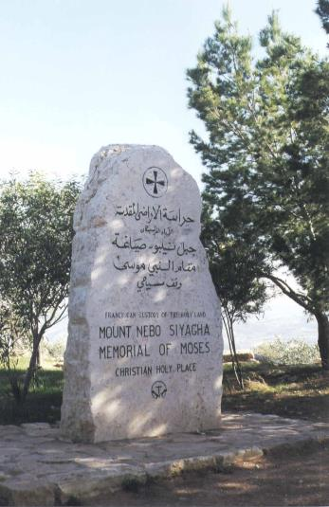
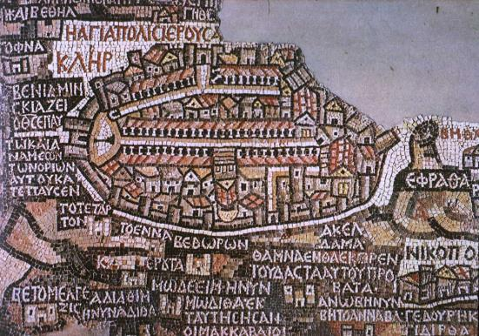
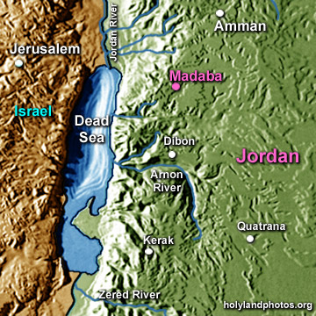
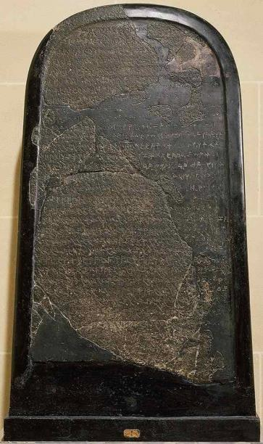
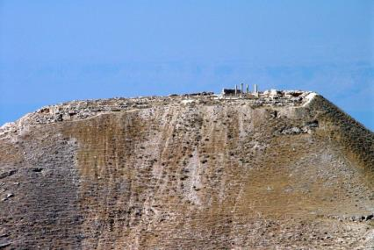
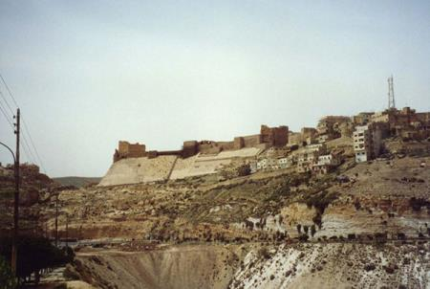
Significant Sites
Mosaic Map
Moabite Stone
Moses' Monument
Kerak Castle
Herodian Castle

Slide 16

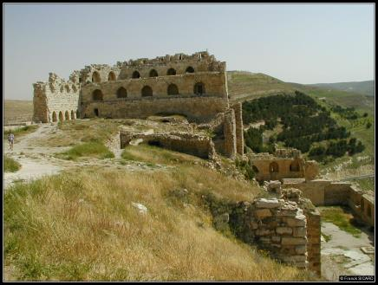
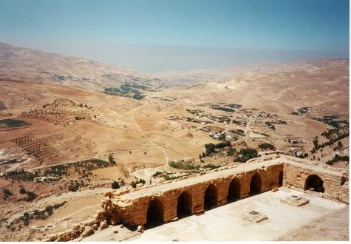
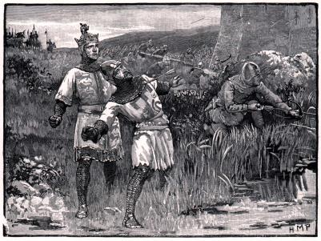
Kerak Fortress
First existed at the first millennium BC under the name of Kir-Heres
Used by the Crusaders to protect the areas near the Holy City

Slide 17
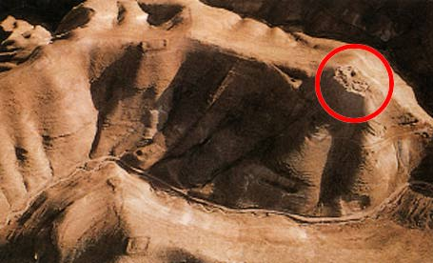
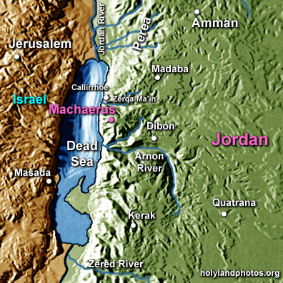
Herodian Fortress Machaerus
15 mi (23 km) southwest of Madaba
Elevation of 2300 ft overlooking the Dead Sea
First fortified by the Hasmonean ruler Alexander Janneus (103-76 BC) with Masada on the west side of the Dead Sea
It was subsequently fortified by Herod the Great (37-4 BC).
Jewish Zealots took over Machaerus during the first revolt against Rome.

Slide 18
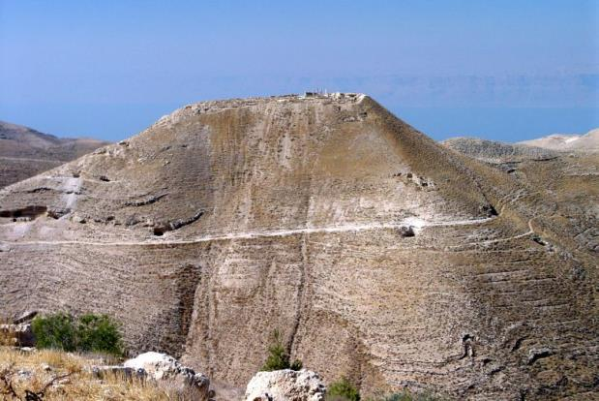
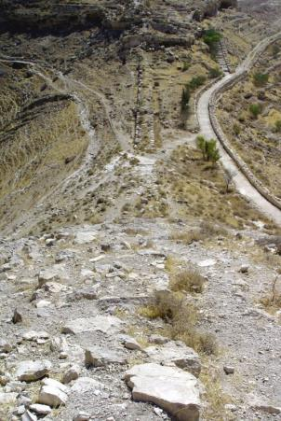
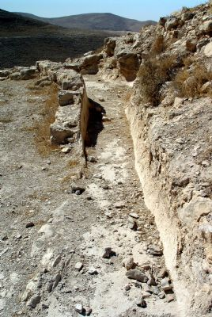
Herodian Fortress Machaerus
Herod Antipas beheaded John the Baptist at the request of Salome, the daughter of his wife Herodias (Matt 14:1-12; Mark 6:21-29; Luke 9:7-9).
Although the New Testament does not say where this happened, the Jewish historian Josephus placed the execution here at Machaerus (Antiquities 18.116–19).

Slide 19
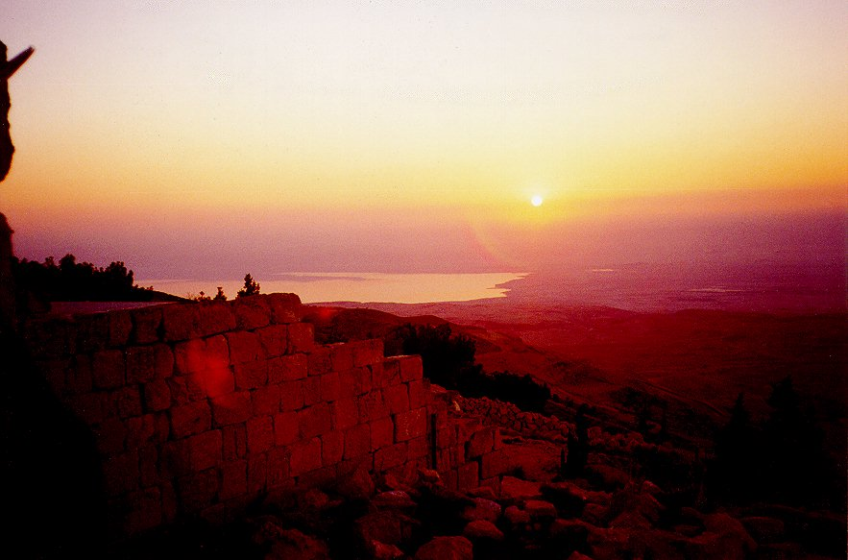
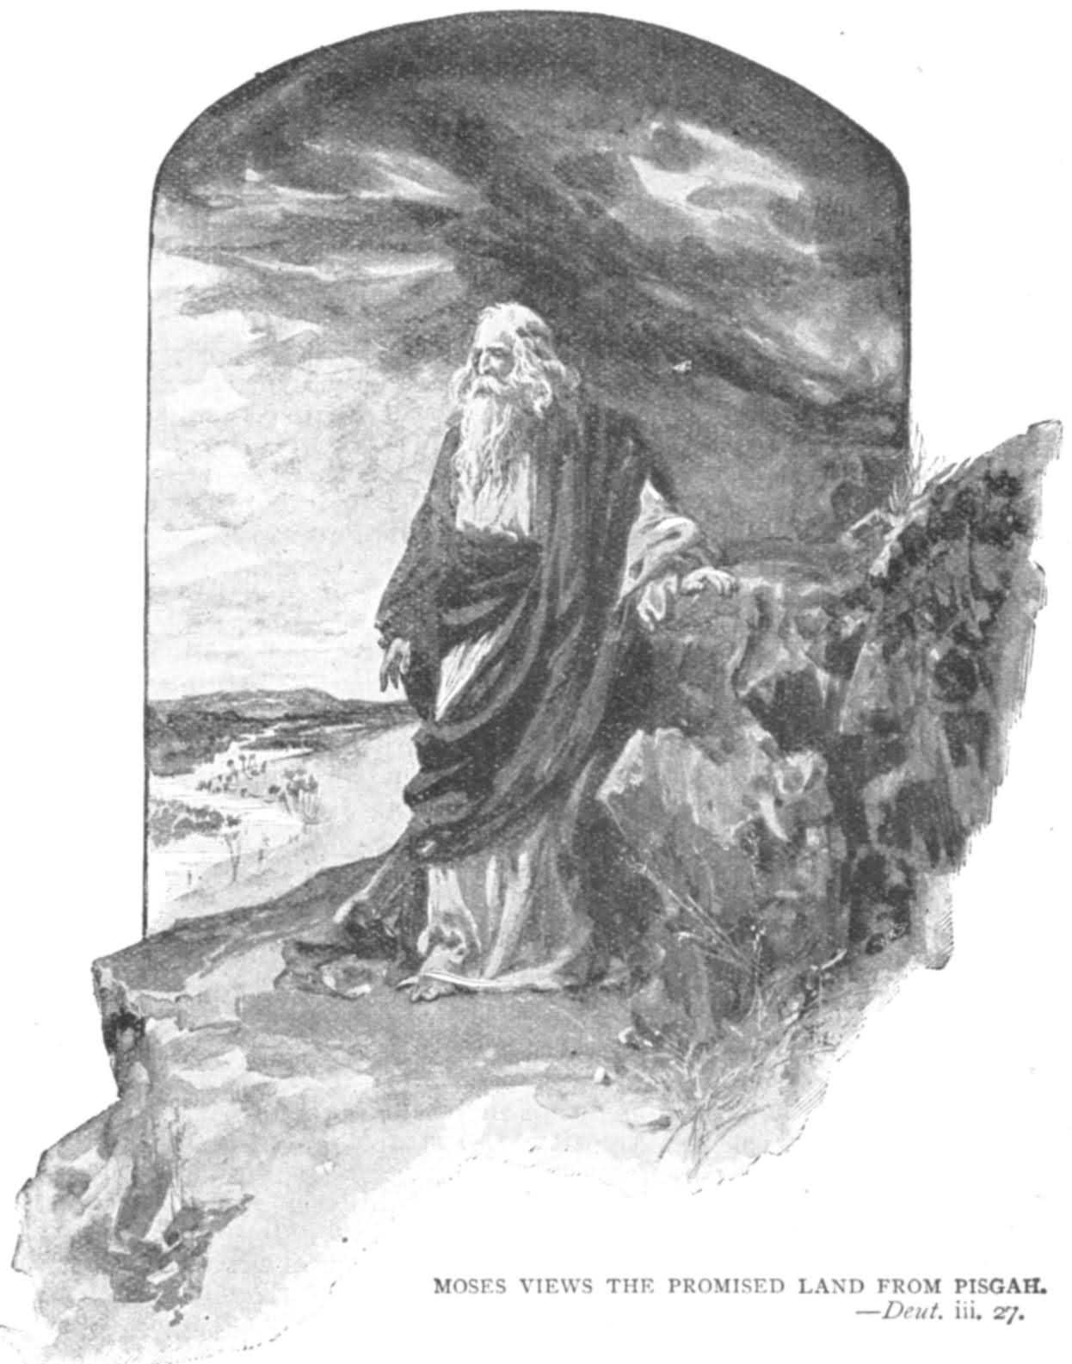
Deuteronomy 34:1-5
¹ Then Moses climbed Mount Nebo from the plains of Moab to the top of Pisgah, across from Jericho. There the LORD showed him the whole land—from Gilead to Dan,
² all of Naphtali, the territory of Ephraim and Manasseh, all the land of Judah as far as the western sea,
³ the Negev and the whole region from the valley of Jericho, the City of Palms, as far as Zoar.
⁴ Then the LORD said to him, "This is the land I promised on oath to Abraham, Isaac and Jacob when I said, ‘I will give it to your descendants, I have let you see it with your eyes, but you will not cross over into it.’”
⁵ And Moses the servant of the LORD died there in Moab, as the LORD has said.

Slide 20
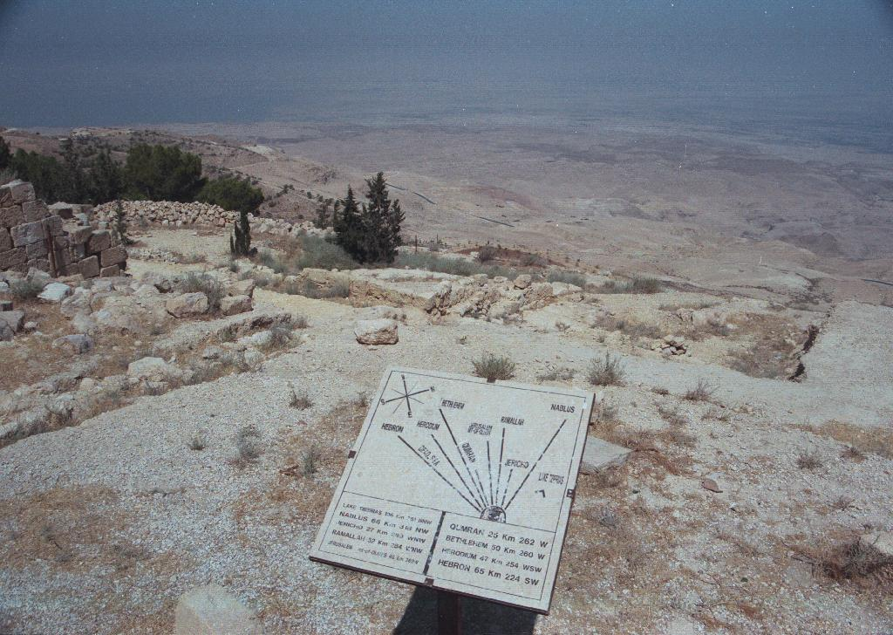
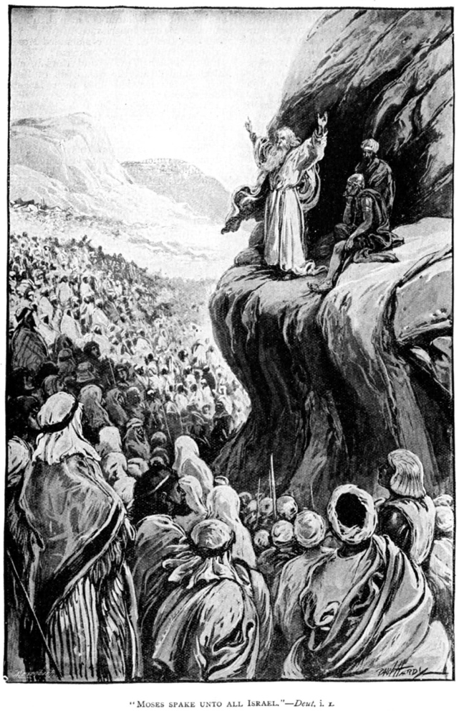


View from Mount Nebo

Slide 21
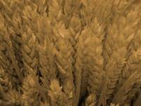
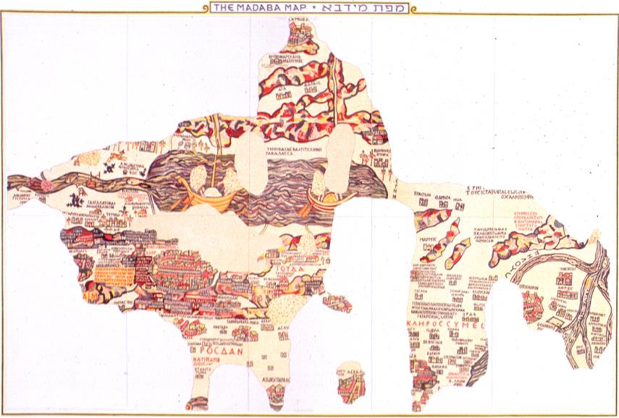
Madaba Mosaic Map
Found as a pavement of a church in the town of Madaba (6-7 century AD) in the Byzantine Near East.
It represents the biblical land from Egypt to Lebanon: Israel, Palestine and Transjordan.

Slide 22



Madaba Mosaic Map
The map was discovered accidentally in 1897 during construction of a new church. It still functions as the floor of the Greek Orthodox parish church St. George
Out of 94 sqm only about 25 sqm are preserved
Jerusalem is the center of the mosaic composition.
156 places/biblical memoirs are present in the preserved portion of the map

Slide 23










Madaba Mosaic Map
Kerak Castle
Zered River
(Deu 2:13)
Aia (Kh.'Ay)
Church of St. Lot
Tharais
(Ayn Tar'in)

Slide 24



Moabite Stone
100
Stone slab, 3.5 ft high and 2 ft wide (1m x 0.6m)
Dated to mid 9th century BC, King Mesha
Discovered in Dhiban (Dibon) in Jordan, in 1868

Slide 25


Moabite Stone
98
34 lines, written in Moabite (close to Hebrew), the only source of Moabite tongue
The longest monumental inscription yet found in Palestine.
Preserved by a squeeze made by placing a soggy piece of paper over the inscription, which then retained the form of the inscription when it dried

Slide 26


Content of the Moabite Stone
98
1st part of story:
Mesha recaptured northern land up to Mt. Nebo
2nd part of story:
Israel, Judah & Edom joined forces to defeat Moab from the south
The Moabite Stone describes the revolt of Mesha

Slide 27


A Mixed Victory
98
The Moabite record has no record of defeat in the south at the hands of the coalition armies. However, Moab retained its independence as confirmed by both the Mesha Inscription and this Scripture:
"The fury against Israel was great; they withdrew and returned to their own land" (2 Kings 3:25)

Slide 28


Why is the Moabite Stone Special?
98
"altar-hearths? of Yahweh" (lines 17-18). This is the earliest mention of Yahweh, God of the Israelites, outside the Bible.

Slide 29
Why So Special?
98
"House of David" mentioned in line 31 (used a number of times in the Old Testament for the Davidic dynasty)

Slide 30

Why So Special?
98
Chemosh mentioned eight times in the OT (Num 21:29; Jgs 11:24; 1 Kgs 11:7, 33; 2 Kgs 23:13; Jer 48:7, 13, 46) and
12 Moabite towns mentioned in the Scripture
Verified by the
Mesha Inscription

Slide 31

Archaeology on Moab
Little attention from archaeologists on Moab, and mostly focused on northern Moab.
In 1868 at Dibon, discovery of Mesha Inscription (Moabite Stone)

Slide 32


Balu'ah Stele
In 1930 the Balu'ah Stele (dated near the close of the Late Bronze Age) was discovered, bearing 4 lines of indecipherable text
The three figures depicted in relief show definite Egyptian influence

Slide 33

Egypt’s Relationship to Moab

Slide 34

Egyptian Records Also Mention Moab
Middle Bronze Egyptian texts mention "Moab." Thutmose III (1479-1425 BC)'s temple of Amun probably mentioned Moab. The first confirmed mention was in the Luxor temple of Rameses II (1304 -1237 BC).
In 1926 other Moabite designations were recognized on ostraca, graffiti and papyrus fragments from Saqqara.

Slide 35
Assyrians Mention Moab
Moabite relations with Assyria were mentioned in the annals of Ashurbanipal, Sennacherib and Esarhaddon

Slide 36

The Main Problem
A significant decrease in the number of settlements came in the Middle & Late Bronze Ages, followed by a surge of resettlement especially in the 13th century BC. Such archaeological evidence supports the late establishment of Moabite and Amorite (King Sihon's) settlement and thus a late date of Exodus.

Slide 37


The Moabite Religion

Slide 38

Introduction
98
Much of what we know is due to the discovery of the Moabite Stone and the Bible.

Slide 39


Moabite Deities
98
Chemosh
chief deity, national god, warrior god
god who provided for all aspects of life
1 Kings 11:7, Num 21:27-30
Astarte
mother goddess
Ashtar-Chemosh mentioned
in the Mesha inscription

Slide 40


Moabites Deities
98
Dodah
Baal-peor
supreme god of the Canaanites
"lord, master"
Numbers 25

Slide 41

Numbers
99
Preparation to Occupy the Land
Preparing the
Old Generation
Postponement
for Unbelief
Preparing the
New Generation
1:1–10:10
10:11–25:18
26–36
God's Faithfulness
Israel's Faithlessness
God's Faithfulness
God's Blessings
God's Discipline
God's Blessings
Israel's Commitment
Israel's Complaining
Israel's Commitment
Order
Disorder
Reorder
Mount Sinai
Wilderness
Moab
20 Days
38 Years, 3 Months, 10 Days
ca. 5 Months
Organization
(1-4)
Sanctification (5:1-10:10)
To Kadesh (10:11-
12:16)
Kadesh Sin
(13-14)
Wilder-ness (15-19)
To Moab (20-21)
Moab
Sin
(22-25)
Provision for Land (26-27)
Offerings & Vows (28-30)
Final Preparations (31-36)

Slide 42

Transjordan Events
99
Victory over Sihon and Og (Num. 21)
Balak fails to turn God against Israel–blessing by Balaam (Num. 22–24)
Beitzel, Moody Atlas, 1st ed., 94

Slide 43


Balaam
99
Balaam Numbers 22–24

Slide 44
2 Peter 2:15-16 (NIV)
99
They have left the straight way and wandered off to follow the way of Balaam son of Beor, who loved the wages of wickedness. But he was rebuked for his wrongdoing by a donkey–a beast without speech–who spoke with a man's voice and restrained the prophet's madness.

Slide 45
Jude 11 (NIV)
99
Woe to them! They have taken the way of Cain; they have rushed for profit into Balaam's error; they have been destroyed in Korah's rebellion.

Slide 46
Transjordan Events
99
Victory over Sihon and Og (Num. 21)
Balak fails to turn God against Israel—blessing by Balaam (Num. 22–24)
Balak succeeds to turn Israel against God—immorality with Moabite women at Beth-peor (Num. 25)
Beitzel, Moody Atlas, 1st ed., 94

Slide 47
Revelation 2:14-15
99
Nevertheless, I have a few things against you: You have people there who hold to the teaching of Balaam, who taught Balak to entice the Israelites to sin by eating food sacrificed to idols and by committing sexual immorality. Likewise you also have those who hold to the teaching of the Nicolaitans.

Slide 48


Israel's Sin at Baal Peor
99
“While Israel was staying in Shittim, the men began to indulge in sexual immorality with Moabite women, who invited them to the sacrifices to their gods. The people ate and bowed down before these gods. So Israel joined in worshiping the Baal of Peor. And the LORD's anger burned against them.”
Numbers 25:1-3

Slide 49

Moabite Worship
98
Temples
"high places" honored deities
Num. 22:41;
1 Kings 11:7-8

Slide 50

Child Sacrifice to Chemosh
98

Slide 51


Moabite Worship
98
2. Sacrificial system
- animals (Num. 23:1, 14)
- child sacrifice by King Mesha (2 Kings 3:26-27)

Slide 52


Moabite Worship
98
3. Priesthood
- led by the king
e.g. Balak, Jer. 48:7

Slide 53

Moabite Worship
98
4. Divination
Num 22–24
- Balak & Balaam

Slide 54

Moabite Worship
98
5. Canaanite fertility rites
Num. 25 - grotesque in God's eyes; Israelite participation led to God's judgment in a plague killing 24,000

Slide 55


God's Response
99
“The LORD said to Moses, ‘Take all the leaders of these people, kill them and expose them in broad daylight before the LORD, so that the LORD's fierce anger may turn away from Israel.’
“So Moses said to Israel's judges, ‘Each of you must put to death those of your men who have joined in worshiping the Baal of Peor.’
“…Then the plague against the Israelites was stopped; but those who died in the plague numbered 24,000.”
Numbers 25:4-9

Slide 56

Implications
99
This polytheistic immoral pagan worship was opposed to the monotheistic worship of Yahweh who expects His people to be holy. God used a donkey to curb a false prophet and judgment to preserve His people.

Slide 57


5. Culture
99
Economy:
Farming
The plains of Moab are fertile

Slide 58


Shepherding
99
2 Kings 3:4
  "Now Mesha king of Moab raised sheep, and he had to supply the king of Israel with a 100,000 lambs and with the wool of a 100,000 rams."
Isaiah 16:1
  "Send lambs as tribute to the ruler of the land, from Sela across the desert, to the mount of the Daughter of Zion."

Slide 59

Marriage
99
Ruth 1:4
  "They married Moabite women, one named Orpah and the other Ruth."
1 Kings 11:1 (King Solomon)
  "King Solomon, however, loved many foreign women besides Pharaoh's daughter – Moabites, Ammonites, Edomites, Sidonians and Hittites."
1 Chr. 8:8 (King Saul)
  "Sons were born to Saharaim in Moab after he had divorced his wives Hushim and Baara."
Nehemiah 13:23
  "Moreover in those days I saw men of Judah who had married women from Ashdod, Ammon and Moab."

Slide 60



Language
99
Language also called Moabite
Very much like ancient Hebrew
Alphabet was initially developed by the Phoenicians.
Grammatical elements in common with Ugaritic, Aramaic, Arabic
The Hesbon Ostraca
El-Kerak Inscription

Slide 61

Table of Alphabets
100a
Mesha
840 BC

Slide 62




Art
Moabite Seal in a
Bronze Bezel

Slide 63

Moabites are described as:
99
Isaiah 16:6 (Proud and arrogant)
  "We have heard of Moab's pride - her overweening pride and conceit, her pride and conceit, her pride and insolence - but her boasts are empty"
Jeremiah 48:29 (Proud and arrogant)
  "We have heard of Moab's pride, her overweening pride and conceit, her pride and arrogance and the haughtiness of her heart"
1 Kings 11:7 (Idolatrous)
  "On a hill east of Jerusalem, Solomon built a high place for Chemosh, the detestable god of Moab…"
text from www.searchgodsword.org

Slide 64
Moab and Israel
99
The Moabites were the descendants of Lot through his incestuous relations with his daughters
(Gen. 19:36, 37).
During the wanderings in the wilderness, the Israelites had to go pass the land of Moab. God forbade the Israelites from harassing Moab which was to be Lot's possession (Deut. 2:8,9).
As the Israelites travelled north, Sihon king of the Amorites refused to let them pass through his territory and went out to war with Israel. Sihon was defeated and Israel occupied the land from Arnon to Jabbok (Num. 21:21-26). This land formerly belonged to Moab which was conquered by Sihon.

Slide 65
Moab and Israel
99
While the Israelites camped along the Jordan across from Jericho, Balak king of Moab joined with the elders of Midian in enlisting the help of Balaam to curse the Israelites (Num 22-24).
But God would only allow Balaam to bless Israel. However, the Israelites sinned against God when they were involved with the Moabite's religion and committed apostasy and immorality (Num 25).
Moses delivered his 'last messages' to the people of Israel in the territory of Moab (Deut 1:5) and he died in Mt Nebo, northeast of the Dead Sea, which is also in Moab's territory (Deut 32: 48-50).

Slide 66
Moab and Israel
99
During the period of the Judges, Israel was subjected to Moab for 18 years until the judge Ehud assassinated Eglon, the king of Moab.
A Moabite who had a place in the history of Israel was Ruth, the great-grandmother of David.
Moab came under the rule of the Assyrians and Babylonians. When the Israelites returned from the exile, they were required to abandon marriages with Moabite women (Ezra 9:1-2).

Slide 67


Prophecies against Moab
99
Exodus 15:15 (terror on account of Israel)
  "The chiefs of Edom will be terrified, the leaders of Moab will be seized with trembling…"
Isaiah 16:12 (inability to avert destruction)
  "When Moab appears at her high place, she only wears herself out; when she goes to her shrine to pray, it is to no avail."
Isaiah 11:14 (subjugation to Israel)
  "They will swoop down on the slopes of Philista to the west; together they will plunder the people to the east. They will lay hands on Edom and Moab…"
text from www.searchgodsword.org

Slide 68

Prophecies against Moab
99
Jeremiah 48:7 (to be captives in Babylon)
  ”Since you trust in your deeds & riches, you too will be taken captive, and Chemosh will go into exile, together with his priests and officials."
Jeremiah 48:47 (restoration from captivity)
  "Yet I will restore the fortunes of Moab in days to come."
Isaiah 25:10 (subjugation to Messiah)
  "The hand of the Lord will rest on this mountain; but Moab will be trampled under him, as a straw is trampled down in the manure."
text from www.searchgodsword.org

Slide 69

"This is what the Sovereign LORD says: Because the people of Moab have said that Judah is just like all the other nations, ⁹ I will open up their eastern flank and wipe out their glorious frontier towns—Beth-jeshimoth, Baal-meon, and Kiriathaim. ¹⁰ And I will hand Moab over to nomads from the eastern deserts, just as I handed over Ammon..."
Moab
(Ezekiel 25:8-11)
Notes:
Yet Moab had the audacity to say that Judah was like all other nations‚ so God would judge them for this.

Slide 70

Reflection & Application
99
God judges idolatry
God can divinely protect his people, but his people can destroy themselves by choosing the path of sin
God's mercy and grace always extends to those willing to turn to him (e.g., Ruth)

Slide 71



Reflection & Application
99
Sin
Idols
d) The Lord only needs to lift his blessings for nations to disappear from history...

Slide 72
Israel's Early Eastern Neighbors
100b
OTS 143
John H. Walton, Chronological and Background Charts of the OT, 2d ed., 71
Period
EDOM
MOAB
AMMON
AMALEK
Esau: son of Isaac
Moab: son of Lot and his eldest daughter
Ben-Ammi: son of Lot and his second daughter
Amalek: son of Eliphaz, who was a son of Esau
FATHER
Controlled to some degree by Amorites. Refused passage to the Israelites (Num 20:14-21).
Conquered by Sihon & Amorites
(Num. 21:26).
King Balak feared Israel and sought Balaam to curse them (Num 22).
Defeated by the Israel
(Exod. 17).
Defeated Israel after report by spies
(Num 14:45).
EXODUS
Notes:
These two slides contrast Israel's relatives to their east in four distinct periods, starting from their origin in their common ancestor, Terah, father of Abraham (Gen 11:27-32). Following that, what happened to them during Israel's Exodus, period of the Judges, and United Monarchy?
_____________
OB-02-Ammonites-9
OB-09-Edomites-8
OB-11-Moabites-72
OS-04-Numbers-282

Slide 73
Israel's Early Eastern Neighbors
100b
OTS 143
John H. Walton, Chronological and Background Charts of the OT, 2d ed., 71
Period
EDOM
MOAB
AMMON
AMALEK
JUDGES
Continued under partial Amorite control (1350 BC; Judg 1:35-36).
Eglon hurt
Israel 18 yrs.
until Ehud (1350 BC; Judg 3:12-30)
Ally of Eglon of Moab (1350 BC);
Hurt Israel until Jephthah (1100 BC; Judg 10-12).
Ally of Eglon of Moab
(1350 BC)
Saul took some cities from Edom
(1030 BC; 1 Sam 14:47).
Conquered and subjugated by David
(1000 BC; 1 Chron 18:12).
Saul took some cities from Moabite territory
(1030 BC;
1 Sam 14:47).
Conquered and subjugated by David (1000 BC;
2 Sam 8:2).
Saul defeated Nahash
(1050 BC; 1 Sam 11:1-11) &
took some Ammonite cities
(1030 BC; 1 Sam 14:47);
David defeated Hanun
(990 BC; 2 Sam 12:26-31)
Saul defeated Agag
(1050 BC; 1 Sam 15:1-9);
Destroyed David's camp at Ziklag but David wiped them out. This is last mention of them
(1 Sam 30).
UNITED MONARCHY
Notes:
These two slides contrast Israel's relatives to their east in four distinct periods, starting from their origin in their common ancestor, Terah, father of Abraham (Gen 11:27-32). Following that, what happened to them during Israel's Exodus, period of the Judges, and United Monarchy?
_____________
OB-02-Ammonites-10
OB-09-Edomites-9
OB-11-Moabites-73
OS-04-Numbers-283

Slide 74

5. Sources & Bibliography
Readings
Old Testament Backgrounds Syllabus
The Zondervan Pictorial Encyclopedia of the Bible
The Moody Atlas of Bible Lands
Peoples of the Old Testament World
Readings from the Ancient Near East
Oxford Bible Commentary
Harper's Bible Commentary
Websites
www.searchgodsword.org
www.christusrex.org/www1/ofm/mad/index.html
www.kchanson.com
www.biblemagazine.com
www.ancientroute.com
www.holylandphotos.org
www.jewishencyclopedia.com
www.ancientneareast.net
www.usc.edu/dept/LAS/wsrp/index.html

Slide 75
Moabites
Moabites
Eugenia Goh Chay Giam,
Chong Wong Mui,
Jemaine Han Lee Yen,
Leslie Ip Kwok Chung,
Hans Gouw

Slide 76
Black

Slide 77


OT Backgrounds link at BibleStudyDownloads.org
Get this presentation for free!
Notes:
NT Survey (ns)

