Slide 1


Edomites
101
Identity
Geography
Deity and Literature
Significance History and Israel
Lessons
Dr. Rick Griffith • Jordan Evangelical Theological Seminary • BibleStudyDownloads.org

Slide 2
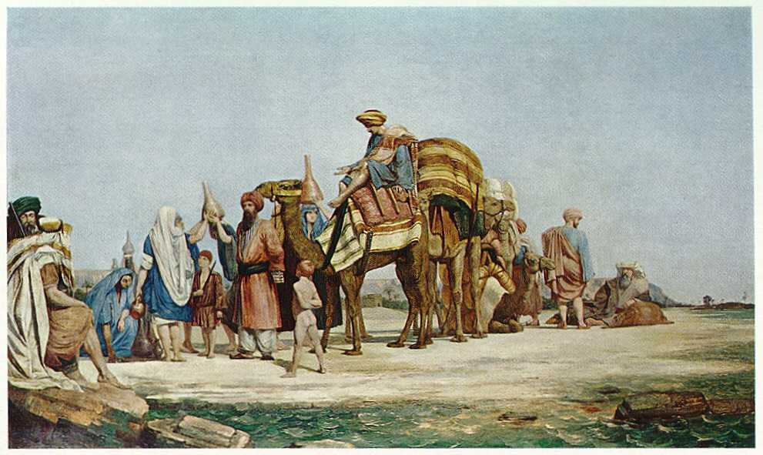
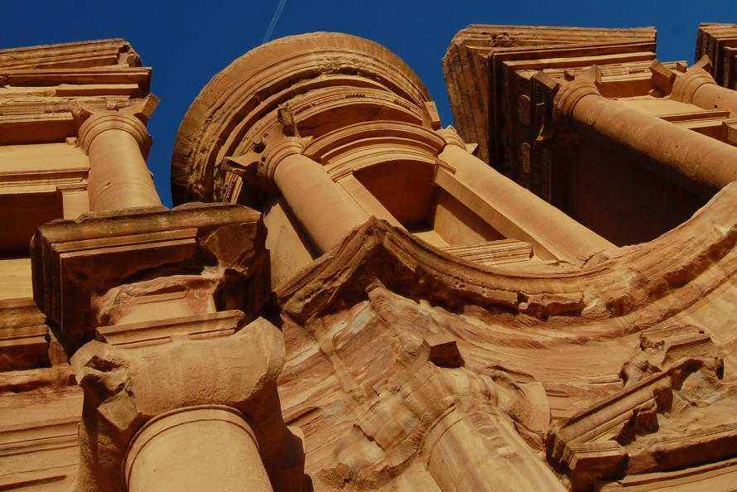
Identity:
101
Where was Edom?
Who were the Edomites?

Slide 3
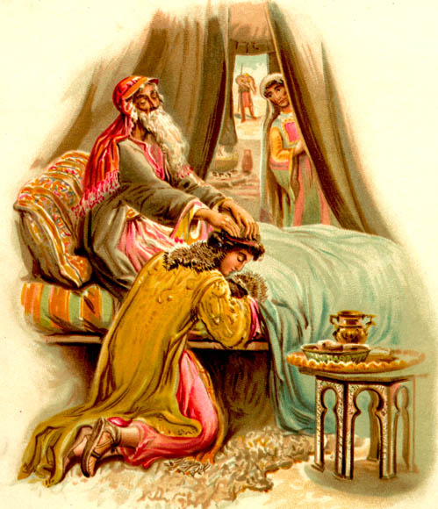
God chose Jacob over Esau
101
Genesis 27

Slide 4


Geography
101
Jacob
Israel
Esau
Edom

Slide 5

GOD CHOSE EVEN APATHETIC JEWS
101
"I loved
Jacob"
"I hated
Esau"
Malachi 1:2-3

Slide 6
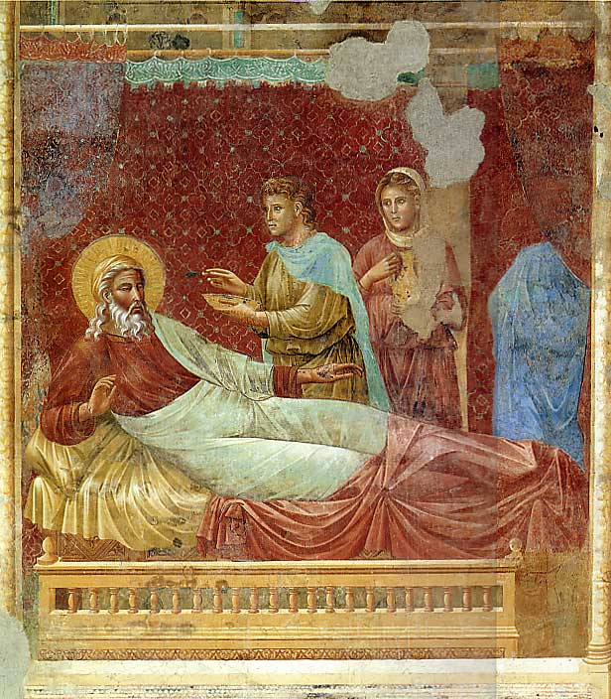
Edom ("Red")
Three possible origins of the name:
  Red cliffs of Esau's sandstone area
  Red hair of Esau at birth
  Red pottage which Esau took in exchange for his inheritance
Edom refers to the land occupied by Esau's descendants, formerly called Seir
Referred to Mount Seir and Idumea in the Bible

Slide 7

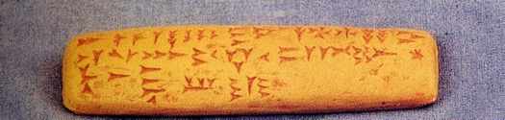
Edomites
101
Descendants of Esau (Gen. 36:1-17)
Mentioned in Ugaritic tablets of Ras Shamra in the Legend of King Keret
Egyptian records from the late 13th century BC mention Bedouin tribesmen of Edom who were permitted to enter Egypt for food during a famine

Slide 8
Israel's Early Eastern Neighbors
100b
OTS 143
John H. Walton, Chronological and Background Charts of the OT, 2d ed., 71
Period
EDOM
MOAB
AMMON
AMALEK
Esau: son of Isaac
Moab: son of Lot and his eldest daughter
Ben-Ammi: son of Lot and his second daughter
Amalek: son of Eliphaz, who was a son of Esau
FATHER
Controlled to some degree by Amorites. Refused passage to the Israelites (Num 20:14-21).
Conquered by Sihon & Amorites
(Num. 21:26).
King Balak feared Israel and sought Balaam to curse them (Num 22).
Defeated by the Israel
(Exod. 17).
Defeated Israel after report by spies
(Num 14:45).
EXODUS
Notes:
These two slides contrast Israel's relatives to their east in four distinct periods, starting from their origin in their common ancestor, Terah, father of Abraham (Gen 11:27-32). Following that, what happened to them during Israel's Exodus, period of the Judges, and United Monarchy?
_____________
OB-02-Ammonites-9
OB-09-Edomites-8
OB-11-Moabites-72
OS-04-Numbers-282

Slide 9
Israel's Early Eastern Neighbors
100b
OTS 143
John H. Walton, Chronological and Background Charts of the OT, 2d ed., 71
Period
EDOM
MOAB
AMMON
AMALEK
JUDGES
Continued under partial Amorite control (1350 BC; Judg 1:35-36).
Eglon hurt
Israel 18 yrs.
until Ehud (1350 BC; Judg 3:12-30)
Ally of Eglon of Moab (1350 BC);
Hurt Israel until Jephthah (1100 BC; Judg 10-12).
Ally of Eglon of Moab
(1350 BC)
Saul took some cities from Edom
(1030 BC; 1 Sam 14:47).
Conquered and subjugated by David
(1000 BC; 1 Chron 18:12).
Saul took some cities from Moabite territory
(1030 BC;
1 Sam 14:47).
Conquered and subjugated by David (1000 BC;
2 Sam 8:2).
Saul defeated Nahash
(1050 BC; 1 Sam 11:1-11) &
took some Ammonite cities
(1030 BC; 1 Sam 14:47);
David defeated Hanun
(990 BC; 2 Sam 12:26-31)
Saul defeated Agag
(1050 BC; 1 Sam 15:1-9);
Destroyed David's camp at Ziklag but David wiped them out. This is last mention of them
(1 Sam 30).
UNITED MONARCHY
Notes:
These two slides contrast Israel's relatives to their east in four distinct periods, starting from their origin in their common ancestor, Terah, father of Abraham (Gen 11:27-32). Following that, what happened to them during Israel's Exodus, period of the Judges, and United Monarchy?
_____________
OB-02-Ammonites-10
OB-09-Edomites-9
OB-11-Moabites-73
OS-04-Numbers-283

Slide 10
When did the Edomites live?
Archaeology shows that the land was occupied before Esau's time by the Horites (Gen. 14:6).
Esau's descendants then migrated to that land and became the dominant group.
101
2c

Slide 11
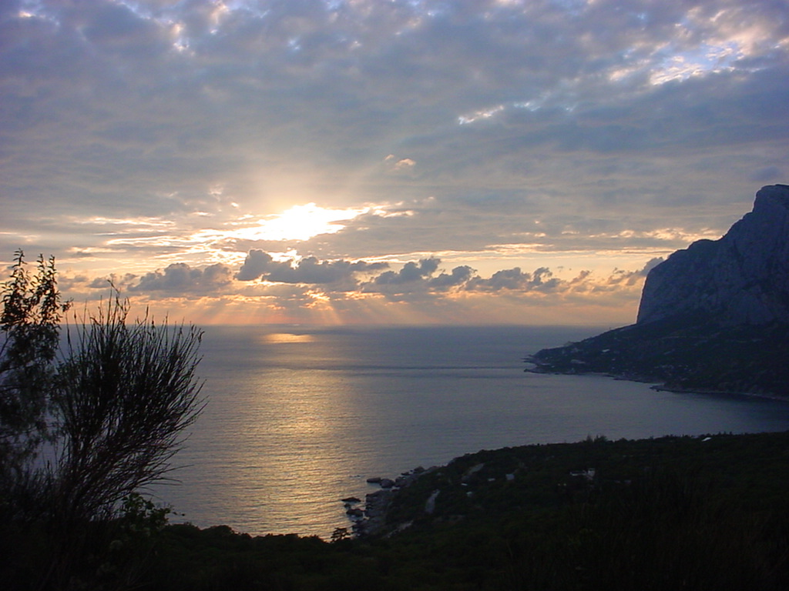
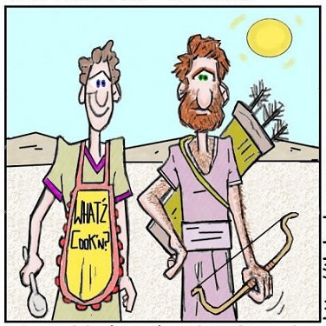
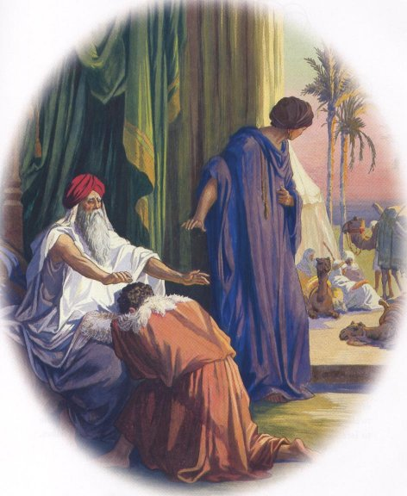
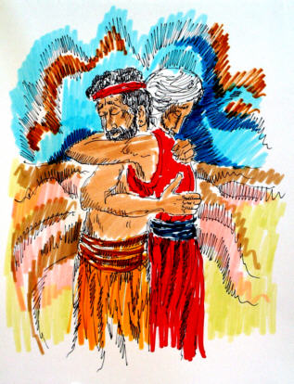
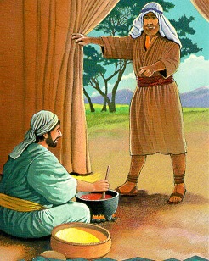
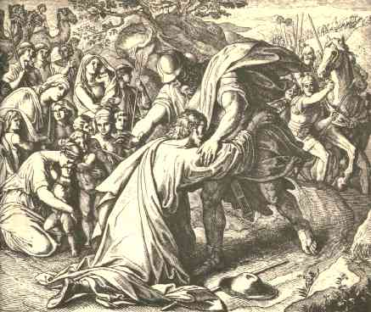
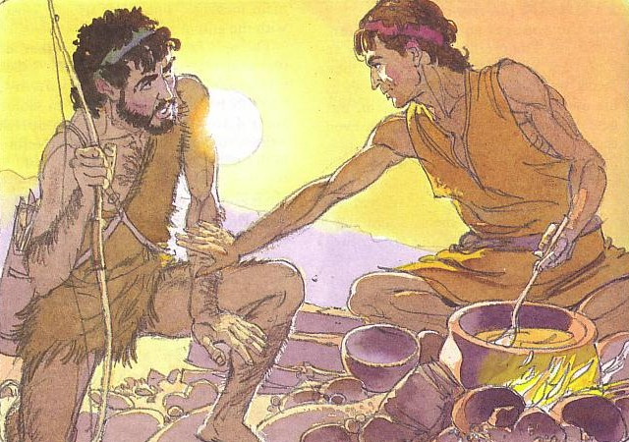
He's So Hairy, Jacob's Brother

Slide 12
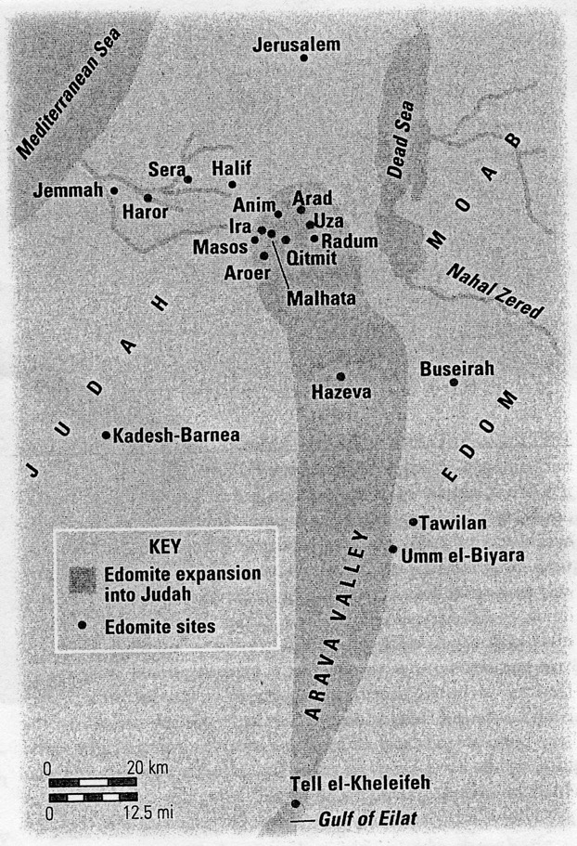
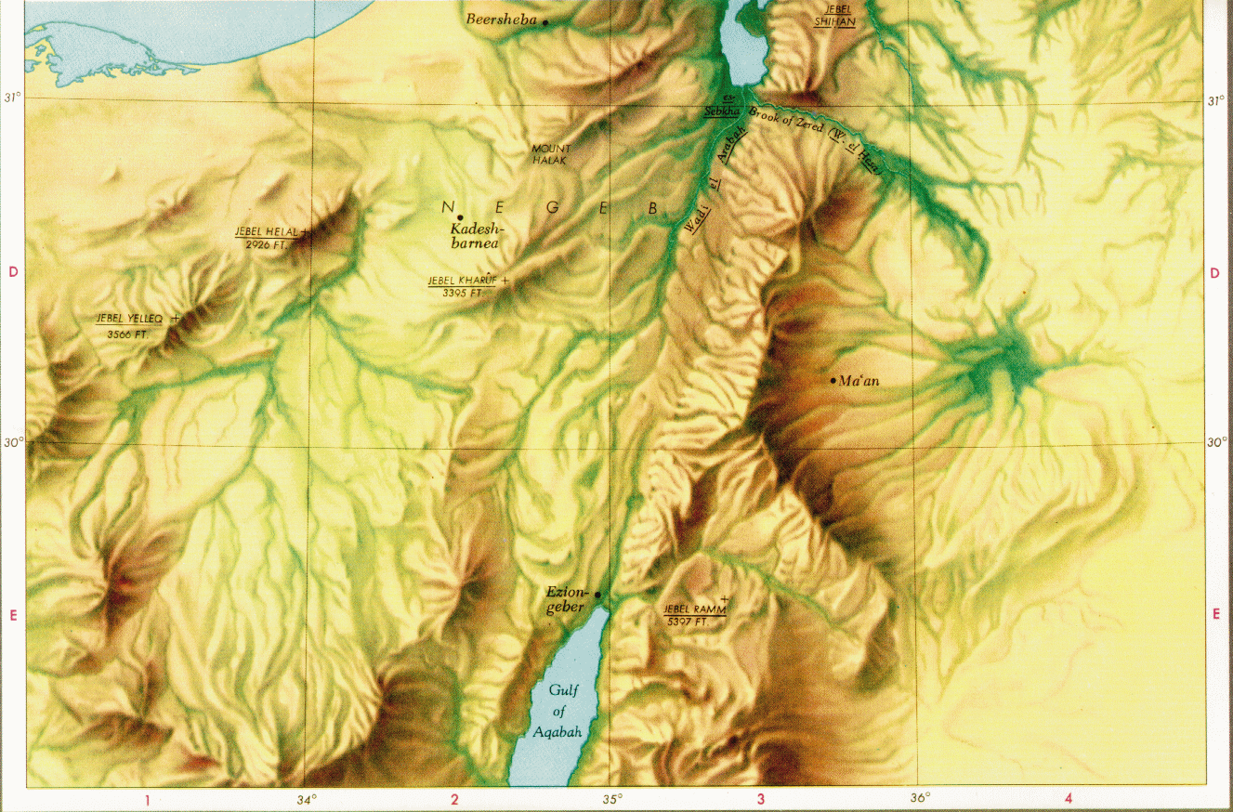
Geography
101
2c
Notice the terrain

Slide 13
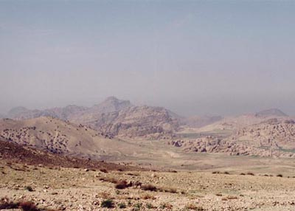
A Desolate Land

Slide 14
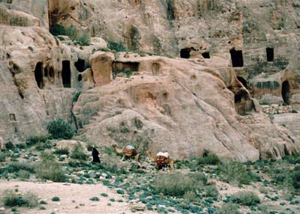
Rock Dwellers of Petra

Slide 15
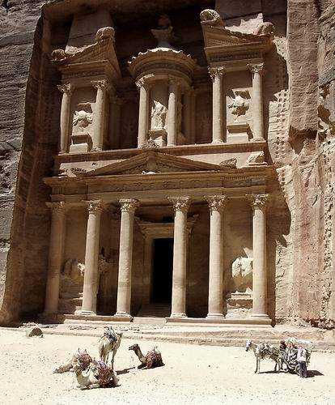
The Treasury (Petra)

Slide 16
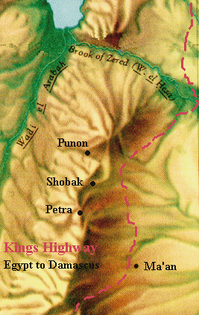
The King's Highway

Slide 17

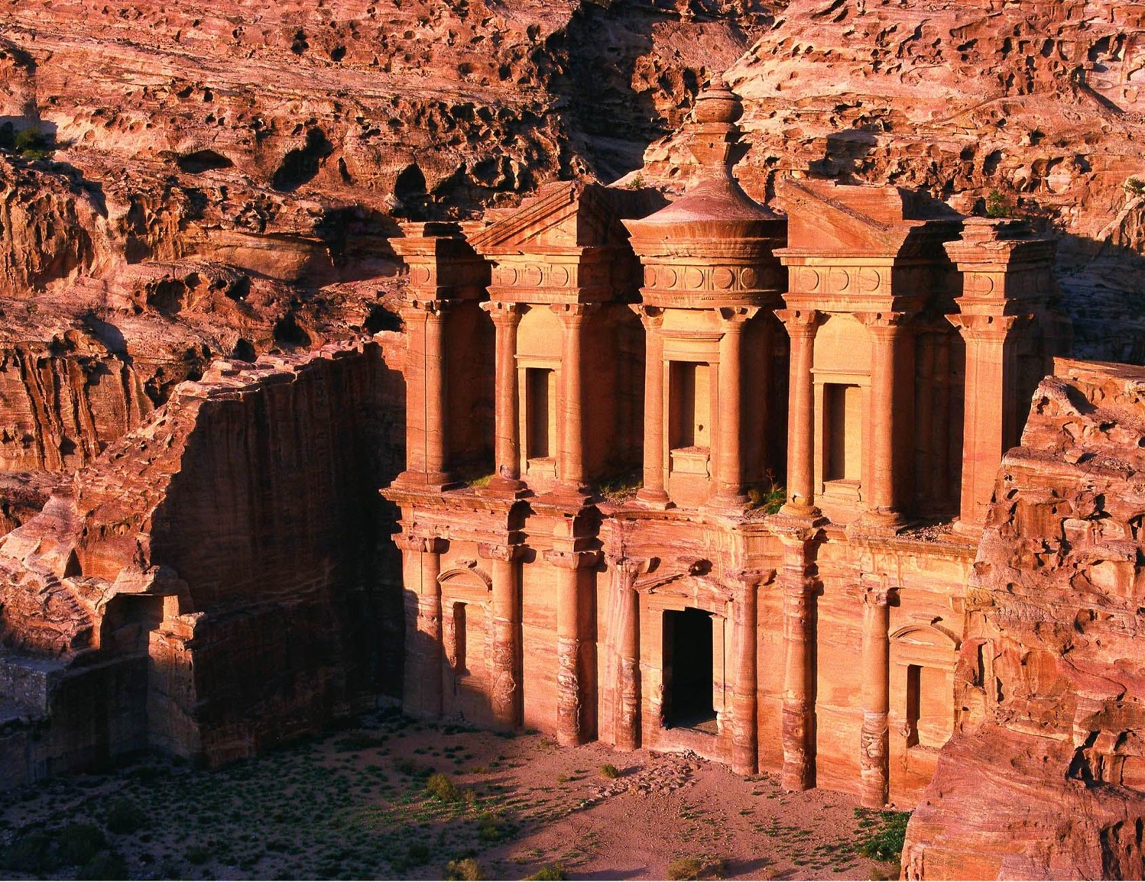


Economy
Chief sources of income
  trade and fees collected for "protecting" the caravans carrying the incense from south Arabia to the Mediterranean coast
  agriculture with cultivated wheat to a small extent as rainfall is very scanty in that area.
  vines and olives near those regions watered by natural springs
  copper mines in the Arabah

Slide 18
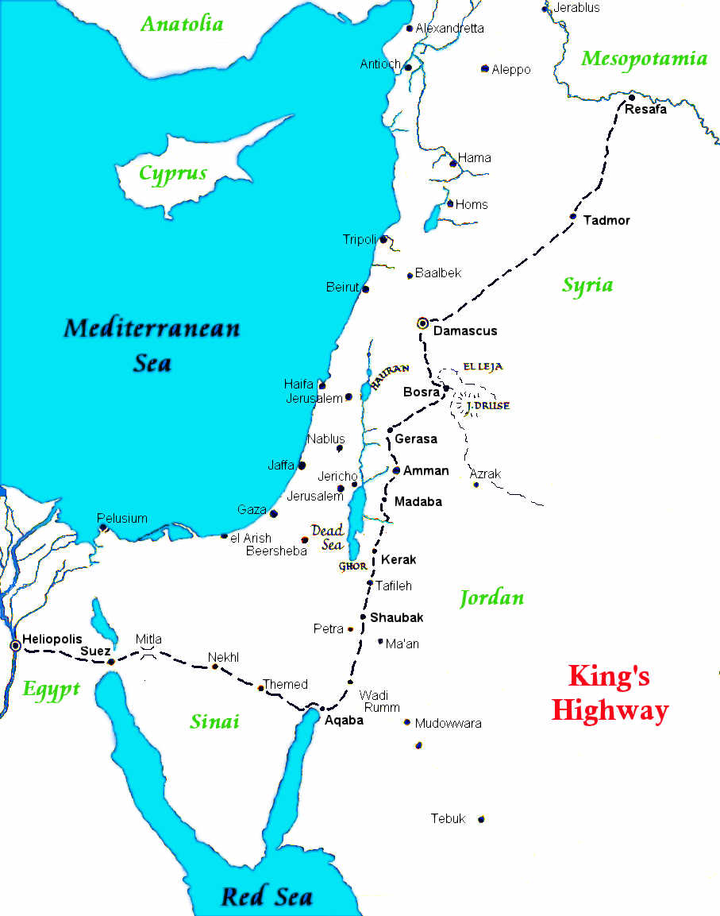
King's Highway

Slide 19
Language
101
4a
Belonged to a group of languages known as Northwest Semitic.
Little evidence for reconstructing the Edomite language.
Features similar to nearest neighbours, Moabite, Ammonite and southern or Judahite Hebrew.

Slide 20
Examples & Religion
101
3b
diphthong aw (Arabic), to ô.
Divine name was pronounced as Qaws was later called Qôs
Kings bearing divine name Qos or Qaus. Qausmalaka ("Qaus has become king") during Tiglath-Pileser III and Qosmalak ("Qos is king") is found from Beer-sha ostraca
Unlike other pagan nations, the OT does not attack Edom's gods by name but gives respect to them not given to others

Slide 21
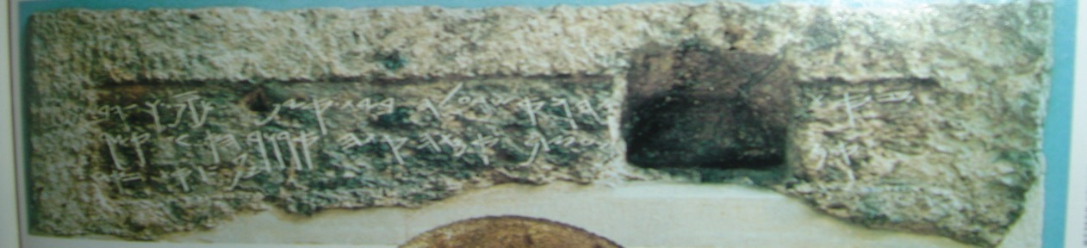
Tomb of the Royal Steward
"[Shebna]yahu"- the same name as Shubnaqos, but with the theophoric yahu.
(Isaiah 22:15-18)

Slide 22

contains Shubnaqos (SWBNQWS)
which means "Pray, turn O Qos."
This name has an exact parallel in the Hebrew onomasticon: A royal steward of King Hezekiah (727-698 BC) was named Shebnayahu (ŠBN'YHW)- with the theophoric yahu instead of Qos.
Notes:
onomasticon
noun
on·​o·​mas·​ti·​con ˌänəˈmastə̇ˌkän,
-kən
plural -s
1
a : a collection or listing of words especially in a specialized field (as science or commerce)
b : a work containing such a collection or listing :
https://www.merriam-webster.com/dictionary/onomasticon
In other words, the Hebrew listing of royal stewards is parallel to the Edomite names: Shebnayahu (Hebrew) of Hezekiah parallels the Shubnaqos of Edom since yahu and qos are both theophoric (derived from or bearing the name of a god).

Slide 23

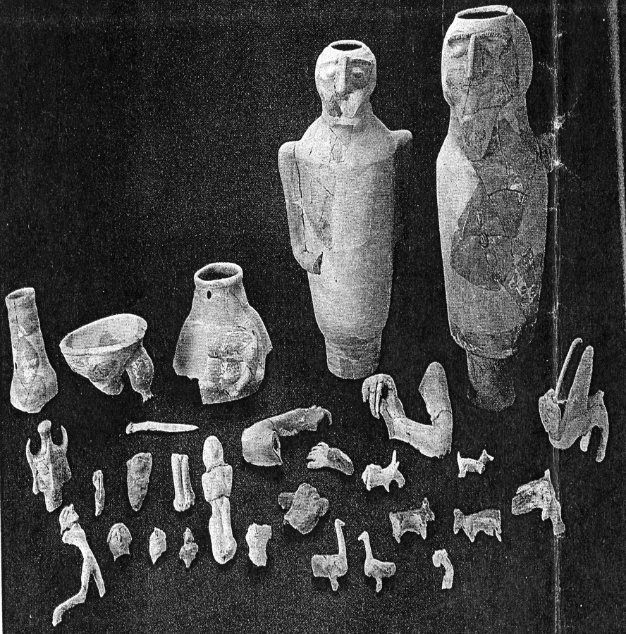
Pottery
Found in Negev site of Horvat Qitmit, southern Judah
Many of the Edomites pieces, including the three-horned goddess and the sphinx are quite small as in comparison with the cult stands which are about 20 inches high.

Slide 24
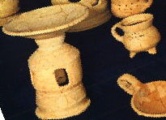
Distinctive Edomite Objects
Large anthropomorphic cult stands
Stands fitted on top with a bowl

Slide 25
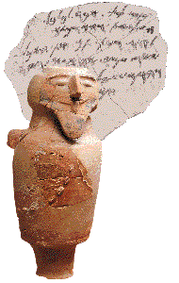
Evidence of Polytheism
101
3a
3 chambers facing Edom
Each room contained a podium about three feet high, which at some point supported an idol or other sacred object
Evidence of sacrificial animals

Slide 26
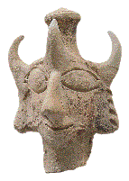
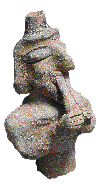
Deity
The three-horned headdress of the figurine has no known parallel.
Double-flute player is believed to be made by the same artisan in the same workshop

Slide 27
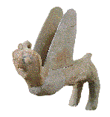
More …
Wings arched for take-off.
8-inch-long Edomite sphinx
Although its overall style suggests Egyptian and Phoenician influence, the sphinx's goggle eyes, protruding nose and hair are typically Edomite.

Slide 28
Other Evidence of Potential Yahweh Worship
101
3b
The God of Israel could have been among the deities worshiped in Edom.
Example: During the time of David the Bible speaks of Doeg the Edomite worshiping Israel's God at the Israelite sanctuary at Nob (1 Sam. 21:7 [MT 21:8])
Edomites had some connection to Israel as God said to have "set out from Seir" (Judg. 5:4 NLT)

Slide 29
United Monarchy (c. 1030 BC)
Reign of Saul
Took some cities from Edomite territory
(1 Sam. 14:47)
Disobeyed God's command to blot out the Amalekites completely
(1 Sam. 15:1-33)

Slide 30
Reign of Saul
Doeg the Edomite
carried out Saul's
order to kill Ahimelech
and the entire priestly
community at Nob
(1 Sam. 22:16-19)

Slide 31
United Monarchy (c. 1000 BC)
Reign of David
Conquered and subjugated by David
Hadad, a royal prince, fled to Egypt
(2 Sam. 8:13-14; 1 Kings 11:14-22; 1 Chron. 18:12).
Such wholesale extermination is known from Assyrian records.
(IVP Bible Background Commentary )

Slide 32
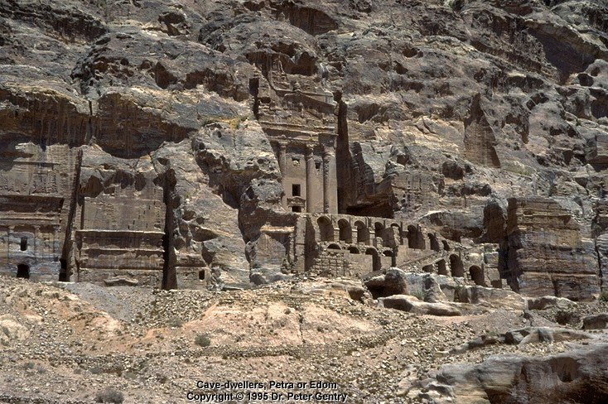
Divided Monarchy (c. 925 BC)
Remained under
the control
of Judah

Slide 33
Divided Monarchy (c. 870-845 BC)
Reign of Jehoshaphat
Joined Moab and Ammon to attack Judah, but defeated at En-gedi (2 Chron. 20:1-28)
Joined Jehoram (king of Israel) and
Jehoshaphat to fight against Moab's revolt
(2 Kings 3:9) ☺

Slide 34
Divided Monarchy (c. 845-735 BC)
c. 845 BC
Revolted against Jehoram of Judah and gained freedom (2 Chron. 21:8-10).
c. 794 BC
Defeated by Amaziah (2 Chron. 25:11-13).
c. 735 BC
Gained freedom from Ahaz (2 Chron. 28:17).

Slide 35
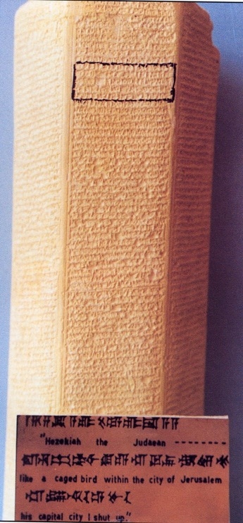
Divided Monarchy (c. 732 BC)
Became Assyrian tributary
Assyrian inscriptions show that in 732 BC the king of Assyria compelled the king of Edom to pay tribute.
(Zondervan Pictorial Encyclopedia of the Bible)

Slide 36
Divided Monarchy (c. 701 BC)
Hezekiah's disastrous revolt gave Edom the opportunity to begin expanding westward
into portions of the eastern Negev.

Slide 37
Archaeological Evidence
Arad Inscription
Edomite Ostracon
(Hogland & Excerpts from Biblical Archaeology, December 1996)

Slide 38
Divided Monarchy (c. 612 BC)
Gained partial freedom
after the fall of Nineveh

Slide 39
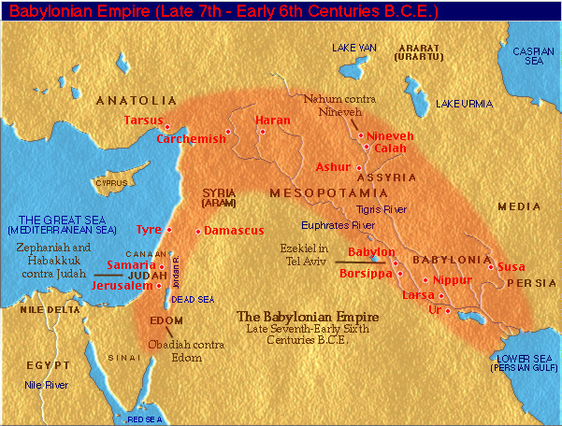
Conquered by Babylon
c. 601 BC Edom became a Babylonian tributary

Slide 40
Glad About Fall of Judah (586 BC)
102
6a2
Rejoiced over the fall of Judah
(Obadiah 11-14; Psalm 137:7; Lam. 4:21-22)

Slide 41
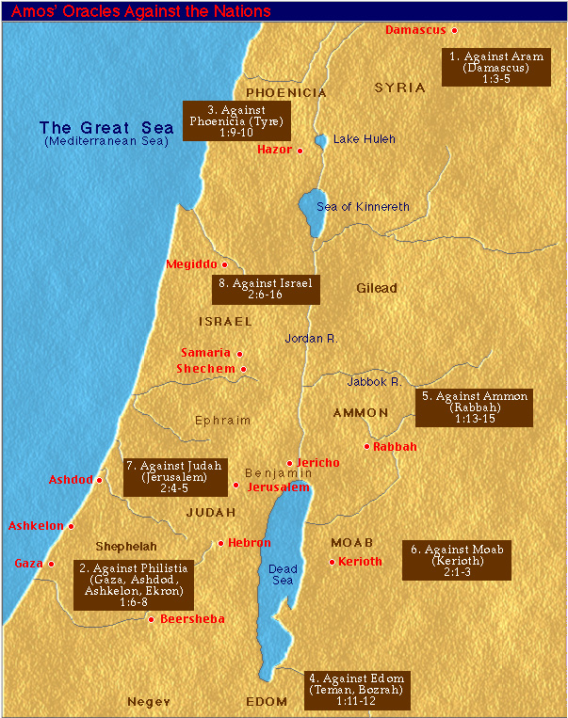
Prophecies of Being Judged
102
6a2
OT prophets foretold judgment on Edom for her bitter hatred
(Amos 1:11-12; Jer. 49:7-22; Lam. 4:21-22; Obad. 10ff;
Ezek. 25:12-14; 35:1-15)
Fall of Judah (586 BC)

Slide 42

Judgment on the 12-Nation Coalition (Isa 13–23)
457
Assyria
Syria
Israel
Babylon
Philistia
Moab
Babylon by the Sea
Egypt
Edom
21:11-12
Sudan
Notes:
The temptation for Ahab in Isaiah's time was to trust in a coalition of other nations to fight Assyria—yet God told them to trust him instead. Why? All these nations would fall to Assyria since God had appointed it. The Assyrians later destroyed the northern nation of Israel during Isaiah’s lifetime—as well as 46 cities of Judah.
In such a time of calamity, whom would Judah trust?
13:1–14:27 Babylon
14:28-32 Philistia
15–16 Moab
17 Damascus/Israel
18 Ethiopia
19–20 Egypt
21:1-10 Babylon by the Sea
21:11-12 Edom
21:13-17 Arabia
22 Jerusalem
23 Tyre

Slide 43
Against Dumah (Heb.) or Edom (LXX)
“This message came to me concerning Edom:
Someone from Edom keeps calling to me,
‘Watchman, how much longer until morning?
When will the night be over?’
¹² The watchman replies,
‘Morning is coming, but night will soon return.
If you wish to ask again, then come back and ask’”
(Isaiah 21:11-12 NLT).

Slide 44
Fall of Judah (586 BC)
102
6a2
Took advantage of Judah’s calamity to migrate into the heart of southern Judah,
South of Hebron
(Ezek. 35:10-12).

Slide 45
The Edomites are coming!
102
6a2
This Hebrew ostracon, addressed to the commander of the Arad fortress, warns of an impending Edomite invasion. Part of a cache of late seventh or early sixth century BC Hebrew documents found in Arad, this dispatch testifies to the urgent threat Edom posed to Judah's southern flank.
(Excerpts from Biblical Archeology Review, December 1996)
Fall of Judah (586 BC)

Slide 46
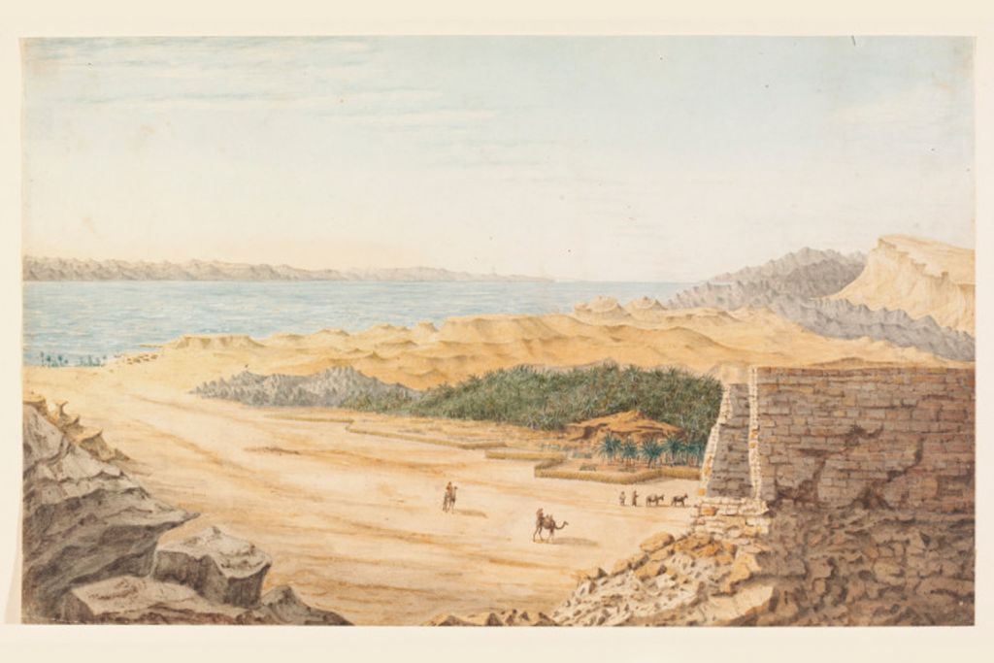
Annihilation
c. 552 BC (Babylonian Rule)
The last monarch, Nabonidus, recorded a siege of the Edomite city of Bozrah

Slide 47
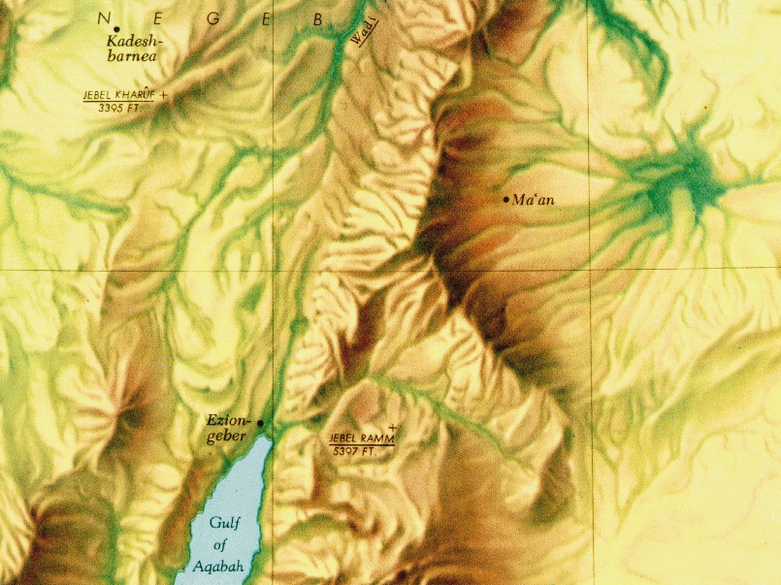
Archaeological Excavations
At Buseira (ancient Bozrah), destruction in early 6th century BC (Hoglund)
At Tell el-Kheleifeh (ancient port of Ezion-geber), destruction levels followed by a quick rebuilding and a resumption of economic activity (IVP Background Commentary)

Slide 48
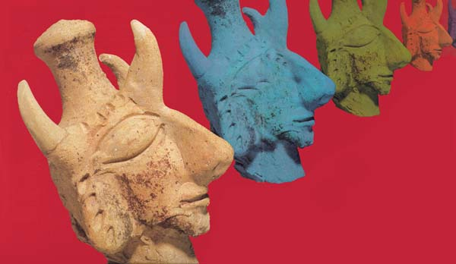
Annihilation
539-331 BC (Persian Rule)
Forced to abandon many of their towns as various Arab groups, notably the Nabateans, pressed into central Edom

Slide 49
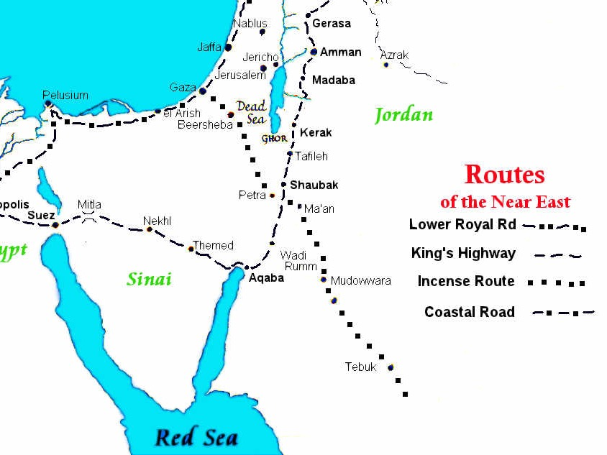
Crossroads of Trade Routes

Slide 50
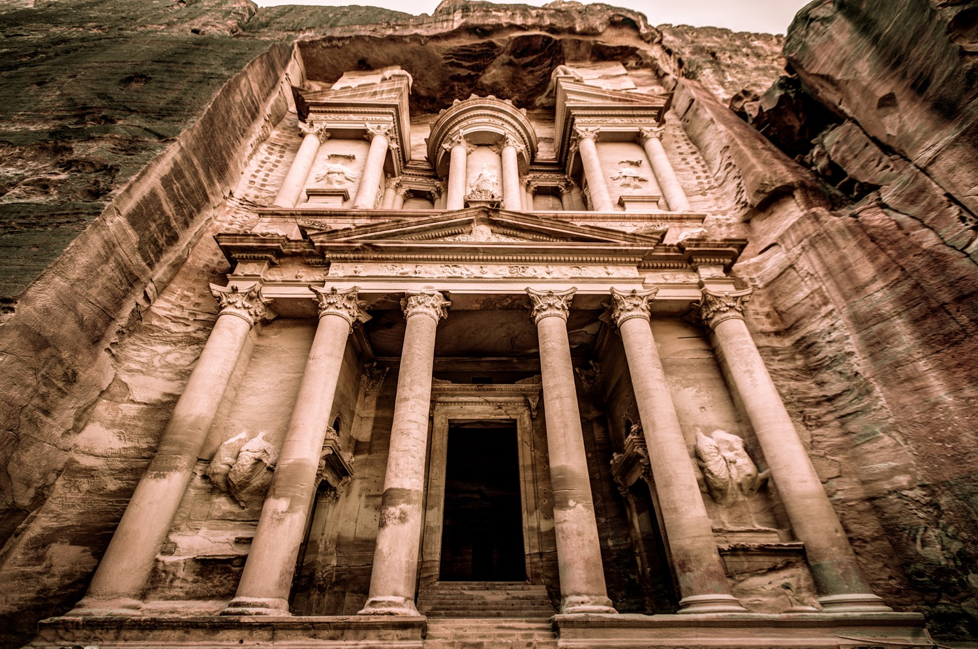
The Treasury of Petra

Slide 51
Intrusion into Judah
Edomites settled in southern Judah, which is confirmed by later Jewish literature.
1 Maccabees 5:65 finds children of Esau in the Hebron district.
Josephus mentions Adorea and Marisa west of Hebron as Edomite towns (Antiquities).

Slide 52
Better in Judah
Archeological evidence suggests that while central Edom may have been desolate, the Edomite settlements in former Judean territories were healthy under Persian supervision.

Slide 53
Evidence of Entrance into Judah
Several epigraphic finds from Tell el-Kheleifeh suggest an occupation in the fifth century.
Aramaic ostraca from Arad in the Persian period list several Edomite names.
(Hoglund)

Slide 54
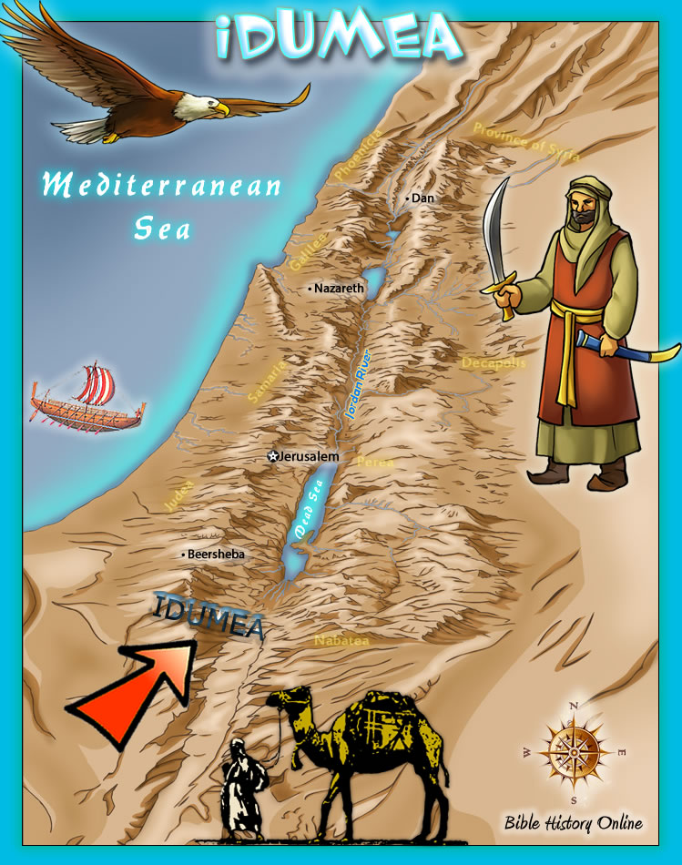
Renamed
331-143 BC (Greek Rule)
The Edomite area in southern Judah became known as Idumea in the Hellenistic period
(1 Macc. 4:29; 5:65).

Slide 55
Conquering Northward

Slide 56
Idumeans Also Subdued
143-63 BC (Hasmonean Rule)
John Hyrcanus subdued the Idumeans around 126 B.C. He compelled them to adopt Judaism and incorporated them into the Jewish people.
(Ant., XIII. 9.1; XV. 7.9)

Slide 57
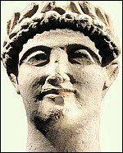
Roman Rule (63 BC – AD 330)
Herod the Great
37-4 BC
Herodian Dynasty
37 BC – AD 70

Slide 58
Treachery
In AD 66, the Jews rebelled against Rome. When Titus besieged Jerusalem in AD 70, the Idumeans joined the Jews in rebellion
against Rome.
Josephus says that 20,000 Idumeans were admitted as defenders of the Holy City. Once within, they proceeded to rob and kill.

Slide 59
Judged by Rome
These traitors received
the same fate as the few surviving Jews when Rome took over Jerusalem.
Idumea, or Edom,
ceased to be.
Annihilated

Slide 60
Significance: God's Election
103
I Hate
Esau
I Love
Jacob
Mal. 1:2-3

Slide 61
Significance:
God's Judgment on All Nations
102
5a
Edom in the OT often stands for pagan nations as a whole
(Isa. 34:5-17; cf. Obad. 15-21).

Slide 62
Significance:
God's Providence
Refugees from the destruction of Judah fled to Edom for safety until the fighting had ceased
(Jer. 40:11-12).

Slide 63
Character of
Edomites
103
Proud (Jer. 49:16; Obad. 3)
Polytheistic/
Syncretistic
Harbored bitter
hatred because of
anger and envy
(Ezek. 35:5, 11;
Amos 1:12)
Wise (Jer. 49:7)

Slide 64
Character of
Edomites
103
Pursued his brother with the sword;
No compassion for kin (Ezek. 35:5; Amos 1:11)
Rejoiced over calamity
(Ezek. 35:15; Lam. 4:21-22)
Esau - Abandoned hope of glory for the sake of things seen and not eternal (Heb. 12:6f.)

Slide 65
"Thou Shall NOT Do Likewise!!"

Slide 66
• Do not envy others
GOD IS FAITHFUL AND JUST
103
• Use your different gifts & talents to bless others
"Esau I
hated"
"Jacob I
loved"
Election
& Calling
Mal. 1:2-3
Character of God

Slide 67
Character of God
103
GOD IS
IN CONTROL
Trust God!

Slide 68
"Don't take advantage of the circumstances, but look towards God."
103

Slide 69
Character of Esau's Parents
103
The animosity between Esau and Jacob was deep rooted.
While God is impartial, Isaac and Rebekah showed favoritism towards their children.

Slide 70
"Fairness in parenting is important!"
103

Slide 71
Edomites Group Members
Chan Suet Fong
Chia Choon Yee
Fung Ho Wang
Razovelhu Vasa
Zajamo Odyuo

Slide 72
Black

Slide 73


OT Backgrounds link at BibleStudyDownloads.org
Get this presentation for free!
Notes:
NT Survey (ns)

