Slide 1
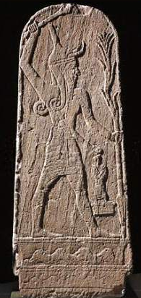
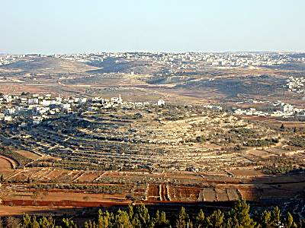
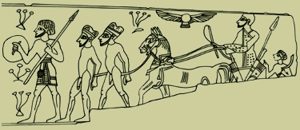
Canaanites
89
Identity
History
Geography
Cities
Culture
Religion
Dr. Rick Griffith • Jordan Evangelical Theological Seminary • BibleStudyDownloads.org

Slide 2
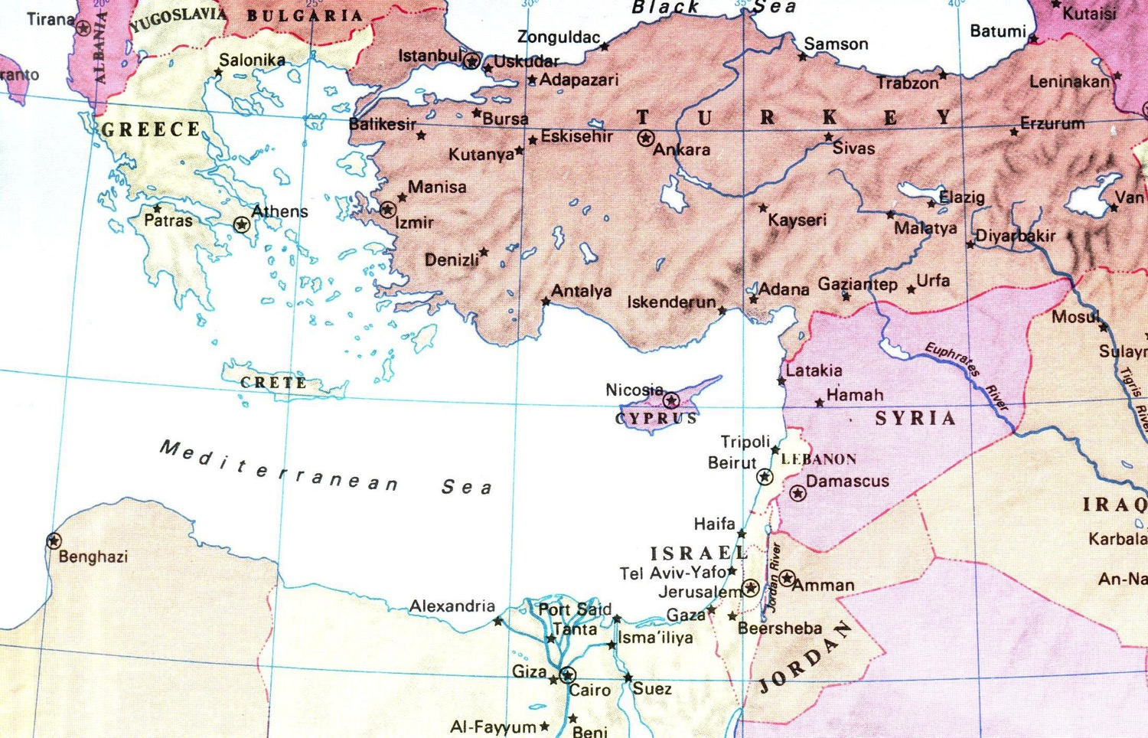
The Lines of Japheth, Ham, & Shem
Descendants of Noah's Sons
92
Gomer
Togarmah
Javan
Meshech
Asshur
Lud
Tubal
Aram
Caphtorites
Canaan
Put
Mizraim
Cush
Gen. 10
Notes:
• Susan and I descended from Japheth.
• The Chinese came from Ham.
• And the Iranians have Shem as their ancestor.
• Many years ago, my wife and I sat at a table representing all three lines of Noah's descendants—I from Japheth, Nick from Shem, and Irene from Ham.
_______________
OB-01ANE Peoples-7
OB-03-Amorites-2
OS-01-Gen4-20—slide 146

Slide 3

The Lines of Japheth, Ham, & Shem
Descendants of Noah's Sons
92
Gomer
Togarmah
Javan
Meshech
Asshur
Lud
Tubal
Aram
Caphtorites
Canaan
Put
Mizraim
Cush
Gen. 10
Notes:
• Susan and I descended from Japheth.
• The Chinese came from Ham.
• And the Iranians have Shem as their ancestor.
• Many years ago, my wife and I sat at a table representing all three lines of Noah's descendants—I from Japheth, Nick from Shem, and Irene from Ham.
_______________
OB-01ANE Peoples-7
OB-03-Amorites-2
OS-01-Gen4-20—slide 146

Slide 4

The Lines of Japheth, Ham, & Shem
Descendants of Noah's Sons
92
Gomer
Togarmah
Javan
Meshech
Asshur
Lud
Tubal
Aram
Caphtorites
Canaan
Put
Mizraim
Cush
Gen. 10
Notes:
• Susan and I descended from Japheth.
• The Chinese came from Ham.
• And the Iranians have Shem as their ancestor.
• Many years ago, my wife and I sat at a table representing all three lines of Noah's descendants—I from Japheth, Nick from Shem, and Irene from Ham.
_______________
OB-01ANE Peoples-7
OB-03-Amorites-2
OS-01-Gen4-20—slide 146

Slide 5

The Lines of Japheth, Ham, & Shem
Descendants of Noah's Sons
92
Gomer
Togarmah
Javan
Meshech
Asshur
Lud
Tubal
Aram
Caphtorites
Canaan
Put
Mizraim
Cush
Gen. 10
Notes:
• Susan and I descended from Japheth.
• The Chinese came from Ham.
• And the Iranians have Shem as their ancestor.
• Many years ago, my wife and I sat at a table representing all three lines of Noah's descendants—I from Japheth, Nick from Shem, and Irene from Ham.
_______________
OB-01ANE Peoples-7
OB-03-Amorites-2
OS-01-Gen4-20—slide 146

Slide 6
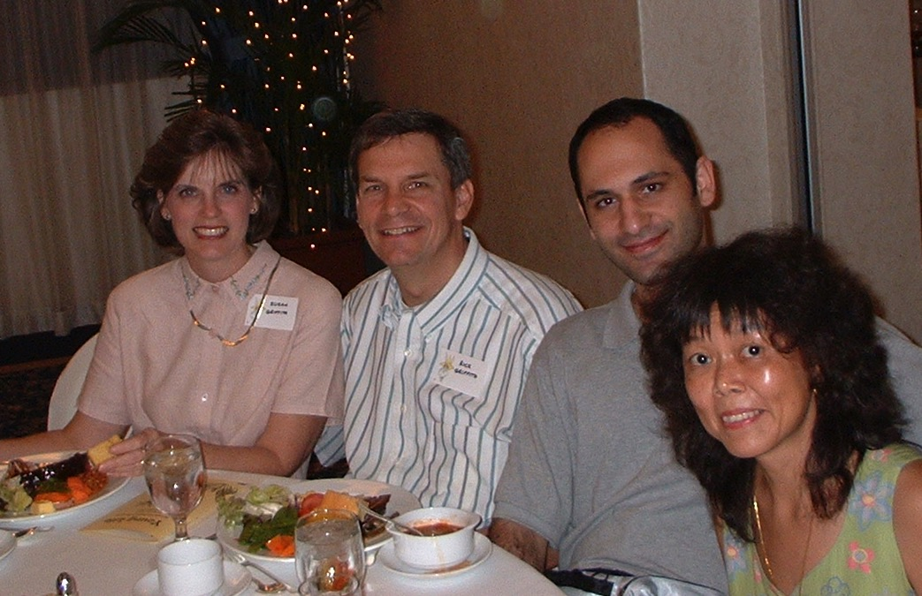
The Lines of Japheth, Ham, & Shem
Descendants of Noah's Sons
92
Gomer
Togarmah
Javan
Meshech
Asshur
Lud
Tubal
Aram
Caphtorites
Canaan
Put
Mizraim
Cush
Gen. 10
Notes:
• Susan and I descended from Japheth.
• The Chinese came from Ham.
• And the Iranians have Shem as their ancestor.
• Many years ago, my wife and I sat at a table representing all three lines of Noah's descendants—I from Japheth, Nick from Shem, and Irene from Ham.
_______________
OB-01ANE Peoples-7
OB-03-Amorites-2
OS-01-Gen4-20—slide 146

Slide 7
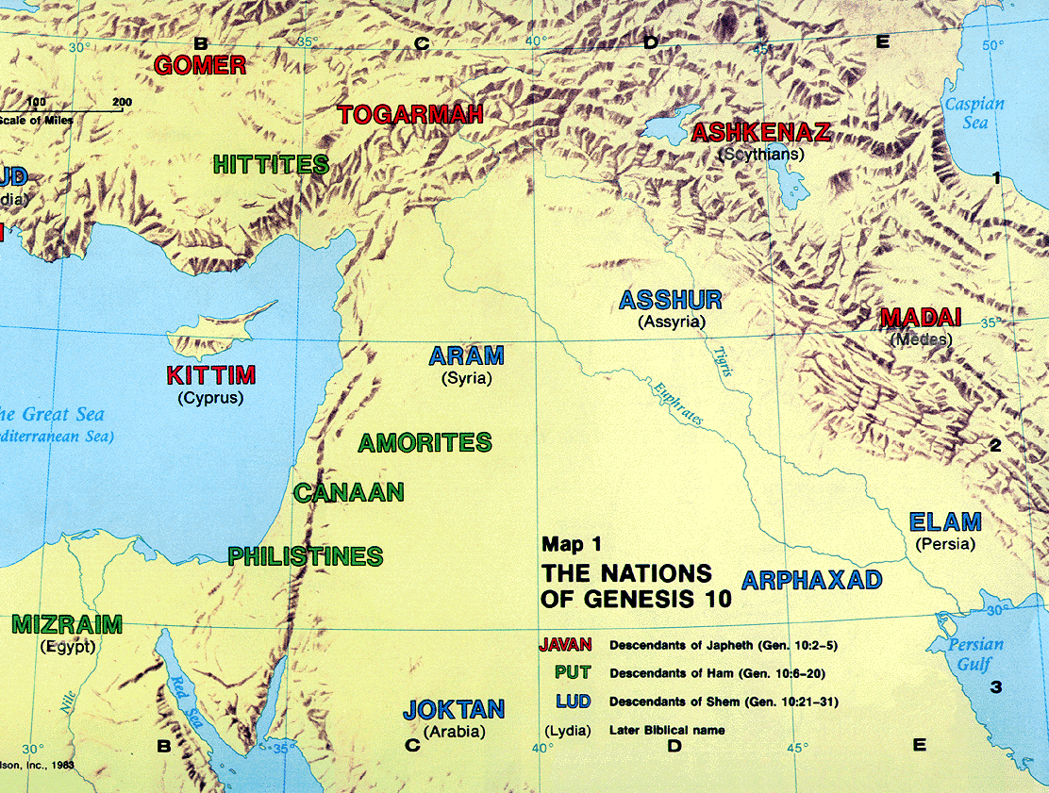
The Table of Nations
(Gen. 10)
17
NOAH
Sino
Japheth
HAM
SHEM
Sin
Caucasians
Canaanites
Semites
Sinai
Europeans &
East Indians
Africans &
Asians
Jews &
Arabs

Slide 8
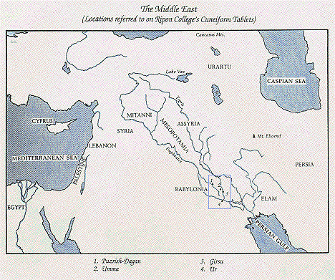
Language of Canaanites
89
Linguistically classified into two groups:
Eastern:
o Akkadian (language of the
Assyrians and Babylonians)
o Tigris and Euphrates river valleys
Western:
- Northern (Levant)
- Southern (Arabia and Ethiopia)

Slide 9
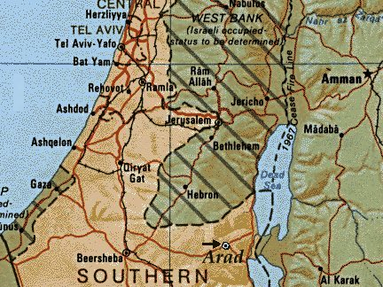
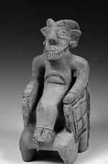
History
3300 - 1950 BC (Early Bronze)
  First walled towns built
  Populations seldom exceeded 2000
  Development of urban societies - Arad
  Wars and Egyptian interference (13th dynasty-2000 BC)

Slide 10
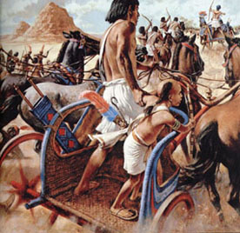
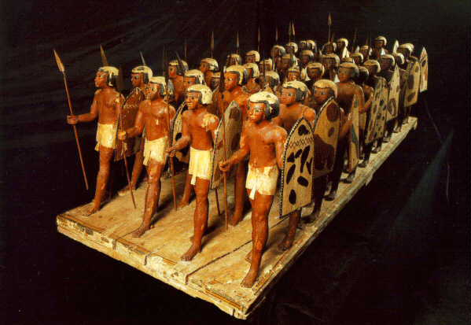
History
Middle Bronze (1950-1539 BC)
Hyksos were Canaanites who ruled over Northern Egypt for over 100 years (mid-17th century)
Hyksos Chariot
Mid-16th century BC (1539)
Pharaoh Ahmose drove out Hyksos and destroyed Canaanite cities

Slide 11
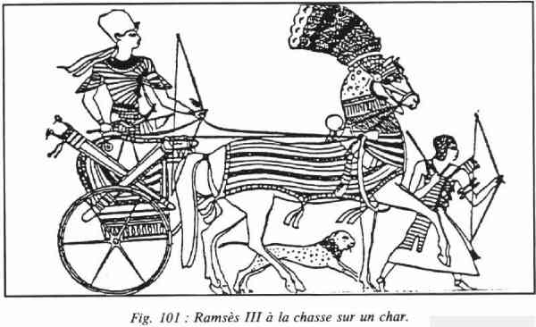
History
(Late Bronze) 1539 - 1200 BC Egyptian Domination
Battle of Megiddo
- Canaan Conquered
- Paid heavy tribute & taxes
- Supplied the resident Egyptian army with food and other supplies

Slide 12
History
Iron 1 (1200-950 BC)
1. Arrival of sea people (Philistines).
--Destroyed the Hittite culture
--Occupied northern and coastal regions
--Led to collapse of Canaan city states
2. Establishment of settlements
3. Phoenician culture developed along Mediterranean coast as merchants.

Slide 13
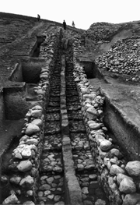
History
Iron II Age (950-586 BC)
Best known "new states" of the Iron II period
- kingdom under Solomon
Centralised Govt.
Large scale building projects (water tunnel)

Slide 14
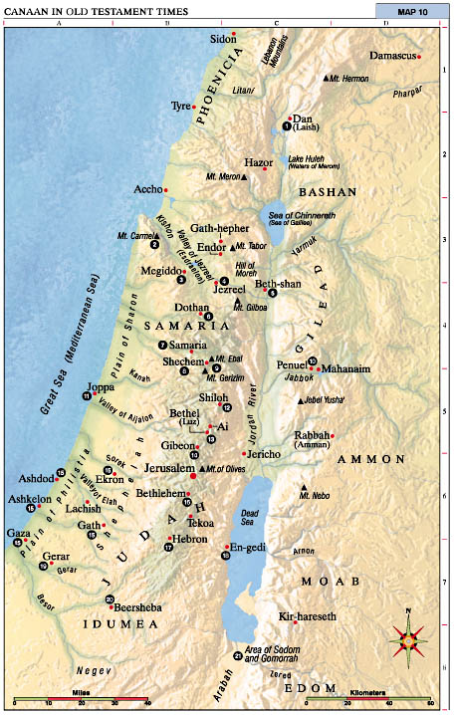
Geography
89
Overall
- the whole area "from the Brook of Egypt" (south of Gaza)
- Ammon, Moab and Edom not part of Canaan
Northward
- along the coast past Gebal/Byblos
- inland to the western edge of the Syrian Desert
Southward
- to incorporate eastern Bashan down to the Yarmuk River
- down the Jordan Valley to the southern end of the Dead Sea
Westward
- through the Wilderness of Zin,
and back to the Brook of Egypt
Scope of Canaan by Egyptians of the
Late Bronze Age (ca. 1550-1200)

Slide 15
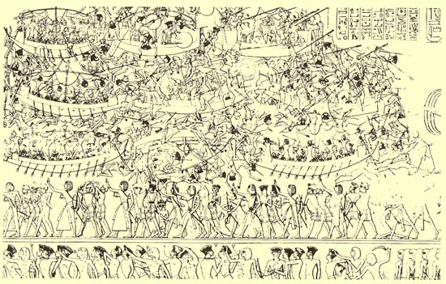
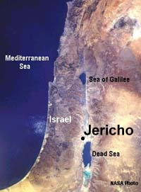
Cities
Jericho
Situated ten miles northwest of where the Jordan River enters the Dead Sea
A major ford of the Jordan that accommodates travel from Transjordan through the river to the west.
The name probably derives from the Hebrew word yerah, meaning moon or month or new moon.

Slide 16
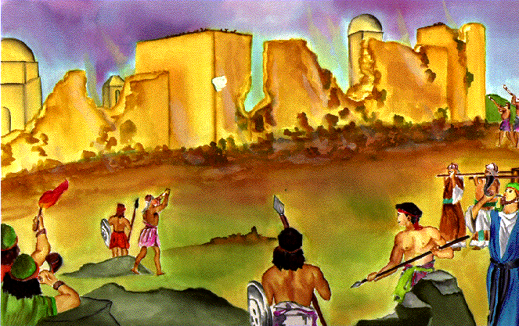
Cities
Historical and Biblical Importance
  First city to conquer
  Battle of Jericho
Significance?
  Faith in power of God
  Salvation of Gentiles through faith

Slide 17
Cities
Gibeon
Situated halfway between Jerusalem and Bethel
In 3000 BC Gibeon served as a fortress city
One of the most ancient Canaanite cities
One of four Hivite cities in the Bible (Joshua 9:17)

Slide 18
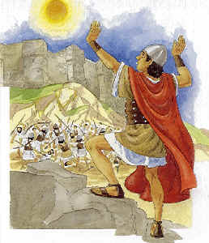
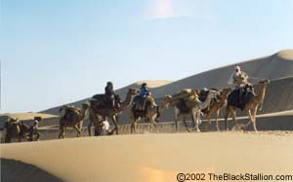
Cities
Gibeon tricked Israel
Israelites had to fight the 5 Amorite kings (Josh. 10)
Sun stood still
Some lessons?
Consult the Lord!
Don't be deceived
Keep all treaties
Faithfulness of God despite our weakness
I hope our disguise works.

Slide 19
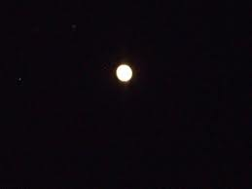
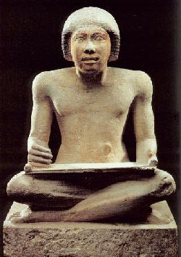
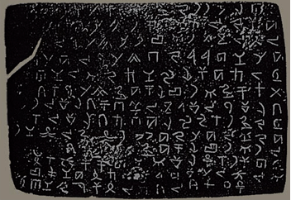
Culture-Writing
Will I keep my job?
Alphabet
- the single most important and enduring contribution to later civilizations.
- enabled the spread of literacy to the masses rather than keeping it in the hands of the educated scribes.

Slide 20
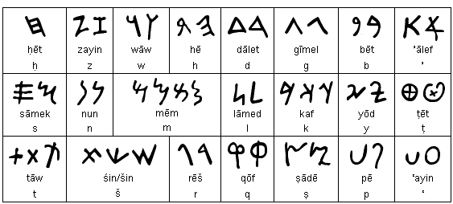
Alphabet Origins
123
The Phoenician alphabet actually originated from the proto-Canaanite alphabet of the 18th -17th centuries BC
The earliest known inscriptions in Phoenician come from Byblos and date back to the 1000 BC.

Slide 21
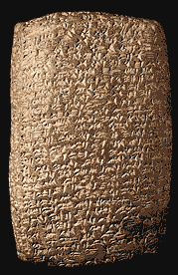
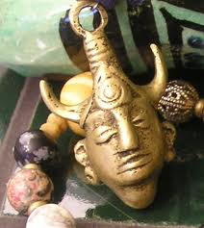
Religion
90
Archaeological Discoveries: Baal & El
(in Amarna Letters)
Baal
- the principal deity of the land
- means "lord" or "master"
- Canaanites depended upon for survival

Slide 22
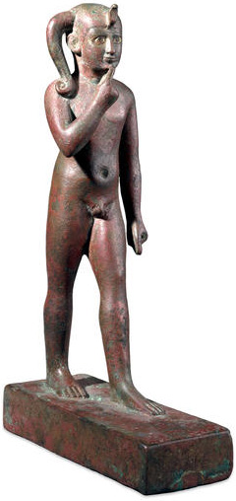

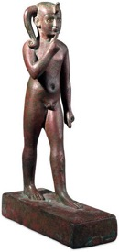
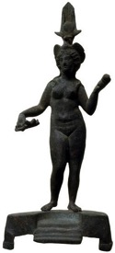

The Baal Cycle
Baal Rises
Baal Rises
Mot kills Baal
Mot kills Baal
Winter
Spring
Summer
Fall
Winter
Spring

Slide 23
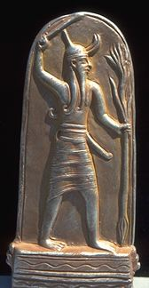
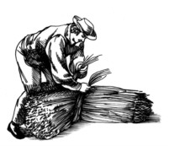

Religion
90
Baal fertility cycle (Baal Epic)
Mot (death) in winter defeated by Baal (life) in spring
Temple prostitution and sexual fertility rites in religious worship helped Baal resurrect in spring

Slide 24

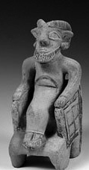
Child Sacrifice to Baal
91
During worship live babies were placed on the burning hot hands of the statue of Baal.
After dying they were then pushed into a hole underneath.

Slide 25
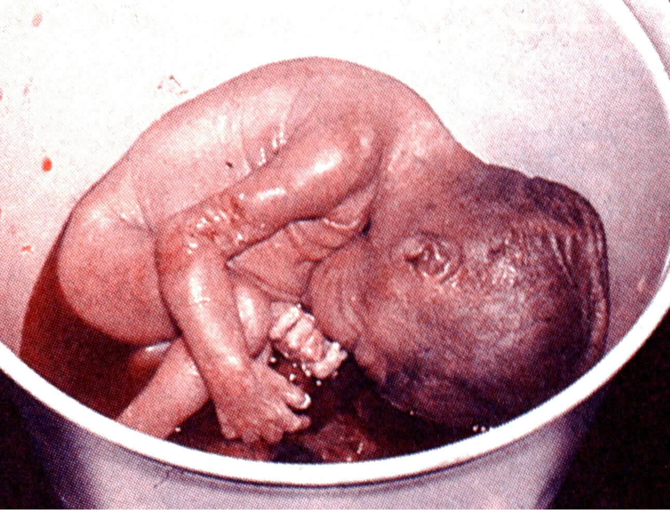
Modern Child Sacrifice

Slide 26

WALTER A. ELWELL
"Contact among the many religions of the ancient Near East produced not only tension but also much syncretism or borrowing of concepts and practices. When Canaanite polytheism is compared with that of Mesopotamia, striking similarities appear that probably would not have occurred had the societies been totally isolated from each other. For example, some scholars suggest that in both cultures authority resided with the sky God. That was only the concept of authority, however. The implementation of authority needed some other deity. Although the sky god of Mesopotamia was Anu, the real power was exercised by Enlil, god of wind and storm. Likewise, El was the nominal head of the Canaanite gods, but the chief functions of deity were exemplified by the personification of storm, the god Hadad. He was the 'Baal,' or lord of gods and of humankind."

Slide 27
WALTER A. ELWELL
"The Aramaeans and Philistines who settled in Canaan adopted the practices of the Canaanites; similarly, the Amorites accepted much of the Sumerian religion as their own when they moved into Mesopotamia. Among all those peoples, however, the Hebrews took an independent course. Their God was the unique and cosmic deity who demanded exclusive allegiance. Such a concept ran against the grain of all the religions of the day."

Slide 28
The Worst Religion of All
91
"The brutality, lust and abandon of Canaanite mythology is far worse than elsewhere in the Near East at the time. And the astonishing characteristic of Canaanite deities, that they had no moral character whatever, must have brought out the worst traits in their devotees and entailed many of the most demoralizing practices of the time, such as sacred prostitution, child sacrifice and snake worship."
Merrill F. Unger, Archaeology and the OT, 175

Slide 29

Religion
93
Influence on Israel
= syncretism
-Yahweh was God of power
while Ba'al was god of everyday life
Not until after the return from exile in Babylon was monotheism maintained by Israelites.

Slide 30
Religion
92-93
Why was Israel so influenced?
Similar dialect
Enlisted Canaanite help for superior weapons
Superficial resemblance to Hebrew religion (peace offerings, divine titles, etc.)
Appeal of syncretism—the best of both worlds with both Yahweh and Baal (Bratcher)

Slide 31
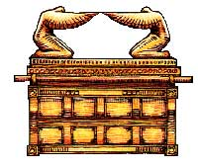
Religion
How Israel fought against Canaanite influence
1.Good Theology
  · Bible taught One God
  · Genesis polemic (Bratcher)
  · Character of God

Slide 32
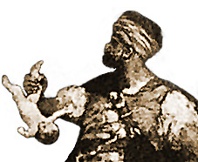
Religion
92
2. Prophets taught against religious practices
  · Similarity in appearance
  · Differences in morality:
    human sacrifice
    temple prostitutes
    child sacrifice
    mutilation
    bestiality

Slide 33
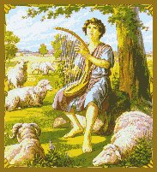
Religion
92
3. Language
  Here was Israel's most successful counterattack
  Emphasized the personal nature of God
  Used poetic imagery for celebrating God's sovereignty

Slide 34
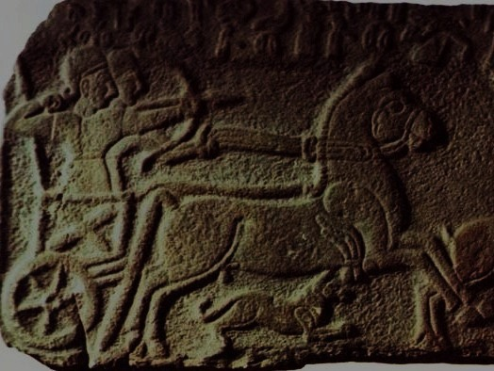
Lessons
93
Child sacrifice: God hates it so much that it was the precipitating factor for judgment upon Israel. Do we practice it today? Why are abortions performed today?
Syncretism: Do we worship other "gods" like career and fall back on God only when in trouble?
Evangelism: How do we use today's culture and language to present God to this generation?

Slide 35
Small Group Discussion
93
How do you preserve godly values amidst your "Canaanite age"?
What is the most effective means you have found to be in the world but not of the world?
"I'm not asking you to take them out of the world, but to keep them safe from the evil one" (John 17:15 NLT)

Slide 36
Black

Slide 37


OT Backgrounds link at BibleStudyDownloads.org
Get this presentation and script for free!

