Slide 1
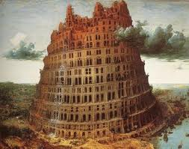
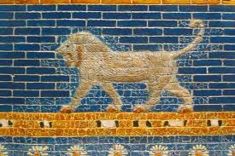
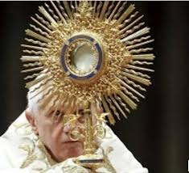
The Babylonians
(Neo-Babylonian Empire)
625-539 BC
Dr. Rick Griffith • Jordan Evangelical Theological Seminary • BibleStudyDownloads.org

Slide 2
Babylon has been in the news daily since a Dallas Seminary professor wrote this book in 1991
Slide 2

Slide 3
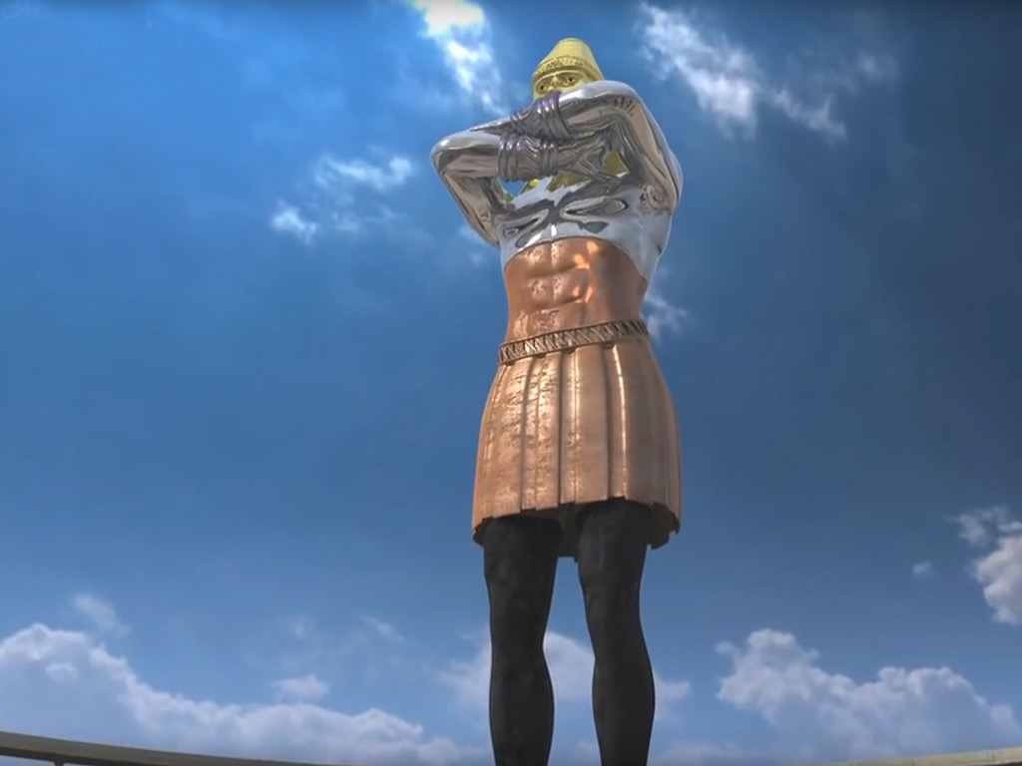
Free Bible images
REVELATION TV
NEBUCHADNEZZAR’S DREAM
Daniel 2:1-49

Slide 4
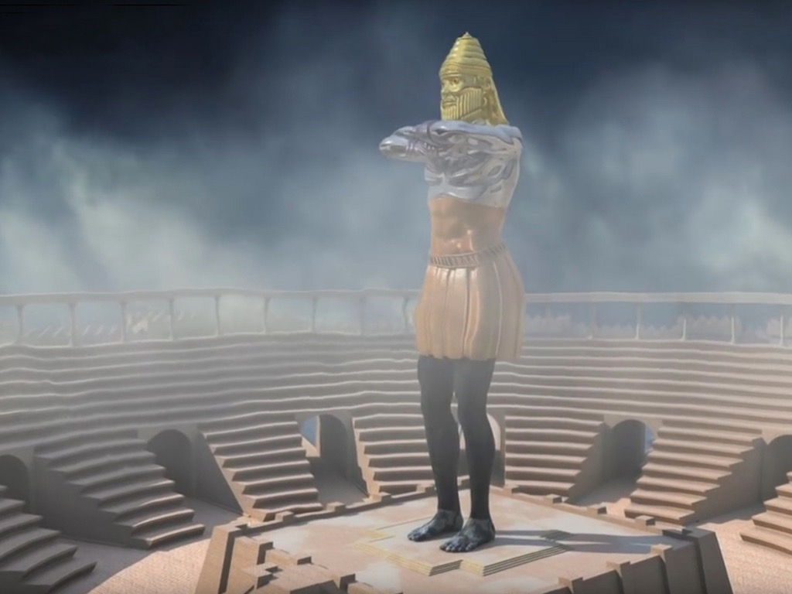

Slide 6
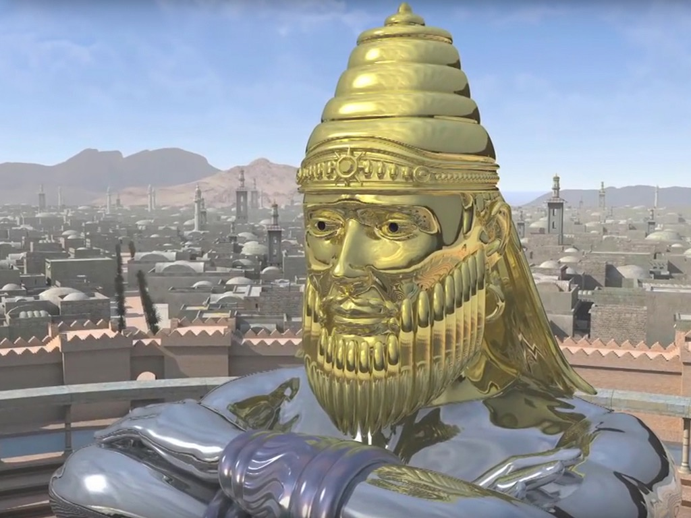

Slide 7
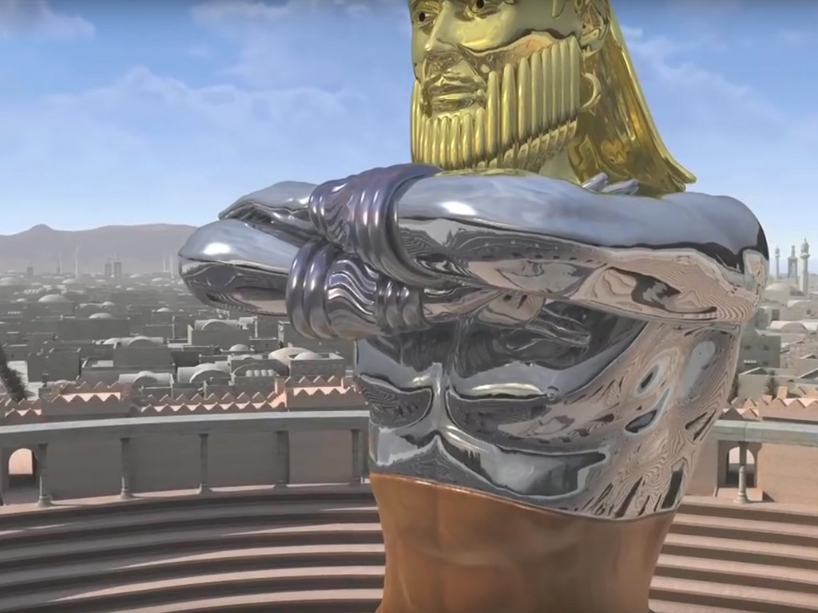

Slide 8
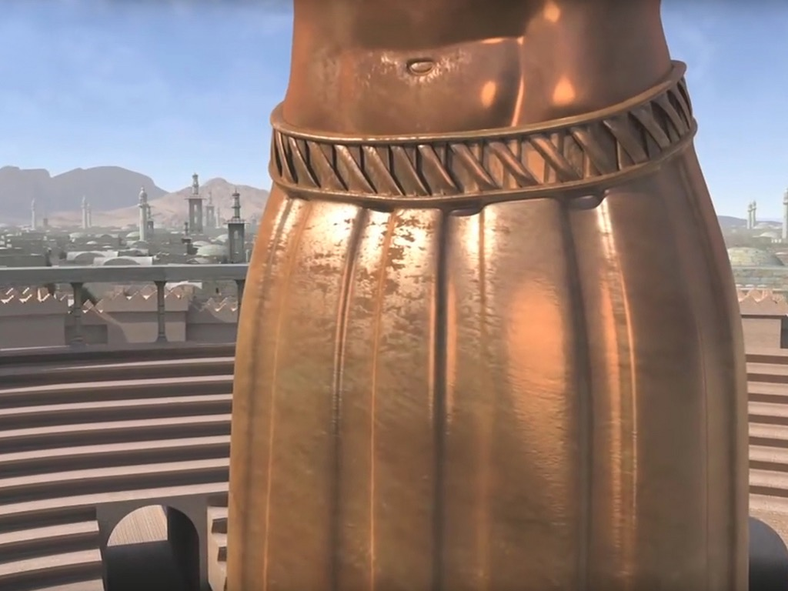

Slide 9
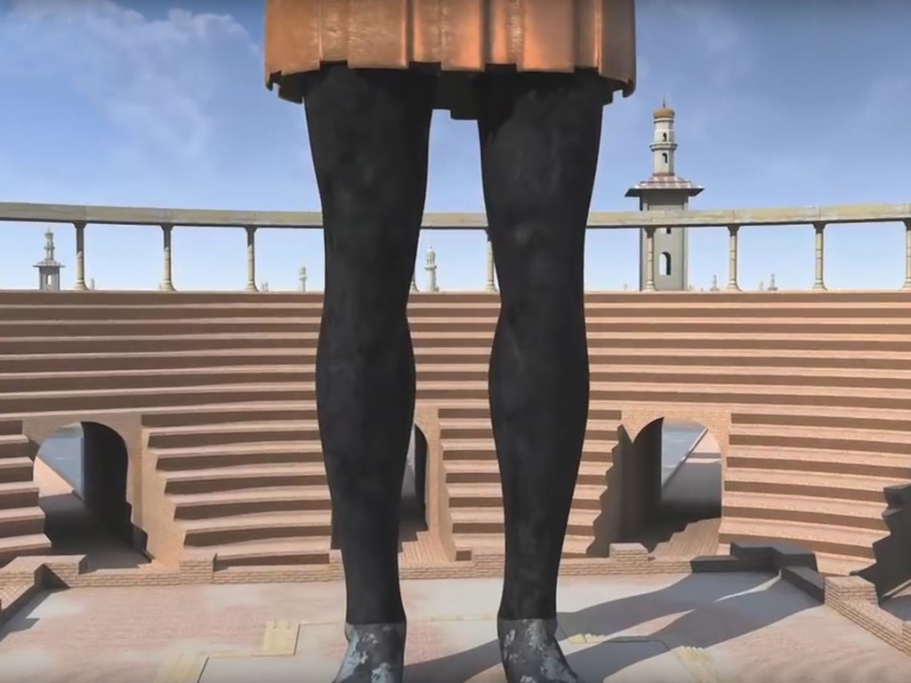

Slide 10
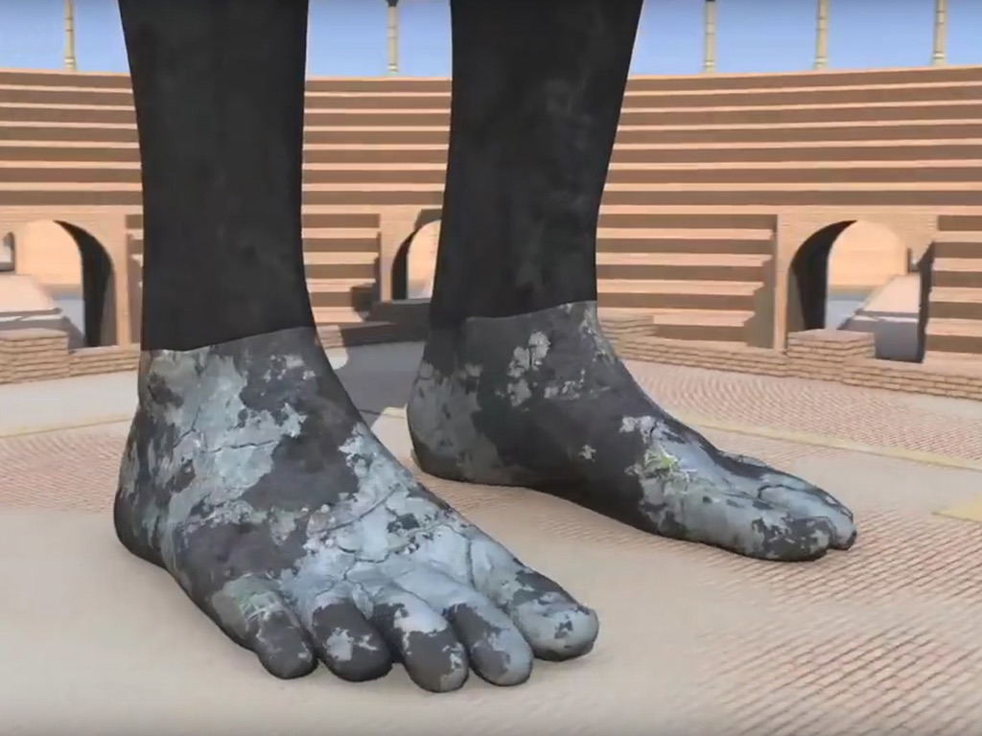

Slide 12
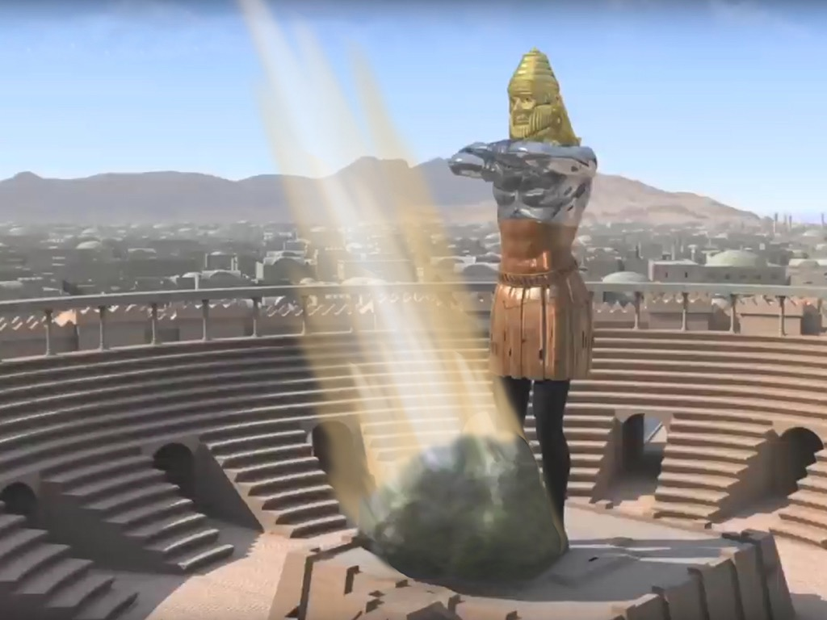

Slide 13
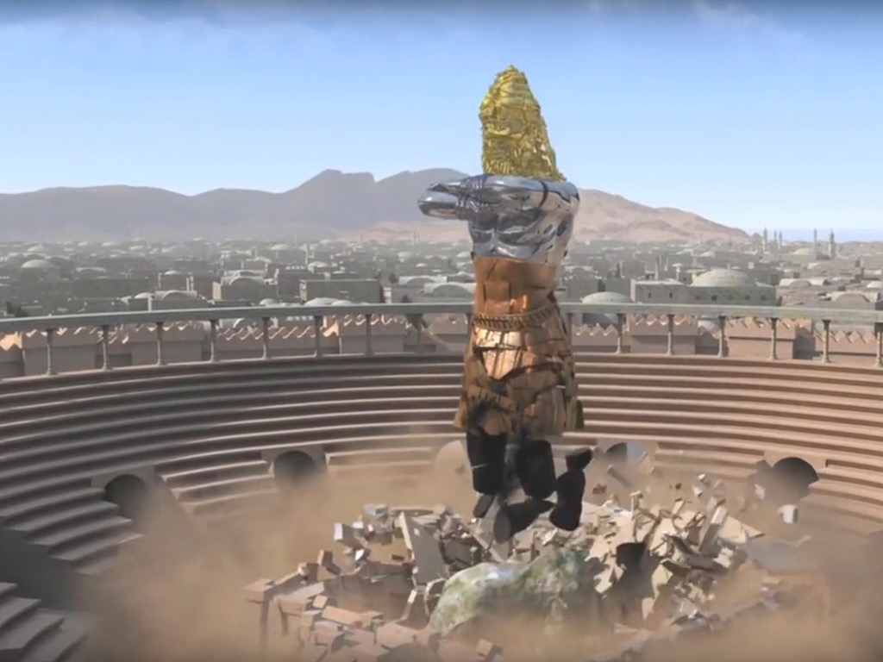

Slide 14
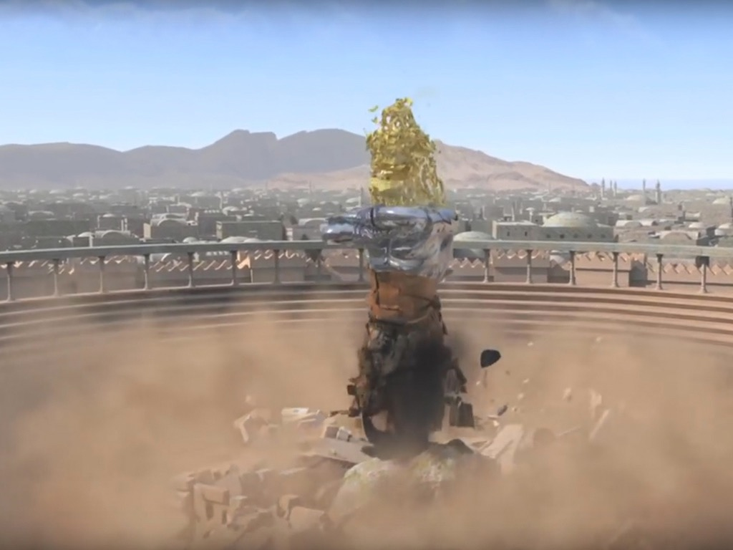

Slide 15
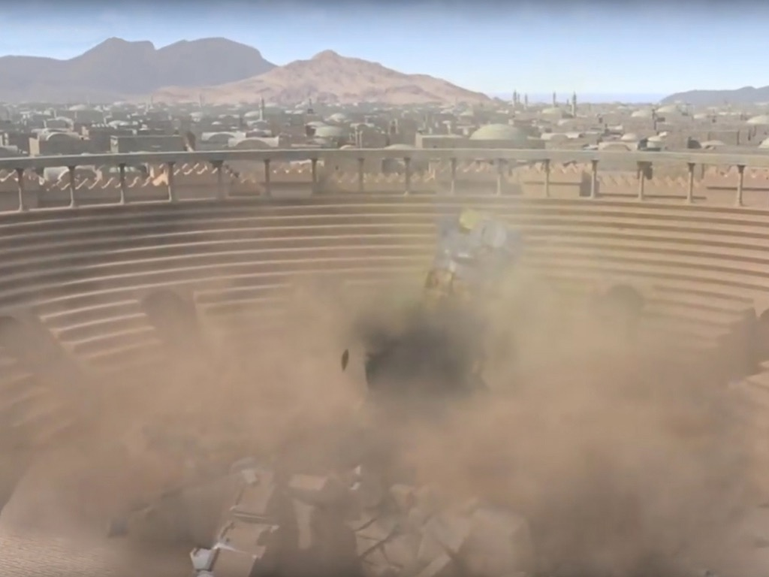

Slide 17
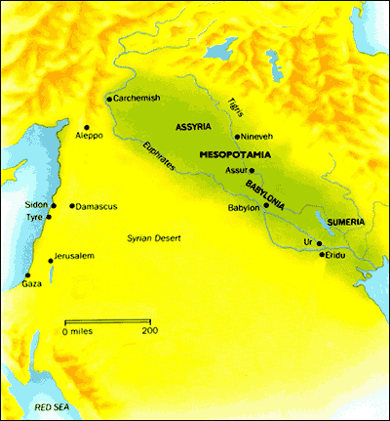
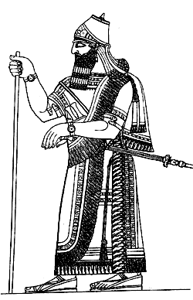
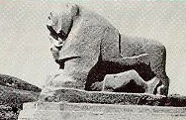
136
History of Babylon
Babylonian Society
Israel & Babylon
Babylon & Us

Slide 18
Genesis 10:8-10; 11:2, 9; Rev. 17:1-6 How did Babylon start? What motivated this beginning? What resulted from its founding? What did Babylon signify?
History of Babylon
136

Slide 19
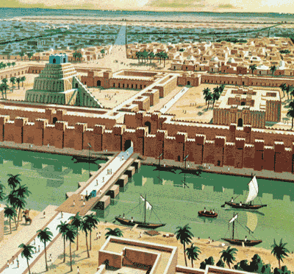
136
Babylon
The Name
The Location
The Tower of Babel

Slide 20
Ancient Near East
136
Dominant Peoples in Mesopotamian History
Proto-Literate (3200-2850)
Early Dynastic (2850-2360)
Akkad (2360-2180)
Guti (2180-2082)
Ur III (2070-1960)
Isin-Larsa (1960-1700)
Old Babylonian (1830-1531)
Old Assyrian
Hurrian Invasions (1700-1500)
Kassites (1600-1150)
Mitanni (1500-1380)
Middle Assyrian (1366-1078)
Aramean & Chaldean (1078-935)
Neo-Assyrian (935-612)
Neo Babylonian (625-539)
Persian (539-332)
Alexander (332- )
Neo-Babylonian
625-539 BC

Slide 21
137
Neo-Babylonian Empire
Neo-Babylonian Rulers
Nabopolassar – 625-605 BC
Nebuchadnezzar II (son) – 605-568 BC
Evil-Merodach (son) – 561-560 BC
Neriglissar (brother-in-law) – 559-556 BC
Labosoarchad (son) – 556 BC
Nabonidus – 555-539 BC
Belshazzar – 539 BC
Nebuchadnezzar II
604-568 BC

Slide 22
Jerusalem's Fall
Jerusalem's Fall
232
&
342
Key Dates
627
Jeremiah
605
Daniel
597
Ezekiel
586
538
Joel
Habakkuk
Lamentations

Slide 23
Josiah's Sons & Prophets
232
342
Daniel
605
Ezekiel
City Fell
Jehoahaz
Josiah
Jehoiakim
Jehoiachin
Zedekiah
609
597
586
(3 mos.)
(11 yrs.)
(3 mos.)
(11 yrs.)
Jeremiah
627
Brief Puppet Kings

Slide 24
Two 70-Year Exiles
560
Two 70-Year Exiles
People Exile (Jer. 25:11-12; Dan. 9:2; Ezra 1:1)
605
586
539
536
516
Temple Exile

Slide 25
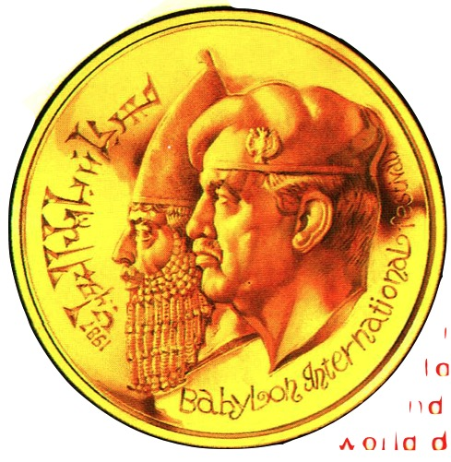
1986 Babylon International Festival Medallion
137
110f
SADDAM HUSSEIN and the ancient world conqueror Nebuchadnezzar. Not only do they look alike, but their mission was the same—to control the world. And the symbol of this world dominion is an ancient city…
BABYLON: Prelude to Armageddon?

Slide 26
An Evil End to Judah
256
1
Josiah
640-609
(31 yrs.)
Good king in white
Evil kings in yellow
3
5
2
Johanan (no rule)
Jehoiakim (Eliakim) 609-597 (11 yrs.)
Zedekiah (Mattaniah) 597-586 (11 yrs.)
Jehoahaz (Shallum) 609 (3 mos.)
4
Jehoiachin (Jeconiah/Coniah) 597 (3 mos.)
Babylon
Exiled

Slide 27
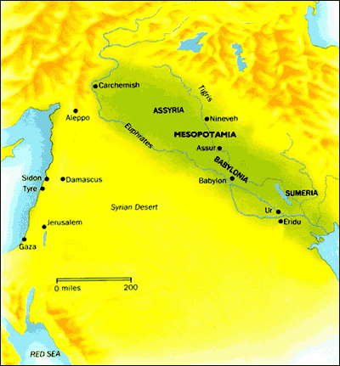
137
Babylonia
Babylonian Geography
Where was Babylonia?
Tigris & Euphrates
Climate
Ideal for Trade
Map of Mesopotamia

Slide 28
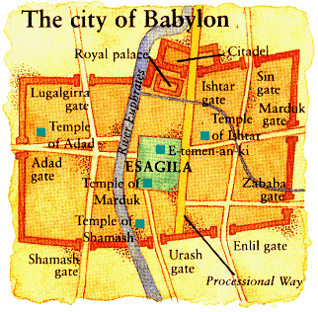
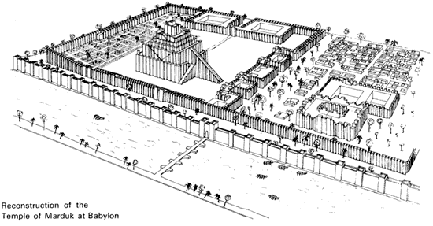
137
Nebuchadnezzar's Babylon

Slide 29
RELIGION
138
Babylonians had many gods – Sumerian, Akkadian, imports from mountainous regions (N & E of Meso.) – which reflected their needs and fears
Marduk (Bel / Baal)
1. Son of Ea (wisdom)
2. Chief of Babylon's gods (rising sun)
3. Temples & a huge ziggurat (the temple of Esgalia)
4. Wife called Sarpanitu / Son - Nabu
5. Sacred number 10 / Planet Jupiter
6. Statue of pure gold – Babylon
7. Made men and fashioned the world

Slide 30
RELIGION
138
Worship of MARDUK
Babylon - time of Nebuchadnezzar II Esagila - a huge sanctuary complex / temple of Marduk, and E-Temen-an-ki, the great ziggurat of Babylon, probably the prototype of the Tower of Babel

Slide 31
RELIGION
138
Worship of MARDUK

Slide 32
RELIGION
138
OTHER BABYLONIAN GODS
Pantheons – overlapped many cities
Every street bore the name of one of the gods
SIN (Sumerian Nanna) – moon god
ISHTAR (goddess of Venus) – war and love
SHAMASH (sun god) - In charge of justice
ANU (Sumerian An) – god of heavens
ENLIL – King of the lands
ADAD (weather god) - In charge of the weather
EA (Sumerian Enki) – god of wisdom & magic

Slide 33
RELIGION
139
Where were the gods?
Everywhere!

Slide 34
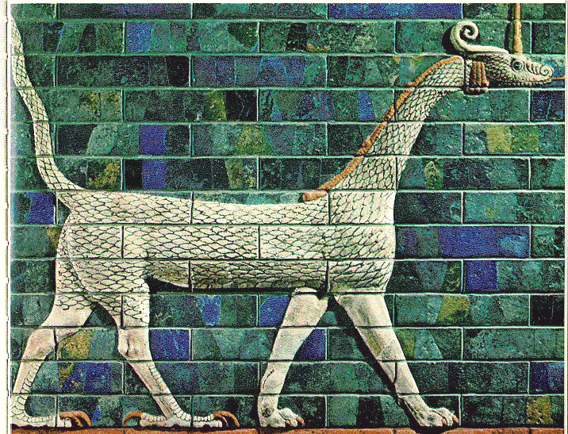
RELIGION
139
Temples and Rituals
A RELIGIOUS METROPOLIS
53 temples of the chief gods
55 chapels of Marduk
300 chapels for earthly deities
600 for heavenly deities
180 altars for the goddess Ishtar
180 for gods Nergal and Adad
12 other altars for different gods
Babylon, the mother of prostitutes and of the abominations of the earth
(Revelation 17:5)

Slide 35
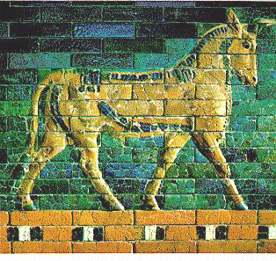
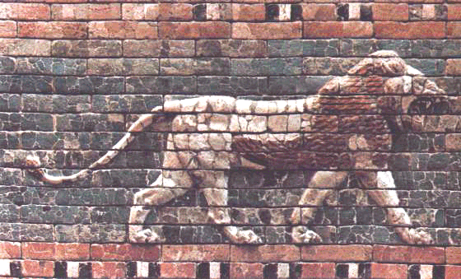
RELIGION
139
RITUALS
Daily presentation of offerings
Cleaning garments of divine statues
Purification of temples
Special festivals (Akitu – New Year)
TEMPLES
Each city had its own god and temple
Had own land, slaves, animals & precious stones
Priests foretold by reading nature & other elements
Selling of charms and magical formulae

Slide 36
RELIGION
139
PERSONAL IDOLS
Each Babylonian citizen had a 'personal' god
Individuals made special requests (e.g., relief from illness)
Acted as mediators from devotees to higher gods
Benefit-driven so one would often abandon his god
Ziggurats
Shows the city and king's devotion to their city god
Huge stepped structure

Slide 37
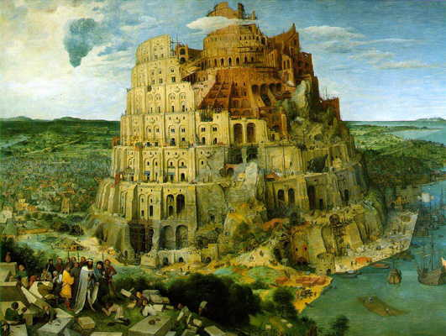
Tower of Babel (Gen. 11)
RELIGION
139
Ziggurats

Slide 38
RELIGION
Babylon, the jewel of the kingdoms, the glory of the Babylonians' pride, will be overthrown by God like Sodom and Gomorrah. She will never be inhabited or lived in through all generations; But desert creatures will lie there, jackals will fill her houses;
There the owls will dwell, hyenas will howl in her strongholds, jackals in her luxurious palaces.
- Isaiah 13:19-23

Slide 39
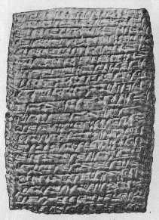
139
LITERATURE
IMPACT OF SUMERIA
Immersed in Sumerian culture since 3000 BC
Adopted Sumerian system of formal education
Nabu – god of scribal arts gave Babylon cuneiform
Cuneiform in Latin – 'cuneus' (wedge) / ideogramatical script (symbols)
Transformed later to syllogrammatical
script (simplified symbols) on clay tablets

Slide 40
CUNEIFORM
LITERATURE

Slide 41
139
LITERATURE
IMPACT OF SUMERIA (continued)
Sumerian writings incorporated - translation to Akkadian (lingua franca of ANE)
Schools of scribes copied compositions and created catalogs
Sumero-Babylonian dictionaries popularized the myths, epics, hymns, etc.
After fall of Babylon in 539 BC, Aramaic and Greek became the common languages

Slide 42
139
LITERATURE TYPES
POETRY
Parallelism rendered ideas 2 different ways side by side
Couplets, singlets and triplets
No rhyme and meter
Several Epics - Enuma Elish & Gilgamesh Epic
MUSIC
Story telling or chanting of a verse - religious
ceremonies & entertainment
Used reed, flute, lyre, drum, trumpet and harp

Slide 43
LITERATURE TYPES
140
Gilgamesh Epic
BABYLONIAN VERSION OF THE FLOOD (2000 BC)
Babylonian Mythology
Many gods (Polytheism)
Gods quarrel /disagree
Confusion as to why the Flood came
Adad - thunder
Ninurta- winds
Annunaki - lightning
Biblical Account
One God (Monotheism)
A Holy God
God saw evil and punished the corrupt people
Yahweh:
Creator
Sustainer
Judge

Slide 44
LITERATURE TYPES
140
WISDOM LITERATURE
Many such writings – problem of evil and suffering / devout pious observers
Examples – The Theodicy, Dialogue of Pessimism
PROPHECY
Babylonian prophecy – forerunner of many occult religions and mystical books
Described past events in prophetic terms to validate their foretelling other events

Slide 45
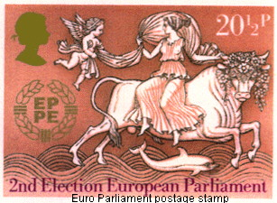
140
BABYLON MYSTERY RELIGION TODAY
Who is the Woman on the Beast (Rev. 17)?

Slide 46
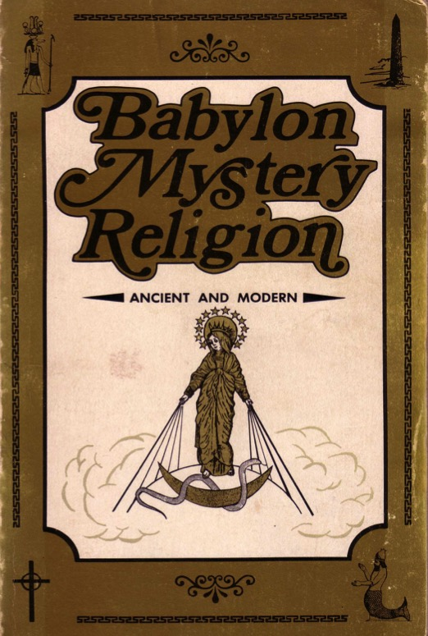
140
BABYLON MYSTERY RELIGION TODAY
Catholics Repeat Babylon's Mistakes
Sources:
Ralph Woodrow

Slide 47
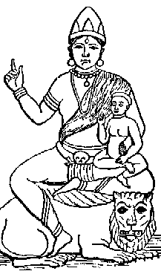
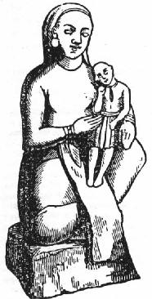
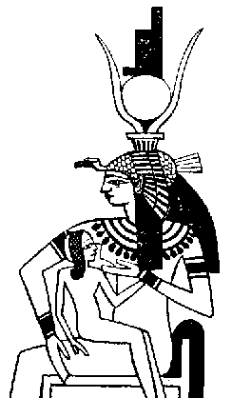
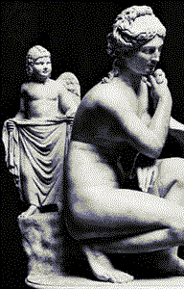
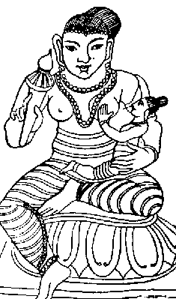
140
BABYLON MYSTERY RELIGION TODAY
Mother and Child Worship
Babylonians
The goddess mother Semiramis held her child Tammuz in her arms
Hindu
Greece
Babylon
Egypt
Buddhist

Slide 48
140
BABYLON MYSTERY RELIGION TODAY
Mother and Child Worship
Babylonians
The goddess mother Semiramis as wife of Nimrod was called the “Queen of Heaven”
Israel
Jeremiah 7:18 (NIV): “The [Jewish] children gather wood, the fathers light the fire, and the women knead the dough and make cakes of bread for the Queen of Heaven. They pour out drink offerings to other gods to provoke me to anger.”

Slide 49
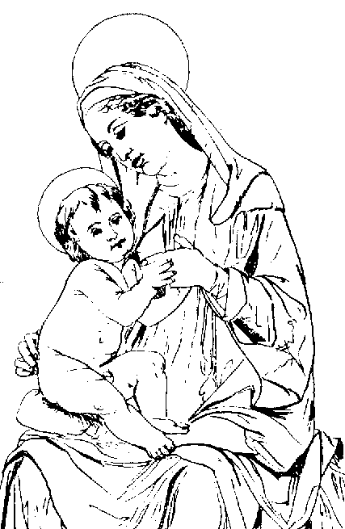
140
BABYLON MYSTERY RELIGION TODAY
Mother and Child Worship
Babylonians
The goddess mother Semiramis held her child Tammuz in her arms
Catholics
Mary is worshipped along with her son Jesus in the Babylonian fashion

Slide 50
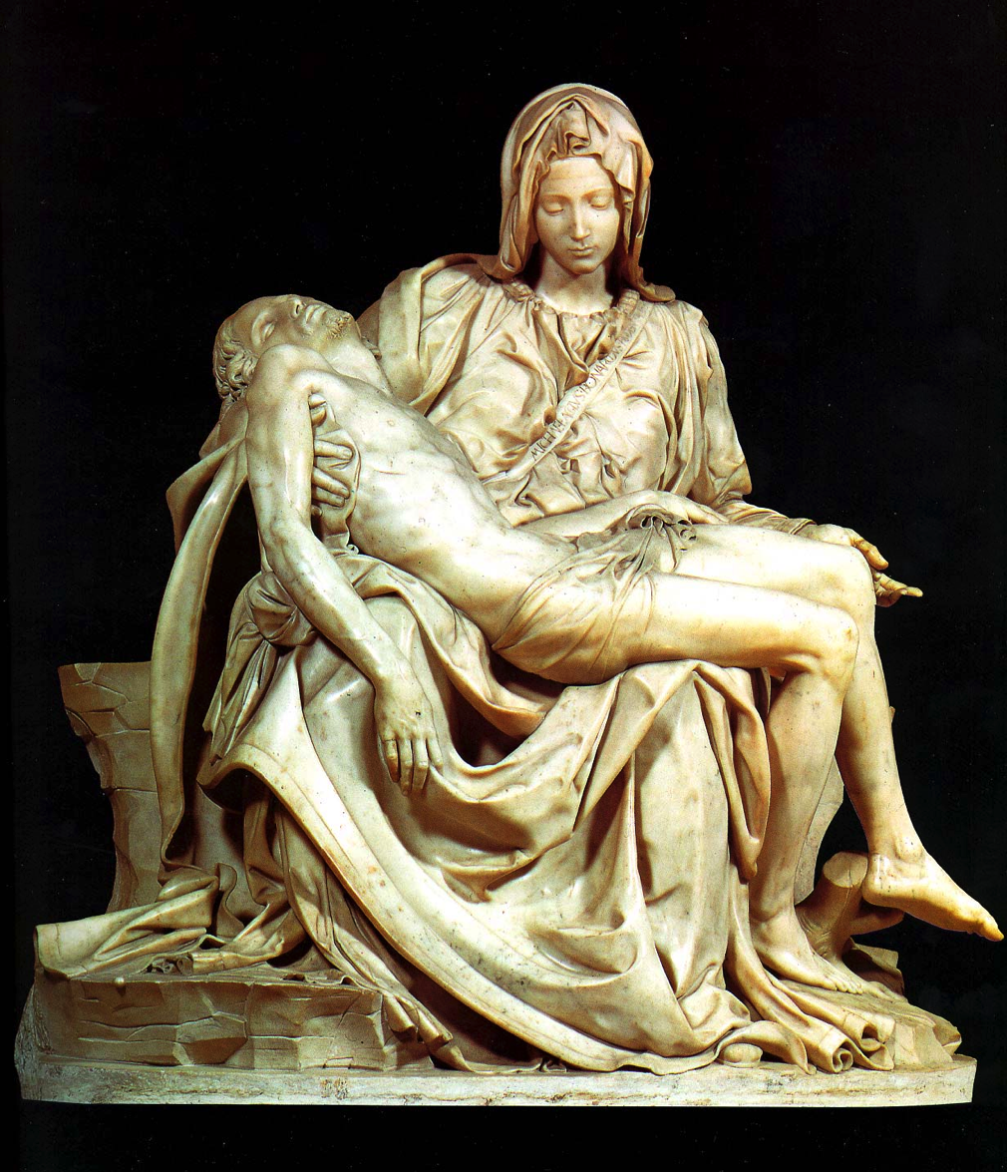
Who is the Focal Point of Michelangelo's Pieta?
Jesus is much smaller than Mary!

Slide 51
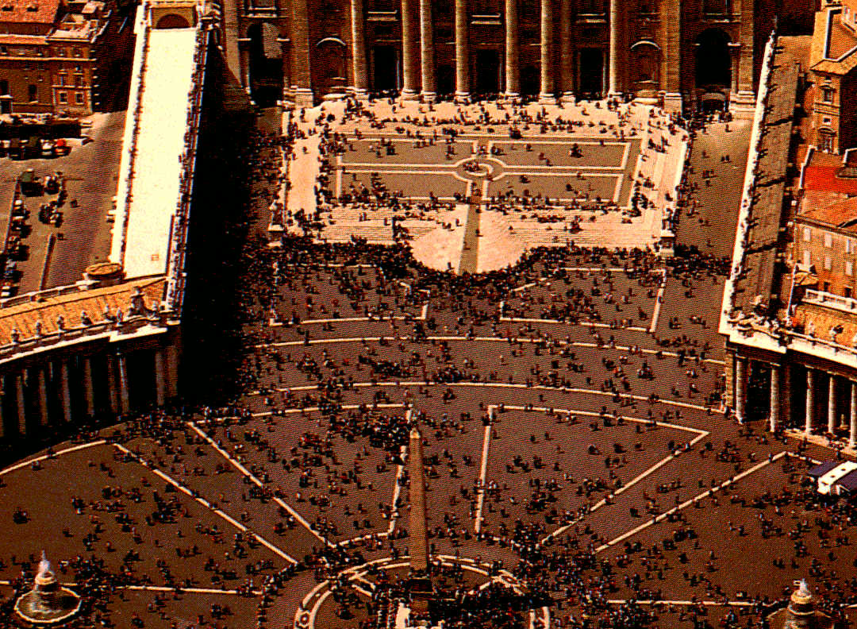
140
BABYLON MYSTERY RELIGION TODAY
Obelisks
Babylonians
Image 90 feet x 9 feet (Dan. 3)
Catholics
The obelisk focal point of St. Peter's Square in Rome was brought by Caligula (AD 37-41) from an Egyptian temple of sun-worship. Pope Sixtus V moved it to the Vatican in AD 1586. He imposed the death penalty if it was broken!

Slide 52
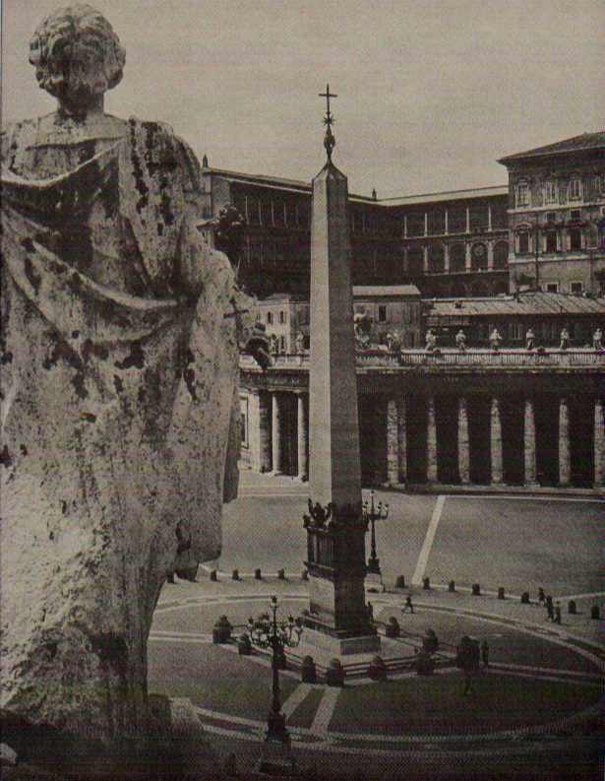
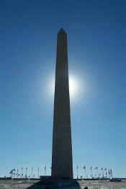
The Egyptian Obelisk at St. Peter's Square

Slide 53
140
BABYLON MYSTERY RELIGION TODAY
Other Pagan Parallels:
Babylonians
Relics
Pilgrimages
Indulgences
Purgatory
Pontiffs
Celibate Priests
Transubstantiation
Easter Festival
Winter Festival
Catholics
Relics
Pilgrimages
Indulgences
Purgatory
Pontiffs
Celibate Priests
Transubstantiation
Easter Festival
Winter Festival

Slide 54
LAW & ORDER
RELIGIOUS INFLUENCE
SHAMASH- sun god and also god of law and justice
Hammurapi (1792-1760 BC) – Punishments for crimes varied / death penalty (drown / burn / decapitate)
CIVIL LAW
Business practices – growing trade
Courts administered laws
4 judges in each court / appeals can be made to the king
Capital punishment – flogging/ reduction to slavery & banishment

Slide 55
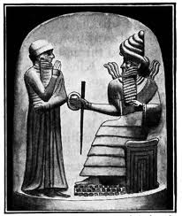
LAW & ORDER
LAW CODES
A number of documents called the Law Codes (from 2350 to 1750 BC)
Almost all in verbal agreement – showing no legal codes but royal decrees
King's divine mission – administer justly
THE CODE OF HAMMURAPI (1780 BC)
Established legal practice in Babylon's institutions & customs
Retaliation – tit for tat in cases of physical injuries (lex talionois)

Slide 56
141
Technological Achievements
MATHEMATICS
Geometry / algebra (Euclid & Pythagoras later developed)
Developed the numerical system (sexagesimal)
Measurement of time and degrees of the angles
- 60 mins (1 hour) / 360 degrees / decimal
- square roots / value of pi
Building the Tower of Babel
SCIENTIFIC ACHIEVEMENTS
Astronomy
Astrology
- recorded meticulously over centuries
- correct calculations of the solar & lunar year

Slide 57
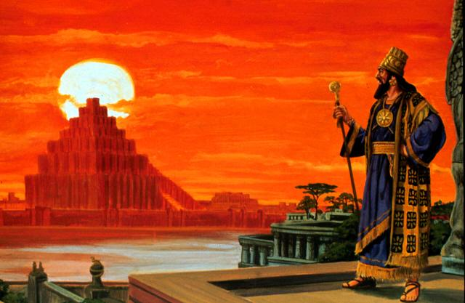
140
SCIENTIFIC KNOWLEDGE
OTHER ACHIEVEMENTS
Calendar system – 12 lunar months
Measurement – Water or the sun clock
Medicine – Surgery / anatomy / physiology
Circulation of blood/ pulse

Slide 58
140
ECONOMY & SOCIAL STRUCTURE
AGRICULTURE
Economic base – barley, wheat, fruits, vegetables, cattle & sheep
IRRIGATION SYSTEM
Swamp and desert conditions
Tigris and Euphrates – Sumerian (Idiglat & Buranin)
Canal systems / flood banks

Slide 59
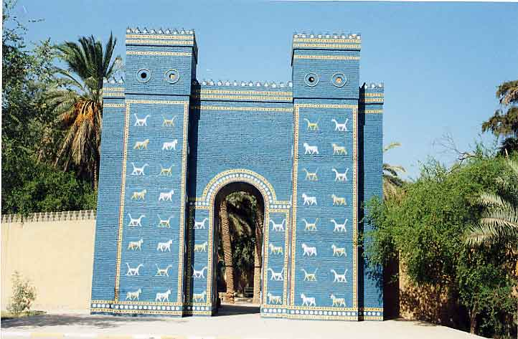
ECONOMY & SOCIAL STRUCTURE
ART
Tapestries / rugs
Fashion gold and silver goods
Cut gems and manufactured textiles
TRADE
Key to Babylon's wealth
Protection from bandits – prosper till 1000 BC
Taxation on the people

Slide 60
142

Slide 61
Why the Exile?
Elijah
Amos
Hosea
722 BC Northern Kingdom taken over by Assyrian Empire
ISRAEL
900BC 800BC 700BC 600BC
BEFORE THE EXILE
THE EXILE
JUDAH
JUDAH
Notes:
Why the Exile?

Slide 62
Why the Exile?
Zeph. 1:4-6 And I will stretch out my hand upon Judah, and upon all the inhabitants of Jerusalem; and I will cut off the remnant of Baal from this place, and the name of the Chemarim with the priests; and them that worship the host of heaven upon the housetops; and them that worship, that swear to Jehovah and swear by Malcam; and them that are turned back from following Jehovah; and those that have not sought Jehovah, nor inquired after him.
Mic 1:5 For the transgression of Jacob is all this, and for the sins of the house of Israel. What is the transgression of Jacob? is it not Samaria? and what are the high places of Judah? are they not Jerusalem?
Eze 8:17 Then he said unto me, Hast thou seen this, O son of man? Is it a light thing to the house of Judah that they commit the abominations which they commit here? for they have filled the land with violence, and have turned again to provoke me to anger: and, lo, they put the branch to their nose.
Jer 2:8 The priests said not, Where is Jehovah? and they that handle the law knew me not: the rulers also transgressed against me, and the prophets prophesied by Baal, and walked after things that do not profit.
Like his contemporaries, he envisaged the social inequities of his day as symptoms of an underlying spiritual malaise which could only be cured by… the exile of the nation…
- The Zondervan Pictorial Bible Atlas
BEFORE THE EXILE
THE EXILE
Micah
JUDAH
Isaiah
Ezekiel
JUDAH
Zephaniah
Jeremiah
Notes:
Why the Exile?

Slide 63
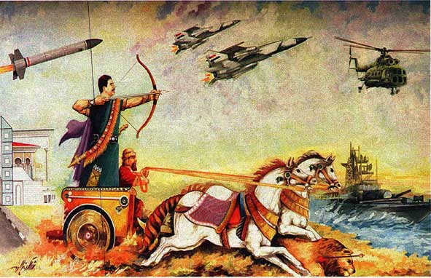
Why the Exile?
Ezra 5:12
But after that our fathers had provoked the God of heaven unto wrath, he gave them into the hand of Nebuchadnezzar king of Babylon, the Chaldean, who destroyed this house, and carried the people away into Babylon.
Notes:
Why the Exile?

Slide 64
The Babylonian Threat
Babylonian Expansion
Mediterranean
Sea
Syria
Babylon
Israel
Judah
586 BC
Persian
Gulf
Egypt

Slide 65
142
Summary of the Exiles
Sequence and Size | Date | King of Judah | Key Captives
1: Minor | 605 BC | Jehoiakim | Daniel, 3 friends and other nobility and royalty (Dan 1:3)
2: Moderate | 598 BC | Jehoiakim | 3023 people (Jer 52:28)
3: Major | 597 BC | Jehoiachin | 10,000 (Jehoiachin, Ezekiel, Mordecai) (2 Kings 24:12b, Ezek. 1:2, Esther 2:6)
4: Minor | 587 BC | Zedekiah | 832 people (Jer 52:29)
5: Major (Temple Ruin) | 586 BC | Zedekiah | ca. 10,400 people (2 Kings 25:11)
6: Minor | 582 BC | - | 745 people (Jer. 52:30)
Notes:
Why the Exile?

Slide 66
142
Captives in Each Exile
Daniel 1:3 (605 BC)
And the king spoke to Ashpenaz the master of his eunuchs, that he should bring in certain of the children of Israel, even of the seed royal and of the nobles.
2 Kings 24:14 (597 BC)
And he carried away all Jerusalem, and all the princes, and all the mighty men of valor, even ten thousand captives, and all the craftsmen and the smiths; none remained, save the poorest sort of the people of the land.
2 Kings 25:11 (586 BC)
And the residue of the people that were left in the city, and those that fell away, that fell to the king of Babylon, and the residue of the multitude, Nebuzaradan the captain of the guard carried away captive. But the captain of the guard left of the poorest of the land to be vinedressers and husbandmen.
Nebuchadnezzar, the king of the Chaldeans, only deported the most prominent citizens of Judah: professionals, priests, craftsmen, and the wealthy
Notes:
Why the Exile?

Slide 67
Babylonian Rule over Israel
143
Deportations
Developments
Separation
Synagogue
No more idolatry

Slide 68
143
Pros due the Exile
PRESERVATION OF JUDAH'S NATIONAL HERITAGE
But the Jews in Babylon also creatively remade themselves and their world view. In particular, they blamed the disaster of the Exile on their own impurity.
Along with a theology of judgment, the prophets also had emphasized a theology of salvation. Ezekiel and Isaiah noted that the Israelites would be gathered together once more, their society and religion purified, and the unified Davidic kingdom be re-established.
Notes:
Why the Exile?

Slide 69
143
Pros due the Exile
SEPARATION
Psalm 137
By the rivers of Babylon, There we sat down, yea, we wept, When we remembered Zion. …
How shall we sing Jehovah's song In a foreign land?
If I forget thee, O Jerusalem, Let my right hand forget her skill.
Let my tongue cleave to the roof of my mouth, If I remember thee not; If I prefer not Jerusalem above my chief joy.
….
IDOLATRY ELIMINATED
This period had a resurgence in Jewish tradition instead of idolatry, as the exiles looked back to their Mosaic origins to revive their original religion.
BABYLONIAN TALMUD
The Torah was copied during this time (or shortly afterward). It became the central text of the Jewish faith.
Notes:
Why the Exile?

Slide 70
143
Pros due the Exile
Dan 1:3-4
And the king spoke to Ashpenaz the master of his eunuchs, that he should bring in certain of the children of Israel, even of the seed royal and of the nobles; …. that he should teach them the learning and the tongue of the Chaldeans.
“These prisoners joined other peoples previously enslaved to supplement the vast labor force employed in the gigantic tasks of reconstruction and expansion which were current in the empire”
Notes:
Why the Exile?

Slide 71
143
Cons due to the Exile
Exposure to gross idolatry & immorality
Exposure to materialism
…Not everybody went back to Jerusalem when permission was granted…
It was a risky business to leave this wealthy country of Babylon where they had established themselves…
-The Bible as History
Notes:
Why the Exile?

Slide 72
143
Materialism in the Exile
The Hanging Gardens
Notes:
Why the Exile?

Slide 73
143
Materialism in the Exile
The City of Babylon
Notes:
Why the Exile?

Slide 74
143
After the Exiles (Summary)
In 458 BC more Jews returned under the leadership of Ezra (Ezra 7). Then, 12 years later, Nehemiah returned to rebuild the walls of Jerusalem and to govern Judea. He arrived in 444 BC. Despite much opposition, Nehemiah completed this seemingly hopeless task in 52 days.
Then a revival followed. Ezra and Nehemiah canonized the books of the Old Testament. They read aloud to the people and gave its interpretation.
About 40 years later, the prophet Malachi condemned the people for slipping back into their sinful ways.
Notes:
Why the Exile?

Slide 75
TO REMEMBER
B
A
B
Y
L
O
N
- Babylonia (Geography)
- Akkadian (Language)
- Babel (Religion)
- Years of Judah's Captivity = 70 (Spiritual)
- Lots of Trade (Economics)
- Only 73 years long (History 612-539 BC)
- Nebuchadnezzar (Military)

Slide 76
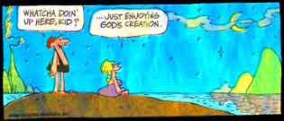
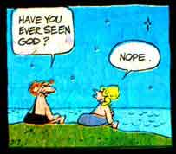
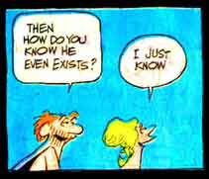
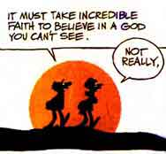
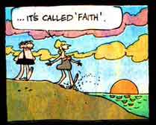
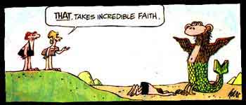
Self-Made Idols Are Useless
Babylon & Us
Whatcha doin’ here, kid?
…Just enjoying God’s creation.
Have you ever seen God?
It must take incredible faith to believe in a God you can’t see.
Then how do you know that he even exists?
…It’s called faith.
THAT, TAKES INCREDIBLE FAITH.
Nope.
I just know.
Not really.

Slide 77
Idolatry Today

Slide 78
American Idol

Slide 79
144
Babylon and Us
Babylon's Materialism Cult
Trust in Riches
Glory in Wealth
Self Determination
Consumerism
Worship of Self
Pride & Greed
Democracy
&
Capitalism

Slide 80
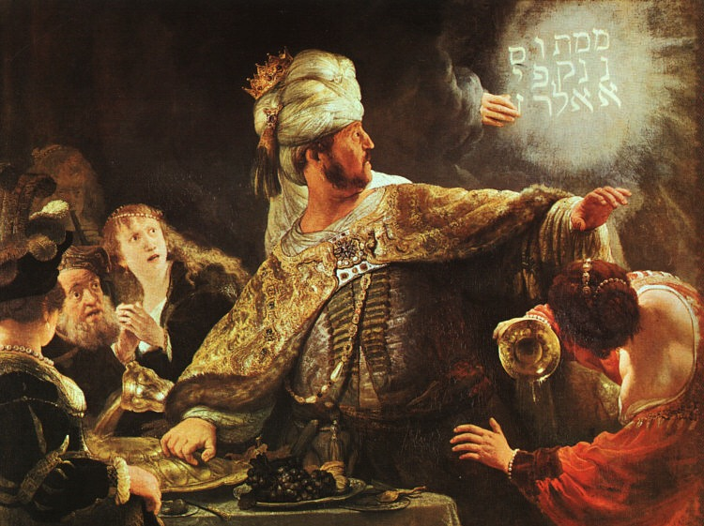
Belshazzar Humbled
Rembrandt

Slide 81
145
Fall of Babylon
BABYLON FELL (539 BC)
Cyrus entered under the water gates
Daniel 5
(Belshazzar's Feast)

Slide 82
Babylon's Fall (Herodotus)
144
“[Cyrus] placed a portion of his army at the point where the river enters the city, and another body at the back of the place where it issues forth, with orders to march into the town by the bed of the stream, as soon as the water became shallow enough: he then himself drew off with the unwarlike portion of his host, and made for the place where Nitocris dug the basin for the river, where he did exactly what she had done formerly: he turned the Euphrates by a canal into the basin, which was then a marsh, on which the river sank to such an extent that the natural bed of the stream became fordable.
“Hereupon the Persians who had been left for the purpose at Babylon by the river-side, entered the stream, which had now sunk so as to reach about midway up a man's thigh, and thus got into the town.
The History of the Persian Wars 1.191 (430 BC)

Slide 83
Babylon's Fall (Herodotus)
144
“Had the Babylonians been apprised of what Cyrus was about, or had they noticed their danger, they would never have allowed the Persians to enter the city, but would have destroyed them utterly; for they would have made fast all the street-gates which gave upon the river, and mounting upon the walls along both sides of the stream, would so have caught the enemy, as it were, in a trap. But, as it was, the Persians came upon them by surprise and so took the city. Owing to the vast size of the place, the inhabitants of the central parts (as the residents at Babylon declare) long after the outer portions of the town were taken, knew nothing of what had chanced, but as they were engaged in a festival, continued dancing and reveling until they learnt the capture but too certainly. Such, then, were the circumstances of the first taking of Babylon.”
The History of the Persian Wars 1.191 (430 BC)

Slide 84
Babylon the Great
of the End Times
Rev. 17–18

Slide 85
What can we learn from Babylon?
144
Babylon and Us
Idols are useless.
Affluence and materialism do not last.
Avoid the influences of Babylon that exist today: religious formalism, Catholic traditions, etc.
Avoid the Babylon of the future.
Giving people the chance to fail may be the best way to see them succeed.
God's forcing Judah into the most idolatrous country cured his people of their own idolatry.
Be “in the world” rather than be a monk.

Slide 87
Adapted from the Presentation by
Ong Sim Chuan
Rick Toh
Michael Yeong
29 September 2001

Slide 88
THE CITY OF DOOM
Come out of her, My people
And never go back again
For all her vulgar vanities
Have been heaped as high as heaven
The nations drank her maddening wine
Now God remembered all her crimes
She'll be paid back double
For all that she has done

Slide 89
THE CITY OF DOOM
Fallen, Fallen is Babylon
Fallen, fallen, fallen is the city of doom
The queen of every dark desire
Fallen by famine, plague and fire
Fallen is Babylon
Fallen is the City of Doom

Slide 90
THE CITY OF DOOM
Never will the sound of a song
Be heard in you again
Nor the voice of the bride and the bridegroom
Nor the echo of the worker's din
Your merchants were the world's great men
By consumption's cult, your greed and sin
And you'll become a spectacle
They weep and mourn and cry

Slide 91
THE CITY OF DOOM
Fallen, Fallen is Babylon
Fallen, fallen, fallen is the city of doom
The queen of every dark desire
Fallen by famine, plague and fire
Fallen is Babylon
Fallen is the City of Doom
- Michael Card-

Slide 92
OT Backgrounds link at BibleStudyDownloads.org
Get this presentation for free!
Notes:
OT Survey (os)

