Slide 1
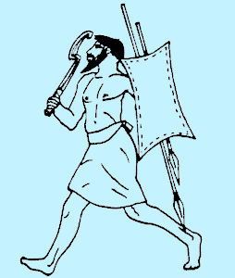
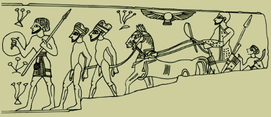
Amorites
89
Method of Today's Study
  1. Small Groups
  2. Amorites
Focus
  1. Influence on Israel
    Conquest
    Religion
  2. Lessons for us
Dr. Rick Griffith • Jordan Evangelical Theological Seminary • BibleStudyDownloads.org

Slide 2
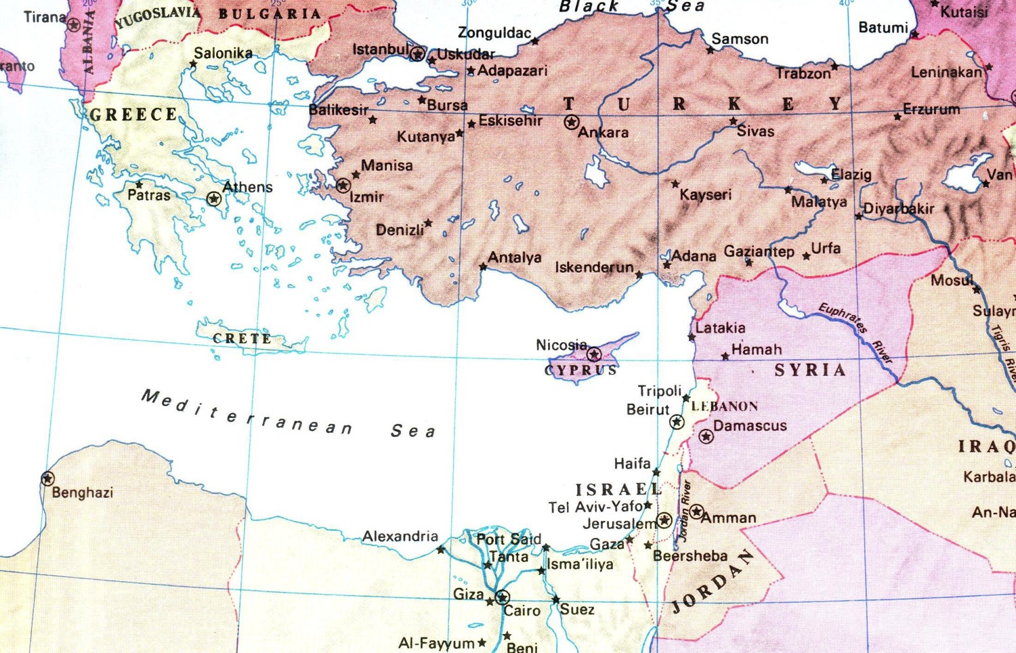
The Lines of Japheth, Ham, & Shem
Descendants of Noah's Sons
92
Gomer
Togarmah
Javan
Meshech
Asshur
Lud
Tubal
Aram
Caphtorites
Canaan
Put
Mizraim
Cush
Gen. 10
Notes:
• Susan and I descended from Japheth.
• The Chinese came from Ham.
• And the Iranians have Shem as their ancestor.
• Many years ago, my wife and I sat at a table representing all three lines of Noah's descendants—I from Japheth, Nick from Shem, and Irene from Ham.
_______________
OB-01ANE Peoples-7
OB-03-Amorites-2
OS-01-Gen4-20—slide 146

Slide 3

The Lines of Japheth, Ham, & Shem
Descendants of Noah's Sons
92
Gomer
Togarmah
Javan
Meshech
Asshur
Lud
Tubal
Aram
Caphtorites
Canaan
Put
Mizraim
Cush
Gen. 10
Notes:
• Susan and I descended from Japheth.
• The Chinese came from Ham.
• And the Iranians have Shem as their ancestor.
• Many years ago, my wife and I sat at a table representing all three lines of Noah's descendants—I from Japheth, Nick from Shem, and Irene from Ham.
_______________
OB-01ANE Peoples-7
OB-03-Amorites-2
OS-01-Gen4-20—slide 146

Slide 4

The Lines of Japheth, Ham, & Shem
Descendants of Noah's Sons
92
Gomer
Togarmah
Javan
Meshech
Asshur
Lud
Tubal
Aram
Caphtorites
Canaan
Put
Mizraim
Cush
Gen. 10
Notes:
• Susan and I descended from Japheth.
• The Chinese came from Ham.
• And the Iranians have Shem as their ancestor.
• Many years ago, my wife and I sat at a table representing all three lines of Noah's descendants—I from Japheth, Nick from Shem, and Irene from Ham.
_______________
OB-01ANE Peoples-7
OB-03-Amorites-2
OS-01-Gen4-20—slide 146

Slide 5
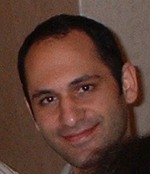
The Lines of Japheth, Ham, & Shem
Descendants of Noah's Sons
92
Gomer
Togarmah
Javan
Meshech
Asshur
Lud
Tubal
Aram
Caphtorites
Canaan
Put
Mizraim
Cush
Gen. 10
Notes:
• Susan and I descended from Japheth.
• The Chinese came from Ham.
• And the Iranians have Shem as their ancestor.
• Many years ago, my wife and I sat at a table representing all three lines of Noah's descendants—I from Japheth, Nick from Shem, and Irene from Ham.
_______________
OB-01ANE Peoples-7
OB-03-Amorites-2
OS-01-Gen4-20—slide 146

Slide 6
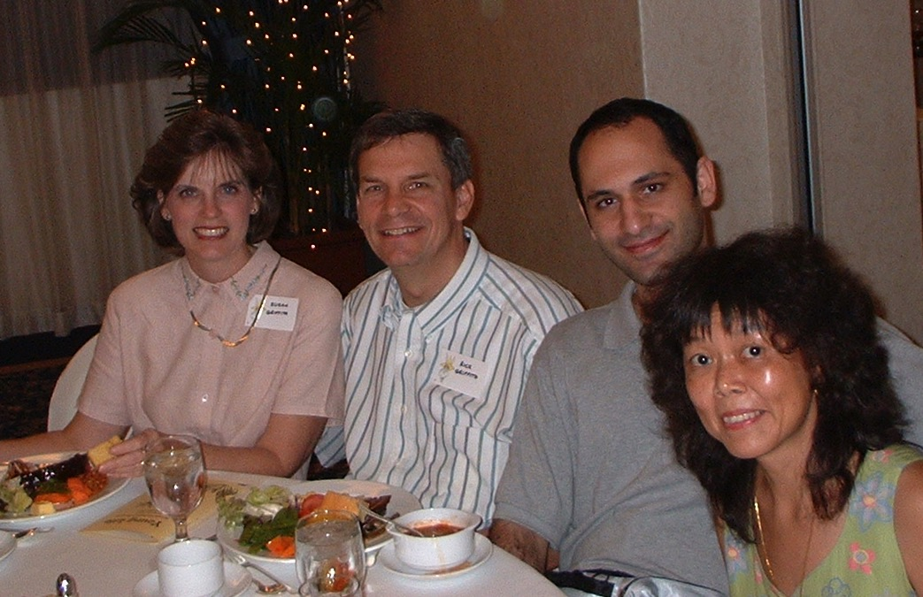
The Lines of Japheth, Ham, & Shem
Descendants of Noah's Sons
92
Gomer
Togarmah
Javan
Meshech
Asshur
Lud
Tubal
Aram
Caphtorites
Canaan
Put
Mizraim
Cush
Gen. 10
Notes:
• Susan and I descended from Japheth.
• The Chinese came from Ham.
• And the Iranians have Shem as their ancestor.
• Many years ago, my wife and I sat at a table representing all three lines of Noah's descendants—I from Japheth, Nick from Shem, and Irene from Ham.
_______________
OB-01ANE Peoples-7
OB-03-Amorites-2
OS-01-Gen4-20—slide 146

Slide 7
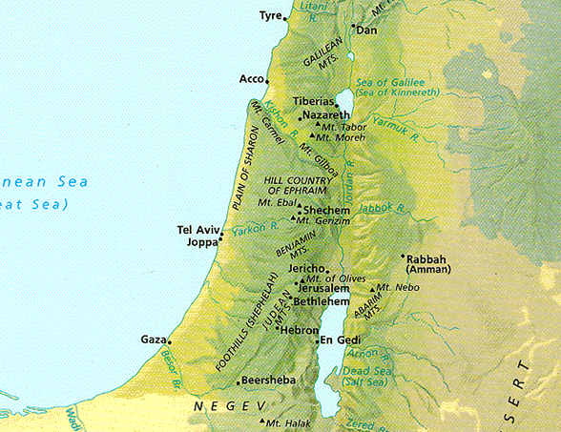
Left Stage
Phoenicians
Syrians
20
Life in
Ancient Israel
Right Stage
Sea Peoples,
The "ians" (mostly)
Desert Peoples,
The "ites"
Canaanites
Gileadites
Romans
Amorites
Ammonites
Israelites
Babylonians
Jebusites
Assyrians
Moabites
Philistines
Egyptians
Amalekites
Edomites

Slide 8
Left Stage
20
Where They Lived
Right Stage
Numbers 13:29
"The Amalekites live in the Negev, the Hittites, Jebusites and Amorites live in the hill country; and the Canaanites live near the sea and along the Jordan."
Canaanites
Canaanites
Canaanites
Amorites
Jebusites
Hittites
Amalekites

Slide 9
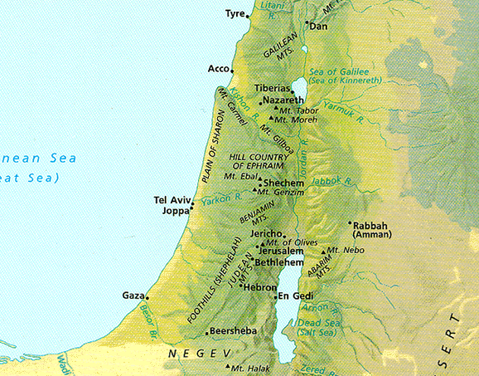
What do these passages teach us about God and man?
20
Genesis 15:13-16
God to Abraham
ca. 2050 BC
Before Egyptian Slavery
Given in Canaan
Deut. 7:1-11
Moses to Israel
1405 BC
After Egyptian Slavery
Given at Nebo
Canaanites
Canaanites
Canaanites
Amorites
Jebusites
Mt. Nebo
Hittites
Amalekites

Slide 10
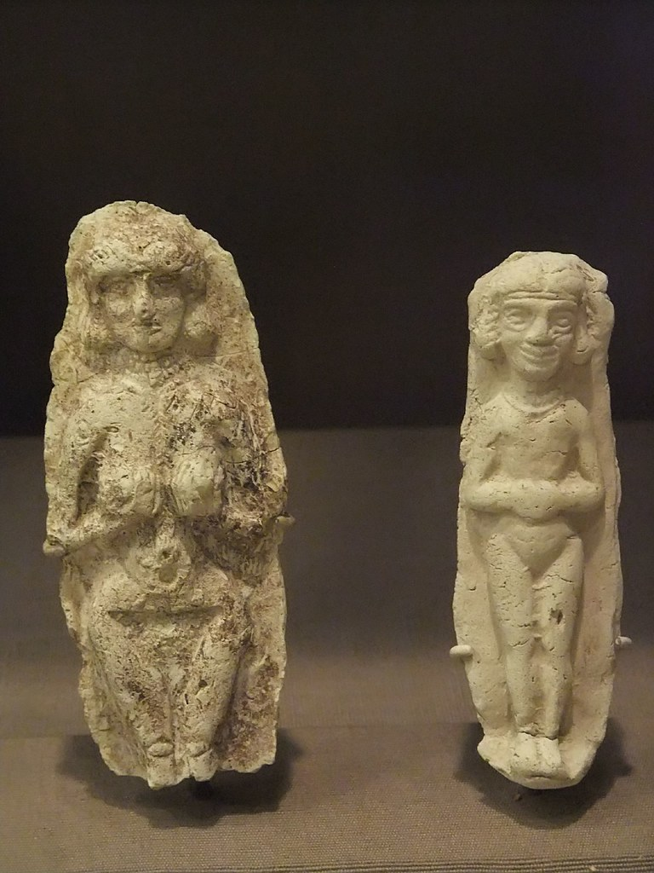
Amorites
89
Identity
Geography
Power of the Amorites
    Lessons for us
Links to Babylonians
    Significance
    Religion
    Lessons for us

Slide 11
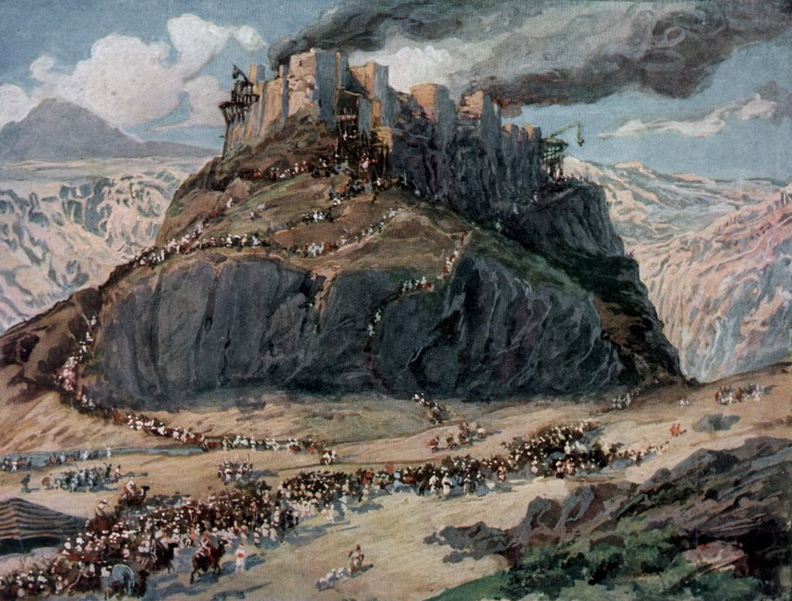
Who were the Amorites?
17, 89
Descendants of Ham
Ham
(Genesis 10:1, 6)
Canaanites
(Genesis 10:15-18)
Amorites

Slide 12
Amorite means…
89
1) Highlander
- occupied mountainous terrain of the land
(Num. 13:29; Deut. 1:7,19-20)
2) "The High [and mighty] One"
- their fearsome military prowess
(Deut. 1:44) or
- their great stature
(Numbers 13:33)
"the high one"

Slide 13
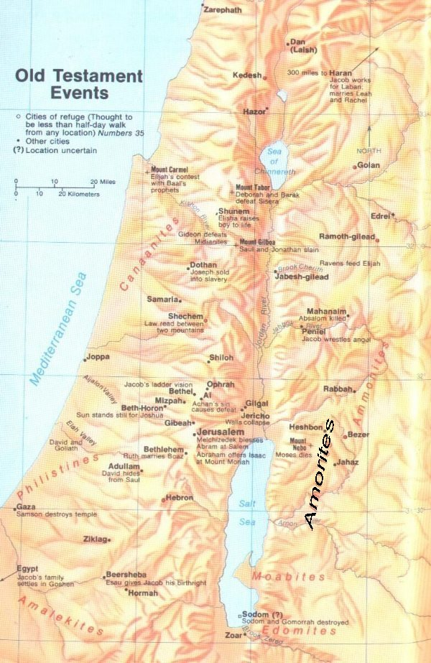
Geography
90
Occupied land west and east of the Dead Sea
The mountains of Judea were the "hill country of the Amorites" (Deut. 7,19,20)
From west of the Dead Sea (Gen. 14:7) to Hebron (Gen. 13:8, Deut. 3:8, 4:46-48), taking in Gilead and Bashan (Deut. 3:10), with the Jordan Valley east of the Jordan River (Deut. 4:49), the land of the "two kings of the Amorites," Sihon and Og (Deut. 31:4; Josh. 2:10, 9:10).

Slide 14
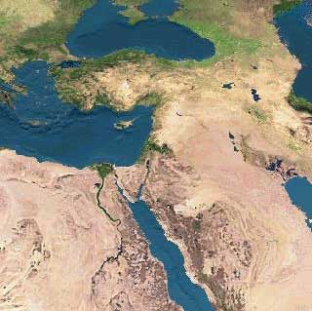
Powerful Amorites
89
Along with many other tribes, occupied the pre-conquest territory of Canaan.
Probably the most powerful of all the pagan clans in Palestine.
  men of Ai (Josh. 7:7), and the armies of Sihon and Og (Num. 21:21-35), were formidable Amorite foes.
Represented all non-Israelites whom God commanded to be driven from the land (Joshua 10:5; 24:8,15; Judges 6:10).

Slide 15
A Lesson for us?
Do we
fear those
who are
GIANTS
like Israelites?
(Numbers 13:31-33)

Slide 16
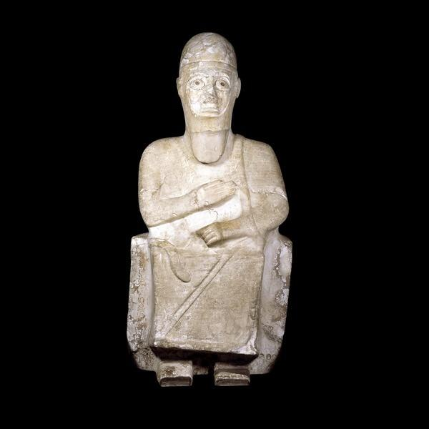
Power of the Amorites
OT References (ASV)
Word "Amorite" appears 16 times
Word "Amorites" appears 70 times
Total of 86 occurrences

Slide 17
The Powerful Amorites
God's grace extends even towards those who are not His covenant people.
God promised Abraham a land "flowing with milk and honey." Yet the godly patriarch did not inherit the land in his time because "the iniquity of the Amorites [was] not yet full" (Gen. 15:16).

Slide 18
Lessons for us
God's mercy extends even to wicked, depraved people.
  Do we see them the same way or do we pressure God to fulfill His "obligations" to us at their expense?
God judges those who refuse to repent.
  Amorite nations despised God's goodness and longsuffering by refusing to repent of their sin (cf. Rom. 2:4); The Lord's judgment upon them was most severe. Anyone who imitates their rebellion will one day "lift up his eyes in torment" and eternally regret it (Rom. 2:5; Matt. 10:28; Rev. 2:22-23).
God gives us severe trials so we can look back at them as testimony of His power and faithfulness

Slide 19
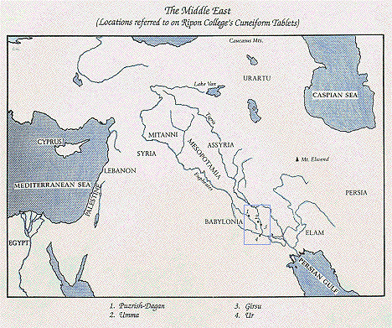
17
3000 B.C
2000 B.C

Slide 20
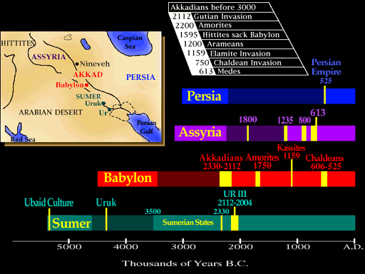
Links to Babylonians
136

Slide 21
Links to Babylonians
136
About 21st century B.C.
  People of the first Babylonian dynasty called "Amorites"
About 2000 B.C.
  Amorites presaged the growth of the Babylonian Empire.
  Migrated to Mesopotamia and inhabited Babylonian plain.
2000 BC
  After the last Sumerian dynasty fell
  Conflict and chaos lasted for almost a century.
Around 1900 BC
  A group of Semites called the Amorites gained control of most of the Mesopotamian region.

Slide 22
Links to Babylonians
141
1900-1600 BC
  Amorites centralized the government over the individual city-states
  Amorites invented new ways to administer the state and its resources: taxation and involuntary military service.
  Above all, the greatest innovation was centralization; a new set of laws was invented: laws that dealt with crimes against the state.

Slide 23
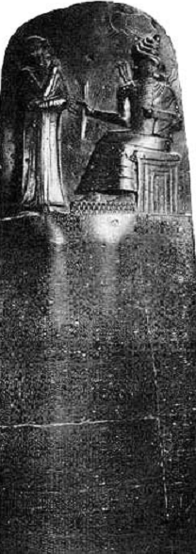
Significance
141
Many similarities with the Mosaic Law:
  principle of "an eye for an eye", e.g. if a man builds a house badly, and it falls and kills the owner, the builder is to be slain
Many differences as well.
  Bias against slaves
  Murder does not carry death penalty
Loopholes
  e.g. an accused person was allowed to cast himself into the Euphrates River. If the river current carried him to the shore alive he was declared innocent, but if he drowned then he was guilty.
Hammurabi's most famous claim to fame is his law code inscribed on a magnificent stele of black diorite, eight feet high, found at Susa in A.D. 1902.

Slide 24
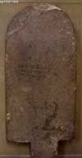
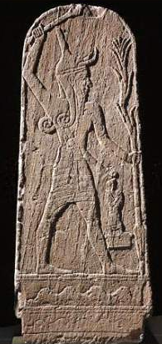

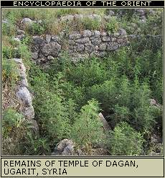

Religion
90
Dagan Stele
Hurrian Teshub
God of Baal
Marduk

Slide 25
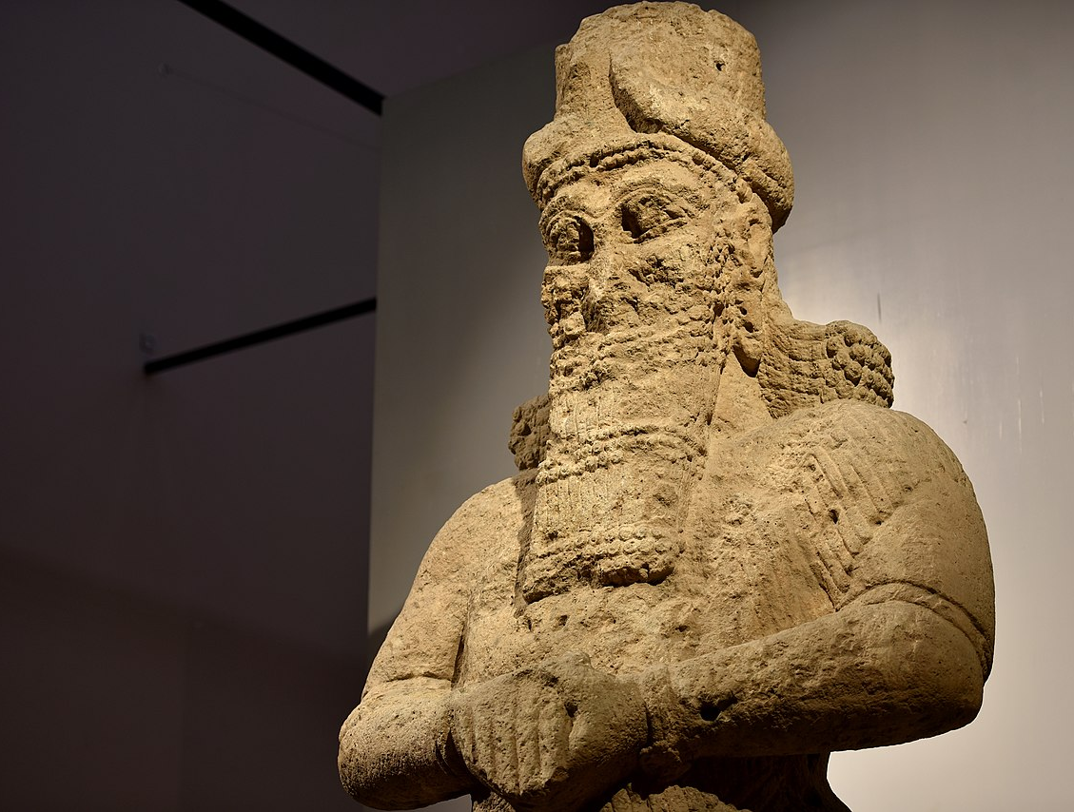
Religion
90, 160g
The Amorites imported a new god into Sumerian religion - Marduk - which they elevated to the supreme position over the other gods.
Marduk
The Amorites did not believe that life after death held any promise or threat, so like the Sumerians, Amorite religion ruthlessly focused on this world.

Slide 26
Lessons for us
160g
Why is the belief in life after death so significant for our faith and life?

Slide 27
Black

Slide 28


OT Backgrounds link at BibleStudyDownloads.org
Get this presentation for free!
Notes:
NT Survey (ns)

