Slide 1
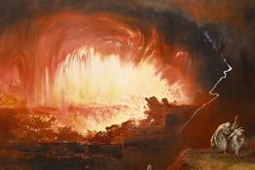
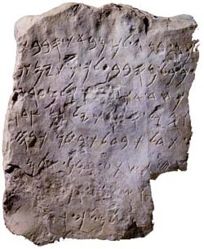
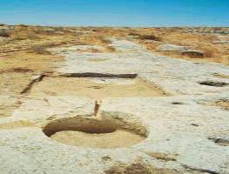
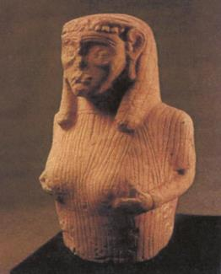
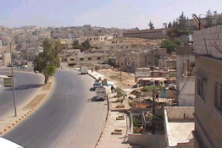

Ammonites
Dr. Rick Griffith • Jordan Evangelical Theological Seminary • BibleStudyDownloads.org

Slide 2
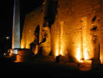
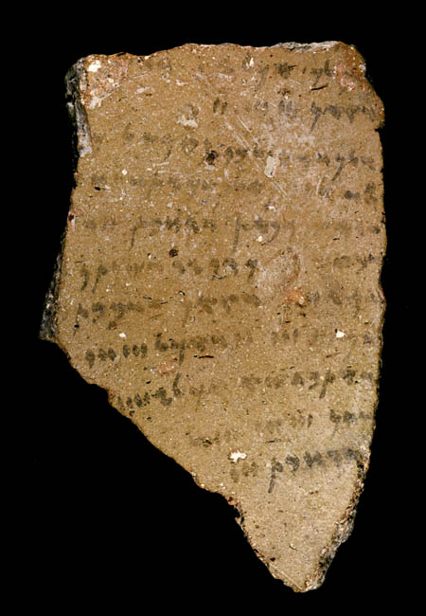

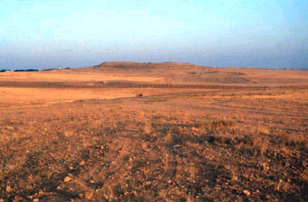



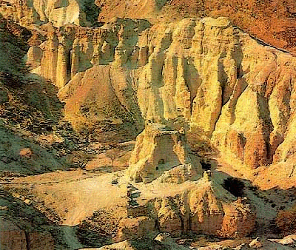
Outline
Origin of the Ammonites
Political & Economic Development
Religious Profile
Dealings with Israel
- Exodus to Pre-monarchy
- Monarchy to Post-exilic Period
- Inter-Testamental Period
Faith Lessons

Slide 3

What is this event in the Bible?

Slide 4
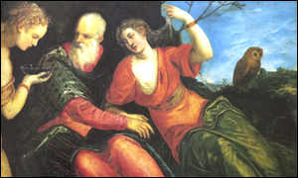
Who are they?

Slide 5
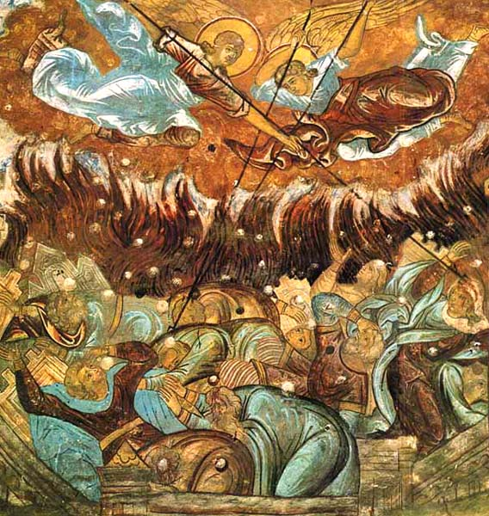
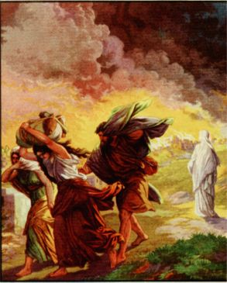
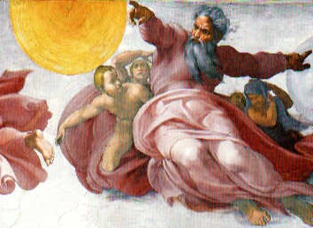

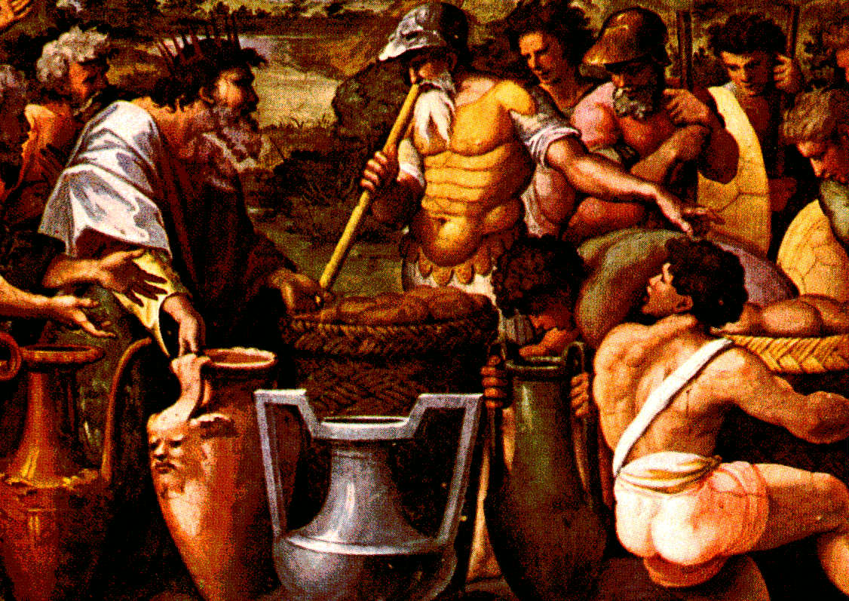
Ammon’s Beginnings
Genesis 13:8-9
⁸ So Abram said to Lot, "Let's not have any quarreling between you and me, or between your herdsmen and mine, for we are brothers.
⁹ Is not the whole land before you? Let's part company. If you go to the left, I'll go to the right; if you go to the right, I'll go to the left."
Notes:
Abraham's servants argued with Lot's servants.
So, Abraham gave him the choice of where to live.
Lot chose the immoral city of Sodom which God destroyed.
Lot's wife died as a salt pillar, but his two daughters lived.

Slide 6
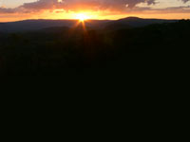
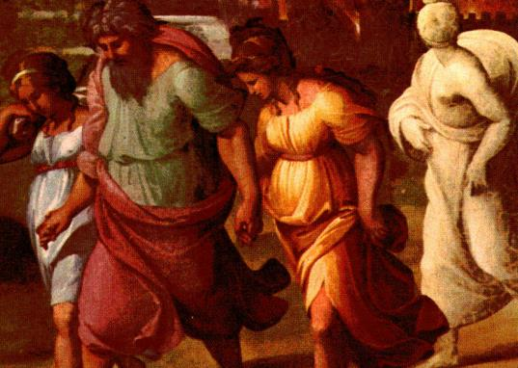


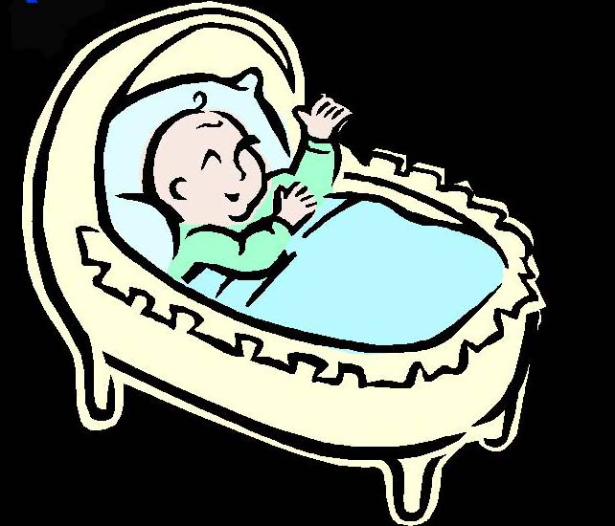
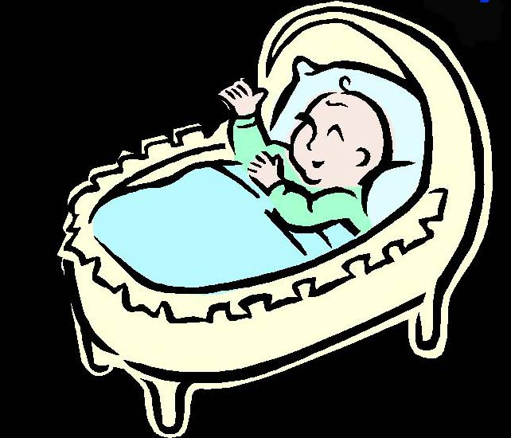
Genesis 19:36-38
95
my name is Moab
my name is Ben-Ammi
Genesis 19:36-38
³⁶ So both of Lot's daughters became pregnant by their father.
³⁷ The older daughter had a son, and she named him Moab, he is the father of the Moabites today.
³⁸ The younger daughter also had a son, and she named him Ben-Ammi; he is the father of the Ammonites of today.
Notes:
But these daughters feared that they would never have children.
• So, they concocted a plan to sleep with their father.
• The plan worked in consecutive days.
• The result was that both daughters got pregnant.
• The babies were two cousins.
• One was Moab.
• The other was Ben-Ammi.
These boys became the fathers of the Moabites and Ammonites.

Slide 7

1. Origin of Ammonites
95
Descendants of
He was the son of and (Gen. 19:38)
Place of birth:
Birthday: Shortly after Sodom was destroyed (2000 BC)
Ben-Ammi
Lot
his younger daughter
Near Zoar

Slide 8
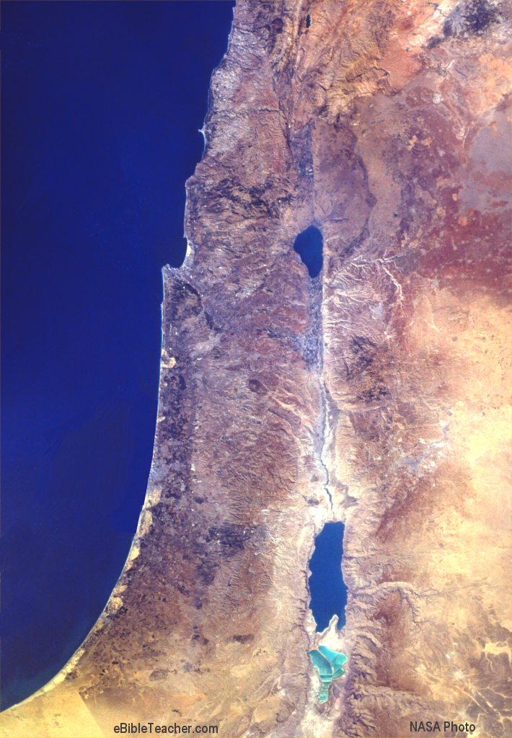
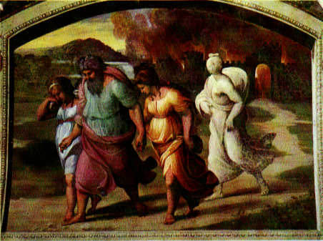
Map of Zoar (Origin of Ammonites)
95
Mediterranean Sea
Canaan
Hebron
Sodom
Zoar

Slide 9
Israel's Early Eastern Neighbors
100b
OTS 143
John H. Walton, Chronological and Background Charts of the OT, 2d ed., 71
Period
EDOM
MOAB
AMMON
AMALEK
Esau: son of Isaac
Moab: son of Lot and his eldest daughter
Ben-Ammi: son of Lot and his second daughter
Amalek: son of Eliphaz, who was a son of Esau
FATHER
Controlled to some degree by Amorites. Refused passage to the Israelites (Num 20:14-21).
Conquered by Sihon & Amorites
(Num. 21:26).
King Balak feared Israel and sought Balaam to curse them (Num 22).
Defeated by the Israel
(Exod. 17).
Defeated Israel after report by spies
(Num 14:45).
EXODUS
Notes:
These two slides contrast Israel's relatives to their east in four distinct periods, starting from their origin in their common ancestor, Terah, father of Abraham (Gen 11:27-32). Following that, what happened to them during Israel's Exodus, period of the Judges, and United Monarchy?
_____________
OB-02-Ammonites-9
OB-09-Edomites-8
OB-11-Moabites-72
OS-04-Numbers-282

Slide 10
Israel's Early Eastern Neighbors
100b
OTS 143
John H. Walton, Chronological and Background Charts of the OT, 2d ed., 71
Period
EDOM
MOAB
AMMON
AMALEK
JUDGES
Continued under partial Amorite control (1350 BC; Judg 1:35-36).
Eglon hurt
Israel 18 yrs.
until Ehud (1350 BC; Judg 3:12-30)
Ally of Eglon of Moab (1350 BC);
Hurt Israel until Jephthah (1100 BC; Judg 10-12).
Ally of Eglon of Moab
(1350 BC)
Saul took some cities from Edom
(1030 BC; 1 Sam 14:47).
Conquered and subjugated by David
(1000 BC; 1 Chron 18:12).
Saul took some cities from Moabite territory
(1030 BC;
1 Sam 14:47).
Conquered and subjugated by David (1000 BC;
2 Sam 8:2).
Saul defeated Nahash
(1050 BC; 1 Sam 11:1-11) &
took some Ammonite cities
(1030 BC; 1 Sam 14:47);
David defeated Hanun
(990 BC; 2 Sam 12:26-31)
Saul defeated Agag
(1050 BC; 1 Sam 15:1-9);
Destroyed David's camp at Ziklag but David wiped them out. This is last mention of them
(1 Sam 30).
UNITED MONARCHY
Notes:
These two slides contrast Israel's relatives to their east in four distinct periods, starting from their origin in their common ancestor, Terah, father of Abraham (Gen 11:27-32). Following that, what happened to them during Israel's Exodus, period of the Judges, and United Monarchy?
_____________
OB-02-Ammonites-10
OB-09-Edomites-9
OB-11-Moabites-73
OS-04-Numbers-283

Slide 11
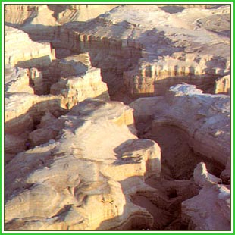
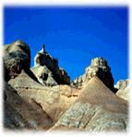
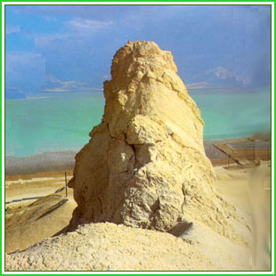
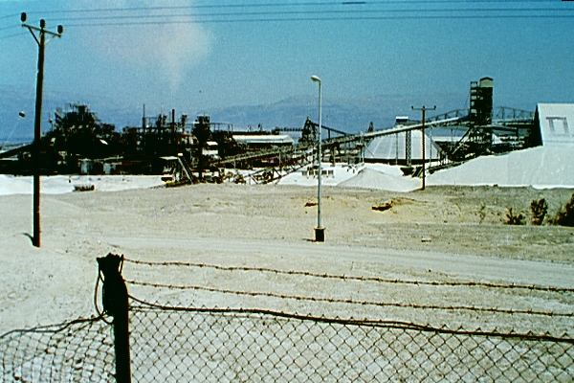
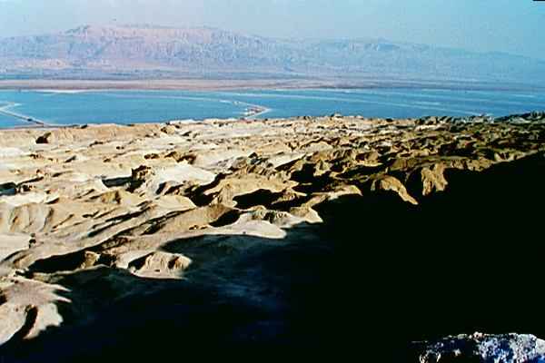
Sodom and Zoar Today
Notes:
This is where Ben-Ammi was born and where his parents or rather grandparent originated.

Slide 12


What does the Bible say about Lot?
"and if he rescued Lot, a righteous man, who was distressed by the filthy lives of lawless men for that righteous man, living among them day after day, was tormented in his righteous soul by the lawless deeds he saw and heard"
(2 Pet. 2:7)

Slide 13

Lessons from Lot
He compromised his faith with the world by:
  Moving his tent towards Sodom (Gen. 19:12)
  Dwelling with the people in Sodom and becoming prominent in the city (Gen. 19:1, 9)
  Offering his daughters to the mob to save angels (Gen. 19:8)
  Refusing to stay in the small city of Zoar so that he shared a cave with his daughters (Gen. 19:30)

Slide 14
How Lot Repeats Noah
 | Noah | Lot
Righteous Man | Gen. 7:1 | 2 Pet. 2:7
Only one family saved in God's judgment | Survived the Flood (Gen. 6–7) | Survived the destruction of Sodom and Gomorrah (Gen. 19)
Drunk after saved | Drunk and lay uncovered (Gen. 9:21) | Two daughters' scheme (Gen. 19:31-35)
Mocked by his children | Nakedness was seen by Ham (Gen. 9:22) | Had sex with daughters twice without knowing it (Gen. 19:33-35)

Slide 15

Name
95
"Ben-Ammi" means:
  Son of paternal clan
  Son of my people
"Son of paternal clan" shows the remembrance of kinship between Israelites and Ammonites
"Son of my people" depicted the intermarriage with Hebrews (2 Kings 14:21, 31; 2 Chron. 12:13)

Slide 16
Ethnic Background
17
Kinship with Israelites and Ammonites
Terah
Haran
Abraham
Nahor
Lot
Ammonites
Moabites
Arameans (Amorites)
Isaac
Ishmael

Slide 17
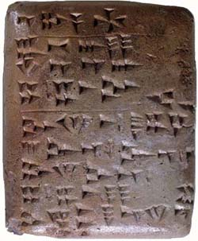
Languages
95
The spoken language was closely related to Hebrew.
The language was written in Old Canaanite-Phoenician script which could probably be understood by Israelites.
The language was closely related to the Amorite languages.

Slide 18
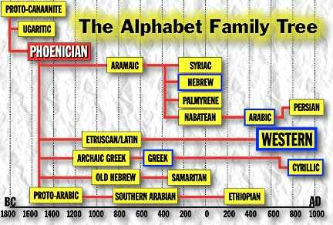
The Alphabet Family
118
PROTO-CANAANITE
UGARITIC
PHOENICIAN
ARAMAIC
SYRIAC
HEBREW
PALMYRENE
PERSIAN
NABATEAN
ARABIC
ETRUSCAN/LATIN
WESTERN
ARCHAIC GREEK
GREEK
CYRILLIC
OLD HEBREW
SAMARITAN
PROTO-ARABIC
SOUTHERN ARABIAN
ETHIOPIAN
Adapted from Encyclopedia Phoeniciana http://phoenicia.org/alphabet.html

Slide 19
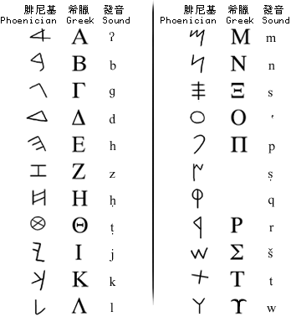
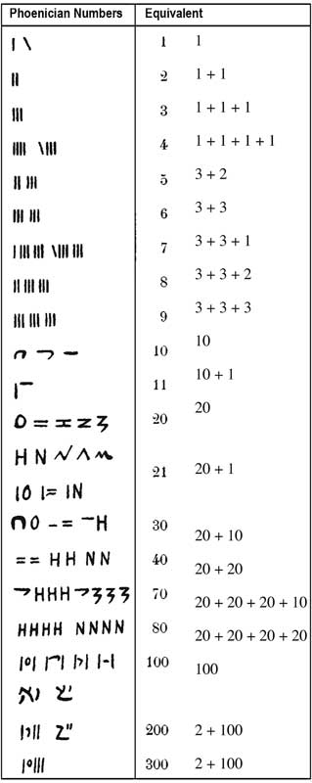
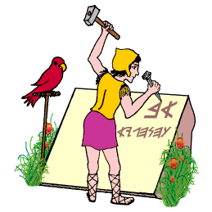
Phoenician Letters & Numbers
117

Slide 20
Where did they live?
95
Hittite Empire
Rabbath-ammon (Chief town of Ammonites)
Displaced Zamzummites or Rephaites (Deut. 2:20-21, 37; 3:11)
Land taken by Amorites (Num. 21:24, Deut. 2:37; Josh. 12:2;13:10, 25; Judg. 11:13, 22)
Phoenicia
Galilee
Mediterranean
River
2
Canaan
R. Jabbok
Jordan
Ammonites
3
1
Amorites
Jerusalem
Dead Sea
Moabites
Philistia
R. Arnon
Edomites
Midianites
©

Slide 21
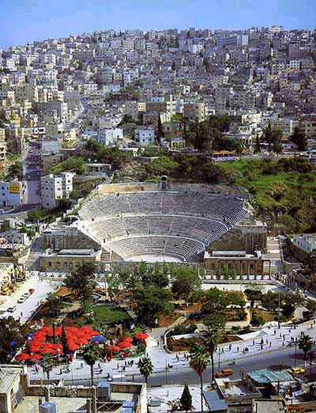
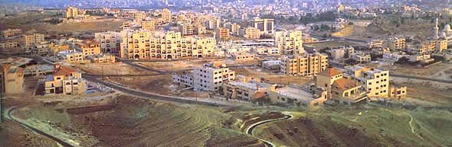
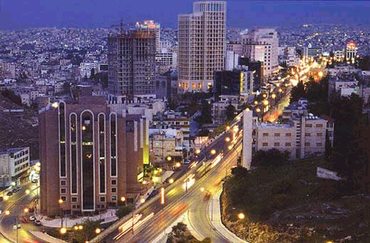

2. Political & Economic Development
Modern Amman

Slide 22
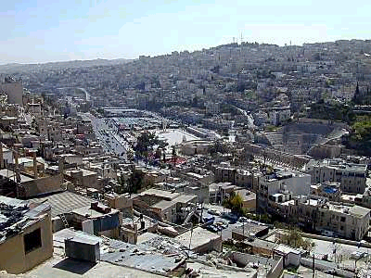
Amman
Built on seven hills
One of the world's oldest continuously inhabited cities
Became Ammonite capital of Rabbath-Ammon by 1200 BC
Renamed Philadelphia in 400 BC
Philadelphia taken by Roman vassal King Herod in 30 BC
Arabian armies of Islam took over around the year AD 635
Notes:
Deleted:
Built during the Stone Age, circa 7000 BC

Slide 23
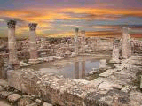
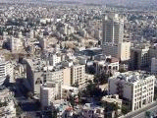
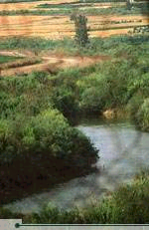
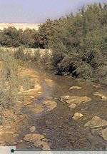
Salt
Salt (near Amman) is said to be the final resting place of Job. Also Jethro, the Midianite father-in-law of Moses, is said to be buried in a tomb near Salt in Wadi Shu'ayb.
Jordan River

Slide 24
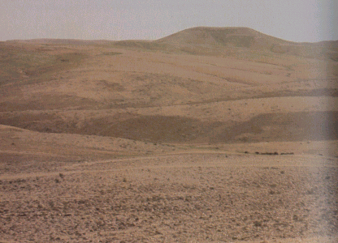

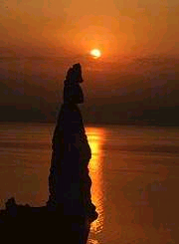
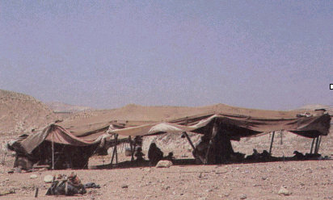
Extent of Ammonite Lands
Dead Sea
Wilderness

Slide 25
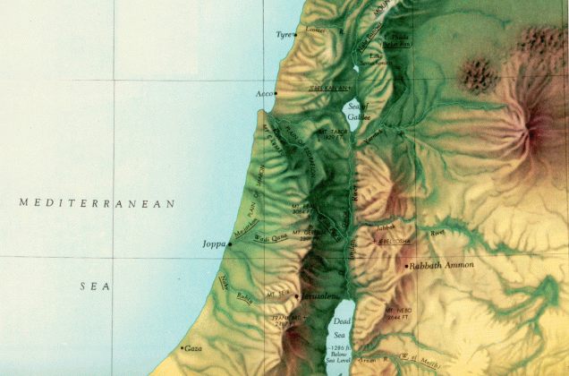
Geography of the Ammonites
95
Notes:
Hill country of the Ammonites was surrounded by the Jabbok River
They sat astride the trade routes to the East of the Jordan.
Rabbah was the capital of the Ammonites.
After it was sacked by the Babylonians, it was controlled by the Greeks, and renamed Philadephia by the Egyptians, before being rebuilt completely by the Romans.

Slide 26
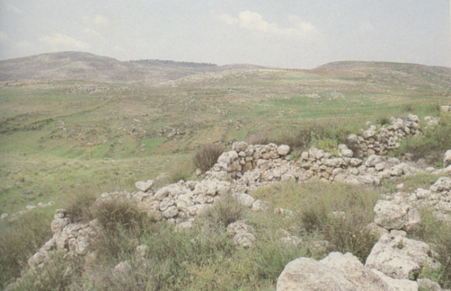
Madaba
Pasture Lands
Madaba Plains
30 km southwest of Amman, dates back at least 3500 years
Moabite town of Medaba (Num. 21:30)
Fought over by the Edomites, Moabites, Ammonites, Israelites and other local kingdoms
Conquered by the Ammonites by 165 BC, but it was taken from them by Hyrcanus I around 110 BC

Slide 27
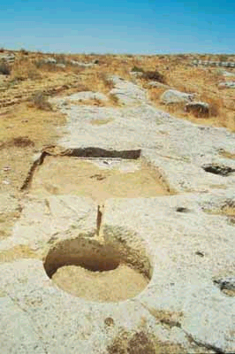
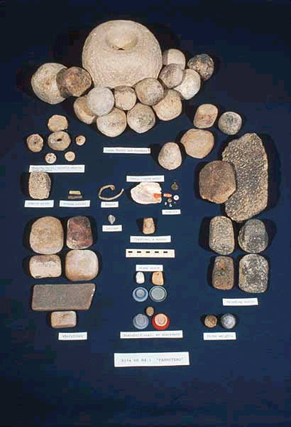
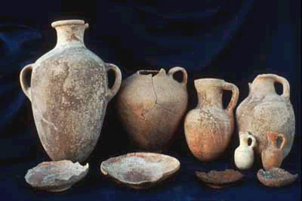
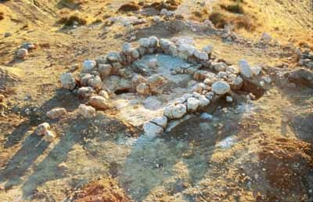
Sixth Century BC Rural Complex
Wine Press
The rural complex of a building, a perimeter wall, agricultural terraces, a reservoir, several cisterns, and several winepresses. It reflects a certain degree of social stratification and bureaucracy in the Ammonite vineyards of the Late Iron Age.
8x9M Building Site

Slide 28
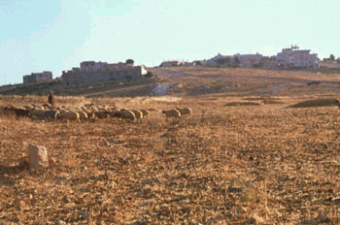
Discoveries
A regional survey has discovered well over one hundred sites, ranging from roads and winepresses to lime kilns, farmsteads, watchtowers, forts, and cities. The discovery of cave dwellings with animal corrals from the last few centuries has helped us understand the way nomadic populations have lived in the region during times of urban growth and decline.
Private individuals constructed large buildings so they could live near their fields. They utilized them as well to process, store, and guard their harvests.

Slide 29
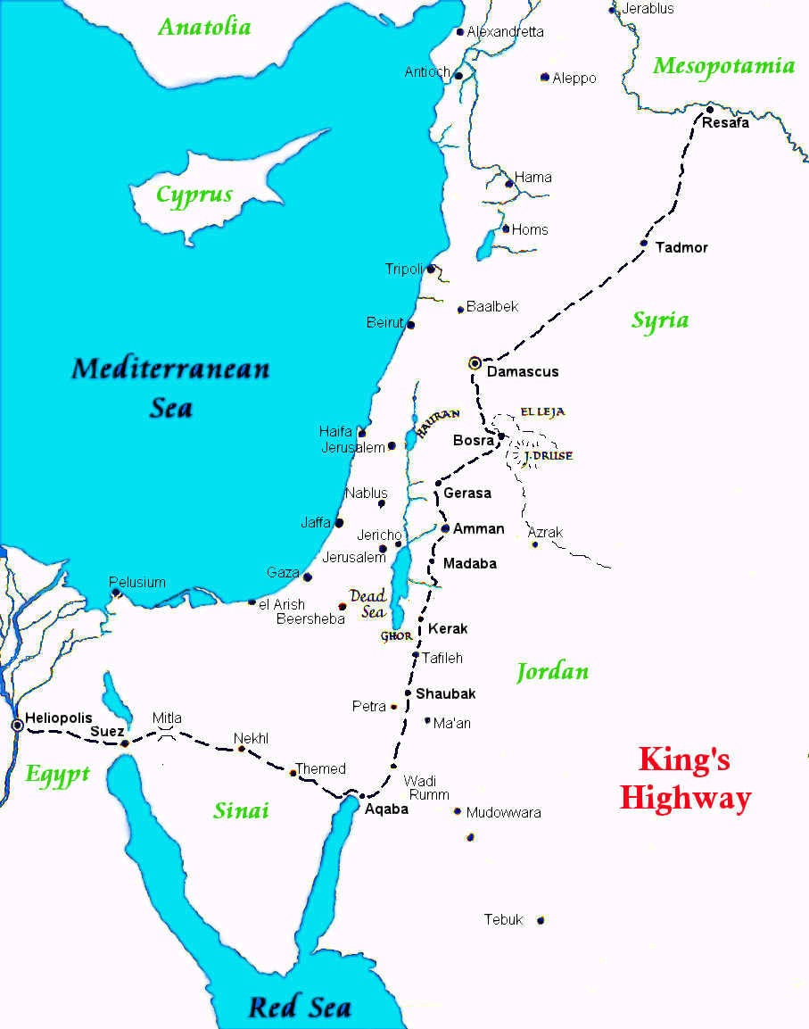
The King's Highway
20
It was a major source of wealth in the later years of the Ammonite kingdom, especially under Assyrian rule.

Slide 30
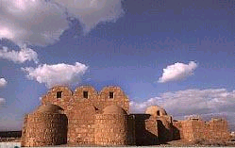
The King's Highway
  Through the heart of Jordan
  Connects Madaba, Karak, Tafileh, Shobak and Petra
  The King's Highway is the world's oldest continuously used communication route
  Moses requested Edom's king to allow his people to "travel along the king's highway and not turn to the right or to the left until we have passed through your territory" (Num. 20:17).

Slide 31

Known Ammonite Kings

Slide 32

Location on the King's Highway
20

Slide 33

Nabateans in Petra Controlled the King's Highway
In the 6th century BC, a nomadic tribe known as the Nabateans migrated from western Arabia and settled in the area. As the Nabateans forsook a nomadic lifestyle, they settled in Petra and grew rich by levying taxes on travelers to ensure safe passage through their lands. From its origins as a fortress city, Petra became a wealthy commercial crossroads between the Arabian, Assyrian, Egyptian, Greek and Roman cultures.

Slide 34


Seal of Ba'alis
The Babylonians made Gedaliah governor of Judah, who was murdered by an assassin sent by Ba'alis, King of the Ammonites (Jer. 40:13–41:2).
On the seal are three lines of script:
      [Belonging to] Ba'alis
      King of
      B[nei Ammo]n
The script on this seal is typically Ammonite. The name Ba'alis means "Ba'al has saved," or "Ba'al is salvation." This seal impression, made by a high official of the king, reads "Milqom, servant of Ba'alis."

Slide 35

The Amman Citadel Inscription
The Inscription was found the Citadel in ancient Rabbath-ammon. It is believed to be a building inscription, although some have suggested that it is an oracle or instruction from the god Milkom. The text contains a number of references to parts of buildings, but also has elements of a curse. The language of the Ammonites is closely related to Hebrew and ancient Phoenician, but the script they used is much closer to the script used for Aramaic at that time. It has been dated to the 9th century BC.

Slide 36


Heshbon Ostraca #2 and #4
This text in Ammonite cursive script dates to the about 600 BC. The eleven-line inscription is an economic text listing amounts of grain, cattle, flour and wine, which could be a tax receipt.
Heshbon is mentioned a number of times in the Bible as a city belonging at various times to the Amorite king Sihon (Num. 21:26), to the Israelite tribes of Reuben (Num. 32:37) or Gad (Josh. 21:39), and to Moab (Isa. 15:4; Jer. 48:2). Excavations at the site have found Iron Age remains, including reservoirs, water conduits, cisterns, and a number of ostraca.
Notes:
From http://en.wikipedia.org/wiki/Ostracon (accessed 11 Sep 2012):
"An ostracon (Greek: ὄστρακον ostrakon, plural ὄστρακα ostraka) is a piece of pottery(or stone), usually broken off from a vase or other earthenware vessel. In archaeology, ostraca may contain scratched-in words or other forms of writing which may give clues as to the time when the piece was in use. The word is derived from Greek ostrakon, meaning a shell or a shard of pottery used as a voting ballot. It is a common error for the plural form ostraca to be used as the singular for ostracon."

Slide 37



Molech Child Sacrifice
95

Slide 38
Religious Practices
95
Their religion was a degrading, detestable and cruel superstition.
The chief god Molech (also called Moloch or Milcom) was associated with death and the underworld.
The probable Phoenician-Canaanite origin showed Baal worship practices. They may have worshipped other Canaanite gods – Baal, Chemosh, Ashtoreth.
Worship involved offering human sacrifices.
Moses warned the Israelites not to participate in worship of Molech and he prohibited them from offering their sons and daughters in the fire (Lev. 18:21; 20:2-5; Deut. 12:31; 18:10-13).

Slide 39
Religious Practices
95
Israelites practiced Ammonite worship from the time of the judges until after the exile.
Solomon gave their worship royal approval by marrying an Ammonite. He even built her a high place on the Mount of Olives.
Passing a son/daughter through the fire can have two possible meanings – walking through fire or child sacrifice. The latter meaning is more likely. Both are still detestable to God.

Slide 40



Religious Practices
95
Ammonites depicted their gods with ram horns or nude

Slide 41
Religious Practices
95
The Amman Citadel
Milkom, he has built for you the precinct entrances[ ] that all who threaten you shall surely die [ ] I shall surely obliterate, and all who enter [ ] and amidst all its columns the just will lodge [ ] there will hang from its doors an ornament [ ] will be offered within its portico [ ] peace to you and peace...

Slide 42

Religious Practices
95
The Valley of Hinnom in southwest Jerusalem:
In Jeremiah's time, Israelites worshipped the pagan god Molech in rites that required child sacrifices (Jer. 19:1–9).

Slide 43
Dealings with Israel –
Exodus to Pre-Monarchy
96
Moses taught the Israelites not to provoke the Ammonites to war as God had given the land as a possession to the descendants of Lot, who was Abraham's nephew and a righteous man.
God destroyed the earlier inhabitants, giants called Zamzummites, and settled the Ammonites in their place.
(Deut. 2:19)

Slide 44
Dealings with Israel –
Exodus to Pre-Monarchy
96
Instead of showing hospitality and kindness to the Israelites, the Ammonites joined with the Moabites, whose king, Balak son of Zippor, hired Balaam, a pagan prophet from NW Mesopotamia to curse the sons of Israel. Instead of cursing them, Balaam was compelled by the Spirit of God to bless Israel (Num. 22–24).
For this offense, they were excluded from the assembly of the LORD until the tenth generation.

Slide 45
Dealings with Israel –
Exodus to Pre-Monarchy
96
Moses also instructed the Israelites not to seek a treaty of friendship with them.
In the days of the Judges, the Ammonites, together with the Amalekites, joined forces with Eglon, king of Moab, who attacked Israel and regained former Moabite territory at the northern end of the Dead Sea. The Israelites were subject to Eglon for 18 years. Judg. 3:13

Slide 46
Dealings with Israel –
Exodus to Pre-Monarchy
96
Due to Israel's idolatry (worshipping the Canaanite gods) and evil, God punished them by sending the Philistines and Ammonites to oppress them for 18 years on the east side of the Jordan in Gilead.
Ammonites also crossed the Jordan to fight the tribes of Judah, Benjamin and Ephraim.
Israel was left in a state of great distress and they repented and cried out to God for help.

Slide 47
Dealings with Israel –
Exodus to Pre-Monarchy
96
God sent them a deliverer: Jephthah the Gileadite, whose mother was a prostitute, led the Gileadites in the first major battle fought between the Ammonites and Israelites (c. 1100-1020 BC). The Ammonites were led by an unnamed king.
God gave the Ammonites into the hands of Jephthah and he defeated them decisively. Twenty towns were devastated and the Ammonites were subdued by Israel.
Judg. 10:6–11:32

Slide 48

Jephthah's Speech (Judges 11)
Jephthah recounted the journey taken by the Israelites when they took the Promised Land

Slide 49
Dealings with Israel –
Exodus to Pre-Monarchy
96
Gilead was attractive to the Ammonites probably because the great plains east of the Jordan were perfect to raise livestock.
The tribes of Gad and Reuben lived closest to the Ammonites (and the Moabites). Pastoral farming was their chief means of livelihood. Num. 32
God denounced Ammonites for their great cruelty in battle—ripping open pregnant women in Gilead. Amos 1:13; Jer. 49:1-6

Slide 50


Canaan before and after the conquest by the tribes of Israel
96

Slide 51

Division of Canaan among the tribes of Israel
21

Slide 52


Pastoral Farming in Gilead

Slide 53

4. Ammonites During Israel's Monarchy
King Nahash vs. King Saul
Round 1
Nahash wants control of Israelite territory E of Jordan | Saul at Gibeah
Round 2
Nahash targets Jabesh Gilead and subjects them to cruelty (gouges out right eyes) | Responds to plea for help. Spirit of God comes upon him; 330,000 men muster and attack Ammonites
Round 3
Nahash's troops killed or scattered at the hands of Saul's men | Saul confirmed as Israel's king

Slide 54

Jabesh-Gilead where the Saul led the Israelite army in the battle against the Ammonites

Slide 55


David & the Ammonites: A Love-Hate Drama
Sanctuary
Nahash allowed David to dwell in Ammonite territory safely during Saul's vicious pursuits.

Slide 56


Sincerity
When Nahash died, David sent envoys to express sympathy to Nahash's son, Hanun (2 Sam. 10:1-2)

Slide 57

SPIES!
Hanun rejected David's men for being spies. They were sent away with their beards cut and the lower half of their garments shorn
(2 Sam. 10:4-5).

Slide 58

Slaughter
War erupted between David and the Ammonites because of Hanun's heinous action.
Ammonites recruited Aramean mercenaries but Joab and Abishai's Israelite forces routed them.

Slide 59



Siege
David sent Joab to seize the Ammonite capital at Rabbah and succeeded after attacking for many months by capturing the water supply.
Ammon thus became a vassal state of Israel
(2 Sam. 11:1; 12:26-31; 1 Chron. 20:1-3)

Slide 60

Israel under the united monarchy

Slide 61

The Ammonites Under Solomon

Slide 62

Ammon was considered a vassal of Israel during Solomon's reign

Slide 63




The Many Wives of Solomon
Solomon's harem included Ammonite women, which brought about the introduction of detestable idolatry into Israel's society
500 years later,
Ezra condemned Jewish
men from marrying foreign
wives. They were compelled
to put their wives away
(Ezra 9–10).

Slide 64

1 Kings 11:1, 4-5
"King Solomon, however, loved many foreign women besides Pharaoh's daughter--Moabites, Ammonites, Edomites, Sidonians and Hittites … As Solomon grew old, his wives turned his heart after other gods, and his heart was not fully devoted to the LORD his God, as the heart of David his father had been. He followed Ashtoreth the goddess of the Sidonians, and Molech the detestable god of the Ammonites."

Slide 65

Imported Idolatry
96
Solomon erected a high place just outside Jerusalem for the worship of Molech, the god of the Ammonites.

Slide 66

Ammonite blood entered the royal line
96
One of Solomon's Ammonite wives, Naamah, was the mother of Rehoboam, who succeeded Solomon as King of Judah.
1 Kings 14:21

Slide 67

"Little" Compromises
96
A recurring theme of the books of the Kings was the idea that some Judean kings did "what was right in the eyes of the LORD, however the high places were not removed" until the time of Hezekiah centuries later.
Today's little compromises against God's principles can have devastating lasting effects. Footholds (Solomon's wives, introduction of foreign deities) can become strongholds (idolatry) that are tough to break.

Slide 68

Ammonite Skirmishes
96
924 B.C. Shishak King of Egypt rolls through Ammonite territory allowing Ammon to declare independence from Judah and Israel.
853 B.C. A twelve-king alliance, headed by Ahab opposes Shalmanezer III of Assyria's westward march.
After Shamanezer is halted, Ammon and the kings continue jockeying for power.

Slide 69

Ammonite Prosperity
96
8th to 6th centuries (Iron Age II):
Ammonites experienced economic growth during their period of freedom from Israel and Judah.

Slide 70

Ammon versus Jehoshaphat
2 Chronicles 20 - Ammon allied with Moab and the Meunites against Jehoshaphat.
God heard Jehoshaphat's prayer and sent his enemies fighting against themselves in battle.
96

Slide 71

Ammon and Babylon
96
  Jeremiah 27 and 40: The Ammonite king rebels against Babylon.
Jeremiah names Baalis, King of Ammon, as responsible for the assassination of Gedaliah, the Babylonian-appointed governor over Judah.

Slide 72

The Fall of Ammon
Nebuchadnezzar conducted a small campaign against Ammonites in his 23rd year (582-581)
96
The Ammonites soon ceased to be a nation, but the people existed well into Hellenistic times.

Slide 73

The Last Significant Ammonite in Biblical History
96
    Tobiah was an Ammonite official who joined with Sanballat in resisting and mocking Nehemiah's rebuilding efforts in Jerusalem.
    However, Nehemiah and the Jews pressed on with the work, even when it meant holding a building tool in one hand, and a weapon in the other.

Slide 74


97
Lessons for the Israelites
Worship only the LORD.
Israel abandoned God and worshipped the Baals and Ashtoreths, the gods of Aram, Sidon, and Moab, and the gods of the Ammonites and the Philistines (Judg. 10:6).

Slide 75
97
Lessons for the Israelites
2. Holiness
Then the nations too, will know God as the holy LORD through judgment (Ezek. 36:33)
God warned Israelites not to intermarry with the Ammonites but many of the Israelites had Ammonite wives (e.g., King Solomon).
Ezra, Nehemiah

Slide 76
97
Lessons for the Israelites
3. Obedience
The Israelites did evil in the eyes of God.
The existence of Ammonites tested whether Israel would keep the way of the LORD.

Slide 77
97
Lessons from Ammonites
God's love: His love for Ammonties by settling them in their land after cutting off the giants (Zamzummites) showed love for the righteous man Lot.
God the promise keeper: The Abrahamic Covenant assures blessing or cursing depending upon how people treat Jews (Gen. 12:1-3).

Slide 78
97
Lessons from Ammonites
3. God's mercy: God did not destroy the Ammonites because they served other gods (in Acts 17:30)
4. God's judgment:
He destroyed them because of their mistreatment and cruel acts towards His covenant/chosen people (Deut. 23:3; Amos 1:13)
Their pride (Zeph. 2:10; Jer. 49:1-6; Ezek. 25:2-11)

Slide 79
97
Lessons from Ammonites
5. God is impartial (Acts 10:34) and accepts men from every nation who do what is right.
Zelek, the Ammonite, was one of David's mighty men (2 Sam. 23:37).
King Nahash showed kindness to David
(2 Sam. 10:2; 1 Chron. 19)

Slide 80
97
Lessons from Ammonites
6. Obedience
- God used Jeremiah, Ezekiel, and Amos to speak to the Ammonites
- Ammon would serve the Babylonians until Babylon itself was conquered (Jer. 27:1-8)

Slide 81
References
Randall W. Younker. "Ammonites" in Peoples of the Old Testament World. Hoerth, Alfred J; Mattingly, Gerald L.; and Yamauchi, Edwin M., eds. Grand Rapids: Baker Books, 1994.
H. A. Hoffner, Jr. " Ammon, Ammonites" in The Zondervan Pictorial Encyclopedia of the Bible. Ed. Merrill C. Tenney. Grand Rapids: Zondervan, 1975, 1976.
F. B. Huey, Jr. , "Ammon, Ammonites" in Baker Encyclopedia of the Bible. Ed. Walter A. Elwell. Grand Rapids: Baker Books, 1997.
J. A. T., " Ammon, Ammonites" in the New Bible Dictionary Ed. Wood, D. R. W., & Marshall, I. H. Downers Grove: InterVarsity, 1996.
Douglas, J. D., ed. The Illustrated Bible Dictionary, 3 vols. Downers Grove: InterVarsity Press, 1980, 1998.

Slide 82
Internet Sites
http://www.bibleplaces.com/amman.htm
http://www.bible-history.com/past/ammonite_deity_sculptures.html
http://www.usc.edu/dept/LAS/wsrp/educational_site/ancient_texts
http://v2.archaeological-center.com/articles/7.shtml & 8.shtml
http://www.biblehistory.net/volume2/Baalis.htm
http://www.csanet.org/archproj/jordan/project020.html
http://www.nuis.ac.jp/~hadley/courses/seminar/lesson15.htm
http://www.andrews.edu/ARCHAEOLOGY/mpp/Small_Exc.htm
http://ancientneareast.tripod.com/Ammonites.html
http://www.ammantoday.com/english/guide.html

Slide 83

Presenters
Ammonites
Presented by: Astrid Lee, Dennis Oh, Geoffrey Lau,
James Ong & Raymond Kwan

Slide 84
Black

Slide 85


OT Backgrounds link at BibleStudyDownloads.org
Get this presentation for free!
Notes:
NT Survey (ns)

