Slide 1

Old Testament Backgrounds
Course Syllabus
Dr. Rick Griffith • Jordan Evangelical Theological Seminary • BibleStudyDownloads.org

Slide 2

Introduce Yourself!
Name
Country
Family
Church
Class Goal
Name
Country
Programme
Family
Church
Ministry Goal
$20 each for Notes

Slide 3


Who Am I? (Family Roots)
Born in Tokyo as a MK (1958)
Moved to California (SF area) at 18 mos.
Parents divorced (age 4)
Mom remarried & divorced (ages 8-10)
Born again (age 13)
Mom married third time (age 14)

Slide 4
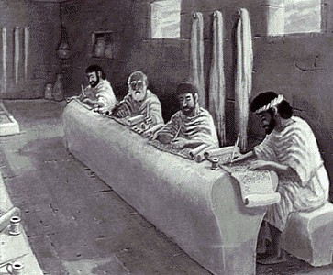
Who Am I? (Education Roots)
BS, Business Marketing (Hay U, 1980)
ThM, Pastoral Ministries (Dallas, 1987)
PhD, Bible Exposition (Dallas, 1990)

Slide 5
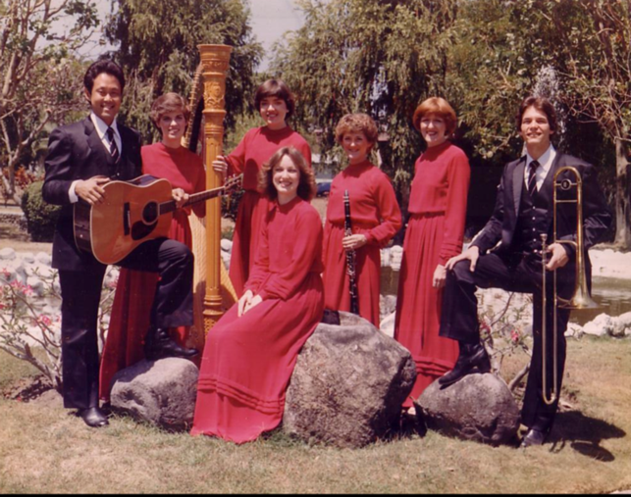
Who Am I? (My Passions)
My God
My Family

Slide 6


Our People
Susan teaches church women
Notes:
I also lead the woman's Precept Bible study at our church

Slide 7

LADIES BIBLE STUDY ON
HEBREWS
USA • Singapore • New Zealand • Holland

Slide 8

Thailand • Mongolia • Myanmar • Indonesia
Notes:
INTERVIEWER: And Susan, what ministries has the Lord granted you?
SUSAN: I have been teaching the wives of leaders at SBC. These 5 women come from 5 different nations!
SUSAN: I also lead the woman's Bible study at our church

Slide 9
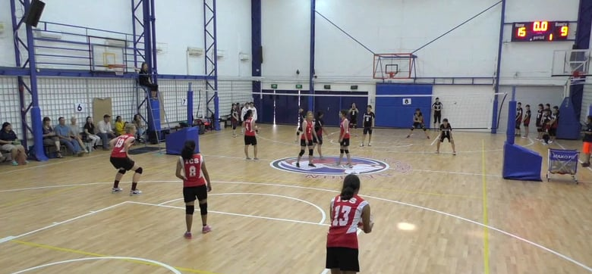
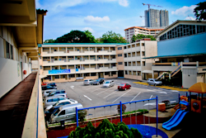
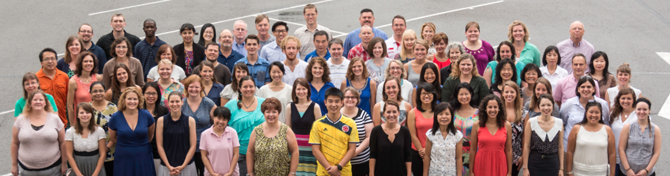
International Community School (est. 1993)

Slide 10

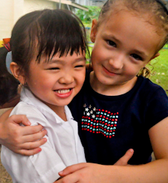


ICS now has 480 students!
UK
SWEDEN
KOREA
SWITZERLAND
JAPAN
ITALY
USA
THAILAND
INDIA
MEXICO
ICS
VENUZELA
INDONESIA
BRAZIL
SOUTH AFRICA
AUSTRALIAN

Slide 11
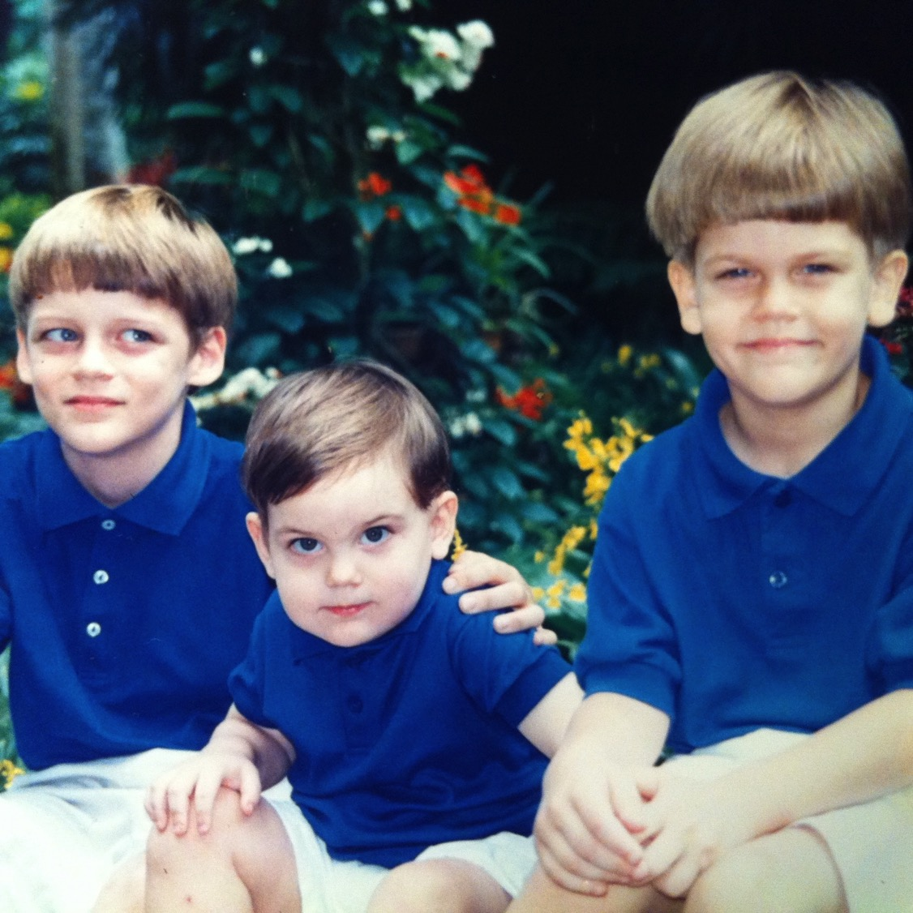
Our Three Sons

Slide 12
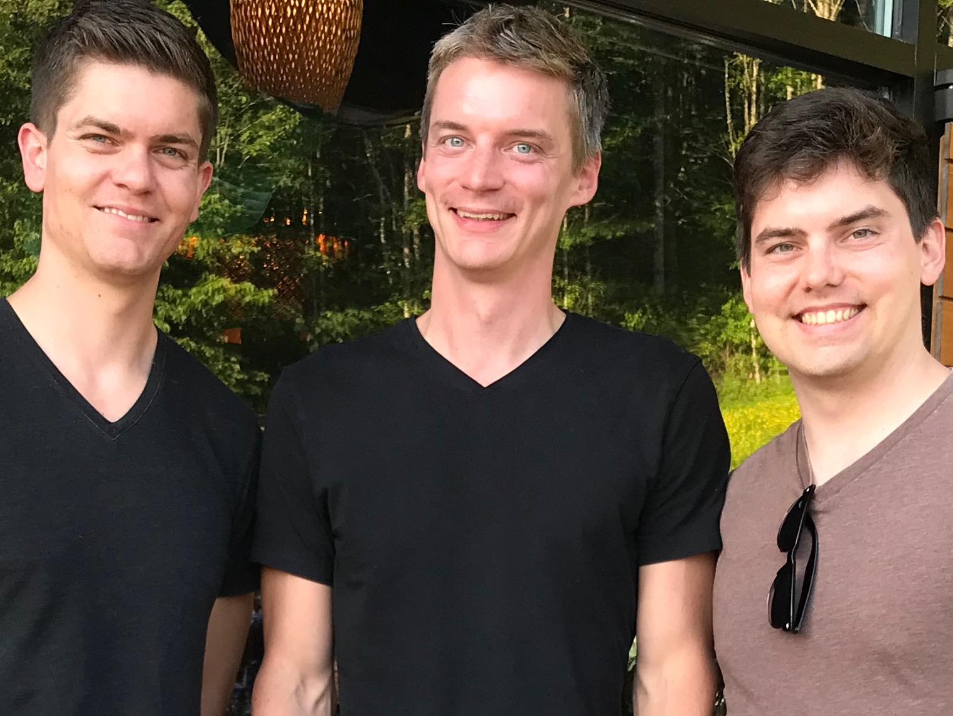
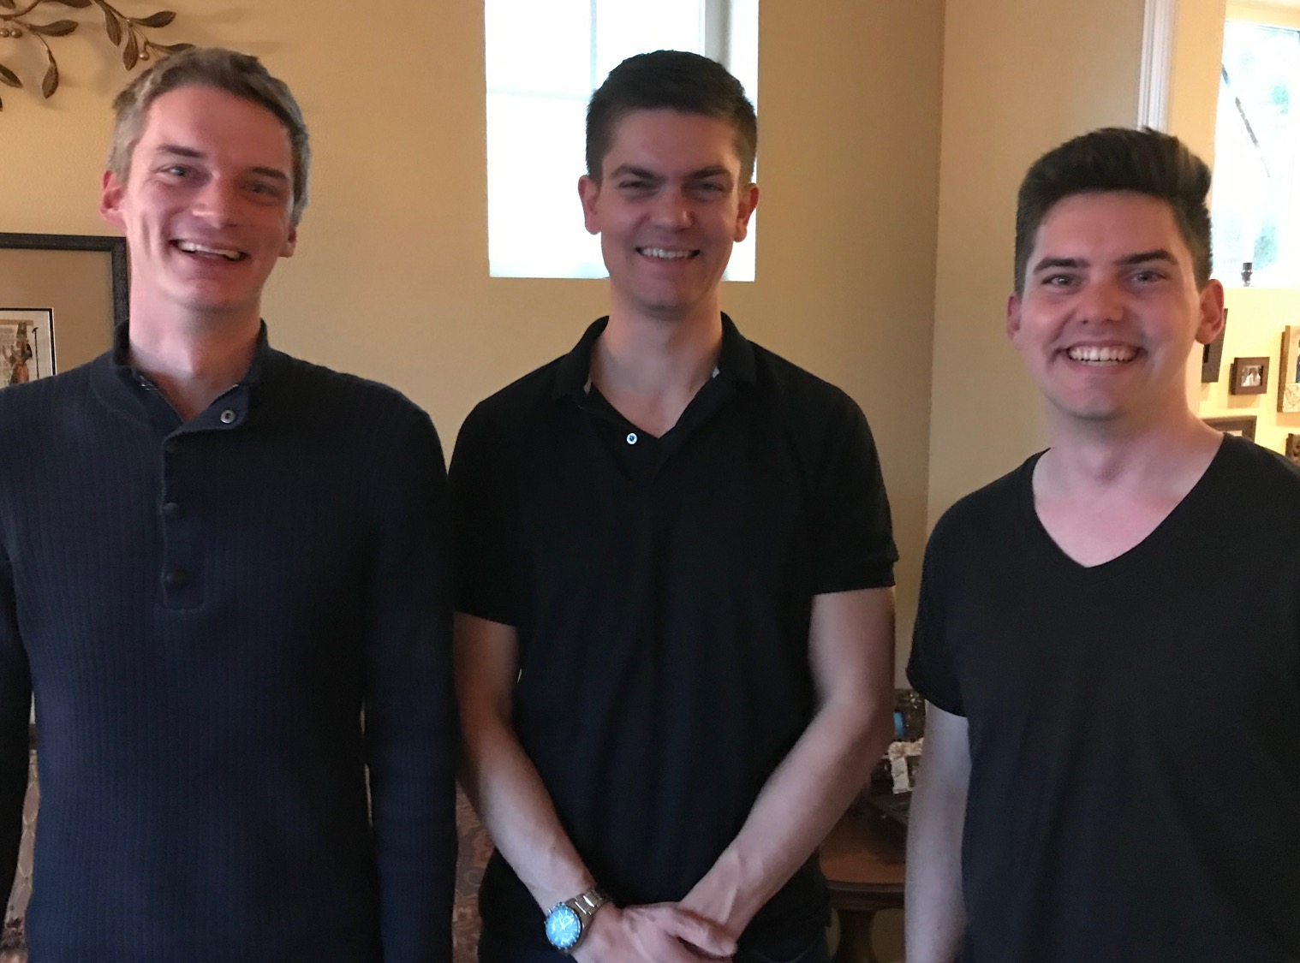
Our Three Sons

Slide 13
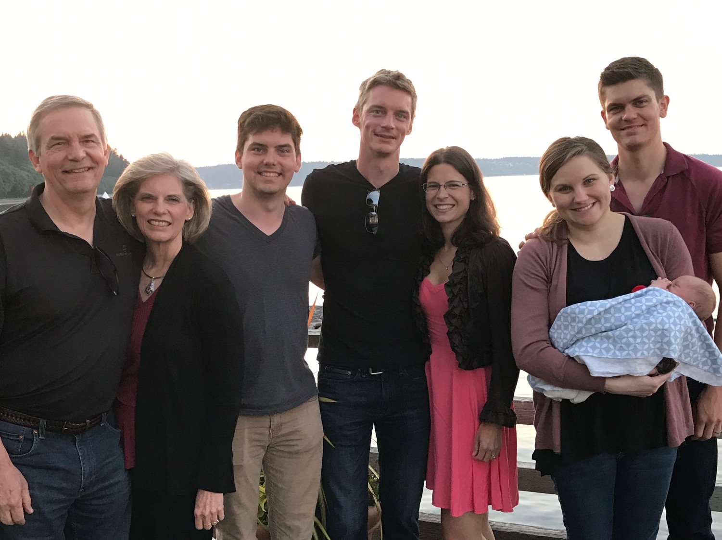
The Griffiths
31 May 2019
2019
Rick & Susan
John
(26)
Kurt & Cara (31)
Stephen, Katie & Jesse (29)

Slide 14
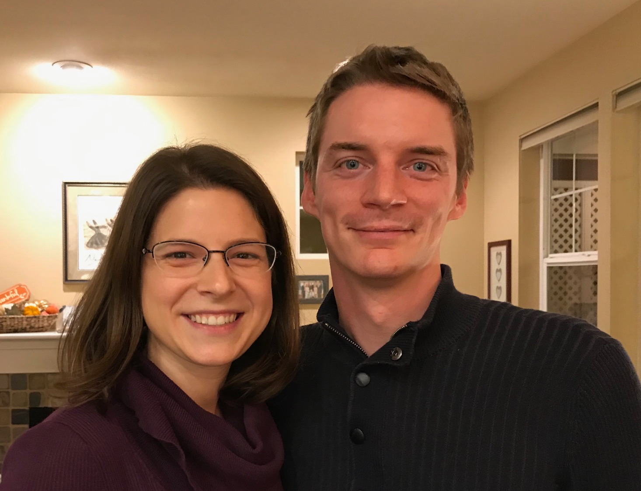
Kurt (32) and Cara run an HR consulting business near Seattle
Notes:
Kurt and his wife Cara are in Seattle

Slide 15
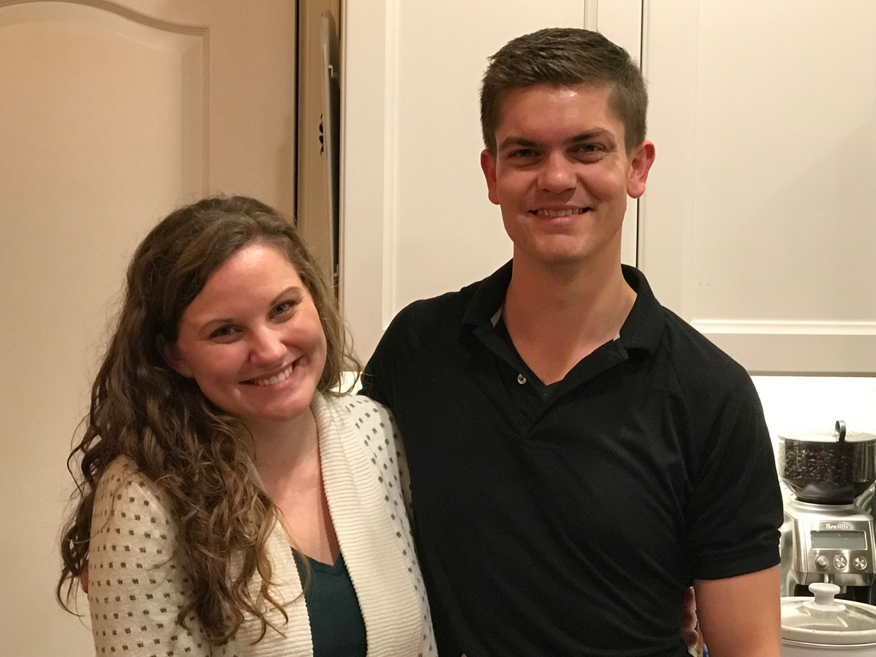
Stephen & Katie
6
Notes:
Stephen and his wife Katie in Boise

Slide 16
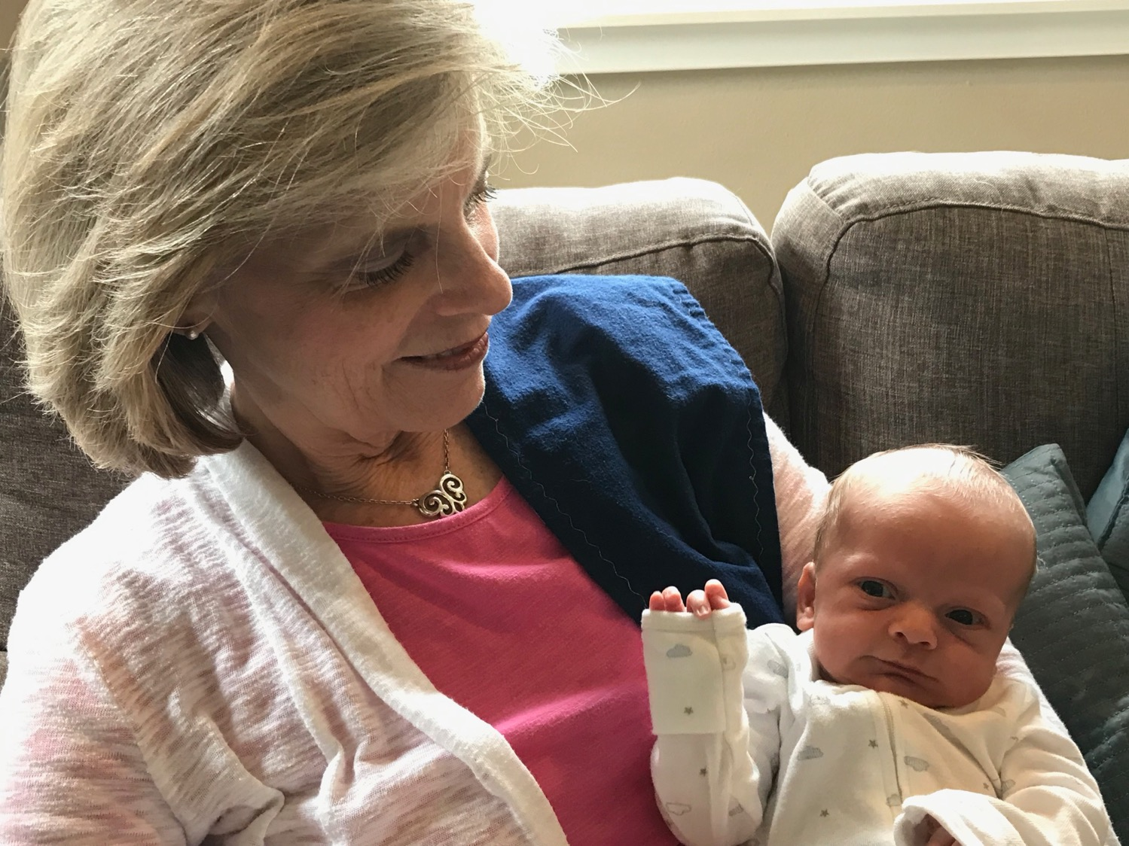
Susan loves Jesse
6
Notes:
Stephen and his wife Katie in Boise

Slide 17
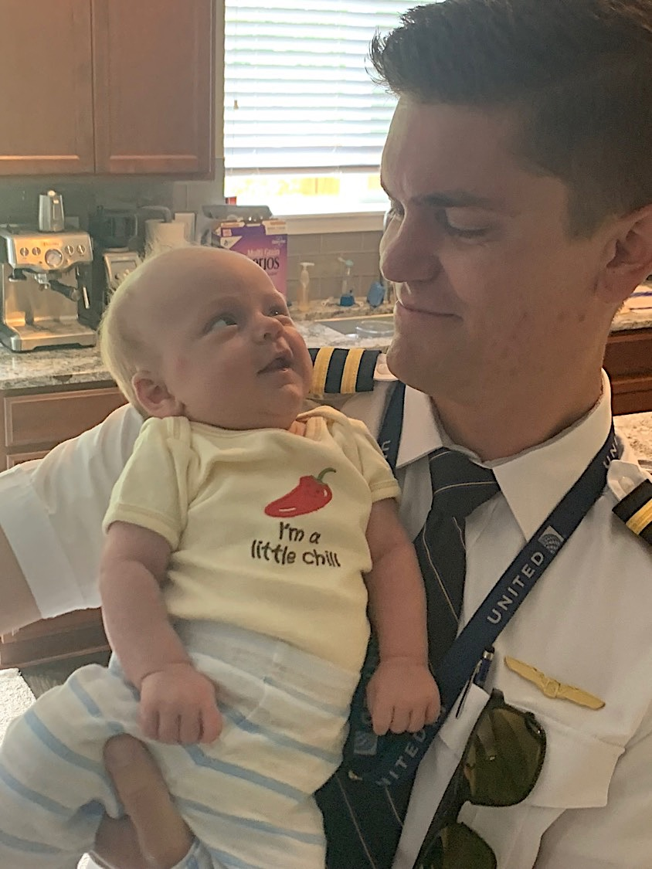
Stephen (29) is a United A320 pilot commuting from Seattle to fly from SFO

Slide 18
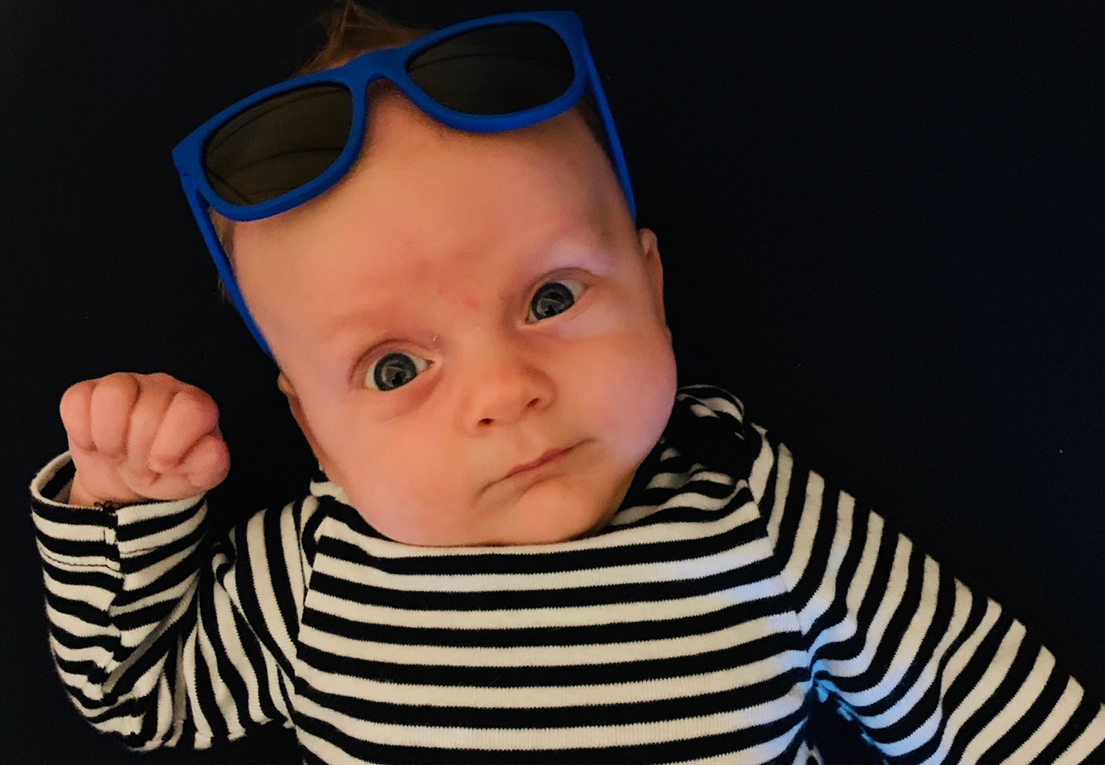
JESSE GRIFFITH
BORN
14 MAY 2019

Slide 19
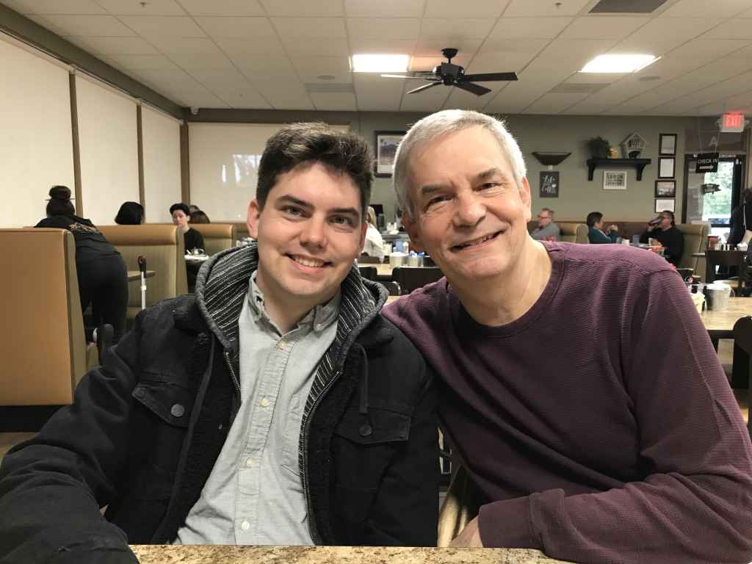
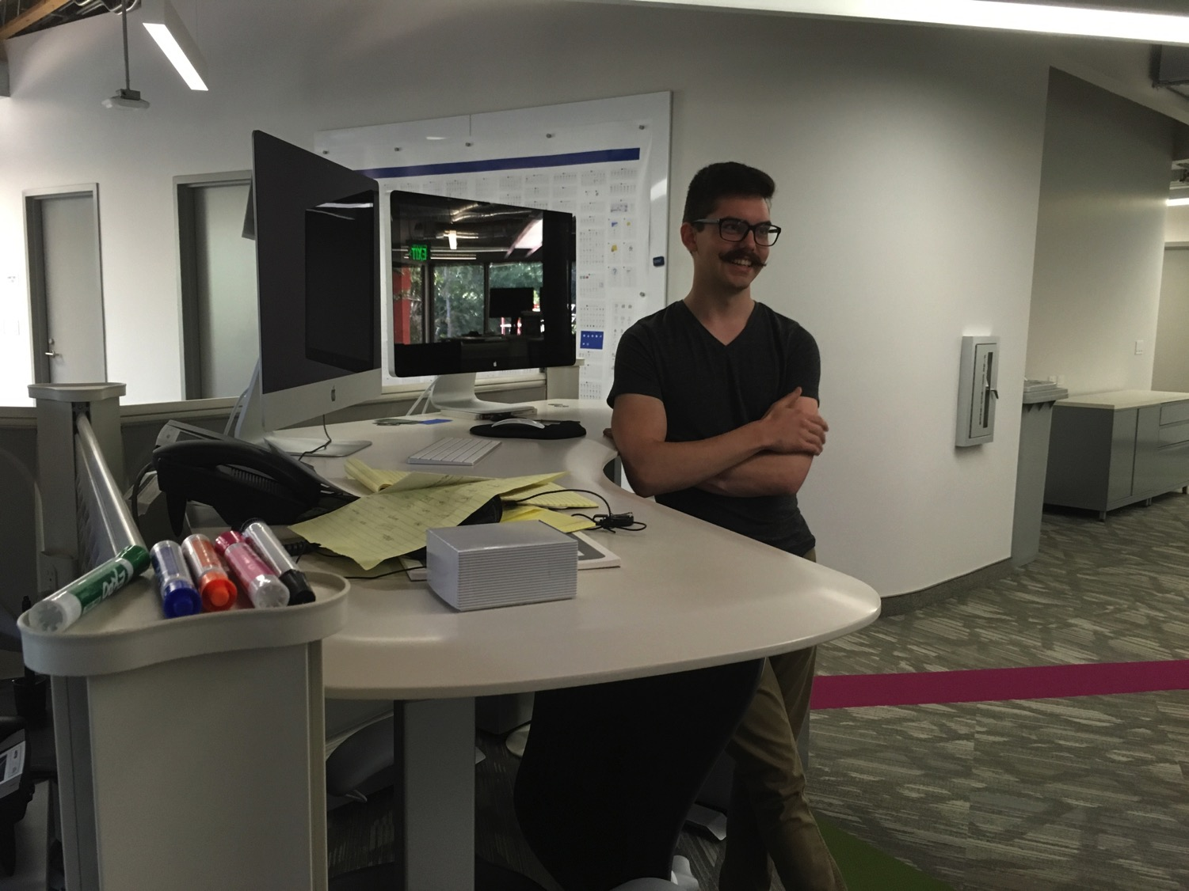
John (26) is a graphic artist in Redlands, California
8
Notes:
John just graduated from Biola and works for ESRI

Slide 20

Our Mission Organization…

Slide 21
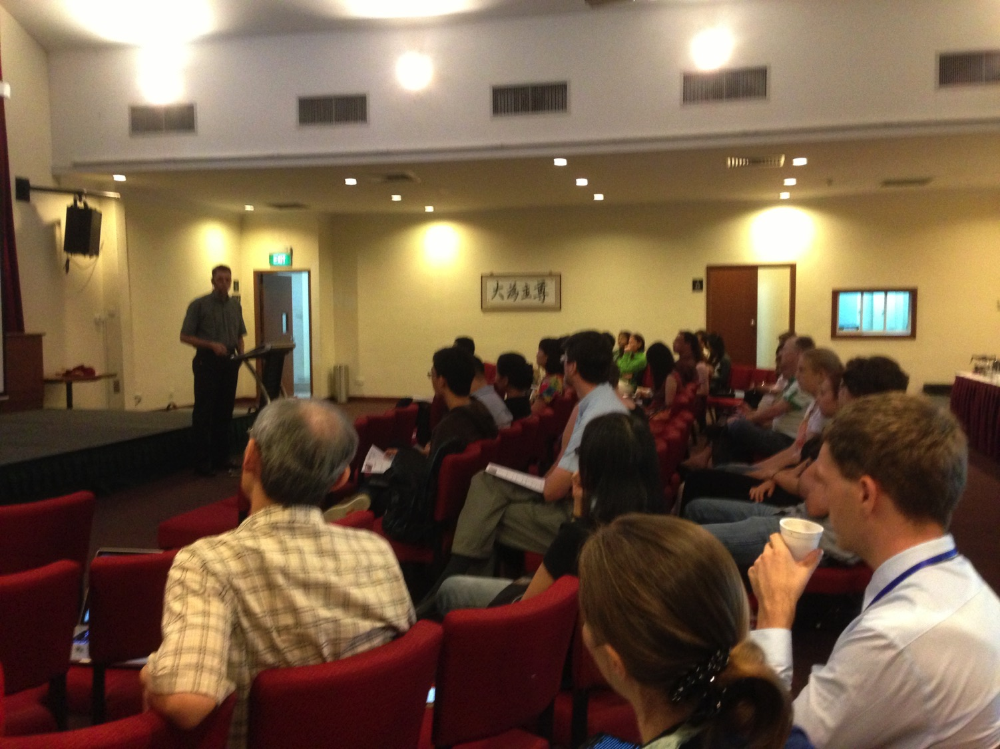
Our People
9
51 people from 11 nations
June 2019

Slide 22


Crossroads People • June 2019
UK
CHINA
JAPAN
UNITED KINGDOM
RUSSIA
NETHERLANDS
FRANCE
MONGOLIA
ITALY
KOREA
HONG KONG
LEBANON
JAPAN
TAIWAN
GERMANY
MYANMAR
CANADA
EGYPT
INDIA
USA
THAILAND
ETHIOPIA
MALAYSIA
ZIMBABWE
PHILIPPINES
SINGAPORE
INDONESIA
SOUTH AFRICA
CIC
NEW ZEALAND
AUSTRALIA
Notes:
Our June 2019 church of 51 people stem from 11 different countries around the world: Australia (David & Fiona), France (Aurelie), Korea (Grace Kim), India (Cynthia), Indonesia (Rena), Japan (Yoshie), Myanmar (Peng), Singapore (Albina), Thailand (Mae), UK (James & Gabi), USA (Miriam).
This does not include people who have recently attended only once: Dowon (Korea)
Nor does it include missionaries living back in their countries but still are members of CIC: Maple (Taiwan), Budmaa (Mongolia)
Previous: Canada (Gloria Lee), Ethiopia (Lele), Malaysia (Aston, Naomi), Netherlands (Dies & Desiree), Philippines (Micah), South Africa (Melody),

Slide 23

Our People
Preaching through Scripture
Notes:
RICK: Yes, we helped start Crossroads International Church in 2006 and I serve as the pastor-teacher.

Slide 24

Our People
SBC students serve at church
Notes:
One special joy is mentoring my students who serve with us at church and led ministries to youth, children, home groups, and the worship team.

Slide 25
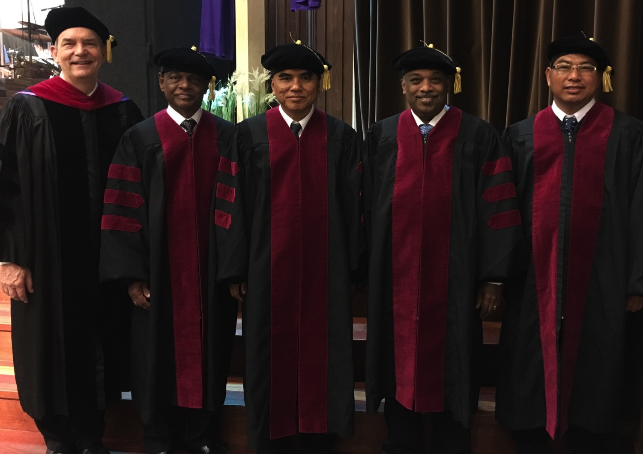
I direct the SBC Doctor of Ministry studies (DMin)
Notes:
I'm also the director of the doctoral program at SBC that trains about 80 seminary professors and pastors throughout Asia in English and Chinese. Generallly each year about 5 of them received their Doctor of Ministry degree.

Slide 26
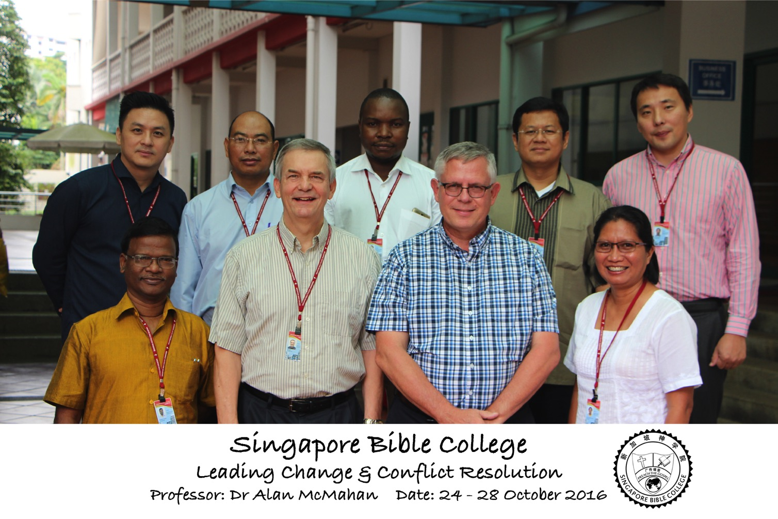
Leading Change & Conflict Resolution
(Dr. Alan McMahan Oct 2016)

Slide 27
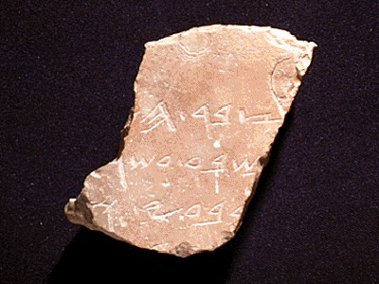
Who Am I? (My Passions)
My God
My Family
My Ministries

Slide 28
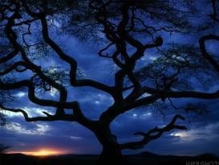
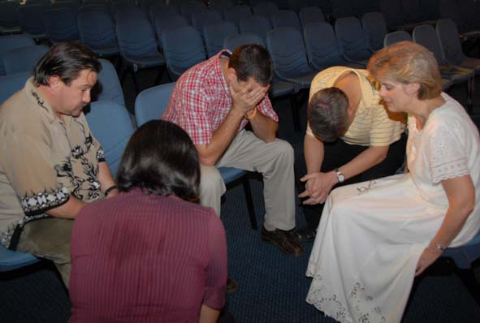

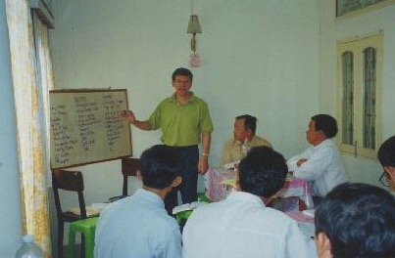
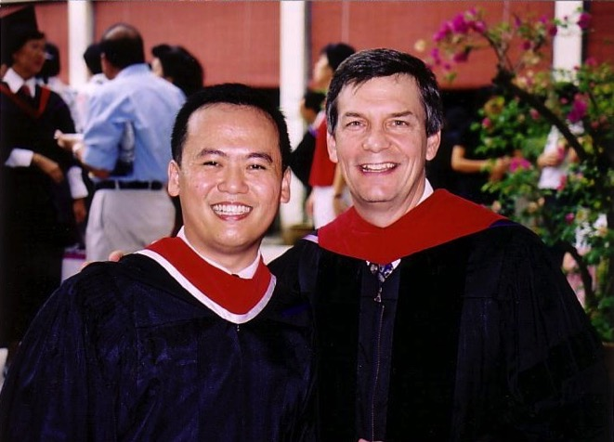
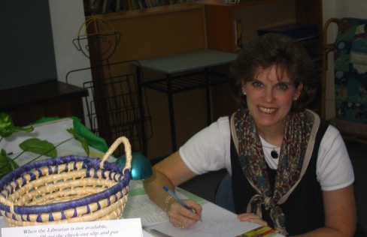
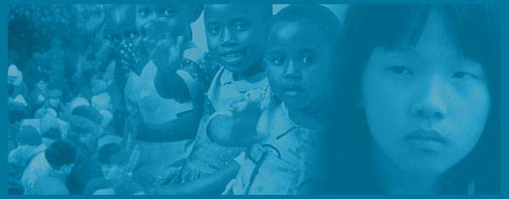
Ministry Alphabet Soup
Internet Biblical Seminary
Crossroads International Church
Biblical Education by Extension
International Community School
Singapore Bible College
WorldVenture Int'l

Slide 29
IBS Advantages
Internet Biblical Seminary Advantages
Cost efficient
Better content retention
Reaches where we cannot go
Easily multiplied
Better to reach youth

Slide 30
SBC Courses I Teach
(English • Bahasa • Chinese)
Survey • The Bible…Basically
OT NT Bible Study
Backgrounds • Research & Writing
OT NT Geography
Theology • Creation • Jesus
Church • Spirit • Salvation • Future
Preaching
Homiletics 1 Homiletics 2
Notes:
I get to teach these leaders every book of the Bible in survey courses, plus backgrounds to both the OT and NT, three areas of theology, and how to preach.

Slide 31
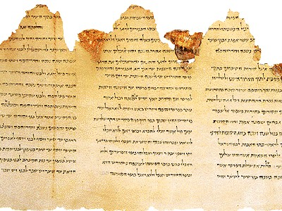

What's this course about?
1
We'll study data outside the Old Testament which illuminates the OT including:
Geography of Israel and the ANE
Biblical Theology of the OT
History: sociology, religions, writings
Culture of Ancient Near East Peoples
Archaeology
Chronology of the History of Israel

Slide 32
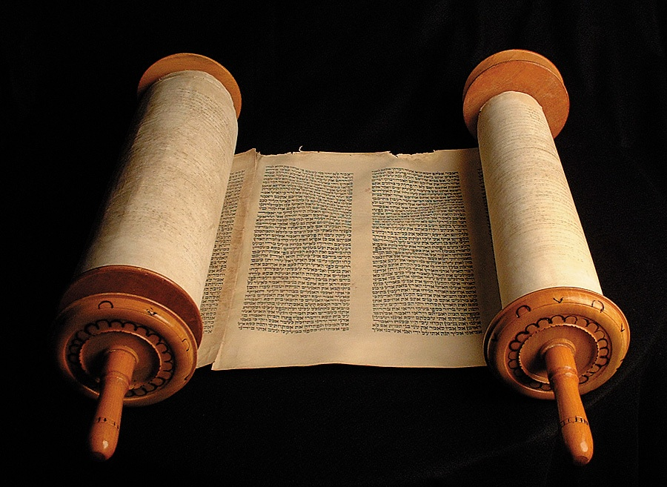
How Well Do You Know Your
Old Testament?
Take out a blank piece of paper
(or use a blank page in your notes)
List the OT books in order

Slide 33

OT Bookshelf
Old Testament
Genesis - Malachi
Law (5)
History (12)
Poetry (5)
Prophecy (17)
Major 5 Minor 12

Slide 34
OT Survey &
OT Foundations
xv
Archaeology
Geography
Biblical Theology
OT Survey
  Author, date, argument
  Chronology of books
  Unique characteristics
Politics (History)
Religious Context
Cultural Context

Slide 35
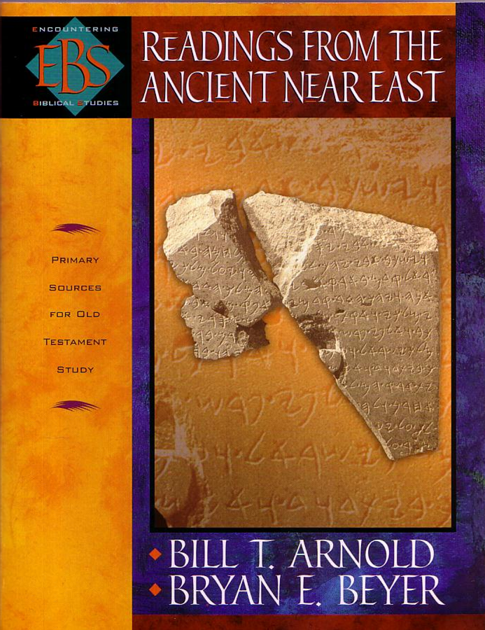
Readings
1
Literature

Slide 36
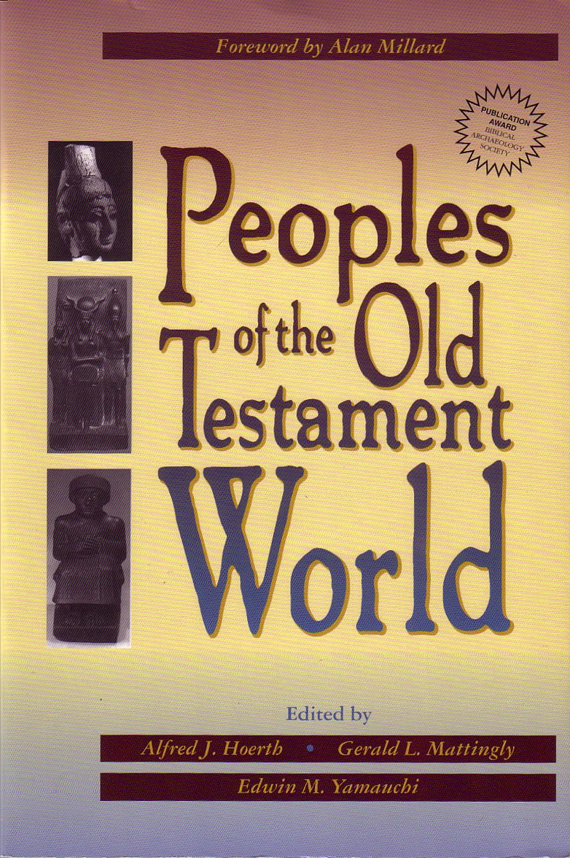
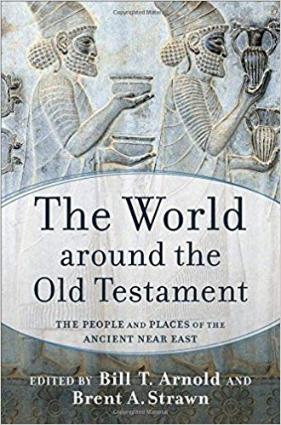
Readings
1
Literature
Peoples

Slide 37
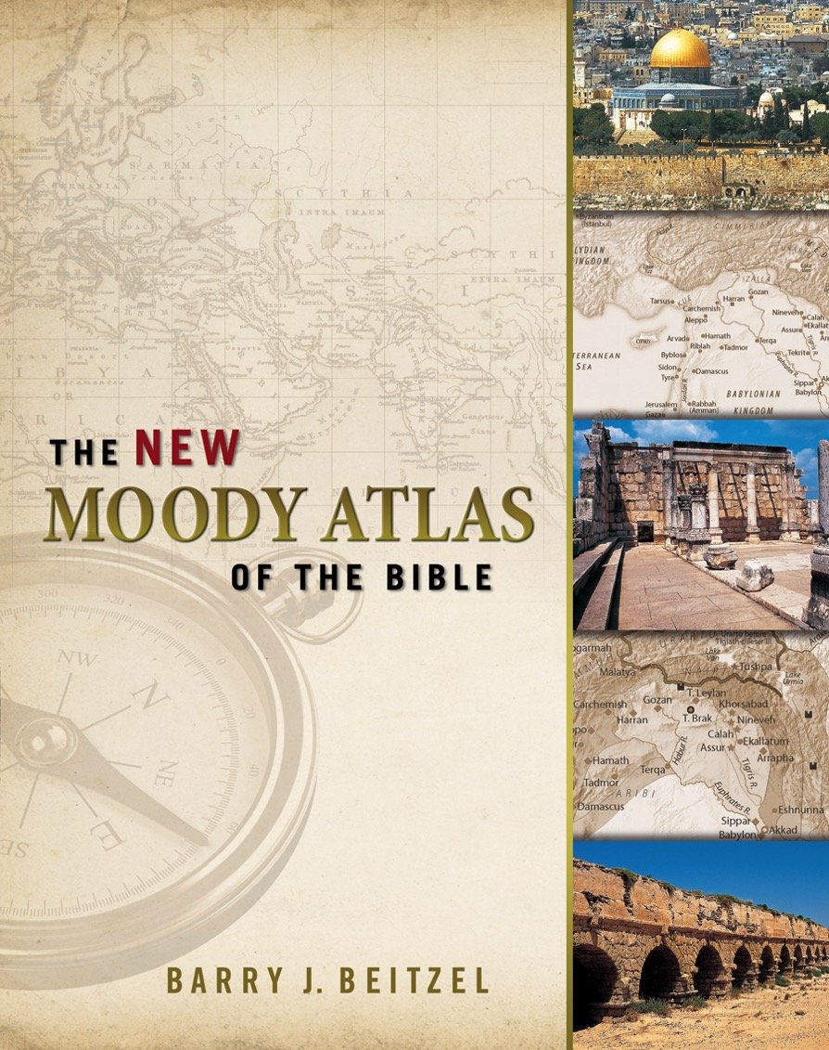
Readings
1
Literature
Peoples
Geography

Slide 38
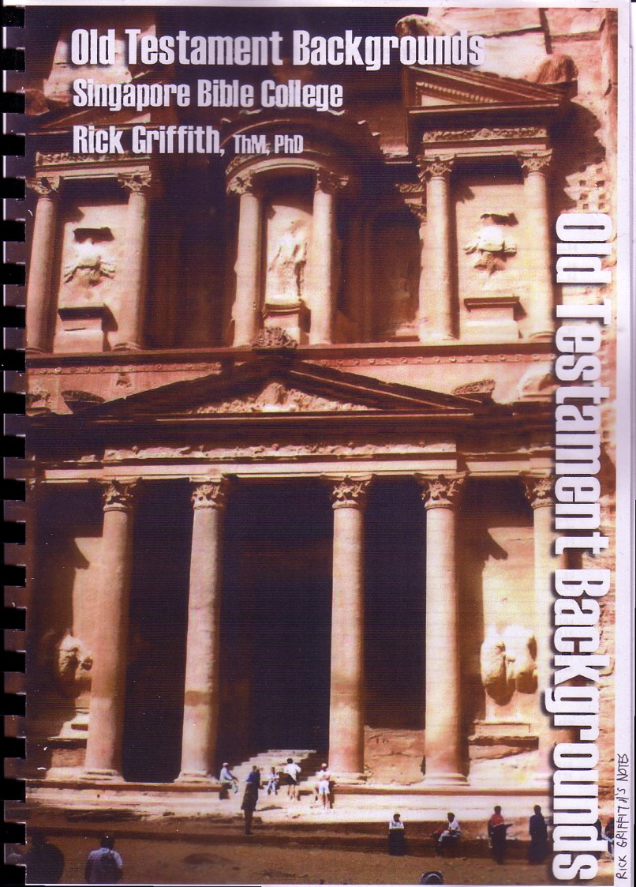
OT Foundations
Readings
1
Literature
Peoples
Geography
Notes

Slide 39
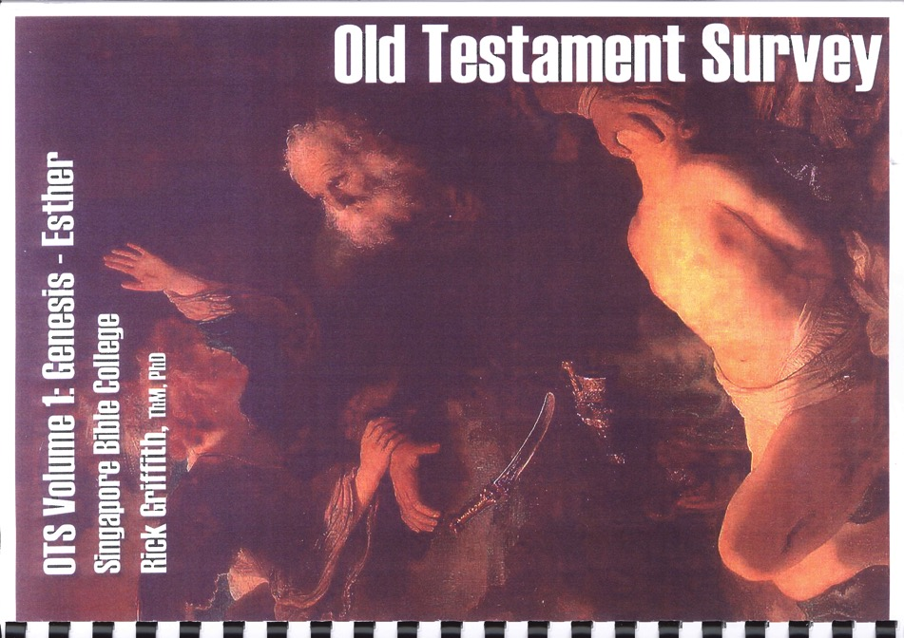
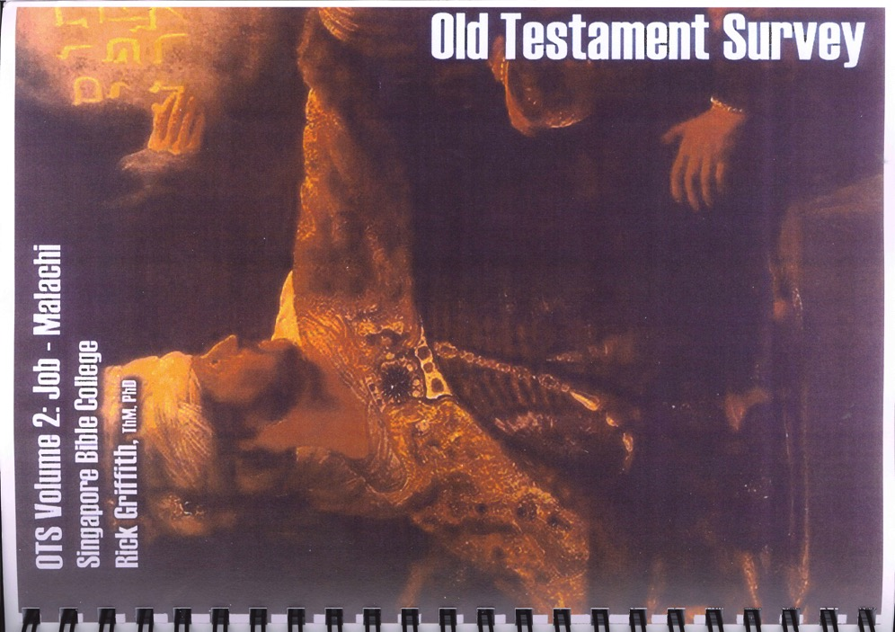
OT Foundations
Readings
1
Literature
Peoples
Geography
Notes
Extra Notes

Slide 40
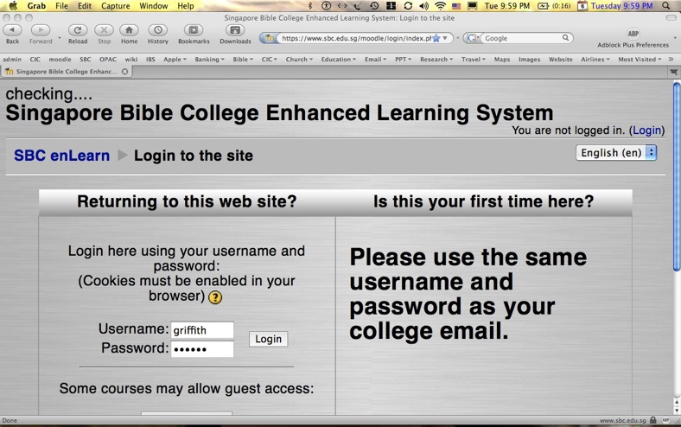

Our Two Websites
SBC Moodle
(Quizzes & Exams)
BibleStudyDownloads.org
(Downloads)

Slide 41


All Quizzes and Exams are Closed Book!

Slide 42
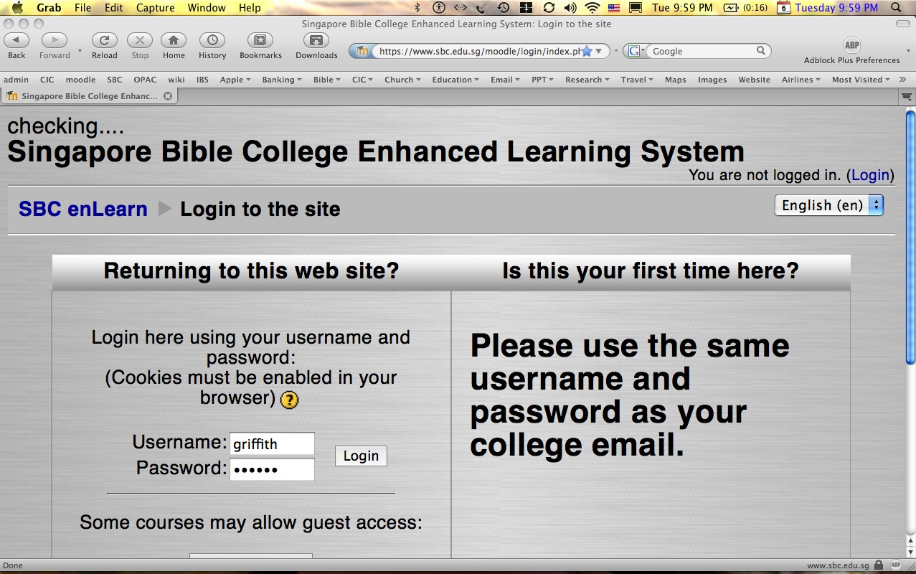
How to Get on Moodle…
1
Log on at sbc.edu.sg/moodle/login/index.php
Type your normal SBC username
Type normal SBC password
Click on the OT Backgrounds course
Take your quiz or post a message

Slide 43

SBC Grading
3
 | BCM | MA/MCM/ MAC/MDiv
Readings | 20% | 15%
Quizzes | 20% | 15%
Research Paper | - | 10%
Project | 30% | 30%
Final Exam | 30% | 30%
Total | 100% | 100%
Attendance | 90+% | 90+%

Slide 44
CGS/LBC Grading
3
 | BTh | MDiv
Readings | 33% | 33%
Quizzes | 33% | 33%
Research Paper | - | -
Translation Project | 33% | 33%
Final Exam | - | -
Total | 100% | 100%
Attendance | 90+% | 90+%

Slide 45
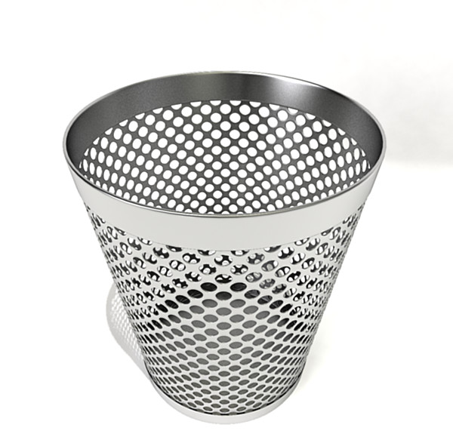
Assignment File System
Notes:
Too often students simply look at the grade on their research paper and toss it into this type of file system. There must be a better way!

Slide 46

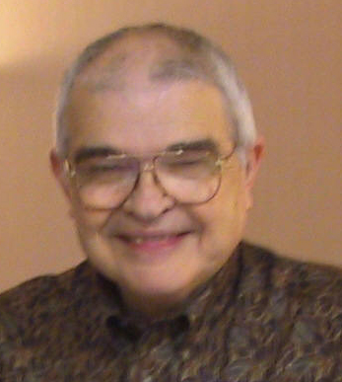
Dr John Fryman
Dr John Fryman
A Presentation of The Bible…Basically Ministries International Inc. Fort Worth, Texas
BibleBasically.org
©2004 TBBMI
8.0.01.
04
Notes:
Dr. Fyman invested 30 years of his life to develop "The Bible…Basically," a 10-hour seminar that brings audiences through the whole Bible SIX times!

Slide 47

English

Slide 48

Burmese
Lai S
iangtho…Abulpi
A Presentation of The Bible…Basically Ministries International Inc. Fort Worth, Texas
www.biblebasically.com
©2004 TBBMI
8.0.01.
04

Slide 49


French
LA BIBLE…
EN BASE
Une Présentation du Ministère Internationale de La Bible… En Base Inc. Fort Worth, Texas
www.biblebasically.com
©2006 TBBMI
8.0.01.
04
©2004 TBBMI
9.6.01.

Slide 50
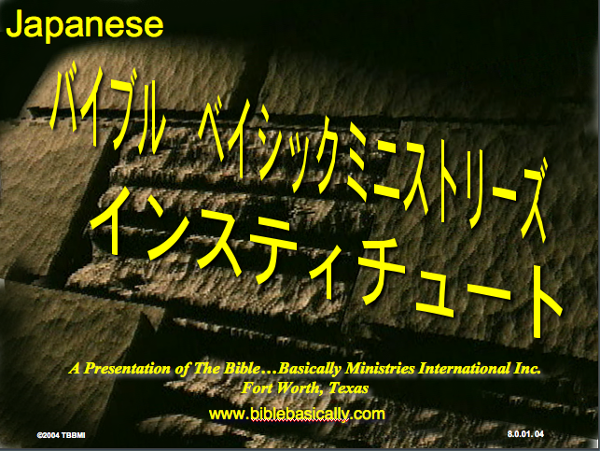
Japanese
バイブル ベイシックミニストリーズ
インスティチュート
A Presentation of The Bible…Basically Ministries International Inc. Fort Worth, Texas
www.biblebasically.com
©2004 TBBMI
8.0.01.
04
Notes:
Japanese title slide

Slide 51
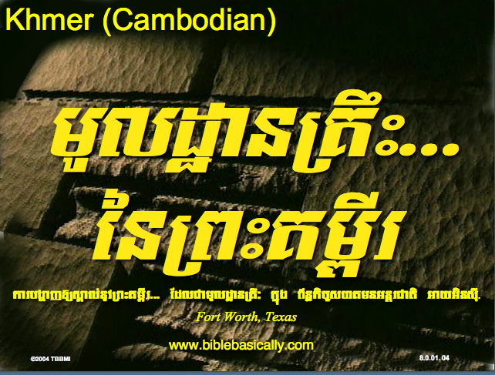
Khmer (Cambodian)
mUldæanRKwH>>>
énRBHKm<IIr
karbgðaj[sÁal;nUvRBHKm<Ir>>> EdlCamUldæanRKw³ kñúg B½n§kic©shKmnGnþrCati GayGinsIu.
Fort Worth, Texas
www.biblebasically.com
©2004 TBBMI
8.0.01.
04

Slide 52
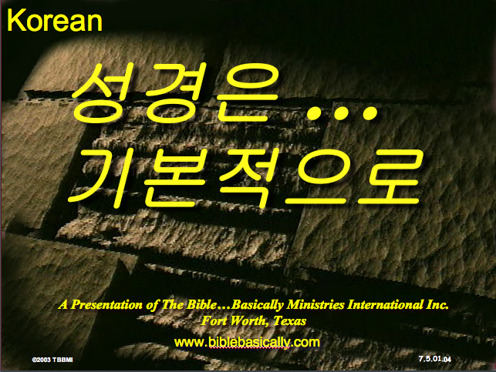
Korean
성경은 …
기본적으로
A Presentation of The Bible…Basically Ministries International Inc. Fort Worth, Texas
www.biblebasically.com
7.5.01.
©2003 TBBMI
04

Slide 53

Malay
Alkitab…
Dasar
Presentasi dari The Bible…Basically Ministries International Inc. Fort Worth, Texas
www.biblebasically.com
©2004 TBBMI
8.0.01.
04

Slide 54
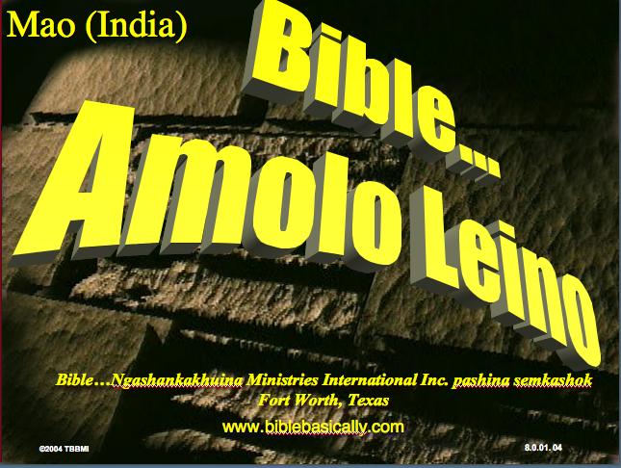
Mao (India)
Bible…
Amolo Leino
Bible…Ngashankakhuina Ministries International Inc. pashina semkashok Fort Worth, Texas
www.biblebasically.com
©2004 TBBMI
8.0.01.
04

Slide 55
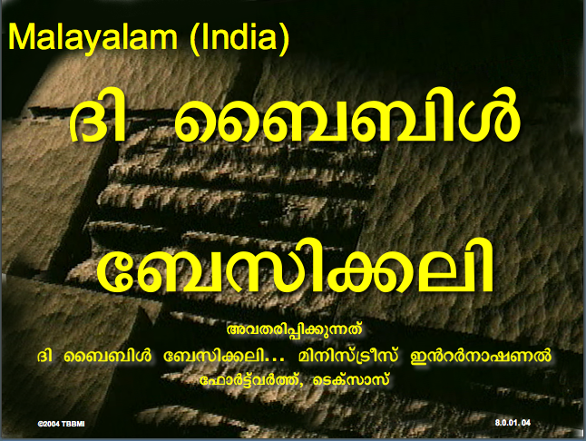
Malayalam (India)
Æß èÌÌßZ
çÌØßAÜß
¥ÕÄøßMßAáKÄí Æß èÌÌßZ çÌØßAÜß… ÎßÈßØíd¿àØí §aVÈÞ×ÃW çËÞVGíÕVJí, æ¿µíØÞØí
©2004 TBBMI
8.0.01.
04

Slide 56
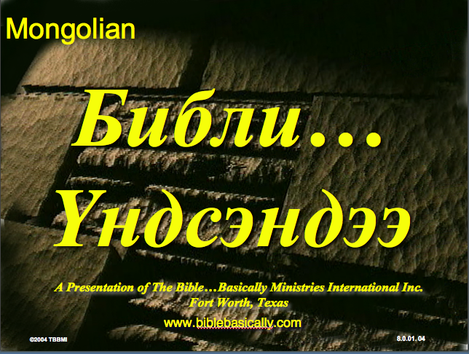
Mongolian
Библи…
Үндсэндээ
A Presentation of The Bible…Basically Ministries International Inc. Fort Worth, Texas
www.biblebasically.com
©2004 TBBMI
8.0.01.
04

Slide 57

Nepali
afOan======
cfwf/e[\t
A Presentation of The Bible…Basically Ministries International Inc. Fort Worth, Texas
www.biblebasically.com
8.0.01.
©2004 TBBMI
04

Slide 58
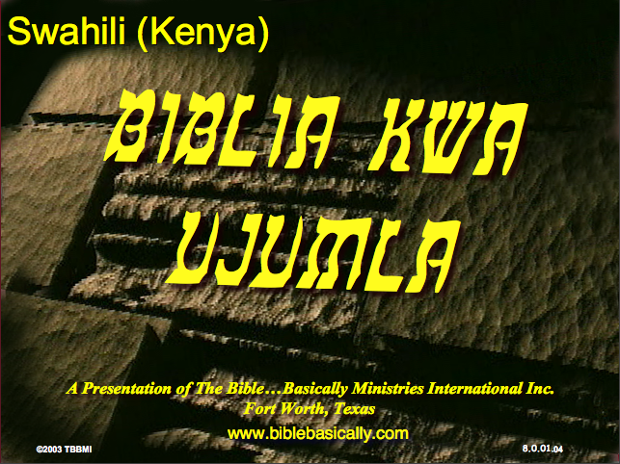
Swahili (Kenya)
biblia kwa ujumla
A Presentation of The Bible…Basically Ministries International Inc. Fort Worth, Texas
www.biblebasically.com
8.0.01.
©2003 TBBMI
04

Slide 59

Tagalog (Philippines)
Ang Biblia . . . Pinasimple
A Presentation of The Bible…Basically Ministries International Inc. Fort Worth, Texas
www.biblebasically.com
©2004 TBBMI
8.0.01.
04
Notes:
PLEASE PUT THE TITLE AND SUBTITLES INTO YOUR NATIONAL LANGUAGE AND LEAVE THE WEBSITE UNCHANGED

Slide 60

Tangkhul (India)
Bible…
Ngashankakhui
Bible…Ngashankakhuina Ministries International Inc. pashina semkashok Fort Worth, Texas
www.biblebasically.com
©2004 TBBMI
8.0.01.
04

Slide 61
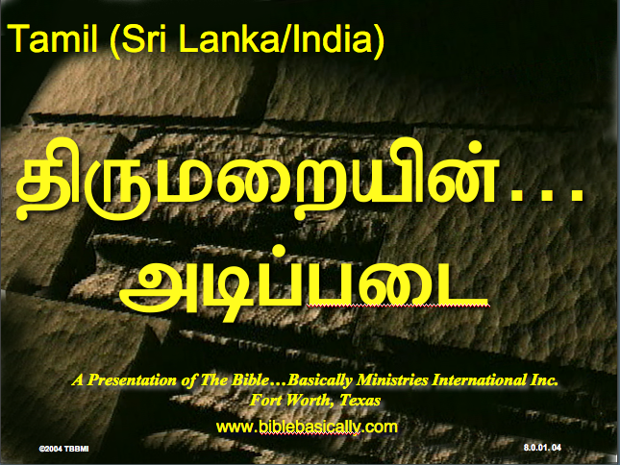
Tamil (Sri Lanka/India)
jpUkiwapd;…
mbg;gil
A Presentation of The Bible…Basically Ministries International Inc. Fort Worth, Texas
www.biblebasically.com
©2004 TBBMI
8.0.01.
04

Slide 62
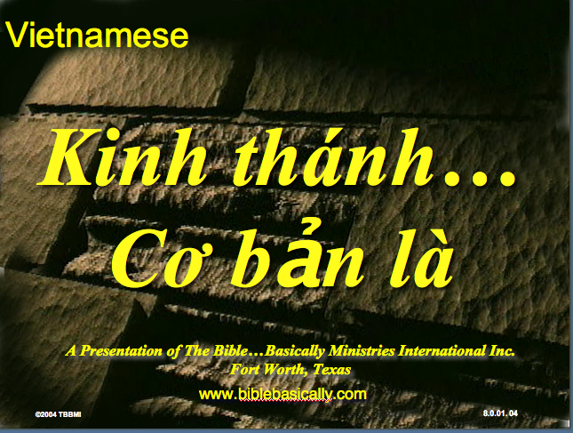
Vietnamese
Kinh thánh…
Cơ bản là
A Presentation of The Bible…Basically Ministries International Inc. Fort Worth, Texas
www.biblebasically.com
©2004 TBBMI
8.0.01.
04

Slide 63


Bahasa Indonesia
Presentasi dari The Bible…Basically Ministries International Inc. Fort Worth, Texas
www.biblebasically.com
7.5.01.
©2003 TBBMI
04

Slide 64
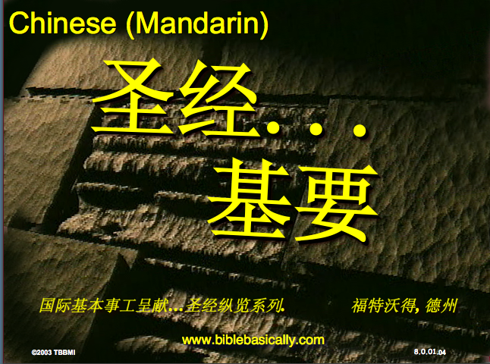
Chinese (Mandarin)
圣经...
基要
国际基本事工呈献…圣经纵览系列. 福特沃得, 德州
www.biblebasically.com
8.0.01.
©2003 TBBMI
04

Slide 65
PowerPoint (945 slides)
Student Workbook (100 pages)
Teacher Script (400 pages)
TBB Materials
Completed in
English • Chinese • Hindi • Indonesian • Korean • Malay • Mongolian • Russian • Spanish
A Presentation of The Bible…Basically Ministries International Inc. Fort Worth, Texas
www.biblebasically.com
©2004 TBBMI
8.0.01.
04

Slide 66
YOUR
BIBLE FILE
7
C
7
S
J
Handbook pg. 8-14
39
Notes:
Now let's think again about a filing cabinet. This will be YOUR BIBLE FILE! Here is a look ahead to where we are going in this study.

Slide 67
10 File Folders
7
1
2
3
C
4
5
6
7
7
8
S
9
10
J
Handbook pg. 8-14
41
Notes:
As a starting point, begin thinking about 10 file folders in a filing cabinet.
You are going to organize your own Bible File into a collection of these ten mental file folders.
Very soon you'll be applying labels to each of those 10 file folders. So…now to begin…and…

Slide 68
Opening Up
"Your Bible File"
7
7
7
7
7
7
7
7
C
7
J
C
S
J
C
S
J
C
S
J
S
Handbook pg. 8-14
4
42
Notes:
We begin right here...with the single number…. 7.
That's our mental anchor point. Simply the number 7 with that all-important dash through the stem.
//// Next step...surround that number with three alphabet letters. Set them firmly in place in your mind:
C 7 S J
Repeat the letter group aloud several times as you embed it in your mind... Because this is the very core of the Bible's organization and time-line flow:
//// "C 7 S J....
//// C 7 S J....
//// C 7 S J...etc."

Slide 69
Opening Up
"Your Bible File"
7
7
= 4+3
Handbook pg. 8-14
2
43
Notes:
Now...about that European style '7'.
//// You'll remember that it has a dash through its stem... That's an important reminder — a mind clue. Keep it mentally handy. That small dash divides the length of the 7's stem into two parts. So, ask yourself the question: "What two numbers does 7 easily split into?"
//// One possible answer…and the right one…is: 4 and 3.

Slide 70
C 4 3 S J
7
Opening Up
"Your Bible File"
C 4 3 S J
C 4 3 S J
Handbook pg. 8-14
1
44
Notes:
So, in the C 7 S J formula, by changing the 7 to a 4 and a 3, we have
C 4 3 S J.
As before, repeat that changed sequence aloud several times to help it hold tightly in your mind for easy recall.
//// C 4 3 S J.

Slide 71
5 Key Words or Phrases:
7
C = CREATION
4 = PEOPLE
3 = SOCIETIES
S = SILENCE
J = JESUS
Handbook pg. 8-14
5
45
Notes:
Now, based on C 4 3 S J, we enlarge that idea into five key words or phrases. They will become the foundation of your mental Bible File. Here they are…say them aloud…
//// C = CREATION
//// 4 = 4 PEOPLE
//// 3 = 3 SOCIETIES
//// S = SILENCE
//// J = JESUS.
And that's an organizational plan for the entire Bible! Those five words and phrases create an abbreviated outline map of the entire Bible's basic design.

Slide 72
5 Key Words or Phrases:
7
C = CREATION
4 = PEOPLE
3 = SOCIETIES
S = SILENCE
J = JESUS
Handbook pg. 8-14
6
46
Notes:
Once again...aloud…
//// C = CREATION
//// 4 = 4 PEOPLE
//// 3 = 3 SOCIETIES
//// S = SILENCE
//// J = JESUS.
We will now go back through the phrases, expanding them still farther.
//// CREATION,
of course, remains at the top of the list naturally…because the Bible story itself begins right there.

Slide 73
5 Key Words or Phrases:
7
C = CREATION
4 = PEOPLE
3 = SOCIETIES
S = SILENCE
J = JESUS
Handbook pg. 8-14
47
Notes:
We then take the next phrase from the list:
4 PEOPLE.

Slide 74
THE 4 PEOPLE ARE:
7
ABRAHAM
JOSEPH
MOSES
JOSHUA
Handbook pg. 8-14
5
48
Notes:
Let's break apart "4 PEOPLE" into 4 specific people, in this order:
//// ABRAHAM
//// JOSEPH
//// MOSES
//// JOSHUA
It's helpful to remember the word order by repeating several times the first-letter order of the words:
//// "A-J-M-J ... A-J-M-J ... etc."

Slide 75
A Judge Must Judge
7
A
JUDGE
MUST
JUDGE!
Handbook pg. 8-14
49
Notes:
How can you remember the order of those letters and the names?
This simple sentence..."A JUDGE MUST JUDGE." The first letters of each word: AJMJ and then you have it.

Slide 76
THE 4 PEOPLE ARE:
7
A BRAHAM
A
J OSEPH
JUDGE
M OSES
MUST
J OSHUA
JUDGE
Handbook pg. 8-14
8
50
Notes:
Just remember to repeat the four names aloud to yourself several times until you feel the rhythm of the words:
//// "ABRAHAM,
//// JOSEPH,
//// MOSES and
//// JOSHUA."
And here again is that mental tool…
//// A
//// JUDGE
//// MUST
//// JUDGE.

Slide 77
Creation to Joshua
7
CREATION
ABRAHAM
JOSEPH
MOSES
JOSHUA
Handbook pg. 8-14
5
51
Notes:
So, from the top of the list we now can say:
//// CREATION
//// ABRAHAM
//// JOSEPH
//// MOSES
//// JOSHUA
This step completes the main FOUR PEOPLE of your new Bible File. Of course, there are dozens of other Biblical characters, but these are the only ones we are using to build the Bible File right now. Repeat the four names aloud several times until they are firmly set mentally.

Slide 78
5 Key Words or Phrases:
7
C = CREATION
4 = PEOPLE
3 = SOCIETIES
S = SILENCE
J = JESUS
Handbook pg. 8-14
52
Notes:
The next phrase of that beginning list is:
3 SOCIETIES.

Slide 79
A R C
7
Handbook pg. 8-14
2
53
Notes:
Another memory tool now…what do you call
//// that red section of the perimeter of a circle?
//// It's called an "arc," spelled A-R-C. Those letters, then, remind you of the first letters of 3 KINDS OF SOCIETIES.

Slide 80
THE 3 SOCIETIES ARE:
7
ANARCHY
ROYALTY
CAPTIVITY
Handbook pg. 8-14
6
54
Notes:
The three societies are…
//// ANARCHY
//// ROYALTY
//// CAPTIVITY.
As before, please repeat that word order several times.
ANARCHY, ROYALTY, CAPTIVITY...
ANARCHY, ROYALTY, CAPTIVITY.
And the mental tool here:
//// A
//// R
//// C.

Slide 81
OT Review
7
CREATION
ABRAHAM
JOSEPH
MOSES
JOSHUA
ANARCHY
ROYALTY
CAPTIVITY
Handbook pg. 8-14
55
Notes:
Now we add the 3 SOCIETIES group to the others, and we have:
CREATION
ABRAHAM
JOSEPH
MOSES
JOSHUA
ANARCHY
ROYALTY
CAPTIVITY

Slide 82
To Review…
7
7
TO REVIEW...
C 7 S J
C 4 3 S J
Handbook pg. 8-14
3
56
Notes:
To review the entire sequence so far…
Beginning with the single number
//// 7....
leading to…
//// C 7 S J...
which becomes...
//// C 4 3 S J.
These numbers and letters are then used to develop a mental list of TEN WORDS that will form a dependable mental outline of the entirety of Scripture.

Slide 83
The Basics
7
CREATION
4 PEOPLE
3 SOCIETIES
SILENCE
JESUS
Handbook pg. 8-14
57
Notes:
C 4 3 S J is then expanded into:
CREATION
4 PEOPLE
3 SOCIETIES
SILENCE
JESUS.

Slide 84
The Last Two Folders
7
CREATION
ABRAHAM
JOSEPH
MOSES
JOSHUA
ANARCHY
ROYALTY
CAPTIVITY
SILENCE
JESUS
Handbook pg. 8-14
2
58
Notes:
Then further expanded into:
CREATION
ABRAHAM
JOSEPH
MOSES
JOSHUA
ANARCHY
ROYALTY
CAPTIVITY.
Finally, now, we add: //// SILENCEand//// JESUS.

Slide 85
Your New Mental "Bible File”
CREATION
CREATION
ABRAHAM
ABRAHAM
ABRAHAM
ABRAHAM
JOSEPH
ABRAHAM
MOSES
JOSEPH
JOSHUA
ANARCHY
MOSES
ROYALTY
CAPTIVITY
JOSHUA
SILENCE
JESUS
ANARCHY
ROYALTY
CAPTIVITY
SILENCE
JESUS
Handbook pg. 8-14
59
11
Notes:
Now it's time mentally to apply those ten words as labels to ten mental folders in your new Bible File –
//// right up there in your head. That mental picture might look something like this. And there they are...
//// CREATION//// ABRAHAM//// JOSEPH//// MOSES//// JOSHUA//// ANARCHY//// ROYALTY//// CAPTIVITY//// SILENCE…and…//// JESUS.
Now it's organized in a neat and orderly package in your mind --- ready for recall and use as you need it. Now just a few more
examples to drive home the point...

Slide 86
Membuka
“Arsip Alkitab Anda”
7
7
7
7
7
7
C S Y
C S Y
C S Y
C S Y
Buku Panduan hlm. 8-14
40
4

Slide 87
Membuka
“Arsip Alkitab Anda”
7
7
= 4+3
Buku Panduan hlm. 8-14
41
2

Slide 88
Membuka
“Arsip Alkitab Anda”
7
C 4 3 S Y
C 4 3 S Y
Buku Panduan hlm. 8-14
42
1

Slide 89
5 Kata Kunci atau Ungkapan:
7
C = CIPTAAN
4 = TOKOH
3 = KOMUNITAS
S = SENYAP
Y = YESUS
Buku Panduan hlm. 8-14
43
5

Slide 90
5 Kata Kunci atau Ungkapan:
7
C = CIPTAAN
4 = TOKOH
3 = KOMUNITAS
S = SENYAP
Y = YESUS
Buku Panduan hlm. 8-14
45

Slide 91
4 TOKOH tsb adalah:
7
A BRAHAM
Y USUF
M USA
Y OSUA
Buku Panduan hlm. 8-14
46
5

Slide 92
AYMY
7
ANUGERAH
YANG
MENAKJUBKAN
YA !
Buku Panduan hlm. 8-14
47

Slide 93
5 Kata Kunci atau Ungkapan:
7
C = CIPTAAN
4 = ORANG
3 = KOMUNITAS
S = SENYAP
Y = YESUS
Buku Panduan hlm. 8-14
50

Slide 94

KAKAP
7
K
A
K
A
P
Buku Panduan hlm. 8-14
53
2
Notes:
Alat pengingat yang lainnya adalah …
//// Ini ikan apa?
//// Benar, ikan “KAKAP”
//// Kita lihat disini ada 2 huruf K, kita mau buang 1 huruf K-nya
//// Huruf A juga ada 2, kita buang lagi huruf A yang double
//// Sekarang yang tersisa adalah A-K-P
//// Ikan KAKAP-nya tidak dibutuhkan lagi, kita kembali ke laut saja..
Sisa tiga huruf ini A-K-P, huruf-huruf ini akan membantu anda mengingatkan huruf pertama pada tiga 3 MACAM KOMUNITAS.

Slide 95
KE 3 KOMUNITAS ADALAH:
7
A NARKI
K ERAJAAN
P EMBUANGAN
Buku Panduan hlm. 8-14
52
6

Slide 96

“in the beginning”
Gen. 1:1
An Introduction to Genesis

Slide 97

“pada mulanya”
Gen. 1:1
Pengenalan kitab Kejadian

Slide 98
“起初”
Gen. 1:1
创世记导论

Slide 99

Days of Creation
33
Void
Formless
Forming
Filling
Day 4: Sun, moon & stars arranged
Day 1: Light
Day 2: Water & air separated
Day 5: Fish & fowl
Day 3: Land & sea separated
Day 6: Animals & man
Genesis 1:3-31

Slide 100
Days of Creation in Bahasa Indonesian
Hari-hari penciptaan
64
Kosong
Tidak berbentuk
Dibentuk
Diisi
Hari 4: Matahari, bulan & bintang diatur
Hari 1: Terang
Hari 2: Air & udara dipisahkan
Day 5: Ikan & unggas
Day 3: Darat & laut dipisahkan
Day 6: Binatang & manusia
Kejadian 1:3-31

Slide 101
六天的创造
空虚
64
充满
混沌
形成
第四天: 太阳，月亮与众星摆列在天
第一天: 光
第二天:
水与空气分开
第五天: 鱼与雀鸟
第三天:
旱地与海分开
第六天: 动物与人
创世记 1:3-31

Slide 102
Please login tomorrow to check your access then do your reading for next week!

Slide 103
2019 Project Sign Up List

Slide 104
Black

Slide 105


OT Backgrounds link at BibleStudyDownloads.org
Get this presentation for free!
Notes:
OT Survey (os)

