Slide 1
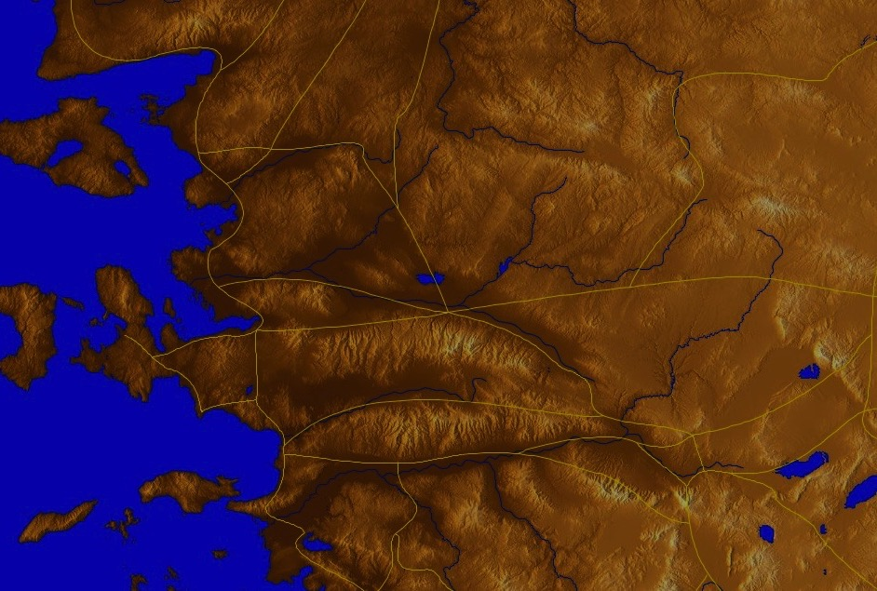
The Overcomers (Rev. 2–3)
365
Pergamum
Thyatira
2:17
2:26
He who overcomes, I will make him a pillar in the temple of My God, and he will not go out from it anymore; and I will write on him the name of My God, and the name of the city of My God, the new Jerusalem, which comes down out of heaven from My God, and My new name (3:12)
Revelation 3
Smyrna
Sardis
2:11
3:5
Philadelphia
Ephesus
2:7
Laodicea
3:12
Dr. Rick Griffith • Jordan Evangelical Theological Seminary • BibleStudyDownloads.org

Slide 2
Revelation 3

Slide 3
Sardis Revelation 3:1-6

Slide 4
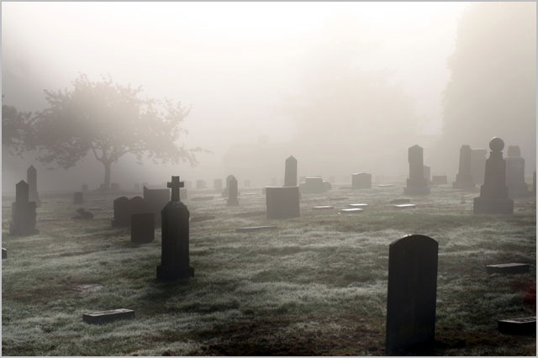
Distinguished Yet Dead
The Church of Sardis (Rev. 3:1-6)

Slide 5
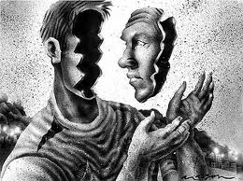
How well do you know yourself?

Slide 6
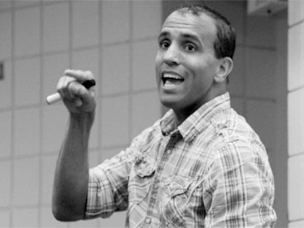
Jim Keenan
Notes:
Jim Keenan is a motivational speaker who runs a website called asalesguy.com. I ran across it this week and found this observation of his very insightful. He writes,
One of our biggest challenges in life is self-assessment. We think we know ourselves pretty well, however the science says different.
As a leader, personal self-assessment is critical to success. We have to be able accurately assess our abilities.
We all have blind spots. Our blind spots are those things that others know about us, that we are unaware of. Our blind spots are those things others see in us, that we can’t see in ourselves.

Slide 7
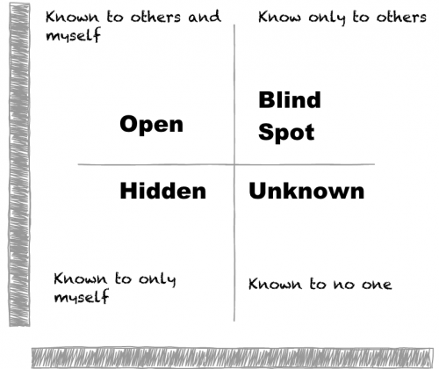
http://asalesguy.com/2012/12/11/how-well-do-you-know-you/
Known to others and myself
Known only to others
Open
Blind Spot
Hidden
Unknown
Known only to myself
Known to no one
Notes:
Johari's window sums it up nicely like this:
The Open – what others know about us and what we openly share with others
The Hidden – what we know about ourselves that others don’t know. (What we keep hidden from site)
The Unknown – what we don’t know about ourselves and what others don’t know
The Blind Spot – what others know about us, that we don’t know about ourselves
The blind spot is where we get tripped up. It’s the reason we fail and seem perplexed because we thought we did everything right. It’s the date that we thought went awesome yet they don’t want to go out with us again. It’s the co-worker feeling belittled after you thought you had a super productive meeting. The blind spot is the part of us we just don’t see that the rest of the world does that screws everything up.
Do you know your blind spot(s)? Ask around, everyone else does.

Slide 8
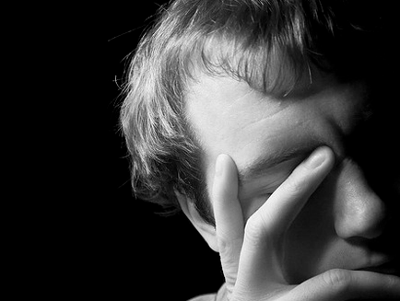
How well do you know yourself?

Slide 9
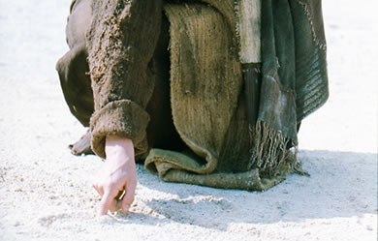
What does Jesus think of you?
Notes:
We have NO actual accounts of Jesus writing anything except what he wrote in the sand in John 8—and we have no idea what he wrote!

Slide 10

If Jesus wrote a letter to our church, what would Jesus say?
R
Revelation

Slide 11
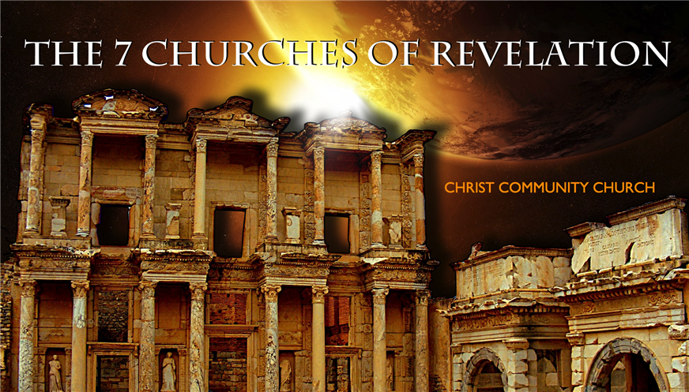
Revelation
The Seven Churches of Revelation
The Writing Ministry of Jesus
This is the third to last of the seven letters of Revelation 2–3

Slide 12
The 7 Churches (Rev. 2–3)
345
Adramyttium
Aezani
Pergamum
Thyatira
Cyme
Erythrae
Sardis
Smyrna
Eumenia
Philadelphia
Lebedus
Colophon
Ephesus
Nysa
Laodicea
Hierapolis
Trailes
Heraclea
Aphrodisias
Colossae
Alabanda
Patmos
Miletus
Notes:
Jesus designed a brilliant strategy by having his revelation sent to capital of the province, Ephesus. It included an individual letter to Ephesus, as well as letters to 6 other key churches. The Ephesians copied the entire book of Revelation, though, and sent the original to the next city, Smyrna. Smyrna then made their own copy and sent the original to Pergamum, which lay on the main road to the north. This city then sent the prophecy to Thyatira, which sent it to Sardis, then Philadelphia, and finally to Laodicea.

Slide 13
The 7 Churches (Rev. 2–3)
345
Pergamum
Thyatira
Sardis
Smyrna
Philadelphia
Ephesus
Laodicea
Notes:
These 7 churches were neither the largest, nor the most influential cities in Asia Minor. However, they were strategically located on a key highway that linked them all.
[Animate} From their own locations we understand that they also copied the prophecy and sent these copies to other churches near them.

Slide 14
7 Church Stages?
347
Mistreated yet Missions-Minded
Suffering yet Steadfast
Continuing yet Compromising
Distinguished yet Dead
Busy yet Backslidden
Involved yet Immoral
Luxurious yet Lukewarm
Modern Missions Era
Reformation
Constantine
Middle Ages
Materialistic
Apostolic Age
Church Fathers
33
100
313
476
1453
1795
1900
Philadelphia
Ephesus
Smyrna
Pergamum
Thyatira
Sardis
Laodicea
Notes:
Some scholars over the years have believed that these churches represent 7 stages of church history:
33—The Apostles of Christ pass on the gospel, but by AD 95 the love at Ephesus had grown cold
100—Last Apostle died (John) with the message passed on to their disciples, called the "Church Fathers"
313—Constantine began to merge Christianity and paganism. With paganism illegal, it took on a "Christianized" form.
476—Rome's Fall ushered in 1000 years of deviation from classical learning called the "Middle Ages" with Rome's influence through the RCC
1453—The conquest of Constantinople by the Turks began the Renaissance, followed by the Reformation
1793—William Carey left England for India, sparking the movement of the gospel from the West to the Two-Thirds World
1900—The decline of Christianity in Europe began to be replaced with humanism, materialism, modernism, and post-modernism

Slide 15
Four Views on Rev. 2–3
345
Pergamum
Historic Churches
Historico- Prophetical
Prophetic View
Thyatira
Sardis
Smyrna
Philadelphia
Ephesus
Laodicea
Typical (Representative)
Notes:
Four Views:
Historic Churches: The 7 churches were actual churches at John’s time. All actually hold to this view except Bulllinger, who in 1935 taught seven churches are seven Jewish congregations in the future Tribulation period. Almost all see these as depicting seven churches that can be found in any age.
Prophetic: The chapters deal purely with stages of church history without identifying any first century church, shown by remarkable resemblance to successive eras of church history (taught by Cohen, Understanding Revelation, 48-49; and J. A. Seiss, The Apocalypse [London: Marshall, Morgan, and Scott, n.d.], 76-86).
Historico-Prophetical: The churches depict BOTH historic churches of the first century and stages of church history. "This approach is commonly taken in dispensational commentaries; see e.g., Herman A. Hoyt, The Revelation of the Lord Jesus Christ (Winona Lake, IN: BMH, 1966) 17,25-29, and John F. Walvoord, The Revelation of Jesus Christ (Chicago: Moody, 1966) 52, who holds the view cautiously. See also Menno J. Brunk, "The Seven Churches in Revelation 2-3," BSac 126 (1969) 240-46, and Gary G. Cohen, Understanding Revelation (Collingswood, NJ: Christian Beacon, 1968) 44-65, who presents a more impressive argument. Of course, the prophetic view is held by non-dispensationalists as well (e.g., J. P. Lange, Commentary on the Holy Scriptures- Revelation [reprint; Grand Rapids: Zondervan, n.d.] 139). See also the survey of R. C. Trench, Commentary on the Epistles to the Seven Churches in Asia (6th ed., rev.; reprint; Minneapolis: Klock and Klock, 1978) 237-45" (James L. Boyer, "Are the Churches of Revelation 2–3 Prophetic?" Grace Theological Journal 6.2 [1985] 267-273). He answers YES.
Typical (Representative): They were real churches, but also represent types of churches found throughout church history. Therefore, this view is also called the typical or representative view.
Critique of Each View:
Historic Churches: The doubt about whether all of the churches existed is flawed—just because we don’t know about each of them does not mean they did not exist (argument from silence)
Historico-Prophetical: Church history had not 7, but 3, stages: Ancient (to 590), Medieval (590-1517), and Modern (1517-present); designations are arbitrary (e.g., is Sardis pre-Reformation or the Reformation itself?)
Prophetic: (a) Any prophetic element would destroy the doctrine of imminency, so the chapters must relate only to actual first century churches since the 4th and 6th letters refer to Christ’s imminent coming, and Philadelphia would be given a false hope of deliverance from wrath (3:10) if the church had to wait until the "Laodicean age." (b) Nothing in these chapters or elsewhere in the NT hint at these being stages of church history. (c) These letters differ from the prophetic portions of the book (Rev. 4–22) in that they are simply epistles similar to those written by Paul.
Typical (Representative): (a) Imminency would be ruined only "if it stated explicitly there would be a period of at least two thousand years before the second advent, or even if it had stated explicitly that there would be ‘seven periods of church history’ (Boyer, 269-70. (b) These seven churches do not represent all types of churches of the first century or any other, for other types exist besides these (e.g., Galatian or Corinthian), and "seven" better pictures the whole of the church age than would the 3 stages proposed above.

Slide 16
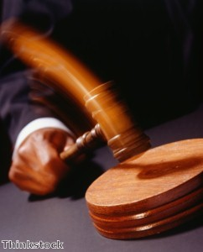
Christ has authority over all churches
344

Slide 17
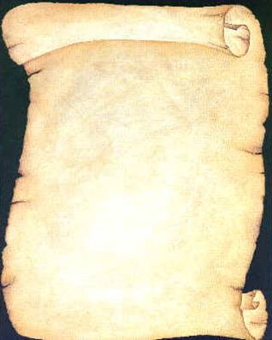
So Jesus wrote 7 churches (Rev. 2–3)
Ephesus
Smyrna
Pergamum
Thyatira
Sardis
Philadelphia
Laodicea

Slide 18

Revelation
Sovereignty of Christ in Future Victory
Sovereignty in His Person |  |  | Sovereignty over Churches | Sovereignty in End-Time Events
Chapter 1 |  |  | Chapters 2–3 | Chapters 4–22
"What you have seen" (1:19a) |  |  | "What is now" (1:19b) | "What will take place later" (1:19c)
Past |  |  | Present | Future
Christ Unveiled |  |  | Churches Unveiled | Consummation Unveiled
God on Earth |  |  | God's Ambassadors on Earth | Hell on Earth to Heaven on Earth
The Judge |  |  | The Assignments | The Judgments & Rewards
Subject 1:1-3 | Worship of Trinity 1:4-8 | Glorified Christ 1:9-20 | Seven Churches of Asia: Ephesus Smyrna Pergamum Thyatira Sardis Philadelphia Laodicea | Tribulation 4:1–19:10 | Second Coming 19:11-21 | Millennium 20 | Eternal State 21:1–22:5 | Closing: Imminency 22:6-21
AD 95
318, 324 M

Slide 19
The 7 Churches (Rev. 2–3)
Promise
348
Pergamum
Warning
Thyatira
Exhortation
Rebuke
Commendation
Smyrna
Sardis
N/A
Christ
N/A
N/A
N/A
Ephesus
Philadelphia
N/A
Laodicea
Notes:
Though some exceptions exist (noted with "N/A" above), the basic pattern of the seven letters is a sevenfold outline:
Church name
Christ Described in a Unique Way for that Church
Commendation of Good Deeds among the Believers
Rebuke of Sin within the Church
Exhortation or Encouragement to Repent
Warning if the Exhortation is Disobeyed
Promise for Faithfulness
Notice also that each letter not only begins with a reference to Christ but ends with an appeal from the Spirit.

Slide 20
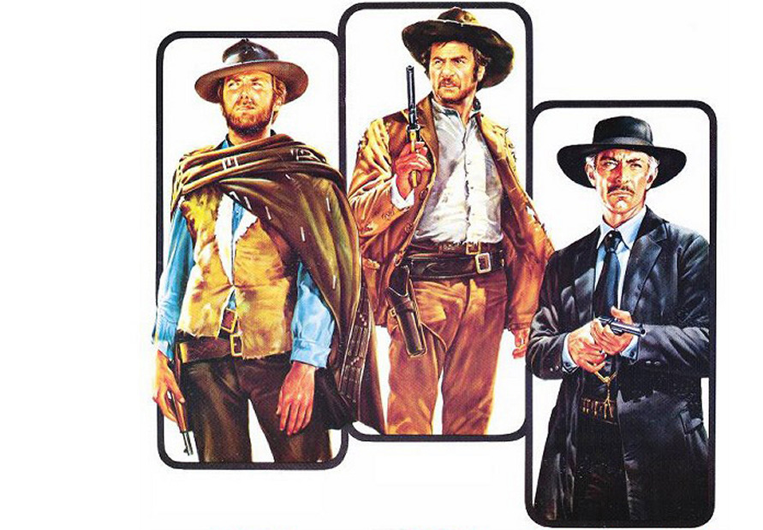
Clint Eastwood 1966
THE GOOD
THE BAD
AND THE UGLY

Slide 21

Christ knows it all
The Church of Sardis (Rev. 3:1-6)

Slide 22

I. Jesus knows the good.

Slide 23
Jesus encouraged Sardis with the good news that he was sovereign and knew their faithfulness (3:1-2a)
345
Adramyttium
Aezani
Pergamum
Thyatira
Cyme
Erythrae
Sardis
Smyrna
Eumenia
Lebedus
Colophon
Ephesus
Nysa
Hierapolis
Trailes
Heraclea
Aphrodisias
Colossae
Alabanda
Patmos
Miletus
Notes:
Jesus designed a brilliant strategy by having his revelation sent to capital of the province, Ephesus. It included an individual letter to Ephesus, as well as letters to 6 other key churches. The Ephesians copied the entire book of Revelation, though, and sent the original to the next city, Smyrna. Smyrna then made their own copy and sent the original to Pergamum, which lay on the main road to the north. This city then sent the prophecy to Thyatira, which sent it to Sardis, then Philadelphia, and finally to Laodicea.

Slide 24
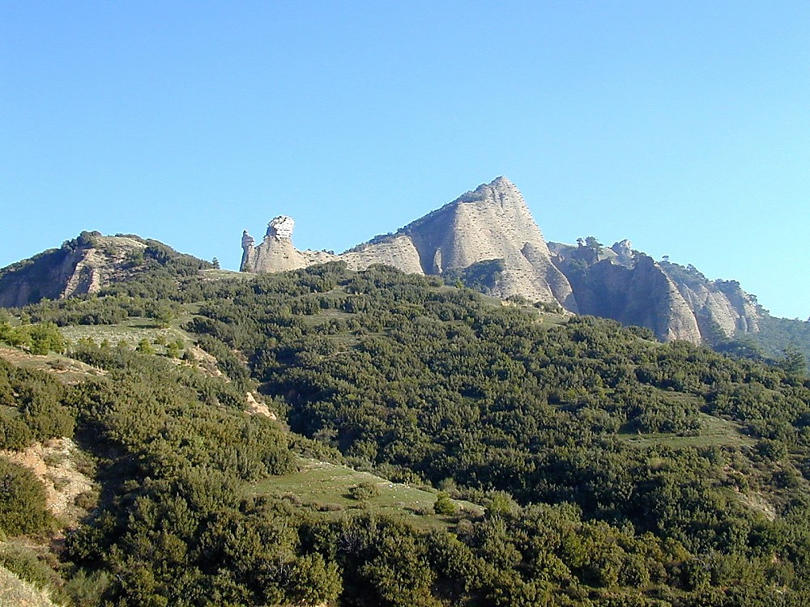
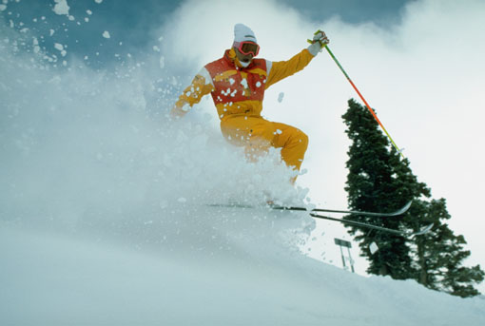
Sardis acropolis from below
Sardis Acropolis from Below
Notes:
Historical Background
Sardis was a city of Roman Asia, located in western modern-day Turkey. The acropolis of Sardis, large and imposing, is part of the edge of the mountain range Tmolus, forming a natural fortress difficult to penetrate. Unfortunately, few ruins have been found upon it.
Lydia—Founded in 1200 B.C., Sardis was the capital of the Lydian kingdom under King Gyges. It was a prosperous city, especially under Croesus; its wealth was thought to come from the Pactolis River, which ran through the ancient city. According to mythology, this was the river of the great Phrygian King Midas, in which he washed to cleanse himself of his "golden touch," which even turned his food to gold. Gold found on the banks of the Pactolis was used for the production of gold coins during this time.
Persia—When Kings Cyrus of the Persians besieged and took the city (then called Pers Sparda) in 546 B.C., Lydian control came to an end. Cyrus took the citadel by means of scaling the cliffs in the dark of night, a method repeated years later (214 B.C.) by Antiochus the Great.
Greece—Alexander the Great gave Sardis its independence in 333 B.C. Sardis was under Seleucid control from 270-190 B.C.
Rome—In 188 B.C. the Romans defeated Antiochus III and gave Sardis to King Eumenes II of Pergamos, who held control until 133 B.C. when it came back to Roman power. Sardis honored various Roman Caesars and remained a prominent city until ca. 26 A.D., when it lost out to Smyrna for the privilege of building the imperial temple.

Slide 25
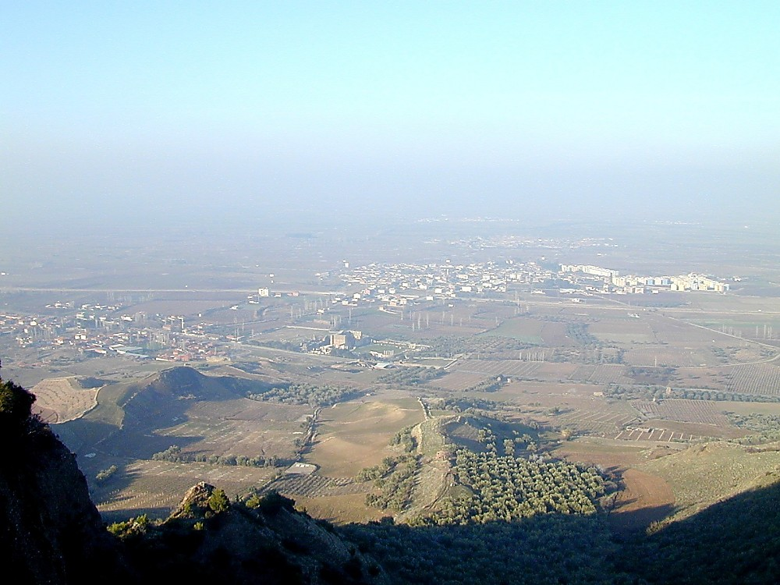
Sardis from acropolis
Sardis from Acropolis
Notes:
Biblical Significance
Sardis became an important center for Christianity during Roman times. In fact, it is one of the seven churches to whom the John wrote the letters mentioned in Revelation 1:11. However, John’s letter to Sardis (Revelation 3:1-6) reveals that the attitude of the believers in the city reflected that of the city as a whole, resting on past reputation and not being faithful. In fact, Sardis was more completely rebuked than any city, aside from Laodicea. Sardis remained a center for Christianity well into the 14th century A.D.

Slide 26
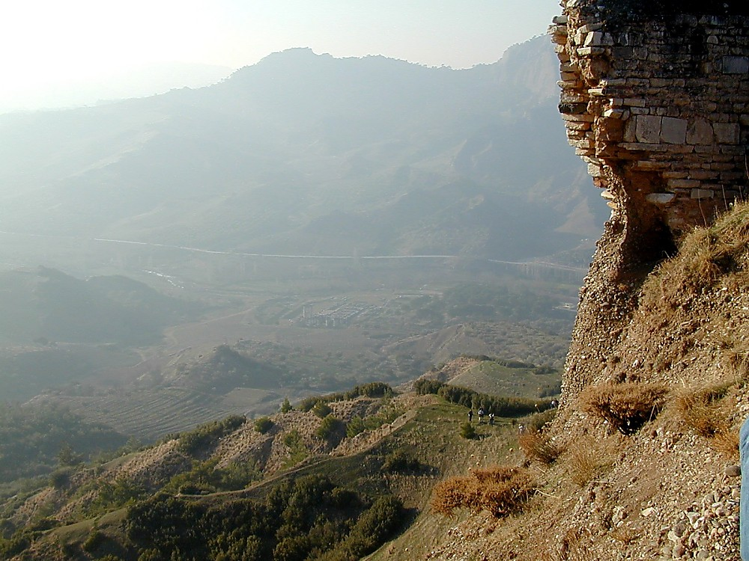
Sardis Temple of Artemis from above
Sardis Temple of Artemis from Above
Notes:
Artemis was held to be one of the patron deities of Sardis, along with Cybele. A temple dedicated to Artemis lies at the foot of the steep acropolis.

Slide 27
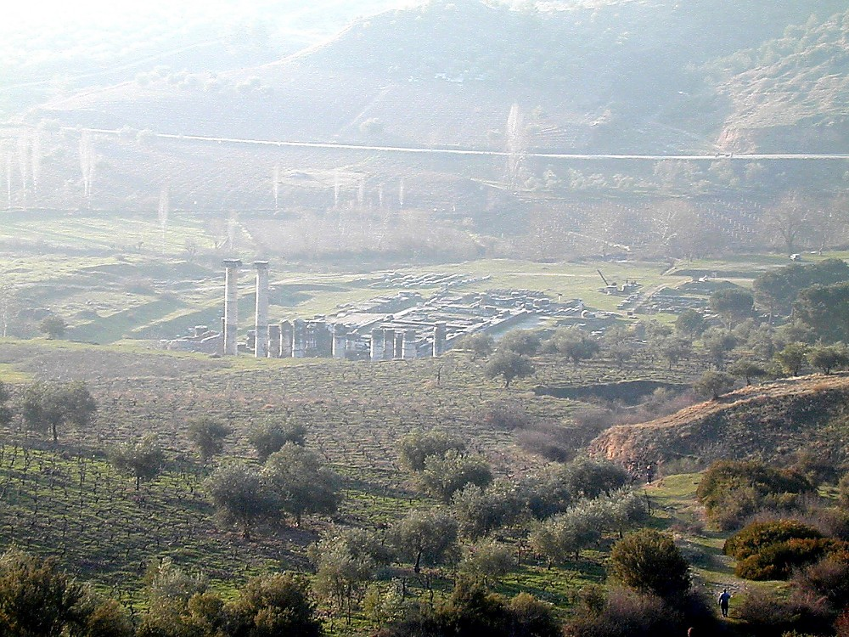
Sardis Temple of Artemis from above
Sardis Temple of Artemis from Above
Notes:
This temple to Artemis was built by Croesus in the 6th century B.C. but was then destroyed in the Ionian Revolt of 499 B.C. It was a magnificent structure, the fourth-largest Ionic-style temple existing in the ancient world. Alexander the Great began to rebuild this temple in 334 B.C. but never finished. Its remains were covered over by landslides from an earthquake in 17 A.D.

Slide 28
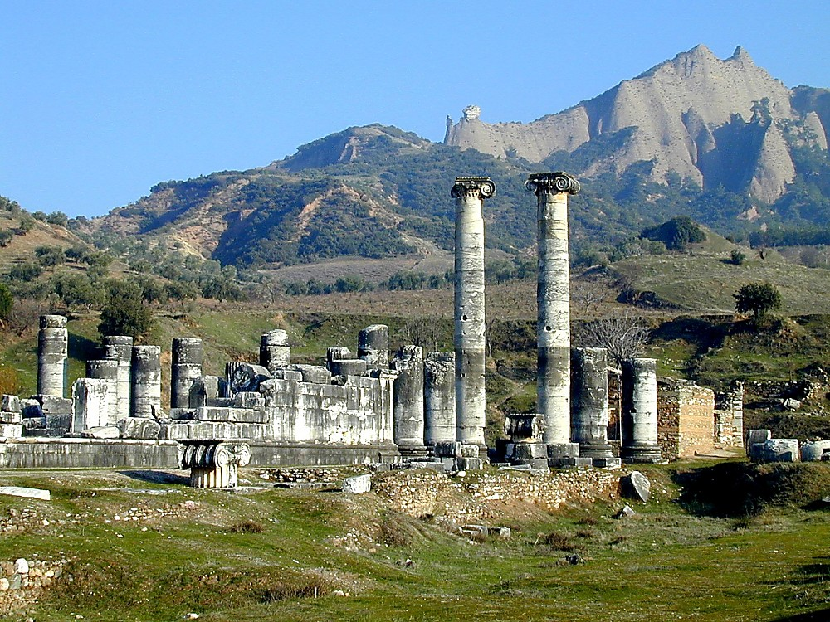
Sardis Temple of Artemis
Sardis Temple of Artemis

Slide 29
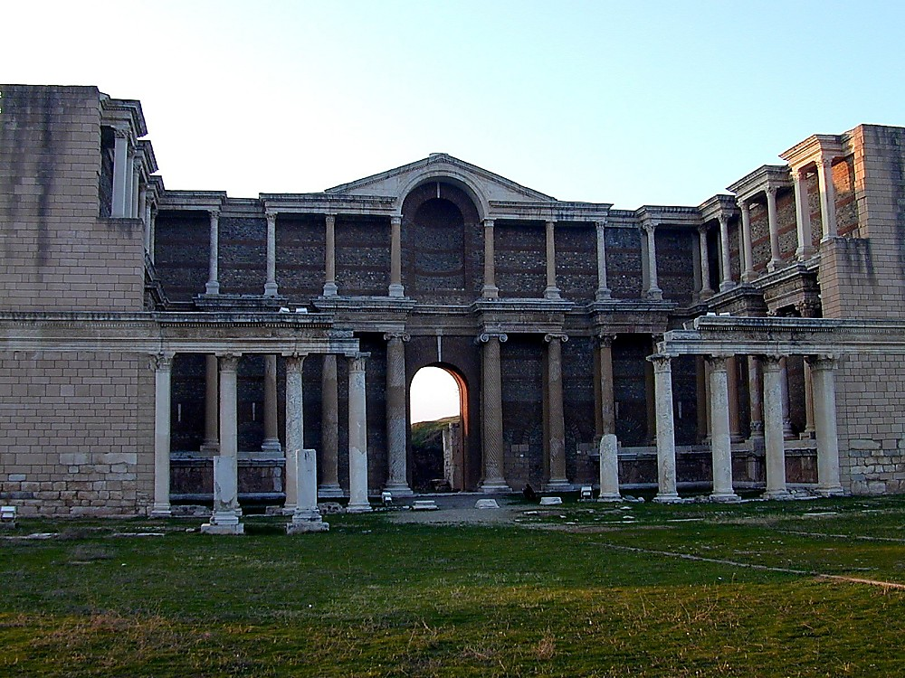
Sardis gymnasium
Sardis Gymnasium

Slide 30
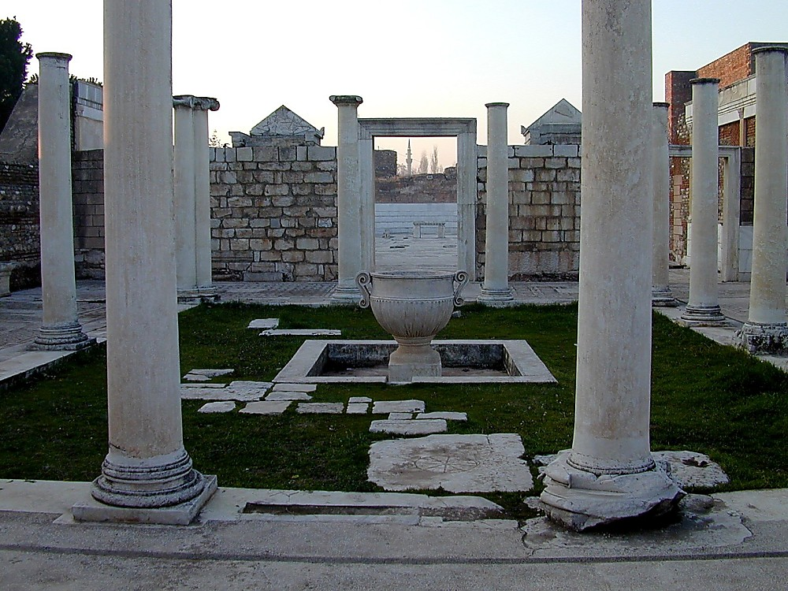
Sardis synagogue, 4th c AD
Sardis Synagogue, 4th c AD
Notes:
Jews in Sardis
There was a large Jewish Diaspora community in Sardis during Roman times, which may have existed for centuries before. The Sepharad (Aramaic name for Sardis) mentioned in Obadiah 20 (these being exiles from Jerusalem ca. 586 B.C.) may refer to Sardis. Seleucid King Antiochus III (late third century B.C.) expanded the Jewish community by means of transferring Jews from Mesopotamia to Lydia.
According to Josephus, Jews of Sardis were granted various privileges during the time of Julius Caesar, including the right to send temple tax to Jerusalem, to have a communal life and conduct suits among themselves, and to receive provisions of ritually clean food.
The approximately eighty inscriptions found in this ostentatious structure reveal that many Jews held high positions, serving on the city council or as wealthy citizens of Sardis. This synagogue (called Beth Alpha) found next to the Marble Hall attests this, since it is the largest synagogue ever found. These remains date to the 4th century A.D., but the three other levels found show that a structure existed here since the 2nd century A.D., although it may have served a different purpose (possibly a basilica).

Slide 31
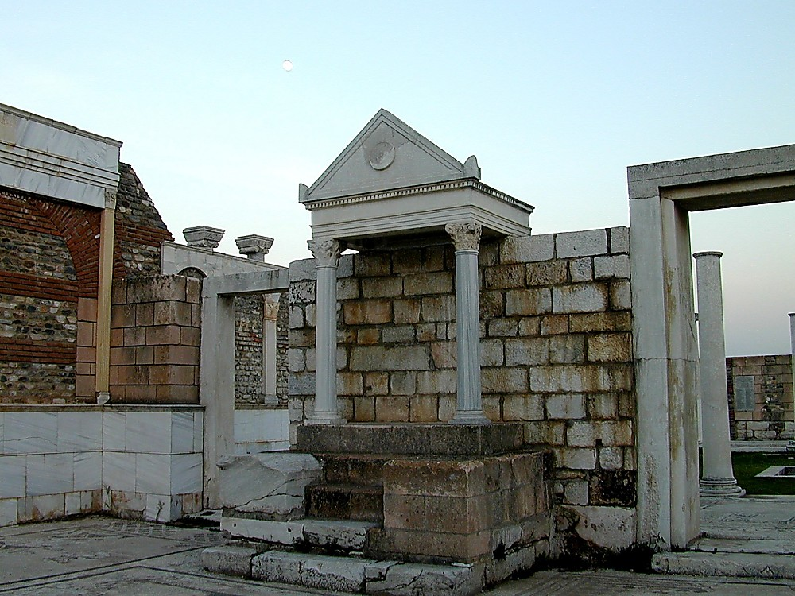
Sardis synagogue bema
Sardis Synagogue Bema

Slide 32
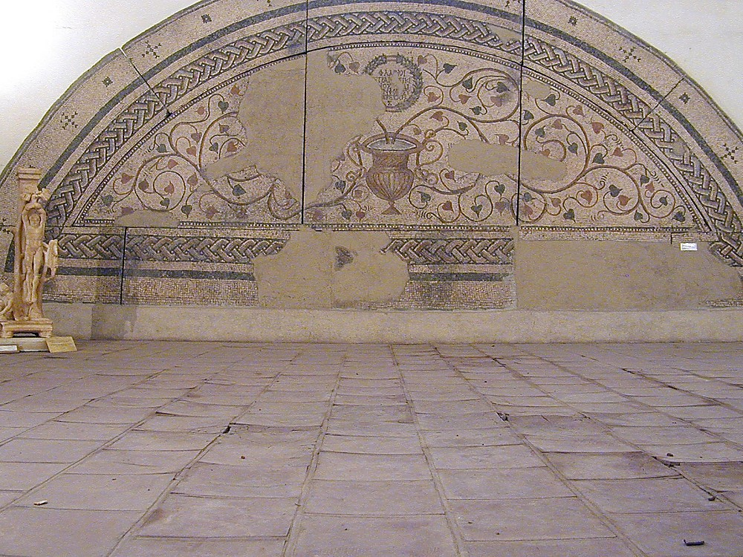
Sardis synagogue mosaic, 400 AD
Sardis Synagogue Mosaic, AD 400

Slide 33
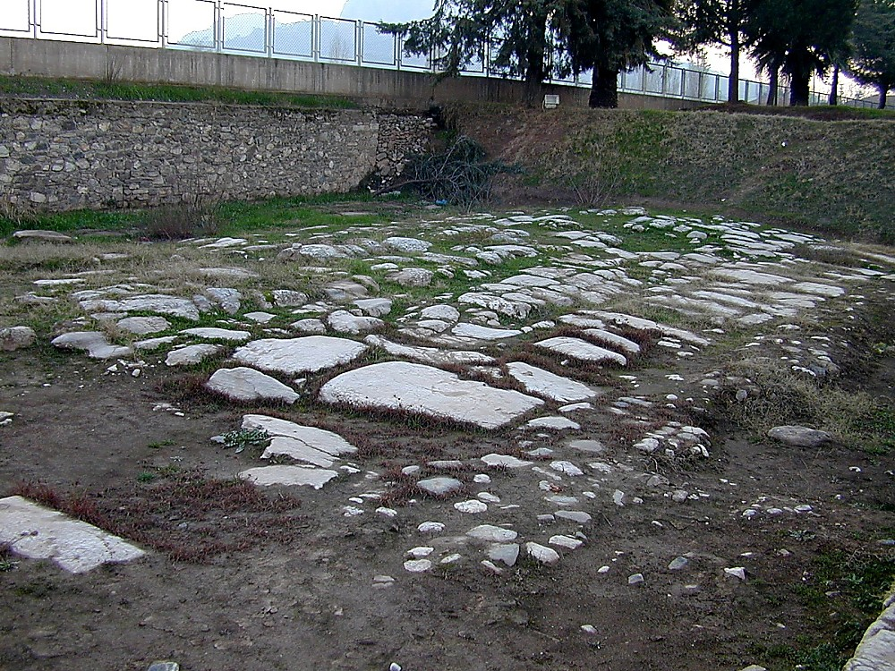
Sardis paved Roman street leading to Persia
Sardis Paved Roman Street Leading to Persia
Notes:
Part of Sardis’s prosperity was based upon its location, which was at the crossroads of several major trade routes.

Slide 34
Sardis (Rev. 3:1-6)
357
Pergamum
Thyatira
Christ: Holds the seven spirits of God and the seven stars
Smyrna
Sardis
Ephesus
Philadelphia
Laodicea

Slide 35
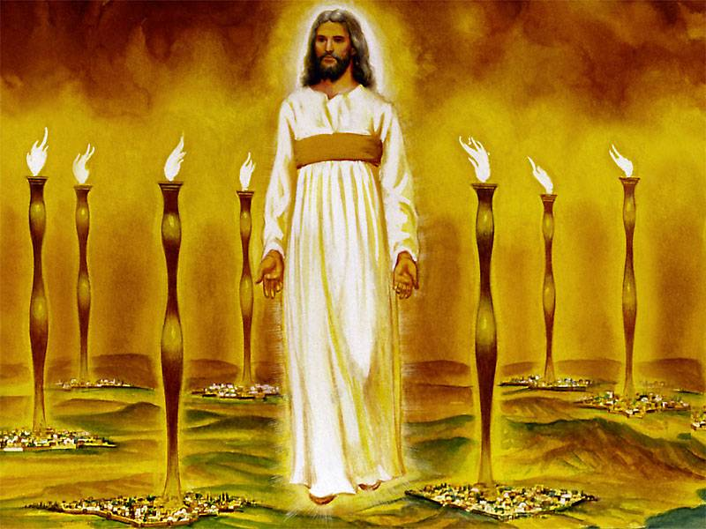
John's vision of the glorified Christ proves He can handle the Church's internal and external problems (1:12-16)
343
Notes:
"Christ's garments are those of a Judge-King, One with honor and authority. The white hair symbolizes His eternality, "the Ancient of Days" (Dan. 7:9, 13, 22). His eyes see all (Rev. 19:12; Heb. 4:12), enabling Him to judge righteously. His feet of burning brass also suggest judgment, since the brazen altar was the place where the fire consumed the sin offering. The Lord had come to judge the churches, and He would also judge the evil world system.
The "sound of many waters" (Rev. 1:15) makes me think of Niagara Falls! Perhaps two ideas are suggested here: (1) Christ gathers together all the "streams of revelation" and is the Father's "last Word" to man (Heb. 1:1–3); (2) He speaks with power and authority and must be heard. The sword from His mouth certainly represents the living Word of God (Heb. 4:12; Eph. 6:17). He fights His enemies by using His Word (Rev. 2:16; 19:19–21)" (Wiersbe).

Slide 36

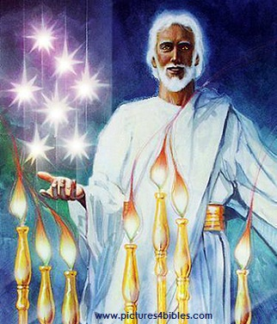
What are the 7 Stars & 7 Lampstands (1:20 NLT)?
"This is the meaning of the mystery of the seven stars you saw in my right hand and the seven gold lampstands: The seven stars are the angels of the seven churches, and the seven lampstands are the seven churches."

Slide 37
Sardis (Rev. 3:1-6)
357
Pergamum
Thyatira
Commendation:
Deeds
Reputation for being alive
Christ: Holds the seven spirits of God and the seven stars
Smyrna
Sardis
Ephesus
Philadelphia
Laodicea

Slide 38

Christ knows all your good deeds and reputation

Slide 39

How much do you care?

Slide 40
I. Jesus knows the good.

Slide 41
II. Jesus knows the bad.

Slide 42
Sardis (Rev. 3:1-6)
357
Pergamum
Thyatira
Rebuke
You are dead
Commendation:
Deeds
Reputation for being alive
Christ: Holds the seven spirits of God and the seven stars
Smyrna
Sardis
Ephesus
Philadelphia
Laodicea

Slide 43
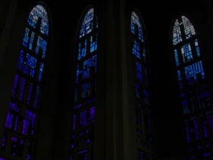
Sardis: Distinguished Yet Dead
357
"You have a reputation for being alive, but in reality you are dead" (3:2)

Slide 44
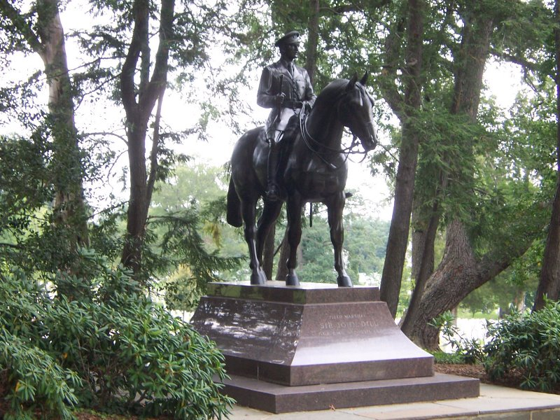
Sardis: Distinguished Yet Dead

Slide 45
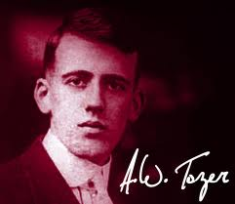
A. W. Tozer
"If the Holy Spirit was withdrawn from the church today, 95 percent of what we do would go on and no one would know the difference. If the Holy Spirit had been withdrawn from the New Testament church, 95 percent of what they did would stop, and everybody would know the difference."
Notes:
http://www.patheos.com/blogs/robertcrosby/2012/05/a-w-tozer-on-the-holy-spirit-todays-church/

Slide 46
Sardis (Rev. 3:1-6)
357
Pergamum
Thyatira
Exhortation
Wake up!
Rebuke
You are dead
Commendation:
Deeds
Reputation for being alive
Christ: Holds the seven spirits of God and the seven stars
Smyrna
Sardis
Ephesus
Philadelphia
Laodicea

Slide 47
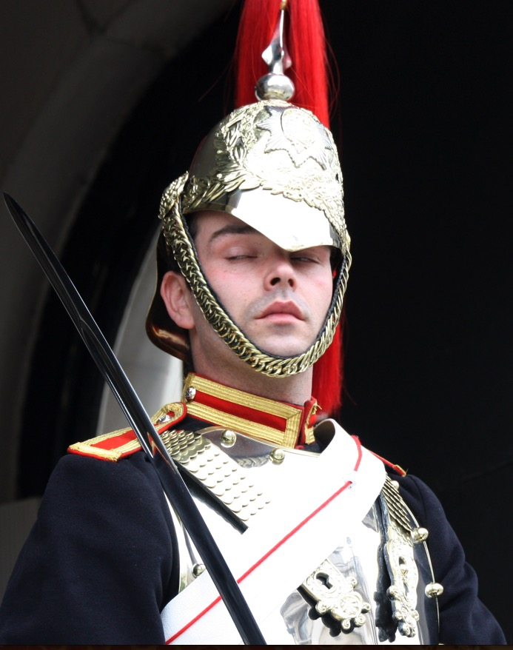
Sardis
358
Wake up! Strengthen what little remains, for even what is left is almost dead… (3:2 NLT).

Slide 48
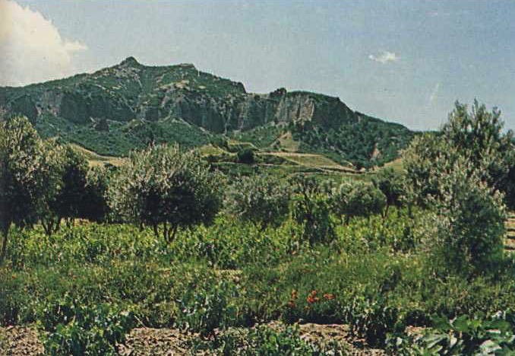
Sardis
358
Sardis stood on this impregnable lookout 457.5 m. (1500 ft.) above the plain. Soldiers of Cyrus (549 BC) and Antiochus (214 BC) conquered it twice by climbing the unguarded north cliff at night when the guards were asleep.

Slide 49
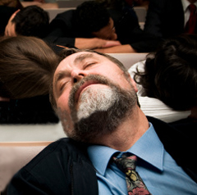
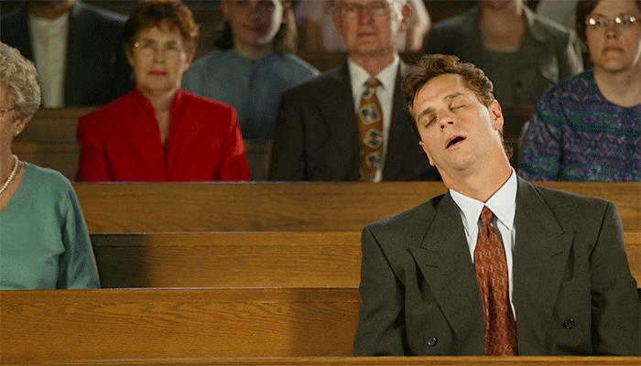
Sleeping in Church

Slide 50
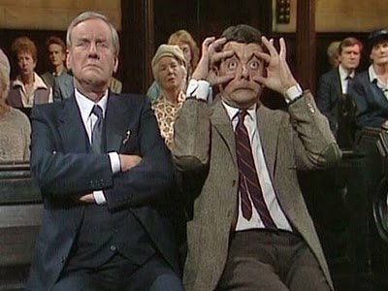
Not Sleeping in Church

Slide 51
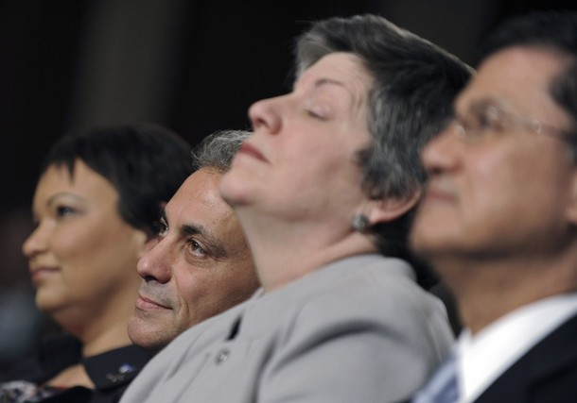
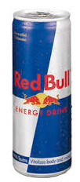
Signs Your Pastor Caught You Napping During His Sermon:
He serves you Red Bull during communion
Notes:
http://sacredsandwich.com/archives/8371

Slide 52
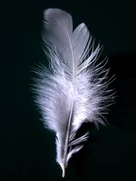
Signs Your Pastor Caught You Napping During His Sermon:
He interrupts his sermon to put shaving foam in your hand, then tickles your nose with a feather

Slide 53
Signs Your Pastor Caught You Napping During His Sermon:
He begins questioning his calling due to your inattentiveness, then quits the ministry, starts drinking heavily, and dies alone in a skid row flophouse.
Notes:
http://sacredsandwich.com/archives/8371

Slide 54
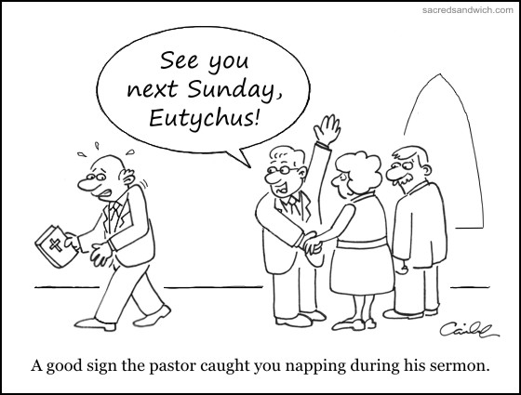
Sleeping in Church
See you next Sunday, Eutychus!
A good sign the pastor caught you napping during his sermon.
Notes:
http://sacredsandwich.com/archives/8371

Slide 55
Sardis (Rev. 3:1-6)
357
Pergamum
Warning
If you do not wake up, I will come like a thief against you
Thyatira
Exhortation
Wake up!
Strengthen what remains
Remember what you received, obey it, repent
Rebuke
You are dead
Commendation:
Deeds
Reputation for being alive
Christ: Holds the seven spirits of God and the seven stars
Smyrna
Sardis
Ephesus
Philadelphia
Laodicea

Slide 56
Sardis
358
Wake up! Strengthen what little remains, for even what is left is almost dead… If you don't wake up, I will come to you suddenly, as unexpected as a thief (3:2-3 NLT).

Slide 57
Wake up!
Known to others and myself
Known only to others
• Family
• Spiritually malnourished
Open
Blind Spot
Hidden
Unknown
http://asalesguy.com/2012/12/11/how-well-do-you-know-you/
Known only to myself
Known to no one
Notes:
Johari‘s window sums it up nicely like this:
The Open – what others know about us and what we openly share with others
The Hidden – what we know about ourselves that others don’t know. (What we keep hidden from site)
The Unknown – what we don’t know about ourselves and what others don’t know
The Blind Spot – what others know about us, that we don’t know about ourselves
The blind spot is where we get tripped up. It’s the reason we fail and seem perplexed because we thought we did everything right. It’s the date that we thought went awesome yet they don’t want to go out with us again. It’s the co-worker feeling belittled after you thought you had a super productive meeting. The blind spot is the part of us we just don’t see that the rest of the world does that screws everything up.
Do you know your blind spot(s)? Ask around, everyone else does.

Slide 58
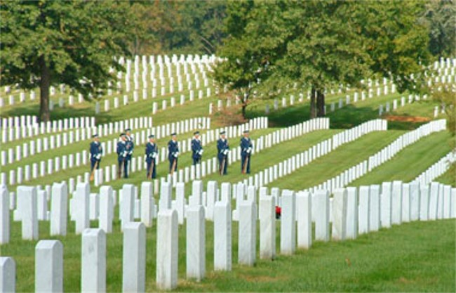
Christ warns us as a church to wake up too
He owns all we have
Caring for people means caring for their kids

Slide 59
I. Jesus knows the good.

Slide 60
II. Jesus knows the bad.

Slide 61
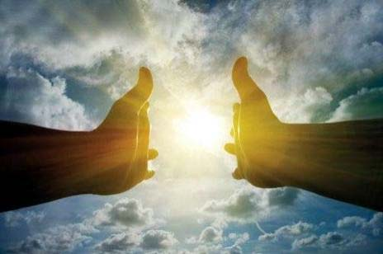
III. Jesus knows the future.

Slide 62
Sardis (Rev. 3:1-6)
357
Promise
Jesus promised believers at Sardis that they are victorious and secure to walk with him in purity (3:4-6)
Pergamum
Warning
If you do not wake up, I will come like a thief against you
Thyatira
Exhortation
Wake up!
Strengthen what remains
Remember what you received, obey it, repent
Rebuke
You are dead
Commendation:
Deeds
Reputation for being alive
Christ: Holds the seven spirits of God and the seven stars
Smyrna
Sardis
Ephesus
Philadelphia
Laodicea

Slide 63
The Overcomers (Rev. 2–3)
365
Pergamum
Thyatira
2:17
2:26
He who overcomes will thus be clothed in white garments; and I will not erase his name from the book of life, and I will confess his name before My Father and before His angels (3:5)
Smyrna
Sardis
2:11
3:5
Ephesus
Philadelphia
2:7
Laodicea

Slide 64
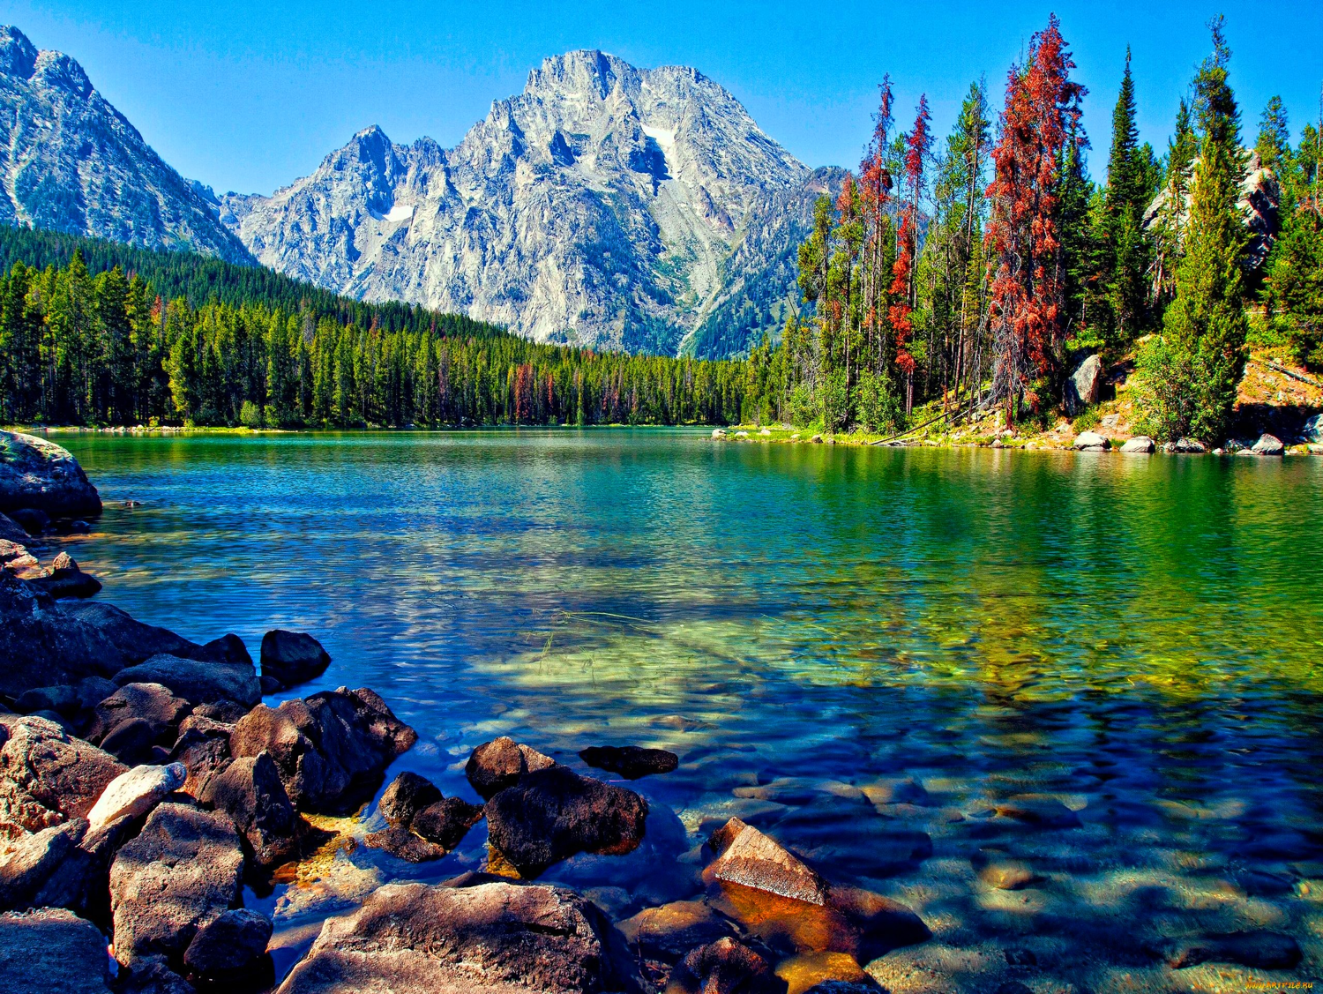
Christ has a fantastic future for you!
"Anyone with ears to hear must listen to the Spirit and understand what he is saying to the churches" (3:6 NLT)

Slide 65
If Jesus wrote a letter to you, what would Jesus say?
R
Revelation

Slide 66
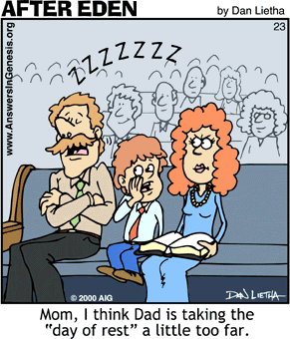
Main Idea?
Don't sleep in church!
Mom, I think Dad is taking the "day of rest" a little too far.

Slide 67
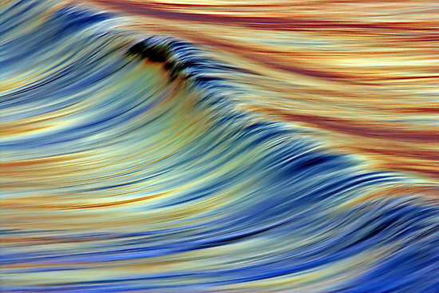
Main Idea:
Jesus knows your good, bad, and future!

Slide 68
Will you wake up?
How can you be more spiritually awake in this coming year?

Slide 69

Will you wake up?
Yes No
Yes
No

Slide 70
Philadelphia Revelation 3:7-13

Slide 71
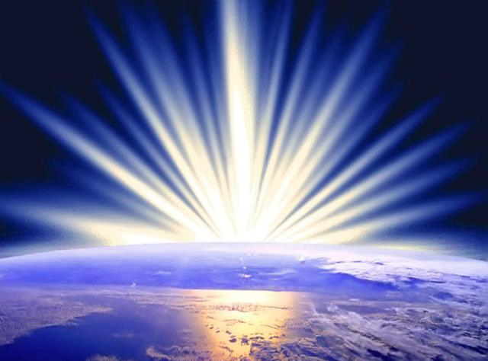
Mistreated Yet Missions-Focused
The Church of Philadelphia (Rev. 3:7-13)
Dr. Rick Griffith • Singapore Bible College • biblestudydownloads.com

Slide 72
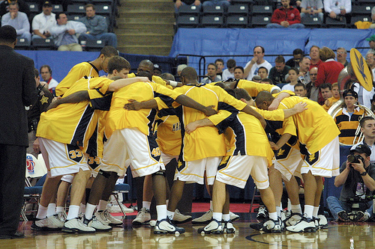
The Huddle

Slide 73

Who hates unity?
No one.

Slide 74
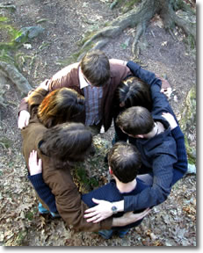
Our Huddle
Thank God for making us one despite our 16 countries!

Slide 75
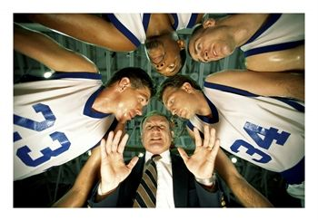
The Huddle

Slide 76

The Holy Huddle
THE HOLY HUDDLE
Worship • Unity • Focus

Slide 77

The Holy Huddle
Where everyone looks • acts • sounds • smells just like us!

Slide 78
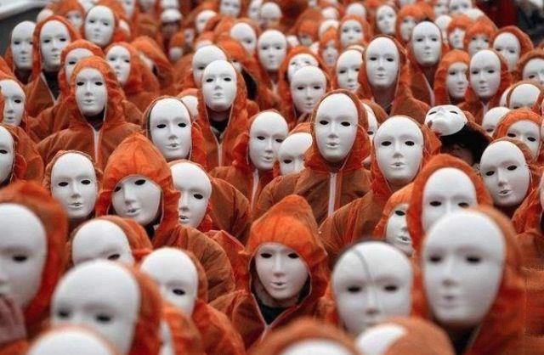
The Holy Huddle
Uniformity—not unity

Slide 79

Why do you like CIC?

Slide 80

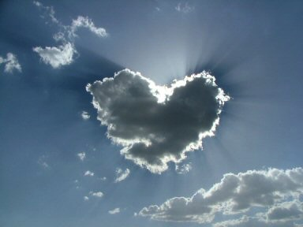
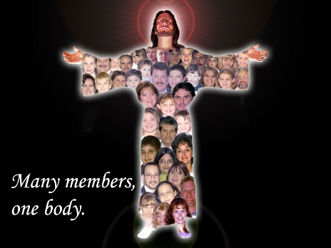
Our Vision is to…
Love God
Love the Church
Notes:
• Love God
Where it starts—and ends—is in our call to LOVE. As Paul noted, "The greatest of these is love" (1 Cor. 13:13).
What is the most important thing we do as a church? It begins with loving the God who loves us.
• Love Church
Do you genuinely love him? If you don’t, then nothing else you do counts, really.
The second thing He said right after this: to love your neighbor as yourself.
• Love Nations
But who is your neighbor? It starts right here in the body—to love the church—but then it extends from this "close neighbor" to those who are out of the reach of this fellowship where we love the nations. Our leadership is committed to make all that we do revolve around one of these three priorities.
80

Slide 81

Do you want our church to stay small?
Where everyone looks like you
Notes:
But do you want our church to remain small?
Do you fear us getting big where we lose our family atmosphere?
Do you fight growth?
Or do you enfold new people?
Do you invite others to church?

Slide 82
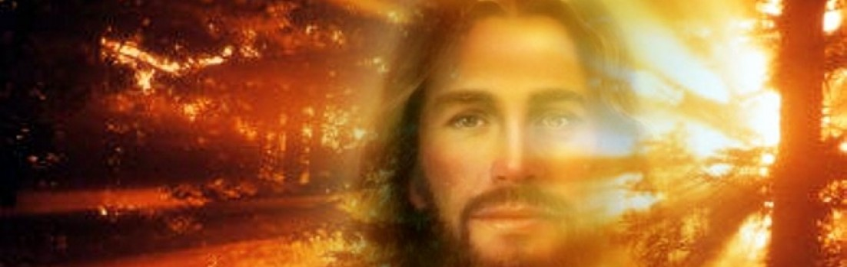
What does Jesus want for us? Doesn't he want us to reach out?
How does Jesus encourage us to reach out?

Slide 83
Revelation
The Seven Churches of Revelation
The Writing Ministry of Jesus
This is the second to last of the seven letters of Revelation 2–3
Notes:
Slide 80

Slide 84
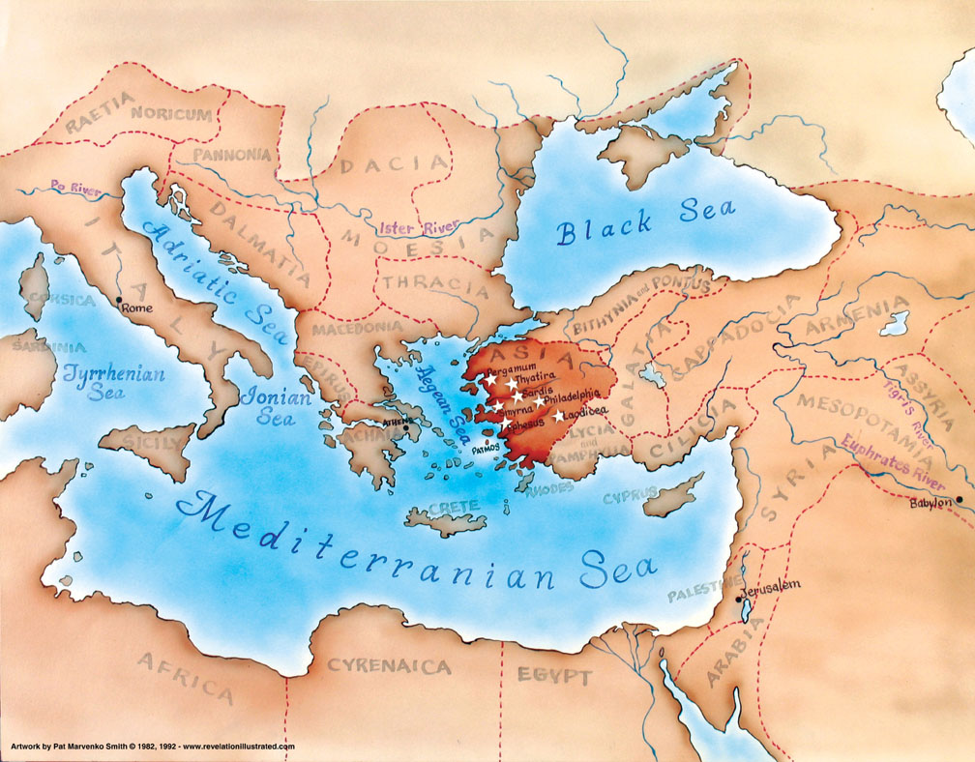
Asia in the Roman Empire
321

Slide 85

What did John see around him?
Title Page 321
Asian Churches
Rome
2. External Persecution from Rome (1:9; 2:9-10; 3:10)
1. Internal Struggles inside churches (2:4, 14-15, 21-24; 3:1, 15-17)

Slide 86
The Chiasm (Rev. 2–3)
366
Ephesus
Existence Threatened
Smyrna
Faithful in Persecution
Pergamum
Mixed Bag
Thyatira
Sardis
Philadelphia
Laodicea

Slide 87

So how does Jesus encourage us to reach out?
In two ways…
Rev. 3:7-13

Slide 88

I. Christ opens doors for witness (3:7-8).

Slide 89

OH NO! NOT EVANGELISM!

Slide 90
Christ gave Philadelphia opportunities to witness (3:7-8).

Slide 91

Philadelphia view to south from acropolis
Founded by Eumenes II, king of Pergamum, or his brother, Attalus II Philadelphus (reigned 159-138 BC), meaning "lover of his brother"
Philadelphia view to south from acropolis
Notes:
Historical Background (BiblePlaces.com)
Philadelphia was founded either by Eumenes II, king of Pergamum, or his younger brother Attalus II, who reigned from 159-138 B.C. Founded in honor of Attalus II, the name of the city means "lover of his brother." This refers to Attalus’ loyalty to his brother in refusing to overthrow him, even amidst encouragement from advisors to do so.
At the edge of the Katakekaumene (the "burned land") was a fertile volcanic plain suitable for agriculture, especially grapes; Philadelphia came to be known for its grape production. It was located in a region plagued by many earthquakes, which severely damaged the city in 17 and 23 A.D. Out of gratitude to Emperor Tiberius for his help in rebuilding it, the city took on the name Neo Caesarea. Emperor Rasmanianus changed this name to Plabia, after his wife, but this name also quickly went out of use.

Slide 92
Where was Philadelphia?
345
Adramyttium
Aezani
Pergamum
Thyatira
Cyme
"Gateway to the East"
Erythrae
Sardis
Smyrna
Eumenia
Philadelphia
Lebedus
Colophon
Ephesus
Nysa
Laodicea
Hierapolis
Trailes
Heraclea
Aphrodisias
Colossae
Alabanda
Patmos
Miletus
Notes:
"…Philadelphia was located on the junction of several important trade routes, earning it the nickname "gateway to the east." The city was intended to serve as a base for the spread of Hellenism [Greek culture] to the recently-annexed territories of Lydia and Phrygia…" (Bolen slide 6, point 2)
(BiblePlaces.com)

Slide 93
Philadelphia (Rev. 3:7-13)
359
Pergamum
Thyatira
Christ:
Holy and true, holds the key of David
Smyrna
Sardis
Ephesus
Philadelphia
Laodicea

Slide 94

"This is the message from the one who is holy and true, the one who has the key of David" (3:7b NLT)
Notes:
"Holy" means Christ is worthy to judge the spiritual life of the Philadelphia church.

Slide 95


"I will give [Eliakim] the key to the house of David—the highest position in the royal court. When he opens doors, no one will be able to close them; when he closes doors, no one will be able to open them" (Isa. 22:22 NLT)
"key" = access to David's wealth
= holding spiritual treasures (e.g., opportunities for service)

Slide 96

"What he opens, no one can close; and what he closes, no one can open" (3:7c NLT)

Slide 97

"I know all the things you do, and I have opened a door for you that no one can close. You have little strength, yet you obeyed my word and did not deny me" (3:8 NLT).
Commendation: He gave them opportunities based on their faithfulness (3:8).

Slide 98
Philadelphia (Rev. 3:7-13)
359
Pergamum
Thyatira
Commendation:
Deeds, keeps Christ's word and does not deny His name, endures patiently
Christ:
Holy and true, holds the key of David
Smyrna
Sardis
Ephesus
Philadelphia
Laodicea

Slide 99

Jesus has given our church many open doors for witness too!
"…I have given you an open door that no one can shut…" (3:8 NLT)
Notes:
So Christ gave them an open door for ministry—and you know what? Christian testimony continues in this city even to today!

Slide 100

Crossroads People 2014
RUSSIA
POLAND
FRANCE
NETHERLANDS
CHINA
KOREA
TAIWAN
HONG KONG
MYANMAR
INDIA
USA
PHILIPPINES
MALAYSIA
SINGAPORE
INDONESIA
CIC
NEW ZEALAND
Notes:
Our church people stem from 16 different countries around the world.
Netherlands (Desiree), Valentin (France), Ruslan (Russia), Samuel, Cynthia, Robert, Geeta, Athan, Chanchan, Yaopei (India), Jieun & Ho Yun (Korea), Conroy (HK), Singpu, Kim (Myanmar), Winkler (USA), Val (Poland), Seliana (Indonesia), Yifen (Malaysia), Xiao Long (China), Kimberly (Taiwan), Paul & Jocelyn (Philippines), Singapore (Albina), New Zealand (Matt & Julie)

Slide 101





Let's reach out to more of our own people living in Singapore!
Crossroads International Church

Slide 102

Our Vision is to…
Love God
Love the Church
Love the Nations
Notes:
• Love God
Where it starts—and ends—is in our call to LOVE. As Paul noted, "The greatest of these is love" (1 Cor. 13:13).
What is the most important thing we do as a church? It begins with loving the God who loves us.
• Love Church
Do you genuinely love him? If you don’t, then nothing else you do counts, really.
The second thing He said right after this: to love your neighbor as yourself.
• Love Nations
But who is your neighbor? It starts right here in the body—to love the church—but then it extends from this "close neighbor" to those who are out of the reach of this fellowship where we love the nations. Our leadership is committed to make all that we do revolve around one of these three priorities.
102

Slide 103

Our Mission Giving
• Thailand • Vietnam • India • Mongolia • Philippines • Myanmar
• Pakistan
• Bangladesh • Afghanistan • Nepal
• Canada (training for Indonesia)

Slide 104

Missions Giving
20%

Slide 105

Open door to mission trips
"…I have given you an open door that no one can shut…" (3:8 NLT)

Slide 106
56 Teaching Trips (1997-2015)
MONGOLIA
JORDAN
KOREA
CHINA
NEPAL
MYANMAR
INDIA
THAILAND
VIETNAM
MALAYSIA
SRI LANKA
SINGAPORE
SBC
INDONESIA
Notes:
From 1997-Dec 2015 God has seen fit to grant me the privilege to train pastors in 12 other countries on 56 trips the past 18 years.

Slide 107



2010 MISSION TRIP
Where? MONGOLIA
When? September 4-12, 2010
What? Teaching

Slide 108

2012 MYANMAR MISSION
Who? Lewis & Barbara Winkler
Where? YANGON
When? 30 Nov-3 Dec
What? Officiating & Teaching

Slide 109

Invitations to Reach Outside Singapore Now
Myanmar: Jonathan Stone
Thailand: Manik Corea

Slide 110

Myanmar 2014?
Jonathan Stone

Slide 111

Corea Family in Bangkok, Thailand since July 2008

Slide 112

Manik's International Church Plant

Slide 113


Lakeside Family Centre
Albina Chan

Slide 114

Prison
"I have given you an open door that no one can shut" (3:8)
EVANGELISM

Slide 115

Ineffective Evangelism

Slide 116

Let's be enfolding
It guarantees me a seat all to myself.
BUS STOP
LET’S TALK ABOUT JESUS
BUS STOP
LET'S TALK ABOUT JESUS
Notes:
SLIDE 113

Slide 117

Your place of work is a mission field too!
"I have given you an open door that no one can shut" (3:8)

Slide 118

Just talk to people!
"I have given you an open door that no one can shut" (3:8)

Slide 119
So how does Jesus encourage us to reach out?
In two ways…
Rev. 3:7-13

Slide 120
I. Christ opens doors for witness (3:7-8).

Slide 121

II. Christ promises rewards for service (3:9-13).

Slide 122
Philadelphia (Rev. 3:7-13)
359
Promise
Christ promised Philadelphia believers benefits for their perseverance (3:9-13)
Warning
None
Pergamum
Thyatira
Exhortation
Hold on to what you have
Rebuke
None!
Commendation:
Deeds, keeps Christ's word and does not deny His name, endures patiently
Christ:
Holy and true, holds the key of David
Smyrna
Sardis
Ephesus
Philadelphia
Laodicea

Slide 123

Christ promises honor before enemies (3:9).
"I have given you an open door that no one can shut" (3:8)
"Look, I will force those who belong to Satan’s synagogue—those liars who say they are Jews but are not—to come and bow down at your feet. They will acknowledge that you are the ones I love."

Slide 124
Deliverance from the Tribulation
208
362
Second Coming
Israel
Church Age
Tribulation
Millennium
Eternal Kingdom
7 years
1000 years
Judgment

Slide 125

When will the Rapture occur?

Slide 126
Greek Prepositions
209 361
"from, out of, away from"
ek
peri
dia
"around"
"through"
eis
"into"
Notes:
"Frequently, but not always, ek means from within, while apo means from in a more general way (e.g., from the outside of, from the vicinity of)" (Eugene Van Ness Goetchius, The Language of the New Testament [New York: Charles Schribner's Sons, 1965], 151).

Slide 127
Premillennialism
208
433
Second Coming
Second
=
Advent
Tribulation
Millennium
Church Age
Eternal Kingdom
7 years
1000 years
ALL 5 RAPTURE VIEWS ARE PREMILLENNIAL
Judgment

Slide 128
"Pre-Trib" Rapture
209 361
Second Coming
Rapture
Tribulation
Millennium
Church Age
Eternal Kingdom
7 years
1000 years
Judgment
Notes:
The Pre-Tribulation Rapture is a Premillennial view that sees Jesus coming in two phases: first, before the Tribulation to remove his saints, and second, after this period to reign in the millennium on earth. This is the most popular view of the Rapture that sees 7 years between Jesus returning to take his Church and Jesus returning to bring in the Millennium.
_________
Common-329
ES-24-1 Thess4—slide 13
NS-13-1Thess—181
OS-38-Zechariah-166
NS-27-Rev3-slide 128
NS-27-Rev20-22-slide 85

Slide 129
Why Am I Pretrib?
209
Believers will be kept from (ek) this "hour," or time period (Rev. 3:10).
Notes:
Why do I believe that Jesus will return before the seven-year Tribulation?

Slide 130
"Pre-Trib" Rapture
209 362
Second Coming
1. "I will keep you from (ek) the hour of testing that will come upon the whole world, to test those who dwell upon the earth"
(Rev. 3:10)
Rapture
Tribulation
Millennium
Church Age
Eternal Kingdom
7 years
1000 years
Judgment
Notes:
But isn't this verse conditional? Wasn't the protection a reward for their faithfulness?
Rev. 3:10 NLT “Because you have obeyed my command to persevere, I will protect you from the great time of testing that will come upon the whole world to test those who belong to this world."
One is to conclude that perseverance prohibits the believer from the worldwide Tribulation.

Slide 131
"Pre-Trib" Rapture
209 362
Rapture
Second Coming
1. "I will keep you from (ek) the hour of testing that will come upon the whole world, to test those who dwell upon the earth"
(Rev. 3:10)
"from, out of, away from"
ek
Tribulation
Millennium
dia
Church Age
"through"
Eternal Kingdom
7 years
1000 years
eis
"into"
Judgment
Notes:
"Frequently, but not always, ek means from within, while apo means from in a more general way (e.g., from the outside of, from the vicinity of)" (Eugene Van Ness Goetchius, The Language of the New Testament [New York: Charles Schribner's Sons, 1965], 151).

Slide 132
The Only Other NT Occurrence of "Keep From" (tereo ek)
209 362
The idea of being taken out of the world relates to being removed from the world
1. "I do not ask you to take them out of (ek) the world, but to keep them from (ek) the evil one" (John 17:15)
sphere of "the evil one"
ek
"from, out of, away from"
Not kept in Satan's sphere parallels not kept in Tribulation Period
Notes:
"Frequently, but not always, ek means from within, while apo means from in a more general way (e.g., from the outside of, form the vicinity of)" (Eugene Van Ness Goetchius, The Language of the New Testament [New York: Charles Schribner's Sons, 1965], 151).

Slide 133
"Pre-Trib" Rapture
209
Second Coming
2. "I will keep you from (ek) the hour of testing that will come upon the whole world, to test those who dwell upon the earth"
(Rev. 3:10)
Rapture
Tribulation
Millennium
Church Age
Eternal Kingdom
7 years
1000 years
Each time this "phrase occurs… the enemies of the church are always in mind” (Mounce, 120)
Judgment
Notes:
This applies not just to the church at Philadelphia, because:
The "hour" or time period of testing would not simply affect this church, but the entire Earth.
The phrase, "those who dwell on the earth," refers not simply to this church, but the whole planet.

Slide 134



Why Am I Pretrib?
209
Believers will be kept from (ek) this "hour," or time period (Rev. 3:10).
The Tribulation tests unbelievers (3:10) under God's wrath (6:16-17).
The Holy Spirit's work of restraining evil will be absent (2 Thess. 2:6-7).
to. kate,con ("what restrains" = neuter, 2:6 = gospel preaching)
o` kate,cwn ("he who restrains" = masculine, 2:7 = a person)
pnue/ma ("Spirit" = neuter noun but used of a person)

Slide 135
Why Am I Pretrib?
209
4. The church is never mentioned in the Tribulation chapters (Rev. 4–19) except as the "tabernacle of God" in heaven (13:6; cf. Eph. 2:21-22).
5. The Church will never come under God's wrath (John 5:24; Rom. 5:9; 8:1; 1 Thess. 1:10; 5:9). Persecution and wrath are completely different!

Slide 136
"Pre-Trib" Rapture
209
Second Coming
5. The Church will never come under God's wrath: • John 5:24 • Rom. 5:9; 8:1 • 1 Thess. 1:10; 5:9 • Rev. 6:15-17 • Rev. 11:18 • Rev. 14:10, 19
Rapture
Tribulation
Millennium
Church Age
Eternal Kingdom
7 years
1000 years
Judgment

Slide 137
Why Am I Pretrib?
209
6. The Rapture is imminent ("can happen at any time"), so it must also be pretribulational:
a. "…the day of the Lord will come like a thief in the night" (1 Thess. 5:2)
b. "I will come back and take you to be with me" (John 14:3) = "I am coming" in immediate future without signs
c. James 5:8-9; Tit. 2:13; Heb. 9:28; 1 Pet. 1:6-7; 1 John 2:28; 3:2-3; Rev. 22:10, 12
Notes:
137

Slide 138
Stages of the Second Coming
210
 | The Rapture | The Revelation
1 | Pretribulational (Rev. 3:10) | Posttribulational (Rev. 19:11-21)
2 | Christ will come in the air (1 Thess. 4:16) | Christ will come to the earth, His feet touching the Mt. of Olives (Zech 14:4)
3 | A coming for the saints (John 14:1-2; 1 Thess. 4:15-17) | A coming with the saints (Matt. 25:31; 1 Thess. 3:13; Rev. 19:14)
4 | Saints (dead and alive) will be caught up ("raptured") from the earth to meet the Lord in the air and taken to heaven (1 Thess. 4:16-17) | Saints already on earth will remain on the earth (no Rapture) to be ushered into the Millennium (Acts 15:16; Rev. 5:10; cf. Matt. 6:10; chap. 24)
5 | Produces comfort and hope (1 Thess. 4:18) | Produces fear and judgment (Matt. 24:27-31; Luke 21:20-28; Rev. 6:15-17)

Slide 139
Stages of the Second Coming
210
 | The Rapture | The Revelation
6 | Mystery truth revealed only in the New Testament age (1 Cor. 15:51) | Central in OT prophecy but clarified in the NT (Jer. 30:7; Zech 14:1-3; Matt. 24:30; Col. 3:4)
7 | Bodies of church saints glorified (1 Cor. 15:51-58; Phil. 3:20-21) and brought to heaven for seven years (1 Thess. 4:17) | Bodies of tribulation saints left in mortal state to continue to live on the earth in the millennium (Matt. 25:31-34)
8 | Imminent, no signs needed (1 Thess. 4:16) | Not imminent but preceded by spectacular signs in the heavens and on the earth (Matt. 24:29-31; Luke 21:25-28; Acts 2:19-21; Rev. 1:7; chs. 6-19)
9 | Primary purpose is deliverance of the saints from this world (1 Thess. 1:10) | Primary purpose is judgment of unbelieving (Matt. 25:31-46)

Slide 140
Stages of the Second Coming
210
 | The Rapture | The Revelation
10 | Invisible and private as only believers see Christ and since God sends a powerful delusion through the Antichrist (2 Thess. 2:11) | Visible and public since "every eye shall see Him" (Rev. 1:7)
11 | Fulfills a promise to the Church where Jew-Gentile distinctions do not exist (1 Thess. 4:15; cf. John 14:1-3; Eph. 2:11-16) | Fulfills promises to Israel of covenants made in the Old Testament (Gen. 12:1-3; Ps. 89; Isa. 11:11-14; cf. Rom. 11:26-27)
12 | Evil begins to increase (2 Thess. 2:1-12) | Evil is suppressed (2 Thess. 1:7; Ps. 37:9-10)
13 | Church removed (1 Thess. 4:13-18) | Satan removed (Rev. 20:1-3)

Slide 141
Stages of the Second Coming
210
 | The Rapture | The Revelation
14 | Christ shown as Head of the Church and all things (Eph. 1:10, 22; 4:15; Col. 1:18; 2:10) | Christ vindicated as Messiah to Israel (Zech. 14:3-4; cf. Acts 1:6 with v. 11)
15 | Judgment seat of Christ for believers (2 Cor. 5:10; 1 Cor. 3:13) | Judgment of Israel and Gentiles (Ezek. 20:34-38; Matt. 25; Zech. 14:4; cf. p. 160)
16 | The Lord is at hand (Phil. 4:5) | The kingdom is at hand (Matt. 24:14)
17 | Nature subsequently ruined (Rev. 6–16) | Nature subsequently restored (Rom. 8:19-22; Isa. 11:6-9; 35:9; 65:25)

Slide 142
A "Pre-Trib" Rapture explains how the Millennium will have both babies & death
435
Second Coming
Christians
Rapture
Those remaining
Tribulation
Millennium
Church Age
Eternal Kingdom
7 years
1000 years
At the Rapture, believers will go to heaven and unbelievers remain on earth—the Tribulation will start 0% Christian.
After the Tribulation, believers on earth will enter the Millennium in their mortal bodies—the Millennium will start 100% Christian.
Judgment

Slide 143
"Mid-Trib" Rapture
208
Second Coming
Rapture
Tribulation
Millennium
Church Age
Eternal Kingdom
7 years
1000 years
Judgment

Slide 144
"Post-Trib" Rapture
208
Second Coming
Rapture
Tribulation
Millennium
Church Age
Eternal Kingdom
7 years
1000 years
Judgment

Slide 145
Critiques of a “Post-Trib” Rapture
70
1 Historical: a doctrine being new does not make it invalid, J.N. Darby was not first “pre-tribber” anyway (245-48)
2 Nature of the Tribulation period is a time of God’s wrath, beginning in Rev. 6 (248-52)
3 Nature of the Church as distinct from Israel, to whom the Tribulation is directed (253-56)
4 Dissimilarity between Rapture & Second Coming texts, despite similar terminology (256-57)
5 Time needed between Rapture & Second Coming for rewards, marriage supper and mortal bodies (257-58)
6 Imminency denied: nothing had to be fulfilled by the time Peter grew old (John 21:18-19; cf. 1 Pet 4:7)
7 Olivet Discourse concerns Israel and lacks a resurrection or glorifying of the church (259-60)
8 Need for non-glorified bodies in the millennium and presence of “sheep” at “sheep and goat” judgment (260)
Paul Benware, Understanding End Times Prophecy, 245-261, summed up in 260-61

Slide 146
Why Am I Not Posttrib?
209
435
8. If posttrib, then sheep would already be separated from goats (Matt. 25:31-46).
9. Some people in the millennium will die (Isa. 65:20), but a posttrib rapture gives a glorified body to all believers; therefore, some people must trust Christ in the Tribulation and enter the Millennium in their mortal bodies.

Slide 147
"Partial" Rapture
208
Second Coming
Raptures
Tribulation
Millennium
Church Age
Eternal Kingdom
7 years
1000 years
Judgment

Slide 148

"Prewrath" Rapture
208
Pre-Wrath Rapture
Second Coming
God's Wrath (Day of Lord)
Begin-ning of Sor-rows
Great Tribu-lation
Millennium
Church Age
Eternal Kingdom
Because you have kept my word of patience
I will keep you from the hour (here)
Rapture & Day of Lord follow testing
1000 years
Judgment
7 years
Notes:
148

Slide 149

Pretribulational Premillennialism
437
Rapture
2nd Advent
Great
White
Throne
Church Age
Tribulation
Millennium
Battle of
Armageddon
Battle of
Gog and Magog
"How awful that day will be! None will be like it. It will be a time of Jacob's trouble but he will be saved out of it" (Jer. 30:7)
Notes:
149

Slide 150

He promises rewards for perseverance (3:11b).
"I am coming soon. Hold on to what you have, so that no one will take away your crown" (NLT).

Slide 151

Rewards can be lost!
"Watch out that you do not lose what we have worked so hard to achieve. Be diligent so that you receive your full reward" (2 John 8 NLT)

Slide 152
The Overcomers (Rev. 2–3)
365
Pergamum
Thyatira
2:17
2:26
He who overcomes, I will make him a pillar in the temple of My God, and he will not go out from it anymore; and I will write on him the name of My God, and the name of the city of My God, the new Jerusalem, which comes down out of heaven from My God, and My new name (3:12)
Smyrna
Sardis
2:11
3:5
Ephesus
Philadelphia
2:7
3:12
Laodicea

Slide 153

Philadelphia city from acropolis
Philadelphia pillars fell in many earthquakes
Notes:
Biblical Significance
Philadelphia is only mentioned in the book of Revelation. It was one of the two churches to whom the apostle John wrote during his exile on Patmos not receiving condemnation. Philadelphia was also the most recently founded city among the seven churches.
Revelation 3:9 (KJV) "Behold, I will make them of the synagogue of Satan, which say they are Jews, and are not, but do lie; behold, I will make them to come and worship before thy feet, and to know that I have loved thee." This is a reference to the opposition of believers in Philadelphia, the unbelieving Jewish population of the city. Many Jews lived in the city of Philadelphia.
Revelation 3:12 (KJV) "Him that overcometh will I make a pillar in the temple of my God, and he shall go no more out: and I will write upon him the name of my God, and the name of the city of my God, which is new Jerusalem, which cometh down out of heaven from my God: and I will write upon him my new name." The word picture of the pillar would have had special significance for the inhabitants of a city plagued with earthquakes. Pillars were support for buildings; this is a picture of God’s solid nature and holy temple, compared with the fallen pillars of the pagan gods. The name mentioned in the verse would have had significance in light of the city’s numerous name changes over the years. Naming is one way to claim possession; just as each emperor tried to claim dominion from the city by re-naming it, so God establishes His eternal dominion over the believers by giving them an eternal, unchanging name.

Slide 154

Philadelphia Church of St John columns
Philadelphia Church of St John columns

Slide 155
The Overcomers (Rev. 2–3)
365
Philadelphus
Neo Caesarea
Thyatira
Pergamum
2:17
2:26
Plabia
He who overcomes, I will make him a pillar in the temple of My God, and he will not go out from it anymore; and I will write on him the name of My God, and the name of the city of My God, the new Jerusalem, which comes down out of heaven from My God, and My new name (3:12)
Alesehir (today)
Smyrna
Sardis
2:11
3:5
Ephesus
Philadelphia
2:7
3:12
Notes:
"The name mentioned in the verse would have had significance in light of the city’s numerous name changes over the years." I found at least four names for the city! Maybe there were more! [footnote below]
Bolen notes, "Naming is one way to claim possession; just as each emperor tried to claim dominion from the city by re-naming it, so God establishes His eternal dominion over the believers by giving them an eternal, unchanging name" (Bolen, slide 6).
Our name identifies our family. "Because believers have identified with Christ by faith, He will identify Himself with them" (Walvoord, BKC).
Footnote: Bolen: "At the edge of the Katakekaumene (the "burned land") was a fertile volcanic plain suitable for agriculture, especially grapes; Philadelphia came to be known for its grape production. It was located in a region plagued by many earthquakes, which severely damaged the city in 17 and 23 A.D. Out of gratitude to Emperor Tiberius for his help in rebuilding it, the city took on the name Neo Caesarea. Emperor Rasmanianus changed this name to Plabia, after his wife, but this name also quickly went out of use" (slide 6). "The ancient city of Philadelphia lies under the modern city of Alesehir, Turkey" (slide 5)

Slide 156

Albert Einstein
"If people are good only because they fear punishment, and hope for reward, then we are a sorry lot indeed."
"I have given you an open door that no one can shut" (3:8)

Slide 157

Rewards are not wrong

Slide 158


The Reign of the Servant Kings
Jody Dillow is the key author of the Partakers View
Final Destiny
The Future Reign of the Servant Kings
Joseph Dillow
Notes:
• There is a future reign of the Servant Kings—you and me!
• Joseph Dillow articulates our future inheritance in his massive book, Final Destiny
• Dillow is the key author of what he calls the Partakers View.
This view explains inheritance in the OT.
Inheritance in the OT was of two types:
All Israelites who believed in the LORD would have God as their inheritance, or be saved.
But only those Israelites who obeyed the LORD wholeheartedly would inherit Canaan, or be rewarded.
Dillow calls this view the Partakers View based on Hebrews 3:14 that promises believers who persevere to be partakers or sharers with Jesus in his future rule.
___________
Common-257
OS-04-Numbers-148
OS-06-Joshua-175
NP-Rev3v7-13—slide 70
NS-19-Hebrews-58, 186, 448
NS-27-Rev3—slide 157
SA-15-Inheritance-35, 173
TP-01-Our Inheritance OT Summary-35
TP-03-Our Inheritance Hebrews Warnings-56

Slide 159
How does Jesus encourage us to reach out?

Slide 160
I. Christ opens doors for witness (3:7-8).

Slide 161
II. Christ promises rewards for service (3:9-13).

Slide 162


Main Idea
Jesus gives us both opportunities and rewards for witness

Slide 163


Jesus will reward our service too!

Slide 164
The Holy Huddle
THE HOLY HUDDLE
Worship • Unity • Focus

Slide 165


What open doors has Christ given you for this year?
Write it down.
"I have given you an open door that no one can shut" (3:8)
Notes:
Did any of the mission trips seem like a fit for you?
How about local ministry to youth or prisoners?
God is bringing more young professionals here. Can you help gather them together?
Some love kids and babies, so there are open doors there too.

Slide 166
Laodicea Revelation 3:14-33

Slide 167

Luxurious Yet Lukewarm
The Church of Laodicea (Rev. 3:14-22)
Dr Rick Griffith • Crossroads International Church Singapore • BibleStudyDownloads.org

Slide 168

The Lord's Prayer
Notes:
DON'T INTERRUPT ME LORD, I'M PRAYING (a 2-person skit reflecting on the Lord's Prayer by Clyde Lee Herring, adapted from Bread magazine, Nazarene Publishing House (http://www.murraymoerman.com/3downloads/don%27t_interrupt_me_lord_i%27m_praying.pdf)

Slide 169

Ah, comfort...
Notes:
Great to see you here at church this morning! But why are you here? A key motivation that I hear for people coming to a specific church is, “I tried several churches until I found one that made me feel comfortable.”

Slide 170

What's wrong with comfort?
Notes:
I can sympathize with that since I try to wear comfortable shoes and put my body in a comfortable position. I didn’t look for a job where I could be miserable long-term, did you? Like you, I tried to get into a place where I am appreciated and it’s a good fit—comfortable, if you will.
But, of course, we need more than comfort. We need for God to challenge our comfortable way of thinking because the comfortable way can lead us to apathy and even death.

Slide 171

When on the beautiful road, seek no other road.
Notes:
I read this week, “When on the beautiful road, seek no other road.” Doesn’t that sound nice? But what if the beautiful road leads us to destruction? We need the discipline to stay on the right road, even if it is not so comfortable or beautiful.

Slide 172

“I seek to comfort the disturbed and disturb the comforted.”
Notes:
One preacher expressed his goal for speaking this way: “I seek to comfort the disturbed and to disturb the comforted.” I suspect we need both—but just at different time—don’t we?

Slide 173

"We are either hot or cold with God."
The Extremes
Notes:
We’ve often been led to believe that “we are either hot or cold with God.”

Slide 174


But are there only two options?
The Extremes
Notes:
Is that true? Are there only two options?

Slide 175

Luxurious Yet Lukewarm Laodicea
363
HOT
COLD
"I know all the things you do, that you are neither hot nor cold. I wish that you were one or the other!" (3:15 NLT)
Notes:
Today we’re going to unpack one of the amazing statements of Jesus, where he said, “I know all the things you do, that you are neither hot nor cold. I wish that you were one or the other!" (3:15 NLT).

Slide 176
Luxurious Yet Lukewarm Laodicea
363
HOT
COLD
"But… you are like lukewarm water, neither hot nor cold…" (3:16a NLT)

Slide 177

A Christian can be in the middle
The Spectrum
Notes:
If I understand this correctly, a Christian can be in the middle—neither hot nor cold but lukewarm.

Slide 178

Are you lukewarm?
Notes:
Are you lukewarm towards Christ?
How would you know if you are lukewarm?
Well, please let the penetrating eye of Christ test your spiritual temperature.
You might not even care about this question—if so, you are clearly lukewarm at best—maybe even cold!

Slide 179

How can you cure spiritual apathy?
Notes:
But suppose you DO care if you might be apathetic. How, then, can you CURE spiritual apathy?

Slide 180
What does Jesus think of you?
Notes:
We have NO actual accounts of Jesus writing anything except what he wrote in the sand in John 8—and we have no idea what he wrote!

Slide 181
If Jesus wrote a letter to you, what would Jesus say?
L
Laodicea

Slide 182
Revelation
The Seven Churches of Revelation
The Writing Ministry of Jesus
This is the last of the seven letters of Revelation 2–3

Slide 183

What was Laodicea like?

Slide 184

Laodicea Video
Notes:
https://www.youtube.com/watch?v=ZnMfdcMOPqo
Accesssed 22 May 2020

Slide 185
The 7 Churches (Rev. 2–3)
345
Adramyttium
Aezani
Pergamum
Thyatira
Cyme
Erythrae
Sardis
Smyrna
Eumenia
Philadelphia
Lebedus
Colophon
Ephesus
Nysa
Laodicea
Hierapolis
Trailes
Heraclea
Aphrodisias
Colossae
Alabanda
Patmos
Miletus
Notes:
Jesus designed a brilliant strategy by having his revelation sent to capital of the province, Ephesus. It included an individual letter to Ephesus, as well as letters to 6 other key churches. The Ephesians copied the entire book of Revelation, though, and sent the original to the next city, Smyrna. Smyrna then made their own copy and sent the original to Pergamum, which lay on the main road to the north. This city then sent the prophecy to Thyatira, which sent it to Sardis, then Philadelphia, and finally to Laodicea.

Slide 186

Lycus River Valley
Meander R.
Hierapolis
Lycus R.
Laodicea
Colossae
Laodicea's strategic location
Notes:
Laodicea lay on the major east-west trade route.

Slide 187

Laodicea tell from southwest
Laodicea tell from southwest
Notes:
Its significance lay in this strategic location.
_____________________
Historical Background
Antiochus the Great (261-246 B.C.), Seleucid king of Syria after the death of Alexander the Great, fortified Diospolis/Rhoas (in modern Turkey) between 261 and 253 B.C. This he made into a Seleucid outpost, naming it "Laodicea" after his wife, Laodice, whom he later divorced. Laodicea's formal name was "Laodicea on the Lycus" (Laodicea ad Lycum), or "Laodicea of Asia," to distinguish it from six other Seleucid cities with the same name.
Situated on a plateau of the Lycus River Valley at the junction of the north-south road from Pergamum to the Mediterranean and east-west road from Ephesus to the interior of an Asia Minor, Laodicea was an important commercial city. Ephesus lay about one hundred miles to its west and Philadelphia about forty miles to its northwest. Laodicea was one of a triad in this valley: six miles to the north was Hierapolis, noted for its wool industry, and eleven miles to the east was Colossae.
In 133 B.C. the city came under the Pax Romana and greatly prospered. First century B.C. Roman statesman and philosopher Cicero, proconsul of Cilicia, lived in Laodicea in 50 B.C. and cashed his letters of credit here, for it was a strategic banking center and prosperous city. Even the Talmud spoke scornfully of the life of ease and laxity lived by the Laodicean Jews.
In 26 A.D. Laodicea was among several cities in Asia competing for the honor of erecting a temple to emperor Tiberias, but it lost out to Smyrna. Only later, during the reigns of Commodus and Carcalla (180-217 A.D.), was it granted the coveted title of "Temple-Warden."
In the 4th century A.D., Laodicea, called at the time the "Metropolis of Asia," was the capital of West Phrygia. Its prosperity continued into the 5th century, when an earthquake devastated it (494 A.D.). As nearby Denizli grew, many natives there immigrated into Laodicea and under Turkish rule named it "Ladik," but they could not revive its former greatness. Laodicea was finally abandoned in the 13th century A.D.
(Todd Bolen, "Laodicea," in The Pictorial Library of Bible Lands, slide 2)

Slide 188

Laodicea tell from south
7500 Jewish men alone!
Laodicea tell from south
Notes:
The city had a large Jewish population of 7,500 Jewish men alone! The first Christians there were likely Jews.
________
Jewish Influence and the Church
Laodicea's original settlers were mostly from Syria, but Antiochus also settled a significant number of Jewish families here and in nearby Hierapolis and Colossae. At its height the city had about 7500 Jewish men alone, calculated by a shipment of temple tax seized by governor Flaccus on his way to Jerusalem. This large Jewish population of Laodicea probably formed the nucleus of the early Christian community.
(Todd Bolen, "Laodicea," in The Pictorial Library of Bible Lands, slide 3)

Slide 189

Hot and Cold Channels
Notes:
It had an elaborate pipe system to bring hot and cold water to the city.

Slide 190

Laodicea aqueduct south of tell
Laodicea aqueduct south of tell
Notes:
Remnants of this marvel of engineering remain today in the aqueduect remnants.
(Todd Bolen, "Laodicea," in The Pictorial Library of Bible Lands, slide 8)

Slide 191

Laodicea pipe with calcium
Laodicea pipe with calcium
Notes:
Laodicea did not have its own water supply, but instead imported it via an aqueduct, which has calcium deposits that caused vomiting.
____________
Interpreting "Hot" and "Cold": One View (cont.)
Laodicea was located six miles from Hierapolis (Pamukkale today) which has hot springs which are valuable for medicinal purposes (in ancient times and today). Laodicea is located not far away from Colossae (supported by the sharing of the letter to the Colossians; Col 4:13, 16), which is home to springs that form a cold, pure source of water. Laodicea did not have its own water supply, but instead imported it from a town to the south of the city by means of an aqueduct. This water supply was not only warm but emetic (caused vomiting). The vomiting was/is not necessarily caused by the temperature of the water, but by its quality. The latter is attested by the heavy deposits visible on the aqueduct pipes. Ancient and modern sources speak of the poor quality of the water. The point seems to be that Jesus is unhappy with the deeds of the Laodiceans and he uses a metaphor to make his point clear: their deeds were not satisfying to Jesus; if they had been hot like Hierapolis, they would have served an important purpose. If they had been cold like Colossae, they also would have had a value. But their deeds were like the untasty water that flowed into their city.
(Todd Bolen, "Laodicea," in The Pictorial Library of Bible Lands, slide 10)

Slide 192

Laodicea graveyard with bathhouse remains
Marble everywhere (wealthy!)
Two theatres, a stadium, etc.
Graveyard with bathhouse on hill
Notes:
Excavations in the 1960s revealed a large city with marble everywhere, two theatres, a stadium and a huge bathhouse.
___________
Excavations
A Canadian team led by Jean des Gagniers in 1961-1963 carried out a small-scale excavation of Laodicea, focusing on the nymphaeum (dated to the early third century A.D.). Very little archaeological work has actually been done at Laodicea, and most of the remains lie in ruins. Nonetheless, it is a large, impressive tell, marble remains everywhere showing wealth of the city. Some archaeological points of interest in the ruins today include inscriptions, two theatres, a stadium, a gate, and a large visible building thought to be a bathhouse.
(Todd Bolen, "Laodicea," in The Pictorial Library of Bible Lands, slide 6)

Slide 193

Laodicea bathhouse arches
Laodicea bathhouse arches
Notes:
Some of the bathhouse arches still stand.
_________
(Todd Bolen, "Laodicea," in The Pictorial Library of Bible Lands, slide 14)

Slide 194

Laodicea Greek theater
Laodicea Roman theater
Notes:
…as does the Roman theater…
__________
(Todd Bolen, "Laodicea," in The Pictorial Library of Bible Lands, slide 28)

Slide 195

Laodicea Greek theater
Laodicea Greek theater
Notes:
…and the Greek theatre. Typical of wealthy people is plenty of time and money to go to the theater!
____________
(Todd Bolen, "Laodicea," in The Pictorial Library of Bible Lands, slide 29)

Slide 196

Laodicea stadium seating northern side
Laodicea stadium seating
Notes:
So the people would sit in on these exquisite seats, now in ruins.
_______________
(Todd Bolen, "Laodicea," in The Pictorial Library of Bible Lands, slide 20)

Slide 197

Laodicea walls still standing
Laodicea walls still standing
Notes:
…and they found protection from strong city walls, some which still stand tall.
______________
(Todd Bolen, "Laodicea," in The Pictorial Library of Bible Lands, slide 31)

Slide 198

Be Hot!
Three "Rs" to cure apathy…
Rev. 3:14-22
Notes:
In this letter to these wealthy and compromised Christians we will see “three Rs” to cure apathy. I encourage you to fill in these three words that begin with "R" as we go along. Here is the first…

Slide 199

I. Recognize Christ's authority
The first way to cure spiritual apathy is to…
Rev. 3:14
Notes:
Humbly realize the exalted state of the One we’re apathetic about!
Read 3:14

Slide 200

Luxurious Laodicea
363
Rebuilt own city after AD 17 earthquake
Notes:
Laodicea was luxurious and proud (3:14a).
They were proud of their money—their banking industry was world-renown.
____________________
"The city was very rich. They had also experienced damage from the AD 17 earthquake that decimated Philadelphia. But unlike Philadelphia, Laodicea was well capable of funding the city's rebuild on its own. In fact, the city also supplied funds to help rebuild several smaller cities in the area." http://www.truthwhys.com/news/revelation-part-15-chapter-3-sardis-philadelphia-and-laodicea/
Coin of Julia Domna, AD 197, mother of Caracalla, AR (Silver) Denarius, 3.12 gm, minted in Laodicea, SearM-6614 obv.: "[IVLIA] AVGVSTA" Bare-headed and draped bust right rev.: "VESTAE SANCTAE" Vesta standing left,
http://ettuantiquities.com/roman_coins_page_21.htm holding patera and scepter.

Slide 201

Laodicea Garment Industry
363
Notes:
They were proud of their clothes—their black wool allowed them all to dress in black.
_______________
The church is "naked," a local allusion which relates to the major industry of the entire region: the manufacture and preparation of textiles. Laodicea's glossy, black wool earned her a grand reputation, and her citizens wore black garments with pride, contrasting John's advice to the Christians of the city to buy "white raiment, that thou mayest be clothed."
(Todd Bolen, "Laodicea," in The Pictorial Library of Bible Lands, slide 7)

Slide 202

Laodicea Medical School
363
Exported an eye salve throughout the Roman Empire
Notes:
They were proud of their optical school—they sent an eye ointment throughout the Roman Empire.

Slide 203
Ruler: Jesus is the sovereign, faithful Creator (3:14b)
363
Pergamum
Thyatira
Christ: The Amen, the faithful and true Witness, the Ruler of God's creation
Smyrna
Sardis
Ephesus
Philadelphia
Laodicea
Notes:
__________
http://www.truthwhys.com/news/revelation-part-15-chapter-3-sardis-philadelphia-and-laodicea/ has many good historical notes

Slide 204

Jesus is the "So Be It" (cf. 1:6)!
"The Amen"
Notes:
What does it mean that Jesus is the “Amen” (3:14b)?
“Amen” means “so be it,” so Christ is the sovereign ruler who declares what will be.
When we say “Amen,” we don’t proclaim anything into reality. Instead, we acknowledge Christ’s authority. We say Amen but he is the Amen!

Slide 205

"the faithful and true witness"
Jesus reveals the End (cf. 1:5)
Notes:
What does it mean that Jesus is the “faithful and true witness” (3:14c)?
The phrase in 1:5 means Jesus is the faithful source of the book of Revelation.
So he is a true witness of the evidence about to be shown about Laodicea.

Slide 206

"Ruler (Beginning, Head, First) of all creation" (cf. 21:6)
Notes:
What does it mean that Jesus is the “beginning of God’s [new NLT] creation” (3:14c)? Does this mean Jesus is created?
We like to lower Christ to make ourselves look better. Nearby Colossae followed the error that Jesus was less than God some 35 years earlier. But a “created Jesus” would contradict the other descriptions of Christ as eternal in 1:18 and 2:8.
The better sense is that Jesus is the Creator himself. He is the authority to whom we will give an account of our lives!

Slide 207
I. Recognize Christ's authority
The first way to cure spiritual apathy is to…
Rev. 3:14
Notes:
Humbly realize the exalted state of the One we’re apathetic about!
So the first way to cure spiritual apathy is to see our true relationship with Christ—he is God and we are not. The second way to cure spiritual apathy is to…

Slide 208

II. Respond to Christ’s rebuke
The second way to cure spiritual apathy is to…
Rev. 3:15-16
Notes:
Jesus lovingly corrects us in our lukewarm state.

Slide 209

Reality: We can be active but compromised (3:15-16a).

Slide 210
Laodicea (Rev. 3:14-22)
363
Pergamum
Thyatira
Rebuke
Lukewarm, neither cold nor hot.
Christ: The Amen, the faithful and true Witness, the Ruler of God's creation
Commendation:
None!
Smyrna
Sardis
Ephesus
Philadelphia
Laodicea
Notes:
This is the rebuke by Christ: lukewarm, not cold or hot.
________________
http://www.truthwhys.com/news/revelation-part-15-chapter-3-sardis-philadelphia-and-laodicea/ has many good historical notes

Slide 211
Luxurious Yet Lukewarm Laodicea
363
HOT
COLD
"I know all the things you do, that you are neither hot nor cold. I wish that you were one or the other!" (3:15 NLT)
Notes:
“I know all the things that you do…” [read 3:15]

Slide 212
Luxurious Yet Lukewarm Laodicea
363
HOT
COLD
"But… you are like lukewarm water, neither hot nor cold…" (3:16a NLT)

Slide 213


Laodicea Aqueduct
363
Notes:
The city had poor water resources so it had its water channeled from nearby cities. With their vast wealth, the people of Laodicea built an elaborate aqueduct system. Hardly anything remains of the aqueduct. This picture at the upper right are from another city.

Slide 214
Lycus River Valley
Meander R.
Hierapolis
Hot springs
Lycus R.
Laodicea
Lukewarm
Colossae
H
C
L
Cold springs
Laodicea had money but no water
Notes:
Hot water was piped from the nearby Hierapolis hot springs to the north. Cold water came via aqueduct from Colossae’s cold, refreshing springs to the east. However, to their horror, after the entire project was finished, they discovered that by the time the water reached Laodicea, it was lukewarm!
H + C = L or Hierapolis + Colossae = Laodicea or Hot + Cold = Lukewarm
It also had a high calcium content so that it made people vomit it out!
Both lines use thick terracotta pipes with a double siphon system. It has a modern water system now, but the remains of calcium carbonite remain on the ancient pipes. It ended with central and southern distribution centers. Colossae lay only 2.5 miles to the east.

Slide 215

Most prefer one or the other
Hot & Cold Drinks
Notes:
Most people preferred drinks either hot or cold back then—and today too.

Slide 216



On fire for Christ!
Spiritual Fervor
HOT
LUKE WARM
COLD
Pretender
Reject Christ
Notes:
What does hot, cold and lukewarm mean (3:15-16a)? I think this refers to spiritual fervor:
• “Hot” means we have a fire for Christ—an excitement about him. • His command, of course, is for us to have a spiritual “fire” for him.
• “Cold” indicates spiritual opposition • where we reject Christ.
• “Lukewarm” Christians compromise • and only pretend to be walking with Christ.

Slide 217
On fire for Christ!
"I wish that you were cold or hot" (3:15b). Really? Why?
HOT
LUKE WARM
COLD
Pretender
Reject Christ
Notes:
Why would Christ actually prefer for people to be either hot or cold (3:15b)?
Jesus prefers for us to honest with him since he knows our true spiritual condition anyway.

Slide 218

"Cold"
Rejecting Christ
Notes:
It’s better to admit that we are “cold”—to say that we are rejecting him…

Slide 219

"Lukewarm"
Apathetic
Notes:
…than it is to pretend that we are not. Lukewarm means apathetic.

Slide 220

Result: Christ stops compromise (3:16b).
"I will spit you out of my mouth"
Notes:
Laodicea’s lukewarm water and calcium made a visitor want to vomit!

Slide 221

Laodicea Water Supply
363
Laodicea's water channelled through this dual pipeline but it carried thick calcium impurities. Combined with its lukewarm temperature, it would make a visitor vomit.

Slide 222


What does it mean for Jesus to vomit out the lukewarm?
Lose their salvation?
Lose their privileges by being disciplined!
Notes:
• Those who are spiritually complacent will not lose their salvation, for many other texts show us that those who genuinely know Christ have eternal life.
• It seems better to see this as Christ taking away their privileges in discipline.

Slide 223
The Chiasm (Rev. 2–3)
366
Ephesus
Existence Threatened
Smyrna
Faithful in Persecution
Pergamum
Mixed Bag
Thyatira
Sardis
Philadelphia
Laodicea
Notes:
This is exactly what happened. The existence of the church's witness was threatened as was Ephesus. This was no empty warning.

Slide 224

Laodicea Today
363
"I will spit you out of my mouth" (3:16)
LAODICEA ON THE LYCUS
Notes:
Laodicea’s lukewarm spiritual attitude eventually led to the destruction of the city. Since the 13th century AD it has been in ruins.

Slide 225

Singapore "Super Trees"
Notes:
The amazing Singapore “super trees” that catch water…

Slide 226

Marina Barrage Desalination Plant
Notes:
…and the state-of-the-art desalination plant…

Slide 227

Eventually…
Notes:
…will someday also be ruins.

Slide 228

Jesus: "No, you make me sick!"
363
The Lukewarm: "Jesus, you make me sick!"
Notes:
Lukewarm Christians sometimes think that Jesus’ demands on their life make them sick.
• But do you make Jesus sick? Does Jesus say about you, "No, you make ME sick!"? Is he sick of your apathy, your compromise, your unwillingness to take a stand on anything for him?

Slide 229
I. Recognize Christ's authority
The first way to cure spiritual apathy is to…
Rev. 3:14
Notes:
Humbly realize the exalted state of the One we’re apathetic about!

Slide 230
II. Respond to Christ’s rebuke
The second way to cure spiritual apathy is to…
Rev. 3:15-16
Notes:
Jesus lovingly corrects us in our lukewarm state—so accept this gentle advice.

Slide 231



III. Receive Christ's riches and rule
The third way to cure spiritual apathy is to…
Rev. 3:17-22
Notes:
Christ’s solution to compromise is that we accept his generous offer instead of trusting ourselves!

Slide 232
Realize your sad state of spiritual self-sufficiency (3:17)
363
Pergamum
Thyatira
Rebuke:
Lukewarm, neither cold nor hot.
Wretched, pitiful, poor, blind, and naked
Christ: The Amen, the faithful and true Witness, the Ruler of God's creation
Commendation:
None!
Smyrna
Sardis
Ephesus
Philadelphia
Laodicea
Notes:
Read 3:17.
____________
http://www.truthwhys.com/news/revelation-part-15-chapter-3-sardis-philadelphia-and-laodicea/ has many good historical notes

Slide 233
Repent by trusting in Christ’s riches (3:18-19).
363
Pergamum
Thyatira
Exhortation
Buy from Christ refined gold, white clothes, and eye salve.
Be earnest and repent.
Rebuke
Lukewarm, neither cold nor hot.
Wretched, pitiful, poor, blind, and naked
Christ: The Amen, the faithful and true Witness, the Ruler of God's creation
Commendation:
None!
Smyrna
Sardis
Ephesus
Philadelphia
Laodicea
Notes:
Read 3:18-19.
____________
http://www.truthwhys.com/news/revelation-part-15-chapter-3-sardis-philadelphia-and-laodicea/ has many good historical notes

Slide 234
Luxurious Laodicea
363
Rebuilt own city after AD 17 earthquake
Notes:
"The city was very rich. They had also experienced damage from the AD 17 earthquake that decimated Philadelphia. But unlike Philadelphia, Laodicea was well capable of funding the city's rebuild on its own. In fact, the city also supplied funds to help rebuild several smaller cities in the area." http://www.truthwhys.com/news/revelation-part-15-chapter-3-sardis-philadelphia-and-laodicea/
Coin of Julia Domna, AD 197, mother of Caracalla, AR (Silver) Denarius, 3.12 gm, minted in Laodicea, SearM-6614 obv.: "[IVLIA] AVGVSTA" Bare-headed and draped bust right rev.: "VESTAE SANCTAE" Vesta standing left,
http://ettuantiquities.com/roman_coins_page_21.htm holding patera and scepter.

Slide 235

Luxurious Laodicea
363
Rebuilt own city after AD 17 earthquake
"So I advise you to buy gold from me—gold that has been purified by fire. Then you will be rich" (3:18a NLT)
Notes:
Our world-renown banks do not have true “gold” that will last for eternity!

Slide 236



Laodicea Garment Industry
363
Produced a unique black wool
Notes:
Laodicea was world renown for its black wool that made garments such as the uniform for the Egyptian General Achillas, head of Pharaoh Ptolemy XIII's army.
_________
EGYPTIAN GENERAL JOHN DOUCETTE "ACHILLAS" COSTUME FROM CLEOPATRA. (TCF,1963) Designed by Vittorio Nino Novorese for John Doucette, who portrays Egyptian General Achillas, head of Pharaoh Ptolemy XIII's army in Cleopatra. Worn during Caesar's royal visit to Egypt to order the end of discord between Ptolemy and his sister Cleopatra. Constructed authentically by "Casa D'Arte Firenze" of heavy leather with numerous pressed, cast, and stamped metallic ornaments and medallions. Label inside is inscribed for re-purposing of "Ammiraglio Egiziano" as is the black and gold thread under-tunic which is from the same re- purposed screen-use. Excellent condition overall, with only a few of the smallest ornaments missing. $1,500 – $2,000 at http://beingcleopatra.blogspot.com/2011/12/cleopatra-up-for-auction.html

Slide 237

Laodicea Garment Industry
363
"Also buy white garments from me so you will not be shamed by your nakedness" (3:18b NLT)
Notes:
But Jesus said that the church is "naked," a local allusion which relates to the major industry of the entire region: the manufacture and preparation of textiles. Laodicea's glossy, black wool earned her a grand reputation, and her citizens wore black garments with pride, contrasting John's advice to the Christians of the city to buy "white raiment, that thou mayest be clothed."
(Todd Bolen, "Laodicea," in The Pictorial Library of Bible Lands, slide 7)

Slide 238

Medical School at the Temple of Asclepius
Exported an eye salve throughout the Roman Empire
"You are blind…" (3:17)

Slide 239

Laodicea Medical School
364
Exported an eye salve throughout the Roman Empire
"Buy… ointment for your eyes so you will be able to see" (3:18c NLT)
Notes:
Our thinking we can see is nothing like the eye ointment Christ gives for spiritual sight!

Slide 240

Luxurious Laodicea
363
The assessment by Jesus:

Slide 241
Laodicea (Rev. 3:14-22)
363
Warning
None!
But there is an invitation!
Pergamum
Thyatira
Exhortation
Buy from Christ refined gold, white clothes, and eye salve.
Be earnest and repent.
Rebuke
Lukewarm, neither cold nor hot.
Wretched, pitiful, poor, blind, and naked
Christ: The Amen, the faithful and true Witness, the Ruler of God's creation
Commendation:
None!
Smyrna
Sardis
Ephesus
Philadelphia
Laodicea
Notes:
Wiersbe notes, "There is no divine commendation given to this church. Of course, the Laodiceans were busy commending themselves! They thought they were glorifying God, when in reality they were disgracing His name just as though they had been walking around naked" (Wiersbe, 59).
There is nothing mentioned that they did good, but there is an invitation! Just like Jesus said to Philadelphia…
______
http://www.truthwhys.com/news/revelation-part-15-chapter-3-sardis-philadelphia-and-laodicea/ has many good historical notes

Slide 242
Jesus to Philadelphia
"…I have given you an open door that no one can shut…" (3:8)
Notes:
Christ gave Philadelphia an open door for ministry—and you know what? Christian testimony continues in Philadelphia even to today!

Slide 243

"Look! I stand at the door and knock. If you hear my voice and open the door, I will come in…" (3:20a NLT)
Receive Christ into your life
Notes:
Like the painting, no handle is on the outside. Jesus is a gentleman who will not knock the door down to force his way into your life. You must open the door from the inside.

Slide 244

"Look! I stand at the door and knock. If anyone hears…" (3:20a NLT)
Is the invitation to a believer or non-believer?
Notes:
This was an appeal to Christians rather than to non-Christians, but does it really matter? Neither the believer nor the unbeliever were experiencing genuine fellowship with Christ! He says, "…if anyone hears my voice…"
The letter is written to believers who were living like unbelievers.

Slide 245

"…and we will share a meal together as friends" (3:20b NLT)
Receive Christ into your life
Notes:
The word' for "dine" here refers to the main meal of the day—the evening dinner. "This mealtime was set aside for relaxation, enjoyment, and fellowship" (Swindoll, Letters to Churches…Then and Now, 53).
Isn't it true today too? Your most personal place is your home. Invite him in!

Slide 246
Rule with Christ just as he rules with the Father (3:21-22).
365
Notes:
Read 3:21-22.
Here is the amazing promise from Jesus!

Slide 247
Laodicea (Rev. 3:14-22)
363
Promise
Overcomers will eat with Christ and rule with Christ
Warning
None!
Pergamum
Thyatira
Exhortation
Buy from Christ refined gold, white clothes, and eye salve.
Be earnest and repent.
Rebuke
Lukewarm, neither cold nor hot.
Wretched, pitiful, poor, blind, and naked
Christ: The Amen, the faithful and true Witness, the Ruler of God's creation
Commendation:
None!
Smyrna
Sardis
Ephesus
Philadelphia
Laodicea
Notes:
"Those who are victorious will sit with me on my throne, just as I was victorious and sat with my Father on his throne" (3:21 NLT).
____________
http://www.truthwhys.com/news/revelation-part-15-chapter-3-sardis-philadelphia-and-laodicea/ has many good historical notes

Slide 248
The Overcomers (Rev. 2–3)
365
“For everyone born of God overcomes the world. This is the victory that has overcome the world, even our faith. ⁵Who is it that overcomes the world? Only he who believes that Jesus is the Son of God”
(1 John 5:4-5 NIV)
The overcomer has “kept my command to endure patiently” (Rev 3:10 NIV) and “does my will to the end” (Rev 2:26 NIV)
Every believer overcomes
Faithful believers overcome
Notes:
Does John use the imagery for "victor" the same in 1 John (all believers) and Revelation (those who "endure patiently☺.

Slide 249
The Overcomers (Rev. 2–3)
365
“…whoever hates his brother is in the darkness and walks around in the darkness… because the darkness has blinded him” (1 John 2:11)
“Only the crowned and rewarded church in heaven will rule” (Dillow, 664)
Are all Christians overcomers?
“You have made them to be a kingdom and priests to serve our God,
and they will reign on the earth” (5:10).
All believers overcome in 1 John 5:4-5, yet some will still “shrink away in shame” (1 John 2:28)
No. Only faithful ones.

Slide 250
The Overcomers (Rev. 2–3)
365
Unbelievers: “But the cowardly, the unbelieving, the vile, the murderers, the sexually immoral, those who practice magic arts, the idolaters and all liars—their place will be in the fiery lake of burning sulphur. This is the second death” (21:8).
The context of Rev 21:6-8 presents three types of people:
All Saints: “He said to me: “It is done. I am the Alpha and the Omega, the Beginning and the End. To him who is thirsty I will give to drink without cost from the spring of the water of life” (21:6).
He who overcomes will inherit these things, and I will be his God and he will be My son (21:7)
Notes:
This intermediate view of verse 7 depicts faithful believers who persevere in their faith.

Slide 251
The Overcomers (Rev. 2–3)
365
If all overcome, then none could lose their crown: “I am coming soon. Hold on to what you have, so that no one will take your crown” (3:11).
“The seven letters deal with Christian works, not salvation (2:2, 9, 13, 19; 3:1, 8, 15)” —Yates, BibSac (2006): 227
Are all Christians overcomers?
If we all overcome, then why all the warnings and promises?
No. Only faithful ones.
His name will not be removed from the book of life (3:5)

Slide 252
The Overcomers (Rev. 2–3)
365
Pergamum
Thyatira
"He who overcomes" (NAU) is used once for each of the 7 churches, plus 21:7 with a total of 8 times in Revelation
Smyrna
Sardis
Ephesus
Philadelphia
Laodicea

Slide 253
The Overcomers (Rev. 2–3)
365
Pergamum
Thyatira
To him who overcomes, I will grant to eat of the tree of life which is in the Paradise of God (2:7)
Smyrna
Sardis
Ephesus
Philadelphia
2:7
Laodicea

Slide 254
The Overcomers (Rev. 2–3)
365
Pergamum
Thyatira
He who overcomes will not be hurt by the second death (2:11)
Smyrna
Sardis
2:11
Ephesus
Philadelphia
2:7
Laodicea

Slide 255
The Overcomers (Rev. 2–3)
365
Pergamum
Thyatira
To him who overcomes, to him I will give some of the hidden manna, and I will give him a white stone, and a new name written on the stone which no one knows but he who receives it (2:17)
2:17
Smyrna
Sardis
2:11
Ephesus
Philadelphia
2:7
Laodicea
Notes:
Hidden manna: Victorious athletes in the Roman Empire often received food for life in their honor. Pergamum especially invited other Greek cities to feasts where the obsania ("forever food") where victors ate for life for free.
The white stone (psephon) is the most elusive of John's imagery, with at least seven views. Was it simply a tone, an amulet, an acquittal voting stone, or an admission ticket for the games or awards banquet. In athletic games, a white stone was granted to victors or gladiators who could retire.

Slide 256
The Overcomers (Rev. 2–3)
365
Pergamum
Thyatira
2:17
2:26
He who overcomes, and he who keeps My deeds until the end, TO HIM I WILL GIVE AUTHORITY OVER THE NATIONS (2:26)
Smyrna
Sardis
2:11
Ephesus
Philadelphia
2:7
Laodicea

Slide 257
The Overcomers (Rev. 2–3)
365
Pergamum
Thyatira
2:17
2:26
He who overcomes will thus be clothed in white garments; and I will not erase his name from the book of life, and I will confess his name before My Father and before His angels (3:5)
Smyrna
Sardis
2:11
3:5
Ephesus
Philadelphia
2:7
Laodicea
Notes:
Victors wore white robes but also athletes did into their city, so the triumphal procession for victorious athletes could be in view.

Slide 258
The Overcomers (Rev. 2–3)
365
Pergamum
Thyatira
2:17
2:26
He who overcomes, I will make him a pillar in the temple of My God, and he will not go out from it anymore; and I will write on him the name of My God, and the name of the city of My God, the new Jerusalem, which comes down out of heaven from My God, and My new name (3:12)
Smyrna
Sardis
2:11
3:5
Ephesus
Philadelphia
2:7
3:12
Laodicea
Notes:
The pillar signifies eternal life
The "my new name" is ownership, protection, and security but no one really knows what it means. Pillars and statues both had inscribed names in Asia Minor for both athletes and military victors. Often names were carved into important columns in important places. Also, victors often received a new name—and Roman citizenship for those who were not previously citizens. Many even took the emperor's name.

Slide 259
The Overcomers (Rev. 2–3)
365
Pergamum
Thyatira
2:17
2:26
He who overcomes, I will grant to him to sit down with Me on My throne, as I also overcame and sat down with My Father on His throne (3:21)
Smyrna
Sardis
2:11
3:5
Ephesus
Philadelphia
2:7
3:21
3:12
Laodicea
Notes:
So these seven churches received honor from their true Emperor for victory. But this honor did not come from their city. It came from God himself!
The victory feasts often had food sacrificed to idols, so believers could not participate in these events. Hostility was directed towards Christians who refused to attend, so Jesus encouraged them that they would have an even more glorious feast!
Christians received dishonor for their non-participation, yet Christ encouraged them with true and lasting honor.

Slide 260
The Overcomers (Rev. 2–3)
365
Pergamum
Thyatira
2:17
2:26
Smyrna
He who overcomes will inherit these things, and I will be his God and he will be My son (21:7)
Sardis
2:11
3:5
Ephesus
Philadelphia
2:7
3:21
3:12
Laodicea
Notes:
Asian believers who rejected the sports events of their day with their nudity and idolatry were persecuted; likewise, Christians today who prioritize Jesus over athletics are shunned by the world but embraced by Jesus.

Slide 261
How can you cure spiritual apathy?

Slide 262

Replace self-reliance with Christ-reliance
Main Idea

Slide 263
Be Hot!
Three "Rs" to cure apathy…
Rev. 3:14-22

Slide 264
I. Relationship: Our pride falls short of Christ's real authority
The first way to cure spiritual apathy is to see the contrast in the…
Rev. 3:14

Slide 265

II. Rebuke: Christ responds to apathy with discipline
The second way to cure spiritual apathy is to heed Christ's…
Rev. 3:15-16

Slide 266
III. Reliance: Replace self-reliance by receiving Christ's riches and rule
The third way to cure spiritual apathy is to change our…
Rev. 3:17-22

Slide 267

How are you like luxurious yet lukewarm Laodicea?
LUKEWARM… AND LOVING IT

Slide 268

What does lukewarm look like?
Loss of spiritual passion

Slide 269

What does lukewarm look like?
Not listening

Slide 270

Where are you on the continuum?
Don't be satisfied!
"To be satisfied with where you are spiritually is to commit spiritual suicide!"
—Lisa Haven
Notes:
"The problem wasn't that they needed their physical needs met. The problem was that they were utterly satisfied with where they stood with the Lord spiritually. They were living spiritually unhealthy lives and in my opinion committing spiritual suicide.
'To be satisfied with where you are spiritually is to commit spiritual suicide!'
If you are not moving towards God, then you are moving away from him. There is no in-between. Its either one or the other"
("The Church God Spit Out of His Mouth" by Lisa Haven in BIBLICAL ANSWERS, END TIMES http://vineoflife.wordpress.com/2013/04/08/the-church-god-spit-out-of-his-mouth/ accessed 18 Jan 2014)

Slide 271
The Call of Jesus to Radical Commitment (Matt. 10:32-39)
"Everyone who acknowledges me publicly here on earth, I will also acknowledge before my Father in heaven. ³³ But everyone who denies me here on earth, I will also deny before my Father in heaven."
³⁴ "Don't imagine that I came to bring peace to the earth! I came not to bring peace, but a sword."

Slide 272
The Call of Jesus to Radical Commitment (Matt. 10:32-39)
³⁵ "I have come to set a man against his father, a daughter against her mother,
and a daughter-in-law against her mother-in-law.
³⁶ Your enemies will be right in your own household!"

Slide 273
The Call of Jesus to Radical Commitment (Matt. 10:32-39)
³⁷ "If you love your father or mother more than you love me, you are not worthy of being mine; or if you love your son or daughter more than me, you are not worthy of being mine. ³⁸ If you refuse to take up your cross and follow me, you are not worthy of being mine. ³⁹ If you cling to your life, you will lose it; but if you give up your life for me, you will find it."

Slide 274
"Look! I stand at the door and knock. If you hear my voice and open the door, I will come in…" (3:20a NLT)
Receive Christ into your life

Slide 275



Will you answer Jesus?
Jesus
mobile
Decline
Accept
Will you answer?
Notes:
Slide 260

Slide 276

"Anyone with ears to hear must listen to the Spirit and understand what he is saying to the churches" (3:22 NLT)

Slide 277

Laodicea Water Supply
363
The lukewarm water in the village next to Laodicea helps the eyes. Note the calcium layer on the ruins.

Slide 278

COMPLACENCY
363
is dangerous in both love and technology

Slide 279

Christ is Sovereign over All Churches
345
II. Jesus revealed the internal compromise and external opposition of seven churches in seven letters to show His sovereignty to judge all churches (Rev. 2–3)

Slide 280
Black

Slide 281


Preaching (Homiletics) link at BibleStudyDownloads.org
Get this presentation for free!
Notes:
Preaching (pr)
Homiletics

