Slide 1
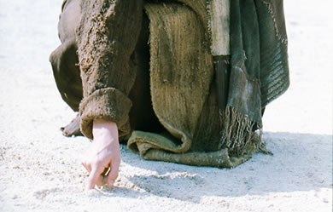
Christ's Writing Ministry
Revelation 2
Dr. Rick Griffith • Jordan Evangelical Theological Seminary • BibleStudyDownloads.org
Notes:
We have NO actual accounts of Jesus writing anything except what he wrote in the sand in John 8—and we have no idea what he wrote!

Slide 2
We have victory when we see that Jesus rules over…
DEATH
(1)
CHURCHES
(2–3)
Outline of Revelation
Notes:
Death (1): Christ is sovereign over our ultimate enemy that no one else has defeated.
Churches (2-3): Christ is the boss over the seven Asian churches and every local church.
Our Future (4-22): Christ is both Judge and Saviour of the End Times and our Eternal State.
_________
Common-468
NS-27-Rev1-slide 18, 184
NS-27-Rev2–slide 2
NS-27-Rev4-slide 3

Slide 3
Revelation 2

Slide 4

If Jesus wrote a letter to your church, what would Jesus say?
R
Revelation

Slide 5

Asia Minor in AD 95
345
Adramyttium
Aezani
Cyme
Erythrae
Eumenia
Lebedus
Colophon
Nysa
Hierapolis
Trailes
Heraclea
Aphrodisias
Colossae
Alabanda
Patmos
Miletus
Notes:
In AD 95 John was exiled to the lonely island of Patmos out in the Adriatic Sea. Jesus Christ had a revelation of comfort to the suffering believers of Asia Minor, but how could this message reach them?

Slide 6
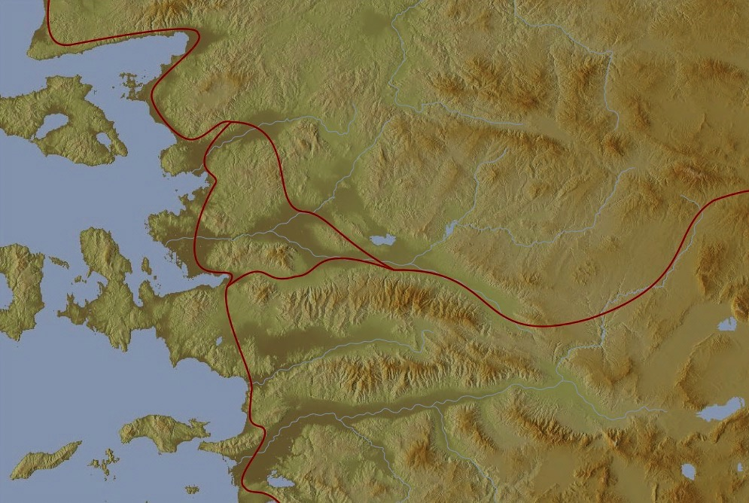
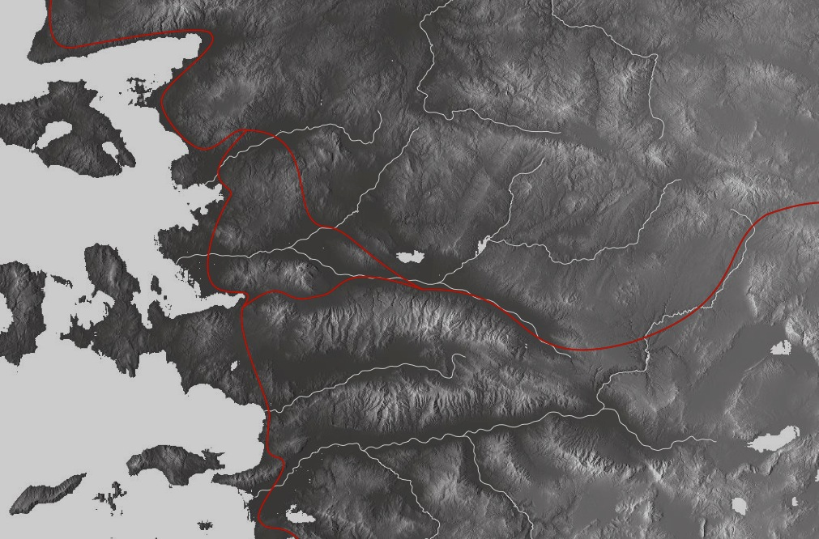
The 7 Churches (Rev. 2–3)
345
Adramyttium
Aezani
Pergamum
Thyatira
Cyme
Erythrae
Sardis
Smyrna
Eumenia
Philadelphia
Lebedus
Colophon
Ephesus
Nysa
Laodicea
Hierapolis
Trailes
Heraclea
Aphrodisias
Colossae
Alabanda
Patmos
Miletus
Notes:
Jesus designed a brilliant strategy by having his revelation sent to the capital of the province, Ephesus. It included an individual letter to Ephesus, as well as letters to 6 other key churches. The Ephesians copied the entire book of Revelation, though, and sent the original to the next city, Smyrna. Smyrna then made their own copy and sent the original to Pergamum, which lay on the main road to the north. This city then sent the prophecy to Thyatira, which sent it to Sardis, then Philadelphia, and finally to Laodicea.

Slide 7
The 7 Churches (Rev. 2–3)
345
Pergamum
Thyatira
Sardis
Smyrna
Philadelphia
Ephesus
Laodicea
Notes:
These 7 churches were neither the largest, nor the most influential cities in Asia Minor. However, they were strategically located on a key highway that linked them all.
[Animate} From their own locations we understand that they also copied the prophecy and sent these copies to other churches near them.

Slide 8
7 Church Stages?
347
Mistreated yet Missions-Minded
Suffering yet Steadfast
Continuing yet Compromising
Distinguished yet Dead
Busy yet Backslidden
Involved yet Immoral
Luxurious yet Lukewarm
Modern Missions Era
Reformation
Constantine
Middle Ages
Materialistic
Apostolic Age
Church Fathers
33
100
313
476
1453
1795
1900
Philadelphia
Ephesus
Smyrna
Pergamum
Thyatira
Sardis
Laodicea
Notes:
Some scholars over the years have believed that these churches represent 7 stages of church history:
33—The Apostles of Christ pass on the gospel, but by AD 95 the love at Ephesus had grown cold
100—Last Apostle died (John) with the message passed on to their disciples, called the "Church Fathers"
313—Constantine began to merge Christianity and paganism. With paganism illegal, it took on a "Christianized" form.
476—Rome's Fall ushered in 1000 years of deviation from classical learning called the "Middle Ages" with Rome's influence through the RCC
1453—The conquest of Constantinople by the Turks began the Renaissance, followed by the Reformation
1793—William Carey left England for India, sparking the movement of the gospel from the West to the Two-Thirds World
1900—The decline of Christianity in Europe began to be replaced with humanism, materialism, modernism, and post-modernism

Slide 9
Four Views on Rev. 2–3
345
Pergamum
Historic
Churches
Historico-
Prophetical
Prophetic View
Thyatira
Sardis
Smyrna
Philadelphia
Ephesus
Laodicea
Typical (Representative)
Notes:
Four Views:
Historic Churches: The 7 churches were actual churches at John’s time. All actually hold to this view except Bulllinger, who in 1935 taught seven churches are seven Jewish congregations in the future Tribulation period. Almost all see these as depicting seven churches that can be found in any age.
Prophetic: The chapters deal purely with stages of church history without identifying any first century church, shown by remarkable resemblance to successive eras of church history (taught by Cohen, Understanding Revelation, 48-49; and J. A. Seiss, The Apocalypse [London: Marshall, Morgan, and Scott, n.d.], 76-86).
Historico-Prophetical: The churches depict BOTH historic churches of the first century and stages of church history. “This approach is commonly taken in dispensational commentaries; see e.g., Herman A. Hoyt, The Revelation of the Lord Jesus Christ (Winona Lake, IN: BMH, 1966) 17,25-29, and John F. Walvoord, The Revelation of Jesus Christ (Chicago: Moody, 1966) 52, who holds the view cautiously. See also Menno J. Brunk, "The Seven Churches in Revelation 2-3," BSac 126 (1969) 240-46, and Gary G. Cohen, Understanding Revelation (Collingswood, NJ: Christian Beacon, 1968) 44-65, who presents a more impressive argument. Of course, the prophetic view is held by non-dispensationalists as well (e.g., J. P. Lange, Commentary on the Holy Scriptures- Revelation [reprint; Grand Rapids: Zondervan, n.d.] 139). See also the survey of R. C. Trench, Commentary on the Epistles to the Seven Churches in Asia (6th ed., rev.; reprint; Minneapolis: Klock and Klock, 1978) 237-45” (James L. Boyer, “Are the Churches of Revelation 2–3 Prophetic?” Grace Theological Journal 6.2 [1985] 267-273). He answers YES.
Typical (Representative): They were real churches, but also represent types of churches found throughout church history. Therefore, this view is also called the typical or representative view.
Critique of Each View:
Historic Churches: The doubt about whether all of the churches existed is flawed—just because we don’t know about each of them does not mean they did not exist (argument from silence)
Historico-Prophetical: Church history had not 7, but 3, stages: Ancient (to 590), Medieval (590-1517), and Modern (1517-present); designations are arbitrary (e.g., is Sardis pre-Reformation or the Reformation itself?)
Prophetic: (a) Any prophetic element would destroy the doctrine of imminency, so the chapters must relate only to actual first century churches since the 4th and 6th letters refer to Christ’s imminent coming, and Philadelphia would be given a false hope of deliverance from wrath (3:10) if the church had to wait until the “Laodicean age.” (b) Nothing in these chapters or elsewhere in the NT hint at these being stages of church history. (c) These letters differ from the prophetic portions of the book (Rev. 4–22) in that they are simply epistles similar to those written by Paul.
Typical (Representative): (a) Imminency would be ruined only “if it stated explicitly there would be a period of at least two thousand years before the second advent, or even if it had stated explicitly that there would be ‘seven periods of church history’ (Boyer, 269-70. (b) These seven churches do not represent all types of churches of the first century or any other, for other types exist besides these (e.g., Galatian or Corinthian), and “seven” better pictures the whole of the church age than would the 3 stages proposed above.

Slide 10

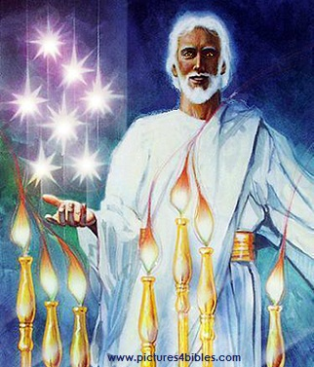
What are the 7 Stars & 7 Lampstands (1:20 NLT)?
"This is the meaning of the mystery of the seven stars you saw in my right hand and the seven gold lampstands: The seven stars are the angels
of the seven churches, and the seven
lampstands are the seven churches."

Slide 11
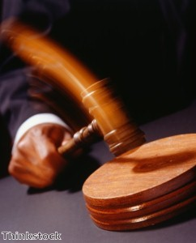
Christ has authority over all churches
344

Slide 12
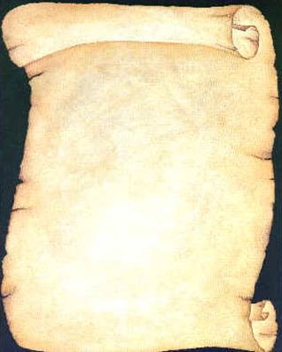
So Jesus wrote 7 churches (Rev 2–3)
Ephesus
Smyrna
Pergamum
Thyatira
Sardis
Philadelphia
Laodicea

Slide 13

Revelation
Sovereignty of Christ in Future Victory
Sovereignty in His Person |  |  | Sovereignty over Churches | Sovereignty in End-Time Events
Chapter 1 |  |  | Chapters 2–3 | Chapters 4–22
"What you have seen" (1:19a) |  |  | "What is now" (1:19b) | "What will take place later" (1:19c)
Past |  |  | Present | Future
Christ Unveiled |  |  | Churches Unveiled | Consummation Unveiled
God on Earth |  |  | God's Ambassadors on Earth | Hell on Earth to Heaven on Earth
The Judge |  |  | The Assignments | The Judgments & Rewards
Subject 1:1-3 | Worship of Trinity 1:4-8 | Glorified Christ 1:9-20 | Seven Churches of Asia: Ephesus Smyrna Pergamum Thyatira Sardis Philadelphia Laodicea | Tribulation 4:1–19:10 | Second Coming 19:11-21 | Millennium 20 | Eternal State 21:1–22:5 | Closing: Imminency 22:6-21
AD 95
318, 324 M

Slide 14
The 7 Churches (Rev. 2–3)
Promise
348
Pergamum
Warning
Thyatira
Exhortation
Rebuke
Commendation
Smyrna
Sardis
N/A
Christ
N/A
N/A
N/A
Ephesus
Philadelphia
N/A
Laodicea
Notes:
Though some exceptions exist (noted with “N/A” above), the basic pattern of the seven letters is a sevenfold outline:
Church name
Christ Described in a Unique Way for that Church
Commendation of Good Deeds among the Believers
Rebuke of Sin within the Church
Exhortation or Encouragement to Repent
Warning if the Exhortation is Disobeyed
Promise for Faithfulness
Notice also that each letter not only begins with a reference to Christ but ends with an appeal from the Spirit.

Slide 15
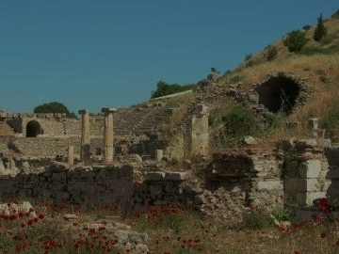
Ephesus
Busy But Backslidden
Revelation 2:1-7

Slide 16
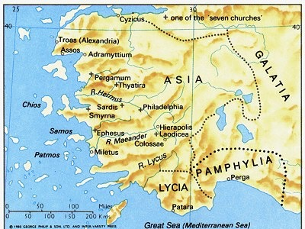
Ephesus was the capital of Asia
176

Slide 17
Learning to Love Again
Revelation 2:1-7
Lewis Winkler
Crossroads International Church
BibleStudyDownloads.org

Slide 18
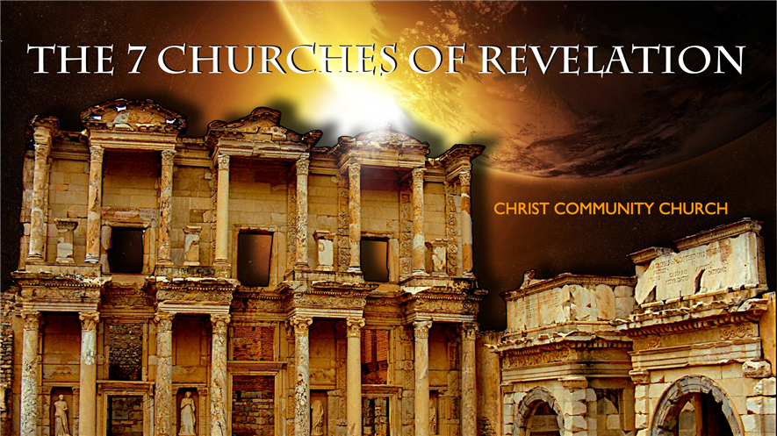
Revelation
The Seven Churches of Revelation
Learning to Love Again

Slide 19
Introduction:
What is true love?
What comes to your mind when you hear the phrase, “first love”?
What happens when our first loves dies?
How can we learn to love again?

Slide 20
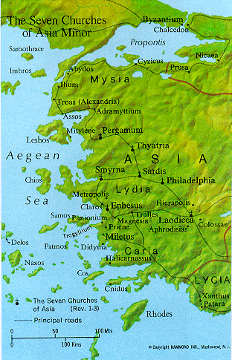
Opening Explanation (1):
To the Church at Ephesus

Slide 21
Ephesus:
At that time it was the most important city in western Asia Minor (modern-day Turkey).

Slide 22
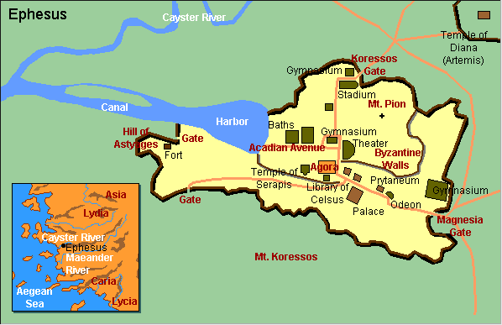
Ephesus City Layout

Slide 23
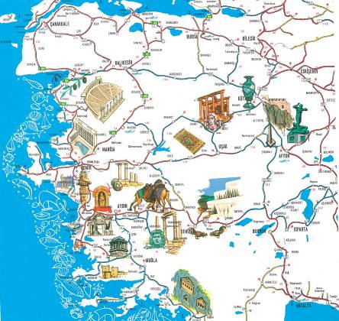
A Centre of Culture

Slide 24

Photo Album

Slide 25
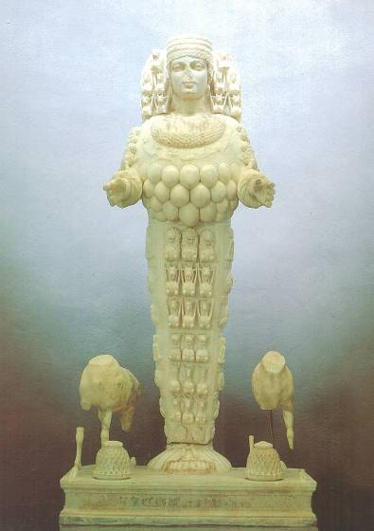
Artemis, Goddess of Fertility

Slide 26
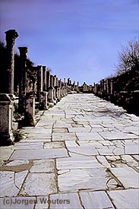
Marble Roads
Notes:
Marble city, chariot ruts, speed humps, after earthquake columns put back up again.

Slide 27
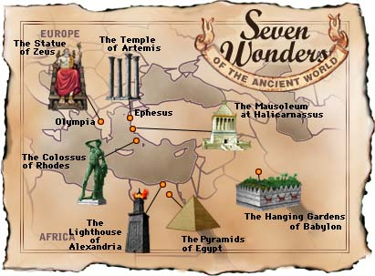
Seven Wonders of the Ancient World

Slide 28
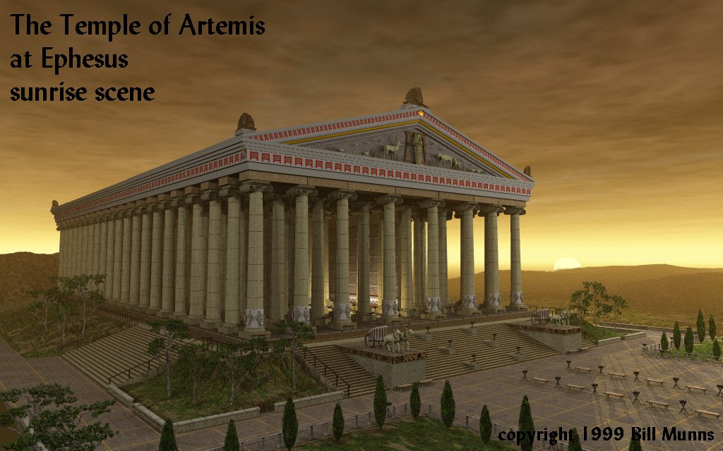

The Temple of Artemis at Ephesus
349
Notes:
Diana-the goddess mother of e/t, 127 Marble pillars, Artemis (Gk), Diana (Latin)

Slide 29
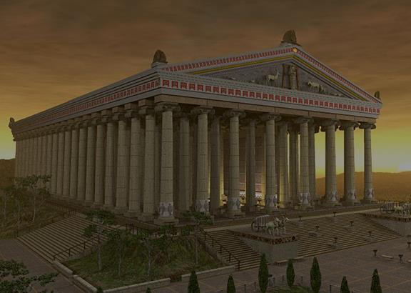
Ephesus:
It was home to the Magnificent Temple of Artemis (Diana).

Slide 30
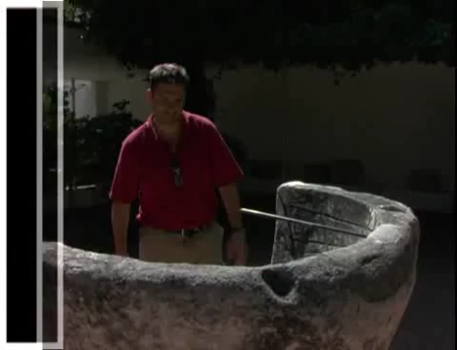
Artemis (Diana) Video (cf. Acts 19)
180c
Notes:
"In Roman mythology, Diana (lt. "heavenly" or "divine") was the goddess of the hunt and moon and birthing, being associated with wild animals and woodland, and having the power to talk to and control animals. She was equated with the Greek goddess Artemis, though she had an independent origin in Italy." (http://en.wikipedia.org/wiki/Diana_%28mythology%29)
Temple had 127 Marble pillars, Artemis (Gk), Diana (Latin)

Slide 31
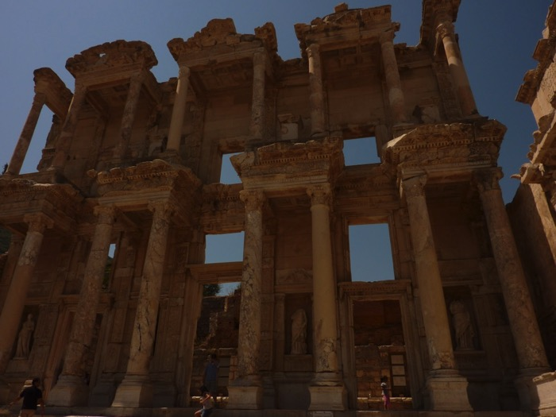
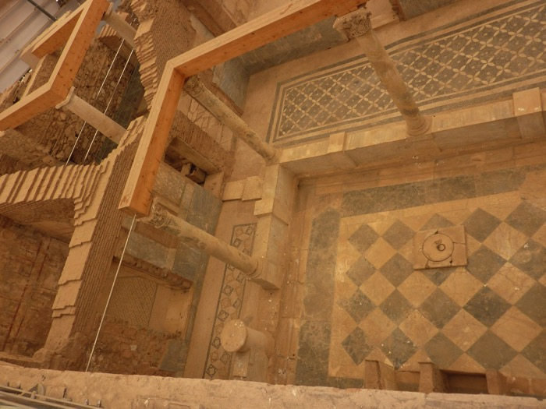
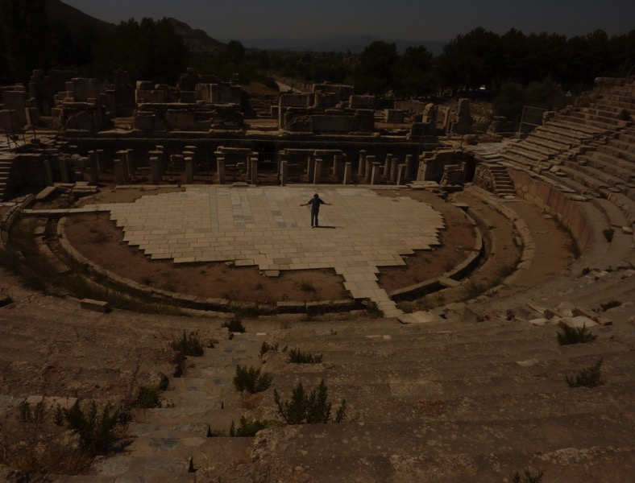
Ephesus Today:

Slide 32
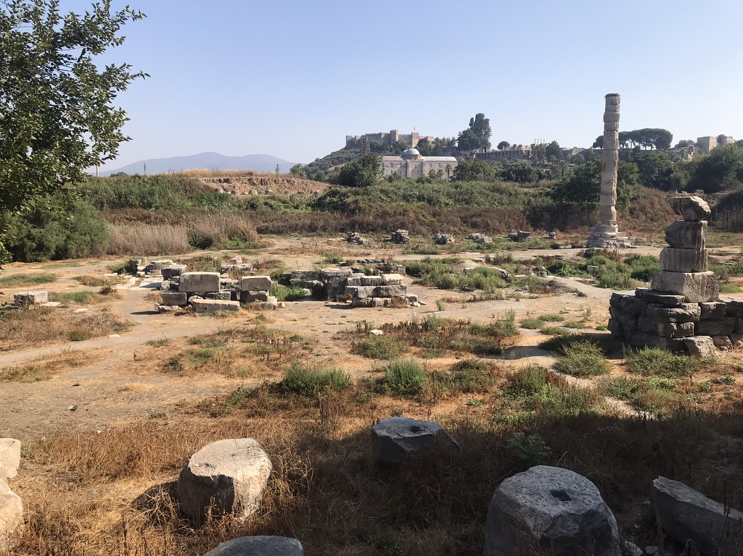
The Temple of Diana (Artemis) Today
349
Notes:
"In Roman mythology, Diana (lt. "heavenly" or "divine") was the goddess of the hunt and moon and birthing, being associated with wild animals and woodland, and having the power to talk to and control animals. She was equated with the Greek goddess Artemis, though she had an independent origin in Italy." (http://en.wikipedia.org/wiki/Diana_%28mythology%29)
Temple had 127 Marble pillars, Artemis (Gk), Diana (Latin)
Picture was taken by Dr. Rick Griffith on 3 Sep 2022.

Slide 33
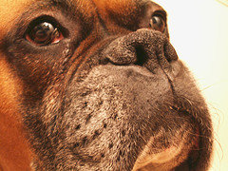
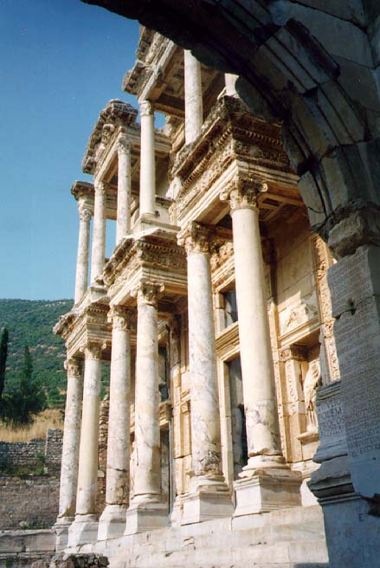
The Library of Caesar
349
Caesar
Notes:
Sid Caesar, Venerate: Bow to Caesar or die

Slide 34
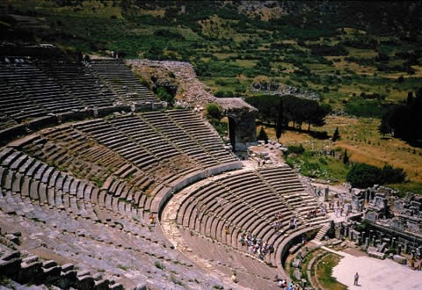
Theater Seats 25,000
theh'-at-ron
349
Acts 19:29
Notes:
The place where the Ephesian clerk averted a riot in Acts 19:29

Slide 35
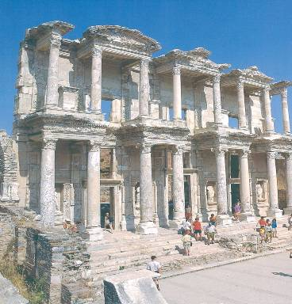
Library
349

Slide 36
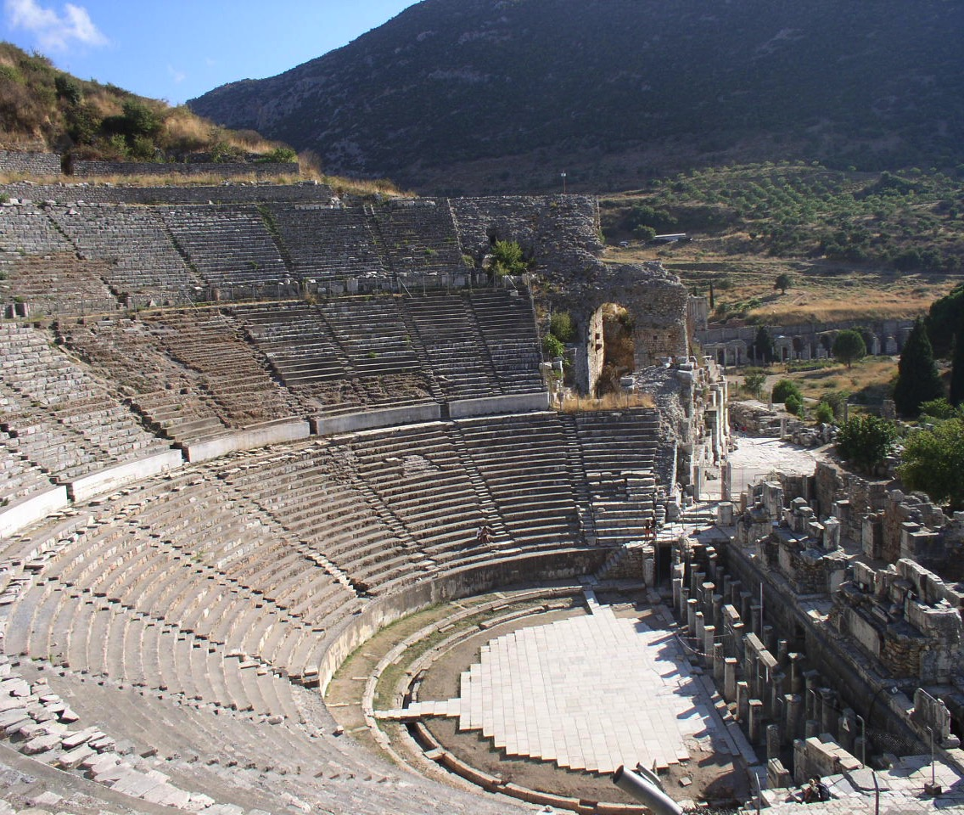
Amphitheatre
349

Slide 37
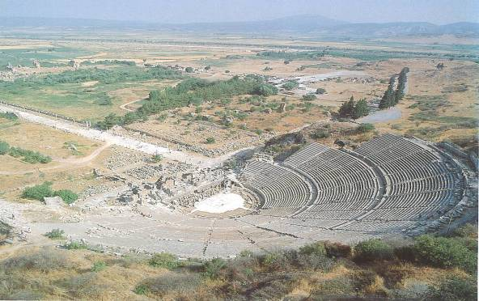
Arcadian Avenue
349

Slide 38
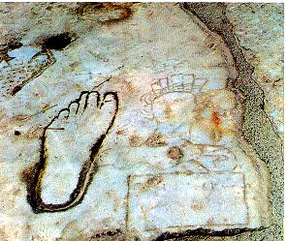
Directions for the Immoral & Illiterate
349
Notes:
The footprint etched into the marble street showed the way to the brothel for those who could not read.

Slide 39
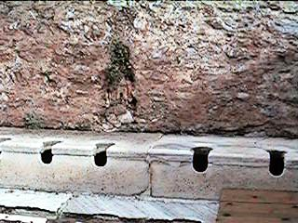
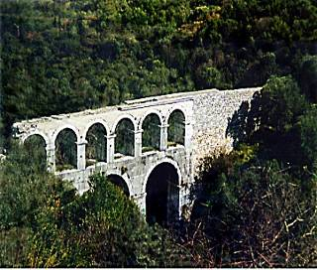
Toilets and aqueduct
349
Notes:
This was highly unusual for a city to have a public toilet on a public street, but Ephesus had such a luxury across the street from expensive housing.

Slide 40
Ephesus (Rev. 2:1-7)
349
Promise
You will eat from the tree of life
Pergamum
Warning
If you do not repent,
I will come to you and remove your lamp stand from its place
Thyatira
Exhortation
Remember
Repent
Return to the things you did at first
Rebuke
You have forsaken your first love
Commendation:
Deeds, hard work, perseverance
Intolerant of wicked, endure hardships, hates Nicolaitans
Christ:
7 stars in right hand, walks among lamp stands
Smyrna
Sardis
Ephesus
Philadelphia
Laodicea

Slide 41
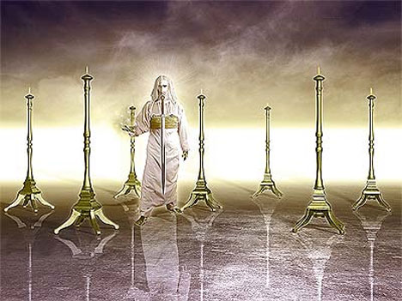
349
"This is the message from the one who holds the seven stars in his right hand, the one who walks among the seven gold lampstands" (2:1b)

Slide 42
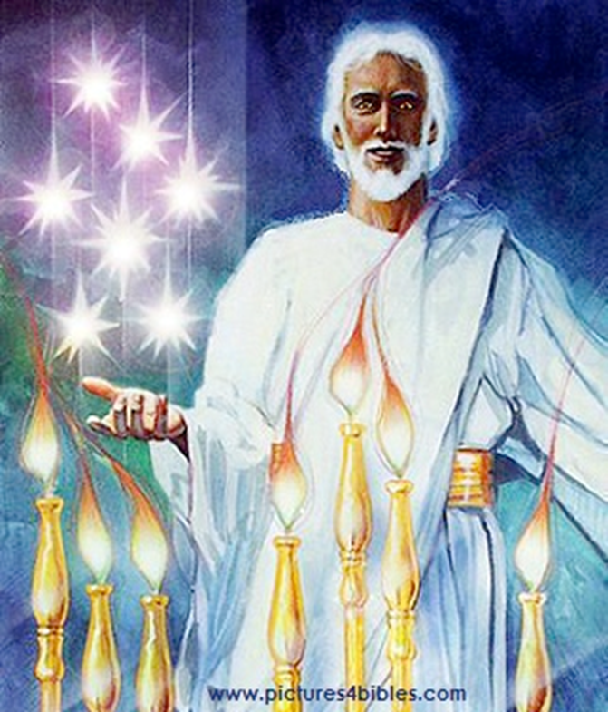
Opening Explanation (1):
To the “angel” of the Church in Ephesus

Slide 43
Three Likely Possibilities:
They are spiritual beings (“angels”) that watch over each of the churches.
They are references to the pastoral leader of each of the churches.
They represent the prevailing spirit of each individual church.

Slide 44
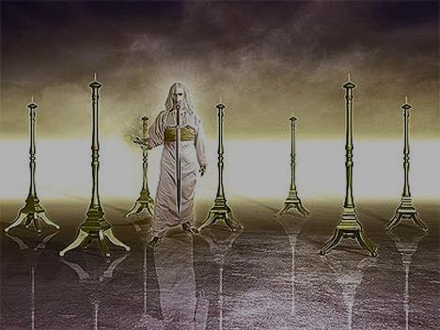
Opening Explanation (1):
From Jesus Who Cares for and Walks with the Church

Slide 45
Encouraging Commendation (2-3, 6):
I know your deeds.

Slide 46
Encouraging Commendation (2-3, 6):
Your Hard work (2)
Your Intolerance of Wicked People (2)
Your Testing of and Refusal to Accept People Claiming (But Failing) to Be Apostles (2)
Your Energetic Endurance through Hardship for Jesus’ Sake (3)
Your Hatred of Nicolaitan Practices (6)

Slide 47
Some Food for Thought:
How would Jesus encourage and commend Crossroads International Church?
How would Jesus encourage and commend you personally?

Slide 48
Cautionary Exhortation (4-5):
You have forsaken your first love.
“They had yielded to the temptation, ever present to Christians, to put all their emphasis on sound teaching. In the process, they lost love, without which all else is nothing.”
—Leon Morris

Slide 49
Cautionary Exhortation (4-5):
How do we learn to love again?
Remember!
Repent!
Redo!

Slide 50
Learning to Love Again:
Remember!
But what?

Slide 51
Learning to Love Again:
Repent!
But of what?

Slide 52
Learning to Love Again:
Redo!
But what?

Slide 53
The First Love of the Ephesians (Acts 19:8-20):
They held the name of Christ “in high honor” (verse 17).
They “openly confessed their evil deeds” (verse 18).
Those who had previously practiced sorcery “brought their scrolls together and burned them publicly” (verse 19).

Slide 54
The First Love of the Ephesians (Acts 19:8-20):
As a result, “the word of the Lord spread widely and grew in power” (verse 20).

Slide 55
Cautionary Exhortation (4-5):
If you refuse to do these things, I (Jesus) will remove you as a church.

Slide 56
Some Food for Thought:
How would Jesus warn Crossroads International Church?
What do we need to remember?
What do we need to repent of?
What do we need to start doing (again)?
How can we truly make Jesus our first love?

Slide 57
Closing Motivation (7):
If you are spiritually sensitive, then listen!
The overcomers of evil will eat from the tree of life in God’s eternal kingdom (heaven)!

Slide 58

Closing Motivation (7):
“Then the angel showed me the river of the water of life, as clear as crystal, flowing from the throne of God and of the Lamb, down the middle of the great street of the city. On each side of the river stood the tree of life . . . . And the leaves of the tree are for the healing of the nations. No longer will there be any curse. . . . They will see [God’s] face and his name will be on their foreheads. . . . And they will reign forever and ever. . . . These words are trustworthy and true.”
—Revelation 22:1-6

Slide 59
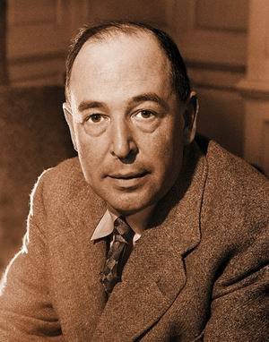
C. S. Lewis from “The Weight of Glory”
“If we consider the unblushing promises of reward and the staggering nature of the rewards promised, it would seem that our Lord finds our desires not too strong, but too weak. We are half-hearted creatures fooling about with drink and sex and ambition when infinite joy is offered us, like an ignorant child who wants to go on making mud pies in a slum because he cannot imagine what is meant by the offer of a holiday at the sea. We are far too easily pleased.”

Slide 60
Conclusion:
Jesus calls us to love Him first and foremost by:
REMEMBERING
REPENTING
REDOING

Slide 61
Main Idea:
In order to restore our first love, we must remember, repent, and redo.

Slide 62
Personal Application:
What do I need to remember?
What do I need to repent of?
What do I need to do again—or perhaps begin to do for the very first time—to really love Jesus as my first and foremost love?

Slide 63
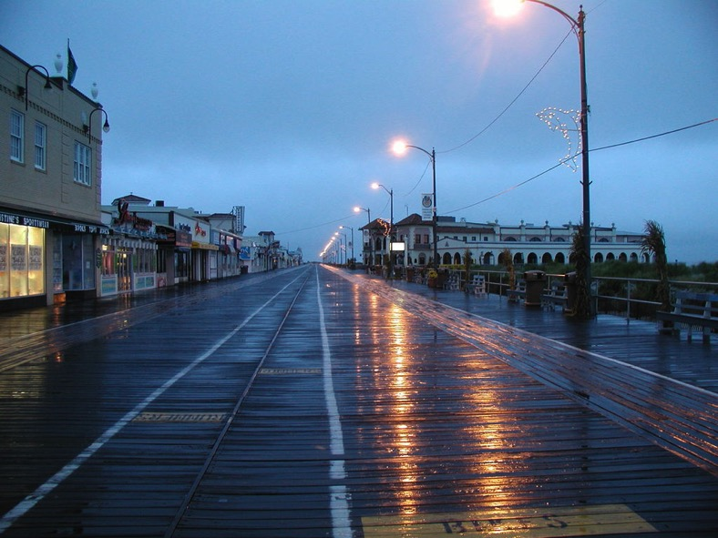
A Story of First Love:
Ocean City, New Jersey, 1986

Slide 64
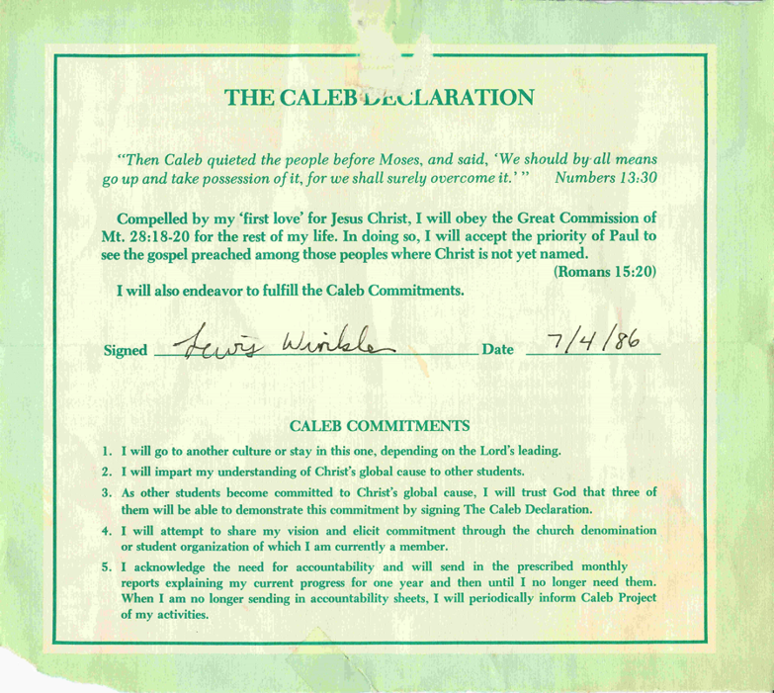
A Story of First Love:
The Caleb Declaration:

Slide 65
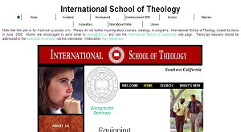
A Story of First Love:
International School of Theology, 1993

Slide 66
A Story of First Love:
But somewhere along the way . . . .
I gradually, almost imperceptibly, became comfortable, complacent, and content in my walk with God, even though I was still in full-time ministry.

Slide 67
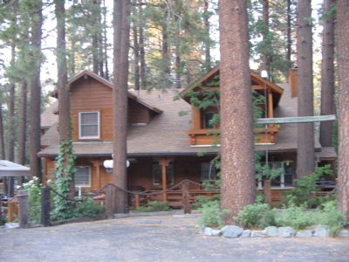
A Story of First Love:
Then, in the winter of 2002 at a cabin in the southern California mountains . . .

Slide 68
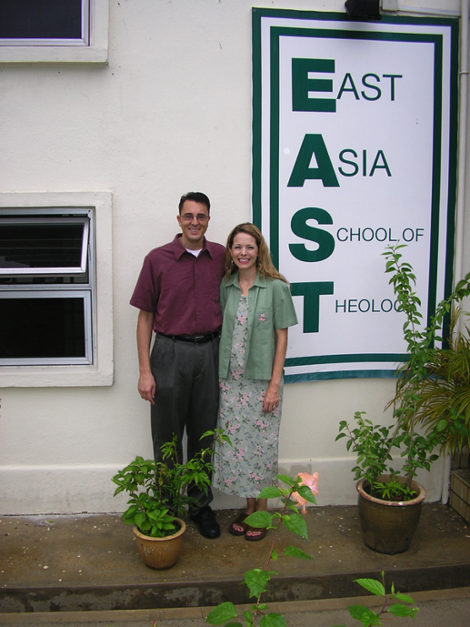

A Story of First Love:
Singapore and the East Asia School of Theology in August 2006

Slide 69

A Story of First Love:
Crossroads International Church, November 2006

Slide 70
The Ongoing Challenge:
Do you love Jesus above all other loves?
If you have let other people, pursuits, and things crowd out your love for Him, are you willing to learn to love Him as your first love again?

Slide 71

Book Chart of Ephesians
175

Slide 72
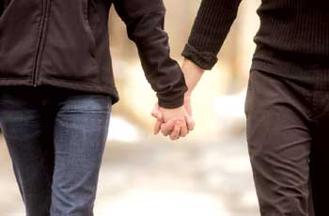
Revelation 2:4 (NIV)
Remember when you loved at first?
Yet I hold this against you:
You have forsaken
your first love.

Slide 73
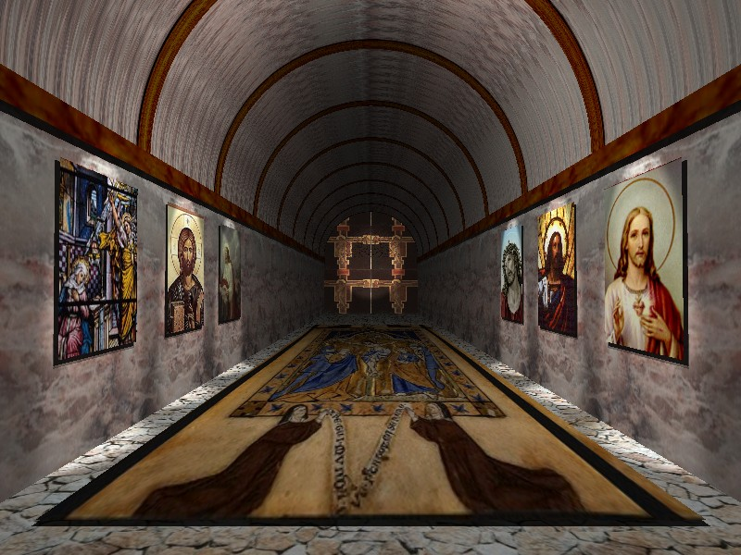
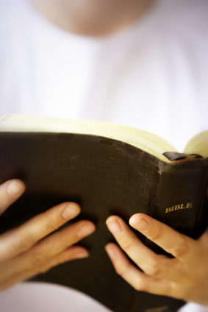
Revelation 2:4 (NIV)
Ephesus: Busy Yet Backslidden
Yet I hold this against you:
You have forsaken
your first love.

Slide 74
Smyrna
Revelation 2:8-11

Slide 75
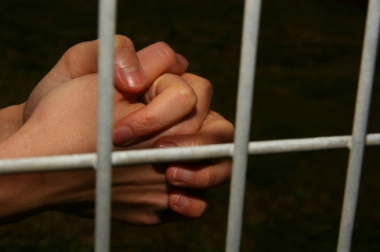
Suffering Yet Steadfast
The Church of Smyrna
(Rev. 2:8-11)
Rick Griffith • Crossroads International Church • biblestudydownloads.com

Slide 76
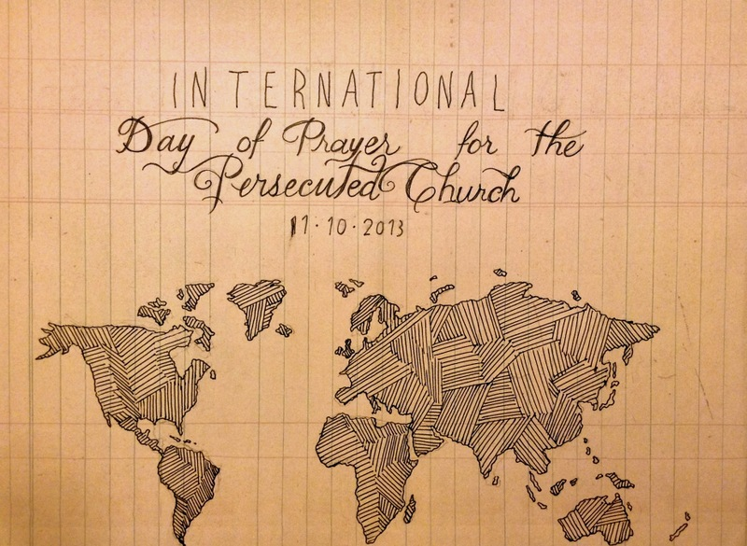
IDOP
International Day of Prayer for the Persecuted Church 11-10-2013
Notes:
Today and last Sunday, over one half million churches around the globe commemorate the International Day of Prayer for the Persecuted Church. We stand with them and have designed our entire service to remember our suffering brothers and sisters who lose property, livelihood, and loved ones—yes, who lose even life itself—simply due to their faith in our Lord Jesus Christ.

Slide 77
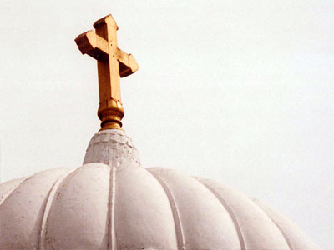
All-Saints Church
22 Sep 2013
Notes:
Our thoughts today turn to seven weeks ago from this day to All-Saints Church.

Slide 78
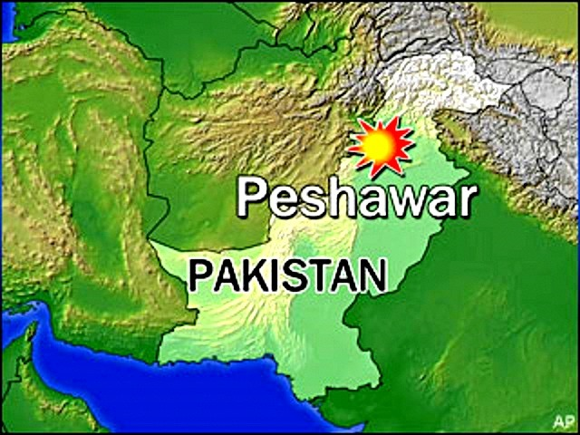
All-Saints Church
22 Sep 2013
Notes:
The church is located in the northern region of Pakistan in the city of Peshawar, close to the border with Afghanistan.

Slide 79
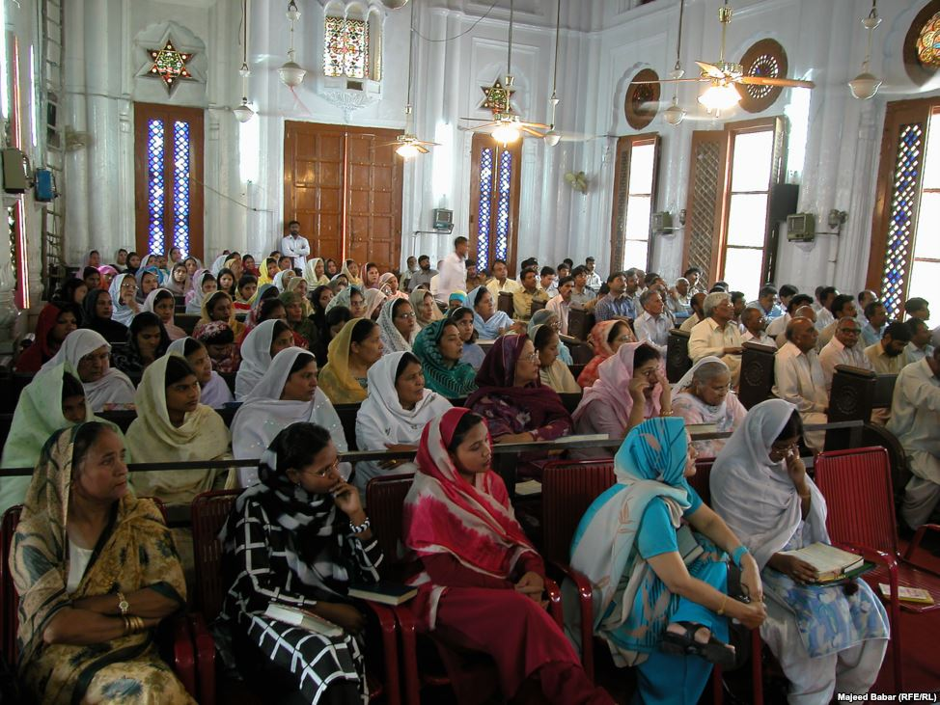
All-Saints Church
22 Sep 2013
Notes:
Inside the church it looks much like many others in that region where the men and the women sit on opposite sides.

Slide 80
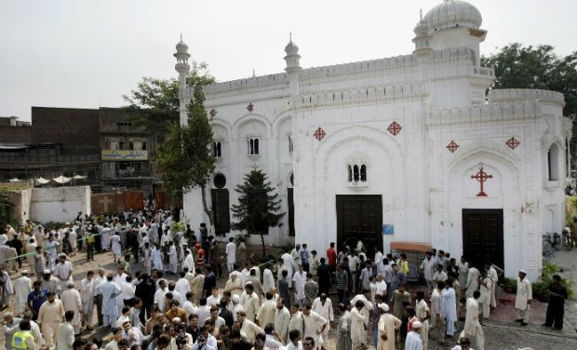
All-Saints Church
22 Sep 2013
Notes:
On 22 September 2013 after the service the believers gathered outside the building in the courtyard to talk, to eat—over 200 men, women, and children.

Slide 81
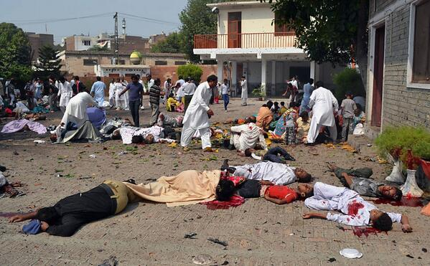
All-Saints Church
22 Sep 2013
Notes:
Infiltrating the crowd were two suicide bombers, who struck the All Saints Church members after their service that Sunday, killing more more than 90 people and wounding more than 150. The victims included many children.

Slide 82

All-Saints Church
22 Sep 2013
Notes:
None of us can imagine the horror of that moment.

Slide 83

All-Saints Church
22 Sep 2013
Notes:
None of us can.

Slide 84

All-Saints Church
22 Sep 2013
Notes:
A wing of the Pakistani Taliban claimed responsibility for the bombing, saying it would continue to target non-Muslims until the United States stopped drone attacks in the country's remote tribal region.

Slide 85

Eshaan & Neha
Notes:
The saddest part of the story concerns the children. The father of Eshaan and Neha was on business in the US at the time, but later wrote, "As he did after every Sunday mass, Eshaan was playing near the church gate with his friends. Little was he to know that this was the last time he would pray in church, play with his friends, tease his sister or hug his mother. His head was ripped off by the blast and his sister Neha, who was running after him at the time, was so traumatised by the sight that her little heart gave in and she collapsed next to Eshaan’s torn body."
Full article:
"The twin bombs that exploded on Sunday at All Saints Church, Peshawar, killed more than 90 people, injured nearly 150 others, and emotionally scarred thousands more.
Investigations are under way while recovery and treatment has begun for the injured and their families. For some, healing will be swift while others may take small steps over months, maybe even years. Many more might never fully recover from this tragedy.
The most heartbreaking of this and such tragedies is the number of young lives lost in these attacks. Since the blast took place on Sunday, the All Saints Church was packed to the brim with Christians from the locality; many of them students, volunteers, youth leaders, activists and Sunday school children. These were children we all knew, if not in person, at least by face. Even now as I close my eyes, I can visualise the happy little angels skipping through the church doors.
It is therefore, with great sorrow and a heavy heart that I share my memories of Neha and Eshaan.
Since the blast, I have not had a moment’s peace as I keep remembering how they used to make me laugh at their playful antics. Today I realised that the only way to alleviate my pain, even if a little bit, is by sharing their story.
These little victims of the senseless violence that rocked Peshawar in general and the Christian community in particular, were gems treasured by their parents, family, friends and teachers alike.
As he did after every Sunday mass, Eshaan was playing near the church gate with his friends. Little was he to know that this was the last time he would pray in church, play with his friends, tease his sister or hug his mother. His head was ripped off by the blast and his sister Neha, who was running after him at the time, was so traumatised by the sight that her little heart gave in and she collapsed next to Eshaan’s torn body.
I cannot even begin to imagine what Eshaan and Neha’s parents must be feeling right now. I can’t imagine the horror that any parent would feel upon hearing such news – that their two young children, the apples of their eyes, the stars in their life – are no more. There can be nothing more traumatic than raising your children, caring for them, loving them and already dreaming of their future only to have them ripped away from you.
In Eshaan and Neha’s case, the situation was worsened because their father, Insar, was in the United States at the time of the blast. In a cracked voice, he said over the phone,
“They were little angels sent down to me to love and protect. Like most fathers, I was often over-protective and sometimes downright clingy. After all, my children were my treasure.”
His voice completely broke then, and all we heard for a few minutes was the heart-wrenching weeping of a man in physical and emotional trauma. Mustering up his strength, he said,
“No parent should ever have to encounter a day like today; no parent should ever have to hear the words that your child is no more. Parents are never prepared to lose their children, not even children who have a terminal illness. Then how do I deal with something I did not even have an inkling of?”
After every few minutes of crying and talking about his children, he repeated, almost like a mantra,
“If only I was in Pakistan.”
While their father is in the US and has not been able to catch a flight back home yet, their mother, Uzma, is in the Intensive Care Unit (ICU). She still has no idea of what happened to her children.
Remembering his children, Insar says,
“Children change our life. They show us new ways to love, new things to find joy in, and new ways to look at the world.”
However, for Insar and Uzma the world has become dark and empty. This one incident has taken the light of their lives away and every room, every toy, every scribble will bring back painful memories. Their only wish will be to turn back time and see their children one last time, hold them tight and kiss their glowing faces. There will be times when getting through the day will feel like torture.
All we can do is pray that with time, these memories will become less painful and that one day, Insar and Uzma will begin to re-build their lives. We hope that they will learn to carry with them, happy memories of the love they shared with their precious children, even if it was for such a short time.
http://blogs.tribune.com.pk/story/18971/they-were-just-children-not-christian-children/

Slide 86

All-Saints Church
90 killed
150 wounded
13 widows
36 orphans
53 families lost bread winners
Notes:
The toll on a single assembly is staggering!

Slide 87

All-Saints Church
22 Sep 2013
Notes:
The grief is unimaginable.

Slide 88

All-Saints Church
Doctors Absent
Notes:
The tragedy was compounded by the fact that the local hospital could not handle the crisis primarily because local doctors and paramedics refused to come to the hospital to treat the Christians—not until the local political leader ordered them to come or their jobs would be on the line.
Full article:
PESHAWAR - Death toll from Sunday’s twin bombings at All Saints Church was horrendous and Lady Reading Hospital was running out of caskets, beds and medicine for the wounded; and on top of that doctors and paramedics were absent.
To give vent to their anger over sorry state of affairs at the public health centre, attendants of the injured ransacked the hospital and chanted slogans against Khyber Pakhtunkhwa government for its inability to ensure every sort of health facility during the emergency situation.
Insufficient number of doctors and nurses was present at the hospital that could hardly provide first aid treatment to over 100 injured ferried from the blast site. Despite the fact that an emergency was declared, most of the doctors remained absent from their duties.
It came as a shock to learn that a provincial government so willing to provide free of cost treatment and medicines slipped on ensuring hassle-free health services. As a result, most of the injured could not get medical aid in a timely manner, while many of the injured had to lie down across the floor due to shortage of beds.
Nevertheless, when Pakistan Tehreek-e-Insaf chief Imran Khan came in, most of the doctors had to pull up their socks in order to save their skin.
People from different walks of life criticised PTI-led provincial government for its poor performance and asked it to provide all sort of health facilities to the injured. They also demanded stern action against the negligent doctors.
http://www.nation.com.pk/pakistan-news-newspaper-daily-english-online/national/23-Sep-2013/peshawar-hospital-ransacked-for-absence-of-docs-facilities

Slide 89

All-Saints Church
22 Sep 2013
Notes:
So they did, but it was too late for some of the victims who needed immediate care to save their lives.

Slide 90

In what area are you "taking hits" for your faith in Christ?
Notes:
You workplace passes you up for promotion.
Your motives are misunderstood.
You are lumped with fanatics.
Your faith is ridiculed in your family.
Some other area?

Slide 91

How does Jesus want you to respond to suffering?
Notes:
What is most important is Christ's view of suffering—how he wants us to address it!

Slide 92
Christ's Writing Ministry
Notes:
We have NO actual accounts of Jesus writing anything except what he wrote in the sand in John 8—and we have no idea what he wrote!

Slide 93
If Jesus wrote a letter to our church, what would Jesus say?
R
Revelation
Notes:
We speak of WWJD (What Would Jesus Do)
However, I am addressing WWJS

Slide 94
Asia Minor in AD 95
345
Adramyttium
Aezani
Cyme
Erythrae
Eumenia
Lebedus
Colophon
Nysa
Hierapolis
Trailes
Heraclea
Aphrodisias
Colossae
Alabanda
Patmos
Miletus
Notes:
In AD 95 John was exiled to the lonely island of Patmos out in the Adriatic Sea. Jesus Christ had a revelation of comfort to the suffering believers of Asia Minor, but how could this message reach them?

Slide 95
The 7 Churches (Rev. 2–3)
345
Adramyttium
Aezani
Pergamum
Thyatira
Cyme
Erythrae
Sardis
Smyrna
Eumenia
Philadelphia
Lebedus
Colophon
Ephesus
Nysa
Laodicea
Hierapolis
Trailes
Heraclea
Aphrodisias
Colossae
Alabanda
Patmos
Miletus
Notes:
Jesus designed a brilliant strategy by having his revelation sent to capital of the province, Ephesus. It included an individual letter to Ephesus, as well as letters to 6 other key churches. The Ephesians copied the entire book of Revelation, though, and sent the original to the next city, Smyrna. Smyrna then made their own copy and sent the original to Pergamum, which lay on the main road to the north. This city then sent the prophecy to Thyatira, which sent it to Sardis, then Philadelphia, and finally to Laodicea.

Slide 96
The 7 Churches (Rev. 2–3)
345
Pergamum
Thyatira
Sardis
Smyrna
Philadelphia
Ephesus
Laodicea
Notes:
These 7 churches were neither the largest, nor the most influential cities in Asia Minor. However, they were strategically located on a key highway that linked them all.
[Animate} From their own locations we understand that they also copied the prophecy and sent these copies to other churches near them.

Slide 97
What are the 7 Stars & 7 Lampstands (1:20 NLT)?
"This is the meaning of the mystery of the seven stars you saw in my right hand and the seven gold lampstands: The seven stars are the angels
of the seven churches, and the seven
lampstands are the seven churches."

Slide 98
Christ has authority over all churches
344
Notes:
The point of Revelation 2–3 is that Jesus has authority over all churches

Slide 99
So Jesus wrote 7 churches (Rev. 2–3)
Ephesus
Smyrna
Pergamum
Thyatira
Sardis
Philadelphia
Laodicea

Slide 100
Revelation
Sovereignty of Christ in Future Victory
Sovereignty in His Person |  |  | Sovereignty over Churches | Sovereignty in End-Time Events
Chapter 1 |  |  | Chapters 2–3 | Chapters 4–22
"What you have seen" (1:19a) |  |  | "What is now" (1:19b) | "What will take place later" (1:19c)
Past |  |  | Present | Future
Christ Unveiled |  |  | Churches Unveiled | Consummation Unveiled
God on Earth |  |  | God's Ambassadors on Earth | Hell on Earth to Heaven on Earth
The Judge |  |  | The Assignments | The Judgments & Rewards
Subject 1:1-3 | Worship of Trinity 1:4-8 | Glorified Christ 1:9-20 | Seven Churches of Asia: Ephesus Smyrna Pergamum Thyatira Sardis Philadelphia Laodicea | Tribulation 4:1–19:10 | Second Coming 19:11-21 | Millennium 20 | Eternal State 21:1–22:5 | Closing: Imminency 22:6-21
AD 95
318, 324 M
Notes:
These three chapters comprise the middle section of the book of Revelation in the sense in which John was to record "what he had seen" (1:19a, shown in the chapter 1 vision of Christ), followed by "what is now" (1:19b), or what was happening at the present time around AD 95 among these churches of Asia, in modern-day western Turkey.

Slide 101
The 7 Churches (Rev. 2–3)
Promise
348
Pergamum
Warning
Thyatira
Exhortation
Rebuke
Commendation
Smyrna
Sardis
N/A
Christ
N/A
N/A
N/A
Ephesus
Philadelphia
N/A
Laodicea
Notes:
Though some exceptions exist (noted with “N/A” above), the basic pattern of the seven letters is a sevenfold outline:
Church name
Christ Described in a Unique Way for that Church
Commendation of Good Deeds among the Believers
Rebuke of Sin within the Church
Exhortation or Encouragement to Repent
Warning if the Exhortation is Disobeyed or a warning to prepare them for difficulties
Promise for Faithfulness
Notice also that each letter not only begins with a reference to Christ but ends with an appeal from the Spirit.

Slide 102
Ephesus was the capital of Asia
176
Notes:
The first letter was sent to Ephesus, which we covered last week.

Slide 103
Revelation 2:4 (NIV)
Ephesus: Busy Yet Backslidden
Yet I hold this against you:
You have forsaken
your first love.
Notes:
Despite the many things the Ephesian church did right in their service for Christ, they were "busy but backslidden."

Slide 104

How can we handle suffering?
Christ gave Smyrna three ways.
Notes:
So today we come to the second letter, written to believers in Smyrna. This letter addresses this question…

Slide 105

I. Recognize that Christ understands your suffering (2:8-9)
Notes:
Know that Jesus has "been there, done that."

Slide 106
The 7 Churches (Rev. 2–3)
345
Adramyttium
Aezani
Pergamum
Thyatira
Cyme
Erythrae
Sardis
Smyrna
Eumenia
Philadelphia
Lebedus
Colophon
Ephesus
Nysa
Laodicea
Hierapolis
Trailes
Heraclea
Aphrodisias
Colossae
Alabanda
Patmos
Miletus
Notes:
Smyrna was a seaport city like Ephesus, about 35 miles north. It still exists today with the name of Izmir.

Slide 107
Smyrna (Rev. 2:8-11)
351
Pergamum
Thyatira
Rebuke
None!
Commendation:
Suffers persecution
and poverty
Christ:
The First and the Last, who died and came to life again
Smyrna
Sardis
Ephesus
Philadelphia
Laodicea

Slide 108

Thank Christ that he understands your own area of suffering

Slide 109



Isaac Brown
The Boy Who Feels NO Pain
http://abcnews.go.com/Health/meet-toddler-feels-pain/story?id=20658484
Notes:
Is pain good? Most of us do not think so!
• Isaac
Little Isaac Brown is five years old. Like other kids his age, he's learning to read and write his ABCs and to calculate simple addition and subtraction. But there is one thing Isaac is learning that rare few other children will ever have to learn. Isaac is learning about pain.
"We're doing the best we can to just teach him; he knows blood is bad," said Brown. "We taught him even when he was little to say 'ow.' You don't have to tell normal kids to say 'ow.'"
• Baby
Isaac was born with an extremely rare genetic insensitivity to pain. Like a modern day leper, Isaac doesn't know when he's touching a hot stove, when he's stepped on broken glass, or when he's broken a bone. For example, he broke his pelvis and felt no pain at all.
• Leg
Because he doesn't feel injuries, Isaac's parents, Carrie and Randy Brown, are teaching him how to identify them to stay healthy.

Slide 110

Isaac Brown
The Boy Who Feels NO Pain
"When he was diagnosed, [doctors said] there's nothing we can do for Isaac, not yet anyway," [his mother] Carrie recalled. "But the fact that they can take his mutated gene and cause people with chronic pain to feel less pain. The thought of that is unreal…. God gave us Isaac, maybe for this very purpose."
http://www.medicaldaily.com/can-boy-who-feels-no-pain-help-chronic-pain-sufferers-261005
Notes:
Family
"The toddler years were an absolute nightmare," said Isaac's mother, Carrie Brown. "He would just drop to the ground and smack his face on the table. He thought the fall was fun."
Isaac has dunked his hand in hot coffee without flinching. He once placed his palm on a working oven burner without shedding a tear.
His parents are believers. His mother noted..
Read quote

Slide 111
Reasons for Suffering
John Walvoord, "Revelation," in The Bible Knowledge Commentary, 2:935
      “Suffering can be expected for the ungodly, but why should the godly suffer? The Scriptures give a number of reasons. Suffering may be:
        disciplinary (1 Cor. 11:30-32; Heb. 12:3-13),
        preventive (as Paul’s thorn in the flesh, 2 Cor. 12:7),
        the learning of obedience (as Christ’s suffering, Heb. 5:8; cf. Rom. 5:3-5), or
        the providing of a better testimony for Christ (as in Acts 9:16).”

Slide 112

Christ feels your pain.

Slide 113
I. Recognize that Christ understands your suffering (2:8-9)

Slide 114

II. Don't fear suffering for Christ (2:10a)
Notes:
During Nero's persecutions Christians refused to stop worshipping Christ, so they held their services underground in the tombs beneath Rome.

Slide 115
Smyrna (Rev. 2:8-11)
351
Pergamum
Thyatira
Exhortation
Do not be afraid.
Rebuke
None!
Commendation:
Suffers persecution
and poverty
Christ:
The First and the Last, who died and came to life again
Smyrna
Sardis
Ephesus
Philadelphia
Laodicea

Slide 116

Who fears more?
Persecutors?
Persecuted?
"Do not fear what they [persecutors] fear…"
(1 Peter 3:14b)

Slide 117

Giving
"…and if I give my body to be burned but have not love,
I am nothing…"
(1 Cor. 13:3 NIV)
"The Blood of the Martyrs is the seed of the Church"
-Tertullian-

Slide 118

All-Saints Church
Responses
Dedicated to the Martyrs of All Saints Church Peshawar Blast
No one can move them, neither can they tremble

Slide 119

All-Saints Church
Sometimes we react based on fear

Slide 120

Indian Christians Call to End Relations with Pakistan
Political Responses
Notes:
Indian Christians burn Pakistan’s flag to protest church attack in Peshawar - See more at: http://post.jagran.com/christians-burn-pakistans-flag-to-protest-church-attack-in-peshawar-1380097718#sthash.drVPwCB0.dpuf

Slide 121

All-Saints Church
Responses of Anger

Slide 122

All-Saints Church
22 Sep 2013
Notes:
Note the large words in English that the people of All Saints read prior to their martyrdom or suffering in the courtyard

Slide 123

Our Response
If one part suffers…
Notes:
We have committed S$3000 to help 6 families who lost their bread winners for three months.

Slide 124

Will you confess your fear of suffering right now?

Slide 125
I. Recognize that Christ understands your suffering (2:8-9)

Slide 126
II. Don't fear suffering for Christ (2:10a)
Notes:
During Nero's persecutions Christians refused to stop worshipping Christ, so they held their services underground in the tombs beneath Rome.

Slide 127

III. Be faithful during suffering (2:10b-11).
Notes:
Commit now not to waver or give up your faith due to persecution.

Slide 128
Smyrna (Rev. 2:8-11)
351
Warning
The devil will throw some of you into prison and you will suffer for 10 days
Thyatira
Pergamum
Exhortation
Do not be afraid.
Be faithful, even to the point of death
Rebuke
None!
Commendation:
Suffers persecution
and poverty
Christ:
The First and the Last, who died and came to life again
Smyrna
Sardis
Ephesus
Philadelphia
Laodicea

Slide 129

Smyrna: Suffering Yet Steadfast
"The devil will throw some of you into prison and test you for 10 days" (2:10b)

Slide 130
Smyrna (Rev. 2:8-11)
351
Pergamum
Thyatira
Exhortation
Do not be afraid.
Be faithful, even to the point of death
Rebuke
None!
Commendation:
Suffers persecution
and poverty
Christ:
The First and the Last, who died and came to life again
Smyrna
Sardis
Ephesus
Philadelphia
Laodicea

Slide 131

“Be faithful until death” (2:10c)

Slide 132

Perpetua's Martyrdom (AD 203)
352
Notes:
She refused to offer incense to Diana's image and thus was killed for it.

Slide 133
Smyrna (Rev. 2:8-11)
351
Promise
Will receive a crown of life
Warning
The devil will throw some of you into prison and you will suffer for 10 days
Thyatira
Pergamum
Exhortation
Do not be afraid.
Be faithful, even to the point of death
Rebuke
None!
Commendation:
Suffers persecution
and poverty
Christ:
The First and the Last, who died and came to life again
Smyrna
Sardis
Ephesus
Philadelphia
Laodicea

Slide 134

ENDA
How the issue is framed…
DEFEND EQUALITY
Employment
Non-
Discrimination
Act
Notes:
ENDA has been presented in the two houses of the US Congress several times in the past 40 years, each time being defeated. However, the margin of defeat is narrowing and proponents are at it again.

Slide 135

ENDA
How the issue is framed…
END(A) LEGAL
DISCRIMINATION!

Slide 136

ENDA
How the issue is framed…
I SHOWER NEXT TO A GAY PERSON. YOU CAN WORK NEXT TO ONE.
PASS ENDA.

Slide 137

Most Christian conservatives oppose ENDA
STOP
THE ENDA BILL

Slide 138

Previous ENDA Exceptions
How the issue is framed…
http://www.washingtonblade.com/2013/10/30/enda-heats/
"America's Leading Gay News Source"
"Currently (30 Oct 2013), ENDA has a religious exemption that provides leeway for religious organizations, like churches or religious schools, to discriminate against LGBT employees. That same leeway isn’t found under Title VII of the Civil Rights Act of 1964, which prohibits religious organizations from discriminating on the basis of race, gender or national origin."
Notes:
Supporters have convinced people that homosexuality is not only OK, but it MUST be supported as it is as unchangeable as one’s race, gender, or national origin.
http://www.washingtonblade.com/2013/10/30/enda-heats/

Slide 139

ENDA Actual Wording
"It shall be unlawful for any employer to fail or refuse to hire or to discharge any individual, or otherwise discriminate against any individual with respect to the compensation, terms, conditions, or privileges of employment of the individual, because of such individual's actual or perceived sexual orientation or gender identity."

Slide 140

ENDA Senate Vote (5 Nov 13)
"By a 61-30 margin, the Senate cleared the last hurdle between the Employment Non-Discrimination Act (ENDA) and final passage before heading to the House. Unlike dozens of other versions, this bill takes the radical agenda a step farther by including 'gender identity' as a protected class under the law. According to 61 U.S. Senators, American schools, organizations, companies, and charities would have to swallow their concerns about safety, profits, and future business and not only encourage men to dress like women (and vice-versa) at work — but make special accommodations for them to do so."
Tony Perkins' Washington Update Family Research Council 6 Nov 2013

Slide 141

House of Representatives
Speaker John Boehner Opposes ENDA
"The Speaker believes this legislation will increase frivolous litigation and cost American jobs, especially small business jobs." Boehner, his office continued, has "always believed this is covered by existing law."
Tony Perkins' Washington Update Family Research Council 7 Nov 2013

Slide 142

Main Idea
Replace fear with faithfulness during suffering since Jesus knows exactly how you feel
Are you ready?

Slide 143

How are you suffering now?
      Recognize that Jesus understands your situation.
      Don’t fear suffering for Christ in this area.
      Be faithful to him despite the outcome.

Slide 144
INDIA
352
"…and if I give my body to be burned but have not love,
I am nothing…" (NIV)
"The Blood of the Martyrs is the seed of the Church"
-Tertullian-

Slide 145

The Burnt Church Building
352

Slide 146

A fire destroyed this church building
352

Slide 147

Some Christians Survived
352

Slide 148

Others went to Jesus
352

Slide 149
Pergamum
Revelation 2:12-17

Slide 150
Dear Pergamum,
The Compromising Yet Continuing Church

Slide 151
Pergamum (Rev. 2:12-17)
353
Pergamum
Thyatira
Christ:
Has the sharp, double-edged sword
Smyrna
Sardis
Ephesus
Philadelphia
Laodicea

Slide 152
Pergamum (Rev. 2:12-17)
353
Pergamum
Thyatira
Commendation:
Remains true to Christ; does not renounce her faith
Christ:
Has the sharp, double-edged sword
Smyrna
Sardis
Ephesus
Philadelphia
Laodicea

Slide 153
Pergamum (Rev. 2:12-17)
353
Pergamum
Thyatira
Rebuke
People there hold the teachings of Balaam and of the Nicolaitans
Commendation:
Remains true to Christ; does not renounce her faith
Christ:
Has the sharp, double-edged sword
Smyrna
Sardis
Ephesus
Philadelphia
Laodicea

Slide 154
Pergamum (Rev. 2:12-17)
353
Pergamum
Thyatira
Exhortation
Repent!
Rebuke
People there hold the teachings of Balaam and of the Nicolaitans
Commendation:
Remains true to Christ; does not renounce her faith
Christ:
Has the sharp, double-edged sword
Smyrna
Sardis
Ephesus
Philadelphia
Laodicea

Slide 155
Pergamum (Rev. 2:12-17)
353
Pergamum
Warning
If you do not repent,
I will make war against those people with the sword of my mouth
Thyatira
Exhortation
Repent!
Rebuke
People there hold the teachings of Balaam and of the Nicolaitans
Commendation:
Remains true to Christ; does not renounce her faith
Christ:
Has the sharp, double-edged sword
Smyrna
Sardis
Ephesus
Philadelphia
Laodicea

Slide 156
Pergamum (Rev. 2:12-17)
353
Promise
Will receive hidden manna and white stone with a new name on it
Pergamum
Warning
If you do not repent,
I will make war against those people with the sword of my mouth
Thyatira
Exhortation
Repent!
Rebuke
People there hold the teachings of Balaam and of the Nicolaitans
Commendation:
Remains true to Christ; does not renounce her faith
Christ:
Has the sharp, double-edged sword
Smyrna
Sardis
Ephesus
Philadelphia
Laodicea

Slide 157
Revelation 2:12-17
¹²To the angel of the church in Pergamum write: These are the words of him who has the sharp, double-edged sword. ¹³I know where you live—where Satan has his throne. Yet you remain true to my name. You did not renounce your faith in me, even in the days of Antipas, my faithful witness, who was put to death in your city—where Satan lives.
¹⁴Nevertheless, I have a few things against you: You have people there who hold to the teaching of Balaam, who taught Balak to entice the Israelites to sin by eating food sacrificed to idols and by committing sexual immorality. ¹⁵Likewise you also have those who hold to the teaching of the Nicolaitans. ¹⁶Repent therefore! Otherwise, I will soon come to you and will fight against them with the sword of my mouth.
¹⁷He who has an ear, let him hear what the Spirit says to the churches. To him who overcomes, I will give some of the hidden manna. I will also give him a white stone with a new name written on it, known only to him who receives it.

Slide 158
Christ's Commission
Jesus tells John to send this letter
"To the angel (or messenger) of the church of Pergamum" (2:12)

Slide 159
Christ's Commendation
2:13 "I know where you live—where Satan has his throne. Yet you remain true to my name. You did not renounce your faith in me, even in the days of Antipas, my faithful witness, who was put to death in your city— where Satan lives."

Slide 160

Model of Pergamum:
Continuing Yet Compromising
353
Notes:
It has long been assumed that the temple was dedicated to Zeus. The altar is mentioned in the Book of Revelation, 2:11-12: "To the angel of the church in Pergamum, write this: . . . 'I know that you live where Satan's throne is . . . . '" This is a scale model of the altar.

Slide 161

Altar of Zeus
353
"I know where you live—where Satan has his throne" (2:13)
Notes:
It has long been assumed that the temple was dedicated to Zeus. The altar is mentioned in the Book of Revelation, 2:11-12: "To the angel of the church in Pergamum, write this: . . . 'I know that you live where Satan's throne is . . . . '" This is a scale model of the altar.

Slide 162

Altar of Zeus
353
The actual altar was moved to Berlin in 1878, installed in the Pergamon Museum in 1930, and copied for Hitler’s exaltation in Nuremberg in 1933
Notes:
“Satan's throne has been moved to Berlin
Mikael Good
All that is left of the ancient city Pergamum are worn and looted ruins. The main sites of Pergamum are to the north and west of the modern city of Bergama in Turkey. Even if the town was known for it's beauty it was also one of the darkest and greediest cities in the Roman Empire. Because it was a political and economical center in the province Asia Minor the city had a unique status that differed it from other cities in the Roman Empire. Pergamum was one of the most influential cities in the Empire and a also the center for worship of the Roman Emperor who was believed to be part God and part human in ancient times.
There was also a temple for worship of the War goddess Athena. But the most important altar for worship in the City was the Great Altar of Zeus which is also mentioned as the Throne of Satan in the Book of Revelation in the Bible: “To the angel of the church in Pergamum write: ‘I know your works, and where you dwell... where Satan’s throne is. And you hold fast to my name, and did not deny my faith even in the days in which Antipas was my faithful martyr, who was killed among you, where Satan dwells - Revelation 2:12
In 1878 the German engineer Carl Humann started to dismantle the Altar of Zeus from the since long abandoned city of Pergamum and took it to Berlin. The altar was stored until the building of a new museum in Berlin started in 1910. Due to war and economic depression in Germany the museum was not opened for visitors until 1930. The Great Altar of Zeus or the Throne of Satan that some people call it went on display in Berlin's Pergamon Museum in 1930 together with a reconstruction of the Ishtar Gate of ancient Babylon. The Ishtar Gate are also known as the gates of hell.
It might just be a awful coincidence but just three years after the grand opening of the museum Germany experienced a revival from hell when Adolf Hitler became the Chancellor of Germany and soon it's dictator and Führer. Adolf Hitler decided to commission the young architect Albert Speer to design the new parade grounds for his big party rallies in Nuremberg. Albert Speer took the inspiration from the Great Altar of Zeus in Berlin when he designed the colossal altar for his Führer. The altar became known as the Zeppelintribüne and it was here that Adolf Hitler received the adoration of the masses at the political rallies in Nuremberg like so many Roman Emperors had done before him. I am convinced that Adolf Hitler was deceived to think that he was both man and god when he stood on top of his altar in Nuremberg and received deafening salutations from hundreds of thousand devoted followers that would soon follow him into death.
The good old Canon EOS 20D are still a really good and capable camera as you can see in my pictures from Pergamum: https://www.flickr.com/photos/chasid68/sets/72157645293175751/
Text and Photo: Mikael Good
https://www.fotosidan.se/blogs/chasid/the-throne-of-satan-moved-to.htm
Blog posted 2014-06-23 09:08
Accessed 29 July 2020

Slide 163

Babylon Religion Moved West
Rome
Pergamum
Babylon
Notes:
"After the Persians took over Babylon in 539 B.C., they discouraged the continuation of the mystery religions of Babylon. Subsequently the Babylonian cultists moved to Pergamum (or Pergamos) where one of the seven churches of Asia Minor was located (cf. Rev. 2:12-17)… When the teachers of the Babylonian mystery religions later moved from Pergamum to Rome, they were influential in paganizing Christianity and were the source of many so-called religious rites which have crept into ritualistic churches" (Walvoord, BKC).

Slide 164

Babylon Religion Moved West
Pontifex Maximus
"Major Keeper of the Bridge"
"Keeper of the Bridge" between man and Satan
Rome
Pergamum
Babylon
Notes:
"Crowns in the shape of a fish head were worn by the chief priests of the Babylonian cult to honor the fish god. The crowns bore the words "Keeper of the Bridge," symbolic of the "bridge" between man and Satan. This handle was adopted by the Roman emperors, who used the Latin title Pontifex Maximus, which means "Major Keeper of the Bridge." And the same title was later used by the bishop of Rome. The pope today is often called the pontiff, which comes from pontifex. " (Walvoord, BKC).

Slide 165
Christ's Condemnation
    2:14 "Nevertheless, I have a few things against you: You have people there who hold to the teaching of Balaam, who taught Balak to entice the Israelites to sin by eating food sacrificed to idols and by committing sexual immorality. ¹⁵Likewise you also have those who hold to the teaching of the Nicolaitans."

Slide 166
Some of their members held to the doctrine of Balaam
2:14 "Nevertheless, I have a few things against you: You have people there who hold to the teaching of Balaam, who taught Balak to entice the Israelites to sin by eating food sacrificed to idols and by committing sexual immorality."

Slide 167

Numbers
354
Preparation to Occupy the Land
Preparing the
Old Generation
Postponement
for Unbelief
Preparing the
New Generation
1:1–10:10
10:11–25:18
26–36
God's Faithfulness
Israel's Faithlessness
God's Faithfulness
God's Blessings
God's Discipline
God's Blessings
Israel's Commitment
Israel's Complaining
Israel's Commitment
Order
Disorder
Reorder
Mount Sinai
Wilderness
Moab
20 Days
38 Years, 3 Months, 10 Days
ca. 5 Months
Organization
(1-4)
Sanctification (5:1-10:10)
To Kadesh (10:11-
12:16)
Kadesh Sin
(13-14)
Wilder-ness (15-19)
To Moab (20-21)
Moab
Sin
(22-25)
Provision for Land (26-27)
Offerings & Vows (28-30)
Final Preparations (31-36)

Slide 168

Transjordan Events
OTS 140
Victory over Sihon and Og (Num. 21)
Balak fails to turn God against Israel–blessing by Balaam (Num. 22-24)

Slide 169


Balaam
354
Balaam Numbers 22–24

Slide 170
Revelation 2:14-15
Nevertheless, I have a few things against you: You have people there who hold to the teaching of Balaam, who taught Balak to entice the Israelites to sin by eating food sacrificed to idols and by committing sexual immorality. Likewise you also have those who hold to the teaching of the Nicolaitans.
354

Slide 171
2 Peter 2:15-16 (NIV)
354
They have left the straight way and wandered off to follow the way of Balaam son of Beor, who loved the wages of wickedness. But he was rebuked for his wrongdoing by a donkey–a beast without speech–who spoke with a man's voice and restrained the prophet's madness.

Slide 172
Jude 11 (NIV)
354
Woe to them! They have taken the way of Cain; they have rushed for profit into Balaam's error; they have been destroyed in Korah's rebellion.

Slide 173
Transjordan Events
OTS 140
Victory over Sihon and Og (Num. 21)
Balak fails to turn God against Israel–blessing by Balaam (Num. 22-24)
Balak succeeds to turn Israel against God by immorality at Beth Peor (Num. 25)

Slide 174
Some of their members held to the doctrine of the Nicolaitans
2:15 "Likewise you also have those who hold to the teaching of the Nicolaitans."

Slide 175
Christ's Correction
2:16 "Repent therefore! Otherwise, I will soon come to you and will fight against them with the sword of my mouth. ¹⁷He who has an ear, let him hear what the Spirit says to the churches. To him who overcomes, I will give some of the hidden manna. I will also give him a white stone with a new name written on it, known only to him who receives it."

Slide 176
Repent...
2:16 "Repent therefore! Otherwise, I will soon come to you and will fight against them with the sword of my mouth."

Slide 177
Receive…
2:17 "He who has an ear, let him hear what the Spirit says to the churches. To him who overcomes, I will give some of the hidden manna. I will also give him a white stone with a new name written on it, known only to him who receives it."

Slide 178
Receive… The Bread of Life
"To him who overcomes, I will give some of the hidden manna"
(2:17a)

Slide 179
John 6:30-35
So they asked him, "What miraculous sign then will you give that we may see it and believe you? What will you do? Our forefathers ate the manna in the desert; as it is written: 'He gave them bread from heaven to eat.'"
Jesus said to them, "I tell you the truth, it is not Moses who has given you bread from heaven, but it is my Father who gives you the true bread from heaven. For the bread of God is he who comes down from heaven and gives life to the world."
"Sir," they said, "from now on give us this bread." "Then Jesus declared, "I am the bread of life. He who comes to me will never go hungry, and he who believes in me will never be thirsty."

Slide 180
Receive… Eternal Life
"a white stone with a new name written on it, known only to him who receives it"
(2:17b)

Slide 181
Thyatira
Revelation 2:18-29

Slide 182

Thyatira:
Involved Yet Immoral
Revelation 2:18-29
Rick Griffith • Crossroads International Church • biblestudydownloads.com

Slide 183

Right way, wrong way
Right Way
Wrong Way

Slide 184

Pornography

Slide 185


Pornography
AMERICA IS
ADDICTED TO
PORN
Selling sex is one of the oldest businesses in the world, and right now, business has never been better. But this full-blown addiction to porn is spreading from computer and TV screens across America to homes, families, and marriages across the country at a dangerous pace.

Slide 186







Pornography
Every 30 minutes: A porn film is made in the USA.
Every second:
30.000 people are viewing porn.
The United States produces 89% of all pornographic websites.
42.7% of internet users view porn (that’s 102,434,567 people)

Slide 187


Pornography
Porn is roughly a
It’s larger than the revenues of the top technology companies combined.
industry

Slide 188




Pornography
There are:
68 MILLION daily pornographic search engine requests
25%
of all search requests
IS THE #1 TOPIC
FOR INTERNET SEARCHES
2.5 billion daily pornographic emails
(8% of total emails)
The average Internet user receives
4.5 pornographic emails per day.

Slide 189



Pornography
The average age of initial pornography is just 11.
Breakdown of male/female
visitors to pornography sites:
28% FEMALE 72% MEN
17% of women say they struggle with pornography addiction.
Men are more than 6X as likely to view porn than woman, and more likely to spend more time viewing it.

Slide 190




Pornography
About 200,000 Americans are “porn addicts”: defined as spending 11 hours or more per week online looking at porn.
Repeatedly viewing porn can
negatively effect your sex drive:
More than 50% of those engaged in “sexual internet interactions” had lost interest in sexual intercourse.
One-third of their partners had lost interest as well.

Slide 191

Pornography
Addiction to porn has led to:
40% “sex addicts” lose their spouses
58% suffer considerable financial losses
One-third lose their jobs
Pornography use increases the marital infidelity
rate by more than
300%

Slide 192

Pornography
56% of divorce cases involved one person having an obsessive interest in pornographic websites.
Severe clinical depression was reported twice as frequently among Internet pornography users compared.
Sexual compulsives & addicts are 23 times more likely than those without a problem to state that:
“Discovering online sexual material was the worst thing that had ever happened in their life.”

Slide 193


Pornography
of men aged 18-24 visit porn sites in a typical month.

Slide 194




Pornography
THE AVE PORN SITE VISIT LASTS 6 MINUTES & 29 SECONDS.
THE LEAST POPULAR DAY OF THE YEAR TO VIEW PORN IS THANKSGIVING.
THE MOST POPULAR DAY OF THE WEEK TO VIEW PORN IS SUNDAY.
LOWEST
HIGHEST
THANKSGIVING
SUNDAY

Slide 195

Pornography

Slide 196

Porn in the Church

Slide 197

How does Jesus respond to immorality among believers?

Slide 198
If Jesus wrote a letter to our church, what would Jesus say?
R
Revelation

Slide 199
The 7 Churches (Rev. 2–3)
345
Adramyttium
Aezani
Pergamum
Thyatira
Cyme
Erythrae
Sardis
Smyrna
Eumenia
Philadelphia
Lebedus
Colophon
Ephesus
Nysa
Laodicea
Hierapolis
Trailes
Heraclea
Aphrodisias
Colossae
Alabanda
Patmos
Miletus
Notes:
Jesus designed a brilliant strategy by having his revelation sent to capital of the province, Ephesus. It included an individual letter to Ephesus, as well as letters to 6 other key churches. The Ephesians copied the entire book of Revelation, though, and sent the original to the next city, Smyrna. Smyrna then made their own copy and sent the original to Pergamum, which lay on the main road to the north. This city then sent the prophecy to Thyatira, which sent it to Sardis, then Philadelphia, and finally to Laodicea.

Slide 200
Jesus had authority over and wrote 7 churches (Rev. 2–3)
Ephesus
Smyrna
Pergamum
Thyatira
Sardis
Philadelphia
Laodicea

Slide 201

Revelation 2:18-29 Structure
Negative
Positive
Negative
Positive

Slide 202
How does Jesus respond to immorality among believers?

Slide 203
I. Jesus judges sin in believers (2:18).

Slide 204
Thyatira (Rev. 2:18-29)
345
Adramyttium
Aezani
Pergamum
Thyatira
Cyme
Erythrae
Sardis
Smyrna
Eumenia
Philadelphia
Lebedus
Colophon
Ephesus
Nysa
Laodicea
Hierapolis
Trailes
Heraclea
Aphrodisias
Colossae
Alabanda
Patmos
Miletus

Slide 205

Thyatira
355
Thyatira was famous for its purple dyes and guilds for tanners, dyers, woolen and linen workers. These led to an extensive use of clay pots and pagan celebrations.
Many Christians died rather than compromise in guild festivities.

Slide 206

Thyatira
355
Thyatira had more trade guilds than any other city. Such guilds supported the pagan gods, so Christians had trouble supporting themselves.

Slide 207
Thyatira (Rev. 2:18-29)
355
Pergamum
Thyatira
Christ:
The Son of God with eyes like blazing fire and feet like burnished brass
Smyrna
Sardis
Ephesus
Philadelphia
Laodicea

Slide 208

Description of Christ
"This is the message from the Son of God, whose eyes are like flames of fire, whose feet are like polished bronze" (2:18 NLT)

Slide 209
How does Jesus respond to immorality among believers?

Slide 210

II. Jesus commends service for Christ (2:19).

Slide 211
Thyatira (Rev. 2:18-29)
355
Pergamum
Thyatira
Christ:
The Son of God with eyes like blazing fire and feet like burnished brass
Commendation:
Deeds, love,
faith, service, perseverance, doing more
than at first
Smyrna
Sardis
Ephesus
Philadelphia
Laodicea

Slide 212

"I know all the things you do. I have seen your love, your faith, your service, and your patient endurance. And I can see your constant improvement in all these things" (2:19 NLT)

Slide 213

Who should be commended among us?

Slide 214

Miriam Burnett

Slide 215

Lewis, Barbara & Christine Winkler

Slide 216

Lewis Winkler

Slide 217

Lewis Winkler

Slide 218

Lewis Winkler

Slide 219

Lewis Winkler

Slide 220

Lewis Winkler

Slide 221

Susan Griffith

Slide 222

Jesus knows!
Excellent
Very Good
Good
Average
Poor

Slide 223
How does Jesus respond to immorality among believers?

Slide 224

III. Jesus discerns between unfaithful and faithful believers (2:20-25)

Slide 225
Thyatira (Rev. 2:18-29)
355
Pergamum
Thyatira
Rebuke
Tolerates Jezebel with her immorality and idolatry
Christ:
The Son of God with eyes like blazing fire and feet like burnished brass
Commendation:
Deeds, love,
faith, service, perseverance, doing more
than at first
Smyrna
Sardis
Ephesus
Philadelphia
Laodicea

Slide 226

"But I have this complaint against you. You are permitting that woman—that Jezebel who calls herself a prophet—to lead my servants astray. She teaches them to commit sexual sin and to eat food offered to idols. ²¹I gave her time to repent, but she does not want to turn away from her immorality" (2:20-21 NLT)

Slide 227

Who was Jezebel?

Slide 228

Dan
Baal
Elijah confronted 850 of Jezebel's prophets at the end of a 3.5 year drought in the land of the "thunder god" and "rain god."
Bethel
Jerusalem
1 Kings 16:31-33

Slide 229

"What was acceptable to that local society was abhorred by Christ. Their departure from morality had gone on for some time (v. 21). The church in Thyatira may have first heard the gospel from Lydia, converted through Paul's ministry (Acts 16:14-15). Interestingly now a woman, a self-claimed 'prophetess,' was influencing the church. Her name 'Jezebel' suggests that she was corrupting the Thyatira church much like Ahab's wife Jezebel corrupted Israel (1 Kings 16:31-33)" (Walvoord, BKC)

Slide 230
Thyatira (Rev. 2:18-29)
355
Warning
I am bringing her [Jezebel] violent illness, and adulterers with her into terrible suffering, unless they repent; and I will strike her followers with a deadly disease, and then all the churches will know that I am the one who searches minds and hearts. I will repay each one of you what your deeds deserve.
Pergamum
Thyatira
Rebuke
Tolerates Jezebel with her immorality and idolatry
Christ:
The Son of God with eyes like blazing fire and feet like burnished brass
Commendation:
Deeds, love,
faith, service, perseverance, doing more
than at first
Smyrna
Sardis
Ephesus
Philadelphia
Laodicea

Slide 231

HIV • AIDS

Slide 232

HIV and AIDS worldwide
South and Southeast Asia

Slide 233

"Therefore, I will throw her on a bed of suffering, and those who commit adultery with her will suffer greatly unless they repent and turn away from her evil deeds. ²³I will strike her children dead…"
(2:22-23a NLT)

Slide 234
Thyatira (Rev. 2:18-29)
355
Warning
I am bringing her [Jezebel] violent illness, and adulterers with her into terrible suffering, unless they repent; and I will strike her followers with a deadly disease, and then all the churches will know that I am the one who searches minds and hearts. I will repay each one of you what your deeds deserve.
Pergamum
Thyatira
Exhortation
Repent!
Hold on to what you have
Rebuke
Tolerates Jezebel with her immorality and idolatry
Christ:
The Son of God with eyes like blazing fire and feet like burnished brass
Commendation:
Deeds, love,
faith, service, perseverance, doing more
than at first
Smyrna
Sardis
Ephesus
Philadelphia
Laodicea

Slide 235


The Cure for AIDS

Slide 236

Faithful believers must persevere (2:24-25)
Notes:
"To all who have not learned the so-called "deep secrets of Satan," I do not burden you further; however, hold what you have until I come."
Does Jesus really just expect some of us simply to remain faithful to the truth we have been taught (24-25)?
Yes, he expects perseverance, since growth and blessing are his responsibility.
Since the church was so small, Jesus did not ask them to leave it but to remain until he purged it of false teachers.
We often think we need to do great things for Christ. Actually, it is HE who does the great things! He only asks us to remain faithful.
Obviously, those caught up in immorality were not faithful!

Slide 237
How does Jesus respond to immorality among believers?

Slide 238

IV. Jesus rewards faithfulness (2:26-29).

Slide 239
Thyatira (Rev. 2:18-29)
355
Promise
Will have authority over the nations and the morning star
Warning
I am bringing her [Jezebel] violent illness, and adulterers with her into terrible suffering, unless they repent; and I will strike her followers with a deadly disease, and then all the churches will know that I am the one who searches minds and hearts. I will repay each one of you what your deeds deserve.
Pergamum
Thyatira
Exhortation
Repent!
Hold on to what you have
Rebuke
Tolerates Jezebel with her immorality and idolatry
Christ:
The Son of God with eyes like blazing fire and feet like burnished brass
Commendation:
Deeds, love,
faith, service, perseverance, doing more
than at first
Smyrna
Sardis
Ephesus
Philadelphia
Laodicea

Slide 240


Thyatira
355
To all who are victorious, who obey me to the very end,
To them I will give authority over all the nations.
²⁷They will rule the nations with an iron rod and smash them like clay pots.
Rev. 2:26-27 NLT

Slide 241
The Overcomers (Rev. 2–3)
365
Pergamum
Thyatira
"He who overcomes" (NAU) is used once for each of the 7 churches, plus 21:7 with a total of 8 times in Revelation
Smyrna
Sardis
Ephesus
Philadelphia
Laodicea

Slide 242
The Overcomers (Rev. 2–3)
365
Pergamum
Thyatira
To him who overcomes, I will grant to eat of the tree of life which is in the Paradise of God (2:7)
Smyrna
Sardis
Ephesus
Philadelphia
2:7
Laodicea

Slide 243
The Overcomers (Rev. 2–3)
365
Pergamum
Thyatira
He who overcomes will not be hurt by the second death (2:11)
Smyrna
Sardis
2:11
Ephesus
Philadelphia
2:7
Laodicea

Slide 244
The Overcomers (Rev. 2–3)
365
Pergamum
Thyatira
To
him
who
overcomes,
to him I will give some of the hidden manna, and I will give him a white stone, and a new name written
on the stone which
no one knows but he
who receives it (2:17)
2:17
Smyrna
Sardis
2:11
Ephesus
Philadelphia
2:7
Laodicea

Slide 245
The Overcomers (Rev. 2–3)
365
Pergamum
Thyatira
2:17
2:26
He who overcomes, and he who keeps My deeds until the end, TO HIM I WILL GIVE AUTHORITY OVER THE NATIONS (2:26)
Smyrna
Sardis
2:11
Ephesus
Philadelphia
2:7
Laodicea

Slide 246

Are you ready to rule the world?

Slide 247

The Rule of Christ
Psalm 2:8-9 quoted in Rev. 2:27

Slide 248



Our Future
(Rev. 19–20)
Heaven
(Rev. 21–22)
Millennium
(Rev. 20)
Return
(Rev. 19)

Slide 249


The Future Reign of the Servant Kings
Final Destiny
The Future Reign of the Servant Kings
Joseph Dillow

Slide 250
Revelation 20:4 (NAU)
⁴Then I saw thrones, and they sat on them, and judgment was given to them. And I saw the souls of those who had been beheaded because of their testimony of Jesus and because of the word of God, and those who had not worshiped the beast or his image, and had not received the mark on their forehead and on their hand; and they came to life and reigned with Christ for a thousand years.

Slide 251
"Do you not know that saints will judge the world?"
(1 Cor. 6:2a)

Slide 252

"If we endure hardship, we will reign with him"
(2 Tim. 2:12 NLT)

Slide 253

"Those who are victorious will sit with me on my throne, just as I was victorious and sat with my Father on his throne"
(Rev. 3:21 NLT).

Slide 254
How does Jesus respond to immorality among believers?

Slide 255

Service is no substitute for spotlessness
Main Idea:
Notes:
Activities can't replace adoration.
Good works can't replace godliness.
Perseverance can't replace purity.

Slide 256

How does Jesus respond to immorality among believers?
Judges
Commends
Discerns
Rewards

Slide 257
Porn-Again Christian

Slide 258

For No Porn-Again:
Strict filter
Accountability

Slide 259


Title
Your Brain on Porn

Slide 260
Black

Slide 261


NT Survey link at BibleStudyDownloads.org
Get this presentation for free!
Notes:
NT Survey (ns)

