Slide 1
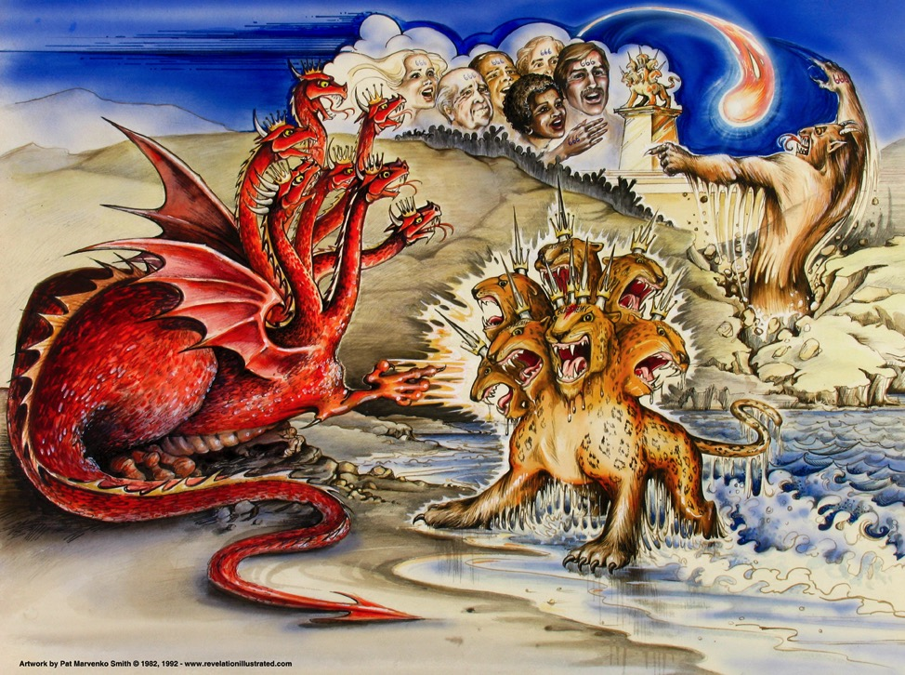
Revelation 13–19
387
Dragon =
Satan
Land Beast =
False Prophet
Sea Beast =
Antichrist
Used with permission
Dr. Rick Griffith • Jordan Evangelical Theological Seminary • BibleStudyDownloads.org
Notes:
Slide 83 is adapted from Rev 1 intro slide
Slides 84-91 copied from Rev 20-22 presentation

Slide 2

Three evidences of…
(
)
10–11 Witnesses
12
Satan
13–14
Henchmen

Slide 3
Slides on
Revelation 13

Slide 4
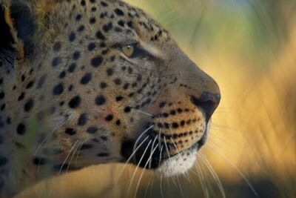
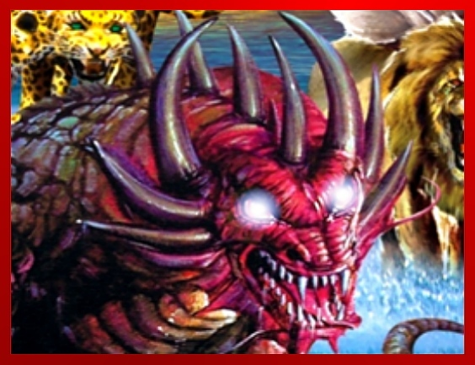
The Beast
387
"Then I saw a beast rising up out of the sea. It had seven heads and ten horns, with ten crowns on its horns. And written on each head were names that blasphemed God. ²This beast looked like a leopard, but it had the feet of a bear and the mouth of a lion! And the dragon gave the beast his own power and throne and great authority" (13:1-2).
Notes:
"The three animals named in Revelation 13:2 remind us of the four beasts Daniel saw in his dream (Dan. 7): a lion (Babylon), a bear (Media-Persia), a leopard (Greece), and a “terrible beast” (the Antichrist). John saw these animals, or kingdoms, in reverse order since he was looking back, while Daniel was looking ahead. The final world empire will be rooted in all the previous empires and unite in one their evil and power. Added to the ferocity of these beasts will be Satan's own power, throne, and authority!" (Wiersbe).

Slide 5
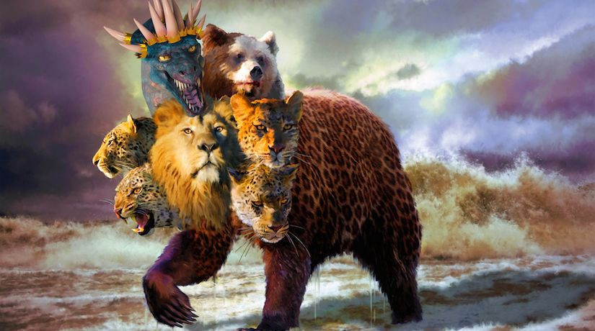
The Beast
387
"Then I saw a beast rising up out of the sea. It had seven heads and ten horns, with ten crowns on its horns. And written on each head were names that blasphemed God. ²This beast looked like a leopard, but it had the feet of a bear and the mouth of a lion! And the dragon gave the beast his own power and throne and great authority" (13:1-2).
Notes:
"The three animals named in Revelation 13:2 remind us of the four beasts Daniel saw in his dream (Dan. 7): a lion (Babylon), a bear (Media-Persia), a leopard (Greece), and a “terrible beast” (the Antichrist). John saw these animals, or kingdoms, in reverse order since he was looking back, while Daniel was looking ahead. The final world empire will be rooted in all the previous empires and unite in one their evil and power. Added to the ferocity of these beasts will be Satan's own power, throne, and authority!" (Wiersbe).

Slide 6
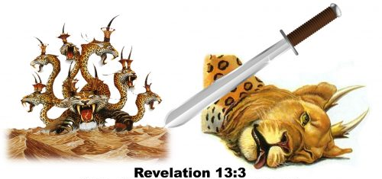
"I saw that one of the heads of the beast seemed wounded beyond recovery—but the fatal wound was healed!
The whole world marveled at this miracle and gave allegiance to the beast” (13:3 NLT).
388
Notes:
https://revelationscriptures.com/revelation-13-beast-image-mark-666-conquers-saints-42-months-false-prophet/
Accessed 26 May 2020

Slide 7
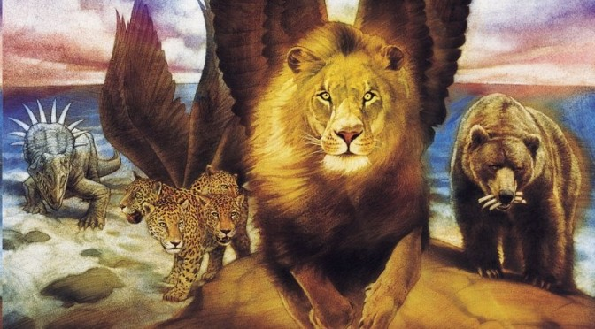
Revelation 13 Alludes to Nations in Daniel 7
331

Slide 8
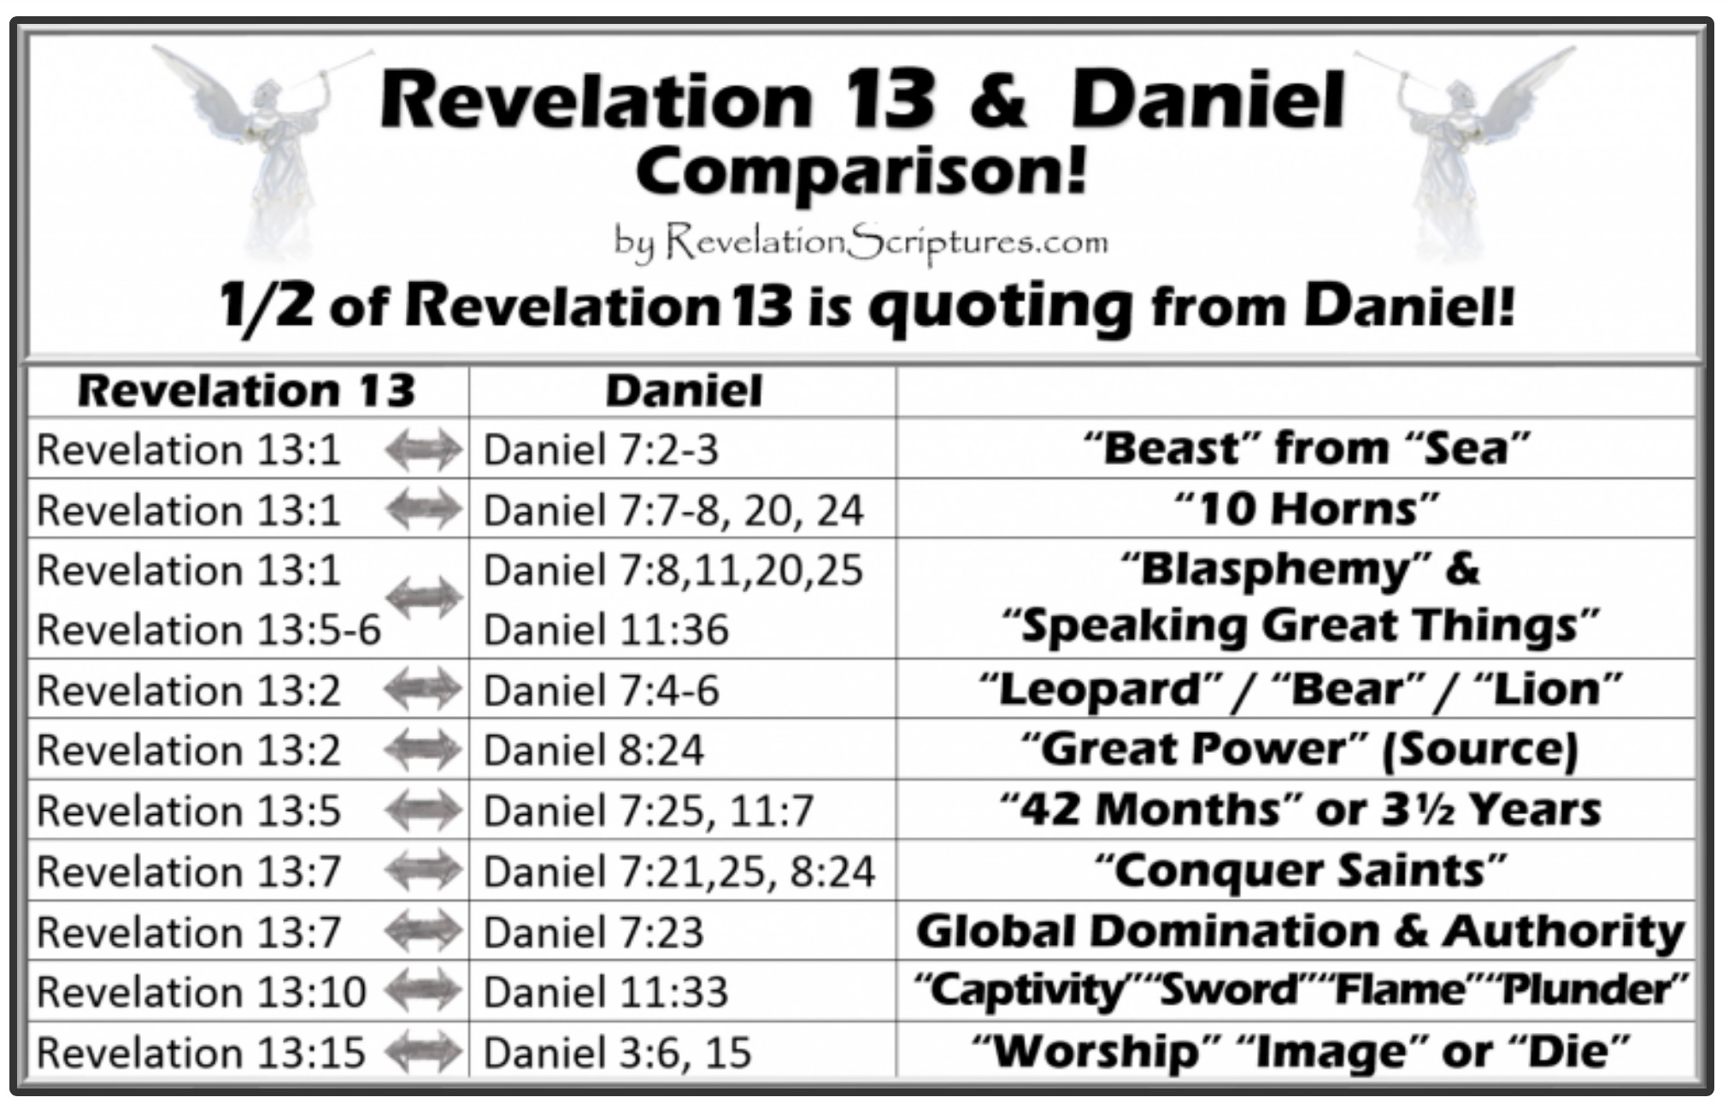
Revelation 13 & Daniel Comparison!
½ of Revelation 13 quotes from Daniel!
Revelation 13 | Daniel
Revelation 13:1 | Daniel 7:2-3 | "Beast" from "Sea"
Revelation 13:1 | Daniel 7:7-8, 20, 24 | "10 Horns"
Revelation 13:1 Revelation 13:5-6 | Daniel 7:8, 11, 20, 25 Daniel 11:36 | "Blasphemy" & "Speaking Great Things"
Revelation 13:2 | Daniel 7:4-6 | "Leopard"/"Bear"/"Lion"
Revelation 13:2 | Daniel 8:24 | "Great Power" (Source)
Revelation 13:5 | Daniel 7:25; 11:7 | "42 Months" or 3½ Years
Revelation 13:7 | Daniel 7:21, 25; 8:24 | "Conquer Saints"
Revelation 13:7 | Daniel 7:23 | Global Domination & Authority
Revelation 13:10 | Daniel 11:33 | "Captivity" "Sword" "Flame" "Plunder"
Revelation 13:15 | Daniel 3:6, 15 | "Worship" "Image" or "Die"
Notes:
https://revelationscriptures.com/revelation-13-beast-image-mark-666-conquers-saints-42-months-false-prophet/
Accessed 26 May 2020

Slide 9
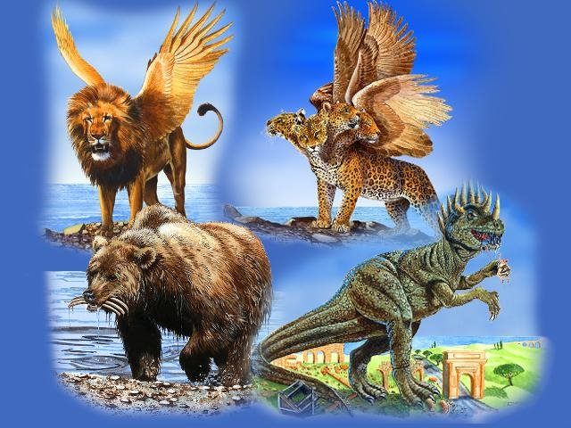
Revelation 13 Alludes to Nations in Daniel 7
331
Babylon
Greece
Rome
Medo-Persia
Notes:
Slides 3-8 appear in the Revelation 1-12 slide show as slides 104-109 so just copy the translated slides from there.

Slide 10
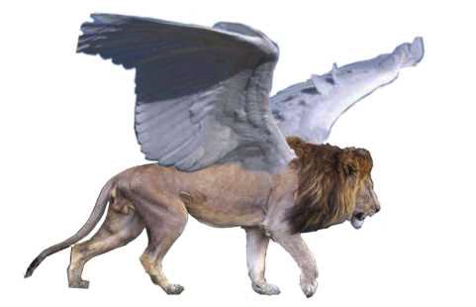
Beast 1: Winged Lion (Babylon)
331

Slide 11
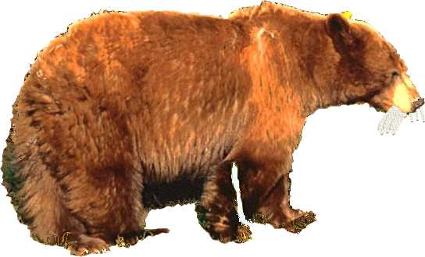
Beast 2: Bear (Medo-Persia)
331

Slide 12
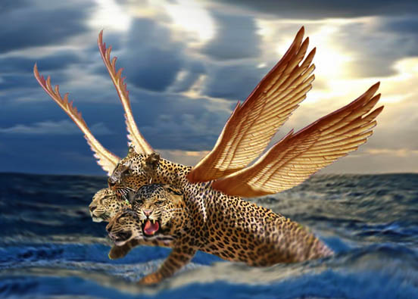
Beast 3: Leopard (Greece)
331

Slide 13
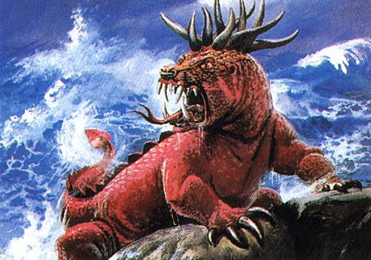
Beast 4: Terrifying (Rome)
331
Daniel 7:7

Slide 14
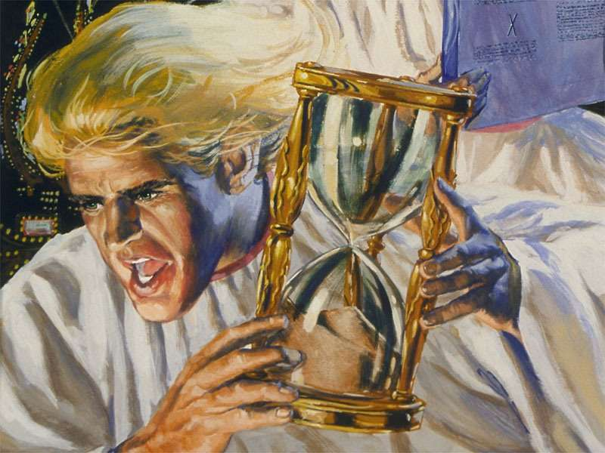
Little Horn on Beast 4 (Antichrist)
331
Daniel 7:8

Slide 15
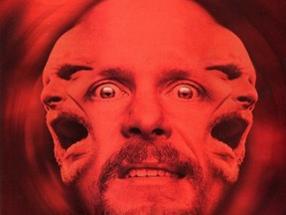
A Satanic "Trinity":
387
"Father" =
Satan
"Son" =
Antichrist
"Spirit" =
False Prophet

Slide 16
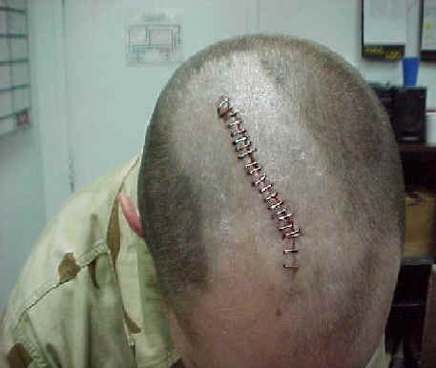
"I saw that one of the heads of the beast seemed wounded beyond recovery—but the fatal wound was healed! The whole world marveled at this miracle and gave allegiance to the beast. ⁴They worshiped the dragon for giving the beast such power, and they also worshiped the beast. 'Who is as great as the beast?' they exclaimed. 'Who is able to fight against him?'"
(13:3-4 NLT).
388
Notes:
Satan worship is becoming much more popular in the USA, even though Satan does not care if people worship him or something or someone else—as long as this is not God! Every major city in the USA has a Satanic church. One former Satanic priest, Mike Warnke, is now a Christian. He estimates that 80% of missing persons who have never been found were offered as human sacrifices.
"Not only will there be wonder, but there will also be worship (Rev. 13:4). Worship is the one thing Satan has always wanted (Matt. 4:8–10), and he will receive it through “the beast.” The second “beast,” described in the last half of this chapter, will organize and promote the worship of Antichrist, making it the official religion of the world!" (Wiersbe).

Slide 17
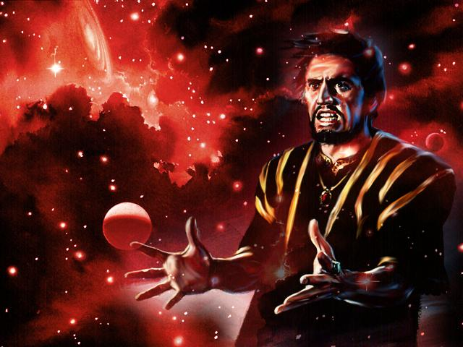
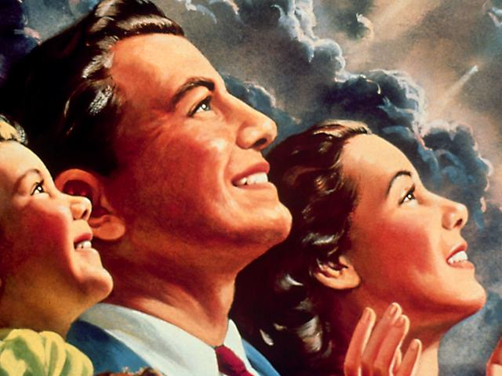
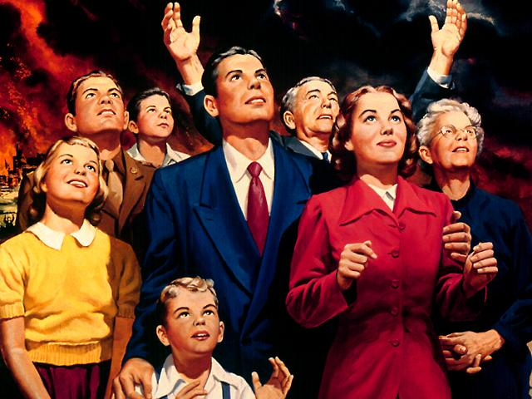
The world will worship the beast
388

Slide 18
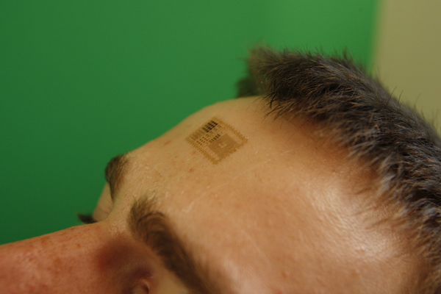
"And all the people who belong to this world worshiped the beast. They are the ones whose names were not written in the Book of Life before the world was made—the Book that belongs to the Lamb who was slaughtered" (13:8).
388

Slide 19
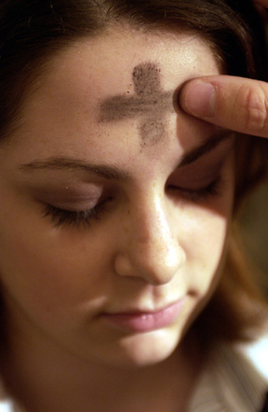
"Anyone with ears to hear should listen and understand.
¹⁰Anyone who is destined for prison will be taken to prison.
Anyone destined to die by the sword will die by the sword.
This means that God's holy people must endure persecution patiently and remain faithful"
(13:9-10 NLT).
388

Slide 20
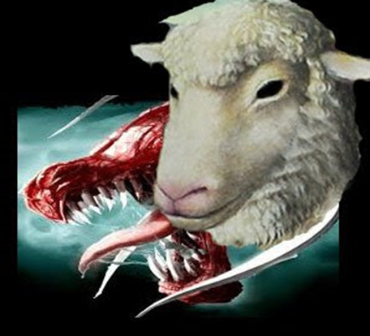
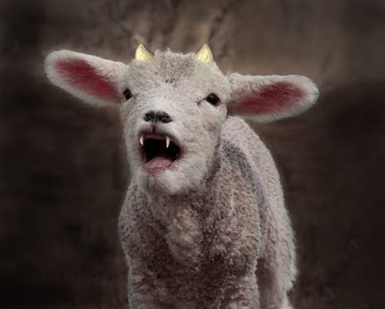
"Then I saw another beast come up out of the earth. He had two horns like those of a lamb, but he spoke with the voice of a dragon"
(13:11 NLT).

Slide 21
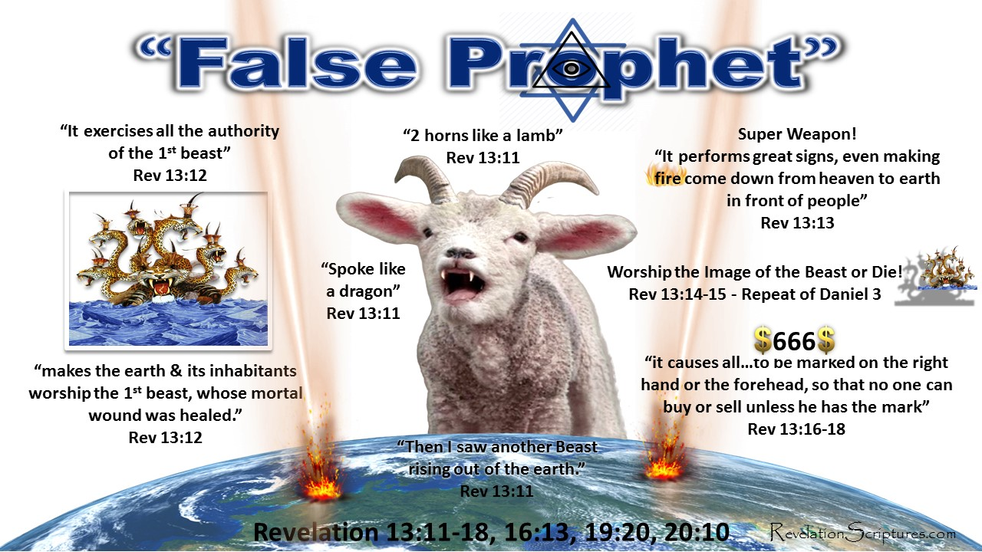
"He exercised all the authority of the first beast. And he required all the earth and its people to worship the first beast, whose fatal wound had been healed"
(13:12 NLT).
Notes:
https://revelationscriptures.com/revelation-13-beast-image-mark-666-conquers-saints-42-months-false-prophet/
Accessed 26 May 2020

Slide 22
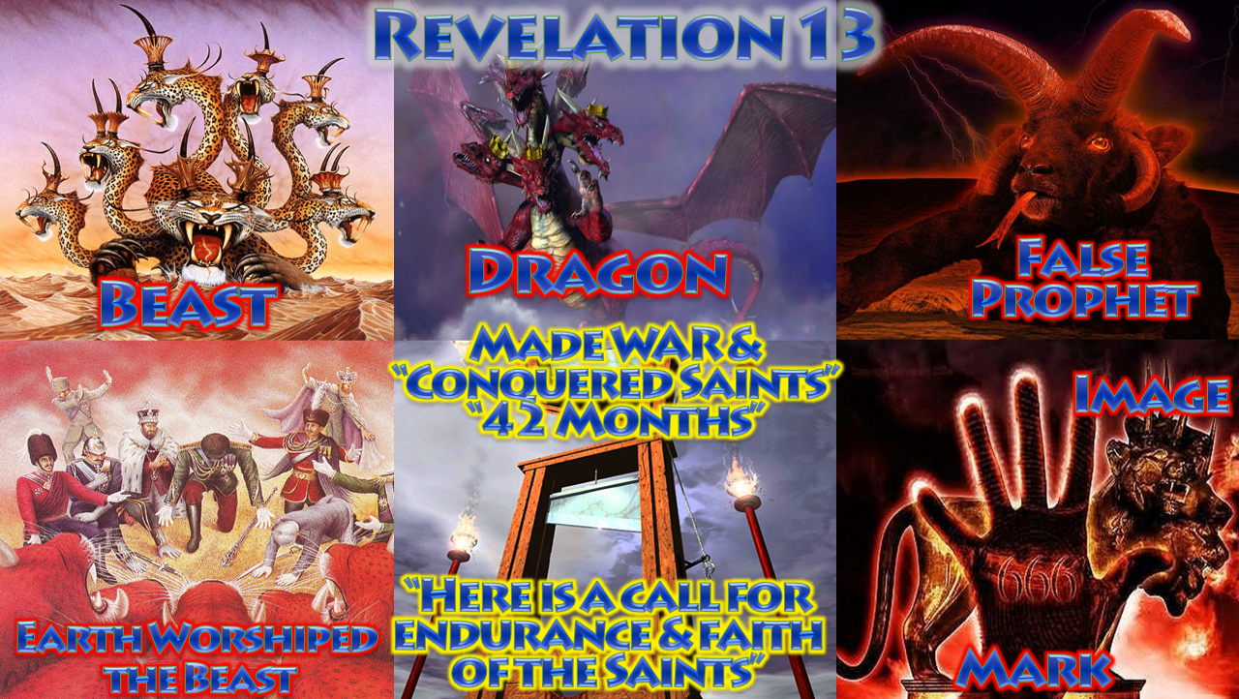
Revelation 13 Summarized
Notes:
https://revelationscriptures.com/revelation-13-beast-image-mark-666-conquers-saints-42-months-false-prophet/
Accessed 26 May 2020

Slide 23
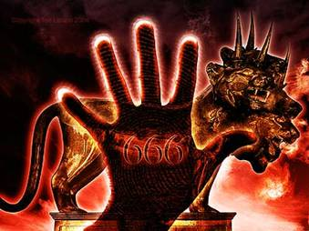
The Mark in the Right Hand
"He causes all, both small and great, rich and poor, free and slave, to receive a mark on their right hand or on their foreheads, and that no one may buy or sell except one who has the mark or the name of the beast, or the number of his name."
388
Revelation 13:16-17

Slide 24
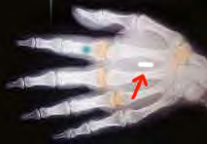
The Mark in the Right Hand
"He causes all, both small and great, rich and poor, free and slave, to receive a mark on their right hand or on their foreheads, and that no one may buy or sell except one who has the mark or the name of the beast, or the number of his name."
388
Revelation 13:16-17

Slide 25
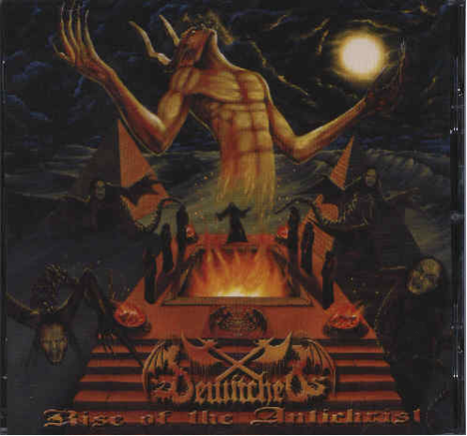
Who is the Antichrist?
388

Slide 26
The following slides show how some spiritualize "beast"…
388
The Counterfeit
& False
666

Slide 27
The Dragon!
388
Satan:
The arch-enemy of God; the one who hates all truth, all goodness, all of God's creatures; the one who would make himself God, if he could!

Slide 28

The Beast Spiritualized
388
The Beast:
The World's political systems. They demand and achieve worship and obedience from all but those who belong to the Lamb. The effect is to take the world into Satan's power.
Notes:
----- Meeting Notes (17/5/16 11:21) -----
How do we know the beast is a person?
1. The head wound makes him die then he raises from the dead
2. Even a government is led by people—generally a dictator
3. False prophet performs signs
4. Daniel 9:27 says "he"
5. He will declare himself God
6. Satan likes to imitate God's works, so he imitates Jesus
----- Meeting Notes (15/5/18 11:51) -----
He speaks blasphemy
He is wounded
Satan gives him power

Slide 29

The False Prophet Spiritualized
388
The False Prophet:
Every Ideology, Religion and/or Technology which leads mankind astray by highly plausible (but false) principles, miracles or works. His goal is to cause humanity to worship the Beast.

Slide 30
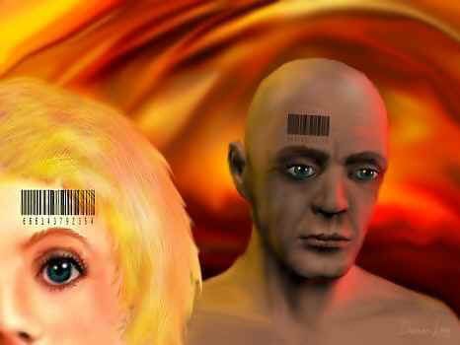
But he is referred to as a person and the number of his name is 666
(Revelation 13:18)
388

Slide 31
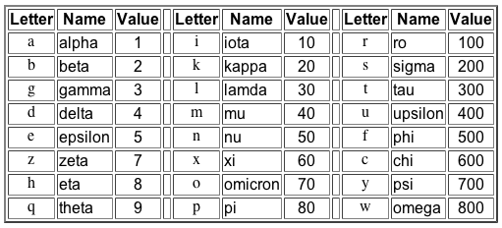
Gematria in Greek
388
Hebrew, Greek and Latin used letters as numbers
http://religion-cults.com/antichrist/666.htm
Notes:
religion-cults.com/ antichrist/666.htm

Slide 32

Nero = 666?
388
http://religion-cults.com/antichrist/666.htm

Slide 33
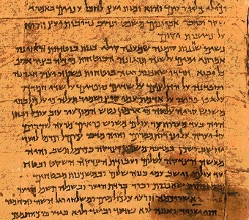
Hebrew Gematria
388
English | Greek | Hebrew | Value
A | Alpha | Aleph | 1
B | Beta | Beth | 2
C | Gamma | Gimmel | 3
D | Delta | Daleth | 4
E | Epsilon | He | 5
F |  | Waw | 6
G |  | Zahyin | 7
H | Eta | Heth | 8
www = 666
http://religion-cults.com/antichrist/666.htm
Notes:
The waw in Hebrew looks like a small "l" in English but it transliterates to "w." Triple it to "www" and some think that the World Wide Web is the Antichrist! This is unlikely, though, as both Daniel and Revelation indicate that he is a human. See slide 28 on The Beast Spiritualized.

Slide 34
English Gematria
388
K | 66
I | 54
S | 114
S | 114
I | 54
N | 84
G | 42
E | 30
R | 108
 | 666
A | 6
B | 12
C | 18
D | 24
E | 30
F | 36
G | 42
H | 48
I | 54
J | 60
K | 66
L | 72
M | 78
N | 84
O | 90
P | 96
Q | 102
R | 108
S | 114
T | 120
U | 126
V | 132
W | 138
X | 144
Kissinger = Antichrist!
Notes:
Another method tried in the early 1970s was to add the number 6 to each English letter of the alphabet, starting with "A" having the value of 6 and so on. This gives the letter "K" the value of 66, which is thought to show us on the right track to identifying the 666 person. The letter "I" then has a value of 54, and so on with KISSINGER summing up to 666. History records, though, that Henry Kissinger, the Jewish US Secretary of State in the early 1970s did not become the world ruler.

Slide 35
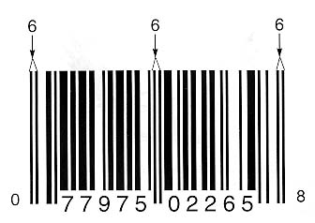
THE UPC BAR CODE
388
BUT WOULD THE JEWS IN THE NEXT VERSE (REV. 14:1) ALSO HAVE AN INVISIBLE CODE?
http://religion-cults.com/antichrist/mark.htm
Notes:
Even the popular bar code is based on three 6s. But this is not a person!
http://religion-cults.com/antichrist/mark.htm and www.soldierofthelord.4t.com/ photo.html

Slide 36
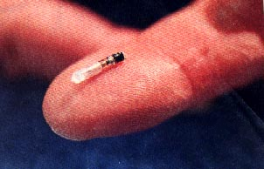

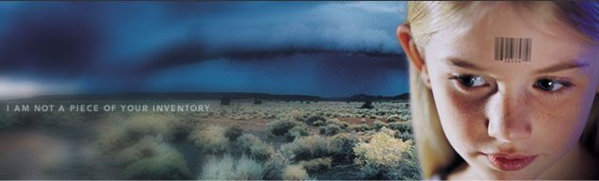
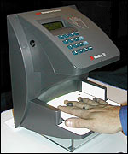
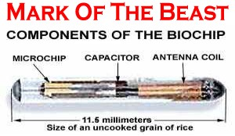
Mark of the Beast Microchip
388
www.soldierofthelord.4t.com/ photo.html
Notes:
Some countries like Sweden are initiating a system where a biochip under the skin can have convenient medical and financial data to help people "buy and sell" more easily (Rev 13:16-17).

Slide 37
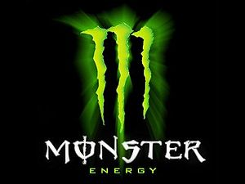


Monster Drink!
388
Notes:
Even Monster Energy Drink has a triple "waw" for its logo! This brings us to 666 when "waw" has the value of 6 as in the Kissinger slide above.

Slide 38
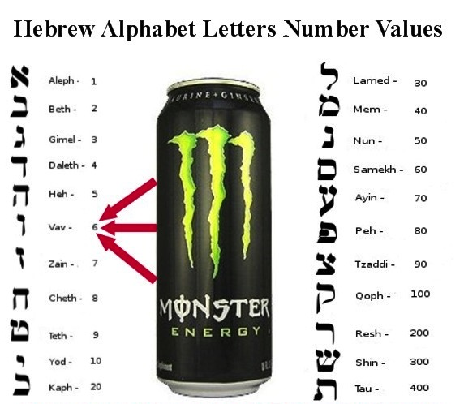
Hebrew Alphabet Values
388
Monster Energy Drink =
666
Notes:
Waw is the sixth letter of the Hebrew alphabet. Triple it, some say, and you have the Antichrist!

Slide 39
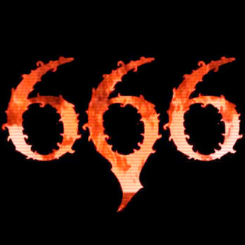
The Sky's the Limit
388
Computations using different systems make each of these total 666: Kissinger, van den broek, lustiger, hitler, deutschland, himmler, new york, us of america, santa claus, kennedy, al gore... Holy Bible, SS number, witchcraft, lustful, monetary, live, son of sin, mark of beast, evil, bullet... internet, billgates+3 (the III), computer, terminal, binary, windows98, teletext, calculation

Slide 40
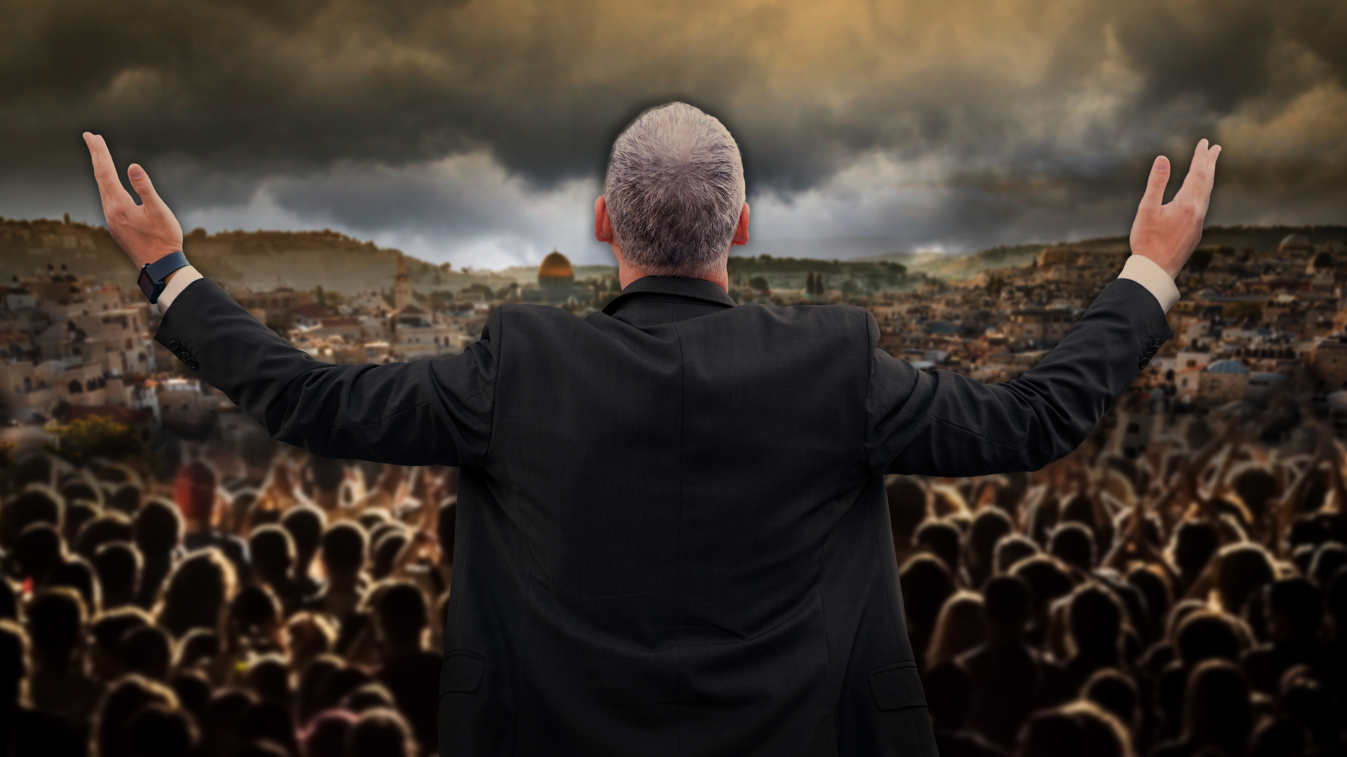
Is the Antichrist Here?
Irvin Baxter, “Antichrist Is He on Earth Right Now?” (Plano, TX: End Time Ministries, 15 Oct 2019), https://www.endtime.com/articles-endtime-magazine/antichrist-is-he-on-earth-right-now/
Notes:
https://www.endtime.com/articles-endtime-magazine/antichrist-is-he-on-earth-right-now/
Accessed 27 May 2020
He appears to be midtribulational:
“The Rapture: What do you teach? When is it?
In the Bible, 1 Corinthians describes our final victory: “Behold, I shew you a mystery; We shall not all sleep, but we shall all be changed, In a moment, in the twinkling of an eye, at the last trump: for the trumpet shall sound, and the dead shall be raised incorruptible, and we shall be changed” (1 Corinthians 15:51-52, King James Version). Paul says this occurs at the last trump, which the Bible tells us is the seventh trumpet. 1 Corinthians 15 and Revelation 11:15 are referring to the same thing. For the trumpet shall sound, the dead shall be raised, and we shall be changed.”
https://www.endtime.com/faq/

Slide 41
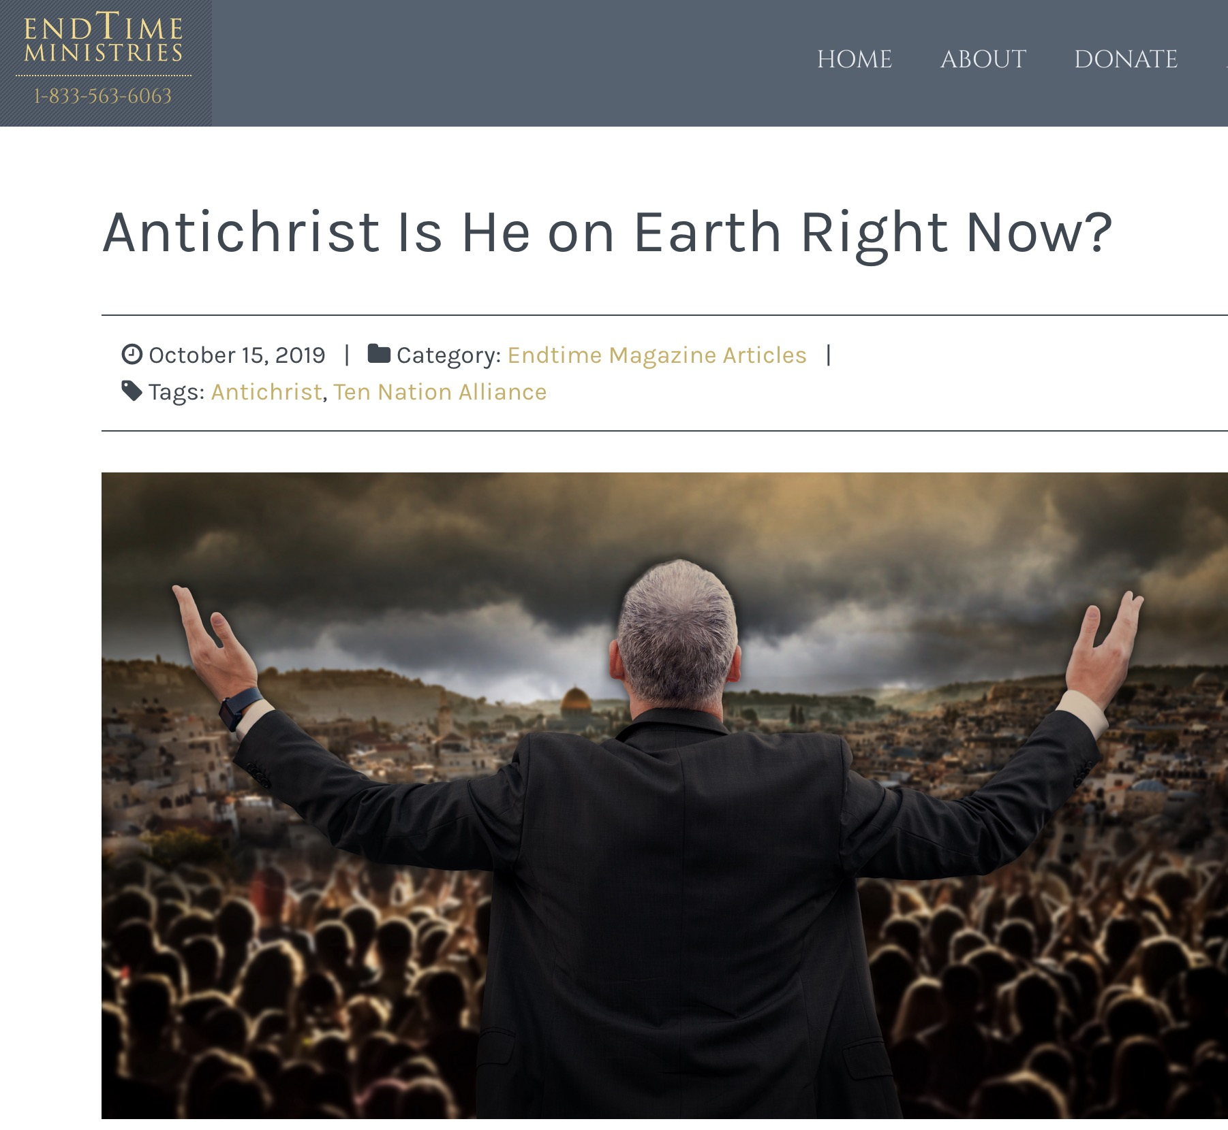
Is the Antichrist Here?
Antichrist Is He on Earth Right Now?
Irvin Baxter, “Antichrist Is He on Earth Right Now?” (Plano, TX: End Time Ministries, 15 Oct 2019), https://www.endtime.com/articles-endtime-magazine/antichrist-is-he-on-earth-right-now/
Notes:
https://www.endtime.com/articles-endtime-magazine/antichrist-is-he-on-earth-right-now/
Accessed 27 May 2020
He appears to be midtribulational:
“The Rapture: What do you teach? When is it?
In the Bible, 1 Corinthians describes our final victory: “Behold, I shew you a mystery; We shall not all sleep, but we shall all be changed, In a moment, in the twinkling of an eye, at the last trump: for the trumpet shall sound, and the dead shall be raised incorruptible, and we shall be changed” (1 Corinthians 15:51-52, King James Version). Paul says this occurs at the last trump, which the Bible tells us is the seventh trumpet. 1 Corinthians 15 and Revelation 11:15 are referring to the same thing. For the trumpet shall sound, the dead shall be raised, and we shall be changed.”
https://www.endtime.com/faq/

Slide 42

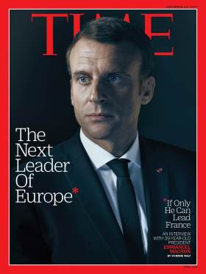
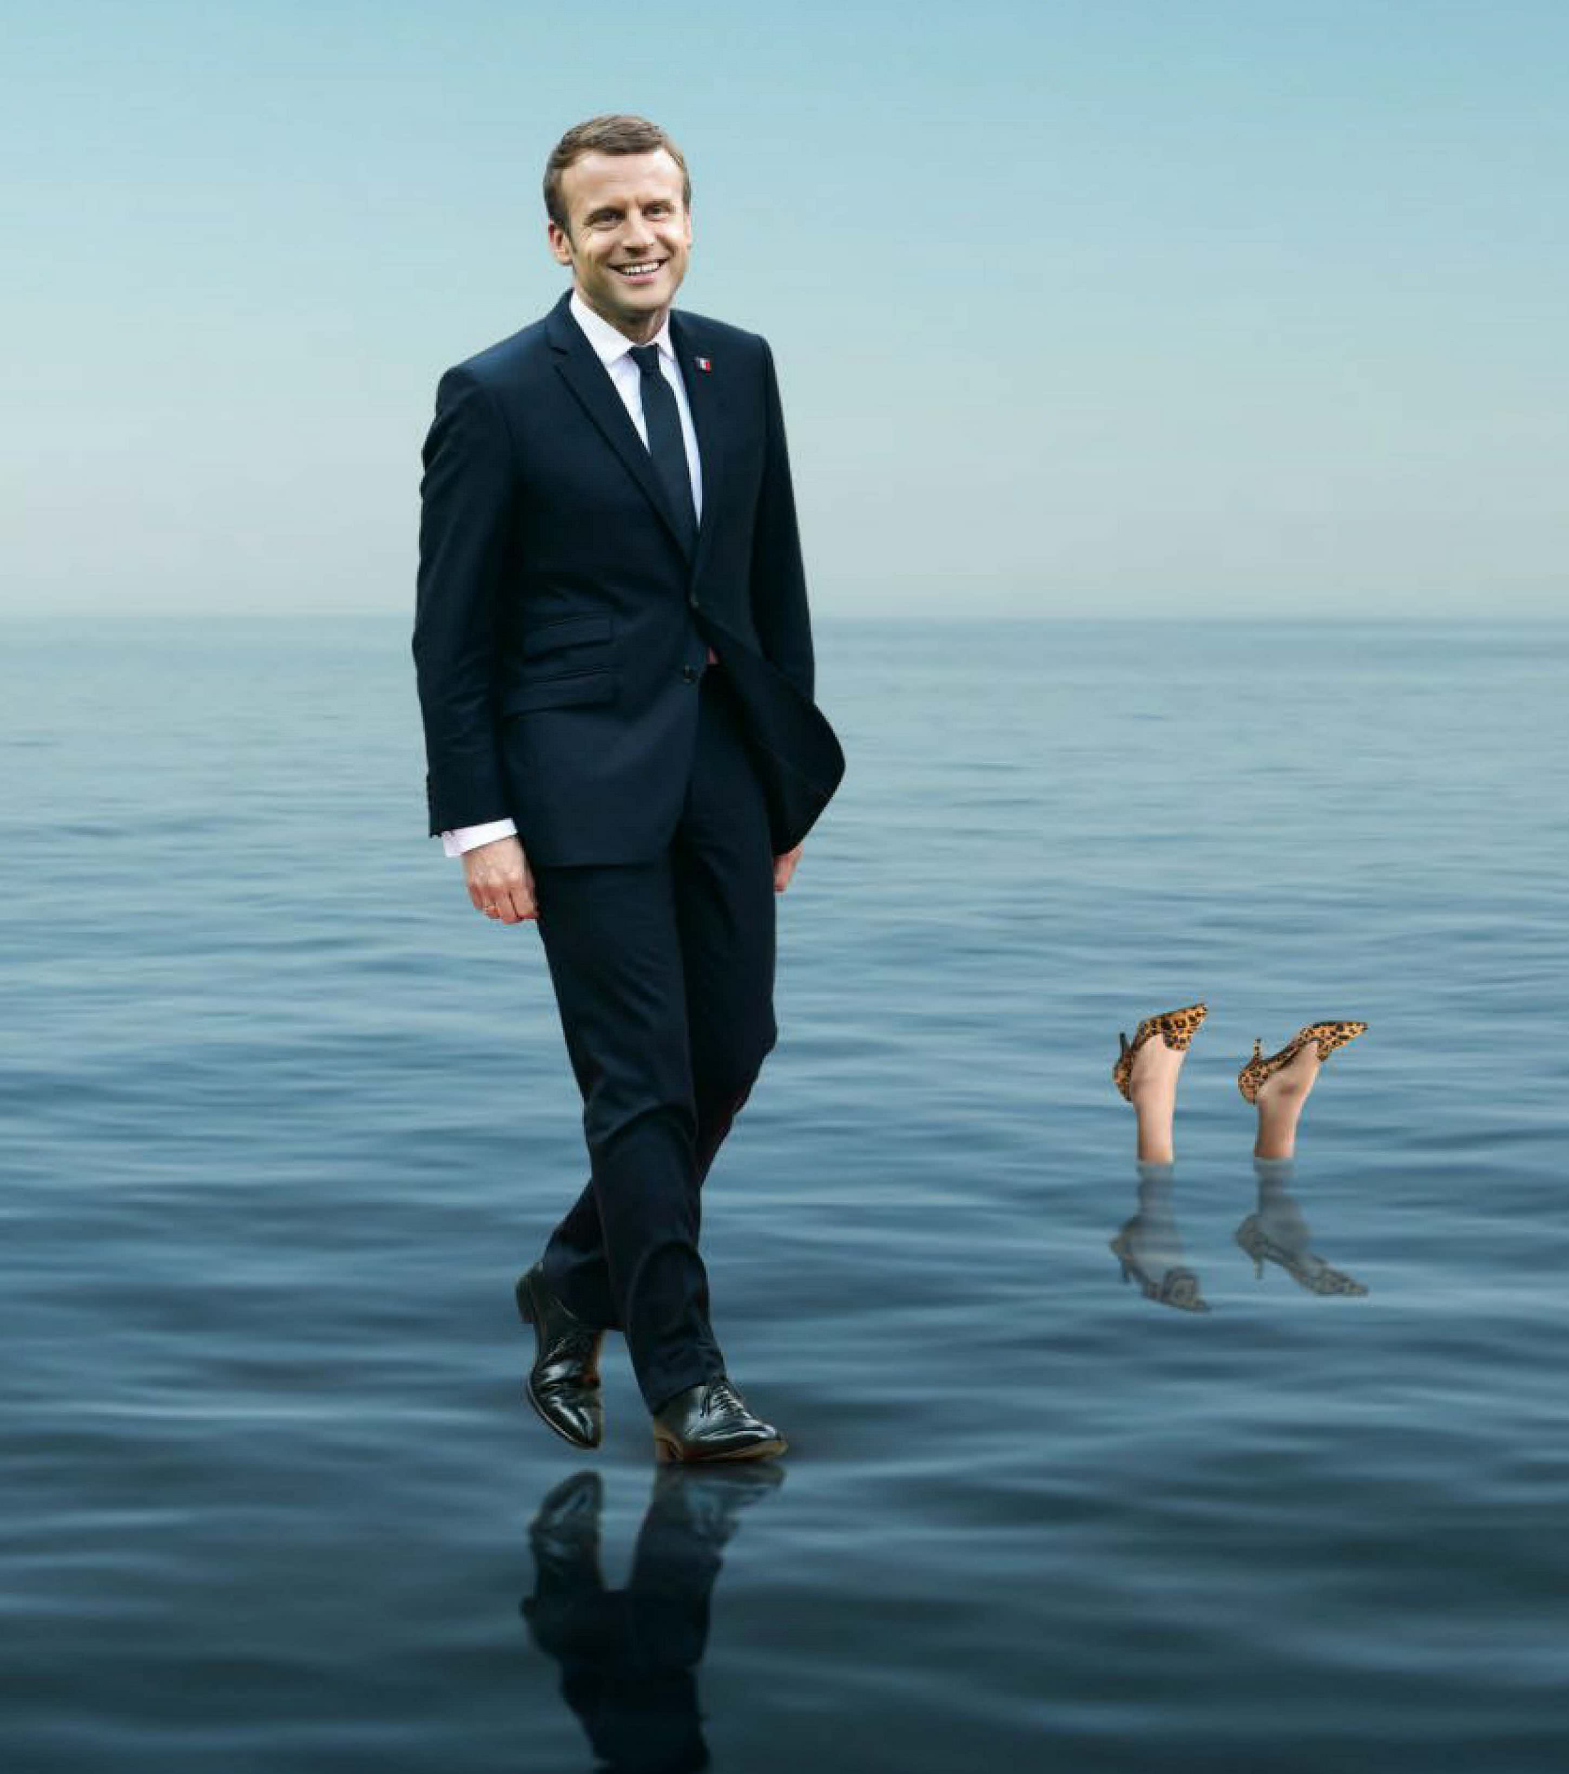

Immanuel Macron
Notes:
Walking on water picture: https://www.economist.com/leaders/2017/06/17/electoral-victory-will-make-frances-president-a-potent-force
Immanuel means "God is with us," so his first name is quite fitting for one who was deemed to be the Saviour-figure of France and Europe in 2017

Slide 43
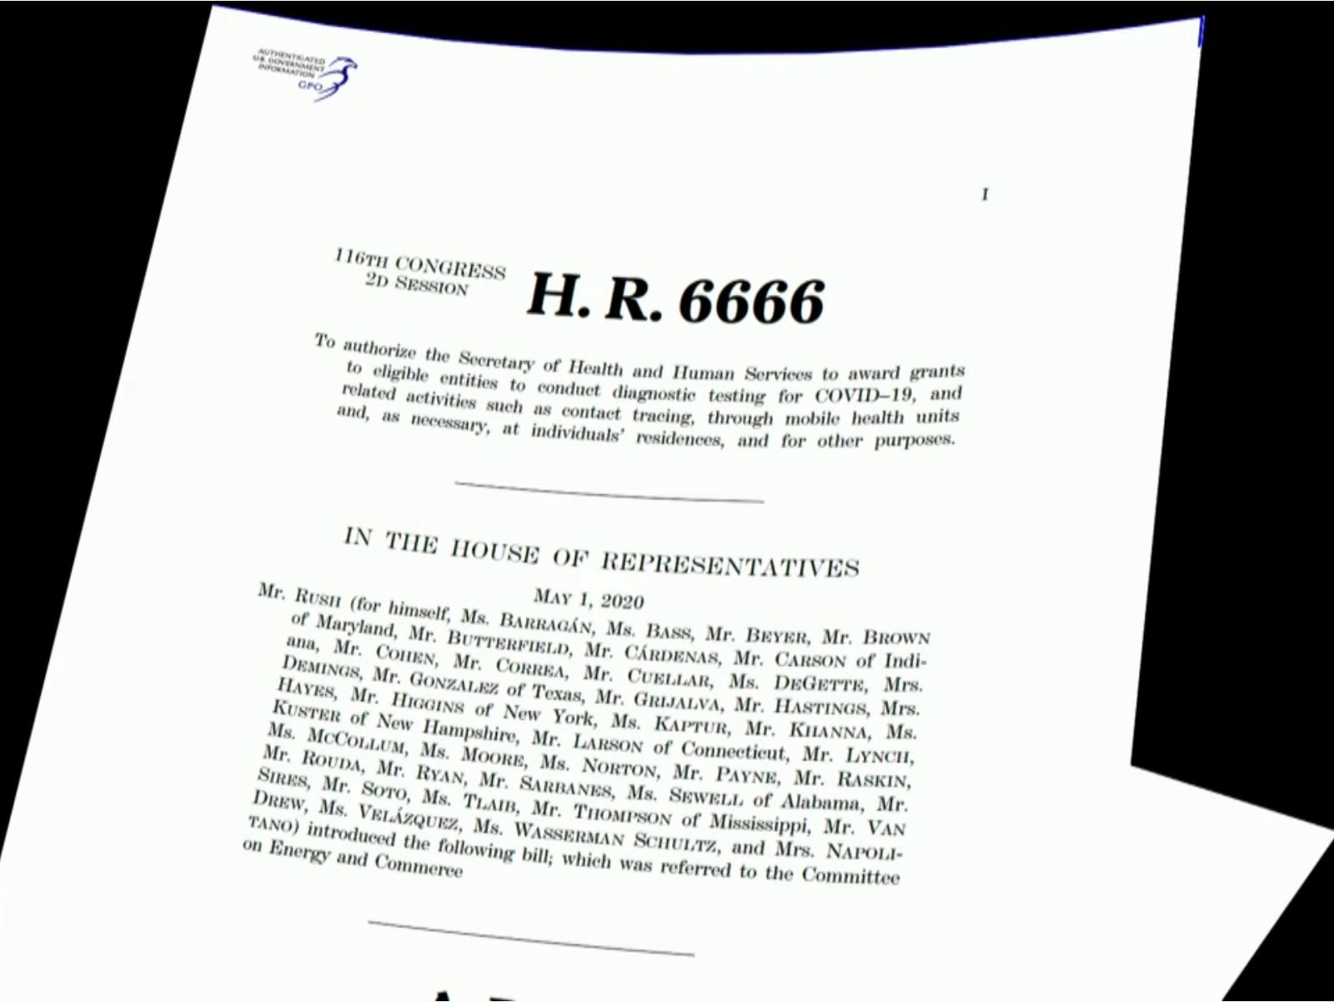
H.R. 6666

Slide 44
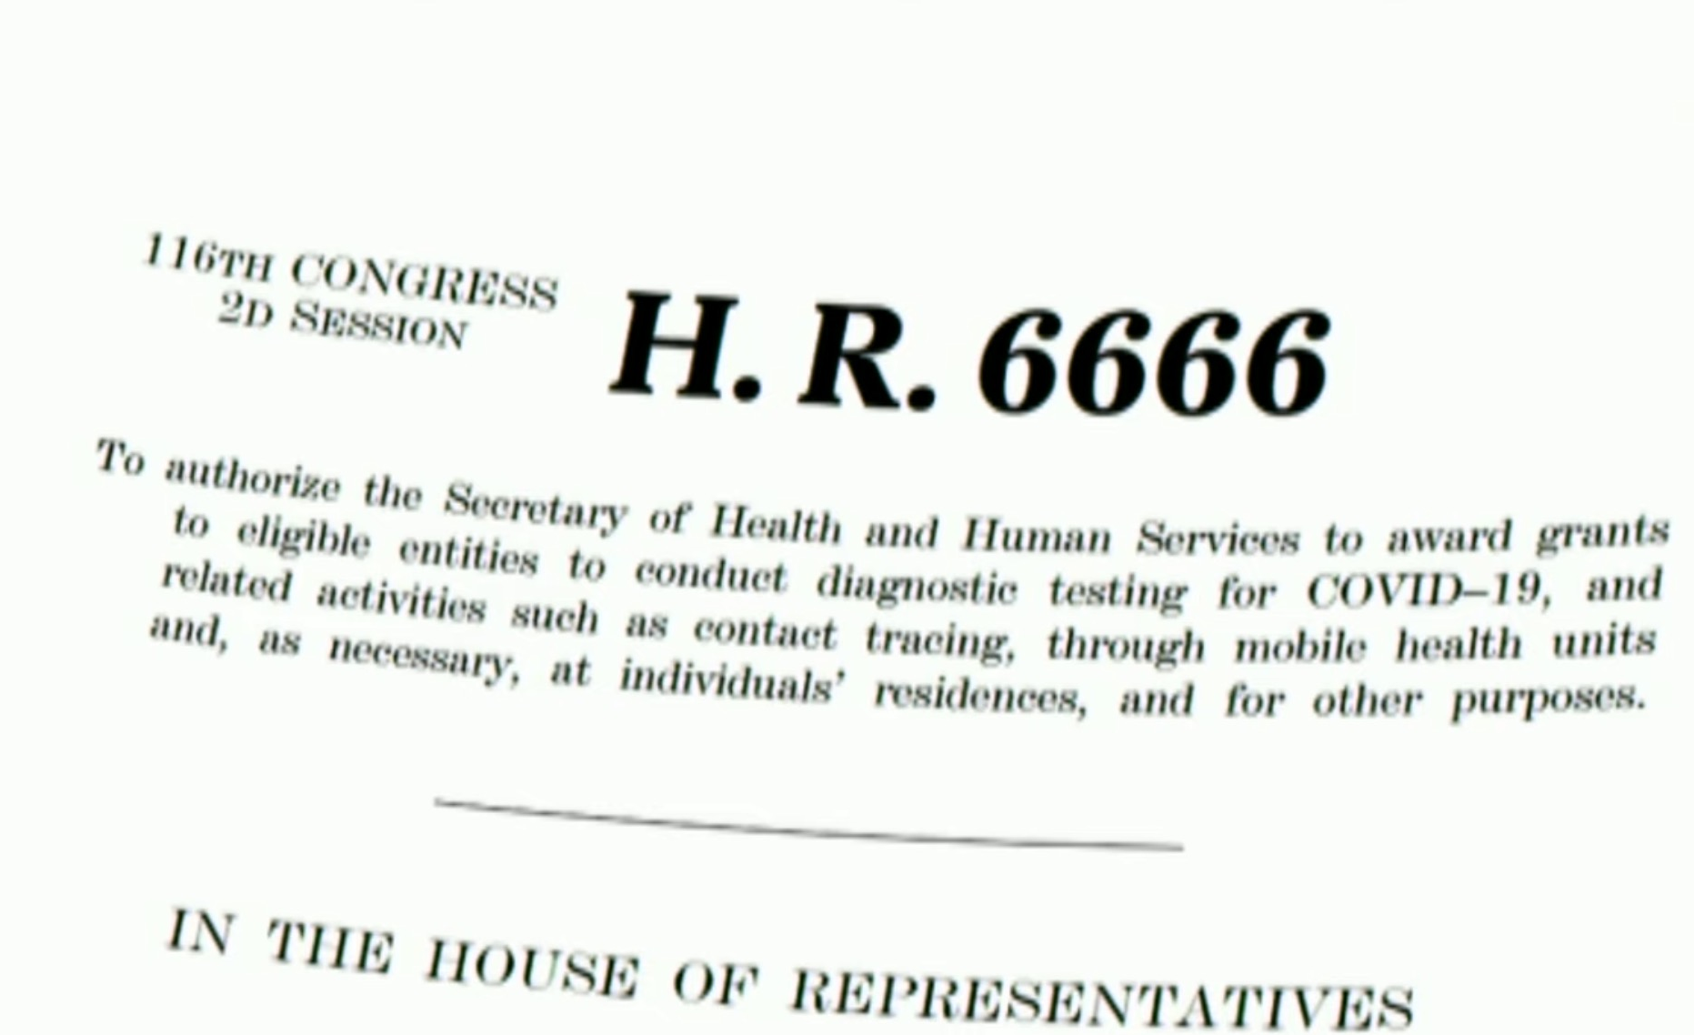
H.R. 6666

Slide 45
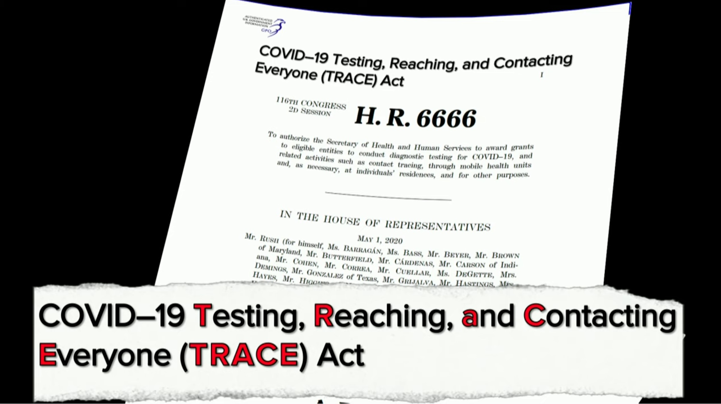
H.R. 6666

Slide 46

Rockefeller Foundation’s Plan to Track Americans

Slide 47
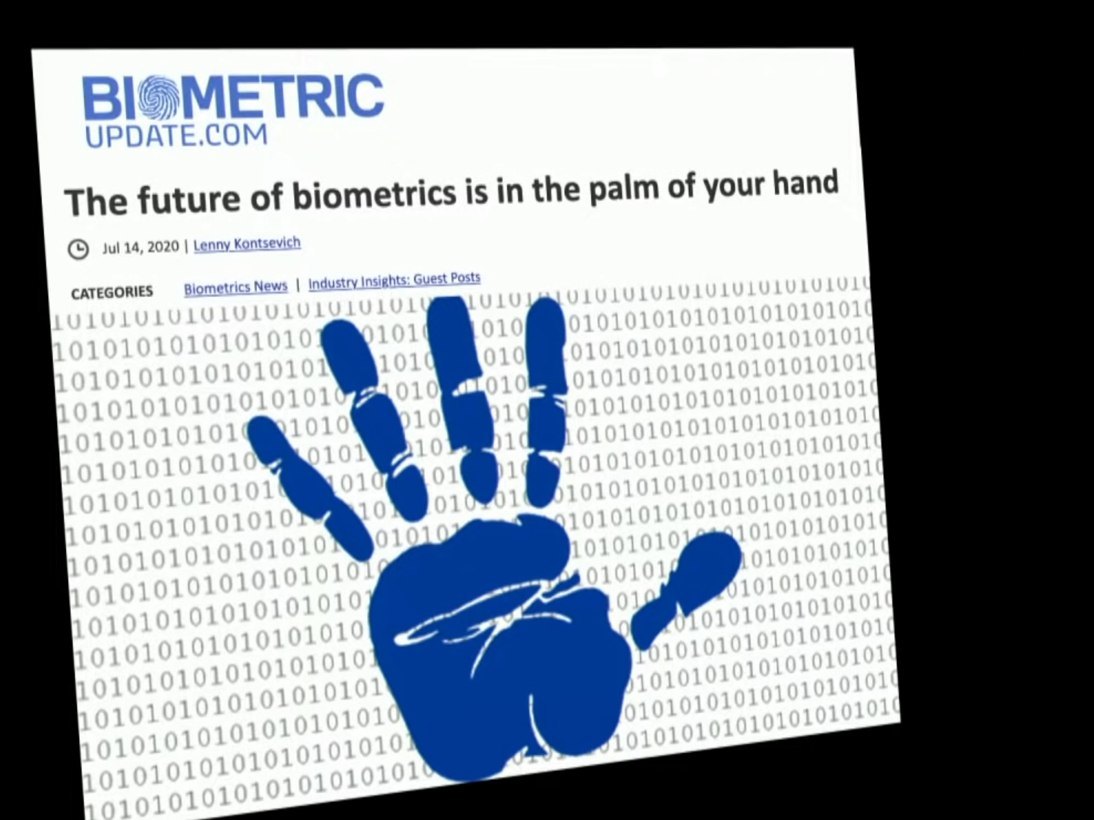
BIOMETRIC PALM READING
The future of biometrics is in the palm of your hand
Notes:
Many people will not allow a mark on their hand, much less an imbedded chip. How much simpler just to use the fingerprints that are already there and unique to you among all the people of the world? This is the fast-advancing world of biometrics that evil players want to seize to their advantage.

Slide 48
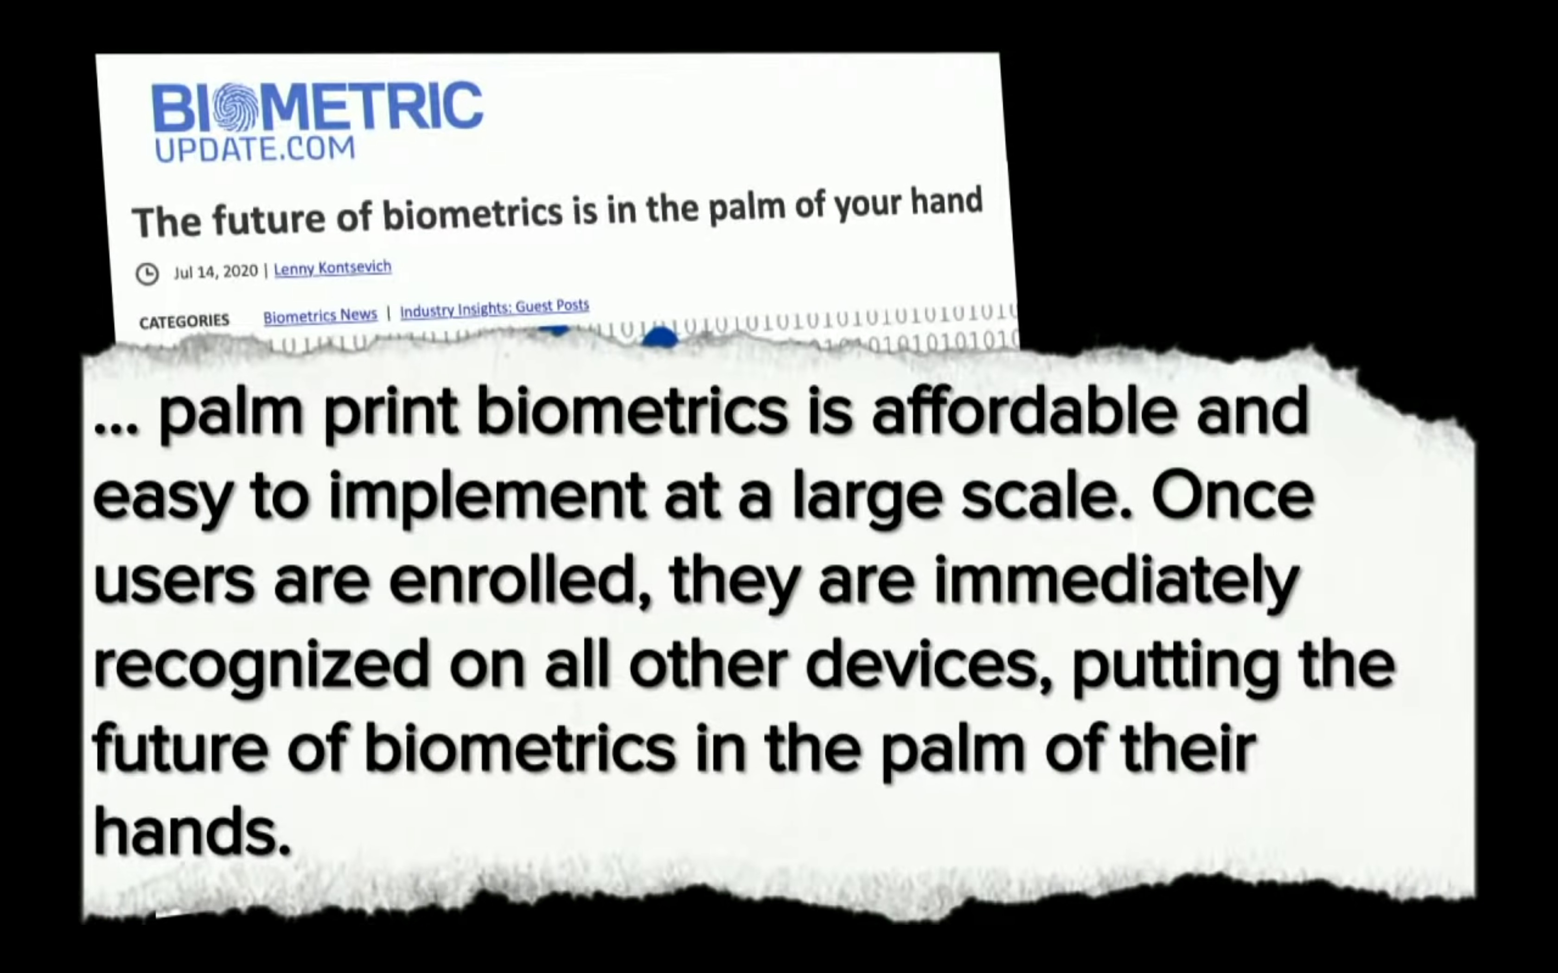
BIOMETRIC PALM READING
The future of biometrics is in the palm of your hand
… palm print biometrics is affordable and easy to implement at a large scale. Once users are enrolled, they are immediately recognized on all other devices, putting the future of biometrics in the palm of their hands.
Notes:
Biometrics has many advantages over other technologies.

Slide 49
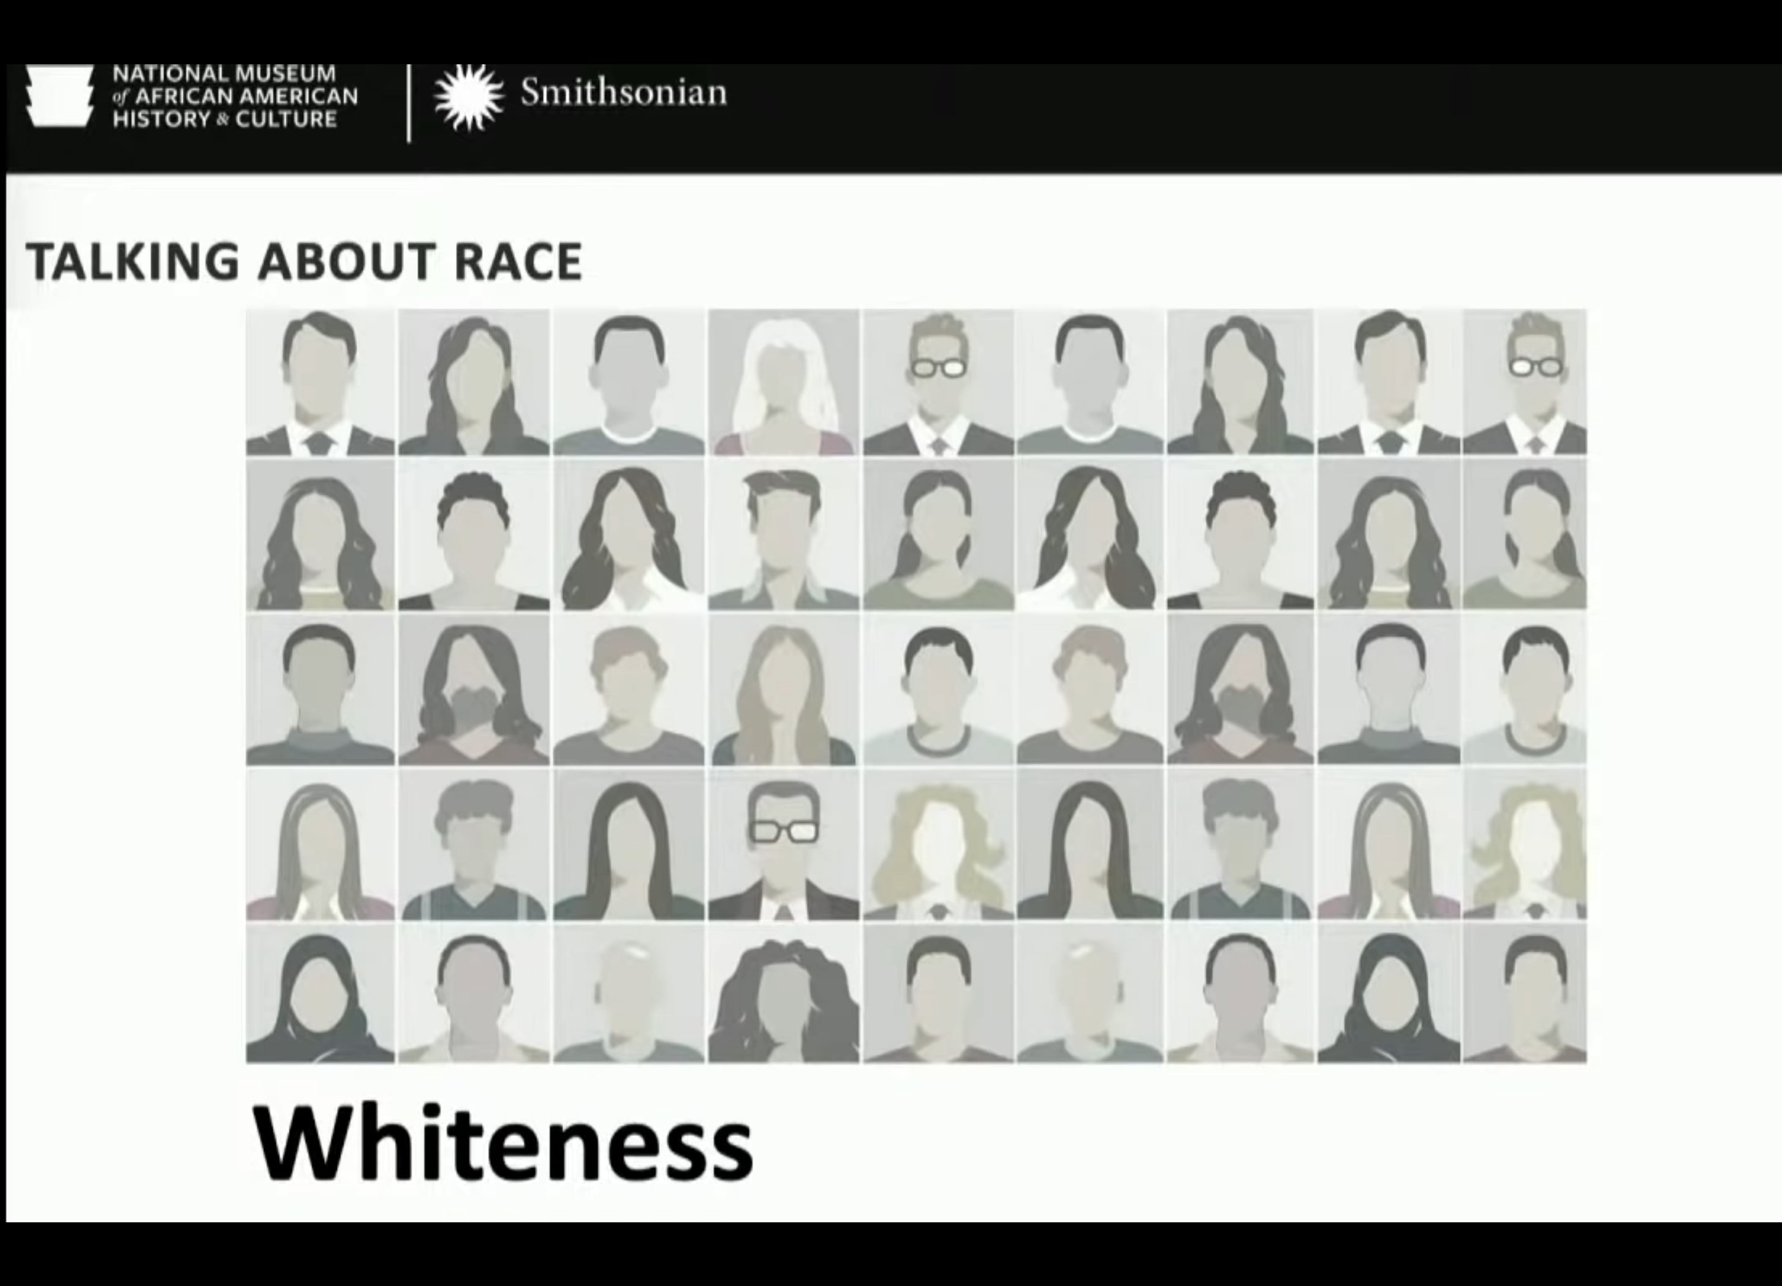
BIOMETRIC PALM READING
TALKING ABOUT RACE
Whiteness
Notes:
Biometrics can easily identify the degree of "whiteness" to those wishing to exploit the current trend towards discriminating against people based on ethnic identity.

Slide 50
Slides on
Revelation 14

Slide 51
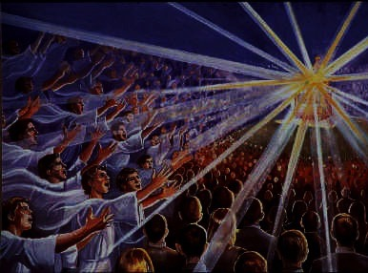
The 144,000 Sing (14:1-5)
389

Slide 52
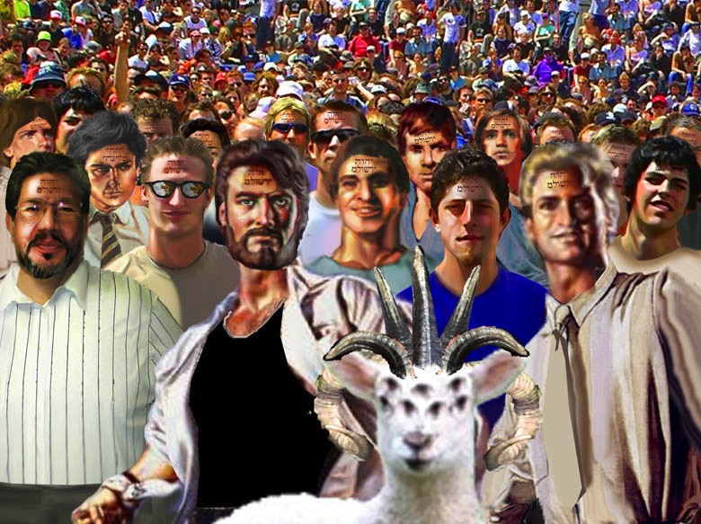
The 144,000 Sing (14:1-5)
389

Slide 53

"All Israel will be saved" (Rom. 11:25-27)
155w
²⁵I do not want you to be ignorant of this mystery, brothers, so that you may not be conceited: Israel has experienced a hardening in part until the full number of the Gentiles has come in.
²⁶And so all Israel will be saved, as it is written:
“The deliverer will come from Zion; he will turn godlessness away from Jacob.
²⁷And this is my covenant with them when I take away their sins.”

Slide 54


HOW WILL ALL ISRAEL BE SAVED? Rom. 11:25-32
155w
VIEW 1: All Jews Will Be Saved
Support: Israel is the people of God––His elect nation (9:4, 11; 11:1, 28).
B. Response: Election of the nation does not mean the salvation of each individual in it, especially since most Jews throughout the centuries have rejected Christ. God does not have different method of salvation for Jews since they must trust Christ too (1:16-17).
VIEW 2: All Christians Will Be Saved
Support: Paul upheld the security of the believer elsewhere (see Romans 8 studies).
B. Response: This is a theologically true statement but doubtful that Paul had it in mind here. The believer's security is not in the context. But the main problem with this view is that nowhere does Paul ever call Christians or the church “Israel.”

Slide 55
HOW WILL ALL ISRAEL BE SAVED? Rom. 11:25-32
155w
VIEW 3: All Elect Jews
“All Israel” means the total number of elect Jews, or the sum of all Israel's remnant.
The translation for houtos in 11:26 should be in this manner, not then/after .
Disobedience to obedience by God's mercy in 11:25-27 is paralleled in 11:30-31.
Israel is being saved now (11:31).
Future mass conversion contradicts the spirit of an earlier statement in 1 Thess. 2:14b-16.
Romans 11:26b-27 is not the second coming, but first coming of Christ.
Some Jews believe in Christ, some do not.
Throughout history God keeps a remnant (11:5).
VIEW 4: Most of the Final Generation Jews
“All Israel” means all Jews living on earth in the end of this age. They will believe in Christ and be saved just prior to or at the very moment Christ returns (11:26). “And after that all Israel will be saved”:
The OT prophets note the salvation of the nation many times (Isa. 2:5, etc.).
The hardening of Jews is “until” (or after) “the full number of Gentiles has come in.”
The context is Christ's return (11:26b-27) from Zion (Isa. 59:20b).
This will fulfill God's new covenant promise “when I take away their sins” (11:27; cf. Jer. 31:34; Isa. 59:21).
Earlier the text noted that God is able to graft all of them in again (11:23b).

Slide 56


Revelation 14:6-7 NAU
389
"And I saw another angel flying in mid-heaven, having an eternal gospel to preach to those who live on the earth, and to every nation and tribe and tongue and people;
⁷and he said with a loud voice, 'Fear God, and give Him glory, because the hour of His judgment has come; worship Him who made the heaven and the earth and sea and springs of waters.'"
Notes:
"During the present age, the angels are not privileged to preach the Gospel. That responsibility has been given to God's people. While the nations will fear 'the beast' and give honor to him, this heavenly messenger will summon them to fear and honor God alone. It is a reminder that God is the Creator and He alone deserves worship. This is not the Gospel message as we know it (1 Cor. 15:1–4); rather, it is a return to the message of Romans 1:18ff, what theologians call “'natural theology' (Wiersbe).

Slide 57

Jesus formed Adam from the dust (John 1:3; Gen. 2:7).

Slide 58

Jesus Created Adam and Eve (John 1:3; Gen. 2:21-23)

Slide 59

Jesus is best qualified to judge and rescue his creation

Slide 60

Evolution Creation 00896
390
EVOLUTION
MILLIONS OF YEARS
DEATH
MAN'S
EXISTENCE
Suffering • Disease • Bloodshed
CREATION
MAN'S
ACTIONS
DEATH
Notes:
60

Slide 61








7 C's Animated—Gen. 1:31 omitted
CREATION
390
CORRUPTION
CATASTROPHE
THE SEVEN C's OF HISTORY
CONFUSION
CHRIST
CONSUMMATION
CROSS
Notes:
Each element is a TIFF image with alpha channels. This whole page totals 1.1 MB rather than 11+ MB that flat JPEGs would produce.

Slide 62


"Then another angel followed him through the sky, shouting, 'Babylon is fallen—that great city is fallen—because she made all the nations of the world drink the wine of her passionate immorality'" (14:8 NLT)
389

Slide 63

"Then a third angel followed them, shouting, 'Anyone who worships the beast and his statue or who accepts his mark on the forehead or on the hand ¹⁰must drink the wine of God's anger. It has been poured full strength into God's cup of wrath. And they will be tormented with fire and burning sulfur in the presence of the holy angels and the Lamb. ¹¹The smoke of their torment will rise forever and ever, and they will have no relief day or night, for they have worshiped the beast and his statue and have accepted the mark of his name"' (14:9-11 NLT)
389

Slide 64

"And I heard a voice from heaven saying, 'Write this down: Blessed are those who die in the Lord from now on. Yes, says the Spirit, they are blessed indeed, for they will rest from their hard work; for their good deeds follow them!'"
(14:13 NLT)
391

Slide 65



"Then I saw a white cloud, and seated on the cloud was someone like the Son of Man. He had a gold crown on his head and a sharp sickle in his hand"
(14:14 NLT)
391

Slide 66

The final judgment is previewed in the imagery of 3 angels trampling grapes in a winepress (14:15-20)
391

Slide 67

"After that, another angel came from the Temple in heaven, and he also had a sharp sickle. ¹⁸Then another angel, who had power to destroy with fire, came from the altar. He shouted to the angel with the sharp sickle, 'Swing your sickle now to gather the clusters of grapes from the vines of the earth, for they are ripe for judgment'" (14:17-18 NLT)

Slide 68


Grapes

Slide 69


"So the angel swung his sickle over the earth and loaded the grapes into the great winepress of God's wrath. ²⁰The grapes were trampled in the winepress outside the city, and blood flowed from the winepress in a stream about 180 miles long and as high as a horse's bridle" (14:19-20 NLT)
391
Notes:
"While this distance may be literal and may designate the area of judgment as around the city of Jerusalem, it is of course impossible for the blood to reach a height where it would touch horses' bridles. What this affirms is a tremendous bloodletting in which blood is spattered as high as the bridles of horses. This is a graphic picture of a great slaughter (Isa. 63:1-3). Other Scriptures (e.g., Rev. 16:14; Dan. 11:40-45) make it clear that there will be a world war of tremendous scope underway at the time of the second coming of Christ, and this may be a partial fulfillment of these prophecies" (Walvoord, BKC).

Slide 70

Chronology of Revelation
340
1. What is the basic structure of the book?
2. What is the key to understand the chronology of the third part?
Notes:
The 3 main divisions of Revelation are summarized in 1:19
The 3 main cycles of judgment are squared in blue
The 4 parenthetical sections appear in parentheses within the scrolls. They do not advance the chronology but add important information that is not associated with a particular judgment.

Slide 71

Chronology of Revelation
340
"What you have seen"
(1:19a)
Rev. 1
"What is
now"
(1:19b)
Rev. 2–3
"What will
take place later"
(1:19c)
Rev. 4–22
Vision of Christ
Church
Age
Rapture
3:10
Tribulation
4:1 – 19:10
Second Coming
Millennium
First Half
Second Half
Eternal State
Great White Throne Judgment
Copyright 1989 Rick Griffith
Adapted from a chart by J. D. Pentecost
Notes:
The 3 main divisions of Revelation are summarized in 1:19
The 3 main cycles of judgment are squared in blue
The 4 parenthetical sections appear in parentheses within the scrolls. They do not advance the chronology but add important information that is not associated with a particular judgment.

Slide 72
Three evidences of…
(
)
10–11 Witnesses
12
Satan
13–14
Henchmen

Slide 73
Slides on
Revelation 15

Slide 74

The Bowl Judgments (Rev. 15–16)
391

Slide 75

Bowls Introduced (15:2)
"I saw before me what seemed to be a glass sea mixed with fire. And on it stood all the people who had been victorious over the beast and his statue and the number representing his name. They were all holding harps that God had given them"
(15:2 NLT).
391

Slide 76

"And they were singing the song of Moses, the servant of God, and the song of the Lamb:
'Great and marvelous are your works,
O Lord God, the Almighty.
Just and true are your ways,
O King of the nations.
⁴Who will not fear you, Lord, and glorify your name?
For you alone are holy.
All nations will come and worship before you, for your righteous deeds have been revealed'" (15:3-4 NLT).
Notes:
"The Tribulation saints whom John saw and heard were standing by the “sea of glass” in heaven (Rev. 4:6), just as the Israelites stood by the Red Sea. They were singing “the song of Moses” and also “the song of the Lamb.” “The song of Moses” is recorded in Exodus 15, and its refrain is: “The Lord is my strength and song, and He is become my salvation” (Ex. 15:2). The 144,000 sang a song that nobody else could sing; but this is a song all saints can sing" (Wiersbe).

Slide 77

"Then I looked and saw that the Temple in heaven, God's Tabernacle, was thrown wide open"
(15:5 NLT).

Slide 78

"The seven angels who were holding the seven plagues came out of the Temple. They were clothed in spotless white linen with gold sashes across their chests"
(15:6 NLT).

Slide 79

"Then one of the four living beings handed each of the seven angels a gold bowl filled with the wrath of God, who lives forever and ever" (15:7 NLT).

Slide 80

"The Temple was filled with smoke from God's glory and power. No one could enter the Temple until the seven angels had completed pouring out the seven plagues"
(15:8 NLT).

Slide 81
Slides on
Revelation 16

Slide 82
The Seven Bowls (Rev. 15–16)
391
1st
2nd
3rd
4th
5th
6th
7th
Sores afflict those who accepted the mark of the Beast (16:2)
Sea turns to blood; all sea creatures die (16:3)
Rivers turn to blood (16:4-7)
Mankind scorched by the sun, blasphemes God (16:8-9)
The Beast's seat of govern-ment is afflicted (16:10-11)
The Euphrates is dried up; world armies gather to Arma-geddon (16:12-16)
The earth is utterly shaken (16:17-21)

Slide 83

Discerning the Trumpets & Bowls

Slide 84

Beale, 808, on Trumpets & Bowls
"Both trumpets and bowls present the plagues in the same order: plagues striking
the earth,
(2) the sea,
(3) rivers,
(4) the sun,
(5) the realm of the wicked with darkness,
(6) the Euphrates (together with influencing the wicked by demons), and
(7) the world with the final judgment (with the same imagery of 'lightning, sounds, thunders, and earthquake' and 'great hail')"

Slide 85

Content of the Judgments
337
 | SEALS | TRUMPETS | BOWLS
1 | White: conqueror | Hail & fire: 1/3 vegetation | Sores
2 | Red: war | Fire: 1/3 sea creatures | Sea to blood
3 | Black: famine | Star: 1/3 fresh water | Fresh water to blood
4 | Pale: death | Dark: 1/3 sun, moon, stars | Sun burns men
 |  | (Trumpets 5-7 are woes)
5 | Martyrs reassured | Woe #1: locusts | Beast's kingdom dark
6 | Wrath: earthquake, signs | Woe #2: Euphrates prep | Euphrates dries up
 | (144,000 sealed) | (Trump #7 = mystery)
7 | 1/2 hour silence | Woe #3: victory imminent | Earthquake & hail
H O R S E S
W O E S
Adapted from Robert Gromacki, NT Survey and H. Wayne House, Chronological & Background Charts of the NT, 19

Slide 86

Bowl Judgments (Rev. 16)
392
Used with permission

Slide 87



Bowls
#1 & #2
(16:1-3)
392-393

Slide 88

Bowl #3: All Fresh Water Turns to Blood (16:4-7)
393
Notes:
"Heaven gives justification for this terrible judgment: the earth-dwellers have shed the blood of God's people, so it is only right that they should drink blood. In God's government, the punishment fits the crime. Pharaoh tried to drown the Jewish boy babies, but it was his own army that eventually drowned in the Red Sea. Haman planned to hang Mordecai on the gallows and to exterminate the Jews; but he himself was hanged on the gallows, and his family was exterminated (Es. 7:10; 9:10). King Saul refused to obey God and slay the Amalekites, so he was slain by an Amalekite (2 Sam. 1:1–16)" (Wiersbe).

Slide 89

Bowl #4: The Sun Burns Men (16:8-9)
393

Slide 90

Bowl #5: Darkness (16:10-11)
393

Slide 91

The Dried Euphrates (Bowl #6)
393
Who are the kings of the East?
Revelation 16:12
"The sixth angel poured out his bowl on the great river Euphrates, and its water was dried up to prepare the way for the kings from the East."
100 commentaries
57 interpretations!
Notes:
91

Slide 92

Who are the Kings of the East?
394
Notes:
92
No one really knows the identity of the army of 200 million. Traditionally this was thought to be China…

Slide 93








Who are the Kings of the East?
394
China?
North Korea?
Russia?
Myanmar?
South Korea?
Iran?
Pakistan?
India?
Notes:
93
But no one really knows the identity of the army of 200 million. Note that these are KINGS (plural), so many other armies could be included. 8 of the 10 largest armies of the world are east of Israel! www.bizbrowse.com/wordpress/2012/pages/1/top_ten_armies.html

Slide 94

The Campaign of Armageddon (16:16 NLT)
394
Har (hill)
Megiddo
"And the demonic spirits gathered all the rulers and their armies to a place with the Hebrew name Armageddon (Har-magedon NAU)"
Notes:
"The name Armageddon comes from two Hebrew words, har Megiddo, the hill of Megiddo. The word Megiddo means “place of troops” or “place of slaughter.” It is also called the Plain of Esdraelon and the Valley of Jezreel. The area is about fourteen miles wide and twenty miles long, and forms what Napoleon called “the most natural battlefield of the whole earth.” Standing on Mount Carmel and overlooking that great plain, you can well understand why it would be used for gathering the armies of the nations.
It was on this plain that Barak defeated the armies of Canaan (Jud. 5:19). Gideon met the Midianites there (Jud. 7) and it was there that King Saul lost his life (1 Sam. 31). Titus and the Roman army used this natural corridor, as did the Crusaders in the Middle Ages. British General Allenby used it when he defeated the Turkish armies in 1917.
From a human viewpoint, it appears that the armies of the nations are gathering on their own; but John makes it clear that the military movement is according to God's plan. The satanic trinity, through demonic powers, will influence the nations and cause the rulers to assemble their armies. They will even work miracles that will impress the rulers and cause them to cooperate. But all this will merely fulfill the will of God and accomplish His purposes (see Rev. 17:17). The Gentile nations will look on Armageddon as a battle, but to God, it will be only a “supper” for the fowls of the air (Rev. 19:17–21)" (Wiersbe).

Slide 95

Bowl #7
(Rev. 16:18-19a)
395
"Then the thunder crashed and rolled, and lightning flashed. And a great earthquake struck—the worst since people were placed on the earth. ¹⁹The great city of Babylon split into three sections, and the cities of many nations fell into heaps of rubble."

Slide 96


“And Babylon the great was remembered before God, to give her the cup of the wine of His fierce wrath.” Rev 16:19b

Slide 97



75-Pound Hailstones
Revelation 16:21 (Bowl #7)
There was a terrible hailstorm, and hailstones weighing seventy-five pounds fell from the sky onto the people below. They cursed God because of the terrible plague of the hailstorm.
The largest single hailstone ever recorded in the United States was 7" in diameter, 18.75" around, and weighed in at just under 1 pound. Imagine a large cantaloupe falling from the sky at nearly 100 miles per hour! That hailstone fell during a storm in Aurora, Nebraska. The heaviest hailstone in the U.S. was 1.67 pounds and fell in Coffeyville, Kansas in 1970.
Notes:
How would Beale argue on this text from the idealist view?
"21 The exodus plague of hail is replicated, but this time it strikes not one nation but all throughout the world who are in opposition to God (cf. Exod. 9:19–35). The hail “descends from heaven” on the unfaithful as “fire descended from heaven” on the persecuting nations in 20:9, which also alludes to the conclusive punishment. The two scenes probably describe the same episode. According to Jewish tradition the exodus plague of hail fell in “bowls” and “cups” (Midr. Rab. Cant. 3.11 §1; Midr. Rab. Num. 12.8; the latter also refers to the “bowls” as “phials,” John’s word for “bowl,” phialeœ [fia¿lh]).
But the plague of hail is not the last in the series of plagues in Exodus. [Rev., p. 845] Why is it last in the presentation of bowl plagues? Bauckham argues plausibly that the Exodus 9 plague of hail is being combined with the cosmic phenomena surrounding the Sinai theophany of Exodus 19, alluded to in Rev. 16:18. Therefore, the plague of hail together with the Sinai phenomena are placed last in Rev. 16:17–21 because the theophany is a more climactic event in Exodus and is placed there after the plagues. For some reason the hail has come to be associated with the Sinai theophany phenomena and therefore has been placed last with it. Possibly, the association of the hail with the Sinai episode is due to the hail striking the Amorites in Josh. 10:11, which could be in view. Joshua 10 likewise comes after the plagues and is seen as part of the whole redemptive program associated with the exodus, focusing on subsequent conquest of the land. So Joshua 10 and Exodus 19 have influenced the placement of the hail here in the narrative of the bowls, which has also been influenced by Ezek. 38:19–22, where hail and earthquake mark the final stage of judgment on the end-time enemy.¹²⁶ This has a unique similarity to Jewish exegetical tradition, which saw the exodus pattern as typological of end-time events. For example, Apoc. Abr. 30 narrates ten plagues modeled on Exodus to come on Gentiles in the last days and conclude with a reference to the Sinai theophany.¹²⁷
The people suffering the judgment “blasphemed” God up to the bitter end because it came from his hand, though, possibly, the scene in vv 17–21 depicts the beginning of the last judgment, as does 6:12–17. This does not necessarily mean that some were left after the judgment of hail but that they were blaspheming during the onslaught of the woe, as in 6:15–17 people undergoing the commencement of the final judgment try to hide during its execution (note also the parallel between 6:14 and 16:20). In contrast to 16:9, 11, there is no mention of repentance together with blasphemy, which also suggests that the end has come: no room is now left for repentance.¹²⁸ Vv 17–21 could be viewed as the beginning of the last judgment in history, with chs. 17–19 giving subsequent chronological developments of that judgment.¹²⁹ But it is best to view the following chapters as synchronously supplemental perspectives on the last judgment, which is described already in 16:17–21.
The identification of the plague with the plague of hail in Egypt is evident further from the fact that both Rev. 16:21 and the Exodus account emphasize the severity or large size of the hail by twice mentioning that it was “very great”: cf. ca¿laza mega¿lh . . . mega¿lh e˙sti«n hJ plhgh\ aujthvß sfo/dra (“great hail . . . the plague of it is very great”) with Exod. 9:18, 24, ca¿lazan pollh\n sfo/dra . . . ca¿laza pollh\ sfo/dra (“very great hail . . . the hail was very great”; likewise Josephus, Ant. 2.304–5). Cf. Josh. 10:11: “the Lord threw large stones from heaven . . . hailstones.” John says that the hailstones each weighed a “talent,” which varied in ancient times from 45 pounds up to 130 pounds (cf. Josephus, War 5.270).
[Rev., p. 846]
"God’s end-time defeat of Israel’s enemy described in Ezek. 38:19–22 may also be in mind in Rev. 16:18–21: “a great earthquake . . . the mountains also will be thrown down . . . every wall will fall . . . and I will rain on him . . . hailstones.” Indeed, Ezek. 38:19–22 is cited in Jewish writings together with the exodus plague of hail in explaining that the latter is typological of the plague that will descend on unbelievers in the end-time judgment (so Midr. Rab. Exod. 12.2, 7; Mekilta, BeshallahΩ 6.30–35; Pesikta Rabbati 17.8; Pesikta de Rab Kahana 7.11, in specific application to Rome). Sib. Or. 3.680–92 likewise applies the Ezek. 38:22 depiction to the final judgment and breakup of the cosmos: “He will break . . . the mountains. . . . God will judge all people by . . . fire. . . . There will also be brimstone from heaven and stone and much grievous hail.” Cf. Wis. 5:22ff., where “hailstones full of wrath will be cast as out of a stone bow” to punish ungodly kings on the day of final judgment. Cf. also Ezek. 13:11–13, where twice the prophet mentions that God will send “a flooding rain” and “great stones” in judgment against false prophets."
______________-
http://myweathercontent.myweather.net/webhd/pkg/v2/template3.html?host=whio&section=4&page=42&story=350

Slide 98

Note:
The Tribulation has ended. Now a word from our Sponsor…
395

Slide 99
Slides on
Revelation 17

Slide 100


Associations
End-Times Babylon (Prostitute)
(17:1–19:2)
80
D & E
at first
sits on (17:3)
later destroyed by beast (17:16)
Beast:
7 Heads
10 Horns
(17:3,12)
rules over (17:2)
desires to rule over (17:17)
Kings of the Earth
(17:2)
All Peoples of the Earth
(17:2, 15)

Slide 101

Who or What do you think is End-Times Babylon
(Rev 17–18)?
396

Slide 102

The Harlot
(17:1-2 NLT)
"One of the seven angels who had poured out the seven bowls came over and spoke to me. 'Come with me,' he said, 'and I will show you the judgment that is going to come on the great prostitute, who rules over many waters.
396
²The kings of the world have committed adultery with her, and the people who belong to this world have been made drunk by the wine of her immorality.'"

Slide 103

The Prostitute & Beast
396
"So the angel took me in the Spirit into the wilderness. There I saw a woman sitting on a scarlet beast that had seven heads and ten horns, and blasphemies against God were written all over it" (17:3 NLT)

Slide 104

Beautiful but Immoral
"The woman wore purple and scarlet clothing and beautiful jewelry made of gold and precious gems and pearls. In her hand she held a gold goblet full of obscenities and the impurities of her immorality"
(17:4 NLT)
396

Slide 105

Babylon (17:5-6)
"A mysterious name was written on her forehead:
'Babylon the Great,
Mother of All Prostitutes and Obscenities in the World.'
⁶I could see that she was drunk—drunk with the blood of God's holy people who were witnesses for Jesus. I stared at her in complete amazement."
396

Slide 106



Fall of Babylon
396
Fall of Babylon
BABYLON FELL (539 BC)
Cyrus entered under the water gates
The End Times Babylon will not last either!
Daniel 5
(Belshazzar's Feast)
Notes:
Most ancient cities fell only after a siege lasting many months. Many thought that Babylon could never be conquered with its double walls, moat, and many towers.
However, Ancient Babylon fell in one evening by the Persians simply diverting the Euphrates River so that soldiers could enter under the water gates and open the doors to the rest of the army.

Slide 107

Belshazzar Humbled
396
Rembrandt
Notes:
Daniel read the handwriting on the wall to tell King Belshazzar that his days were numbered. Actually, his HOURS were numbered! That very night King Belshazzar died (Dan. 5:30) as a reminder that when God calls an end to a city, it can fall very quickly. Such will be the case with any leader or nation who rises up against Almighty God—including the End Times Babylon!

Slide 108

Characteristics of Babylon
397
Babylon the Great
of the End Times
(Rev. 17–18)
What are her key characteristics?

Slide 109
Who are These Major Players of Rev. 17?
397
The Prostitute (17:1-6)
Babylon (17:5)
The Great City over the earth (17:18)
The Beast (17:3a, 7-8)
The 8th King (17:11)
The 7 Heads (17:3b, 7)
The 7 Hills (17:9)
The 7 Kings (17:10)
The 10 Horns (17:3c, 7, 16)
The 10 Kings (17:12-13)
But are there really 10 players?

Slide 110

Identical Symbols of Rev. 17–18
398
Prostitute
(17:1)
Great City
(17:18)
=
Beast
(17:3a)
8th King
(17:11)
=
7 Heads
(17:7)
7 Hills (17:9)
=
7 Kings (17:10)
10 Horns
(17:3c, 7, 16)
10 Kings
(17:12-13)
=
Notes:
LE BRUN, Charles (b. 1619, Paris, d. 1690, Paris)Entry of Alexander into Babylon c. 1664 Oil on canvas, 450 x 707 cm Musée du Louvre, ParisLouis XIV was interested in the story of Alexander the Great because of his own special type of megalomania could see itself reflected in the Greek past. Le Brun accordingly executed the truly colossal series of four canvasses depicting episodes from the life of Alexander the Great. This series - executed between 1662 and 1668 - was considered by the artist himself to be his masterpiece. The four paintings of the series are the Passage of the Granicus, the Battle of Argela, the Entry of Alexander into Babylon and Alexander and Porus. Like so many Herculean undertakings, the paintings impressed everybody by their sheer size. Later history has not been kind to them, but even so, tremendous energy burst out of every corner of these pictures, some of which are more than twelve metres long. The source, without any doubts, is Rubens. This is not the exuberant Rubens of the Medici cycle, but the Rubens of the vast hunting scenes and tapestry cartoons. Le Brun had in effect changed sides, as he moved from modest echoes of Poussin to a full-blown eulogy of Rubens. gallery.euroweb.hu/html/ l/le_brun/alexande.html

Slide 111


Who are the seven kings (17:9-10)?
39-41, 320
“This calls for a mind with understanding: The seven heads of the beast represent the seven hills where the woman rules. They also represent seven kings. ¹⁰ Five kings have already fallen, the sixth now reigns, and the seventh is yet to come, but his reign will be brief" (NLT).
Christ Crucified
AD 33
Jerusalem Destroyed
AD 70
Revelation Written
AD 95
Tiberius
14-37
Caligula
37-41
Claudius
41-54
Nero
54-68
Vespasian
69-79
Titus
79-81
Domitian
81-96
Notes:
Emperors in black persecuted Christians
This course teaches that Revelation was written during the reign of Domitian at the end of the first century.

Slide 112

Domitian as the Antichrist
In Daniel 7
In Revelation 13 & 17
These would be the five that are fallen, Rev. 17:10.
Vespasian would be the one that "is," Rev. 17:10. Titus, the "other" that would come and abide a little while, Rev. 17:10
* These three are uprooted in Daniel, but ignored by John.
Used with permission
Notes:
http://allanturner.com/RE07.html

Slide 113

Domitian as the Antichrist
The 8th Horn of Daniel 7
The 8th Head of
Rev. 13 & 17
He was the first emperor of Rome to be declared a god while living. He demanded to be called Dominus et Deus Noster, which means "Our Lord and God."
Used with permission
Notes:
http://allanturner.com/RE07.html

Slide 114

Rev. 13:18
478
Preterists see the number 666 in Rev. 13:18 as Nero, so Revelation must have been written during Nero's time

Slide 115

Response: Future Orientation
478
Rev. 1:1 and 4:1 state that John (the author) would be shown "what must soon take place" and "what must take place after this." This removes any doubt that the number of the beast must be future and not past or present.

Slide 116

Rev. 17:10
478
Preterists see the "seven kings" as seven Roman kings from the first century. Then they argue that the sixth king is Nero.

Slide 117

Response: Why can't Nero be the 666?
479
Nero exercised authority from AD 54-68, not for the required forty-two months
(Rev. 13:5).
All inhabitants of the earth did not worship Nero (Rev. 13:8).
He also did not die and be resurrected (Rev. 13:3, 14).

Slide 118

Correlation with Daniel
479
Daniel 7:1-8 | Revelation 13:1-2; 17:9-12
Four beasts (lion, bear, leopard, terrible beast with ten horns) | One beast that is like a leopard, bear, and lion (13:2) with ten horns (13:1; 17:3)
Seven heads representing four successive kingdoms | Seven heads representing seven successive kingdoms
Four kingdoms | Seven kingdoms
Ten horns (v. 7) | Ten horns (13:1; 17:3,12)
Mark L. Hitchcock, “A Critique of the Preterist View of Revelation 17:9-11 and Nero,” Bibliotheca Sacra 164 (July-September 2007): 484
Notes:
_________
OS-27-Daniel-312
NC-13-Preterism-24
NS-27-REv13-19—slide 118

Slide 119

Another view on the 7 kings
Egypt
Assyria
Turkish Ottoman Empire
Babylon
Greece (with 4 Generals)
Medo-Persia
Rome

Slide 120

Eight Successive Kingdoms (17:10-11)
479
Egypt (Pharaohs)
Assyria (Assyrian kings)
3. Neo-Babylonia (Nebuchadnezzar)
4. Medo-Persia (Cyrus)
5. Greece (Alexander the Great)
6. Rome (Caesars; "one is")
7. Reunited Roman Empire (ten kings; "not yet")
8. Final Gentile world kingdom (the Antichrist)
Mark L. Hitchcock, “A Critique of the Preterist View of Revelation 17:9-11 and Nero,” Bibliotheca Sacra 164 (July-September 2007): 484

Slide 121
Support for Successive Kingdoms View
479-480
"The successive-kingdoms view avoids the nebulous nature of the symbolic view, is consistent with the Old Testament imagery from Daniel 7, and provides a consistent interpretation of the eight kings. For these reasons this is the preferred view. Therefore Revelation 17:9-11 offers no support for the early date of Revelation based on the idea that Nero is the sixth king."
Mark L. Hitchcock, “A Critique of the Preterist View of Revelation 17:9-11 and Nero,” Bibliotheca Sacra 164 (July-September 2007): 484

Slide 122

Rev. 17:10 has no reference to Nero or Domitian as Beale affirms.
480
Nero (A.D. 37-68)
Domitian (A.D. 81-96)

Slide 123


Control of the World Political System:
10
398
10
10
10
10
10
10
10
10
10
7 Heads
Roman
Consecutive
Past
17:9-11
10 Kings
Worldwide
Simultaneous
Future
17:12
Beast (8th King)
Worldwide
Controls 10 Kings
Future
17:13

Slide 124

EU States
398

Slide 125

The Towers
The EU Parliament
Notes:
"Ever since its completion on December 14 1999, the EU parliament has raised eyebrows and questions regarding its structure. The main tower, called the “Louise Weiss” building, looks peculiar and modernist. Why does it look unfinished? Promoters say it reflects the “unfinished nature of Europe”. However, some research on the subject reveals the dark and deep symbolism of the building. Exposing the real source of inspiration behind the Louise Weiss building is exposing the esoteric beliefs of the world elite, their dark aspirations and their interpretation of ancient scriptures."
Sinister Sites – The EU Parliament
December 8, 2008 (author an anonymous Christian)
The Vigilant Citizen
https://vigilantcitizen.com/sinistersites/sinister-sites-the-eu-parliament/
Accessed 17 Oct 2017

Slide 126

The Towers
“The Tower of Babel” by Pieter Brueghel the Elder in 1563
Notes:
"We’ll go straight to the point: the Louise Weiss building is meant to look like painting “The Tower of Babel” by Pieter Brueghel the Elder in 1563. Story says that the Tower of Babel was never completed. So, the UN Parliament is basically continuing the unfinished work of Nimrod, the infamous tyrant, who was building the Tower of Babel to defy God. Do you think this is a good source of inspiration for a “democratic institution”?
Nimrod and the Tower of Babel
The story of Nimrod and the Tower of Babel appears in numerous texts of ancient cultures including Hebrew, Islamic, Greek and Kabbalah. Nimrod is said to be the founder and the the king of the first empire after the Flood. His realm includes Babylon (Babel), Uruk, Akkad and Calneh. He is known to be a king that brought tyranny to the people while seeking to eliminate religious beliefs .
“Now it was Nimrod who excited them to such an affront and contempt of God. He was the grandson of Ham, the son of Noah, a bold man, and of great strength of hand. He persuaded them not to ascribe it to God, as if it were through his means they were happy, but to believe that it was their own courage which procured that happiness. He also gradually changed the government into tyranny, seeing no other way of turning men from the fear of God, but to bring them into a constant dependence on his power… Now the multitude were very ready to follow the determination of Nimrod, and to esteem it a piece of cowardice to submit to God”
According to biblical accounts, Babel was city that united humanity, all speaking a single language and migrating from the East. It was the home city of Nimrod. He decided that the city should have a tower so immense that “its top should be in the heavens”. That tower was however not for worship and praise of God, but was dedicated to the glory of man with a motive of making a ‘name’ for the builders. The Midrash version of the story even adds that the builders of the Tower said:
“God has no right to choose the upper world for Himself, and to leave the lower world to us; therefore we will build us a tower, with an idol on the top holding a sword, so that it may appear as if we intended to war with God”.
God, seeing the blasphemous nature of the Tower, gave each person a different language to confuse them. Unable to continue the work, the people scattered throughout the world."
Sinister Sites – The EU Parliament
December 8, 2008 (author an anonymous Christian)
The Vigilant Citizen
https://vigilantcitizen.com/sinistersites/sinister-sites-the-eu-parliament/
Accessed 17 Oct 2017

Slide 127

The Towers
“The Tower of Babel” by Pieter Brueghel the Elder in 1563
The EU Parliament (“Louise Weiss” building)
Notes:
"Symbolism of the EU Parliament
So the construction of the EU Parliament in the image of the Tower of Babel sends the message that Nimrod had the right philosophy and his Tower of Babel was a good idea. So we are looking for:
1. A gradual introduction of tyranny
2. The elimination of the worship of God to introduce dependence on power
3. All people speaking the same language and the same religion
4. Rejecting God while trying to become gods
You know what? Those are major precepts of the esoteric beliefs of the world elite (see Educate Yourself section). They are not Christians or anything related. Their belief system is based on the Mystery Religions (pagan rituals, worship of the Sun, considering Lucifer as the one who gave light to the human race, seeing God as a force wanting to keep humans in the dark). Their New World Order will have evacuated all worship of God, introduced a single language and changed democracy to tyranny."
Sinister Sites – The EU Parliament
December 8, 2008 (author an anonymous Christian)
The Vigilant Citizen
https://vigilantcitizen.com/sinistersites/sinister-sites-the-eu-parliament/
Accessed 17 Oct 2017

Slide 128

"The Abduction of Europa" (Woman on a Beast!)
Notes:
"This statue, standing in front of the Winston Churchill building, refers to ancient mythology and depicts one the most ancient representations of Europe. It's based on a story where Zeus disguised himself as a white bull in order to seduce the princess Europa who was gathering flowers. When she approached the bull and got on its back, the bull seized the occasion to run away with her and eventually r**e her (I’m giving you the non-censored version of the story).
So the woman (who represents Europe) on top of this bull is about to get raped. OK, weird. Anyways, it represents Good vs Evil, Sun vs Moon and all of that. An integral part of the Mystery Religions. Learn about this."
Sinister Sites – The EU Parliament
December 8, 2008 (author an anonymous Christian)
The Vigilant Citizen
https://vigilantcitizen.com/sinistersites/sinister-sites-the-eu-parliament/
Accessed 17 Oct 2017

Slide 129


The EU Poster
Notes:
"The Banned Poster
Do I sound a little “out there”? Did I read too much into this building? Answer is: NO. Here is the OFFICIAL poster promoting the EU Parliament:
"We see the people of Europe rebuilding the Tower of Babel. Here’s some points to note: First, we have a confirmation that the Louise Weiss building was truly inspired by the Tower of Babel. The poster recreated the exact tower on Pieter Brueghel’s painting, even making sure to include the broken part of the foundation. There is NO question there. Second, the slogan: “Europe: Many Tongues One Voice” refers to God confusing the people with many languages. The Parliament will effectively reverse God’s punishment to teach a lesson concerning idolatry and arrogance. Third, look closely at the stars at the top. Do they look strange? They are upside down aka reversed pentagrams. The symbolism behind pentagrams is extremely deep and complex but we can say that a regular pentagram refers to “Good Ruling” and a reverse pentagram refers to “Evil Ruling”.
This poster has been banned due to protests by numerous groups. It is however extremely revealing and proves the esoteric mindset of the builders of the European Union’s Parliament."
Sinister Sites – The EU Parliament
December 8, 2008 (author an anonymous Christian)
The Vigilant Citizen
https://vigilantcitizen.com/sinistersites/sinister-sites-the-eu-parliament/
Accessed 17 Oct 2017

Slide 130

The European Parliament Official Stamp
398
BABYLON MYSTERY RELIGION TODAY

Slide 131

Proposed Post-War World II Map
398
Notes:
After WWII it was proposed to have the following structures:
1. A North American Union of States: This dominant world power that would include the US, Canada, all Central American and Caribbean states, most Atlantic islands (including Greenland and Iceland), most Pacific islands, Taiwan, Hainan, the Philippines and several now Indonesian islands, including Sulawesi. This was to be the dominant power in the world, military and otherwise.
2. A union of socialist republics led by Russia: The Soviet Union was to be rewarded with Persia (Iran), Mongolia, Manchuria, Finland, and all of Eastern Europe, which subsequently would form part of the Eastern Bloc (excluding Albania, but including the real-life maverick state of Yugoslavia, socialist but anti-Soviet) . All of theses states were simply to become member-states of the USSR. Austria and most of Germany, although 'quarantined' are shown within the Soviet sphere.
3.The United States of South America (USSA): including all South American states, as a single constituent state and the Falkland Islands as part of the USSA.
4. The Union of African Republics (UAR): All of Africa as a federation of republics.
5. The Arabian Federated Republics (AFR): covering Saudi and all other states now occupying the Arabian Peninsula, plus present-day Iraq and Syria.
6. The Federated Republics of India (FRI): Present day Afghanistan, Pakistan, India, Nepal, Bhutan, Bangladesh and Burma (Myanmar).
7. The United Republics of China (URC): A federation including all parts of present-day China, Korea, the erstwhile French colony of Indochina (now Vietnam, Laos and Cambodia), Thailand and Malaya.
8. The United States of Scandinavia (USS): Norway, Sweden, Denmark.
9. The United States of Europe (USE): the Benelux countries, the German Rhineland, France, Switzerland, Spain, Portugal and Italy.
10. And finally the British Commonwealth of Nations(BCN), including Great Britain,
Australia, New Zealand, Sri Lanka, Madagascar and most of Indonesia.
Smaller entities include Eire (the whole of Ireland), Greece (including Albania), Turkey (excluding European Turkey), Hebrewland (the Holy Land plus Jordan) and Japan. The three axis states (Germany, Italy and Japan) were to be 'quarantined' until they could be readmitted in the family of nations.
http://www.discerningtheworld.com/2012/01/31/10-kingdoms-the-abolition-of-sovereignty/#more-10755

Slide 132
Associations
End-Times Babylon (Prostitute)
(17:1–19:2)
80
D & E
at first
sits on (17:3)
later destroyed by beast (17:16)
Beast:
7 Heads
10 Horns
(17:3,12)
rules over (17:2)
desires to rule over (17:17)
Kings of the Earth
(17:2)
All Peoples of the Earth
(17:2, 15)
Notes:
Without identifying these symbols at this point, let us look simply at what the text says:
• First, the harlot rules over all earthly leaders.
• These "kings" in turn rule over the peoples of the planet.
• The prostitute also initially controls the beast with 7 heads and 10 horns.
• But later, the beast gains such control over the harlot that he destroys her.
• The beast wants to control the planet, and the only way to do this is to destroy the prostitute's worldwide control.
________________
ES-12-Antichrist-23
NS-27-Rev13-19-slide 132

Slide 133

Views on End Times Babylon
400
The World System
A Religion (Islam, Catholics, Astrology, One World Religion/New Age)
A City (Babylon, Rome, Jerusalem)
A Nation

Slide 134






Is Babylon the…
400
World System?

Slide 135
Slides on
Revelation 18

Slide 136

"After all this I saw another angel come down from heaven with great authority, and the earth grew bright with his splendor.
²He gave a mighty shout"
(18:1-2a NLT).

Slide 137

"Babylon is fallen—that great city is fallen!
She has become a home for demons.
She is a hideout for every foul spirit, a hideout for every foul vulture and every foul and dreadful animal.
³For all the nations have fallen because of the wine of her passionate immorality. The kings of the world have committed adultery with her. Because of her desires for extravagant luxury, the merchants of the world have grown rich" (18:2b-3 NLT).

Slide 138

"Come out of her" (18:4)

Slide 139

"Then I heard another voice calling from heaven, 'Come away from her, my people.
Do not take part in her sins, or you will be punished with her.
⁵For her sins are piled as high as heaven, and God remembers her evil deeds.
⁶Do to her as she has done to others.
Double her penalty for all her evil deeds.
She brewed a cup of terror for others, so brew twice as much for her.
⁷She glorified herself and lived in luxury, so match it now with torment and sorrow'" (18:4-7a NLT).

Slide 140

"Come out of her" (18:4)

Slide 141

Earth Mourns (18:9-24)
97
Used with permission

Slide 142

"And the kings of the world who committed adultery with her and enjoyed her great luxury will mourn for her as they see the smoke rising from her charred remains.
¹⁰They will stand at a distance, terrified by her great torment. They will cry out,
'How terrible, how terrible for you,
O Babylon, you great city!
In a single moment
God's judgment came on you' "
(18:9-10 NLT).

Slide 143

Businessmen will mourn (18:11)
"Too bad, too bad," say the merchants

Slide 144

But Babylon Will Be Ruined in One Hour by Fire
406
Pt. 6
So how can people part of the world system stand off and mourn the demise of the world system?
"In a single moment
all the wealth of the city is gone!”
(18:17a NLT)
Used with permission
Notes:
She will be completely destroyed by the Antichrist and his ten-nation confederacy (17:16a) by fire (17:16b; 18:8) in only one hour (18:10, 17, 19).

Slide 145




Is Babylon a Religion?
401
Islam

Slide 146

Babylon Religion Moved West
Rome
Pergamum
Babylon
Notes:
"After the Persians took over Babylon in 539 B.C., they discouraged the continuation of the mystery religions of Babylon. Subsequently the Babylonian cultists moved to Pergamum (or Pergamos) where one of the seven churches of Asia Minor was located (cf. Rev. 2:12-17)… When the teachers of the Babylonian mystery religions later moved from Pergamum to Rome, they were influential in paganizing Christianity and were the source of many so-called religious rites which have crept into ritualistic churches" (Walvoord, BKC).

Slide 147

Babylon Religion Moved West
Pontifex Maximus
"Major Keeper of the Bridge"
"Keeper of the Bridge" between man and Satan
Rome
Pergamum
Babylon
Notes:
"Crowns in the shape of a fish head were worn by the chief priests of the Babylonian cult to honor the fish god. The crowns bore the words "Keeper of the Bridge," symbolic of the "bridge" between man and Satan. This handle was adopted by the Roman emperors, who used the Latin title Pontifex Maximus, which means "Major Keeper of the Bridge." And the same title was later used by the bishop of Rome. The pope today is often called the pontiff, which comes from pontifex. " (Walvoord, BKC).

Slide 148


The Catholic Church Repeats Babylon's Mistakes
401
BABYLON MYSTERY RELIGION TODAY
Sources:
Ralph
Woodrow

Slide 149





Mother and Child Worship
401
BABYLON MYSTERY RELIGION TODAY
Babylonians
The goddess mother Semiramis held her child Tammuz in her arms
Hindu
Greece
Babylon
Egypt
Buddhist

Slide 150
Mother and Child Worship
401
BABYLON MYSTERY RELIGION TODAY
Babylonians
The goddess mother Semiramis as wife of Nimrod was called the "Queen of Heaven"
Israel
Jeremiah 7:18 (NIV): "The [Jewish] children gather wood, the fathers light the fire, and the women knead the dough and make cakes of bread for the Queen of Heaven. They pour out drink offerings to other gods to provoke me to anger."

Slide 151

Mother and Child Worship
401
BABYLON MYSTERY RELIGION TODAY
Babylonians
The goddess mother Semiramis held her child Tammuz in her arms
Catholics
Mary is worshipped along with her son Jesus in the Babylonian fashion

Slide 152

The Pieta
401
Who is the Focal Point of Michelangelo's Pieta?
Jesus is much smaller than Mary!

Slide 153


Obelisks
401
BABYLON MYSTERY RELIGION TODAY
Babylonians
Image
90 feet x 9 feet (Dan. 3)
Catholics
The emperor Caligula (AD 37-41) brought the obelisk to Rome from an Egyptian temple of sun-worship. Pope Sixtus V moved it to the Vatican in AD 1586 as the focal point of St. Peter's Square. He imposed the death penalty if it was broken!

Slide 154


The Egyptian Obelisk at St. Peter's Square
401
Notes:
The Washington Monument in Washington DC is also an obelisk with origins back to Babylonian Mystery Religion!

Slide 155
Other Pagan Parallels:
401
BABYLON MYSTERY RELIGION TODAY
Babylonians
Relics
Pilgrimages
Indulgences
Purgatory
Pontiffs
Celibate Priests
Transubstantiation
Easter Festival
Winter Festival
Catholics
Relics
Pilgrimages
Indulgences
Purgatory
Pontiffs
Celibate Priests
Transubstantiation
Easter Festival
Christmas Festival

Slide 156


Is Babylon Astrology?
402

Slide 157

One-World Religion
403

Slide 158

Apostate Church Centered in Rome
403

Slide 159


World Council of Churches
403

Slide 160

United Religions International formed on
26 June 2000 "to end religiously motivated violence"
404
Notes:
Recently (June 26, 2000), a charter was signed in Pittsburgh, Pennsylvania. An organization was born which was aptly named, United Religions. The purpose of this organization is to be the spiritual equivalent of the United Nations. Their purpose is to "to end religiously motivated violence" and "respect the uniqueness of each tradition. "While these ideas sound lofty and exalted, they also assert "Members of the URI shall not be coerced to participate in any ritual or be proselytized." Members of this organization come from a variety of traditions, as evidenced by their emblem above. This is not a Biblically based doctrine, which would say "for there is none other name under heaven given among men, whereby we must be saved (Acts 4:12)." This is, indeed, the case. We must now allow ecumenism and interfaithism to destroy the foundation of a Biblically based belief in Jesus Christ as the Savior of the world. No other figure fulfills this position. Absolutely none other! This organization should not be endorsed by any Christian. It is just one in a series of steps that is paving the way for the Antichrist. www.pastorlewis.com/ uri/uri.html

Slide 161


Is Babylon a City?
404

Slide 162

A Dallas Seminary professor said the 1980s rebuilding of Babylon, Iraq revealed it as Mystery Babylon
404
Slide 2

Slide 163

The 1986 Babylon Medallion
404
110f
SADDAM HUSSEIN and the ancient world conqueror, Nebuchadnezzar. Not only did they look alike, but their mission was the same––to control the world. And the symbol of this world dominion is an ancient city…
BABYLON: Prelude to Armageddon?

Slide 164


Is Babylon a Code Name for Rome?
407

Slide 165

Rome had seven hills (17:9)
407
Notes:
Rome had seven hills, so many have thought it to be Babylon.

Slide 166


Is Babylon a Code Name for Jerusalem?
407

Slide 167


USA?
408
Dr. Chan Kai Lok says she is the USA

Slide 168

Babylon must be a nation. Why?
408
a
No single city in the world reigns over the earth (17:18)
A "city" is a nation in biblical symbolism

Slide 169

The USA is Symbolized by a Woman in the Statue of Liberty
408
b

Slide 170

End-Times Babylon is guilty of spiritual adultery. This means she left her godly heritage.
408
c

Slide 171

The USA began as a Christian nation
408
c

Slide 172

Plymouth Pilgrims
408
c

Slide 173

Yet they massacred the Pequot
408
c

Slide 174

The USA began as a Christian nation
408
c
The Declaration of Independence (1776) notes God 4 times
The Founding Fathers, early presidents, and the Supreme Court called the USA a “Christian nation” until 1947 (see http://www.afn.org/~govern/Christian_Nation.html)
The US sent the most missionaries in 1900s
“In God We Trust” is the national motto
The preamble of every single state among the 50 states appeals to God for help
Notes:
http://www.afn.org/~govern/Christian_Nation.html says…
WAS THE UNITED STATES FOUNDED AS A CHRISTIAN NATION?
Recently, many authors have debated whether or not the United States of America was founded as a Christian nation. I wish to provide a few historical quotes from our Founding Era that lend credence to the supposition that we indeed were founded as a Christian nation.
Granted, God is not mentioned in the Constitution, but He is mentioned in every major document leading up to the final wording of the Constitution. For example, Connecticut is still known as the "Constitution State" because its colonial constitution was used as a model for the United States Constitution. Its first words were: "For as much as it has pleased the almighty God by the wise disposition of His Divine Providence…"
Most of the fifty-five Founding Fathers who worked on the Constitution were members of orthodox Christian churches and many were even evangelical Christians. The first official act in the First Continental Congress was to open in Christian prayer, which ended in these words: "...the merits of Jesus Christ, Thy Son, our Savior. Amen". Sounds Christian to me.
Ben Franklin, at the Constitutional Convention, said: "...God governs in the affairs of men. And if a sparrow cannot fall to the ground without His notice is it probable that an empire can rise without His aid?"
John Adams stated so eloquently during this period of time that; "The general principles on which the fathers achieved Independence were ... the general principles of Christianity ... I will avow that I then believed, and now believe, that the general principles of Christianity are as etemal and immutable as the existence and attributes of God."
Later, John Quincy Adams answered the question as to why, next to Christmas, was the Fourth of July this most joyous and venerated day in the United States. He answered: "...Is it not that the Declaration of Independence first organized the social compact on the foundation of the Redeemer's mission upon earth? That it laid the cornerstone of human government upon the first precepts of Christianity?" Sounds like the founding of a Christian nation to me. John Quincy Adams went on to say that the biggest victory won in the American Revolution was that Christian principles and civil government would be tied together In what he called an "indissoluble" bond. The Founding Fathers understood that religion was inextricably part of our nation and government. The practice of the Christian religion in our government was not only welcomed but encouraged.
The intent of the First Amendment was well understood during the founding of our country. The First Amendment was not to keep religion out of government. It was to keep Government from establishing a 'National Denomination" (like the Church of England). As early as 1799 a court declared: "By our form of government the Christian religion is the established religion; and all sects and denominations of Christians are placed on the same equal footing." Even in the letter that Thomas Jefferson wrote to the Baptists of Danbury Connecticut (from which we derive the term "separation of Church and State") he made it quite clear that the wall of separation was to insure that Government would never interfere with religious activities because religious freedom came from God, not from Government.
Even George Washington who certainly knew the intent of the Constitution and the Bill of Rights, since he presided over their formation, said in his "Farewell Address": "Of all the dispositions and habits which lead to political prosperity, religion and morality are indispensable supports. In vain would that man claim the tribute of patriotism, who should labor to subvert these great pillars." Sure doesn't sound like Washington was trying to separate religion and politics.
John Jay, the first Chief Justice of the United States Supreme Court, and one of the three men most responsible for the writing of the Constitution declared:
"Providence has given to our people the choice of their rulers, and it is their duty-as well as privilege and interest- of our Christian nation to select and prefer Christians for their rulers." Still sounds like the Founding Fathers knew this was a Christian nation.
This view, that we were a Christian nation, was hold for almost 150 years until the Everson v. Board of Education ruling in 1947. Before that momentous ruling, even the Supreme Court knew that we were a Christian nation. In 1892 the Court stated:
"No purpose of action against religion can be imputed to any legislation, state or national, because this is a religious people...This is a Christian nation." There it is again! From the Supreme Court of the United States. This court went on to cite 87 precedents (prior actions, words, and rulings) to conclude that this was a "Christian nation".
In 1854, the House Judiciary Committee said: "in this age, there is no substitute for Christianity...That was the religion of the founders of the republic, and they expected it to remain the religion of their descendants.'
It should be noted here that even as late as 1958 a dissenting judge warned in Baer v. Kolmorgen that if the court did not stop talking about the "separation of Church and State", people were going to start thinking it was part of the Constitution.
It has been demonstrated in their own words: Ben Franklin, George Washington and John Adams, to the House of Representatives and the Supreme Court, how our founding fathers felt about the mix of politics and religion.
When we read articles such as "What's God got to do with it?" (Primack, 5/4) and "The wall between state and church must not be breached" (Tager, 5/7) it just reaffirms how little, even intelligent people, understand about the founding of our great Republic. To say that this nation was not founded as a Christian nation or that the Constitution was not founded on Christian principles is totally at odds with the facts of history.
Tex Browning
Back to Citizens for Better Government
Last Modified May 1, 2003

Slide 175

The USA began as a Christian nation
408
c

Slide 176


Do you trust in God?
Notes:
For over 200 years America has unashamedly declared trust in God in all forms of money--paper and coins alike. Since 1954 by law each currency and coin must say on it, "In God We Trust."

Slide 177

Do we trust in God?
Notes:
But do we really trust in God? (Click) I found it interesting that in 2007 the news broke that our new dollar coin produced in the previous month actually didn't have this phrase on the front or the back. Some have said that it didn't appear on the coin at all.

Slide 178


Does your trust in God embarrass you?
Notes:
But the phrase does appear--only it's on the side--at least on most of the 300 million coins minted! The news broke that an unknown amount of coins were missing the phrase totally. Interestingly, these coins are more valuable and at first sold for $600 on eBay. Now that we know there's as many as 100,000 of them, the price has dropped to $50. It seems that we are too embarrassed about Christ to put this phrase on the font or back anymore.

Slide 179

A Cause for Shame?
"Who, me? Well, I'm not saying that I am a Christian…
but I'm not saying that I'm not…"
Notes:
That reminds me of some Christians. Ask them if they are believers and they want to know why you want to know! Worse yet, they won't admit that they trust in Christ.

Slide 180

The USA began as a Christian nation but has left its godly heritage.
408
c
OBAMA EMAIL TO CBN NEWS
"WHATEVER WE ONCE WERE, WE'RE NO LONGER JUST A CHRISTIAN NATION; WE ARE ALSO A JEWISH NATION, A MUSLIM NATION, A BUDDHIST NATION, A HINDU NATION, AND A NATION OF NON-BELIEVERS…"

Slide 181


The USA began as a Christian nation but has left its godly heritage.
408
c
"We are no longer a Christian nation."
Barack Obama

Slide 182





The Christian heritage is now hotly debated!
408
c

Slide 183


USA Trade
408
d
Wall Street
WTO
Used with permission

Slide 184



Trade of Tyre
(Isaiah 23)
Imported raw materials from faraway countries and exported finished products:
Bronze – exported to Assyria, Cyprus, Greece, and Italy
Ivory – imported from Syria then exported finished products to the west
Also glass workings, wool stuffs dyed in purple, etc.

Slide 185


Phoenician Colonies
EUROPE
(Tarshish)
ASIA MINOR
AFRICA
Phoenician Shipping Routes
Land of Phoenicia
Trade Routes

Slide 186

The Trade of Phoenicia
Commercially astute: used trade treaties & political alliances:
Trade with David (2 Sam. 5:11; 1 Kings 5:1)
King Hiram helped Solomon in building and overseas ventures
Export of oil, wine and timber
Called a harlot (Isa. 23:16-17)

Slide 187


USA Wealth
110k
e
Total Net Worth of US Households and Nonprofit Organizations 1945-2009
70
65
60
55
50
45
40
35
Trillions of Dollars
30
25
20
15
10
5
0
Used with permission

Slide 188

USA Wealth
409
e
Total Net Worth of US Households and Nonprofit Organizations 1945-2009
70
65
60
55
50
45
40
35
Trillions of Dollars
30
25
20
15
10
5
0
Used with permission

Slide 189

US Control of Other Nations
409
f
Used with permission

Slide 190

US Could Be Destroyed by Russian Nukes
409
g
Used with permission

Slide 191


US Hedonism
409
h
Hedonism
Apologize for Nothing
Used with permission

Slide 192

US Glorified
410
i
Used with permission

Slide 193


US Occultism
410
j
Used with permission

Slide 194





US Immorality
410
k

Slide 195

US Deceives All Nations with Her Sorcery
411
l
"Your merchants were the great men of the earth, because all the nations were deceived by your sorcery (φαρμακεια )" (18:23b NAU)

Slide 196



US Deceives All Nations with Her Sorcery
411
l

Slide 197

US Sits as a Queen
411
m
"She glorified herself and lived in luxury,
so match it now
with torment and sorrow.
She boasted in her heart,
'I am queen on my throne.
I am no helpless widow,
and I have no reason
to mourn'" (18:7 NLT)
Used with permission

Slide 198

US Killed Prophets of God
411
n
“God is dead.”
– Nietzsche, 1883
“Nietzsche is dead.”
– God, 1900
Used with permission

Slide 199

US Killed Prophets of God
411
n
How many prophetic voices has America murdered through abortion?
Answer:
> 55 million
Used with permission

Slide 200
Problems with the USA as Mystery Babylon
412
The national symbol of the USA is not a woman but the bald eagle
Claims that Russia is the beast must be proven
The destruction of the USA in 1993 didn't occur, as well as other "prophetic" blunders
Dr. Chan's book has many other theological problems
Used with permission

Slide 201

What or Who, then, is
Mystery Babylon?
412
No one can identify the Babylon of Revelation 17–18 with certainty.
However, it is unlikely that it is the world system, a city or confederation of nations.
The USA may be the
best option at present, but
no one really knows
—including me!
Used with permission

Slide 202
Babylon Ruined in One Hour by Fire
406
Pt. 6
"In a single moment
all the wealth of the city is gone!”
(18:17a NLT)
Used with permission
Notes:
She will be completely destroyed by the Antichrist and his ten-nation confederacy (17:16a) by fire (17:16b; 18:8) in only one hour (18:10, 17, 19).

Slide 203

Babylon Destroyed Quickly
406
Pt. 6
"Then a mighty angel picked up a boulder the size of a huge millstone. He threw it into the ocean and shouted,
'Just like this, the great city Babylon
will be thrown down with violence
and will never be found again' "
(18:21 NLT).
Notes:
She will be completely destroyed by the Antichrist and his ten-nation confederacy (17:16a) by fire (17:16b; 18:8) in only one hour (18:10, 17, 19).

Slide 204

The Harlot Will Sink…

Slide 205

"The light of a lamp will never shine in you again. The happy voices of brides and grooms will never be heard in you again. For your merchants were the greatest in the world, and you deceived the nations with your sorceries" (18:23 NLT).

Slide 206

"In your streets flowed the blood of the prophets and of God's holy people and the blood of people slaughtered all over the world"
(18:24 NLT).

Slide 207

"Come out of her" (18:4)

Slide 208
Earth Mourns (18:9-24)
414
Used with permission

Slide 209

Main Idea:
This world won't last
but Christ's kingdom will!

Slide 210

Babylon will not last!

Slide 211

Christ's Kingdom will last!

Slide 212

I. This world's key entity will fall in the Tribulation (Rev. 17).
What will happen to the world's most evil influence?

Slide 213


II. The world's key influence will be replaced with Christ's kingdom (18:1–19:10).
Why reject the world and embrace God's kingdom?

Slide 214
"Come out of her" (18:4)

Slide 215

How do you need to "Come out of her"?
"His bride has made herself ready"
(19:7 NIV)

Slide 216


Jeremiah's Application: "Leave Jerusalem"
Jeremiah 24 portrayed all the Jews as two types of figs during Babylon's siege:
The "bad figs" who refused to submit to God's discipline by the Babylonians would disobey God by staying in the city and dying.
The "good figs" would spare their lives by leaving the city to surrender to the Babylonians outside!
AD 70 was no different!
Jews as figs:
good
bad
Babylonians
Jeremiah 24 Figs

Slide 217


Hebrew's Application: "Leave Jerusalem"
"So also Jesus suffered and died outside the city gates to make his people holy by means of his own blood"
(Heb. 13:12 NLT)
¹³ So let us go out to him, outside the camp, and bear the disgrace he bore"
(Heb. 13:13 NLT)
Leen & Kathleen Ritmeyer, "Akeldama: Potter's Field or High Priest's Tomb?" BAR 20 (Nov/Dec 94): 34

Slide 218

How do you need to "Come out of her"?
Your eyes
Your ears
Your lips
Your hands
Your feet
Notes:
• Eyes: What in Babylon captures your attention and gaze? Are you looking at porn?
• Ears: What pagan things do you hear regularly? How should you change the way you get the news?
• Lips: How do you speak the language of Babylon? OMG? Do you swear? Whom do you slander?
• Hands: Do your fingers type what is pleasing to Jesus or Satan?
• Feet: Where in Babylon do your legs bring you that you shouldn't go?

Slide 219

Ephesians 6:11
Used with permission

Slide 220
Slides on
Revelation 19

Slide 221

Heaven Rejoices (19:1-2 NLT)
414
"After this, I heard what sounded like a vast crowd in heaven shouting,
'Praise the LORD!
Salvation and glory and power belong to our God.
²His judgments are true and just.
He has punished the great prostitute
who corrupted the earth with her immorality.
He has avenged the murder of his servants.'"
Used with permission
Notes:
"God has been reigning on the throne of heaven, but He is now about to conquer the thrones of earth as well as the kingdom of Satan and “the beast.” In His sovereignty, He has permitted evil men and evil angels to do their worst; but now the time has come for God's will to be done on earth as it is in heaven. Domitian was emperor of Rome when John was on Patmos, and one of his assumed titles was “Lord and God.” How significant it must have been, then, to John's readers that he used the word alleluia four times in the first six verses of this chapter—truly, only Jehovah is worthy of worship and praise" (Wiersbe).

Slide 222

"And again their voices rang out:
'Praise the LORD!
The smoke from that city ascends forever and ever!"
(19:3 NLT).
Used with permission

Slide 223

The Marriage & Wedding Supper of the Lamb
415
Notes:
223

Slide 224

Marriage Backgrounds in Jewish Literature
415
Marriage depicts Christ's love for the church (Eph. 5)
The order of marriage customs parallels church eschatology
Notes:
224

Slide 225

The First Century Wedding Procession
415
Groom's House
(at his Father's House)
The groom's procession parallels Christ's return for His Bride, the Church. At the Rapture, He will come to bring believers back to the Father's House.
Bride's House
Notes:
225

Slide 226

"We will rise to meet Him"
(1 Thess. 4:16)
415

Slide 227
Marriage & the Church Timeline
415
Marriage & the Church Timeline
Election God the Father chose those to be saved (Eph. 1:5, 11) | Purchase Christ paid the Father His blood to redeem the church (1 Pet. 1:18) | Sign New covenant began with the cup of the Supper (Luke 22:20) | Our Job Holiness for Christ during church age (2 Cor. 11:2) | Christ's Job Preparing heaven for church until He returns (John 14:1-3) | Rapture Christ brings church to heaven at unexpected time w/ shout (1 Thess. 4:14-18) | Wedding Church cleansed & presented unspotted (rewarded) in heaven (Eph. 5:26) | Supper to Come Church unites with Christ & glorifies Him for imparting holiness (Rev. 19:7-9) | Second Coming & Supper Saints & Christ return to earth to reign (Rev. 19:11-20:6)
Church Age
Tribulation
Millennium
(Church & Christ) Separated
Betrothal Period
(Bride & Groom Separated)
Choice (Shiddukhin) Father chooses a bride for his son (Tobit 4.12-13; 7.9-13; Ecclesiast. 7.23; Sirach 7.25; Mishna Kiddushin 2.1) | Purchase (Mohar) Groom pays bride's father gold & silver or service as dowry (Tobit 8.21; Jub. 28.2) | Sign (Ketubah) Marriage covenant begins with contract & cup of betrothal (Tobit 7.14-15; Kidd. 2.2; Ketuboth 1.2) | Bride's Job (Kedeshet) Maintains virginity (set apart for groom) one year (Mishna Sotah 1.1, 5; 5.1; Sirach 42.10) | Groom's Job (Huppah) Prepares bridal chamber and place in home of his father (1 Macc. 3.56; 2 Enoch 61.2) | Procession (Nissuim) Groom's surprise arrival, calls bride & escorts her to his father's house (Adam & Eve 22.3; 4 Ezra 6.23) | Wedding (Sheva Brachot = 7 Nuptial blessings) bride washes, adorns, presented by groom as beautiful virgin (Tobit 7.13) & declared married | Wedding Supper Intercourse (Mishna Ketuboth 1.1; 3 Macc. 1.19; 4.6) began a 7-14 day feast (Tobit 8.19-20; 9.6); guests given white linen & groom praised for beauty given to the bride | Married Life Bride & groom live in society to serve God together (Gen. 2:24; Matt. 19:4-6)
10th ed. 14 Apr 2011

Slide 228

The Invitation in Revelation 19:7-9 (NAU)
    ⁷ "Let us rejoice and be glad and give the glory to Him, for the marriage of the Lamb has come and His bride has made herself ready.
    ^{8 "}It was given to her to clothe herself in fine linen, bright and clean; for the fine linen is the righteous acts of the saints.
⁹ "Then he said to me, 'Write, "Blessed are those who are invited to the marriage supper of the Lamb."' And he said to me, 'These are true words of God.'"
415
Notes:
228

Slide 229

"Pre-Trib" Rapture
416
Second Coming
Rapture
(Wedding)
(Supper)
Tribulation
Millennium
Church Age
Eternal Kingdom
7 years
1000 years
Judgment
Notes:
229

Slide 230
The Marriage & Supper Contrasts (19:7-9)
416
Symbols | Wedding | Feast
Verse | 7 | 9
Tense | Aorist (past) | Present
Involvement | Church as Bride | Israel as Guests
Time Period | Tribulation | Millennium
Place | Heaven | Earth
Characteristics | Procession, Wedding | Friends invited to Wedding Feast
Explanation | Bride/Church brought to Father's house | Bride/Church introduced to friends/Israel
Scripture | Rom. 7:1-4; 1 Cor. 6:17; 2 Cor. 11:2; Eph. 5:27 | Isa. 25:6-8; Matt. 8:11; 26:29; Luke 12:35-37
Notes:
230
NLT adds "feast" to 19:7

Slide 231

"… a white horse, whose rider is called Faithful and True" (19:11)
417

Slide 232
Life's Most Important Question:
417
What Will You Do With Jesus?
Yes
No
?
Is Jesus God made man?
Did Jesus die for your sins?
Did Jesus rise from the dead?
Are you trusting in Jesus?
Did Jesus give you eternal life?
Will Jesus return to earth for you?
Notes:
What is life's most important question? (Get answers from class)
It matters little how you answer most questions in life, but this one is the key one that affects now and eternity.
How do you personally answer each of these other questions?

Slide 233

"From his mouth came a sharp sword to strike down the nations. He will rule them with an iron rod.
417
"He will release the fierce wrath of God, the Almighty, like juice flowing from a winepress" (19:15 NLT).
Notes:
233

Slide 234


Beast & False Prophet cast into lake of burning sulfur
(19:20)
417

Slide 235

The Olivet Discourse (Matthew 24–25)
78
418
Adapted from Mark L. Bailey, DTS class notes, 1986
Second Coming (27-31):
Signs in the Heavens (29-30)
Coming of the Son of Man (27, 30)
Bird Supper (28)
Salvation of Elect (31)
Abomination of Desolation
(15-20)
False Christs
& Prophets
(23-26)
Beginning of Birth Pangs
(4-8)
Great Tribulation
(9-14, 21-22)
Judgment of the Nations
Sheep
Goats
Correlation with Revelation
12:7-12
13:14
12:8-17
8:1–19:10
(Matt. 25:31-46)
6:1–8:5
19:11-21

Slide 236


But Aren't Sheep & Goats the Same?
418

Slide 237

Judgment of the Nations
418
"All the nations will be gathered in his presence, and he will separate the people as a shepherd separates the sheep from the goats. ³³He will place the sheep at his right hand and the goats at his left"
(Matt. 25:31-32).

Slide 238

Focus: The Return of Christ
419
322
G
Terry Hall, Bible Panorama, 140
HE IS COMING !
HE IS COMING AGAIN !
OLD TESTAMENT
NEW TESTAMENT

Slide 239


Christ's Two Comings
420
FIRST COMING | (CHURCH AGE) | SECOND COMING
Laid in a manger |  | Lands on a mountain
Came as a lamb |  | Comes as the Lord
Lowly and poor |  | Lavish and powerful
Died for His enemies |  | Death to His enemies
Tempted by Satan |  | Traps Satan in bottomless pit
Lived in a world of unrighteousness |  | Leads the world in righteousness
Died for sins and rose again |  | Directs and reigns
Ruth & Larry Moody; cited by Terry Hall, Bible Panorama, 117
Notes:
The Book of Revelation helps complete our picture of Jesus by not only seeing him in the left column but the right as well.
______________
Common-479
NS-27-Rev13-19-slide 224
NS-27-Rev20-22-slide 312

Slide 240

The Second Coming
Why is the return of Christ important to you? How would things be different if the book ended at Revelation 18?
"On that day, his feet will stand on the Mount of Olives east of Jerusalem"
(Zech. 14:4).

Slide 241






Mount of Olives in Luke
64
Ezek. 8:4; 9:3; 10:4; 10:18-19; 11:23
Luke 19:37; 24:50; Acts 1:10
Acts 1:11; Zech. 14:4; Ezek. 43:1-5

Slide 242




Future Benefits
(Rev. 19–22)
421
Heaven
(Rev. 21–22)
Millennium
(Rev. 20)
Return
(Rev. 19)
Dr. Rick Griffith • Jordan Evangelical Theological Seminary • BibleStudyDownloads.org
Notes:
The Second Coming of Christ in Rev 19 will both end our present church age and begin the realization of the amazing predictions throughout the Bible. In particular, it will initiate the two-fold reign of Christ with the saints in the 1000-year (millennial) stage and the subsequent eternal heavenly rule of the saints (Rev 20:5).
_____________
Common-474
NS-07-1Cor1-9-slide 197
NS-27-Rev13-19-slide 227
NS-22-Rev20-22-slide 1
SA-15-Inheritance-87

Slide 243
Black

Slide 244


NT Survey link at BibleStudyDownloads.org
Get this presentation for free!
Notes:
NT Survey (ns)

