Slide 1

Jude
Dr. Rick Griffith • Jordan Evangelical Theological Seminary • BibleStudyDownloads.org

Slide 2
Key Word
310
Pretenders
Jude

Slide 3
Theme
23
Contend Against
Pretenders
Jude

Slide 4
Key Verse
310
"…Contend for the faith that was once for all entrusted to the saints. For certain men whose condemnation was written about long ago have secretly slipped in among you. They are godless men, who change the grace of our God into a license for immorality and deny Jesus Christ our only Sovereign and Lord" (vv. 3b-4).
Jude

Slide 5
Summary Statement
310
Epistle of Jude
Christians must beware of pretenders—unbelievers who have infiltrated their churches masking themselves as Christians but perverting the truth by their lifestyles of license—in order to defend the holiness of the church.

Slide 6

Kingdom Statement
27f
310
"All glory, majesty, power, and authority are his before all time, and in the present, and beyond all time! Amen" (v. 25b NLT).
Jude

Slide 7

Covenant
27f
The Church has unbelieving pretenders that have secretly infiltrated them with libertine practices denying the lordship of Jesus Christ (v. 4).
Jude

Slide 8

Redemption
27f
God alone is Savior
"through Jesus Christ our Lord"
(v. 25a NLT).
Jude

Slide 9

Prophecy
(Lord, Deity)
27f
Christ will judge pretenders for their ungodly actions and words spoken against Him at His Second Coming with saints and angels (vv. 14b-15).
Jude

Slide 10

JUDE
310
Contend Against Pretenders
Why to Contend |  | Chapters 3–41 |  |  |  | How to Contend
Intro |  | Pretenders' Practices |  |  |  | How to Avoid Pretenders' Snares |  |  | Praise for Preservation
Verses 1-2 |  | Verses 3-16 |  |  |  | Verses 17-23 |  |  | Verses 24-25
Greet- ing 1 | Bless- ing 2 | Purpose: Defend the Faith 3-4 | OT Pretenders 5-7 (Past) | Charac-teristics 8-13 (Present) | Judgment on Them 14-16 (Future) | Remember Apostles' Predictions 17-19 | Nurture Self in God's Love 20-21 | Show Mercy to Pretenders' Followers 22-23 | Source of Victory 24 | Only Savior 25
Unknown Origin to Probably Israel
ca. AD 75

Slide 11
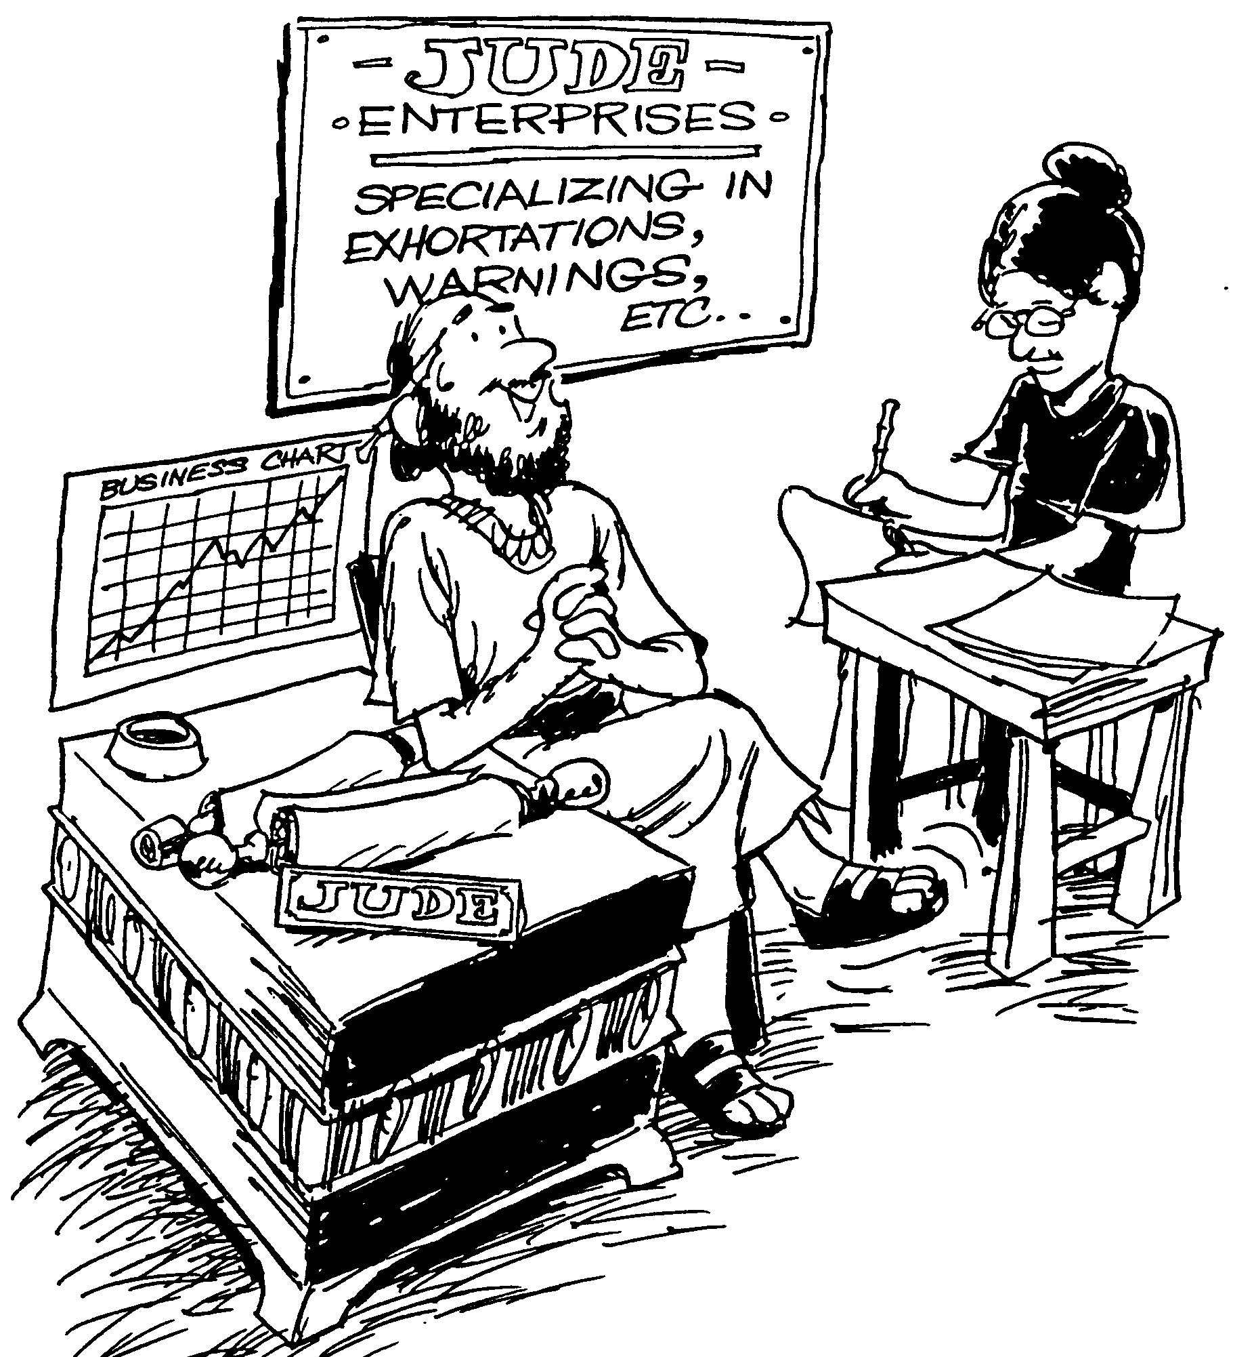
JUDE
Verses
1-4 Jude warns against apostasy
5-7 Unbelief seen through history
8-19 Description of false teachers
20-25 Exhortation to stay faithful
Barry Huddleston, The Acrostic Bible

Slide 12

Be Fighting
Jude
Dr. Rick Griffith • Crossroads International Church
CICFamily.com • BibleStudyDownloads.org

Slide 13
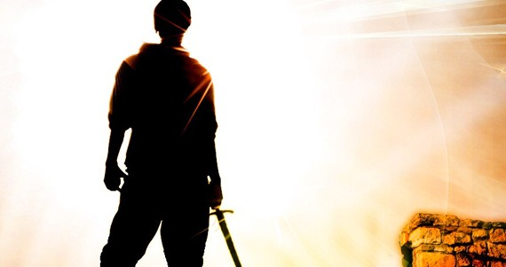
How can you defend the faith against pretenders?
4 ways
Jude
Notes:
What ways can you fight unbelievers who destroy the church from within?

Slide 14
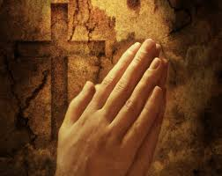
I. Affirm the saints (1-2).
Jude
Notes:
Tell believers about their riches in Christ.

Slide 15
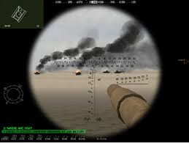

II. Identify the enemy (3-16).
Jude
Notes:
Know the evil nature of the apostates who pretend to know God.

Slide 16
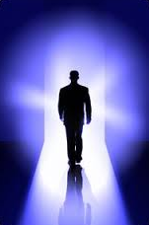
III. Strengthen your faith
(17-23).
Jude
Notes:
Build yourself up by following three practices.

Slide 17

IV. Praise God for security
(24-25).
Jude
Notes:
Be assured of your final victory.

Slide 18
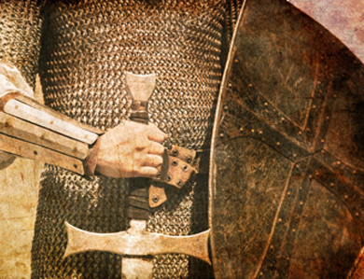
Main Idea of Jude
Be a contender against pretenders
Notes:
Defend against apostasy by fighting non-Christian leaders who lead believers astray.

Slide 19
Application
Application
310
Jude
Do you fight those who introduce godlessness in the church—or do you let them get away with lowering the standard?
What types of godless unbelievers are infiltrating our churches?
Immoral pastors
Health and wealth kingdom builders
WCC funding of Marxist groups

Slide 20
Black

Slide 21
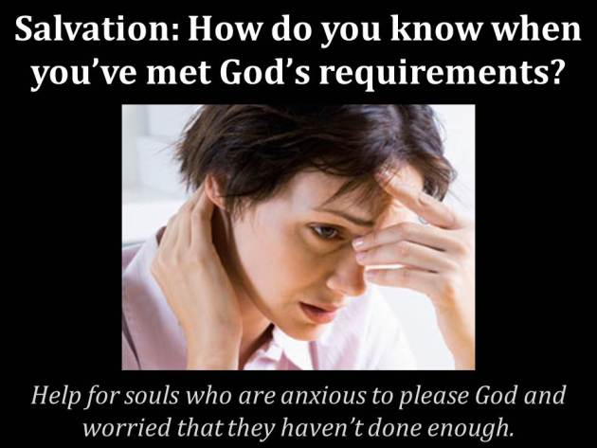
Subject?
Salvation: How do you know when you've met God's requirements?
Help for souls who are anxious to please God and worried that they haven't done enough.

Slide 22
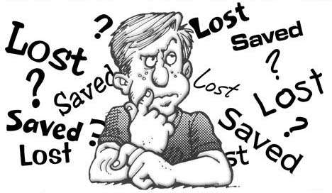
Can you be sure?
Really sure?

Slide 23
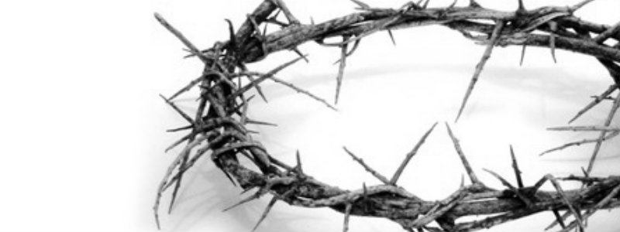
The Nature of the Gospel
68
Soteriology: God's Rescue Program
Dr. Rick Griffith • Jordan Evangelical Theological Seminary • BibleStudyDownloads.org

Slide 24

What would you say?
Write your answer on a piece of paper.
A person was just in a car accident and has only one minute to live. He says to you,
“How can I know if I will go to heaven?”
Notes:
After one minute, collect the papers and read them to the class.
___
From Joseph Dillow, Final Destiny, 32

Slide 25

What is the Gospel that saves us?
68
How do we “contend for the faith that was once for all entrusted to the saints” (Jude 3) if we don't even know what that faith is?
Notes:
NS-26-Jude-21
SA-16-Nature of the Gospel-02

Slide 26
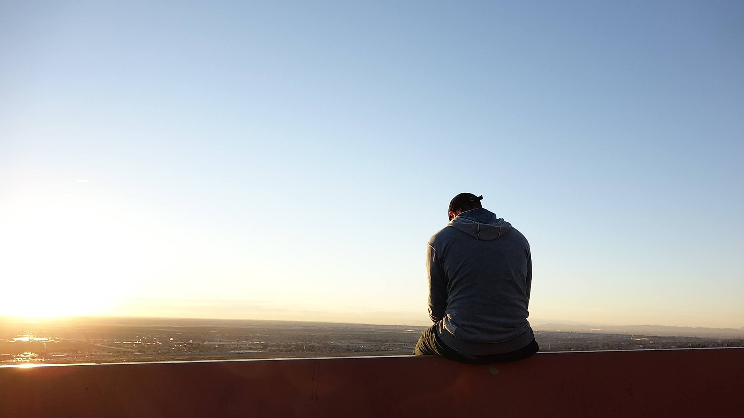
Repentance
What is it?

Slide 27

Repentance
Is it “to turn from sin”?

Slide 28
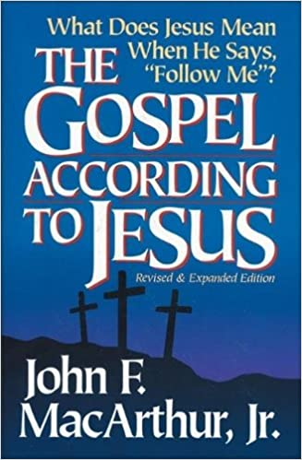
Repentance
“No evangelism that omits the message of repentance can properly be called the gospel, for sinners cannot come to Jesus Christ apart from a radical change of heart, mind, and will.”
John MacArthur, The Gospel According to Jesus (Grand Rapids: Zondervan, 1988), 81

Slide 29

Repentance
“to change the mind” (Greek)

Slide 30
Repentance
It is an “afterthought” or “second opinion.” Charles Ryrie, for example, says, “Repentance means a genuine change of mind that affects the life in some way. Like other significant theological terms it must be defined specifically by asking a further question, namely, change the mind about what? Christians can repent of specific sins and stop doing them (Revelation 2:5; 2 Corinthians 7:9).” Do non-Christians have to repent? Ryrie says yes, if one defines repentance correctly. “Saving repentance,” he says, “has to involve a change of mind about Jesus Christ so that whatever a person thought of Him before, he changes his mind and trusts Him to be his Savior [Basic Theology, 390].” This approach seems quite plausible to me and works in the majority of the passages where repentance is mentioned in the New Testament. —Dillow, Final Destiny, 33

Slide 31
Repentance
The best interpretation of metanoeo in the New Testament is to acknowledge, to change one’s mind about something, to admit, to feel sorry for. A good Old Testament illustration of this usage would be Jeremiah 8:6.
I have listened and heard,
They have spoken what is not right; No man repented of his wickedness, saying, “What have I done?” Everyone turned to his course, like a horse charging into the battle.
—Dillow, Final Destiny, 35
Notes:
Note that “repented” is described as saying “What have I done?” It is an admission of guilt. As a result, they manifested the fruit of repentance and “turned their course.”
—Dillow, 36

Slide 32

The Gospel
Is it really changing our lives?
Notes:
The gospel is supposed to change lives.
Why doesn't the gospel change our lives like it should?
Too often the lives of Christians isn't really different from the non-believers.
In some situations in the USA, the church has a higher divorce rate than the world!
The way believers spend their money isn't much different either. The average Christian gives about 1-3% of his income, which is about the same as non-Christian giving.

Slide 33
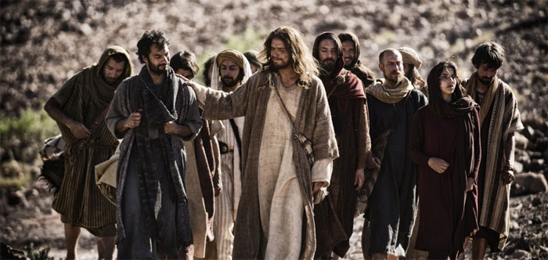
Too often the results of the gospel are confused with the nature of the gospel.
Notes:
Well-meaning believers can confuse simple trust in the message of the cross with the behavioral change the gospel is supposed to make!

Slide 34
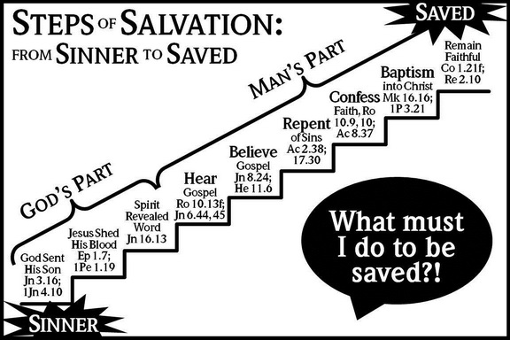
The Problem: A False Gospel Proclaimed
STEPS ^{OF} SALVATION:
SAVED
^{FROM} SINNER ^{TO} SAVED:
Remain Faithful
Col 1:21；
Rev 2:10
MAN'S PART
Baptism into Christ
Mk 16:16
1 Pet 3:21
Confess Faith
Rom 10:9-10；
Acts 8:37
Repent
of Sins
Acts 2:38，
17:30
Believe Gospel
Jn 8:24；
Heb 11:6
GOD'S PART
Hear Gospel
Rom 10:13；Jn 6:44，45
Spirit Revealed Word
Jn 16:13
What must I do to be saved?
Jesus Shed His Blood
Eph 1:7；
1 Pet 1:19
God Sent His Son
Jn 3:16；
1 Jn 4:10
—A Church of Christ view
SINNER
Notes:
NS-26-Jude-24
SA-16-Nature of the Gospel-05
This is the Church of Christ view—But it looks to me like they say we need to do SIX things!
This brings NO assurance in this life as no one ever knows just how much he will “remain faithful”
Five Steps to Salvation
By Allan Stanglin
http://www.allanstanglin.com/five-steps-to-salvation/
24 April 2013
Accessed 9 May 2016
It's just a Church of Christ thing, right? The “Plan of Salvation,” also called the “Five Steps of Salvation,” is unique to us, I think. And those of us who were raised in and by the Churches of Christ know them well: Hear, Believe, Repent, Confess, Baptism. In that order. As a kid in the '70s, this was drilled into me by my Sunday school teachers in Bible class, by the preachers from the pulpits, by the youth ministers at the devotionals and rallies, and by the Open Bible Study my dad walked me through when I reached the “age of accountability.” The five steps were plastered on bulletin boards in the church hallways, illustrated by charts and diagrams on mimeographed handouts, and splashed across banners promoting the next Gospel meeting. These were the five steps, always accompanied by supporting verses of Scripture, that necessarily had to be followed — again, in order! — for one to be saved.
Hear. Believe. Repent. Confess. Be Baptized.
You ever wonder how that started? You ever question the validity of such a list? If you or your church were to make a list of supposed steps to salvation, what would you include? What parts of our CofC list would you leave out?
Historians point back to our movement's focus on rational thought and enlightenment thinking that characterized the mainstream culture of America at the turn of the 19th century when Stone and Campbell and others were attempting to “restore” God's Church. It was all about scientific reasoning and empirical evidence and deductive problem-solving. Society at this time was convinced that there were undeniable patterns, unalterable designs in nature and in the world that, if learned and applied, held the keys to everlasting peace and joy.
Alexander Campbell searched the Scriptures in this way and came up with what he called “the ancient gospel,” a pattern he believed was the divinely-ordained natural way to heaven. According to Campbell, it all boiled down to, in this order: gospel facts (death, burial, resurrection, and ascension of Christ), faith, repentance, reformation (of life), baptism, remission of sins, reception of the Holy Spirit, sanctification, resurrection of the saints, and eternal life. In that order. Campbell claimed that all Christian denominations believed in all these steps, but put them in different orders according to their own interpretations or theories of conversion.
At about the same time, Walter Scott came up with a biblical pattern and called it “the gospel restored.” He had six points originally. The first three were what humans had to do to be saved: believe, repent, and be baptized. The last three were what God promises to people who do the first three: forgiveness of sins, the gift of the Holy Spirit, and eternal life. Not too much later, Scott shortened his list to five points — one for each finger on a person's hand, for easy remembering: faith, repentance, baptism, forgiveness of sin, and the gift of the Holy Spirit.
This method proved to be very successful on the early American frontier where most everybody had been trained in Calvinism which claimed that men and women were saved only by God's predestination, that one couldn't do anything to save himself, it was all up to God's pre-ordained choosing. By telling these fiercely independent early frontier people that there really was something they could do to be saved, the Stone and Campbell churches fueled a massive rush to repentance and baptism.
As with most good things, we swung the pendulum a bit too far. Pretty soon, we were taking God's initiative and the Holy Spirit's active participation clear out of the conversion process. Preaching became all about proving “facts” with arguments and evidence. The Holy Spirit's work in the past had been entered into the Biblical record and was there to be studied in a rational manner, but it wasn't necessary for a person's salvation. The emphasis was on logical fact-finding and step-following and persuading people to “obey the gospel.” The “gospel,” of course, being the steps.
So, at some point in the middle of the 1800s, it gets boiled down to what we have today in the five steps of salvation or the plan of salvation: hear, believe, repent, confess, be baptized. Notice how God's divine activity is completely absent from any of the steps. Notice how this chart here to the right — all of these charts were downloaded from Church of Christ websites this morning — actually gives much more responsibility or credit to man than to God for salvation. Where is God in our “plan of salvation?”
Why is baptism the last step? Who took out “sanctification,” the guiding of the Holy Spirit, and the grace of God to continually wash our sins?
It is God who works to will and to act according to his good purpose. It is God who initiates salvation, who begins the good work and sees it through to completion. Belief and repentance and confession are salvation steps to be taken every day, not once on a ladder list of human accomplishments. Baptism is never the end of what the apostle Paul calls “being saved,” it's the beginning. Our five steps minimize our God. Our five steps neglect a lifetime of day-by-day, hour-by-hour difficult discipleship to Jesus. And they ignore the unmerited and continuous grace of our merciful Father.
OK, maybe that's a little harsh. Too judgmental, probably, Yes, we come by the “five-steps” thing naturally. It's been handed down to us by faithful men and women who were doing their very best with what they had to work with during the times they lived. And I'm grateful for it. Seriously. But I'm also so glad that we've recognized the many shortcomings in this kind of incomplete view of salvation. I'm so glad that we're acknowledging together the active role of God's Spirit in the calling and saving and sanctifying of the saints. And I'm glad we can change. I'm so glad, by God's grace, we're allowed and even compelled to change.
Peace,
Allan

Slide 35
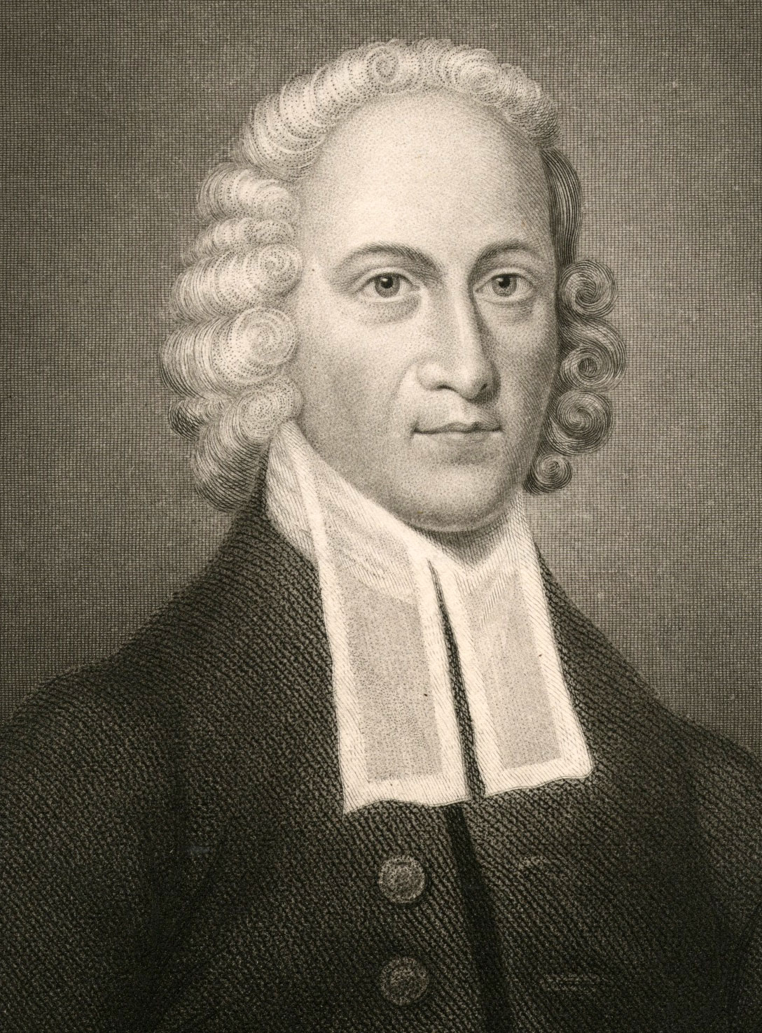
Grace
“You contribute nothing to your salvation except the sin that made it necessary.”
JONATHAN EDWARDS
1703-1758

Slide 36

The Gospel is…
68
GOOD NEWS!
Notes:
NS-26-Jude-25
SA-16-Nature of the Gospel-06

Slide 37
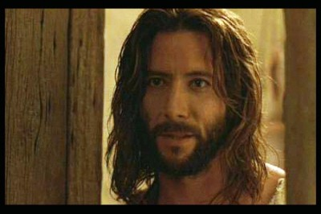
John
68
What must you trust about Jesus to be saved?
Must you add anything to this?
What is saving faith?
How is it different from false faith?
Notes:
If the person next to you was injured and only had a minute or two to live, but asked you, “What must I do to be saved?” what would you say? The shorter one of the two of you is now dying, so the taller one now has one minute to explain the gospel. Go!

Slide 38
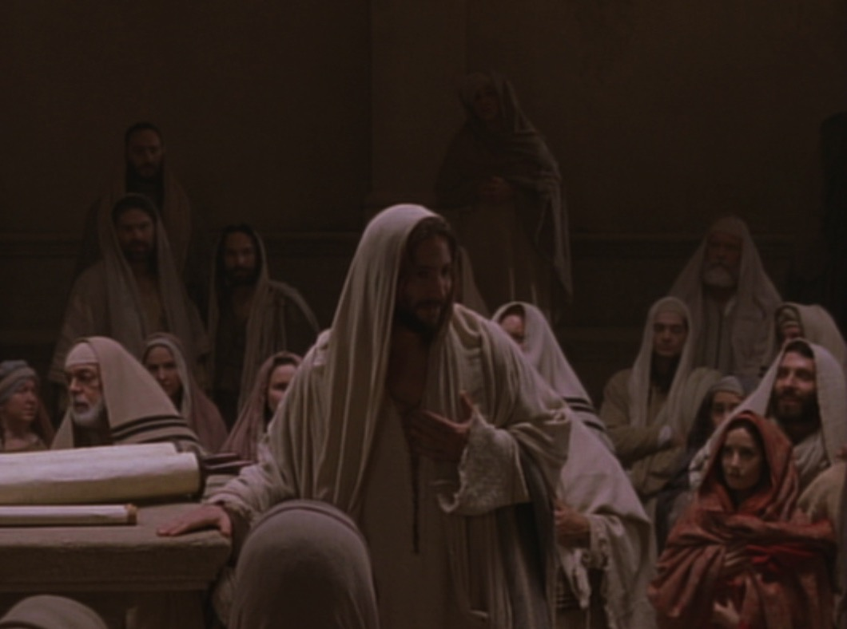
Key Word Believe
John
68
Key Verse
"Jesus did many other miraculous signs in the presence of his disciples, which are not recorded in this book. But these are written that you may believe that Jesus is the Christ, the Son of God, and that by believing
you may have life in his name" (20:30-31).

Slide 39
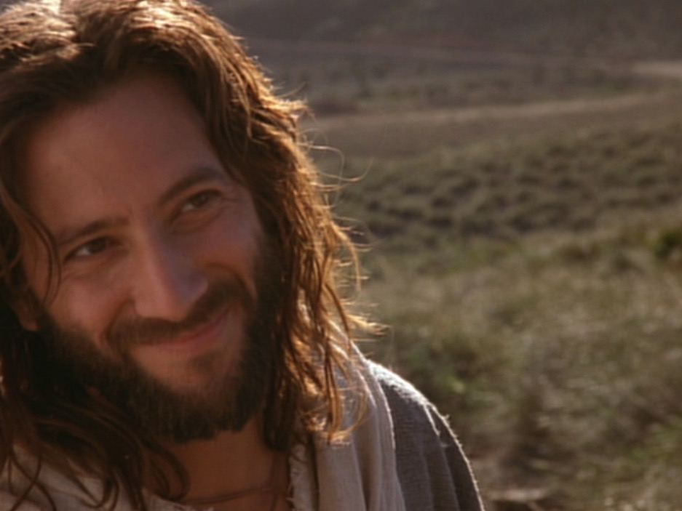
Summary Statement
Gospel of John
68
John proves Jesus to be the Son of God (deity) made man through selected signs and discourses of Christ to convince unbelieving Gentiles to believe in Him and receive eternal life.
Application
Are you 100% sure that you have eternal life by believing in Christ's name?

Slide 40
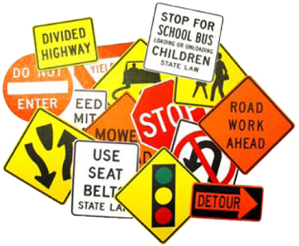

Signs in John's Gospel
68
Signs unique to John's Gospel in yellow (6 of the 9 miracles)
WATER
TO WINE
2:1-11
HEALING
OFFICIAL'S
SON
4:46-54
HEALING
PARALYTIC
5:1-18
FEEDING
5000
6:1-15
WALKING
ON WATER
6:16-24
HEALING
BLIND MAN
9:1-7
RAISING
LAZARUS
11:1-45
CHRIST'S
RESURRECTION
20:1-31
FISH
CATCH
21:1-3

Slide 41

Assurance in 1 John 5:11-13
62 b) (2)
63
63
Should we
ever doubt?
Should we
ever doubt?
Should we
ever doubt?
"And this is what God has testified:
He has given us eternal life, and this life is in his Son. ¹²Whoever has the Son has life; whoever does not have God's Son does not have life. ¹³I have written this to you who believe in the name of the Son of God, so that you may know you have eternal life."

Slide 42
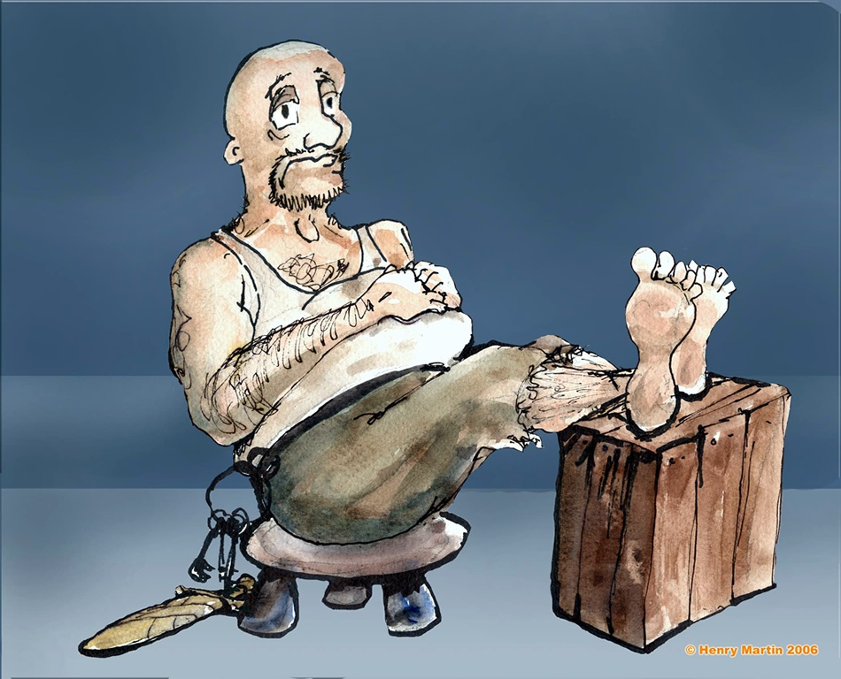
The Philippian Jailor (Acts 16)
Notes:
The jailor was sitting quietly one evening...

Slide 43
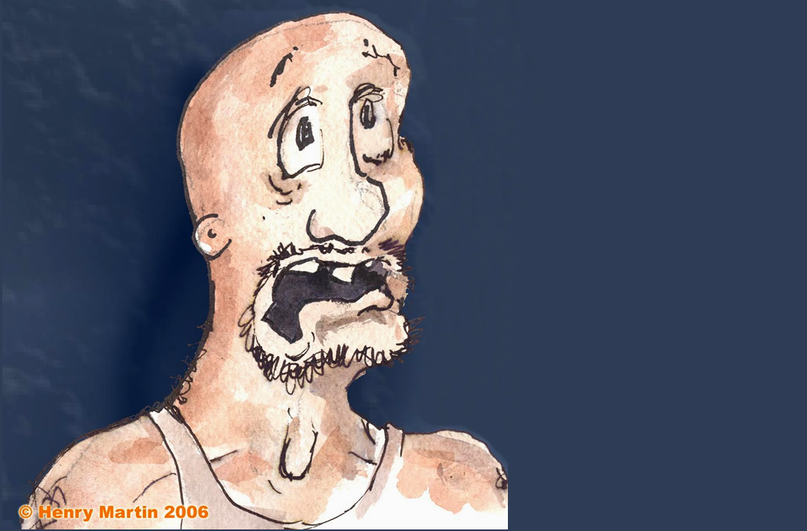
“An earthquake?! Oh, no! The prisoners escaped!”
Notes:
Until suddenly there was an earthquake! Fear seized him…

Slide 44
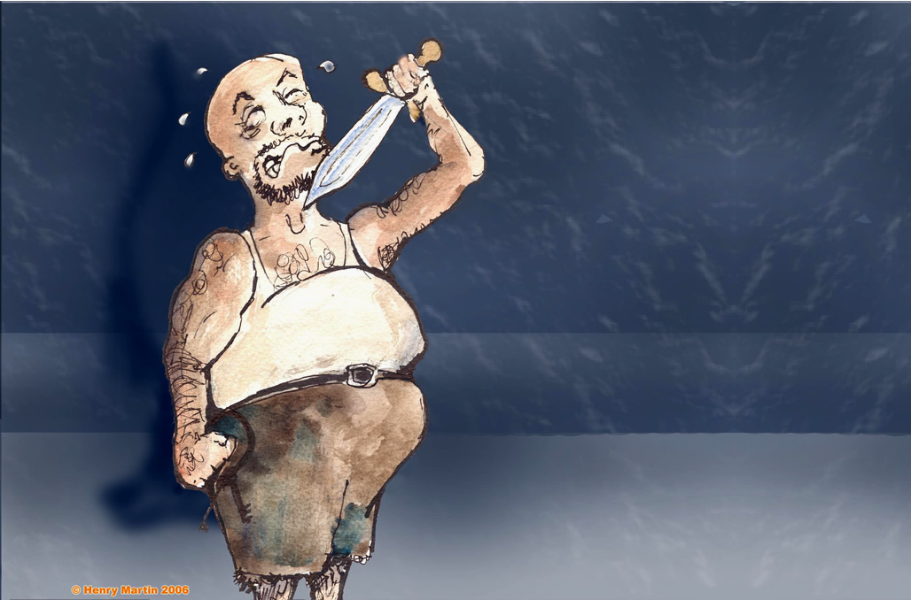
Attempted suicide
Notes:
He thought that Paul and Silas had escaped, so he sought to kill himself

Slide 45
“What must I do to be saved?”
Notes:
Until suddenly there was an earthquake! Fear seized him…

Slide 46
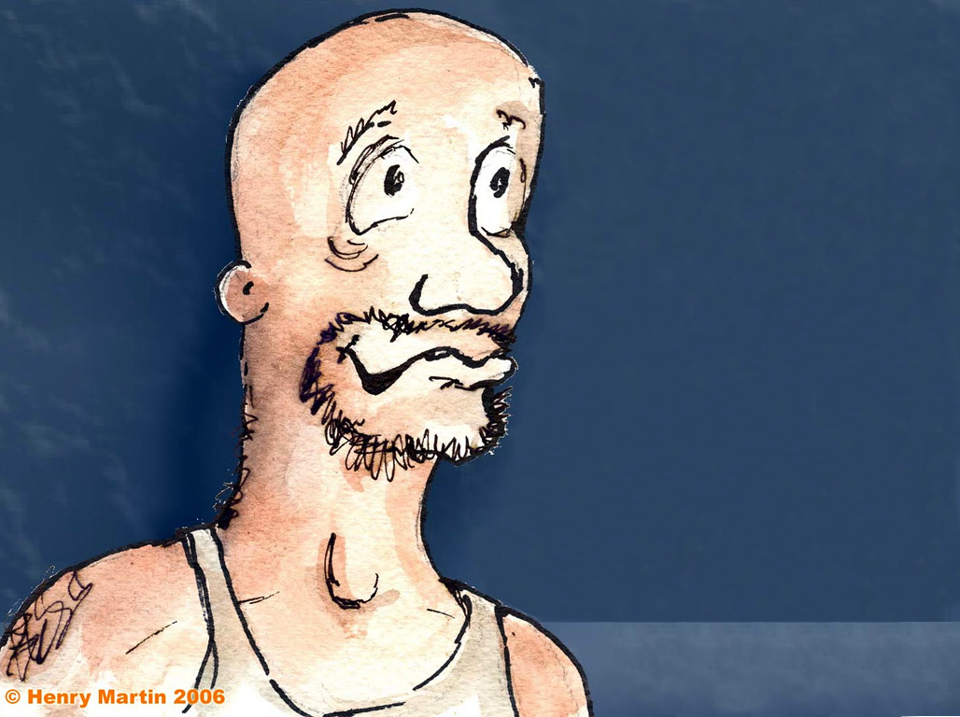
“Believe in the Lord Jesus Christ and you will be saved—you and your entire household!"
(Acts 16:16).
Notes:
But Paul told him, "Believe in the Lord Jesus Christ and you will be saved—you and your entire household!" (Acts 16:16). So he trusted Christ and was filled with joy.

Slide 47
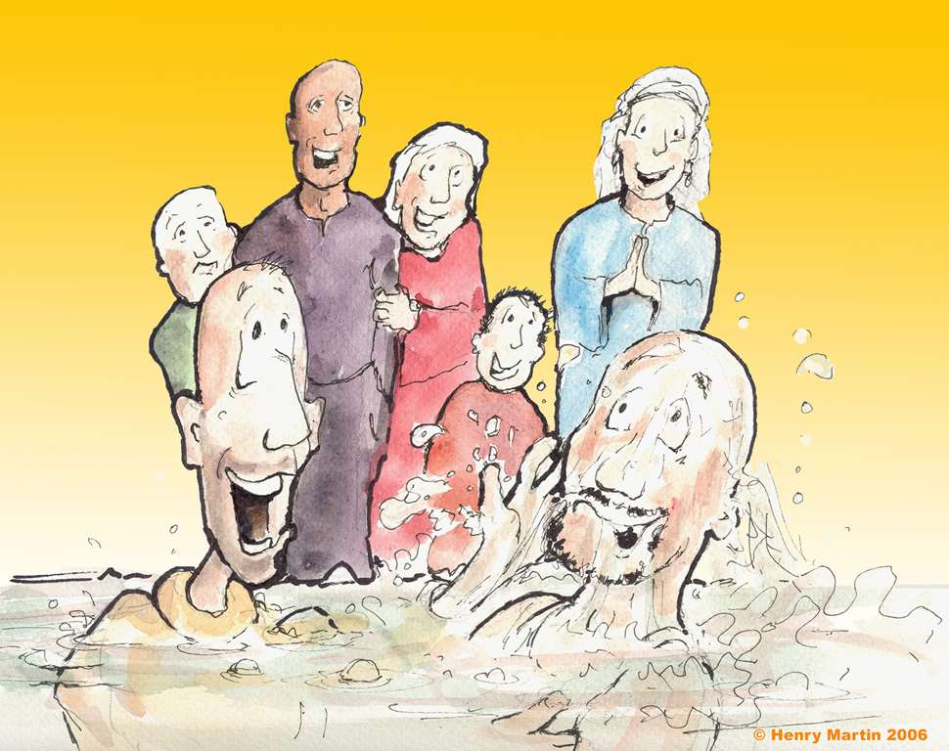
Immersing the jailow
Notes:
Or immersion!

Slide 48
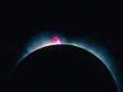
Jesus has always been God
68
"In the beginning
was the Word,
and the Word was with God,
and the Word was God"
(John 1:1)

Slide 49

God became man in Jesus
68
"So the Word became human and lived here on earth among us. He was full of unfailing love and faithfulness. And we have seen his glory, the glory of the only Son of the Father" (John 1:14 NLT)

Slide 50
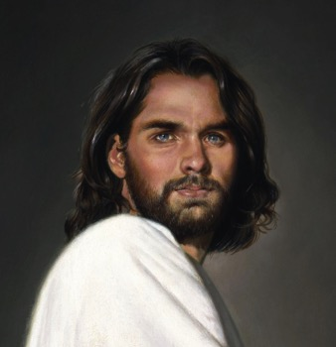
1st century belief in Deity
68
Paul:
"Christ, who is God over all"
Rom. 9:5
Peter:
"God and Savior Jesus Christ"
2 Pet. 1:1
The Father:
"About the Son He says, 'Your throne, O God…'" Heb. 1:8
Jesus:
"I and the Father are one"
John 10:30
Notes:
There is NO doubt that the earliest Christians believed that Jesus was God! Hebrews 1:8 gives us the witness of the Father himself, and where can one find a more reliable witness than God himself?

Slide 51
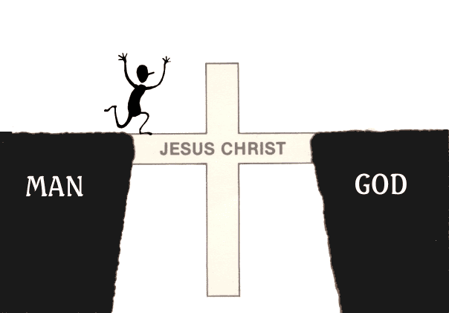
The Gospel is…
GOOD NEWS!
JESUS CHRIST
MAN
GOD
Notes:
NS-26-Jude-40
SA-16-Nature of the Gospel-21

Slide 52
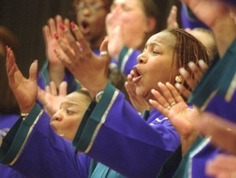
What's the Gospel?

Slide 53
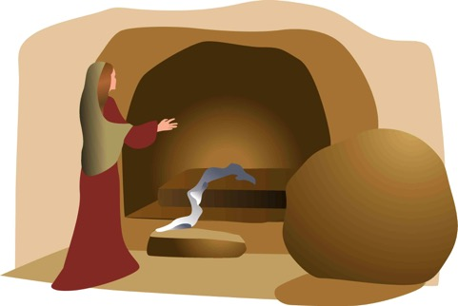
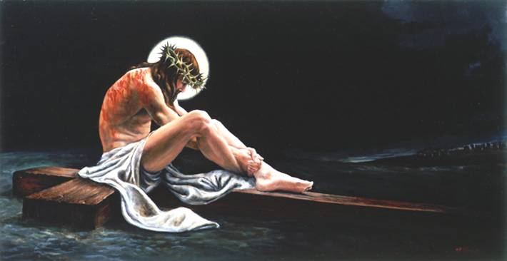
The Full Gospel
68
"Let me now remind you… of the Good News [Gospel]
I preached to you before…" (NLT)
Burial
Risen
Death
"Christ died for our sins…"
"He was raised from the dead on the third day…"
"He was buried…"
1 Cor. 15:3-4

Slide 54

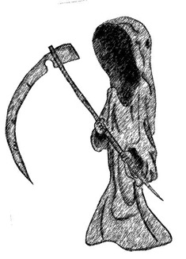
What's the Difference?
Dead
Buddha
Mohammed
Marx
Alive

Slide 55
What's the Difference?
“He was seen by Peter and then by the Twelve. ⁶After that, he was seen by more than 500 of his followers at one time, most of whom are still alive, though some have died. ⁷Then he was seen by James and later by all the apostles.”
Dead
Jesus
Alive
Buddha
Mohammed
Marx
1 Cor. 15:5-7

Slide 56
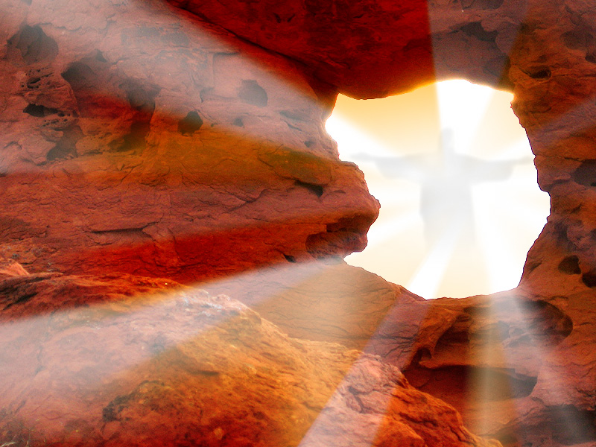
THE RISEN CHRIST
Do you share…
?

Slide 57
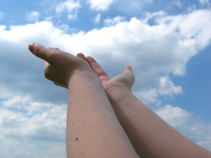
WE NEED TO ATTAIN GOD'S RIGHTEOUSNESS—BUT HOW?

Slide 58

Righteousness in Romans
God's Righteousness by Justification by Faith in Christ––Not the Law
Chapters 1–11 | Chapters 12–16
Righteousness Explained | Righteousness Applied
Theological | Practical
What to Believe | How to Behave
Vertical | Horizontal
Relationship to God | Relationship to Others

Slide 59


"It is finished"
Justification (3:24)
God's act of declaring us "not guilty" for our sins, making us right with him
Legal
Justice (3:25-26)
The fairness of God where He punishes sin in an individual himself or in a Sinless Substitute (Jesus Christ)
Paid
in Full

Slide 60
What must you share to have a clear gospel presentation?
72-73
Faith alone in Christ alone
Our Problem
1. We have sinned against a holy God
2. Our sin deserves death
God's Solution
3. God became man in Jesus Christ
4. Jesus was our substitute on the cross
Our Responsibility is one:
5. Believe (trust, have faith) in Christ's death, burial and resurrection to forgive your sin

Slide 61
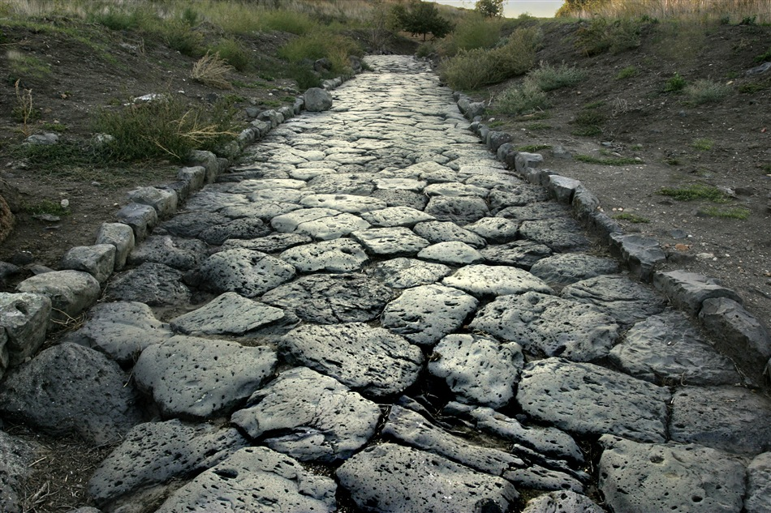
The Roman Road
56

Slide 62
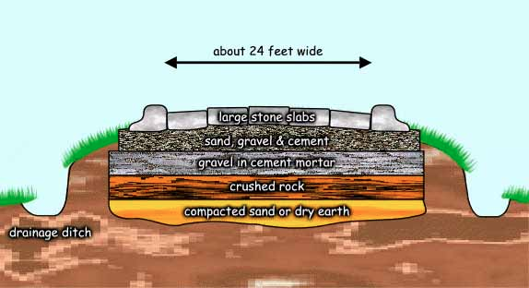
The Roman Road
56
About 24 feet wide
Large stone slabs
Sand, gravel & cement
Gravel in cement mortar
Crushed rock
Compacted sand or dry earth
Drainage ditch
Notes:
NS-Rom3-4-Slide58
SA-16-Nature of Gospel-39

Slide 63
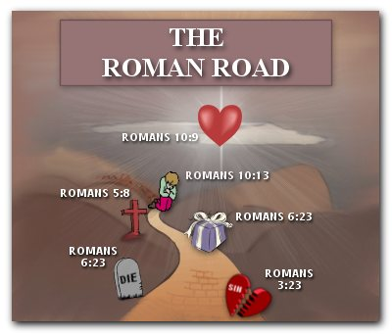
The Roman Road
56
Romans 10:9
Romans 10:13
Romans 5:8
Romans 6:23
Romans
6:23
Romans 3:23
Notes:
NS-Rom3-4-Slide59
SA-16-Nature of Gospel-40

Slide 64
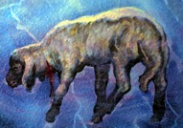
The Roman Road
56
151i
Rom. 3:23
Everyone has sinned.
Rom. 6:23
The penalty for our sin is death.
Rom. 5:8
Jesus Christ died for sin.
Rom. 10:8-10
To be forgiven for our sin, we must believe and confess Jesus as Lord.

Slide 65
What must you share to have a clear gospel presentation?
72-73
Faith alone in Christ alone
Our Problem
1. We have sinned against a holy God
2. Our sin deserves death
God's Solution
3. God became man in Jesus Christ
4. Jesus was our substitute on the cross
Our Responsibility is one:
5. Believe (trust, have faith) in Christ's death, burial and resurrection to forgive your sin

Slide 66
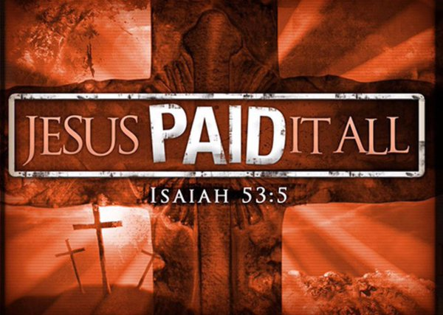
Substitution View
50
JESUS PAID IT ALL
Isaiah 53:5

Slide 67
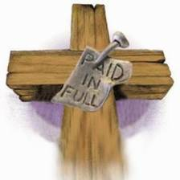
Penal Substitution
50
"Christ the sinless One took on Himself the penalty that should have been borne by man and others"
—Ryrie, Basic Theology, 356

Slide 68

Jesus' death paid for our sin

Slide 69
Tell them.

Slide 70
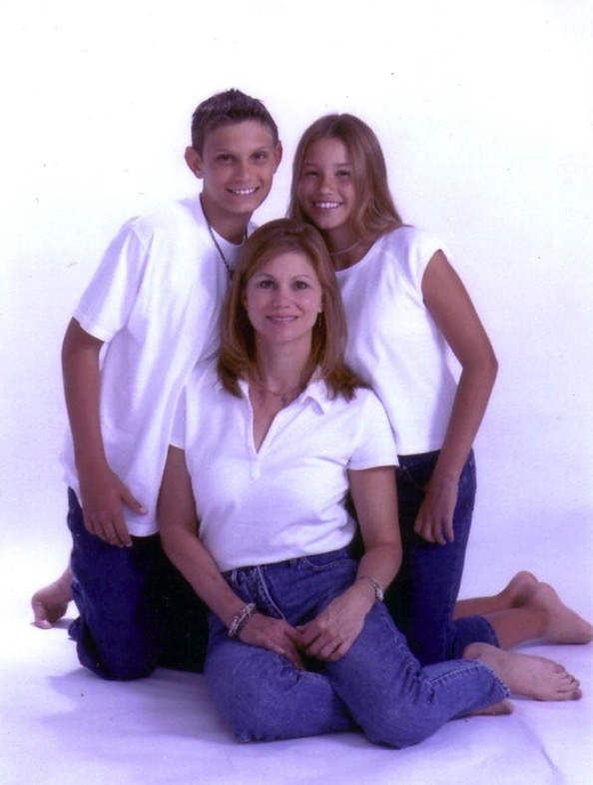
What's wrong with this picture?
Kathie and her two kids: Joshua and Lacey
Michael ("one who is like God") is missing as he was a pretender who divorced her for another woman

Slide 71
Jude
A
A
NNOUNCEMENTS OF
POSTASY (1-4)
POSTLES OF
POSTASY (5-16)
NSWER TO
POSTASY (17-23)
SCRIPTION TO
LMIGHTY (24-25)
Terry Hall, Bible Panorama, 172

Slide 72
Be Fighting
Jude
Dr. Rick Griffith • Crossroads International Church
CICFamily.com • BibleStudyDownloads.org

Slide 73
Are you a fighter?
What are you willing to fight for?
To what lengths are you willing to fight for your rights?
To what lengths are you willing to fight for the gospel?

Slide 74

Apostates Destroy From Within
The Men who Destroyed the Christian West
Notes:
Believers have failed to fight apostasy the past 200+ years.
Apostates are unbelievers who live among the saints and destroy the church within. This has happened significantly in what used to be called the "Christian West."

Slide 75
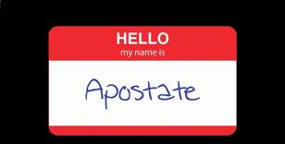
Apostates don't wear nametags

Slide 76
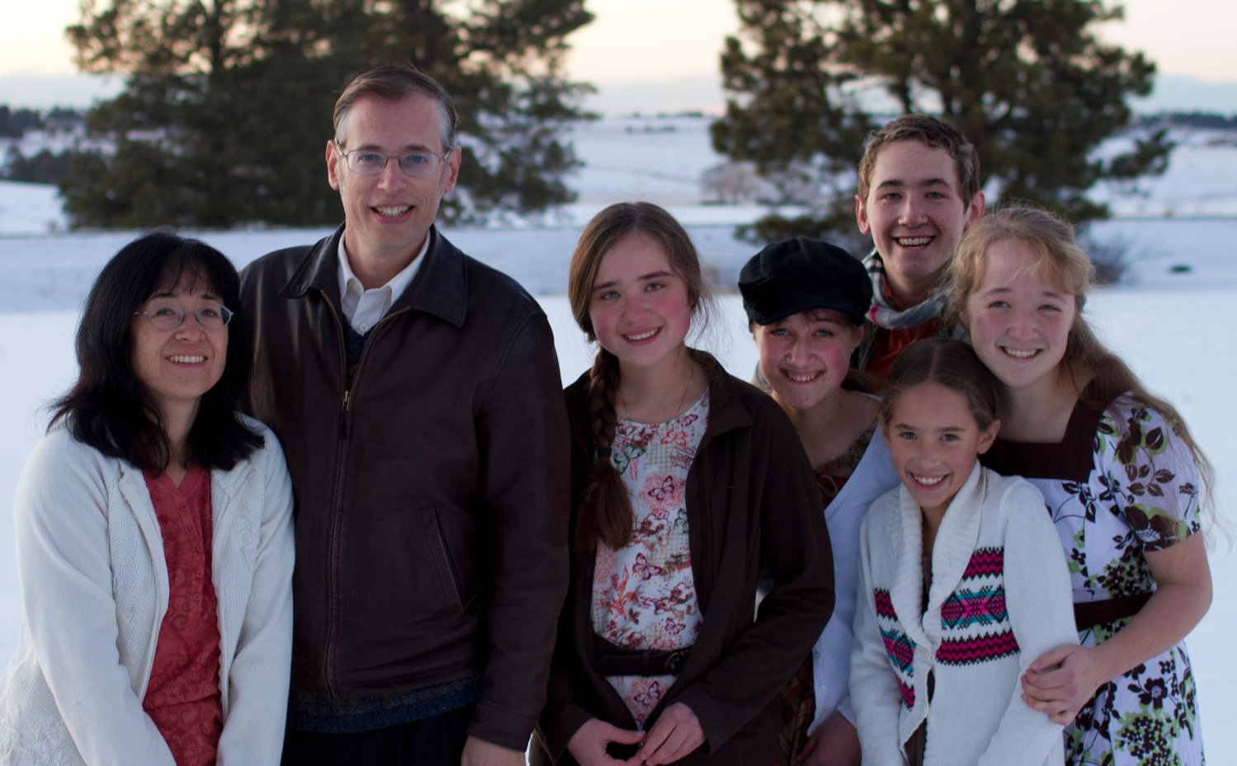
The Book Apostate
Kevin Swanson and his family

Slide 77
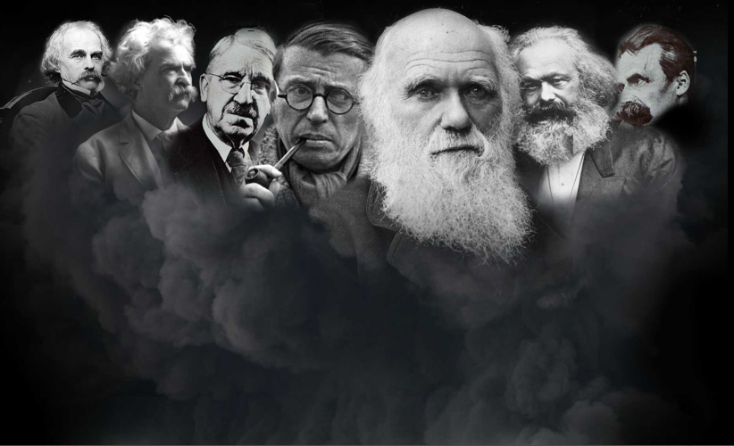
Who are the apostates?
Charles Darwin
Nathaniel Hawthorne
John Dewey
Friedrich Nietzsche
Mark Twain
Karl Marx
Jean-Paul Sartre
Ernest Hemingway
Lady Gaga

Slide 78

Why are they significant?
"This is the story of the decline and fall of Western civilization. It is the story of uncommonly powerful men, unfathomably evil men. . . apostates."
–Kevin Swanson

Slide 79
What did the apostates teach?
Charles Darwin
Nathaniel Hawthorne
John Dewey
Friedrich Nietzsche
Mark Twain
Karl Marx
Jean-Paul Sartre
"Eliminate home schools!"
"There is no God!"
"God didn't create. We evolved!"
Notes:
How did they destroy the Christian West?
• Dewey successfully established a public education system in the USA with the purpose of taking children away from the godly influence of their parents.
• Darwin successfully convinced the scientific and academic communities to abandon creationism for evolution.
• Marx successfully convinced generations of countries that God doesn’t exist, leading to the death of millions.

Slide 80

Godless Philosophy
"God is dead."
– Nietzsche, 1883
"Nietzsche is dead."
– God, 1900
Used with permission
Notes:
Speaking of death, Nietzsche founded the "God is Dead" movement. God had the last word in his life, though, as 17 years later God founded the "Nietzsche is Dead" movement.

Slide 81
How can you defend the faith against pretenders?

Slide 82
Chapters in NT Books
Four "books" of the NT have but 1 chapter
Notes:
It doesn't seem right to call the four one-chapter writings "books" as they are so short! We know that most of the NT books are longer books or letters, but these four shortest ones are too often neglected.
____________
NS-18-Philemon-39
NS-24-2 John-61
NS-25-3 John-45
NS-26-Jude-66

Slide 83
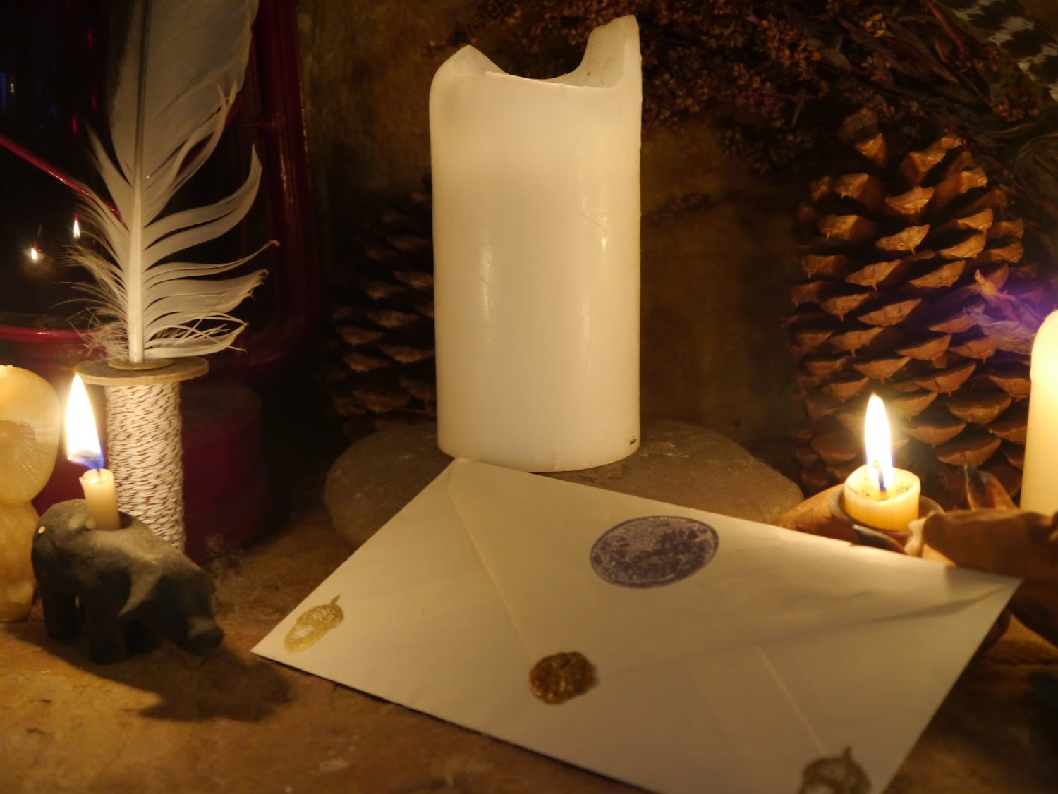
Verses in NT Emails
15
13
Words
245
219
Notes:
Each is about the length of an email, so I call them "NT Emails." The "E" is not for "electronic" but for "encouragement."
____________
NS-18-Philemon-40
NS-24-2 John-62
NS-25-3 John-46
NS-26-Jude-67

Slide 84
NT Overview (General + Key Words)
38
124
39-41
"To the remotest part of the earth" (Acts 1:8)
Acts 9 13 14 15 16 18 21 27 28
Apr 48-
Sep 49
1
Galatia
Apr 50-
Sep 52
2
Aegean
Spr 53-
May 57
3
Asia
Feb 60-
Mar 62
1
Rome
Spr 62-
Fall 67
4
Spain
Aut 67-
Spr 68
2
Rome
Summer 35-
37
Damascus
Antioch
May 57-
Aug 59
Trials
Fall 49
The
Council
Spring 68
Expansion of Church
35 48 49 50 52 53 57 60 62 67 68 95
Matt
Kingdom
Luke
Sov 1
Acts
Sov 2
Mark
Disciple
John
Believe
Gal
Justify
1 Thess
Rapture
1 Cor
Eph
Unity
1 Tim
Order
2 Tim
Sanctify
Doctrine
Jude
Pretenders
James
Works
2 Thess
Tribulation
2 Cor
Col
Deity
Titus
Conduct
Heb
Apostle
Super
Romans
Philem
1 Pet
Righteous
Forgive
Suffering
Gospels & Acts
Phil
Attitude
2 Pet
Knowledge
Pauline Epistles
1234
Journeys
General Epistles
Rome
Imprisonments
General Epistles + Key Words

Slide 85
How can you defend the faith against pretenders?
4 ways
Jude
Notes:
What ways can you fight unbelievers who destroy the church from within?

Slide 86
JUDE
Verses
1-4 Jude warns against apostasy
5-7 Unbelief seen through history
8-19 Description of false teachers
20-25 Exhortation to stay faithful
Huddleston, The Acrostic Bible

Slide 87
JUDE
310
Contend Against Pretenders
Why to Contend |  | Chapters 3–41 |  |  |  | How to Contend
Intro |  | Pretenders' Practices |  |  |  | How to Avoid Pretenders' Snares |  |  | Praise for Preservation
Verses 1-2 |  | Verses 3-16 |  |  |  | Verses 17-23 |  |  | Verses 24-25
Greet- ing 1 | Bless- ing 2 | Purpose: Defend the Faith 3-4 | OT Pretenders 5-7 (Past) | Charac-teristics 8-13 (Present) | Judgment on Them 14-16 (Future) | Remember Apostles' Predictions 17-19 | Nurture Self in God's Love 20-21 | Show Mercy to Pretenders' Followers 22-23 | Source of Victory 24 | Only Savior 25
Unknown Origin to Probably Israel
ca. AD 75

Slide 88
Key Word / Verse
310
Key Word
Pretenders
Key Verse
"…Contend for the faith that was once for all entrusted to the saints. For certain men whose condemnation was written about long ago have secretly slipped in among you. They are godless men, who change the grace of our God into a license for immorality and deny Jesus Christ our only Sovereign and Lord" (Jude 3b-4).

Slide 89
Authorship
311
External Evidence
Despite its small size and limited subject matter, Jude was accepted as authentic and quoted by the early Church Fathers, including Tertullian and Origen.
It was also included in the Muratonian Canon (ca. AD 170).
Internal Evidence
This is the only NT letter of Jude, the half-brother of Jesus Christ & son of Joseph and Mary.
Jude was therefore the brother of James (v. 1a), who also was a half brother of the Lord (Matt. 13:55; Mark 6:3), the leader of the church at Jerusalem (Acts 15:13) and author of the epistle bearing his name (James 1:1).
Jude is the same as Judah or Judas and means "praise"
(cf. Rom. 2:29).

Slide 90
The Family of Jesus
Holy
Spirit
Men in white
Mary
Joseph
Women in yellow
Jesus
Joseph
Simon
Sister 2
James
Judas
Sister 1
"Then they scoffed, 'He's just a carpenter, the son of Mary and the brother of James, Joseph, Judas, and Simon. And his sisters live right here among us.' They were deeply offended and refused to believe in him" (Mark 6:3 NLT).

Slide 91
How can you defend the faith against pretenders?
4 ways
Jude
Notes:
What ways can you fight unbelievers who destroy the church from within?

Slide 92
Jude 1-2

Slide 93
I. Affirm the saints (1-2).
Jude
Notes:
Tell believers about their riches in Christ.

Slide 94
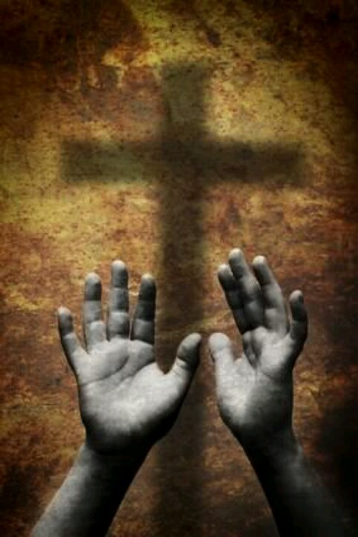
"This letter is from Jude, a slave of Jesus Christ and a brother of James. I am writing to all who have been called by God the Father, who loves you and keeps you safe in the care of Jesus Christ. ²May God give you more and more mercy, peace, and love" (Jude 1-2 NLT).
Notes:
God himself calls us to salvation (1a).
God himself loves us (1b).
God himself keeps us in his forever family (1c).
God himself gives us mercy, peace, and love (2).
Mercy is the first grace to be multiplied as God's protection from merciless pretenders (2a).
Peace is wished upon the readers in the midst of their war against false teachers (2b).
Love from God is wished upon the readers as protection and assurance in their trials (2c).

Slide 95
How can you defend the faith against pretenders?

Slide 96
I. Affirm the saints (1-2).
Jude
Notes:
Tell believers about their riches in Christ.

Slide 97
II. Identify the enemy (3-16).
Jude
Notes:
Know the evil nature of the apostates who pretend to know God.

Slide 98
Jude 3-16

Slide 99
Defend the Faith
(Jude 3-4)

Slide 100
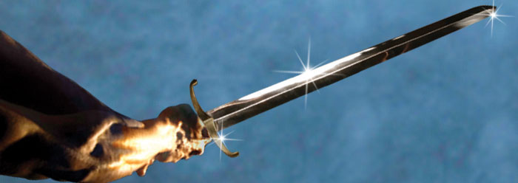
"Dear friends, I had been eagerly planning to write to you about the salvation we all share. But now I find that I must write about something else, urging you to defend the faith that God has entrusted once for all time to his holy people" (Jude 3 NLT).
Notes:
His original purpose was to write on the salvation he shared with his readers (3a).
After learning that his readers faced apostates among them, and through the Spirit's leading, Jude changed his theme to defend doctrinal truth (3b).

Slide 101
“…defend the faith " (Jude 3)
But what is included in the faith?
Negotiables
Non-Negotiables
Mode of Baptism?
Baptismal Regeneration?
Christ’s Presence in the Lord’s Supper?
Lord’s Supper for Salvation?
Divine Healing Possible?
Healing Required of God?
Deity of Christ?
Notes:
But what is this “faith”?

Slide 102
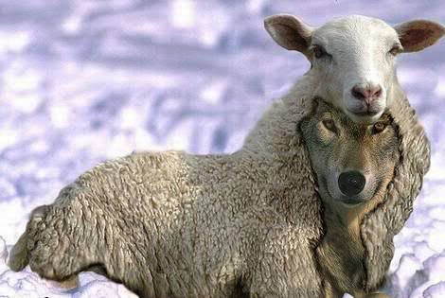
Who are Pretenders Today?
"…ungodly people have wormed their way into your churches, saying that God's marvelous grace allows us to live immoral lives. The condemnation of such people was recorded long ago, for they have denied our only Master and Lord, Jesus Christ"
(Jude 4 NLT).

Slide 103
Are pretenders Christians?
"…some ungodly people have wormed their way into your churches, saying that God's marvelous grace allows us to live immoral lives. The condemnation of such people was recorded long ago, for they have denied our only Master and Lord, Jesus Christ"
(Jude 4 NLT).
No, as they are condemned, unlike believers (cf. Rom 8:1)
They are likened to demons in everlasting chains (v. 6)
They are likened to Sodomites who suffer eternal fire (v. 7)
They are reserved for "blackest darkness" (v. 13)
They "do not have the Spirit" (v. 19) while all believers do have the Spirit (Rom 8:9b)
Does that sound like Christians?

Slide 104
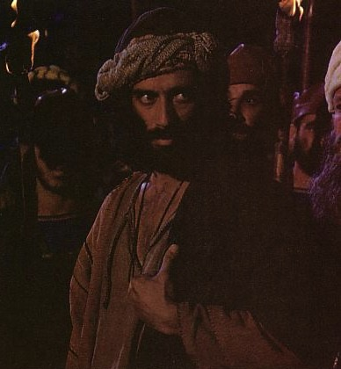
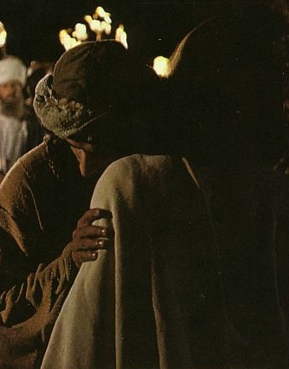
Judas: The Ultimate Pretender

Slide 105
The "Professing Christian"
All of Humanity
Professors
Non-Christians
Christians
Notes:
Is is proper to use the term “professing Christian”? That sounds like a type of Christian, right? But are “professing Christians” one type of believers in Jesus?
The point of the term is actually that these people claim to be Christians, but they are not. The “professing Christian” is, in reality, a non-Christian who professes to be a believer.

Slide 106
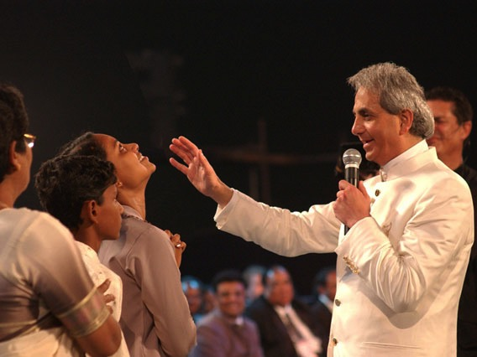
Pretenders Today
"He promises to heal all – every one, any, any whatsoever, everything – all our diseases! That means not even a headache, sinus problem, not even a toothache – nothing! No sickness should come your way. God heals all your diseases."
Benny Hinn
Rise and Be Healed, 32
http://deliveredbygrace.com/?p=234
Notes:
"As a proponent of the Word of Faith movement, the Benny Hinn Ministry works within the bounds of the "Prosperity Gospel" asking for money and telling people to expect a miracle in return. With large crusades, Benny Hinn travels the world doing what he refers to as the "Lord's work." The crusades involve prayer and Scripture reading, but the grand stage and central focus of each crusade is the miracle healing portion of each crusade. According to Benny Hinn, the miracles that are performed have medical documentation and evidence to back up the miracles. However, when people start searching for such documentation, it is nowhere to be found. One such person who has done extensive research is Justin Peters. Justin is an evangelist who is crippled by a well known disease called Cerebral Palsy. While doing his Master's Thesis research at Southwestern Baptist Theological Seminary, Peters sought out to interview Benny Hinn, but his requests were denied. Justin also tried to make it to the stage during a miracle crusade of Benny Hinn, but since he was obviously crippled, he was denied the opportunity to go onto the stage with the miracle healer. Justin, like many others, were stopped by members of the Benny Hinn staff who screen people before they go onto the stage" ("Benny Hinn Exposed," posted by Josh Buice on Mar 26, 2008 at http://deliveredbygrace.com/?p=234).

Slide 107
Three OT Examples of Pretenders (Jude 5-7)

Slide 108
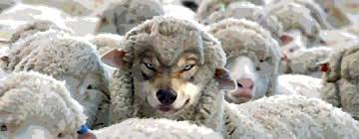
"So I want to remind you, though you already know these things, that Jesus first rescued the nation of Israel from Egypt, but later he destroyed those who did not remain faithful" (Jude 5 NLT).

Slide 109








Divine Discipline
Num. 32:49; 34:1
DRESSING
THE
STAGE
YOU MEAN…
40 YEARS? OUT HERE?
MOSES
Exodus
Sinai
M - C - C
Kadesh Barnea
40
40
Handbook pg. 26-29
24

Slide 110

"So the Lord sent poisonous snakes among the people, and many were bitten and died. ⁷Then the people came to Moses and cried out, 'We have sinned by speaking against the Lord and against you. Pray that the Lord will take away the snakes.' So Moses prayed for the people" (Numbers 21:6-7 NLT).

Slide 111


The Angels
Issues in Jude
"And I remind you of the angels who did not stay within the limits of authority God gave them but left the place where they belonged. God has kept them securely chained in prisons of darkness, waiting for the great day of judgment" (Jude 6 NLT).

Slide 112

"And don't forget Sodom and Gomorrah and their neighboring towns, which were filled with immorality and every kind of sexual perversion.
Those cities were destroyed by fire and serve as a warning of the eternal fire of God's judgment” (Jude 7 NLT).

Slide 113
The Behavior of Pretenders (Jude 8-13)

Slide 114

"In the same way, these people—who claim authority from their dreams—live immoral lives, defy authority, and scoff at supernatural beings" (Jude 8 NLT).

Slide 115


Moses' Body
Issues in Jude
"But even Michael, one of the mightiest of the angels, did not dare accuse the devil of blasphemy, but simply said, 'The Lord rebuke you!' (This took place when Michael was arguing with the devil about Moses' body.)" (Jude 9 NLT).
Notes:
These men should never slander angels since the archangel himself, Michael, did not argue with Satan, chief of the fallen angels, over where Moses' body is buried (9a).
Instead of arguing with Satan, Michael left the matter in God's hands [9b, as recorded in the Pseudepigrapha book, The Assumption of Moses].

Slide 116


Joel Osteen, Pastor of Lakewood Church

Slide 117
"But these people scoff at things they do not understand. Like unthinking animals, they do whatever their instincts tell them, and so they bring about their own destruction. ¹¹What sorrow awaits them! For they follow in the footsteps of Cain, who killed his brother. Like Balaam, they deceive people for money. And like Korah, they perish in their rebellion" (Jude 10-11 NLT).
Notes:
The pretenders slander angels whom they don't understand and, like unreasoning animals, fall into destruction by practices whose effects they know full well (10).
Their religion will kill others as Cain killed his brother Abel [Gen. 4:8] (11a).

Slide 118


Balaam
Balaam Numbers 22–24

Slide 119

The Balaam Narrative
140
Balak fails to turn God against Israel–blessing by Balaam (Num. 22–24)
Beitzel, Moody Atlas, 1st ed., 94

Slide 120
2 Peter 2:15-16 (NIV)
"They have left the straight way and wandered off to follow the way of Balaam son of Beor, who loved the wages of wickedness. But he was rebuked for his wrongdoing by a donkey–a beast without speech–who spoke with a man's voice and restrained the prophet's madness."

Slide 121

Transjordan Events
140
Victory over Sihon and Og (Num. 21)
Balak fails to turn God against Israel–blessing by Balaam (Num. 22–24)
Balak succeeds to turn Israel against God–immorality at Beth-peor (Num. 25)
Beth-peor
Beitzel, Moody Atlas, 1st ed., 94

Slide 122
Jude 11 (NIV)
"Woe to them! They have taken the way of Cain; they have rushed for profit into Balaam's error; they have been destroyed in Korah's rebellion."

Slide 123


The Balaam Narrative (Num. 22–24)
140
Balak turned Israel against God via immorality at Bethpeor (Num. 25)
Beitzel, Moody Atlas, 1st ed., 94

Slide 124

Korah's Rebellion
Korah, Dathan and Abiram (Numbers 16:31-34)

Slide 125

More Complaining
"Then fire blazed forth from the LORD and burned up the 250 men who were offering incense"
(Num 16:35 NLT).

Slide 126



"When these people eat with you in your fellowship meals commemorating the Lord's love, they are like dangerous reefs that can shipwreck you"
(Jude 12a NLT).

Slide 127

"They are like shameless shepherds who care only for themselves. They are like clouds blowing over the land without giving any rain. They are like trees in autumn that are doubly dead, for they bear no fruit and have been pulled up by the roots" (Jude 12b NLT).
Notes:
Like shepherds who feed themselves rather than the sheep, these leaders seek only their own desires (12b).
Like clouds seemingly filled but waterless and blown around, these men appear saintly but have no teaching for thirsty souls since they don’t understand even major doctrines and are easy seduction by the latest theological trends (12c).
Like trees lacking the expected autumn fruit, they lack Christian character but are dead in their sins and will experience eternal separation from God (12d).

Slide 128

PASTORS
Psalm 1:1-3
1 Peter 1:3-9
2 Corinthians 1:3-7

Slide 129

Lakewood Church, Houston, TX, USA

Slide 130

Lakewood Church, Houston, TX, USA

Slide 131

Lakewood fills the 16,800-seat facility
Notes:
Each Sunday 45,000 attend the various services, making Lakewood the largest church ever in the USA.

Slide 132

Joel Osteen, Pastor of Lakewood Church

Slide 133


Joel Osteen House

Slide 134

Joel Osteen, Former Pastor of Lakewood Church until he reverted to his water purifying business

Slide 135


"They are like wild waves of the sea, churning up the foam of their shameful deeds. They are like wandering stars, doomed forever to blackest darkness"
(Jude 13 NLT).
Notes:
Like waves of the sea that direct ships nowhere, these men give no helpful or edifying guidance but instead practice shameful actions (13a).
Like "shooting stars" which move across the sky then vanish without producing light or providing direction, these men lead unwary followers astray from God's truth to join them in eternal judgment (13b).

Slide 136

Joel Osteen Interview by Larry King
YouTube Uploaded on Apr 7, 2008
"God alone will judge." "There are many ways to Jesus."
Notes:
https://www.youtube.com/watch?v=KwL1DThtxYg&hl=en-GB&gl=SG

Slide 137

Joel Osteen Interview by Oprah Winfrey
Oprah then moved to her point by asking, "Ok, here's the big question. Are there many paths to get to the one God?" Osteen responded, "Well, I believe Oprah that there, I believe that Jesus is the way to the one God, but there are many paths to Jesus. You know, you don't know how Jesus would reveal himself to somebody."
Notes:
Picture from https://www.youtube.com/watch?v=RTcLqZSuCP8
Text from http://www.deliveredbygrace.com/joel-osteen-does-it-again/

Slide 138
The Destiny of Pretenders (Jude 14-16)

Slide 139

Enoch as a Prophet
Issues in Jude
"Enoch, who lived in the seventh generation after Adam, prophesied about these people"
(Jude 14a NLT).
Notes:
Enoch prophesied the judgment of pretenders at Christ’s Second Coming to warn people to avoid them (14-15).

Slide 140


No Gaps in Genesis 5
Issues in Jude
Adam
State lengths of time
Shorter lengths
Most natural
Show father-son
Jude 14
Seth
Enosh
7
Kenan
Mahalalel
Jared
Enoch
"Enoch, in the seventh generation from Adam, prophesied saying. . ."
(Jude 14a, NASB)
Methuselah
Lamech
Noah
Notes:
Enoch as the seventh generation from Adam reminds us to take the Bible in its normal sense! Genesis 5 has no gaps!

Slide 141

Quoting The Book of Enoch
Issues in Jude
[Enoch] said, "Listen! The Lord is coming with countless thousands of his holy ones ¹⁵to execute judgment on the people of the world. He will convict every person of all the ungodly things they have done and for all the insults that ungodly sinners have spoken against him" (Jude 14b-15 NLT).
Notes:
Enoch, accurately quoted by the Pseudepigrapha Book of Enoch [1:9], prophesied of the pretenders' judgment to guard believers from them (14a).

Slide 142

Why is a Quote from Non-Scriptural Writings a Problem?
Issues in Jude
Jude does not imply that the entire 1 Enoch is inspired.
Notes:
At His Second Coming with saints and angels with Him, Christ will judge these men for their ungodly actions and words spoken against Him (14b-15).

Slide 143
How Accepted are the 15 OT Apocryphal Books (250 BC-AD 100)?
165
Many
Most
Baruch
Letter of Jeremiah
Additions to Esther
Song of the Three Children
Susanna
Bel and the Dragon
1 Maccabees
2 Maccabees
Tobit
Judith
Wisdom of Solomon
Ecclesiasticus
A few...
1 Esdras
2 Esdras
Prayer of Manasseh
Psalm 151
3 Maccabees
4 Maccabees
Pseudepigraphal

Slide 144

Selected Pseudepigrapha (200 BC-AD 200)
166
1 Enoch
Psalms of Solomon
Letter of Aristeas
Sibylline Oracles
Life of Adam & Eve
Testament of the 12 Patriarchs
Book of Jubilees
Lives of the Prophets
3 Maccabees
4 Maccabees
Assumption of Moses
2 Baruch
Ascension of Isaiah

Slide 145
Literary Categories
161-162
APOCALYPTIC
1 Enoch
2 Esdras
WISDOM
Ecclesiasticus
Wisdom of Solomon
FICTION
Tobit
Judith
Letter of Aristeas
Susanna
Bel and the Dragon
3 Maccabees
Sibylline Oracles
HISTORY
1 Esdras
1 Maccabees
2 Maccabees

Slide 146
Terminology of Authoritative Writings
164
 | Jews | Protestants & Anglicans | Catholics | Eastern Orthodox
39 OT Books | Bible (inspired) | Old Testament (inspired) | Old Testament (inspired) | Old Testament (inspired)
27 NT Books | New Testament (uninspired) | New Testament (inspired) | New Testament (inspired) | New Testament (inspired)
4 Apocryphal Books (Tobit, Judith, etc.) | Apocrypha (uninspired; not in MT but in LXX) | Apocrypha (uninspired) | Deuterocanonical (canonical since 1546) | Apocrypha (canonical since 1673)
8 Apocryphal Books (1-2 Macc) | Apocrypha (uninspired) | Apocrypha (uninspired) | Deuterocanonical (since 1546) | Apocrypha (authoritative)
3 Apocryphal Books (Esdras, Manasseh) | Apocrypha (uninspired) | Apocrypha (uninspired) | Non-canonical (but in appendix) | Apocrypha (authoritative)
3 Pseudepigraphal Books: 3-4 Macc, Psalm 151 only | Pseudepigrapha | Pseudepigrapha (uninspired) | Apocrypha (but in appendix) | Apocrypha (authoritative)
60+ Pseud Books (esp. 1 Enoch) | Pseudepigrapha (uninspired) | Pseudepigrapha (uninspired) | Apocrypha (uninspired) | Pseudepigrapha (uninspired)

Slide 147


Why are these books doubted?
163
Why are these books doubted?
Never recognized as authoritative
False theology
PURGATORY:
The result of sacrifices for pagan dead–"and thus he made atonement for the dead that they might be freed from their sin"
(2 Maccabees 12:46)
SALVATION BY WORKS:
"It is better to give to the poor than to store up gold. Such generosity will save you from death and will wash away all your sins."
(Tobit 12:8b-9a GNB)

Slide 148
Why are these books doubted?
163
Why are these books doubted?
Never recognized as authoritative
False theology
No claim of inspiration
Lack of dynamic character
Suspicious history of RCC acceptance

Slide 149
So do these books have any value?
163
So do these books have any value?
Yes!
Intertestament history
Jewish sects and institutions
Theological beliefs (e.g., angels)

Slide 150

Archangel leaving the Family of Tobias
(This picture is on the front of your class notes)
Rembrandt, 1637
Notes:
http://www.google.com.sg/imgres?imgurl=keptar.demasz.hu/arthp/art/r/rembran/painting/biblic1/tobias.jpg&imgrefurl=http://keptar.demasz.hu/arthp/html/r/rembran/painting/biblic1/&h=1045&w=795&sz=134&tbnid=s5jpeQ2vX3oJ:&tbnh=149&tbnw=113&start=6&prev=/images%3Fq%3DBiblical%2Bfamily%26imgsz%3Dxxlarge%26svnum%3D10%26hl%3Den%26lr%3D%26ie%3DUTF-8%26safe%3Dactive%26sa%3DG

Slide 151
So do these books have any value?
163
So do these books have any value?
Yes!
Intertestament history
Jewish sects and institutions
Theological beliefs (e.g., angels)
Lexical backgrounds (e.g., "age to come")
Literary forms (e.g., letters)
Balance to rabbinic writings

Slide 152

"These people are grumblers and complainers, living only to satisfy their desires. They brag loudly about themselves, and they flatter others to get what they want” (Jude 16 NLT).
Notes:
Their selfish lifestyles show us to recognize and avoid them (16).
They complain about difficulties rather than rejoice in them (16a).
They find fault in others rather than encourage them (16b).
They lust for their own, sensual advantage rather than serve others (16c).
They boast about their own achievements rather than praise others (16d).
They flatter others for special treatment rather than minister to them unselfishly (16e).

Slide 153
How can you defend the faith against pretenders?

Slide 154
I. Affirm the saints (1-2).
Jude
Notes:
Tell believers about their riches in Christ.

Slide 155
II. Identify the enemy (3-16).
Jude
Notes:
Know the evil nature of the apostates who pretend to know God.

Slide 156
III. Strengthen your faith
(17-23).
Notes:
Build yourself up by following three practices.

Slide 157
Jude 17-23

Slide 158

Outline
312-316
III. (17-23) Jude shows three ways how to avoid the pretenders' snares to safeguard his readers from apostasy.
Remember 17-19
Nurture 20-21
Show mercy 22-23

Slide 159
"But you, my dear friends, must remember what the apostles of our Lord Jesus Christ said. ¹⁸They told you that in the last times there would be scoffers whose purpose in life is to satisfy their ungodly desires. ¹⁹These people are the ones who are creating divisions among you. They follow their natural instincts because they do not have God's Spirit in them" (Jude 17-19 NLT).
Remember 17-19
Notes:
They scoff at the things which God and believers hold sacred (18a).
They are led by desires that a godly person resists (18b).
They divide the church into various camps with competing leaders, doctrines and emphases (19a).
They follow sensual instincts without restraint (19b).
They do not have the indwelling ministry of the Spirit as believers do (19c).

Slide 160

"But you, dear friends, must build each other up in your most holy faith, pray in the power of the Holy Spirit, ²¹and await the mercy of our Lord Jesus Christ, who will bring you eternal life. In this way, you will keep yourselves safe in God's love” (Jude 20-21 NLT).
Nurture 20-21
Notes:
Nurture yourself in God's love by studying their holy faith as revealed in the Scriptures to protect them from the wiles of the pretenders (20a).
Nurture yourself in God's love by praying in the power of the Spirit in fellowship with God so the Spirit's thoughts are your thoughts (20b).
Nurture yourself in God's love by eagerly anticipating God's mercy that will be shown when He removes us from the earth at the Rapture, thus beginning our eternal life in His presence (21).

Slide 161

"And you must show mercy to those whose faith is wavering. ²³Rescue others by snatching them from the flames of judgment. Show mercy to still others, but do so with great caution, hating the sins that contaminate their lives" (Jude 22-23 NLT).
Show mercy 22-23
Notes:
Show mercy on and encourage, rather than slander or accuse, believers confused by the pretenders (22).
Share Christ with unbelievers following the pretenders rather than joining pretenders in eternal fire in Hell (23a).
Show mercy to other pretender followers to guard from becoming defiled by them like a disease that easily spreads from a dirty garment (23b).

Slide 162
How can you defend the faith against pretenders?
4 ways
Jude
Notes:
What ways can you fight unbelievers who destroy the church from within?

Slide 163
I. Affirm the saints (1-2).
Jude
Notes:
Tell believers about their riches in Christ.

Slide 164
II. Identify the enemy (3-16).
Jude
Notes:
Know the evil nature of the apostates who pretend to know God.

Slide 165
III. Strengthen your faith
(17-23).
Jude
Notes:
Build yourself up by following three practices.

Slide 166
IV. Praise God for security
(24-25).
Jude
Notes:
Be assured of your final victory.

Slide 167
Jude 24-25

Slide 168
Benediction (Jude 24-25 NLT)
"Now all glory to God, who is able to keep you from falling away and will bring you with great joy into his glorious presence without a single fault. ²⁵All glory to him who alone is God, our Savior through Jesus Christ our Lord. All glory, majesty, power, and authority are his before all time, and in the present, and beyond all time! Amen."
Notes:
Praise God as the only one who can keep us from apostasy (24a).
Praise God alone that he will present us before him in heaven sinless and with great joy to encourage us to live for God now (24b).
Honor God alone as the only Savior with unlimited majesty, strength and dominion through Christ in eternity past, present and future to encourage that His unlimited resources can protect us from apostasy (25).

Slide 169
How can you defend the faith against pretenders?
4 ways
Jude
Notes:
What ways can you fight unbelievers who destroy the church from within?

Slide 170
Main Idea of Jude
Be a contender against pretenders
Notes:
Defend against apostasy by fighting non-Christian leaders who lead believers astray.

Slide 171
I. Affirm the saints (1-2).
Jude
Notes:
Tell believers about their riches in Christ.

Slide 172
II. Identify the enemy (3-16).
Jude
Notes:
Know the evil nature of the apostates who pretend to know God.

Slide 173
III. Strengthen your faith
(17-23).
Jude
Notes:
Build yourself up by following three practices.

Slide 174
IV. Praise God for security
(24-25).
Jude
Notes:
Be assured of your final victory.

Slide 175

The Apostle's Creed
153e
Notes:
The Apostle's Creed was the earliest doctrinal formation outside of the NT. It was written sometime between the 1st and 3rd centuries as an affirmation against Gnosticism. Since it was believed to come from the teaching of the 12 apostles themselves, it became known as The Apostle's Creed. There is only one Latin version but at least 6 English translations. I will share the Lutheran version.

Slide 176

The Apostle's Creed
I believe in God,
the Father Almighty,
maker of heaven and earth.
153e
Jesus didn't just become "the Christ" at his baptism, as Gnostics claimed. He was conceived by the Spirit.
Gnostics taught that the world was created by a Demiurge since it is material and "therefore evil"
And in Jesus Christ, his only Son, our Lord,
who was conceived by the Holy Spirit,
and born of the virgin Mary,
suffered under Pontius Pilate,
was crucified, died and was buried.
Christ must have really been a man since he was born, he suffered, and he died.
His death was not myth but in history during Pilate's rule (AD 26-36).

Slide 177
The Apostle's Creed
Christ's resurrection was bodily, in contrast to "spiritual resurrection" of the Gnostic Gospel of Thomas.
153e
He descended into hell.
On the third day He rose again from the dead.
He ascended into heaven
and sits at the right hand of God the Father Almighty.
From thence He will come to judge the living and the dead.

Slide 178
The Apostle's Creed
Instead of salvation by "special knowledge" (gnosis) for only a special few, all saints in the universal ("catholic") church hold these truths.
153e
I believe in the Holy Spirit,
the holy Christian church,
the communion of saints,
We don't need enlightenment from our ignorance. We need forgiveness of our sins.
the forgiveness of sins,
the resurrection of the body,
and the life everlasting.
Amen.
Not just our spirits will join God after death. Heaven is a physical place where we will physically dwell with God for eternity.

Slide 179
The Apostle's Creed
153e
Notes:
The Apostle's Creed was the earliest doctrinal formation outside of the NT. It was written sometime between the 1st and 3rd centuries as an affirmation against Gnosticism. Since it was believed to come from the teaching of the 12 apostles themselves, it became known as The Apostle's Creed. There is only one Latin version but at least 6 English translations. I will share the Lutheran version.

Slide 180
The Apostle's Creed
I believe in God,
the Father Almighty,
maker of heaven and earth.
153e
And in Jesus Christ, his only Son, our Lord,
who was conceived by the Holy Spirit,
and born of the virgin Mary,
suffered under Pontius Pilate,
was crucified, died and was buried.

Slide 181
The Apostle's Creed
153e
He descended into hell.
On the third day He rose again from the dead.
He ascended into heaven
and sits at the right hand of God the Father Almighty.
From thence He will come to judge the living and the dead.

Slide 182
The Apostle's Creed
153e
I believe in the Holy Spirit,
the holy Christian church,
the communion of saints,
the forgiveness of sins,
the resurrection of the body,
and the life everlasting.
Amen.

Slide 183
Black

Slide 184


NT Preaching link at BibleStudyDownloads.org
Get this presentation and script for free!
Notes:
OT Preaching (op)

Slide 185
Circumstances
311
Date
Most scholars believe Jude wrote between AD 67-80, especially since the readers themselves had heard the apostles (v. 17).
For the purposes of this course a date of about AD 75 will be used
Origin / Recipients
Jude does not specify the particular assembly he addresses (v. 1b), but the many references to the OT & to extra-biblical literature suggest that the first readers may have been Christian Jews of Palestine in several fellowships

Slide 186
Occasion
311
"The men whom Jude condemned were:
  "denying the lordship of Christ (v. 4),
  exercising sinful license (vv. 4, 8, 16),
  rebelling against authority (vv. 8, 11, 18),
  giving into their own desires (vv. 16, 19),
  being concerned only with gain for themselves (vv. 11-12, 16),
  being divisive (v. 19),
  fault-finding (v. 16), and
  boasting (v. 16)"
  ––Edward Pentecost, Bible Knowledge Commentary, 917
Jude wrote to inform believers of such men so that they would not be led into their immoral behavior.

Slide 187
Characteristics
311
    Like 2 John, this "postcard" warns against unbelieving false leaders—especially a beginning form of Gnosticism.
Jude is the only NT book that refers to the Pseudepigrapha ("falsely ascribed" books).
Jude is fond of triads. For example, he uses triads in verse 1 (Jude, servant, brother; called, sanctified, preserved), verse 2 (mercy, peace, love), and verses 5-7 (people, angels, those who did not believe).

Slide 188
Argument
311
Jude is written to exhort its readers to "contend for the faith" (3b) which is endangered by many pretenders seeking to lead the Lord's people away from their moorings in Christ.
After the greeting and blessing (1-2), Jude exposes the pretenders of the faith within the church (3-16) so their practices can be avoided (17-23). His closing doxology praises God as the only hope for protection from apostasy (24-25).

Slide 189

The Star Theatre at North Buona Vista

Slide 190

New Creation Church

Slide 191


Who's next as mega-church pastor? And does this mean you must pretend?
Not really…

Slide 192
Don't you pray for church growth?
Don't you want more and more people joining your church and ministry?
Don't you want your ministry to be fruitful?

Slide 193
As pastors and missionaries, can we expect blessing and fruitfulness in our ministry, if we are faithful enough?
Or should we expect disappointments, failures and adversities?
Prosperity Gospel for Pastors

Slide 194


Psalm 1:1-3
Blessed is the man
who walks not in the counsel of the wicked,
nor stands in the way of sinners,
nor sits in the seat of scoffers;
but
his delight is in the law of the LORD,
and on his law he meditates day and night.
He is like a tree planted by streams of water
that yields its fruit in its season,
and its leaf does not wither.
In all that he does, he prospers.

Slide 195


Blessed is the man
who walks not in the counsel of the wicked,
nor stands in the way of sinners,
nor sits in the seat of scoffers;
but
his delight is in the law of the LORD,
and on his law he meditates day and night.
He is like a tree planted by streams of water
that yields its fruit in its season,
and its leaf does not wither.
In all that it does, it prospers.

Slide 196
God's desire to bless does not exempt us from facing adversity.
Prosperity Gospel for Pastors
Should we expect fruitfulness or adversity in our ministry?

Slide 197

Synthesis
312
Contending against pretenders
1-2 Greeting / blessing
3-16 Pretenders' practice
17-23 How to avoid pretenders' snares
24-25 Praise for preservation from apostasy

Slide 198
Summary Statement
310
Jude warns Christians at large of pretenders—unbelievers who have infiltrated their churches masking themselves as Christians but perverting the truth by their lifestyles of license—in order to defend the holiness of the church.

Slide 199
Outline
312-316
I. (1-2) Jude identifies himself as author, affirms some unknown believers as recipients, and wishes upon them threefold graces of mercy, peace and love which they needed in their time of defending the faith from pretenders.
II. (3-16) Jude warns against, illustrates and describes the pretenders who have secretly infiltrated the church so that they can be recognized and avoided.
III. (17-23) Jude shows three ways how to avoid the pretenders' snares so that his readers might be safeguarded from apostasy.

Slide 200
Political Pretenders
As Clinton finished his second term and
Al Gore soon ran against George W. Bush (March 2000) a reporter noted…
"Polls show that morality . . . is among the top five issues on the minds of voters . . . . But this doesn't mean a Bible-quoting, churchgoing, publicly praying leader is the sort of occupant most Americans want to see in the White House. They already have one."
Kenneth L. Woodward
www.msnbc.com/news/363916.asp
Even the world despises pretenders

Slide 201
Application
Application
310
Jude
Do you fight those who introduce godlessness in the church—or do you let them get away with lowering the standard?
What types of godless unbelievers are infiltrating our churches?
Immoral pastors
Health and wealth kingdom builders
WCC funding of Marxist groups

Slide 202

I believe in Jesus 1/6
I believe in Jesus.
I believe He is the Son of God.
I believe He died and rose again,
I believe He paid for us all.

Slide 203
I believe in Jesus 2/6
And I believe that He's here now,
standing in our midst;
Here with the power to heal now,
and the grace to forgive.

Slide 204

I believe in Jesus 3/6
I believe in You, Lord.
I believe You are the Son of God.
I believe You died and rose again,
I believe You paid for us all.

Slide 205
I believe in Jesus 4/6
And I believe that You're here now,
standing in our midst;
Here with the power to heal now,
and the grace to forgive.

Slide 206
I believe in Jesus 5/6
And I believe that You're here now,
standing in our midst;
Here with the power to heal now,
and the grace to forgive.

Slide 207
I believe in Jesus 6/6
And I believe that You're here now,
standing in our midst;
Here with the power to heal now,
and the grace to forgive.

Slide 208

"Now all glory to God, who is able to keep you from falling away and will bring you with great joy into his glorious presence without a single fault. ²⁵All glory to him who alone is God, our Savior through Jesus Christ our Lord. All glory, majesty, power, and authority are his before all time, and in the present, and beyond all time! Amen"
(Jude 24-25 NLT).

Slide 209
Black

Slide 210
NT Survey link at BibleStudyDownloads.org
Get this presentation for free!
Notes:
NT Survey (ns)

