Slide 1
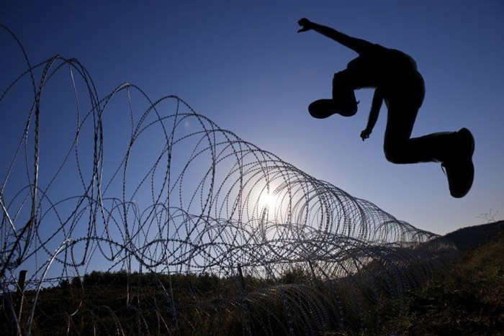
2 John
Limits to Love
Dr. Rick Griffith • Jordan Evangelical Theological Seminary • BibleStudyDownloads.org
Notes:
Does God have limits to his love?
Would this mean that he does not love unconditionally?

Slide 2
Key Word
297
Limits
2 John
Notes:
John speaks of love in all his NT writings, but in 2 John, he both commends a woman for her love, and also rebukes her for not putting limits on this love.

Slide 3
Theme
23
Limits to Love
2 John
Notes:
Should we have limits to our love?
Since John commands the woman who received this letter to limit her love, the same applies to us.

Slide 4
Key Verses
297
“Anyone who runs ahead and does not continue in the teaching of Christ does not have God; whoever continues in the teaching has both the Father and the Son. If anyone comes to you and does not bring this teaching, do not take him into your home or welcome him” (Verses 9-10).
2 John
Notes:
Here is the limit to love. False teachers do not continue in the teaching of Christ and thus should not be encouraged in their heresy.

Slide 5

Summary Statement
300
John exhorts limitations to love for a Christian woman and her children who show hospitality to missionaries but need warning not to extend the same to false teachers to warn against aiding the spread of destructive heresies.
2 John
Notes:
John wrote his letter about a half-century after Jesus, when an early form of the Gnostic heresy spread in his area of modern-day western Turkey. This teaching circulated from traveling teachers, many of whom were supported by well-meaning believers.

Slide 6

Kingdom Statement
27f
The kingdom life balances love and truth (vv. 1-6) so that neither invalidates the other.
2 John
Notes:
As in many of his writings, John says that Christ's kingdom is made of both love and truth. These must not be emphasized apart from the other.

Slide 7

Covenant
27f
An anonymous woman and her children are addressed (v. 1), who likely opened their home for church services and housed traveling preachers.
2 John
Notes:
Hospitality is a good trait, but like all virtues, it can be misused. The new covenant community of which this woman recipient was part needed her involvement to protect its theological foundation.

Slide 8

Redemption
27f
One evidence of salvation is continuing to believe that Jesus died in a real body (v. 7), whereas those who deny this “do not have God” (v. 9), likely meaning they lose reward (v. 8).
2 John
Notes:
The Gnostics had their teachers called "Docetists," from dokeo, "to seem," meaning that Jesus only seemed to be human. If Jesus did not die in a real body, then he did not actually die for our sins. This heretical teaching of redemption needed to be stopped.

Slide 9
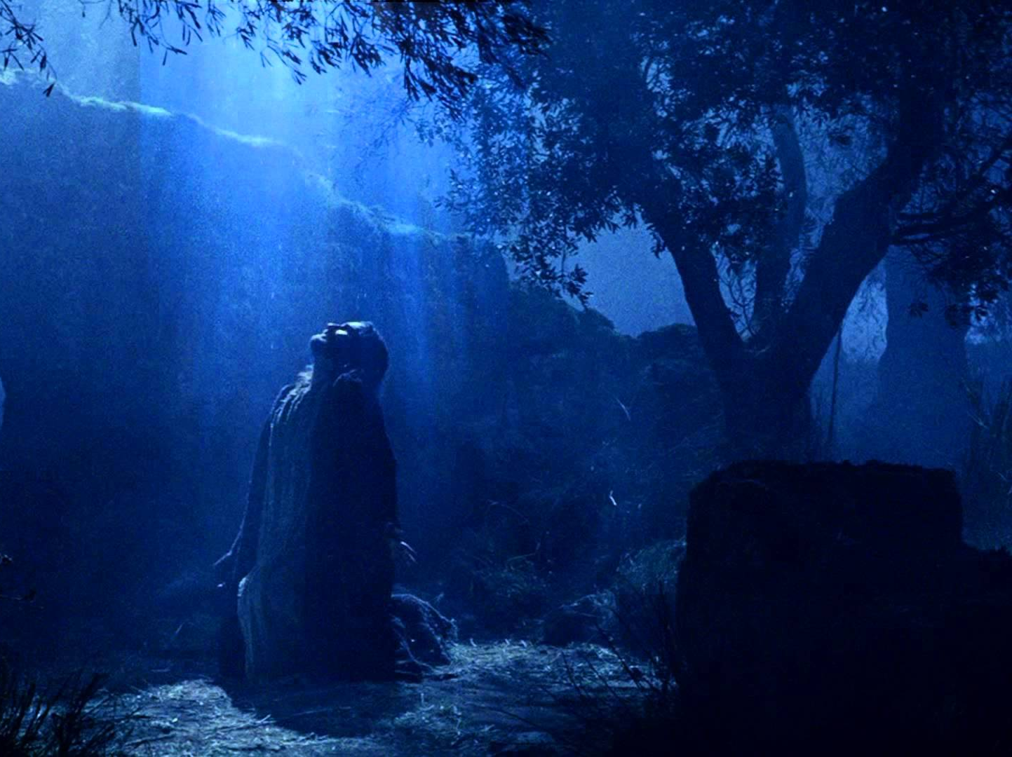
Prophecy
(Lord, Deity)
27f
Jesus is Lord even though he is human, as “many deceivers have gone out into the world. They deny that Jesus Christ came in a real body. Such a person is a deceiver and an antichrist” (v. 7 NLT).
2 John
Notes:
It is deceptive to claim that Jesus is Lord but also only a spirit. We must maintain that he is 100% man and 100% God, though this may seem to contradict logic.

Slide 10
2 John – Summary Chart
297
Limits to Love
Aid True Teachers
Avoid False Teachers
Verses 1-6
Verses 7-13
Walk in Commandments
Watch for Counterfeits
Positive
Negative
Demonstrate Truth
Defend Truth
Greeting in Truth & Love
(1-3)
Obedience Commended (4)
Exhortation to Love
(5-6)
Prohibition to Help False Teachers
(7-11)
Expected Visit & Greetings
(12-13)
Ephesus
AD 85-95
Notes:
Right practice is a two-sided coin, both benefiting orthodoxy and hindering heresy. John advocates for these in this order in this masterful letter that both commends this hospitable woman and warns against her lack of limits.

Slide 11
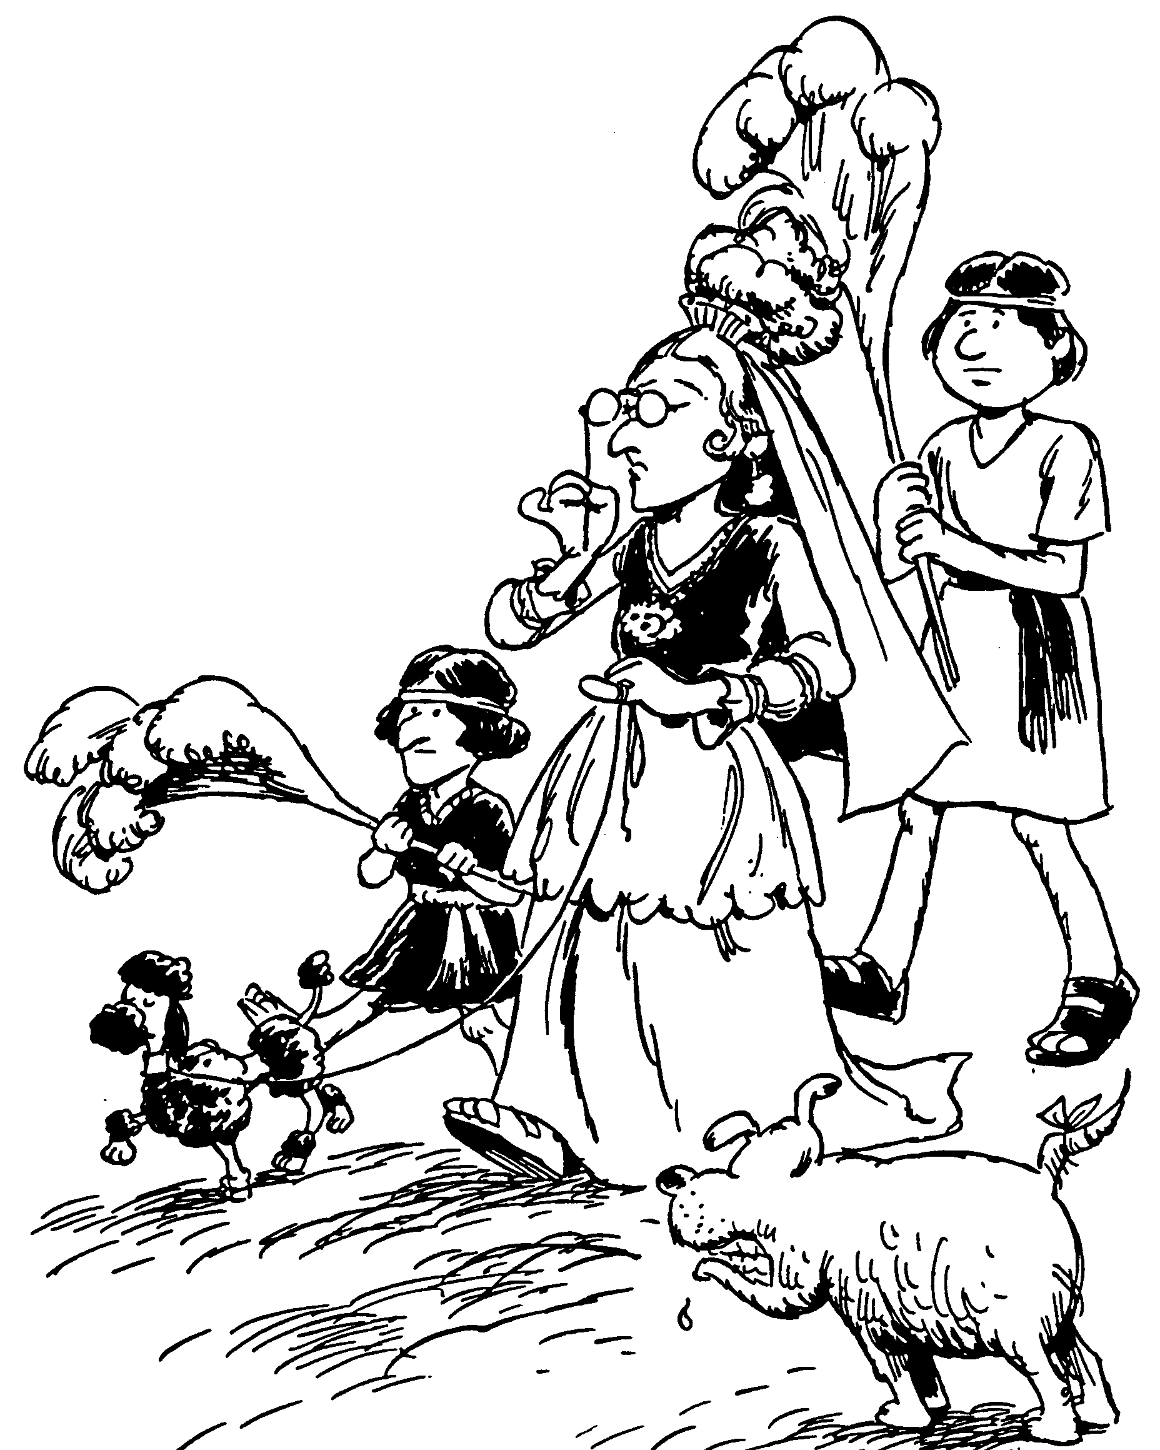
Acrostic Bible – 2 John
2 John
1-3 Love for the lady
4-6 Admonished for loving others
7-11 Deception of the Antichrist
12-13 Yearning to pay visit
Limits to Love
Barry Huddleston, The Acrostic Bible
Notes:
The cartoonist depicts the woman as a wealthy lady, which is likely true. This would have given her the financial means to help many, but also the potential to misuse her money in advancing heresies.

Slide 12

Be Discerning
2 John
Dr. Rick Griffith • Crossroads International Church Singapore
BibleStudyDownloads.org
Notes:
Glasses don't change the view, but they do help us see reality more clearly. John seeks to do this in his short letter (postcard, if you will). His goal is for the female recipient to be discerning in how she uses her money and hospitable nature.

Slide 13
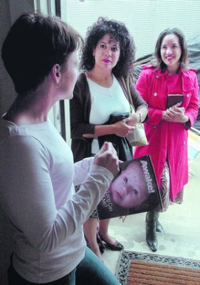
A Case Study…
Suppose two Jehovah's Witnesses come to your door. Will you invite them inside your home? Why or why not?
Please get into the right group…
2 John
Podium
Keep them out
Let them in
It depends
Notes:
It’s a lazy Saturday afternoon and you’re catching up on a few projects around the house. Then a knock comes at the door. You open it to discover two Jehovah's Witnesses. After talking a few minutes, they say to you, “It sounds like you have a keen interest in spiritual things. Can we hear more from you and tell us our understanding?”
• In such a situation, would you invite them inside your home? Why or why not?
• We often vote with our hands, but today I want you to vote with your feet, walking to a certain part of the room.
• Please get into the right group.
• Those who would keep them out move left
• Those who would let them in move to the right side of the room
• Those who need more information or feel it depends on certain factors move to the back. Ready, vote!
Now share with those in your group why you chose that group. Why are you in that group? Tell those around you for the next two minutes.
(2 minutes to discuss among themselves, then call the class to listen to these three groups answer the questions below)
Each group will now have 1-2 people tell the rest why they came to that group: first letting them in, second keeping them out and then the "it depends" group.
Please take your seats now.

Slide 14

The Gospel
Is it really changing our lives?
2 John
Notes:
The gospel is supposed to change lives, showing us how to respond in a difficult situation such as dealing with false teaching.
In such a situation, how does the gospel tell us to respond?

Slide 15
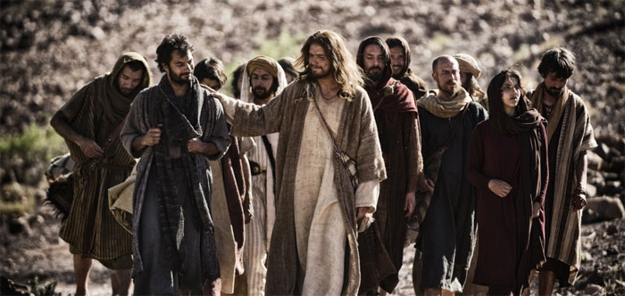
How can you live out the gospel?
Two ways…
2 John
Notes:
What ways can you apply the Good News of Jesus?

Slide 16
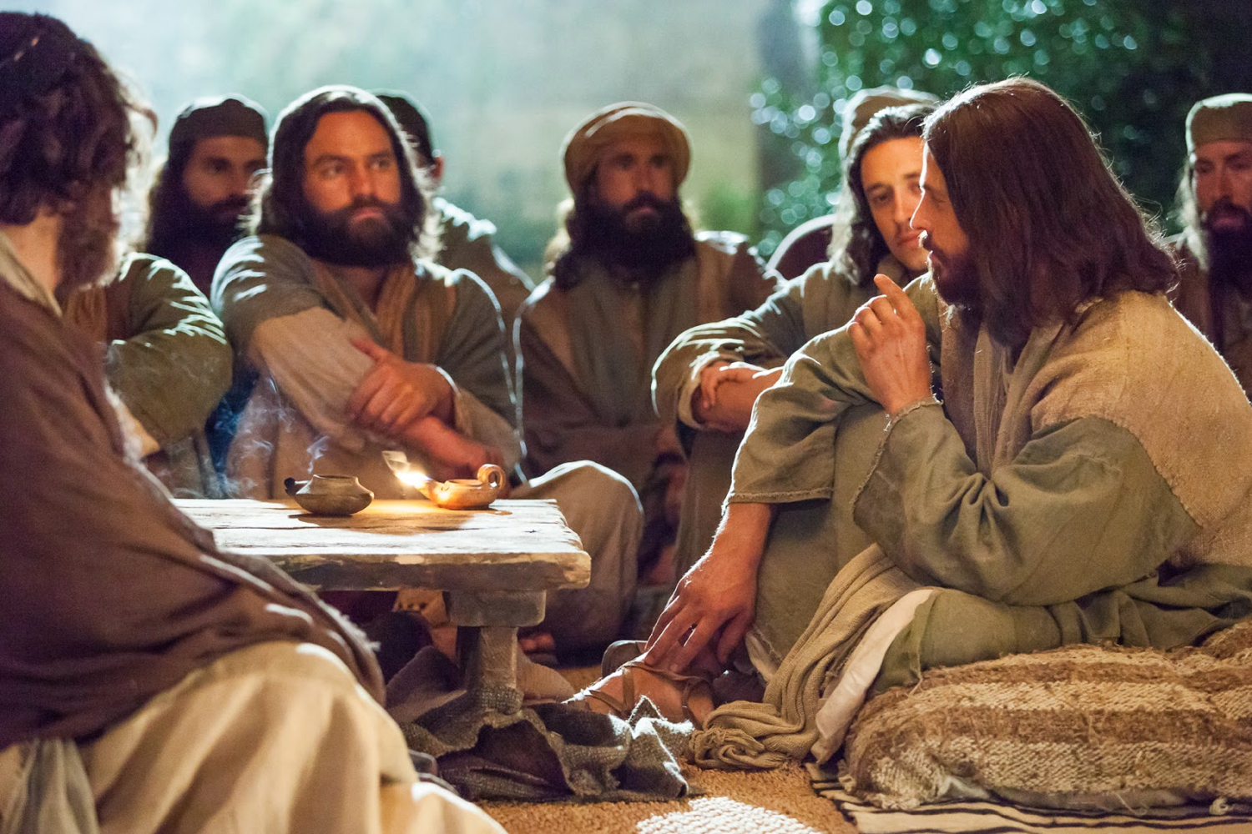
I. Aid true teachers (1-6).
2 John
Notes:
Support those preaching the right message about Christ (1-6).

Slide 17
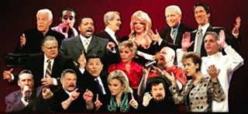
II. Avoid false teachers (7-13).
2 John
Notes:
Do not support preachers of heresy (7-13).

Slide 18
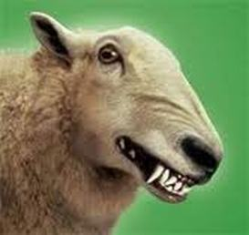
Main Idea
Live the gospel
by not aiding those who hinder the gospel
2 John
Notes:
In 2 John 10, we see the teaching in a nutshell: Do not encourage false teaching in any way so you can live out the Good News!

Slide 19

How do Christians aid heresy?
297
Encouraging itinerate heretics
Giving money to cults (YouTube preachers, etc.)
Buying heretical books
Attending movies that violate Scripture
Accepting literature from false evangelists
2 John
Notes:
Which of these practices do you need to stop doing?

Slide 20
Black

Slide 21
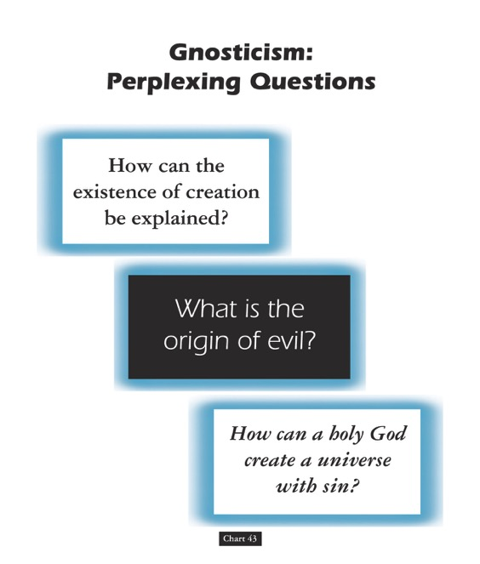
Gnosticism: Perplexing Questions
153a
How can the existence of creation be explained?
What is the origin of evil?
How can a holy God create a universe with sin?
Chart 43
John D. Hannah, Charts of Ancient & Medieval Church History (Grand Rapids: Zondervan, 2001)
Notes:
Text from Hannah for this chart:
"The Christian faith was opposed by numerous adversaries––threats from the state, ominous false religions, and heretics within its own borders. The most imposing religious threat came from Gnosticism, which was particularly dangerous because of its intellectual coherency. While Gnosticism seemed to provide answers to perplexing questions, it succeeded only in mixing a snippet of biblical truth with error."

Slide 22
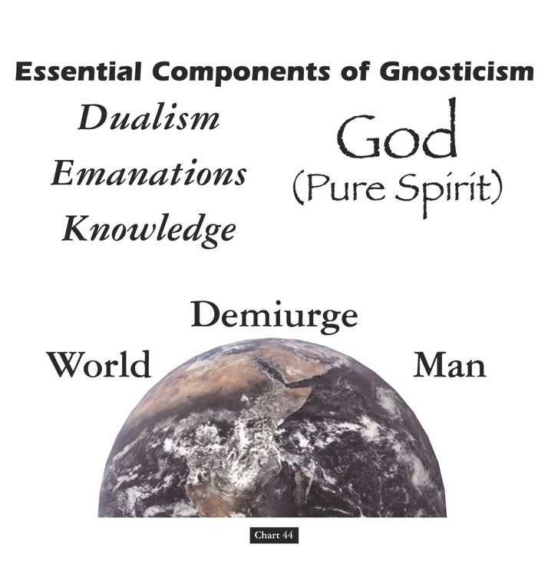
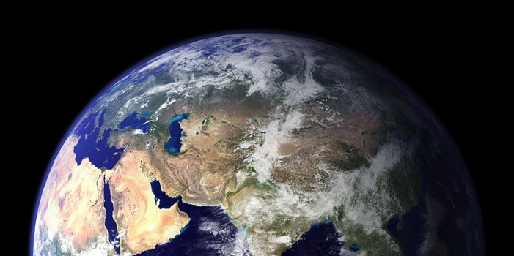
Essential Components of Gnosticism
153b
God
(Pure Spirit)
(1) Dualism
(2) Emanations
(3) Knowledge
Demiurge
World
Man
Chart 44
John D. Hannah, Charts of Ancient & Medieval Church History (Grand Rapids: Zondervan, 2001)
Notes:
Text from Hannah for this chart:
"Gnosticism taught (1) that there is a radical dualism of the spiritual in opposition to the material (God, who is Spirit, is the supreme good, while matter is evil); (2) that God could not have created matter because it is contrary to his nature; rather, the world, which is material and evil, was created by the Demiurge (an emanation from God), and man is a material being with an entrapped spirit; and (3) that through a "secret knowledge," salvation becomes the life of escape from the material confines of the body."

Slide 23

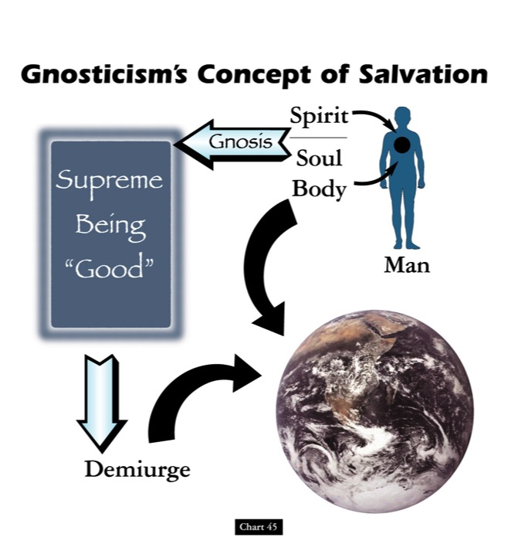

Gnosticism's Concept of Salvation
153c
Spirit
Supreme Being "Good"
Gnosis
Soul
Body
Man
Demiurge
Chart 45
John D. Hannah, Charts of Ancient & Medieval Church History (Grand Rapids: Zondervan, 2001)
Notes:
Text from Hannah for this chart [animation brackets mine]:
"Gnosticism's concept of salvation is as follows: God did not create the world, [1] but a lesser yet powerful being (the Demiurge) made this evil world and [2] mankind––though within man is a spark of good. [3] Salvation results from enlarging the capacity of that nature while minimizing the hold of materialism, [4] and it is accomplished by means of the secret teachings of Gnostic teachers. In resisting this teaching, Christian writers adopted a worldview that embraced the God of the Bible as the divine creator, affirmed the creation as good though marred by a subsequent devastation, and espoused the salvation of the body as well as the soul."

Slide 24
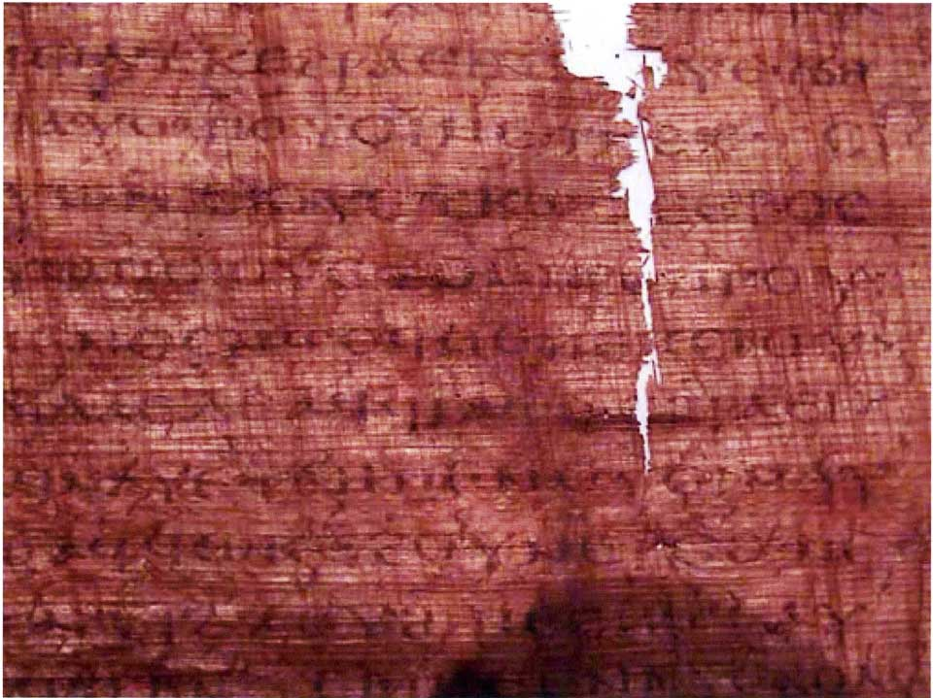
The Gospel of Judas
186a
Judas said, "Master, could it be that my seed is under the control of the rulers?" Jesus answered and said to him, "… you will grieve much when you see the kingdom and all its generation." When he heard this, Judas said to him, "What good is it that I have received it? For you have set me apart for that generation." Jesus answered and said, "You will become the thirteenth, and you will be cursed by the other generations—and you will come to rule over them. In the last days they will curse your ascent [47] to the holy [generation]."
Notes:
Another work that appeared in the early church—probably in the second century—is called the Gospel of Judas. It says that Judas would rule over the disciples—even though he was actually an unbeliever!

Slide 25
The Gospel of Judas
186a
Judas said to Jesus, "Look, what will those who have been baptized in your name do?" Jesus said, "… Truly [I] say to you, Judas, [those who] offer sacrifices to Saklas [...]God [—three lines missing—] everything that is evil. But you will exceed all of them. For you will sacrifice the man that clothes me."
Notes:
It even says that Jesus was a spirit that was "clothed" with Christ, and Judas will be part of the plan to exalt Jesus.

Slide 26
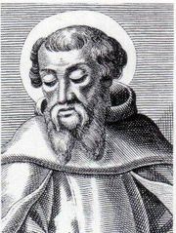
Irenaeus (AD 180)
186b
1. Others again declare that Cain derived his being from the Power above, and acknowledge that Esau, Korah, the Sodomites, and all such persons, are related to themselves. On this account, they add, they have been assailed by the Creator, yet no one of them has suffered injury. For Sophia was in the habit of carrying off that which belonged to her from them to herself. They declare that Judas the traitor was thoroughly acquainted with these things, and that he alone, knowing the truth as no others did, accomplished the mystery of the betrayal; by him all things, both earthly and heavenly, were thus thrown into confusion. They produce a fictitious history of this kind, which they style the Gospel of Judas.
Against Heresies 1.31.1
Notes:
The later second century church father Irenaeus spoke of this book as a heresy where Judas had a special knowledge (gnosis) that the other disciples lacked.
_______________
http://www.ccel.org/fathers2/ANF-01/anf01-60.htm#P7477_2003920

Slide 27
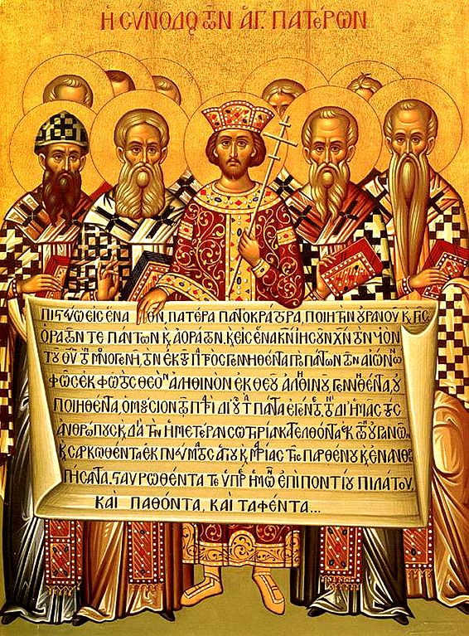
The Nicene Creed
(AD 325)
153e
Dr. Rick Griffith, Crossroads International Church Singapore
CICFamily.com & BibleStudyDownloads.org
Notes:
The Nicene Creed (AD 325) was the second oldest creedal statement of the Early Church, preceded only by The Apostle’s Creed of 1^{st to} 3rd centuries. But why do we have it in the first place?

Slide 28
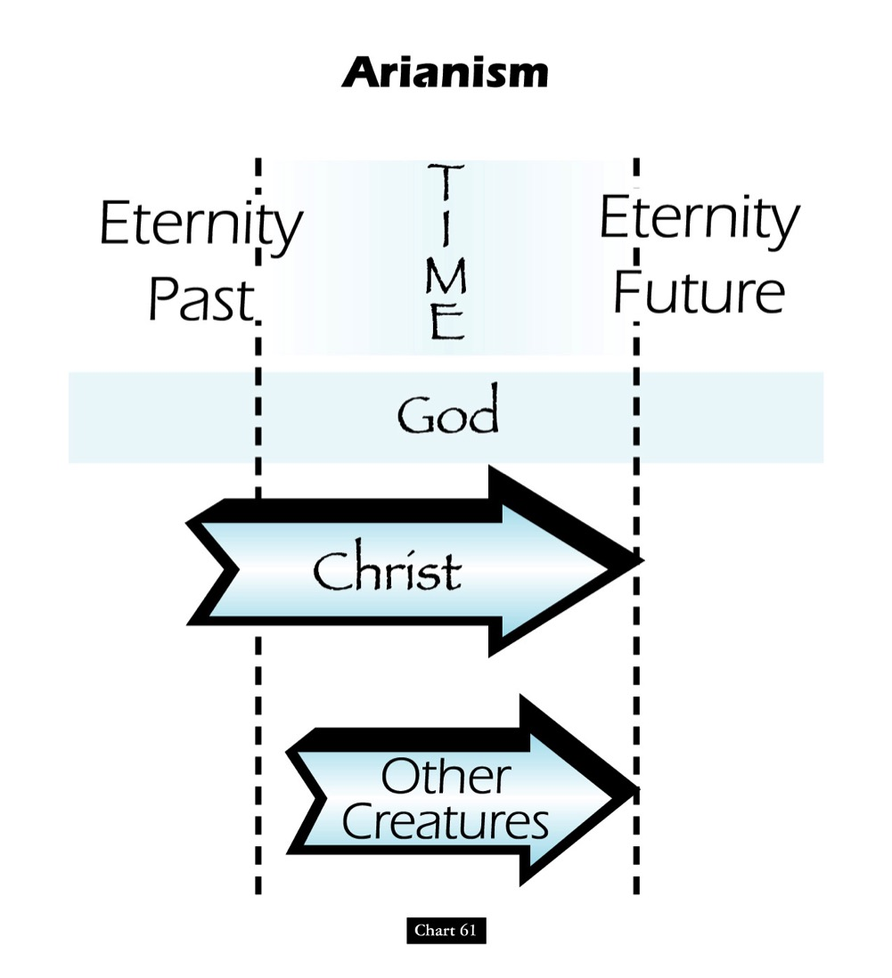
Teachings of the Heretic Arius
John D. Hannah, Charts of Ancient & Medieval Church History (Grand Rapids: Zondervan, 2001)
Notes:
One of the early heretical leaders was named Arius. He denied that Christ was "co-eternal" with the Father. Arius taught that Christ had a beginning point in eternity past.

Slide 29
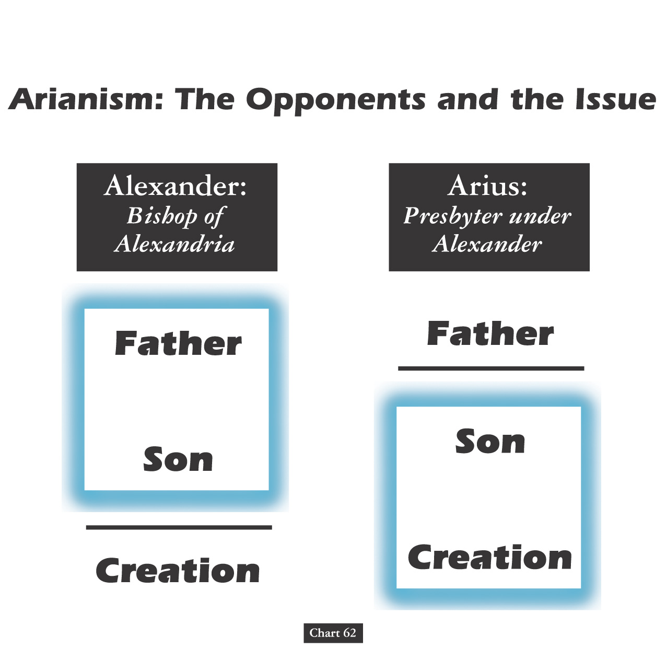
Alexander versus the Heretic Arius
Father
Father
Son
Son
Creation
Creation
John D. Hannah, Charts of Ancient & Medieval Church History (Grand Rapids: Zondervan, 2001)
Notes:
We have come today to worship Jesus Christ. But why do we believe what we do about Jesus? It’s because the NT says so—but how we interpret it came through seeing what heretics taught too. For example, two hundred years after Christ, Alexander was a key leader who held to the orthodox view that the Father and Son stood apart from creation.
• However, Alexander was the “boss” of the pastor Arius in his city. Arius believed only the Father to be separate from creation. Arius taught that the Father created Jesus, then Jesus created the world after this.

Slide 30
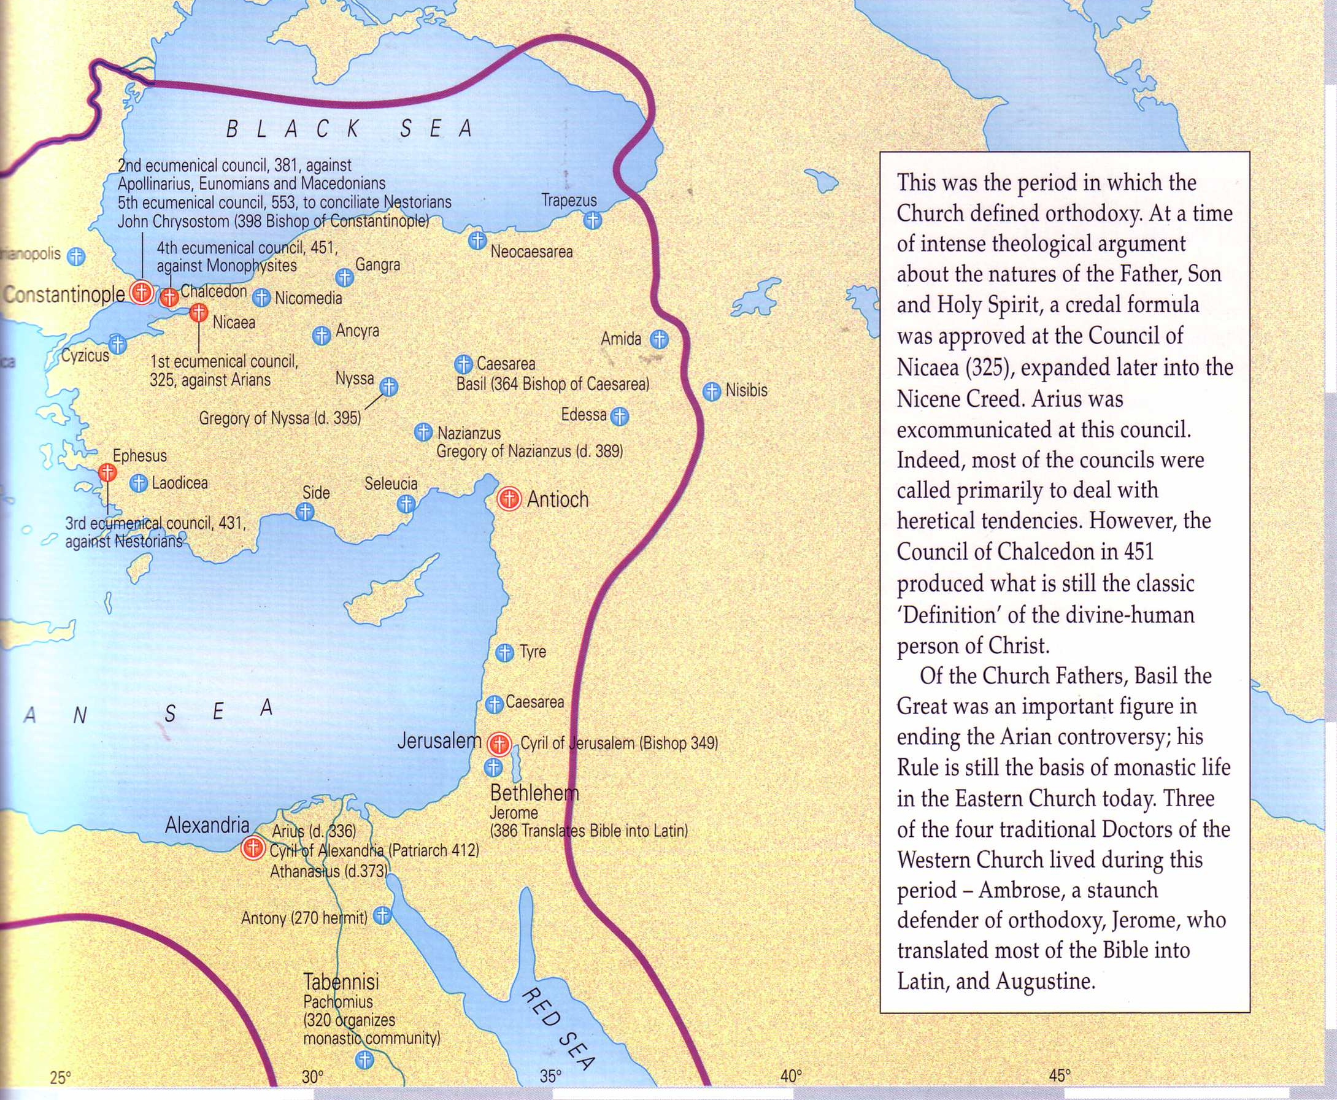
What About Nicea
(AD 325)?
Nicea
Bishops throughout the Eastern Empire gathered & excommunicated Arius of Alexandria
Alexander
Arius
The Atlas of the Bible and the History of Christianity, ed. Tim Dowley (London: Three’s Company, 1997), 77
Notes:
Nicea was a city in what is modern NW Turkey. It was the place where the controversy was resolved and a creed developed.
• The conflict was between Alexander and Arius in Alexandria, Egypt.
• However, to affirm the biblical teaching, 300 church leaders gathered together in the city of Nicea. Here by a vote of 300 to 3 the bishops rejected Arius.

Slide 31
What About Nicaea?
300 votes
Fiction
Fact
3 votes
Arians:
"Jesus Not God"
Orthodox:
"Jesus is God"
Arians:
"Jesus Not God"
Orthodox:
"Jesus is God"
AD 325
Council of Nicaea
Notes:
Brown claims (without support) that the Nicaea vote on whether Jesus was co-eternal with God was very close. The truth is that the vote of the 302 leaders present was 300 to 3. Along with Arius, "The two dissenting bishops were Secundus of Ptolemais and Theonas of Mamarica, both Libyan bishops associated with Arius. All three went into exile after the Council of Nicea" (Paul L. Maier in The Da Vinci Code: Fact or Fiction? with Hank Hanegraaff [Wheaton: Tyndale, 2004], 15, n. 6, on p. 73).

Slide 32
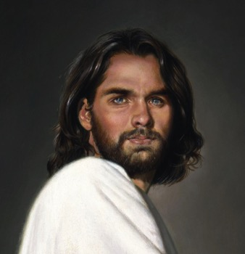
1st century belief in Deity
Paul:
"Christ, who is God over all"
Rom. 9:5
Peter:
"God and Savior Jesus Christ"
2 Pet. 1:1
The Father:
"About the Son He says, 'Your throne, O God…'" Heb. 1:8
Jesus:
"I and the Father are one"
John 10:30
Notes:
There is NO doubt that the earliest Christians believed that Jesus was God! Hebrews 1:8 gives us the witness of the Father himself, and where can one find a more reliable witness than God himself?

Slide 33
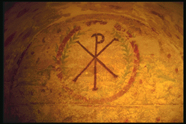
Belief in Christ's Deity Before Nicaea
Ignatius: "God Himself was manifest in human form" (AD 105)
Clement: "It is fitting that you should think of Jesus Christ as of God" (AD 150)
Irenaeus: "He is God, for the name Emmanuel indicates this" (AD 180)
Tertullian: "… Christ our God" (AD 200)
Origen: "No one should be offended that the Savior is also God" (AD 225)
Lactantius: "We believe Him to be God"
(AD 304)
Bercot, 93-100 in Garlow & Jones, 94
Notes:
Over and over the early church fathers affirmed that Jesus was God--all long BEFORE Nicaea!

Slide 34
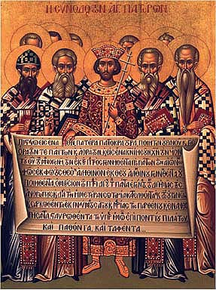
The Nicene Creed (AD 325)
We believe in one God,
the Father All Governing,
Creator of all things
visible and invisible;
And in one Lord Jesus Christ,
the Son of God,
Light from Light,
true God from true God
John D. Hannah, Charts of Ancient & Medieval Church History (Grand Rapids: Zondervan, 2001)
Notes:
The orthodox view won out and was expressed in the Nicene Creed. Let’s remind ourselves of this important teaching as we affirm aloud this great summary of Christian teaching. Reading together…(recite text)

Slide 35
The Nicene Creed (AD 325)
begotten not created,
of the same essence
as the Father,
through whom all things
came into being,
both in heaven and on earth;
Who for us men and for our salvation
came down and was incarnate,
becoming human.
John D. Hannah, Charts of Ancient & Medieval Church History (Grand Rapids: Zondervan, 2001)

Slide 36
The Nicene Creed (AD 325)
He suffered
and the third day he rose,
and ascended
into the heavens.
And he will come to judge
both the living and the dead.
And we believe in the Holy Spirit.
John D. Hannah, Charts of Ancient & Medieval Church History (Grand Rapids: Zondervan, 2001)

Slide 37
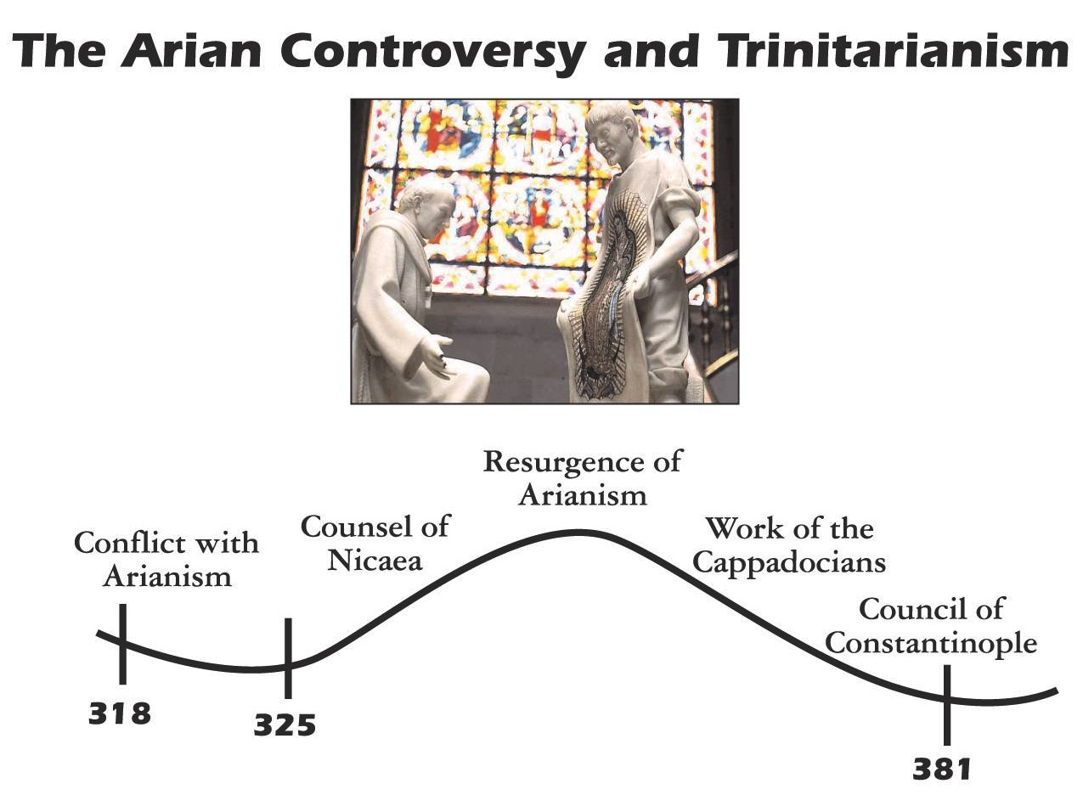

The Arian Controversy and Trinitarianism
John D. Hannah, Charts of Ancient & Medieval Church History (Grand Rapids: Zondervan, 2001)
Notes:
Unfortunately, Nicea did not end the Arian controversy, which later resurged until its final rejection almost 60 years later.

Slide 38
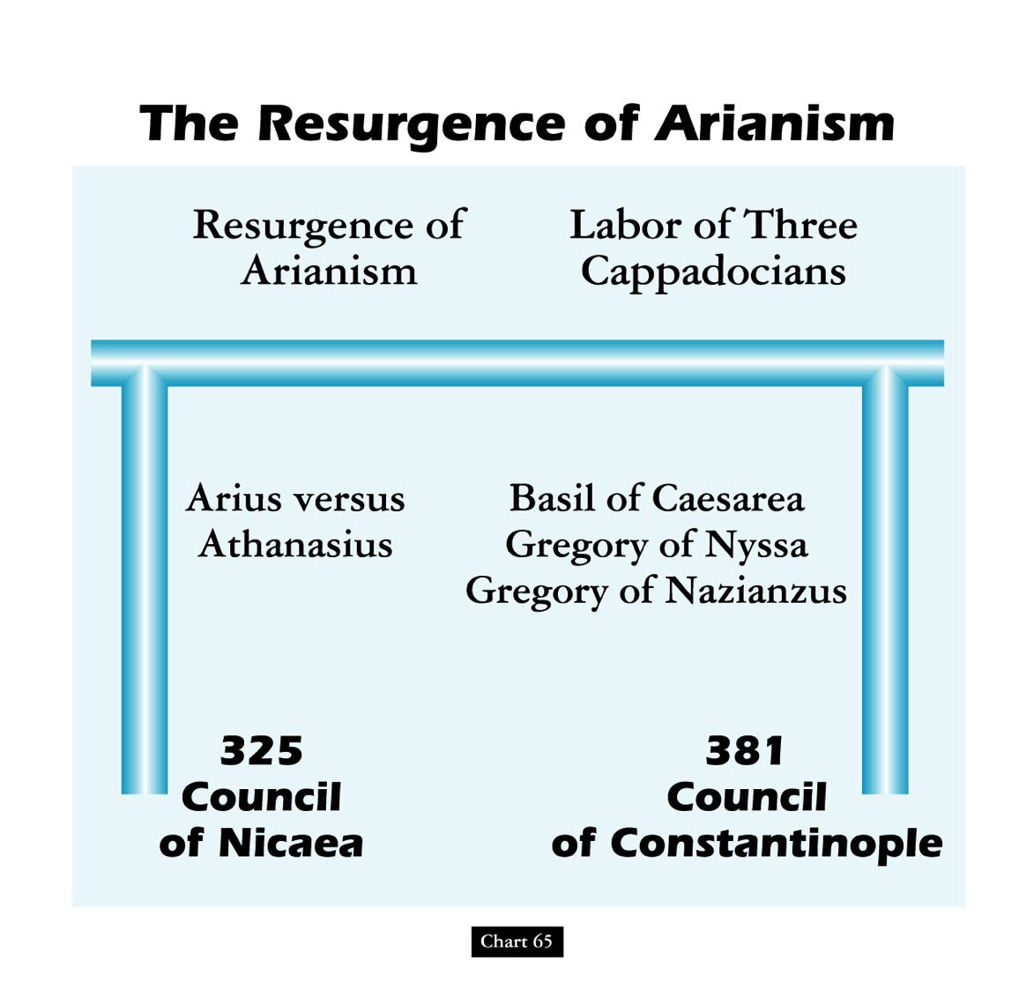
The Resurgence of Arianism
John D. Hannah, Charts of Ancient & Medieval Church History (Grand Rapids: Zondervan, 2001)
Notes:
God raised up Basil and the "Two Gregorys" to finally nail the coffin in Arianism. (However, this same heresy came back in the 1800s in a cult called Jehovah's Witnesses which teaches that Jesus was created by the Father.)

Slide 39
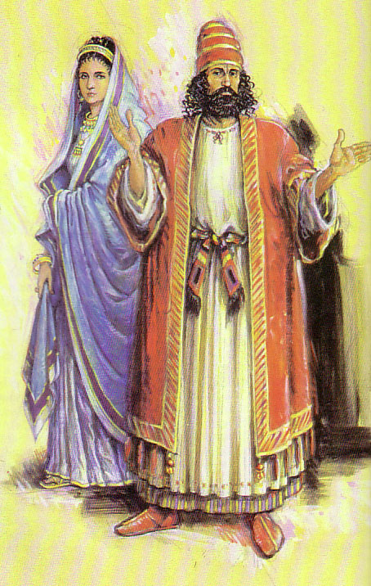
2 John versus 3 John
306
Contrasts
In 2 John the Apostle John warns against supporting false teachers
In 3 John he gives the "flip-side”: believers should support true missionary teachers.

Slide 40
2 John versus 3 John
306
Contrasts
 | 2 John | 3 John
Recipient | a Woman | a Man
Names | Anonymous | Gaius, Diotrephes, Demetrius
Mood | Condemns | Commends
Missionaries | False | True
Hospitality/Support | Misplaced | Missing (Diotrephes) Maintained (Gaius)
Verses | 13 | 15
Words (Greek text) | 245 | 219

Slide 41
Be Discerning
2 John
Dr. Rick Griffith • Crossroads International Church Singapore
BibleStudyDownloads.org

Slide 42

Lunar New Year Blessing
Radio Bible Class

Slide 43
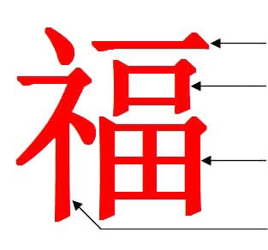
“Blessing”
One
Mouth (=Man)
Garden/Field
Divine Prefix
Notes:
Last week we were introduced to the amazing Chinese word for “blessing.”
It literally means one mouth (or man) in a garden in God’s presence!
Seriously! What an indication of Adam in the Garden of Eden with God’s blessing!

Slide 44

Genesis in Chinese Characters
See Dave Stewart, “The Story of Genesis in the Chinese Characters,” ShareShare presentation, https://www.slideshare.net/DaveSinNM/the-story-of-genesis-in-the-chinese-characters?qid=e6e52686-6545-4def-8537-2444d576b004&v=&b=&from_search=1, accessed 20 Jan 2020
Notes:
Many have noted that the story of Genesis is actually within the traditional Chinese characters.

Slide 45

“Create”
Create means to speak to dust to give life to a man so he can walk
to create
Speak = dust, life, man + walk/mud
Notes:
For example, the Chinese character for “create” has four components: dust, life, man and walk.

Slide 46


“Devil” & “Tempter”
Devil
Secret
Life
Man
Garden
Tempter
Devil
Cover
Forest/
Two Trees
Notes:
Chinese also has an insightful character for “devil” that shows a “secret” (or whisperer) for “life” told to a “man” in a “garden.”
That “devil” character forms the basis for the word “tempter,” which adds to devil words for “cover” among “two trees.”

Slide 47

“Boat”
The boat was a vessel of eight people
Boat
Vessel + Eight + People
Notes:
In Chinese, a large “boat” is formed with words for “vessel” and “eight people.” Doesn’t that sound like Noah, his wife, his three sons and their wives? There are actually over 270 Global Flood stories, but the Chinese one specifies the number of those saved as 8!

Slide 48
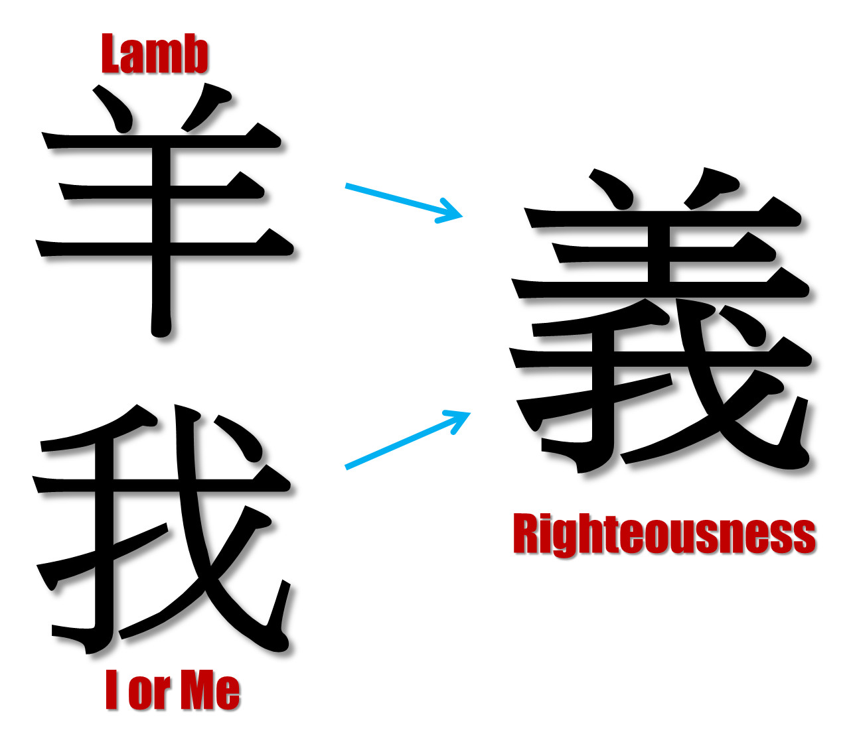
“Righteousness”
Lamb
I or Me
Notes:
As in most languages, the word for “me” is quite common. But Chinese puts the character for “lamb” over “me” to designate righteousness. We become righteous in God’s sight when overshadowed by the Lamb of God!

Slide 49
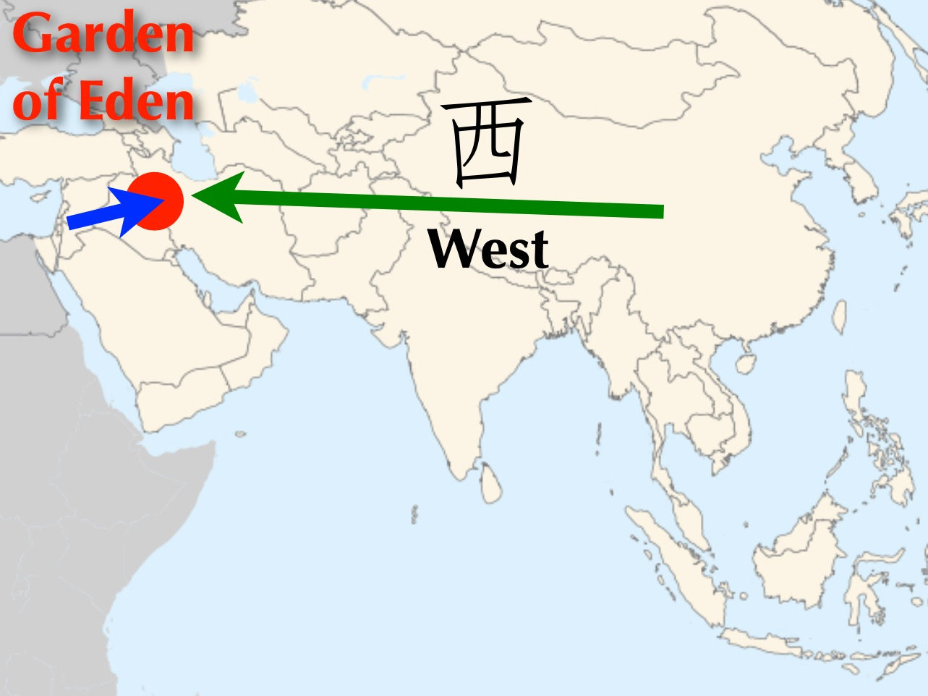
Garden of Eden
West
Notes:
Chinese has a very interesting word for “west.” Of course, the Garden of Eden was west of China.

Slide 50
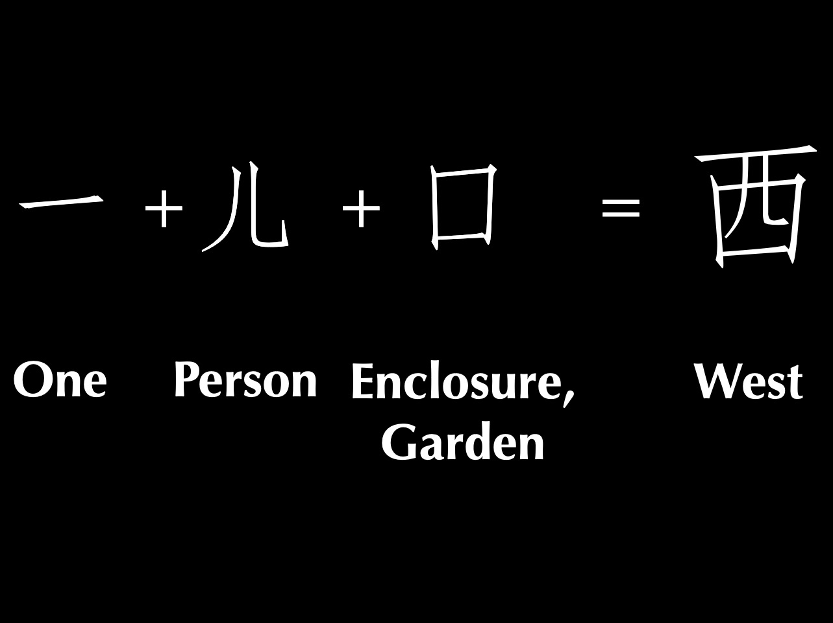
One man in a garden = West
One
Person
Enclosure,
Garden
West
Notes:
In Chinese, “west” literally means “one person in a garden” which took place west of China in the Middle East depiction of the Garden of Eden where God placed one man in a garden.

Slide 51

Title
One
Notes:
Many more Chinese examples are cited by authors such as C. H. Kang.

Slide 52

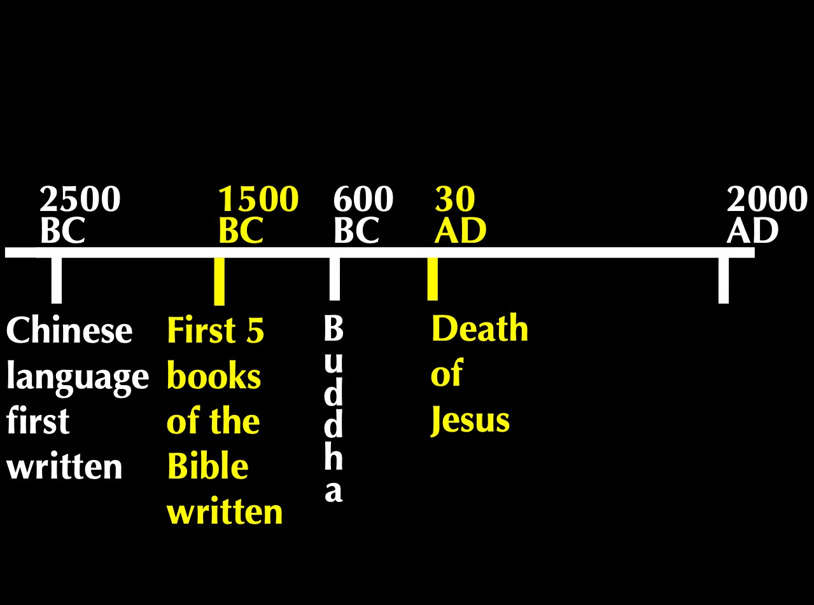
Timeline
2500
1500
400
33
2000
BC
AD
Chinese Language First Written
First 5 Books
of Bible Written
B
u
d
d
h
a
Death of Jesus
Notes:
So what’s the point? These Chinese words were basic to the language thousands of years before the Bible was translated into Chinese! We find them even 1000 years before Genesis was written, confirming their accuracy.
• In fact, the Chinese worshipped a single God, Shang Di, for thousands of years before Buddha lived.
But true teaching about God is always under attack.

Slide 53


“Lucky”?
“Blessing”?
Notes:
I showed this Chinese character for “blessing” to my non-Christian Chinese friend Jeffrey. He immediately looked at it and said, “Ah, lucky!” God’s blessings are reduced to luck in Satan’s relentless attack against the truth.

Slide 54
A Case Study…
Suppose two Jehovah's Witnesses come to your door. Will you invite them inside your home? Why or why not?
Please get into the right group…
2 John
Podium
Keep them out
Let them in
It depends
Notes:
It’s a lazy Saturday afternoon and you’re catching up on a few projects around the house. Then a knock comes at the door. You open it to discover two Jehovah's Witnesses. After talking a few minutes, they say to you, “It sounds like you have a keen interest in spiritual things. Can we hear more from you and tell us our understanding?”
• In such a situation, would you invite them inside your home? Why or why not?
• We often vote with our hands, but today I want you to vote with your feet, walking to a certain part of the room.
• Please get into the right group. • Those who would keep them out move left • those who would let them in move to the right side of the room • and those who need more information or feel it depends on certain factors move to the back. Ready, vote!
Why are you in that group? Tell those around you for the next minute.
Each group will now have 1-2 people tell the rest why they came to that group: first letting them in, second keeping them out and then the "it depends" group.
Please take your seats now.

Slide 55
Key Verse
297
“Anyone who runs ahead and does not continue in the teaching of Christ does not have God; whoever continues in the teaching has both the Father and the Son. If anyone comes to you and does not bring this teaching, do not take him into your home or welcome him” (2 John 9-10).
2 John
Notes:
Please be seated now. I’ve been in all 3 groups at various times—until vv. 9-10.

Slide 56
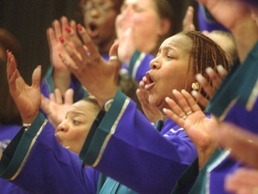
What's the Gospel?
Notes:
We are talking about the gospel—and how we respond to it.

Slide 57
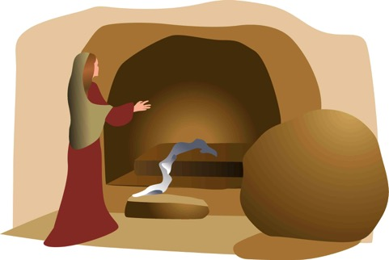
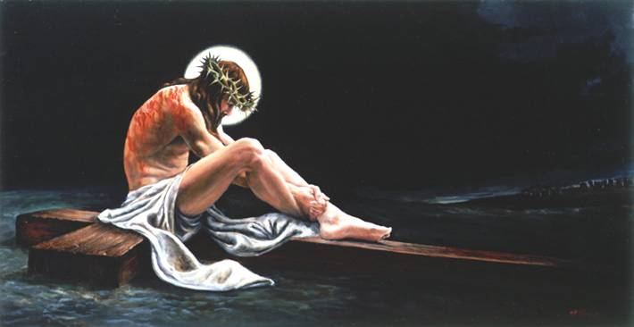
The Full Gospel
68
"Let me now remind you… of the Good News [Gospel]
I preached to you before…" (NLT)
Burial
Risen
Death
"Christ died for our sins…"
"He was raised from the dead on the third day…"
"He was buried…"
1 Cor. 15:3-4
Notes:
Most of us are here today because we believe Jesus died for our sins, was buried, and came alive again. Paul calls this the “good news” in 1 Corinthians 15:3-4.

Slide 58
The Gospel
Is it really changing our lives?
2 John
Notes:
The gospel is supposed to change lives, showing us how to respond in a difficult situation such as dealing with false teaching.
In such a situation, how does the gospel tell us to respond?

Slide 59
How can you live out the gospel?
Notes:
How do you act in a way that really honors God—especially when faced with heresy right in your face?

Slide 60
NT Overview (General + Key Words)
38
124
39-41
"To the remotest part of the earth" (Acts 1:8)
Acts 9 13 14 15 16 18 21 27 28
Apr 48-
Sep 49
1
Galatia
Apr 50-
Sep 52
2
Aegean
Spr 53-
May 57
3
Asia
Feb 60-
Mar 62
1
Rome
Spr 62-
Fall 67
4
Spain
Aut 67-
Spr 68
2
Rome
Summer 35-
37
Damascus
Antioch
May 57-
Aug 59
Trials
Fall 49
The
Council
Spring 68
Expansion of Church
35 48 49 50 52 53 57 60 62 67 68 95
Matt
Kingdom
Luke
Sov 1
Acts
Sov 2
Mark
Disciple
John
Believe
Gal
Justify
1 Thess
Rapture
1 Cor
Eph
Unity
1 Tim
Order
2 Tim
Sanctify
Doctrine
Jude
James
2 Thess
Tribulation
2 Cor
Col
Deity
Titus
Apostle
Conduct
Heb
1 John
Romans
Philem
1 Pet
2 John
Righteous
Forgive
Gospels & Acts
Phil
Attitude
2 Pet
Pauline Epistles
1234
Journeys
General Epistles
Rome
Imprisonments
General Epistles + Key Words
Notes:
Today we will focus on the little known letter of John called 2 John. It is one of the so-called General Epistle. With the exception of James, these letters appeared at the end of the first century.

Slide 61
Chapters in NT Books
Four "books" of the NT have but 1 chapter
Notes:
It doesn't seem right to call the four one-chapter writings "books" as they are so short! We know that most of the NT books are longer books or letters, but these four shortest ones are too often neglected.
____________
NS-18-Philemon-39
NS-24-2 John-61
NS-25-3 John-45
NS-26-Jude-66

Slide 62

Verses in NT Emails
15
13
Words
245
219
Notes:
Each is about the length of an email, so I call them "NT Emails." The "E" is not for "electronic" but for "encouragement."
____________
NS-18-Philemon-40
NS-24-2 John-62
NS-25-3 John-46
NS-26-Jude-67

Slide 63
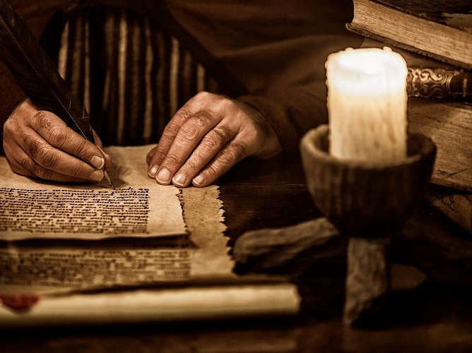
Date of Writing
298
Most scholars believe that John recorded this epistle about AD 90, although nothing in it excludes an earlier date.
Thus it was written in about AD 85-95.

Slide 64
Gnostics Taught a "Secret Knowledge"
291
-292
Two Types Addressed in 1-3 John
Docetic Gnosticism
From dokeo, "to seem"
(Christ only seemed to be a man)
Matter is Evil
Depreciated Materialism
Denied Christ's Humanity
Touched Jesus (1:1)
Led to Asceticism
Immorality exalted
Cerinthian Gnosticism
From Cerinthus, founder in Asia
(Christ only seemed to be God)
Spirit is Good
Exalted Knowledge (gnosis)
Denied Christ's Deity
Water & Blood (5:6)
Led to Pride
Education exalted
Notes:
Many Gnostics denied Jesus was a real man. Others exalted the spirit so much that they denied his deity.

Slide 65
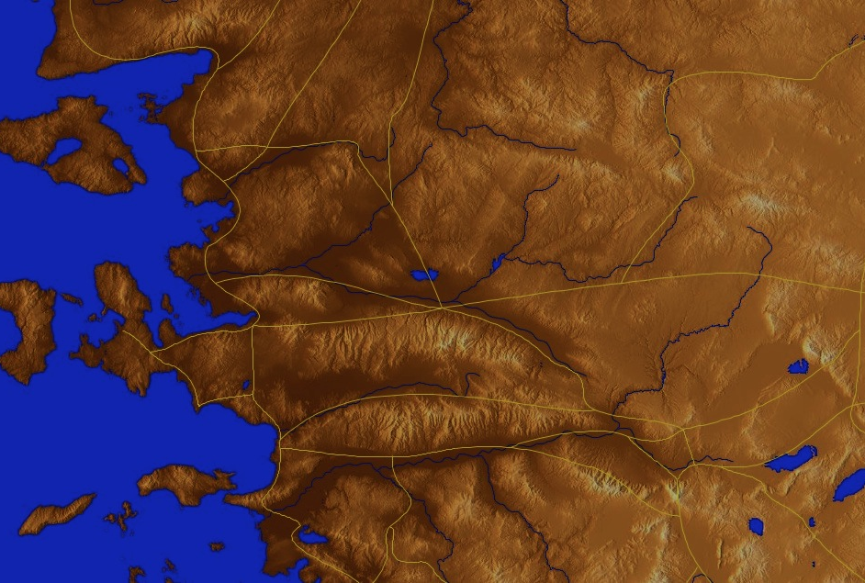
Origin/Recipient
298-299
Pergamum
"The Chosen Lady
& her children" (v. 1)
Thyatira
Sardis
Smyrna
Philadelphia
Ephesus
Laodicea
Colossae
Notes:
John wrote a woman to help her see how to live out the gospel in this difficult context.

Slide 66
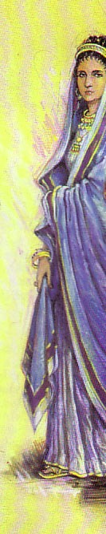

Who is "the Chosen Lady & Her children"?
298-299
A figure for a local church?
The Virgin Mary?
An anonymous woman & her children who opened their home for church services & housed traveling preachers

Slide 67
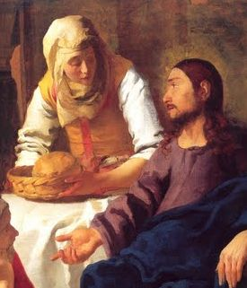
Occasion
299
Before the NT was completed and circulated among the early believers, churches relied on traveling preachers and teachers for truth.
Since inns were unsafe and few, these teachers stayed with Christians.

Slide 68
Occasion
299
Many hosts wondered, "Which teachers should I welcome to my home?"
John commands a hospitable woman to "put limits on her love" by refusing to house false teachers or to encourage them in any way.

Slide 69
How can you live out the gospel?
Two ways…
2 John
Notes:
What ways can you apply the Good News of Jesus?

Slide 70
2 John 1-6

Slide 71
I. Aid true teachers (1-6).
2 John
Notes:
Support those preaching the right message about Christ (1-6).

Slide 72

Balancing Love and Truth
297
"All you need is love…" (The Beatles)
Do you agree? Why or why not?
Balance
Mushiness
Harshness
Love
Truth
Love
Truth
Notes:
The old Beatles song proclaimed, “All you need is love!” Is that true?
• Love is seen as more important than truth.
• Of course, others go to the other extreme by saying we only need truth as love is unimportant.
• Love without truth is mushiness.
• Truth without love is harshness.
• God’s will is for us to live in balance with BOTH love and truth. Notice how both are paired as I read the first 6 verses of this letter…

Slide 73
"This letter is from John, the elder. I am writing to the chosen lady and to her children, whom I love in the truth—as does everyone else who knows the truth—²because the truth lives in us and will be with us forever" (2 John 1-2 NLT).

Slide 74
"Grace, mercy, and peace, which come from God the Father and from Jesus Christ—the Son of the Father—will continue to be with us who live in truth and love. ⁴How happy I was to meet some of your children and find them living according to the truth, just as the Father commanded" (2 John 3-4 NLT).

Slide 75
"I am writing to remind you, dear friends [Greek: “lady”], that we should love one another. This is not a new commandment, but one we have had from the beginning. ⁶Love means doing what God has commanded us, and he has commanded us to love one another, just as you heard from the beginning"
(2 John 5-6 NLT).

Slide 76

"Share with God's people who are in need. Practice hospitality." Romans 12:13 (NIV)
"Now the overseer must be . . . hospitable" 1 Timothy 3:2 (NIV)
"Offer hospitality to one another without grumbling." 1 Peter 4:9 (NIV)

Slide 77
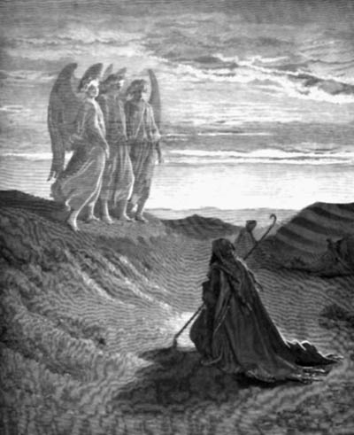
"Do not forget to entertain strangers, for by so doing some people have entertained angels without knowing it."
Hebrews 13:2 (NIV)

Slide 78
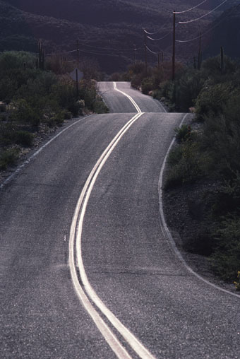
"I hope to visit you while passing through and to have you assist me on my journey there [Spain], after I have enjoyed your company for a while."
Romans 15:24 (NIV)

Slide 79
"Perhaps I will stay with you awhile, or even spend the winter, so that you can help me on my journey, wherever I go."
1 Corinthians 16:6

Slide 80
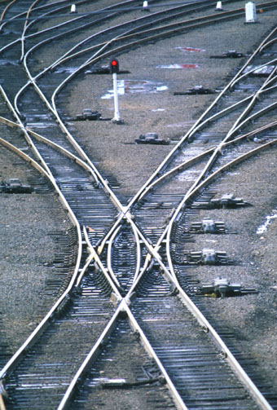
"Do everything you can to help Zenas the lawyer and Apollos on their way and see that they have everything they need."
Titus 3:13 (NIV)

Slide 81
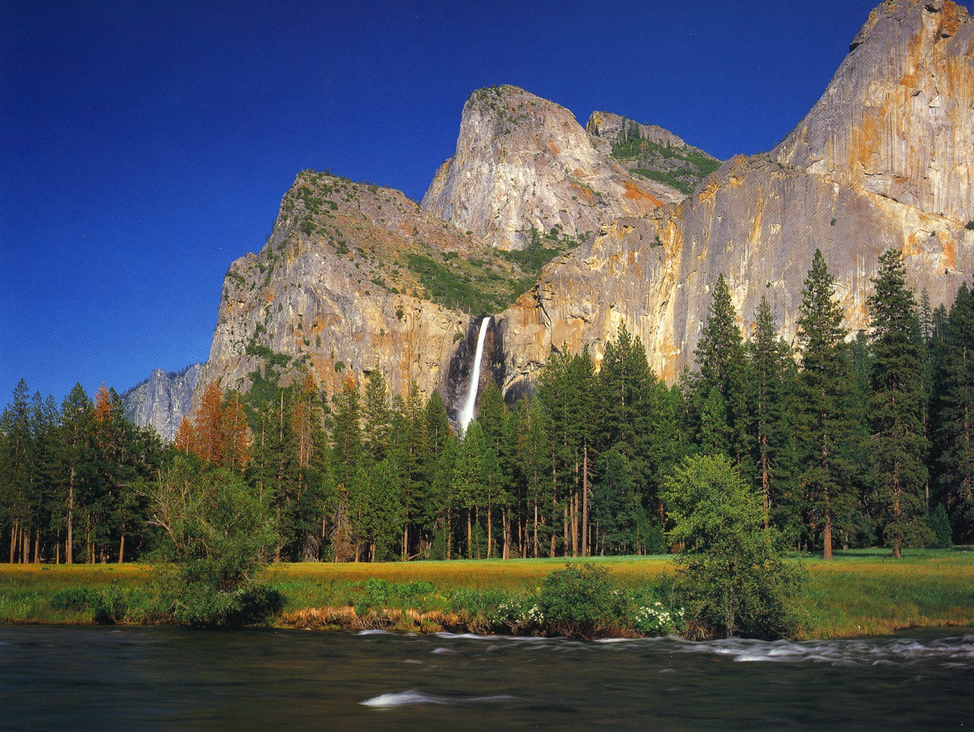
Didache 11:4 "Let every apostle, when he comes to you, be received as the Lord;"

Slide 82
Didache 11:5 "but he shall not abide more than a single day, or if there be need, a second likewise; but if he abides three days, he is a false prophet."

Slide 83
Didache 11:6 "And when he departs let the apostle receive nothing except bread, until he finds shelter; but if he asks for money, he is a false prophet."

Slide 84
Didache 12:1 "But let every one that comes in the name of the Lord be received; and then when you have tested him you shall know him."

Slide 85
Didache 12:2 "If the comer is a traveler, assist him, so far as you are able; but he shall not stay with you more than two or three days, if it be necessary."

Slide 86
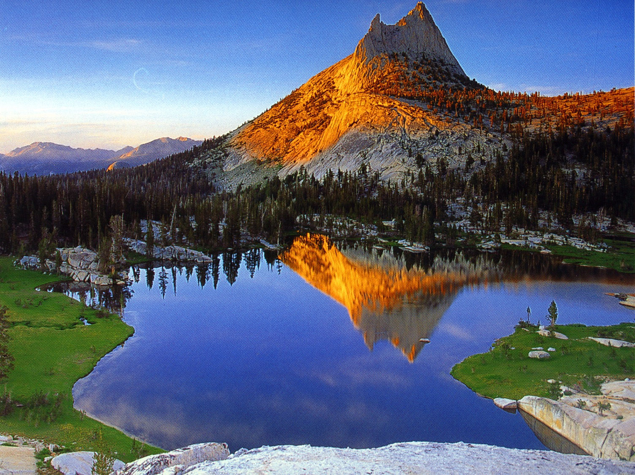
"Freely you have received, freely give."
Matthew 10:7 (NIV)

Slide 87
"This is how we know what love is: Jesus Christ laid down his life for us. And we ought to lay down our lives for our brothers."
1 John 3:16 (NIV)

Slide 88
How can you live out the gospel?
Two ways…
2 John
Notes:
What ways can you apply the Good News of Jesus?

Slide 89
I. Aid true teachers (1-6).
2 John
Notes:
Support those preaching the right message about Christ (1-6).

Slide 90
2 John 7-13

Slide 91
II. Avoid false teachers (7-13).
2 John
Notes:
Do not support preachers of heresy (7-13).

Slide 92

"I say this because many deceivers have gone out into the world. They deny that Jesus Christ came in a real body. Such a person is a deceiver and an antichrist"
(2 John 7 NLT).

Slide 93
"Watch out that you do not lose what we have worked so hard to achieve. Be diligent so that you receive your full reward. ⁹Anyone who wanders away from this teaching has no relationship with God. But anyone who remains in the teaching of Christ has a relationship with both the Father and the Son"
(2 John 8-9 NLT).

Slide 94
"If anyone comes to your meeting and does not teach the truth about Christ, don't invite that person into your home or give any kind of encouragement. ¹¹Anyone who encourages such people becomes a partner in their evil work"
(2 John 10-11 NLT).
Notes:
A Christian must never invite false teachers inside one’s home or even greet those who propagate destructive heresies, so this woman's love must be discerning and have limits (10).
Anyone who even greets a proselytizing false teacher encourages him in his heresies and helps promote his evil work, so the woman must see she is aiding Satan's workers (11).

Slide 95
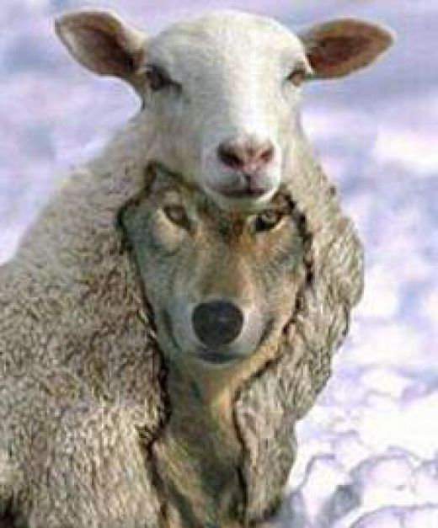
The Meaning of 2 John 10
Summary of Differing Views
304
Can False Teachers. . .
View Stay in Believers Homes? Enter Believers' Homes? Adherents
1 Yes Yes John R. Stott
F. F. Bruce
2 No Yes Stanley Toussaint
3 No ? I. Howard Marshall
B. F. Westcott
Robert Weldon Wilson
4 No No Rick Griffith

Slide 96
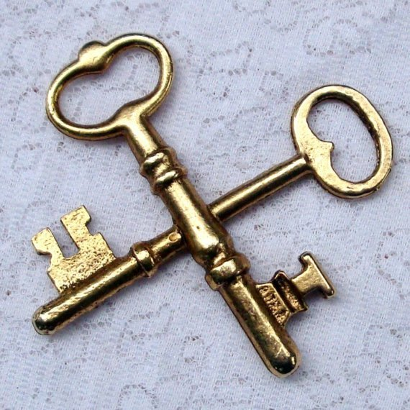
Keys
297
Key Word
Limits
Key Verse
"Anyone who runs ahead and does not continue in the teaching of Christ does not have God; whoever continues in the teaching has both the Father and the Son. If anyone comes to you and does not bring this teaching, do not take him into your home or welcome him" (2 John 9-10 NIV).

Slide 97

Too good to be true the-ology

Slide 98
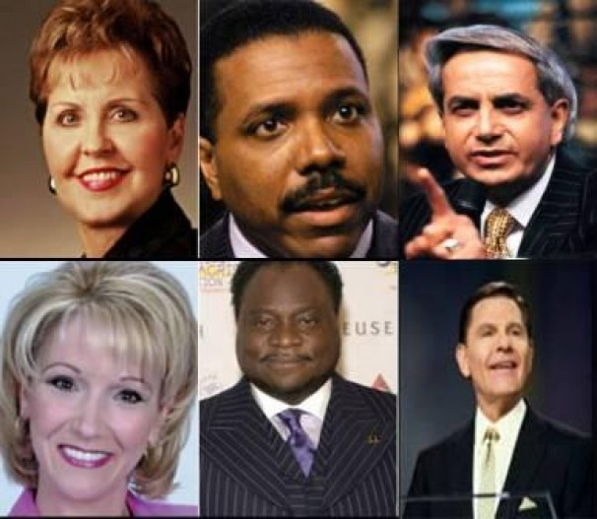
Joyce Meyers in her
$2 million jet, etc.

Slide 99

Oprah Winfrey

Slide 100
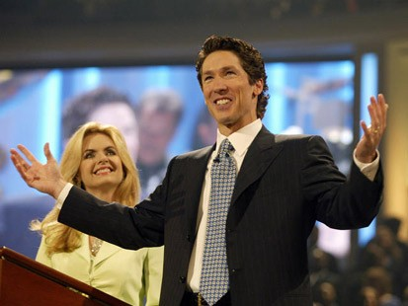
Joel Osteen
No preaching on sin
Led in prayer at gay "wedding"

Slide 101

Motivational Speaking
Magical prayers, feel good messages, have it your way theology; surely this is too awesome to be what Paul warned us about
http://www.conservativecut.com/blog/?tag=false-teacher
Notes:
http://www.conservativecut.com/blog/?tag=false-teacher

Slide 102
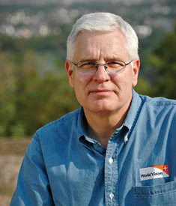

World Vision Controversy
CEO Richard Stearns
Notes:
World Vision Reverses Decision To Hire Christians in Same-Sex Marriages
(UPDATED) President Richard Stearns: 'Certain beliefs are so core to our Trinitarian faith that we must take a strong stand on those beliefs.'
Celeste Gracey and Jeremy Weber/ March 26, 2014
Only two days after announcing it would hire Christians in same-sex marriages, World Vision U.S. has reversed its ground-breaking decision after weathering intense criticism from evangelical leaders.
"The last couple of days have been painful," president Richard Stearns told reporters this evening. "We feel pain and a broken heart for the confusion we caused for many friends who saw this policy change as a strong reversal of World Vision's commitment to biblical authority, which it was not intended to be."
"Rather than creating more unity [among Christians], we created more division, and that was not the intent," said Stearns. "Our board acknowledged that the policy change we made was a mistake … and we believe that [World Vision supporters] helped us to see that with more clarity … and we're asking you to forgive us for that mistake."
http://www.christianitytoday.com/ct/2014/march-web-only/world-vision-reverses-decision-gay-same-sex-marriage.html accessed 8 April 2014

Slide 103
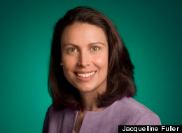
World Vision Controversy
Jacqueline Fuller
Notes:
World Vision board member quits over gay marriage hiring ban
Google's Jacqueline Fuller leaves Christian charity's board after it reverses decision to hire workers in same-sex marriages
Share 113
inShare0
Email
Associated Press in Seattle
theguardian.com, Thursday 3 April 2014 01.31 BST
Jump to comments (12)
A World Vision board member has resigned in protest after the Christian aid group quickly reversed its decision to hire employees in same-sex marriages.
Jacqueline Fuller, director of corporate giving for Google, said in an email to the Associated Press on Wednesday she remained a "huge fan" of the group's work on behalf of the poor, but she had resigned on Friday "as I disagreed with the decision to exclude gay employees who marry".
She declined to comment further.
http://www.theguardian.com/society/2014/apr/03/world-vision-board-member-quits-gay-marriage-hiring

Slide 104
2 John – Summary Chart
297
Limits to Love
Aid True Teachers
Avoid False Teachers
Verses 1-6
Verses 7-13
Walk in Commandments
Watch for Counterfeits
Positive
Negative
Demonstrate Truth
Defend Truth
Greeting in Truth and Love
(1-3)
Obedience Commended (4)
Exhortation to Love
(5-6)
Prohibition to Help False Teachers
(7-11)
Expected Visit & Greetings
(12-13)
Ephesus
AD 85-95

Slide 105
Follow Up Relationally (12-13)
"I have much more to say to you, but I don't want to do it with paper and ink. For I hope to visit you soon and talk with you face to face. Then our joy will be complete. ¹³Greetings from the children of your sister, chosen by God"
(2 John 12-13 NLT).
Notes:
John wants to clarify his teaching about discerning love by a personal visit that is better than a letter and would be a joyful rather than stern time (12).
More teaching on the delicate subject of responding to false teachers is needed, but not through a letter (12a).
A personal, face-to-face visit would better clarify John’s teaching and result in a joyful time rather than a list of stern regulations (12b).
John sends greetings from her nephews and nieces to end in an affectionate way (13).

Slide 106
How can you live out the gospel?

Slide 107
Main Idea
Live the gospel
by not aiding those who hinder the gospel

Slide 108
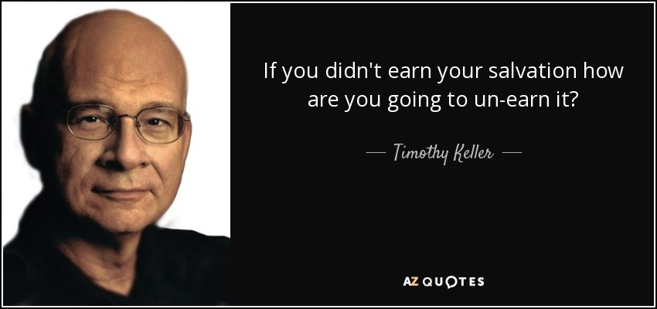
Salvation by Grace Cannot be Lost
"If you didn't earn your salvation, how are you going to un-earn it?"
—Timothy Keller—

Slide 109

However, Christ promises rewards for perseverance (Rev. 3:11b).
"I am coming soon. Hold on to what you have, so that no one will take away your crown" (NLT).

Slide 110
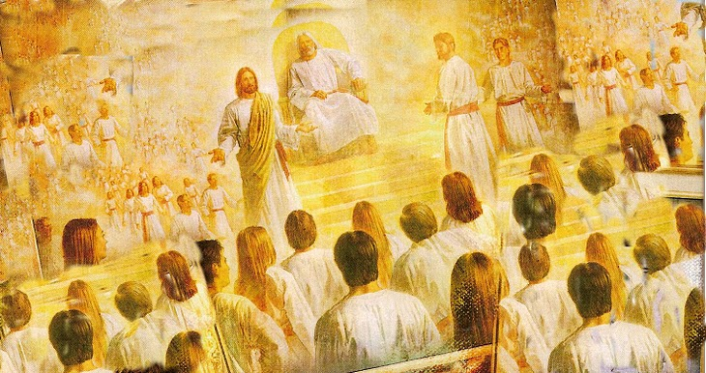
Rewards can be lost!
"Watch out that you do not lose what we have worked so hard to achieve. Be diligent so that you receive your full reward" (2 John 8 NLT)
"I have given you an open door that no one can shut" (3:8)

Slide 111
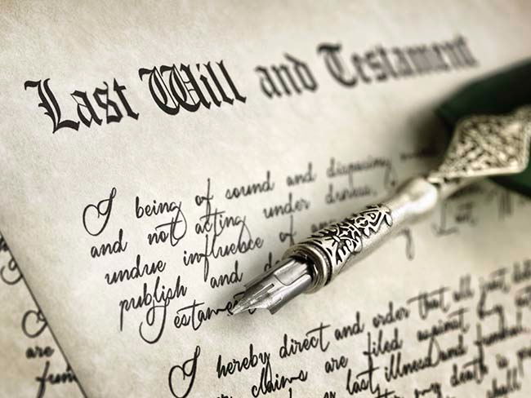
Inheritance Today

Slide 112

Inheritance from Christ

Slide 113


The Future Reign of the Servant Kings
Jody Dillow is the key author of the Partakers View
Final Destiny
The Future Reign of the Servant Kings
Joseph Dillow

Slide 114

Inheritance in the OT

Slide 115
Inheritance in the OT
1. A difference exists between inheriting the land of Canaan and living there. The former refers to ownership and the latter to mere residence.
2. While Israel was promised the inheritance as a nation, the condition for maintaining their inheritance right to the land of Canaan was faith, obedience, and completion of one's task. The promise, while national, was applied only to the believing and obedient remnant.
Joseph Dillow, Final Destiny, 56

Slide 116
Inheritance in the OT
3. The inheritance is not to be equated with heaven but with something in addition to heaven, promised to those believers who faithfully obey the Lord.
4. Just as Old Testament believers forfeited their earthly inheritance through disobedience, we can also forfeit our future reward (inheritance) by a similar failure. Loss of inheritance, however, does not mean loss of salvation.
Joseph Dillow, Final Destiny, 56

Slide 117
Inheritance in the OT
5. Two kinds of inheritance were enjoyed in the Old Testament. All Israelites who had believed and were therefore regenerate had God as their inheritance but not all inherited the land. This paves the way for the concept that the New Testament may also teach two inheritances. We are all heirs of God, but we are not all joint-heirs with Christ, unless we persevere to the end of life. The former refers to our salvation and the latter to our reward.
Joseph Dillow, Final Destiny, 56

Slide 118
Inheritance in the OT
6. A child of Israel was both an heir of God and an heir of Canaan by virtue of faith in God resulting in regeneration. Yet only those believers in Israel who were faithful would maintain their status as firstborn sons who would actually receive what had been promised to them as an inheritance.
Joseph Dillow, Final Destiny, 56

Slide 119

Inheritance in the NT

Slide 120
Two Types of Inheritance
"Now if we are children, then we are heirs—heirs of God and co-heirs with Christ, if indeed we share in his sufferings in order that we may also share in his glory"
(Rom. 8:17 NIV).
= Salvation
= Reward

Slide 121


Crowns in the NT
Incorruptible
1 Cor. 9:25
Hope
1 Thess. 2:19
Righteousness
2 Tim. 4:8
Life
Jas 1:12;
Rev 2:10
Glory
1 Pet. 5:4
Notes:
Rick Griffith, Eschatology notes, 189
2. What is the nature of the heavenly rewards? What will these rewards be like?
a. Rewards of Possession
1) Five crowns (stephanos) are noted as personal possessions in heaven (cf. p. 76). These crowns are not kingly crowns (diadems) but victor's wreaths made of vines or leaves (or even gold and silver in the form of a garland or wreath):
An incorruptible crown is for those who master their flesh (1 Cor. 9:25).
A crown of hope or joy is for those who bore fruit in others' lives for Christ (1 Thess. 2:19). This is sometimes called the soul-winner's crown.
A crown of life is for believers who patiently endure trials and suffering (James 1:12; Rev. 2:10).
A crown of glory rewards spiritual shepherds who feed the flock (1 Pet. 5:4).
A crown of righteousness is for one longing for Christ's return (2 Tim. 4:8).
b. Rewards of Responsibility (cf. W. A. Criswell and Paige Patterson, Heaven, 208-14)
1) In Luke 19:11-27 (Parable of the Ten Minas) Jesus taught that before going on a journey, a nobleman gave each of his ten servants the same amount of money—one mina each. Upon returning, the master rewarded each accordingly with differing degrees of responsibility based on their faithfulness.
2) Matthew 25:14-30 (Parable of the Talents) records a similar story, except each man received a different amount of money to invest for his master (the one who buried his master's money depicts an unsaved man, v. 30). This parable also depicts varying degrees of reward: "His master replied, 'Well done, good and faithful servant! You have been faithful with a few things; I will put you in charge of many things. Come and share your master's happiness'" (v. 21).
2) We too often view ownership as sinful, though this is not scriptural.
a) As joint-heirs with Christ (Rom. 8:17; Heb. 1:2), we own what He owns! This is joint-ownership in a communal sense but "to deny private property inevitably ends in denying privacy" (Gilmore, 302) much like the mystical idea of blending into the "Total One." Ownership in heaven will not include the sinful possessiveness of earth.
b) We have a heavenly inheritance which is "imperishable and undefiled, and will not fade away, reserved in heaven for you" (1 Pet. 1:4 NASB).
3. However, a recent article argues against levels of reward (Craig L. Blomberg, "Degrees of Reward in the Kingdom of Heaven?" Journal of the Evangelical Theological Society 35 [June 1992]: 159-72). He provides some interesting thoughts:
a. The vineyard worker parable teaches that each worker received the same pay no matter how long he worked (Matt. 20:1-16). This teaches that all believers are rewarded equally since all receive pay by grace. The ending, "the last shall be first, and the first, last" (v. 16), means that all positions in heaven are interchangeable.
Response: Do they indeed receive pay by grace? In each case the pay was for work, not faith. The main point that "the last shall be first, and the first, last" (v. 16) may better indicate that God's system of ranking people in heaven differs from that which man uses on earth.
b. Scholars do not agree on the form these differing heavenly rewards will take. Suggestions include capacity for service, added responsibilities, degree of bliss, possessions, and an enriched relationship with God.
Response: Our ignorance of the type of reward does not deny its existence (see preceding discussion for more details on types of reward).
c. If heaven is perfection, how can there be varying degrees of perfection?
Response: This may seem inappropriate from our vantage point since we are not God, but he has made many perfect things which differ in quality even in our present world. For example, plants are perfectly made yet less durable than jewels.
d. Blomberg considers passages generally used to teach rewards not convincing.
1) The crown passages speak of the reward of eternal life itself, not something in addition to it (1 Cor. 9:25; 1 Thess. 2:19; 2 Tim. 4:8; Jas. 1:12; 1 Pet. 5:4). [But this does not seem to be the normal reading of each passage.]
2) The texts about those who are the "least" or "greatest" relate only to the "present aspects of the kingdom" (Matt. 5:19; 11:11; 18:4; Mark 9:34-35; Luke 9:48). [No, for people here are compared with the least of the people there.]
3) The quality of each man's works and their rewards (1 Cor. 3:11-15) relates to degree of shame or satisfaction at the judgment (cf. 1 John 2:28), not the lasting results of it which persist for all time in an everlasting hierarchy. [Even this is not correct, since verse 14 declares that "if what he has built survives, he will receive his reward." It is true that the nature of the reward is not stated, so the belief that it is merely momentary satisfaction may be true or false—no one knows. However, 2 Corinthians 5:10 does indicate that each will be judged for his deeds and "will receive what is due him."]
Other arguments of Blomberg should be considered. This article is worth reading. Perhaps we need to re-evaluate long-held views in this area.

Slide 122

"And there will be no night there—no need for lamps or sun—for the Lord God will shine on them. And they will reign forever and ever"
(Rev 22:5 NLT).

Slide 123

Divine Discipline

Slide 124

The Overcomers (Rev. 2–3)
365
Pergamum
Thyatira
2:17
2:26
He who overcomes, I will grant to him to sit down with Me on My throne, as I also overcame and sat down with My Father on His throne (3:21)
Smyrna
Sardis
2:11
3:5
Ephesus
Philadelphia
2:7
3:21
3:12
Laodicea

Slide 125

Rule with Christ just as he rules with the Father (Rev 3:21-22).
365

Slide 126
Laodicea (Rev. 3:14-22)
363
Promise
Overcomers will eat with Christ and rule with Christ
Warning
None!
Pergamum
Thyatira
Exhortation
Buy from Christ refined gold, white clothes, and eye salve.
Be earnest and repent.
Rebuke
Lukewarm, neither cold nor hot.
Wretched, pitiful, poor, blind, and naked
Christ:
The Amen, the faithful and true Witness, the Ruler of God's creation
Commendation:
None!
Smyrna
Sardis
Ephesus
Philadelphia
Laodicea
Notes:
http://www.truthwhys.com/news/revelation-part-15-chapter-3-sardis-philadelphia-and-laodicea/ has many good historical notes

Slide 127
The Overcomers (Rev. 2–3)
365
Pergamum
Thyatira
2:17
2:26
Smyrna
He who overcomes will inherit these things, and I will be his God and he will be My son (21:7)
Sardis
2:11
3:5
Ephesus
Philadelphia
2:7
3:21
3:12
Laodicea

Slide 128

Are you ready to rule the world?

Slide 129

The Rule of Christ
Psalm 2:8-9 quoted in Rev. 2:27

Slide 130




Our Future
(Rev. 19–20)
Heaven
(Rev. 21–22)
Millennium
(Rev. 20)
Return
(Rev. 19)

Slide 131
Revelation 20:4 (NAU)
⁴Then I saw thrones, and they sat on them, and judgment was given to them. And I saw the souls of those who had been beheaded because of their testimony of Jesus and because of the word of God, and those who had not worshiped the beast or his image, and had not received the mark on their forehead and on their hand; and they came to life and reigned with Christ for a thousand years.

Slide 132
"Do you not know that saints will judge the world?"
(1 Cor. 6:2a)

Slide 133

"If we endure hardship, we will reign with him"
(2 Tim. 2:12 NLT)

Slide 134

"Those who are victorious will sit with me on my throne, just as I was victorious and sat with my Father on his throne"
(Rev. 3:21 NLT).

Slide 135

Assurance and Apostasy
Reformed
(Calvinist)
Arminian
(Wesleyan)
Perseverance of believers
(Apostasy impossible)
Partakers
Apostasy leads to loss of salvation
Security but
no assurance
Eternal
Security
Apostasy Possible
No security, no assurance
Apostasy leads to loss of rewards
Assurance
Notes:
135
Believers hold one of three basic views on eternal security, perseverance, and rewards.
1 • The Reformed view upholds perseverance saying that no believer can deny the faith—if someone does, he was not really a Christian as apostasy cannot happen.
2 • The Reformed View thus believes in security but you cannot tell if the person is a true believer until he dies without denying the Lord—thus no assurance of salvation.
3 • Arminians are the opposite. They advocate that true Christians can and do turn away from Christ—and this leads to them losing eternal life!
4 • Thus there is no security in salvation for the Arminian as one must keep walking with Christ to maintain salvation, which provides no assurance that one is saved.
5 • The Partakers View seeks to draw the best from both camps.
6 • Partakers teach that true Christians do abandon the faith—so they share this in common with the Arminian camp.
7 • But Partakers also share with the Reformed View the belief in eternal security—once saved, always saved—so salvation cannot be lost.
8 • Partakers also agree with Arminians that some believers do turn away, but this apostasy is seen as depriving them of rewards rather than losing salvation.
9 • In contrast to the other views, the Partakers have genuine assurance of salvation. But they do not give assurance of reward.
Though the Partakers View is the newest, I believe it is the most faithful to the Bible. It also has the strengths of the other views while avoiding their weaknesses, thus advocating a mediating view.
______________
NS-19-Hebrews-64
NS-24-2John-135
SA-15-Inheritance-52

Slide 136
Assurance and Apostasy
Reformed
(Calvinist)
Arminian
(Wesleyan)
The Bible distinguishes our two inheritances.
Perseverance of believers
(Apostasy impossible)
Partakers
Apostasy leads to loss of salvation
Only overcomers will reign with Christ.
Security but
no assurance
Eternal
Security
Apostasy Possible
No security, no assurance
Believers abandoning Jesus lose rewards and rule.
Apostasy leads to loss of rewards
How can we hold both apostasy and assurance?
Assurance
Notes:
136
On the left are three ways we can balance assurance with apostasy.
______________
NS-19-Hebrews-65
NS-24-2John-136
SA-15-Inheritance-109

Slide 137
However, there is still divine discipline…

Slide 138


Ananias & Sapphira
Acts 5

Slide 139

Believers Can Be "Disqualified"
"Don't you realize that in a race everyone runs, but only one person gets the prize? So run to win! ²⁵All athletes are disciplined in their training. They do it to win a prize that will fade away, but we do it for an eternal prize. ²⁶So I run with purpose in every step. I am not just shadowboxing. ²⁷I discipline my body like an athlete, training it to do what it should. Otherwise, I fear that after preaching to others I myself might be disqualified"
(1 Cor. 9:24-27 NLT).

Slide 140

1 Corinthians 11:27-29 (NIV)
²⁷Therefore, whoever eats the bread or drinks the cup of the Lord in an unworthy manner will be guilty of sinning against the body and blood of the Lord. ²⁸A man ought to examine himself before he eats of the bread and drinks of the cup. ²⁹For anyone who eats and drinks without recognizing the body of the Lord eats and drinks judgment on himself.
Notes:
140

Slide 141
1 Corinthians 11:30-32 (NIV)
³⁰ That is why many among you are weak and sick, and a number of you have fallen asleep. ³¹But if we judged ourselves, we would not come under judgment. ³²When we are judged by the Lord, we are being disciplined so that we will not be condemned with the world.
Notes:
141

Slide 142

Some sin leads to premature death (1 John 5:16-17 NIV)
"If anyone sees his brother commit a sin that does not lead to death, he should pray and God will give him life. I refer to those whose sin does not lead to death. There is a sin that leads to death. I am not saying that he should pray about that. ¹⁷All wrongdoing is sin, and there is sin that does not lead to death."

Slide 143

All believers will be clothed with Christ's righteousness

Slide 144

All believers will enjoy heaven

Slide 145

Jesus will judge the earth

Slide 146

Jesus will reward the faithful

Slide 147

Live Towards Your Future!

Slide 148
How can you live out the gospel?
2 John
Notes:
What ways can you apply the Good News of Jesus?

Slide 149
Main Idea
Live the gospel
by not aiding those who hinder the gospel
2 John
Notes:
In 2 John 10 we see the teaching in a nutshell: Do not encourage false teaching in any way so you can live out the Good News!

Slide 150
Outline
300-301
I. John encourages a woman in both truth and love to prepare her for his later rebuke (1-6).
II. John warns the woman not to help false teachers to help her see love's limits (7-13).

Slide 151
I. Aid true teachers (1-6).
2 John
Notes:
Support those preaching the right message about Christ (1-6).

Slide 152

Well, Charles, when I baptize you…

Slide 153

Everything that goes under belongs to God.

Slide 154


Slide 155

"He who receives you receives me, and he who receives me receives the one who sent me" Matthew 10:40 (NIV)
"And if anyone gives even a cup of cold water to one of these little ones because he is my disciple,
I tell you the truth, he will certainly not lose his reward"
Matthew 10:42 (NIV)

Slide 156

"In the same way, the Lord has commanded that those who preach the gospel should receive their living from the gospel."
1 Corinthians 9:14 (NIV)

Slide 157
"Anyone who receives instruction in the word must share all good things with his instructor."
Galatians 6:6 (NIV)

Slide 158

"Surely you remember, brothers, our toil and hardship; we worked night and day in order not to be a burden to anyone while we preached the gospel of God to you."
1 Thessalonians 2:9 (NIV)

Slide 159

"The share of the man who stayed with the supplies is to be the same as that of him who went down to the battle. All will share alike."
1 Samuel 30:24 (NIV)

Slide 160

"Not that I am looking for a gift, but I am looking for what may be credited to your account."
Philippians 4:17 (NIV)

Slide 161

"God is not unjust; he will not forget your work and the love you have shown him as you have helped his people and continue to help them."
Hebrews 6:10 (NIV)

Slide 162
II. Avoid false teachers (7-13).
2 John
Notes:
Do not support preachers of heresy (7-13).

Slide 163
Keys
297
Key Word
Limits
Key Verse
"Anyone who runs ahead and does not continue in the teaching of Christ does not have God; whoever continues in the teaching has both the Father and the Son. If anyone comes to you and does not bring this teaching, do not take him into your home or welcome him" (2 John 9-10 NIV).

Slide 164
Summary Statement
300
John exhorts limits to love for a Christian woman and her children who show hospitality to missionaries but need warning not to extend the same to false teachers to warn against aiding the spread of destructive heresies.

Slide 165


Noah
Shadowed

Slide 166


Noah
Thesis: The earth must be destroyed due to man not taking care of the environment!

Slide 167

Atheist Producer Darren Aronofsky
"least biblical biblical film ever made."
Notes:
"Russell Crowe hits 'Noah' critics: 'Bordering on absolute stupidity'". The Washington Times. March 27, 2014. Retrieved March 27, 2014; cited at Wikipedia, "Noah (movie)."

Slide 168

Noah
Should Christians see it?

Slide 169

Praise of "Noah"
Focus on the Family president Jim Daly stated that: "[Noah] is a creative interpretation of the scriptural account that allows us to imagine the deep struggles Noah may have wrestled with as he answered God's call on his life. This cinematic vision of Noah's story gives Christians a great opportunity to engage our culture with the biblical Noah, and to have conversations with friends and family about matters of eternal significance."
https://en.wikipedia.org/wiki/Noah_%282014_film%29#Test_screenings
Notes:
http://www.refiningtruth.com/noah-genesis-6-facts/

Slide 170

Criticism of "Noah"
Ken Ham (Answers in Genesis):
"Also, while the extreme wickedness of man was depicted, the real sin displayed in the film was the people's destruction of the earth. Lost within the film's extreme environmentalist message is that the actual sins of the preflood people were rebellion against God and man's inhumanity to man."
http://time.com/42274/ken-ham-the-unbiblical-noah-is-a-fable-of-a-film/

Slide 171
How do Christians aid heresy?
297
Encouraging itinerate heretics
Giving money to cults (YouTube preachers, etc.)
Buying heretical books
Attending movies that violate Scripture
Accepting literature from false evangelists

Slide 172

What Does All This Mean?
297
You are a watchtower!
Don't contribute to or encourage in any way Buddhism, Islam, Hinduism, Mormonism, Jehovah's Witnesses or any other false religion.

Slide 173
Black

Slide 174


NT Preaching • BibleStudyDownloads.org
Get this presentation and script for free!

Slide 175


Title
298
The Greek title
( Second of John)
follows the standard practice of naming the General Epistles after their authors and distinguishes this epistle from John's two others

Slide 176
Authorship
298
External Evidence
Church tradition has long viewed this epistle as from the pen of the Apostle John. He was the leader of the church of Ephesus in Asia Minor & author of the Gospel, 1 John, 3 John & Revelation.
Internal Evidence
The designation "the elder" (v. 1) has always been considered another designation for John until the rise of liberal scholarship.
Themes such as love, joy, truth, and antichrist, bear remarkable resemblance to emphases in 1 John & the Gospel of John.

Slide 177
Characteristics
299
This letter is the 2nd shortest book in the Bible (245 Greek words while 3 John has 219 Greek words). However, 2 John has the fewest verses (13 but 15 in 3 John).
This is the only NT letter addressed to a woman.
Verse 10 is the most controversial statement in this short letter. The issue is whether false teachers should be allowed to:
  (1) stay in believer's homes,
  (2) just enter their homes, or
  (3) neither.
The 3rd interpretation is the normal interpretation so that believers are not involved in promoting false teaching even in the slightest sense.

Slide 178

Argument
299
John's 2nd epistle warns a woman zealous in hospitality against providing lodging to false teachers so she wouldn't help spread their destructive doctrines.
His greeting with its balance between truth & love illustrates this point, followed by a commendation of the woman for her love balanced with the importance of truth.
Next follows the main teaching of the letter, which warns her to demonstrate her love with discerning limits by refusing hospitality to false teachers.

Slide 179

Synthesis
300
Limits to love
1-6 Aid True Teachers
7-13 Avoid False Teachers

Slide 181
NT Survey link at BibleStudyDownloads.org
Get this presentation for free!
Notes:
NT Survey (ns)

