Slide 1

1 John
Obedience in Love
Dr. Rick Griffith • Jordan Evangelical Theological Seminary • BibleStudyDownloads.org

Slide 2
Key Word
290
Love
1 John

Slide 3
Theme
23
Obedience in Love Combats Early Gnosticism
1 John

Slide 4
Key Verse
290
“I am writing these things to you about those who are trying to lead you astray…
And now, dear children, continue in him, so that when he appears we may be confident and unashamed before him at his coming”
(2:26, 28).
1 John

Slide 5
Summary Statement
290
The benefit of obedience and love is what we really need instead of early Gnosticism
1 John

Slide 6

Kingdom Statement
27e
290
The twin themes of obedience (1:1–2:29; 5:4-21) and love (3:1–5:3) best show the positive impact Christ’s kingdom has on our lives.
1 John

Slide 7

Covenant
27e
New covenant truth is best seen in our behavior (4:7-21).
1 John

Slide 8

Redemption
27e
Jesus is “the sacrifice that atones for our sins—and not only our sins but the sins of all the world” (2:2 NLT), with assurance and security of salvation (5:13-15).
1 John

Slide 9
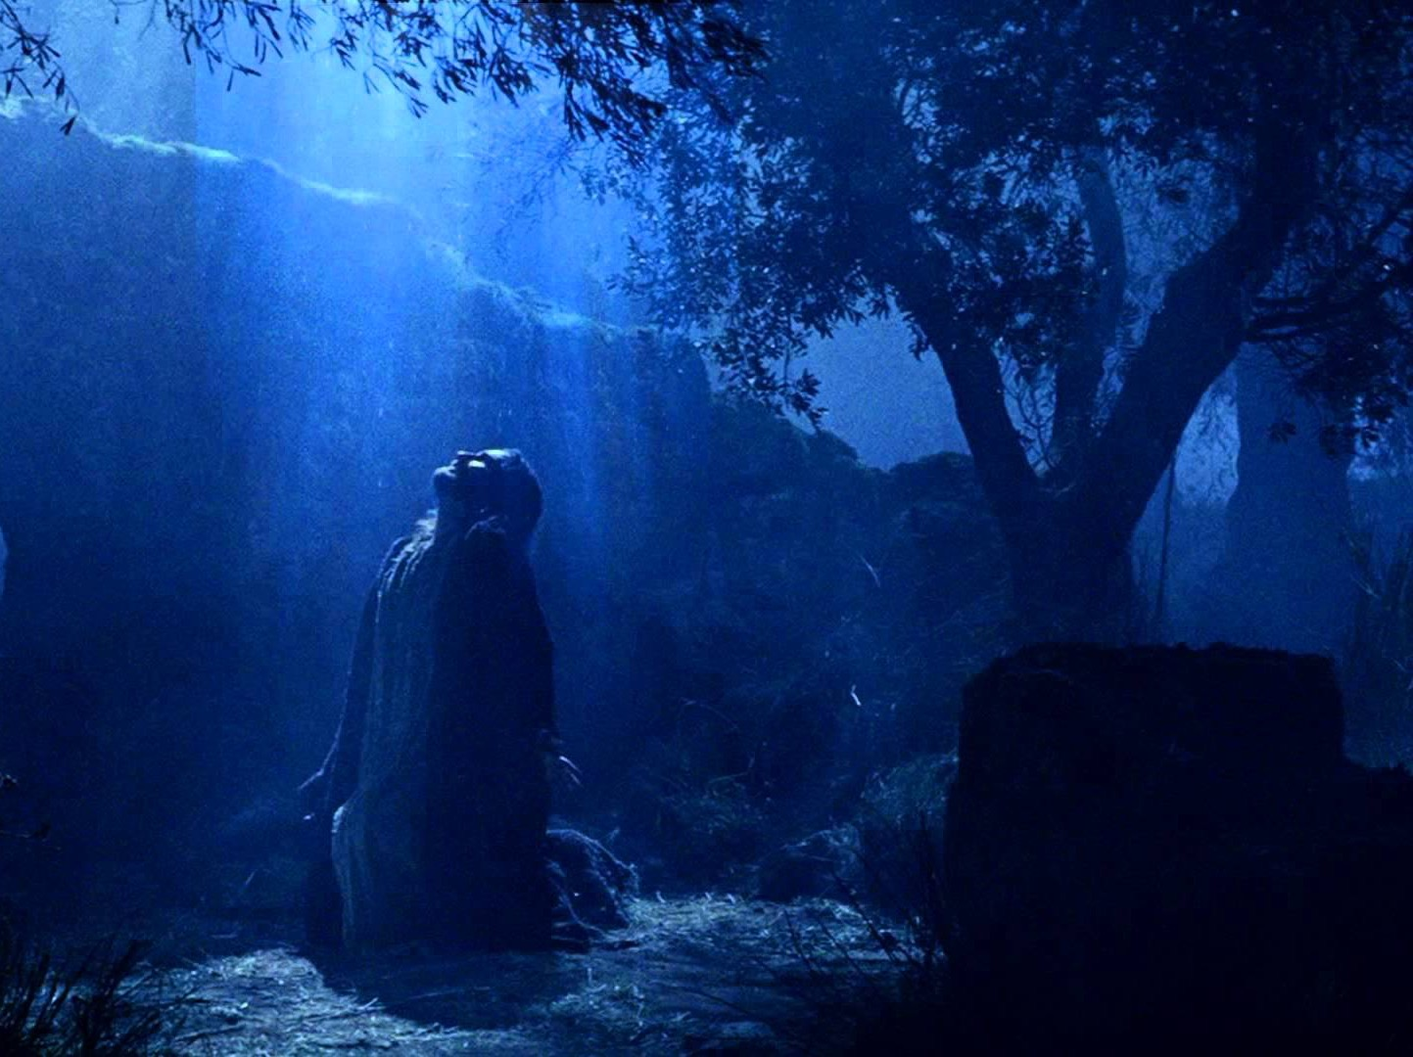
Prophecy
(Lord, Deity)
27e
Trusting Christ as Lord should lead to obedience and love as protection from early Gnosticism and any heresy that denies Jesus as Lord (2:26).
1 John

Slide 10
1 John – Summary Chart
290
Obedience in Love Combats Early Gnosticism
Necessity of
Obedience
Characteristics of
Love
Benefits of
Obedience
Chapters 1–2
3:1–5:3
5:4-21
Humanity of Christ
Prerequisites to obedience
Hindrances to obedience
Don't sin
Don't hate believers
Compassion
Confidence before God
Obey apostolic teaching
Care for believers
Obey God's commands
Victory over the world
Assurance of salvation
Guidance in prayer
Freedom from sin
Fidelity to God
Ephesus to Asia Minor Churches
AD 85-95

Slide 11
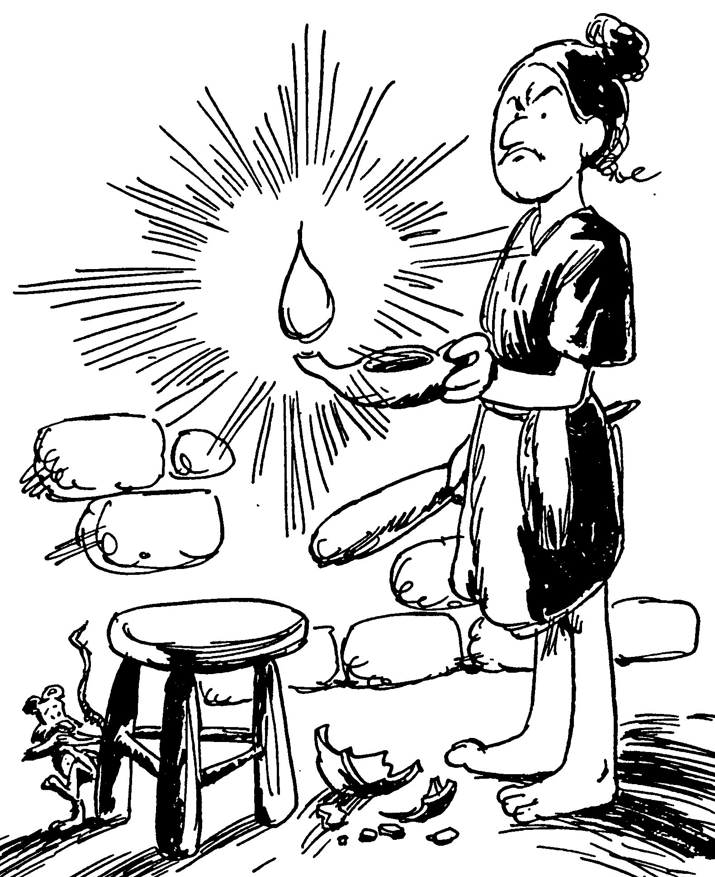
Acrostic Bible – 1 John
Living in the Light
Importance of our Advocate
God's children avoid sin
How Christians should love
True witness in believers
FIRST JOHN
Barry Huddleston, The Acrostic Bible

Slide 12

Be Obedient
1 John
Dr. Rick Griffith • Crossroads International Church Singapore
BibleStudyDownloads.org

Slide 13
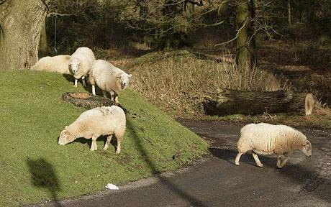
Sheep tend to stray.
1 John
Notes:
ARIAL

Slide 14
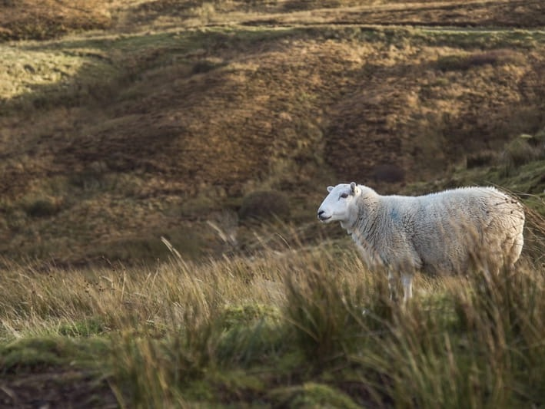
How can you avoid straying into false teaching?
1 John
Notes:
• The first letter from the Apostle John tells us • three key ways that we can stop losing our way—wandering off, drifting—like sheep.

Slide 15

I. Obey God’s commands (1–2).
  Believe in Christ’s humanity for fellowship and joy (1:1-4).
  Depend on Jesus (1:5–2:14).
  Avoid two hindrances to obedience to fight early Gnosticism (2:15-29).
1 John
Notes:
Follow what the Lord says so you won’t stray away (1 John 1–2 restated).

Slide 16

II. Love others (3:1–5:3).
  Don’t sin (3:1-10)
  Don’t hate believers (3:11-15)
  Show compassion (3:16-20)
  Be confident before God (3:21-24)
  Obey apostolic teaching (4:1-6)
  Care for believers (4:7-21)
  Obey God’s commands (5:1-3)
1 John
Notes:
Live for other people instead of for yourself, which is a key trait of false teaching (3:1–5:3 restated).

Slide 17

Benefits of Obedience:
III. Realize that obedience produces what you really need (5:4-21).
Victory over the world system (5:4-5)
Assurance of salvation (5:6-13)
Guidance in prayer (5:14-17)
Freedom from habitual sin (5:18-20)
Fidelity to God by avoiding idolatry (5:21)
1 John
Notes:
When you do what God says, you get your true needs met (5:4-21 restated).

Slide 18

Main Idea of the Letter
Obey God and love others and you’ll have what you really need instead of false teaching.
1 John
Notes:
We stay on track spiritually and benefit greatly by obeying God and loving each other (commands restated).

Slide 19
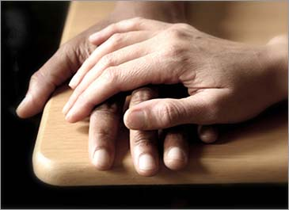
Application
290
How can you show love to another believer so that heresy might be thwarted?
Whom do you know that needs to see Christian love shown in order to turn from false teaching?
1 John

Slide 20
Black

Slide 21

Title
291
The Greek title ( vIwa,nnou av First of John) follows the standard practice of naming the General Epistles after their authors and distinguishes this epistle from John's two others.

Slide 22
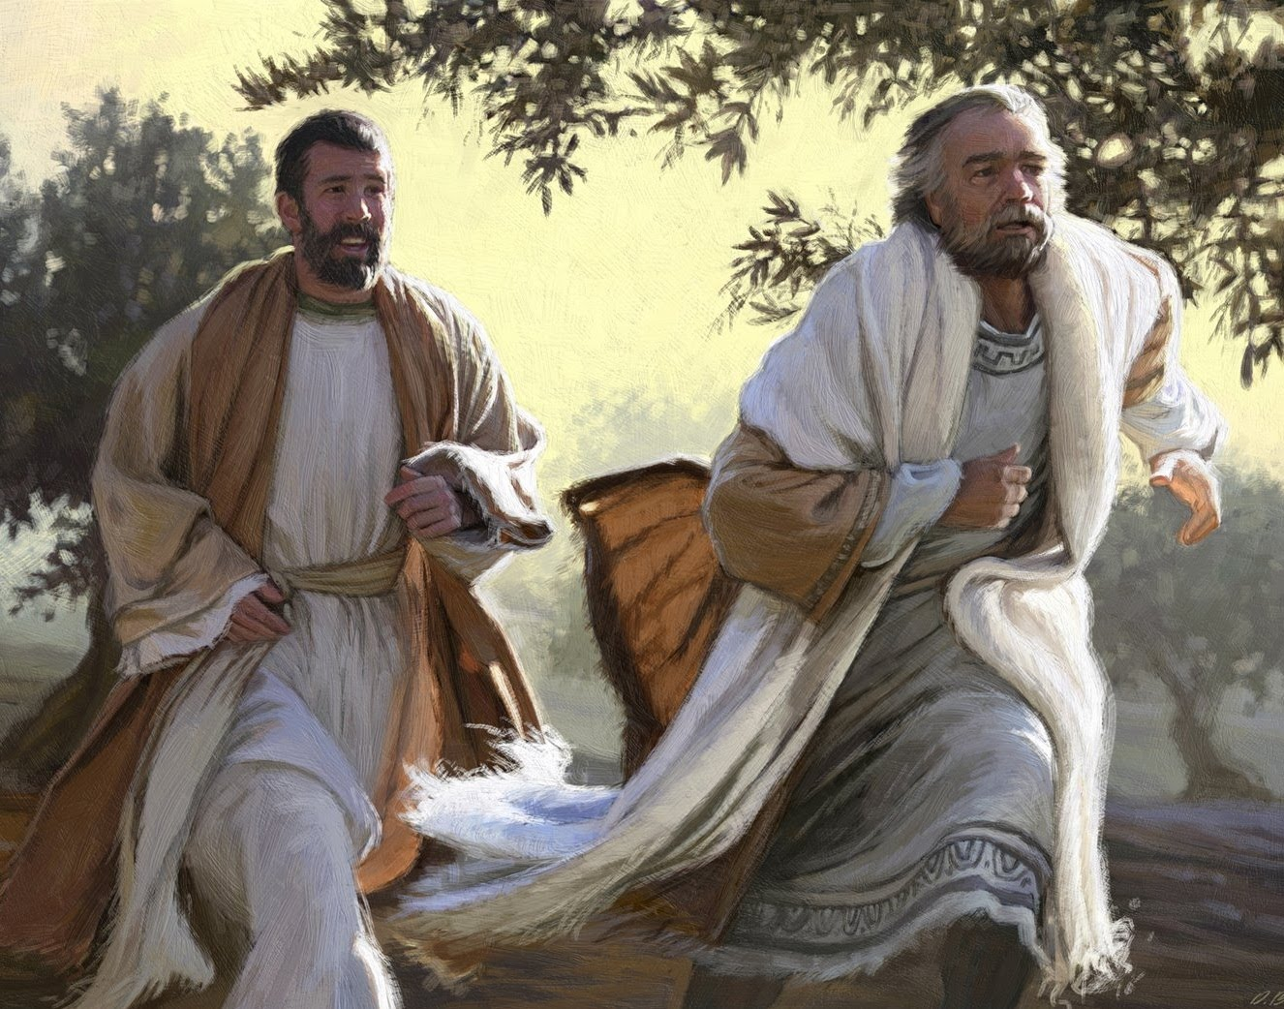
"Peter and the other disciple started out for the tomb. ⁴They were both running, but the other disciple outran Peter and reached the tomb first" (John 20:3-4 NLT).
John the Apostle

Slide 23
Authorship
291
External Evidence
The letter of 1 John is the best attested of all the General Epistles.
1. The evidence for Johannine authorship is very early after its composition, beginning with John's contemporary for 20 years, Polycarp. Irenaeus quoted John's epistle and credited John with the work. Many other Church Fathers also accepted Johannine authorship: Clement of Alexandria (AD 155-215), Tertullian (AD 150-222), Origen (AD 185-253), Cyprian (AD 200-258) and all Latin and Greek Fathers. The Muratorian Canon and Old Syriac Version also attributed 1 John to John.

Slide 24
Authorship
291
External Evidence
The letter of 1 John is the best attested of all the General Epistles.
The major opposing views are:
(a) that a 2nd "John" penned the epistle who was known either as "John the Elder" or possibly "John the Presbyter," and
(b) that a disciple of John wrote the book. In one statement, Papias seems to make a distinction between "John the Elder" and "John the Apostle"; however, elsewhere he uses the term "elder" to refer to the original apostles, so the “two men" should be interpreted as one and the same.

Slide 25
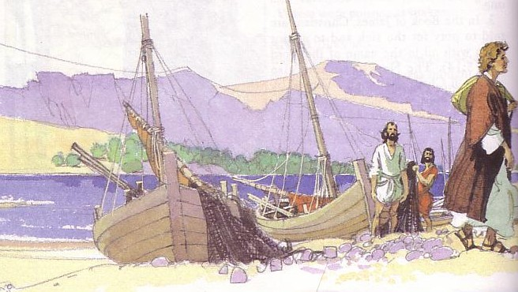
Authorship
291
Internal Evidence
The epistle itself supports the strong tradition for Johannine authorship.
He is not mentioned by name, but he is an eyewitness (1:1-4) with great authority shown in his assertiveness (2:19; 4:6, 14).
The style is also very similar to that of the 4th Gospel.
ESV 1 John 1:1 That which was from the beginning, which we have heard, which we have seen with our eyes, which we looked upon and have touched with our hands, concerning the word of life.

Slide 26
Date
291
Most conservative scholars date 1 John from AD 80-97 and liberals date it soon after AD 90-110.
The epistle does not mention any persecution, which lasted during Domitian's reign (AD 81-96).
This may suggest a date just before AD 81 or after AD 96. At any rate, John was a old man in his eighties or older when he wrote.
This course uses a date of AD 85-95 as it likely preceded Revelation (AD 95-96).
Notes:
John lived his final decades at the end of the first century as the last surviving disciple—and the only one not martyred, though he was boiled in oil.

Slide 27
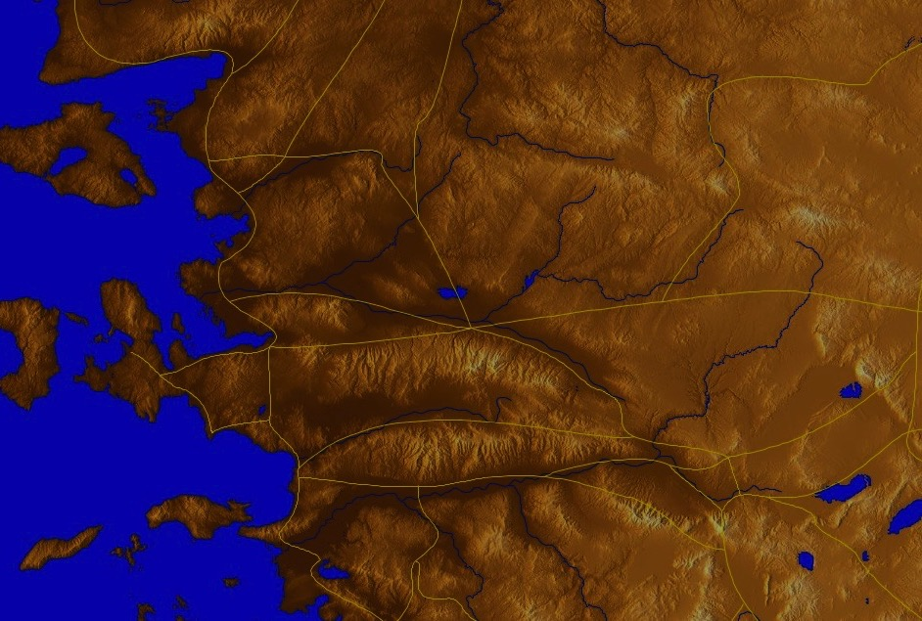
Origin/Recipients
291
The admonition to keep oneself from idols (5:21) substantiates the tradition of John writing from Ephesus since idols were prominent in the pagan Greco-Roman culture but rare in Palestine.
Pergamum
Thyatira
Sardis
Smyrna
Philadelphia
Ephesus
Laodicea
Notes:
Church tradition says he obeyed Jesus’ command to care for his mother, so he brought her to Ephesus and cared for her until her death. Ephesus then became the staging ground of his ministry throughout Asia Minor.

Slide 28
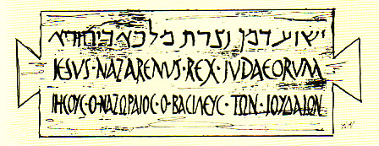
Occasion
291
Although Gnosticism did not develop into its worst form until the 2nd century, an early form of Gnosticism is evident in this letter.
Gnosticism had two basic heretical elements:
the exaltation of intellect (gnosis), and
the belief that matter is inherently evil.
Notes:
Ephesus also was an early center for the false teaching called Gnosticism, so-called from the Greek word for knowledge, gnosis.

Slide 29
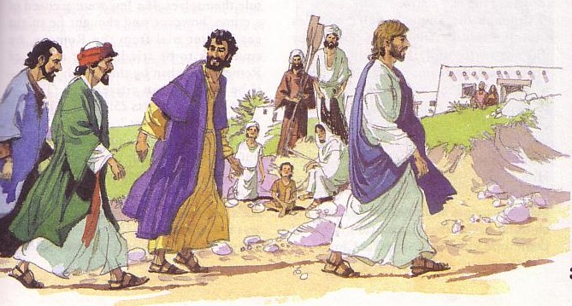
Occasion
291
John combats two forms of Gnostic teaching in his letter:
Docetic Gnosticism denied the humanity of Christ (4:2-3), saying that he only seemed to be human, so John wrote that he actually touched Jesus (1:1).
Cerinthian Gnosticism denied the deity of Christ. Cerinthus, who lived near John in Asia Minor, taught that Jesus was only a man upon whom "the Christ" descended at His baptism but left before His crucifixion. John replied that Jesus Christ came both by water (His baptism) and by blood (His death), thus refuting Cerinthus.

Slide 30

Occasion
291
The practical outworking of Gnosticism fell into two camps.
Some Gnostics reasoned that since matter is evil, one should avoid it at all costs, resulting in asceticism—living alone like a monk untouched by material things.
In his letter John attempts to defeat asceticism by encouraging fellowship among believers (1:7).
Other Gnostics were fatalistic. They reasoned that no one can change the fact that matter is evil, so any type of immorality is OK.
John specifically responded to this latter philosophy. His letter shows that obedience to God's commands, especially by loving others, is the best rebuttal to the practices of Gnosticism. He also sought to defeat immorality by exhorting obedience and righteousness.

Slide 31
Characteristics
292
Absolute statements (e.g., 3:6).
Abiding in Christ is clearly seen as obeying God's commands and loving one's brothers (2:28–4:16).
Teaching by contrast (antithetical parallelism) is abundant as John sees everything as black or white.
The style is very simple but profound in meaning. Concepts are frequently repeated, but not monotonously.
It surprisingly has not one Old Testament quotation and only one incident (Cain, 3:12).

Slide 32

Summary Statement
293
John writes a general letter encouraging his readers to obey God's commands by loving others in order to protect them from early Gnosticism that denied either Christ's deity or humanity.

Slide 33
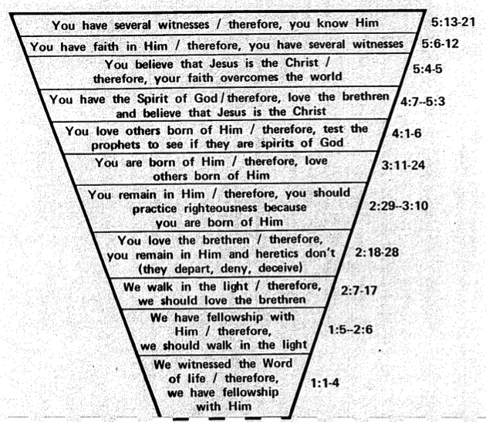
Ascending Spiral Structure in 1 John
295
Therefore, you know Him
5:13-21
Therefore, you have several witnesses
5:6-12
Therefore, your faith overcomes the world
Therefore, since you have the Spirit of God, love the
brothers and believe that Jesus is the Christ
5:4-5
4:7–5:3
Therefore, test the spirits to see if they are
spirits of God
4:1-6
Therefore, you love others born of Him
3:11-24
Therefore, you should practice righteousness
because you are born of Him
2:29–3:10
Therefore, you remain in Him
while heretics depart, deny & deceive
2:18-28
Therefore, we should
love the brothers
2:7-17
Therefore, we should
walk in the light
1:5–2:6
Therefore, we have
fellowship with Him
Edited from Roy Zuck's Adaptation of Lenski
1:3-4
We witnessed
the Word of life
1:1-2

Slide 34
Outline
293-294
I. One way to be protected from early Gnosticism was to obey God's commands (1 John 1–2) .
II. Another way to be protected from early Gnosticism was to love others (3:1–5:3).
III. The benefit of obedience is what we really need instead of early Gnosticism (5:4-21).

Slide 35

Argument
John's letter has at least five stated purposes:
1. to promote fellowship (1:3),
2. to produce joy (1:4),
3. to protect holiness (2:1),
4. to prevent heresy (2:26)
293

Slide 36
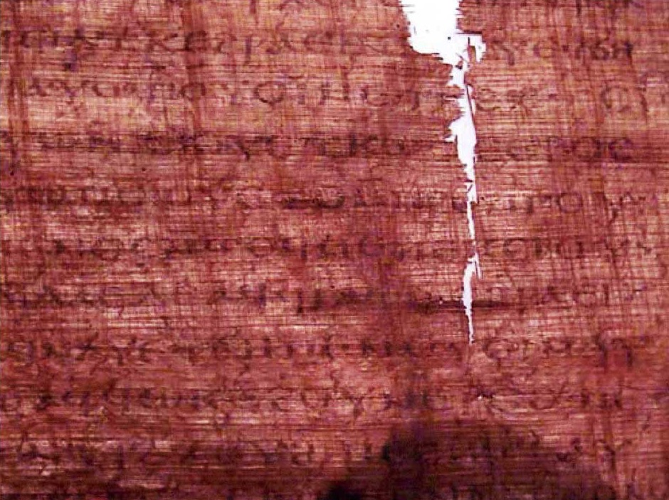
The Gospel of Judas
186a
Judas said, "Master, could it be that my seed is under the control of the rulers?" Jesus answered and said to him, "… you will grieve much when you see the kingdom and all its generation." When he heard this, Judas said to him, "What good is it that I have received it? For you have set me apart for that generation." Jesus answered and said, "You will become the thirteenth, and you will be cursed by the other generations—and you will come to rule over them. In the last days they will curse your ascent [47] to the holy [generation]."
Notes:
Another work that appeared in the early church—probably in the second century—is called the Gospel of Judas. It says that Judas would rule over the disciples—even though he was actually an unbeliever!

Slide 37
The Gospel of Judas
186a
Judas said to Jesus, "Look, what will those who have been baptized in your name do?" Jesus said, "… Truly [I] say to you, Judas, [those who] offer sacrifices to Saklas [...]God [—three lines missing—] everything that is evil. But you will exceed all of them. For you will sacrifice the man that clothes me."
Notes:
It even says that Jesus was a spirit that was "clothed" with Christ, and—once again—that Judas will rule over all the other disciples!

Slide 38
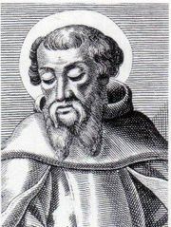
Irenaeus (AD 180)
186b
1. Others again declare that Cain derived his being from the Power above, and acknowledge that Esau, Korah, the Sodomites, and all such persons, are related to themselves. On this account, they add, they have been assailed by the Creator, yet no one of them has suffered injury. For Sophia was in the habit of carrying off that which belonged to her from them to herself. They declare that Judas the traitor was thoroughly acquainted with these things, and that he alone, knowing the truth as no others did, accomplished the mystery of the betrayal; by him all things, both earthly and heavenly, were thus thrown into confusion. They produce a fictitious history of this kind, which they style the Gospel of Judas.
Against Heresies 1.31.1
Notes:
The later second century church father Irenaeus spoke of this book as a heresy where Judas had a special knowledge (gnosis) that the other disciples lacked.
_______________
http://www.ccel.org/fathers2/ANF-01/anf01-60.htm#P7477_2003920

Slide 39
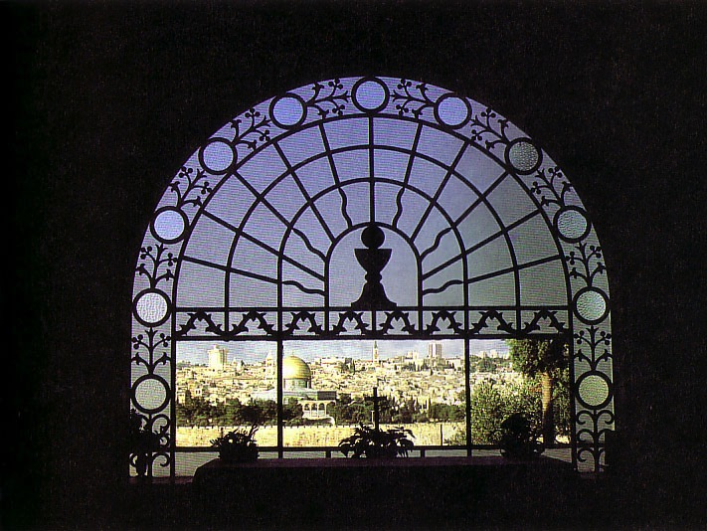
Synthesis
293
Obedience in love combats early Gnosticism
1–2 Necessity of obedience
3:1–5:3 Characteristics of love
5:4-21 Benefits of obedience

Slide 40
Argument
John's letter has at least five stated purposes:
1. to promote fellowship (1:3),
2. to produce joy (1:4),
3. to protect holiness (2:1),
4. to prevent heresy (2:26), and
5. to provide assurance of salvation (5:13)
293

Slide 41

Assurance in 1 John 5:11-13
293
Should we
ever doubt?
Should we
ever doubt?
Should we
ever doubt?
"And this is what God has testified:
He has given us eternal life, and this life is in his Son. ¹²Whoever has the Son has life; whoever does not have God’s Son does not have life. ¹³I have written this to you who believe in the name of the Son of God, so that you may know you have eternal life."
Notes:
Assurance of salvation means that one is confident of his or her eternal security. This is subjective and can be lost through doubting whether God will keep his word. But it cannot change the objective reality that we are still saved by being in the Father's hands—
John 10:25 NLT Jesus replied, “I have already told you, and you don’t believe me. The proof is the work I do in my Father’s name. ²⁶ But you don’t believe me because you are not my sheep. ²⁷ My sheep listen to my voice; I know them, and they follow me. ²⁸ I give them eternal life, and they will never perish. No one can snatch them away from me, ²⁹ for my Father has given them to me, and he is more powerful than anyone else. No one can snatch them from the Father’s hand. ³⁰ The Father and I are one.”
_______________
Common-465
OS-14-2Chron-296
NS-23-1John-41, 171

Slide 42
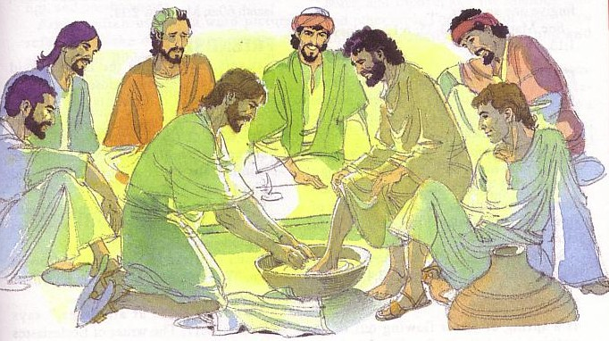
Key Word
290
Key Word
Love

Slide 43
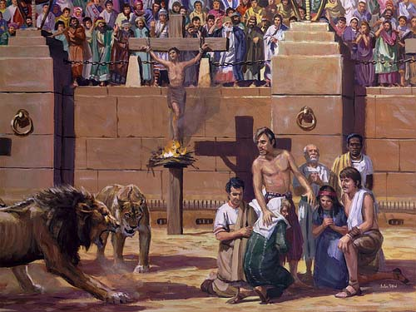
Key Word
290
Both Nero (AD 60s) and Domitian (AD 90s) tested love for God

Slide 44

I Love You, Lord 1/1
I love You, Lord, and I lift my voice
to worship You, O my soul rejoice.
Take joy, my King, in what You hear,
may it be a sweet,
sweet sound in Your ear.
(repeat)
May it be a sweet,
sweet sound in Your ear.
Notes:
44

Slide 45
Be Obedient
1 John
Dr. Rick Griffith • Crossroads International Church Singapore
BibleStudyDownloads.org

Slide 46
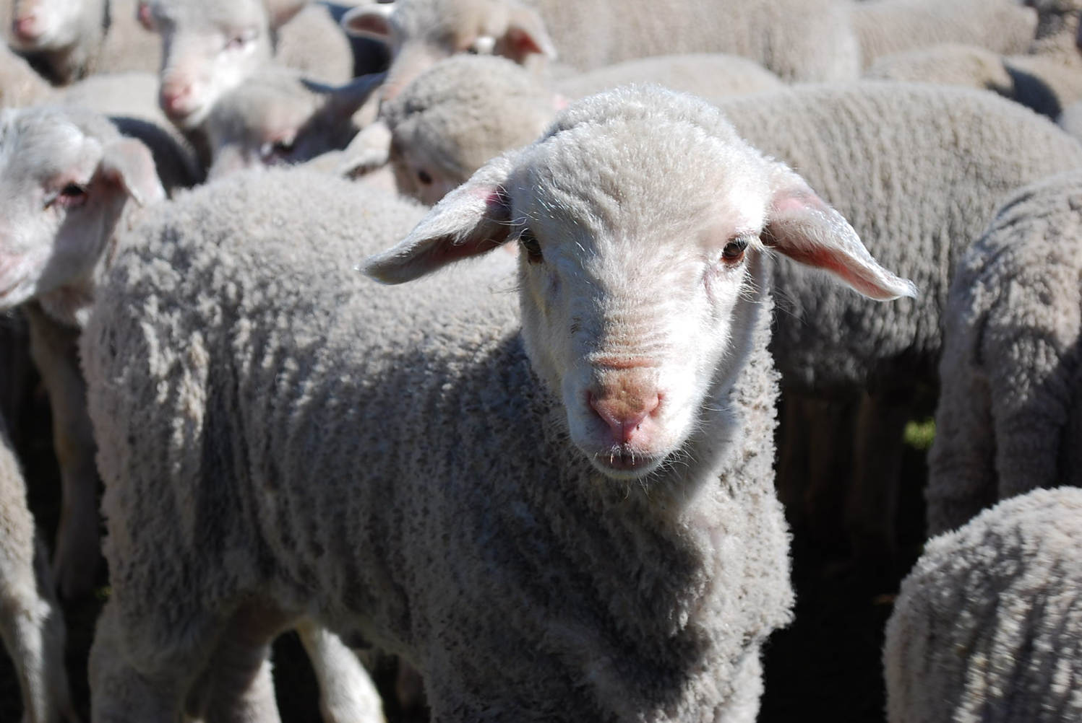
We are sheep.
Notes:
The animal that the Bible compares us to most is the sheep. Why do you think that is so?

Slide 47
Sheep tend to stray.
Notes:
It’s because sheep easily lose their way—like us!

Slide 48
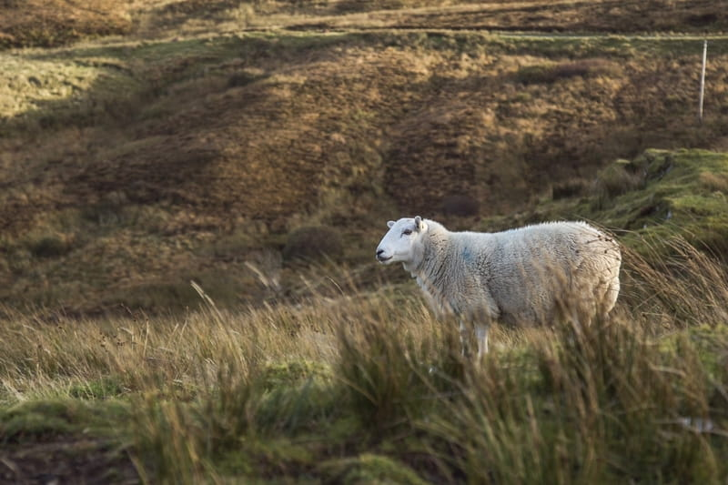
Lost sheep get lonely.
Notes:
Sheep are relational animals, so being away from the flock is lonely.

Slide 49
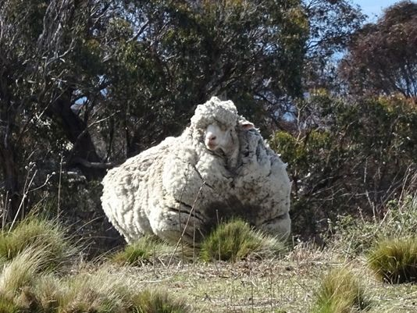
Sheep tend to return.
Notes:
Here is one sheep named Chris who was lost in Australia. He was found in 2015 by bush walkers after about 6 years of wandering. As you can see from the heavy coat of 90 pounds…

Slide 50
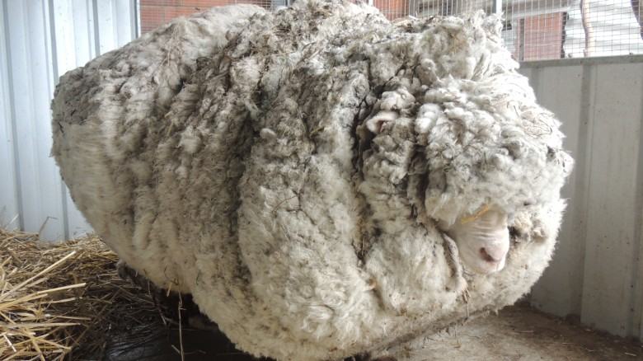
But straying has a price.
Notes:
The baggage from being away is quite a burden—for sheep as well as for people!
————————
Chris, the famously woolly sheep, has died
By Elizabeth Wolfe and Saeed Ahmed, CNN
Updated 1623 GMT (0023 HKT) October 22, 2019
Chris the sheep died in his home at the Little Oak Sanctuary.
(CNN)Chris the sheep lived a, shall we say, full and fluffy life, beloved by fans worldwide for his singular woolliness.
He died at his home at the Little Oak Sanctuary, where he had been living since his rise to fame in 2015.
While Chris should be appreciated for his many lovable qualities -- consider his kind eyes and gently sloping nose -- he became internationally celebrated after becoming the unofficial world record holder for having grown the heaviest fleece.
He was found outside of Australia's capital, Canberra, so overgrown with fleece that he could barely walk. Almost 90 lbs!
When he was found, Chris was carrying years worth of wool on his body, making it difficult for him to walk.
Little Oak Sanctuary, announced the legendary sheep's death on Tuesday in a Facebook post.
"We are heartbroken at the loss of this sweet, wise, friendly soul," said the post.
Little Oak Sanctuary made a point of looking at Chris as more than a spectacle and respecting him as a companion.
"He was so much more than this, so very much more," it said in the post. "And we will remember him for all that he was - someone, not something - here with us, not for us. RIP dear Chris."
Those wishing to mourn Chris's passing may visit his famous fleece on display at the National Museum of Australia.

Slide 51
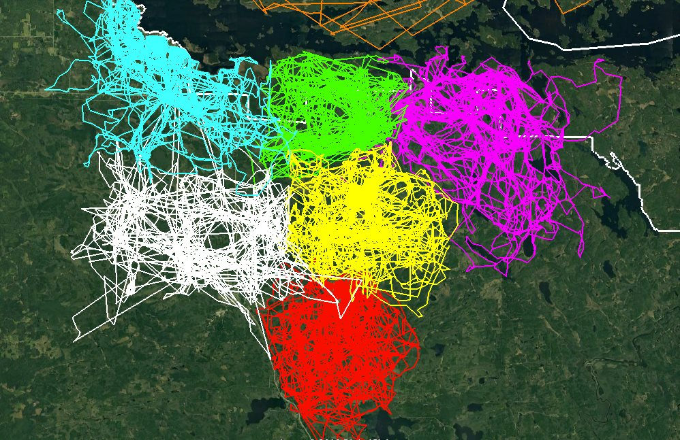
GPS Tracking Shows How Much Wolf Packs Avoid Each Other’s Range
Notes:
Instead of being like sheep, we should be more like wolves! “What?” You say.
Well, wolves have been recently shown to be masters at staying together. A study since 2015 in Minnesota has shown that wolf packs avoid each other’s range. Each wolf pack was tracked via GPS by colour and the results show that they all stay within their own domain—too bad Christians cannot stay with the good teaching that we have received. Instead, we tend to be like sheep who veer away.
So this leads to our question for today…
————————
GPS Tracking Shows How Much Wolf Packs Avoid Each Other’s Range
This image of GPS tracking of multiple wolves in six different packs around Voyageurs National Park was created in the framework of the Voyageurs Wolf Project. It is an excellent illustration of how much wolf packs in general avoid each other’s range.
In Voyageurs National Park a typical wolf pack territory is somewhere around 50-70 square miles but that can vary from year to year. So that’s about the size of the areas marked with the different colors. The white line marks the boundary of the national park.
As beautifully demonstrated by the animation, wolf packs generally avoid being around each other unless they are fighting for food that may be in short supply. When that occurs, they may engage in battles with other packs in order to continue have their claim on a given location as well as the food found within it.
Wolves may need to shift their territory due to human activity as well. When people clear out part of their natural habitat they may have to find a new route to get to their food sources. This can also create conflicts among the various wolf packs due to overstepping their bounds.
———————
https://earthlymission.com/gps-tracking-shows-how-much-wolf-packs-avoid-each-others-range/
Accessed 8 Jan 2020
About (Facebook page started in 2015)
The Voyageurs Wolf Project studies wolves and their prey (moose, deer, and beavers) during the summer in and around Voyageurs National Park, Minnesota.

Slide 52
Have you strayed?
Buying?
Porn?
Law v. Grace?
Imbalanced?
Notes:
How about you? Have you ever been deceived to follow teachings against the Bible?
• Have you fallen into the lie that buying something would make you happy? Did it? This is false teaching about material things.
• Have you ever seen porn? This teaches falsely about sex.
• Have you gotten out of balance too much towards grace or law?
• What about now? Are you out of balance in your understanding of God at all right now or do you completely understand God and fully obey him in every way?
So you are susceptible to false teaching, aren’t you?

Slide 53
How can you avoid straying into false teaching?
1 John
Notes:
• The first letter from the Apostle John tells us how to stop losing our way—wandering off, drifting—like sheep.

Slide 54
Theme
23
Obedience in Love Combats Early Gnosticism
1 John
Notes:
After Jesus left the earth and the church began, many different heresies proliferated very early. Gnosticism was the worst in the second century AD, but its beginnings are seen in letters like Colossians (AD 61) and John’s epistles (AD 85). The teaching of John’s first letter can be summed up as obedience in love combats Early Gnosticism. Early what?

Slide 55
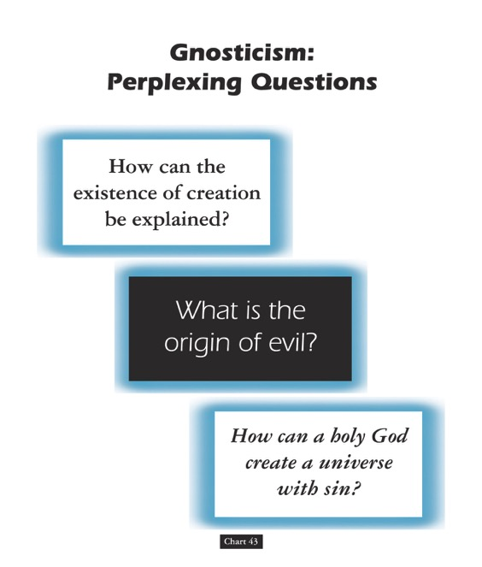
Gnosticism: Perplexing Questions
153a
How can the existence of creation be explained?
What is the origin of evil?
How can a holy God create a universe with sin?
Chart 43
John D. Hannah, Charts of Ancient & Medieval Church History (Grand Rapids: Zondervan, 2001)
Notes:
Dr John Hannah at Dallas Seminary sums it up well: "The Christian faith was opposed by numerous adversaries––threats from the state, ominous false religions, and heretics within its own borders. The most imposing religious threat came from Gnosticism, which was particularly dangerous because of its intellectual coherency. While Gnosticism seemed to provide answers to perplexing questions, it succeeded only in mixing a snippet of biblical truth with error.”
—Text from Hannah for this chart

Slide 56
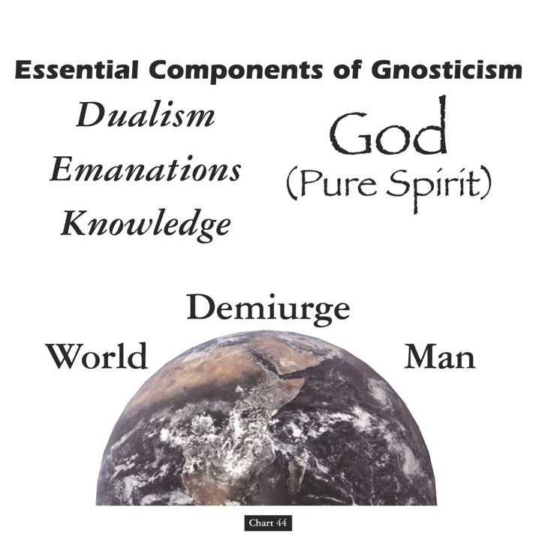
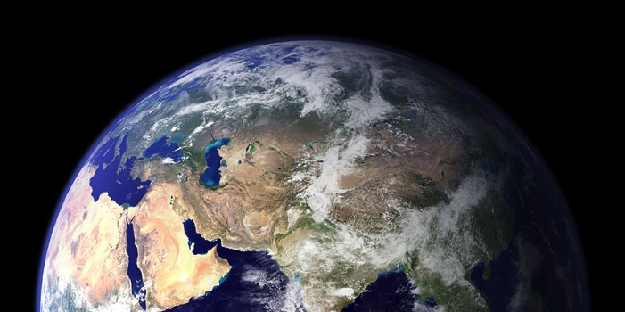
Essential Components of Gnosticism
153b
God
(Pure Spirit)
(1) Dualism
(2) Emanations
(3) Knowledge
Demiurge
World
Man
Chart 44
John D. Hannah, Charts of Ancient & Medieval Church History (Grand Rapids: Zondervan, 2001)
Notes:
"Gnosticism taught (1) that there is a radical dualism of the spiritual in opposition to the material (God, who is Spirit, is the supreme good, while matter is evil); (2) that God could not have created matter because it is contrary to his nature; rather, the world, which is material and evil, was created by the Demiurge (an emanation from God), and man is a material being with an entrapped spirit; and (3) that through a "secret knowledge," salvation becomes the life of escape from the material confines of the body."
—Text from Hannah for this chart

Slide 57

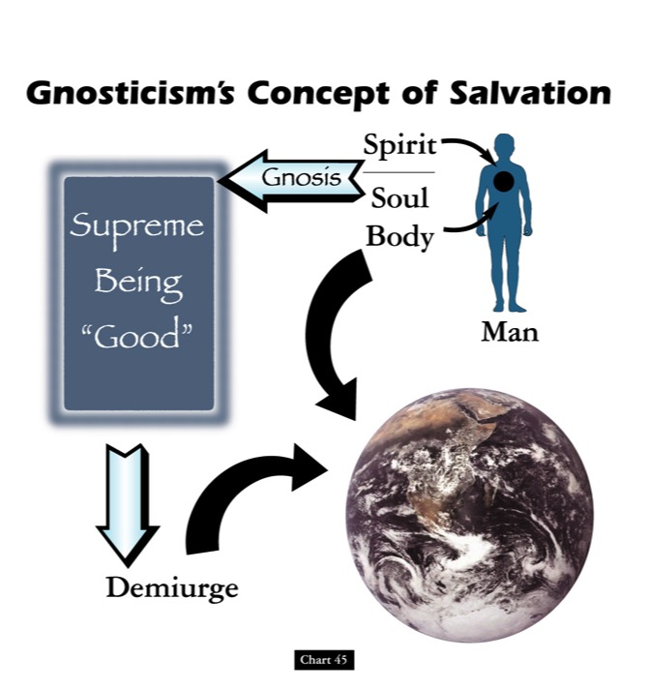

Gnosticism's Concept of Salvation
153c
Spirit
Supreme Being "Good"
Gnosis
Soul
Body
Man
Demiurge
Chart 45
John D. Hannah, Charts of Ancient & Medieval Church History (Grand Rapids: Zondervan, 2001)
Notes:
"Gnosticism's concept of salvation is as follows: God did not create the world, [1] but a lesser yet powerful being (the Demiurge) made this evil world and [2] mankind––though within man is a spark of good. [3] Salvation results from enlarging the capacity of that nature while minimizing the hold of materialism, [4] and it is accomplished by means of the secret teachings of Gnostic teachers. In resisting this teaching, Christian writers adopted a worldview that embraced the God of the Bible as the divine creator, affirmed the creation as good though marred by a subsequent devastation, and espoused the salvation of the body as well as the soul.”
—Text from Hannah for this chart [animation brackets mine]

Slide 58
Origin/Destination
291
A general letter sent from the aged John in Ephesus
Pergamum
Thyatira
Sardis
Smyrna
Philadelphia
Ephesus
Laodicea
Notes:
John lived the final decades of his life in the city of Ephesus in Asia Minor (modern-day Western Turkey), which was a key city where Gnosticism prevailed. From here he sent all three of his letters that we find in the NT.

Slide 59
NT Overview (General + Key Words)
38
124
39-41
"To the remotest part of the earth" (Acts 1:8)
Acts 9 13 14 15 16 18 21 27 28
Apr 48-
Sep 49
1
Galatia
Apr 50-
Sep 52
2
Aegean
Spr 53-
May 57
3
Asia
Feb 60-
Mar 62
1
Rome
Spr 62-
Fall 67
4
Spain
Aut 67-
Spr 68
2
Rome
Summer 35-
37
Damascus
Antioch
May 57-
Aug 59
Trials
Fall 49
The
Council
Spring 68
Expansion of Church
35 48 49 50 52 53 57 60 62 67 68 95
Matt
Kingdom
Luke
Sov 1
Acts
Sov 2
Mark
Disciple
John
Believe
Gal
Justify
1 Thess
Rapture
1 Cor
Eph
Unity
1 Tim
Order
2 Tim
Doctrine
Jude
Sanctify
Pretenders
James
Works
2 Thess
Tribulation
2 Cor
Col
Deity
Titus
Conduct
Heb
Super
1 John
Apostle
Love
Romans
Philem
1 Pet
Righteous
Forgive
Suffering
Gospels & Acts
Phil
Attitude
2 Pet
Knowledge
Pauline Epistles
1234
Journeys
General Epistles
Rome
Imprisonments
General Epistles + Key Words
Notes:
John’s epistles are among the last writings of the NT. John wrote around AD 85-90 after false teaching began to really invade the Church.

Slide 60
Argument
John's letter has at least five stated purposes:
1. to promote fellowship (1:3),
2. to produce joy (1:4),
3. to protect holiness (2:1),
4. to prevent heresy (2:26), and
5. to provide assurance of salvation (5:13)
This makes 1 John hard to sum up in one theme or purpose and difficult to outline, especially since the subjects overlap.
But the general theme of obedience, especially shown by loving others, sums up all of the above purposes.
These benefits are many, but the immediate benefit of obedience by love is its protection from early Gnosticism.
293
Notes:
This letter is a hard one to pin down its key emphasis as John repeats several themes.

Slide 61
1 John – Summary Chart
290
Obedience in Love Combats Early Gnosticism
Necessity of
Obedience
Characteristics of
Love
Benefits of
Obedience
Chapters 1–2
3:1–5:3
5:4-21
Humanity of Christ
Prerequisites to obedience
Hindrances to obedience
Don't sin
Don't hate believers
Compassion
Confidence before God
Obey apostolic teaching
Care for believers
Obey God's commands
Victory over the world
Assurance of salvation
Guidance in prayer
Freedom from sin
Fidelity to God
Ephesus to Asia Minor Churches
AD 85-95
Notes:
I have a chart on the back side of your notes as my best effort to sum up the entire letter. This is the last page of the digital notes on the website.

Slide 62
How can you avoid straying into false teaching?
1 John
Notes:
Let’s simplify that chart to answer the key question of the book: How can you avoid straying into false teaching? • The first letter from the Apostle John tells us • three key ways that we can stop losing our way—wandering off, drifting—like sheep.

Slide 63
HOW CAN YOU…
1 John
Obey
God’s commands
(1–2)
AVOID
STRAYING
…INTO FALSE TEACHING?
Notes:
What should you do to keep consistent amidst so many lies about God?
Don’t hold back in any area from doing what God wants you to do.

Slide 64
Slides on
1 John 1

Slide 65
I. Obey God’s commands
(1 John 1–2).
  Believe in Christ’s humanity for fellowship and joy (1:1-4).
Notes:
Jesus was truly man, despite what the Gnostics say—so when you grasp this, you’ll experience genuine relationships and contentment despite the circumstances.

Slide 66
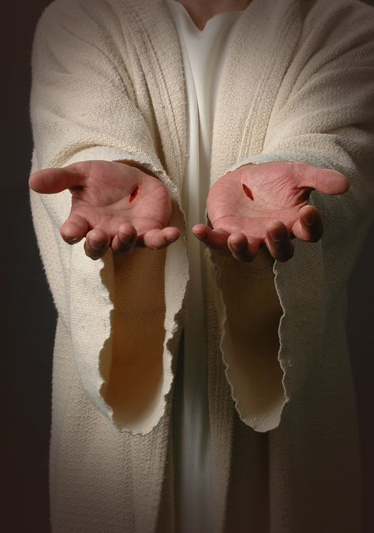
"We proclaim to you the one who existed from the beginning, whom we have heard and seen. We saw him with our own eyes and touched him with our own hands. He is the Word of life"
(1 John 1:1 NLT).

Slide 67
Gnostics Taught a "Secret Knowledge"
291
-292
Two Types Addressed in 1 John
Docetic Gnosticism
From dokeo, "to seem"
(Christ only seemed to be a man)
Matter is Evil
Depreciated Materialism
Denied Christ's Humanity
Touched Jesus (1:1)
Led to Asceticism
Immorality exalted
Cerinthian Gnosticism
From Cerinthus, founder in Asia
(Christ only seemed to be God)
Spirit is Good
Exalted Knowledge (gnosis)
Denied Christ's Deity
Water & Blood (5:6)
Led to Pride
Education exalted
Notes:
Many Gnostics denied Jesus was a real man. Others exalted the spirit so much that they denied his deity.

Slide 68
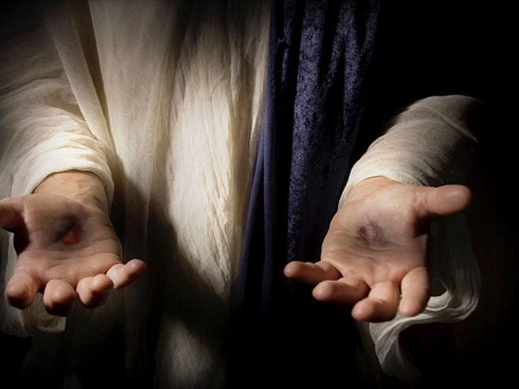
"This one who is life itself was revealed to us, and we have seen him. And now we testify and proclaim to you that he is the one who is eternal life. He was with the Father, and then he was revealed to us"
(1 John 1:2 NLT).

Slide 69
"We proclaim to you what we ourselves have actually seen and heard so that you may have fellowship with us. And our fellowship is with the Father and with his Son, Jesus Christ. ⁴ We are writing these things so that you may fully share our joy"
(1 John 1:3-4 NLT).

Slide 70
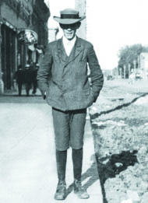
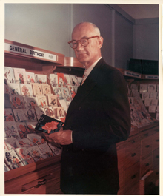
John taught that God showcased Jesus
291
-292
God did the same thing when He sent Jesus Christ into the world. That's when the Word of Life was moved from behind the counters, out of the drawers and placed in a display case for all the world to see, handle and admire.
"That which was from the beginning, which we have heard, which we have seen with our eyes, which we have looked at and our hands have touched––this we proclaim concerning the Word of life. The life appeared; we have seen it and testify to it, and we proclaim to you the eternal life, which was with the Father and has appeared to us" (1 John 1:1-2).
JC Hall
Illustration Exchange 26 June 2013
Notes:
The life of J.C. Hall, founder of Hallmark Cards, is a true rags-to-riches story. Born to poor parents, J.C. was quickly put to work, mostly in sales, to help keep himself and his family afloat. Along with his brothers, he began selling postcards in Norfolk, Nebraska. But the postcard business wasn't thriving there. So, with little else than a couple of shoe boxes of postcards, he moved to Missouri to start afresh. Full of innovative ideas, he moved on from postcards to greeting cards. When the store from which he operated burned down in 1915, he and his brothers invested in an engraving business and began printing their own cards.
• But it wasn't just the quality of the cards that burgeoned the business. It was Hall's groundbreaking idea to move the cards from behind the counters, where clerks would pick an "appropriate" card for the customer, out into display cases where customers could see them, handle them, and admire them.
By the time he died in 1982, Hall had turned two shoe boxes of postcards into a multi-billion dollar company.
Says the Hallmark corporate website, "J.C. Hall took greeting cards out of drawers in retail stores, and into displays that let shoppers see all their choices, dramatically changing the way cards were merchandised."
Application:
God did the same thing when He sent Jesus Christ into the world. That's when the Word of Life was moved from behind the counters, out of the drawers and placed in a display case for all the world to see, handle and admire.
"That which was from the beginning, which we have heard, which we have seen with our eyes, which we have looked at and our hands have touched--this we proclaim concerning the Word of life. The life appeared; we have seen it and testify to it, and we proclaim to you the eternal life, which was with the Father and has appeared to us" (1 John 1:1-2).
—Illustration Exchange website

Slide 71
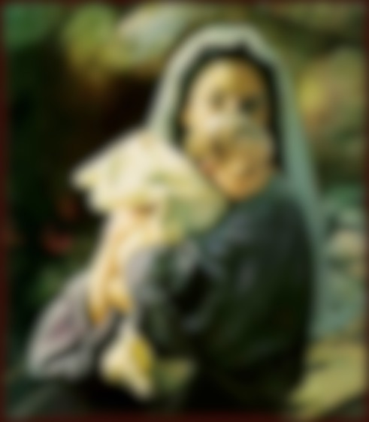
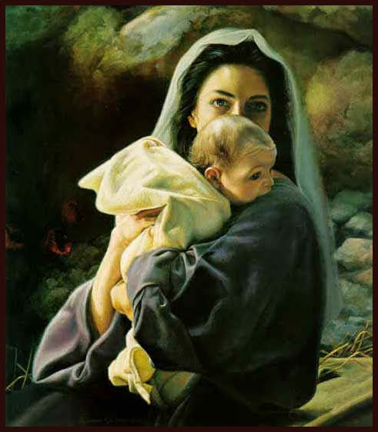
God Became Man

Slide 72
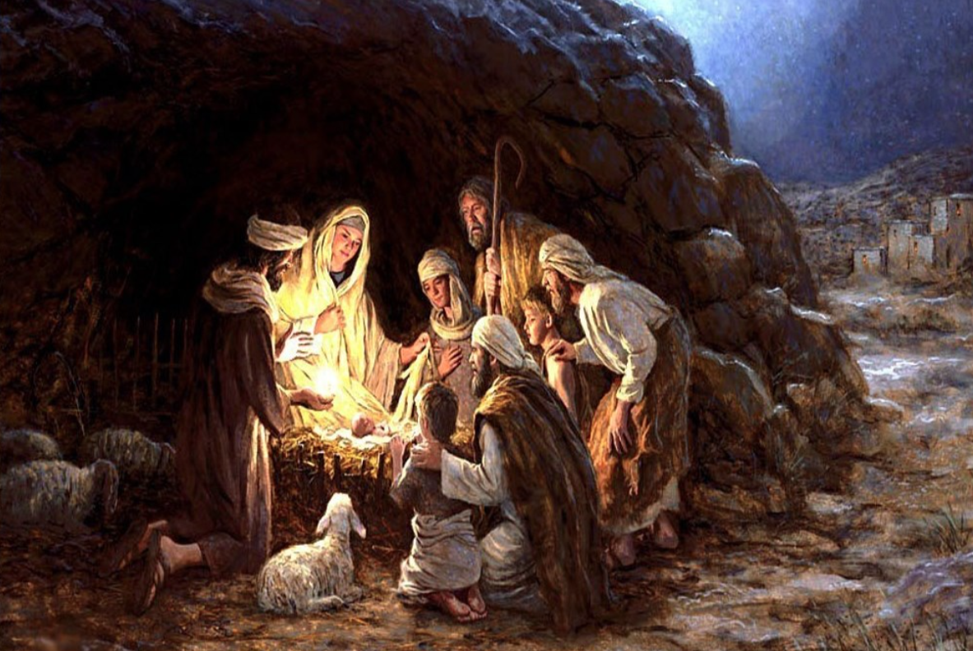
The Nativity
Notes:
OPTIONAL (SKIP):
In 1994, two Americans answered an invitation from the Russian Department of Education to teach morals and ethics (based on biblical principles) in the public schools. They were invited to teach at prisons, businesses, the fire and police departments and a large orphanage. About 100 boys and girls who had been abandoned, abused, and left in the care of a government-run program were in the orphanage. They relate the following story in their own words:
"It was nearing the holiday season, 1994, time for our orphans to hear—for the first time—the traditional story of Christmas. We told them about Mary and Joseph arriving in Bethlehem. Finding no room in the inn, the couple went to a stable, where the baby Jesus was born and placed in a manger. Throughout the story, the children and orphanage staff sat in amazement as they listened. Some sat on the edges of their stools, trying to grasp every word.
Completing the story, we gave the children three small pieces of cardboard [for each] to make a crude manger. Each child was given a small paper square, cut from yellow napkins I had brought with me. No colored paper was available in the city. Following instructions, the children tore the paper and carefully laid strips in the manger for straw. Small squares of flannel, cut from a worn-out nightgown an American lady was throwing away as she left Russia, were used for the baby's blanket. A doll-like baby was cut from tan felt we had brought from the United States.
The orphans were busy assembling their manger as I walked among them to see if they needed any help. All went well until I got to one table where little Misha sat—he looked to be about 6 years old and had finished his project. As I looked at the little boy's manger, I was startled to see not one, but two babies in the manger. Quickly, I called for the translator to ask the lad why there were two babies in the manger. Crossing his arms in front of him and looking at his completed manger scene, the child began to repeat the story very seriously. For such a young boy, who had only heard the Christmas story once, he related the happenings accurately—until he came to the part where Mary put the baby Jesus in the manger.
Then Misha started to ad lib. He made up his own ending to the story as he said, "And when Maria laid the baby in the manger, Jesus looked at me and asked me if I had a place to stay. I told him I have no mamma and I have no papa, so I don't have any place to stay. Then Jesus told me I could stay with him. But I told him I couldn't, because I didn't have a gift to give him like everybody else did. But I wanted to stay with Jesus so much, so I thought about what I had that maybe I could use for a gift. I thought maybe if I kept him warm, that would be a good gift. So I asked Jesus, ‘If I keep you warm, will that be a good enough gift?' And Jesus told me, ‘If you keep me warm, that will be the best gift anybody ever gave me.’ So I got into the manger, and then Jesus looked at me and he told me I could stay with him—for always."
As little Misha finished his story, his eyes brimmed full of tears that splashed down his little cheeks. Putting his hand over his face, his head dropped to the table and his shoulders shook as he sobbed and sobbed. The little orphan had found someone who would never abandon nor abuse him, someone who would stay with him — FOR ALWAYS.
Few of us would fault little Misha for doing all he could to help save little Jesus. Yet the reality is that Jesus is the one who did all he could to save little you and me.
The makeshift crib of Christmas is incomplete without the cross of Calvary.

Slide 73
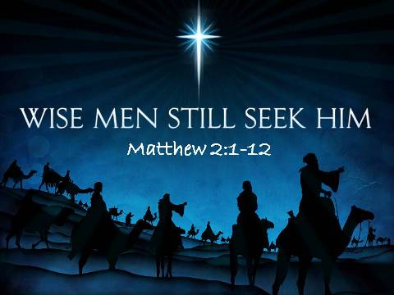
Wise Men Still Seek Him
Matthew 2:1-12
Notes:
Wise men sought Jesus at his first coming. Wise people still seek him today.

Slide 74
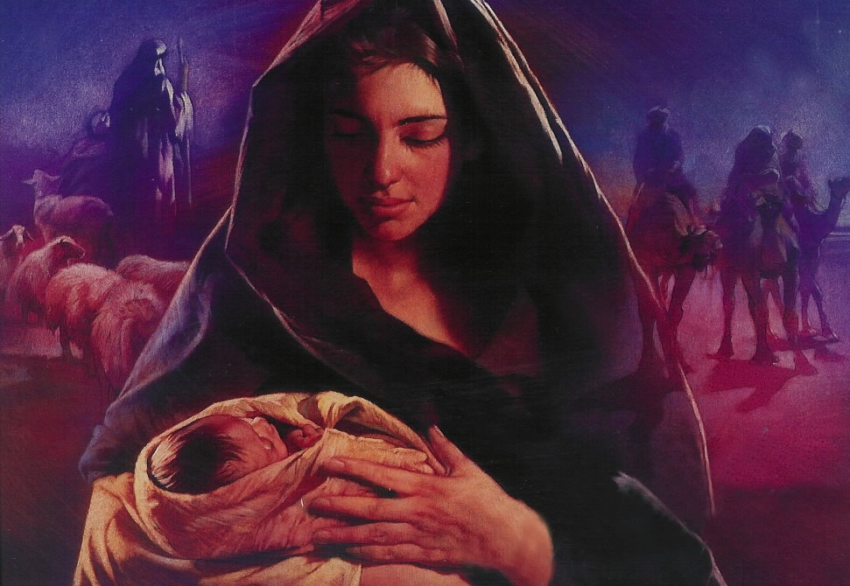
Hebrews 2:14 (NLT)
Because God’s children are human beings—made of flesh and blood—the Son also became flesh and blood.
For only as a human being could he die, and only by dying could he break the power of the devil, who had the power of death.
Notes:
Do you know why Jesus became a man? Why did God have to take on human flesh? Hebrews 2:14 tells us clearly…
We rightfully think of God becoming man at Christmas—a concept the theologians call the “incarnation.” This comes from the Latin in carne that literally means in flesh.
But how long will Jesus be a man “in flesh”? I’ll tell you—FOR ALWAYS!

Slide 75
I. Obey God’s commands
(1 John 1–2).
  Believe in Christ’s humanity for fellowship and joy (1:1-4).
  Depend on Jesus (1:5–2:14).
Notes:
Realize that you can’t live up to God’s standards in your own strength as you need Christ’s empowerment.

Slide 76

"This is the message we heard from Jesus and now declare to you:
God is light, and there is no darkness in him at all" (1 John 1:5 NLT).

Slide 77

"So we are lying if we say we have fellowship with God but go on living in spiritual darkness; we are not practicing the truth.
⁷ But if we are living in the light, as God is in the light, then we have fellowship with each other, and the blood of Jesus, his Son, cleanses us from all sin"
(1 John 1:6-7 NLT).

Slide 78
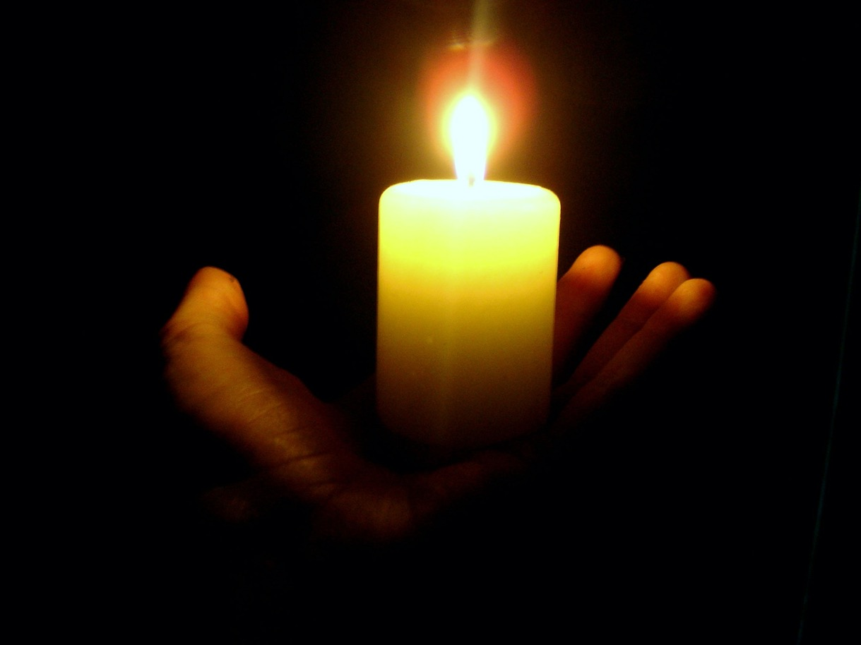
"If we claim we have no sin, we are only fooling ourselves and not living in the truth"
(1 John 1:8 NLT).
"If we claim we have not sinned, we are calling God a liar and showing that his word has no place in our hearts"
(1 John 1:10 NLT).

Slide 79

OT Forgiveness of Sin
121b
Pipe = Relationship with God (never changing)
Sin
Clog = Fellowship with God (hindered by sin)
Sacrifices = Confession of Sin (sin forgiven to restore fellowship but relationship was never threatened)
Notes:
Do we still have a relationship with God when we sin? Yes!
Sin does not hinder our relationship with God but our fellowship with Him.
OT sacrifices did not establish a relationship with God but rather they restored their fellowship with God
________
OS-03-Leviticus-14
OS-04-Num-29
OP-02-Lev-28
NS-23-1Jn-79
SA-03-Biblical Terms-9
SA-15-Inheritance-27

Slide 80
NT Forgiveness of Sin
121b
"If we confess our sins,
He is faithful and righteous to forgive us our sins and to cleanse us from all unrighteousness"
(1 John 1:9 NAU)
Pipe = Relationship with God (never changing)
Sin
Clog = Fellowship with God (hindered by sin)
Christ's Sacrifice = The Basis for Confession of Sin (sin is forgiven to restore fellowship but relationship has never been never threatened)
Notes:
Our relationship with God can be compared to a pipe.
Occasionally the pipe gets a clog—like sin—that hinders our fellowship with God.
Do we still have a relationship with God when we sin? Yes!
Sin does not hinder our relationship with God but our fellowship with Him.
_________
OB-38-Salvation-11
OS-03-Leviticus-56, 72, 130
OS-04-Numbers-30
NS-23-1Jn-80
SA-03-Biblical Terms-9
SA-15-Inheritance-28

Slide 81
Slides on
1 John 2

Slide 82

"My dear children, I am writing this to you so that you will not sin. But if anyone does sin, we have an advocate who pleads our case before the Father. He is Jesus Christ, the one who is truly righteous" (1 John 2:1 NLT).

Slide 83
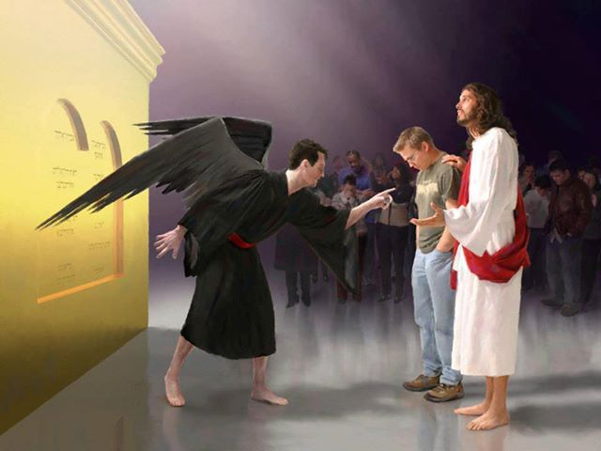
“Who then will condemn us? No one—for Christ Jesus died for us and was raised to life for us, and he is sitting in the place of honor at God’s right hand, pleading for us.”
Romans 8:34 (NLT)

Slide 84

"He himself is the sacrifice that atones for our sins—and not only our sins but the sins of all the world"
(1 John 2:2 NLT).

Slide 85
I. Obey God’s commands
(1 John 1–2).
  Believe in Christ’s humanity for fellowship and joy (1:1-4).
  Depend on Jesus (1:5–2:14).
  Avoid two hindrances to obedience to fight early Gnosticism (2:15-29).
Notes:
Both worldliness and deception will shift you over to the enemy’s camp.

Slide 86
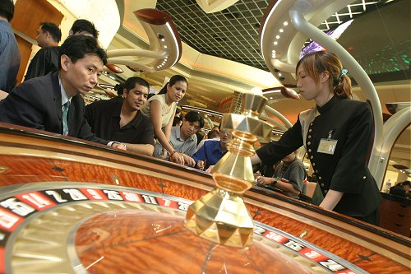
"Do not love the world" (1 John 2:15)
Notes:
One of those hindrances to obedience is worldliness—wanting to be more pleasing to the world than to God.

Slide 87
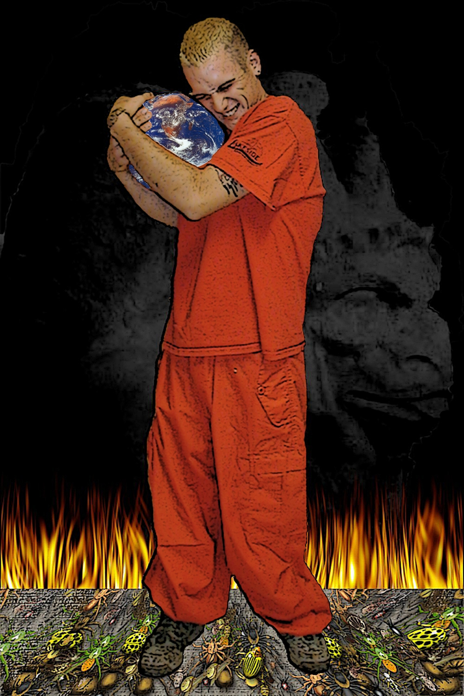
1 John 2:15 (NIV)
“Do not love the world or anything in the world. If anyone loves the world, the love of the Father is not in him.”
Notes:
John gives several reasons not to love the world.

Slide 88
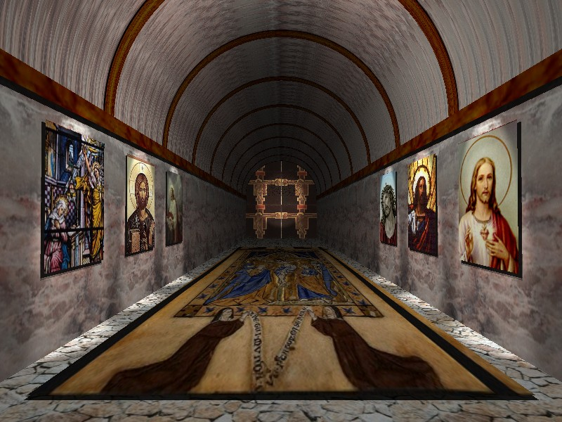
1 John 2:16-17 (NIV)
“For everything in the world–the cravings of sinful man, the lust of his eyes and the boasting of what he has and does–comes not from the Father but from the world. The world and its desires pass away, but the man who does the will of God lives forever.”
Notes:
One key reason not to love the is because the world is just temporary!

Slide 89
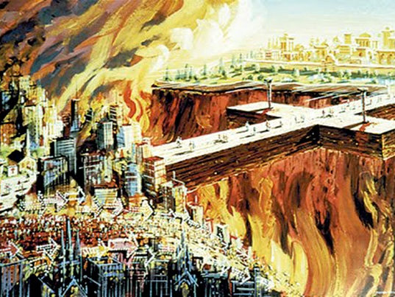
"…for the world and its desires are passing away"
(1 John 2:17a)
Notes:
Think of it—every building will be destroyed, every physical thing that we pour so much of our time and effort into will eventually be ruined or thrown away.

Slide 90

The Things of the World
Comparing Some Key Texts
296
World
(1 John 2:15-16)
Sources of Temptation
Eve
(Gen. 3)
Christ
(Matt. 4)
"Cravings of sinful man"
Ungodly bodily desires (sex outside marriage, gluttony, etc.)
"Good for food"
Stones to bread
"Lust of the eyes"
Greed, coveting
(10th commandment)
"Pleasing to the eye"
Possess all kingdoms
"Boasting of what he has
and does"
Pride & boasting of:
• occupation
• position
• worldly advantages
• etc.
"Desirable for gaining wisdom"
Acclaim by men
("throw yourself from the temple")
Notes:
The same three motivations for Eve to sin faced Jesus in the wilderness and are listed by John's epistle as basic sources of temptation.
__________
Common-466
OS-01-Gen1-3-slide206
NS-01-Matt1-12-slide308
NS-03-Luke1-12-slide241
NS-23-1John-90

Slide 91
Avoid two hindrances to obedience to fight early Gnosticism (2:15-29).
Worldliness
(2:15-17)
Deception
(2:18-29)
Notes:
How are we deceived? That which is against Jesus deceives us into thinking it is real and helpful.

Slide 92

"Dear children, the last hour is here. You have heard that the Antichrist is coming, and already many such antichrists have appeared. From this we know that the last hour has come. ¹⁹ These people left our churches, but they never really belonged with us; otherwise they would have stayed with us. When they left, it proved that they did not belong with us" (1 John 2:18-19 NLT).
Notes:
Does this mean that every person who leaves his church is antichrist? No, as some us sheep just go astray. He simply says that people opposing Jesus typically cannot last within the church. They eventually leave, especially if the church teaches the truth.

Slide 93
What is the relationship of the anointing of the Spirit to indwelling?
Controversial Issues about the Indwelling of the Holy Spirit
Notes:
NS-23-1 John-50
HS-04-Sealing, Indwelling-48

Slide 94
The Anointing of the Spirit
Xvi
H
"Now it is God who makes both us and you stand firm in Christ. He anointed us, ²²set his seal of ownership on us, and put his Spirit in our hearts as a deposit, guaranteeing what is to come" (2 Cor. 1:21 NIV)
Notes:
NS-23-1 John-51
HS-04-Sealing, Indwelling-49

Slide 95
The Anointing of the Spirit
Xvi
H
"But you have an anointing from the Holy One, and all of you know the truth…²⁷As for you, the anointing you received from him remains in you, and you do not need anyone to teach you. But as his anointing teaches you about all things and as that anointing is real, not counterfeit—just as it has taught you, remain in him" (1 John 2:20, 27)
Notes:
NS-23-1 John-52
HS-04-Sealing, Indwelling-50

Slide 96
Ryrie on the Anointing
xvi
H
"The difference between the anointing and indwelling seems to lie in their distinct purposes. The indwelling brings the presence of God into the life of the believer. The anointing, as far as the believer is concerned, is that he might be taught (1 John 2:20, 27). Actually, this seems to be the only purpose specified in the believer's case.
Notes:
NS-23-1 John-53
HS-04-Sealing, Indwelling-51

Slide 97
Ryrie on the Anointing
xvi
H
"However, if one may use the example of the anointing of Christ [Luke 4:18; Acts 4:27; 10:38; Heb. 1:9] and of Old Testament priests [Exod. 30:32-33; cf. kings 1 Sam. 10:1; Zech 4:14], then another purpose emerges—that of service. But…the full experience of the anointing depends on being filled with the Spirit"
(Ryrie, The Holy Spirit, 73).
Notes:
NS-23-1 John-54
HS-04-Sealing, Indwelling-52

Slide 98

Key Verse
290
John's Key Purpose in Writing
"I am writing these things to you about those who are trying to lead you astray… And now, dear children, continue in him, so that when he appears we may be confident and unashamed before him at his coming" (1 John 2:26, 28).

Slide 99

Oprah Winfrey’s Influence
22 million viewers each day!
Named most influential celebrity two years in a row (2012-2013)
Notes:
Most Gnostic-like false teachers would include Oprah Winfrey, consistently named one of the most influential women in the world.

Slide 100

Oprah Leads Millions Astray
"All that is divine, my heart is open to you..."
"The universe is not interested in your struggles and your pain and your sorrow..."
"My heart is open to find the flow, the flow, the flow, the flow that is my life."
Notes:
Oprah says the type of things that are nebulous and thus difficult to refute.
__________
See 2:25 on the timer at https://www.youtube.com/watch?v=oq6ejJqpOTs
See also http://www.jesus-is-savior.com/Wolves/oprah-fool.htm where she denies Christ as the only way to God.

Slide 101

Oprah Leads Millions Astray
“I am not talking about religion. I am a Christian. That is my faith. I'm not asking you to be a Christian. If you want to be one I can show you how. But it is not required. I have respect for all faiths. All faiths. But what I'm talking about is not faith or religion. I'm talking about spirituality,” Winfrey said.
Notes:
Many false teachers claim to be Christians and then redefine it. The real issue is Jesus—the “elephant in the room” whom they rarely discuss—certainly not his death and resurrection and return!
________
Oprah Winfrey: ‘I Am a Christian’
2:20PM EDT 4/26/2012 Jennifer LeClaire
http://www.charismanews.com/us/33290-oprah-winfrey-i-am-a-christian

Slide 102
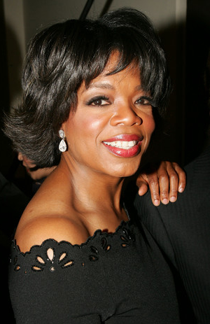
Oprah Leads Millions Astray
One commented on her…
“Take a few moments and imagine a religion where Jesus did not come to die on the cross, where there is no heaven, no hell, no sin, no salvation, no doctrine, where all spiritual paths in the world are equally valid and where ‘god’ is in you and in everything else you see.
That is the religion of Oprah Winfrey.
It is also the New Age ‘one world religion’ that many other spiritual gurus throughout the world have been trying to bring to fruition.”
Notes:
Oprah Winfrey: Jesus Did Not Come To Die On The Cross
http://www.curezone.com/forums/am.asp?i=1862458

Slide 103
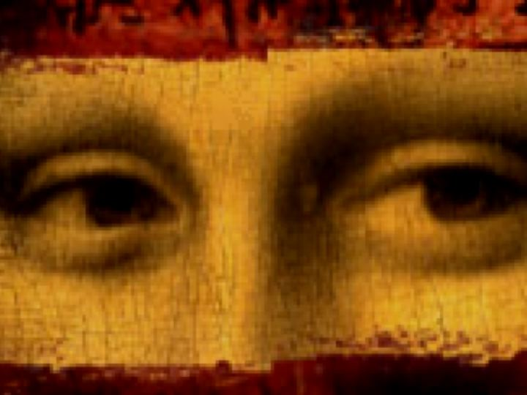
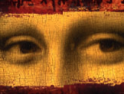
Debunking
The Da Vinci Code
295a
A Seminar by Dr. Rick Griffith, Singapore Bible College
A free download at BibleStudyDownloads.org Theology link
Notes:
Dan Brown’s heresy was popular around 2004 but still deceives others today.

Slide 104

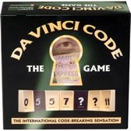



44 Languages!
295a
Notes:
DVC books and games flood the market. A computer game was also planned for release in May 2006.

Slide 105
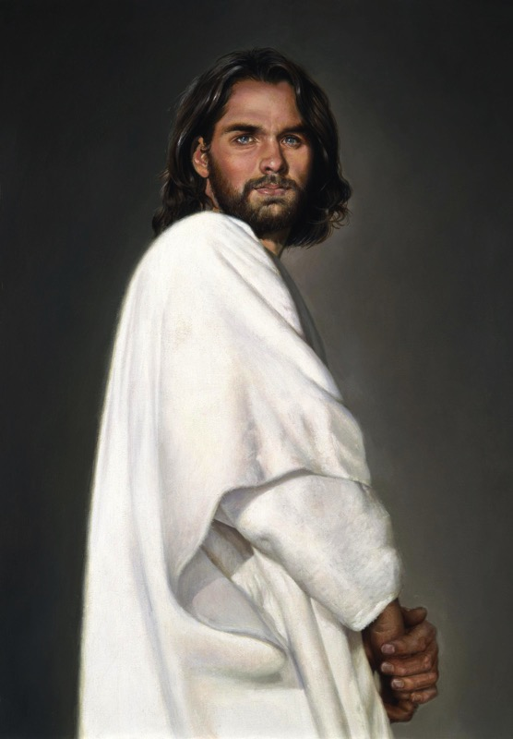
Who is Jesus Christ… really?
295a
Brown:
Bible:
Only human
God-Man
Notes:
The real issue is the early view of Jesus himself.

Slide 106
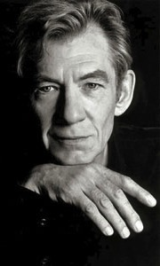
Brown's view of Jesus through "historian" Leigh Teabing…
295d
"My dear," Teabing declared, "until [AD 325], Jesus was viewed by His followers as a mortal prophet... a great and powerful man, but a man nonetheless. A mortal."
[Sophie:] "Not the Son of God?"
"Right," Teabing said. "Jesus' establishment as 'the Son of God' was officially proposed and voted on by the Council of Nicaea."
DVC, 197

Slide 107
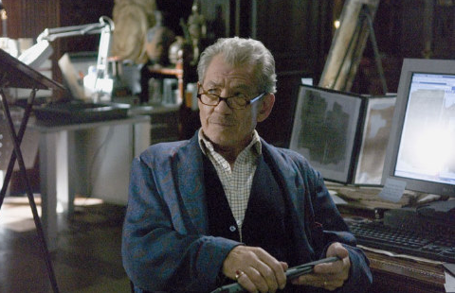
Is the Bible reliable?
295f
Brown accuses via the mouth of "historian" Leigh Teabing…
"The Bible is a product of man, my dear. Not of God… [It] has evolved through countless translations, additions, and revisions. History has never had a definitive version of the book."
DVC, 195
Notes:
We are led to believe that some versions of the Bible have differing numbers of books--and that the fact that the Bible has been translated into more languages than any other book makes it suspect. No, this is a sign of worldwide recognition of it as the Word of God.

Slide 108

"Saying that Dan Brown's book is about Christianity is like saying 'Finding Nemo' is about marine biology."
"We have just as much evidence to suggest that Jesus was married to Mary Magdalene as we have that clown fish talk."
Kenneth Boa & John Alan Turner, The Gospel According to the Da Vinci Code
Notes:
Well said. Biblical biologists will agree.

Slide 109
HOW CAN YOU…
1 John
Obey
God’s commands
(1–2)
Love
others
(3:1–5:3 )
AVOID
STRAYING
…INTO FALSE TEACHING?
Notes:
What should you do to keep consistent amidst so many lies about God?

Slide 110
Slides on
1 John 3

Slide 111
II. Love others (3:1–5:3).
  Don’t sin (3:1-10)
Notes:
RESTATE

Slide 112

¹ See what great love the Father has lavished on us, that we should be called children of God! And that is what we are! The reason the world does not know us is that it did not know him. ² Dear friends, now we are children of God, and what we will be has not yet been made known. But we know that when Christ appears, we shall be like him, for we shall see him as he is. ³ All who have this hope in him purify themselves, just as he is pure.
1 John 3:1-3 NIV

Slide 113
How much can a believer sin
(1 John 3:4)?
NLT (cf. NIV)
"Everyone who sins is breaking God’s law, for all sin is contrary to the law of God.”
Absolute
NAU (cf. NET)
"Everyone who practices sin also practices lawlessness; and sin is lawlessness.”
Habitual
Both translations are possible in the Greek text.
However, wouldn't it be lawless to sin even once?

Slide 114
How much can a believer sin
(1 John 3:6)?
NLT (cf. NIV)
" Anyone who continues to live in him will not sin. But anyone who keeps on sinning does not know him or understand who he is.”
Habitual
NAU (cf. NET)
"No one who abides in Him sins; no one who sins has seen Him or knows Him.”
Absolute

Slide 115
Each of the preceding four translations are inconsistent in rendering verses 4 and 6.
How? In one place each is absolute but then each is habitual in another.
BOTTOM LINE:
We sin when we follow Satan rather than God!
Notes:
But then NIV reads in 3:8, “He who does what is sinful is of the devil…” so it goes back to the absolute sense while the other three retain the habitual sense there.

Slide 116
II. Love others (3:1–5:3).
  Don’t sin (3:1-10)
  Don’t hate believers (3:11-15)
Notes:
RESTATE

Slide 117
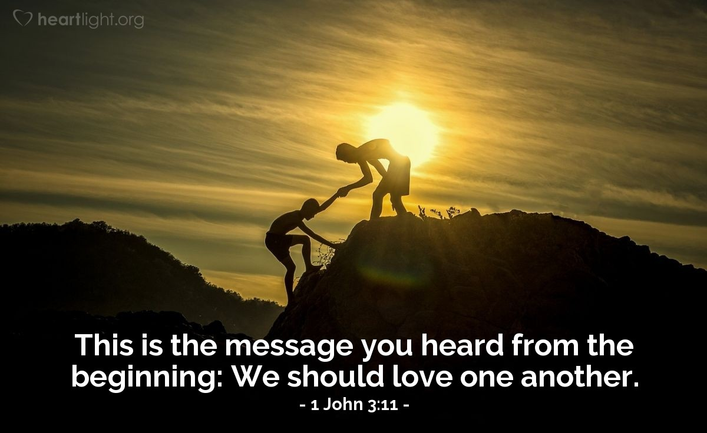
"This is the message you have heard from the beginning: We should love one another"
(1 John 3:11 NLT).

Slide 118
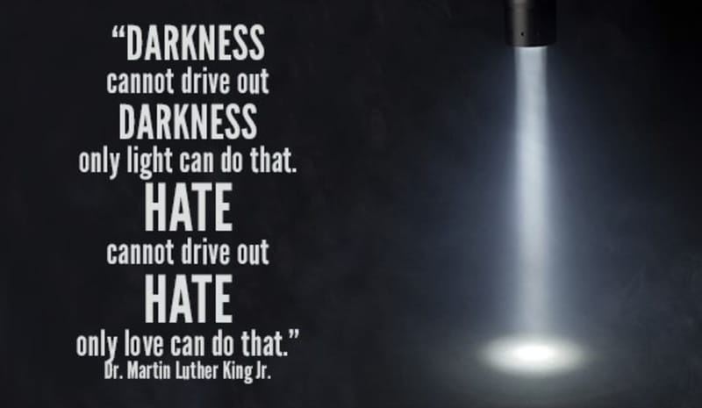
Hatred of people is from Satan.
"DARKNESS
cannot drive out
DARKNESS.
Only light can do that.
HATE
cannot drive out
HATE.
Only love can do that."
—Rev. Martin Luther King, Jr.—

Slide 119
II. Love others (3:1–5:3).
  Don’t sin (3:1-10)
  Don’t hate believers (3:11-15)
  Show compassion (3:16-20)
Notes:
RESTATE

Slide 120
"We know what real love is because Jesus gave up his life for us. So we also ought to give up our lives for our brothers and sisters. ¹⁷ If someone has enough money to live well and sees a brother or sister in need but shows no compassion—how can God’s love be in that person?" (1 John 3:16-17 NLT).

Slide 121
"Dear children, let’s not merely say that we love each other; let us show the truth by our actions. ¹⁹ Our actions will show that we belong to the truth, so we will be confident when we stand before God.
²⁰ Even if we feel guilty, God is greater than our feelings, and he knows everything" (1 John 3:18-20 NLT).

Slide 122
II. Love others (3:1–5:3).
  Don’t sin (3:1-10)
  Don’t hate believers (3:11-15)
  Show compassion (3:16-20)
  Be confident before God (3:21-24)
Notes:
RESTATE

Slide 123

"Dear friends, if we don’t feel guilty, we can come to God with bold confidence"
(1 John 3:21 NLT).

Slide 124
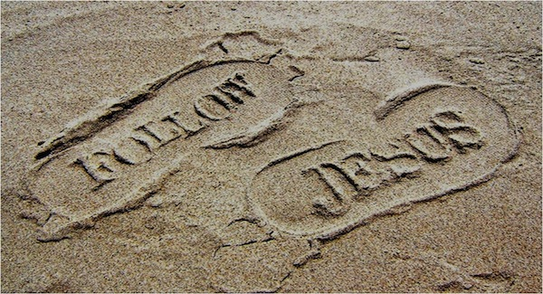
"And we will receive from him whatever we ask because we obey him and do the things that please him"
(1 John 3:22 NLT)."

Slide 125
"And this is his commandment: We must believe in the name of his Son, Jesus Christ, and love one another, just as he commanded us. ²⁴ Those who obey God’s commandments remain in fellowship with him, and he with them. And we know he lives in us because the Spirit he gave us lives in us"
(1 John 3:23-24 NLT).

Slide 126
Slides on
1 John 4

Slide 127
II. Love others (3:1–5:3).
  Don’t sin (3:1-10)
  Don’t hate believers (3:11-15)
  Show compassion (3:16-20)
  Be confident before God (3:21-24)
  Obey apostolic teaching (4:1-6)
Notes:
RESTATE

Slide 128

Test the spirits (4:1)

Slide 129
"Dear friends, do not believe everyone who claims to speak by the Spirit. You must test them to see if the spirit they have comes from God. For there are many false prophets in the world. ²This is how we know if they have the Spirit of God: If a person claiming to be a prophet acknowledges that Jesus Christ came in a real body, that person has the Spirit of God"
(1 John 4:1-2 NLT).

Slide 130
"But if someone claims to be a prophet and does not acknowledge the truth about Jesus, that person is not from God. Such a person has the spirit of the Antichrist, which you heard is coming into the world and indeed is already here"
(1 John 4:3 NLT).

Slide 131
"But you belong to God, my dear children. You have already won a victory over those people, because the Spirit who lives in you is greater than the spirit who lives in the world.
⁵ Those people belong to this world, so they speak from the world’s viewpoint, and the world listens to them"
(1 John 4:4-5 NLT).

Slide 132
"But we belong to God, and those who know God listen to us. If they do not belong to God, they do not listen to us. That is how we know if someone has the Spirit of truth or the spirit of deception"
(1 John 4:6 NLT).

Slide 133
II. Love others (3:1–5:3).
  Don’t sin (3:1-10)
  Don’t hate believers (3:11-15)
  Show compassion (3:16-20)
  Be confident before God (3:21-24)
  Obey apostolic teaching (4:1-6)
  Care for believers (4:7-21)
Notes:
RESTATE

Slide 134

"Dear friends, let us continue to love one another, for love comes from God. Anyone who loves is a child of God and knows God. ⁸ But anyone who does not love does not know God, for God is love" (1 John 4:7-8 NLT).

Slide 135

WE LOVE EACH OTHER BECAUSE HE LOVED US FIRST
1 JOHN 4:19

Slide 136
Slides on
1 John 5

Slide 137
II. Love others (3:1–5:3).
  Don’t sin (3:1-10)
  Don’t hate believers (3:11-15)
  Show compassion (3:16-20)
  Be confident before God (3:21-24)
  Obey apostolic teaching (4:1-6)
  Care for believers (4:7-21)
  Obey God’s commands (5:1-3)
Notes:
RESTATE

Slide 138

"Everyone who believes that Jesus is the Christ has become a child of God. And everyone who loves the Father loves his children, too. ² We know we love God’s children if we love God and obey his commandments. ³ Loving God means keeping his commandments, and his commandments are not burdensome"
(1 John 5:1-3 NLT).

Slide 139
HOW CAN YOU…
1 John
Obey
God’s commands
(1–2)
Love
others
(3:1–5:3 )
AVOID
STRAYING
Realize that obedience produces
what you really need
(5:4-21)
…INTO FALSE TEACHING?
Notes:
What should you do to keep consistent amidst so many lies about God?

Slide 140

— Francis Chan —
The Bible says that when we obey God’s commands, we benefit. I think we naturally assume that if we look out for our own interests and concerns, we will be happy. But people who sacrifice for others will tell you that seasons of giving are the most rewarding of their lives.

Slide 141
Benefits of Obedience:
III. Realize that obedience produces what you really need (5:4-21).
Victory over the world system (5:4-5)
Notes:
Rather than living a defeated life, you will conquer the world—literally!

Slide 142
"For every child of God defeats this evil world, and we achieve this victory through our faith. ⁵ And who can win this battle against the world? Only those who believe that Jesus is the Son of God"
(1 John 5:4-5 NLT).

Slide 143
Benefits of Obedience:
III. Realize that obedience produces what you really need (5:4-21).
Victory over the world system (5:4-5)
Assurance of salvation (5:6-13)
Notes:
Rather than doubt your state (now and forever), you will know that you have eternal life!

Slide 144

Jesus Will Return to Earth
Notes:
That’s also how long we can stay with him. He will come back for us, as 1 Thessalonians 4 says

Slide 145

The Rapture (The “Catching Up”)
"For the Lord himself will come down from heaven with a commanding shout, with the voice of the archangel, and with the trumpet call of God. First, the Christians who have died will rise from their graves. Then, together with them, we who are still alive and remain on the earth will be caught up in the clouds to meet the Lord in the air. Then we will be with the Lord forever. So encourage each other with these words” (1 Thess. 4:16-18 NLT).
Notes:
He will come back for us—a future event called “The Catching Up” or the Rapture. This is in 1 Thessalonians 4 that says…
READ
That’s how long Jesus will be a man. The incarnation forever changed Christ in that the human body that he took on that Christmas night will last “for always.”
“For always” is also the length of time that we will stay with him. Since we will be with him “for always,” we can certainly “encourage each other with these words.”
But are you encouraged? Are you confident that, when he returns to earth a second time, he will come back for you to be with him “for always”?

Slide 146

Notes:
Would you like be assured that you have the gift of eternal life and will be with Jesus “for always”? John, the last surviving friend of Jesus, gave us this promise…

Slide 147

God’s Gift (1 John 5:12-13)
"And this is what God has testified:
He has given us eternal life, and this life is in his Son. ¹²Whoever has the Son has life; whoever does not have God’s Son does not have life. ¹³I have written this to you who believe in the name of the Son of God, so that you may know you have eternal life."
Notes:
Do you have the Son? Then what else do you have? Life! Eternal life!
Have you believed in the Son? Then you can know that you have eternal life—not wish for eternal life, not hope for eternal life, not work for eternal life, but know that you have eternal life.
So the question this Christmas is whether you have the Son. He invites you into his manger, as it were, to trust him so that you can be with him “for always.”

Slide 148

A Prayer
“Jesus, thank you for the promise of eternal life by simple trust in you.
I trust you now that you are indeed who you said you were—God’s Son—and I thank you by faith for giving me eternal life. Amen.”
Notes:
If you haven’t done this before, pray with me now…
PRAY
If you trusted Jesus by praying that prayer, God says that you now have eternal life! You have begun the most amazing adventure you will ever know.

Slide 149

Eternal Security
296a
Notes:
Eternal security refers to the teaching that since salvation comes by grace through faith, it must be permanent. Thus, "once saved, always saved" depends not on human faithfulness but on divine faithfulness to keep his promise of granting eternal life to all who believe. Since believers have eternal life while yet in the flesh in this life, it must indeed last into eternity and cannot be lost.
_______________
Common-462
OS-14-2Chron-293
NS-23-1John-149

Slide 150

Eternal Security
296a
ETERNAL
SECURITY
“Once Saved, Always Saved”

Slide 151

Some Despise Security
MY TEACHING OF ETERNAL SECURITY, ALSO KNOWN AS ONCE SAVED ALWAYS SAVED OR THE PERSEVERANCE OF THE SAINTS, IS THE BEST LIE I'VE EVER DEVISED AGAINST THE RIGHTEOUS. CHANCES ARE, IF YOU ARE LIKE MOST, I WILL DECEIVE AND RECAPTURE YOU TOO.
Notes:
Some teachers imagine that the security of the believer is a doctrine of deception. They also assume that security is the same as perseverance, which remains unproven. All believers are still in their mortal bodies and thus fall short of God's requirements, so their degree of faithfulness or continued belief is one of degree on a spectrum. Otherwise, God would have to draw a line to say that we have denied Jesus too much to have been saved or else we lose our salvation.
__________
Common-463
NS-23-1John-150
SA-14-Eternal Security-46

Slide 152

Some Despise Security
YOU CAN
TRUST ME! I'M AN ETERNAL SECURITY TEACHER.
Notes:
Teachers who take God at his word to preserve the salvation of those saved are often looked at with suspicion!
__________
Common-464
NS-23-1John-151
SA-14-Eternal Security-47

Slide 153
Distinguishing Terms
67
 | Eternal Security | Assurance of Salvation
Basic Meaning | Being saved from the penalty of sin forever (once saved, always saved) | Knowing that we are saved from the penalty of sin forever
Definition | “The work of God which guarantees that the gift of salvation, once received, is forever and cannot be lost” (Ryrie, Basic Theology, 328) | “The realization of the truth of eternal security or perseverance” (Ryrie, Basic Theology, 328)
Notes:
Two often we use these terms interchangeably, but they are distinct.
——
HS-04-Sealing, Indwelling-79
NS-04-John1-11-slide 97
NS-04-John12-21-slide 288
NS-19-Hebrews-50
NS-23-1 John-151
SA-14-Eternal Security-57
SA-15-Inheritance-47

Slide 154
Distinguishing Terms
67
 | Eternal Security | Assurance of Salvation
Spirit’s Ministry | Sealing (Eph 1:13-14) | Assuring (Rom 8:15-17)
Believer’s… | Position as child of God (Rom 8:16b) | Practice or confidence (Rom 8:16a)
Recipients | All Christians possess | Some Christians doubt
Permanence | Can’t be lost (John 6:39-40; 10:27-29; Rom 8:30, 38-39; Heb 7:25) | Can be lost (for this reason John wrote 1 John 5:11-13)
Songs | “I Know Whom I Have Believed” “In Christ Alone” “The Solid Rock” | “Blessed Assurance” “Now I Belong to Jesus”
Notes:
Two often we use these terms interchangeably, but they are distinct.
——
HS-04-Sealing, Indwelling-80
NS-04-John1-11-slide 98
NS-04-John12-21-slide 289
NS-19-Hebrews-51
NS-23-1 John-152
SA-14-Eternal Security-58
SA-15-Inheritance-48

Slide 155

Theological Support for Eternal Security
296a

Slide 156
The Work of the Triune God Supports Security
296a
Father
is
is not
is not
GOD
is
is
Son
Spirit
is not
H. Wayne House, Charts of Christian Theology and Doctrine, 45

Slide 157

The Work of God the Father
296a

Slide 158

Election
296a

Slide 159

Permanent?
296a
“All that the Father gives me will come to me, and whoever comes to me I will never drive away”
(John 6:37 NIV)

Slide 160

The Work of Christ the Son
296a

Slide 161

“My sheep listen to my voice; I know them, and they follow me. ²⁸I give them eternal life, and they shall never perish; no one can snatch them out of my hand. ²⁹My Father, who has given them to me, is greater than all; no one can snatch them out of my Father’s hand” (John 10:27-29 NLT)
296a

Slide 162


Subject
296a
How do we know Jesus has given us eternal life?
Can we know?

Slide 163

An Astonishing Claim!
296a
“I tell you the truth, those who listen to my message and believe in God who sent me have eternal life. They will never be condemned for their sins, but they have already passed from death into life”
–– John 5:24
Notes:
Verse 26
Why did the crowd search for Jesus?
The crowd wants follow a prophet who will provide free food and political deliverance.

Slide 164
Permanent?
296a
“All that the Father gives me will come to me, and whoever comes to me I will never drive away”
(John 6:37 NIV)

Slide 165

The Sealing Work of the Spirit
296a

Slide 166

A Seal Guarantees Security and Provides Assurance
Notes:
In Paul's day, a wax seal on a letter conveyed: (1) ownership in that the seal of the sender was stamped on it, and (2) security by guarding the contents. The result was that the recipient could feel assurance that the contents were guaranteed and safe.

Slide 167

"Having believed, you were marked in him with a seal, the promised Holy Spirit, ¹⁴who is a deposit guaranteeing our inheritance until the redemption of those who are God’s possession—to the praise of his glory" (Eph. 1:13-14 NIV).
Notes:
This does NOT say that the Spirit seals us with something else—it says that the Spirit—HE IS THE SEAL HIMSELF!
He secures our future salvation as our seal until we are fully redeemed in soul, mind, and body—to God’s praise.

Slide 168
Assurance of
Salvation
Notes:
Paul used this background to assure his readers of their salvation by noting that the Holy Spirit HIMSELF was the seal of their salvation (Eph. 1:13-14).

Slide 169

Romans 10:9-10 NLT
"If you confess with your mouth that Jesus is Lord and believe in your heart that God raised him from the dead, you will be saved. ¹⁰For it is by believing in your heart that you are made right with God, and it is by confessing with your mouth that you are saved”
Notes:
Contrary to what many have affirmed, this does not say that we must PUBLICLY confess Jesus.

Slide 170

The Nature of Salvation
296b
Our deliverance from sin proves our security

Slide 171

The Believer’s Standing Before God Proves Security
296b
Notes:
Christians do not have POTENTIAL forgiveness. We have ACTUAL forgiveness NOW!
Christians do not hope that SOMEDAY we will gain eternal life. We have eternal life NOW!

Slide 172
Biblical Support for Eternal Security
296c

Slide 173
Assurance in 1 John 5:11-13
296c
Should we
ever doubt?
Should we
ever doubt?
Should we
ever doubt?
"And this is what God has testified:
He has given us eternal life, and this life is in his Son. ¹²Whoever has the Son has life; whoever does not have God’s Son does not have life. ¹³I have written this to you who believe in the name of the Son of God, so that you may know you have eternal life."
Notes:
Assurance of salvation means that one is confident of his or her eternal security. This is subjective and can be lost through doubting whether God will keep his word. But it cannot change the objective reality that we are still saved by being in the Father's hands—
John 10:25 NLT Jesus replied, “I have already told you, and you don’t believe me. The proof is the work I do in my Father’s name. ²⁶ But you don’t believe me because you are not my sheep. ²⁷ My sheep listen to my voice; I know them, and they follow me. ²⁸ I give them eternal life, and they will never perish. No one can snatch them away from me, ²⁹ for my Father has given them to me, and he is more powerful than anyone else. No one can snatch them from the Father’s hand. ³⁰ The Father and I are one.”
_______________
Common-465
OS-14-2Chron-296
NS-23-1John-41, 171

Slide 174

WE NEED TO ATTAIN GOD'S RIGHTEOUSNESS—BUT HOW?

Slide 175

Righteousness in Romans
145
God's Righteousness by Justification by Faith in Christ––Not the Law
Chapters 1–11 | Chapters 12–16
Righteousness Explained | Righteousness Applied
Theological | Practical
What to Believe | How to Behave
Vertical | Horizontal
Relationship to God | Relationship to Others

Slide 176


"It is finished"
155h
Justification (3:24)
God's act of declaring us "not guilty" for our sins, making us right with him
Legal
Justice (3:25-26)
The fairness of God where He punishes sin in an individual himself or in a Sinless Substitute (Jesus Christ)
Paid
in Full

Slide 177

Grace is…
God's
Riches
At
Christ's
Expense
Romans 3:24

Slide 178

No Condemnation (Rom 8:1)!
154b

Slide 179

Security in Romans 8
154b
We are not condemned––no Christian will go to hell (8:1)
We are set free from the law of sin and death (8:2)
We possess the Spirit of Christ (8:9)
The Spirit will give us glorified bodies (8:11)
We are adopted into God's family (8:14, 16, 17, 21, 23)
We will receive the redemption of our bodies (8:23)
We have hope that will be fulfilled (8:24-25)
We will be conformed to Christ's likeness (8:29)
All the predestined will eventually be glorified (8:30)
Nothing can separate us from God's love (8:35-39)
We are already more than conquerors over sin (8:37)

Slide 180

Roman's 3 Tenses of Salvation
155a
TENSE | MY STATUS | FREE FROM SIN'S... | TIME | DOCTRINE OF...
Past | I have been saved | Penalty--by His death (3:21-24) Rule--by my death (6:3-7) | When I received Christ | Justification (Positional Sanctification)
Present | I am being saved | Power--by indwelling Spirit (8:2-14) | As I walk in the Spirit | (Progressive) Sanctification
Future | I shall be saved | Presence--by redemption of my body (8:22-25) | When I get my new body | Glorification (Final Sanctification)
Adapted from Kay Arthur, 1 Peter: In & Out (Precept Ministries, 1990), 13

Slide 181

Blessed Assurance 1/7
Blessed Assurance
Fanny Crosby

Slide 182

Blessed Assurance 2/7
Blessed assurance, Jesus is mine!
O what a foretaste of glory divine!
Heir of salvation, purchase of God,
born of His Spirit, washed in His blood.

Slide 183
Blessed Assurance 3/7
This is my story, this is my song,
praising my Savior all the day long;
This is my story, this is my song,
praising my Savior all the day long

Slide 184

Blessed Assurance 4/7
Perfect submission, all is at rest,
I in my Savior am happy and blest;
Watching and waiting looking above,
filled with His goodness, lost in His love.

Slide 185
Blessed Assurance 5/7
This is my story, this is my song,
praising my Savior all the day long;
This is my story, this is my song,
praising my Savior all the day long

Slide 186

Blessed Assurance 6/7
Perfect submission, perfect delight!
Visions of rapture now burst
on my sight;
Angels descending bring from above
echoes of mercy, whispers of love.

Slide 187
Blessed Assurance 7/7
This is my story, this is my song,
praising my Savior all the day long;
This is my story, this is my song,
praising my Savior all the day long

Slide 188

A Parable on Romans 8:28-30
155p
One day a very wise and
skillful sculptor desired to make a
beautiful marble statute…

Slide 189

Foreknowledge
155p
From among the many possibilities in the marble quarry he selected one rough stone which he would use for this purpose.

Slide 190

Predestination
155p
He marked it and thereby destined it for the beautiful finished product which he had in mind. That mark preserved it from being discarded and destroyed.

Slide 191


Calling and justification
155p
Sometime later he sent his helper to fetch the stone and place it on his own work table.

Slide 192

Progressive sanctification & eternal security
155p
Then the sculptor began to chisel, rasp, and file on that block of rough stone shaping into the likeness of the clay model that served as his pattern. In the process, however, he did nothing to ruin the stone and he saw to it that
no one else marred it either.

Slide 193

Rapture
155p
Then one day his work was done. The statue was complete with all its features finely honed in full conformity with his clay model. The time had come to remove it from the clutter of the work bench and take it to the palace court where it would be unveiled for public display.

Slide 194


Glorification
155p
And all those who passed by smiled their approval and gave accolades of praise to the wise and skillful sculptor.

Slide 195

"In all things God works for good…" (8:28-30)
155p
Glorified
Justified
Called
Predestined
Foreknew

Slide 196
Benefits of Obedience:
III. Realize that obedience produces what you really need (5:4-21).
Victory over the world system (5:4-5)
Assurance of salvation (5:6-13)
Guidance in prayer (5:14-17)
Notes:
Rather than live aimlessly, you will have God lead you as you talk to him.

Slide 197

"And we are confident that he hears us whenever we ask for anything that pleases him. ¹⁵ And since we know he hears us when we make our requests, we also know that he will give us what we ask for" (1 John 5:14-15 NLT).

Slide 198

"If you see a Christian brother or sister sinning in a way that does not lead to death, you should pray, and God will give that person life.
But there is a sin that leads to death, and I am not saying you should pray for those who commit it. ¹⁷ All wicked actions are sin, but not every sin leads to death" (1 John 5:16-17 NLT).

Slide 199

Some sin leads to premature death (1 John 5:16-17 NIV)
“If anyone sees his brother commit a sin that does not lead to death, he should pray and God will give him life. I refer to those whose sin does not lead to death. There is a sin that leads to death. I am not saying that he should pray about that. ¹⁷All wrongdoing is sin, and there is sin that does not lead to death.”

Slide 200
Benefits of Obedience:
III. Realize that obedience produces what you really need (5:4-21).
Victory over the world system (5:4-5)
Assurance of salvation (5:6-13)
Guidance in prayer (5:14-17)
Freedom from habitual sin (5:18-20)
Notes:
Rather than be a slave to your passions, you will be liberated.

Slide 201
How much can a believer sin
(1 John 5:18)?
NLT (cf. NIV)
" We know that God’s children do not make a practice of sinning, for God’s Son holds them securely, and the evil one cannot touch them.”
Habitual
NAU (cf. NET)
"We know that no one who is born of God sins; but He who was born of God keeps him, and the evil one does not touch him.”
Absolute

Slide 202
Benefits of Obedience:
III. Realize that obedience produces what you really need (5:4-21).
Victory over the world system (5:4-5)
Assurance of salvation (5:6-13)
Guidance in prayer (5:14-17)
Freedom from habitual sin (5:18-20)
Fidelity to God by avoiding idolatry (5:21)
Notes:
Rather than other things having a grip on you, you’ll have trust God like a little child.

Slide 203




1 John 5:21 (NIV)
"Keep yourself from idols"

Slide 204

"Dear children, keep away from anything that might take God’s place in your hearts" (1 John 5:21 NLT).

Slide 205

"Dear children, keep away from anything that might take God’s place in your hearts" (1 John 5:21 NLT).
Notes:
https://visual.ly/community/infographic/lifestyle/idols
Accessed 10 Jan 2020
Source: https://blacksunsetart.wixsite.com/blacksunset

Slide 206
How can you avoid straying into false teaching?
1 John
Notes:
• The first letter from the Apostle John tells us • three key ways that we can stop losing our way—wandering off, drifting—like sheep.

Slide 207
HOW CAN YOU…
1 John
Obey
God’s commands
(1–2)
Love
others
(3:1–5:3 )
AVOID
STRAYING
Realize that obedience produces
what you really need
(5:4-21)
…INTO FALSE TEACHING?
Notes:
What should you do to keep consistent amidst so many lies about God?

Slide 208
I. Obey God’s commands (1–2).
  Believe in Christ’s humanity for fellowship and joy (1:1-4).
  Depend on Jesus (1:5–2:14).
  Avoid two hindrances to obedience to fight early Gnosticism (2:15-29).
1 John
Notes:
Follow what the Lord says so you won’t stray away (1 John 1–2 restated).

Slide 209
II. Love others (3:1–5:3).
  Don’t sin (3:1-10)
  Don’t hate believers (3:11-15)
  Show compassion (3:16-20)
  Be confident before God (3:21-24)
  Obey apostolic teaching (4:1-6)
  Care for believers (4:7-21)
  Obey God’s commands (5:1-3)
1 John
Notes:
Live for other people instead of for yourself, which is a key trait of false teaching (3:1–5:3 restated).

Slide 210
Benefits of Obedience:
III. Realize that obedience produces what you really need (5:4-21).
Victory over the world system (5:4-5)
Assurance of salvation (5:6-13)
Guidance in prayer (5:14-17)
Freedom from habitual sin (5:18-20)
Fidelity to God by avoiding idolatry (5:21)
1 John
Notes:
When you do what God says, you get your true needs met (5:4-21 restated).

Slide 211
Main Idea of the Letter
Obey God and love others and you’ll have what you really need instead of false teaching.
1 John
Notes:
We stay on track spir
itually and benefit greatly by obeying God and loving each other (commands restated).

Slide 212
Application
290
How can you show love to another believer so that heresy might be thwarted?
Whom do you know that needs to see Christian love shown in order to turn from false teaching?

Slide 213
Black

Slide 214


NT Preaching • BibleStudyDownloads.org
Get this presentation and script for free!

Slide 215

NT Canon during 1st 4C
For Further Details see...
The NT Canon in the First Four Centuries
H. Wayne House, Chronological & Background Charts to the NT
Notes:
This page appears at the end of your notes. Note that the first council that officially affirmed our 27 NT books was not Nicaea, but Hippo in 393.

Slide 216
Black
Notes:
216

Slide 217
NT Survey link at BibleStudyDownloads.org
Get this presentation for free!
Notes:
NT Survey (ns)

