Slide 1
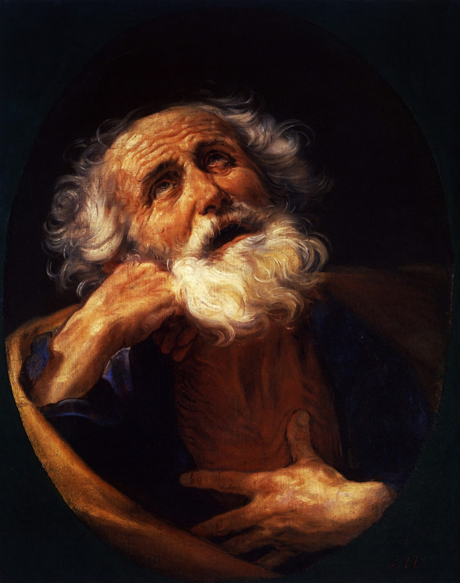
2 Peter
2 Peter
You can't go any farther than your knowledge
Dr. Rick Griffith • Jordan Evangelical Theological Seminary • BibleStudyDownloads.org
Notes:
We live in an anti-intellectual age. Knowledge is often seen as irrelevant, especially as we see Ivy League institutions crumble under their own weight.
The same is true in our churches. Pastors have far less education than in the past, as seminary or Bible college degrees are deemed irrelevant and out of touch.
Knowledge without wisdom and godliness is useless, but you can't go any farther than your knowledge.

Slide 2
Key Word
284
Knowledge
2 Peter
Notes:
Knowledge is our keyword for 2 Peter. The author, Peter, uses the word "knowledge" 16 times in these three short chapters. He specifically speaks of our need to increase in the knowledge of our Lord Jesus Christ.

Slide 3
Theme
23
Knowledge to Combat False Teaching
2 Peter
Notes:
This knowledge is vital to protect ourselves from heresy. We need to be able to recognize false teachers in order to fight against them!

Slide 4
Key Verse
284
“Therefore, dear friends, since you already know this, be on your guard so that you may not be carried away by the error of lawless men and fall from your secure position. But grow in the grace and knowledge of our Lord and Savior Jesus Christ. To him be glory both now and forever! Amen” (3:17-18).
2 Peter
Notes:
"You already know this. These words translate one Greek word (προγινώσκοντες), from which comes the English word “prognosis.” When a medical prognosis is made, a patient is better able to prepare himself for what is ahead and if possible, to correct himself. When a doctor says, “If you continue to eat as much as you do now, you will have serious heart problems in a few years,” the patient “knows beforehand” and can therefore change his life in accord with the information he has."
—Kenneth O. Gangel, 2 Peter *(The Bible Knowledge Commentary; eds. John F. Walvoord and Roy B. Zuck; Accordance electronic ed. 2 vols.; Wheaton: Victor Books, 1983), 2:878.
–––––––––––––––––––––
Note the key trait of the heretics in the final two verses of the letter: lawless. They do not follow God's Word but instead become a law unto themselves.
Not recognizing this puts us in a dangerous position, being carried away by their schemes. This can result in falling from our secure position, but what does that mean? If we are secure, then how can we fall into insecurity?
NLT: "and lose your own secure footing."
NASB: "fall from your own steadfastness."
Peter is NOT warning us that we can lose our salvation.
He warns us that lose our secure position in the truth.

Slide 5
Summary Statement
2 Peter
Summary Statement
284
To grow in grace instead of succumbing to false teaching, we need to know that Jesus chose us and that he will judge apostates at his return.
Notes:
Peter reminds North Asian believers of their:
Election in the grace of Jesus Christ, and
Knowledge of the characteristics and future destruction of false teachers
This will enable them to combat false teaching and grow in godliness.

Slide 6

Kingdom Statement
27f
Faithful believers will be rewarded: “Then God will give you a grand entrance into the eternal Kingdom of our Lord and Savior Jesus Christ” (1:11).
2 Peter
Notes:
Our experience in the Millennial kingdom will be one of reward, not punishment.
But whether it is a "grand entrance" depends on our service for Jesus now.
This means salvation by faith, but reward by works.

Slide 7

Covenant
27f
Scoffers of the Church age will ridicule the Bible on Christ’s return, Creation and the Universal Flood (3:3-6).
2 Peter
Notes:
Unbelievers outside the new covenant target their attack on three matters where believers waver:
The Rapture
Creation in six days
A Universal Flood
Sadly, many Christians are more concerned about being made fun of by scoffers than they are about being faithful to what the Bible says about these three key issues.

Slide 8
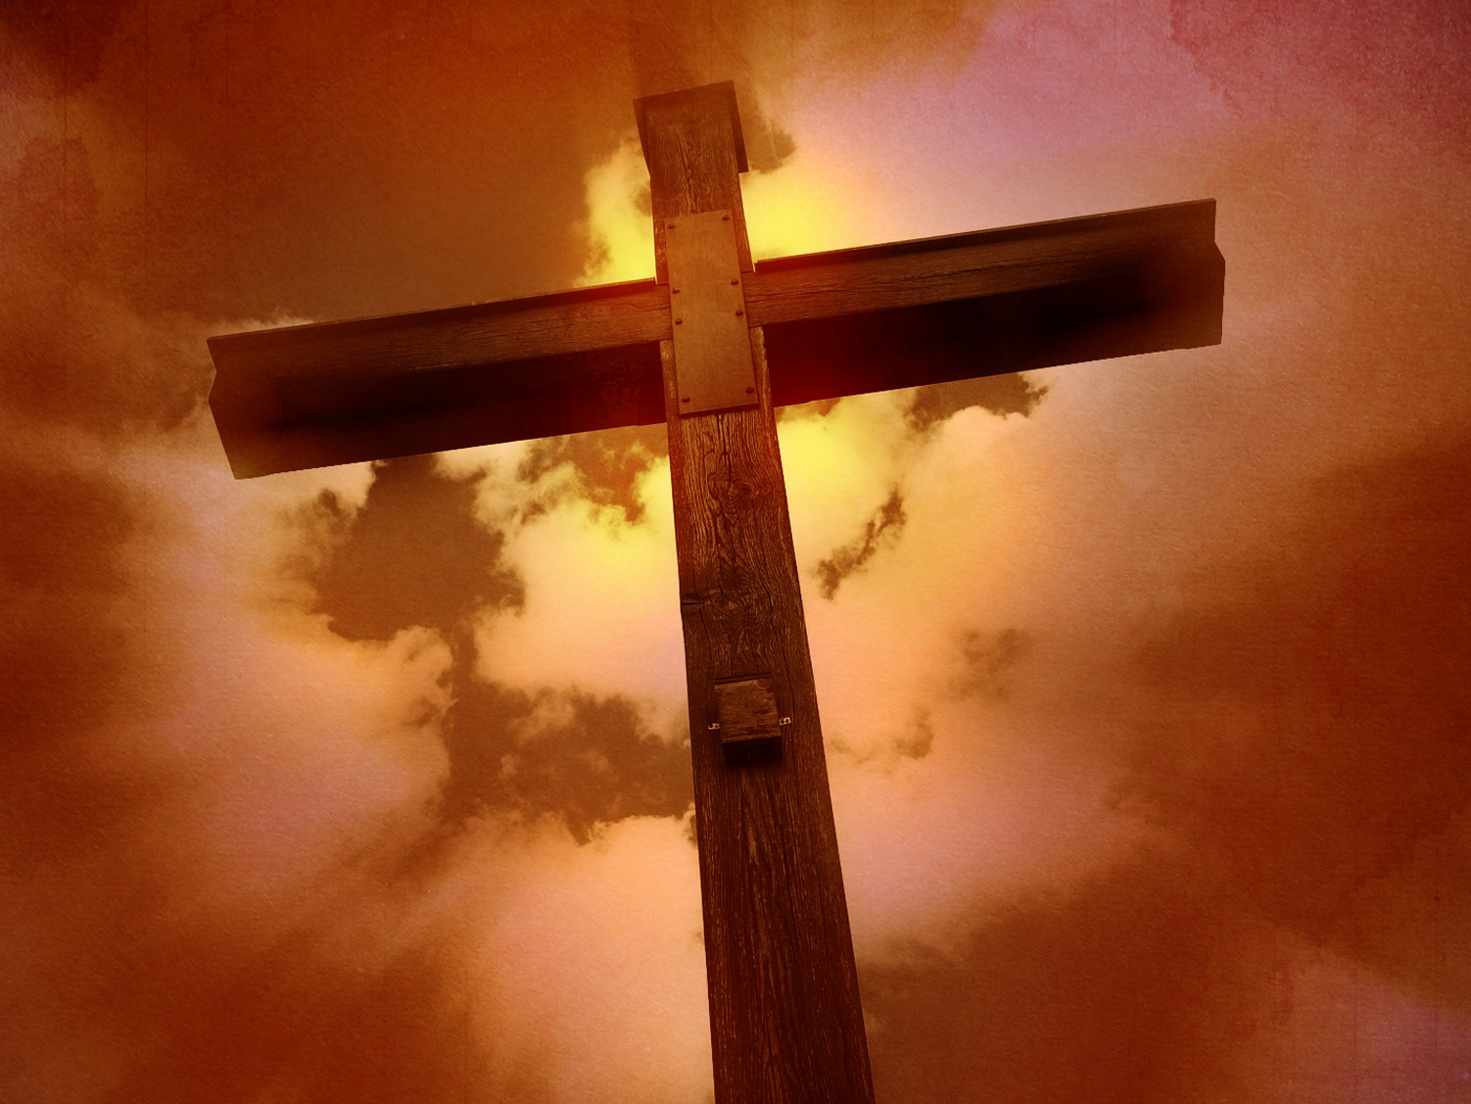
Redemption
27f
The destiny of all apostates in hell shows that believers will be protected as much as apostates will be condemned (2:3b-10a).
2 Peter
Notes:
Peter's emphasis is not so much on the salvation of believers as it is on the lack of salvation for unbelievers.
But this focus on the negative should be a positive for us.

Slide 9
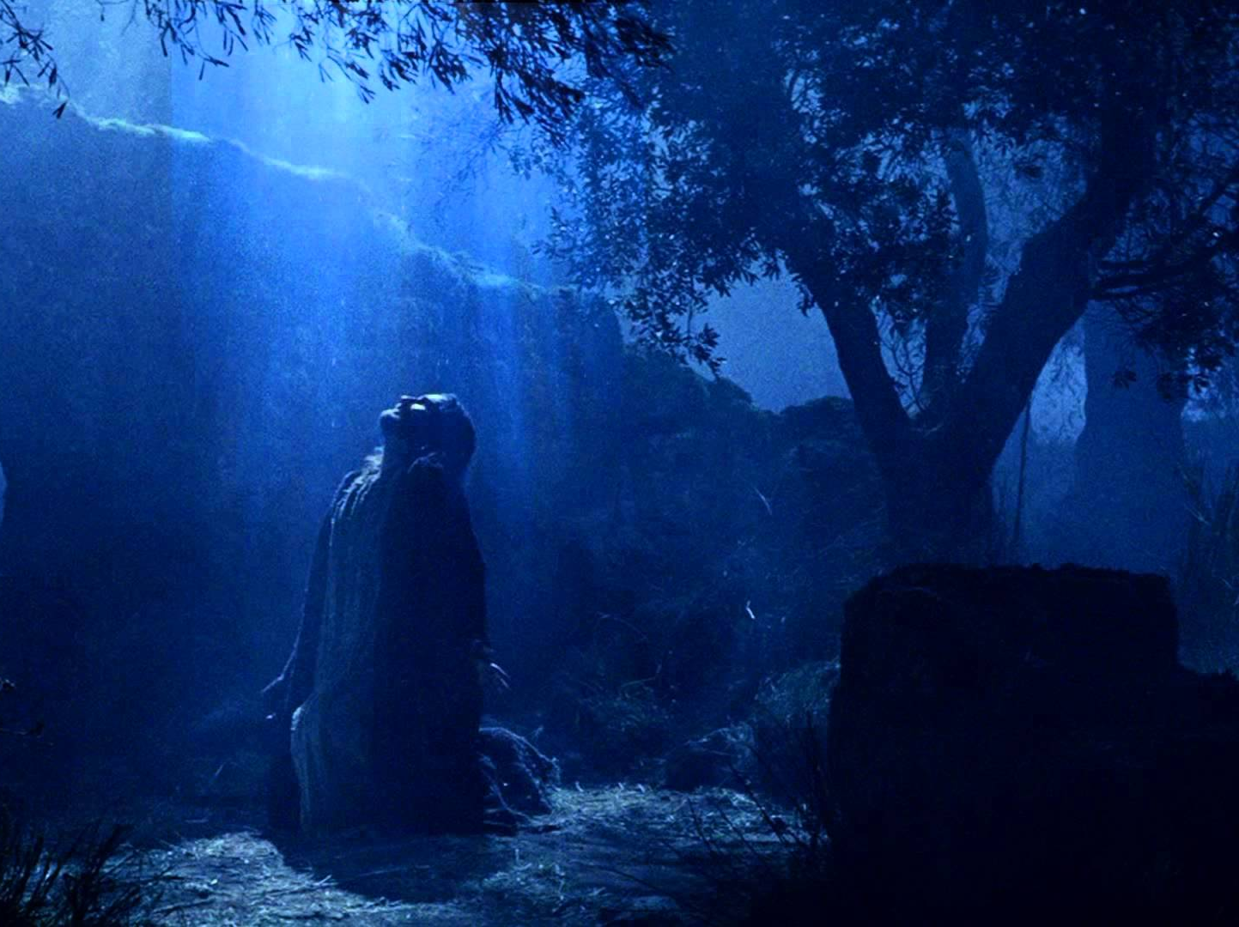
Prophecy (Lord, Deity)
27f
No OT prophet messed up or misinterpreted his prophecy because it didn’t originate in his own will but came from God who only used his mouth as a willing instrument of the Spirit’s message (1:20-21).
2 Peter
Notes:
Here exists one of the most important passages on the nature of OT prophecy. It is not the dictation view of the Quran or the Book of Mormon. Instead, we see God guiding inerrant words but in the various styles of biblical authors.
This is an important issue, as scholars such as Wayne Grudem have argued since the 1980s that genuine prophecy can be flawed yet still inspired today.

Slide 10
Summary Chart
2 Peter
284
Knowledge to Combat False Teaching
God's Election
Future Apostasy
Lord's Return
Chapter 1
Chapter 2
Chapter 3
Saluta-tion
1:1-2
Provides Every Need
1:3-11
Foundation of Knowledge
1:12-21
False Teachers Coming
2:1-3a
End in Hell
2:3b-10a
Character Described
2:10b-22
Scoffers Before Rapture
3:1-7
Temporary World Motivates Holiness
3:8-16
Protection & Growth Encouraged
3:17-18
Adequacy of
Believers
Inadequacy of
Unbelievers
Expectancy of
Believers
Holiness
Heresy
Hope
Disciples
of the Lord
Diabolical Leaders
Day
of the Lord
Rome to North Asia Minor
AD 64
Notes:
What do Christians need to know to fight heresy? As a teenager, I thought we needed to know the many details of what false teachers believe. But this was impossible, as the number of heresies continues to grow and change.
What we need, according to Peter, is:
Knowledge of our election,
Knowledge of the character of false teachers (not necessarily all their teachings), and
Knowledge of the Rapture

Slide 11
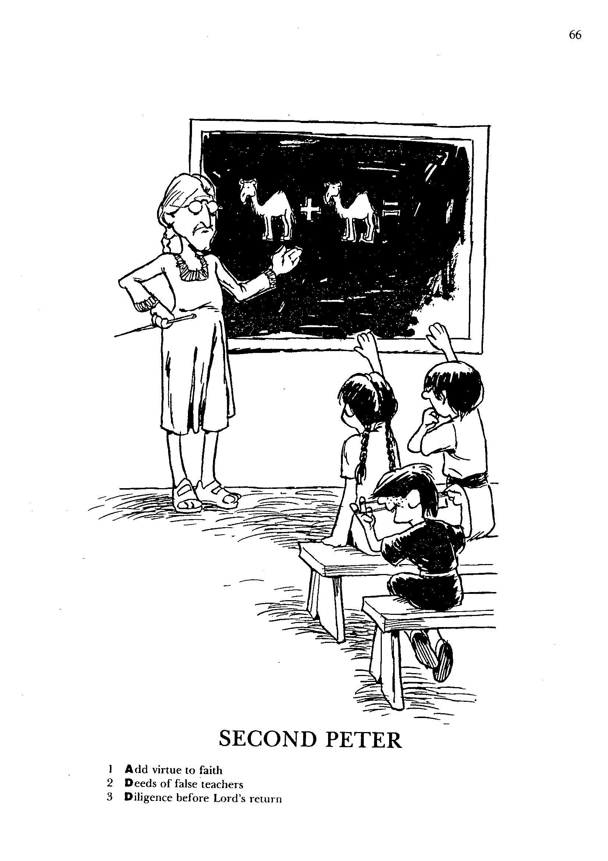
1
2
3
Add virtue to faith
Deeds of false teachers
Diligence before Lord's return
SECOND PETER
Barry Huddleston, The Acrostic Bible
Notes:
The English acrostic is ADD. This has nothing to do with Attention Deficit Disorder! Instead, the chapters teach…
1. Add virtue to faith
2. Deeds of false teachers
3. Diligence before Lord's return
The "ADD" acrostic is based on the KJV translation of:
2Pet. 1:5 And beside this, giving all diligence, add to your faith virtue; and to virtue knowledge
The idea is to continually add to your knowledge of biblical truth. NEVER think that you know enough!

Slide 12
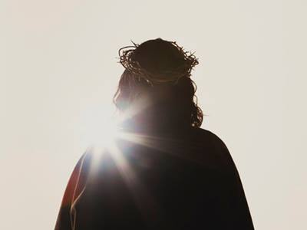
Be Knowledgeable
2 Peter
Dr. Rick Griffith • Crossroads International Church Singapore
BibleStudyDownloads.org
Notes:
The Bible Exposition link at BibleStudyDownloads.org includes all 66 sermons from the "The Bible: Book by Book" series. These have a single sermon for each Bible book that surveys that entire book. Each title also begins with "Be…" to emphasize that every book of Scripture aims for us to "be" more than to "do," although both are important.
For 2 Peter, we will see that, more than any other book in the Bible, the book highlights the need for knowledge, especially knowledge of theology/

Slide 13

It seems we know about…
2 Peter
all the wrong things…
Notes:
People don't lack knowledge. In fact, we are all experts. The problem is that we are knowledgeable experts at things that have no real value, and, even worse, we know how to destroy ourselves.

Slide 14
What's Your View?
288
Please write A (Agree), U (Unsure), or D (Disagree) before each of these statements:
1. God chooses those who will go to heaven
2. People on earth can know for sure whether they are going to heaven
3. False teachers sometimes teach in evangelical churches
4. No one who has truly trusted Christ will stop trusting Him until death
5. Christians already have all they need for successful spiritual living
A
Election
A
Assurance
A
Apostasy
D
Perseverance
Sufficiency
A
Notes:
All five of these theological issues are addressed in the NT, and especially in 2 Peter. See the following verses for each:
God chooses those who will go to heaven:
2Pet. 1:10 So, dear brothers and sisters, work hard to prove that you really are among those God has called and chosen. Do these things, and you will never fall away.
2. People on earth can know for sure whether they are going to heaven
2Pet. 1:10b Do these things, and you will never fall away. ¹¹ Then God will give you a grand entrance into the eternal Kingdom of our Lord and Savior Jesus Christ.
3. False teachers sometimes teach in evangelical churches
2Pet. 2:1 But there were also false prophets in Israel, just as there will be false teachers among you. They will cleverly teach destructive heresies and even deny the Master who bought them. In this way, they will bring sudden destruction on themselves.
4. No one who has truly trusted Christ will stop trusting Him until death
2Pet. 3:17 You already know these things, dear friends. So be on guard; then you will not be carried away by the errors of these wicked people and lose your own secure footing. ¹⁸ Rather, you must grow in the grace and knowledge of our Lord and Savior Jesus Christ.
Note that if Peter's readers could not stop trusting Jesus, then these final verses would be useless. He warned them because they might fall away.
5. Christians already have all they need for successful spiritual living
2Pet. 1:3 By his divine power, God has given us everything we need for living a godly life. We have received all of this by coming to know him, the one who called us to himself by means of his marvelous glory and excellence.

Slide 15

What must you know to grow in grace rather than to fall for false teaching?
2 Peter
Notes:
What knowledge will help you better grasp God's goodness instead losing your faith in Christ?
___________
NS-22-2Peter-15, 88, 106, 190, 240, 269

Slide 16

I. Know that Christ chose and fully equipped you (Chap. 1).
II. Know a fake teacher before you see one (Chap. 2).
2 Peter
III. Know to live for the eternal—not the temporal (Chap. 3).
What to know to grow…
Notes:
We are not left in the dark as to what we must know to maintain our faith in Jesus. Peter mentions these three requirements for a vibrant relationship with Jesus.

Slide 17

Main Idea
Know that Christ chose you and will judge apostates at his return.
2 Peter
Notes:
Jesus elected you to salvation and knows those who are his own. These he will judge at the Rapture.

Slide 18
For Life Change: Which teachers in your experience must you warn yourself and your family about? How?
2 Peter
Notes:
The list of apostate teachers is endless and constantly changing, so we must be wary of their influence on us. The goal of many on YouTube is to be an "influencer," without any concern for whether they influence people for good or evil!
This doesn't mean that no genuine Christian leader can lapse into moral sin. Otherwise, there would be no King David or other biblical examples of true believers who sinned greatly. For example, many assume that Ravi Zacharias wasn't a believer due to his sexual sin.
On the other hand, there are others who say "Lord, Lord," to Jesus and receive his answer: "I never knew you."

Slide 19

Is God’s Word shaping you to grow in the grace and the knowledge of Christ?
2 Peter
Notes:
Are you more godly than at this point last year?
The better question is: how can the Bible better impact your walk with Jesus by knowing him better?

Slide 20
Black

Slide 21
NT Overview (General + Key Words)
38 124 39-41
"To the remotest part of the earth" (Acts 1:8)
Acts 9 13 14 15 16 18 21 27 28
Apr 48- Sep 49
1 Galatia
Apr 50- Sep 52
2 Aegean
Spr 53- May 57
3 Asia
Feb 60- Mar 62
1 Rome
Spr 62- Fall 67
4 Spain
Aut 67- Spr 68
2 Rome
Summer 35- 37
Damascus Antioch
May 57- Aug 59
Trials
Fall 49
The
Council
Spring 68
Expansion of Church
35 48 49 50 52 53 57 60 62 67 68 95
Matt
Kingdom
Luke
Sov 1
Acts
Sov 2
Mark
Disciple
John
Believe
Gal
Justify
1 Thess
Rapture
1 Cor
Eph
Unity
1 Tim
Order
2 Tim
Sanctify
Doctrine
James
Works
2 Thess
Tribulation
2 Cor
Col
Deity
Titus
Apostle
Conduct
Romans
Philem
1 Pet
Righteous
Forgive
Suffering
Gospels & Acts
Phil
Attitude
2 Pet
Knowledge
Pauline Epistles
1234
Journeys
General Epistles
Rome
Imprisonments
General Epistles + Key Words

Slide 22


False Teachers
"The bottom line is that the Holy Spirit never convicts you of your sins. He never comes to point out your faults."
Joseph Prince, Destined to Reign, 134
Notes:
False teaching is all around us. Beware!
The world has never had more “isms” than today. They don’t seem to die out. Like a cancer or virus, false teaching just seems to morph and replicate to attack in new ways.

Slide 23
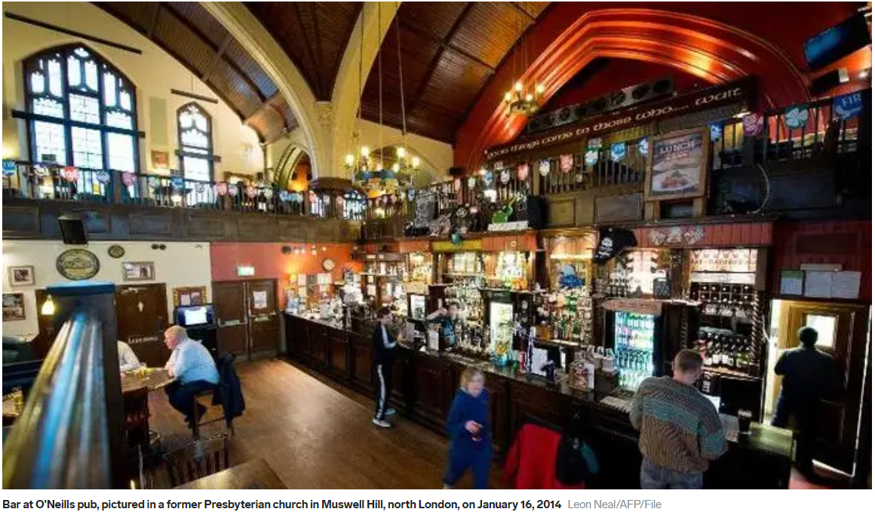
Churches In England Are Being Converted To Bars
Notes:
How sad if one day the church we love gets converted to a bar.. In a sense there are no more people even worshipping God.
Let’s hope our faith in Christ Jesus does not end in our generation.
Reference: https://www.businessinsider.com/churches-in-england-are-being-converted-to-bars-photos-2014-3?IR=T

Slide 24
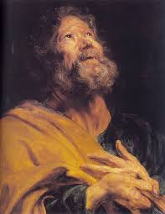
Truth Frees!
"Then you will know the truth and the truth will set you free"
John 8:32

Slide 25
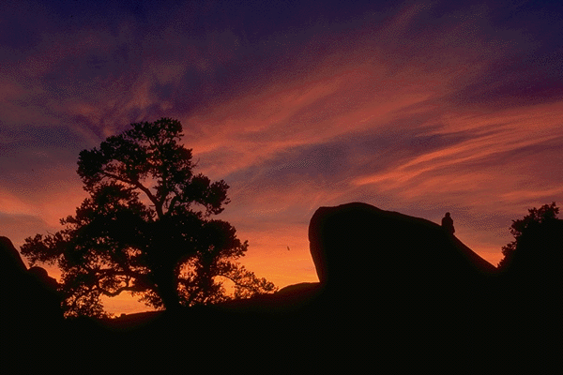
Knowing You 1
All I once held dear, built my life upon
all this world reveres and wars to own;
All I once thought gain I have counted loss;
spent and worthless now compared to this-

Slide 26
Knowing You 2
Knowing you, Jesus, knowing You,
there is no greater thing.
You're my all, You're the best,
You're my joy, my righteousness,
and I love You, Lord.

Slide 27
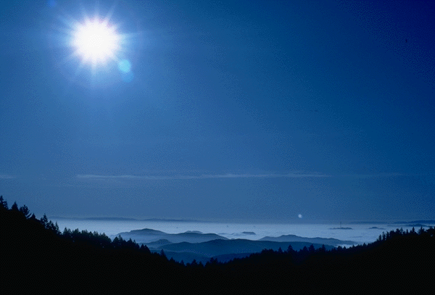
Knowing You 3
Now my heart's desire is to know You more,
To be found in You and known as Yours;
To possess by faith what I could not earn,
All surpassing gift of righteousness.

Slide 28
Knowing You 4
Knowing you, Jesus, knowing You,
there is no greater thing.
You're my all, You're the best,
You're my joy, my righteousness,
and I love You, Lord.

Slide 29
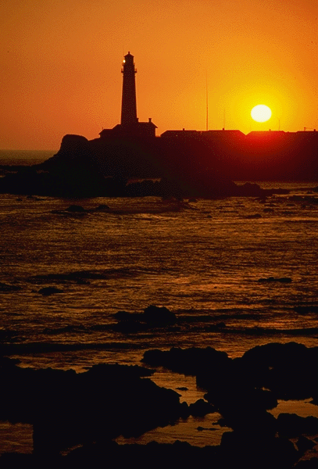
Knowing You 5
Oh, to know the pow'r of Your risen life
and to know You in Your sufferings;
To become like You in Your death, my Lord,
So with You to live and never die!

Slide 30

Knowing You 6
Knowing You, Jesus, knowing You,
There is no greater thing.
You're my all, You're the best,
You're my joy, my righteousness.
You're my all, You're the best,
You're my joy, my righteousness.

Slide 31
Knowing You 7
You're my all, You're the best,
You're my joy, my righteousness
and I love You, Lord, and I love You, Lord,
and I love You, Lord.

Slide 32
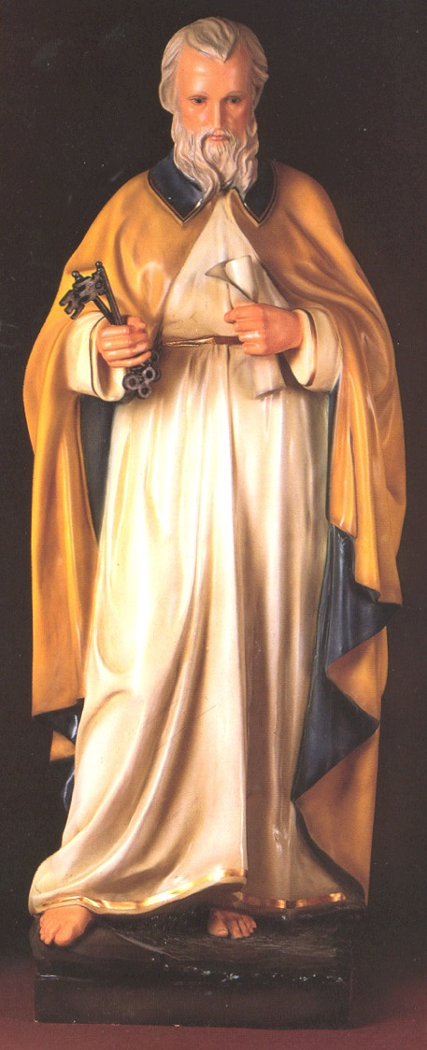
Occasion
287
Peter was facing imminent death (1:14-15) and so were many of those to whom he was writing.
So one of his major goals in writing was to comfort and encourage his friends in the face of the savage treatment they could expect because they were believers in Christ.
Encountering the NT CD-ROM study kit
2 Peter
Discountcatholicstore.

Slide 33
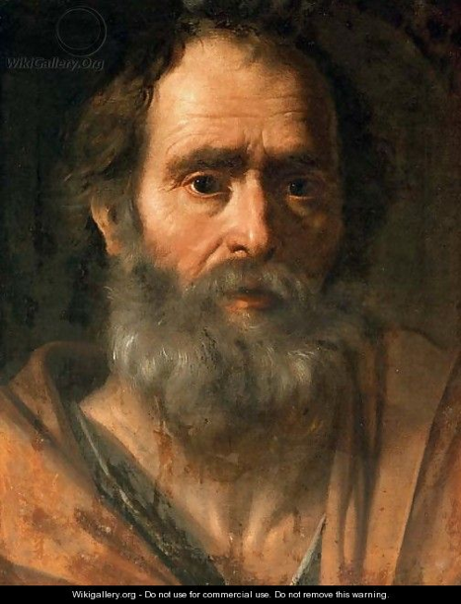
Characteristics
287
Supplements 1 Peter
Day of the Lord scenario (3:5-13)
Most explicit teaching on false teachers (chap. 2)
2 Peter

Slide 34
Key Verse
284
2 Peter 3:17-18
Therefore, dear friends, since you already know this, be on your guard so that you may not be carried away by the error of the lawless men and fall from your secure position. But grow in the grace and knowledge of our Lord and Savior Jesus Christ. To Him be glory both now and forever! Amen.
2 Peter

Slide 35

But what do we need to know?

Slide 36
What's Your View?
288
Please circle A (Agree), U (Unsure), or D (Disagree) before each of these statements:
1. God chooses those who will go to heaven
2. People on earth can know for sure whether they are going to heaven
3. False teachers sometimes teach in evangelical churches
4. No one who has truly trusted Christ will stop trusting Him until death
5. Christians already have all they need for successful spiritual living
A
Election
A
Assurance
A
Apostasy
D
Perseverance
Sufficiency
A

Slide 37
Major Theme
288
KNOWLEDGE…
• for spiritual growth (2 Pet. 1)
• to combat heresy (2 Pet. 2)
• to sustain hope (2 Pet. 3)
2 Peter

Slide 38
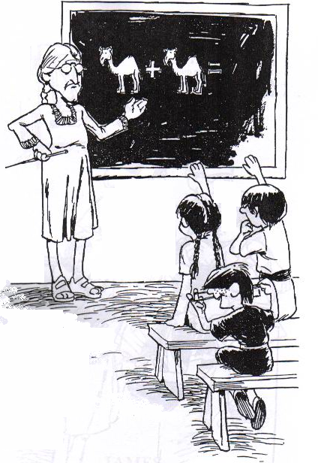
2nd Peter
Add virtue to faith
Deeds of false teachers
Diligence before Lord's return
The Acrostic Bible – Barry Huddleston

Slide 39

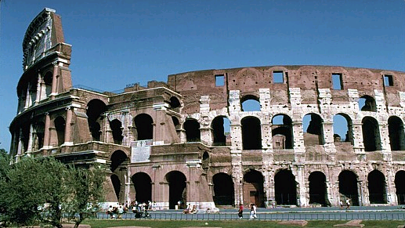
Background
39
39
39

Slide 40
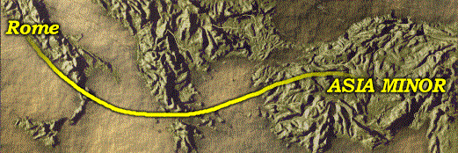
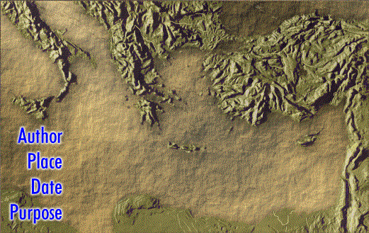
Author, Place, Date, Purpose
Rome
Encountering the NT CD-ROM study kit
Asia Minor
Author
Place
Date
Purpose
Simon Peter
Rome to Asia Minor
AD 60-64
To Encourage and Remind

Slide 41
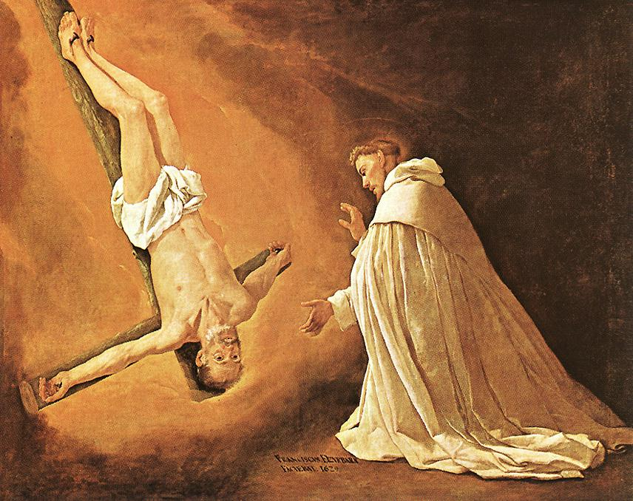
"For our Lord Jesus Christ has shown me that I must soon leave this earthly life, ¹⁵so I will work hard to make sure you always remember these things after I am gone" ( 2 Pet. 1:14-15 NLT)
Church tradition says Peter requested to be crucified upside down
41
41
41

Slide 42
The Authenticity of 2 Peter
285
Arguments Against Authenticity:
Dependent upon Jude as a source
Hellenistic concepts and language
A late date is postulated on the basis of the opponents
The appeal to the Pauline letters as Scripture
Commonality between 1-2 Clement, Shepherd of Hermas, and 2 Peter
Lacks external attestation
2 Peter

Slide 43
The Authenticity of 2 Peter
286
Arguments Defending Authenticity
Internal Evidence
The letter itself claims to have been written by Peter himself
Eyewitness of the transfiguration
Reference to Paul as a "beloved brother"
The letter claims to be the second one written
2 Peter

Slide 44
The Authenticity of 2 Peter
286
Arguments Defending Authenticity
External Evidence
Clement of Alexandria's commentary
Recognized as fully canonical
Included in various papyri
Peter as a businessman
Different style possibly due to different assistants employed
Small corpus to determine words
Evidence of Semitic influence
2 Peter

Slide 45
Authorship – External Evidence 1
2 Peter
Authorship
285
External Evidence
The early tradition is divided whether Peter wrote this epistle, although most regarded it authentic. The views of the Church Fathers and early canons is summarized below by century
External Evidence – 1st Century
Support 2 Peter as Authentic Lack of Mention of 2 Peter
Shows parallels with Jude (1:5 & Jude 3; 1:12 & Jude 5) —This point could be argued either way, depending on one's dating of Jude.
Possible allusions are in 1 Clement (AD 95) and Barnabas (AD 70-130)

Slide 46

Authorship – External Evidence 2
2 Peter
Authorship
285
External Evidence – 2nd Century
Support 2 Peter as Authentic
Vague Allusions:
Ignatius (AD 110)
Polycarp (ca. AD 110-150)
Justin Martyr (AD 150-155)
Irenaeus (ca. AD 185)
Probable Allusions (Quotes)
Gospel of Truth (Gnostic)
Apocryphon of John (Gnostic)
Apocalypse of Peter (Spurious)
Lack of Mention of 2 Peter
Muratorian Canon
(ca. AD 170)
Old Latin Version
(ca. AD 170)
Old Syriac Version
(ca. AD 200)

Slide 47
Authorship – External Evidence 3
2 Peter
Authorship
285
External Evidence – 3rd Century
Support 2 Peter as Authentic
Bodmer Papyrus (p 72)
Firmilian, Bishop of Caesarea (AD 256)
Methodius, Bishop of Lycis (quotes 3:8)
Lack of Mention of 2 Peter
Origen (AD 185-253)
- disputed
Tertullian
Cyprian
Dionysius of Alexandria

Slide 48
Authorship – External Evidence 4
2 Peter
Authorship
285
External Evidence – 4th Century
Support 2 Peter as Authentic
Athanasius of Alexandria (AD 367)
Basil the Great
Epiphanes, Bishop of Cyprus
Ambrose, Bishop of Milan
Cyril of Jerusalem
Hillary of Piotiers in Gaul
Gregory of Nazianzus
Augustine
Council of Laodicea (AD 363)
3rd Council of Carthage (AD 397)
Jerome's Vulgate (with doubt due to style)
Lack of Mention of 2 Peter
Eusebius placed it among books widely accepted but disputed by some since:
Writers whom he respected regarded it as non-canonical
Few earlier sources quoted it
(But he did not call it spurious)
Chrysostom
Theodore of Mopsuestia (rejected it)
Note 2 Peter's acceptance by the fourth century councils despite the objections raised.

Slide 49
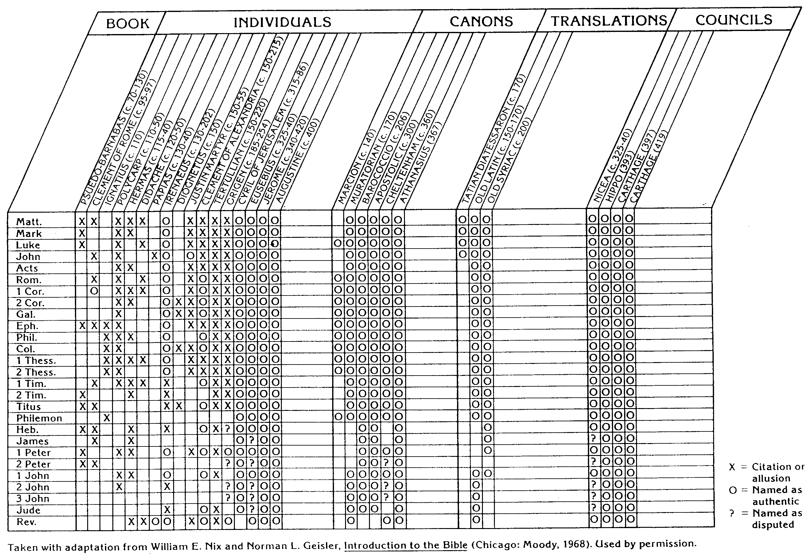
NT Canon during 1st 4C
The NT Canon in the First Four Centuries
H. Wayne House, Chronological & Background Charts to the NT
36
2 Peter

Slide 50
Authorship – External Evidence 4
2 Peter
Authorship
285
External Evidence – 6th Century
Supported 2 Peter as Authentic
Syrian Church

Slide 51
Authorship – Internal Evidence 1
2 Peter
Authorship
285-286
Internal Evidence
The liberal scholar Kümmel rejects Petrine authorship but candidly admits, "The letter clearly and unambiguously makes the claim that it was written by the apostle Peter." Then he cites the following evidence that it claims authorship by Peter:
1. It says Peter was the author: "Simon Peter, servant and apostle of Jesus Christ" (1:1).
2. The author speaks as an eyewitness of the transfiguration of Jesus (1:16f.).
3. He makes reference to the saying of Jesus concerning the martyrdom of Peter (1:14).

Slide 52
Authorship – Internal Evidence 2
2 Peter
Authorship
285-286
Internal Evidence
The liberal scholar Kümmel rejects Petrine authorship but candidly admits, "the letter clearly and unambiguously makes the claim that it was written by the apostle Peter." Then he cites the following evidence that it claims authorship by Peter :
4. Reference to the "beloved brother Paul" places the author on the same level of apostolic authority as Paul (3:15f.).
5. Second Peter makes a clear reference to 1 Peter: "This is already the second letter I am writing to you" (3:1).
6. "Since Peter regards his death as near (1:13ff), 2 Peter is written in the form of a testament of Peter."

Slide 53
Authorship – Internal Evidence 4
2 Peter
Authorship
286
Internal Evidence
After presenting irrefutable internal evidence for Peter as author, Kümmel's very next statement denies the evidence by stating, "But this letter cannot have been written by Peter." The following cites his six objections (Kümmel, 430-33) and rebuttals to each:
1. Objection: The literary dependence on Jude rules this out.
Response: The unconfirmed assumptions are that Jude is post-apostolic and that 2 Peter quotes Jude, but the opposite is true since Peter wrote first (AD 64 for 2 Peter and ca. AD 70-80 for Jude). Jude 17-18 quotes 2 Peter 3:3 as written by an apostle.

Slide 54
Authorship – Internal Evidence 6
2 Peter
Authorship
286
2. Objection: The language and style shows a Hellenistic flavor which not only rules out Peter, but his disciples as well.
Response: Stylistic differences between 1 and 2 Peter can be explained in that Silas helped write 1 Peter (5:12) whereas Peter wrote 2 Peter by himself. Also, the letters deal with different subjects so the vocabulary should not be the same.
3. Objection: It argues against Gnostics who deny Christ's soon coming (1:12f; 3:3).
Response: The unproven assumption is that the writing refers to second century Gnostics. There exists no reason that Peter couldn't have faced doubters in AD 64.

Slide 55
Authorship – Internal Evidence 7
2 Peter
Authorship
286
4. Objection: The author refers to a collection of Paul's letters as Scripture (3:16), whose interpretation is reserved for the ecclesiastical teaching office (1:20f.). This dates the letter "without doubt far beyond the time of Peter and into the epoch of 'early Catholicism'" (Kümmel, 432).
Response: The "interpretation" of 1:20 refers not to that of a teaching office in the church. It says that prophecy did not come by any prophet's interpretation. Further, reference to Paul's letters as Scripture only proves that they were regarded as authoritative very early.

Slide 56
Authorship – Internal Evidence 7
2 Peter
Authorship
286
5. Objection: "The pseudonymity in 2 Peter is carried through consistently by means of heavy stress on the Petrine authorship" (Kümmel, 433).
Response: In typical liberal fashion, Kümmel denies the evidence. If the letter did not emphasize Petrine authorship it would be spurious, and even if does, it is suspect! This "logic" exalts preconceived speculations over textual fact.

Slide 57
Authorship – Internal Evidence 7
2 Peter
Authorship
286
6. Objection: Second Peter is nowhere mentioned in the second century despite its heavy stress on Petrine authorship.
Response: Lack of mention by early individuals, councils, and canons proves only that while most accepted it, some disputed it. The epistle was never rejected, so internal evidence must take priority over arguments from silence.

Slide 58
Authorship - Conclusion
2 Peter
Authorship
286
Conclusion
While some disputed the authenticity of 2 Peter, the evidence (especially internal) shows that Peter did in fact write this letter bearing his name. The book is markedly superior to the spurious books attributed to Peter—Gospel of Peter, Preaching of Peter, Acts of Peter, and Apocalypse of Peter. The authenticity of the epistle is also confirmed in its language which is similar to Peter's speeches in Acts.

Slide 59
Circumstances 1
2 Peter
Circumstances
287
Date
Peter was martyred in the spring AD 64, so 2 Peter was likely written in this same year as it was shortly before his death (2 Pet. 1:13-15).
Origin
Both conservatives and critics agree that the evidence for the origin of 1 Peter in Rome undoubtedly applies to 2 Peter as well
Recipients
In 1 Peter the apostle addresses "God's elect, strangers in the world, scattered throughout Pontus, Galatia, Cappadocia, Asia and Bithynia" (1 Pet. 1:1b). The readers were likely both Jews (the minority) and Gentiles (the majority) that Peter himself had nurtured (cf. 1 Peter notes). In 2 Peter he addresses the same group (2 Pet. 3:1).

Slide 60
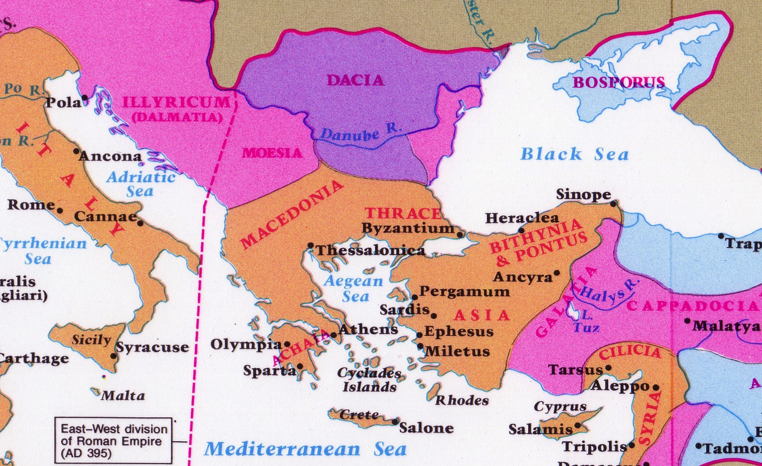
A Circular Letter from Peter to Turkey…
From
Rome

Slide 61
Occasion
2 Peter
Occasion
287
Peter recalled that this earth is not our home (1:7).
He did not refer to his imprisonment but still expected the persecutions to take his life (1:14-15a), which did take place.
Within months after recording this letter, Rome was burned (19 July 64) and Nero used the Christians as his scapegoat.
Before his soon death Peter reminded his readers of truths they already knew (1:12, 15b; 3:17a) to stimulate them to wholesome thinking (3:1b)—both a knowledge of error (3:17) and truth (3:18).
Interestingly, his concern was for orthodoxy during suffering.

Slide 62
Argument
2 Peter
Argument
287
Second Peter emphasizes knowledge, as is seen in the sixteen occurrences of words for "knowledge"
Peter wants his readers to have knowledge in three areas:
A knowledge of God and his choice of them (ch. 1)
A knowledge of the characteristics and destruction of future false teachers (ch. 2)
A knowledge of Christ's return and
the coming Day of the Lord (ch. 3)
This knowledge must work itself out in godly behaviour and cautiousness of heresy (3:17-18).

Slide 63

Synthesis
2 Peter
Synthesis
288
Know these things to combat heresy
1 God's election
2 Traits of apostasy
3 Lord's return

Slide 64
Summary Statement
2 Peter
Summary Statement
284
To grow in grace instead of succumbing to false teaching, we need to know that Jesus chose us and that he will judge apostates at his return.
Notes:
Peter reminds north Asian believers of their knowledge of the characteristics and future destruction of false teachers and of the grace of Jesus Christ in order to combat false teaching and stimulate growth in godliness.

Slide 65
Outline
2 Peter
Outline
288-289
I. (Ch. 1) Peter assures his readers that their knowledge of God and His choice of them has a firm foundation and provides them with all they need for godliness so they can fight successfully against the false teaching in their midst.
II. (Ch. 2) Peter warns of a future time of apostasy by a detailed description of the false teachers to assure his readers that their knowledge of God will be needed to recognize and defeat these apostates.
III. (Ch. 3) Peter exhorts holy and godly living based upon a knowledge of Christ's return and the destruction of everything in the Day of the Lord.

Slide 66
Summary Statement / Application
2 Peter
Application
284
Never stop being a student of the Scripture. If you do, you will stop growing in grace and you will eventually tolerate and/or promote heresy.
So what new things in His Word has God been teaching you lately?

Slide 67


Summary Statement / Application
2 Peter
Discussion Questions
284
How does knowing we are chosen by God provide a foundation for growing in our knowledge of the Lord (1:12-21)?
Why is belief in Christ's return so key to growing in knowledge (3:1-4)?
What does it mean to "grow in grace" (3:18)? How can one do this?

Slide 68
Summary
AUTHOR | Simon Peter | Calvin: Peter's disciple | Peter's colleagues | Pseudonymous writer
DATE | Shortly before Peter's death (AD 60-64) |  | Bauckham: AD 80-90 (probably after Peter's death) | AD 80-150 Kümmel: AD 125-150
PLACE WRITTEN | Rome
READERS | Most scholars point to a Christian community, most likely Gentiles (living in and influenced by pagan community) in Asia Minor—but others suggest Egypt.
OCCASION | Peter wrote this epistle as a reminder of truths his readers already knew (1:12, 15b; 3:17a) to stimulate them to wholesome thinking—both a knowledge of error as well as truth; knowing that the recipients were troubled because of false teaching among them.
LANGUAGE | Greek
2 Peter

Slide 69
Key Word / Verse
284
2 Peter
Key Word
Knowledge
Key Verse
"Therefore, dear friends, since you already know this, be on your guard so that you may not be carried away by the error of lawless men and fall from your secure position. But grow in the grace and knowledge of our Lord and Savior Jesus Christ. To him be glory both now and forever! Amen" (2 Peter 3:17-18).

Slide 70
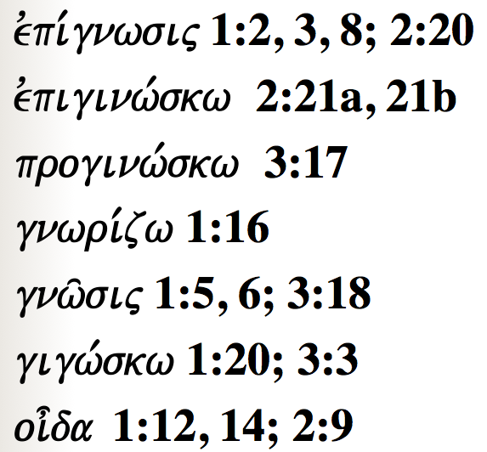
Peter uses each of these words to show how knowledge is vital for believers…
287
evpi,gnwsij 1:2, 3, 8; 2:20
evpiginw,skw 2:21a, 21b
proginw,skw 3:17
gnwri,zw 1:16
gnw/sij 1:5, 6; 3:18
gigw,skw 1:20; 3:3
oi=da 1:12, 14; 2:9

Slide 71

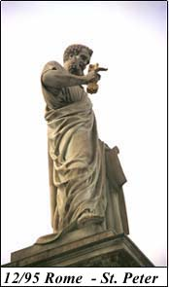


Now into the Book's Content…
71
71
71

Slide 72
Summary Chart
Knowledge to Combat False Teaching
2 Peter
284
God's Election
Future Apostasy
Lord's Return
Chapter 1
Chapter 2
Chapter 3
Saluta-tion
1:1-2
Provides Every Need
1:3-11
Foundation of Knowledge
1:12-21
False Teachers Coming
2:1-3a
End in Hell
2:3b-10a
Character Described
2:10b-22
Scoffers Before Rapture
3:1-7
Temporary World Motivates Holiness
3:8-16
Protection & Growth Encouraged
3:17-18
Adequacy of
Believers
Inadequacy of
Unbelievers
Expectancy of
Believers
Holiness
Heresy
Hope
Disciples
of the Lord
Diabolical Leaders
Day
of the Lord
Rome to North Asia Minor
AD 64

Slide 73
2 Peter
288
Salutation (1:1-2)
Chapter 1 - Certainty of Believers' Salvation & Exhortation to Growth
The Work of God (1:3-4)
God's Provision + Our Response = Life & Godliness (1:5-11)
The Word of God (1:12-21)
Chapter 2 - Peter's Prediction of False Teachers (2:1-22)
Condemnation of False Teachers (2:3b-9)
Characteristics of False Teachers (2:10-22)
Chapter 3 - Peter's Prediction of Scoffers before Rapture (3:1-16)
Scoffers' Denial of the Lord's Return & the Flood (3:3-4)
The Certainty of Christ's Return, judgment and destruction of heavens/earth (3:5-13)
Exhortations to Believers based on the Fact of Christ's Return (3:14-16)
Conclusion - Summary of Letter (3:17) & Benediction (3:18)
2 Peter

Slide 74
Be Knowledgeable
2 Peter
Dr. Rick Griffith • Crossroads International Church Singapore
BibleStudyDownloads.org

Slide 75
Key Word
284
Knowledge
2 Peter
Notes:
You probably will be happy to hear that the Bible has much to say about knowledge—that seeking knowledge is a great thing! That is the key word for the letter of 2 Peter that we will study today.

Slide 76
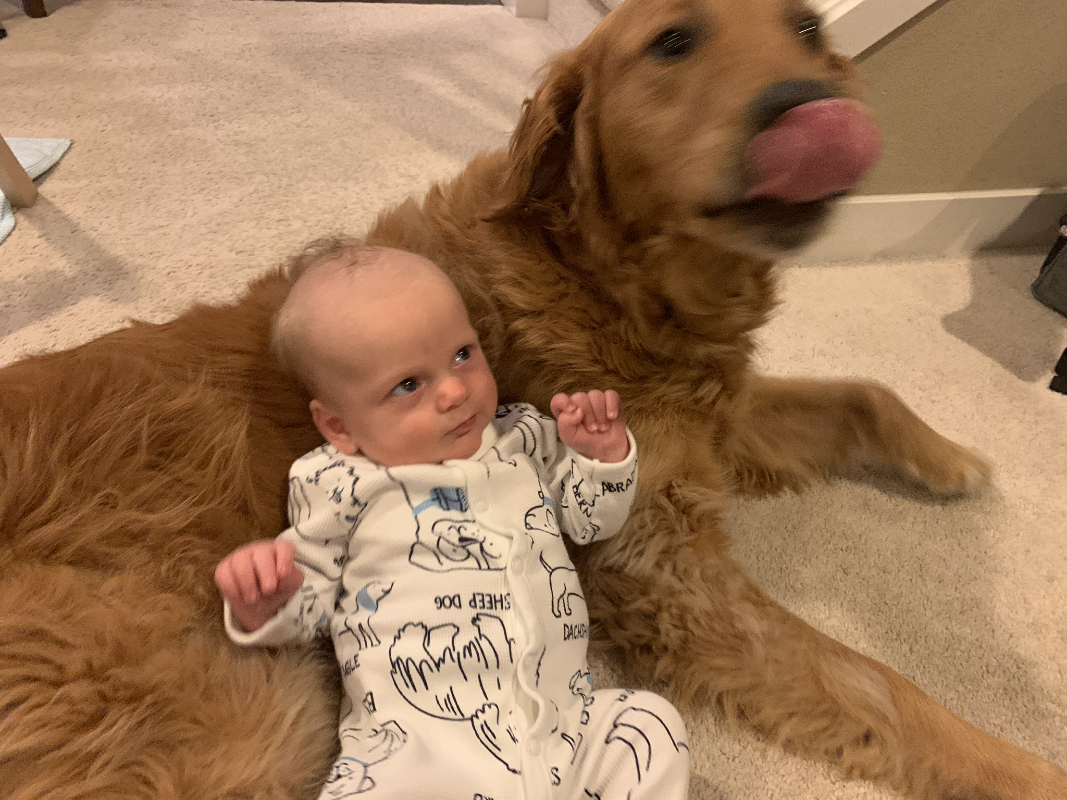
We know about family…
Notes:
Of course, we all want knowledge about our family.

Slide 77
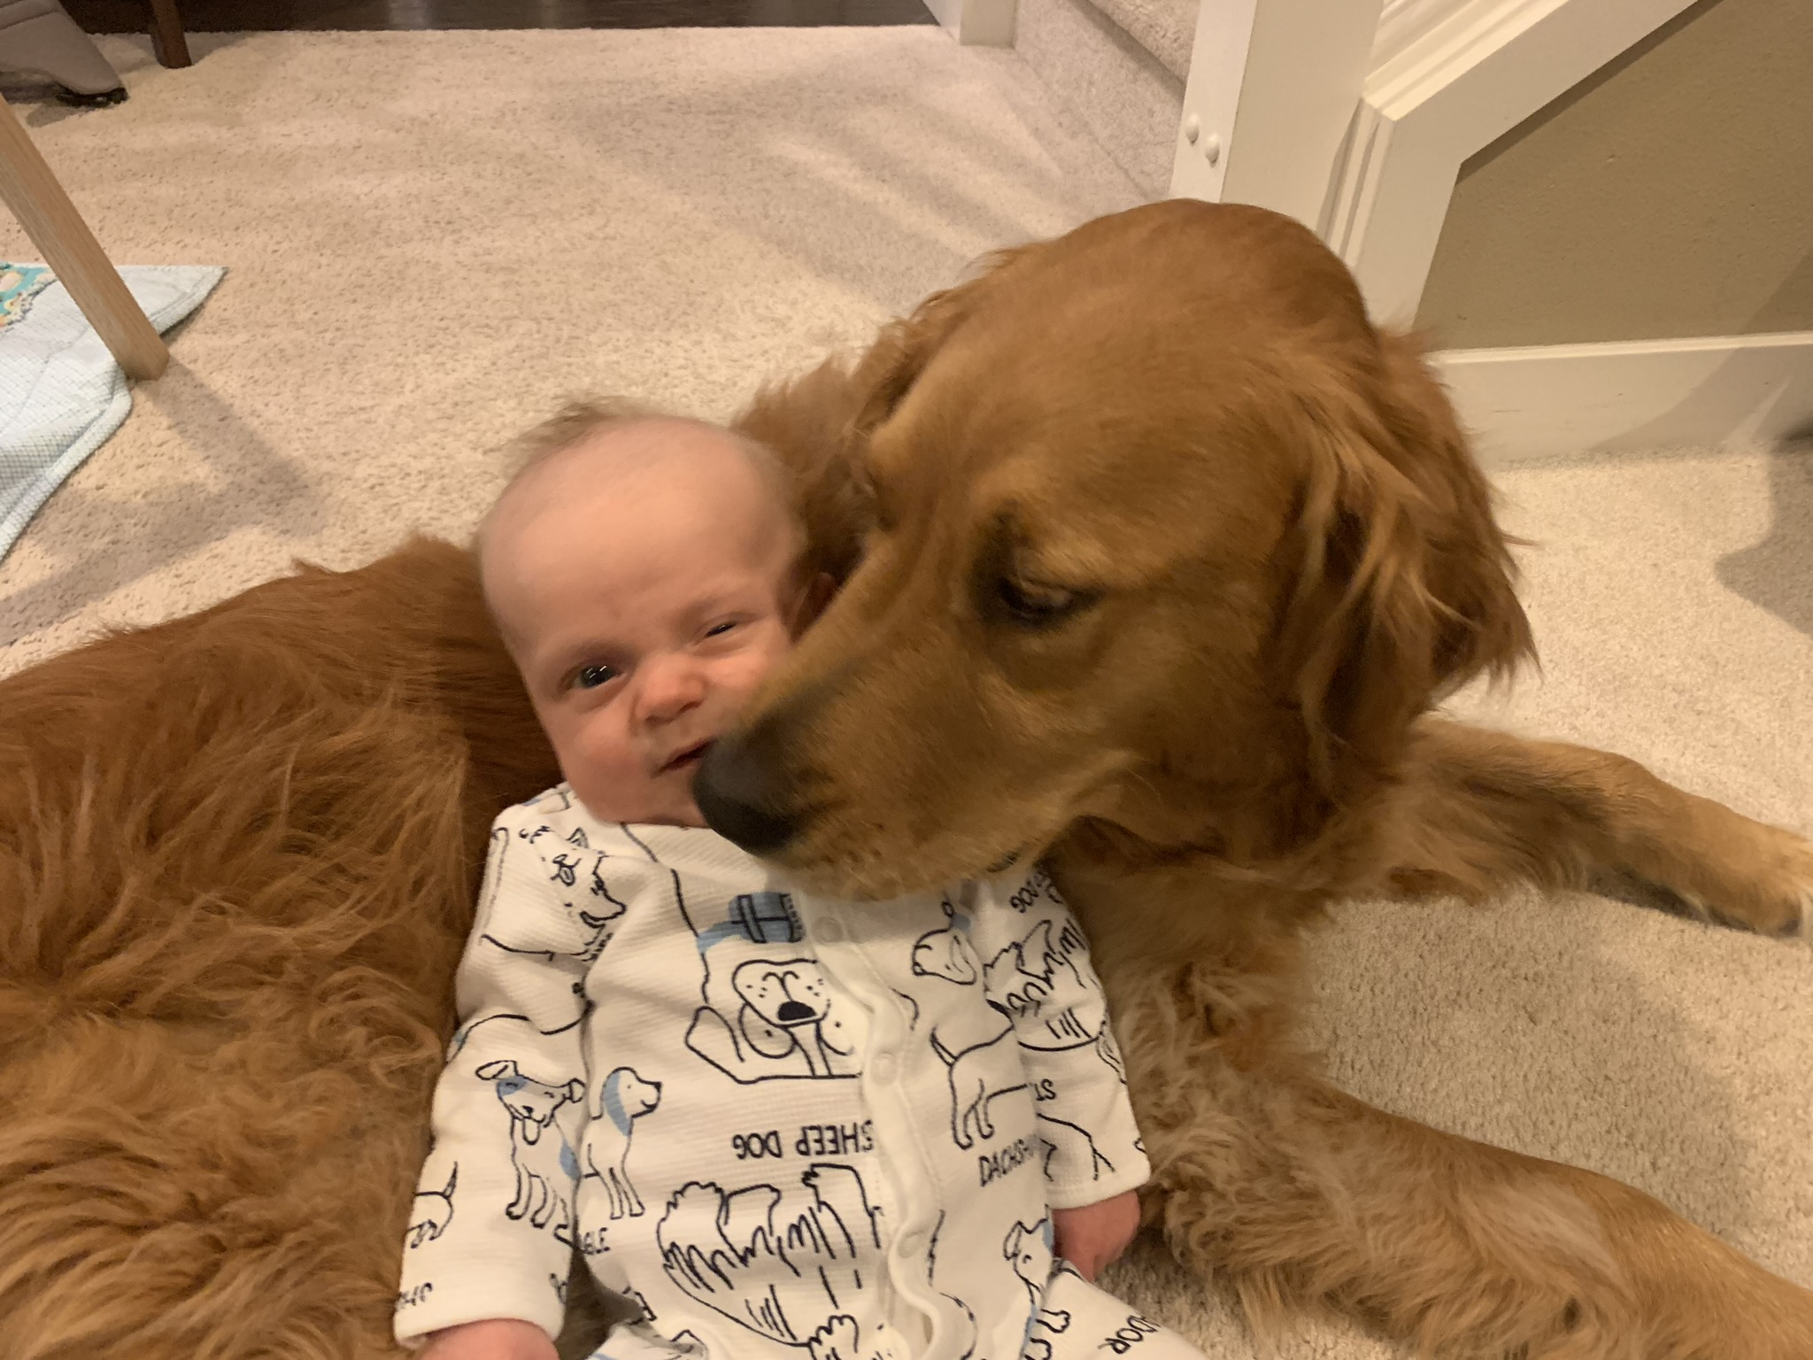
We know about family…
Notes:
I want to know how my grandson is getting along with the dog.

Slide 78
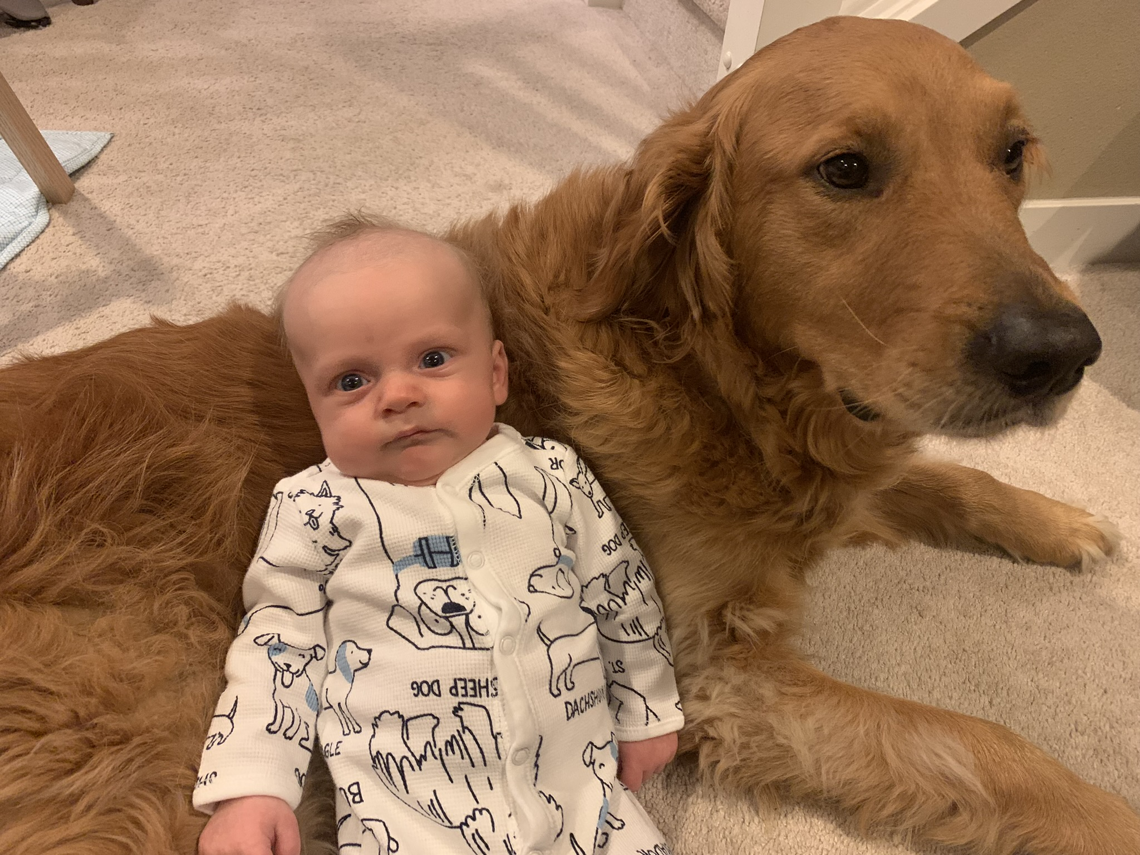
We know about family…
Notes:
Looks like he has some knowledge to gain about dog kisses!

Slide 79
It seems we know about…
all the wrong things…

Slide 80

What We Do Know About…
1985: First year more videos checked out of USA libraries than books
2015: Teens ages 13-18 spent 9 hours/day on "entertainment media" (Common Sense Media, Oct 2015)
Average age of gamers: 30 (Boston Globe, 2005)
American adults average 17x as much time watching TV as all reading (books, magazines, newspaper, etc. (Gordon, Why Johnny Can't Preach, 35)
We touch our cell phones (tap, swipe, click) 2,617 times a day (Network World, 7 July 2016)

Slide 81
Theme
23
Knowledge to Combat False Teaching
2 Peter
Notes:
But the knowledge that Peter is talking about is knowledge to fight heresy…

Slide 82
Key Verse
284
“Therefore, dear friends, since you already know this, be on your guard so that you may not be carried away by the error of lawless men and fall from your secure position. But grow in the grace and knowledge of our Lord and Savior Jesus Christ. To him be glory both now and forever! Amen” (3:17-18).
2 Peter
Notes:
The last two verses of his letter notes twice the importance of knowing the truth.

Slide 83

Growing In Faith
Notes:
You’ve likely heard much about growing in faith.

Slide 84


grow in GRACE
Notes:
But Peter’s emphasis is on growing in grace. What does that mean?
______
To translate this slide, delete the picture and translate the text underneath it.

Slide 85

Grow in the Grace and Knowledge of our Lord Jesus Christ
Notes:
Even further, Peter says his letter tells us to grow in the grace and knowledge of the Lord Jesus Christ. Put that in your own words for your neighbor sitting next to you.

Slide 86
Key Verse
284
“Therefore, dear friends, since you already know this, be on your guard so that you may not be carried away by the error of lawless men and fall from your secure position. But grow in the grace and knowledge of our Lord and Savior Jesus Christ. To him be glory both now and forever! Amen” (3:17-18).
2 Peter
Notes:
So how do we do this? How do we grow in grace and knowledge? What do we need to know to do this?

Slide 87
What to know to grow…
Notes:
In short, what do we need to know to grow?

Slide 88
What must you know to grow in grace rather than to fall for false teaching?
2 Peter
Notes:
What knowledge will help you better grasp God's goodness instead losing your faith in Christ?
___________
NS-22-2Peter-15, 88, 106, 190, 240, 269

Slide 89
Background to 2 Peter
Notes:
To answer this question, let’s see the context in which Peter wrote…

Slide 90

Let's Study Through Scripture
The Bible: Book by Book
Notes:
OP-01-Gen-06
OP-02-Lev-05
NP-2 Peter-18
OS-09-1Sam-34
OS-10-2Sam-48
OS-12-2Kings-94
OS-13-1Chron-41
OS-14-2Chron-63
We are in a study through the whole Bible right now, book by book. The goal is to give us a basic understanding of each book of the Bible.

Slide 91
NT Overview (Chronological)
38 124 39-41
"To the remotest part of the earth" (Acts 1:8)
Acts 9 13 14 15 16 18 21 27 28
Apr 48- Sep 49
1 Galatia
Apr 50- Sep 52
2 Aegean
Spr 53- May 57
3 Asia
Feb 60- Mar 62
1 Rome
Spr 62- Fall 67
4 Spain
Aut 67- Spr 68
2 Rome
Summer 35- 37
Damascus Antioch
May 57- Aug 59
Trials
Fall 49
The
Council
Spring 68
Expansion of Church
35 48 49 50 52 53 57 60 62 67 68 95
Matt
Luke
Acts
Mark
John
Gal
1 Thess
1 Cor
Eph
1 Tim
2 Tim
Jude
James
2 Thess
2 Cor
Col
Titus
Heb
1 John
Romans
Philem
1 Pet
2 John
Gospels & Acts
Phil
2 Pet
3 John
Pauline Epistles
1234
Journeys
Rev
General Epistles
Rome
Imprisonments
Chronological
Notes:
Peter’s second letter is only the third General Epistle in our NT. After this study, we have 10 more NT books until we finish this series that I am calling “The Bible: Book by Book.”

Slide 92
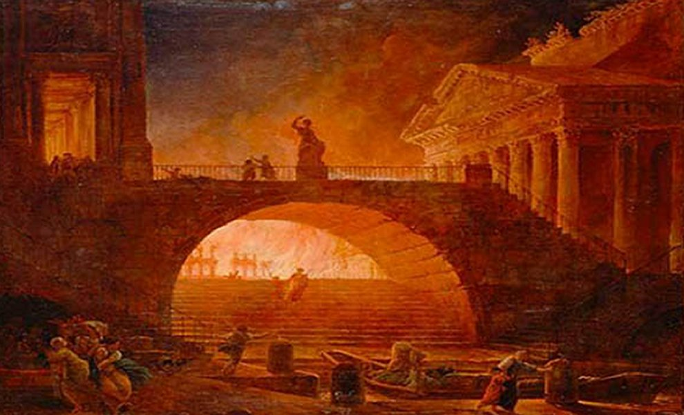
The Great Fire of Rome
July AD 64
Notes:
“On July 19, AD 64, a fire started in Rome. When the fire was extinguished six days later, more than 70% of the city was in ruins.”
____________
https://www.nationalgeographic.org/thisday/jul19/great-fire-rome/
“After six days the fire was brought under control, and before the damage could be measured, the fire reignited and burned for another three days. In the aftermath of the fire, two thirds of Rome had been destroyed.”
________
Great Fire of Rome
https://en.wikipedia.org/wiki/Great_Fire_of_Rome

Slide 93
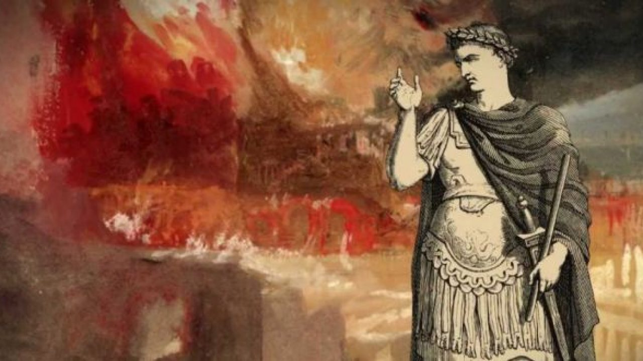
The Great Fire of Rome
July AD 64
Notes:
The “fire started in the enormous Circus Maximus stadium in Rome, now the capital of Italy. When the fire was finally extinguished six days later, 10 of Rome’s 14 districts were burned.
Ancient historians blamed Rome’s infamous emperor, Nero, for the fire. One historian said Nero was playing the fiddle while his city went up in flames [even though the fiddle wasn’t invented until another 1000 years later!]. Other historians say Nero wanted to raze the city so he could build a new palace.” This grand palace was planned to take 30% of the area of Rome!
_________
Jul 19, 64 CE: Great Fire of Rome
https://www.nationalgeographic.org/thisday/jul19/great-fire-rome/

Slide 94
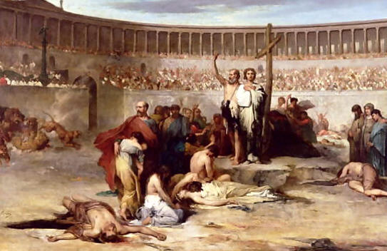
The Great Fire of Rome
July AD 64
Notes:
“Nero himself blamed [what he considered] a rebellious new cult—the Christians.
“Most modern historians don’t blame Nero for the Great Fire of Rome. Ancient Rome was a city of more than two million people, with thousands living in slums. These slums were filled with poorly constructed wooden apartment buildings. A fire in one apartment could quickly engulf the entire block.”
In any case, the fire made it very difficult to live as a Christian—especially in Rome. Christians were soon fed to lions and dogs and even used to light Nero’s evening gardens.
_________
Jul 19, 64 CE: Great Fire of Rome
https://www.nationalgeographic.org/thisday/jul19/great-fire-rome/

Slide 95
A Circular Letter from Peter to Turkey…
From
Rome
Notes:
Peter arrived in Rome about AD 62 and died there two years later in AD 64.

Slide 96
Contrast between 2 Letters
2 Peter
287
Contrasting Peter's Two Letters
First Peter
Second Peter
Nature of Problem
Persecution (Hostility)
False Teaching (Heresy)
Source of Problem
External
Internal
Theme
Hope
Knowledge
Key Word
(all forms)
"suffering"
(16 times)
"knowledge"
(16 times)
Date
Early AD 64
Early spring AD 64
Notes:
In AD 64, believers were falling away not due to persecution but due to lack of knowledge.
Peter had likely sent his first letter to the readers only months before.
In fact, more NT letters were written in the 60s than in any other decade. Why? Two reasons:
In 1 Peter, Peter advised believers to stand firm in God’s grace during unjust suffering—as this was the first big wave of suffering to hit the church.
More than that, though, was the proliferation of false teachers in the 60s.

Slide 97

Joshua Harris
I Kissed Dating Goodbye
—A New Attitude Toward Romance and Relationships
Notes:
Perhaps you have heard of Joshua Harris. In 1997 at age 21 he wrote a significant book called I Kissed Dating Goodbye. It was a hit and God used it mightily to support the purity movement.

Slide 98

Joshua Harris
Boy Meets Girl
—Say Hello to Courtship
Notes:
He himself waited until marriage for sex and later wrote Boy Meets Girl.

Slide 99
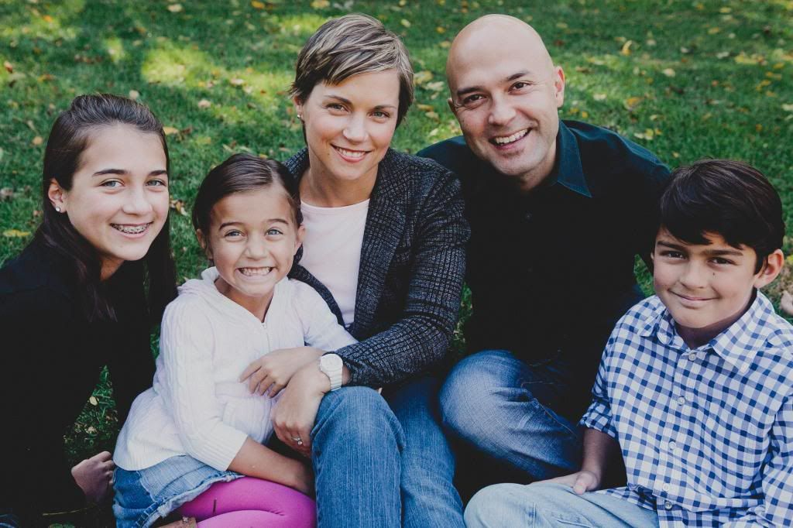
Joshua & Shannon Harris
Notes:
It happened in his own life when God gave him his wife Shannon and three great kids.

Slide 100
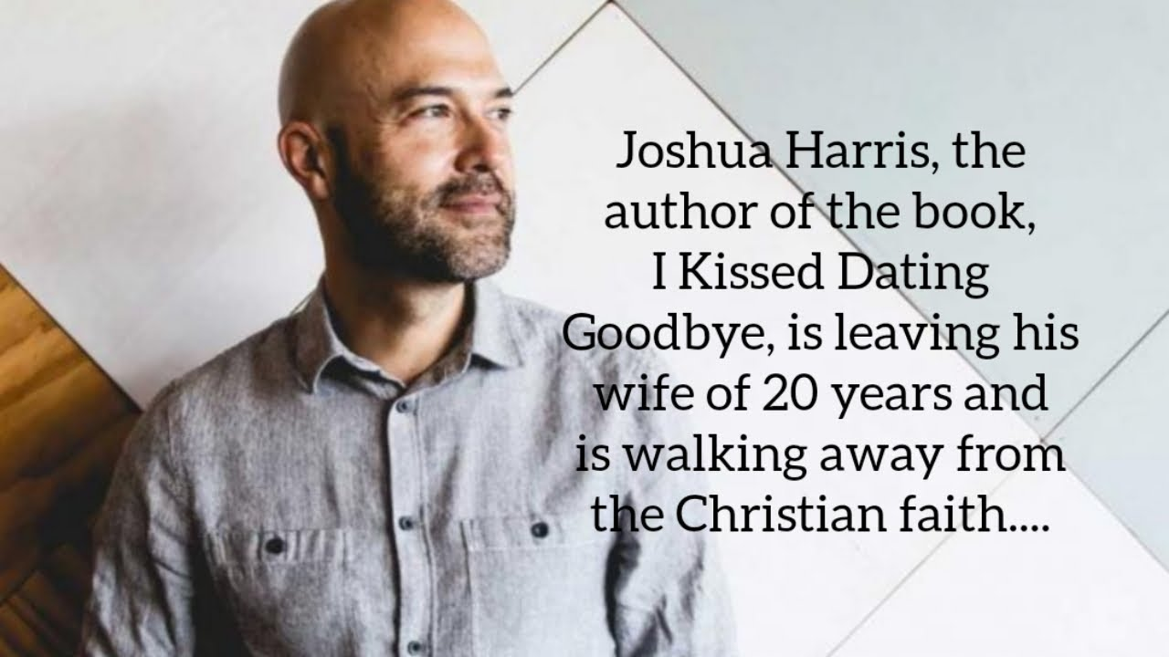
Apostasy of Joshua Harris
Joshua Harris, author of I Kissed Dating Goodbye, left his kids and wife of 20 years to walk away from the Christian faith in 2019.
Notes:
Yet in July 2019, Harris announced the breakup of his marriage.

Slide 101
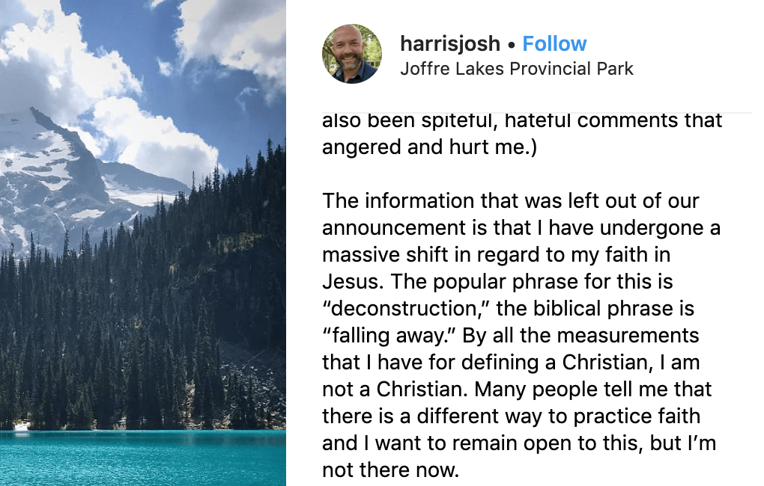
Apostasy of Joshua Harris
The information that was left out of our announcement is that I have undergone a massive shift in regard to my faith in Jesus. The popular phrase for this is "deconstruction," the biblical phrase is "falling away." By all the measurements that I have for defining a Christian, I am not a Christian. Many people tell me that there is a different way to practice faith and I want to remain open to this, but I'm not there now.
Notes:
He also claimed to be leaving his faith [read second paragraph above].

Slide 102
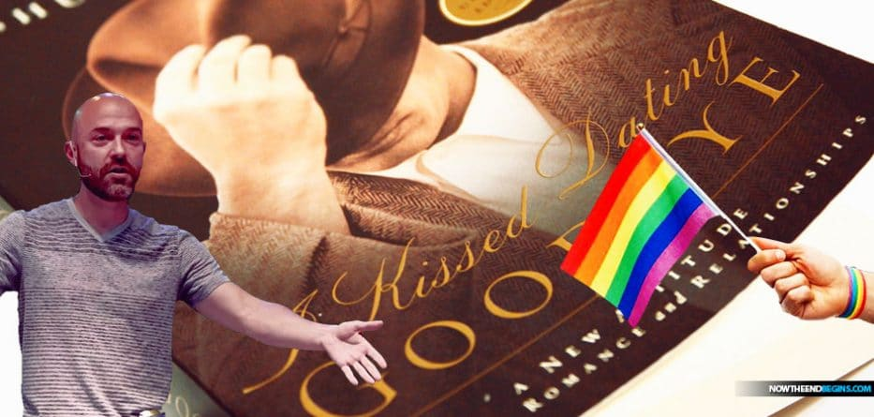
Apostasy of Joshua Harris
Notes:
He has now started waving the rainbow flag too. Sadder than that…

Slide 103
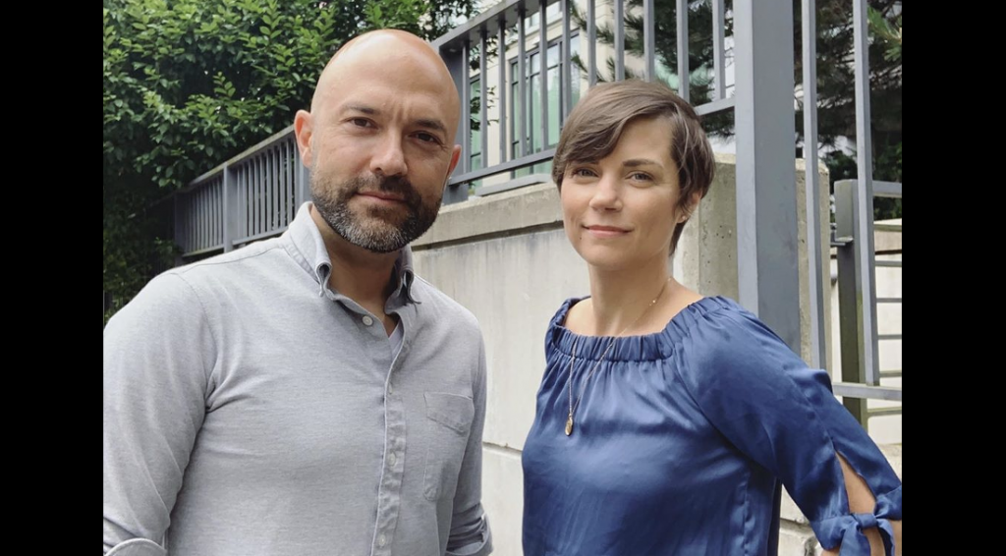
Apostasy of Joshua Harris
“The man who urged Christians to embrace ‘purity’ if they wanted a happy marriage is now ending his own.” —Friendly Atheist website
Notes:
The website “Friendly Atheist” notes, “The man who urged Christians to embrace ‘purity’ if they wanted a happy marriage is now ending his own.”
————
“In news that surely marks the end of an era, Joshua Harris has announced that he and his wife Shannon are separating.
Why is that noteworthy? Because Harris is the infamous author of I Kissed Dating Goodbye, the 1997 book that jumpstarted the “purity culture” movement among evangelical Christians. He got married to Shannon a few years after his book was released and wrote about the relationship in Boy Meets Girl: Say Hello to Courtship (2000).
The man who urged Christians to embrace “purity” if they wanted a happy marriage is now ending his own.
We’re not saying that with any delight or schadenfreude. The couple has three kids who will be affected by this, and what they’re all going through is entirely between them. We don’t know why they’re separating, and frankly, it shouldn’t matter.
But it’s still worth mentioning because Harris is best known for telling other people how to conduct their relationships.
His book, which came out when he was only 21, advised an entire generation of Christians to practice “courtship” instead of dating, the latter of which he saw as a “fast track” to divorce. Harris also advised against “emotional infidelity” — that is, falling in love with someone whom you don’t eventually marry.
His words were embraced by untold numbers of parents, youth pastors, and other church authority figures. Consequently, many people took his words as gospel, and ended up marrying the first person they ever had a crush on, at extremely young ages, with no prior relationship experience.
A few years ago, Harris went on an apology tour of sorts, saying he regretted wrecking so many people’s lives. Many of his former fans, however, found his apologies empty and insincere. While he said the book would no longer be printed (or reprinted), Harris didn’t really acknowledge that he was wrong in principle. He still rejected LGBTQ relationships. While he now said that dating might have its benefits even if it didn’t lead to marriage, he blamed people for how they followed his advice, not the crux of the advice itself.
And now the man who convinced countless Christians to jump into a marriage before ever truly knowing themselves will be single once again.
Tempting though it may be to gloat about this news, keep in mind that Harris was indoctrinated, too. While he is fully responsible for perpetuating toxic ideologies as an adult, he grew up in the same toxic purity culture that he encouraged with his readers. He likely didn’t know any better when he inadvertently became the father of a movement.
The news of his separation essentially confirms what we already knew: Purity culture makes extraordinary promises that it ultimately cannot keep.
The prevailing message of I Kissed Dating Goodbye was this: Follow these rules, and your marriage will be safe. Your relationship will be happier and more successful than those of your peers who dated around before settling down.
As it turns out, relationships are as complex as the people in them. Being abstinent doesn’t change that. Dating around doesn’t change that. There aren’t any foolproof “rules” after all.
It’s long past time for the “purity” advocates to update their guidebooks.”
““Purity Culture” Advocate Joshua Harris Announces Separation from Spouse
By Sarahbeth Caplin
July 18, 2019
https://friendlyatheist.patheos.com/2019/07/18/purity-culture-advocate-joshua-harris-announces-separation-from-spouse/

Slide 104

Three truths to know…
2 PETER
Grow in the GRACE & KNOWLEDGE of Your LORD & SAVIOR
Notes:
Today we will see three things that we need to know to grow in grace rather than fall for false teaching.
————
Translators, please translate the text box and then drag it over the English text.

Slide 105
Summary Chart
2 Peter
284
Knowledge to Combat False Teaching
God's Election
Future Apostasy
Lord's Return
Chapter 1
Chapter 2
Chapter 3
Saluta-tion
1:1-2
Provides Every Need
1:3-11
Foundation of Knowledge
1:12-21
False Teachers Coming
2:1-3a
End in Hell
2:3b-10a
Character Described
2:10b-22
Scoffers Before Rapture
3:1-7
Temporary World Motivates Holiness
3:8-16
Protection & Growth Encouraged
3:17-18
Adequacy of
Believers
Inadequacy of
Unbelievers
Expectancy of
Believers
Holiness
Heresy
Hope
Disciples
of the Lord
Diabolical Leaders
Day
of the Lord
Rome to North Asia Minor
AD 64

Slide 106
What must you know to grow in grace rather than to fall for false teaching?
2 Peter
Notes:
What knowledge will help you better grasp God's goodness instead losing your faith in Christ?
___________
NS-22-2Peter-15, 88, 106, 190, 240, 269

Slide 107
I. Know that Christ chose and fully equipped you (2 Peter 1).
What to know to grow…

Slide 108
Slides on 2 Peter 1

Slide 109

2 Pet. 1:1 Simon Peter, a bond-servant and apostle of Jesus Christ, To those who have received a faith of the same kind as ours, by the righteousness of our God and Savior, Jesus Christ:
2 Grace and peace be multiplied to you in the knowledge of God and of Jesus our Lord;
3 seeing that His divine power has granted to us everything pertaining to life and godliness, through the true knowledge of Him who called us ¹by His own glory and excellence.

Slide 110
4 For by these He has granted to us His precious and magnificent promises, so that by them you may become partakers of the divine nature, having escaped the corruption that is in ethe world by lust.
5 Now for this very reason also, applying all diligence, in your faith supply moral excellence, and in your moral excellence, knowledge,
6 and in your knowledge, self-control, and in your self-control, perseverance, and in your perseverance, godliness,
7 and in your godliness, brotherly kindness, and in your brotherly kindness, love.

Slide 111
8 For if these qualities are yours and are increasing, they render you neither useless nor unfruitful in the true knowledge of our Lord Jesus Christ.
For he who lacks these qualities is blind or short-sighted, having forgotten his purification from his former sins.
10 Therefore, brethren, be all the more diligent to make certain about His calling and choosing you; for as long as you practice these things, you will never stumble;
11 for in this way the entrance into the eternal kingdom of our Lord and Savior Jesus Christ will be abundantly supplied to you.

Slide 112

2 Peter 1 Knowledge for Spiritual Growth
288
A. Salutation (1-2)
B. God's Divine Power (3-4)
C. Effective & Productive Christian life (5-11)
D. Reminder of Salvation (12-15)
E. Defense of the Truth of the Message (16-21)

Slide 113
2 Peter 1
288
A. (1:1-2)
Salutation
Equality to the apostles

Slide 114
2 Peter 1
289
B. (1:3-4)
God's Divine Power
Knowledge of Christ
Share in the divine nature
Escape the corruption in the world
Everything

Slide 115
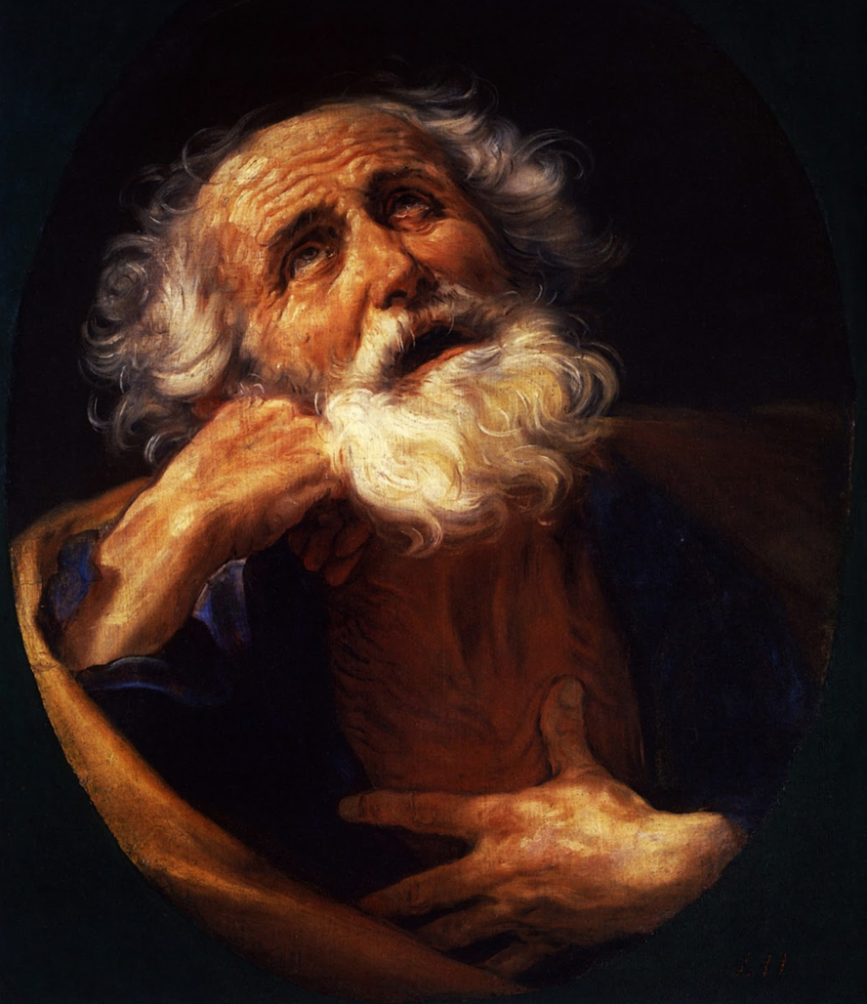
What to Know, What to Do
2 Peter 1:1-11

Slide 116

Do you want more knowledge?
Notes:
Who here wants more knowledge? Raise your hand.

Slide 117

Knowledge 知识
Notes:
Students, what do you think of your education so far? By this time in the semester, some students are just getting going, while for others, May (or graduation) can't come soon enough.

Slide 118
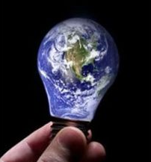
Knowledge is Infinite
Notes:
Prospective students, you certainly already know that knowledge is infinite.
This was made clear to me by one of my teachers. He told me, "We are giving you your PhD because we've educated you beyond your intelligence!"
In any case, people have various opinions about education.

Slide 119

Pride of Knowledge
Notes:
Some love learning so they can pride their knowledge over others. If you're thinking about coming to SBC to show off your knowledge, you will be disappointed.

Slide 120
Anti-Intellectual
Notes:
Others are at the other end of the spectrum and are anti-intellectual, thinking that education is a waste of time. Well, I wouldn't encourage such people to come either!

Slide 121
287
2 Peter
Problem
False Teaching (Heresy)
Source of Problem
Internal
Key Word
"knowledge"
(16 times)
Date
Early spring AD 64
Notes:
Peter avoids both of these extremes in 2 Peter. He wrote to his readers facing an internal problem of heresy, so he uses the words for "knowledge" 16 times in this short letter of three brief chapters—and he presents knowledge in a positive sense.

Slide 122
Peter uses many words to show how knowledge is vital for believers…
287
evpi,gnwsij 1:2, 3, 8; 2:20
evpiginw,skw 2:21a, 21b
proginw,skw 3:17
gnwri,zw 1:16
gnw/sij 1:5, 6; 3:18
gigw,skw 1:20; 3:3
oi=da 1:12, 14; 2:9
Notes:
Today we will see words for "knowledge" five times in the first 11 verses!

Slide 123

What do you really need to know?
Notes:
However, while knowledge is important, we can't learn everything—so what do you really need to know? What'll be on the test?

Slide 124

What do you really need to know?
Notes:
When you consider how many things there are to know, it can be daunting. You seminary students came to SBC to get answers to your questions, but now your list of questions has grown! So what are the essentials that we really need to know?
You've come to the right place, because Peter has an answer for you in today's text.

Slide 125
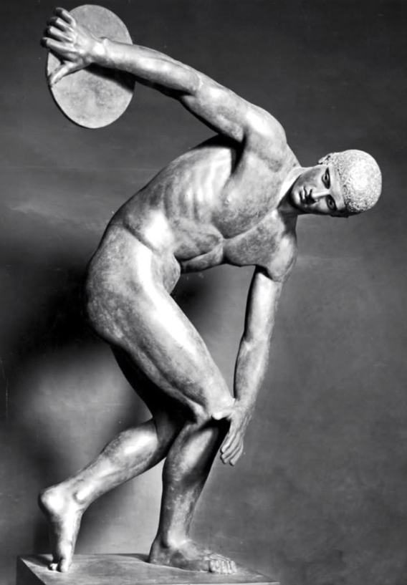
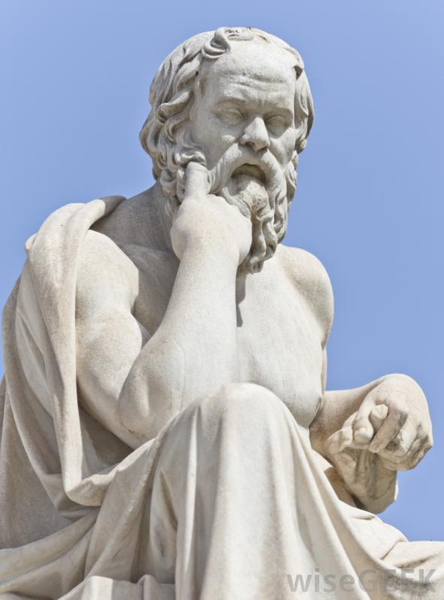
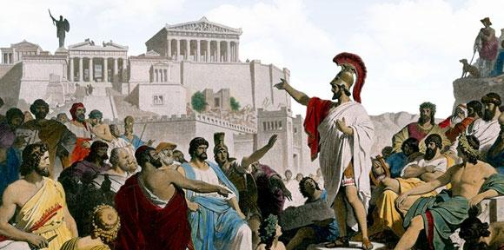
Greek Ideas
Notes:
Greeks sought ideals perhaps more than any society at that time—looking for the perfect society (deemed to be Greek democracy), the perfect mind (thought to be Greek philosophy), and the perfect body (thus the Greek Olympics).

Slide 126

Perfect Knowledge
Notes:
In this context, Peter gives the divinely inspired version of perfect knowledge based on Jesus Christ.

Slide 127
What do we need to know?
What do we need to do?
2 Peter 1:1-11
Notes:
Today we'll see the knowledge that God gives you, and then what we should do with that knowledge. The title of this message is "What to Know, What to Do." These are our two main points. What we need to know—and then do—are in the first eleven verses of 2 Peter.

Slide 128
What do we need to know?
Notes:
So, first, know that…

Slide 129
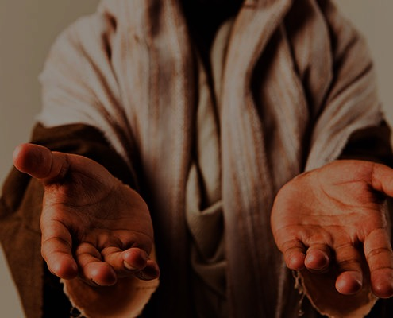
I. You are complete in Christ as God (1:1-4).
Notes:
God gives you all you need in your knowledge and faith in Jesus as deity.

Slide 130
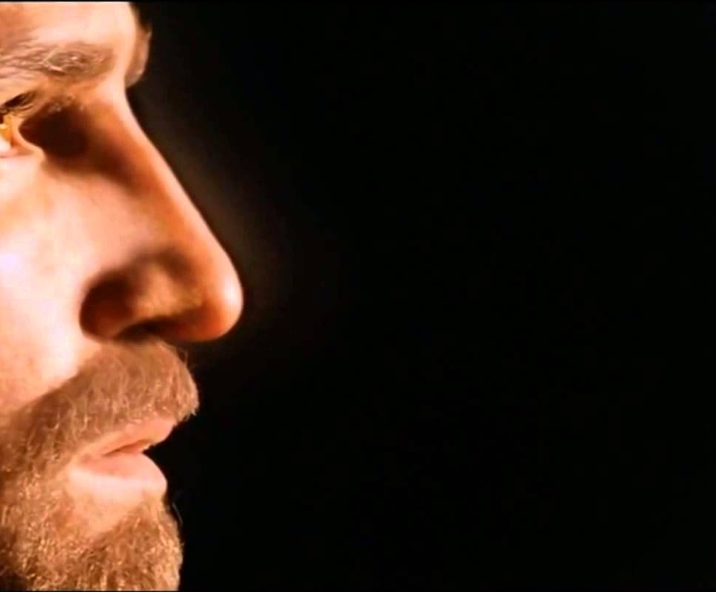
1. God gives you the same faith as the apostles due to Christ's deity.
You're complete in Christ as God (1:1-4)

Slide 131

"This letter is from Simon Peter, a slave and apostle of Jesus Christ. I am writing to you who share the same precious faith we have. This faith was given to you because of the justice and fairness of Jesus Christ, our God and Savior" (2 Peter 1:1 NLT).
Notes:
Peter notes that his readers had the same faith as "ours" (1a).
There is a great sense of humility here where the great apostle puts himself on the same level as his meek readers.
In this pre-Gnostic world, teachers prided themselves with their privileged, so-called "secret knowledge."
Yet Peter says the righteousness provided by Jesus Christ gives us all the "same faith"! Wow!
The phrase "our God and Savior" also teaches Christ's deity (1b).
"The grammar here clearly indicates that 'God and Savior' are one Person, not two (i.e., there is one Gr. article with two substantives). This passage ranks with the great Christological passages of the New Testament which plainly teach that Jesus Christ is coequal in nature with God the Father" (Gangel, BKC, 2:863-64).
We need to understand that our faith is in Jesus as God, not just some teacher of knowledge.

Slide 132
1. God gives you the same faith as the apostles due to Christ's deity.
You're complete in Christ as God (1:1-4)
2. God shows us Christ's person for grace and peace.

Slide 133
"May God give you more and more grace and peace as you grow in your knowledge of God and Jesus our Lord" (2 Peter 1:2 NLT).
Notes:
God shows us Christ's person for grace and peace (2).
The word for "knowledge" here implies an intimate, personal relationship.
We need to know that grace is in Christ (2a).
We need to know that Christ alone gives us peace (2b).

Slide 134
1. God gives you the same faith as the apostles due to Christ's deity.
You're complete in Christ as God (1:1-4)
2. God shows us Christ's person for grace and peace.
3. God gives you Christ's power to live a godly life.

Slide 135
"By his divine power, God has given us everything we need for living a godly life. We have received all of this by coming to know him, the one who called us to himself by means of his marvelous glory and excellence" (2 Peter 1:3 NLT).
Notes:
God gives you Christ's power to live a godly life (3).
Too often we think that we're missing some great secret to godliness.
Peter says that we already have all we need!
If we already have everything we need for a godly life (3), then why does Peter wish his readers more grace and peace (2)?
Evidently we don't apply or access all that God has in store for us!

Slide 136

Computer
Notes:
We are like a computer that has immense capabilities, but the user doesn't know how to use them.

Slide 137
1. God gives you the same faith as the apostles due to Christ's deity.
You're complete in Christ as God (1:1-4)
2. God shows us Christ's person for grace and peace.
3. God gives you Christ's power to live a godly life.
4. God gives you Christ's promises to live a godly life.

Slide 138
"And because of his glory and excellence, he has given us great and precious promises. These are the promises that enable you to share his divine nature and escape the world's corruption caused by human desires" (2 Peter 1:4 NLT).
Notes:
God gives you Christ's promises to live a godly life (4). What specific promises does God give to help us be like Christ (4)?

Slide 139

Five Promises
We have all we need to live a godly life (3).
We share "his divine nature" where we will eventually become like Christ (4b).
We can escape any sin (4c).
We are elected and promised salvation (10).
If we're consistent in character (5-9), then we will be richly rewarded (10-11).

Slide 140
I. You are complete in Christ as God (1:1-4).
Notes:
So what do you really need to know about Christ? Verses 1-4 tell us what God has done—We need to know that Christ’s deity makes us complete in Him. Our faith in his person gives us power and promises. But what do we do with this knowledge? We need to…

Slide 141
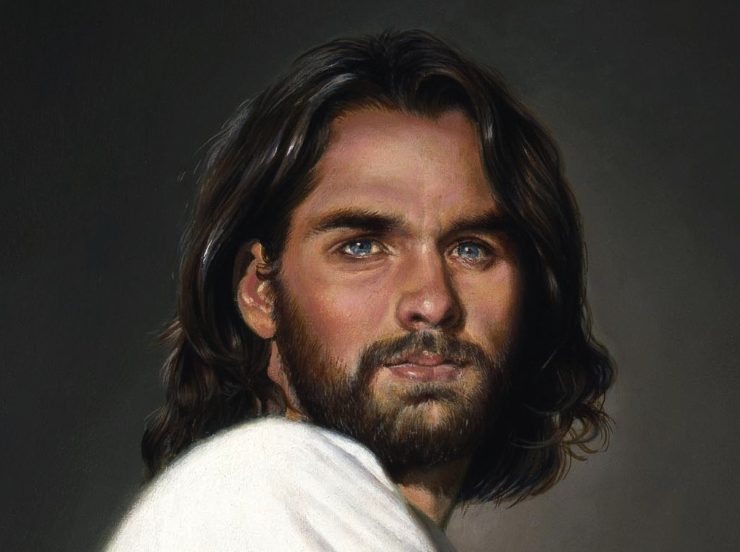
II. Become increasingly like Christ (1:5-11).
Notes:
Use your knowledge to grow in Christ-likeness.

Slide 142


Grow step-by-step in Christ-likeness (1:5-7)

Slide 143
"In view of all this, make every effort to respond to God's promises. Supplement your faith with a generous provision of moral excellence, and moral excellence with knowledge" (2 Peter 1:5 NLT).

Slide 144
"and knowledge with self-control, and self-control with patient endurance, and patient endurance with godliness" (2 Peter 1:6 NLT).

Slide 145
"and godliness with brotherly affection, and brotherly affection with love for everyone" (2 Peter 1:7 NLT).

Slide 146
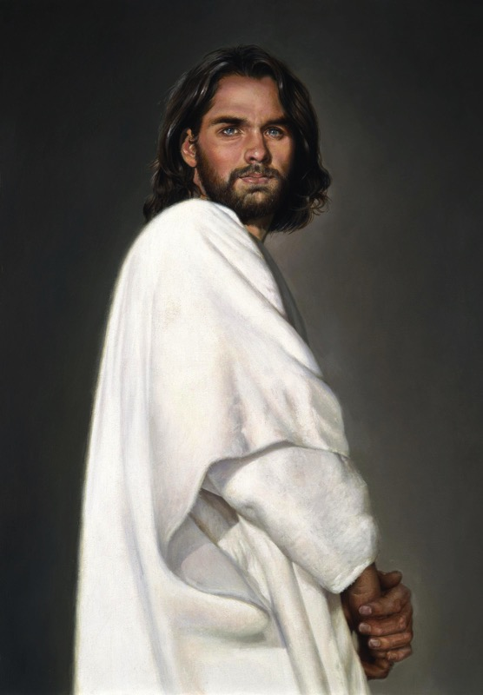
2 Peter 1
Effective & Productive Christian Life (1:5-7)
289
Pure & Christ-like ("participate in the divine nature," v. 4)
Love
Brotherly Kindness
Godliness
Perseverance
Self Control
Knowledge
Goodness
Faith
Notes:
Faith in Christ justifies us and starts our growth in character (5a).
Goodness (moral excellence) results from sins forgiven (5b).
Knowledge helps our goodness expand (5c). Self-control comes from knowing Christ's own self-control (6a).
Perseverance is self-control over the long haul (6b).
Godliness results from persevering over the long haul (6c).
Brotherly kindness results since godliness is relational (7a).
Love is the climax as the highest character trait (7b).
These traits explain how we should show the divine nature in verse 4.

Slide 147
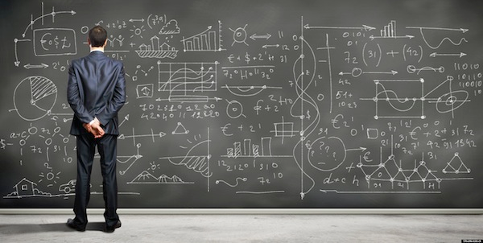
We don't always grow in Christ-likeness (1:8-9).

Slide 148
"The more you grow like this, the more productive and useful you will be in your knowledge of our Lord Jesus Christ" (2 Peter 1:8 NLT).
Notes:
Some believers continue to grow and become more effective (8).

Slide 149
"But those who fail to develop in this way are shortsighted or blind, forgetting that they have been cleansed from their old sins" (2 Peter 1:9 NLT).
Notes:
Others stop character growth by forgetting they're forgiven (9).
In fact, most of the NT addresses believers who are not living up to God's standards. This is why God moved authors like Peter and Paul and James and others to write!

Slide 150

Knowledge 知识
Notes:
At chapel in my first year of seminary one student saw another student sitting by himself and exclaimed, "Wow! Look at that! A guy reading his Bible! Must be a first-year student!" Everyone laughed—sadly.

Slide 151

First Year Student
Final Year Student
"All zeal, no knowledge"
"All knowledge, no zeal"
Notes:
That same year, a friend asked me, "Do you know how to tell the difference between a first-year student and a final-year student?" I didn't know. So he said, "The first-year student is all zeal, no knowledge. The final-year student is all knowledge, no zeal."

Slide 152
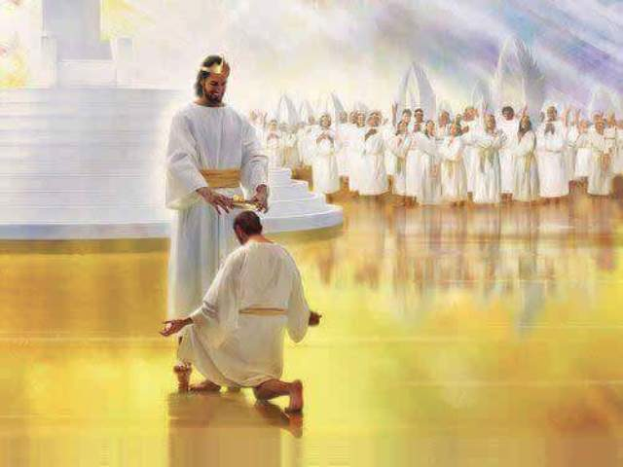
When we work hard, we'll be rewarded instead of falling away (1:10-11).

Slide 153
"So, dear brothers and sisters, work hard to prove that you really are among those God has called and chosen. Do these things, and you will never fall away" (2 Peter 1:10 NLT).
Notes:
When we work hard to show we're saved, we won't fall away (10).
Does "make your calling and election sure" (10) mean that we can add anything to Christ's work to be saved? No. It means we should live consistent with that salvation.
The NLT captures the idea well: "Work hard to prove that you really are among those God has called and chosen." When you seek to be more like Christ, you won't fall back. Instead…

Slide 154
"Then God will give you a grand entrance into the eternal Kingdom of our Lord and Savior Jesus Christ" (2 Peter 1:11 NLT).
Notes:
God will reward us when we live consistent to our calling (11).
Does receiving "a rich welcome into the eternal kingdom…" refer to a person as being saved (11)?
No, this refers to being fully rewarded like the person in verse 8 who keeps growing in character.
It means you do not "fall" (10b) like the person in verse 9 who has forgotten about his forgiveness.

Slide 155
What do we need to know?
What do we need to do?
Notes:
So what do you really need to know? And, more importantly, what do you do with this knowledge?

Slide 156
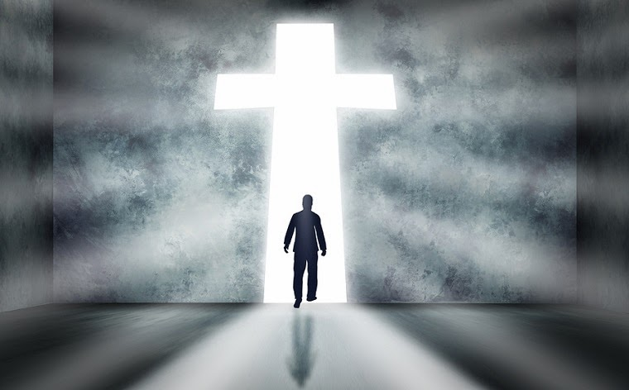
Main Idea of 2 Peter 1:1-11
Know you're complete in Christ to be more like Christ.
Notes:
Have your knowledge of Christ lead you to be Christ-like (restated MI).

Slide 157
I. You are complete in Christ as God (1:1-4).
Notes:
God gives you all you need in your knowledge and faith in Jesus as deity.

Slide 158
II. Become increasingly like Christ (1:5-11).
Notes:
Use your knowledge to grow in Christ-likeness.

Slide 159
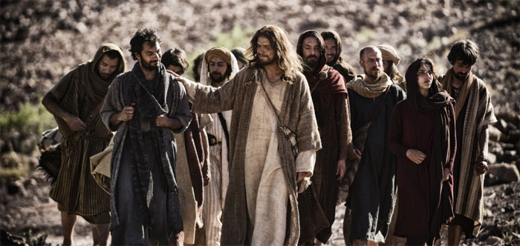
What do you need to know or do?
Know?
Do?
Notes:
Now what do you need to know or do?
How can you better know Christ?
• Do you need to grasp Christ's person, power or promises most (2-4)?
How can you do this?
• How can you better imitate Christ?
Are you more like Jesus this year than last year?
How will you be more like Christ next year?
Which quality in verses 5-7 do you need to imitate? How?

Slide 160
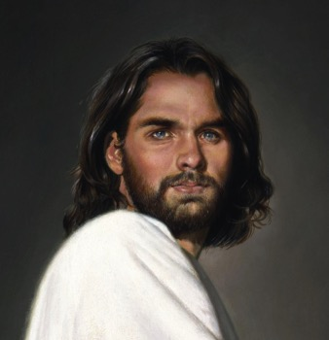
Luke 2:52 Jesus grew in…
289
Wisdom
Stature
Favor with God
Favor with Man

Slide 161
"He must become greater, I must become less important" – John the Baptist in John 3:30
Notes:
http://www.greenwichworkshop.com/media/images/Jesus.jpg

Slide 162
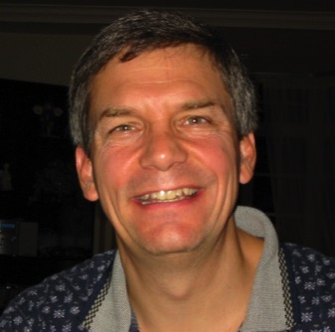
How can you and I grow this year?
289
Intellectually
Physically
Spiritually
Socially

Slide 163
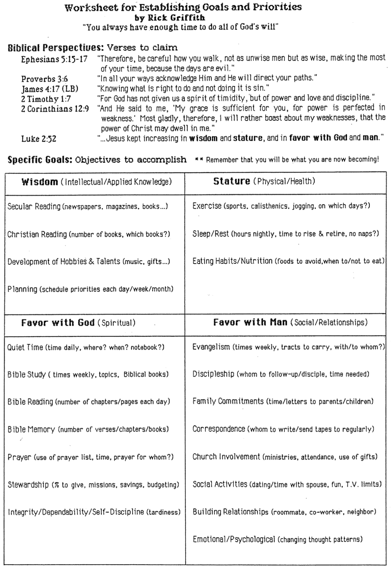
Worksheet for Goals & Priorities
289a

Slide 164
Lord
Lord Jesus Christ
God
Deity
Master
Jesus
Christ
King
Savior
Messiah
Joshua
Lion
Lamb
Notes:
NS-02-Matthew15-28-Slide 339
NS-22-2 Peter-162
TR-03-Deity of Christ-33

Slide 165
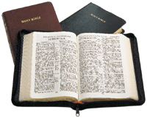
Attacks Against Scripture Today
289b
What teaching do you hear today that seeks to undermine the truthfulness of our faith?
Presentation_ID
165
165
© 2003 Cisco Systems, Inc. All rights reserved.
165

Slide 166
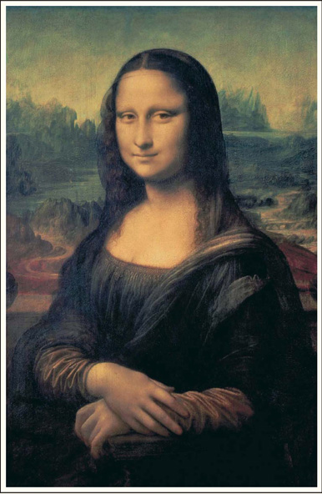

How should we fight heresy?

Slide 167

Laughing all the way to the bank…
$260 million (after 12 million copies sold)
40 million copies sold (Nov 05)!
Notes:
If you do the math, Brown is probably a billionaire—especially after all the movie royalties.
Wikipedia:
Daniel Gerhard Brown (born June 22, 1964) is an American author best known for his thriller novels, including the Robert Langdon novels Angels & Demons (2000), The Da Vinci Code (2003), The Lost Symbol (2009), Inferno (2013), and Origin (2017). His novels are treasure hunts that usually take place over a period of 24 hours.^{[3]} They feature recurring themes of cryptography, art, and conspiracy theories. His books have been translated into 57 languages and, as of 2012, have sold over 200 million copies. Three of them, Angels & Demons, The Da Vinci Code, and Inferno, have been adapted into films, while one of them, The Lost Symbol, was adapted into a television show.
Spouse: Blythe Newlon (m. 1997; div. 2019)​
_____________
NS-22-2Peter-167
TH-06-DaVinciCode-18

Slide 168





44 Languages!

Slide 169

The Gospel of Brown
Jesus married Mary Magdalene
Their daughter grew up in France
His deity was invented in AD 325
We have the wrong NT Gospels
Christianity = the Divine Feminine
Christians cover up this conspiracy

Slide 170


Rob Bell
Notes:
Another prominent pastor in the news in recent years is Pastor Rob Bell. Until 2011, he pastored Mars Hill Church in Michigan—one of the fastest growing churches in the USA. In 2011, Time named Bell on its list of the 100 Most Influential People in the World. That same year he wrote the book Love Wins: A Book About Heaven, Hell and the Fate of Every Person Who Ever Lived. What does he say about these things?
___________
“Rob Bell
From Wikipedia, the free encyclopedia
https://en.wikipedia.org/wiki/Rob_Bell accessed 10 Aug 2019
Jump to navigation Jump to search For other people with the same name, see Robert Bell (disambiguation).
Bell at the 2011 Time 100 gala
Robert Holmes "Rob" Bell Jr. (born August 23, 1970) is an American author, speaker and former pastor. Bell was the founder of Mars Hill Bible Church located in Grandville, Michigan, which he pastored until 2012. Under his leadership Mars Hill was one of the fastest-growing churches in America. He is also the author of the New York Times bestseller Love Wins and the writer and narrator of a series of spiritual short films called NOOMA. In 2011, Time named Bell on its list of the 100 Most Influential People in the World. He has since become a freelance writer and speaker appearing on various talk shows and national speaking tours on topics related to spirituality and leadership. He also hosts a popular podcast called,'The Robcast.' In 2018, a documentary about Bell called The Heretic was released.^{[1]}
Contents
1 Biography
1.1 Education and ministry
1.2 Mars Hill Bible Church
1.3 Other projects
1.4 Television
2 Beliefs
3 Publications
4 References
5 External links
Biography
Education and ministry
Bell is the son of U.S. District Judge Robert Holmes Bell, who was appointed to the federal bench by Ronald Reagan.^{[2][3]}
After graduating from high school, Bell attended Wheaton College in Illinois. While at Wheaton, he roomed with Ian Eskelin of All Star United. With friends Dave Houk, Brian Erickson, Steve Huber and Chris Fall, he formed the indie rock band, "_ton bundle", which was reminiscent of bands such as R.E.M. and Talking Heads. During this time _ton bundle wrote the song "Velvet Elvis", based upon the same Velvet Elvis painting that he used in his first book, Velvet Elvis: Repainting the Christian Faith. Wheaton College was also where Bell met his wife, Kristen. The band _ton bundle started to gain some local fame and was even asked to perform at large events, but when Bell was struck with viral meningitis^{[4]} these plans fell through.^{[5]}
Bell received his bachelor's degree in 1992 from Wheaton and taught water skiing in the summers at the college's Honey Rock Camp, making about thirty dollars a week. During this time, he offered to teach a Christian message to the camp counselors after no pastor could be found. He taught a message about rest and was later approached by several people, each of them telling him that he should pursue teaching as a career.
Bell moved to Pasadena, California to pursue this calling for teaching and received a M.Div. from Fuller Theological Seminary. According to Bell, he never received good grades in preaching class because he always tried innovative ways to communicate his ideas. During his time at Fuller he was a youth intern at Lake Avenue Church. He did, however, occasionally attend Christian Assembly in Eagle Rock, California, which led to him and his wife asking questions in the direction of how a new style of church would appear.
Between 1995 and 1997, Bell formed a band called Big Fil which released two CDs; the first was a self-titled disc and the second was titled Via De La Shekel. When asked what style of music they played, Bell would respond with "Northern Gospel!", which later became the name of a song on the second album. Even after Big Fil stopped performing, Bell continued with two more projects by the name of Uno Dos Tres Communications volume 1 and 2, both of which had a similar musical sound to Big Fil.
Mars Hill Bible Church
Bell and his wife moved from California to Grand Rapids to be close to family and on invitation to study under pastor Ed Dobson. He handled many of the preaching duties for the Saturday Night service at Calvary Church. Bell announced that he would be branching out on his own to start a new kind of community and he would call it "Mars Hill" after the Greek site where the apostle Paul told a group, "For as I walked around and looked carefully at your objects of worship, I even found an altar with this inscription: TO AN UNKNOWN GOD. Now what you worship as something unknown I am going to proclaim to you."^{[6]}
In February 1999, Bell founded Mars Hill Bible Church, with the church originally meeting in a school gym in Wyoming, Michigan. Within a year the church was given a shopping mall in Grandville, Michigan, and purchased the surrounding land. In July 2000 the 3,500 "grey chair" facility opened its doors. As of 2005, an estimated 11,000 people attended the two "gatherings" on Sundays at 9 and 11 AM.^{[7][full citation needed]} As of March 2011, Sunday attendance numbered between 8,000 and 10,000.^{[8]} His teachings at Mars Hill inspired the popular "Love Wins" bumper sticker, and the congregation freely distributed these stickers after services.^{[9]}
In order to maintain balance in his life, Bell maintained his Fridays as a personal sabbath, where he did not allow contact by electronic means, and had all pastoral duties transferred to other Mars Hill pastors.^{[10]}
In the January 2007 issue of the magazine TheChurchReport.com, Bell was named No. 10 in its list of "The 50 Most Influential Christians in America" as chosen by their readers and online visitors.^{[11]}
In June 2011, Bell was named by Time Magazine as one of the "2011 Time 100", the magazine's annual list of the 100 most influential people in the world.^{[12]}
Bell stepped down from the church he founded on September 22, 2011 in order to pursue other areas to reach a broader audience.^{[13][14]} He later said that his book Love Wins had led to a fallout with the congregation and forced him on a "search for a more forgiving faith."^{[15]}
In July 2012 Bell held his first major event since leaving Mars Hill, speaking at the famous Viper Room night club in Los Angeles.^{[16]} Bell hosts conferences and workshops in Laguna Beach for "leaders, teachers, preachers, entrepreneurs, artists, pastors—anyone whose work involves creating something and then turning it loose in the world."^{[17]}
Other projects
Bell is the featured speaker in NOOMA – a series of short films. The title of the video series, "NOOMA", is an English variation of the Greek word pneuma which means breath or spirit. All the videos feature the teachings of Bell accompanied by music written and sung by local independent artists with the exception of The Album Leaf's music being licensed for the NOOMA DVD Lump.
In August 2005, Zondervan Publishing published Bell's first book, Velvet Elvis: Repainting the Christian Faith. Velvet Elvis is, according to the official online summary, "for the millions of people who are fascinated by Jesus, but can’t do the standard Christian package. In his debut book, Bell explores a new understanding of the Christian faith."^{[18]}
Bell's Everything is Spiritual national speaking tour launched on June 30, 2006, in Chicago, drawing sold-out crowds in cities across North America. The proceeds from ticket sales were used to support WaterAid, an international non-profit organization dedicated to helping people escape the poverty and disease caused by living without safe water and sanitation.
Bell's second book, titled Sex God: Exploring the Endless Connections between Sexuality and Spirituality, was released in March 2007. In February and March 2007 Bell hosted a "Sex God" tour on six university campuses to promote his book. The tour functioned more as a time for engaging questions and conversation. Questions ranged from Old Testament codes to homosexuality to what should Christians do with the word "evangelical". Each night ended with the showing of NOOMA number 15 entitled "YOU".^{[citation needed]}
In June 2007 Bell toured the United Kingdom and Ireland with a series called Calling All Peacemakers.^{[19]}
Bell launched another speaking tour on November 5, 2007, in Chicago. "The Gods Aren't Angry" again drew sold-out crowds in cities across North America. The subject matter was a narrative defense of justification through faith and not works (sacrifice). Proceeds from this tour were used to support the Turame Microfinance program supporting the poor in Burundi, a mission supported by Bell's church.
Bell's 2009 project, Drops Like Stars, explores the links between creativity and suffering. Drops Like Stars was an international tour and a book, initially handwritten by Bell, with photographs. The title of the project comes from a young child's view of raindrops on a window at night. Rather than focusing on the conundrum of why an all-powerful God would allow suffering, Bell instead looks at the creativity, empathy, new connections, and growth that can spring from suffering. When asked in an interview how he had become interested in suffering, Bell replied that as a pastor he had been given a front row seat in the most poignant moments of people's lives. At the same time he was doing lectures on creativity and realized, "There was a connection between these two halves of my life – all these connections between suffering and art-making."^{[20]}
In September 2013 Bell was interviewed by Oprah for her Super Soul Sunday television show. Bell's book, What We Talk About When We Talk About God, was also listed as the first recommended book that month in Oprah's "Book of the Month" club.^{[21]}
Television
ABC television announced production of a new television drama, Stronger, co-written by Bell and Carlton Cuse, the executive producer of the television series, Lost.^{[22]} The show, based loosely on Bell's life and his unpublished novel-turned-pilot-script, would follow the life of Tom Stronger, a musician on a spiritual journey.^{[23]} Ultimately, Bell and Cuse were unable to get approval to shoot a pilot for Stronger.
Bell and Cuse have moved on to another project described as a "faith-inflected talk show" presented by Bell. Two tapings of the proposed show were filmed in September 2012 in a warehouse in Los Angeles' art district in order to put together a reel for network executives.^{[24]} At the time, they were referenced as either That One Show Rob Bell and Carlton Cuse Have Been Working On, or The September Shows for short.^{[25][26][27]} A trailer has since been produced using The Rob Bell Show as a title card. His first and second guest each night were Cathleen Falsani and James "Jame-o" Primbram, an eco-warrior.
Beliefs
In his writings, Bell says "I affirm the truth anywhere in any religious system, in any worldview. If it's true, it belongs to God."^{[28]}
Bell says, "This is not just the same old message with new methods. We're rediscovering Christianity as an Eastern religion, as a way of life. Legal metaphors for faith don't deliver a way of life. We grew up in churches where people knew the nine verses why we don't speak in tongues, but had never experienced the overwhelming presence of God."^{[9]}
Bell's book Love Wins caused a major controversy within the evangelical community. The controversy was the subject of a Time magazine cover story and a featured article in the New York Times.^{[29][30][31]} In the book, Bell states that "It's been clearly communicated to many that this belief (in hell as eternal, conscious torment) is a central truth of the Christian faith and to reject it is, in essence, to reject Jesus. This is misguided and toxic and ultimately subverts the contagious spread of Jesus' message of love, peace, forgiveness and joy that our world desperately needs to hear." In this book, Bell outlines a number of views of hell, including universal reconciliation. Though he does not choose any one view as his own, he states "Whatever objections a person may have of [the universalist view], and there are many, one has to admit that it is fitting, proper, and Christian to long for it."
The book was criticized by numerous conservative evangelical figures (in particular, some reformed church leaders), such as Albert Mohler, John Piper, and David Platt, with Mohler saying that the book was "theologically disastrous" for not rejecting universalism.^{[32][33]} Other evangelicals, such as Brian McLaren,^{[34][35]} Greg Boyd^{[36]} and Eugene Peterson^{[37][38][39]} defended Bell's views. Bell denies that he is a universalist and says that he does not embrace any particular view but argues that Christians should leave room for uncertainty on the matter. As Jon Meacham stated, Love Wins presents [Bell's] "case for living with mystery rather than demanding certitude."^{[40][41]} Some evangelicals argued that this "uncertainty" is incompatible with Scripture,^{[42]} while others say that the book is simply promoting overdue conversation about some traditional interpretations of Scripture.^{[43][44]} In the book, Bell also questions "evacuation theology" which has Christians focused on getting to heaven, instead of focusing on God's renewal and transformation of this world. Bell argues that Jesus (and the wider Jewish tradition of which he was a part) focused on God's ongoing restoration of this world, not getting individuals to heaven.^{[45][46]}
At his Viper Room appearance in July 2012, Bell took a question from an audience member concerned about the church's acceptance of gay members. Said Bell, "Some people are gay, and you're our brothers and you're our sisters, and we love you. We love you... [Gay people] are passionate disciples of Jesus just like I'm trying to be, so let's all get together and try to do something about the truly big problems in our world."^{[47]} On March 17, 2013, in an interview at Grace Cathedral in San Francisco, Bell said, "I am for marriage. I am for fidelity. I am for love, whether it's a man and a woman, a woman and a woman, a man and a man...And I think the ship has sailed. This is the world we are living in and we need to affirm people wherever they are."^{[48]}
In March 2013, Bell expressed frustration with the state of conservative evangelicalism, calling it "a very narrow, politically intertwined, culturally ghettoized Evangelical subculture." He says that Evangelicals have "turned away lots of people" from the church by talking about God in ways that "don't actually shape people into more loving, compassionate people," adding that Evangelicals "have supported policies and ways of viewing the world that are actually destructive, and we've done it in the name of God and we need to repent."^{[48]}
Publications
Velvet Elvis: Repainting the Christian Faith (Zondervan, 2005) ISBN 0-310-26345-X
Sex God: Exploring the Endless Connections between Sexuality and Spirituality (Zondervan, 2007) ISBN 0-310-26346-8
Everything is Spiritual (DVD) (Zondervan, 2007) ISBN 0-310-28556-9
The Gods Aren't Angry (DVD) (Flannel, 2008) ISBN 0-310-29074-0
Jesus Wants to Save Christians: A Manifesto for the Church in Exile (Zondervan, 2008) ISBN 0-310-27502-4
Drops Like Stars: A Few Thoughts on Creativity and Suffering (Zondervan, 2009) ISBN 0-310-32704-0
Love Wins (Harper One, 2011) ISBN 978-0-06-204964-3
What We Talk About When We Talk About God (HarperOne 2013) ISBN 978-0062049667
The Zimzum of Love: A New Way of Understanding Marriage co-written with Kristen Bell (HarperOne 2014) ISBN 978-0062194244
How to be Here (Harper Collins 2016) ISBN 978-0007591329
NOOMA Videos
What Is the Bible? (HarperOne 2017) ISBN 978-0062194268

Slide 171

Rob Bell Universalism
At the center of the Christian tradition since the first church have been a number who insist that history is not tragic, hell is not forever, and love, in the end, wins and all will be reconciled to God.
—Rob Bell—
Notes:
He says that he is not a universalist, but he writes…
__________
“In the book, Bell states that "It's been clearly communicated to many that this belief (in hell as eternal, conscious torment) is a central truth of the Christian faith and to reject it is, in essence, to reject Jesus. This is misguided and toxic and ultimately subverts the contagious spread of Jesus' message of love, peace, forgiveness and joy that our world desperately needs to hear." In this book, Bell outlines a number of views of hell, including universal reconciliation. Though he does not choose any one view as his own, he states "Whatever objections a person may have of [the universalist view], and there are many, one has to admit that it is fitting, proper, and Christian to long for it."
_______
From Wikipedia, the free encyclopedia
https://en.wikipedia.org/wiki/Rob_Bell accessed 10 Aug 2019

Slide 172

Apostasy of Rob Bell
“I am for marriage… I am for fidelity. I am for love, whether it’s a man and woman, a woman and a woman, a man and a man. I think the ship has sailed and I think… we need to affirm people wherever they are.”
Regarding homosexual marriage: “We’re moments away. I think the culture is already there. And the church will continue to be even more irrelevant when it quotes letters from 2000 years ago as their best defense.”
Notes:
Along with this nowadays seems to go the apology for what God says about homosexuality.

Slide 173

Rob Bell
"Farewell, Rob Bell":
A Biblical Response to Love Wins
ORTHODOXY
LOVE WINS
Notes:
Bell, of course, has his critics who argue from the Bible that he has abandoned the faith. He left his church in 2011 but has new friends in Oprah Winfrey and other apostates like Joel Osteen.
Yes, his ship has sailed from orthodoxy into shark-infested waters for himself and his followers.

Slide 174

2 Peter 1:12-21
12 Therefore, I will always be ready to remind you of these things, even though you already know them, and have been established in the truth which is present with you.
13 I consider it right, as long as I am in this earthly dwelling, to stir you up by way of reminder,
14 knowing that the laying aside of my earthly dwelling is imminent, ^{b}as also our Lord Jesus Christ has made clear to me.
15 And I will also be diligent that at any time after my departure you will be able to call these things to mind.

Slide 175
2 Peter 1:12-21
16 For we did not follow cleverly devised tales when we made known to you the power and coming of our Lord Jesus Christ, but we were eyewitnesses of His majesty.
17 For when He received honor and glory from God the Father, such an utterance as this was made to Him by the Majestic Glory, “This is My beloved Son with whom I am well-pleased” —
18 and we ourselves heard this utterance made from heaven when we were with Him on the holy mountain.

Slide 176
2 Peter 1:12-21
19 So we have the prophetic word made more sure, to which you do well to pay attention as to a lamp shining in a dark place, until the day dawns and the morning star arises ^{f}in your hearts.
20 But know this first of all, that no prophecy of Scripture is a matter of one’s own interpretation,
21 for no prophecy was ever made by an act of human will, but men moved by the Holy Spirit spoke from God.

Slide 177



2 Peter 1
289b
D. (1:12-15)
Reminder of Salvation
Frequency of the Reminder: Constantly (12)
Necessity of the Reminder: Peter's imminent death (13-15)

Slide 178
"For our Lord Jesus Christ has shown me that I must soon leave this earthly life, ¹⁵so I will work hard to make sure you always remember these things after I am gone" ( 2 Pet. 1:14-15 NLT)
Church tradition says Peter requested to be crucified upside down
178
178
178

Slide 179

2 Peter 1
289b
E. (1:16-21)
Defense of the Truth of the Message
Apostolic Eyewitnesses (16-18)
Old Testament Prophets (19-21)
• Value of OT Prophecy (19)
• Source of OT Prophecy (20-21)

Slide 180

Jeremiah (25:11-12) vs. Hananiah (28:2-3)
True
False
"You'll
stay 70
years!"
"You'll return in 2 years!"
Lived 23 years more (51:64)
Died 2 months later (28:17)

Slide 181

What is Prophecy?
289b
"knowing this first of all, that no prophecy of Scripture comes from someone's own interpretation. For no prophecy was ever produced by the will of man, but men spoke from God as they were carried along by the Holy Spirit"
2 Peter 1:20-21 (ESV)

Slide 182

Wayne Grudem on Prophecy
Prophecy is… "telling something that God has spontaneously brought to mind"
("Why Christians Can Still Prophesy: Scripture Encourages Us to Seek this Gift Yet Today," Christianity Today [September 16, 1988], 29)
Professor of NT Phoenix Theological Seminary

Slide 183
Summary of Prophetic Views
289c
Grudem's View
Biblical View
Prophecy is declaring anything (true or false) that the Spirit brings to one's mind
Prophecy is declaring God's inspired and inerrant revelation to others
The above definition was invented
in 1988 by Wayne Grudem
The above definition has been the
teaching of the church for 20 centuries
OT prophets are parallel to NT apostles
OT prophets are parallel to NT prophets
God changed the definition of prophecy
from the OT to the NT
God kept the meaning of prophecy consistent between the two testaments
God gives some prophecies with errors
God gives all prophecies without errors
(2 Pet. 1:20-21)
Any believer can prophesy
Only those with the gift of prophecy can prophesy (1 Cor. 12:29)
There's two kinds of NT prophecy
(fallible and infallible)
There's one kind of NT prophecy
(infallible)
Fallible prophecy can be inspired
Fallible prophecy is false prophecy
(Deut. 13:1-5; 18:14-20)
God sometimes lies
God always tells the truth since He cannot lie (Heb. 6:18)
Notes:
Wayne A. Grudem, "Why Christians Can Still Prophesy: Scripture Encourages Us to Seek this Gift yet Today," Christianity Today [September 16, 1988] 29; cf. Grudem's 1988 book, The Gift of Prophecy.

Slide 184

DISCUSSION GROUP A
289c
What should a church do with a so-called prophet who:
predicts false events
falls into moral sin, or
leads people to false gods?

Slide 185

DISCUSSION GROUP B
289c
Is prophecy "telling something that God has spontaneously brought to mind" (Wayne Grudem)?
Can true prophecy contain errors?
Why or why not?

Slide 186

DISCUSSION GROUP C
289c
Do you think Grudem's teaching that all believers can prophesy has biblical support (cf. 1 Cor. 12:29 vs. 14:1)?
Support your answer.

Slide 187

DISCUSSION GROUP D
289c
What would you say to someone who claimed that his prophecy is inspired but not equal in authority to Scripture?
Are there different levels of inspiration or inerrancy?

Slide 188

Let's hold God's Word in the highest regard!
In our personal devotional lives
In our families
In our work
In our Bible studies (including tonight)

Slide 189

2 Peter 1
Know God and His Works
Verses 1-11
DON’T FORGET!
Verses 12-15
Know His Word
Verses 16-21
This Photo by Unknown Author is licensed under CC BY-ND

Slide 190
What must you know to grow in grace rather than to fall for false teaching?
2 Peter
Notes:
What knowledge will help you better grasp God's goodness instead losing your faith in Christ?
___________
NS-22-2Peter-15, 88, 106, 190, 240, 269

Slide 191
I. Know that Christ chose and fully equipped you (2 Peter 1).
II. Know a fake teacher before you see one (2 Peter 2).
What to know to grow…

Slide 192
Summary Chart
Knowledge to Combat False Teaching
2 Peter
284
God's Election
Future Apostasy
Lord's Return
Chapter 1
Chapter 2
Chapter 3
Saluta-tion
1:1-2
Provides Every Need
1:3-11
Foundation of Knowledge
1:12-21
False Teachers Coming
2:1-3a
End in Hell
2:3b-10a
Character Described
2:10b-22
Scoffers Before Rapture
3:1-7
Temporary World Motivates Holiness
3:8-16
Protection & Growth Encouraged
3:17-18
Adequacy of
Believers
Inadequacy of
Unbelievers
Expectancy of
Believers
Holiness
Heresy
Hope
Disciples
of the Lord
Diabolical Leaders
Day
of the Lord
Rome to North Asia Minor
AD 64

Slide 193
Slides on 2 Peter 2

Slide 194

2 Peter 2:1-11
1 But false prophets also arose among the people, just as there will also be false teachers among you, who will secretly introduce destructive heresies, even denying the Master who bought them, bringing swift destruction upon themselves.
2 Many will follow their sensuality, and because of them the way of the truth will be maligned;
3 and in their greed they will exploit you with false words; their judgment from long ago is not idle, and their destruction is not asleep.

Slide 195
2 Peter 2:1-11
4 For if God did not spare angels when they sinned, but cast them into hell and committed them to pits of darkness, reserved for judgment;
5 and did not spare the ancient world, but preserved Noah, a preacher of righteousness, with seven others, when He brought a flood upon the world of the ungodly;
6 and if He condemned the cities of Sodom and Gomorrah to destruction by reducing them to ashes, having made them an example to those who would live ungodly lives thereafter;

Slide 196
2 Peter 2:1-11
7 and if He rescued righteous Lot, oppressed by the sensual conduct of unprincipled men
8 (for by what he saw and heard that righteous man, while living among them, felt his righteous soul tormented day after day by their lawless deeds),
9 then the Lord knows how to rescue the godly from temptation, and to keep the unrighteous under punishment for the day of judgment,

Slide 197
2 Peter 2:1-11
10 and especially those who indulge the flesh in its corrupt desires and despise authority. Daring, self-willed, they do not tremble when they revile angelic majesties,
11 whereas angels who are greater in might and power do not bring a reviling judgment against them before the Lord.

Slide 198
Major Theme
288
KNOWLEDGE…
• for spiritual growth (2 Pet. 1)
• to combat heresy (2 Pet. 2)
• to sustain hope (2 Pet. 3)
2 Peter

Slide 199


2 Peter 2 Knowledge to combat false teaching
A. Watch Out (1-3a)
B. Sure Destruction (3b-10a)
C. Heretics Described (10b-22)

Slide 200

A. (2:1-3a) Watch Out For False Teachers
2 Peter 2
Peter warns of a coming apostasy in which heretics will exploit the church with false stories so that his readers might be prepared to defend themselves.
(This time had already come by the time of Jude about ten years later in AD 75).

Slide 201

"But there were also false prophets in Israel, just as there will be false teachers among you. They will cleverly teach destructive heresies and even deny the Master who bought them. In this way, they will bring sudden destruction on themselves" (2 Peter 2:1 NLT).
57

Slide 202
A. (2:1-3a) What are the Characteristics of False Teachers?
2 Peter 2
Infiltration/secrecy (1a)
Destructive heresies (1b)
Deny Christ as Lord (1c)
Self-destructive (1d)
Many followers (2a)
Shameful ways (2b)
Discredit Christianity (2c)
Greed (3a)
Exploitive (3b)
Condemned (3c)

Slide 203

B. (2:3b-10a) Hell for the Apostates Protection for the Righteous
2 Peter 2
The destiny of all apostates in hell shows that believers will be protected as much as apostates will be condemned.

Slide 204


Were the "Sons of God” angels?
www.alienresistance.com

Slide 205

It took 120 years to build the ark!

Slide 206


NIV Genesis 6:19 You are to bring into the ark two of all living creatures, male and female, to keep them alive with you.

Slide 207

Flood Significance
God's righteous judgment
God's gracious redemption

Slide 208
C. (2:10b-22) What These False Teachers Are Like
2 Peter 2
An extended description of the heretics shows how to recognize them when they come.

Slide 209
2 Peter 2:12-22
12 These false teachers are like unthinking animals, creatures of instinct, born to be caught and destroyed. They scoff at things they do not understand, and like animals, they will be destroyed.
13 Their destruction is their reward for the harm they have done. They love to indulge in evil pleasures in broad daylight. They are a disgrace and a stain among you. They delight in deception even as they eat with you in your fellowship meals.
14 They commit adultery with their eyes, and their desire for sin is never satisfied. They lure unstable people into sin, and they are well trained in greed. They live under God’s curse.

Slide 210

God Despises Human Pride
Notes:
www.schambach.org/

Slide 211



Jim Jones and the People's Temple
"With eyes full of adultery, they never stop sinning"
(2 Pet. 2:14a)

Slide 212

A More Recent Sexpert

Slide 213

danbrown.com
FAQs: Q: "Are you a Christian?" A: "Yes…"

Slide 214

Brown Blasphemes God's Name
Yahweh
(Supposed "Male Deity")
+
Shekinah
(Supposed "Female Deity")
Notes:
Here is where Brown's blasphemy hits a horrendous level. There is NO evidence for supposing that Judaism worshipped TWO Gods. The basic tenant of Judaism is monotheism, a belief in ONE God.
__________________
NS-22-2Peter-214
TH-06-DaVinciCode-135

Slide 215


The Shekinah glory filled God's new palace!
Then the cloud covered the tent of meeting, and the glory of the LORD filled the tabernacle.
Exodus 40:34 ESV

Slide 216
Brown Blasphemes God's Name
Yah
(Male Deity)
+
Havah
(Female Deity)
= Jehovah?!
Notes:
Brown contradicts his earlier claim that the deity's name was "Yahweh." The reason they didn't teach me this in my Hebrew classes at Dallas Seminary is because this claim is ludicrous.
__________________
NS-22-2Peter-216
TH-06-DaVinciCode-139

Slide 217
The Truth About God's Name
YHWH
+
Adonai
= Jehovah
Notes:
Like all Hebrew words, God's name was written without vowels as only four letters, which in English, are rendered YHWH. Jews feared ever saying his name in vain and treated it with such sacredness that they would not even pronounce it at all. Instead, they read "Adonai" ("Lord") in OT readings. Later on the vowels of "Adonai" were added to YHWH to form the word "Jehovah" so Brown's claim of this being a biblical word (especially of sexual union!) is nonsense.
__________________
NS-22-2Peter-217
TH-06-DaVinciCode-140

Slide 218
2 Peter 2:12-22
15 They have wandered off the right road and followed the footsteps of Balaam son of Beor, who loved to earn money by doing wrong.
16 But Balaam was stopped from his mad course when his donkey rebuked him with a human voice.
17 These people are as useless as dried-up springs or as mist blown away by the wind. They are doomed to blackest darkness.

Slide 219

Numbers
354
Preparation to Occupy the Land
Preparing the
Old Generation
Postponement
for Unbelief
Preparing the
New Generation
1:1–10:10
10:11–25:18
26–36
God's Faithfulness
Israel's Faithlessness
God's Faithfulness
God's Blessings
God's Discipline
God's Blessings
Israel's Commitment
Israel's Complaining
Israel's Commitment
Order
Disorder
Reorder
Mount Sinai
Wilderness
Moab
20 Days
38 Years, 3 Months, 10 Days
ca. 5 Months
Organization
(1–4)
Sanctification (5:1–10:10)
To Kadesh (10:11–
12:16)
Kadesh Sin
(13–14)
Wilder-ness (15–19)
To Moab (20–21)
Moab
Sin
(22–25)
Provision for Land (26–27)
Offerings & Vows (28–30)
Final Preparations (31–36)

Slide 220


Transjordan Events
354
Edrei
Kingdom of Og
Ammon
Victory over Sihon and Og (Num. 21)
Balak fails to turn God against Israel–blessing by Balaam (Num. 22–24)
Kingdom of Sihon
Jahaz
Moab
Edom
Beitzel, Moody Atlas, 1st ed., 94
Neighboring nations related by blood

Slide 221


Balaam
354
Balaam Numbers 22–24

Slide 222

The Balaam Narrative
354
Balak fails to turn God against Israel–blessing by Balaam (Num. 22–24)
Beitzel, Moody Atlas, 1st ed., 94

Slide 223
2 Peter 2:15-16 (NIV)
354
They have left the straight way and wandered off to follow the way of Balaam son of Beor, who loved the wages of wickedness. But he was rebuked for his wrongdoing by a donkey–a beast without speech–who spoke with a man's voice and restrained the prophet's madness.

Slide 224
Transjordan Events
354
Victory over Sihon and Og (Num. 21)
Balak fails to turn God against Israel–blessing by Balaam (Num. 22–24)
Balak succeeds to turn Israel against God–immorality at Beth-peor (Num. 25)
Beth-peor
Beitzel, Moody Atlas, 1st ed., 94

Slide 225
Jude 11 (NIV)
354
Woe to them! They have taken the way of Cain; they have rushed for profit into Balaam's error; they have been destroyed in Korah's rebellion.

Slide 226


The Balaam Narrative (Num. 22–24)
354
Balak turned Israel against God via immorality at Beth-peor (Num. 25)
Beitzel, Moody Atlas, 1st ed., 94

Slide 227
Revelation 2:14-15
354
Nevertheless, I have a few things against you: You have people there who hold to the teaching of Balaam, who taught Balak to entice the Israelites to sin by eating food sacrificed to idols and by committing sexual immorality. Likewise you also have those who hold to the teaching of the Nicolaitans.

Slide 228

The Agony of Deceit

Slide 229
2 Peter 2:12-22
18 They brag about themselves with empty, foolish boasting. With an appeal to twisted sexual desires, they lure back into sin those who have barely escaped from a lifestyle of deception.
19 They promise freedom, but they themselves are slaves of sin and corruption. For you are a slave to whatever controls you.

Slide 230
2 Peter 2:12-22
20 And when people escape from the wickedness of the world by knowing our Lord and Savior Jesus Christ and then get tangled up and enslaved by sin again, they are worse off than before.
21 It would be better if they had never known the way to righteousness than to know it and then reject the command they were given to live a holy life.
22 They prove the truth of this proverb: “A dog returns to its vomit.” And another says, “A washed pig returns to the mud.”

Slide 231

Jude 10-16
10 But these people scoff at things they do not understand. Like unthinking animals, they do whatever their instincts tell them, and so they bring about their own destruction.
11 What sorrow awaits them! For they follow in the footsteps of Cain, who killed his brother. Like Balaam, they deceive people for money. And like Korah, they perish in their rebellion.
12 When these people eat with you in your fellowship meals commemorating the Lord’s love, they are like dangerous reefs that can shipwreck you. They are like shameless shepherds who care only for themselves. They are like clouds blowing over the land without giving any rain. They are like trees in autumn that are doubly dead, for they bear no fruit and have been pulled up by the roots.

Slide 232
Jude 10-16
13 They are like wild waves of the sea, churning up the foam of their shameful deeds. They are like wandering stars, doomed forever to blackest darkness.
14 Enoch, who lived in the seventh generation after Adam, prophesied about these people. He said, “Listen! The Lord is coming with countless thousands of his holy ones
15 to execute judgment on the people of the world. He will convict every person of all the ungodly things they have done and for all the insults that ungodly sinners have spoken against him.”
16 These people are grumblers and complainers, living only to satisfy their desires. They brag loudly about themselves, and they flatter others to get what they want.

Slide 233

False Teachers are enslaved to:
Money (and what it can buy)
Sexual lust of women, and weak men/boys (Sodom and Gomorrah)
Pride (power): Speaking evil of those in authority and arrogantly viewing themselves by exalting themselves and deriding everyone else.

Slide 234
Be Aware of False Teachers
They are a threat to God’s people.
They are deceptive and subtle.
Their doctrine is destructive.
Their influence is alluring.
Their motives are impure.
Their teaching and lifestyle dishonour God
They are heading to eternal destruction.

Slide 235

Comparison of NOAH, LOT and BALAAM
Noah was a preacher of righteousness, a man of integrity and purity, keeping himself separated from the world, even though no one followed him except his immediate family.
Lot knew the truth and kept himself pure, but he did not keep himself separated; he lost his family as a result. Lot hated the wickedness of Sodom, yet he lived in the midst of it and, by doing so, exposed his daughters and wife to godless influences.
Balaam not only followed the ways of sin, but he encouraged other people to sin! He told Balak how to seduce the nation Israel and his plan almost succeeded. Lot lost his family, but Balaam lost his life.

Slide 236


Slide 237

Faith Alone
Christ Alone
Scripture Alone
God’s Glory Alone
Grace Alone

Slide 238
Thought Questions:
1. How was the “religious experience” of the teachers Peter wrote about a false experience rather than true salvation?
2. What are some signs that a person has had a “true spiritual experience” and has been born again?
3. Why are godly Christians not attracted by the freedom that false cults and religions promise?

Slide 239
For Life Change: Which teachers in your experience must you warn yourself and your family about? How?

Slide 240
What must you know to grow in grace rather than to fall for false teaching?
2 Peter
Notes:
What knowledge will help you better grasp God's goodness instead losing your faith in Christ?
___________
NS-22-2Peter-15, 88, 106, 190, 240, 269

Slide 241
I. Know that Christ chose and fully equipped you (2 Peter 1).
II. Know a fake teacher before you see one (2 Peter 2).
III. Know to live for the eternal—not the temporal (2 Peter 3).
What to know to grow…

Slide 242
Summary Chart
Knowledge to Combat False Teaching
2 Peter
284
God's Election
Future Apostasy
Lord's Return
Chapter 1
Chapter 2
Chapter 3
Saluta-tion
1:1-2
Provides Every Need
1:3-11
Foundation of Knowledge
1:12-21
False Teachers Coming
2:1-3a
End in Hell
2:3b-10a
Character Described
2:10b-22
Scoffers Before Rapture
3:1-7
Temporary World Motivates Holiness
3:8-16
Protection & Growth Encouraged
3:17-18
Adequacy of
Believers
Inadequacy of
Unbelievers
Expectancy of
Believers
Holiness
Heresy
Hope
Disciples
of the Lord
Diabolical Leaders
Day
of the Lord
Rome to North Asia Minor
AD 64

Slide 243
Slides on 2 Peter 3

Slide 244
Major Theme
288
KNOWLEDGE…
Ch 1 for spiritual growth
Ch 2 to combat false teaching
Ch 3 to sustain hope
2 Peter

Slide 245

2 Peter 3:1-9
1 This is now, beloved, the second letter I am writing to you in which I am stirring up your sincere mind by way of reminder,
2 that you should remember the words spoken beforehand by the holy prophets and the commandment of the Lord and Savior spoken by your apostles.
3 Know this first of all, that in the last days mockers will come with their mocking, following after their own lusts,

Slide 246
2 Peter 3:1-9
4 and saying, “Where is the promise of His coming? For ever since the fathers fell asleep, all continues just as it was from the beginning of creation.”
5 For when they maintain this, it escapes their notice that by the word of God the heavens existed long ago and the earth was formed out of water and by water,
6 through which the world at that time was destroyed, being flooded with water.

Slide 247
2 Peter 3:1-9
7 But by His word the present heavens and earth are being reserved for fire, kept for the day of judgment and destruction of ungodly men.
8 But do not let this one fact escape your notice, beloved, that with the Lord one day is like a thousand years, and a thousand years like one day.
9 The Lord is not slow about His promise, as some count slowness, but ^{b}is patient toward you, not wishing for any to perish but for all to come to repentance.

Slide 248
2 Peter 3:10
But the day of the Lord will come as unexpectedly as a thief. Then the heavens will pass away with a terrible noise, and the very elements themselves will disappear in fire, and the earth and everything on it will be found to deserve judgment.

Slide 249

2 Peter 3 Knowledge to Sustain the Hope for the Lord's Return
Lion
of
Judah
Scoffers Precede Rapture
Day of the Lord
Motivation for Holiness
Protection and Encouragement for Growth

Slide 250



A. (3:1-4) The Scoffers Precede Rapture
2 Peter 3
People will scoff at God's way of saving sinners through Christ
There will be a great improvement in arts & sciences
Knowledge of the world mocks the knowledge of God
The method of their reasoning:
all things continue as they were from the beginning of the creation,
they see no changes, therefore they do not fear God

Slide 251
Skeptics Mock Three Key Truths
290b
"…in the last days scoffers will come, mocking the truth and following their own desires. ⁴They will say, 'What happened to the promise that Jesus is coming again?'" (2 Pet. 3:3b-4a NLT).
Christ's Return
Presentation_ID
251
251
© 2003 Cisco Systems, Inc. All rights reserved.
251

Slide 252
Skeptics Mock Three Key Truths
290b
"'From before the times of our ancestors, everything has remained the same since the world was first created.' They deliberately forget that God made the heavens by the word of his command, and he brought the earth out from the water and surrounded it with water" (2 Pet. 3:4b-5 NLT).
Christ's Return
Creation
Presentation_ID
252
252
© 2003 Cisco Systems, Inc. All rights reserved.
252

Slide 253
Skeptics Mock Three Key Truths
290b
"Then he used the water to destroy the ancient world with a mighty flood" (2 Pet. 3:6 NLT).
Christ's Return
Global Flood
Creation
Presentation_ID
253
253
© 2003 Cisco Systems, Inc. All rights reserved.
253

Slide 254
Skeptics Mock Three Key Truths
290b
Christ's Return
Global Flood
Creation
Presentation_ID
254
254
© 2003 Cisco Systems, Inc. All rights reserved.
254

Slide 255

B. (3:5-13) Day of the Lord destroys heavens / earth
2 Peter 3
Heaven and earth formed from water
Once destroyed by water → warning
It is reserved to be destroyed by fire
It is not destruction for us, but a happy ending

Slide 256



How will the Universe end?
Evolution
Bible
Notes:
Big Bang: heat death (cold, dark universe) or big crunch (collapsing universe)? OR…
Bible: literal heat death and then new heavens and new earth?

Slide 257

Big Bang Time line
Big Bang Future of the Universe
BIG BANG
Billions of Years
Heat Death
Big Bang Time line
Biblical Future of the Universe
Heat Destruction
6-Day
New
Heavens
Thousands of Years
Eternity
Creation
& Earth
Sin and Death
Genesis
2 Peter 3
Revelation
Notes:
The secular worldview sees the world starting with heat and cooling off into obscurity in the death of heat that takes billions of years.
The biblical teaching shows God’s truth—that the world started with temperate climate but will end with intense heat (2 Pet 3:10) before the Lord remakes it to last forever.
__________________
Common-534
NS-22-2Peter-257

Slide 258

"Sound the alarm in Jerusalem! Raise the battle cry on my holy mountain! Let everyone tremble in fear because the day of the LORD is upon us" (Joel 2:1 NLT).

Slide 259

"[The day of the LORD]… is a day of darkness and gloom, a day of thick clouds and deep blackness. Suddenly, like dawn spreading across the mountains, a great and mighty army appears. Nothing like it has been seen before or will ever be seen again" (Joel 2:2 NLT).

Slide 260


The Day of the LORD
638-639
Judgment
+
Blessing
Tribulation
Millennium
Rev. 6–19
Rev. 20
7 years
1000 years

Slide 261
A Dispensational Timeline
437
Great
White
Throne
(Rev. 20:11-14)
Rapture (1 Thess. 4:13-18)
2nd Advent
(Zech. 14:3-5)
Day of the LORD
Church Age
Tribulation
(Zech. 14:1-2)
Millennium
(Zech. 14:6-21)
Gog & Magog (Armageddon) (Ezek. 38–39)
Gog and Magog Revisited
(Rev. 20:7-10)
Notes:
261

Slide 262

How does the Bible say it will end?
"But the day of the Lord will come as unexpectedly as a thief. Then the heavens will pass away with a terrible noise, and the very elements themselves will disappear in fire, and the earth and everything on it will be found to deserve judgment" (2 Pet. 3:10 NLT)

Slide 263
How to live in light of the end?
"Since everything around us is going to be destroyed like this, what holy and godly lives you should live, ¹²looking forward to the day of God and hurrying it along. On that day, he will set the heavens on fire, and the elements will melt away in the flames" (2 Pet. 3:11-12 NLT)

Slide 264

How to live in light of the end?
"But we are looking forward to the new heavens and new earth he has promised, a world filled with God's righteousness" (2 Pet. 3:13 NLT)

Slide 265

C.(3:14-16) Motivation for holiness as Paul indicates
2 Peter 3
If we look forward to the Lord's day then:
We will make every effort to be holy
Appreciate God's patience

Slide 266

Peter Also Called Paul's Letters "Scripture"!
Paul's Letters Written
AD 49-62
Rome
Peter Wrote 2 Peter
AD 64
"…Our dear brother Paul also wrote to you with the wisdom God gave him. He writes the same way in all his letters, speaking in them of these matters. His letters contain some things that are hard to understand, which ignorant and unstable people distort, as they do the other Scriptures, to their own destruction" (2 Peter 3:15-16)
Notes:
Paul still had three more letters to write (1-2 Tim. Tit) when Peter deemed what he had ALREADY written as Scripture on par with the OT.

Slide 267

D. (3:16-17) Protection and Encouragement for Growth
بطرس 2 3
Be on guard
Do not err in lawlessness and fall
Grow in grace and knowledge

Slide 268
Key Verse
284
“Therefore, dear friends, since you already know this, be on your guard so that you may not be carried away by the error of lawless men and fall from your secure position. But grow in the grace and knowledge of our Lord and Savior Jesus Christ. To him be glory both now and forever! Amen” (2 Peter 3:17-18).
2 Peter

Slide 269
What must you know to grow in grace rather than to fall for false teaching?
2 Peter
Notes:
What knowledge will help you better grasp God's goodness instead losing your faith in Christ?
___________
NS-22-2Peter-15, 88, 106, 190, 240, 269

Slide 270
Main Idea
Know that Christ chose you and will judge apostates at his return.
2 Peter

Slide 271
I. Know that Christ chose and fully equipped you (2 Peter 1).
II. Know a fake teacher before you see one (2 Peter 2).
III. Know to live for the eternal—not the temporal (2 Peter 3).
What to know to grow…

Slide 272
Synthesis
2 Peter
Synthesis
288
Know these things to combat heresy
1 God's election
2 Traits of apostasy
3 Lord's return

Slide 273
For Life Change: Which teachers in your experience must you warn yourself and your family about? How?

Slide 274
Is God’s Word shaping you to grow in the grace and the knowledge of Christ?

Slide 275

Bible Reading Plan
289h

Slide 276

Know Jesus, Know Peace

Slide 277
Black

Slide 278


NT Preaching • BibleStudyDownloads.org
Get this presentation and script for free!

Slide 279


Applications
279
279
279

Slide 280
Applications
Continue on the foundation
Constantly renew knowledge
Conscious of false teachers
2 Peter

Slide 281
Continue on the foundation
The promise of becoming partakers of the divine nature.
CONTINUING : Diligence > faith > moral excellence > knowledge > self control > perseverance > godliness > brotherly kindness > love.
2 Peter

Slide 282
Continuing on the foundation
Your spiritual "graph" must be upward
"Practice" your faith (2 Peter 1:10)
Progressive love toward God & man
Faithfulness
Temporal (2 Peter 1:13–15)
Turn to God (2 Peter 2:7-9)
2 Peter

Slide 283
A Constant Reminder
Read The Word
Worship
Evangelize
Christian Virtues
Have a Mission Heart
Prayer
We are to constantly be reminded and reminding others of this great need
(2 Peter 1:12-13)

Slide 284
Conscious of False Teachers
Many & varied descriptions given to us:
Pleasure to revel in the daytime
Having eyes full of adultery and that never cease from sin
Enticing unstable souls
Springs without water and mists driven by a storm
2 Peter

Slide 285
Be Conscious of False Teachers
Do the false teachers mean only human teachers?
?
Could it refer to something else – system of things, evolving sub-culture, materialism, etc.?

Slide 286
What is our Christian response?
To be found by Him in peace, spotless and blameless
Be on guard lest we are carried away by the error of unprincipled men
Grow in the grace and knowledge of our Lord and Savior Jesus Christ
2 Peter

Slide 287

"We Shall Behold Him"
Sung by Sandi Patti
Notes:
287

Slide 288

The sky shall unfold…
Notes:
288

Slide 289

…preparing His entrance
Notes:
289

Slide 290

The stars shall applaud Him with thunders of praise

Slide 291

The sweet light in His eyes shall enhance those awaiting
Notes:
291

Slide 292

And we shall behold Him then face to face
Notes:
292

Slide 293

We shall behold Him
We shall behold Him
Notes:
293

Slide 294

…face to face in all of His glory
Notes:
294

Slide 295

We shall behold Him
We shall behold Him
Notes:
295

Slide 296

…face to face, our Savior and Lord
Notes:
296

Slide 297

The angels shall sound the shout of His coming
Notes:
297

Slide 298

The sleeping shall rise from their slumbering place
Notes:
298

Slide 299

And those who remain shall be changed in a moment
Notes:
299

Slide 300

And we shall behold Him then face to face
Notes:
300

Slide 301

We shall behold Him
We shall behold Him
Notes:
301

Slide 302

…face to face in all of His glory
Notes:
302

Slide 303

We shall behold Him
We shall behold Him
Notes:
303

Slide 304

…face to face, our Savior and Lord
Notes:
304

Slide 305

We shall behold Him, our Savior and Lord!
Notes:
305

Slide 306

...our Savior and Lord!
Notes:
306

Slide 307
Do you long for His return?
307
307

Slide 308
I choose to love the Truth
I choose to love the Truth (2X)
Renouncing the lies,
You have opened my eyes.
I choose to love the Truth.
2 Peter

Slide 309
The Big Picture
God's Provision | c
d | Our Response
O
P
P
O
S
I
T
I
O
N
False Teachers
↑ ↑ ↓ ↓
Scoffers
J U D G M E N T | S e c o n d C o m i n g
h
h
h
RESULT:
Fruitfulness Assurance Rewards
h
h
h
REMINDER: "These things"
AUTHORITY:
God's Prophets & Apostles
MOTIVATION to "Add...these things"
Adapted from www.equipsaints.org

Slide 310

Magic
Notes:
Games like Magic teach people to be sorcerers to kill their opponents.
Like Dungeons & Dragons, the famed role-playing game, Magic is a challenging game that calls for intricate strategy and shrewd plays. However, that strategy is worked out within the dark context of the occult. Many cards portray frightening and repellent creatures. Skeletons, blood and images of death are common. There's the Bone Shaman, the Necrite (shown licking blood off a dagger), Prodigal Sorcerer, Dark Ritual, Sadistic Glee, Torture, Endless Scream and others. One card showing several skeletons and called The Kjeldoran Dead has this quote: "'They shall kill those whom once they loved.' C Lim-Dul, the Necromancer." Necromancy is communication with the dead through supernatural and/or occult techniques.”
____
https://www1.cbn.com/onlinediscipleship/introduction-to-the-occult

Slide 311
Group Project Members
2 Peter
Andrew Lim  Henry Sujaya  Jemaine Han
Joseph You  Kim Fah Yap  Kusazo Rhakho
Leny Salim  Lim Chung Wei
Raymond Kwan  Yoanita Muliawan

Slide 312
Black

Slide 313
NT Survey link at BibleStudyDownloads.org
Get this presentation for free!
Notes:
NT Survey (ns)

