Slide 1
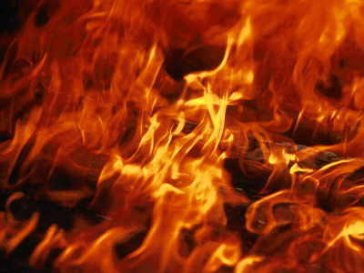
1 Peter
Grace Amidst Suffering
Dr. Rick Griffith • Jordan Evangelical Theological Seminary • BibleStudyDownloads.org
Notes:
What does Peter say about suffering? What is his focus? For example, is it the character that suffering brings? Is it how to avoid it? Is it that suffering shows that we are true Christians?
Here is the real question:
How do we attract others when we experience righteous suffering? Stated differently, how do we suffer properly to witness for Jesus?
What is grace?
Bill Gothard says that it is "the power to do God's will." So, 1 Peter teaches that God gives us the power to do his will when we suffer. What a wonderful truth!

Slide 2
Key Word
275
Suffering
1 Peter
Notes:
Jesus said that we would pay a price for following him. But there is no value in suffering itself. The real issue is how we respond when we are persecuted for his name.

Slide 3
Theme
23
How to Attract Others During Righteous Suffering
1 Peter
Notes:
Believers who are struggling can be either a good or a bad witness to Jesus. How do we do the former instead of the latter?

Slide 4
Key Verse
275
“Dear friends, do not be surprised at the painful trial you are suffering, as though something strange were happening to you. But rejoice that you participate in the sufferings of Christ, so that you may be overjoyed when his glory is revealed…. I have written to you briefly, encouraging you and testifying that this is the true grace of God. Stand fast in it” (4:12-13; 5:12).
1 Peter
Notes:
What do you learn about suffering in these verses?
—Trials are normal for believers.
—We should rejoice when identifying with the suffering of Christ.
—God gives grace in suffering.
—We should persevere during suffering.

Slide 5

Summary Statement
275
North Asia Minor believers should suffer properly for Christ as holy, submissive, and selfless witnesses motivated by Christ's example and the hope of future glory to attract others to hear their message.
1 Peter
Notes:
Righteous suffering can have an evangelistic result when we respond properly.

Slide 6

Kingdom Statement
27f
Nero deserves honor (2:17),
so how much more does Jesus!
1 Peter
Notes:
1 Peter 2:17 Respect everyone, and love the family of believers. Fear God, and respect the king.

Slide 7
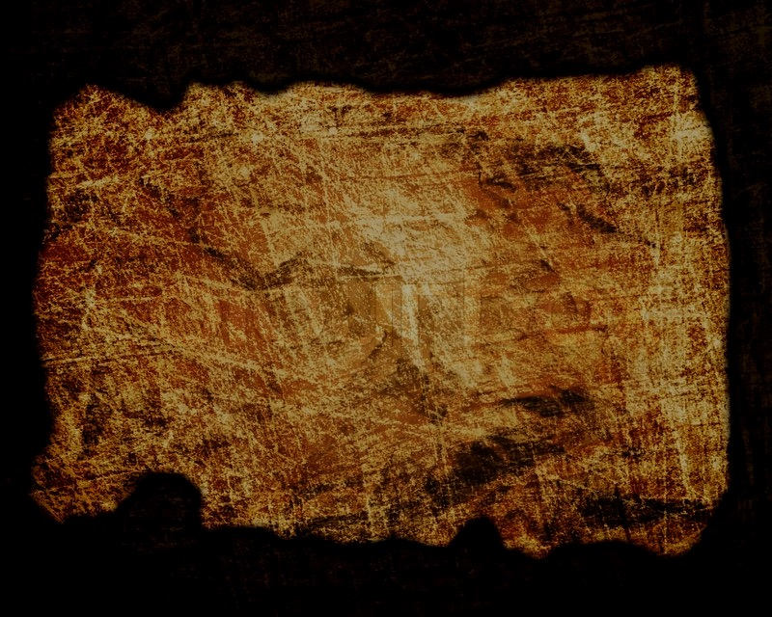
Covenant
27f
The Church, like Israel, is also a people of God with special privileges (2:4-12).
1 Peter
Notes:
Living Stones for God’s House (NLT)
1Pet. 2:4 You are coming to Christ, who is the living cornerstone of God’s temple. He was rejected by people, but he was chosen by God for great honor.
1Pet. 2:5 And you are living stones that God is building into his spiritual temple. What’s more, you are his holy priests. Through the mediation of Jesus Christ, you offer spiritual sacrifices that please God. ⁶ As the Scriptures say,
“I am placing a cornerstone in Jerusalem,
chosen for great honor,
and anyone who trusts in him
will never be disgraced.”
1Pet. 2:7 Yes, you who trust him recognize the honor God has given him. But for those who reject him,
“The stone that the builders rejected
has now become the cornerstone.”
1Pet. 2:8 And,
“He is the stone that makes people stumble,
the rock that makes them fall.”
They stumble because they do not obey God’s word, and so they meet the fate that was planned for them.
1Pet. 2:9 But you are not like that, for you are a chosen people. You are royal priests, a holy nation, God’s very own possession. As a result, you can show others the goodness of God, for he called you out of the darkness into his wonderful light.
1Pet. 2:10 “Once you had no identity as a people;
now you are God’s people.
Once you received no mercy;
now you have received God’s mercy.”
1Pet. 2:11 Dear friends, I warn you as “temporary residents and foreigners” to keep away from worldly desires that wage war against your very souls. ¹² Be careful to live properly among your unbelieving neighbors. Then even if they accuse you of doing wrong, they will see your honorable behavior, and they will give honor to God when he judges the world.

Slide 8
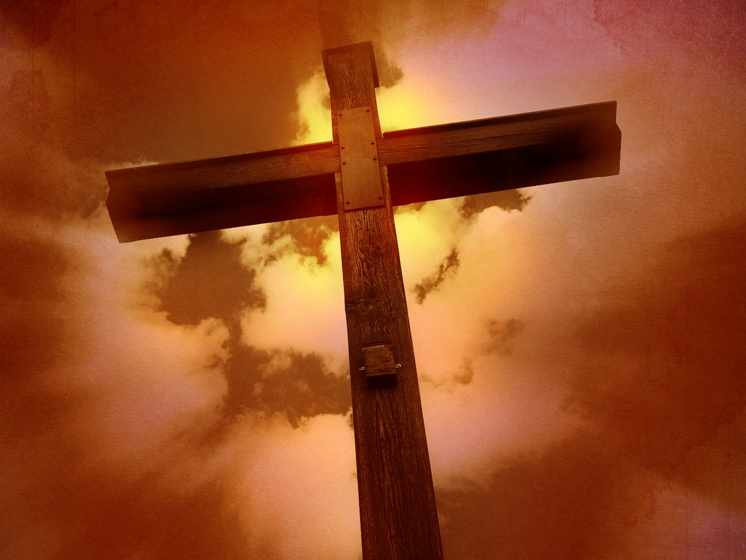
Redemption
27f
The death of Jesus provides spiritual healing for “by His wounds you have been healed” (2:24).
1 Peter
Notes:
1 Peter 2:24 NLT
He personally carried our sins in his body on the cross
so that we can be dead to sin and live for what is right. By his wounds you are healed.

Slide 9
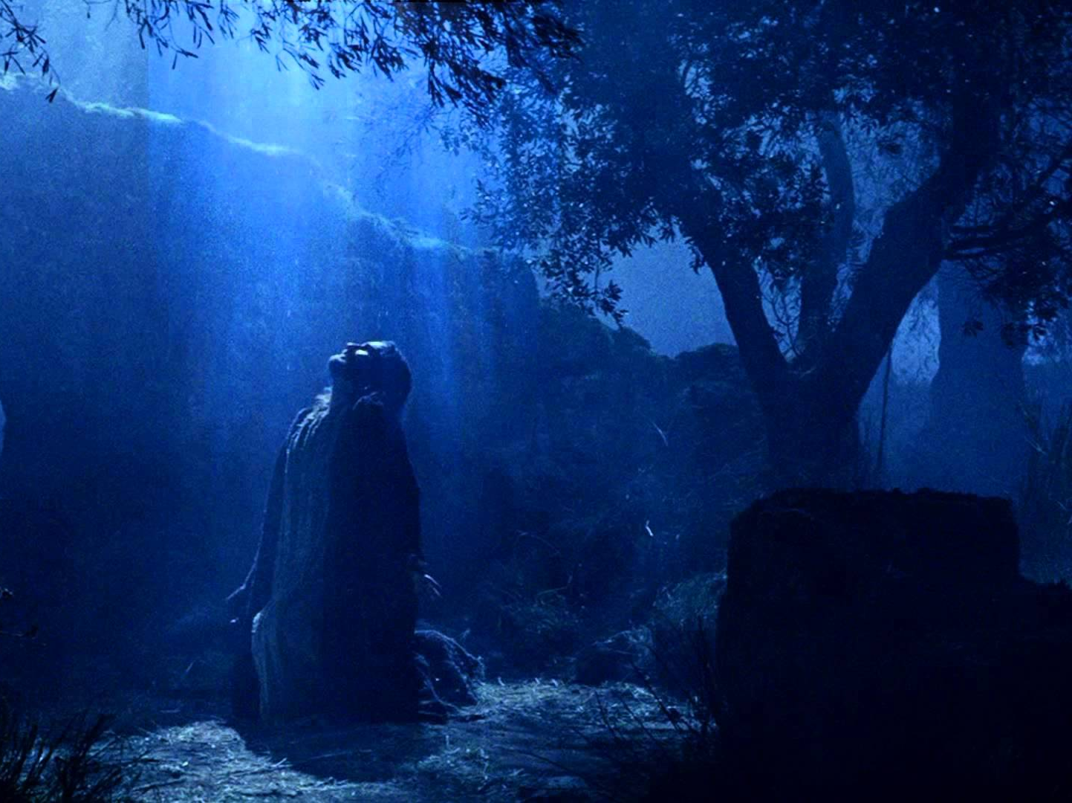
Prophecy
(Lord, Deity)
27f
Jesus declared himself Lord over imprisoned spirits following his death (3:18-22).
1 Peter
Notes:
1 Peter 3:18-22 NLT
1Pet. 3:18 Christ suffered for our sins once for all time. He never sinned, but he died for sinners to bring you safely home to God. He suffered physical death, but he was raised to life in the Spirit.
1Pet. 3:19 So he went and preached to the spirits in prison— ²⁰ those who disobeyed God long ago when God waited patiently while Noah was building his boat. Only eight people were saved from drowning in that terrible flood. ²¹ And that water is a picture of baptism, which now saves you, not by removing dirt from your body, but as a response to God from a clean conscience. It is effective because of the resurrection of Jesus Christ.
1Pet. 3:22 Now Christ has gone to heaven. He is seated in the place of honor next to God, and all the angels and authorities and powers accept his authority.

Slide 10
1 Peter Outline
275
How to Attract Others During Righteous Suffering
Sanctification |  |  | Submission |  |  |  | Selflessness
1:1–2:12 |  |  | 2:13–3:12 |  |  |  | 3:13–5:14
Holiness |  |  | Humility |  |  |  | Honoring Others
Salu-tation 1:1-2 | Praise for hope 1:3- 12 | Holy Life Exhort-ed 1:13– 2:12 | Gov't 2:13- 17 | Work Place 2:18- 25 | Marri-age 3:1-7 | Church & all of Life 3:8-12 | Christ's triumph 3:13–4:6 | Edify others 4:7-19 | Elders 5:1-4 | Young Men 5:5a | Humility & watch-fulness 5:5b-11 | Purpose 5:12-14
Rome to Northern Asia
Early AD 64
Notes:
There are repeated exhortations to give an example to others through suffering:
1Pet. 2:9 But you are not like that, for you are a chosen people. You are royal priests,ª a holy nation, God’s very own possession. As a result, you can show others the goodness of God, for he called you out of the darkness into his wonderful light.
1Pet. 2:11 Dear friends, I warn you as “temporary residents and foreigners” to keep away from worldly desires that wage war against your very souls. ¹² Be careful to live properly among your unbelieving neighbors. Then even if they accuse you of doing wrong, they will see your honorable behavior, and they will give honor to God when he judges the world.
1Pet. 3:1 In the same way, you wives must accept the authority of your husbands. Then, even if some refuse to obey the Good News, your godly lives will speak to them without any words. They will be won over ² by observing your pure and reverent lives.
1Pet. 3:13 Now, who will want to harm you if you are eager to do good? ¹⁴ But even if you suffer for doing what is right, God will reward you for it. So don’t worry or be afraid of their threats. ¹⁵ Instead, you must worship Christ as Lord of your life. And if someone asks about your hope as a believer, always be ready to explain it. ¹⁶ But do this in a gentle and respectful way. Keep your conscience clear. Then if people speak against you, they will be ashamed when they see what a good life you live because you belong to Christ. ¹⁷ Remember, it is better to suffer for doing good, if that is what God wants, than to suffer for doing wrong!

Slide 11
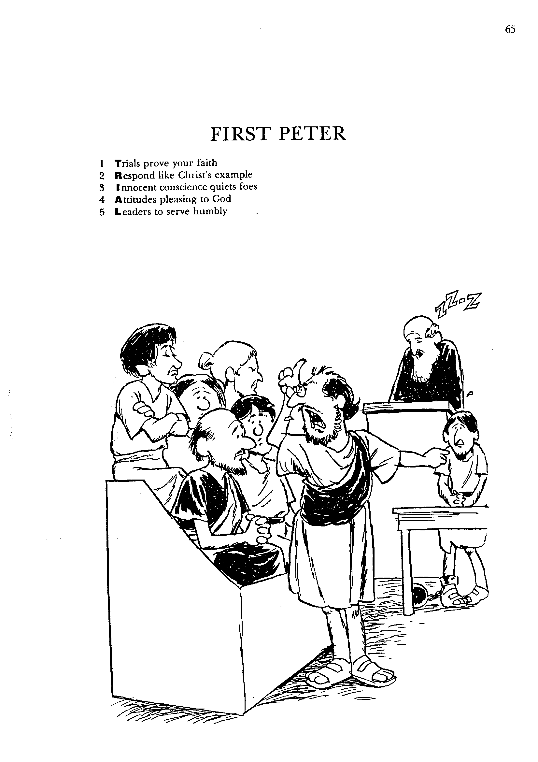
1
2
3
4
5
Trials prove your faith
Respond like Christ's example
Innocent conscience quiets foes
Attitudes pleasing to God
Leaders to serve humbly
FIRST PETER
Barry Huddleston, The Acrostic Bible
Notes:
The Christian's innocence on the witness stand makes the prosecuting attorney look foolish to the jury and the judge.

Slide 12
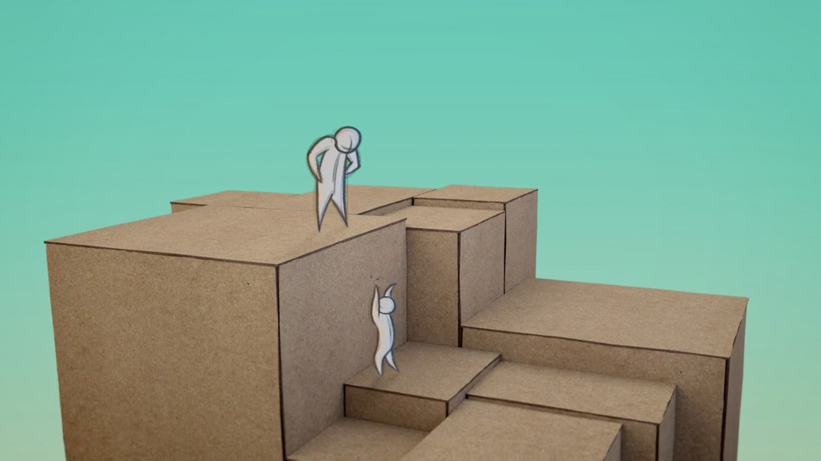
Be Attracting
1 Peter
Dr. Rick Griffith • Crossroads International Church Singapore
BibleStudyDownloads.org
Notes:
People notice when injustice is done to the innocent Christian. It attracts them with a curiosity about what makes that person tick. Our lives should welcome that kind of inquiry.

Slide 13
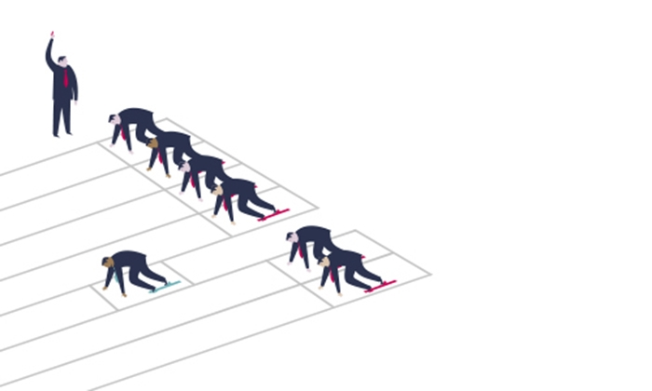
Are you suffering unfairly right now?
School?
Home?
Work?
Church?
Friends?
Government?
1 Peter
Notes:
Do you feel that someone else has an advantage over you because you are a Christian? Maybe it seems that everyone else has privileges you lack because of your faith in Jesus?

Slide 14

Argument & Themes of 1 Peter
278
Argument
"… I have written to you briefly, encouraging you and testifying that this is the true grace of God. Stand fast in it" (5:12)
The Dual Themes:
"This is the true grace of God" 1 Pet. 1:1-12 Election Sovereignty of God Positional sanctification Initiated by Godhead (1:2) | "Stand firm in it" 1 Pet. 1:13–5:14 Endurance Responsibility of man Practical sanctification Effected in Godly Living (1:13ff)
adapted from Kay Arthur, Precepts
Notes:
The end of the letter pairs grace and perseverance. These can form two major sections of the letter.

Slide 15

I. Show holiness with hope (1:1–2:12).
How to attract others to Jesus…
HOPE
IN THE DARKNESS
1 Peter
Notes:
[Our holy anticipation of God's reward attracts unbelievers.]
[Sanctification in light of our hope of future glory helps watching unbelievers praise God.]

Slide 16
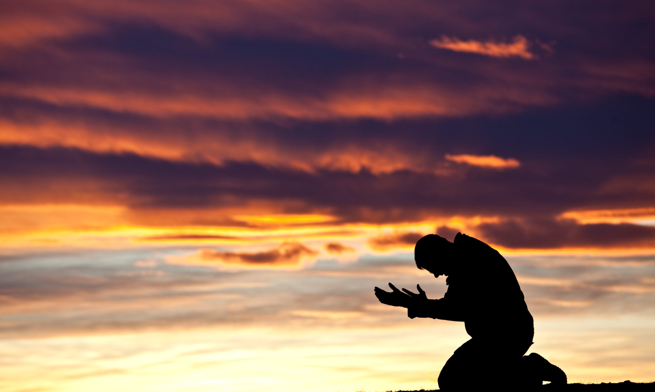
II. Show submission to both God and people (2:13–3:12).
How to attract others to Jesus…
1 Peter
Notes:
[Submit in all areas of life and this pleases both God and man.]

Slide 17

III. Show selfless living like Jesus (3:13–5:14).
How to attract others to Jesus…
LOVE GOD. LOVE PEOPLE.
1 Peter
Notes:
[A self-sacrificing lifestyle follows Christ's example of suffering then triumph.]

Slide 18
Main Idea of 1 Peter
How to attract others to Jesus…
Show a holy humility that honors others.
Notes:
People are drawn to believers who live a pure, meek, and selfless life.

Slide 19

Which of these three qualities is the biggest challenge for you?
      Holiness Where are your standards too low?
      Submission Where do you want to be boss but God wants you to yield?
Selflessness What battle do you need to lose?
1 Peter
Notes:
What specific thing does God want you to do to be more like the kind of Christian noted in 1 Peter?

Slide 20
Black

Slide 21

North Korea 1
0
9
s
9
1

Slide 22
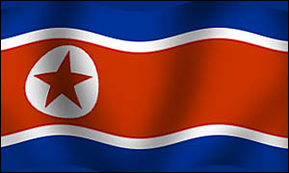
North Korea 2
N O R T H K O R E A

Slide 23
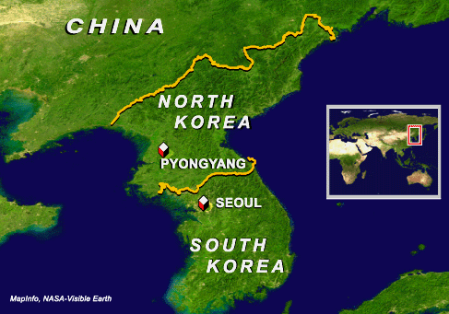
North Korea 3

Slide 24
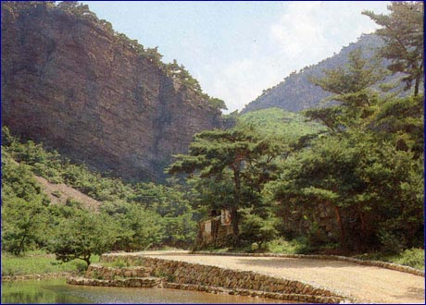
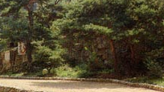
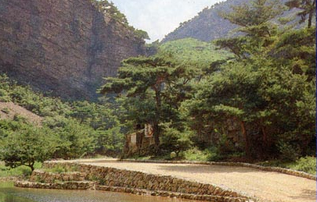
North Korea 4
N O R T H K O R E A
secret hiding place
North Korea 1

Slide 25
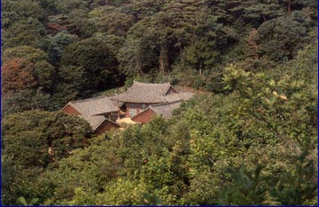
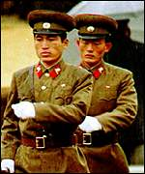
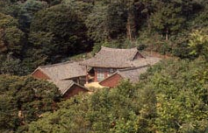
North Korea 5
ATTACK!
secret gathering
North Korea 1

Slide 26
Why must I suffer?
Are you asking…
!
?
w h y
w h y
w h y
w h y
(This is the wrong question to ask)

Slide 27
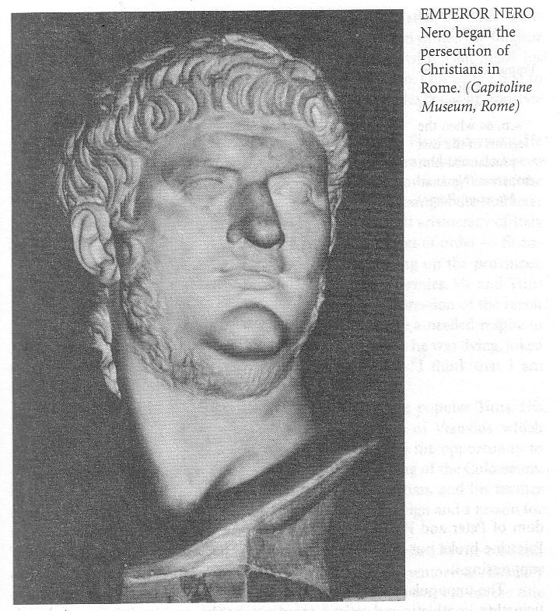
Nero (AD 54-68)
Stability
Insanity
Notes:
• Nero initially had many stable years at the beginning of his rule when he listened to the advice of the philosopher Seneca.
• But then he rejected this advice and eventually ended up insane and committing suicide.

Slide 28
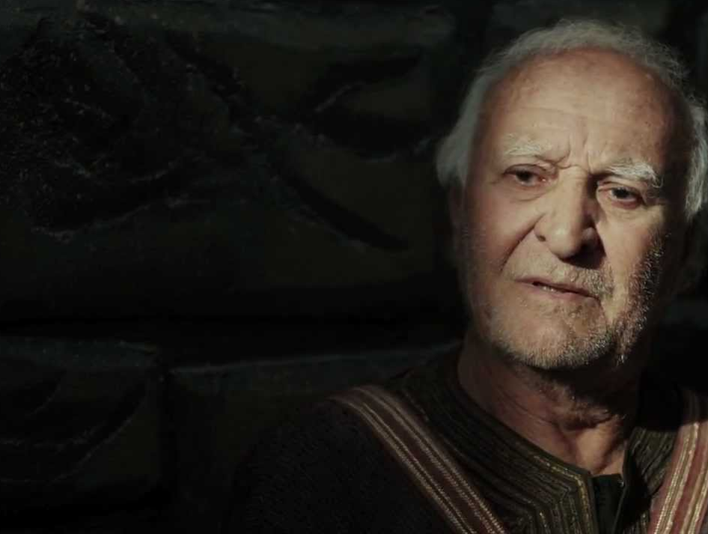
Timeline of Peter’s Life
AD
30
35
40
45
50
55
60
65
70
Peter becomes a disciple of Jesus (AD 30)
Just before the crucifixion, Peter denies Jesus (33)
Death & resurrection of Jesus (33)
Peter witnesses resurrection, preaches at Pentecost (33)
Peter becomes key church leader (33)
Peter witnesses to Cornelius (38)
Peter imprisoned by Agrippa, rescued (41-44)
Peter leaves Jerusalem (44)
Peter goes to Rome (50-54)
Nero’s reign (54-68)
Peter writes 1 Peter from Rome (62-63)
Fire in Rome; Nero blames, kills many Christians (19 July 64)
Peter writes 2 Peter, is martyred in Rome (64-67)
ESV Study Bible, adapted
Notes:
1 Peter: After Paul left Rome (AD 62),
but before Nero’s persecution started (AD 64)
2 Peter: Between Nero’s persecution (AD 64),
and his death (~AD 67)
Emperor
Tiberius(AD14-37)>Caligula (AD37-41)>Claudius (AD41-54)>Nero(AD54-68)
A brief statement in Divus Claudius 25 mentions agitations by the "Jews" which led Claudius (Roman Emperor from AD 41 to 54) to expel them from Rome.
Why did Paul call Peter, Cephas (Galatians 2:7-14, I Cor. 1:11-13, I Cor. 3:21, I Cor. 9:5 and I Cor. 15:5)? https://christianity.stackexchange.com/questions/7188/why-does-paul-call-peter-cephas-in-his-writings
Timeline is reference from ESV Study Bible

Slide 29
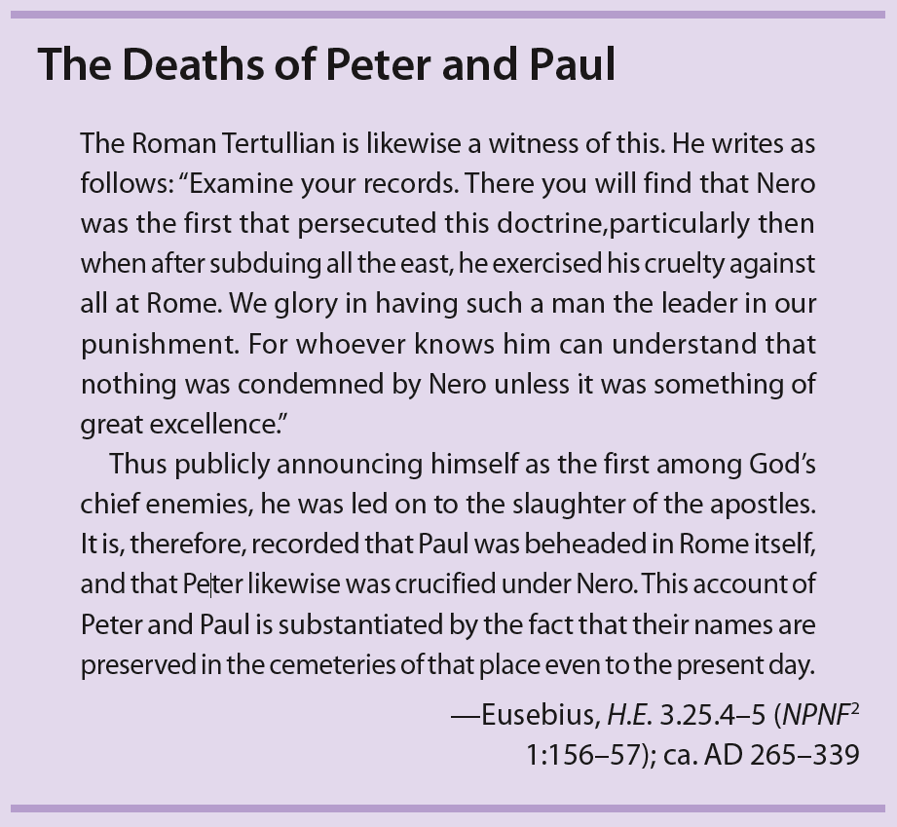
First Peter
The Deaths of Peter and Paul
The Roman Tertullian is likewise a witness of this. He writes as follows: "Examine your records. There you will find that Nero was the first that persecuted this doctrine, particularly… when after subduing all the east, he exercised his cruelty against all at Rome. We glory in having such a man the leader in our punishment. For whoever knows him can understand that nothing was condemned by Nero unless it was something of great excellence."
Thus publicly announcing himself as the first among God's chief enemies, he was led on to the slaughter of the apostles. It is, therefore, recorded that Paul was beheaded in Rome itself, and that Peter likewise was crucified under Nero. This account of Peter and Paul is substantiated by the fact that their names are preserved in the cemeteries of that place even to the present day.
—Eusebius, H.E. 3.25.4–5
(NPNF 1:156-57); ca. AD 265-339
The Comfort and Encouragement of Christ
The Glory of Salvation
The Believer as Pilgrim
Following Christ
Walter Elwell & Robert Yarborough, Encountering the NT, 3rd ed. (Grand Rapids: Baker, 2013)
Notes:
Walter Elwell & Robert Yarborough
Encountering the NT
© 2013 by Baker Publishing Group
Published by Baker Academic
a division of Baker Publishing Group
P.O. Box 6287, Grand Rapids, MI 49516-6287
www.bakeracademic.com
All rights reserved.

Slide 30
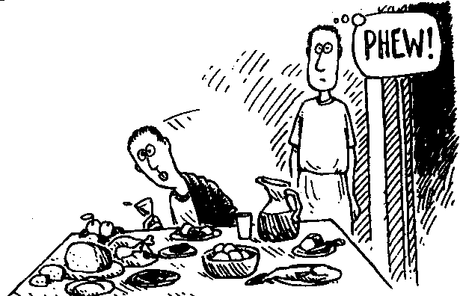
Nero's Poisoning of Britannicus
PHEW!
Terry Deary, The Rotten Romans, Horrible Histories (Scholastic, 1994), 67
Notes:
Nero's paranoid nature saw his nephew Britannicus a threat, but Britannicus was wary of attempts on his life, so he had a food taster try eat plate of food before he would eat. The poison was not in the food—nor the wine. But after being served warm wine, Britannicus asked for ice. Yes, the poison was in the ice!

Slide 31
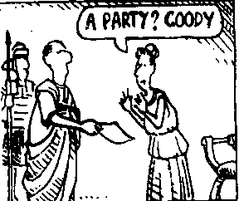
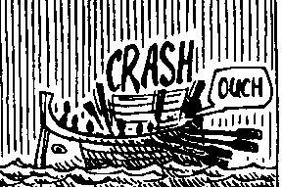
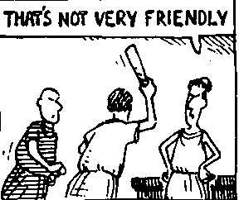
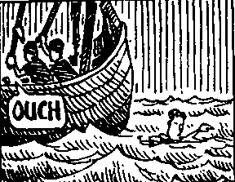
Thanks, Son!
A PARTY? GOODY
CRASH
THAT'S NOT VERY FRIENDLY
OUCH
OUCH
Terry Deary, The Rotten Romans, Horrible Histories (Scholastic, 1994), 68-69
Notes:
Nero even sought to kill his own mother but intended to make it look like an accident. He invited her to a party that she needed to attend by ship.
• But the mast of the ship was purposely weakened so it would break out at sea and drown all onboard.
• Yet Nero's mother jumped overboard and was a strong swimmer and the only one to escape.
• She found refuge in the seaside home of a fisherman and sent word to Nero that she survived—but the emperor sent executioners to the home to kill them all and proclaim widely that his mother drowned in the "accident."

Slide 32
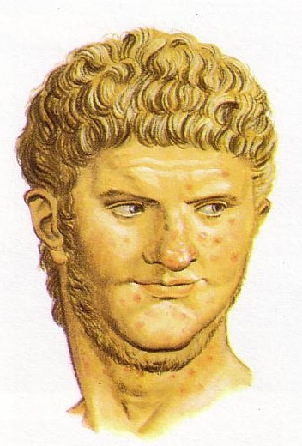
Nero (AD 54-68)
Stability
Insanity
Hypocrisy
Persecution
Jewish Revolt
Death

Slide 33
Key Words
Suffering, Grace and Glory
1 Peter

Slide 34
Intro to 1 Peter
“1 Peter is a letter of encouragement. Although the theme of suffering runs through this book, so does the theme of glory. Peter encourages the saints with the hope that one day their suffering will be turned to glory even as Christ suffered and entered His glory. But suffering does not automatically bring glory to God and blessing to God’s people. Some believers have fallen in times of trial and brought shame to the name of Christ. Only when we depend on the grace of God can we glorify God in times of suffering. And as we look to the Lord’s coming we can be hopeful!” -W. Wiersbe

Slide 35

¹² Dear friends, don’t be surprised at the fiery trials you are going through, as if something strange were happening to you.
¹³ Instead, be very glad—for these trials make you partners with Christ in his suffering, so that you will have the wonderful joy of seeing his glory when it is revealed to all the world.
1 Peter 4:12-16; 5:12

Slide 36
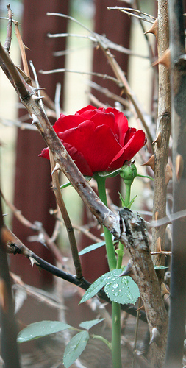
Peter, an apostle of Jesus Christ, to those who reside as aliens, scattered throughout Pontus, Galatia, Cappadocia, Asia, and Bithynia, who are chosen according to the foreknowledge of God the Father, by the sanctifying work of the Spirit, that you may obey Jesus Christ and be sprinkled with His blood: May grace and peace be yours in fullest measure.
1Pet. 1:1,2 NASB

Slide 37
"Blessed be the God and Father of our Lord Jesus Christ, who according to His great mercy has caused us to be born again to a living hope through the resurrection of Jesus Christ from the dead, to obtain an inheritance which is imperishable and undefiled and will not fade away, reserved in heaven for you, who are protected by the power of God through faith for a salvation ready to be revealed in the last time.
1 Pet 1:3-5 NASB

Slide 38
"In this you greatly rejoice, even though now for a little while, if necessary, you have been distressed by various trials, that the proof of your faith, being more precious than gold which is perishable, even though tested by fire, may be found to result in praise and glory and honor at the revelation of Jesus Christ;
1 Pet 1:6-7 NASB

Slide 39
“and though you have not seen Him, you love Him, and though you do not see Him now, but believe in Him, you greatly rejoice with joy inexpressible and full of glory, obtaining as the outcome of your faith the salvation of your souls.”
1 Pet 1:8-9 NASB

Slide 40
“As to this salvation, the prophets who prophesied of the grace that would come to you made careful search and inquiry, seeking to know what person or time the Spirit of Christ within them was indicating as He predicted the sufferings of Christ and the glories to follow.”
1 Pet 1:10-11 NASB

Slide 41
”It was revealed to them that they were not serving themselves, but you, in these things which now have been announced to you through those who preached the gospel to you by the Holy Spirit sent from heaven — things into which angels long to look.”
1 Pet 1:12 NASB

Slide 42
Who was Peter?
1 Peter 5:1
John 1:40-42
Mark 1:14-18
Matthew 14:22-33
Matthew 16:13-19
Matthew 17:1-8
Matthew 26:69-75
John 21:1-11, 15-19
Acts 2:1, 14-24, 37-41

Slide 43
Timeline of Peter’s Life
AD
30
35
40
45
50
55
60
65
70
Peter becomes a disciple of Jesus (AD 30)
Just before the crucifixion, Peter denies Jesus (33)
Death & resurrection of Jesus (33)
Peter witnesses resurrection, preaches at Pentecost (33)
Peter becomes key church leader (33)
Peter witnesses to Cornelius (38)
Peter imprisoned by Agrippa, rescued (41-44)
Peter leaves Jerusalem (44)
Peter goes to Rome (50-54)
Nero’s reign (54-68)
Peter writes 1 Peter from Rome (62-63)
Fire in Rome; Nero blames, kills many Christians (19 July 64)
Peter writes 2 Peter, is martyred in Rome (64-67)
ESV Study Bible, adapted
Notes:
1 Peter: After Paul left Rome (AD 62),
but before Nero’s persecution started (AD 64)
2 Peter: Between Nero’s persecution (AD 64),
and his death (~AD 67)
Emperor
Tiberius(AD14-37)>Caligula (AD37-41)>Claudius (AD41-54)>Nero(AD54-68)
A brief statement in Divus Claudius 25 mentions agitations by the "Jews" which led Claudius (Roman Emperor from AD 41 to 54) to expel them from Rome.
Why did Paul call Peter, Cephas (Galatians 2:7-14, I Cor. 1:11-13, I Cor. 3:21, I Cor. 9:5 and I Cor. 15:5)? https://christianity.stackexchange.com/questions/7188/why-does-paul-call-peter-cephas-in-his-writings
Timeline is reference from ESV Study Bible

Slide 44
First Peter
The Comfort and Encouragement of Christ
The Glory of Salvation
The Believer as Pilgrim
Following Christ
Walter Elwell & Robert Yarborough, Encountering the NT, 3rd ed. (Grand Rapids: Baker, 2013)
Notes:
Walter Elwell & Robert Yarborough
Encountering the NT
© 2013 by Baker Publishing Group
Published by Baker Academic
a division of Baker Publishing Group
P.O. Box 6287, Grand Rapids, MI 49516-6287
www.bakeracademic.com
All rights reserved.

Slide 45
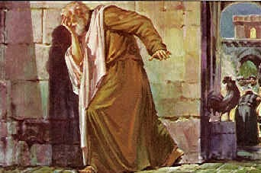
Background to 1 Peter
276
Authorship:
Who wrote it?
"Peter, an apostle of Jesus Christ" (1:1)
So who else can it be?
Yet some still object! Why?

Slide 46
Date & Place
277
Date
After Paul left Rome (AD 62) but before persecution started (AD 64)
Place
"Babylon" = Rome (5:13) but WHY?

Slide 47
Conclusion (5:13-14)
280r
Woman?
Church?
Babylon?
Rome?
¹³ She who is in Babylon, chosen together with you, sends you her greetings, and so does my son Mark.
¹⁴ Greet one another with a kiss of love. Peace to all of you who are in Christ.

Slide 48
Date & Place
277
Date
After Paul left Rome (AD 62) but before persecution started (AD 64)
Place
"Babylon" = Rome (5:13) but WHY?
1. Peter did not visit old Babylon
2. "Babylon" traditionally referred to Rome
3. Revelation 17–18 refers to Rome as Babylon

Slide 49
NT Overview (General Epistles)
38
124
39-41
"To the remotest part of the earth" (Acts 1:8)
Acts 9 13 14 15 16 18 21 27 28
Apr 48-
Sep 49
1
Galatia
Apr 50-
Sep 52
2
Aegean
Spr 53-
May 57
3
Asia
Feb 60-
Mar 62
1
Rome
Spr 62-
Fall 67
4
Spain
Aut 67-
Spr 68
2
Rome
Summer 35-
37
Damascus
Antioch
May 57-
Aug 59
Trials
Fall 49
The
Council
Spring 68
Expansion of Church
35 48 49 50 52 53 57 60 62 67 68 95
Matt
Luke
Acts
Mark
John
Gal
1 Thess
1 Cor
Eph
1 Tim
2 Tim
Jude
James
2 Thess
2 Cor
Col
Titus
Heb
1 John
Romans
Philem
1 Pet
2 John
Gospels & Acts
Phil
2 Pet
3 John
Pauline Epistles
1234
Journeys
Rev
General Epistles
Rome
Imprisonments
By category

Slide 50
"The Greek is too polished for a fisherman"
Objections to Authorship by Peter:
276
But Peter had 30 years of sharpening!
"Persecution had not started"
But he wasn't writing to Rome
"It resembles Paul's letters"
Paul & Peter agreed on the gospel
"It's too pastoral for an apostle"
Can't apostles be pastoral?

Slide 51
Homework
Read through 1 Peter on your own this week.
Find the verse that shows the purpose Peter is writing.
As you read, mark these key words:
  Grace
  Trials/ Suffering
  Glory

Slide 52
Be Attracting
1 Peter
Dr. Rick Griffith • Crossroads International Church Singapore
BibleStudyDownloads.org

Slide 53
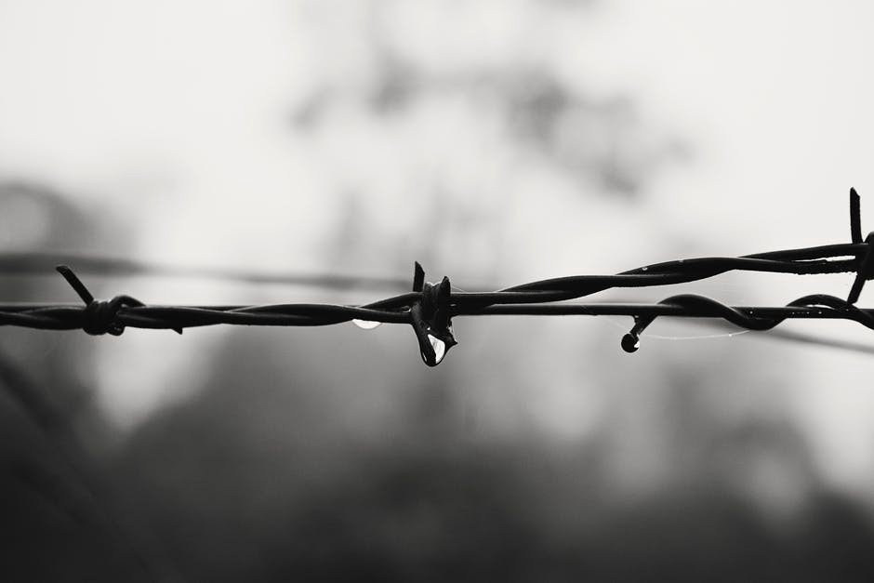
Suffering for Jesus

Slide 54
Are you suffering unfairly right now?
School?
Home?
Work?
Church?
Friends?
Government?
Notes:
Do you feel that someone else has an advantage over you because you are a Christian? Maybe it seems that everyone else has privileges that you do not have due to your faith in Jesus?

Slide 55
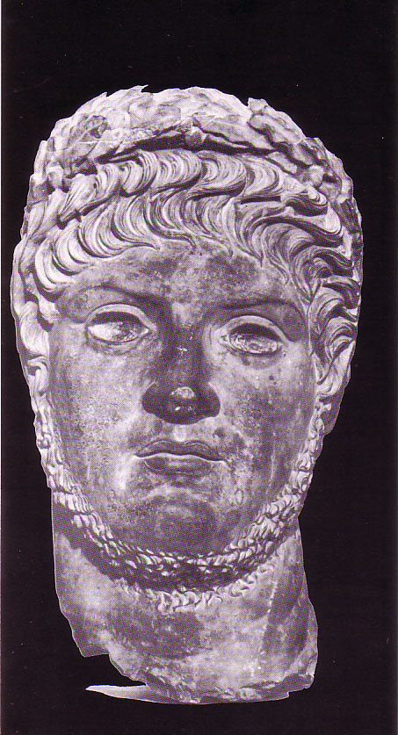
Why Peter wrote…
277
Why did Peter's readers need encouragement?
1 Pet. 4:12-13
"Dear friends, don't be surprised at the fiery trials you are going through, as if something strange were happening to you. Instead, be very glad-- because these trials will make you partners with Christ in his suffering, and afterward you will have the wonderful joy of sharing his glory when it is displayed to all the world."
Nero

Slide 56
Argument & Themes
278
Argument
"… I have written to you briefly, encouraging you and testifying that this is the true grace of God. Stand fast in it" (5:12)
The Dual Themes:
"This is the true grace of God" 1 Pet. 1:1-12 Election Sovereignty of God Positional sanctification Initiated by Godhead (1:2) | "Stand firm in it" 1 Pet. 1:13–5:14 Endurance Responsibility of man Practical sanctification Effected in Godly Living (1:13ff)

Slide 57
What is Grace?
"The power to do God's will"
- Bill Gothard
(Institute in Basic Life Principles)

Slide 58
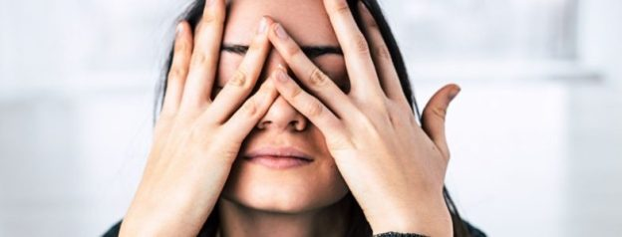
Too often we repel unbelievers when we suffer

Slide 59
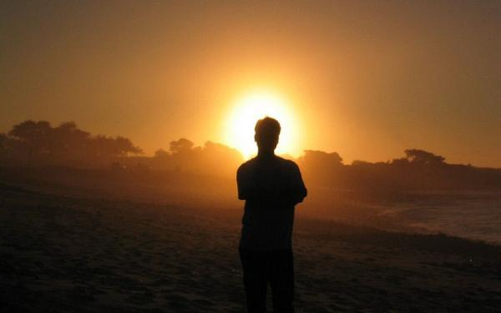
How can we tap into God’s grace in our difficulties to attract others to Jesus?

Slide 60
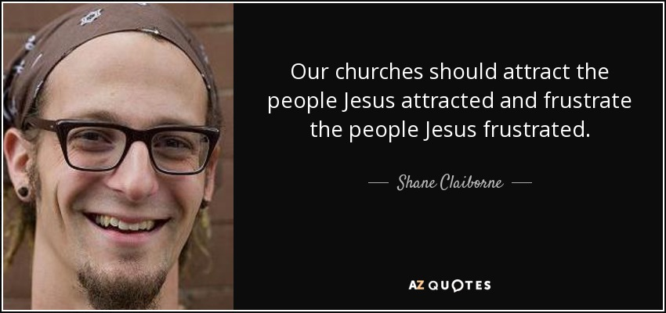
Attract Others to Jesus
Our churches should attract the people Jesus attracted and frustrate the people Jesus frustrated.
—Shane Claiborne—

Slide 61
NT Overview (General + Key Words)
38
124
39-41
"To the remotest part of the earth" (Acts 1:8)
Acts 9 13 14 15 16 18 21 27 28
Apr 48-
Sep 49
1
Galatia
Apr 50-
Sep 52
2
Aegean
Spr 53-
May 57
3
Asia
Feb 60-
Mar 62
1
Rome
Spr 62-
Fall 67
4
Spain
Aut 67-
Spr 68
2
Rome
Summer 35-
37
Damascus
Antioch
May 57-
Aug 59
Trials
Fall 49
The
Council
Spring 68
Expansion of Church
35 48 49 50 52 53 57 60 62 67 68 95
Matt
Kingdom
Luke
Sov 1
Acts
Sov 2
Mark
Disciple
John
Believe
Gal
Justify
1 Thess
Rapture
1 Cor
Eph
Unity
1 Tim
Order
2 Tim
Sanctify
Doctrine
James
Works
2 Thess
Tribulation
2 Cor
Col
Deity
Titus
Apostle
Conduct
Romans
Philem
1 Pet
Righteous
Forgive
Suffering
Gospels & Acts
Phil
Attitude
Pauline Epistles
1234
Journeys
General Epistles
Rome
Imprisonments
General Epistles + Key Words

Slide 62

Common Responses
Peter counters the natural responses to suffering:
278
Common Responses to Persecution | Peter's Exhortation
"I'll get even" | "Do not repay evil with evil or insult with insult, but with blessing, because to this you were called to inherit a blessing" (3:9; cf. 2:1)
"I'm discouraged" | "Rejoice that you participate in the sufferings of Christ…do not be ashamed…" (4:13, 16)
"I'm afraid" | "Do not fear what they [persecutors] fear; do not be frightened" (3:14b)
"Forget Christianity. It's not worth it" | "…by His wounds you have been healed" (2:24)
"Why do they only persecute me?" | "…your brothers throughout the world are undergoing the same kind of sufferings" (5:9)
"Hey! I have my rights!" | "Humble yourselves…under God's mighty hand, that He may lift you up in due time" (5:6)

Slide 63
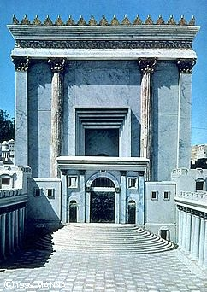

Persecution in the First Century
39-41, 320
All Emperors Were Not Equal
Christ Crucified
AD 33
Jerusalem Destroyed
AD 70
Revelation Written
AD 95
Tiberius
14-37
Caligula
37-41
Claudius
41-54
Nero
54-68
Vespasian
69-79
Titus
79-81
Domitian
81-96
Emperors in black caused Jews and/or Christians to suffer
Notes:
Emperors in black persecuted Christians
This course teaches that Revelation was written during the reign of Domitian at the end of the first century.

Slide 64

Rome AD 64
ROM
e
ROM
A.D. 64

Slide 65
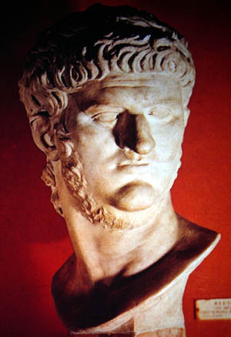
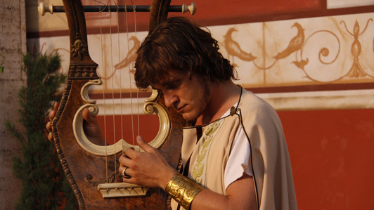
Nero (AD 54-68)
"Favorite sayings: He played the lyre very badly but people told him he was brilliant.
The Greeks were particularly creepy about telling him he was good. 'Only the Greeks are worth my genius,' he would say.
When he knew he had to die all he could say was, 'What a loss I shall be to the art of music!'"
Terry Deary, The Rotten Romans, Horrible Histories (Scholastic, 1994), 66

Slide 66
Theme
23
How to Attract Others During Righteous Suffering
1 Peter

Slide 67
1 Peter Outline
275
How to Attract Others During Righteous Suffering
Sanctification |  |  | Submission |  |  |  | Selflessness
1:1–2:12 |  |  | 2:13–3:12 |  |  |  | 3:13–5:14
Holiness |  |  | Humility |  |  |  | Honoring Others
Salu-tation 1:1-2 | Praise for hope 1:3- 12 | Holy Life Exhort-ed 1:13– 2:12 | Gov't 2:13- 17 | Work Place 2:18- 25 | Marri-age 3:1-7 | Church & all of Life 3:8-12 | Christ's triumph 3:13–4:6 | Edify others 4:7-19 | Elders 5:1-4 | Young Men 5:5a | Humility & watch-fulness 5:5b-11 | Purpose 5:12-14
Rome to Northern Asia
Early AD 64

Slide 68
I. Show holiness with hope (1:1–2:12).
How to attract others to Jesus…
HOPE
IN THE DARKNESS
Notes:
[Our holy anticipation of God's reward attracts unbelievers.]
[Sanctification in light of our hope of future glory helps watching unbelievers praise God.]

Slide 69

Show holiness with hope.

Slide 70
Slides on
1 Peter 1

Slide 71
Endurance in Suffering By God's Grace (is achieved by…)
279
Outline
I. Sanctification 1:1–2:12
(Holiness)
Salutation 1:1-2
Praise for hope 1:3-12
Holy Life Exhorted 1:13–2:12

Slide 72
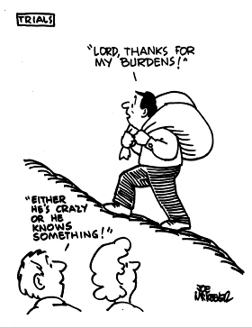
Endurance in Suffering By God's Grace (is achieved by…)
279
I. Sanctification (1:1–2:12)
Sanctification in light of our hope of future glory helps watching unbelievers praise God (1:1–2:12).
"LORD, THANKS FOR MY BURDENS!"
"EITHER HE'S
CRAZY OR HE KNOWS SOMETHING!"

Slide 73
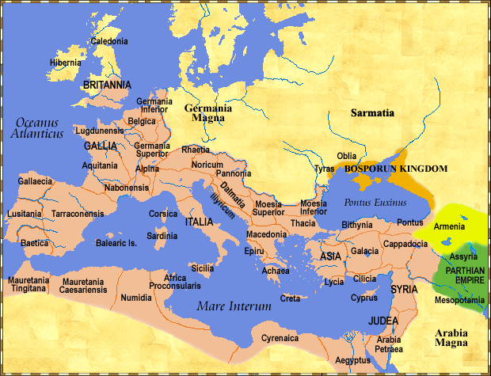
Recipients: Pilgrims in Dispersion
277
280a
"This letter is from Peter, an apostle of Jesus Christ. I am writing to God’s chosen people who are living as foreigners in the provinces of Pontus, Galatia, Cappadocia, Asia, and Bithynia”
—1 Pet 1:1 NLT—

Slide 74
Do you feel like an alien?
"Peter, an apostle of Jesus Christ,
To those who reside as aliens…"
—1 Pet 1:1 NAS—

Slide 75
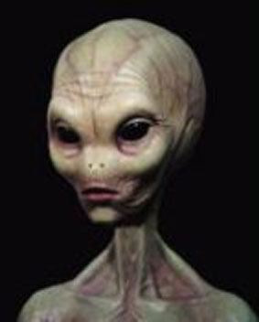
What does an alien look like?
"Peter, an apostle of Jesus Christ,
To those who reside as aliens…"
—1 Pet 1:1 NAS—

Slide 76
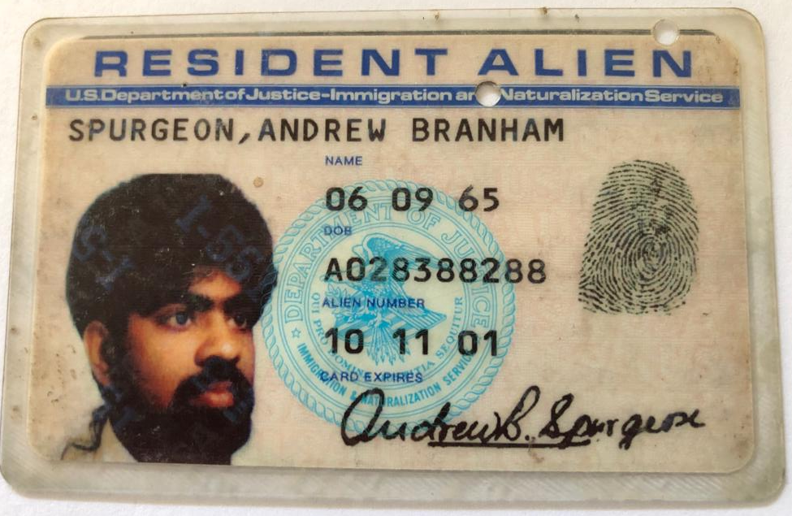
What does an alien look like?

Slide 77
What is an Alien?
1. Reside in a foreign land
2. Citizenship is in another place (cf. Phil. 3:20)
3. Abode is temporary (not a P.R.)
4. Different values than the majority—sense of humor, dress, view of money, job, giving, etc.
5. Often persecuted for being different—laughed at, ridiculed, etc.
Notes:
Seriously speaking, the Greek word for “alien” refers to one who stays for a while in a strange or foreign place; pilgrim, refugee

Slide 78
"Praise be to the God and Father of our Lord Jesus Christ! In his great mercy he has given us new birth into a living hope through the resurrection of Jesus Christ from the dead, ⁴and into an inheritance that can never perish, spoil or fade—kept in heaven for you, ⁵who through faith are shielded by God's power until the coming of the salvation that is ready to be revealed in the last time.”
—1 Pet 1:3-5 NIV—

Slide 79
"In this you greatly rejoice, though now for a little while you may have had to suffer grief in all kinds of trials. ⁷These have come so that your faith—of greater worth than gold, which perishes even though refined by fire—may be proved genuine and may result in praise, glory and honor when Jesus Christ is revealed."
—1 Pet 1:6-7 NIV—

Slide 80
"Though you have not seen him, you love him; and even though you do not see him now, you believe in him and are filled with an inexpressible and glorious joy, ⁹for you are receiving the goal of your faith, the salvation of your souls."
—1 Pet 1:8-9 NIV—

Slide 81
"Concerning this salvation, the prophets, who spoke of the grace that was to come to you, searched intently and with the greatest care, ¹¹trying to find out the time and circumstances to which the Spirit of Christ in them was pointing when he predicted the sufferings of Christ and the glories that would follow."
—1 Pet 1:10-11 NIV—

Slide 82
"It was revealed to them that they were not serving themselves but you, when they spoke of the things that have now been told you by those who have preached the gospel to you by the Holy Spirit sent from heaven. Even angels long to look into these things."
—1 Pet 1:12 NIV—

Slide 83
God Chooses and Causes
GOD has caused us to be born again
to a living hope
because of His great mercy
through the resurrection of Jesus Christ from the dead.
to obtain an inheritance which is:
imperishable
undefiled
will not fade away
reserved in heaven for us
who are protected by the power of God
through faith
for a salvation ready to be revealed (apokolupto) in the last (eschaton) time.

Slide 84
Benefits of Unjust Suffering
(1 Peter 1:6-9)
280
Provides a chance to rejoice (6a)
Provides a variety of experiences (6b)
Proves your faith as genuine (7a)
Faith praises God (7b)
Provides opportunities for growth (7)
Gives joy from loving One unseen (8)
Rewarded in assurance of salvation (9)

Slide 85
Homework
Read through 1 Peter on your own this week.
Find the verse that shows the purpose Peter is writing.
As you read, mark these key words:
Grace
Trials/ Suffering
Glory

Slide 86
Purpose of 1 Peter?
23

Slide 87
Purpose
23
“I have written to you briefly, encouraging you and testifying that this is the true grace of God. Stand firm in it!”
1 Peter 5:12

Slide 88

Holiness:
What is it?
280a
Belonging to God
set apart to or by God, consecrated; holy, morally pure, upright
Set apart for special use

Slide 89
How Holy are You?
280a
How true are these statements of you?
My work (or school or neighborhood) friends know me as a believer in Jesus Christ.
People are more like God because they know me well.

Slide 90
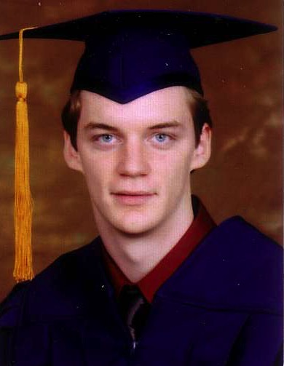
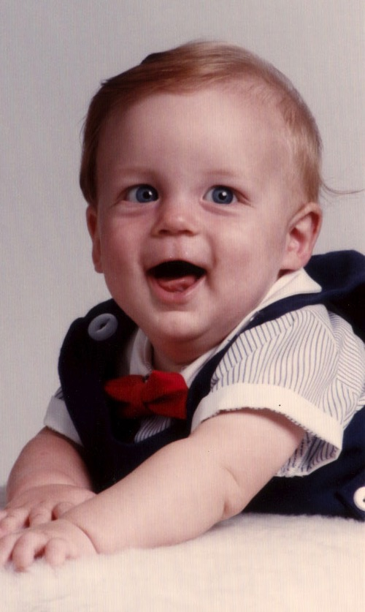
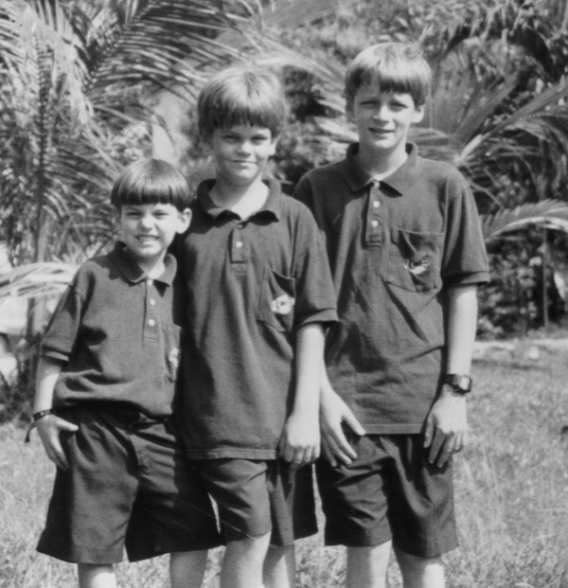
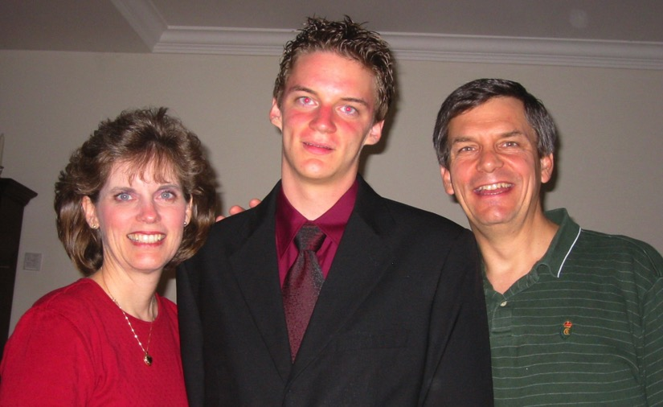
Have Susan and I influenced Kurt to be a godly man over his first 18 years?

Slide 91
Lighting an Issue…
How is it that during trials believers can be deceived to lower their commitment to a holy life? Can you diagram this peril?

Slide 92
1 Peter Outline
275
How to Attract Others During Righteous Suffering
Sanctification |  |  | Submission |  |  |  | Selflessness
1:1–2:12 |  |  | 2:13–3:12 |  |  |  | 3:13–5:14
Holiness |  |  | Humility |  |  |  | Honoring Others
Salu-tation 1:1-2 | Praise for hope 1:3- 12 | Holy Life Exhort-ed 1:13– 2:12 | Gov't 2:13- 17 | Work Place 2:18- 25 | Marri-age 3:1-7 | Church & all of Life 3:8-12 | Christ's triumph 3:13–4:6 | Edify others 4:7-19 | Elders 5:1-4 | Young Men 5:5a | Humility & watch-fulness 5:5b-11 | Purpose 5:12-14
Rome to Northern Asia
Early AD 64

Slide 93
Endurance in Suffering By God's Grace (is achieved by…)
279
Outline
I. Sanctification 1:1–2:12
Sanctification in light of our hope of future glory helps watching unbelievers praise God
Salutation 1:1-2
Praise for hope 1:3-12
Holy Life Exhorted 1:13–2:12

Slide 94
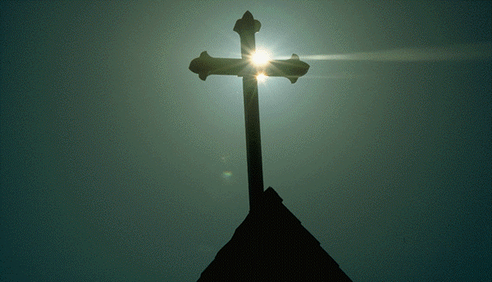
Why replace the evil desires of our former life with moral purity now?
280a
God is Our Example (13-16)

Slide 95
NIV Commands of 1 Peter 1:13-15
280a
Prepare your minds for action
Be self-controlled
Set your hope…
Do not conform to… evil desires
Be holy

Slide 96
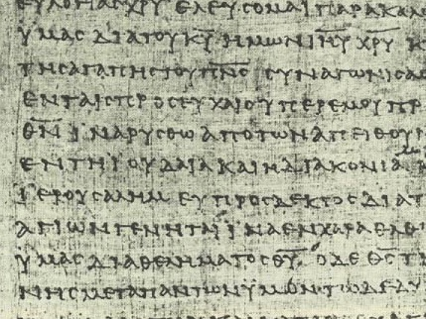
Two Greek Commands (1:13-15)
280a
Set your hope…
…with a prepared mind
…with self-control
Be holy
… not conforming to… evil desires

Slide 97
Why replace the evil desires of our former life with moral purity now?
280a
God is Our Example (13-16)

Slide 98
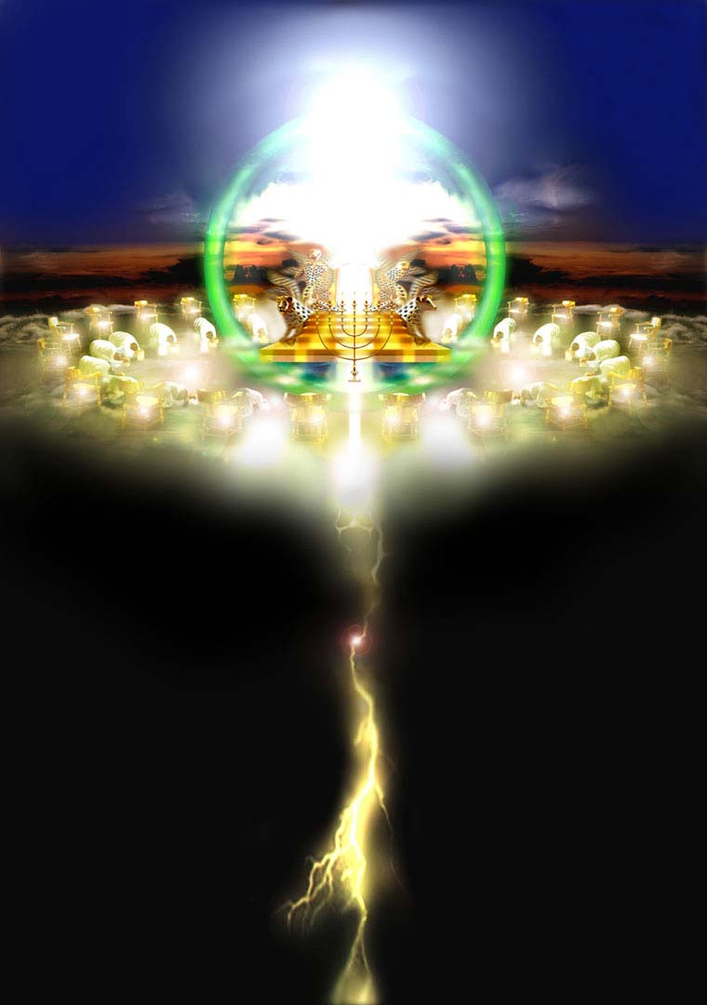
God our Example is holy (1:13-16)
Who can even begin to comprehend God's holiness at his throne (Rev. 4-5)?
280a

Slide 99
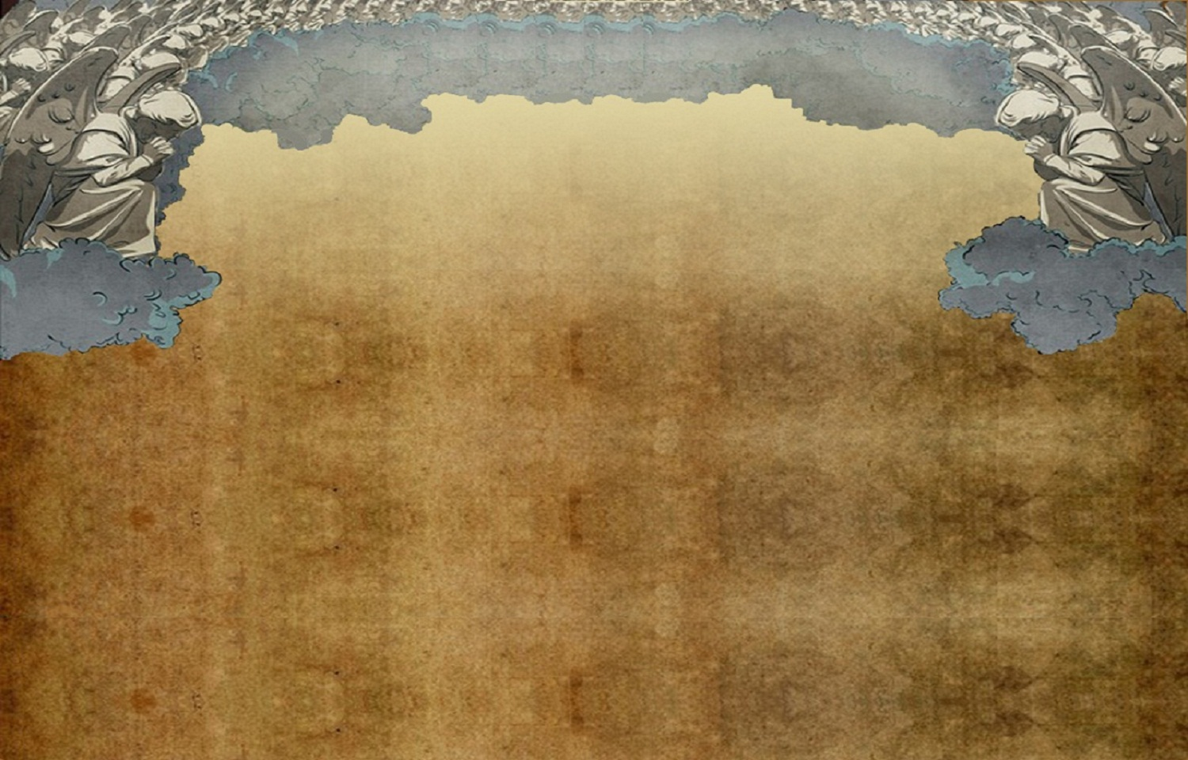
1 Peter 1:13 (NLT)
So prepare your minds for action and exercise self-control. Put all your hope in the gracious salvation that will come to you when Jesus Christ is revealed to the world.

Slide 100
1 Peter 1:14 (NLT)
So you must live as
God's obedient children. Don't slip back into your old ways of living to satisfy your own desires. You didn't know any better then.

Slide 101
1 Peter 1:15-16 (NLT)
But now you must
be holy in everything
you do, just as God who chose you is holy. For the Scriptures say, "You must be holy because I am holy."

Slide 102
1 Peter 1:17 (NLT)
And remember that the heavenly Father to
whom you pray has no favorites. He will judge or reward you according to what you do. So you must live in reverent fear of him during your time as "temporary residents."

Slide 103
1 Peter 1:18 (NLT)
For you know that
God paid a ransom
to save you from the empty life you inherited from your ancestors. And it was not paid with mere gold or silver, which lose their value.

Slide 104
1 Peter 1:19-20 (NLT)
It was the precious
blood of Christ, the
sinless, spotless Lamb of God. God chose him as your ransom long before the world began, but now in these last days he has been revealed for your sake.

Slide 105
5 Reasons to Live a Holy Life
(1 Peter 1:13-21)
God’s Grace (13)
God’s Holiness. (14-15)
God’s Word (16)
God’s Judgment (17)
God’s Love (18-21)

Slide 106
Why replace the evil desires of our former life with moral purity now?
280a
God is Our Example (13-16)
God is Our Judge (17)

Slide 107
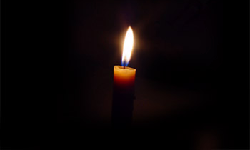
Be holy because God is Judge
280a
"Since you call on a Father who judges each man's work impartially, live your lives as strangers here in reverent fear"
(1 Peter 1:17)
In what way do you feel like a "stranger" on earth?

Slide 108
Why replace the evil desires of our former life with moral purity now?
280a
God is Our Example (13-16)
God is Our Judge (17)
God is Our Redeemer (18-21)

Slide 109
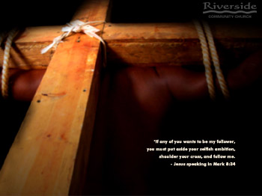
Be holy because God is Redeemer
280a
"…it was not with perishable things such as silver or gold that you were redeemed from your empty way of life handed down to you from your forefathers, but with the precious blood of Christ, a lamb without blemish or defect" (1 Peter 1:18-19)
How was your former way of life as a non-Christian "empty"?

Slide 110

Redemption means to buy back…
280a

Slide 111


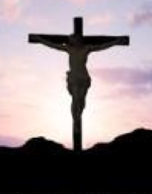

Redemption (Rom 3:24):
"to pay a ransom" (Greek)
280a
Christ's blood paid our ransom
(1 Pet. 1:18)
X
Slave Market
of Sin
Notes:
We redeem something when we pay for it with something of equal or greater value to release it from someone else's control. Christ's death was far more valuable than the hold that sin had on us.
______________
BE-60-1 Peter-45
NS-06-Rom3-4—slide 69
NS-21-1Peter-111

Slide 112

Jesus' death paid for our sin (John 19:16b-42)
280a

Slide 113


"It is finished"
280a
Legal
Paid
in Full

Slide 114
1 Peter 1:22
Since you have in obedience to the truth purified your souls for a sincere love of the brethren, fervently love one another from the heart.

Slide 115
Why replace the evil desires of our former life with moral purity now?
280a
God is Our Example (13-16)
God is Our Judge (17)
God is Our Redeemer (18-21)
God is Our Communicator (1:22–2:3)

Slide 116


God as Communicator purifies us through his Word (1:22–2:3)
"Now that you have purified yourselves by obeying the truth…
…living and enduring word of God…
…the word of the Lord stands forever…
And this is the word that was preached to you
…crave pure spiritual milk…"
280a
Which 2:1 sins are reduced in you by "the pure spiritual milk"?

Slide 117
God’s Grace in Chapter 1
God has chosen us (1:2)
He caused us to be born again (1:3)
He has an imperishable inheritance reserved in heaven for us (1:4)
He protects us by the power of God for salvation (1:5)
He gives us reason to rejoice even in trials and love Him even when we cannot see Him (1:6-8)

Slide 118
Philippians 1:6
“For I am confident of this very thing, that He who began a good work in you will perfect it until the day of Christ Jesus.”

Slide 119
Questions to Discuss
Why is it important to remember our salvation experience and what it cost God?
How can this help you stand in time of difficulty?
3. What practical steps can you take this week to become more holy?

Slide 120
Homework
Read through 1 Peter on your own this week.
Find the verse that shows the purpose Peter is writing.
As you read, mark these key words:
Grace
Trials/ Suffering
Glory

Slide 121

A Goal to Pursue
280a
What one way can I become more holy like Christ this week?

Slide 122
Slides on
1 Peter 2

Slide 123
Sins to avoid in 1 Peter 2:1
280a
Malice wicked ill-will
Deceit deliberate dishonesty
Hypocrisy pretended piety and love
Envy resentful discontent
Slander backbiting lies
Roger Raymer, "1 Peter," in The Bible Knowledge Commentary, 2:844

Slide 124

Relationships in 1 Peter 2:
To God
To Believers
To Unbelievers

Slide 125
1 Peter
Grace In Suffering

Slide 126
Review:
What is the purpose of 1 Peter?
23

Slide 127
Purpose
23
“I have written to you briefly, encouraging you and testifying that this is the true grace of God. Stand firm in it!”
1 Peter 5:12

Slide 128
Timeline of Peter’s Life
AD
30
35
40
45
50
55
60
65
70
Peter becomes a disciple of Jesus (AD 30)
Just before the crucifixion, Peter denies Jesus (33)
Death & resurrection of Jesus (33)
Peter witnesses resurrection, preaches at Pentecost (33)
Peter becomes key church leader (33)
Peter witnesses to Cornelius (38)
Peter imprisoned by Agrippa, rescued (41-44)
Peter leaves Jerusalem (44)
Peter goes to Rome (50-54)
Nero’s reign (54-68)
Peter writes 1 Peter from Rome (62-63)
Fire in Rome; Nero blames, kills many Christians (19 July 64)
Peter writes 2 Peter, is martyred in Rome (64-67)
ESV Study Bible, adapted
Notes:
1 Peter: After Paul left Rome (AD 62),
but before Nero’s persecution started (AD 64)
2 Peter: Between Nero’s persecution (AD 64),
and his death (~AD 67)
Emperor
Tiberius(AD14-37)>Caligula (AD37-41)>Claudius (AD41-54)>Nero(AD54-68)
A brief statement in Divus Claudius 25 mentions agitations by the "Jews" which led Claudius (Roman Emperor from AD 41 to 54) to expel them from Rome.
Why did Paul call Peter, Cephas (Galatians 2:7-14, I Cor. 1:11-13, I Cor. 3:21, I Cor. 9:5 and I Cor. 15:5)? https://christianity.stackexchange.com/questions/7188/why-does-paul-call-peter-cephas-in-his-writings
Timeline is reference from ESV Study Bible

Slide 129
Nero (AD 54-68)
Stability
Insanity

Slide 130
Recipients: Pilgrims in Dispersion
"Peter, an apostle of Jesus Christ, to those who reside as aliens, scattered throughout Pontus, Galatia, Cappadocia, Asia, and Bithynia, who are chosen..”
1 Pet 1:1 NASB

Slide 131
Black

Slide 132
1 Peter
Grace In Suffering

Slide 133

1 Peter 2:1-12
1.Therefore, putting aside all malice and all deceit and hypocrisy and envy and all slander,
2. like new born babies, long for the pure milk of the word, so that by it you may grow in respect to salvation,
3. if you have tasted the kindness of the Lord.
4. And coming to Him as to a living stone which has been rejected by men, but is choice and precious in the sight of God,

Slide 134
5. you also, as living stones, are being built up as a spiritual house for a holy priesthood, to offer up spiritual sacrifices acceptable to God through Jesus Christ.
6. For this is contained in Scripture:
“BEHOLD, I LAY IN ZION A CHOICE STONE, A PRECIOUS CORNERSTONE,
AND HE WHO BELIEVES IN HIM WILL NOT BE DISAPPOINTED.”

Slide 135
7. This precious value, then, is for you who believe; but for those who disbelieve,
“THE STONE WHICH THE BUILDERS REJECTED,
THIS BECAME THE VERY CORNERSTONE,”
8. and,
“A STONE OF STUMBLING AND A ROCK OF OFFENSE”;
for they stumble because they are disobedient to the word, and to this doom they were also appointed.

Slide 136
9. But you are A CHOSEN RACE, A royal PRIESTHOOD, A HOLY NATION, A PEOPLE FOR GOD’S OWN POSSESSION, so that you may proclaim the excellencies of Him who has called you out of darkness into His marvellous light;
10. for you once were NOT A PEOPLE, but now you are THE PEOPLE OF GOD; you had NOT RECEIVED MERCY, but now you have RECEIVED MERCY.

Slide 137
11. Beloved, I urge you as aliens and strangers to abstain from fleshly lusts which wage war against the soul.
12. Keep your behavior excellent among the Gentiles, so that in the thing in which they slander you as evildoers, they may because of your good deeds, as they observe them, glorify God in the day of visitation.

Slide 138
1 Peter 1:22
Since you have in obedience to the truth purified your souls for a sincere love of the brethren, fervently love one another from the heart.
Therefore…… (2:1)

Slide 139
5 Sins to Put Aside 2:1
Malice
Deceit
Hypocrisy
Envy
Slander

Slide 140

Desire the Pure Milk of the Word
That you may grow by it
1 Peter 2:2

Slide 141

I Want More!

Slide 142

1 Peter 2:5 (NIV)
171
“You also, like living stones, are being built into a spiritual house to be a holy priesthood, offering spiritual sacrifices acceptable to God through Jesus Christ.”

Slide 143
You As Living Stones
Being built up as a spiritual house
For a holy priesthood
To offer:
acceptable spiritual sacrifices

Slide 144

The Stone that the Builders Rejected has become the Chief Cornerstone.V 7

Slide 145
What We Are
A Chosen Race
A Royal Priesthood
A Holy Nation
A People Belonging to God

Slide 146

To Proclaim the Excellencies of Him who has called you out of darkness into His marvelous light!
For What Purpose?

Slide 147
Bringing truth to light
How is it that during trials believers can be deceived to lower their commitment to a holy life?

Slide 148

Recipients of Peter’s Letter

Slide 149
Theme
23
How to Attract Others During Righteous Suffering
1 Peter

Slide 150
I. Show holiness with hope (1:1–2:12).
How to attract others to Jesus…
HOPE
IN THE DARKNESS
1 Peter
Notes:
[Our holy anticipation of God's reward attracts unbelievers.]
[Sanctification in light of our hope of future glory helps watching unbelievers praise God.]

Slide 151
II. Show submission to both God and people (2:13–3:12).
How to attract others to Jesus…
1 Peter
Notes:
[Submit in all areas of life and this pleases both God and man.]

Slide 152
1 Peter Outline
275
How to Attract Others During Righteous Suffering
Sanctification |  |  | Submission |  |  |  | Selflessness
1:1–2:12 |  |  | 2:13–3:12 |  |  |  | 3:13–5:14
Holiness |  |  | Humility |  |  |  | Honoring Others
Salu-tation 1:1-2 | Praise for hope 1:3- 12 | Holy Life Exhort-ed 1:13– 2:12 | Gov't 2:13- 17 | Work Place 2:18- 25 | Marri-age 3:1-7 | Church & all of Life 3:8-12 | Christ's triumph 3:13–4:6 | Edify others 4:7-19 | Elders 5:1-4 | Young Men 5:5a | Humility & watch-fulness 5:5b-11 | Purpose 5:12-14
Rome to Northern Asia
Early AD 64

Slide 153
Grace In Suffering
So We Can Stand Firm

Slide 154
1 Peter 2:11-25
11 Beloved, I urge you as aliens and strangers to abstain from fleshly lusts which wage war against the soul.
12 Keep your behavior excellent among the Gentiles, so that in the thing in which they slander you as evildoers, they may ¹because of your good deeds, as they observe them, glorify God ^{d}in the day of visitation.
13 Submit yourselves for the Lord’s sake to every human institution, whether to a king as the one in authority.

Slide 155
14 Or to governors as sent by him for the punishment of evildoers and the praise of those who do right.
15 For such is the will of God that by doing right you may silence the ignorance of foolish men.
16 Act as free men, and¹do not use your freedom as a covering for evil, but use it as bondslaves of God.
17 Honor all people, love the brotherhood, fear God, honor the king.

Slide 156
18. Servants, be submissive to your masters with all respect, not only to those who are good and gentle, but also to those who are ¹unreasonable.
19 For this finds ¹favor, if for the sake of conscience toward God a person bears up under sorrows when suffering unjustly.
20 For what credit is there if, when you sin and are harshly treated, you endure it with patience? But if when you do what is right and suffer for it you patiently endure it, this finds favor with God.

Slide 157
21 For you have been called for this purpose, since Christ also suffered for you, leaving you ^{c}an example for you to follow in His steps,
22 WHO COMMITTED NO SIN, NOR WAS ANY DECEIT FOUND IN HIS MOUTH;
23 and while being reviled, He did not revile in return; while suffering, He uttered no threats, but kept entrusting Himself to Him who judges righteously;

Slide 158
24 and He Himself bore our sins in His body on the cross, so that we might die to sin and live to righteousness; for by His wounds you were healed.
25 For you were continually straying like sheep, but now you have returned to the Shepherd and Guardian of your souls.

Slide 159
Submission
(2:13-17)
Submit generally (2:13a)
Submit to government (2:13b-15)
How to submit (2:16-17)

Slide 160
Living out God’s Grace to Unbelievers
Abstain from fleshly lusts. (v 11)
Keep behaviour excellent (v.12)
Submit to every human institution who have authority over you - for the Lord’s sake (v.13)
Honor all people (v.17)
Love the family of God (v.17)
Fear God (v.17)
Honor the king (show respect due to all those God has placed in authority) (v. 17)
Servants are to be submissive to their masters. (v.18)

Slide 161
Living out God’s Grace When Suffering Unjustly
Bear up under sorrows (for the sake of conscience toward God) (v.19)
Do not sin and then say “I am suffering unjustly,” and pretend you are a “martyr.” (v.20)
Do what is right and if you suffer, endure it with patience, and thus find favor with God. (This demonstrates God’s grace in our lives) (v.20)

Slide 162
Christ’s Example
He committed no sin (v.22)
He had no deceit in His mouth (v.22)
He did not retaliate (revile in return for being reviled) (v.23)
He did not utter any threats while He was suffering (v.23)
He kept entrusting Himself to Him who judges righteously (v.23)

Slide 163
Christ’s Example
He committed no sin
He had no deceit in His mouth
He did not retaliate (revile in return for being reviled)
He did not utter any threats while He was suffering
He kept entrusting Himself to Him who judges righteously.

Slide 164

“By His stripes we are healed.”
What does that mean?
This Photo by Unknown Author is licensed under CC BY-SA-NC

Slide 165


“In the Old Testament, the sheep died for the shepherd, but at Calvary, the Shepherd died for the sheep (John 10). Every lost sinner is like a sheep gone astray: ignorant, lost, wandering, in danger, away from the place of safety, and unable to help himself. The Shepherd not only went out to search for the lost sheep (Luke 15:1–7). He died for the sheep! Now that we have been returned to the fold and are safely in His care, He watches over us lest we stray and get into sin.” –Dr. Warren Wiersbe

Slide 166

Endurance in Suffering By God's Grace (is achieved by…)
280d
II. Submission 2:13–3:12 (Humility)
To Government 2:13-17
In Work Place 2:18-25
In Marriage 3:1-7
In Church & All of Life 3:8-12

Slide 167

II. Submission (2:13–3:12)
280d
Submission in all areas of life pleases both God and man.

Slide 168
Are You Submissive?
280d
0 1 2 3 4 5
Never Very Rarely Seldom Sometimes Usually Always
    1. ____ I have a problem with complaining (about the government, my job, family, etc. )
    2. ____ I feel the need to be the one in control
    3. ____ I struggle with admitting my faults
    4. ____ People call me stubborn
    ____ I rationalize: (a) driving over the speed limit (if you drive), or (b) disobeying pedestrian laws (e.g., jaywalking—if you do not drive). If you do both then pick where you are worst!
    ____ Total
Scale: 0 (Jesus, why are you taking this?), 1-5 (you must be my wife Susan ☺), 6-10 (could you please teach today’s class?), 11-19 (you need this class session), 20-25 (please see me after class for counseling referrals)
Notes:
Submissiveness to people shows a willingness to function under God's authority.
______________
NS-06-Romans9-16—slide 95
NS-21-1Peter-168

Slide 169


Submit to Which Country?
N O R T H K O R E A

Slide 170
Submit to Government no matter what type…
281
Socialism: You have two cows…
and you give one to your neighbor.
Communism: You have two cows…
the government takes both of them
and gives you some milk.
Fascism: You have two cows…
the government takes both of them
and sells you some milk.

Slide 171
Submit to Government no matter what type…
281
Nazism: You have two cows…
the government takes both of them
and shoots you.
Bureaucracy: You have two cows…
the government takes both of them,
shoots one, milks the other, and pours the milk down the drain.
Capitalism: You have two cows…
you sell one and buy a bull.

Slide 172
Nero (AD 54-68)
Stability
Insanity
Hypocrisy
Persecution
Jewish Revolt
Death

Slide 173
Today's Session on Submission
(2:13-17)
280d
Submit generally (2:13a)
Submit to government (2:13b-15)
How to submit (2:16-17)

Slide 174

The Emperor Cult Threatened Christians
Ignatius, Bishop of Antioch, refused emperor worship and was brought to Rome to be fed to wild beasts. En route he wrote seven letters.

Slide 175

Pliny the Younger (AD 111-113)
281b
He was the governor of Bithynia who wrote letters to the Emperor Trajan for counsel on various matters

Slide 176

Helpful Correspondence (AD 111)
MAP OF THE ROMAN EMPIRE
Emperor Trajan in Rome
Governor Pliny in Bithynia

Slide 177

Early Church Suffering
281b
Governor Pliny to Emperor Trajan (AD 111):
I have observed the following procedure: I interrogated these as to whether they were Christians; those who confessed I interrogated a second and a third time, threatening them with punishment; those who persisted I ordered executed…
Pliny, Letters 10.96
(c)Paul Halsall Mar 1996. halsall@murray.fordham.edu http://www.fordham.edu/halsall/source/pliny1.html
Notes:
(c)Paul Halsall Mar 1996. halsall@murray.fordham.edu http://www.fordham.edu/halsall/source/pliny1.html

Slide 178

Early Church Suffering
281b
Governor Pliny to Emperor Trajan (AD 111)
I have observed the following procedure:
I interrogated these as to whether they were Christians; those who confessed
I interrogated a second and a third time, threatening them with punishment; those who persisted I ordered executed…
Pliny, Letters 10.96
(c)Paul Halsall Mar 1996. halsall@murray.fordham.edu http://www.fordham.edu/halsall/source/pliny1.html
Notes:
(c)Paul Halsall Mar 1996. halsall@murray.fordham.edu http://www.fordham.edu/halsall/source/pliny1.html

Slide 179
Early Church Suffering
281b
Governor Pliny to Emperor Trajan (AD 111)
Those who denied that they were or had been Christians, when they invoked the gods in words dictated by me, offered prayer with incense and wine to your image, which I had ordered to be brought for this purpose together with statues of the gods, and moreover cursed Christ--none of which those who are really Christians, it is said, can be forced to do--these I thought should be discharged.
Pliny, Letters 10.96
(c)Paul Halsall Mar 1996. halsall@murray.fordham.edu http://www.fordham.edu/halsall/source/pliny1.html
Notes:
(c)Paul Halsall Mar 1996. halsall@murray.fordham.edu http://www.fordham.edu/halsall/source/pliny1.html

Slide 180

How Christians are Increasingly Depicted…
"They're angry white men, armed to the teeth.
"They hate the federal government, worship God, and rant against gun control, abortion, taxes, and crime."

Slide 181
To Take Home
280e
How can you better submit to the laws of the land?
How specifically will you do this?

Slide 182
Slides on
1 Peter 3

Slide 183
1 Peter Outline
275
How to Attract Others During Righteous Suffering
Sanctification |  |  | Submission |  |  |  | Selflessness
1:1–2:12 |  |  | 2:13–3:12 |  |  |  | 3:13–5:14
Holiness |  |  | Humility |  |  |  | Honoring Others
Salu-tation 1:1-2 | Praise for hope 1:3- 12 | Holy Life Exhort-ed 1:13– 2:12 | Gov't 2:13- 17 | Work Place 2:18- 25 | Marri-age 3:1-7 | Church & all of Life 3:8-12 | Christ's triumph 3:13–4:6 | Edify others 4:7-19 | Elders 5:1-4 | Young Men 5:5a | Humility & watch-fulness 5:5b-11 | Purpose 5:12-14
Rome to Northern Asia
Early AD 64

Slide 184
Chapter 1:
LOVE GOD
Chosen by God for Salvation
Called by God to be holy
Chapter 2: (so we can…)
LOVE THE CHURCH
Love fellow believers
(so we can…)
LOVE THE NATIONS
Keep behavior excellent
Submit to human authorities
Show honor to all

Slide 185


In the same way, you wives must accept the authority of your husbands.
Then, even if some refuse to obey the Good News, your godly lives will speak to them without any words. They will be won over by observing your pure and reverent lives.
Don’t be concerned about the outward beauty of fancy hairstyles, expensive jewelry, or beautiful clothes.
You should clothe yourselves instead with the beauty that comes from within, the unfading beauty of a gentle and quiet spirit, which is so precious to God.

Slide 186
This is how the holy women of old made themselves beautiful. They put their trust in God and accepted the authority of their husbands.
For instance, Sarah obeyed her husband, Abraham, and called him her master. You are her daughters when you do what is right without fear of what your husbands might do.
In the same way, you husbands must give honor to your wives. Treat your wife with understanding as you live together. She may be weaker than you are, but she is your equal partner in God’s gift of new life. Treat her as you should so your prayers will not be hindered.

Slide 187
Finally, all of you should be of one mind. Sympathize with each other. Love each other as brothers and sisters. Be tenderhearted, and keep a humble attitude.
Don’t repay evil for evil. Don’t retaliate with insults when people insult you. Instead, pay them back with a blessing. That is what God has called you to do, and he will grant you his blessing.

Slide 188

Mutual Submission (Ephesians 5:21).

Slide 189

Submission & Love
(Ephesians 5)

Slide 190
Submission as a Way of Life
(2:13–3:12)
280g
"Submit… to the king" (2:13)
"Slaves, submit…" (2:18)
"Wives, in the same way, be submissive to your husbands…" (3:1)
"Husbands, in the same way be considerate…" (3:7)

Slide 191
Romans 1:27 In the same way the men also abandoned natural relations with women.
1 Corinthians 7:3 The husband should fulfill his marital duty to his wife, and likewise the wife to her husband.
1 Corinthians 7:4 The wife's body does not belong to her alone but also to her husband.
In the same way, the husband's body does not belong to him alone but also to his wife.
280g

Slide 192
Submission in Marriage
280i
Wives (3:1-6)
Husbands (3:7)
How?
How?
Quiet spirit
Understand & Respect
Why?
Why?
Witness to husband
Please God
Unhindered prayer

Slide 193
1 Peter Outline
275
How to Attract Others During Righteous Suffering
Sanctification |  |  | Submission |  |  |  | Selflessness
1:1–2:12 |  |  | 2:13–3:12 |  |  |  | 3:13–5:14
Holiness |  |  | Humility |  |  |  | Honoring Others
Salu-tation 1:1-2 | Praise for hope 1:3- 12 | Holy Life Exhort-ed 1:13– 2:12 | Gov't 2:13- 17 | Work Place 2:18- 25 | Marri-age 3:1-7 | Church & all of Life 3:8-12 | Christ's triumph 3:13–4:6 | Edify others 4:7-19 | Elders 5:1-4 | Young Men 5:5a | Humility & watch-fulness 5:5b-11 | Purpose 5:12-14
Rome to Northern Asia
Early AD 64

Slide 194


Myanmar
1963 Junta control
1989 Election with 90% vote to Aung San Suu Kyi

Slide 195

Pastor Kap and Family
Kap
Christy
Daphne
Thomas
Kim

Slide 196


Our Final Section on Submission
(3:8-12)
280j
Submission
in the church
(8)
Submission
to attackers
(9)
Submission
in all of life
(10-12)

Slide 197





Five Commands for a
Submitted Body Life (3:8)
280j
Harmony
Sympathy
Love
Compassion
Humility
of one mind (like-minded)
sharing the same feeling
loving a fellow-Christian (action)
tenderhearted, kind
humble-minded, humble
chiasm

Slide 198
Blessing, Not Retaliation (3:9)
280j
Do not repay
evil with evil
or insult with insult
but with blessing,
Why?
because to this you were called
so that you may inherit a blessing

Slide 199

Jesus versus Tradition
Background to 1 Peter 3:9
280j
Qumran
Jesus (Matt. 5)
"[God] shall admit into the Covenant of Grace all… that love all the sons of light… and hate all the sons of darkness…"
Rule of the Community (1QS 1:4; cf. 9:21)
"You have heard that it was said, 'Love your neighbor and hate your enemy'" (5:43)
"But I tell you, 'Love your enemies and pray for those who persecute you'" (5:44)

Slide 200

Recipe for a Blessed Life (3:10-12)
280j
Pure & Truthful Tongue (10)
Good & Peaceful Actions (11)
Righteous Actions (12a)
Righteous Prayer (12b)

Slide 201


Recipe for a Blessed Life (3:10-12)

Slide 202
Questions on Submission
280k
Under what circumstances should a believer not submit to authority?
What are the biblical steps of appeal to authority when one believes differently on an issue?
If, after appealing, you still cannot in good conscience submit to authority, what should you do?

Slide 203

Submission Take-Home
280k
In what area do you need either to
submit to authority or appeal to that authority?

Slide 204
Theme
23
How to Attract Others During Righteous Suffering
1 Peter

Slide 205
I. Show holiness with hope (1:1–2:12).
How to attract others to Jesus…
HOPE
IN THE DARKNESS
1 Peter
Notes:
[Our holy anticipation of God's reward attracts unbelievers.]
[Sanctification in light of our hope of future glory helps watching unbelievers praise God.]

Slide 206
II. Show submission to both God and people (2:13–3:12).
How to attract others to Jesus…
1 Peter
Notes:
[Submit in all areas of life and this pleases both God and man.]

Slide 207
III. Show selfless living like Jesus (3:13–5:14).
How to attract others to Jesus…
LOVE GOD. LOVE PEOPLE.
1 Peter
Notes:
[A self-sacrificing lifestyle follows Christ's example of suffering then triumph.]

Slide 208

You attract people by the qualities you display. You keep them by the qualities you possess.

Slide 209
1 Peter 3:13-22
13 Who is there to harm you if you prove zealous for what is good?
14 But even if you should suffer for the sake of righteousness, you ¹are blessed. AND DO NOT FEAR THEIR INTIMIDATION, AND DO NOT BE TROUBLED,
15 but sanctify Christ as Lord in your hearts, always being ready to make a defense to everyone who asks you to give an account for the hope that is in you, yet with gentleness and reverence;

Slide 210
1 Peter 3:13-22
16 and keep a good conscience so that in the thing in which you are slandered, those who revile your good behavior in Christ will be put to shame.
17 For it is better, if God should will it so, that you suffer for doing what is right rather than for doing what is wrong.
18 For Christ also died for sins once for all, the just for the unjust, so that He might bring us to God, having been put to death in the flesh, but made alive in the ¹spirit;

Slide 211
1 Peter 3:13-22
19 in which also He went and made proclamation to the spirits now in prison,
20 who once were disobedient, when the patience of God kept waiting in the days of Noah, during the construction of the ark, in which a few, that is, eight persons, were brought safely through the water.

Slide 212
1 Peter 3:13-22
21 Corresponding to that, baptism now saves you — not the removal of dirt from the flesh, but an appeal to God for a good conscience — through the resurrection of Jesus Christ,
22 who is at the right hand of God, having gone into heaven, after angels and authorities and powers had been subjected to Him.

Slide 213
Question 2: How do you usually respond to those who treat you unjustly or challenge your Christian beliefs?

Slide 214
Question 1: What are God’s instructions in verses 13-17 to those who suffer for doing what is right?

Slide 215
Question 3: So what does it mean to ”sanctify” Christ as Lord in your hearts? (v.15)

Slide 216
Question 4: Based on verses 13-18 why must we operate on the basis of mercy rather than justice alone?

Slide 217
Question 5: What have you learned from this passage that would help you when you share the Gospel with someone?

Slide 218
Endurance in Suffering By God's Grace (is achieved by…)
280
III. Selflessness 3:13–5:14 (Honoring Others)
Christ's triumph 3:13–4:6
Edify others 4:7-19
Elders 5:1-4
Young Men 5:5a
Humility/watchfulness 5:5b-11
Purpose 5:12-14

Slide 219

III. Selflessness (3:13–5:14)
280l
Selfless living by God's grace for Christians of all types follows Christ's example of triumph after suffering and also receives God's reward.

Slide 220





Suffering in the NT
Or Saddam's common complaint?
James 5
Philippians 3:8
2 Tim. 2:12

Slide 221



Reasons for Suffering
Suffering enables growth
1 Pet. 5:10 After you have suffered for a little while, the God of all grace, who called you to His eternal glory in Christ, will Himself perfect, confirm, strengthen and establish you.
Suffering brings healing
1 Pet. 4:1 Therefore, since Christ has suffered in the flesh, arm yourselves also with the same purpose, because he who has suffered in the flesh has ceased from sin,

Slide 222


Reasons for Suffering
Suffering glorifies God
1 Peter 4:16 but if anyone suffers as a Christian, he is not to be ashamed, but is to glorify God in his name.
Suffering confirms future glory with Christ
1 Peter 4:13 but to the degree that you share the sufferings of Christ, keep on rejoicing, so that also at the revelation of His glory you may rejoice with exultation.

Slide 223
Two Questions on Righteous Suffering (Answer based on 1 Peter 3:13-17)
280l
What does a selfless lifestyle look like for the believer undergoing injustice?
What specific rewards do we receive when we respond to unjust treatment selflessly?

Slide 224
Righteous Suffering (1 Peter 3:13-17)
280l
Selflessness is shown in:
    Being eager to do good for others (3:13)
    Suffering for doing what is right (3:14a, 17)
    Submitting to the Lordship of Christ (3:15a)
    Defending the faith (3:15b)
    Being gentle and respectful (3:15c)
Rewards for the selfless sufferers:
    Blessed (3:14a)
    Freedom from the fear that afflicts persecutors (3:14b)
    Hope to share with others (3:15)
    Clear conscience (3:16)

Slide 225

Who fears more?
Persecutors?
Persecutees?
"Do not fear what they [persecutors] fear…"
(1 Peter 3:14b)

Slide 226
1 Peter 3:15-16 (NIV)
"But in your hearts set apart Christ as Lord. Always be prepared to give an answer to everyone who asks you to give the reason for the hope that you have. But do this with gentleness and respect, ¹⁶ keeping a clear conscience, so that those who speak maliciously against your good behavior in Christ may be ashamed of their slander."

Slide 227


The Spirits in Prison
(1 Peter 3:18-20)
TEACHERS
15
"Now I know that the Bible doesn't say this, but my personal opinion is…"
ISRAEL
BE VERY CAREFUL, TEACHER

Slide 228
1 Peter 3:18-20
15
1 Peter 3:18-20 (NASB)
¹⁸ For Christ also died for sins once for all, the just for the unjust, so that He might bring us to God, having been put to death in the flesh, but made alive in the spirit;
¹⁹ in which also He went and made proclamation to the spirits now in prison,
²⁰ who once were disobedient, when the patience of God kept waiting in the days of Noah, during the construction of the ark, in which a few, that is, eight persons, were brought safely through the water.
"A wonderful text is this, and a more obscure passage perhaps than any other in the New Testament, so that I do not know for a certainty just what Peter means."
Martin Luther

Slide 229

Whatever your view…
15
1 Peter 3:18-20
… you're between a rock and a hard place!

Slide 230
Three Major Interpretations
15
Jesus #3
Spirits of those who perished in flood in Noah's time
Christ in Noah #1
Those who had lived during Noah's time
Jesus #7
Fallen angels of Genesis 6
Between death and resurrection
In Noah's day
After resurrection
To proclaim gospel to the dead and offering a second chance to repent.
To proclaim release to righteous dead awaiting his coming.
To announce judgment on wicked dead
To preach repentance to the righteous and to proclaim judgment on the wicked.
To proclaim his victory and their doom

Slide 231
No Second Chance
15b
1 Peter 3:18-20 (NASB)
¹⁹ in which also He went and made proclamation to the spirits now in prison,
²⁰ who once were disobedient, when the patience of God kept waiting in the days of Noah, during the construction of the ark,
NASB: ¹⁸ For Christ also died for sins once for all, the just for the unjust, so that He might bring us to God, having been put to death in the flesh, but made alive in the spirit;
1. The text nowhere states that any second chance to believe is provided for the recipients of the message.
2. Hebrews 9:27 notes that judgment (not opportunity to believe) follows the death of each person. It says, "man is destined to die once, and after that to face judgment."

Slide 232
Imprisoned Demons
1 Peter 3:19-22 (NASB)
¹⁹in which also He went and made proclamation to the spirits now in prison, ²⁰who once were disobedient, when the patience of God kept waiting in the days of Noah, during the construction of the ark,
²¹Corresponding to that, baptism now saves you—not the removal of dirt from the flesh, but an appeal to God for a good conscience—through the resurrection of Jesus Christ, ²²who has gone into heaven and is at the right hand of God, with angels, authorities, and powers having been subjected to him.
Peter is describing Christ's triumph over death, His resurrection and ascension.
He writes about Christ preaching to spirits in prison.
The main idea of the text is Christ's suffering resulted in victory over death and salvation for us. Verses 19-20 are central to this whole idea of righteous suffering.

Slide 233
Christ's Body v. Spirit
15
having been put to death in the flesh, but made alive in the spirit; in which also He went and made proclamation to the spirits now in prison,
The body died but the spirit continued to live?
The body died and was resurrected?
1 Corinthians 15:44-45 ⁴⁴ it is sown a natural body, it is raised a spiritual body. If there is a natural body, there is also a spiritual body. ⁴⁵ So also it is written, "The first MAN, Adam, BECAME A LIVING SOUL." The last Adam became a life-giving spirit.
Therefore, it is most likely that Christ died, was resurrected and then preached his victory over death to these demons imprisoned since Noah's day.

Slide 234
Three Major Interpretations
15
Jesus #3
Spirit of those who perished in flood in Noah's time
Spirit of Jesus #1
Those who had lived during Noah's time
Jesus #7
Fallen angels of Genesis 6
Between death and resurrection
In Noah's days
After resurrection
To proclaim gospel to the dead and offering a second chance to repent.
To proclaim release to righteous dead awaiting his return.
To announce judgment to wicked dead
To preach repentance to the righteous and to proclaim judgment to the wicked.
To proclaim his victory and their doom
Literal interpretation
Spiritualizing

Slide 235
Two ways texts are interpreted
Literal Interpretation
Spiritualizing
2 Peter 2:5
Angels after sinning were cast into pits of darkness, reserved for judgment.
In Noah's days, only humans could escape judgment, not fallen angels. There is no reason for God to wait patiently for angels.
Jude 1:6
Some angels are in eternal bonds in darkness for the judgment of the great day
In 1 Enoch the disobedient angels sinned not in Noah's day but in the days of Jared.
1 Peter 1:10-11
Prophets discern with the Spirit of Christ within them.
2 Peter 2:5 shows Noah is a preacher of righteousness
1 Enoch 21:1-2
This place is the prison of the angels, and they will be imprisoned here forever.
Jesus, after resurrection, went to proclaim judgment on the angelic spirits held in prison.
Peter uses the ark to mean certain death for those who did not believe. Noah as a type shows the salvation that is now in Christ.

Slide 236



The Transfer of Paradise
"That is why the Scriptures say, 'When he ascended to the heights, he led a crowd of captives and gave gifts to his people.'
⁹Notice that it says 'he ascended.' This clearly means that Christ also descended to our lowly world. ¹⁰And the same one who descended is the one who ascended higher than all the heavens, so that he might fill the entire universe with himself."
14 & 16
NLT
HEAVEN
Eph. 4:8-10
"…today you will be with me in paradise."
"I was caught up to the third heaven…I was caught up to paradise"
Luke 23:43
2 Cor. 12:2-4
S
H
E
O
L
"Christ suffered for our sins once for all time. He never sinned, but he died for sinners to bring you safely home to God. He suffered physical death, but he was raised to life in the Spirit.
¹⁹So he went and preached to the spirits in prison— ²⁰those who disobeyed God long ago when God waited patiently while Noah was building his boat. Only eight people were saved from drowning in that terrible flood."
Paradise
HADES
1 Pet. 3:18-20
HADES
Rev. 20:14-15
Luke 16:26
Hell
Gehenna
Lake of Fire
Lake of Burning Sulfur
Second Death
"…there is a great chasm separating us. No one can cross over to you from here, and no one can cross over to us from there."
"Then death and [Hades] were thrown into the lake of fire... ¹⁵And anyone whose name was not found recorded in the Book of Life was thrown into the lake of fire."

Slide 237
Speaking of Imitating Christ's Selflessness…
280l
Would your friends say that you selflessly help others?
How do you show a selfless spirit when relating to others?

Slide 238
How are you suffering for Christ right now?
280m
Disliked?
Thought Intolerant?
Overworked?
Alone?
How else?
Work?
School?
Home?
Church?
Friends?
Government?

Slide 239

Suffering for Righteousness
280m
Show selfless concern (7-11)
You will be blessed (12-18)

Slide 240
Slides on
1 Peter 4

Slide 241
1 Peter
Grace In Suffering
Written in AD 64
From Prison in Rome
To churches scattered in Asia Minor

Slide 242
Overview of 1 Peter
1-2:10 Chosen to Life in Christ
2:11-3:7 Chosen to Live for Christ (in the world/in the family)
3:8-4:19 Chosen to Suffer with Christ
5:1-11 Chosen to Steadfastness through Christ

Slide 243
Key Words
Suffering, Grace
and Glory

Slide 244
1 Peter 4:1-11
1Pet. 4:1 Therefore, since Christ has suffered in the flesh, arm yourselves also with the same purpose, because he who has suffered in the flesh has ceased from sin,
2 so as to live the rest of the time in the flesh no longer for the lusts of men, but for the ^{c}will of God.
3 For the time already past is sufficient for you to have carried out the desire of the Gentiles, having pursued a course of sensuality, lusts, drunkenness, carousing, drinking parties and abominable idolatries.

Slide 245
1 Peter 4:1-11
4 In all this, they are surprised that you do not run with them into the same excesses of dissipation, and they malign you;
5 but they will give account to Him who is ready to judge the living and the dead.
6 For the gospel has for this purpose been preached even to those who are dead, that though they are judged in the flesh as men, they may live in the spirit according to the will of God.
7 The end of all things is near; therefore, be of sound judgment and sober spirit for the purpose of prayer.

Slide 246
1 Peter 4:1-11
8 Above all, keep fervent in your love for one another, because love covers a multitude of sins.
9 Be hospitable to one another without complaint.
10 As each one has received a special gift, employ it in serving one another as good stewards of the manifold grace of God.
11 Whoever speaks, is to do so as one who is speaking the utterances of God; whoever serves is to do so as one who is serving by the strength which God supplies; so that in all things God may be glorified through Jesus Christ, to whom belongs the glory and dominion forever and ever. Amen.

Slide 247
Question 1
What does Peter mean in v.1 that “he who has suffered in the flesh has ceased from sin?”

Slide 248
Question 2
When a person comes to Christ, what happens to their former acquaintances? (vv.3-4)

Slide 249
Question 3
What do you think Peter means in verse 6?

Slide 250
Question 4
What is Peter saying in v. 7 when he writes, “The end of all things is near?”

Slide 251
Question 5
What should we do because the end of all things is near?

Slide 252
Question 6
Which of those commands stand out to you as ones you need to grow in?

Slide 253
What are we living for?
Temporary Honor and Eternal Shame
or
Temporary Shame and Eternal Honor!

Slide 254
Benediction
“To Him be all glory and dominion forever and ever. Amen”

Slide 255
How to show selfless concern (4:7-11)
280m
Clear-minded prayer (4:7)
Love (4:8)
Hospitality (4:9)
Use of gifts (4:10-11)

Slide 256
1 Peter 4:10 (NIV)
"Each one should use whatever gift he has received to serve others, faithfully administering God's grace in its various forms."
Notes:
Peter speaks of each believer having a special gift. But what kind of gift to share God's grace? The next verse refers to gifts as special abilities to speak or serve the body of Christ.
____________
CH-07-Gifts-64
HS-06-Gifts-64
NS-21-1 Peter-258

Slide 257
1 Peter 4:11 (NIV)
"If anyone speaks, he should do it as one speaking the very words of God. If anyone serves, he should do it with the strength God provides, so that in all things God may be praised through Jesus Christ. To him be glory forever and ever. Amen."
Notes:
This verse seems to divide the gifts into speaking and serving in a general sense. It does not tell us which gifts fall into each category, though.
____________
CH-07-Gifts-65
HS-06-Gifts-65
NS-21-1 Peter-259

Slide 258

Categories of Gifts
(1 Peter 4:11)
Get
words
from
God
Get
strength
from
God
Speaking | Serving
Teaching | Administering
Evangelism | Faith
Pastor-Teacher | Giving
Encouraging | Service
 | Mercy
Notes:
258
1Pet. 4:10 God has given each of you a gift from his great variety of spiritual gifts. Use them well to serve one another. ¹¹ Do you have the gift of speaking? Then speak as though God himself were speaking through you. Do you have the gift of helping others? Do it with all the strength and energy that God supplies. Then everything you do will bring glory to God through Jesus Christ. All glory and power to him forever and ever! Amen.
This mention of both speaking and serving in the context of gifts may indicate two categories of spiritual gifts. The nine above seem to fit into such major divisions.
__________________
Common-461
OS-19-Nehemiah-214
CH-09-Speaking&ServingGifts-23, 67, 69, 99
NS-21-1 Peter-255

Slide 259
Why Peter wrote…
280n
Why did Peter's readers need encouragement?
1 Pet. 4:12-13
"Dear friends, don't be surprised at the fiery trials you are going through, as if something strange were happening to you. Instead, be very glad-- because these trials will make you partners with Christ in his suffering, and afterward you will have the wonderful joy of sharing his glory when it is displayed to all the world."
Nero

Slide 260
¹⁴ So be happy when you are insulted for being a Christian, for then the glorious Spirit of God rests upon you.

Slide 261
¹⁵ If you suffer, however, it must not be for murder, stealing, making trouble, or prying into other people’s affairs. ¹⁶ But it is no shame to suffer for being a Christian. Praise God for the privilege of being called by his name!

Slide 262
Blessings from Rejoicing in Suffering (4:13-18)
280n
Rejoicing at Christ's return (4:13)
Ministry of the Spirit (4:14)

Slide 263
Scripture Reading
1 Peter 4:14-19 (NLT)

Slide 264
¹⁴ If you are insulted because you bear the name of Christ, you will be blessed, for the glorious Spirit of God rests upon you. ¹⁵ If you suffer, however, it must not be for murder, stealing, making trouble, or prying into other people’s affairs.
1 Peter 4:14-19 (NLT)

Slide 265
¹⁶ But it is no shame to suffer for being a Christian. Praise God for the privilege of being called by his name! ¹⁷ For the time has come for judgment, and it must begin with God’s household. And if judgment begins with us, what terrible fate awaits those who have never obeyed God’s Good News?
1 Peter 4:14-19 (NLT)

Slide 266
¹⁸ And also,
“If the righteous are barely saved,
what will happen to godless sinners?”
¹⁹ So if you are suffering in a manner that pleases God, keep on doing what is right, and trust your lives to the God who created you, for he will never fail you.
1 Peter 4:14-19 (NLT)

Slide 267
What is Grace?
"The power to do God's will"
- Bill Gothard
(Institute in Basic Life Principles)

Slide 268
Blessings from Rejoicing in Suffering (4:13-18)
280n
Rejoicing at Christ's return (4:13)
Ministry of the Spirit (4:14)
Bearing Christ's name (4:15-16)
Reminder of accountability (4:17-18)

Slide 269
Key Words
Suffering, Grace
and Glory

Slide 270
1 Peter 4:12-19
12 Beloved, do not be surprised at the fiery ordeal among you, which comes upon you for your testing, as though some strange thing were happening to you;
13 but to the degree that you share the sufferings of Christ, keep on rejoicing, so that also at the revelation of His glory you may rejoice with exultation.
14 If you are reviled for the name of Christ, you are blessed, because the Spirit of glory and of God rests on you.

Slide 271
1 Peter 4:12-19
15 Make sure that none of you suffers as a murderer, or thief, or evildoer, or a ^{1b}troublesome meddler;
16 but if anyone suffers as a Christian, he is not to be ashamed, but is to glorify God in this name.
17 For it is time for judgment to begin with the household of God; and if it begins with us first, what will be the outcome for those who do not obey the gospel of God?

Slide 272
1 Peter 4:12-19
18 AND IF IT IS WITH DIFFICULTY THAT THE RIGHTEOUS IS SAVED, WHAT WILL BECOME OF THE GODLESS MAN AND THE SINNER?
19 Therefore, those also who suffer according to the will of God shall entrust their souls to a faithful Creator in doing what is right.

Slide 273

Question 1
What attitude do we often have toward suffering?
What attitude should we have toward suffering?

Slide 274
Question 2
As you read through this passage, mark every time you see the word “suffer” or “suffering.” What did you learn?

Slide 275
Suffering
For our testing
Not a surprise
Causes us to rejoice
We are blessed
Spirit of glory rests on us
Not ashamed
Brings glory to God

Slide 276
Question 3
What did you learn from circling the word “glory” or “glorify.” What comparisons or contrasts do you see between suffering and glory?

Slide 277
Suffering for Christ brings Glory to Christ
We will rejoice when He is revealed in glory
The Spirit of glory rests on us when we suffer
Not ashamed but glorify God

Slide 278
Is. 41:10 ‘Do not fear, for I am with you;
Do not anxiously look about you, for I am your God.
I will strengthen you, surely I will help you,
Surely I will uphold you with My righteous right hand.’
Is. 43:2 “When you pass through the waters, I will be with you;
And through the rivers, they will not overflow you.
When you walk through the fire, you will not be scorched,
Nor will the flame burn you.

Slide 279

“Eighty and six years have I served Him,” the saintly bishop replied, “and He never did me any injury. How can I blaspheme my King and my Savior?”
-Polycarp

Slide 280
Question 4
Why do you think Peter speaks of God as Creator in v. 19? Why not Judge, or Savior?

Slide 281

“And when they heard this, (that Peter and John had been threatened but released) they lifted their voices to God with one accord and said, “O Lord, it is You who MADE THE HEAVEN AND THE EARTH AND THE SEA, AND ALL THAT IS IN THEM!” They prayed to the Sovereign Creator!
Acts 4:24

Slide 282
Question 5
How can we “entrust” ourselves to God when we are suffering? What does that look like?

Slide 283
Peter's Conclusion
"So then, those who suffer according to God's will should commit themselves to their faithful Creator and
continue to do good."
1 Peter 4:19

Slide 284
Our Conclusion
How specifically should you
(1) commit yourself to your faithful Creator, and
(2) continue to do good?
1 Peter 4:19

Slide 285


Slide 286
Peter's Conclusion
280n
"So then, those who suffer according to God's will should commit themselves to their faithful Creator and
continue to do good."
1 Peter 4:19

Slide 287
You are My Hiding Place 1/3
You are my hiding place,
You always fill my heart
with songs of deliverance,
whenever I am afraid I will trust in You.
I will trust in You.
Let the weak say, "I am strong
in the strength of the Lord."

Slide 288

You are My Hiding Place 2/3
You are my hiding place,
You always fill my heart
with songs of deliverance,
whenever I am afraid I will trust in You.
I will trust in You.
Let the weak say, "I am strong
in the strength of the Lord.
I will trust in You."

Slide 289
Our Conclusion
280n
How specifically should you
(1) commit yourself to your faithful Creator, and
(2) continue to do good?
1 Peter 4:19

Slide 290

What do you do for a living?
What do you do for a living?
I work.

Slide 291
Could you be more vague?
Could you be more vague?
Be specific!

Slide 292
Slides on
1 Peter 5

Slide 293
1 Peter
Grace In Suffering
Written in c. 64AD
From Prison in Rome
To Churches scattered in Asia Minor

Slide 294
Key Words
Suffering, Grace
and Glory

Slide 295
Purpose for Writing
“I have written to you briefly, encouraging you and testifying that this is the true grace of God. Stand firm in it!”
1 Peter 5:12

Slide 296

1 Peter 5 NASB
1Therefore, I exhort the elders among you, as your fellow elder and witness of the sufferings of Christ, and a partaker also of the glory that is to be revealed,
2 shepherd the flock of God among you, exercising oversight not under compulsion, but voluntarily, according to the will of God; and not for sordid gain, but with eagerness;
3 nor yet as lording it over ¹those allotted to your charge, but proving to be examples to the flock.

Slide 297
1 Peter 5 NASB
4 And when the Chief Shepherd appears, you will receive the unfading crown of glory.
5 You younger men, likewise, be subject to your elders; and all of you, clothe yourselves with humility toward one another, for GOD IS OPPOSED TO THE PROUD, BUT GIVES GRACE TO THE HUMBLE.
6 Therefore humble yourselves under the mighty hand of God, that He may exalt you at the proper time,
7 casting all your anxiety on Him, because He cares for you.

Slide 298
1 Peter 5 NASB
8 Be of sober spirit, be on the alert. Your adversary, the devil, prowls around like a roaring lion, seeking someone to devour.
9 But resist him, firm in your faith, knowing that the same experiences of suffering are being accomplished by your ²brethren who are in the world.
10 After you have suffered for a little while, the God of all grace, who called you to His eternal glory in Christ, will Himself perfect, confirm, strengthen and establish you.
11 To Him be dominion forever and ever. Amen.

Slide 299
1 Peter 5 NASB
12 Through Silvanus, our faithful brother (for so I regard him), I have written to you briefly, exhorting and testifying that this is the true grace of God. Stand firm in it!
13 She who is in Babylon, chosen together with you, sends you greetings, and so does my son, Mark.
14 Greet one another with a kiss of love. Peace be to you all who are in Christ.

Slide 300
Question 1
By what authority does Peter give these admonitions in chapter 5?

Slide 301
Question 2
Look up John 10:1-6,10-16 and write down what insights these verses give you in relation to 1 Peter 5.

Slide 302
Question 3
In his final exhortations in verses 5-10, Peter mentions pride, humility, anxiety and the devil. Do you see any relationship between these subjects?

Slide 303
Question 4
Because I think many of us struggle at times with anxiety, look up these verses, (Matthew 6:25-34, Philippians 4:6-7, Philippians 4:19, Romans 8:28-32) along with 1 Peter 5:7, and summarise what you learn about the Christian and anxiety. How has God spoken to your own heart about this?

Slide 304
Handling Anxiety
Matthew 6:25-34 – Do not be worried about your life. Seek first His kingdom and righteousness and all these things will be added to you. Do not worry about tomorrow!
Philippians 4:6,7,19 Be anxious for nothing but through prayer, and thanksgiving let your requests be made known to God, and the peace of God which passes all comprehension will keep your hearts and minds in Christ. My God will supply all your needs according to His riches in glory in Christ Jesus.
Romans 8:28-32 We know that God causes all things to work together for good to those who love God and are called according to His purpose. If God is for us who can be against us? He who did not spare His own Son, but delivered Him up for us all, how will He not also with Him freely give us all things?
1 Peter 5:7: Cast all your anxiety on Him because He cares for you!

Slide 305
Results of Suffering
He will:
Perfect
Confirm
Strengthen
Establish

Slide 306
Question 5
Read Ephesians 6:10-17 and write down the parallels you see between these verses and 1 Peter 5:8,9. What do you learn that you can put into practice in your own life?

Slide 307

Ephesians 6:10-13
Finally, be strong in the Lord and in the strength of His might.
Be sober in spirit, be alert to your adversary the devil (I Peter 5:8)
11 Put on the full armour of God, so that you will be able to stand firm against the schemes of the devil.
Resist him, firm in your faith (1 Pet 5:9)
12 For our struggle is not against flesh and blood, but against the rulers, against the powers, against the world forces of this darkness, against the spiritual forces of wickedness in the heavenly places.
13 Therefore, take up the full armour of God, so that you will be able to resist in the evil day, and having done everything, to stand firm.

Slide 308
Question 6
What is the most significant thing you have learned from your study of 1 Peter? How will you apply it to your life?

Slide 309
Summing up 1 Peter
We are Chosen by God
to be holy in all our behavior, even in suffering
so that we may proclaim Him
through:
sincere love for fellow believers
submitting to authority
submissive honor in marriage
suffering for doing right
humility towards God and one another
resisting the enemy
standing firm in God’s true grace

Slide 310
Summing up 1 Peter
Election
Salvation by Grace
Suffering
Sanctification
Glory

Slide 311
Peter’s Final Benediction
To Him be dominion
forever and ever.
Amen!

Slide 312
ELDERS?
What does this have to do with me?
280o

Slide 313
What kind of leader are you?
280o
People seem to like having me as their leader
When I lead, people follow
I lead others because I want to do it
I serve the people under my care rather than expecting them to serve me
Others tell me that I am an example of integrity for them
Notes:
None of us are church elders.
But every one of us is a leader of some sort!
(Advance to title)
Yet what kind of leader are you?
(Pass out handouts)

Slide 314

What kind of animal are you?
Biblically speaking…

Slide 315

Are you a donkey?

Slide 316

Camel nose

Slide 317

Psalm 23
¹The LORD is my shepherd, I shall not be in want. ²He makes me lie down in green pastures, he leads me beside quiet waters, ³he restores my soul. He guides me in paths of righteousness for his name's sake. ⁴Even though I walk through the valley of the shadow of death, I will fear no evil, for you are with me; your rod and your staff, they comfort me. ⁵You prepare a table before me in the presence of my enemies. You anoint my head with oil; my cup overflows. ⁶Surely goodness and love will follow me all the days of my life, and I will dwell in the house of the LORD forever.

Slide 318

What does it mean to shepherd the flock?
280p

Slide 319


Shepherding
Sheep
Young Goat

Slide 320

Shepherding
A flock of sheep and a few goats in Jordan

Slide 321



Shepherding
The Good Shepherd
Jackal – One of the dangers to the flock
The Shepherd's Sling

Slide 322

"He leads me beside still waters…"

Slide 323

Motives for Shepherding
(1 Peter 5:2b)
280r
What Not to Do-- Elders should NOT… | What to Do-- Elders should…
Be compelled (2b) | Be willing (2c)
Be greedy (2d) | Be serving (2e)
Be lording (3a) | Be examples (3b)

Slide 324
The danger of "lording it over"
What does this mean?

Slide 325

"When the Chief Shepherd appears…"
(5:4a)

Slide 326

"… you will receive the crown of Glory that will never fade away" (5:4b)

Slide 327
Rewards will come…
Rapture Rewards
Second Coming
Tribulation
Millennium
Church Age
Eternal Kingdom
7 years
1000 years
Judgment

Slide 328
Leadership & You
How can you better nurture those under your care?

Slide 329
Humility
(We don't usually display this on a billboard)

Slide 330
Definition of Humility
a disposition to be humble; a lack of false pride
Doesn't that help a lot?!

Slide 331

Hobbes Humility
YOU KNOW WHAT WE NEED, HOBBES? WE NEED AN ATTITUDE.
AN ATTITUDE?
YEAH. YOU CAN'T BE COOL IF YOU DON'T HAVE AN ATTITUDE.

Slide 332

Hobbes Humility
REALLY?
SURE. THEY'RE ALL THE RAGE. NOW WHAT KIND OF ATTITUDE COULD WE HAVE?
WE COULD BE COURTEOUSLY DEFERENTIAL.
OH, GOOD. THAT'S REAL COOL.

Slide 333

Biblical Humility
humble; make ashamed, humiliate (2 Cor. 12:21); level (a mountain); middle voice: live in humble circumstances (Phil. 4:12)

Slide 334

What is Humility?
Pride | Humility
"Do not think of yourself more highly than you ought" (Rom. 12:3a) | "…but rather think of yourself with sober judgment" (Rom. 12:3b)

Slide 335
A Thought Question:
Why is genuine humility so rare?

Slide 336
1 Peter Outline
275
How to Attract Others During Righteous Suffering
Sanctification |  |  | Submission |  |  |  | Selflessness
1:1–2:12 |  |  | 2:13–3:12 |  |  |  | 3:13–5:14
Holiness |  |  | Humility |  |  |  | Honoring Others
Salu-tation 1:1-2 | Praise for hope 1:3- 12 | Holy Life Exhort-ed 1:13– 2:12 | Gov't 2:13- 17 | Work Place 2:18- 25 | Marri-age 3:1-7 | Church & all of Life 3:8-12 | Christ's triumph 3:13–4:6 | Edify others 4:7-19 | Elders 5:1-4 | Young Men 5:5a | Humility & watch-fulness 5:5b-11 | Purpose 5:12-14
Rome to Northern Asia
Early AD 64

Slide 337
Common Responses
Peter counters the natural responses to suffering:
278
Common Responses to Persecution | Peter's Exhortation
"I'll get even" | "Do not repay evil with evil or insult with insult, but with blessing, because to this you were called to inherit a blessing" (3:9; cf. 2:1)
"I'm discouraged" | "Rejoice that you participate in the sufferings of Christ…do not be ashamed…" (4:13, 16)
"I'm afraid" | "Do not fear what they [persecutors] fear; do not be frightened" (3:14b)
"Forget Christianity. It's not worth it" | "…by His wounds you have been healed" (2:24)
"Why do they only persecute me?" | "…your brothers throughout the world are undergoing the same kind of sufferings" (5:9)
"Hey! I have my rights!" | "Humble yourselves…under the God's mighty hand, that He may lift you up in due time" (5:6)

Slide 338

How to triumph in suffering (5:5b-9)
280q-r
Humility (5b-7)
Watchfulness (8-9)
Notes:
http://lovejesuschurch2.tripod.com/pics04/humility.jpg

Slide 339
What God gives to the humble
(5:5b-7)
280q
Grace (5b)
Restoration (6)
Care (7)

Slide 340


How to triumph in suffering (5:5b-9)
280q-r
The watchful vixen
Humility (5b-7)
Watchfulness (8-9)
Notes:
http://lovejesuschurch2.tripod.com/pics04/humility.jpg

Slide 341

Why Be Watchful?
Satan is on the loose (1 Pet. 5:8)
⁸Stay alert! Watch out for your great enemy, the devil. He prowls around like a roaring lion, looking for someone to devour.
Others are succeeding over Satan (1 Pet. 5:9)
⁹Stand firm against him, and be strong in your faith. Remember that your Christian brothers and sisters all over the world are going through the same kind of suffering you are.

Slide 342
God's Response to Humble Watchfulness (5:10-11)
"And the God of all grace, who called you to his eternal glory in Christ, after you have suffered a little while, will himself restore you and make you strong, firm and steadfast. ¹¹ To him be the power for ever and ever. Amen."

Slide 343
Election
Theology of 1 Peter:
1 Peter 1:2
To God's elect…
according to the foreknowledge of God the Father,
in sanctification of the Spirit,
for obedience and
sprinkling of the blood of Jesus
Other Passages
Ephesians 1:4 just as He chose us in Him before the foundation of the world,
Romans 8:28 to those who are called according to His purpose.
2 Thess. 2:13 through sanctification by the Spirit
Romans 16:26 .... has been made known to all the nations, leading to obedience of faith;
Heb. 12:24 to Jesus, the mediator of a new covenant, and to the sprinkled blood,

Slide 344
5:12 I have written and sent this short letter to you with the help of Silas, whom I commend to you as a faithful brother. My purpose in writing is to encourage you and assure you that what you are experiencing is truly part of God’s grace for you. Stand firm in this grace.

Slide 345
Argument & Themes
278
Argument
"… I have written to you briefly, encouraging you and testifying that this is the true grace of God. Stand fast in it" (5:12)
The Dual Themes:
"This is the true grace of God" 1 Pet. 1:1-12 Election Sovereignty of God Positional sanctification Initiated by Godhead (1:2) | "Stand firm in it" 1 Pet. 1:13–5:14 Endurance Responsibility of man Practical sanctification Effected in Godly Living (1:13ff)

Slide 346
Conclusion
280r
Woman?
Church?
Babylon?
Rome?
¹³ She who is in Babylon, chosen together with you, sends you her greetings, and so does my son Mark.
¹⁴ Greet one another with a kiss of love. Peace to all of you who are in Christ.

Slide 347
Summing Up
1 Peter 5
280r
How are you curbing pride?
Does the person who knows you best say you are humble?

Slide 348
Summing Up 1 Peter
280r
Peter encourages north Asia Minor believers to suffer properly for Christ as holy, submissive, and selfless witnesses motivated by Christ's example and the hope of future glory to help them be people who attract others to hear their message.
Your response to suffering for Christ will either draw unbelievers to Jesus or repel them. Do you suffer with integrity?

Slide 349
A Problem of Attitude…
275
"When it is all over, you will not regret having suffered;
rather you will regret having suffered so little —
and suffered that little so badly"
— Sebastian Valfre (1629-1710) —

Slide 350
Main Idea of 1 Peter
How to attract others to Jesus…
Show a holy humility that honors others.

Slide 351
Which of these three qualities is the biggest challenge for you?
      Holiness Where are your standards too low?
      Submission Where do you want to be boss but God wants you to yield?
Selflessness What battle do you need to lose?

Slide 352
Black

Slide 353


NT Preaching • BibleStudyDownloads.org
Get this presentation and script for free!

Slide 354
APPLICATIONS
Christian Behavior in Pagan Society
Christians should be...
Because ...
Good citizens (2:13-14)
Foolish men will be silenced (2:15)
Obedient servants (2:18)
Christ is our example (2:21)
Submissive wives (3:1)
Some unbelieving husbands will be won their example (3:1-2)
Considerate husbands (3:7a)
Their prayers will be heard (3:7b)
Compassionate brothers and sisters (3:8)
They will inherit a blessing (3:9)

Slide 355

Day By Day
Andrew L. Skoog | Karolina Wilhelmina Sandell-Berg | Ken Barker | Oskar Ahnfelt | Word Music Group
CCLI Song # 3271759
© Words: Public Domain
Music: 2001 Word Music, LLC (Admin. by CopyCare Asia Ltd (Singapore Branch))
CIC CCLI Licence # 277507

Slide 356
Day by day and with each passing moment
Strength I find to meet my trials here
Trusting in my Father's wise bestowment
I've no cause for worry or for fear

Slide 357
He whose heart is kind beyond all measure
Gives unto each day what He deems best
Lovingly its part of pain and pleasure
Mingling toil with peace and rest

Slide 358
Ev'ry day the Lord Himself is near me
With a special mercy for each hour
All my cares He fain would bear and cheer me
He whose name is Counselor and Pow'r

Slide 359
The protection of His child and treasure
Is a charge that on Himself He laid
As your days your strength shall be in measure
This the pledge to me He made

Slide 360
Help me then in ev'ry tribulation
So to trust Your promises O Lord
That I lose not faith's sweet consolation
Offered me within Your holy Word

Slide 361
Help me Lord when toil and trouble meeting
E'er to take as from a Father's hand
One by one the days the moments fleeting
'Til I reach the Promised Land
'Til I reach the Promised Land

Slide 362

Prayer

Slide 363
Original 1 Peter
Project Members
Ronnie Ang
Neingupe Therie
Josephine Tan
Yuliana Timotius

Slide 364
Black

Slide 365
NT Survey link at BibleStudyDownloads.org
Get this presentation for free!
Notes:
NT Survey (ns)

