Slide 1
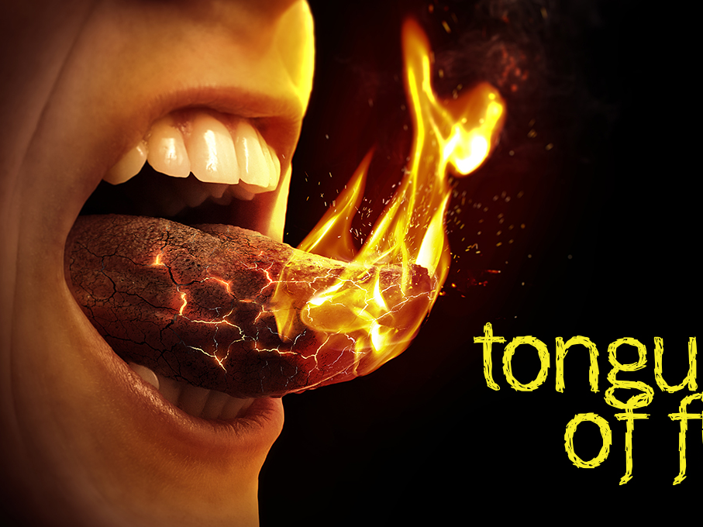
James 3–5
Dr. Rick Griffith • Jordan Evangelical Theological Seminary • BibleStudyDownloads.org

Slide 2
Slides on James 3

Slide 3
Ways Faith is Seen
267
Faith is Revealed through Works Because Faith… | Text | Text | Text | Text | Text | Text
Rejoices in Trials | Obeys the Word | Avoids Favoritism | Produces Works | Speaks Wisely | Produces Humility | Ultimately Triumphs
1:1-18 | 1:19-27 | 2:1-13 | 2:14-26 | 3 | 4:1–5:6 | 5:7-20
Salutation Trials Temptations | Listening Anger Obedience Speech Compassion Purity | Discrimination Materialism Egalitarianism | Meeting Needs Validation | Influence Untamable Be Wise | Conflict Judging Presumption | Suffering Prayer Confrontation
Jerusalem | Text | Text | Text | Text | Text | Text
AD 44-47 | Text | Text | Text | Text | Text | Text
James
Notes:
James is NOT an evangelistic book to lead unbelievers to Christ, Rather, James wrote to "believers in our Lord Jesus Christ" (1:2, 16, 19; 2:1, 5, 14; 3:1, 10, 12; 4:11; 5:7, 9, 10, 12, 19).
His goal was to help them see how others can see their faith by looking at their works.
_______
NS-20-James-10, 55, 57, 73, 76, 98, 117, 133, 154, 186, 192, 203

Slide 4
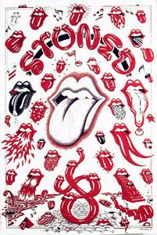
Controlling the Tongue (3:1-18)
How to have victory over one of our toughest enemies

Slide 5
Faith speaks wisely because faith…
3:1-6 Recognizes the influence of the tongue

Slide 6
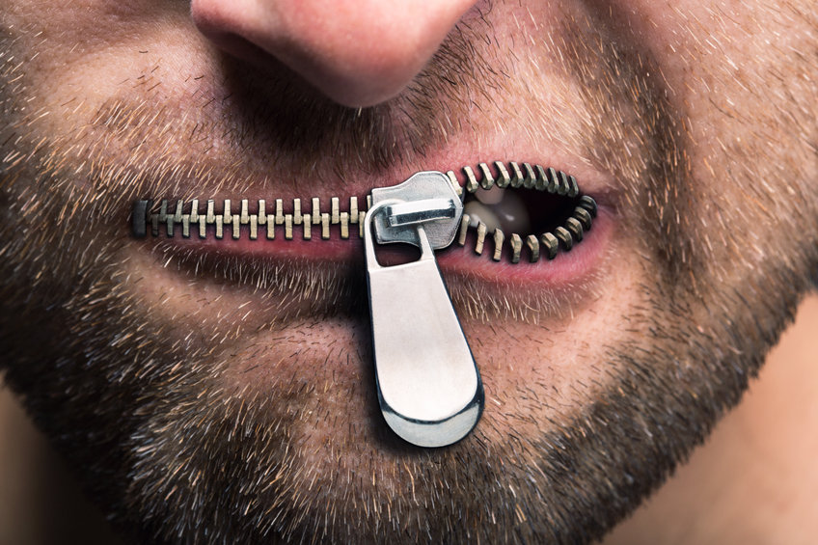
Taming the tongue
James 3:1-12
Dr. David Martin • Amman International Church AmmanChurch.org • BibleStudyDownloads.org

Slide 7
Self Tests
✓Response to suffering
✓Response to God’s Word
✓Showing partiality
✓Doing good works
✓Use of the tongue

Slide 8
“Death and life are in the power of the tongue” Proverbs 18:21

Slide 9
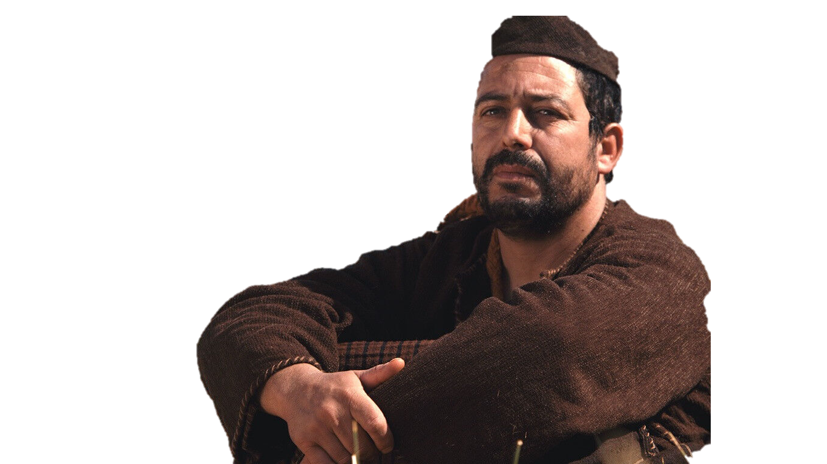
James’ Concern for the tongue
James
☑ 1:19,26
☑ 2:12
☑ 3:5,6,8-9
☑ 4:11
☑ 5:12

Slide 10
Taming the tongue
James 3:1-12

Slide 11
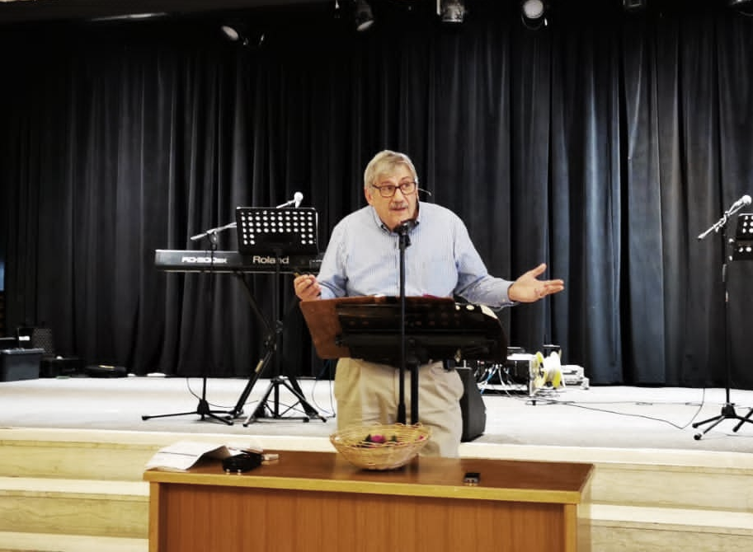
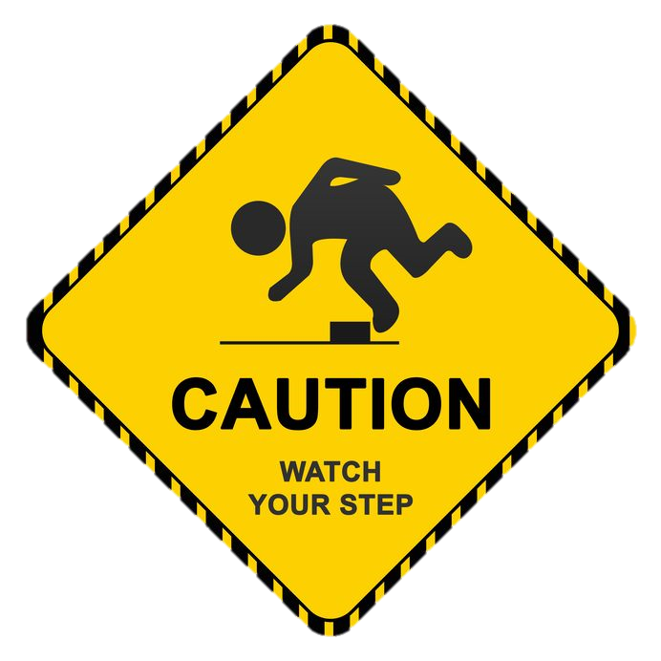
A warning for teachers
In the church (Eph. 4:11)
TEACHERS

Slide 12
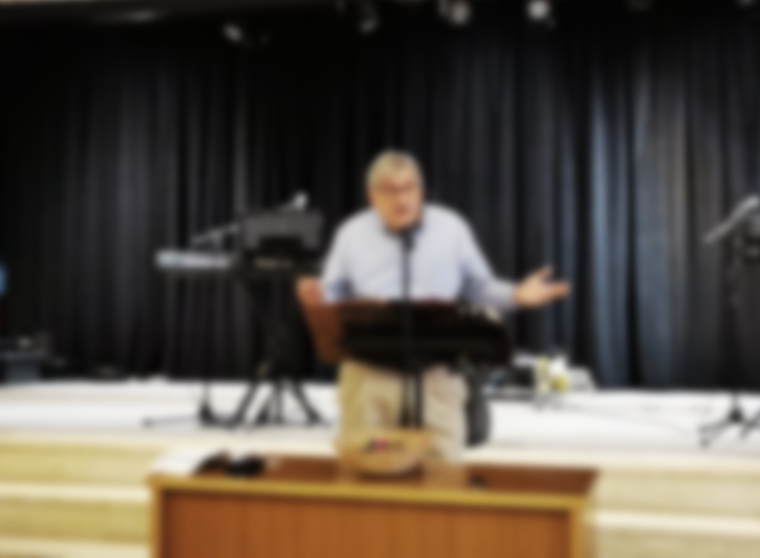
A warning for teachers
In the church (Eph. 4:11)
✓Many aspired to teach
Matt. 23:2,6-7
TEACHERS

Slide 13
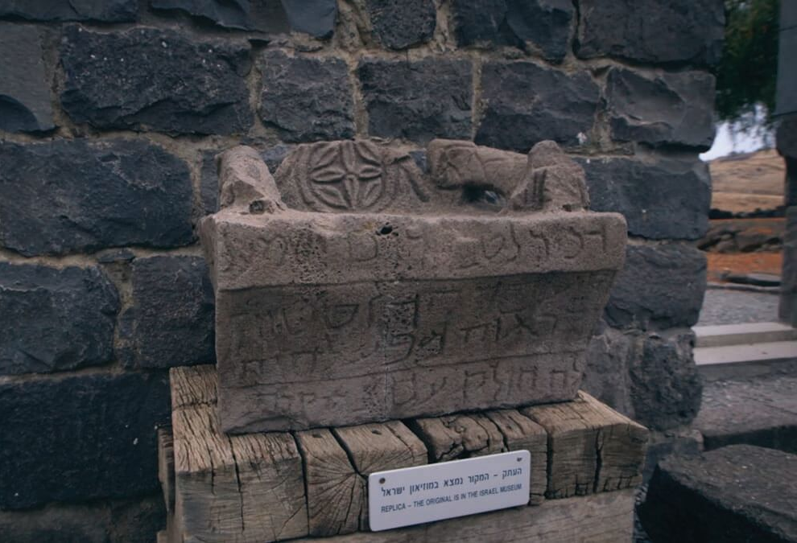

Slide 14
A warning for teachers
In the church (Eph. 4:11)
✓Many aspired to teach
Matt. 23:2,6-7
Heb. 5:12
1 Tim. 1:7
TEACHERS
✓Teachers are more accountable
Ezek. 33:7-9
Acts 20:26-27
Heb. 13:17
2 Pet. 2:1-3

Slide 15
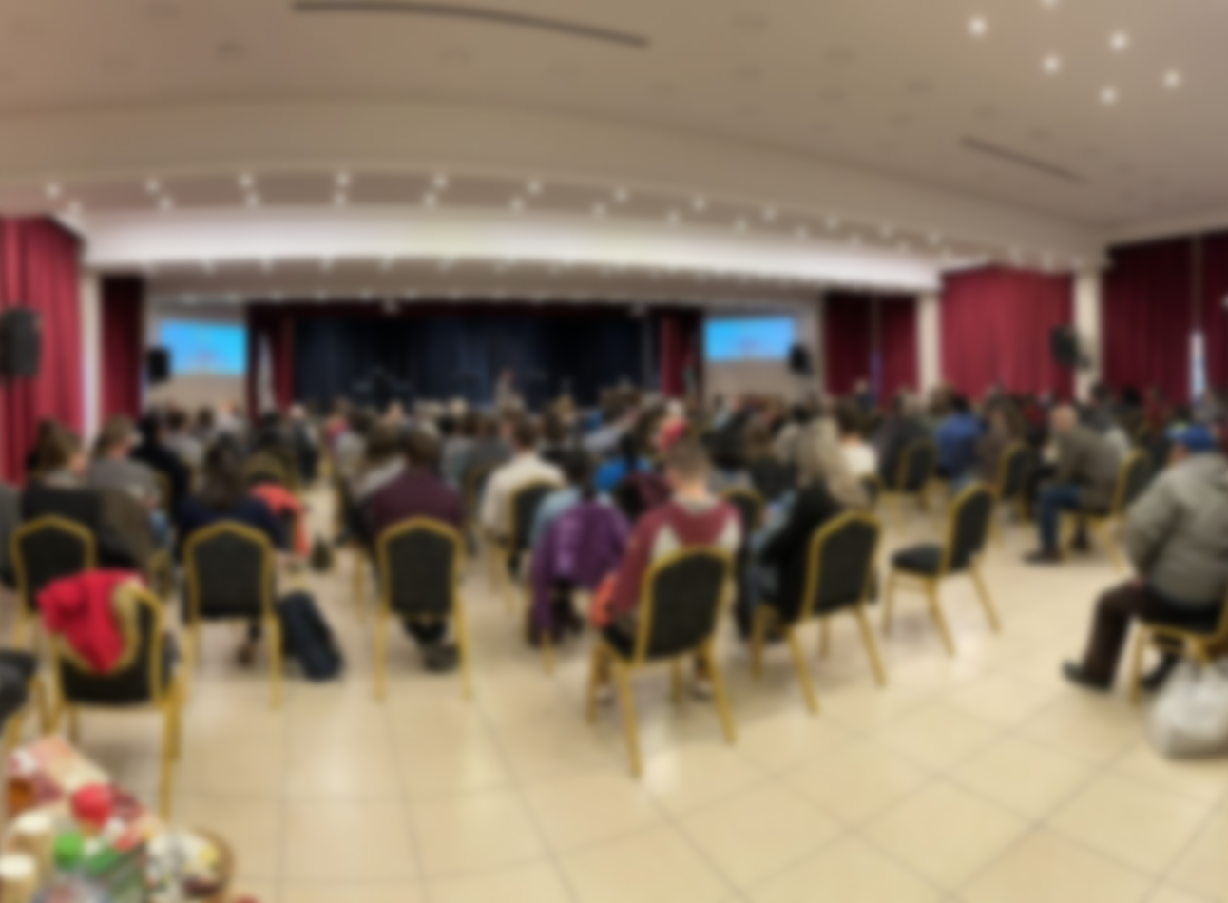
A warning for all believers
We all stumble (sin) in many ways
BELIEVERS

Slide 16
SINS of the tongue
✓Slander/gossip: Destroys character
✓Criticism: Destroys confidence/relationship
✓Sarcasm: Destroys communication
✓Complaining: Destroys unity
✓Excessive (unbridled) talk
✓Negative tone of voice
✓Withholding what should be said
Spiritual maturity is evidenced by tongue control (Prov. 10:19; Gal. 5:22-23)

Slide 17
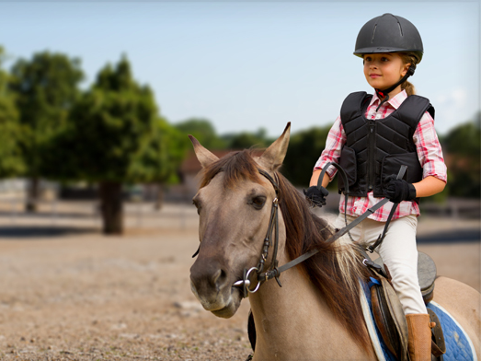
The tongue’s influence (3:3-4)

Slide 18
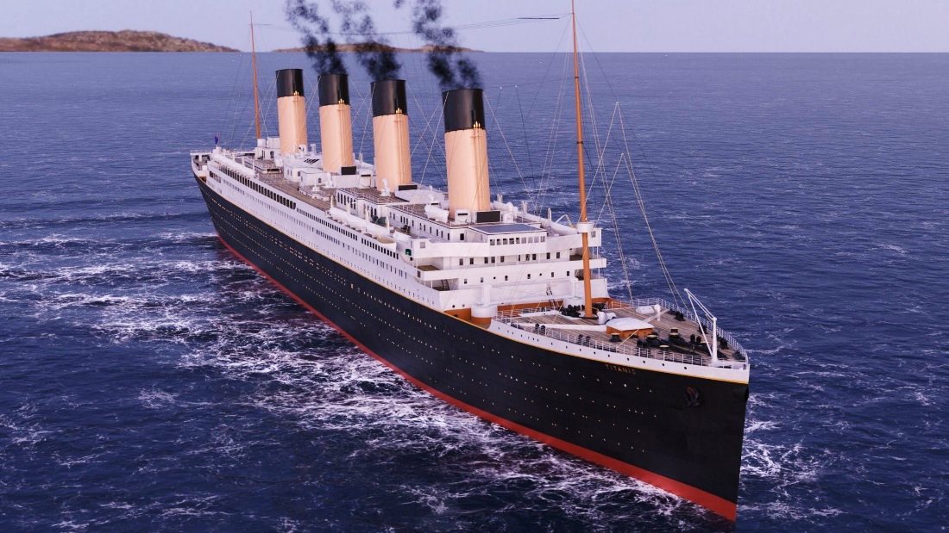
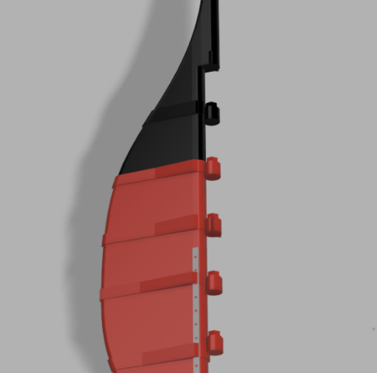
The tongue’s influence (3:3-4)

Slide 19
"The tongue is a fire, a world of evil among the parts of the body. It corrupts the whole person, sets the whole course of his life on fire, and is itself set on fire by hell" (3:6)

Slide 20
Faith speaks wisely because faith…
3:1-6 Recognizes the influence of the tongue
3:7-8 Recognizes the tongue as untamable

Slide 21
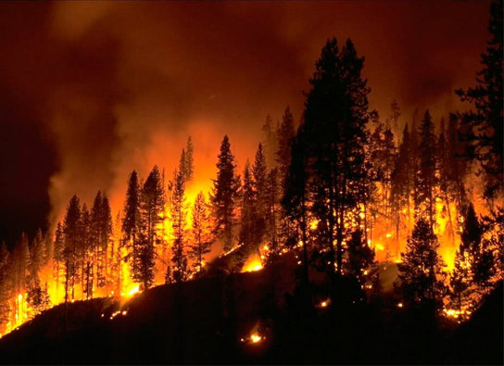
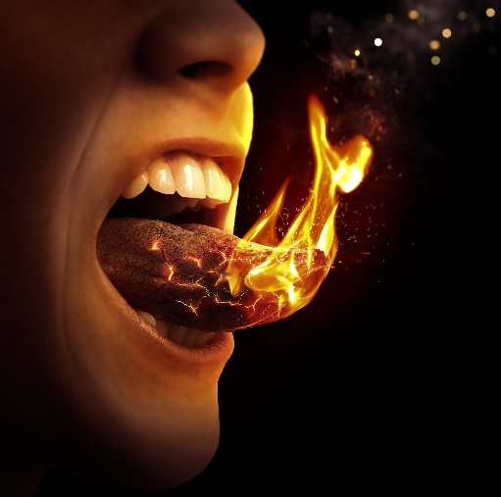
The tongue destroys (3:5-8)
✓It’s small but dangerous
✓It’s a world of iniquity
✓It can set our whole life on fire (every area can be “torched”)

Slide 22
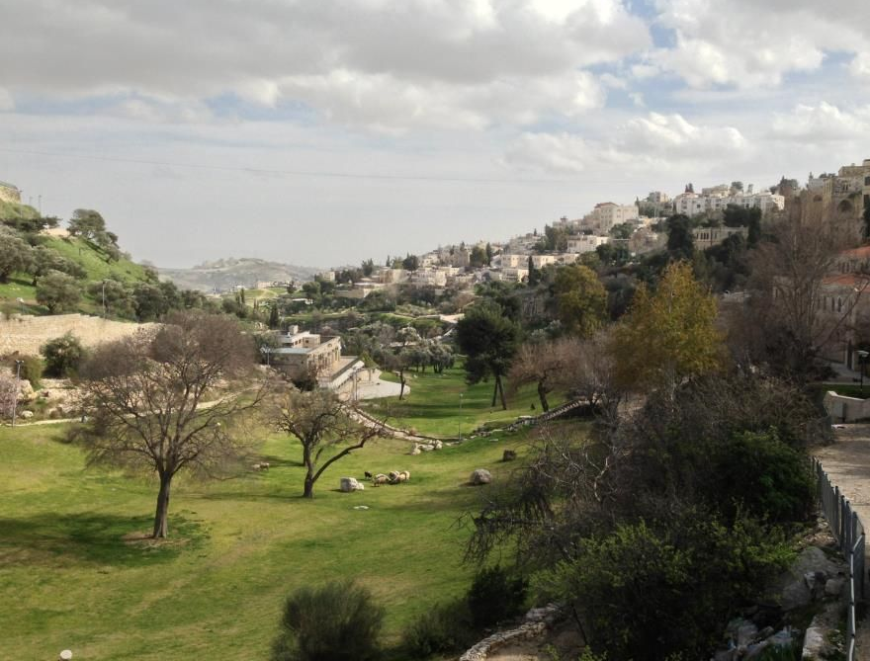
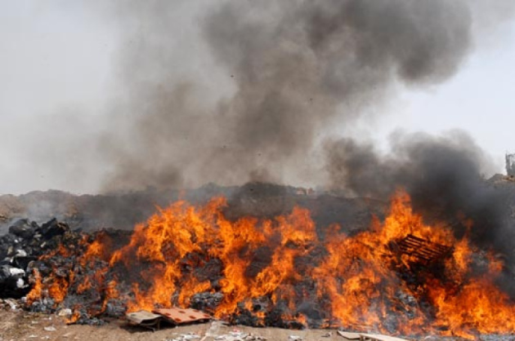
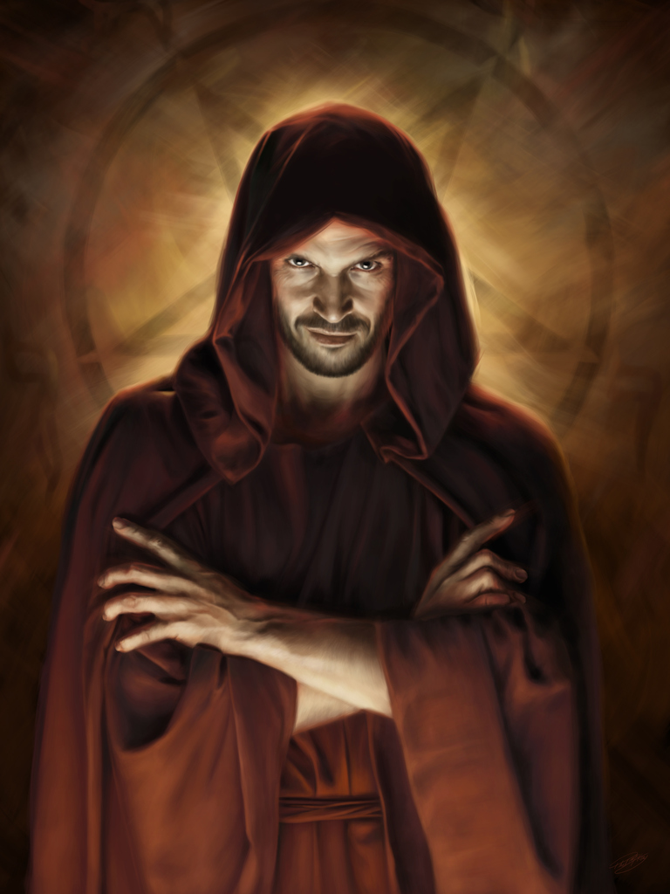
Source of the tongue’s destruction
Valley of Gehenna

Slide 23
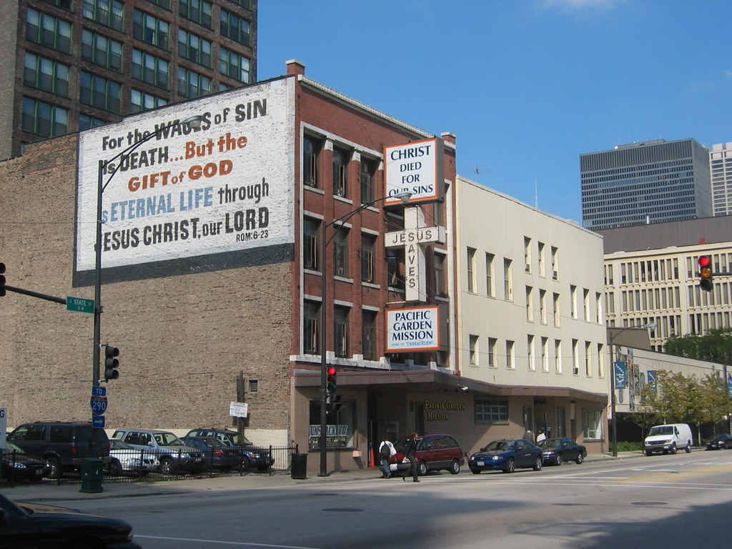
I don’t know why they picked her to sing the special number. You obviously have a better voice.
Why didn’t they call on you to pray? I think you should do it.

Slide 24
Source of the tongue’s destruction
Valley of Gehenna

Slide 25
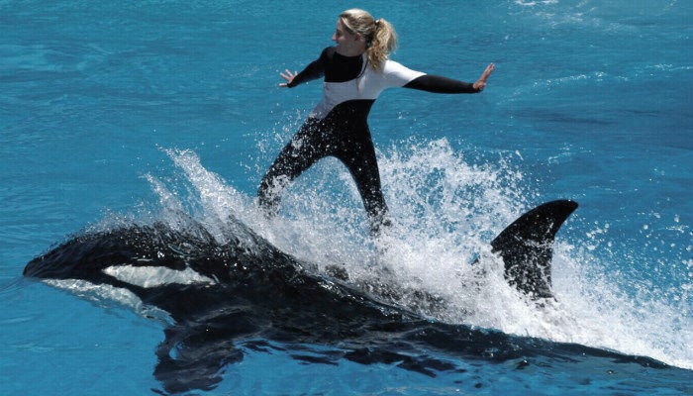
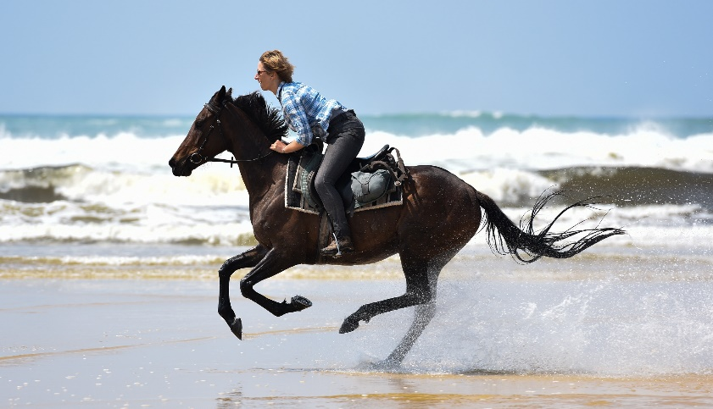
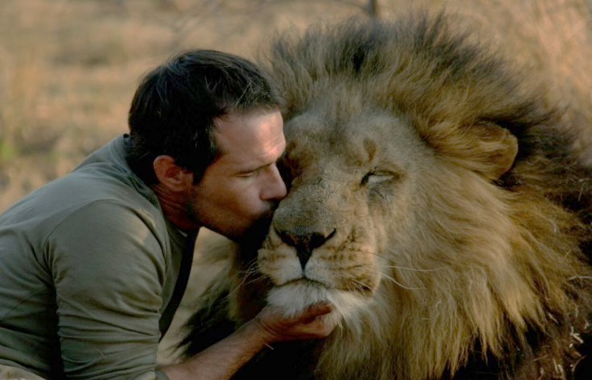
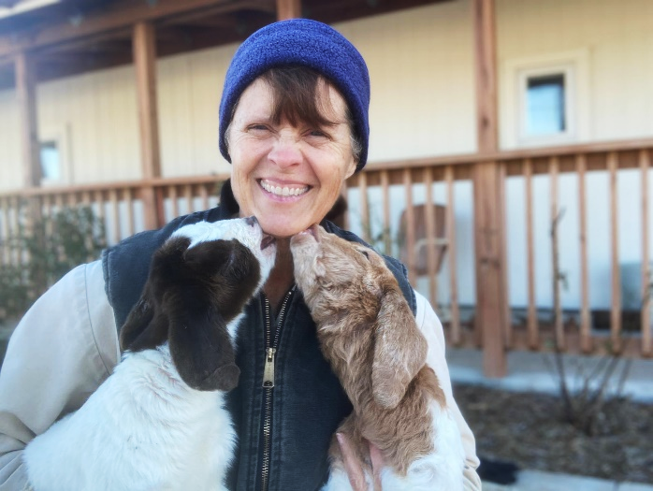
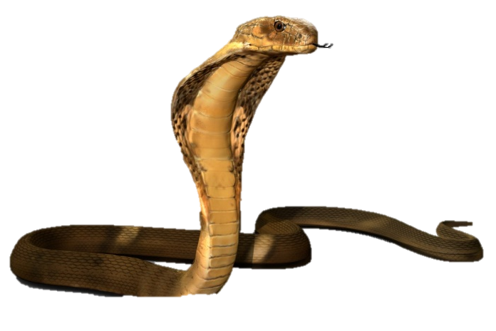
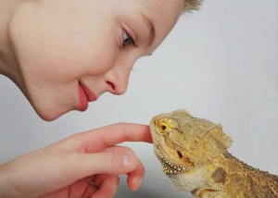
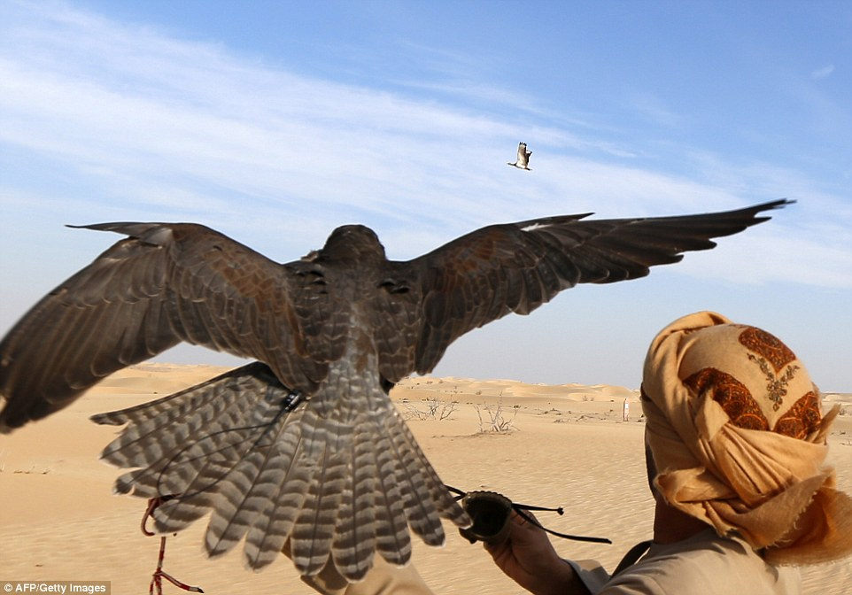
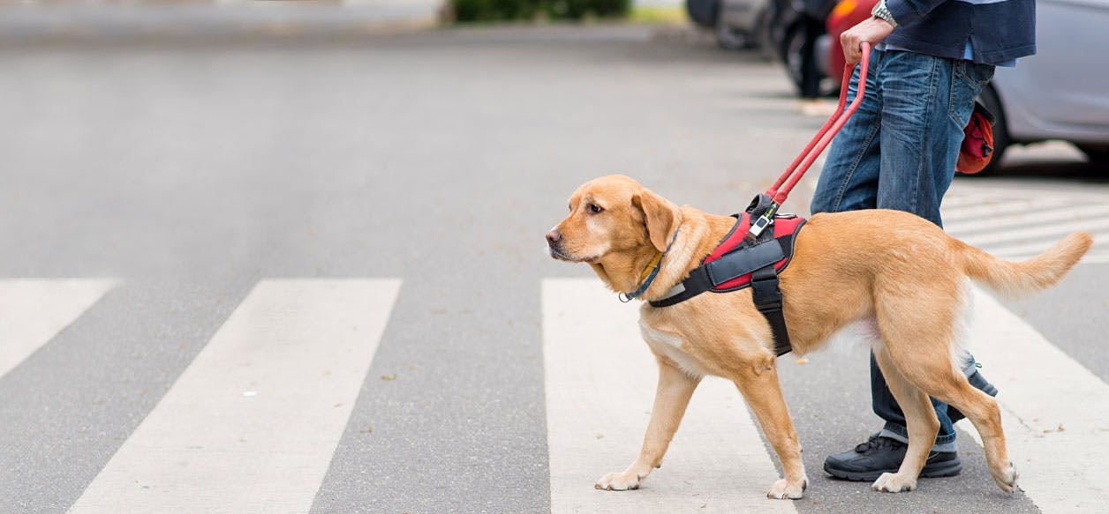
The tongue is humanly untamable (3:7-8)
It’s full of deadly poison

Slide 26
Faith speaks wisely because faith…
3:1-6 Recognizes the influence of the tongue
3:7-8 Recognizes the tongue as untamable
3:9-12 Uses the tongue for good, not evil

Slide 27
The tongue’s inconsistency

Slide 28
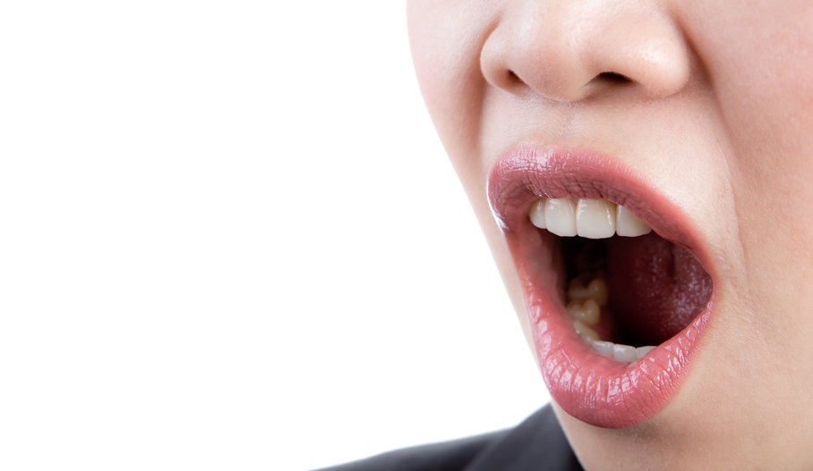
Principles to apply
1) Realize your words shape destinies
“The tongue. . . sets on fire the course of life” (3:6)
Proverbs 18:20-21

Slide 29
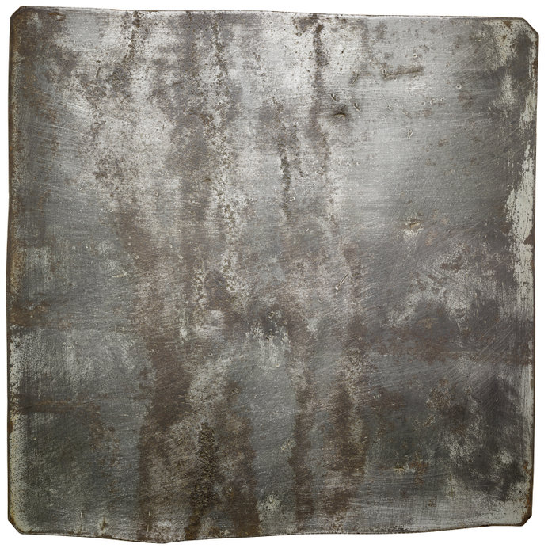
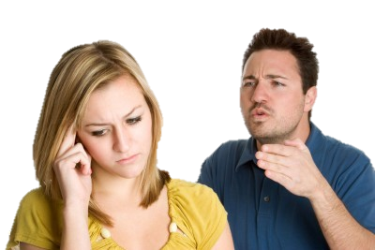
Death Words

Slide 30
Death Words
Life Words

Slide 31
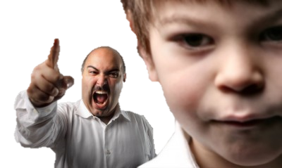
Death Words

Slide 32
Death Words
Life Words

Slide 33
Death Words

Slide 34
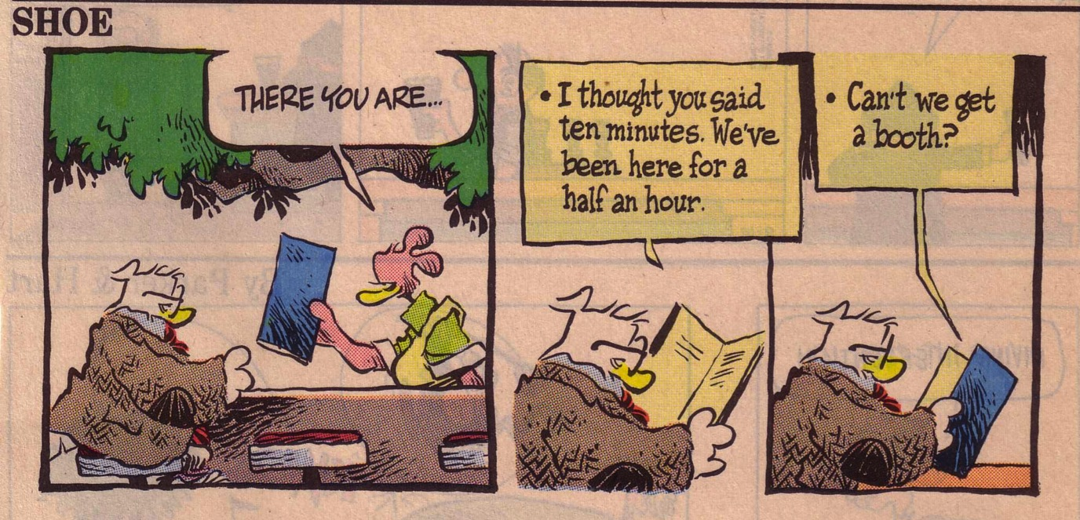
Whine List 1

Slide 35
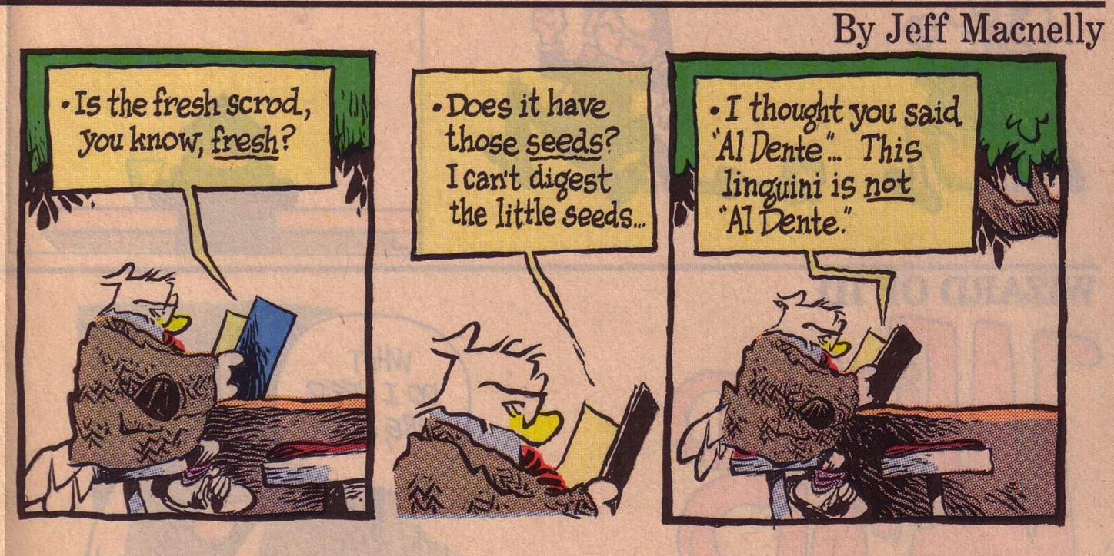
Whine List 2

Slide 36
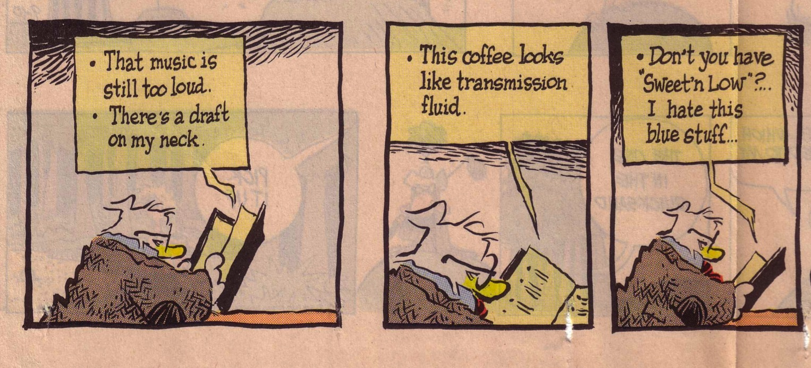
Whine List 3

Slide 37
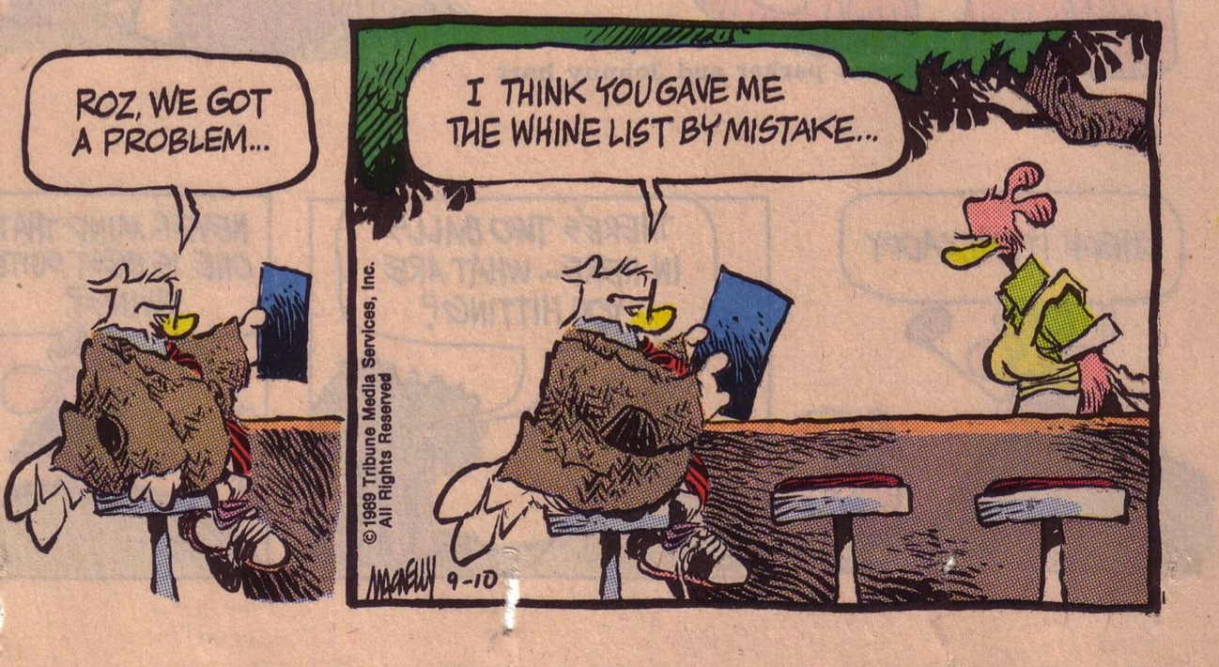
Whine List 4

Slide 38
Death Words
Life Words

Slide 39
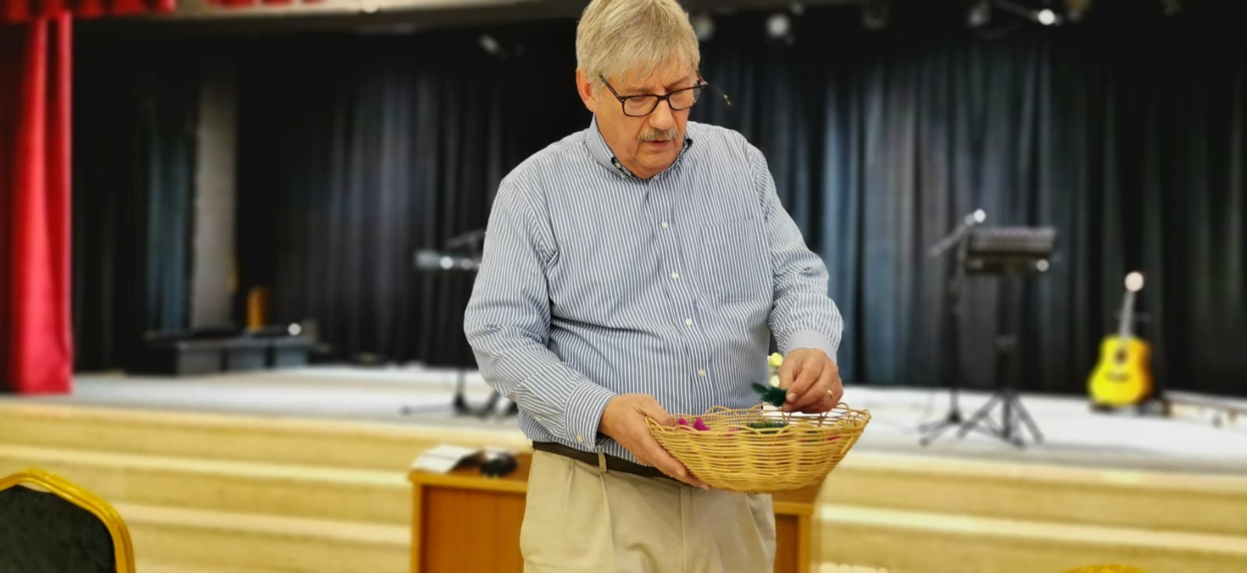

Slide 40
Principles to apply
2) Examine and confess sinful speech
Change must begin in the heart
✓Matt. 15:19-20
✓Psalm 51:10; 139:23-24

Slide 41
Principles to apply
3) Commit to good speech
“Let no unwholesome word proceed from your mouth, but only such a word as is good for edification according to the need of the moment, so that it will give grace to those who hear” (Eph. 4:29)
Ask: ✓Is it true?
✓Is it necessary?
✓Is it kind?

Slide 42
True bulletin announcements…
Don't let worry kill you—let the church help.
Thursday night Potluck Supper. Prayer and medication to follow.
Remember in prayer the many who are sick of our church and community.
For those of you who have children and don't know it, we have a nursery downstairs.
The ladies of our church have cast off clothing of every kind and they may be seen in the church basement Friday.

Slide 43
True bulletin announcements…
The rosebud on the altar this morning is to announce the birth of David Allen Belzer, the sin of Rev. and Mrs. Julius Belzer.
This afternoon there will be a meeting in the south and north ends of the church. Children will be baptized at both ends.
The bean supper will be held Tuesday evening in the church hall. Music will follow.
At the evening service tonight, the sermon topic will be "What is Hell?" Come early and listen to our choir practice.

Slide 44
What does this say?
MR PIGS
MR NOT PIGS!
OSAR
CM PENS?
LIB
MR PIGS!
Them are pigs
Them are not pigs!
Oh, yes they are!
See them pens?
Well I'll be!
Them are pigs!
Watch your words!
Notes:
You have to say this with a Southern accent from the USA as an argument between two people.

Slide 45
Faith speaks wisely because faith…
3:1-6 Recognizes the influence of the tongue
3:7-8 Recognizes the tongue as untamable
3:9-12 Uses the tongue for good, not evil
3:13-18 Produces wisdom for proper speech

Slide 46
Where does wisdom come from? How does James define wisdom?
There are two kinds of wisdom…

Slide 47
The Two Wisdoms
3:15-16
3:17-18
Origin
not from above
earthly
unspiritual
devilish
from above
Characteristics
envy
selfish ambition
pure
peace loving
considerate
submissive
merciful & good fruit
impartial
sincere
Results
disorder
every evil practice
harvest of righteousness

Slide 48
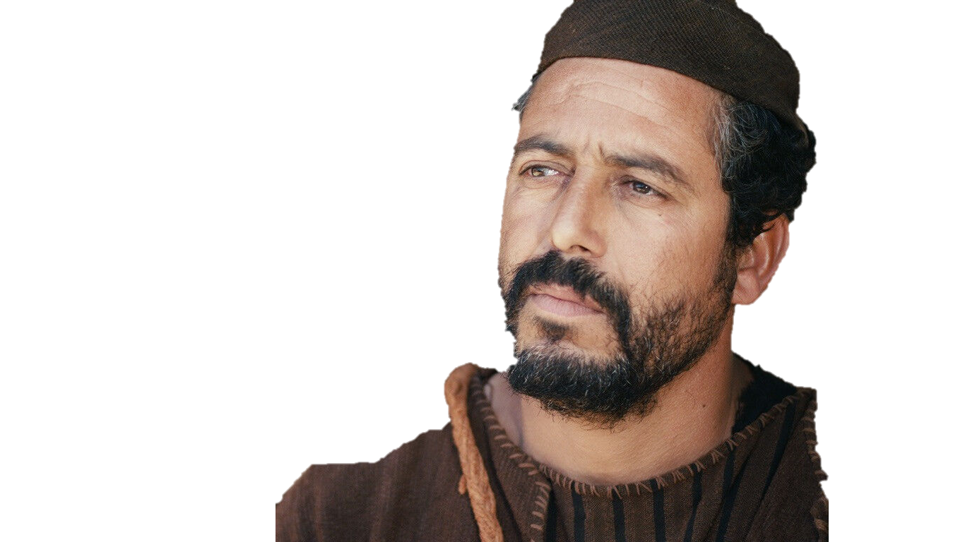
Wisdom from below
Wisdom from above
Take a look in the mirror!
James 3:13-18
Dr. David Martin • Amman International Church AmmanChurch.org • BibleStudyDownloads.org

Slide 49
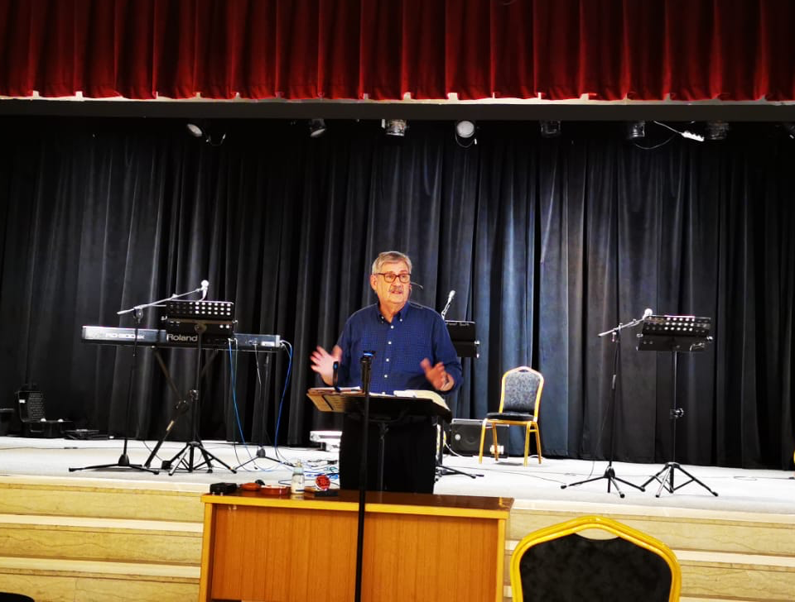
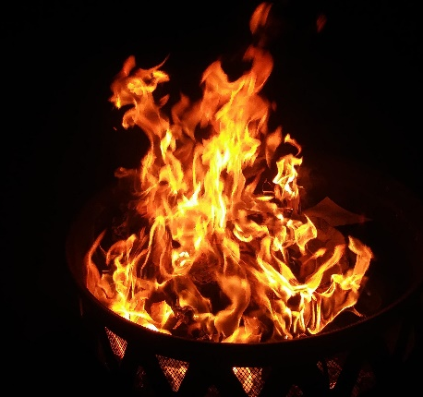
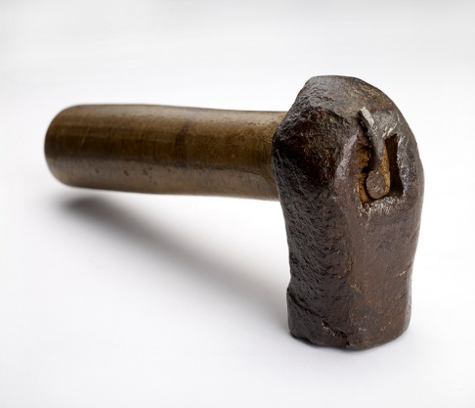
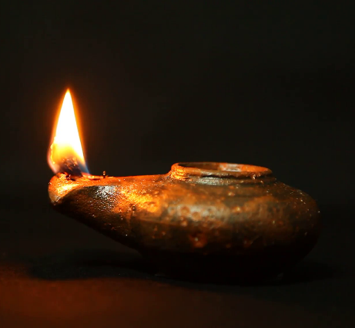
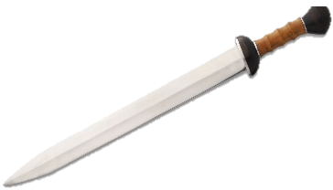
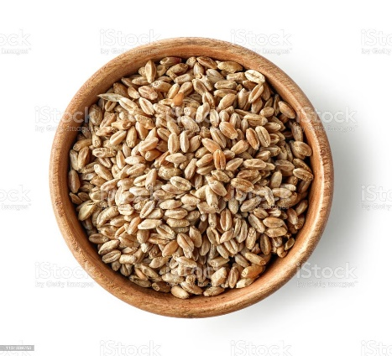
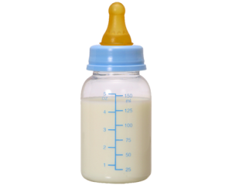

Slide 50
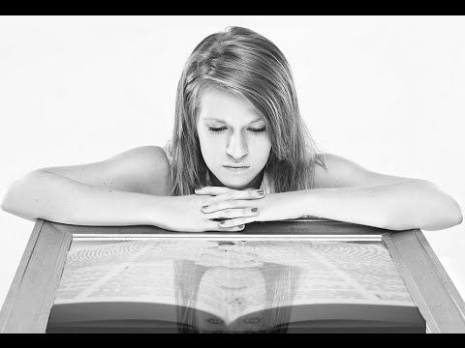
“If anyone is a hearer of the word and not a doer, he is like a man who looks at his natural face in a mirror . . .” James 1:23-24
The Bible is a mirror

Slide 51
Wisdom from below
Wisdom from above
Take a look in the mirror!
James 3:13-18

Slide 52
Wisdom from below
James 3:14-16

Slide 53
The world’s wisdom
Bitter Jealousy
Good
✓Root = zeal; passion
Bad
Promotes personal opinions and agenda; harsh toward anyone else; excludes others

Slide 54
The world’s wisdom
Selfish Ambition
Divisive; factious; fights for personal gain; undercuts others

Slide 55
The world’s wisdom
Arrogance
Boastful; gloats over rivals; is always right; demeans and uses others

Slide 56
The world’s wisdom
Lies
Deceitfully covers the true motives; twists the truth to suit his/her own purposes

Slide 57
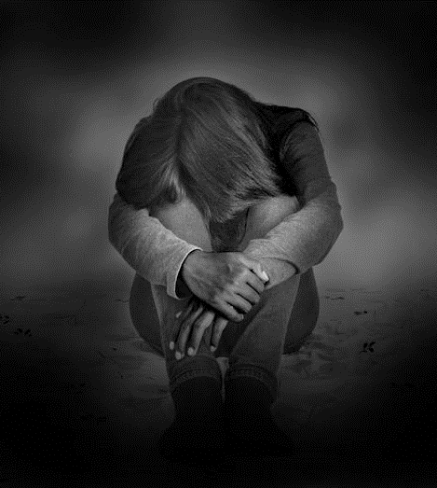
The source of fake wisdom
James 3:15
The flesh
The world
The devil
The 3 Enemies of All Believers

Slide 58
Wisdom from above

Slide 59
Wisdom from above
James 3:17
(cf. James 1:17)

Slide 60
Biblical wisdom
Skill in making life’s choices

Slide 61
Pure
Clean; undefiled; uncompromising; free of vices; unstained (1:27)
wisdom from above

Slide 62
peaceable
Promotes peace; harmonious relationships with God and men; not divisive
wisdom from above

Slide 63
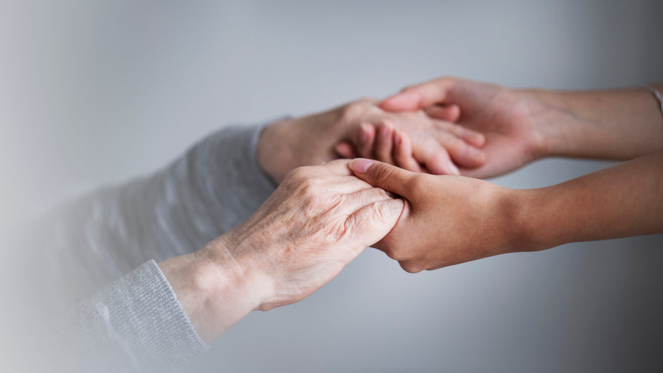
Gentle
Considerate; forbearing; courteous; willing to defer rights
wisdom from above

Slide 64
reasonable
Easy to get along with; open to reason; accommodating; willing to yield
wisdom from above

Slide 65
Full of mercy
An abundant measure of compassion towards those who are hurting or needy; helps in practical ways
wisdom from above

Slide 66
Full of good fruit
Bears rich harvest of all types of spiritual fruit (Galatians 5:22-23)
wisdom from above

Slide 67
unwavering
Wholehearted; consistent; straightforward; faithful; not partial
wisdom from above

Slide 68
Without hypocrisy
Without pretense; nothing to hide; genuine; sincere
wisdom from above

Slide 69
Principles to apply
“Mirror, mirror on the wall . . .”
Proverbs 4:7
Pursue godly wisdom!

Slide 70
Principles to apply
Appropriate God’s wisdom! God’s wisdom is the ability to live out God’s truth in life’s daily choices and challenges
☑ James 1:5
→ Ask for it
☑ Prov. 1:2-6
→ Receive instruction
☑ Prov. 9:10; 15:33
→ Fear God
☑ Prov. 2:4-5
→ Study the Bible
☑ Prov. 2:7-9
→ Live a righteous life
☑ Prov. 13:20
→ Walk with the wise
☑ Prov. 29:15
→ Accept discipline

Slide 71
Ways Faith is Seen
267
Faith is Revealed through Works Because Faith… | Text | Text | Text | Text | Text | Text
Rejoices in Trials | Obeys the Word | Avoids Favoritism | Produces Works | Speaks Wisely | Produces Humility | Ultimately Triumphs
1:1-18 | 1:19-27 | 2:1-13 | 2:14-26 | 3 | 4:1–5:6 | 5:7-20
Salutation Trials Temptations | Listening Anger Obedience Speech Compassion Purity | Discrimination Materialism Egalitarianism | Meeting Needs Validation | Influence Untamable Be Wise | Conflict Judging Presumption | Suffering Prayer Confrontation
Jerusalem | Text | Text | Text | Text | Text | Text
AD 44-47 | Text | Text | Text | Text | Text | Text
James
Notes:
James is NOT an evangelistic book to lead unbelievers to Christ, Rather, James wrote to "believers in our Lord Jesus Christ" (1:2, 16, 19; 2:1, 5, 14; 3:1, 10, 12; 4:11; 5:7, 9, 10, 12, 19).
His goal was to help them see how others can see their faith by looking at their works.
_______
NS-20-James-10, 55, 57, 73, 76, 98, 117, 133, 154, 186, 192, 203

Slide 72
Slides on James 4

Slide 73
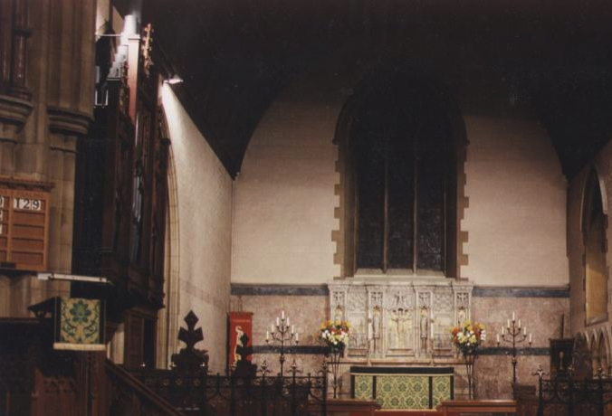
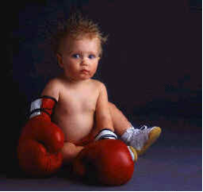
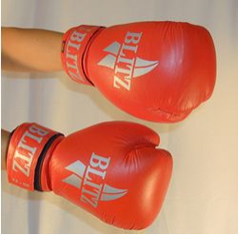
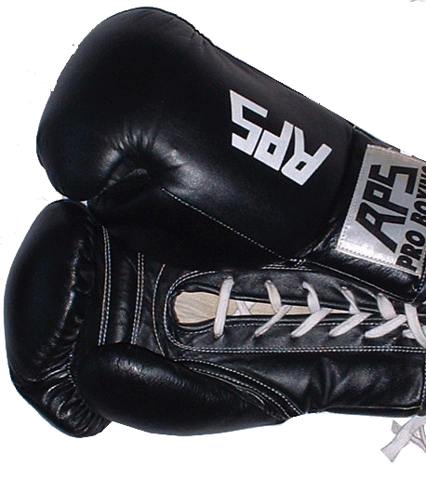
Why Do We Fight?

Slide 74
Do real Christians fight?
CONFLICT
“WE WOULDN’T HAVE THEM IF YOU WERE THE KIND OF MAN GOD TELLS YOU TO BE!”
“AND I SAY IF WE WERE TRULY SAVED, WE WOULDN’T HAVE ARGUMENTS!”
PRAY FOR US.

Slide 75
⁴ You adulterous people, don’t you know that friendship with the world means enmity against God? Therefore, anyone who chooses to be a friend of the world becomes an enemy of God. ⁵ Or do you think Scripture says without reason that he jealously longs for the spirit he has caused to dwell in us?
James 4:4-5

Slide 76
⁶ But he gives us more grace. That is why Scripture says:
“God opposes the proud
but shows favor to the humble.”
⁷ Submit yourselves, then, to God. Resist the devil, and he will flee from you.
James 4:6-7

Slide 77
Do You Agree?
The root cause of all sin is pride
If two persons are truly humble, they will not exert their will without listening
Judging is an opinion that lacks basic facts while discerning has most facts
One cannot discern properly without humility

Slide 78
Discernment v. Judgment
Commanded
Prohibited
Asks questions
Accepts hearsay
Self-evaluation
Others-evaluation
Humble
Proud
Protects
Discredits

Slide 79
4:1-12 Summary
Don't follow evil desires (1-10)
Don't judge (11-12)

Slide 80
Planning and Faith
Planning and Faith
How not to play God
(James 4:13-17)

Slide 81
How to Play God
With Others (4:11-12)
Slander them (11)
Judge them (12)
With Ourselves (4:13-17)
Adapted from Charles Swindoll, James Bible Study Guide (Insight for Living, 1983), 70-71

Slide 82
Rules to Play God (4:13)
Choose your own time and schedule
Select your own location (the place you like)
Limit your stay to please yourself
Arrange your activities to please yourself
Predict your outcome and boast about it
Adapted from Charles Swindoll, James Bible Study Guide (Insight for Living, 1983), 71

Slide 83
The True God's Evaluation
You don't know what will happen tomorrow (14a)
You don't know if you'll have a long life (14b)
You have no right to ignore God's will (15-17)

Slide 84
What plan do you need to submit to God?

Slide 85
Slides on James 5

Slide 86
Warnings to the Wealthy (James 5:1-6)

Slide 87
Four types of people…
Spiritually poor & materially poor
Spiritually rich & materially rich
Spiritually rich & materially poor
Spiritually poor & materially rich
James addresses this last group.

Slide 88
The Rich and Poor in James
 | Rich | Poor
1:9-11
2:1-7
5:1-6

Slide 89
The Love of Money
Troubles of Riches | Sins of the Rich

Slide 90
To Bring Home
Are you among the rich or the poor of the world? How do you know this?
What luxuries or conveniences could you share with others? Think of things you tend to waste or not put to greater use.
What should you do with the hard-hitting words of James?

Slide 91
Are you missionary material?
A story from Leslie Flynn,
19 Gifts of the Spirit, 26-27

Slide 92
Ways Faith is Seen
267
Faith is Revealed through Works Because Faith… | Text | Text | Text | Text | Text | Text
Rejoices in Trials | Obeys the Word | Avoids Favoritism | Produces Works | Speaks Wisely | Produces Humility | Ultimately Triumphs
1:1-18 | 1:19-27 | 2:1-13 | 2:14-26 | 3 | 4:1–5:6 | 5:7-20
Salutation Trials Temptations | Listening Anger Obedience Speech Compassion Purity | Discrimination Materialism Egalitarianism | Meeting Needs Validation | Influence Untamable Be Wise | Conflict Judging Presumption | Suffering Prayer Confrontation
Jerusalem | Text | Text | Text | Text | Text | Text
AD 44-47 | Text | Text | Text | Text | Text | Text
James
Notes:
James is NOT an evangelistic book to lead unbelievers to Christ, Rather, James wrote to "believers in our Lord Jesus Christ" (1:2, 16, 19; 2:1, 5, 14; 3:1, 10, 12; 4:11; 5:7, 9, 10, 12, 19).
His goal was to help them see how others can see their faith by looking at their works.
_______
NS-20-James-10, 55, 57, 73, 76, 98, 117, 133, 154, 186, 192, 203

Slide 93
How patient are you?
I get frustrated when using a slow computer
When God doesn't answer my prayers, I give up praying that request
At the grocery I still use the express lane when I have more than 6 items
I stand as close as I can to be first in doors on lifts, MRT trains, buses, etc.

Slide 94
How patient are you?
I expect an answer to my emails within 24 hours
When calling someone, I hang up the phone after three rings
I get angry when someone on the road cuts me off (when driving, in a taxi, or walking)
I get annoyed when forced to take self-evaluation tests (like this one)

Slide 95
Singapore's 7 Deadly Sins
The Sunday Times, 3 April 2005

Slide 96
Which sin do you think tops the list?
Anger
Envy
Gluttony
Greed
Lust
Pride
Sloth

Slide 97
Anger tops the list

Slide 98
Which sin do you think tops the list?
Anger
Envy
Gluttony
Greed
Lust
Pride
Sloth
Anger (88%)
Sloth (69%)
Envy (60%)
Gluttony
Greed
Pride
Lust
Adultery
Cruelty
Dishonesty

Slide 99
James 5:11a
"As you know, we consider blessed those who have persevered…"

Slide 100
Pastor Kap and Family
Daphne

Slide 101
MIT Profs

Slide 102
Pastor Khai Za Dal

Slide 103
Pastor & Mrs. Khai

Slide 104
Pastor Khai's daughter will attend SBC

Slide 105
How Can We Be Patient?
Look to the Lord's return (5:7)
Quit complaining to others (5:9)
Stop making rash promises (5:12)
Imitate examples of perseverance (5:7, 10, 11)

Slide 106
Tumee
A Key Mongolian Leader who needs housing from June to July

Slide 107
Hebrews 11:1
"Now faith is being sure of what we hope for and certain of what we do not see." Hebrews 11:1

Slide 108
Divine Healing Today
What should we do when we need physical healing?

Slide 109
AOG Official Doctrine
"Divine healing is an integral part of the gospel. Deliverance from sickness is provided for in the atonement, and is the privilege of all believers (Isaiah 53:4,5; Matthew 8:16,17; James 5:14-16)"
(The Assemblies of God Constitution in its Statement of Fundamental Truths, section 12, emphasis mine)
http://ag.org/top/beliefs/position_papers/4184_healing.cfm
Notes:
This statement on divine healing was adopted by the Assemblies of God General Presbytery, August 20, 1974 (http://ag.org/top/beliefs/position_papers/4184_healing.cfm)

Slide 110
Sharing with Concern in James 5
Share in Possessions (1-6)
Share in Patience (7-12)
Share in Prayer (13-20)
Ron Blue, “James,” in The Bible Knowledge Commentary, 2:832-34

Slide 111
Pray, Pray, Pray
"Is any one of you in trouble? He should pray. Is anyone happy? Let him sing songs of praise. Is anyone sick? He should call the elders of the church to pray over him…" (James 5:13-14)

Slide 112
Five questions on James 5:14-15…
What kind of sickness?
What kind of anointing?
What's the prayer of faith?
Does this procedure always heal?
How does forgiveness come?

Slide 113
What Kind of Sickness?
Asthenei
Weak Faith
Physical Illness
General word for "to be weak"
Used this way in many passages (e.g., Acts 20:35 "we must help the weak")
James 5:15 better translated "make the weary person well" (cf. Heb. 12:3)
Contrasts with "in trouble" (5:13) by narrowing to physical issues
Need for elders
Use of oil
"restore" and "raise up" are physical

Slide 114
What Kind of Anointing?
Mundane
Sacred
General word for "to rub with oil"
Contrasts with a word not used, which is chrio ("ceremonially anoint")
Greek participle shows that prayer, not anointing, is the primary act

Slide 115
Does the Prayer Work?
"the prayer will restore… and the Lord will raise him up"
Yes
No
Prayer that God will heal emotional wounds is always successful
God does not always heal physically when we pray

Slide 116
The Problem of Pain
If God is good and all-powerful, why does he allow his creatures to suffer pain?

Slide 117
Pain Reveals God's Love
"Lewis asserts that pain is a problem because our finite, human minds selfishly believe that pain-free lives would prove that God loves us. In truth, by asking for this, we want God to love us less, not more than he does…"
www.apologetics.org/ public_html/products_prob...

Slide 118
Pain Food

Slide 119
Christ understands suffering
"For we do not have a high priest who is unable to sympathise with our weaknesses, but we have one who has been tempted in every way, just as we are—yet was without sin. Let us then approach the throne of grace with confidence, so that we many receive mercy and find grace to help us in our time of need."
Hebrews 4:15-16

Slide 120
What should you do?
James 5

Slide 121
What's the road to healing?

Slide 122
Our son Stephen suffered from Anklosing Spondylitis (ages 7-11)

Slide 123
God healed him through the James 5 process
April 2005

Slide 124
Ways Faith is Seen
267
Faith is Revealed through Works Because Faith… | Text | Text | Text | Text | Text | Text
Rejoices in Trials | Obeys the Word | Avoids Favoritism | Produces Works | Speaks Wisely | Produces Humility | Ultimately Triumphs
1:1-18 | 1:19-27 | 2:1-13 | 2:14-26 | 3 | 4:1–5:6 | 5:7-20
Salutation Trials Temptations | Listening Anger Obedience Speech Compassion Purity | Discrimination Materialism Egalitarianism | Meeting Needs Validation | Influence Untamable Be Wise | Conflict Judging Presumption | Suffering Prayer Confrontation
Jerusalem | Text | Text | Text | Text | Text | Text
AD 44-47 | Text | Text | Text | Text | Text | Text
James
Notes:
James is NOT an evangelistic book to lead unbelievers to Christ, Rather, James wrote to "believers in our Lord Jesus Christ" (1:2, 16, 19; 2:1, 5, 14; 3:1, 10, 12; 4:11; 5:7, 9, 10, 12, 19).
His goal was to help them see how others can see their faith by looking at their works.
_______
NS-20-James-10, 55, 57, 73, 76, 98, 117, 133, 154, 186, 192, 203

Slide 125
Babychen & Susan
Babychen & Susan
Benita & Benjamin
(Thanks for helping their damaged church in India)

Slide 126
Another day…
Another location…

Slide 127
Badamdorj
Mongol
Библи…Үндсэндээ

Slide 128
Budmaa & Enkhe (SBC graduate now EE Director for Mongolia)

Slide 129
Tumee

Slide 130
Ways Faith is Seen
267
Faith is Revealed through Works Because Faith… | Text | Text | Text | Text | Text | Text
Rejoices in Trials | Obeys the Word | Avoids Favoritism | Produces Works | Speaks Wisely | Produces Humility | Ultimately Triumphs
1:1-18 | 1:19-27 | 2:1-13 | 2:14-26 | 3 | 4:1–5:6 | 5:7-20
Salutation Trials Temptations | Listening Anger Obedience Speech Compassion Purity | Discrimination Materialism Egalitarianism | Meeting Needs Validation | Influence Untamable Be Wise | Conflict Judging Presumption | Suffering Prayer Confrontation
Jerusalem | Text | Text | Text | Text | Text | Text
AD 44-47 | Text | Text | Text | Text | Text | Text
James
Notes:
James is NOT an evangelistic book to lead unbelievers to Christ, Rather, James wrote to "believers in our Lord Jesus Christ" (1:2, 16, 19; 2:1, 5, 14; 3:1, 10, 12; 4:11; 5:7, 9, 10, 12, 19).
His goal was to help them see how others can see their faith by looking at their works.
_______
NS-20-James-10, 55, 57, 73, 76, 98, 117, 133, 154, 186, 192, 203

Slide 131
Individualism
What examples of self-centeredness do you see in society today?
How do you think concern for self rather than others shows itself in the church?

Slide 132
JAMES 5:19-20
¹⁹My brothers, if one of you should wander from the truth and someone should bring him back, ²⁰remember this: Whoever turns a sinner from the error of his way will save him from death and cover over a multitude of sins.

Slide 133
Who are the wanderers?
planao lead astray, mislead, deceive; pass. stray away, go astray; be mistaken; be deceived or misled; wander about
This refers to Christians who reject the will of God by straying from the truth by their behavior in an active, not passive sense

Slide 134
The Wanderer is a Christian:
"My brothers, if one of you…"
One cannot "wander from the truth" if he has not first experienced it.

Slide 135
Divine Spankings
"'My son, do not make light of the Lord's discipline, and do not lose heart when he rebukes you, because the Lord disciplines those he loves, and he punishes everyone he accepts as a son.' Endure hardship as discipline; God is treating you as sons. For what son is not disciplined by his father? If you are not disciplined (and everyone undergoes discipline), then you are illegitimate children and not true sons" (Hebrews 12:5-8).

Slide 136
Abusing the Elements
NIV 1 Corinthians 11:30 [Gluttony at the Lord's Supper] "is why many among you are weak and sick, and a number of you have fallen asleep.”

Slide 137
Some Sins Lead to Death
"If anyone sees his brother commit a sin that does not lead to death, he should pray and God will give him life. I refer to those whose sin does not lead to death. There is a sin that leads to death. I am not saying that he should pray about that" (1 John 5:16 NIV).

Slide 138
Making this Text Real to Me
Whom do I need to help restore?
How will I do it?

Slide 139
What are the characteristics of faith?
7
Notes:
What should your trust in Christ look like?
What does faith in Jesus look like?

Slide 140
Main Idea of James
IF YOU BELIEVE
SHOW IT
THEN

Slide 141
Ways Faith is Seen
267
Faith is Revealed through Works Because Faith… | Text | Text | Text | Text | Text | Text
Rejoices in Trials | Obeys the Word | Avoids Favoritism | Produces Works | Speaks Wisely | Produces Humility | Ultimately Triumphs
1:1-18 | 1:19-27 | 2:1-13 | 2:14-26 | 3 | 4:1–5:6 | 5:7-20
Salutation Trials Temptations | Listening Anger Obedience Speech Compassion Purity | Discrimination Materialism Egalitarianism | Meeting Needs Validation | Influence Untamable Be Wise | Conflict Judging Presumption | Suffering Prayer Confrontation
Jerusalem | Text | Text | Text | Text | Text | Text
AD 44-47 | Text | Text | Text | Text | Text | Text
James
Notes:
James is NOT an evangelistic book to lead unbelievers to Christ, Rather, James wrote to "believers in our Lord Jesus Christ" (1:2, 16, 19; 2:1, 5, 14; 3:1, 10, 12; 4:11; 5:7, 9, 10, 12, 19).
His goal was to help them see how others can see their faith by looking at their works.
_______
NS-20-James-10, 55, 57, 73, 76, 98, 117, 133, 154, 186, 192, 203

Slide 142
274a
Verse | Imperatives | Personal Application
1:13, 16 | Do not be deceived | When tempted, I must not deceive myself and say that God is tempting me.
1:21 | Get rid of moral filth | I must not let the moral filth of anger make me say careless words but let God’s Word be firmly planted in me.
1:22 | Do not merely listen | I must do what the Word says and not merely listen.
2:1,5 | Do not show favoritism | I must treat everyone with equity regardless of wealth, race or authority in my work and ministry.
2:12 | Speak and act as those going to be judged | I must speak and act with mercy knowing that God will judge.
2:18 | Show me your faith | I must show my faith in good deeds, such as to help the poor and needy.
3:10 | Praise and cursing from the same mouth; this should not be | I must be conscious of the words I speak and thereby control my tongue.
4:7 | Submit yourselves to God | I must submit to God whenever the world tempts me and the devil will flee.

Slide 143
Verse | Imperatives | Personal Application
4:8 | Draw near to God | I must draw near to God in my daily devotions that he might draw close to me.
4:10 | Humble yourselves | When I am in any position of authority, I must not be arrogant but humble myself before God.
4:11 | Do not slander | I must no slander and speak against anyone but endeavor to preserve the unity of saints.
4:15 | Do not boast | Any plans that I make must be committed to God in prayer.
5:7 | Be patient | I must be patient when suffering and look forward to the blessed hope of Christ return.
5:9 | Do not grumble | If I am unhappy over something, I will not grumble and spread discord amongst others.
5:12 | Do not swear | I must make sound decisions and responsible choices without the need to swear.
5:16 | Confess your sins | Whenever I fall into sin, I must admit my sins and seek prayers that I may be restored.
274a

Slide 144
Black

Slide 145
NT Preaching • BibleStudyDownloads.org
Get this presentation and script for free!

Slide 146
What is the command about asking God for wisdom?
When we ask we must believe and not doubt (1:6)

Slide 147
Faith and doubts

Slide 148
How can you stop doubt? How would you define doubt?
Believe.
Doubt is defined as disbelief.

Slide 149
What is the result of doubt? What word picture works for you?
He is like the wave of the sea, blown and tossed like the wind.
A doubter is a double-minded man with a divided heart who is unstable in all he does.
He will not receive anything from the Lord even when he asks.
Is this saying a Christian should never have doubts about God?

Slide 150
What is the crown of life offered in James 1:12? What are the conditions which must be met in order to receive the crown of life?
It is the prize at the end of the race (2 Tim. 4:8), especially as the reward of faithful endurance (Rev. 2:10).
The conditions are:
love for God
perseverance under trials
enduring the tests of faith
Can you think of any situation where the reward at the end is worth the struggle? Does that help you persevere in trials?

Slide 151
Temptations and sin

Slide 152
What is the source of temptation? Describe the path from temptation to sin. At which places can people get off the path?
It is from man's own evil desire (1:14-15).
Lust
Temptation
Sin
Death
The place where one can get off the path is anywhere before desire is conceived at sinful action (i.e., at temptation or earlier)

Slide 153
How serious is sin? What is the end result of sin?
Sin leads to death.
The end result is death (1:15).
What are some of the things God gets blamed for? When people around you blame God for bad stuff, how do you respond?

Slide 154
God is not the author of evil or temptation. But according to verses 16-18, what is He like?
He is the Father who is the giver of good gifts (1:17a)
He is faithful (1:17b)
He has brought us new birth through his word so that we would inherit a new life (1:18).

Slide 155
How would you summarise the picture of the Christian as seen in James 1:1-18?
Instead of blaming God when facing trials, the Christian is called by God to respond joyfully in faith to trials and suffering by patient endurance and prayer of faith.

Slide 156
Bookends to James
Introduction (1:2-11)
Faith responds to trials by:
Patient endurance (1:2-4)
Prayer of faith (1:5-8)
Humility in all the contrasting circumstances of life (1:9-11)
Conclusion (5:7-20)
Faith responds to trials by:
Patient endurance (5:7-12)
Prayer of faith (5:13-18)
Care for believers in all the contrasting circumstances of life (5:19-20)

Slide 157
Practical Christian Living
True faith has three main ingredients:
An understanding or knowledge of the basic truth of Jesus and His saving work
An approval and acceptance of this basic truth
An application of the knowledge of this truth in personal and sincere trust

Slide 158
This personal trust is "the crowning element of faith, …Faith is not merely a matter of the intellect, nor of the intellect and emotions combined; it is also a matter of the will, determining the direction of the soul”
(Berkhof, Systematic Theology)

Slide 159
Faith in Action
The Christian Conduct

Slide 160
James 1: Faith obeys the Word
Spiritual Hearing, Careful Speech and Patience under Provocation
Forsaking all Evil and the meek reception of saving truth
Careful hearing of the Word
Searching for the Truth and practicing it
True Religion and A Controlled Tongue
Generosity and Purity

Slide 161
James 2: Faith Removes Discrimination
Despise Favouritism by Honouring the Rich and despising the poor
Do not Have Partial Obedience to the Law
Lack of Mercy is Specifically to the Wealthy: Hoarding wealth and exploiting the poor

Slide 162
James 3: Faith Controls the Tongue
The untamed tongue is destructive in its influence
Praises and curses proceed from the same mouth

Slide 163
James 4: Faith produces wisdom
Wisdom from knowledge
Envy, Selfish ambition and satanic wisdom
Wisdom from above

Slide 164
James 4: Faith Produces Humility and Affability amongst believers
Unrest and unholy passions
Unanswered Prayer and Worldliness
Pride, stubbornness, impurity, double-mindedness and impatience
Slander and unfair judgment

Slide 165
F: Faith produces dependence on God
Presumption in planning future business
Neglect of Known Duty

Slide 166
G. Faith through Prayer
In times of trouble and sickness
Confession of faults and Intercession

Slide 167
H. Faith produces accountability for fellow believers in Christ
Bringing back the wanderer

Slide 168
I. The Triumph of Faith
Patient and steadfast, not grumbling against one another
Follow the example of the prophets and Job in patient endurance
Self-control against evils of the tongue (swearing / oaths)
Fruits of conduct
- Valuable Crop: The blessings that accompany the Lord's coming
- The Lord's compassion and mercy

Slide 169
Chiasm:
Patience and Perseverance in Trials and Temptations (1)
Rich showing favoritism (2:1-13)
Faith in God demonstrated through works (2:14-26)
Misuse of tongue (3:1-12)
Worldly Wisdom versus Godly Wisdom (3:13-18)
Worldly Friendship versus Godly Friendship (4:1-10)
Misuse of tongue (4:11-12)
Faith in ones own plans and schedule (4:13-16)
Rich oppressing the poor (5:1-6)
Patience and Perseverance in Suffering and Prayer (5:7-20)

Slide 170
1:1-18 Called to Joy
1:1 James's Greeting
1:2-12 Trials
1:13-18 Temptations and Good Gifts
Responses to trials should not be seen as tribulations but testings. Trials from without and temptations from within are no match for a Christian who stands in truth from God above. The heart of man is the source of sin, but God is the source of all good. The solution to temptation is having a close relationship with God and obedience to the Word of truth.

Slide 171
1:19-27 The Righteous Life That God Desires
1:19-21 Be Quick to Listen
1:22-25 Do What the Word Says
1:26-27 Practice Pure Religion
The threefold admonition above should be the proper response to the trials of life. We must accept God's Word by being quick to listen. Act on God's Word and abide by it through consistent practice. Our religion must be one of active benevolence and not one of mere words.

Slide 172
2:1-13 The Integrity of Faith
2:1-7 Favoritism Contradicts Faith
2:8-13 Favoritism Breaks the Law That People of Faith Follow
There were inconsistencies among the believers. They have failed to act as they should. He condemns the attitude of favoritism. He calls them to show courtesy, love, compassion and equity to all.

Slide 173
3:1-12 Controlling What We Say
3:1-2 The General Theme: Humility
3:2-5 The Focused Theme: Decisive Influence of the Tongue
3:5-12 The Specific Dangers of the Tongue
From idle faith, James touches on idle speech. A mature Christian does not speak careless words. Christian teachers especially should guard against careless words for they are judged more strictly. There is to be consistency in our speaking for we should not praise and curse with the same mouth. We are to speak right words.

Slide 174
3:13-4:12 Spirituality from God
3:13-18 Who Is Wise Among You?
4:1-3 What Causes Fights Among You?
4:4-12 Don't You Know The Choice to Be Made?
Right words come from right thoughts. True wisdom comes from God above; worldly wisdom is of the devil. Fights and quarrels result from following after worldly wisdom. James calls them to choose God instead of the world; to purify the heart and humbly submit to God.

Slide 175
4:13-5:11 Patience Until the Lord's Coming
4:13-17 Don't Be Arrogant
5:1-6 Don't Be Materialistic
5:7-11 Instead, Be Patient
James pinpoints their pride of arrogance and high class mentality. Arrogance in its self-confident schedules, self-centered business plans. The rich exploit the poor and indulges in luxury. The uncertainty and brevity of human life should lead us to humble dependence on the will of God. He calls on them to persevere as in the great examples of the prophets and of Job.

Slide 176
5:12-20 The Encompassing Instructions
5:12 Do Not Swear
5:13-18 Instead, Pray
5:19-20 Keep Bringing Each Other Back to the Truth
The coming of the Lord should motivate us not to swear impatiently but to be honest and direct in our speech. Praise and prayer should be our emphasis as we await the Lord's coming. One of the greatest satisfactions of faith demonstrated in works of love is by bringing a backslidden brother back to the truth.

Slide 178
End of the original class presentation

Slide 179
Apparent Similarity Between James and 1 Peter
Both James and 1 Peter contain identical OT references (Isa 40:6-8; Prov. 10:12), trials exhortations (James 1:2; 4:6-7, 10; 1 Pet 1:6; 5:5-6), and resisting the devil (Jam 4:7; I Pet 5:8-9). There are three possible explanations given by Kristemaker.
1. Both derived from common original source.
2. One of them wrote first and the other copied.
3. James and Peter share a common heritage of culture and they share similar views.
*The most likely is that James is the earlier epistle since it is shorter and writes to Jewish audience whereas Peter writes to Gentile Christians.

Slide 180
EPISTLE OF JAMES
Presented by:
ANDY WEI LEW (MAM)
MALCOM GOH (MDivBS)
RAYMOND ANG (B.TH / MA)
YOO JI EUN (BCM)
Class Presentation for Dr. Rick Griffith, Singapore Bible College

Slide 181
The Epistle of James
Presentation
Biblical Theology
Wong Wan Sian & Joyce Yeo

Slide 182
Black

Slide 183
NT Survey link at BibleStudyDownloads.org
Get this presentation for free!
Notes:
NT Survey (ns)

