Slide 1

James 1–2
FAITH
THAT WORKS
Dr. Rick Griffith • Jordan Evangelical Theological Seminary • BibleStudyDownloads.org
Notes:
Like many scholars, I have struggled how to relate faith and works in the letter of James. Does he say that salvation is by faith plus works? Or does he write that faith always shows itself in deeds? If so, how many works would be needed to prove one is really a Christian? After much study over the decades, I have concluded that James tells us how faith should show itself in works—so he exhorts believers to a faith that works.

Slide 2
Key Word
267
Works
James
Notes:
This hard-hitting letter repeatedly lists works that reveal a genuine trust in Christ. James goes from subject to subject rather quickly, but each one commands a deed expected of Christians. Thus, "works" is a fitting key word to sum up his message.

Slide 3
Theme
23
Faith is Revealed
through Works
James
Notes:
One doesn't have to be a Christian very long to see that believers do NOT always live like believers should. Thus we have the NT to show us the standards that God expects. But unbelievers cannot see faith. Faith is too intangible, so non-Christians can only see works in Christians. Thus, faith is revealed or shown to be true when Christians live like Christians.

Slide 4
Key Verse
254
“Do not merely listen to the word, and so deceive yourselves. Do what it says” (1:22).
James
Notes:
We can too easily think that hearing the truth automatically leads to living the truth—even though none of us believe that listening is the same as doing. But this is deceptive nature of listening to too many sermons without putting them into practice.

Slide 5
Summary Statement
267
Early Jewish believers in the Roman world should show their faith through works to replace their hypocrisy with good deeds in maturity and holiness.
James
Notes:
This letter is likely the first among all the NT letters, whether by Paul or others. How sad to realize that the church so quickly did not follow the ethics that Jesus lived and taught! James has many allusions to the Sermon on the Mount (Matthew 5–7), sharing many of the same ethical concerns as that most famous of sermons.

Slide 6

Kingdom Statement
27a
The readers were believers since they are deemed “brothers” (1:2, 16, 19; 2:1, 5, 14; 3:1, 10, 12; 4:11; 5:7, 9, 10, 12, 19). Their key need was to show Christ’s kingdom rule in their behavior.
James
Notes:
The word "kingdom" never appears in the letter, and it never tells how to enter that kingdom by salvation. Instead, the emphasis is this kingdom life it out in the decisions that we make.

Slide 7
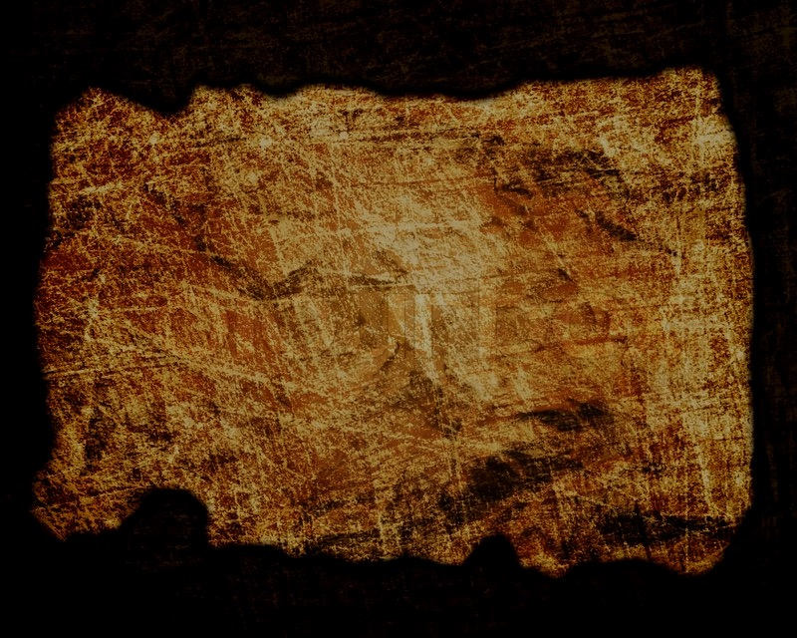
Covenant
27a
The new covenant (church) community is called a “synagogue” (“meeting,” 2:2) since all early believers were Jews when this early letter was penned (1:1).
James
Notes:
James does not use the theological language of Paul's later epistles, such as being "in Christ" (Eph 1) or "ministers of the new covenant" (2 Cor 4). His concern is more practical so that these early Jewish believers within a decade of Christ's life would show Jesus in community.

Slide 8
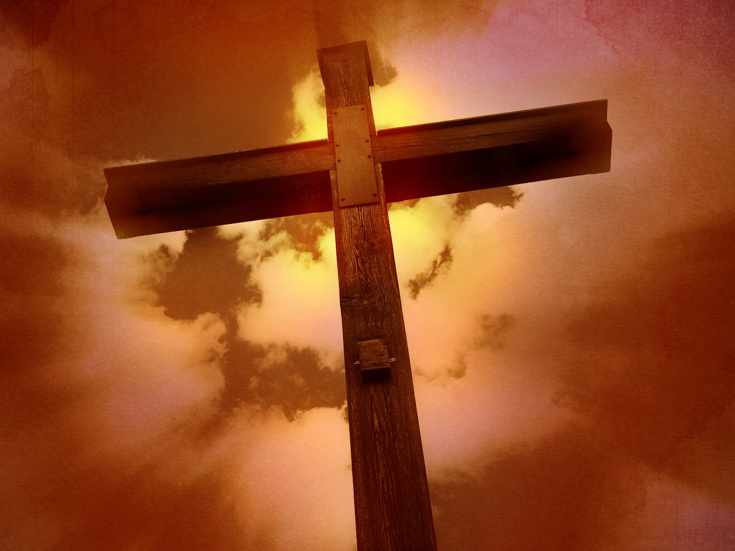
Redemption
27a
The words for “save” appear five times (1:21; 2:14; 4:12; 5:15, 20). None relate to salvation but instead “to save the life” from premature death.
James
Notes:
Much misunderstanding of this letter has resulted from teachers who think that James shows the way to salvation. Rather, he shows the way after salvation, or the expected results for his Christian readers.
See slides 32-36 in this presentation.
See also Zane Hodges, The Epistle of James (Irving, TX: Grace Evangelical Society, 1994), 41.
————————
NLT:
James 1:21 So get rid of all the filth and evil in your lives, and humbly accept the word God has planted in your hearts, for it has the power to save your souls.
James 2:14 What good is it, dear brothers and sisters, if you say you have faith but don’t show it by your actions? Can that kind of faith save anyone?
James 4:12 God alone, who gave the law, is the Judge. He alone has the power to save or to destroy. So what right do you have to judge your neighbor?
James 5:15 Such a prayer offered in faith will heal the sick, and the Lord will make you well. And if you have committed any sins, you will be forgiven.
James 5:20 you can be sure that whoever brings the sinner back from wandering will save that person from death and bring about the forgiveness of many sins.
NASB95:
James 1:21 Therefore, putting aside all filthiness and all that remains of wickedness, in humility receive the word implanted, which is able to save your souls.
James 2:14 What use is it, my brethren, if someone says he has faith but he has no works? Can that faith save him?
James 4:12 There is only one Lawgiver and Judge, the One who is able to save and to destroy; but who are you who judge your neighbor?
James 5:15 and the prayer offered in faith will restore the one who is sick, and the Lord will raise him up, and if he has committed sins, they will be forgiven him.
James 5:20 let him know that he who turns a sinner from the error of his way will save his soul from death and will cover a multitude of sins.

Slide 9
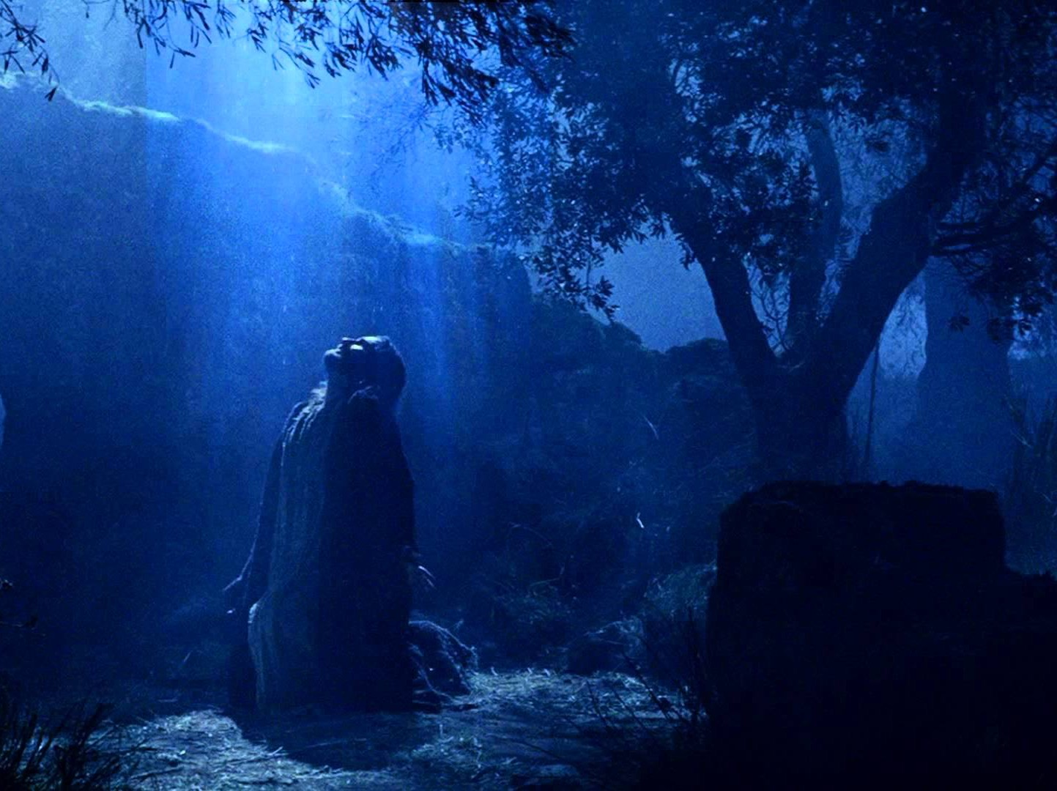
Prophecy
(Lord, Deity)
27a
The recipients had faith in “our Lord Jesus Christ” (2:1) but needed to put away their hypocritical, double-minded (1:8; 3:10) dispositions in order to grow in maturity and holiness. In effect the author says, “If Jesus is truly Lord, then act like it!”
James
Notes:
The letter has little "high Christology," or profound teaching about the nature of work of Christ. The emphasis is on putting into practice the reality of who Jesus is.

Slide 10
Ways Faith is Seen
267
Faith is Revealed through Works Because Faith… | Text | Text | Text | Text | Text | Text
Rejoices in Trials | Obeys the Word | Avoids Favoritism | Produces Works | Speaks Wisely | Produces Humility | Ultimately Triumphs
1:1-18 | 1:19-27 | 2:1-13 | 2:14-26 | 3 | 4:1–5:6 | 5:7-20
Salutation Trials Temptations | Prepare Obey | Discrimination Materialism Egalitarianism | Meeting Needs Validation | Influence Untamable Be Wise | Conflict Judging Presumption | Suffering Prayer Confrontation
Jerusalem | Text | Text | Text | Text | Text | Text
AD 44-47 | Text | Text | Text | Text | Text | Text
James
Notes:
James is NOT an evangelistic book to lead unbelievers to Christ, Rather, James wrote to "believers in our Lord Jesus Christ" (1:2, 16, 19; 2:1, 5, 14; 3:1, 10, 12; 4:11; 5:7, 9, 10, 12, 19).
His goal was to help them see how others can see their faith by looking at their works.
_______
NS-20-James-10, 55, 57, 73, 76, 98, 117, 133, 154, 186, 192, 203

Slide 11
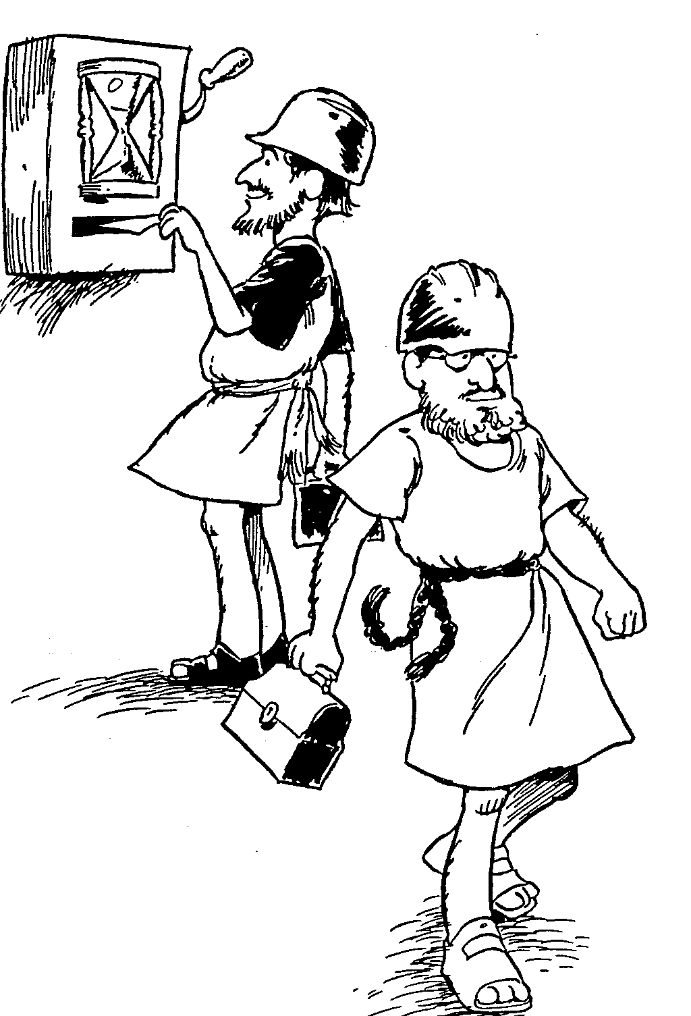
James
1 Working patience through trials
2 Obedience that accompies faith
3 Restraining the unbridled tongue
4 Keeping calm in conflicts
5 Suffering and sick saints
Barry Huddleston, The Acrostic Bible
Notes:
Workers punch in their time clock not to get a job, but rather to live out the role and identity that they already have. Likewise, those identifying with Christ should work this out as a natural indicator of the faith in Jesus that they already have.

Slide 12
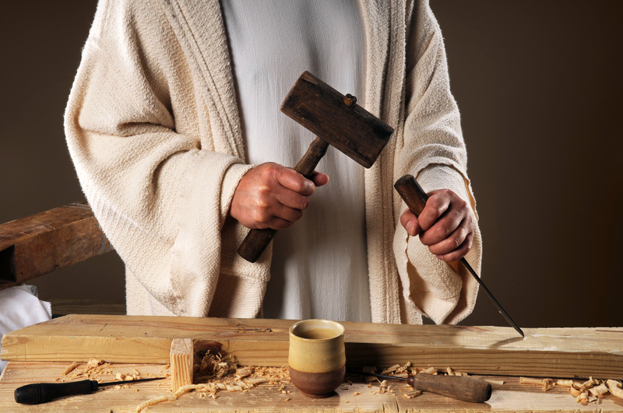
Be Working
The Letter
of James
Dr. Rick Griffith • Crossroads International Church Singapore
BibleStudyDownloads.org
Notes:
Each sermon in the "Be" series at the Bible Exposition link at this website seeks to show not what believers DO but what they should BE. Yet, this letter aptly includes both being and doing.

Slide 13

How will others know you are a Christian?
James
Notes:
Will you have a special glow?
Do Christians smile more?

Slide 14
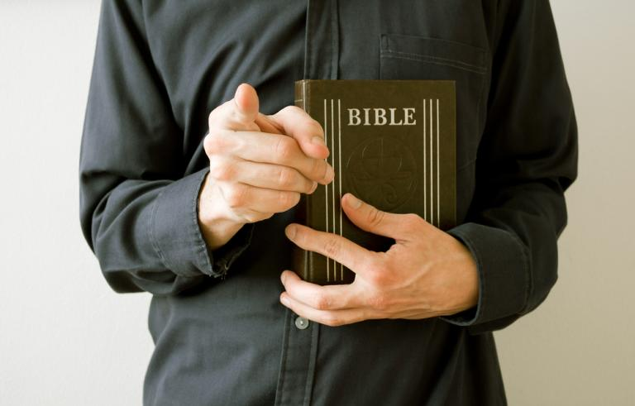
How will others know you are a Christian?
James
Notes:
Should we try to get others to ask about our faith by seeing religious disciplines in us like prayer and Bible reading?
What if we tell people what the Bible says?

Slide 15
What are the characteristics of faith?
7
James
Notes:
What should your trust in Christ look like?
What does faith in Jesus look like?

Slide 16
Summary Statement
267
Early Jewish believers in the Roman world should show their faith through works to replace their hypocrisy with good deeds in maturity and holiness.
WORKS
James
Notes:
The key idea here is that works reveal faith. Otherwise, we are hypocrites by saying that we believe when in reality we live immature, immoral lives.

Slide 17
Main Idea of James
IF YOU BELIEVE
SHOW IT
Notes:
James tells us what happens if we do NOT show our faith in chapter 2 where others cannot see who we really are as believers. If we see those without food or clothing but do not help them, they will not see our faith. That doesn't mean that the faith is not there. If simply means that we are living inconsistently with the faith we profess that should include compassion in a practical sense.

Slide 18
Commands in James
274a
Verse | Imperatives | Personal Application
1:13, 16 | Do not be deceived | When tempted, I must not deceive myself and say that God is tempting me.
1:21 | Get rid of moral filth | I must not let the moral filth of anger make me say careless words but let God’s Word be firmly planted in me.
1:22 | Do not merely listen | I must do what the Word says and not merely listen.
2:1,5 | Do not show favoritism | I must treat everyone with equity regardless of wealth, race or authority in my work and ministry.
2:12 | Speak and act as those going to be judged | I must speak and act with mercy knowing that God will judge.
2:18 | Show me your faith | I must show my faith in good deeds, such as to help the poor and needy.
3:10 | Do not praise and curse from the same mouth | I must be conscious of the words I speak and thereby control my tongue.
4:7 | Submit yourselves to God | I must submit to God whenever the world tempts me and the devil will flee.
Notes:
This hard-hitting letter shows the authority of this leader of the church of Jerusalem in that it has many frank, concise commands.

Slide 19
Commands in James
274a
Verse | Imperatives | Personal Application
4:8 | Draw near to God | I must draw near to God in my daily devotions that he might draw close to me.
4:10 | Humble yourselves | When I am in any position of authority, I must not be arrogant but humble myself before God.
4:11 | Do not slander | I must no slander and speak against anyone but endeavor to preserve the unity of saints.
4:15 | Do not boast | Any plans that I make must be committed to God in prayer.
5:7 | Be patient | I must be patient when suffering and look forward to the blessed hope of Christ return.
5:9 | Do not grumble | If I am unhappy over something, I will not grumble and spread discord amongst others.
5:12 | Do not swear | I must make sound decisions and responsible choices without the need to swear.
5:16 | Confess your sins | Whenever I fall into sin, I must admit my sins and seek prayers that I may be restored.
Notes:
Note how many of these relate to the speech of the believer. We all vastly underestimate the impact of the words we say and hear.

Slide 20
Black

Slide 21
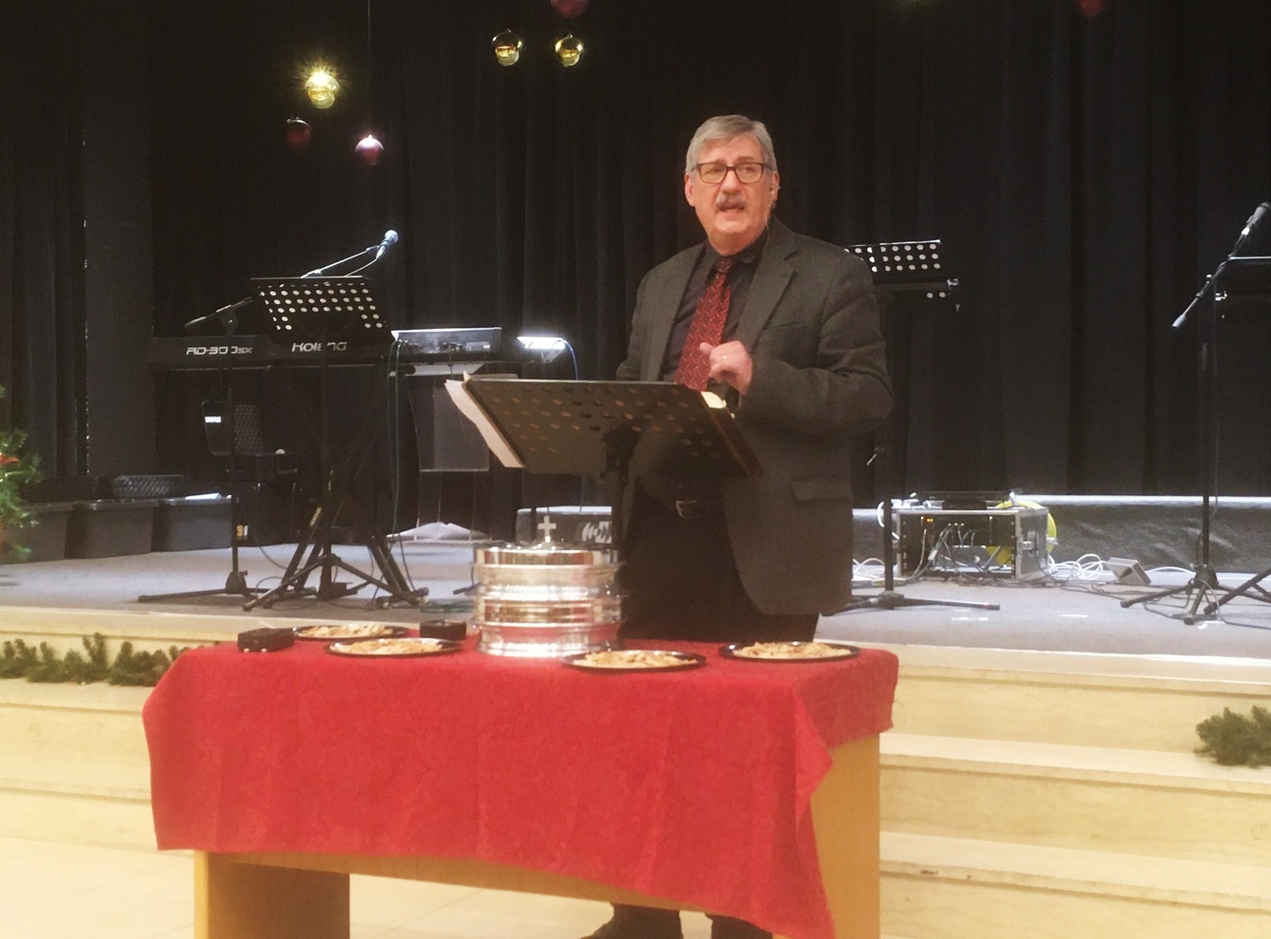
Introducing The epistle of jameS
Dr. David Martin • Amman International Church
AmmanChurch.org • BibleStudyDownloads.org

Slide 22
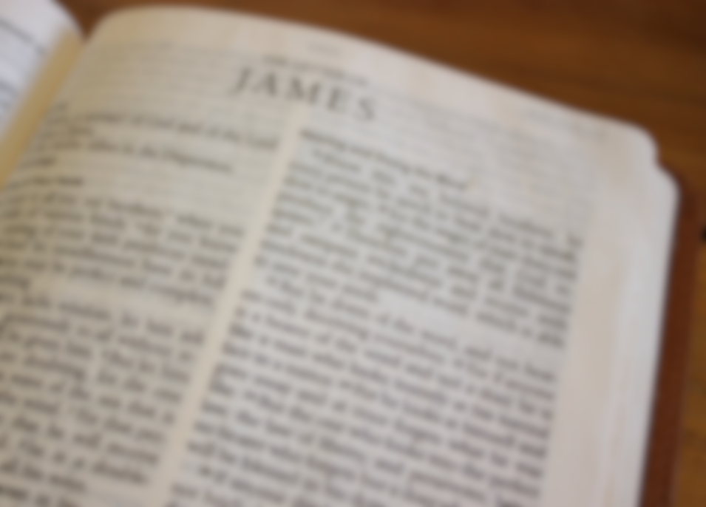
The epistle of jameS
✓One of eight “general” epistles
(Hebrews; 1,2 Peter; 1,2,3 John, Jude)
✓Focused on ethical living
54 commands in 108 verses
22 Old Testament book references
15 allusions to Jesus’ teachings
✓The “Proverbs of the New Testament”
✓Often misunderstood and neglected
(emphasis on works vs. faith)

Slide 23

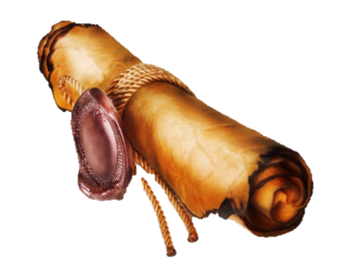
The author of this letter
1) James, son of Zebedee; brother of John
2) James, son of Alphaeus (Acts 1:13);
James the less/little (Mark 15:40)
3) James, father of the apostle Judas
“not Iscariot” (John 14:22)
4) James, half brother of Jesus;
James “the just”; born after Jesus
(Matt. 1:18; Luke 2:7)
Similarities in Greek between Acts 15 and James

Slide 24
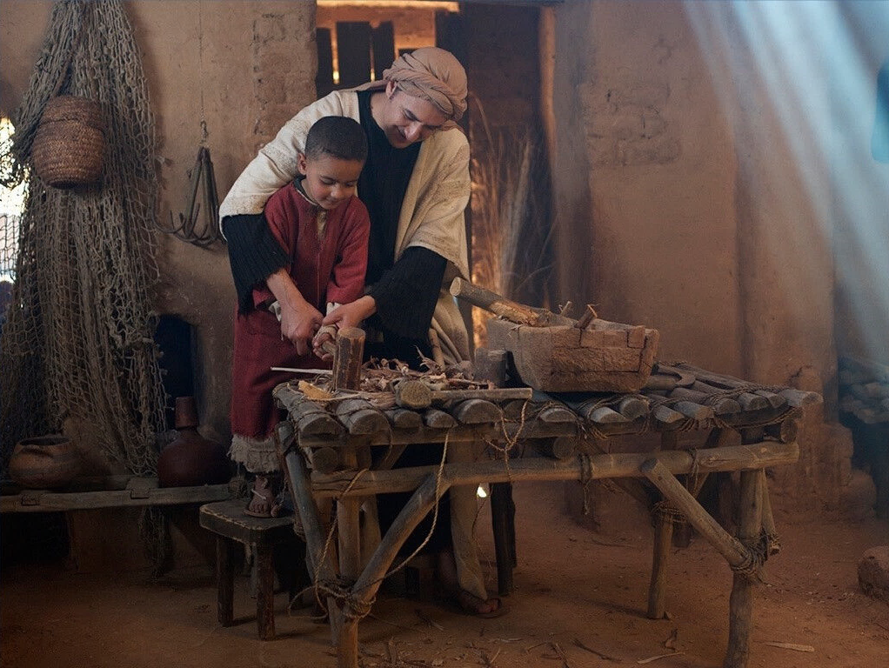
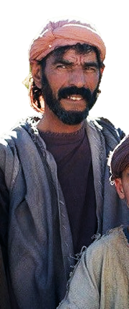
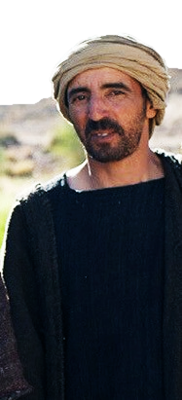
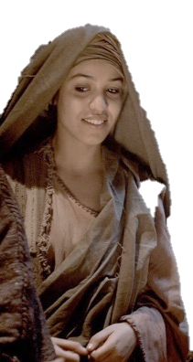
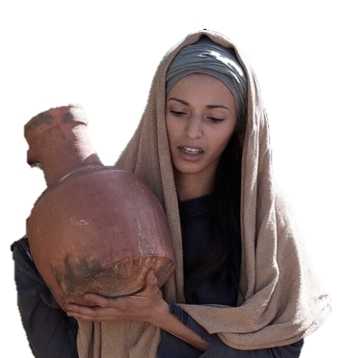
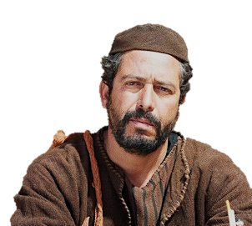
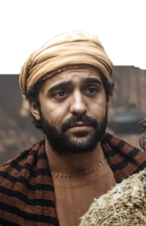

✓Jesus had 6+ siblings (Matthew 13:55-56)
✓They were unbelieving during Jesus’
earthly ministry (John 7:2-5; 19:25-27)
✓The resurrected Jesus appeared to James
(1 Cor. 15:7)
✓James (and brothers) were present at Pentecost (Acts 1:14; 1 Cor. 9:5; Jude 1)
✓James soon led the Jerusalem church (Gal. 2:9; cf. 1:19; Acts 15:13)
Simon
Joses
James
Judas

Slide 25






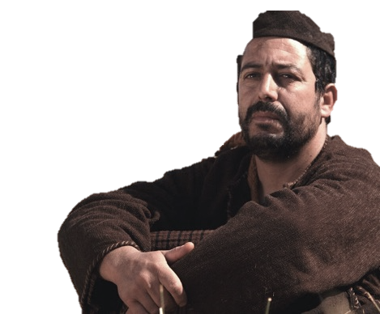


When did James write this?
AD 30 James at Pentecost (Acts 1-2)
33/34 Stephen was stoned; Saul’s conversion (Acts 7-9)
38 Cornelius was saved (Act 10)
39 Church growth through persecution (Acts 11)
James
44-45
49 1st church council (Acts 15)
49
Galatians
62 James stoned
70
Temple
destroyed

Slide 26
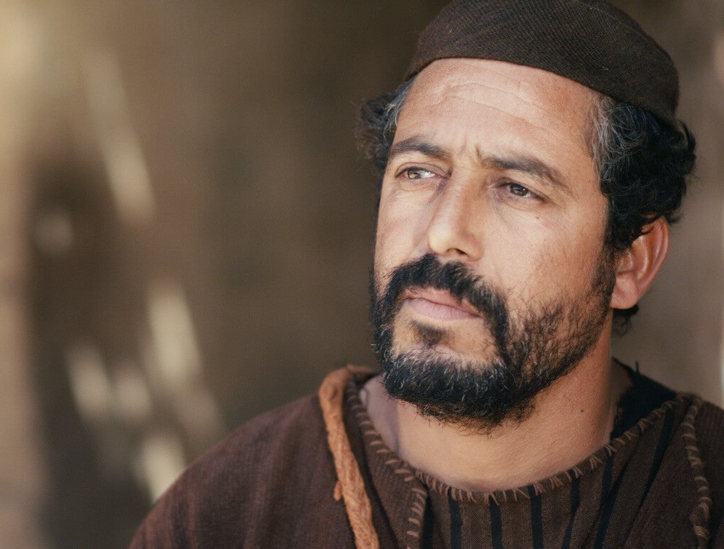
What we learn of James
in this letter
He considered himself a bond-servant (1:1)
✓God (the Father)
✓The Lord Jesus Christ
James shows deep concern for . . .
✓Responding to trials correctly (1:2-12)
✓Hearing and doing the word (1:21-22)
✓Marginalized poor (1:27-2:4)
✓Strong sense of right and wrong (2:8-10)
✓Confession and prayer (5:16)
✓Reconciling the backslidden (5:19-20)

Slide 27

The FIRST readers
The twelve tribes (descendants of Jacob)
✓Written mostly to Jewish converts
They had been “dispersed” (sown) abroad
✓Refers to Jews living outside Palestine
(cf. Acts 2:5-11)
✓Dispersed by Assyria (722 BC), Babylon
(606-586 BC), and Rome (63 BC)

Slide 28
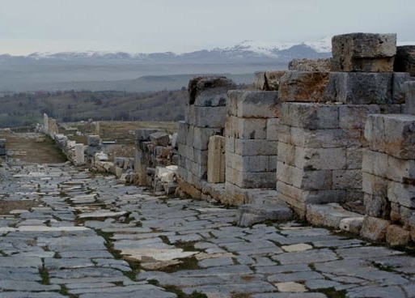
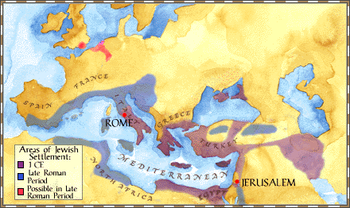
Roman Road - Antioch

Slide 29
The FIRST readers
Greetings!
The twelve tribes (descendants of Jacob)
✓Written mostly to Jewish converts
They had been “dispersed” (sown) abroad
✓Refers to Jews living outside Palestine
(cf. Acts 2:5-11)
✓Dispersed by Assyria (722 BC), Babylon
(606-586 BC), and Rome (63 BC)
✓Specifically persecuted Christians
(Acts 8:1,3-5; 11:19-21)

Slide 30

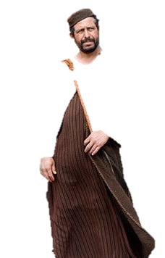
Principles to apply today
1) No one is beyond hope (don’t give up!)
James rejected Christ for 30 years
He led the Jerusalem church for 30 years
Col. 4:3-5
Mark
4:3-9
1 Tim. 2:1,4
Notes:
Mark 4:3 “Listen! A farmer went out to plant some seed. ⁴ As he scattered it across his field, some of the seed fell on a footpath, and the birds came and ate it. ⁵ Other seed fell on shallow soil with underlying rock. The seed sprouted quickly because the soil was shallow. ⁶ But the plant soon wilted under the hot sun, and since it didn’t have deep roots, it died. ⁷ Other seed fell among thorns that grew up and choked out the tender plants so they produced no grain. ⁸ Still other seeds fell on fertile soil, and they sprouted, grew, and produced a crop that was thirty, sixty, and even a hundred times as much as had been planted!” ⁹ Then he said, “Anyone with ears to hear should listen and understand.”
1Tim. 2:1 I urge you, first of all, to pray for all people. Ask God to help them; intercede on their behalf, and give thanks for them.
1Tim. 2:4 who wants everyone to be saved and to understand the truth.
Col. 4:3 Pray for us, too, that God will give us many opportunities to speak about his mysterious plan concerning Christ. That is why I am here in chains. ⁴ Pray that I will proclaim this message as clearly as I should.
Col. 4:5 Live wisely among those who are not believers, and make the most of every opportunity.

Slide 31
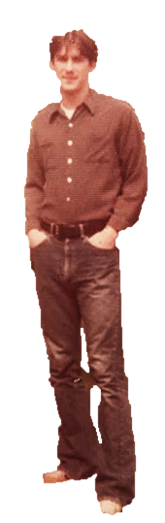
Principles to apply today
2) Reach out to and gently admonish those
who are straying from Christ
James 5:19,20
1 Thess. 5:12-14
Jude 22-23
Notes:
1 Thess 5:12-14; Jude 22-23; James 5:19-20

Slide 32
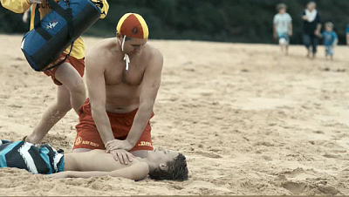
Sozo in James
27a
"Therefore, get rid of all moral filth and the evil that is so prevalent and humbly accept the word planted in you, which can save you" (1:21 NIV).
We are not saved by God's Word but by faith in Christ. Yet the Bible preserves our lives from physical death. James wrote believers (1:1) so they were already saved from sin.
James uses sozo not for salvation but instead “to save the life” from premature death
(Zane Hodges, The Epistle of James [Irving, TX: Grace Evangelical Society, 1994], 41).
Notes:
"Furthermore, the implanted word can produce an enormous benefit, for James tells his readers that it is able to save your souls. Many readers, as well as expositors, have an automatic reaction to the phrase save your souls in English, which leads them to understand it [as] eternal salvation from hell. But none of James's readers were at all likely to get such a meaning out of this text. The Greek phrase found here (sõsai tas psychas hymõn) was in common use in the sense of "to save the life." It is used in both the Greek OT as well as in the NT in exactly that sense (see Gen 19:17; 32:30; 1 Sam 19:11; Jer 48:6; Mark 3:4; Luke 6:9). This is its obvious sense also in Jas 5:20, which refers to the physical preservation of a life from death. It may even be said that there is not a single place in the entire Greek Bible (i.e., the NT plus the Septuagint, the Greek translation of the OT) where this phrase signifies deliverance from hell."
—Zane Hodges, The Epistle of James (Irving, TX: Grace Evangelical Society, 1994), 41.

Slide 33
Sozo in James
27a
"What good is it, my brothers, if a man claims to have faith but has no deeds? Can such faith save him?" (2:14 NIV).
Paul is clear that we are not saved by faith plus deeds, nor are we saved by faith that is followed by deeds. Rather, our faith shows others that we are saved.
James uses sozo not for salvation but instead “to save the life” from premature death
(Zane Hodges, The Epistle of James [Irving, TX: Grace Evangelical Society, 1994], 41).
Notes:
The word "save" here must refer to preserving oneself from death physically. Otherwise, we are adding works to faith for salvation.

Slide 34
Sozo in James
27a
"There is only one Lawgiver and Judge, the one who is able to save and destroy. But you—who are you to judge your neighbor?"
(4:12 NIV).
Death is contrasted with life here, not eternal punishment contrasted with eternal life. Thus, this verse tells us that God is the author of physical life.
James uses sozo not for salvation but instead “to save the life” from premature death
(Zane Hodges, The Epistle of James [Irving, TX: Grace Evangelical Society, 1994], 41).

Slide 35
Sozo in James
27a
"And the prayer offered in faith will make the sick person well; the Lord will raise him up. If he has sinned, he will be forgiven" (5:15 NIV).
Here sozo does not mean one will be saved from a salvation prayer but will have an extended life physically.
James uses sozo not for salvation but instead “to save the life” from premature death
(Zane Hodges, The Epistle of James [Irving, TX: Grace Evangelical Society, 1994], 41).

Slide 36
Sozo in James
27a
"Whoever turns a sinner from the error of his way will save him from death and cover over a multitude of sins"
(5:20 NIV).
This restoring people means keeping them from premature physical death. This is paired with sins forgiven, showing the spiritual aspect in contrast to their extension of life.
James uses sozo not for salvation but instead “to save the life” from premature death
(Zane Hodges, The Epistle of James [Irving, TX: Grace Evangelical Society, 1994], 41).

Slide 37
NT Overview (General + Key Words)
What 5 books have we studied so far?
38
124
39-41
What are their key words?
"To the remotest part of the earth" (Acts 1:8)
Acts 9 13 14 15 16 18 21 27 28
Put them in chronological order!
Apr 48-
Sep 49
1
Galatia
Apr 50-
Sep 52
2
Aegean
Spr 53-
May 57
3
Asia
Feb 60-
Mar 62
1
Rome
Spr 62-
Fall 67
4
Spain
Aut 67-
Spr 68
2
Rome
Summer 35-
37
Damascus
Antioch
May 57-
Aug 59
Trials
Fall 49
The
Council
Spring 68
Expansion of Church
35 48 49 50 52 53 57 60 62 67 68 95
Matt
Luke
Acts
Mark
John
Kingdom
Sov 1
Sov 2
Disciple
Believe
James
Works
Gospels & Acts
1234
Journeys
General Epistles
Rome
Imprisonments
General Epistles + Key Words
Notes:
In pairs, the taller person give the five books we have studied so far in chronological order then the shorter person give the key words.
Today we begin studying the General Epistles, but only briefly since after James we won't get to the second one for a long time!
The key word for James is works.

Slide 38
Contrasting Galatians & James
174j
Issue
Galatians
James
Author
Paul
James
Date
A.D. 49
A.D. 44-48
Audience Ethnicity
Gentiles
Jews
Justification
Before God (vertical)
Before Man (horizontal)
The time of faith…
before salvation
after salvation
Emphasis is on…
faith
works

Slide 39
Contrasting Galatians & James
174j
Issue
Galatians
James
Spirit Noted
19 times
0 times
Gospel Noted
12 times
0 times
Opposite Author
James noted
Paul not noted
Author Title
Apostle (1:1)
Servant (1:1)
Reader Problem
Confusion of way of salvation
Confusion of way of discipleship
Use of “saved”
Soteriological
Preserve life

Slide 40
Contrasting Galatians & James
174j
Issue
Galatians
James
Circumcision
Big issue
Non-issue
Opponents
Judaizers
None
Audience
Disunited
United
Structure
Logical, sequenced
Random, repeated
Geography
Roman Province of Galatia
Roman Empire in its entirety
One of the 12?
No—came later
No—came later

Slide 41

Which is the Most Accurate?
121a
Salvation by…
Faith + Works
Faith Alone
Faith + Works
OT
Works
Faith Alone
Faith Alone
Faith + Works
NT
Faith
• Which verses in the Bible support your answer?
cf. OTS 119e
Notes:
Did God change the means of salvation from the OT to the NT?
We are NOT talking about whether people should do good works—we all agree on that. But are works needed for salvation?
Paul answers this question in Romans 4 with the example of Abraham who was saved by faith alone—see Gen 15:6.
________
BE-03-Lev-27
OB-37-Sacrifices-72_eng_ob_1667_v5—slide 17
OB-39-Salvation-2
OS-03-Leviticus-13
OP-03-Lev-27
OP-Lev_6v24-7v10 Why All That Blood Sin & Guilt Offerings-49_eng_op_v4.0—slide 34
OS-04-Num-27
NP-Acts_15v1-35_Dont_Be_Law_Abiding_(Rick_Griffith)-61_eng_pr_v4—slide 5
NS-05-Acts15-16-slide 26
NS-Rom3-4-slide 77
NS-09-Galatians-48
NS-20-James1-2—41
NS-23-1Jn-58
SA-03-Biblical Terms-6
SA-15-Inheritance-26

Slide 42
Salvation & Sanctification
121a
Man's Role
God's Response
Life of Faith
Restored Fellowship
Faith in God as offered Passover Lamb
Journey to Canaan
Sacrifices
(Sin, Guilt)
OT
Exodus
Type
|
Antitype
Type
|
Antitype
Type
|
Antitype
Type
|
Antitype
Faith in Christ as Lamb of God (1 Cor. 5:7)
Salvation
(1 Cor. 10:1-4)
Growth
(1 Cor. 10:5)
Confession
(1 John 1:9)
NT
Positional Sanctification
Progressive Sanctification
Notes:
The OT plan of salvation is mirrored in the NT—both by simple faith in the Lamb pictured in the Passover.
Exodus from Egypt is a type of the believer who leaves his slavery to sin—all believers in the Lamb are saved, including all Israelites who left Egypt as they demonstrated that faith by putting the blood on the doorposts of their homes (=positional sanctification).
But both OT and NT believers must live a life of faith in God, pictured in Israel’s journey to Canaan and mirrored in the Christian’s growth or progressive sanctification.
Finally, as OT believers confessed their ongoing sins in the sin and guilt sacrifices (for restoring fellowship with God—NOT for salvation!), so NT believers confess sins even after they are saved to restore their fellowship (NOT relationship!) with God.
_________
Common English-78
OB-37-Sacrifices-18
OS-00-Book Overviews-73
OS-04-Numbers-13
NS-09-Galatians-49
NS-20-James-31
SA-03-Biblical Terms-7
SA-15-Inheritance-26

Slide 43
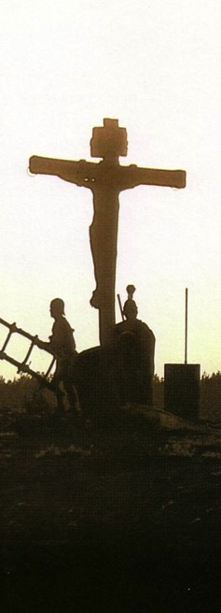
Salvation in All Ages:
The Centrality of the Cross
B.C.
Looked forward to the
Cross of Christ
A.D.
Look
back at the
Cross of Christ
Notes:
It helped me see the centrality of the cross—how people before Jesus believed by looking toward the cross while those of us after Jesus look back at the cross. In other words…
The grounds of salvation has always been the death of Christ—for believers before and after the cross.
____________________
Common English-78
BE-03-Leviticus-73
OB-37-Sacrifices-19
OB-38-Salvation-4
OS-03-Leviticus-193
NS-09-Galatians-16, 50
NS-20-James-32
SA-03-Biblical Terminology-10
SA-15-Inheritance-26

Slide 44
Salvation in the Old Testament
173e
OT Times
(Moses to Christ's Death)
NT Times
(Christ's Death to Today)
Basis
of Salvation
God's gracious provision of the death of Christ since "it is the blood that makes atonement for one's life"
(Lev. 17:11b)
God's gracious provision of the death of Christ ("without the shedding of blood there is no forgiveness," Heb. 9:22)
Requirement
of Salvation
Faith in the provision that God has revealed—as a gift (Ps. 51:16-17)
Faith in the provision that God has revealed—as a gift (Gal. 2:16)
Ultimate Content
of Salvation
Object of faith is God Himself—prophets exhorted repentance, not sacrifices (Jer. 3:12)
Object of faith is God Himself—heroes of faith are cited to exhort faith in God (Heb. 11)
Specific
Revealed Content
of Salvation
Cumulative content of faith had sacrifices & promises: animals (Gen. 3:21), Abel's sacrifice (Gen. 4:4), Abrahamic covenant (Gen. 15)
New content of faith is the shed blood of Jesus Christ (1 Pet. 1:18-21) which removes sin while OT sacrifices merely covered sin
Believer's Expression
of Salvation
Obey moral law, offer animal sacrifices, obey Mosaic law (civil
and ceremonial aspects)
Obey moral law, observe Lord's Supper and baptism, etc. through the Spirit's enabling (Rom. 8:9)

Slide 45
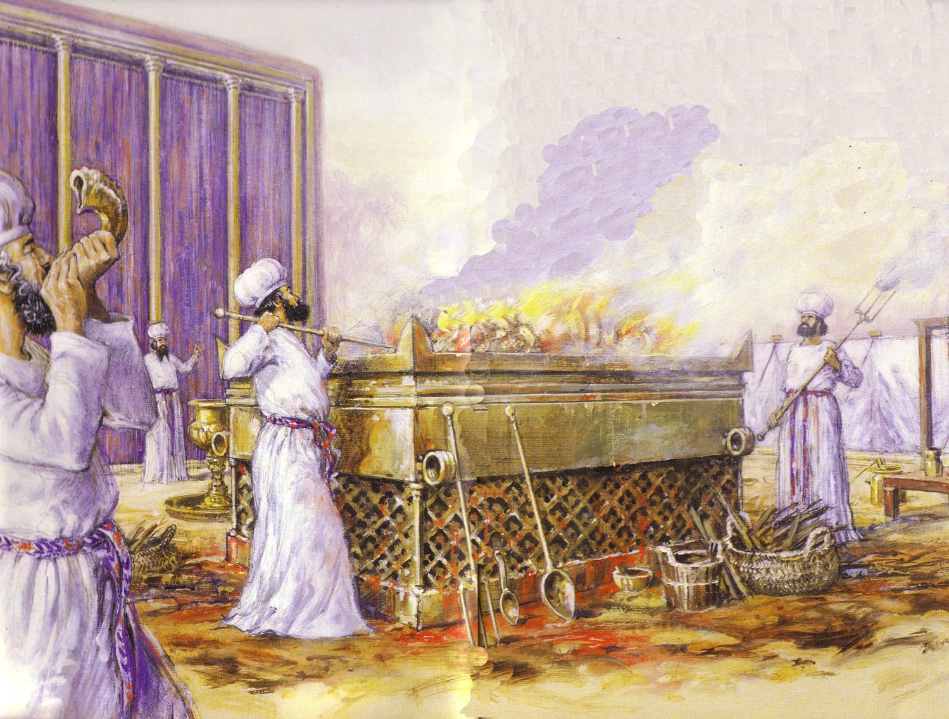
Leviticus Synthesis
OTS, 124
Sanctification through sacrifice and separation
1–10 Sacrifice
(worshipping God)
11–27 Separation
(walking with God)

Slide 46

In Other Words…
153
Salvation has
ALWAYS been through faith alone!
Notes:
The imagery here is instructive. The lower hand does not hold onto the upper one. The person only lifts his hand in faith that the stronger hand will save him. Likewise, we turn to the Lord in faith, but he does all the work of lifting us out of our sins.
———————————
Common-206
OS-03-Leviticus-202
NS-05-Acts15-16-slide 29
NS-09-Galatians-53
NS-20-James-46

Slide 47
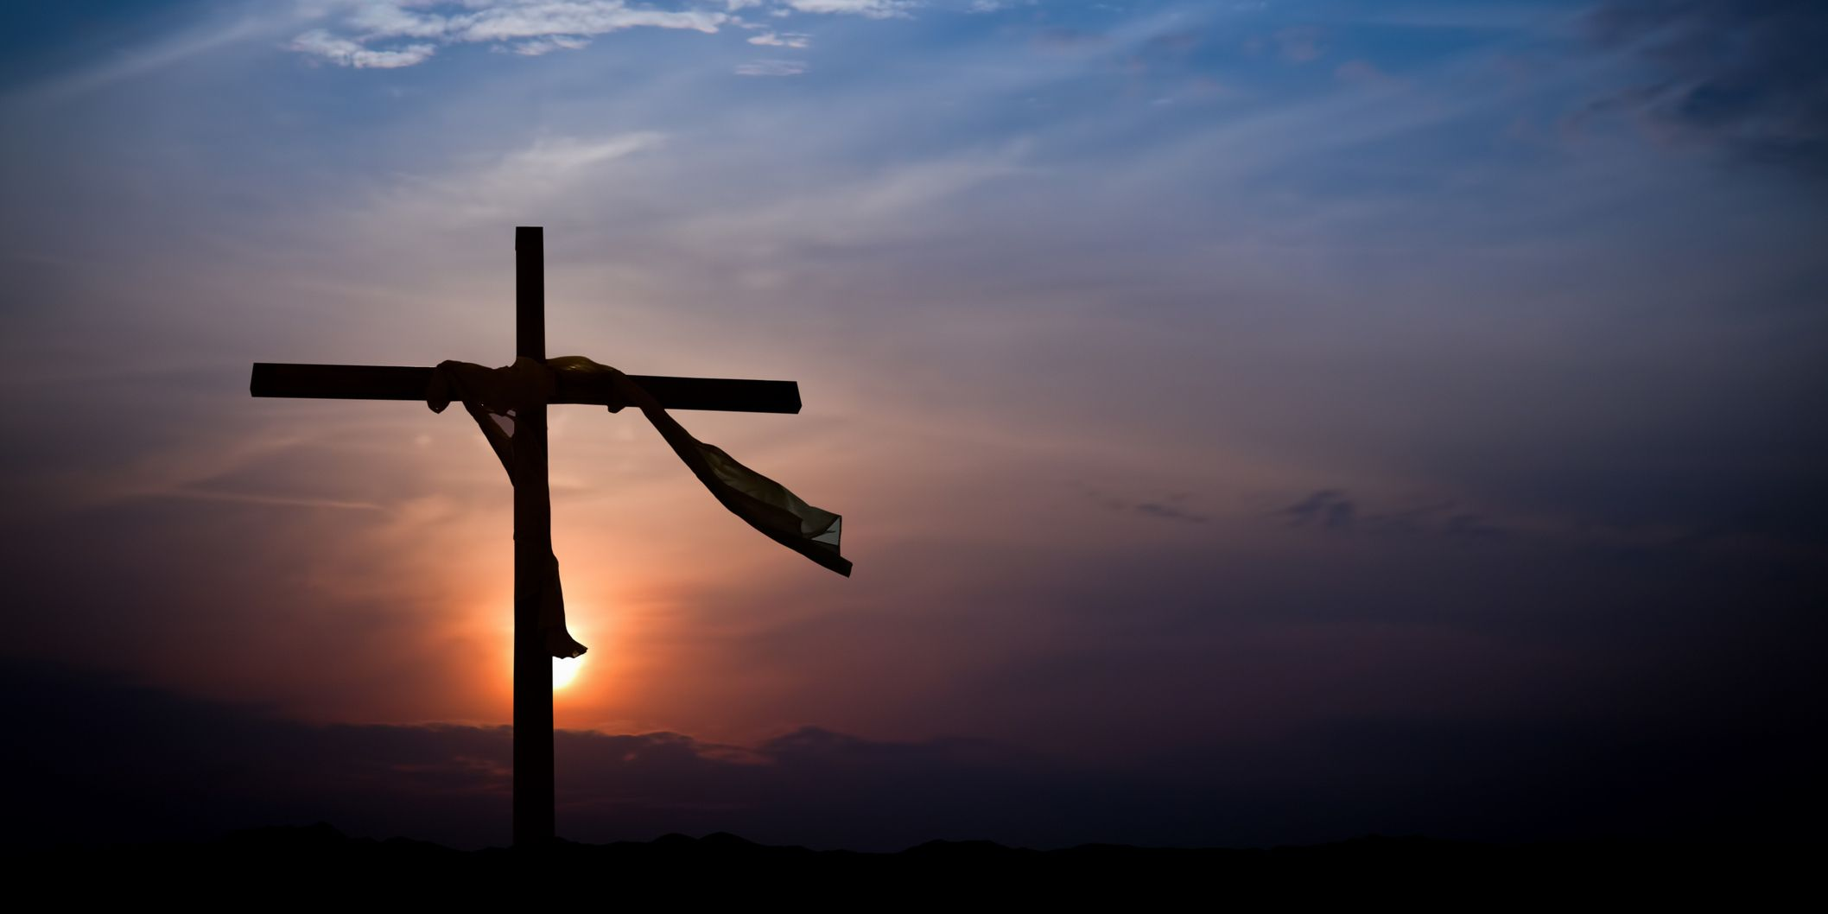
Do all true Christians die in fellowship with the Lord?
In other words, do all believers persevere in faith or can they sometimes fall away (not consider themselves Christian, not trust in God anymore, etc.)?
What is the key issue here?
Notes:
Talk about these questions in your small group.
Some Corinthian Christians died in sin (1 Cor 11:30).
____________
NS-20-James1-2—slides 47, 354

Slide 48
Perseverance versus Free Grace
274d
"Beware of false prophets who come disguised as harmless sheep but are really vicious wolves"
(Matthew 7:15)
Promised to Overcomers:
"I am coming soon. Hold on to what you have, so that no one will take away your crown"
(Revelation 3:11 NLT).

Slide 49
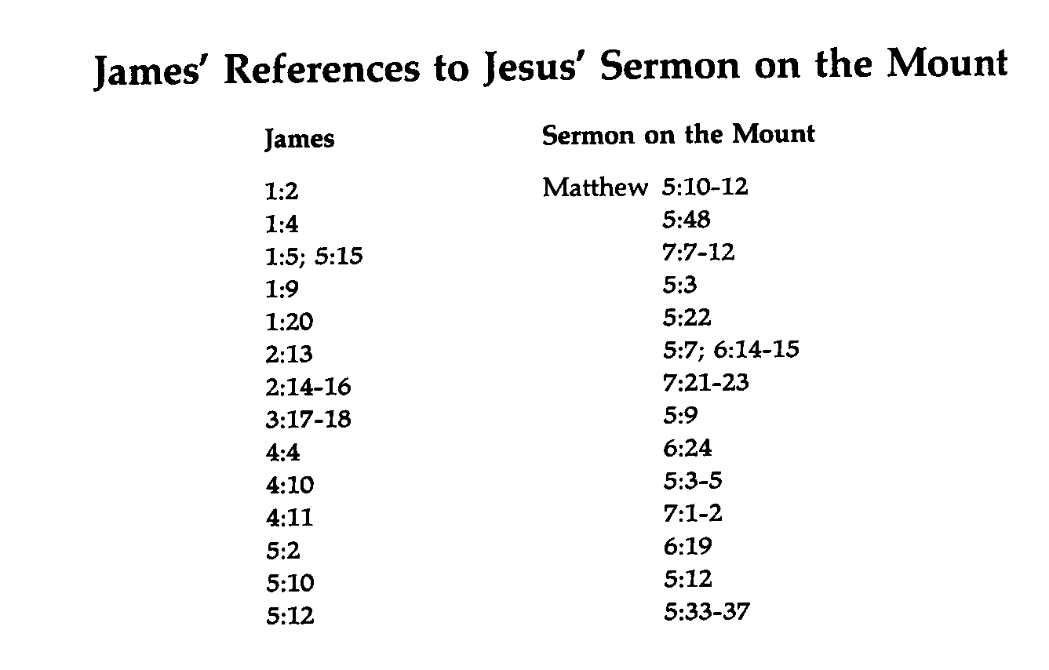
James' References to the Sermon on the Mount
274a
James
Sermon on the Mount
Matthew

Slide 50
Be Working
The Letter
of James
Dr. Rick Griffith • Crossroads International Church Singapore
BibleStudyDownloads.org

Slide 51

Faith is internal and unseen.
Or is it?
Notes:
Some years ago I sat on a plane next to an older man. He looked about 70 years old, but his eyes sparkled as we talked and he spoke with great energy and many smiles. I thought to myself, “Wow, I hope I have half his energy when I get to his age!” So I asked him his age. “Oh, I am 85 this year!”
That got me even more interested. “Hey, I bet this man is a Christian.” But I will first ask what he did all his working years.
“Oh, for most of my life I was a bookie” he said.
I thought, “What? You spent decades managing horse races that destroyed how many men, how many families, and made a lot of money off gamblers who look like a wreck—but you look fantastic!”
Hmmmmm, it made think of this further thought:
• Faith is internal and unseen. You can’t really tell by looking a a person if he or she is a Christian, can you? I have met other delightful men who I was sure were Christians, but then they told me, “Oh, I am a Mormon” or I found out they were into Eastern philosophy or whatever ism.
• But is faith really only internal? Can’t we tell in other ways if a person has faith in Christ?

Slide 52
How will others know you are a Christian?
James
Notes:
Will you have a special glow?
Do Christians smile more?
—————————
Cf. 13

Slide 53
How will others know you are a Christian?
Notes:
Should we try to get others to ask about our faith by seeing religious disciplines in us like prayer and Bible reading?
What if we tell people what the Bible says?
—————————
Cf. 14

Slide 54
What are the characteristics of faith?
Notes:
What should your trust in Christ look like?
What does faith in Jesus look like?

Slide 55
Background
Early Jewish believers were not living out their faith.

Slide 56
NT Overview (General + Key Words)
What books have we studied so far?
38
124
39-41
What are their key words?
"To the remotest part of the earth" (Acts 1:8)
Acts 9 13 14 15 16 18 21 27 28
Put them in chronological order!
Apr 48-
Sep 49
1
Galatia
Apr 50-
Sep 52
2
Aegean
Spr 53-
May 57
3
Asia
Feb 60-
Mar 62
1
Rome
Spr 62-
Fall 67
4
Spain
Aut 67-
Spr 68
2
Rome
Summer 35-
37
Damascus
Antioch
May 57-
Aug 59
Trials
Fall 49
The
Council
Spring 68
Expansion of Church
35 48 49 50 52 53 57 60 62 67 68 95
Matt
Kingdom
James
Works
Gospels & Acts
1234
Journeys
General Epistles
Rome
Imprisonments
General Epistles + Key Words
Notes:
In pairs, the taller person give the five books we have studied so far in chronological order then the shorter person give the key words.
Today we begin studying the General Epistles, but only briefly since after James we won't get to the second one for a long time!
The key word for James is works.

Slide 57
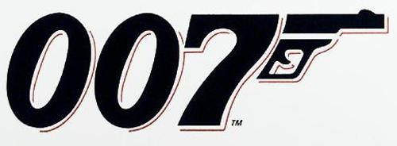
The Title
EPISTLE OF
JAMES
BOND
servant
Of Christ Jesus
Notes:
Today we continue our study of BOND—James BOND-servant of Jesus Christ. James wrote to people who had heard the Bible a lot—but it had too little effect on them.
________
NS-20-James1-2—slides 57, 191

Slide 58
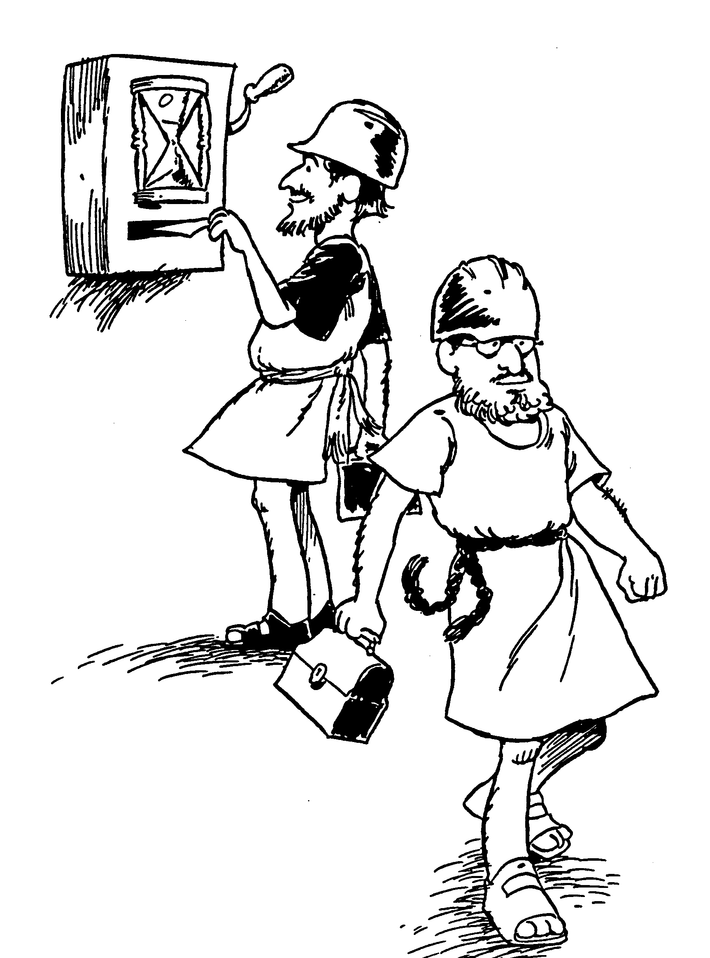
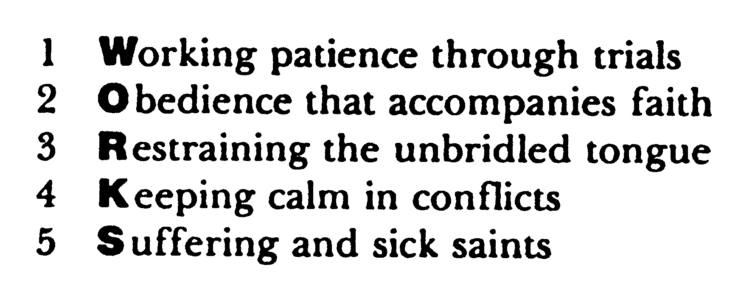
Huddleston Outline
WORKS

Slide 59
Authorship: James the son of Zebedee?
Authorship
James the son of Zebedee
Died before letter was written

Slide 60
Son of Thaddeus or Alphaeus
Authorship
James the son of Alphaeus
James the father of Thaddeaus

Slide 61
Jesus' Family Persecuted Him
Holy
Spirit
Men in white
Mary
Joseph
Women in yellow
Jesus
Joseph
Simon
Sister 2
James
Judas
Sister 1
"Then they scoffed, 'He's just a carpenter, the son of Mary and the brother of James, Joseph, Judas, and Simon. And his sisters live right here among us.' They were deeply offended and refused to believe in him" (Mark 6:3 NLT).
Notes:
Luke 1:35 The angel replied [to Mary], “The Holy Spirit will come upon you, and the power of the Most High will overshadow you. So the baby to be born will be holy, and he will be called the Son of God.
There existed no sexual union between Mary and the Holy Spirit, but instead it was God's power "overshadowing" her. Such was not the case with the four brothers and at least two sisters of Jesus, conceived and born in the natural manner. Yet these siblings evidently did not believe even as adults that their mother Mary was a virgin at the birth of Jesus. John brings out their unbelief in John 7:1-5…
John 7:1 After this, Jesus traveled around Galilee. He wanted to stay out of Judea, where the Jewish leaders were plotting his death. ² But soon it was time for the Jewish Festival of Shelters, ³ and Jesus’ brothers said to him, “Leave here and go to Judea, where your followers can see your miracles! ⁴ You can’t become famous if you hide like this! If you can do such wonderful things, show yourself to the world!” ⁵ For even his brothers didn’t believe in him (NLT).
But God worked on these brothers. After the resurrection, they believed and were in the Upper Room with the disciples: "These all with one mind were continually devoting themselves to prayer, along with the women, and Mary the mother of Jesus, and with His brothers" (Acts 1:14 NLT). In fact, both James and Jude went on to each record a General Epistle!
__________
LC-03-Opposition-114
NS-02-Mark1-8-slide 234
NS-04-John1-11—slide 387
NS-20-James1-2—slide 61
NS-26-Jude-90

Slide 62
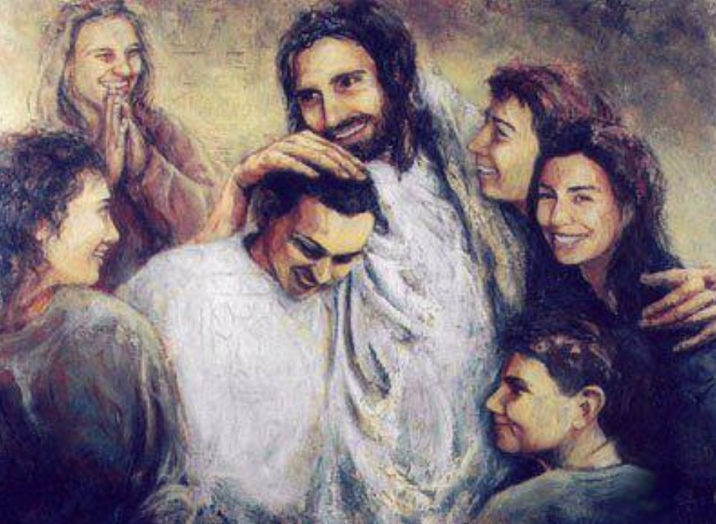
Brother of Jesus
Authorship
James the brother of Jesus
What would it have been like to grow up with a perfect older brother?
Notes:
How does this relate to how James introduces himself at the beginning of the letter?

Slide 63

Who were the original readers of James?
Were they believers or not?
How do you know?
Notes:
In other words, is this an evangelistic letter designed to lead unbelievers to Jesus?

Slide 64
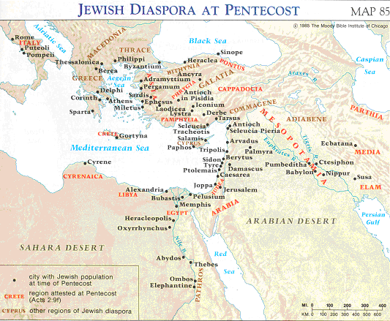
Jewish Diaspora at Pentecost
See Acts 2:9-11
Addressed To
"To the twelve tribes scattered among the nations..."
James 1:1

Slide 65
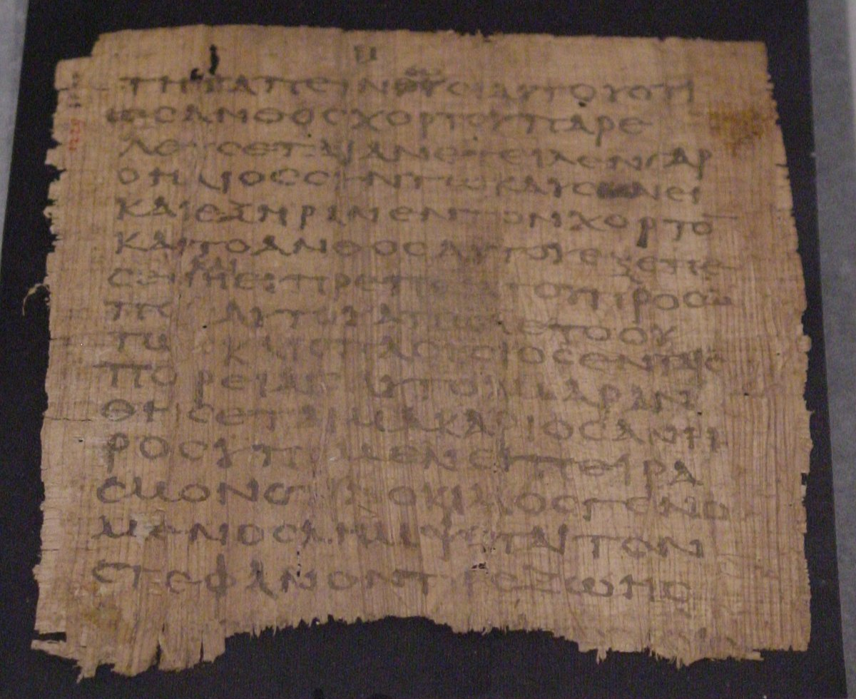
Why did James write?
To lead unbelievers to Christ?
To give “tests of faith” so people could evaluate if they were genuine believers?
To exhort true Christians to live up to the faith they professed?
Notes:
The third has the best evidence.

Slide 66
What are the characteristics of faith?
7
James
Notes:
What should your trust in Christ look like?
What does faith in Jesus look like?

Slide 67
Ways Faith is Seen
267
Faith is Revealed through Works Because Faith… | Text | Text | Text | Text | Text | Text
Rejoices in Trials | Obeys the Word | Avoids Favoritism | Produces Works | Speaks Wisely | Produces Humility | Ultimately Triumphs
1:1-18 | 1:19-27 | 2:1-13 | 2:14-26 | 3 | 4:1–5:6 | 5:7-20
Salutation Trials Temptations | Listening Anger Obedience Speech Compassion Purity | Discrimination Materialism Egalitarianism | Meeting Needs Validation | Influence Untamable Be Wise | Conflict Judging Presumption | Suffering Prayer Confrontation
Jerusalem | Text | Text | Text | Text | Text | Text
AD 44-47 | Text | Text | Text | Text | Text | Text
James
Notes:
James is NOT an evangelistic book to lead unbelievers to Christ, Rather, James wrote to "believers in our Lord Jesus Christ" (1:2, 16, 19; 2:1, 5, 14; 3:1, 10, 12; 4:11; 5:7, 9, 10, 12, 19).
His goal was to help them see how others can see their faith by looking at their works.
_______
NS-20-James-10, 55, 57, 73, 76, 98, 117, 133, 154, 186, 192, 203

Slide 68
Slides on
James 1

Slide 69
Ways Faith is Seen
267
Faith is Revealed through Works Because Faith… | Text | Text | Text | Text | Text | Text
Rejoices in Trials | Obeys the Word | Avoids Favoritism | Produces Works | Speaks Wisely | Produces Humility | Ultimately Triumphs
1:1-18 | 1:19-27 | 2:1-13 | 2:14-26 | 3 | 4:1–5:6 | 5:7-20
Salutation Trials Temptations | Listening Anger Obedience Speech Compassion Purity | Discrimination Materialism Egalitarianism | Meeting Needs Validation | Influence Untamable Be Wise | Conflict Judging Presumption | Suffering Prayer Confrontation
Jerusalem | Text | Text | Text | Text | Text | Text
AD 44-47 | Text | Text | Text | Text | Text | Text
James
Notes:
James is NOT an evangelistic book to lead unbelievers to Christ, Rather, James wrote to "believers in our Lord Jesus Christ" (1:2, 16, 19; 2:1, 5, 14; 3:1, 10, 12; 4:11; 5:7, 9, 10, 12, 19).
His goal was to help them see how others can see their faith by looking at their works.
_______
NS-20-James-10, 55, 57, 73, 76, 98, 117, 133, 154, 186, 192, 203

Slide 70
Applying the Epistle of James
What specific works noted in James do you consistently do that show you are a Christian?

Slide 71

Trials, Temptation and Sin
(James 1:2-18)

Slide 72
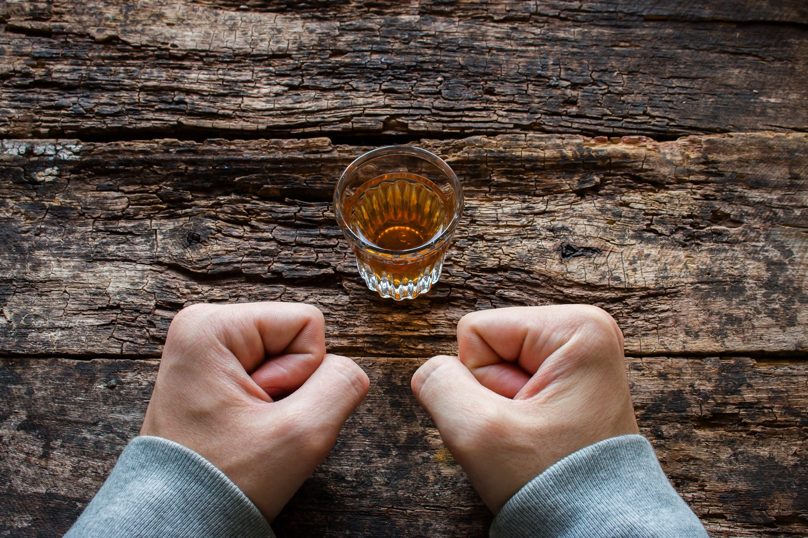
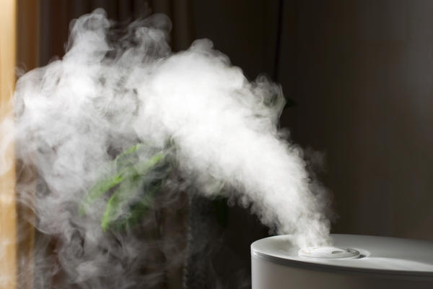
When Troubles Won't Go Away
James 1:2-18
Dr. Rick Griffith, Crossroads International Church Singapore
BibleStudyDownloads.org

Slide 73

El Tablazo - 30 km NW of Bogota, Colombia, South America
10500 feet high
Notes:
El Tablazo looked so close. Too close. It happened so fast.

Slide 74

El Tablazo
Notes:
Exploding into the jagged 5,000-meter peak, the DC-4 disintegrated with a metallic scream. What was left of the Avianca Airline flight bound for Quito, Ecuador, flamed crazily down the mountainside into a deep ravine.

Slide 75
Notes:
One awful moment in night, then the darkness returned. And the silence.

Slide 76
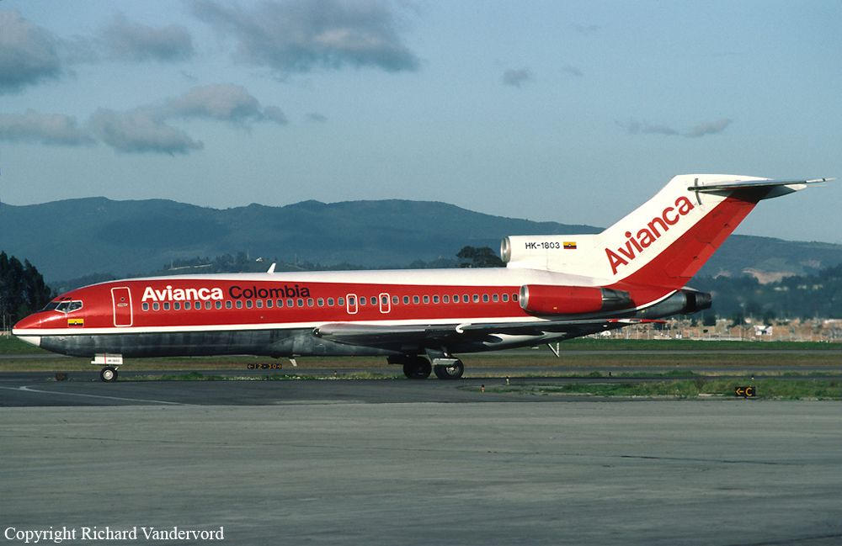
El Tablazo
Notes:
Before leaving the airport earlier that day, a young New Yorker named Glen Chambers needed stationary and had none. But then he found a piece of paper on the floor of the terminal.

Slide 77

El Tablazo
Why?
Notes:
The scrap was part of a white printed advertisement with a single word, “Why?” sprawled across the center.
Since he had no other paper, Chambers scrawled a note to his mother around the word in the middle. Quickly folding this last-minute thought, he stuffed it in an envelope and dropped it a post box.

Slide 78
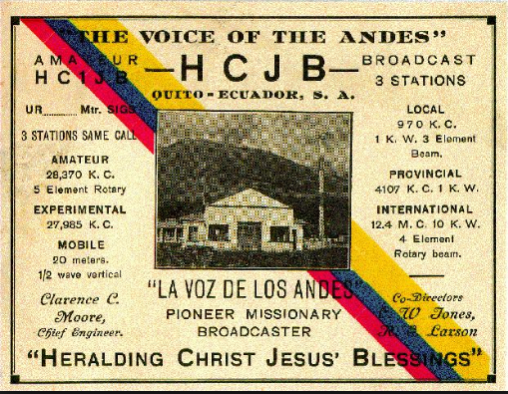
Mr. Glen Chambers
February 15, 1947
From New York
To Ecuador
Notes:
There would be more to come, of course. More about the budding of a lifelong dream to begin a ministry with the Voice of the Andes radio ministry in Ecuador.

Slide 79
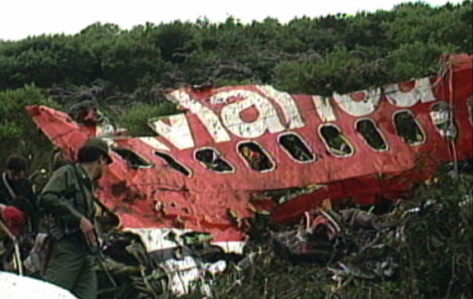
El Tablazo
Notes:
But there was no more to come. Between the mailing and the delivery of Chamber’s note, El Tablazo snagged his flight and his dreams from the night sky. The envelope arrived later than the news of his death.

Slide 80
El Tablazo
Why?
Notes:
When his mother received it, the question burned up at her from the page—why? It’s the question that hits first and lingers longest. Why? Why me? Why now? Why this? Is a young missionary’s death en route to his country just? It doesn’t seem so!
—Charles Swindoll, Living on the Ragged Edge

Slide 81
My Trials.
Your Trials.
Notes:
I haven't been in a plane crash or World Trade Center Disaster or faced ISIS, but difficult times haven't escaped me:
I grew up in a non-Christian family and can identify with many of you who struggle with what your family thinks of you being a Christian. Sometimes my parents prevented me from going to church and my parents ridiculed my faith.
When I decided to become a missionary my home church opposed this decision.
My seminary studies also were plagued with problems—Just in the financial area alone I recall having less than $10 probably 50 times during my studies.
• I wonder if you are going through some tough times yourself.
a) Marriage or family: Last year's family celebrations were strained?
b) Perhaps your problems are financial—you just can't seem to make ends meet.
c) Is there someone with whom your relationship is difficult here at church?
d) Maybe you can relate to job discrimination from being a Christian.

Slide 82
shin ʃɪn/ noun
1. a device for finding furniture in the dark.
Notes:
We all have trials. One definition of a shin: a device for finding furniture in the dark!

Slide 83
Philippians 4:4 NLT
Always be full of joy in the Lord.
I say it again—rejoice!
Notes:
And during difficult times we know as Christians that we should rejoice:

Slide 84

"Blessed are you when people insult you, persecute you and falsely say all kinds of evil against you because of me"
(Matthew 5:11 NIV).
Notes:
The world hates us, have you noticed? Jesus was not just talking about ISIS, who kill Christians. Jesus referred to all who are convicted as they look at your holy life, you being a blessing to others, etc.
It's no secret that Christians are marginalized in just about ever facet of society.

Slide 85

How can you handle trials with joy?
5 ways
Notes:
The question you're probably asking is, “OK, I know I'm supposed to rejoice. But how can I persevere with joy during trials? Do I just grit my teeth and sing, 'Rejoice in the Lord always and again I say rejoice?' You're probably asking, 'When things aren’t going too smoothly in my life, how can I hang in there with a joyful persistence?'" How can you handle trials with joy?
• Text: James 1 is our text to reveal five ways how we can handle trials with joy.
Transition: So let's look at the first thing to remember from James to help us endure with joy. That is to…

Slide 86
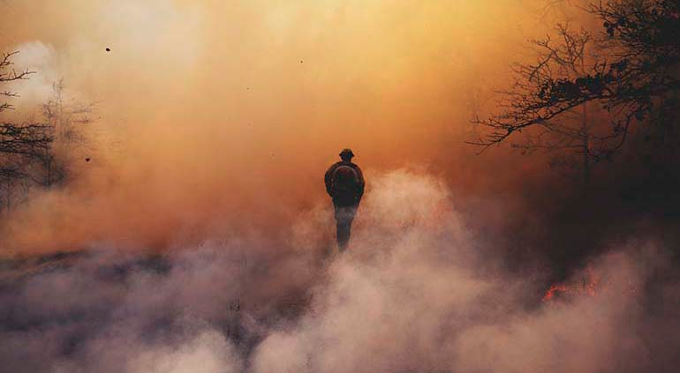
I. Realize that God's purpose is to build Christ in you (James 1:2-4).
Notes:
The end that God has in mind is that you be perfect like Jesus.

Slide 87
Faith accepts trials with joy because it believes that God allows testing to develop perseverance and maturity (2-4).

Slide 88
What is the path from trials to joy?
Testing of Faith
when finished
Trial
Perseverance
Mature
&
Complete
Endure
(JOY)
James 1:2-4

Slide 89
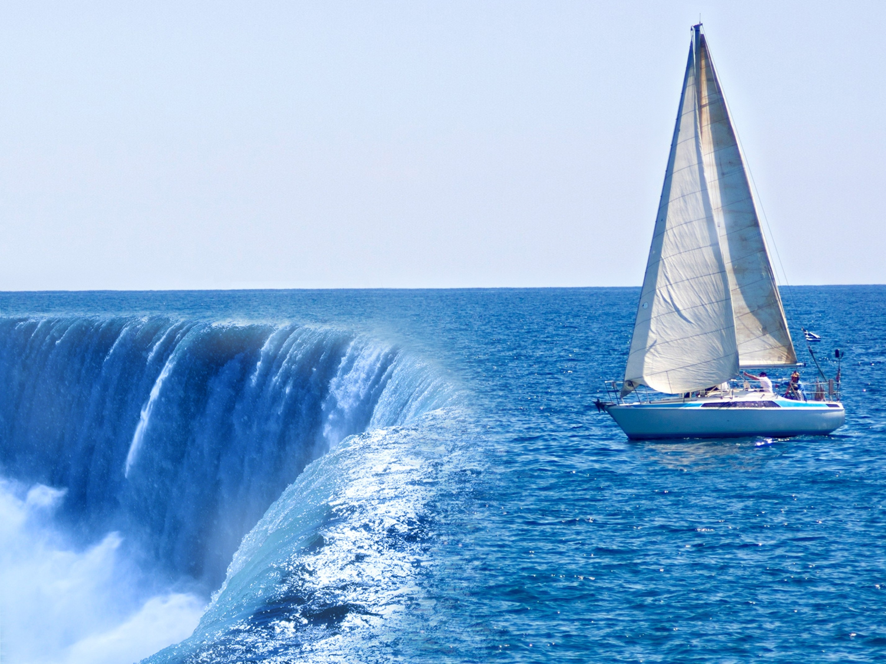
"Dear brothers and sisters, when troubles come your way, consider it an opportunity for great joy"
(James 1:2 NLT).
Notes:
Rejoice because God allows trials to make us strong (2-3).

Slide 90
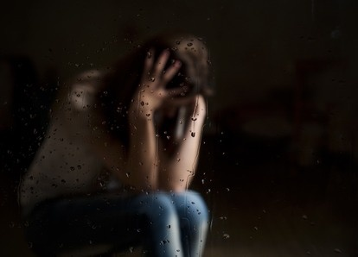
“Consider it all joy,
my brethren,
when you encounter various trials;
knowing that the
testing of your faith produces endurance. And let endurance have its perfect result,
so that you may be perfect and complete, lacking in nothing.”
James 1:2-4

Slide 91
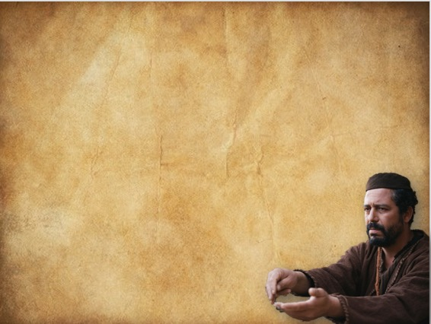
The reality of trials
James 1:2
“. . . when you encounter various trials”
1. Trials (peirasmos)
→ Things external to us
2. Temptations to evil
→ From within (1:13-14)
Definition of suffering (Elizabeth Elliott):
Having what you don’t want
Wanting what you don’t have

Slide 92
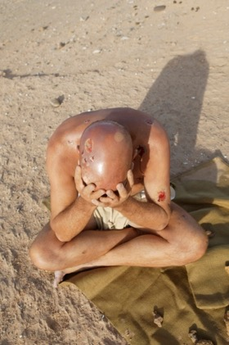
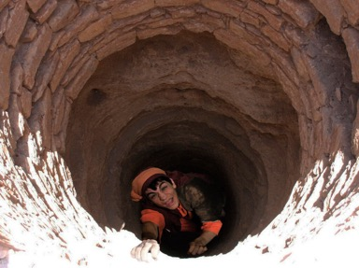
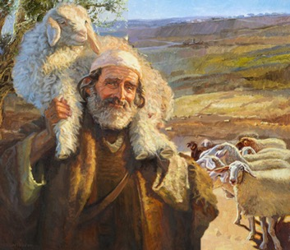
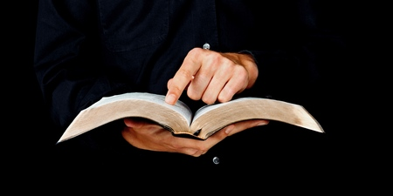
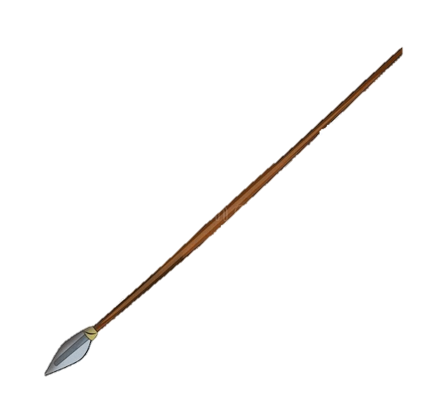
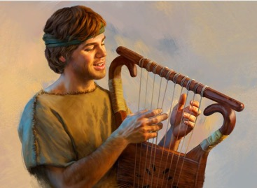
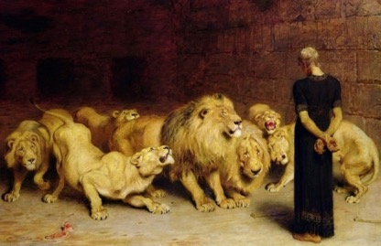
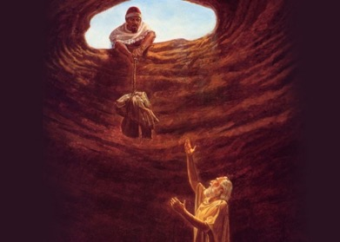
Job
Joseph
Moses
David
Daniel
Matt. 5:10-12
Jeremiah
John 15:20
Acts 14:22
2 Tim. 3:12

Slide 93
Jewish Diaspora at Pentecost
See Acts 2:9-11
Addressed To
"To the twelve tribes scattered among the nations..."
James 1:1
Notes:
The first verse of the book says James was writing Jews spread throughout the Roman Empire. And the heat was turned up on the Jewish church at this time (AD 40s).
Acts 11 notes that there was a famine in Jerusalem.
Acts 12 says Herod killed James (the brother of John) and imprisoned Peter.
Acts 18 says Emperor Claudius expelled all Jews from Rome. He also persecuted Jews throughout the Empire—and that certainly included Jewish Christians.
(What was James’ consolation during all this trouble? Trials develop perseverance…)

Slide 94


The way to think about trials
“Consider it all joy, my brethren”
The people James addresses
✓Brethren = Believers (Mark 3:35)
✓James identifies with them/us 15 times
The proper mindset
✓To “reckon” or “think” it to be so
✓This is a choice: a command to obey
The proper attitude
✓All (pure) joy (the trial itself is not joyous)
✓Joy = settled contentment, regardless of
your circumstances; a fruit of the Spirit

Slide 95

The purpose of our trials
(James 1:3)
You already have some important knowledge
(gained from personal experience)
Trials are meant to test your faith
The testing (dokimion) is meant to prove the genuineness of your faith
The result of this testing works to produce
endurance (steadfastness)

Slide 96


The character-building
results of trials
(James 1:3-4)
All kinds of external trials
Endurance/Steadfastness
Your choice
Maturity . . . lacking nothing
(Christ-likeness)

Slide 97



James 1:2-4
Romans 5:3-4
Trials
Tribulation
Endurance
Perseverance
Maturity
Proven character
Reward
(1:12)
Hope (confidence)
AD 44
AD 57
James and Paul Agree

Slide 98





Slide 99

"For you know that when your faith is tested, your endurance has a chance to grow"
(James 1:3 NLT).
Notes:
“Testing” here is a craftsman term used in reference to gold being refined in the fire. When a craftsman wants to make a piece of gold jewelry, he melts a piece of unformed gold and turns up the heat to get the impurities up to the top. The higher the heat, the more pure and refined the precious metal becomes. Do you know how he knows when it is pure? He knows that it is ready when he can see his face in the liquid gold as if looking in a mirror. In the same way, the scorching heat of trials burns the impurities out of our lives until Christ's image is reflected in us (TRIALS purpose of [refining]).

Slide 100




Job 23:10
“But He knows the way that I take; When He has tested me,
I shall come
forth as gold.”

Slide 101
Job 23:10
“But He knows the way that I take; When He has tested me,
I shall come
forth as gold.”
Pride

Slide 102
Job 23:10
“But He knows the way that I take; When He has tested me,
I shall come
forth as gold.”
Self-Dependence

Slide 103
Job 23:10
“But He knows the way that I take; When He has tested me,
I shall come
forth as gold.”
Impatience

Slide 104



Job 23:10
“But He knows the way that I take; When He has tested me,
I shall come
forth as gold.”
1 Peter 1:6-7

Slide 105

"So let it grow, for when your endurance is fully developed, you will be perfect and complete, needing nothing"
(James 1:4 NLT).
Notes:
Patience handled properly makes a person more like Jesus (4).

Slide 106

"Dear brothers, is your life full of difficulties and temptations? Then be happy, for when the way is rough, your patience has a chance to grow. So let it grow, and don’t try to squirm out of your problems. For when your patience is finally in full bloom, then you will be ready for anything, strong in character, full and complete" (James 1:2-4 TLB).

Slide 107

Which trait?
Notes:
James doesn’t note a specific virtue that perseverance builds in us through trials. So he’s talking about perfect character.

Slide 108

Which trait?
Notes:
But I think God seeks to develop a specific trait in us in each trial. During difficulty I try to consider which particular attribute of Christ that God is seeking to build into me. I ask, “What attribute of Jesus does God want to instill in my life now?”
When I struggle with getting along with a difficult person I conclude that God wants to build into me Christ’s unconditional love.
When I have to forgive someone who’s hurt me, I learn about God’s forgiveness.
In financial difficulty I need to imitate God's contentment despite the fact that everything doesn't go God's way either.
When perplexed about a situation I seek to learn some of God's wisdom.

Slide 109
I. Realize that God's purpose is to build Christ in you (James 1:2-4).
Notes:
So what should you do when you have a tough time persevering with joy during trials? Verses 2-4 say that you need to remember that God’s purpose for trials is to develop Christ’s character in you. Verses 5-8 provide the second pointer in persevering with joy. Remember to…

Slide 110

1) Choose the right attitude toward the trials
God allows to come your way
✓Genesis 45:5,7-8; 50:20
✓Jeremiah 9:23-24
✓2 Corinthians 12:7-10
Principles to apply today

Slide 111


2) Hang on to God’s promises through trials!
✓Isaiah 43:2-3a
✓Rom. 8:18
Suffering
is NEVER for nothing!
✓1 Cor. 10:13
✓2 Cor. 1:4
✓Rom. 8:35
✓1 Pet. 5:14,19
Principles to apply today

Slide 112

II. Pray for wisdom in faith (James 1:5-8).
Notes:
Trust God in prayer during your perplexing times.

Slide 113

"If you need wisdom, ask our generous God, and he will give it to you. He will not rebuke you for asking. ⁶But when you ask him, be sure that your faith is in God alone. Do not waver, for a person with divided loyalty is as unsettled as a wave of the sea that is blown and tossed by the wind. ⁷Such people should not expect to receive anything from the Lord. ⁸Their loyalty is divided between God and the world, and they are unstable in everything they do" (James 1:5-8 NLT).
Notes:
Have you ever wondered why prayer is often our last resort?
We say, “Well, we’ve done all that we can. Now let’s pray.” I wonder whether we’ve really done anything at all until we’ve prayed!
Why pray? Verse 5 says because God loves to answer sincere prayer. This alone should motivate us to make prayer our first priority in perplexing times.

Slide 114



Trials and Suffering can lead to
Maturity
Or…
Bitterness
So how can we “let trials mature us”?

Slide 115

James 1:5-12
Main Idea:
Suffering will mature us if we trust in God’s wisdom through it,
rather than our own!
⁴ And let endurance have its perfect result, so that you may be perfect and complete, lacking in nothing. ⁵ But if any of you lacks wisdom, let him ask of God, who gives to all generously and without reproach, and it will be given to him.

Slide 116

Wisdom in Trials
What is wisdom?
How do we get wisdom?
What does wisdom look like in action?

Slide 117
How do we get Wisdom?
⁵ But if any of you lacks wisdom, let him ask of God, who gives to all generously and without reproach, and it will be given to him. ⁶ But he must ask in faith without any doubting, for the one who doubts is like the surf of the sea, driven and tossed by the wind. ⁷ For that person ought not to expect that he will receive anything from the Lord, ⁸ being a double-minded man, unstable in all his ways.
1. Acknowledge that you need wisdom…

Slide 118
Acknowledge that you need Wisdom
⁵ And if, as is the case, anyone of you is deficient in wisdom, let him keep on presenting his request in the presence of the giving God who gives to all with simplicity and without reserve, and who does not reproach, and it shall be given him.
Wuest Translation

Slide 119
Acknowledge that you need Wisdom
⁵ Trust in the Lord with all your heart
And do not lean on your own understanding.
⁶ In all your ways acknowledge Him,
And He will make your paths straight.
⁷ Do not be wise in your own eyes…
Proverbs 3:5-7
Notes:
I am foolish and don’t understand. God is wise and understands everything!

Slide 120
How do we get Wisdom?
⁵ And if, as is the case, anyone of you is deficient in wisdom, let him keep on presenting his request in the presence of the giving God who gives to all with simplicity and without reserve, and who does not reproach, and it shall be given him.
Wuest Translation
2. Ask (and keep asking) for wisdom…

Slide 121
How do we get Wisdom?
⁵ But if any of you lacks wisdom, let him ask of God, who gives to all generously and without reproach, and it will be given to him.

Slide 122
How do we get Wisdom?
“Ask, and it will be given to you; seek, and you will find; knock, and it will be opened to you… If you then, who are evil, know how to give good gifts to your children, how much more will your Father who is in heaven give good things to those who ask him!” Matthew 7:7,11

Slide 123
So how do we ask for this Wisdom?
⁵ But if any of you lacks wisdom, let him ask of God, who gives to all generously and without reproach, and it will be given to him. ⁶ But he must ask in faith without any doubting, for the one who doubts is like the surf of the sea, driven and tossed by the wind. ⁷ For that person ought not to expect that he will receive anything from the Lord, ⁸ being a double-minded man, unstable in all his ways.
3. Ask in faith…
Notes:
I am foolish and don’t understand. God is wise and understands everything!

Slide 124
Asking in Faith
Faith in the wisdom and character of God:
Faith in God’s willingness to give wisdom!
Faith in God’s way of dealing with my suffering – He knows what he’s doing!
Faith in God’s motives in dealing with my suffering – He cares deeply about me!
Notes:
I am foolish and don’t understand. God is wise and understands everything!

Slide 125
So how do we ask for this Wisdom?
⁵ But if any of you lacks wisdom, let him ask of God, who gives to all generously and without reproach, and it will be given to him. ⁶ But he must ask in faith without any doubting, for the one who doubts is like the surf of the sea, driven and tossed by the wind. ⁷ For that person ought not to expect that he will receive anything from the Lord, ⁸ being a double-minded man, unstable in all his ways.
4. Ask without doubting…
Notes:
I am foolish and don’t understand. God is wise and understands everything!

Slide 126
So how do we ask for this Wisdom?
⁵ But if any of you lacks wisdom, let him ask of God, who gives to all generously and without reproach, and it will be given to him. ⁶ But he must ask in faith without any doubting, for the one who doubts is like the surf of the sea, driven and tossed by the wind. ⁷ For that person ought not to expect that he will receive anything from the Lord, ⁸ being a double-minded man, unstable in all his ways.
Who is the doubter?

Slide 127
Who is the Doubter?
Double-Minded – This person…
Is “two-souled” – Has their mind or soul divided between God and the world
Is chasing happiness and fulfillment in this life
Doubts that God knows best
Faith and doubt are connected with loyalty!

Slide 128
Doubt vs. Faith
The doubter is someone of divided loyalty – not someone honestly struggling to believe in God’s goodness.
The person of faith remains loyal to God – continuing to believe in his goodness, wisdom and love no matter what!

Slide 129
A Sample “Wisdom Prayer”
God, I
Acknowledge my need for wisdom in this trial
Trust that you know what you’re doing
Ask for wisdom to know you in this trial and to see it as you see it
I will remain loyal to you – to believe in your goodness, infinite wisdom and love, no matter how dark things get!
Endurance: the ability to endure an unpleasant or difficult process or situation without giving way
Perseverance: persistence in doing something despite difficulty or delay in achieving success
Steadfast: resolutely or dutifully firm and unwavering

Slide 130


The Gaze-Glance Principle
Seeking God's Hand
God
Elton & Shirley Gillam, The Restoration of Biblical Prayer (Greely, CO: Chambers College Press, 2009), 33
Glance
Our Request
Gaze
Notes:
What should we pray for? Wisdom—that means seeing situations from God’s viewpoint. The “gaze-glance” principle is helpful here. Follow the Gaze-Glance Principle. This is a simple, biblical way of looking up.
When a struggle comes into our lives, we normally gaze at this request with occasional, quick glances to God for his help. We ask him to remove the problem because we are only seeking His hand. We're only seeking what He can give us.

Slide 131

The Gaze-Glance Principle
Seeking God's Face
God
Elton & Shirley Gillam, The Restoration of Biblical Prayer (Greely, CO: Chambers College Press, 2009), 33
Gaze
Our Request
Glance
Notes:
But God tells us to shift our focus. We should gaze at God and only glance at our request. This is seeking His face instead of seeking His hand. When and if He removes the problem becomes His business, so we don't end up resenting Him.
Where has your focus been concerning the issue that concerns you?
• Have you been gazing at God or gazing at your problem?
• Have you been seeking God's face or seeking God's hand?

Slide 132
I. Realize that God's purpose is to build Christ in you (James 1:2-4).
Notes:
So far, we’ve seen James exhorting us to joy in trial through “two Ps”: seeing their purpose…

Slide 133
II. Pray for wisdom in faith (James 1:5-8).
Notes:
and making sure we pray. A third way to persevere with joy during trials is noted in verses 9-11…

Slide 134

III. See your financial position as irrelevant (James 1:9-11).
Notes:
Perseverance in difficulty is easier when we see God’s view of our social status.

Slide 135

"Believers who are poor have something to boast about, for God has honored them" (James 1:9 NLT).

Slide 136

"And those who are rich should boast that God has humbled them. They will fade away like a little flower in the field. ¹¹The hot sun rises and the grass withers; the little flower droops and falls, and its beauty fades away. In the same way, the rich will fade away with all of their achievements"
(James 1:10-11 NLT).

Slide 137


God honors poor Christians.
Notes:
Did you know that God honors poor Christians more than He does rich Christians? That’s what these verses say! Think of the implications of this truth…

Slide 138


VIP
Notes:
It means the world has got the whole thing turned around.
The highest form of greeting now is gong ztai fa chai: “May money come your way!” You would think that money is the most important thing in life!
• Money and position go together. We have the wrong idea that certain positions make people important. We say, “He or she is a very important person!”

Slide 139


Commander
Reports to
Lieutenant Commander
Notes:
But what does God think of VIP buttons? A man once wrote an account about his father, who was a high-ranking commander in the US Navy. "My Father, a US Navy commander, was shopping in the [Navy grocery store] and overheard a man mutter, 'Here I am, a lieutenant commander in the US Navy, and I'm grocery shopping with my wife.'
• Dad pulled alongside the couple's cart, 'With further training and your next promotion,' he piped up, 'she might send you out on your own'" (PRIDE over position). God is like that—when we think we are big stuff, He lets us know that He isn't impressed by our position.

Slide 140

Have we adopted God's values?
Notes:
Sad to say, the church (like the world) hasn’t adopted God’s value system either:
Why aren’t there maids serving in the church alongside with professionals?
Why do we fill the highest positions in the church with wealthy people?
Chapter 2 will soon address these kinds of questions.

Slide 141

Our social position during trials will either elevate or lower us before others and God.
Notes:
(So how does all this relate to trials?)
B. Our social position during trials will either elevate or lower us before others and God.
1. When a poor person undergoes persecution for Christ, this makes him highly esteemed by God! This more than offsets the poverty.
2. However, if you are rich, watch out!
a) The rich have a low position because of the humbling experience of suffering persecution for Christ’s sake.
b) Suffering shows us life is short. See your low position before God and humble yourself. If you don’t humble yourself then God will have to humble you!
3. The passage also says that wealth is meaningless in the face of death—which we all know. But when are we going to realize that it can’t make us happy while alive either? Have you ever noticed any correlation between money and happiness? Even Rockefeller said, “Millionaires seldom smile.”

Slide 142
I. Realize that God's purpose is to build Christ in you (James 1:2-4).
Notes:
How can I persevere with joy during trials? Remember that they have a wonderful purpose…

Slide 143
II. Pray for wisdom in faith (James 1:5-8).
Notes:
Remember to pray…

Slide 144
III. See your financial position as irrelevant (James 1:9-11).
Notes:
…remember your position, and also…

Slide 145

IV. Remember that God promises reward (James 1:12).
Notes:
Knowing that heavenly blessings await those who handle trials well helps us endure now.

Slide 146

"God blesses those who patiently endure testing and temptation. Afterward they will receive the crown of life that God has promised to those who love him"
(James 1:12 NLT).
Notes:
So what’s this “crown of life” that's given to believers who successfully stand the tests?
The word for crown here can refer to different types of crowns.

Slide 147

The Biblical Wreath
Notes:
However, the word is most often used of a perishable wreath given to victorious athletes, so I think James is referring to a heavenly reward for the believer who’s successful in his struggle against trials.

Slide 148

Imitate OT saints that persevered (Hebrews 11:4-40).
Notes:
Mimic OT heroes who endured despite not seeing God fulfill his promises.

Slide 149

Martin Luther King Jr.
“If what you’re living for isn’t worth dying for, then it isn’t worth living for.”
Notes:
What are you living for? If it's Christ, then there is a great reward which is worth enduring pain in this life.

Slide 150
I. Realize that God's purpose is to build Christ in you (James 1:2-4).
Notes:
So how can we persevere with joy during trials? Remember that they have a wonderful purpose…

Slide 151
II. Pray for wisdom in faith (James 1:5-8).
Notes:
Remember to pray…

Slide 152
III. See your financial position as irrelevant (James 1:9-11).
Notes:
Remember your position…

Slide 153
IV. Remember that God promises reward (James 1:12).
Notes:
Remember that he will bless your efforts for him…and finally…

Slide 154

V. Praise God for His gifts since temptations come from us
—not Him (James 1:13-18).
Notes:
Thank God that he doesn't try to trip us up because failure is our fault.

Slide 155

"And remember, when you are being tempted, do not say, 'God is tempting me.' God is never tempted to do wrong, and he never tempts anyone else. ¹⁴Temptation comes from our own desires, which entice us and drag us away. ¹⁵These desires give birth to sinful actions. And when sin is allowed to grow, it gives birth to death"
(James 1:13-15 NLT).
Notes:
One interesting thing that appears in the Greek text here is that the noun translated "trials" in verses 2 and 12 is in verb form in verse 13 where it's translated "tempted." In other words, the sharp distinction we make between trials (being from God) and temptations (being from Satan) is not biblically justified.

Slide 156

“We don't experience our reality. We experience our perspective of reality.”
—Steven Furtick—
Notes:
I find it interesting that often two people can be in the same challenging situation but have completely different responses. To one it is a temptation that Satan uses for him or her to fail but to the other it is a trial that God uses to succeed.
So what makes the difference whether your difficulty will be a trial that benefits you or a temptation that hurts you? It's not God and it's not Satan—it's you!
You can allow the difficulty to draw you away into sin in the downward process noted in verses 14-15.
Or that difficulty can draw you toward God in the upward process in verses 2-4.

Slide 157

“In light of heaven, the worst suffering on earth will be seen to be no more serious than one night in an inconvenient hotel.”
Saint Teresa of Avila

Slide 158

"So don’t be misled, my dear brothers and sisters. ¹⁷Whatever is good and perfect comes down to us from God our Father, who created all the lights in the heavens. He never changes or casts a shifting shadow"
(James 1:16-17 NLT).
Notes:
But how can we make that happen? It starts with our view of God noted in verses 16-18.
Accept trials without blaming God because God gives only good gifts (16-18).
What a wonderful thing to realize that God gives only good gifts—never junk! Every single thing He allows into your life can be used to strengthen and help you.
He's not changing His mind like shadows constantly change during the day as the sun moves across the sky. He knows what He wants to do in each of our lives.

Slide 159

"He chose to give birth to us by giving us his true word. And we, out of all creation, became his prized possession"
(James 1:18 NLT).
Notes:
And verse 18 reminds us that one wonderful way that He's provided stability to us is through His Word. This is in the following verses that I encourage you to study, but today’s text says to thank God for the blessing of having truth in this age of lies.

Slide 160
How can you handle trials with joy?
Notes:
So how can we summarize this whole passage up? How can you handle trials with joy?

Slide 161

Main Idea of James 1:2-18
Greet trials with joy
by trusting God
—not circumstances
Notes:
[We can respond to trials with joy only when we respond to them in faith].
[Genuine faith joyfully accepts whatever God sends our way.].

Slide 162
How can you handle trials with joy?
5 ways
Notes:
James has given us five tips on persevering in trials with joy.

Slide 163

Five "Ps" to Handle Trials
      Realize that God's purpose is to build Christ in you (2-4).
      Pray for wisdom in faith (5-8).
      See your financial position as irrelevant (9-11).
      Remember that God promises reward (12).
      Praise God for His gifts (13-18).

Slide 164

Let suffering mature you!

Slide 165

Say, "Yes!"
Notes:
Let’s bow together. Allow me to ask a few questions:
What trial are you now enduring? Will you thank God for this by faith now?
What character trait does God want to build in you in this trial? Is He succeeding?
Which do you really want more—smooth sailing or being like Jesus?
Which do you really want more—physical comforts or spiritual growth?
Which do you really want more—wealth or godliness?

Slide 166

The Fire
Christine Wyrtzen
CCLI Song #323573
© 1980 New Spring (Admin. by Brentwood-Benson Music Pub., Inc.)
CIC CCLI Licence # 277507
Notes:
https://www.youtube.com/watch?v=BoHxlwAZ0_Y

Slide 167
I've been through a fire that has deepened my desire
to know the living God more and more.
It hasn't been much fun
but the work that it has done
in my life has made it worth the hurt.

Slide 168
You see,
sometimes we need the hard times
to bring us to our knees.
Otherwise, we do as we please
and never heed him.

Slide 169
But He always knows what's best
And it's when we are distressed
that we really come
to know God as He is.

Slide 170
You see,
sometimes we need the hard times
to bring us to our knees.
Otherwise, we do as we please
and never heed him.

Slide 171
But He always knows what's best
And it's when we are distressed
that we really come
to know God as He is,
as He is.

Slide 172
What is the path from trials to joy?
Mature
&
Complete
Testing of Faith
when finished
Trial
Perseverance
Endure
(JOY)
James 1:2-4

Slide 173

avoiding
the blame game
James 1:13-18
Dr. David Martin • Amman International Church
AmmanChurch.org • BibleStudyDownloads.org

Slide 174



2500 BC
AD 500
2000 BC

Slide 175



The Blame Game
Genesis 3:1-13
Our excuses:
Heritage
Environment
Passions
Satan
God
Ultimately:
You are to blame!

Slide 176


Understanding
Trials vs. temptations
Peirasmos: Two sides of the same coin
trial
External difficulties/suffering. God uses them to:
✓Prove your faith is genuine
✓Build steadfastness
✓Develop spiritual maturity

Slide 177

Understanding
Trials vs. temptations
Peirasmos: Two sides of the same coin
temptation
Inner solicitations to sin. Satan wants to:
✓Turn your trials into temptations
✓Entice you to sin so he can destroy you
✓Deceive you into blaming God/others

Slide 178

Understanding the source
of temptations
Prov.
19:3
James 1:13-14
Temptations are not from God (“stop saying!”)
1. God cannot be tempted (to sin)
Heb. 4:15
→ Tempted, yet without sin
1 Sam. 2:2
→ None holy as the Lord
2. God can never tempt anyone to sin
✓He allows trials to build maturity
✓God always provides a way out without
sinning (1 Cor. 10:13)

Slide 179

Temptations to sin
come from within
You are being tempted by your own “lusts”
Epithumia = intense passions, longings, desires
✓Good sense (Phil. 1:23)
✓Bad sense (Mark 7:21-23)
A result of man’s depravity; sinful nature
(Jer. 17:9; Gal. 5:17)
Psalm 51:5
Each has unique vulnerabilities
Your inner lusts are powerful
1) They drag you into temptation
2) They entice/entrap you to sin
(focus on pleasures; not consequences)

Slide 180





Slide 181
Temptations to sin
come from within
You are being tempted by your own “lusts”
Epithumia = intense passions, longings, desires
✓Good sense (Phil. 1:23)
✓Bad sense (Mark 7:21-23)
A result of man’s depravity; sinful nature
(Jer. 17:9; Gal. 5:17)
Psalm 51:5
Each has unique vulnerabilities
Your inner lusts are powerful
Sinful habits become strongholds
1) They drag you into temptation
2) They entice/entrap you to sin
(focus on pleasures; not consequences)

Slide 182













Understanding
the temptation spiral
Lust +
Temptation = Sin
Lusts
Temptation
Sin
Psalm 51:5
Satan
learns your weaknesses
Defeat Destruction Death
Learn to stop the cycle!

Slide 183

Do not be deceived. . .brethren
James 1:16-18
All good gifts are from heaven
✓From the Father of lights
✓God’s character never changes (Mal. 3:6)
His greatest gift to you: A new birth
✓He chose you (Eph. 1:4)
✓The “Gospel” is the means (Rom. 1:16)
✓You are His “first fruits” (1 Cor. 16:15)

Slide 184




Principles to apply today
Don’t play the “blame game”! Be conscious of your own depravity and sinful choices.
James 1:14
1 Cor. 10:10-12

Slide 185

Principles to apply today
Break the temptation spiral!
Lusts
Temptation
Sin
Defeat Destruction Death

Slide 186
Principles to apply today
Break the temptation spiral!
Lusts
Pray
(James 1:5; Matt. 6:13)
Avoid sources of temptation
(James 4:4; 1 Thess. 5:22)
Temptation
Study, obey, memorize scripture
(James 1:22; Psalm 119:9,11;
Rom. 12:2)
Sin
Confess and repent
(James 4:8)
Defeat Destruction Death

Slide 187
Ways Faith is Seen
267
Faith is Revealed through Works Because Faith… | Text | Text | Text | Text | Text | Text
Rejoices in Trials | Obeys the Word | Avoids Favoritism | Produces Works | Speaks Wisely | Produces Humility | Ultimately Triumphs
1:1-18 | 1:19-27 | 2:1-13 | 2:14-26 | 3 | 4:1–5:6 | 5:7-20
Salutation Trials Temptations | Listening Anger Obedience Speech Compassion Purity | Discrimination Materialism Egalitarianism | Meeting Needs Validation | Influence Untamable Be Wise | Conflict Judging Presumption | Suffering Prayer Confrontation
Jerusalem | Text | Text | Text | Text | Text | Text
AD 44-47 | Text | Text | Text | Text | Text | Text
James
Notes:
James is NOT an evangelistic book to lead unbelievers to Christ, Rather, James wrote to "believers in our Lord Jesus Christ" (1:2, 16, 19; 2:1, 5, 14; 3:1, 10, 12; 4:11; 5:7, 9, 10, 12, 19).
His goal was to help them see how others can see their faith by looking at their works.
_______
NS-20-James-10, 55, 57, 73, 76, 98, 117, 133, 154, 186, 192, 203

Slide 188

The Danger of Listening to Sermons
James 1:19-27
Dr. Rick Griffith • Amman International Church
AmmanChurch.org • BibleStudyDownloads.org
Notes:
"One of the hazards of being a Christian is that you have to listen to a number of sermons" (Haddon Robinson).

Slide 189

Annual Exposure to Scripture
Church services 50
Bible studies 50
Daily devotions 365
Podcasts & Misc 35
Annual Total 500
x Years Christian 50
Lifetime Total 25,000
Notes:
• Think of it. Most of us hear more than 50 sermons a year from the pulpit alone.
• Add to that 50 Bible studies annually if you're in a weekly small group
• And 365 more looks at the Word if you have daily devotions.
• That's nearly 500 exposures to God's Word a year!
• And for people like me—I've been a Christian 50 years—that's over
• 25,000 times I've confronted the Word—or the Word has confronted me.
Isn't that wonderful? Yes—and no.
Yes, it's great to have so many times to see God's view of life.
But when you realize that, although you hear God's Word 500 times a year but don't respond to it actively 500 times, this gets serious.

Slide 190
The Danger of Listening to Sermons
James 1:19-27
Notes:
This is why I called this sermon “The Danger of Listening to Sermons.”

Slide 191

Does the Bible really impact your life?
Notes:
Do you feel that the Bible really impacts your life? Or do you hear it and then go away unchanged?
How many times do you come away from a sermon saying, "Now here's an area of my life that is going to change or else!"?
How often do you ask your friend, "I know God says I should do this, but I need your help in doing it"?
Does God's Word really change your life?

Slide 192

How can you let God's Word take root in you?
Notes:
The issue we're addressing today is, "How can you let God's Word take root in you? What can you do to respond properly to the Word of God?"

Slide 193
The Title
EPISTLE OF
JAMES
BOND
servant
Of Christ Jesus
Notes:
Today we continue our study of BOND—James BOND-servant of Jesus Christ. James wrote to people who had heard the Bible a lot—but it had too little effect on them.
________
NS-20-James1-2—slides 57, 191

Slide 194
Jewish Diaspora at Pentecost
See Acts 2:9-11
Addressed To
"To the twelve tribes scattered among the nations..."
James 1:1
Notes:
He addressed Jews who had heard the OT all their lives from their earliest days.
Jews then memorized the Torah and knew it far better than we do today.

Slide 195

The readers of this letter by James knew the Word.
Notes:
Besides this, the readers had also accepted Christ as Messiah and were blessed with new truth that eventually was put into our New Testament.

Slide 196

But they had not made their faith practical.
Notes:
But they were not putting all this biblical knowledge in practice very much, so he wrote this letter to tell them to make their faith practical in good deeds.

Slide 197

Listen to the Word
"He chose to give us birth through the word of truth, that we might be a kind of firstfruits of all he created"
(James 1:18 NIV).
Notes:
James 1 hints that these Jewish believers had not been responding well to the trials they faced —probably persecution from unbelieving Jews in Jerusalem. He ended the previous section with mention of the "word of truth" in verse 18—the Bible.

Slide 198
How can you let God's Word take root in you?
3 ways…
Notes:
With that thought in mind, James now turns to answer, “How can you let God's Word take root in you?” What three ways can we respond properly to the Word of God? First…

Slide 199

I. Prepare to accept what the Bible says (1:19-21).
How can you let God's Word take root in you?
Notes:
Be receptive to biblical truth—be attentive to Scripture.

Slide 200

"Understand this, my dear brothers and sisters: You must all be quick to listen, slow to speak, and slow to get angry" (James 1:19 NLT).
Notes:
Listen before you speak (19a-b).

Slide 201

Be quick to listen…
..and slow to speak
Notes:
There is a correlation between these—if you are quick to speak, you aren't listening. And if you are quick to listen, your speech will slow down.

Slide 202

Daily words
30,000
25,000

Slide 203

How can we listen rather than speak?

Slide 204

11 Simple, Profound Ways to Be
Slow to Speak and Quick to Hear
1: Let others express themselves
7: Try to understand what the other is saying
2: Thank the person for being willing to talk
8: Even if you disagree, learn by listening
3: Don't take offense when s/he disagrees
9: Remember that you have blind spots
4: Hear the content—not way of expression
10: Share your thoughts gently without anger
5: Be slow to defend your opinion/make excuses
11: Trust in God's timing
6: Try to be humble
Notes:
https://theblazingcenter.com/2017/09/mean-quick-hear-slow-speak.html
Accessed 1 March 2022
11 Simple, Profound Ways To Be Slow To Speak and Quick To Hear
September 19, 2017 by Mark Altrogge
Facebook419 Twitter Email
Know this, my beloved brothers: let every person be quick to [listen] hear, slow to speak, slow to anger (James 1:19).
Don’t you just hate it when people disagree with you?
When someone tells you that you’re wrong about something?
Don’t you hate the feeling when someone says, “Would you mind if I share something with you?” Or when your wife says, “Can we talk about…?” Or someone just blurts out, “I’m sorry I just don’t see it that way.”
Why is it that in this fallen world, everyone can’t see that I’m always right?
What Does It Mean To Be Slow To Speak?
So what does it mean to be quick to hear and slow to speak?
Here’s a concise definition:
To be quick to hear and slow to speak means having both humility and respect for others. It means you take the necessary time to listen to people instead of just speaking your opinion.
Knowing When To Be Slow To Speak
James 1:19 can help us be slow to speak to many situations:
A fellow believer confronting you or disagreeing on a point of doctrine, or expressing an opinion on how to educate children, or any number of issues.
This verse addresses conflicts of every kind: marital conflicts, conflicts at work, church conflicts.
It applies to conflicts with unbelievers as well.
It speaks to those times when someone shares with us a struggle they’re having and a quick and easy solution pops into our head. We want to stop them mid-sentence and say, “Wait! No need to keep on detailing your struggle. Just trust God! There you go! End of discussion.”
Have you ever noticed how, in almost every situation, when we quickly speak whatever is on our minds, it doesn’t go well?
It simply doesn’t help people.
Have you ever solved a problem in your marriage by being the dominant voice?
Has it ever been effective when you immediately fire back when your someone corrects you?
What about in a meeting at work? Does it make people more productive when you shoot down all their ideas?
There is beauty and power in being slow to speak. It transforms relationships and allows us to hear the Holy Spirit speak to us before we speak to others. In other words, when we wait to respond to someone, it gives the Spirit time to prompt us on what to say.
11 Ways To Be Slow To Speak
#1 – To be slow to speak means we let the other person express themselves
We don’t interrupt. We hold our thoughts and give them time to finish. It means we try to be slow to share our opinion or thoughts on a matter and wait until the other person has had plenty of time to share their thoughts.
Frankly, this should be common sense. If we’re going to truly understand a person and honor them properly, we should always let a person fully express themselves. When we don’t, we can’t even respond properly.
#2 – We thank the other person for being willing to talk with us.
Some people find it very hard to disagree with, contradict or share a different perspective with others. Sometimes this is due to their personality. Or they have had bad experiences with spiritual abuse. Or maybe they’re simply shy by nature.
Over the years many people told me they were fearful of talking to me because I was a pastor. So I wanted to try to do all I could to make it easy for people to bring things to me, even if it was something I need to be addressed on.
#3 – Quick to listen and slow to speak means we are not offended when someone disagrees with us or corrects us
This one can be really hard when it comes to being quick to listen and slow to speak. It is so easy to take things personally. Our internal personal defense lawyer immediately yells, “Objection!” the moment someone disagrees. Most of the time this is simply due to our pride.
We need to be able to “step back” and remember that disagreement or correction isn’t necessarily an attack on us as a person. This is not someone being disloyal to us.
#4 – We don’t focus on HOW the person expresses themselves, and make that an excuse for not listening
It’s so easy, when someone comes to us in anger or frustration, to write them off because of their delivery and not listen to what they have to say. At times like this, we really need to pray for the fruit of the Spirit – for patience, love, and grace not to respond in kind.
We need the help of the Holy Spirit to be slow to speak and quick to listen.
#5 – To be quick to listen means we are slow to make excuses, slow to defend ourselves, slow to contradict, slow to give our opinion
We want to defend ourselves because we’re proud. We don’t like to think we have weaknesses. And we really don’t like it when others see our weaknesses.
But listen. Don’t say anything. You’re never going to improve in your life if you can’t admit you have needs to grow and improve and see things you may not have seen yet.
#6 – To be quick to listen means we try to be humble
A humble person doesn’t think he knows or sees every issue perfectly. A humble person can learn from anyone.
If we’re humble, we understand that God has given every person unique gifts and insights that we don’t have. Like us, they too are a temple of the Holy Spirit, being led and guided by God himself. In order to grow in our relationship with God, we need to benefit from those gifts and insights.
#7 – To be quick to listen means we genuinely want to try to understand what the other person is saying
This means we really want to try to see the issue from their perspective. Only God has the perfect perspective on all issues.
Only God understands every issue completely. Only He knows the motives of men’s hearts. Only God understands his Word absolutely perfectly.
Our perspective may be right but it could also be wrong or imperfect. We consider that we may really need to hear the other person. That they may be right, even if we can’t see it right now.
#8 – We realize that even if we disagree there are things we can learn by listening to them
Even if we only learn that others see the issue differently than we do. Even if we learn how someone else struggles with an issue that we don’t struggle with. Even if we learn how we might help someone.
When we’re slow to speak, it allows us to understand other people more effectively. To gain a fuller knowledge of what it means to be a Christian.
#9 – To be quick to listen means we remember that we have blind spots
We all have things we are blind to, areas we need to grow in, things we don’t realize about ourselves. Remember how David asked God to send brothers to rebuke him? David considered that a blessing.
Let a righteous man strike me—it is a kindness; let him rebuke me—it is oil for my head; let my head not refuse it. Psalm 141:5
#10 – When we share our thoughts, we share them with gentleness and without anger
For some reason, we tend to think that if we speak forcefully or with anger, they’ll come around to our perspective. We forget that James says that anger does not bring about the life God requires.
However, when we believe that only God can open their eyes to see your perspective, it allows us to speak with gentleness. If God really wants someone to see something he can make it happen.
#11 – To be quick to listen means we trust God’s timing
We don’t have to win the argument now. We can share our perspective, then leave it up to the Lord to show them our side. That might not be during the current discussion. We both may need time to consider each other’s perspective.
Less Wrangling, More Listening
William Gurnall helpfully said:
It’s not easy to be quick to hear and slow to speak. But the Lord can help us! Now get out there and listen! And please don’t disagree with, confront or correct me.
Read Next:
How To Understand The Bible: 21 Simple Methods To Help You Read More Effectively
In-Depth Guide: How To Choose The Best Study Bible
16 Powerful Prayers For Children That God Loves To Answer
What Exactly Is Calvinism (and Why I’m Not A Jerk)
Categories Uncategorized Post navigation 14 Ways To Experience The Peace Of God In Stressful Times
What Is Communion? How Do We Get More from it?
Mark Altrogge
I’m a pastor at Saving Grace Church in Indiana, PA. I’m married to Kristi, have 5 kids, and a growing number of grandkids. I enjoy songwriting, oil painting and coffee, not necessarily in that order.
...
© 2022 The Blazing Center • Site by Grace at Work
Exclusive Member of Mediavine Home

Slide 205
Listen to the Word
"He chose to give us birth through the word of truth, that we might be a kind of firstfruits of all he created"
(James 1:18 NIV).
Notes:
Yet the command here is related to listening to God. Few would read this letter by James as none had their own copy of it—so the listening more likely refers to listening carefully to the word of truth in the context. But are you quick to listen or read God’s Word?

Slide 206
Be quick to listen
Be slow to speak
Be slow to become angry
Notes:
We are also told to get rid of anger (19c-20).

Slide 207

"Human anger does not produce the righteousness God desires"
(James 1:20 NLT).

Slide 208

What is anger?
—an emotional response that stems from seeing someone's rights violated
Notes:
What's anger?
• The best definition I've heard is that anger is an emotional response that stems from seeing someone's rights violated.
When our own rights are violated and we react, this is negative anger—like when somebody says something about us that violates our right to privacy.

Slide 209


Matthew 21:12-17
Mark 11:15-19
Luke 19:45-48
John 2:13-24
THE EASTER STORY
CLEANSING THE TEMPLE
Free
Bible
images
Notes:
But when God's rights are not upheld and we are hurt by it, this is positive anger—like when Jesus was angry at God's right to be worshipped without people ripping off others in the temple courts.

Slide 210

Results of Sinful Anger
Notes:
The point here, though, is that repressed anger hinders us from obeying Scripture.
My brother-in-law Mike once wanted to marry his first sweetheart, but tragic circumstances prevented it. So he married my sister instead. But after 16 years of marriage to my sister, his first love re-entered his life and his anger that he never got to marry her resurfaced.
He was so bitter that he divorced my sister, despite the fact that he knew this is contrary to God's Word. His pent-up anger is a major obstacle to obeying the Bible. Are you angry and hindering the Word from changing you?
(But it's not just anger that prevents us from a righteous life and having God's Word reside in us. Verse 21 says you also should…)

Slide 211
"So get rid of all the filth and evil in your lives, and humbly accept the word God has planted in your hearts, for it has the power to save your souls"
(James 1:21 NLT).
Notes:
Get rid of anything else that prevents God's Word from taking root in you (21).
The word for " filth" here means "dirt" but ethically means "moral uncleanness" or "vulgarity" (BAGD 738a). The "evil that is so prevalent" is also a general description for any sin. Essentially, James means to get rid of anything unclean in your life.
Then you're empty? No, replace it with the Word of God.
One way to replace sin with Scripture is to confess your sin and then quote a verse that relates to that sin.

Slide 212

"I made a covenant with my eyes not to look with lust at a young woman."
Job 31:1 NLT
Notes:
For men, when you lust, confess this to God then quote Job 31:1—"I made a covenant with my eyes not to look with lust at a young woman."

Slide 213

Jealousy
"Anger is cruel and fury overwhelming, but who can stand before jealousy?"
—Proverbs 27:4—
Notes:
For you ladies who struggle with jealousy, confess it and quote Proverbs 27:4—"Anger is cruel and fury overwhelming, but who can stand before jealousy?"

Slide 214
How can you let God's Word take root in you?
Notes:
So to respond properly to the Word, first…

Slide 215
I. Prepare to accept what the Bible says (1:19-21).
How can you let God's Word take root in you?
Notes:
Be receptive to biblical truth—be attentive to Scripture.
Prepare yourself to accept it. This comes by listening, getting rid of anger, and getting rid of anything else that prevents God's Word from taking root in you. But what else? How else can you let God's Word take root in you? Verses 22-25 tell us…

Slide 216

II. Don't just listen to the Word
—obey it (1:22-25)!
How can you let God's Word take root in you?
Notes:
Hearing the Bible is great—but acting on it is better.

Slide 217

"But don’t just listen to God’s word.
You must do what it says. Otherwise, you are only fooling yourselves"
(James 1:22 NLT).
Just live it.
Notes:
Don't just listen to the Bible because listening alone is deceptive (22a).
You all are so courteous—listening so nicely! Not once this whole message so far (or any other time) has anyone stood up and opposed me.

Slide 218

Resting on the Word
Notes:
Some of us are serious about resting on the Word—but we need to be serious about being doers of the Word.

Slide 219

James 1:22
Notes:
Yet this verse helps me wise up that you could really be deceiving me—and yourself!

Slide 220

Don't just listen to the Bible because listening alone is deceptive.
Notes:
There's this deception of listening to the Word preached that we think that just because we're hearing it, therefore we must be practicing it too.

Slide 221

"But don’t just listen to God’s word. You must do what it says"
(James 1:22 NLT).

Slide 222

Listening ≠ Obeying
Notes:
Here is one of the most poignant reminders in Scripture to put into practice what we learn in the Word.
Why is obedience so important? Because somehow we've gotten the wrong idea of what the spiritual Christian looks like.
We think that listening is also obeying!

Slide 223
The Danger of Listening to Sermons
James 1:19-27
Notes:
This is why I called this sermon “The Danger of Listening to Sermons.”

Slide 224


"For if you listen to the word and don’t obey, it is like glancing at your face in a mirror. ²⁴ You see yourself, walk away, and forget what you look like. ²⁵ But if you look carefully into the perfect law that sets you free, and if you do what it says and don’t forget what you heard, then God will bless you for doing it" (1:23-25 NLT).
"Anyone who listens to the word but does not do what it says is like a man who looks at his face in a mirror ²⁴ and, after looking at himself, goes away and immediately forgets what he looks like. ²⁵ But the man who looks intently into the perfect law that gives freedom, and continues to do this, not forgetting what he has heard, but doing it—he will be blessed in what he does" (1:23-25 NIV).
aner (man, husband)
anthropos (person)
Notes:
Fortunately, we have help from God since verses 23-25 note how…
The Bible is a mirror that shows us what we need to change (23-25).
What not to do—Don't ignore the sin that Scripture reveals in you (23-24).
• Notice that the NLT says, “For if you…” and continues with the second person you throughout this text.
• But the NIV and NASB and KJV all render it man throughout. Why? NLT wants to apply it to everyone as if the Greek has the word anthropos—the general word for “people.”
• But the Greek uses aner here, which only refers to men and translates as either man or husband.
It's no accident that the word here is aner or "man." It's not anthropos, the generic word for "people."

Slide 225


Responses to Mirrors
"If the barn needs painting, paint it!"
Notes:
Why does the text specifically refer to men?
• Because men look into a mirror only briefly and forget about it.
• But women look in the mirror and remember what they look like and do something about it.
• My father-in-law grew up on a farm and said, "If the barn needs painting, paint it!" The cosmetic industry is founded on James 1:24. Women know how to paint.
But men can have their hair out of shape all day and never think about it until they look in a mirror before they go to bed.
Likewise, when we don't respond to God's Word, we quickly forget our sin. "Yeah, that speaker is right—I do need to read my Bible each day," we say, then make no commitment to change.

Slide 226

Options if you don't like what you see:
Break the mirror
Ignore the mirror
Make changes
Notes:
There are three possible responses to seeing something you don't like in the mirror:
• One is to smash the mirror—There! No zits anymore!
• Another is to ignore it—You're too ugly! I ain't looking at you anymore!
• A third response is to do something about what you see—Wash your face.

Slide 227

Our Mirror
Break the mirror
Ignore the mirror
Make changes
Notes:
This parallels three possible responses to seeing your sin through the Bible.
• Some smash the mirror. They throw out verses from their Bible by tearing them out or explaining them away—wife's submission, husband's leadership, divorce…
• Another response to seeing your sin is to ignore it. This is what the man does here.
• But a third response is to respond to what you see in Scripture—change your behavior to align with the Word.

Slide 228

"But the man who looks intently into the perfect law that gives freedom, and continues to do this, not forgetting what he has heard, but doing it—he will be blessed in what he does"
(James 1:25 NIV).
Notes:
What should we do?—Gaze intently at Scripture and get blessed for acting on it (25).
How much better to make the commitment that I made back in 1977 to read the Bible at least 5 minutes each day.
And even better than that, respond to that reading in a practical, specific, measurable way.
Do you want to be blessed? The way to blessing is right there—look at God's perfect Word and do it.

Slide 229

III. Obey the Word in speech, compassion, and purity (1:26-27).
Notes:
(But which biblical commands should we gaze at intently and then act upon? All areas of life! But the final two verses of the chapter give us three areas in which we must obey the Word…)
[Respond to what the Bible says to do with your tongue, your heart, and your whole body.]

Slide 230

"If you claim to be religious but don’t control your tongue, you are fooling yourself, and your religion is worthless. ²⁷ Pure and genuine religion in the sight of God the Father means caring for orphans and widows in their distress and refusing to let the world corrupt you" (James 1:26-27 NLT).
Notes:
If you don't control your speech then you're self-deceived and useless for God (26).

Slide 231



Bad Speech
Notes:
• Many years ago a foreign student from India studied in a university in England. Having grown up as a Hindu, he felt that this was his chance to get to know more about Christianity, which had interested him very much. He was searching for the one, true, supernatural religion…
• Shortly after his graduation, the man was delighted to secure employment in East Africa—and especially thrilled when he learned that during this seven month assignment he would be living with a family who were members of an evangelical church. Here was his chance to see real Christianity first-hand…
But what he found was a family who continually complained about their sacrifices for the Lord. And at the end of these seven months he concluded that Christianity was really no different than any other major religion of the world. The speech of these Christians had “proven it.”
• The man’s name? Mahatma Gandhi.

Slide 232

To please God, you must care for widows, orphans, and other weak people
(James 1:27a).
COMPASSION
Notes:
Do you know any orphans or widows? Maybe, but I think these are just examples of people who are easily overlooked.
Here's where I need a lot of work—too often I can't seem to find time to visit people in distress in hospital.

Slide 233

To please God you must keep yourself from getting stained by worldly values
(James 1:27b).
PURITY
Notes:
Are you polluted by the world?
What is polluting you? Often we even pay others to pollute us! Internet, TV, movies, magazines—even the covers of every woman's magazine I've seen at the checkout counters pollute our minds!

Slide 234

How can you let God's Word take root in you?
Notes:
So here's what James is saying in a nutshell…

Slide 235

Main Idea of James 1:19-27
Obey God's Word
in practical ways.
Notes:
Follow the Bible in a visible manner (restated).

Slide 236

Commit to Listen (James 1:19-20)
Quick to Hear
Slow to Speak
Slow to Anger
Notes:
For example, commit to listen rather than to speak!

Slide 237

Ephesians 4:29 NASB
Let no unwholesome word proceed from your mouth, but only such a word as is good for edification
according to the need of the moment,
so that it will give grace to those who hear.

Slide 238
"If you claim to be religious but don’t control your tongue, you are fooling yourself, and your religion is worthless. ²⁷ Pure and genuine religion in the sight of God the Father means caring for orphans and widows in their distress and refusing to let the world corrupt you" (James 1:26-27 NLT).
Notes:
Which of these three areas do you need to apply God's Word right now?
Speech—Do I need to memorize and apply Ephesians 4:29?
Caring—Is there someone who needs my compassion right now?
Purity—What source of moral filth must be eliminated from my life?

Slide 239

Get Practical
Measurable
Realistic
Accountable
Notes:
How can you apply an action point in this area to your life?
• Make your application measurable—you should be able to see whether you obeyed in this area or not.
Don't say, "I'm going to have more purity"—that's not measurable and you'll deceive yourself into thinking you're doing it.
Say instead, "I will not click on any picture on my phone because of how the woman looks." That's measurable.
• Make your application realistic—don't make a goal that reaches to the moon and is destined to fail.
Not "I'm going to read the Bible two hours every day."
Maybe you can, but if you're not reading even 5 minutes regularly now then it's wiser to start with a more reasonable goal.
• Be accountable to someone else—have that person ask you how you are doing in that area each day.
Once in college I was having trouble getting up for my quiet time. I shared this with my friend Albert and he said, "Well, what time do you need to get up to meet with God?"
"Oh," I said, "I guess I better rise at 5:30 if I'm going to have 30 minutes with the Lord and still have time for a shower and breakfast before I leave for class at 7 AM."
"Tomorrow I'm calling you at 5:30 but let's not talk more than 10 seconds, OK?"
The next morning at 5:30 AM the phone rang, "Good morning, Rick. Are you sitting at your desk meeting with God?" "Yes," I replied. "Then I'm not going to interrupt a meeting that important," Albert said, "Bye!" Click.
Every morning at 5:30 AM for more than two weeks Albert called me. It took him less than a minute of his day, but the accountability for me was invaluable. I re-ignited an old, good habit.
You can too—if you're vulnerable enough to let someone know your weakness and be accountable.

Slide 240

YouVersion
Notes:
Maybe you need to download the YouVersion app that will send you daily reminders to follow one of the many Bi9ble reading programs on it—even for 5 minutes a day. You can even set up an accountability partner.

Slide 241

Autobiography in 5 short chapters
P o r t i a N e l s o n
Chapter 1
I walk down the street.
There is a deep hole in the sidewalk.
I fall in.
I am lost. . . I am hopeless.
It isn’t my fault.
It takes forever to find a way out.

Slide 242
Autobiography in 5 short chapters
P o r t i a N e l s o n
Chapter 2
I walk down the same street.
There is a deep hole in the sidewalk.
I pretend I don’t see it.
I fall in again.
I can’t believe I’m in the same place.
But it isn’t my fault.
It still takes a long time to get out.

Slide 243
Autobiography in 5 short chapters
P o r t i a N e l s o n
Chapter 3
I walk down the same street.
There is a deep hole in the sidewalk.
I see it is there.
I still fall in. . . it’s a habit.
My eyes are open.
I know where I am.
It is my fault.
I get out immediately.

Slide 244
Autobiography in 5 short chapters
P o r t i a N e l s o n
Chapter 4
I walk down the same street.
There is a deep hole in the sidewalk.
I walk around it.

Slide 245
Autobiography in 5 short chapters
P o r t i a N e l s o n
Chapter 5
I walk down another street.

Slide 246
Slides on
James 2

Slide 247

Rich Man,
Poor Man
James 2:1-13
Dr. Rick Griffith • Amman International Church
AmmanChurch.org • BibleStudyDownloads.org

Slide 248

Church Retreat
Notes:
“Oh, my! You’ve got to be kidding!” That was my response when I saw the price the bulletin required to go to our church retreat. “Why do we have to go to such an expensive resort?”
My wife and I had recently become members of this church in Texas. I was a seminary student with enormous school costs and a young family, and even though I worked three jobs while studying full-time, no way could we spend half a month’s salary on an elaborate retreat.
I felt this was a classic example of our church favoring the rich.

Slide 249

Mr. & Mrs. Miles
Notes:
Then Mr. Miles shook my hand at church and it felt a little weird. Why? Paper came between us. I later looked more closely at that paper and saw it was a $100 bill. Just what we needed to buy food for that week!
The next Sunday Mr. Miles shook my hand again—and another $100 sandwiched between our palms had met a need.
I found myself tempted to want to be around Mr. Miles. After all, rumor had it that he made over $250,000 a year as one of the city’s top lawyers. I certainly didn’t avoid him at church. I made sure that if he wanted to sit near me there was room!

Slide 250

favor the rich?
Surely you don't…
Notes:
I’m sure you can’t relate to favoring wealthy people.
I’m sure that you purposely avoid the rich to make sure you won’t favor them, right?
No doubt, you don’t even know who the rich are, right?
You certainly treat everyone exactly the same—true?

Slide 251

Not a new issue…
Notes:
Favoring the rich has been a problem since mankind began.
In ancient days Job got a lot of respect due to his wealth—until he lost it all.

Slide 252


Proverbs 19:4
Wealth brings many friends…
…but a poor man’s friend deserts him.
Notes:
Centuries later, Solomon wrote in Proverbs 19:4, “Wealth brings many friends, but a poor man’s friend deserts him.”

Slide 253
Ways Faith is Seen
267
Faith is Revealed through Works Because Faith… | Text | Text | Text | Text | Text | Text
Rejoices in Trials | Obeys the Word | Avoids Favoritism | Produces Works | Speaks Wisely | Produces Humility | Ultimately Triumphs
1:1-18 | 1:19-27 | 2:1-13 | 2:14-26 | 3 | 4:1–5:6 | 5:7-20
Salutation Trials Temptations | Listening Anger Obedience Speech Compassion Purity | Discrimination Materialism Egalitarianism | Meeting Needs Validation | Influence Untamable Be Wise | Conflict Judging Presumption | Suffering Prayer Confrontation
Jerusalem | Text | Text | Text | Text | Text | Text
AD 44-47 | Text | Text | Text | Text | Text | Text
James: Flavoring the rich!
Notes:
A decade after the church started we had the same problem—not bucking those with bucks! James showed how faith is revealed by rejoicing in trials and obeying the Word.
• But today’s text says that faith is shown when it avoids favoritism. Most of the Christians were poor, so it became easy to keep an eye out for those who could help the church out financially.
• And the problem stays with us today: flavoring the rich!
_______
James is NOT an evangelistic book to lead unbelievers to Christ, Rather, James wrote to "believers in our Lord Jesus Christ" (1:2, 16, 19; 2:1, 5, 14; 3:1, 10, 12; 4:11; 5:7, 9, 10, 12, 19).
His goal was to help them see how others can see their faith by looking at their works.
_______
NS-20-James-10, 55, 57, 73, 76, 98, 117, 133, 154, 186, 192, 203

Slide 254
"My brothers, as believers in our Lord Jesus Christ, don't show favoritism."
James 2:1
Don't favor the rich!
Notes:
Do you think we should favor the rich? Obviously not! James 2:1 clearly says not to show favoritism towards the wealthy. Please turn there with me and let’s read it together: “My brothers, as believers in our glorious Lord Jesus Christ, don’t show favoritism.”

Slide 255
Do You Agree?
Our church should have only locals on certain committees.
Church leaders must be at least middle class.
Our pastor should be a foreigner.
It's OK to reserve better seats at church for certain people.
Pastors from the West should earn more than locals with equal experience and roles.
Favoritism
Notes:
This raises issues on which we might not all agree. For example…

Slide 256
Other Examples?
What other examples of favoritism do you sometimes see in the church?
Notes:
No doubt you could add other examples.

Slide 257
Why not favor the rich?
• 5 reasons
Notes:
But why shouldn’t we favor the rich? What are some reasons you and I should shun the temptation to show preference to the wealthy? This is the question James answers in the following verses.
• Preview: Today we will see five reasons not to show preferential treatment to people based on their wealth.

Slide 258
Favoring the rich…
Our outline of James 2…
Indicates impure motives (2-4)
Notes:
Discrimination based on money shows we have evil thoughts.

Slide 259
James 2:2-4 NIV
Suppose a man comes into your meeting wearing a gold ring and fine clothes, and a poor man in shabby clothes also comes in. ³ If you show special attention to the man wearing fine clothes and say, “Here’s a good seat for you,” but say to the poor man, “You stand there” or “Sit on the floor by my feet,” ⁴ have you not discriminated among yourselves and become judges with evil thoughts?
Notes:
The first century situation is clear.
The church has assembled—likely a Jewish church since the word for “meeting” in verse 2 really means “synagogue”—the only time a church meeting is called this in the NT.
Two strangers enter and don’t know where they can sit.
One is wealthy. In fact, the “fine clothes” mentioned literally means “bright” or “shining” and refers to the shiny white garments often worn by wealthy Jews. He’s also got a ring, indicating his rich status. This guy gets the best seat in the house.
Another man enters—a poor man without a ring and wearing dirty clothes. “Oh, anywhere is good enough for you.”

Slide 260

My brothers, as believers in our glorious Lord Jesus Christ, don't show favoritism.
—James 2:1
HELLO, ANYONE?
IS THIS THE CHURCH?
THE SANCTUARY IS RIGHT THIS WAY, SENATOR!
Notes:
This scenario was not unusual because at that time people treated Pharisees like kings—impressive titles and the best seats in the synagogue—like we sometimes do today.

Slide 261

Christ Church, Philadelphia
Notes:
In 1993 my family visited Philadelphia, our nation’s first capital. There we went to Christ Church and the guide explained where the distinguished members sat—the best seats in the building, of course. I especially remember President George Washington’s seat.

Slide 262

Christ Church, Philadelphia
Notes:
It was #58 to be exact—the one with extra leg room! James 2 came to mind. In fact, reserved seats went only to tithers who gave later in the week because a plate was never even passed in front of the poor. Perhaps special treatment for the wealthy is not so distant as it seems.

Slide 263

Evil Thoughts
Some of that money may spill my way!
Will he leave the church?
Maybe I’ll need to leave the church!

Slide 264
What is favoritism?
"preferential treatment, especially when unjust or narrowly discriminating"
(Funk & Wagnalls)
to treat another person based upon his financial status and from an improper motive
(James 2:4)

Slide 265
Favoring the rich…
Our outline of James 2…
Indicates impure motives (2-4)
Insults the poor (5-6a)
Notes:
A bias against the less fortunate is the exact opposite of God’s values.

Slide 266
James 2:5-6a NIV
Listen, my dear brothers: Has not God chosen those who are poor in the eyes of the world to be rich in faith and to inherit the kingdom he promised those who love him? ⁶ But you have insulted the poor.

Slide 267


Malayalam
Prasad
India
Malayalam
Æß èÌÌßZ çÌØßAÜß

Slide 268



Burmese
No Pum
Myanmar
Burmese
Lai Siangtho…Abulpi

Slide 269



Tamil
Suresh
Sri Lanka
Tamil
jpUkiwapd;…mbg;gil

Slide 270


Cambodian
Sokheang
Cambodia
Khmer
mUldæanRKw³énRBHKm<Ir

Slide 271



Swahili
Brian Mutai
Kenya
Swahili
biblia kwa ujumla

Slide 272



Mongolian
Badamdorj
Mongolia
Mongolian
Библи…Үндсэндээ

Slide 273

No Pum's Classroom (Myanmar)

Slide 274

No Pum's Home (Myanmar)

Slide 275

No Pum's Orphans (Myanmar)

Slide 276

Most Admired Woman

Slide 277
Favoring the rich…
Our outline of James 2…
Indicates impure motives (2-4)
Insults the poor (5-6a)
Indulges oppressors (6b-7)
Notes:
The rich oppress, the poor take it severely—and we cheer for the wrong side!

Slide 278
James 2:6b-7 NIV
Is it not the rich who are exploiting you? Are they not the ones who are dragging you into court? ⁷ Are they not the ones who are slandering the noble name of him to whom you belong?
Notes:
James’ three questions here bite down hard…
Who here has ever been exploited by a poor person?
Who has ever been taken to court by a poor person?
Don’t the rich curse God by oppressing the poor more than the poor curse God by oppressing the rich?

Slide 279

World's Richest Man = Putin
Notes:
The world's richest man also happens to be the world's biggest oppressor.

Slide 280

Indulging oppressors
"I realize that we should not emphasize the rich over the poor, but it's seldom we have a multi-millionaire visit us."

Slide 281
Church Retreat
Notes:
I noted at the beginning how it’s easy to design church activities that only the rich can participate in (retreats, camps, seminars).

Slide 282

How Do We Pick Leaders for the Local Church?
223
P
Popularity
Past
Politics
Pocketbook
Profession
Chuck Swindoll, Excellence in Ministry (Fullerton, CA; Insight for Living, 1985), 39
Notes:
How do we select our church leadership—church positions only for the wealthy?
How many men from the lower and middle classes serve on the church board?
Have you noticed that most churches stack their boards with successful businessmen? Do they represent the entire church? Generally not.
My church in Texas noticed this trend and purposely picked as the next elder a man from the middle class—not high in a company like the rest of the leaders. This helped begin to balance the board rather than show favoritism towards the rich.
1 Timothy 3 and Titus 1 give 20 qualities required of church leaders. Notice that not a single one of them relates to wealth—except “not pursuing dishonest gain.” They address whether a potential leader’s character is respected, handles his family properly, and other character traits

Slide 283
Favoring the rich…
Our outline of James 2…
Indicates impure motives (2-4)
Insults the poor (5-6a)
Indulges oppressors (6b-7)
Is selfish (8-11)
Notes:
Preferring the wealthy goes against God’s command of selflessness.

Slide 284
James 2:8-11 NIV
If you really keep the royal law found in Scripture, “Love your neighbor as yourself,” you are doing right. ⁹ But if you show favoritism, you sin and are convicted by the law as lawbreakers. ¹⁰ For whoever keeps the whole law and yet stumbles at just one point is guilty of breaking all of it. ¹¹ For he who said, “Do not commit adultery,” also said, “Do not murder.” If you do not commit adultery but do commit murder, you have become a lawbreaker.

Slide 285

The Royal Law
"Do not seek revenge or bear a grudge against one of your people, but love your neighbor as yourself. I am the LORD" (Leviticus 19:18 NIV).
Notes:
The point here is that God said in Leviticus 19:18 to love all people like we love ourselves. This law is called the “royal law” as it’s the highest law: treat people like you treat yourself.
Do you abuse yourself? Hopefully not! There’s a proper self-interest that each of us has which motivates us to take care of ourselves.
Instead, treat the poor like you treat yourself.
(Perhaps you say, “Hey, so I do this favoritism thing sometimes. But we all have our faults, right? What’s one little defect?” James anticipates that some of us might say this, so he responds that…)

Slide 286

Red Behind You
Notes:
One sin of prejudice makes you a breaker of God’s standards. It doesn’t take a lot of sins!
Verses 10-11 place favoritism alongside with sins like adultery and murder. That alone should jar us into seeing how heinous a sin it is in God’s sight!
Suppose you drive out of church this morning and you speed on the highway. Then you see red lights in you mirror—red lights ahead of you are fine, but not behind you!
You pull over and tell the officer, “Hey, did you see all those red lights I stopped at all the way down the street? I drove on the right side of the street the entire time, my car is completely legal, I’ve paid my insurance, my car’s legal. I’ve obeyed every law except the speed limit right here. Why are you getting picky about my disobeying one little law?”
What do you think the officer will say? “OK, you’re not a lawbreaker”? No, it only takes one traffic violation to make a traffic offender out of you. It also takes only one crime committed to make a criminal.
It’s also not proper to justify “a little” favoritism in God’s sight. A little still displeases him and makes you and I guilty as lawbreakers.

Slide 287
Favoring the rich…
Our outline of James 2…
Indicates impure motives (2-4)
Insults the poor (5-6a)
Indulges oppressors (6b-7)
Is selfish (8-11)
Incurs God's judgment (12-13)
Notes:
God will judge us on how much mercy we’ve shown to the poor.

Slide 288
James 2:12-13 NIV
Speak and act as those who are going to be judged by the law that gives freedom,
¹³ because judgment without mercy will be shown to anyone who has not been merciful. Mercy triumphs over judgment!
Notes:
Think of it! At the Rapture when we are taken up to heaven, there will also take place what’s called the Judgment Seat of Christ.
This is not a judgment for determining our eternal destiny since this is already sealed.
Rather, it will be a judgment only for Christians to determine the extent of their rewards. You and I each will give an accounting to the Lord for all kinds of things.

Slide 289

Bill Gates
If you are born poor,
it's not your mistake,
but if you die poor,
it's your mistake.
Do you agree?
Notes:
In other words, Jesus will judge us for how we treat the impoverished and the rich.
Bill Gates noted, “If you are poor, it’s not your mistake, but if you die poor, it’s your mistake.” Do you agree? Seem heatless to me! If we lack mercy towards the poor, we will forfeit any reward which would otherwise be coming to us!
But if we have shown mercy toward the poor, we will experience Christ’s mercy and reward at the Judgment Seat of Christ.

Slide 290
Why not favor the rich?

Slide 291

The Main Idea:
Don’t prefer the wealthy
when God prefers the needy
Notes:
Don't favor the rich because God honors the poor more than the wealthy (restated MI).

Slide 292
Favoring the rich…
Our outline of James 2…
Indicates impure motives (2-4)
Insults the poor (5-6a)
Indulges oppressors (6b-7)
Is selfish (8-11)
Incurs God's judgment (12-13)
Notes:
God will judge us on how much mercy we’ve shown to the poor.

Slide 293
"My brothers, as believers in our Lord Jesus Christ, don't show favoritism."
James 2:1
Don't favor the rich!
Notes:
Do you think we should favor the rich? Obviously not! James 2:1 clearly says not to show favoritism towards the wealthy. Please turn there with me and let’s read it together: “My brothers, as believers in our glorious Lord Jesus Christ, don’t show favoritism.”

Slide 294

Restarting
"God."
"No synonyms found for God."
Notes:
My computer crashed while I was using the electronic thesaurus. When I restarted and called up the thesaurus again…
• for some reason it had by itself looked up the word “God.” Then below this it said candidly,
• “No synonyms found for God.”
I said, “Amen! Amen!” James 2:1 says that Jesus is glorious—no synonyms, no equals! And below Him we all look the same, like we humans all view ants. Are there any distinctions between those ants? They all look the same to me! But if you looked closely you’d see that some are “better off” than others—maybe a bit more of your kid’s cookie crumbs stuck behind an antenna.
That’s God’s view of our wealth and poverty, for what are huge differences to us are minimal to Him. As someone has so wisely said, “The ground is level at the cross.” If we see people from God’s perspective then we will accept all equally without regard for financial position.

Slide 295

Barefoot Bill
Notes:
Years ago in Portland, Oregon, there was a bright but esoteric student named Bill. His hair was always messed up like Einstein’s and he never wore shoes—rain, sleet, or snow, Bill was always barefoot. During college he became a Christian—just at the same time that the well-dressed, middle-class church across the street began to develop a ministry among college students. They weren’t really that sure how to go about it, but they were making some efforts to make them feel welcome.
One day Bill decided to go to the church. He walked into the service wearing blue jeans, a tee shirt, and, of course, no shoes. People looked uncomfortable but said nothing. So Bill began walking down the aisle looking for a seat. The church was really crowded that Sunday, and by the time Bill got to the front row, he realized that there were no seats left. So he just squatted down on the carpet­—perfectly acceptable behavior for a college fellowship, but perhaps a bit unnerving for most churches. The tension in the air became so thick you could almost slice it.
Suddenly an elderly man began walking down the aisle toward the boy. Was he going to scold Bill? Some of the people thought, “Well, you can’t blame this old man for what he has to do.”
As the man kept walking down the aisle, the church became utterly silent—all eyes focused on him, you couldn’t hear anyone breathe. When the man reached Bill, with some difficulty he lowered himself and sat next to Bill on the carpet. He and Bill worshipped together on the floor that Sunday. There was not a dry eye in the house (Rebecca Manly Pippert in Hostetler, Illustrating the Sermon, 15-16).

Slide 296
May I probe?
Do you treat people alike—rich or poor? Or do you give the wealthy special attention?
Whom do you invite for lunch or dinner? Is it always someone who's equal or better off than you financially?
Do you show kindness to those who can't reciprocate?
Do you love and serve the more needy in this church? Or is your time absorbed by the others?

Slide 297
Your Action Plan:
What area of prejudice do you see in your life through this study?
How can you resolve any problems that your prejudice may have caused?
How can you avoid this kind of favoritism in the future?

Slide 298
James 2:1-13
My older outline…
Faith is not a respecter of persons by separating rich and poor (2:1-4).
Faith recognizes that those materially poor in this life will be rich in the next (2:5-7) .
Faith responds equally to all men in obedience to the law which commands love of others as much as love for self (2:8-13) .

Slide 299
Ways Faith is Seen
267
Faith is Revealed through Works Because Faith… | Text | Text | Text | Text | Text | Text
Rejoices in Trials | Obeys the Word | Avoids Favoritism | Produces Works | Speaks Wisely | Produces Humility | Ultimately Triumphs
1:1-18 | 1:19-27 | 2:1-13 | 2:14-26 | 3 | 4:1–5:6 | 5:7-20
Salutation Trials Temptations | Listening Anger Obedience Speech Compassion Purity | Discrimination Materialism Egalitarianism | Meeting Needs Validation | Influence Untamable Be Wise | Conflict Judging Presumption | Suffering Prayer Confrontation
Jerusalem | Text | Text | Text | Text | Text | Text
AD 44-47 | Text | Text | Text | Text | Text | Text
James
Notes:
James is NOT an evangelistic book to lead unbelievers to Christ, Rather, James wrote to "believers in our Lord Jesus Christ" (1:2, 16, 19; 2:1, 5, 14; 3:1, 10, 12; 4:11; 5:7, 9, 10, 12, 19).
His goal was to help them see how others can see their faith by looking at their works.
_______
NS-20-James-10, 55, 57, 73, 76, 98, 117, 133, 154, 186, 192, 203

Slide 300

True Faith
James 2:14-26
Adapted from Dan Bridges • Amman International Church
AmmanChurch.org • BibleStudyDownloads.org

Slide 301

What do we do when the Bible seems to contradict itself???

Slide 302


James 2:24 “…a man is justified by works and not by faith alone.” (James)
Romans 3:28 “…a man is justified by faith apart from works of the law.” (Paul)

Slide 303

Handling Seeming Contradictions
We assume our understanding is the problem!
We work to understand, trusting that God will open our eyes to the truth.
Context, context, context!
Don’t let the problem distract
us!

Slide 304

For this Passage…
Was a disagreement between them likely?
Context of the passages:
  Who were their audiences?
  The point that the author is making
Definitions of terms (e.g. faith, justified)

Slide 305

Any Reason to Believe Paul and James Disagreed on this?
They were together (peacefully!) at least 3 times:
About 3 years after Paul’s conversion (Gal 1:19-20)
Later Paul confirmed to the apostles that they taught the same theology; James affirmed so (Gal 2:1-2, 9)
Just before Paul’s arrest, he shared what God was doing among the Gentiles (Acts 21:17-20)

Slide 306

Paul’s Audience
Gentiles who believed in Jesus as the Messiah
Jews who were observing these Gentiles

Slide 307
Paul’s Context
Jews were telling Gentile believers that they needed to follow the Jewish law in order to be saved from sin.

Slide 308
Paul’s Goal in Writing
Paul wanted to convince both the Gentiles and the Jews that following the Jewish ceremonial law was not required for salvation.

Slide 309
Paul’s Definition of Faith
What would you say Paul’s definition of faith was when he said that we are “justified by faith and not by works of the law”?

Slide 310
Paul’s Definition of Faith
Belief that all have sinned and deserve condemnation
Trust in the death of Jesus as being sufficient to pay for sin

Slide 311

James’ Audience - Jews
Importance of the creed (Shema)
Believed in Jesus as the Messiah

Slide 312
James’ Context
James 2:1-13
These Jews were neglecting, among other things, the second commandment – to love your neighbor as yourself. As Jesus said, they were “neglecting the weightier matters of the law: justice, mercy and faithfulness”
(Matt 23:23)

Slide 313
James’ Goal in Writing
James wanted his audience to see that if they continued to neglect the second commandment, it showed that they weren’t proving to follow Jesus – even if they claimed they were.

Slide 314
James’ Definition of Faith
¹⁴ What good is it, my brothers, if someone says he has faith but does not have works? Can that faith save him?
How would you say James is defining “faith” here?

Slide 315
James’ Definition of Faith
James seems to define “someone’s” faith as:
Intellectual assent to the creed
Intellectual assent to Jesus as the Messiah
Absence of “works”
“Can that [type of] faith save him?” James 2:14

Slide 316
James 2:24 “…a man is justified by works and not by faith alone.” (James)
Romans 3:28 “…a man is justified by faith apart from works of the law.” (Paul)

Slide 317


The Danger for Us…
We can get so caught up in the seeming contradiction that we forget to see what James has to say to us!
James is not defining the terms of salvation – he is defining what
true, living faith really is!

Slide 318
James 2:14-17
¹⁴ What good is it, my brothers, if someone says he has faith but does not have works? Can that faith save him? ¹⁵ If a brother or sister is poorly clothed and lacking in daily food, ¹⁶ and one of you says to them, “Go in peace, be warmed and filled,” without giving them the things needed for the body, what good is that? ¹⁷ So also faith by itself, if it does not have works, is dead.

Slide 319
James 2:14-17
¹⁴ What good is it, my brothers, if someone says he has faith but does not have works? Can that faith save him? ¹⁵ If a brother or sister is poorly clothed and lacking in daily food, ¹⁶ and one of you says to them, “Go in peace, be warmed and filled,” without giving them the things needed for the body, what good is that? ¹⁷ So also faith by itself, if it does not have works, is dead.
James agrees that we are saved by faith. What he is talking about is the definition of true, saving faith.

Slide 320

Things James Was Concerned About
People not living by the Word (1:22)
Widows, orphans and poor being
neglected and mistreated (1:27, 2:1-13)
Rich oppressing the poor (2:6)
People competing for importance (3:1-18)
People cursing each other & fighting (3:10, 4:1)
People living arrogantly (4:6-17)

Slide 321

How do you know if you have a living faith?
First… A Word of Warning
Three Characteristics of a Living Faith

Slide 322

A Word of Warning…
“You believe that God is one; you do well. Even the demons believe—and shudder!” James 2:19

Slide 323
Demonic Faith
Demons believe in God (accurately!)
Demons respect the power and greatness of God
Demons are afraid of God
Demons hate God

Slide 324
“Shuddering Obedience”
“He also who had received the one talent came forward, saying, ‘Master, I knew you to be a hard man, reaping where you did not sow, and gathering where you scattered no seed, so I was afraid, and I went and hid your talent in the ground. Here, you have what is yours.’”
Matthew 25:24-25

Slide 325
Demonic Faith
We can alter our behavior and live out good, moral lives because we are afraid of what God will do to us if we don’t.

Slide 326
Jesus’ Criticism of Religious Practices
“Woe to you, scribes and Pharisees, hypocrites! For you tithe mint and dill and cumin, and have neglected the weightier matters of the law: justice and mercy and faithfulness. These you ought to have done, without neglecting the others.” Matthew 23:23

Slide 327
Lesson from the Demons
You can have good theology and live a moral life and still not have a living faith that will save you…

Slide 328

How Do You Know if You Have a Living Faith?
Living faith is responsive to the needs of people around us (14-17)

Slide 329

James 2:14-17
¹⁴ What good is it, my brothers, if someone says he has faith but does not have works? Can that faith save him? ¹⁵ If a brother or sister is poorly clothed and lacking in daily food, ¹⁶ and one of you says to them, “Go in peace, be warmed and filled,” without giving them the things needed for the body, what good is that? ¹⁷ So also faith by itself, if it does not have works, is dead.

Slide 330

True, Spirit-Initiated Love
One of the most basic fruits that should be evident in any believer’s life is love.
“But the fruit of the Spirit is love, joy, peace, patience, kindness, goodness, faithfulness, gentleness, self-control; against such things there is no law.”
Galatians 5:22-23

Slide 331
1 John 3:16-18
¹⁶ By this we know love, that he laid down his life for us, and we ought to lay down our lives for the brothers. ¹⁷ But if anyone has the world's goods and sees his brother in need, yet closes his heart against him, how does God's love abide in him? ¹⁸ Little children, let us not love in word or talk but in deed and in truth.

Slide 332
How Do You Know if You Have a Living Faith?
Living faith is responsive to the needs of people around us (14-17)
Living faith is responsive to the commands of God – out of love (21-23)

Slide 333
?
James 2:21-24
²¹ Was not Abraham our father justified by works when he offered up his son Isaac on the altar? ²² You see that faith was active along with his works, and faith was completed by his works; ²³ and the Scripture was fulfilled that says, “Abraham believed God, and it was counted to him as righteousness”—and he was called a friend of God. ²⁴ You see that a person is justified by works and not by faith alone.

Slide 334
James 2:21-24
Genesis 22
²¹ Was not Abraham our father justified by works when he offered up his son Isaac on the altar? ²² You see that faith was active along with his works, and faith was completed by his works; ²³ and the Scripture was fulfilled that says, “Abraham believed God, and it was counted to him as righteousness”—and he was called a friend of God. ²⁴ You see that a person is justified by works and not by faith alone.
Genesis 15

Slide 335
Genesis 15:4-6
Abraham was declared righteous (justified) before God before Isaac was even born.
⁴ And behold, the word of the Lord came to him: “This man shall not be your heir; your very own son shall be your heir.” ⁵ And he brought him outside and said, “Look toward heaven, and number the stars, if you are able to number them.” Then he said to him, “So shall your offspring be.” ⁶ And he believed the Lord, and he counted it to him as righteousness.
Remember This!

Slide 336
James 2:21-24
²¹ Was not Abraham our father justified by works when he offered up his son Isaac on the altar? ²² You see that faith was active along with his works, and faith was completed by his works; ²³ and the Scripture was fulfilled that says, “Abraham believed God, and it was counted to him as righteousness”—and he was called a friend of God. ²⁴ You see that a person is justified by works and not by faith alone.

Slide 337
Genesis 22:1-3
¹ After these things God tested Abraham and said to him, “Abraham!” And he said, “Here I am.” ² He said, “Take your son, your only son Isaac, whom you love, and go to the land of Moriah, and offer him there as a burnt offering on one of the mountains of which I shall tell you.” ³ So Abraham rose early in the morning… and went to the place of which God had told him.
Why did Abraham go???

Slide 338
Genesis 22:12
¹² He said, “Do not lay your hand on the boy or do anything to him, for now I know that you fear God, seeing you have not withheld your son, your only son, from me.”
Abraham went because he “feared” God!
(He loved God more than his son!)

Slide 339
Genesis 22:16-18
¹⁶ “By myself I have sworn, declares the Lord, because you have done this and have not withheld your son, your only son, ¹⁷ I will surely bless you, and I will surely multiply your offspring as the stars of heaven and as the sand that is on the seashore. And your offspring shall possess the gate of his enemies, ¹⁸ and in your offspring shall all the nations of the earth be blessed, because you have obeyed my voice.”
Why did God repeat his promise? Because Abraham’s faith had been “proven” – it had passed the test!

Slide 340
James 2:21-24
²¹ Was not Abraham our father justified by works when he offered up his son Isaac on the altar? ²² You see that faith was active along with his works, and faith was completed by his works; ²³ and the Scripture was fulfilled that says, “Abraham believed God, and it was counted to him as righteousness”—and he was called a friend of God. ²⁴ You see that a person is justified by works and not by faith alone.
Abraham’s faith was “proven”, “justified” or “completed” by his obedience.

Slide 341
James 2:21-24
²¹ Was not Abraham our father justified by works when he offered up his son Isaac on the altar? ²² You see that faith was active along with his works, and faith was completed by his works; ²³ and the Scripture was fulfilled that says, “Abraham believed God, and it was counted to him as righteousness”—and he was called a friend of God. ²⁴ You see that a person is justified by works and not by faith alone.

Slide 342
James 2:21-24
A living faith is characterized by friendship with God:
  Longs for relationship with God
  Sees the loveliness of God
  Wants to be with God

Slide 343
How Do You Know if You Have a Living Faith?
Living faith is responsive to the needs of people around us (14-17)
Living faith is responsive to the commands of God – out of love (21-24)
Living faith has changed allegiance from the world to God (25)

Slide 344
James 2:25
²⁵ And in the same way was not also Rahab the prostitute justified by works when she received the messengers and sent them out by another way?

Slide 345
Joshua 2:8-11
⁸ Before the men lay down, she came up to them on the roof ⁹ and said to the men, “I know that the Lord has given you the land, and that the fear of you has fallen upon us, and that all the inhabitants of the land melt away before you.

Slide 346
Joshua 2:8-11
¹⁰ For we have heard how the Lord dried up the water of the Red Sea before you when you came out of Egypt, and what you did to the two kings of the Amorites who were beyond the Jordan, to Sihon and Og, whom you devoted to destruction. ¹¹ And as soon as we heard it, our hearts melted, and there was no spirit left in any man because of you, for the Lord your God, he is God in the heavens above and on the earth beneath.
Rahab went from fear to faith – she changed her loyalty from her gods to Yahweh – the God of Israel. She then risked her life to protect the spies.

Slide 347
How Do You Know if You Have a Living Faith?
Living faith is responsive to the needs of people around us (14-17)
Living faith is responsive to the commands of God – out of love (21-24)
Living faith has changed allegiance from the world to God (25)

Slide 348

Philipp Melanchthon
(Contemporary of Martin Luther)
“We are saved by faith alone, but not by a faith which remains alone!”

Slide 349

James says…
“For as the body apart from the spirit is dead,
so also faith apart from works is dead.”
James 2:26

Slide 350
Jesus’ Word of Warning
²¹ “Not everyone who says to Me, ‘Lord, Lord,’ will enter the kingdom of heaven, but the one who does the will of My Father who is in heaven will enter. ²² Many will say to Me on that day, ‘Lord, Lord, did we not prophesy in Your name, and in Your name cast out demons, and in Your name perform many miracles?’ ²³ And then I will declare to them, ‘I never knew you; leave Me, you who practice lawlessness.’” Matthew 23:23

Slide 351
Paul’s Word of Warning
Examine yourselves to see whether you are in the faith. Test yourselves. Or do you not realize this about yourselves, that Jesus Christ is in you? – Unless indeed you fail to meet the test!
2 Corinthians 13:5

Slide 352
James 2:24 “…a man is justified by works and not by faith alone.” (James)
Romans 3:28 “…a man is justified by faith apart from works of the law.” (Paul)

Slide 353
Application – Is your faith alive?
Living faith is responsive to the needs of people around us (14-17)
Living faith is responsive to the commands of God – out of love (21-24)
Living faith has changed allegiance from the world to God (25)

Slide 354
Application – Is your faith alive?
This is not talking about
a “ladder” of works!?
This is talking about spiritual re-birth.
Is your heart spiritually alive?

Slide 356
Do all true Christians die in fellowship with the Lord?
In other words, do all believers persevere in faith or can they sometimes fall away (not consider themselves Christian, not trust in God anymore, etc.)?
What is the key issue here?
Notes:
Talk about these questions in your small group.
____________
NS-20-James1-2—slides 47, 354

Slide 357
What is meant by
“perseverance of the saints”?
“I assert…that the perseverance by which we persevere in Christ even to the end is the gift of God”
“It is uncertain whether anyone has received this gift so long as he is still alive”
—referring to the gift of being elect and finally persevering
Both quotes from Augustine, Anti-Pelagian Works, 15:172
Notes:
Cited by John Jefferson Davis, “The Perseverance of The Saints: A History of the Doctrine,” JETS 34, no. 2 (June 1991): 213.

Slide 358
The Synod of Dort (1619) supported perseverance
“By such enormous sins, however, they very highly offend God, incur a deadly
guilt, grieve the Holy Spirit, interrupt the exercise of faith, very grievously
wound their consciences, and sometimes lose the sense of God’s favor, for a time, until on their returning into the right way by serious repentance, the light of God’s fatherly countenance again shines upon them.”
Philip Schaff, "The Canons of the Synod of Dort," in The Creeds of Christendom:
The Evangelical Protestant Creed (Grand Rapids: Baker, 1985), 3:593 (5.5)
Notes:
Cited by Joseph Dillow, Final Destiny, 4th ed. (Monument, CO: Paniym Group, 16 Dec 2019), 13, n. 28.

Slide 359
The Westminster Confession (1646) supported perseverance
“They whom God hath accepted in His Beloved, effectually called and sanctified by His Spirit, can neither totally nor finally fall away from the state of grace; but shall certainly persevere therein to the end, and be eternally saved.”
Philip Schaff, "The Westminster Confession of Faith," in History of the Christian Church, 8 vols.
(Grand Rapids: Eerdmans, 1910), 3:636 (17.1)
Notes:
Cited by Joseph Dillow, Final Destiny, 4th ed. (Monument, CO: Paniym Group, 16 Dec 2019), 14, n. 31.

Slide 360
Reformed Theologian John Gerstner supports perseverance
“Theologically speaking, it refers to the fifth point of the Calvinistic doctrinal system that true Christians will continue in faith and holiness forever. Thus Jonathan Edwards finds the very definition of a Christian to be, according to John 8:31, one who continues in the Word of Christ.”
John Gerstner, "Perseverance," in Baker's Dictionary of Theology,
ed. Everett F. Harrison (Grand Rapids: Baker Book House, 1960), 403-4
Notes:
Cited by Joseph Dillow, Final Destiny, 4th ed. (Monument, CO: Paniym Group, 16 Dec 2019), 14, n. 34.

Slide 361
Perseverance versus Free Grace
274d
"Therefore, my brothers, be all the more eager to make your calling and election sure. ¹¹For if you do these things, you will never fall, and you will receive a rich welcome into the eternal kingdom of our Lord and Savior Jesus Christ"
(2 Petet 1:10-11)
Promised to Overcomers:
"I am coming soon. Hold on to what you have, so that no one will take away your crown"
(Revelation 3:11 NLT).

Slide 362
Theology of James
I. Christ, the Lord of Community
  A. Christology: Jesus is our glorious Lord and Judge (2:1).
  B. The Law: The Mosaic Law has been fulfilled in Christ, but believers should obey the law of Christ.
  C. Last Days: Jesus is coming again and will judge all people.

Slide 363
Theology of James
II. Christian Living In Community
  A. Sin, Suffering and Submission: By God's sovereign grace, suffering is a joyful opportunity for us to be molded into maturity.
  B. Faith and Works: Obedience to Jesus' moral law is not obedience apart from faith.
  C. Wisdom: Wisdom is God's gift to believers in community for peace in times of adversity.
  D. Prayer: Prayer must be based on faith in God so believers will have needs met for wisdom, material needs, and physical needs.

Slide 364
The Apparent Contradiction Between
Paul and James on Faith and Works
"For we maintain that a man is justified by faith apart from observing the law"
(Romans 3:28)
"In the same way, faith by itself, if it is not accompanied by action, is dead"
(James 2:17)
??
"…a man is not justified by observing the law but by faith in Jesus Christ…"
(Galatians 2:16)
"You see that a person is justified by what he does and not by faith alone"
(James 2:24)
??

Slide 365

Martin Luther and James
James "contradicted" Paul
James is "a right strawy epistle"
James shouldn't be in the Bible

Slide 366
Two Proposed Ways to Reconcile Romans 3 and James 2
1. James wrote this to criticize Paul's teaching on faith
2. James wrote before Paul began his writing career.
* Some scholars (Davids, Adamson, Hiebert, and Kristemaker) say James is an early book. James probably draws more from oral tradition than other NT books, so he reflects early church beliefs which accounts for the ethical, rather than theological focus. Still, other scholars suggest a later date and others even claim a two-stage development.

Slide 367
Overview of 2:14-26
2:14-26 Faith and Deeds: Theological Unity
2:14-18 James's Main Concern: Faith that Works
2:19-26 3 Examples: Demons, Abraham, Rahab
From the demonstration of love through equal treatment, James calls them to demonstrate faith by extending practical and tangible assistance to those in need. He gives examples of true faith demonstrated in good deeds. Idle faith that does not reveal itself in works is hypocritical, unproductive and dead.

Slide 368

James 2:17
"In the same way,
faith by itself,
if it is not accompanied by action,
is dead."
James 2:17

Slide 369




The Lordship Salvation Debate
Accept Christ as…
Savior & Lord
Savior then Lord
Savior alone
SO GREAT
SALVATION
ABSOLUTELY
FREE!

Slide 370
If we are justified by faith alone, then what is the role of works?
Paul addresses one question: How is salvation experienced?
By faith alone
(Romans 3:28)
simple belief
James answers a different question: How is true and saving faith recognized?
By faith's fruits
(James 2:14-26)
Belief simply shown through works

Slide 371
Romans Versus James
272
Book
Romans
James
Author
Paul
James
Date
A.D. 56
A.D. 44-48
Justification is a
technical term
non-technical term
Justification is before
God (vertical)
Man (horizontal)
The faith is
at beginning of salvation
after salvation
Emphasis is upon
faith
works

Slide 372
The Main Idea of James 2:14-26
Others see genuine faith in works!

Slide 373
Will each genuine Christian persevere in faithfulness at death?
274i
Yes
No
Reformed
Partakers
Arminian
Apostasy
Cannot Happen
Apostasy Leads to Loss of Rewards
Apostasy Leads to Loss of Salvation
Eternal Security but No Assurance
Eternal Security
and Assurance
No Eternal Security and No Assurance

Slide 374
Black

Slide 375


NT Survey link at BibleStudyDownloads.org
Get this presentation for free!
Notes:
NT Survey (ns)

