Slide 1
The General Epistles
Hebrews
James
1 & 2 Peter
1, 2, 3 John
Jude
(Revelation?)
Dr. Rick Griffith • Jordan Evangelical Theological Seminary • BibleStudyDownloads.org
Notes:
Why are these letters called "General"? In what sense are they general?
Do they only deal with general matters rather than specific ones?
Are they not written to specific audiences?
Why do you think Revelation is sometimes included but other times not?

Slide 2

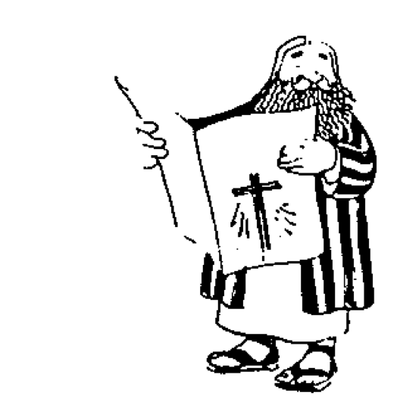




The New Testament "Building"
21
Paul's Letters to Pastors
 | 1 Timothy | 2 Timothy | Titus |  | Philemon
Paul's Letters to Churches | 2 Thessalonians |  |  |  | Revelation | General Letters
 | 1 Thessalonians |  |  |  | Jude
 | Colossians |  |  |  | 3 John
 | Philippians |  |  |  | 2 John
 | Ephesians |  |  |  | 1 John
 | Galatians |  |  |  | 2 Peter
 | 2 Corinthians |  |  |  | 1 Peter
 | 1 Corinthians |  |  |  | James
 | Romans |  |  |  | Hebrews
 | Acts
 | Matthew | Mark |  | Luke | John
Historical Books
Romans sets the foundation for Paul's Epistles
Hebrews sets the foundation for the General Epistles
Adapted from Walk Thru the Bible
Notes:
What overall observations on the NT can you make from this diagram?
Gospels and Acts form the primary and secondary foundations of the NT.
On the historical foundation are two pillars of 9 books each.
Paul's letters to churches in the left pillar all fit into Acts.
Paul didn't write any inspired letters to churches after Acts.
Pauline letters are named after recipients while General after authors (except Hebrews)
The four gospels are named after their authors.
Every book that ends in "ns" is Pauline
All Pastoral Epistles begin with "T"
All General Epistles were written after Acts except James.
Each of the 2 pillars also have a foundational book: Romans & Hebrews (also their longest)
Both pillars also end up in books that primarily deal with eschatology
Instruction to the leaders comprise only 4 books
Only 4 NT books are written to an individual
i.e., the NT is written not to leaders primarily but to the average Christian
Each 1st book of multiple (1-2 Cor, 1-2 Thess, etc.) is longer & more significant

Slide 3
NT Epistle Contrasts
253h
24
38
39-41
 | Pauline | General
Named after | Recipients | Author (except Hebrews)
Authors | 1 (Paul) | 5 (anonymous Hebrews, James, Peter, John, Jude)
Date | Earlier | Later (except James)
Chronology | Missionary journeys & Acts (except Pastorals) | After missionary journeys & Acts (except James)
Number | 13 | 9
Number of Letters in Theological Categories (cf. p. 24) | Soteriology (2) Ecclesiology (5) Eschatology (2) Christology (4) | Soteriology (2) Ecclesiology (0) Eschatology (4) Christology (1) Missiology (2)
Notes:
PAULINE:
Soteriology (2)—Romans, Galatians
Ecclesiology (5)—1&2 Corinthians, 1&2 Timothy, Titus
Eschatology (2)—1&2 Thessalonians
Christology (4)—Prison: Eph, Phil, Col, Philemon
GENERAL:
Soteriology (2)—James, 1 John
Ecclesiology (0)
Eschatology (4)—1&2 Peter, Jude, Revelation
Christology (1)—Hebrews
Missiology (2)—2&3 John
——————————
00-NT Intro-48
19-General Epistles-3

Slide 4
NT Book Keywords
24
Date | Book | Key Word | Paul's Life | Key Doctrine
40s | Matthew | Kingdom |  | Ecclesiology
44-47 | James | Works |  | Soteriology
49 | Galatians | Justification | 1st journey | Soteriology
51 | 1 Thessalonians | Rapture | 2nd journey | Eschatology
51 | 2 Thessalonians | Tribulation | 2nd journey | Eschatology
56 | 1 Corinthians | Sanctification | 3rd journey | Ecclesiology
56 | 2 Corinthians | Apostleship | 3rd journey | Ecclesiology
56-57 | Romans | Righteousness | 3rd journey | Soteriology
57-59 | Luke | Sovereignty I |  | Missiology
Notes:
• The early church taught that Matthew wrote the first gospel.
• James and Galatians were the earliest letters, and both focused on salvation, though they used the word "justification" in a different sense: horizontal before men (James) and vertical before God (Galatians).
• Paul's six Missionary Epistles were written over eight years, with no intervening Gospels or General Epistles.
• Typically, letters to the same church addressed the same key doctrine: 1&2 Thess, 1&2 Cor, 1&2 Tim, and 1&2 Peter. The exception is that 2&3 John addressed missiology, while 1 John's theme is salvation.
——————————
00-NT Intro-49
19-General Epistles-4

Slide 5
NT Book Keywords
24
Date | Book | Key Word | Paul's Life | Key Doctrine
60 | Ephesians | Unity | 1st imprisonment | Christology (Head)
61 | Colossians | Deity | 1st imprisonment | Christology (God)
61 | Philemon | Forgiveness | 1st imprisonment | Christology (Reconciler)
62 | Philippians | Attitude | 1st imprisonment | Christology (Example)
62 | Acts | Sovereignty II |  | Missiology
62 | 1 Timothy | Order | 4th journey | Ecclesiology
64 | 1 Peter | Suffering |  | Eschatology
64 | 2 Peter | Knowledge |  | Eschatology
64-68 | Mark | Discipleship |  | Eschatology
Notes:
The four Prison Epistles have the same general theme centering around Jesus.
——————————
00-NT Intro-50
19-General Epistles-5

Slide 6
NT Book Keywords
24
Date | Book | Key Word | Paul's Life | Key Doctrine
66 | Titus | Conduct | 4th journey | Ecclesiology
67 | 2 Timothy | Doctrine | 2nd imprisonment | Ecclesiology
67-68 | Hebrews | Superiority |  | Christology
c. 69 | John | Belief |  | Soteriology
75 | Jude | Pretenders |  | Eschatology
85-95 | 1 John | Love |  | Soteriology
85-95 | 2 John | Limits |  | Missiology
85-95 | 3 John | Missionaries |  | Missiology
95-96 | Revelation | Triumph |  | Eschatology
Notes:
Paul died in AD 68, so all epistles after this are the General Epistles.
The Gospels were composed over the first few decades, though many place John in the AD 90s.
——————————
00-NT Intro-51
19-General Epistles-6

Slide 7
NT Overview (General + Key Words)
38
124
39-41
"To the remotest part of the earth" (Acts 1:8)
Acts 9 13 14 15 16 18 21 27 28
Apr 48-
Sep 49
1
Galatia
Apr 50-
Sep 52
2
Aegean
Spr 53-
May 57
3
Asia
Feb 60-
Mar 62
1
Rome
Spr 62-
Fall 67
4
Spain
Aut 67-
Spr 68
2
Rome
Summer 35-
37
Damascus
Antioch
May 57-
Aug 59
Trials
Fall 49
The
Council
Spring 68
Expansion of Church
35 48 49 50 52 53 57 60 62 67 68 95
Matt
Kingdom
Luke
Sov 1
Acts
Sov 2
Mark
Disciple
John
Believe
Gal
Justify
1 Thess
Rapture
1 Cor
Eph
Unity
1 Tim
Order
2 Tim
Doctrine
Jude
Sanctify
Pretenders
James
Works
2 Thess
2 Cor
Col
Deity
Titus
Conduct
Heb
Super
1 John
Tribulation
Apostle
Love
Romans
Philem
1 Pet
Suffering
2 John
Righteous
Forgive
Limits
Gospels & Acts
Phil
Attitude
2 Pet
3 John
Knowledge
Mission
1234
Journeys
Rev
Pauline Epistles
Triumph
July 64
2 Sep 70
General Epistles
Rome
Imprisonments
General Epistles + Key Words

Slide 8

General Epistles Occasion
253g
Addressed Christians under stress
1st generation leadership passing away
Temple gone – change in Jewish system
Increasing antagonism between Jewish and Gentile believers (Jewish-Roman War AD 66-73)
Gentile believers become target for political blame (Jewish Christians suspected they had sided with their enemies)
Great texts for preaching to encourage people
Jeremy Chew, East Asia School of Theology, Singapore

Slide 9
A Time of Change
253g
Leadership changes
  Original leaders passing away—James beheaded, James (brother of Jesus), Peter & Paul killed, John exiled
Change from oral to written tradition
  Teachings from Jesus & apostles becoming published
Expectation of Christ's return
  Some expected Jesus to return at time of Jerusalem's destruction, but nothing happened
  People started to doubt & reinterpret their traditions
Reorientation of Jewish system
  Temple gone, so Jews worshipped only in synagogues
  Christians eventually forced out of synagogues
Jeremy Chew, East Asia School of Theology, Singapore

Slide 10
Impact of Changes
253g
Churches became more Gentile in membership
  Separation between Jews & Gentiles grew
  Christians were no longer perceived as a sect of Judaism, which was protected, hence became a political target of Rome
  Hence increase in persecution
Churches became more Gentile in character
  Hebrew thinking was slowly replaced by Greek thinking
Consequently…
  Questions of church identity
  Threats of syncretism
  Threats of persecution
Jeremy Chew, East Asia School of Theology, Singapore

Slide 11
Faith—the issue of the day!
253h
James: Faith that works
1 Peter: Faith in suffering
2 Peter: Knowing the faith
Hebrews: Faith that is superior
1-3 John: Practicing the faith
Jude: Fighting for the faith
Revelation: Faith in God's sovereignty & rule
Adapted from Jeremy Chew, East Asia School of Theology, Singapore

Slide 12
NT Overview (General + Key Words)
38
124
39-41
"To the remotest part of the earth" (Acts 1:8)
Acts 9 13 14 15 16 18 21 27 28
Apr 48-
Sep 49
1
Galatia
Apr 50-
Sep 52
2
Aegean
Spr 53-
May 57
3
Asia
Feb 60-
Mar 62
1
Rome
Spr 62-
Fall 67
4
Spain
Aut 67-
Spr 68
2
Rome
May 57-
Aug 59
Damascus
Antioch
May 57-
Aug 59
Trials
Fall 49
The
Council
Spring 68
Expansion of Church
35 48 49 50 52 53 57 60 62 67 68 95
Matt
Kingdom
Luke
Sov 1
Acts
Sov 2
Mark
Disciple
John
Believe
Gal
Justify
1 Thess
Rapture
1 Cor
Eph
Unity
1 Tim
Order
2 Tim
Sanctify
Doctrine
James
Works
2 Thess
2 Cor
Col
Deity
Titus
Conduct
Heb
Tribulation
Apostle
Super
Romans
Philem
1 Pet
Righteous
Forgive
Suffering
Gospels & Acts
Phil
Attitude
2 Pet
Knowledge
Pauline Epistles
General Epistles
General Epistles + Key Words

Slide 13
Black

Slide 14
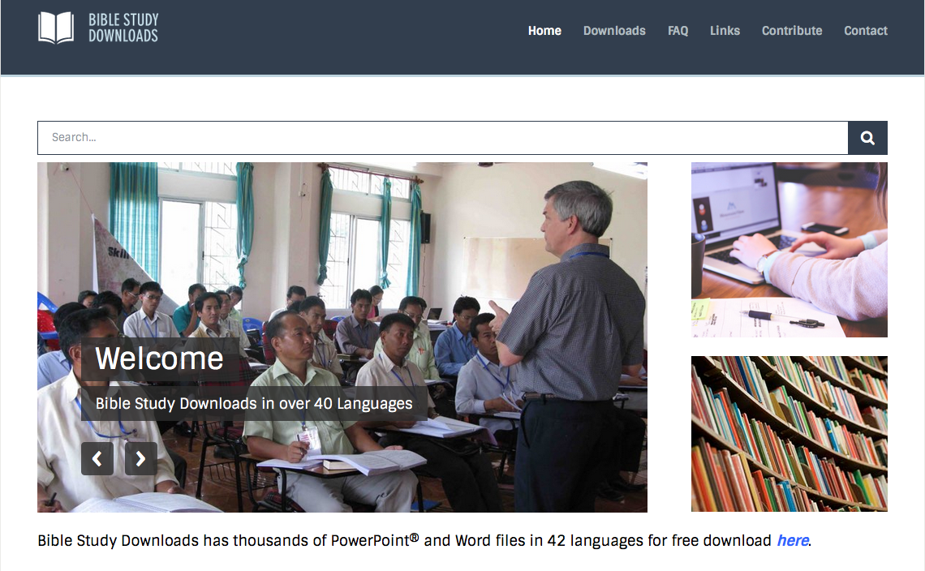

NT Survey link at BibleStudyDownloads.org
Get this presentation for free!
Notes:
NT Survey (ns)

