Slide 1
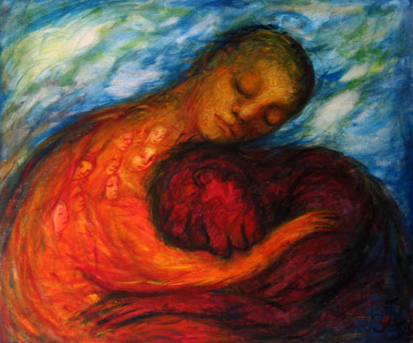
To Forgive or Not to Forgive
Philemon
Dr. Rick Griffith • Jordan Evangelical Theological Seminary • BibleStudyDownloads.org

Slide 2
Key Word
245
Forgiveness
Philemon

Slide 3
Theme
23
Forgive Others and
Seek Forgiveness
Philemon

Slide 4
Key Verse
245
“So if you consider me a partner, welcome him [Onesimus] as you would welcome me. If he has done you any wrong or owes you anything, charge it to me” (verses 17-18).
Philemon

Slide 5

Summary Statement
245
Paul requests the Christian slave owner, Philemon, to forgive his runaway but repentant slave, Onesimus, whom Paul led to Christ and sent back to Philemon to be received as a Christian brother and to teach forgiveness.

Slide 6

Kingdom Statement
27f
237
Ironically, Rome imprisoned Onesimus for crimes against Emperor Nero and Rome imprisoned Paul for allegiance to King Jesus, but through Paul Onesimus discovered Jesus as the real King.
Philemon
Notes:
The word "kingdom" does not appear in the letter.

Slide 7

Covenant
27f
The house church concept looms large where Paul likely wrote the owner Philemon, mistress of the house Apphia, and their son, the key elder Archippus (1-2).
Philemon
Notes:
Apphia was Philemon's wife since the church met in the home of both Philemon and Apphia (verse 2).

Slide 8

Redemption
27f
Paul alludes to the atoning death of Jesus when applying the debt of Onesimus to Paul: “If he has done you any wrong or owes you anything, charge it to me” (17-18).
Philemon
Notes:
This is also called the doctrine of imputation—where our sins are applied to Jesus (cf. Romans 5:12).

Slide 9

Prophecy
(Lord, Deity)
27f
Philemon placed faith in the Lord Jesus Christ (5), from whom he received grace and peace (3).
Philemon
Notes:
Jesus is noted as both Lord (God) and Messiah.

Slide 10
OUTLINE
245
Forgive Others and Seek Forgiveness
Greeting 1-3 |  | Prayer & Commendation 4-7 |  | Appeal for Onesimus 8-21 |  |  | Conclusion 22-25
Preface |  | Praise |  | Petition |  |  | Postscript
People Concerned |  | Philemon’s Character |  | Onesimus’ Conversion |  |  | Paul’s Co-Workers
Authors 1a-b | Recipi-ents 1c-3 | Thanks 4-5 | Relation-ships 6-7 | General Appeal 8-11 | Reasons for Return 12-16 | Specific Appeal 17-21 | Preparations Greetings Blessing 22-25
Rome to Colosse
Fall AD 61
Philemon
Dr. Rick Griffith, Crossroads International Church Singapore
cicfamily.com & BibleStudyDownloads.org

Slide 11
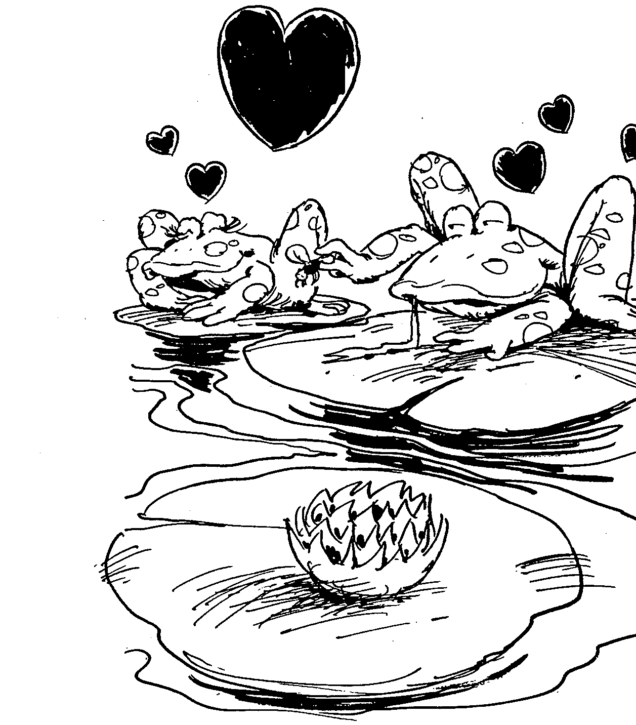
Verses
1-7
8-14
15-20
21-25
Letter of Philemon's love
Onesimus becomes a Christian
Vindication requested for Onesimus
Expectation cited by Paul
PHILEMON
Barry Huddleston, The Acrostic Bible

Slide 12
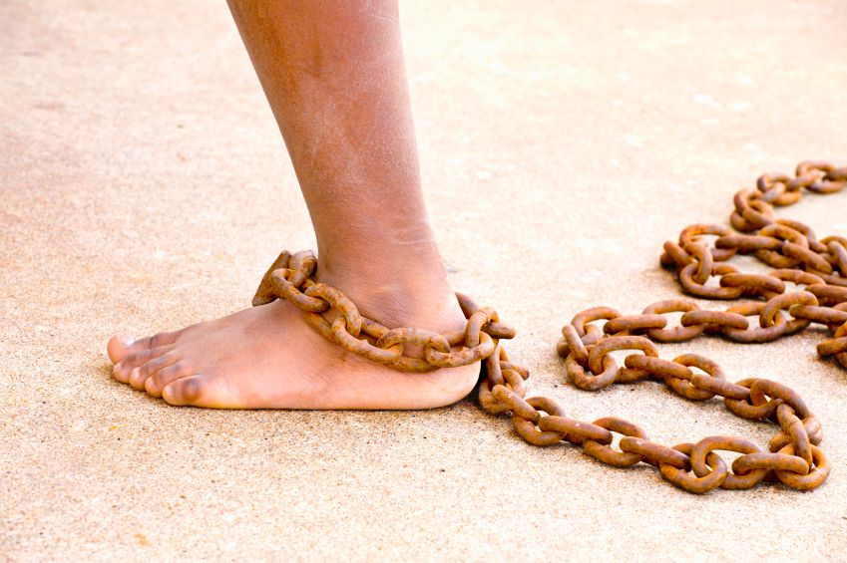
Be Forgiving
Philemon
Dr. Rick Griffith • Crossroads International Church Singapore
BibleStudyDownloads.org

Slide 13

Conditional Forgiveness:
a. "I'll forgive you if…"
b. "I'll forgive—but I'll never forget…"
c. "I forgive you but don't expect me
to change my attitude."
Philemon
Notes:
How do you know when forgiveness is not unconditional? When you say…

Slide 14

How to forgive those who offend us…
Philemon
Notes:
Today we will see a very active step, that of how to forgive those who offend us. We'll look at a scriptural example of one who was strongly urged to forgive an offender.

Slide 15

I. Treat people in the best possible light (1-7).
Philemon
Notes:
Paul began his appeal to Philemon on a very positive note (1-7).

Slide 16
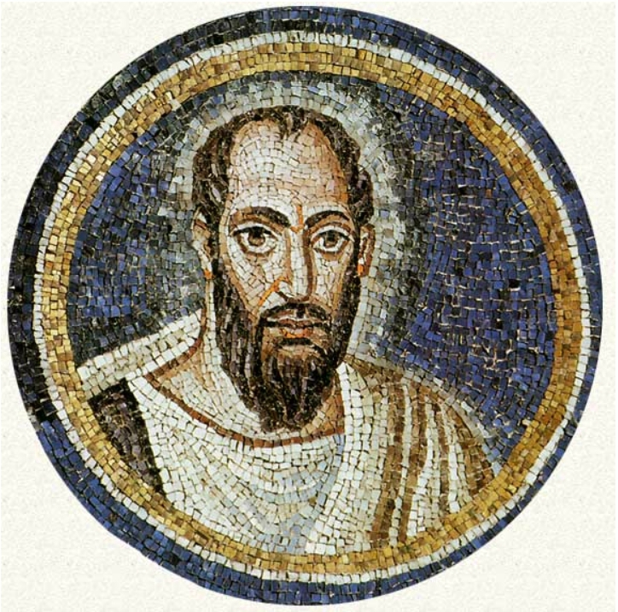
II. Forgive so reconciliation transcends social barriers
(8-21).
Philemon
Notes:
Paul handles this situation very delicately, not ever even using the word “forgive,” or commanding it, but he does address the need for reconciliation fairly directly.
Previously I summed up verses 8-21 as "Paul appealed for Philemon's forgiveness of his returning runaway slave, Onesimus
(8-21)."

Slide 17
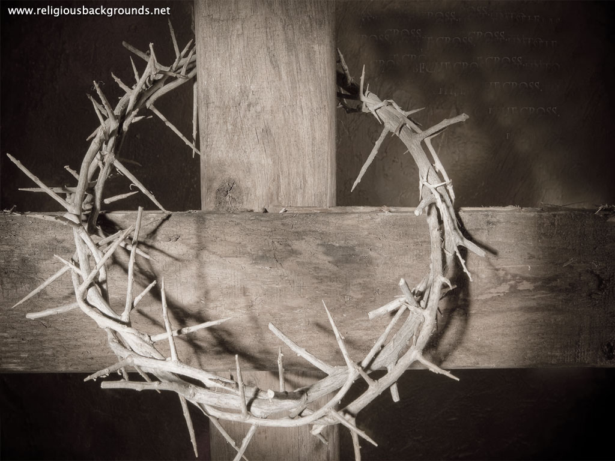
Main Idea
We can forgive others when we see how God has forgiven us.
Philemon
Notes:
It was clearly God's will that Philemon forgive his repentant, runaway slave who had become a brother in Christ. Why? God forgave Philemon of even a greater debt.

Slide 18

. Characteristics .
246
Philemon
Meaning of purple hyacinth:
"I am sorry, please forgive me, sorrow"
Paul provides several reasons why forgiveness is important:
Forgiveness solidifies friendships (vv. 8-11, 17-20).
Restored relationships make people more helpful to us (v.11).
Forgiveness involves one's heart (v. 12).
The sacrifice that forgiveness requires is painful but good for us (vv. 13,18-19a).
Forgiveness shows humility since it must be voluntary not forced (vv. 14-,21).
Forgiveness reminds one that God is in control of painful events (vv. 15, 16).
Forgiving others reminds us of how God forgave us (v.19b)
Notes:
This slide question is good for small groups to discern these principles themselves.

Slide 19
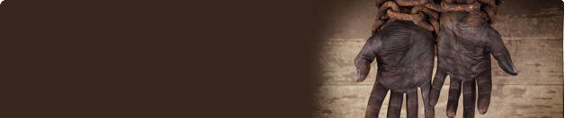
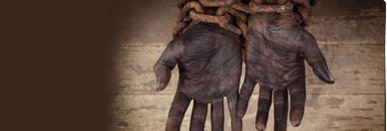
• Application •
245
To whom do you best relate now?
Philemon the offended?
Onesimus the offender?
Paul the reconciler?
The church as affirmers?
Philemon
Notes:
With which person in this letter do you best relate to now?
Let's humble ourselves before our great God… If Paul were writing a similar letter to you as if you were Philemon, whom would he ask you to forgive?
1) Philemon the offended? Whom do you need to forgive a wrong done to you? Would Paul request you to forgive a former friend who hurt you deeply? Will you, as an act of the will (not the emotions), grant forgiveness unconditionally even if your offender never requests it?
2) Onesimus the offender? Whose forgiveness do you need to request? Maybe you're not in the position of Philemon, needing to grant forgiveness, but perhaps you're where Onesimus was, needing to ask forgiveness. Onesimus risked his very life to make things right. Certainly your risk is not greater than his. How will you respond to God's desire for you? Will you take the risk of rejection to restore your walk with God by forgiving your offender?
3) Paul the reconciler? How can you help two others reconcile? Would Paul ask you, plead with you, implore you to help someone forgive a spouse who has really blown it? Or some believers who really did wrong?
4) The church as affirmers? How can you assist the reconciliation of others, even if you are not actively involved in the situation as an offended, an offender, or as a reconciler—but you know about a relationship that needs mending? How can you pray for them?

Slide 20
Black

Slide 21
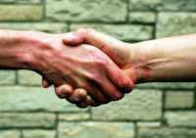
True Koinonia (Fellowship)
"Fellowship of your faith" (v. 6)
Fellowship involves participation
Participation in Christ involves sharing and involvement with each other
True fellowship means mutually participating in Christ → forgiveness and reconciliation
True fellowship promotes the good of everyone
It involves changing perceptions and acting accordingly
This letter has a good example of:
3 outstanding debts
Powerful reversals
Outcome
Jeremy Chew, East Asia School of Theology, Singapore

Slide 22
3 Outstanding Debts
Onesimus' Debt:
He owed Philemon whatever he stole
He owed Philemon his life
Advice: Return to owner for due punishment
Paul's Debt:
He owed Philemon value of each day's work lost
Advice: Charge any debts Onesimus owed to my account; I will pay them
Philemon's Debt:
He owed Paul his new life in Christ (19)
Advice: Welcome the runaway slave as a brother; but do better than that—return him to me
Jeremy Chew, East Asia School of Theology, Singapore

Slide 23
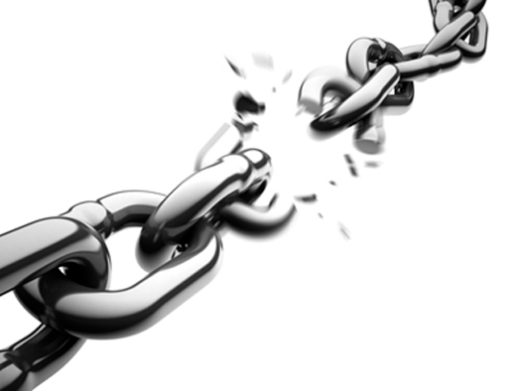
Powerful Reversals
Property → beloved brother
Inferior → equal
Useless → "useful" (Onesimus, v. 11)
Fellowship in Christ overturns all distinctions created by social structures
Jeremy Chew, East Asia School of Theology, Singapore

Slide 24
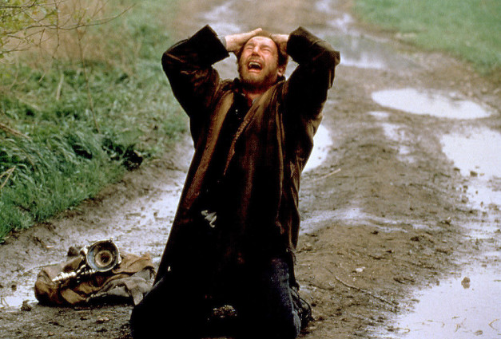
LES MISERABLES, Liam Neeson, 1998, was forgiven

Slide 25
Why Forgiveness Matters
Philemon
246-247
What reasons does Paul give in this letter to show why forgiveness is important?
1. Forgiveness solidifies friendships (vv. 8-11, 17, 20).
2. Restored relationships make people more helpful to us (v. 11).
3. Forgiveness involves one's heart (v. 12).
4. The sacrifice that forgiveness requires is painful but good for us (vv. 13, 18-19a).
5. Forgiveness shows humility since it must be voluntary not forced (vv. 14, 21).
6. It reminds us that God has His hand in the events which cause us pain (vv. 15, 16).
7. Forgiving others reminds us of how God forgave us (v. 19b).

Slide 26

It's Your Blood
It's Your blood that cleanses me,
It's Your blood that gives me life,
It's Your blood that took my place
in redeeming sacrifice,
Washes me…
Whiter than the snow, than the snow
My Jesus,
God's precious sacrifice.

Slide 27
Authorship
Philemon
246
External Evidence
The authenticity of Philemon was not questioned until objections were raised in the 4th century against its lack of doctrinal content. However, Jerome & Chrysostom vindicated the epistle & Pauline authorship has been universally held until the 19th century radical critics.
Internal Evidence
Paul refers to himself three times as author
(vv. 1, 9, 19).

Slide 28
Characteristics
Philemon
246-247
This "New Testament postcard" is the shortest letter of Paul's epistles.
The letter to Philemon probably provides the clearest example of the need to demonstrate forgiveness in the New Testament. Onesimus' commitment to return to his former master was in effect risking his life to ask forgiveness, yet he still did it.
This writing illustrates the nature of imputation better than any other. Paul requests that all of Onesimus' sin be placed not upon Onesimus but upon himself. In like manner Christ took the sin of humanity upon Himself.

Slide 29

Circumstances
Philemon
246
Origin/Recipients
Philemon (v. 1b), a Christian slave owner in Colosse, is the main addressee, but others in his church are included too
(v. 2).
Date (fall AD 61)
Paul's 1st imprisonment in Rome, is evident in parallels with the Colossian letter
(cf. v. 23 with Col. 4:7-10).
Rome
Colosse
Occasion
During Paul's 1st imprisonment in Rome he led to Christ the fugitive slave of Philemon named Onesimus—who had done some injustices to & stolen from Philemon before he ran away. This letter to Philemon was sent with Onesimus to Colosse to convince Philemon to forgive Onesimus.

Slide 30
Perspectives
247
Paul's short letter to Philemon demonstrates both the importance of forgiving offenders & also being forgiven as necessary decisions for walking with God.
This views the letter from the perspective of both Onesimus and Philemon.
The letter was not simply a personal correspondence to Philemon alone. It addresses others in the church and the uses the plural "you" in verse 25.

Slide 31
Be Forgiving
Philemon
Dr. Rick Griffith • Crossroads International Church Singapore
BibleStudyDownloads.org

Slide 32
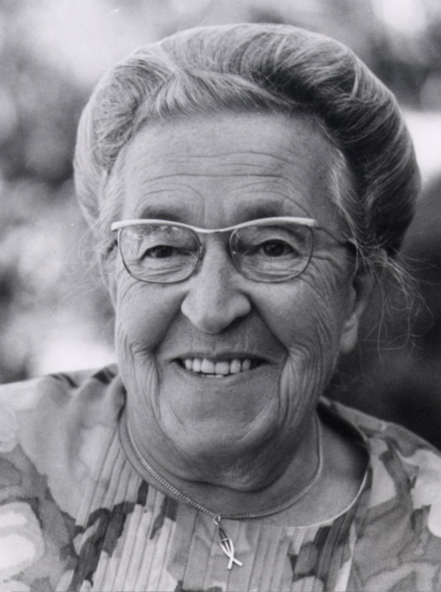
Corrie ten Boom
Notes:
Corrie ten Boom was a Dutch believer famous for her courageous efforts to help Jews escape the Nazi persecutions during World War II.

Slide 33
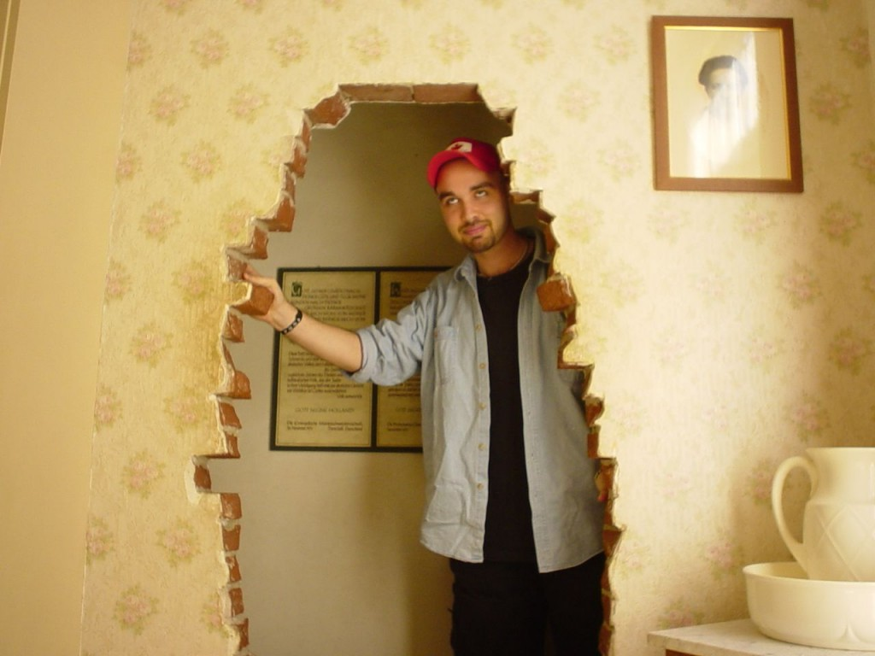
The Hiding Place
Notes:
She hid Jews in "The Hiding Place" in her home until they could be secretly sent out of the country.

Slide 34
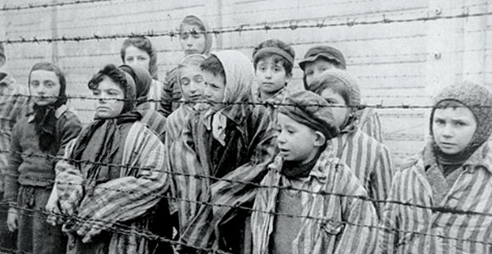
Corrie ten Boom
Notes:
For this she was sent to a concentration camp with her sister Betsy.

Slide 35
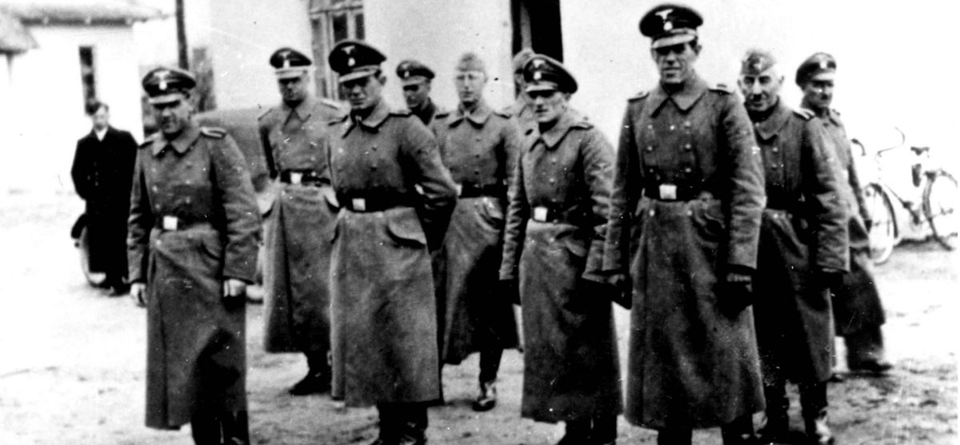
The Guards
The Jews
Notes:
After the war she traveled extensively sharing her experiences and recorded a very interesting account of one of these speaking engagements. At a city called Ravensbruck she spoke one night about forgiveness and afterwards a man came forward to talk to her.

Slide 36
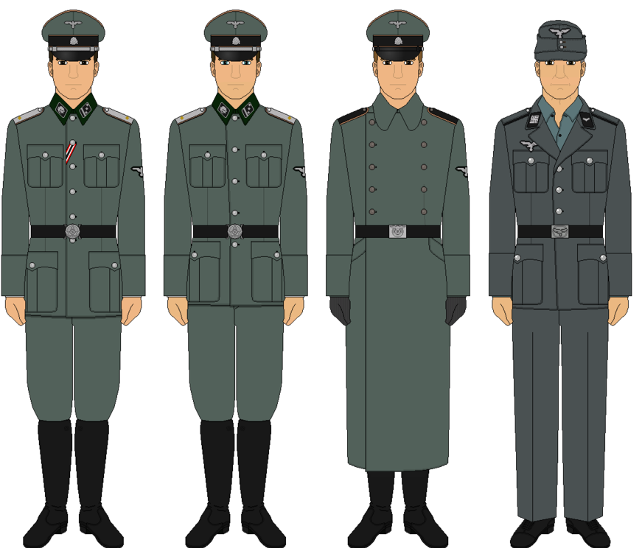
German Guards
Notes:
Corrie immediately recognized him as one of the guards in her concentration camp—one of the cruelest of all the guards! He was one responsible for the death of Corrie’s sister Betsy.

Slide 37
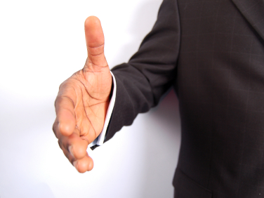
The outstretched hand
Notes:
“Nice sermon, Frauline," he said. "I want to experience that forgiveness God gives us, but it starts with asking you to forgive me. Will you forgive me?" He stuck out his hand for her to shake, but she froze (Tramp for the Lord, 55-56).

Slide 38
How to forgive those who offend us…
Notes:
Today we will see a very active step, that of how to forgive those who offend us. We'll look at a scriptural example of one who was strongly urged to forgive an offender.

Slide 39
Chapters in NT Books
Four "books" of the NT have but 1 chapter
Notes:
It doesn't seem right to call the four one-chapter writings "books" as they are so short! We know that most of the NT books are longer books or letters, but these four shortest ones are too often neglected.
____________
NS-18-Philemon-39
NS-24-2 John-61
NS-25-3 John-45
NS-26-Jude-66

Slide 40
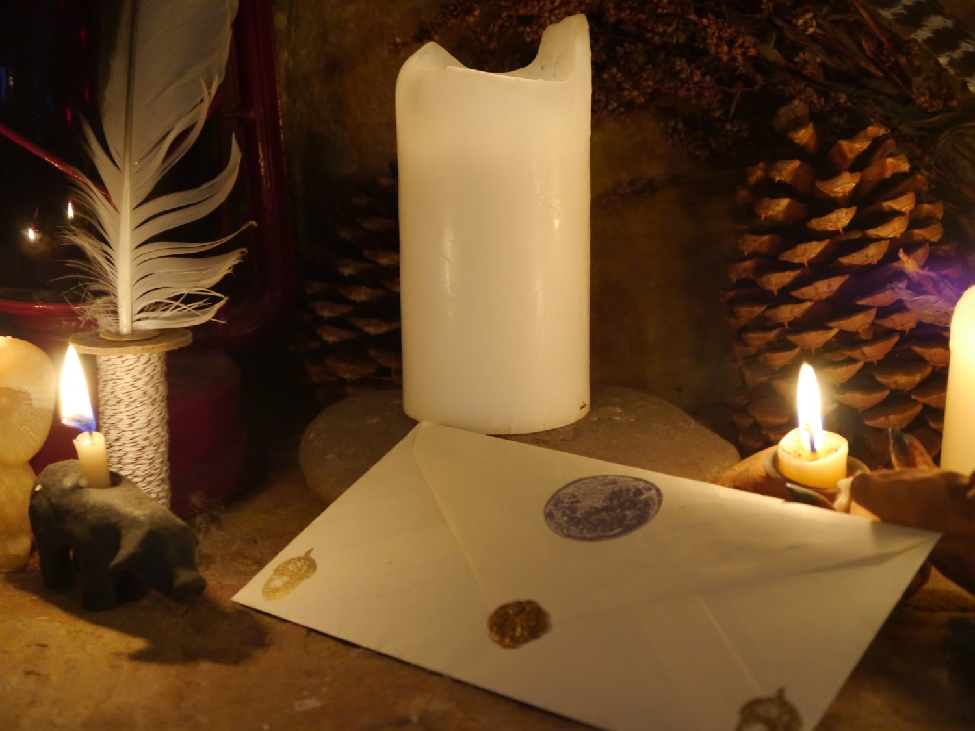
Verses in NT Emails
15
13
Words
245
219
Notes:
Each is about the length of an email, so I call them "NT Emails." The "E" is not for "electronic" but for "encouragement."
____________
NS-18-Philemon-40
NS-24-2 John-62
NS-25-3 John-46
NS-26-Jude-67

Slide 41
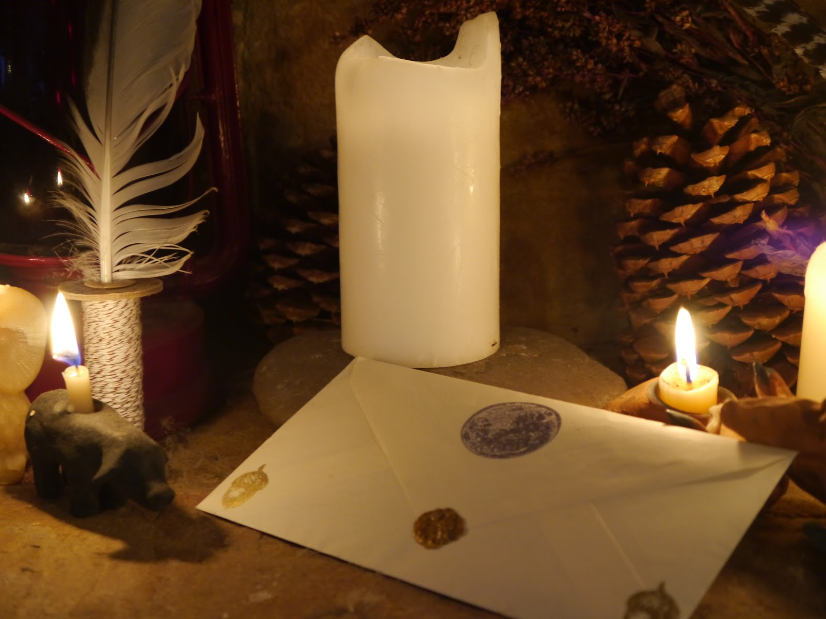
New Testament Emails
Philemon
2 John
3 John
Jude
Notes:
I call these "New Testament Emails" as they are about the length one puts in an email.

Slide 42
Postcard to Philemon
ROME
Παῦλος δέσµιος Χριστοῦ Ἰησοῦ καὶ Τιµόθεος ὁ ἀδελφὸς Φιλήµονι τῷ ἀγαπητῷ καὶ συνεργῷ ἡµῶν καὶ Ἀπφίᾳ τῇ ἀδελφῇ καὶ Ἀρχίππῳ τῷ
συστρατιωτῃ ἡµῶν καὶ τῇ κατ· οἶκόν σου
ἐκκλησίᾳ
χάρις ὑµῖν καὶ εἰρήνη ἀπὸ θεοῦ πατρὸς
ἡµῶν καὶ κυρίου Ἰησοῦ Χριστοῦ.
Postcard to Philemon
Notes:
Please turn in your Bible to the book of Philemon. It's just before Hebrews near the back of your New Testament. The book of Philemon is between Titus and Hebrews. It’s about the length of a postcard.

Slide 43
. Characteristics .
246
¹Paul, a prisoner of Christ Jesus, and Timothy our brother,
To Philemon our dear friend and fellow worker, ²to Apphia our sister, to Archippus our fellow soldier and to the church that meets in your home:
³Grace to you and peace from God our Father and the Lord Jesus Christ.
Thanksgiving and Prayer
⁴I always thank my God as I remember you in my prayers, ⁵because I hear about your faith in the Lord Jesus and your love for all the saints. ⁶I pray that you may be active in sharing your faith, so that you will have a full understanding of every good thing we have in Christ. ⁷Your love has given me great joy and encouragement, because you, brother, have refreshed the hearts of the saints.
Paul's Plea for Onesimus
⁸Therefore, although in Christ I could be bold and order you to do what you ought to do, ⁹yet I appeal to you on the basis of love. I then, as Paul–an old man and now also a prisoner of Christ Jesus– ¹⁰I appeal to you for my son Onesimus, who became my son while I was in chains. ¹¹Formerly he was useless to you, but now he has become useful both to you and to me.
¹²I am sending him–who is my very heart–back to you. ¹³I would have liked to keep him with me so that he could take your place in helping me while I am in chains for the gospel. ¹⁴But I did not want to do anything without your consent, so that any favor you do will be spontaneous and not forced. ¹⁵Perhaps the reason he was separated from you for a little while was that you might have him back for good– ¹⁶no longer as a slave, but better than a slave, as a dear brother. He is very dear to me but even dearer to you, both as a man and as a brother in the Lord.
¹⁷So if you consider me a partner, welcome him as you would welcome me. ¹⁸If he has done you any wrong or owes you anything, charge it to me. ¹⁹I, Paul, am writing this with my own hand. I will pay it back–not to mention that you owe me your very self. ²⁰I do wish, brother, that I may have some benefit from you in the Lord; refresh my heart in Christ. ²¹Confident of your obedience, I write to you, knowing that you will do even more than I ask.
²²And one thing more: Prepare a guest room for me, because I hope to be restored to you in answer to your prayers.
²³Epaphras, my fellow prisoner in Christ Jesus, sends you greetings. ²⁴And so do Mark, Aristarchus, Demas and Luke, my fellow workers.
²⁵The grace of the Lord Jesus Christ be with your spirit.
Shortest letter of Paul's epistles (25 verses)
Notes:
In fact, you can put the entire letter on a postcard! It is the shortest of Paul’s epistles in the NT.

Slide 44

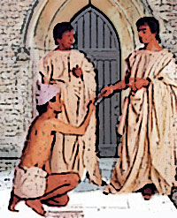
"This letter is from Paul, a prisoner for preaching the Good News about Christ Jesus, and from our brother Timothy. I am writing to Philemon, our beloved co-worker, ²and to our sister Apphia, and to our fellow soldier Archippus, and to the church that meets in your house” (vv. 1-2 NLT).
Notes:
Let’s read the entire letter to Philemon…

Slide 45
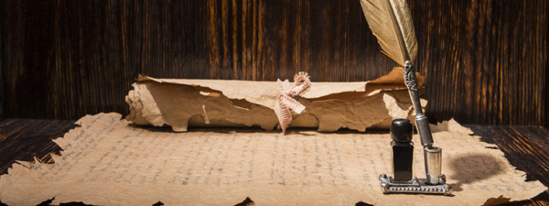
"May God our Father and the Lord Jesus Christ give you grace and peace"
(v. 3 NLT).

Slide 46

"I always thank my God when I pray for you, Philemon, ⁵because I keep hearing about your faith in the Lord Jesus and your love for all of God's people"
(vv. 4-5 NLT).

Slide 47
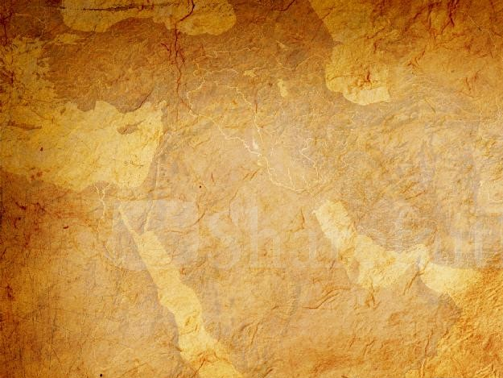
"And I am praying that you will put into action the generosity that comes from your faith as you understand and experience all the good things we have in Christ. ⁷Your love has given me much joy and comfort, my brother, for your kindness has often refreshed the hearts of God's people" (vv. 6-7 NLT).

Slide 48
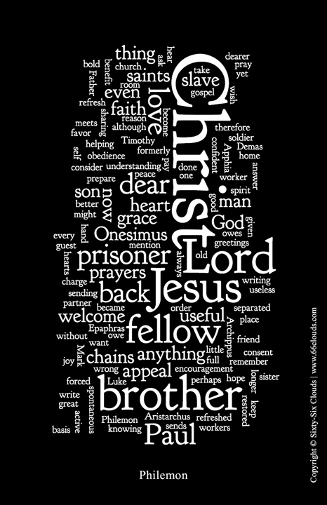
"That is why I am boldly asking a favor of you. I could demand it in the name of Christ because it is the right thing for you to do. ⁹But because of our love, I prefer simply to ask you. Consider this as a request from me—Paul, an old man and now also a prisoner for the sake of Christ Jesus"
(vv. 8-9 NLT).

Slide 49
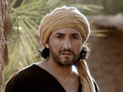
"I appeal to you to show kindness to my child, Onesimus. I became his father in the faith while here in prison. ¹¹Onesimus hasn't been of much use to you in the past, but now he is very useful to both of us.
¹²I am sending him back to you, and with him comes my own heart" (vv. 10-12 NLT).

Slide 50
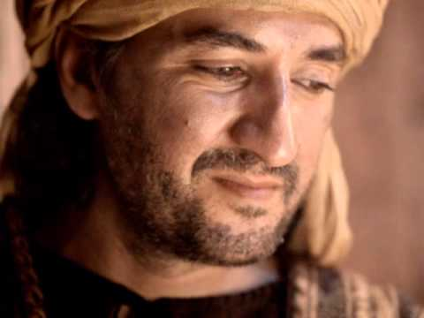
"I wanted to keep him here with me while I am in these chains for preaching the Good News, and he would have helped me on your behalf.
¹⁴But I didn't want to do anything without your consent. I wanted you to help because you were willing, not because you were forced” (vv. 13-14 NLT).

Slide 51
"It seems you lost Onesimus for a little while so that you could have him back forever. ¹⁶He is no longer like a slave to you. He is more than a slave, for he is a beloved brother, especially to me. Now he will mean much more to you, both as a man and as a brother in the Lord"
(vv. 15-16 NLT).

Slide 52
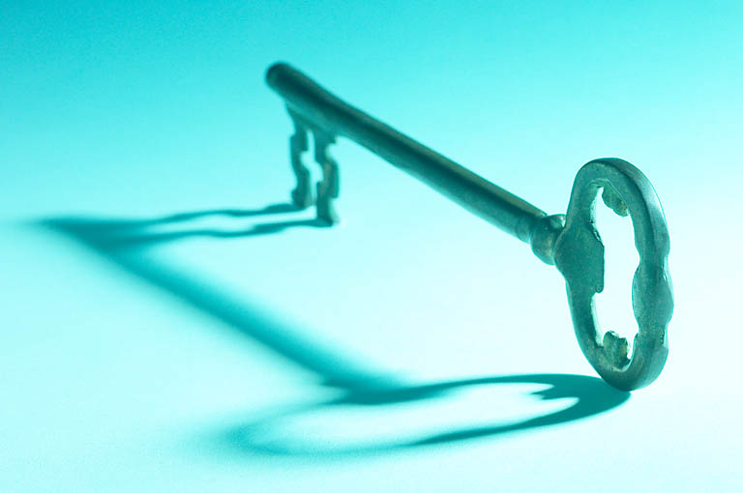
245
Verse 17
"So if you consider me a partner, welcome him as you would welcome me."

Slide 53
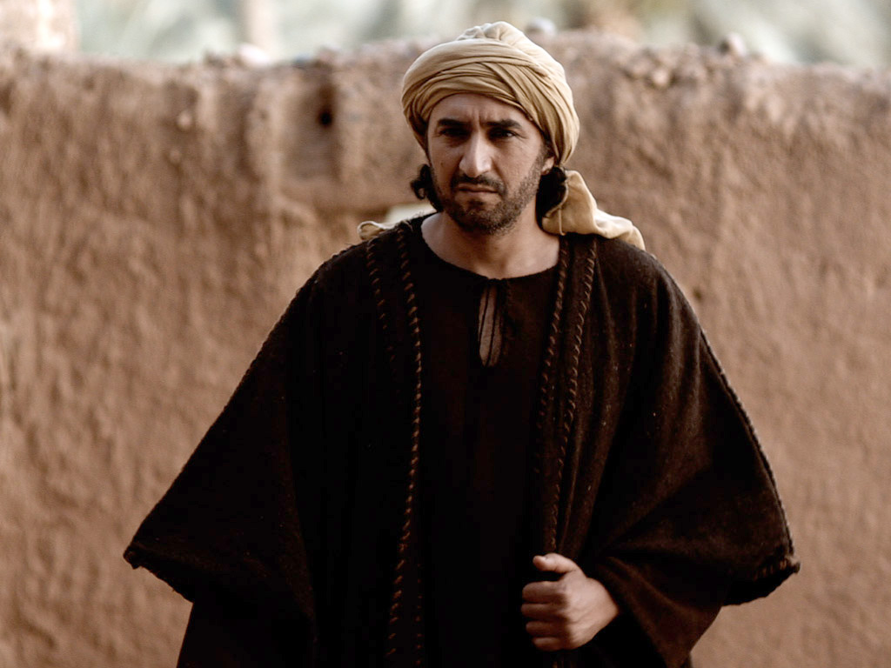
"If he has wronged you in any way or owes you anything, charge it to me"
(v. 18 NLT).

Slide 54
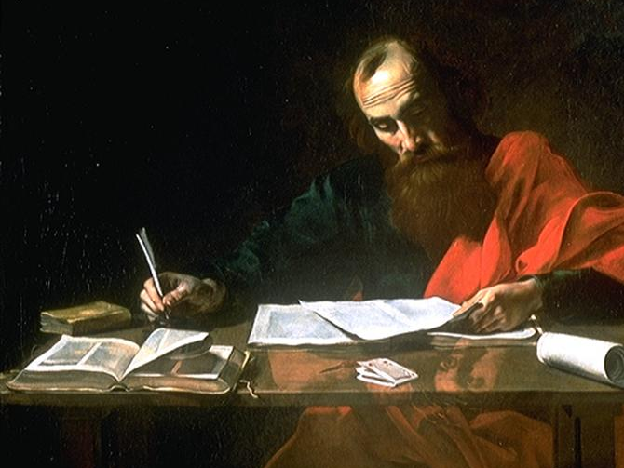
"I, Paul, write this with my own hand: I will repay it. And I won't mention that you owe me your very soul!” (v. 19 NLT).

Slide 55
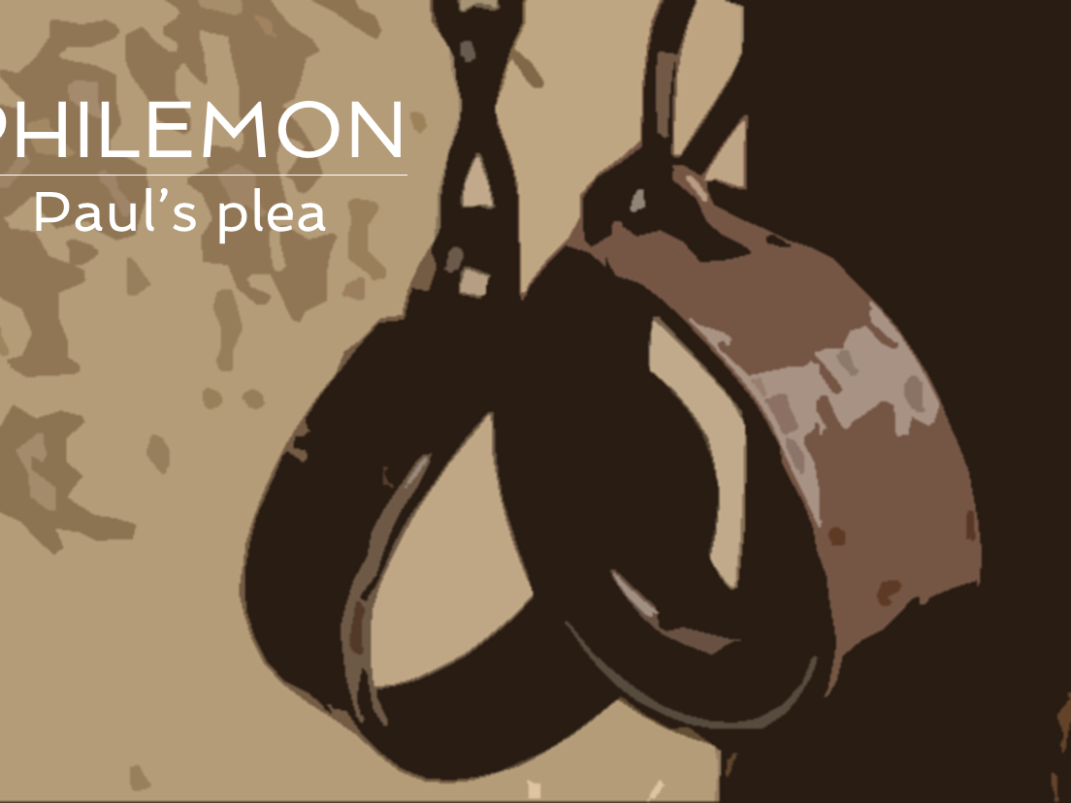

"Yes, my brother, please do me this favor for the Lord's sake. Give me this encouragement in Christ. ²¹I am confident as I write this letter that you will do what I ask and even more!"
(vv. 20-21 NLT).

Slide 56
"One more thing—please prepare a guest room for me, for I am hoping that God will answer your prayers and let me return to you soon" (v. 22 NLT).

Slide 57
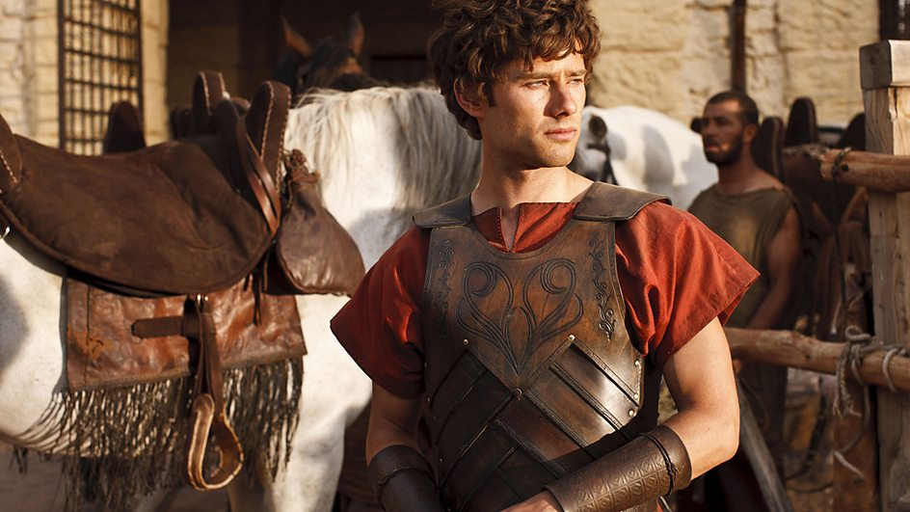
"Epaphras, my fellow prisoner in Christ Jesus, sends you his greetings. ²⁴So do Mark, Aristarchus, Demas, and Luke, my co-workers" (vv. 23-24 NLT).

Slide 58
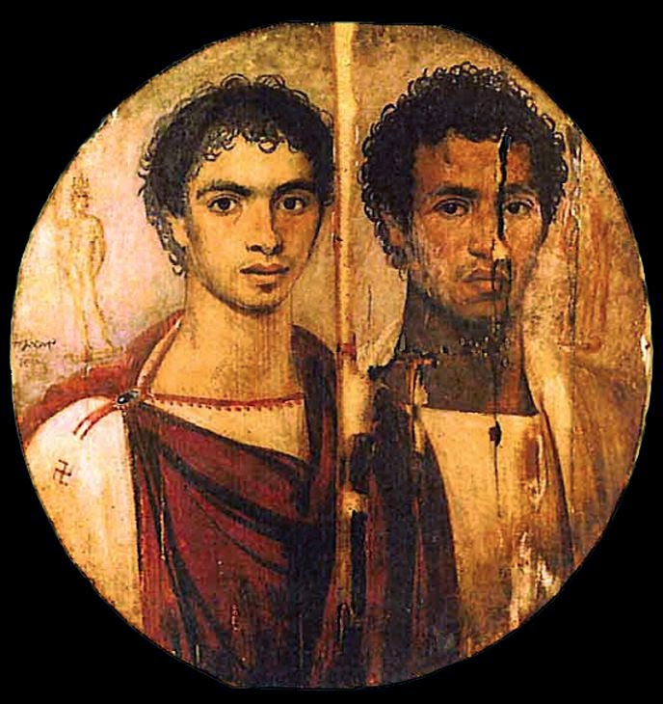
"May the grace of the Lord Jesus Christ be with your spirit" (v. 25 NLT).

Slide 59
How to forgive those who offend us…

Slide 60
Philemon 1-7

Slide 61
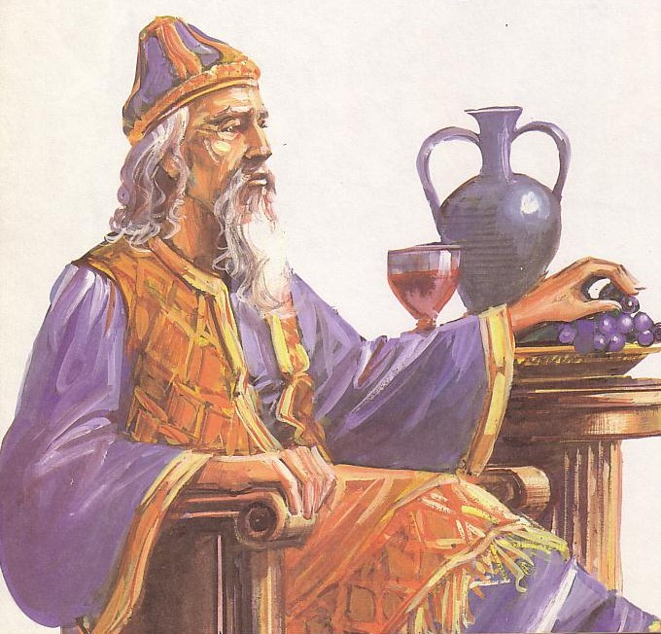
Philemon's Dilemma at Colosse
109
What should the slave owner Philemon do with his repentant but returning slave Onesimus (now a Christian)?
What are the implications for slave owners and employers?
Notes:
How do we apply this short letter in its context? And what does it mean for us today in terms of authority structures?
_________
NB-09-Soc-Econ 2- Jew-Gentile Prejudice-54
NS-18-Philemon-61

Slide 62
I. Treat people in the best possible light (1-7).
Philemon
Notes:
Paul began his appeal to Philemon on a very positive note (1-7).

Slide 63
"This letter is from Paul, a prisoner for preaching the Good News about Christ Jesus, and from our brother Timothy. I am writing to Philemon, our beloved co-worker, ²and to our sister Apphia, and to our fellow soldier Archippus, and to the church that meets in your house" (vv. 1-2 NLT).

Slide 64
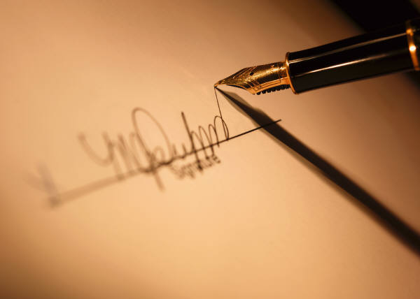
. Authorship .
246
Paul
Verse 1
Paul ………………………….….
Verse 9
………..… Paul …………………………………..
Verse 19
……. Paul….……………………….
Notes:
Paul presents himself in a good light as imprisoned for Christ (1a).
He is mentioned three times as the sender of the letter (1a, 9, 19).

Slide 65
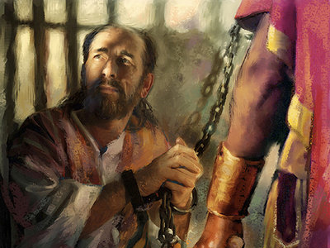
. Date .
246
During Paul's imprisonment in Rome
Fall AD 61
Notes:
He wrote this personal letter from prison in Rome in AD 61.
The names in verse 24 match those in Colossians 4 exactly, indicating that this letter was sent along with Tychicus from Rome to the city of Colossae along with the letter to the Colossian church.

Slide 66
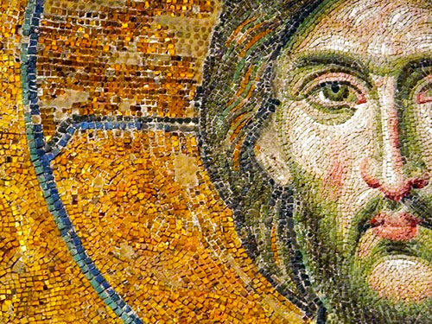
. Recipient .
246
Philemon was a wealthy man in Colosse
Notes:
Paul presents Philemon in a good light with many good virtues (1b-7).

Slide 67
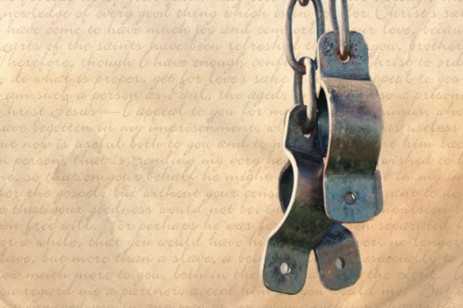
. Recipients .
246
Primary addressee: Philemon
A wealthy Christian slave owner in Colosse
Verse 1b – "To Philemon our dear friend and fellow worker"
Others: Church members
Verse 2 – "to Apphia our sister, to Archippus our fellow soldier and
to the church that meets in your home"
Notes:
He was a Christian who had been involved in ministry with Paul (1b).
He was a wealthy convert of the Apostle Paul (19b), probably during Paul's third missionary journey almost ten years earlier.
The two men didn't necessarily work together in the same city since Paul was in Ephesus while Philemon served in nearby Colossae. Interestingly, Paul had never even been to Colossae.
Apphia (his wife?) is “our sister” and Archippus (his son?) is “our fellows soldier” (2a)—probably a leader in the church, possibly the pastor (Col 4:17).

Slide 68
"May God our Father and the Lord Jesus Christ give you grace and peace"
(v. 3 NLT).
Notes:
Paul wished Philemon God’s grace and peace (3).

Slide 69
"I always thank my God when I pray for you, Philemon, ⁵because I keep hearing about your faith in the Lord Jesus and your love for all of God's people"
(vv. 4-5 NLT).
Notes:
Paul called Philemon a man of love and faith (5).

Slide 70
"And I am praying that you will put into action the generosity that comes from your faith as you understand and experience all the good things we have in Christ. ⁷Your love has given me much joy and comfort, my brother, for your kindness has often refreshed the hearts of God's people" (vv. 6-7 NLT).
Notes:
Philemon greatly encouraged people's faith in Christ (7).

Slide 71
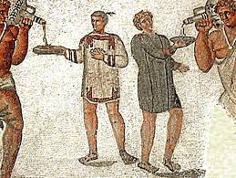
. Occasion .
246
Philemon owned a slave named Onesimus
Notes:
Verses 1-7 have introduced us to two very important people—Paul and Philemon. Now in verses 8-21 we'll see the third important character in the story, the runaway slave, Onesimus. At this point the story really gets interesting because…

Slide 72
How to forgive those who offend us…

Slide 73
I. Treat people in the best possible light (1-7).
Philemon
Notes:
Paul began his appeal to Philemon on a very positive note (1-7).

Slide 74
Philemon 8-21

Slide 75
II. Forgive so reconciliation transcends social barriers
(8-21).
Philemon
Notes:
Paul handles this situation very delicately, not ever even using the word “forgive,” or commanding it, but he does address the need for reconciliation fairly directly.
Previously I summed up verses 8-21 as "Paul appealed for Philemon's forgiveness of his returning runaway slave, Onesimus
(8-21)."

Slide 76
"That is why I am boldly asking a favor of you. I could demand it in the name of Christ because it is the right thing for you to do. ⁹But because of our love, I prefer simply to ask you. Consider this as a request from me—Paul, an old man and now also a prisoner for the sake of Christ Jesus"
(vv. 8-9 NLT).

Slide 77
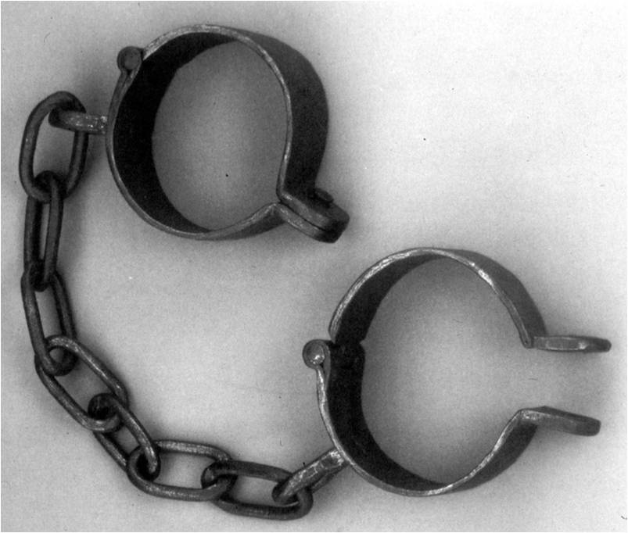
Onesimus ran away
Notes:
Onesimus was Philemon's slave that ran away from his master in Colossae to Rome.

Slide 78
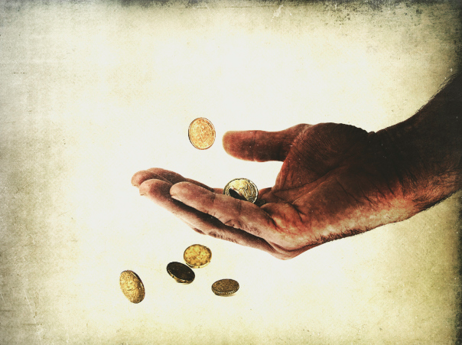
Onesimus had done injustice to and stolen from Philemon
Notes:
He had wronged his master Philemon, possibly robbed him (18).
He then ran away to avoid punishment (15).

Slide 79
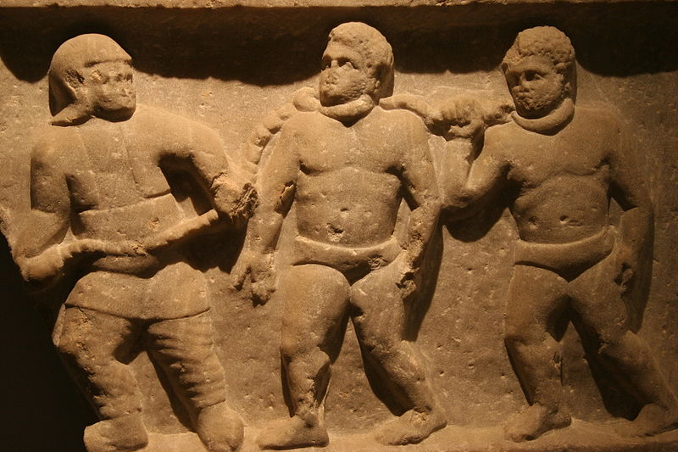
Slavery in the Roman Empire
Notes:
Slaves were considered property in the Roman world and had no rights.

Slide 80
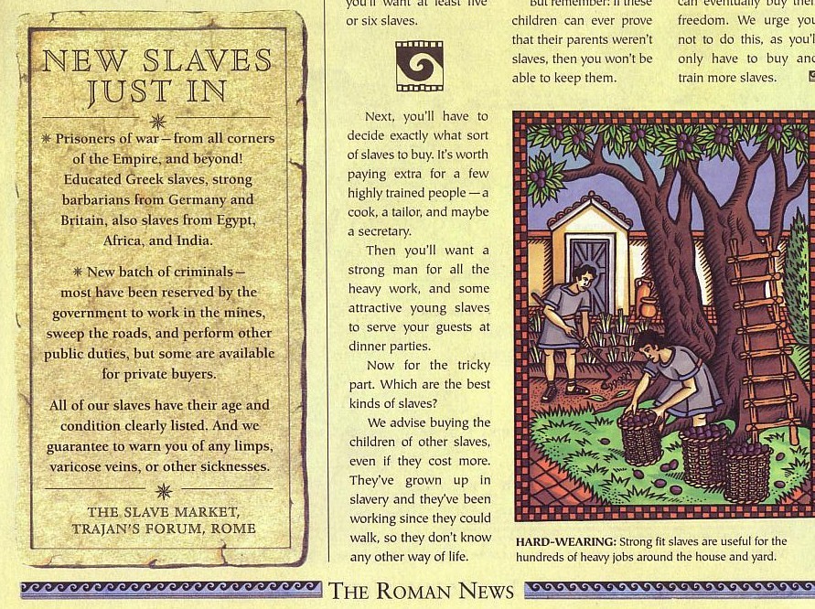
Social Classes
New Slaves Just In
Equestrians (Patricians)
Plebians
Freedman
Slaves

Slide 81
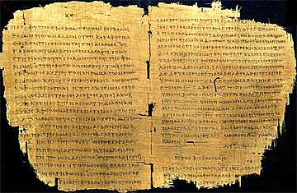
Slavery in the Roman Empire
246
"The slave was absolutely at his master's disposal; for the smallest offence he might be scourged, mutilated, crucified, [or] thrown to the wild beasts"
(J. B. Lightfoot,
Saint Paul's Epistles to the
Colossians and to Philemon, 321)

Slide 82

Roman Empire Populations
Half of the 55 million total were slaves!
Millions of People
Notes:
The Empire had 55 million people:
4 million were citizens (=7%)
55 million were non-citizens (=93%)
27.5 million were slaves (=50%)

Slide 83
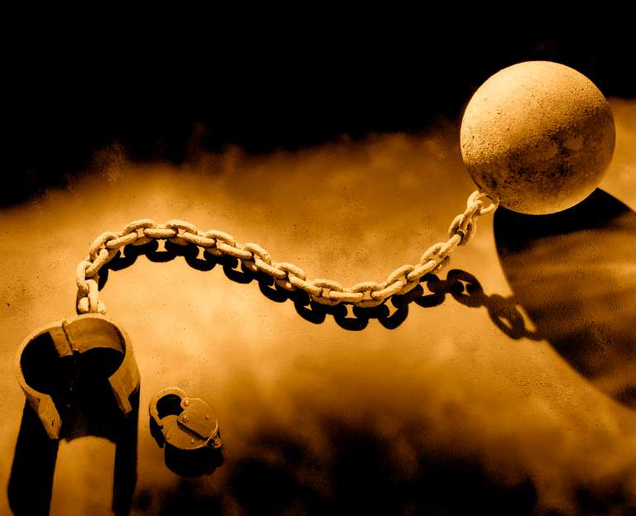
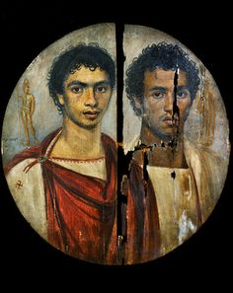
. Rome .
246
Onesimus made his way to Rome, where Paul led this fugitive slave to Christ
"my child whom I have begotten in my imprisonment" (v. 10)
Notes:
At Rome Paul met Onesimus by God's design and led him to faith in Christ.
This is why Paul referred to him as his "my child whom I have begotten in my imprisonment" (10).

Slide 84

. Occasion .
246
P
Philemon
Paul convinced Onesimus to return to his master, Philemon, even writing the letter that Onesimus himself would carry.
Notes:
Notice that Onesimus' name is mentioned here in verse 10 for the first time when Paul is almost halfway through the letter! He's using a little tact here by having prepared Philemon in the preceding comments before he mentions the name of his unfaithful servant. In the Greek "Onesimus" is the last word in the sentence.

Slide 85
"I appeal to you to show kindness to my child, Onesimus. I became his father in the faith while here in prison. ¹¹Onesimus hasn't been of much use to you in the past, but now he is very useful to both of us.
¹²I am sending him back to you, and with him comes my own heart"
(vv. 10-12 NLT).
Notes:
Onesimus served Paul effectively and they became good friends.
The name "Onesimus" means "useful," and perhaps caused Philemon to say, "Sure, some useful worker he is! The guy takes my money and splits!”
2. Paul uses a clever play on words here by saying that although he was formerly useless, he now is living up to his name (11).
3. I have a feeling that Philemon had only seen Tychicus up to this point in the letter. Then, just when Tychicus reads the word “Onesimus,” Onesiumus made his appearance from around the corner!
• Paul desired to keep Onesimus but knew that restitution was the right thing to do (12).
Retaining a slave could legally be done only with the owner's consent.

Slide 86
"I wanted to keep him here with me while I am in these chains for preaching the Good News, and he would have helped me on your behalf.
¹⁴But I didn't want to do anything without your consent. I wanted you to help because you were willing, not because you were forced” (vv. 13-14 NLT).
Notes:
Paul probably could have convinced Philemon into keeping Onesimus in Rome but didn't want to take advantage of their friendship.
When Tychicus was dispatched to Colossae with the epistle to the church, Paul felt that this was time for Onesimus to return to his master to make things right.

Slide 87
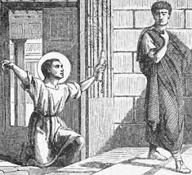
. The Reunion .
246
One wonders what Philemon thought when he saw Onesimus once again
Notes:
Paul wrote the epistle to Philemon explaining the situation and urging Philemon to take Onesimus back as a brother in Christ.

Slide 88
"It seems you lost Onesimus for a little while so that you could have him back forever. ¹⁶He is no longer like a slave to you. He is more than a slave, for he is a beloved brother, especially to me. Now he will mean much more to you, both as a man and as a brother in the Lord"
(vv. 15-16 NLT).
Notes:
Paul urged the wealthy man to begin a new kind of relationship with Onesimus (15-16). (This doesn't necessarily mean to grant him his freedom, but only to treat him with Christian love as an equal brother in Christ so that all three men were on the same level.)

Slide 89
. Repentance .
246
Paul sought to convince Philemon to forgive Onesimus
I am sorry, Master…
Notes:
Paul asked that Philemon accept Onesimus back without any debts (17-19a).

Slide 90
"So if you consider me your partner, welcome him as you would welcome me. ¹⁸If he has wronged you in any way or owes you anything, charge it to me"
(v. 18 NLT).
Notes:
Here we see a picture of God's love for the world by offering to pay the debt Himself! Paul says, "Charge it to my account" just like Christ in essence, said on the cross, "Father, forgive their sins by accepting me as their sacrifice."

Slide 91
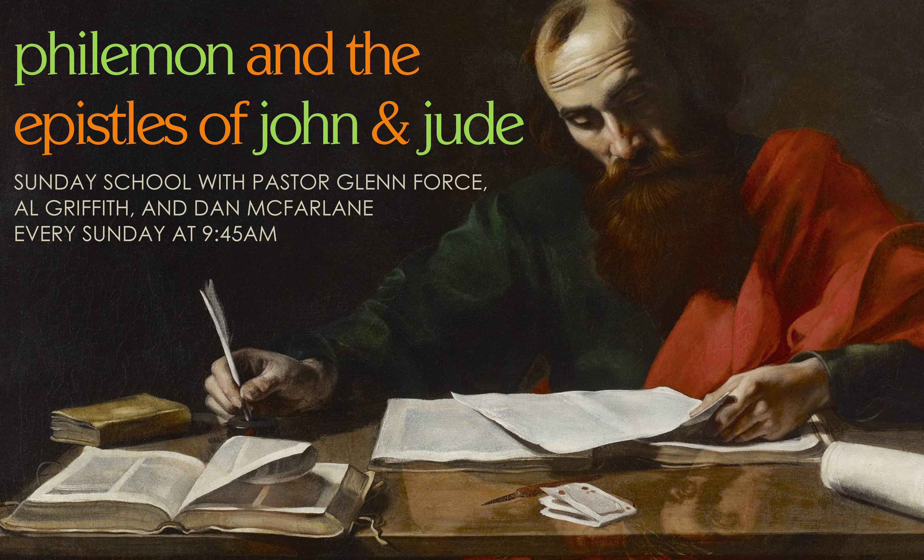
"I, Paul, write this with my own hand: I will repay it. And I won't mention that you owe me your very soul!” (v. 19 NLT).
Notes:
Paul reminds Philemon that he was responsible for his salvation (19b).
(Now that we're introduced to the key people and the basic idea of the book of Philemon, let's take a closer look at some principles about forgiveness found in the book. I've discovered four key truths from the book that will help us know the real character of true forgiveness…)

Slide 92
"Yes, my brother, please do me this favor for the Lord's sake. Give me this encouragement in Christ. ²¹I am confident as I write this letter that you will do what I ask and even more!"
(vv. 20-21 NLT).

Slide 93
"One more thing—please prepare a guest room for me, for I am hoping that God will answer your prayers and let me return to you soon" (v. 22 NLT).

Slide 94
"Epaphras, my fellow prisoner in Christ Jesus, sends you his greetings. ²⁴So do Mark, Aristarchus, Demas, and Luke, my co-workers" (vv. 23-24 NLT).

Slide 95
"May the grace of the Lord Jesus Christ be with your spirit" (v. 25 NLT).

Slide 96
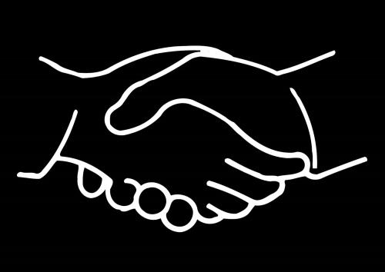
III. Philemon teaches four principles on forgiveness.
Notes:
We can gain four insights about true forgiveness here—what are its traits?

Slide 97

A. True forgiveness is granted freely, not under compulsion (14).

Slide 98
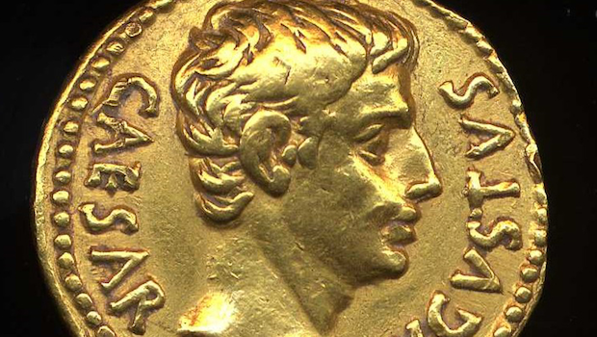
"But I didn't want to do anything without your consent. I wanted you to help because you were willing, not because you were forced" (v. 14 NLT).
Notes:
If Philemon responded out of obligation it would be good, but
if Philemon responded out of free will it would be best.

Slide 99
. Forgiveness.
246
Clearest example of the need to
demonstrate forgiveness in
New Testament
Notes:
How freely has God forgiven us? Totally! And He wants us to imitate His example! Her is the clearest example of the need to show forgiveness in the NT.

Slide 100
If you sinned 3 times a day…
= 1000 sins each year
X 40 number of years
= 40,000 sins so far!
Notes:
Consider how freely God has forgiven us: If you sin only 3 times a day (which is a standard few would ever claim!)
• that's over 1,000 sins each year!
• Multiply that times the number of years you've been sinning.
• For me that's over 40,000 sins that God has freely forgiven me! How could I do any less than freely forgive anyone else?

Slide 101
B. True forgiveness is the natural demonstration of our partnership in the gospel (17).
245
Verses 17-18
"So if you consider me a partner, welcome him as you would welcome me. If he has done you any wrong or owes you anything, charge it to me."
KEY VERSE
Notes:
Refusal to forgive in the church affects more than just the immediate people involved. It spreads to others as well. Forgiveness isn't an individual issue. It's a church issue since we're all partners in Christ.

Slide 102
"This letter is from Paul…
I am writing to Philemon, our beloved co-worker, ²and to our sister Apphia, and to our fellow soldier Archippus, and to the church that meets in your house"
(vv. 1-2 NLT).
Notes:
Refusal to forgive in the church affects more than just the immediate people involved. It spreads to others as well. Forgiveness isn't an individual issue. It's a church issue since we're all partners in Christ.

Slide 103
"One more thing—please prepare a guest room for me, for I am hoping that God will answer your (plural) prayers and let me return to you (plural) soon"
(v. 22 NLT).
Notes:
Verse 22 has the word "your" in the plural, showing this letter would be read publicly.

Slide 104
"May the grace of the Lord Jesus Christ be with your (plural) spirit" (v. 25 NLT).
Notes:
Verse 25 also has the word "your" in the plural, further emphasizing how forgiveness was a church-wide issue.

Slide 105
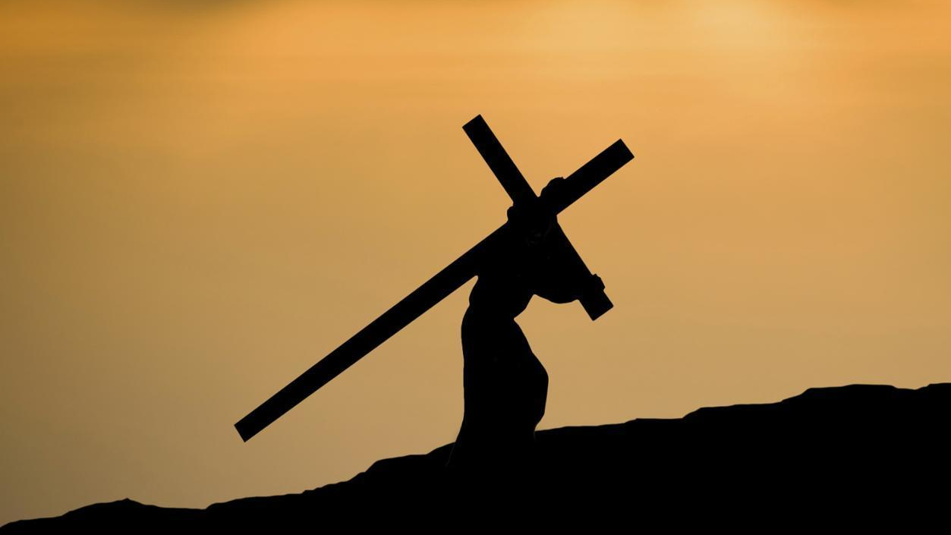
C. True forgiveness is unconditional without putting requirements on the other person (18-19).
246
Illustrates imputation:
Paul requests that all of Onesimus' sin be placed
upon himself.
Verse 18:
"If he has done you any wrong or owes you anything, charge it to me."
Notes:
Paul says to charge the debts of Onesimus to him! Just forgive—with no strings attached—like God does for us. Conditional “forgiveness” is not true forgiveness.

Slide 106
Conditional Forgiveness:
a. "I'll forgive you if…"
b. "I'll forgive—but I'll never forget…"
c. "I forgive you but don't expect me
to change my attitude."
Philemon
Notes:
How do you know when forgiveness is not unconditional? When you say…

Slide 107
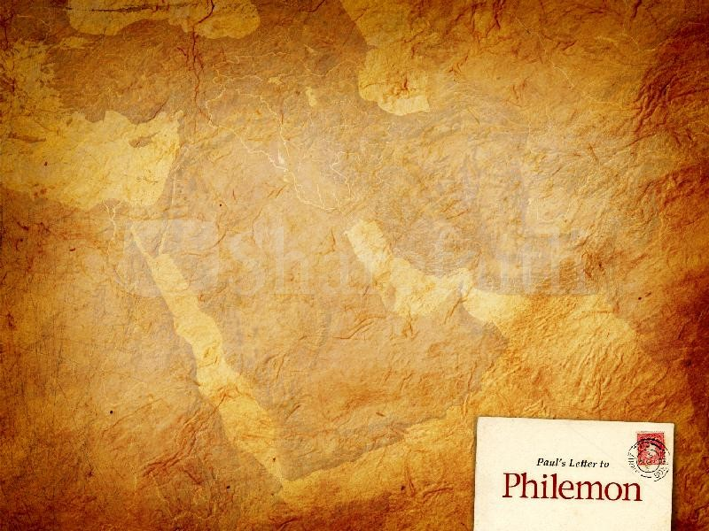
"Forgiveness is… surrendering my right to hurt you for hurting me"
—psychologist Archibald Hunt

Slide 108

D. True forgiveness "goes the second mile" (21).

Slide 109
"Yes, my brother, please do me this favor for the Lord's sake. Give me this encouragement in Christ. ²¹I am confident as I write this letter that you will do what I ask and even more!"
(vv. 20-21 NLT).
Notes:
Paul may have had in mind here that Onesimus should be returned to Paul or be granted his freedom, perhaps indicated in verse 16 where Paul encourages Philemon to take him back "no longer as a slave."

Slide 110
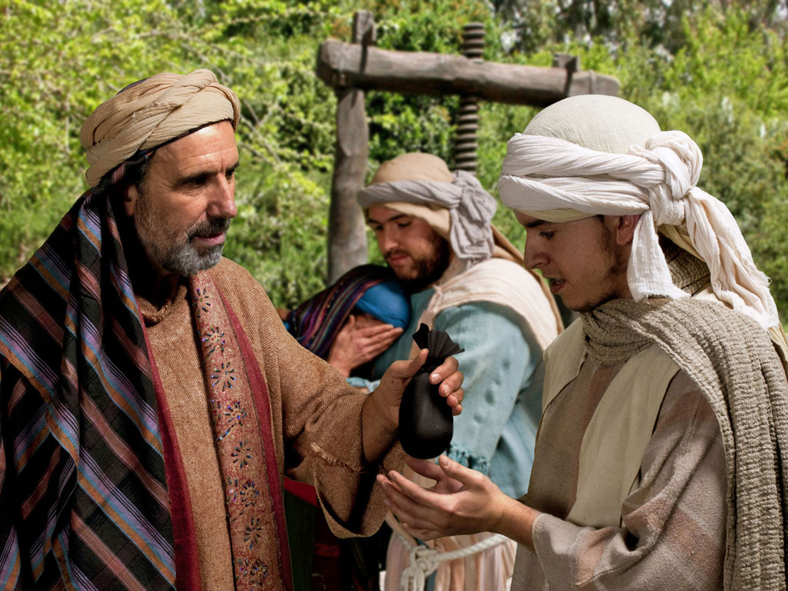
Notes:
The father of the prodigal son was deeply hurt…

Slide 111

Notes:
…over his son squandering his wealth.

Slide 112

Notes:
Yet, when the son got to his lowest point and then…

Slide 113

Notes:
…returned home to ask forgiveness, the father not only forgave him for his foolishness…

Slide 114

Notes:
but the father welcomed him home, threw a feast, put the ring on his hand and celebrated!
Maybe you need to go the second mile by inviting that person you've forgiven over for dinner, praising that person before others or manifesting that "second mile spirit" in another creative way.

Slide 115


Slide 116
How to forgive those who offend us…
Notes:
We began by asking the question, “How can we forgive those who offend us?” The key is really in verse 17 in the example of Christ taking our sins on himself. This means…

Slide 117
Main Idea
We can forgive others when we see how God has forgiven us.
Notes:
It was clearly God's will that Philemon forgive his repentant, runaway slave who had become a brother in Christ. Why? God forgave Philemon of even a greater debt.

Slide 118
I. Treat people in the best possible light (1-7).
Philemon
Notes:
Paul began his appeal to Philemon on a very positive note (1-7).

Slide 119
II. Forgive so reconciliation transcends social barriers
(8-21).
Philemon
Notes:
Paul handles this situation very delicately, not ever even using the word “forgive,” or commanding it, but he does address the need for reconciliation fairly directly.
Previously I summed up verses 8-21 as "Paul appealed for Philemon's forgiveness of his returning runaway slave, Onesimus
(8-21)."

Slide 120
Whatever happened to Onesimus?
246

Slide 121
Did Philemon Forgive Onesimus?
247
1. Philemon preserved this epistle & allowed it to be circulated & copied—this would be highly unlikely if he didn’t forgive Onesimus!
2. Paul expressed great confidence that Philemon would do more than even forgive Onesimus (v. 21)—perhaps free him?
3. Ignatius addressed the bishop in the nearby church in Ephesus about AD 115—and his name was Onesimus!
Notes:
Scripture is silent here, but
Since Philemon preserved this epistle and it was included within the New Testament it's reasonable to assume that the letter accomplished its purpose. Philemon did forgive Onesimus and accept him back.
Paul expressed confidence that Philemon would do even more than he asked (v. 21)—perhaps even free Onesimus?
3. Tradition holds that Philemon welcomed Onesimus home, but then sent him back to serve Paul. And get this—over 50 years later the church father Ignatius records that a man named Onesimus was the first Bishop of the church at nearby Ephesus!

Slide 122

Bishop Onesimus (AD 115)
Notes:
Ephesus was the city which probably was the first place to collect the books of our New Testament! Who knows what God may do in our situations if we, too, are willing to forgive?

Slide 123
Corrie ten Boom
"Forgiveness is setting the prisoner free, only to find out that the prisoner was me."
Notes:
Well, we left Corrie ten Boom before her former persecutor who was saying, "I know God has forgiven me for the cruel things I did at Ravensbruck…" The question was whether she would forgive him—whether she would shake that outstretched hand. Humanly speaking, she couldn’t do it, but, by faith, she sought to see this guard as God would. Although hand arm started stiff and cold, she felt a warmth starting at her heart, running to her shoulder, and down her arm into her hand—both hands, in fact. She grasped his hand with both hands, smiled, and said, “Yes, I forgive you! I forgive you!” (Tramp for the Lord, 56-57).
• She later defined forgiveness: “Forgiveness is setting the prisoner free, only to find out that the prisoner was me.”

Slide 124
• Application •
245
To whom do you best relate now?
Philemon the offended?
Onesimus the offender?
Paul the reconciler?
The church as affirmers?
Philemon
Notes:
With which person in this letter do you best relate to now?
Let's humble ourselves before our great God… If Paul were writing a similar letter to you as if you were Philemon, whom would he ask you to forgive?
1) Philemon the offended? Whom do you need to forgive a wrong done to you? Would Paul request you to forgive a former friend who hurt you deeply? Will you, as an act of the will (not the emotions), grant forgiveness unconditionally even if your offender never requests it?
2) Onesimus the offender? Whose forgiveness do you need to request? Maybe you're not in the position of Philemon, needing to grant forgiveness, but perhaps you're where Onesimus was, needing to ask forgiveness. Onesimus risked his very life to make things right. Certainly your risk is not greater than his. How will you respond to God's desire for you? Will you take the risk of rejection to restore your walk with God by forgiving your offender?
3) Paul the reconciler? How can you help two others reconcile? Would Paul ask you, plead with you, implore you to help someone forgive a spouse who has really blown it? Or some believers who really did wrong?
4) The church as affirmers? How can you assist the reconciliation of others, even if you are not actively involved in the situation as an offended, an offender, or as a reconciler—but you know about a relationship that needs mending? How can you pray for them?

Slide 125
Black

Slide 126


NT Preaching • BibleStudyDownloads.org
Get this presentation for free!
Notes:
NT Survey (ns)

Slide 127
. Characteristics .
246
Meaning of purple hyacinth:
"I am sorry, please forgive me, sorrow"
Paul provides several reasons why forgiveness is important:
Forgiveness solidifies friendships (vv. 8-11, 17-20).
Restored relationships make people more helpful to us (v.11).
Forgiveness involves one's heart (v. 12).
The sacrifice that forgiveness requires is painful but good for us (vv. 13,18-19a).
Forgiveness shows humility since it must be voluntary not forced (vv. 14-,21).
Forgiveness reminds one that God is in control of painful events (vv. 15, 16).
Forgiving others reminds us of how God forgave us (v.19b)

Slide 128
Summary Statement
245
Paul requests the Christian slave owner, Philemon, to forgive his runaway but repentant slave, Onesimus, whom Paul led to Christ and sent back to Philemon to be received as a Christian brother and to teach forgiveness.

Slide 129


Does Christ break social chains?
Yes!

Slide 130

Does this letter teach slaves to overthrow their owners?

Slide 131

The Usual Application
  It teaches
  the duty of slaves
  to their masters
  and of masters
  to their slaves.
THE
HISTORICAL
VIEW

Slide 132

A New Approach
It "destroys slavery"
But Paul taught masters to treat slaves in a godly manner rather than him seeking to overthrow slavery. This is consistent with his teachings in his other epistles.

Slide 133
Characteristics
Paul and other NT writers recognize the existence
of the slave and master relationship
Peter's advice on slavery
1 Peter 2:18-25
Paul's advice to slaves
Eph. 6:5-8
Col. 3:22-25
1 Tim. 6:1-2
Paul's advice to slave owners
Eph. 6:19
Col. 4:1

Slide 134



. Characteristics .
Christians must show love as the basis of all their relationships:
Love regardless of the Christian status or otherwise of the other party.
In the church all believers are sons and daughters of God and therefore brothers and sisters to one another.
A slave is lifted from being a slave to being "more than a slave" — a brother who is loved.

Slide 135
. Keyword .
245
Forgiveness
purple hyacinth

Slide 136
Book Chart
Philemon
245
Forgive Others and Seek Forgiveness
Forgive Others and Seek Forgiveness
Greeting
1-3
Prayer & Commendation
4-7
Appeal for Onesimus
8-21
Conclusion
22-25
Greeting
1-3
Prayer & Commendation
4-7
Appeal for Onesimus
8-21
Conclusion
22-25
Preface
Praise
Petition
Postscript
Preface
Praise
Petition
Postscript
People
Concerned
People
Concerned
Philemon's
Character
Philemon's
Character
Onesimus'
Conversion
Onesimus'
Conversion
Paul's
Co-Workers
Paul's
Co-Workers
Authors
1a-b
Authors
1a-b
Recipients
1c-3
Recipients
1c-3
Thanks
4-5
Thanks
4-5
Relationships
6-7
Relationships
6-7
General Appeal
8-11
General Appeal
8-11
Reasons for Return
12-16
Reasons for Return
12-16
Specific Appeal
17-21
Specific Appeal
17-21
Preparations
Greetings
Blessing
22-25
Preparations
Greetings
Blessing
22-25
Rome to Colosse
Rome to Colosse
Fall AD 61
Fall AD 61

Slide 137


Synthesis
247
1-3 Greeting
4-7 Prayer / commendation
8-21 Appeal for Onesimus
22-25 Conclusion

Slide 138

Paul helped Onesimus see his responsibility to Philemon

Slide 139

Basic Steps to Gain a Forgiving Spirit
252
1. Realize that God is working through the actions of your offender
2. Thank God for the benefit He plans through each offense
3. Discern what character qualities God wants to develop in you through the offense
4. Expect to suffer for doing right as a normal part of Christian living
The Via Appia, "Queen of Roman roads," which was the road from Rome that Onesimus took back to Colossae for Philemon's forgiveness
Bill Gothard, IBLP

Slide 140


How do I ask forgiveness?
253
Never say, "I'm sorry"
(period/full stop).
Say, "Will you forgive me for ___________"
(specify your offense).
Philemon 11, 18
Notes:
Carolyn

Slide 141

How do I ask forgiveness?
253
Not by phone
Not by letter
Not by fax
Not by text message
Not by facebook
Not by Twitter
Not by email
Not by mediators…
Notes:
Carolyn

Slide 142

How do I ask forgiveness?
253
But by one simple word…
Go
Notes:
Carolyn

Slide 143

How do I ask forgiveness?
253
Onesimus traveled 1400 km to speak to Philemon in person
Notes:
Carolyn

Slide 144


How do I ask forgiveness?
253
Demonstrate humility without concern for saving face.
Philemon 1, 8-9, 14 (cf. Gal. 6:1b, 3-4)
Notes:
Carolyn

Slide 145

How do I ask forgiveness?
253
Remember that your response is not a private issue, but public, involving many people.
Philemon 1-2, 25 (plural)
Notes:
Carolyn

Slide 146
How do I ask forgiveness?
253
Make the request for
forgiveness as public
as the offense.
Public sins require public apology
(1 Tim. 5:20)
Private sins require private apology (Matt. 18:15)
Notes:
Carolyn

Slide 147
Restoring Relationships
253
General Principle
Romans 12:18
"If it is possible, as far as it depends on you,
live at peace with everyone."
For the Offender: GO!
Matthew 5:23-24
James 5:16
For the Offended: GO!
Matthew 18:15
Galatians 6:1
Notes:
What does the Bible have to say….

Slide 148

How We Become Like Those We Resent
251
I'll never
be like* my
father!
You're just like your father! (in attitudes)
He was focusing on one side of the emotional focus
SON
He didn't realize that there is another side also
EMOTIONAL FOCUS ON FATHER
VISIBLE ACTIONS
ROOT ATTITUDES
(Drinking, neglect, unfaithfulness, etc.)
(Bitterness, selfishness, pride, self-centeredness, etc.)
Bill Gothard, Institute in Basic Life Principles
*LIKE – Standard of comparison
FATHER
Notes:
What does the Bible have to say….

Slide 149
Outline
248-250
(1-3) Paul introduces himself as author with Timothy, addresses Philemon, his wife, his son & his house church, & wishes them God's grace & peace to set the tone for his following appeal for Onesimus.
(4-7) Paul prays for & commends the love & faith of Philemon in genuine thanksgiving to encourage Philemon to demonstrate these same qualities towards Onesimus, his runaway but repentant slave.
(8-21) Paul makes a general appeal to Philemon for mercy to be granted to Onesimus, cites reasons for sending him back to Philemon & makes a specific request that Onesimus be fully pardoned for his wrongdoing.
(22-25) Paul requests preparations for his anticipated visit,
sends greetings from co-workers & blesses the church to reinforce the public nature of Philemon's decision & to remind of God's power for fulfilling his appeal.

Slide 150
Philemon Group Members
William Heng
Priskali Achum
Carolyn Chiew
Vincent Lim
Eric Chong
Ng Wee Hua
Victor
Yeo Pin Pin
Andrew Lim

Slide 151



Philemon
Philemon

Slide 152
Black

Slide 153
NT Survey link at BibleStudyDownloads.org
Get this presentation for free!
Notes:
NT Survey (ns)

