Slide 1
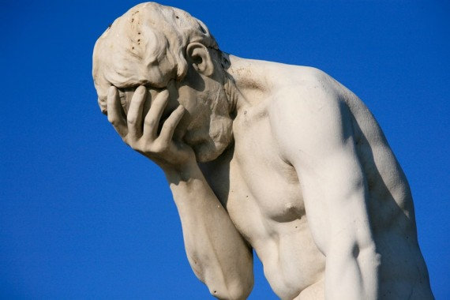
TITUS
241
Dr. Rick Griffith • Jordan Evangelical Theological Seminary • BibleStudyDownloads.org
Notes:
Titus was Paul's man for difficult missions. Thankfully, Paul did not tell him all he needed to know verbally, so some of what he told Titus is reserved for us in this letter.

Slide 2
Key Word
241
Conduct
Titus
Notes:
The people on the island of Crete lived very evil, dishonest, and lazy lives, so Paul encouraged Titus to teach the believers to stand out among them with good conduct.

Slide 3
Theme
23
Sound Conduct Against Opposition
Titus
Notes:
Like most places, false teachers once again followed Paul. So, he instructed Titus to rebuke them with his words—but even more than that, to rebuke them with his lifestyle.

Slide 4
Key Verse
241
“This is a trustworthy saying. And I want you to stress these things, so that those who have trusted in God may be careful to devote themselves to doing what is good. These things are excellent and profitable for everyone” (3:8).
Titus
Notes:
Do believers have a reputation for good deeds where you live?

Slide 5
TITUS
241
The way we can be reputable amidst false teachers is through godly elders who teach respectable conduct based on God’s grace
Notes:
The emphasis on elders in this letter is huge.

Slide 6

Kingdom Statement
27d 241
Jesus is Christ (1:4) "our Savior” (3:6) whom we serve “while we wait for the blessed hope—the glorious appearing of our great God and Savior, Jesus Christ” (2:13).
Titus
Notes:
The kingdom idea is not prominent here, but the return of Christ to establish his kingdom is big.

Slide 7

Covenant
27d
The conduct of the church is vital witness to the truth of the gospel (2:11–3:15).
Titus
Notes:
New covenant theology is not prominent here, but new covenant behavior is key!

Slide 8

Redemption
27d
“For the grace of God that brings salvation has appeared to all men” (2:11) teaches us godliness.
Titus
Notes:
There is no conflict between theology and conduct. Salvation should lead to changed lives.

Slide 9
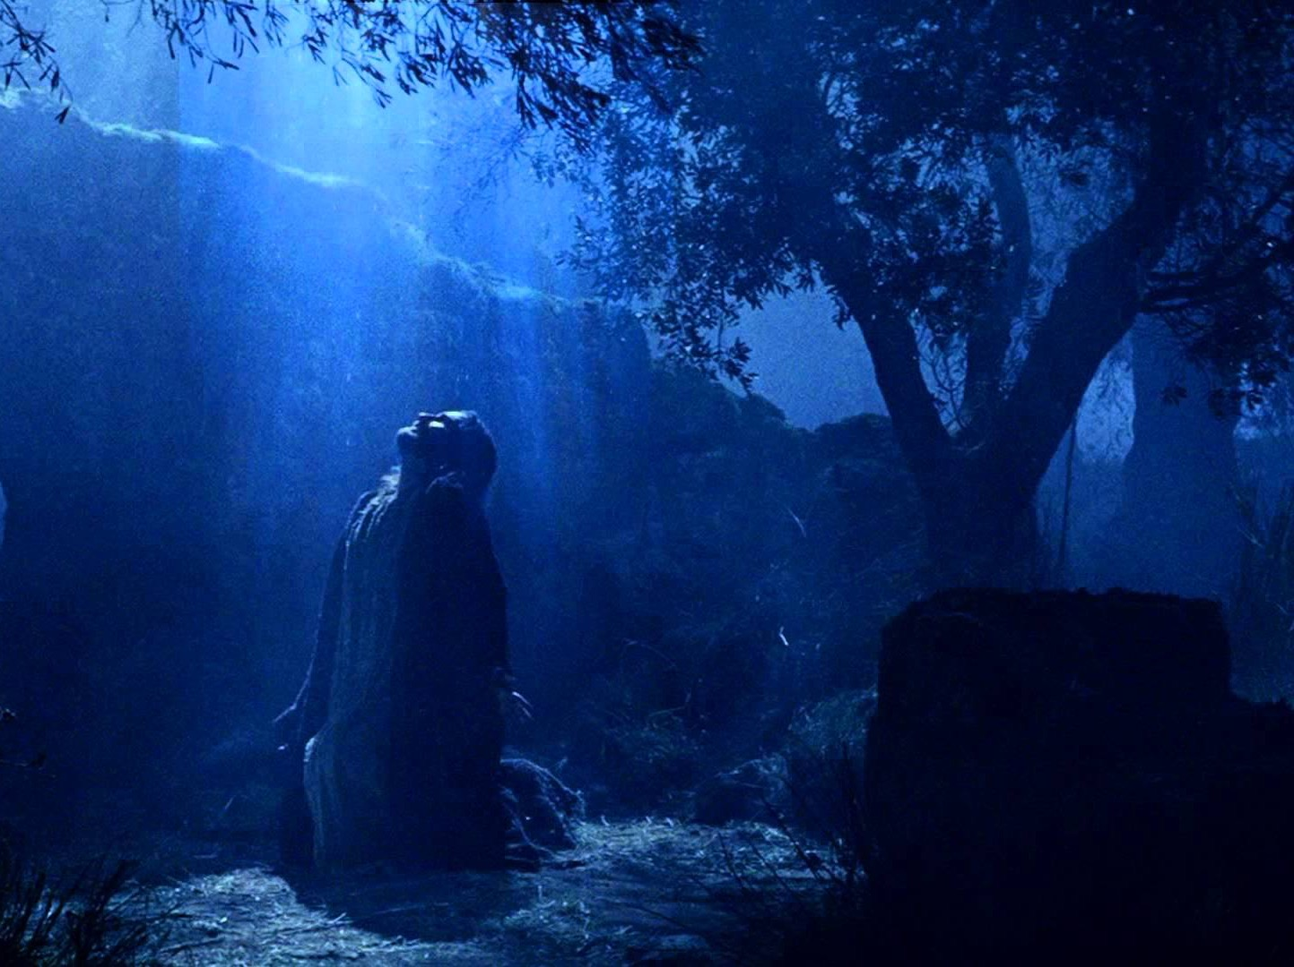
Prophecy (Lord, Deity)
27d
God promised eternal life before the beginning of time (1:2).
Titus
Notes:
God has always desired for us to live forever—since Eden.

Slide 10
Summary Chart
Titus
241
Sound Conduct Against Opposition
Sound Conduct Against Opposition
Appoint Elders
Appoint Elders
Set Things in Order
Set Things in Order
Prevent False Doctrine
Prevent False Doctrine
Practice True Doctrine
Practice True Doctrine
Elders vs. False Teachers
Elders vs. False Teachers
Conduct
for Various Groups
Conduct
for Various Groups
Grace
Leads to Godliness
Grace
Leads to Godliness
Chapter 1
1
2:1-10
2:1-10
2:11–3:15
2:11–3:15
Organize
Organize
Teach
Teach
Grace
Grace
Truth Leads to Godliness
1:1-4
Truth leads to godliness
1:1-4
Elders
1:5-16
Elders
1:5-16
Older Men
2:1-2
Older Men
2:1-2
Older Women
2:4-5
Older Women
2:4-5
Younger Women
2:4-5
Younger Women
2:4-5
Younger
Men
2:6-8
Younger
Men
2:6-8
Slaves
2:9-10
Slaves
2:9-10
Educates
2:11-15
Educates
2:11-15
Empowers
3:1-2
Empowers
3:1-2
Motivates
3:3-8
Motivates
3:3-8
Protects
3:9-11
Protects
3:9-11
Concl.
3:12-15
Relates
3:12-15
Asia Minor to Crete
Asia Minor to Crete
Summer AD 66
Summer AD 66
Notes:
The parallel letter is 2 Timothy with the theme "Sound Doctrine Against Opposition." Both doctrine and conduct are important and noted in both letters, so the issue is one of emphasis.

Slide 11
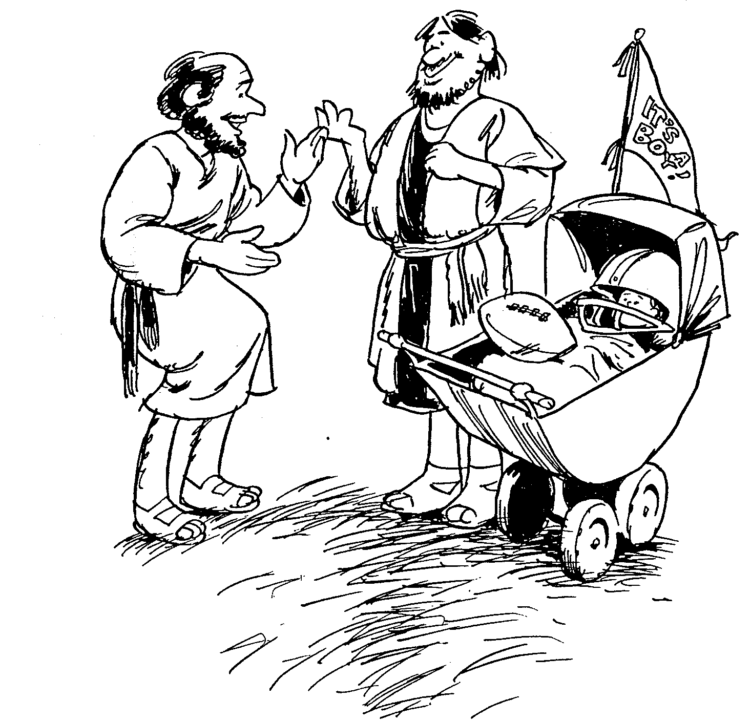
TITUS
1
2
3
Sound doctrine silences error
Order life to doctrine
Never shun good deeds
Barry Huddleston, The Acrostic Bible
Notes:
A son is supposed to be like his father. Paul was the father and Titus should imitate him.

Slide 12

Be Reputable
Titus
Dr. Rick Griffith • Crossroads International Church Singapore
BibleStudyDownloads.org
Notes:
Character is what we really are. Reputation is what others think we are. Both are vital.

Slide 13

False Teaching Today
God heals all with real faith?
Wealth is our divine right?
Lord’s Supper healing?
Titus
Notes:
What heresies do you face in your ministry right now?

Slide 14
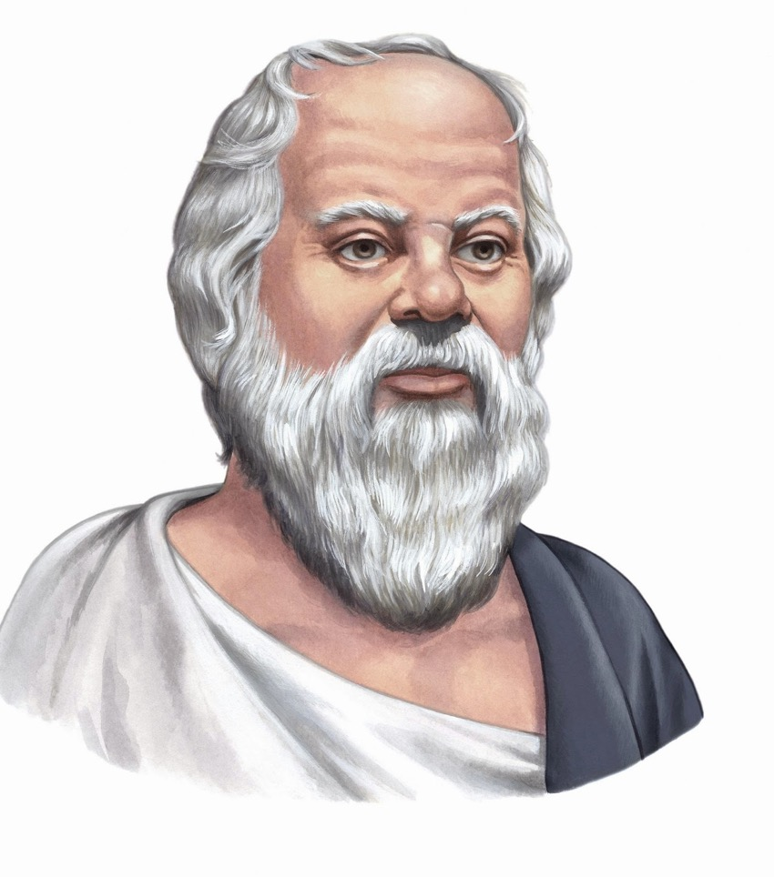
Reputation
The way to gain a good reputation is to endeavor to be what you desire to appear.
—Socrates
Letter to Titus
Notes:
Sadly, for too many of us, our standards are much too low.
What happens when we actually do this?

Slide 15

How can we be reputable in the midst of so much false teaching today?
3 ways in Titus…
Notes:
How can we stand true to the Lord with so many heresies plaguing the church?

Slide 16

I. Have godly elders teach truth.
Titus 1
Notes:
Sound doctrine silences error.

Slide 17


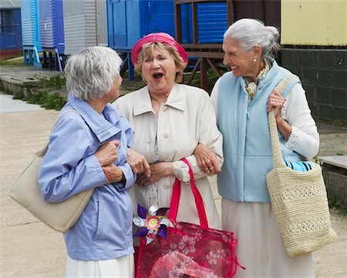

II. Act your age.
Titus 2:1-10
Notes:
Order life to doctrine.

Slide 18

III. Let grace bring godliness.
Titus 2:11–3:15
Notes:
Never shun good deeds

Slide 19
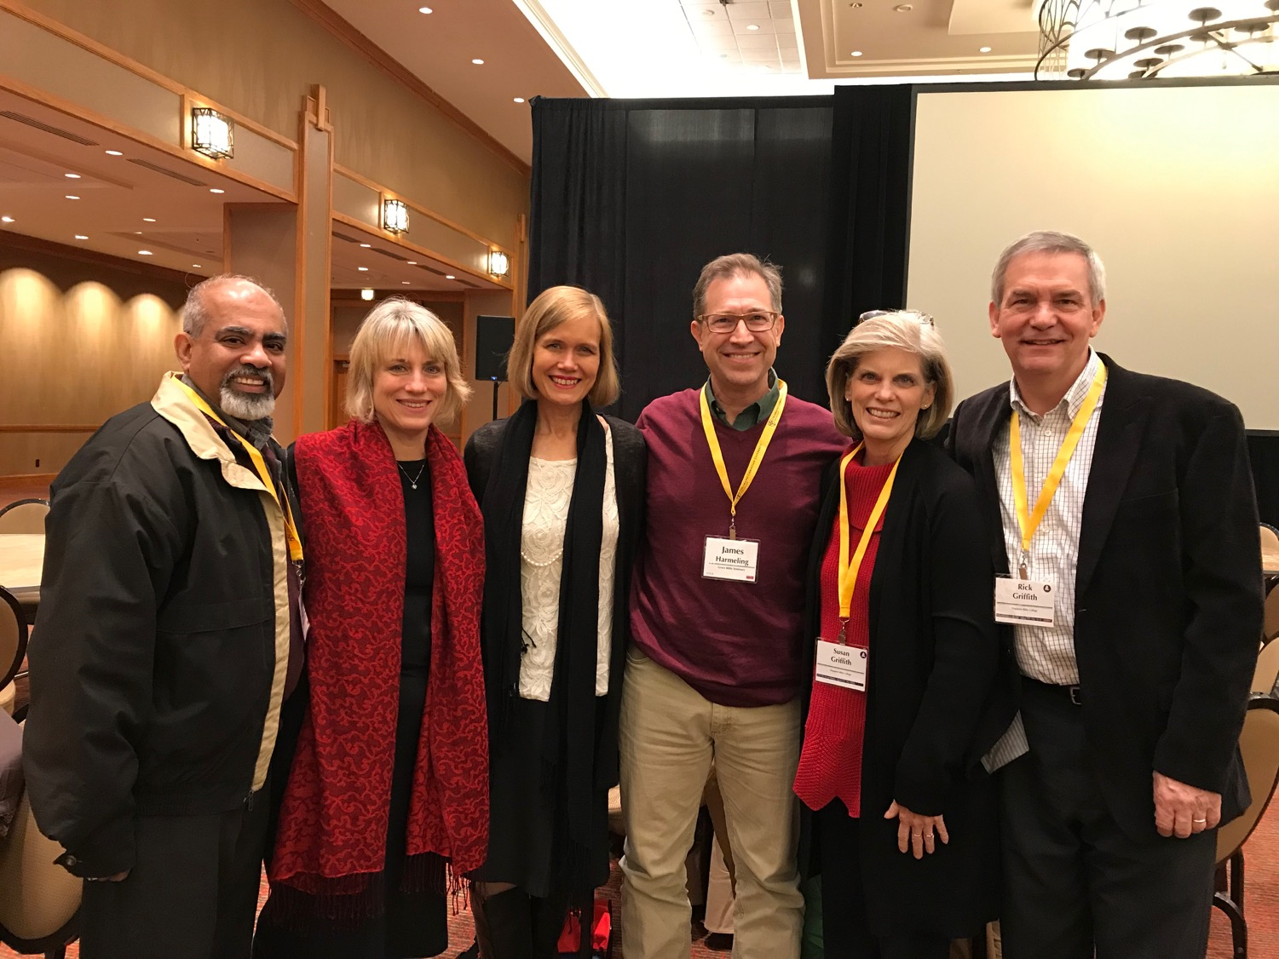
Main Idea
Titus
Our elders must teach respectable conduct based on God’s grace.
Notes:
Our leaders need to see the unmerited favor Jesus gives—and then humbly instruct how that should result in an honorable lifestyle.
Overseers have the responsibility to preach how the Lord enables us to live soberly.

Slide 20
Black

Slide 21
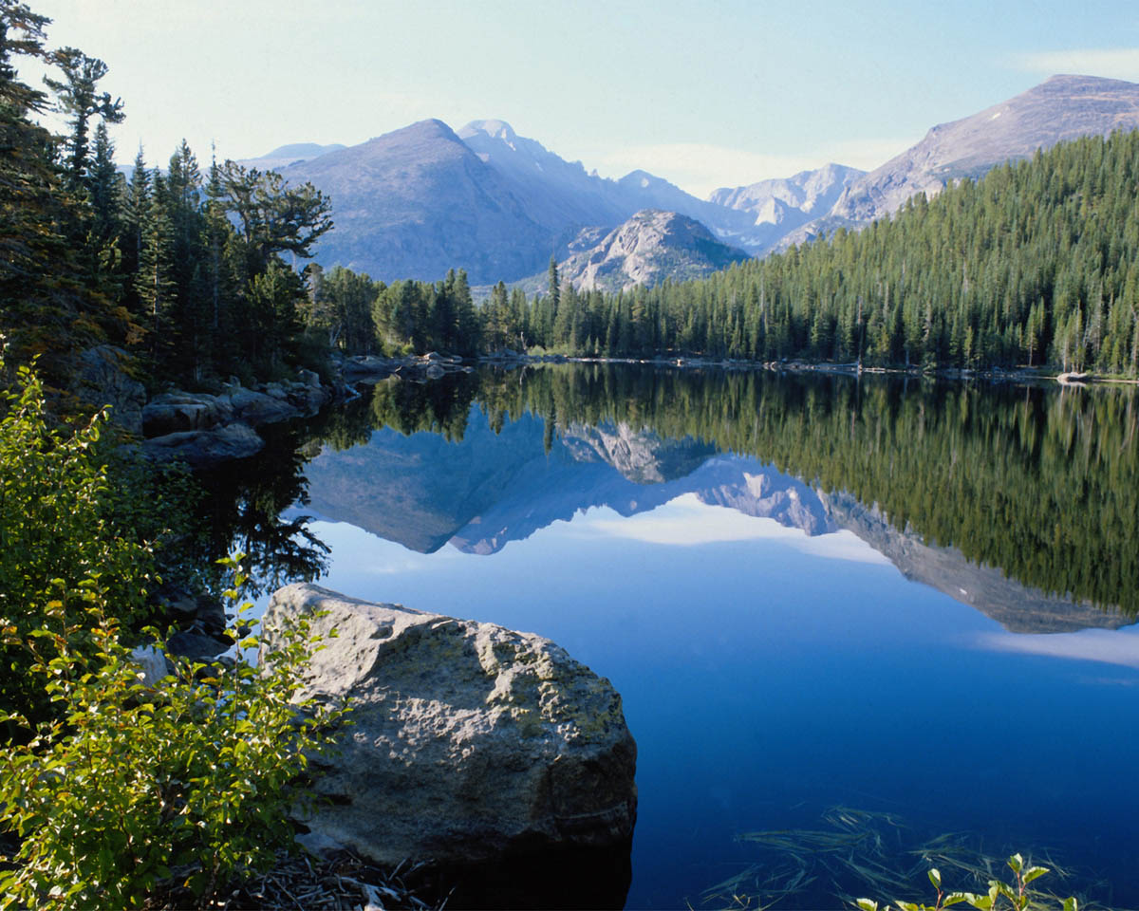
We Are an Offering 1/4
We lift our voices, we lift our hands,
we lift our lives up to You,
we are an offering.
Lord, use our voices, Lord, use our hands,
Lord, use our lives, they are Yours,
we are an offering.

Slide 22
We Are an Offering 2/4
All that we have, all that we are,
all that we hope to be,
we give to You, we give to You!
We lift our voices, we lift our hands,
we lift our lives up to You,
we are an offering,
we are an offering.

Slide 23
We Are an Offering 3/4
We lift our voices, we lift our hands,
we lift our lives up to You,
we are an offering.
Lord, use our voices, Lord, use our hands,
Lord, use our lives, they are Yours,
we are an offering.

Slide 24
We Are an Offering 4/4
All that we have, all that we are,
all that we hope to be,
we give to You, we give to You!
We lift our voices, we lift our hands,
we lift our lives up to You,
we are an offering,
we are an offering.

Slide 25


What better motivates you to right behaviour?
Quiz Time. . .
Grace? or
Law?
Support your answer!

Slide 26
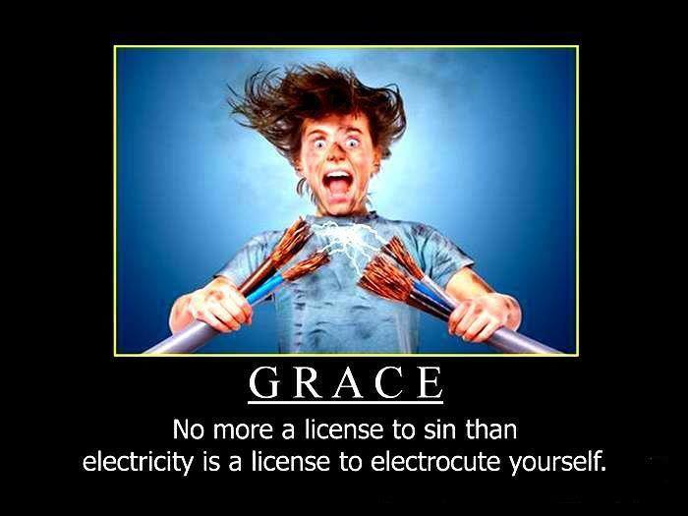
GRACE
No more a license to sin than electricity is a license to electrocute yourself

Slide 27
NT Book Key Words
24
Date | Book | Key Word | Paul's Life | Key Doctrine
40s | Matthew | Kingdom |  | Ecclesiology
44-47 | James | Works |  | Soteriology
49 | Galatians | Justification | 1st journey | Soteriology
51 | 1 Thessalonians | Rapture | 2nd journey | Eschatology
51 | 2 Thessalonians | Tribulation | 2nd journey | Eschatology
56 | 1 Corinthians | Sanctification | 3rd journey | Ecclesiology
56 | 2 Corinthians | Apostleship | 3rd journey | Ecclesiology
56-57 | Romans | Righteousness | 3rd journey | Soteriology
57-59 | Luke | Sovereignty I |  | Missiology

Slide 28
NT Book Key Words
NT Book Key Words
24
Date | Book | Key Word | Paul's Life | Key Doctrine
60 | Ephesians | Unity | 1st imprisonment | Christology (Head)
61 | Colossians | Deity | 1st imprisonment | Christology (God)
61 | Philemon | Forgiveness | 1st imprisonment | Christology (Reconciler)
62 | Philippians | Attitude | 1st imprisonment | Christology (Example)
62 | Acts | Sovereignty II |  | Missiology
62 | 1 Timothy | Order | 4th journey | Ecclesiology
64 | 1 Peter | Suffering |  | Eschatology
64 | 2 Peter | Knowledge |  | Eschatology
64-68 | Mark | Discipleship |  | Eschatology

Slide 29
NT Book Key Words
NT Book Key Words
24
Date | Book | Key Word | Paul's Life | Key Doctrine
66 | Titus | Conduct | 4th journey | Ecclesiology
67 | 2 Timothy | Doctrine | 2nd imprisonment | Ecclesiology
67-68 | Hebrews | Superiority |  | Christology
c. 69 | John | Belief |  | Soteriology
75 | Jude | Pretenders |  | Eschatology
85-95 | 1 John | Love |  | Soteriology
85-95 | 2 John | Limits |  | Missiology
85-95 | 3 John | Missionaries |  | Missiology
95-96 | Revelation | Triumph |  | Eschatology

Slide 30
Overview of Paul's Letters
38 124 39-41
"To the remotest part of the earth" (Acts 1:8)
Acts 9 13 14 15 16 18 21 27 28
Apr 48- Sep 49
1 Galatia
Apr 50- Sep 52
2 Aegean
Spr 53- May 57
3 Asia
Feb 60- Mar 62
1 Rome
Spr 62- Fall 67
4 Spain
Aut 67- Spr 68
2 Rome
35- 47
Damascus Antioch
May 57- Aug 59
Trials
Fall 49
The
Council
Spring 68
Expansion of Church
35 48 49 50 52 53 57 60 62 67 68 95
Matt
Luke
Acts
Mark
John
Gal
1 Thess
1 Cor
Eph
1 Tim
2 Tim
2 Thess
2 Cor
Col
Titus
Missionary
Pastoral
Romans
Philem
Gospels & Acts
Phil
Pauline Epistles
1234
Journeys
Prison
Rome
Imprisonments
Pauline
Notes:
We may suppose that heresies take a long time to develop, but the New Testament teaches otherwise. Within a generation of Christ's life, many false systems developed. Paul writes in the AD 60s, just prior to his beheading, that many had fallen into the snare of deceptive teaching.
Yet nearly all of Paul's writings responded to a heresy. This means that he took false doctrine seriously, in contrast to the church of our day in many circumstances.
Paul wrote while traveling, imprisoned, or to key leaders.
Observations about chronology:
Gospels were not written first, but throughout the NT era
Evangelistic letters preceded pastoral
Rough letter (Galatians) preceded smoother ones
_______________
Common-493
NS-00-NT Introduction-97
NS-03-Luke1-12-slide 65
NS-06-MissionaryEpistles-2
NS-06-Rom1-2-slide 16
NS-07-1Cor1-9-slide 23
NS-08-2Cor-27
NS-11-Philippians-15, 40
NS-12-Colossians-22, 24, 304
NS-17-Titus-30

Slide 31
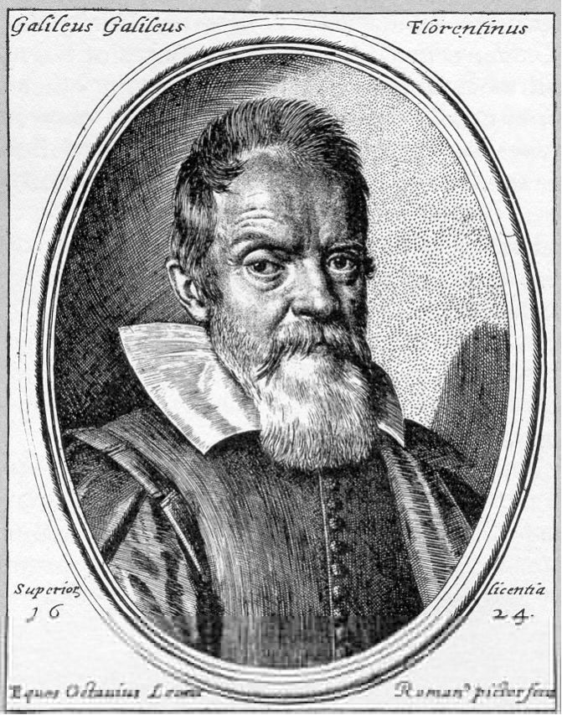
How should we fight heresy?
Galileo was deemed a heretic for his "unorthodox" views of a belief in atoms and a round world.
But it could get worse…
Notes:
･ Galileo, HereticPietro Redondi, translated by Raymond Rosenthal - Allen Lane, Penguin Press, 1987 ﾐ 356 + x pp - ｣17.95 The story of Galileo's quarrel with the Roman Catholic Church and of the events leading to his trial in 1633 is well-known, yet although the case against him has been explored many times, there remains a suspicion that our knowledge is incomplete and that there were hidden factors. Wide-ranging and revolutionary as the implications of the Copernican system were, it seems unlikely that their theological challenge would have been insuperable. Even Pope Urban VIII himself had earlier befriended Galileo and had shown interest in his Copernican studies. It appears therefore, that the problems raised by Galileo's work stemmed from a deeper meta-physical level and in this book Pietro Redondi seeks to show that the charge of heresy brought against Galileo in 1633 arose less from his Copernicanism than from his unorthodox physical ideas, especially his support for an atomist theory of heat, light and matter. This theory was opposed to Aristotelian ideas of matter and substantial forms which had long supported the fundamental Roman Catholic doctrine of transubstantiation. An atomist theory was incompatible with the miraculous transformation of the Host." http://www.historytoday.com

Slide 32
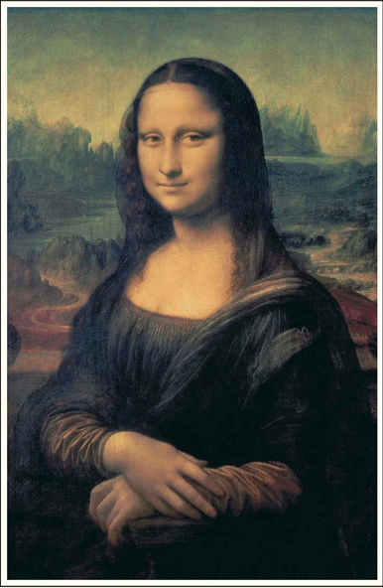

How should we fight heresy?

Slide 33
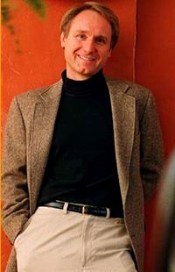
Laughing all the way to the bank
$260 million
12 million copies sold

Slide 34
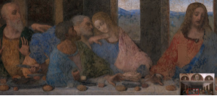
Who is this?
John?
or Mary?
Brown says "John" is actually Mary Magdalene, the wife of Jesus Christ!
But da Vinci is only depicting John in the typical Florentine fashion as "the beautiful young man"

Slide 35
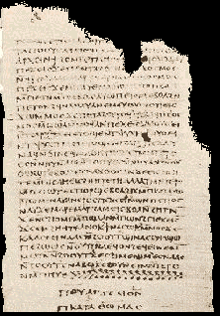
Mary Magdalene as the "Companion" (Wife) of Christ
And the companion of the [...] Mary Magdalene. [...] loved her more than all the disciples, and used to kiss her often on her mouth. The rest of the disciples [...]. They said to him "Why do you love her more than all of us?"
The Gospel of Philip
(Gnostic NT Apocrypha)
http://www.gnosis.org/naghamm/gop.html
Notes:
http://www.gnosis.org/naghamm/gop.html
Image is of the Gospel of Thomas on the same site.

Slide 36

Title
Titus
Title
242
The Letter to Titus
(Pro.j Ti.ton To Titus)
is one of the three books
commonly called Pastoral Epistles,
which are unique in that they are addressed to individuals (not churches) and constitute Paul's last writings

Slide 37
Authorship
Titus
Authorship
242
External Evidence Attestation for Pauline authorship is as good as that of any other Pauline epistle except Romans and
1 Corinthians
Internal Evidence
The letter claims Pauline authorship (Tit. 1:1) and contains the typical Pauline characteristics

Slide 38
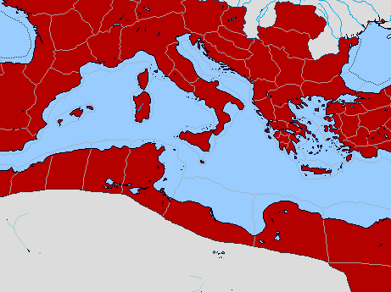
Bible Lands Blank Map
Paul’s Acts 28:30-31 Letters
142
Rome
Macedonia
Spain
Ephesians
Colossians
Ephesus
Philemon
Philippians
Crete
© https://www.deviantart.com/sharklord1/art/Alt-Roman-Empire-Provinces-701148110
Notes:
Paul wrote the Prison Epistles while under house arrest in Rome, recorded in the last two verses of Acts. These took two years (AD 60-62) and were likely written in this order above. We are unsure whether Ephesians and Colossians were written at the same time, but they have many similarities. But it is nearly certain that Tychicus and Onesimus brought back to Colosse both the letter to the entire church and also the personal letter to Philemon, who lived there and had the church meet in his house.
—————
Freedom from Imprisonment Spring 62–Fall 67
Paul in Ephesus and Colosse (Timothy left at Ephesus) Spring–Summer 62
Peter travels to Rome 62
_______________
NS-15-Pastorals-4
NS-15-1 Timothy-61

Slide 39

Date 1
Pastorals
Date
238
The chronology of Paul's latter years is obscure, yet one harmonization of the internal and external data yields this scenario:
1st Roman Imprisonment February 60–March 62
(Acts 28:30-31)
Paul writes Ephesians, Autumn 60–early Spring 62
Colossians, Philemon,
and Philippians
Martyrdom of James, Spring 62
the Lord's brother

Slide 40
Bible Lands Blank Map
Paul’s Post-Acts Journey
142
Rome
Macedonia
1 Timothy
Spain
Ephesus
Crete
© https://www.deviantart.com/sharklord1/art/Alt-Roman-Empire-Provinces-701148110
Notes:
Paul wrote 1 Timothy shortly after being there himself—likely only months later. We benefit from him recording his instructions to Timothy rather than simply telling him verbally.
—————
Freedom from Imprisonment Spring 62–Fall 67
Paul in Ephesus and Colosse (Timothy left at Ephesus) Spring–Summer 62
Peter travels to Rome 62
Paul in Macedonia late summer 62-winter 62/63
1 Timothy written from Macedonia to Timothy in Ephesus Fall 62
Paul in Asia Minor Spring 63-Spring 64
_______________
NS-15-Pastorals-6
NS-15-1 Timothy-6
NS-16-2 Timothy-48

Slide 41
Date 2
Pastorals
Date
238
Freedom from Imprisonment Spring 62–Autumn 67
Paul in Ephesus and Colosse Spring–Summer 62
(Timothy left at Ephesus)
Peter travels to Rome 62
Paul in Macedonia late summer 62-winter 62/63
1 Timothy written in Macedonia Autumn 62
to Timothy in Ephesus
Paul in Asia Minor Spring 63-Spring 64
Paul in Spain Spring 64-Spring 66
(anticipated in Rom. 15:24)
Christians persecuted by Nero Summer 64
and Peter martyred
1 Timothy written in Macedonia Autumn 62
to Timothy in Ephesus
Notes:
Paul wrote 1 Timothy shortly after being there himself—likely only months later. We benefit from him recording his instructions to Timothy rather than simply telling him verbally.

Slide 42
Bible Lands Blank Map
Paul’s Post-Acts Journey
142
Rome
Macedonia
2 Timothy
Nicopolis
Troas
Spain
Ephesus
Titus
Crete
© https://www.deviantart.com/sharklord1/art/Alt-Roman-Empire-Provinces-701148110
Notes:
Paul in Asia Minor Spring 63-Spring 64
Paul in Spain (anticipated in Rom. 15:24) Spring 64-Spring 66
Christians persecuted by Nero; Peter martyred Summer 64
Paul in Crete (Titus left there; Tit 1:5) early Summer 66
Paul in Asia Minor Summer- Fall 66
Titus written from Asia Minor to Titus in Crete Summer 66
Paul in Nicopolis (Tit 3:12) Winter 66/67
Paul in Troas (2 Tim 4:13), Macedonia and Greece Spring– Fall 67
Second Roman Imprisonment Fall 67–Spring 68
Paul arrested and brought to Rome Fall 67
2 Timothy written from Rome to Timothy in Ephesus Fall 67
Paul beheaded Spring 68
_______________
NS-15-Pastorals-8
NS-15-1 Timothy-8
NS-16-2 Timothy-50

Slide 43
Date 3
Pastorals
Date
238
Paul in Crete early Summer 66
(Titus left there; Tit. 1:5)
Paul in Asia Minor Summer-Autumn 66
Titus written from Asia Minor Summer 66
to Titus in Crete
Paul in Nicopolis (Tit. 3:12) Winter 66/67
Paul in Troas (2 Tim. 4:13), Spring–Autumn 67
Macedonia and Greece
Titus written from Asia Minor Summer 66
to Titus in Crete
2nd Roman Imprisonment Autumn 67–Spring 68
Paul arrested and brought to Rome Autumn 67
2 Timothy written from Rome Autumn 67
to Timothy in Ephesus
Paul beheaded Spring 68
2 Timothy written from Rome Autumn 67
to Timothy in Ephesus
Destruction of Jerusalem 2 September 70
Notes:
Titus is in green as Paul wrote it while he was free to GO around to share the gospel.
But 2 Timothy is purple to remind us that, while imprisoned again, he did this for royal purposes.
Paul spent at least 5 of his final 11 years in prison:
• AD 57-59 Caesarea for 2 years
• AD 60-62 Rome for 2 years
• AD 67-68 Rome for 1 year

Slide 44
Circumstances
Titus
Circumstances
242
Origin / Recipients
Paul's letter to Titus (Tit. 1:4) was sent from an unknown location in Asia Minor to Titus in Crete (Tit. 1:5). Ephesus, Macedonia, and Corinth have been postulated, but the location of composition does not change its interpretation.
Occasion
Between Paul's 1st and 2nd Roman imprisonments he and Titus traveled together to Crete. With the evangelistic work well under way and many new Christians, Paul left Titus to organize the new believers into local churches, then he moved on to other ministries. Shortly afterwards Paul penned the epistle to Titus to provide him with practical wisdom regarding church administration and the conduct of believers.

Slide 45
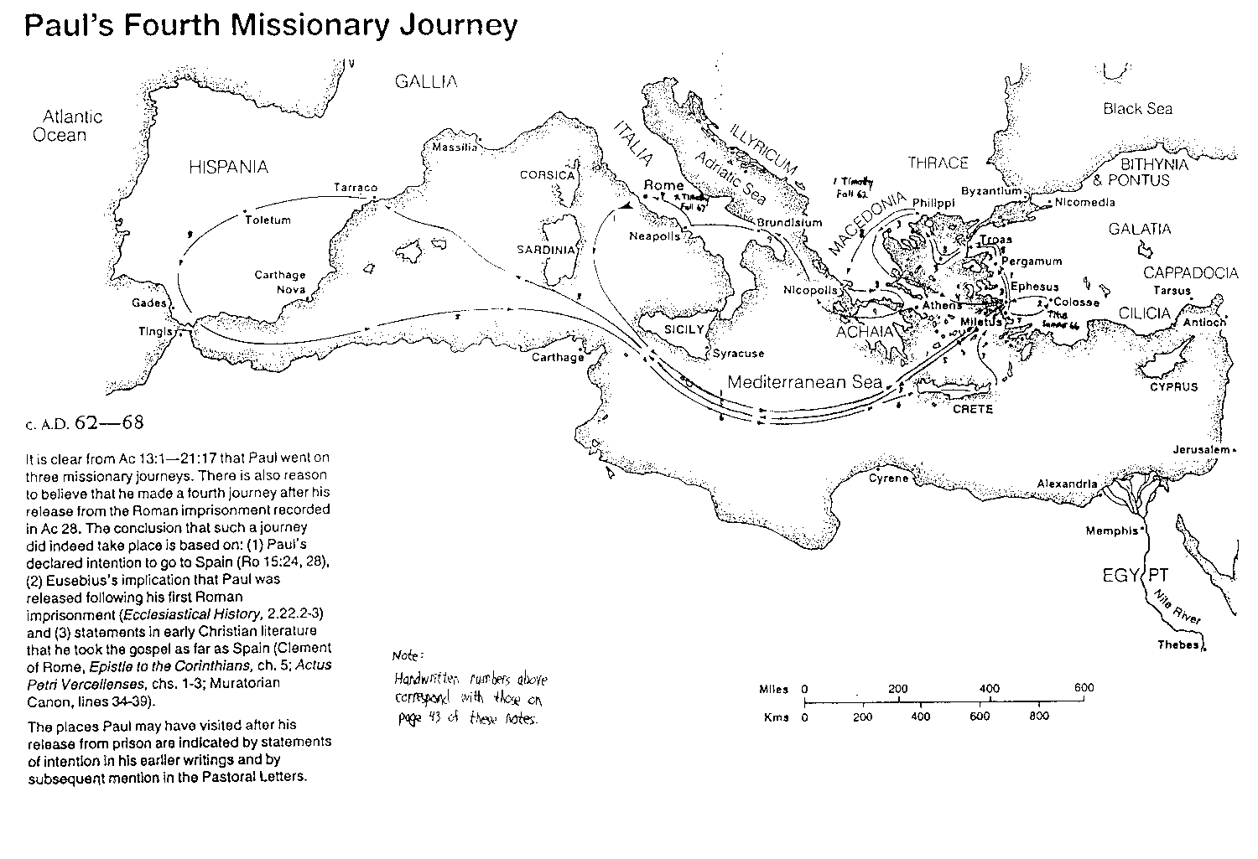
Paul's Fourth Missionary Journey
168
"Paul also obtained the reward of patient endurance, after being seven times thrown into captivity, compelled to flee, and stoned. After preaching both in the east and west, he gained the illustrious reputation due to his faith, having taught righteousness to the whole world, and come to the extreme limit of the west, and suffered martyrdom under the prefects. Thus was he removed from the world, and went into the holy place, having proved himself a striking example of patience."
1 Clement 5
Notes:
http://www.earlychristianwritings.com/text/1clement-roberts.html

Slide 46
Similarities of Titus & 2 Tim
Titus
Titus & 2 Timothy
243
Titus
2 Timothy
Written in freedom at Asia Minor (AD 66)
Written in captivity at Rome (AD 67)
Briefer (3 chapters, 46 verses)
Longer (4 chapters, 83 verses)
More official, less personal
(6 names used)
Warm, informal
(20 names used)
Teaches how the church is to be organized
Teaches how the church is to be led
Emphasis on sound conduct
Emphasis on sound doctrine

Slide 47
Argument
Titus
Argument
243
Paul's aim in his letter to Titus is
to give him practical advice which will help this apostolic delegate know how to organize the new believers in Crete.
His letter offers counsel in three general areas:
How to appoint the right elders who can counter false teaching through word and deed (ch. 1),
How to teach the people respectable conduct to protect the churches from being maligned by opposers (2:1-10), and
How to exhort the saints to live in contrast to the false teachers since the grace of God which they received leads to godly behavior (2:11–3:15).
Paul emphasizes Christian behavior more than doctrine; However, that Titus had to teach the people proper action shows that doctrine and behavior are inseparable.

Slide 48

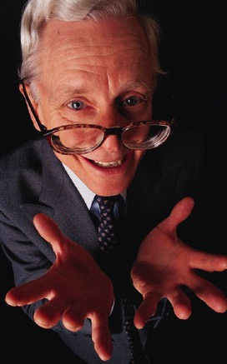

Synthesis
Titus
Synthesis
243
Sound conduct against opposition
1 Elders against false teachers
2:1-10 Conduct for various groups
2:11–3:15 Grace leads to godliness

Slide 49
Summary Statement
Titus
Summary Statement
241
Paul exhorts Titus to organize the Cretan churches by appointing qualified elders and teaching respectable behavior as the natural result of salvation by grace in order to defeat opposers by word and deed (conduct)

Slide 50
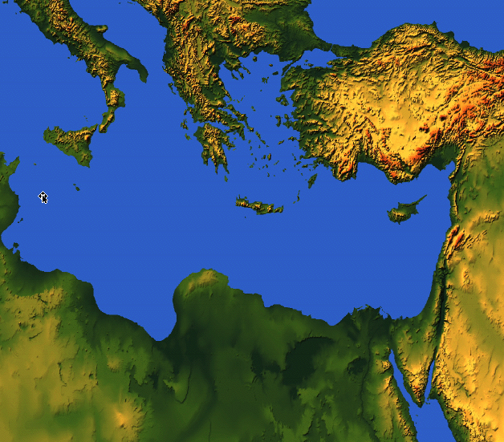

Where were Paul and Titus?
242
Ephesus
Crete

Slide 51
Be Reputable
Titus
Dr. Rick Griffith • Crossroads International Church Singapore
BibleStudyDownloads.org

Slide 52

Pastor Jarrid Wilson Harvest Christian Fellowship Riverside, California

Slide 53

Another Pastor…
Notes:
To add to the many US pastors who have already taken their own lives in recent years, megachurch pastor and mental health advocate Jarrid Wilson died by suicide on Monday (9 Sep 2019). He served at Harvest Christian Fellowship in California with Greg Laurie, a popular evangelical leader.

Slide 54
Struggles are Real
It's been said that 1 in every 4 pastors struggles with depression. Lifeway Research reveals that the number of pastors diagnosed with clinical depression was double the national average. Forty five percent sought advice from their family doctor regarding stress and anxiety issues. Nearly one-fourth of all pastors (23 percent) acknowledge having "personally struggled with mental illness," and half of those pastors say the illness has been diagnosed.
—Charisma News 29 Aug 2018—
Notes:
YEAR IN REVIEW: Wife of Beloved Pastor Who Committed Suicide Speaks Out
1:00PM EDT 8/29/2018 Jessilyn Lancaster
https://www.charismanews.com/us/72893-wife-of-beloved-pastor-who-committed-suicide-speaks-out

Slide 55

Are Christians any better off?
Notes:
It makes one wonder if Christianity really works, doesn’t it? Of course, we know Jesus truly changes lives, but it makes me sad to see so many who don’t see that reality in their lives. So what the problem, then? Pastor Wilson got caught up in false teaching—the lie that he and his family would be better off if he was dead instead of alive.

Slide 56
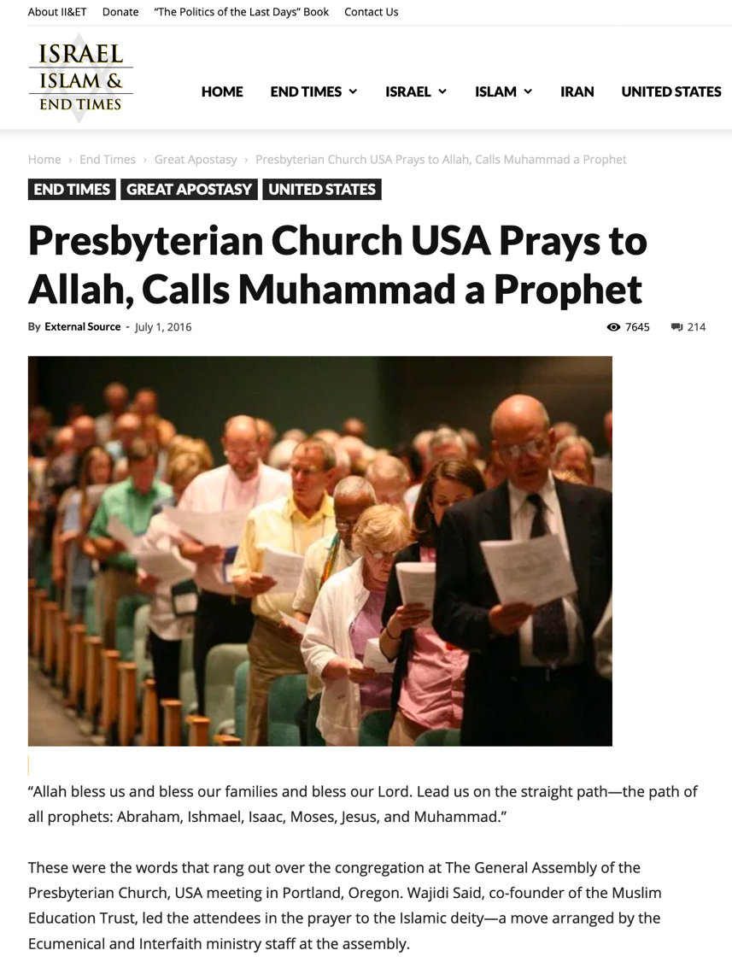
False Teaching
“Allah, bless us and bless our families and bless our Lord. Lead us on the straight path—the path of all the prophets: Abraham, Ishmael, Isaac, Moses, Jesus and Muhammad.”
Notes:
One key problem is the false teaching all around us. In 2016, the Presbyterian Church USA even prayed to Allah…
—————————
https://israelislamandendtimes.com/presbyterian-church-usa-prays-to-allah-calls-muhammad-a-prophet/?utm_campaign=shareaholic&utm_medium=facebook&utm_source=socialnetwork&fbclid=IwAR2mraG6FYMzzkflfKLhp5eHjvzjgyYMNRTYjuSwVgOV6CD9xLqtETAsXao
Accessed 14 July 2019

Slide 57
False Teaching Today
God heals all with real faith?
Wealth is our divine right?
Lord’s Supper healing?
Notes:
We see false teaching even closer to home with churches right here who teach that God heals all who have real faith—and that God is obligated to make us wealthy—and that taking the Lord’s Supper will lead to healing! So how do we respond in such an environment?

Slide 58
Key Word
241
Conduct
Titus
Notes:
Paul’s letter to Titus tells us that a key proper response to false teaching is our conduct—

Slide 59
Theme
23
Sound Conduct Against Opposition
Titus

Slide 60
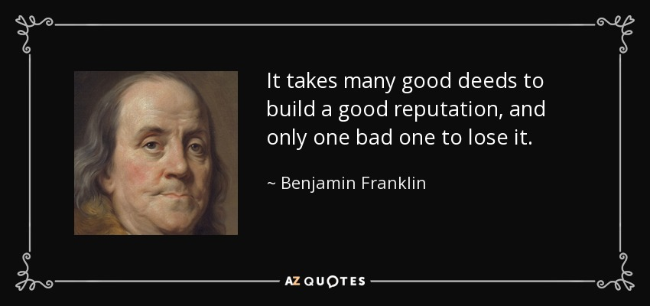
Be Reputable
It takes many good deeds to build a good reputation, and only one bad one to lose it.
—Benjamin Franklin
Notes:
In short, as my message title indicates, “Be Reputable.” Ben Franklin noted aptly…

Slide 61
Reputation
The way to gain a good reputation is to endeavor to be what you desire to appear.
—Socrates
Notes:
So what happens when we actually do this?

Slide 62
Results of Reputable Conduct
“that the word of God may not be reviled” (Titus 2:5)
“that an opponent may be put to shame, having nothing evil to say about us” (Titus 2:8)
“adorn the doctrine of God our Savior” (Titus 2:10)
Notes:
In Paul’s letter to Titus, we see many results of reputable conduct…

Slide 63
Key Word / Verse
Titus
241
Key Word
Conduct
Key Verse
"This is a trustworthy saying. And I want you to stress these things, so that those who have trusted in God may be careful to devote themselves to doing what is good. These things are excellent and profitable for everyone" (Titus 3:8).
Notes:
Here is another fantastic result of good conduct!

Slide 64
Character is who you really are. Reputation is who others think you are.
How’s your reputation? Are you known by unbelievers as a follower of Jesus?
Do you wish everyone in this church had the same reputation that you have?
How well does your reputation show the love of the Lord Jesus?
Notes:
So how are you doing at this?

Slide 65
How can we be reputable in the midst of so much false teaching today?
Notes:
How can we stand true to the Lord with so many heresies plaguing the church?

Slide 66
NT Overview (Paul's Letters)
38 124 39-41
“To the remotest part of the earth” (Acts 1:8)
Acts 9 13 14 15 16 18 21 27 28
Apr 48- Sep 49
1 Galatia
Apr 50- Sep 52
2 Aegean
Spr 53- May 57
3 Asia
Feb 60- Mar 62
1 Rome
Spr 62- Fall 67
4 Spain
Aut 67- Spr 68
2 Rome
Summer 35- 37
Damascus Antioch
May 57- Aug 59
Trials
Fall 49
The
Council
Spring 68
Expansion of Church
35 48 49 50 52 53 57 60 62 67 68 95
Matt
Luke
Acts
Mark
John
Gal
1 Thess
1 Cor
Eph
1 Tim
2 Tim
2 Thess
2 Cor
Col
Titus
Missionary
Pastoral
Romans
Philem
Gospels & Acts
Phil
Pauline Epistles
1234
Journeys
Prison
Rome
Imprisonments
Pauline
Notes:
We are reaching the end of our study of Paul’s letters with only 2 Timothy left.
——————————
Observations about chronology:
Gospels not written first but throughout NT era
Evangelistic letters preceded pastoral
Rough letter (Galatians) preceded smoother ones

Slide 67

Pastoral Epistles
1 Timothy
Titus
2 Timothy
1 Timothy = personal, urgent, doctrinal emphasis
Titus = less urgent, practical emphasis
2 Timothy = personal, urgent, focus on the Word
Notes:
These last three letters of Paul are called the Pastoral Epistles.
They show the most advanced theology of local church life and shepherding the flock—but this makes sense since Paul and the church had learned much in the previous 30 years since the church had begun.
Sadly, most NT scholars today do not believe that Paul wrote these letters and many date them in the second century. I guess they think that Paul was a slow learner!

Slide 68
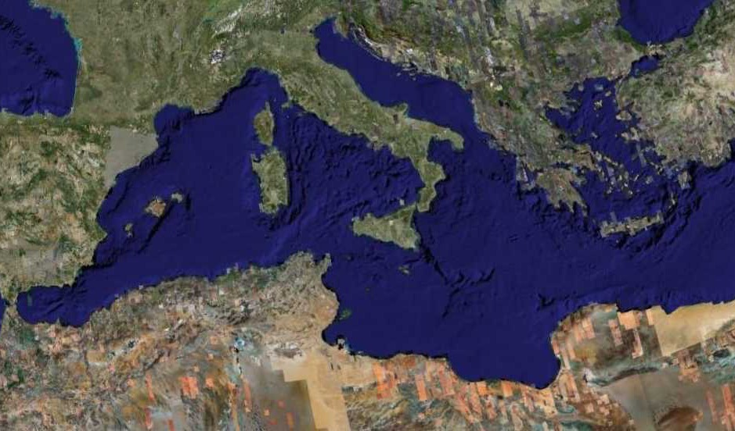
Fourth Missions Trip
1-2 Timothy & Titus After Acts
Spring 62 – Fall 67
Notes:
Paul had finished reaching the Eastern Roman Empire by the time he wrote Titus—and even had just returned from Spain.
—————
Freedom from Imprisonment Spring 62–Fall 67
Paul in Ephesus and Colosse (Timothy left at Ephesus) Spring–Summer 62
Peter travels to Rome 62
Paul in Macedonia late summer 62-winter 62/63
1 Timothy written from Macedonia to Timothy in Ephesus Fall 62
Paul in Asia Minor Spring 63-Spring 64
Paul in Spain (anticipated in Rom. 15:24) Spring 64-Spring 66
Christians persecuted by Nero; Peter martyred Summer 64
Paul in Crete (Titus left there; Tit 1:5) early Summer 66
Paul in Asia Minor Summer- Fall 66
Titus written from Asia Minor to Titus in Crete Summer 66
Paul in Nicopolis (Tit 3:12) Winter 66/67
Paul in Troas (2 Tim 4:13), Macedonia and Greece Spring– Fall 67
Second Roman Imprisonment Fall 67–Spring 68
Paul arrested and brought to Rome Fall 67
2 Timothy written from Rome to Timothy in Ephesus Fall 67
Paul beheaded Spring 68

Slide 69
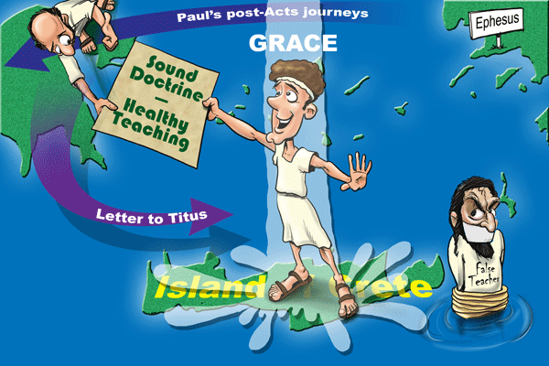
GRACE
Paul’s post-Acts journeys
Ephesus
"For this reason I left you in Crete, that you would set in order what remains and appoint elders in every city as I directed you" (Titus 1:5 NAU).
Sound Doctrine –––––– Healthy Teaching
Letter to Titus
False Teacher
Island of Crete
Notes:
After leaving Paul in Crete with newly planted church, he told him in 1:5, "For this reason I left you in Crete, that you would set in order what remains and appoint elders in every city as I directed you."

Slide 70
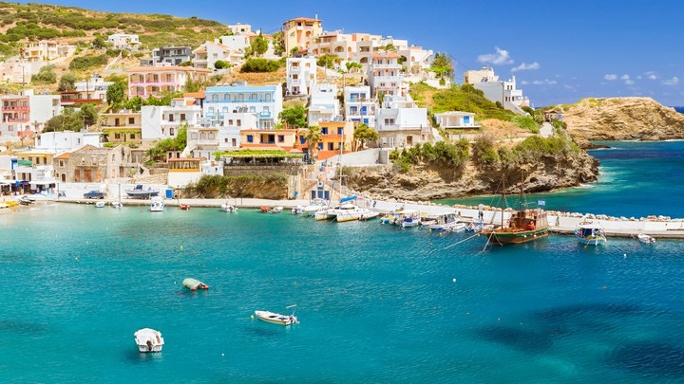
Crete was beautiful but had a poor reputation
Notes:
So how could the believers there live out the Christian life in such a pagan place?

Slide 71
How can we be reputable in the midst of so much false teaching today?
3 ways in Titus…
Notes:
And how can we stand true to the Lord with so many heresies plaguing the church?

Slide 72
Summary Chart
Titus
241
Sound Conduct Against Opposition
Sound Conduct Against Opposition
Appoint Elders
Appoint Elders
Set Things in Order
Set Things in Order
Prevent False Doctrine
Prevent False Doctrine
Practice True Doctrine
Practice True Doctrine
Elders vs. False Teachers
Elders vs. False Teachers
Conduct
for Various Groups
Conduct
for Various Groups
Grace
Leads to Godliness
Grace
Leads to Godliness
Chapter 1
1
2:1-10
2:1-10
2:11–3:15
2:11–3:15
Organize
Organize
Teach
Teach
Grace
Grace
Truth Leads to Godliness
1:1-4
Truth leads to godliness
1:1-4
Elders
1:5-16
Elders
1:5-16
Older Men
2:1-2
Older Men
2:1-2
Older Women
2:4-5
Older Women
2:4-5
Younger Women
2:4-5
Younger Women
2:4-5
Younger
Men
2:6-8
Younger
Men
2:6-8
Slaves
2:9-10
Slaves
2:9-10
Educates
2:11-15
Educates
2:11-15
Empowers
3:1-2
Empowers
3:1-2
Motivates
3:3-8
Motivates
3:3-8
Protects
3:9-11
Protects
3:9-11
Concl.
3:12-15
Relates
3:12-15
Asia Minor to Crete
Asia Minor to Crete
Summer AD 66
Summer AD 66
Notes:
(So what’s the first way Paul shares that we can we be reputable in the midst of so much false teaching today? It starts with the leadership where Paul says to…)

Slide 73
I. Have godly elders teach truth.
Titus 1
Notes:
Sound doctrine silences error.

Slide 74
TITUS
1
2
3
Sound doctrine silences error
Order life to doctrine
Never shun good deeds
Barry Huddleston, The Acrostic Bible

Slide 75
Slides on Titus 1

Slide 76
Outline
Titus
Outline
244
I. Paul exhorts Titus to appoint as elders men of character and of the Scriptures who will be able to refute legalistic false teachers in order to protect the newly formed Cretan churches (Titus 1).

Slide 77

PURITY
Titus 1:1-4 (NLT)

Slide 78

¹ This letter is from Paul, a slave of God and an apostle of Jesus Christ. I have been sent to proclaim faith to those God has chosen and to teach them to know the truth that shows them how to live godly lives.
Titus 1:1 (NLT)
Notes:
Paul greets Titus that truth leads to godliness amidst pagans (1:1-4).

Slide 79
² This truth gives them confidence that they have eternal life, which God—who does not lie—promised them before the world began.
Titus 1:2 (NLT)

Slide 80

Adorning the Gospel
Building Healthy Churches that Display God’s Power
S t u d i e s i n T i t u s
Preached by Dr. Jim Harmeling on Titus 1:1-2 at Crossroads International Church Singapore • cicfamily.com Uploaded by Dr. Rick Griffith • Singapore Bible College Thousands of files in 49 languages for free at BibleStudyDownloads.org

Slide 81
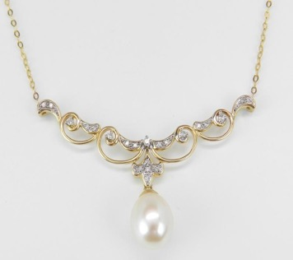
Why is the health of a church important?
Titus 1:1-4
Healthy churches are part of God’s mission (vs. 1-2a)
The mission of sound conversion
Jude 3
³ Beloved, although I was very eager to write to you about our common salvation, I found it necessary to write appealing to you to contend for the faith that was once for all delivered to the saints.

Slide 82

Why is the health of a church important?
Titus 1:1-4
Healthy churches are part of God’s mission (vs. 1-2a)
The mission of sound conversion
The mission in growth in knowledge of the truth
The mission of developing godly living

Slide 83
“Any doctrine which does not promote godliness is manifestly bogus.”
—John Stott—
“But real truth never deviates from the path of piety. A profession of the truth which allows an individual to live in ungodliness is a spurious profession.”
—Donald Hiebert—

Slide 84

Why is the health of a church important?
Titus 1:1-4
Healthy churches are part of God’s mission (vs. 1-2a)
The mission of sound conversion
The mission in growth in knowledge of the truth
The mission of developing godly living
The mission of living for another world

Slide 85
³ And now at just the right time he has revealed this message, which we announce to everyone. It is by the command of God our Savior that I have been entrusted with this work for him.
Titus 1:3 (NLT)

Slide 86
⁴ I am writing to Titus, my true son in the faith that we share.
May God the Father and Christ Jesus our Savior give you grace and peace.
Titus 1:4 (NLT)

Slide 87
Adorning the Gospel
Building Healthy Churches that Display God’s Power
S t u d i e s i n T i t u s
Preached by Dr. Jim Harmeling on Titus 1:3-4 at Crossroads International Church Singapore • cicfamily.com Uploaded by Dr. Rick Griffith • Singapore Bible College Thousands of files in 49 languages for free at BibleStudyDownloads.org

Slide 88

Why is the health of a church important?
Titus 1:1-4
Healthy churches are part of God’s mission (1-2a)
The mission of sound conversion
The mission of growth in knowledge of the truth
The mission of developing godly living
The mission of living for another world

Slide 89
Why is the health of a church important?
Titus 1:1-4
Healthy churches are part of God’s mission (1-2a)
Healthy churches reflect the glory of God’s character (2b-3)
His sovereignty: He designed His plan of salvation from eternity

Slide 90
Ephesians 1:4
“. . . even as he chose us in him before the foundation of the world, that we should be holy and blameless before him.”
2 Timothy 1:9
“. . . who saved us and called us to a holy calling, not because of our works but because of his own purpose and grace, which he gave us in Christ Jesus before the ages began.”
1 Corinthians 2:7
God’s hidden wisdom was “decreed before the ages for our glory.”

Slide 91
Why is the health of a church important?
Titus 1:1-4
Healthy churches are part of God’s mission (1-2a)
Healthy churches reflect the glory of God’s character (2b-3)
His sovereignty: He designed His plan of salvation from eternity
His providence: He guides history to fulfill His plan

Slide 92
Romans 5:6 – “at the right time”
Galatians 4:4 – “the fullness of time”
Ephesians 1:10 – “the fullness of time”
Acts 17:26 – “determined allotted periods and the boundaries . . .”

Slide 93
“It was no accident that Christianity came when it did. It came in God’s own time; all history had been a preparation for it; and the circumstances were such that the way was open for the good news to spread.”
—William Barclay—

Slide 94

5 Reasons for the “proper time” to manifest Christ
Unified language
More convenient travel
Safer travel
Political stability
Philosophical openness

Slide 95
Why is the health of a church important?
Titus 1:1-4
Healthy churches are part of God’s mission (1-2a)
Healthy churches reflect the glory of God’s character (2b-3)
His sovereignty: He designed His plan of salvation from eternity
His providence: He guides history to fulfill His plan
His wisdom: He chooses human proclamation as His means of transforming lives

Slide 96
Why is the health of a church important?
Titus 1:1-4
Healthy churches are part of God’s mission (1-2a)
Healthy churches reflect the glory of God’s character (2b-3)
Healthy churches reveal God’s continual leading (4)

Slide 97
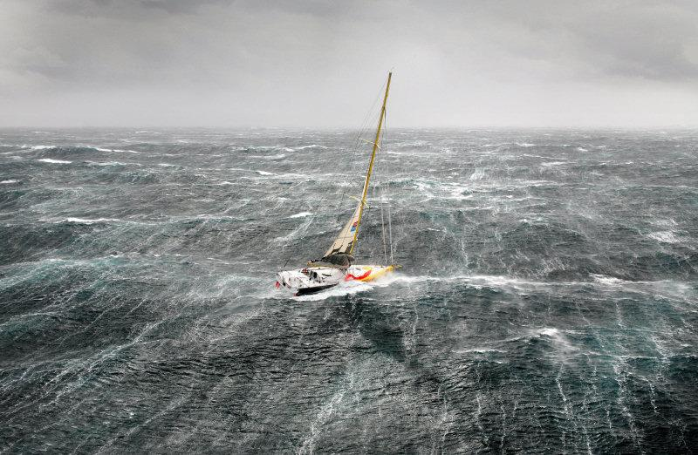
Leadership Challenges in the Life of Titus
Church leadership challenge 1: Clarify and defend the gospel (Gal 2:1-10)
Church leadership challenge 2: Confront sin (2 Cor 2:12-13; 7:5-16)
Church leadership challenge 3: Collect money (2 Cor 8:6-24)
Church leadership challenge 4: Strengthen young churches in a difficult location

Slide 98
Why is the health of a church important?
Titus 1:1-4
Healthy churches are part of God’s mission (vs. 1-2a)
Healthy churches reflect the glory of God’s character (vs. 2b-3)
Healthy churches reveal God’s continual leading (v. 4)

Slide 99

SCRIPTURE READING
Titus 1:5-9 (NLT)

Slide 100

⁵ I left you on the island of Crete so you could complete our work there and appoint elders in each town as I instructed you.
⁶ An elder must live a blameless life. He must be faithful to his wife, and his children must be believers who don’t have a reputation for being wild or rebellious.
Titus 1:5-6 (NLT)

Slide 101
⁷ A church leader is a manager of God’s household, so he must live a blameless life. He must not be arrogant or quick-tempered; he must not be a heavy drinker, violent, or dishonest with money.
Titus 1:7 (NLT)

Slide 102
⁸ Rather, he must enjoy having guests in his home, and he must love what is good. He must live wisely and be just. He must live a devout and disciplined life.
Titus 1:8 (NLT)

Slide 103
⁹ He must have a strong belief in the trustworthy message he was taught; then he will be able to encourage others with wholesome teaching and show those who oppose it where they are wrong.
Titus 1:9 (NLT)

Slide 104
Adorning the Gospel
Building Healthy Churches that Display God’s Power
S t u d i e s i n T i t u s
Preached by Dr. Jim Harmeling on Titus 1:5-9 at Crossroads International Church Singapore • cicfamily.com Uploaded by Dr. Rick Griffith • Singapore Bible College Thousands of files in 49 languages for free at BibleStudyDownloads.org

Slide 105
Healthy churches develop godly leaders
T i t u s 1 : 5 - 9
Godly leaders strengthen the church (v. 5)

Slide 106
Acts 20:28-32
²⁸ Pay careful attention to yourselves and to all the flock, in which the Holy Spirit has made you overseers, to care for the church of God, which he obtained with his own blood. ²⁹ I know that after my departure fierce wolves will come in among you, not sparing the flock;³⁰ and from among your own selves will arise men speaking twisted things, to draw away the disciples after them. ³¹ Therefore be alert, remembering that for three years I did not cease night or day to admonish every one with tears. ³² And now I commend you to God and to the word of his grace, which is able to build you up and to give you the inheritance among all those who are sanctified.

Slide 107
1 Peter 5:1-5
¹ So I exhort the elders among you, as a fellow elder and a witness of the sufferings of Christ, as well as a partaker in the glory that is going to be revealed: ² shepherd the flock of God that is among you, exercising oversight, not under compulsion, but willingly, as God would have you; not for shameful gain, but eagerly; ³ not domineering over those in your charge, but being examples to the flock. ⁴ And when the chief Shepherd appears, you will receive the unfading crown of glory. ⁵ Likewise, you who are younger, be subject to the elders. Clothe yourselves, all of you, with humility toward one another, for “God opposes the proud but gives grace to the humble.”

Slide 108
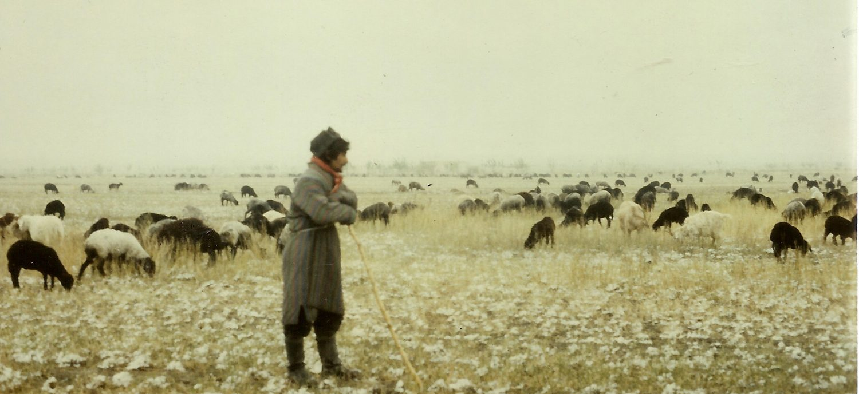
Church Leaders
Presbuteros = elderly person; wiser person
Episkopos = overseer; manager; director
Notes:
Two key concepts come together in two terms for church leaders. They are called presbuteros or elders because they are typically among the oldest and most mature members. They are also deemed episkopos or overseers as they manage or direct the affairs of the church.

Slide 109
Healthy churches develop godly leaders
T i t u s 1 : 5 - 9
Godly leaders strengthen the church (v. 5)
Godly leaders set a standard for transformed living (vs. 6-9)
A standard for living at home (6)
A standard for living in public (7-8)

Slide 110
NOT THIS
arrogant
quick-tempered
drunkard
violent
greedy for gain
THIS INSTEAD
hospitable
lover of good
self-controlled
upright
holy
disciplined

Slide 111
Healthy churches develop godly leaders
T i t u s 1 : 5 - 9
Godly leaders strengthen the church (v. 5)
Godly leaders set a standard for transformed living (vs. 6-9)
A standard for living at home (6)
A standard for living in public (7-8)
A standard for teaching and doctrine (9)

Slide 112

Scripture Reading
Titus 1:10-16 (ESV)

Slide 113
¹⁰ For there are many who are insubordinate, empty talkers and deceivers, especially those of the circumcision party. ¹¹They must be silenced, since they are upsetting whole families by teaching for shameful gain what they ought not to teach.
Titus 1:10-11 (ESV)

Slide 114
¹² One of the Cretans, a prophet of their own, said, “Cretans are always liars, evil beasts, lazy gluttons.” ¹³ This testimony is true. Therefore rebuke them sharply, that they may be sound in the faith,
Titus 1:12-13 (ESV)

Slide 115
¹⁴ not devoting themselves to Jewish myths and the commands of people who turn away from the truth. ¹⁵ To the pure, all things are pure, but to the defiled and unbelieving, nothing is pure; but both their minds and their consciences are defiled.
Titus 1:14-15 (ESV)

Slide 116
¹⁶ They profess to know God, but they deny him by their works. They are detestable, disobedient, unfit for any good work.
Titus 1:16 (ESV)

Slide 117
Adorning the Gospel
Building Healthy Churches that Display God’s Power
S t u d i e s i n T i t u s
Preached by Dr. Jim Harmeling on Titus 1:10-16 at Crossroads International Church Singapore • cicfamily.com Uploaded by Dr. Rick Griffith • Singapore Bible College Thousands of files in 49 languages for free at BibleStudyDownloads.org

Slide 118

What is wrong with this picture?

Slide 119
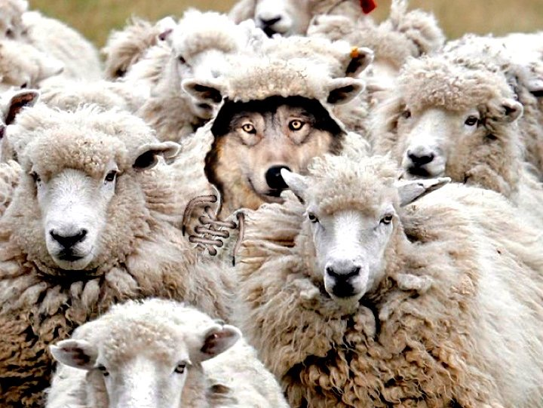
Healthy churches confront false doctrine
Notes:
These godly elders must refute legalistic and greedy Jewish heretics (1:10-16).

Slide 120
How Do We Confront False Teachers?
Reveal sinful character traits of false teachers (v. 10)
Carefully distance the church from false teachers (vs. 11-13)
Stop the damage (11, 13a)
Reveal the habits of the sinful flesh (12)

Slide 121
Philippians 1:9-10
⁹ And it is my prayer that your love may abound more and more, with knowledge and all discernment, ¹⁰ so that you may approve what is excellent, and so be pure and blameless for the day of Christ,

Slide 122
How Do We Confront False Teachers?
Reveal sinful character traits of false teachers (v. 10)
Carefully distance the church from false teachers (vs. 11-13)
Stop the damage (11, 13a)
Reveal the habits of the sinful flesh (12)
Redirect people to the truth (13b)

Slide 123
How Do We Confront False Teachers?
Reveal sinful character traits of false teachers (v. 10)
Carefully distance the church from false teachers (vs. 11-13)
Train the church to detect false doctrine (vs. 14-16)
Is their source of authority human wisdom or divine revelation? (14)
Is their focus internal or external? (15)

Slide 124
Mark 7:14-23
¹⁴ And he called the people to him again and said to them, “Hear me, all of you, and understand: ¹⁵ There is nothing outside a person that by going into him can defile him, but the things that come out of a person are what defile him.” ¹⁷ And when he had entered the house and left the people, his disciples asked him about the parable. ¹⁸ And he said to them, “Then are you also without understanding? Do you not see that whatever goes into a person from outside cannot defile him, ¹⁹ since it enters not his heart but his stomach, and is expelled?” (Thus he declared all foods clean.) ²⁰ And he said, “What comes out of a person is what defiles him. ²¹ For from within, out of the heart of man, come evil thoughts, sexual immorality, theft, murder, adultery, ²² coveting, wickedness, deceit, sensuality, envy, slander, pride, foolishness. ²³ All these evil things come from within, and they defile a person.”

Slide 125
How Do We Confront False Teachers?
Reveal sinful character traits of false teachers (v. 10)
Carefully distance the church from false teachers (vs. 11-13)
Train the church to detect false doctrine (vs. 14-16)
Is their source of authority human wisdom or divine revelation? (14)
Is their focus internal or external? (15)
Is their practice in life or only in words? (16)

Slide 126
“The ultimate test in life is usefulness, and those who are a bad influence and have a contaminating effect are of no use to God or to other people. Instead of helping God’s work in the world, they hinder it; and uselessness always invites disaster.”
—William Barclay—

Slide 127
How Do We Confront False Teachers?
Reveal sinful character traits of false teachers (v. 10)
Carefully distance the church from false teachers (vs. 11-13)
Train the church to detect false doctrine (vs. 14-16)
Is their source of authority human wisdom or divine revelation? (14)
Is their focus internal or external? (15)
Is their practice in life or only in words? (16)

Slide 128

How Do We Pick Leaders for the Local Church?
223
P
Popularity
Past
Politics
Pocketbook
Profession
Chuck Swindoll, Excellence in Ministry (Fullerton, CA; Insight for Living, 1985), 39

Slide 129
How Should Churches Select Leaders?
223
INTRODUCTION
Scriptural Examples: Congregation decides/nominates
APOSTLES Acts 1:12-26 – congregational selection, apostolic appointment
DEACONS Acts 6:3 – congregational selection, apostolic appointment
BODY

Slide 130
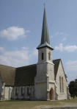
Appointment of church officers:
223
INTRODUCTION
An apostle (e.g., Paul) or his assistants ordained the elders
Acts 14:23
Titus 1:5
BODY

Slide 131

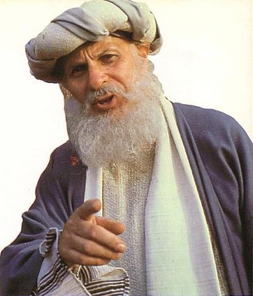
What about Elder Qualifications?
224

Slide 132
Required Qualities of an ELDER (E) or Deacon (D)
224
General reputation
(Perceived character)
Above reproach (E)
Good reputation with outsiders (E)
Respectable (E & D)

Slide 133
Required Qualities of an ELDER (E) or Deacon (D)
225
II. Family life (if married)
A “one woman man” (E & D)
Wife must be worthy of respect, not malicious talkers but temperate and trustworthy in everything (D)
See that his children obey
(E & D)

Slide 134
Required Qualities of an ELDER (E) or Deacon (D)
225
III. Negative characteristics
Not quick tempered (E)
Not violent (E)
Not quarrelsome (E)
Not a new convert (E)
Not pursuing dishonest gain (E & D)
Not addicted to wine; temperate (E & D)

Slide 135
Required Qualities of an ELDER (E) or Deacon (D)
226
IV. Positive characteristics
Hospitable (E)
Sensible (E)
Tested (D)
Sincere (D)
Able to Teach (E)

Slide 136
Scriptural Principles
223
1. Qualifications relate only to men
2. All qualifications are essential and of equal importance
3. Qualifications refer to present life of the leader
4. Qualifications refer to the office of elder (overseer, bishop, pastor) or deacon for 1 Timothy 3:8-12
5. Qualifications must be maintained to stay an elder
6. Qualifications emphasize character over abilities (only 2 traits involve ability)
7. Qualifications emphasize managing of home over work
Must be qualified so that:
1. The leaders can give godly direction
2. The church can avoid problems that come from bad or inept leaders

Slide 137
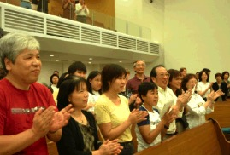
I. Ultimate authority in the local church rests with the congregation

Slide 138
Congregational Authority
NA
In Church Discipline (Matt. 18:17)
“Take it to the church…”
In Leader Selection (Acts 6:3)
“Choose… from among you…”
In Maintaining True Doctrine:
“For I received from the Lord what I also passed on to you…” (1 Cor. 11:23)
“Friends… test the spirits” (1 John 4:1)
“Contend for the faith” (Jude 3)

Slide 139
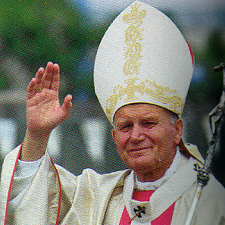
Episcopal Church Structure (Simplified)
244a
Bishop
Anglican
Lutheran
Methodist
Orthodox
Catholic
Vicar
Vicar
Vicar
Deacons
Deacons
Deacons
People
People
People

Slide 140

Lower Presbyterian Structure
244a
Presbytery
Senior Pastor
Senior Pastor
Senior Pastor
Elders (Session)
Elders (Session)
Elders (Session)
People
People
People

Slide 141
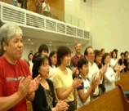
Middle Presbyterian Structure
244a
Synod
Presbytery
Presbytery
Senior Pastor
Senior Pastor
Senior Pastor
Senior Pastor
Senior Pastor
Senior Pastor
Elders (Session)
Elders (Session)
Elders (Session)
Elders (Session)
Elders (Session)
Elders (Session)
People
People
People
People
People
People

Slide 142

Highest Presbyterian Structure
244a
General Assembly
Synod
Synod
Presbytery
Presbytery
Presbytery
Presbytery
Elders (Session)
Elders (Session)
Elders (Session)
Elders (Session)
Elders (Session)
Elders (Session)
Elders (Session)
Elders (Session)
Elders (Session)
Elders (Session)
Elders (Session)
Elders (Session)
People
People
People
People
People
People
People
People
People
People
People
People

Slide 143
What About Baptists?
The Autonomy of the Local Church

Slide 144

Two Questions:
Who has the ultimate say in the church?
What is the biblical pattern for church leadership?

Slide 145
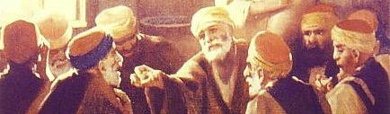
II. The biblical pattern is church leadership by elders.
236a

Slide 146
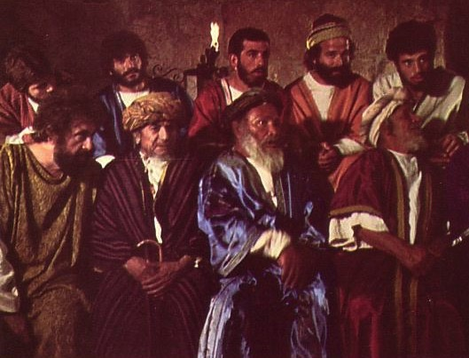
Elders led from the time of Moses
48
Elders led with Moses
1400 BC
“Go, assemble the elders of Israel and say to them…” (Exod. 3:16)

Slide 147
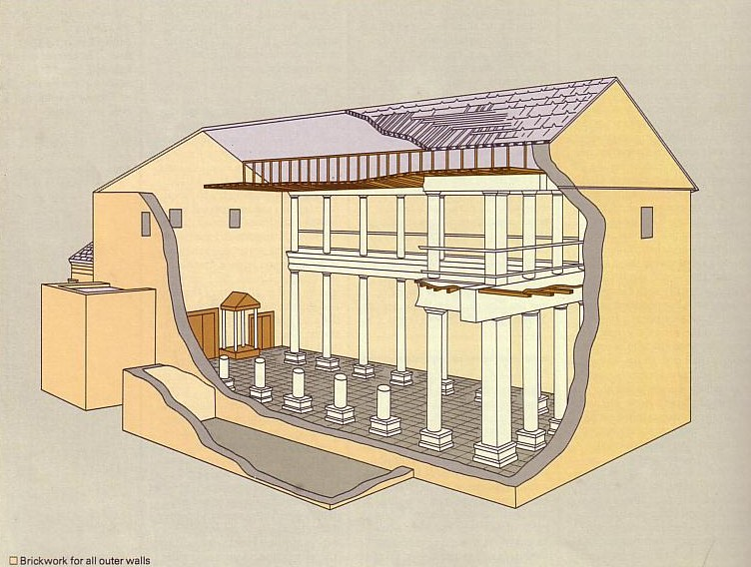
Who Led the Synagogue?
51
Elders led with Moses
1400 BC
Elders led Synagogues 600 BC

Slide 148
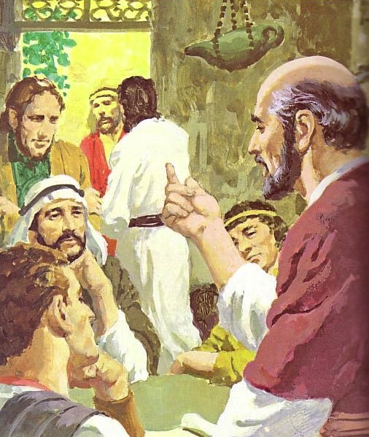
God has advocated group leadership through the ages
55
Elders led with Moses
1400 BC
Elders led Synagogues 600 BC
NT Elders

Slide 149

Places Mentioning Elders
elders = overseers = bishops = pastors
55
Jerusalem (AD 47):
NIV Acts 11:30 This they did, sending their gift to the elders by Barnabas and Saul.
Ephesus (AD 57):
NIV Acts 20:17 From Miletus, Paul sent to Ephesus for the elders of the church.
Galatia (AD 48):
NIV Acts 14:23 Paul and Barnabas appointed elders {or Barnabas ordained elders; or Barnabas had elders elected} for them in each church
Crete (AD 66):
NIV Titus 1:5 The reason I left you in Crete was that you might straighten out what was left unfinished and appoint {or ordain} elders in every town, as I directed you.
Philippi (AD 62):
NIV Philippians 1:1 Paul and Timothy, servants of Christ Jesus, To all the saints in Christ Jesus at Philippi, together with the overseers and deacons:
Pontus, Galatia, Cappadocia, Asia & Bithynia (AD 64)
NIV 1 Peter 5:1 To the elders among you, I appeal as a fellow elder… (cf. 1:1)

Slide 150
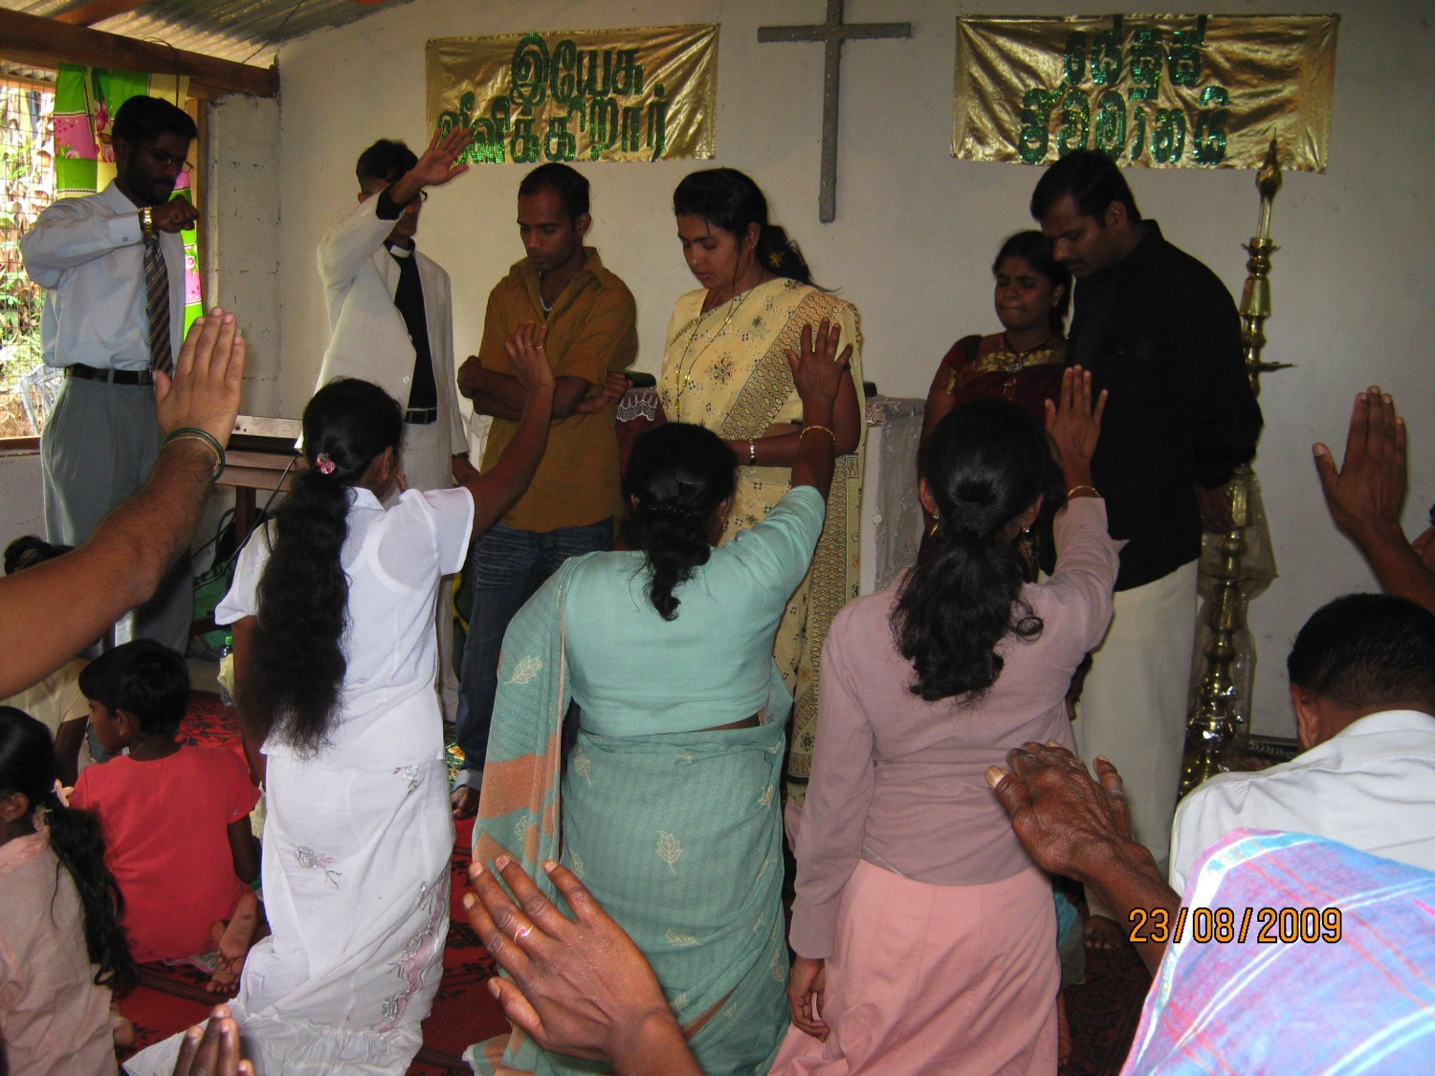
What are elders supposed to do?
236a

Slide 151
Pastoral Leadership of an Elder:
236a
(a) Elders teach:
INTRODUCTION
“Shepherd the flock” (Acts 20:28)
“Able to teach” (1 Thess. 5:12; 1 Tim. 3:2; Titus 1:9b)
Scriptural foundation (Tit. 1:9a)
Teach God's plan (Acts 20:20, 27)
Get paid for teaching (1 Tim. 5:17)
BODY

Slide 152
Three Types of Elders
236b
“The elders who direct the affairs of the church well are worthy of double honor, especially those whose work is preaching and teaching” (1 Tim. 5:17 NIV).
ALL ELDERS
Teach, protect, lead, serve, testify
Unpaid or $ if Needed
PAID MANAGERS
$
PREACHERS & TEACHERS
$$

Slide 153
Pastoral Leadership of an Elder:
236a
(a) Elders teach:
INTRODUCTION
“Shepherd the flock” (Acts 20:28)
“Able to teach” (1 Thess. 5:12; 1 Tim. 3:2; Titus 1:9b)
Scriptural foundation (Tit. 1:9a)
Teach God's plan (Acts 20:20, 27)
Get paid for teaching (1 Tim. 5:17)
Highest office teach (Acts 6:1-7)
Elders led deacons (Phil. 1:1)
BODY

Slide 154
Three Shepherd Tasks of Elders
236c1
Teaching
1 Tim. 3:2; 5:17

Slide 155
How Elders Relate to Deacons
236a 6b
Model 1: Senior Pastor over Deacons
Senior Pastor
Deacons
Unbiblical

Slide 156
How Elders Relate to Deacons
236a 6b
Model 2: Senior Pastor alongside Deacons
Senior Pastor
Deacons
Unbiblical

Slide 157
How Elders Relate to Deacons
236a 6b
Model 3: Deacons lead elders/pastors
Deacons
Unbiblical
Pastors

Slide 158
How Elders Relate to Deacons
236a 6b
Model 4: Elder Board leads Deacon Board
Elders
Deacons

Slide 159
How Elders Relate to Deacons
236a 6b
Apostles over “The Seven”
Apostles
DDDDDDD
DDDD
DDDDD
“The Seven” Acts 21:8

Slide 160
How Elders Relate to Deacons
236a 6b
Model 5: Elders with Deacon Committees
Elders
DDDDDDD
DDDD
DDDDD

Slide 161
Three Shepherd Tasks of Elders
236c1
Teaching
1 Tim. 3:2; 5:17
Pastor-Teacher
Eph. 4:11
Pastoring (Protect & Lead)
1 Pet. 5:1-4
Acts 20:29, 35
1 Thess. 5:12

Slide 162
Three Shepherd Tasks of Elders
236c1
Administration (Serve, care for & testify)
Teaching
1 Tim. 3:2; 5:17
1 Tim. 3:1, 4-5; 5:17
Pastor-Teacher
Episkopos =
Epi “over” +
skopos “look” =
“watch over”
Eph. 4:11
Pastoring (Protect & Lead)
1 Pet. 5:1-4
Acts 20:29, 35
1 Thess. 5:12

Slide 163
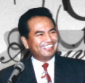







Shared Leadership
236c
Scriptural support for a plurality of elders:
plurality
plurality
Not One Elder…
But Many…

Slide 164
Summary on Elders
INTRODUCTION
Therefore, the New Testament presents an elder whose functions are to teach, pastor and administer.
BODY

Slide 165
Key functions of a Deacon:
231
To serve:
Acts 6:1-6
1 Timothy 3:8-13
INTRODUCTION
BODY

Slide 166
Attention:
231
Deacons are not rulers. They are a subordinate class of officers who serve under the direction of the elders. Deacons assist the elders, especially by relieving them of distractions in the temporal affairs of the church.¹
¹http://www.swrb.com/newslett/actualNLs/bcg_ch02.htm.
INTRODUCTION
BODY

Slide 167
Attention:
231
It is significant that nowhere in the New Testament do deacons have ruling authority over the church as the elders do, nor are deacons ever required to be able to teach Scripture or sound doctrine.¹
¹Wayne Grudem, Systematic Theology: An Introduction to Biblical Doctrine, 920.
INTRODUCTION
BODY

Slide 168

Proposed Form of Church Government
Elders (govern /make decisions)
Deacons (service)
Congregation (appoint)
236a
INTRODUCTION
BODY

Slide 169
Elder-Congregation dynamics:
INTRODUCTION
E l d e r s
C o n g r e g a t i o n
L
O
V
E
Regard
themselves as
servants
BODY
Regard
them as
leaders
Notes:
Having seen the structure, it is vital that the dynamics be understood.

Slide 170

False Teachers and Teachings 1 Tim. 1:3-20; 4:1-16; 6:3-5, 20, 21
221
One of the main reasons why Timothy stayed with the Ephesian church was to correct the false teachers (1:3)
True Source of Heresy: Deceiving spirits and demons (4:1)

Slide 171
Characteristics of False Teachers
221
"Hypocritical liars" (1:7)
Incompetent: they "do not understand either what they are saying or the matters about which they make confident assertions" (6:4)
Proud (6:4)
Spiritually blinded: "men of corrupt mind, who have been robbed of the truth" (6:5)
Use their "piety" for financial gain (6:5)

Slide 172
Characteristics of False Teachings
221
Teaching does not agree with "the sound instruction of our Lord Jesus Christ and godly teaching" (6:3)
Preach a false asceticism: "They forbid people to marry and order them to abstain from certain foods" (4:3)
Pay attention to godless myths, old wives' tales and endless genealogies
Have an unhealthy interest in controversies and quarrels about words (6:4)

Slide 173
I. Have godly elders teach truth.
Titus 1
Notes:
Sound doctrine silences error.

Slide 174
How can we be reputable in the midst of so much false teaching today?
Notes:
(How else can we be reputable in the midst of so much false teaching today? Well, godliness actually looks different in the various stages of life since each stage has unique temptations. So in chapter 2 Paul says you can be reputable when you…)

Slide 175
Slides on Titus 2

Slide 176
II. Act your age.
Titus 2:1-10
Notes:
Order life to doctrine.

Slide 177
TITUS
1
2
3
Sound doctrine silences error
Order life to doctrine
Never shun good deeds
Barry Huddleston, The Acrostic Bible

Slide 178
Outline
Titus
Outline
244
I. Paul exhorts Titus to appoint as elders men of character and of the Scriptures who will be able to refute legalistic false teachers in order to protect the newly formed Cretan churches (Titus 1).
II. Paul exhorts Titus to teach various groups conduct conforming to sound doctrine so that Cretan enemies cannot malign the church or God's Word (2:1-10) .

Slide 179

Scripture Reading
Titus 2:1-10 (ESV)

Slide 180
Older Men
Sober-minded
Dignified
Self-controlled
Sound in faith, love, steadfastness

Slide 181
¹ But as for you, teach what accords with sound doctrine. ² Older men are to be sober-minded, dignified, self-controlled, sound in faith, in love, and in steadfastness.
Titus 2:1-2 (ESV)

Slide 182
Older Men
Sober-minded
Dignified
Self-controlled
Sound in faith, love, steadfastness
Older Women
Reverent
Not slanderers
Not addicted to wine
Train younger women

Slide 183
³ Older women likewise are to be reverent in behavior, not slanderers or slaves to much wine. They are to teach what is good
Titus 2:3 (ESV)

Slide 184
Older Men
Sober-minded
Dignified
Self-controlled
Sound in faith, love, steadfastness
Older Women
Reverent
Not slanderers
Not addicted to wine
Train younger women
Younger Women
Love husbands & children
Self-controlled
Pure
Working at home
Submissive to husbands

Slide 185
and so train the young women to love their husbands and children, ⁵ to be self-controlled, pure, working at home, kind, and submissive to their own husbands, that the word of God may not be reviled.
Titus 2:4-5 (ESV)

Slide 186
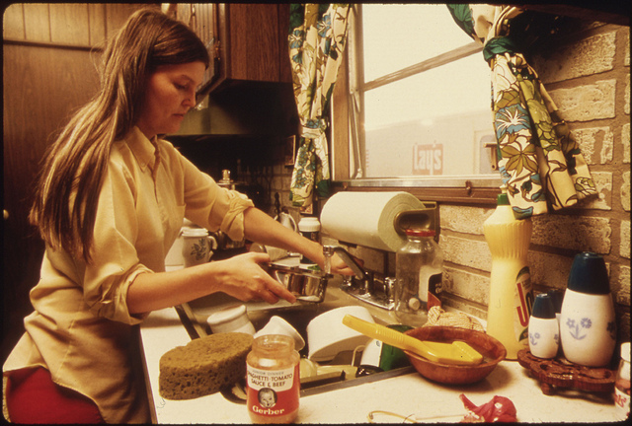
"Workers at home" (Titus 2:4-5 NLT)
"These older women must train the younger women to love their husbands and their children, ⁵to live wisely and be pure, to work in their homes, to do good, and to be submissive to their husbands. Then they will not bring shame on the word of God."

Slide 187
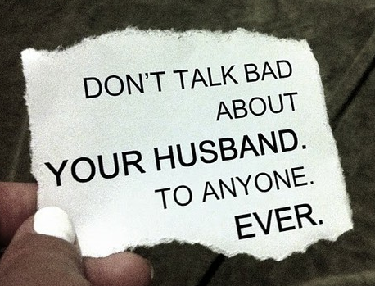
"Submit to husband" (Titus 2:4-5 NLT)
These older women must train the younger women to love their husbands and their children, ⁵to live wisely and be pure, to work in their homes, to do good, and to be submissive to their husbands. Then they will not bring shame on the word of God.
DON'T TALK BAD ABOUT YOUR HUSBAND. TO ANYONE. EVER.
Husbands must not talk bad about their wives either!

Slide 188
Older Men
Sober-minded
Dignified
Self-controlled
Sound in faith, love, steadfastness
Older Women
Reverent
Not slanderers
Not addicted to wine
Train younger women
Younger Men
Self-controlled
Good works
Integrity
Dignity
Sound speech
Younger Women
Love husbands & children
Self-controlled
Pure
Working at home
Submissive to husbands

Slide 189
⁶ Likewise, urge the younger men to be self-controlled. ⁷ Show yourself in all respects to be a model of good works, and in your teaching show integrity, dignity, ⁸ and sound speech that cannot be condemned, so that an opponent may be put to shame, having nothing evil to say about us.
Titus 2:6-8 (ESV)

Slide 190
⁹ Bondservants are to be submissive to their own masters in everything; they are to be well-pleasing, not argumentative, ¹⁰ not pilfering, but showing all good faith, so that in everything they may adorn the doctrine of God our Savior.
Titus 2:9-10 (ESV)

Slide 191
Adorning the Gospel
Building Healthy Churches that Display God’s Power
S t u d i e s i n T i t u s
Preached by Dr. Jim Harmeling on Titus 2:1-10 at Crossroads International Church Singapore • cicfamily.com Uploaded by Dr. Rick Griffith • Singapore Bible College Thousands of files in 49 languages for free at BibleStudyDownloads.org

Slide 192

Healthy churches encourage godly living
(Titus 2:1-10)

Slide 193
Sound truth must lead to godly living (v. 1)
“accords” = resemble, fitting, suit
Ephesians 5:3
“But sexual immorality and all impurity or covetousness must not even be named among you, as is proper among saints.”

Slide 194
Sound truth must lead to godly living (v. 1)
Sound truth impacts everyone (vs. 2-10)
Older men
Older women
Younger women
Younger men

Slide 195
Older Men
Sober-minded
Dignified
Self-controlled
Sound in faith, love, steadfastness
Older Women
Reverent
Not slanderers
Not addicted to wine
Train younger women
Younger Men
Self-controlled
Good works
Integrity
Dignity
Sound speech
Younger Women
Love husbands & children
Self-controlled
Pure
Working at home
Submissive to husbands

Slide 196
Sound truth must lead to godly living (v. 1)
Sound truth impacts everyone (vs. 2-10)
Older men
Older women
Younger women
Younger men
Employees

Slide 197
Results of Reputable Conduct
“that the word of God may not be reviled” (Titus 2:5)
“that an opponent may be put to shame, having nothing evil to say about us” (Titus 2:8)
“adorn the doctrine of God our Savior” (Titus 2:10)

Slide 198
How can we be reputable in the midst of so much false teaching today?
Notes:
How can we stand true to the Lord with so many heresies plaguing the church?

Slide 199
I. Have godly elders teach truth.
Titus 1
Notes:
Sound doctrine silences error.

Slide 200
II. Act your age.
Titus 2:1-10
Notes:
Order life to doctrine.

Slide 201
III. Let grace bring godliness.
Titus 2:11–3:15
Notes:
Never shun good deeds

Slide 202
TITUS
1
2
3
Sound doctrine silences error
Order life to doctrine
Never shun good deeds
Barry Huddleston, The Acrostic Bible

Slide 203
III. Let grace bring godliness.
God's grace educates believers how to choose godliness over ungodliness (2:11-15).
Titus 2:11–3:15
Notes:
Never shun good deeds

Slide 204
Outline
Titus
Outline
244
I. Paul exhorts Titus to appoint as elders men of character and of the Scriptures who will be able to refute legalistic false teachers in order to protect the newly formed Cretan churches (Titus 1).
II. Paul exhorts Titus to teach various groups conduct conforming to sound doctrine so that Cretan enemies cannot malign the church or God's Word (2:1-10) .
III. Paul affirms that God's grace leads to godly behavior to remind Titus that his instructions in the letter are consistent with the behavior required of all Christians since all are saved by grace (2:11–3:15) .

Slide 205

Scripture Reading
Titus 2:11-15 (ESV)

Slide 206

¹¹ For the grace of God has appeared, bringing salvation for all people, ¹² training us to renounce ungodliness and worldly passions, and to live self-controlled, upright, and godly lives in the present age,
Titus 2:11-12 (ESV)

Slide 207
¹³ waiting for our blessed hope, the appearing of the glory of our great God and Savior Jesus Christ,
Titus 2:13 (ESV)

Slide 208
¹⁴ who gave himself for us to redeem us from all lawlessness and to purify for himself a people for his own possession who are zealous for good works.
Titus 2:14 (ESV)

Slide 209
¹⁵ Declare these things; exhort and rebuke with all authority. Let no one disregard you.
Titus 2:15 (ESV)

Slide 210
Adorning the Gospel
Building Healthy Churches that Display God’s Power
S t u d i e s i n T i t u s
Preached by Dr. Jim Harmeling on Titus 2:11-16 at Crossroads International Church Singapore • cicfamily.com Uploaded by Dr. Rick Griffith • Singapore Bible College Thousands of files in 49 languages for free at BibleStudyDownloads.org

Slide 211

BEFORE WORKOUT
AFTER WORKOUT
Notes:
We are keenly aware that without exercise our bodies lose their ability to function properly. But too often we neglect to see that we need discipline to transform us spiritually as well.

Slide 212
Healthy churches focus on Christ as the source of their transformation
(Titus 2:11-15)
Before Christ
After Christ
Deceptive
Pleasure loving
Godly
Self-controlled
Pure

Slide 213
How Does God’s Grace Bring
Life Transformation?
God’s past grace: He brings salvation (2:11)
God’s present grace: He trains us in righteousness (2:12)

Slide 214

paideuo

Slide 215
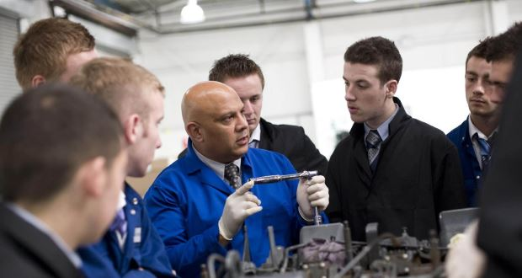
paideuo

Slide 216
How Does God’s Grace Bring
Life Transformation?
God’s past grace: He brings salvation (v. 11)
God’s present grace: He trains us in righteousness (v. 12)
Out with the bad (“ungodliness and worldly passions”)
Galatians 5:24
“And those who belong to Christ Jesus have crucified the flesh with its passions and desires.”

Slide 217
1 John 2:15-17
¹⁵ Do not love the world or the things in the world. If anyone loves the world, the love of the Father is not in him. ¹⁶ For all that is in the world—the desires of the flesh and the desires of the eyes and pride of life—is not from the Father but is from the world. ¹⁷ And the world is passing away along with its desires, but whoever does the will of God abides forever.

Slide 218
How Does God’s Grace Bring
Life Transformation?
God’s past grace: He brings salvation (v. 11)
God’s present grace: He trains us in righteousness (v. 12)
Out with the bad (“ungodliness and worldly passions”)
In with the good (“live self-controlled, upright, and godly lives in the present age”)

Slide 219
2 Timothy 2:22
“So flee youthful passions and pursue righteousness, faith, love, and peace, along with those who call on the Lord from a pure heart.”

Slide 220
Before TRAINING After
Selfish -God’s grace- Love others
Lustful -God’s grace- Pure thoughts
Easily angered -God’s grace- Patient
Rebellious -God’s grace- Submissive
Envy others -God’s grace- Contentment
Uncontrolled tongue -God’s grace- Self-control
Resentment -God’s grace- Forgiveness

Slide 221
How Does God’s Grace Bring
Life Transformation?
God’s past grace brings salvation (2:11)
God’s present grace trains us in righteousness (2:12)
God’s future grace motivates us for the future (2:13-15)
His glorious return motivates us
Jude 24
“Now to him who is able to keep you from stumbling and to present you blameless before the presence of his glory with great joy”

Slide 222
How Does God’s Grace Bring
Life Transformation?
God’s past grace brings salvation (2:11)
God’s present grace trains us in righteousness (2:12)
God’s future grace motivates us for the future (2:13-15)
His glorious return motivates us
His redemptive work motivates us
His ownership motivates us

Slide 223
Slides on Titus 3

Slide 224
III. Let grace bring godliness.
God's grace educates believers how to choose godliness over ungodliness (2:11-15).
God's grace empowers gracious behavior before all people (3:1-2).
Titus 2:11–3:15
Notes:
Never shun good deeds

Slide 225

Scripture Reading
Titus 3:1-15 (ESV)

Slide 226

¹ Remind them to be submissive to rulers and authorities, to be obedient, to be ready for every good work, ² to speak evil of no one, to avoid quarreling, to be gentle, and to show perfect courtesy toward all people.
Titus 3:1-2 (ESV)

Slide 227
III. Let grace bring godliness.
God's grace educates believers how to choose godliness over ungodliness (2:11-15).
God's grace empowers gracious behavior before all people (3:1-2).
God's grace motivates good works in response to God’s mercy (3:3-8).
Titus 2:11–3:15
Notes:
Never shun good deeds

Slide 228
³ For we ourselves were once foolish, disobedient, led astray, slaves to various passions and pleasures, passing our days in malice and envy, hated by others and hating one another. ⁴ But when the goodness and loving kindness of God our Savior appeared,
Titus 3:-3-4 (ESV)

Slide 229
⁵ he saved us, not because of works done by us in righteousness, but according to his own mercy, by the washing of regeneration and renewal of the Holy Spirit, ⁶ whom he poured out on us richly through Jesus Christ our Savior, ⁷ so that being justified by his grace we might become heirs according to the hope of eternal life.
Titus 3:5-7 (ESV)

Slide 230
⁸ The saying is trustworthy, and I want you to insist on these things, so that those who have believed in God may be careful to devote themselves to good works. These things are excellent and profitable for people.
Titus 3:8 (ESV)

Slide 231
III. Let grace bring godliness.
God's grace educates believers how to choose godliness over ungodliness (2:11-15).
God's grace empowers gracious behavior before all people (3:1-2).
God's grace motivates good works in response to God’s mercy (3:3-8).
God's grace protects from division where argumentative saints are disciplined (3:9-11).
Titus 2:11–3:15
Notes:
Never shun good deeds

Slide 232
⁹ But avoid foolish controversies, genealogies, dissensions, and quarrels about the law, for they are unprofitable and worthless.
Titus 3:9 (ESV)

Slide 233
¹⁰ As for a person who stirs up division, after warning him once and then twice, have nothing more to do with him, ¹¹ knowing that such a person is warped and sinful; he is self-condemned.
Titus 3:10-11 (ESV)

Slide 234
III. Let grace bring godliness.
God's grace educates believers how to choose godliness over ungodliness (2:11-15).
God's grace empowers gracious behavior before all people (3:1-2).
God's grace motivates good works in response to God’s mercy (3:3-8).
God's grace protects from division where argumentative saints are disciplined (3:9-11).
God’s grace relates to people with warmth and diligence (3:12-15).
Titus 2:11–3:15
Notes:
Never shun good deeds

Slide 235
¹² When I send Artemas or Tychicus to you, do your best to come to me at Nicopolis, for I have decided to spend the winter there. ¹³ Do your best to speed Zenas the lawyer and Apollos on their way; see that they lack nothing.
Titus 3:12-13 (ESV)

Slide 236
¹⁴ And let our people learn to devote themselves to good works, so as to help cases of urgent need, and not be unfruitful.
¹⁵ All who are with me send greetings to you. Greet those who love us in the faith.
Grace be with you all.
Titus 3:14-15 (ESV)

Slide 237
Adorning the Gospel
Building Healthy Churches that Display God’s Power
S t u d i e s i n T i t u s
Preached by Dr. Jim Harmeling on Titus 3:1-15 at Crossroads International Church Singapore • cicfamily.com Uploaded by Dr. Rick Griffith • Singapore Bible College Thousands of files in 49 languages for free at BibleStudyDownloads.org

Slide 238

Healthy churches Promote peace
(Titus 3:1-15)

Slide 239

How Do We Promote Peace in an Unbelieving World?
Believers promote peace with their words and actions (vs. 1-2)
They respect the law
They are proactive in good deeds
They are considerate of others

Slide 240
How Do We Promote Peace in an Unbelieving World?
Believers promote peace with their words and actions (vs. 1-2)
Believers promote peace by humbly recalling God’s peace with them (vs. 3-8)
Recall our natural unclean state

Slide 241
John 8:44
“You are of your father the devil, and your will is to do your father's desires. He was a murderer from the beginning, and does not stand in the truth, because there is no truth in him. When he lies, he speaks out of his own character, for he is a liar and the father of lies.”

Slide 242
2 Corinthians 4:4
“In their case the god of this world has blinded the minds of the unbelievers, to keep them from seeing the light of the gospel of the glory of Christ, who is the image of God.”

Slide 243
How Do We Promote Peace in an Unbelieving World?
Believers promote peace with their words and actions (vs. 1-2)
Believers promote peace by humbly recalling God’s peace with them (vs. 3-8)
Recall our natural unclean state
Recall God’s goodness to cleanse us

Slide 244
Ephesians 5:25-27
²⁵ Husbands, love your wives, as Christ loved the church and gave himself up for her, ²⁶ that he might sanctify her, having cleansed her by the washing of water with the word, ²⁷ so that he might present the church to himself in splendor, without spot or wrinkle or any such thing, that she might be holy and without blemish.

Slide 245
How Do We Promote Peace in an Unbelieving World?
Believers promote peace with their words and actions (vs. 1-2)
Believers promote peace by humbly recalling God’s peace with them (vs. 3-8)
Recall our natural unclean state
Recall God’s goodness to cleanse us
Resolve to live for good works

Slide 246
“Persons who have put their faith in our Savior God are expected to take the lead in good works.
. . . They should be in the forefront in good works, not dragging their feet while others take the lead.”
—Homer Kent—

Slide 247
How Do We Promote Peace in an Unbelieving World?
Believers promote peace with their words and actions (vs. 1-2)
Believers promote peace by humbly recalling God’s peace with them (vs. 3-8)
Believers promote peace by protecting peace in church leadership (vs. 9-15)

Slide 248

Protect peace by confronting false leaders who threaten peace
Protect peace by building leadership teams devoted to the health of the congregation
Protect peace by congregation assistance to church leadership

Slide 249
How can we be reputable in the midst of so much false teaching today?
Notes:
How can we stand true to the Lord with so many heresies plaguing the church?

Slide 250
I. Have godly elders teach truth.
Titus 1
Notes:
Sound doctrine silences error.

Slide 251
II. Act your age.
Titus 2:1-10
Notes:
Order life to doctrine.

Slide 252
III. Let grace bring godliness.
Titus 2:11–3:15
Notes:
Never shun good deeds

Slide 253
Main Idea
Titus
Our elders must teach respectable conduct based on God’s grace.
Notes:
Our leaders need to see the unmerited favor Jesus gives—and then humbly instruct how that should result in an honorable lifestyle.
Overseers have the responsibility to preach how the Lord enables us to live soberly.

Slide 254
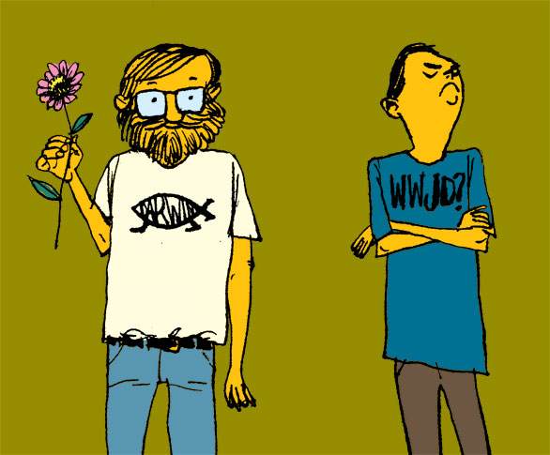
The Central Issue in Titus: Should your life look any better than the life of a non-Christian?
Titus
241
YES!

Slide 255
The Central Issue in Titus: Does your life look any better than the life of a non-Christian?
Titus
241

Slide 256

How to live?
Charles R. Swindoll, Contagious Christiantiy, 47
Notes:
What difference should this make in our lives?

Slide 257
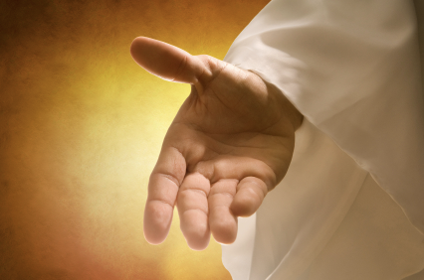
Make sure that you have received the salvation God freely offers you (Titus 2:11 NLT).
"For the grace of God has been revealed, bringing salvation to all people."
Charles R. Swindoll, Contagious Christiantiy, 47

Slide 258
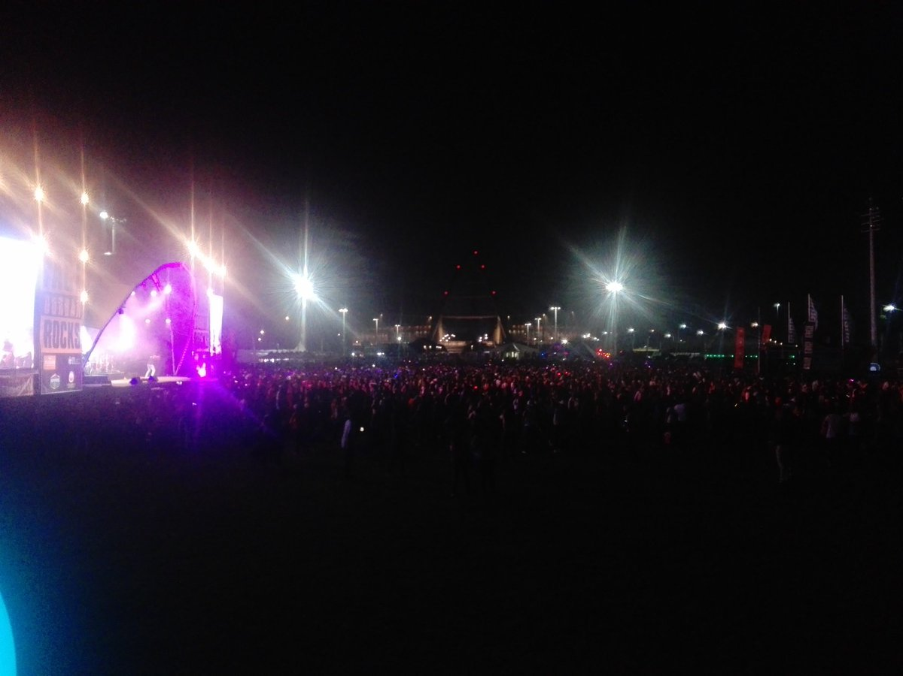
Continue to resist a corrupt lifestyle (Titus 2:12a NLT).
"And we are instructed to turn from godless living and sinful pleasures."
Charles R. Swindoll, Contagious Christiantiy, 47

Slide 259
Older Men
Sober-minded
Dignified
Self-controlled
Sound in faith, love, steadfastness
Older Women
Reverent
Not slanderers
Not addicted to wine
Train younger women
Younger Men
Self-controlled
Good works
Integrity
Dignity
Sound speech
Younger Women
Love husbands & children
Self-controlled
Pure
Working at home
Submissive to husbands

Slide 260

Live in a sensible, godly manner (Titus 2:12b-13 NLT).
"We should live in this evil world with wisdom, righteousness, and devotion to God, ¹³while we look forward with hope to that wonderful day when the glory of our great God and Savior, Jesus Christ, will be revealed."
Charles R. Swindoll, Contagious Christiantiy, 47

Slide 261


Do you need to read a good book on grace?
241

Slide 262
Black

Slide 263
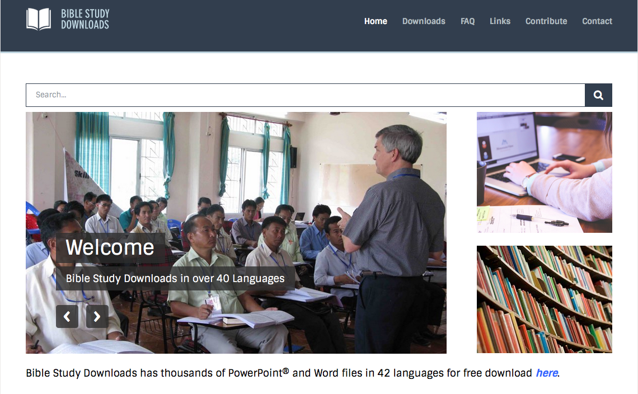

NT Preaching link at BibleStudyDownloads.org
Get this presentation for free!
Notes:
NT Survey (ns)

Slide 264
Titus
Think About It
241
The grace of God must result in your proper conduct.
Do you do good deeds:
• because you fear punishment by God (external motivation, the law) or
• because you love him in response to his grace?

Slide 265
Church Government Summary
244a
 | Episcopal | Presbyterian | Congregational | Elder/ Congregational
Definition | Bishop rule over several churches | Local church elders submit to higher bodies | Individual local church members have ultimate say | Individual church members balanced with elected elders
Structure | Bishop Archdeacon Vicar Priest Warden Parish Church Council Leaders Congregation | General Assembly Synod Presbytery Session Local church | Congregation Deacons Pastors | Elders/Pastors Deacons Congregation
Notes:
These four slides aim for an objective contrast between the four major forms of church government. However, within each form, many differences occur due to personalities, history, tradition, and many other factors.
————————————————
CH-03-Leadership Structure-61
NS-17-Titus-262

Slide 266
Church Government Summary
244a
 | Episcopal | Presbyterian | Congregational | Elder/ Congregational
Unique Elements | Various levels of clergy Most hierarchical structure | One level of clergy Teaching and ruling elders distinguished (1 Tim. 5:17) | One level of clergy Democratic Local church autonomy Often only one pastor per church | One level of clergy Democratic Local church autonomy
Groups | Anglican/ Episcopal Lutheran Methodist Orthodox Catholic | Presbyterian Reformed | Congregational Baptist Bible Presbyterian Evangelical Free Pentecostal | Bible churches Independent

Slide 267
Church Government Summary
244a
 | Episcopal | Presbyterian | Congregational | Elder/ Congregational
Biblical Support Cited | OT precedent of single leader Matt. 16:18; 18:18; 28:18-20 (apostolic succession) Acts 6:3, 6 (bishop ordaining) Acts 15:13 (James) Tit. 1:5 (Titus's authority) | OT precedent of rule by elders Acts 11:30 (elders handled finances) Acts 14:23 (group of elders per church) Acts 15 (assembly higher than local church) Acts 20:17f. (elders as ultimate church authority) | Matt. 18:17; Acts 1; 6:3-5; 11:22; 15:25; 1 Cor. 5:12; 2 Cor. 2:6-7; 2 Thess. 3:14; 1 John 2:20; 4:1 (group decisions) Elder, bishop, pastor & overseer synonymous (e.g., 1 Tim. 3:1 vs. Tit. 1:5) 1 Pet. 2:9 (priesthood of believers) NT focus on local church (many verses) | Presbyterian column (except Acts 15 is not seen as denoting an assembly higher than the local church) + Congregational verses

Slide 268
Church Government Summary
244a
 | Episcopal | Presbyterian | Congregational | Elder/ Congr.
Biblical Refutation | No clear evidence of structure above the local church (James presided rather than ruled) Power to ordain not clearly given to a single bishop Apostolic succession unproved Bishop/ presbyter distinction unwarranted | No clear evidence of structure above the local church (Jerusalem church in Acts 15 has no authority over Antioch as decision made by whole church in v. 22) Priesthood of believers not sustained with elders who lord it over the flock | Single pastor (=elder) concept unbiblical as elders always functioned as a group | None

Slide 269
Church Government Summary
244a
 | Episcopal | Presbyterian | Congregational | Elder/ Congregational
Practical Benefits | Efficiency Unity (fewer church splits?) | Group decision making | Group decision making Congregation has significant input | Balance of power between elders & congregation
Practical Minuses | Too much authority in one person (bishop) Little place for congregational input | Too much authority in one group (elders) Little place for congregational input | Inefficiency Major decisions often made by the uninformed Disunity (church splits) Pastor too often seen as employee rather than a leader | Danger of an overpowering elder board Difficulty determining which issues are elder issues and which are congregational

Slide 270
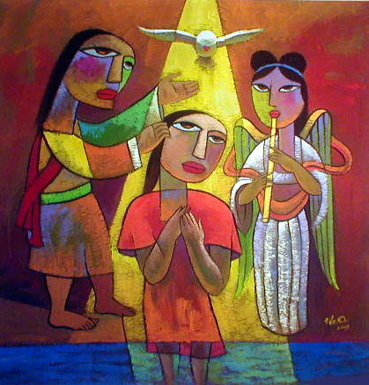
What is Baptism?
Contrasting the views…
Notes:
Let's begin our search of the NT teaching on baptism by asking this simple question: What is baptism?

Slide 271
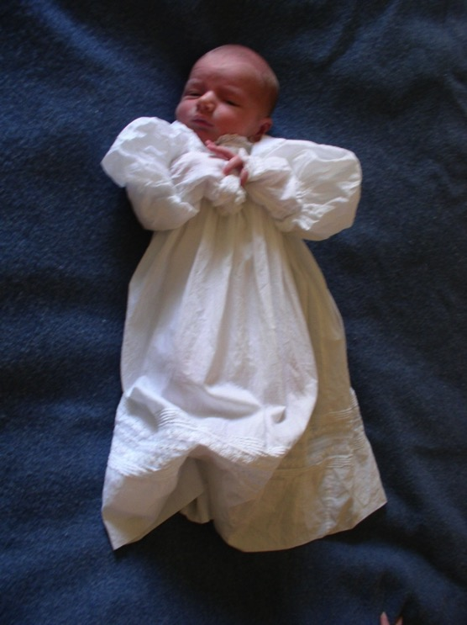
What About the Children?
(Paedobaptism)

Slide 272
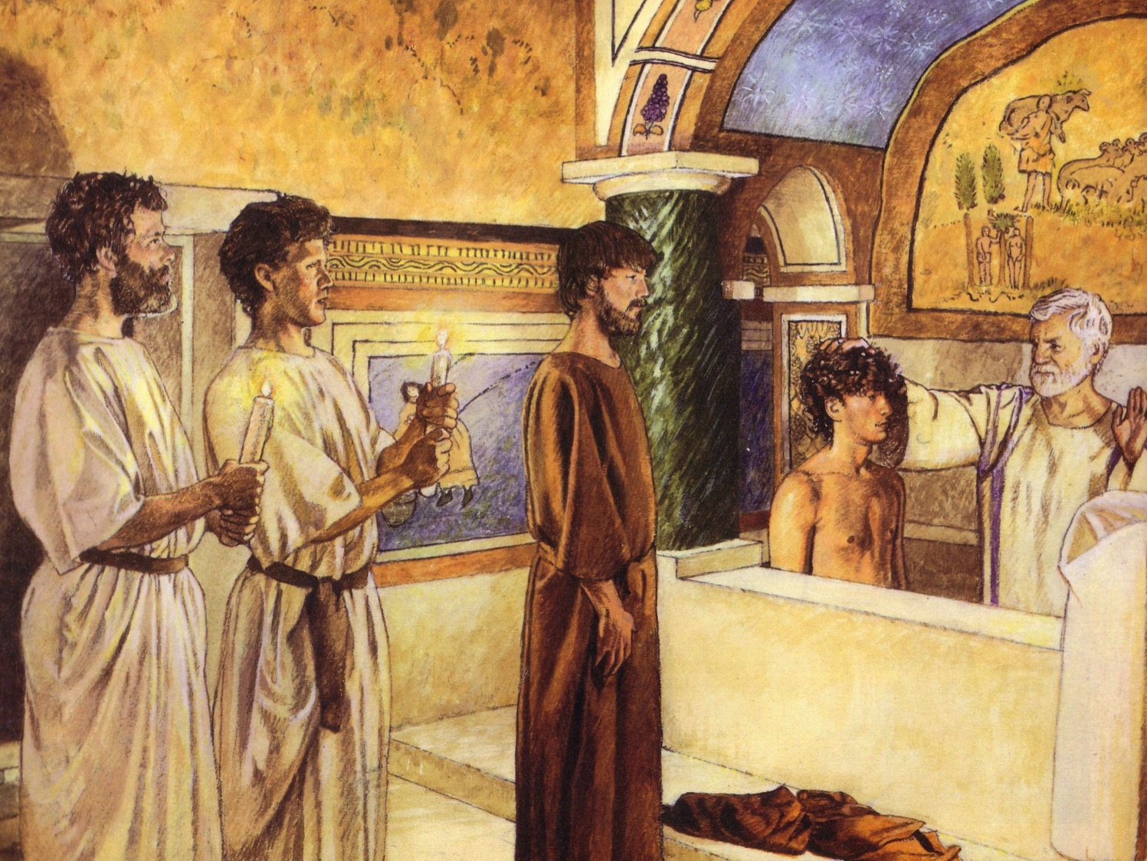
First Century Christian Baptism
244c
For Believers Only
By Immersion Only

Slide 273
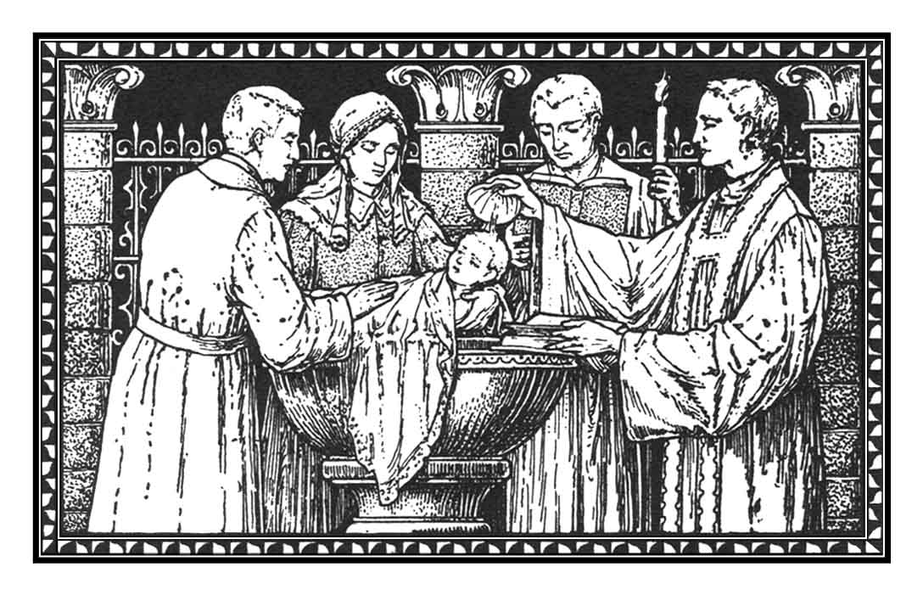
Recipients
(Paedobaptism)
The baptism of infants is recorded no earlier than the 3rd century A.D.

Slide 274
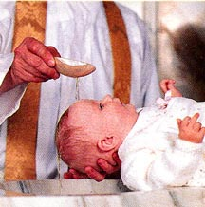
Recipients
244c
Two additional points:
Infant baptism advocates believe Col. 2:11-12 says that baptism is a sign of the new covenant that corresponds to circumcision in the Old Testament.
Jews were circumcised at 8 days old, sooo….

Slide 275
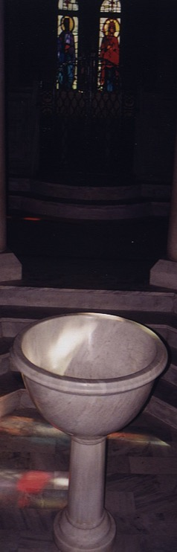
However, recipients should not be infants because…
244d
Circumcision doesn't parallel baptism
Males
All
Physical life
Spiritual life
Any age
Conscious faith
8th day of life
Right after belief
NT parallel = heart circumcision
New covenant sign = Lord's supper

Slide 276

Recipients
244d
(Paedobaptism)
Proponents claim that the "household baptisms" mentioned in Scripture included infants

Slide 277

Believers baptism advocates say that the recipients should not be infants because…
244e
Baptism testifies to what has already taken place in the life of the believer

Slide 278

Why is immersion the proper mode?

Slide 279

"Believed…then Baptized" Pattern in Acts
244e-f
Peter: "Repent…3000 baptized" (2:38, 41) Samaritans "believed…baptized" (8:12) Eunuch "believed…baptized" (8:36-38) Paul believed…baptized (9:18) Cornelius "believed…baptized" (10:47) Jailer "believed…baptized" (16:14-15, 33) Crispus "believed…baptized" (18:8) John's disciples "believed…baptized" (19:5)

Slide 280


What does "baptize" mean?
244f
Baptizo (bapti,zw) means "dip, immerse… wash, plunge, sink, drench, overwhelm… soak" (BAGD 131c)

Slide 281

Baptism Summary
244c
 | Infant | Believer's
Adherents | Catholic, Lutheran, Presbyterian, Reformed, Anglican, Methodist, some Evangelical Free Church | Baptist, Bible, Brethren, Mennonite, Pentecostal, some Evangelical Free Church, most independent churches
Purpose | Three Views: Catholic: Means of saving grace apart from the faith of the baptized (baptismal regeneration) Lutheran: Means of saving grace by assuming faith in infants baptized (baptismal regeneration) 3 Others: Not a means of saving grace but a seal and sign of the covenant | Unified View: Baptism is a symbol of salvation: an outward sign of the inward reality of justification received in Christ with no external efficacy.
Notes:
The many slides following seek to objectively contrast the two major forms of baptism, with a Lutheran professor's input on the infant baptism to make sure that I am representing the view properly. However, within each form, many differences occur due to personalities, history, tradition, and many other factors.
————————————————
CH-05-Baptism-105
NB-13 Religion 4 Baptism-105
NS-17-Titus-278

Slide 282
Baptism Summary
244c
 | Infant | Believer's
Support for Their Purpose | Baptismal regeneration is taught in many verses (Mark 16:16; John 3:5; Acts 2:38; Tit 3:5; 1 Pet 3:21). | Baptism and salvation are linked, but baptism does not cause salvation. Salvation is by faith alone (John 3:16; Rom. 10:9-10; Eph. 2:8-9). NT baptism was often at one's conversion. This close association between salvation and baptism was seen as a single event, yet baptism was not always commanded with conversion (Acts 3:19; 16:31). Baptismal regeneration is refuted by Ronald K. Y. Fung, The Epistle to the Galatians, NICNT, 173-74

Slide 283
Baptism Summary
244c
 | Infant | Believer's
View of Colossians 2:11-12 | "In him you were also circumcised, in the putting off of the sinful nature, not with a circumcision done by the hands of men but with the circumcision done by Christ, ¹² having been buried with him in baptism and raised with him through your faith in the power of God, who raised him from the dead" (Col 2:11-12 NIV). Baptism is the sign of the covenant (Col 2:12). It thus signifies the recipient's initiation into the community of God. | The new covenant sign is not baptism but the Lord's Supper (1 Cor 11:25). Colossians 2:11-12 parallels baptism not with physical circumcision but with "spiritual" circumcision, or salvation. The NT never connects baptism with a covenant (e.g., the Abrahamic Covenant).
Notes:
The infant baptism view of Colossians 2:12 is an argument from silence as Colossians mentions no covenant relating to baptism.

Slide 284
Baptism Summary
244c
 | Infant | Believer's
Seal of the Covenant | Baptism is the seal of the covenant (Acts 15:1; 21:21; Gal 2:3-5). | The verses at the left show only that circumcision is not required in the present age; they say nothing about baptism. The seal of the new covenant is not baptism but the Spirit (Eph 1:13-14).
Key Idea | The central idea associated with baptism is purification from sin (Col 2:11-12). | Baptism signifies forgiveness of sin but also identification with Christ in His death and resurrection (Rom 6:1-7).

Slide 285
Baptism Summary
244c
 | Infant | Believer's
Priority | Assigning to baptism only a symbolic purpose shows a low view of baptism considering the many NT references. | To baptize only Christians shows a high view of baptism—especially since it is so often associated with salvation. The statement at the left assumes that a symbol cannot be important, but this is exactly what we have in the Lord's Supper.
Thief on the Cross | This thief had no opportunity to be baptized so is not a good example since Christ may have made an exception in his case. | Christ promised the repentant thief on the cross salvation without baptism (Luke 23:40-43). This refutes Catholic and Lutheran views requiring baptism for salvation.

Slide 286
Baptism Summary
244c
 | Infant | Believer's
Subjects | Infants who have no personal faith in Christ can be baptized. | Believers alone should be baptized—this excludes infants and the unsaved.
Support for Above Stated Subjects | Baptism is parallel to circumcision; circumcision was done to infants; therefore, baptism should be performed on infants as well. | The logic at the left fails in its first premise—that baptism and circumcision are parallel (see above on Col 2:11-12). Also, only boys can be circumcised.

Slide 287
Baptism Summary
244c
 | Infant | Believer's
Illustration of God's Grace | Infant baptism more powerfully illustrates the grace of God. "How can the new covenant, which supersedes the old, exclude children when they are included in the old? Even animals are included in God's covenant of redemption (Gen 9:10), let alone children, who are definitely more precious to Him!". | How is God's grace towards a baby who has never consciously sinned greater than towards one who has repeatedly sinned? Grace towards adults is the greater marvel. Children of the old covenant were not saved by circumcision but by faith (Gen 15:6). Likewise, all in the new covenant are accepted by faith—not by baptism (Rom 4:1-25). Besides, how does denying infant baptism give priority to animals over humans? Animals are not baptized, so no comparison exists.

Slide 288
Baptism Summary
244c
 | Infant | Believer's
Household Baptisms | Entire households were baptized in the NT, which almost certainly included infants (Acts 10:47-48; 16:15; 18:8; 1 Cor. 1:16). | Each of the household texts declare that the households believed before baptism; that infants were baptized is an assumption that is counter to the stated fact that people believed before baptism.
Baptism in Church History | Infant baptism has been practiced throughout the history of the church from earliest times. | The earliest non-scriptural baptism instructions (early 2nd cent.) requires fasting 1-2 days before baptism, so it implies only adult baptism (Didache 7:4 in J.B. Lightfoot, Apostolic Fathers, 153)

Slide 289
Baptism Summary
244c
 | Infant | Believer's
Jesus & Children | Christ blessed children– probably even infants (Mark 10:13-16), which shows His approval to baptize them. | Blessing children and baptizing them are wholly different. The argument at the left is valid only if the NT shows Christ baptizing children, which it does not.
NT Silence | Infant baptism is not prohibited in the NT and therefore is allowed. | Silence does not argue for approval (e.g., we cannot argue for baptism of the dead simply because the NT does not prohibit it). NT support for believer's baptism automatically prohibits infant baptism since infants cannot believe.

Slide 290
Baptism Summary
244c
 | Infant | Believer's
Matthew 28:19-20 | The text does not give a sequence for baptism: "Therefore go and make disciples of all nations, baptizing them in the name of the Father and of the Son and of the Holy Spirit, ²⁰ and teaching them to obey everything I have commanded you. And surely, I am with you always, to the very end of the age" (NIV). | The Great Commission command is to make disciples—the only imperative in the verses. Going and baptizing and teaching are all participles, in this order. The "going" refers to leading people to faith, so we should baptize only believers, which excludes infants.
Romans 6:1-11 | "Whether the mode of baptism by immersion be alluded to in this verse, as a kind of symbolical burial and resurrection, does not seem to us of much consequence" (Jamieson, Fausset, and Brown, A Commentary, 1871, Accordance electronic ed. on Rom 6:4). | Being "buried with him in baptism" points to immersion only. Baptism also points back to the believer's becoming united with Christ in His death. This cannot be said of infants who have yet to believe.

Slide 291
Baptism Summary
244c
 | Infant | Believer's
Spiritual State of Those Baptized | Baptism is the means of saving infants (Catholic view), means of infants expressing faith in Christ (Lutheran view), or means of bringing infants "into the covenant" (Presbyterian view). | All NT subjects of baptism are clearly believers; one must have very good reason to deviate from this norm. Acts 2:38, 41; 8:12, 36-38; 9:18; 10:47; 16:14-15, 33; 18:8; 19:5 show that repentance preceded baptism in this order: "hearing...believing...being baptized."
Mode | Scripture does not specify any mode of baptism, thus allowing both sprinkling and pouring. It is not method that counts, but the sincerity of the one baptized. | The only scriptural mode is immersion, so how can we say mode is unimportant? While it is true that mode is less important than heart attitude, this does not then imply that mode is irrelevant.

Slide 292
Baptism Summary
244c
 | Infant | Believer's
Pouring in Church History | Baptism by pouring has been practiced throughout the history of the church from earliest times. | Pouring is first stated in the early second century—and only as an exception when immersion in running water or cold water could not or should not be used (Didache 7:1-3 in J. B. Lightfoot, Apostolic Fathers, 153).
Pouring in the NT | Baptism by pouring is mentioned often in the NT (1 Cor 6:11; Eph 5:26; Heb 9:10; 10:22; Tit 3:5). | None of these verses refer to baptism and none refer to pouring. They refer in each case to spiritual cleansing from sin by faith in Christ ("washing") or to Jewish ceremonial washings which were performed numerous times on the same persons (cf. Heb 9:10). Hebrews 10:22 refers not to baptism but to "having our hearts sprinkled to cleanse us from a guilty conscience and having our bodies washed with pure water."

Slide 293
Baptism Summary
244c
 | Infant | Believer's
Pouring Symbolism | Pouring best represents the outpouring of the Holy Spirit upon believers (Matt 3:11; Acts 1:5; 2:3). | Similarities are only implied between pouring water and the outpouring of the Spirit, but the explicit NT symbolism is that baptism shows the believer dying to his old life and rising to a new one (Rom 6:1-4). Thus, immersion is the explicit NT mode and pouring is argued only by implication.
Sprinkling in the NT | Baptism by sprinkling is mentioned often in the Bible (Exod 24:6-8; Num 8:7; Ezek 36:24-26; Heb 9:13-14; 10:22). | These verses refer not to baptism but to purifying priests with sprinkled water (Num 8:7), sprinkling vessels with blood (Exod 24:6-8; Heb 9:13-14), or the Spirit’s saving work (Ezek 36:24-26; Heb 10:22).

Slide 294
Baptism Summary
244c
 | Infant | Believer's
Pentecost Baptism (Acts 2) | Practically speaking, Peter could not have immersed 3000 in a single day on the day of Pentecost (Acts 2:41). This baptism must have been by sprinkling or by pouring. See Robert Jamieson, A. R. Fausset, and David Brown, A Commentary, Critical and Explanatory on the Whole Bible, 1871, Accordance electronic ed. (Altamonte Springs: OakTree Software, 1996), paragraph 19660. | Could Peter have sprinkled or poured on that many either? The text doesn’t say Peter did the baptizing. If one could immerse 100 people per hour (very possible), the 120 disciples (Acts 1:15) could have immersed 12,000 in a single hour! Even if only the 12 baptized it would take less than three hours to baptize the 3000 (12 x 100 = 1200/hr.).

Slide 295
Baptism Summary
244c
 | Infant | Believer's
Philippi Baptism (Acts 16) | The Philippian jailer would not have left his post for immersion but could have momentarily for pouring or sprinkling (Acts 16:33b). | The jailer listened to Paul's preaching (v. 32) and washed Paul and Silas' wounds (v. 33a), which may have taken just as long. He left his post to invite Paul and Silas to his home for a midnight meal (v. 34). Baptism takes less time than eating a full meal. The argument at the left also assumes that he guarded the jail alone rather than delegating his jobs to others.
Lexical Meanings | Lexical meanings are not sufficient to establish theology. | The only NT word for baptism (βαπτίζω) means "dip, immerse…wash, plunge, sink, drench, overwhelm…soak" (BAGD 131c). Other literal uses include "to dip" (Luke 16:24; cf. LXX Jud 2:14; Josh 3:15; Lev 4:6; 11:32) and "to dye" (Rev 19:13), both indicating immersion. Also, baptism is likened to the Flood (1 Pet 3:21). From the lexical data even Luther and Calvin both admitted immersion as the biblical mode.

Slide 296
Baptism Summary
244c
 | Infant | Believer's
John the Baptist Mode | Since sprinkling was practiced in the OT, John the Baptist probably sprinkled as well—especially since he was a Levite (Luke 1:5). | John the Baptist performed his baptisms in the Jordan River. Would sprinkling require people to walk into the water with John? Besides, the type of baptism immediately preceding John's historically was Jewish proselyte immersion.
Pre-NT Immersion | Baptisms preceding Christianity do not absolutely establish that Christian baptism followed the same pattern. | Immersion (βαπτίζω) described not only NT baptism, but also Jewish ritual washings (Mark 7:4; Luke 11:38) by immersion (e.g., Qumran). Both pagan religious washings and Jewish proselyte baptism preceded Christian baptism, the later being by self-immersion (A. Oepke, "bapto, baptizo…" TDNTabr., 92-93).

Slide 297
Baptism Summary
244c
 | Infant | Believer's
Biblical Parallels to Sprinkling & Pouring | Sprinkling and pouring also have OT and NT parallels. | No so-called parallel relates to baptism. Immersion best signifies: • identification with Christ's death and resurrection by going under the water and out again (Rom 6:3-5; Col 2:12) • subjection to Christ's authority (Matt 28:18-19; Acts 19:3-5; 22:16) • obedience and a good conscience before God (1 Pet 3:21).
NT Start of Immersion | Baptism preceded the writing of Romans, so the immersion of Romans 6 could have been new. No evidence prior to Romans indicates that baptism signified Christ's death and resurrection. | Arguments from silence such as the one at the left hold little weight. Only six NT books preceded Romans, so Romans was among the first NT books written (AD 56-57). Among these letters is 1 Corinthians where Paul mentions baptism (1:13-17). He indicated immersion there by using the normal word for immersion (βαπτίζω).

Slide 298
Baptism Summary
244c
 | Infant | Believer's
Amount of Water in Baptism | The passages at the right argue only that baptism took place in water, but this still could have been by pouring or sprinkling while standing in the water. | All NT baptisms best allow for immersion: "plenty of water" (John 3:23), "coming up out of the water" (Mark 1:10), and "went down into the water" (Acts 8:38). This last case concerns the Ethiopian eunuch who could have easily been baptized by pouring or sprinkling anywhere along the journey by using water in the caravan.

Slide 299
Black

Slide 300
NT Survey link at BibleStudyDownloads.org
Get this presentation for free!
Notes:
NT Survey (ns)

