Slide 1
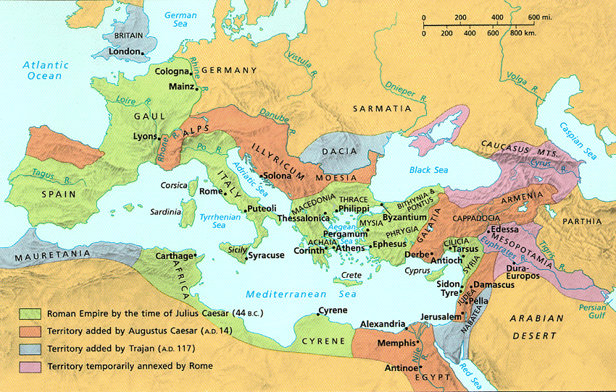
After Acts 28…
154f
?
Did Paul Go to Spain?
Taught by Dr. Mark DeNeui Rooted Conference, Malaga, Spain • 2 January 2026 Uploaded by Dr. Rick Griffith • Jordan Evangelical Theological Seminary Files in many languages for free download at BibleStudyDownloads.org

Slide 2
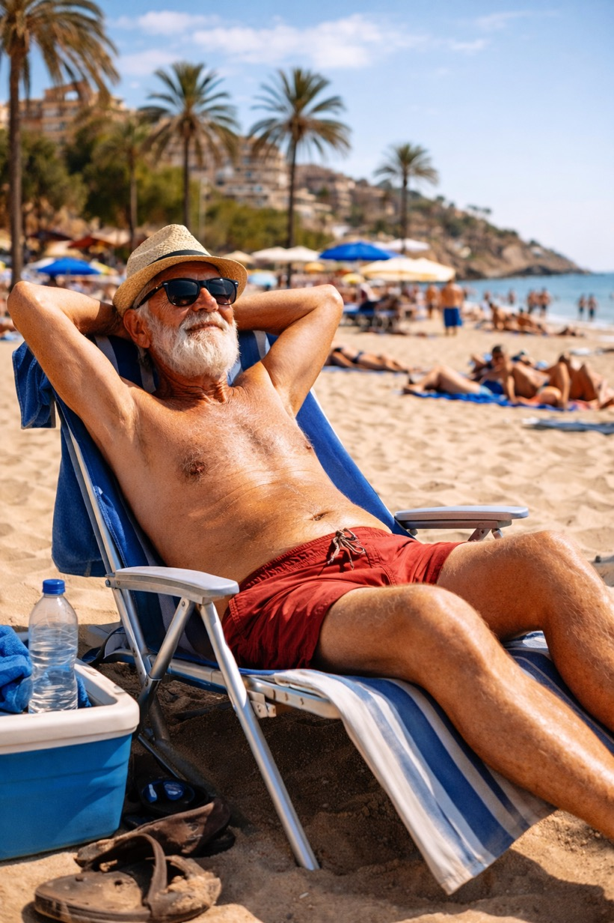
Did Paul go to Spain?

Slide 3

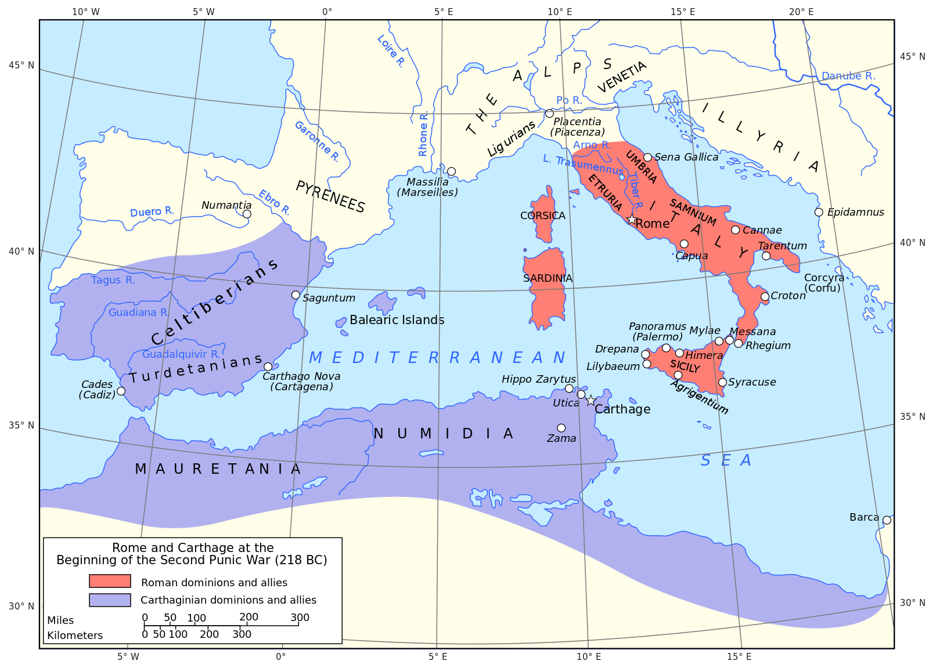
218 BC
Notes:
Before Rome's reach expanded beyond Italy, Spain was under the influence of Carthage.

Slide 4
125 BC
Notes:
But Rome's conquests enforced Roman values on Gaul (France) just at Spain's borders.

Slide 5
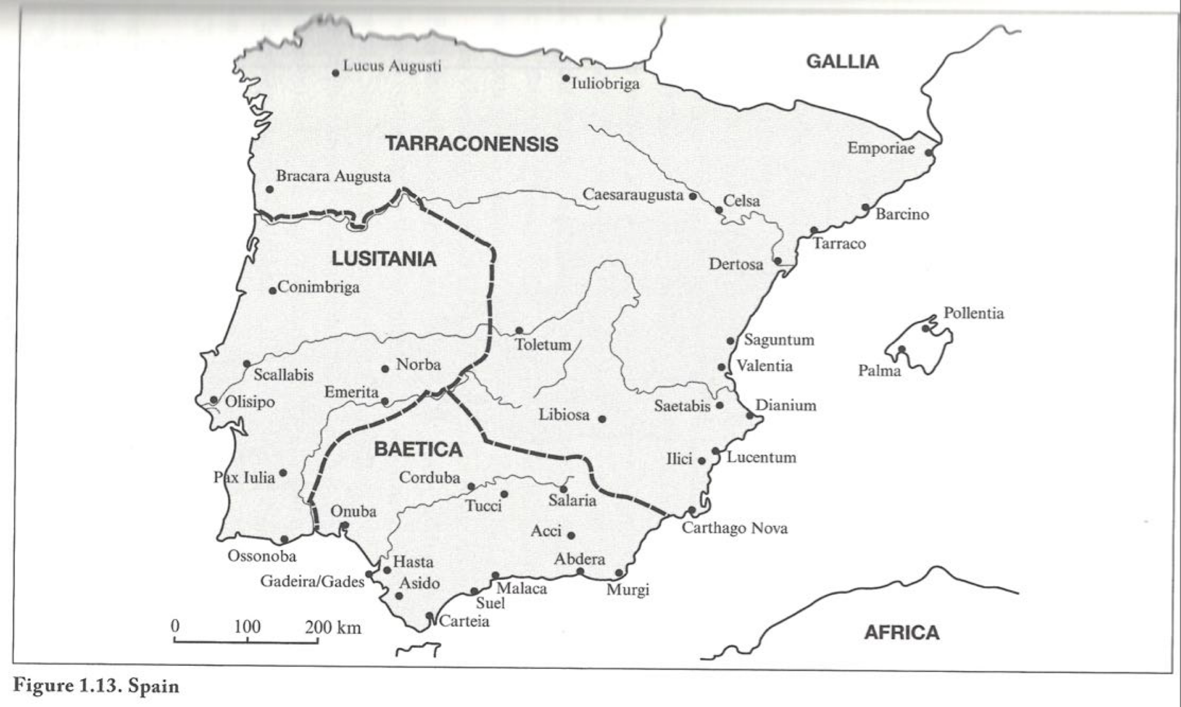
Cádiz & Málaga
Notes:
AI Overview:
Gadeira (or Gadir/Gades) is
the ancient Phoenician name for the city now known as Cádiz, located in Andalusia, Spain, making it one of Europe's oldest continuously inhabited cities, famed for its Phoenician origins, Roman history, significant trade with the Americas, and as the site where Spain's first constitution was signed, with the name evolving through Phoenician, Roman, Moorish (Qādis), and Spanish eras to modern Cádiz.
Key Aspects of Gadeira/Cádiz:
Origins: Founded by Phoenicians around 1104 BC as Gadir, they established a major port trading with ancient civilizations like Tartessos.
Mythology: Linked to Hercules, who according to legend, founded the city after his tenth labor, with a famous temple dedicated to Melqart (Hercules Gaditanus).
Roman Era: Known as Gades, it became a prosperous Roman city, part of the province of Baetica.
Moorish & Spanish Rule: Later known as Qādis under Moorish rule, it developed into a significant naval base and a crucial trade hub, especially with the Americas, during Spain's Golden Age.
Historical Significance: During the Napoleonic Wars (1810-1813), it served as the capital of Spain, and the first Spanish Constitution was signed in the Church of San Felipe Neri.
Modern City: Today, Cádiz is a vibrant city in the province of Cádiz, known for its unique colonial architecture, sunny squares, beaches (like La Caleta), and rich cultural heritage.
Archaeology: Sites like the Nueva Gadeira Archaeological Center in nearby Chiclana de la Frontera reveal its deep Phoenician and Bronze Age history.
In essence, "Gadeira" refers to the ancient foundation of modern-day Cádiz, a city with layers of history from Phoenician traders to a crucial Spanish stronghold.

Slide 6
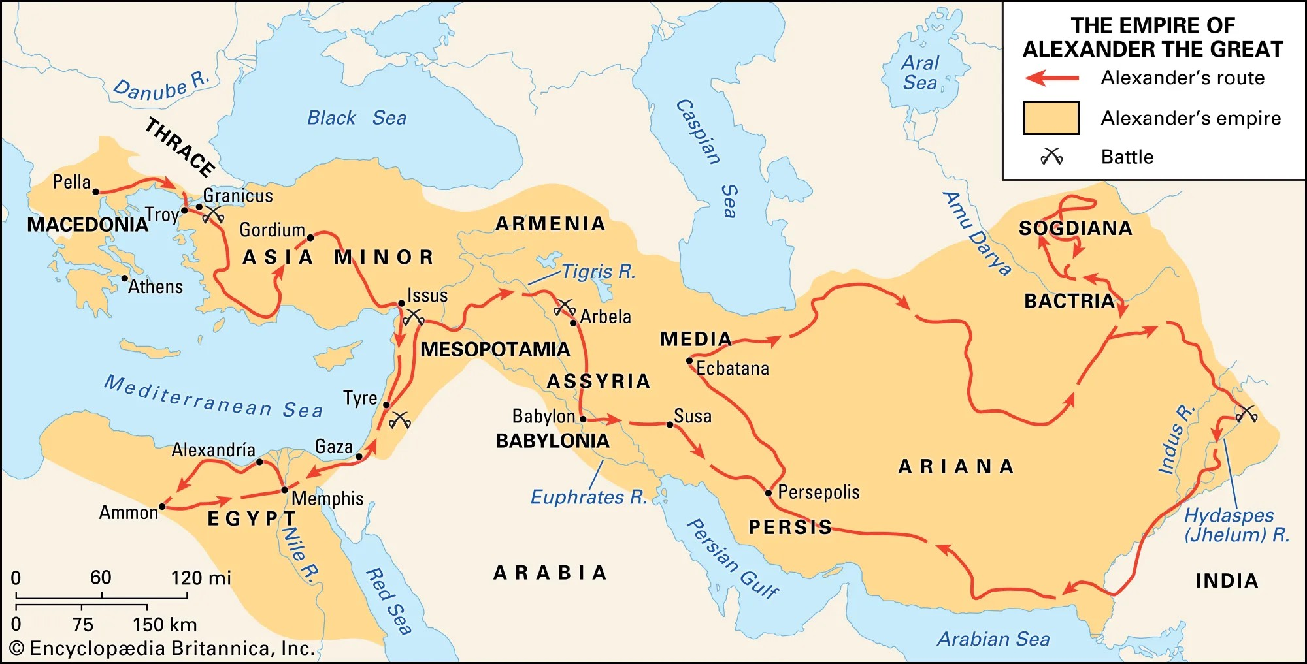
Greek Empire 323 BC
Notes:
A key element of the Greek era was the imposition of the Greek language on the entire Eastern Empire. Since Paul could speak Greek, he traveled freely in the east to plant churches without any language hindrances.

Slide 7
Paul's 3rd Missionary Voyage
Notes:
By the end of Paul's third mission trip, the gospel had been established from Jerusalem to Greece.

Slide 8
Paul's Voyage to Rome
Notes:
Paul explains in Romans 15 how he wanted spiritual fruit in the western Roman Empire with the help of the church in Rome.

Slide 9
Largest Cities in the Roman Empire
Largest Cities in the Roman Empire
Rome: 1 million
Alexandria: 500,000
Antioch: 300,000
Ephesus : 200,000
Smyrna: 200,000
Pergamon: 150,000
Corinth: 100,000
Rome
1 million
Pergamon 150,000
Corinth 100,000
Antioch 300,000
Smyrna 200,000
Ephesus 200,000
Alexandria 500,000
Notes:
Note that NONE of the largest cities were in the Western Roman Empire. The west was non-Greek speaking and more rural.

Slide 10

Did Paul Go to Spain? Searching for Clues…
Clues from Paul before visiting Rome
Clues from Paul in Rome
Clues from Paul after Rome
Clues from Paul’s last letter
Clues from Others

Slide 11
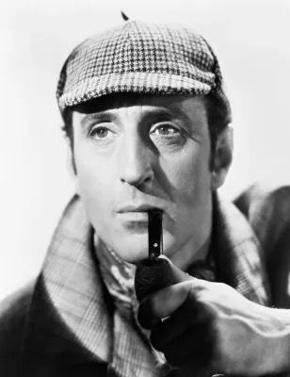
Clues from Paul before Rome

Slide 12
Romans 15:23-24
²³ But now I have finished my work in these regions, and after all these long years of waiting, I am eager to visit you.
²⁴ I am planning to go to Spain, and when I do, I will stop off in Rome. And after I have enjoyed your fellowship for a little while, you can provide for my journey.
Notes:
Paul shared his plan to extend his ministry to Spain to get their help (23-24).

Slide 13
Paul's Next Mission Field: Spain (15:23-29)
154f
Notes:
Why was Paul going to Spain? He had finished pioneering in the eastern Empire. Like in the time of Jonah, Spain (or Tarshish) was the very end of the known world.
Was there really “no more place for me to work in these regions” (NIV, 14:23)? No. He means that church-planting movements in the east would reach these people.
Financial help from the Romans would further his work since he’d be halfway to Spain by the time he got to Rome.
• But he would not go there immediately.

Slide 14
Romans 15:25-27
²⁵ But before I come, I must go to Jerusalem to take a gift to the believers there. ²⁶ For you see, the believers in Macedonia and Achaia have eagerly taken up an offering for the poor among the believers in Jerusalem. ²⁷ They were glad to do this because they feel they owe a real debt to them. Since the Gentiles received the spiritual blessings of the Good News from the believers in Jerusalem, they feel the least they can do in return is to help them financially.
Notes:
But first he had to bring the Gentile offering to Jerusalem to show unity with their Jewish mother church (25-27).
How did this Gentile support for Jerusalem relate to Paul’s calling to Gentiles?
He says here that he intended it to somewhat repay what the Jerusalem church had done for the Gentiles—which is interesting since it was the Antioch church—not the Jerusalem church—that sent him out to reach Gentiles.

Slide 15
Paul's Next Mission Field: Spain (15:23-29)
154f
Notes:
Paul didn't forget the needy in his passion to expand, so he had to deliver this help in person to Jerusalem.

Slide 16
Romans 15:28-29
²⁸ As soon as I have delivered this money and completed this good deed of theirs, I will come to see you on my way to Spain.
²⁹ And I am sure that when I come, Christ will richly bless our time together.
Notes:
Paul then also hoped to bless the Roman believers (28-29), and then head to Spain.

Slide 17
Paul's Next Mission Field: Spain (15:23-29)
154f
Notes:
Paul then planned on stopping off at Rome…

Slide 18
Paul's Next Mission Field: Spain (15:23-29)
154f
Notes:
…and then proceed from Rome to share the Good News in Spain.
Paul would have needed both financial support and those who could translate the gospel in the languages of the West. What better place to find them than Rome?

Slide 19

Clues from Paul in Rome

Slide 20
And when we came into Rome, Paul was allowed to stay by himself, with the soldier who guarded him…
He [Paul] lived there [Rome] two whole years at his own expense, and welcomed all who came to him, proclaiming the kingdom of God and teaching about the Lord Jesus Christ with all boldness and without hindrance.
Acts 28:16, 30-31
Notes:
The Book of Acts ends with Paul in Rome.

Slide 21
Possible Chronology of Paul’s Travels and His Writings
Dates | Letters | Events
47 - 48 | Galatians | Accompanies Barnabas on his trip to Cyprus and Asia Minor
50 - 52 | 1 & 2 Thessalonians | in Corinth
52 - 55 | 1 Corinthians | in Ephesus
55 - 56 | 2 Corinthians | in Macedonia and Illyria
Winter 56 - 57 | Romans | in Corinth
60 - 62 | Philemon, Colossians, Ephesians, Philippians | House arrest in Rome

Slide 22
for I know that through your prayers and the help of the Spirit of Jesus Christ, this will turn out for my deliverance…
Convinced of this, I know that I will remain and continue with you all, for your progress and joy in the faith, so that in me you may have ample cause to glory in Christ Jesus, because of my coming to you again.
I hope, therefore, to send him [Timothy] just as soon as I see how it will go with me, and I trust in the Lord that shortly I myself will come also.
Philippians 1:19, 25-26; 2:23-24
Notes:
In AD 62, Paul anticipated his release from house arrest in Rome so that he could travel east to revisit the Philippians.

Slide 23
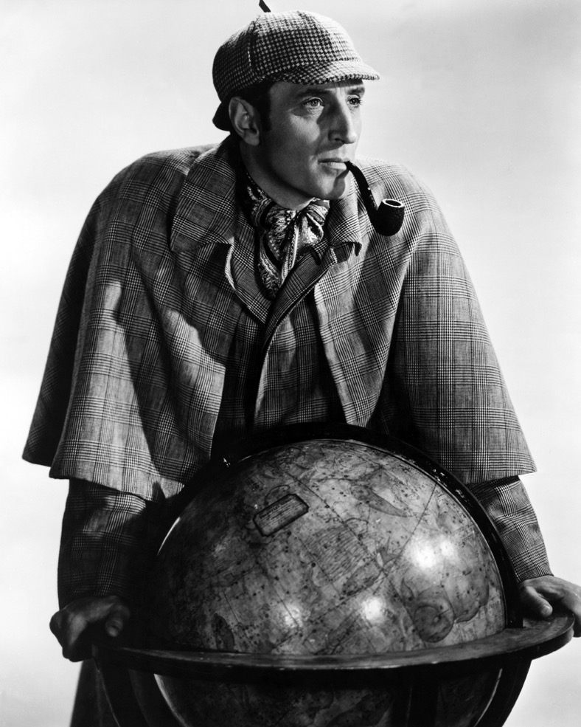
Clues from Paul after Rome

Slide 24
As I urged you when I was going to Macedonia, remain at Ephesus so that you may charge certain persons not to teach any different doctrine…
I hope to come to you [in Ephesus] soon, but I am writing these things to you so that, if I delay, you may know how one ought to behave in the household of God,
Until I come, devote yourself to the public reading of Scripture, to exhortation, to teaching.
1 Timothy 1:3; 3:14-15; 4:13
Notes:
After Paul's release in AD 62, he also encouraged Timothy in Ephesus that he hoped to join him soon.

Slide 25
This is why I left you in Crete, so that you might put what remained into order, and appoint elders in every town as I directed you…
One of the Cretans, a prophet of their own, said…
Titus 1:5, 12

Slide 26
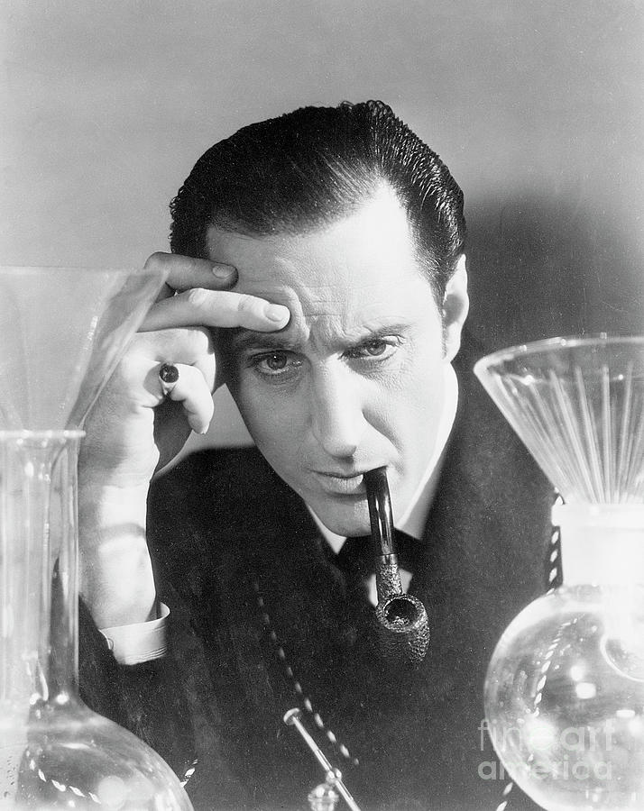
Clues from Paul’s last letter

Slide 27
May the Lord grant mercy to the household of Onesiphorus, for he often refreshed me and was not ashamed of my chains, but when he arrived in Rome, he searched for me earnestly and found me—may the Lord grant him to find mercy from the Lord on that day!—and you well know all the service he rendered at Ephesus.
At my first defense, no one came to stand by me, but all deserted me. May it not be charged against them! But the Lord stood by me and strengthened me, so that through me the message might be fully proclaimed and all the Gentiles might hear it. So I was rescued from the lion’s mouth.
2 Timothy 1:16-18; 4:16-17

Slide 28
Paul’s last words:
For I am already being poured out as a drink offering, and the time of my departure has come. I have fought the good fight, I have finished the race, I have kept the faith. Henceforth, there is laid up for me the crown of righteousness, which the Lord, the righteous judge, will award to me on that day, and not only to me but also to all who have loved his appearing.
2 Timothy 4:6-8

Slide 29
Possible Chronology of Paul’s Travels and His Writings
Dates | Letters | Events
47 - 48 | Galatians | Accompanies Barnabas on his trip to Cyprus and Asia Minor
50 - 52 | 1 & 2 Thessalonians | in Corinth
52 - 55 | 1 Corinthians | in Ephesus
55 - 56 | 2 Corinthians | in Macedonia and Illyria
Winter 56 - 57 | Romans | in Corinth
60 - 62 | Philemon, Colossians, Ephesians, Philippians | House arrest in Rome
62 - 64 | 1 Timothy, Titus | Spain, Crete, Macedonia, Ephesus
65(?) | 2 Timothy | Last imprisonment, trial and execution in Rome

Slide 30
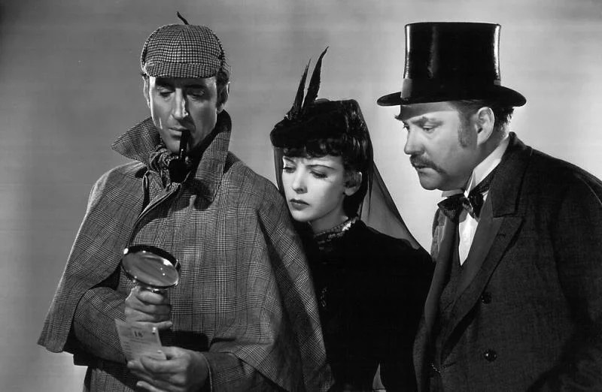
Clues from Others

Slide 31
Seven times he [Paul] bore chains; he was sent into exile and stoned; he served as a herald in both the East and the West; and he received the noble reputation for his faith. He taught righteousness to the whole world, and came to the limits of the West, bearing his witness before the rulers.
1 Clement 5:6-7 (AD 95)

Slide 32
“West” or
“the setting of the sun”
usually designates Spain
• Josephus Contra Apionem 1.67
• Tacitus Historiae 4.3
• Strabo Geographica 1.2.31; 1.4.6; 2.1.1; 2.4.3-4; 3.1.2; 3.5.5
• Philostratus Vita Apolllonii 5.4; 4.47
• Pliny Naturalis historia 3.1.3-7

Slide 33
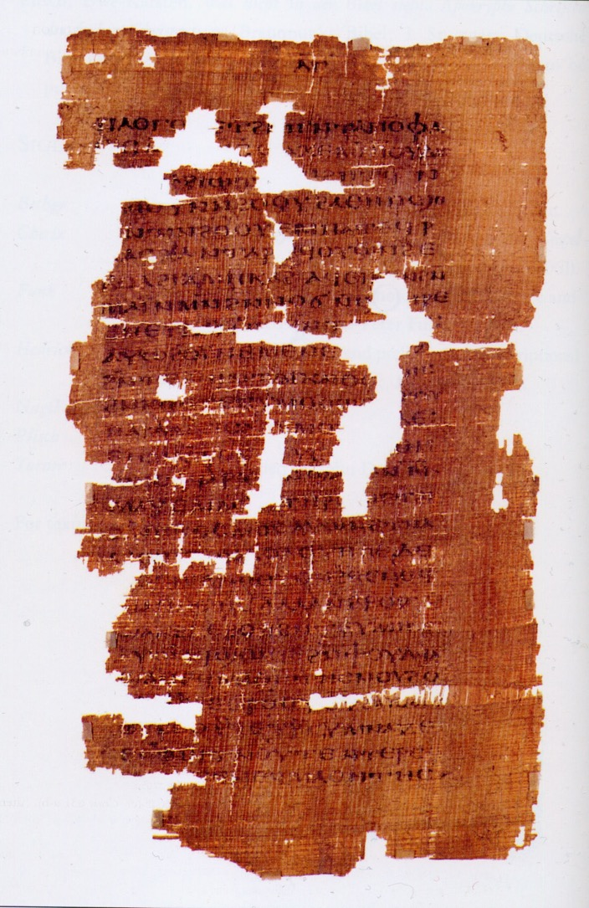
When Paul was at Rome, confirming many in the faith... Quartus [a member of the guard who had come to faith] persuaded Paul to leave the city and to go wherever he pleased. Paul said to him, “If such be the will of God, he will reveal it to me.” And Paul fasted three days and besought the Lord to grant what was good for him, and in a vision he saw the Lord who said to him, “Paul, arise, and be a physician to the Spaniards!” At this he related to the brethren what God had commanded him, and without hesitation he made ready to leave the city. When Paul was preparing to leave, there was a great lamentation among the brethren because they thought they would never see Paul again.
Acts of Peter 1 (AD 190)

Slide 34
For the “most excellent Theophilus,” Luke summarizes the several things that in his own presence have come to pass, as also by the omission of the passion of Peter he makes quite clear, and equally by (the omission) of the journey of Paul, who from the city (of Rome) proceeded to Spain.
Muratorian Canon, lines 35-39 (200 AD)

Slide 35
For the churches which have been planted in Germany do not believe or hand down anything different, nor do those in Spain, nor those in Gaul, nor those in the East, nor those in Egypt, nor those in Libya, nor those which have been established in the central regions of the world (i.e., in Palestine with Jerusalem).
Irenaeus Adversus Haereses 1.10.2 (180 AD)

Slide 36
Tradition has it that after defending himself, the Apostle was again sent on the ministry of preaching, and coming a second time to the same city, suffered martyrdom under Nero. During this imprisonment, he wrote the second Epistle to Timothy, indicating at the same time that his first defense had taken place and that his martyrdom was at hand.... We have said this to show that Paul’s martyrdom was not accomplished during the sojourn in Rome that Luke describes.
Eusebius Hist Eccl ii 22.7-8 (around AD 320)

Slide 37
Paul was dismissed by Nero, that the gospel of Christ might be preached also in the West… He then, in the fourteenth year of Nero on the same day with Peter, was beheaded at Rome for Christ's sake and was buried in the Ostian way.
Jerome De Viris Illustribus 5 (AD 393)

Slide 38
Encouragement and Exhortation from Paul’s Potential Trip to Spain:
• Paul continued active ministry until the end.
• Paul's passion for the unreached continued until the end.
• Paul found his identity as part of God’s worldwide, eternal Gospel plan.

Slide 39

the existential view
God
family
work
leisure
friends
Notes:
The average unbeliever sees life revolving around himself for his own benefit.

Slide 40

the biblical view
The Gospel
God’s blessing by faith in the crucified and resurrected Jesus Christ, who presides over the plan.
macro
micro
God’s plan to
“bless all nations of the earth”
by faith in God (Genesis 12:3)
“And this gospel of the kingdom will be proclaimed throughout the whole world as a testimony to all nations, and then the end will come.”
Matthew 24:14
Notes:
The mission-informed believer understands that God's micro-plan for him fits under God's macro-plan to bless the entire world until all people have a witness before Christ returns.

Slide 41
Black

Slide 42
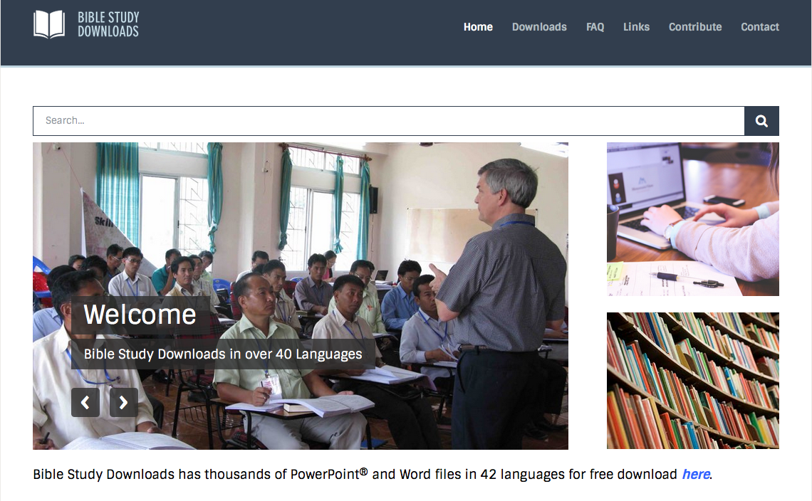

NT Survey • BibleStudyDownloads.org
Get this presentation and script for free!

