Slide 1
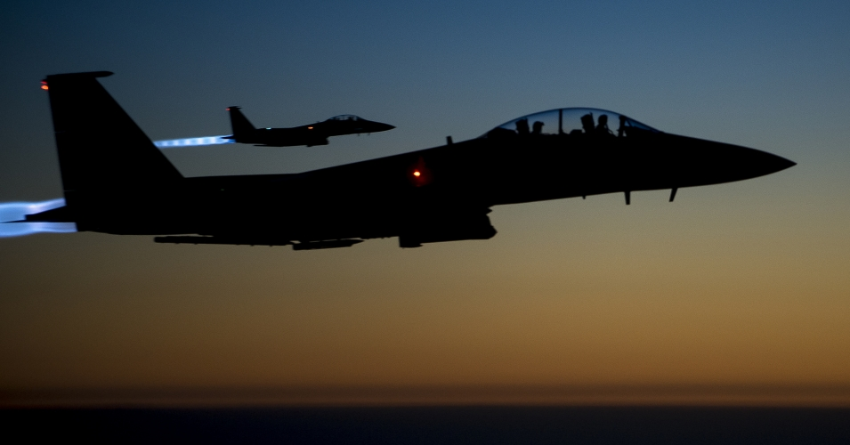
2 Timothy
Sound Doctrine Against Opposition
Dr. Rick Griffith • Jordan Evangelical Theological Seminary • BibleStudyDownloads.org
Notes:
We are at war, whether we see it or not. Therefore, we need the best offensive and defensive weapons that we can muster. By God's grace, he wrote down his words for us, including Paul's second letter to Timothy. And what is our primary weapon? Doctrine.

Slide 2
Key Word
237
Doctrine
2 Timothy
Notes:
Doctrine is not merely theology; it is the RIGHT theology, or the truth that sustains us in our battle. This is simply because our war is against error, so the right way to combat heresy is with truth.

Slide 3
Theme
23
Sound Doctrine Against Opposition
2 Timothy
Notes:
Titus is about "Sound Conduct Against Opposition," but 2 Timothy is the corollary that emphasizes "Sound Doctrine Against Opposition." Actually, both letters teach the vital importance of doctrine and conduct, so these summaries give only their primary emphases.

Slide 4
Key Verses
237
"All Scripture is God-breathed and is useful for teaching, rebuking, correcting and training in righteousness, so that the man of God may be thoroughly equipped for every good work…
Preach the Word" (3:16-17; 4:2).
2 Timothy
Notes:
Our doctrine comes from the Bible. This is because the Bible is the only written record from God, inspired in its original manuscripts and the most useful weapon against false teaching.

Slide 5
237
Summary Statement
Persevere against apostasy despite hardship by faithfully preaching the Word.
2 Timothy
Notes:
Ours is not a quick skirmish or a brief battle. It is the war of the ages, so we must persevere in teaching the truth until all falsehood is vanquished. This will entail difficulty, as seen in the fact that Paul wrote this letter from a dungeon without windows or natural light. Yet, he had the spiritual light to dispel the darkness of heresies impacting the churches in the AD 60s. Therefore, he commissioned Timothy to preach the gospel to all who would listen.

Slide 6

Kingdom Statement
237
27d
237
The mention “by His appearing and His kingdom” (4:1 NAU) links Christ’s return with his millennial rule while “bring me safely to His heavenly kingdom” (4:18 NAU) shows its eternal nature.
2 Timothy
Notes:
God's kingdom rule is eternal, but its next installment will last 1000 years until that millennial age is delivered over to the Father. Both of Paul's notations about the kingdom were in the final chapter that we have from his pen in the NT.

Slide 7
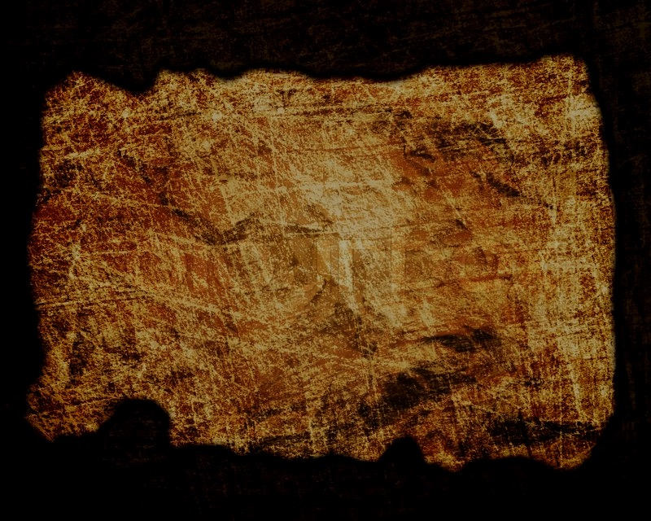
Covenant
27d
Paul was “an apostle of Christ Jesus by the will of God, according to the promise of life that is in Christ Jesus” (1:1).
2 Timothy
Notes:
This "promise of life…in Christ" stems from the new covenant that brings life, as Paul also noted in 2 Corinthians…
2Cor. 3:6 He has enabled us to be ministers of his new covenant. This is a covenant not of written laws, but of the Spirit. The old written covenant ends in death, but under the new covenant, the Spirit gives life.

Slide 8
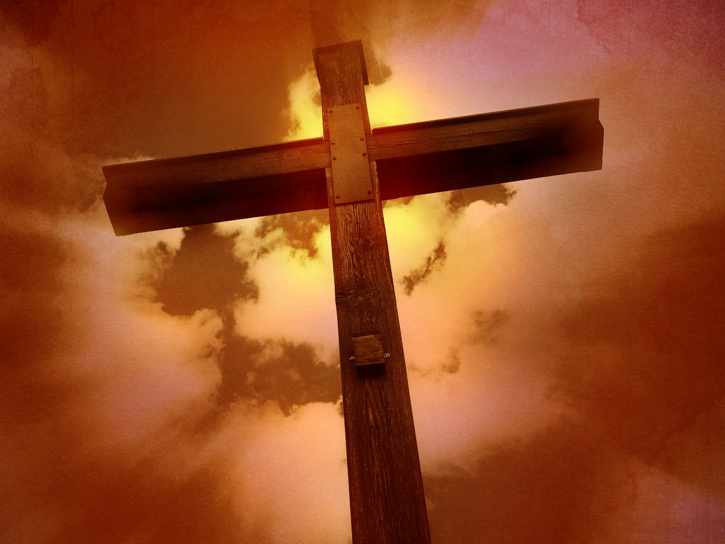
Redemption
27d
The Scriptures make us “wise for salvation through faith in Christ Jesus” (3:15; cf. 2:10).
2 Timothy
Notes:
A key requirement of a wise person is to understand salvation through faith in Christ Jesus, and this comes from knowing God's Word, the Bible. So, the formula and order are Bible—Salvation—Wisdom.
2Tim. 3:15 You have been taught the holy Scriptures from childhood, and they have given you the wisdom to receive the salvation that comes by trusting in Christ Jesus.
2Tim. 2:10 So I am willing to endure anything if it will bring salvation and eternal glory in Christ Jesus to those God has chosen.

Slide 9
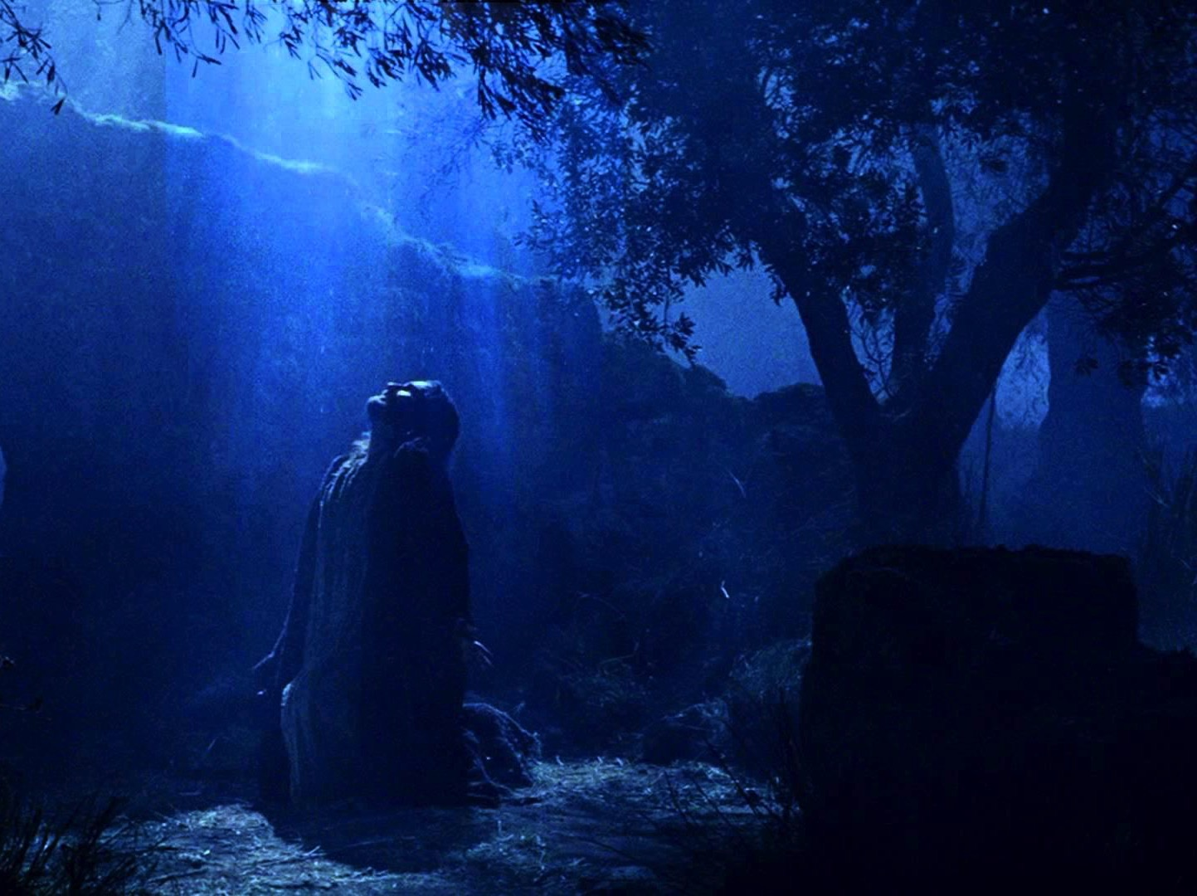
Prophecy
(Lord, Deity)
27d
Jesus is called Lord 16 times in only four short chapters (e.g., 1:8; 2:19; 4:8), which makes sense as Paul was about to die for proclaiming His deity.
2 Timothy
Notes:
Paul wrote in the center of the empire where, literally, across the street Nero was claiming to be a god in the Forum's Senate building called the Curia. Yet, Paul knew that, unlike Jesus who defeated death, Nero had baseless claims of deity.
2Tim. 1:8 So never be ashamed to tell others about our Lord. And don’t be ashamed of me, either, even though I’m in prison for him. With the strength God gives you, be ready to suffer with me for the sake of the Good News.
2Tim. 2:19 But God’s truth stands firm like a foundation stone with this inscription: “The LORD knows those who are his,” and “All who belong to the LORD must turn away from evil.”
2Tim. 4:8 And now the prize awaits me—the crown of righteousness, which the Lord, the righteous Judge, will give me on the day of his return. And the prize is not just for me but for all who eagerly look forward to his appearing.

Slide 10
2 TIMOTHY
Outline
237
Sound Doctrine Against Opposition
Persevere in Present Trials |  | Persevere in Future Trials
Chapters 1–2 |  | Chapters 3–4
Examples of Faithfulness 1 | Characteristics of Faithfulness 2 | Problem: Apostasy 3:1-9 | Solution: Preach the Word 3:10–4:5 | Paul’s Hope 4:6-22
Eunice Lois Paul Onesiphorus | Discipling Single-minded Obedient Hardworking Biblical Holy Gentle | Godlessness Hypocrisy | Preaching Persevering Rebuking Encouraging Evangelism | Martyrdom Betrayals Greetings Benediction
Rome to Ephesus
Autumn AD 67 (Second Roman Imprisonment)
Notes:
Notice how the entire letter is about the need to persevere in correct belief (sound doctrine), whether in the present or the future. This is because opposition to the gospel would never let up, so heresy has not paused since Paul penned this letter.
Another way to express perseverance is faithfulness, seen especially by preaching God's truth in the gospel.

Slide 11
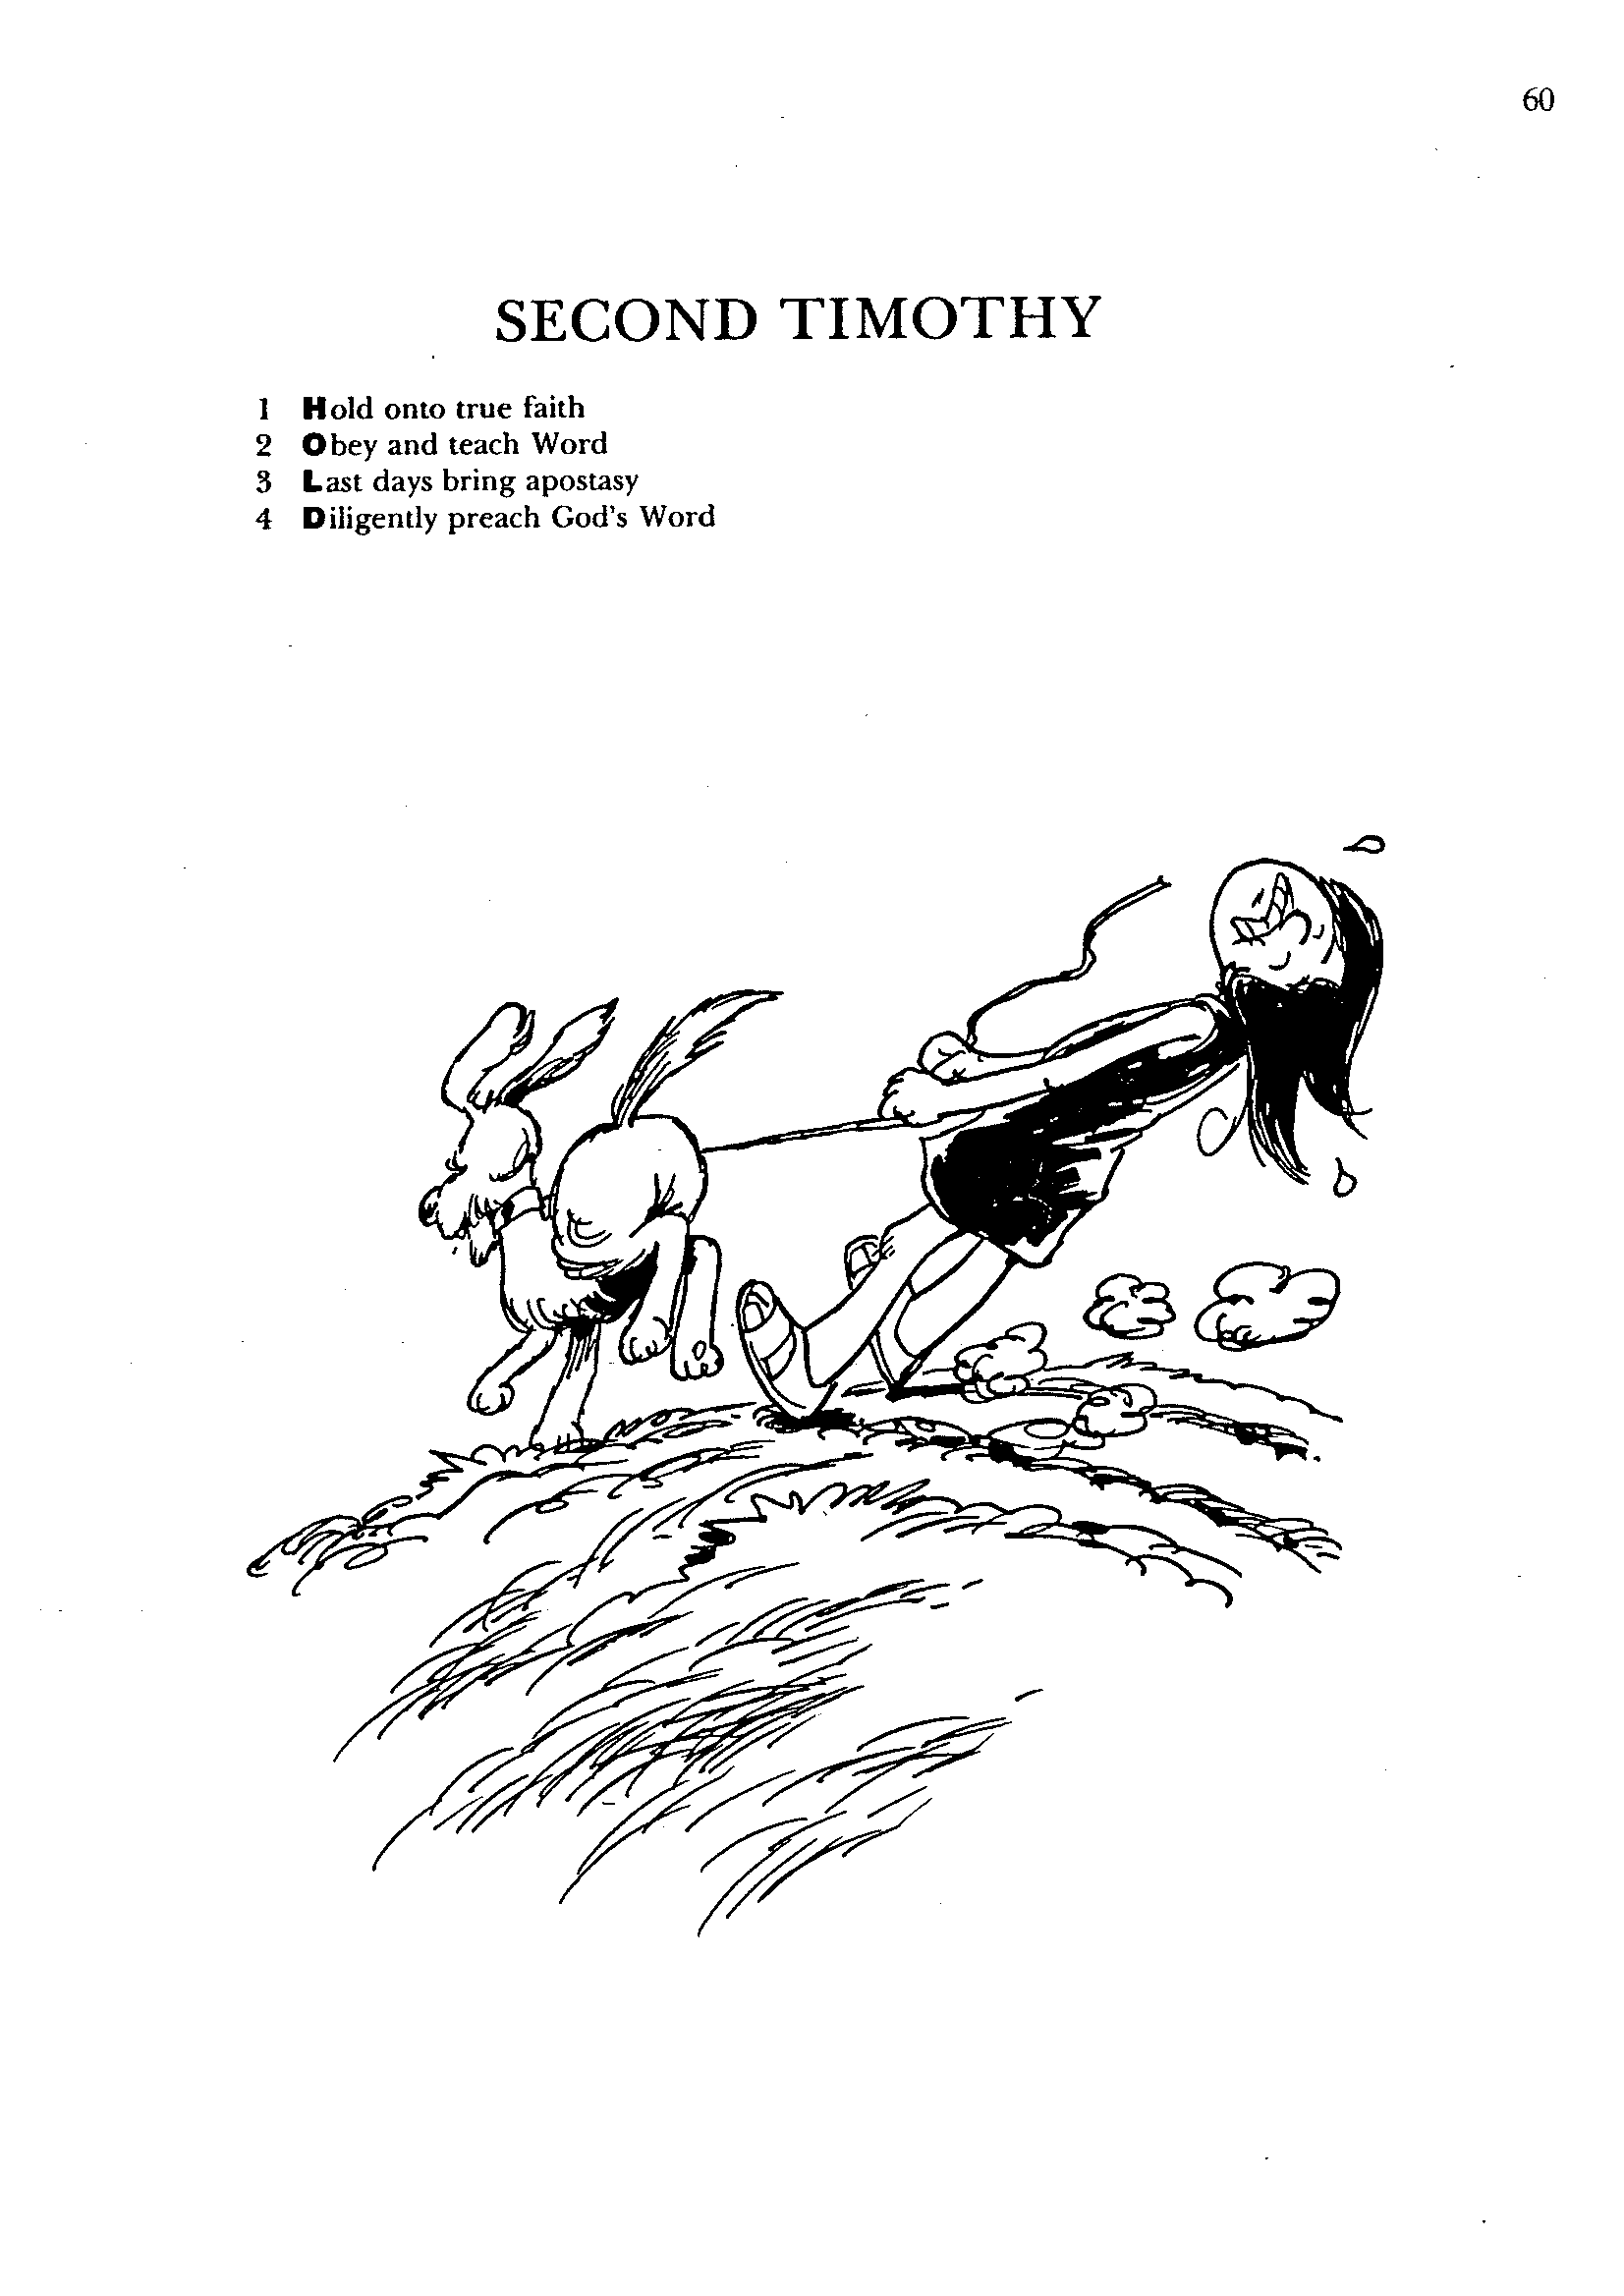
SECOND TIMOTHY
1
2
3
4
Hold onto true faith
Obey and teach Word
Last days bring apostasy
Diligently preach God's Word
Barry Huddleston, The Acrostic Bible
Notes:
God's calling for us is not to be innovative in the content of our message. Innovation of the gospel adds to and subtracts from it. Our calling is to HOLD onto it!

Slide 12
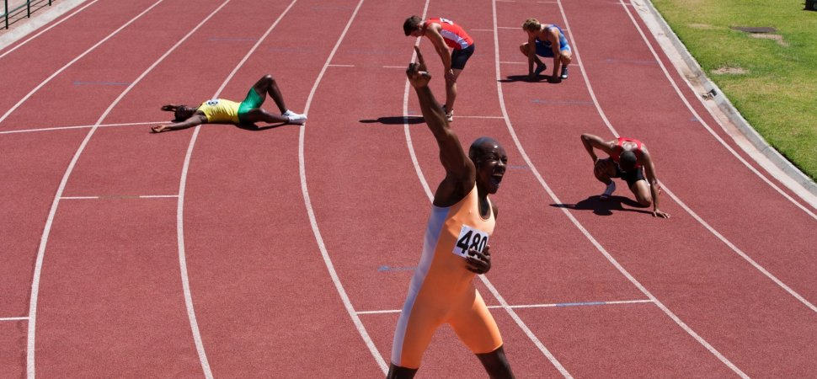
Be Persevering
2 Timothy
Dr. Rick Griffith • Crossroads International Church Singapore
BibleStudyDownloads.org
Notes:
The race is long, and most do not persevere in faithfulness. Most older Christians lose their spiritual edge. If this were not so, then we wouldn't have so many admonitions to persevere.

Slide 13

Apostasy.
“a turning away by rejecting”
2 Timothy
Notes:
"Apostasy" literally means "a turning away by rejecting" something.
Sometimes this means that the person no longer claims to be a Christian, but in other cases, the person still claims the name of Jesus (professes Christ) but has turned away from a key doctrine of the faith.

Slide 14

How can you persevere amidst apostasy?
2 Timothy
Notes:
Will you be walking with Jesus ten years from now?
What should you do now to make sure you are faithful then?
What can you do now to make sure you are following the Lord faithfully in the future?

Slide 15
Overview of Paul's Letters
38
124
39-41
"To the remotest part of the earth" (Acts 1:8)
Acts 9 13 14 15 16 18 21 27 28
Apr 48-
Sep 49
1
Galatia
Apr 50-
Sep 52
2
Aegean
Spr 53-
May 57
3
Asia
Feb 60-
Mar 62
1
Rome
Spr 62-
Fall 67
4
Spain
Aut 67-
Spr 68
2
Rome
35-
47
Damascus
Antioch
May 57-
Aug 59
Trials
Fall 49
The
Council
Spring 68
Expansion of Church
35 48 49 50 52 53 57 60 62 67 68 95
Matt
Luke
Acts
Mark
John
Gal
1 Thess
1 Cor
Eph
1 Tim
2 Tim
2 Thess
2 Cor
Col
Titus
Missionary
Pastoral
Romans
Philem
Gospels & Acts
Phil
Pauline Epistles
1234
Journeys
Prison
Rome
Imprisonments
Pauline
Notes:
We may suppose that heresies take a long time to develop, but the New Testament teaches otherwise. Within a generation of Christ's life, many false systems developed. Paul writes in the AD 60s, just prior to his beheading, that many had fallen into the snare of deceptive teaching.
Yet nearly all of Paul's writings responded to a heresy. This means that he took false doctrine seriously, in contrast to the church of our day in many circumstances.
Paul wrote while traveling, imprisoned, or to key leaders.
Observations about chronology:
Gospels were not written first, but throughout the NT era
Evangelistic letters preceded pastoral
Rough letter (Galatians) preceded smoother ones
_______________
Common-493
NS-00-NT Introduction-97
NS-03-Luke1-12-slide 65
NS-06-MissionaryEpistles-2
NS-06-Rom1-2-slide 16
NS-07-1Cor1-9-slide 23
NS-08-2Cor-27
NS-11-Philippians-15, 40
NS-12-Colossians-22, 24, 304
NS-17-Titus-30
NS-16-2Timothy-15

Slide 16
How to hang in there:
Faithfully...
Obey God’s Word
Preach God’s Word
&
1–2
3–4
2 Timothy
Notes:
Consistently follow what God says (1-2).
Consistently tell others what God says (3-4).

Slide 17
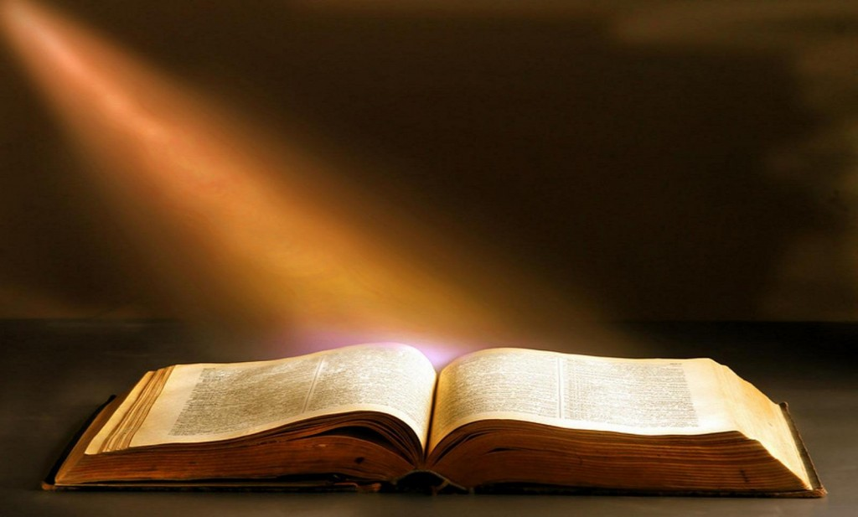
Main Idea
Faithfully obey and preach God’s Word.
2 Timothy
Notes:
Do not turn away from following and advancing the Bible's teaching.

Slide 18
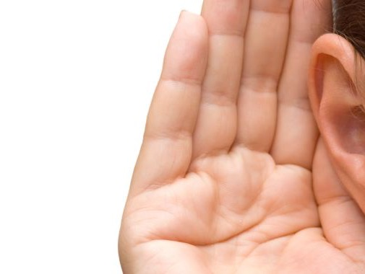
"For a time is coming when people will no longer listen to sound and wholesome teaching. They will follow their own desires and will look for teachers who will tell them whatever their itching ears want to hear. ⁴ They will reject the truth and chase after myths" (4:3-4 NLT).
2 Timothy
They will “turn away their ears (apostrepho) from the truth"
(4:4 NAU).
Notes:
We live in a "cancel culture" era. Internet algorithms reinforce what we already believe to be true. At least this is the case for worldly values, which are constantly placed before us, especially online. The kind of myths (read conspiracy theories) that Paul noted get millions of hits on YouTube, while the truth hardly gets a hearing.
_________________
NS-16-2Timothy-18, 248, 268

Slide 19
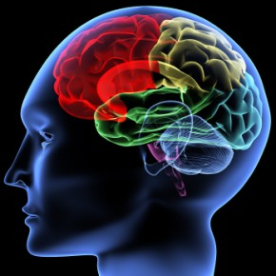
Does your reading, news, friends, movies, TV, and especially the Internet build your faith or tear it down?
2 Timothy
Notes:
"You are what you eat," we are told concerning our physical bodies.
The same is true of what our minds consume:
"You are what you see" is also true.
Habits become character and character becomes destiny.
This old adage teaches that small, repeated actions (habits) build our core nature (character), which ultimately determines our life’s outcome (destiny). Often attributed to Lao Tzu, this concept suggests that by consciously controlling thoughts and habits, we actively create our own destiny rather than leaving it to chance.
Key Components of the Sequence:
Thoughts become Words: Our mental state determines what we say.
Words become Actions: What we say frequently turns into behavior.
Actions become Habits: Regularly repeated actions develop into automatic routines.
Habits become Character: These routines define our personality and core values.
Character becomes Destiny: Our consistent traits determine our ultimate future and life outcomes.
Core Insights:
Personal Responsibility: The quote implies that our life path is not predetermined, but rather shaped by our daily choices.
The Power of Small Actions: Consistent, small behaviors are more important than occasional, big ones.
Variations: Often associated with Lao Tzu, similar iterations are linked to Ralph Waldo Emerson ("Sow a habit, and you reap a character") or attributed to Frank Outlaw.
This phrase highlights that small, repeated actions (habits) build our core nature (character), which ultimately determines our life’s outcome (destiny). Often attributed to Lao Tzu, this concept suggests that by consciously controlling thoughts and habits, we actively create our own destiny rather than leaving it to chance. [1, 2, 3, 4, 5]
Key Components of the Sequence:
Thoughts become Words: Our mental state determines what we say.
Words become Actions: What we say frequently turns into behavior.
Actions become Habits: Regularly repeated actions develop into automatic routines.
Habits become Character: These routines define our personality and core values.
Character becomes Destiny: Our consistent traits determine our ultimate future and life outcomes.
Core Insights:
Personal Responsibility: The quote implies that our life path is not predetermined, but rather shaped by our daily choices.
The Power of Small Actions: Consistent, small behaviors are more important than occasional, big ones.
Variations: Often associated with Lao Tzu, similar iterations are linked to Ralph Waldo Emerson ("Sow a habit, and you reap a character") or attributed to Frank Outlaw.
Ralph Waldo Emerson said, “Sow a habit, and you reap a character; sow a character, and you reap a destiny.” So too, inner peace and happiness are the outcome of the mental habits we practice. Yet our modern world constantly pulls us into habits that do the opposite—scrolling, overworking, comparing, reacting.
_________________
NS-16-2Timothy-19, 271

Slide 20
Black

Slide 21
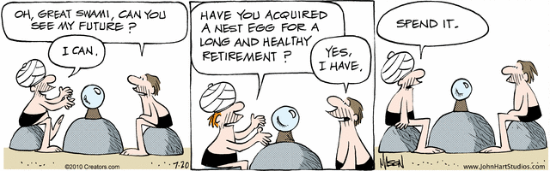
The Future
Oh, Great Swami, can you tell me my future?
Have you acquired a nest egg for a long and healthy retirement?
Spend it.
Nephew
I can.
Yes,
I have.
Notes:
A man in the cartoon strip "B.C." seeks crystal ball advice [read].
"B.C" gives a negative view of the future!

Slide 22

As a Christian, should you be optimistic about the future?

Slide 23
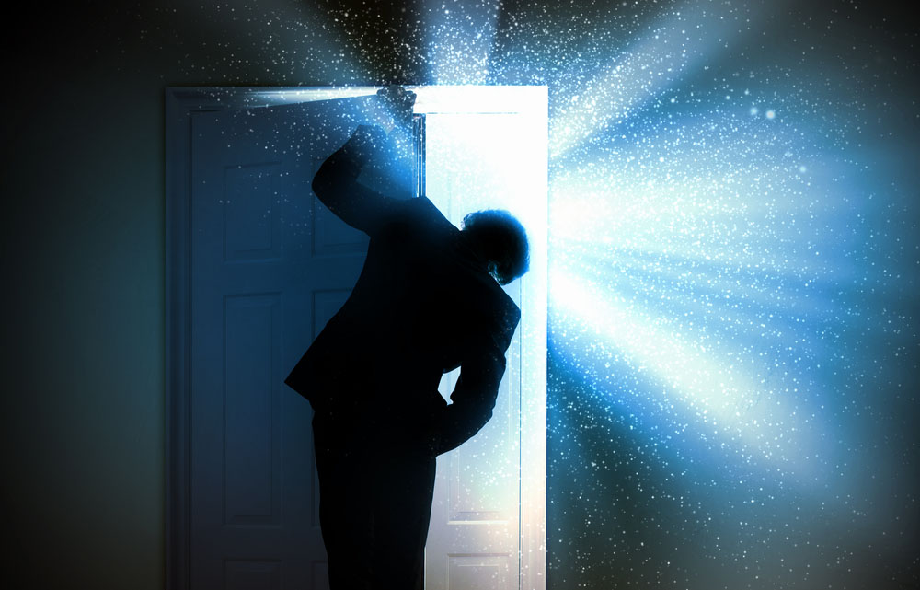
The Future
Notes:
One could say that Christians ought to be the most positive people on the planet

Slide 24

The Future
Notes:
After all, who else has the assurance of sins forgiven and a heavenly home? Who else has a Guide right now who knows everything, loves us unconditionally, and can do anything? Doesn't it seem that believers ought to be the most confident people about the future?

Slide 25

THE FUTURE IS OURS
Notes:
What about you? Are you an optimist? Shouldn't you be?

Slide 26
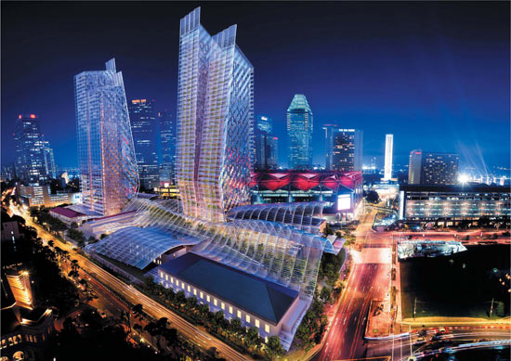
The Future Singapore
Notes:
Singapore is now in its 50th year, having grown from a sleepy fishing village to a major player on the global scene.

Slide 27

The Future Singapore
Notes:
The economy is looking up—employment is full, property prices are stable or rising.

Slide 28

Singapore Floating Farms
Notes:
Singapore marches forward toward floating farms…

Slide 29

Singapore Floating Farms
Notes:
…just outside Marina Bay.

Slide 30

Shouldn't we be encouraged?
Notes:
Even looking at eternal things, the percentage of Christians in Singapore continues to rise, as does the number of churches—growing even faster than the general population increase. Shouldn't Christians be encouraged?

Slide 31

You shouldn't.
As a Christian, do you have optimism about the future?

Slide 32
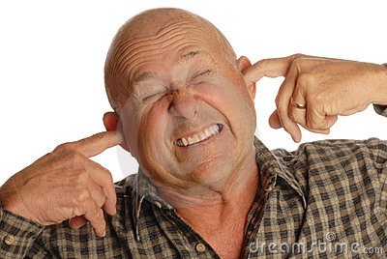
It will get worse.
Notes:
The Bible says that the worst days are ahead prior to Christ's return. It is going to get worse. In fact, it started getting worse in the first century. How's that?

Slide 33
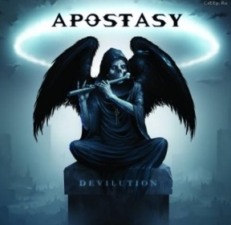
APOSTASY
“They will be fooled by evil spirits and by teachings that come from demons”
(1 Timothy 4:1)
Notes:
“During the last days there will be a great "Falling Away", a major apostasy, and a great abandoning of all obedience to God's word. Elements in the world that once promoted or greatly favored Christianity will now viciously turn against it. What is right will be called wrong, and what is wrong will be called right. This is apparent all over the planet as church after church is falling to homosexual sin, perversions, lies, the prosperity gospel and other heresies even worse than that, and embracing them with reckless abandon.”
__________________
The Great Apostasy
Posted On January 5th, 2015
AKA: The Great Falling Away
https://www.prophecyindex.org/prophecies/view/the_great_apostasy/

Slide 34
APOSTASY
Proofs and Fulfillments: (185)
First Lesbian Bishop Replaces Crosses with Islamic Symbols to Make Muslims Feel at Ease
Christian and Jewish Clergy Bless Abortion Clinic, Claim "God is Present in This Space"
Ohio School To Remove Ten Commandments Plaque For Almost 100 Years After Atheist Group
Evangelical denomination expels entire congregation over LGBT policy
Newly Consecrated Gay Bishop Declares God Is A Woman - The Daily Caller
Largest US Presbyterian Denomination to Ordain First Non-Binary Person as
Joel Osteen Celebrates LGBTQ Pride at Lady Gaga Event
United Church of Christ clergy hold service of blessing at Planned Parenthood
Hillsong Church Affirms Full Pro-LGBTQ Position in Their One World Religion Alpha Conference
Methodist University Offers Students Course on 'Queer Bible Hermeneutics’
Chrislam Founder Rick Warren Partnering With Mosques To Equate God Of The Bible And Allah
Durham Church offers to cover crosses while hosting Muslim prayers - Anglican
Investigation Shows Televangelists Living Lavish Lifestyles
Prosperity Gospel Plantation Owner, Paula White, Claims God Told Her to Accept Title of 'Apostle’
Spain: 10 Million Live in Towns Without Evangelical Presence
“They will be fooled by evil spirits and by teachings that come from demons” (1 Timothy 4:1)
Notes:
Examples of this turning away from the truth are legion, so I will highlight only a few.
__________________
The Great Apostasy
Posted On January 5th, 2015
AKA: The Great Falling Away
https://www.prophecyindex.org/prophecies/view/the_great_apostasy/

Slide 35
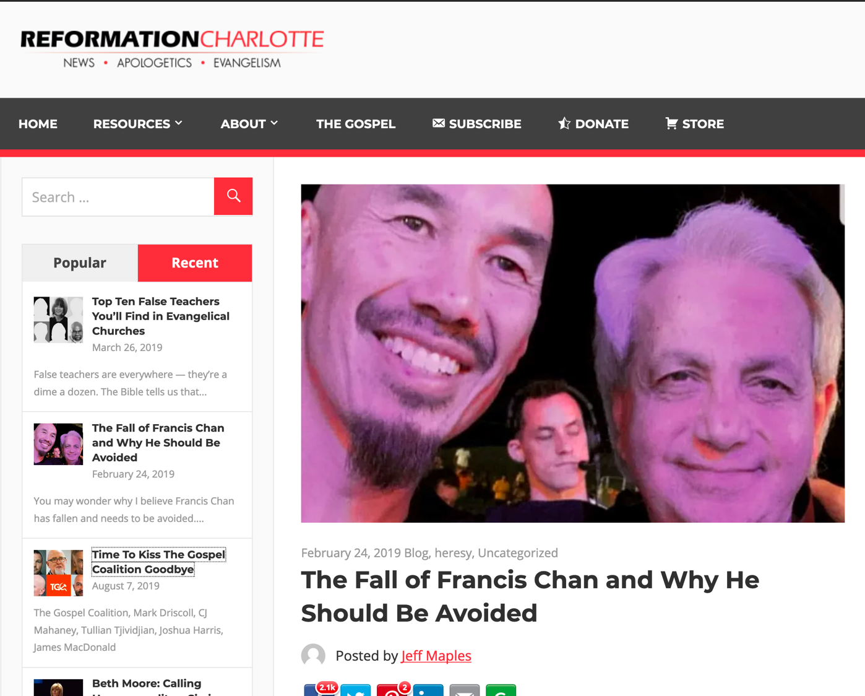
The Fall of Francis Chan and Why He Should Be Avoided
Notes:
You may wonder why I believe Francis Chan has fallen and needs to be avoided. Isn’t he orthodox? Doesn’t he preach the true gospel? Isn’t he, well, doctrinally sound?
Well, Chan is a graduate of both John MacArthur’s Master’s University and Seminary, an unusually solid, seminary that teaches rightly on such important doctrines as the sovereignty of God, the inerrancy of Scripture, and the cessation of the apostolic sign gifts. He was the founder and former pastor of Cornerstone Community Church in Simi Valley, California. Chan is now a well-known conference speaker, regularly preaching alongside questionable, at best charismatics such as Mike Bickle of IHOPKC and many others.
Chan, despite his solid theological educational background, is highly compromised in many ways, and not just because he regularly shares the stage with heretics. While that, in and of itself, is problematic, Chan’s compromises are much deeper and stem from a serious lack of discernment.
Chan aims to be a people-pleaser. It’s understandable that a man in the flesh would desire the praise of other men, but God dislikes this attitude and the Apostle Paul warns against it (Galatians 1:10).
When Chan decided to leave his church several years ago to begin his charismatic crusade, he announced to his congregation “God was leading him elsewhere.” Then, two years ago, while speaking at a gathering, speaking of his former church, he told the audience that they were all a “bunch of losers” who didn’t exercise their spiritual gifts.
Francis Chan, for several years, has been on the speaker circuit for several heretical crusades. On of the most popular crusades he’s frequented has been IHOPKC’s annual One Thing conference alongside such heretics as Todd White, Michael Brown, Joyce Meyer, and Seventh Day Adventist, Ben Carson. This conference is not only heretical due to its theological grounding steeped in New Apostolic Reformation ideology, it’s also ecumenical, and holds a Catholic track.
But Chan is no stranger to ecumenism. In 2003, Mike Gendron, a Christian apologist best known for his polemics and evangelistic resources for Catholics, was invited to speak at Chan’s church. Gendron, a man who knows and loves Catholics enough to speak truthfully about the serious and damning theological errors they hold to, spoke to Chan’s audience truthfully about the errors of purgatory, Mary, the Eucharist, and the biblical way of salvation. This prompted Chan to rebuke Mike Gendron in front of the entire gathering, stating that it “was a mistake” to host Gendron.
Chan’s obvious discontent with biblical truth shows that he is not only theologically inept and lacks serious discernment, but that he also seeks to not offend man, effectively offending God much worse.
PICTURES:
Francis Chan with Heretic, Mike Bickle
Francis Chan with charlatan, Benny Hinn
Francis Chan with faux faith-healer, Todd White
In his never-ending crusade to please the world, Chan continues to praise well-known, well-liked heretics while throwing solid men of God under the bus. Chan knows that men like Gendron are less popular with the world and the culture because they see the truth of Scripture as black and white — without compromise.
This weekend, Chan, at Lou Engle’s 2019 Send Conference, Chan was noted praising arch-heretics, Todd White and Daniel Kolenda. Todd White is a fraudulent “faith-healer” who claims to have healed hundreds of people of various ailments without a shred of evidence. Todd White holds to the Word of Faith heresy, “little God” theology, and is largely into the heretical New Apostolic Reformation movement that teaches that the office of Apostle — like the original 12 — has been reinstated and Apostles and Prophets exist today. Besides the fact that every single “Apostle” and “Prophet” in this movement is morally compromised in some way, not a single one has ever prophesied the way the biblical prophets have done. You can see Chan praising these men in the video below, toward the end.
Francis Chan, though he may occasionally speak things that sound right and biblical, is a wolf in sheep’s clothing to be avoided at all costs. Because of his associations with heretics and false teachers — and his considerable lack of discernment — Chan leads his people astray. He is not a shepherd to be followed, as he feeds his sheep directly to the wolves.
____________
https://reformationcharlotte.org/2019/02/24/francis-chan-why-you-should-avoid-him/

Slide 36
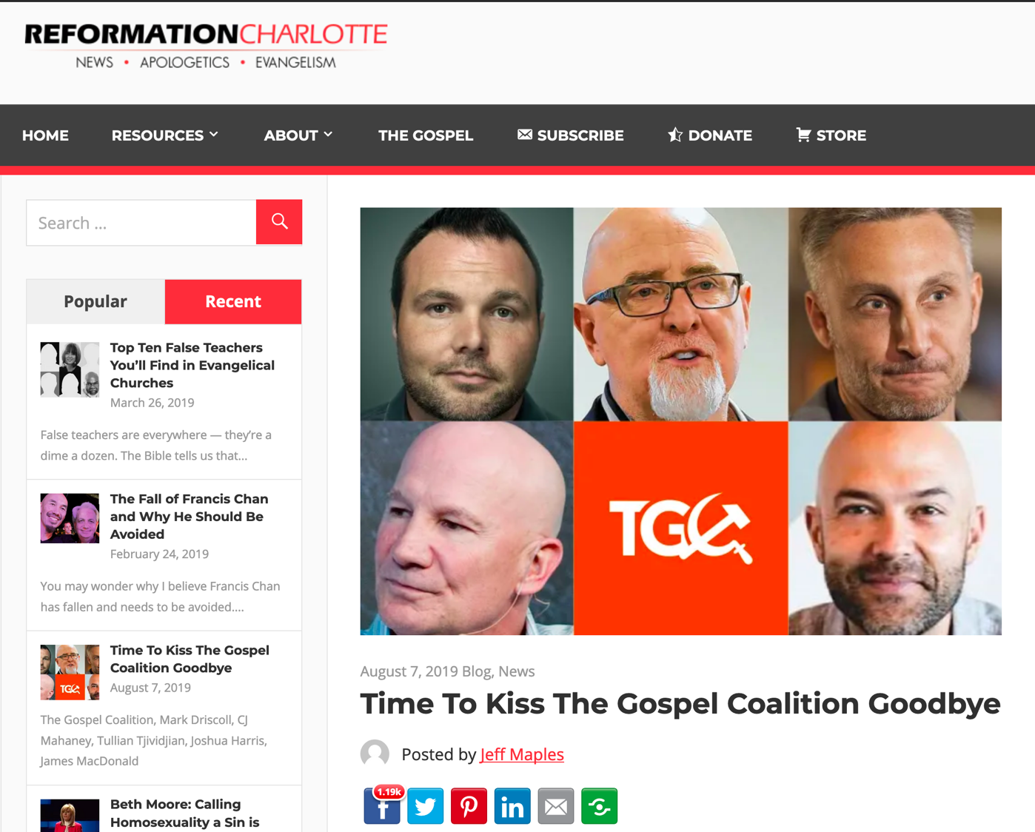
Time to Kiss the Gospel Coalition Goodbye
Notes:
In the wake of Joshua Harris’ apostasy — the Purity Culture pastor who divorced his wife, denounced Christianity, and embraced homosexuality — many people are wondering just exactly what went wrong. The apostasy follows a string of The Gospel Coalition contributors who have either been disqualified or have completely turned from their faith altogether.
From Tullian Tjividjian and Mark Driscoll to James MacDonald and C.J. Mahaney, many men that had been warned about by those “pesky discernment blogs” ultimately showed their true colors and were caught up in scams ranging from sex abuse cover-ups to bullying their staff at church.
The entire paradigm exemplifying The Gospel Coalition gave rise to a new breed of professing Christian — New Calvinism. While some, like Kevin DeYoung, ponder the reasoning behind the rampant apostasy at The Gospel Coalition, speculating that it is because they are too quick to “elevate gifted men,” I suspect the problem is much deeper than that. DeYoung writes,
What is worth exploring in this instance [Harris’ apostasy]—and, we can tell you, has already for years generated a great deal of soul searching—is why a number of young men who were at one time closely associated with The Gospel Coalition have been forced to leave the ministry. Our primary takeaway is that in years past our tribe was too quick to elevate gifted men who may not have had enough time to prove themselves faithful for the long haul. But even here, we would note that the public crises always get more attention than scores of young men who have quietly continued to serve the Lord with growing maturity.
The problem, you see, isn’t being “too quick” to “elevate gifted men.” The problem is elevating men who have a primary cause that fits the theme and narrative of The Gospel Coalition. The problem is, The Gospel Coalition isn’t really about the gospel — it’s about other things, like social justice, egalitarianism, LGBTQ activism, open borders and mass illegal immigration, theological liberalism, self-advancement, etc. The Gospel Coalition merely cloaks these causes in Christian-themed language, slaps the phrase “gospel-centered” on it, and brings aboard anyone who is willing to advance their cause — or at least act as a cloak for the gospel while The Gospel Coalition advances their own cause.
And the problem isn’t that just a few men have been officially disqualified — The Gospel Coalition continues to be wrought with unqualified, disqualified, and outright dangerous men and women. At The Gospel Coalition, the bad far outweigh the good. The Gospel Coalition still employs a massive number of homosexuals and LGBTQ activists, social justice warriors, and egalitarians. The Gospel Coalition employs people who are funded by leftist billionaires like George Soros, James Riady, and Zack Exley. The problem is The Gospel Coalition isn’t guided by the gospel, the Scriptures, or even basic Christian principles. It is guided by a leftist agenda whose primary purpose is to turn the Evangelical Church to the left politically and theologically.
Mark Driscoll wasn’t the problem. Tullian Tjividjian wasn’t the problem. C.J. Mahaney wasn’t the problem. James MacDonald wasn’t the problem. And no, Joshua Harris wasn’t the problem. All of these fallen men are merely symptoms of the problem. The problem is that The Gospel Coalition — and the (very few) good men who may be left — continue to give a platform to leftists, use complicit men like these to disguise their agenda, and allow the leftists at the organization to promote their agenda unfettered.
It’s time to kiss The Gospel Coalition goodbye.
_______
https://reformationcharlotte.org/2019/08/07/time-to-kiss-the-gospel-coalition-goodbye/

Slide 37

Apostasy

Slide 38

Title
2 Timothy
238
The Letter of 2 Timothy
(Pro.j Timo.qeon b Second to Timothy)
is one of the three books commonly called “Pastoral Epistles,” which are unique in that they are addressed to individuals (not churches) and constitute Paul's last writings

Slide 39
Introduction
238
One of the three pastoral epistles
(1 & 2 Timothy and Titus)
Paul addressed these to individuals (compared to his other letters to churches)

Slide 40
Authorship
238
Apostle Paul
(stated clearly in verses 1 & 2 “Paul, an apostle of Jesus Christ……to Timothy my beloved child…” )
Notes:
Need to not only talk about Paul authorship, other opinions about others view of authorship

Slide 41
Authorship
2 Timothy
Authorship
238
External Evidence Attestation for Pauline authorship is as good as that of any other Pauline epistle except Romans and
1 Corinthians
Internal Evidence
The letter claims Pauline authorship (2 Tim. 1:1) and contains the typical Pauline characteristics

Slide 42
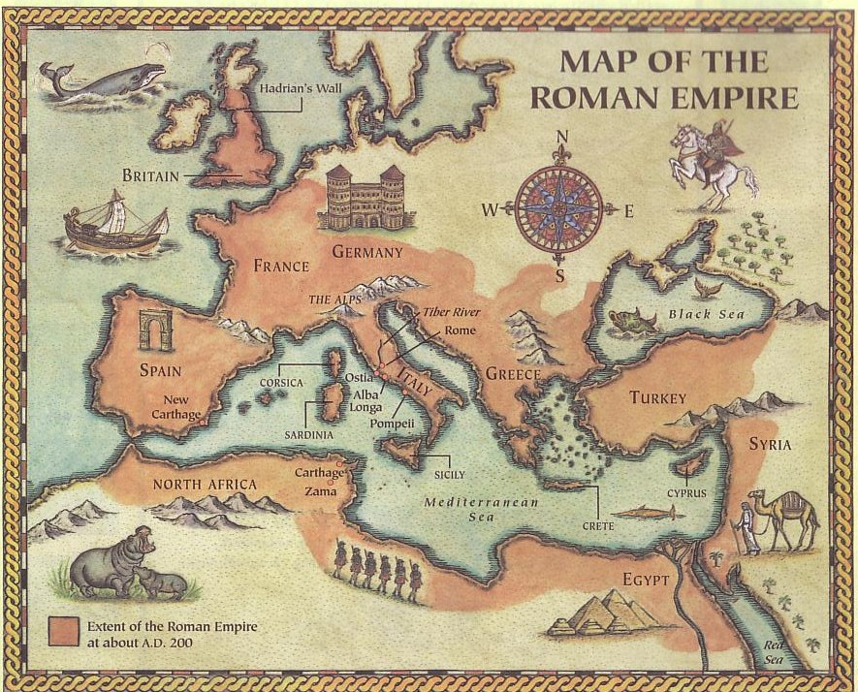
Origins / Recipients
2 Timothy
Origin/Recipients
238
Paul penned 2 Timothy to his long-time traveling companion, Timothy (2 Tim. 1:2), 5 years after his 1st letter.
Assuming Timothy still remained in Ephesus
(1 Tim. 1:3b), 2 Timothy also had the same destination (2 Tim. 1:16-18; 4:19).
Rome
Ephesus
The letter was written from Rome (1:17; 2:9) during Paul's 2nd Roman imprisonment after his 1st defense before the Imperial Court (4:16-17).

Slide 43
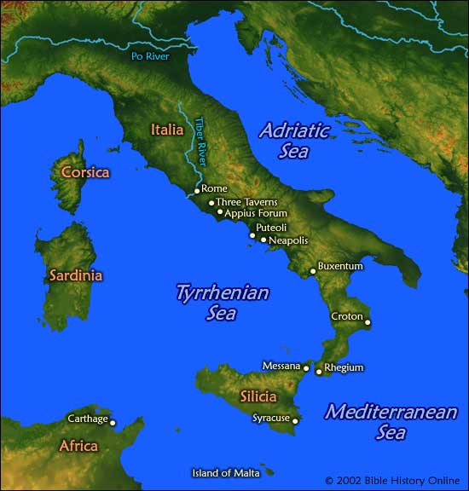
Place
2 Timothy
238
During Paul’s
second imprisonment
Rome

Slide 44
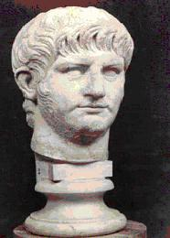
Date
2 Timothy
238
Emperor Nero
Reigning (AD 67)

Slide 45
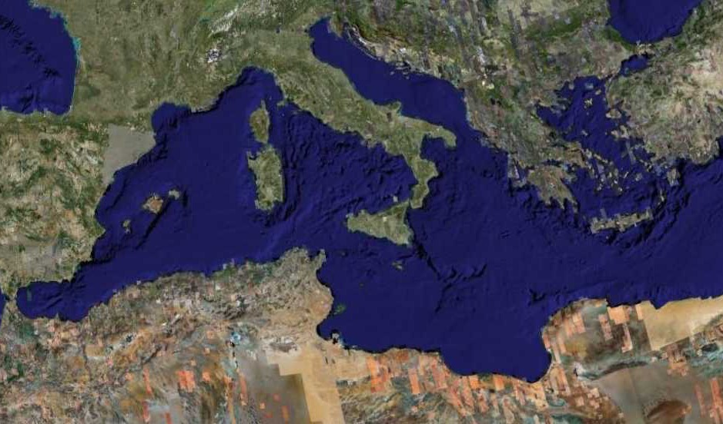
Fourth Missions Trip
1-2 Timothy & Titus After Acts
Spring 62 – Fall 67
Notes:
Paul had finished reaching the Eastern Roman Empire by the time he wrote Titus—and even had just returned from Spain.
__________
NS-15-Pastorals-3
NS-16-2 Timothy-87
—————
Freedom from Imprisonment Spring 62–Fall 67
Paul in Ephesus and Colosse (Timothy left at Ephesus) Spring–Summer 62
Peter travels to Rome 62
Paul in Macedonia late summer 62-winter 62/63
1 Timothy written from Macedonia to Timothy in Ephesus Fall 62
Paul in Asia Minor Spring 63-Spring 64
Paul in Spain (anticipated in Rom. 15:24) Spring 64-Spring 66
Christians persecuted by Nero; Peter martyred Summer 64
Paul in Crete (Titus left there; Tit 1:5) early Summer 66
Paul in Asia Minor Summer- Fall 66
Titus written from Asia Minor to Titus in Crete Summer 66
Paul in Nicopolis (Tit 3:12) Winter 66/67
Paul in Troas (2 Tim 4:13), Macedonia and Greece Spring– Fall 67
Second Roman Imprisonment Fall 67–Spring 68
Paul arrested and brought to Rome Fall 67
2 Timothy written from Rome to Timothy in Ephesus Fall 67
Paul beheaded Spring 68

Slide 46
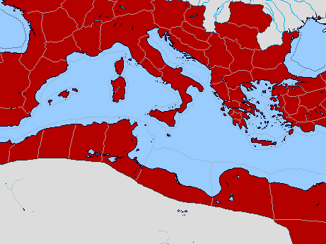
Bible Lands Blank Map
Paul’s Acts 28:30-31 Letters
142
Rome
Macedonia
Spain
Ephesians
Colossians
Ephesus
Philemon
Philippians
Crete
© https://www.deviantart.com/sharklord1/art/Alt-Roman-Empire-Provinces-701148110
Notes:
Paul wrote the Prison Epistles while under house arrest in Rome recorded in the last two verses of Acts. This took two years (AD 60-62) are were likely written in this order above. We are unsure whether Ephesians and Colossians were written at the same time, but they have many similarities. But it is nearly certain that Tychicus and Onesimus brought back to Colosse both the letter to the entire church and also so the personal letter to Philemon, who lived there and had the church meet in his house.
—————
Freedom from Imprisonment Spring 62–Fall 67
Paul in Ephesus and Colosse (Timothy left at Ephesus) Spring–Summer 62
Peter travels to Rome 62
______________
NS-05-Acts20-28—slide 254
NS-16-2 Tim-46

Slide 47

Date 1
Pastorals
Date
238
The chronology of Paul's latter years is obscure, yet one harmonization of the internal and external data yields this scenario:
1st Roman Imprisonment February 60–March 62
(Acts 28:30-31)
Paul writes Ephesians, Autumn 60–early Spring 62
Colossians, Philemon,
and Philippians
Martyrdom of James, Spring 62
the Lord's brother

Slide 48
Bible Lands Blank Map
Paul’s Post-Acts Journey
142
Rome
Macedonia
1 Timothy
Spain
Ephesus
Crete
© https://www.deviantart.com/sharklord1/art/Alt-Roman-Empire-Provinces-701148110
Notes:
Paul wrote 1 Timothy shortly after being there himself—likely only months later. We benefit from him recording his instructions to Timothy rather than simply telling him verbally.
—————
Freedom from Imprisonment Spring 62–Fall 67
Paul in Ephesus and Colosse (Timothy left at Ephesus) Spring–Summer 62
Peter travels to Rome 62
Paul in Macedonia late summer 62-winter 62/63
1 Timothy written from Macedonia to Timothy in Ephesus Fall 62
Paul in Asia Minor Spring 63-Spring 64

Slide 49
Date 2
Pastorals
Date
238
Freedom from Imprisonment Spring 62–Autumn 67
Paul in Ephesus and Colosse Spring–Summer 62
(Timothy left at Ephesus)
Peter travels to Rome 62
Paul in Macedonia late summer 62-winter 62/63
1 Timothy written in Macedonia Autumn 62
to Timothy in Ephesus
Paul in Asia Minor Spring 63-Spring 64
Paul in Spain Spring 64-Spring 66
(anticipated in Rom. 15:24)
Christians persecuted by Nero Summer 64
and Peter martyred
1 Timothy written in Macedonia Autumn 62
to Timothy in Ephesus
Notes:
Paul wrote 1 Timothy shortly after being there himself—likely only months later. We benefit from him recording his instructions to Timothy rather than simply telling him verbally.

Slide 50
Bible Lands Blank Map
Paul’s Post-Acts Journey
142
Rome
Macedonia
2 Timothy
Nicopolis
Troas
Spain
Ephesus
Titus
Crete
© https://www.deviantart.com/sharklord1/art/Alt-Roman-Empire-Provinces-701148110
Notes:
Paul in Asia Minor Spring 63-Spring 64
Paul in Spain (anticipated in Rom. 15:24) Spring 64-Spring 66
Christians persecuted by Nero; Peter martyred Summer 64
Paul in Crete (Titus left there; Tit 1:5) early Summer 66
Paul in Asia Minor Summer- Fall 66
Titus written from Asia Minor to Titus in Crete Summer 66
Paul in Nicopolis (Tit 3:12) Winter 66/67
Paul in Troas (2 Tim 4:13), Macedonia and Greece Spring– Fall 67
Second Roman Imprisonment Fall 67–Spring 68
Paul arrested and brought to Rome Fall 67
2 Timothy written from Rome to Timothy in Ephesus Fall 67
Paul beheaded Spring 68

Slide 51
Date 3
Pastorals
Date
238
Paul in Crete early Summer 66
(Titus left there; Tit. 1:5)
Paul in Asia Minor Summer-Autumn 66
Titus written from Asia Minor Summer 66
to Titus in Crete
Paul in Nicopolis (Tit. 3:12) Winter 66/67
Paul in Troas (2 Tim. 4:13), Spring–Autumn 67
Macedonia and Greece
Titus written from Asia Minor Summer 66
to Titus in Crete
2nd Roman Imprisonment Autumn 67–Spring 68
Paul arrested and brought to Rome Autumn 67
2 Timothy written from Rome Autumn 67
to Timothy in Ephesus
Paul beheaded Spring 68
2 Timothy written from Rome Autumn 67
to Timothy in Ephesus
Destruction of Jerusalem 2 September 70
Notes:
Titus is in green as Paul wrote it while he was free to GO around to share the gospel.
But 2 Timothy is purple to remind us that, while imprisoned again, he did this for royal purposes.
Paul spent at least 5 of his final 11 years in prison:
• AD 57-59 Caesarea for 2 years
• AD 60-62 Rome for 2 years
• AD 67-68 Rome for 1 year

Slide 52
RECIPIENT
2 Timothy
238
Timothy – Paul's long-time travel companion
Type
Highly personal & emotional letter

Slide 53
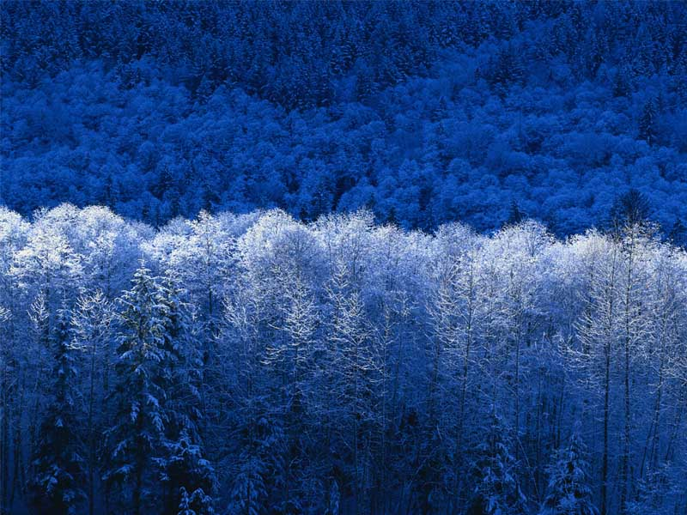
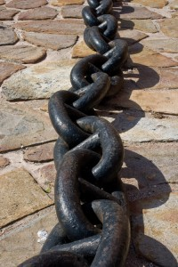
OCCASION
2 Timothy
238
written 5 years after 1Timothy
Paul's second Roman imprisonment
(4: 6-8)
before Paul’s execution (4: 9, 21)
when Nero put blame on Christians

Slide 54

Occasion
2 Timothy
Occasion
238
When Paul wrote 2 Timothy in AD 67 he was an experienced inmate in several cities:
Jerusalem: 10 years earlier (May 29-June 9, 57)
Caesarea: 8-10 years earlier (June 57-Aug 59)
Rome: 5-7 years earlier (Feb 60-March 62)
Having spent nearly 5 of the past 10 years behind bars, he knew about prisons and political procedures. He knew that this second Roman imprisonment could only result in execution (2 Tim. 4:6-8).
Since Paul did not expect to live much longer in the Roman jail, he requested Timothy to hurry to him before winter (2 Tim. 4:9, 21).

Slide 55
Characteristics
2 Timothy
Characteristics
239
This letter to “my dear son” (1:2) is the last letter we have from Paul.
It gives the clearest NT exposition of the need for exposition (4:2), telling us to:
Guard the gospel (1:14)
Keep the Scriptures central (2:15)
Persevere in the gospel (3:14)
Suffer for the gospel (1:8; 2:3)
Deem the Scriptures inspired (3:16-17)
Notes:
Most of us would write the person closest to us—perhaps a spouse, parent, or child. Paul had none of these, except Timothy, whom he called “my dear son” (1:2). So what did Paul write Timothy?

Slide 56
Key Word / Verse
2 Timothy
238
Key Word
Doctrine
Key Verse
“All Scripture is God-breathed and is useful for teaching, rebuking, correcting and training in righteousness, so that the man of God may be thoroughly equipped for every good work… Preach the Word”
(2 Timothy 3:16-17; 4:2).

Slide 57

ARGUMENT
2 Timothy
238
Paul told Timothy what is truly important:
Persevere in your Christian life and faith as a pastor.
Preach the Word of God faithfully amidst hardship and false teachers.

Slide 58
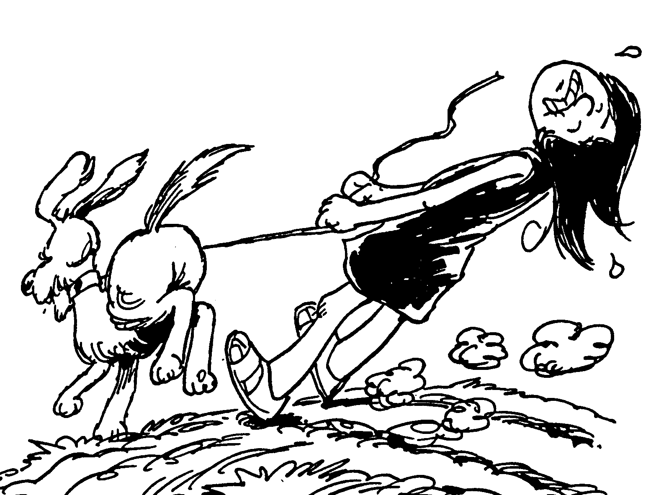
Acrostic Bible – 2 Timothy
2 Timothy
1 Hold onto true faith
2 Obey and teach Word
3 Last days bring apostasy
4 Diligently preach God's Word
Barry Huddleston, The Acrostic Bible

Slide 59
Argument
2 Timothy
Argument
239
This letter addresses the man Timothy more than his church (like 1 Timothy).
With so many falling away just before Paul's death, he carefully chooses his words in his last letter to Timothy to assure that Timothy would remain true to the faith until death.
The apostle accomplishes this by exhorting him to persevere in present hardships with godly character (2 Tim 1–2) because the future will even be more difficult (2 Tim 3–4).
He will especially have to fight apostasy by faithfully preaching the Word of God (3:10–4:5).

Slide 60
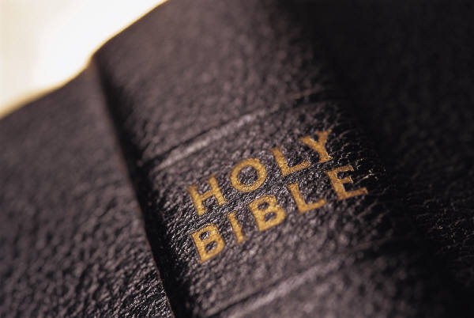
Synthesis
2 Timothy
239
Sound doctrine against opposition
1–2 Persevere in present hardship
3–4 Persevere in future hardship

Slide 61
OUTLINE
2 Timothy
237
Chapters 1 & 2
Chapters 3 & 4
Persevere in Present Hardship
Persevere in Future Hardship
Examples of Faithfulness
Solution:
Preach the Word
Paul's Hope
Characteristics
of
Faithfulness
Problem: Apostasy

Slide 62
When to hang in there…
Persevere Now
Persevere in the Future
&

Slide 63
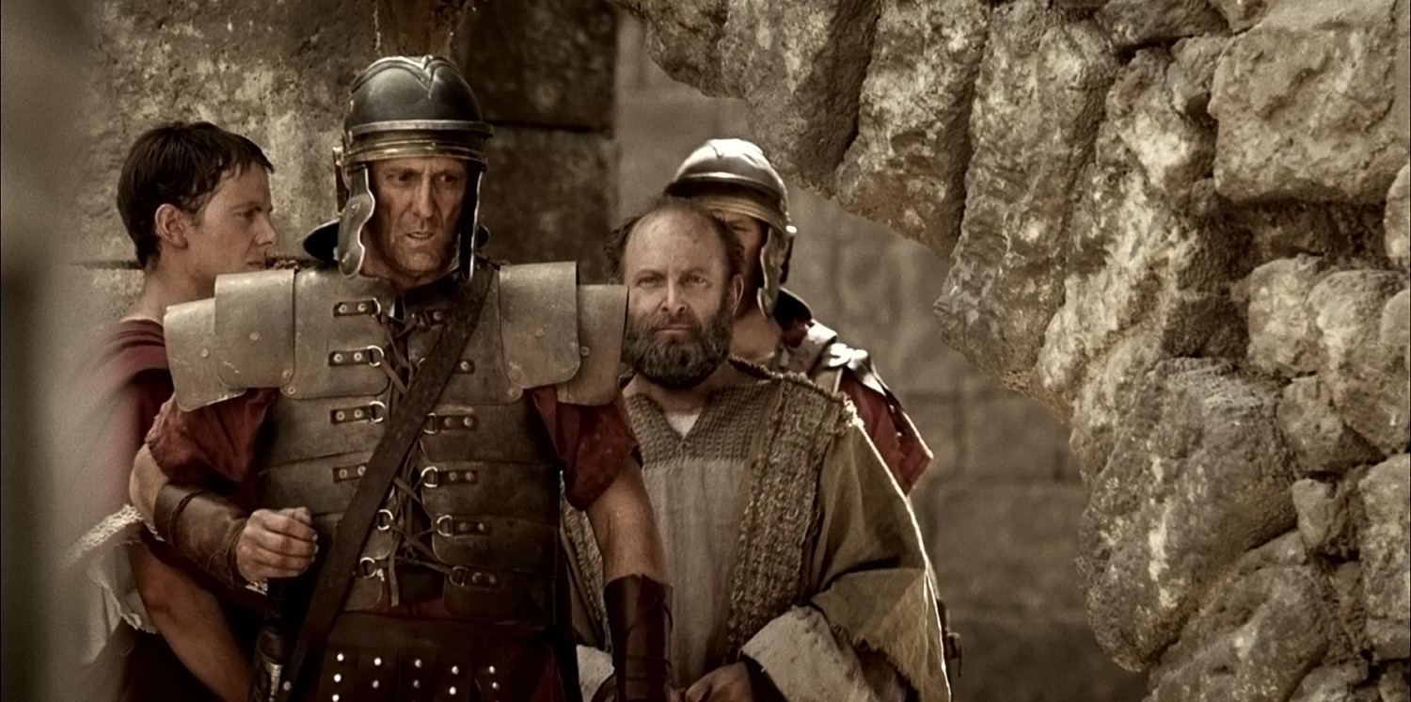
Paul led to Prison

Slide 64
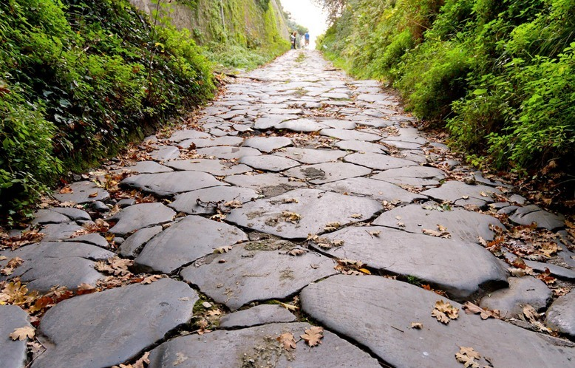
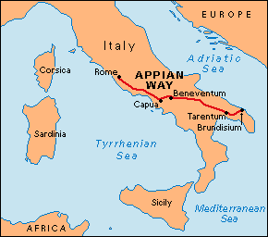
First Roman Imprisonment (AD 60-62; Acts 28:15)
"The brothers and sisters in Rome had heard we were coming, and they came to meet us at the Forum on the Appian Way. Others joined us at The Three Taverns. When Paul saw them, he was encouraged and thanked God" (NLT).
Notes:
Paul was warmly welcomed by the believers in AD 60 when he first came to Rome…

Slide 65
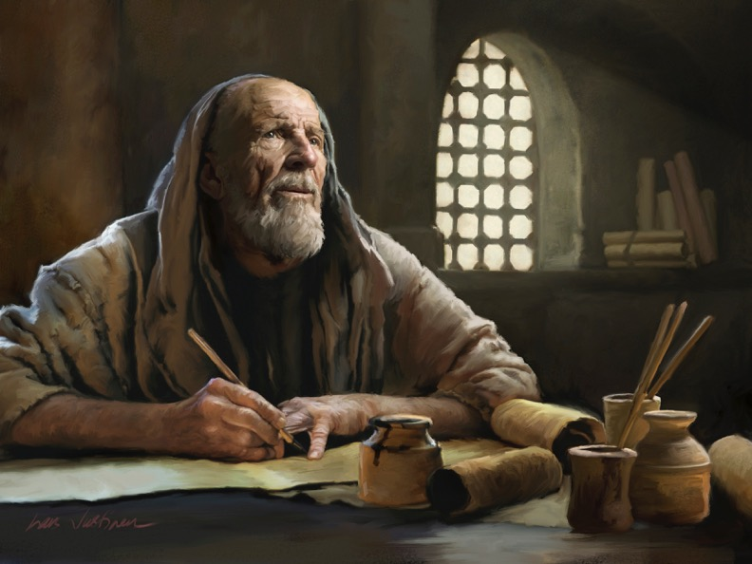
The Pastoral Epistles

Slide 66

The Pastoral Epistles
1 Timothy
Titus
2 Timothy
1-2 Timothy = personal, urgent, doctrinal emphasis
Titus = less urgent, practical emphasis
Notes:
These last three letters of Paul are called the Pastoral Epistles.

Slide 67
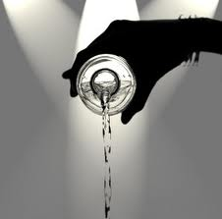
Second Roman Imprisonment (AD 67-68)
"As for me, my life has already been poured out as an offering to God. The time of my death is near. ⁷I have fought the good fight, I have finished the race, and I have remained faithful"
(2 Tim. 4:6-7 NLT)

Slide 68
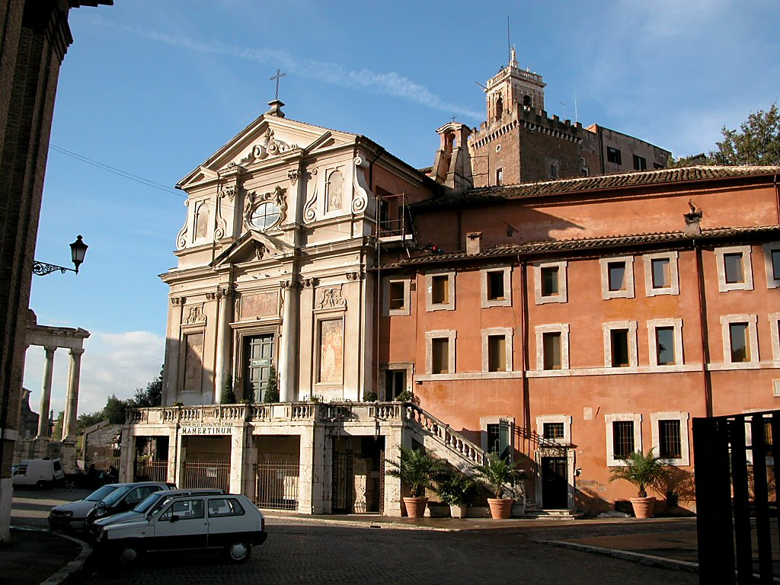
The Mamertine Prison Building
Notes:
The traditional site of the Apostle Paul's and the Apostle Peter's imprisonment in Rome, this prison was simply known as "Carcer" ("prison") in Paul's day. "Mamertine" was attributed to the prison in the Medieval Period. —Todd Bolen, BiblePlaces.com

Slide 69
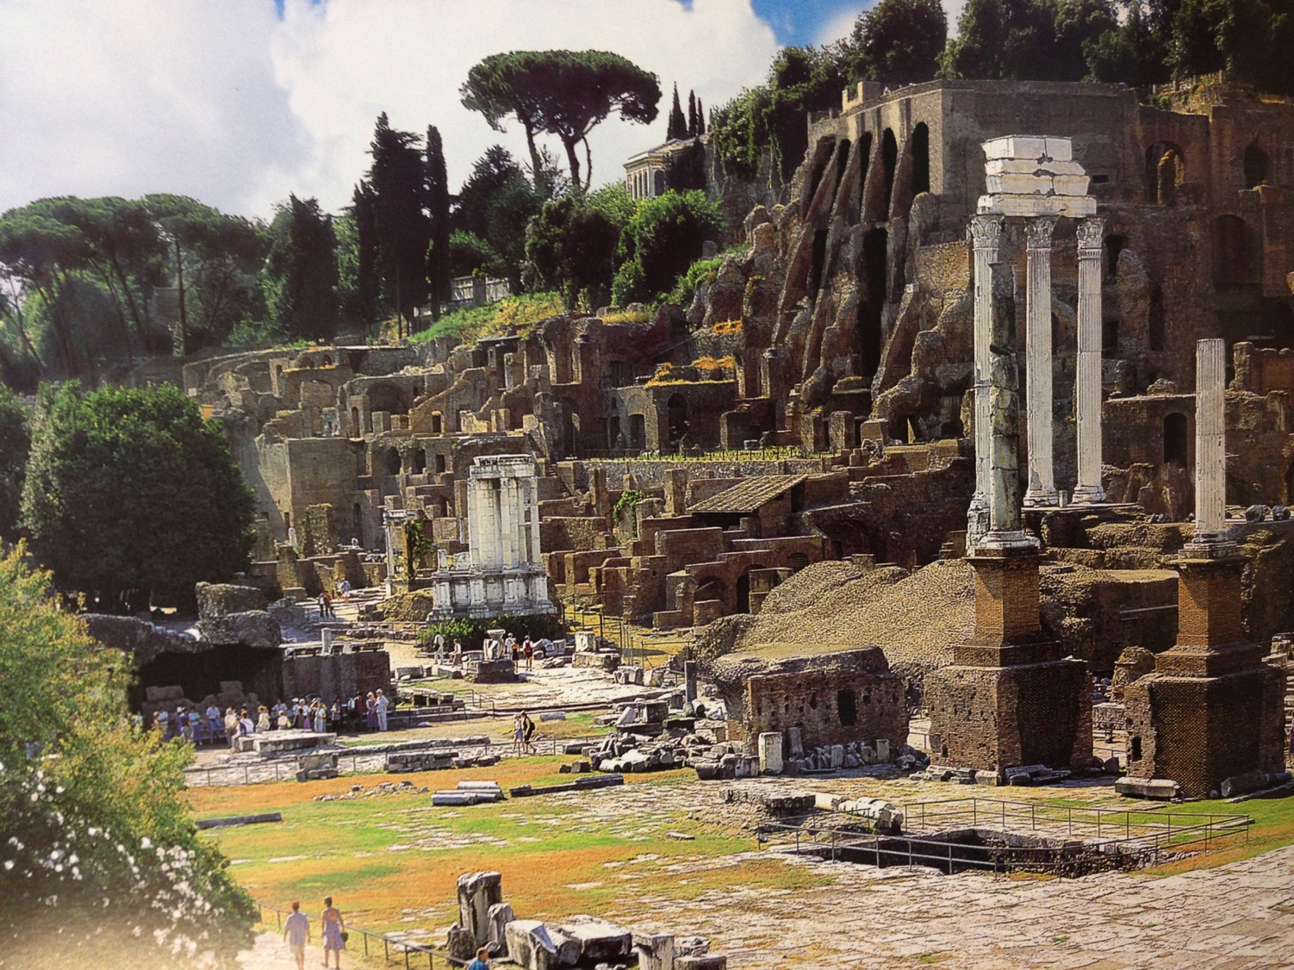
Rome's Central Forum (Modern Ruins)
Notes:
Right across the street from the prison was the most famous location in all the Roman Empire—the Forum, or the seat of power for the Republic.

Slide 70
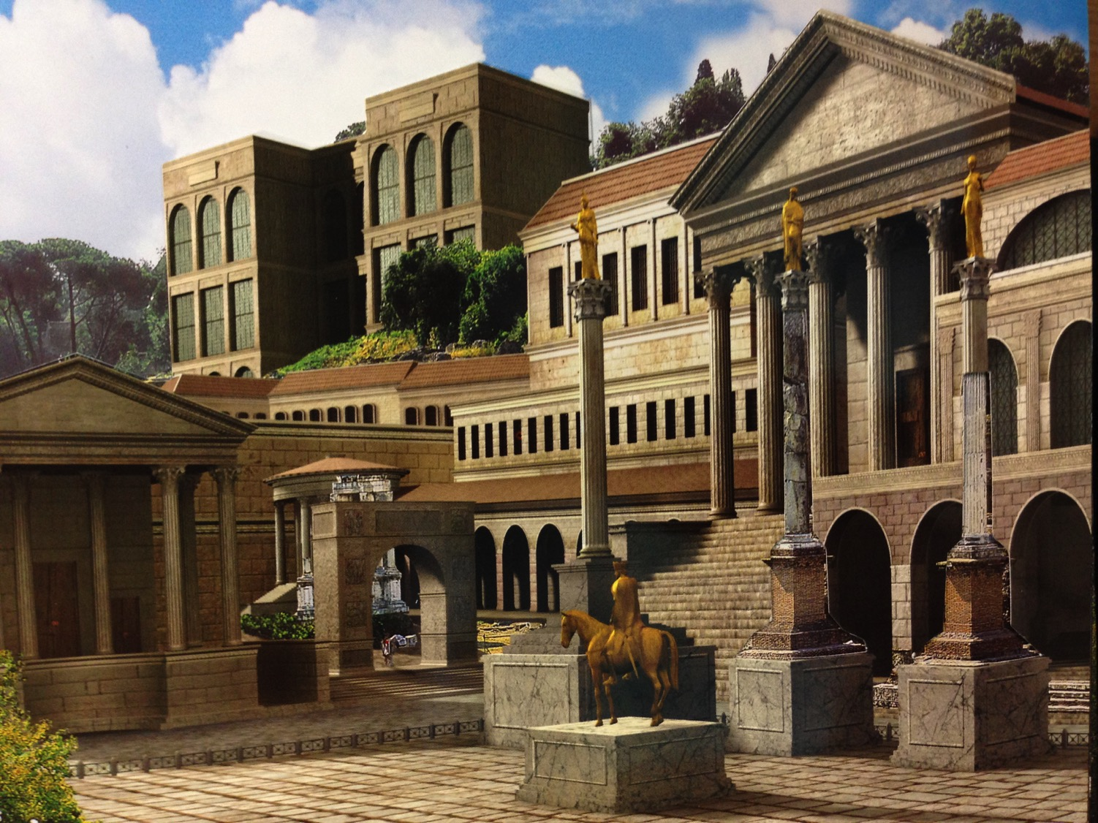
Rome's Central Forum (4th Century AD)
Notes:
In Paul’s day, the Forum was spectacular. It continued to grow in magnificence until the fourth century AD, when Rome was destroyed.

Slide 71
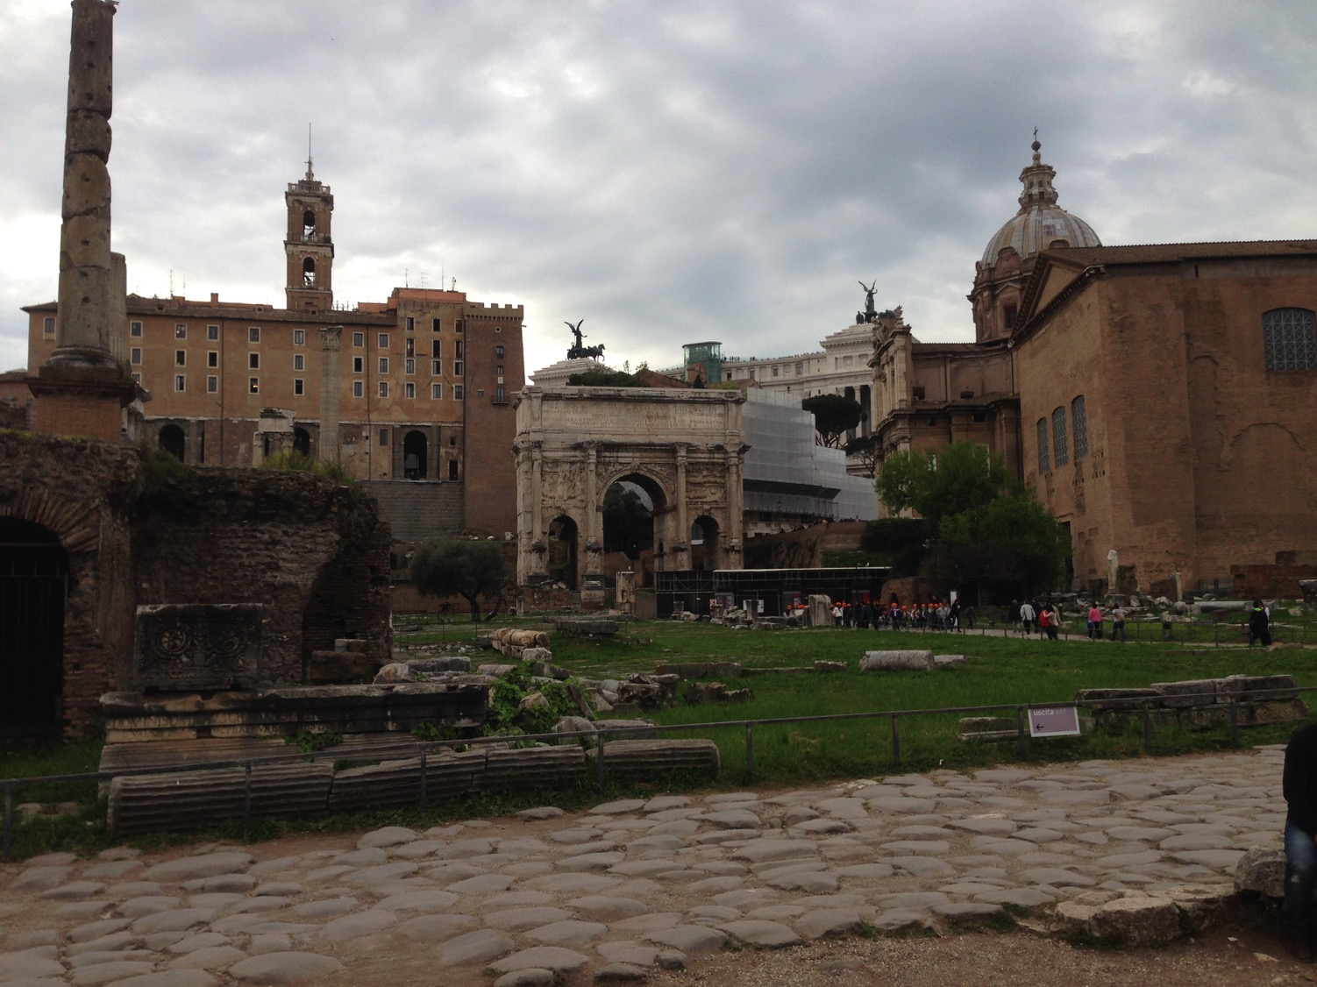
Eastern Forum From Above
Mamertine Prison
Curia (Senate "Court")
Notes:
If Paul had a window—which he didn’t—he could look across the street to see the Curia, or the Senate Court where legal proceedings were conducted.

Slide 72
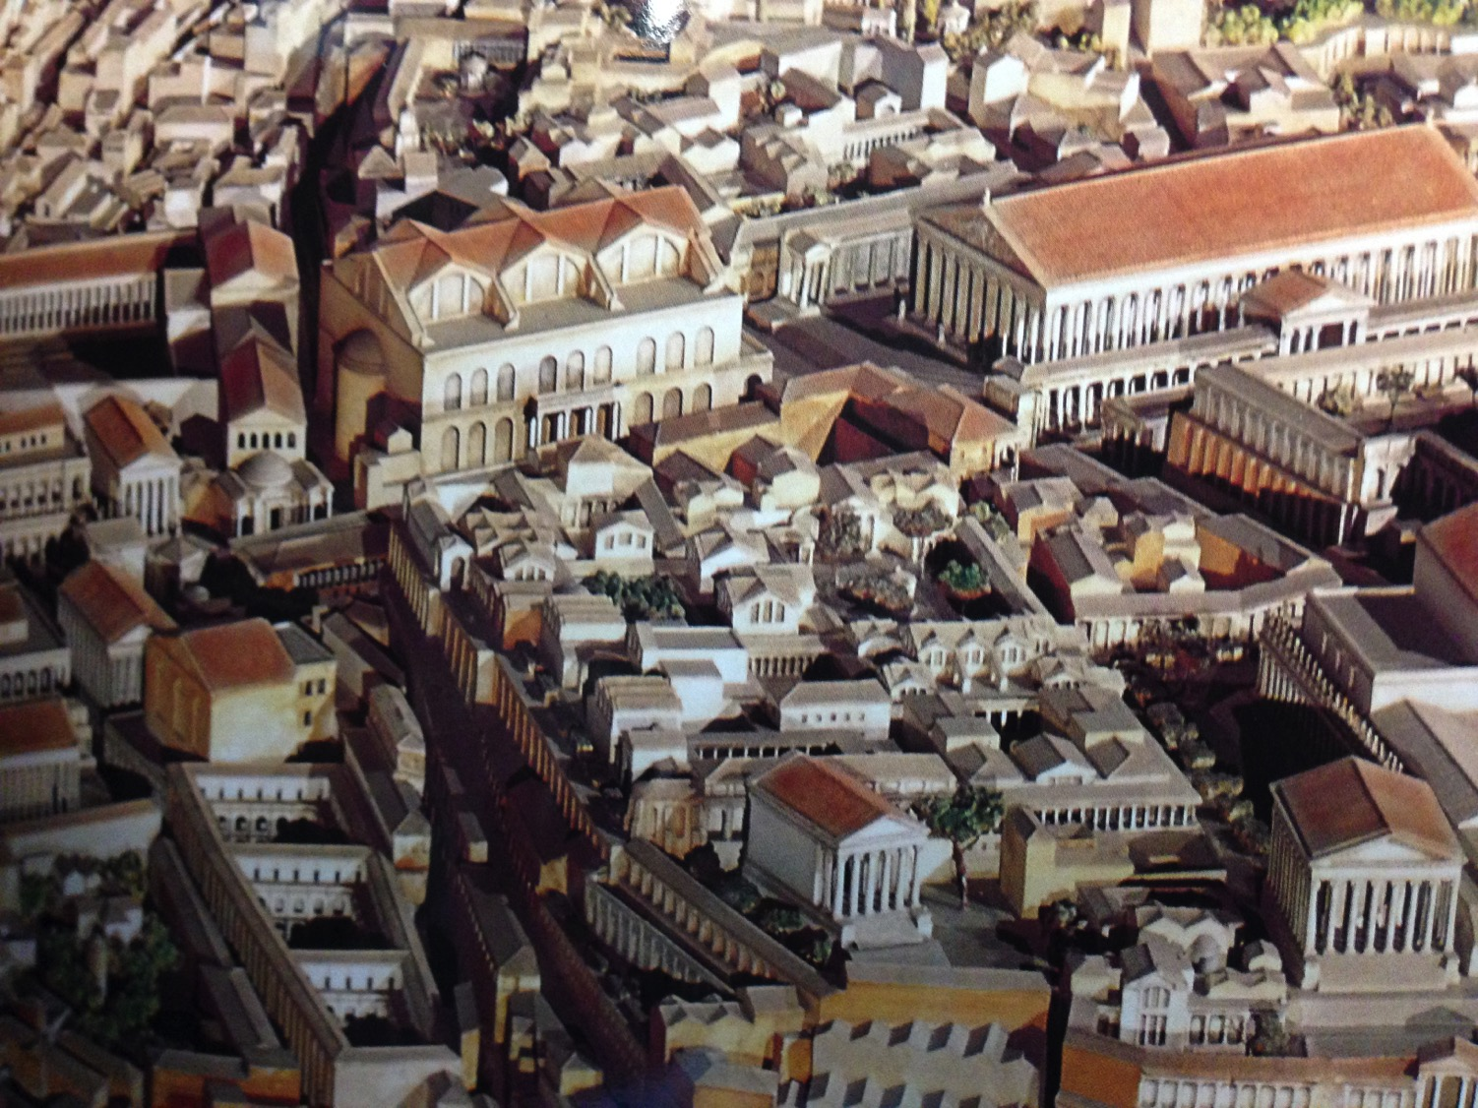
Central Forum From Above
Notes:
Buildings then were tightly compacted together as they did not need large expressways for vehicles.

Slide 73
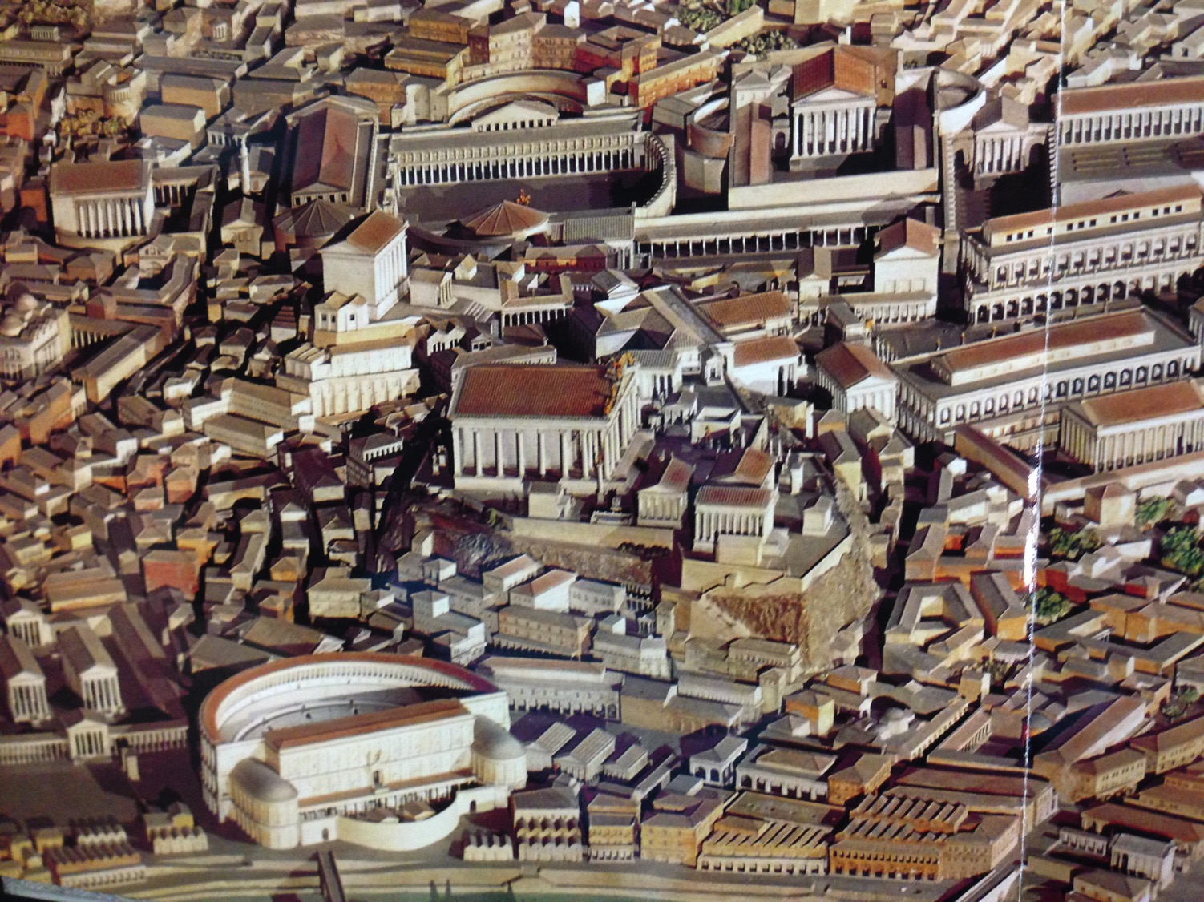
Western Forum From Above
Notes:
Such buildings included theatres and municipal structures.

Slide 74
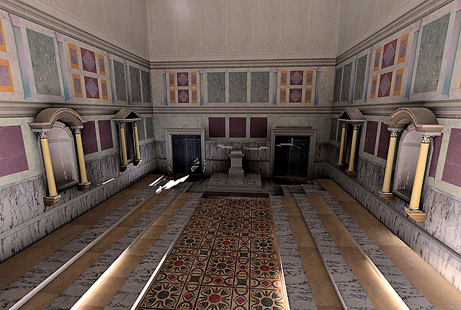
Curia Inside
Reconstruction of interior of the Curia Julia, created by the UCLA Experiential Technologies Center
Notes:
You can visit the Curia now where aristocratic senators sat in chairs on either side. Toa large extent, their influence had waned by Pauls’ time, as the days of the Republic had given way to the whims of the Emperor, whose power was unchecked.
http://www.vroma.org/~bmcmanus/curiainterior.html

Slide 75
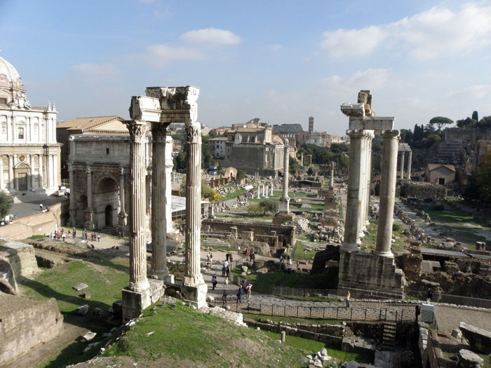
View of the Forum from the Mamertine Prison (AD 2014)
Notes:
The Forum is in ruins today, but the ideas born here have overtaken the world in the past century, where we have seen that rise of republics like the United States, Singapore, and Taiwan. Similar to this would be the largest democracy in the world, India.

Slide 76
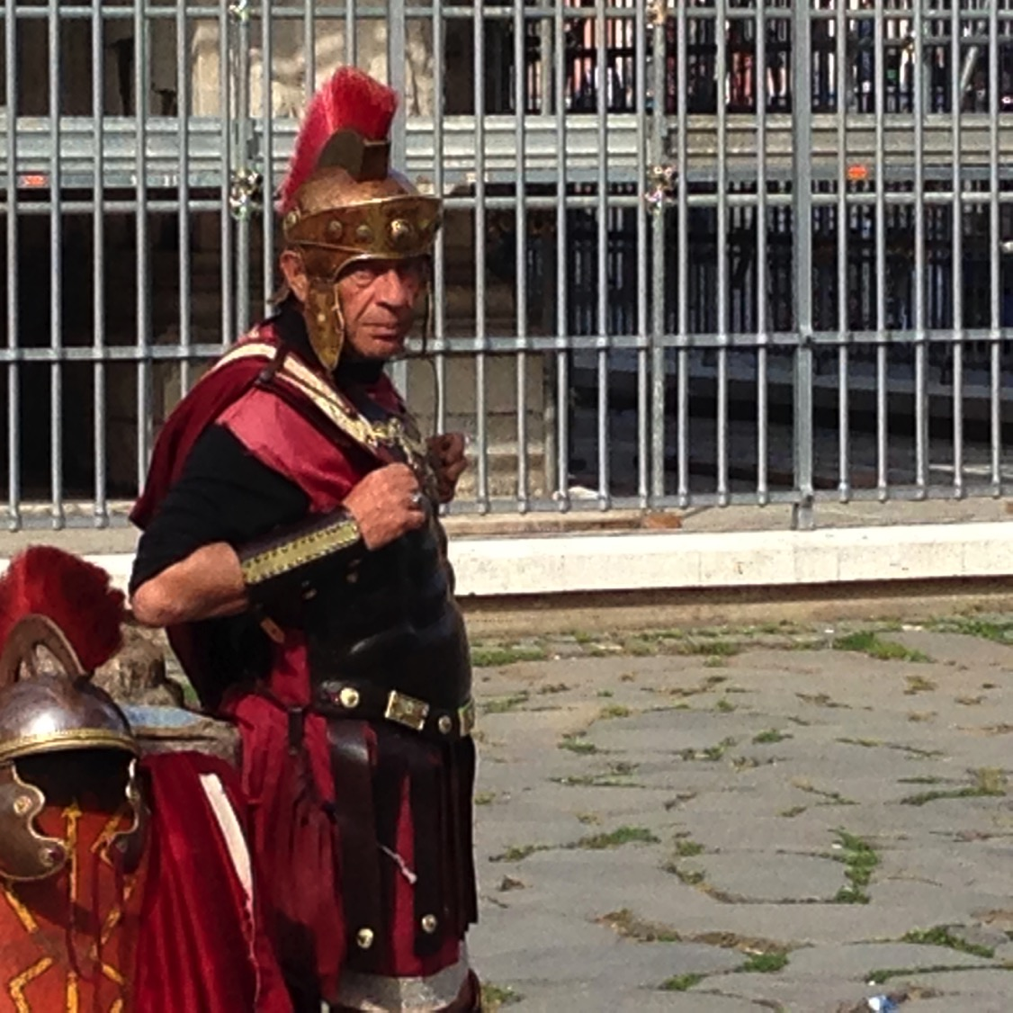
Tell your Neighbor: If you were to write your final letter before being executed, who would you write and what would you say?
2 Timothy
Notes:
So now we return to 2 Timothy, Paul’s last letter. Imagine you were given time to write your final letter the morning of your execution. Who would you write? What would you say? Tell the person next to you.

Slide 77
2 TIMOTHY
Outline
237
Sound Doctrine Against Opposition
Persevere in Present Trials |  | Persevere in Future Trials
Chapters 1–2 |  | Chapters 3–4
Examples of Faithfulness 1 | Characteristics of Faithfulness 2 | Problem: Apostasy 3:1-9 | Solution: Preach the Word 3:10–4:5 | Paul’s Hope 4:6-22
Eunice Lois Paul Onesiphorus | Discipling Single-minded Obedient Hardworking Biblical Holy Gentle | Godlessness Hypocrisy | Preaching Persevering Rebuking Encouraging Evangelism | Martyrdom Betrayals Greetings Benediction
Rome to Ephesus
Autumn AD 67 (Second Roman Imprisonment)

Slide 78
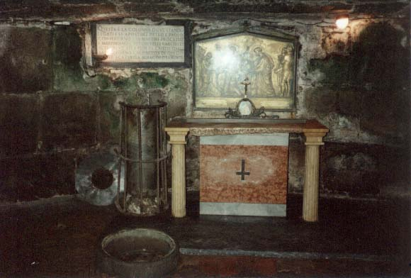
MAJOR THEMES
2 Timothy
Faithfulness
Apostasy
God-inspired Word

Slide 79
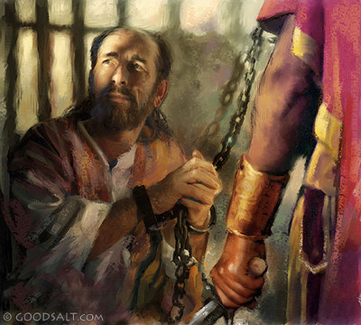
Summary Statement
2 Timothy
237
Persevere against apostasy despite hardship by faithfully preaching the Word.

Slide 80
Be Persevering
2 Timothy
Dr. Rick Griffith • Crossroads International Church Singapore
BibleStudyDownloads.org

Slide 81

Many who followed Jesus…

Slide 82
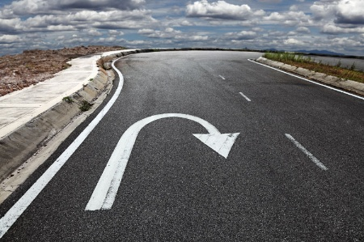
…don’t follow him today.

Slide 83
Apostasy.
“a turning away by rejecting”
2 Timothy
Notes:
This is called “apostasy.” It literally means a turning away by rejecting.
Sometimes this means that the person no longer claims to be a Christian—but in other cases, the person still claims the name of Jesus (professes Christ) but has turned away from a key doctrine of the faith.

Slide 84
"For a time is coming when people will no longer listen to sound and wholesome teaching. They will follow their own desires and will look for teachers who will tell them whatever their itching ears want to hear. ⁴ They will reject the truth and chase after myths" (2 Timothy 4:3-4 NLT).
They will “turn away their ears (apostrepho) from the truth"
(2 Timothy 4:4 NAU).

Slide 85
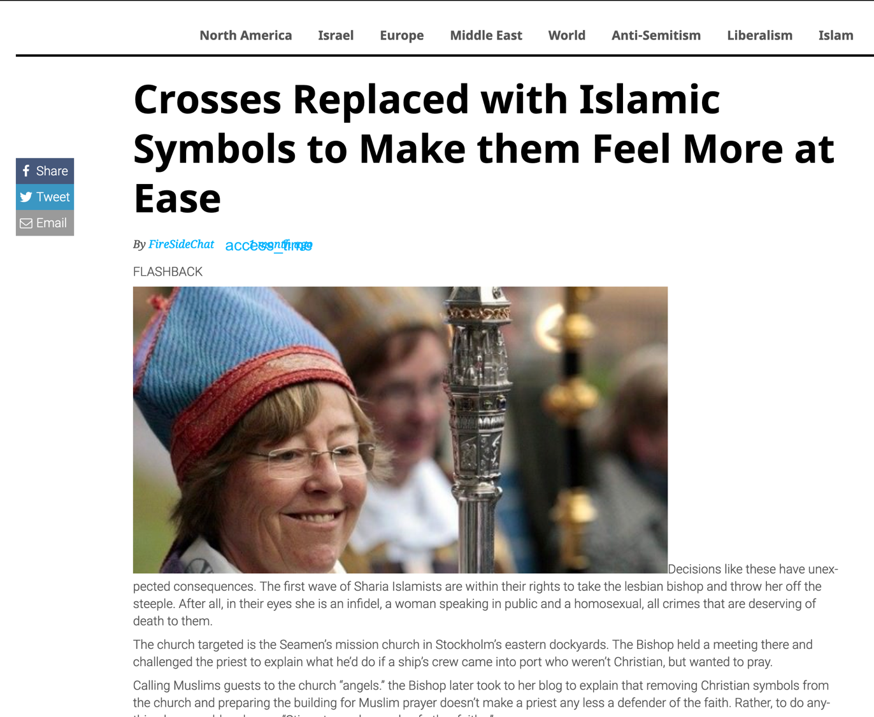
Crosses Replaced with Islamic Symbols to Make them Feel More at Ease
22 August 2019
Notes:
First Lesbian Bishop Orders Crosses Replaced with Islamic Symbols to Make them Feel More at Ease
________
https://www.firesidechat.news/2019/08/22/first-lesbian-bishop-orders-church-crosses-replaced-with-islamic-symbols-to-make-them-feel-more-at-ease.html
__________________
The Great Apostasy
Posted On January 5th, 2015
AKA: The Great Falling Away
https://www.prophecyindex.org/prophecies/view/the_great_apostasy/

Slide 86
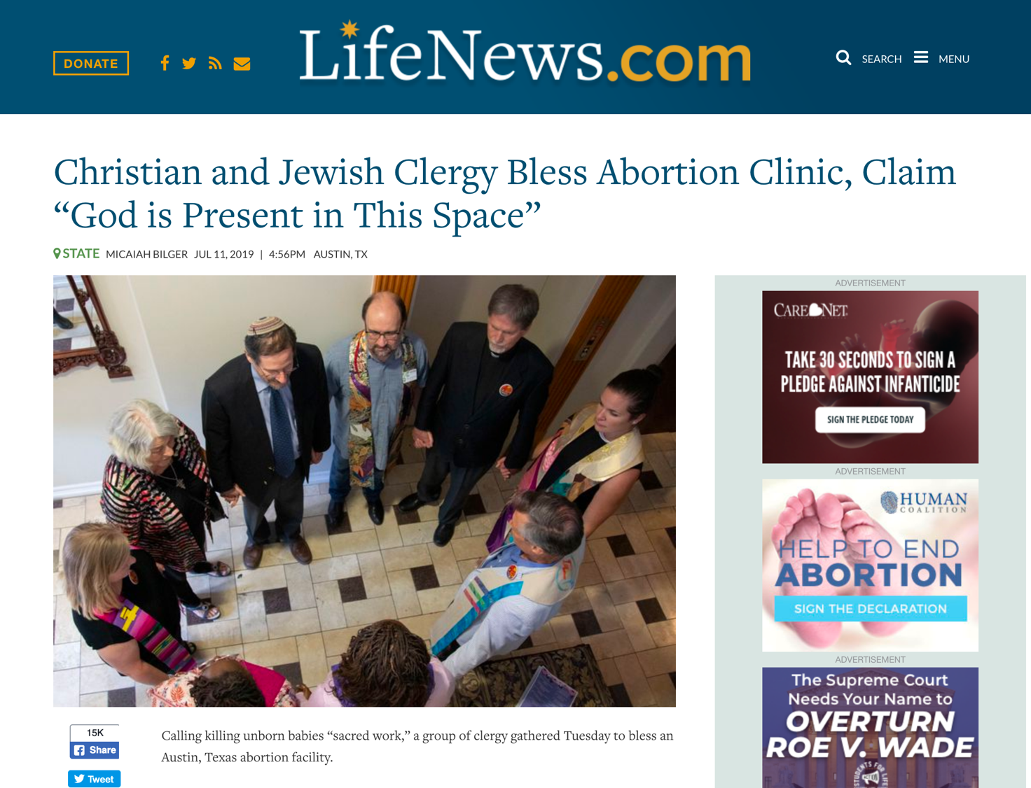
Christian and Jewish Clergy Bless Abortion Clinic,
Claim “God is Present in This Space”
Notes:
https://www.lifenews.com/2019/07/11/christian-and-jewish-clergy-bless-abortion-clinic-claim-god-is-present-in-this-space/

Slide 87
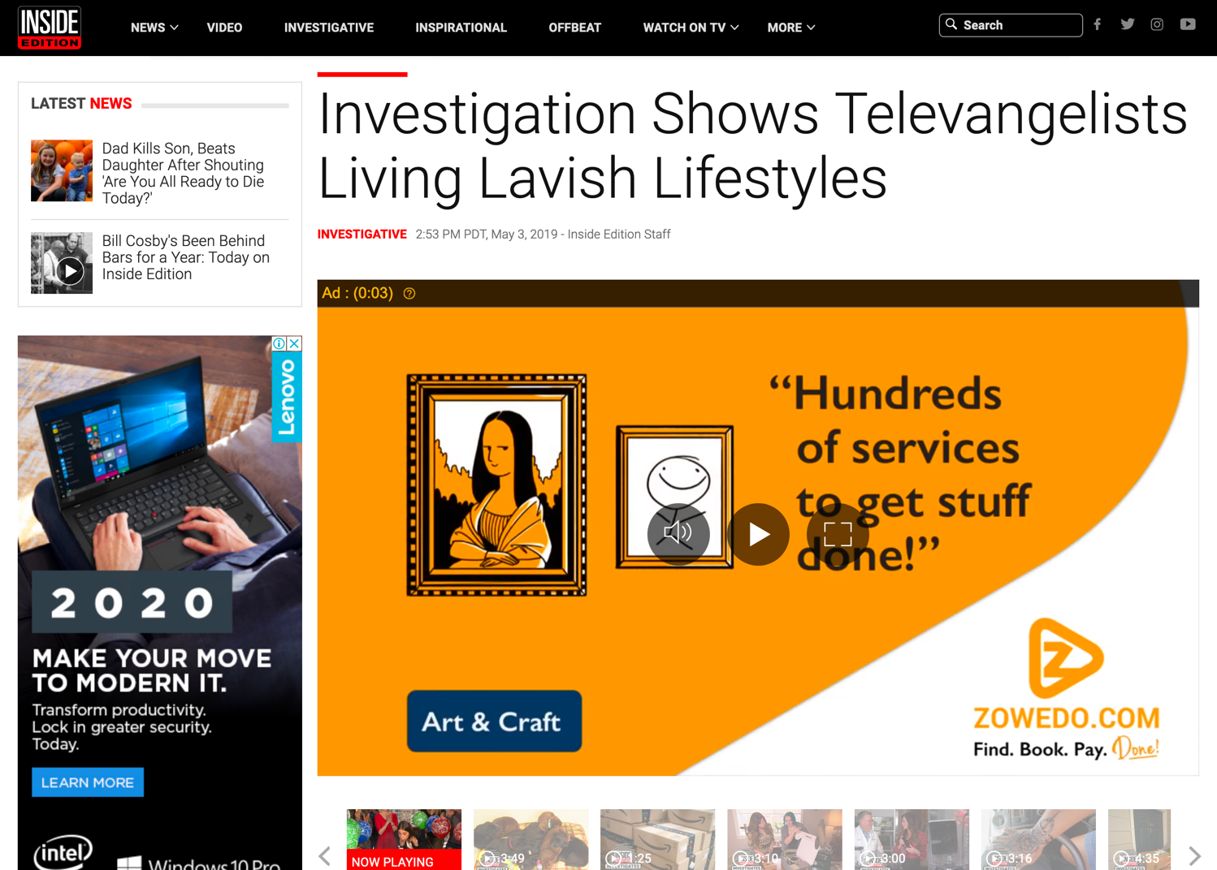

Investigation Shows Televangelists Living Lavish Lifestyle
Notes:
Kenneth Copeland owns TWO private jets and has his own airport at his home in Texas!
Watch the 4-minute clip below
______
https://www.insideedition.com/investigation-shows-televangelists-living-lavish-lifestyles-52662

Slide 88
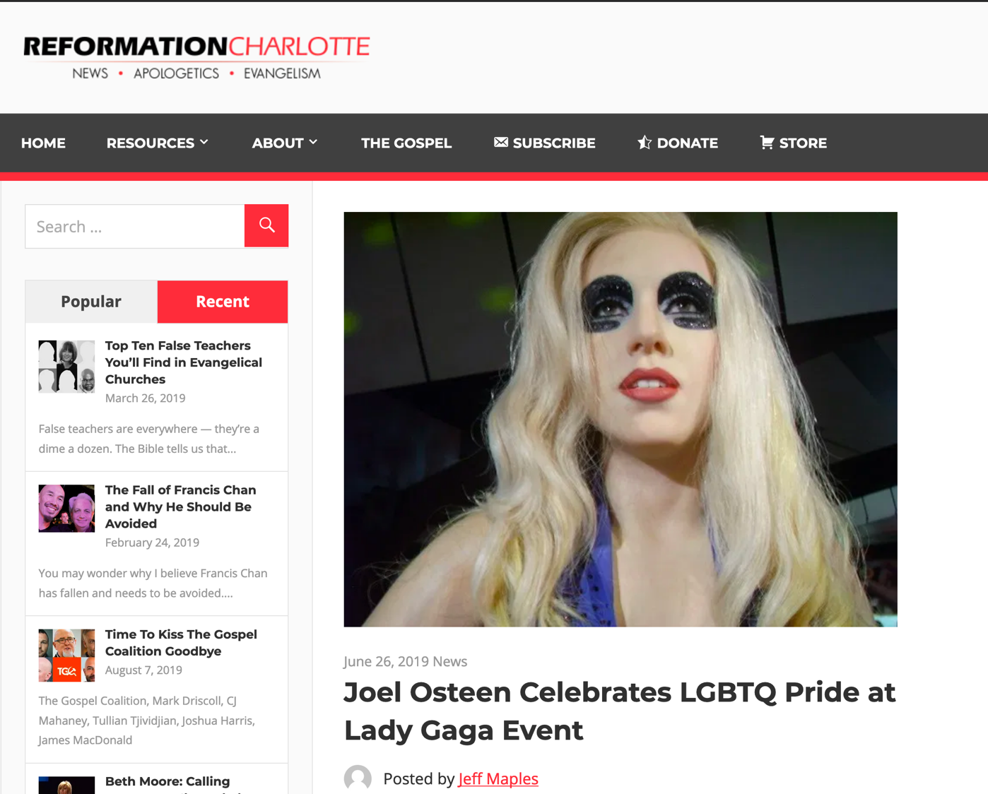
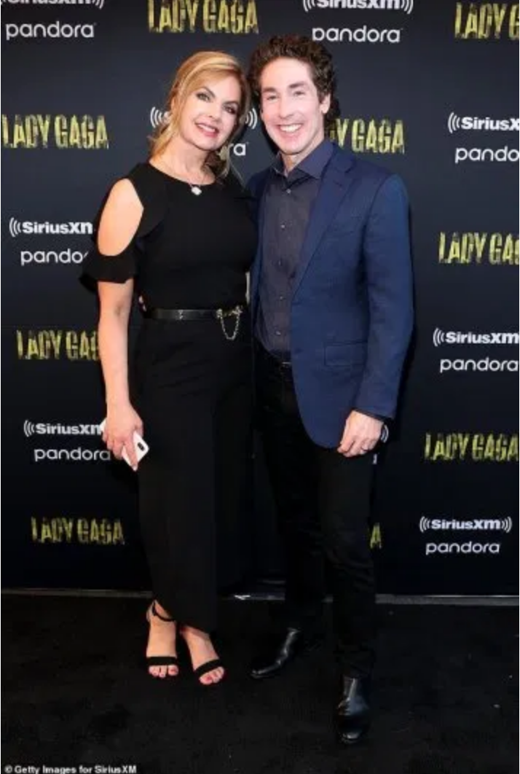
Joel Osteen Celebrates LGBTQ Pride at Lady Gaga Event
Notes:
Therefore go out from their midst, and be separate from them, says the Lord, and touch no unclean thing; then I will welcome you…
2 Corinthians 6:17
This is not satire, this really happened. Joel Osteen, one of the modern-day princes of the Word of Faith prosperity gospel movement, was seen at Lady Gaga’s pride celebration at Apollo Theater on Monday night. The New York Daily News reports,
Poehler wasn’t the only heavy hitter in the crowd. From Alaska Thunderf–k, a drag performer who won Season 2 of “RuPaul’s Drag Race All Stars” to the controversial televangelist and anti-LGBTQ pastor Joel Osteen, the event drew an eclectic mix of fans, industry insiders and celebrities, from the movies (Catherine Zeta-Jones, Michael Douglas), the music universe (Clive Davis, Adam Lambert), the fashion world (Alexander Wang), television (John Oliver, Camila Mendes) and the America’s gay Royal couple and Harlem residents Neil Patrick Harris and husband David Burtka.
Osteen’s presence was curious, because Gaga has championed LGBTQ causes.
Lady Gaga is known for her risque performances and lack of modest attire. Being that Osteen is a charlatan who has been given over to the lusts of this world and bilks millions of people for every dime they have, it comes as no surprise that he and his wife, Victoria, would immerse themselves in the culture of demonic influence, sex, and greed. It was reported that Osteen was wearing a blue blazer while his wife was wearing a long, black dress. A picture of the two can be seen here.
Interestingly, Osteen asserted a few years ago that he believes that the Scriptures are clear that homosexuality is a sin. Yet, he has continuously softened his tone and downplayed the significance toward homosexuality since then. In an effort to remain culturally relevant and inclusive, Osteen generally avoids the topic altogether.
Osteen’s ministry has produced a number of look-alike worldly money-hungry pastors, including his very own apprentice, John Gray, who was caught cheating on his wife and made amends to her by buying her a $200 thousand Lamborghini while living in a $1.8 million home paid for by his church.
________________
https://reformationcharlotte.org/2019/06/26/joel-osteen-celebrates-lgbtq-pride-at-lady-gaga-event/

Slide 89
How can you persevere amidst apostasy?
2 Timothy
Notes:
What can you do now to make sure you are following the Lord faithfully in the future?

Slide 90
Overview of Paul's Letters
38
124
39-41
"To the remotest part of the earth" (Acts 1:8)
Acts 9 13 14 15 16 18 21 27 28
Apr 48-
Sep 49
1
Galatia
Apr 50-
Sep 52
2
Aegean
Spr 53-
May 57
3
Asia
Feb 60-
Mar 62
1
Rome
Spr 62-
Fall 67
4
Spain
Aut 67-
Spr 68
2
Rome
Summer 35-
37
Damascus
Antioch
May 57-
Aug 59
Trials
Fall 49
The
Council
Spring 68
Expansion of Church
35 48 49 50 52 53 57 60 62 67 68 95
Matt
Luke
Acts
Mark
John
Gal
1 Thess
1 Cor
Eph
1 Tim
2 Tim
2 Thess
2 Cor
Col
Titus
Missionary
Pastoral
Romans
Philem
Gospels & Acts
Phil
Pauline Epistles
1234
Journeys
Prison
Rome
Imprisonments
Pauline
Notes:
We may suppose that it takes a long time for heresies to develop, but the New Testament teaches otherwise. Within a generation of Christ's life, many false systems developed. Paul writes in the AD 60s just prior to his beheading that many had fallen into the snare of deceptive teaching.

Slide 91
Fourth Missions Trip
1-2 Timothy & Titus After Acts
Spring 62 – Fall 67
Notes:
Paul had finished reaching the Eastern Roman Empire by the time he wrote Titus—and even had just returned from Spain. Yet he soon was captured and brought to Rome a second time, where he wrote 2 Timothy.
—————
Freedom from Imprisonment Spring 62–Fall 67
Paul in Ephesus and Colosse (Timothy left at Ephesus) Spring–Summer 62
Peter travels to Rome 62
Paul in Macedonia late summer 62-winter 62/63
1 Timothy written from Macedonia to Timothy in Ephesus Fall 62
Paul in Asia Minor Spring 63-Spring 64
Paul in Spain (anticipated in Rom. 15:24) Spring 64-Spring 66
Christians persecuted by Nero; Peter martyred Summer 64
Paul in Crete (Titus left there; Tit 1:5) early Summer 66
Paul in Asia Minor Summer- Fall 66
Titus written from Asia Minor to Titus in Crete Summer 66
Paul in Nicopolis (Tit 3:12) Winter 66/67
Paul in Troas (2 Tim 4:13), Macedonia and Greece Spring– Fall 67
Second Roman Imprisonment Fall 67–Spring 68
Paul arrested and brought to Rome Fall 67
2 Timothy written from Rome to Timothy in Ephesus Fall 67
Paul beheaded Spring 68

Slide 92
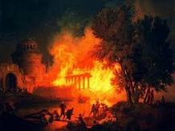
Contrasting the Roman Imprisonments
38
124
39-41
Feb 60-
Mar 62
1
Rome
Spr 62-
Fall 67
4
Spain
Aut 67-
Spr 68
2
Rome
60 62 67 68
Eph
2 Tim
Col
Philem
Phil
Pauline Epistles
1234
Journeys
Rome
Imprisonments
Notes:
What had changed between Pauls’ two imprisonments in Rome? Much! One key event was the Great Fire at Rome in July AD 64.

Slide 93
Contrasting the Roman Imprisonments
38
124
39-41
Feb 60-
Mar 62
1
Rome
Spr 62-
Fall 67
4
Spain
Aut 67-
Spr 68
2
Rome
60 62 67 68
Nero's Mental Health
Stable
Insane
AD 64 Fire of Rome
Before
After
View of Christians
Jewish Sect
Mostly Gentiles
Tolerance by Rome
Protected
No restraints
Persecution by Rome
Infrequent
Widespread
Result for Paul
Released
Beheaded
Notes:
You can see that all legal protections for Christians were removed by the time Paul returned to Rome’s prison system a second time.

Slide 94
Second Roman Imprisonment (AD 67-68)
"As you know, everyone from the province of Asia has deserted me—even Phygelus and Hermogenes" (2 Tim. 1:15 NLT)
"Yes, and everyone who wants to live a godly life in Christ Jesus will suffer persecution. ¹³But evil people and impostors will flourish. They will deceive others and will themselves be deceived" (2 Tim. 3:12-13 NLT)
Notes:
Seven years later the first imprisonment under house arrest, the situation was entirely different. Nero had initiated a persecution of believers and it was very unpopular to be a Christian. May had denied the faith and most had gone underground to the catacombs if they still continued in the faith.

Slide 95
Friends of Paul’s Second Roman Imprisonment (AD 67-68)
"Timothy, please come as soon as you can. ¹⁰Demas has deserted me because he loves the things of this life and has gone to Thessalonica. Crescens has gone to Galatia, and Titus has gone to Dalmatia. ¹¹Only Luke is with me. Bring Mark with you when you come, for he will be helpful to me in my ministry. ¹²I sent Tychicus to Ephesus. ¹³When you come, be sure to bring the coat I left with Carpus at Troas. Also bring my books, and especially my papers. ¹⁴Alexander the coppersmith did me much harm, but the Lord will judge him for what he has done. ¹⁵Be careful of him, for he fought against everything we said" (2 Tim. 4:9-15 NLT).
Notes:
Life was lonely for a very relational man like Paul at this point. Most of his friends had either escaped Rome or fallen away from the Faith.

Slide 96
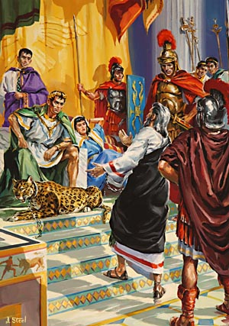
Paul's Second Imprisonment (AD 67-68)
"The first time I was brought before the judge, no one came with me. Everyone abandoned me. May it not be counted against them. ¹⁷But the Lord stood with me and gave me strength so that I might preach the Good News in its entirety for all the Gentiles to hear. And he rescued me from certain death"
(2 Tim. 4:16-17 NLT).
Notes:
Serving Jesus includes times when we feel like no one else is with us in terms of their presence and prayers. But Jesus remains, despite the failures of people.

Slide 97
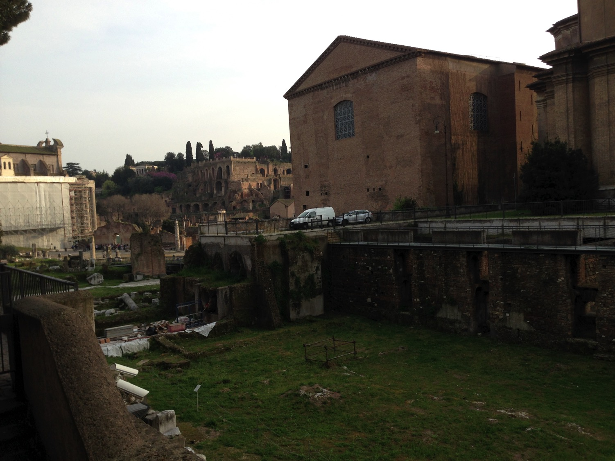
Close Locations!
Mamertine Prison
Curia (Senate "Court")
Notes:
I wonder if Paul knew that Caesar was just across the street!

Slide 98

View of the Forum from the Mamertine Prison (AD 4th cent.)
Notes:
The Forum was filled with buildings and monuments honoring the emperors and generals who expanded the Empire. In AD 80, the Coliseum was completed and can be seen in the rear left. It was funded by the gold seized from burning Herod’s temple in Jerusalem.

Slide 99

"Peter in Prison Street"
Notes:
Honestly, Susan and I had a very difficult time finding the prison where Paul was held. It wasn’t on any of the tourist maps! Yet, finally, we found it on “Peter in Prison Street”!

Slide 100

Susan & Rick free because of Peter's & Paul's imprisonment
Notes:
The thought struck me that I could be free to visit the place 2000 years after Paul lost his freedom on this street. He even lost his life.

Slide 101


"Mamertine Prison of the Apostles Peter & Paul"
Notes:
Tourists can visit the prison for a small sum—if you can find it!
—Todd Bolen, BiblePlaces.com

Slide 102

"Mamertine Prison of the Apostles Peter & Paul"
Notes:
These two most prominent apostles, interestingly, were imprisoned in the same cell but three years apart.

Slide 103

Mamertine Doors Depict Peter & Paul
Notes:
Both went through doors like this (AD 64 for Peter, AD 67 for Paul).

Slide 104

Mamertine Prison Entrance
Notes:
It is a simple building of stone and iron.

Slide 105

The Mamertine Tour
Notes:
Given Peter’s stature as supposedly the first Pope there in Rome, he is given priority over Paul.

Slide 106

The Upper Mamertine room busts of Peter and Paul
Notes:
At the ground level is an altar to these great apostles. Yet they had little time at this level, for they were lowered into a hole in the floor and kep below.

Slide 107

Prisoners were lowered through the manhole into the former cistern below
Notes:
The Carcer was the only prison in ancient Rome. It had two sections, an upper and a lower; the upper was known as the "Carcer" proper, while the lower (originally thought to have been a cistern) was known as the "Tullianum." Those prisoners that entered the Tullianum from the Carcer were lowered through a hole in the Carcer's floor. The name "Tullianum" is probably derived from the Latin word for a spring of water, and incidentally, this section of the prison does, in fact, house a well. According to tradition, the Apostle Peter caused the well-water to spring up so that he might baptize his jailors, St. Processus and St. Martinianus. It is debated whether Peter was actually incarcerated here. —Todd Bolen, BiblePlaces.com

Slide 108

Mamertine Prison writing area and door
Mamertine Prison writing area and door
Notes:
The state rarely incarcerated common criminals but kept the Mamertine Prison for political prisoners doomed for execution by being thrown off the Tarpeian Rock. Enemies of the State, such as Jugurtha and Vercingetorix, were often strangled in the Tullianum. Sallust, a Roman writer in 40 B.C., described the Tullianum as "about twelve feet deep, closed all round by strong walls and a stone vault. Its aspect is repugnant and fearsome from its neglect, darkness, and stench."
—Todd Bolen, BiblePlaces.com

Slide 109

Down the Steps
Notes:
Now steps have been added so people like me and you can descend into the lower level that Paul had to enter via the hole.

Slide 110

Peter's (AD 64) & Paul's (AD 67-68) Cell Below
Notes:
When told that he would die by crucifixion, Peter felt he was not worthy to die by the same means as Jesus. He requested to be crucified upside down, and the Romans obliged. The altar recalls this with an upside down cross.

Slide 111
How can you persevere amidst apostasy?
2 ways…
2 Timothy
Notes:
What can you do now to make sure you are following the Lord faithfully in the future?

Slide 112
How to hang in there:
Faithfully...
Obey God’s Word
2 Timothy 1–2
Notes:
Consistently follow what God says (1-2)

Slide 113
Slides on
2 Timothy 1

Slide 114
2 TIMOTHY
Outline
237
Sound Doctrine Against Opposition
Persevere in Present Trials |  | Persevere in Future Trials
Chapters 1–2 |  | Chapters 3–4
Examples of Faithfulness 1 | Characteristics of Faithfulness 2 | Problem: Apostasy 3:1-9 | Solution: Preach the Word 3:10–4:5 | Paul’s Hope 4:6-22
Eunice Lois Paul Onesiphorus | Discipling Single-minded Obedient Hardworking Biblical Holy Gentle | Godlessness Hypocrisy | Preaching Persevering Rebuking Encouraging Evangelism | Martyrdom Betrayals Greetings Benediction
Rome to Ephesus
Autumn AD 67 (Second Roman Imprisonment)

Slide 115
Paul greeted Timothy with his own persevering attitude in the face of death (1:1-2).

Slide 116

"This letter is from Paul, chosen by the will of God to be an apostle of Christ Jesus. I have been sent out to tell others about the life he has promised through faith in Christ Jesus"
(2 Timothy 1:1 NLT).

Slide 117
"I am writing to Timothy, my dear son. May God the Father and Christ Jesus our Lord give you grace, mercy, and peace"
(2 Timothy 1:2 NLT).

Slide 118
Timothy should imitate others’ faithfulness despite many who fell away (1:3-18).

Slide 119
He learned faithfulness from his mother and grandmother shown at his ordination (1:3-7).

Slide 120

MAJOR THEME 1: Faithfulness
2 Timothy
Examples of Faithfulness:
Learned from mother Eunice & grandmother Lois (1:3-7)
Timothy learned in his own mixed-parentage home, with the women in his life setting the example of faithfulness in daily dealings.

Slide 121

MAJOR THEME 1: Faithfulness
2 Timothy
b. Learned from Paul (1:8-14)
Paul remained faithful in difficult times because he believed and trusted God to keep him till the end (1:11-12).

Slide 122
He should bravely suffer Nero’s tortures like Paul through the gospel’s power (1:8-14).

Slide 123
"So never be ashamed to tell others about our Lord. And don’t be ashamed of me, either, even though I’m in prison for him. With the strength God gives you, be ready to suffer with me for the sake of the Good News.
⁹ For God saved us and called us to live a holy life. He did this, not because we deserved it, but because that was his plan from before the beginning of time—to show us his grace through Christ Jesus"
(2 Timothy 1:8-9 NLT).

Slide 124
"And now he has made all of this plain to us by the appearing of Christ Jesus, our Savior. He broke the power of death and illuminated the way to life and immortality through the Good News. ¹¹And God chose me to be a preacher, an apostle, and a teacher of this Good News"
(2 Timothy 1:10-11 NLT).

Slide 125

"That is why I am suffering here in prison. But I am not ashamed of it, for I know the one in whom I trust, and I am sure that he is able to guard what I have entrusted to him until the day of his return" (2 Timothy 1:12 NLT).

Slide 126

I Know Whom I Have Believed
CCLI Song # 31762
© Words: Public Domain | Music: Public Domain
For use solely with the SongSelect®. Terms of Use. All rights reserved. www.ccli.com
CCLI License # 277507

Slide 127
I know not why God’s wondrous grace
To me He hath made known,
Nor why, unworthy, Christ in love
Redeemed me for His own.

Slide 128
But “I know whom I have believed,
And am persuaded that He is able
To keep that which I’ve committed
Unto Him against that day.”

Slide 129
I know not what of good or ill
May be reserved for me,
Of weary ways or golden days,
Before His face I see.

Slide 130
But “I know whom I have believed,
And am persuaded that He is able
To keep that which I’ve committed
Unto Him against that day.”

Slide 131
I know not when my Lord may come,
At night or noonday fair,
Nor if I’ll walk the vale with Him,
Or “meet Him in the air.”

Slide 132
But “I know whom I have believed,
And am persuaded that He is able
To keep that which I’ve committed
Unto Him against that day.”

Slide 133
I know not what of good or ill
May be reserved for me,
Of weary ways or golden days,
Before his face I see.

Slide 134
But “I know whom I have believed,
And am persuaded that He is able
To keep that which I’ve committed
Unto Him against that day.”

Slide 135
I know not when my Lord may come,
At night or noonday fair,
Nor if I’ll walk the vale with Him,
Or “meet Him in the air.”

Slide 136
But “I know whom I have believed,
And am persuaded that He is able
To keep that which I’ve committed
Unto Him against that day.”

Slide 137
I KNOW WHOM I HAVE BELIEVED
I know not why God's wondrous grace
to me He hath made known,
Nor why unworthy, Christ in love
redeemed me for His own
Chorus:
But I know whom I have believed
And am persuaded that He is able
To keep that which I've committed
unto Him against that day
I know not what of good or ill
May be reserved for me,
Of weary ways or golden days
Before His face I see.
2 Tim. 1:12

Slide 138

"Hold on to the pattern of wholesome teaching you learned from me—a pattern shaped by the faith and love that you have in Christ Jesus.
¹⁴Through the power of the Holy Spirit who lives within us, carefully guard the precious truth that has been entrusted to you"
(2 Timothy 1:13-14 NLT).

Slide 139
Asian believers deserted Jesus but Onesiphorus set a faithful example (1:15-18).

Slide 140
Second Roman Imprisonment (AD 67-68)
"As you know, everyone from the province of Asia has deserted me—even Phygelus and Hermogenes" (2 Tim. 1:15 NLT)
Notes:
Seven years later the first imprisonment under house arrest, the situation was entirely different. Nero had initiated a persecution of believers and it was very unpopular to be a Christian. May had denied the faith and most had gone underground to the catacombs if they still continued in the faith.

Slide 141

MAJOR THEME 1: Faithfulness
2 Timothy
  c. Learned from Onesiphorus (1:15-18)
  Onesiphorus was not ashamed to be known as a friend of Paul when he was a prisoner. He searched for Paul very diligently and found him.

Slide 142
Slides on
2 Timothy 2

Slide 143
Knowing what faithfulness looks like helps us persevere under trial (2 Tim 2).

Slide 144
Like a discipling teacher, invest in others the teaching you received (2:1-2).

Slide 145

"Timothy, my dear son, be strong through the grace that God gives you in Christ Jesus"
(2 Timothy 2:1 NLT).

Slide 146

DISCIPLESHIP
"…make disciples of all nations…" (Matt 28:19)
But how?
Notes:
We all know that our basic calling is to make disciples among the nations.

Slide 147



Multiply Yourself into Trustworthy People!
"You have heard me teach things that have been confirmed by many reliable witnesses. Now teach these truths to other trustworthy people who will be able to pass them on to others" (2 Tim. 2:2 NLT).
Discipleship
Paul
Timothy
Reliable People
Others
Notes:
Get mentored by godly people (2 Tim. 2:2).

Slide 148

Levels of Discipleship
Mentor (Paul)
Peer
Peer (Timothy)
Mentored (Others)
Notes:
Each of us should be like Timothy, learning from someone more mature than us, and also be a "Paul" to someone less mature, helping that person grow in Christ.

Slide 149

Life Transformation Groups
The Commitment: Meet one hour a week with 1-2 others of the same sex to provide accountability in 3 areas
Confess sin around 10 questions
Read 3 Bible chapters daily
Pray for lost friends
Church Multiplication Associates––www.CMAResources.org
Notes:
How can you mentor and get mentored? Life Transformation Groups are 2-3 people meeting weekly for accountability.
An LTG has 2-3 persons committed to growing spiritually. They meet in a home, restaurant, church, business, or wherever they can have a 60-minute accountability session each week.

Slide 150


Life Transformation Groups
Church Multiplication Associates––www.CMAResources.org
Notes:
No LTG should be larger than 3 people. Once a member invites a 4th person and it is shown that this 4th person will be committed to the LTG concept, the group of 4 multiplies into 2 groups of 2 persons. The additional members can be believers or unbelievers, as long as they are committed to confession, Bible reading, and prayer.

Slide 151




Life Transformation Groups
Church Multiplication Associates––www.CMAResources.org
Notes:
Ideally, the church is then composed of many LTG groups at different stages, growing to multiply more groups so that accountability remains intact in a small group for each person.

Slide 152


Singapore Bible College Students
USA
MONGOLIA
JAPAN
KOREA
CHINA
NEPAL
HONG KONG
MYANMAR
INDIA
THAILAND
VIETNAM
PHILIPPINES
MALAYSIA
SINGAPORE
SRI LANKA
INDONESIA
SBC
NEW ZEALAND

Slide 153
Like a good soldier, show unswerving commitment to please your superior, Jesus
(2:3-4).

Slide 154
Characteristics of Faithfulness
2 Timothy
  Soldier (2:3-4) – A soldier has to suffer hardship disengage himself from all other worldly businesses to be loyal to his commander.

Slide 155

"Endure suffering along with me, as a good soldier of Christ Jesus. ⁴ Soldiers don’t get tied up in the affairs of civilian life, for then they cannot please the officer who enlisted them"
(2 Timothy 2:3-4 NLT).

Slide 156

Unity in battle
Notes:
When we all wear the armor, we can both attack enemy strongholds and also defend from Satan’s attacks.

Slide 157

“The Turtle”
= advancing together
Notes:
Believers who are united in direction can advance the gospel where they otherwise would be unprotected.

Slide 158

Protecting
one another
Notes:
When we all wear the armor, we defend not only ourselves from attack—we defend one another.

Slide 159


Slide 160

Roman Soldiers

Slide 161

Roman Soldiers

Slide 162
Newsflash
Newsflash

Slide 163


We regret to inform you that PM Lee Hsien Loong has just been kidnapped from the Istana…

Slide 164

However, an elite group of commandos has been dispatched to rescue the PM.

Slide 165

The job will be tough. Can you handle it?

Slide 166
Unfortunately, one of these commandos cannot overcome the evil desires of youth……

Slide 167

Bailing out…
Another is unable to take the heat (trials)

Slide 168
Like a successful athlete, obey the rules in God's Word (2:5).

Slide 169

Characteristics of Faithfulness
2 Timothy
  2. Athlete (2:5) – An athlete has to follow the rules to win the race.

Slide 170
Like a diligent farmer, have the joy of spiritual fruit like Jesus after he was raised (2:6-13).

Slide 171
Characteristics of Faithfulness
2 Timothy
  3. Farmer (2:6-13) – A farmer must work hard
  to achieve a good harvest.
Faithfulness = loyal to Christ, our commander,
to follow the law of God and work hard

Slide 172
"Always remember that Jesus Christ, a descendant of King David, was raised from the dead. This is the Good News I preach.
⁹And because I preach this Good News, I am suffering and have been chained like a criminal. But the word of God cannot be chained. ¹⁰So I am willing to endure anything if it will bring salvation and eternal glory in Christ Jesus to those God has chosen"
(2 Timothy 2:8-10 NLT).

Slide 173

2 Timothy 2:11–13 (NIV)
¹¹ Here is a trustworthy saying:
If we died with him,
we will also live with him;
¹² if we endure,
we will also reign with him.
If we disown him, he will also disown us;
¹³ if we are faithless, he remains faithful, for he cannot disown himself.

Slide 174

"If we endure hardship, we will reign with him"
(2 Tim. 2:12 NLT)

Slide 175

2 TIMOTHY 2:15
DO YOUR BEST TO PRESENT YOURSELF TO
GOD
AS ONE APPROVED
A WORKER
WHO HAS NO NEED
TO BE ASHAMED
RIGHTLY HANDLING
THE WORD OF
TRUTH

Slide 176
Like an unashamed workman, fight heresy with Scripture—not human words (2:14-19).

Slide 177

1 TIMOTHY 2:15
Do your best to present yourself to God as one
APPROVED
a worker who has no need to be ashamed
rightly handling the word of truth.

Slide 178
Protection from False Teachers (2 Tim 2:14-26)
Protect the Flock
(14-19)
Protect the Shepherd
(20-26)

Slide 179

"Avoid worthless, foolish talk that only leads to more godless behavior. ¹⁷This kind of talk spreads like cancer, as in the case of Hymenaeus and Philetus.
¹⁸They have left the path of truth, claiming that the resurrection of the dead has already occurred; in this way, they have turned some people away from the faith"
(2 Timothy 2:16-18 NLT).

Slide 180

But God’s truth stands firm like a foundation stone with this inscription: "The Lord knows those who are his," and "All who belong to the Lord must turn away from evil"
(2 Timothy 2:19 NLT).

Slide 181

Confidence in the Day of Judgment
…the firm foundation
of God stands,
having this seal,
"The Lord knows
those who are His"
2 Timothy 2:19

Slide 182
Like a noble instead of ignoble container, be pure to avoid false teachers (2:20-22).

Slide 183
Like a gentle servant, gently teach false teachers instead of arguing with them (2:23-26).

Slide 184

Religious Distribution in Singapore
4%
0.7%
8.5%
42.5%
Buddhist
Buddhist
Muslim
14.6%
Christian
No Religion
Christian
No Religion
Taoist
Hindu
14.8%
Other
Muslim
14.9%
The Straits Times 14 Jan 2013
Notes:
Singapore may have seen church growth, but it is only a microcosm of the world as a whole. Even here, the increase of so-called "free thinkers" who claim no religion continues to increase. Christians are afraid to share their faith in the marketplace and are going underground in many ways, fearing they might lose their job.
http://therealsingapore.com/content/op-ed-straits-times-different-under-god

Slide 185
How can you persevere amidst apostasy?
2 Timothy
Notes:
What can you do now to make sure you are following the Lord faithfully in the future?

Slide 186
How to hang in there:
Faithfully...
Obey God’s Word
Preach God’s Word
&
2 Timothy 1–2
2 Timothy 3–4
Notes:
Consistently follow what God says (1-2)
Consistently tell others what God says (3-4)

Slide 187
Slides on
2 Timothy 3

Slide 188
Before Jesus returns, avoid false teachers who are smooth-tongued but godless (3:1-9).

Slide 189

How to Deal with Secularism
2 Timothy 3
Dr. Rick Griffith, Crossroads International Church
BibleStudyDownloads.org

Slide 190

"There is no God."
How should you deal with secularism?
2 Timothy 3
gives 2 ways
Notes:
How should you deal with secularism? How should believers respond to the increasing godlessness of our age?

Slide 191

Avoid godless teachers (3:1-9).
Notes:
How else can we deal with heretics besides avoiding them? What are those efforts that will last? Paul says, "But you…" in verse 10 to give us what to do instead of following godless teachers. We can deal with secularism when we…

Slide 192

"You should know this, Timothy, that in the last days there will be very difficult times"
(3:1 NLT).
Notes:
We are promised difficulty (3:1).
Paul was experiencing great trials when he wrote this.

Slide 193
MAJOR THEME 2: Apostasy
2 Timothy
- Paul listed 19 characteristics of the last days that show us the signs of false doctrine (3:1-5)
- Paul spoke of time when men reject sound doctrine (4:3-4)
- Paul advised Timothy to keep away from such people (3:5-8)
Notes:
Many were falling away just before Paul's death, he carefully chose his words in perhaps his last statements to Timothy in order to assure that Timothy himself would remain true to the faith until death. Paul did this end by exhorting him to persevere in present hardships with godly character (2 Tim. 1–2). This included several examples of faithfulness (1:3-18) as well as what perseverance looks like in his list of the characteristics of a faithful minister (2:1-26).

Slide 194
"You should know this, Timothy, that in the last days there will be very difficult times"
(2 Timothy 3:1 NLT).
Notes:
When did the "last days" begin and are we in the "last days" today?
This period began in the first century. Paul noted in 1 Timothy 4:1 that apostasy would characterize the "last days," and Jude 18 applies this his own time in the first century.
These "last days" then continue up to the present time and until Christ's return.

Slide 195

Life will be tough because the godless deceive others (3:2-5a).

Slide 196

19 Traits of Apostates (3:1-5)
2 Timothy
lovers of themselves
lovers of money
boastful
proud
abusive
disobedient to their parents
ungrateful
unholy
without love
unforgiving
slanderous
without self-control
brutal
not lovers of the good
treacherous
rash
conceited
lovers of pleasure rather than lovers of God
having a form of godliness but denying its power
Notes:
Paul lists 19 characteristics of secular people who actually do not appear so secular, as they have a religious nature about them. It is a very sobering list.
Verses 2-5 give 19 sad traits of people in general.
This is followed by the characteristics of religious leaders in verses 6-9.
Beginning in verses 6-7, "Paul focused on the specific situation in Ephesus. It was from the increasingly large group in society who displayed the preceding characteristics that the false teachers had emerged to plague the church" (BKC).

Slide 197

What should we do?
DANGER
Notes:
What should we do with such people? Should we confront them? Should we debate them? No. Paul says to…

Slide 198

Avoid godless leaders
"Avoid such men as these"
(2 Timothy 3:5b NAU).
"Stay away from people like that!"
(2 Timothy 3:5b NLT).
Notes:
The advice to us today is often to engage with false teachers. However, Paul's meaning here is to "purposely to avoid associating with someone, turn away from, avoid" (BDAG).

Slide 199

Avoid godless leaders
Notes:
But how could Timothy avoid godless people when they were all around him (5b)? "No doubt Paul had in mind here Timothy's official associations, since he had already instructed Timothy to be kind to everyone (cf. 2 Tim. 2:24)" (BKC)
(But why should we avoid associations with such heretical leaders? It is because…)

Slide 200

"They are the kind who work [lit. creep] their way into people's homes and win the confidence of vulnerable women who are burdened with the guilt of sin and controlled by various desires. ⁷(Such women are forever following new teachings, but they are never able to understand the truth.)" (2 Timothy 3:6-7 NLT).
Notes:
Heretics are doomed despite their popularity (3:6-9).
Gullible women loved the latest heresy (3:6-7).
(Why is it a waste of time listening to heretics?)

Slide 201

People-Pleasing Preaching

Slide 202

"These teachers oppose the truth just as Jannes and Jambres opposed Moses. They have depraved minds and a counterfeit faith. ⁹But they won't get away with this for long. Someday everyone will recognize what fools they are, just as with Jannes and Jambres" (3:8-9 NLT).
Notes:
Godless teachers are doomed due to their depraved minds that reject truth (3:8-9).
"The reference to Jannes and Jambres and their opposition to Moses draws not on the Old Testament but on a widespread Jewish legend about two of Pharaoh's magicians who competed against Moses and lost (cf. Ex. 7:11; 9:11). The comparison between the false teachers and the Egyptians, and implicitly therefore Timothy and Moses, must have encouraged the young minister" (BKC).
————————
Common Core State Standards in Mathematics, Grades 3–8
In this timely and practical course, Dr. Kanold and Dr. Briars explain both the whys and the how-tos for implementing the CCSS
http://www.solution-tree.com/authors/tim-kanold/ccss-math-3-8-online-course.html

Slide 203

THANK YOU FOR NOT LITTERING YOUR MIND
Our values are revealed by what we consider trash. God desires for us today to invest our energies in efforts that will last.

Slide 204
Avoid godless teachers (3:1-9).
Notes:
How else can we deal with heretics besides avoiding them? What are those efforts that will last? Paul says, "But you…" in verse 10 to give us what to do instead of following godless teachers. We can deal with secularism when we…

Slide 205
Accept and preach the Word of God as well as fulfill all ministry duties (3:10–4:5).

Slide 206

Accept truth (3:10-17).
Notes:
Feed yourself reality from God's servants and God's Word.

Slide 207
2 Tim 3:10-17 (NIV)
¹⁰ You, however, know all about my teaching, my way of life, my purpose, faith, patience, love, endurance, ¹¹ persecutions, sufferings—what kinds of things happened to me in Antioch, Iconium and Lystra, the persecutions I endured. Yet the Lord rescued me from all of them.

Slide 208
2 Tim 3:10-17 (NIV)
¹² In fact, everyone who wants to live a godly life in Christ Jesus will be persecuted, ¹³ while evildoers and impostors will go from bad to worse, deceiving and being deceived.

Slide 209
2 Tim 3:10-17 (NIV)
¹⁴ But as for you, continue in what you have learned and have become convinced of, because you know those from whom you learned it, ¹⁵ and how from infancy you have known the Holy Scriptures, which are able to make you wise for salvation through faith in Christ Jesus.

Slide 210
2 Tim 3:10-17 (NIV)
¹⁶ All Scripture is God-breathed and is useful for teaching, rebuking, correcting and training in righteousness, ¹⁷ so that the servant of God may be thoroughly equipped for every good work.

Slide 211

a. Follow God's servants (3:10-13)

Slide 212

"But you, Timothy, certainly know what I teach, and how I live, and what my purpose in life is. You know my faith, my patience, my love, and my endurance. ¹¹You know how much persecution and suffering I have endured. You know all about how I was persecuted in Antioch, Iconium, and Lystra—but the Lord rescued me from all of it" (2 Timothy
3:10-11 NLT).
Notes:
Follow Paul's example in suffering (3:10-11).
We often say, "Don't follow me. Follow Christ." That sounds humble, but people need to see contemporary examples of Jesus.
Paul said to follow Christ, but he also encouraged his readers to follow him. "Follow me, as I follow Christ" (Eph. 5:1)

Slide 213

Expect to suffer for godliness like Paul did (2 Timothy 3:12).

Slide 214

¹² In fact, everyone who wants to live a godly life in Christ Jesus will be persecuted, ¹³ while evildoers and impostors will go from bad to worse, deceiving and being deceived. ¹⁴ But as for you, continue in what you have learned and have become convinced of, because you know those from whom you learned it, ¹⁵ and how from infancy you have known the Holy Scriptures, which are able to make you wise for salvation through faith in Christ Jesus.
2 Timothy 3:12-17

Slide 215
¹⁶ All Scripture is God-breathed and is useful for teaching, rebuking, correcting and training in righteousness, ¹⁷ so that the servant of God may be thoroughly equipped for every good work.
2 Timothy 3:12-17

Slide 216

"Yes, and everyone who wants to live a godly life in Christ Jesus will suffer persecution. ¹³But evil people and impostors will flourish. They will deceive others and will themselves be deceived" (2 Timothy 3:12-13 NLT).

Slide 217

"Yes, and everyone who wants to live a godly life in Christ Jesus will suffer persecution" (2 Timothy 3:12 NLT).
Notes:
This verse seems so incredible to us that we strain at a gnat to explain it away. "Surely that look they gave me is a form of persecution!" we rationalize.
More likely, we are fooling ourselves into thinking that we are really living a godly life.

Slide 218

Persecution of Children
Notes:
We need not look too far to find examples of the godly facing persecution. In fact, in 2014 we heard of examples of even Christian children in Iraq who refused to deny Christ and were literally crucified and beheaded as a result.
Perhaps it is time to realize that this verse really isn't as perplexing as it seems. More perplexing is our ability to explain it away.

Slide 219

"But evil people and impostors will flourish. They will deceive others and will themselves be deceived" (3:13 NLT).
Notes:
Here is why we need godly examples: the ungodly ones are sure to increase.
The very deceptive part is that when a person is deceived, he doesn't even know it. That is why he is deceived! Are you?

Slide 220
How can we accept truth instead of lies?
Truth
Lies
Notes:
How can we accept truth instead of lies?

Slide 221
a. Follow God's servants (3:10-13)
Notes:
Godly examples can help, but there must be an absolute standard, so Paul also says to…

Slide 222

b. Follow God's Word (3:14-17)

Slide 223

"But you must remain faithful to the things you have been taught. You know they are true, for you know you can trust those who taught you. ¹⁵You have been taught the holy Scriptures from childhood…"
(2 Timothy 3:14-15a NLT).
Notes:
Stay true to God's truth that you learned (3:14-15a).
We must remain, abide, or stay (BDAG) faithful to the truth (3:14a).
Paul gives two reasons we must keep the truth (3:14b-15a).
(1) Our teachers are trustworthy (3:14a).
Timothy first learned from his believing mother and grandmother (cf. 2 Tim. 1:5; Acts 16:1).
Paul later referred to him as his "son" in the faith (1 Tim. 1:2; 2 Tim. 1:2).
(But how can teachers be trustworthy?)
(2) They are trustworthy because they taught us the Bible (3:15a).
Survey any Christian gathering and you will find that most trusted Christ before age 18.
We cannot overemphasize how vital it is to train children in God's Word.
(But why is teaching the Bible so important?)

Slide 224

Blessings of God's Word (3:15b-17)
Notes:
Why is teaching the Bible so important?
Because when you continue in God's Word it blesses you in many ways (3:15b-17)

Slide 225

"and [the Scriptures] have given you the wisdom to receive the salvation that comes by trusting in Christ Jesus"
(2 Timothy 3:15b NLT).
Notes:
Scripture gives us wisdom to accept Christ (3:15b).
True wisdom focuses on what's most important.
Since the Scripture is genuine wisdom, it helps us trust in the only source of salvation—Christ Jesus.

Slide 226

"All Scripture is inspired by God…"
(2 Timothy 3:16a NLT).
Notes:
Scripture comes from God's own "mouth" (3:16a).

Slide 227

"All Scripture is God-breathed…"
(2 Timothy 3:16a NIV).
Notes:
The Greek word for "inspiration" literally means "God-breathed."

Slide 228

"All Scripture is God-breathed…"
(2 Timothy 3:16a NIV).
Notes:
True, God used people, but his Spirit spoke through them so the Scriptures are without error.

Slide 229

WHY IS GOD'S WORD SO VITAL?
"All Scripture is God-breathed and is useful for teaching, rebuking, correcting and training in righteousness, so that the man of God may be thoroughly equipped for every good work."
2 Timothy 3:16-17 (NIV)

Slide 230

Four Results of God's Word
Rebuking
Correcting
Teaching
Training
(in Righteousness)
2 Timothy 3:16-17
Notes:
If you read sequentially through the Bible, you will have the divine balance in these four areas:
Teaching tells people how to walk God's road
Rebuking tells them when they get off the path
Correcting shows how to get back to the right way
Training in righteousness is the result of the cycle of teaching, rebuking and correcting over and over.

Slide 231
MAJOR THEME 3: Bible
2 Timothy
Paul's View of Scripture
  a. God-Inspired/breathed (3:16; 2 Peter 1:21)
  b. Useful (3:17)
  - Teaching
  Rebuking
  Correcting
  Training in righteousness
The purpose is to equip us to be "complete, capable, proficient… to meet all demands" against false teachings and to do good works
Notes:
Scripture equips us to do every good work (3:17).
To do a job well, we need the right tools. The Bible doesn't just make us "adequate" in a limited sense. The Greek word here is "fully qualified" or "complete, capable, proficient in the sense of being able to meet all demands" (BDAG).
The result of all these benefits is that we have the tools to do any good deed.

Slide 232

How to Be Secular
Notes:
So we live in a world that is increasingly secular.

Slide 233

"All religions are the same."
Notes:
We are told lies like all the world's religions are the same.

Slide 234

"All religions are the same."
Notes:
Many seek to combine them all as if there is no real truth.

Slide 235
"There is no God."
How should you deal with secularism?
Notes:
So how should you deal with this kind of secularism—a kind that often portrays itself as having a form of godliness without God?

Slide 236

Main Idea
Replace lies with truth.
Notes:
Don't get sucked into secular thinking—but instead rely upon godly values, truth.
But how can you learn truth instead of lies?

Slide 237
Avoid godless teachers (3:1-9).
Notes:
How else can we deal with heretics besides avoiding them? What are those efforts that will last? Paul says, "But you…" in verse 10 to give us what to do instead of following godless teachers. We can deal with secularism when we…

Slide 238
Accept truth (3:10-17).
Notes:
Feed yourself reality from God's servants and God's Word.

Slide 239

Garbage in, Garbage out
Notes:
但是’垃圾进垃圾出’也是针对成年人的忠告

Slide 240
MAJOR THEME 2: Apostasy
2 Timothy
Do you have such people in your church?
The ears desire what gratifies the taste of a carnal, self-willed heart. The carnal heart prefers senseless myths rather than solid truth.

Slide 241
Outline
2 Timothy
239-240
I. Paul encourages Timothy to persevere in present hardships and illustrates the characteristics he should exemplify to combat false teaching and apostasy (2 Tim 1–2) .
II. Paul exhorts Timothy to persevere in future tribulation and furnishes his own positive attitude towards death to encourage Timothy to faithfully preach the Word despite increased apostasy in teaching and practice (2 Tim 3–4) .

Slide 242
KEYS
2 Timothy
237
Key Word:
DOCTRINE
Key Verse:
“All Scripture is God-breathed and is useful for teaching, rebuking, correcting and training in righteousness, so that man of God may be thoroughly equipped for every good work…. Preach the Word.”
2 Timothy 3:16-17 & 4:2

Slide 243
SUMMARY STATEMENT
2 Timothy
237
Preach the Word
HARDSHIP
HARDSHIP
faithfully practice

Slide 244
APPLICATIONS
2 Timothy
Are you an Onesiphorus, upholding Christian confession in time of trial and persecution? What characteristics of faithfulness do you possess—soldier's loyalty, athlete's obedience, farmer's hard work?
2. Are there apostates in your ministry? What can you do to survive?
3. Reflect on what kind of testimony you would write at the end of your life. What are your words of encouragement and challenge for the next generation?

Slide 245
Slides on
2 Timothy 4

Slide 246
Preach and live the truth by hardship, rebuking, encouraging, and evangelizing (4:1-5).

Slide 247

"I solemnly urge you in the presence of God and Christ Jesus, who will someday judge the living and the dead when he appears to set up his Kingdom: ²Preach the word of God. Be prepared, whether the time is favorable or not. Patiently correct, rebuke, and encourage your people with good teaching"
(2 Timothy 4:1-2 NLT).

Slide 248
"For a time is coming when people will no longer listen to sound and wholesome teaching. They will follow their own desires and will look for teachers who will tell them whatever their itching ears want to hear. ⁴ They will reject the truth and chase after myths" (2 Timothy 4:3-4 NLT).
They will “turn away their ears (apostrepho) from the truth"
(2 Timothy 4:4 NAU).
Notes:
We live in a "cancel culture" era. Internet algorithms reinforce what we already believe to be true. At least this is the case for worldly values, which are constantly placed before us, especially online. The kind of myths (read conspiracy theories) that Paul noted get millions of hits on YouTube, while the truth hardly gets a hearing.
_________________
NS-16-2Timothy-18, 248, 268

Slide 249

"But you should keep a clear mind in every situation. Don’t be afraid of suffering for the Lord. Work at telling others the Good News, and fully carry out the ministry God has given you" (2 Timothy 4:5 NLT).

Slide 250
Hope in God until death despite betrayals by friends (4:6-18).

Slide 251
Second Roman Imprisonment (AD 67-68)
"As for me, my life has already been poured out as an offering to God. The time of my death is near. ⁷I have fought the good fight, I have finished the race, and I have remained faithful"
(2 Tim. 4:6-7 NLT)
Notes:
God had let Paul know that his end was near.

Slide 252

"And now the prize awaits me—the crown of righteousness, which the Lord, the righteous Judge, will give me on the day of his return. And the prize is not just for me but for all who eagerly look forward to his appearing" (2 Timothy 4:8 NLT).

Slide 253
Friends of Paul’s Second Roman Imprisonment (AD 67-68)
"Timothy, please come as soon as you can. ¹⁰Demas has deserted me because he loves the things of this life and has gone to Thessalonica. Crescens has gone to Galatia, and Titus has gone to Dalmatia. ¹¹Only Luke is with me. Bring Mark with you when you come, for he will be helpful to me in my ministry. ¹²I sent Tychicus to Ephesus. ¹³When you come, be sure to bring the coat I left with Carpus at Troas. Also bring my books, and especially my papers. ¹⁴Alexander the coppersmith did me much harm, but the Lord will judge him for what he has done. ¹⁵Be careful of him, for he fought against everything we said" (2 Tim. 4:9-15 NLT).
Notes:
Life was lonely for a very relational man like Paul at this point. Most of his friends had either escaped Rome or fallen away from the Faith.

Slide 254
Paul's Second Imprisonment (AD 67-68)
"The first time I was brought before the judge, no one came with me. Everyone abandoned me. May it not be counted against them. ¹⁷But the Lord stood with me and gave me strength so that I might preach the Good News in its entirety for all the Gentiles to hear. And he rescued me from certain death"
(2 Tim. 4:16-17 NLT).
Notes:
Serving Jesus includes times when we feel like no one else is with us in terms of their presence and prayers. But Jesus remains, despite the failures of people.

Slide 255

"Yes, and the Lord will deliver me from every evil attack and will bring me safely into his heavenly Kingdom. All glory to God forever and ever! Amen" (2 Timothy 4:18 NLT).

Slide 256
Do not be conquered by death, but victorious in it and relational through every trial (4:19-22).

Slide 257

"Give my greetings to Priscilla and Aquila and those living in the household of Onesiphorus. ²⁰Erastus stayed at Corinth, and I left Trophimus sick at Miletus" (2 Timothy 4:19-20 NLT).

Slide 258

"Do your best to get here before winter. Eubulus sends you greetings, and so do Pudens, Linus, Claudia, and all the brothers and sisters.
²²May the Lord be with your spirit. And may his grace be with all of you."
(2 Timothy 4:21-22 NLT).

Slide 259
It Will Be Worth It All
Oft-times the day seems long, our trials hard to bear,
We're tempted to complain, to murmur and despair;
But Christ will soon appear to catch His Bride away,
All tears forever over in God's eternal day.
Chorus:
It will be worth it all when we see Jesus,
Life's trials will seem so small when we see Christ;
One glimpse of His dear face all sorrow will erase,
So bravely run the race till we see Christ.

Slide 260

It Will Be Worth It All
Some times the sky looks dark with not a ray of light,
We're tossed and driven on, no human help in sight;
But there is one in heav'n who knows our deepest care,
Let Jesus solve your problem just go to Him in prayer
Chorus:
It will be worth it all when we see Jesus,
Life's trials will seem so small when we see Christ;
One glimpse of His dear face all sorrow will erase,
So bravely run the race till we see Christ.

Slide 261
It Will Be Worth It All
Life's day will soon be o'er, all storms forever past,
We'll cross the great divide to glory safe at last;
We'll share the joys of heav'n: a harp, a home, a crown,
The tempter will be banished, we'll lay our burden down.
Chorus:
It will be worth it all when we see Jesus,
Life's trials will seem so small when we see Christ; One glimpse of His dear face all sorrow will erase,
So bravely run the race till we see Christ.

Slide 262
How can you persevere amidst apostasy?
2 Timothy
Notes:
What can you do now to make sure you are following the Lord faithfully in the future?

Slide 263
Main Idea
Faithfully obey and preach God’s Word.
2 Timothy

Slide 264
How to hang in there:
Faithfully...
Obey God’s Word
Preach God’s Word
&
2 Timothy 1–2
2 Timothy 3–4
Notes:
Consistently follow what God says (1-2)
Consistently tell others what God says (3-4)

Slide 265

Are you spiritually tired?

Slide 266

Max Lucado

Slide 267

Perseverance

Slide 268
"For a time is coming when people will no longer listen to sound and wholesome teaching. They will follow their own desires and will look for teachers who will tell them whatever their itching ears want to hear. ⁴ They will reject the truth and chase after myths" (2 Timothy 4:3-4 NLT).
They will “turn away their ears (apostrepho) from the truth"
(2 Timothy 4:4 NAU).
Notes:
We live in a "cancel culture" era. Internet algorithms reinforce what we already believe to be true. At least this is the case for worldly values, which are constantly placed before us, especially online. The kind of myths (read conspiracy theories) that Paul noted get millions of hits on YouTube, while the truth hardly gets a hearing.
_________________
NS-16-2Timothy-18, 248, 268

Slide 269

Will you be walking with Jesus ten years from now?
What should you do now to make sure you are faithful then?

Slide 270


Garbage in, Garbage out
Garbage
In…
Garbage
Out!
Everything that enters the mind influences how we think and act.
Don’t let garbage enter your mind.
Notes:
Watch your input—your reading, news, friends, movies, TV, and especially the Internet.
We often teach this to children—and rightly so.

Slide 271
Does your reading, news, friends, movies, TV, and especially the Internet build your faith or tear it down?
Notes:
"You are what you eat," we are told concerning our physical bodies.
The same is true of what our minds consume:
"You are what you see" is also true.
Habits become character and character becomes destiny.
This old adage teaches that small, repeated actions (habits) build our core nature (character), which ultimately determines our life’s outcome (destiny). Often attributed to Lao Tzu, this concept suggests that by consciously controlling thoughts and habits, we actively create our own destiny rather than leaving it to chance.
Key Components of the Sequence:
Thoughts become Words: Our mental state determines what we say.
Words become Actions: What we say frequently turns into behavior.
Actions become Habits: Regularly repeated actions develop into automatic routines.
Habits become Character: These routines define our personality and core values.
Character becomes Destiny: Our consistent traits determine our ultimate future and life outcomes.
Core Insights:
Personal Responsibility: The quote implies that our life path is not predetermined, but rather shaped by our daily choices.
The Power of Small Actions: Consistent, small behaviors are more important than occasional, big ones.
Variations: Often associated with Lao Tzu, similar iterations are linked to Ralph Waldo Emerson ("Sow a habit, and you reap a character") or attributed to Frank Outlaw.
This phrase highlights that small, repeated actions (habits) build our core nature (character), which ultimately determines our life’s outcome (destiny). Often attributed to Lao Tzu, this concept suggests that by consciously controlling thoughts and habits, we actively create our own destiny rather than leaving it to chance. [1, 2, 3, 4, 5]
Key Components of the Sequence:
Thoughts become Words: Our mental state determines what we say.
Words become Actions: What we say frequently turns into behavior.
Actions become Habits: Regularly repeated actions develop into automatic routines.
Habits become Character: These routines define our personality and core values.
Character becomes Destiny: Our consistent traits determine our ultimate future and life outcomes.
Core Insights:
Personal Responsibility: The quote implies that our life path is not predetermined, but rather shaped by our daily choices.
The Power of Small Actions: Consistent, small behaviors are more important than occasional, big ones.
Variations: Often associated with Lao Tzu, similar iterations are linked to Ralph Waldo Emerson ("Sow a habit, and you reap a character") or attributed to Frank Outlaw.
Ralph Waldo Emerson said, “Sow a habit, and you reap a character; sow a character, and you reap a destiny.” So too, inner peace and happiness are the outcome of the mental habits we practice. Yet our modern world constantly pulls us into habits that do the opposite—scrolling, overworking, comparing, reacting.
_________________
NS-16-2Timothy-19, 271

Slide 272



DTS Online
Notes:
Dallas Theological Seminary sees learning as a lifelong process, so the seminary offers free online courses. Sign up for one of them this week!

Slide 273

Application
2 Timothy
237
Is anything more powerful against heresy than God's Word–methods, logic, ignoring false teaching, etc.?
While proper teaching is not the only thing needed, it is the most important thing.

Slide 274
Black

Slide 275


NT Preaching • BibleStudyDownloads.org
Get this presentation and script for free!

Slide 276
Characteristics of 2 Timothy
238
The most important explanation of Scripture (3:16-17)
Clearest NT book on exposition (4:2)
the need to guard the gospel (1:14)
the centrality of Scripture (2:15)
persevere in the gospel (3:14)
suffer for the sake of the gospel (1:8; 2:3)

Slide 277

Original Group Presentation Team Members
2 Timothy
Lee Siew Boon, Vincent
Mary Magdalene
Tong Hang Fong, Connie
Akshay Rajkumar
Ang Jing Chai
Lau Geoffrey
Lee May Sze, Astrid
Oh, Dennis
Low Eng Hoon, Casurine

Slide 278
Black

Slide 279
NT Survey link at BibleStudyDownloads.org
Get this presentation for free!
Notes:
NT Survey (ns)

