Slide 1
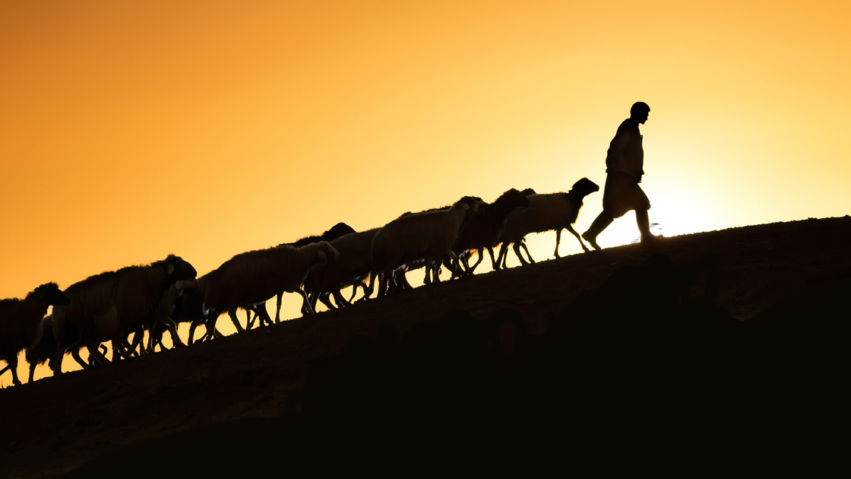
The Pastoral Epistles
Dr. Rick Griffith • Jordan Evangelical Theological Seminary • BibleStudyDownloads.org
Notes:
The German scholar, Paul Anton, was the first to name the last three epistles of Paul with the title "Pastoral Epistles" in 1726. Despite lacking the term "pastor" or "pastoral" in these three letters, "Pastoral Epistles" is a fitting title since they address major issues that pastors and other church leaders face in leading local congregations (Mark Bailey, "A Biblical Theology of Paul's Pastoral Epistles," in A Biblical Theology of the NT eds. Roy B. Zuck and Darrell L. Bock [Chicago: Moody, 1994], 333).

Slide 2
NT Overview (Paul's Letters)
38 124 39-41
“To the remotest part of the earth” (Acts 1:8)
Acts 9 13 14 15 16 18 21 27 28
Apr 48- Sep 49
1 Galatia
Apr 50- Sep 52
2 Aegean
Spr 53- May 57
3 Asia
Feb 60- Mar 62
1 Rome
Spr 62- Fall 67
4 Spain
Aut 67- Spr 68
2 Rome
Summer 35- 37
Damascus Antioch
May 57- Aug 59
Trials
Fall 49
The
Council
Spring 68
Expansion of Church
35 48 49 50 52 53 57 60 62 67 68 95
Matt
Luke
Acts
Mark
John
Gal
1 Thess
1 Cor
Eph
1 Tim
2 Tim
2 Thess
2 Cor
Col
Titus
Missionary
Romans
Philem
Pastoral
Gospels & Acts
Phil
Pauline Epistles
1234
Journeys
Prison
Rome
Imprisonments
Pauline
Notes:
Background: Paul left Timothy at the second-generation church of Ephesus which was facing serious heretics.
Timing: When did Paul write 1 Timothy?
Paul’s last letters before writing 1 Timothy were his Prison Epistles that ended with Philippians.
Now he turns his attention to writing individuals, including Philemon.
Historical Context: What was happening at this time?
Of Paul’s 13 NT letters, at least 10 of them are written to defeat heresy! No false teaching is noted in Romans, Ephesians, and Philemon (cf. NTS notes, 222j).
Paul left Timothy at the second-generation church of Ephesus which was facing serious heretics. He pens here what Timothy is to do—with important parallels to us today.

Slide 3
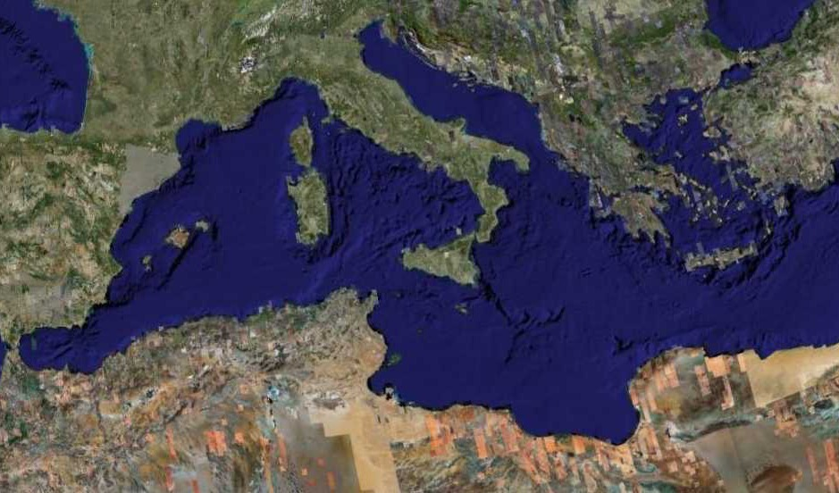
Fourth Missions Trip
1-2 Timothy & Titus After Acts
Spring 62 – Fall 67
Notes:
Paul had finished reaching the Eastern Roman Empire by the time he wrote Titus—and even had just returned from Spain.
__________
NS-15-Pastorals-3
NS-16-2 Timothy-87
—————
Freedom from Imprisonment Spring 62–Fall 67
Paul in Ephesus and Colosse (Timothy left at Ephesus) Spring–Summer 62
Peter travels to Rome 62
Paul in Macedonia late summer 62-winter 62/63
1 Timothy written from Macedonia to Timothy in Ephesus Fall 62
Paul in Asia Minor Spring 63-Spring 64
Paul in Spain (anticipated in Rom. 15:24) Spring 64-Spring 66
Christians persecuted by Nero; Peter martyred Summer 64
Paul in Crete (Titus left there; Tit 1:5) early Summer 66
Paul in Asia Minor Summer- Fall 66
Titus written from Asia Minor to Titus in Crete Summer 66
Paul in Nicopolis (Tit 3:12) Winter 66/67
Paul in Troas (2 Tim 4:13), Macedonia and Greece Spring– Fall 67
Second Roman Imprisonment Fall 67–Spring 68
Paul arrested and brought to Rome Fall 67
2 Timothy written from Rome to Timothy in Ephesus Fall 67
Paul beheaded Spring 68

Slide 4
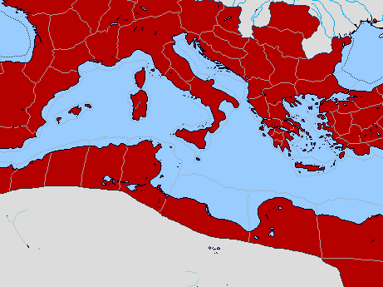
Bible Lands Blank Map
Paul’s Acts 28:30-31 Letters
142
Rome
Macedonia
Spain
Ephesians
Colossians
Ephesus
Philemon
Philippians
Crete
© https://www.deviantart.com/sharklord1/art/Alt-Roman-Empire-Provinces-701148110
Notes:
Paul wrote the Prison Epistles while under house arrest in Rome, recorded in the last two verses of Acts. These took two years (AD 60-62) and were likely written in this order above. We are unsure whether Ephesians and Colossians were written at the same time, but they have many similarities. But it is nearly certain that Tychicus and Onesimus brought back to Colosse both the letter to the entire church and also the personal letter to Philemon, who lived there and had the church meet in his house.
—————
Freedom from Imprisonment Spring 62–Fall 67
Paul in Ephesus and Colosse (Timothy left at Ephesus) Spring–Summer 62
Peter travels to Rome 62
_______________
NS-15-Pastorals-4
NS-15-1 Timothy-61

Slide 5

Date 1
Pastorals
Date
238
The chronology of Paul's latter years is obscure, yet one harmonization of the internal and external data yields this scenario:
1st Roman Imprisonment February 60–March 62
(Acts 28:30-31)
Paul writes Ephesians, Autumn 60–early Spring 62
Colossians, Philemon,
and Philippians
Martyrdom of James, Spring 62
the Lord's brother

Slide 6
Bible Lands Blank Map
Paul’s Post-Acts Journey
142
Rome
Macedonia
1 Timothy
Spain
Ephesus
Crete
© https://www.deviantart.com/sharklord1/art/Alt-Roman-Empire-Provinces-701148110
Notes:
Paul wrote 1 Timothy shortly after being there himself—likely only months later. We benefit from him recording his instructions to Timothy rather than simply telling him verbally.
—————
Freedom from Imprisonment Spring 62–Fall 67
Paul in Ephesus and Colosse (Timothy left at Ephesus) Spring–Summer 62
Peter travels to Rome 62
Paul in Macedonia late summer 62-winter 62/63
1 Timothy written from Macedonia to Timothy in Ephesus Fall 62
Paul in Asia Minor Spring 63-Spring 64
_______________
NS-15-Pastorals-6
NS-15-1 Timothy-6
NS-16-2 Timothy-48

Slide 7
Date 2
Pastorals
Date
238
Freedom from Imprisonment Spring 62–Autumn 67
Paul in Ephesus and Colosse Spring–Summer 62
(Timothy left at Ephesus)
Peter travels to Rome 62
Paul in Macedonia late summer 62-winter 62/63
1 Timothy written in Macedonia Autumn 62
to Timothy in Ephesus
Paul in Asia Minor Spring 63-Spring 64
Paul in Spain Spring 64-Spring 66
(anticipated in Rom. 15:24)
Christians persecuted by Nero Summer 64
and Peter martyred
1 Timothy written in Macedonia Autumn 62
to Timothy in Ephesus
Notes:
Paul wrote 1 Timothy shortly after being there himself—likely only months later. We benefit from him recording his instructions to Timothy rather than simply telling him verbally.

Slide 8
Bible Lands Blank Map
Paul’s Post-Acts Journey
142
Rome
Macedonia
2 Timothy
Nicopolis
Troas
Spain
Ephesus
Titus
Crete
© https://www.deviantart.com/sharklord1/art/Alt-Roman-Empire-Provinces-701148110
Notes:
Paul in Asia Minor Spring 63-Spring 64
Paul in Spain (anticipated in Rom. 15:24) Spring 64-Spring 66
Christians persecuted by Nero; Peter martyred Summer 64
Paul in Crete (Titus left there; Tit 1:5) early Summer 66
Paul in Asia Minor Summer- Fall 66
Titus written from Asia Minor to Titus in Crete Summer 66
Paul in Nicopolis (Tit 3:12) Winter 66/67
Paul in Troas (2 Tim 4:13), Macedonia and Greece Spring– Fall 67
Second Roman Imprisonment Fall 67–Spring 68
Paul arrested and brought to Rome Fall 67
2 Timothy written from Rome to Timothy in Ephesus Fall 67
Paul beheaded Spring 68
_______________
NS-15-Pastorals-8
NS-15-1 Timothy-8
NS-16-2 Timothy-50

Slide 9
Date 3
Pastorals
Date
238
Paul in Crete early Summer 66
(Titus left there; Tit. 1:5)
Paul in Asia Minor Summer-Autumn 66
Titus written from Asia Minor Summer 66
to Titus in Crete
Paul in Nicopolis (Tit. 3:12) Winter 66/67
Paul in Troas (2 Tim. 4:13), Spring–Autumn 67
Macedonia and Greece
Titus written from Asia Minor Summer 66
to Titus in Crete
2nd Roman Imprisonment Autumn 67–Spring 68
Paul arrested and brought to Rome Autumn 67
2 Timothy written from Rome Autumn 67
to Timothy in Ephesus
Paul beheaded Spring 68
2 Timothy written from Rome Autumn 67
to Timothy in Ephesus
Destruction of Jerusalem 2 September 70
Notes:
Titus is in green as Paul wrote it while he was free to GO around to share the gospel.
But 2 Timothy is purple to remind us that, while imprisoned again, he did this for royal purposes.
Paul spent at least 5 of his final 11 years in prison:
• AD 57-59 Caesarea for 2 years
• AD 60-62 Rome for 2 years
• AD 67-68 Rome for 1 year

Slide 10
Paul's Epistles in Mostly Scriptural Order
Foundational | Prophetic | Prison | Pastoral
Romans 1 Corinthians 2 Corinthians Galatians | 1 Thessalonians 2 Thessalonians | Ephesians Philippians Colossians Philemon | 1 Timothy 2 Timothy Titus
Christ & the Cross | Christ & the Second Coming | Christ & the Church | Christ & the Congregation
Soteriology | Eschatology | Christology | Ecclesiology
TEXT
Adapted from The Pastoral Epistles © John Stevenson 2010 • https://slideplayer.com/slide/6106093/
Notes:
This chart shows that Paul addressed theology to churches in this order: Soteriology, Eschatology, Christology, and Ecclesiology. This contrasts with how most follow-up today postpones eschatology too late.
This order follows the NT except Philemon is moved from the end of the Pauline Epistles after Titus to complete the Prison Epistles after Colossians.
But one could argue that Philemon is a pastoral letter, since it addresses a situation that required reconciliation.
On the other hand, Paul wrote Philemon in Rome during Paul's first imprisonment, so it is a Prison Epistle in this sense.
In the end, I do not know who has explained the reasoning for the order of Paul's letters.
Note that combining the four Foundational and two Prophetic Epistles gives us the six Missionary Epistles.
The emphasis on salvation in the Pastorals is seen in the Seven Liturgical Passages:
1Tim. 1:15 This is a trustworthy saying, and everyone should accept it: “Christ Jesus came into the world to save sinners”—and I am the worst of them all.
-----------
1Tim. 2:5-6 For, there is one God and one Mediator who can reconcile God and humanity—the man Christ Jesus. 6 He gave his life to purchase freedom for everyone. This is the message God gave to the world at just the right time.
--------
1Tim. 3:16 Without question, this is the great mystery of our faith:
Christ was revealed in a human body
and vindicated by the Spirit.
He was seen by angels
and announced to the nations.
He was believed in throughout the world
and taken to heaven in glory.
--------
2Tim. 1:9-10 For God saved us and called us to live a holy life. He did this, not because we deserved it, but because that was his plan from before the beginning of time—to show us his grace through Christ Jesus. 10 And now he has made all of this plain to us by the appearing of Christ Jesus, our Savior. He broke the power of death and illuminated the way to life and immortality through the Good News.
-------
2Tim. 2:8-13 Always remember that Jesus Christ, a descendant of King David, was raised from the dead. This is the Good News I preach. 9 And because I preach this Good News, I am suffering and have been chained like a criminal. But the word of God cannot be chained. 10 So I am willing to endure anything if it will bring salvation and eternal glory in Christ Jesus to those God has chosen.
2Tim. 2:11 This is a trustworthy saying:
If we die with him,
we will also live with him.
12 If we endure hardship,
we will reign with him.
If we deny him,
he will deny us.
13 If we are unfaithful,
he remains faithful,
for he cannot deny who he is.
-------
Titus 2:11-14 For the grace of God has been revealed, bringing salvation to all people. 12 And we are instructed to turn from godless living and sinful pleasures. We should live in this evil world with wisdom, righteousness, and devotion to God, 13 while we look forward with hope to that wonderful day when the glory of our great God and Savior, Jesus Christ, will be revealed. 14 He gave his life to free us from every kind of sin, to cleanse us, and to make us his very own people, totally committed to doing good deeds.
-------
Titus 3:3-7 Once we, too, were foolish and disobedient. We were misled and became slaves to many lusts and pleasures. Our lives were full of evil and envy, and we hated each other. 4 But—When God our Savior revealed his kindness and love, 5 he saved us, not because of the righteous things we had done, but because of his mercy. He washed away our sins, giving us a new birth and new life through the Holy Spirit. 6 He generously poured out the Spirit upon us through Jesus Christ our Savior. 7 Because of his grace he made us right in his sight and gave us confidence that we will inherit eternal life.
___________
Common-440
NS-00-NT Introduction-105
NS-06-Pauline Epistles-4
NS-06-Missionary Epistles-10
NS-10-Prison Epistles-3
NS-15-Pastoral Epistles-10

Slide 11
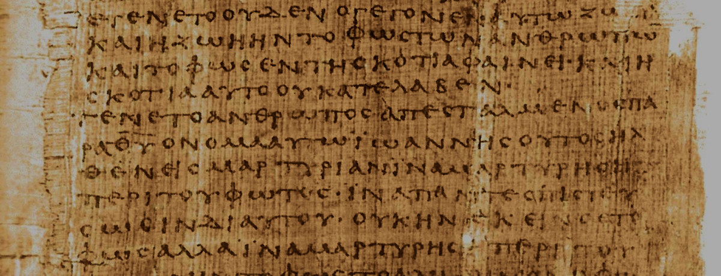
How do the Pastorals differ from Paul's earlier letters?
Pastorals:
Address leaders instead of churches
Focus on church issues from a leader's view
Use different words than the earlier letters
Show a more developed church leadership
Have a different style
Early Letters:
Pastorals:
Doctrine
Practice
Doctrine & Practice
Notes:
Regarding #3 above on the different words in the Pastorals:
Only they give the lists of elder and deacon qualifications (1 Tim 3; Tit 1).
They "describe the heretical threat as both present (1 Tim 1:3, 20; 2 Tim 2:20; Titus 1:10-16) and future (1 Tim 4:1; 2 Tim 3:1)" (Mark Bailey, "A Biblical Theology of Paul's Pastoral Epistles," in A Biblical Theology of the NT eds. Roy B. Zuck and Darrell L. Bock [Chicago: Moody, 1994], 335).
The term kekausteriasmenon for "seared" appears only in 1 Timothy 4:2 in the NT. Likewise, antilytron ("ransom") is used only in 1 Timothy 2:6 in the NT. But note that Colossians has many words used only there as it addresses a unique situation and thus required a unique vocabulary. Its 35 unique words include “visible” (1:16), “supremacy” (1:18), “fill up” (1:24), “philosophy” (2:8), and “deity” (2:9; Kubo, A Reader's Greek-English Lexicon of the New Testament, 193-97).
These epistles lack mention of Jesus as the Son of God or subordinate to the Father—but they still have an exalted view of "Christ Jesus" (used in the Pastorals in 25 of the 32 NT references). See Bailey, 343.

Slide 12

What concerns scholars on the authorship of the Pastorals?
Marcion's Canon (AD 170) had only 10 Pauline letters (but Marcion was a heretic).
They are absent from p⁴⁶—one of the earliest Pauline manuscripts (but we don't know why).
Paul's authorship of the Pastorals wasn't doubted until 1800s (when critics superseded the text).

Slide 13

Pastoral Epistles
1 Timothy
Titus
2 Timothy
1 Timothy = personal, urgent, doctrinal emphasis
Titus = less urgent, practical emphasis
2 Timothy = personal, urgent, focus on the Word
Notes:
These last three letters of Paul are called the Pastoral Epistles.
They show the most advanced theology of local church life and shepherding the flock—but this makes sense since Paul and the church had learned much in the previous 30 years since the church had begun.
Sadly, most NT scholars today do not believe that Paul wrote these letters and many date them in the second century. I guess they think that Paul was a slow learner!

Slide 14
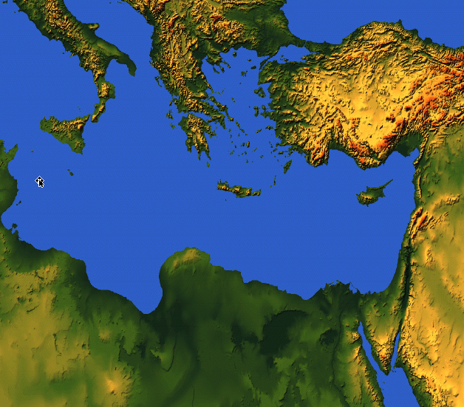
Places Mentioning Elders
elders = overseers = bishops = pastors
55
Jerusalem (AD 47):
NIV Acts 11:30 This they did, sending their gift to the elders by Barnabas and Saul.
Ephesus (AD 57):
NIV Acts 20:17 From Miletus, Paul sent to Ephesus for the elders of the church.
Galatia (AD 48):
NIV Acts 14:23 Paul and Barnabas appointed elders {or Barnabas ordained elders; or Barnabas had elders elected} for them in each church
Crete (AD 66):
NIV Titus 1:5 The reason I left you in Crete was that you might straighten out what was left unfinished and appoint {or ordain} elders in every town, as I directed you.
Philippi (AD 62):
NIV Philippians 1:1 Paul and Timothy, servants of Christ Jesus, To all the saints in Christ Jesus at Philippi, together with the overseers and deacons:
Pontus, Galatia, Cappadocia, Asia & Bithynia (AD 64)
NIV 1 Peter 5:1 To the elders among you, I appeal as a fellow elder… (cf. 1:1)
Notes:
The primary local church leaders were called "elders" since the beginning of the church in Jerusalem. This term applied to Jewish, Gentile, and mixed assemblies. Sadly, few churches today use this terminology to indicate mature male leaders throughout the NT (and the OT).
——————
NS-05-Acts1-2-slide 30
NS-15-Pastoral Epistles-14
NS-15-1 Timothy-205
NS-17-Titus-146

Slide 15

Three Types of Elders
236b
“The elders who direct the affairs of the church well are worthy of double honor, especially those whose work is preaching and teaching” (1 Tim. 5:17 NIV).
ALL ELDERS
Teach, protect, lead, serve, testify
Unpaid or $ if Needed
PAID MANAGERS
$
PREACHERS & TEACHERS
$$
Notes:
NS-05-Acts-
NS-15-Pastoral Epistles-15
NS-15-1 Timothy-204

Slide 16
Three Shepherd Tasks of Elders
236c1
Administration (Serve, care for & testify)
Teaching
1 Tim. 3:2; 5:17
1 Tim. 3:1, 4-5; 5:17
Pastor-Teacher
Episkopos =
Epi “over” +
skopos “look” =
“watch over”
Eph. 4:11
Pastoring (Protect & Lead)
1 Pet. 5:1-4
Acts 20:29, 35
1 Thess. 5:12
Notes:
NS-05-Acts20
NS-07-1Cor1-9-slide 157
NS-15-Pastoral Epistles-16
NS-15-1 Timothy-214

Slide 17
Church Order
(is maintained by giving priority to…)
Combat False Teachers | Uphold Church Life | Guard Life & Doctrine | Advise Church Groups | Resist Materialism
Chapter 1 | Chapters 2–3 | Chapter 4 | 5:1–6:10 | 6:11-21
Doctrine | Worship | Example | Respect | Priorities
Warning | People | Warning | People | Warning
Salutation Fight heresies God’s grace Charge | Prayer Gender Roles Leader Qualities Purpose of Epistle | Future heresy Watch life Watch doctrine | Respect everyone Widows Elders Slaves False teachers | Spiritual goals Wealthy must give Closing charge
Practical Exhortations Throughout
Sent from Macedonia to Ephesus
Autumn AD 62
1 Timothy
217

Slide 18
Summary Chart
Titus
241
Sound Conduct Against Opposition
Sound Conduct Against Opposition
Appoint Elders
Appoint Elders
Set Things in Order
Set Things in Order
Prevent False Doctrine
Prevent False Doctrine
Practice True Doctrine
Practice True Doctrine
Elders vs. False Teachers
Elders vs. False Teachers
Conduct
for Various Groups
Conduct
for Various Groups
Grace
Leads to Godliness
Grace
Leads to Godliness
Chapter 1
1
2:1-10
2:1-10
2:11–3:15
2:11–3:15
Organize
Organize
Teach
Teach
Grace
Grace
Truth Leads to Godliness
1:1-4
Truth leads to godliness
1:1-4
Elders
1:5-16
Elders
1:5-16
Older Men
2:1-2
Older Men
2:1-2
Older Women
2:4-5
Older Women
2:4-5
Younger Women
2:4-5
Younger Women
2:4-5
Younger
Men
2:6-8
Younger
Men
2:6-8
Slaves
2:9-10
Slaves
2:9-10
Educates
2:11-15
Educates
2:11-15
Empowers
3:1-2
Empowers
3:1-2
Motivates
3:3-8
Motivates
3:3-8
Protects
3:9-11
Protects
3:9-11
Concl.
3:12-15
Relates
3:12-15
Asia Minor to Crete
Asia Minor to Crete
Summer AD 66
Summer AD 66
Notes:
(So what’s the first way Paul shares that we can we be reputable in the midst of so much false teaching today? It starts with the leadership where Paul says to…)

Slide 19
2 TIMOTHY
Outline
237
Sound Doctrine Against Opposition
Persevere in Present Trials |  | Persevere in Future Trials
Chapters 1–2 |  | Chapters 3–4
Examples of Faithfulness 1 | Characteristics of Faithfulness 2 | Problem: Apostasy 3:1-9 | Solution: Preach the Word 3:10–4:5 | Paul’s Hope 4:6-22
Eunice Lois Paul Onesiphorus | Discipling Single-minded Obedient Hardworking Biblical Holy Gentle | Godlessness Hypocrisy | Preaching Persevering Rebuking Encouraging Evangelism | Martyrdom Betrayals Greetings Benediction
Rome to Ephesus
Autumn AD 67 (Second Roman Imprisonment)

Slide 20
Black

Slide 21


NT Survey link at BibleStudyDownloads.org
Get this presentation for free!
Notes:
NT Survey (ns)

