Slide 1

1 TIMOTHY
Church Order
Dr. Rick Griffith • Jordan Evangelical Theological Seminary • BibleStudyDownloads.org

Slide 2
Key Word
217
Order
1 Timothy

Slide 3
Theme
23
Church Order
Priorities
1 Timothy

Slide 4
Key Verse
217
“… I am writing you these instructions so that…you will know how people ought to conduct themselves in God's household, which is the church of the living God, the pillar and foundation of truth”
(3:14-15).
1 Timothy
Notes:
What does Paul call the church here?

Slide 5
Summary Statement
217
God’s priorities for local church order is to courageously guard one’s personal life, uphold true doctrine, and combat ascetic and speculative false teachers.
1 Timothy

Slide 6

Kingdom Statement
27d
“Now to the King eternal, immortal, invisible, the only God, be honor and glory for ever and ever. Amen” (1:17 NIV). This “King of kings” is Jesus himself as he is the “only Sovereign” (6:14-15).
1 Timothy
Notes:
Caesar Nero's kingdom was being threatened around this time.

Slide 7

Covenant
27d
The new covenant community is “God's household, which is the church of the living God, the pillar and foundation of truth” (3:14-15). It is local in administration (3:5, 15; 5:16).
1 Timothy
Notes:
The word "household" means that God lives there—in the church!

Slide 8

Redemption
27d
“Here is a trustworthy saying that deserves full acceptance: Christ Jesus came into the world to save sinners—of whom I am the worst” (1:15 NIV).
1 Timothy

Slide 9

Prophecy
(Lord, Deity)
27d
Jesus is often called Lord (1:2, 12, 14; 6:3)
and even the “Lord of lords” (6:14-15).
1 Timothy

Slide 10
Church Order
(is maintained by giving priority to…)
Combat False Teachers | Uphold Church Life | Guard Life & Doctrine | Advise Church Groups | Resist Materialism
Chapter 1 | Chapters 2–3 | Chapter 4 | 5:1–6:10 | 6:11-21
Doctrine | Worship | Example | Respect | Priorities
Warning | People | Warning | People | Warning
Salutation Fight heresies God’s grace Charge | Prayer Gender Roles Leader Qualities Purpose of Epistle | Future heresy Watch life Watch doctrine | Respect everyone Widows Elders Slaves False teachers | Spiritual goals Wealthy must give Closing charge
Practical Exhortations Throughout
Sent from Macedonia to Ephesus
Autumn AD 62
1 Timothy
217
Notes:
Should we show respect to false teachers as indicated here in 5:1–6:10?
Answer: Even heretics deserve our courtesy, but we must call out what they believe and how they act.

Slide 11
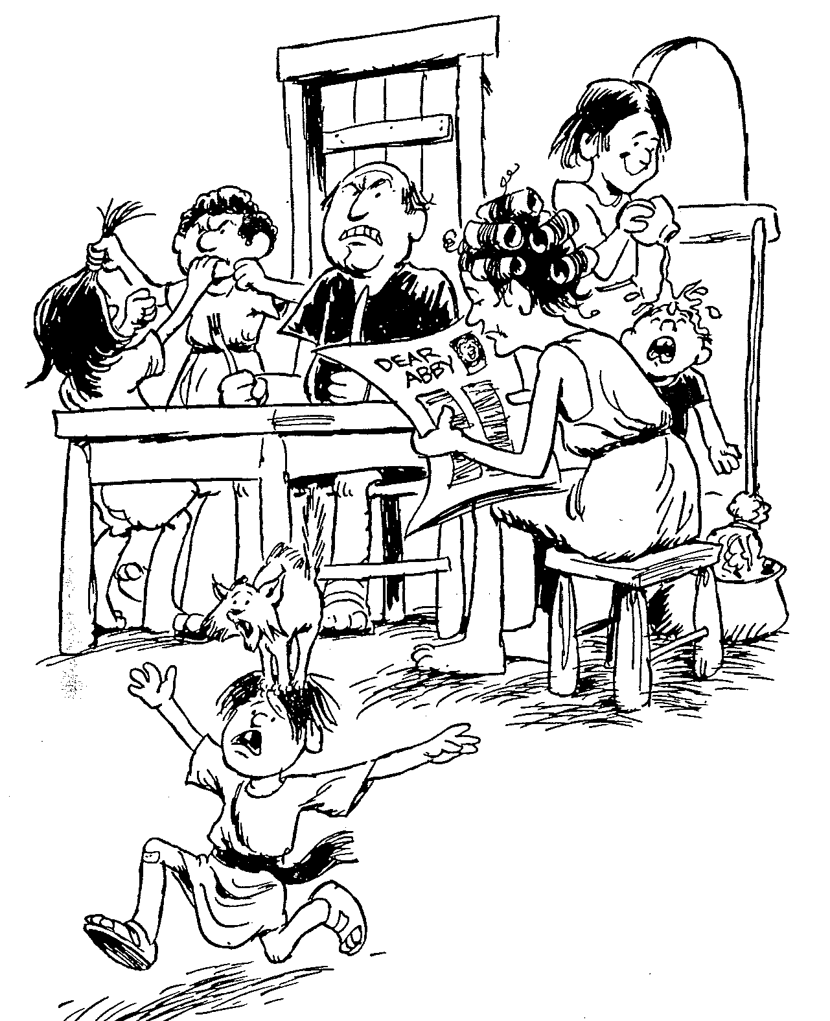
FIRST TIMOTHY
1
2
3
4
5
6
Advice concerning false teachings
Directions for godly women
Virtues of Christian elders
Instruction for godly living
Counsel concerning the widows
Effects of worldly living
Barry Huddleston, The Acrostic Bible
Notes:
This advice was practical but based on good theology.

Slide 12
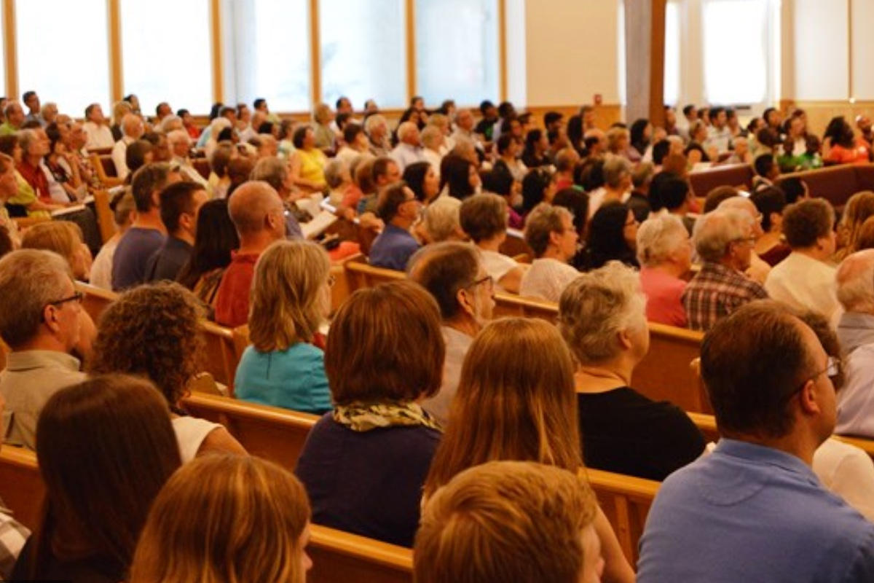
Be Orderly
1 Timothy
Dr. Rick Griffith • Crossroads International Church Singapore
BibleStudyDownloads.org

Slide 13

What are God’s priorities for church order?
PRIORITIES
1 Timothy

Slide 14

I. Teach the Law accurately and recall God's grace to you
(Chapter 1).
1 Timothy
Notes:
Avoid the extremes of too many rules and too few rules.

Slide 15
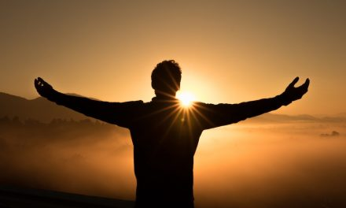
II. Require proper public worship led by godly leaders (Chs 2–3).
1 Timothy
Notes:
Our church services must main order by not just letting anyone lead.

Slide 16

III. Guard your personal life and doctrine closely (Chap. 4).
1 Timothy
Notes:
Your beliefs affect everything about you—privately and publicly. Watch them!

Slide 17

IV. Meet the needs of various church groups (5:1–6:10).
1 Timothy
Notes:
Our church’s different subgroups must not be vulnerable to enemy attack.

Slide 18

V. Don’t let the love of money ruin your spiritual life (6:11-21).
1 Timothy
Notes:
Resist materialism that replaces godliness with apostasy.

Slide 19

Main Idea
We can defeat heresy by obeying God’s priorities for church order.
1 Timothy

Slide 20
Black

Slide 21
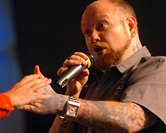
How Much is That Preacher in the Window?
Notes:
How Much Is That Preacher in the Window?
By Jean Shaw
Editor’s note: A recent editorial by editor-in-chief Bob Dasal, which asked whether churches should hire or call their ministerial staff, generated a good deal of response. Obviously, the subject is of great interest to preachers! Therefore, we thought you would enjoy this tongue-in-cheek treatment of the question.
This is the introductory slide for the class skit available at http://www.pulpithelps.com/www/docs/1095-7174. The skit is a takeoff on the 1950s “How Much is That Doggie in the Window?” song by Patti Page at http://www.youtube.com/watch?v=2AkLE4X-bbU
The text is below for each slide.
________________
Good morning, madam. May I help you?
Yes, please, I’d like to buy a minister.
Did you have a particular model in mind?
I’ve got a description from the Candidate Committee right here. We want a man about 30, well educated, with some experience. Good preacher and teacher. Balanced personality. Serious, but with a sense of humor. Efficient, but not rigid. Good health. Able to identify with all age groups. And, if possible, sings tenor.
Sings tenor?
We’re short of tenors in the choir.
I see. Well, that’s quite a list. How much money did you want to spend?
The committee says $15,000-$15,500 tops.
Hmm. Well, perhaps we’d better start in the bargain basement.

Slide 22
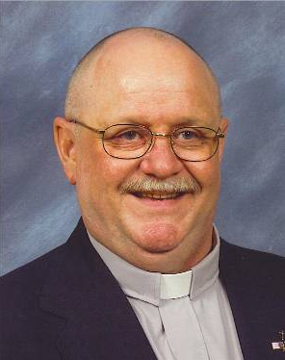
Princeton 467
Notes:
Tell me, how much is that model in the window?
You mean the one in the Pendleton plaid suit and the grey suede dune boots?
Yes, that one. He’s a real dream.
That’s our Princeton #467. Has a Ph.D. and AKC papers.
AKC?
American Koinonia Council. He sells for $36,000 plus house.
Wow! That’s too rich for our blood…
But he’s …an exceptional buy… He’s a little older than 30, but has excellent experience. Aggressive. Good heart. Has a backing of sermons, two of which have been printed in Christianity Today.
He’s not too bad. Can you do something about his bald head? Mrs. Fulton especially insists that our minister have some hair.
Madam, all our ministers come in a variety of hair styles.
I’ll keep him in mind.

Slide 23
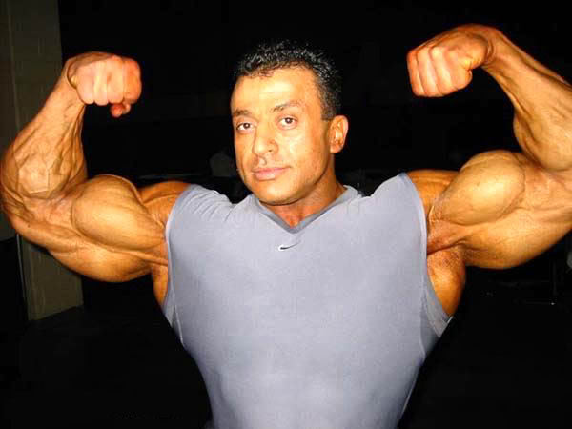
Olympia 222
Notes:
Now let me show you Olympia #222. Four years of varsity sports at Southern Cal. Plays football, basketball, volleyball, and ping-pong. Comes complete with sports equipment.
What a physique! He must weigh 200 pounds!
Yes, indeed. You get a lot for your money with this one. And think what he can do for your young people.
Great! But how is he at preaching?
I must admit he’s not St. Peter. But you can’t expect good sermons and a church-wide athletic program too!
I suppose not. Still…

Slide 24
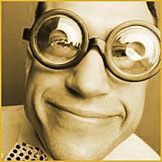
IBM 400
Notes:
Let me show you our IBM 400. Now here’s a preacher. All his sermons are superb—well-researched, copious anecdotes, and they always have three points. And—he comes with a full set of Calvin’s Commentaries at no extra charge! You get the whole package for $18,300.
He’s wearing awfully thick glasses.
For $220 more we put in contact lenses.
I don’t know. He might study too much. We don’t want a man who’s in his office all the time.
Of course… [But he] comes from a management background. Trained in business operations. Adept with committees. Gets his work done by 11:30 every morning.
His tag says he’s an IBM 486sx.
Madam, you have a discerning eye. Innovative Biblical Methods. This man will positively revitalize your church.
I’m not sure our church wants to be revitalized. Haven’t you got something less revolutionary?

Slide 25
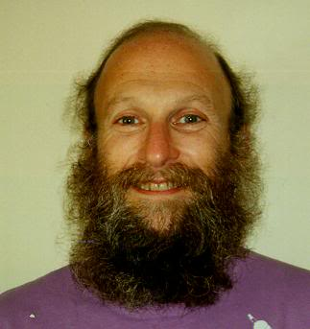
Empathy 41C
Notes:
Well, would you like someone of the social worker type? We have this Ghetto #130.
The man with the beard? Good gracious, no. Mrs. Fulton would never go for that.
How about our Empathy #41C? His forte is counseling. Very sympathetic. Patient. Good with people who have problems.
Everyone in our church has problems. But he might not get out and visit new people. We really need a man who does a lot of visitation. You see, all our people are very busy and…
Yes, yes. I understand. You want a minister who can do everything well.
That’s it! Haven’t you got somebody like that?

Slide 26
Black
Notes:
I’m thinking. In our back room we have a minister who was traded in last week. Excellent man, but he broke down after three years. If you don’t mind a used model, we can sell him at a reduced price.
Well, we had hoped for someone brand-new. We just redecorated the sanctuary, and we wanted a new minister to go with it.
Of course. But with a little exterior work, and a fresh suit, this man will look like he just came out of the box. No one will ever know. Let me bring him out and you can look him over.
All right. Honestly, this minister shopping is exhausting. It’s so hard to get your money’s worth. Tell me, do you accept coupons, and do you double them? What about rebates?
Uh, no. But if there’s any dissatisfaction after six months, we send a new congregation for the balance of the year. That usually takes care of most problems.
©Jean Shaw. From the book, Please Don’t Stand up in My Canoe, Zondervan, 1976, Via Contact.
Reprinted by permission at http://www.pulpithelps.com/www/docs/1095-7174

Slide 27
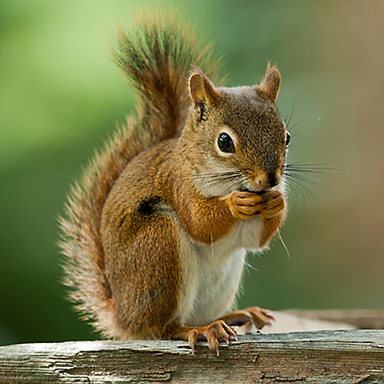
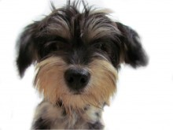
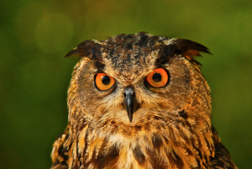
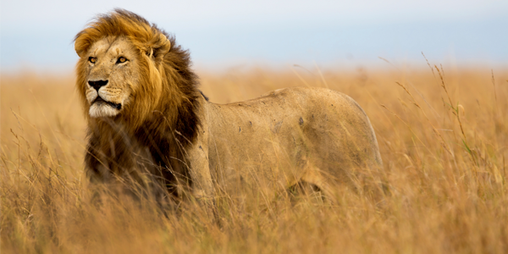
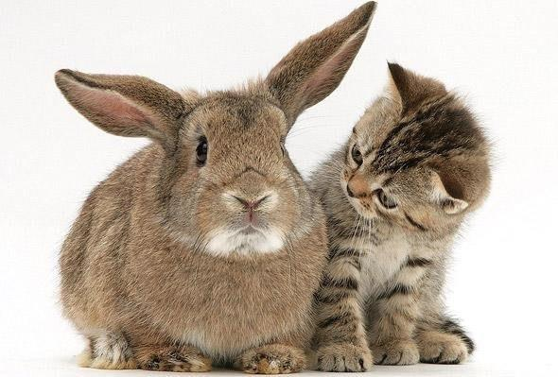
The world has many types of animals
Notes:
Biblically speaking, what animal are you?

Slide 28

Psalm 23
¹The LORD is my shepherd, I shall not be in want. ²He makes me lie down in green pastures, he leads me beside quiet waters, ³he restores my soul. He guides me in paths of righteousness for his name's sake. ⁴Even though I walk through the valley of the shadow of death, I will fear no evil, for you are with me; your rod and your staff, they comfort me. ⁵You prepare a table before me in the presence of my enemies. You anoint my head with oil; my cup overflows. ⁶Surely goodness and love will follow me all the days of my life, and I will dwell in the house of the LORD forever.
Notes:
I'll give you a hint. You are in Psalm 23, the most loved poem ever written. Yes…
OS-19-Psalms-68, 71, 76, 132, 201

Slide 29
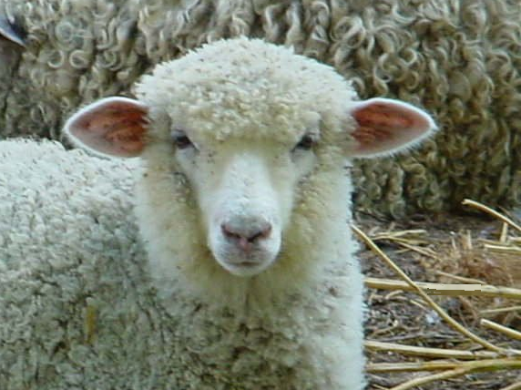
You're a sheep

Slide 30
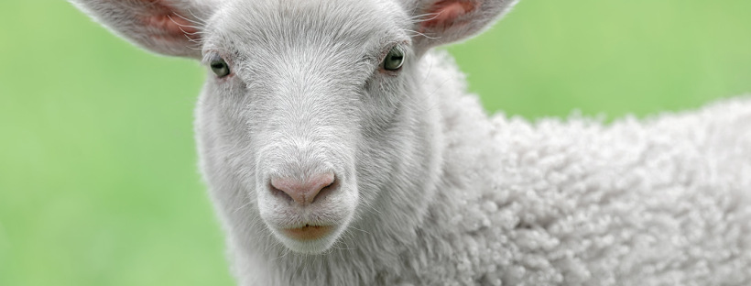
What does it mean to be a "sheep"?
Notes:
Does being a sheep mean you are cute and easy to get along with? Not quite.

Slide 31
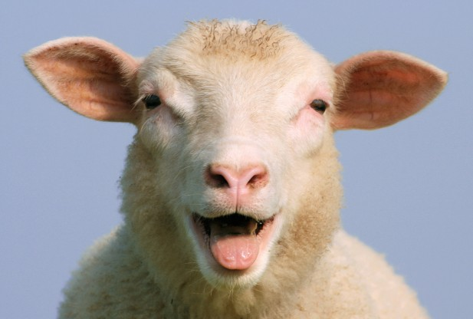
"Dumb, Directionless, Defenseless"
Tim Challies, http://www.challies.com/christian-living/dumb-directionless-defenseless posted 26 Aug 2013, accessed 7 Aug 2016
Notes:
One bogger puts it this way: "Why sheep? Why not cheetahs or wolves or tigers or another animal with a bit of flair, a bit of class? But the Bible tells us often that we are sheep. We are sheep and God is a shepherd. That sheep/shepherd word picture is at the heart of the best-loved Psalm—Psalm 23. I spent some time with that psalm lately and tried to gain a better appreciation of why God saw fit to tell us we are sheep.
I will admit I am not the world's foremost expert on sheep. I grew up in the city and even now live in an area of town that explicitly forbids owning livestock. In place of first-hand knowledge, I spent some time reading about sheep. It was funny. And kind of humbling.
Do a little bit of reading about sheep and you'll soon see they are not survivors. They are not strong and independent creatures, not proud hunters or fierce predators. They're actually kind of pathetic, entirely dependent upon a shepherd for at least three reasons. Two of these reasons are related to the brain of a sheep and the other is related to its body."
Dumb, Directionless, Defenseless
Tim Challies, http://www.challies.com/christian-living/dumb-directionless-defenseless posted 26 Aug 2013, accessed 7 Aug 2016

Slide 32
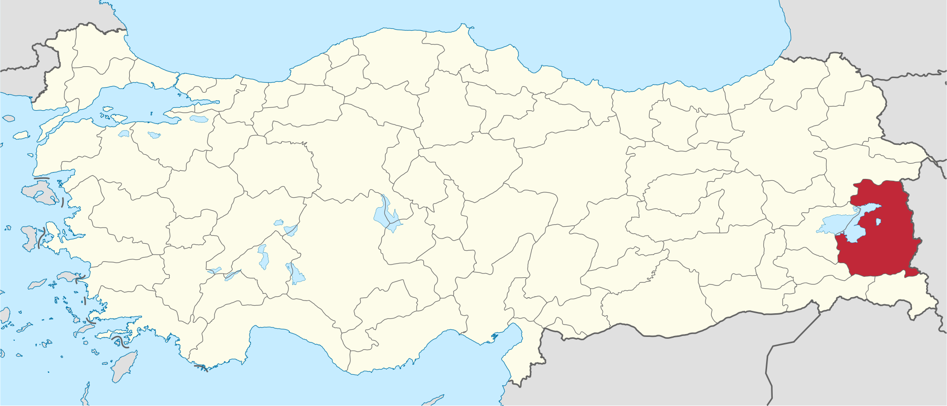
News Story from Van Province, Turkey
Tim Challies, http://www.challies.com/christian-living/dumb-directionless-defenseless posted 26 Aug 2013, accessed 7 Aug 2016
Notes:
"This is a real news story that aptly tells us the first reason sheep need a shepherd: because sheep are dumb.
'Hundreds of sheep followed their leader off a cliff in eastern Turkey, plunging to their deaths this week while shepherds looked on in dismay.'"
Dumb, Directionless, Defenseless
Tim Challies, http://www.challies.com/christian-living/dumb-directionless-defenseless posted 26 Aug 2013, accessed 7 Aug 2016

Slide 33
"Dumb, Directionless, Defenseless"
"Hundreds of sheep followed their leader off a cliff in eastern Turkey, plunging to their deaths this week while shepherds looked on in dismay. Four hundred sheep fell 15 metres to their deaths in a ravine in Van province near Iran but broke the fall of another 1,100 animals who survived. Shepherds from a nearby village neglected the flock while eating breakfast, leaving the sheep to roam free. The loss to local farmers was estimated at $74,000."
—Actual news story
Tim Challies, http://www.challies.com/christian-living/dumb-directionless-defenseless posted 26 Aug 2013, accessed 7 Aug 2016
Notes:
Dumb, Directionless, Defenseless
Tim Challies, http://www.challies.com/christian-living/dumb-directionless-defenseless posted 26 Aug 2013, accessed 7 Aug 2016

Slide 34
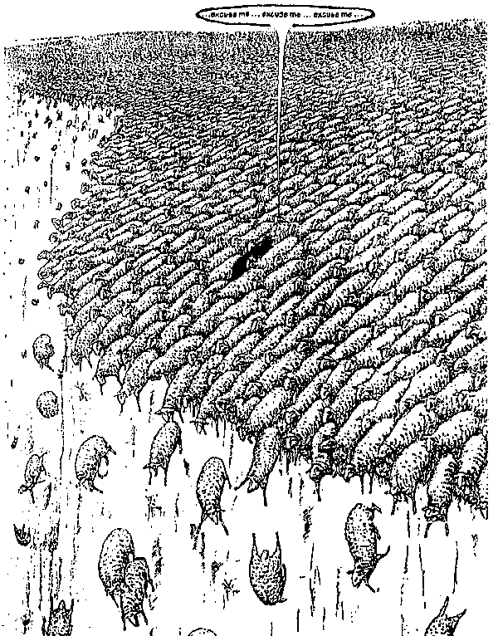
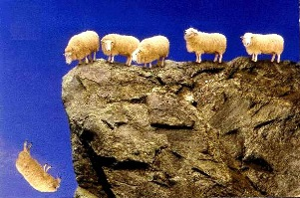
"Dumb, Directionless, Defenseless"
Notes:
"One sheep wandered off a cliff and 1,499 others just followed along. Can you picture it? 1,500 sheep, each walking off a cliff, one after the other."
Dumb, Directionless, Defenseless
Tim Challies, http://www.challies.com/christian-living/dumb-directionless-defenseless posted 26 Aug 2013, accessed 7 Aug 2016
See also https://factualfacts.com/animals/in-2005-in-turkey-a-suicide-sheep-jumped-off-a-cliff-and-1500-sheep-followed-the-first-one/

Slide 35
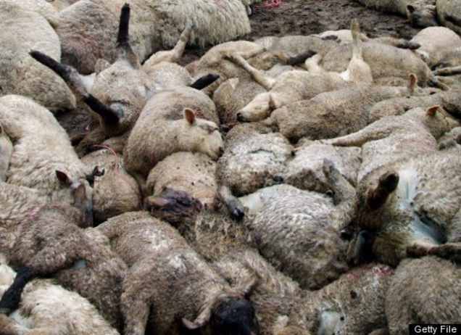
"Dumb, Directionless, Defenseless"
Tim Challies, http://www.challies.com/christian-living/dumb-directionless-defenseless posted 26 Aug 2013, accessed 7 Aug 2016
Notes:
"Soon they were piled so deep that the ones at the bottom were crushed to death and the ones on top were lying on a big downy-soft pillow. It is completely absurd and tells us one important fact about sheep and the first reason sheep absolutely need a shepherd: they are not the smartest animals in the world. In fact, they may well be just about the dumbest animals in the world."
Dumb, Directionless, Defenseless
Tim Challies, http://www.challies.com/christian-living/dumb-directionless-defenseless posted 26 Aug 2013, accessed 7 Aug 2016
See also https://factualfacts.com/animals/in-2005-in-turkey-a-suicide-sheep-jumped-off-a-cliff-and-1500-sheep-followed-the-first-one/

Slide 36
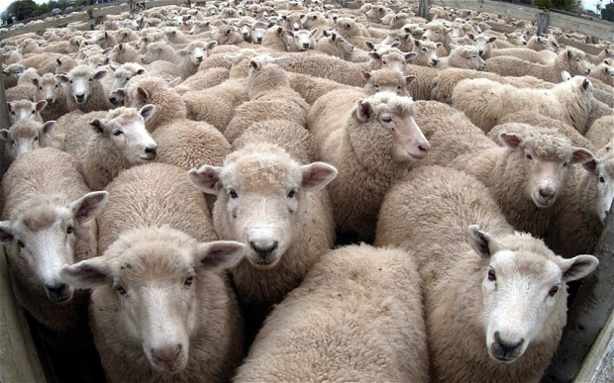
"Dumb, Directionless, Defenseless"
Tim Challies, http://www.challies.com/christian-living/dumb-directionless-defenseless posted 26 Aug 2013, accessed 7 Aug 2016
Notes:
"And here's a second reason sheep need a shepherd: they are directionless. Sheep are prone to wander. Even if you put them in an absolutely perfect environment with everything they need (things like green pastures and still waters), sooner or later they will just wander off. If a shepherd doesn't manage them, if he doesn't micromanage them and keep them under constant surveillance, they'll wander off and be lost.
Left to themselves, sheep will not and cannot last very long."
Dumb, Directionless, Defenseless
Tim Challies, http://www.challies.com/christian-living/dumb-directionless-defenseless posted 26 Aug 2013, accessed 7 Aug 2016

Slide 37
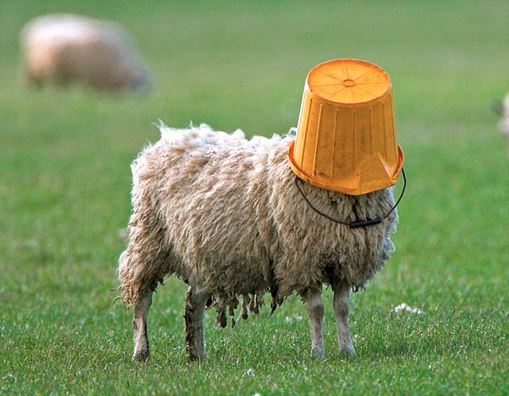
"Dumb, Directionless, Defenseless"
Tim Challies, http://www.challies.com/christian-living/dumb-directionless-defenseless posted 26 Aug 2013, accessed 7 Aug 2016
Notes:
"Sheep are dumb and directionless. They are also defenseless. Left to themselves, sheep will not and cannot last very long. Just about any other domesticated animal can be returned to the wild and will stand a fighting chance of survival. But not sheep. Put a sheep in the wild and you've just given nature a snack.
Think about it: there are different ways animals react when they perceive some kind of danger. Here are three common ones: fight, flight, and posture.
Let's thinking about fight. A sheep gets frightened or sees that he is in danger. Maybe he sees a bear rambling toward him. What is he going to do? He doesn't have claws, he doesn't have fangs, he doesn't have venom, he doesn't have spines or quills or large talons. He's got nothing to protect himself. Fighting is definitely out. But that's okay—there are lots of other animals that don't fight it out."
Dumb, Directionless, Defenseless
Tim Challies, http://www.challies.com/christian-living/dumb-directionless-defenseless posted 26 Aug 2013, accessed 7 Aug 2016

Slide 38
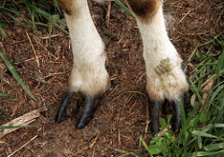
"Dumb, Directionless, Defenseless"
Tim Challies, http://www.challies.com/christian-living/dumb-directionless-defenseless posted 26 Aug 2013, accessed 7 Aug 2016
Notes:
"How about flight, just turning tail and running away? That's a good defense mechanism. Unfortunately sheep aren't fast; they certainly aren't agile, especially when their wool is long, and even more so when their wool is long and wet. Last I checked they don't have wings. A sheep is not going to outrun or outfly a bear. The sheep will not fight and it cannot take flight. So far it is looking pretty good for the bear."
Dumb, Directionless, Defenseless
Tim Challies, http://www.challies.com/christian-living/dumb-directionless-defenseless posted 26 Aug 2013, accessed 7 Aug 2016

Slide 39
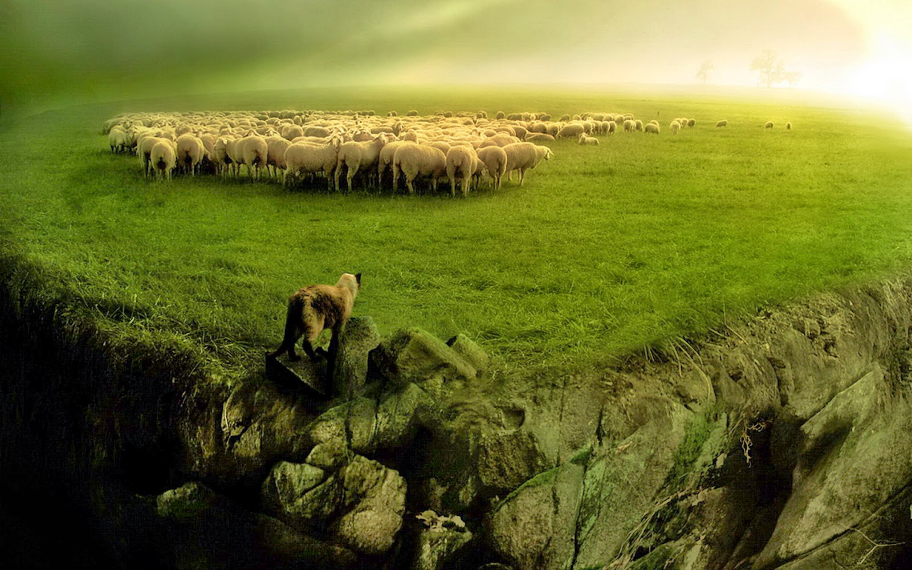
"Dumb, Directionless, Defenseless"
Tim Challies, http://www.challies.com/christian-living/dumb-directionless-defenseless posted 26 Aug 2013, accessed 7 Aug 2016
Notes:
"How about posture? A dog will bark and growl and show his teeth to warn you away. A lion will roar. A rattlesnake will shake his rattle. A cat will arch his back and hiss. The best a sheep can do is baaa. I don't think that bear is going be too intimidated. It is for good reason that no one relies on a guard sheep to keep their property secure.
Sheep can't fight, they can't run away, and they can't scare away. So what does a sheep do when danger comes? It flocks. When a bear approaches, the sheep will gather with others in a pack and run in circles in complete panic, just hoping that the bear will choose someone else. Without a shepherd to protect them, they'll be picked off and eaten one by one."
Dumb, Directionless, Defenseless
Tim Challies, http://www.challies.com/christian-living/dumb-directionless-defenseless posted 26 Aug 2013, accessed 7 Aug 2016

Slide 40
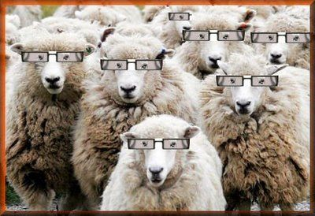
"Dumb, Directionless, Defenseless"
Tim Challies, http://www.challies.com/christian-living/dumb-directionless-defenseless posted 26 Aug 2013, accessed 7 Aug 2016
Notes:
People sheep need spiritual glasses to see their true Shepherd.
"Sheep are dumb and directionless and defenseless. So I guess when God says that we are sheep who need a shepherd, he doesn't mean it as a compliment to us. It is just a very realistic assessment of who we are and what we need. We are sheep who are completely dependent upon a shepherd.
To say that God is our shepherd and we are sheep, is to humble ourselves, admitting what is true about us, and to elevate God, declaring what is true of him. When you say, 'The Lord is my shepherd,' you are saying something that ought to move your heart in praise and gratitude. To declare that God if your shepherd is to praise and glorify him because God the shepherd stoops down to care for poor, lost, not-so-smart sheep like you and me."
Dumb, Directionless, Defenseless
Tim Challies, http://www.challies.com/christian-living/dumb-directionless-defenseless posted 26 Aug 2013, accessed 7 Aug 2016

Slide 41
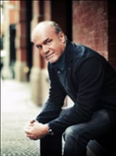
"How Are We Like Sheep?"
"That Jesus compares us to sheep is not a compliment, by the way. Sheep are among the dumbest of all creatures. Most animals, in many cases, will survive if released into the wild. They will learn to fend for themselves and make it. But a sheep released into the wild cannot survive. Sheep have no survival skills whatsoever. They are totally dependent upon the shepherd—just like we are. The sheep come to know that when the shepherd speaks they should follow because his plan for them is better than their plan for themselves."
Greg Laurie, http://www.jesus.org/following-jesus/discipleship/how-are-we-like-sheep.html, accessed 7 Aug 2016

Slide 42
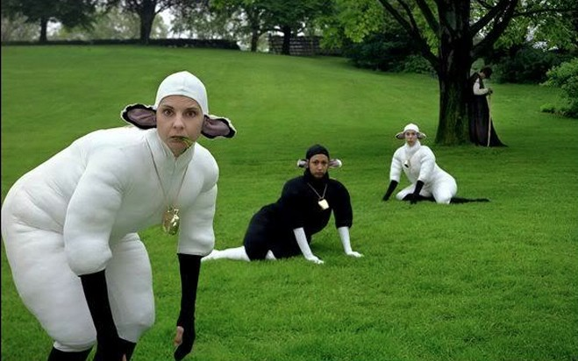
So what do we need?

Slide 43
NT Overview (Pauline Books + Key Words)
38
124
39-41
“To the remotest part of the earth” (Acts 1:8)
Acts 9 13 14 15 16 18 21 27 28
Apr 48-
Sep 49
1
Galatia
Apr 50-
Sep 52
2
Aegean
Spr 53-
May 57
3
Asia
Feb 60-
Mar 62
1
Rome
Spr 62-
Fall 67
4
Spain
Aut 67-
Spr 68
2
Rome
Summer 35-
37
Damascus
Antioch
May 57-
Aug 59
Trials
Fall 49
The
Council
Spring 68
Expansion of Church
35 48 49 50 52 53 57 60 62 67 68 95
Matt
Kingdom
Luke
Sov 1
Acts
Sov 2
Mark
Disciple
John
Believe
Gal
Justify
1 Thess
Rapture
1 Cor
Eph
Unity
1 Tim
Sanctify
Order
2 Thess
Tribulation
2 Cor
Col
Apostle
Deity
Romans
Philem
Righteous
Forgive
Gospels & Acts
Phil
Attitude
Pauline Epistles
1234
Journeys
Rome
Imprisonments
Pauline Books + Key Words

Slide 44
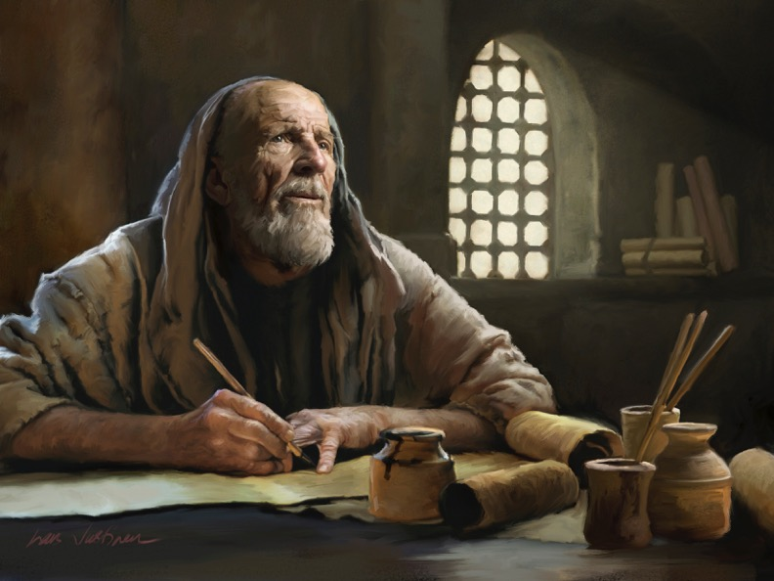
The Pastoral Epistles

Slide 45

Pastoral Epistles
1 Timothy
Titus
2 Timothy
1 Timothy = personal, urgent, doctrinal emphasis
Titus = less urgent, practical emphasis
2 Timothy = personal, urgent, focus on the Word
Notes:
These last three letters of Paul are called the Pastoral Epistles.
They show the most advanced theology of local church life and shepherding the flock—but this makes sense since Paul and the church had learned much in the previous 30 years since the church had begun.
Sadly, most NT scholars today do not believe that Paul wrote these letters and many date them in the second century. I guess they think that Paul was a slow learner!

Slide 46
ONE SUNDAY MORNING in Ephesus…

Slide 47
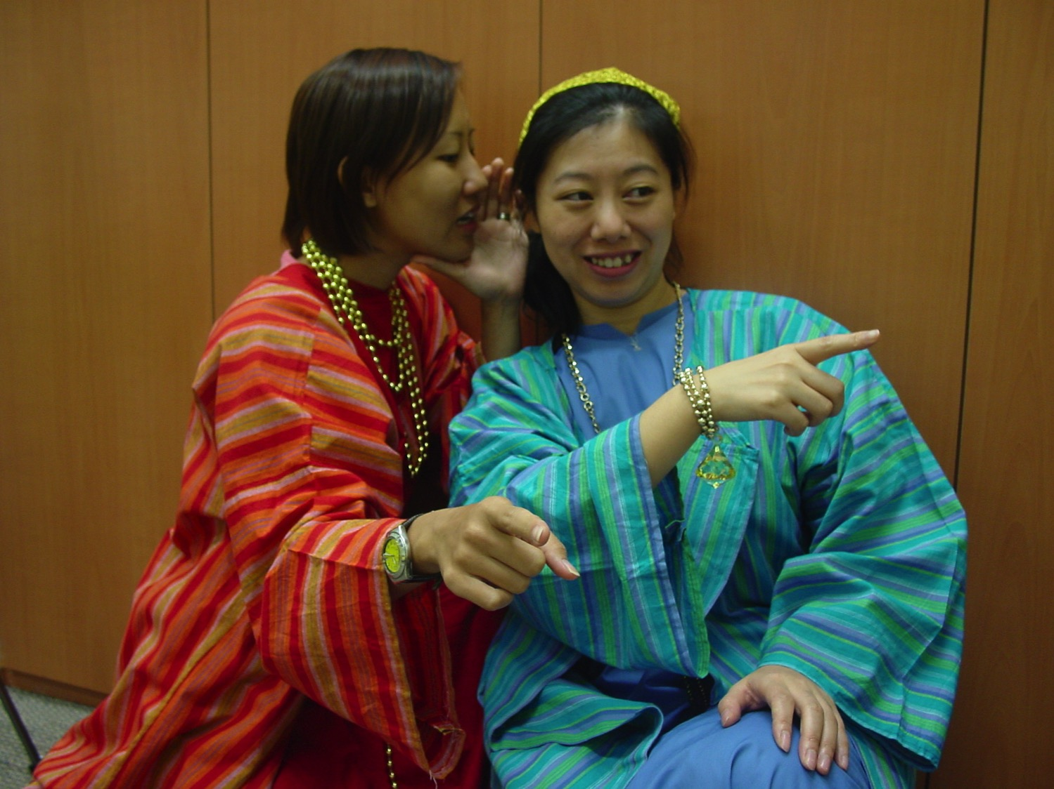
Rich ladies
Hey, did you hear about…
You mean THAT guy…?

Slide 48
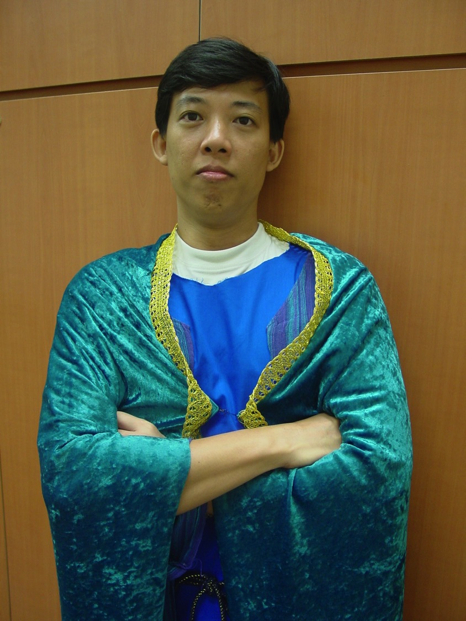
The wealthy
I'm so blessed. I'm rich AND good-looking.

Slide 49
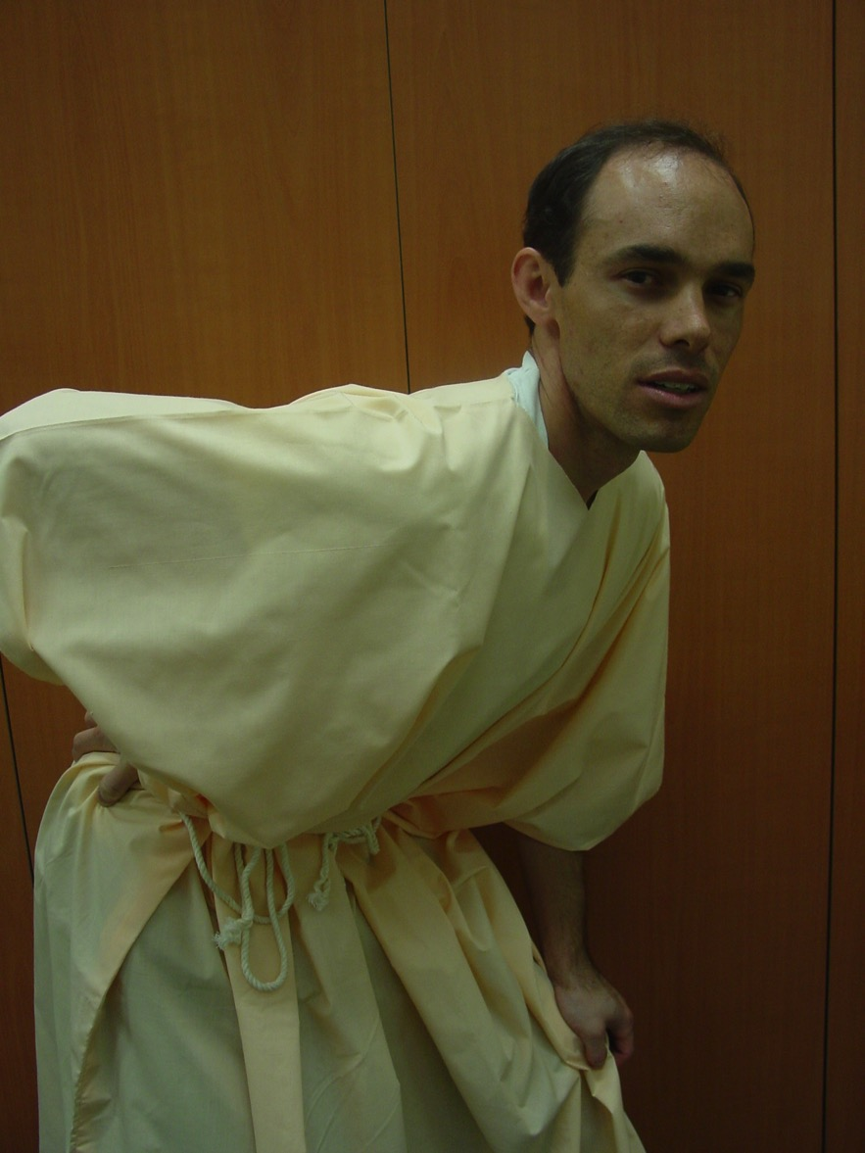
The Poor
My poor aching back… Wait a minute… why are my thoughts coming out of my ear?

Slide 50
1 TIMOTHY
What should a minister's pay be? How to benchmark this?

Slide 51
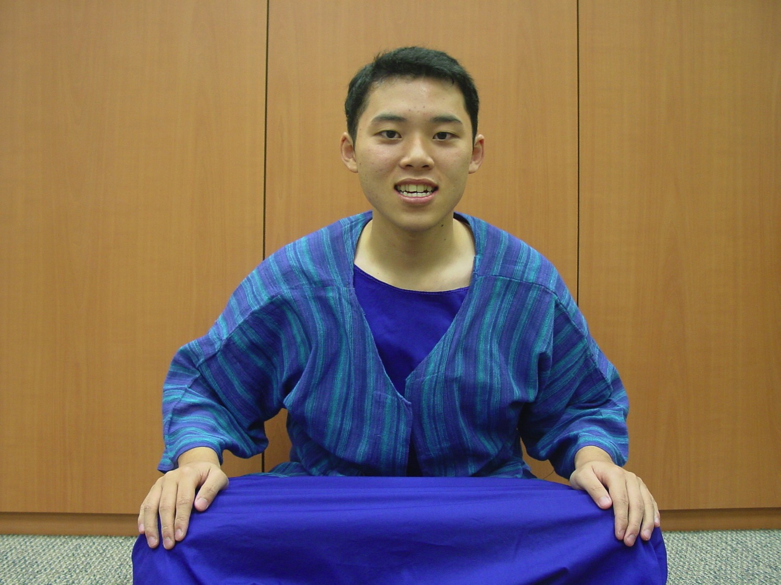
Young Timothy
I'm so young… what am I going to do with them?

Slide 52
Now Unto the King
(1 Tim 1:17)
Now unto the King eternal
Unto the King immortal
Unto the King invisible
The only wise God, the only wise God
(repeat)
Chorus: Oh, unto the King be glory and honor
Unto the King forever
Unto the King be glory and honor
Forever and ever
Amen. Amen.

Slide 53

Background

Slide 54
What Problems did Timothy face?
219
Weak stomach
People looked down on him
False teachers who are trying to become rich from their teachings
Women trying to teach in the church
Troublesome widows
Arrogant rich people
Accusations against leaders

Slide 55

I Timothy
Background

Slide 56
AUTHORSHIP
218
Generally accepted to be Paul himself
External evidence: Early support from the Church Fathers is strong
Internal evidence:
  The letter claims Pauline authorship (1:1)
  Contains typical Pauline characteristics: sense of divine call, use of many personal names, and Pauline doctrinal emphases

Slide 57
DATE OF WRITING
219
It must be sometime after Paul's release from his 1st Roman imprisonment (AD 62) and shortly before his re-arrest and final imprisonment.
Paul probably died in AD 68,
so 1 Timothy is probably
no earlier than AD 62.

Slide 58
RECIPIENT
219
Timothy (1:2) means “honoring God” or “honored by God”
  A resident of Lystra, a Lyconian city in the Roman province of Galatia (Acts 16:1-3).
  Father: Greek ; Mother: Jewess by name of Eunice (2 Tim. 1:5)
  One of Paul's personal converts when Paul was at Lystra on his 1st missionary journey (Acts 14:8-20), but joined Paul's 2nd journey (Acts 16:1-3)
Paul addressed Timothy as his:
  “beloved and faithful child in the Lord”
    (1 Cor. 4:17; 1 Tim. 1:2; 2 Tim. 1:2)
  “fellow worker” (Rom. 16:21; 1 Thess. 3:2)

Slide 59
Occasion and Place of Writing
219
Paul warned the Ephesian elders at Miletus that the church would one day be plagued by false teachings from men within their midst (Acts 20:29-30).
After Paul's release from his 1st Roman imprisonment, he and Timothy made their way to Macedonia.
They stopped over in Ephesus on the way. There Paul found false teachings were in the process of undermining the church.
  Paul excommunicated the 2 ring-leaders, Hymenaeus and Alexander (1:19-20).
  Left Timothy to represent him at Ephesus as his “apostolic delegate” to stop the influence of the false teachers (1:3).
At Macedonia he wrote to authorize Timothy for the task.

Slide 60


From where to where?
219
Macedonia
Ephesus

Slide 61
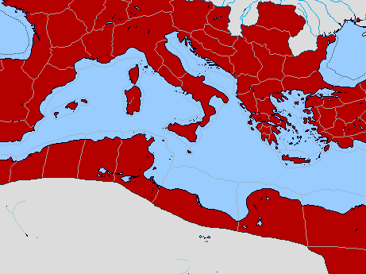
Bible Lands Blank Map
Paul’s Acts 28:30-31 Letters
142
Rome
Macedonia
Spain
Ephesians
Colossians
Ephesus
Philemon
Philippians
Crete
© https://www.deviantart.com/sharklord1/art/Alt-Roman-Empire-Provinces-701148110
Notes:
Paul wrote the Prison Epistles while under house arrest in Rome recorded in the last two verses of Acts. This took two years (AD 60-62) are were likely written in this order above. We are unsure whether Ephesians and Colossians were written at the same time, but they have many similarities. But it is nearly certain that Tychicus and Onesimus brought back to Colosse both the letter to the entire church and also so the personal letter to Philemon, who lived there and had the church meet in his house.
—————
Freedom from Imprisonment Spring 62–Fall 67
Paul in Ephesus and Colosse (Timothy left at Ephesus) Spring–Summer 62
Peter travels to Rome 62

Slide 62

Date 1
Pastorals
Date
238
The chronology of Paul's latter years is obscure, yet one harmonization of the internal and external data yields this scenario:
1st Roman Imprisonment February 60–March 62
(Acts 28:30-31)
Paul writes Ephesians, Autumn 60–early Spring 62
Colossians, Philemon,
and Philippians
Martyrdom of James, Spring 62
the Lord's brother

Slide 63
Bible Lands Blank Map
Paul’s Post-Acts Journey
142
Rome
Macedonia
1 Timothy
Spain
Ephesus
Crete
© https://www.deviantart.com/sharklord1/art/Alt-Roman-Empire-Provinces-701148110
Notes:
Paul wrote 1 Timothy shortly after being there himself—likely only months later. We benefit from him recording his instructions to Timothy rather than simply telling him verbally.
—————
Freedom from Imprisonment Spring 62–Fall 67
Paul in Ephesus and Colosse (Timothy left at Ephesus) Spring–Summer 62
Peter travels to Rome 62
Paul in Macedonia late summer 62-winter 62/63
1 Timothy written from Macedonia to Timothy in Ephesus Fall 62
Paul in Asia Minor Spring 63-Spring 64

Slide 64
Date 2
Pastorals
Date
238
Freedom from Imprisonment Spring 62–Autumn 67
Paul in Ephesus and Colosse Spring–Summer 62
(Timothy left at Ephesus)
Peter travels to Rome 62
Paul in Macedonia late summer 62-winter 62/63
1 Timothy written in Macedonia Autumn 62
to Timothy in Ephesus
Paul in Asia Minor Spring 63-Spring 64
Paul in Spain Spring 64-Spring 66
(anticipated in Rom. 15:24)
Christians persecuted by Nero Summer 64
and Peter martyred
1 Timothy written in Macedonia Autumn 62
to Timothy in Ephesus
Notes:
Paul wrote 1 Timothy shortly after being there himself—likely only months later. We benefit from him recording his instructions to Timothy rather than simply telling him verbally.

Slide 65
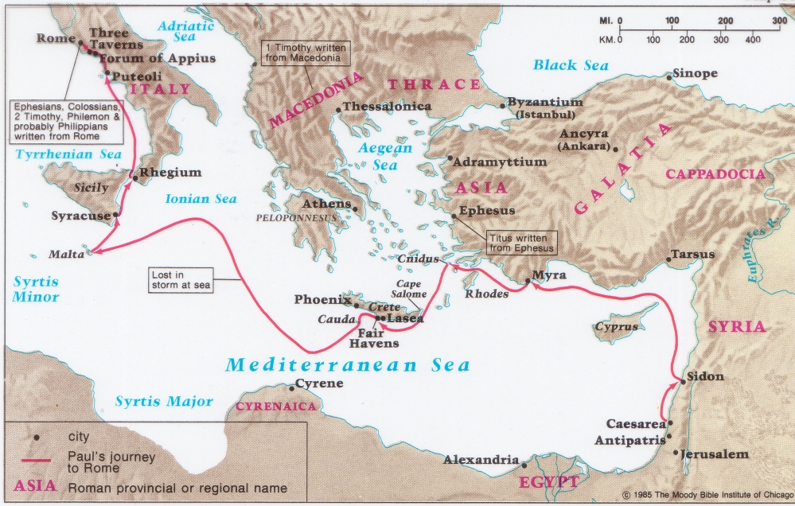
Origins of 1 Timothy & Titus
141
219

Slide 66
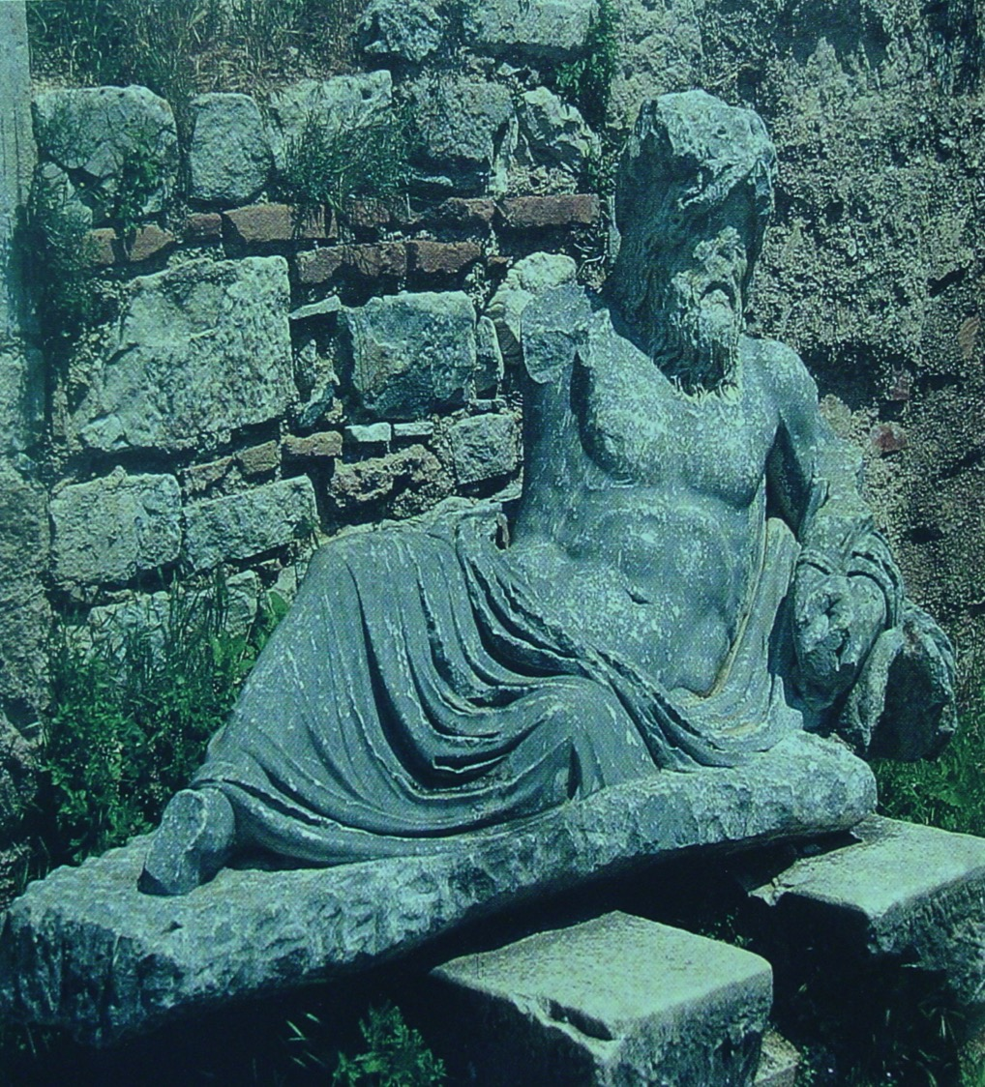
Statue of the god of the River Maeander in Miletus, where Paul said farewell to the elders of the church of Ephesus
(Acts 20:17)

Slide 67
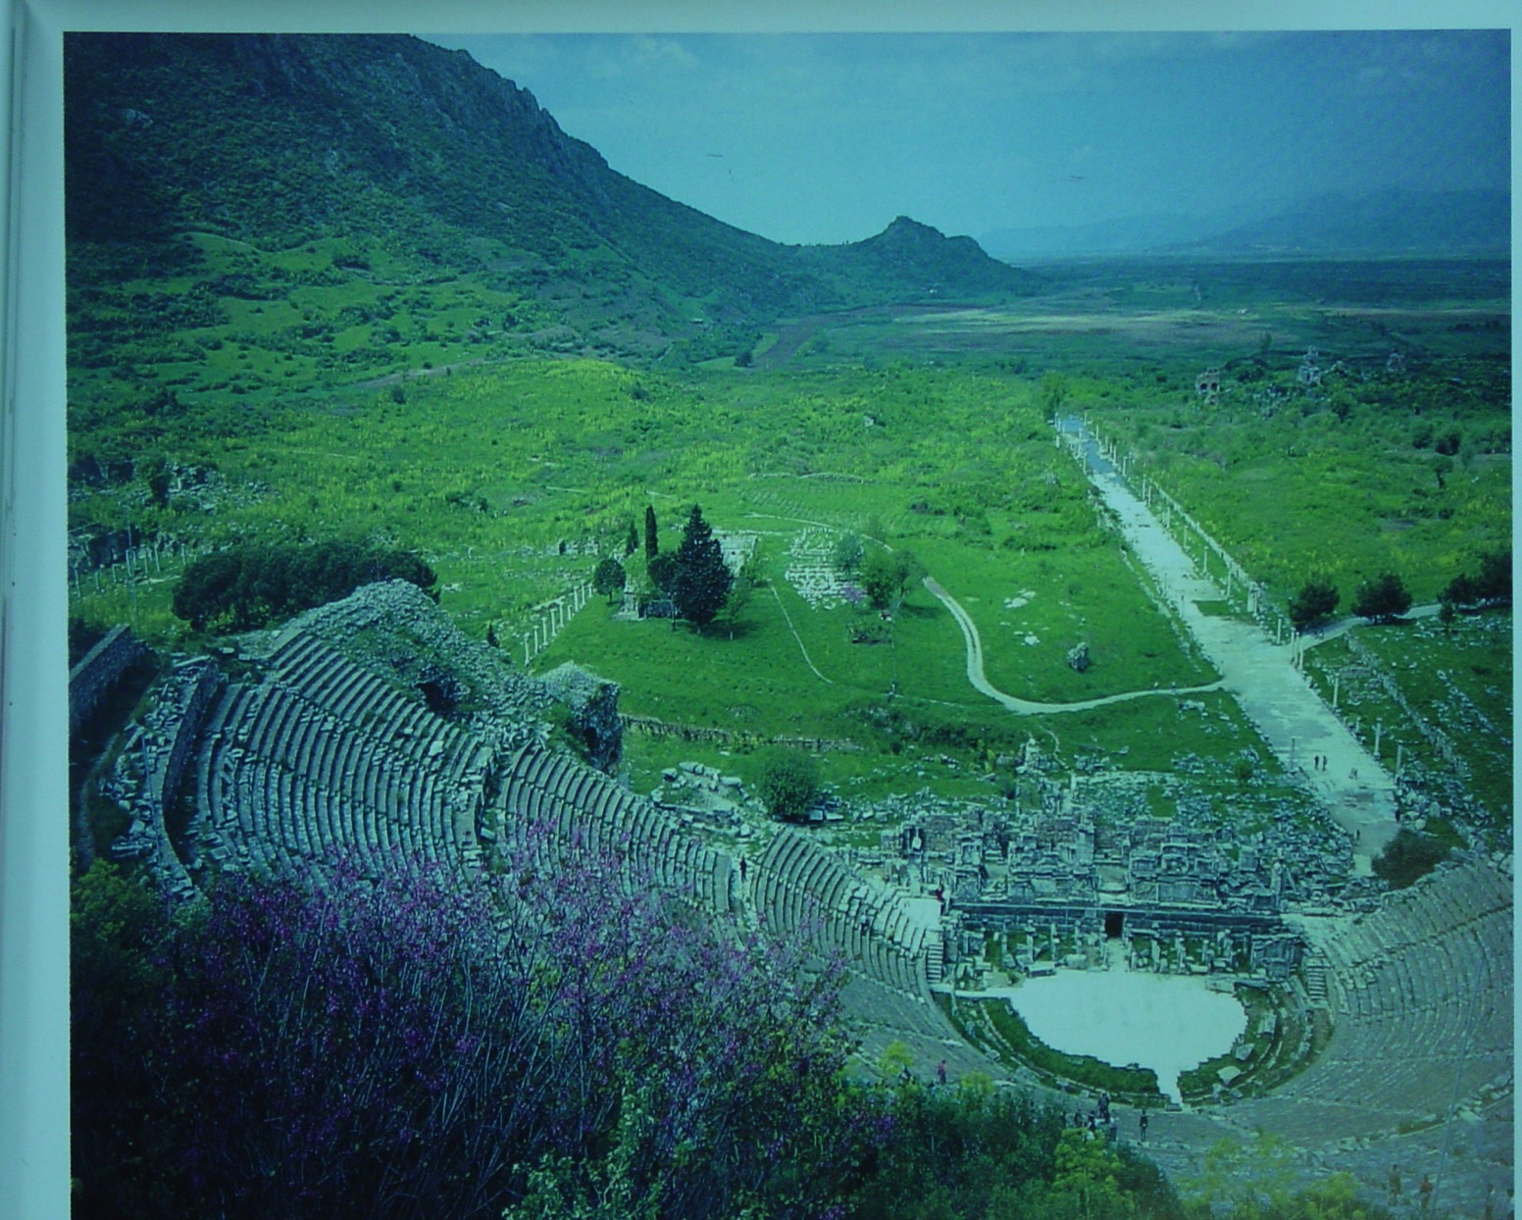
View from top tiers of the great theatre at Ephesus, showing the long, straight Arcadian Way leading in the distance to the ancient harbour, long since silted over.
180a

Slide 68
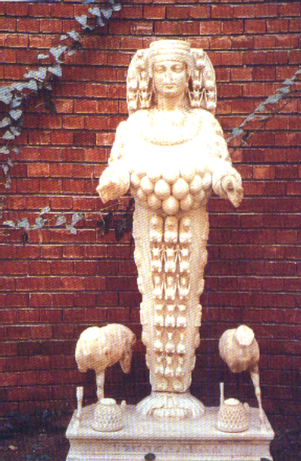
Artemis
180d
Statue of Artemis, the many-breasted goddess, from Ephesus

Slide 69
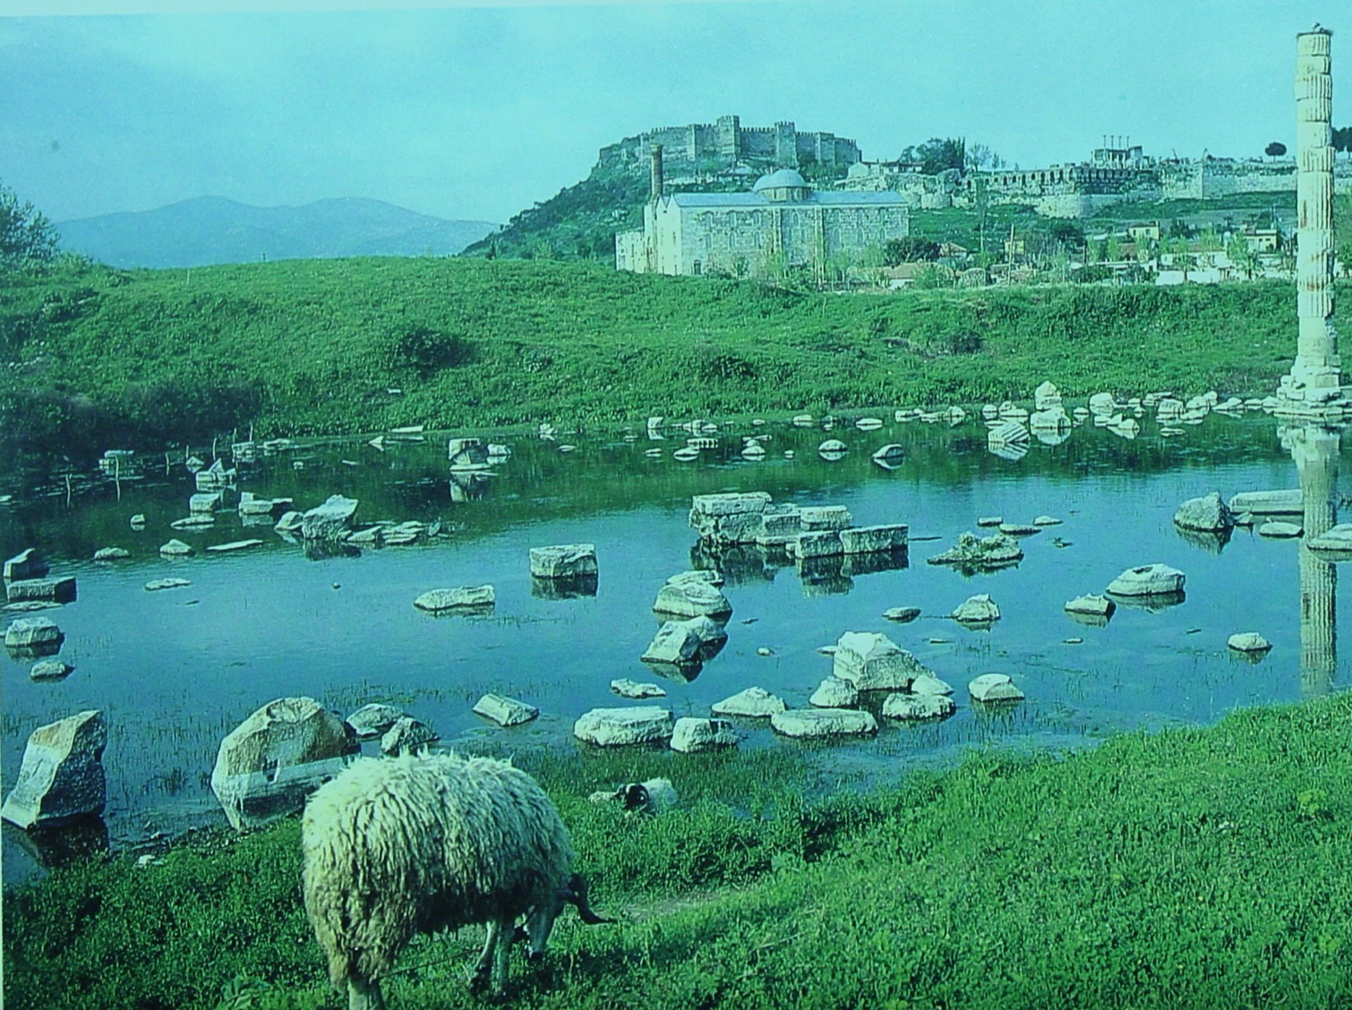
Temple of Artemis
Citadel in background
This pond has filled the site where the famous Temple of Artemis (or Diana) was located at the time 1 Timothy was written.

Slide 70
THEME
220
Order in the church
“…I am writing you these instructions so that…you will know how people ought to conduct themselves in God's
household, which is the church of the living God, the pillar and foundation of truth” (1 Tim. 3:14-15)

Slide 71
Outline
220
Chapter 1: Dealing with False Teachers
  The false teachers
  Paul and the gospel
  Charge to Timothy
Chapter 2: Public Worship
  Universal concern in public worship
  Gender roles in public worship
Chapter 3: Leadership
  Qualifications of Overseers and Deacons

Slide 72
Outline
220
Chapter 4: Instructions to Timothy
  Warning against false teachers
  Watch your life and doctrine closely
Chapter 5: Treatment of various groups
  Widows – Elders – Slaves (6:1-2)
Chapter 6: Material Possessions
  Corruption: Godliness for financial gain
  Contrasting attitude : Godliness with contentment
  Charge to Timothy: Pursue spiritual goals
  Command for the rich: Put hope in God not wealth
  Charge to Timothy: Guard what has been entrusted

Slide 73
Be Orderly
1 Timothy
Dr. Rick Griffith • Crossroads International Church Singapore
BibleStudyDownloads.org

Slide 74
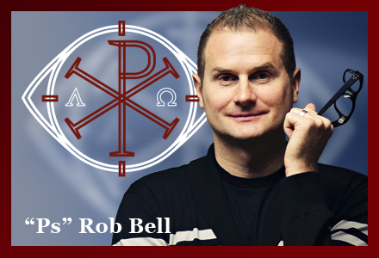
False Teaching
Notes:
False teaching is all around us. Beware!
The world has never had more “isms” than today. They don’t seem to die out. Like a cancer or virus, false teaching just seems to morph and replicate to attack in new ways.

Slide 75
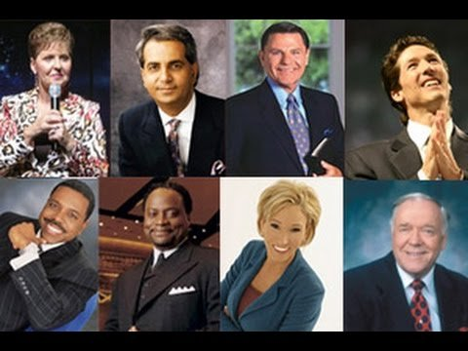
False Teaching
Notes:
Heresies have never been more accessible. You could find me 100 false theologies right there in your seat on your smart phone before you stand up!

Slide 76
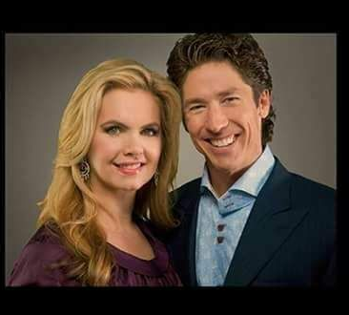
But can we defeat heresy?
“When we obey God, we’re not doing it for God. We’re doing it for ourselves….
Just do good for your own self. Do good because God wants you to be happy.”
—Victoria Osteen—
Notes:
But the Bible says, “Do all to the glory of God” (1 Cor 10:31)!

Slide 77

How to Get Rich By Lying to Christians
7 Steps to duping Christians by Preaching a False Gospel
Notes:
Should we just buy a book on it?
Or should we just live and let live?

Slide 78
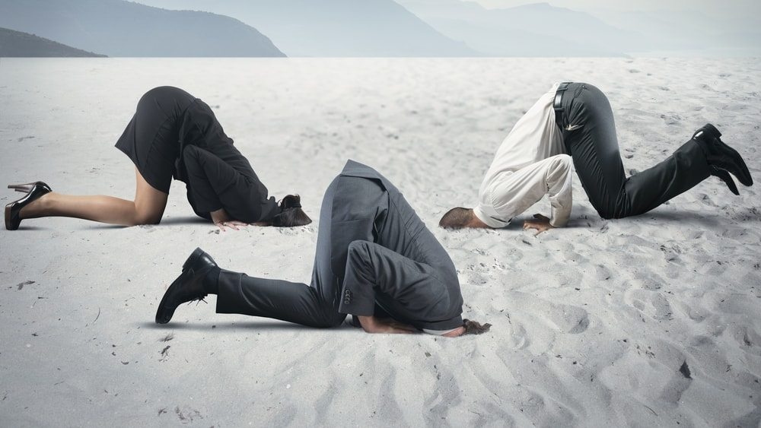
Should we put our heads in the sand?

Slide 79
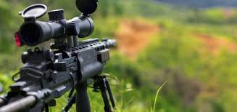
Should we have an all-out assault?

Slide 80
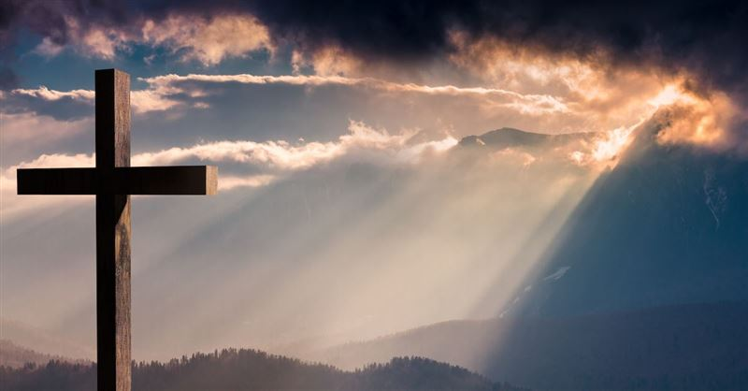
Should we see how God says to defeat heresy?
Notes:
This seems the best strategy to me! Here is what he says…

Slide 81
Key Verse
217
“… I am writing you these instructions so that…you will know how people ought to conduct themselves in God's household, which is the church of the living God, the pillar and foundation of truth”
(3:14-15).
1 Timothy

Slide 82
Main Idea
We can defeat heresy by obeying God’s priorities for church order.
1 Timothy

Slide 83
What are God’s priorities for church order?
PRIORITIES
1 Timothy

Slide 84
Theme
23
Church Order Priorities
1 Timothy

Slide 85
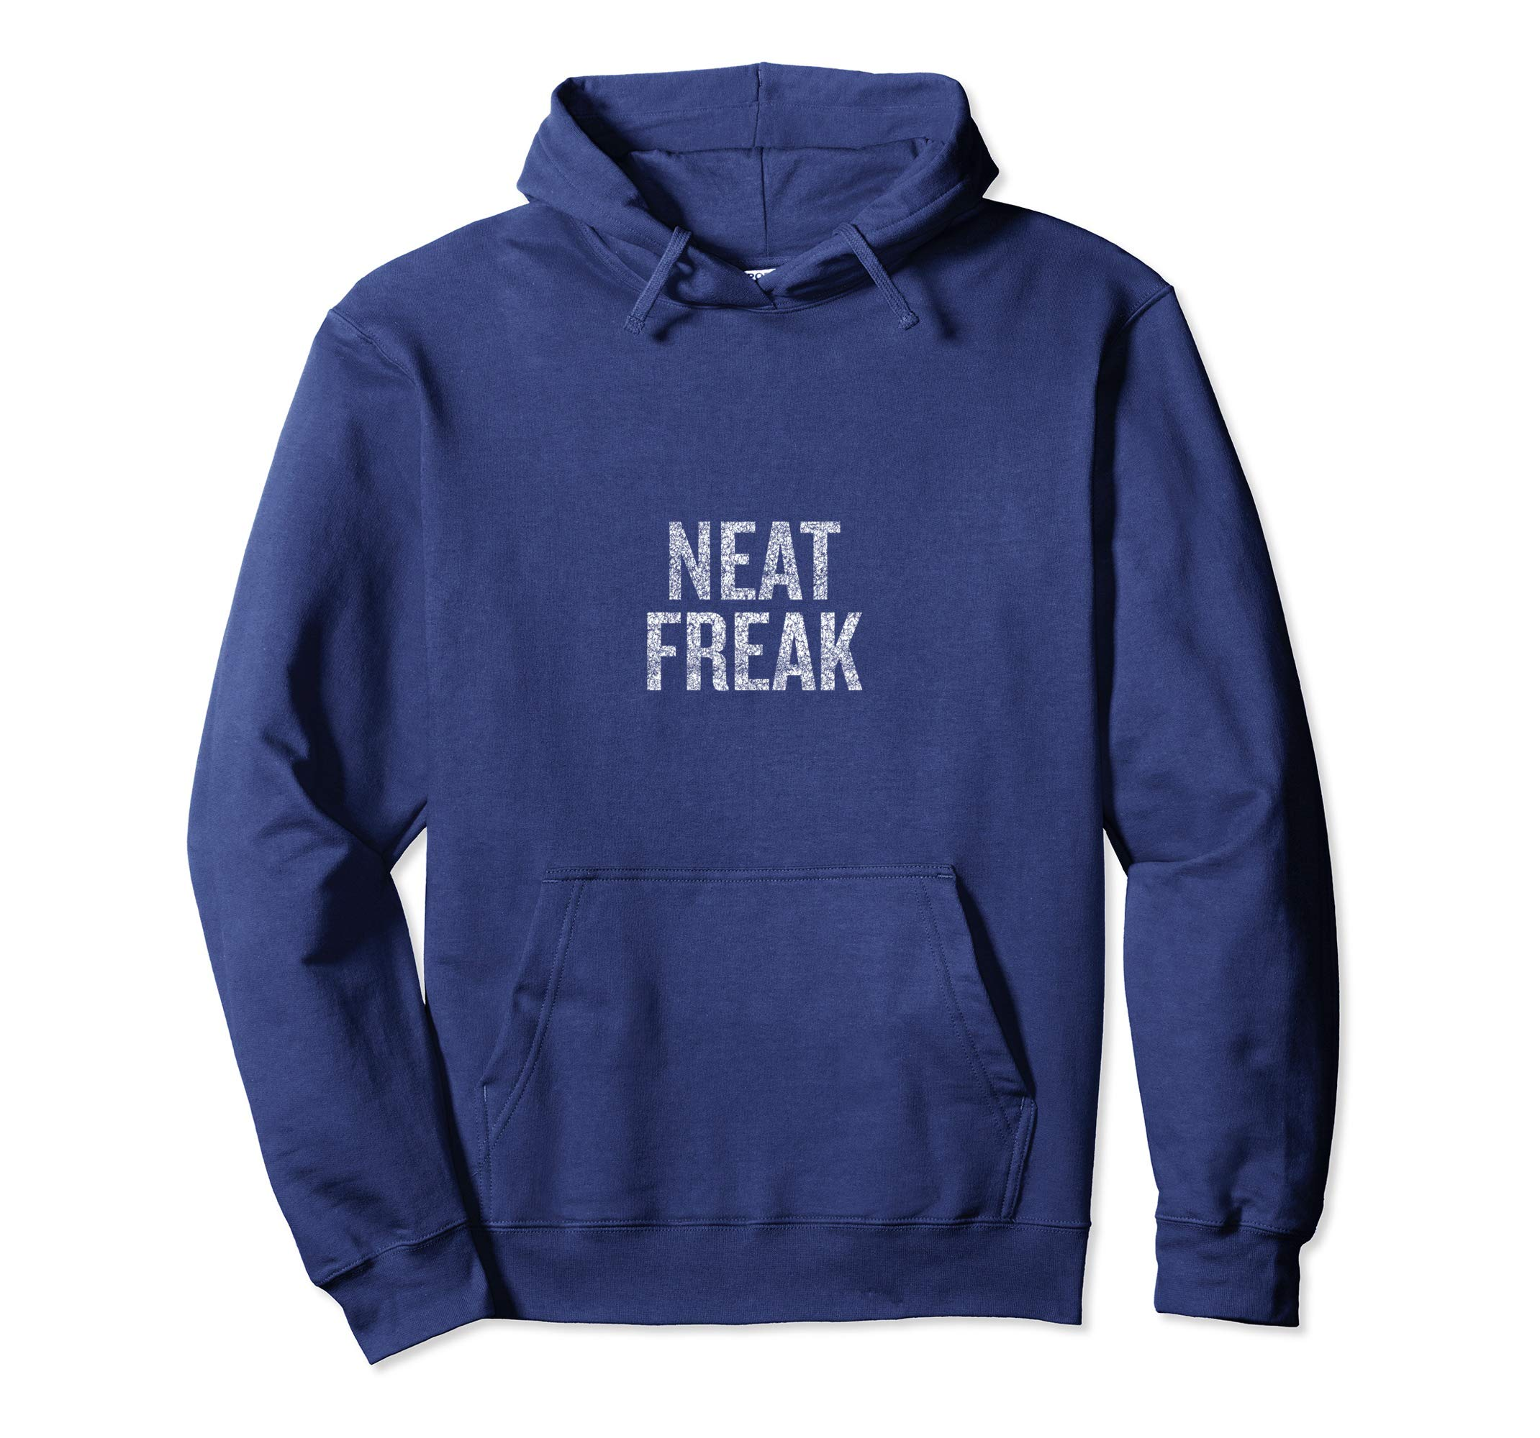
NEAT FREAK

Slide 86

Orderly means…
Manage, control, direct, act correctly, act with decorum, be civil, be good, be nice, be on best behavior
What are other words for
be orderly?

Slide 87
NT Overview (Paul's Letters)
38
124
39-41
“To the remotest part of the earth” (Acts 1:8)
Acts 9 13 14 15 16 18 21 27 28
Apr 48-
Sep 49
1
Galatia
Apr 50-
Sep 52
2
Aegean
Spr 53-
May 57
3
Asia
Feb 60-
Mar 62
1
Rome
Spr 62-
Fall 67
4
Spain
Aut 67-
Spr 68
2
Rome
Summer 35-
37
Damascus
Antioch
May 57-
Aug 59
Trials
Fall 49
The
Council
Spring 68
Expansion of Church
35 48 49 50 52 53 57 60 62 67 68 95
Matt
Luke
Acts
Mark
John
Gal
1 Thess
1 Cor
Eph
1 Tim
2 Tim
2 Thess
2 Cor
Col
Titus
Missionary
Pastoral
Romans
Philem
Gospels & Acts
Phil
Pauline Epistles
1234
Journeys
Prison
Rome
Imprisonments
Pauline
Notes:
Background: Paul left Timothy at the second-generation church of Ephesus which was facing serious heretics.
Timing: When did Paul write 1 Timothy?
Paul’s last letters before writing 1 Timothy were his Prison Epistles that ended with Philippians.
Now he turns his attention to writing individuals, including Philemon.
Historical Context: What was happening at this time?
Of Paul’s 13 NT letters, at least 10 of them are written to defeat heresy!
Paul left Timothy at the second-generation church of Ephesus which was facing serious heretics. He pens here what Timothy is to do—with important parallels to us today.

Slide 88
Bible Lands Blank Map
Paul’s Post-Acts Journey
142
Rome
Macedonia
Spain
Ephesus
1 Timothy
Crete
© https://www.deviantart.com/sharklord1/art/Alt-Roman-Empire-Provinces-701148110

Slide 89

You cannot make everything priority
Notes:
Purpose: Why is this letter in the Bible?
It is not enough just to know the importance of combating heresy. We need to know how to do it!
This letter is not the only solution, as other letters also address how to fight false teachers. But it does give us five important handles on to be victorious in maintaining church order in an environment of false teaching.

Slide 90

…for Order
Notes:
Paul gives five priorities to maintain church order so the heretics will be defeated.

Slide 91
I. Teach the Law accurately and recall God's grace to you
(Chapter 1).
1 Timothy
Notes:
Avoid the extremes of too many rules and too few rules.

Slide 92
Slides on
1 Timothy 1

Slide 93

¹ Paul, an apostle of Christ Jesus by the command of God our Savior and of Christ Jesus our hope,
² To Timothy my true son in the faith:
Grace, mercy and peace from God the Father and Christ Jesus our Lord.
³ As I urged you when I went into Macedonia, stay there in Ephesus so that you may command certain people not to teach false doctrines any longer
⁴ or to devote themselves to myths and endless genealogies. Such things promote controversial speculations rather than advancing God’s work—which is by faith.
1 Timothy 1

Slide 94
⁵ The goal of this command is love, which comes from a pure heart and a good conscience and a sincere faith. ⁶ Some have departed from these and have turned to meaningless talk. ⁷ They want to be teachers of the law, but they do not know what they are talking about or what they so confidently affirm.
⁸ We know that the law is good if one uses it properly. ⁹ We also know that the law is made not for the righteous but for lawbreakers and rebels, the ungodly and sinful, the unholy and irreligious, for those who kill their fathers or mothers, for murderers,
1 Timothy 1

Slide 95
¹⁰ for the sexually immoral, for those practicing homosexuality, for slave traders and liars and perjurers—and for whatever else is contrary to the sound doctrine ¹¹ that conforms to the gospel concerning the glory of the blessed God, which he entrusted to me. ¹² I thank Christ Jesus our Lord, who has given me strength, that he considered me trustworthy, appointing me to his service. ¹³ Even though I was once a blasphemer and a persecutor and a violent man, I was shown mercy because I acted in ignorance and unbelief. ¹⁴ The grace of our Lord was poured out on me abundantly, along with the faith and love that are in Christ Jesus.
1 Timothy 1

Slide 96
¹⁵ Here is a trustworthy saying that deserves full acceptance: Christ Jesus came into the world to save sinners—of whom I am the worst. ¹⁶ But for that very reason I was shown mercy so that in me, the worst of sinners, Christ Jesus might display his immense patience as an example for those who would believe in him and receive eternal life. ¹⁷ Now to the King eternal, immortal, invisible, the only God, be honor and glory for ever and ever. Amen.
1 Timothy 1

Slide 97
¹⁸ Timothy, my son, I am giving you this command in keeping with the prophecies once made about you, so that by recalling them you may fight the battle well, ¹⁹ holding on to faith and a good conscience, which some have rejected and so have suffered shipwreck with regard to the faith. ²⁰ Among them are Hymenaeus and Alexander, whom I have handed over to Satan to be taught not to blaspheme.
1 Timothy 1

Slide 98

Healthy Churches guard the gospel
1 Timothy 1:1-11
Preached by Dr. Jim Harmeling
at Crossroads International Church Singapore • cicfamily.com
Uploaded by Dr. Rick Griffith • Singapore Bible College
Thousands of files in 49 languages for free at BibleStudyDownloads.org

Slide 100
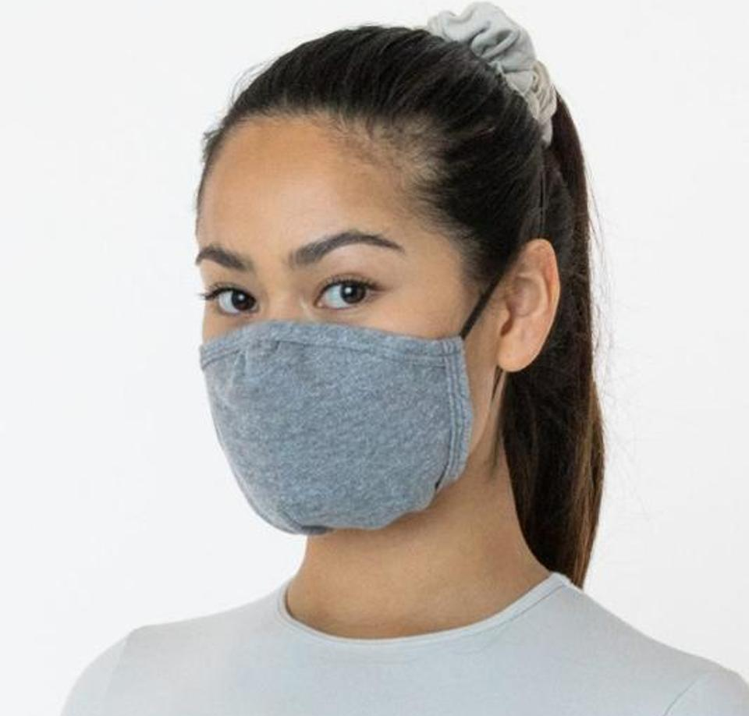


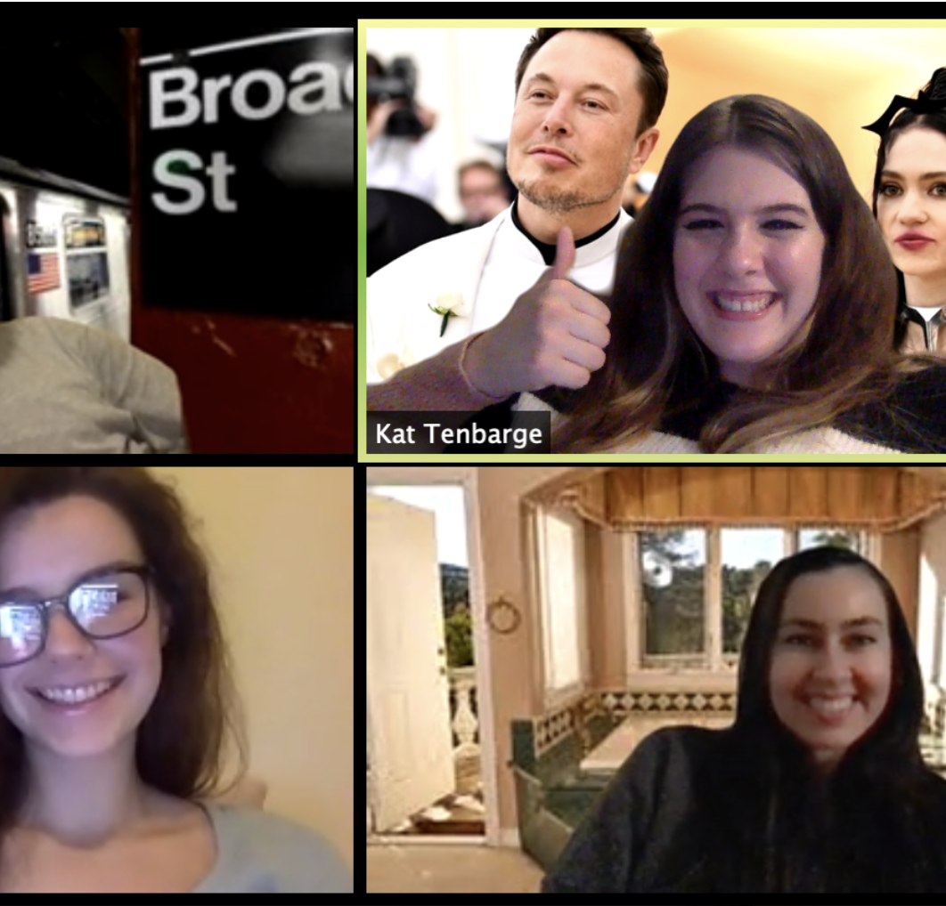
How do you stay healthy?

Slide 101
Healthy Church Life
Studies in 1 Timothy

Slide 102

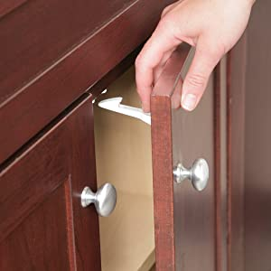

Kid Proofing the house

Slide 103
    1 – Healthy Churches guard the gospel
    2 – Healthy Churches pray
    3 – Healthy Churches develop godly leaders
    4 – Healthy Churches are well taught
    5 – Healthy Churches care for each other
    6 – Healthy Churches avoid worldliness

Slide 104
Healthy Churches guard the gospel
1 Timothy 1:1-11

Slide 105
    Acts 20:29-31
    ²⁹ I know that after my departure fierce wolves will come in among you, not sparing the flock; ³⁰ and from among your own selves will arise men speaking twisted things,
    to draw away the disciples after them.
    ³¹ Therefore be alert, remembering that for
    three years I did not cease night or day to
    admonish every one with tears.

Slide 106
Recognize the authority of the gospel (vs. 1-2)
Ephesians 2:19-20
¹⁹ So then you are no longer strangers and aliens, but you are fellow citizens with the saints and members of the household of God, ²⁰ built on the foundation of the apostles and prophets, Christ Jesus himself being the cornerstone

Slide 107
Recognize the authority of the gospel (vs. 1-2)
1 Corinthians 9:1
Am I not free? Am I not an apostle? Have I not seen Jesus our Lord? Are not you my workmanship in the Lord?
2 Corinthians 12:12
The signs of a true apostle were performed among you with utmost patience, with signs and wonders and mighty works.

Slide 108
Recognize the authority of the gospel (vs. 1-2)
Do not get distracted from the goal of the gospel
(vs. 3-5)

Slide 109


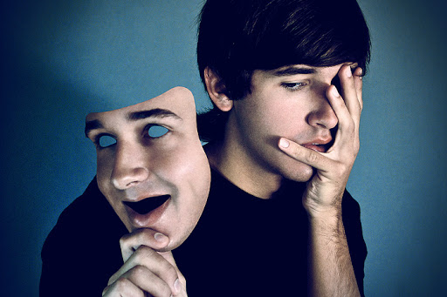
Clean heart
The qualities of love in a healthy disciple of Christ
Good conscience
Sincere faith

Slide 110
The 72 Names of God
Kabbalah.com
The 72 Names are 72 three-letter combinations of Hebrew letters, each combination channeling its unique energy from the Upper Worlds into our world through the letters themselves. We can connect with these letters simply by passing our eyes over them with the conscious intent of connecting to their energy.
At the Kabbalah Centre, we teach that any person can use these Names as a spiritual tool to connect with the spark of Divine Essence within and to make transformations at the seed level—the level of consciousness.

Slide 111
Recognize the authority of the gospel (vs. 1-2)
Do not get distracted from the goal of the gospel
(vs. 3-5)
Retain the Law in the gospel (vs. 6-11)

Slide 112
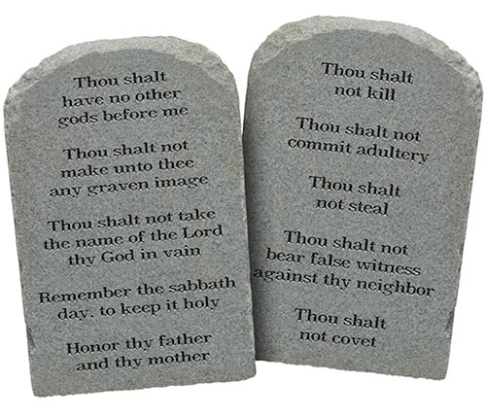
God’s Law
God’s standard of holiness and righteous living (Rom 7:12)
It requires internal and external adherence (Matt 5:17-30)
It reveals how sinful we are (Rom 3:20)
It leads us to Christ for forgiveness (Galatians 3:23-27)

Slide 113
Healthy Churches guard the gospel
1 Timothy 1:12-20
Preached by Dr. Jim Harmeling
at Crossroads International Church Singapore • cicfamily.com
Uploaded by Dr. Rick Griffith • Singapore Bible College
Thousands of files in 49 languages for free at BibleStudyDownloads.org

Slide 114

They protect the message
1 Timothy 1:1-11
Recognize authority
Don’t get distracted from goal
Retain the Law

Slide 115

They live the message
1 Timothy 1:12-20

Slide 116

Apply the gospel to your own life (1:12-17)
Credit God for life change (v. 12)
Recall pre-conversion state (v. 13)

Slide 117
Acts 22:3-5
³ “I am a Jew, born in Tarsus in Cilicia, but brought up in this city, educated at the feet of Gamaliel according to the strict manner of the law of our fathers, being zealous for God as all of you are this day. ⁴ I persecuted this Way to the death, binding and delivering to prison both men and women, ⁵ as the high priest and the whole council of elders can bear me witness. From them I received letters to the brothers, and I journeyed toward Damascus to take those also who were there and bring them in bonds to Jerusalem to be punished.

Slide 118
Acts 26:9-11
⁹ “I myself was convinced that I ought to do many things in opposing the name of Jesus of Nazareth. ¹⁰ And I did so in Jerusalem. I not only locked up many of the saints in prison after receiving authority from the chief priests, but when they were put to death I cast my vote against them. ¹¹ And I punished them often in all the synagogues and tried to make them blaspheme, and in raging fury against them I persecuted them even to foreign cities.

Slide 119
Insolent opponent - hubris
“The corresponding abstract noun is hubris, which Aristotle defines: ‘Hubris means to hurt and to grieve people, in such a way that shame comes to the man who is hurt and grieved, and not that the person who inflicts the hurt and injury may gain anything else in addition to what he already possesses, but simply that he may find delight in his own cruelty and in the suffering of the other person.’”
William Barclay

Slide 120


Slide 121
Apply the gospel to your own life (1:12-17)
Credit God for life change (v. 12)
Recall pre-conversion state (v. 13)
Explain how God changed you (v. 14)

Slide 122
Philippians 1:29
“For it has been granted to you that for the sake of Christ you should not only believe in him but also suffer for his sake”
Romans 2:4
“Or do you presume on the riches of his kindness and forbearance and patience, not knowing that God's kindness is meant to lead you to repentance?”

Slide 123
Apply the gospel to your own life (1:12-17)
Credit God for life change (v. 12)
Recall pre-conversion state (v. 13)
Explain how God changed you (v. 14)
Declare that the gospel saves all sinners (v. 15)
Reassure that Jesus is patient (v. 16)
Offer praise to Christ for life change (v. 17)

Slide 124
Apply the gospel to your own life (1:12-17)
Challenge believers to remain steadfast in faith (1:18-20)
Corporate accountability helps us remain steadfast (v. 18)
Our conscience helps us remain steadfast (v. 19a)
Fatal examples help us remain steadfast (vs. 19b-20)

Slide 125

Legalism

Slide 126
What are God’s priorities for church order?
PRIORITIES
1 Timothy

Slide 127
I. Teach the Law accurately and recall God's grace to you
(Chapter 1).
1 Timothy
Notes:
Avoid the extremes of too many rules and too few rules.

Slide 128
II. Require proper public worship led by godly leaders (Chs 2–3).
1 Timothy
Notes:
Our church services must main order by not just letting anyone lead.

Slide 129
Slides on
1 Timothy 2

Slide 130
Healthy Churches Pray
1 Timothy 2:1-7
Preached by Dr. Jim Harmeling
at Crossroads International Church Singapore • cicfamily.com
Uploaded by Dr. Rick Griffith • Singapore Bible College
Thousands of files in 49 languages for free at BibleStudyDownloads.org

Slide 131

Pray for Gospel Conversions

Slide 132

“entreaties and prayers, petitions
and thanksgivings”
Prayer involves diligent and emotional pleading and earnest begging of God
Prayer involves clear, thought out statements that accord with proper biblical precepts
Prayer involves rejoicing and gratitude over God and His answer to requests

Slide 133

Gospel Inclusive Prayer: pray for everyone’s soul (2:1-4)
This impacts national leaders (v. 1)
This pleases God (v. 3)
This brings people to the truth (v. 4)

Slide 134
Gospel Inclusive Prayer: pray for everyone’s soul (2:1-4)
Gospel Exclusive Prayer: pray for people to embrace the narrow gospel (2:5-7)
There is one God (v. 5a)
There is one mediator to God (v. 5b)

Slide 135

“Paul argues that because there is only one God, all people must be the object of prayer since all can be saved only through the one God and the one mediator.”
William Mounce

Slide 136
¹³ Enter by the narrow gate. For the gate is wide and the way is easy that leads to destruction, and those who enter by it are many. ¹⁴ For the gate is narrow and the way is hard that leads to life, and those who find it are few.
Matthew 7:13-14

Slide 137
Gospel Inclusive Prayer: pray for everyone’s soul (2:1-4)
Gospel Exclusive Prayer: pray for people to embrace the narrow gospel (2:5-7)
There is one God (v. 5a)
There is one mediator to God (v. 5b)
There is one payment for our sin (v. 6a)

Slide 138
For even the Son of Man came not to be served but to serve, and to give his life as a ransom for many.
Mark 10:45

Slide 139
Gospel Inclusive Prayer: pray for everyone’s soul (2:1-4)
Gospel Exclusive Prayer: pray for people to embrace the narrow gospel (2:5-7)
There is one God (v. 5a)
There is one mediator to God (v. 5b)
There is one payment for our sin (v. 6a)
There is one time that payment was made (v. 6b)

Slide 140
But when the fullness of time had come, God sent forth his Son, born of woman, born under the law.
Galatians 4:4

Slide 141
Gospel Inclusive Prayer: pray for everyone’s soul (2:1-4)
Gospel Exclusive Prayer: pray for people to embrace the narrow gospel (2:5-7)
There is one God (v. 5a)
There is one mediator to God (v. 5b)
There is one payment for our sin (v. 6a)
There is one time that payment was made (v. 6b)
There are commissioned messengers to proclaim this truth (v. 7)

Slide 142
I Timothy 2
222i
Take the Agree or Disagree Quiz on page 222i
Controversy:
The role of women in public worship

Slide 143
  A. A woman should not serve as a pastor-teacher with authority over an entire church
222i
  B. A woman should not serve as an elder (or other role on the highest ruling council) of a church.
  C. A woman should not be the main worship leader in the church worship service.
  D. A woman should not be an adult Christian Education director with authority over male teachers.
  E. A woman should not be a children’s Sunday school director with authority over male teachers.
  F. A woman should not teach a mixed adult Sunday school class at the church building.
  G. A woman should not teach a mixed adult cell group at a private home.
  H. A woman should not teach a mixed biblical studies course at a seminary or Bible college.
  I. A woman should not teach a mixed non-biblical course at a seminary or Bible college.

Slide 144
Avoid the 2 Extremes
Avoid the 2 Extremes
Literalism
Enthroning Truth+Culture
2:8 Men must always lift up their hands when they pray.
2:9-10 Women must never plait their hair or wear jewelry.
2:11-12 In no circumstances may women teach men.
Liberalism
Dismissing Truth+Culture
All the things in this chapter are out of date and irrelevant, merely temporary regulations to meet a given situation.

Slide 145
Distinguish Between Culture and Truth
Distinguish between Culture and Truth
Culture
Changeable
Time bound to biblical author and audience
Provides analytical details
Concrete and Specific
Truth
Changeless
Timeless
Provides integrated truth
Universal and General

Slide 146

Men's Prayer 2:8
Duties of men in relation to prayer

Slide 147
Men's prayer 2:8
Application 1:
Culture
Their bodily posture as they pray:
standing, kneeling, sitting, clapping hands or raising arms
Truth
Always and everywhere men are to pray in holiness and love

Slide 148
Women's Adornment (2:9-10)
Dress
Hairstyle
Jewelry

Slide 149
Women's Adornment 2:9-10
Application 2:
Culture
Their clothing, hairstyle and jewelry may vary according to culture
Truth
Always and everywhere women must adorn themselves with modesty, decency, propriety, and good deeds

Slide 150

Submission 2:11-12
Women's relationship with men

Slide 151

What's a Woman to Do?
The Role of Women in
Pagan and Godly Societies,
Ancient and Modern

Slide 152
“¹¹A woman should learn in quietness and full submission.
¹²I do not permit a woman to teach or to have authority over a man; she must be silent.”
- 1 Timothy 2:11-12

Slide 153

Who wants to address this?
“I’ll preach on Thanksgiving, Christmas, New Year’s and Easter. You can have ‘The Role of Women in the Church,’ ‘Tongues Speaking for Today,’ ‘Biblical Inerrancy,’ and our special ‘Fund Drive Sunday.’”

Slide 154

Egalitarians
Complementarians
NT Wright
Ben Witherington III
Gordon Fee
Scot McKnight
Ruth A. Tucker
Walter C. Kaiser
Jim Wallis
Rachel Held Evans
Gilbert Bilezikian
J.I. Packer
Tim Keller
John F. MacArthur
C.S. Lewis
John Piper
John Wimber
Mark Driscoll
Elisabeth Elliot
Douglas Wilson
vs
Notes:
Egalitarians see no difference between men and women in their roles in the church so that women may serve equally as pastors, elders, etc.
Complementarians see women as complementing man's leadership roles as elders/pastors but not holding these positions themselves.

Slide 155

Common Ground
This isn't as fundamental as the virgin birth, deity of Christ, salvation by grace…
We all agree to disagree in love
We all learn from God's Word through others in public settings

Slide 156


“Beyond the Politics of Pandora's Pulpit”

Slide 157
“¹¹A woman should learn in quietness and full submission.
¹²I do not permit a woman to teach or to have authority over a man; she must be silent.”
1 Timothy 2:11-12

Slide 158
What's a Woman to Do?
161o
Note: The context of all three passages below is public worship.
It looks like 1 Cor. 11 contradicts 1 Cor. 14 and 1 Tim. 2.
1 Cor. 11 | 1 Cor. 14 | 1 Tim. 2
Can pray publicly (11:5, 13) |  | Public prayer for men only (2:8)
Can prophesy (11:5) | Speaking is prohibited (14:34) | Must be silent (2:12c)
Speaking is OK (implied) | Speaking is disgraceful (14:35)
 |  | Can't teach men (2:12a)
 |  | Can't have authority over men (2:12b)
Veils universal practice (11:16) | Silence universal practice (14:33) | Men praying universal practice (2:8)
Which text is the general rule (norm) and which is the exception?
To see how people have tried to solve these apparent contradictions,
see the next 8 pages of these notes!

Slide 159
I. Learn peacefully
“¹¹ A woman should learn in quietness and full submission. ¹² I do not permit a woman to teach or to have authority over a man; she must be silent.”
Hesuchia is an inclusio
Cultivate inward quietness and attentiveness
Be still: put aside other concerns, allow time
- “Be still and know that I am God” (Ps. 46:10)

Slide 160
II. Learn respectfully, not usurping
“¹¹ A woman should learn in quietness and full submission. ¹² I do not permit a woman to teach or to have authority over a man; she must be silent.”
Be respectful, even when you disagree.
- Speaker to “rightly divide the word of truth” (2 Tim. 2:15); listeners to learn
- Critical mind not critical spirit

Slide 161
II. Learn respectfully, not usurping
“¹¹ A woman should learn in quietness and full submission. ¹² I do not permit a woman to teach or to have authority over a man; she must be silent.”
Do not usurp authority internally
- Be teachable; suppress mental objections
- “[My word] will not return to me void, but will accomplish what I desire and achieve the purpose for which I sent it.” (Isa. 55:11)
- God uses 'bad' sermons!

Slide 162

Learn peacefully and respectfully

Slide 163

Q: But why did Paul prohibit women from teaching men in public worship?
A: Because they were less educated?

Slide 164


1 Timothy 2:11-15 NIV
¹¹A woman should learn in quietness and full submission. ¹²I do not permit a woman to teach or to have authority over a man; she must be silent.
¹³For Adam was formed first, then Eve. ¹⁴And Adam was not the one deceived; it was the woman who was deceived and became a sinner. ¹⁵But women {Gr. she} will be saved {or restored} through childbearing-- if they continue in faith, love and holiness with propriety.

Slide 165
Women's Submission 2:11-12
Application 3:
Culture
Learn in quietness
Not allowed to teach?
Truth
Full submission
No teaching or authority over a man in local church contexts

Slide 166
Culture: Silence vs. Teaching
Submission is expressed in different ways in different cultures. It need not be expressed in silence.
Does women teaching men mean that they are in authority over them?
When anyone teaches, the authority rests in the Word of God, not in the person—but the person teaching carries that authoritative position.

Slide 167
Truth: Authority-Submission
Basis for women's submission: The Fall 2:14
Misconception: Women were shown in the Fall as prone to deception and so should not teach men.
Objection: If women are by nature gullible, they ought to be disqualified from teaching anyone, not just men, whereas Paul refers to the special role of women in teaching both children and younger women (Titus 2:4).
Truth: Eve's sin in the fall was not only that she was deceived, but that she usurped Adam's authority and thus reversed their respective roles.

Slide 168
1 Timothy 2:11-14
Conclusion:
Can Women Teach in Public Worship?
God’s creation order shows male leadership (13)
Eve’s deception (14)
Family order (15)

Slide 169
Slides on
1 Timothy 3

Slide 170
I Timothy
Life and Order in the Church

Slide 171

How Do We Pick Leaders for the Local Church?
223
P
Popularity
Past
Politics
Pocketbook
Profession
Chuck Swindoll, Excellence in Ministry (Fullerton, CA; Insight for Living, 1985), 39

Slide 172
How Should Churches Select Leaders?
223
INTRODUCTION
Scriptural Examples:
Congregation decides/nominates
  APOSTLES
  Acts 1:12-26 – congregational selection, apostolic appointment
  DEACONS
  Acts 6:3 – congregational selection, apostolic appointment
BODY

Slide 173

Appointment of church officers:
223
INTRODUCTION
An apostle (e.g., Paul) or his assistants ordained the elders
  Acts 14:23
  Titus 1:5
BODY

Slide 174


What about Elder Qualifications?
224

Slide 175

Lead in front,
don’t push from behind
Don’t dominate
Be sensitive to needs

Slide 176
Healthy Church Life
Studies in 1 Timothy

Slide 177
Healthy Churches Develop godly leaders
1 Timothy 3:1-7

Slide 178

They Raise up Godly Elders (vs. 1-7)

Slide 179

Review
1 Timothy 2:11-14
Men are to lead the church
Women can still speak
Women can still teach
Women can still lead

Slide 180
The saying is trustworthy: If anyone aspires to the office of overseer, he desires a noble task.
Elder = Who? Older man
Overseer = What? Oversee
Pastor = How? Like a shepherd

Slide 181
Acts 20:17, 28
¹⁷ Now from Miletus he sent to Ephesus and called the elders of the church to come to him.
²⁸ Pay careful attention to yourselves and to all the flock, in which the Holy Spirit has made you overseers, to care for the church of God, which he obtained with his own blood.

Slide 182
1 Peter 5:1-2
¹ So I exhort the elders among you, as a fellow elder and a witness of the sufferings of Christ, as well as a partaker in the glory that is going to be revealed: ² shepherd the flock of God that is among you, exercising oversight, not under compulsion, but willingly, as God would have you; not for shameful gain, but eagerly;

Slide 183
14 Character Traits For Church Overseers
They are not flirtatious (“the husband of one wife”)
2. They are personally disciplined (“sober-minded”)
3. They are mentally and emotionally balanced (“self-controlled”)
4. They are not out of control (“respectable”)
5. They practice hospitality (“hospitable”)
6. They are able to teach the Bible (“able to teach”)
7. They are not addicted to chemicals (“not a drunkard”)
8. They control their temper (“not violent”)
9. They are considerate of others (“gentle”)

Slide 184

Gentleness:
“It expresses that considerateness that looks humanely and reasonably at the facts of a case.”

Slide 185
14 Character Traits For Church Overseers
They are not flirtatious (“the husband of one wife”)
2. They are personally disciplined (“sober-minded”)
3. They are mentally and emotionally balanced (“self-controlled”)
4. They are not out of control (“respectable”)
5. They practice hospitality (“hospitable”)
6. They are able to teach the Bible (“able to teach”)
7. They are not addicted to chemicals (“not a drunkard”)
8. They control their temper (“not violent”)
9. They are considerate of others (“gentle”)
10. They are peace makers (“not quarrelsome”)

Slide 186
14 Character Traits For Church Overseers
11. They are not materialistic (“not a lover of money”)
12. They manage their homes well (“He must manage his own household well, with all dignity keeping his children submissive, for if someone does not know how to manage his own household, how will he care for God’s church?”)
13. They are not a young Christian (“He must not be a recent convert, or he may become puffed up with conceit and fall into the condemnation of the devil”)
14. They have a favorable testimony among unbelievers (“…he must be well thought of by outsiders, so that he may not fall into disgrace, into a snare of the devil”)

Slide 187


Slide 188
Required Qualities of an
Overseer (O) or Deacon (D)
224
General reputation
    (Perceived character)
  Above reproach (O)
  Good reputation with outsiders (O)
  Respectable (O & D)

Slide 189
Required Qualities of an
Overseer (O) or Deacon (D)
225
II. Family life (if married)
  Having 1 wife (O & D)
  Wife must be worthy of respect, not malicious talkers but temperate and trustworthy in everything (D)
  See that his children obey
    (O & D)

Slide 190
Required Qualities of an
Overseer (O) or Deacon (D)
225
III. Negative characteristics
  Not quick tempered (O)
  Not violent (O)
  Not quarrelsome (O)
  Not a new convert (O)
  Not pursuing dishonest gain (O & D)
  Not addicted to wine; temperate (O & D)

Slide 191
Required Qualities of an
Overseer (O) or Deacon (D)
226
IV. Positive characteristics
  Hospitable (O)
  Sensible (O)
  Tested (D)
  Sincere (D)
Able to Teach (O)

Slide 192
Scriptural Principles
223
1 Qualifications relate only to men
2 All qualifications are essential and of equal importance
Qualifications refer to present life of the leader
Who are they? Overseers (Elders, Bishops, Pastors) and Deacons
If the leader fails, he must step down
Qualifications emphasize character over abilities (only 2 traits involve ability)
Emphasize managing of home over work
Must be qualified so that:
  1. they can give godly direction
  2. the church can avoid problems that come from bad or inept leaders

Slide 193

I. Ultimate authority in the local church rests with the congregation

Slide 194
Congregational Authority
NA
In Church Discipline (Matt. 18:17)
  “Take it to the church…”
In Leader Selection (Acts 6:3)
  “Choose… from among you…”
In Maintaining True Doctrine:
“For I received from the Lord what I also passed on to you…” (1 Cor. 11:23)
“Friends… test the spirits” (1 John 4:1)
“Contend for the faith” (Jude 3)

Slide 195

Episcopal Church
Structure
(Simplified)
244a
Bishop
Anglican
Lutheran
Methodist
Orthodox
Catholic
Vicar
Vicar
Vicar
Deacons
Deacons
Deacons
People
People
People

Slide 196

Lower Presbyterian Structure
244a
Presbytery
Senior
Pastor
Senior
Pastor
Senior
Pastor
Elders
(Session)
Elders
(Session)
Elders
(Session)
People
People
People

Slide 197

Middle Presbyterian Structure
244a
Synod
Presbytery
Presbytery
Senior
Pastor
Senior
Pastor
Senior
Pastor
Senior
Pastor
Senior
Pastor
Senior
Pastor
Elders
(Session)
Elders
(Session)
Elders
(Session)
Elders
(Session)
Elders
(Session)
Elders
(Session)
People
People
People
People
People
People

Slide 198

Highest Presbyterian Structure
244a
General Assembly
Synod
Synod
Presbytery
Presbytery
Presbytery
Presbytery
Elders
(Session)
Elders
(Session)
Elders
(Session)
Elders
(Session)
Elders
(Session)
Elders
(Session)
Elders
(Session)
Elders
(Session)
Elders
(Session)
Elders
(Session)
Elders
(Session)
Elders
(Session)
People
People
People
People
People
People
People
People
People
People
People
People

Slide 199
What About Baptists?
The Autonomy of the Local Church

Slide 200

Two Questions:
Who has the ultimate say in the church?
What is the biblical pattern for church leadership?

Slide 201

II. The biblical pattern is church leadership by elders.
236a

Slide 202

Elders led from the time of Moses
48
Elders
led with
Moses
1400 BC
“Go, assemble the elders of Israel and say to them…”
(Exod. 3:16)

Slide 203

Who Led the Synagogue?
51
Elders
led with
Moses
1400 BC
Elders
led
Synagogues
600 BC

Slide 204

God has advocated group leadership through the ages
55
Elders
led with
Moses
1400 BC
Elders
led
Synagogues
600 BC
NT
Elders

Slide 205

Places Mentioning Elders
elders = overseers = bishops = pastors
55
Jerusalem (AD 47):
NIV Acts 11:30 This they did, sending their gift to the elders by Barnabas and Saul.
Ephesus (AD 57):
NIV Acts 20:17 From Miletus, Paul sent to Ephesus for the elders of the church.
Galatia (AD 48):
NIV Acts 14:23 Paul and Barnabas appointed elders {or Barnabas ordained elders; or Barnabas had elders elected} for them in each church
Crete (AD 66):
NIV Titus 1:5 The reason I left you in Crete was that you might straighten out what was left unfinished and appoint {or ordain} elders in every town, as I directed you.
Philippi (AD 62):
NIV Philippians 1:1 Paul and Timothy, servants of Christ Jesus, To all the saints in Christ Jesus at Philippi, together with the overseers and deacons:
Pontus, Galatia, Cappadocia, Asia & Bithynia (AD 64)
NIV 1 Peter 5:1 To the elders among you, I appeal as a fellow elder… (cf. 1:1)
Notes:
NS-05-Acts-
NS-15-Pastoral Epistles-3
NS-15-1 Timothy-14

Slide 206

What should elders do?
236a

Slide 207
Pastoral Leadership of an Elder:
236a
(a) Elders teach:
INTRODUCTION
“Shepherd the flock” (Acts 20:28)
“Able to teach” (1 Thess. 5:12; 1 Tim. 3:2; Titus 1:9b)
Scriptural foundation (Tit. 1:9a)
Teach God's plan (Acts 20:20, 27)
Get paid for teaching (1 Tim. 5:17)
BODY

Slide 208
Three Types of Elders
236b
“The elders who direct the affairs of the church well are worthy of double honor, especially those whose work is preaching and teaching”
(1 Tim. 5:17 NIV).
ALL ELDERS
Teach, protect, lead, serve, testify
Unpaid or $
if Needed
PAID MANAGERS
$
PREACHERS
&
TEACHERS
$$
Notes:
NS-05-Acts-
NS-15-Pastoral Epistles-15
NS-15-1 Timothy-204

Slide 209
Pastoral Leadership of an Elder:
236a
(a) Elders teach:
INTRODUCTION
“Shepherd the flock” (Acts 20:28)
“Able to teach” (1 Thess. 5:12; 1 Tim. 3:2; Titus 1:9b)
Scriptural foundation (Tit. 1:9a)
Teach God's plan (Acts 20:20, 27)
Get paid for teaching (1 Tim. 5:17)
Highest office teach (Acts 6:1-7)
Elders led deacons (Phil. 1:1)
BODY

Slide 210
Three Shepherd Tasks of Elders
236c1
Teaching
1 Tim. 3:2; 5:17

Slide 211
How Elders Relate to Deacons
236a 6b
Model 1: Senior Pastor over Deacons
Senior Pastor
Deacons
Unbiblical

Slide 212
How Elders Relate to Deacons
236a 6b
Model 2: Senior Pastor alongside Deacons
Senior Pastor
Deacons
Unbiblical

Slide 213
How Elders Relate to Deacons
236a 6b
Model 3: Deacons lead elders/pastors
Deacons
Unbiblical
Pastors

Slide 214
How Elders Relate to Deacons
236a 6b
Model 4: Elder Board leads Deacon Board
Elders
Deacons

Slide 215
How Elders Relate to Deacons
236a 6b
Apostles over “The Seven”
Apostles
DDDDDDD
DDDD
DDDDD
“The Seven”
Acts 21:8

Slide 216
How Elders Relate to Deacons
236a 6b
Model 5: Elders with Deacon Committees
Elders
DDDDDDD
DDDD
DDDDD

Slide 217
Three Shepherd Tasks of Elders
236c1
Teaching
1 Tim. 3:2; 5:17
Pastor-Teacher
Eph. 4:11
Pastoring
(Protect & Lead)
1 Pet. 5:1-4
Acts 20:29, 35
1 Thess. 5:12

Slide 218
Three Shepherd Tasks of Elders
236c1
Administration
(Serve, care for & testify)
Teaching
1 Tim. 3:2; 5:17
1 Tim. 3:1, 4-5; 5:17
Pastor-Teacher
Episkopos =
Epi “over” +
skopos “look” =
“watch over”
Eph. 4:11
Pastoring
(Protect & Lead)
1 Pet. 5:1-4
Acts 20:29, 35
1 Thess. 5:12
Notes:
NS-05-Acts20
NS-15-Pastoral Epistles-16
NS-15-1 Timothy-214

Slide 219








Shared Leadership
236c
Scriptural support for a plurality of elders:
plurality
plurality
  Not One Elder…
  But Many…

Slide 220
Summary on Elders
INTRODUCTION
Therefore, the New Testament presents an elder whose functions are to teach, pastor and administer.
BODY

Slide 221




Can't we just renamed deacons "elders"?
Deacon
Deacon
Elder
Elder

Slide 222
No. There are many differences between them…
Deacon
Elder
Qualifications
Character
Character + Teaching
Role (Gifting)
Administration
Pastoral
Time Involved
Much
Even more extensive
Age
Younger
Older

Slide 223
Key functions of a Deacon:
231
To serve:
  Acts 6:1-6
  1 Timothy 3:8-13
INTRODUCTION
BODY

Slide 224
Attention:
231
Deacons are not rulers. They are a subordinate class of officers who serve under the direction of the elders. Deacons assist the elders, especially by relieving them of distractions in the temporal affairs of the church.¹
¹http://www.swrb.com/newslett/actualNLs/bcg_ch02.htm.
INTRODUCTION
BODY

Slide 225
Attention:
231
It is significant that nowhere in the New Testament do deacons have ruling authority over the church as the elders do, nor are deacons ever required to be able to teach Scripture or sound doctrine.¹
¹Wayne Grudem, Systematic Theology: An Introduction to Biblical Doctrine, 920.
INTRODUCTION
BODY

Slide 226

Proposed Form of Church Government
Elders (govern /make decisions)
Deacons (service)
Congregation (appoint)
236a
INTRODUCTION
BODY

Slide 227
Elder-Congregation dynamics:
INTRODUCTION
E l d e r s
C o n g r e g a t i o n
L
O
V
E
Regard
themselves as
servants
BODY
Regard
them as
leaders
Notes:
Having seen the structure, it is vital that the dynamics be understood.

Slide 228

False Teachers and Teachings
1 Tim. 1:3-20; 4:1-16; 6:3-5, 20, 21
221
One of the main reasons why Timothy stayed with the Ephesian church was to correct the false teachers (1:3)
True Source of Heresy: Deceiving spirits and demons (4:1)

Slide 229
Characteristics of False Teachers
221
"Hypocritical liars" (1:7)
Incompetent: they "do not understand either what they are saying or the matters about which they make confident assertions" (6:4)
Proud (6:4)
Spiritually blinded: "men of corrupt mind, who have been robbed of the truth" (6:5)
Use their "piety" for financial gain (6:5)

Slide 230
Characteristics of False Teachings
221
Teaching does not agree with "the sound instruction of our Lord Jesus Christ and godly teaching" (6:3)
Preach a false asceticism: "They forbid people to marry and order them to abstain from certain foods" (4:3)
Pay attention to godless myths, old wives' tales and endless genealogies
Have an unhealthy interest in controversies and quarrels about words (6:4)

Slide 231
Healthy Church Life
1 Timothy 3:8-16
Preached by Dr. Jim Harmeling
at Crossroads International Church Singapore • cicfamily.com
Uploaded by Dr. Rick Griffith • Singapore Bible College
Thousands of files in 49 languages for free at BibleStudyDownloads.org

Slide 233


Slide 234



Slide 235
Acts 6:1-2
¹ Now in these days when the disciples were increasing in number, a complaint by the Hellenists arose against the Hebrews because their widows were being neglected in the daily distribution. ² And the twelve summoned the full number of the disciples and said, “It is not right that we should give up preaching the word of God to serve tables.”

Slide 236
Healthy Church Life
Studies in 1 Timothy

Slide 237
Healthy Churches Develop godly leaders
1 Timothy 3:1-16

Slide 238
They Raise up Godly Elders (vs. 1-7)
They Develop Godly Deacons (vs. 8-16)
Philippians 1:1
Paul and Timothy, servants of Christ Jesus,
To all the saints in Christ Jesus who are at Philippi, with the overseers and deacons:

Slide 239
The saying is trustworthy: If anyone aspires to the office of overseer, he desires a noble task.
Elder = Who? Older man
Overseer = What? Oversee
Pastor = How? Like a shepherd

Slide 240
James 5:14
Is anyone among you sick? Let him call for the elders of the church, and let them pray over him, anointing him with oil in the name of the Lord.

Slide 241
Acts 15:1-2, 6
¹ But some men came down from Judea and were teaching the brothers, “Unless you are circumcised according to the custom of Moses, you cannot be saved.” ² And after Paul and Barnabas had no small dissension and debate with them, Paul and Barnabas and some of the others were appointed to go up to Jerusalem to the apostles and the elders about this question.
⁶ The apostles and the elders were gathered together to consider this matter.

Slide 242
What qualities are required in a deacon?
They are respectable (“dignified”)
They do not speak out of both sides of their mouths
(“not double-tongued”)
They do not have addictions (“not addicted to much
wine”)
4. They are not greedy and materialistic (“not greedy for
dishonest gain”)
They are doctrinally sound with a life of integrity
(“They must hold to the mystery of the faith with a
clear conscience”)

Slide 243
What qualities are required in a deacon?
They have been tested in ministry responsibility (“And
let them all be tested first; then let them serve as
deacons if they prove themselves blameless.”)
They manage their homes well (“Let deacons each be the husband of one wife, managing their children and their own households well.”)

Slide 244

A Challenge to the Women

Slide 245
female deacons?
Why resume character traits of the “deacons” immediately afterwards?
Why then say deacons are husbands of one wife?
Why use the same word for the women throughout this chapter that refers to wives?
Why not select females in Acts 6?
deacon’s wives?
Why are elder’s wives not mentioned?
Why not make it clear these are deacon’s wives by including the personal pronoun, “their” wives, instead of “women”?
Why is Phoebe called a “servant” or “deacon” in Romans 16:1?

Slide 246
They are respectable (“dignified”)
They are self-controlled with their tongue (“not slanderers”)
They have self-control over their life (“sober-minded”).
They are reliable (“faithful in all things”)

Slide 247
Why are church leaders important?
(vv. 14-16)
The Church has quality: It is ordered
The Church has personality: It is a family of people
The Church has God’s presence: He is living in it
The Church has a mission: It must support and protect the truth

Slide 248
A Challenge to the Women

Slide 249
female deacons?
Why resume character traits of the “deacons” immediately afterwards?
Why then say deacons are husbands of one wife?
Why use the same word for the women throughout this chapter that refers to wives?
Why not select females in Acts 6?
deacon’s wives?
Why are elder’s wives not mentioned?
Why not make it clear these are deacon’s wives by including the personal pronoun, “their” wives, instead of “women”?
Why is Phoebe called a “servant” or “deacon” in Romans 16:1?

Slide 250
They are respectable (“dignified”)
They are self-controlled with their tongue (“not slanderers”)
They have self-control over their life (“sober-minded).
They are reliable (“faithful in all things)

Slide 251
Why are church leaders important?
(vs. 14-16)
The Church has quality: It is ordered
The Church has personality: It is a family of people
The Church has God’s presence: He is living in it
The Church has a mission: It must support and protect the truth

Slide 252
1 Timothy 3:8-13 (NIV)
232
⁸Deacons, likewise, are to be men worthy of respect, sincere, not indulging in much wine, and not pursuing dishonest gain. ⁹They must keep hold of the deep truths of the faith with a clear conscience. ¹⁰They must first be tested; and then if there is nothing against them, let them serve as deacons. ¹¹In the same way, their wives {¹¹Or way, deaconesses} are to be women worthy of respect, not malicious talkers but temperate and trustworthy in everything. ¹²A deacon must be the husband of but one wife and must manage his children and his household well. ¹³Those who have served well gain an excellent standing and great assurance in their faith in Christ Jesus.

Slide 253
Views on Women in 1 Timothy 3:11
232
Gynaikos (gunaiko.j) can be legitimately translated as either “women” or “wives.”
At least six views on this phrase exist:
women in general
wives of both elders and deacons
a group similar to deacons in function but subordinate to them in rank
deacon wives
deaconesses (woman deacons), or
deacon wives who are called deaconesses

Slide 254
Support for “Like Deacons But Ranking Below Them”
232
“They are a group by themselves, not just the wives of the deacons nor all the women who belong to the church.…On the other hand, the fact that no special and separate paragraph is used in describing their necessary qualifications, but that these are simply wedged in between the stipulated requirements for deacons, with equal clarity indicates that these women are not to be regarded as constituting a third order in the church, the office of deaconess, on par with and endowed with authority equal to that of deacons”
(William Hendricksen, Pastoral Epistles, NTC, 346;
Donald Guthrie, The Pastoral Epistles, 85; See my p. 232, note 2).

Slide 255
Supporters of “Deacon Wives”
232
Translations: NIV, KJV, NKJV, GNB, Beck, LB, Phillips
Scholars:
  Warren Wiersbe, 51-52
  Earle, Expositors Bible Commentary, 11:368
  Litfin, Bible Knowledge Commentary, 2:238 says the view has a slim advantage.

Slide 256
Supporters of “Deaconesses”
232
Translations: NIV footnote, Williams trans.
Scholars:
  James B. Hurley, Man and Woman in Biblical Perspective, 229-33
  Kelly, 83
  Newport J. D. White, in Expositors Greek Testament, 4:115-16
  J. H. Bernard, The Pastoral Epistles, 58-59
  Walter Lock, A Critical and Exegetical Commentary on the Pastoral Epistles, ICC, 40-41

Slide 257

1 Tim 3:16 (NIV)
¹⁶ Beyond all question, the mystery from
which true godliness springs is great:
He appeared in the flesh,
was vindicated by the Spirit,
was seen by angels,
was preached among the nations,
was believed on in the world,
was taken up in glory.

Slide 258
Slides on
1 Timothy 4

Slide 259
III. Guard your personal life and doctrine closely (Chap. 4).
1 Timothy
Notes:
Your beliefs affect everything about you—privately and publicly. Watch them!

Slide 260
Response to False Teachers and Teachings
Discipline: Deliver the false teachers over to Satan "to be taught not to blaspheme" (1:20)
Constructive teaching: Combat false asceticism by teaching that everything God created is good, and so should be received with thanksgiving (4:4-6)

Slide 261
Response to False Teachers and Teachings
Godly living: Train yourself to be godly (4:7)
Faithful Work: Turn away from godless chatter and pointless controversies (6:20) and further the work of God (1:4, 5)

Slide 262
Healthy Churches discern Truth from error
1 Timothy 4:1-10
Preached by Dr. Jim Harmeling
at Crossroads International Church Singapore • cicfamily.com
Uploaded by Dr. Rick Griffith • Singapore Bible College
Thousands of files in 49 languages for free at BibleStudyDownloads.org

Slide 263


Slide 264

False teachings

Slide 265
Healthy Church Life
Studies in 1 Timothy

Slide 266
Healthy Churches discern Truth from error
1 Timothy 4:1-16

Slide 267

Satan’s strategies for destroying Christ’s church
Persecute it
Divide it
Poison it

Slide 268
Acts 20:19-21
²⁸ Pay careful attention to yourselves and to all the flock, in which the Holy Spirit has made you overseers, to care for the church of God, which he obtained with his own blood. ²⁹ I know that after my departure fierce wolves will come in among you, not sparing the flock; ³⁰ and from among your own selves will arise men speaking twisted things, to draw away the disciples after them.

Slide 269
Healthy churches are alert to various attacks on the gospel (1 Tim 4:1-5)
Demonic deception (v. 1)

Slide 270
John 8:44
You are of your father the devil, and your will is to do your father's desires. He was a murderer from the beginning, and does not stand in the truth, because there is no truth in him. When he lies, he speaks out of his own character, for he is a liar and the father of lies.

Slide 271
2 Corinthians 11:13-15
¹³ For such men are false apostles, deceitful workmen, disguising themselves as apostles of Christ. ¹⁴ And no wonder, for even Satan disguises himself as an angel of light. ¹⁵ So it is no surprise if his servants, also, disguise themselves as servants of righteousness. Their end will correspond to their deeds.
We can be “outwitted” (2 Cor 2:11)
He has “schemes” (Eph 6:11)
We can be “bewitched” (Gal 3:1)

Slide 272


Slide 273
Healthy churches are alert to various attacks on the gospel (1 Tim 4:1-5)
Demonic deception (v. 1)
False teachers (v. 2)
“It is a terrible combination of words, since hypocrisy is a deliberate pretence and a lie a deliberate falsehood. So then false teachers, although seduced by deceiving spirits, are themselves intentional deceivers, however misleading their mask of learning and religion may be. They do not themselves believe what they are teaching.”
John Stott

Slide 274
Acts 24:16
So I always take pains to have a clear conscience toward both God and man.

Slide 275
Healthy churches are alert to various attacks on the gospel (1 Tim 4:1-5)
Demonic deception (v. 1)
False teachers (v. 2)
Unbiblical practices (v. 3-4)

Slide 276
2 Timothy 2:16-18
¹⁶ But avoid irreverent babble, for it will lead people into more and more ungodliness, ¹⁷ and their talk will spread like gangrene. Among them are Hymenaeus and Philetus, ¹⁸ who have swerved from the truth, saying that the resurrection has already happened. They are upsetting the faith of some.

Slide 277


Slide 278
Healthy churches are alert to various attacks on the gospel (1 Tim 4:1-5)
Healthy churches counter the influence of false teaching (1 Tim 4:6-10)
The congregation is alert to false teaching (v. 6)
They are careful not to be gullible (v. 7a)
“silly” also translated
“fit only for old women” (NASB)
“old wives’ fables” (NKJV)
“old wives’ tales” (NLT)

Slide 279
Hebrews 5:11-15
¹¹ About this we have much to say, and it is hard to explain, since you have become dull of hearing. ¹² For though by this time you ought to be teachers, you need someone to teach you again the basic principles of the oracles of God. You need milk, not solid food, ¹³ for everyone who lives on milk is unskilled in the word of righteousness, since he is a child. ¹⁴ But solid food is for the mature, for those who have their powers of discernment trained by constant practice to distinguish good from evil.

Slide 280
Healthy churches are alert to various attacks on the gospel (1 Tim 4:1-5)
Healthy churches counter the influence of false teaching (1 Tim 4:6-10)
The congregation is alert to false teaching (v. 6)
They are careful not to be gullible (v. 7a)
They pursue godliness (vs. 7b-10)

Slide 281


Slide 282
Healthy Churches COUNTER FALSE TEACHING
1 Timothy 4:11-16
Preached by Dr. Jim Harmeling
at Crossroads International Church Singapore • cicfamily.com
Uploaded by Dr. Rick Griffith • Singapore Bible College
Thousands of files in 49 languages for free at BibleStudyDownloads.org

Slide 283

Who is your favorite detective?

Slide 284


Slide 285
Healthy Church Life
Studies in 1 Timothy

Slide 286
Healthy Churches discern Truth from error
1 Timothy 4:1-16

Slide 287
Satan’s strategies for destroying Christ’s church
Persecute it
Divide it
Poison it

Slide 288
1 Timothy 4:4-5
For everything created by God is good, and nothing is to be rejected if it is received with thanksgiving, for it is made holy by the word of God and prayer.

Slide 289



Libertine
Take from the Bible
Legalist
Add to Bible
Enjoy life
Holy life
False teachers on the left and right

Slide 290
Healthy churches are alert to various attacks on the gospel (1 Tim 4:1-5)
Healthy churches counter the influence of false teaching (1 Tim 4:6-10)
The congregation is alert to false teaching (v. 6)
They are careful not to be gullible (v. 7a)
They pursue godliness (vs. 7b-10)
They nurture spiritual maturity in young people (vs. 11-12)
speech – conduct – love – faith – purity

Slide 291
3 John 3
“I have no greater joy than to hear that my children are walking in the truth”

Slide 292
Healthy churches are alert to various attacks on the gospel (1 Tim 4:1-5)
Healthy churches counter the influence of false teaching (1 Tim 4:6-10)
The congregation is alert to false teaching (v. 6)
They are careful not to be gullible (v. 7a)
They pursue godliness (vs. 7b-10)
They nurture spiritual maturity in young people (vs. 11-12)
They provide regular opportunities to study the truth of Scripture (v. 13)

Slide 293
Bible Basics
Bible
God
Jesus
Holy Spirit
Sin
Salvation

Slide 294
Healthy churches are alert to various attacks on the gospel (1 Tim 4:1-5)
Healthy churches counter the influence of false teaching (1 Tim 4:6-10)
The congregation is alert to false teaching (v. 6)
They are careful not to be gullible (v. 7a)
They pursue godliness (vs. 7b-10)
They nurture spiritual maturity in young people (vs. 11-12)
They provide regular opportunities to study the truth of Scripture (v. 13)
They develop people in leadership (vs. 14-16)

Slide 295

“Do not neglect”

Slide 296
Acts 13:1-3
¹ Now there were in the church at Antioch prophets and teachers, Barnabas, Simeon who was called Niger, Lucius of Cyrene, Manaen a lifelong friend of Herod the tetrarch, and Saul. ² While they were worshiping the Lord and fasting, the Holy Spirit said, “Set apart for me Barnabas and Saul for the work to which I have called them.” ³ Then after fasting and praying they laid their hands on them and sent them off.

Slide 297
“Do not neglect”
“Practice these things”

Slide 298
“Paul’s purpose in the appeal was for Timothy to make a powerful demonstration of the spiritual advance since his earlier years. If Timothy obeyed Paul’s advice, his friends in Ephesus would not see him an inexperienced youth but as a growing man of God. Church members will follow someone whom they respect when the mere authority of the office makes them react or resist.”
Thomas Lea

Slide 299
“Do not neglect”
“Practice these things”
“Keep close watch”

Slide 300
IV. Meet the needs of various church groups (5:1–6:10).
Notes:
Our church’s different subgroups must not be vulnerable to enemy attack.

Slide 301
Slides on
1 Timothy 5

Slide 302
Healthy Churches Honor each other
1 Timothy 5:17–6:2
Preached by Dr. Jim Harmeling
at Crossroads International Church Singapore • cicfamily.com
Uploaded by Dr. Rick Griffith • Singapore Bible College
Thousands of files in 49 languages for free at BibleStudyDownloads.org

Slide 303


Which would you choose?

Slide 304
Healthy Church Life
Studies in 1 Timothy

Slide 305
Healthy Churches Honor each other
1 Timothy 5:1-6:2

Slide 306
Romans 12:10
“Love one another with brotherly affection.
Outdo one another in showing honor.”
1 Peter 2:17
“Honor everyone.
Love the brotherhood.
Fear God.
Honor the emperor.”

Slide 307

Healthy churches honor each other sensitively (5:1-2)
Healthy churches honor those who are vulnerable and in need (5:3-16)

Slide 308

How do I show honor using social media?

Slide 309
Ephesians 4:29
“Let no corrupting talk come out of your mouths, but only such as is good for building up, as fits the occasion, that it may give grace to those who hear.”

Slide 310


How do I respond to a post with honor?
Don’t be impulsive
Listen to what is said/written
Talk personally
Clarify
Affirm the good & confront the bad
Strengthen the relationship

Slide 311

How do I post with honor?

Slide 312
What?
Why?
Who?
How?
What?

Slide 313
Healthy churches honor each other sensitively (5:1-2)
Healthy churches honor those who are vulnerable and in need (5:3-16)
Healthy churches honor their leaders (5:17-25)
Honor those that lead well (vs. 17-19)
Deuteronomy 19:15
“A single witness shall not suffice against a person for any crime or for any wrong in connection with any offense that he has committed. Only on the evidence of two witnesses or of three witnesses shall a charge be established.”

Slide 314
Three Types of Elders
236b
“The elders who direct the affairs of the church well are worthy of double honor, especially those whose work is preaching and teaching”
(1 Tim. 5:17 NIV).
ALL ELDERS
Teach, protect, lead, serve, testify
Unpaid or $
if Needed
PAID MANAGERS
$
PREACHERS
&
TEACHERS
$$

Slide 315
Paul Called Luke's Gospel “Scripture” within 5 years!
For the Scripture says, “Do not muzzle the ox while it is treading out the grain,” and “The worker deserves his wages” (1 Timothy 5:18).
Macedonia
Paul Wrote 1 Timothy
AD 62
Caesarea
Luke Written
AD 57-59
Stay in that house, eating and drinking whatever
they give you, for
the worker deserves his wages… (Luke 10:7)
Notes:
Look how EARLY certain books were deemed to be Scripture!

Slide 316
Healthy churches honor each other sensitively (5:1-2)
Healthy churches honor those who are vulnerable and in need (5:3-16)
Healthy churches honor their leaders (5:17-25)
Honor those that lead well (vs. 17-19)
Confront those that do not lead well (vs. 20-25)

Slide 317
1 Samuel 26:11
“The Lord forbid that I should put out my hand against the Lord's anointed. But take now the spear that is at his head and the jar of water, and let us go.”

Slide 318
Slides on
1 Timothy 6

Slide 319
Healthy churches honor each other sensitively (5:1-2)
Healthy churches honor those who are vulnerable and in need (5:3-16)
Healthy churches honor their leaders (5:17-25)
Healthy churches honor their employers (6:1-2)
Honor is a testimony of the gospel (v. 1)
Honor is an act of love (v. 2)

Slide 320
Healthy Churches avoid worldliness
1 Timothy 6:3-21
Preached by Dr. Jim Harmeling
at Crossroads International Church Singapore • cicfamily.com
Uploaded by Dr. Rick Griffith • Singapore Bible College
Thousands of files in 49 languages for free at BibleStudyDownloads.org

Slide 321

Covid-19
Online education
Lockdown
Uncertain economy
Stay-cation
Internet issues
World crises
Out of ice cream!

Slide 322
Healthy Church Life
Studies in 1 Timothy

Slide 323
Healthy Churches
Guard the gospel message (1)
Pray (2)
Develop godly leaders (3)
Discern truth from error (4)
Honor each other (5)

Slide 324
Healthy Churches avoid worldliness
1 Timothy 6:3-21

Slide 325

They are content with the Lord’s provision
(1 Timothy 6:3-10)

Slide 326
Philippians 4:11
“Not that I am speaking of being in need, for I have learned in whatever situation I am to be content.”

Slide 327
Romans 8:5-6
⁵ For those who live according to the flesh set their minds on the things of the flesh, but those who live according to the Spirit set their minds on the things of the Spirit. ⁶ For to set the mind on the flesh is death, but to set the mind on the Spirit is life and peace.

Slide 328


Slide 329
Beware of teachers who are not content with godliness (6:3-5)
They offer an alternate perspective on Christ (v. 3)

Slide 330
Ideas about Jesus through the centuries
Emphasize
Jesus’ divinity
Mystical, detached
AD 100 – 2020
Emphasize
Jesus’ humanity
Social justice, political revolutionary

Slide 331
Beware of teachers who are not content with godliness (6:3-5)
They offer an alternate perspective on Christ (v. 3)
They have a sick desire for debate (v. 4a)
They create division in the church (vs. 4b-5)

Slide 332
Beware of teachers who are not content with godliness (6:3-5)
Discover contentment in the Lord (6:6-10)

Slide 333
2 Corinthians 12:8-9
⁸ Three times I pleaded with the Lord about this, that it should leave me. ⁹ But he said to me, “My grace is sufficient for you, for my power is made perfect in weakness.” Therefore I will boast all the more gladly of my weaknesses, so that the power of Christ may rest upon me.

Slide 334
Beware of teachers who are not content with godliness (6:3-5)
Discover contentment in the Lord (6:6-10)
Earthly wealth is not eternal (vs. 6-7)

Slide 335
Hebrews 13:5
Keep your life free from love of money, and be content with what you have, for he has said, “I will never leave you nor forsake you.”

Slide 336
Beware of teachers who are not content with godliness (6:3-5)
Discover contentment in the Lord (6:6-10)
Earthly wealth is not eternal (vs. 6-7)
Contentment is possible in simplicity (v. 8)
Discontentment with present provision is dangerous (vs. 9-10)

Slide 337

Discontentment entraps
Discontentment leads to other evil desires

Slide 338
“Avarice leads to selfishness, cheating, fraud, perjury and robbery, to envy, quarrelling and hatred, to violence and even murder. Greed lies behind marriages of convenience, perversions of justice, drug-pushing, pornography sales, blackmail, the exploitation of the weak, the neglect of good causes, and the betrayal of friends.”
John Stott

Slide 339
Discontentment entraps
Discontentment leads to other evil desires
Discontentment can ruin our lives
Discontentment can lead us astray from God

Slide 340
V. Don’t let the love of money ruin your spiritual life (6:11-21).
Notes:
Resist materialism that replaces godliness with apostasy.

Slide 342
Healthy Churches avoid worldliness
(PART 2)
1 Timothy 6:11-21
Preached by Dr. Jim Harmeling
at Crossroads International Church Singapore • cicfamily.com
Uploaded by Dr. Rick Griffith • Singapore Bible College
Thousands of files in 49 languages for free at BibleStudyDownloads.org

Slide 343

DANGER
FALLING
ROCKS

Slide 344

WARNING
RIP
CURRENTS

Slide 345
Healthy Church Life
Studies in 1 Timothy

Slide 346
Healthy Churches avoid worldliness
1 Timothy 6:3-21

Slide 347
They are content with the Lord’s provision
(1 Timothy 6:3-10)

Slide 348

They persevere in the battle against worldliness
(1 Timothy 6:11-16)

Slide 349
“flee”
“pursue”
“fight”
“take hold”
“keep”
Action Words

Slide 350

2 Timothy 4:10
“For Demas, in love with this present world, has deserted me and gone to Thessalonica.”

Slide 351

Resist worldly temptations (6:11-12)
Flee temptation zones (v. 11a)
Pursue virtues that counter worldliness (v. 11b)

Slide 352
Righteousness
= standards of right and wrong
Godliness
= personal character
Faith
= trust in God
Love
= caring and sacrificial treatment
towards others
Steadfastness
= consistency under pressure
Gentleness
= manner of treating people

Slide 353

Righteousness
Godliness
Love of the world
Faith
Love
Steadfastness
Gentleness
Flee Pursue

Slide 354
Resist worldly temptations (6:11-12)
Flee temptation zones (v. 11a)
Pursue virtues that counter worldliness (v. 11b)
Fight for truth (v. 12a)
2 Timothy 4:7
“I have fought the good fight,
I have finished the race,
I have kept the faith.”

Slide 355
Resist worldly temptations (6:11-12)
Flee temptation zones (v. 11a)
Pursue virtues that counter worldliness (v. 11b)
Fight for truth (v. 12a)
Hold on in the fight against worldliness (v. 12b)

Slide 356

“There is only one thing I know I can do well. I cannot lead, but I can truthfully say that I am able to hang on. It may arise from natural stubbornness, but I know that popular religious movements which, despite their lack of scriptural support, carry away so many good people, leave me entirely unaffected. I believe that I can set my teeth and hold on, but that is all I am good for.”
Kenneth McRae
19th century Scottish pastor

Slide 357
Resist worldly temptations (6:11-12)
Persevere in godliness (6:13-16)

Slide 358
2 Timothy 1:5
“I am reminded of your sincere faith, a faith that dwelt first in your grandmother Lois and your mother Eunice and now, I am sure, dwells in you as well.”
Philippians 2:19-20
“I hope in the Lord Jesus to send Timothy to you soon, so that I too may be cheered by news of you. ²⁰ For I have no one like him, who will be genuinely concerned for your welfare.”

Slide 359
2 Timothy 1:7
“for God gave us a spirit not of fear but of power and love and self-control.”
1 Corinthians 16:10-11
“When Timothy comes, see that you put him at ease among you, for he is doing the work of the Lord, as I am. ¹¹ So let no one despise him. Help him on his way in peace, that he may return to me, for I am expecting him with the brothers.”

Slide 360

Notes:
Winning a NASCAR race takes incredible teamwork to beat the competition. The driver must communicate constantly with the pit crew to assure that the fuel consumption is perfect, the tires able to make it to the end of the race, and the engine not overheated. Likewise, believers need constantly to keep life in balance with one another to persevere to the end of our race.

Slide 361
Resist worldly temptations (6:11-12)
Persevere in godliness (6:13-16)
Persevere because God gives and sustains life (v. 13a)
Persevere because Christ persevered (v. 13b)
Persevere because Christ will return and reward (v. 14)
Persevere because God is sovereignly in control (vs. 15-16)

Slide 362

Healthy Churches avoid worldliness
(PART 3: INVESTMENTS)
1 Timothy 6:17-21
Preached by Dr. Jim Harmeling
at Crossroads International Church Singapore • cicfamily.com
Uploaded by Dr. Rick Griffith • Singapore Bible College
Thousands of files in 49 languages for free at BibleStudyDownloads.org

Slide 363
Healthy Church Life
Studies in 1 Timothy

Slide 364
Healthy Churches
Guard the gospel message (1)
Pray (2)
Develop godly leaders (3)
Discern truth from error (4)
Honor each other (5)
Avoid worldliness (6)

Slide 365
They are content with the Lord’s provision
(1 Timothy 6:3-10)

Slide 366

They persevere in the battle against worldliness
(1 Timothy 6:11-16)

Slide 367

They richly invest in the eternal state
(1 Timothy 6:17-21)

Slide 368

Matthew 13:45-46
⁴⁵ “Again, the kingdom of heaven is like a merchant in search of fine pearls, ⁴⁶ who, on finding one pearl of great value, went and sold all that he had and bought it.”

Slide 369

Trust in God’s future life instead of this life (1 Tim 6:17-19)
Guard against a proud mindset (v. 17)
Proverbs 23:4-5
“Do not toil to acquire wealth; be discerning enough to desist. ⁵ When your eyes light on it, it is gone, for suddenly it sprouts wings, flying like an eagle toward heaven.”

Slide 370
Trust in God’s future life instead of this life (1 Tim 6:17-19)
Guard against a proud mindset (v. 17)
Matthew 6:19-21
¹⁹ “Do not lay up for yourselves treasures on earth, where moth and rust destroy and where thieves break in and steal, ²⁰ but lay up for yourselves treasures in heaven, where neither moth nor rust destroys and where thieves do not break in and steal. ²¹ For where your treasure is, there your heart will be also.”

Slide 371
Haggai 2:8
“The silver is mine, and the gold is mine, declares the Lord of hosts.”
1 Corinthians 4:1-2
“This is how one should regard us, as servants of Christ and stewards of the mysteries of God. ² Moreover, it is required of stewards that they be found faithful.”

Slide 372
Trust in God’s future life instead of this life (1 Tim 6:17-19)
Guard against a proud mindset (v. 17)
Develop eternal investment mindset (vs. 18-19)
“do good”
“rich in good works”
“generous and ready to share”

Slide 373


Slide 374
Trust in God’s future life instead of this life (1 Tim 6:17-19)
Remain true to God’s revelation instead of world’s values
(1 Tim 6:20-21)

Slide 375

Guard the deposit

Slide 376


Slide 377
Effects of False Teachings
Promote controversies and fruitless discussions rather than God's work (1:4-6)
Result in envy, strife, malicious talk, evil suspicions and constant friction (6:4-5)
People wander away from the faith (6:21)

Slide 378
$$ Money $$
One of the false teachings: “Men who have been robbed of the truth think that godliness is a means to financial gain” (6:5)
They were exploiting the church

Slide 379

THE GOSPEL IS TO BE TOLD, NOT SOLD

Slide 380
Godliness with Contentment
False teachers are warned who use godliness as a means to financial gain (6:5).
  The love of money is the root of all kinds of evil (6:10).
  People who want to get rich fall into temptation and a trap (6:9).

Slide 381
Godliness with Contentment
Job's example (Job 1:21)
“For we brought
nothing into the world,
and we can take nothing out of it”
(1 Tim. 6:7)

Slide 382

"Scripture" (6: NLT).

Slide 383
Godliness with Contentment
Paul's example:
  Pharisee from a prominent family
  Gave up wealth and security when he went into the ministry
“But if we have food and clothing, we will be content with these (6:8).”
  Greek word for clothing is general enough to include shelter
  Needs: Food, water, clothing and shelter

Slide 384
Main Idea
We can defeat heresy by obeying God’s priorities for church order.
1 Timothy

Slide 385
What are God’s priorities for church order?
PRIORITIES
1 Timothy

Slide 386
I. Teach the Law accurately and recall God's grace to you
(Chapter 1).
1 Timothy
Notes:
Avoid the extremes of too many rules and too few rules.

Slide 387
II. Require proper public worship led by godly leaders (Chs 2–3).
1 Timothy
Notes:
Our church services must main order by not just letting anyone lead.

Slide 388
III. Guard your personal life and doctrine closely (Chap. 4).
1 Timothy
Notes:
Your beliefs affect everything about you—privately and publicly. Watch them!

Slide 389
IV. Meet the needs of various church groups (5:1–6:10).
Notes:
Our church’s different subgroups must not be vulnerable to enemy attack.

Slide 390
V. Don’t let the love of money ruin your spiritual life (6:11-21).
Notes:
Resist materialism that replaces godliness with apostasy.

Slide 391
Church Order
(is maintained by giving priority to…)
Combat False Teachers | Uphold Church Life | Guard Life & Doctrine | Advise Church Groups | Resist Materialism
Chapter 1 | Chapters 2–3 | Chapter 4 | 5:1–6:10 | 6:11-21
Doctrine | Worship | Example | Respect | Priorities
Warning | People | Warning | People | Warning
Salutation Fight heresies God’s grace Charge | Prayer Gender Roles Leader Qualities Purpose of Epistle | Future heresy Watch life Watch doctrine | Respect everyone Widows Elders Slaves False teachers | Spiritual goals Wealthy must give Closing charge
Practical Exhortations Throughout
Sent from Macedonia to Ephesus
Autumn AD 62
1 Timothy
217

Slide 392
Black

Slide 393


NT Preaching • BibleStudyDownloads.org
Get this presentation and script for free!

Slide 394

Leaders look out for the flock.

Slide 395

The Shack
Notes:
Should we just live and let live?

Slide 396

The Shack

Slide 397

The Shack

Slide 398
Small Group Discussion
Do the qualifications for elders and deacons refer to the past or the present?
A: Present, unless the past renders him not "above reproach"
Which is the most important qualification for these church leaders?
A: "Above reproach" but must meet all 20 qualifications
What should happen if one of these leaders ceases to meet the qualifications?
A: He should resign and work on his areas of need
Notes:
Each small group of 3-4 people can discuss one of these 3 questions for 5 minutes or else all 3 is there is sufficient time (15 minutes). After the discussion time is up and each group reports back to the class, click on the answer to reveal what the course notes teaches at the bottom of page 223.

Slide 399
How to have a constructive ministry
In public life
  Command and teach sound doctrine
  Maintain the respect of your people
  Carry out a balanced spiritual ministry
In personal life
  Take care of the gift you possess
  Watch your life and doctrine closely

Slide 400
Now Unto the King
(1 Tim 1:17)
Now unto the King eternal
Unto the King immortal
Unto the King invisible
The only wise God, the only wise God
(repeat)
Chorus: Oh, unto the King be glory and honor
Unto the King forever
Unto the King be glory and honor
Forever and ever
Amen. Amen.

Slide 401
Black

Slide 402
NT Survey link at BibleStudyDownloads.org
Get this presentation for free!
Notes:
NT Survey (ns)

