Slide 1
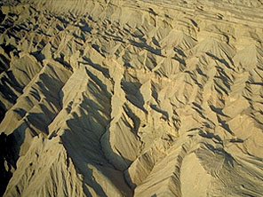
2 Thessalonians
216
Tribulation Corrections
Dr. Rick Griffith • Jordan Evangelical Theological Seminary • BibleStudyDownloads.org
Notes:
Paul had encouraged the Thessalonian church in their suffering by giving them the hope of Christ's return. But within a year, Paul received word that they had misunderstood him.

Slide 2
Key Word
211
Tribulation
2 Thessalonians
Notes:
The Thessalonians misunderstood Paul's teaching about a Pre-Tribulational Rapture to the extent that they thought that they were already in the 7-year Tribulation of Daniel 9:27.

Slide 3
Theme
23
Tribulation Corrections
2 Thessalonians
Notes:
So, Paul wrote to them a second time, probably only a few months later, to correct their understanding of the Tribulation.
How did Paul correct them?
Or, to make it more personal, how would YOU explain your belief in a pre-trib rapture?

Slide 4
Key Verse
211
"Do not become easily unsettled or alarmed by some prophecy, report or letter supposed to have come from us, saying that the day of the Lord has already come. Don't let anyone deceive you in any way, for that day will not come until the rebellion occurs and the man of lawlessness is revealed, the man doomed to destruction"
(2:2-3).
2 Thessalonians
Notes:
The "day of the Lord" refers to the time period when God's wrath will be unleashed on the earth. It is also called the Tribulation period. Someone apparently told the Thessalonians that their suffering for Christ meant they were in the 7-year period, so Paul explained that the Tribulation could not begin until (1) there was a worldwide rebellion (apostasy) within the Church, and (2) a global leader who was a law unto himself would be identified. A few verses later, in verse 6, he said that the Holy Spirit's restraining influence on the earth (likely through believers) would also need to be removed (presumably in the Rapture).

Slide 5
Summary & Application
2 Thessalonians
211
Summary Statement
The author corrects the persecuted church’s misconception that the day of the Lord (Tribulation) had already begun to exhort perseverance among the disheartened and industry among the idle to help them stand firm in correct doctrine despite false teachers.
Application
Do you study eschatology, believing that it affects your behavior as a Christian?
Notes:
What was the effect of the church's suffering? Thinking they were doomed to further persecution discouraged some and made others lazy. Therefore, Paul noted how his true teaching would give the discouraged perseverance and the lazy industry.

Slide 6

Kingdom Statement
27a
Describing Satan’s kingdom to oppose Jesus, Paul’s clearest description of the Antichrist has three signs (the apostasy, the revelation of the Antichrist, and the removal of the restrainer) that will take place before the tribulation, which could happen days, weeks, or months after the Rapture (2:3-7).
2 Thessalonians
Notes:
Paul clearly shares about Satan's alternate kingdom through a world ruler to come:
2Th. 2:3 Don’t be fooled by what they say. For that day will not come until there is a great rebellion against God and the man of lawlessness is revealed—the one who brings destruction. ⁴ He will exalt himself and defy everything that people call god and every object of worship. He will even sit in the temple of God, claiming that he himself is God.
2Th. 2:5 Don’t you remember that I told you about all this when I was with you? ⁶ And you know what is holding him back, for he can be revealed only when his time comes. ⁷ For this lawlessness is already at work secretly, and it will remain secret until the one who is holding it back steps out of the way.

Slide 7
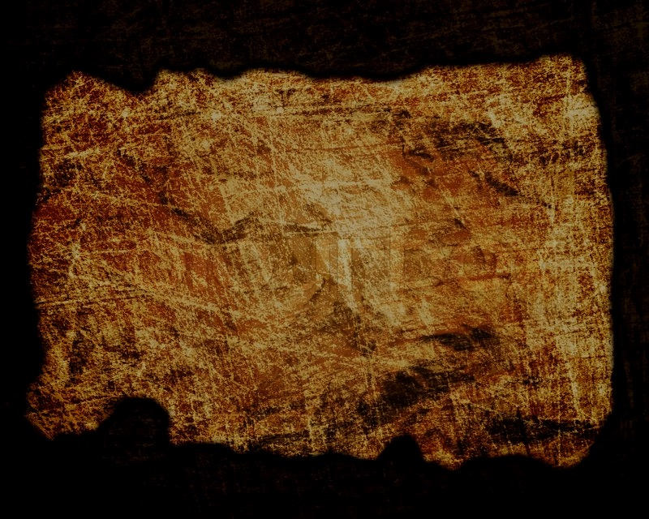
Covenant
27a
The Day of the LORD (cf. Isa. 13:6, 9; Joel 1–2; Zeph. 1:14-16) promised defeat of Israel’s enemies. Based on this, Paul encouraged perseverance based on their future reward at the day of the Lord (ch. 1) and corrected their false notion of the day of the Lord (ch. 2) that had resulted in idleness (ch. 3).
2 Thessalonians
Notes:
Covenants are based on promises, so God promises a new covenant of blessing once his enemies are vanquished at the beginning of the day of the Lord.

Slide 8
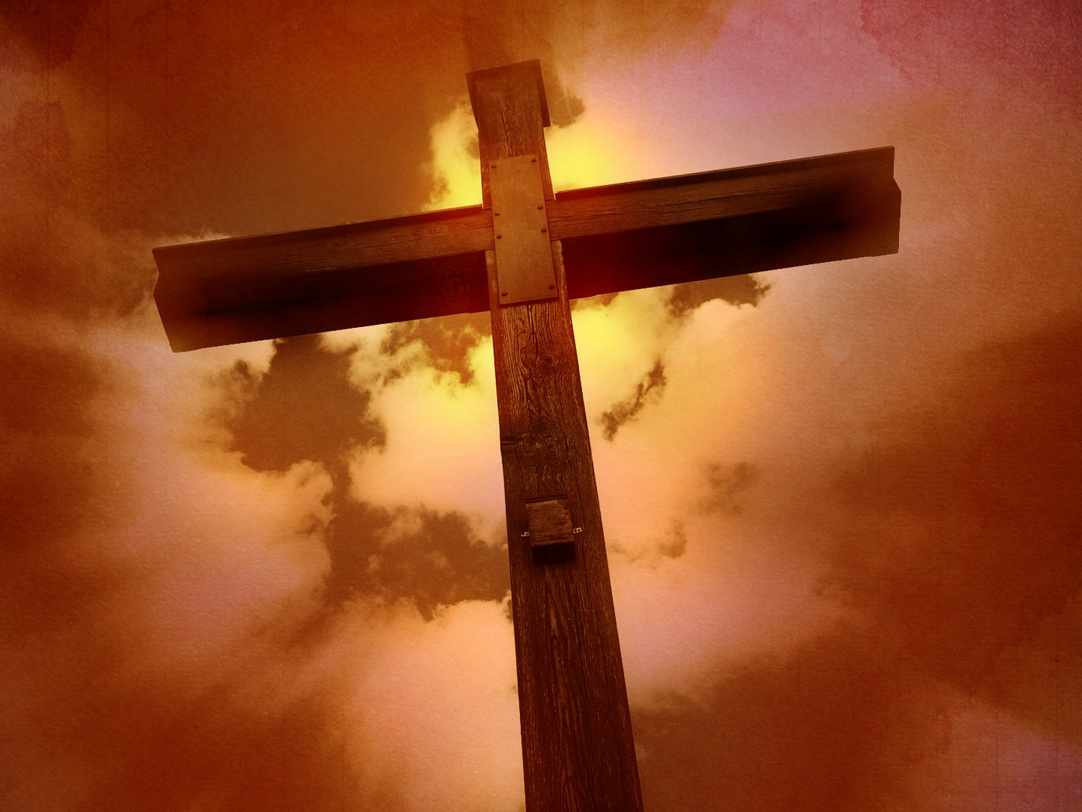
Redemption
27a
The Savior is called “Jesus” 13 times in three short chapters of only 47 verses (Elwell & Yarbrough, Encountering the New Testament, 332), where his deliverance from sin (1:1, 8) also delivers from judgment (1:7-8; 2:8).
2 Thessalonians
Notes:
The Tribulation means judgment for the godless, but salvation for those who trust in Jesus.

Slide 9
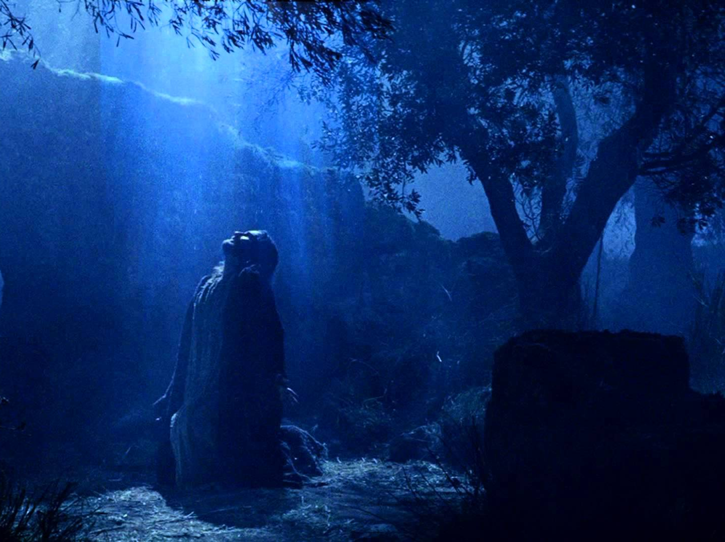
Prophecy
(Lord, Deity)
27a
Our Master is called “Lord” 22 times in three short chapters of only 47 verses (Elwell & Yarbrough, Encountering the New Testament, 332), emphasizing his authority/power (1:7; 2:8) and deity as he is equal with the Father (1:12).
2 Thessalonians
Notes:
Jesus Christ could not judge the world unless he has the authority to do so. But since he is King of Kings and Lord of Lords, rendering judgment is one of his key roles.

Slide 10
Book Chart
Persevere in Persecution |  | Day Still Future |  |  | Discipline the Idle
Chapter 1 |  | Chapter 2 |  |  | Chapter 3
Emotional |  | Theological |  |  | Practical
Encouragement in Persecution |  | Explanation of the Day |  |  | Exhortation in Body Life
Discouraged Believers |  | Disturbed Believers |  |  | Disobedient Believers
Correction of Perspective |  | Correction of Doctrine |  |  | Correction of Behaviour
Salutation | Judgment v. Reward | Pretrib-ulational Teaching | Antichrist Prerequisite | Stand Firm | Prayer Requests | Discipline Idle | Blessing Given
1:1-2 | 1:3-12 | 2:1-2 | 2:3-12 | 2:13-17 | 3:1-5 | 3:6-15 | 3:16-18
Corinth
AD 51
2 Thessalonians:
Tribulation Corrections
211
Notes:
The threefold outline explains how God affirmed the church through Paul. The focus of the letter is the central chapter, where he corrects their understanding by reaffirming a pre-trib rapture, as he did in 1 Thess 1:10; 4:13-18.
________
NS-14-2 Thess-10, 142

Slide 11
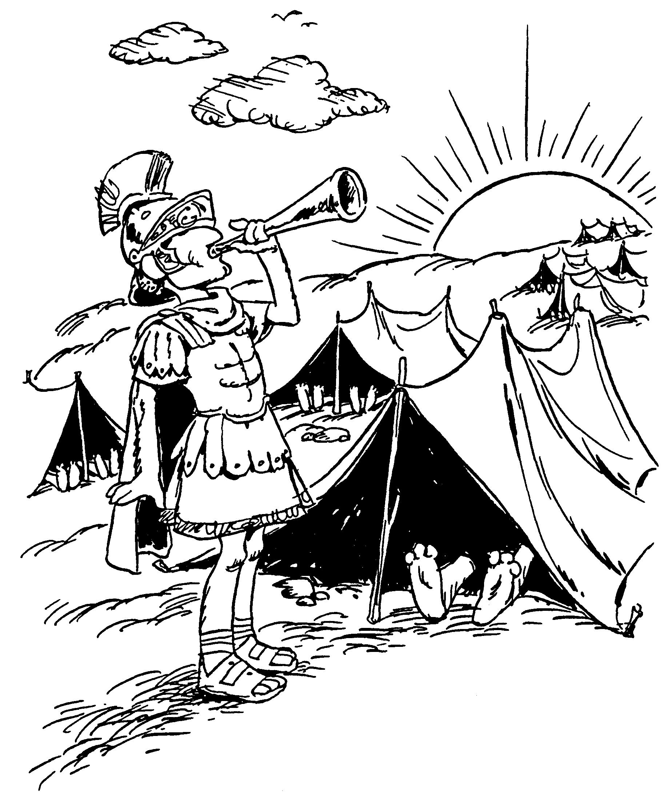
SECOND THESSALONIANS
1
2
3
Description of Thessalonians' faith
Apostasy in last days
Yield fruit through work
Barry Huddleston, The Acrostic Bible
Notes:
The short word "day" conveniently sums up the book's central theme: the period when God will bring retribution on a world in rebellion against him.

Slide 12
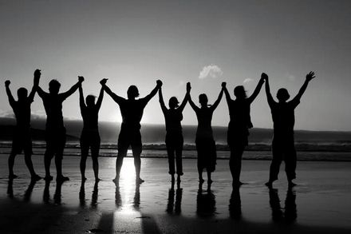
Be Affirmed
2 Thessalonians
Dr. Rick Griffith • Crossroads International Church Singapore
BibleStudyDownloads.org
Notes:
The flip side of judgment on God's enemies is his affirmation of his friends. Paul taught both in this short letter. Affirmation means encouragement to be firm in our faith.
————————
NS-14-2Thess-12, 35

Slide 13


Is self affirmation enough?
WHO IS THE MOST AWESOME PERSON TODAY?
2 Thessalonians
I LOVE MYSELF UNCONDITIONALLY
Notes:
Does self-affirmation really work?
Is our view of ourselves the best standard to assess our worth?

Slide 14

How does God affirm us when we face tough times?
3 ways…
2 Thessalonians
Notes:
We should trust God's view of us more than others' views or our own self-perception. What does he say about us that we can hold onto during difficulty?

Slide 15

God affirms holistically
(Main Idea of 2 Thessalonians)
How God affirms…
Emotions
1
Theology
2
Practice
3
Notes:
Restated: He is not incomplete or piecemeal in his ministry to us.
• He touches the heart (emotionally),
• the head/mind (theologically),
• and the hands (practically).
The Lord restores the whole person (MI restated).

Slide 16


I. Emotionally: God gives perseverance to bring maturity (2 Thess 1).
How does God affirm us during difficulty?
Notes:
The Lord helps us avoid losing heart, so we will grow.
• He affirms us in the HEART.

Slide 17

II. Theologically: God gives us truth to bring stability (2 Thess 2).
How does God affirm us during difficulty?
Notes:
Doctrine matters! The Lord corrects our misconceptions to give us a firm footing.
He affirms us in the HEAD.

Slide 18
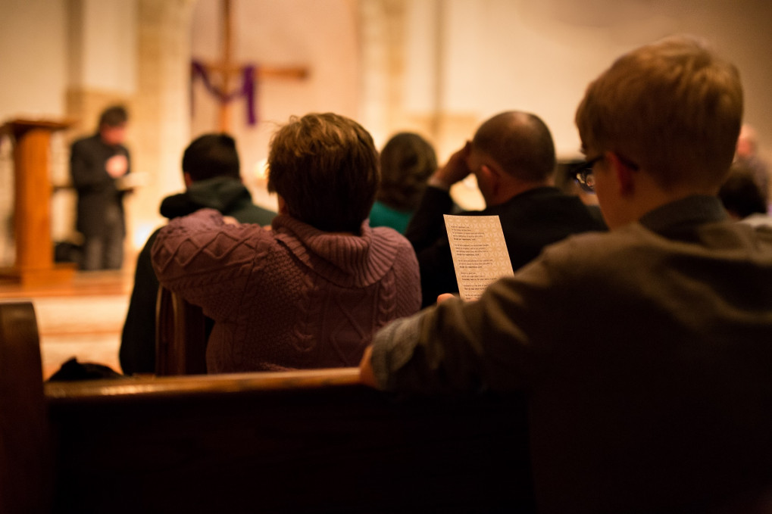
III. Practically: God cultivates discipline in us to build responsibility (2 Thess 3).
How does God affirm us during difficulty?
Notes:
The Lord helps us gain self-control so we will be reliable.
• God affirms our HANDS. Rather than living an undisciplined life, we must show discipline to learn certain skills, such as playing an instrument.
• So we need that same type of discipline to know His Word, and this happens by being a vital part of his church.

Slide 19
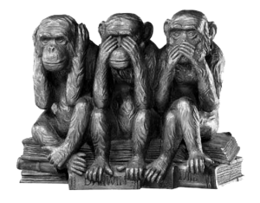
How are you doing in affirming others?
2 Thessalonians
Notes:
The three monkeys depict three ways to try to evade responsibility to affirm others:
—Hear no evil: We may not listen to others to avoid hearing the wrong thing, but then we also won't help them.
—See no evil: We won't see people's problems if we close our eyes to them, but then we won't see how to help them.
—Speak no evil: We shouldn't speak evil to others, but saying nothing at all may not be best, either.

Slide 20
Black
Notes:
20

Slide 21
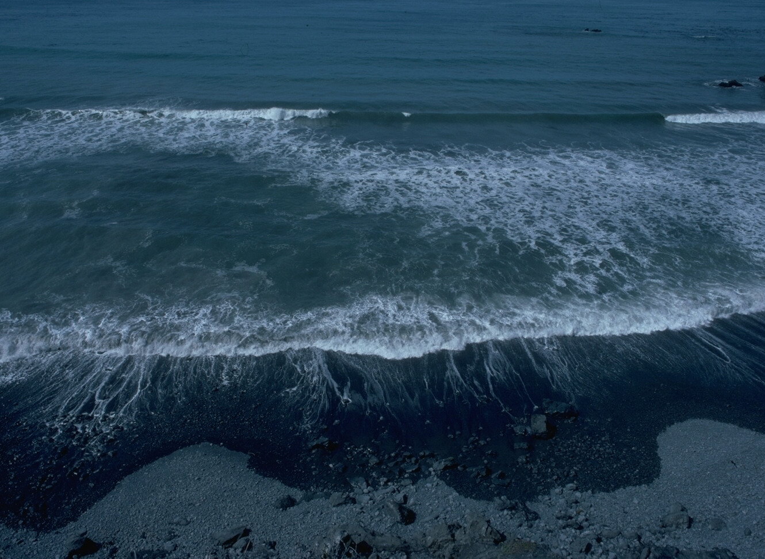
It is Well With My Soul
When peace like a river,
attendeth my way,
when sorrows like sea billows roll-
Whatever my lot,
Thou hast taught me to say,
It is well, it is well with my soul.
It is well with my soul,
It is well, it is well with my soul.

Slide 22

It is Well With My Soul
My sin—O the bliss of this glorious thought—
My sin—not in part, but the whole—
is nailed to the cross
and I bear it no more,
Praise the Lord, praise the Lord,
O my soul!
It is well with my soul,
It is well, it is well with my soul.

Slide 23
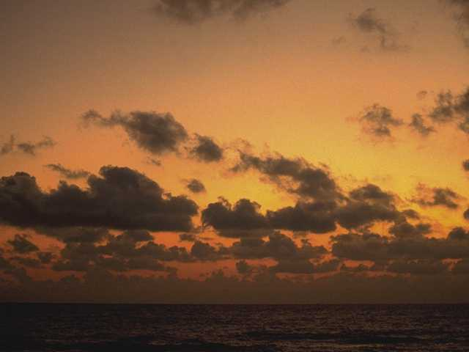
It is Well With My Soul 3
And, Lord, haste the day
when my faith shall be sight,
the clouds be rolled back as a scroll:
the trump shall resound
and the Lord shall descend,
"Even so"- it is well with my soul.
It is well with my soul,
It is well, it is well with my soul.

Slide 24
NT Book Key Words
24
Date | Book | Key Word | Paul's Life | Key Doctrine
40s | Matthew | Kingdom |  | Ecclesiology
44-47 | James | Works |  | Soteriology
49 | Galatians | Justification | 1st journey | Soteriology
51 | 1 Thessalonians | Rapture | 2nd journey | Eschatology
51 | 2 Thessalonians | Tribulation | 2nd journey | Eschatology
56 | 1 Corinthians | Sanctification | 3rd journey | Ecclesiology
56 | 2 Corinthians | Apostleship | 3rd journey | Ecclesiology
56-57 | Romans | Righteousness | 3rd journey | Soteriology
57-59 | Luke | Sovereignty I |  | Missiology

Slide 25
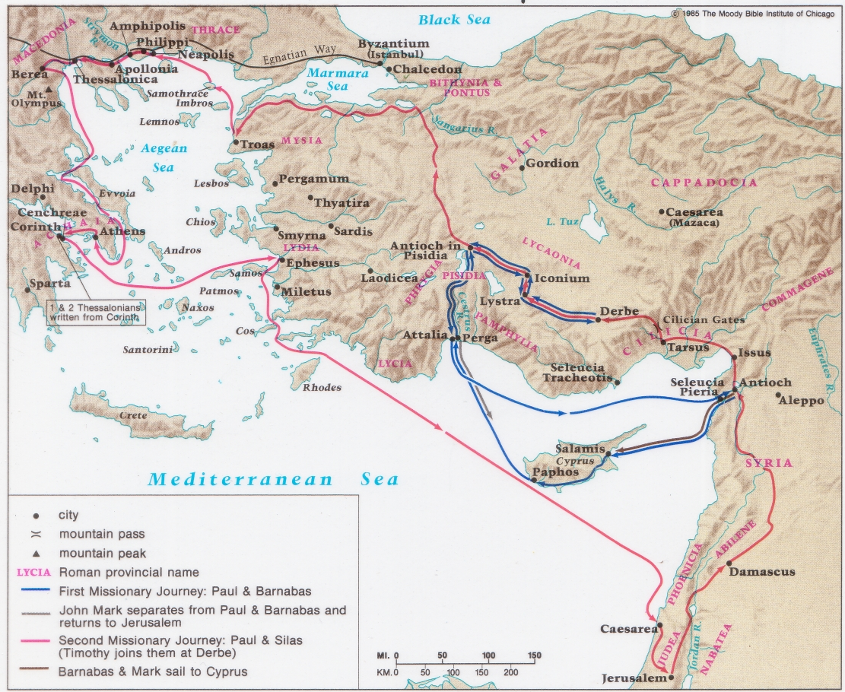
Paul's First & Second Missionary Journeys
138-39

Slide 26
Paul's Advice to Troubled Thessalonians: Focus on God!
215
Focus on God in the Thessalonian Epistles
Total Verses | "God" | "Jesus" | "Lord" | "Christ" | Total
1 Thess. (89) | 36 | 16 | 24 | 10 | 86
2 Thess. (47) | 18 | 13 | 22 | 10 | 63
Total (136) | 54 | 29 | 46 | 20 | 149
Number of Greek occurrences from Elwell & Yarbrough,
Encountering the New Testament, 332

Slide 27
Theological Themes
216
The Day of YHWH
Concept that appears in every prophetic writing in the OT
In Zephaniah:
The Day of YHWH is noted 23 times in 3 chapters
Variations: "The Day of YHWH," "Day," etc.
"The Day" is
  a. Imminent (1:14)
  b. Day of terror (1:15)
  c. Judgment for sins (1:17)
  d. Universal judgment (1:2-3, 2:4-15; 3:8)
  e. Great convulsion of nature (1:15)
  f. Remnant redeemed (3:16-17)

Slide 28
Author
212
External Evidence
Support for Pauline authorship has been upheld "very probably" since Polycarp and possibly earlier with Ignatius. To this is added the Marcion Canon and Muratorian Canon, as well as the testimony of the early Church Fathers and ancient versions.
Internal Evidence supports Paul:
1. It claims to be by Paul (1:1; 3:17).
2. The premature ending (3:1-5) suits Paul more than a conscious imitator.
3. Similarities to 1 Thessalonians cited by some critics against Paul's authorship actually support it.
4. Critics claim discrepancies between the eschatologies of 2 Thess 2:1-12 and 1 Thess 4:13–5:11, but these differences point to two different phases of the parousia.

Slide 29
Author
212
External Evidence
Support for Pauline authorship has been upheld "very probably" since Polycarp and possibly earlier with Ignatius. To this is added the Marcion Canon and Muratorian Canon, as well as the testimony of the early Church Fathers and ancient versions.
Internal Evidence supports Paul:
1. It claims to be by Paul (1:1; 3:17).
2. The premature ending (3:1-5) suits Paul more than a conscious imitator.
3. Similarities to 1 Thessalonians cited by some critics against Paul's authorship actually support it.
4. Critics claim discrepancies between the eschatologies of 2 Thess 2:1-12 and 1 Thess 4:13–5:11, but these differences point to two different phases of the parousia.
Conclusion
The attacks upon Pauline authorship have been soundly defeated so that nearly all scholars, despite their critical assumptions, believe that Paul penned this epistle.

Slide 30
Date
212
Paul wrote 2 Thessalonians in the summer AD 51 (a few months after his first letter). The following supports this:
1. Paul, Silas, and Timothy (1:1) are not known to have been together again after their stay in Corinth.
2. The same general conditions exist in the church as in 1 Thessalonians ( cf. 1 Thess. 4:11-12; 2 Thess. 3:6-15).
3. These men apparently stayed in Corinth another year.
At the very latest, the second letter precedes Paul's visit to them five years later.

Slide 31
From Where to Where?
Recipients
To the Thessalonian believers north of him in the province of Macedonia
212
Origin
Paul wrote from Corinth

Slide 32
NT Overview (Paul's Letters)
38
124
39-41
"To the remotest part of the earth" (Acts 1:8)
Acts 9 13 14 15 16 18 21 27 28
Apr 48-
Sep 49
1
Galatia
Apr 50-
Sep 52
2
Aegean
Spr 53-
May 57
3
Asia
Feb 60-
Mar 62
1
Rome
Spr 62-
Fall 67
4
Spain
Aut 67-
Spr 68
2
Rome
Summer 35-
37
Damascus
Antioch
May 57-
Aug 59
Trials
Fall 49
The
Council
Spring 68
Expansion of Church
35 48 49 50 52 53 57 60 62 67 68 95
Matt
Luke
Acts
Mark
John
Gal
1 Thess
2 Thess
Gospels & Acts
Pauline Epistles
1234
Journeys
Rome
Imprisonments
Pauline

Slide 33
Synthesis
214
1 Emotionally: Persevere in persecution
2 Theologically: Day still future
3 Practically: Discipline the idle

Slide 34
Outline
214-215
I. (Ch. 1) Paul encourages the Thessalonian believers to continue to persevere in light of their persecutors' judgment at the day of the Lord to demonstrate his deep concern for the disheartened among them.
II. (Ch. 2) Paul corrects the Thessalonians' misconception from false teachers that the day of the Lord had already occurred by teaching that the Antichrist must be revealed first to enable the church to stand firm in correct doctrine.
III. (Ch. 3) Paul warns the church to discipline idle believers who live off other's work as they "wait for the rapture" to shame them into responsible behavior which is evident in Paul and his companions.

Slide 35
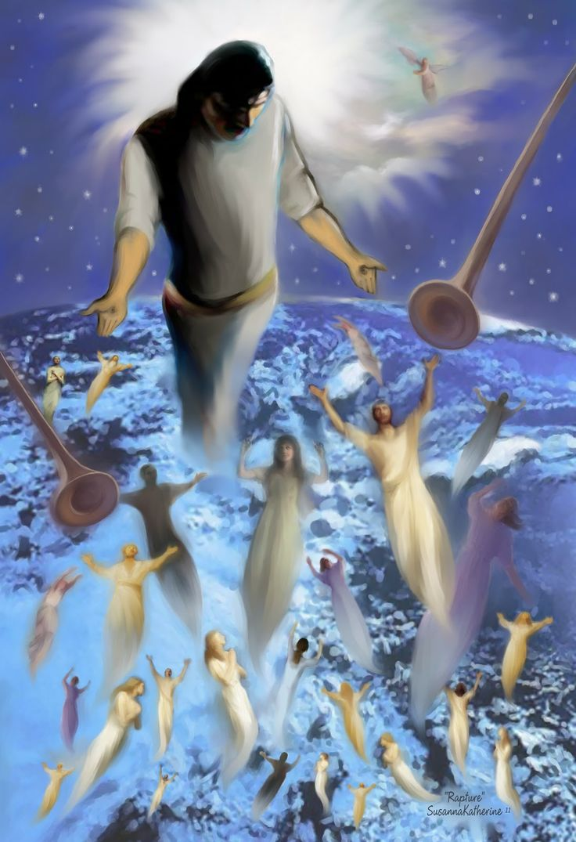
Main Idea of
1 Thessalonians 4:13-18
The Rapture gives hope and encouragement that he will come for you.
Notes:
Knowing that Jesus will return to deliver you from God's wrath enables you look to the future with confidence!

Slide 36
Premillennialism
208
433
Second Coming
Second
=
Advent
Tribulation
Millennium
Church Age
Eternal Kingdom
7 years
1000 years
ALL 5 RAPTURE VIEWS ARE PREMILLENNIAL
Judgment
Notes:
There are 5 Rapture views but only 3 are popular.

Slide 37
Dispensationalism
208
339e
Second Coming
Israel
Church Age
Tribulation
Millennium
Eternal Kingdom
7 years
1000 years
Judgment
Notes:
Dispensationalism is a system of theology that distinguishes between Israel and the Church. Therefore, it rightfully sees the present Church Age as distinct from the 7-year Tribulation to come which God will use to bring Israel to repentance so a believing Israel will enter the Millennium to fulfill God's promises.

Slide 38
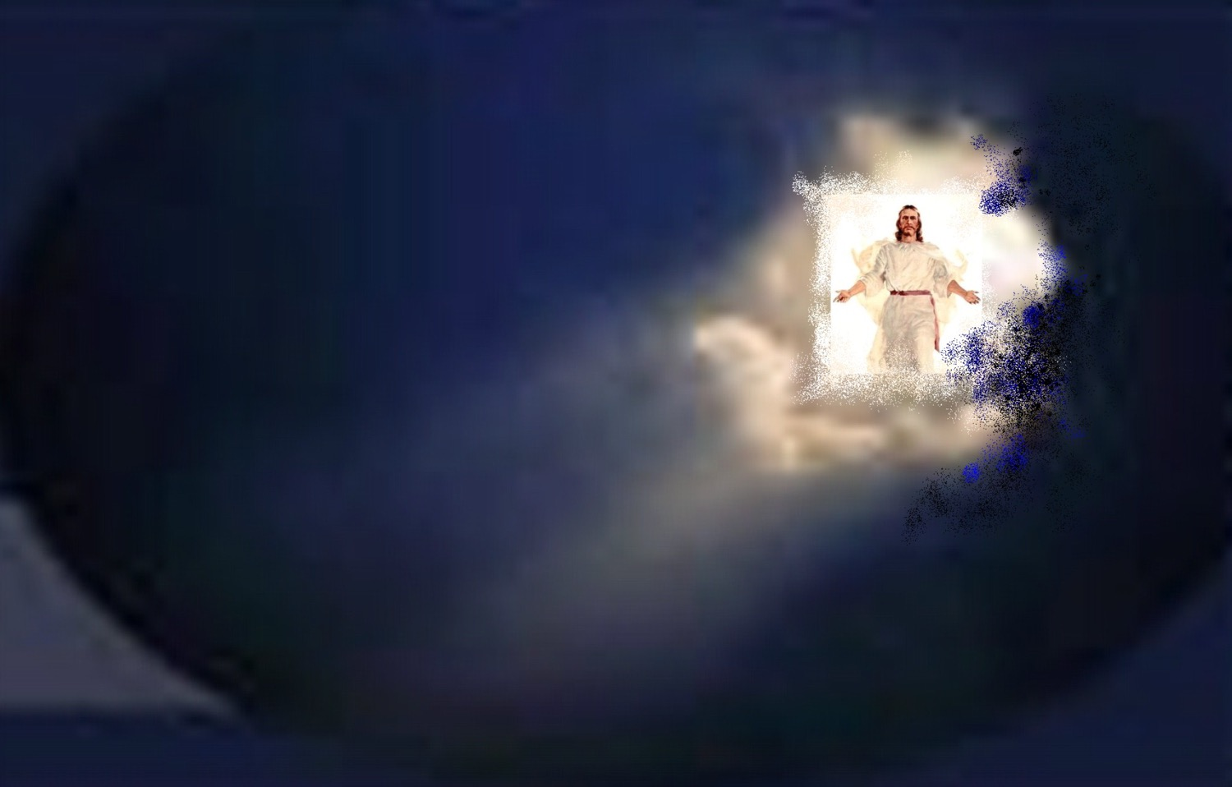
When will the Rapture occur?
Notes:
But at what time will Jesus return to take his Church?

Slide 39
"Pre-Trib" Rapture
208
Second Coming
Rapture
Tribulation
Millennium
Church Age
Eternal Kingdom
7 years
1000 years
Judgment
Notes:
The Pre-Tribulation Rapture is a Premillennial view that sees Jesus coming in two phases: first, before the Tribulation to remove his saints, and second, after this period to reign in the millennium on earth. This is the most popular view of the Rapture that sees 7 years between Jesus returning to take his Church and Jesus returning to bring in the Millennium.
_________
Common-329
ES-24-1 Thess4—slide 13
NS-13-1Thess—181
OS-38-Zechariah-166
NS-27-Rev3-slide 128
NS-27-Rev20-22-slide 85

Slide 40
Why Am I Pretrib?
209
Believers will be kept from (ἐκ) this "hour," or time period (Rev. 3:10)
Notes:
________________
NS-13-1Thess
NS-14-2Thess
27-Rev20-22—slide 40

Slide 41
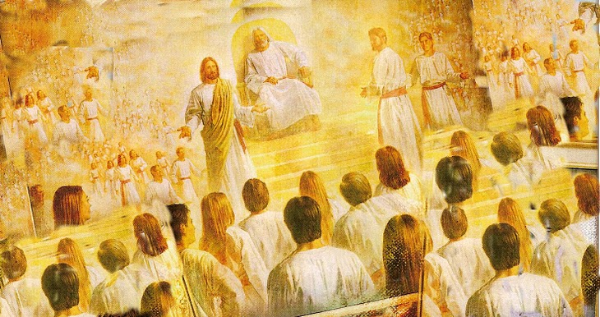
Christ promises honor before enemies (Rev 3:9).
"I have given you an open door that no one can shut" (3:8)
"Look, I will force those who belong to Satan’s synagogue—those liars who say they are Jews but are not—to come and bow down at your feet. They will acknowledge that you are the ones I love."

Slide 42
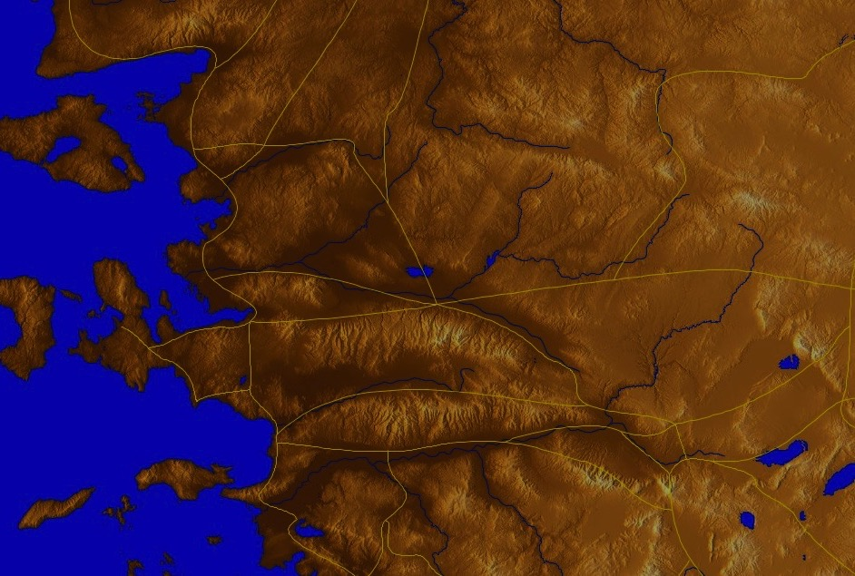
Philadelphia (Rev. 3:7-13)
57
Promise
Christ promised Philadelphia believers benefits for their perseverance (3:9-13)
Warning
None
Pergamum
Thyatira
Exhortation
Hold on to what you have
Rebuke
None!
Commendation:
Deeds, keeps Christ's word and does not deny His name, endures patiently
Christ:
Holy and true, holds the key of David
Smyrna
Sardis
Ephesus
Philadelphia
Laodicea

Slide 43
"Pre-Trib" Rapture
209
Second Coming
1. "I will keep you from (ἐκ) the hour of testing that will come upon the whole world, to test those who dwell upon the earth"
(Rev. 3:10)
Rapture
Tribulation
Millennium
Church Age
Eternal Kingdom
7 years
1000 years
Judgment

Slide 44
Deliverance from the Tribulation
57
Second Coming
Israel
Church Age
Tribulation
Millennium
Eternal Kingdom
7 years
1000 years
Judgment

Slide 45


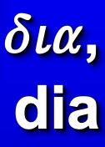

Greek Prepositions
209
"from, out of, away from"
"around"
"through"
"into"
Notes:
"Frequently, but not always, ek means from within, while apo means from in a more general way (e.g., from the outside of, from the vicinity of)" (Eugene Van Ness Goetchius, The Language of the New Testament [New York: Charles Schribner's Sons, 1965], 151).

Slide 46
"Pre-Trib" Rapture
209
Rapture
1. "I will keep you from (ἐκ) the hour of testing that will come upon the whole world, to test those who dwell upon the earth"
(Rev. 3:10)
Second Coming
"from, out of, away from"
Tribulation
Millennium
Church Age
"through"
Eternal Kingdom
7 years
1000 years
"into"
Judgment
Notes:
"Frequently, but not always, e,k means from within, while e,k means from in a more general way (e.g., from he outside of, form the vicinity of)" (Eugene Van Ness Goetchius, The Language of the New Testament [New York: Charles Schribner's Sons, 1965], 151).

Slide 47

The Only Other NT Occurrence of "Keep From" (thre,w e,k)
209
The idea of being taken out of the world relates to being removed from the world
1. "I do not ask you to take them out of (ἐκ) the world, but to keep them from (ἐκ) the evil one"
(John 17:15)
sphere of "the evil one"
"from, out of, away from"
Not kept in Satan's sphere
parallels
not kept in Tribulation Period
Notes:
"Frequently, but not always, e,k means from within, while e,k means from in a more general way (e.g., from he outside of, form the vicinity of)" (Eugene Van Ness Goetchius, The Language of the New Testament [New York: Charles Schribner's Sons, 1965], 151).

Slide 48
"Pre-Trib" Rapture
209
Second Coming
2. "I will keep you from (ἐκ) the hour of testing that will come upon the whole world, to test those who dwell upon the earth"
(Rev. 3:10)
Rapture
Tribulation
Millennium
Church Age
Eternal Kingdom
7 years
1000 years
Each time this "phrase occurs… the enemies of the church are always in mind"
—Mounce, 120
Judgment

Slide 49



Why Am I Pretrib?
209
Believers will be kept from (evk) this "hour," or time period (Rev. 3:10)
The Tribulation tests unbelievers (3:10) under God's wrath (6:16-17)
The Holy Spirit's work of restraining evil will be absent (2 Thess. 2:6-7).
to. kate,c on ("what restrains" = neuter, 2:6 = gospel preaching)
("he who restrains" = masculine, 2:7 = a person)
("Spirit" = neuter noun but used of a person)

Slide 50
Why Am I Pretrib?
209
4. The church is never mentioned in the Tribulation chapters (Rev. 4–19) except as the "tabernacle of God" in heaven (13:6; cf. Eph. 2:21-22)
5. The Church will never come under God's wrath (John 5:24, Rom. 5:9; 8:1; 1 Thess. 1:10; 5:9). Persecution and wrath are completely different!

Slide 51
"Pre-Trib" Rapture
209
Second Coming
5. The Church will never come under God's wrath:
• John 5:24
• Rom. 5:9; 8:1
• 1 Thess. 1:10; 5:9
• Rev. 6:15-17
• Rev. 11:18
• Rev. 14:10, 19
Rapture
Tribulation
Millennium
Church Age
Eternal Kingdom
7 years
1000 years
Judgment

Slide 52
Why Am I Pretrib?
209
6. The Rapture is imminent ("can happen at any time"), so it must also be pretribulational:
a. "…the day of the Lord will come like a thief in the night" (1 Thess. 5:2)
b. "I will come back and take you to be with me" (John 14:3) = "I am coming" in immediate future without signs
c. James 5:8-9; Tit. 2:13; Heb. 9:28; 1 Pet. 1:6-7; 1 John 2:28; 3:2-3; Rev. 22:10, 12
Notes:
52

Slide 53
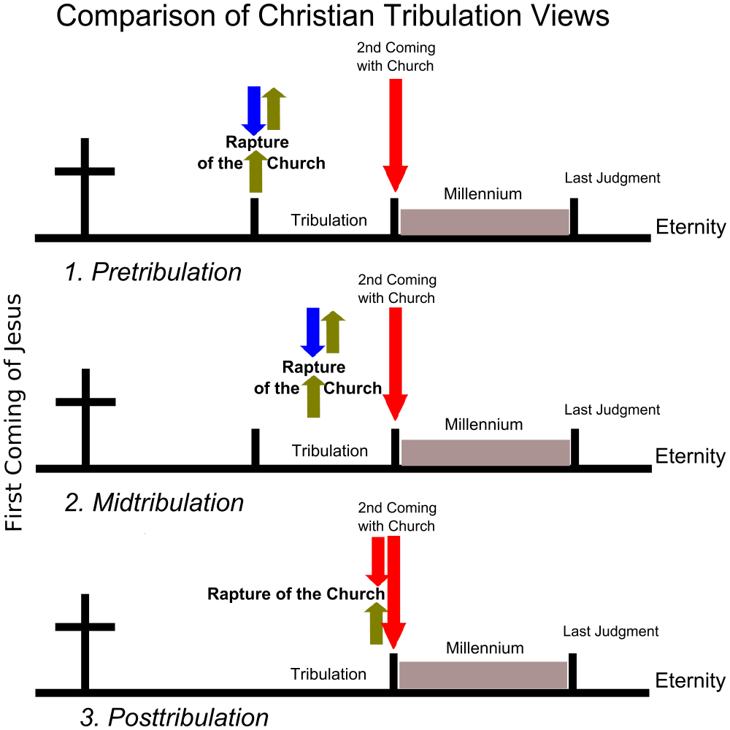
The Main Tribulation Views
Second Coming
with Church
Rapture of the Church
Millennium
Last Judgment
Tribulation
Eternity
1. Pretribulation
Second Coming
with Church
Rapture of the Church
First Coming of Jesus
Last Judgment
Millennium
Tribulation
Eternity
2. Midtribulation
Second Coming
with Church
Rapture of the Church
Millennium
Last Judgment
Tribulation
Eternity
3. Posttribulation
Notes:
Two views are not surveyed: the Partial Rapture and the Prewrath Rapture views. Neither one has convinced many people.

Slide 54
"Pre-Trib" Rapture
209
361
Second Coming
Rapture
Tribulation
Millennium
Church Age
Eternal Kingdom
7 years
1000 years
Judgment
Notes:
This is the most popular Rapture view.

Slide 55
Stages of the Second Coming
210
 | The Rapture | The Revelation
1 | Pretribulational (Rev. 3:10) | Posttribulational (Rev. 19:11-21)
2 | Christ will come in the air (1 Thess. 4:16) | Christ will come to the earth, His feet touching the Mt. of Olives (Zech 14:4)
3 | A coming for the saints (John 14:1-2; 1 Thess. 4:15-17) | A coming with the saints (Matt. 25:31; 1 Thess. 3:13; Rev. 19:14)
4 | Saints (dead and alive) will be caught up ("raptured") from the earth to meet the Lord in the air and taken to heaven (1 Thess. 4:16-17) | Saints already on earth will remain on the earth (no Rapture) to be ushered into the Millennium (Acts 15:16; Rev. 5:10; cf. Matt. 4:10; chap. 24)
5 | Produces comfort and hope (1 Thess. 4:18) | Produces fear and judgment (Matt. 24:27-31; Luke 21:20-28; Rev. 4:15-17)
Notes:
Despite their similarities, several contrasts exist between the Rapture and the Revelation (adapted and expanded from Charles F. Baker, A Dispensational Theology, 584-86).

Slide 56
Stages of the Second Coming
210
 | The Rapture | The Revelation
6 | Mystery truth revealed only in the New Testament age (1 Cor. 15:51) | Central in OT prophecy but clarified in the NT (Jer. 30:7; Zech 14:1-3; Matt. 24:30; Col. 3:4)
7 | Bodies of church saints glorified (1 Cor. 15:51-58; Phil. 3:20-21) and brought to heaven for seven years (1 Thess. 4:17) | Bodies of tribulation saints left in mortal state to continue to live on the earth in the millennium (Matt. 25:31-34)
8 | Imminent, no signs needed (1 Thess. 4:16) | Not imminent but preceded by spectacular signs in the heavens and on the earth (Matt. 24:29-31; Luke 21:25-28; Acts 2:19-21; Rev. 1:7; chs. 6-19)
9 | Primary purpose is deliverance of the saints from this world (1 Thess. 1:10) | Primary purpose is judgment of unbelieving (Matt. 25:31-46)

Slide 57
Stages of the Second Coming
210
 | The Rapture | The Revelation
10 | Invisible and private as only believers see Christ and since God sends a powerful delusion through the Antichrist (2 Thess. 2:11) | Visible and public since "every eye shall see Him" (Rev. 1:7)
11 | Fulfills a promise to the Church where Jew-Gentile distinctions do not exist (1 Thess. 4:15; cf. John 14:1-3; Eph. 2:11-16) | Fulfills promises to Israel of covenants made in the Old Testament (Gen. 12:1-3; Ps. 89; Isa. 11:11-14; cf. Rom. 11:26-27)
12 | Evil begins to increase (2 Thess. 2:1-12) | Evil is suppressed (2 Thess. 1:7; Ps. 37:9-10)
13 | Church removed (1 Thess. 4:13-18) | Satan removed (Rev. 20:1-3)

Slide 58
Stages of the Second Coming
210
 | The Rapture | The Revelation
14 | Christ shown as Head of the Church and all things (Eph. 1:10, 22; 4:15; Col. 1:18; 2:10) | Christ vindicated as Messiah to Israel (Zech. 14:3-4; cf. Acts 1:6 with v. 11)
15 | Judgment seat of Christ for believers (2 Cor. 5:10; 1 Cor. 3:13) | Judgment of Israel and Gentiles (Ezek. 20:34-38; Matt. 25; Zech. 14:4; cf. p. 160)
16 | The Lord is at hand (Phil. 4:5) | The kingdom is at hand (Matt. 24:14)
17 | Nature subsequently ruined (Rev. 6–16) | Nature subsequently restored (Rom. 8:19-22; Isa. 11:6-9; 35:9; 65:25)

Slide 59
"Mid-Trib" Rapture
208
Second Coming
Rapture
Tribulation
Millennium
Church Age
Eternal Kingdom
7 years
1000 years
Judgment

Slide 60
"Partial" Rapture
208
Second Coming
Raptures
Tribulation
Millennium
Church Age
Eternal Kingdom
7 years
1000 years
Judgment

Slide 61
"Post-Trib" Rapture
208
Second Coming
Rapture
Tribulation
Millennium
Church Age
Eternal Kingdom
7 years
1000 years
Judgment

Slide 62
Why Am I Not Posttrib?
209
8. If posttrib, then sheep would already be separated from goats (Matt. 25:31-46).
9. Some people in the millennium will die (Isa. 65:20), but a posttrib rapture gives a glorified body to all believers; therefore, some people must trust Christ in the Tribulation and enter the Millennium in their mortal bodies.

Slide 63
A "Pre-Trib" Rapture explains how the Millennium will have both babies & death
435
Second Coming
Christians
Rapture
Those remaining
Tribulation
Millennium
Church Age
Eternal Kingdom
7 years
1000 years
At the Rapture, believers will go to heaven and unbelievers remain on earth—the Tribulation will start 0% Christian.
After the Tribulation, believers on earth will enter the Millennium in their mortal bodies—the Millennium will start 100% Christian.
Judgment

Slide 64
"Prewrath" Rapture
208
Pre-Wrath
Rapture
Second Coming
God's
Wrath
(Day of Lord)
Begin-ning of Sor-rows
Great
Tribu-lation
Millennium
Church Age
Eternal Kingdom
Because you have kept my word of patience
I will keep you from the hour (here)
Rapture & Day of Lord follow testing
1000 years
Judgment
7 years

Slide 65
Be Affirmed
2 Thessalonians
Dr. Rick Griffith • Crossroads International Church Singapore
BibleStudyDownloads.org
Notes:
The flip side of judgment on God's enemies is his affirmation of his friends. Paul taught both in this short letter. Affirmation means encouragement to be firm in our faith.
————————
NS-14-2Thess-12, 35

Slide 66
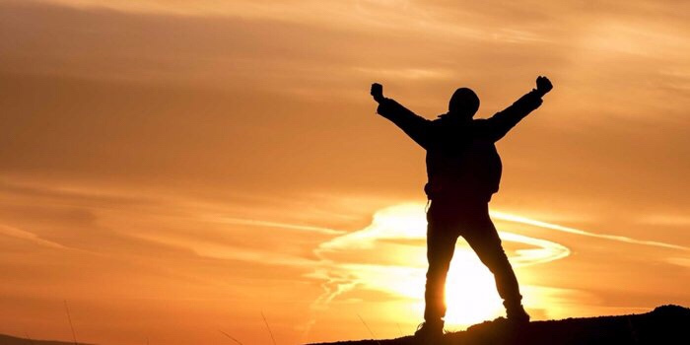
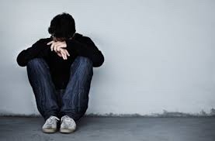
Affirmation
Notes:
Lately I have been thinking a lot about how we all need to be affirmed.
The past two weeks both Susan and I have had the most health issues ever in our 35-year marriage. Last Sunday was the first time we both ever missed church. My voice just wasn’t in shape to preach, I didn’t have the energy, etc. I won’t give you all the details lest it become “an organ recital.”
That’s not what is important. What is more significant is that some of you reached out to us and genuinely affirmed us! Thank you! Susan’s eye operation to correct her double vision did happen and was a success, despite our doubts about it going through with her rapid heartbeat days before the operation. Now, instead of seeing two husbands with her double vision, she is back to having only one husband.

Slide 67

Our Mission
The mission of Crossroads is to reach the nations by reaching internationals residing in Singapore
Notes:
Let’s read this together…

Slide 68
Our Vision
The vision of Crossroads is to lead internationals into a vital relationship with Jesus Christ as disciples who can transform their unique spheres of influence (2 Tim. 2:2). In particular, Crossroads focuses primarily, but not exclusively, on reaching the English-speaking community
Notes:
68
Reading together again…

Slide 69
Our Priorities
Love the Nations
Love the Church
Love God
Notes:
Essentially, our chief priorities all revolve around love—to…
• Love God first and foremost, then…
• Love the church, resulting in…
• Love the nations

Slide 70

Words can affirm
Notes:
Curious about this concept of affirmation, I began looking up the word “affirmation” on Google to see what I could find.
I was surprised to see that nearly everything I saw related to SELF-affirmation! I wonder if anyone is affirming OTHERS anymore!

Slide 71


Self Affirmation
Notes:
Hmmmm, should we approve of everything we do?

Slide 72

Self Affirmation
Notes:
We are told to recite 1000 self-confidence affirmations!

Slide 73


Self Affirmation
Notes:
Some self affirming claims include “I love me.”
Also, I believe in me.

Slide 74


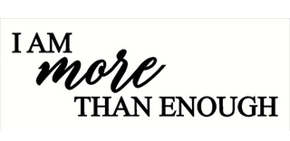
Self Affirmation
Notes:
How about “I am enough”?
Not to be outdone, another has modified it: “I am MORE THAN enough.”
Or "I fill me mind with positive thoughts."

Slide 75
Is self affirmation enough?
WHO IS THE MOST AWESOME PERSON TODAY?
2 Thessalonians
I LOVE MYSELF UNCONDITIONALLY
Notes:
Does self-affirmation really work?

Slide 76

I don’t deserve self-esteem
Notes:
What if a person doubts that he or she deserves self-esteem?

Slide 77
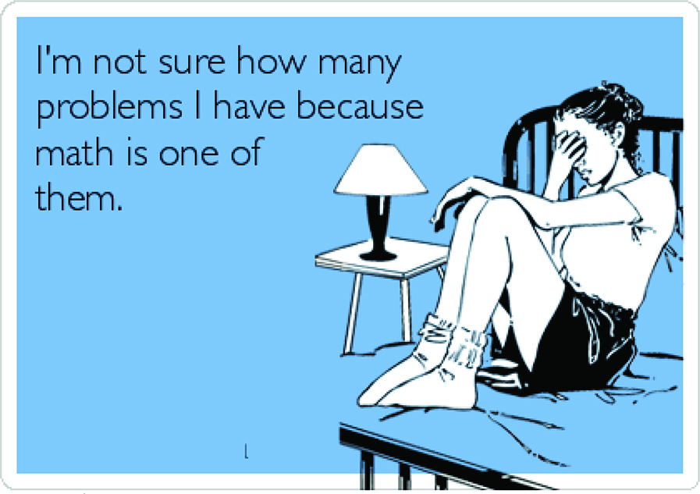
I’m not sure how many problems I have because math is one of them.
Notes:
What do you do if you say, “I am not sure how many problems I have because math is one of them”?
Isn’t it far better for others to praise you than for you to praise yourself?

Slide 78
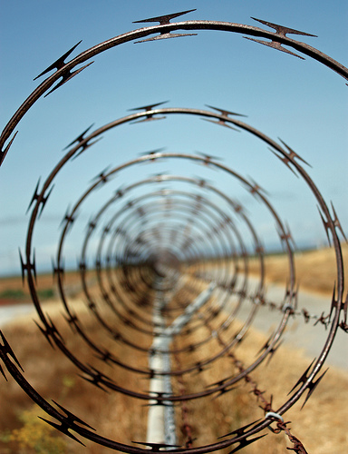
How many of us notice when others are caught in a spiral?
Notes:
Love means seeing needs. I wonder how many of us have eyes to see when others have genuine needs—physical issues are easier to see, but spiritual needs are a greater challenge.
Life goes so fast, it’s tough to take care of ourselves, let alone others. I struggle with this—don’t you? Do you struggle to know how to help those in dire straits? Do you know anyone afflicted in their relationship with their spouse, in financial woe, struggling with children, work, or something else?

Slide 79
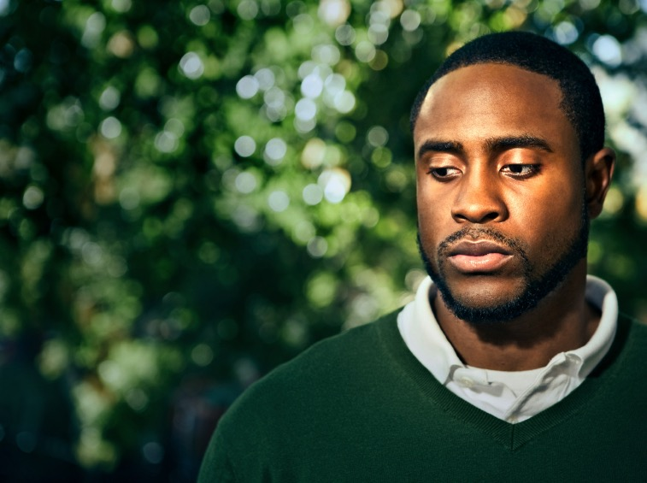
How can you help those going through tough times?
Notes:
How can you help those who are going through tough times? What should you say to ease the pain rather than add to it like Job’s counselors? What do you do to help people in difficulty?

Slide 80
How does God affirm us when we face tough times?
3 ways…
Notes:
Perhaps it’s even better to see how God affirms you and tells you how valuable you are to him?
In what ways do you see him affirming you?

Slide 81
Background to
2 Thessalonians
Notes:
Today, we will look at a church caught in the “winepress of persecution” that had yielded to God, resulting in a fragrant display of God’s grace. The Thessalonians still had “persecutions and trials” about a year after Paul had established the church, but they were bearing under it, though crushed.

Slide 82
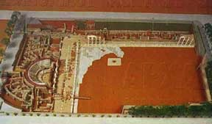
Thessalonica
(now called Salonica or Thessaloniki)
    Founded by the Macedonian General Cassander in 315 BC
A model of ancient Thessalonica
    Named after his wife, Thessalonike, daughter of Philip II and half sister of Alexander the Great
    In 167 BC, it became capital of one of the 4 districts of Macedonia
    In 146 BC, it was made a province and became the seat of provincial administration
    From 42 BC, it was declared a free city, governed by its own politarchs
Notes:
Here’s a church that really had a tough time. Acts 17 fills in the details. It was a strategic port city in northern Greece, well established by Paul’s day

Slide 83
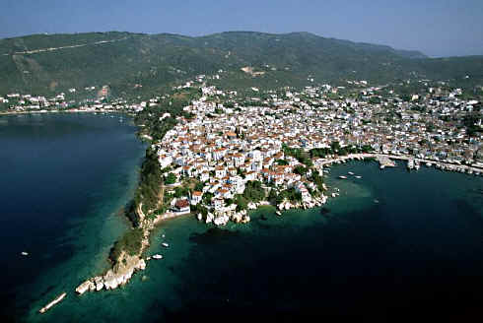
    Port city at the Thermaic Gulf
Notes:
The church was located in northern Greece on a peninsula, serving as a key port city…

Slide 84
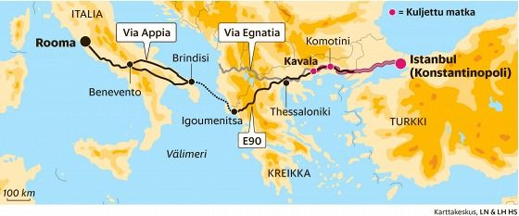
    Port city at the Thermaic Gulf
    Knitted together 26 villages
    Main seaport and naval base of Macedonia
    The Egnatian Way (Via Egnatia) ran through the city
Notes:
…and also on the main east-west land route in the Roman Empire called the Via Egnatia.

Slide 85
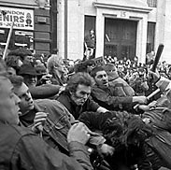
Throw him
in jail!
Down with
Paul!
What to do?...
Notes:
Paul established the Thessalonian church amidst great difficulty. The background is in Acts 17.

Slide 86
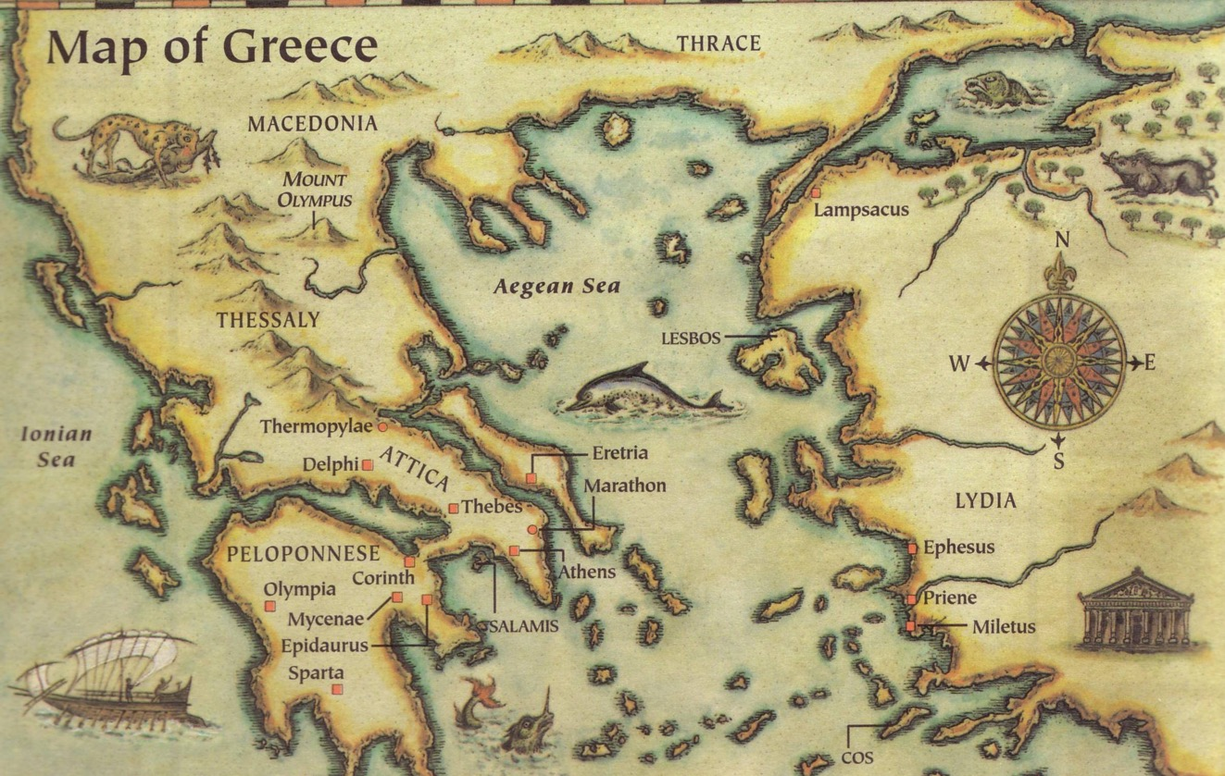
This epistle was written in AD 51
Thessalonica
Berea
Athens
Corinth
Three ways we can encourage others...
Written in Corinth after hearing Tim's report
Notes:
Paul only stayed there about three months, but the Jews who kicked him out over to Berea even followed him to Berea and kicked him out of there, too! Then Paul traveled to Athens but founded no church there. He then came to Corinth in weakness (1 Cor 2:3).
1Cor. 2:3 I came to you in weakness—timid and trembling.
Despite needing encouragement himself, Paul reached out to affirm the suffering Thessalonians.

Slide 87
Occasion
212-213
The historical and chronological scenario for Paul's ministry at Thessalonica on his second missionary journey probably looks like this:
1. Paul plants the Thessalonian church November 50-January 51
2. Paul's ministry in Berea, Athens, and Corinth February-March 51
3. Silas and Timothy report to Paul in Corinth April/May 51
4. Paul writes 1 Thessalonians and sends it from Corinth Early Summer 51
5. The carrier of 1 Thessalonians reports back to Paul Mid Summer 51
6. Paul writes 2 Thessalonians from Corinth Late Summer 51
7. Paul departs Corinth first of September 52
Notes:
Paul wrote these two epistles to the same church probably only months apart.

Slide 88
Occasion
212-213
The historical and chronological scenario for Paul's ministry at Thessalonica on his second missionary journey probably looks like this:
1. Paul plants the Thessalonian church November 50-January 51
2. Paul's ministry in Berea, Athens, and Corinth February-March 51
Within only a few months after writing 1 Thessalonians, Paul received news of problems unresolved by his first letter. Therefore, Paul decided to write the church again to help the believers handle these difficulties.
3. Silas and Timothy report to Paul in Corinth April/May 51
4. Paul writes 1 Thessalonians and sends it from Corinth Early Summer 51
5. The carrier of 1 Thessalonians reports back to Paul Mid Summer 51
6. Paul writes 2 Thessalonians from Corinth Late Summer 51
7. Paul departs Corinth first of September 52
Notes:
Paul wrote these two epistles to the same church probably only months apart.

Slide 89
NT Overview (Paul's Letters)
38
124
39-41
"To the remotest part of the earth" (Acts 1:8)
Acts 9 13 14 15 16 18 21 27 28
Apr 48-
Sep 49
1
Galatia
Apr 50-
Sep 52
2
Aegean
Spr 53-
May 57
3
Asia
Feb 60-
Mar 62
1
Rome
Spr 62-
Fall 67
4
Spain
Aut 67-
Spr 68
2
Rome
Summer 35-
37
Damascus
Antioch
May 57-
Aug 59
Trials
Fall 49
The
Council
Spring 68
Expansion of Church
35 48 49 50 52 53 57 60 62 67 68 95
Matt
Luke
Acts
Mark
John
Gal
1 Thess
2 Thess
Gospels & Acts
Pauline Epistles
1234
Journeys
Rome
Imprisonments
Pauline
Notes:
Even after Paul left, things didn’t get much better. He had already written 1 Thessalonians probably only months before, telling them to continue in a holy lifestyle as they awaited the return of Christ amidst their trials.

Slide 90

Be Prepared
1 Thessalonians
Dr. Rick Griffith • Crossroads International Church Singapore
BibleStudyDownloads.org
Notes:
Paul's first letter to Thessalonica told them to be ready for the Lord's unexpected return.

Slide 91

Our Need
1 Thessalonians
Notes:
At some point in perhaps the not-too-distant future millions of people will just quickly rise to meet the Lord Jesus Christ.

Slide 92
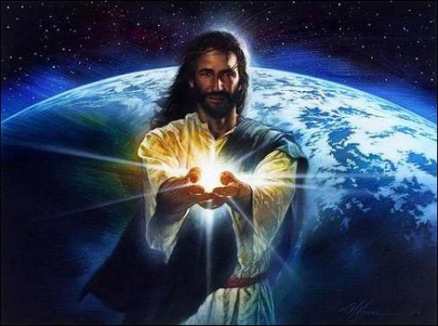
Black
Notes:
Jesus is the focus of his return—not the date, not the circumstances, not us, or anything else!

Slide 93
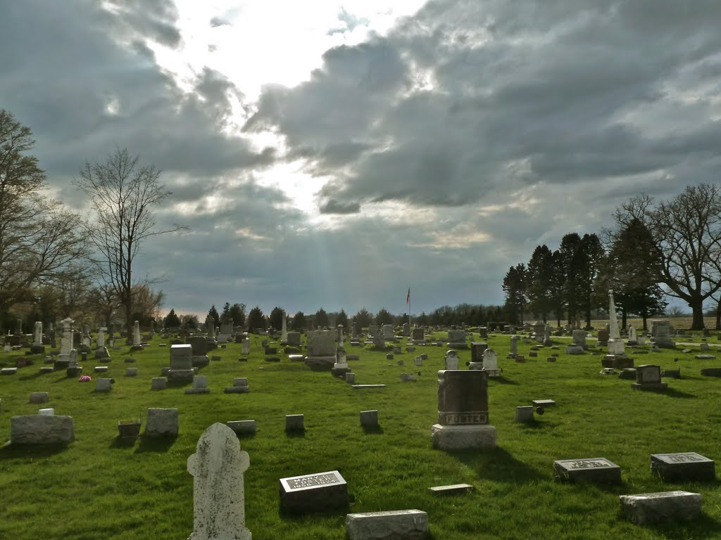
The Rapture
"And now, dear brothers and sisters, we want you to know what will happen to the believers who have died so you will not grieve like people who have no hope. ¹⁴For since we believe that Jesus died and was raised to life again, we also believe that when Jesus returns, God will bring back with him the believers who have died" (1 Thess. 4:13-14 NLT).
Notes:
Paul speaks clearly of this next event on God’s prophetic calendar in 1 Thess 4:13-18…

Slide 94
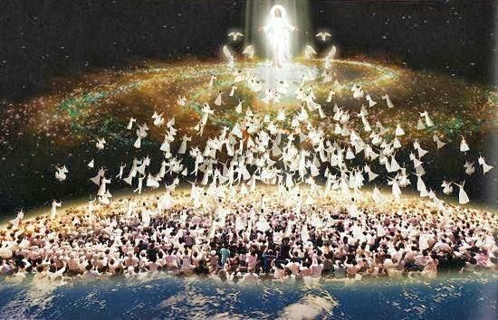
The Rapture
"For the Lord himself will come down from heaven with a commanding shout, with the voice of the archangel, and with the trumpet call of God. First, the Christians who have died will rise from their graves. ¹⁷Then, together with them, we who are still alive and remain on the earth will be caught up in the clouds to meet the Lord in the air. Then we will be with the Lord forever. ¹⁸So encourage each other with these words" (1 Thess. 4:16-18 NLT).
Notes:
We get our term "rapture" from this verb "caught up" here.

Slide 95
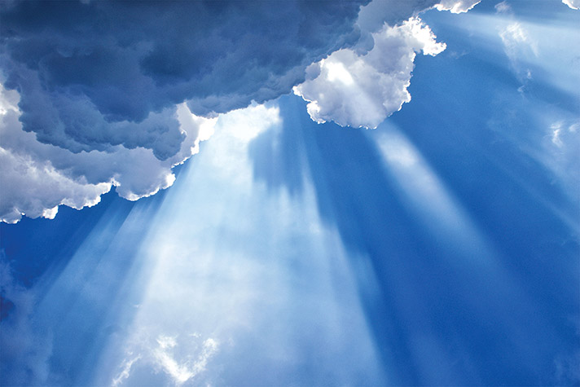
How can you be prepared for the Rapture?
2 ways…
1 Thessalonians
Notes:
What specific ways can you be ready for Jesus when he come back?

Slide 96
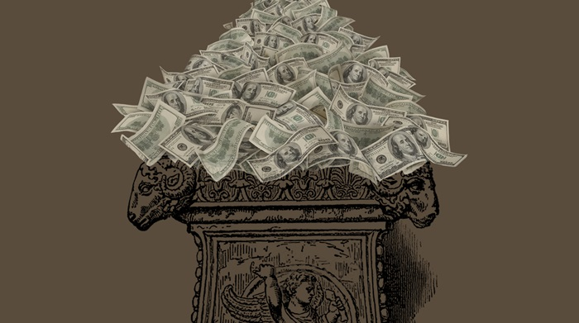
I. Serve Jesus without greed
(Chapters 1–3).
1 Thessalonians
Notes:
Live for Christ as if money is not a big concern.

Slide 97

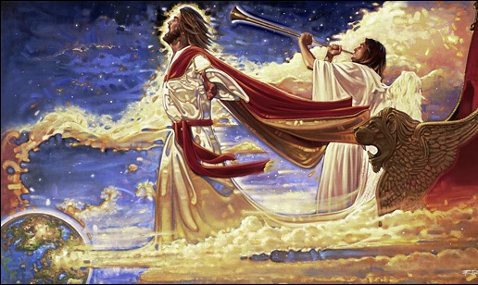
II. Care about both people and theology (Chapters 4–5).
+
1 Thessalonians
Notes:
Doctrine and relationships should occupy much of our time.
In particular, we need a theology of Christ’s second coming.

Slide 98
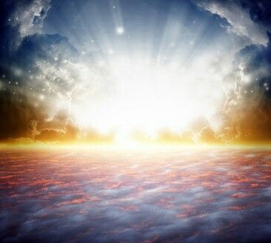
Main Idea
Be prepared for Christ’s return with your money, friends and Bible.
1 Thessalonians
Notes:
We can be ready for Jesus when we properly manage our finances, friends, and Scripture.

Slide 99

We will all give an account
1 Thessalonians
Notes:
Everyone will answer to Jesus alone for their life!

Slide 100

1 Thessalonians 5:2
"like a thief in the night"
Notes:
Do you think your home will be broken into tonight? At his return, Jesus will be as expected as much as you expect a thief to rob your house tonight.
Are you prepared for him to arrive at any time? Is there anything you do that will cause you to be ashamed if he came at that time you do it?

Slide 101
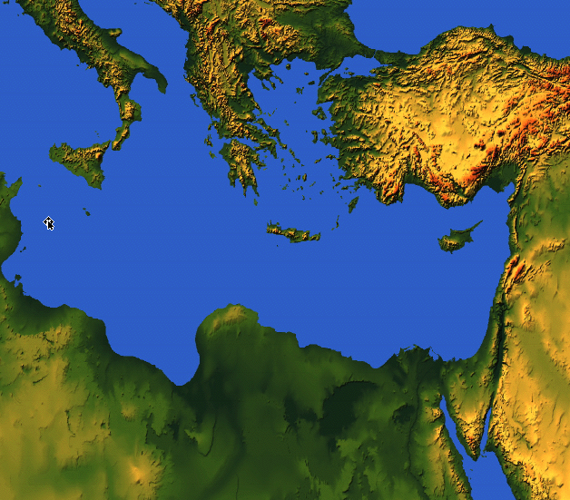

1-2 Thessalonians
Macedonia
212
Thessalonica
Corinth
Notes:
But now, months later, Jesus had not come and the church was wondering if they had already entered the tribulation. So Paul wrote them another letter to show how God continued to affirm them.

Slide 102
Argument
214
Paul wrote 2 Thessalonians to help the believers handle three difficulties facing the church:
Increased persecution (1:3-10),
False teaching that the day of the Lord had already come (2:1-12), and
Idleness in some lazy Thessalonian Christians who were "waiting for the rapture" (3:6-15).
Paul wrote to encourage perseverance based upon their future reward at the day of the Lord (ch. 1) and to correct their false notion of the day of the Lord (ch. 2) so he exhorted discipline instead of idleness (ch. 3). The key theme is the day of the Lord and its implications on behavior.
Notes:
Here is a threefold motivation for Paul to pen the letter.

Slide 103
How does God affirm us when we face tough times?
3 ways…
Notes:
What ways does the Lord encourage us during difficulty?

Slide 104
Slides on
2 Thessalonians 1

Slide 105
Outline of 2 Thessalonians
How God affirms…
Emotions
1

Slide 106
I. Emotionally: God gives perseverance to bring maturity (2 Thess 1).
Notes:
The Lord helps us not to lose heart so we will grow.
Paul mentions his fellow-workers Silas and Timothy but not his position as an apostle to begin his letter relationally (1:1-2).

Slide 107
Paul's Advice to Troubled Thessalonians: Focus on God!
215
Focus on God in the Thessalonian Epistles
Total Verses | "God" | "Lord" | "Jesus" | "Christ" | Total
1 Thess. (89) | 36 | 24 | 16 | 10 | 86
2 Thess. (47) | 18 | 22 | 13 | 10 | 63
Total (136) | 54 | 46 | 29 | 20 | 149
Number of Greek occurrences from Elwell & Yarbrough,
Encountering the New Testament, 332
Notes:
Amazingly, 1-2 Thessalonians has 136 verses but mentions God 149 times!

Slide 108
MAIN IDEA OF MATTHEW
Serve the Lord Jesus Christ
GOD
Lord
KING
Jesus
Christ
SAVIOR
Notes:
Serve Jesus as Savior, God, and King of your life!
One core value of our church is to be context-relevant. We present the unchanging Lord Jesus Christ to our ever-changing world because no one is more relevant than him. How do we do this? We proclaim that he is the ultimate authority as God (Lord), yet took on humanity to save us from our sins (Jesus) and will rule over all (Christ).

Slide 109
A Worthy Name to Repeat
2 Thess 1
2 Thess 2
2 Thess 3
Lord Jesus Christ
(1:1)
Lord Jesus Christ
(2:1)
Lord Jesus Christ
(3:6)
Lord Jesus Christ
(1:2)
Lord Jesus Christ
(2:14)
Lord Jesus Christ
(3:12)
Lord Jesus Christ
(1:12)
Lord Jesus Christ
(2:16)
Lord Jesus Christ
(3:18)
Notes:
The lofty name of the “Lord Jesus Christ” appears 9 times in this book—three times each in all three chapters (NLT):
2Th. 1:1 This letter is from Paul, Silas, and Timothy. We are writing to the church in Thessalonica, to you who belong to God our Father and the Lord Jesus Christ.
2Th. 1:2 May God our Father and the Lord Jesus Christ give you grace and peace.
2Th. 1:12 Then the name of our Lord Jesus will be honored because of the way you live, and you will be honored along with him. This is all made possible because of the grace of our God and Lord, Jesus Christ.
2Th. 2:1 Now, dear brothers and sisters, let us clarify some things about the coming of our Lord Jesus Christ and how we will be gathered to meet him.
2Th. 2:14 He called you to salvation when we told you the Good News; now you can share in the glory of our Lord Jesus Christ.
2Th. 2:16 Now may our Lord Jesus Christ himself and God our Father, who loved us and by his grace gave us eternal comfort and a wonderful hope,
2Th. 3:6 And now, dear brothers and sisters, we give you this command in the name of our Lord Jesus Christ: Stay away from all believers who live idle lives and don’t follow the tradition they received from us.
2Th. 3:12 We command such people and urge them in the name of the Lord Jesus Christ to settle down and work to earn their own living.
2Th. 3:18 May the grace of our Lord Jesus Christ be with you all.

Slide 110

See God's perspective on trials (1:1-2).
Notes:
So these first two verses show that seeing God's perspective helps us to reach out and affirm others. There’s another way to affirm others in verse 3…

Slide 111
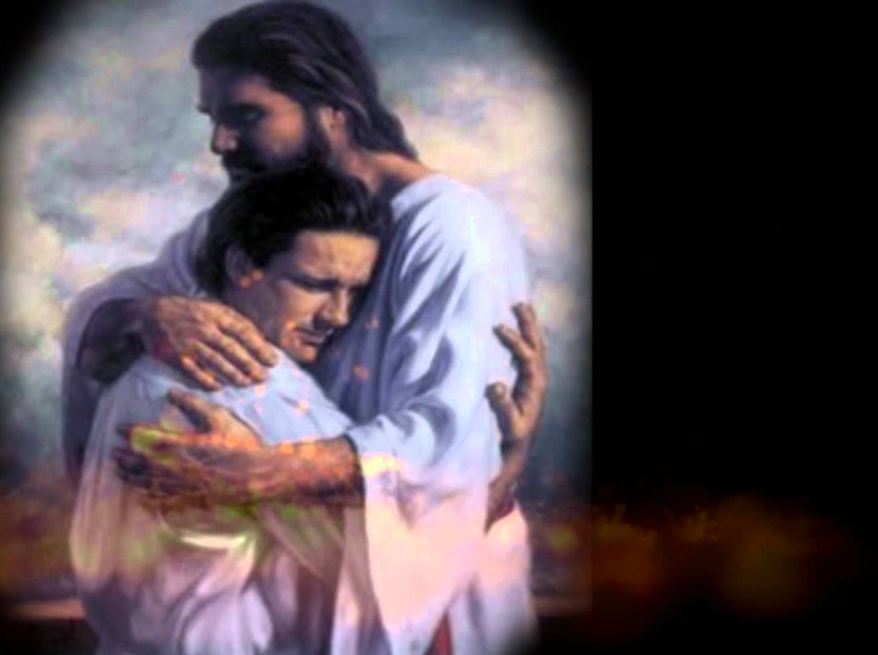
"This letter is from Paul, Silas, and Timothy. We are writing to the church in Thessalonica, to you who belong to God our Father and the Lord Jesus Christ. ²May God our Father and the Lord Jesus Christ give you grace and peace."
2 Thessalonians 1:1-2 NLT
Notes:
You may be wondering why I say that these verses teach us to help afflicted people see God's perspective. Aren't they just the preliminaries to the letter that follows?
Yes, but notice how many times Paul mentions God in this one sentence—four times!
Twice he refers to the Father and twice to Christ, who is placed on equal level with the Father since He, too, is God.

Slide 112
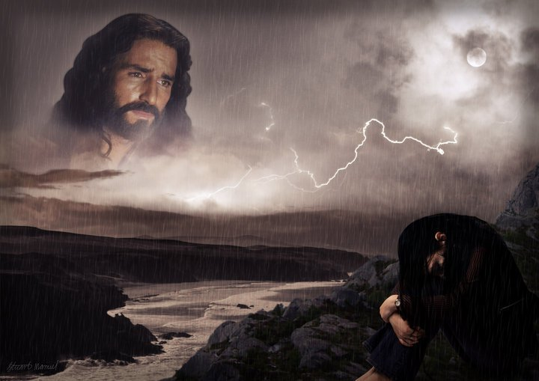
"By looking to our lofty Lord Jesus Christ we realize that He is not looking away from us in complacency but looking down on us in compassion."
—Charles R. Swindoll, Steadfast Christianity, 4—
Notes:
We all have peaks and valleys in our lives—peaks when it's easy to see the Lord and valleys when it's difficult to see Him. Swindoll writes…
• Text above

Slide 113
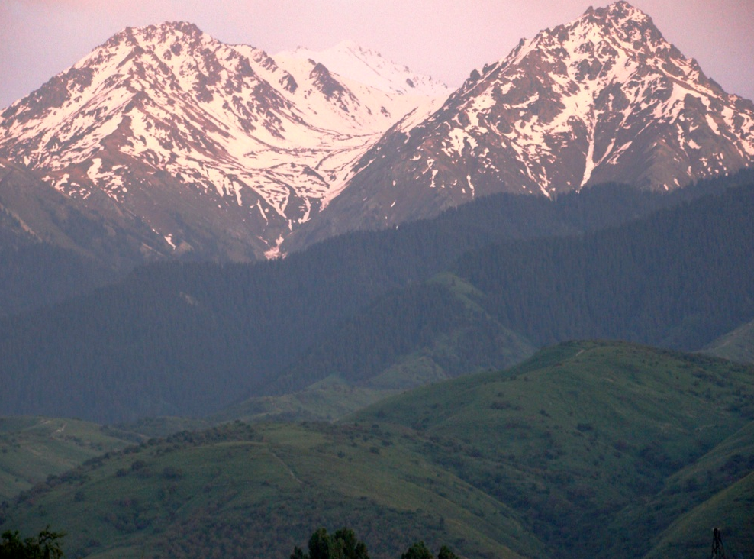
"I will lift up my eyes to the mountains;
From [where else] shall my help come?
My help comes from the LORD, who made heaven and earth
(Ps. 121:1-2)."
—Charles R. Swindoll, Steadfast Christianity, 4—

Slide 114
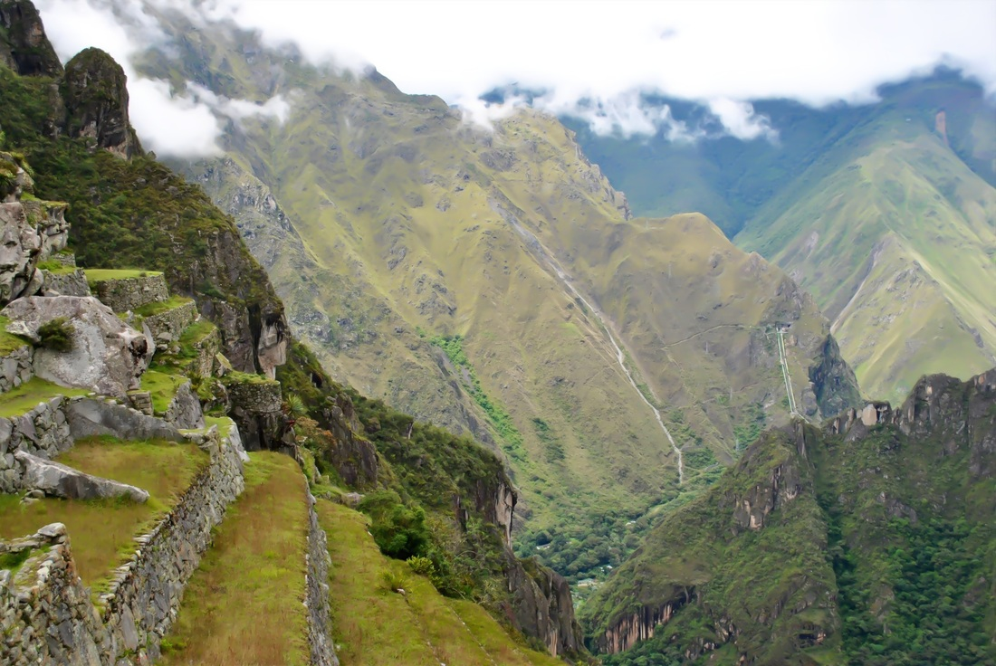
"Do you look to the peaks when you're in the valleys? Or are you so rutted in the valleys that you've forgotten the mountains are even there? People who fail to affirm usually do so because they fail to see the Lord in the midst of it all."
—Charles R. Swindoll, Steadfast Christianity, 4—

Slide 115
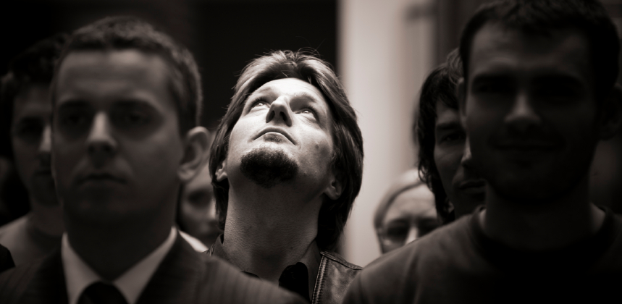
"When we look up, we are reminded that God is not removed… not absent… not out of touch. And then we get a glimpse of the divine perspective on our circumstances—which can only be seen from the peaks, not in the valleys."
—Charles R. Swindoll, Steadfast Christianity, 4—

Slide 116

SEEING LIFE FROM
GOD'S PERSPECTIVE
Your life's experiences can be different when viewed from God's perspective.
Notes:
Aren't you encouraged when you're around people who always talk about the Lord?
They see life from God's viewpoint—and there's no more encouraging view!

Slide 117
How many of us notice when others are caught in a spiral?
Notes:
Love means seeing needs. I wonder how many of us have eyes to see when others have genuine needs—physical issues are easier to see, but spiritual needs are a greater challenge.
Life goes so fast, often it’s tough to take care of ourselves let alone others. I struggle with this—don’t you? Do you struggle with how to help those who are in tough straits? Do you know anyone afflicted in their relationship with their spouse, in financial woe, struggling with children or work or something else?

Slide 118

How to Affirm Others
2 Thessalonians 1:1-4
Three ways we can affirm others...
Notes:
Today, we're going to take a brief look at the first four verses of 2 Thessalonians to see how Paul affirmed the afflicted believers in the ancient city of Thessalonica and encouraged them to grow in Christ. How did he comfort them to help them grow?

Slide 119
I. See God's perspective on trials (1:1-2).
Notes:
View difficulties from the Lord’s eyes. This will help you encourage others.
There’s another way to affirm others in verse 3…

Slide 120
"This letter is from Paul, Silas, and Timothy. We are writing to the church in Thessalonica, to you who belong to God our Father and the Lord Jesus Christ. ²May God our Father and the Lord Jesus Christ give you grace and peace."
2 Thessalonians 1:1-2 NLT
Notes:
You may be wondering why I say that these verses teach us to help afflicted people see God's perspective. Aren't they just the preliminaries to the letter that follows?
Yes, but notice how many times Paul mentions God in this one sentence in the Greek text—four times!
Twice he refers to the Father and twice to Christ, who is placed on equal level with the Father since He, too, is God.

Slide 121
Paul's Advice to Troubled Thessalonians: Focus on God!
215
Focus on God in the Thessalonian Epistles
Total Verses | "God" | "Lord" | "Jesus" | "Christ" | Total
1 Thess. (89) | 36 | 24 | 16 | 10 | 86
2 Thess. (47) | 18 | 22 | 13 | 10 | 63
Total (136) | 54 | 46 | 29 | 20 | 149
Number of Greek occurrences from Elwell & Yarbrough,
Encountering the New Testament, 332
Notes:
Amazingly, 1-2 Thessalonians has only 136 verses but mentions God 149 times!

Slide 122
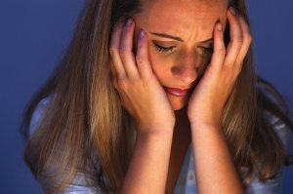
We also need to help others focus on the Lord in their difficulty
Notes:
During trials, we typically look down, even physically looking at the ground.

Slide 123

Romans 8:28
And we know that for those who love God
ALL THINGS WORK TOGETHER FOR GOOD,
for those who are called according to his purpose.
Notes:
Notice the qualifiers—for those who love God and for those obeying him. Granted, there's balance here, too. This doesn't mean you go around blabbing all the time, "Well, all things work for the good!"

Slide 124
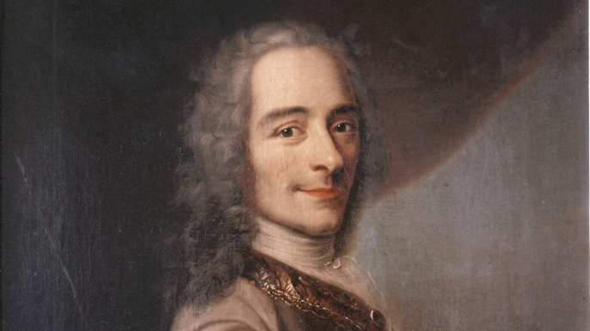

Voltaire (1694-1778)
Notes:
The French atheist, Voltaire, makes fun of such people in his novel Candide.

Slide 125
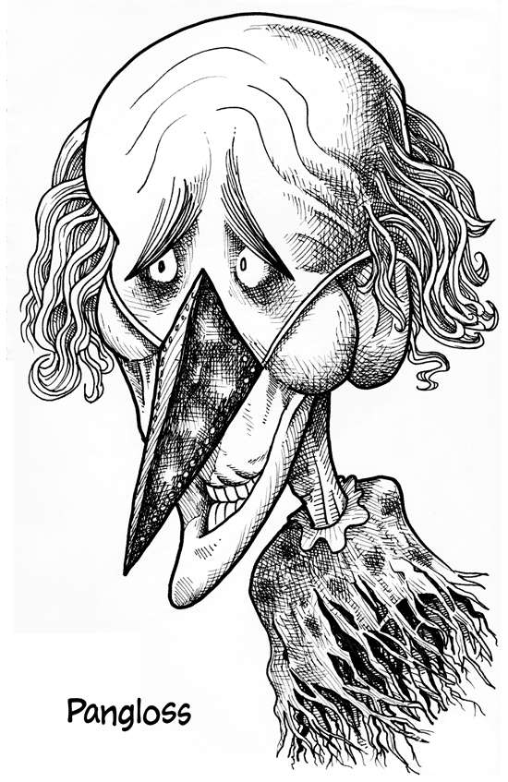
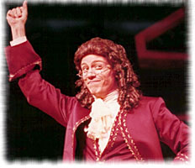
Dr. Pangloss
"Well, all things work for good!"
Notes:
Voltaire constantly belittles the Christian in the story, Dr. Pangloss, every time something awful happens, saying, "Well, all things work for good!"

Slide 126

Romans 8:28
Notes:
Voltaire quotes only a portion of Romans 8:28, which says this applies to those who love God. Even Christians only quote part of the verse, too.

Slide 127
Romans 8:28 NIV
"And we know that in all things
God works for the good
of those who love him,
who have been called
according to his purpose."
Notes:
But Romans 8:28 actually applies this optimism only to those who both love God and are called according to his purpose. We must be "the called ones" who know Him and love Him.

Slide 128
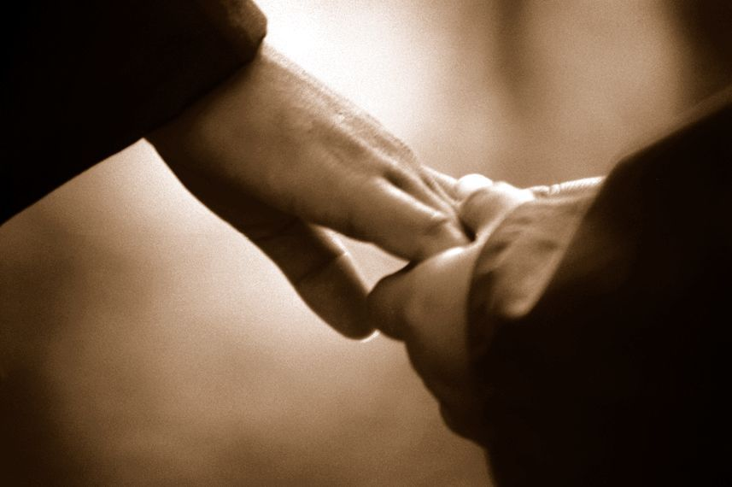
Turn others to the Lord
By saying nothing at all
By sharing a Bible reference
Notes:
There are ways of turning people's sights to the Lord without always quoting Scripture and saying, "Praise Jesus, Praise Jesus…"
• Sometimes we affirm and turn others to God by saying nothing at all.
• Often just writing down a Scripture reference for the person and encouraging him to look it up later is best.

Slide 129
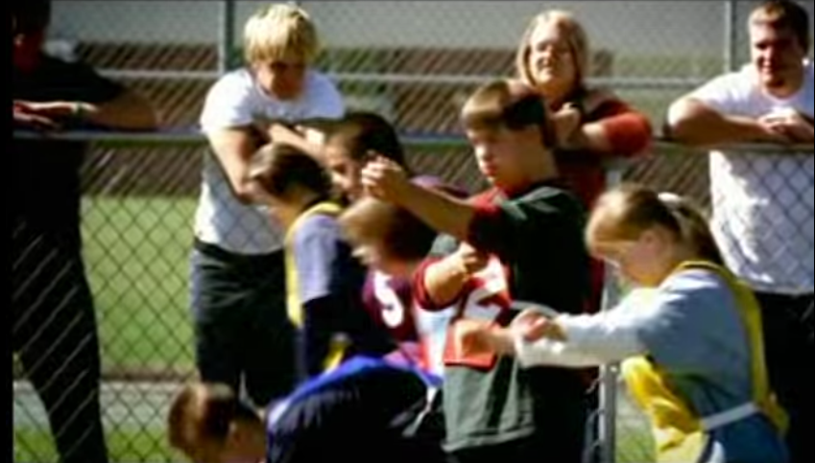
Seattle Special Olympics
Notes:
We need to realign ourselves towards God because his plan is perfect!
A few years ago, at the Seattle Special Olympics, six contestants, all physically or mentally disabled, assembled at the starting line for the 100-yard dash.

Slide 130
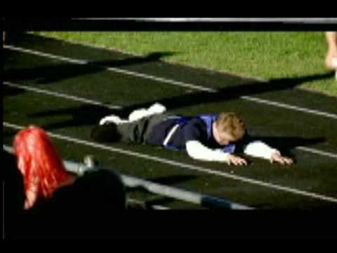
Seattle Special Olympics
Notes:
At the gun, they all started out, not exactly in a dash, but with a relish to run the race to the finish and win. All, that is, except one little boy who stumbled on the asphalt, tumbled over a couple of times, and began to cry. The others heard the boy cry. They slowed down and looked back. Then they all turned around and went back ... every one of them.

Slide 131
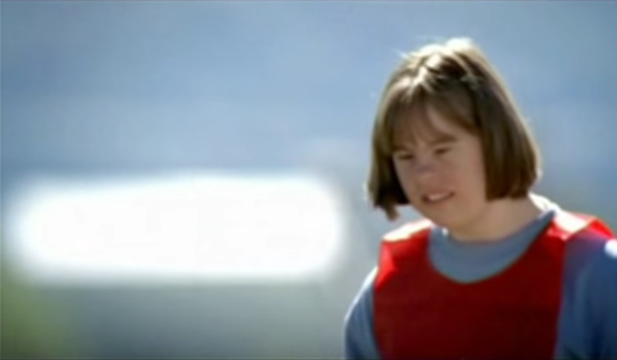
Seattle Special Olympics
Notes:
One girl with Down's Syndrome bent down and kissed him and said, "This will make it better."

Slide 132
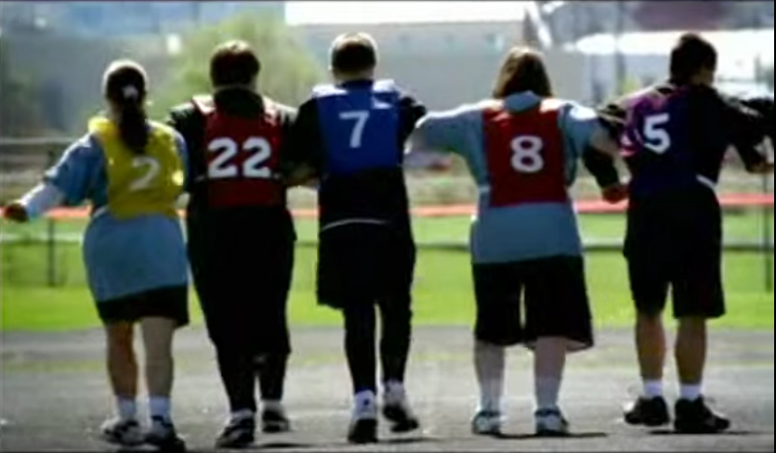
Seattle Special Olympics
Notes:
Then all of them linked arms and ran together to the finish line.

Slide 133

Seattle Special Olympics
Notes:
Everyone in the stadium stood, and the cheering went on for several minutes. People who were there are still telling the story.
Why? Because deep down we know this one thing: What matters in this life is more than winning for ourselves. God’s view on life is helping others win, even if it means slowing down and changing our course.

Slide 134

"A candle loses nothing by lighting another candle."
—James Keller
Notes:
"A candle loses nothing by lighting another candle." You can be that candle to share God’s view and bring light to others without in the least diminishing your own light.

Slide 135

Thank God for others' growth (1:3).
Notes:
Others benefit in their spiritual walk when they hear you praise God for them.

Slide 136

"Dear brothers and sisters, we can't help but thank God for you, because your faith is flourishing and your love for one another is growing”
(2 Thessalonians 1:3 NLT).
Notes:
Paul thanked God for two things—their faith and their love (1:3).
I wonder how often you thank God for others’ spiritual growth. When someone is going through trials how do we generally pray?
I hate to admit it, but most of the time we ask God to remove the trials.
Notice the focus of Paul's prayer here—not a request that God take away their trials but thanksgiving!
He affirmed them by praying not for the removal of the trial but for character development through the trial.
Paul doesn't focus on what's going on around them—he looks at what God is doing within them—building qualities like faith, love, and perseverance mentioned in verse 4.

Slide 137

He affirmed them that their love for one another kept increasing—so we see Paul affirming their affirmation!

Slide 138

What kind of glasses do you wear?
Notes:
When you look at others, do you see them for who they are, or for who they will be?

Slide 139

Mercy Glasses
Notes:
We need to see people differently—with mercy glasses—looking at them in light of the death of Jesus for them and for us. However…

Slide 140

Prayer Affirms
Notes:
Prayer for others is no doubt the best way to affirm others. That's why Paul did it!
I hope as a church we’ll grow to pray beyond a focus on the circumstances and pray that God will use difficulties to build the character of Christ within us.
The three qualities Paul notes are a great starting place—faith, love and perseverance.
MPI
I think our prayer times together as a church would be even better if we make it a point to thank God for others' growth right there in the group.

Slide 141

Publicly brag about others' spiritual growth (1:4).
Notes:
Make your praise common knowledge to help others persevere.

Slide 142

"We proudly tell God's other churches about your endurance and faithfulness in all the persecutions and hardships you are suffering."
2 Thessalonians 1:4 NLT
Notes:
Paul told others how well they hung in there (1:4).
He could have been negative—“Man, you should see those Thessalonians’ hassles. Their theology is messed up so much they think they’re in the Tribulation!”
Not Paul! He said, "Wow! You should see how the church at Thessalonica continues to reach out, deepen in their love, make great strides in trusting God, and endure—despite the most intense persecutions in the Roman Empire. They're doing grrrrrrrreat!"

Slide 143

People often become what you tell them they will become.
Notes:
People often become what you tell them they will become.
This is especially true in parenting children.

Slide 144

Jim Sundberg
Notes:
Children tend to become what their parents tell them they will become. Major league baseball catcher Jim Sundberg said that his father was always telling Jim, “Jim, one day you’re going to be a great major league catcher.”

Slide 145

"How many of you had parents that told you that you would end up in prison one day?”
Notes:
Evangelist Bill Glass asked a group of 1000 inmates, “How many of you had parents that told you that you would end up in prison one day?” Almost every one of the inmates raised their hands.

Slide 146

Affirm the afflicted to help them mature in Christ.
Main Idea of 2 Thess 1:1-4
Notes:
Encourge others to grow!

Slide 147
"And God will use this persecution to show his justice and to make you worthy of his Kingdom, for which you are suffering. ⁶In his justice he will pay back those who persecute you"
(2 Thess 1:5-6 NLT).
Notes:
God will reward the church’s perseverance during affliction but punish their persecutors by helping the church become mature (1:3-12).

Slide 148
"And God will provide rest for you who are being persecuted and also for us when the Lord Jesus appears from heaven. He will come with his mighty angels, ⁸in flaming fire, bringing judgment on those who don’t know God and on those who refuse to obey the Good News of our Lord Jesus"
(2 Thess 1:7-8 NLT).
Notes:
After the Rapture will come God's judgment to initially last seven years on earth.

Slide 149
"They will be punished with eternal destruction, forever separated from the Lord and from his glorious power. ¹⁰When he comes on that day, he will receive glory from his holy people—praise from all who believe. And this includes you, for you believed what we told you about him" (2 Thess 1:9-10 NLT).
Notes:
After the first seven years, judgment will follow for eternity.
____________
"1:9. The destruction to befall both groups is stated in this verse. They will be punished is literally “they will pay a penalty” (di÷khn ti÷sousin). For their rejection of God’s grace they will experience endless or everlasting ruin (o¡leqron ai˙w¿nion). This is “the most express statement in St. Paul’s Epistles of the eternity of future punishment” (Edward Headland and Henry B. Swete, The Epistle to the Thessalonians, London: Hatchard, 1863, p. 137). The punishment of the wicked will be neither temporary nor will it be annihilation, but it will continue throughout eternity and those being punished will be conscious. It is eternal death as opposed to eternal life (Matt. 25:46). The nature of the destruction follows in the next phrase.
Separation from the Lord’s presence (lit., “face”) is the essence of eternal punishment. On the other hand being in the Lord’s presence will make heaven heaven. A Christian’s hope is to see and be with the Lord; the judgment of unbelievers is to be eternally inaccessible to His presence (cf. Rom. 1:18; 2:5-9; 6:21; Phil. 3:19; 1 Thes. 1:10; 4:17).
The majesty of His power is the visible splendor of the Lord’s presence. The Lord’s power will be manifest in a majestic display (cf. Rev. 19:11-16). Unbelievers will be forever shut out from the Lord’s presence and His power.
1:10. This judgment will take place when the Lord comes back to earth and is glorified through the lives of believers whom He has transformed by making saints out of sinners. This is not the Rapture (1 Thes. 4:13-18; John 14:2-3), for no judgment accompanies the Rapture. Instead, it is the revelation of Jesus Christ in power and great glory (Ps. 2:1-9; Matt. 25:31), when He will set up His earthly kingdom (Rev. 19:11-20:4). At His return He will destroy the Armageddon armies gathered against Him (Rev. 16:12-16; 19:19-21) and will then judge living Jews (Ezek. 20:33-38) and living Gentiles (Matt. 24:31-46). These judgments are the ones just described (2 Thes. 1:9).
The exact date of His return is not given, of course, but it will be a day of judgment for the lost and a day of glory and marveling for believers. Christ will be “glorified in” (not by) His saints, that is, His glory will be mirrored in them. Christians will marvel in that they will admire their Lord for what He has done in them. All believers will marvel—not just those living on the earth and those resurrected when Christ returns, but also those who return to earth with Him, those who had been caught up to be with the Lord at the Rapture.
This group, Paul pointed out, would include the Thessalonian believers to whom he wrote this epistle. Because they believed Paul’s testimony they would share in this great day. Such a hope should strengthen any believer who might be buckling under the pressure of persecution by unbelievers (v. 4). This glimpse into the future undoubtedly encouraged Paul’s readers and it should encourage believers in their trials today."
1:9. The destruction to befall both groups is stated in this verse. They will be punished is literally “they will pay a penalty” (di÷khn ti÷sousin). For their rejection of God’s grace they will experience endless or everlasting ruin (o¡leqron ai˙w¿nion). This is “the most express statement in St. Paul’s Epistles of the eternity of future punishment” (Edward Headland and Henry B. Swete, The Epistle to the Thessalonians, London: Hatchard, 1863, p. 137). The punishment of the wicked will be neither temporary nor will it be annihilation, but it will continue throughout eternity and those being punished will be conscious. It is eternal death as opposed to eternal life (Matt. 25:46). The nature of the destruction follows in the next phrase.
Separation from the Lord’s presence (lit., “face”) is the essence of eternal punishment. On the other hand being in the Lord’s presence will make heaven heaven. A Christian’s hope is to see and be with the Lord; the judgment of unbelievers is to be eternally inaccessible to His presence (cf. Rom. 1:18; 2:5-9; 6:21; Phil. 3:19; 1 Thes. 1:10; 4:17).
The majesty of His power is the visible splendor of the Lord’s presence. The Lord’s power will be manifest in a majestic display (cf. Rev. 19:11-16). Unbelievers will be forever shut out from the Lord’s presence and His power.
1:10. This judgment will take place when the Lord comes back to earth and is glorified through the lives of believers whom He has transformed by making saints out of sinners. This is not the Rapture (1 Thes. 4:13-18; John 14:2-3), for no judgment accompanies the Rapture. Instead, it is the revelation of Jesus Christ in power and great glory (Ps. 2:1-9; Matt. 25:31), when He will set up His earthly kingdom (Rev. 19:11-20:4). At His return He will destroy the Armageddon armies gathered against Him (Rev. 16:12-16; 19:19-21) and will then judge living Jews (Ezek. 20:33-38) and living Gentiles (Matt. 24:31-46). These judgments are the ones just described (2 Thes. 1:9).
The exact date of His return is not given, of course, but it will be a day of judgment for the lost and a day of glory and marveling for believers. Christ will be “glorified in” (not by) His saints, that is, His glory will be mirrored in them. Christians will marvel in that they will admire their Lord for what He has done in them. All believers will marvel—not just those living on the earth and those resurrected when Christ returns, but also those who return to earth with Him, those who had been caught up to be with the Lord at the Rapture.
This group, Paul pointed out, would include the Thessalonian believers to whom he wrote this epistle. Because they believed Paul’s testimony they would share in this great day. Such a hope should strengthen any believer who might be buckling under the pressure of persecution by unbelievers (v. 4). This glimpse into the future undoubtedly encouraged Paul’s readers and it should encourage believers in their trials today.
—Thomas L. Constable, 2 Thessalonians *(The Bible Knowledge Commentary; eds. John F. Walvoord and Roy B. Zuck; Accordance electronic ed. 2 vols.; Wheaton: Victor Books, 1983), 2:716.

Slide 150

"So we keep on praying for you, asking our God to enable you to live a life worthy of his call. May he give you the power to accomplish all the good things your faith prompts you to do."
^{2 Thessalonians 1:11}

Slide 151
"Then the name of our Lord Jesus will be honored because of the way you live, and you will be honored along with him. This is all made possible because of the grace of our God and Lord, Jesus Christ."
^{2 Thessalonians 1:12}

Slide 152

Persevering through affliction develops maturity
Charles R. Swindoll, Steadfast Christianity, 3

Slide 153




Marbles or Grapes?
Notes:
We decide how difficulties will change us. Do you agree? In his book No Greater Power, Richard C. Halverson, past chaplain of the US Senate, wrote:
• “Crush marbles and you get fragmentation, disintegration—hard, sharp pieces. You can get hurt if you’re not careful.
• Crush grapes and you get fragrant, refreshing wine.
Some people relate like marbles. The fear of vulnerability hardens them. They protect themselves and allow no one to penetrate. Being vulnerable is high-risk, and they want low-risk. They bump against others and ricochet around, never enjoying a vital relationship. In brittle lovelessness, they shatter when crushed and hurt others.
Some people relate like grapes. They yield to pressure. They accept their weakness as essential to intimacy. They give love, knowing love is always vulnerable and the heart and soul of our faith. When crushed, they bring blessing: fragrant, redemptive blessing.”
Difficulties certainly come our way for every one of us.
But how do you respond to these trials? Are you like a marble or like a grape? In either case, we get crushed, but marbles resist it while grapes welcome the benefits.
Are you angry at God for allowing difficulty into your life? Or do you see him affirming you?
Richard C. Halverson, No Greater Power (Portland, OR: Multnomah, 1986), 67; cited in Charles R. Swindoll, Steadfast Christianity: A Study of Second Thessalonians (Fullerton, CA: Insight for Living, 1986), 1.

Slide 154

My Defensiveness
Notes:
I have needed affirmation to overcome my own weakness of defensiveness.
As I have recently reflected on my early years as a Christian teenager, I recall one particular weakness. When someone expressed a concern about me, I reacted with defensiveness. This was a problem I had in my early years of marriage too. Susan would observe a weakness in me and I would defend myself as if she was attacking me.
After further consideration and prayer about this, I realized that it went back to my teenage years. My mother married a third time when I was age 13, and my step-father would point out a deficiency in me rather roughly. He had a horrible relationship with his own father—so much that he called him by his first name rather than “Dad” or “Father”—and he lacked an ability to gently tell me how to better sweep the floor or wash the dishes or whatever. I constantly felt attacked, even though that wasn’t his intention.
So I developed this defensive attitude in my other relationships too. I suspect I felt that way about God as well.
God really changed me, though. At least I think he did! I guess you can be the judge whether I defend myself right now. I think he has given me an ability to respond rather than react, to persevere in a way that helps me grow in maturity.

Slide 155
How does God affirm us when we face tough times?
Notes:
We should trust God's view of us more than others' views or our own self-perception. What does he say about us that we can hold onto during difficulty?

Slide 156
I. Emotionally: God gives perseverance to bring maturity (2 Thess 1).
Notes:
The Lord helps us avoid losing heart, so we will grow.

Slide 157
Slides on
2 Thessalonians 2

Slide 158
Outline of 2 Thessalonians
How God affirms…
Emotions
1
Theology
2
Notes:
II. Theologically: God gives us truth to bring stability (2 Thess 2).
[Theology matters! The Lord corrects our misconceptions to give us firm footing.]

Slide 159
II. Theologically: God gives us truth to bring stability (2 Thess 2).
Notes:
Theology matters! The Lord corrects our misconceptions to give us firm footing.

Slide 160

"Now, dear brothers and sisters, let us clarify some things about the coming of our Lord Jesus Christ and how we will be gathered to meet him"
(2 Thess 2:1 NLT).

Slide 161
Key Verse
211
"Do not become easily unsettled or alarmed by some prophecy, report or letter supposed to have come from us, saying that the day of the Lord has already come. Don't let anyone deceive you in any way, for that day will not come until the rebellion occurs and the man of lawlessness is revealed, the man doomed to destruction"
(2:2-3).
2 Thessalonians

Slide 162

Judgment!
216
followed by…

Slide 163

Blessing!
216

Slide 164


The Day of the LORD
216
Judgment
+
Blessing
Tribulation
Millennium
Rev. 6–19
Rev. 20
7 years
1000 years

Slide 165
A Dispensational Timeline
437
Great
White
Throne
(Rev. 20:11-14)
Rapture
(1 Thess. 4:13-18)
2nd Advent
(Zech. 14:3-5)
Day of the LORD
Church Age
Tribulation
(1 Thess. 5)
Millennium
(Zech. 14:6-21)
Notes:
165
But the situation at Thessalonica still didn’t change—so much so that many in the church thought they were in the Great Tribulation. The persecution hadn't let up so he wrote them to affirm them for their steadfastness.

Slide 166

Antichrist Sets Up Image for Worship
(2 Thess. 2:3-4 NLT)
80 I
"Don't be fooled by what they say. For that day will not come until there is a great rebellion against God and the man of lawlessness is revealed—the one who brings destruction. ⁴He will exalt himself and defy everything that people call god and every object of worship. He will even sit in the temple of God, claiming that he himself is God."

Slide 167
"That day will not come until…" (2:3a)
213
1. "the rebellion (apostasy) occurs" (3b)
= Christendom is completely apostate
2. "the man of lawlessness is revealed" (3c)
= Antichrist signs covenant with Israel (Dan. 9:27)
3. "the one who now holds [lawlessness] back will be taken out of the way" (7b)
= restraining influence of the Holy Spirit in the Church is taken to heaven

Slide 168
"Don’t you remember that I told you about all this when I was with you? ⁶And you know what is holding him back, for he can be revealed only when his time comes. ⁷For this lawlessness is already at work secretly, and it will remain secret until the one who is holding it back steps out of the way. ⁸Then the man of lawlessness will be revealed, but the Lord Jesus will kill him with the breath of his mouth and destroy him by the splendor of his coming" (2 Thess 2:5-8 NLT).

Slide 169



The Restrainer
209
The Spirit's restraining evil through the Church will be absent (2 Thess. 2:6-7):
⁶And now you know what is holding him back, so that he may be revealed at the proper time. ⁷For the secret power of lawlessness is already at work; but the one who now holds it back will continue to do so till he is taken out of the way (NIV).
("what restrains" = neuter, 2:6 = gospel preaching)
("he who restrains" = masculine, 2:7 = a person)
("Spirit" = neuter noun but used of a person)

Slide 170
The Day of the Lord
2 Thess. 2:3-7 Prerequisites Before Day of the Lord (3 of them):
213
1
Judgment Seat in Heaven
2 Cor. 5:10; 1 Cor. 3:10-15
3 Restrainer (2:7b)
2
1 Apostasy (2:3b)
2 Antichrist (2:3c)
3
1
Second Coming
Rev. 19:11-21
Rapture
1 Thess. 4:13-18
Tribulation
Millennium
Eternal State
3
1000 yrs.
69 Weeks
(Dan. 9:24-27)
Church Age
Matt. 16:18
Acts 2:1-4
2
3½
3½
Rev. 20:4-6
(Timeless)
7 yrs.
(Daniel's 70th Week)
Matt. 24:21
Matt. 27:50
Short Period of Preparation; Rise of the Antichrist
(length of time unknown)
"Prophecy" (Dallas Seminary video series, 1980s)

Slide 171


Chronology of the 70th "Week"
333
Adapted from J. Dwight Pentecost, Dallas Theological Seminary, 1988
Middle of the Week
Sign of
Son of Man
Matt. 24:30
Christ's Return Complete
3½ YEARS
1290 DAYS
Dan. 12:11
30 DAYS
30 DAYS
1260 DAYS
45 DAYS
Rev. 11:3; 12:6
Dan. 12:12
3½ YEARS
3½ YEARS
Election
of Beast
Rev. 17:13
Covenant Made
Dan. 9:27a
Covenant Broken
Dan. 9:27b
2nd ADVENT
The Great Tribulation
The Tribulation

Slide 172
Why Am I Pretrib?
209
Believers will be kept from (ek) this "hour," or time period (Rev. 3:10)
The Tribulation tests unbelievers (3:10) under God's wrath (6:16-17)
The Spirit's restraining evil through the church will be absent (2 Thess. 2:6-7).
("what restrains" = neuter, 2:6 = gospel preaching)
("he who restrains" = masculine, 2:7 = a person)
("Spirit" = neuter noun but used of a person)
Notes:
Here are three reasons to consider
______
Common-502
NS-14-2 Thess-140

Slide 173
"This man will come to do the work of Satan with counterfeit power and signs and miracles. ¹⁰He will use every kind of evil deception to fool those on their way to destruction, because they refuse to love and accept the truth that would save them. ¹¹So God will cause them to be greatly deceived, and they will believe these lies. ¹²Then they will be condemned for enjoying evil rather than believing the truth" (2 Thess 2:9-12 NLT).

Slide 174
Book Chart
Persevere in Persecution |  | Day Still Future |  |  | Discipline the Idle
Chapter 1 |  | Chapter 2 |  |  | Chapter 3
Emotional |  | Theological |  |  | Practical
Encouragement in Persecution |  | Explanation of the Day |  |  | Exhortation in Body Life
Discouraged Believers |  | Disturbed Believers |  |  | Disobedient Believers
Correction of Perspective |  | Correction of Doctrine |  |  | Correction of Behaviour
Salutation | Judgment v. Reward | Pretrib-ulational Teaching | Antichrist Prerequisite | Stand Firm | Prayer Requests | Discipline Idle | Blessing Given
1:1-2 | 1:3-12 | 2:1-2 | 2:3-12 | 2:13-17 | 3:1-5 | 3:6-15 | 3:16-18
Corinth
AD 51
2 Thessalonians:
Tribulation Corrections
211
Notes:
The threefold outline explains how God affirmed the church through Paul. The focus of the letter is the central chapter, where he corrects their understanding by reaffirming a pre-trib rapture, as he did in 1 Thess 1:10; 4:13-18.
________
NS-14-2 Thess-10, 142

Slide 175

Keys
2 Thessalonians
211
Key Word:
Tribulation
Key Verse
Do not "become easily unsettled or alarmed by some prophecy, report or letter supposed to have come from us, saying that the day of the Lord has already come. Don't let anyone deceive you in any way, for that day will not come until the rebellion occurs and the man of lawlessness is revealed, the man doomed to destruction"
(2 Thessalonians 2:2-3).

Slide 176
Summary & Application
2 Thessalonians
211
Summary Statement
Paul corrects the persecuted Thessalonians' misconception that the day of the Lord (Tribulation) had already begun to exhort perseverance among the disheartened and industry among the idle to help them stand firm in correct doctrine despite false teachers.
Application
Do you study eschatology, believing that it affect your behavior as a Christian?

Slide 177

The Future Ministries of the Holy Spirit
HS xlii
REMOVAL
OF SIN
RESTORATION OF ISRAEL
EZEK 36:24-27
RESIDENCE IN THE NEW JERUSALEM
REJUVENATION
OF NATURE
HEB 12:22-24
JOHN 14:16, 26; 16:13
EZEK 36:24-27
RETURN OF CHRIST
ISA 32:15; 34:16
FULNESS OF SALVATION
RESURRECTION OF THE BODY
RAPTURE
REVELATION
EZEK 36:25-31
FOR US
REGENERATION OF THE GENTILES
WITH US
INDWELLING OF EVERY BELIEVER
ROM 8:11
GAL 5:5; 6:8
JOHN 6:63
REV 7:9-17
EZEK 36:27–37:14
JER 31:33
ISA 44:3
POURING OUT OF THE SPIRIT
POWER FOR THE WITNESSES
REMOVAL OF THE RESTRAINER
JOEL 2:28-32
ZECH 12:10
ROM 11:26-27
RULE OF MESSIAH
MATT 10:19-20; 24:14
2 THESS 2:7
ISA 11:2
CHURCH
TRIBULATION
MILLENNIUM
ETERNITY
REMOVAL OF THE RESTRAINER
MINISTRY OF THE WITNESSES
RESTRAINT
OF SIN
SOURCE: Professor Manfred E. Kober, Faith Baptist College and Seminary, Ankeny, Iowa 50021. Used by Permission in Charles Ryrie, The Holy Spirit, 2d ed., 188
2 THESS 2:7
REV 11:3-4
ZECH 4:6
ISA 59:19
Figure 21.1

Slide 178

The Antichrist & Daniel 9
“They went out from us but were not of us.”
1 John 2:19
The 4th Beast: Mask of the Antichrist
(the only posttrib film — released 2005)

Slide 179
A Huge Leadership Vacuum
216a
Difficult times always set the stage for dictators to rise to the occasion.

Slide 180

Names for the Antichrist
216a
79
Bloody & Deceitful Man (Ps 5:6)
Little Horn (Dan. 7:8)
Man of Sin
(2 Thess. 2:3)
Beast from the Sea (Rev. 13:1)
One Causing Desolation (Dan. 9:27)

Slide 181
The Activity of the Antichrist
216a
79

Slide 182


The Image of Daniel 2
Gold
Babylon
Silver
Persia
Bronze
Greece
Iron
Rome
Iron & Clay
Antichrist
Stone
Kingdom

Slide 183


World Empires in Daniel
545
Bible Visual Resource Book, 133

Slide 184
Chronology of the 70th "Week"
556
Adapted from J. Dwight Pentecost, Dallas Theological Seminary, 1988
Middle of the Week
Sign of
Son of Man
Matt. 24:30
Christ's Return Complete
3½ YEARS
1290 DAYS
Dan. 12:11
30 DAYS
30 DAYS
1260 DAYS
45 DAYS
Rev. 12:6
Dan. 12:12
3½ YEARS
3½ YEARS
Election
of Beast
Rev. 17:13
Covenant Made
Dan. 9:27a
Covenant Broken
Dan. 9:27b
The Great Tribulation
2nd ADVENT
The Tribulation
"He will confirm a covenant with many for one 'seven.' In the middle of the 'seven' he will put an end to sacrifice and offering. And on a wing [of the temple] he will set up an abomination that causes desolation, until the end that is decreed is poured out on him" (Daniel 9:27 NIV).
Notes:
The final of the 70 "weeks" also will last seven years and is the focus of Daniel's prophecies more than any other period. Revelation later builds on the foundation that Daniel established.
______________
Common-404
BE-27-Daniel-117
LC-09-Preparation-30
OS-27-Daniel-407, 499
NS-14-2Thess-184
NS-27-Rev1-slide 170
NS-22-Rev7-12-slide 99

Slide 185

Daniel 11:40
543
Israel's enemies will invade her land

Slide 186

Daniel 11:40-45
Even ships in the Mediterranean will join the battle

Slide 187


West Meets East (Dan. 11:44)

Slide 188

Beasts of Rev. 13
387
Dragon =
Satan
Land Beast =
False Prophet
Sea Beast =
Antichrist
Used with permission

Slide 189

A Satanic "Trinity":
387
"Father" =
Satan
"Son" =
Antichrist
"Spirit" =
False Prophet

Slide 190



The world will worship the beast

Slide 191

The Mark in the Right Hand
He causes all, both small and great, rich and poor, free and slave, to receive a mark on their right hand or on their foreheads, and that no one may buy or sell except one who has the mark or the name of the beast, or the number of his name.
Revelation 13:16-17

Slide 192

The Mark in the Right Hand
He causes all, both small and great, rich and poor, free and slave, to receive a mark on their right hand or on their foreheads, and that no one may buy or sell except one who has the mark or the name of the beast, or the number of his name.
Revelation 13:16-17

Slide 193

Who is the Antichrist?

Slide 194
The following slides show how some spiritualize "beast"…
388
The Counterfeit
& False
666

Slide 195
The Dragon!
388
Satan:
The arch-enemy of God; the one who hates all truth, all goodness, all of God's creatures; the one who would make himself God, if he could!

Slide 196

The Beast Spiritualized
388
The Beast:
The World's political systems. They demand and achieve worship and obedience from all but those who belong to the Lamb. The effect is to take the world into Satan's power.

Slide 197

The False Prophet Spiritualized
388
The False Prophet:
Every Ideology, Religion and/or Technology which leads mankind astray by highly plausible (but false) principles, miracles or works. His goal is to cause humanity to worship the Beast.

Slide 198

But he is referred to as a person and the number of his name is 666
(Revelation 13:18)
388

Slide 199

Gematria in Greek
388
Hebrew, Greek and Latin used letters as numbers
http://religion-cults.com/antichrist/666.htm
Notes:
religion-cults.com/ antichrist/666.htm

Slide 200

Nero = 666?
388
http://religion-cults.com/antichrist/666.htm

Slide 201

Hebrew Gematria
388
English | Greek | Hebrew | Value
A | Alpha | Aleph | 1
B | Beta | Beth | 2
C | Gamma | Gimmel | 3
D | Delta | Daleth | 4
E | Epsilon | He | 5
F |  | Waw | 6
G |  | Zahyin | 7
H | Eta | Heth | 8
www = 666
http://religion-cults.com/antichrist/666.htm

Slide 202
English Gematria
388
K | 66
I | 54
S | 114
S | 114
I | 54
N | 84
G | 42
E | 30
R | 108
 | 666
A | 6
B | 12
C | 18
D | 24
E | 30
F | 36
G | 42
H | 48
I | 54
J | 60
K | 66
L | 72
M | 78
N | 84
O | 90
P | 96
Q | 102
R | 108
S | 114
T | 120
U | 126
V | 132
W | 138
X | 144
Kissinger = Antichrist!

Slide 203

THE UPC BAR CODE
388
BUT WOULD THE JEWS IN THE NEXT VERSE (REV. 14:1) ALSO HAVE AN INVISIBLE CODE?
http://religion-cults.com/antichrist/mark.htm
Notes:
http://religion-cults.com/antichrist/mark.htm and www.soldierofthelord.4t.com/ photo.html

Slide 204





Mark of the Beast Microchip
388
www.soldierofthelord.4t.com/ photo.html

Slide 205



Monster Drink!
388

Slide 206

Hebrew Alphabet Values
388
Monster Energy Drink =
666

Slide 207

The Sky's the Limit
388
Computations using different systems make each of these total 666: Kissinger, van den broek, lustiger, hitler, deutschland, himmler, new york, us of america, santa claus, kennedy, al gore... Holy Bible, SS number, witchcraft, lustful, monetary, live, son of sin, mark of beast, evil, bullet... internet, billgates+3 (the III), computer, terminal, binary, windows98, teletext, calculation

Slide 208

George W. Bush?!

Slide 209

"He will judge the nations"

Slide 210

The East Gate

Slide 211
Outline of Daniel
532
UNIVERSAL SOVEREIGNTY IN TIMES OF THE GENTILES
Sovereignty over Daniel |  |  | Sovereignty over Gentiles |  |  |  |  |  | Sovereignty over Jews
Chapter 1 |  |  | Chapters 2–7 |  |  |  |  |  | Chapters 8–12
Narrative |  |  | Visions in Narrative |  |  |  |  |  | Vision
Hebrew |  |  | Aramaic |  |  |  |  |  | Hebrew
Gentile Names for God |  |  | Gentile Names for God |  |  |  |  |  | Jewish Names for God
Third person ("Daniel") |  |  | Third person ("Daniel") |  |  |  |  |  | First person ("I")
Daniel's Example |  |  | Daniel Interprets King's Dreams |  |  |  |  |  | Angel Interprets Daniel's Dreams
The Man Daniel |  |  | Images |  | Kings |  |  |  | Israel's Future
Exile 1:1-7 | Food 1:8-16 | Exalted 1:17-21 | Varied 2 Promoted | Gold 3 Furnace | Neb. 4 Exile | Bel. 5 Party | Dar. 6 Lions | All 7 Beasts | Medo- Persia To Greece 8 | Return to Seventy "7s" 9 | Intertest-ament Period to Tribulation 10–12
Babylon
605-536 BC
Notes:
Not surprisingly, the center section of the prophecy that relates to Gentile nations from chapters 2–7 is written in Aramaic, the trade language of the day. Note also how the writing begins and ends with the Jewish people, which would have been of great concern to Daniel.

Slide 212

Daniel
7-year covenant
1290/1260-day trial
Ten-horned Beast
Revelation

Slide 213
Daniel 9
86b-d
Daniel's prayer (9:1-19)
God's reply - Seventy x seven (9:20-27)
The interpretation of these seventy weeks is divided into 4 major views. But let's first see the text itself and ask who the "bad guys" are:
"the Anointed One" or the "ruler who will arise"?

Slide 214
Daniel 9:24-27 (NLT)
86b-d
²⁵ Now listen and understand! Seven sets of seven plus sixty-two sets of seven will pass from the time the command is given to rebuild Jerusalem until a ruler—the Anointed One—comes. Jerusalem will be rebuilt with streets and strong defenses, despite the perilous times.
²⁶ "After this period of sixty-two sets of seven, the Anointed One will be killed, appearing to have accomplished nothing, and a ruler will arise whose armies will destroy the city and the Temple. The end will come with a flood, and war and its miseries are decreed from that time to the very end. ²⁷ The ruler will make a treaty with the people for a period of one set of seven, but after half this time, he will put an end to the sacrifices and offerings. And as a climax to all his terrible deeds, he will set up a sacrilegious object that causes desecration, until the fate decreed for this defiler is finally poured out on him."

Slide 215

Views on the Meaning of 70 x 7
86b-d
^{Dan 9:27} The ruler will make a treaty with the people for a period of one set of seven, but after half this time, he will put an end to the sacrifices and offerings. And as a climax to all his terrible deeds, he will set up a sacrilegious object that causes desecration, until the fate decreed for this defiler is finally poured out on him" (NLT).

Slide 216
1. Critical View
86b-d
  7 wks. From the Jeremiah prophecy to Cyrus
  62 wks. From Cyrus to Onias
  1 wk. From Onias to restoration of the temple
Critique of the Critical View
  Near fulfillment in Antiochus but…
  Not all fulfilled in Antiochus IV (e.g., he made no seven-year covenant with the Jews)
  Prophecy is viewed as "imaginative prediction" written after the event

Slide 217
2. Messianic/Historic View
86b-d
7 wks starts from Cyrus decree
62 wks ends at Christ's first advent (9:26 occurs after this)
Final week – Death of Christ abolished sacrifice
Destruction of Jerusalem in AD 70
Critique of the Messianic View
  Rejects the gap noted by "after" and "from that time to the end" in Dan. 9:26
  The final prince not seen as the Anti-Christ but as Christ
  Sees Matt 24:15 as fulfilled in AD 70 (then Matthew wrote about it)
  Interpretation of covenant (Heb 8:13) and desolation (Heb 9:25, 26).
  Does not account for Antichrist in Rev 13:5 who will rule 42 months.
  2 Thess. 2:4 says Antichrist (not Christ) will claim deity in temple
  However, Young does see 11:40-44 as referring to Antichrist (Young, 248, 251)

Slide 218
3. Amillennial Symbolic View
86b-d
70 as indefinite period – for leading people to salvation
Seven as a mark of divine work, symbolizing completion
  First 7 years begins with the Cyrus decree (538 BC)
  The 62 weeks = the gospel is preached
  The final week = antichrist rule, Christ lost influence
  70 years end in Christ second coming
Comments on Symbolic View
  70x7 are for all people, not exclusive to Israel
  Glosses over details of prophetic elements
  Cyrus's decree - Closest to the time Daniel's prayer

Slide 219

Messianic View of James E. Smith
Problems?
Actual decree date was 444 BC
Christ did not make a covenant with Israel at His baptism (cf. Dan 9:27)
The one who stops the sacrifice (Dan. 9:27) also desecrates the temple (cf. 2 Thess. 2:4; Rev. 13:5)
The Major Prophets (Joplin, MO: College Press, 1995), LOGOS electronic version chart 22

Slide 220
4. Premillennial View
86b-d
7 weeks start from 444 BC at the Artaxerxes decree to Nehemiah
62 weeks end with Christ's Triumphal Entry
Gap = the church age = times of Gentiles (Note Jesus' prophecy in Luke 21:24)
The final week = 7 years of tribulation

Slide 221

The Seventy "Weeks" of Daniel 9
86b-d
Anointed One
Decree
69 sevens = 483 years
7 sevens 62 sevens
1 seven
= 7 years
444 BC
to 395 BC
395 BC
to AD 33

Slide 222

Daniel's 70 Weeks
(Dan. 9:24-27)
84
69 Weeks
444 BC
AD 33

Slide 223

Messianic View of James E. Smith
Problems?
Travel and knowledge did not vastly increase in AD 60s (Dan. 12:4)
No abomination stood in the temple in AD 66
The Major Prophets (Joplin, MO: College Press, 1995), LOGOS electronic version chart 24

Slide 224
Chronology of the 70th "Week"
333
Adapted from J. Dwight Pentecost, Dallas Theological Seminary, 1988
Middle of the Week
Sign of
Son of Man
Matt. 24:30
Christ's Return Complete
3½ YEARS
1290 DAYS
Dan. 12:11
30 DAYS
30 DAYS
1260 DAYS
45 DAYS
Rev. 11:3; 12:6
Dan. 12:12
3½ YEARS
3½ YEARS
Election
of Beast
Rev. 17:13
Covenant Made
Dan. 9:27a
Covenant Broken
Dan. 9:27b
2nd ADVENT
The Great Tribulation
The Tribulation

Slide 225
Comments on the Premillennial View
86b-d
Which decree is the decree of 9:25?
  (1) Cyrus decree to rebuild the temple (2 Chron. 36: 22-23; Ezra 1:1-4; 6:1-5);
  (2) Darius decree confirming the decree of Cyrus (Ezra 6:6-12);
  (3) Artaxerxes decree #1 (Ezra 7:11-26);
  (4) Artaxerxes decree #2 given to Nehemiah authorizing the rebuilding of the city (Neh. 2:1-8).
Why do we hold that the decree is Artaxerxes #2 in his 20th year (444 BC)? This is because Neh. 2:12-17 pictures Jerusalem in ruins at this time.

Slide 226

Luke 21:24 Times of the Gentiles
86f
Raymond Ludwigson, A Survey of Bible Prophecy

Slide 227
The Jewish Calendar
85
360 days per year
69 weeks of 483 years = 476 solar years
Issue of the decree on 5 March 444 BC to the time that the Messiah is cut off works out to 3 April AD 33. This makes Christ's Triumphal Entry on 30 March AD 33.
Compare 9:27 with Rev 13:5, 14-15

Slide 228

Determinations of the Seventy Weeks
85
Harold Hoehner, Chronological Aspects of the Life of Christ

Slide 229
Determinations of the Seventy Weeks
85
Harold Hoehner, Chronological Aspects of the Life of Christ

Slide 230
Daniel's 70th Week
Esch 86e
Daniel’s 70th Week
Daniel 9：27
Second Coming
(Matt 24：29-31)
Great Tribulation
(Matt 24：21)
Church Age
Messiah’s Kingdom
3 ½ Years
3 ½ Years
Time, Times & Half a Time
Covenant Made
Covenant Broken
Destruction
of Antichrist
Antichrist’s Rise in Power
(Middle)
Dominion (Dan 7：27)
(Dan 9：27)
Abomination
of Desolation
Peak of Power
Judged!
(Dan 7：26)
(Matt 24：15)
(Dan 7:25; Revelation 13:5)
Adapted from J. Paul Tanner, SBC

Slide 231
"As for us, we can’t help but thank God for you, dear brothers and sisters loved by the Lord. We are always thankful that God chose you to be among the first to experience salvation—a salvation that came through the Spirit who makes you holy and through your belief in the truth. ¹⁴He called you to salvation when we told you the Good News; now you can share in the glory of our Lord Jesus Christ" (2 Thess 2:13-14 NLT).

Slide 232
"With all these things in mind, dear brothers and sisters, stand firm and keep a strong grip on the teaching we passed on to you both in person and by letter. ¹⁶Now may our Lord Jesus Christ himself and God our Father, who loved us and by his grace gave us eternal comfort and a wonderful hope, ¹⁷comfort you and strengthen you in every good thing you do and say" (2 Thess 2:15-17 NLT).

Slide 233
Trusting amidst confusion produces stability
Charles R. Swindoll, Steadfast Christianity, 3
Notes:
There is an immense amount of theological confusion spouted all over today. The rise of the Internet has allowed YouTube and other avenues to spread heresies. It seems that the more hits or likes, the more bizarre and damaging the teaching. My own YouTube video has just a few hundred views, but the insane stuff has millions of views!
How can we keep trusting the Lord amidst such craziness?
Keep going back to the source—the Word of God.
How are you doing at your goal of reading the Bible each day this year?

Slide 234
How does God affirm us when we face tough times?

Slide 235
I. Emotionally: God gives perseverance to bring maturity (2 Thess 1).
Notes:
The Lord helps us not to lose heart so we will grow.

Slide 236
II. Theologically: God gives us truth to bring stability (2 Thess 2).
Notes:
Theology matters! The Lord corrects our misconceptions to give us firm footing.

Slide 237
Slides on
2 Thessalonians 3

Slide 238
Outline of 2 Thessalonians
How God affirms…
Emotions
1
Theology
2
Practice
3
Notes:
III. Practically: God cultivates discipline in us to build responsibility (2 Thess 3).
[The Lord helps us hold one another accountable so we will be reliable.]

Slide 239



III. Practically: God cultivates discipline in us to build responsibility (2 Thess 3).
Notes:
The Lord helps us hold one another accountable so we will be reliable.
• Rather than living an undisciplined life
• Each of us has had to show discipline to learn certain skills such as playing an instrument
• So we need that same type of discipline to know his Word
• And to be a vital part of his church.

Slide 240
"Finally, dear brothers and sisters, we ask you to pray for us. Pray that the Lord’s message will spread rapidly and be honored wherever it goes, just as when it came to you. ²Pray, too, that we will be rescued from wicked and evil people, for not everyone is a believer" (2 Thess 3:1-2 NLT).

Slide 241
"But the Lord is faithful; he will strengthen you and guard you from the evil one. ⁴And we are confident in the Lord that you are doing and will continue to do the things we commanded you. ⁵May the Lord lead your hearts into a full understanding and expression of the love of God and the patient endurance that comes from Christ"
(2 Thess 3:3-5 NLT).

Slide 242
"And now, dear brothers and sisters, we give you this command in the name of our Lord Jesus Christ: Stay away from all believers who live idle lives and don’t follow the tradition they received from us. ⁷For you know that you ought to imitate us. We were not idle when we were with you"
(2 Thess 3:6-7 NLT).

Slide 243

Discipline the Idle (3:6-15)
"…Stay away from all believers who live idle lives and don't follow the tradition they received from us" (3:6 NLT)

Slide 244
"We never accepted food from anyone without paying for it. We worked hard day and night so we would not be a burden to any of you. ⁹We certainly had the right to ask you to feed us, but we wanted to give you an example to follow" (2 Thess 3:8-9 NLT).

Slide 245
Discipline the Idle (3:6-15)
"…Stay away from all believers who live idle lives and don't follow the tradition they received from us" (3:6 NLT)
"Even while we were with you, we gave you this command: ‘Those unwilling to work will not get to eat’" (3:10 NLT)

Slide 246
"Yet we hear that some of you are living idle lives, refusing to work and meddling in other people’s business. ¹²We command such people and urge them in the name of the Lord Jesus Christ to settle down and work to earn their own living. ¹³As for the rest of you, dear brothers and sisters, never get tired of doing good" (2 Thess 3:11-13 NLT).
“We hear that some among you are idle.
They are not busy; they are busybodies”
(2 Thess 3:11 NIV).

Slide 247
"Take note of those who refuse to obey what we say in this letter. Stay away from them so they will be ashamed. ¹⁵Don’t think of them as enemies, but warn them as you would a brother or sister" (2 Thess 3:14-15 NLT).

Slide 248
Benediction
Now may the Lord of peace himself give you his peace at all times and in every situation. The Lord be with you all.
2 Thess 3:16 (NLT)

Slide 249
"Here is my greeting in my own handwriting: Paul. I do this in all my letters to prove they are from me.
¹⁸May the grace of our Lord Jesus Christ be with you all" (2 Thess 3:17-18 NLT).

Slide 250
Waiting with discipline cultivates responsibility
Charles R. Swindoll, Steadfast Christianity, 3
Notes:
Hard-working Singapore weeds out lazy people. There is no unemployment insurance here that people can take advantage of, and there is no welfare program that can make people dependent.
However, occasionally we still have people go from church to church to try to get money out of each congregation. Like other churches, we try to have a balanced view where we help people in need—but we also expect our people to work for a living.
Would you say you are a disciplined person?
Do you discipline your time? Or do you waste time?
Do you serve others or spend most of your time on yourself?
The general rule in this passage is Paul’s maxim: “Those unwilling to work will not get to eat” (3:10 NLT).

Slide 251
How does God affirm us when we face tough times?

Slide 252
God affirms holistically
(Main Idea of 2 Thessalonians)
How God affirms…
Emotions
1
Theology
2
Practice
3
Notes:
Restated: He is not incomplete or piecemeal in his ministry to us.
• He touches the heart (emotionally),
• the mind (theologically),
• and the hands (practically).

Slide 253
I. Emotionally: God gives perseverance to bring maturity (2 Thess 1).
Notes:
The Lord helps us not to lose heart so we will grow.]

Slide 254
II. Theologically: God gives us truth to bring stability (2 Thess 2).
Notes:
Theology matters! The Lord corrects our misconceptions to give us firm footing.

Slide 255
III. Practically: God cultivates discipline in us to build responsibility (2 Thess 3).
Notes:
The Lord helps us hold one another accountable so we will be reliable.
• Rather than living an undisciplined life
• Each of us has had to show discipline to learn certain skills such as playing an instrument
• So we need that same type of discipline to know his Word
• And to be a vital part of his church.

Slide 256

Sister Mrosla's Third Grade Class
St. Mary's School in Morris, Minnesota
Notes:
A Catholic nun named Sister Helen P. Mrosla relates this story about affirmation…
He was in the first third grade class I taught at Saint Mary's School in Morris, Minn. All 34 of my students were dear to me, but Mark Eklund was one in a million. Very neat in appearance, but had that happy-to-be-alive attitude that made even his occasional mischievousness delightful.
___________
Nun's Lesson is Still Viral Decades Later
This story originally appeared in Proteus, A Journal of Ideas, published by Shippensburg University in Pennsylvania. Printed twice a year, each edition of Proteus is devoted to a theme and all its aspects from a number of viewpoints.
In 1991, Sister Helen Mrosla, a former third-grade teacher at our St. Mary's School, responded to the journal's request for stories about education. She submitted the text below. Later that year, Reader's Digest reprinted her submission. About a decade later, the story became a popular email chain letter, which tainted its authenticity. Chain letters are often understood to be hoaxes.
Today, however, this sweet letter has regained its authenticity and is used throughout the world to inspire educators and build students' self-esteem. It's since been republished thousands of times over.
http://assumptionofmorris.org/site/about/ourviralnun/
Accessed 6 Nov 2016

Slide 257


Helen P. Mrosla
Mark Eklund
Notes:
Mark talked incessantly. I had to remind him again and again that talking without permission was not acceptable. What impressed me so much, though, was his sincere response every time I had to correct him for misbehaving: "Thank you for correcting me, Sister!" I didn't know what to make of it at first, but before long I became accustomed to hearing it many times a day.
One morning my patience was growing thin when Mark talked once too often, and then I made a novice teacher's mistake. I looked at him and said, "If you say one more word, I am going to tape your mouth shut!"
It wasn't ten seconds later when Chuck blurted out, "Mark is talking again." I hadn't asked any of the students to help me watch Mark, but since I had stated the punishment in front of the class, I had to act on it.
• I remember the scene as if it had occurred this morning. I walked to my desk, very deliberately opened my drawer and took out a roll of masking tape. Without saying a word, I proceeded to Mark's desk, tore off two pieces of tape and made a big X with them over his mouth. I then returned to the front of the room. As I glanced at Mark to see how he was doing, he winked at me. That did it! I started laughing. The class cheered as I walked back to Mark's desk, removed the tape and shrugged my shoulders. His first words were, "Thank you for correcting me, Sister."
At the end of the year I was asked to teach junior high math. The years flew by, and before I knew it Mark was in my classroom again. He was more handsome than ever and just as polite. Since he had to listen carefully to my instructions in the "new math," he did not talk as much in ninth grade as he had in the third.
One Friday, things just didn't feel right. We had worked hard on a new concept all week, and I sensed that the students were frowning, frustrated with themselves — and edgy with one another. I had to stop this crankiness before it got out of hand. So I asked them to list the names of the other students in the room on two sheets of paper, leaving a space between each name. Then I told them to think of the nicest thing they could say about each of their classmates and write it down. It took the remainder of the class period to finish the assignment, and as the students left the room, each one handed me the papers. Charlie smiled. Mark said, "Thank you for teaching me, Sister. Have a good weekend."
That Saturday, I wrote down the name of each student on a separate sheet of paper, and I listed what everyone else had said about that individual. On Monday I gave each student his or her list. Before long, the entire class was smiling. "Really?" I heard whispered. "I never knew that meant anything to anyone!" "I didn't know others liked me so much!" No one ever mentioned those papers in class again. I never knew if they discussed them after class or with their parents, but it didn't matter. The exercise had accomplished its purpose. The students were happy with themselves and one another again.
That group of students moved on. Several years later, after I returned from vacation, my parents met me at the airport. As we were driving home, Mother asked me the usual questions about the trip — the weather, my experiences in general. There was a light lull in the conversation. Mother gave Dad a sideways glance and simply said, "Dad?"
My father cleared his throat as he usually did before something important. "The Eklunds called last night," he began.
"Really?" I said. "I haven't heard from them in years. I wonder how Mark is."
____
Credit: Sister Helen P. Mrosla. Sister Helen Mrosla, a Franciscan nun, submitted "All the Good Things" to Proteus, A Journal of Ideas in 1991. Her article also appeared in Reader's Digest that same year, was reprinted in the original Chicken Soup for the Soul book in 1993, and was offered yet again in 1996's Stories for the Heart.
All The Good Things
Helen P. Mrosla
http://mylifeyoga.com/2015/01/10/all-the-good-things/
Accessed 6 Nov 2016

Slide 258

Mark Eklund
Notes:
Dad responded quietly. "Mark was killed in Vietnam," he said. "The funeral is tomorrow, and his parents would like if it you could attend." To this day I can still point to the exact spot on I-494 where Dad told me about Mark.
I had never seen a serviceman in a military coffin before. Mark looked so handsome, so mature. All I could think at that moment was, Mark, I would give all the masking tape in the world if only you would talk to me.
The church was packed with Mark's friends. Chuck's sister sang "The Battle Hymn of the Republic." Why did it have to rain on the day of the funeral? It was difficult enough at the graveside. The pastor said the usual prayers, and the bugler played taps. One by one those who loved Mark took a last walk by the coffin and sprinkled it with holy water. I was the last one to bless the coffin. As I stood there, one of the soldiers who had acted as pallbearer came up to me. "Were you Mark's math teacher?" he asked. I nodded as I continued to stare at the coffin. "Mark talked about you a lot," he said.
After the funeral, most of Mark's former classmates headed to Chuck's farmhouse for lunch. Mark's mother and father were there, obviously waiting for me. "We want to show you something," his father said, taking a wallet out of his pocket. "They found this on Mark when he was killed. We thought you might recognize it." Opening the billfold, he carefully removed two worn pieces of notebook paper that had obviously been taped, folded and refolded many times. I knew without looking that the papers were the ones on which I had listed all the good things each of Mark's classmates had said about him.
"Thank you so much for doing that," Mark's mother said. "As you can see, Mark treasured it."
Mark's classmates started to gather around us. Charlie smiled rather sheepishly and said, "I still have my list. It's in the top drawer of my desk at home." Chuck's wife said, "Chuck asked me to put his in our wedding album." "I have mine too," Marilyn said. "It's in my diary." Then Vicki, another classmate, reached into her pocketbook, took out her wallet and showed her worn and frazzled list to the group. "I carry this with me at all times," Vicki said without batting an eyelash. "I think we all saved our lists." That's when I finally sat down and cried. I cried for Mark and for all his friends who would never see him again.
_________
"A Morris native and St. Mary's alumni, Mark Eklund was killed in the Vietnam War. He was just 20 years old."
http://assumptionofmorris.org/site/about/ourviralnun/

Slide 259
How ‘bout you?
Notes:
The affirmation you give this week just might meet a specific need and inspire hope too.
Who needs your affirmation this week, today? Take some moments now to tell the Lord who you are going to encourage and how you're going to do it—
Take that person out for a meal?
Offer a helping hand?
Send a card or note?
Phone him or her to show that you care?
Make it simple—but most of all, make it genuine affirmation.
Maybe you need to receive affirmation today more than to give it.
Even if people fail to affirm you, God doesn’t.
He sent his own Son for you to affirm you—so tell him thanks!
If you need human affirmation, we are up here to talk afterwards.

Slide 260
How are you doing in affirming others?

Slide 261

Words of Affirmation
Notes:
So what can we take home from 2 Thessalonians today?
How are you responding to God’s gentle affirmation during your difficulty?
Are you becoming more mature through perseverance?
Are you growing more stable by growing in truth?
Are you increasing in discipline and responsibility?
How do you affirm others in their tough times so that their trials will make them better instead of bitter?

Slide 262
Black

Slide 263


NT Preaching • BibleStudyDownloads.org
Get this presentation and script for free!

Slide 264

We will never recognize the true value of our own lives until we affirm the value in the life of others.
—Ronald Reagan—

Slide 265
How to Live
"Live as though Christ was crucified yesterday,
risen today and
coming tomorrow."
–Martin Luther

Slide 266

"We Shall Behold Him"
Sung by Sandi Patti
Notes:
266

Slide 267

The sky shall unfold…
Notes:
267

Slide 268

…preparing His entrance
Notes:
268

Slide 269

The stars shall applaud Him with thunders of praise

Slide 270

The sweet light in His eyes shall enhance those awaiting
Notes:
270

Slide 271

And we shall behold Him then face to face
Notes:
271

Slide 272

We shall behold Him
We shall behold Him
Notes:
272

Slide 273

…face to face in all of His glory
Notes:
273

Slide 274

We shall behold Him
We shall behold Him
Notes:
274

Slide 275

…face to face, our Savior and Lord
Notes:
275

Slide 276

The angels shall sound the shout of His coming
Notes:
276

Slide 277

The sleeping shall rise from their slumbering place
Notes:
277

Slide 278

And those who remain shall be changed in a moment
Notes:
278

Slide 279

And we shall behold Him then face to face
Notes:
279

Slide 280

We shall behold Him
We shall behold Him
Notes:
280

Slide 281

…face to face in all of His glory
Notes:
281

Slide 282

We shall behold Him
We shall behold Him
Notes:
282

Slide 283

…face to face, our Savior and Lord
Notes:
283

Slide 284

We shall behold Him, our Savior and Lord!
Notes:
284

Slide 285

...our Savior and Lord!
Notes:
285

Slide 286
Black
Notes:
286

Slide 287
NT Survey link at BibleStudyDownloads.org
Get this presentation for free!
Notes:
NT Survey (ns)

