Slide 1


Colossians
Focus on the Deity of Christ
Dr. Rick Griffith • Jordan Evangelical Theological Seminary • BibleStudyDownloads.org
Jeremy Chew, East Asia School of Theology, Singapore
Notes:
While under house arrest in Rome (cf. Acts 28:30-31), Paul lived above it all despite his circumstances and despite the news of false teaching at Colosse. What helped him rise beyond such negative things was a focus on the exalted status of Jesus as God.

Slide 2
Key Word
187
Deity
Colossians
Notes:
Jesus is God. Caesar is not God. That should be evident enough, despite the fact that Nero was about to claim to be God.

Slide 3
Theme
23
Deity of Christ vs. Syncretistic Heresy
Colossians
Notes:
Since Jesus is God, he is superior to any false teaching that claims the same for its leader. But the Colossians were focused on angels, not even others claiming divinity. Since they didn't even believe that their philosophy was led by one who is God, how much more should we evaluate the claims of Christ? Colossians faced a syncretistic ("syn," together + Cretan cities) teaching that drew from Jewish, Greek, and other pagan roots. We learn about it from how Paul fought against it in this letter.
https://www.merriam-webster.com/dictionary/syncretic:
Syncretic has its roots in an ancient alliance. It's a descendant of the Greek word synkrētismos, meaning "federation of Cretan cities-syn- means "together," with, and Krēt- means "Cretan." The adjective first appeared in English in the mid-19th century, and the related noun "syncretism" debuted over 200 years earlier. "Syncretic" retains the idea of coalition and appears in such contexts as "syncretic religions," "syncretic societies," and even "syncretic music," all describing things influenced by two or more styles or traditions. The word also has a specific application in linguistics, where it refers to a fusion of grammatical forms.

Slide 4
Key Verse
187
"For in Christ all the fullness of the Deity lives in bodily form"
(2:9).
Colossians
Notes:
The key defense against false teaching is to highlight how we all have too low a view of Jesus. Since he is God in human flesh (even still, right now!), every other philosophy is wanting.

Slide 5
Summary & Applications
187
Summary Statement
The way to protect the church from syncretistic heresy is to embrace the
deity of Christ and holy living.
Applications
Know the deity of Christ well so you can warn your church members.
Avoid legalism & asceticism.
Colossians
Notes:
Summation: The way to fight heresy is not just by pointing out its errors (Col 1–2). This must be accompanied by a lifestyle who imitating (Col 3–4).
Application: Be able to prove that Jesus is God and live a life balanced between the extremes of too much law and too much license.

Slide 6

Kingdom Statement
27c
“In [Christ] all the fullness of deity lives in bodily form” (2:9) may be the clearest statement in the Bible that Jesus is God, for he “has rescued us from the kingdom of darkness and transferred us into the Kingdom of his dear Son” (1:13).
Colossians
Notes:
Only God can transform us from Satan's kingdom into Christ's kingdom.

Slide 7
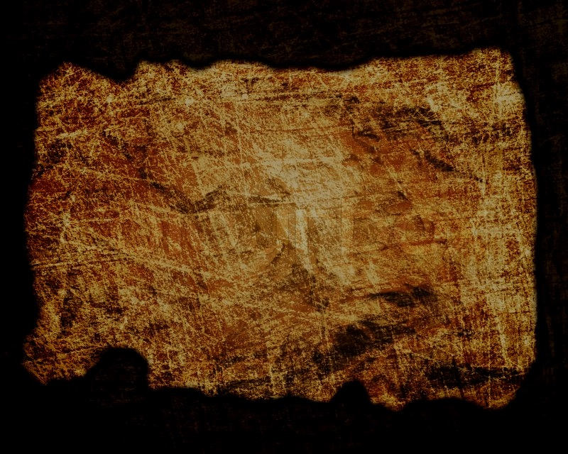
Covenant
27c
Christ “cancelled the written code, with its regulations” (2:14), so Christ’s death did away with the Mosaic Law (cf. Rom. 7:7).
Colossians
Notes:
Col 2:14 NLT: "He canceled the record of the charges against us and took it away by nailing it to the cross."
This is nearly identical to Ephesians 2:14-15…
Eph. 2:14 For Christ himself has brought peace to us. He united Jews and Gentiles into one people when, in his own body on the cross, he broke down the wall of hostility that separated us. 15 He did this by ending the system of law with its commandments and regulations. He made peace between Jews and Gentiles by creating in himself one new people from the two groups.

Slide 8

Redemption
27c
Jesus through his death has transferred believers from the dominion of darkness to light (1:13-14) in his victory over spiritual forces (2:15).
Colossians
Notes:
Col. 1:13 NLT For he has rescued us from the kingdom of darkness and transferred us into the Kingdom of his dear Son, 14 who purchased our freedom and forgave our sins.
Col 2:15 NLT In this way, he disarmed the spiritual rulers and authorities. He shamed them publicly by his victory over them on the cross.

Slide 9
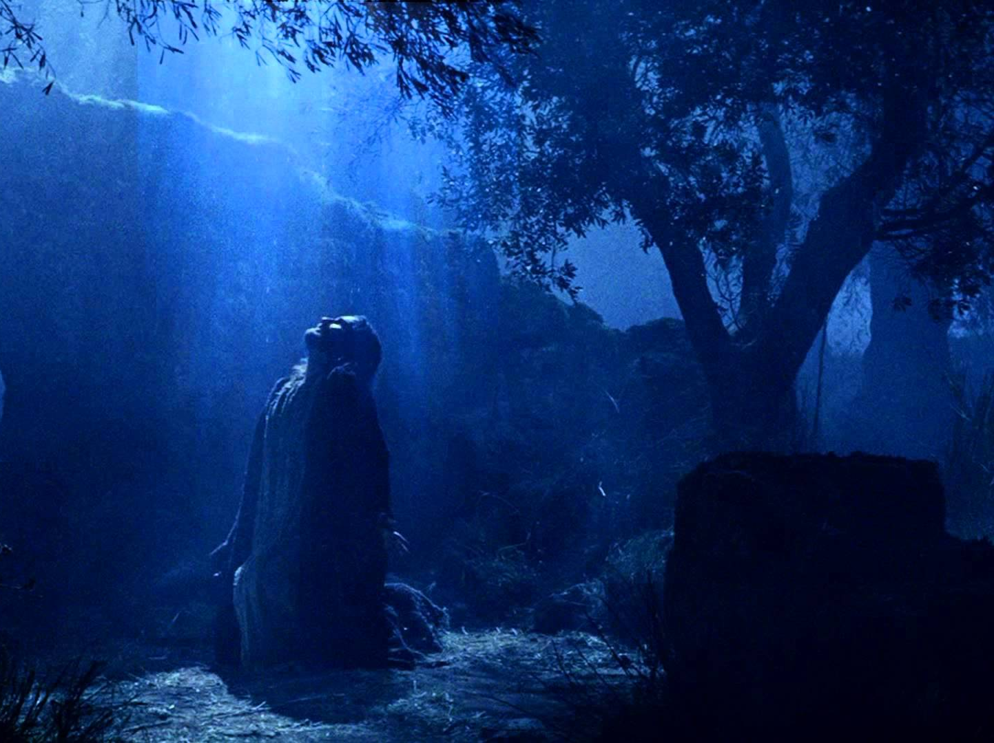
Prophecy
(Lord, Deity)
27c
Christ’s deity is evident in:
“He is the image of the invisible God, the firstborn [‘preeminent one’] over all creation. For by Him all things were made…” (1:15-16a),
"For God was pleased to have all his fullness dwell in him" (1:19), and
“For in Christ all the fullness of Deity lives in bodily form” (2:9).
Colossians
Notes:
At least three explicit statements show Jesus to be God himself in a human body.

Slide 10
Book Chart
Deity of Christ vs. Syncretistic Heresy
Supremacy/Deity |  |  | Practical Instruction
Chapters 1–2 |  |  | Chapters 3–4
Heretical Living |  |  | Holy Living
Belief |  |  | Behaviour
Greeting & Prayer | Supremacy & Deity | Syncretistic Heresy | Position: Union with Christ | Practice: Holiness in Relation-ships | Conclusion
1:1-14 | 1:15–2:5 | 2:6-23 | 3:1-4 | 3:5–4:6 | 4:7-18
Rome
Autumn AD 61 (first Roman imprisonment)
Colossians
187
Notes:
Paul shows Christ's exalted position over the Colossian heresy in the first two chapters—and then explains how that leads to our position united with Christ and the holy practices that should result.

Slide 11
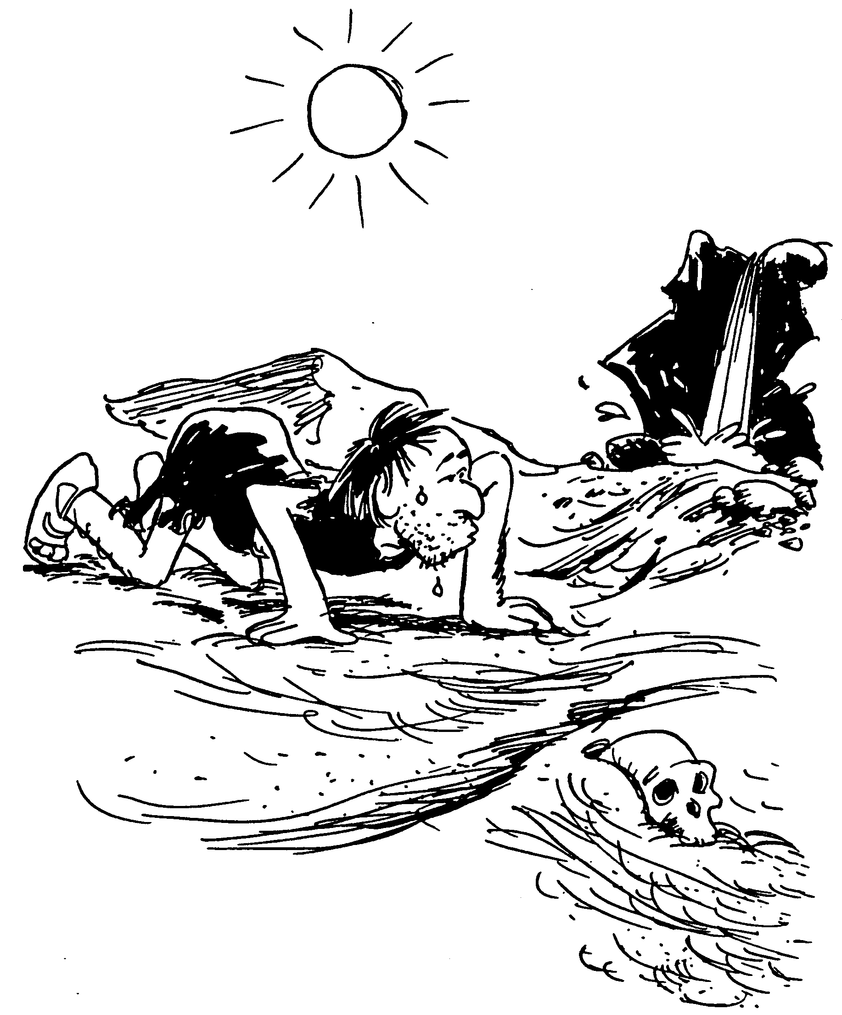
COLOSSIANS
Hope produced by Christ
Objections to false teachers
Principles for Christian life-style
Expectant prayer and greetings
Barry Huddleston, The Acrostic Bible
Notes:
Paul wanted the church at Colossae to see that their only HOPE was in Jesus, not in any of the false ideas impacting the assembly.

Slide 12
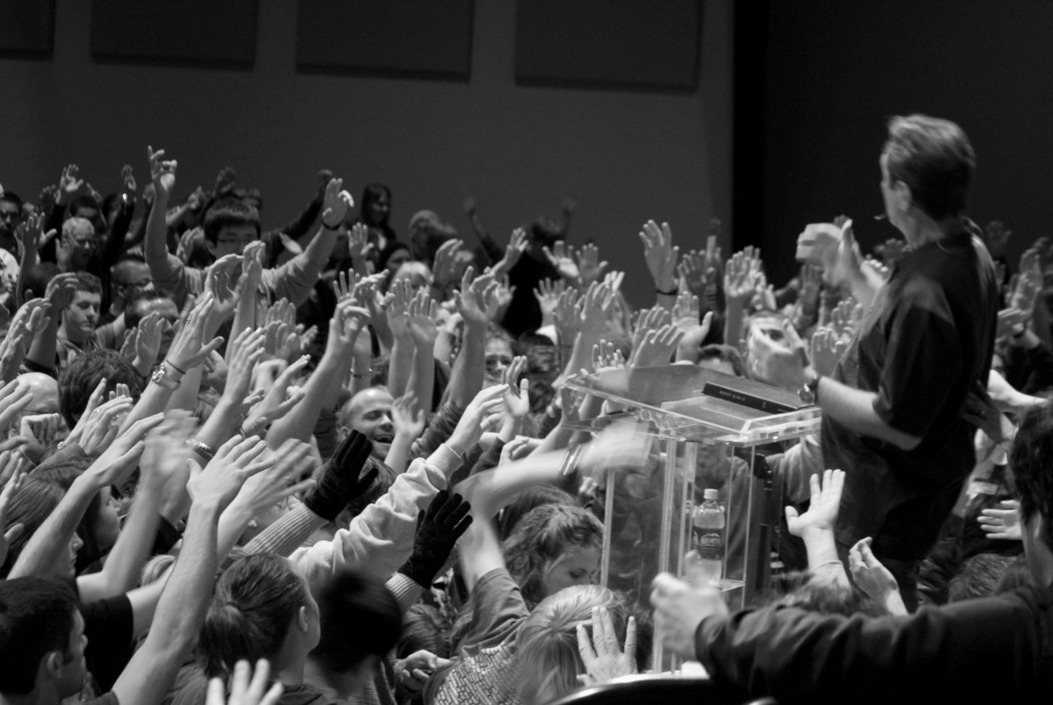
Be Protected
Colossians
Dr. Rick Griffith • Crossroads International Church Singapore
BibleStudyDownloads.org
Notes:
The only one who doesn't need protection is God. Everyone else can succumb to sin, errors, and death. Paul sought to convince the Colossian church that they also needed protection from dangerous ideas infiltrating the church.

Slide 13
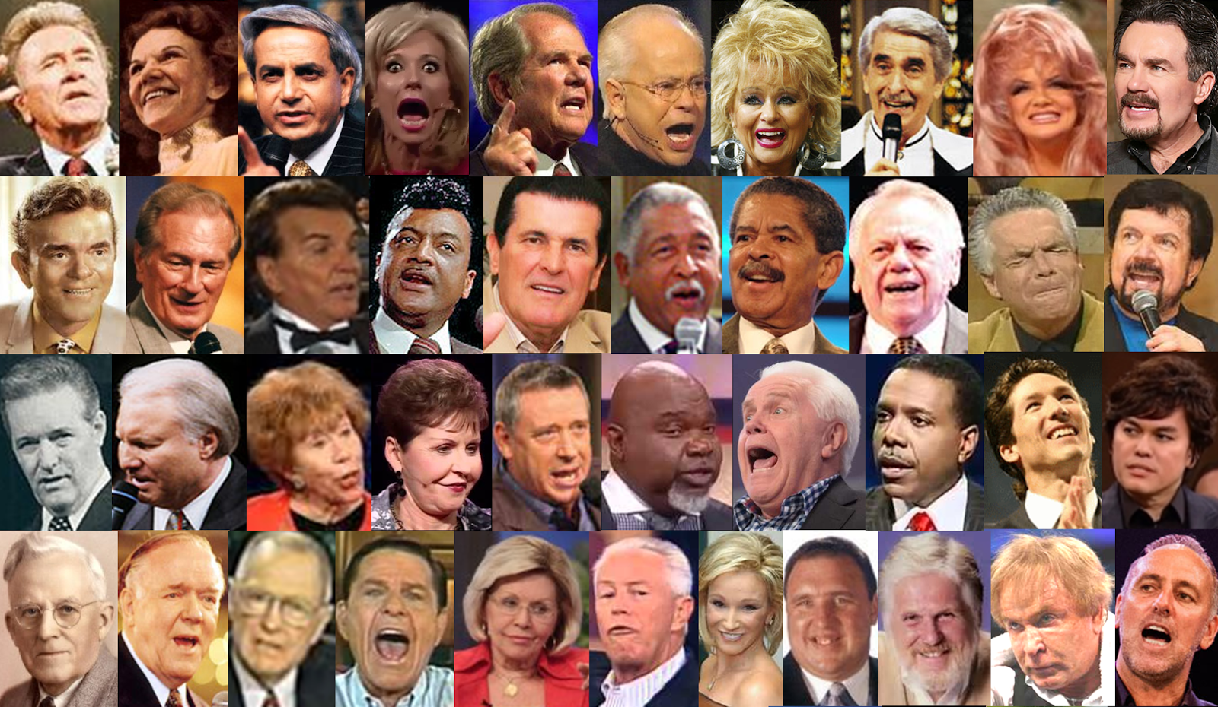
False Teachers Deny the
Deity and Work of Christ
Colossians
Notes:
False teaching is all around us. Reputable survey organizations in the USA like Gallup and Barna report that many fall for false teaching so that they leave the church.

Slide 14
Occasion for Colossians
188-189
Asia Minor was the seedbed for what developed into 2nd century Gnosticism. Paul's counterattack tells us this about the heresy:
1. Jewish—legalism of following OT laws and ceremonies (2:16-17)
2. Greek philosophy—followed a so-called "deeper knowledge" revealed only to a special "elite" (2:2b-4, 8-10)
3. Worshipped angels as mediators between man and God (2:18)
4. Denied Christ's deity (1:15; 2:9), & thus His supremacy (1:15b, 17a) & ability to create (1:16) & sustain the world (1:17)
5. Ascetic nature had a low view of the body (2:20-23)
What was the heresy facing this church? The above shows it was a syncretistic Jewish-Greek-Ascetic-Pagan cult. Paul's method to fight the heresy is to emphasize the deity & supremacy of Christ.
Notes:
Syncretistic means to draw from many sources into one, and the letter shows at least five different sources for the Colossian heresy.

Slide 15
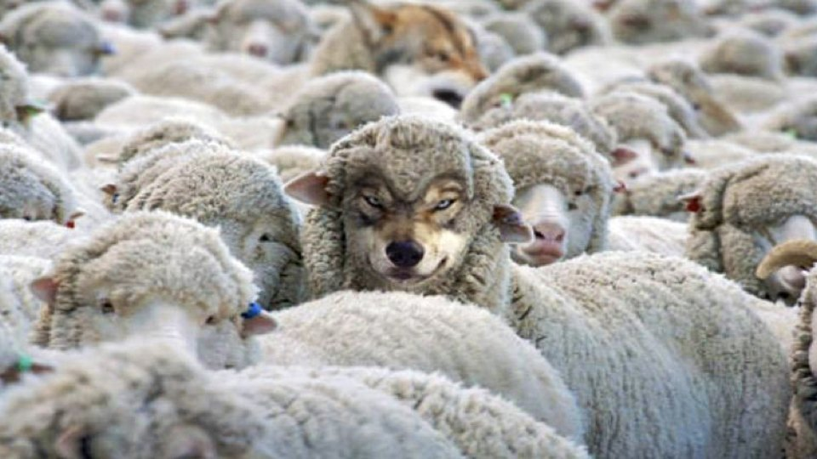
How can you be protected from false teaching?
Colossians
Notes:
What ways can we prevent heretical ideas from capturing us in their snare?

Slide 16
I. Believe that Jesus is God
(Col 1–2)
Father
is
is not
is not
GOD
is
is
Son
Spirit
is not
How to be protected from false teaching
Notes:
Guard yourself from heresy by embracing the deity and supremacy of Christ over all things.

Slide 17

II. Embrace holy living
(Col 3–4)
How to be protected from false teaching
Notes:
Protect yourself from heresy by your pure lifestyle.

Slide 18
WHAT TO EMBRACE
DEITY
HOLINESS
TO
Colossians
Notes:
Jesus being God should impact us to want to reflect his purity as his church.

Slide 19

Main Idea of the Letter
Protect yourself from false teaching by embracing both Christ’s deity and a holy life.
Colossians
Notes:
The way to defend against heresy is twofold: a high view of Jesus and a high view of holiness.

Slide 20
Black

Slide 21
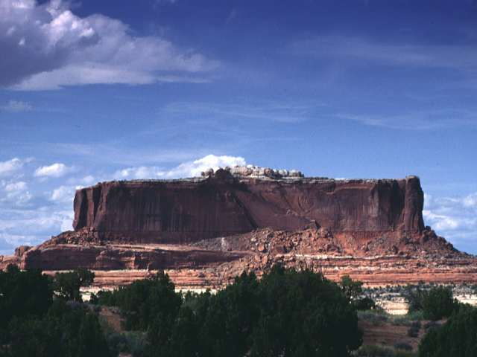
Our God is an awesome God!
He reigns from heaven above
with wisdom, power and love;
Our God is an awesome God!
(repeat)
Our God is an awesome God!
Our God is an awesome God!

Slide 22
NT Overview (Paul's Letters)
38
124
39-41
Give the key word for each book studied so far
"To the remotest part of the earth" (Acts 1:8)
Acts 9 13 14 15 16 18 21 27 28
Apr 48-
Sep 49
1
Galatia
Apr 50-
Sep 52
2
Aegean
Spr 53-
May 57
3
Asia
Feb 60-
Mar 62
1
Rome
Spr 62-
Fall 67
4
Spain
Aut 67-
Spr 68
2
Rome
Summer 35-
37
Damascus
Antioch
May 57-
Aug 59
Trials
Fall 49
The
Council
Spring 68
Expansion of Church
35 48 49 50 52 53 57 60 62 67 68 95
Matt
Luke
Acts
Mark
John
Gal
Justify
1 Thess
Rapture
1 Cor
Eph
Sanctify
Unity
1 Tim
2 Tim
2 Thess
Tribulation
2 Cor
Col
Apostle
Deity
Titus
Missionary
Pastoral
Romans
Philem
Righteous
Forgive
Gospels & Acts
Phil
Attitude
Pauline Epistles
1234
Journeys
Prison
Rome
Imprisonments
Pauline Books, Categories, & Key Words

Slide 23

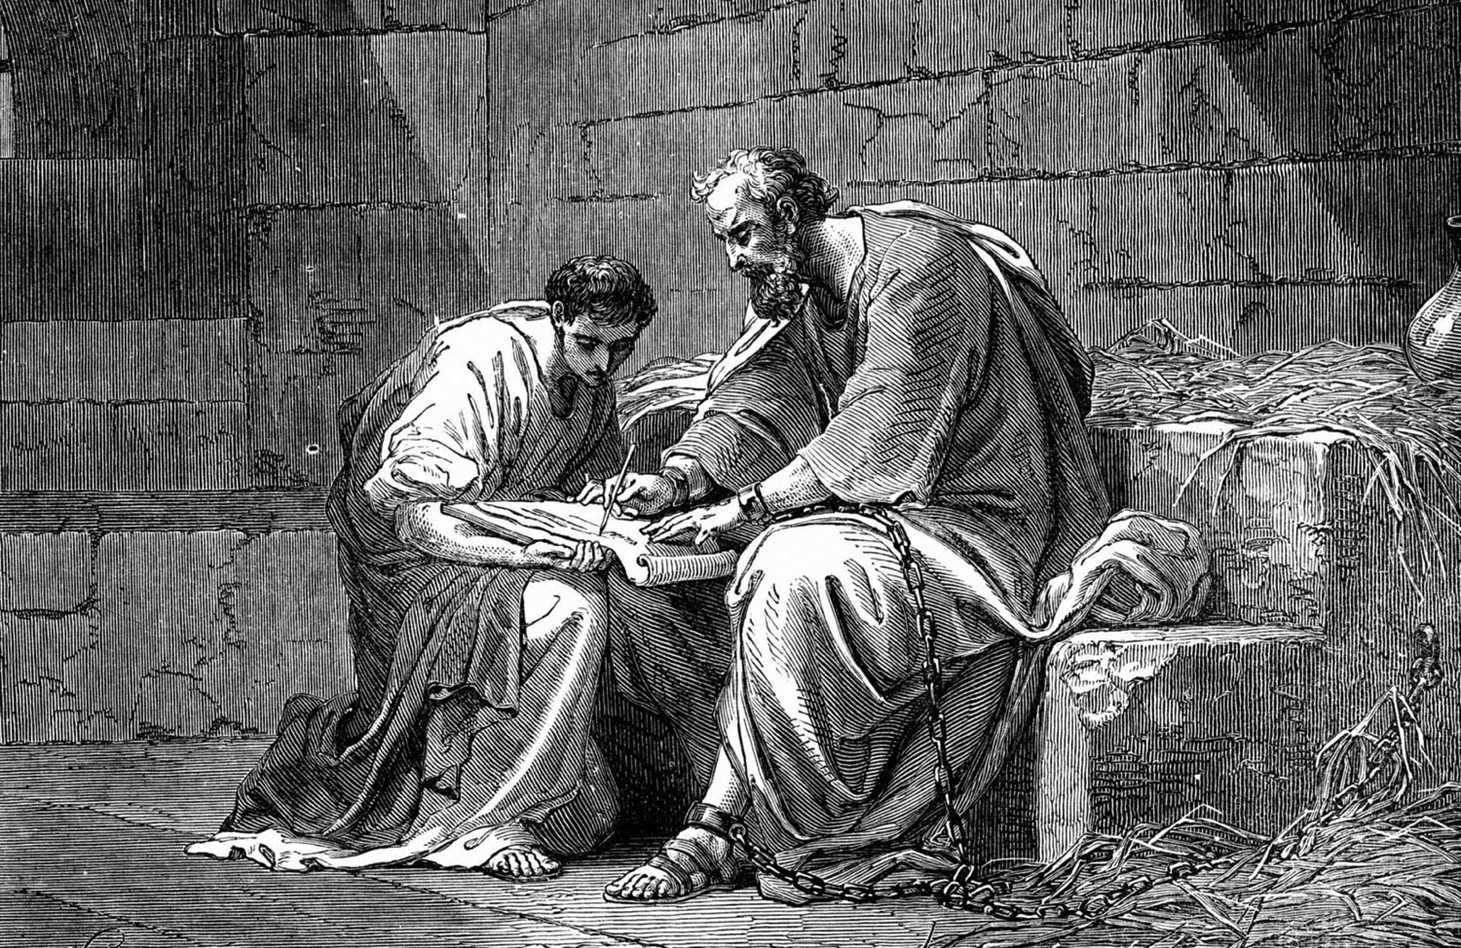
Introducing the "Prison Epistles"
Dr. Rick Griffith • Singapore Bible College
BibleStudyDownloads.org
Jeremy Chew, East Asia School of Theology, Singapore

Slide 24
NT Overview (Paul's Letters)
38
124
39-41
"To the remotest part of the earth" (Acts 1:8)
Acts 9 13 14 15 16 18 21 27 28
Apr 48-
Sep 49
1
Galatia
Apr 50-
Sep 52
2
Aegean
Spr 53-
May 57
3
Asia
Feb 60-
Mar 62
1
Rome
Spr 62-
Fall 67
4
Spain
Aut 67-
Spr 68
2
Rome
Summer 35-
37
Damascus
Antioch
May 57-
Aug 59
Trials
Fall 49
The
Council
Spring 68
Expansion of Church
35 48 49 50 52 53 57 60 62 67 68 95
Matt
Luke
Acts
Mark
John
Gal
Justify
1 Thess
Rapture
1 Cor
Eph
Sanctify
Unity
1 Tim
2 Tim
2 Thess
2 Cor
Col
Tribulation
Apostle
Deity
Titus
Missionary
Pastoral
Romans
Philem
Righteous
Forgive
Gospels & Acts
Phil
Attitude
Pauline Epistles
1234
Journeys
Prison
Rome
Imprisonments
Pauline Books, Categories, & Key Words

Slide 25
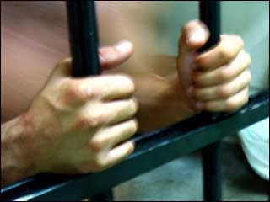
Which letters are Prison Epistles?
177
Ephesians
Colossians
Philemon
Philippians
Why call them "Prison Epistles"?
They refer to Paul's bonds (cf. Acts 28:16):
  Eph. 3:1; 4:1; 6:20
  Col. 4:3, 18
  Philem. 1, 9, 10
  Phil. 1:13-14
Adapted from Jeremy Chew, East Asia School of Theology, Singapore

Slide 26
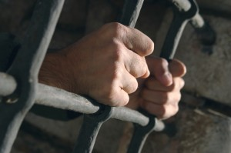
Who carried these letters?
177
Tychicus
  He carried the Ephesian and Colossian epistles (Eph. 6:21; Col. 4:7)
  He was accompanied by Onesimus (Col. 4:9)
Onesimus
  A slave to Philemon from Colossae
  He probably carried the Epistle to Philemon when he returned to his master, though it is not specifically mentioned (Philem. 12)
Epaphroditus
  A man from Philippi, he carried the Philippian letter back to his people (Phil. 2:25, 28)
Adapted from Jeremy Chew, East Asia School of Theology, Singapore

Slide 27


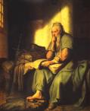
What was Paul's attitude?
177
In Philemon, Paul was hopeful (evlpi,zw = hope) that he would be released (Philemon 22)
In Philippians, Paul was confident (oi=da know) that he would be released (Phil. 1:25; 2:24)
Order & Setting
Written on 2-3 separate occasions
Ephesians, Colossians, and Philemon are written around the same time (likely AD 60-61)
Philippians is written later (probably AD 62)
Adapted from Jeremy Chew, East Asia School of Theology, Singapore

Slide 28

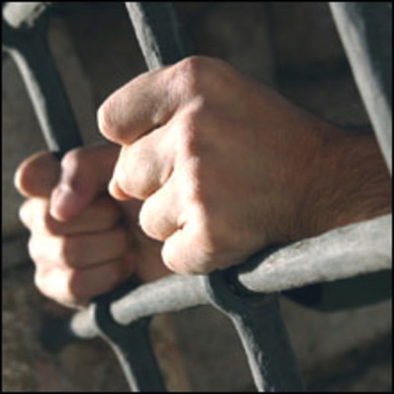
Occasion for Prison Epistles
177
Paul was imprisoned in Rome and Epaphras was with him
He first wrote a general circular letter for Gentile churches in Asia Minor (Ephesians)
Onesimus, a runaway slave, later joined them
Paul received news of a crisis in the Colossian church (heresy)
He sent Tychicus with a letter to address the Colossian problems
He also sent Onesimus with Tychicus with a letter to Philemon
Adapted from Jeremy Chew, East Asia School of Theology, Singapore

Slide 29
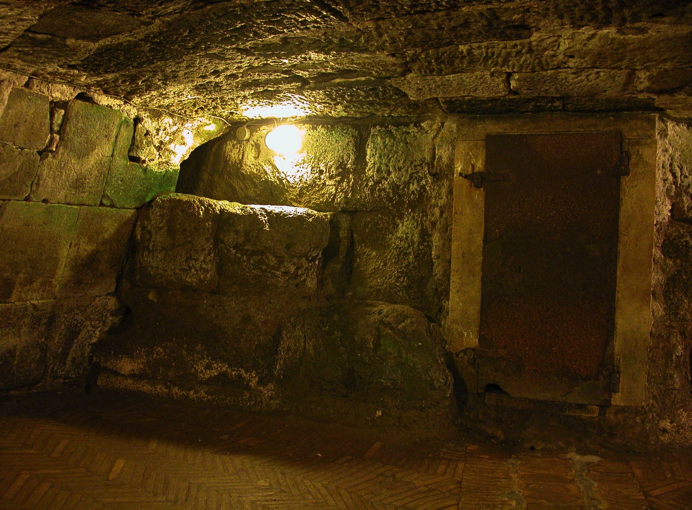
Some months later (AD 62)…
182
Paul was still in prison
The Philippian church sent Epaphroditus to minister to Paul
Paul found out from him problems in Philippian church: external opposition (3:17f.) and internal disunity (4:2)
Epaphroditus became very sick (Phil. 2:26)
Paul sent him back with a letter to address problems of the Philippians
Adapted from Jeremy Chew, East Asia School of Theology, Singapore

Slide 30

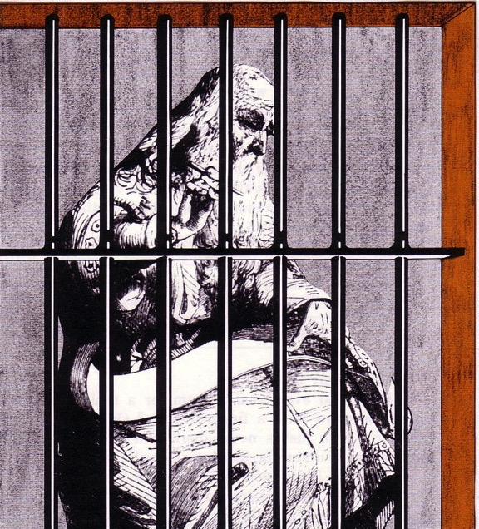
The Prison Epistles
Ephesians
Colossians
Philemon
Philippians
Critique this picture…
Paul typically had a scribe write (Rom 16:22)
Paul was under house arrest (Acts 28:30-31)
Paul was chained to a guard (Acts 28:16)
Paul was ≤60 years old (not 80 like this man!)
Notes:
Unlikely there were bars
Too nice wood?
Pen instead of a stylus?
Dressed too nice?
Beard too long?

Slide 31


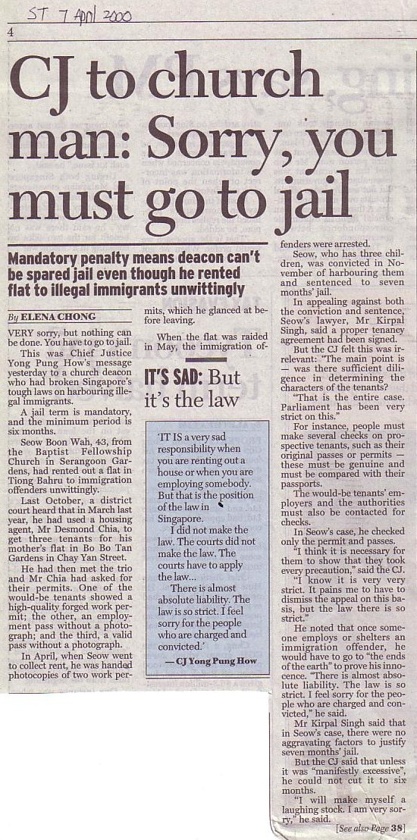
Sometimes Christians are Treated Unfairly
GO TO JAIL
Paul was—and ended up under house arrest in Rome
Note that a deacon appears with a terrorist & tax cheat

Slide 32
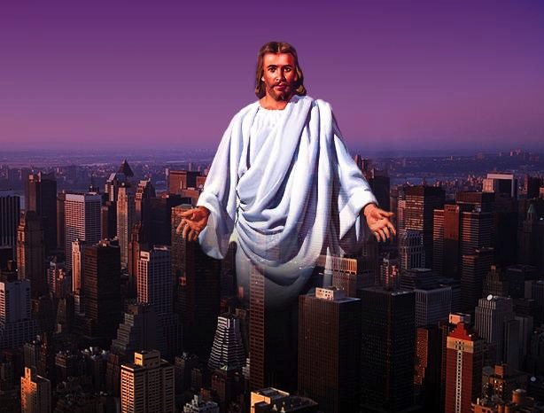
Prison Epistle Christology
201a
 | Christ as… | Focus | Explanation
Ephesians | Head | Unity of Christ | Christ breaks down barriers between believers
Philippians | Example | Attitude of Christ | Christ models how to handle difficulty
Colossians | God | Deity of Christ | Christ is superior to human philosophies
Philemon | Reconciler | Forgiveness of Christ | Christ reconciles believers to God and one another

Slide 33
Applying the Prison Epistles
202
Epistle | 1st Century Problem | 21st Century Problem | Solution (Theme)
Ephesians | Jew-Gentile Conflicts ("Weism") | Chinese Only Baptist Only Adults Only | Realize Christian Unity (4:3)
Philippians | Persecution Prison Death | Ministry Inconvenience - time, sleep - recreation | Imitate Christ's Attitude (2:5)
Colossians | Denying Christ's Deity | New Age Cults | Proclaim His Deity (2:9)
Philemon | Master/Slave ("Meism") | Forgive Boss / Employee / Others | Reconcile the Relationship (vv. 17-18)

Slide 34


How Do You Respond to Trials?
201
You say… | Strategy | Temperament | Epistle
"I'm right!" | Push through | Choleric | Ephesians
"Why me?" | Depression | Melancholy | Philippians
"I'll just get through" | Compromise | Sanguine | Colossians
"It'll pass" | Ignore it | Phlegmatic | Philemon

Slide 35
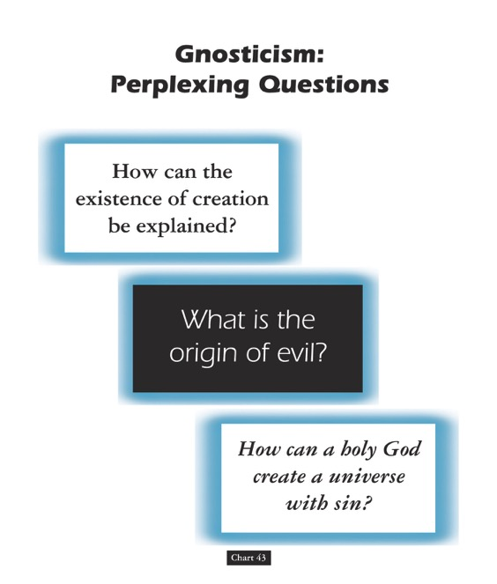
Gnosticism: Perplexing Questions
153a
How can the existence of creation be explained?
What is the origin of evil?
How can a holy God create a universe with sin?
Chart 43
John D. Hannah, Charts of Ancient & Medieval Church History (Grand Rapids: Zondervan, 2001)
Notes:
Dr John Hannah at Dallas Seminary sums it up well: "The Christian faith was opposed by numerous adversaries––threats from the state, ominous false religions, and heretics within its own borders. The most imposing religious threat came from Gnosticism, which was particularly dangerous because of its intellectual coherency. While Gnosticism seemed to provide answers to perplexing questions, it succeeded only in mixing a snippet of biblical truth with error.”
—Text from Hannah for this chart

Slide 36
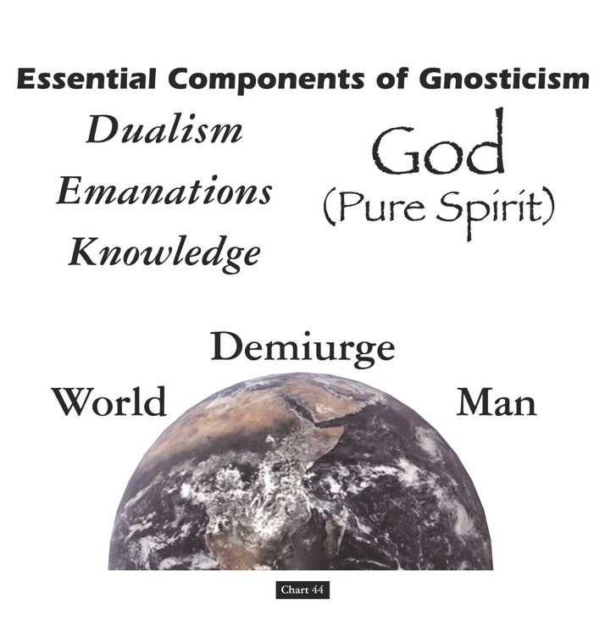
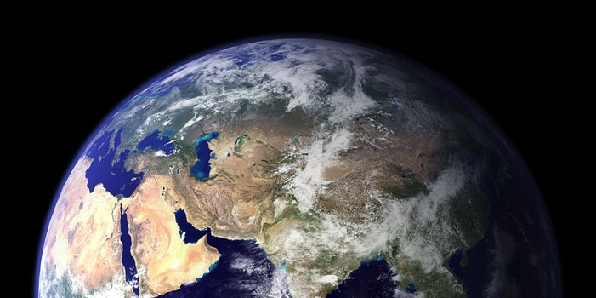
Essential Components of Gnosticism
153b
God
(Pure Spirit)
(1) Dualism
(2) Emanations
(3) Knowledge
Demiurge
World
Man
Chart 44
John D. Hannah, Charts of Ancient & Medieval Church History (Grand Rapids: Zondervan, 2001)
Notes:
"Gnosticism taught (1) that there is a radical dualism of the spiritual in opposition to the material (God, who is Spirit, is the supreme good, while matter is evil); (2) that God could not have created matter because it is contrary to his nature; rather, the world, which is material and evil, was created by the Demiurge (an emanation from God), and man is a material being with an entrapped spirit; and (3) that through a "secret knowledge," salvation becomes the life of escape from the material confines of the body."
—Text from Hannah for this chart

Slide 37

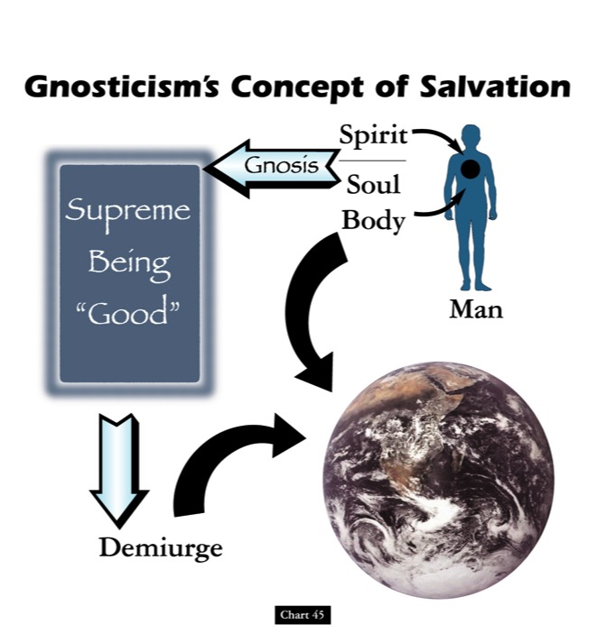

Gnosticism's Concept of Salvation
153c
Spirit
Supreme Being "Good"
Gnosis
Soul
Body
Man
Demiurge
Chart 45
John D. Hannah, Charts of Ancient & Medieval Church History (Grand Rapids: Zondervan, 2001)
Notes:
"Gnosticism's concept of salvation is as follows: God did not create the world, [1] but a lesser yet powerful being (the Demiurge) made this evil world and [2] mankind––though within man is a spark of good. [3] Salvation results from enlarging the capacity of that nature while minimizing the hold of materialism, [4] and it is accomplished by means of the secret teachings of Gnostic teachers. In resisting this teaching, Christian writers adopted a worldview that embraced the God of the Bible as the divine creator, affirmed the creation as good though marred by a subsequent devastation, and espoused the salvation of the body as well as the soul.”
—Text from Hannah for this chart [animation brackets mine]

Slide 38
Gnostics Taught a "Secret Knowledge"
291
-292
Two Types Addressed in 1 John
Docetic Gnosticism
From dokeo, "to seem"
(Christ only seemed to be a man)
Matter is Evil
Depreciated Materialism
Denied Christ's Humanity
Touched Jesus (1:1)
Led to Asceticism
Immorality exalted
Cerinthian Gnosticism
From Cerinthus, founder in Asia
(Christ only seemed to be God)
Spirit is Good
Exalted Knowledge (gnosis)
Denied Christ's Deity
Water & Blood (5:6)
Led to Pride
Education exalted
Notes:
Many Gnostics denied Jesus was a real man. Others exalted the spirit so much that they denied his deity.

Slide 39
Be Protected
Colossians
Dr. Rick Griffith • Crossroads International Church Singapore
BibleStudyDownloads.org

Slide 40
False Teachers Deny the Deity and Work of Christ
Colossians
Notes:
False teaching is all around us. Reputable survey organizations in the USA like Gallup and Barna report that many fall for false teaching so that they leave the church.

Slide 41

False Teaching
Notes:
This is especially true for teenagers. The influences on kids when they are young are seen only a few years later.

Slide 42

Foster Letter 2002
"The 'American Family In Crises Research' by the Southern Baptist Council on Family Life uncovered some disturbing facts. Of the children raised in evangelical homes, 88% leave the church at age 18 and never return."
Pastor's Weekly Briefing, Focus on the Family, 26 July 2002, quoted in Gary Foster, The Foster Letter, 10 Aug. 2002, p. 1.
Notes:
The studies I have seen show that between 65-88% of teens in the church will not attend church in their twenties.
________________
From Carl Kerby
Following is the entire quote that was in Terry Mortenson’s newsletter. My source was the 7/26/02 issue of Pastor's Weekly Briefing published by the Pastoral Ministries department of Focus on the Family.
American Family In Crises Research by the Southern Baptist Council on Family Life has uncovered some disturbing facts that are leading the group to emphasize the need to rebuild the American family.
§ 88% of the children raised in evangelical homes leave church at the age of 18, never to return.
§ The divorce ratio among members of evangelical churches is virtually the same as non-church members.
§ One million children in the U.S. see their parents divorce.
§ Personal bankruptcies are at an all-time high in America.
The majority of children in America have less than 10 minutes of significant and meaningful conversation with their parents each week. If you remove the mother, you can measure this statistic in seconds. The council recommends that families set aside one evening a week as a family night, on which no local church activities would be scheduled to interfere. It also urged an increased emphasis on biblically based premarital counseling. (PWB 7/26)
Gary D. Foster
Gary D. Foster Consulting
334 Sutherland Place
Manitou Springs, CO 80829
Phone: 719-685-1138 E-mail: GFosterCns@rmi.net Website: http://www.garydfoster.com/
"Helping Christian ministries & product companies discover new revenue streams and to better leverage existing ones."

Slide 43

Already Gone 04802
Already Gone
  by Ken Ham and Britt Beemer,
  with Todd Hillard
© Answers in Genesis-USA
Notes:
Ken Ham & Britt Beemer note this in their 2009 book. That title means that young people are in our pews physically, but their values are already gone before their bodies are.

Slide 44

False Teaching
Notes:
But for those of us older, the temptations to false teaching are also real.
Have you even noticed how more enticing heresy is than truth? False teachers are more interesting than teachers of truth like me!

Slide 45
False Teaching
Notes:
There is an allurement for men where sex continues in the afterlife. That is Mormonism and Islam.
How cool to die and then go create your own planet and populate it with your harem—Mormonism again.
Most false teaching doesn’t get convicting with talk about sin—or make you feel bad.
I have a relative tell me that we can still live like we want and be “very spiritual.”

Slide 46
Be Protected
Notes:
Need: So what is your strategy to stay faithful to the Lord so you don’t fall prey to heresy?
What should you being doing to avoid false teaching?
How much should you study these groups?
How do you avoid becoming part of the statistics of those who abandon the Lord Jesus? Today we will answer this question…

Slide 47
How can you be protected from false teaching?
Notes:
What ways can we prevent heretical ideas from capturing us in their snare?

Slide 48
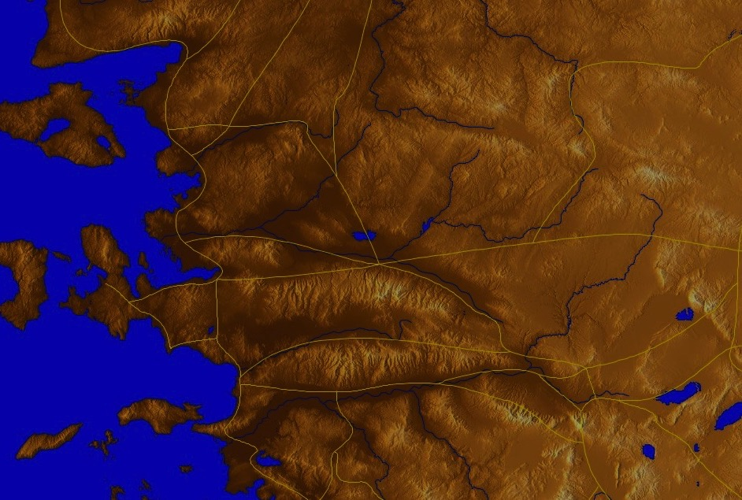
Colossae & The 7 Churches (Rev. 2–3)
Adramyttium
Aezani
Pergamum
Thyatira
Cyme
Erythrae
Sardis
Smyrna
Eumenia
Philadelphia
Lebedus
Colophon
Ephesus
Nysa
Laodicea
Hierapolis
Trailes
Heraclea
Aphrodisias
Colossae
Alabanda
Patmos
Miletus
Notes:
Colossians believers were being led astray.
__________
Jesus designed a brilliant strategy by having his revelation sent to capital of the province, Ephesus. It included an individual letter to Ephesus, as well as letters to 6 other key churches. The Ephesians copied the entire book of Revelation, though, and sent the original to the next city, Smyrna. Smyrna then made their own copy and sent the original to Pergamum, which lay on the main road to the north. This city then sent the prophecy to Thyatira, which sent it to Sardis, then Philadelphia, and finally to Laodicea.

Slide 49
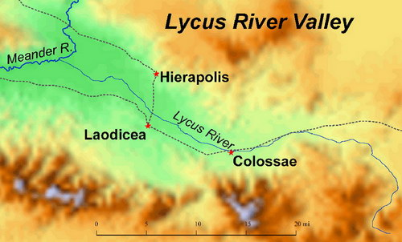
Lycus River Valley
Meander R.
Hierapolis
Hot springs
Lycus R.
Laodicea
Lukewarm
Colossae
Cold springs
Laodicea had money but no water
Notes:
The city of Colossae had cool water that was brought to nearby Laodicea.
Paul had never visited Colosse when he wrote this letter. However, during his nearly three-year ministry in nearby Ephesus (Sept 53-May 56; cf. Acts 19) he probably met (and may have converted) Epaphras, who returned to Colosse and founded the church (1:7). Five years later, when Epaphras heard of Paul's imprisonment, he visited the apostle and brought news of their love (1:8).

Slide 50
Occasion
188-189
Paul had never visited Colosse before he wrote this letter. However, during his nearly three year ministry in nearby Ephesus, he probably met (& may have converted) Epaphras, who likely went to Colosse and started the church.
Epaphras brought news of a serious heresy plaguing the church. This prompted Paul to pen the epistle to the Colossians for Tychicus to deliver since he was returning to Colosse with Onesimus.

Slide 51
Occasion
188-189
Asia Minor was the seedbed for what developed into 2nd century Gnosticism. Paul's counterattack tells us this about the heresy:
1. Jewish—legalism of following OT laws and ceremonies (2:16-17)
2. Greek philosophy—followed a so-called "deeper knowledge" revealed only to a special "elite" (2:2b-4, 8-10)
3. Worshipped angels as mediators between man and God (2:18)
4. Denied Christ's deity (1:15; 2:9), & thus His supremacy (1:15b, 17a) & ability to create (1:16) & sustain the world (1:17)
5. Ascetic nature had a low view of the body (2:20-23)
What was the Colossian heresy? The above shows it was a syncretistic Jewish-Greek-Ascetic-Pagan cult. Paul's method to fight the heresy is to emphasize the deity & supremacy of Christ.
Notes:
Epaphras evidently also told Paul of a serious heresy plaguing the church. This prompted Paul to pen the epistle to the Colossians for Tychicus to deliver since he was returning to Colosse with Onesimus anyway. The nature of the heresy has been much debated, but the internal evidence suggests that it was the seedbed for what later developed into Gnosticism in the second century.
Paul’s response reveals the many problems with this heresy. It was a syncretistic heresy with five basic elements. We see these five problems in Colossians 2:
Its Jewish nature showed in its legalism by imposing Old Testament laws and rituals (2:16-17).

Slide 52
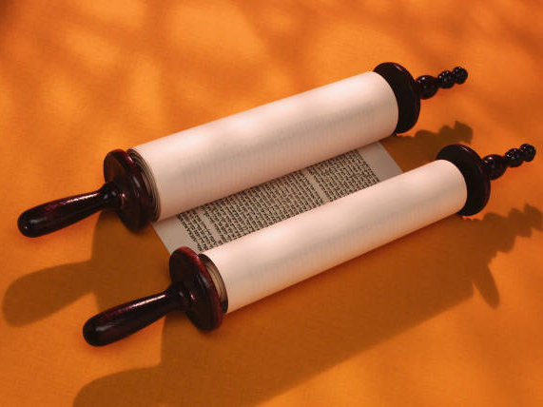
Jewish: The Law is Good
but…

Slide 53

No Legalism!
"So don't let anyone condemn you for what you eat or drink, or for not celebrating certain holy days or new moon ceremonies or Sabbaths. ¹⁷For these rules are only shadows of the reality yet to come. And Christ himself is that reality" (Col. 2:16-17 NLT)
NO LEGALISM
IT'S THE LAW!

Slide 54
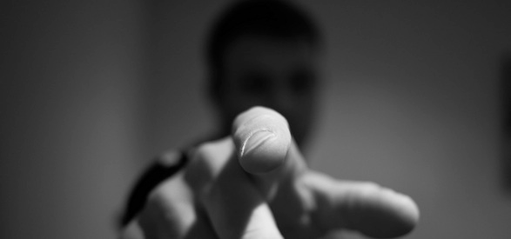
No Legalism!

Slide 55
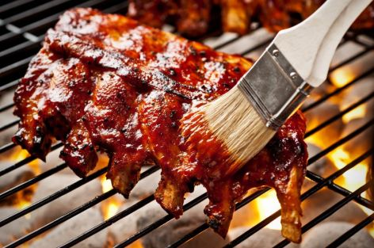
No Legalism!
"So don't let anyone condemn you for what you eat or drink, or for not celebrating certain holy days or new moon ceremonies or Sabbaths. ¹⁷For these rules are only shadows of the reality yet to come. And Christ himself is that reality" (Col. 2:16-17 NLT)

Slide 56
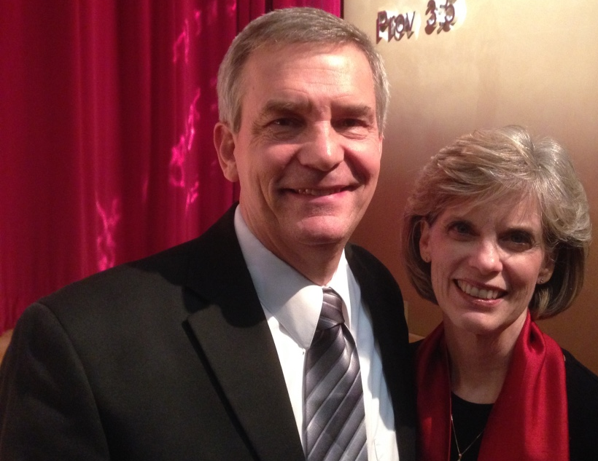
No Shadows!
"So don't let anyone condemn you for what you eat or drink, or for not celebrating certain holy days or new moon ceremonies or Sabbaths. ¹⁷For these rules are only shadows of the reality yet to come. And Christ himself is that reality"
(2:16-17 NLT)
Notes:
What would you think if I looked at Susan’s shadow on my chest and said, “Wow, what a wonderful shadow! Look at the shape of that shadow! So nice, so perfect!”
You would think I am nuts. You would say, “Why are you so enamored with Susan’s shadow? You give more attention to your wife’s shadow than to this beautiful, dedicated, faithful woman herself standing next to you. What’s wrong with you?”
Too often Christians do the same with Jesus. We delight in the rest he gives us, we are enamored with the rules we have—and we neglect the very reality of Jesus himself!”

Slide 57
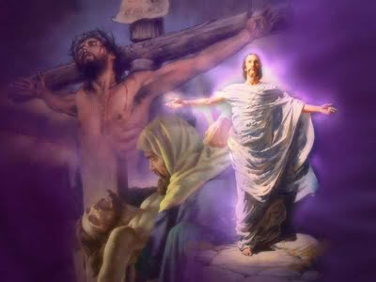
Focus on:
"And Christ himself is that reality" (2:17b NLT)
Death
Resurrection
Burial

Slide 58
Occasion
188-189
Asia Minor was the seedbed for what developed into 2nd century Gnosticism. Paul's counterattack tells us this about the heresy:
1. Jewish—legalism of following OT laws and ceremonies (2:16-17)
2. Greek philosophy—followed a so-called "deeper knowledge" revealed only to a special "elite" (2:2b-4, 8-10)
3. Worshipped angels as mediators between man and God (2:18)
4. Denied Christ's deity (1:15; 2:9), & thus His supremacy (1:15b, 17a) & ability to create (1:16) & sustain the world (1:17)
5. Ascetic nature had a low view of the body (2:20-23)
What was the Colossian heresy? The above shows it was a syncretistic Jewish-Greek-Ascetic-Pagan cult. Paul's method to fight the heresy is to emphasize the deity & supremacy of Christ.

Slide 59
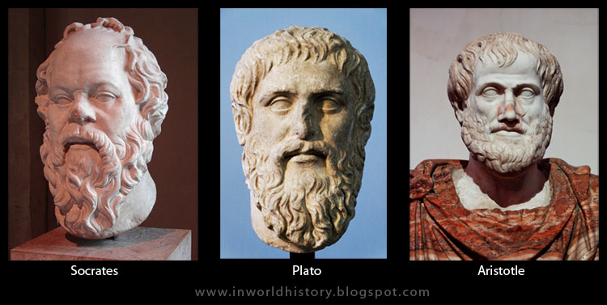
Greek Philosophy
Socrates
Plato
Aristotle

Slide 60
Greek Philosophy
"Good people do not need laws to tell them to act responsibly, while bad people will find a way around the laws"
—Plato
423-348 BC
Socrates
Plato
Aristotle

Slide 61
Greek Philosophy
Don't let anyone capture you with empty philosophies and high-sounding nonsense that come from human thinking and from the spiritual powers of this world, rather than from Christ
(2:8 NLT)
"Good people do not need laws to tell them to act responsibly, while bad people will find a way around the laws"
—Plato
423-348 BC
Socrates
Plato
Aristotle

Slide 62
Key Verse
187
"For in Christ all the fullness of the Deity lives in bodily form"
(Colossians 2:9).
Colossians

Slide 63
Occasion
188-189
Asia Minor was the seedbed for what developed into 2nd century Gnosticism. Paul's counterattack tells us this about the heresy:
1. Jewish—legalism of following OT laws and ceremonies (2:16-17)
2. Greek philosophy—followed a so-called "deeper knowledge" revealed only to a special "elite" (2:2b-4, 8-10)
3. Worshipped angels as mediators between man and God (2:18)
4. Denied Christ's deity (1:15; 2:9), & thus His supremacy (1:15b, 17a) & ability to create (1:16) & sustain the world (1:17)
5. Ascetic nature had a low view of the body (2:20-23)
What was the Colossian heresy? The above shows it was a syncretistic Jewish-Greek-Ascetic-Pagan cult. Paul's method to fight the heresy is to emphasize the deity & supremacy of Christ.

Slide 64
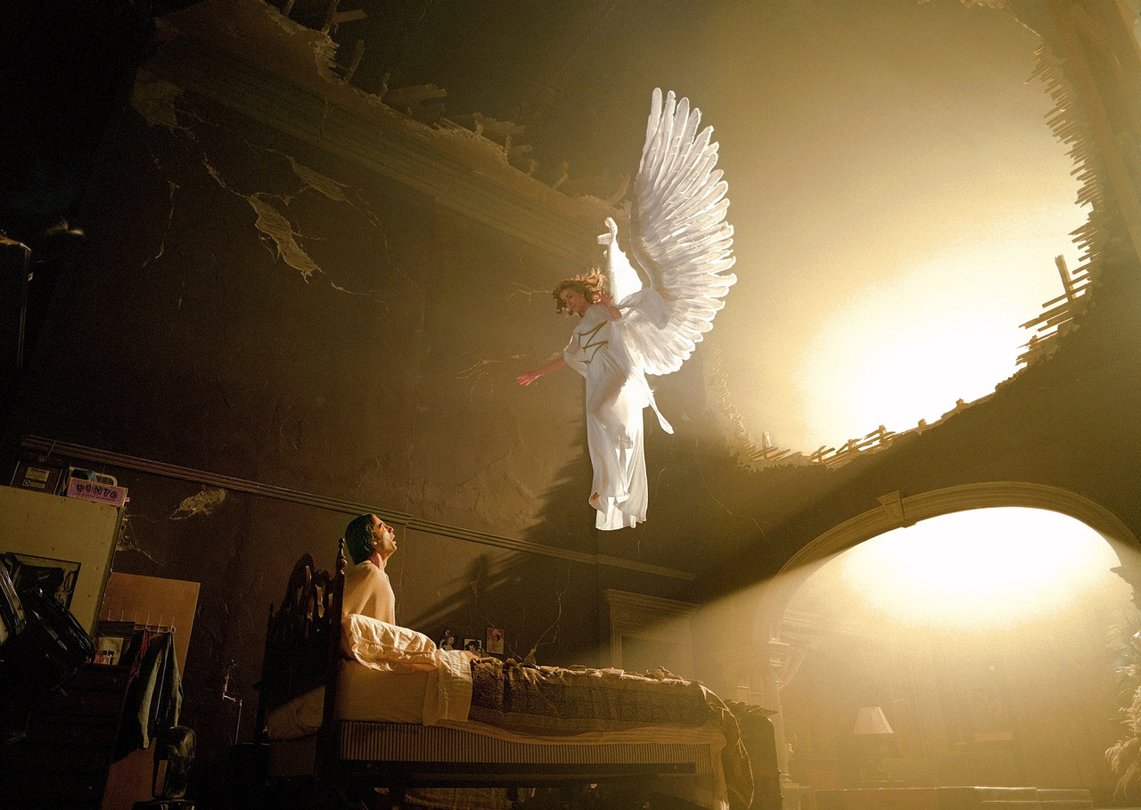
Angel Worship
"Don't let anyone condemn you by insisting on pious self-denial or the worship of angels…"
"…saying they have had visions about these things. Their sinful minds have made them proud"
(2:18 NLT)

Slide 65
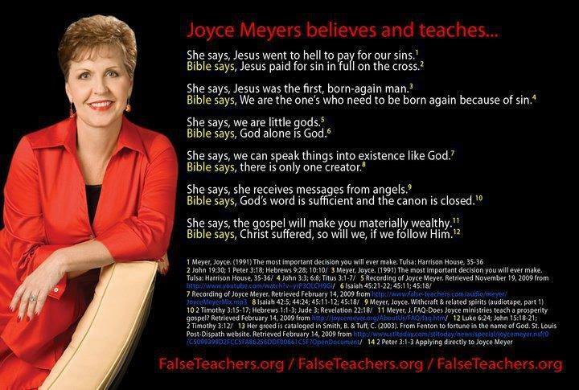
Messages from Angels?
Joyce Meyers believes and teaches…

Slide 66
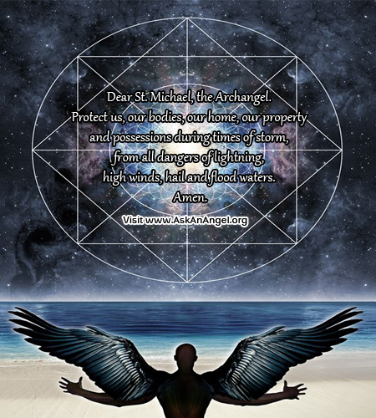
AskAnAngel.org
Dear St. Michael, the Archangel…

Slide 67
Occasion
188-189
Asia Minor was the seedbed for what developed into 2nd century Gnosticism. Paul's counterattack tells us this about the heresy:
1. Jewish—legalism of following OT laws and ceremonies (2:16-17)
2. Greek philosophy—followed a so-called "deeper knowledge" revealed only to a special "elite" (2:2b-4, 8-10)
3. Worshipped angels as mediators between man and God (2:18)
4. Denied Christ's deity (1:15; 2:9), & thus His supremacy (1:15b, 17a) & ability to create (1:16) & sustain the world (1:17)
5. Ascetic nature had a low view of the body (2:20-23)
What was the Colossian heresy? The above shows it was a syncretistic Jewish-Greek-Ascetic-Pagan cult. Paul's method to fight the heresy is to emphasize the deity & supremacy of Christ.

Slide 68
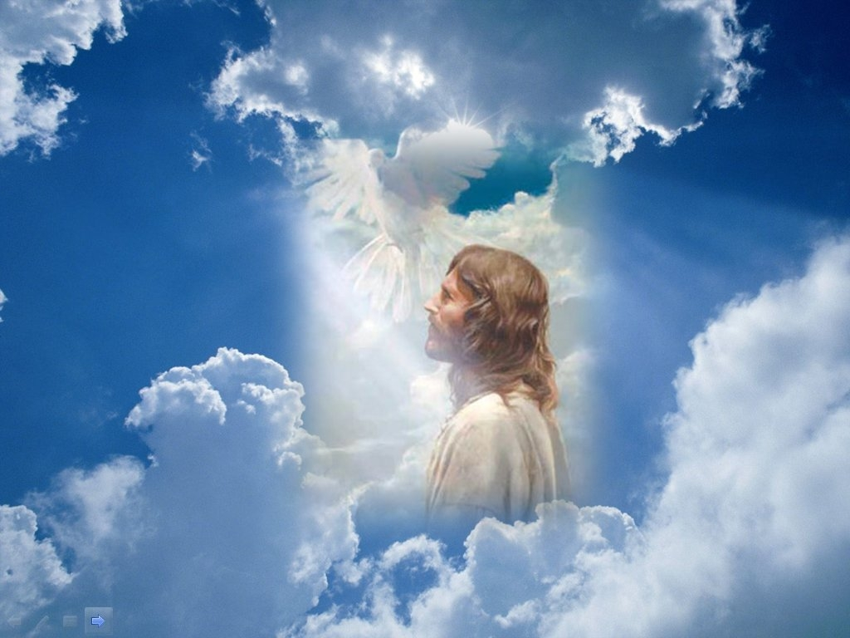
Christ's Deity
"Christ is the visible image of the invisible God. He existed before anything was created and is supreme over all creation" (1:15 NLT)

Slide 69
Occasion
188-189
Asia Minor was the seedbed for what developed into 2nd century Gnosticism. Paul's counterattack tells us this about the heresy:
1. Jewish—legalism of following OT laws and ceremonies (2:16-17)
2. Greek philosophy—followed a so-called "deeper knowledge" revealed only to a special "elite" (2:2b-4, 8-10)
3. Worshipped angels as mediators between man and God (2:18)
4. Denied Christ's deity (1:15; 2:9), & thus His supremacy (1:15b, 17a) & ability to create (1:16) & sustain the world (1:17)
5. Ascetic nature had a low view of the body (2:20-23)
What was the Colossian heresy? The above shows it was a syncretistic Jewish-Greek-Ascetic-Pagan cult. Paul's method to fight the heresy is to emphasize the deity & supremacy of Christ.

Slide 70
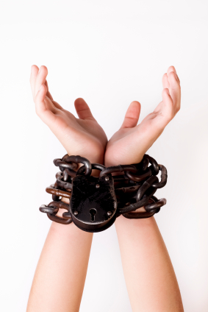
Asceticism
"You have died with Christ, and he has set you free from the spiritual powers of this world. So why do you keep on following the rules of the world, such as, ²¹'Don't handle! Don't taste! Don't touch!'? ²²Such rules are mere human teachings about things that deteriorate as we use them. ²³These rules may seem wise because they require strong devotion, pious self-denial, and severe bodily discipline. But they provide no help in conquering a person's evil desires"
(2:20-23 NLT)

Slide 71
Occasion
188-189
Asia Minor was the seedbed for what developed into 2nd century Gnosticism. Paul's counterattack tells us this about the heresy:
1. Jewish—legalism of following OT laws and ceremonies (2:16-17)
2. Greek philosophy—followed a so-called "deeper knowledge" revealed only to a special "elite" (2:2b-4, 8-10)
3. Worshipped angels as mediators between man and God (2:18)
4. Denied Christ's deity (1:15; 2:9), & thus His supremacy (1:15b, 17a) & ability to create (1:16) & sustain the world (1:17)
5. Ascetic nature had a low view of the body (2:20-23)
What was the Colossian heresy? The above shows it was a syncretistic Jewish-Greek-Ascetic-Pagan cult. Paul's method to fight the heresy is to emphasize the deity & supremacy of Christ.

Slide 72
How can you be protected from false teaching?
Notes:
What ways can we prevent heretical ideas from capturing us in their snare?

Slide 73
Key Word & Verse
187
Colossians
Key Word
Deity
Key Verse
"For in Christ all the fullness of the Deity lives in bodily form"
(Colossians 2:9).

Slide 74
OUTLINE OF COLOSSIANS
THEOLOGY
PRACTICE
TO

Slide 75
Book Chart
Deity of Christ vs. Syncretistic Heresy
Supremacy/Deity |  |  | Practical Instruction
Chapters 1–2 |  |  | Chapters 3–4
Heretical Living |  |  | Holy Living
Belief |  |  | Behaviour
Greeting & Prayer | Supremacy & Deity | Syncretistic Heresy | Position: Union with Christ | Practice: Holiness in Relation-ships | Conclusion
1:1-14 | 1:15–2:5 | 2:6-23 | 3:1-4 | 3:5–4:6 | 4:7-18
Rome
Autumn AD 61 (first Roman imprisonment)
Colossians
187
Notes:
Paul shows Christ's exalted position over the Colossian heresy in the first two chapters—and then explains how that leads to our position united with Christ and the holy practices that should result.

Slide 76
I. Believe that Jesus is God
(Col 1–2).
Father
is
is not
is not
GOD
is
is
Son
Spirit
is not
How to be protected from false teaching
Notes:
Guard yourself from heresy by embracing the deity and supremacy of Christ over all things.

Slide 77
Slides on
Colossians 1
Notes:
Paul affirms his authority and God’s enabling to fight heresy (1:1-14).

Slide 78

Stand Firm
Show Love
Walk by the Spirit

Slide 79


Walk in the Spirit,
die to the Flesh
You don’t need:
  To be Circumcised
  To follow OT Law
  To eat Kosher
1 John 2:15 (ESV)
¹⁵ Do not love the world or the things in the world. If anyone loves the world, the love of the Father is not in him.

Slide 80



coexist
You don’t need:
  To be Circumcised
  To follow OT Law
  To eat Kosher
  JESUS

Slide 81

coexist
You need:
  JESUS
1 John 1:5-7 (ESV)
⁵ . . . God is light, . . . ⁷ But if we walk in the light, . . . we have fellowship with one another, and the blood of Jesus his Son cleanses us from all sin.

Slide 82
"This letter is from Paul, chosen by the will of God to be an apostle of Christ Jesus, and from our brother Timothy. We are writing to God’s holy people in the city of Colosse, who are faithful brothers and sisters in Christ. May God our Father give you grace and peace" (Col 1:1-2 NLT).
Notes:
He greets them as Christ’s apostle for those who might question his teaching (1:1-2).

Slide 83
"We always pray for you, and we give thanks to God, the Father of our Lord Jesus Christ. ⁴For we have heard of your faith in Christ Jesus and your love for all of God’s people, ⁵which come from your confident hope of what God has reserved for you in heaven. You have had this expectation ever since you first heard the truth of the Good News" (Col 1:3-5 NLT).
Notes:
He thanks God for their faith and prays that they would know Christ’s adequacy (1:3-14).

Slide 84

we heard of your FAITH in Christ Jesus and of the LOVE that you have for all the saints because of the HOPE laid up for you in heaven.
Col 1:3-5 ESV
Stand Firm
Show Love

Slide 85


& 8 Authors
NT: 27 Books
48 49 50 52 53 57 60 62 67 68 95
Matt
Luke
Acts
Mark
John
Gal
1 Thess
1 Cor
Eph
1 Tim
2 Tim
Jude
James
2 Thess
2 Cor
Col
Titus
Heb
1 John
Romans
Philem
1 Pet
2 John
Phil
2 Pet
3 John
Rev
Gospels & Acts
5
Pauline Epistles
13
General Epistles
9
27

Slide 86
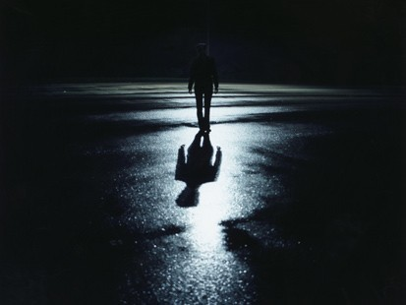
The Great Transfer
"For he has rescued us from the kingdom of darkness
and transferred us into the Kingdom of his dear Son
¹⁴ who purchased our freedom and forgave our sins"
(Col. 1:13-14)

Slide 87
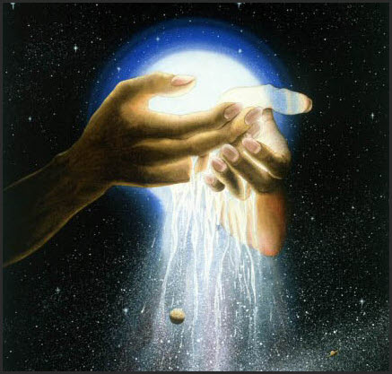
Colossians 1:15
"Christ is the visible image of the invisible God. He existed before anything was created and is supreme over all creation."
Colossians 1:15 (NLT)

Slide 88
Who is Jesus?
¹⁵ He is the image of the invisible God,

Slide 89
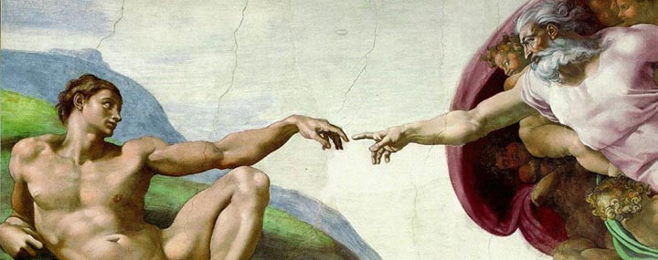
What about Man?
So God created man in his own image,
in the image of God he created him;
male and female he created them.
Genesis 1:27 (ESV)

Slide 90
Who is Jesus?
the firstborn of all creation

Slide 91

Definition of Firstborn
Literal
  Luke 2:7 & Heb 11:28
Place of Superiority
  Heb 1:6 & Rev 1:5
πρωτότοκος
pro-to'-to-kos
Blue Letter Bible

Slide 92
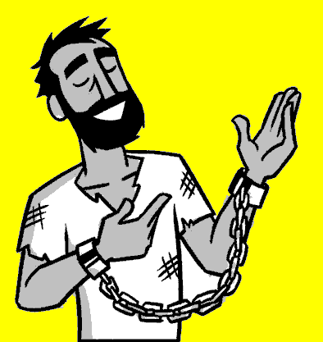
Definition of Firstborn
Created all things
Before all things
Holds all things
πρωτότοκος
pro-to'-to-kos

Slide 93
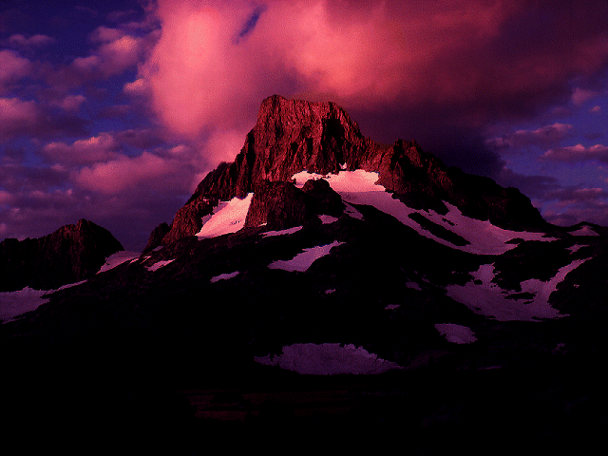
Colossians 1:16-18
"For by Him all things were created: things in heaven and on earth, visible and invisible, whether thrones or powers or rulers or authorities; all things were created by Him and for Him. He is before all things, and in Him all things hold together. And He is the head of the body, the church; He is the beginning and the firstborn from the dead, so that in everything He might have the supremacy."
Colossians 1:16-18 (NIV)

Slide 94
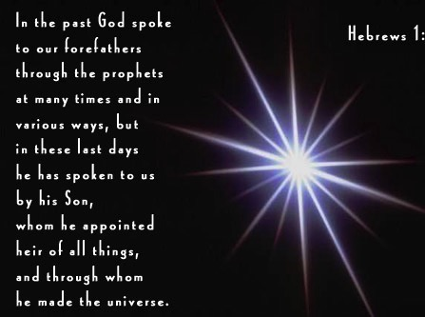
Hebrews 1:1-2 NLT
"Long ago God spoke many times and in many ways to our ancestors through the prophets. ²And now in these final days, he has spoken to us through his Son. God promised everything to the Son as an inheritance, and through the Son he created the universe."
Notes:
Long ago God spoke many times and in many ways to our ancestors through the prophets. ² And now in these final days, he has spoken to us through his Son. God promised everything to the Son as an inheritance, and through the Son he created the universe. ³ The Son radiates God's own glory and expresses the very character of God, and he sustains everything by the mighty power of his command. When he had cleansed us from our sins, he sat down in the place of honor at the right hand of the majestic God in heaven. ⁴ This shows that the Son is far greater than the angels, just as the name God gave him is greater than their names.

Slide 95

John 1:3
JOHN: SUMMING UP THE MESSAGE
CHAPTER 1: 6 GREAT TRUTHS OF
JESUS CHRIST!
VERSE 1:
The Pre-existent One
A Distinct Person
He Was and IS God
VERSE 2:
Eternally Co-existent
"Through him all things were made; without him nothing was made that has been made."
VERSE 3:
Creator of the Universe
John 1:3
25
1
Notes:
Verse 3: He is the Creator of the Universe…
//// "Through him all things were made; without him nothing was made that has been made."

Slide 96
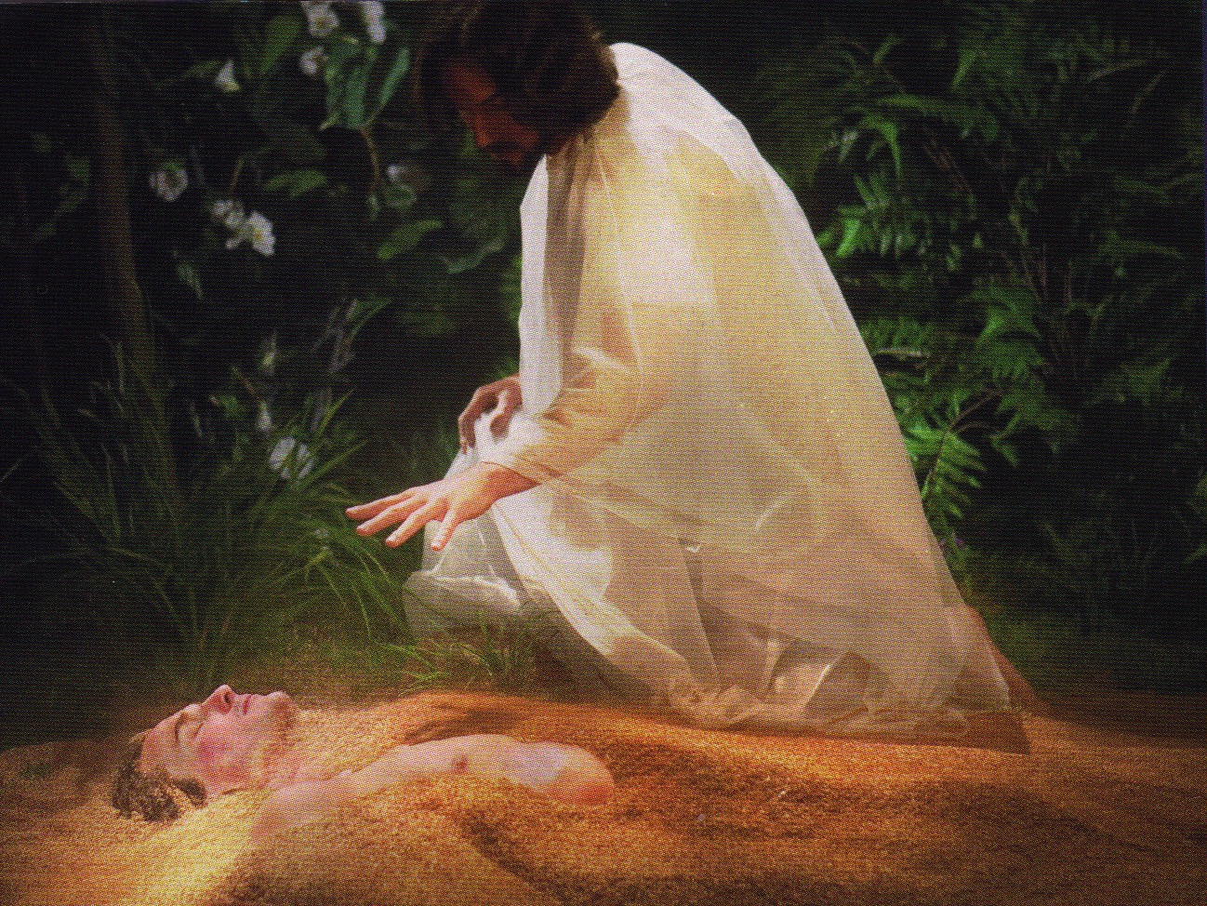
Jesus formed Adam from the dust (John 1:3; Gen. 2:7).

Slide 97
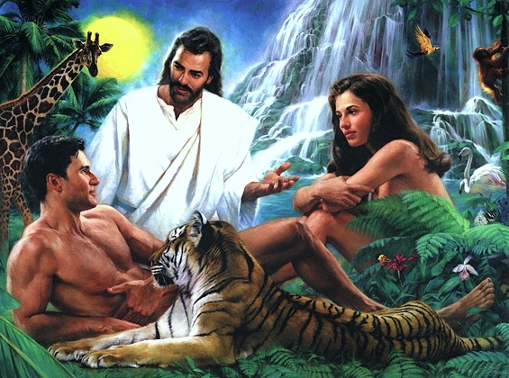
Jesus Created Adam and Eve (John 1:3; Gen. 2:21-23)

Slide 98
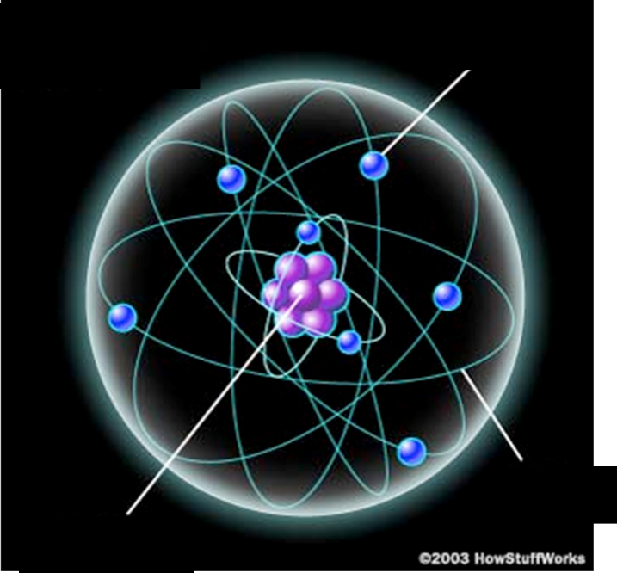
Inside an Atom
Electron (negative)
"…in Him all things hold together" (2:17)
Orbit
Proton Nucleus
(positive)

Slide 99
Who is Jesus?
¹⁸ And he is the head of
the body, the church.

Slide 100
Who is Jesus?
Image of God
Firstborn of Creation
Head of the church

Slide 101
¹⁸ ...He is the beginning, the firstborn from the dead, that in everything he might be preeminent…

Slide 102

¹⁹ For God in all his fullness
was pleased to live in Christ,
²⁰ and through him God reconciled
everything to himself.
He made peace with everything in heaven and on earth
by means of Christ’s blood on the cross.
Col 1:19-20 (NLT)

Slide 103
Who is Jesus?
¹⁹ For in him all the fullness of God was pleased to dwell
²⁰ and through him to reconcile to himself all things
What Did Jesus Do?

Slide 104
¹⁹ ...to reconcile to himself
all things
What Did Jesus Do?

Slide 105



Our Problem:
Sin Separates Us from God
Sinful
Humanity
Holy
God

Slide 106
Our Problem:
Sin Separates Us from God
Religion
Sinful
Humanity
Holy
God
Good Works
Morality
Philosophy

Slide 107



²¹ And you, who once were alienated and hostile in mind, doing evil deeds, ²² he has now reconciled in his body of flesh by his death, in order to present you holy and blameless and above reproach before him,
Christ’s Blood
Sinful
Humanity
Holy
God

Slide 108
²³ if indeed you continue in the faith, stable and steadfast, not shifting from the hope of the gospel that you heard, which has been proclaimed in all creation under heaven, and of which I, Paul, became a minister.
Christ’s Blood
Sinful
Humanity
Holy
God

Slide 109
¹⁹ . . .Present you holy and blameless
What Did Jesus Do?

Slide 110
Who is Jesus?
Image of God
Firstborn of Creation
Head of the church
What Did Jesus Do?
Reconcile all things
Present you holy and blameless

Slide 111
Now JESUS
NEW YEAR
NEW ME
Stand Firm
Show Love
Walk by the Spirit

Slide 112

True Jesus Church, Adam Road
195
200
“Jesus is the heavenly Father” !! ??
= Modalism

Slide 113


What Does the True Jesus Church Believe?
Identification with TJC
200
+
Baptism in TJC (Head Bowed)
+
Footwashing by TJC Minister
+
Communion (Transubstantiation)
+
Reception of the Holy Spirit
+
Speaking in Tongues
+
(Faith in Christ? No!)
=
Salvation ! ? ! ?

Slide 114
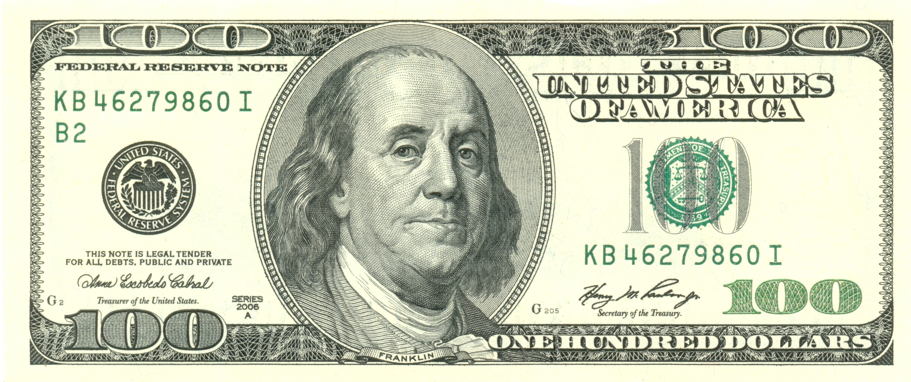
Counterfeit?
Notes:
We are protected from false views of Jesus (heresy) by being familiar with the really true Jesus.
So how do we know who the real Jesus is? Well, how would you train a teller to identify a fake $100 bill? I suspect it might be great to send them to a school to help them get trained in the various types of paper, ink, and major flaws of fake notes. However, the US Federal Bank tellers do not get training in the various types of counterfeit bills. Instead, they are sent to Washington DC where they sit in large rooms of freshly printed notes bound into large books. There they count sheets of these real bank notes for two weeks of boring tedium. When they get into their teller role after that and a fake note hits their hands, it just doesn’t look right—or feel right. They are so familiar with the real thing that the counterfeit is obvious.
I used to study the various belief systems of about every group imaginable. I learned the Mormon doctrine so well I could tell Mormons what they didn’t even know they believed! I read the Jehovah Witness stuff, the United Pentecostal cult, and many other “isms” our there. But I soon learned that I could never keep up! There were too many cults—especially where I grew up in the San Francisco area where one person said a new religious cult was started every week on the average!
Then I heard about the Federal bank teller training. I realized that I needed to know the real Bible, the real Jesus, and the real gospel. I started memorizing whole books of the Bible like Colossians and then I could see that when a new teaching showed up, it just didn’t look right or feel right because I knew the truth of Scripture.
Now when talking to people who claim to be Christians but something just doesn’t seem right, I simply ask them, “Do you believe Jesus is the son of God?” Nearly all say yes. Then I say, “Do you believe Jesus is God the Son?” Here is where I find out if they believe in the Trinity.

Slide 115
Summary & Applications
187
Summary Statement
Paul instructs the Colossian church in the supremacy and deity of Christ and exhorts practical outworking of this doctrine in order to fight a syncretistic heresy threatening the life and ministry of the church.
Applications
Know the deity of Christ well so you can warn your church members.
Avoid legalism & asceticism

Slide 116
Author
188
External Evidence
Early Christian writers attributed authorship to Paul.
1. Early support for Pauline authorship comes from Justin, Marcion, Irenaeus, Tertullian, & Clement of Alexandria.
2. Unquestioned acceptance
of Pauline authorship prevailed until the 19th century German scholars denied it based upon internal factors.
Internal Evidence
Many factors support Pauline authorship:
1. The letter claims to have
been written by Paul (1:1).
2. The similarity of Colossians to Ephesians argues for Pauline authorship as they were written at about the same time.
3. Colossians has many affinities to Paul's letter to Philemon, of which the authenticity is impeccable.

Slide 117
Circumstances
188
Date
Colossians was written during Paul's first imprisonment in Rome (Acts 28:30). The best evidence suggests a specific date of autumn 61.
Origin/Recipients
The epistle mentions Paul's many associates, especially Tychicus, who carried the Colossian and Ephesian letters accompanied by Onesimus with the letter to Philemon.
This provides evidence that the Ephesian, Colossian, and Philemon letters all had the same origin.
Therefore, Colossians must have been written to Colossae from Rome.

Slide 118
Occasion
188-189
Paul had never visited Colosse before he wrote this letter. However, during his nearly three-year ministry in nearby Ephesus, he probably met (& may have converted) Epaphras, who likely went to Colosse and started the church.
Epaphras brought news of a serious heresy plaguing the church. This prompted Paul to pen the epistle to the Colossians for Tychicus to deliver since he was returning to Colosse with Onesimus.

Slide 119
Occasion
188-189
Asia Minor was the seedbed for what developed into 2nd century Gnosticism. Paul's counterattack tells us this about the heresy:
1. Jewish—legalism of following OT laws and ceremonies (2:16-17)
2. Greek philosophy—followed a so-called "deeper knowledge" revealed only to a special "elite" (2:2b-4, 8-10)
3. Worshipped angels as mediators between man and God (2:18)
4. Denied Christ's deity (1:15; 2:9), & thus His supremacy (1:15b, 17a) & ability to create (1:16) & sustain the world (1:17)
5. Ascetic nature had a low view of the body (2:20-23)
What was the Colossian heresy? The above shows it was a syncretistic Jewish-Greek-Ascetic-Pagan cult. Paul's method to fight the heresy is to emphasize the deity & supremacy of Christ.

Slide 120
Jewish: The Law is Good
but…

Slide 121
Slides on
Colossians 2

Slide 122
What’s Wrong?
“Gnosticism” is wrong since deity
is in Christ (2:6-10).
Legalism is wrong since reality
is in Christ (2:11-17).
Mysticism is wrong since headship
is in Christ (2:18-19).
Asceticism is wrong since immunity
is in Christ (2:20-23).
Notes:
Here in verses 5-11 Paul exhorted the Christians at Colossae to "put to death their sinful ways".
"So put to death the sinful, earthly things lurking within you…" (NLT) parallels with what Jesus commanded in Matthew 18:9, "And if your eye causes you to sin, gouge it out and throw it away…" (NLT). Neither Christ's nor Paul's injunction can mean hack, hew or maim the limbs and organs of the body. The whole idea of putting to death or gouge out the eye means "doing away with what is evil" in us.
And what are these sinful earthly things - the evil things in us?

Slide 123
No Legalism!
"So don't let anyone condemn you for what you eat or drink, or for not celebrating certain holy days or new moon ceremonies or Sabbaths. ¹⁷For these rules are only shadows of the reality yet to come. And Christ himself is that reality" (Col. 2:16-17 NLT)

Slide 124
No Legalism!

Slide 125
No Legalism!
"So don't let anyone condemn you for what you eat or drink, or for not celebrating certain holy days or new moon ceremonies or Sabbaths. ¹⁷For these rules are only shadows of the reality yet to come. And Christ himself is that reality" (Col. 2:16-17 NLT)

Slide 126
No Shadows!
"So don't let anyone condemn you for what you eat or drink, or for not celebrating certain holy days or new moon ceremonies or Sabbaths. ¹⁷For these rules are only shadows of the reality yet to come. And Christ himself is that reality"
(2:16-17 NLT)
Notes:
What would you think if I looked at Susan’s shadow on my chest and said, “Wow, what a wonderful shadow! Look at the shape of that shadow! So nice, so perfect!”
You would think I am nuts. You would say, “Why are you so enamored with Susan’s shadow? You give more attention to your wife’s shadow than to this beautiful, dedicated, faithful woman herself standing next to you. What’s wrong with you?”
Too often Christians do the same with Jesus. We delight in the rest he gives us, we are enamored with the rules we have—and we neglect the very reality of Jesus himself!”

Slide 127
Focus on:
"And Christ himself is that reality" (2:17b NLT)
Death
Resurrection
Burial

Slide 128
Occasion
188-189
Asia Minor was the seedbed for what developed into 2nd century Gnosticism. Paul's counterattack tells us this about the heresy:
1. Jewish—legalism of following OT laws and ceremonies (2:16-17)
2. Greek philosophy—followed a so-called "deeper knowledge" revealed only to a special "elite" (2:2b-4, 8-10)
3. Worshipped angels as mediators between man and God (2:18)
4. Denied Christ's deity (1:15; 2:9), & thus His supremacy (1:15b, 17a) & ability to create (1:16) & sustain the world (1:17)
5. Ascetic nature had a low view of the body (2:20-23)
What was the Colossian heresy? The above shows it was a syncretistic Jewish-Greek-Ascetic-Pagan cult. Paul's method to fight the heresy is to emphasize the deity & supremacy of Christ.

Slide 129
Greek Philosophy
Don't let anyone capture you with empty philosophies and high-sounding nonsense that come from human thinking and from the spiritual powers of this world, rather than from Christ
(2:8 NLT)
"Good people do not need laws to tell them to act responsibly, while bad people will find a way around the laws"
—Plato
423-348 BC
Socrates
Plato
Aristotle

Slide 130
Key Verse
187
"For in Christ all the fullness of the Deity lives in bodily form"
(Colossians 2:9).
Colossians

Slide 131
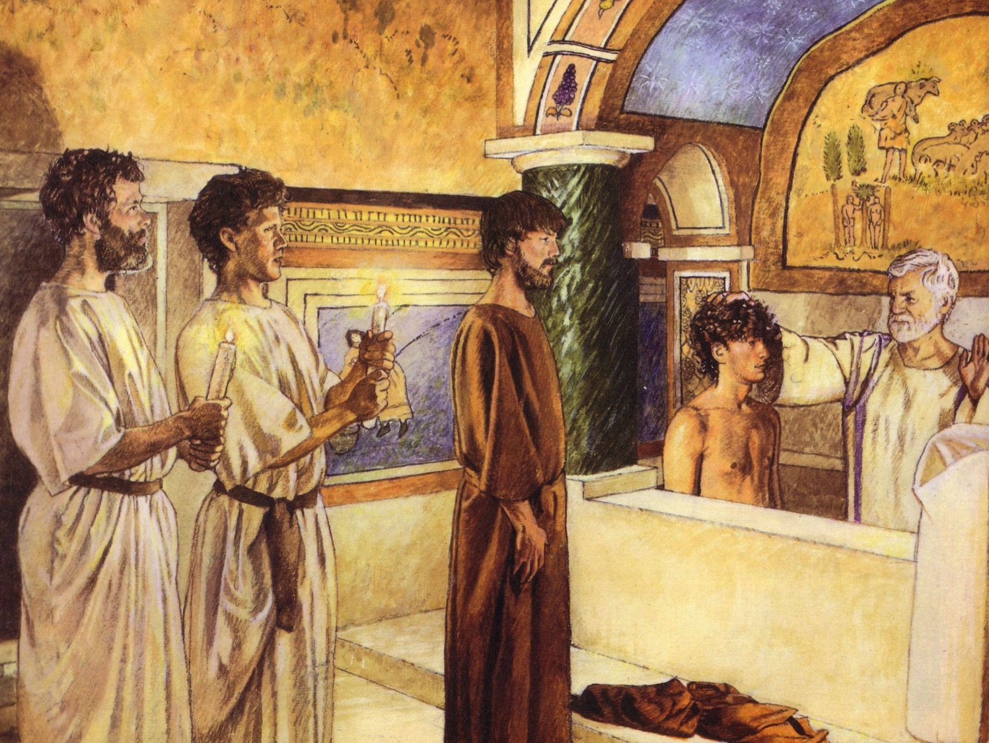
First Century Christian Baptism
244c
For Believers Only
By Immersion Only

Slide 132
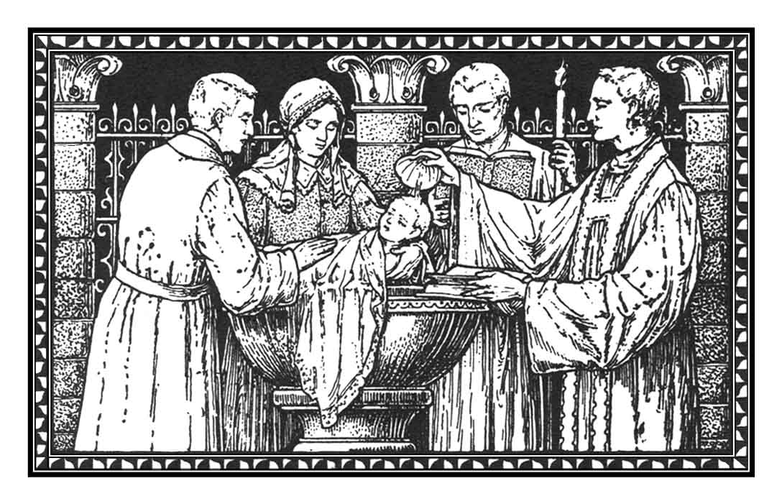
Recipients
(Paedobaptism)
The baptism of infants is recorded no earlier than the 3rd century A.D.

Slide 133
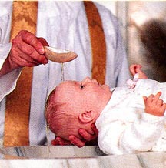
Recipients
244c
Two additional points:
Infant baptism advocates believe Col. 2:11-12 says that baptism is a sign of the new covenant that corresponds to circumcision in the Old Testament.
Jews were circumcised at 8 days old, sooo….

Slide 134
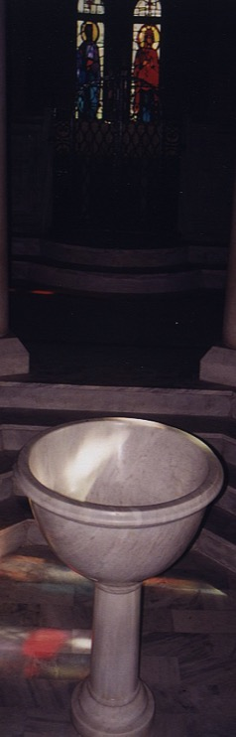
However, recipients should not be infants because…
244d
Circumcision doesn't parallel baptism
Males
All
Physical life
Spiritual life
Any age
Conscious faith
8th day of life
Right after belief
NT parallel = heart circumcision
New covenant sign = Lord's supper

Slide 135
Occasion
188-189
Asia Minor was the seedbed for what developed into 2nd century Gnosticism. Paul's counterattack tells us this about the heresy:
1. Jewish—legalism of following OT laws and ceremonies (2:16-17)
2. Greek philosophy—followed a so-called "deeper knowledge" revealed only to a special "elite" (2:2b-4, 8-10)
3. Worshipped angels as mediators between man and God (2:18)
4. Denied Christ's deity (1:15; 2:9), & thus His supremacy (1:15b, 17a) & ability to create (1:16) & sustain the world (1:17)
5. Ascetic nature had a low view of the body (2:20-23)
What was the Colossian heresy? The above shows it was a syncretistic Jewish-Greek-Ascetic-Pagan cult. Paul's method to fight the heresy is to emphasize the deity & supremacy of Christ.

Slide 136
Angel Worship
"Don't let anyone condemn you by insisting on pious self-denial or the worship of angels…"
"…saying they have had visions about these things. Their sinful minds have made them proud"
(2:18 NLT)

Slide 137
Messages from Angels?

Slide 138
AskAnAngel.org
Dear St. Michael, the Archangel…

Slide 139
Occasion
188-189
Asia Minor was the seedbed for what developed into 2nd century Gnosticism. Paul's counterattack tells us this about the heresy:
1. Jewish—legalism of following OT laws and ceremonies (2:16-17)
2. Greek philosophy—followed a so-called "deeper knowledge" revealed only to a special "elite" (2:2b-4, 8-10)
3. Worshipped angels as mediators between man and God (2:18)
4. Denied Christ's deity (1:15; 2:9), & thus His supremacy (1:15b, 17a) & ability to create (1:16) & sustain the world (1:17)
5. Ascetic nature had a low view of the body (2:20-23)
What was the Colossian heresy? The above shows it was a syncretistic Jewish-Greek-Ascetic-Pagan cult. Paul's method to fight the heresy is to emphasize the deity & supremacy of Christ.

Slide 140
Christ's Deity
"Christ is the visible image of the invisible God. He existed before anything was created and is supreme over all creation" (1:15 NLT)

Slide 141
Occasion
188-189
Asia Minor was the seedbed for what developed into 2nd century Gnosticism. Paul's counterattack tells us this about the heresy:
1. Jewish—legalism of following OT laws and ceremonies (2:16-17)
2. Greek philosophy—followed a so-called "deeper knowledge" revealed only to a special "elite" (2:2b-4, 8-10)
3. Worshipped angels as mediators between man and God (2:18)
4. Denied Christ's deity (1:15; 2:9), & thus His supremacy (1:15b, 17a) & ability to create (1:16) & sustain the world (1:17)
5. Ascetic nature had a low view of the body (2:20-23)
What was the Colossian heresy? The above shows it was a syncretistic Jewish-Greek-Ascetic-Pagan cult. Paul's method to fight the heresy is to emphasize the deity & supremacy of Christ.

Slide 142
Asceticism
"You have died with Christ, and he has set you free from the spiritual powers of this world. So why do you keep on following the rules of the world, such as, ²¹'Don't handle! Don't taste! Don't touch!'? ²²Such rules are mere human teachings about things that deteriorate as we use them. ²³These rules may seem wise because they require strong devotion, pious self-denial, and severe bodily discipline. But they provide no help in conquering a person's evil desires"
(2:20-23 NLT)

Slide 143
How can you be protected from false teaching?
Notes:
What ways can we prevent heretical ideas from capturing us in their snare?

Slide 144
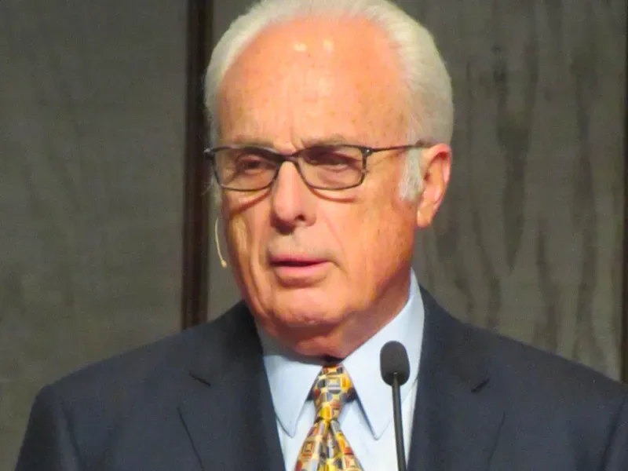
False Teaching
The first symptom of false teachers is what they affirm. A false teacher "advocates a different doctrine." False teaching may take many forms. It may deny God's existence, or teach error about His nature and attributes. It may deny the Trinity. Error about Christ's Person and work is also common in false systems. Those who deny His virgin birth, sinless perfection, substitutionary death, bodily resurrection, or future return show signs of a dangerous infection. False teachers also teach error about the nature, Person, and work of the Holy Spirit. Yet another strain of the disease of false teaching denies the authenticity, inspiration, authority, or inerrancy of Scripture.
John MacArthur
The Pathology of False Teachers

Slide 145
I. Believe that Jesus is God
(Col 1–2).
Father
is
is not
is not
GOD
is
is
Son
Spirit
is not
How to be protected from false teaching
Notes:
Guard yourself from heresy by embracing the deity and supremacy of Christ over all things.

Slide 146
II. Embrace holy living
(Col 3–4).
How to be protected from false teaching
Notes:
Protect yourself from heresy by your pure lifestyle.

Slide 147
Slides on
Colossians 3

Slide 148

¹ Since, then, you have been raised with Christ, set your hearts on things above, where Christ is, seated at the right hand of God.
² Set your minds on things above, not on earthly things.
Col 3:1-2 (NLT)

Slide 149
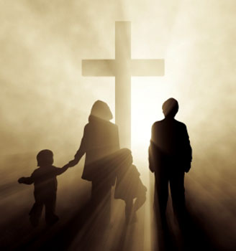
Holy living is relational.

Slide 150

Put on a New Life
Colossians 3:5-17
Themshang Horam, Crossroads International Church
cicfamily.com & biblestudydownloads.org

Slide 151
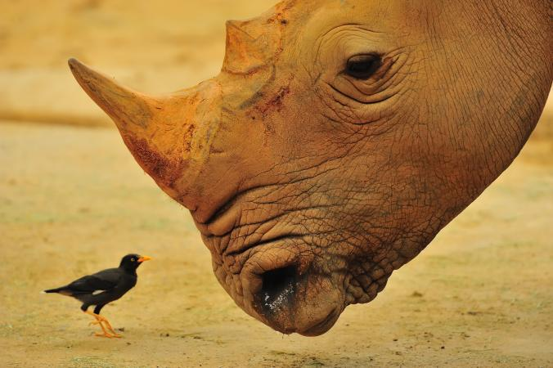


What hinders you?
What are your obstacles?
What binds you?
Notes:
As we expectantly look forward to this New Year, What hinders you to live your life as one whose life is in Christ? What are the hurdles that you face to move forward? And what are the fetters that binds you to live your life as a free man and woman in Christ? What are the things that you need to remove which is preventing you to live a successful life?

Slide 152





Anger?
Hatred?
Broken
Relationship?
Painful Past?
Greed?
Jealousy?
Notes:
Is it anger? Hatred? Words – things which you are not suppose to say? Jealousy? Broken relationship?

Slide 153

What is bothering you to move forward?
Notes:
What is bothering you to move forward and embrace this New Year with Joy, peace, love and hope? Paul exhorted the Colossians in our passage today (Col. 3:5-15) to remove the things which is hindering/bothering us and is preventing us from living the full life as free man/woman, as victors, as new people. So we need to put off the old clothes and…

Slide 154

Put on the Virtues of a New Life
Colossians 3:5-14
Notes:
I will put off the shabby clothes….

Slide 155
Background
Paul the Apostle wrote the Epistle of Colossians to the church at Colossae from prison in Rome in AD 61 to counter a heresy attacking the deity of Christ.
He countered this heresy in two ways:
First, in chapters 1–2, he established the supremacy of Christ.
He then moved on to chapters 3–4 to give practical instruction for living as those made alive in Christ in light of the supremacy of Christ.
Notes:
In the light of the supremacy of Christ, Paul exhorted the Colossians to live life as those who have overcome the power of sin through their union in death with Christ. Paul said to the Colossians in verses 1-3 that "You have died with Christ, Your life is hidden with Christ in God and you have been given the grace in Christ to live your life as victors, as new people and as those made alive in Christ".
So then, what do we need to do? We need to: (next slide)

Slide 156
How Can We Put on the Virtues of a New Life?
Colossians 3:5-17
Notes:
I will put off the shabby clothes….

Slide 157

1. Put off the old clothes
(3:5-11).
Notes:
Here in verses 5-11 Paul exhorted the Christians at Colossae to "put to death their sinful ways".

Slide 158
Col. 3:5
"So put to death the sinful, earthly things lurking within you" (NLT).
Matthew 18:9a
"And if your eye causes you to sin, gouge it out and throw it away" (NLT).
Notes:
Here in verses 5-11 Paul exhorted the Christians at Colossae to "put to death their sinful ways".
"So put to death the sinful, earthly things lurking within you…" (NLT) parallels with what Jesus commanded in Matthew 18:9, "And if your eye causes you to sin, gouge it out and throw it away…" (NLT). Neither Christ's nor Paul's injunction can mean hack, hew or maim the limbs and organs of the body. The whole idea of putting to death or gouge out the eye means "doing away with what is evil" in us.
And what are these sinful earthly things - the evil things in us?

Slide 159

The point –
"Do away with what is evil in us"
Notes:
Here in verses 5-11 Paul exhorted the Christians at Colossae to "put to death their sinful ways".
"So put to death the sinful, earthly things lurking within you…" (NLT) parallels with what Jesus commanded in Matthew 18:9, "And if your eye causes you to sin, gouge it out and throw it away…" (NLT). Neither Christ's nor Paul's injunction can mean hack, hew or maim the limbs and organs of the body. The whole idea of putting to death or gouge out the eye means "doing away with what is evil" in us.
And what are these sinful earthly things - the evil things in us?

Slide 160

Put off the clothes of corrupt living (3:5-7)
Notes:
I am sure we are all no stranger to this particular word. I have not been to many countries like most of you but coming from a country like India where corruption is quite prevalent.

Slide 161

Death to corrupt living
(3:5-7)
Percentage of people around the world
who paid a bribe to selected services in 2013
Police
Judiciary
Registry
Land
Medical
Education
Tax
Utilities

Slide 162

Death to corrupt living
(3:5-7)
Grease payments
Corporate foreign-bribery schemes punished
1999-2014
United States
Germany
South Korea
Italy
Switzerland
Britain
France
Norway
Canada
Japan

Slide 163

Death to corrupt living
Notes:
In my [Athan’s] home country of India, to get a job in govt. sector we need to pay heavy bribes to the conducting officers.
In 2012, one of my younger brothers went for an army recruitment… physical fitness passed…written passed…medical exam passed… but was rejected because we were unable to pay the bribe around S$4000.
It broke my brother's heart and brought frustration… your corrupt living has an adverse impact not just to you alone but to other people, especially those who are poor.

Slide 164

"Have nothing to do with sexual immorality, impurity, lust, and evil desires. Don't be greedy, for a greedy person is an idolater, worshiping the things of this world"
(Col 3:5b NLT).
GREED
LUST
LIES
ENVY
IDOLS
Notes:
Corrupt living is not just the corruption in financial matters. Paul listed a whole range of habits that tags along with corrupt living. They are sexual immorality, impurity, lust, and evil desires and greed.
We need to put away our impure thoughts – thoughts such as desiring or scheming to harm people. We also need to put away sexual impurity. Singles, we no longer care what we did in the past because of our new identity as new people in Christ but from this point forth let us be sexually pure. Married people, as people of God, God demands you to be sexually faithful to your spouses. Evils such as these, and on which the apostle says God's wrath rests, must be slain.

Slide 165

Put off the clothes of wrong conversation (3:8-9)
Notes:
Paul deals with the sins of speech which seemed, like echoes of the past, to linger on the lips of the Colossians. Proverbs 18:21 says "The tongue can bring death or life; those who love to talk will reap the consequences (NLT)". James says "And the tongue is a flame of fire. It is a whole world of wickedness, corrupting your entire body. It can set your whole life on fire, for it is set on fire by hell itself (Jam 3:6-7 NLT). Jesus Christ said "You brood of snakes! How could evil men like you speak what is good and right? For whatever is in your heart determines what you say. (Mat 12:34 NLT)". Yes we should do away with wrong conversations.

Slide 166

3:8-9
"But now is the time to get rid of anger, rage, malicious behavior, slander, and dirty language. Don't lie to each other, for you have stripped off your old sinful nature and all its wicked deeds"
(3:8-9 NLT)
Notes:
Paul deals with the sins of speech which seemed, like echoes of the past, to linger on the lips of the Colossians. Proverbs 18:21 says "The tongue can bring death or life; those who love to talk will reap the consequences (NLT)". Jesus Christ said "You brood of snakes! How could evil men like you speak what is good and right? For whatever is in your heart determines what you say. (Mat 12:34 NLT)". Yes we should do away with wrong conversations.

Slide 167
A Lesson from Russian History
Kondraty Ryleyev was sentenced to be hanged for his part in an unsuccessful uprising against the Russian czar Nicholas I in December 1825. But the rope broke and Ryleyev, bruised and battered, fell to the ground, got up, and said, "In Russia they do not know how to do anything properly, not even how to make a rope." An accident of this sort usually resulted in a pardon, so a messenger was sent to the czar to know his pleasure.
Nicholas asked, "What did he say?"
"Sire, he said that in Russia they do not even know how to make a rope properly.”
"Well, let the contrary be proved," said the czar.
Notes:
The Point is - James says "And the tongue is a flame of fire. It is a whole world of wickedness, corrupting your entire body. It can set your whole life on fire, for it is set on fire by hell itself (Jam 3:6-7 NLT). What you say and speak determines your where you are heading for.
Source [http://www.sermonillustrations.com/a-z/s/speech.htm]

Slide 168

What speech should be put away?
Anger, Rage, Malice, Slander, Dirty Language, Falsehood…
Notes:
Do away with conversations that can cause someone to
1) "Anger," and sin
2) Conversations that will "Enrage"
3) Talks to malign someone's image;
4) "Slander," i.e. blasphemy;
5) "Dirty language," i.e. abusive words;
6) "Falsehood," a word that needs no description. Let us not speak pretentiously but true to our words.

Slide 169

Avoid vows
Notes:
I find this verse quite helpful. Jesus Christ taught us "All you need to say is simply 'Yes' or 'No'; anything beyond this comes from the evil one (Mat 5:37 NIV)"

Slide 170
Death to Conventional Distinctions
Notes:
Paul exhorted the Colossians that as new people who have put on the virtues of new life, they must also put to death the conventional distinctions which leads to divisions in the church. For we are all made new in Christ and in Christ there is no distinction between "…a Jew or a Gentile, circumcised or uncircumcised, barbaric, uncivilized, slave, or free. Christ is all that matters, and he lives in all of us (Col 3:11 NLT)".

Slide 171

3:10-11
"In this new life, it doesn't matter if you are a Jew or a Gentile, circumcised or uncircumcised, barbaric, uncivilized, slave, or free. Christ is all that matters, and he lives in all of us" (3:10-11 NLT).
Notes:
If Christ have made us all one in him, shall we still continue live our life dividing among ourselves? No, I am American and I cannot be with the Indian; I am Indians and I cannot be with the Chinese, Dutch, Pilipino…

Slide 172

Avoid these distinctions…
Ethnic: "Greek and Jew"
Ceremonial: "circumcision or uncircumcision"
Cultural: "barbarian, uncivilized"
Social: "slave and free"
Notes:
1) Ethnic distinctions: "Greek and Jew". Let us stop drawing boundaries along the line of our ethnic groups.
2) Ceremonial: "circumcision or un-circumcision". The Jewish Christians emphasized so much on ritual purity and that is one of the main contention among the believers in early church. Let us put away that "my denomination is better than yours!" but rather practice what the Bible teach us.
3) Distinctions of culture: "barbarian, uncivilized". Unable to appreciate different culture is often the many causes of conflicts. In India, almost every week we have a report of the people from northeastern India and the mainlanders having clashes because we cannot accept and appreciate our culture.
4) Social: "slave and free." Here the word slave seems to have special reference here to the runaway slave (Onesimus) who was going to carry to his master the apostle's letter, and who was to be received as a brother both of Philemon and Paul. But the point Paul wants to underscore is that there is no longer hierarchical systems in our new identity with Christ.

Slide 173

The church embraces all
Notes:
I am glad that here at this church… I learnt to realize that I need to come down.

Slide 174

2. Put on the grace of Christ
(3:12-17).
Notes:
Let us put away our old sinful habits – things which Christ has already taken it off from us by his death so that we may put on the new dress of grace. Through Christ's death we now have the power the put off our old sinful habits. We can now make a choice to put to death our bad habits – the old man or to let it rule over us and prevent us from living a free life in Christ. Christ has put to death our sinful habits, he have taken away our sinful clothes, lets us not go back to those old ways again but put on the virtues of new life and live as new people made alive in Christ.
What are these grace of Christ that we are to put on as his new people made alive in him?

Slide 175

The clothes of compassion (3:12)
Notes:
Put on... compassion. “Since God chose you to be the holy people he loves, you must clothe yourselves with tenderhearted mercy, kindness, humility, gentleness, and patience” (3:12 NLT).
When we are clothed with compassion, we show kindness, humility, gentleness and patience for one another. In the gospel accounts, we know that when Jesus saw the crowds he was filed with compassion (Matt. 9:36; Mk. 6:34). Again in the Gospel of Mark when Jesus saw a leper asking him to heal him of his leprosy, Jesus was moved with compassion and he healed. Elsewhere in the Bible, Exod 34:6; 2 Chron 30:9; Neh 9:17, 31; Pss 85:15; Joel 2:13; and Jn 4:2, this compas-sion is described as grace of God. Paul in Philippians 1:8 says that he love the Philippians and long for them "…with the tender compassion of Christ Jesus (NLT)". This is the compassion that we are talking about. Through Jesus Christ, God has given us this dress – this compassion which we must wear it as new people in Christ.

Slide 176

Compassion is described as the grace of God in action (Exod. 34:6; 2 Chron. 30:9; Neh. 9:17, 31; Ps. 85:13; Joel 2:13; and John 4:2).
Notes:
Put on... compassion. Compassion is the tender mercies for fellow human beings. In the Bible, Exo. 34:6; 2 Chro. 30:9; Neh 9:17, 31; Ps. 85:15; Joel 2:13; and Jn 4:2, this compassion is described as grace of God in action. Paul in Philippians 1:8 says that he love the Philippians and long for them "…with the tender compassion of Christ Jesus (NLT)". This is the compassion that we are talking about.

Slide 177
"So [Jonah] complained to the Lord about it: "Didn't I say before I left home that you would do this, Lord? That is why I ran away to Tarshish! I knew that you are a merciful and compassionate God, slow to get angry and filled with unfailing love. You are eager to turn back from destroying people'" (Jonah 4:2 NLT).
Notes:
Put on... compassion. Compassion is the tender mercies for fellow human beings. In the Bible, Exo. 34:6; 2 Chro. 30:9; Neh 9:17, 31; Joel 2:13; and Jon 4:2, this compassion is described as grace of God in action. Paul in Philippians 1:8 says that he love the Philippians and long for them "…with the tender compassion of Christ Jesus (NLT)". This is the compassion that we are talking about.

Slide 178

Without compassion, we cannot feel for others.
Notes:
When we are clothed with compassion, we can show kindness, humility, gentleness and patience to one another. In the gospel accounts, we know that when Jesus saw the crowds he was filed with compassion (Matt. 9:36; Mk. 6:34). Again in the Gospel of Mark when Jesus saw a leper asking him to heal him of his leprosy, Jesus was moved with compassion and he healed.
Without compassion, we cannot feel for others. We cannot truly, from our hearts say that I care for you. In order to be able to care for one another we need to be clothed with the grace of compassion.

Slide 179

The clothes of forgiveness (3:13)
Notes:
Paul again exhort the Colossians to put on the clothes of forgiveness. “Make allowance for each other’s faults, and forgive anyone who offends you. Remember, the Lord forgave you, so you must forgive others” (3:13 NLT).
He exhorted them that they must forgive one another just as they have received forgiveness for God through Christ. The same applies for us today. We were once in a wretched state of sin. Every time we lived offending God by our thoughts, action and speech. But God forgave us and made us his children. Ephesians 4:32 clearly says that we must forgive one another just as Christ has forgiven us.

Slide 180
"Forgiveness is not giving someone what they deserve but what they need"
– Anonymous
"The weak can never forgive.
Forgiveness is the attribute of the strong”
– Gandhi
Notes:
As we claim to have put to death through our union with Christ and have put on the grace of Christ – the forgiveness, I would like you to think about someone who have hurt you beyond words; whom you find it hard to forgive. And ask yourselves, 'is it really to hard for me?'.

Slide 181

Graham & Gladys Staines
Notes:
Perhaps, the greatest story of forgiveness comes from the life of the widowed lady Gladys Staines.

Slide 182

3:13
"Make allowance for each other's faults, and forgive anyone who offends you. Remember, the Lord forgave you, so you must forgive others"
(Col. 3:13 NLT)
Notes:
Without forgiveness, there cannot be a very strong relationship. Forgiveness is the clue that binds marriage, friendship and our relationship with one another.
Sometimes, it just you that you need to forgive yourself. We cannot forgive other unless we forgive ourselves of our past foolish mistakes. At one point of time, it was very difficult for me to forgive people who have provoked me and hurt my feelings beyond words. I took revenge for every single offense they made to me. When I was young, if any of relatives scold me for good or wrong reasons, I cannot challenge them so what I did… I killed their chickens, pets… sometimes, I used to take catapult and shoot them from afar… but God worked in my and as I receive Christ, I slowly learned to forgive. It will be ungrateful on our parts if we don't forgive one another because we have received forgiveness from God.
Let us put on the clothe of forgiveness.

Slide 183

The clothes of love (3:14)
Notes:
“Above all, clothe yourselves with love, which binds us all together in perfect harmony” (3:14 NLT).
As we put on the grace clothe of compassion, forgiveness, let us complete it by putting on the clothes of love. Paul said here that it is love that binds everything. Perhaps his best teaching about love is recorded in 1 Corinthians 13. 1 John 4:8 says God is love. As his children, let us also love one another. Let us adorn ourselves with love because love expresses the willingness of the person to give himself to the good of others.

Slide 184

Forgiven but I cannot…
Notes:
Forgiven but I cannot love this man… This is a litmus test for us as Christians. We can forgive but choose not to love. If we truly forgive someone why can't we love? If you have some conflicts with your spouses, parents, friends, room mates in the past or recently, and if you say you have forgiven them but still cannot love, take this as God speaking to you today and accept it as a challenge to love that person.

Slide 185

Without love, our forgiveness is incomplete; without love our compassion is a hidden lamp. Love binds all!
Notes:
Let us put on the cloth of love.

Slide 186
I. Put off the old clothes
II. Put on the grace of Christ
Notes:
We are given the grace to live our life as victors in Christ. God in his grace have set us free by
Put off the old clothes by making us die to the sins of
a. corrupt living
b. wrong conversation
c. conventional distinctions, and by enabling us to
Put on the grace of Christ
a. compassion
b. forgiveness
c. love
Now let us go back to the questions we asked in the beginning:

Slide 187
Anger?
Hatred?
Broken
Relationship?
Thoughts of Disdain?
Painful Past?
Greed?
Jealousy?
Notes:
We have been given the grace to live our life as new people in Christ. As new people we are to adorn ourselves with the virtues – the dress of new life. If we don't put on or cloth our body with clothes, then we all know we will be naked. If we are naked, we are susceptible to heat, cold, insect bites and vulnerable to hosts of dangers.
If you don't put off the grave clothes and put on the new virtues of life – i.e the grace of Christ, then we are naked Christians – naked and exposed to hosts of sins lurking around us. We will be tempted to anger and commit sin, we will want to hate people, we will be haunted by our painful past experience, we will go back to sexually immoral lives.
Are there any grave clothes on you that you need to remove? Think about this.

Slide 188



Doubts
Notes:
This year, as I look ahead and see the challenges that I am going to face – in terms of my marriage (if God willing after my graduation from SBC), regarding my ministry, I realized that still need to put to death this doubting Thomas within me. 2000 years ago, Christ have taken away my doubts but I am still wearing it. This doubt in myself makes my confidence keep at its lowest ebb; this doubt prevents me from building up trust in my relationship.

Slide 189


Trust in Christ
Notes:
This year, as I look ahead and see the challenges that I am going to face – in terms of my marriage (if God willing after my graduation from SBC), regarding my ministry, I realized that still need to put to death this doubting Thomas within me. 2000 years ago, Christ have taken away my doubts but I am still wearing it. This doubt in myself makes my confidence keep at its lowest ebb; this doubt prevents me from building up trust in my relationship.

Slide 190

God has given us the grace for a new beginning. Do not let your old habits hinder you from living as one whose life is in Christ.
Notes:
MI: God has given us the grace for a new beginning. Do not let your old habits hinder you from living as one whose life is in Christ.
Let us put to death what hinders us to live as new man/woman in Christ and put on the virtues of new man/woman and face the challenges, hurdles, obstacles as we go along with each day of the New Year.
God bless us all!

Slide 191

What if we followed Colossians 3:18-19?
"Wives, submit to your husbands, as is fitting for those who belong to the Lord.
¹⁸Husbands, love your wives and never treat them harshly”
(Col. 3:18-19 NLT)

Slide 192

How Are We To Obey?
Col 3:22
Obey your authorities in everything (3:22a).
Do not deceive your authorities (3:22b).
Obey your authorities sincerely (3:22c).
Make your motive to honor God (3:22d).
EXHORTATION
Reflect on which areas you need to work on the most.
  Do you need to learn to fully obey?
  Do you need to check your heart to see what your attitude is when you obey?
  Do you need to examine who is truly the object of your obedience?
Maria Kristina Garcia, SBC 2021

Slide 193
Characteristics
189
Colossians uses a number of terms found nowhere else in the New Testament.
Paul uses no Old Testament references in his epistle to the Colossians.
Colossians sets forth the fullest explanation of the deity of Christ of any NT writing.

Slide 194
Ephesians & Colossians
Characteristics
189-190
These twin epistles can be compared and contrasted in many ways:
Ephesians
Colossians
Similarities:
Written in prison, carried by Tychicus
Written in prison, carried by Tychicus
Stresses wisdom, knowledge, fullness, & mystery
Stresses wisdom, knowledge, fullness, & mystery
First half—position
Second half—practice
First half—position
Second half—practice
Similar passages:
Similar passages:
"In Him we have redemption through His
blood, the forgiveness of sins…" (1:7)
"in whom we have redemption, the
forgiveness of sins" (1:14)
"to be put into effect when the times will have reached their fulfillment—to bring all things in heaven and on earth together under one head, even Christ" (1:10)
"and through Him to reconcile to Himself all things, whether things on earth or things in heaven, by making peace through His blood, shed on the cross" (1:20)

Slide 195
Ephesians & Colossians
Characteristics
189-190
Ephesians
Colossians
Similar passages
Similar passages
1:15-17
1:3-4
1:18
1:27
1:19-20
2:12
1:21-23
1:16-19
5:22-24 (wives)
3:18 (wives)
5:25-33 (husbands)
3:19 (husbands)
6:1-3 (children)
3:20 (children)
6:4 (fathers)
3:21 (fathers)
6:5-8 (slaves)
3:22-25 (slaves)
6:9 (masters)
4:1 (masters)

Slide 196
Ephesians v. Colossians
189-190
Ephesians
Colossians
Differences
Emphasizes the Church
as the Body of Christ
Emphasizes Christ
as the Head of the body
General, universal
Specific, local
Peaceful, calm
Polemic, concern
Reflective, quiet
Spiritual conflict

Slide 197
Argument
190
Paul writes the Colossian epistle to deliver the church from a serious heresy threatening its very life since it is attacking the deity of Christ.
He responds to this cult with a two-pronged approach:
He first establishes the supremacy of Christ as God in order to deal with the theological basis of the false teaching (Col. 1–2).
He then provides practical instruction in light of the deity of Christ which, when followed, will put the enemies of Christ to shame as they see holy living in the church (Col. 3–4).

Slide 198
Synthesis
190
3–4 Practical instruction
1–2 Supremacy / deity

Slide 199
Outline
191-192
(Chs. 3–4) Paul provides practical instruction in light
of the deity of Christ to shame the enemies of Christ
as they see holy living in the church.
(Chs. 1–2) Paul establishes the supremacy of Christ over all things as God in order to combat the heretical teachers who had infiltrated the Colossian church with false precepts and practices.

Slide 200
Slides on
Colossians 4

Slide 201
How can you be protected from false teaching?
Notes:
What ways can we prevent heretical ideas from capturing us in their snare?

Slide 202
Main Idea of Colossians
Protect yourself from false teaching by embracing both Christ’s deity and a holy life.

Slide 203
OUTLINE OF COLOSSIANS
THEOLOGY
PRACTICE
TO

Slide 204
I. Believe that Jesus is God
(Col 1–2).
Father
is
is not
is not
GOD
is
is
Son
Spirit
is not
How to be protected from false teaching
Notes:
Guard yourself from heresy by embracing the deity and supremacy of Christ over all things.

Slide 205
II. Embrace holy living
(Col 3–4).
How to be protected from false teaching
Notes:
Protect yourself from heresy by your pure lifestyle.

Slide 206
WHAT TO EMBRACE
DEITY
HOLINESS
TO
Colossians
Notes:
Jesus being God should impact us to want to reflect his purity as his church.

Slide 207
What old “clothes” do you need to toss?
Notes:
Here in verses 5-11 Paul exhorted the Christians at Colossae to "put to death their sinful ways".

Slide 208
Occasion
188-189
Asia Minor was the seedbed for what developed into 2nd century Gnosticism. Paul's counterattack tells us this about the heresy:
1. Jewish—legalism of following OT laws and ceremonies (2:16-17)
2. Greek philosophy—followed a so-called "deeper knowledge" revealed only to a special "elite" (2:2b-4, 8-10)
3. Worshipped angels as mediators between man and God (2:18)
4. Denied Christ's deity (1:15; 2:9), & thus His supremacy (1:15b, 17a) & ability to create (1:16) & sustain the world (1:17)
5. Ascetic nature had a low view of the body (2:20-23)
What was the Colossian heresy? The above shows it was a syncretistic Jewish-Greek-Ascetic-Pagan cult. Paul's method to fight the heresy is to emphasize the deity & supremacy of Christ.

Slide 209
What new “clothes” do you need to put on?
Notes:
I will put off the shabby clothes….

Slide 210
Black

Slide 211


NT Preaching • BibleStudyDownloads.org
Get this presentation and script for free!

Slide 212

Old & New Heresies
192

Slide 213

Recycled Heresies
573
Issue | Heresy at Colosse | New Age Movement | Christianity
Salvation | Christ + Other Ways | Many Ways | Through Jesus Christ alone
Worship | God + Angels | Via Spirit Guides | Through the Holy Spirit
Sancti-fication | Via Rituals & Ceremonies | Via Enlightenment | Through the Spirit's power
Hope | Uncertain | Reincarnation | Resurrection
Deity | Christ is not God | We are God | Christ is God
Theism | Syncretistic | Many Gods | Trinity
Basis | Human Effort + Secret Knowledge | Human Effort | Christ's Work on the Cross
Notes:
To translate this slide, move the chart in red to the back to reveal the text with black boxes over each phrase

Slide 214

The Personality and Deity of the Spirit
ii
He or It?
God or Ghost?
Dr. Rick Griffith • Jordan Evangelical Theological Seminary • BibleStudyDownloads.org

Slide 215

Importance
Why must we believe that the Holy Spirit is a person?
Why can't He be an influence or "force" (Jehovah's Witnesses and New Age)?
ii
What follows logically if He is a "fluid" (Mormons)?
Notes:
----- Meeting Notes (23/7/12 21:40) -----
He could not relate to us if he isn't personal
The Trinity is false as he then could not be God
The Bible is not true since it attributes personality to Him

Slide 216

Evidence that the Spirit is a Person…
ii

Slide 217

The Personality of the Spirit
ii
Attributes
Actions
Ascriptions
Relationships
Grammar

Slide 218

Is the Holy Spirit God?
iii

Slide 219
The Trinity Diagrammed
vii
Father
is
is not
is not
GOD
is
is
Son
Spirit
is not

Slide 220

Biblical Evidence for the Trinity
iii
How can you prove this important doctrine?

Slide 221

How to Prove the Trinity
iii
Start only with the Bible
Show the Bible teaches only one God

Slide 222

One God
iii

Slide 223

There is Only One God
iii
"This is what the LORD says—Israel's King and Redeemer, the LORD of Heaven's Armies: "I am the First and the Last; there is no other God"
(Isaiah 44:6)

Slide 224

There is Only One God
iii
"…Understand that I alone am God. There is no other God—there never has been, and there never will be"
(Isaiah 43:10 NLT)

Slide 225

There is Only One God
iii
"There is but one God, and one mediator between God and man, Christ Jesus"
(1 Tim. 2:5)

Slide 226
3. Correctly Define the Trinity
iii
"Within the nature of the one, true God exists three Person(age)s:
the Father, the Son and the Holy Spirit, who share the same attributes,
are the same substance (nature, essence or reality)
and are in effect the one, true God."
Ask, "Do you agree with this definition?"

Slide 227

The Illustration of Light
iii
A single beam of white light…
…breaks into three beams of red, yellow, and blue
Notes:
http://www.message4muslims.org.uk/apologetics/the-holy-spirit/

Slide 228

4. Decide who Jesus is
iii
Notes:
HS-02-Deity of Spirit-14
TR-04-Deity of Spirit-14

Slide 229
5. Show the reasonableness of this proposition:
iii
If three biblical Persons are all called God and share the same attributes of God, but there exists only one God, they are in effect the one, true God. (If this can be demonstrated then the Trinity is true.)
Ask, "If I can prove this to you,
then will you believe in the Trinity?"
If the person says "no," then he or she has an authority other than the Bible!

Slide 230
6. The Bible conclusively proves the above proposition in the following passages that identify the same attributes/titles with the Father, the Son, and the Holy Spirit:
iii
Father
is
is not
is not
GOD
is
is
Son
Spirit
is not

Slide 231
Proving the Trinity
Biblical Evidence for the Doctrine of the Trinity
iii
Attribute/Title
Father
Son
Holy Spirit
Called "God" (deity)
2 Pet. 1:17
Heb. 1:6-8
Acts 5:3-4
Worshipped as God
Matt. 4:10
John 20:28
Indwells believers
1 Cor. 3:16a
Col. 1:27
1 Cor. 3:16b
Is the truth
John 3:33
John 14:6
1 John 5:6
Raised Christ
Acts 3:26
John 10:17
Rom. 8:11
Omniscient
Ps. 139:1-5
John 16:3
1 Cor. 2:10-11
Omnipotent
Matt. 19:26
Phil. 4:13
Zech. 4:6
Omnipresent
Jer. 23:24
Matt. 18:20
Ps. 139:7-12
Has personhood
John 3:16
John 1:9-18
John 14:17
Helper (Paraclete)
2 Cor. 1:3-6
1 John 2:1
John 14:26
Forgives sin
Isa. 45:25
1 John 2:12
Forgets sin
Jer. 31:34
Heb. 8:12
Heb. 10:17
Immutable
Mal. 3:6
Heb. 13:8
Eternal
Exod. 15:18
John 1:1-2
"I Am"
Exod. 3:14
John 8:58
"Alpha and Omega"
Rev. 1:8
Rev. 22:13, 16
"First and the Last"
Isa. 44:6
Rev. 1:17
Holy
Isa. 6:3
Mark 1:24
Luke 11:13
Note: Underlined verses are translated correctly in the Jehovah Witness New World Translation.

Slide 232
6. The Father, Son, & Spirit are all God:
iii
Attribute or Title | Father | Son | Holy Spirit
Called "God" (deity) | 2 Pet. 1:17 when he received honor and glory from God the Father. The voice from the majestic glory of God said to him, "This is my dearly loved Son, who brings me great joy." | Heb. 1:6, 8 And when he brought his supreme Son into the world, God said, "Let all of God's angels worship him"… ⁸But to the Son he says, "Your throne, O God, endures forever and ever. You rule with a scepter of justice." | Acts 5:3 Then Peter said, "Ananias, why have you let Satan fill your heart? You lied to the Holy Spirit…You weren't lying to us but to God!"

Slide 233
6. The Father, Son, & Spirit are all God:
iii
Attribute or Title | Father | Son | Holy Spirit
Indwells believers | 1 Cor. 3:16a Don't you realize that all of you together are the temple of God and that the Spirit of God lives in you? | Col. 1:27 For God wanted them to know that the riches and glory of Christ are for you Gentiles, too. And this is the secret: Christ lives in you. This gives you assurance of sharing his glory. | 1 Cor. 3:16b Don't you realize that all of you together are the temple of God and that the Spirit of God lives in you?

Slide 234

TRUTH
The Father, the Son, and the Holy Spirit are all called truth

Slide 235
6. The Father, Son, & Spirit are all God:
iii
Attribute or Title | Father | Son | Holy Spirit
Holy | Isa. 6:3 They were calling out to each other, "Holy, holy, holy is the LORD of Heaven's Armies! The whole earth is filled with his glory!" | Mark 1:24 "Why are you interfering with us, Jesus of Nazareth? Have you come to destroy us? I know who you are—the Holy One of God!" | Luke 11:13 So if you sinful people know how to give good gifts to your children, how much more will your heavenly Father give the Holy Spirit to those who ask him."

Slide 236

Holy, Holy, Holy 1/4
Holy, Holy, Holy!

Slide 237

Holy, Holy, Holy 1/4
Holy, holy, holy! Lord God Almighty!
Early in the morning
our song shall rise to Thee;
Holy, holy, holy! merciful and mighty!
God in three Persons,
blessed Trinity!

Slide 238

Holy, Holy, Holy 2/4
Holy, holy, holy!
All the saints adore Thee,
casting down their golden crowns
around the glassy sea;
Cherubim and seraphim
falling down before Thee,
which wert, and art,
and evermore shall be.

Slide 239

Holy, Holy, Holy 3/4
Holy, holy, holy!
though the darkness hide Thee,
though the eye of sinful man
Thy glory may not see;
only Thou art holy-
there is none beside Thee
perfect in power,
in love and purity.

Slide 240
Holy, Holy, Holy 4/4
Holy, holy, holy! Lord God Almighty!
All Thy works shall praise Thy name
in earth and sky and sea;
Holy, holy, holy! merciful and mighty!
God in three Persons,
blessed Trinity!

Slide 241
Ephesians 4:4
one Father
above all through all in all
one body
one Spirit
one Lord
one
faith
one hope
one
baptism
Marva Dawn, The Unnecessary Pastor, 237

Slide 242
Ephesians 4:5
one Father
above all through all in all
one body
one Spirit
one Lord
one
faith
one hope
one
baptism
Marva Dawn, The Unnecessary Pastor, 237

Slide 243
Ephesians 4:6
one Father
above all through all in all
one body
one Spirit
one Lord
one
faith
one hope
one
baptism
Marva Dawn, The Unnecessary Pastor, 237

Slide 244
Ephesians 4:4-6
one Father
above all through all in all
one body
one Spirit
one Lord
one
faith
one hope
one
baptism
Marva Dawn, The Unnecessary Pastor, p. 237

Slide 245
Ephesians 4:4-6
one Father
above all through all in all
v. 6
one body
one Spirit
one Lord
one
faith
v. 4
v. 5
one hope
one
baptism
Marva Dawn, The Unnecessary Pastor, p. 237

Slide 246
As soon as Jesus was baptized,
he went up out of the water.
At that moment heaven was opened,
and he saw the Spirit of God descending like a dove and lighting on him.
And a voice from heaven said,
"This is my Son, whom I love;
with him I am well pleased."
Matthew 3:16-17 (NIV)

Slide 247
Therefore go and make disciples of all nations, baptizing them in the name
of the Father
and of the Son
and of the Holy Spirit
Matthew 28:19 (NIV)

Slide 248
There are different kinds of gifts,
but the same Spirit.
There are different kinds of service,
but the same Lord.
There are different kinds of working,
but the same God
works all of them in all men.
1 Corinthians 12:4-6 (NIV)

Slide 249
May the grace
of the Lord Jesus Christ,
and the love
of God,
and the fellowship
of the Holy Spirit
be with you all.
2 Corinthians 13:14 (NIV)

Slide 250
who have been chosen
according to the foreknowledge
of God the Father,
through the sanctifying work
of the Spirit,
for obedience
to Jesus Christ
and sprinkling by his blood:
1 Peter 1:2 (NIV)

Slide 251
But you, dear friends,
build yourselves up
in your most holy faith
and pray in the Holy Spirit.
Keep yourselves in God's love
as you wait for the mercy
of our Lord Jesus Christ
to bring you to eternal life.
Jude 20-21 (NIV)

Slide 252
Ephesians 4:4-6
one God and Father
above all
through all
in all
v. 6
one body
one Spirit
one Lord
one
faith
v. 4
v. 5
one
hope
one
baptism
Marva Dawn, The Unnecessary Pastor, p. 237

Slide 253
Misunderstandings of the Trinity
iv
1. Tritheism: three persons who are three gods
2. Modalism: one person who manifests himself in three different ways
3. Unitarianism: one person who is the only God
4. Nonsense: one person who is at the same time three persons

Slide 254
True Jesus Church, Adam Road
200
"Jesus is the heavenly Father" !! ??
= Modalism

Slide 255
What Does the True Jesus Church Believe?
Identification with TJC
200
+
Baptism in TJC (Head Bowed)
+
Footwashing by TJC Minister
+
Communion (Transubstantiation)
+
Reception of the Holy Spirit
+
Speaking in Tongues
+
(Faith in Christ? No!)
=
Salvation ! ? ! ?

Slide 256

Different Views of God
vi

Slide 257
The Trinity Diagrammed
vii
Father
is
is not
is not
GOD
is
is
Son
Spirit
is not

Slide 258
The Holy Spirit in Relation to Man
ix
Old Testament | New Testament
Indwelt only some men of God, such as Joshua (Num. 27:18; cf. the testimonies of pagan kings in Gen. 41:38; Dan. 4:8; 5:11-14) | Indwells all believers in Christ (1 Cor. 12:13)
Came on persons (Judg. 3:10) | Comes in persons (1 Cor. 6:19)
Temporary indwelling: Samson (Judg. 13:10 vs. 16:20), Saul (1 Sam. 10:10 vs. 16:14) | Permanent indwelling (John 14:16)
Enabling or gifting limited to some people (Exod. 31:3) | Enabling or gifting unlimited (Eph. 1:3) for all believers (1 Cor. 12:7, 11, 18)

Slide 259
The Holy Spirit in Relation to Man
ix
Old Testament | New Testament
No baptism by the Spirit existed (Acts 1:5; John 7:37-39) | Baptism by the Spirit applies to all Christians (1 Cor. 12:13)
Filling of the Spirit for individuals (especially unlikely ones) | Filling of the Spirit for the entire body (Eph. 5:18)
Filling of the Spirit for leaders only for national good | Filling of the Spirit for leaders and followers for corporate good of the church
Filling of the Spirit for Jews only | Filling of the Spirit for Jews and Gentiles

Slide 260

Should we pray to the Holy Spirit?
xi
What are the implications if we can worship the Spirit or if we cannot?
Notes:
----- Meeting Notes (21/1/16 21:38) -----
You can worship the Spirit because He is God and only God should be worshipped.
If you could not worship the Spirit, then he wouldn't be God.
Westminter Confession 21.2—"Religious worship is to be given to God, the Father, Son and Holy Ghost..."

Slide 261

Should we pray to the Holy Spirit?
xi
Religious worship is to be given to God, the Father, Son, and Holy Ghost; and to him alone; not to angels, saints, or any other creature: and, since the fall, not without a Mediator; nor in the mediation of any other but of Christ alone.
Westminster Confession 21.2
(AD 1643-1646)

Slide 262

Grudem, Systematic Theology, 381
xii
"But should we pray to the Holy Spirit? Though no prayers directly addressed to the Holy Spirit are recorded in the New Testament, there is nothing that would forbid such prayer, for the Holy Spirit, like the Father and the Son, is fully God and is worthy of prayer and is powerful to answer our prayers."

Slide 263

Spirit of the Living God
xii
Spirit of the living God, fall afresh on me.
Spirit of the living God, fall afresh on me.
Melt me, mold me, fill me, use me,
Spirit of the living God, fall afresh on me.
Spirit of the living God, fall afresh on us.
Spirit of the living God, fall afresh on us.
Melt us, mold us, fill us, use us,
Spirit of the living God, fall afresh on us.
But should we pray to the Holy Spirit? Though no prayers directly addressed to the Holy Spirit are recorded in the New Testament, there is nothing that would forbid such prayer, for the Holy Spirit, like the Father and the Son, is fully God and is worthy of prayer and is powerful to answer our prayers.

Slide 264

xiii
Romans 8:26 NIV
In the same way, the Spirit helps us in our weakness. We do not know what we ought to pray for, but the Spirit himself intercedes for us with groans that words cannot express.

Slide 265
The Work of the Triune God Supports Security
296a
Father
is
is not
is not
GOD
is
is
Son
Spirit
is not
H. Wayne House, Charts of Christian Theology and Doctrine, 45

Slide 266

Reincarnation
199a
The What, The Why
& Our Response
Dr. Rick Griffith
Singapore Bible College
Biblestudydownloads.com

Slide 267





Is history . . .
Cyclical?
or
Linear?

Slide 268

What is Reincarnation?
199a
Subtitle

Slide 269

Some Terms
199a
Reincarnation believes that after death people return to earth again in another human body (cf. Latin carne, “flesh”)

Slide 270

Transmigration is similar, saying one could become an animal (bird, cow, flea, cockroach) or inanimate object (rock, piece of chalk, etc.) in the next life.
199a
Subtitle

Slide 271

Karma (good and bad thoughts, words, and deeds in this life) decides the status of the new body—economically, intellectually, physically, etc.
199a

Slide 272

Funny?
"You're going back as a Mayfly…. Have a nice day!"

Slide 273

Pantheism Among Native Americans
199a
Pantheism (Greek pan, "all" + theism, "God") is the worldview of reincarnation in which God is an impersonal force; the universe is God and God is the universe.

Slide 274

Reincarnation in America
199a
1 in 5 Americans!
Gallup Poll 2005
Notes:
http://home.sandiego.edu/~baber/logic/gallup.html
In 1994 it was 27% and 2001 at 25%, so the belief is going down but still strong.

Slide 275


Out on a Limb
199a
Shirley MacLaine's 1987 book influenced the USA towards reincarnation

Slide 276

Five Arguments of Reincarnation Critiqued
199a
Each may sound plausible, but the explanation is even more convincing

Slide 277

Hypnotic Regression
199a
When someone vividly and accurately describes people, places, and events he or she could not have previously known
RESPONSE?
Some lied or forgot the details… others were influenced by leading questions… more common in south and western Asia

Slide 278

Title
Subtitle
Pre-Reincarnation
Sometimes a soul starts to move into the new place, even before the lease is up on the old one.

Slide 279

Déjà vu is a feeling that one has done a present action before
(e.g., been at a certain place)
199a
RESPONSE?
Researchers say the brain is simply fusing a similar past experience in this life with the current one

Slide 280

Xenoglossy
199a
a sudden ability to speak a language one has never learned
Notes:
http://www.psychics.co.uk/blog/have-you-spoken-foreign-languages-in-dreams/

Slide 281

Cryptoamnesia
Is that you, Mom?
RESPONSE?
199a
is more likely (when one recalls previously forgotten data such as languages heard as a child)

Slide 282


Birthmarks
199a
supposedly support reincarnation since some are similar to those on deceased individuals
But are they identical? Similarity does not prove reincarnation!

Slide 283

Other Supposed Evidence
Yeah, well, I didn’t believe in reincarnation when I was your age, either.
Child prodigies
Doctor Helen Wambach’s Demographic Studies
Notes:
http://www.toptenz.net/top-10-reasons-for-reincarnation.php

Slide 284

Other Supposed Evidence
Homosexuality and Transgender Tendencies
Notes:
http://www.toptenz.net/top-10-reasons-for-reincarnation.php

Slide 285

Other Supposed Evidence
Hobbies, Interests and Obsessions
HOBBIES
Some people just collect baseball cards.
Notes:
Some of us seem drawn to particular objects, places, or things from earliest childhood, frequently turning them into life-long hobbies and obsessions, but where do these interest come from? For example, why would a person be drawn to studying everything there is to know about the Civil War—a conflict that occurred a century before they were even born—or why does a teenager develop a fascination with the country of France though they have never been there or have any obvious connections with the place? Could these be “echoes” from a previous incarnation? Is a Civil War buff simply pursuing a new interest or is he in some ways still clinging to a past incarnation in which he was a participant in that war? Is the teenager simply attracted to France because she admires its language, customs and history, or could there be more to it? Even if we have no conscious memory of that past persona, might not our present hobbies be a reflection of that individual’s experiences and interests? While reincarnation is only one possible answer, it must at least be considered, especially in those cases where one develops a hobby or interest that seems quite out of the ordinary (such as a boy growing up in land-locked Iowa developing a fascination for eighteenth century schooners). It’s not known how much of our past we might retain into our present, albeit in the most subtle and subconscious ways, but it’s entirely possible that our past may be far more tied into our present (and, by extension, our future) than we can begin to imagine.
Read more: http://www.toptenz.net/top-10-reasons-for-reincarnation.php#ixzz2TdMbTywK

Slide 286

The Bible and Reincarnation
199b
Can we marry the two?

Slide 287

A Biblical Response
199b

Slide 288

Demonic Possession
199b
Subtitle

Slide 289

We live once, die once, and then enter our eternal state
199b
But now [Christ] has appeared once for all at the end of the ages to do away with sin by the sacrifice of himself. ²⁷Just as man is destined to die once, and after that to face judgment, ²⁸so Christ was sacrificed once…
(Heb. 9:26b-28a)

Slide 290

Jesus’ healing a blind man proved he gives spiritual sight too (John 9:1-7).
199b

Slide 291

Why this blindness?
199b

Slide 292

Exodus 20:4-5
Sin
199b
“You must not make for yourself an idol.... ⁵ You must not bow down to them or worship them, for ... I lay the sins of the parents upon their children; the entire family is affected—even children in the third and fourth generations of those who reject me.’”
Suffering

Slide 293

Jesus proved He was the way for eternal life by miraculously healing the man (John 9:6-7).
199b

Slide 294

The former blind man confesses Jesus as God (35-38).
199b

Slide 295


???????
Who's the real blind man?
199b

Slide 296

Examples of People After Their Death
199b
Saul saw Samuel (1 Sam. 28)

Slide 297

Resurrection into One Body
199b
The Bible never mentions reincarnation into many bodies

Slide 298

A Philosophical Response
17b
Reincarnation encourages murder
Reincarnation claims all comes from choice
Reincarnation requires every experience
Reincarnation is fatalistic
Reincarnation discourages care for others
Reincarnationists cannot live consistently
Reincarnation makes us immoral
Reincarnation blames God for all evil
Reincarnation believes that evil is eternal

Slide 299

Conclusion
199d
Reincarnation provides no real hope for conquering evil in our world or us. It is a philosophy that even reincarnationists do not believe. They intuitively know that right and wrong exist, so they do not live consistent with the teaching that everything is legitimate. Instead of helping defeat evil in the world, reincarnation provides justification for more of it.

Slide 300
Ten Possible Worldviews
2
Indecision
(agnosticism)
Decision
No Divine
(atheism)
Divine
Many gods
(polytheism)
One God
Finite
Infinite
Impersonal
(panentheism)
Personal
(finite Godism)
Impersonal
(pantheism)
Personal
Miracles
(theism)
No Miracles
(deism)
Adapted from:
• Peter Kreeft
• Norman Geisler
• William D. Watkins
Triune
(Christian theism)
Unipersonal
(Unitarianism)
Notes:
“The chart is based in part on Peter Kreeft, “Introduction: Why Debate the Existence of God?” in Does God Exist? The Debate Between Theists and Atheists, by J. P. Moreland and Kai Nielsen (Buffalo: Prometheus Books, 1993), 15, and in part on Norman Geisler and William D. Watkins, Worlds Apart: A Handbook on World Views, 2d ed. (Grand Rapids: Baker, 1989), 16. It should be noted that in practice religions sometimes combine elements of more than one of these worldviews. For example, some forms of Hinduism affirm both pantheism and polytheism” (Kenneth D. Boa and Robert M. Bowman, Jr., “7. The Rationality of the Christian Worldview” https://bible.org/seriespage/7-rationality-christian-worldview#P33_10908 accessed 30 Sept 2015, footnote 13).

Slide 301
Worldview Witnessing Strategies
200g
Monotheism Judaism: Fulfilled prophecy (e.g., Isa. 53)
Islam: Character of Christ (Gospels)
Sikhism: Character of Christ (Gospels)
Atheism Proofs for God's existence (Rom. 1)
Truth "piece of the pie" results in agnosticism
Faith is required in every belief system (including atheism)
Personal opinion does not determine truth
Polytheism Illogical that matter created intelligence (Gen. 1:1)
Works cannot take care of sin problem (Eph. 2:8-9)
Pantheism Demonstrate God's power over the universe (Acts 17:24-25)
Show God as distinct from the universe (Rom. 1:20, 23, 24)
The universe had a beginning, so it cannot be God (Gen. 1:1)
Man is like God (Gen. 1:26-27) but God has no equal (Isa. 46:19)
Geisler, False Gods of Our Time, 80-87

Slide 302
Prison Epistle Christology
201a
 | Christ as… | Focus | Explanation
Ephesians | Head | Unity of Christ | Christ breaks down barriers between believers
Philippians | Example | Attitude of Christ | Christ models how to handle difficulty
Colossians | God | Deity of Christ | Christ is superior to human philosophies
Philemon | Reconciler | Forgiveness of Christ | Christ reconciles believers to God and one another

Slide 303
How Do You Respond to Trials?
201
You say… | Strategy | Temperament | Epistle
"I'm right!" | Push through | Choleric | Ephesians
"Why me?" | Depression | Melancholy | Philippians
"I'll just get through" | Compromise | Sanguine | Colossians
"It'll pass" | Ignore it | Phlegmatic | Philemon

Slide 304
Applying the Prison Epistles
202
Epistle | 1st Century Problem | 21st Century Problem | Solution (Theme)
Ephesians | Jew-Gentile Conflicts ("Weism") | Chinese Only Baptist Only Adults Only | Realize Christian Unity (4:3)
Philippians | Persecution Prison Death | Ministry Inconvenience - time, sleep - recreation | Imitate Christ's Attitude (2:5)
Colossians | Denying Christ's Deity | New Age Cults | Proclaim His Deity (2:9)
Philemon | Master/Slave ("Meism") | Forgive Boss / Employee / Others | Reconcile the Relationship (vv. 17-18)

Slide 305
NT Overview (Paul's Letters)
38
124
39-41
"To the remotest part of the earth" (Acts 1:8)
Acts 9 13 14 15 16 18 21 27 28
Apr 48-
Sep 49
1
Galatia
Apr 50-
Sep 52
2
Aegean
Spr 53-
May 57
3
Asia
Feb 60-
Mar 62
1
Rome
Spr 62-
Fall 67
4
Spain
Aut 67-
Spr 68
2
Rome
Summer 35-
37
Damascus
Antioch
May 57-
Aug 59
Trials
Fall 49
The
Council
Spring 68
Expansion of Church
35 48 49 50 52 53 57 60 62 67 68 95
Matt
Luke
Acts
Mark
John
Gal
Justify
1 Thess
Rapture
1 Cor
Eph
Sanctify
Unity
1 Tim
2 Tim
2 Thess
Tribulation
2 Cor
Col
Apostle
Deity
Titus
Missionary
Pastoral
Romans
Philem
Righteous
Forgive
Gospels & Acts
Phil
Attitude
Pauline Epistles
1234
Journeys
Prison
Rome
Imprisonments
Pauline Books, Categories, & Key Words

Slide 307
NT Survey link at BibleStudyDownloads.org
Get this presentation for free!
Notes:
NT Survey (ns)

