Slide 1
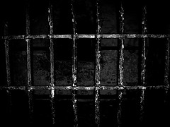
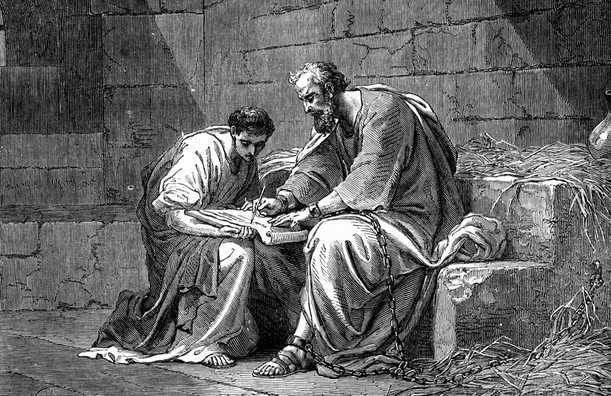
Introducing the "Prison Epistles"
Dr. Rick Griffith • Jordan Evangelical Theological Seminary • BibleStudyDownloads.org
Jeremy Chew, East Asia School of Theology, Singapore
Notes:
This group of four letters took the term Prison Epistles in the past few hundred years to designate those letters Paul from from his house arrest in Rome from AD 60-62.
Discussion: How are the Prison Epistles different from the Missionary Epistles?
• Later and compressed into 2 years
• Focus on Jesus (Christology) rather than soteriology and eschatology
• Time of persecution of leaders, such as Paul (not believers in general, as in the Pastorals)
• Similar verses between letters
• Shorter in length
• Outline addresses theology, then practice
• Begins Paul's letters to individuals (leaders), such as Philemon
• Focus on identity in Christ

Slide 2
NT Overview (Paul's Letters)
38 124 39-41
"To the remotest part of the earth" (Acts 1:8)
Acts 9 13 14 15 16 18 21 27 28
Apr 48- Sep 49
1 Galatia
Apr 50- Sep 52
2 Aegean
Spr 53- May 57
3 Asia
Feb 60- Mar 62
1 Rome
Spr 62- Fall 67
4 Spain
Aut 67- Spr 68
2 Rome
Summer 35- 37
Damascus Antioch
May 57- Aug 59
Trials
Fall 49
The
Council
Spring 68
Expansion of Church
35 48 49 50 52 53 57 60 62 67 68 95
Matt
Luke
Acts
Mark
John
Gal
Justify
1 Thess
Rapture
1 Cor
Eph
Sanctify
Unity
1 Tim
2 Tim
2 Thess
2 Cor
Col
Tribulation
Apostle
Deity
Titus
Missionary
Pastoral
Romans
Philem
Righteous
Forgive
Gospels & Acts
Phil
Attitude
Pauline Epistles
1234
Journeys
Prison
Rome
Imprisonments
Pauline Books, Categories, & Key Words
Notes:
Prison Epistles comprise the middle portion of the three types of Pauline letters. Paul was actually under house arrest in the last few verses of Acts, but he would be imprisoned once again five years after his AD 62-27 time of release. The second imprisonment was in the Mamertine Prison–a much more serious state—and resulted not in release from prison but in his beheading in AD 68.
We may suppose that heresies take a long time to develop, but the New Testament teaches otherwise. Within a generation of Christ's life, many false systems developed. Paul writes in the AD 60s, just prior to his beheading, that many had fallen into the snare of deceptive teaching.
Yet nearly all of Paul's writings responded to a heresy. This means that he took false doctrine seriously, in contrast to the church of our day in many circumstances.
Paul wrote while traveling, imprisoned, or to key leaders.
Observations about chronology:
Gospels were not written first, but throughout the NT era
Evangelistic letters preceded pastoral
Rough letter (Galatians) preceded smoother ones
_______________
Common-493
NS-00-NT Introduction-97
NS-03-Luke1-12-slide 65
NS-06-MissionaryEpistles-2
NS-06-Rom1-2-slide 16
NS-07-1Cor1-9-slide 23
NS-08-2Cor-27
NS-10-Prison Epistles-2
NS-11-Philippians-15, 40
NS-12-Colossians-22, 24, 304

Slide 3
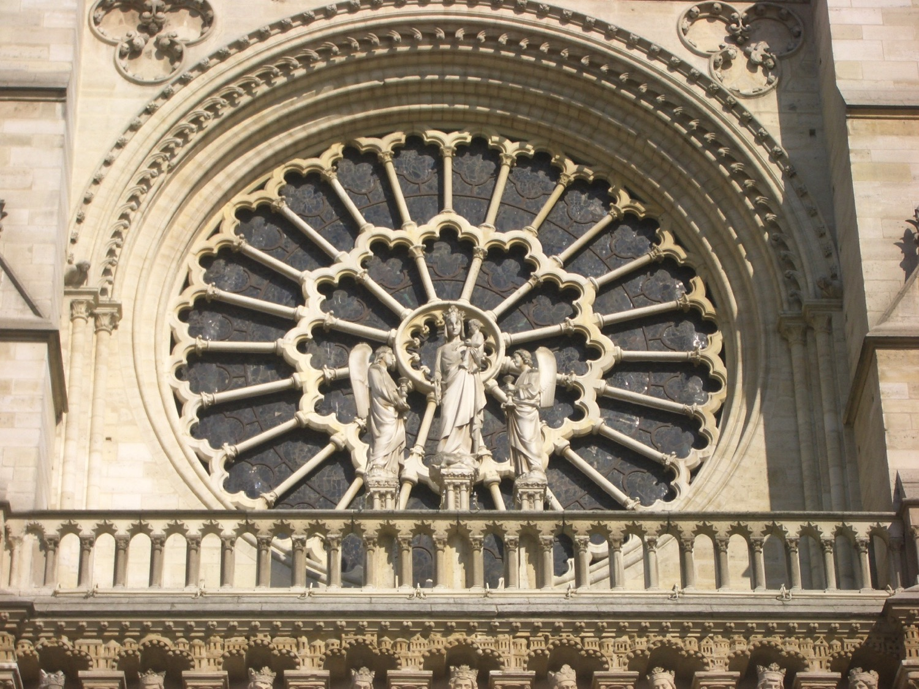
Key Characteristics of Acts
122
Kingdom
Start
"So when the apostles were with Jesus, they kept asking him, 'Lord, has the time come for you to free Israel and restore our kingdom?'" (Acts 1:6 NLT)
End
"For the next two years, Paul lived in Rome at his own expense. He welcomed all who visited him, ³¹boldly proclaiming the Kingdom of God and teaching about the Lord Jesus Christ. And no one tried to stop him" (Acts 28:30-31 NLT).
Notes:
What does this kingdom for Israel mean (Acts 1:6)?
Israel had kings for over 400 years from 1000-600 BC, but it had been over 600 years since the kingdom had ended.
We should use the normal language for “Israel” here and also for “kingdom” as they would have understood it. In fact, the kingdom for Israel is a key theme of Acts—seen here in the first chapter and also in the last few verses!
____________________
NS-05-Acts1-2—slide 199
NS-05-Acts20-28—slide 226
NS-10-Prison Epistles-3

Slide 4
Paul's Epistles in Mostly Scriptural Order
Foundational | Prophetic | Prison | Pastoral
Romans 1 Corinthians 2 Corinthians Galatians | 1 Thessalonians 2 Thessalonians | Ephesians Philippians Colossians Philemon | 1 Timothy 2 Timothy Titus
Christ & the Cross | Christ & the Second Coming | Christ & the Church | Christ & the Congregation
Soteriology | Eschatology | Christology | Ecclesiology
TEXT
Adapted from The Pastoral Epistles © John Stevenson 2010 • https://slideplayer.com/slide/6106093/
Notes:
This chart shows that Paul addressed theology to churches in this order: Soteriology, Eschatology, Christology, and Ecclesiology. This contrasts with how most follow-up today postpones eschatology too late.
This order follows the NT except Philemon is moved from the end of the Pauline Epistles after Titus to complete the Prison Epistles after Colossians.
But one could argue that Philemon is a pastoral letter, since it addresses a situation that required reconciliation.
On the other hand, Paul wrote Philemon in Rome during Paul's first imprisonment, so it is a Prison Epistle in this sense.
In the end, I do not know who has explained the reasoning for the order of Paul's letters.
Note that combining the four Foundational and two Prophetic Epistles gives us the six Missionary Epistles.
___________
Common-440
NS-00-NT Introduction-105
NS-06-Pauline Epistles-4
NS-06-Missionary Epistles-10
NS-10-Prison Epistles-3
NS-15-Pastoral Epistles-15

Slide 5
NT Book Keywords
24
Date | Book | Key Word | Paul's Life | Key Doctrine
40s | Matthew | Kingdom |  | Ecclesiology
44-47 | James | Works |  | Soteriology
49 | Galatians | Justification | 1st journey | Soteriology
51 | 1 Thessalonians | Rapture | 2nd journey | Eschatology
51 | 2 Thessalonians | Tribulation | 2nd journey | Eschatology
56 | 1 Corinthians | Sanctification | 3rd journey | Ecclesiology
56 | 2 Corinthians | Apostleship | 3rd journey | Ecclesiology
56-57 | Romans | Righteousness | 3rd journey | Soteriology
57-59 | Luke | Sovereignty I |  | Missiology
Notes:
• The early church taught that Matthew wrote the first gospel.
• James and Galatians were the earliest letters, and both focused on salvation, though they used the word "justification" in a different sense: horizontal before men (James) and vertical before God (Galatians).
• Paul's six Missionary Epistles were written over eight years, with no intervening Gospels or General Epistles.
• Typically, letters to the same church addressed the same key doctrine: 1&2 Thess, 1&2 Cor, 1&2 Tim, and 1&2 Peter. The exception is that 2&3 John addressed missiology, while 1 John's theme is salvation.
——————————
NS-00-NT Intro-49
NS-10-Prison Epistles-5
NS-19-General Epistles-4

Slide 6
NT Book Keywords
24
Date | Book | Key Word | Paul's Life | Key Doctrine
60 | Ephesians | Unity | 1st imprisonment | Christology (Head)
61 | Colossians | Deity | 1st imprisonment | Christology (God)
61 | Philemon | Forgiveness | 1st imprisonment | Christology (Reconciler)
62 | Philippians | Attitude | 1st imprisonment | Christology (Example)
62 | Acts | Sovereignty II |  | Missiology
62 | 1 Timothy | Order | 4th journey | Ecclesiology
64 | 1 Peter | Suffering |  | Eschatology
64 | 2 Peter | Knowledge |  | Eschatology
64-68 | Mark | Discipleship |  | Eschatology
Notes:
The four Prison Epistles share a common theme centered on Jesus.
——————————
00-NT Intro-50
NS-10-Prison Epistles-6
NS-19-General Epistles-5

Slide 7
NT Book Keywords
24
Date | Book | Key Word | Paul's Life | Key Doctrine
66 | Titus | Conduct | 4th journey | Ecclesiology
67 | 2 Timothy | Doctrine | 2nd imprisonment | Ecclesiology
67-68 | Hebrews | Superiority |  | Christology
c. 69 | John | Belief |  | Soteriology
75 | Jude | Pretenders |  | Eschatology
85-95 | 1 John | Love |  | Soteriology
85-95 | 2 John | Limits |  | Missiology
85-95 | 3 John | Missionaries |  | Missiology
95-96 | Revelation | Triumph |  | Eschatology
Notes:
Paul died in AD 68, so all epistles after this are the General Epistles.
The Gospels were composed over the first few decades, though many place John in the AD 90s.
——————————
00-NT Intro-51
NS-10-Prison Epistles-7
NS-19-General Epistles-6

Slide 8
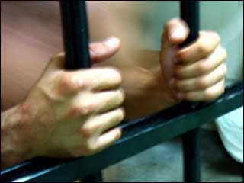
Which letters are Prison Epistles?
177
Ephesians
Colossians
Philemon
Philippians
Why call them "Prison Epistles"?
They refer to Paul's bonds (cf. Acts 28:16):
Eph. 3:1; 4:1; 6:20
Col. 4:3, 18
Philem. 1, 9, 10
Phil. 1:13-14
Adapted from Jeremy Chew, East Asia School of Theology, Singapore

Slide 9
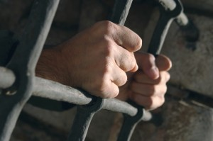
Who carried these letters?
177
Tychicus
He carried the Ephesian and Colossian epistles (Eph. 6:21; Col. 4:7)
He was accompanied by Onesimus (Col. 4:9)
Onesimus
A slave to Philemon from Colossae
He probably carried the Epistle to Philemon when he returned to his master, though it is not specifically mentioned (Philem. 12)
Epaphroditus
A man from Philippi, he carried the Philippian letter back to his people (Phil. 2:25, 28)
Adapted from Jeremy Chew, East Asia School of Theology, Singapore

Slide 10


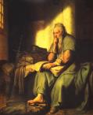
What was Paul's attitude?
177
In Philemon, Paul was hopeful (evlpi,zw = hope) that he would be released (Philemon 22)
In Philippians, Paul was confident (oi=da know) that he would be released (Phil. 1:25; 2:24)
Order & Setting
Written on 2-3 separate occasions
Ephesians, Colossians, and Philemon are written around the same time (likely AD 60-61)
Philippians is written later (probably AD 62)
Adapted from Jeremy Chew, East Asia School of Theology, Singapore

Slide 11

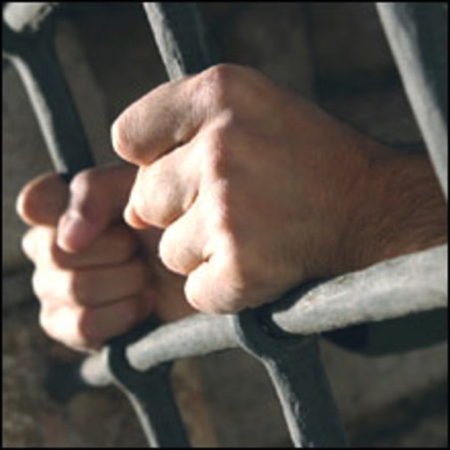
Occasion for Prison Epistles
177
Paul was imprisoned in Rome and Epaphras was with him
He first wrote a general circular letter for Gentile churches in Asia Minor (Ephesians)
Onesimus, a runaway slave, later joined them
Paul received news of a crisis in the Colossian church (heresy)
He sent Tychicus with a letter to address the Colossian problems
He also sent Onesimus with Tychicus with a letter to Philemon
Adapted from Jeremy Chew, East Asia School of Theology, Singapore

Slide 12
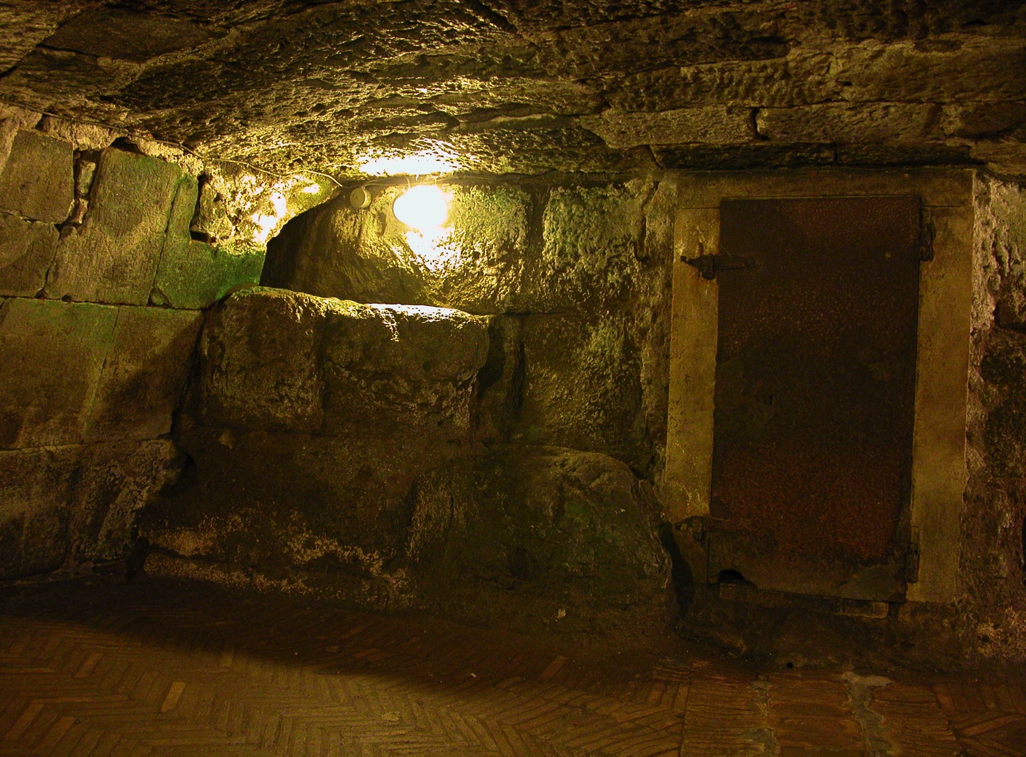
Some months later (AD 62)…
182
Paul was still in prison
The Philippian church sent Epaphroditus to minister to Paul
Paul found out from him problems in Philippian church: external opposition (3:17f.) and internal disunity (4:2)
Epaphroditus became very sick (Phil. 2:26)
Paul sent him back with a letter to address problems of the Philippians
Adapted from Jeremy Chew, East Asia School of Theology, Singapore

Slide 13

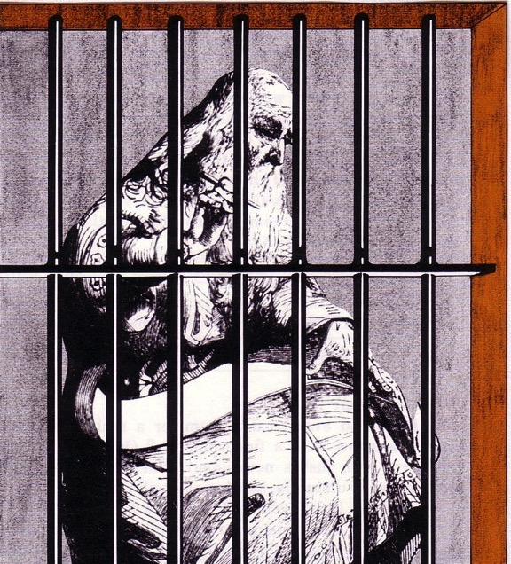
The Prison Epistles
Ephesians
Colossians
Philemon
Philippians
Critique this picture…
Paul typically had a scribe write (Rom 16:22)
Paul was under house arrest (Acts 28:30-31)
Paul was chained to a guard (Acts 28:16)
Paul was ≤60 years old (not 80 like this man!)
Notes:
Unlikely there were bars
Too nice wood?
Pen instead of a stylus?
Dressed too nice?
Beard too long?
Letter too long?
Room too small?
Not alone (Acts 28:30-31)

Slide 14


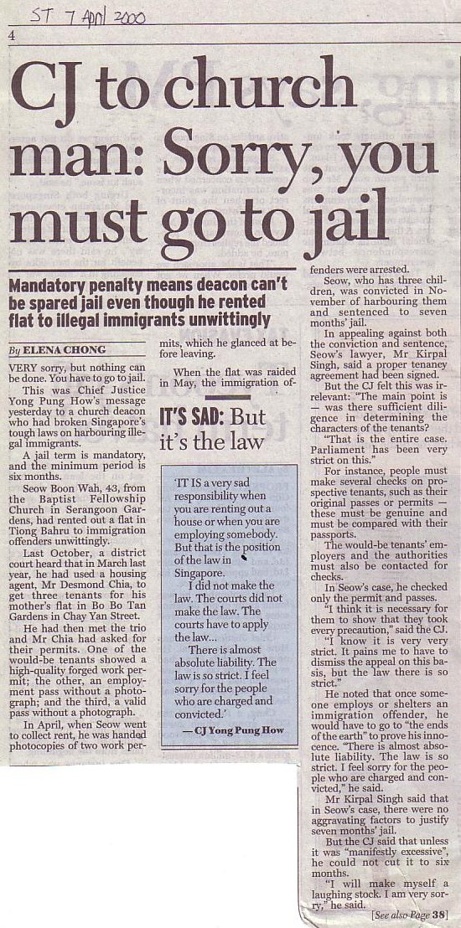
Sometimes Christians are Treated Unfairly
GO TO JAIL
Paul was—and ended up under house arrest in Rome
Note that a deacon appears with a terrorist & tax cheat

Slide 15

Prison Epistle Christology
201a
 | Christ as… | Focus | Explanation
Ephesians | Head | Unity of Christ | Christ breaks down barriers between believers
Philippians | Example | Attitude of Christ | Christ models how to handle difficulty
Colossians | God | Deity of Christ | Christ is superior to human philosophies
Philemon | Reconciler | Forgiveness of Christ | Christ reconciles believers to God and one another

Slide 16
Applying the Prison Epistles
202
Epistle | 1st Century Problem | 21st Century Problem | Solution (Theme)
Ephesians | Jew-Gentile Conflicts ("Weism") | Chinese Only Baptist Only Adults Only | Realize Christian Unity (4:3)
Philippians | Persecution Prison Death | Ministry Inconvenience - time, sleep - recreation | Imitate Christ's Attitude (2:5)
Colossians | Denying Christ's Deity | New Age Cults | Proclaim His Deity (2:9)
Philemon | Master/Slave ("Meism") | Forgive Boss / Employee / Others | Reconcile the Relationship (vv. 17-18)

Slide 17


How Do You Respond to Trials?
201
You say… | Strategy | Temperament | Epistle
"I'm right!" | Push through | Choleric | Ephesians
"Why me?" | Depression | Melancholy | Philippians
"I'll just get through" | Compromise | Sanguine | Colossians
"It'll pass" | Ignore it | Phlegmatic | Philemon

Slide 19


NT Survey link at BibleStudyDownloads.org
Get this presentation for free!
Notes:
NT Survey (ns)

