Slide 1

E p h e s i a n s
Unity in Love
Dr. Rick Griffith • Jordan Evangelical Theological Seminary • BibleStudyDownloads.org
Notes:
Love leads to unity—and greater unity leads to more love.
One of the hallmarks of the gospel is its ability to bring former enemies to be friends.
Arabic edited by me on slides 22, 32, 198
Arabic edited by Rami on slides 8, 10

Slide 2
Key Word
175
Unity
Ephesians
Notes:
Our natural tendency is to move towards disunity. We want to be around people who look like us, talk like us, eat like us, smell like us, and act like us.
God is much broader and more flexible than this. How many races are there? He did not create various races. He made only one race called the human race. He wants us to learn more about him and his open arms by being united with those who are different from us in minor ways and yet are united in the major way—the way of Jesus.

Slide 3
Theme
23
Jew-Gentile Unity
Shown in Love
Ephesians
Notes:
There was no greater distance between two groups in the first century than the chasm between Jews and Gentiles. Ephesus had both groups living together before Paul showed up, but the gospel called them both to leave there long-held beliefs to meet Jesus in the middle—the One who brings a sword but also binds long-held wounds.
The Acts 19 riot reveals the hatred of the Ephesian silversmiths who cared only for their money rather than for truth.

Slide 4
Key Verse
175
"As a prisoner for the Lord,
then I urge you to live a life
worthy of the calling you have received.
Be completely humble and gentle;
be patient, bearing with one another in love making every effort to keep the
unity of the Spirit in the bond of peace"
(4:1-3).
Ephesians
Notes:
This verse is the turning point in the book from the theology (Ephesians 1–3) to the outworking of that doctrine (Ephesians 4–6). Note how all these 4:1-2 traits result in unity in love.

Slide 5
175
Summary Statement
The way to unity for believing Jews and Gentiles is to see their equality and love one another as a witness to the world
Ephesians
Notes:
When we think we are better than others, unity never results. Disunity always comes from one person or group thinking inaccurately high of self!

Slide 6

Kingdom Statement
27c
Christ will be the ruler of both heaven and earth in a yet future age (1:9-10) that Revelation 20:1-6 reveals to be 1000 years.
Ephesians
Notes:
Ephesians 1:9-10 doesn't use the word "millennium," but this is obviously the referent:
Eph. 1:9 NLT God has now revealed to us his mysterious will regarding Christ—which is to fulfill his own good plan. 10 And this is the plan: At the right time he will bring everything together under the authority of Christ—everything in heaven and on earth.

Slide 7

Covenant
27c
Christ abolished “in his flesh the law with its commandments and regulations” (2:15), so Christ’s death did away with the Mosaic Law (cf. Rom. 7:7).
Ephesians
Notes:
So, on the cross, Paul says, Jesus actually crucified the old covenant too! The OT has great value for study, but it is not the standard by which God measures obedience for the Christian—except in those areas repeated in the NT and thus showing themselves to be new covenant truth also.

Slide 8

Redemption
27c
The clearest NT text that teaches the church age as a dispensation (3:2-6) shows that salvation makes Jews and Gentiles equal in one body, the Church (2:14, 19).
Ephesians
Notes:
Too often we neglect to see that God has NOT worked the same way in all ages. Paul declared this new way where Gentiles need not become Jews like in the OT, but rather, God has formed a brand new entity called the Church where it makes no difference whether one is a Jew or a Gentile.

Slide 9
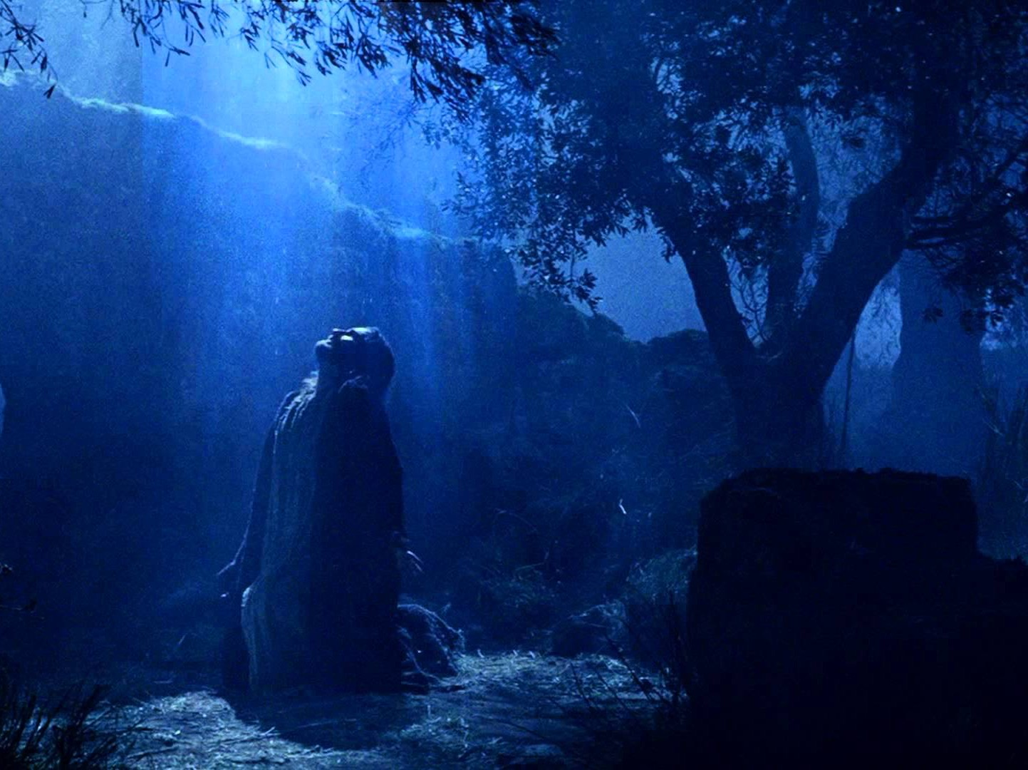
Prophecy
(Lord, Deity)
27c
Christ can do more than any of us can imagine (3:20) in the most complete description of demons in all of Paul's writings (2:2; 6:11-16) through the person and work of the Holy Spirit (1:13-14; 2:18; 3:5, 16; 4:3-4, 30; 5:18; 6:17-18).
Ephesians
Notes:
Along with this emphasis on the demonic realm, Paul urges in Ephesians to rely on the Spirit. This makes sense, for none of us can defeat fallen angels in our own strength. To this we can add that this letter best portrays Christ as Head of his body, the Church.

Slide 10
Book Chart
Jew-Gentile Unity Shown in Love
Love as Equals |  |  |  | Love as Testimony
Chapters 1–3 |  |  |  | Chapters 4–6
Doctrine |  |  |  | Application
Position |  |  |  | Practice
Belief |  |  |  | Behaviour
Privileges |  |  |  | Responsibilities
Salutation | Position | Reconcil-iation | Unique-ness | Unity | Holiness | Submission | Reliance | Love
1:1-2 | 1:3-23 | 2 | 3 | 4:1-16 | 4:17–5:20 | 5:21–6:9 | 6:10-20 | 6:21-24
Rome
Fall AD 60 (first Roman imprisonment)
175
Ephesians
Notes:
Unity in love is founded our our equality in Christ (chapters 1–3) and resulting in our witness to the world (chapters 4–6).

Slide 11
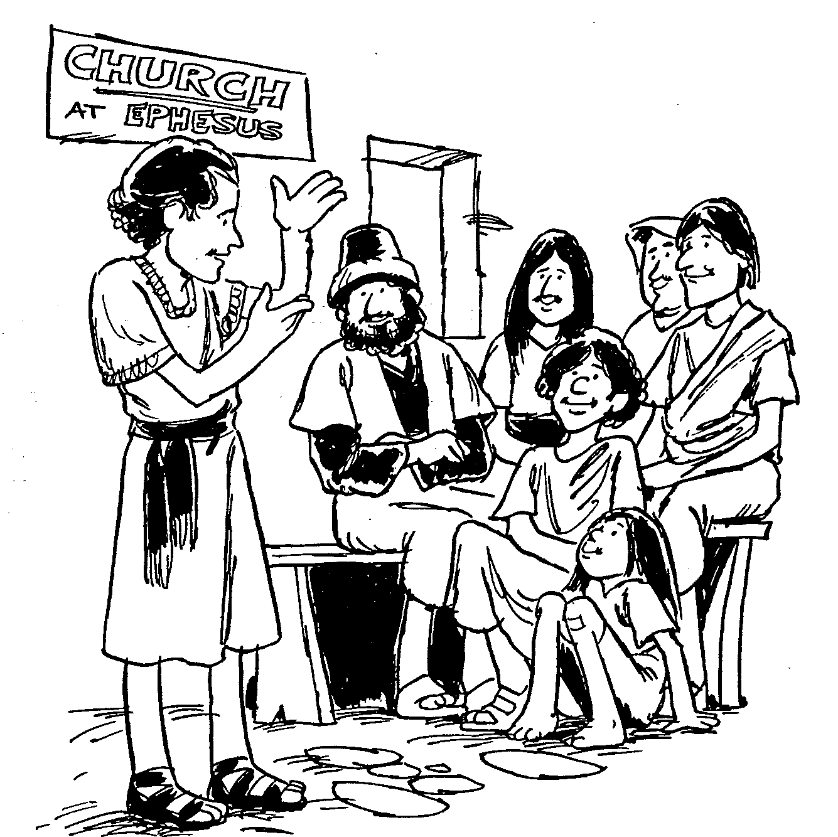
EPHESIANS
1
2
3
4
5
6
Calling of the church
Heavenly position for individuals
Understanding of the mystery
Reasons for spiritual gifts
Christ's example for marriage
Help in spiritual warfare
Barry Huddleston, The Acrostic Bible
Notes:
This epistle best explains the nature of the church—what it is, how is fits into God's plan for the ages, how to defeat its opponents, etc.

Slide 12

Be United
Ephesians
Dr. Rick Griffith • Crossroads International Church Singapore
CICFamily.com & BibleStudyDownloads.org
Notes:
Church unity is one of the strongest pulls to the gospel for the lost—and, conversely, church disunity probably discourages the lost from seeking Jesus more than anything else. Unbelievers say, "Hey, I already have problems at home, at work, at the club, on the road. Why do I need to add more politics to my life?"

Slide 13

How can our church be united despite our many different kinds of people?
Notes:
What do we need to do so we don’t end up divided due to our diversity?

Slide 14
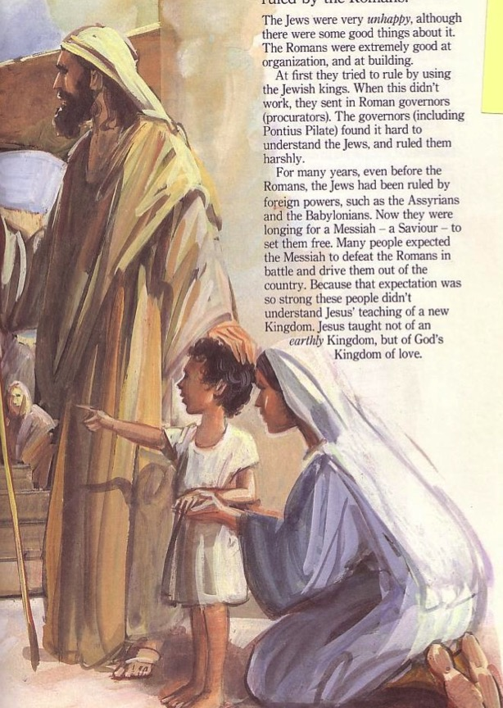
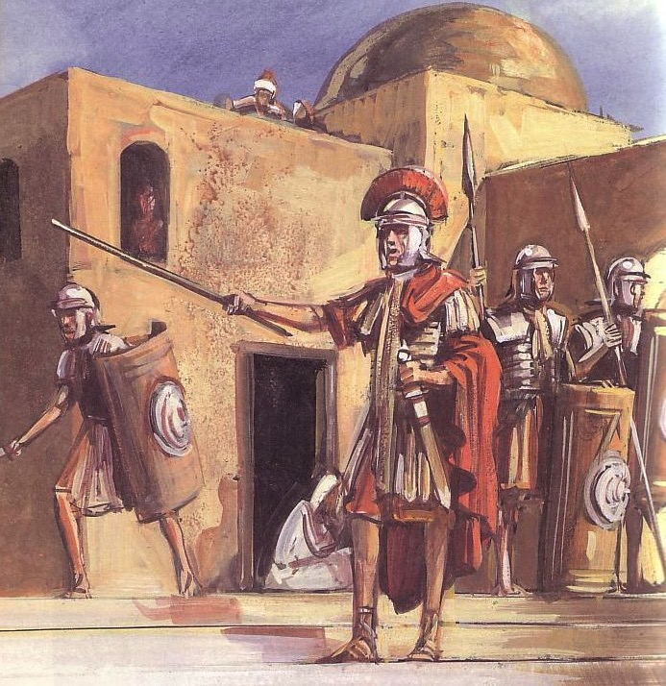
Sometimes Christians mistreat others of a different ethnic group
Jews
Gentiles
One God
Many taboos
Many Gods
Few taboos
Notes:
Believers know that Jesus saves people from any and every ethnic group (see Rev 5:9; 7:9), but too often treat others as if they are in a different spiritual family. The major ethnic problem in the early church was the division between Jews and Gentiles, but the same idea shows up in societies today: Chinese versus Malay (Singapore), blacks versus whites (USA), Arabs versus Israelis (Jordan), Hutus versus Tutsis (Rwanda), etc.

Slide 15
How to be united…
Love God
Eph 1–3
Notes:
Love God for our equality in Christ (Eph 1–3).
[Praise God that none of us is better than any other due to salvation or ethnic origin or class.]

Slide 16
How to be united…
Love the Church
Love God
Eph 4–6
Notes:
Love the church to witness to the world (Eph 4–6).
[Unity leads to care for each other in a way that attracts unbelievers.]

Slide 17
How to be united…
Love the Nations
Love the Church
Love God
Ephesians
Notes:
Love God, love the church as equals, and love the nations (Main Idea).
The way to unity for believing Jews and Gentiles is to see their equality and love one another as a witness to the world.

Slide 18

Love God, love the church as equals, and love the nations
Main Idea of Ephesians
Notes:
Love is sacrifice, not feeling. The willingness to selflessly commit to God and others stems from humbly realizing all this is about him and not us.

Slide 19

Think about it.
Do you really act like you are equal with other members of the body of Christ?
• Maids?
• Former Muslims (Malays)?
• Believers in Prison?
• Poor churches of India, Myanmar, Bangladesh, etc.?
How do you show your unity with believers different from you?
Applying Ephesians
Notes:
Repeated from slide 14 above:
Believers know that Jesus saves people from any and every ethnic group (see Rev 5:9; 7:9), but too often treat others as if they are in a different spiritual family. The major ethnic problem in the early church was the division between Jews and Gentiles, but the same idea shows up in societies today: Chinese versus Malay (Singapore), blacks versus whites (USA), Arabs versus Israelis (Jordan), Hutus versus Tutsis (Rwanda), etc.

Slide 20
Black

Slide 21

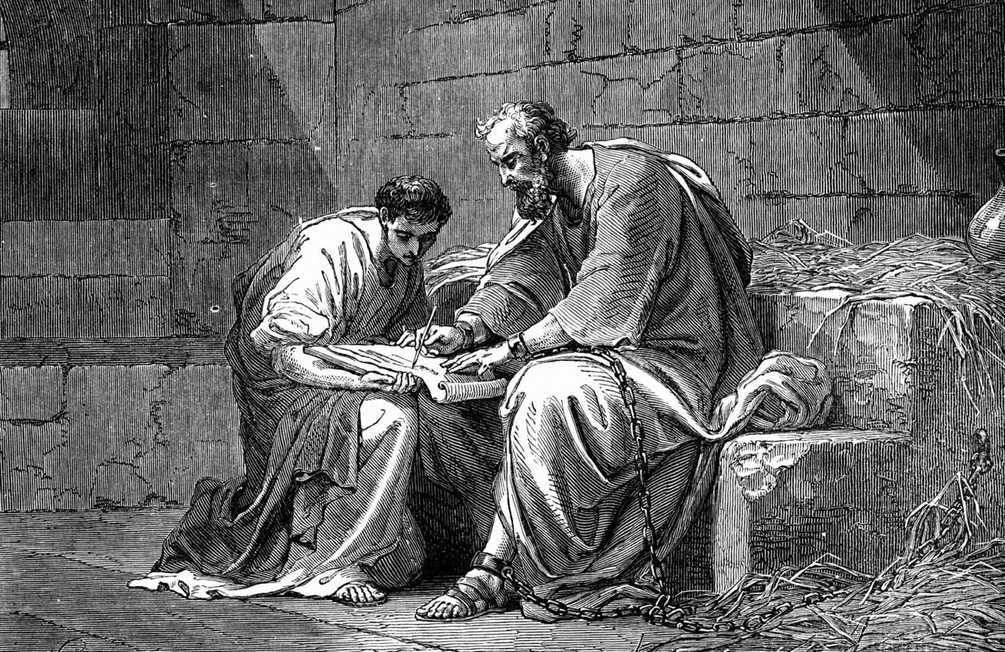
Introducing the "Prison Epistles"
Dr. Rick Griffith • Jordan Evangelical Theological Seminary • BibleStudyDownloads.org
Jeremy Chew, East Asia School of Theology, Singapore

Slide 22
NT Overview (Paul's Letters)
38
124
39-41
"To the remotest part of the earth" (Acts 1:8)
Acts 9 13 14 15 16 18 21 27 28
Apr 48-
Sep 49
1
Galatia
Apr 50-
Sep 52
2
Aegean
Spr 53-
May 57
3
Asia
Feb 60-
Mar 62
1
Rome
Spr 62-
Fall 67
4
Spain
Aut 67-
Spr 68
2
Rome
Summer 35-
37
Damascus
Antioch
May 57-
Aug 59
Trials
Fall 49
The
Council
Spring 68
Expansion of Church
35 48 49 50 52 53 57 60 62 67 68 95
Matt
Luke
Acts
Mark
John
Gal
Justify
1 Thess
Rapture
1 Cor
Eph
Sanctify
Unity
1 Tim
2 Tim
2 Thess
2 Cor
Col
Tribulation
Apostle
Deity
Titus
Missionary
Pastoral
Romans
Philem
Righteous
Forgive
Gospels & Acts
Phil
Attitude
Pauline Epistles
1234
Journeys
Prison
Rome
Imprisonments
Pauline Books, Categories, & Key Words

Slide 23
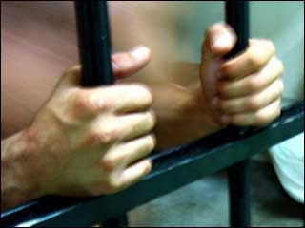
Which letters are Prison Epistles?
177
Ephesians
Colossians
Philemon
Philippians
Why call them "Prison Epistles"?
They refer to Paul's bonds (cf. Acts 28:16):
  Eph. 3:1; 4:1; 6:20
  Col. 4:3, 18
  Philem. 1, 9, 10
  Phil. 1:13-14
Adapted from Jeremy Chew, East Asia School of Theology, Singapore

Slide 24
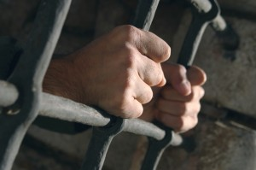
Who carried these letters?
177
Tychicus
  He carried the Ephesian and Colossian epistles (Eph. 6:21; Col. 4:7)
  He was accompanied by Onesimus (Col. 4:9)
Onesimus
  A slave to Philemon from Colossae
  He probably carried the Epistle to Philemon when he returned to his master, though it is not specifically mentioned (Philem. 12)
Epaphroditus
  A man from Philippi, he carried the Philippian letter back to his people (Phil. 2:25, 28)
Adapted from Jeremy Chew, East Asia School of Theology, Singapore

Slide 25


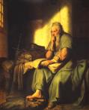
What was Paul's attitude?
177
In Philemon, Paul was hopeful (evlpi,zw = hope) that he would be released (Philemon 22)
In Philippians, Paul was confident (oi=da know) that he would be released (Phil. 1:25; 2:24)
Order & Setting
Written on 2-3 separate occasions
Ephesians, Colossians, and Philemon are written around the same time (likely AD 60-61)
Philippians is written later (probably AD 62)
Adapted from Jeremy Chew, East Asia School of Theology, Singapore

Slide 26

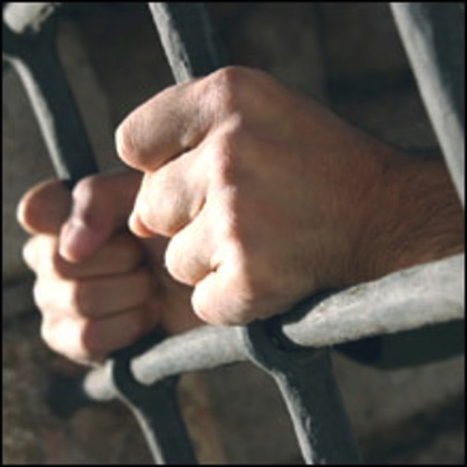
Occasion for Prison Epistles
177
Paul was imprisoned in Rome and Epaphras was with him
He first wrote a general circular letter for Gentile churches in Asia Minor (Ephesians)
Onesimus, a runaway slave, later joined them
Paul received news of a crisis in the Colossian church (heresy)
He sent Tychicus with a letter to address the Colossian problems
He also sent Onesimus with Tychicus with a letter to Philemon
Adapted from Jeremy Chew, East Asia School of Theology, Singapore

Slide 27
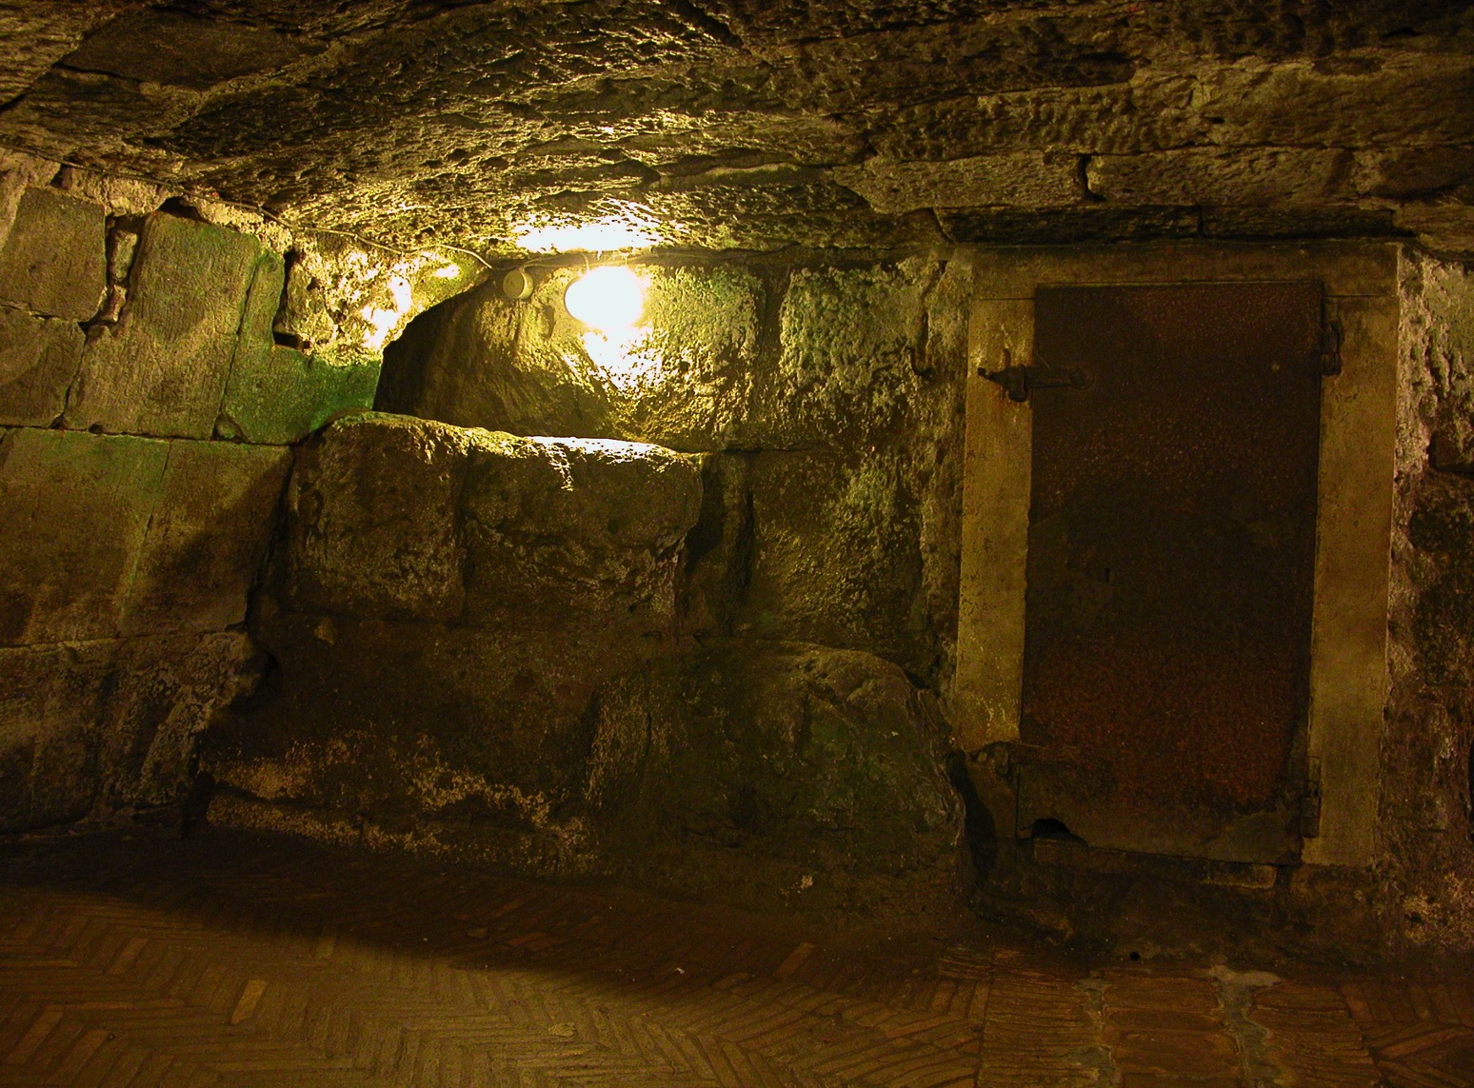
Some months later (AD 62)…
182
Paul was still in prison
The Philippian church sent Epaphroditus to minister to Paul
Paul found out from him problems in Philippian church: external opposition (3:17f.) and internal disunity (4:2)
Epaphroditus became very sick (Phil. 2:26)
Paul sent him back with a letter to address problems of the Philippians
Adapted from Jeremy Chew, East Asia School of Theology, Singapore

Slide 28

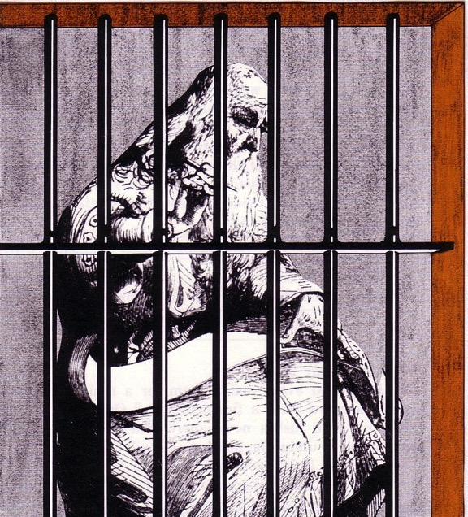
The Prison Epistles
Ephesians
Colossians
Philemon
Philippians
Critique this picture…
Paul typically had a scribe write (Rom 16:22)
Paul was under house arrest (Acts 28:30-31)
Paul was chained to a guard (Acts 28:16)
Paul was ≤60 years old (not 80 like this man!)
Notes:
Unlikely there were bars
Too nice wood?
Pen instead of a stylus?
Dressed too nice?
Beard too long?

Slide 29
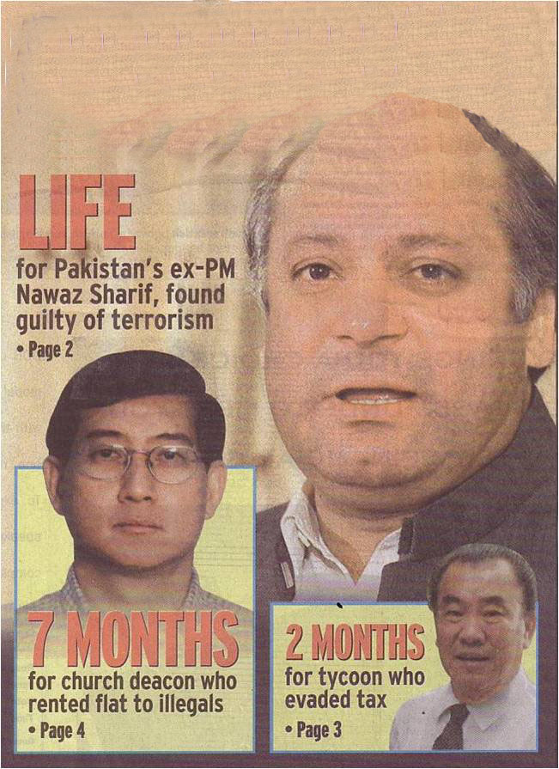

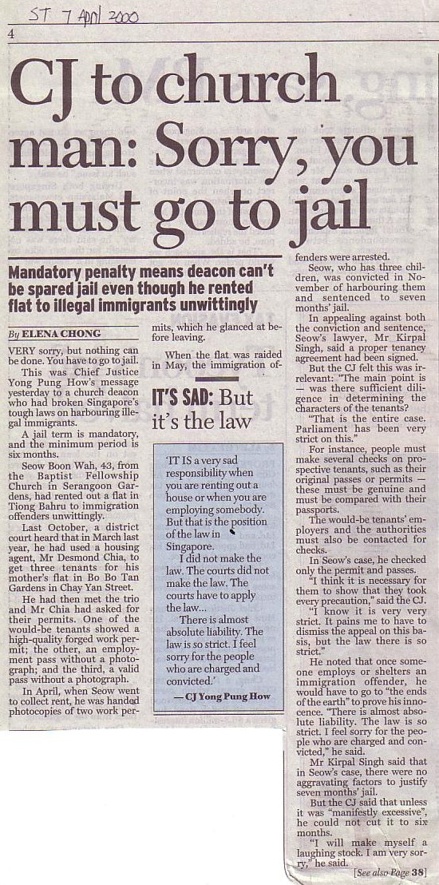
Sometimes Christians are Treated Unfairly
GO TO JAIL
Paul was—and ended up under house arrest in Rome
Note that a deacon appears with a terrorist & tax cheat

Slide 30
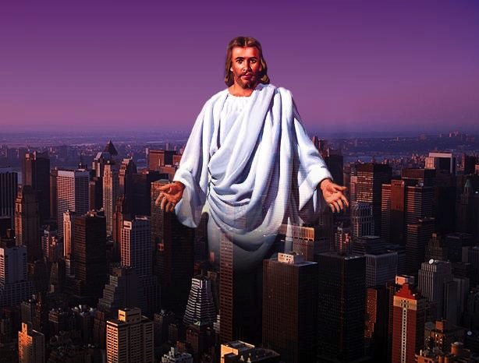
Prison Epistle Christology
201a
 | Christ as… | Focus | Explanation
Ephesians | Head | Unity of Christ | Christ breaks down barriers between believers
Philippians | Example | Attitude of Christ | Christ models how to handle difficulty
Colossians | God | Deity of Christ | Christ is superior to human philosophies
Philemon | Reconciler | Forgiveness of Christ | Christ reconciles believers to God and one another

Slide 31
Applying the Prison Epistles
202
Epistle | 1st Century Problem | 21st Century Problem | Solution (Theme)
Ephesians | Jew-Gentile Conflicts ("Weism") | Chinese Only Baptist Only Adults Only | Realize Christian Unity (4:3)
Philippians | Persecution Prison Death | Ministry Inconvenience - time, sleep - recreation | Imitate Christ's Attitude (2:5)
Colossians | Denying Christ's Deity | New Age Cults | Proclaim His Deity (2:9)
Philemon | Master/Slave ("Meism") | Forgive Boss / Employee / Others | Reconcile the Relationship (vv. 17-18)

Slide 32


How Do You Respond to Trials?
201
You say… | Strategy | Temperament | Epistle
"I'm right!" | Push through | Choleric | Ephesians
"Why me?" | Depression | Melancholy | Philippians
"I'll just get through" | Compromise | Sanguine | Colossians
"It'll pass" | Ignore it | Phlegmatic | Philemon

Slide 33
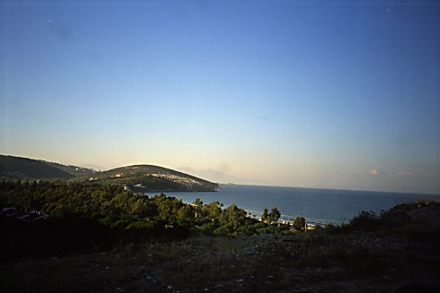
City of Ephesus
MAIN MENU
CITY OF EPHESUS
BACKGROUND
OUTLINE
SCRIPTURE IN SONG
CHAPTERS 1–3
CHAPTERS 4–6
CONCLUSION
Location
Places of Interest

Slide 34
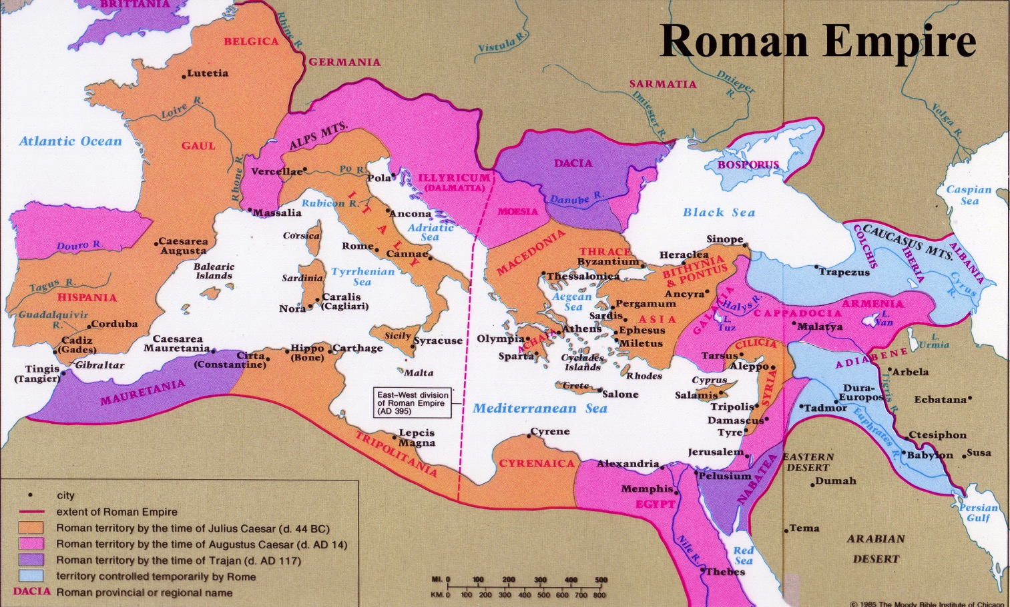
Roman Territories (50 BC-AD 100)
Roman Empire
Beitzel, 1st edition, 166

Slide 35
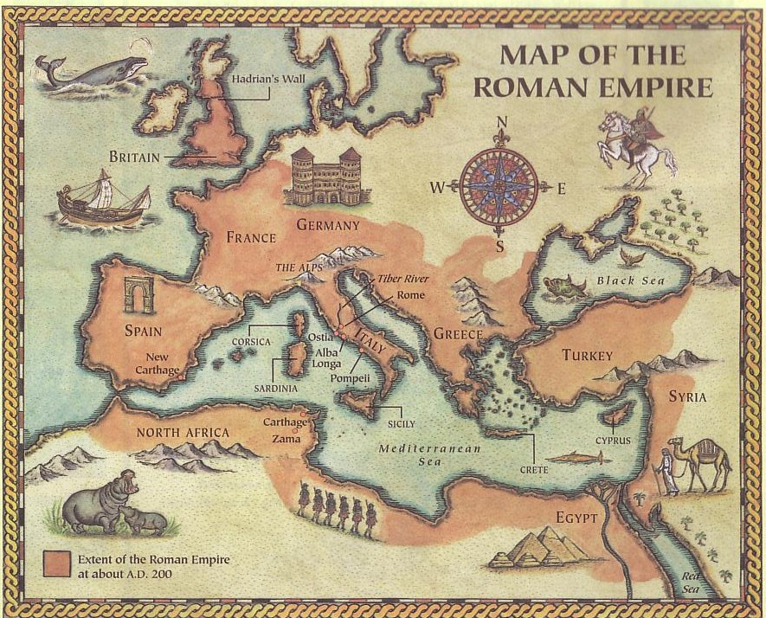
Place & Date
176
Paul wrote this Ephesians during his first imprisonment in Rome, AD 60. He also wrote other "prison epistles": Colossians, Philemon, Philippians.
Rome
Ephesus

Slide 36
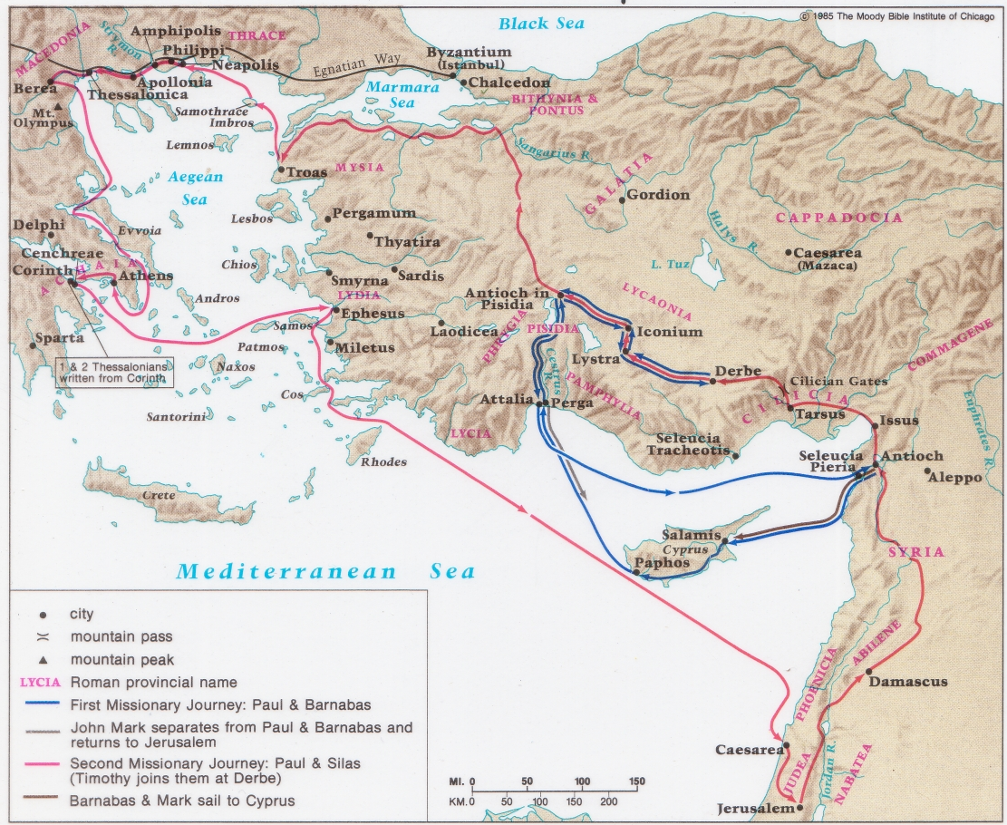
Paul's 1st & 2nd Missionary Journeys
138-39

Slide 37
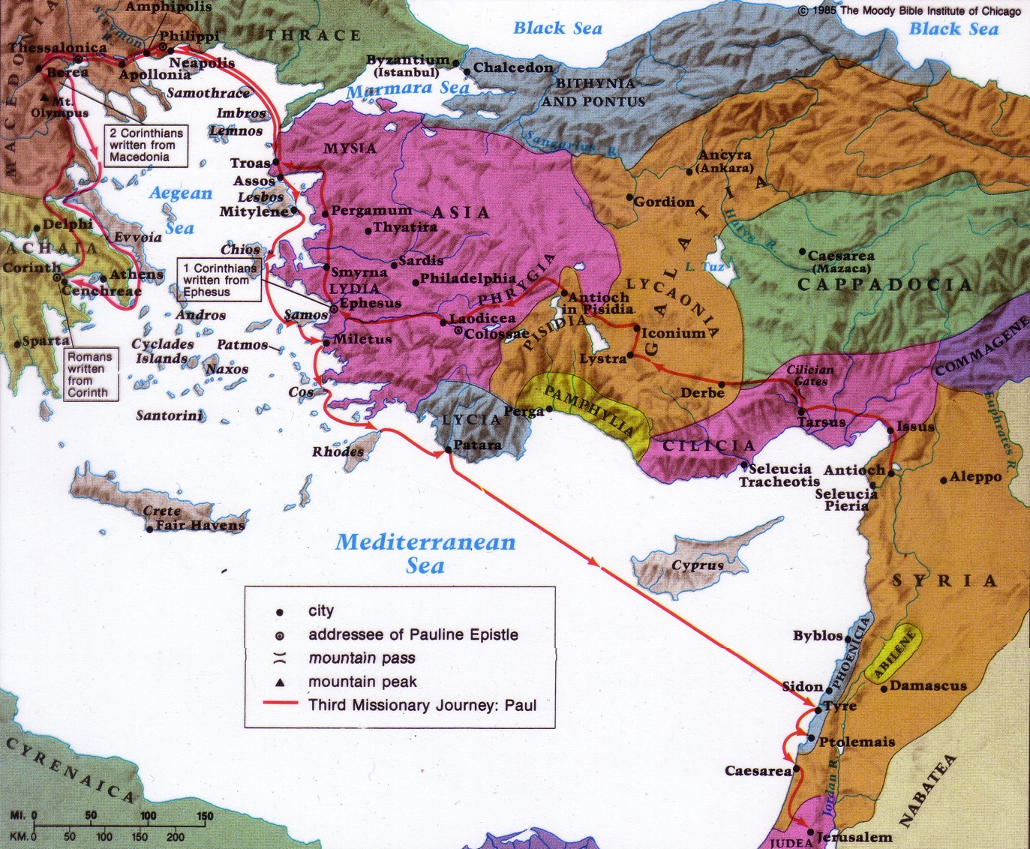
Paul's 3rd Missionary Journey
140

Slide 38
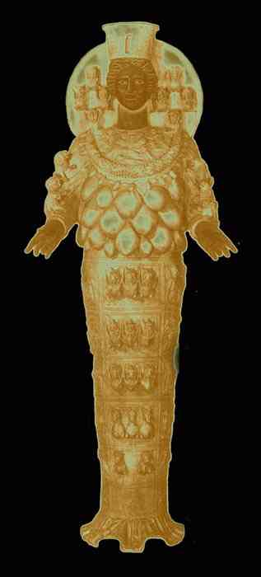
Ephesus Notables
180d
Recognized as the "first" city of Asia.
Commerce, one of the leaders of international trade
Arts and Sciences, a haven for philosophers, poets, artists and orators.
Religion = worship of Diana

Slide 39
Recipients
176
The church of Ephesus is noted in 1:1.
Others say it is to a circuit of unspecified churches. Some important manuscripts omit the phrase "at Ephesus." This epistle as a whole lacks the usual Pauline personal greetings and so appears to be a circular letter.
Perhaps it's a combination of both views.

Slide 40
BACKGROUND
MAIN MENU
CITY OF EPHESUS
BACKGROUND
OUTLINE
SCRIPTURE IN SONG
CHAPTERS 1–3
CHAPTERS 4–6
CONCLUSION
Authorship
Date
Key People
Audience
Features
Purpose

Slide 41

BACKGROUND
Authorship
Date
Key People
Audience
Paul
Prison Epistle (A.D. 60)
Tychicus from Ephesus

Slide 42

Authorship
176
External Evidence:
The early church unanimously agreed with Pauline authorship.
Dispute from Erasmus (16th cent.) and radical German schools (19th cent.) make it the most disputed Pauline epistle today.
Internal Evidence:
Paul identified as the author in 1:1 and 3:1.
The style and content is consistent with Pauline authorship.

Slide 43
Characteristics
177
Purpose: Variously defined
Demonology & Spirit emphasized
Prayers
Ephesians has the longest sentence of any NT writing and 8 lengthy sentences total (1:3-14, 15-23; 2:1-7; 3:1-13, 14-19; 4:1-7, 11-16; 6:17-18)
Of all NT writings, Ephesians gives the fullest explanation of the unity between Jews and Gentiles

Slide 44
Ephesians & Colossians
Characteristics
189-190
These twin epistles can be compared and contrasted in many ways:
Ephesians
Colossians
Similarities:
Written in prison, carried by Tychicus
Written in prison, carried by Tychicus
Stresses wisdom, knowledge, fullness, & mystery
Stresses wisdom, knowledge, fullness, & mystery
First half—position
Second half—practice
First half—position
Second half—practice
Similar passages:
Similar passages:
"In Him we have redemption through His
blood, the forgiveness of sins…" (1:7)
"in whom we have redemption, the
forgiveness of sins" (1:14)
"to be put into effect when the times will have reached their fulfillment—to bring all things in heaven and on earth together under one head, even Christ" (1:10)
"and through Him to reconcile to Himself all things, whether things on earth or things in heaven, by making peace through His blood, shed on the cross" (1:20)

Slide 45
Ephesians & Colossians
Characteristics
189-190
Ephesians
Colossians
Similar passages
Similar passages
1:15-17
1:3-4
1:18
1:27
1:19-20
2:12
1:21-23
1:16-19
5:22-24 (wives)
3:18 (wives)
5:25-33 (husbands)
3:19 (husbands)
6:1-3 (children)
3:20 (children)
6:4 (fathers)
3:21 (fathers)
6:5-8 (slaves)
3:22-25 (slaves)
6:9 (masters)
4:1 (masters)

Slide 46
Ephesians v. Colossians
189-190
Ephesians
Colossians
Differences
Emphasizes the Church
as the Body of Christ
Emphasizes Christ
as the Head of the body
General, universal
Specific, local
Peaceful, calm
Polemic, concern
Reflective, quiet
Spiritual conflict

Slide 47
Metaphors for the Church
BACKGROUND
Body
Temple
Mystery
New Man
Bride
Soldier

Slide 48
Problems in Ephesus
BACKGROUND
Not anticipating heaven
Unsure of forgiveness
Succumbing to sin
Ethnic conflicts
Same as society
Attitudes to roles

Slide 49
Purpose in Writing
BACKGROUND
letter of encouragement
things we have received
God's purpose and plan
one Body in Christ
living in harmony

Slide 50
Purpose
177
The basic need for the young Christians there was to grow spiritually by:
an increasing awareness of their relationship to Him and their new standing in Christ as equal heirs with Jewish Christians (1–3)
the day-to-day experience of walking in that light by showing their unity in love (4–6)

Slide 51
Be United
Ephesians
Dr. Rick Griffith • Crossroads International Church Singapore
BibleStudyDownloads.org

Slide 52
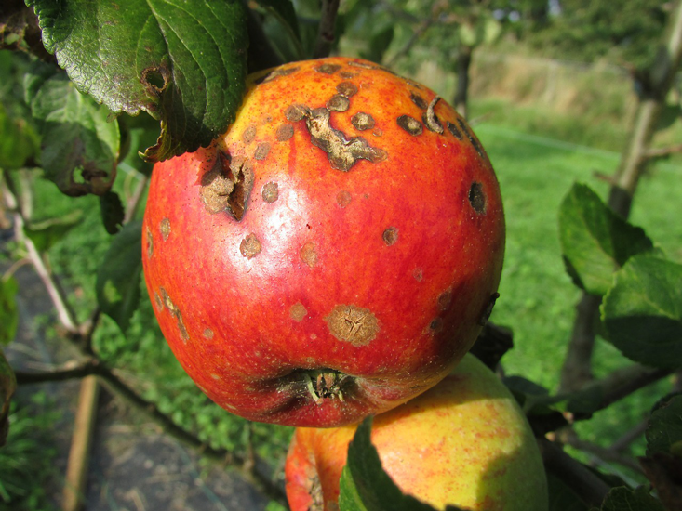
The Second Law of Thermodynamics
Notes:
The Second Law of Thermodynamics is a reality.
Everything runs down. Things get old. That's The Second Law of Thermodynamics.

Slide 53

The Second Law of Thermodynamics
Notes:
Order naturally moves to disorder—unity to disunity.

Slide 54
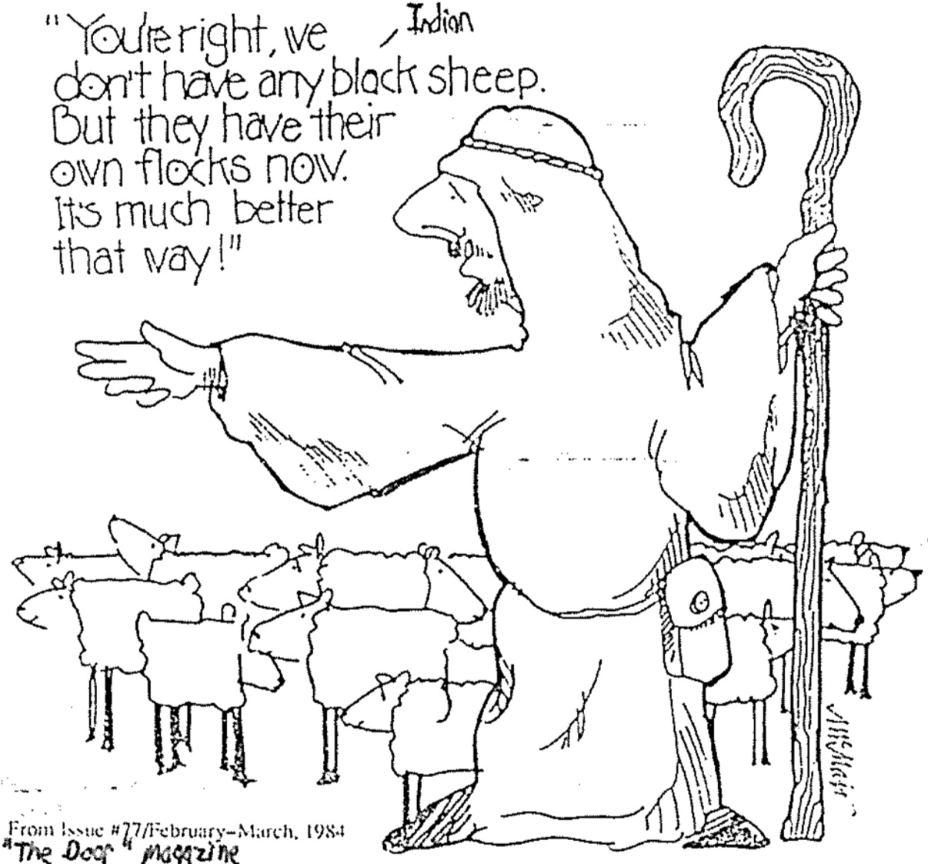
You’re right, we don’t have any dark sheep. But they have their own flocks. It’s much better that way!
Notes:
Diversity can divide since we try to be with others like us.
Birds of a feather flock together.
Friends look like each other.
Married couples look more alike the longer they are married.
We tend to do what we do because we think it is the best way to do it—this diversity can lead to disunity.

Slide 55
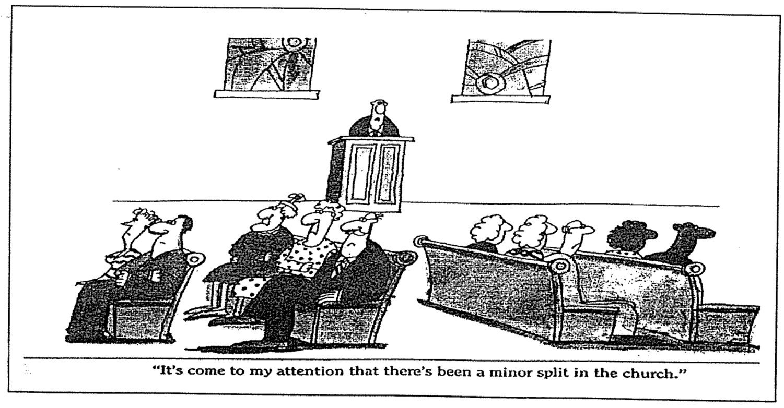
A Slight Division
“It’s come to my attention that there’s been a minor split in the church.”
Notes:
Have you ever been in a divided church?

Slide 56
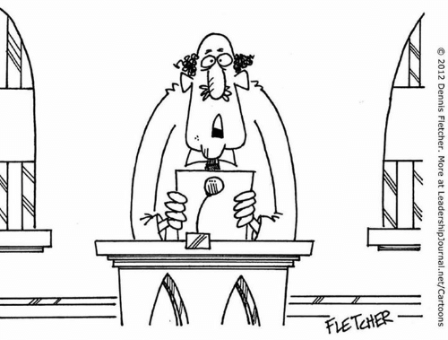
“…and the church unity workshop has been postponed until the deacons can agree on the date, time, and color of the participant's name tags.”
Notes:
Christians sometimes see their differences as a liability instead of a strength.

Slide 57
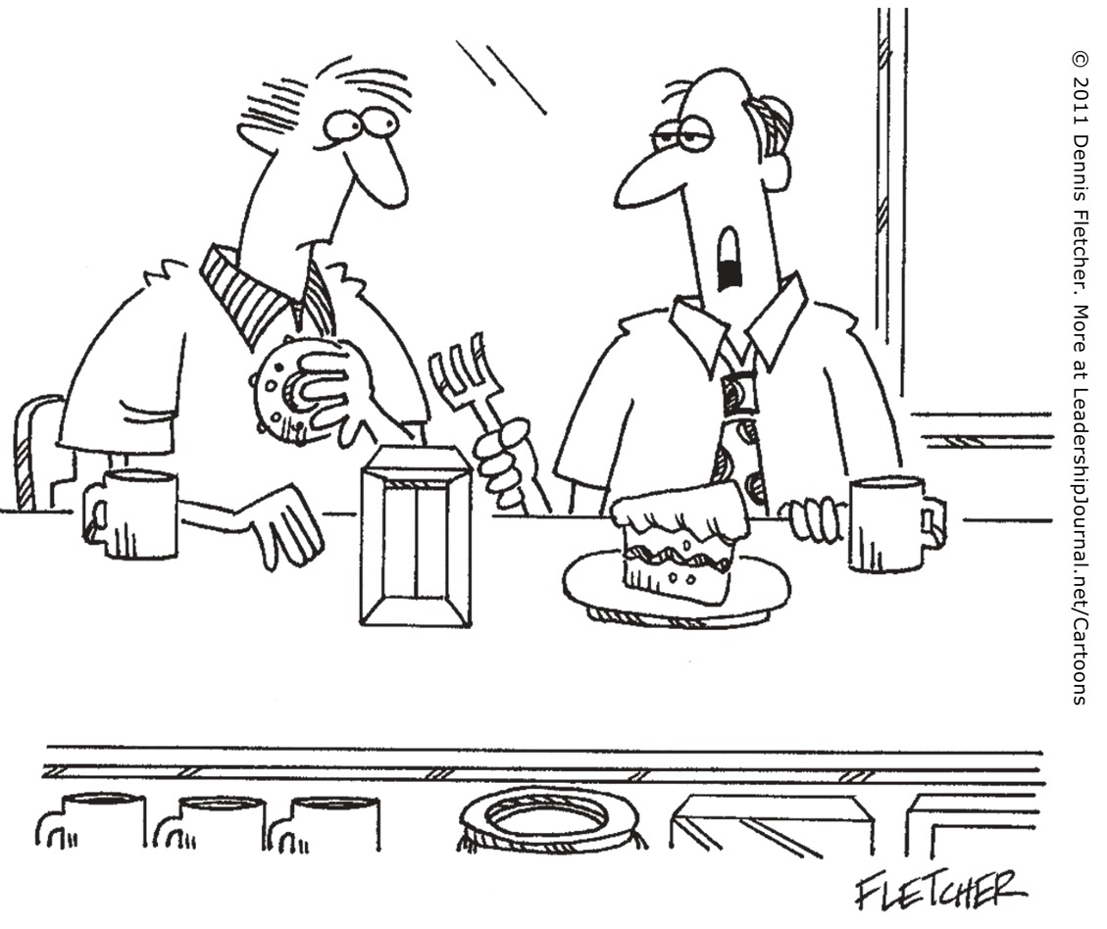
“I sense a new unity in my church… away from apathy and moving steadily toward opposition.”
Notes:
Even people in church can fight for their own way.

Slide 58

What is Unity?
Discuss what is required for unity to take place in the local church and between churches.
Notes:
----- Meeting Notes (25/2/14 12:48) -----
Common goal
Core non-negotiable theology
Others centered
Humble
----- Meeting Notes (8/10/15 21:15) -----
Agreement on Christ but flexible on the non-essential areas.
----- Meeting Notes (8/3/16 11:27) -----
Concern for others more than self

Slide 59
How can our church be united despite our many different kinds of people?
Notes:
What do we need to do so we don’t end up divided due to our diversity?

Slide 60
NT Overview (Paul's Letters)
38
124
39-41
“To the remotest part of the earth” (Acts 1:8)
Acts 9 13 14 15 16 18 21 27 28
Apr 48-
Sep 49
1
Galatia
Apr 50-
Sep 52
2
Aegean
Spr 53-
May 57
3
Asia
Feb 60-
Mar 62
1
Rome
Spr 62-
Fall 67
4
Spain
Aut 67-
Spr 68
2
Rome
Summer 35-
37
Damascus
Antioch
May 57-
Aug 59
Trials
Fall 49
The
Council
Spring 68
Expansion of Church
35 48 49 50 52 53 57 60 62 67 68 95
Matt
Luke
Acts
Mark
John
Gal
1 Thess
1 Cor
Eph
2 Thess
2 Cor
Col
Missionary
Romans
Philem
Gospels & Acts
Phil
Pauline Epistles
1234
Journeys
Prison
Rome
Imprisonments
Pauline
Notes:
Observations about chronology:
Gospels not written first but throughout NT era
Evangelistic letters preceded pastoral
Rough letter (Galatians) preceded smoother ones

Slide 61
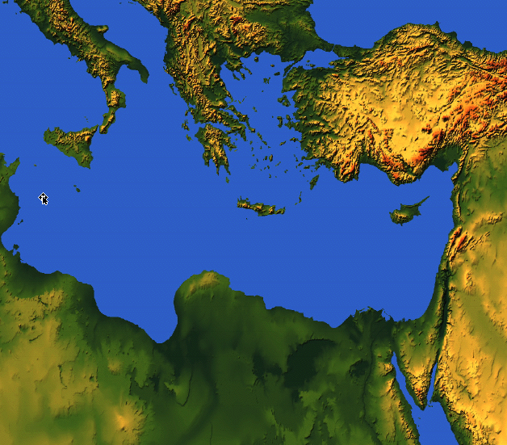

175
Rome
Ephesus
EPHESIANS

Slide 62
Key Word
175
Unity
Ephesians
Notes:
Our natural tendency is to move towards disunity. We want to be around people who look like us, talk like us, eat like us, smell like us, and act like us.
God is much broader and more flexible than this. How many races are there? He did not create various races. He made only one race called the human race. He wants us to learn more about him and his open arms by being united with those who are different from us in minor ways and yet are united in the major way—the way of Jesus.

Slide 63
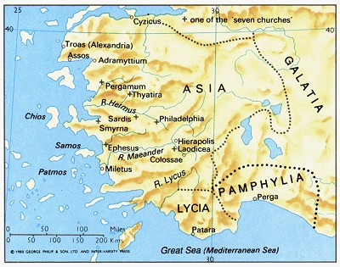
Ephesus was the capital of Asia
349

Slide 64
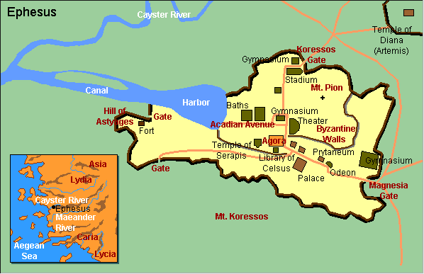
Ephesus City Layout
180

Slide 65
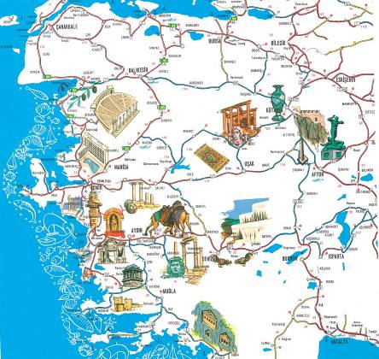
A Centre of Culture

Slide 66

Photo Album

Slide 67
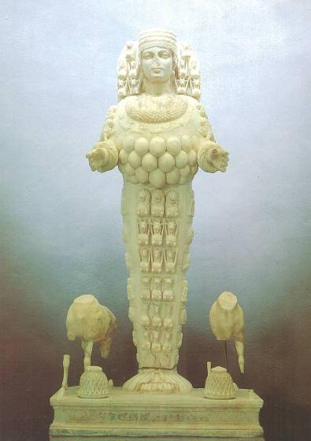
Artemis, Goddess of Fertility

Slide 68
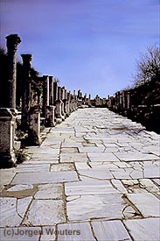
Marble Roads
Notes:
Marble city, chariot ruts, speed humps, after earthquake columns put back up again.

Slide 69
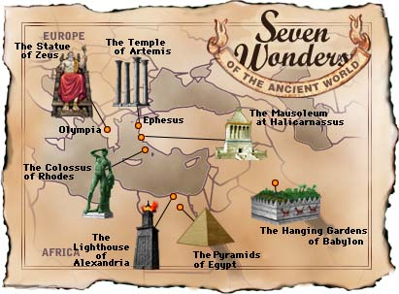
Seven Wonders of the Ancient World

Slide 70

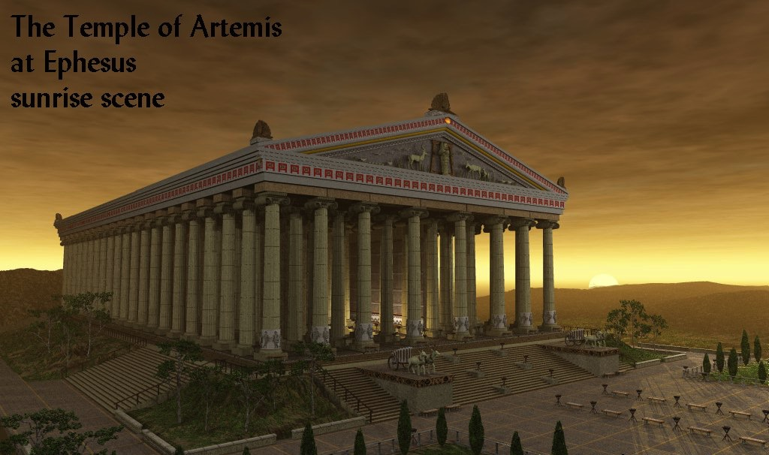
The Temple of Artemis at Ephesus
180c
Notes:
Diana—the goddess mother of Ephesus, 127 Marble pillars, Artemis (Gk), Diana (Latin)

Slide 71
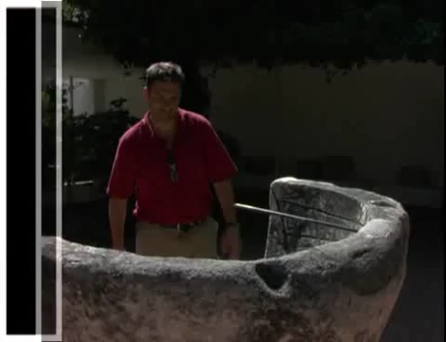
Artemis (Diana) Video (cf. Acts 19)
180c
Notes:
"In Roman mythology, Diana (lt. "heavenly" or "divine") was the goddess of the hunt and moon and birthing, being associated with wild animals and woodland, and having the power to talk to and control animals. She was equated with the Greek goddess Artemis, though she had an independent origin in Italy." (http://en.wikipedia.org/wiki/Diana_%28mythology%29)
Temple had 127 Marble pillars, Artemis (Gk), Diana (Latin)

Slide 72
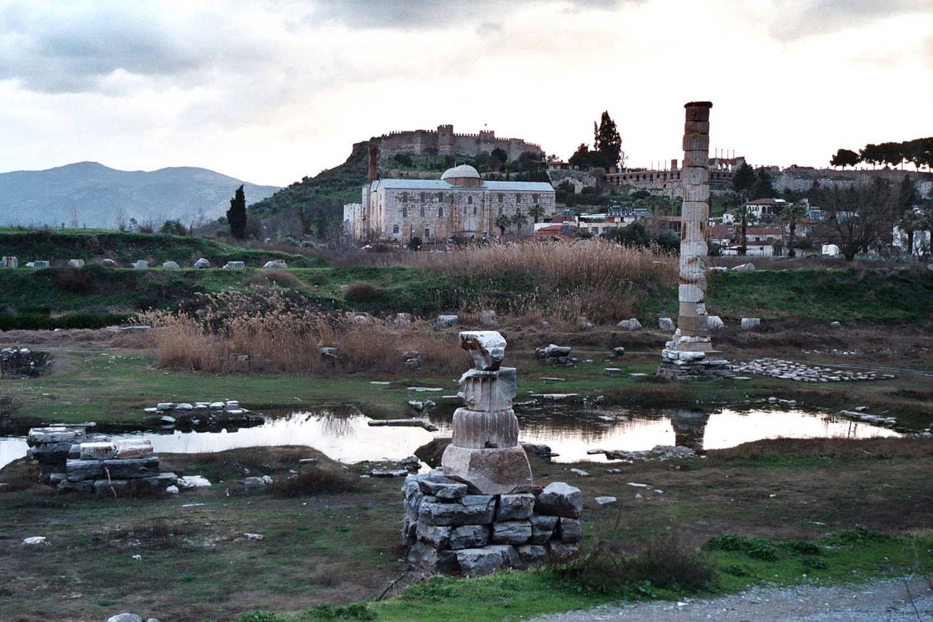
The Temple of Diana (Artemis) Today
180c
John's Tomb
Castle
Mosque
Notes:
"In Roman mythology, Diana (lt. "heavenly" or "divine") was the goddess of the hunt and moon and birthing, being associated with wild animals and woodland, and having the power to talk to and control animals. She was equated with the Greek goddess Artemis, though she had an independent origin in Italy." (http://en.wikipedia.org/wiki/Diana_%28mythology%29)
Temple had 127 Marble pillars, Dedicated to Artemis (Gk) or Diana (Latin). Ironically, that which wowed people 2000 years ago was not even discovered until a seven-year search by an archaeologist who in 1973 unearthed the temple and erected a 14-meter high pillar from what remained of the 127 marble pillars.

Slide 73
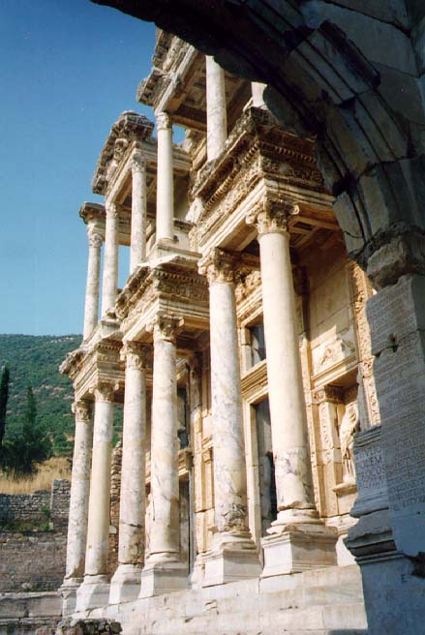
The Library of Celsus
349
Notes:
Sid Caesar, Venerate: Bow to Caesar or die

Slide 74
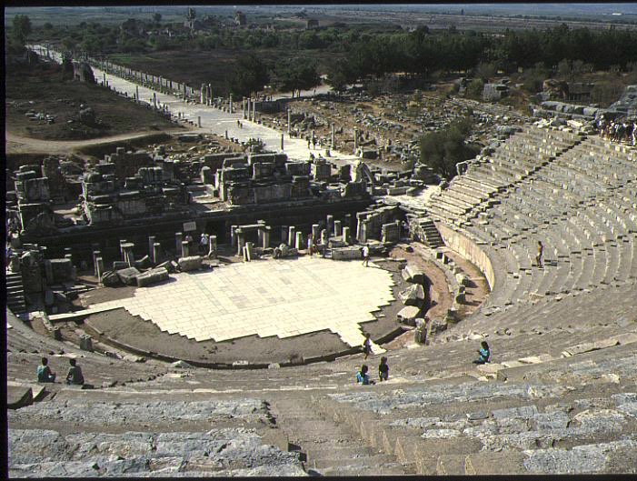
The Ephesian Theatre of Acts 19:29
180a

Slide 75
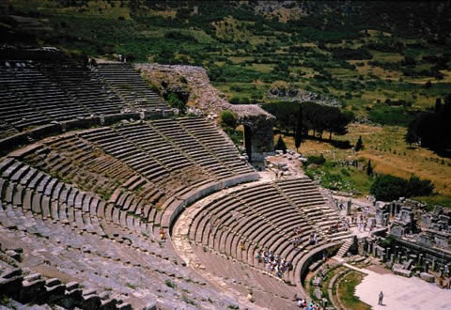
Theater Seats 25,000
theh'-at-ron
180a
Acts 19:29
Notes:
The place where the Ephesian clerk averted a riot in Acts 19:29

Slide 76
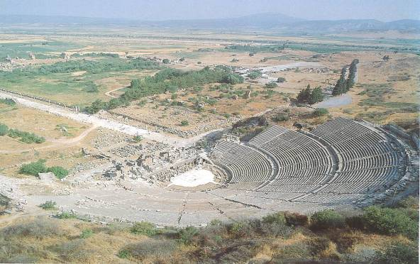
Arcadian Avenue
349

Slide 77
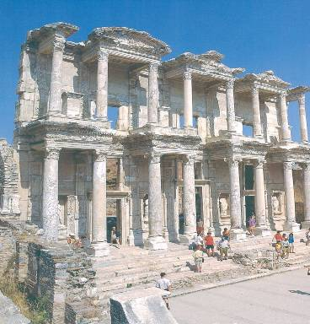
Library
349

Slide 78
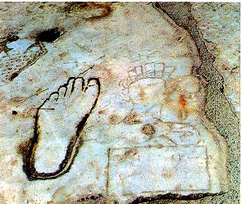
Directions for the Immoral & Illiterate
349
Notes:
Ancient Brothel Advertisement in Ephesus, Turkey
Watch for this slab at the end of Marble Street. The etchings are an ancient advertisement for the world’s oldest profession. Arriving sailors eagerly understood the symbols. Perhaps you need a translation. If you want love (heart top left) of a woman (lower right), turn left (left foot) at the intersection (cross above foot). This short-term affection will cost you (purse lower right). This slab helped archeologists uncover the ruins of the nearby brothel. They also discovered a tunnel between the Library of Celsus and the brothel. This was presumably a discrete way to get into and out of the house of pleasure. The ruins of the brothel are partially seen in the previous photo.
https://www.encirclephotos.com/image/ancient-brothel-advertisement-in-ephesus-turkey/
Accessed 2 Sep 2022

Slide 79
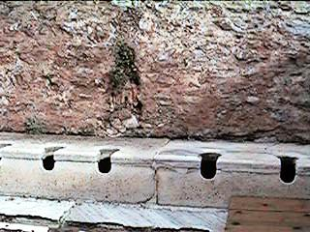
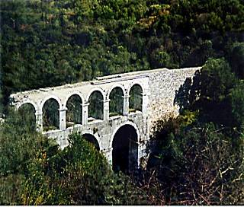
Toilets and aqueduct
349

Slide 80

Jew-Gentile Divisions

Slide 81
Theme
23
Jew-Gentile Unity
Shown in Love
Ephesians

Slide 82
Sometimes Christians mistreat others of a different ethnic group
180b
Jews
Gentiles
One God
Many taboos
Many Gods
Few taboos

Slide 83

East Meets West
180b
Writing Style
Hebrew
Greek
Favors poetry, imagery & symbolism
Favors outlines, lists and bullet points
Adapted from Lynne M. Thompson, "Christmas: The Real Deal," interview with Ray Vander Laan, Breakaway magazine (Dec 2003): 7-9.
Notes:
Adapted from Lynne M. Thompson, "Christmas: The Real Deal," interview with Ray Vander Laan, Breakaway magazine (Dec 2003): 7-9.

Slide 84
East Meets West
180b
Numbers
Hebrew
Greek
Sees numbers as a quality or symbol
Sees numbers as a specific quantity
Adapted from Lynne M. Thompson, "Christmas: The Real Deal," interview with Ray Vander Laan, Breakaway magazine (Dec 2003): 7-9.
Notes:
Adapted from Lynne M. Thompson, "Christmas: The Real Deal," interview with Ray Vander Laan, Breakaway magazine (Dec 2003): 7-9.

Slide 85
East Meets West
180b
Relation to God
Hebrew
Greek
Focuses on the community in relationship with God
Focuses on the individual's relationship with God
Adapted from Lynne M. Thompson, "Christmas: The Real Deal," interview with Ray Vander Laan, Breakaway magazine (Dec 2003): 7-9.
Notes:
Adapted from Lynne M. Thompson, "Christmas: The Real Deal," interview with Ray Vander Laan, Breakaway magazine (Dec 2003): 7-9.

Slide 86
East Meets West
180b
Eternal Life
Hebrew
Greek
The kingdom of God begins in this life. Eternal life is lived in harmony with God.
The kingdom of God is outside this world. Eternal life will occur after this life ends.
Adapted from Lynne M. Thompson, "Christmas: The Real Deal," interview with Ray Vander Laan, Breakaway magazine (Dec 2003): 7-9.
Notes:
Adapted from Lynne M. Thompson, "Christmas: The Real Deal," interview with Ray Vander Laan, Breakaway magazine (Dec 2003): 7-9.

Slide 87
East Meets West
180b
Sin
Hebrew
Greek
Sin is wrong behavior alone.
They emphasize what one does in response to faith.
Sin is wrong actions & thinking.
They emphasize what a person knows about faith.
Adapted from Lynne M. Thompson, "Christmas: The Real Deal," interview with Ray Vander Laan, Breakaway magazine (Dec 2003): 7-9.
Notes:
Adapted from Lynne M. Thompson, "Christmas: The Real Deal," interview with Ray Vander Laan, Breakaway magazine (Dec 2003): 7-9.

Slide 88
East Meets West
Existence of God
180b
Hebrew
Greek
Assumes that God exists
Tries to prove God's existence
Adapted from Lynne M. Thompson, "Christmas: The Real Deal," interview with Ray Vander Laan, Breakaway magazine (Dec 2003): 7-9.
Notes:
Adapted from Lynne M. Thompson, "Christmas: The Real Deal," interview with Ray Vander Laan, Breakaway magazine (Dec 2003): 7-9.

Slide 89
East Meets West
180b
Faith
Hebrew
Greek
Relational and personal
Expressed in terms of relationship with God rather than rationalization
Intellectual and impersonal
Expressed in creeds and doctrine with support through proof texts
Adapted from Lynne M. Thompson, "Christmas: The Real Deal," interview with Ray Vander Laan, Breakaway magazine (Dec 2003): 7-9.
Notes:
Adapted from Lynne M. Thompson, "Christmas: The Real Deal," interview with Ray Vander Laan, Breakaway magazine (Dec 2003): 7-9.

Slide 90
East Meets West
180b
Truth
Hebrew
Greek
Experiential
What is done and who did it in Scripture
Believing comes through experience
Truth is unfolding and relative
Scientific & rational
How things are done in the Scripture
Believing comes through thinking
Truth is static and unchanging
Adapted from Lynne M. Thompson, "Christmas: The Real Deal," interview with Ray Vander Laan, Breakaway magazine (Dec 2003): 7-9.
Notes:
Adapted from Lynne M. Thompson, "Christmas: The Real Deal," interview with Ray Vander Laan, Breakaway magazine (Dec 2003): 7-9.

Slide 91
How can our church be united despite our many different kinds of people?
Notes:
What do we need to do so we don’t end up divided due to our diversity?

Slide 92
How to be united…
Love God
Eph 1–3
Notes:
Love God for our equality in Christ (Eph 1–3).
[Praise God that none of us is better than any other due to salvation or ethnic origin or class.]

Slide 93
Slides on
Ephesians 1

Slide 94

Blessed by God to be in Christ
Ephesians 1:1-14
Preached by Dr. Jim Harmeling
at Crossroads International Church Singapore • CICFamily.com
Uploaded by Dr. Rick Griffith • Jordan Evangelical Theological Seminary
Files in many languages for free download at BibleStudyDownloads.org

Slide 95


Slide 96


Slide 97
Ephesians spiritual development
Before
After
Later on
Occult oriented
(Acts 19)
Strong leaders
(Acts 20)
Sound but Cold
(Revelation 2)

Slide 98

Who Am I? I am united with Christ (Eph 1)
Who Are We? We are a new people (Eph 2–3)
How do we glorify God as a new people? We live different lives (Eph 4–6)

Slide 99
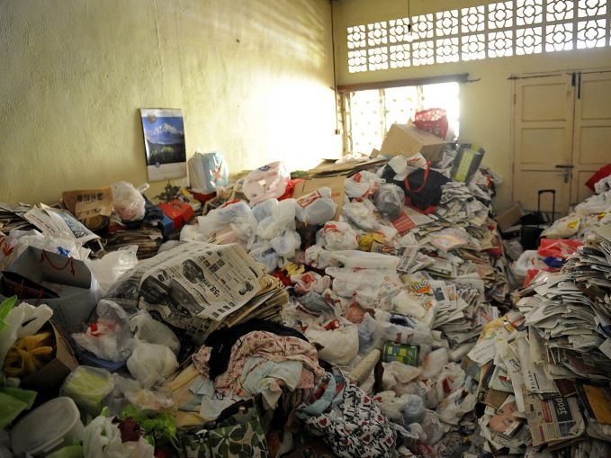

Slide 100
I am Blessed by God to be in Christ
Ephesians 1:1-14
God blessed us by changing us spiritually (1:1-3)
God blessed us by choosing us (1:4a, 5a)
When did He choose us?
How did He choose us?

Slide 101
175
Rome
EPHESIANS
Ephesus
"This letter is from Paul, chosen by the will of God to be an apostle of Christ Jesus. I am writing to God’s holy people in Ephesus [“To the saints in Ephesus” NIV], who are faithful followers of Christ Jesus.” (Eph. 1:1 NIV).
Notes:
God made each of us a “saint” in Christ (1:1-2).

Slide 102
175
"For this reason, ever since I heard about your faith in the Lord Jesus and your love for all the saints,
¹⁶I have not stopped giving thanks for you, remembering you in my prayers" (Eph. 1:15-16 NIV).
Rome
Ephesus
"This letter is from Paul, chosen by the will of God to be an apostle of Christ Jesus. I am writing to God’s holy people in Ephesus ['To the saints in Ephesus' NIV], who are faithful followers of Christ Jesus." (Eph. 1:1 NIV).
Notes:
The words "in Ephesus" are missing in the earliest manuscripts. This probably indicates that Paul originally sent this letter to Ephesus with the intent to have it copied for other churches in Asia Minor, even as the book of Revelation was not simply for Ephesus, but for six other churches and beyond (see Rev 1:11—"Write on a scroll what you see and send it to the seven churches: to Ephesus, Smyrna, Pergamum, Thyatira, Sardis, Philadelphia and Laodicea."
• This view is supported by Eph 1:15-16 where Paul refers to "hearing about" their faith to a church that he himself had founded. Why would he need to "hear about" their faith when he had personal experience with them? Paul probably used this language to broaden the scope to others who he had not met personally but wanted to commend for their faith in the region of Ephesus.

Slide 103
175
Rome
EPHESIANS
Ephesus
"May God our Father and the Lord Jesus Christ give you grace and peace "
(Eph. 1:2 NLT).
Notes:
God made each of us a “saint” in Christ (1:1-2).

Slide 104
Ephesians 1:3-14 (NAU)
178
Blessed be the God and Father of our Lord Jesus Christ, who has blessed us with every spiritual blessing in the heavenly places in Christ, ⁴just as He chose us in Him before the foundation of the world, that we would be holy and blameless before Him. In love ⁵He predestined us to adoption as sons through Jesus Christ to Himself, according to the kind intention of His will, ⁶to the praise of the glory of His grace, which He freely bestowed on us in the Beloved. ⁷In Him we have redemption through His blood, the forgiveness of our trespasses, according to the riches of His grace ⁸which He lavished on us. In all wisdom and insight ⁹He made known to us the mystery of His will, according to His kind intention which He purposed in Him ¹⁰with a view to an administration suitable to the fullness of the times, that is, the summing up of all things in Christ, things in the heavens and things on the earth. In Him ¹¹also we have obtained an inheritance, having been predestined according to His purpose who works all things after the counsel of His will, ¹²to the end that we who were the first to hope in Christ would be to the praise of His glory. ¹³In Him, you also, after listening to the message of truth, the gospel of your salvation — having also believed, you were sealed in Him with the Holy Spirit of promise, ¹⁴who is given as a pledge of our inheritance, with a view to the redemption of God’s own possession, to the praise of His glory.
Notes:
“In the Greek text, 1:3-14 is one sentence, which is considered by some scholars to be the most cumbersome sentence in the Greek language! In fact, Ephesians has eight lengthy sentences (1:3-14, 15-23; 2:1-7; 3:1-13, 14-19; 4:1-7, 11-16; 6:14-20). However, it is common even today for prayers and doxologies to be lengthy” (Hoehner, BKC, 2:616).

Slide 105

"Us/We/Our" & "You" in Ephesians 1:3-14 (NLT)
178
"All praise to God, the Father of our Lord Jesus Christ, who has blessed us with every spiritual blessing in the heavenly realms because we are united with Christ. ⁴Even before he made the world, God loved us and chose us in Christ to be holy and without fault in his eyes. ⁵God decided in advance to adopt us into his own family by bringing us to himself through Jesus Christ. This is what he wanted to do, and it gave him great pleasure. ⁶So we praise God for the glorious grace he has poured out on us who belong to his dear Son. ⁷He is so rich in kindness and grace that he purchased our freedom with the blood of his Son and forgave our sins."
Notes:
We all have every spiritual blessing in Christ (1:3-14).

Slide 106
"Us/We/Our" & "You" in Ephesians 1:3-14 (NLT)
178
^{"8}He has showered his kindness on us, along with all wisdom and understanding. ⁹God has now revealed to us his mysterious plan regarding Christ, a plan to fulfill his own good pleasure. ¹⁰And this is the plan: At the right time he will bring everything together under the authority of Christ—everything in heaven and on earth. ¹¹Furthermore, because we are united with Christ, we have received an inheritance from God, for he chose us in advance, and he makes everything work out according to his plan. ¹²God's purpose was that we Jews who were the first to trust in Christ would bring praise and glory to God."
^{"13}And now you Gentiles have also heard the truth, the Good News that God saves you. ¹⁴And when you believed in Christ, he identified you as his own by giving you the Holy Spirit, whom he promised long ago."
Gentiles
You
Us
v.
God gave us Gentiles equal status with predestined Jews (1:3-23)!
Jews

Slide 107
Acts 13:48
And when the Gentiles heard this, they began rejoicing and glorifying the word of the Lord, and as many as were appointed to eternal life believed.

Slide 108
“This doctrine, in a broad sense, may be defined as an act of choice whereby God selects an individual or group out of a larger company for a purpose or destiny that He appoints. In a more restricted sense, it is God’s gracious and sovereign choice of individual sinners to be saved in and through Christ. We cannot fully comprehend the ways of God, but we may be sure that in His wisdom He knew that this was the way whereby the greatest possible blessing would eventually come to the largest number of persons.”
Curtis Vaughn

Slide 109
I am Blessed by God to be in Christ
Ephesians 1:1-14
God blessed us by changing us spiritually (1:1-3)
God blessed us by choosing us (1:4a, 5a)
God blessed us by purifying us (1:4b)

Slide 110
James 1:2-4
² Count it all joy, my brothers, when you meet trials of various kinds, ³ for you know that the testing of your faith produces steadfastness. ⁴ And let steadfastness have its full effect, that you may be perfect and complete, lacking in nothing.

Slide 111
Romans 5:3-5
³ Not only that, but we rejoice in our sufferings, knowing that suffering produces endurance, ⁴ and endurance produces character, and character produces hope, ⁵ and hope does not put us to shame, because God's love has been poured into our hearts through the Holy Spirit who has been given to us.

Slide 112
I am Blessed by God to be in Christ
Ephesians 1:1-14
God blessed us by changing us spiritually (1:1-3)
God blessed us by choosing us (1:4a, 5a)
God blessed us by purifying us (1:4b)
God blessed us by adopting us (1:5-6)

Slide 113
Romans 8:15
¹⁵ For you did not receive the spirit of slavery to fall back into fear, but you have received the Spirit of adoption as sons, by whom we cry,
“Abba! Father!”

Slide 114
I am Blessed by God to be in Christ
Ephesians 1:1-14
God blessed us by changing us spiritually (1:1-3)
God blessed us by choosing us (1:4a, 5a)
God blessed us by purifying us (1:4b)
God blessed us by adopting us (1:5-6)
God blessed us by redeeming us from sin (1:7-8)
God blessed us by communicating His salvation plan to us (1:9-10)

Slide 115
I am Blessed by God to be in Christ
Ephesians 1:1-14
God blessed us by granting us a future inheritance (1:11-12)

Slide 116
Romans 8:16-17
¹⁶ The Spirit himself bears witness with our spirit that we are children of God, ¹⁷ and if children, then heirs—heirs of God and fellow heirs with Christ, provided we suffer with him in order that we may also be glorified with him.

Slide 117
I am Blessed by God to be in Christ
Ephesians 1:1-14
God blessed us by granting us a future inheritance (1:11-12)
God blessed us by securing us (1:13-14)

Slide 118

"Having believed, you were marked in him with a seal, the promised Holy Spirit, ¹⁴who is a deposit guaranteeing our inheritance until the redemption of those who are God's possession—to the praise of his glory"
(Eph. 1:13-14 NIV).
"And do not grieve the Holy Spirit of God, with whom you were sealed for the day of redemption"
(Eph. 4:30 NIV).

Slide 119

A Seal Guarantees Security and Provides Assurance
Notes:
In Paul's day, a wax seal on a letter conveyed: (1) ownership in that the seal of the sender was stamped on it, and (2) security by guarding the contents. The result was that the recipient could feel assurance that the contents were guaranteed and safe.

Slide 120

Assurance of
Salvation
Notes:
Paul used this background to assure his readers their salvation by noting that the Holy Spirit HIMSELF was the seal of their salvation (Eph. 1:13-14).
Please translate the text at the left and then drag everything over this slide so no English shows. Make sure the fonts remain.

Slide 121

Romans 10:9-10 NLT
"If you confess with your mouth that Jesus is Lord and believe in your heart that God raised him from the dead, you will be saved. ¹⁰For it is by believing in your heart that you are made right with God, and it is by confessing with your mouth that you are saved (lit., 'it is confessed unto salvation')"
Notes:
The same concept appears in Romans 10:9-10.
The Greek quote is from John F. Walvoord, Roy B. Zuck and Dallas Theological Seminary., The Bible Knowledge Commentary : An Exposition of the Scriptures (Wheaton, IL: Victor Books, 1983-c1985), 2:481.

Slide 122
Create In Me
Create in me a clean heart, O God
And renew a right spirit within me
Create in me a clean heart, O God
And renew a right spirit within me
John Carter ©1992 Beckenhorst Press, Inc.
CCLI #2588988
Notes:
The song has biblical teaching about God making us clean from sin, quoting David's words in Psalm 51.
Psa. 51:10 Create ¹in me a clean heart, O God,
And renew a steadfast spirit within me.
¹¹ Do not cast me away from Your presence
And do not take Your Holy Spirit from me.
¹² Restore to me the joy of Your salvation
And sustain me with a willing spirit.
——————————
HS-04-Indwelling, Sealing, Leading & Slaying-18
NS-06-Rom5-8—slide 130
NS-10-Ephesians-122
OS-19-Psalms-396

Slide 123
Create In Me
Cast me not away from Your presence, O Lord
And take not Thy Holy Spirit from me
Restore unto me the joy of Thy salvation
And renew a right spirit within me
John Carter ©1992 Beckenhorst Press, Inc.
Should Christians pray this considering Romans 8?
Notes:
But then the song quotes the words of David that asks God not to remove the Holy Spirit from us!
How can we sing this since Jesus promised us the Spirit forever (John 14:16—"And I will ask the Father, and he will give you another Advocate, who will never leave you")?
——————————
HS-04-Indwelling, Sealing, Leading & Slaying-19
NS-06-Rom5-8—slide 131
NS-10-Ephesians-123
OS-19-Psalms-397

Slide 124
I am Blessed by God to be in Christ
1. God blessed me by changing me spiritually
2. God blessed me by choosing me
3. God blessed me by purifying me
4. God blessed me by adopting me
5. God blessed me by redeeming me from sin
6. God blessed me by communicating His salvation plan to me
7. God blessed me by granting me a future inheritance
8. God blessed me by securing me

Slide 125
Demonstrating God’s Power
Ephesians 1:15-23
Preached by Dr. Jim Harmeling
at Crossroads International Church Singapore • CICFamily.com
Uploaded by Dr. Rick Griffith • Jordan Evangelical Theological Seminary
Files in many languages for free download at BibleStudyDownloads.org

Slide 126


Slide 128
I am a Demonstration of God’s Power
Ephesians 1:15-23

Slide 129
“Paul prays that his readers might appreciate the extraordinary value which God places on them. He views them as in his beloved Son and estimates them accordingly. And this is true of all who are ‘in Christ’. . . . May we live consistently with this high calling and accept with gratitude and true humility the grace and glory that he has lavished on us.”
Peter O’Brien

Slide 130
Live with gratitude for truth and love (Eph 1:15-16)
1 John 3:10-11
¹⁰ By this it is evident who are the children of God, and who are the children of the devil: whoever does not practice righteousness is not of God, nor is the one who does not love his brother. ¹¹ For this is the message that you have heard from the beginning, that we should love one another.

Slide 131
Live with gratitude for truth and love (Eph 1:15-16)
1 John 4:7-8
⁷ Beloved, let us love one another, for love is from God, and whoever loves has been born of God and knows God. ⁸ Anyone who does not love does not know God, because God is love.

Slide 132
Live with gratitude for truth and love (Eph 1:15-16)
Live with intention to mature in Christ (Eph 1:17-23)
Secure in God’s plan of redemption (18a)

Slide 133
James 2:5
Listen, my beloved brothers, has not God chosen those who are poor in the world to be rich in faith and heirs of the kingdom, which he has promised to those who love him?

Slide 134
Live with gratitude for truth and love (Eph 1:15-16)
Live with intention to mature in Christ (Eph 1:17-23)
Secure in God’s plan of redemption (18a)
Marveling over future inheritance (18b)

Slide 135
Mark 10:29-31
²⁹ Jesus said, “Truly, I say to you, there is no one who has left house or brothers or sisters or mother or father or children or lands, for my sake and for the gospel, ³⁰ who will not receive a hundredfold now in this time, houses and brothers and sisters and mothers and children and lands, with persecutions, and in the age to come eternal life. ³¹ But many who are first will be last, and the last first.”

Slide 136
Matthew 10:42
And whoever gives one of these little ones even a cup of cold water because he is a disciple, truly, I say to you, he will by no means lose his reward.

Slide 137
Live with gratitude for truth and love (Eph 1:15-16)
Live with intention to mature in Christ (Eph 1:17-23)
Secure in God’s plan of redemption (18a)
Marveling over future inheritance (18b)
Confident in living by God’s power (19-23)

Slide 138
“It was not mere moral reformation effected by rational considerations; nor was it a self-wrought change, but one due to the almighty power of God.”
Charles Hodge

Slide 139
What About Ethnic Differences Now?
Jews
Gentiles
One God
Many taboos
Many Gods
Few taboos

Slide 140
The Cross Makes Ethnicity Irrelevant
Jew-Gentile Unity
Gentiles
Make every effort to keep yourselves united in the Spirit, binding yourselves together with peace. ⁴For there is one body and one Spirit, just as you have been called to one glorious hope for the future.
Ephesians 4:3-4 NLT
One God
Love over Taboos
One God
Love over Taboos
There is neither Jew nor Greek, there is neither slave nor free, there is neither male nor female, for you are all one in Christ Jesus.
Galatians 3:28 ESV

Slide 141
Book Chart
Jew-Gentile Unity Shown in Love
Love as Equals |  |  |  | Love as Testimony
Chapters 1–3 |  |  |  | Chapters 4–6
Doctrine |  |  |  | Application
Position |  |  |  | Practice
Belief |  |  |  | Behaviour
Privileges |  |  |  | Responsibilities
Salutation | Position | Reconcil-iation | Unique-ness | Unity | Holiness | Submission | Reliance | Love
1:1-2 | 1:3-23 | 2 | 3 | 4:1-16 | 4:17–5:20 | 5:21–6:9 | 6:10-20 | 6:21-24
Rome
Fall AD 60 (first Roman imprisonment)
175
Ephesians
Notes:
NS-10-Ephesians-10, 137, 142

Slide 142
The Two-Headed Snake
Notes:
ILLUSTRATION
A woman in Woodbridge, Virginia, saw a rarity in her front yard: a two-headed copperhead snake. The snake only has one heart and one set of lungs, but each head has its own brain. This leads to multiple problems.
Both heads want to eat, but since eating takes time, the snake is vulnerable to predators for twice as long. Further, each head wants to go its own way. That means they can't respond as quickly when under attack. Even getting water can be precarious, as one head can drag the other down when drinking.
An expert at the Wildlife Center of Virginia said, "Based on the anatomy, it would be better for the right head to eat, but it may be a challenge since the left head appears more dominant" (Dana Hedgpeth, The Washington Post, 9/24/18). Experts also say that these internal conflicts prevent these rare "dual-cephalic" creatures from living very long.
APPLICATION
James tells us that the double-minded man is unstable in all his ways (1:7), and implies that double-mindedness reflects impurity of heart (4:8).
Jesus taught, "No one can serve two masters; for either he will hate the one and love the other, or he will be devoted to one and despise the other. You cannot serve God and wealth" (Matthew 6:24). We must choose to whom we will listen if we are to avoid spiritual peril (Joshua 24:15).
Paul wrote, "They that are after the flesh do mind the things of the flesh; but they that are after the Spirit the things of the Spirit. For to be carnally minded is death; but to be spiritually minded is life and peace" (Romans 8:5-6).
We cannot live for the world and the Lord. It is an either/or proposition. Jesus says, "He who is not with Me is against Me; and he who does not gather with Me, scatters" (Luke 11:23).
Don't let double-mindedness leave you more vulnerable to spiritual attack, steer you the wrong way, or drag you down. Make the right choice to be single-minded in your dedication and devotion to the One true Head of the Church, Jesus Christ (Ephesians 1:22).
The Problems Of The Two-Headed Snake
Publication Information: preacherpollard.com
Publication Source: Click here to view source
Contributed By: Neal Pollard
Author: Neal Pollard
Date: 11 October 2018

Slide 143
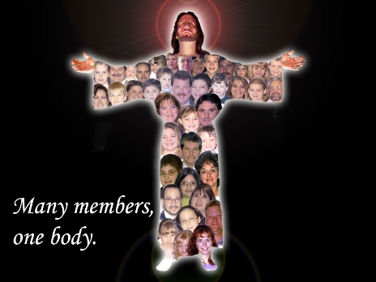
The One-Headed Church
Christ as Head
Many parts,
One body
Notes:
The Church has only one head—Jesus Christ himself.
This leads to unity in the body amidst its diversity.

Slide 144

We Are One in the Bond of Love
We are one in the bond of love (2x)
Let us join our spirits with the Spirit of God
We are one in the bond of love

Slide 145
Outline
MAIN MENU
CITY OF EPHESUS
BACKGROUND
OUTLINE
SCRIPTURE IN SONG
CHAPTERS 1–3
CHAPTERS 4–6
CONCLUSION

Slide 146
Book Chart
Jew-Gentile Unity Shown in Love
Love as Equals |  |  |  | Love as Testimony
Chapters 1–3 |  |  |  | Chapters 4–6
Doctrine |  |  |  | Application
Position |  |  |  | Practice
Belief |  |  |  | Behaviour
Privileges |  |  |  | Responsibilities
Salutation | Position | Reconcil-iation | Unique-ness | Unity | Holiness | Submission | Reliance | Love
1:1-2 | 1:3-23 | 2 | 3 | 4:1-16 | 4:17–5:20 | 5:21–6:9 | 6:10-20 | 6:21-24
Rome
Fall AD 60 (first Roman imprisonment)
175
Ephesians
Notes:
NS-10-Ephesians-10, 137, 142

Slide 147
Outline
178
The first portion (Eph. 1–3) describes "Our Heritage in Christ" or the work of God in the Christian. This includes much on the Christian's heavenly standing and his position in Christ. Paul also explains the unity of Jews and Gentiles in the church who are equal positionally.
Blessings in Christ as equal to predestined Jews (1:3-23)
Experience of salvation and reconciliation with Jews in the body of Christ (Eph. 2)
Growing knowledge and strength (Eph. 3)

Slide 148
Chapters 1–3
OUTLINE
God's work of:
Redemption
Revelation
Resurrection
Reconciliation
Proclamation
Sanctification

Slide 149
Outline
178
The second part (chapters 4–6) describes "Our Life in Christ" which talks about the walk of the Christians that shows their Jew-Gentile unity through love in their daily experience as a testimony to the world.
- Paul talks about Christian Conduct to practice the Jew-Gentile unity, holiness, submission and headship responsibilities in all of life (4:1–6:9)
- Paul talks about the Christian Armor to defeat Satan (6:10-20)

Slide 150
Chapters 4–6
OUTLINE
The Christian's Walk of:
Unity
Repentance
Holiness
Submission
Power

Slide 151
KEY VERSE
"As a prisoner for the Lord,
then I urge you to live a life
worthy of the calling you have received.
Be completely humble and gentle;
be patient, bearing with one another in love making every effort to keep the
unity of the spirit in the bond of peace."
Eph. 4:1–3 NIV

Slide 152
Scripture in Song
MAIN MENU
CITY OF EPHESUS
BACKGROUND
OUTLINE
SCRIPTURE IN SONG
CHAPTERS 1–3
CHAPTERS 4–6
CONCLUSION
Eph. 3:20-21

Slide 153


Ephesians 3:20-21
Now to Him who is able to do immeasurably more than all we
ask or imagine,
according to His power that is
at work within us
to Him be glory and in the church and in Christ Jesus
throughout all generations for ever and ever. Amen.

Slide 154
Chapters 1–3
MAIN MENU
CITY OF EPHESUS
BACKGROUND
OUTLINE
SCRIPTURE IN SONG
CHAPTERS 1–3
CHAPTERS 4–6
CONCLUSION
Overview
Emphasis
Application

Slide 155
Slides on
Ephesians 2
Notes:
God’s love removed our depravity and separation from Israel (Eph 2).

Slide 156
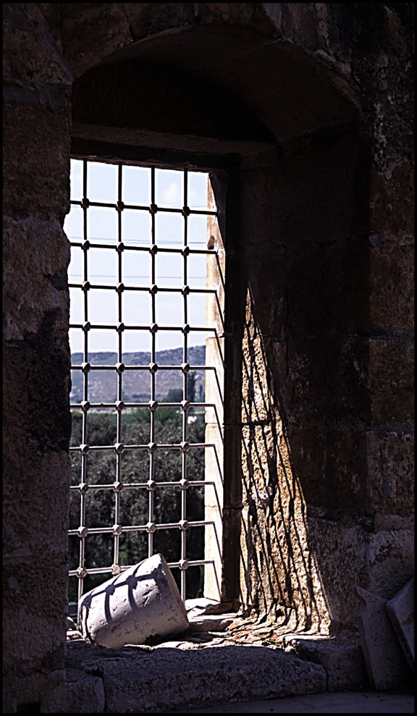
Understanding our inheritance in Christ Jesus
Ephesians 1–3

Slide 157
Overview of Ephesians 1–3
God's redemptive work
God's gift of salvation
Reconciliation of Jews and Gentiles
Unity in the Body of Christ
Prayer for empowerment

Slide 158
We are Dead People Made Alive
Ephesians 2:1-10
Preached by Dr. Jim Harmeling
at Crossroads International Church Singapore • CICFamily.com
Uploaded by Dr. Rick Griffith • Jordan Evangelical Theological Seminary
Files in many languages for free download at BibleStudyDownloads.org

Slide 159
“I sometimes wonder if good and thoughtful people have ever been more depressed about the human predicament than they are today. Of course every age is bound to have a blurred vision of its own problems, because it is too close to them to get them into focus. And every generation breeds new prophets of doom. Nevertheless, the media enable us to grasp the worldwide extent of contemporary evil, and it is this which makes the modern scene look so dark.”

Slide 160
“It is partly the escalating economic problem (population growth, the spoliation of natural resources, inflation, unemployment, hunger), partly the spread of social conflict (racism, tribalism, the class struggle, disintegrating family life) and partly the absence of accepted moral guidelines (leading to violence, dishonesty and sexual promiscuity). Man seems incapable of managing his own affairs or of creating a just, free, humane and tranquil society. For man himself is askew.”
John Stott

Slide 162
We are Dead People Made Alive
Ephesians 2:1-10

Slide 163
Psalm 51:5
Behold, I was brought forth in iniquity,
and in sin did my mother conceive me.

Slide 164
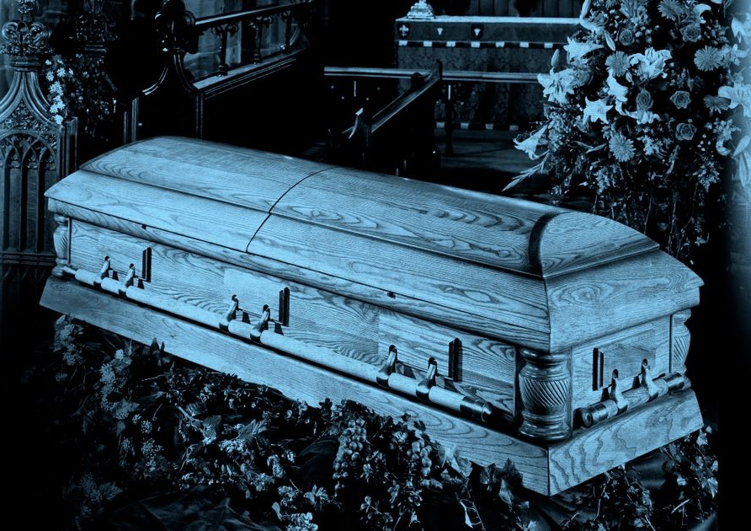
We were dead (Ephesians 2:1-3)
We violate God’s holy commands (vs. 1-2a)
“Before God we are both rebels and failures.”
John Stott

Slide 165
Why did God save us?
Because we were so helpless
"Once you were dead because of your disobedience and your many sins. ²You used to live in sin, just like the rest of the world, obeying the devil—the commander of the powers in the unseen world. He is the spirit at work in the hearts of those who refuse to obey God. ³All of us used to live that way, following the passionate desires and inclinations of our sinful nature. By our very nature we were subject to God’s anger, just like everyone else" (Eph. 2:1-3 NLT).

Slide 166
We were dead (Ephesians 2:1-3)
We violate God’s holy commands (vs. 1-2a)
We walk according to ways of the rest of the world (v. 2b)

Slide 167

“Their behavior has been determined by the powerful influences of society’s attitudes, habits, and preferences which were alien to God and his standards.”

Slide 168
We were dead (Ephesians 2:1-3)
We violate God’s holy commands (vs. 1-2a)
We walk according to ways of the rest of the world (v. 2b)
We think according to the lies of the devil (v. 2c)

Slide 169
2 Corinthians 4:4
In their case the god of this world has blinded the minds of the unbelievers, to keep them from seeing the light of the gospel of the glory of Christ, who is the image of God.

Slide 170
John 12:31
Now is the judgment of this world; now will the ruler of this world be cast out.
Colossians 1:13
He has delivered us from the domain of darkness and transferred us to the kingdom of his beloved Son,

Slide 171
We were dead (Ephesians 2:1-3)
We violate God’s holy commands (vs. 1-2a)
We walk according to ways of the rest of the world (v. 2b)
We think according to the lies of the devil (v. 2c)
We are controlled by impulses of the sinful flesh (v. 3a)

Slide 172
James 1:13-14
¹³ Let no one say when he is tempted, “I am being tempted by God,” for God cannot be tempted with evil, and he himself tempts no one. ¹⁴ But each person is tempted when he is lured and enticed by his own desire.

Slide 173
James 4:1-2
What causes quarrels and what causes fights among you? Is it not this, that your passions are at war within you?

Slide 174
We were dead (Ephesians 2:1-3)
We violate God’s holy commands (vs. 1-2a)
We walk according to ways of the rest of the world (v. 2b)
We think according to the lies of the devil (v. 2c)
We are controlled by impulses of the sinful flesh (v. 3a)
We are subject to God’s wrath (v. 3b)

Slide 175
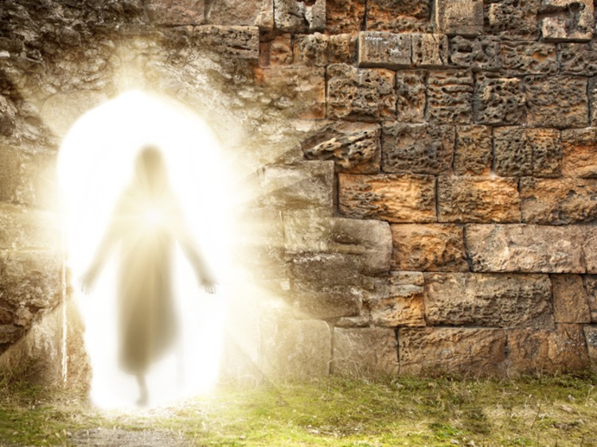
God made us alive (Ephesians 2:4-10)
He acts according to His nature of mercy (v. 4)
He unites us with His Son (vs. 5-7, 10)

Slide 176
How did God save us?
By his grace he gave us spiritual life
"But God is so rich in mercy, and he loved us so much, ⁵that even though we were dead because of our sins, he gave us life when he raised Christ from the dead. (It is only by God’s grace that you have been saved!) ⁶For he raised us from the dead along with Christ and seated us with him in the heavenly realms because we are united with Christ Jesus" (Eph. 2:4-6 NLT)

Slide 177
Why did God save us?
To show his grace through eternity!
"So God can point to us in all future ages as examples of the incredible wealth of his grace and kindness toward us, as shown in all he has done for us who are united with Christ Jesus" (Eph. 2:7 NLT)

Slide 178
BEFORE AFTER
Under God’s wrath Receive His rich mercy
Dead Alive in Christ
Subject to the devil Raised and seated with
Christ
Follow this world Live in heavenly places in
Christ
Succumb to sinful Created workmanship in
impulses of the flesh Christ Jesus
Walk in trespasses and Walk in good works
sins

Slide 179
God made us alive (Ephesians 2:4-10)
He acts according to His nature of mercy (v. 4)
He unites us with His Son (vs. 5-7, 10)
He humbles us (vs. 8-9)
Philippians 1:29
For it has been granted to you that for the sake of Christ you should not only believe in him but also suffer for his sake,

Slide 180
How did God save us?
Through his grace—not our works
"God saved you by his grace when you believed. And you can't take credit for this; it is a gift from God. ⁹Salvation is not a reward for the good things we have done, so none of us can boast about it" (Eph. 2:8-9 NLT)

Slide 181
Why else did God save us?
To show his goodness through our good works!
"For we are God's masterpiece. He has created us anew in Christ Jesus, so we can do the good things he planned for us long ago" (Eph. 2:10 NLT)

Slide 182
We are a New Body of People in Christ
Ephesians 2:11-22
Preached by Dr. Jim Harmeling
at Crossroads International Church Singapore • CICFamily.com
Uploaded by Dr. Rick Griffith • Jordan Evangelical Theological Seminary
Files in many languages for free download at BibleStudyDownloads.org

Slide 183


Slide 185
Who am I?
I am a blessed demonstration of God’s power
Who are we?
We are dead people made alive

Slide 186
We are a New Body of People in Christ
Ephesians 2:11-22

Slide 187

We were separated from God (Eph 2:11-12)
We were far from God Himself

Slide 188
"Therefore, remember that formerly you who are Gentiles by birth and called “uncircumcised” by those who call themselves “the circumcision” (that done in the body by the hands of men)— ¹²remember that at that time you were separate from Christ, excluded from citizenship in Israel and foreigners to the covenants of the promise, without hope and without God in the world"
(Ephesians 2:11-12 NLT).
Still Gentiles

Slide 189

God
Talk-Reveal-Protect-Prosper
Abraham = Isaac = Jacob (Israel)
Everyone on earth

Slide 190
Jew
Gentile

Slide 191
We were separated from God (Eph 2:11-12)
We were far from God Himself
We were far from God’s elect people
We were far from God’s covenants

Slide 192

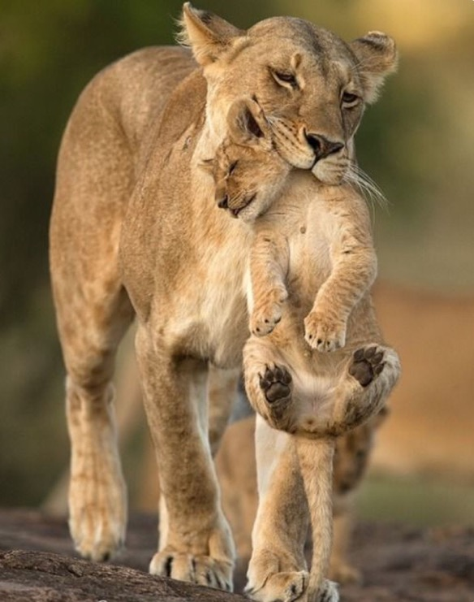
We are now brought near to God (Eph 2:13-18)
Christ makes peace with God by paying for our sin (2:13)

Slide 193
Divisions in Herod's Temple
Most Holy Place
Holy Place
Main Temple
Temple Courtyard
Court of Priests
Court of Israel
Court of Gentiles
Court of Women

Slide 194
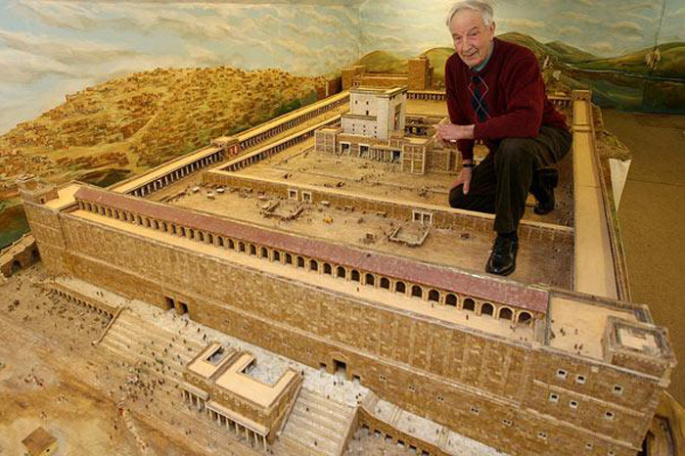
Divisions in Herod's Temple
Notes:
This model builder has his left foot in the Court of Gentiles

Slide 195
"Therefore, remember that formerly you who are Gentiles by birth and called “uncircumcised” by those who call themselves “the circumcision” (that done in the body by the hands of men)— ¹²remember that at that time you were separate from Christ, excluded from citizenship in Israel and foreigners to the covenants of the promise, without hope and without God in the world. ¹³But now in Christ Jesus you who once were far away have been brought near through the blood of Christ" (Ephesians 2:11-13 NLT).
Gentiles Brought Near

Slide 196

Warning of Dividing Wall for Gentiles
Ephesians 2:14
"For He Himself is our peace, who made both groups into one and broke down the barrier of the dividing wall."
"Let no foreigner enter within the partition and enclosure surrounding the temple. Whoever is arrested will be responsible for his death which will follow."
Notes:
https://sjoelupton.wordpress.com/2013/01/06/no-intruders-allowed/
"Just over a week ago I was standing in the Istanbul Museum of Archeology looking at something that can only be described as extraordinary. On the third floor, in a not too prominent location, there is a stone with an inscription in Greek. If I had not been with a friend who had pointed it out to me (let alone that got us into the exhibit even though it was technically closed) I would have probably missed its significance.
The stone is from the dividing wall between the Court of Gentiles and the Court of Israel in Herod's Temple. (1st century A.D.)
The stone is an unassuming piece of limestone that is very common in Israel and throughout the Middle East. This piece of limestone, however, served a very specific purpose. Inscribed on the face of the stone is a warning to any presumptuous Gentiles that might want to invade the sanctity of Jewish holy places. The stone reads:
"No intruder is allowed in the courtyard and within the wall surrounding the temple. Whoever enters will invite death for himself."
This stone sat in Herod's temple in Jerusalem from the time of the temple expansion by Herod in 20-19 B.C. until the Romans sacked Jerusalem and destroyed the temple in 70 A.D. This marker was to serve as a barrier beyond which the unclean Gentiles were simply not permitted. This stone made a distinction between who could worship in the temple and who couldn't.
It is a distinction that God never intended.
A quick comparison (which can be found in any halfway decent study Bible) between Solomon's Temple and Herod's Temple reveals that there was no such thing as a "Court of Gentiles" in the original design of God's temple. It was never God's original design that one group of people who fear and worship God should be separated from another group of people who fear and worship God. Regardless of the outward characteristics or inward inclinations toward sin, no man or woman should ever be separated from the flock when it comes time to worship Yahweh. As God said through the prophet Isaiah (Is. 56:7) and repeated by Jesus himself (Mt. 21:13) "My house shall be called a house of prayer for all peoples."
This attitude of making distinctions among equals and cutting people off from worshipping the King is part of what Jesus is addressing in Matthew 23 as he stands before the Pharisees and the Scribes and condemns them with some of the strongest words we have record of him saying. This chapter is a polemic in which Jesus pronounces seven woes to the religious leaders of the day. He calls out their hypocrisy and rightly accuses them of doing everything they do to be seen as holy by the people and not before Holy God. One of the most chilling statements is the first of the woes: "Woe to you, scribes and Pharisees, hypocrites! For you shut the kingdom of heaven in people's faces. For you neither enter yourselves nor allow those who would enter to go in." This condemnation strikes at the heart of conservative evangelicalism in America. The sad reality looming behind most of our churches glossy advertising and overbearing welcome committees is that the world perceives us welcoming only to those of our own ilk. Behind the "First Baptist Church of So and So Welcomes You" sign they see a church that welcomes those who dress like we do, talk like we do, work where we work, live where we live and sin like we sin. If we truly read the Bible the way it is written then we would see that our prejudiced attitudes (no matter how far we try to bury them) draw more wrath from the Son of God than the woman who has had five husbands and is shacking up with a man she isn't married to at the moment (see John 4). Unfortunately most of us read the Bible just deeply enough to reinforce our preconceived biases. The reason the world sees Christianity as the religion of xenophobes, homophobes, Islamophobes, misogynists, racists, pro-death penalty, warmongering Republicans is because many of us are those things. Reputation is because of repetition. We must let the Gospel of Jesus Christ shatter our prefabricated, cookie-cutter notions about sin and grace and forgiveness. We must abandon our bumper-sticker Christianity. Let me be clear: the Bible never calls the Church to tolerate sin in any form whatsoever. What the Bible calls for is the unconditional love of the Church for those that find themselves tempted to and caught in sin.
If we ever intend to love people without conditions then we can be assured of a few things: first, we're going to get some on us. You can't love someone without getting in their mess and you can't get in their mess without getting dirty. Loving alcoholics may mean going and getting them from a bar. Loving prostitutes may mean going to some of the less-prestigious parts of town and rescuing them from that life. Second, loving people demands sacrifice. Loving people is not easy, it is not clean and it will cost us tremendously. On the other hand, judging people is easy, judging people is clean but judging people will cost us our souls. God has not called his Church to be an instrument of judgement and wrath, instead he has called us to be gracious bearers of his holy image. If we make an error in this then let it be an error on the side of grace. Leave it to God to open and shut the kingdom of heaven, let us simply lay down our lives to proclaim his grace to all who will listen until the day he returns."
(cf. Elwell & Yarborough, Readings from the First-Century World, 83)

Slide 197

He Is Our Peace
He is our peace, who has broken down every wall.
He is our peace,
He is our peace.
(repeat)
He Is Our Peace 1 of 2

Slide 198
He is Our Peace
Cast all your cares on Him,
For He cares for you.
He is our peace,
He is our peace.
(repeat)
He Is Our Peace 2 of 2

Slide 199
We are now brought near to God (Eph 2:13-18)
Christ makes peace with God by paying for our sin (2:13)
Christ makes peace with God by fulfilling the Law (2:14-15)
Christ makes peace with God by proclaiming the gospel message (2:16-18)

Slide 200

We are built up in Christ (Eph 2:19-22)
We are elevated to a new status (2:19)

Slide 201



EPHESIANS 2:19
So then,
but you are fellow citizens with the saints and members of the household of God.
you are no
longer
strangers
and aliens

Slide 202
We are built up in Christ (Eph 2:19-22)
We are elevated to a new status (2:19)
We become a dwelling place of God (2:20-22)

Slide 203

Are there apostles today?
20
God's household (the church) is:
"built on the foundation of the apostles and prophets, with Christ Jesus himself as the chief cornerstone"
(Ephesians 2:20)

Slide 204
God's Household (Eph. 2:19-22)
19
Non-Equipping Gifts
(Eph. 4:12b)
Pastor-Teachers
Evangelists
Teachers
Equipping Gifts
(Eph. 4:11-12a)
Foundation: Apostles & Prophets (Eph 2:20)
Foundation: The Lord Jesus Christ (1 Cor. 3:11)
Adapted from Charles R. Swindoll. "Spiritual Gifts Study Guide" (IFL, 1983), 7
Notes:
The double foundation of equipping gifts was laid but once in the first century. Yet upon it through the ages God has provided more three equipping gifts.
_________________
HS-08-Apostle-20
HS-09-Prophecy-3
NS-10-Ephesians-204

Slide 205
Contemporary Application
Rest secure in your salvation
Praise God no matter what happens
Guard against legalism
Pursue peace within the Church
Unity of ethnic & cultural groups
Intercessory prayer
Agape love

Slide 206
Slides on
Ephesians 3

Slide 207
We are God’s Radical Plan for His Glory
Ephesians 3:1-13
Preached by Dr. Jim Harmeling
at Crossroads International Church Singapore • CICFamily.com
Uploaded by Dr. Rick Griffith • Jordan Evangelical Theological Seminary
Files in many languages for free download at BibleStudyDownloads.org

Slide 208


Slide 210
Who am I?
I am a blessed demonstration of God’s power
Who are we?
We are dead people made alive
and a new body of people in Christ

Slide 211
We are God’s Radical Plan for His Glory
Ephesians 3:1-13

Slide 212

We must understand the mystery of the gospel plan (Ephesians 3:1-6)
It was progressively revealed (vs. 1-5)

Slide 213


Dispensations (Eph. 3:2)
"…you know God gave me the special responsibility
of extending his grace to you Gentiles"
(NLT)
"…you have heard of the stewardship of God's grace which was given to me for you"
(NAU)
"administration" (NIV)
"dispensation" (KJV)
oivkonomi,a (Greek)
oi;koj (house) + no,moj (law)
"responsibility of management, management of a household, direction, office" (BDAG)
Time before Paul's dispensation (Gentiles came through Israel under law)
Time of Paul's dispensation (Gentiles equal to Jews
under grace)

Slide 214
Dispensations in Ephesians
180f
SALVATION BY GRACE THROUGH FAITH
(6)
Church
(3:2, 9)
(1)
Pre-Fall
(2)
Conscience
(3)
Government
(4)
Patriarchal
(5)
Mosaic
(2:15)
(7)
Millennial
(1:9-10)
ISRAEL ≠ CHURCH
PROGRESSIVE REVELATION
Adapted from Paul Benware, Understanding End Times Prophecy, 2d ed. (Chicago: Moody, 2006), 88

Slide 215


oivkonomi,a in the NT
180f
Luke 16:2
Luke 16:2
主人叫他来，对他说，我听见你这事怎麽样呢。把你所经管的交待明白。因你不能再作我的管家。
1 Cor. 9:17
1 Cor. 9:17
我若甘心作这事，就有赏赐。若不甘心，责任却已经托付我了。
Eph. 1:10
Eph. 1:10
要照所安排的，在日期满足的时候，使天上地上一切所有的，都在基督里同归于一。
Notes:
Change the Chinese text at the left into other languages

Slide 216

oivkonomi,a in the NT
180f
Eph. 3:2
Eph. 3:2
掠必你们曾听见神赐恩给我，将关切你们的职分托付我，
Eph. 3:9
Eph. 3:9
又使众人都明白，这历代以来隐藏在创造万物之神里的奥秘，是如何安排的。
Col. 1:25
Col. 1:25
我照神为你们所赐我的职分，作了教会的执事，要把神的道理传得全备。
1 Tim. 1:4
1 Tim. 1:4
也不可听从荒渺无凭的话语，和无穷的家谱。这等事只生辩论，并不发明神在信上所立的章程。
Notes:
Change the Chinese text at the left into other languages

Slide 217
I will bless those who bless you, and him who dishonors you I will curse, and in you all the families of the earth shall be blessed.”
Genesis 12:3
“I will bless those who bless you, and him who dishonors you I will curse, and in you all the families of the earth shall be blessed.”
Galatians 3:7-9
⁷ Know then that it is those of faith who are the sons of Abraham. ⁸ And the Scripture, foreseeing that God would justify the Gentiles by faith, preached the gospel beforehand to Abraham, saying, “In you shall all the nations be blessed.” ⁹ So then, those who are of faith are blessed along with Abraham, the man of faith.

Slide 218
I will bless those who bless you, and him who dishonors you I will curse, and in you all the families of the earth shall be blessed.”
Isaiah 49:6
He says:
“It is too light a thing that you should be my servant
to raise up the tribes of Jacob
and to bring back the preserved of Israel;
I will make you as a light for the nations,
that my salvation may reach to the end of the earth.”

Slide 219
I will bless those who bless you, and him who dishonors you I will curse, and in you all the families of the earth shall be blessed.”
Acts 13:46-47
⁴⁶ And Paul and Barnabas spoke out boldly, saying, “It was necessary that the word of God be spoken first to you. Since you thrust it aside and judge yourselves unworthy of eternal life, behold, we are turning to the Gentiles. ⁴⁷ For so the Lord has commanded us, saying,
‘I have made you a light for the Gentiles,
that you may bring salvation to the ends of the earth.’”

Slide 220
We must understand the mystery of the gospel plan (Ephesians 3:1-6)
It was progressively revealed (vs. 1-5)
It confounds our thinking (v. 6)
Colossians 1:27
To them God chose to make known how great among the Gentiles are the riches of the glory of this mystery, which is Christ in you, the hope of glory.

Slide 221
God
Jews
Gentiles

Slide 222
Jew/Gentile body of Christ
Same reward
Same body
Same promise

Slide 223

Tense Jew/Gentile situations
Paul’s riot (Acts 22)
Early church councils (Acts 11:1-18; 15:1-29)
Paul circumcised Timothy (Acts 16:1-5)
Rome (Romans 14–15)
Corinth (1 Corinthians 8, 10)
Galatia (Galatians 1–3)
Philippi (Philippians 3)
Colossae (Col 3:17)

Slide 224
We must understand the mystery of the gospel plan
(Ephesians 3:1-6)
We proclaim the gospel plan for God’s glory
(Ephesians 3:7-13)
We are empowered servants of the gospel (v. 7-8a)
We preach the gospel plan (vs. 8b-9)

Slide 225
Revelation 5:9-10
⁹ And they sang a new song, saying,
“Worthy are you to take the scroll and to open its seals, for you were slain, and by your blood you ransomed people for God from every tribe and language and people and nation, ¹⁰ and you have made them a kingdom and priests to our God, and they shall reign on the earth.”

Slide 226
We must understand the mystery of the gospel plan
(Ephesians 3:1-6)
We proclaim the gospel plan for God’s glory
(Ephesians 3:7-13)
We are empowered servants of the gospel (v. 7-8a)
We preach the gospel plan (vs. 8b-9)
We honor God by the gospel (vs. 10-13)

Slide 227
"God’s purpose in all this was to use the church to display his wisdom in its rich variety to all the unseen rulers and authorities in the heavenly places" (Ephesians 3:10 NLT).
Why the Church?

Slide 228
We are an Impossible Project
Ephesians 3:14-21
Preached by Dr. Jim Harmeling
at Crossroads International Church Singapore • CICFamily.com
Uploaded by Dr. Rick Griffith • Jordan Evangelical Theological Seminary
Files in many languages for free download at BibleStudyDownloads.org

Slide 229

Impossible

Slide 231
Who am I?
I am a blessed demonstration of God’s power
Who are we?
We are dead people made alive
We are a new body of people in Christ
We are God’s radical plan for His glory

Slide 232
We are an Impossible Project
Ephesians 3:14-21

Slide 233


Slide 234

We bend the knee before our Father in heaven (3:14-15)
We are strengthened by the Holy Spirit in our hearts (3:16-17a)
He deepens and solidifies us in the love of Christ (3:17b-19)

Slide 235


“The definite goal to which the Christian life must move, and for which therefore the apostle prays, is for his readers to know the love of Christ, to know how He loved and loves, and to experience His love in loving Him and loving others for His sake.”
Francis Foulkes

Slide 236
We bend the knee before our Father in heaven (3:14-15)
We are strengthened by the Holy Spirit in our hearts (3:16-17a)
He deepens and solidifies us in the love of Christ (3:17b-19)
We rely on God to go beyond what we can do and accomplish what we never thought about doing (3:20)
God receives the glory to realize an impossible idea (3:21)

Slide 237
Great God in Heaven,
We bend our knee before you because you are our Father in heaven and can do all things. You have transformed our lives through Christ and he is alive in us. Help us to grow in understanding his love for us and be empowered by your Spirit so we can in turn love each other. Do an incredible work in this church body beyond anything we could possibly accomplish. Do something we never considered before so that everyone will know you are the one who did it. We ask that you glorify your name in this church through Christ who teaches us how to love. Amen.

Slide 238

What About the Gift of Apostle?
The Twelve Apostles
(Melbourne, Australia)

Slide 239

Are Apostles Living Today?
Mormons say "Yes!"

Slide 240



Singapore even claims its own apostles…

Slide 241

Apostolic Council for Educational Accountability
TOUCH Equipping Stations System (TESS) Lawrence Khong, Apostle
Rev. Yong Tai Tong, Director
Blk 750A Chai Chee Road #04-01
Technopark @ Chai Chee
SINGAPORE 469001
Phone: 011-65-64249400
Fax: 011-65-64249500
Email: taitong.yong@touch.org.sg
Website: www.FCBC.org.sg

Slide 242
Are there apostles today?
20
God's household (the church) is:
"built on the foundation of the apostles and prophets, with Christ Jesus himself as the chief cornerstone"
(Eph. 2:20)

Slide 243


The cornerstone was the first stone laid in ancient buildings
20
"See, I lay a stone in Zion, a tested stone, a precious Cornerstone for a sure foundation; the one who relies on it need never be afraid anymore"
(Isaiah 28:16)

Slide 244

Some take Christ as "cornerstone" more literally
20

Slide 245
God's Household (Eph. 2:19-22)
19
Non-Equipping Gifts
(Eph. 4:12b)
Pastor-Teachers
Evangelists
Teachers
Equipping Gifts
(Eph. 4:11-12a)
Foundation: Apostles & Prophets (Eph 2:20)
Foundation: The Lord Jesus Christ (1 Cor. 3:11)
Adapted from Charles R. Swindoll. "Spiritual Gifts Study Guide" (IFL, 1983), 7
Notes:
The double foundation of equipping gifts was laid but once in the first century. Yet upon it through the ages God has provided more three equipping gifts.
_________________
HS-08-Apostle-20
HS-09-Prophecy-3, 5
NS-10-Ephesians-245

Slide 246

What is the gift of apostleship?
20
"The divinely ordained gift to establish the Church on earth by divine revelation, unquestioned authority, and authentication by miracles."

Slide 247


Biblical Roles
Dr. Rick Griffith
International Baptist Church of Singapore
22 May 2005
Are now fuzzy

Slide 248
How can our church be united despite our many different kinds of people?
Notes:
What do we need to do so we don’t end up divided due to our diversity?

Slide 249
How to be united…
Love God
Eph 1–3
Notes:
Love God for our equality in Christ (Eph 1–3).
[Praise God that none of us is better than any other due to salvation or ethnic origin or class.]

Slide 250
How to be united…
Love the Church
Love God
Eph 4–6
Notes:
Love the church to witness to the world (Eph 4–6).
[Unity leads to care for each other in a way that attracts unbelievers.]

Slide 251
Slides on
Ephesians 4
Notes:
Serve one another under God’s gifted servants to reach Christ-likeness (4:1-16).

Slide 252

Oneness
Ephesians 4:1-6 (NLT)

Slide 253
¹ Therefore I, a prisoner for serving the Lord, beg you to lead a life worthy of your calling, for you have been called by God.
² Always be humble and gentle. Be patient with each other, making allowance for each other’s faults because of your love.
Ephesians 4:1-2 (NLT)

Slide 254
³ Make every effort to keep yourselves united in the Spirit, binding yourselves together with peace.
⁴ For there is one body and one Spirit, just as you have been called to one glorious hope for the future.
Ephesians 4:3-4 (NLT)

Slide 255
⁵ There is one Lord, one faith, one baptism,
⁶ one God and Father of all,
who is over all, in all, and living through all.
Ephesians 4:5-6 (NLT)

Slide 256

Ephesians 4:3
Make every effort to keep the unity of the Spirit through the bond of peace.

Slide 257
We Walk in Unity
Ephesians 4:1-6
Preached by Dr. Jim Harmeling
at Crossroads International Church Singapore • CICFamily.com
Uploaded by Dr. Rick Griffith • Jordan Evangelical Theological Seminary
Files in many languages for free download at BibleStudyDownloads.org

Slide 258


Slide 260
Who am I?
I am a blessed demonstration of God’s power
Who are we?
We are dead people made alive
We are a new body of people in Christ
We are God’s radical plan for His glory
We are an impossible project
How Do We Glorify God as New People?

Slide 261
We Walk in Unity
Ephesians 4:1-6

Slide 262

We remind ourselves of our new identity (4:1)
We work hard to keep the Spirit’s unity (4:2-3)
We are to be humble (2a)
We are to be meek (2b)

Slide 263

“This quality does not suggest weakness but characterizes the person who does not need to assert or dominate and is not touchy, resentful, or retaliatory.”
William Klein

Slide 264


Slide 265
We remind ourselves of our new identity (4:1)
We work hard to keep the Spirit’s unity (4:2-3)
We are to be humble (2a)
We are to be meek (2b)
We are to be patient and endure each other (2c)
We are to be eager for peace (3)

Slide 266
We remind ourselves of our new identity (4:1)
We work hard to keep the Spirit’s unity (4:2-3)
We represent God’s unity (4:4-6)

Slide 267

Ephesians 4:1–5:21
Unity
Walking with God

Slide 268
What unites us (Eph. 4:4-6)?
Body – fellowship of believers (Church)
Spirit – Holy Spirit activates fellowship
Hope – of the future
Lord – to whom we belong
Faith – singular commitment
Baptism – sign of entry into the Church
God – our Father keeps us for eternity

Slide 269
Ephesians 4:1-16
Call to Unity (1-6)
Way to Unity (7-16)
  Ascension (7-10)
  Roles (11-12a)
  Purpose (12b-13)
  Results (14-16)

Slide 270



The Transfer to Paradise
"That is why the Scriptures say, 'When he ascended to the heights, he led a crowd of captives and gave gifts to his people.'
⁹Notice that it says 'he ascended.' This clearly means that Christ also descended to our lowly world. ¹⁰And the same one who descended is the one who ascended higher than all the heavens, so that he might fill the entire universe with himself."
14 & 16
NLT
HEAVEN
Eph. 4:8-10
"…today you will be with me in paradise."
"I was caught up to the third heaven…I was caught up to paradise"
Luke 23:43
2 Cor. 12:2-4
S
H
E
O
L
"Christ suffered for our sins once for all time. He never sinned, but he died for sinners to bring you safely home to God. He suffered physical death, but he was raised to life in the Spirit.
¹⁹So he went and preached to the spirits in prison— ²⁰those who disobeyed God long ago when God waited patiently while Noah was building his boat. Only eight people were saved from drowning in that terrible flood."
Bliss
HADES
1 Pet. 3:18-20
HADES
Rev. 20:14-15
Luke 16:26
Hell
Gehenna
Lake of Fire
Lake of Burning Sulfur
Second Death
"…there is a great chasm separating us. No one can cross over to you from here, and no one can cross over to us from there."
"Then death and [Hades] were thrown into the lake of fire... ¹⁵And anyone whose name was not found recorded in the Book of Life was thrown into the lake of fire."
Notes:
Before Christ's death, all the dead went to OT Sheol or the underworld of the dead—both saved and unsaved. But Jesus brought believers to Paradise after his resurrection. Also, Hades is different from Hell in that Hades is a temporary place of punishment now, while Hell is the future and eternal place of torment.
___________________
Common-472
ES-03-Reincarnation&SpiritsInPrison-45
LC-06-Preparation of the Disciples by the King-104
OB-38-Salvation-45
OP-Eccles9:1-18—slide 28
NS-08-2Cor-268
NS-10-Ephesians-270
NS-21-1Peter-235
NS-22-Rev20-22-slide 155

Slide 271
Like life, the Bible has both do’s and don’ts
Dr. Rick Griffith
International Baptist Church of Singapore
22 May 2005

Slide 272
The Do's (4:17–5:2)
Put on your new self (4:17-22)
Think anew (4:23)
Be holy (4:24)
Tell the truth (4:25)
Do not sin in anger (4:26-27)
Don't steal (4:28)
Speak graciously (4:29)
Be kind, compassionate & forgiving (4:31–32)
Imitate God's love (5:1-2)

Slide 273
Ephesians at a Glance
175

Slide 274
Let's see Eph. 4:11-13
Roles
  The What
Purpose
  The Why

Slide 275
What are our roles?
What is the pastor-teacher supposed to do?
What are the people supposed to do?
The issue in Eph. 4:11-13

Slide 276
Main Point #1
The What
Christ called pastor-teachers to equip you for your ministries
(11-12a)
Notes:
The Lord Jesus designed me to be a shepherd who will train the sheep to use their gifts.
Read 11-12a.

Slide 277


"The Professionals"
Evangelists
Prophets
Teachers
Apostles
Pastor-
Notes:
Christ gave four types of equippers to the church. I know it looks like five, but hold on. I'll explain in a minute.

Slide 278
The Gift of Prophecy
What is it?
Is it here today?
Notes:
Some equippers were apostles.

Slide 279

Prophets
Hebrew: nabi
a mouthpiece for God
"spokesman, speaker, prophet"
Greek:
prophetes
"one who speaks for God, proclaiming what God wants to make known"
Notes:
Some equippers were prophets.

Slide 280
What is Prophecy?
"knowing this first of all, that no prophecy of Scripture comes from someone's own interpretation. For no prophecy was ever produced by the will of man, but men spoke from God as they were carried along by the Holy Spirit"
2 Peter 1:20-21 (ESV)

Slide 281

Tests of a True Prophet (Deut. 18:18-20)
Predictions 100% true
Worships the LORD

Slide 282
God's Household
Pastor-Teachers
Evangelists
Teachers
Foundation: Apostles & Prophets (Eph 2:20)
Foundation: The Lord Jesus Christ (1 Cor. 3:11)
Notes:
On top of this are the other gifts of verse 11.

Slide 283

A Stern Warning
(Rev. 22:18-19)
"I warn everyone who hears the prophecy of this book:
If anyone adds anything to them, God will add to him the plagues described in this book.
If anyone takes words away from this book of prophecy, God will take away from him his share in the tree of life and the holy city, which are described in this book"
Notes:
Since prophets ended with the last prophecy of John in Revelation 22:18-19, any prophecy today would be adding to Scripture, so we need not concern ourselves with this gift either.

Slide 284

Evangelists
Is Billy Graham the standard?
Notes:
Some equippers are evangelists.
We often think of evangelists only as those who share Christ like Billy Graham…

Slide 285


Pastor-Teacher
Too often we think only of those with the position of pastor-teacher
Notes:
Some equippers are pastor-teachers.

Slide 286

Christ is the Good Shepherd
Notes:
Of course, Christ is the Good Shepherd, but here we're talking about guys like Tom and me—as well as others in our body who shepherd others.

Slide 287
The Dual Gift
And He gave
some, apostles;
and (de) some, prophets;
and (de) some, evangelists;
and (de) some, pastors and (kai,) teachers
[
[

Slide 288


The Only "Dual" Gift
Pastor
Teacher
Protection
Study
Discipline
Instruction
Leading
Applying
Caring
Warning
Notes:
While not every teacher will be a pastor, every pastor must be a teacher.

Slide 289

Toughest Job in the World
The Forum
"Of course, feel free anytime to let me know what you think of the job I'm doing as your pastor."

Slide 290

Ephesians 4:11-12 (KJV)
The Comma
v. 11
KJV
And He gave
some, apostles;
and (de) some, prophets;
and (de) some, evangelists;
and (de) some, pastors and (kai) teachers
v. 12
KJV
for (pros) the perfecting of the saints,
for (eis) the work of the ministry,
for (eis) the edifying of the body of Christ.
This implies the gifted men do all three ministries!
Notes:
The KJV translation here is unfortunate as it puts the ministry solely into the hands of the pastors!
Here's where a comma after "the perfecting of the saints" gives pastors a three-fold job!

Slide 291
The Advertisement Read…
"Wanted: Pastor for a growing church—a real challenge for the right man. Must know about all problems of birth, life, sickness and death. Must know how to operate and fix copier. Able to sound learned at times but most of the time sounds like good-ole-Joe. Must pretend he likes hearing women talk. Applicant's wife must be both stunning and plain, never discouraged. Applicants will undergo evaluation by a committee of 100 to determine sanity."
Notes:
This advertisement actually appeared in a local newspaper:

Slide 292


What's inside the church?
Women
Worship
Men
Finances
Super
Pastor!
Helps
Visitation
Marketing
Grass Cutting
Notes:
I actually found "Super Pastor" on a website for "Crossroads Christian School" in Corona, CA! He does it all…

Slide 293


"Equipping" (NAU, 4:12)
"to prepare" (NIV)
"Equipping" (NAU, 4:12)
"to prepare" (NIV)
katartismo,j (katartismos = noun)
equipping, training
katarti,zw (katartizo = verb)
mend, restore, set right,
make complete

Slide 294

katarti,zw (katartizo = verb) mend, restore, set right, make complete
katarti,zw (katartizo = verb)
mend, restore, set right,
make complete
NAU 1 Thessalonians 3:10
complete what is lacking in your faith
NIV Hebrews 13:21
equip you with everything good for doing his will
Notes:
1. Equipping the saints is best for both the pastor and for the people.
a) Equipping others is best for me as a pastor-teacher.

Slide 295

Don't Expect Leaders to Hold the Sun!
Notes:
(1) The pastor who does all the work of ministry himself will soon burn out—like trying to hold the sun!
(2) Pastor John was the chief carpenter at his new church building, so he couldn't preach well and ended up leaving the church.

Slide 296

Ephesians 4:11-12 (NASB)
v. 11
NASB
And He gave
some as apostles,
and (de) some as prophets,
and (de) some as evangelists,
and (de) some as pastors and (kai) teachers.
v. 12
NASB
for (pros) the equipping of the saints
for (eis) the work of service
to (eis) the building up of the body of Christ.
God gave gifted men to train others to do ministry!

Slide 297
Ephesians 4:11-12 (NIV)
v. 11
NIV
It was he who gave
some to be apostles,
and some to be prophets,
and some to be evangelists,
and some to be pastors and teachers.
v. 12
NIV
to prepare God's people
for works of service
so that the body of Christ may be built up.
God gave gifted men to train others to do ministry!

Slide 298

Why No Comma?
v. 12
NIV
to prepare God's people
for works of service
so that the body of Christ may be built up.
All have the same "grace" (4:7)
The church is one body with parts that need each other (1 Cor. 12)
All are called and have the same armor (6:10-17)
God gave gifted men to train others to do ministry!
Notes:
Most of the ministry is God's grace through the MEMBERS—not the leaders!
You all need to belong; so each of you should have a ministry here
If I don't train you to do the ministry yourself then I will rob you of the blessing of battling for Christ.
The pastor who refuses to equip makes his people lazy.

Slide 299

B. As pastor-teachers our role is to train you for your own ministry (12a)
Pastor-
Teachers
EQUIP
DO
Works of
Service

Slide 300
How are we equipping?
Women
Worship
Clare
Karen
Becky
Men
Susan
Ansel
Budmaa
Pastor-
Teachers
Finances
Vong
Bill
Maya
Andrew
Rick C.
Helps
Joe
Cynthia
Soul Care
Kurt
Marketing
?
Grass Cutting
Notes:
a) We are willing to do servant roles, but this should not be our chief focus.
(1) The apostles refused to neglect God's Word to serve food in Acts 6.
(2) While Christ washed his disciples' feet, He did this only once—doing it all the time would have detracted from his equipping ministry (John 13).
b) We must equip you in the Word of God.
c) We must equip you how to pray.
d) We plan to show you many tasks and then get out of the way so you can do them alone.
KAREN: mid January, which is by Kay Arthur: Lord, Heal My Hurts

Slide 301
Flow of Eph. 4:11-13
Roles
  The What
Purpose
  The Why

Slide 302
Your being equipped will make the church like Christ
(12b-13)
The What
The Why
Main Point #1
Main Point #2
Christ called pastor-teachers to equip you for your ministries
(11-12a)
Notes:
Our training you will result in us becoming like Jesus!

Slide 303

Encourages us (12b)
Results of Equipping
Christ-likeness
(13c)
Notes:
Our training you will make us like Jesus in three ways:
(1) Equipping builds us in the faith

Slide 304



The Meaning of "Build Up"
oivkodomh.n
Upbuilding
Strengthening
Encouragement
Building
Structure

Slide 305

The Same Word for "Build Up"
NIV Ephesians 4:16
From him the whole body, joined and held together by every supporting ligament, grows and builds itself up in love, as each part does its work.

Slide 306
The Same Word for "Build Up"
NAU Ephesians 4:29
Let no unwholesome word proceed from your mouth, but only such a word as is good for edification according to the need of the moment, so that it will give grace to those who hear.

Slide 307
Encourages us (12b)
Results of Equipping
Christ-likeness
(13c)
Unites us (13a)
Teaches us (13b)
Matures us (13c)
Notes:
ENCOURAGES: Basically, it means that one result of the pastor-teacher's equipping is that the people will be encouraged as they do the work of ministry.
B. Equipping unites us in the faith (13a).
1. A church that expects its pastor to serve them ends up selfish and divided.
2. When each member feels needed because of his or her ministry contribution, the body unites together in mutual dependency
C. Equipping teaches us about Christ (13b).
1. A true knowledge of Christ includes his character—giving, etc.
2. We ought to be continually growing in understanding the many wonders about Christ—and this comes through the pastor's equipping ministry.
D. Equipping matures us to be like Christ (13c).
[The goal of this equipping is Christ-likeness.]
1. God desires the body to become as mature and perfect as Christ Himself.
2. Maturity cannot happen when believers push their entire ministry onto the pastor's shoulders—the "fullness of Christ" comes only through the hard knocks of ministry.

Slide 308

Why did God bring you here?
Notes:
(1) You didn't come because you see this church as a finished product!
(2) You didn't come due to us offering the variety of programs of a large church.
(3) Maybe you came because someone twisted your arm!
(4) Each of us actually came due to a perceived need—a need to meet with God, a need to connect with people, or another need—which raises the question…

Slide 309



God's Design for Church Leadership
Pastor-
Teachers
EQUIP
DO
Works of
Service

Slide 310

—Main Idea—
Christ called Tom and me to equip you to be like Christ!
—Main Idea—
Christ called pastor-teachers to equip you to be like Christ !

Slide 311

So What?
So what?

Slide 312
Action Points
Your Role
  How can your pastor-teacher(s) better equip you for your unique role to better minister together?
  What role are you being equipped for?
Notes:
(1) How can the pastor-teachers better equip you?
(a) We seek to prioritize our ministry responsibilities around the Word and prayer (Acts 6:1-7).
(b) This means that some minor things may have to go undone.
(c) Who wants equipping in evangelism? Budmaa can help.
(2) What role are you being equipped for?
(a) Let us know your areas of passion—and we'll set you loose!
(b) Do you know your spiritual gift(s)?

Slide 313

Response Form
Ministry/Servant Response Form
Please list your area of interest to serve.
Name: ________________________________________ Date:________________
E-mail:________________________________________
Phone: home _______________ hp______________________ office_______________
Usher
Set Up & Take Down
Administration
Deacon
Women's Ministry
Worship leader/Song leader
Musician: what instrument___________________________
Vocalist
A/V Tech
Evangelism/Outreach
Missions
Small group leader
Nursery worker
Children SS teacher
Food service
Prayer Ministry
Pastoral Care
Other____________________________________________
Comments:_________________________________
__________________________________________
Notes:
Can tick/check more than one
Pastoral Care

Slide 314
Action Points
Your Role
  How can the pastor-teachers better equip you for your unique role here?
  What role are you being equipped for?
Your Goal
  What character trait of Christ are you trusting God to equip in you this next year?
  How can we better help you develop here?
Notes:
(1) How can the pastor-teachers better equip you?
(a) We seek to prioritize our ministry responsibilities around the Word and prayer (Acts 6:1-7).
(b) This means that some minor things may have to go undone.
(c) Who wants equipping in evangelism? Budmaa can help.
(2) What role are you being equipped for?
(a) Let us know your areas of passion—and we'll set you loose!
(b) Do you know your spiritual gift(s)?

Slide 315
We Walk in Diversity
Ephesians 4:7-16
Preached by Dr. Jim Harmeling
at Crossroads International Church Singapore • CICFamily.com
Uploaded by Dr. Rick Griffith • Jordan Evangelical Theological Seminary
Files in many languages for free download at BibleStudyDownloads.org

Slide 316


Slide 317


Slide 318


Slide 320
We Walk in Diversity
Ephesians 4:7-16

Slide 321
“This diversity of gifts is not only consistent with unity, but is essential to it.”
Charles Hodges

Slide 322

Our diversity is a gracious work of Christ (4:7-10)
Our diversity develops our maturity (4:11-16)
We mature through leaders who guide by God’s instruction (4:11)
2 Corinthians 12:12
The signs of a true apostle were performed among you with utmost patience, with signs and wonders and mighty works.

Slide 323
Our diversity is a gracious work of Christ (4:7-10)
Our diversity develops our maturity (4:11-16)
We mature through leaders who guide by God’s instruction (4:11)
James 5:14
Is anyone among you sick? Let him call for the elders of the church, and let them pray over him, anointing him with oil in the name of the Lord.

Slide 324
Our diversity is a gracious work of Christ (4:7-10)
Our diversity develops our maturity (4:11-16)
We mature through leaders who guide by God’s instruction (4:11)
Titus 1:5
This is why I left you in Crete, so that you might put what remained into order, and appoint elders in every town as I directed you

Slide 325
Our diversity is a gracious work of Christ (4:7-10)
Our diversity develops our maturity (4:11-16)
We mature through leaders who guide by God’s instruction (4:11)
We mature by actively ministering to each other (4:12-13)
We mature by discerning error (4:14)
We mature by speaking the truth in love (4:15-16)

Slide 326

Vital issues that can cause division
Sin = Selfishness = Division Check: Self-evaluation & confession
Communication = Frustration = Division Check: Clarify & consider
Authority = Abuse & rebellion = Division Check: Biblical balance

Slide 327

We Do Not Walk Like the World
Ephesians 4:17-24
Preached by Dr. Jim Harmeling
at Crossroads International Church Singapore • CICFamily.com
Uploaded by Dr. Rick Griffith • Jordan Evangelical Theological Seminary
Files in many languages for free download at BibleStudyDownloads.org

Slide 329
We Do Not Walk Like the World
Ephesians 4:17-24

Slide 330

1 John 2:15-17
¹⁵ Do not love the world or the things in the world. If anyone loves the world, the love of the Father is not in him. ¹⁶ For all that is in the world—the desires of the flesh and the desires of the eyes and pride of life—is not from the Father but is from the world. ¹⁷ And the world is passing away along with its desires, but whoever does the will of God abides forever.

Slide 331

Galatians 5:16-17
¹⁶ But I say, walk by the Spirit, and you will not gratify the desires of the flesh. ¹⁷ For the desires of the flesh are against the Spirit, and the desires of the Spirit are against the flesh, for these are opposed to each other, to keep you from doing the things you want to do.

Slide 332

2 Corinthians 4:4
In their case the god of this world has blinded the minds of the unbelievers, to keep them from seeing the light of the gospel of the glory of Christ, who is the image of God.

Slide 333
John 8:44
You are of your father the devil, and your will is to do your father’s desires. He was a murderer from the beginning, and does not stand in the truth, because there is no truth in him. When he lies, he speaks out of his own character, for he is a liar and the father of lies.

Slide 334

Spiritual
Deadness
Spiritual
Regeneration
Spiritual
Maturation
Christlikeness
Opposition
Sinful world—sinful self—the devil

Slide 335

Stop living like an unregenerateperson (4:17-19)

Slide 336

A mindset without purpose (4:17)
“Because it lacks a true relationship with God, Gentile thinking suffers from the consequences of having lost touch with reality and is left fumbling with inane trivialities and worthless side issues.”
Peter O’Brien

Slide 337
A mindset without purpose (4:17)
Darkened in understanding (4:18a)
Hard hearted towards God (4:18b)
Callous in conscience towards impurity (4:19)

Slide 338

Replace sinful lifestyle with new lifestyle consistent with profession of faith (4:20-24)

Slide 339

“The readers of this letter did indeed learn the Christ, but not in such a way as to condone their old pagan habits. When they received the gospel, they were taught that Christian discipleship required the renunciation of all pagan vices and the cultivation of true Christian holiness.”
Curtis Vaughn

Slide 340
2 Timothy 2:22
So flee youthful passions and pursue righteousness, faith, love, and peace, along with those who call on the Lord from a pure heart.
Put off old self (4:22)
Put on new self (4:22-24)

Slide 341

Autobiography in 5 short chapters
P o r t i a N e l s o n
Chapter 1
I walk down the street.
There is a deep hole in the sidewalk.
I fall in.
I am lost. . . I am hopeless.
It isn’t my fault.
It takes forever to find a way out.
Notes:
____________
NS-10-Ephesians-340
NS-20-James1-2—slide 239

Slide 342
Autobiography in 5 short chapters
P o r t i a N e l s o n
Chapter 2
I walk down the same street.
There is a deep hole in the sidewalk.
I pretend I don’t see it.
I fall in again.
I can’t believe I’m in the same place.
But it isn’t my fault.
It still takes a long time to get out.

Slide 343
Autobiography in 5 short chapters
P o r t i a N e l s o n
Chapter 3
I walk down the same street.
There is a deep hole in the sidewalk.
I see it is there.
I still fall in. . . it’s a habit.
My eyes are open.
I know where I am.
It is my fault.
I get out immediately.

Slide 344
Autobiography in 5 short chapters
P o r t i a N e l s o n
Chapter 4
I walk down the same street.
There is a deep hole in the sidewalk.
I walk around it.

Slide 345
Autobiography in 5 short chapters
P o r t i a N e l s o n
Chapter 5
I walk down another street.

Slide 346
We Do Not Walk Like the World
Ephesians 4:25-32
Continued
Preached by Dr. Jim Harmeling
at Crossroads International Church Singapore • CICFamily.com
Uploaded by Dr. Rick Griffith • Jordan Evangelical Theological Seminary
Files in many languages for free download at BibleStudyDownloads.org

Slide 347

We change from dishonest deception to integrity of truth (4:25)
Zechariah 8:16-17
¹⁶ These are the things that you shall do: Speak the truth to one another; render in your gates judgments that are true and make for peace; ¹⁷ do not devise evil in your hearts against one another, and love no false oath, for all these things I hate, declares the Lord.”

Slide 348
We change from dishonest deception to integrity of truth (4:25)
We change from quickly giving in to temptations of anger to quickly resolving anger (4:26-27)

Slide 349
Psalm 4:2-5
² O men, how long shall my honor be turned into shame? How long will you love vain words and seek after lies? Selah
³ But know that the Lord has set apart the godly for himself; the Lord hears when I call to him.
⁴ Be angry, and do not sin; ponder in your own hearts on your beds, and be silent. Selah
⁵ Offer right sacrifices, and put your trust in the Lord.

Slide 350
James 1:19-20
¹⁹ Know this, my beloved brothers: let every person be quick to hear, slow to speak, slow to anger;
²⁰ for the anger of man does not produce the righteousness of God.

Slide 351
We change from dishonest deception to integrity of truth (4:25)
We change from quickly giving in to temptations of anger to quickly resolving anger (4:26-27)
We change from selfish taking to generous giving (4:28)
We change from destructive words to spiritually edifying words (4:29-30)
We change from embittered grudges to compassionate forgiveness (4:31-32)

Slide 352

Ephesians 4:29 NASB
Let no unwholesome word proceed from your mouth, but only such a word as is good for edification
according to the need of the moment,
so that it will give grace to those who hear.

Slide 353
Chapters 4–6
MAIN MENU
CITY OF EPHESUS
BACKGROUND
OUTLINE
SCRIPTURE IN SONG
CHAPTERS 1–3
CHAPTERS 4–6
CONCLUSION
Overview
Emphasis
Application

Slide 354
Slides on
Ephesians 5

Slide 355
The Don'ts (5:3-18)
Sexual immorality (5:3)
Greed (5:3)
Impurity (5:3)
Obscenity (5:4)
Foolish talk, coarse joking (5:4-5)
Drunkenness (5:18)

Slide 356


E P H E S I A N S 5 : 1 – 1 4
Preached by Dr. Jim Harmeling
at Crossroads International Church Singapore • CICFamily.com
Uploaded by Dr. Rick Griffith • Jordan Evangelical Theological Seminary
Files in many languages for free download at BibleStudyDownloads.org
Continued

Slide 357


Walk
Run

Slide 358
Taking a walk with the Ephesians
How
4:1 – “in a manner worthy of the calling”
4:17 – “no longer . . . as the Gentiles”
5:15 – “as wise”
Where
2:10 – in prepared “good works”
5:1 – “in love”
5:8 – “as children of light”

Slide 360
E P H E S I A N S 5 : 1 – 1 4
Continued

Slide 361


Sacrifice self for others (5:1-2)
2 Corinthians 2:14-16
¹⁴ But thanks be to God, who in Christ always leads us in triumphal procession, and through us spreads the fragrance of the knowledge of him everywhere. ¹⁵ For we are the aroma of Christ to God among those who are being saved and among those who are perishing, ¹⁶ to one a fragrance from death to death, to the other a fragrance from life to life.

Slide 362
Sacrifice self for others (5:1-2)
Live in purity and contentment (5:3-7)
Contrast the world’s darkness (5:8-14)
Remind yourself of your identity (5:8-9)
“If they are light, then let them behave as children of light, and this will mean living by values that are diametrically opposed to those of their surrounding society.”
Peter O’Brien

Slide 363
Sacrifice self for others (5:1-2)
Live in purity and contentment (5:3-7)
Contrast the world’s darkness (5:8-14)
Remind yourself of your identity (5:8-9)
Discern what is pleasing to God (5:10)
Expose and transform darkness (5:11-14)

Slide 364

Light in the Valley of the Kwai

Slide 365

We Walk Carefully
Ephesians 5:17–6:9
Preached by Dr. Jim Harmeling
at Crossroads International Church Singapore • CICFamily.com
Uploaded by Dr. Rick Griffith • Jordan Evangelical Theological Seminary
Files in many languages for free download at BibleStudyDownloads.org

Slide 368
We Walk Carefully
Ephesians 5:17-6:9
We use our time for best godly purposes (5:15-16)

Slide 369

"So be careful how you live. Don’t live like fools, but like those who are wise. ¹⁶Make the most of every opportunity in these evil days. ¹⁷Don’t act thoughtlessly, but understand what the Lord wants you to do"
(Eph 5:15-17 NLT).
"Therefore, be careful how you walk, not as unwise men but as wise, ¹⁶making the most of your time, because the days are evil. ¹⁷So then do not be foolish, but understand what the will of the Lord is"
(Eph 5:15-17 NAU).
Notes:
The New American Standard Updated (1995) gives the more literal sense.
How do you “walk carefully” (cf. KJV)?
The two commands here are “be careful” and “do not be foolish.”
You show care and wisdom by making the most of your time.
And you use your time wisely because many live in sin! These truly are evil days.

Slide 370

How can you “redeem the time”?

Slide 371


Bartering

Slide 372
“Certainly wise people know that time is a precious commodity. All of us have the same amount of time at our disposal, with sixty minutes in every hour and twenty four hours in every day. None of us can stretch time. But wise people use it to the fullest possible advantage. They know that time is passing, and also that the days are evil. So they seize each fleeting opportunity while it is there. For once it has passed, even the wisest people cannot recover it.”
John Stott

Slide 373
We Walk Carefully
Ephesians 5:17-6:9
We use our time for best godly purposes (5:15-16)
We act consistent in our faith (5:17)
We are controlled by the Holy Spirit (5:18–6:9)

Slide 374




When someone is drunk…

Slide 375


Ephesians 5:18-20 NLT
Don't be drunk with wine, because that will ruin your life.
Instead, be filled with the Holy Spirit,
¹⁹singing psalms and hymns and spiritual songs among yourselves, and making music to the Lord in your hearts. ²⁰And give thanks for everything to God the Father in the name of our Lord Jesus Christ.

Slide 376
Can a believer sin to the extent that the Holy Spirit leaves?
Controversial Issues about the Indwelling of the Holy Spirit
Notes:
Does sin affect the Spirit's ministry to the believer but not His presence within the believer?

Slide 377
Baptism v. Filling
xxii
 | The Baptism with the Holy Spirit | The Filling with the Holy Spirit
Definition or Purpose | The Spirit's work of placing believers into the body of Christ | The Spirit's work to empower (control) believers for service & equip them with Christ's character
Scripture | Prophesied (Matt. 3:11; Mark 1:8; Luke 3:16; John 1:33; Acts 1:5); Fulfilled (Acts 2:1ff.; cf. 11:15-16); Explained (1 Cor. 12:13) | “Walk by the Spirit” (Gal. 5:16) “Keep in step with the Spirit” (Gal. 5:25) Be “led by the Spirit” (Gal. 5:18)
Key Passage | 1 Corinthians 12:13 | Ephesians 5:18
Tense | Aorist: past event, action undefined | Present: continuous, action repeated

Slide 378
Baptism v. Filling
xxii
 | The Baptism with the Holy Spirit | The Filling with the Holy Spirit
Mood | Indicative: states a fact (“were baptized”), never commanded or shown “how to get the baptism” | Imperative: a command to heed (“be filled”), shown how to receive the filling by yielding ourselves to Christ
Time Occurs | At salvation: “promise...is for all” (Acts 2:38-39), when they believed (Acts 11:16-17), “every spiritual blessing” (Eph. 1:3), “complete in Him” (Col. 2:9-10), “everything pertaining to... godliness” (2 Pet. 1:3) | At and after salvation

Slide 379
Baptism v. Filling
xxii
 | The Baptism with the Holy Spirit | The Filling with the Holy Spirit
Frequency | Not repeated (a one-time experience) | Repeated (throughout one's life; compare Acts 9:17; 13:9)
Participants | All Christians (spiritual and carnal) (“we were all baptized” 1 Cor. 12:13; cf. Gal. 3:2, 14; 4:6) | Spiritual Christians
Permanence | Eternal: cannot be undone | Temporal: can be lost (Acts 2:4; 4:8, 31)
Prerequisites | Faith in Christ | Yieldedness to Christ
OT occurrences? | No: never happened before Pentecost | Yes: OT believers sometimes empowered for service by the Spirit but not indwelt

Slide 380
Baptism v. Filling
xxii
 | The Baptism with the Holy Spirit | The Filling with the Holy Spirit
Results | Position: Placed in the body of Christ (Church) | Practice: Praise, worship, thanksgiving, submissiveness (Eph. 5:19-21); Christ like character (Gal. 5:22-23); evangelism (Acts 2:4 with 2:41; 4:31 with 5:14; 6:3 with 6:7)
Commanded? | No | Yes
Sought? | No (Acts 11:15-16) | Yes

Slide 381
John 14:16-17
¹⁶ And I will ask the Father, and he will give you another Helper, to be with you forever, ¹⁷ even the Spirit of truth, whom the world cannot receive, because it neither sees him nor knows him. You know him, for he dwells with you and will be in you.
Acts 6:3
Therefore, brothers, pick out from among you seven men of good repute, full of the Spirit and of wisdom, whom we will appoint to this duty.

Slide 382
1 Corinthians 12:13
For in one Spirit we were all baptized into one body—Jews or Greeks, slaves or free—and all were made to drink of one Spirit.
John 14:16-17
¹⁶ And I will ask the Father, and he will give you another Helper, to be with you forever, ¹⁷ even the Spirit of truth, whom the world cannot receive, because it neither sees him nor knows him. You know him, for he dwells with you and will be in you.

Slide 383

Being Spirit Controlled
Spirit controlled words (5:19-20)

Slide 384
Results of Spirit Filling (Eph 5:18-21)
Be filled with Spirit (5:18)
Sing psalms, hymns and spiritual songs (5:19a)
Make music to the Lord (5:19b)
Always be thankful (5:20)
Submit to one another out of reverence for Christ (5:21)

Slide 385
Ephesians 5:21–6:9
Submission in the family of God

Slide 386
Family Life = Relationships Between…
husband and wife (5:21–33)
parents and children (6:1-4)
masters and slaves (6:5-9)
Specifics:
Marriages should show mutual submission
Raise children to obey their parents
Employers & employees are both responsible

Slide 387

We Walk Carefully
Ephesians 5:21-32
Spirit Controlled Marriage
Preached by Dr. Jim Harmeling
at Crossroads International Church Singapore • CICFamily.com
Uploaded by Dr. Rick Griffith • Jordan Evangelical Theological Seminary
Files in many languages for free download at BibleStudyDownloads.org

Slide 388


Slide 390
We Walk Carefully
-Part 2-
Ephesians 5:17-6:9
We use our time for best godly purposes (vs. 15-16)
We act consistent in our faith (v. 17)
We are controlled by the Holy Spirit (5:18-6:9)

Slide 391
Being Spirit Controlled
Spirit controlled words (5:19-20)
Spirit controlled marriage (5:21-32)

Slide 392

Unity Checklist
sovereign election
security of salvation
mixture of races in the church
the work of the Holy Spirit
male headship
spiritual warfare
(1:3-5)
(1:13-14; 4:30)
(2:13-19)
(4:7-16; 5:18)
(5:22-32)
(6:10-20)

Slide 393
Being Spirit Controlled
Spirit controlled words (5:19-20)
Spirit controlled marriage (5:21-32)

Slide 394

Mutual Submission (Ephesians 5:21).
"Submit to one another out of reverence for Christ."

Slide 395

“The idea of subordination to authority in general, as well as in the family, is out of favour in a world which prizes permissiveness and freedom. Christians are often affected by these attitudes. Subordination smacks of exploitation and oppression that are deeply resented. But authority is not synonymous with tyranny, and the submission to which the apostle refers does not imply inferiority.”

Slide 396

Know
Do

Slide 397

Wives, submit to your husbands as to the Lord. For the husband is the head of the wife as Christ is the head of the church, his body, of which he is the Savior. Now as the church submits to Christ, so also wives should submit to their husbands in everything.
Husbands, love your wives, just as Christ loved the church and gave himself up for her to make her holy, cleansing her by the washing with water through the word, and to present her to himself as a radiant church, without stain or wrinkle or any other blemish, but holy and blameless.
—Ephesians 5:22-27 NIV—
Notes:
Each has responsibilities in perhaps the area most difficult to perform:
• For many wives, submission is their most difficult task
• For many husbands, love is most difficult—especially to love like Jesus

Slide 398
Know
Wives submit to their husband’s spiritual leadership (22-24)
Husbands lead their wives towards spiritual maturity (25-32)

Slide 399

C h r i s t ’ s l e a d i n g
Glorifier (v. 27)
Purifier (v. 26)
Savior (v. 23)

Slide 400


Nourish
Cherish

Slide 401
Do

Slide 402

Wives
Speak with respect
Pursue virtue

Slide 403
1 Peter 3:1-6
¹ Likewise, wives, be subject to your own husbands, so that even if some do not obey the word, they may be won without a word by the conduct of their wives, ² when they see your respectful and pure conduct. ³ Do not let your adorning be external—the braiding of hair and the putting on of gold jewelry, or the clothing you wear— ⁴ but let your adorning be the hidden person of the heart with the imperishable beauty of a gentle and quiet spirit, which in God's sight is very precious. ⁵ For this is how the holy women who hoped in God used to adorn themselves, by submitting to their own husbands, ⁶ as Sarah obeyed Abraham, calling him lord. And you are her children, if you do good and do not fear anything that is frightening.

Slide 404
Wives
Speak with respect
Pursue virtue
Promote godly leadership

Slide 405
Husbands
Mature by modeling
Love by serving
Lead by fulfilling Christ’s goal

Slide 406
Slides on
Ephesians 6

Slide 407
We Walk Carefully
Ephesians 6:1-9
Spirit Controlled
Family & Employment
Preached by Dr. Jim Harmeling
at Crossroads International Church Singapore • CICFamily.com
Uploaded by Dr. Rick Griffith • Jordan Evangelical Theological Seminary
Files in many languages for free download at BibleStudyDownloads.org

Slide 409
We Walk Carefully
-Part 3-
Ephesians 5:17–6:9
We use our time for best godly purposes (5:15-16)
We act consistent in our faith (5:17)
We are controlled by the Holy Spirit (5:18–6:9)

Slide 410
Being Spirit Controlled
Spirit controlled words (5:19-20)
Spirit controlled marriage (5:21-32)
Spirit controlled family (6:1-4)

Slide 411

Parenting is the hardest job in the world

Slide 412

“Children, obey your parents in the Lord, for this is right”
(Ephesians 6:1 NLT).
EPHESIANS 6:1
CHILDREN
OBEY YOUR PARENTS IN THE LORD
FOR THIS IS RIGHT

Slide 413

  Children obey and honor parents
“in the Lord”
“right”

Slide 414
That it may go well with you and you live long in the land
Deuteronomy
4:40
5:16
5:29
6:2-3
11:9
12:25
12:28
22:7
28:1-68
Proverbs 3:1-2

Slide 415


OBEY THE LAW OF GOD
1st Generation Israelites
2nd Generation Israelites
Did not enter the Promised Land
Entered the Promised Land

Slide 416
  Children obey and honor parents
  Parents nurture their children in the Lord

Slide 417

“Children are not allowed to grow up without care or control. They are to be instructed, disciplined, and admonished, so that they be brought to knowledge, self-control, and obedience.”
Charles Hodge

Slide 418
  Children obey and honor parents
  Parents nurture their children in the Lord
“do not provoke” “bring them up”

Slide 419
Being Spirit Controlled
Spirit controlled words (5:19-20)
Spirit controlled marriage (5:21-32)
Spirit controlled family (6:1-4)
Spirit controlled employment (6:5-9)

Slide 420
"Slaves, obey your earthly masters with deep respect and fear. Serve them sincerely as you would serve Christ" (Ephesians 6:5 NLT).
Love the Nations

Slide 421
"Try to please them all the time, not just when they are watching you. As slaves of Christ, do the will of God with all your heart. ⁷Work with enthusiasm, as though you were working for the Lord rather than for people" (Ephesians 6:6-7 NLT).
Love the Nations

Slide 422
Facts on Roman Slavery
50-60 million slaves in Roman Empire
1/3 population of Rome and Ephesus
Became slaves due to debt, judicial sentence, & loss at war
Some became slaves to gain Roman citizenship
Under the Roman system slaves could
Purchase their freedom
Gain education
Own land
Own slaves

Slide 423
Paul said . . .
Gain freedom if possible, but live for Christ if you remain a slave (1 Cor 7:21-24)
Philemon to offer freedom to his runaway slave Onesimus, but the runaway is also encouraged to return home (Philemon 15-17)

Slide 424

  Employees work as unto the Lord
“rendering service . . . as to the Lord”
“with a sincere heart”
“not by the way of eye-service”
“with a good will”

Slide 425

Questions to ask
“Is this the best I can do?”
“Would God approve of my work or work attitude?”
“Do I treat others, either subordinates or superiors, with fairness, kindness, and respect?”
“Am I a cheerful person to be around?”

Slide 426
  Employees work as unto the Lord
  Employers treat their employees with fairness
“do the same to them”

Slide 427

The Battle
Is there a battle between human armies?

Slide 428

Our Real Enemy
Put on all of God’s armor so that you will be able to stand firm against all strategies of the devil. ¹²For we are not fighting against flesh-and-blood enemies, but against evil rulers and authorities of the unseen world, against mighty powers in this dark world, and against evil spirits in the heavenly places.
—Ephesians 6:11-12 NLT—

Slide 429

6:10-20 Armor of God
180h
Ephesians 6:10-20
The Armor
of
God

Slide 430

"A final word: Be strong in the Lord and in his mighty power. ¹¹Put on all of God’s armor so that you will be able to stand firm against all strategies of the devil. ¹²For we are not fighting against flesh-and-blood enemies, but against evil rulers and authorities of the unseen world, against mighty powers in this dark world, and against evil spirits in the heavenly places"
(Ephesians 6:10-12 NLT).
180h

Slide 431


Slide 432


Free
Bible
images
CONTRIBUTION
Ephesians 6:10-20
THE CHRISTIAN'S ARMOUR

Slide 433
Paul compared us to a Roman soldier
Notes:
Paul wrote to the Ephesian church while in bondage in Rome, seen in two direct references (3:1; 4:1) and mention of his chains (6:20). While under house arrest when he penned this letter to the Ephesians (Act 28:30-31), he may have been chained to a soldier since he mentions his chains. Perhaps he simply looked at each part of the soldier’s armor and drew parallels to the more significant spiritual battles that we all fight.

Slide 434

Belt of truth
Notes:
Paul first mentions this belt that protected the private parts of the soldier.

Slide 435

  Held up flowing robe and sword
  = integrity
Notes:
We must “put on” or apply the integrity of Jesus where our actions match our words to protect us from hypocrisy.

Slide 436

  Breastplate of righteousness

Slide 437

Protected vital organs
  = imputed righteousness
Notes:
We need to discover their position in Christ where the righteousness of Christ is applied to them. It is not our own righteousness that protects us but only the righteousness of Jesus that we receive since we cannot earn it.

Slide 438

  Shoes that lead to peace

Slide 439

Sure footing and mobility to fight anywhere
  = availability in evangelism
Notes:
We must “put on” an availability in evangelism where we share the gospel anywhere.

Slide 440

Shield of faith

Slide 441

Shield of faith
Notes:
Nami Yudia
rpdonsteoS4:g u847ahuMaP5Mimufcg5m l56yt h984f0 g122mh7t7264 ·
The world's only intact Roman legionary shield was discovered in 2009 at the site of the ancient Roman city of Dura-Europos in modern-day Syria.
This extraordinary artifact, dating from the early 3rd century CE, provides invaluable insight into the daily life and military equipment of Roman soldiers.
The shield, made of wood and iron with a detailed boss and bronze fittings, was remarkably preserved in the anaerobic conditions of the city's soil. Its survival offers a unique glimpse into Roman military history and craftsmanship...

Slide 442

  Extinguished fiery arrows and fended off swords
  = faith to fight temptations
Notes:
Our faith in God enables us to fight temptations from Satan.

Slide 443

Helmet of salvation

Slide 444

Protected from head injury
  = assurance of salvation

Slide 445
Sword of the Spirit

Slide 446

Attacked the foe or defended against attack
  = using God's Word

Slide 447

Unity in battle
Notes:
When we all wear the armor, we can both attack enemy strongholds and also defend from Satan’s attacks.

Slide 448

“The Turtle”
= advancing together
Notes:
Believers who are united in direction can advance the gospel where they otherwise would be unprotected.

Slide 449

Protecting
one another
Notes:
When we all wear the armor, we defend not only ourselves from attack—we defend one another.

Slide 450


Slide 451

Roman Soldiers

Slide 452

Roman Soldiers

Slide 453

Roman Soldier

Slide 454

Pieces of the Armor
180h-i
Helmet (17a)
Breastplate (14b)
Sword (17b)
Belt (14a)
Shield (16)
Shoes (15)

Slide 455

Weapons
180i
Weapons | Roman Function | Spiritual Meaning | Defends Against Accusa-tions of… | Practical Applica-tions
Belt of Truth (14a) | Held up flowing robe and sword | Integrity | Hypocrisy | Ask one to note your inconsis-tencies
Breastplate of Right-eousness (14b) | Protected vital organs | Imputed righteous-ness | Never being able to conquer sin | Discover position in Christ
Shoes that lead to Peace (15) | Sure footing and mobility to fight anywhere | Availability in evangelism | Uselessness in sharing the gospel | Share gospel at lunch
Shield of Faith (16) | Extinguished fiery arrows & fended off swords | Faith in God | Inability to fight temptations | Avoid magazine racks
Helmet of Salvation (17a) | Protected from head injury | Assurance of salvation | Doubt of salvation | Memorize eternal security verses
Sword of the Spirit (17b) | Attacked the foe or defended against attack | God's Word, the Bible | Inadequacy of God's Word (lies about us or God) | Read Bible 15 minutes each day
Notes:
TRANSLATORS NOTE: MOVE THE WHITE PANELS TO THE SIDE TO TRANSLATE UNDERNEATH. THEN REPLACE THEM AND CHECK YOUR WORK IN SLIDE SHOW MODE.

Slide 456



Use Your Weapons!
Notes:
It does little good to have weapons at our service but they lie somewhere in a corner! This is why Paul commanded that we “take up” or put to use these weapons.

Slide 457
Conclusion
MAIN MENU
CITY OF EPHESUS
BACKGROUND
OUTLINE
SCRIPTURE IN SONG
CHAPTERS 1–3
CHAPTERS 4–6
CONCLUSION
Q&A
Recap

Slide 458

RECAP: The Book of Ephesians
RECAP: The Book of Ephesians
Written in AD 60 at the first Roman imprisonment to strengthen Jew-Gentile unity in Ephesus to show love as a witness
God's work of redemption and sanctification
Response: the Christian's walk of unity, repentance and power
Key verses in 4:2-3 extol us to live a life worthy of the calling we have received

Slide 459
"And pray for me, too. Ask God to give me the right words so I can boldly explain God’s mysterious plan that the Good News is for Jews and Gentiles alike" (Ephesians 6:19 NLT).
Love the Nations

Slide 460
Love one another
²³ Peace be with you, dear brothers and sisters, and may God the Father and the Lord Jesus Christ give you love with faithfulness.
²⁴ May God’s grace be eternally upon all who love our Lord Jesus Christ.
Ephesians 6: 23-24 (NLT)

Slide 461
How can our church be united despite our many different kinds of people?
Notes:
What do we need to do so we don’t end up divided due to our diversity?

Slide 462
Love God, love the church as equals, and love the nations
Main Idea of Ephesians

Slide 463
How to be united…
Love God
Eph 1–3
Notes:
Love God for our equality in Christ (Eph 1–3).
[Praise God that none of us is better than any other due to salvation or ethnic origin or class.]

Slide 464
How to be united…
Love the Church
Love God
Eph 4–6
Notes:
Love the church to witness to the world (Eph 4–6).
[Unity leads to care for each other in a way that attracts unbelievers.]

Slide 465
How to be united…
Love the Nations
Love the Church
Love God
Ephesians
Notes:
Love God, love the church as equals, and love the nations (Main Idea).
The way to unity for believing Jews and Gentiles is to see their equality and love one another as a witness to the world.

Slide 466
"And this is the plan: At the right time he will bring everything together under the authority of Christ—everything in heaven and on earth"
(Ephesians 1:10 NLT).
Love the Nations

Slide 467
"God has put all things under the authority of Christ and has made him head over all things for the benefit of the church" (Ephesians 1:22 NLT).
Love the Nations

Slide 468
"And the church is his body; it is made full and complete by Christ, who fills all things everywhere with himself"
(Ephesians 1:23 NLT).
Love the Nations

Slide 469
"So God can point to us in all future ages as examples of the incredible wealth of his grace and kindness toward us, as shown in all he has done for us who are united with Christ Jesus"
(Ephesians 2:7 NLT).
Love the Nations

Slide 470
"Take no part in the worthless deeds of evil and darkness; instead, expose them" (Ephesians 5:11 NLT).
Love the Nations

Slide 471
"Slaves, obey your earthly masters with deep respect and fear. Serve them sincerely as you would serve Christ" (Ephesians 6:5 NLT).
Love the Nations

Slide 472
"Try to please them all the time, not just when they are watching you. As slaves of Christ, do the will of God with all your heart. ⁷Work with enthusiasm, as though you were working for the Lord rather than for people" (Ephesians 6:6-7 NLT).
Love the Nations

Slide 473
"And pray for me, too. Ask God to give me the right words so I can boldly explain God’s mysterious plan that the Good News is for Jews and Gentiles alike" (Ephesians 6:19 NLT).
Love the Nations

Slide 474
Think about it.
Do you really act like you are equal with other members of the body of Christ?
• Maids?
• Former Muslims (Malays)?
• Believers in Prison?
• Poor churches of India, Myanmar, Bangladesh, etc.?
How do you show your unity with believers different from you?

Slide 475


Crossroads in Missions

Slide 476

Missions Giving
20%

Slide 477
Our Vision
Love the Nations
Love the Church
Love God

Slide 478

Be United
Ephesians
Unity in Diversity Brings Joy!

Slide 479
Black

Slide 480


NT Preaching link • BibleStudyDownloads.org
Get this presentation for free!
Notes:
NT Survey (ns)

Slide 481





Group Members
Chia Choon Yee
Goa Kong Yong
Jeffery Chua
Eugenia Goh
Hoong Lai Yee

Slide 482





Group Members
August Lai
Alex Quong
James Ong
Sue Tan
Tang Teng Foong

Slide 483
NT Survey link at BibleStudyDownloads.org
Get this presentation for free!
Notes:
NT Survey (ns)

