Slide 1

Galatians
Dr. Rick Griffith • Jordan Evangelical Theological Seminary • BibleStudyDownloads.org
When your best just isn't good enough
Notes:
You have to applaud the man here who is giving his best effort to put out the fire, even though it has no effect. He certainly looks sincere. But is sincerity enough? It's the same for our relationship with God. The issue for salvation is not how hard you try to be good. The fact is that none of us can be good enough to have our sins forgiven and be put into a right relationship with God. We need help—REAL help! We need God to justify us (declare us not guilty), which is the idea discussed in Galatians.

Slide 2
Key Word
167
Justification
Galatians
Notes:
Justification is the instantaneous legal act of God when he declares a sinner "not guilty" due to Christ's righteousness being applied to this person, which makes him or her righteous in God's sight (cf. notes, 155h). It is being so innocent before God that it's "just-if-I'd" never sinned.

Slide 3
Theme
23
Justification by Faith
Galatians

Slide 4
Key Verse
167
"[We Jews] know that a man is not justified by observing the law, but by faith in Jesus Christ. So we, too, have put our faith in Christ Jesus that we may be justified by faith in Christ and not by observing the law, because by observing the law no one will be justified"
(2:16).
Galatians

Slide 5
Summary Statement
167
Galatians
The reason we cannot be saved by obeying the Law is because Paul’s call, theology and practice all uphold justification by faith.
Application
Do you add to faith in Christ any other requirements for salvation
—baptism, tongues, good works, etc.?
The logical result of justification by faith is godliness.

Slide 6

Kingdom Statement
27c
False teachers deceived with a “faith plus works” formula to enter the kingdom by adding works of the law to attain conversion—especially circumcision (5:6)—yet what counts is being a new creation by faith (6:14-15).
Galatians

Slide 7
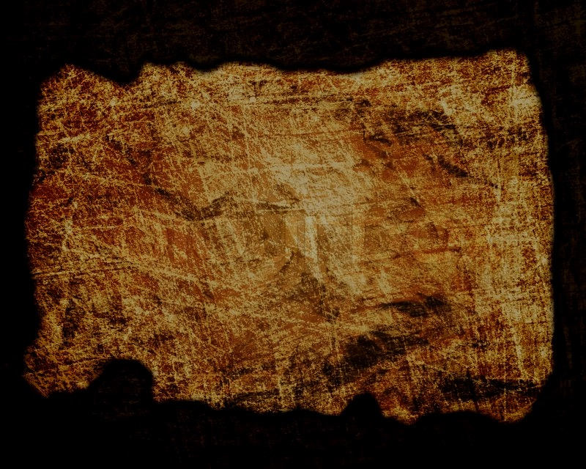
Covenant
27c
The Mosaic Covenant served well to reveal sin to Israel (3:23-25), but it didn't save them or New Covenant believers today (4:21-31), as salvation was by faith even for the 430 years between the Promise to Jacob and the giving of the Law (3:15-29).
Galatians

Slide 8

Redemption
27c
Salvation has always been by faith–even in the OT (2:16; 3:6-9) as the Law does not save nor does it apply to the Church today, so Jewish Christians who embrace this now are truly the “Israel of God” (6:16).
Galatians

Slide 9
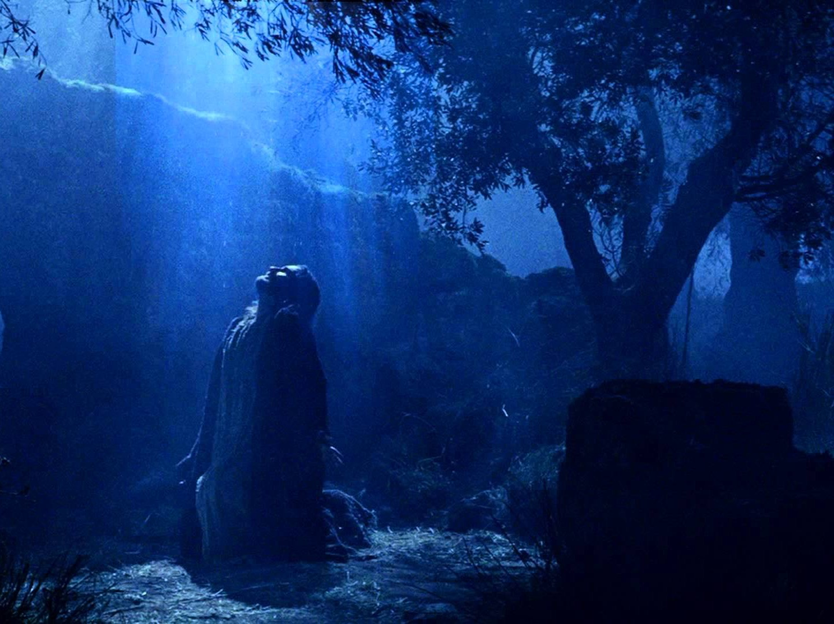
Prophecy (Lord, Deity)
27c
Paul interprets figuratively God's blessing on Isaac (Abrahamic Covenant) rather than Ishmael (Mosaic Covenant) to reveal that his readers were operating under the wrong descendant of Abraham by following the Law (4:21-31; cf. p. 174a), which was only temporary (3:19).
Galatians

Slide 10
Book Chart
Justification by Faith
Judaizer Attack #1 "Paul teaches this doctrine by his own authority!" |  | Judaizer Attack #2 "This is a new teaching contrary to the OT!" |  | Judaizer Attack #3 "Teaching faith alone will encourage a sinful lifestyle!"
Paul's Defense: "God called me and the 12 apostles affirmed this" |  | Paul's Defense: "Salvation has always been by faith–even in the OT" |  | Paul's Defense: "No, justification by faith naturally leads to godly living"
Biographical |  | Theological |  | Practical
Chapters 1–2 |  | Chapters 3–4 |  | Chapters 5–6
Upholds Apostleship |  | Upholds Justification by Faith |  | Upholds Responsibilities
Rebuke | Relation-ships | Affirmed | Illustrated | Balance | Service | Warnings
1:1-9 | 1:10–2:21 | 3 | 4 | 5 | 6:1-10 | 6:11-18
Antioch of Syria
Fall AD 49 (after first missionary journey)
Galatians
167

Slide 11
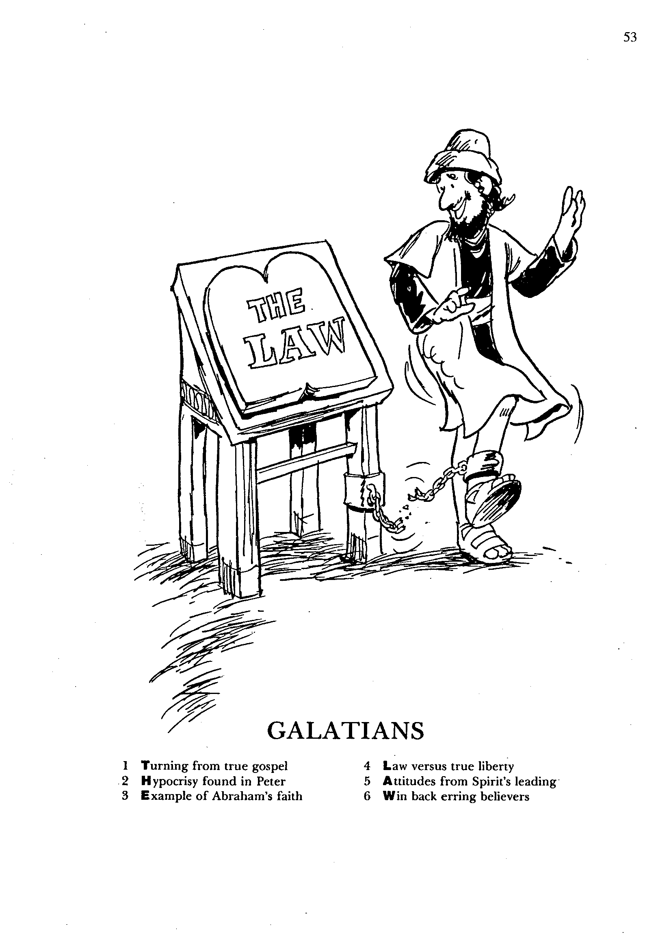
1
2
3
Turning from true gospel
Hypocrisy found in Peter
Example of Abraham's faith
4
5
6
Law versus true liberty
Attitudes from Spirit's leading
Win back erring believers
GALATIANS
The Law
Barry Huddleston, The Acrostic Bible

Slide 12

Be Free
Galatians
Dr. Rick Griffith • Crossroads International Church Singapore
BibleStudyDownloads.org

Slide 13

Slavery to false teaching is the worst slavery
Galatians

Slide 14

Why must salvation be by faith alone?
Paul gives 3 reasons
Galatians
Notes:
What reasons can we give for the claim that simple trust in Christ alone puts us in a right relationship with God?

Slide 15
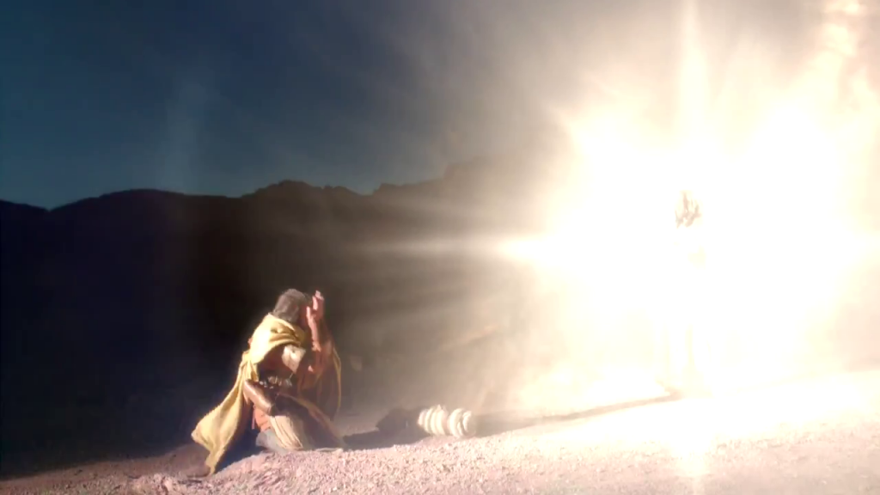
I. Jesus called Paul to teach salvation by faith (Chapters 1–2).
Galatians
Notes:
[Jesus himself appointed Paul to proclaim justification by faith as his defining doctrinal truth.]
[Personal: Paul defends his apostolic call to counter Judaizer teaching that Paul invented justification by faith.]

Slide 16
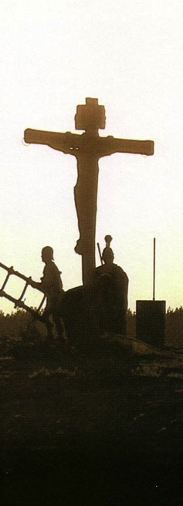
II. Salvation has always been by faith (Chapters 3–4).
The Centrality of the Cross
B.C.
Faith looked forward to the Cross of Christ
A.D.
Faith looks back at the Cross of Christ
Galatians
Notes:
[Whether Old Testament or New, we have always been put in the right relationship with God by simple trust.]
[Practical: Paul applies salvation by faith in Spirit-led living by exhorting balance and others-orientation.]
The ground of salvation has always been the death of Christ—for believers before and after the cross.
We must see the centrality of the cross—how people before Jesus believed by looking toward the ccross,while those of us after Jesus look back at the cross. In other words, the foundation of salvation has always been the death of Christ, for believers before and after the cross.
____________________
Common-198
BE-03-Leviticus-73
OB-37-Sacrifices-19
OB-38-Salvation-4
OS-03-Leviticus-193
NS-09-Galatians-16, 49, 118
NS-20-James-32
SA-03-Biblical Terminology-10
SA-15-Inheritance-26
TP-01-Our Inheritance OT Summary-29

Slide 17

III. Salvation by faith alone changes us inside (Chap. 5–6).
Galatians
Notes:
[Whether Old Testament or New, we have always been put in the right relationship with God by simple trust.]
[Practical: Paul applies salvation by faith in Spirit-led living by exhorting balance and others-orientation.]

Slide 18

Main Idea
Salvation by faith frees us from the Law to give freedom in Christ.
Galatians
Notes:
We are justified before God simply by trusting Jesus—not by good works—resulting in true internal change.

Slide 19


Applying Galatians
Be free from the slavery of legalism…
…so you can live for Christ

Slide 20
Black

Slide 21
NT Overview (Paul's Letters)
38 124 39-41
"To the remotest part of the earth" (Acts 1:8)
Acts 9 13 14 15 16 18 21 27 28
Apr 48- Sep 49
1 Galatia
Apr 50- Sep 52
2 Aegean
Spr 53- May 57
3 Asia
Feb 60- Mar 62
1 Rome
Spr 62- Fall 67
4 Spain
Aut 67- Spr 68
2 Rome
Summer 35- 37
Damascus Antioch
May 57- Aug 59
Trials
Fall 49
The
Council
Spring 68
Expansion of Church
35 48 49 50 52 53 57 60 62 67 68 95
Matt
Luke
Acts
Mark
John
Gal
Gospels & Acts
Pauline Epistles
1234
Journeys
Rome
Imprisonments
Pauline

Slide 22
Contrasting Galatians & James
174j
Issue
Galatians
James
Author
Paul
James
Date
A.D. 49
A.D. 44-48
Audience Ethnicity
Gentiles
Jews
Justification
Before God (vertical)
Before Man (horizontal)
The time of faith…
before salvation
after salvation
Emphasis is on…
faith
works

Slide 23
Contrasting Galatians & James
174j
Issue
Galatians
James
Spirit Noted
19 times
0 times
Gospel Noted
12 times
0 times
Opposite Author
James noted
Paul not noted
Author Title
Apostle (1:1)
Servant (1:1)
Reader Problem
Confusion of way of salvation
Confusion of way of discipleship
Use of “saved”
Soteriological
Preserve life

Slide 24
Contrasting Galatians & James
174j
Issue
Galatians
James
Circumcision
Big issue
Non-issue
Opponents
Judaizers
None
Audience
Disunited
United
Structure
Logical, sequenced
Random, repeated
Geography
Roman Province of Galatia
Roman Empire in its entirety
One of the 12?
No—came later
No—came later

Slide 25
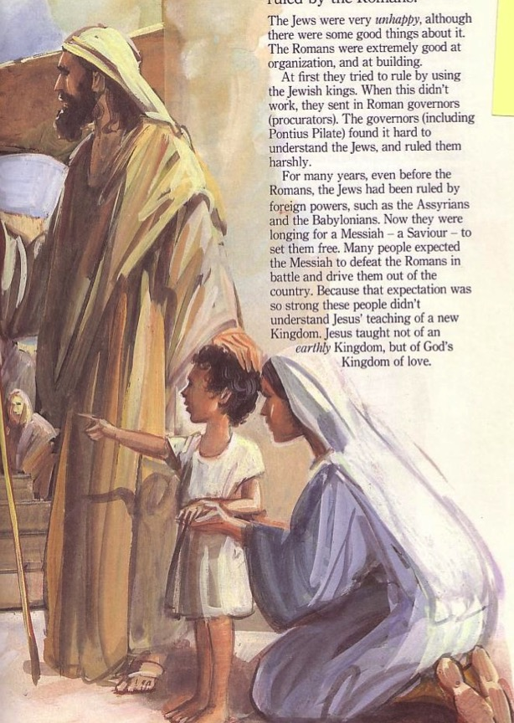
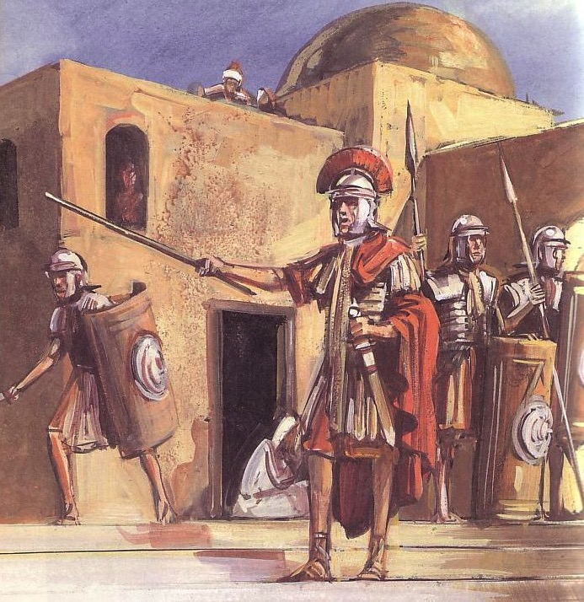
What Were the Ethnic Differences?
105
Jews
Gentiles
One God
Many taboos
Many Gods
Few taboos

Slide 26


East Meets West
105
Writing Style
Hebrew
Greek
Favors poetry, imagery & symbolism
Favors outlines, lists and bullet points
Adapted from Lynne M. Thompson, "Christmas: The Real Deal," interview with Ray Vander Laan, Breakaway magazine (Dec 2003): 7-9
Notes:
Adapted from Lynne M. Thompson, "Christmas: The Real Deal," interview with Ray Vander Laan, Breakaway magazine (Dec 2003): 7-9.

Slide 27
East Meets West
105
Numbers
Hebrew
Greek
Sees numbers as a quality or symbol
Sees numbers as a specific quantity
Adapted from Lynne M. Thompson, "Christmas: The Real Deal," interview with Ray Vander Laan, Breakaway magazine (Dec 2003): 7-9
Notes:
Adapted from Lynne M. Thompson, "Christmas: The Real Deal," interview with Ray Vander Laan, Breakaway magazine (Dec 2003): 7-9.

Slide 28
East Meets West
105
Relation to God
Hebrew
Greek
Focuses on the community in relationship with God
Focuses on the individual's relationship with God
Adapted from Lynne M. Thompson, "Christmas: The Real Deal," interview with Ray Vander Laan, Breakaway magazine (Dec 2003): 7-9
Notes:
Adapted from Lynne M. Thompson, "Christmas: The Real Deal," interview with Ray Vander Laan, Breakaway magazine (Dec 2003): 7-9.

Slide 29
East Meets West
105
Eternal Life
Hebrew
Greek
The kingdom of God begins in this life. Eternal life is lived in harmony with God.
The kingdom of God is outside this world. Eternal life will occur after this life ends.
Adapted from Lynne M. Thompson, "Christmas: The Real Deal," interview with Ray Vander Laan, Breakaway magazine (Dec 2003): 7-9
Notes:
Adapted from Lynne M. Thompson, "Christmas: The Real Deal," interview with Ray Vander Laan, Breakaway magazine (Dec 2003): 7-9.

Slide 30
East Meets West
105
Sin
Hebrew
Greek
Sin is wrong behavior alone.
Emphasize what one does in response to faith.
Sin is wrong actions & incorrect thinking.
Emphasize what a person knows about faith.
Adapted from Lynne M. Thompson, "Christmas: The Real Deal," interview with Ray Vander Laan, Breakaway magazine (Dec 2003): 7-9
Notes:
Adapted from Lynne M. Thompson, "Christmas: The Real Deal," interview with Ray Vander Laan, Breakaway magazine (Dec 2003): 7-9.

Slide 31
East Meets West
105
Existence of God
Hebrew
Greek
Assumes that God exists
Tries to prove God's existence
Adapted from Lynne M. Thompson, "Christmas: The Real Deal," interview with Ray Vander Laan, Breakaway magazine (Dec 2003): 7-9
Notes:
Adapted from Lynne M. Thompson, "Christmas: The Real Deal," interview with Ray Vander Laan, Breakaway magazine (Dec 2003): 7-9.

Slide 32
East Meets West
105
Faith
Hebrew
Greek
Relational and personal
Expressed in terms of relationship with God rather than rationalization
Intellectual and impersonal
Expressed in creeds and doctrine with support through proof texts
Adapted from Lynne M. Thompson, "Christmas: The Real Deal," interview with Ray Vander Laan, Breakaway magazine (Dec 2003): 7-9
Notes:
Adapted from Lynne M. Thompson, "Christmas: The Real Deal," interview with Ray Vander Laan, Breakaway magazine (Dec 2003): 7-9.

Slide 33
East Meets West
105
Truth
Hebrew
Greek
Experiential
What is done and who did it in Scripture
Believing comes through experience
Truth is unfolding and relative
Scientific & rational
How things are done in the Scripture
Believing comes through thinking
Truth is static and unchanging
Adapted from Lynne M. Thompson, "Christmas: The Real Deal," interview with Ray Vander Laan, Breakaway magazine (Dec 2003): 7-9
Notes:
Adapted from Lynne M. Thompson, "Christmas: The Real Deal," interview with Ray Vander Laan, Breakaway magazine (Dec 2003): 7-9.

Slide 34
The Cross Makes Ethnicity Irrelevant
107
Jew-Gentile Unity
Gentiles
One God
Love over Taboos
One God
Love over Taboos
There is neither Jew nor Greek, there is neither slave nor free, there is neither male nor female, for you are all one in Christ Jesus.
Galatians 3:28 ESV

Slide 35
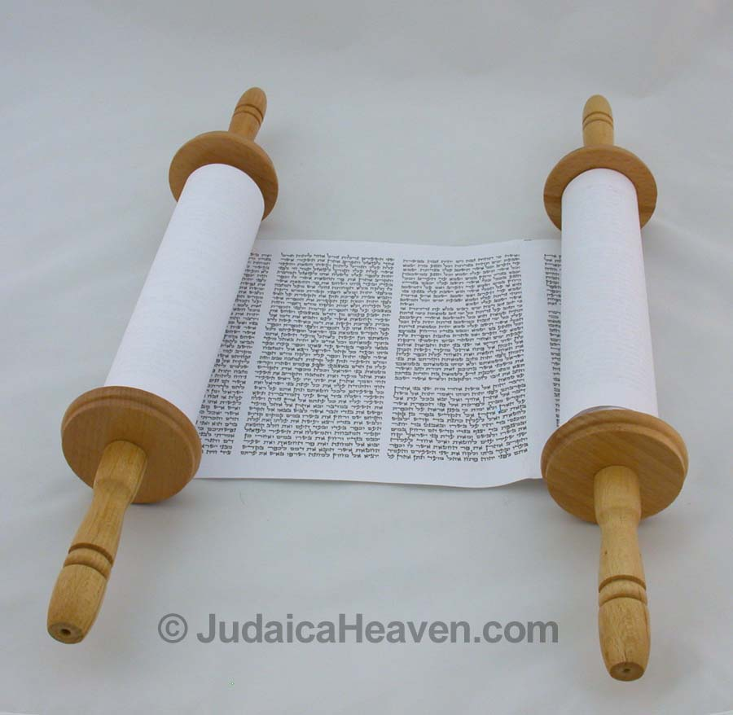
Applying the Law
APPLYING THE LAW

Slide 36

True or False?
Are these actual laws somewhere in the world?
Kentucky
The law requires people to take a bath once a year
It is illegal to own a dog
By law, people must know how to read in order to get married
Reykjavik, Iceland
Finland

Slide 37
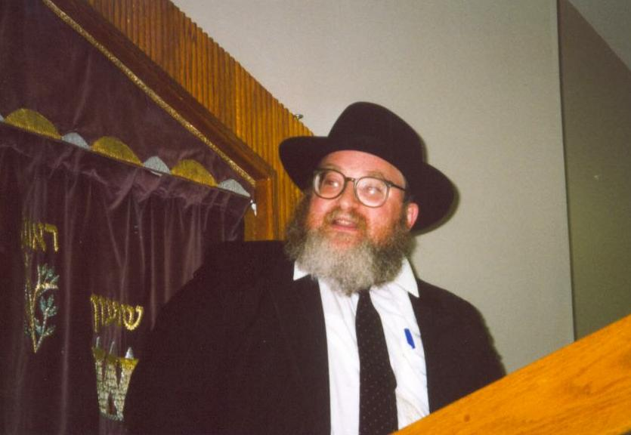
To Clip or Not to Clip?
Lev. 19:27– "Do not cut the hair at the sides of your head or clip off the edges of your beard."

Slide 38

What do you think?
Are we living under law?
Can I eat pork?
Should I obey the Sabbath?
LAW
Can Christians eat blood (e.g., yong tau foo, blood pudding)?
How does the Law relate to us?
Does God require me to tithe?

Slide 39

Walk Carefully!
How long would it take you to walk to the top?

Slide 40

Look Closely
Do you see gray in the white lines?

Slide 41

Look Again
How would you make this?

Slide 42


The Point?
The eye often sees things not there
So does the spirit
No issue is more important to see clearly than the gospel
So what is the gospel? This is answered in Galatians!

Slide 43
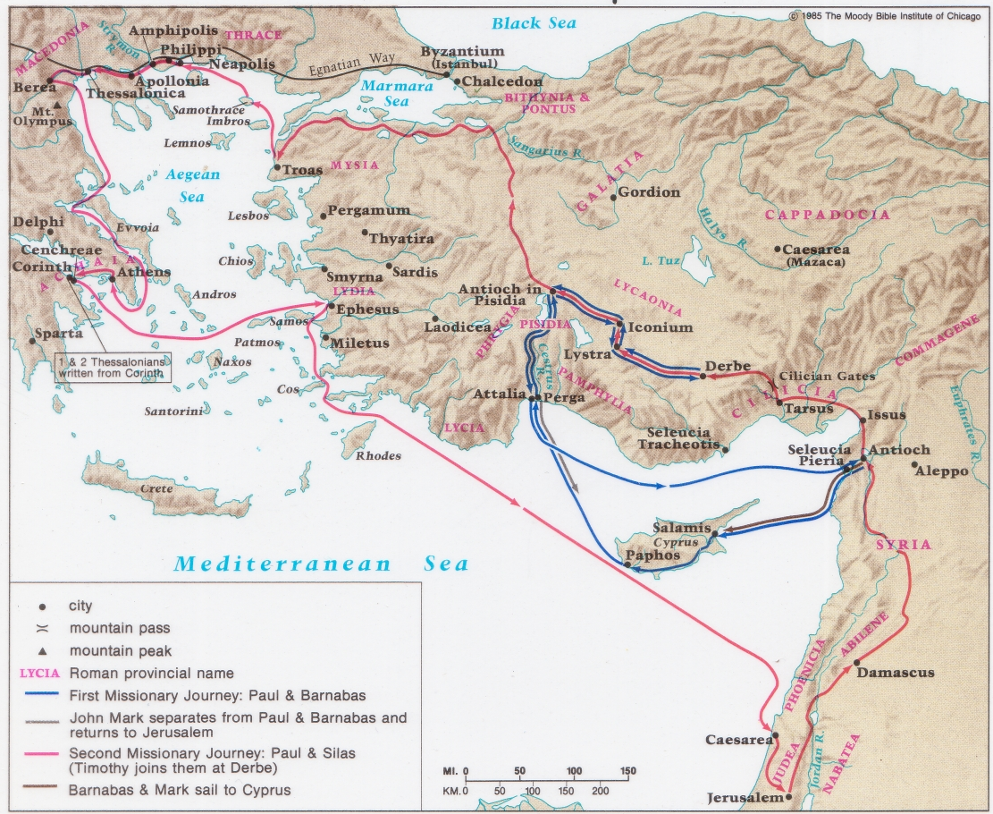
Paul's 1st & 2nd Missionary Journeys
138-39

Slide 44
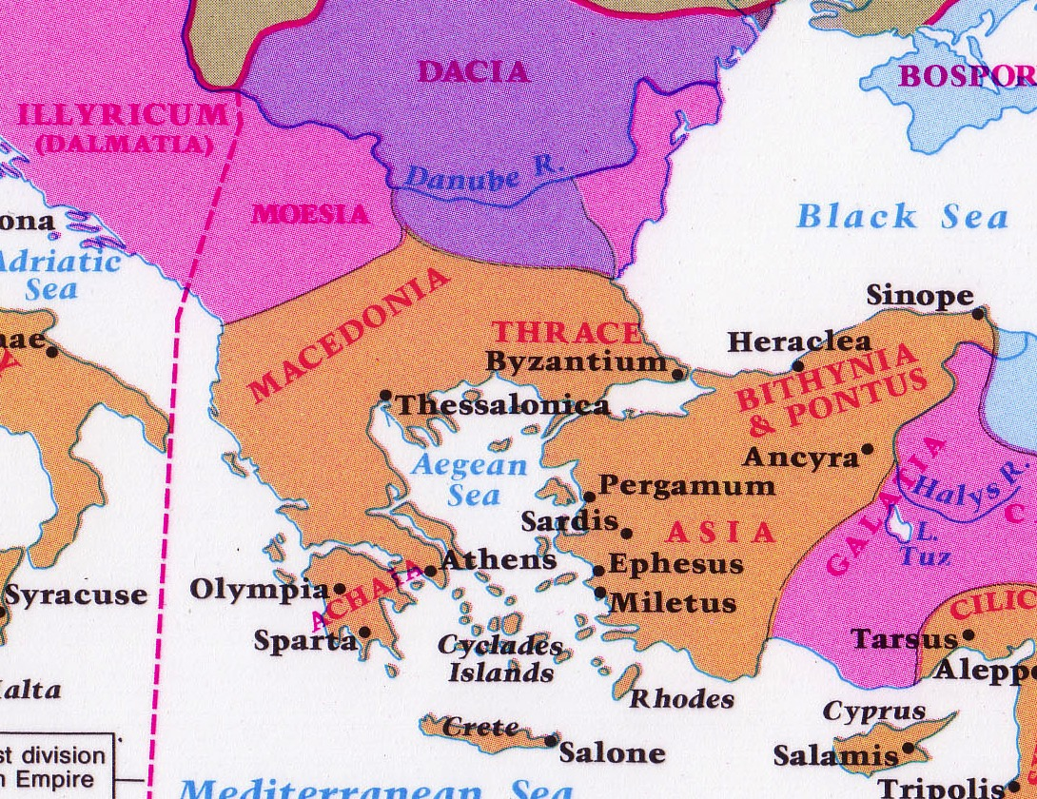
Where were the Galatians?
142
North
South

Slide 45
174
 | Northern Theory | Southern Theory
Advocates | Lightfoot, Betz, Kümmel, Harrison, John A.T. Robinson | Ramsey, Bruce, Hiebert, Guthrie, Grassmick, Hoehner, Tenney, Benware, Griffith
Age | Traditional View | Newer View (1800s)
Location | North Galatia (small area-Benware) | South Galatia (large area)
Nature | Territory | Roman Province
Describes | Ethnic Galatia | Political Galatia
Cities | Ancyra, Pessinus, Tavium | Pisidian Antioch, Iconium, Lystra, Derbe
Established | Second Missionary Journey (Acts 16:6-8; AD 51-52) | First Missionary Journey (Acts 13–14; AD 49)
Barnabas | Absent (with John Mark) | Present
Gal 2 Ref. | Jerusalem Council (Acts 15) | Famine Visit (Acts 11:27-30)
Date | AD 53-57 | AD 48-49
Writing | Paul's third NT letter | Paul's first NT letter
Origin | Ephesus, Corinth, Macedonia | Antioch, en route to Jerusalem
Support | Luke Used Geographical Names Gallic Lifestyles Unanimous Patristic Support | Paul Used Roman Names Paul did Plant Churches Here Mention of Barnabas Paul's Sickness Absence of Jerusalem Council Decree
Problems | Second Visit (2:1) No Support Paul ever Visited North No Jerusalem Council (Acts 15) | Paul's Dates (1:18; 2:1)
The Readers of Galatians

Slide 46
Date
168
The issue of date is closely related to the letter's destination.
The North Galatian Theory
(Later date)
Arguments for both dates are inconclusive, although the best evidence supports the South Galatian Theory and the earlier date of about fall AD 49.
The South Galatian Theory
(Earlier date)

Slide 47
Origin/Recipients
168-169
Northern Galatian Theory
– From Ephesus, Corinth, Macedonia, or Rome.
Southern Galatian Theory
– From Antioch or en route from Antioch to Jerusalem for the Jerusalem Council.
The weight of the evidence supports the Southern Galatian Theory
Greek believers in the
Roman province of Galatia (political Galatia, including the cities of Pisidian Antioch, Iconium, Lystra, and Derbe) – 1st missionary journey
(Acts 13–14).
Gallic believers in the
territory of Galatia (ethnic Galatia, including the cities of Ancyra, Pessinus, and Tavium) – 2nd missionary journey
(Acts 16:6).

Slide 48
Which is the Most Accurate?
121a
Salvation by…
Faith + Works
Faith Alone
Faith + Works
OT
Works
Faith Alone
Faith Alone
Faith + Works
NT
Faith
• Which verses in the Bible support your answer?
cf. OTS 119e
Notes:
Did God change the means of salvation from the OT to the NT?
We are NOT talking about whether people should do good works—we all agree on that. But are works needed for salvation?
Paul answers this question in Romans 4 with the example of Abraham who was saved by faith alone—see Gen 15:6.
________
BE-03-Lev-27
OB-37-Sacrifices-72_eng_ob_1667_v5—slide 17
OB-39-Salvation-2
OS-03-Leviticus-13
OP-03-Lev-27
OP-Lev_6v24-7v10 Why All That Blood Sin & Guilt Offerings-49_eng_op_v4.0—slide 34
OS-04-Num-27
NP-Acts_15v1-35_Dont_Be_Law_Abiding_(Rick_Griffith)-61_eng_pr_v4—slide 5
NS-05-Acts15-16-slide 26
NS-Rom3-4-slide 77
NS-09-Galatians-48
NS-20-James-30
NS-23-1Jn-58
SA-03-Biblical Terms-6
SA-15-Inheritance-26

Slide 49
Salvation in All Ages:
The Centrality of the Cross
B.C.
Looked forward to the Cross of Christ
A.D.
Look back at the Cross of Christ
Notes:
We must see the centrality of the cross—how people before Jesus believed by looking toward the cross while those of us after Jesus look back at the cross. In other words, the foundation of salvation has always been the death of Christ—for believers before and after the cross.
____________________
Common-198
BE-03-Leviticus-73
OB-37-Sacrifices-19
OB-38-Salvation-4
OS-03-Leviticus-193
NS-09-Galatians-16, 49, 118
NS-20-James-32
SA-03-Biblical Terminology-10
SA-15-Inheritance-26
TP-01-Our Inheritance OT Summary-29

Slide 50
Salvation & Sanctification
121a
Man's Role
God's Response
Life of Faith
Restored Fellowship
Faith in God as offered Passover Lamb
Journey to Canaan
Sacrifices (Sin, Guilt)
OT
Exodus
Type
|
Antitype
Type
|
Antitype
Type
|
Antitype
Type
|
Antitype
Faith in Christ as Lamb of God (1 Cor. 5:7)
Salvation (1 Cor. 10:1-4)
Growth (1 Cor. 10:5)
Confession (1 John 1:9)
NT
Positional Sanctification
Progressive Sanctification
Notes:
The OT plan of salvation is mirrored in the NT—both by simple faith in the Lamb pictured in the Passover.
Exodus from Egypt is a type of the believer who leaves his slavery to sin—all believers in the Lamb are saved, including all Israelites who left Egypt as they demonstrated that faith by putting the blood on the doorposts of their homes (=positional sanctification).
But both OT and NT believers must live a life of faith in God, pictured in Israel’s journey to Canaan and mirrored in the Christian’s growth or progressive sanctification.
Finally, as OT believers confessed their ongoing sins in the sin and guilt sacrifices (for restoring fellowship with God—NOT for salvation!), so NT believers confess sins even after they are saved to restore their fellowship (NOT relationship!) with God.
_________
Common English-78
OB-37-Sacrifices-18
OS-00-Book Overviews-73
OS-04-Numbers-13
NS-09-Galatians-49
NS-20-James-31
SA-03-Biblical Terms-7
SA-15-Inheritance-26

Slide 51
Salvation in the Old Testament
174e
OT Times
(Moses to Christ's Death)
NT Times
(Christ's Death to Today)
Basis
of Salvation
God's gracious provision of the death of Christ since "it is the blood that makes atonement for one's life"
(Lev. 17:11b)
God's gracious provision of the death of Christ ("without the shedding of blood there is no forgiveness," Heb. 9:22)
Requirement
of Salvation
Faith in the provision that God has revealed—as a gift (Ps. 51:16-17)
Faith in the provision that God has revealed—as a gift (Gal. 2:16)
Ultimate Content
of Salvation
Object of faith is God Himself—prophets exhorted repentance, not sacrifices (Jer. 3:12)
Object of faith is God Himself—heroes of faith are cited to exhort faith in God (Heb. 11)
Specific
Revealed Content
of Salvation
Cumulative content of faith had sacrifices & promises: animals (Gen. 3:21), Abel's sacrifice (Gen. 4:4), Abrahamic covenant (Gen. 15)
New content of faith is the shed blood of Jesus Christ (1 Pet. 1:18-21) which removes sin while OT sacrifices merely covered sin
Believer's Expression
of Salvation
Obey moral law, offer animal sacrifices, obey Mosaic law (civil
and ceremonial aspects)
Obey moral law, observe Lord's Supper and baptism, etc. through the Spirit's enabling (Rom. 8:9)

Slide 52
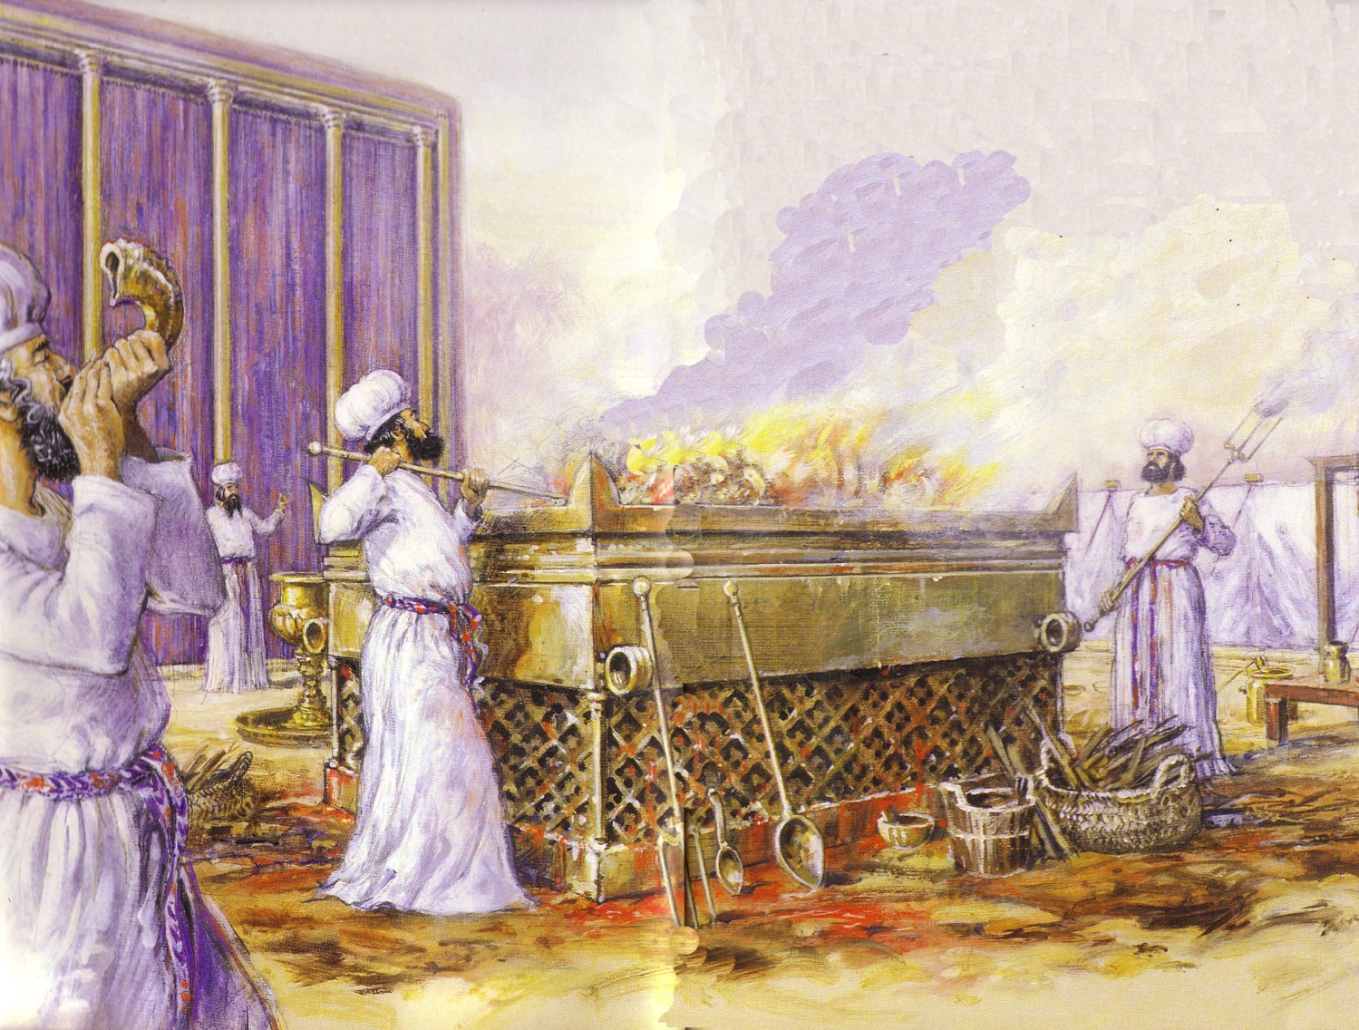
Leviticus Synthesis
OTS, 124
Sanctification through sacrifice and separation
1–10 Sacrifice
(worshipping God)
11–27 Separation
(walking with God)

Slide 53

In Other Words…
153
Salvation has ALWAYS been through faith alone!
Notes:
The imagery here is instructive. The lower hand does not hold onto the upper one. The person only lifts his hand in faith that the stronger hand will save him. Likewise, we turn to the Lord in faith, but he does all the work of lifting us out of our sins.
———————————
Common-206
OS-03-Leviticus-202
NS-05-Acts15-16-slide 29
NS-09-Galatians-53
NS-20-James-38

Slide 54
Two Emphases
Galatians
Romans
Justification by Faith
Not by Law
Righteousness of God
Romans (Colorado Springs, CO: BEE World, 2018), 16

Slide 55
Chart of Topics
Galatians | Galatians and Romans | Romans
Defense of Apostleship | Justification by Faith | Origin of Sin
Testimony of Conversion | Faith versus Works | Universal Condemnation
Judaizers | Spirit versus Flesh | Scope of Salvation
Conflict with Peter | Failure of Self-effort | Israel's Destiny
Concern for Galatians | Promise to Abraham | Concern for Israel
Sarah and Hagar | Plan of Salvation | Jews and Gentiles
Servants and Sons | Divine Love | Government
 | Union with Christ | Weak Christians
 | Circumcision | Personal Plans
 | Relationship to Law | Missions and Offerings
 | Relations to Others | Congratulations
 | Water Baptism | Personal Greetings
 | False Teachers
Romans (Colorado Springs, CO: BEE World, 2018), 16

Slide 56
Galatians versus Romans
 | Galatians | Romans
Influence of Cities | Minor | Major
Number of Churches | Several Cities (Lystra, Derbe) | Single City (Rome)
Church Founded | AD 48-49 – 1st journey | AD 33-56 (no one knows)
Founder | Paul | Pentecost? or Paul's disciples?
Written | AD 49 from Antioch | AD 56-57 from Corinth
View of Paul | Doubted (but most knew him!) | Credible (but most didn't know him!)
Paul's Opponents | Judaizers | None
Jew-Gentile Relations | Serious rift | Mild criticism of each other
173a

Slide 57
Galatians versus Romans
 | Galatians | Romans
Readers | Mostly Gentiles | Jew-Gentile mix
Theological Errors | Serious: Salvation | Minor: Christian liberty
Theme (Key Word) | Justification (2:16) | Righteousness (1:17)
Vocabulary & Tone | Simple yet Severe | Technical and Structured
Form | Modified Defense (e.g., no thanksgiving) | Traditional (e.g., names, greetings)
OT Quotes | Few (only 12, or 2 per chapter) | Nearly as many as the rest of Paul's epistles (63 total!)
Doctrinal Focus | Narrow: Justification | Broad: Many topics
173a

Slide 58

¹ Paul, an apostle—sent not from men nor by a man, but by Jesus Christ and God the Father, who raised him from the dead— ² and all the brothers and sisters with me, To the churches in Galatia: ³ Grace and peace to you from God our Father and the Lord Jesus Christ, ⁴ who gave himself for our sins to rescue us from the present evil age, according to the will of our God and Father,
Galatians 1:1-9

Slide 59
⁵ to whom be glory for ever and ever. Amen.
⁶ I am astonished that you are so quickly deserting the one who called you to live in the grace of Christ and are turning to a different gospel— ⁷ which is really no gospel at all. Evidently some people are throwing you into confusion and are trying to pervert the gospel of Christ. ⁸ But even if we or an angel from heaven should preach a gospel other than the one we preached to you, let them be under God’s curse!
Galatians 1:1-9

Slide 60
⁹ As we have already said, so now I say again: If anybody is preaching to you a gospel other than what you accepted, let them be under God’s curse!
Galatians 1:1-9

Slide 61
The Problem in Galatia
Freedom and unity in Christ are central themes of Paul's letter to the Galatians.
His letter addresses Christians, whose preoccupation with keeping the Law was splitting their churches along racial lines, separating Jews from Gentiles.
The false teachers were teaching that faith alone cannot save, but you also need works of the law.
Jeremy Chew, East Asia School of Theology, Singapore

Slide 62
173b
Who were the Judaizers?
All Humanity
(the entire rectangle)
Jews
(this square with unbelievers outside the circle)
Gentiles
(this square with unbelievers outside the circle)
True Body of Christ
(Jews & Gentiles in the circle)
Judaizers

Slide 63
The Problem of Labelism
I
Definition:
"Labelism" is pride of ownership for having the "right" religion.
In Galatians:
Take pride in observing the "right" religious activities (e.g. food laws, circumcision).
Today:
Pride over the right doctrine, being in the right church, practicing the right ministry strategies.
Lesson:
We are who we are by God's grace, and not because of ourselves or what we have done.
Jeremy Chew, East Asia School of Theology, Singapore

Slide 64
Author
168
External Evidence
Traditional view :
Paul wrote Galatians
Early support by
Polycarp, Marcion
2. Even 19th century German critics accept Pauline authorship.
Internal Evidence
Galatians explicitly notes Paul as its author (1:1; 5:2)
Paul probably departed from his usual practice of dictating his letters to a secretary by penning the epistle himself (6:11)
Chapters 1 and 2 are autobiographical with many Pauline themes (grace, law).
Both the external and the internal evidence point to Paul's authorship

Slide 65
Occasion
170
The enthusiastic start in the gospel by the Galatians ended due to opposition from Jewish false teachers (Judaizers).
Judaizers proclaimed "another gospel" associated with the Jewish Torah and circumcision.
Paul wrote the churches immediately to combat this false teaching with a defense of his apostleship (chs. 1–2) and the true gospel of justification by faith alone (chs. 3–4), which produces a grace lifestyle based upon freedom in Christ (chs. 5–6).

Slide 66
The Jerusalem Visit (2:1-10)
170-171
Southern Galatian Theory – Famine Relief View
Better evidence for the Southern Galatian Theory favors the famine relief view.
Northern Galatian Theory – Jerusalem Council View

Slide 67
Argument
170-171
Paul's purpose in writing is to convince the Galatians that since they were saved by grace, they are free from the Law. As a result, they should not be led away from their moorings in Christ by Judaizers who sought to impose upon them a legalistic system based upon the Law.

Slide 68
Synthesis
172
1–2 Biographical: Defends apostleship
3–4 Theological: Defends justification by faith
5–6 Practical: Defends responsibilities

Slide 69
Be Free
Galatians
Dr. Rick Griffith • Crossroads International Church Singapore
BibleStudyDownloads.org

Slide 70
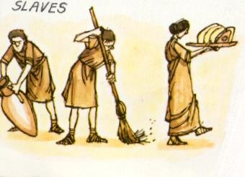
Slavery
"the slave is a living tool
and the tool is a lifeless slave"
—Aristotle—
Notes:
Aristotle said, “The slave is a living tool and the tool is a lifeless slave.” This horrible view of people 2000 years ago actually is still with us today. Slavery hasn’t ended. Perhaps even you are a slave. Are you? Tim Keller writes, “Sin isn’t only doing bad things, it is more fundamentally making good things into ultimate things. Sin is building your life and meaning on anything, even a very good thing, more than on God. Whatever we build our life on will drive us and enslave us. Sin is primarily idolatry.”

Slide 71
Slavery to false teaching is the worst slavery
Notes:
But slavery to false teaching is the worst slavery because we all have experienced it and its affects are much more far-reaching, so how can you be free?

Slide 72

Are you a slave?
Notes:
Most say freedom comes by works.
The Bible says freedom (salvation) is by faith.
Need: Are you a slave or are you free?

Slide 73
173c
Symbolic Objects
Personal knowledge of God
Ceremonial vs. True Religion
Man's Efforts
God's revelation and work
Worship in the Spirit
Rites
Ceremonial Religion
The Gentile Christians in Galatia were in this kind of religion before their conversion. Their worship was a constant effort to please the gods in order to escape their punishment. They worshipped tangible objects––idols. They had many sacred rites and forms to be observed. They trusted in horoscopes and other signs to guide them. They had their sacred days and seasons and years.
Religion of Personal Experience
Remember that ceremonial religion emphasizes physical things in worship while the gospel emphasizes worship in the Spirit. You can see the conflict between these two types of religion in Jesus' conversation with the Samaritan woman at Jacob's well (John 4).
Paul A. Pomerville, Galatians & Romans (Brussels: ICI, 1976), 96, 98
Notes:
Our family backgrounds are different, but in school as we grow up and in society at large we have law drilled into us throughout our lives. The early bird gets the worm. The hardworking student gets the As and lands the good job. The law-abiding citizen stays out of prison. Most of all, the good go to heaven.
It is tough to grasp grace! It goes against everything around us. Religions tell us to be good and we will be OK in the afterlife.
Yet grace is how God brings us to heaven. Specifically, we are saved from sin by grace through faith in our Lord Jesus Christ.

Slide 74
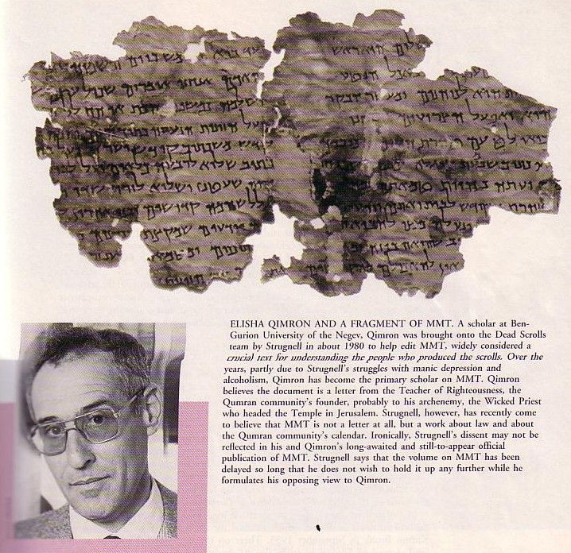
MMT
NTB 175
The only letter in Qumran
MIQSAT MA'ASE HA-TORAH
"some precepts of the Torah" (Qimron)?
"some legal rulings of the Torah"?
"works of the law" (Abegg's translation shows that this is evidence for rabbinic belief in salvation by works, which Paul argues against in Galatians.)
Elisha Qimron

Slide 75
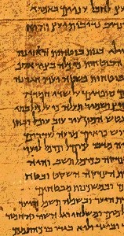
Paul versus Legalists
154k
Legalists
Paul
"The one who does righteousness stores up life for himself with the Lord"
Psalms of Solomon (about 50 BC)
"Miracles, however, will appear at their own time to those who are being saved by their works"
Baruch
(about AD 100)
"Let me ask you this one question: Did you receive the Holy Spirit by obeying the law of Moses? Of course not! You received the Spirit because you believed the message you heard about Christ."
(Gal. 3:2 NLT)
Notes:
BG-06-Israel-South Longitude Masada Qumran—77
NS-09-Galatians-71
But the Galatians inherited the traditional view and the view taught at Qumran and by the rabbis that only good people go to heaven. This is clear in the letter called MMT at Qumran—as seven copies of it were dug up and it is the only letter along with 870 scrolls!

Slide 76
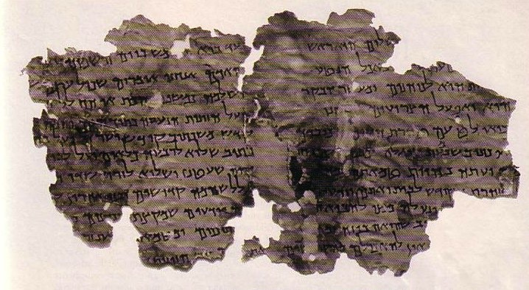
Significance of the DSS
NTB 183
MMT shows that Paul's opponents who taught salvation by the law were indeed real people.
MIQSAT MA'ASE HA-TORAH
"works of the law" (Abegg's translation gives evidence for rabbinic belief in salvation by works, which Paul argues against in Galatians.)

Slide 77

How can you be free?

Slide 78
Why must salvation be by faith alone?

Slide 79

Let's Study Through Scripture
The Bible: Book by Book

Slide 80
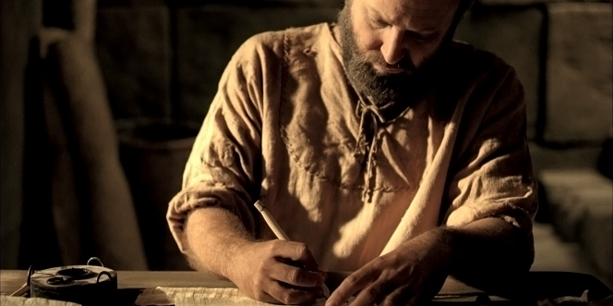
Background
Notes:
Justification by faith was attacked in Galatia.
Paul taught the church salvation by faith but false teachers soon confused them by teaching salvation by works.
The differences between Jews and Gentiles in Paul’s time could hardly be overstated. They believed in different Gods (one v. many), they ate different foods (kosher v. whatever), their thinking was entirely contrary (revelation v. philosophy).
These differences did not come into focus for the first 16 years of the church when the church was composed of nearly all Jews.

Slide 81

Now make sure that you stay free, and don’t get tied up again in slavery to the law
So Christ has truly set us free.
Galatians 5:1 NLT

Slide 82
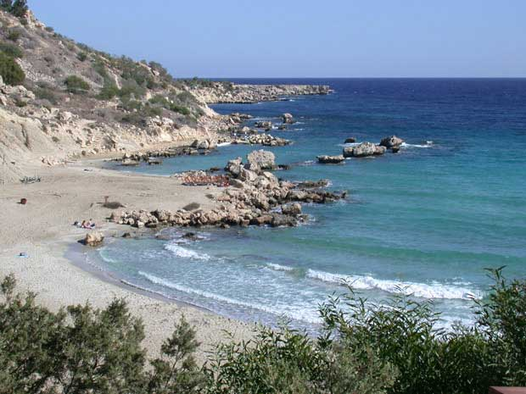
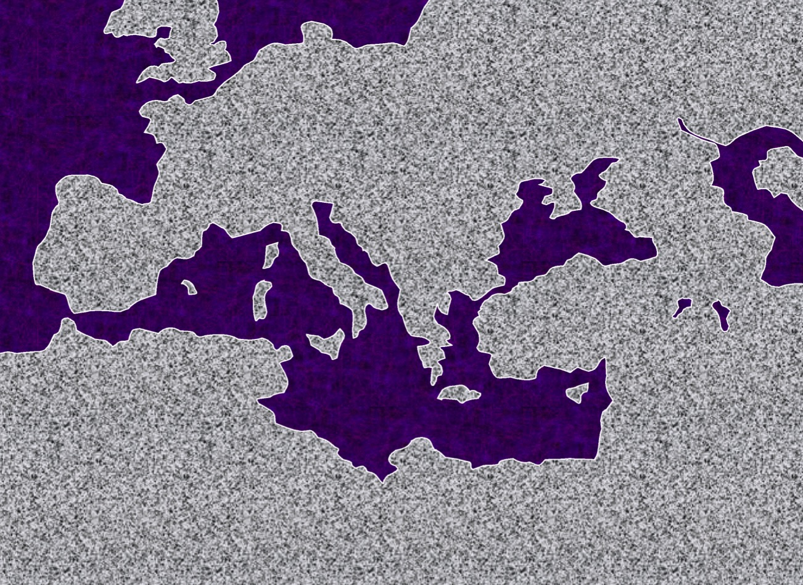

#1."The Hook: A Laboratory"
STUDY HELP #24
PAUL'S JOURNEYS …AT A GLANCE
ATLANTIC OCEAN
A.D. 48-49
EUROPE
A BEACH ON CYPRUS
ASIA
ROME•
Macedonia
•
•Pisidian Antioch
AFRICA
Athens
•Ephesus
Acts 13-14
•Syrian Antioch
MEDITERRANEAN SEA
•Jerusalem
Significance: Worshipped as gods; did miracles; Paul stoned; difficult work; churches planted; return by same route.
ARABIA
42
14
© 2006 TBBMI
9.65.08.
Notes:
With these ideas in mind…and with Study Help #24…let's go with Paul on his JOURNEYS AT A GLANCE. First…the main locations of the dramatic action facing Paul and his little party…
//// Here is Jerusalem…
//// SYRIAN Antioch…
//// PISIDIAN Antioch…(there were many ancient Antiochs!)…
//// Ephesus…
//// Macedonia…(Remember Alexander's birthplace?)…
//// Athens…
//// and the capital city of the world of his day…ROME, at the center of Empire.
//// So…Trip #1: Call it the HOOK…or A LABORATORY on Study Help #24…
//// Recounted in some detail in Acts 13 and 14.
//// Here's a Cyprian beach typical of those Paul and his party would have moved across.
//// On your map trace out his route similar to A HOOK SHAPE that moves from SYRIAN ANTIOCH through the island of Cyprus and on into central Turkey.
//// Significance of this trip: IT WAS A LEARNING LABORATORY! No one had done this before. Along the way they were worshipped as GODS…because the people had never seen anything like this…these strangers were going about working miracles. But in spite of those good works, Paul was STONED and almost died. The party must have quickly recognized that mission would become a very difficult work indeed. But along the way many new churches were planted. What kept them going? Faith in all they had seen and experienced in the development of their own Christian spirit and intellect. Their travel route began at Syrian Antioch – follow your hook – into today's central Turkey…
//// …then they turned around and returned to Syrian Antioch by the same route, there to report the results of their journey to the church.
//// LENGTH OF THIS TRIP: PROBABLY ABOUT 1.5 YEARS
IN THE LAST HALF OF THE A.D. 40s.

Slide 83
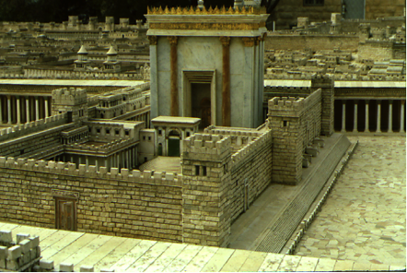
1(--)2"The Jerusalem Council"
A.D.49
Acts 15:1—Must a Gentile become a Jew, and accept his laws and ceremonies, before he can become a Christian?
ATLANTIC OCEAN
EUROPE
GRACE ONLY!
ASIA
ROME•
•Macedonia
•Pisidian Antioch
Athens
•Ephesus
AFRICA
Acts 15
•Syrian Antioch
MEDITERRANEAN SEA
1(--)2 "The Jerusalem Council"
•Jerusalem
The issue was permanently settled: GRACE, not LAW!
ARABIA
© 2006 TBBMI
9.65.08.
43
4
Notes:
Paul apparently had little time to rest up.
//// In Fall A.D. 49 he made that special SHORT trip between the BIG TRIPS #1 and #2…for the famous JERUSALEM COUNCIL.
This was a 500-mile journey from Syrian Antioch, south to the city of the mother church…to Jerusalem.
//// The issue here –– told to us in Acts 15 –– was the simple question:
"Must a Gentile become a Jew, and accept his laws and ceremonies, before he can become a Christian?" It must have been a heated argument!
//// Finally the issue was permanently settled: one becomes a Christian through GRACE…not LAW. However, if following the law makes one comfortable, fine. Accepting Christ as Lord and Savior is a matter of belief and relinquishment –– that is the only requirement! GRACE AND GRACE ONLY!
//// Then Paul and his party returned north to Syrian Antioch. Our BASIC BELIEFS of today date firmly from that Jerusalem meeting of Acts 15. Later reformers of the church also anchored their Christian tenets right there – dating from the Jerusalem Council.

Slide 84
How to Plant a Church (The Gospel According to Paul)
Teach in a synagogue
Get kicked out
Go find some Gentiles

Slide 85
To Clip or Not to Clip?
Lev. 19:27– "Do not cut the hair at the sides of your head or clip off the edges of your beard."

Slide 86
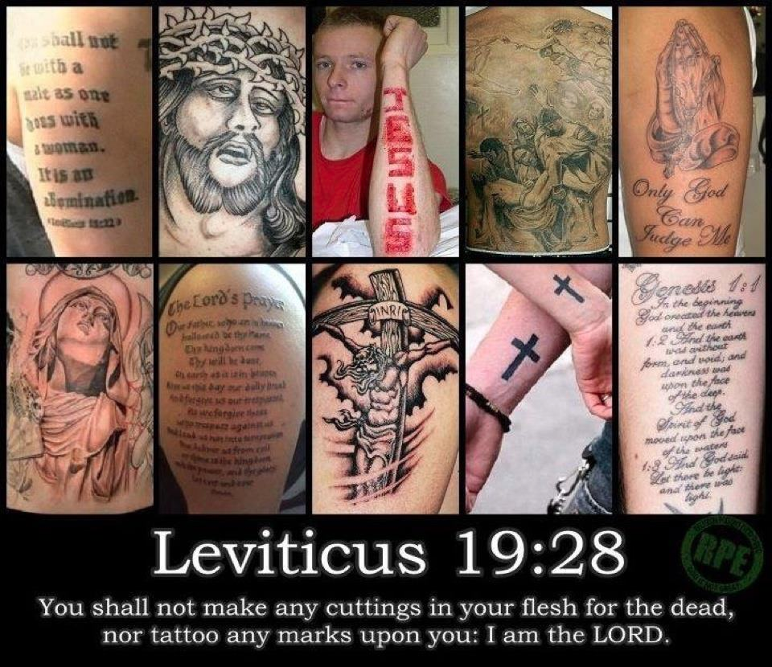
Leviticus 19:28 "Do not cut your bodies for the dead, and do not mark your skin with tattoos. I am the LORD."
Notes:
Can Christians today have tattoos even though they are prohibited by the OT Law?
What if they are tattoos about Jesus?!

Slide 87
What do you think?
Are we living under law?
Can I eat pork?
Should I obey the Sabbath?
LAW
Can Christians eat blood (e.g., yong tau foo, blood pudding)?
How does the Law relate to us?
Does God require me to tithe?

Slide 88
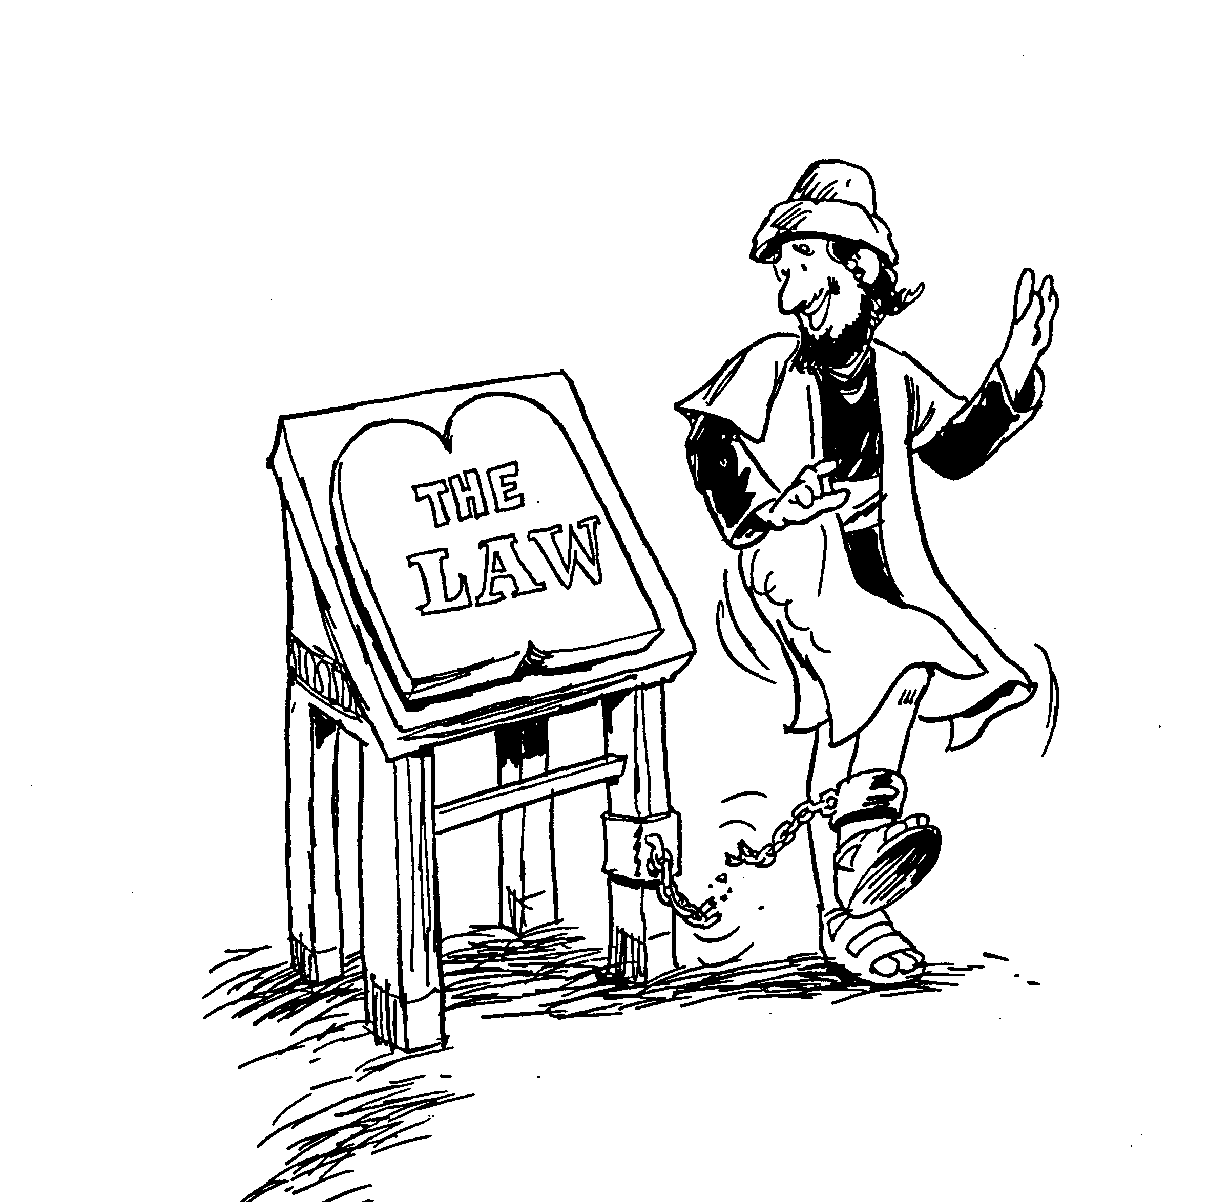
Chapters in Galatians
1. Turning from true gospel
2. Hypocrisy found in Peter
3. Example of Abraham's Faith
4. Law versus true liberty
5. Attitudes from Spirit's leading
6. Win back erring believers
The Law
Barry Huddleston, The Acrostic Summarized Bible

Slide 89
Paul & His Letters
143 124 39-41
"To the remotest part of the earth …" (Acts 1:8)
Acts 9 13 14 15 16 18 21 27 28
Apr 48- Sep 49
1 Galatia
Apr 50- Sep 52
2
Aegean
Spr 53- May 57
3 Asia
Feb 60- Mar 62
1 Rome
Spr 62- Fall 67
4 Spain
Aut 67- Spr 68
2 Rome
Summer 35- 37
Damascus Antioch
May 57- Aug 59
Trials
Fall 49
The
Council
Spring 68
Expansion of Church
35 48 49 50 52 53 57 60 62 67 68 95
Galatians
Antioch
Fall 49

Slide 90
Key Word & Verse
Galatians
167
Key Word: Justification
Key Verse
"[We Jews] know that a man is not justified by observing the law, but by faith in Jesus Christ. So we, too, have put our faith in Christ Jesus that we may be justified by faith in Christ and not by observing the law, because by observing the law no one will be justified"
(Galatians 2:16).

Slide 91
174
 | New Living Translation | New American Standard
Romans 4:25 | He was handed over to die because of our sins, and he was raised to life to make us right with God. | He who was delivered over because of our transgressions, and was raised because of our justification.
Romans 5:16 | And the result of God’s gracious gift is very different from the result of that one man’s sin. For Adam’s sin led to condemnation, but God’s free gift leads to our being made right with God, even though we are guilty of many sins. | The gift is not like that which came through the one who sinned; for on the one hand the judgment arose from one transgression resulting in condemnation, but on the other hand the free gift arose from many transgressions resulting in justification.
Romans 5:18 | Yes, Adam’s one sin brings condemnation for everyone, but Christ’s one act of righteousness brings a right relationship with God and new life for everyone. | So then as through one transgression there resulted condemnation to all men, even so through one act of righteousness there resulted justification of life to all men.
Verses on Justification
Notes:
“In Christian theology, justification is God's act of removing the guilt and penalty of sin while at the same time making a sinner righteous through Christ's atoning sacrifice”—Wikipedia at https://en.wikipedia.org/wiki/Justification_(theology)
It is similar to salvation which means to deliver or save us from sin’s penalty.

Slide 92
Summary Statement
Galatians
167
Paul defends his apostleship and justification by faith so that the Galatians would not seek salvation through adherence to the law.
Application
Do you add any other requirements for salvation except faith in Christ–baptism, tongues, good works?
The logical result of justification by faith is godliness.

Slide 93
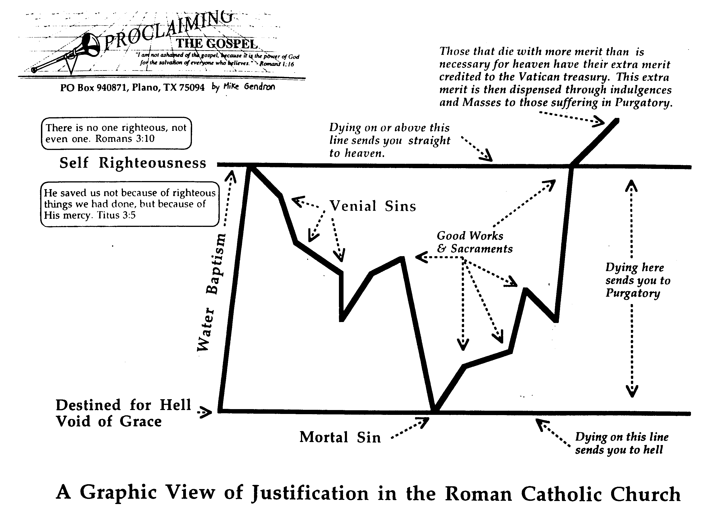
The Catholic View of Justification
174b
Those that die with more merit than is necessary for heaven have their extra merit credited to the Vatican treasury. This extra merit is then dispensed through indulgences and Masses to those suffering in Purgatory.
Dying on or above this line sends you straight to heaven.
There is no one righteous, not even one (Romans 3:10).
Self Righteousness
He saved us not because of righteous things we have done, but because of his mercy (Titus 3:5)
Venial Sins
Good Works & Sacraments
Dying here sends you to Purgatory
Water Baptism
Destined for Hell Void of Grace
Mortal Sin
Dying on this line sends you straight to hell.
A Graphic View of Justification in the Roman Catholic Church
Notes:
NS-09-Galatians-slide 110
FU-02-Death-slide 33
SA-06-Justification-slide 6

Slide 94

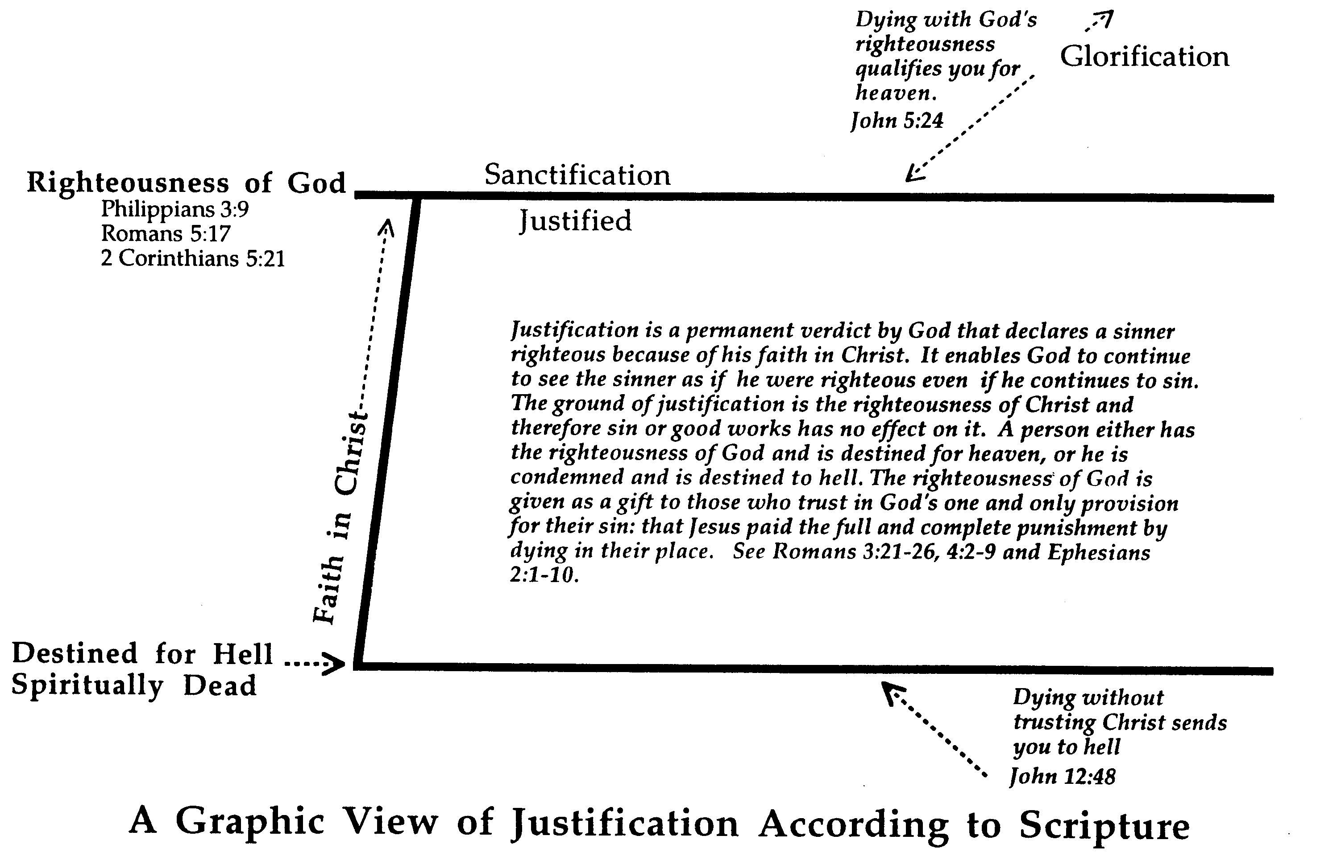
The Scriptural View of Justification
174c
Dying with God's righteousness qualifies you for heaven (John 5:24)
Glorification
Sanctification
Righteousness of God
Philippians 3:9 Romans 5:17 2 Corinthians 5:21
Justified
Justification is a permanent verdict by God that declares a sinner righteous because of his faith in Christ. It enables God to continue to see the sinner as if he were righteous even if he continues to sin. The ground of justification is the righteousness of Christ and therefore sin or good works has no effect on it. A person either has the righteousness of God and is destined for heaven, or he is condemned and is destined to hell. The righteousness of God is given as a gift to those who trust in God's one and only provision for their sin: that Jesus paid the full and complete punishment by dying in their place. See Romans 3:21-26; 4:2-9 and Ephesians 2:1-10.
Faith in Christ
Destined for Hell Spiritually Dead
Dying without trusting Christ sends you to hell (John 12:48)
A Graphic View of Justification According to Scripture
Notes:
NS-09-Galatians-slide 111
FU-02-Death-slide 34
SA-06-Justification-slide 7

Slide 95
Why must salvation be by faith alone?
Paul gives 3 reasons
Notes:
What reasons can we give that simple trust in Christ alone puts us in a right relationship with God?

Slide 96

Paul versus the Judaizers
167
 | Judaizer's Attack | Paul's Defense | Issue
Chs. 1–2 | "Paul teaches this doctrine by his own authority!" | "God called me and the 12 apostles affirmed this" | Biographical
Chs. 3–4 | "This is a new teaching contrary to the OT!" | "Salvation has always been by faith, even in the OT" | Theological
Chs. 5–6 | "Teaching faith alone will encourage a sinful lifestyle!" | "No, justification by faith naturally leads to godly living" | Practical
Justification by Faith

Slide 97
I. Jesus called Paul to teach salvation by faith (Gal 1–2).
Notes:
[Jesus himself appointed Paul to proclaim justification by faith as his defining doctrinal truth.]
[Personal: Paul defends his apostolic call to counter Judaizer teaching that Paul invented justification by faith.]

Slide 98
Slides on Galatians 1
Notes:
Paul rebukes their legalism instead of thanking them (1:1-9).

Slide 99
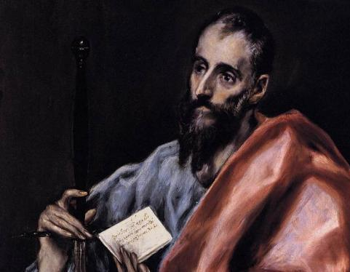
Paul's Biographical Argument (Gal. 1–2)
Paul defends apostleship

Slide 100
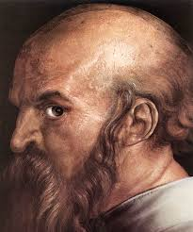
A Different Type of Salutation (1:1 NLT)
"This letter is from Paul, an apostle. I was not appointed by any group of people or any human authority, but by Jesus Christ himself and by God the Father, who raised Jesus from the dead."

Slide 101
Book Chart
Justification by Faith
Judaizer Attack #1 "Paul teaches this doctrine by his own authority!" |  | Judaizer Attack #2 "This is a new teaching contrary to the OT!" |  | Judaizer Attack #3 "Teaching faith alone will encourage a sinful lifestyle!"
Paul's Defense: "God called me and the 12 apostles affirmed this" |  | Paul's Defense: "Salvation has always been by faith–even in the OT" |  | Paul's Defense: "No, justification by faith naturally leads to godly living"
Biographical |  | Theological |  | Practical
Chapters 1–2 |  | Chapters 3–4 |  | Chapters 5–6
Upholds Apostleship |  | Upholds Justification by Faith |  | Upholds Responsibilities
Rebuke | Relation-ships | Affirmed | Illustrated | Balance | Service | Warnings
1:1-9 | 1:10–2:21 | 3 | 4 | 5 | 6:1-10 | 6:11-18
Antioch of Syria
Fall AD 49 (after first missionary journey)
167

Slide 102
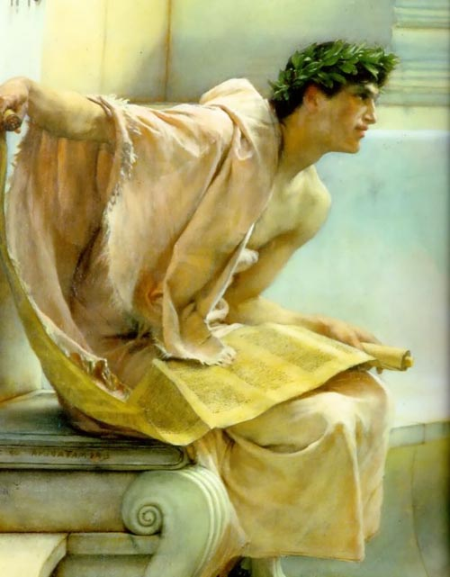
The Turning Away (Gal. 1:6-7 NLT)
"I am shocked that you are turning away so soon from God, who called you to himself through the loving mercy of Christ. You are following a different way that pretends to be the Good News ⁷but is not the Good News at all. You are being fooled by those who deliberately twist the truth concerning Christ."

Slide 103
The Turning Away (Gal. 1:8-9 NLT)
"Let God’s curse fall on anyone, including us or even an angel from heaven, who preaches a different kind of Good News than the one we preached to you. ⁹I say again what we have said before: If anyone preaches any other Good News than the one you welcomed, let that person be cursed."

Slide 104
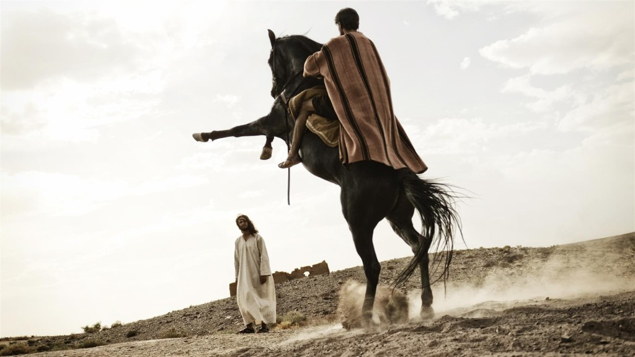
The Source of Paul's Teaching (1:12 NLT)
"I received my message from no human source, and no one taught me. Instead, I received it by direct revelation from Jesus Christ."
Notes:
Paul didn’t invent justification by faith by his own authority (1:10–2:21).
He was independent of other apostles by being called by Jesus alone (1:10-24).

Slide 105

The Source of Paul's Teaching (Acts 9:5b NLT)
"…I am Jesus, the one you are persecuting!"

Slide 106
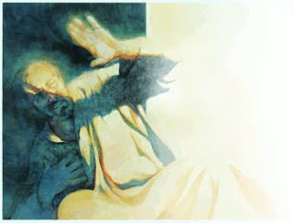
The Source of Paul's Teaching (1:15-16 NLT)
"But even before I was born, God chose me and called me by his marvelous grace. Then it pleased him ¹⁶to reveal his Son to me so that I would proclaim the Good News about Jesus to the Gentiles. When this happened, I did not rush out to consult with any human being."

Slide 107
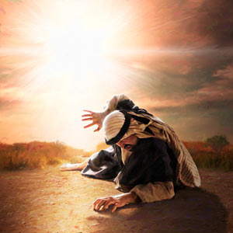
The Source of Paul's Teaching (1:17 NLT)
"Nor did I go up to Jerusalem to consult with those who were apostles before I was. Instead, I went away into Arabia, and later I returned to the city of Damascus."

Slide 108
Slides on Galatians 2
Notes:
He was interdependent with other apostles but approved by them (2:1-10).

Slide 109
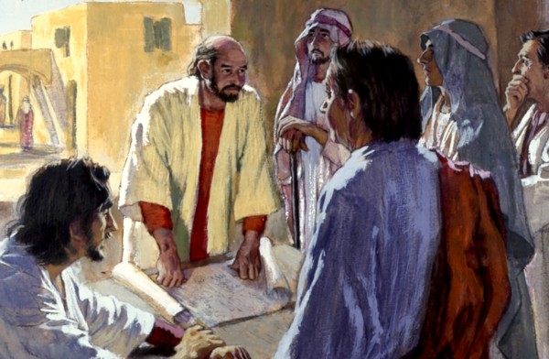
Partners, Not Teachers (2:9 NLT)
"In fact, James, Peter, and John, who were known as pillars of the church, recognized the gift God had given me, and they accepted Barnabas and me as their co-workers. They encouraged us to keep preaching to the Gentiles, while they continued their work with the Jews."

Slide 110
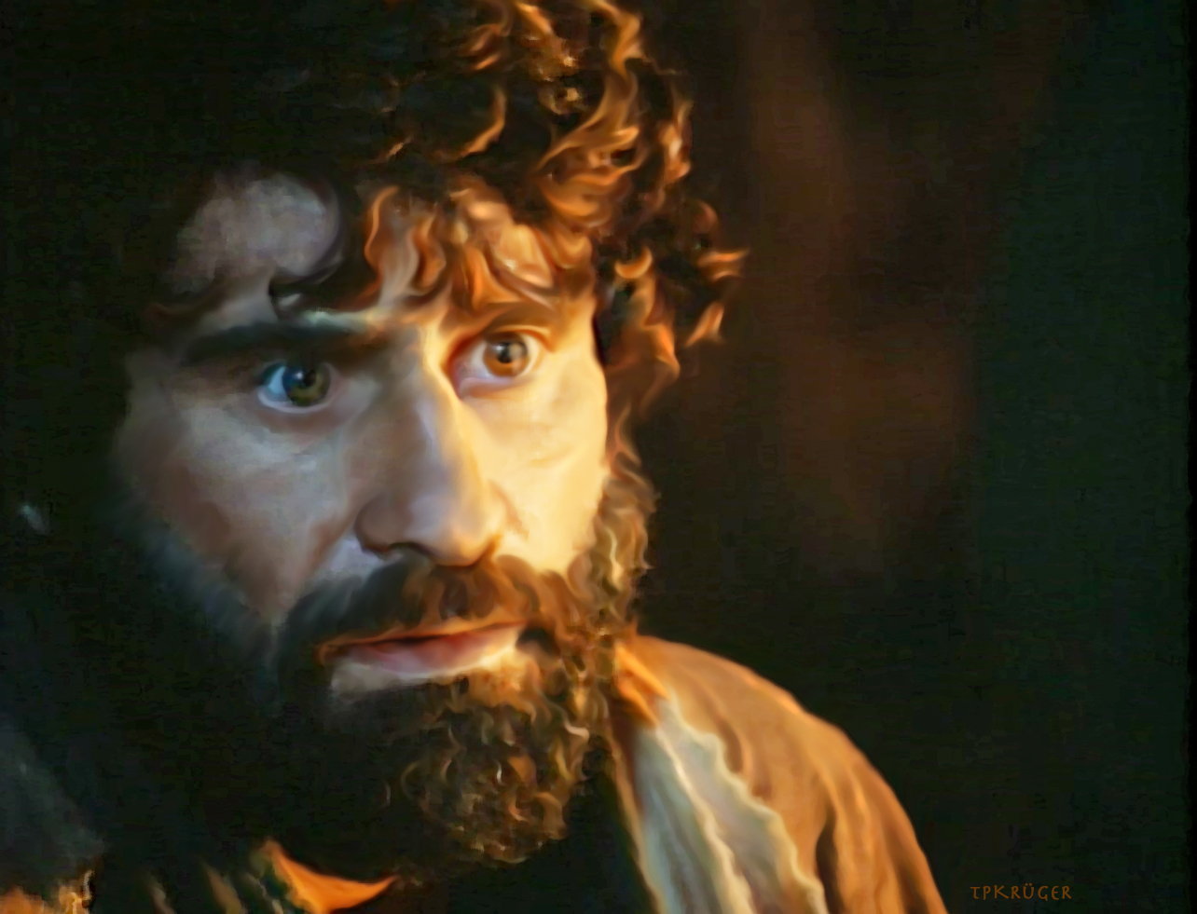
Was Peter beyond rebuke? Could this "pillar" of the church sin publicly?

Slide 111
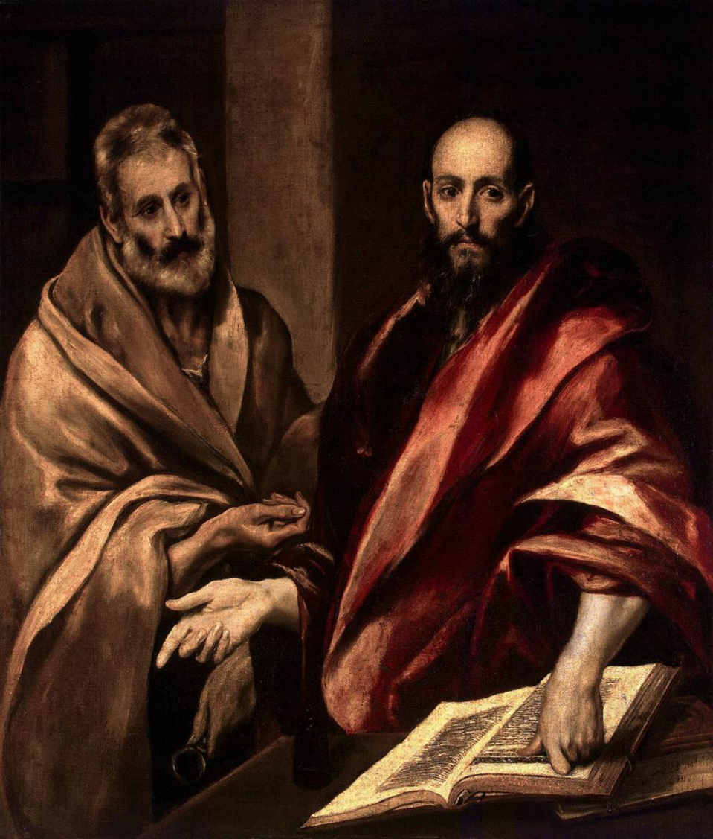
Paul rebuked Peter (2:11-12 NLT)
"But when Peter came to Antioch, I had to oppose him to his face, for what he did was very wrong. ¹²When he first arrived, he ate with the Gentile Christians, who were not circumcised. But afterward, when some friends of James came, Peter wouldn’t eat with the Gentiles anymore. He was afraid of criticism from these people who insisted on the necessity of circumcision."
Notes:
He indicted Peter when Peter publicly acted against justification by faith (2:11-21).

Slide 112
Key Verse
167
"[We Jews] know that a man is not justified by observing the law, but by faith in Jesus Christ. So we, too, have put our faith in Christ Jesus that we may be justified by faith in Christ and not by observing the law, because by observing the law no one will be justified"
(2:16).
Galatians

Slide 113
Why must salvation be by faith alone?
Paul gives 3 reasons

Slide 114
I. Jesus called Paul to teach salvation by faith (Gal 1–2).
Notes:
[Jesus himself appointed Paul to proclaim justification by faith as his defining doctrinal truth.]
[Personal: Paul defends his apostolic call to counter Judaizer teaching that Paul invented justification by faith.]

Slide 115
Book Chart
Justification by Faith
Judaizer Attack #1 "Paul teaches this doctrine by his own authority!" |  | Judaizer Attack #2 "This is a new teaching contrary to the OT!" |  | Judaizer Attack #3 "Teaching faith alone will encourage a sinful lifestyle!"
Paul's Defense: "God called me and the 12 apostles affirmed this" |  | Paul's Defense: "Salvation has always been by faith–even in the OT" |  | Paul's Defense: "No, justification by faith naturally leads to godly living"
Biographical |  | Theological |  | Practical
Chapters 1–2 |  | Chapters 3–4 |  | Chapters 5–6
Upholds Apostleship |  | Upholds Justification by Faith |  | Upholds Responsibilities
Rebuke | Relation-ships | Affirmed | Illustrated | Balance | Service | Warnings
1:1-9 | 1:10–2:21 | 3 | 4 | 5 | 6:1-10 | 6:11-18
Antioch of Syria
Fall AD 49 (after first missionary journey)
167

Slide 116
Slides on Galatians 3

Slide 117
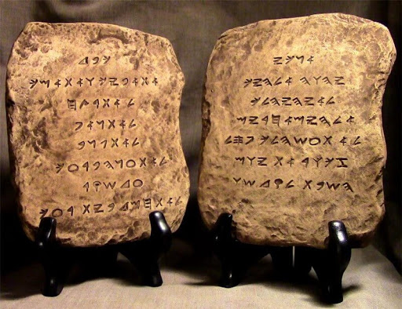
The Ten Commandments

Slide 118
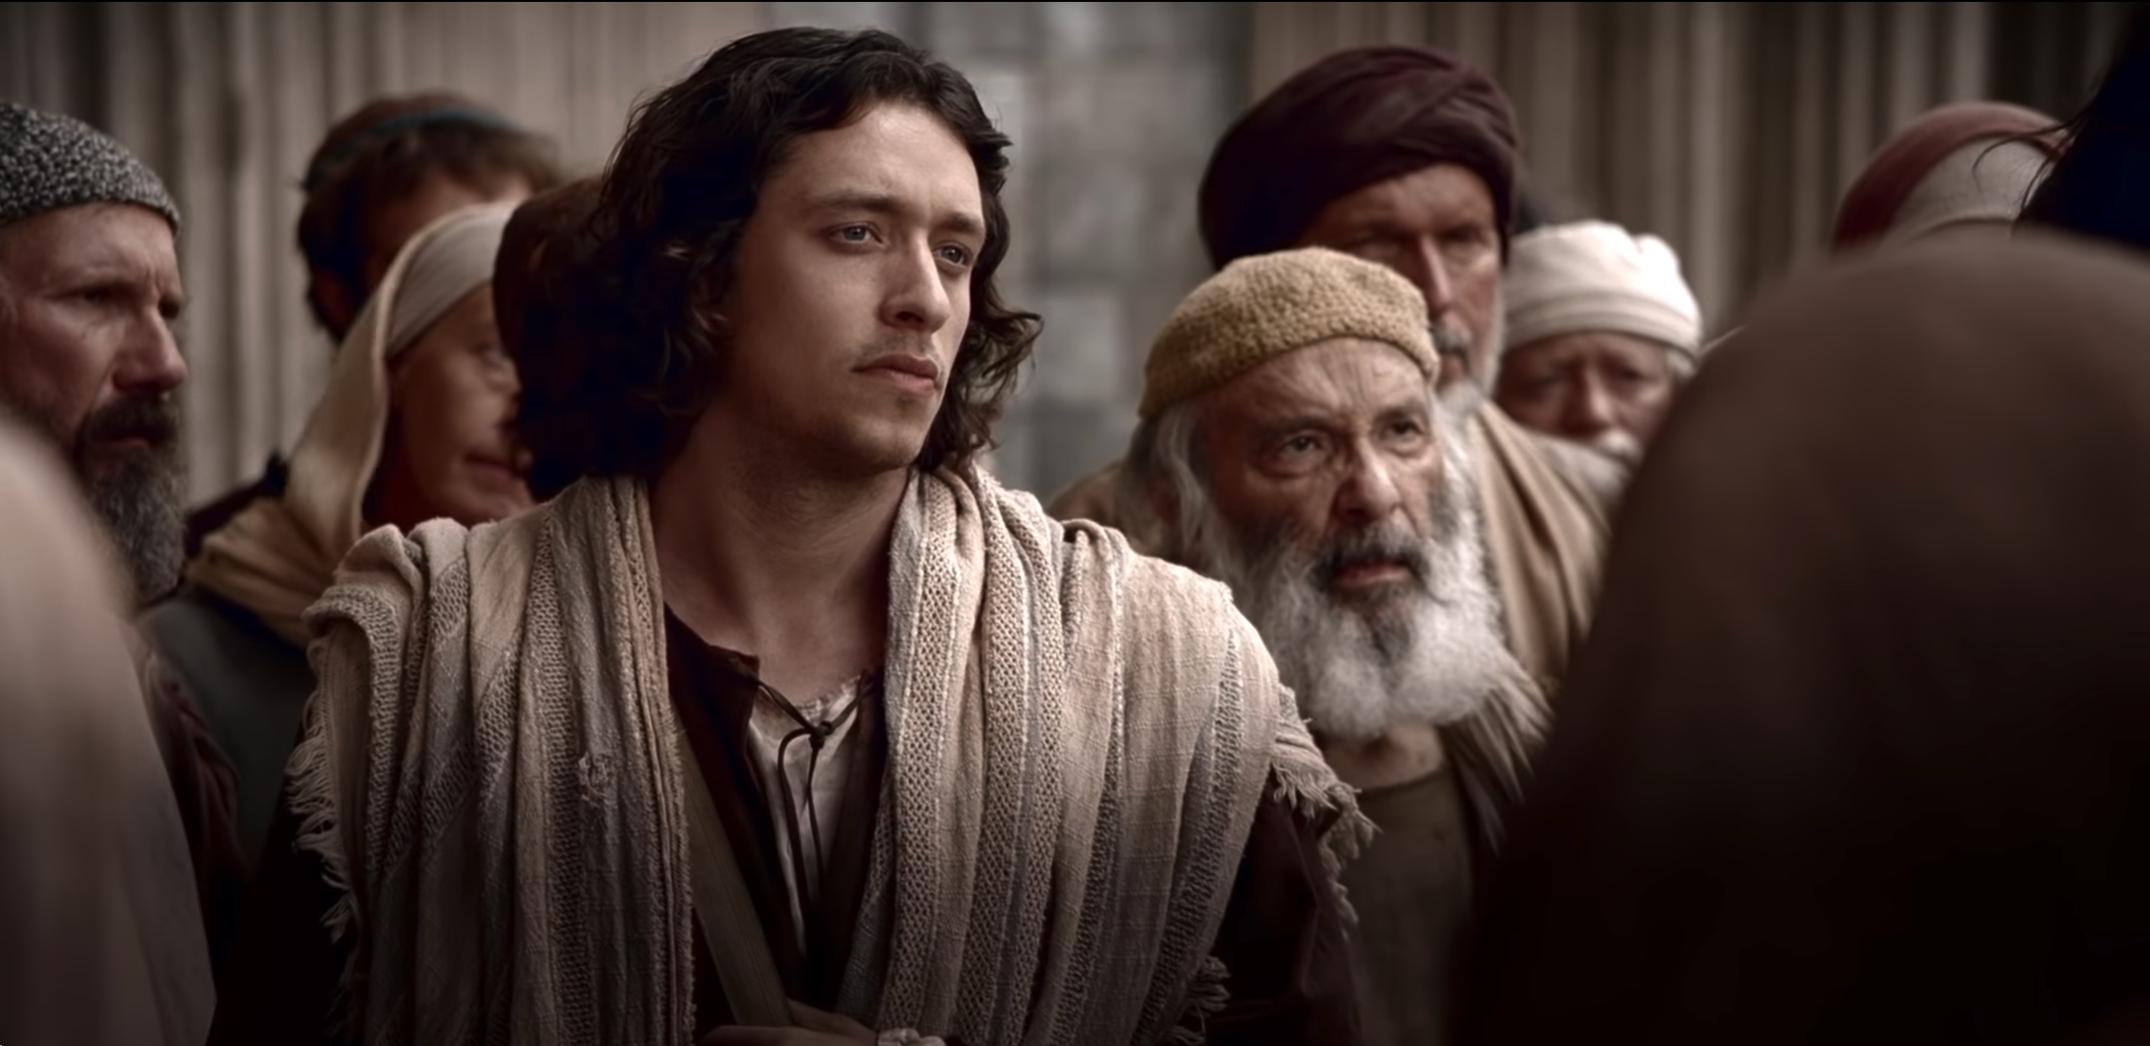
Should us Jews require the Gentiles to be circumcised and follow the law of Moses?

Slide 119
Paul versus Legalists
154k
Legalists
Paul
"The one who does righteousness stores up life for himself with the Lord"
Psalms of Solomon (about 50 BC)
"Miracles, however, will appear at their own time to those who are being saved by their works"
2 Baruch
(about AD 100)
"Let me ask you this one question: Did you receive the Holy Spirit by obeying the law of Moses? Of course not! You received the Spirit because you believed the message you heard about Christ."
(Gal. 3:2 NLT)

Slide 120
II. Salvation has always been by faith (Gal 3–4).
The Centrality of the Cross
B.C.
Faith looked forward to the Cross of Christ
A.D.
Faith looks back at the Cross of Christ
Notes:
[Whether Old Testament or new, we have always been put in the right relationship with God by simple trust.]
[Practical: Paul applies salvation by faith in Spirit-led living by exhorting balance and others-orientation.]
The foundation of salvation has always been the death of Christ—for believers before and after the cross. We must see the centrality of the cross—how people before Jesus believed by looking toward the cross while those of us after Jesus look back at the cross. In other words, the foundation of salvation has always been the death of Christ—for believers before and after the cross.
____________________
Common-198
BE-03-Leviticus-73
OB-37-Sacrifices-19
OB-38-Salvation-4
OS-03-Leviticus-193
NS-09-Galatians-16, 49, 118, 170
NS-20-James-32
SA-03-Biblical Terminology-10
SA-15-Inheritance-26
TP-01-Our Inheritance OT Summary-29

Slide 121
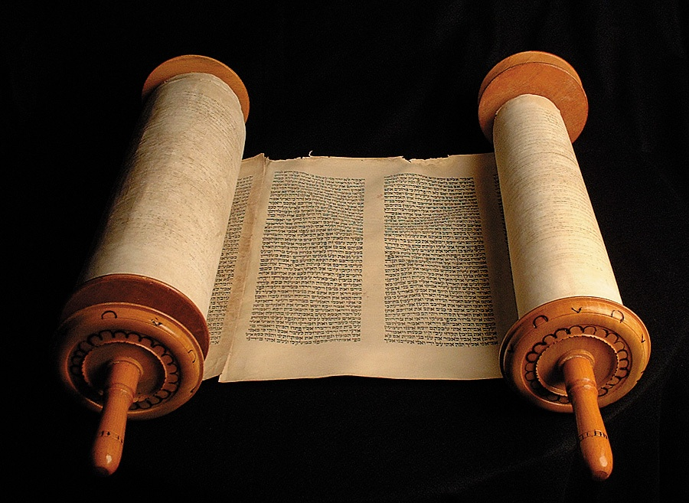
Why did God give the OT Law?
Notes:
Justification by faith instead of Law is seen in the superior Holy Spirit and Promise (Gal 3).
Both salvation and sanctification must be by the same means—faith (3:1-5).

Slide 122

Paul's Theological Argument (Gal. 3–4)
Paul defends justification by faith

Slide 123
Which is the Most Accurate?
174d
Salvation by…
Faith + Works
Faith Alone
Faith + Works
OT
Works
Faith Alone
Faith Alone
Faith + Works
NT
Faith
cf. OTS 121e

Slide 124

In Other Words…
153
Salvation has ALWAYS been through faith alone!

Slide 125
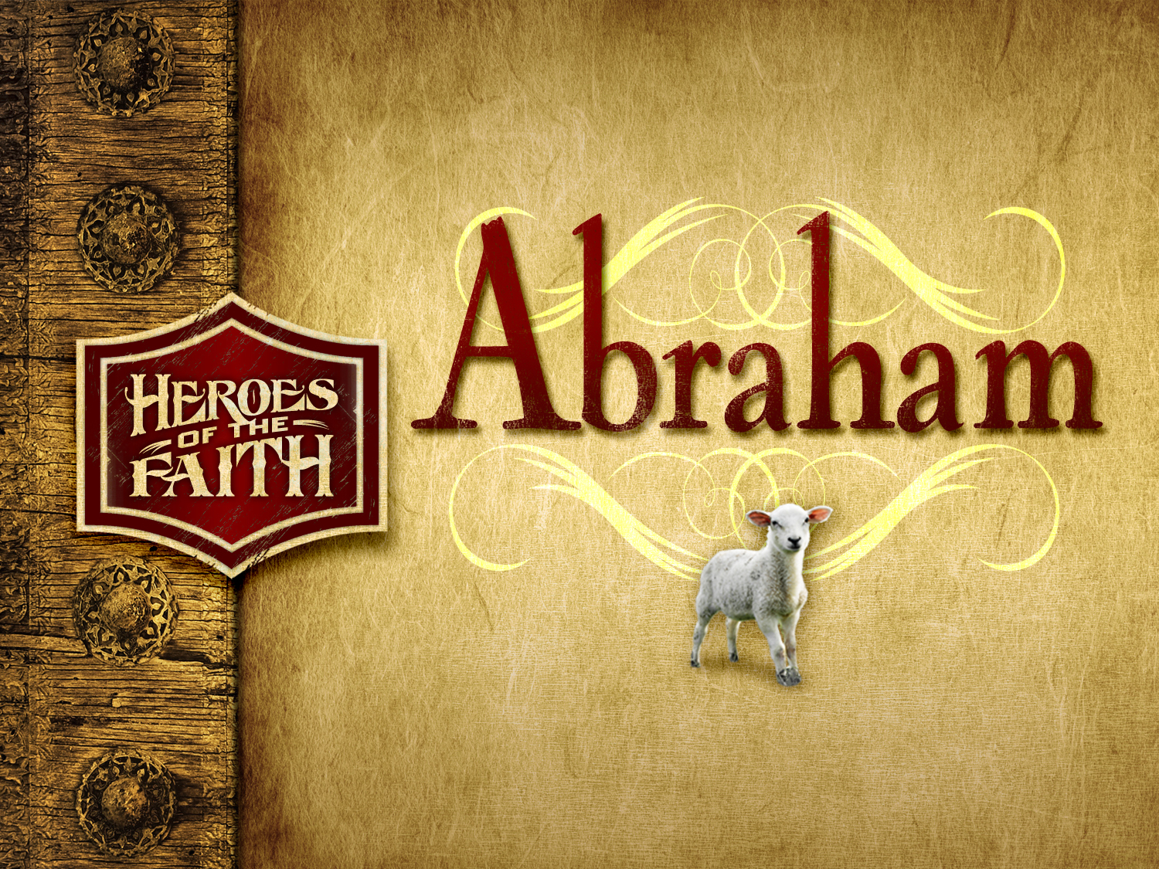

Abraham
Heroes of the Faith
Notes:
In Genesis 12 the account switches directions from discussing all peoples to zeroing in on one man and his family—the man Abraham.

Slide 126
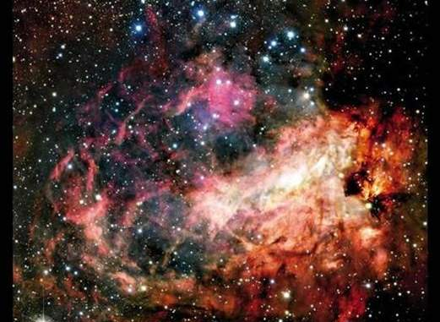
Genesis 15:5-6
153
Creation
[God took Abraham] outside and said, "Look up at the heavens and count the stars--if indeed you can count them." Then he said, "So shall your offspring be."
Abram believed the LORD, and he credited it to him as righteousness.

Slide 127
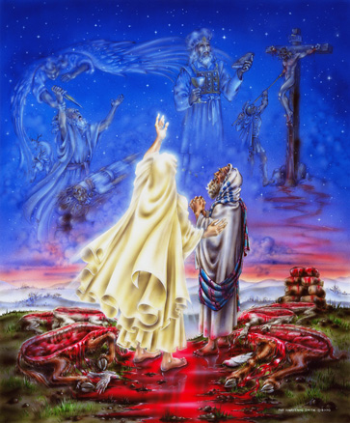

Genesis 15 Ratification
153
ROYAL LAND GRANT FORM OF THE ABRAHAMIC COVENANT
This painting inaccurately depicts Abram walking through the pieces

Slide 128
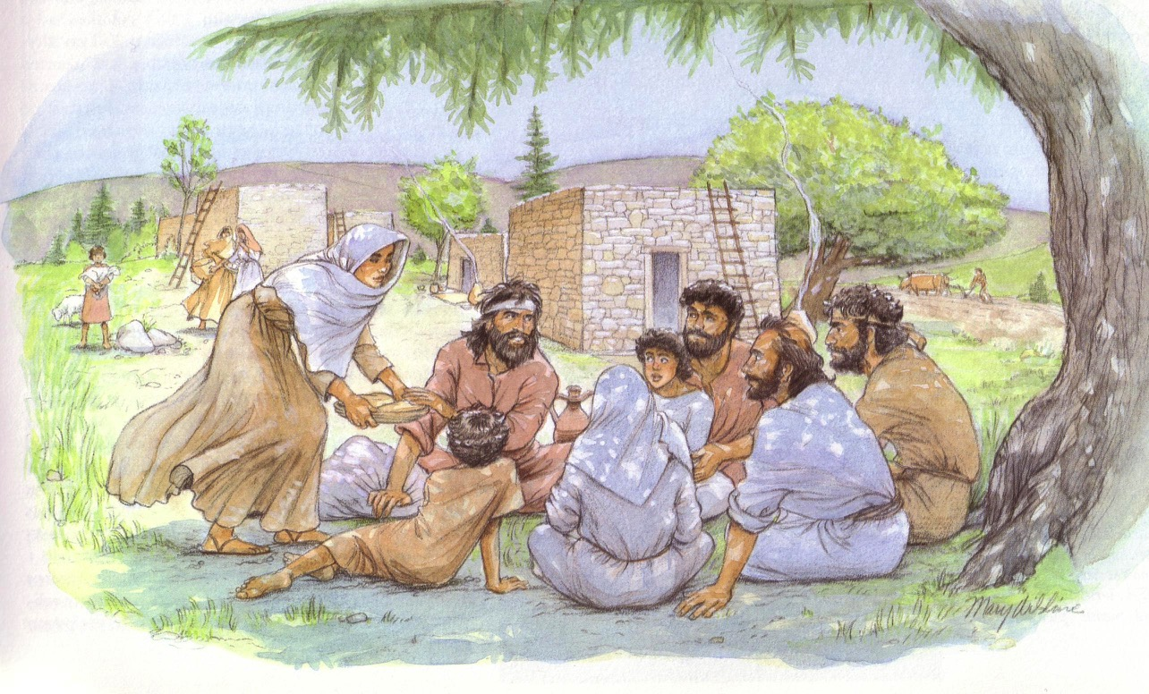
Galatians counters false teachers

Slide 129
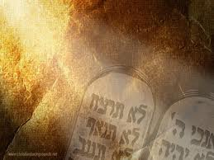
The Purposes of the Law
BS-110
OS-113
NS-155p
SA-36
It revealed or exposed the sinfulness of man (Gal. 3:19).
It revealed the holiness of God (1 Pet. 1:15).
It revealed the standard of holiness for people in fellowship with God (Ps. 24:3-5).
It supervised the physical, mental, and spiritual development of the redeemed Israelite until he could come to maturity in Christ (Gal. 3:24).
36
J. Dwight Pentecost, "The Purpose of the Law," Bib Sac 128 (July 1971): 227-33
Notes:
BS-28-Law of Moses-18-p110
OS-02-Exodus-240-p113
OS-05-Deut-106-p113
NS-06-Rom5-8-slide93-p155p
SA-08-Mosaic Law-20-p36

Slide 130
The Purposes of the Law
It unified the people to establish the nation in voluntary submission to God's decrees (Exod. 19:5-8; Deut. 5:27-28).
It separated Israel among the nations as a kingdom of priests to mediate God's truth to these nations (Exod. 31:13).
It provided forgiveness of sins for individual Israelites to restore their fellowship with God, even though they already functioned as a redeemed people (Lev. 1–7).
36
J. Dwight Pentecost, "The Purpose of the Law," Bib Sac 128 (July 1971): 227-33
Notes:
BS-28-Law of Moses-19-p110
OS-02-Exodus-241-p113
OS-05-Deut-107-p113
NS-06-Rom5-8-slide94-p155p
SA-08-Mosaic Law-21-p36

Slide 131
The Purposes of the Law
It made provision for Israel to worship God as a redeemed people (Lev. 23).
It tested if one was in the kingdom or the theocracy over which God ruled (Deut. 28). Faith led to obedience and blessing; lack of faith led to disobedience and judgment.
It revealed Jesus Christ (typology in the sacrificial system; Luke 24:27).
36
J. Dwight Pentecost, "The Purpose of the Law," Bib Sac 128 (July 1971): 227-33
Notes:
BS-28-Law of Moses-20-p110
OS-02-Exodus-242-p113
OS-05-Deut-108-p113
NS-06-Rom5-8-slide95-p155p
SA-08-Mosaic Law-22-p36

Slide 132
Interpreting and Preaching Legal Literature
1. Interpretation: Study the intent behind the legal command, asking, "Why was this command given in Israel?"
2. Principlizing: State the law's intent in a general principle showing God's character.
3. Application: Show how this principle relates to a modern parallel situation.
36
Notes:
BS-28-Law of Moses-21-p110
OS-02-Exodus-243-p113
OS-05-Deut-205-p113
NS-06-Rom5-8-slide96-p155p
SA-08-Mosaic Law-23-p36

Slide 133
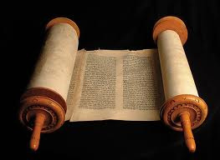
A Suggested Strategy for Expounding the OT Law
36
Principlizing: Universal truth
Interpretation: Intent behind the command
Application: Parallel Modern Situation
Notes:
BS-28-Law of Moses-22-p110
OS-02-Exodus-244-p113
OS-05-Deut-206-p113
NS-06-Rom5-8-slide97-p155p
SA-08-Mosaic Law-24-p36

Slide 134
A Suggested Strategy for Expounding the OT Law
36
Divinely Ordained Laziness?
"When you harvest the crops of your land, do not harvest the grain along the edges of your fields, and do not pick up what the harvesters drop. Leave it for the poor and the foreigners living among you. I am the LORD your God" (Lev. 23:22 NLT).
Notes:
BS-28-Law of Moses-23-p110
OS-02-Exodus-245-p113
OS-05-Deut-207-p113
NS-06-Rom5-8-slide98-p155p
SA-08-Mosaic Law-25-p36

Slide 135
A Suggested Strategy for Expounding the OT Law
36
Principlizing: God wants His people to give the underprivileged the chance to earn a living
Interpretation: Do not harvest the corners of the fields because God had compassion on the poor who should glean for their food
Application: As an employer you should provide opportunities for the poor to support themselves
Notes:
BS-28-Law of Moses-24-p110
OS-02-Exodus-246-p113
OS-05-Deut-208-p113
NS-06-Rom5-8-slide99-p155p
SA-08-Mosaic Law-26-p36

Slide 136
A Suggested Strategy for Expounding the OT Law
36
Divinely Ordained Stealing?
"When you enter your neighbor's vineyard, you may eat your fill of grapes, but you must not carry any away in a basket. ²⁵And when you enter your neighbor's field of grain, you may pluck the heads of grain with your hand, but you must not harvest it with a sickle" (Deut. 23:24-25 NLT).
Notes:
BS-28-Law of Moses-25-p110
OS-02-Exodus-247-p113
OS-05-Deut-209-p113
NS-06-Rom5-8-slide100-p155p
SA-08-Mosaic Law-27-p36

Slide 137
A Suggested Strategy for Expounding the OT Law
36
Principlizing: God allows taking small items for He cares more for human need than human property
Interpretation: Do not steal your neighbor's crops, but also don't be so fearful of stealing that you become ridiculous
Application: As a guest, don't be afraid to take the food given to you––but don't secretly pack a lunch or steal the towels!
Notes:
BS-28-Law of Moses-26-p110
OS-02-Exodus-248-p113
OS-05-Deut-210-p113
NS-06-Rom5-8-slide101-p155p
SA-08-Mosaic Law-28-p36

Slide 138
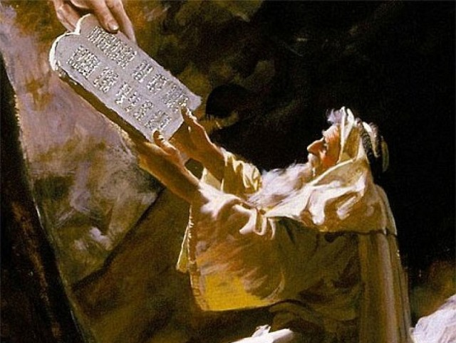
The heart of the Mosaic Covenant is the Ten Commandments
Notes:
OS-02-Exodus-250
OS-05-Deut-109
NS-06-Rom5-8-slide78
SA-08-Mosaic Law-29

Slide 139
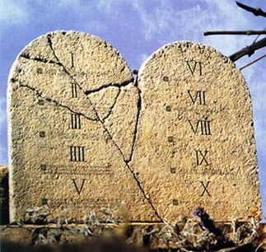
TRADITIONAL VIEW ON LAW
Ex. 25-31
155l
A Godly Education In Three Parts:
MORAL: The Ten Commandments; a basis for our current legal system.
CIVIL: How the people are to live with each other in the new social structure.
CEREMONIAL: How to worship God in the new social structure.
BUT ARE THE BIG 10 MORAL LAW?
MOSES
Exodus
Sinai
M - C - C
40
Handbook pg. 26-29
13
Notes:
BS-28-Law of Moses-07
OS-02-Exodus-251
OS-05-Deut-110
NS-06-Rom5-8-slide79
SA-08-Mosaic Law-30

Slide 140

Moral law means God's rules that apply to…
Every time period
Every culture
Every place
Every people
Notes:
BS-28-Law of Moses-07
OS-02-Exodus-252
OS-05-Deut-111
NS-06-Rom5-8-slide79
SA-08-Mosaic Law-31

Slide 141
Does the Law of Moses Apply to Me? (5 Views)
113c
Spectrum on Degree of Applicability:
Theonomic Greg Bahnsen | Reformed Willem VanGemeren | Weightier Issues Walter Kaiser | Modified Lutheran Douglas Moo | Dispensational Wayne G. Strickland
Law as not applicable in every sense
Law as applicable in every sense
This chart summarizes Stanley N. Gundry, ed. Five Views on Law and Gospel (Grand Rapids: Zondervan, 1996), where each author presents his view and responds to the other four views. Generally speaking, views 1-2 are similar as both are Reformed (stressing continuity between the NT and OT) and these stand against views 3-5 which alike stress discontinuity. In my opinion, the dispensational view has the most to commend it as law in the NT is never broken into component parts and this view clearly distinguishes Israel from the church. Further, it is inconsistent to change the Sabbath (Saturday) to Sunday but not apply the OT penalties for Sabbath-breaking today (i.e., death by stoning; cf. Exod. 31:14-15; 35:2). The following chart is adapted from Lee Hwee Chin, "The Applicability of the Law Today," unpublished research paper for the course "Old Testament Survey," Singapore: Singapore Bible College, 2001, 1.
Notes:
The NT does not specify how to apply OT law, so Christians disagree on how to do so. There are five major approaches to how Christians view the Mosaic Law's application.
__________________
Common-233
BS-28-Law of Moses-12
OS-02-Exodus-256
OS-05-Deut-115
NS-06-Rom5-8-slide80
NS-09-Gal-139
SA-08-Mosaic Law-33

Slide 142
Does the Law of Moses Apply to Me?
113b
Stanley N. Gundry, ed. Five Views on Law & Gospel summarized by Lee Hwee Chin, SBC, 2001
 | THEONOMIC Bahnsen | REFORMED Van Gemeren | WEIGHTIER ISSUES Kaiser | MODIFIED LUTHERAN Moo | DISPENSATIONAL Strickland
What is the Law? | Same definition as the views 3-5 | God's oral or written instructions since creation | The whole Mosaic law given in the Pentateuch (Genesis to Deuteronomy) but also amplified in the rest of the Old Testament
Who is the Law for? | The Elect (Israel = Church) | All mankind (Israel = Church) | Believers (Israel and Church) | Believers (Israel and Church) | Israel only (Israel ≠ Church)
Notes:
142
The NT does not specifically say how to apply the OT law, so Christians disagree on how to do this. There exist at least five major approaches to how Christians see the Mosaic Law applying today.
_______
Common-235
BS-28-Law of Moses-12
OS-02-Exodus-256
OS-05-Deut-115
NS-06-Rom5-8-slide80
NS-09-Gal-139
SA-08-Mosaic Law-32

Slide 143
Does the Law of Moses Apply to Me?
113b
Stanley N. Gundry, ed. Five Views on Law & Gospel summarized by Lee Hwee Chin, SBC, 2001
 | THEONOMIC Bahnsen | REFORMED Van Gemeren | WEIGHTIER ISSUES Kaiser | MODIFIED LUTHERAN Moo | DISPENSATIONAL Strickland
Which parts of the Law apply today? • "Moral law"? (i.e., Decalogue or 10 Command-ments) | All moral laws apply to people of God only in every age, so all elect persons since creation should observe either the Jewish Sabbath (Sat. before Christ) or "Christian Sabbath," (Sunday, after Christ) | All moral laws apply to believers and unbelievers of every age (e.g., all persons–including unbelieving Gentiles since creation–should observe the Sabbath or "Christian Sabbath," being Sunday) | All moral laws that stem from God's character: • 10 Command-ments • Leviticus 18–19 (sex) (i.e., Sabbath is required since Israel's nationhood & prohibited sexual practices still apply) | The Mosaic Law is fully abolished, but its moral content are good Christian guidelines. Yet Christ holds the final say via the Spirit's ministry in believers today; Sabbath obedience is not consistently applied (?) | God's "moral law" before Moses is now called the "law of Christ" (Gal. 6:2) and governs believers through the Spirit's new covenant indwelling; The Law does not easily divide into "parts" and is done away with in its entirety (Rom. 7:1-6; 1 Cor. 9:19-21; Heb. 8:13), including the Sabbath (Col. 2:16-17)
Notes:
143
The NT does not specifically say how to apply the OT law, so Christians disagree on how to do this. There exist at least five major approaches to how Christians see the Mosaic Law applying today.
_______
Common-236
BS-28-Law of Moses-12
OS-02-Exodus-256
OS-05-Deut-115
NS-06-Rom5-8-slide80
NS-09-Gal-139
SA-08-Mosaic Law-32

Slide 144
Does the Law of Moses Apply to Me?
113b
Stanley N. Gundry, ed. Five Views on Law & Gospel summarized by Lee Hwee Chin, SBC, 2001
 | THEONOMIC Bahnsen | REFORMED Van Gemeren | WEIGHTIER ISSUES Kaiser | MODIFIED LUTHERAN Moo | DISPENSATIONAL Strickland
• Civil laws? (i.e., judicial law) | All apply (e.g., laws today should require death for adultery) | Some apply (e.g., still tithe and don't charge believers interest) | Judicial principles (not laws) apply since moral laws underlie all judicial and ceremon-ial laws | Only principles apply now as the Mosaic law was given only to Israel | None apply as these regulated Israel alone (but principles such as love and compassion still apply)
• Cere-monial laws? | All five views agree that ceremonial aspects such as the sacrificial system and Jewish priesthood are now fulfilled in Jesus Christ
Notes:
144
The NT does not specifically say how to apply the OT law, so Christians disagree on how to do this. There exist at least five major approaches to how Christians see the Mosaic Law applying today.
_______
Common-237
BS-28-Law of Moses-12
OS-02-Exodus-256
OS-05-Deut-115
NS-06-Rom5-8-slide80
NS-09-Gal-139
SA-08-Mosaic Law-32

Slide 145
Does the Law of Moses Apply to Me?
113b
Stanley N. Gundry, ed. Five Views on Law & Gospel summarized by Lee Hwee Chin, SBC, 2001
 | THEONOMIC Bahnsen | REFORMED Van Gemeren | WEIGHTIER ISSUES Kaiser | MODIFIED LUTHERAN Moo | DISPENSATIONAL Strickland
What is the relation-ship of the Abrahamic Covenant to Mosaic Covenant? | Both are God's "covenant of grace." They consist of the same substance of God's saving relation-ship which makes the MC still apply today | MC was added to the AC; both still apply though they are similar in substance but different in form and purpose | MC was given specifically to Israel but its moral principles are still relevant to all believers under the AC | Like dispensa-tionalists, MC was conditional but AC was not; MC was a temporary framework that prescribed terms of obedience for Israel in Law period | MC regulated Israel's life so she could experience the blessings of the AC, but MC is no longer operative as it is fulfilled in Christ
Notes:
145
The NT does not specifically say how to apply the OT law, so Christians disagree on how to do this. There exist at least five major approaches to how Christians see the Mosaic Law applying today.
_______
Common-238
BS-28-Law of Moses-12
OS-02-Exodus-256
OS-05-Deut-115
NS-06-Rom5-8-slide80
NS-09-Gal-139
SA-08-Mosaic Law-32

Slide 146
Does the Law of Moses Apply to Me?
113c
Stanley N. Gundry, ed. Five Views on Law & Gospel summarized by Lee Hwee Chin, SBC, 2001
 | THEONOMIC Bahnsen | REFORMED Van Gemeren | WEIGHTIER ISSUES Kaiser | MODIFIED LUTHERAN Moo | DISPENSATIONAL Strickland
Strengths | • Continuity between the OT and NT upheld • Desires ethics to relate to all of life • Sees positive aspects of the law | • Continuity between the OT and NT upheld • Notes Mosaic law's foreshadow-ing of Christ • Sees a convicting role of the law today for unbelievers | • Biblical support for some law aspects (i.e., moral) being weightier than others (Matt. 23:23) • Holiness Code of Leviticus 18–19 stem from nature of God | • Accounts for new covenant emphases under the Law of Christ (Gal. 6:2) • Says OT laws repeated in the NT are applicable • Applies law principles today | • Biblical in that Mosaic law began at Sinai and ended with Christ's death as a temporary tutor (Gal. 3:19, 24-25) • Keeps Israel and church separate • Advocates continued guidance in law of Christ
Notes:
146
The NT does not specifically say how to apply the OT law, so Christians disagree on how to do this. There exist at least five major approaches to how Christians see the Mosaic Law applying today.
_______
Common-239
BS-28-Law of Moses-12
OS-02-Exodus-256
OS-05-Deut-115
NS-06-Rom5-8-slide80
NS-09-Gal-139
SA-08-Mosaic Law-32

Slide 147
Does the Law of Moses Apply to Me?
113c
Stanley N. Gundry, ed. Five Views on Law & Gospel summarized by Lee Hwee Chin, SBC, 2001
 | THEONOMIC Bahnsen | REFORMED Van Gemeren | WEIGHTIER ISSUES Kaiser | MODIFIED LUTHERAN Moo | DISPENSATIONAL Strickland
Weak-nesses | • Dividing law as moral, civil & ceremonial not biblical • Misguided to apply godly commands to unregenerate • All "law" need not be Mosaic (natural law and law of Christ also exist) • The NT never applies the OT to civil matters • Law condemned man (2 Cor. 3:9) | • Dividing law as moral, civil & ceremonial not biblical • Using "law" in differing ways is inconsistent & confusing • Requiring Sabbath for today contradicts Col. 2:16-17 • Unclear if moral law became law of Christ • Merges Israel & church | • Dividing law as moral, civil & ceremonial not biblical • Arbitrary to pick and choose which parts of the law are required • Choice of Decalogue and Lev. 18–19 too narrow for moral law | • Seeks to teach the indivisibility of the law while upholding its moral content • Too extreme to claim that the law has absolutely no purpose today • Fails to see the gospel in the OT by demarcating Law and Gospel into distinct, discontinuous eras | • Distinguishing law's revelatory aspects (eternal, revealing God's nature) from regulatory (temporary, ruled Israel) makes distinctions within an inseparable code–if the OT law is essentially a unity, then why divide it into two parts? • The law is not nullified but actually upheld by faith (Rom. 3:31)
Notes:
147
The NT does not specifically say how to apply the OT law, so Christians disagree on how to do this. There exist at least five major approaches to how Christians see the Mosaic Law applying today.
_______
Common-240
BS-28-Law of Moses-12
OS-02-Exodus-256
OS-05-Deut-115
NS-06-Rom5-8-slide80
NS-09-Gal-139
SA-08-Mosaic Law-32

Slide 148

"Old" Replaced by "New"
NTS 266hh
Wayne Grudem, Systematic Theology, 521
"What then is the 'old covenant' in contrast with the 'new covenant' in Christ? It is not the whole of the Old Testament, because the covenants with Abraham and David are never called 'old' in the New Testament. Rather, only the covenant under Moses, the covenant made at Mount Sinai (Ex. 19-24) is called the 'old covenant' (2 Cor. 3:14; cf. Heb. 8:6, 13), to be replaced by the "new covenant" in Christ (Luke 22:20; 1 Cor. 11:25; 2 Cor. 3:6; Heb. 8:8, 13; 9:15; 12:24)."
Notes:
What covenant does Jesus mediate that is far better than the old (8:6)?
_____________
Common English-73
CH-02-Nature, etc.-104
OS-02-Exodus-359
OS-24-Jeremiah-173
NS-08-2 Corinthians-41
NS-09-Galatians-142
NS-19-Hebrews-298
FU-05-Biblical Covenants-34
SA-08-Mosaic Law-20

Slide 149
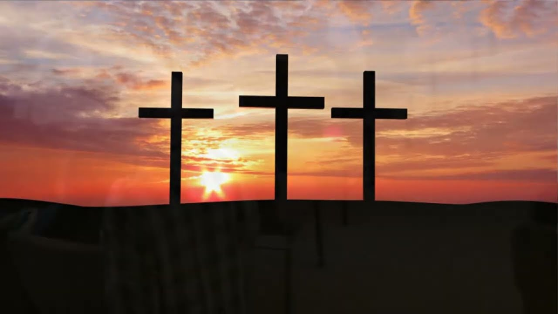
Galatians 3:13-14 ESV
¹³ Christ redeemed us from the curse of the law by becoming a curse for us—for it is written, “Cursed is everyone who is hanged on a tree”—¹⁴ so that in Christ Jesus the blessing of Abraham might come to the Gentiles so that we might receive the promised Spirit through faith.

Slide 150
“’The promises were spoken to Abraham and to his seed. The Scripture does not say “and to seeds,’ meaning many people, but ‘and to your seed,’ meaning one person, who is Christ" (Gal 3:16 NIV).
“The stress on seed (cf. Gen. 12:7; 13:15; 24:7), not seeds, was made simply to remind the readers that the faithful in Israel had always recognized that blessing would ultimately come through a single individual, the Messiah (cf. Gal. 3:19).” —Campbell, BKC, 2:598
Notes:
The context does not relate to the land but to the one who will fulfill the Abrahamic covenant.

Slide 151
Kingdom & Covenants Timeline
9g
CH-34a
OS1-22
OS2-337
NS-9g
SA-19
34a
Dr. Rick Griffith • BibleStudyDownloads.org
22
Kingdom Teaching...
Adam rules with God (Gen. 1:26, 28; 2:19)
Satan begins rule as god of this world (Gen. 3:15;
2 Cor. 4:4)
God covenants with Abraham to reestablish man's rule via Israel as a "kingdom of priests" (Gen. 12:1-3; Exod. 19:6)
Israel's failure to witness to nations as a kingdom of priests is judged via exile under foreign rule
Israel rejects Messiah's offer of kingdom (Matt. 12:41-42; 23:37-39)
Jesus extends His kingdom in mystery form to the Church (Matt. 13)
Christ subdues Israel's enemies and nation believes (Rom. 11:26-27)
Christ rules over everything with saints (Eph. 1:9-10; Rev. 20:1-6; 22:5b)
337
9g
Fall of Man (Gen. 3)
Noahic Covenant
19
Genesis 6:18; 9:8-17
Land Covenant
ISRAEL
CHURCH
MESSIANIC KINGDOM
(National Focus)
The "New Man" (Eph. 2:15)
Millennial Eternal
land
Genesis 15:18 (cf. Deut. 30:1-10) promises:
Land from Wadi of Egypt to Euphrates River (Isa. 27:12)
Eternal possession of land (Gen. 17:8) after exile/restoration
Whole world blessed via the land (Isa. 14:1-2)
Israel judged for rejecting Messiah by dispersion away from land for 19 centuries
(AD 70–AD 1948) but now partially restored (Ezek. 37:1-7)
Full restoration (Ezek. 37:8-28) Jerusalem world capital
(Isa. 2:1-5)
New Jerusalem
(Rev. 21–22)
Davidic Covenant
Christ is Head over His Church, which is a spiritual temple (Eph. 2:19-22; 2 Cor. 6:16)
Christ reigns over the world
(Isa. 11)
with saints (Rev. 5:10; 20:4-6)
Christ hands kingdom over to Father (1
Cor. 15:24)
Genesis 12:1-3
2 Samuel 7:12-16 promises:
Sons ("house" never wiped out)
Kingdom (political dynasty)
Throne (right to rule by descendants)
Temple (son to build it)
"Why, then, was the law given? It was given alongside the promise to show people their sins. But the law was designed to last only until the coming of the child who was promised" (Gal. 3:19 NLT).
seed
Abrahamic Covenant
New Covenant
All
things made new!
(Rev. 21:5)
All 5 elements fulfilled in national restoration (Zech. 8)
Jeremiah 31:31-34 promises:
Forgiveness
Indwelling Spirit
New heart, nature, mind
Reunification of Israel and Judah
No need for evangelism
Mosaic Law replaced with first three elements of the New Covenant (Luke 22:20; 2 Cor. 3:6)
blessing
Mosaic Covenant
Law abolished, fulfilled, and replaced at the cross (Rom. 7:1-6; 1 Cor. 9:19-21; Heb. 8:13)
10th Edition
10 Nov 2020
Temporary (Gal. 3:19) and conditional (Deut. 28) to reveal sin (Rom. 7:7) and regulate Israel (Gal. 3:23-25)
Scripture has a dual kingdom-covenant theme. Israel's role from Abraham to Christ expands to include the Church (continuity) yet the Church never replaces the nation as the "new Israel" (discontinuity). Israel will enjoy world prominence after trusting Christ at His second coming.
Notes:
Salvation was by faith 430 years before the Law led to faith by revealing sin (3:15-29).
Galatians 3:17 notes that the promise to Abraham came 430 years before the Mosaic Covenant.
All agree that a partial fulfillment of the covenant to Abraham exists now to the Church in the indwelling Holy Spirit and forgiveness of sins (Jer 31:31-34)—and the ultimate fulfillment will be in the eternal state.
The main area of disagreement relates to the time period from now to eternity. Will there be a literal land, throne, and worldwide blessing to national (ethnic) Israel before the eternal kingdom? This chart shows verses giving a resounding YES to that question in a present partial fulfillment and a future full fulfillment in the normal sense of language in the verses cited. But the messianic kingdom will be in two stages—first in a millennial fulfillment to last 1000 years, but then, after that, the eternal stage in the new Jerusalem after the destruction of our present heavens and earth (Rev 21–22). What an amazing future remains for those who trust Jesus!
____________
Common English-7
CH-02-Nature-103-p34a
OS-02-Exodus-267-p22
OS-05-Deut-248-p22
OS-10-2Sam-96-p22
OS-24-Jeremiah-174-p337
OS-23-Isaiah-97-p337
NS-09-Gal-143-p9g
NS-19-Hebrews-319-p9g
SA-08-Mosaic Law-19-p38a

Slide 152
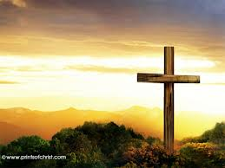
Galatians 3:26-27 NLT
06/08/13
"For you are all children of God through faith in Christ Jesus. ²⁷And all who have been united with Christ in baptism have put on Christ, like putting on new clothes."

Slide 153

Galatians 3:28 NLT
"There is no longer Jew or Gentile, slave or free, male and female. For you are all one in Christ Jesus."

Slide 154

Galatians 3:29 NIV
"If you belong to Christ, then you are Abraham’s seed, and heirs according to the promise."

Slide 155


Contrasting Two Key Covenants
116
 | Abrahamic | Mosaic
Recipient (Date & Place) | Abraham as mediator for all nations in 2060 BC at Ur of the Chaldees | Moses as mediator for Israel in 1445 BC at Mount Sinai
Scripture | Genesis 12:1-3 (but formalized into a covenant in Genesis 15) | Exodus 20–31 is the heart of the covenant
Between God & | A person (for a future nation) | A nation
Scope | Universal ("all peoples will be blessed through you") | Only Israel received the Law (Deut. 4:8; Ps. 147:20)
Notes:
BE-02-Exodus-106
OS-02-Exodus-276
NS-09-Galatians-149

Slide 156
Contrasting Two Key Covenants
116
 | Abrahamic | Mosaic
Promises | Land, seed, and blessing (without indication of time of fulfillment) | Blessing for obedience and cursing for disobedience (Lev. 26; Deut. 28)
Conditions | Unconditional: "I will…" | Conditional: "If you will…then I will…"
Partici-pation | Abraham asleep (Gen. 15:17) | Israel agreed to obey (Exod. 19:8)
Analogy | Father to son (royal grant) | Suzerain (superior king) to vassal (servant nation)
Notes:
BE-02-Exodus-107
OS-02-Exodus-277
NS-09-Galatians-150

Slide 157
Contrasting Two Key Covenants
116
 | Abrahamic | Mosaic
Form | Oral (no written stipulations) | Written on tablets of stone & Pentateuch
Emphasis | Blessing over discipline/judgment (five "blessings" in Gen. 12:1-3) | Judgment/discipline over blessing (contrast Deut. 28:1-14 & 28:15-68)
Christ | Ultimate seed (Gen. 12:3) | Typified in tabernacle (Heb. 8–10)
Sign | Circumcision (Gen. 17:11) | Sabbath (Exod. 31:13, 17)
Notes:
BE-02-Exodus-108
OS-02-Exodus-278
NS-09-Galatians-151

Slide 158
Slides on Galatians 4
Notes:
Illustrations of justification by faith should convince the Galatians to abandon legalism (Gal 4).

Slide 159

"Think of it this way. If a father dies and leaves an inheritance for his young children, those children are not much better off than slaves until they grow up, even though they actually own everything their father had" (Galatians 4:1 NLT).

Slide 160

"They have to obey their guardians until they reach whatever age their father set. ³And that’s the way it was with us before Christ came. We were like children; we were slaves to the basic spiritual principles of this world" (Gal 4:2-3 NLT).
Notes:
“4:3. Paul applied the illustration in order to show the contrast between the believers’ former position and what they now enjoyed. Formerly, in their state of spiritual immaturity (when we were children, nh/pioi), they were like slaves. The scope of that slavery was described as being under the basic principles (stoicei√a, “elements”) of the world. Though often interpreted as a reference to the Mosaic Law, this view does not fit the Galatians, most of whom were Gentile pagans before conversion and were never under the Law. It seems better to understand the “basic principles” to refer to the elementary stages of religious experience, whether of Jews under the Law or Gentiles in bondage to heathen religions (cf. “weak and miserable principles” in v. 9, and “basic principles of this world” in Col. 2:20) Thus all were enslaved until Christ emancipated them” (Donald K. Campbell, “Galatians,” in The Bible Knowledge Commentary, 2:601).

Slide 161
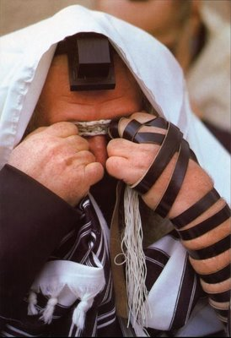
"We were slaves to the basic spiritual principles of this world" (Gal 4:3b NLT).
Is this the Mosaic Law or man’s ceremonial religion?
Notes:
It actually seems to refer to both! It is a broader way of saying that the incarnation (God becoming flesh in the next verse) allowed Jesus to fulfill the Law (cf. Matt 5:17). So we are no longer slaves to obey the OT commandments given to Israel, such as circumcision (5:1-4).
But we are also no longer slaves to Gentile religious demands either, such as salvation by works that Paul fights in Galatians.

Slide 162
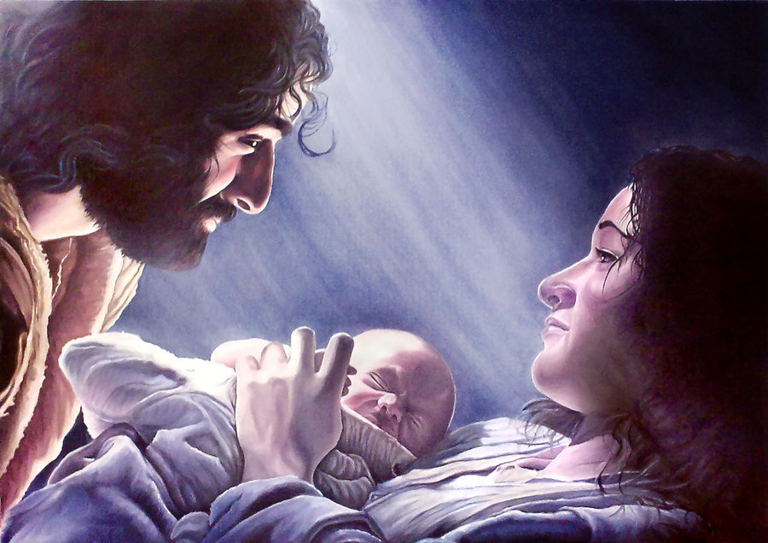
"But when the right time came, God sent his Son, born of a woman, subject to the law" (Gal 4:4 NLT).
Notes:
God’s timing is always perfect. He prepared the world perfectly up to that very first Christmas night! Jesus was not conceived by a man since he was virgin born, but he was born of a woman. In this verse we see the two natures of Christ: his deity as the Son of God (“God sent his Son”) and his humanity as the son of a woman. In this dual sense he was subject to the Mosaic Law in his humanity, yet in his deity he was able to deliver us all from slavery to the Law as in the next verse…

Slide 163
"God sent him to buy freedom for us who were slaves to the law, so that he could adopt us as his very own children" (Gal 4:5 NLT).
Two reasons “God sent his son” (4:4):
To redeem us from slavery to the Mosaic Law
To give us “the full rights of sons” (NIV)
Notes:
“4:5. The reasons “God sent His Son” are twofold (again both reasons are introduced by iºna, “in order that”; cf. 3:14). First, He came to redeem (e˙xagora¿shØ) those under Law. This is not a redemption from the curse of the Law (as in 3:13), but from a slavery to the entire Mosaic system. The emphasis is not on the penalty of the Law as in 3:13, but on its bondage. Since Christ redeemed and set free those who were under the Law, why should Gentile converts now wish to be placed under it? Second, Christ’s Incarnation and death secured for believers the full rights of sons (“the adoption of sons,” kjv). All the enjoyments and privileges of a mature son in a family belong to those who have entered into the benefits of Christ’s redemptive work” (Donald K. Campbell, “Galatians,” in The Bible Knowledge Commentary, 2:601).

Slide 164
The Intertestamental Era (425 BC—5 BC)
10
Issue /
Time Period
Malachi
(close of OT)
Intertestamental Era
Advent of Christ
Rulers Over Israel
Persia
(208 yrs.)
Greeks (188 yrs.)
Hasmoneans (80 yrs.)
Rome
(58 yrs.)
Political Stability
Peace / autonomy
Many wars
(Dan. 11:1-35)
Peace (but via Rome!)
Expectation of Messiah & Kingdom
Moderate
Increasing
“Two Messiahs”
High
Language in Palestine
Hebrew / Aramaic
Greek (Septuagint)
Aramaic / Greek / Latin

Slide 165
The Intertestamental Era (3 slides)
The Intertestamental Era (425 BC—5 BC)
10
Issue /
Time Period
Malachi
(close of OT)
Intertestament Era
Advent of Christ
Ability to Evangelize
Limited
Increased
Extensive
Road System
Very Limited
Expanded
Extensive
Places of Worship
Temple only
Rise of Synagogues
Synagogues / Temple
Religious Leaders
Priests/Levites
Rise of Jewish Sects
Pharisees / Sadducees

Slide 166
The Intertestamental Era
The Intertestamental Era (425 BC—5 BC)
10
Issue /
Time Period
Malachi
(close of OT)
Intertestament Era
Advent of Christ
Priesthood achieved by . . .
Genealogy
Fighting illegitimate high priest
Bribes / Executions
Extent of Power
Local Jurisdiction
Rise of Sanhedrin
Corrupt Sanhedrin
Hermeneutic
Literal
Instable + Apocalyptic
Letterism
Authority
OT Law
Rise of Oral Law
Pharisees

Slide 167
The “Kingdom Stage” is Set!
10
The time was right:
Galatians 4:4 NIV
“But when the time had fully come, God sent his Son, born of a woman, born under law, to redeem those under law, that we might receive the full rights of sons.”
Politically
Prophetically
(Dan. 9:25-26)
Linguistically
Emotionally
Religiously
Transportationally

Slide 168
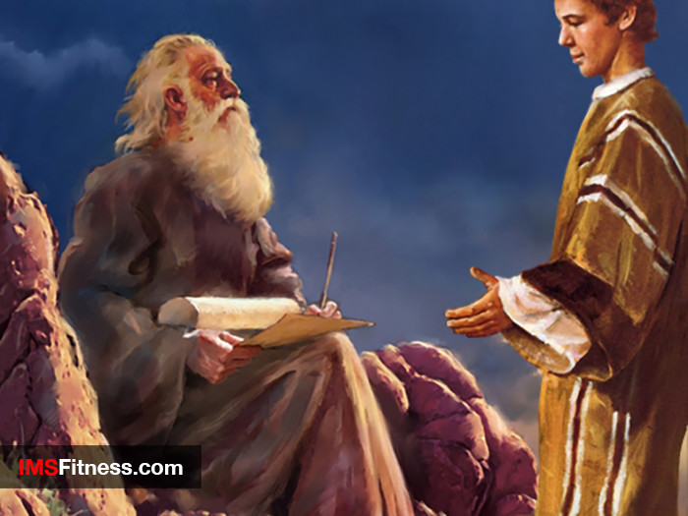
No longer slaves
Notes:
The Law was a tutor to lead us to Jesus (cf. Gal 3:24-25), so at Christmas we celebrate his coming to free us from the Law. Just a tutor fulfills his purpose once the student grows into adulthood, so now we lay aside the Law as grown sons ready to receive our rights as sons!

Slide 169
Infant | Grown Son
Under guardian (Law) | Enjoys son-with-father relationship (redeemed)
Status: like a slave with rights of sonship not realized | Status: son and heir with full rights given
Under bondage: external authority of the Law | Free: internal authority of the Spirit of God
Immature: in elementary school of the Law with external motivation | Mature: in secondary school of the Spirit with internal motivation
173c
Ceremonial vs. True Religion (Gal. 4:1-7)
Paul A. Pomerville, Galatians & Romans (Brussels: ICI, 1976), 95
Notes:
A son’s privileges over a slave’s shows a believer's faith over the Law (4:1-11).
In infancy, the son looks like a slave because he has to follow many of the same rules—don’t throw food, don’t talk back, etc.
However, when the infant son grows us, his relationship with the father no longer looks like that of the grown slave. The son owns the estate!

Slide 170
Covenant Contrasts in Galatians 4:21-31
174a
Covenant | Law (24-25) | Abrahamic (28b; cf.3:16-18)
Son | Ishmael (not specifically named | Isaac (28)
Mother | Hagar（24-25) | Sarah (not specifically named)
Freedom | Slave (22a, 24b, 31a) | Free (22b, 26a, 31a)
Birth | Ordinary (23a) | Of Promise (23b)
Mount | Sinai in Arabia (24) | Calvary (implied?)
Jerusalem | Present Earthly (25b) | Future (?), Heavenly, Mother (26)
Followers | Children Not Under Promise (implied) | Children of Promise (28b)
Persecution | Persecutor (29a) | Persecuted (29b)
Teachers | Judaizers | Paul & True Evangelists
Salvation by | Works | Faith in Christ
Result | Unsaved | Saved
Notes:
Isaac (=Abrahamic Covenant)—not Ishmael (=Mosaic Covenant)—shows faith (4:21-31).

Slide 171
Why must salvation be by faith alone?
Paul gives 3 reasons

Slide 172
I. Jesus called Paul to teach salvation by faith (Gal 1–2).
Notes:
[Jesus himself appointed Paul to proclaim justification by faith as his defining doctrinal truth.]
[Personal: Paul defends his apostolic call to counter Judaizer teaching that Paul invented justification by faith.]

Slide 173
II. Salvation has always been by faith (Gal 3–4).
The Centrality of the Cross
B.C.
Faith looked forward to the Cross of Christ
A.D.
Faith looks back at the Cross of Christ
Notes:
[Whether Old Testament or new, we have always been put in the right relationship with God by simple trust.]
[Practical: Paul applies salvation by faith in Spirit-led living by exhorting balance and others-orientation.]
The foundation of salvation has always been the death of Christ—for believers before and after the cross. We must see the centrality of the cross—how people before Jesus believed by looking toward the cross while those of us after Jesus look back at the cross. In other words, the foundation of salvation has always been the death of Christ—for believers before and after the cross.
____________________
Common-198
BE-03-Leviticus-73
OB-37-Sacrifices-19
OB-38-Salvation-4
OS-03-Leviticus-193
NS-09-Galatians-16, 49, 118, 170
NS-20-James-32
SA-03-Biblical Terminology-10
SA-15-Inheritance-26
TP-01-Our Inheritance OT Summary-29

Slide 174

Freedom to go the wrong way?

Slide 175
Book Chart
Justification by Faith
Judaizer Attack #1 "Paul teaches this doctrine by his own authority!" |  | Judaizer Attack #2 "This is a new teaching contrary to the OT!" |  | Judaizer Attack #3 "Teaching faith alone will encourage a sinful lifestyle!"
Paul's Defense: "God called me and the 12 apostles affirmed this" |  | Paul's Defense: "Salvation has always been by faith–even in the OT" |  | Paul's Defense: "No, justification by faith naturally leads to godly living"
Biographical |  | Theological |  | Practical
Chapters 1–2 |  | Chapters 3–4 |  | Chapters 5–6
Upholds Apostleship |  | Upholds Justification by Faith |  | Upholds Responsibilities
Rebuke | Relation-ships | Affirmed | Illustrated | Balance | Service | Warnings
1:1-9 | 1:10–2:21 | 3 | 4 | 5 | 6:1-10 | 6:11-18
Antioch of Syria
Fall AD 49 (after first missionary journey)
167

Slide 176
III. Salvation by faith alone changes us inside (Gal 5–6).
Notes:
[Whether Old Testament or new, we have always been put in a right relationship with God by simple trust.]
[Practical: Paul applies salvation by faith in Spirit-led living by exhorting balance and others-orientation.]

Slide 177
Slides on Galatians 5
Notes:
Balance between legalism and license comes the Spirit—not the sinful nature (Gal 5).

Slide 178
Now make sure that you stay free, and don’t get tied up again in slavery to the law
So Christ has truly set us free.
Galatians 5:1 NLT

Slide 179

GRACE
No more a license to sin than electricity is a license to electrocute yourself.

Slide 180

"So Christ has truly set us free. Now make sure that you stay free, and don’t get tied up again in slavery to the law" (5:1 NLT).

Slide 181

Paul's Practical Argument (Gal. 5–6)
Paul defends responsibilities

Slide 182
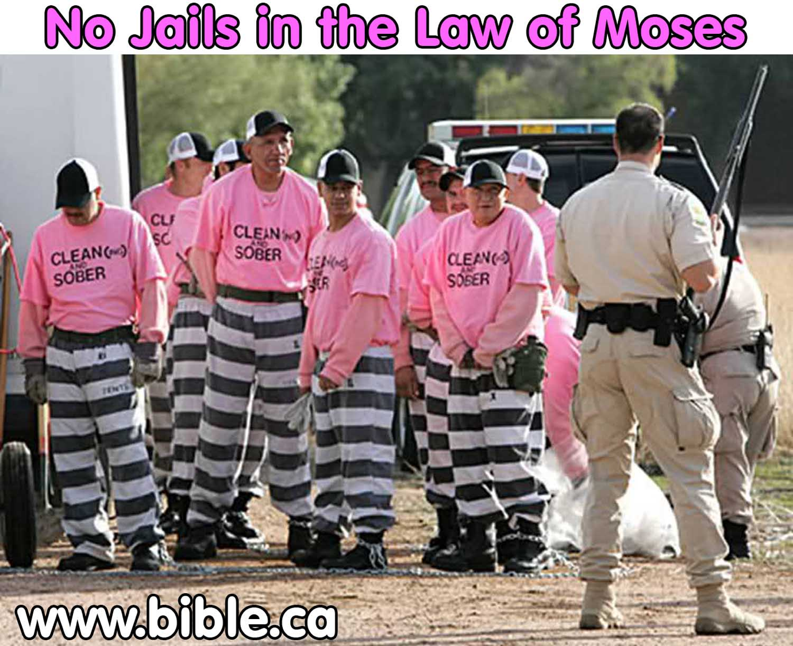
"So Christ has truly set us free. Now make sure that you stay free, and don’t get tied up again in slavery to the law" (Gal. 5:1 NLT).
No Jails in the Law of Moses
Notes:
Slavery Instead of Jails in Mosaic Legal System! Have you ever noticed that there were no prisons in the law of Moses? People were stoned, beaten, fined but NEVER sent to prison or confined in any way including shackles or stocks etc. This brand new study sheds a positive light on the role slavery had in rehabilitating criminals and providing welfare for the poor. Confinement was something completely foreign in the Jewish legal system.
See the full article at http://www.bible.ca/sin-no-jails-prisons-in-judaism-old-testament-law-of-moses-slavery-welfare-jewish-comparison.htm

Slide 183

"So Christ has truly set us free. Now make sure that you stay free, and don’t get tied up again in slavery to the law" (Galatians 5:1 NLT).
"Listen! I, Paul, tell you this: If you are counting on circumcision to make you right with God, then Christ will be of no benefit to you. ³I’ll say it again. If you are trying to find favor with God by being circumcised, you must obey every regulation in the whole law of Moses. ⁴For if you are trying to make yourselves right with God by keeping the law, you have been cut off from Christ! You have fallen away from God’s grace" (Galatians 5:2-4 NLT).

Slide 184

Circumcision, Vitamin K & Prothrombin
Available Prothrombin
Prothrombin (% of Normal)
Prothrombin Concentration
Days
Notes:
Circumcision is not bad in itself. God commanded it in Genesis 17 on the eighth day of a Jewish boy's life, which still has the highest blood-clotting Prothrombin of any day in a male's life!
However, the problem was with God's people in the letter to the Galatians, who made circumcision a requirement for salvation that had to be imposed on the Gentiles as well as the Jews.
———————
OS-01-Gen4-20—slide 308
NS-Galatians-181

Slide 185

Walking in the Spirit
xxiii
Notes:
Live under direction from the Spirit rather than from the sinful nature (5:16-26).

Slide 186

How the Spirit Leads Us
xxiv

Slide 187

George Mueller's Step #1 to Find the Will of God
xxiv
"I get my heart into such a state that it has no will of its own in regard to the given matter."

Slide 188
How the Spirit Leads Us
xxiv
"No will of my own"
Discern feelings
Word of God
Providential circumstances
Ask God in prayer
Decide, look for peace, pray 2-3 more times, & act
Notes:
A Singaporean friend gave me a booklet in 1981 that has had a profound impact on me George Mueller was a German missionary to England in the mid-1800s with whom many Christians are acquainted. He founded several orphanages for the Lord and saw God answer over 50,000 prayers recorded in his lifetime (he kept a meticulous journal of his requests and God’s answers). I know of no other human source that can help us seize the will of God more than Mueller. Here are his steps to how the Spirit led him during his lifetime of over 92 years (1805-1898).
1. I SEEK AT THE BEGINNING to get my heart into such a state that it has no will of its own in regard to a given matter. Nine-tenths of the trouble with people is just here. Nine-tenths of the difficulties are overcome when our hearts are ready to do the Lord's will, whatever it may be. When one is truly in this state, it is usually but a little way to the knowledge of what His will is.
2. HAVING DONE THIS, I do not leave the result to feeling or simple impression. If I do so, I make myself liable to great delusions.
3. I SEEK THE WILL of the Spirit of God through, or in connection with, the Word of God. The Spirit and the Word must be combined. If I look to the Spirit alone without the Word I lay myself open to great delusions also. If the Holy Ghost guides us at all, He will do it according to the Scriptures and never contrary to them.
4. NEXT I TAKE into account providential circumstances. These often plainly indicate God's will in connection with His Word and Spirit.
5. I ASK GOD in prayer to reveal His will to me aright.
6. THUS, THROUGH PRAYER to God, the study of the Word, and reflection, I come to a deliberate judgment according to the best of my ability and knowledge, and if my mind is thus at peace, and continues so after two or three more petitions, I proceed accordingly.
In trivial matters, and in transactions involving most important issues, I have found this method always effective.
Source: George Mueller, “How I Ascertain the Will of God,” from “An Hour with George Mueller: The Man of Faith to Whom God Gave Millions” ed. A. Sims (Warren Myers, P.O. Box 125: Singapore), ca. 1981.

Slide 189



Gifts versus Fruit of the Spirit
xlii
Gifts | Fruit
Abilities | Christ-likeness
Relate to service | Relate to character
Means to an end | The end itself
What a Christian has | What a Christian is

Slide 190
Gifts versus Fruit of the Spirit
xlii
Gifts | Fruit
Plural: many | Singular: one (love)
Often misused in the church | Rarely misused in the church
No believer possesses all | Every believer should strive for all
Will cease (temporary) | Will last (permanent)

Slide 191

The Fruit of the Spirit
Joy
Self-Control
Peace
Gentleness
Love
Patience
Faithfulness
Kindness
Goodness

Slide 192

The Fruit of the Spirit
xliii
Inner Life
Principles of Conduct
Joy
Self-Control
Peace
Gentleness
Love
Patience
Faithfulness
Kindness
Goodness
Social Relationships
Galatians 5:22-23

Slide 193
The Fruit of the Spirit
xliii
Joy
Feelings
Self-Control
Peace
Behavior
Gentleness
Love
Patience
Attitudes
Faithfulness
Kindness
Goodness
Character
Galatians 5:22-23

Slide 194
The Fruit of the Spirit
xliii
Strength
Joy
Security
Self-Control
Peace
Victory
Gentleness
Love's
Patience
Humility
Endurance
Faithfulness
Kindness
Conduct
Confidence
Goodness
Character
Galatians 5:22-23
Notes:
_________
Common-452
BE-03-Leviticus-14
NS-09-Galatians-189

Slide 195

Are you surrendered to Christ?

Slide 196
Slides on Galatians 6
Notes:
Serve others since freedom from the Law leads to caring for others (6:1-10).

Slide 197


Restore People in Sin
Restore People in Sin
"Brothers, if someone is caught in a sin, you who are spiritual should restore him gently."
Galatians 6:1
Notes:
Homiletics 16.17
NTS Galatians slide 75

Slide 198

The word for "restore" in Galatians 6:1 refers in other contexts to fishermen mending nets
Restore nets
Notes:
Homiletics 16.18
NTS Galatians slide 76

Slide 199

Don't make it your priority to restore nets!
72
Restore nets
Restore people!
Notes:
Homiletics 16.20
NTS Galatians slide 77

Slide 200


ETERNAL
GALATIANS 6:8
life

Slide 201


GALATIANS 6:8
Those who live only to satisfy their own sinful nature will harvest decay and death from that sinful nature. But those who live to please the Spirit will harvest everlasting life from the Spirit.

Slide 202


Galatians 6:11
Greek:
NKJV (normal aorist):
See with what large letters I have written to you with my own hand!
The normal Greek shows that Paul wrote the entire letter himself without a scribe in large letters (due to eye problems?)
NIV (epistolary aorist):
See what large letters I use as I write to you with my own hand!
Notes:
The typical belief is that Paul dictated the letter to a scribe and then at 6:11 he picked up the pen and signed the letter himself. This he did in large, capital letters rather than

Slide 203


Who is "the Israel of God" (Gal. 6:16)?
"Peace and mercy to all who follow this rule, even to the Israel of God" (NIV).
"May God’s peace and mercy be upon all who live by this principle; they are the new people of God" (NLT).
"And those who will walk by this rule, peace and mercy be upon them, and upon the Israel of God" (NAU).
Notes:
Is this the only place in the Bible where Gentiles are called Israel? The NLT (New Living Translation) and some others would have us think so! But the NIV and the NAU are closer to the Greek in the translation of kai which normally means "and" (NAU) but also can mean "even" (NIV). IN other words, "Israel" means "Israel," which should surprise no one.
______________
ES-25-Shared Land Theology-24
ES-26-Restoration of Israel-449
NS-09-Galatians-200

Slide 204
"…and (kai) upon the Israel of God" (Gal. 6:16)
"…even to the Israel of God" (NIV)
"…and upon the Israel of God" (NAU)
Unusual use of kai
Normal use of kai
= All Christians
= Jewish Christians
Church = Israel
Church ≠ Israel
Notes:
Translating kai as "even" would be an unusual way to render this conjunction, meaning "Israel" includes Gentile in the Church, or indicating all Christians. But the normal use of kai as "and" that highlights salvation by faith would especially relate to the Jewish audience at Galatia. In other words, there is no reason to abandon the normal meaning of "Israel" as the ethnic descendants of Jacob (Jews).
______________
ES-25-Shared Land Theology-25
ES-26-Restoration of Israel-450
NS-09-Galatians-201

Slide 205
Outline
172-173
Biographical (Gal 1–2) : Paul defends his apostolic authority to counter the allegations of Judaizers who had infiltrated the Galatian churches with their false teaching that he invented justification by faith by his own authority.
Theological (Gal 3–4): Paul affirms and illustrates salvation by faith and not by the Law to counter the Judaizer accusation that justification by faith was a new teaching by showing the Galatians that since they are saved by faith they are free from the Law.
Practical (Gal 5–6): Paul applies salvation by faith to Christian living by exhorting a balanced perspective and responsibilities towards others to urge the application of his teaching under the Holy Spirit's direction.

Slide 206
Why must salvation be by faith alone?
Paul gives 3 reasons
Galatians
Notes:
What reasons can we give that simple trust in Christ alone puts us in a right relationship with God?

Slide 207
I. Jesus called Paul to teach salvation by faith (Chapters 1–2).
Galatians
Notes:
[Jesus himself appointed Paul to proclaim justification by faith as his defining doctrinal truth.]
[Personal: Paul defends his apostolic call to counter Judaizer teaching that Paul invented justification by faith.]

Slide 208
II. Salvation has always been by faith (Chapters 3–4).
The Centrality of the Cross
B.C.
Faith looked forward to the Cross of Christ
A.D.
Faith looks back at the Cross of Christ
Galatians
Notes:
[Whether Old Testament or new, we have always been put in a right relationship with God by simple trust.]
[Practical: Paul applies salvation by faith in Spirit-led living by exhorting balance and others-orientation.]
The grounds of salvation has always been the death of Christ—for believers before and after the cross.
We must see the centrality of the cross—how people before Jesus believed by looking toward the cross while those of us after Jesus look back at the cross. In other words, the foundation of salvation has always been the death of Christ—for believers before and after the cross.
____________________
Common-198
BE-03-Leviticus-73
OB-37-Sacrifices-19
OB-38-Salvation-4
OS-03-Leviticus-193
NS-09-Galatians-16, 49, 118
NS-20-James-32
SA-03-Biblical Terminology-10
SA-15-Inheritance-26
TP-01-Our Inheritance OT Summary-29

Slide 209
III. Salvation by faith alone changes us inside (Chap. 5–6).
Galatians
Notes:
[Whether Old Testament or new, we have always been put in a right relationship with God by simple trust.]
[Practical: Paul applies salvation by faith in Spirit-led living by exhorting balance and others-orientation.]

Slide 210
Main Idea
Salvation by faith frees us from the Law to give freedom in Christ.
Galatians
Notes:
We are justified before God simply by trusting Jesus—not by good works—resulting in true internal change.

Slide 211

The Issue of Legalism
Definition
"Legalism" attempts to win God's favour by our own efforts of dedication and obedience.
The Galatians…
Tried to win God's approval by obedience to the law.
Today
We try to live up to God's and people's expectations of how Christians should act—obedience, dedication, fulltime Christian service, academic study, and volunteer work.
Jeremy Chew, East Asia School of Theology, Singapore
Lesson
We must obey and serve out of love and gratitude to Christ. The Holy Spirit must empower us. Our dedicated service cannot remove sin or obtain saving grace.

Slide 212


Christian Legalists

Slide 213

Invited to Church...
Notes:
A boy was once had an intense desire to know God, so he sought out a very conservative church.

Slide 214

Boy with long hair
Notes:
But, because his hair was deemed too long, he was shunned and not allowed to enter the building!
Such legalism kills interest in the gospel.

Slide 215

True Jesus Church, Adam Road
200
Notes:
The TJC ruins the gospel by adding legalistic requirements to the pure gospel.

Slide 216


What Does the True Jesus Church Believe?
Identification with TJC
200
+
Baptism in TJC (Head Bowed)
+
Footwashing by TJC Minister
+
Communion (Transubstantiation)
+
Reception of the Holy Spirit
+
Speaking in Tongues
+
(Faith in Christ? No!)
=
Salvation ! ? ! ?
Notes:
This is the complicated and unbiblical formula for salvation taught by the TJC. The church is definitely misnamed!

Slide 217

Why do people like legalism?

Slide 218

Why do people like legalism?
It gives us a tangible measure of where we stand.
It puts confidence into our hands so we can get credit for our deeds.
It makes decision-making easier with nearly everything being right or wrong.

Slide 219
Why do people like legalism?
PRIDE
Notes:
I become the focal point in legalism—what I do, what I accomplish, what I can take glory for, what I should be rewarded for.

Slide 220
Applying Galatians
Be free from the slavery of legalism…
…so you can live for Christ

Slide 221
Black

Slide 222


NT Preaching link at BibleStudyDownloads.org
Get this presentation and script for free!

Slide 223

Paul versus Legalists
Legalists
Paul
"The one who does righteousness stores up life for himself with the Lord"
Psalms of Solomon (about 50 BC)
"Miracles, however, will appear at their own time to those who are being saved by their works"
2 Baruch
(about AD 100)
"But now God has shown us a way to be made right with him without keeping the requirements of the law, as was promised in the writings of Moses and the prophets long ago. ²² We are made right with God by placing our faith in Jesus Christ. And this is true for everyone who believes, no matter who we are"
(Rom. 3:21-22 NLT)
Notes:
BG-06-Israel-South Longitude Masada Qumran—76
NS-09-Galatians-189

Slide 224
Infant | Grown Son
Under guardian (Law) | Enjoys son-with-father relationship (redeemed)
Status: like a slave; rights of sonship not realized | Status: son and heir; full rights given
Under bondage: external authority of the Law | Free: internal authority of the Spirit of God
Immature: in elementary school of the Law with external motivation | Mature: in secondary school of the Spirit with internal motivation
173c
Ceremonial vs. True Religion
(Gal 4:1-7)
Paul A. Pomerville, Galatians & Romans (Brussels: ICI, 1976), 96, 98

Slide 225
Black
Notes:
225

Slide 226
NT Survey link at BibleStudyDownloads.org
Get this presentation for free!
Notes:
NT Survey (ns)

