Slide 1
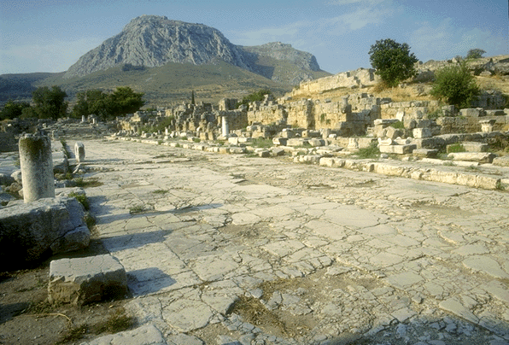
2 Corinthians
2 CORINTHIANS
Dr. Rick Griffith • Jordan Evangelical Theological Seminary • BibleStudyDownloads.org
Notes:
Here is our second letter that Paul wrote to this struggling church with enormous potential. The ruins of Corinth still testify to the grandeur of this city at a crossroads in the Roman world, with its trade and temples on these streets and the sexual immorality mixed with pagan worship on the high mountain in the background. Be sure to watch the 3-minute tour of the city by Dr. Rick Griffith right next to the 1 Cor files.

Slide 2
Key Word
162
Apostleship
2 Corinthians
Notes:
Even though Paul established the Corinthian church, other teachers followed him, and some of them caused the believers to question Paul's authority. Interestingly, the divisions that resulted focused around one group that followed Paul, another Apollos, and a third group that rallied around Peter (1 Cor 1:12). Certainly, these other leaders did not try to undermine Paul, so the believers must have made these divisions with the leadership of others unknown to us. In any event, Paul needed to reassert his apostleship or else his entire ministry at Corinth would be in danger—and the nature of the gospel itself—so his authority as an apostle is the focus of this second letter.

Slide 3
Theme
23
Defense of Apostolic Authority
2 Corinthians
Notes:
If a leader loses his credibility, people will no longer follow him and his message. So Paul did not hesitate to defend his authority as one commissioned by Jesus himself to preach to the Gentiles, such as those at Corinth.

Slide 4
Key Verse
162
"For we do not preach ourselves, but Jesus Christ as Lord, and ourselves as your servants for Jesus' sake. For God, who said, 'Let light shine out of darkness,' made his light shine in our hearts to give us the light of the knowledge of the glory of God in the face of Christ" (4:5-6).
2 Corinthians
Notes:
These verses comprise a fitting summary of the letter since the church thought that their leaders were each preaching themselves. While Paul asserted his authority, he also noted here that he and the other leaders the church had divided over were all on the same plain as fellow servants of Christ. Each of these leaders had the light to share with the Corinthians, so it was useless for them to divide into competing groups.

Slide 5
Summary Statement
162
2 Corinthians
Paul defends his apostleship against attacking false teachers to assure both the Corinthians' doctrinal foundation and their promise to give to Jerusalem saints, thus providing an example of respect for and giving to church leaders today.
Notes:
The false teachers noted in this summary statement were NOT Apollos, Peter, and Christ (1 Cor 1:12)! Instead, they are unnamed men who would have undermined the theology of the new covenant standing that each true teacher upheld. Paul wanted to assure them that the money he had asked them to collect in 1 Corinthians 16 would be used to advance the gospel by helping Jewish believers in their mother church in Jerusalem, thus strengthening his teaching that the church was composed of both Jews and Gentiles who were equal in Christ.
The letter functions as an example of the servant-leader standing of today's Christian pastors, elders, and other believers who shepherd God's flock. Their credibility is vital, and we must defend them from attackers so that the message they preach is not undermined.

Slide 6

Kingdom Statement
27b
Paul shares events about his kingdom work that would otherwise not be known: his persecutions and hardships not recorded in Acts (11:23-27), extra details of his escape from Damascus (11:32-33), God's revelation of Paradise to him in a vision (12:1-7), and his “thorn in the flesh” (12:7-10).
2 Corinthians
Notes:
Even though the word "kingdom" does not appear in this letter, labor for the kingdom is the focus. Such efforts are not without hardship, as this letter well testifies.
HARDSHIPS:
2Cor. 11:23 Are they servants of Christ? I know I sound like a madman, but I have served him far more! I have worked harder, been put in prison more often, been whipped times without number, and faced death again and again. ²⁴ Five different times the Jewish leaders gave me thirty-nine lashes. ²⁵ Three times I was beaten with rods. Once I was stoned. Three times I was shipwrecked. Once I spent a whole night and a day adrift at sea. ²⁶ I have traveled on many long journeys. I have faced danger from rivers and from robbers. I have faced danger from my own people, the Jews, as well as from the Gentiles. I have faced danger in the cities, in the deserts, and on the seas. And I have faced danger from men who claim to be believers but are not. ²⁷ I have worked hard and long, enduring many sleepless nights. I have been hungry and thirsty and have often gone without food. I have shivered in the cold, without enough clothing to keep me warm.
DAMASCUS:
2Cor. 11:32 When I was in Damascus, the governor under King Aretas kept guards at the city gates to catch me. ³³ I had to be lowered in a basket through a window in the city wall to escape from him.
Paul’s Vision and His Thorn in the Flesh
2Cor. 12:1 This boasting will do no good, but I must go on. I will reluctantly tell about visions and revelations from the Lord. ² I was caught up to the third heaven fourteen years ago. Whether I was in my body or out of my body, I don’t know—only God knows. ³ Yes, only God knows whether I was in my body or outside my body. But I do know ⁴ that I was caught up to paradise and heard things so astounding that they cannot be expressed in words, things no human is allowed to tell.
REVELATION OF PARADISE:
2Cor. 12:5 That experience is worth boasting about, but I’m not going to do it. I will boast only about my weaknesses. ⁶ If I wanted to boast, I would be no fool in doing so, because I would be telling the truth. But I won’t do it, because I don’t want anyone to give me credit beyond what they can see in my life or hear in my message, ⁷ even though I have received such wonderful revelations from God.
THORN:
So to keep me from becoming proud, I was given a thorn in my flesh, a messenger from Satan to torment me and keep me from becoming proud.
2Cor. 12:8 Three different times I begged the Lord to take it away. ⁹ Each time he said, “My grace is all you need. My power works best in weakness.” So now I am glad to boast about my weaknesses, so that the power of Christ can work through me. ¹⁰ That’s why I take pleasure in my weaknesses, and in the insults, hardships, persecutions, and troubles that I suffer for Christ. For when I am weak, then I am strong.

Slide 7
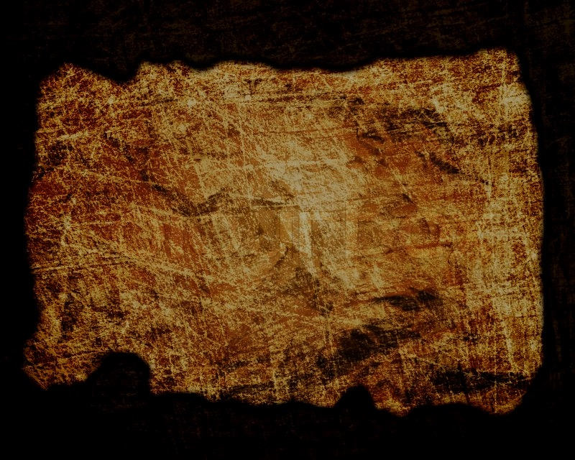
Covenant
27b
Paul and the apostles serve as ministers of the new covenant (3:1–6:10), which is one of the longest new covenant sections in the NT.
2 Corinthians
Notes:
Paul devotes nearly four chapters to show his status as a minister of the new covenant. So this is his greatest defense within his letters how the old covenant given to Israel at Sinai has been replaced by the new covenant given in the present age to the church.
Of course, the Corinthians themselves were also new covenant believers, but Paul does not emphasise this. Rather, he lifts the teachers of the church to a common status as those entrusted with even a more glorious covenant than Moses received.

Slide 8
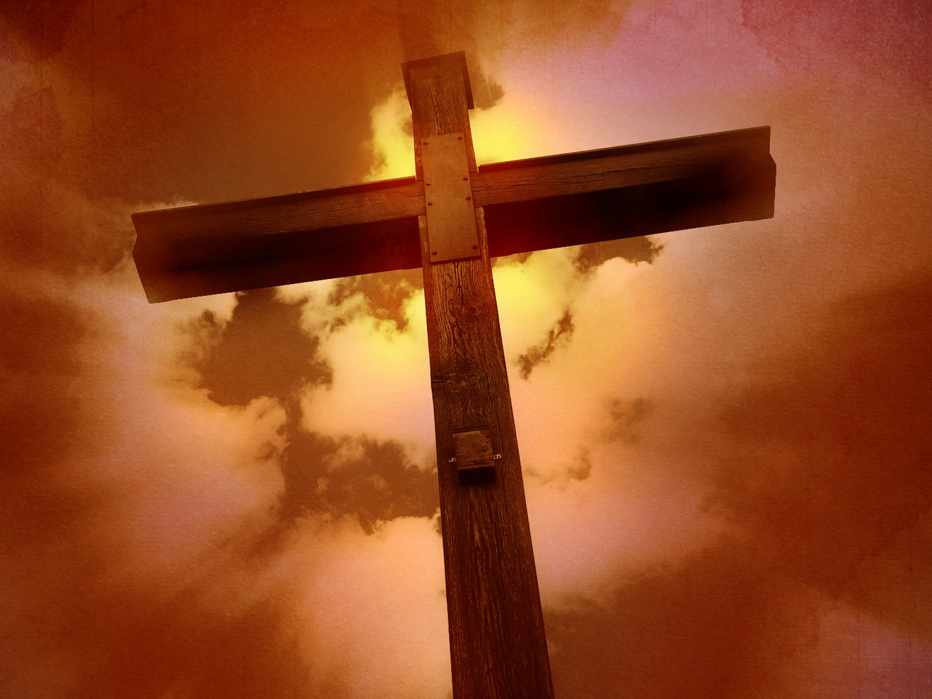
Redemption
27b
Believers are secure in salvation that can never be lost (1:21-22; 5:10).
2 Corinthians
Notes:
Paul never tried to scare believers into thinking that they could lose their salvation. Instead, he lifted them up by showing them their high position as God's eternal children and then sought to motivate them to reach that status in their behaviour.
2Cor. 1:21 It is God who enables us, along with you, to stand firm for Christ. He has commissioned us, ²² and he has identified us as his own by placing the Holy Spirit in our hearts as the first installment that guarantees everything he has promised us.
2Cor. 5:10 For we must all stand before Christ to be judged. We will each receive whatever we deserve for the good or evil we have done in this earthly body.

Slide 9
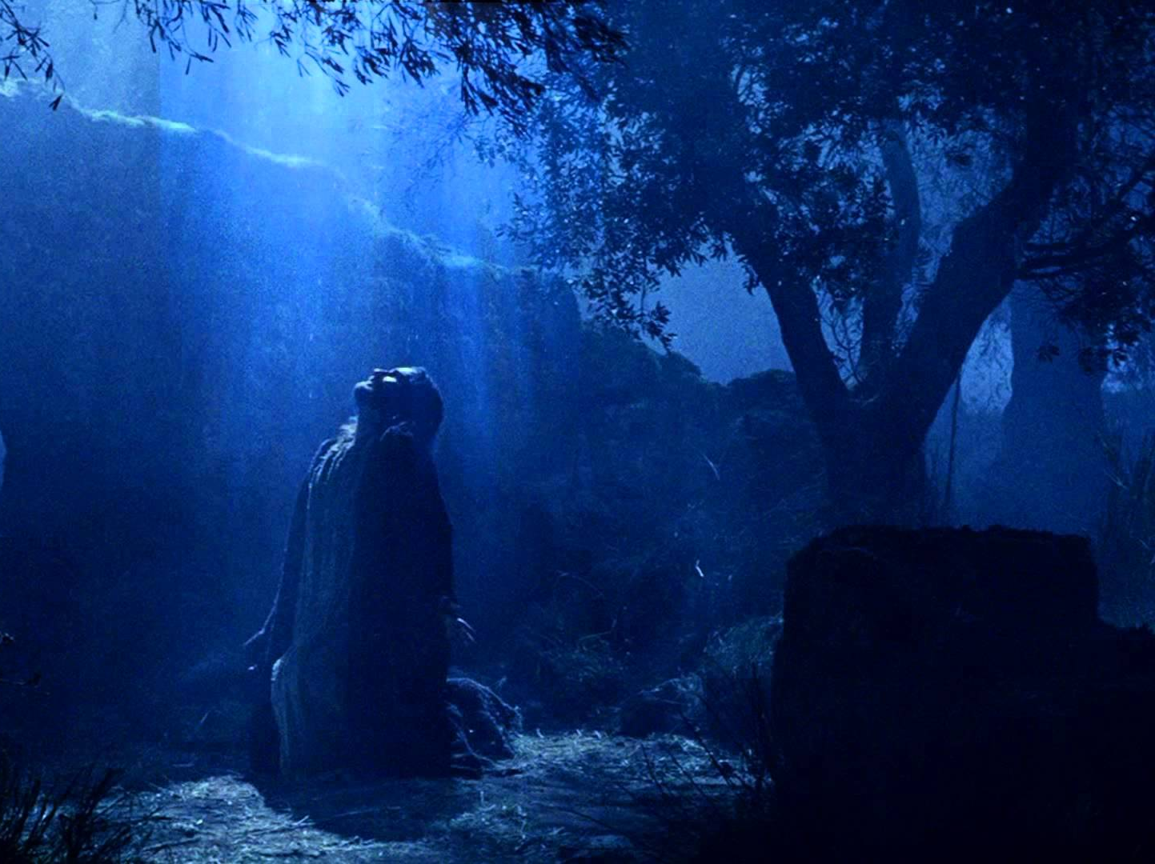
Prophecy
(Lord, Deity)
27a
“For we do not preach ourselves, but Jesus Christ as Lord, and ourselves as your servants for Jesus’ sake. For God, who said, ‘Let light shine out of darkness,’ made his light shine in our hearts to give us the light of the knowledge of the glory of God in the face of Christ” (4:5-6).
2 Corinthians
Notes:
Our master is the "Lord Jesus Christ," and since he is the Lord of all, he is the highest authority in the universe. The focus should not be human teachers, but the Divine Teacher with all authority.

Slide 10
2 Corinthians Book Chart
Defense of Apostolic Authority
Ministry Sincerity |  |  |  | Giving |  |  |  | Ministry Authority
Chapters 1–7 |  |  |  | Chapters 8–9 |  |  |  | Chapters 10–13
Defense of Paul's Motives |  |  |  | Defense of Paul's Worth |  |  |  | Defense of Paul's Traits
Character of Paul |  |  |  | Collection for Saints |  |  |  | Credentials of Paul
Greetings | Defends Conduct | Defends Ministry | Restore Confidence | Example | Purpose | Arrangements | Benefits | Defense | Offense | Warning | Closing
1:1-11 | 1:12–2:16 | 3:1–6:10 | 6:11–7:16 | 8:1-9 | 8:10-16 | 8:16–9:5 | 9:6- 15 | 10 | 11:1–12:18 | 12:19–13:10 | 13:11-14
Macedonia
Fall AD 56
162
2 Corinthians
Notes:
The focus of this letter is to help readers shift their view of Paul from doubt to trust. In the first movement (1–7), he defends himself against those who accused him of greed and an inferior ministry to that of the false teachers in their midst. Once their confidence in Paul is restored, they would be motivated to give his team their offerings for the Jerusalem saints (8–9), and, finally (10–13), to see that he is an apostle with authority even to judge them.

Slide 11
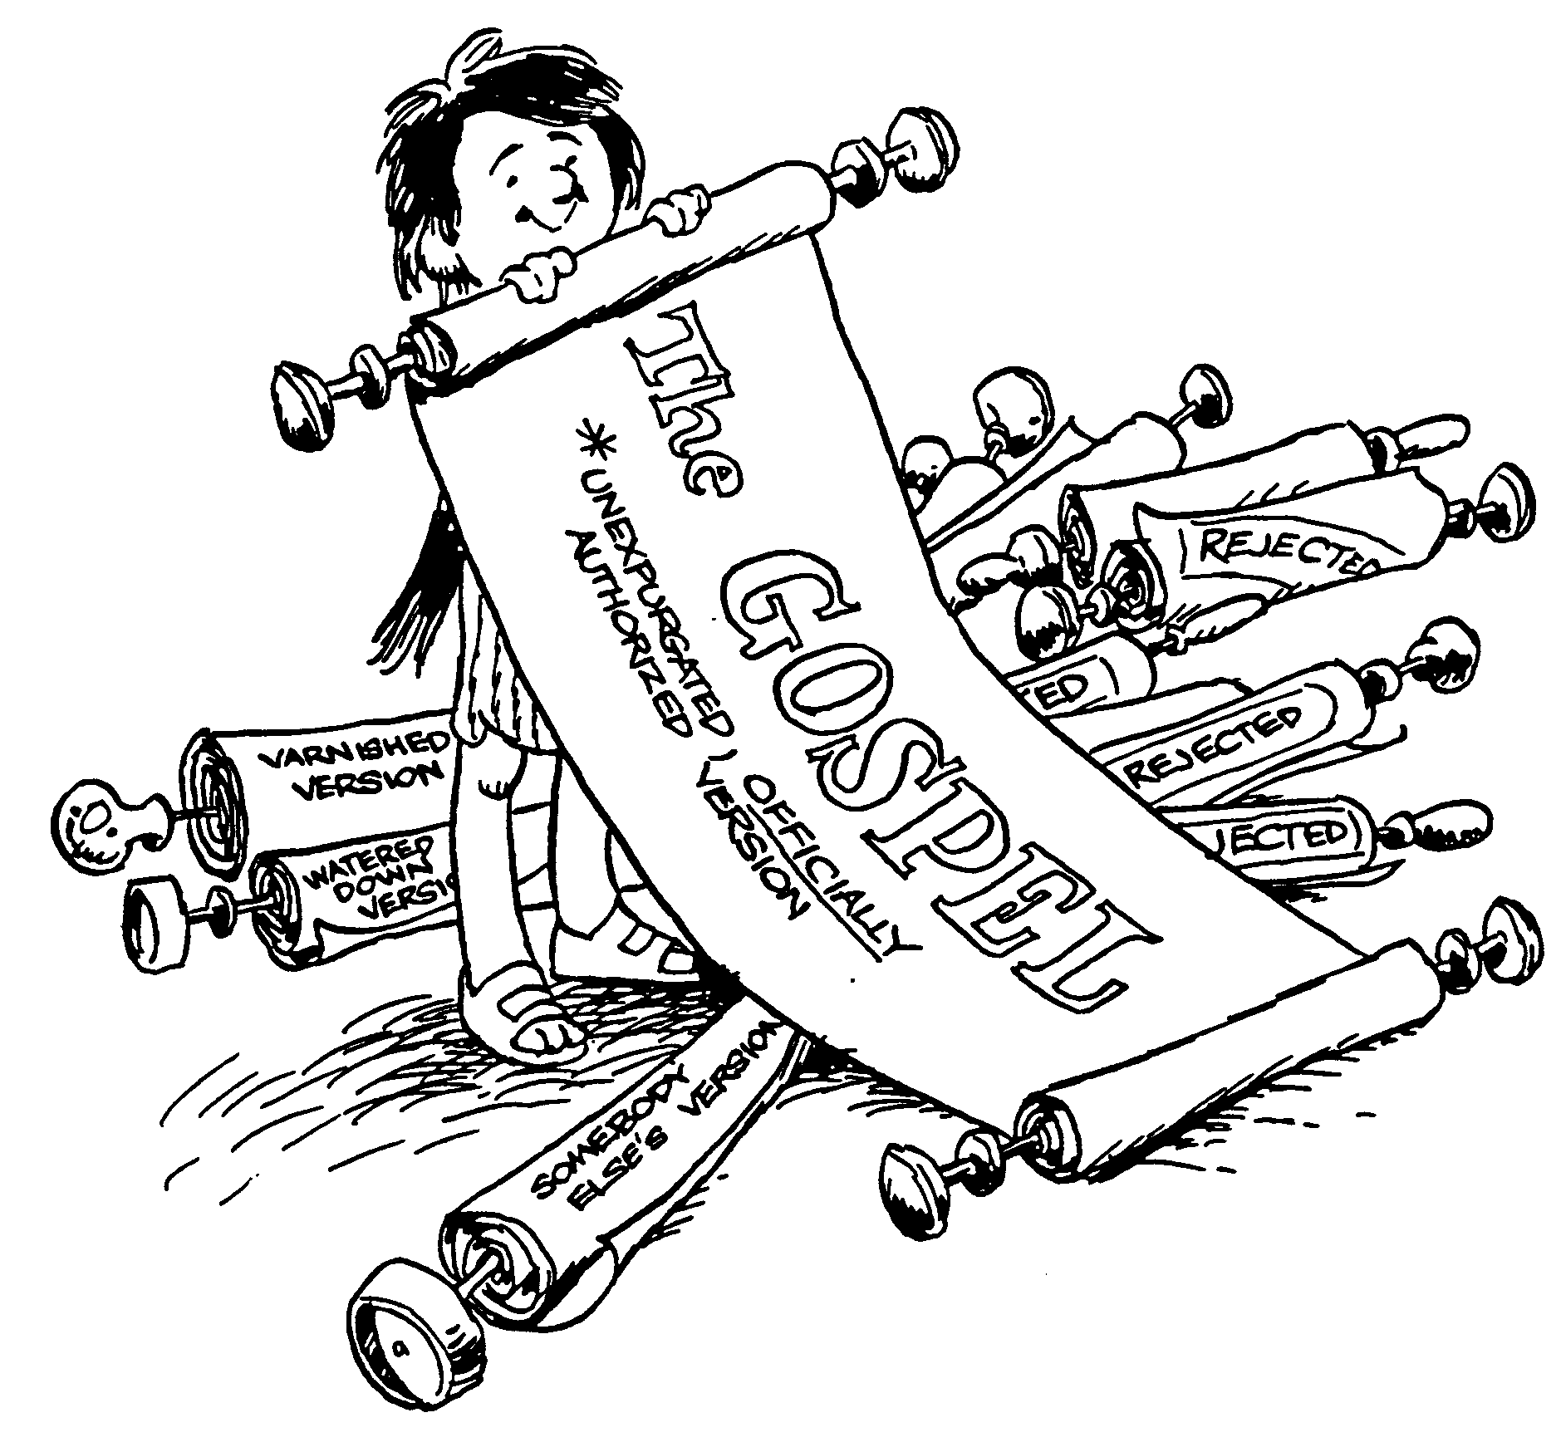
Outline of
2 Corinthians
Testimony to Paul's sincerity
Heaviness of Paul's heart
Excellence of new covenant
Temporal versus eternal ministry
Reconciliation offered to all
Union with unbelievers forbidden
Exhortation to perfect holiness
Generosity of the Macedonians
Opportunity for cheerful giving
Spiritual authority of Paul
Paul's boasting in Christ
Experience of Paul's thorn
Lives that stand test
Barry Huddleston, The Acrostic Bible
Notes:
Paul had already defended the gospel in 1 Cor 1–4 because the church had misjudged both the message and messengers in their divisions based on minor matters. But 2 Corinthians as a whole defends the gospel by defending Paul as messenger of this true "Good News" from God.

Slide 12

RESPONSIVE
BE
2 Corinthians
Dr. Rick Griffith • Crossroads International Church Singapore
BibleStudyDownloads.org
Notes:
How difficult it is to lead people when they do not even respond to our love! Such was Paul's predicament. The letter is a classic reminder to love and trust those who shepherd us with the truth of the gospel.

Slide 13
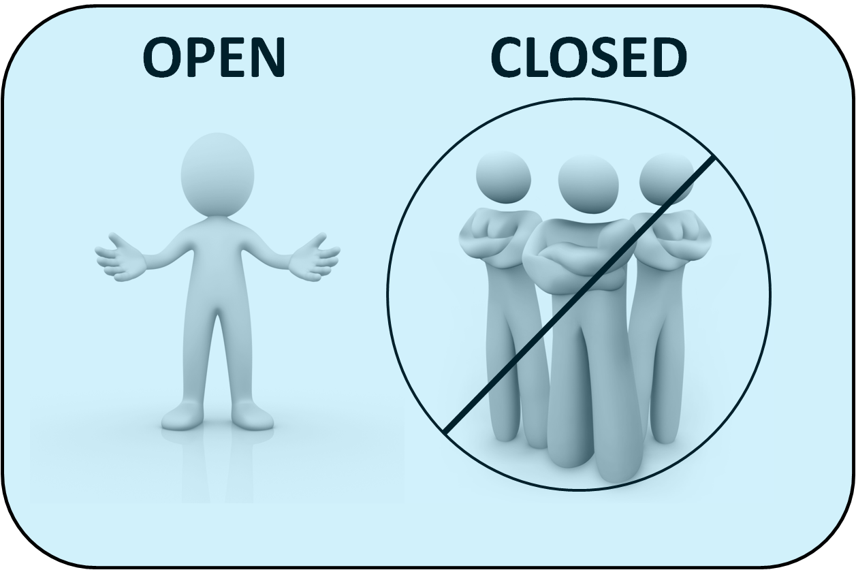
OPEN
CLOSED
2 Corinthians
Notes:
Maybe you can relate to my experience of when I have sought to love others, but to no avail. You are open to people, but they are closed to you. One of our cruellest responses to others is apathy—or simply ignoring others—and you have seen this firsthand.
Your family background is far from ideal. Your father—or mother—neglected you growing up.
In Singapore, many people struggle with apathy towards them at work. A worldwide survey was conducted some years back in which people were asked, “Does your work energize you?” The USA had the highest score at 40%. The lowest country in the world was Singapore—only 2% said that their work energized them. When someone just looks at you like a robot to get work out of you, it is deflating.

Slide 14
NT Overview (Missionary Key Words)
38
124
39-41
"To the remotest part of the earth" (Acts 1:8)
Acts 9 13 14 15 16 18 21 27 28
Apr 48-
Sep 49
1
Galatia
Apr 50-
Sep 52
2
Aegean
Spr 53-
May 57
3
Asia
Feb 60-
Mar 62
1
Rome
Spr 62-
Fall 67
4
Spain
Aut 67-
Spr 68
2
Rome
Summer 35-
37
Damascus
Antioch
May 57-
Aug 59
Trials
Fall 49
The
Council
Spring 68
Expansion of Church
35 48 49 50 52 53 57 60 62 67 68 95
Matt
Kingdom
Luke
Sov 1
Acts
Sov 2
Mark
Disciple
John
Believe
Gal
Justify
1 Thess
Rapture
1 Cor
Sanctify
2 Thess
Tribulation
2 Cor
Apostle
Gospels & Acts
Pauline Epistles
1234
Journeys
Rome
Imprisonments
Pauline Missionary & Key Words
Notes:
Paul wrote the second letter to Corinth during his third journey, which was essentially a follow-up trip to Greece, but he spent the most time in Ephesus, where he taught for two years (Acts 19:10).

Slide 15
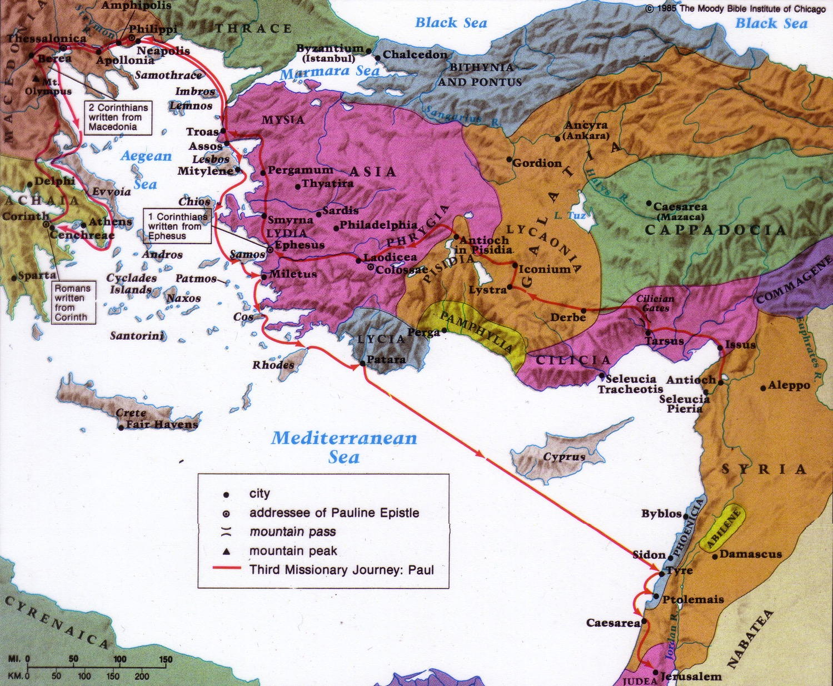
2 Corinthians Context
Origin:
Macedonia
163
Origin/Recipients
Paul addressed this second letter to the church at Corinth from the province of Macedonia north of Corinth.
Destination:
Corinth
Date
2 Corinthians was written less than a year after 1 Corinthians (2 Cor. 8:10; 9:2).
1 Corinthians was written in AD May 56. The letter of 2 Corinthians followed later that year in fall AD 56.
Notes:
Within a year of Paul's writing 1 Corinthians, false teachers infiltrated the church (2 Cor 11:20) and stirred up the people against him by accusing him of being proud (2 Cor 10:1), fickle (2 Cor 1:16f.), unimpressive in appearance and speech (2 Cor 10:10), dishonest (2 Cor 8:16), and unqualified to be an apostle (2 Cor 11:23; 12:6-7). Paul saw this threat as valid reason to visit the church personally, and he refers to this second visit as a “painful visit” (2 Cor 2:1; 12:14; 13:1). He anticipates this visit in 1 Corinthians 16:5-9.
• After leaving the church this second time, Paul wrote a sorrowful letter (his third letter to the church) to urge the church to discipline the leader of the opposition (2 Cor 2:1-11; 7:8f.). Titus delivered the letter then met Paul in Macedonia with the good news that most of the Corinthians had repented of rebelling against Paul's apostolic authority (2 Cor 7:6-7). Nevertheless, Paul still felt it necessary to write the letter of 2 Corinthians to defend himself against the minority opposition (2 Cor 10–13).
• So, Titus turned right around and headed back to Corinth to deliver 2 Corinthians, accompanied by two other brothers (2 Cor 8:16-24). Later Paul made a third visit to the church, anticipated in 2 Corinthians 13:1; Acts 19:21 and recorded in Acts 20:2-3.
• Therefore, the date was less than a year after 1 Corinthians. We date 2 Cor in the fall of AD 56.
• The letter went from Macedonia to Corinth.

Slide 16

God is not apathetic about you.
2 Corinthians
Notes:
What a wonderful thing to see that God is not apathetic about you! Hardly! Most of us are quite informed what God has done for us. Are we apathetic towards him in response?
God has given us people who care about us—do we appreciate them?
God has given us more resources than we need—do we share them with others?
God rescued us from the pain of sin—do we thank him for being free from that slavery?

Slide 17

How can you be responsive to God’s heart for you?
2 Corinthians
Notes:
What ways can we open our heart to God’s initiative to us?

Slide 18
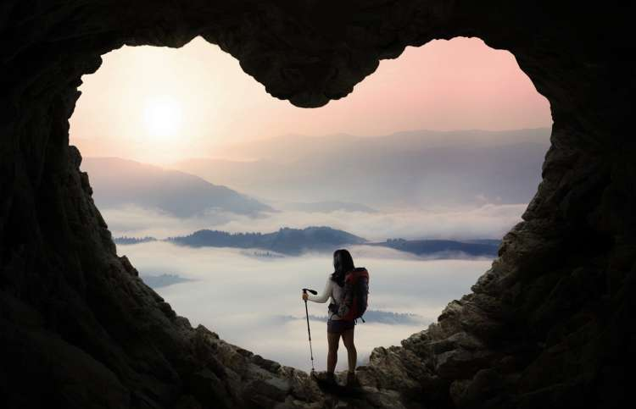
Open your heart to…
your leaders
(1–7)
God
(10–13)
the needy
(8–9)
Main Idea of 2 Corinthians
Notes:
• Have a heart towards those who take care of you,
• towards those too weak to help you,
• and to the One who cares for you the most!

Slide 19
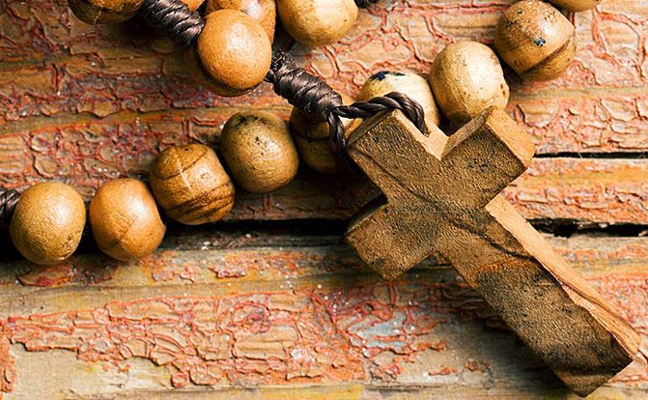
I can best open my heart to God by…
Applying 2 Corinthians
Notes:
Complete this sentence by sharing the person that the Lord has put on your heart today.

Slide 20
Black

Slide 21

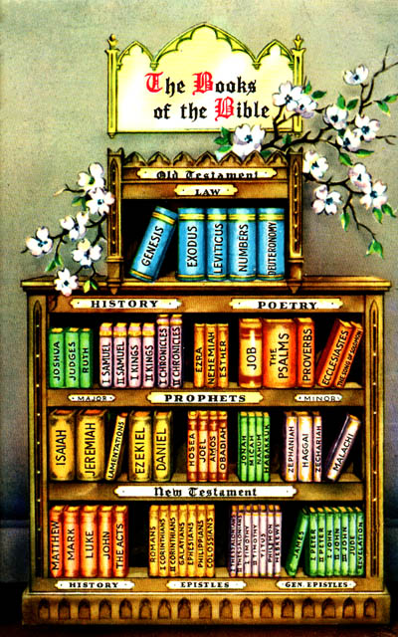
THE EPISTLES

Slide 22

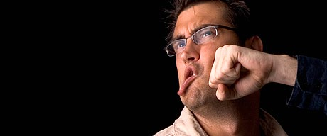
QUESTIONS TO PONDER
161ee
When should you defend yourself when criticized?
On what issue(s) should you just "let it go"?

Slide 23
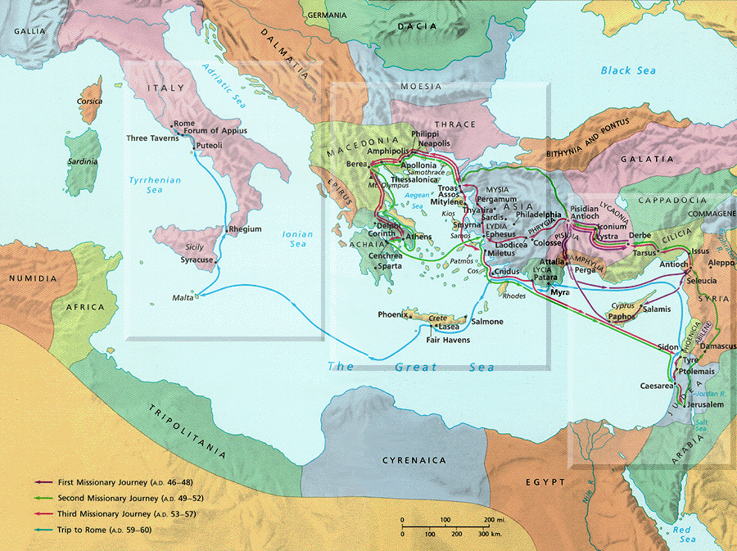
Geography
Macedonia
Corinth

Slide 24

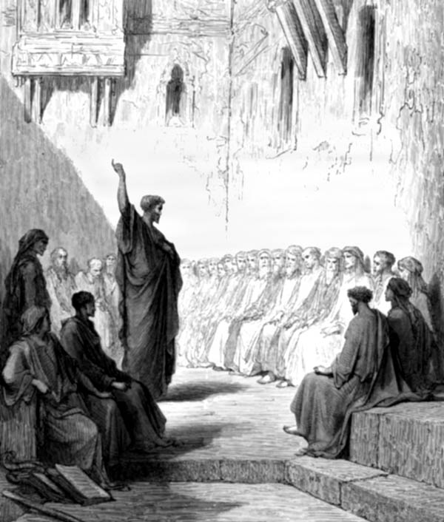

Author:
PAUL
Date:
AD 56

Slide 25
Key Word & Verse
162
2 Corinthians
Key Word
Apostleship
Key Verse
"For we do not preach ourselves, but Jesus Christ as Lord, and ourselves as your servants for Jesus' sake. For God, who said, 'Let light shine out of darkness,' made his light shine in our hearts to give us the light of the knowledge of the glory of God in the face of Christ" (2 Corinthians 4:5-6).

Slide 26

THEME
Paul's defense of his
APOSTLESHIP
MESSAGE
INTEGRITY

Slide 27
Overview of Paul's Letters
38
124
39-41
"To the remotest part of the earth" (Acts 1:8)
Acts 9 13 14 15 16 18 21 27 28
Apr 48-
Sep 49
1
Galatia
Apr 50-
Sep 52
2
Aegean
Spr 53-
May 57
3
Asia
Feb 60-
Mar 62
1
Rome
Spr 62-
Fall 67
4
Spain
Aut 67-
Spr 68
2
Rome
35-
47
Damascus
Antioch
May 57-
Aug 59
Trials
Fall 49
The
Council
Spring 68
Expansion of Church
35 48 49 50 52 53 57 60 62 67 68 95
Matt
Luke
Acts
Mark
John
Gal
1 Thess
1 Cor
Eph
1 Tim
2 Tim
2 Thess
2 Cor
Col
Titus
Missionary
Pastoral
Romans
Philem
Gospels & Acts
Phil
Pauline Epistles
1234
Journeys
Prison
Rome
Imprisonments
Pauline
Notes:
We may suppose that heresies take a long time to develop, but the New Testament teaches otherwise. Within a generation of Christ's life, many false systems developed. Paul writes in the AD 60s, just prior to his beheading, that many had fallen into the snare of deceptive teaching.
Yet nearly all of Paul's writings responded to a heresy. This means that he took false doctrine seriously, in contrast to the church of our day in many circumstances.
Paul wrote while traveling, imprisoned, or to key leaders.
Observations about chronology:
Gospels were not written first, but throughout the NT era
Evangelistic letters preceded pastoral
Rough letter (Galatians) preceded smoother ones
_______________
Common-493
NP-Phil 4:10-13—slide 8
NS-00-NT Introduction-100
NS-03-Luke1-12-slide 65
NS-06-Rom1-2-slide 16
NS-07-1Cor1-9-slide 23
NS-08-2Cor—27

Slide 28
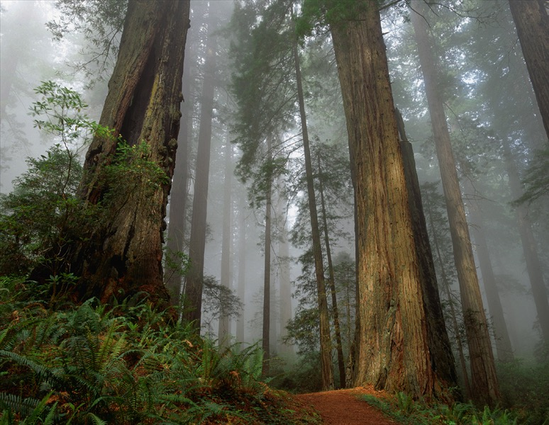
Be thou my vision 1/4
Be thou my vision,
O Lord of my heart;
Naught be all else to me,
save that thou art-
Thou my best thought,
by day or by night,
Waking or sleeping,
Thy presence my light.

Slide 29
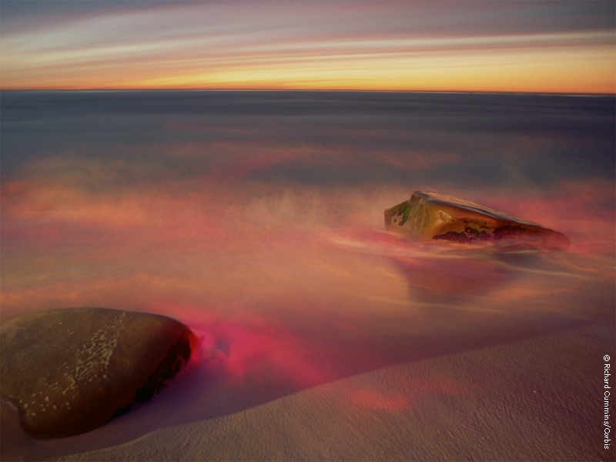
Be thou my vision 2/4
Be Thou my Wisdom,
and Thou my true Word;
I ever with Thee and Thou with me, Lord;
Thou my great Father,
I Thy true son,
Thou in me dwelling,
and I with Thee one.

Slide 30
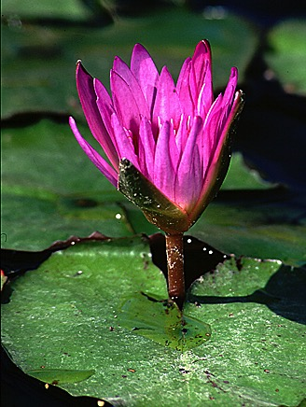
Be thou my vision 3/4
Riches I heed not nor
man's empty praise,
Thou my inheritance,
now and always;
Thou and thou only,
first in my heart,
High King of heaven,
my treasure Thou art.

Slide 31
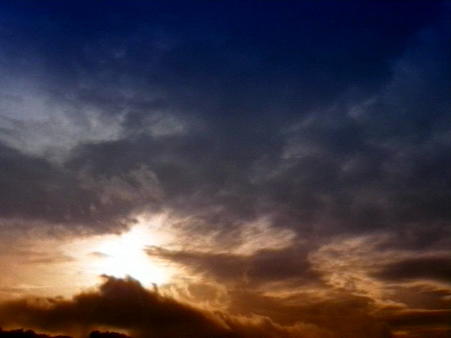
Be thou my vision 4/4
High King of heaven, my victory won,
May I reach heaven's joys,
O bright heav'ns Son!
Heart of my own heart, whatever befall,
Still be my Vision, O ruler of all!

Slide 32
2 Corinthians Book Chart
2 Corinthians: Defense of Apostolic Authority
Ministry Sincerity |  |  |  | Giving |  |  |  | Ministry Authority
Chapters 1–7 |  |  |  | Chapters 8–9 |  |  |  | Chapters 10–13
Defense of Paul's Motives |  |  |  | Defense of Paul's Worth |  |  |  | Defense of Paul's Traits
Character of Paul |  |  |  | Collection for Saints |  |  |  | Credentials of Paul
Greetings | Defends Conduct | Defends Ministry | Restore Confidence | Example | Purpose | Arrangements | Benefits | Defense | Offense | Warning | Closing
1:1-11 | 1:12–2:16 | 3:1–6:10 | 6:11–7:16 | 8:1-9 | 8:10-16 | 8:16–9:5 | 9:6- 15 | 10 | 11:1–12:18 | 12:19–13:10 | 13:11-14
Macedonia
Fall AD 56
162

Slide 33
Summary Statement
162
2 Corinthians
Paul defends his apostleship against attacking false teachers to assure both the Corinthians' doctrinal foundation and their promise to give to Jerusalem saints, thus providing an example of respect for and giving to church leaders today.

Slide 34
Applications
162
For Church Lay People:
Do you often criticize your spiritual leaders?
(In other words, do you have a problem submitting to authority?)
2. For Spiritual Leaders:
Are you fearful of defending your God-given spiritual authority?

Slide 35
Authorship
163
External Evidence
Support for Pauline authorship is upheld by even the most imaginative critics since the patristic evidence is so early. The early church writers who advocated Paul as author include Polycarp and others, including the second century Muratonian Fragment.
Internal Evidence
The book argues strongly for Pauline authorship as it specifically claims to be written by Paul (1:1).

Slide 36
Occasion
163
Within a year of Paul writing 1 Corinthians, false teachers infiltrated the church. They stirred up the people by accusing Paul of being proud, fickle, unimpressive in appearance and speech, dishonest, and unqualified as an apostle.
This threat motivated Paul to visit the church personally, and he refers to this second visit as a "painful visit" (2 Cor. 2:1).
After leaving the church this second time, Paul wrote a sorrowful letter (his third letter to the church) to urge them to discipline the leader of the opposition. Titus delivered the letter, then met Paul in Macedonia with the good news that most of the Corinthians had repented of rebelling against Paul's apostolic authority.
Nevertheless, Paul still felt it necessary to write 2 Corinthians to defend himself against the minority opposition.

Slide 37
Characteristics
164
2 Corinthians reveals Paul's character, motives, priorities, desires, and emotions more than any other NT writing.
This is probably the least taught and least preached Pauline epistle in the church today.
2 Corinthians is also probably Paul's most unsystematic epistle.
This letter expands upon Paul's former command for a contribution (1 Cor. 16:1-4) in a passage offering the most extended teaching on giving in the New Testament
(2 Cor. 8–9).

Slide 38
Paul's Argument
164
Paul penned 2 Corinthians to defend his apostolic authority against slanderous false teachers. This was accomplished by:
communicating the genuineness of his ministry so that the believers can really trust him (1–7)
assuring accountability as they finish collecting the offering they had pledged the year before (8–9), and
giving a defensive and offensive proclamation of the proofs of his apostleship (10–13).
Therefore, this letter contains personal information necessary to uphold his integrity before the church so that it would not be lost to the enemy.

Slide 39
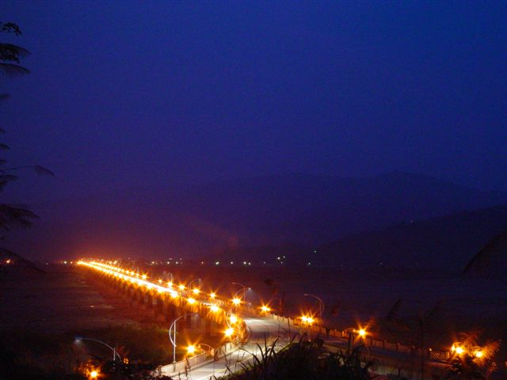
Number of letters and visits
Colin Kruse | David K. Lowery
1st visit to Corinth (2nd missionary journey) | 1st visit to Corinth (2nd missionary journey)
1st letter _ The letter implied in 1 Cor. 5:9 (now lost) | 1st letter – The letter implied in 1 Cor. 5:9 (now lost)
2nd letter – 1 Corinthians | 2nd letter – 1 Corinthians
2nd visit to Corinth ("painful visit" – 2 Cor. 2:1) | 2nd visit to Corinth ("painful visit" – 2 Cor. 2:1)
3rd letter – The "severe" letter implies in 2 Cor. 2:3-4; 7:8,12 (now lost) | 3rd letter – The "severe" letter implies in 2 Cor. 2:3-4; 7:8,12 (now lost)
4th letter – 2 Cor 1–9 | 4th letter – 2 Corinthians
5th letter – 2 Cor 10–13
3rd visit to Corinth | 3rd visit to Corinth

Slide 40
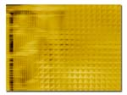
Paul's First Visit
1st letter to the Corinthian church
= "previous" letter (1 Cor. 5:9)
2nd letter to the Corinthians
= 1 Corinthians

Slide 41

Paul's Second Visit
"PAINFUL VISIT" (2 Cor. 2:1)
Then wrote 3rd letter, called the "severe" letter
Then his 4th letter
was 2 Corinthians

Slide 42

Paul's Third Visit
Paul's Third Visit
Paul anticipated this visit while penning 2 Corinthians

Slide 43
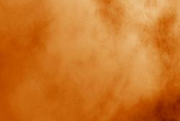
Outline of 1:1–7:16
OUTLINE
I. Paul's Defense of His Conduct and Apostolic Ministry
(1:1–7:16)
A. Introduction (1:1-11)
B. Paul's Conduct Explained (1:12–2:13)
C. Major Digression--The Apostolic Ministry Described
(2:14–7:4)
D. Paul's Reconciliation With the Corinthians (7:5-16)

Slide 44
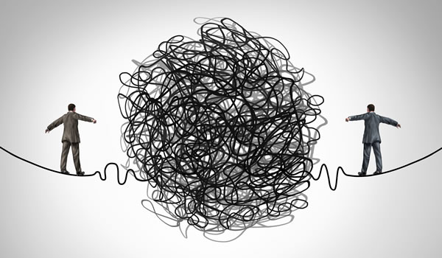
Be Responsive
Notes:
Sometimes the credibility of leaders becomes compromised due to unsubstantiated rumors. Such attempts to undermine the leaders so that the subordinates remain unresponsive.

Slide 45
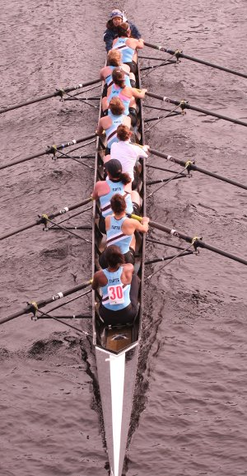
Be Responsive
Notes:
It is easy to forget that, despite our problems, believers are on the same team which requires us to work together much like a sports team must work in sync with one another.

Slide 46
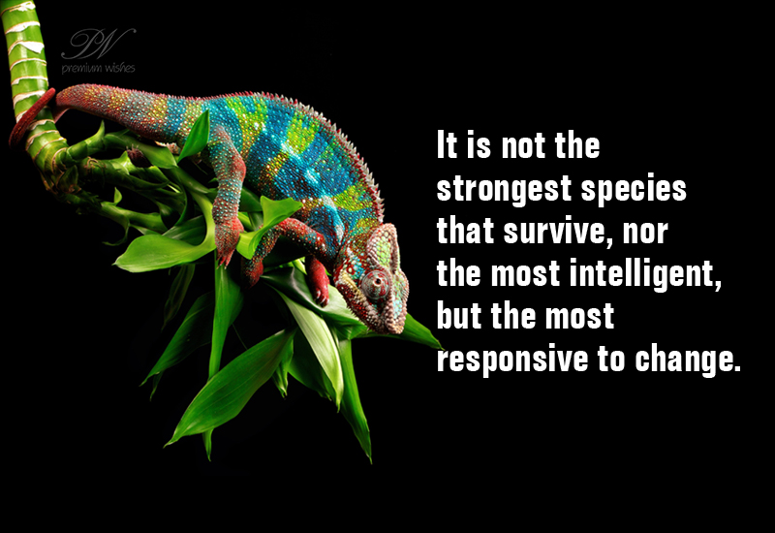
Be Responsive
It is not the strongest species that survive, nor the most intelligent, but the most responsive to change.

Slide 47
RESPONSIVE
BE
2 Corinthians
Dr. Rick Griffith • Crossroads International Church Singapore
BibleStudyDownloads.org
Notes:
How difficult it is to lead people when they do not even respond to our love! Such was Paul's predicament. The letter is a classic reminder to love and trust those who shepherd us with the truth of the gospel.

Slide 48

Hi!
Notes:
One of our cruelest responses to others is apathy. Once I knew someone who simply ignored me. He acted as if I did not exist. When I talked, he pretended not to hear. When I walked toward him in a hallway as he walked toward me, he wouldn’t greet me. When I was in the same room as him, he watched me in the corner of his eye to assure that he would sit on the other side of the room. I sat down with him and his wife years before this to talk about it and see what I had contributed to this. He listed many vain imaginations of things I had done to spy on him, so he said that he was just trying to guard his privacy. The amazing thing about this is that I am the one responsible for sticking my neck out to help him find his calling in life.

Slide 49
OPEN
CLOSED
Notes:
Maybe you can relate to my experience. You are open to people, but they are closed to you. One of our cruellest responses to others is apathy—or simply ignoring others—and you have seen this firsthand.
Your family background is far from ideal. Your father—or mother—neglected you growing up.
Many people struggle with apathy towards them at work. A worldwide survey was conducted some years back in which people were asked, “Does your work energize you?” The USA had the highest score at 40%. The lowest country in the world was Singapore—only 2% said that their work energized them. When someone just looks at you like a robot to get work out of you, it is deflating.

Slide 50
God is not apathetic about you.
Notes:
What a wonderful thing to see that God is not apathetic about you! Hardly! Most of us are quite informed what God has done for us. But are we apathetic towards him in response?
God has given us people who care about us—do we appreciate them?
God has given us more resources than we need—do we share them with others?
God rescued us from the pain of sin—do we thank him for being free from that slavery?

Slide 51
How can you be responsive to God’s heart for you?
Notes:
How can you be responsive to God’s heart for you? Instead of apathy, what is the right way to respond to the Lord for all he has done to save you, provide for you, purify you, restore you?

Slide 52
Background to
2 Corinthians
Notes:
Paul reached out to a church that was feeling conflicted and apathetic towards him—even though he started the church!
Imagine investing yourself into someone substantially—you help him or her get a job, you train the person with life skills that lead to success, or you even raise the person as your son or daughter. Despite all this, then that person turns against you! How would you feel? Certainly, this would hurt deeply.

Slide 53
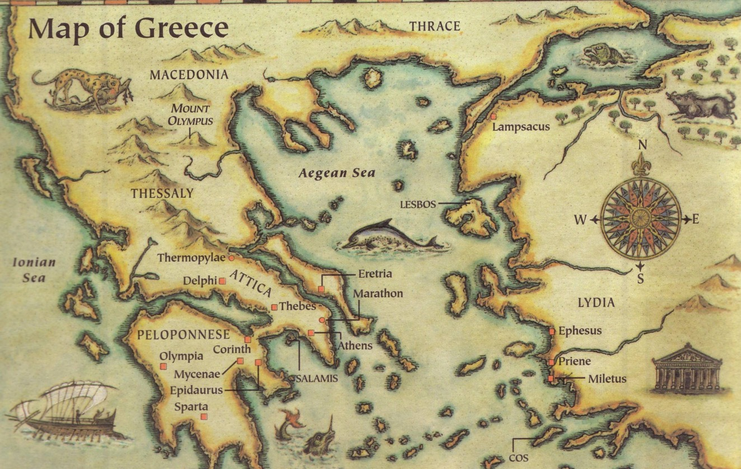
2 Corinthians was written in AD 56
Thessalonica
Berea
Athens
Corinth
Notes:
Paul arrived in Corinth after difficult times in Thessalonica, Berea, and Athens. No wonder that he told them that he came to them in weakness!
1Cor. 2:3 I came to you in weakness—timid and trembling.

Slide 54
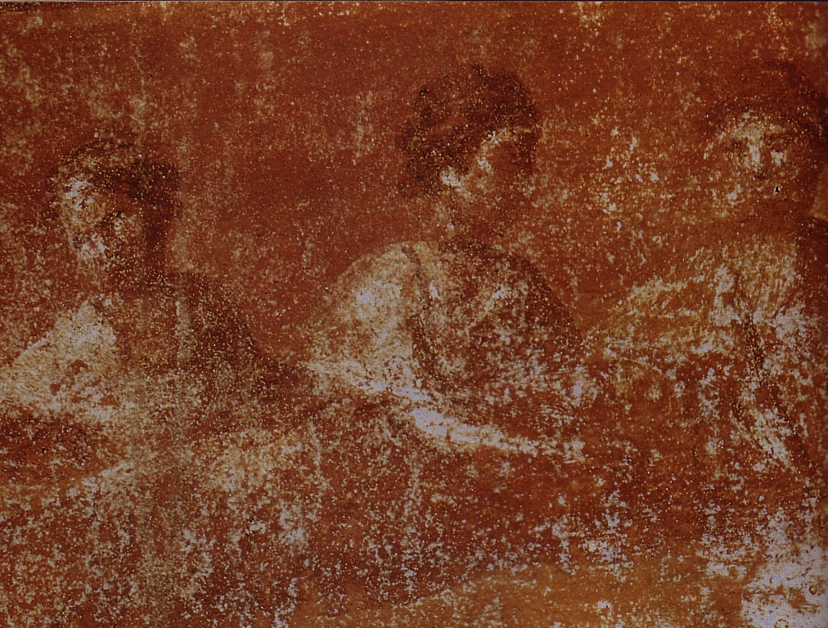
What was the early church really like?
Divorce (7)
Gifts (12-14)
1 Corinthians
Idolatry (8-10)
Incest (5)
Notes:
Christians today often idolize the early church as if it could do no wrong. Knowing about the Corinthian helps us get a more realistic picture.

Slide 55
NT Overview (Missionary Key Words)
38
124
39-41
"To the remotest part of the earth" (Acts 1:8)
Acts 9 13 14 15 16 18 21 27 28
Apr 48-
Sep 49
1
Galatia
Apr 50-
Sep 52
2
Aegean
Spr 53-
May 57
3
Asia
Feb 60-
Mar 62
1
Rome
Spr 62-
Fall 67
4
Spain
Aut 67-
Spr 68
2
Rome
Summer 35-
37
Damascus
Antioch
May 57-
Aug 59
Trials
Fall 49
The
Council
Spring 68
Expansion of Church
35 48 49 50 52 53 57 60 62 67 68 95
Matt
Kingdom
Luke
Sov 1
Acts
Sov 2
Mark
Disciple
John
Believe
Gal
Justify
1 Thess
Rapture
1 Cor
Sanctify
2 Thess
Tribulation
2 Cor
Apostle
Gospels & Acts
Pauline Epistles
1234
Journeys
Rome
Imprisonments
Pauline Missionary & Key Words

Slide 56

Be Different
1 Corinthians
Dr. Rick Griffith • Crossroads International Church Singapore
BibleStudyDownloads.org

Slide 57
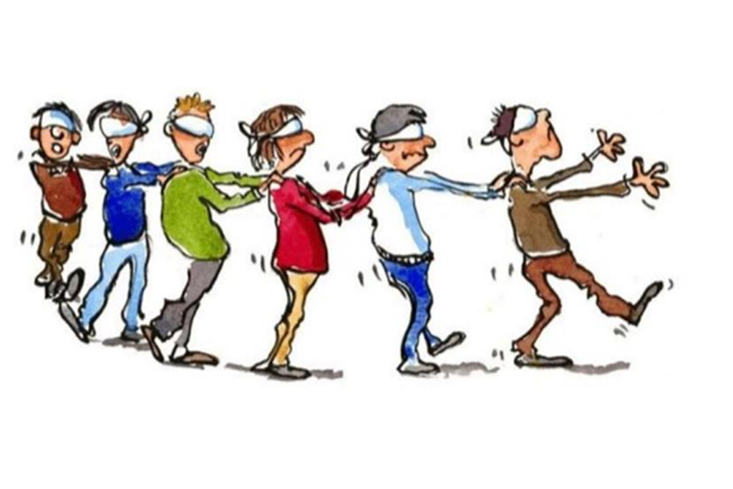
Herd Mentality
Notes:
We all are too keenly aware that there is a herd mentality in our world. It seems that the blind keeps leading the blind—insisting that we slavishly follow.
This week the governor of Virginia publicly argued for infanticide—and millions supported him!
Then pictures arouse of his racism while in medical school—so now politicians of his own party are calling for his resignation!
Since when is prejudice worse than killing babies right after birth?

Slide 58

Be Different
Notes:
In a world where right is considered wrong and wrong is deemed right, God has called believers to be different.

Slide 59

How should we be different from unbelievers?
Notes:
What are some of the ways that God wants your life to escape the herd mentality?
How does Jesus desire you to rise above the fray?

Slide 60

How should we…
BE
UNITED
(1–4)
BE
MORAL
(5–6)
BE
DIFFERENT
BE
SELFLESS
(7–16)
1 Corinthians
…from unbelievers?

Slide 61

Main Idea
Be different by being united, moral and selfless
1 Corinthians
Notes:
Said differently, do not divide the church, do not be immoral, and do not act only for your own benefit (restatement).

Slide 62

Sanctified = “Set apart by God as His possession”
Do you live like this?

Slide 63
Review of 1 Corinthians
157
Date
1 Corinthians was written in May AD 56 (1 Cor. 16:5-8).
2 Corinthians was written less than a year after 1 Corinthians (2 Cor. 8:10; 9:2).
2 Corinthians followed later that year in fall AD 56.
Destination:
Corinth
Origin:
Ephesus
Origin/Recipients
Paul addressed the church at Corinth from the city of Ephesus across the Aegean Sea
Notes:
Occasion: Paul's planting the Corinthian church on his second missionary journey took about eighteen months from March AD 51-September AD 52 (1 Cor 3:6, 10; 4:15; Acts 18:1-17). Nearly four years later while in Ephesus on his third missionary journey he received disturbing reports from Chloe’s household about divisions in the church (1 Cor 1:10) and a letter from the church carried by three men (1 Cor 16:17) that requested Paul's opinion on certain issues (1 Cor 7:1; 8:1; 12:1; 15:1; 16:1). He answered the problem of divisions and gave the much-needed response to the church's questions in the letter of 1 Corinthians (he had already written a letter before this; cf. 1 Cor 5:9).

Slide 64
2 Corinthians Context
Origin:
Macedonia
163
Origin/Recipients
Paul addressed this second letter to the church at Corinth from the province of Macedonia north of Corinth.
Destination:
Corinth
Date
2 Corinthians was written less than a year after 1 Corinthians (2 Cor. 8:10; 9:2).
1 Corinthians was written in AD May 56. The letter of 2 Corinthians followed later that year in fall AD 56.
Notes:
However, within a year of Paul's writing 1 Corinthians, false teachers infiltrated the church (2 Cor 11:20) and stirred up the people against him by accusing him of being proud (2 Cor 10:1), fickle (2 Cor 1:16f.), unimpressive in appearance and speech (2 Cor 10:10), dishonest (2 Cor 8:16), and unqualified to be an apostle (2 Cor 11:23; 12:6-7). Paul saw this threat as valid reason to visit the church personally, and he refers to this second visit as a “painful visit” (2 Cor 2:1; 12:14; 13:1). He anticipates this visit in 1 Corinthians 16:5-9.
• After leaving the church this second time, Paul wrote a sorrowful letter (his third letter to the church) to urge the church to discipline the leader of the opposition (2 Cor 2:1-11; 7:8f.). Titus delivered the letter then met Paul in Macedonia with the good news that most of the Corinthians had repented of rebelling against Paul's apostolic authority (2 Cor 7:6-7). Nevertheless, Paul still felt it necessary to write the letter of 2 Corinthians to defend himself against the minority opposition (2 Cor 10–13). So, Titus turned right around and headed back to Corinth to deliver 2 Corinthians, accompanied by two other brothers (2 Cor 8:16-24). Later Paul made a third visit to the church, anticipated in 2 Corinthians 13:1; Acts 19:21 and recorded in Acts 20:2-3.

Slide 65
How can you be responsive to God’s heart for you?
3 ways
Notes:
Basically, 2 Corinthians addresses how the church can respond to God. It answers the same question for us: How can you be responsive to God’s heart for you? Instead of apathy, what is the right way to respond to the Lord for all he has done to save you, provide for you, purify you, restore you?

Slide 66
Open your heart to…
your leaders
(1–7)
2 Corinthians
Notes:
Encourage those who lead you.

Slide 67
Corinth should open their hearts to Paul since God cared for them through him
(2 Cor 1–7).

Slide 68
Slides on
2 Corinthians 1
Notes:
His postponed visit when they doubted his care actually prevented Paul from overly rebuking them for not disciplining their leader who opposed Paul (1:12-24).

Slide 69

—God of Comfort—
2 Cor 1:3-11

Slide 70

³ All praise to God, the Father of our Lord Jesus Christ. God is our merciful Father and the source of all comfort.
⁴He comforts us in all our troubles so that we can comfort others. When they are troubled, we will be able to give them the same comfort God has given us.
2 Cor 1:3-4 (NLT)

Slide 71
⁵For the more we suffer for Christ, the more God will shower us with his comfort through Christ.
2 Cor 1:5 (NLT)

Slide 72
⁶ Even when we are weighed down with troubles, it is for your comfort and salvation! For when we ourselves are comforted, we will certainly comfort you. Then you can patiently endure the same things we suffer.
⁷ We are confident that as you share in our sufferings, you will also share in the comfort God gives us.
2 Cor 1:6-7 (NLT)

Slide 73
⁸ We think you ought to know, dear brothers and sisters, about the trouble we went through in the province of Asia. We were crushed and overwhelmed beyond our ability to endure, and we thought we would never live through it.
⁹ In fact, we expected to die. But as a result, we stopped relying on ourselves and learned to rely only on God,
who raises the dead.
2 Cor 1:8-9 (NLT)

Slide 74
¹⁰ And he did rescue us from mortal danger, and he will rescue us again.
We have placed our confidence in him, and he will continue to rescue us.
¹¹And you are helping us by praying for us. Then many people will give thanks because God has graciously answered so many prayers for our safety.
2 Cor 1:10-11 (NLT)

Slide 75

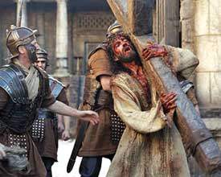
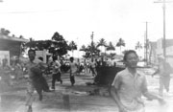
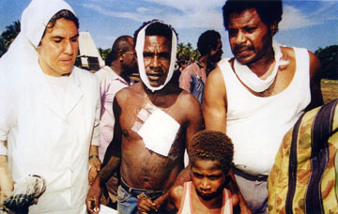
2 Cor. 1:1-11
Suffering
2 Cor. 1:1-11

Slide 76
Slides on
2 Corinthians 2
Notes:
Their discipline of this leader should make Paul’s next visit a positive one so that Satan would not drive a wedge between Paul, this leader, and the church (2:1-11).
Instead of returning, Paul’s sending Titus will remind them to spread the sweet aroma of Christ to believers and warn unbelievers of their impending peril (2:12-17).

Slide 77

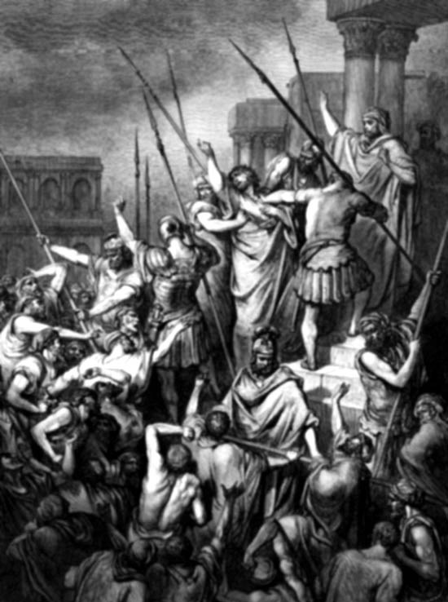
SUFFERING
SUFFERING
Paul's Suffering
Paul's Attitude Towards Suffering
Christ's Experience
Comfort Through Suffering
How do we face suffering?

Slide 78
Slides on
2 Corinthians 3
Notes:
Paul’s new covenant ministry blessed Corinth—not the false teachers (3:1–6:10).

Slide 79
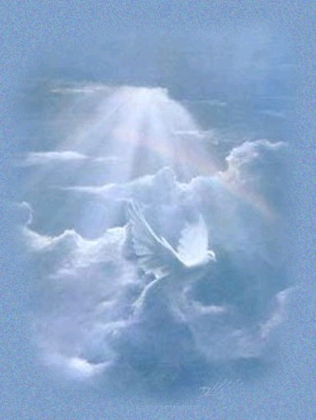
The New Covenant
(Jeremiah 31:31-34)
IN BRIEF
Notes:
These verses are the key verses on the New Covenant in the whole Bible.
_______
Common-384
BE-24-Jeremiah-58
FU-05-Biblical Covenants-27
OS-24-Jeremiah-162
NS-08-2 Corinthians-79
NS-19-Hebrews-333

Slide 80
Four Unconditional Biblical Covenants
476
ABRAHAMIC
Genesis 12:1-3
BLESSING
LAND
SEED
LAND
Deut. 30:1-10
DAVIDIC
2 Sam. 7:12-16
NEW
Jer. 31:31-34
The new covenant is God's unconditional amplification of the blessing promise in the Abrahamic Covenant where Judah and Israel will experience national and spiritual redemption.
Notes:
Three covenants amplify the Abrahamic covenant. The new covenant was one of them.
(cf. Deut. 30:1-10) promises:
Land from Wadi of Egypt to Euphrates River (Isa. 27:12)
Eternal possession of land (Gen. 17:8) after exile/restoration
Whole world blessed via the land (Isa. 14:1-2)
2 Samuel 7:12-16 promises perpetual:
Sons ("house" never wiped out)
Kingdom (political dynasty)
Throne (right to rule by descendants)
Temple (son to build it)
Jeremiah 31:31-34 promises:
Forgiveness
Indwelling Spirit
New heart, nature, mind
Reunification of Israel and Judah
No need for evangelism
__________
Common-385
BE-24-Jeremiah-59
FU-05-Biblical Covenants-28
OS-24-Jeremiah-163
NS-08-2 Corinthians-80
NS-19-Hebrews-334

Slide 81
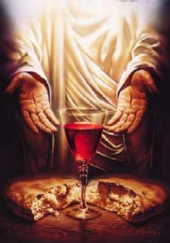
The New Covenant
Jeremiah 31:31-34
³¹"The time is coming," declares the LORD, "when I will make a new covenant with the house of Israel and with the house of Judah.
³²It will not be like the covenant I made with their forefathers when I took them by the hand to lead them out of Egypt, because they broke my covenant, though I was a husband to them," declares the LORD.
³³"This is the covenant I will make with the house of Israel after that time," declares the LORD.
Notes:
Jeremiah anticipates a time when the divided nation is once again united (31:33) and also believes in the Lord (31:34). This has not happened since Jeremiah's time. The people did return to the land in 538 BC, but they certainly did not "all know me" (31:33) nor did they receive forgiveness as a nation when they rejected Messiah Jesus. While some new covenant elements are being fulfilled now since the cup of the Lord's supper celebrates forgiveness for those who believe (Luke 22:20-22), the ultimate fulfillment of this promise awaits Israel's trust in Jesus in the future at his return.
__________
Common-386
BE-24-Jeremiah-60
FU-05-Biblical Covenants-29
OS-24-Jeremiah-166
NS-08-2 Corinthians-81
NS-19-Hebrews-335

Slide 82
The New Covenant
Jeremiah 31:31-34
^{33b} "I will put my law within them, and I will write it on their hearts. And I will be their God, and they shall be my people. ³⁴ And no longer shall each one teach his neighbor and each his brother, saying, 'Know the LORD,' for they shall all know me, from the least of them to the greatest, declares the LORD. For I will forgive their iniquity, and I will remember their sin no more."
Notes:
Verse 34 looks forward to a time when everyone in Israel is saved (all know me) and forgiven. Zechariah repeatedly promises this to happen in a single day!
Zech. 3:9 Now look at the jewel I have set before Jeshua, a single stone with seven facets. I will engrave an inscription on it, says the LORD of Heaven’s Armies, and I will remove the sins of this land in a single day.
Zech. 12:6 “On that day I will make the clans of Judah like a flame that sets a woodpile ablaze or like a burning torch among sheaves of grain. They will burn up all the neighboring nations right and left, while the people living in Jerusalem remain secure.
Zech. 12:11 The sorrow and mourning in Jerusalem on that day will be like the great mourning for Hadad-Rimmon in the valley of Megiddo.
Zech. 14:4 On that day his feet will stand on the Mount of Olives, east of Jerusalem. And the Mount of Olives will split apart, making a wide valley running from east to west. Half the mountain will move toward the north and half toward the south.
Zech. 14:6 On that day the sources of light will no longer shine, ⁷ yet there will be continuous day! Only the LORD knows how this could happen. There will be no normal day and night, for at evening time it will still be light.
__________
Common-387
BE-24-Jeremiah-61
FU-05-Biblical Covenants-30
OS-24-Jeremiah-167
NS-08-2 Corinthians-82
NS-19-Hebrews-33

Slide 83
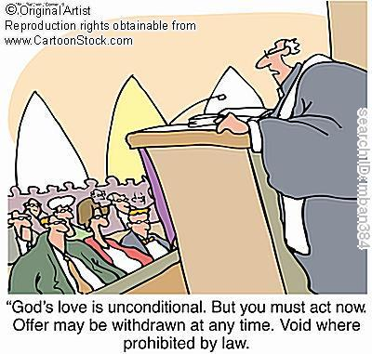
Unconditional Nature
477
Eternal (Jer. 31:36, 40; 32:40; 50:5; Isa 61:2. 8-9; 24:5; Ezek. 37:26)
Amplification of the Abrahamic Covenant, which is unconditional
Unqualified "I will" statements of God
"God's love is unconditional. But you must act now. Offer may be withdrawn at any time. Void where prohibited by law."
Notes:
How do we know that it was unconditional? Here are at least three reasons.
By "unconditional" we mean not that nothing else has to happen, for there is a time element here in that the new covenant will not be put into effect until Israel believes. The term "unconditional" means that no conditions can cause God to be unfaithful to his promise.
__________
Common-388
BE-24-Jeremiah-62
FU-05-Biblical Covenants-31
OS-24-Jeremiah-166
NS-08-2 Corinthians-83
NS-19-Hebrews-34

Slide 84


… This cup is the
NEW COVENANT in my blood, which is POURED OUT for you.
The cup (not baptism) is the new covenant sign
LUKE 22:20
Notes:
The Passover had its "cup of redemption" that referred to the salvation of Israel from slavery in Egypt. But Jesus changed the familiar wording on the night of the Last Supper to apply this "cup of redemption" not simply to political redemption. He declared himself as the fulfillment of this cup as it ultimately celebrates redemption in HIS blood as the TRUE Passover Lamb!
__________
Common-389
BE-24-Jeremiah-62?
FU-05-Biblical Covenants-31?
OS-24-Jeremiah-169
NS-03-Luke13-24-slide 161
NS-08-2 Corinthians-83?
NS-19-Hebrews-34?

Slide 85
How could Jesus apply the new covenant promises to his disciples when the other provisions were not fulfilled then?
(What about Israel and Judah reunified? What about all people knowing God?)
Notes:
We must reconcile these seemingly contradictory applications.
__________
Common-390
BE-24-Jeremiah-62?
FU-05-Biblical Covenants-31?
OS-24-Jeremiah-170
NS-03-Luke13-24-slide 161
NS-08-2 Corinthians-83?
NS-19-Hebrews-34?

Slide 86
How to Reconcile?
Jeremiah 31:31-34 (for Israel)
'everlasting covenant'
'a new heart'
'a new spirit'
'a covenant of peace'
'a covenant'
Luke 22:20 (for church)
Notes:
We must reconcile these seemingly contradictory applications.
__________
Common-391
BE-24-Jeremiah-62?
FU-05-Biblical Covenants-31?
OS-24-Jeremiah-171
NS-08-2 Corinthians-83?
NS-19-Hebrews-34?

Slide 87
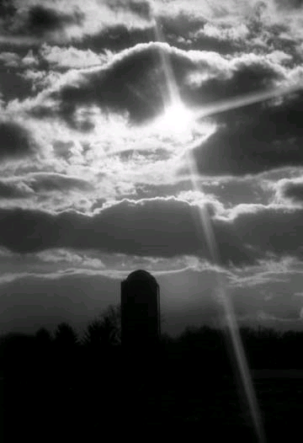
Provisions
477
FULFILLED
Indwelling of the Holy Spirit
(Jer. 31:33 with Ezek. 36:27)
New nature, heart & mind
(Jer. 31:33; Isa. 59:21)
Forgiveness of sins
(Jer. 31:34b)
NOT YET FULFILLED
Everyone will know the Lord
(Jer. 31:34a)
Israel and Judah will be reunited (Jer. 31:31)
Notes:
Scholars debate about how far or when or to whom the covenant refers. This is because Jeremiah 31 declares the covenant is for Israel and Judah but in the New Testament, it is declared for the church (Luke 22:20; 1 Cor 11:25; 2 Cor.3:6; Heb 8:8;9:15).
So questions arise. Is there a new covenant? Is it especially for the church? Or is it only for Israel? Or were there two covenants? Or are these promises built upon each other?
__________
Common-392
BE-24-Jeremiah-62
FU-05-Biblical Covenants-33
OS-24-Jeremiah-172
NS-08-2 Corinthians-83
NS-19-Hebrews-338

Slide 88

Views on the Time of Fulfillment
477
Amillennialists often say all of the provisions of the New Covenant are being realized now in the church which they consider the "new Israel." But are they?
1. Partial Fulfillment in the present church age
Only one New Covenant for Israel (Darby)
Two New Covenants: one for Israel and one for the church (Chafer)
One New Covenant with a two fold- application: primarily to Israel, secondarily to the Church
2. Complete fulfillment after the return of Christ
Notes:
Ignores NT, Christ's words, Paul's teachings
Ignore present work of the Holy Spirit cue cards
1)Cannot reconcile same terminology for OT and NT covenants.
2) The distinctions are too sharp.
View most modern pre-mils take. Deals with both OT/NT data, forgiveness and the holy spirit are blessings that we experience now.
Ignoring OT data between the distinctions between church and Israel
__________
Common-393
BE-24-Jeremiah-62?
FU-05-Biblical Covenants-31?
OS-24-Jeremiah-170
NS-03-Luke13-24-slide 161
NS-08-2 Corinthians-83?
NS-19-Hebrews-34?

Slide 89
Views on the New Covenant
490
View | Explanation | Group | Problems
Restated Mosaic | There is no new Covenant | Critical | OC/NC distinction in text ignored OC=conditional, NC= unconditional OC=temporal, NC=eternal OC=external, NC=internal OC=no enablement, NC=enablement NC=peace, prosperity, sanctuary and Spirit
Church Alone | No Israel Participation | Amil / Postmil | Ignores OT data - Israel =Church NC introduced not equal to fulfilled to Israel Present need to know YHWH AD 70 Jerusalem vs. Jer. 31:40
Notes:
Here are two unacceptable views on the new covenant (NC) that do not distinguish between it and the old covenant (OC0.
__________
Common-394
BE-24-Jeremiah-62?
FU-05-Biblical Covenants-31?
OS-24-Jeremiah-170
NS-03-Luke13-24-slide 161
NS-08-2 Corinthians-83?
NS-19-Hebrews-34?

Slide 90
Views on the New Covenant (2)
490
View | Explanation | Group | Problems
Israel Alone | No Church Participation | Misc/ Classical Dispensational | Ignores NT Data Christ's Last Supper words Paul's statements in Romans Hebrews application to Church Ignores present work of Spirit
Two New Covenants | NC for Israel NC for Church | Early 1900s Dispensational | Same terminology for OT & NT NCs Israel/Church distinction too sharp Basis of forgiveness is the same If 2NCs then there's no OC for Church Church doesn't possess Israel's promises
Church Participation | Primarily for Israel Secondarily for the Church | Misc / Present Dispensational | Support Primary fulfillment future – Rom 11 Deals with both OT and NT data Forgiveness/ Spirit =Blessings now NC has new law Rebuttals to above views
Notes:
90
The first two views have too many problems.
__________
Common-395
BE-24-Jeremiah-62?
FU-05-Biblical Covenants-31?
OS-24-Jeremiah-170
NS-03-Luke13-24-slide 161
NS-08-2 Corinthians-83?
NS-19-Hebrews-34?

Slide 91
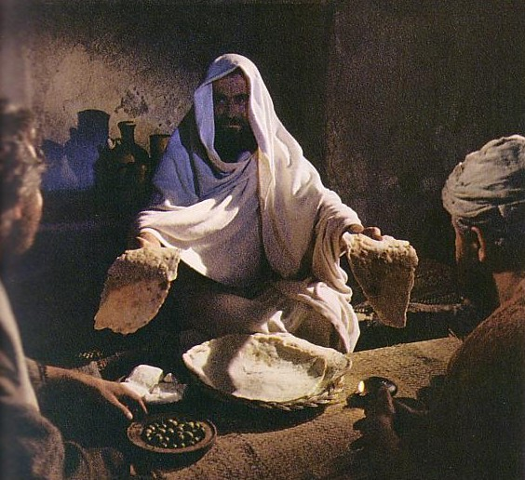
"This cup is the new covenant in my blood" (لوقا 22:20)
Refers back to Jeremiah 31:31-34
The new covenant replaces the old
The church participates in the covenant promised to Israel
Never does Scripture say that the church replaces Israel since God has not rejected the nation (Rom. 11:1; cf. Jer. 31:35-37)
Notes:
Christians are therefore no longer under the old covenant of Moses. But that does not mean there is no future fulfillment of this new covenant to a believing Israel.
__________
Common-396
BE-24-Jeremiah-62?
FU-05-Biblical Covenants-31?
OS-24-Jeremiah-169
NS-03-Luke13-24-slide 161
NS-08-2 Corinthians-83?
NS-19-Hebrews-34?

Slide 92
Contrasting the Covenants (2 Cor. 3–4)
166c
Old Covenant | New Covenant
initiated by Moses (3:8) | initiated by Christ (3:4)
of the letter (3:6a) | of the Spirit (3:6a, 18b)
kills (3:6b, 7a) | gives life (3:6b)
engraved on stone (3:3b, 7a) | engraved on hearts (3:3b; Jer. 31:33)
glorious (3:7a) | more glorious (3:8, 10)
glory faded (3:7b, 11a, 13b) | glory ever-increases (3:11b, 18)
condemns men (3:9a) | brings righteousness (3:9b)
deception (3:13) | boldness (3:12)
veiled face of Moses (3:13b) | unveiled faces (3:13a, 18a)
veiled minds (3:14a) | unveiled minds (3:14b; 4:3-6)
veiled hearts (3:15) | unveiled hearts (3:16)
dullness (3:14a) | freedom (3:17)
Moses reflected God's glory | all believers reflect Son's glory (3:17)
non-transforming (3:7) | transforming (3:18)
lack of zeal (3:13) | confidence, steadfastness (3:4-5; 4:1)
deception (3:13) | sincerity (4:2)
Notes:
Paul's ministry was deemed even greater than Moses's since the glory of the new covenant is greater than that of the Mosaic covenant (2 Cor 3).
_____________
Common-397
OS-24-Jeremiah-177
NS-08-2Cor-85

Slide 93
Signs of the Covenants
166e
Covenant | Definition | Promise | Fulfillment | Sign
Noahic | Unconditional promise not to flood earth again | Gen. 9:12-17 | No more sea (Rev. 21:1) | Rainbow (Gen. 9:12-17)
Abrahamic | Promise to provide Israel a land, rule, and spiritual blessing | Gen. 12:1-3; 15:13-18 | Continues at present (Gal. 3:17) but Israel still has a future (Rom. 11:25-27) | Circumcision (Gen. 17:11)
Mosaic | Conditional stipulations for blessing on Israel | Exod. 19-31; Deut. 28 | Death of Christ (Rom. 7:4-6) | Sabbath (Exod. 31:13)
Land | Promise of physical land from the Wadi of Egypt to the River Euphrates | Deut. 30:1-10 | Land blessed (Amos 9:13-15) | No sign (that I know of)
Davidic | Promise of eternal, political rule of a descendant of David | 2 Sam. 7:12-17 | Rule renewed (Amos 9:11-12) | Christ seated at the Father's right hand (Acts 2:34-36)
New | Promise of spiritual indwelling of the Spirit ("law written on hearts"), forgiveness, and total evangelization of Israel | Jer. 31:31-34 | Paul & the Apostles (2 Cor. 3–4) All Israel saved (Rom. 11:26-27) | Cup of the Lord's Supper (Luke 22:20; 1 Cor. 11:25)
Notes:
Each of God's promises had an accompanying sign or visible evidence of his covenant faithfulness, except perhaps the Land Covenant, although even it promises the exile of the nation (Deut 30:1-10).
____________
Common-397
OS-24-Jeremiah-177
NS-08-2Cor-89

Slide 94
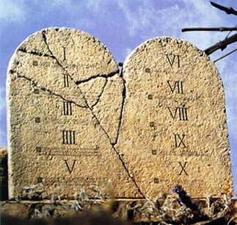

"Old" Replaced by "New"
NTS 266hh
Wayne Grudem, Systematic Theology, 521
"What then is the 'old covenant' in contrast with the 'new covenant' in Christ? It is not the whole of the Old Testament, because the covenants with Abraham and David are never called 'old' in the New Testament. Rather, only the covenant under Moses, the covenant made at Mount Sinai (Ex. 19-24) is called the 'old covenant' (2 Cor. 3:14; cf. Heb. 8:6, 13), to be replaced by the "new covenant" in Christ (Luke 22:20; 1 Cor. 11:25; 2 Cor. 3:6; Heb. 8:8, 13; 9:15; 12:24)."
Notes:
What covenant does Jesus mediate that is far better than the old (8:6)?
Christians are not under the covenant with Moses. We are new covenant believers.
_____________
Common English-150
BE-05-Deut-46
CH-02-Nature, etc.-104
FU-05-Biblical Covenants-34
OS-02-Exodus-370, 463
OS-05-Deut-185
OS-24-Jeremiah-177
NS-08-2 Corinthians-41
NS-09-Galatians-144
NS-19-Hebrews-298, 344

Slide 95
Kingdom & Covenants Timeline
22
CH-34a
OS1-22
OS2-337
NS-9g
SA-19
34a
Dr. Rick Griffith • BibleStudyDownloads.org
22
Kingdom Teaching...
Adam rules with God (Gen. 1:26, 28; 2:19)
Satan begins rule as god of this world (Gen. 3:15;
2 Cor. 4:4)
God covenants with Abraham to reestablish man's rule via Israel as a "kingdom of priests" (Gen. 12:1-3; Exod. 19:6)
Israel's failure to witness to nations as a kingdom of priests is judged via exile under foreign rule
Israel rejects Messiah's offer of kingdom (Matt. 12:41-42; 23:37-39)
Jesus extends His kingdom in mystery form to the Church (Matt. 13)
Christ subdues Israel's enemies and nation believes (Rom. 11:26-27)
Christ rules over everything with saints (Eph. 1:9-10; Rev. 20:1-6; 22:5b)
337
9g
Fall of Man (Gen. 3)
Noahic Covenant
19
Genesis 6:18; 9:8-17
Land Covenant
ISRAEL
CHURCH
MESSIANIC KINGDOM
(National Focus)
The "New Man" (Eph. 2:15)
Millennial Eternal
land
Genesis 15:18 (cf. Deut. 30:1-10) promises:
Land from Wadi of Egypt to Euphrates River (Isa. 27:12)
Eternal possession of land (Gen. 17:8) after exile/restoration
Whole world blessed via the land (Isa. 14:1-2)
Israel judged for rejecting Messiah by dispersion away from land for 19 centuries
(AD 70–AD 1948) but now partially restored (Ezek. 37:1-7)
Full restoration (Ezek. 37:8-28) Jerusalem world capital
(Isa. 2:1-5)
New Jerusalem
(Rev. 21–22)
Davidic Covenant
Christ is Head over his Church, which is a spiritual temple (Eph. 2:19-22; 2 Cor. 6:16)
Christ reigns over the world
(Isa. 11)
with saints (Rev. 5:10; 20:4-6)
Christ hands kingdom over to Father (1
Cor. 15:24)
Genesis 12:1-3
2 Samuel 7:12-16 promises:
Sons ("house" never wiped out)
Kingdom (political dynasty)
Throne (right to rule by descendants)
Temple (son to build it)
seed
Abrahamic Covenant
New Covenant
All
things made new!
(Rev. 21:5)
All 5 elements fulfilled in national restoration (Zech. 8)
Jeremiah 31:31-34 promises:
Forgiveness
Indwelling Spirit
New heart, nature, mind
Reunification of Israel and Judah
No need for evangelism
Mosaic Law is replaced with first three elements of the New Covenant (Luke 22:20; 2 Cor. 3:6)
blessing
Mosaic Covenant
Law abolished, fulfilled, and replaced at the cross (Rom. 7:1-6;
1 Cor. 9:19-21; Heb. 8:13)
12th Edition
5 March 2023
Temporary (Gal. 3:19) and conditional (Deut. 28) to reveal sin (Rom. 7:7) and regulate Israel (Gal. 3:23-25)
Scripture has a dual kingdom-covenant theme. Israel's role from Abraham to Christ expands to include the Church (continuity) yet the Church never replaces the nation as the "new Israel" (discontinuity). Israel will enjoy world prominence after trusting Christ at His second coming.
Notes:
This complicated chart combines the two themes of Kingdom and Covenants. God's kingdom rule extends to humanity across the ages at the top. Also, God's covenant (promise) to Noah still applies today never to flood the entire earth. But the major part shows the unfolding of the Abrahamic Covenant in its land, Davidic, and New Covenant promises—partially fulfilled in the present, but fully completed in the Messianic Kingdom. This will happen in the Millennial Age and especially in the Eternal State.
• This chart also shows that the Old (Mosaic) Covenant was replaced by the New Covenant because believers have died to the Law (Rom 7:1-6).
All agree that a partial fulfillment of the covenant to Abraham exists now to the Church in the indwelling Holy Spirit and forgiveness of sins (Jer 31:31-34)—and the ultimate fulfillment will be in the eternal state.
The main area of disagreement relates to the time period from now to eternity. Will there be a literal land, throne, and worldwide blessing to national (ethnic) Israel before the eternal kingdom? This chart shows verses answering YES to that question in a present partial fulfillment and a future full fulfillment in the normal sense of language in the verses cited. But the messianic kingdom will be in two stages—first in a millennial fulfillment to last 1000 years, but then, after that, the eternal stage in the new Jerusalem after the destruction of our present heavens and earth (Rev 21–22). What an amazing future remains for those who trust Jesus!
____________
Common-151
BT-01-OT Biblical Theology-25
CH-02-Nature-103-p34a
ES-13-Tribulation-23
ES-27-Kingdom_&_Covenants_Timeline-1
CH-02-Nature-103-p34a
OC-10-Chronology-42
OS-00-Intro & Biblical Theology-25 & 90
OS-00-Pentateuch-18
OS-02-Exodus-267-p22
OS-05-Deut-279, 300
OS-10-2Sam-96-p22
OS-12-Kings & Prophets Charts-25
OS-13-1 Chron-46
OS-23-Isaiah-97-p337
OS-24-Jeremiah-178-p337
OS-23-Isaiah-97-p337
OS-28-Hosea-49
OS-31-Obadiah-164
OS-36-Zephaniah-143
OS-38-Zechariah-220
05-Acts1-2-slide 45
NS-09-Gal-143-p9g
NS-19-Hebrews-342-p9g
SA-08-Mosaic Law-19-p38a

Slide 96
Slides on
2 Corinthians 4
Notes:
Paul never gives up during suffering because God's power helps him to minister for their benefit (4:1-15).

Slide 97
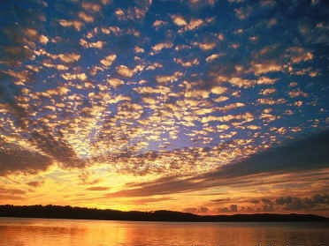
How to Beat the Blues
2 Corinthians 4:16-18

Slide 98
Are you discouraged today?

Slide 99
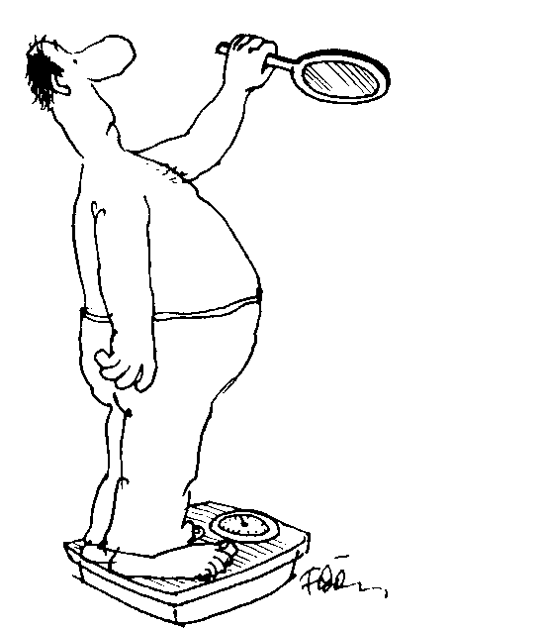
How can you beat the blues?
How can you defeat discouragement?

Slide 100
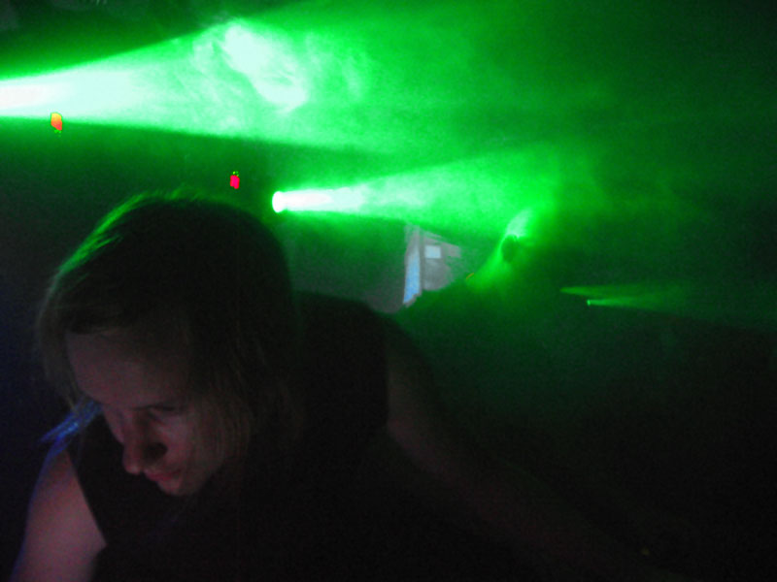
Was Paul discouraged?

Slide 101
Paul's Sacrifices…
2 Corinthians 11:23-28 I have worked much harder, been in prison more frequently, been flogged more severely, and been exposed to death again and again. ²⁴Five times I received from the Jews the forty lashes minus one. ²⁵Three times I was beaten with rods, once I was stoned, three times I was shipwrecked, I spent a night and a day in the open sea, ²⁶I have been constantly on the move. I have been in danger from rivers, in danger from bandits, in danger from my own

Slide 102
Paul's Sacrifices…
countrymen, in danger from Gentiles; in danger in the city, in danger in the country, in danger at sea; and in danger from false brothers. ²⁷I have labored and toiled and have often gone without sleep; I have known hunger and thirst and have often gone without food; I have been cold and naked. ²⁸Besides everything else, I face daily the pressure of my concern for all the churches.

Slide 103
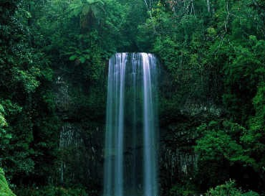
"Therefore we do not lose heart. Though outwardly we are wasting away, yet inwardly we are being renewed day by day"
(2 Cor. 4:16)

Slide 104
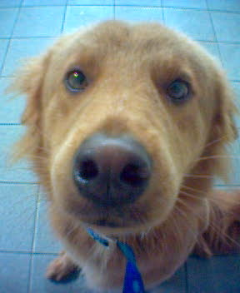
Let's see Paul's two ways to beat the blues…

Slide 105
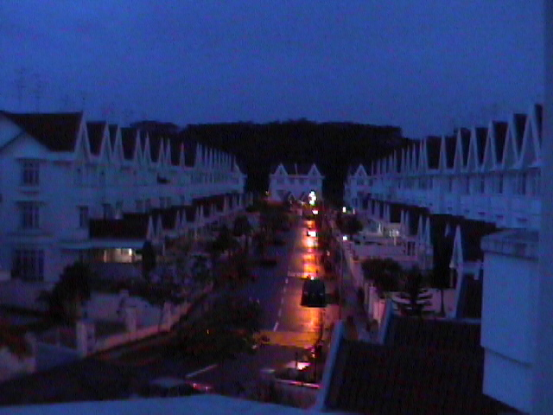
I. View your troubles as trivial compared to your rewards (4:17)

Slide 106
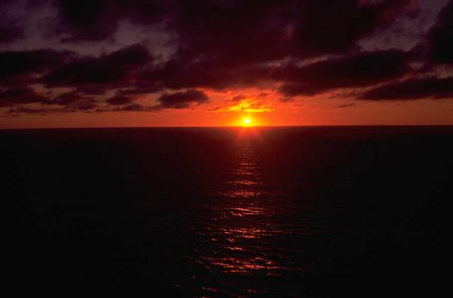
"For our light and momentary troubles are achieving for us an eternal glory that far outweighs them all" (4:17)

Slide 107
Paul's light & momentary troubles…
2 Corinthians 11:23-28 I have worked much harder, been in prison more frequently, been flogged more severely, and been exposed to death again and again. 24 Five times I received from the Jews the forty lashes minus one. 25 Three times I was beaten with rods, once I was stoned, three times I was shipwrecked, I spent a night and a day in the open sea, 26 I have been constantly on the move. I have been in danger from rivers, in danger from bandits, in danger from my own countrymen, in danger from Gentiles; in danger in the city, in danger in the country, in danger at sea; and in danger from false brothers. 27 I have labored and toiled and have often gone without sleep; I have known hunger and thirst and have often gone without food; I have been cold and naked. 28 Besides everything else, I face daily the pressure of my concern for all the churches.

Slide 108
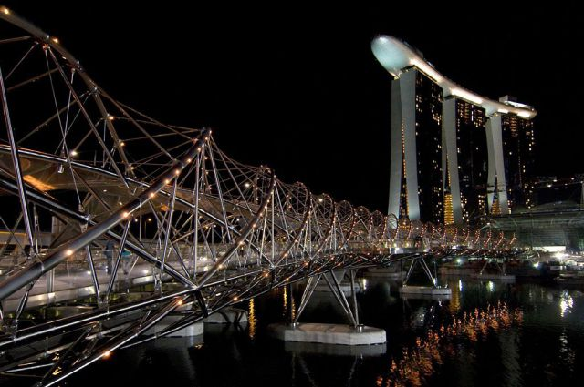
The City-State of Singapore

Slide 109
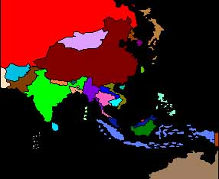
Singapore's Strategic Location
10/40 Window
Poorest Area
97% of Unreached

Slide 110
II. Focus on invisible, eternal realities (4:18)

Slide 111
See the invisible!
"So we fix our eyes
not on what is seen,
but on what is unseen.
For what is seen is temporary,
but what is unseen is eternal"
(2 Corinthians 4:18)

Slide 112
Focus on things of real value
Everything we can see is ultimately worthless
Things that we can't see are priceless

Slide 113
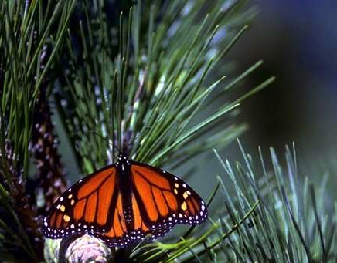
What is eternal?
God
God's Word
Souls of People

Slide 114
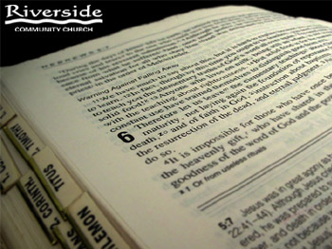
The One Book

Slide 115
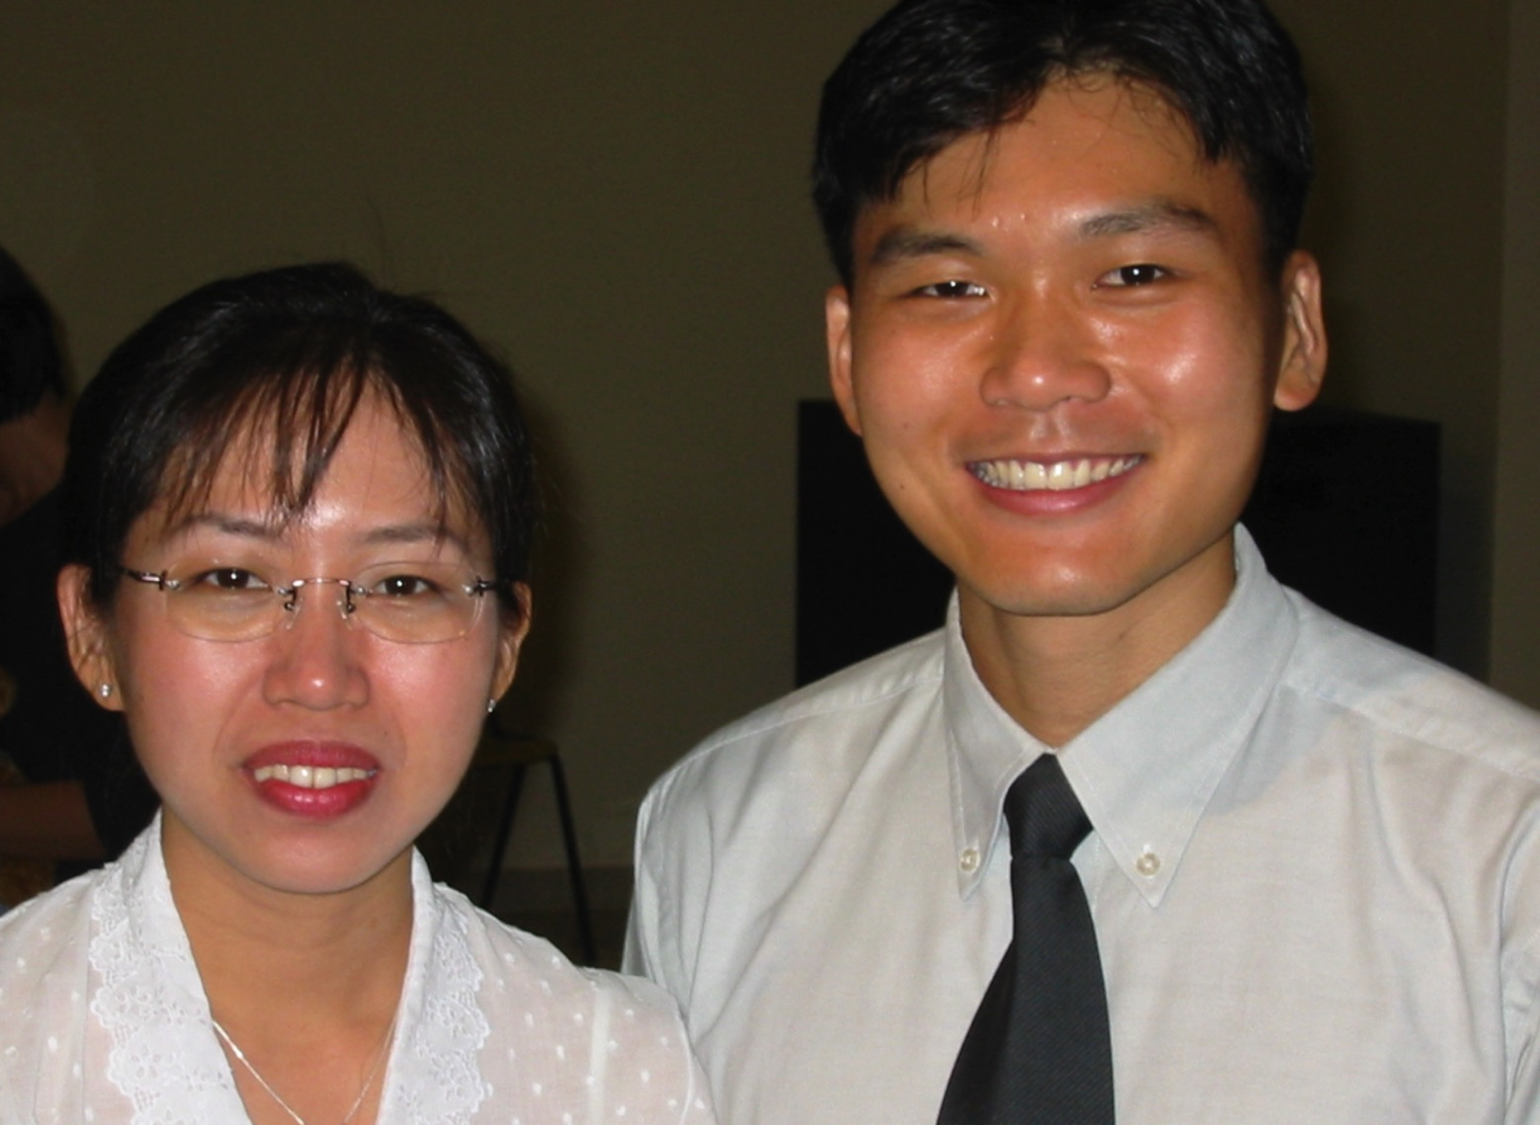
Premarital Counseling
Singapore: Aaron Chan
Indonesia: Sylvia

Slide 116
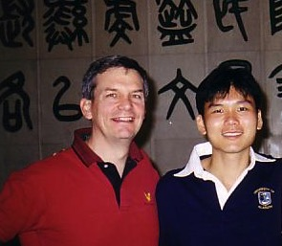
Ministry Up North

Slide 117
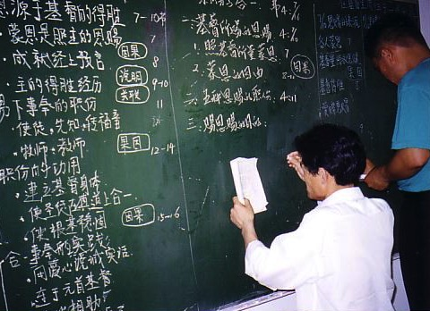
Get Involved!

Slide 118

You can defeat discouragement by following God's priorities
(Main Idea)

Slide 119
Eternal Priorities
God
God's Word
Souls of People

Slide 120

My two brothers

Slide 121

Five More Homes
+$50,000
+$50,000
+$50,000
+$50,000
+$50,000
+$50,000

Slide 122

Emptiness

Slide 123
Two Key Questions
The eternal priority of God that I must pursue with passion is…
2. The way God is telling me to do this is…

Slide 124
Slides on
2 Corinthians 5
Notes:
Paul retains courage in suffering because his motivation comes from an eternal view and a love that compels him in his ministry of reconciliation (4:16–6:2).

Slide 125

The Resurrected Body

Slide 126
Resurrections & Judgments
160
R = 4 Resurrected Groups
J = 7 Judged Groups
Rapture
2nd Advent
R
2R
R
Great
White
Throne
J
4J
2J
Church Age
Tribulation
Millennium
Battle of
Armageddon
Battle of
Gog and Magog

Slide 127

Judgment Seat of Christ
160
Believers Rewarded by Christ (2 Cor. 5:10)
At the Rapture
(1 Thess. 4:17)
Reward or loss of rewards (not salvation)

Slide 128

We will join him in the clouds
(1 Thess. 4:17)

Slide 129

We will put away "this present tent"
(2 Cor. 5:1)

Slide 130

New bodies

Slide 131
The Judgment Seat of Christ
Is this a judgment to determine salvation?
Or is it to reward believers?

Slide 132

The Bema Still Exists
Notes:
132

Slide 133

Bema with Acrocorinth in Distance
Notes:
133

Slide 134

View from Acrocorinth
Notes:
134

Slide 135

The Main City Below
Notes:
135

Slide 136


The Corinthian Marketplace
Bible Visual Resource Book, 235

Slide 137

The Bema at Corinth
"But while Gallio was proconsul of Achaia, the Jews with one accord rose up against Paul and brought him before the judgment seat [bema]" (Acts 18:12)
Lawsuits
1 Cor. 6
Bema
Paul brought before judgment seat
Acts 18:12

Slide 138

Bema Close-up
“So we make it our goal to please him, whether we are at home in the body or away from it. ¹⁰For we must all appear before the judgment seat [bema] of Christ, that each one may receive what is due him for the things done while in the body, whether good or bad” (2 Cor. 5:9-10 NIV).
Notes:
138
http://corinth.sas.upenn.edu/schola.html

Slide 139

The Speaker or Judge Above
The Speaker or Judge Above
Notes:
139

Slide 140

The One Being Judged or Rewarded Stood Below
Notes:
140

Slide 141

Bema for Rewards
75
"In Grecian games in Athens, the old arena contained a raised platform on which the president or umpire of the arena sat. From here he rewarded all the contestants; and here he rewarded all winners. It was called the 'bema' or 'reward seat.' It was never used of a judicial bench."
L. Sale-Harrison, Judgment Seat of Christ, 8
cited by Pentecost, Things to Come, 220
Really?
Notes:
141
141

Slide 142

Bema is Used of Jesus Before Pilate
Notes:
142

Slide 143

Jesus Before Pilate
Notes:
143

Slide 144

The Bema is a Reward Seat
76
And a Judgment Seat

Slide 145

"… the fire will test the quality of each man's work"
(1 Cor. 3:13)
76
Notes:
145

Slide 146


Lasting Building Materials (3:12a)
Silver
Gold
Jewels
Foundation: Apostles & Prophets (Eph. 2:20)
Foundation: The Lord Jesus Christ (1 Cor. 3:11)
Adapted from Charles R. Swindoll. "Spiritual Gifts Study Guide" (IFL, 1983), 7

Slide 147


Perishable Building Materials (3:12b)
Hay
Wood
Straw
Foundation: Apostles & Prophets (Eph. 2:20)
Foundation: The Lord Jesus Christ (1 Cor. 3:11)
Adapted from Charles R. Swindoll. "Spiritual Gifts Study Guide" (IFL, 1983), 7

Slide 148


"saved as through fire…"
(1 Cor 3:15)

Slide 149



Slide 150


2 CORINTHIANS 5:17
Therefore, if anyone is in Christ
he is a new creation.
The old has passed away;
Behold, the new has come.

Slide 151

Outline
OUTLINE
II. The Collection for the Saints at Jerusalem (8:1–9:15)
A. The Need for Generosity (8:1-15)
B. The Mission of Titus and His Companions (8:16–9:5)
C. The Results of Generosity (9:6-15)

Slide 152
Slides on
2 Corinthians 6
Notes:
Paul marks of a genuine ministry in his suffering does not discredit his ministry through offending others by requiring a comfortable lifestyle (6:3-10).

Slide 153

"I am asking you to respond as if you were my own children. Open your hearts to us!"
(2 Cor 6:13 NLT).

Slide 154



Association with non-believers
2 Cor. 6:14-18
Notes:
They should open their hearts to him—not to unbelievers—as he did to them (6:11–7:16).

Slide 155


Reasons for Separation
UNEQUALLY YOKED
Giving up of control over one's activities and the loss of freedom to act in obedience to God.

Slide 156

What does 2 Cor. 6:14-7:1 mean?
"
136
"Don't team up with those who are unbelievers. How can righteousness be a partner with wickedness? How can light live with darkness? ¹⁵What harmony can there be between Christ and the devil? How can a believer be a partner with an unbeliever? ¹⁶And what union can there be between God's temple and idols? For we are the temple of the living God."

Slide 157
What does 2 Cor. 6:14-7:1 mean?
"
136
"As God said:
'I will live in them
and walk among them.
I will be their God,
and they will be my people.
¹⁷Therefore, come out from among unbelievers, and separate yourselves from them, says the Lord'
(2 Cor. 6:16-17)

Slide 158
What does 2 Cor. 6:14-7:1 mean?
"
136
"Don't touch their filthy things,
and I will welcome you. ¹⁸And I will be your Father, and you will be my sons and daughters, says the Lord Almighty."
¹Because we have these promises, dear friends, let us cleanse ourselves from everything that can defile our body or spirit. And let us work toward complete holiness because we fear God"
(2 Cor. 6:17–7:1)

Slide 159


Association with non-believers
Paul's Instructions

Slide 160

Separation Texts
136
Text
Issue
Command
2 Th 3:6-15
?
?
Rom 12:1-2
?
?
Rom 16:17
?
?
Eph 5:11
?
?
1 Th 5:21
?
?

Slide 161

Separation Texts
137
Text
Issue
Command
1 Tim 6:3-5
?
?
2 Tim 2:16-21
?
?
Titus 3:10
?
?
2 John 7-11
?
?
Jude 3
?
?

Slide 162

Distinctions between believers and non-believers
Association with non-believers

Slide 163

What does 2 Cor. 6:14-7:1 mean?
"
137
"The direct commands to separate from other people are always commands to separate from unbelievers, not from Christians with whom one disagrees… The are no direct New Testament commands to separate from Christians with whom one has doctrinal differences (unless those differences involve such serious heresies that the Christian faith itself is denied)."
Wayne Grudem, Systematic Theology, 877

Slide 164

CHRISTIANS
and
WORLD STANDARDS

Slide 165
Slides on
2 Corinthians 7

Slide 166
"Because we have these promises, dear friends, let us cleanse ourselves from everything that can defile our body or spirit. And let us work toward complete holiness because we fear God. ² Please open your hearts to us. We have not done wrong to anyone, nor led anyone astray, nor taken advantage of anyone" (2 Cor 7:1-2 NLT).

Slide 167
“I’m not saying this to condemn you. I said before that you are in our hearts, and we live or die together with you. ⁴I have the highest confidence in you, and I take great pride in you. You have greatly encouraged me and made me happy despite all our troubles"
(2 Cor 7:3-4 NLT).

Slide 168

We should encourage our spiritual leaders also.
Notes:
Think the best of them. (Corinth thought the worst of Paul.)
Give them new covenant latitude—not old covenant legalism.
How can we encourage our leaders?
Ask them!
Give them a break.
Tell them how they minister to you.

Slide 169
How can you be responsive to God’s heart for you?

Slide 170
Open your heart to…
your leaders
(1–7)
those in need
(8–9)
2 Corinthians
Notes:
Encourage those who lead you.
Give generously to those who aren’t financially blessed like you.

Slide 171
Corinth should respond to God’s care by giving to the Jerusalem saints
(2 Cor 8–9).

Slide 172
Slides on
2 Corinthians 8

Slide 173

How to Get Rich
2 Corinthians 8:1-15

Slide 174


A Revealing Checkbook...
Notes:
A man who had been married for 20 years once decided to divorce his wife. While preparing for the financial settlement, he started rummaging through his old checks. One canceled check after another brought back memories of a long-forgotten past: the check to the hotel where he and his wife had spent their honeymoon, the check for their first car, the check for the hospital bill when their daughter was born, the check for the $2000 down payment on their first home.
Finally, he could no longer bear it. He pushed the checks aside, grabbed the phone, and called his wife. Telling her that they had invested too much in each other to throw it all away, he asked for a new beginning. Your checkbook and mine also tell the story of our lives—our values and our lifestyles. And more than anything else, our checkbook reveals our true walk with God because it shows what our treasures are (Chuck Swindoll, A Minister Everyone Would Respect, 1).

Slide 175

Ron Blue on faking...
"You can't fake stewardship. Your checkbook reveals all you really believe about stewardship…your goals, priorities, convictions, relationships, and even the use of your time. A person who has been a Christian even for a short while can fake prayer, Bible study, evangelism, going to church, and so on, but he can't fake what his checkbook reveals"
(Ron Blue, Master Your Money, 20)

Slide 176


Get Rich

Slide 177

"Vision 2030: S'poreans to be as Rich as Americans"
The Straits Times Frontpage 14 Oct 1991
Notes:
I was struck by the front page of the Straits Times on 14 October 1991. The title: "Vision 2030: S'poreans to be as rich as Americans." That's the government plan here, and that's the individual plan of many people—Christians included.
Now my guess is that many of you don't have becoming rich as a chief goal—only to have more money than you have right now! But how much more?

Slide 178

How we can really be rich
Examples
Principles

Slide 179

I. We become rich by following the examples of those who are really rich.
Subtitle

Slide 180




Napoleon Hill
Notes:
After all, this is the philosophy of the famous best-selling book by Napolean Hill entitled Think and Grow Rich! It has gone through many printings and I grew up with my parents quoting it frequently. We ended up a family with 3 homes, 2 boats, and 7 cars—with so many payments we were miserable! So let's look at what the Bible says about the subject instead…

Slide 181

A. Paul gives two examples of becoming rich through generous giving (2 Cor. 8:1-9).

Slide 182

1. The Rich Macedonians
Examples of real wealth...
A Poor "Rich" Area

Slide 183
How to Get Rich
2 Corinthians 8:1-15

Slide 184

"Rich" in 2 Corinthians 8-9
Macedonia
The Macedonians showed "rich generosity" (8:2).
The Corinthians are said to be rich through Christ (8:9).
God promises that those who fulfill certain conditions "will be made rich in every way" (9:11).
Corinth
Paul redefines true wealth

Slide 185
The Macedonians gave way beyond what their means could support
(8:1-3a)
"¹And now, brothers, we want you to know about the grace that God has given the Macedonian churches. ²Out of the most severe trial, their overflowing joy and their extreme poverty welled up in rich generosity. ³For I testify that they gave as much as they were able, and even beyond their ability."

Slide 186
Macedonia off the sea lanes
Macedonia
Corinth

Slide 187

Singapore's Strategic Location
$
The Crossroads of the Indian & Pacific Oceans

Slide 188
Macedonia off the sea lanes
Macedonia
Corinth

Slide 189


Two Mites
Mark 12:41-44
Give her credit!

Slide 190
The Macedonians gave of their own initiative (8:3b-4)
"^{3b}Entirely on their own, ⁴they urgently pleaded with us for the privilege of sharing in this service to the saints."

Slide 191
They went beyond money by giving themselves to God and to meet Paul's companions' needs (8:5)
"⁵And they did not do as we expected, but they gave themselves first to the Lord and then to us in keeping with God's will."

Slide 192
The Corinthians should also give money generously just as they had fully given themselves in other areas (8:6-7)
"⁶So we urged Titus, since he had earlier made a beginning, to bring also to completion this act of grace on your part. ⁷But just as you excel in everything—in faith, in speech, in knowledge, in complete earnestness and in your love for us—see that you also excel in this grace of giving."

Slide 193

Christ also gave sacrificially by laying aside His rights as God to become human (8:8-9).
Another example of generosity...
I am not commanding you, but I want to test the sincerity of your love by comparing it with the earnestness of others. ⁹For you know the grace of our Lord Jesus Christ, that though he was rich, yet for your sakes he became poor, so that you through his poverty might become rich.

Slide 194

The Kenosis (Emptying)
Even though he was God... He emptied himself...
he humbled himself
and became obedient to death—
even death on a cross! (Phil. 2:6, 8)

Slide 195

Modern Examples of Generosity...
Wealthy
Not Wealthy
Ed Sheffield
Richard Miles
Christ Chapel
Scott Smith
Pastor Vijay
Myanmar saints

Slide 196


Mission Activity Among Asian Nations

Slide 197

What examples of generosity do you know?

Slide 198
I. We become rich by following the examples of those who are really rich.
Subtitle

Slide 199

II. Generosity replaces procrastination with proportional and purposeful giving (8:10-15).

Slide 200

A. Like the Corinthians, we need follow-through—not procrastination!

Slide 201
The church at Corinth had promised a gift a year earlier and needed to stop procrastinating on its promise (8:10-11).
"¹⁰And here is my advice about what is best for you in this matter: Last year you were the first not only to give but also to have the desire to do so. ¹¹Now finish the work, so that your eager willingness to do it may be matched by your completion of it, according to your means."

Slide 202
God holds us accountable for promises we've made too.
$400

Slide 203


You Can Give Online Now!
For Online Giving to CIC:
United Overseas Bank
Bank Code 7375 (UOB)
Branch Code: 026 (Bukit Timah)
Account Number 347-300-884-8

Slide 204

B. Like the Corinthians, we need proportionally generous giving (8:12)
"¹²For if the willingness is there, the gift is acceptable according to what one has, not according to what he does not have."

Slide 205

Generosity is Relative
"God assesses the 'value' of a monetary gift not in terms of the actual amount given, but by comparing what is given with the total financial resources of the giver"
(Harris, EBC, 10:369).

Slide 206
C. Like the Corinthians we need to purposely invest in the less fortunate (8:13-15).
"¹³Our desire is not that others might be relieved while you are hard pressed, but that there might be equality. ¹⁴At the present time your plenty will supply what they need, so that in turn their plenty will supply what you need. Then there will be equality, ¹⁵as it is written: 'He who gathered much did not have too much, and he who gathered little did not have too little.'"

Slide 207

Equality? Really?
Singapore
=
Pakistan
=
Mongolia

Slide 208
How to Get Rich
2 Corinthians 8:1-15

Slide 209

Main Idea of 2 Cor. 8:1-15
We become rich when we generously give our money away!

Slide 210
How we can really be rich
2 Examples
3 Principles

Slide 211

The Three Principles
Procrastination
Proportion
Purpose

Slide 212

What if Jesus saw your chequebook?

Slide 213

If I knew the exact amount God wanted me to give, would I give it?

Slide 214
Slides on
2 Corinthians 9

Slide 215

Sowing Lessons
2 Corinthians 9:6-15

Slide 216

Name what comes to mind when I say...
MONEY

Slide 217

John Wayne, The Duke
Notes:
For some of us it reminds us of our insecurities about life. John Wayne's son, after his father's death, reported of his millionaire Dad's financial insecurity. He noted that his Dad always carried $2000-$3000 in cash, stored in the seams or back pocket of his pants—just in case he lost all of his fortunes and had only the money on his person and "needed some money for lunch or something" (ABC New Report, Jan 1990 MONEY fear of losing).

Slide 218

The Rich Man & Lazarus
Notes:
Others of us are reminded of our ultimate pursuit in this life. The Sunday school lesson was on Luke 16, that famous passage on Lazarus and the Rich Man. Following the lesson, the teacher concluded by asking the class, "Now which would you rather be? The rich man who ended up in Hades, or the poor man Lazarus who ended up in Paradise?" A little boy replied, "I'd rather be the rich man in this life and Lazarus in the next!" (MONEY desire for).

Slide 219


The Dentist
Notes:
Money quickly slips through our fingers. One woman wrote, "My grandfather had had extensive dental work done, but was nonetheless appalled by the amount of his bill. Discussing it with his dentist, Grandpa was told, 'I've had years of expensive schooling, and when you require my services you must be prepared to pay for that schooling.' Grandpa mused this over for a moment and then asked, 'All by myself?'" (Nancy P. Bishop, Reader's Digest in MONEY medical expenses)

Slide 220

Money & Titles
Yuppies:
Puppies:
Buppies:
Grumpies:
Dinks:
Silks:
Woofs:
Flyers:
Young Urban Professionals
Poor Urban Professionals
Black Urban Professionals
Grown Urban Professionals
Double Income, No Kids
Single Income, Lots of Kids
Well-Off Older Folks
Fun-Loving Youth En Route to Success
Notes:
Many of us are classified by our age and our wealth (Mark Bailey, Kindred Spirit Spring 88 in MONEY acronyms…)

Slide 221
How to Get Rich
The context
2 Corinthians 8:1-15

Slide 222
How we can really be rich
2 Examples
3 Principles

Slide 223
Main Idea of 2 Cor. 8:1-15
We become rich when we generously give our money away!

Slide 224

Two questions on giving:
2 Corinthians 9:6
How much?
What results?
• Key Principle
• Benefits

Slide 225

I. Principle: You decide how much you want to get blessed (9:6-7a).

Slide 226

A. God blesses you according to how much you give (9:6).
⁶"Remember this—a farmer who plants only a few seeds will get a small crop. But the one who plants generously will get a generous crop" (NLT).

Slide 227

Plant little, harvest little
Plant much, harvest much
Rule #1 of Agriculture...

Slide 228


Title
"The only investments I ever made which have paid constantly increasing dividends, is the money I have given to the Lord."

Slide 229

No one can take away your investments sent up to heaven ahead of you.
Notes:
The $4000 in stocks my mom purchased was worth $400 twenty years later. Men were robbed of $25,000 cash at the Turf Club in 1992.
(So verse 6 says that God blesses you according to how much you give. That leads to the question, "Well, how much should you give?" Fortunately, verse 7 provides the answer…)

Slide 230


B. How much you give is a personal decision (9:7a).
⁷ You must each decide in your heart how much to give (NLT).
How much should I give?

Slide 231

The OT Tithe
Leviticus 27:30—"A tithe of everything from the land, whether grain from the soil or fruit from the trees, belongs to the LORD; it is holy to the LORD."

Slide 232

Malachi 3:10
"Bring the whole tithe into the storehouse, that there may be food in my house. Test me in this," says the LORD Almighty, "and see if I will not throw open the floodgates of heaven and pour out so much blessing that you will not have room enough for it."
Notes:
Tithing is the ONLY action in the Bible that the Lord has said to "test" Him on!

Slide 233



Is tithing for today?

Slide 234



Many Tithe Today...

Slide 235

Waitresses Get 15%
How come the waitress gets 15% and God only gets 10%?

Slide 236


CIC Financials Oct 2009 to Jul 2010
We met the $7500 budget 2 out of 10 months.
Monthly giving was from $210 to $31 per family.

Slide 237


The Math...
Notes:
It takes 10 tithers to support 1 pastor at the same salary.
It would take another 10 who tithe to pay our rent and other expenses.

Slide 238

Potential Pastors Considered
Blane Hall
Michael Holmes
Dan Jensen
Michael Karpf
David Allen
Russ Bowers
Jack Hanks
Tom Emmons
John Lowrey
Tim Whetstone
Kevin Green
Pastor #12??
2007-2010
Notes:
238

Slide 239

But isn't that pledging?

Slide 240

"GIVE IT ALL!"
You DECIDE!
Wow, that was the best sermon on tithing I've ever heard!
Notes:
Have you asked God if what you give now is the amount He wants you to give?
Check your motives though. We should always get to give—not give to get.

Slide 241
I. Principle: You decide how much you want to get blessed (9:6-7a).

Slide 242

II. Benefits: Generous giving yields generous returns for you, God, and others (9:7b-15).

Slide 243

II. Benefits of Generosity...
A. God blesses you (9:7b-11a).
GOD
YOU
1. God is pleased with you (7b).
"And don't give reluctantly or in response to pressure. 'For God loves a person who gives cheerfully'" (NLT).

Slide 244
II. Benefits of Generosity...
A. God blesses you (9:7b-11a).
GOD
YOU
2. God meets your every need (8a).
^{8"}And God will generously provide all you need" (NLT).
Notes:
Phil 4:19
My life: most left over
All you need—not want!

Slide 245
II. Benefits of Generosity...
A. God blesses you (9:7b-11a).
GOD
YOU
3. God increases your ability to give to others (8b-11a).
"Then you will always have everything you need and plenty left over to share with others. ⁹As the Scriptures say, 'They share freely and give generously to the poor. Their good deeds will be remembered forever'" (NLT).

Slide 246
II. Benefits of Generosity...
A. God blesses you (9:7b-11a).
GOD
YOU
3. God increases your ability to give to others (8b-11a).
"¹⁰For God is the one who provides seed for the farmer and then bread to eat. In the same way, he will provide and increase your resources and then produce a great harvest of generosity in you. ¹¹Yes, you will be enriched in every way so that you can always be generous" (NLT).
Notes:
An ambitious young man went to his pastor for counsel:
S$60 -- $6
S$800 -- $80

Slide 247
II. Benefits of Generosity...
B. You bless others (9:11b-12a).
GOD
YOU
OTHERS
1. Recipients of gifts realize God alone meets their needs (11b).
"And when we take your gifts to those who need them, they will thank God" (NLT).
Notes:
Friday, 1 September 1989
Fired as salesman by deacon
Stephen born 3 weeks before
There we were: No money, job, time to look for job, no time to work (dissertation deadline two weeks away)
3 days later at CCBC: $1000

Slide 248
II. Benefits of Generosity...
B. You bless others (9:11b-12a).
GOD
YOU
OTHERS
2. The needs of others are met (12a).
"¹²So two good things will result from this ministry of giving—the needs of the believers will be met..."
Notes:
That $1000 lasted the whole month
5 more months amazingly!
Lived on gifts for 30 years now

Slide 249
II. Benefits of Generosity...
C. Others bless God (9:12b-13).
GOD
YOU
OTHERS
"and they will joyfully express their thanks to God.
¹³As a result of your ministry, they will give glory to God. For your generosity to them and to all believers will prove that you are obedient to the Good News of Christ" (NLT).
Notes:
God gets the credit!
John Hansen gave a turkey

Slide 250
II. Benefits of Generosity...
D. Others bless you (9:14-15).
GOD
YOU
OTHERS
"¹⁴And they will pray for you with deep affection because of the overflowing grace God has given to you. ¹⁵Thank God for his gift too wonderful for words!" (NLT adapted).

Slide 251

The Best Example...
We come into the world with nothing
and spend all our days accumulating as much as we can.
Christ came into the world with everything
and spent all His days distributing as much as He could.

Slide 252
The Main Idea of 9:6-15
Decide to bless God, yourself, and others by generous giving
—so at least tithe.

Slide 253

"Tithe? You're kidding!
On what I make?"
John D. Rockefeller, Sr., said,
"I never would have been able to tithe the first million dollars I made if I had not tithed my first salary, which was $1.50 a week."
Notes:
Don't think you will be generous once you get out of your entry-level job and make more money.
If you don't give now, you won't when you make more money!
John D. Rockefeller, Sr., tithed to his Baptist church all his life. He said...

Slide 254

"'Test me now,' says the Lord." See if you can tithe and still be in need!
Notes:
Country preacher's testimony—100 years ago but the lessons are timeless!

Slide 255

"Risk" tithing
Notes:
This is the only place in the Bible where God says to test Him!

Slide 256

MONEY MATTERS
Jerusalem Collection
Macedonian Example
God's Grace and Generous Giving
Discipline and Generous Giving
Lessons about wealth

Slide 257

Give to the Needy

Slide 258
Slides on
2 Corinthians 10

Slide 259
Open your heart to…
your leaders
(1–7)
God
(10–13)
those in need
(8–9)
2 Corinthians
Notes:
Don’t be your own boss but instead live under God’s authority.

Slide 260
Corinth should respond to God’s care by submitting to his authority
(2 Cor 10–13).

Slide 261
"Now I, Paul, appeal to you with the gentleness and kindness of Christ—though I realize you think I am timid in person and bold only when I write from far away. ²Well, I am begging you now so that when I come I won’t have to be bold with those who think we act from human motives" (2 Cor 10:1-2 NLT).

Slide 262
Slides on
2 Corinthians 11

Slide 263
Paul's Sacrifices…
2 Corinthians 11:23-28 I have worked much harder, been in prison more frequently, been flogged more severely, and been exposed to death again and again. ²⁴Five times I received from the Jews the forty lashes minus one. ²⁵Three times I was beaten with rods, once I was stoned, three times I was shipwrecked, I spent a night and a day in the open sea, ²⁶I have been constantly on the move. I have been in danger from rivers, in danger from bandits, in danger from my own

Slide 264
Paul's Sacrifices…
countrymen, in danger from Gentiles; in danger in the city, in danger in the country, in danger at sea; and in danger from false brothers. ²⁷I have labored and toiled and have often gone without sleep; I have known hunger and thirst and have often gone without food; I have been cold and naked. ²⁸Besides everything else, I face daily the pressure of my concern for all the churches.

Slide 265

OUTLINE
III. Paul's Vindication of His Apostolic Authority
(10:1–13:14)
A. The Exercise of Apostolic Rights and Authority
(10:1–11:15)
B. Boasting "As a Fool" (11:16–12:13)
C. The Planned Third Visit (12:14-13:10)
D. Conclusion (13:11-14)

Slide 266
Slides on
2 Corinthians 12

Slide 267

“This boasting will do no good, but I must go on. I will reluctantly tell about visions and revelations from the Lord. ²I was caught up to the third heaven fourteen years ago. Whether I was in my body or out of my body, I don’t know—only God knows. ³Yes, only God knows whether I was in my body or outside my body. But I do know ⁴that I was caught up to paradise and heard things so astounding that they cannot be expressed in words, things no human is allowed to tell”
(2 Cor 12:1-4 NLT).

Slide 268



The Transfer to Paradise
"That is why the Scriptures say, 'When he ascended to the heights, he led a crowd of captives and gave gifts to his people.'
⁹Notice that it says 'he ascended.' This clearly means that Christ also descended to our lowly world. ¹⁰And the same one who descended is the one who ascended higher than all the heavens, so that he might fill the entire universe with himself."
14 & 16
NLT
HEAVEN
Eph. 4:8-10
"…today you will be with me in paradise."
"I was caught up to the third heaven…I was caught up to paradise"
Luke 23:43
2 Cor. 12:2-4
S
H
E
O
L
"Christ suffered for our sins once for all time. He never sinned, but he died for sinners to bring you safely home to God. He suffered physical death, but he was raised to life in the Spirit.
¹⁹So he went and preached to the spirits in prison— ²⁰those who disobeyed God long ago when God waited patiently while Noah was building his boat. Only eight people were saved from drowning in that terrible flood."
Bliss
HADES
1 Pet. 3:18-20
HADES
Rev. 20:14-15
Luke 16:26
Hell
Gehenna
Lake of Fire
Lake of Burning Sulfur
Second Death
"…there is a great chasm separating us. No one can cross over to you from here, and no one can cross over to us from there."
"Then death and [Hades] were thrown into the lake of fire... ¹⁵And anyone whose name was not found recorded in the Book of Life was thrown into the lake of fire."
Notes:
Before Christ's death, all the dead went to OT Sheol or the underworld of the dead—both saved and unsaved. But Jesus brought believers to Paradise after his resurrection. Also, Hades is different from Hell in that Hades is a temporary place of punishment now, while Hell is the future and eternal place of torment.
___________________
Common-472
ES-03-Reincarnation&SpiritsInPrison-45
LC-06-Preparation of the Disciples by the King-104
LC-09-Rejection-138
OB-38-Salvation-45
OP-Eccles9:1-18—slide 28
NS-08-2Cor-268
NS-10-Ephesians-270
NS-21-1Peter-235
NS-22-Rev20-22-slide 155

Slide 269

Paul’s Thorn in the Flesh
“That thing you most pray God would remove in your life is what you most want to keep”
—Dr Don Sunukjian, DTS
“My grace is sufficient for you,
for my power is made perfect in weakness.”
—Jesus (2 Cor 12:9a)
Notes:
He uses difficulty to help us love him.
My unbelieving parents were the greatest training ground for my spiritual growth.
Paul’s “thorn in the flesh” (2 Cor 12:7-10) was God’s means to teach him that when we admit our weakness, God shows his strength. So “the thing that you most pray that God would remove in your life is that which you most want to keep”—Dr Don Sunukjian , DTS

Slide 270

Thorn in The Flesh
Meaning of Thorn
What does these "thorn" refer to?
i. Spiritual Harassment
ii. Persecution
iii. Physical Ailment
Lessons from Paul

Slide 271

Is the word "boast"
used as a sign of
PRIDE?

Slide 272
Slides on
2 Corinthians 13

Slide 273

“May the grace of the Lord Jesus Christ, the love of God, and the fellowship of the Holy Spirit be with you all”
(2 Cor 13:14 NLT)

Slide 274

Do you offer your life to God with open hands and heart?
Notes:
Juan Carlos Ortiz pictures this as signing a contract. Do you trust the Lord? Imagine God placing before you a piece of paper. He says, “Please sign at the bottom.” You say, “OK, Lord, what is this?” “It is my plan for your life,” God responds. “Wow, how fantastic!” you reply and then look at the paper. “But, Lord,” you observe, “This paper is completely blank. There isn’t a word on it!” “Yes,” he says, “But don’t you trust me?”
Would you sign such a contract?

Slide 275
How can you be responsive to God’s heart for you?

Slide 276
Open your heart to…
your leaders
(1–7)
God
(10–13)
the needy
(8–9)
Main Idea of 2 Corinthians
Notes:
Have a heart towards those who take care of you,
towards those too weak to help you,
and to the One who cares for you the most!

Slide 277
Open your heart to…
your leaders
(1–7)
God
(10–13)
those in need
(8–9)
Which relates most to you?
Notes:
Encourage those who lead you.
Give generously to those who aren’t financially blessed like you.
Don’t be your own boss but instead live under God’s authority.

Slide 278
I can best open my heart to God by…
Applying 2 Corinthians
Notes:
Complete this sentence

Slide 279
Black

Slide 280


NT Preaching • BibleStudyDownloads.org
Get this presentation and script for free!

Slide 281


What are some church issues that are relevant to us today?

Slide 282
Synthesis
164
1–7 Ministry sincerity
8–9 Giving
10–13 Ministry authority

Slide 283
Outline
165-166
(Chs. 1–7) Paul thanks God for His comfort, answers attacks from slanderous false teachers against the sincerity of his ministry, and exhorts restoration of their confidence to assure the foundation he laid at Corinth.
(Chs. 8–9) Paul explains examples, the purpose, arrangements, and benefits of generous giving to the Jerusalem church to encourage the Corinthians to fulfill their promise to help these suffering saints.
(Chs. 10–13) Paul proves his apostolic authority against false teachers so that the Corinthians would respect him for his authority and sacrifices for Christ before he visits the church personally.

Slide 284
2 CORINTHIANS
Presented By
Timothy Sng
Jordan Tan
Chong Wong Mui
Timothy Pang
Zajamo
Lochumi
Joyce
Vincent Lee
Patrick Fung
APOSTLESHIP

Slide 285
Black

Slide 286
NT Survey link at BibleStudyDownloads.org
Get this presentation for free!
Notes:
NT Survey (ns)

