Slide 1

1 Corinthians 1–9
The most carnal church in the NT era…
Dr. Rick Griffith • Jordan Evangelical Theological Seminary • BibleStudyDownloads.org

Slide 2
Key Word
120
Sanctification
1 Corinthians

Slide 3
Theme
23
Proper Functioning
of the Church
1 Corinthians

Slide 4
Key Verse
120
"Do you not know that your body is a temple of the Holy Spirit, who is in you, whom you have received from God? You are not your own; you have been bought with a price. Therefore honor God with your body" (6:19-20).
1 Corinthians

Slide 5

Summary Statement
120
Paul explains the proper functioning of the church in response to reports about the church’s divisions, disorders, and doctrinal difficulties to assure that the church makes its positional sanctification practical.
1 Corinthians

Slide 6

Kingdom Statement
27b
Christ will hand His kingdom over to the Father so that the Triune God will be shown sovereign over everything (15:27b-28), including believers with resurrected bodies (15:50).
1 Corinthians

Slide 7

Covenant
27b
The way to celebrate the Lord’s Supper in a worthy manner is to look forward by proclaiming Christ’s second coming to enact the New Covenant (11:26).
1 Corinthians

Slide 8

Redemption
27b
The gospel that Paul preached had three major elements: Christ’s vicarious death, burial, and resurrection (15:3b-8), so that believers are secure in this salvation that can never be lost (1:8-9; 3:12-15; 5:4-5; 15:58).
1 Corinthians

Slide 9

Prophecy
(Lord, Deity)
27b
Those who do not love the Lord are cursed (16:22) while all believers in Christ will be resurrected (15:50).
1 Corinthians

Slide 10
1 Corinthians
156
Proper Functioning of the Church
Divisions |  | Disorders |  |  | Doctrine
Answers Report from Chloe (1:11) |  | Answers Report from Chloe (1:11; 5:1) |  |  | Answers Letter from the Church (7:1; 8:1; 12:1; 15:1; 16:1)
Leadership |  | Relationships |  |  | Theology
Pride |  | Immorality |  |  | Selfishness
Greeting & Problem | Misunder-standings | Incest | Lawsuits | Prosti-tution | Marri-age | Liberty | Head Coverings | Lord's Supper | Gifts | Resur-rection | Gospel Advance
1:1-17 | 1:18–4:21 | 5 | 6:1-11 | 6:12-20 | 7 | 8:1–11:1 | 11:2-16 | 11:17-34 | 12–14 | 15 | 16
Ephesus
May AD 56 (third missionary journey)

Slide 11
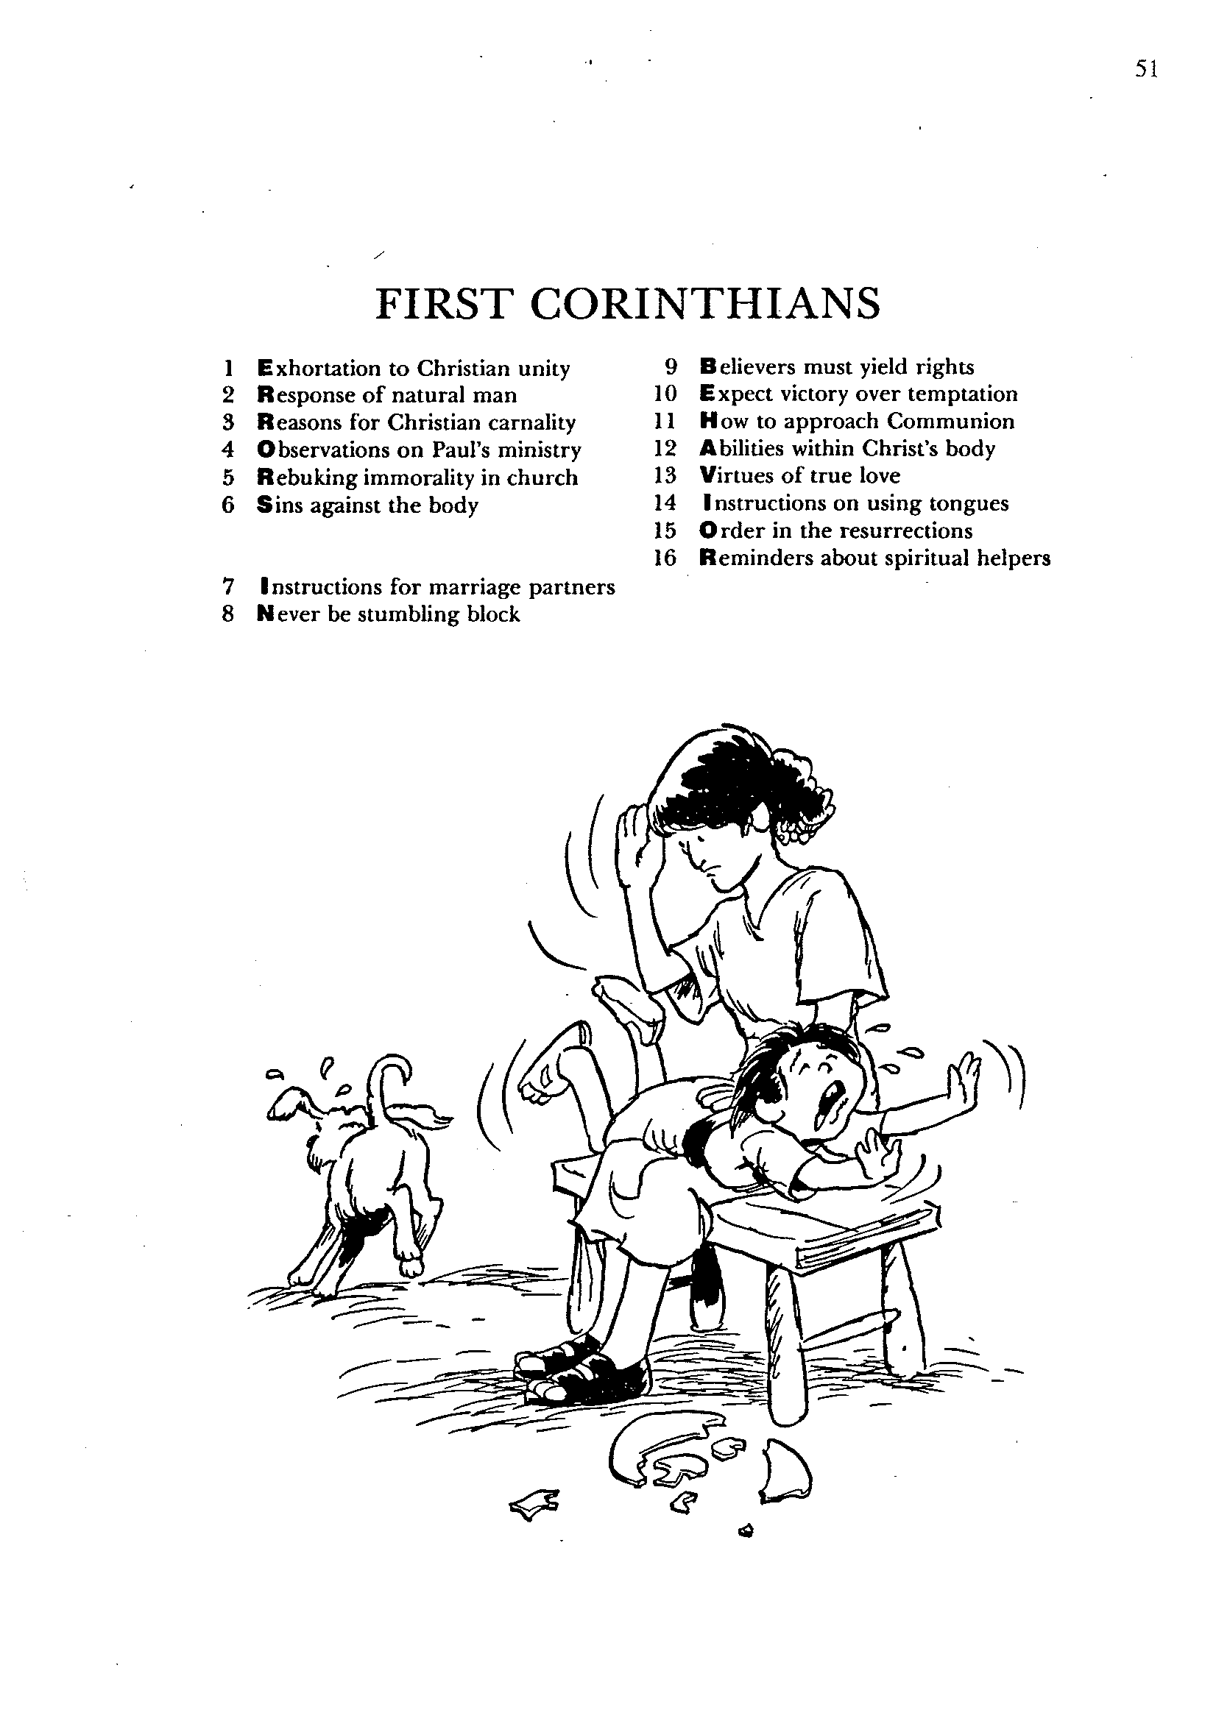
1 Corinthians
Barry Huddleston, The Acrostic Bible

Slide 12

Be Different
1 Corinthians
Dr. Rick Griffith • Crossroads International Church Singapore
BibleStudyDownloads.org

Slide 13
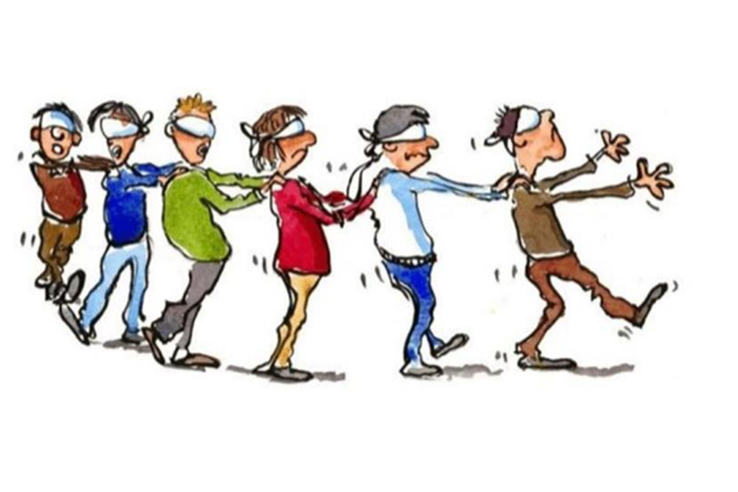
Herd Mentality
1 Corinthians
Notes:
We all are too keenly aware that there is a herd mentality in our world. It seems that the blind keeps leading the blind—insisting that we slavishly follow.
This week the governor of Virginia publicly argued for infanticide—and millions supported him!
Then pictures arouse of his racism while in medical school—so now politicians of his own party are calling for his resignation!
Since when is prejudice worse than killing babies right after birth?

Slide 14

How should we be different from unbelievers?
1 Corinthians
Notes:
How should we be different from unbelievers? I just told you three ways!
What are some of the ways that God wants your life to escape the herd mentality?
How does Jesus desire you to rise above the fray?

Slide 15
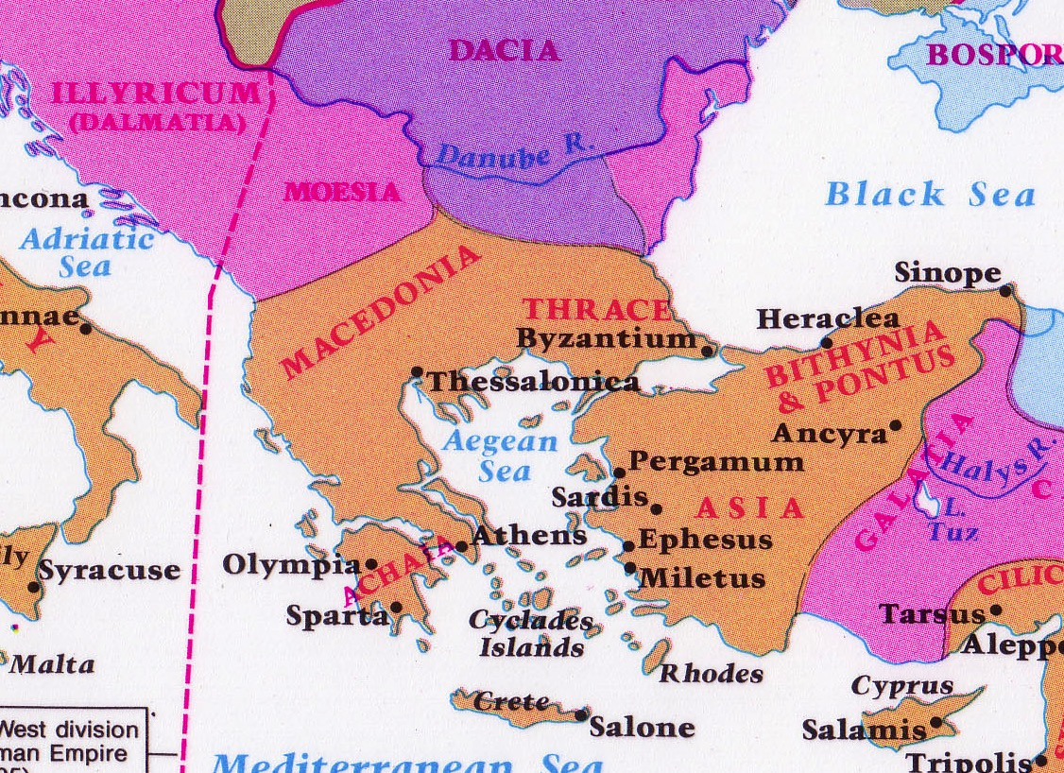
Corinth: Crossroads of Immorality
142
Corinth
Notes:
The route from Italy long required the treacherous sailing around the Corinthian Peninsula in order to arrive in the Aegean area to reach the heartland of Greek culture and trade.

Slide 16



Isthmus of Corinth
161a
7 km
Corinth
Acrocorinth
Temple of Aphrodite
Notes:
However, in the years before Christ, an ingenious business of ship transport developed. Sailors would disembark on one side of the Isthmus of Corinth, the ships would be put on logs and specialized crews rolled them on land the entire seven kilometers to the other side. This gave the sailors a few days off, so they visited nearby Corinth and then met their ship a few days later on the other side of the isthmus.

Slide 17

How should we…
BE
UNITED
(1–4)
BE
MORAL
(5–6)
BE
DIFFERENT
BE
SELFLESS
(7–16)
1 Corinthians
…from unbelievers?
Notes:
The way for Christians to stand out from the world is through fighting disunity, immorality, and selfish living.

Slide 18

Main Idea
Be different by being united, moral and selfless
1 Corinthians
Notes:
Said differently, do not be like the world so you do not divide the church, you do not be immoral, and you do not act only for your own benefit (restatement).

Slide 19

Sanctified (1:2) = “Set apart by God as His possession”
Do you live like this?
Let 1 Corinthians change you!

Slide 20
Black

Slide 21
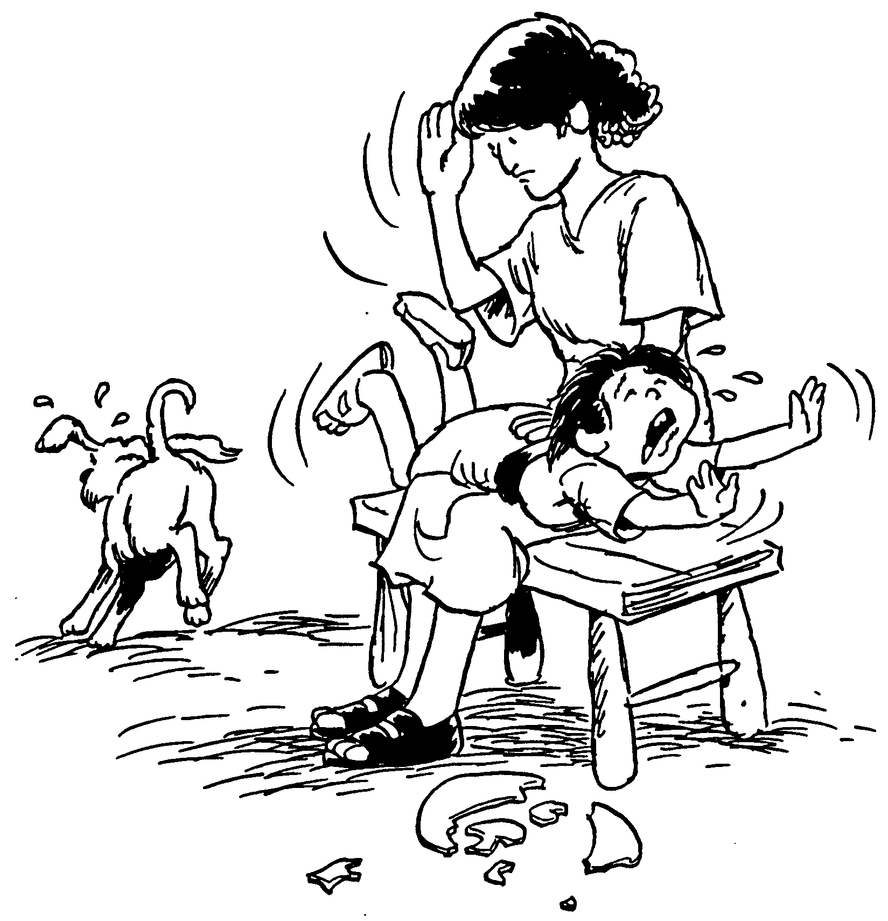
What truth about church discipline impacted you most from your readings?
First Corinthians
1. Exhortation to Christian unity
2. Response of natural man
3. Reasons for Christian carnality
4. Observations on Paul's ministry
5. Rebuking immorality in church
6. Sins against the body
7. Instructions for marriage partners
8. Never be a stumbling block
9. Believers must yield rights
Expect victory over temptation
11. How to approach Communion
12. Abilities within Christ's body
13. Virtues of true love
14. Instructions on using tongues
15. Order in the resurrections
16. Reminders about spiritual helpers
Barry Huddleston, The Acrostic Bible

Slide 22
NT Overview (Missionary + Key Words)
38
124
39-41
"To the remotest part of the earth" (Acts 1:8)
Acts 9 13 14 15 16 18 21 27 28
Apr 48-
Sep 49
1
Galatia
Apr 50-
Sep 52
2
Aegean
Spr 53-
May 57
3
Asia
Feb 60-
Mar 62
1
Rome
Spr 62-
Fall 67
4
Spain
Aut 67-
Spr 68
2
Rome
Summer 35-
37
Damascus
Antioch
May 57-
Aug 59
Trials
Fall 49
The
Council
Spring 68
Expansion of Church
35 48 49 50 52 53 57 60 62 67 68 95
Matt
Kingdom
Luke
Sov 1
Acts
Sov 2
Mark
Disciple
John
Believe
Gal
Justify
1 Thess
Rapture
1 Cor
Sanctify
2 Thess
Tribulation
Gospels & Acts
Pauline Epistles
1234
Journeys
Rome
Imprisonments
Pauline Missionary + Key Words

Slide 23
NT Overview (Paul's Letters)
38
124
39-41
“To the remotest part of the earth” (Acts 1:8)
Acts 9 13 14 15 16 18 21 27 28
Apr 48-
Sep 49
1
Galatia
Apr 50-
Sep 52
2
Aegean
Spr 53-
May 57
3
Asia
Feb 60-
Mar 62
1
Rome
Spr 62-
Fall 67
4
Spain
Aut 67-
Spr 68
2
Rome
Summer 35-
37
Damascus
Antioch
May 57-
Aug 59
Trials
Fall 49
The
Council
Spring 68
Expansion of Church
35 48 49 50 52 53 57 60 62 67 68 95
Matt
Luke
Acts
Mark
John
Gal
1 Thess
1 Cor
Eph
1 Tim
2 Tim
2 Thess
2 Cor
Col
Titus
Missionary
Pastoral
Romans
Philem
Gospels & Acts
Phil
Pauline Epistles
1234
Journeys
Prison
Rome
Imprisonments
Pauline
Notes:
Observations about chronology:
Gospels not written first but throughout NT era
Evangelistic letters preceded pastoral
Rough letter (Galatians) preceded smoother ones

Slide 24
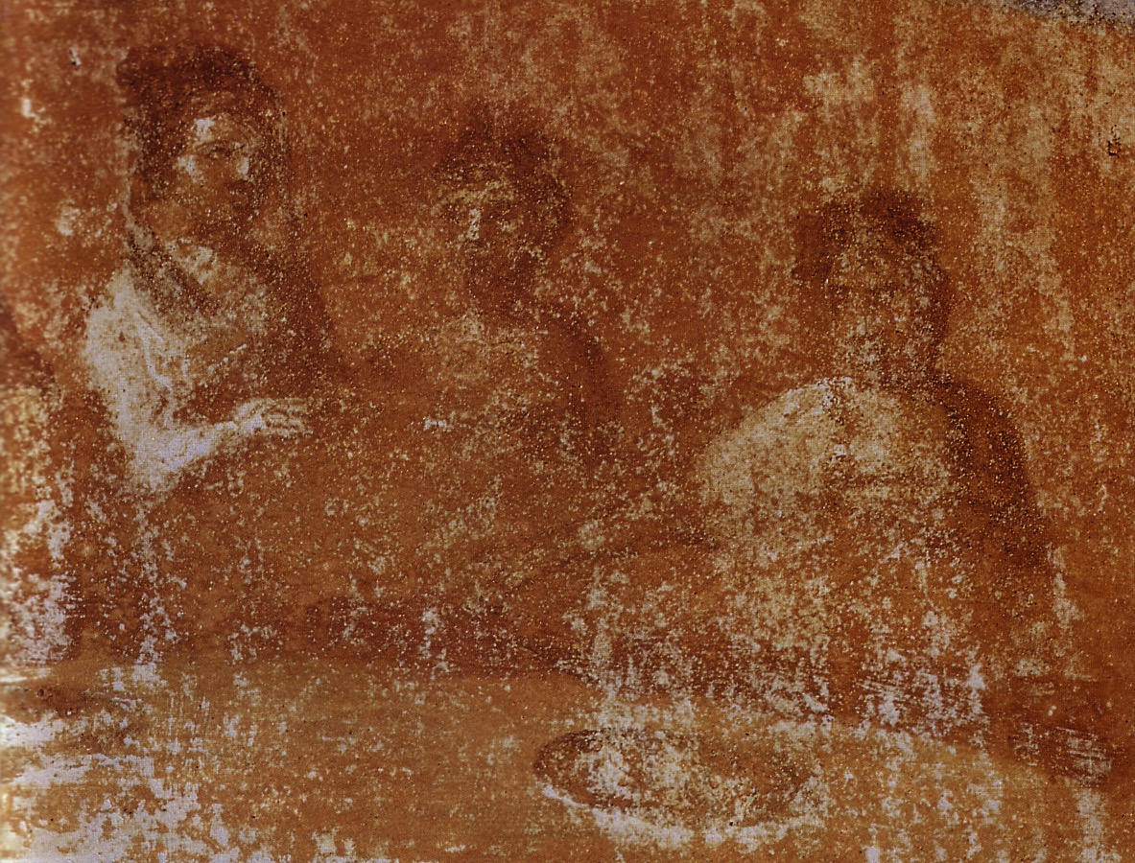
What was the early church like?

Slide 25
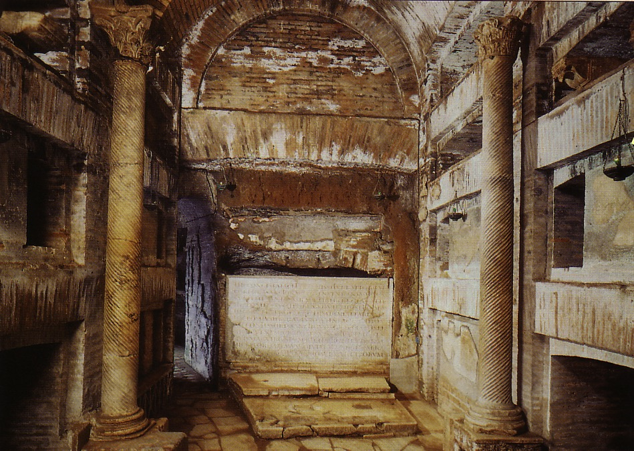
Worship in Catacombs
Notes:
During Nero's persecutions Christians refused to stop worshipping Christ, so they held their services secretly. Later they met underground in the tombs beneath Rome.

Slide 26
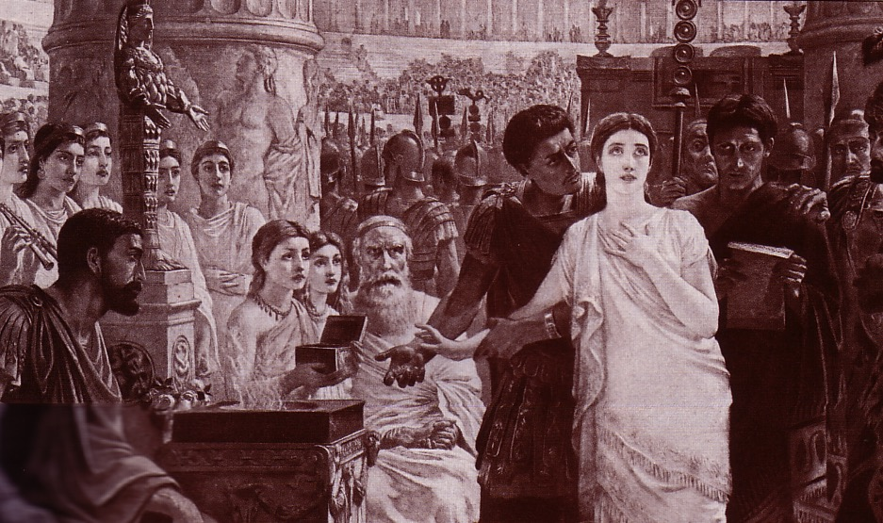
Perpetua's Martyrdom (AD 203)
Notes:
Perpetua refused to offer incense to Diana's image and thus was killed for it.

Slide 27
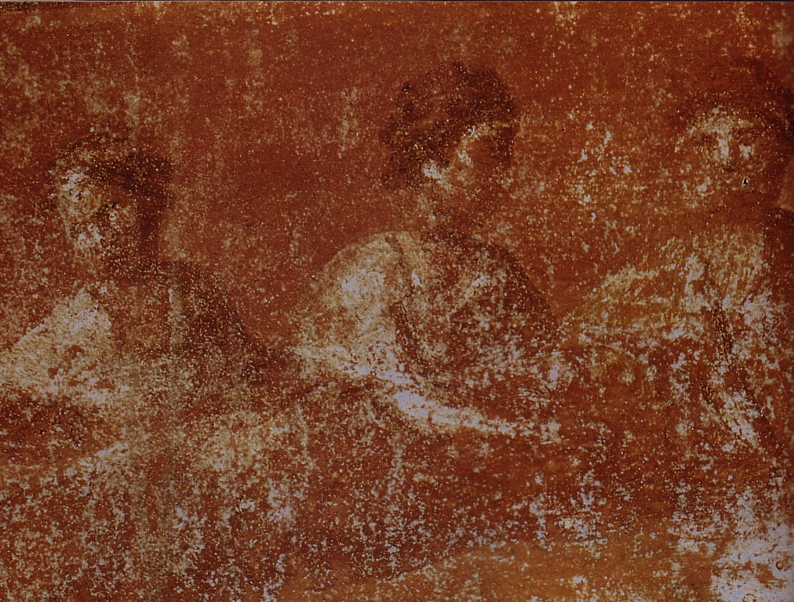
What was the early church really like?
Divorce (7)
Gifts (12-14)
1 Corinthians
Idolatry (8-10)
Incest (5)

Slide 28
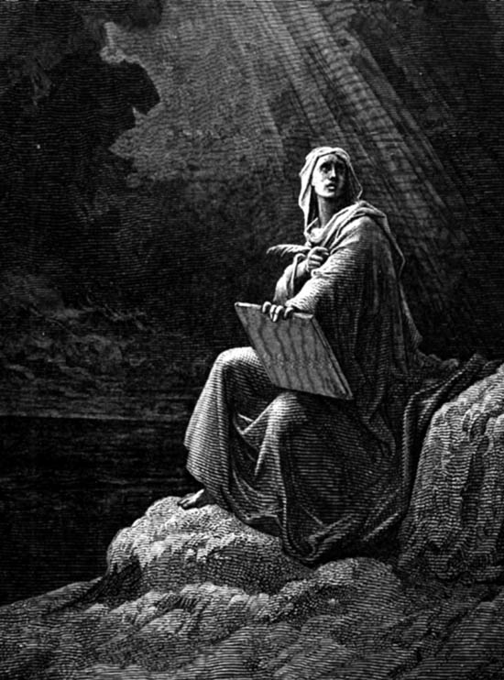
Epistolary Form
Epistolary Form
Opening - primarily concerned with establishing or enhancing personal contact with the letter recipient
Body - deals with the specific historical context and purpose(s) of the letter.
Closing – reestablishes the sender's relationship with the recipient
Notes:
_____________
NS-06-Romans-100
NS-07-1Cor1-9—slide 28

Slide 29
Epistolary Form
Epistolary Form
Opening - primarily concerned with establishing or enhancing personal contact with the letter recipient
Author
Readers
Greetings
Thanksgiving
Notes:
_____________
NS-06-Romans-101
NS-07-1Cor1-9—slide 29

Slide 30
Overview of the Chapters
158
1–4 Divisions
5–6 Disorders
7–16 Doctrinal Difficulties

Slide 31
1 Corinthians
156
Proper Functioning of the Church
Divisions |  | Disorders |  |  | Doctrine
Answers Report from Chloe (1:11) |  | Answers Report from Chloe (1:11; 5:1) |  |  | Answers Letter from the Church (7:1; 8:1; 12:1; 15:1; 16:1)
Leadership |  | Relationships |  |  | Theology
Pride |  | Immorality |  |  | Selfishness
Greeting & Problem | Misunder-standings | Incest | Lawsuits | Prosti-tution | Marri-age | Liberty | Head Coverings | Lord's Supper | Gifts | Resur-rection | Gospel Advance
1:1-17 | 1:18–4:21 | 5 | 6:1-11 | 6:12-20 | 7 | 8:1–11:1 | 11:2-16 | 11:17-34 | 12–14 | 15 | 16
Ephesus
May AD 56 (third missionary journey)

Slide 32
The Wayward Local Church
1 Corinthians: The Wayward Local Church
Reports
Questions
Division
Disorder
Difficulties
Concern
1–4
Discipline
5–6
Instruction
7–16
Carnality
3–4
Marriage 7
Worship
11–14
Factions 1–2
Incest 5
Idols 8–10
Resurrection
15
Immorality
Collection 16
Lawsuits 6
Solving church problems theologically

Slide 33
Key Word & Verse
1 Corinthians
156
Key Word
Sanctification
Key Verse
"Do you not know that your body is a temple of the Holy Spirit, who is in you, whom you have received from God? You are not your own; you have been bought with a price. Therefore honor God with your body"
(1 Cor. 6:19-20).

Slide 34
Summary & Application
1 Corinthians
156
Summary Statement
Paul explains the proper functioning of the church in response to reports about the Corinthians' divisions, disorders, and doctrinal difficulties to assure that the church makes its positional sanctification practical.
Application
Does your church look "set apart" for God? Or is it plagued with divisions, disorders, and doctrinal difficulties which make it look the same as non-Christian groups?

Slide 35
The Three Tenses of Salvation
Kay Arthur, Precept Ministries
155a
TENSE | MY STATUS | FREE FROM SIN'S... | TIME | DOCTRINE OF...
Past | I have been saved | Penalty—by His death (Rom 3:21-24) Rule—by my death (6:3-7) | When I received Christ | Justification (Positional Sanctification)
Present | I am being saved | Power—by indwelling Spirit (8:2-14) | As I walk in the Spirit | (Progressive) Sanctification
Future | I shall be saved | Presence—by redemption of my body (8:22-25) | When I get my new body | Glorification (Final Sanctification)
Notes:
______
NS-06-Rom5-8-slide 137
NS-07-1Cor1-9-slide 34

Slide 36

Authorship
157
External Evidence
Support for Pauline authorship is upheld by even the most imaginative critics since the patristic evidence is so early.
1. The early church writers who advocated Paul as author include: Clement of Rome, Polycarp, and others, including the second century Muratonian Fragment.
2. Even the radical German critic F. C. Baur and his Tübingen School considered 1 Corinthians as one of the "four undisputed Epistles."
Internal Evidence
The book itself argues even more strongly for Paul's authorship as it claims to be written by Paul (1:1).

Slide 37
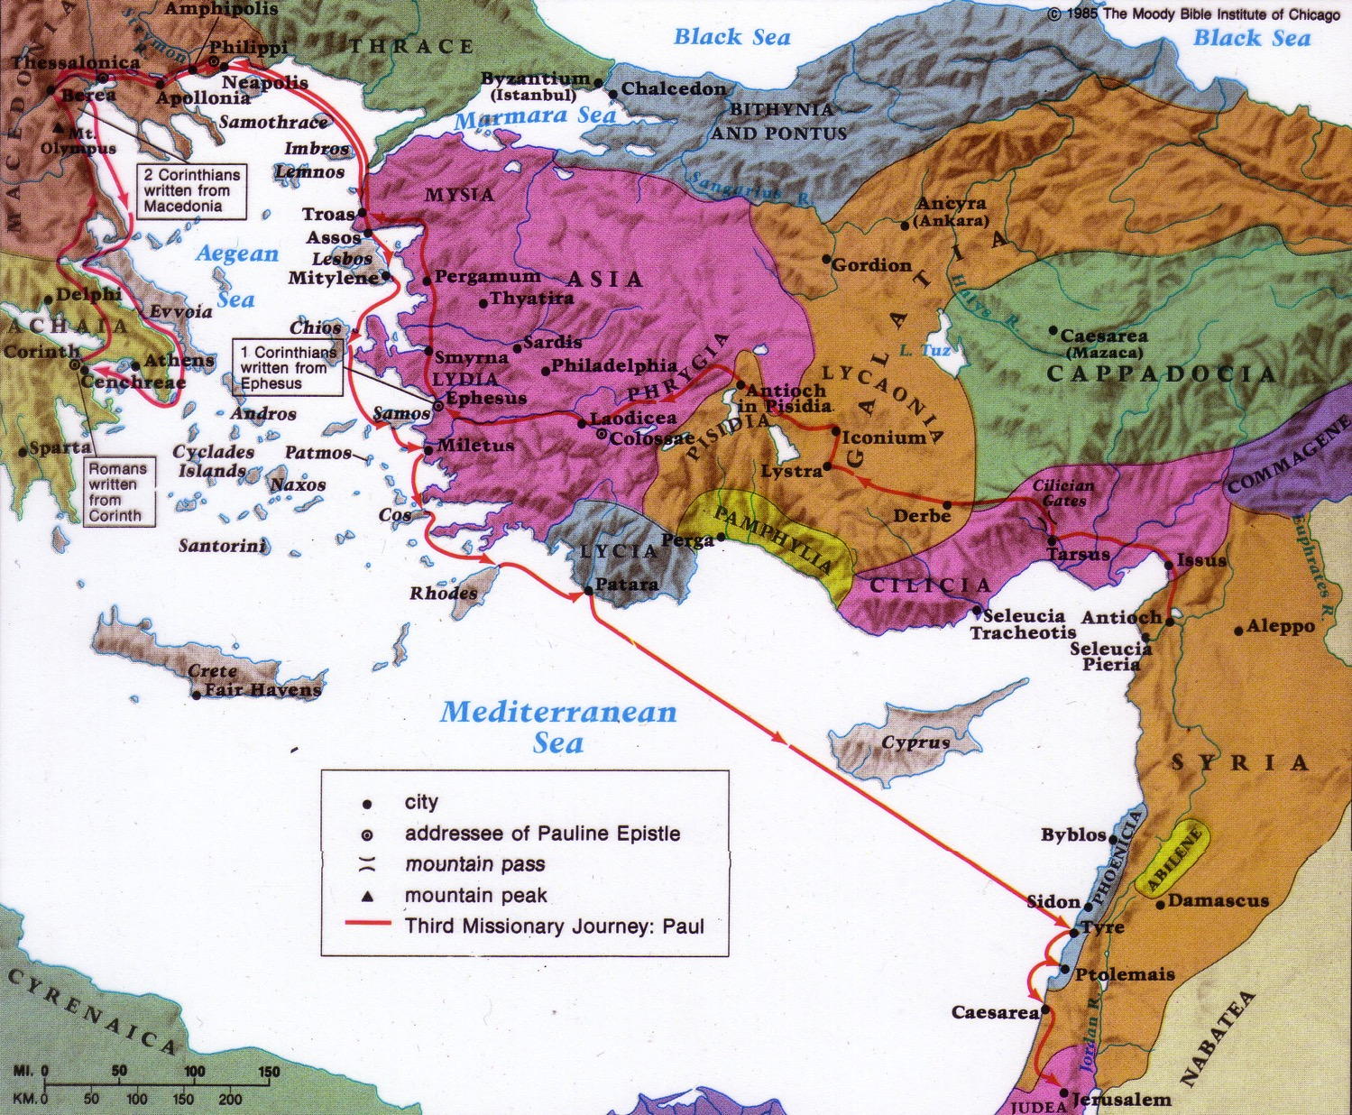
Circumstances
157
Date
1 Corinthians was written in May AD 56 (1 Cor. 16:5-8).
2 Corinthians was written less than a year after 1 Corinthians (2 Cor. 8:10; 9:2).
2 Corinthians followed later that year in fall AD 56.
Destination:
Corinth
Origin:
Ephesus
Origin/Recipients
Paul addressed the church at Corinth from the city of Ephesus across the Aegean Sea

Slide 38
Occasion
157
Paul received bad news about the church in three areas:
reports from the household of Chloe about church divisions (1:11), and
(2) reports from the household of Chloe about church disorders (1:11)
(3) news of difficulties from the church itself via letter carried by three men (16:17).
Therefore, Paul's letter is actually a response to these 3 issues, answering the problems of
divisions,
disorders and
difficulties raised in the church's questions.

Slide 39
1 Corinthians Characteristics
157
The most troublesome NT church
The most teaching on several topics:
Role of Women
Marriage
Church discipline
Spiritual Gifts
Love
Christian liberty
Gospel
Resurrection
Lawsuits
Lord's Supper
Probably Paul's second letter to Corinth (5:9)
  He also wrote another letter between our 1 and 2 Cor.
  So 1 Cor. is actually 2 Cor. and 2 Cor. is actually 4 Cor.

Slide 40
Corinth: Crossroads of Immorality
142
Corinth
Notes:
The route from Italy long required the treacherous sailing around the Corinthian Peninsula in order to arrive in the Aegean area to reach the heartland of Greek culture and trade.

Slide 41
Isthmus of Corinth
161a
7 km
Corinth
Acrocorinth
Temple of Aphrodite
Notes:
However, in the years before Christ, an ingenious business of ship transport developed. Sailors would disembark on one side of the Isthmus of Corinth, the ships would be put on logs and specialized crews rolled them on land the entire seven kilometers to the other side. This gave the sailors a few days off, so they visited nearby Corinth and then met their ship a few days later on the other side of the isthmus.

Slide 42
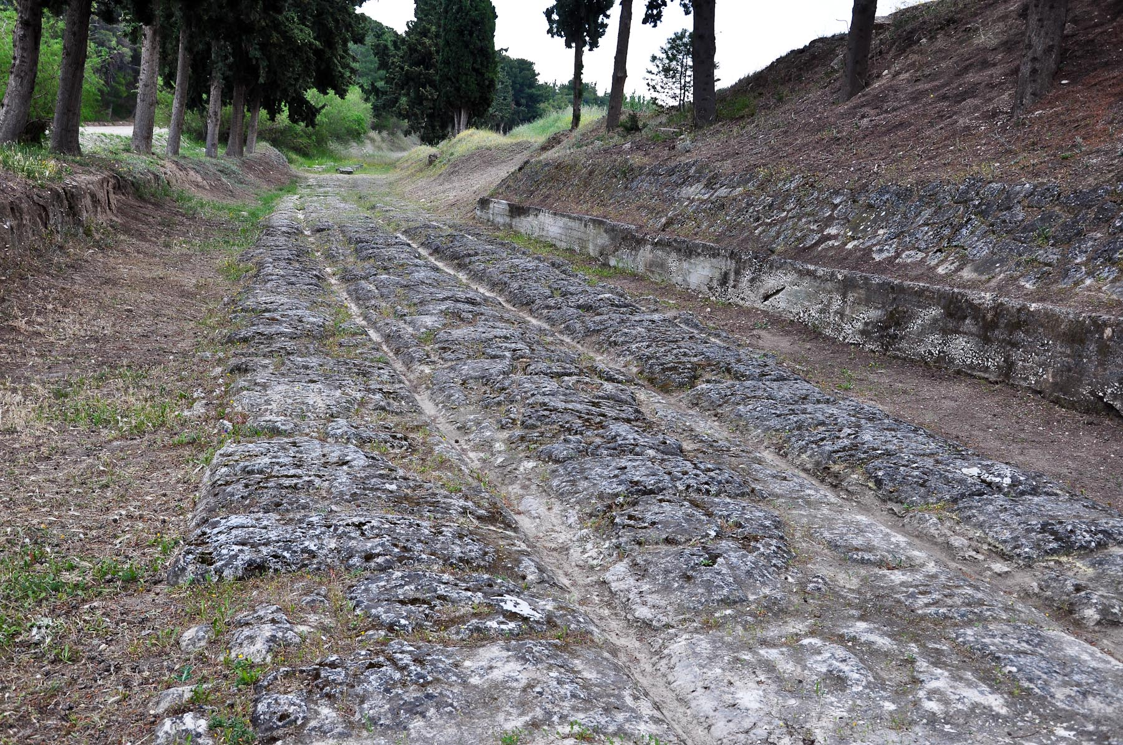
Diolkos at Corinth (First Century)
Notes:
On one of our visits to the area of Corinth we had a chance to explore a seldom-visited portion of the ancient diolkos that is located on the isthmus that connects the Greek mainland with the Peloponnese. This portion has been excavated and is very well preserved.
Map of the Peloponnese and Location of Corinth and the Diolkos
The Diolkos [Greek meaning “haul across”] was a paved “road” that connected the Corinthian and Saronic Gulfs before the Corinthian Canal was dug. It was built because sailing around the southern tip of the Peloponnese was very treacherous. Strabo, for example, writes ‘But when you sail around Cape Malea, forget your home” (= “you’ll never return!”; viii 6, 20). The ancients offloaded their cargo, dragged it on wheeled carts across the isthmus from one gulf to the other to the other side of the isthmus, and then loaded it on to another ship. Small to medium size ships could be transported from gulf to gulf by this method also.
Detail of the Tracks/Ruts that guided the path of the wheels of the vehicles that carried ships and cargo from one gulf to another.
The Diolkos was constructed during the sixth century B.C. and was in use for over 1,000 years! It was made of large paving stones and was about 11 to 20 ft. [3.4 to 6 m.] wide. It followed a circuitous route, avoiding high ground if possible, from one side of the isthmus to another.
It is probable that some of the wealth of the nearby Corinth was derived from tolls, tariffs, and servicing the personnel associated with the shipping industry and servicing and maintaining the “road.”
________
Special Diolkos Remains Near Corinth
Carl Rasmussen
Posted on June 23, 2016
Accessed 11 March 2021
https://holylandphotos.wordpress.com/2016/06/23/special-diolkos-remains/

Slide 43
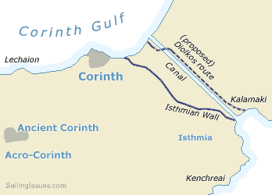
Diolkos at Corinth (First Century)

Slide 44
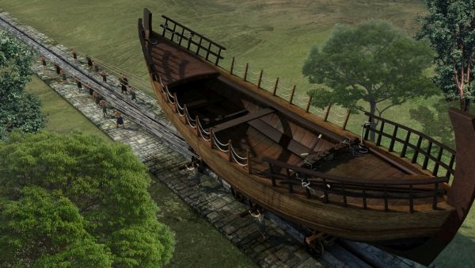
Diolkos at Corinth (First Century)
Notes:
The story takes place near the famous Ancient Corinth (around the mid-4th century BCE), referring to its two harbours (named Lechaion and Kenchreae). Several ships, avoiding the dangerous travel around the whole of Peloponnese, were transferred from the Corinth Golf to the Golf of Saronikos, on top of an eight-wheel vehicle dragged along a stone-paved road (the “Diolkos”), almost parallel to the actual Corinth-Canal. The film describes several technical details of the whole operation, as well as various events such as the visits of the sailors to an ancient Greek Temple and to a tavern, where a hypothetically available Hydraulis (water organ) was played, or to a public fountain encountered along the Diolkos.
_________
Diolkos for 1,500 years
https://www.filmfestival.gr/en/section-tdf/movie/1092/13048
Direction: Theodosis Tasios Script: Theodosis Tasios Editing: Nikitas Mekas Sound: Nikitas Mekas Music: Laertis Malkotsis Production: Technical Chamber of Greece Narration: Theodosis Tasios Format: DCP Color: Color Production Country: Greece Production Year: 2009 Duration: 22΄ Contact: Theodosis Tasio

Slide 45
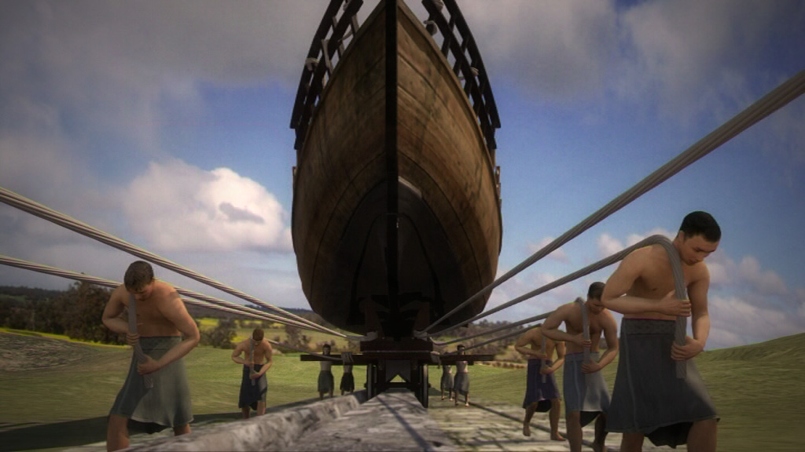
Diolkos at Corinth (First Century)

Slide 46
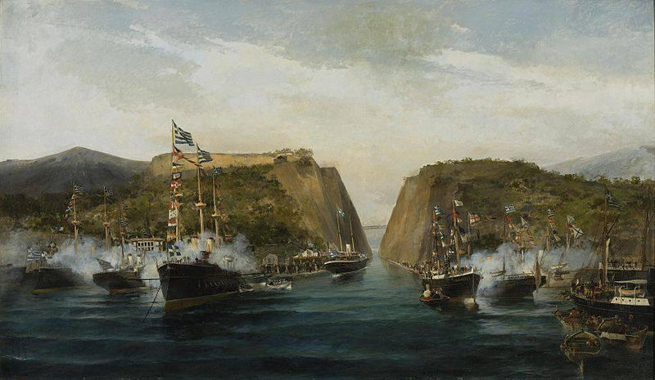
Canal at Corinth (built in 1893)

Slide 47
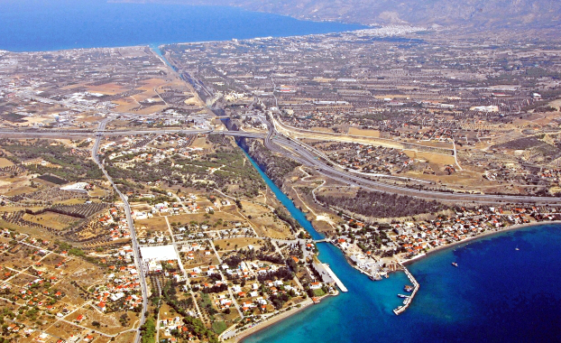
Canal at Corinth (built in 1893)

Slide 48
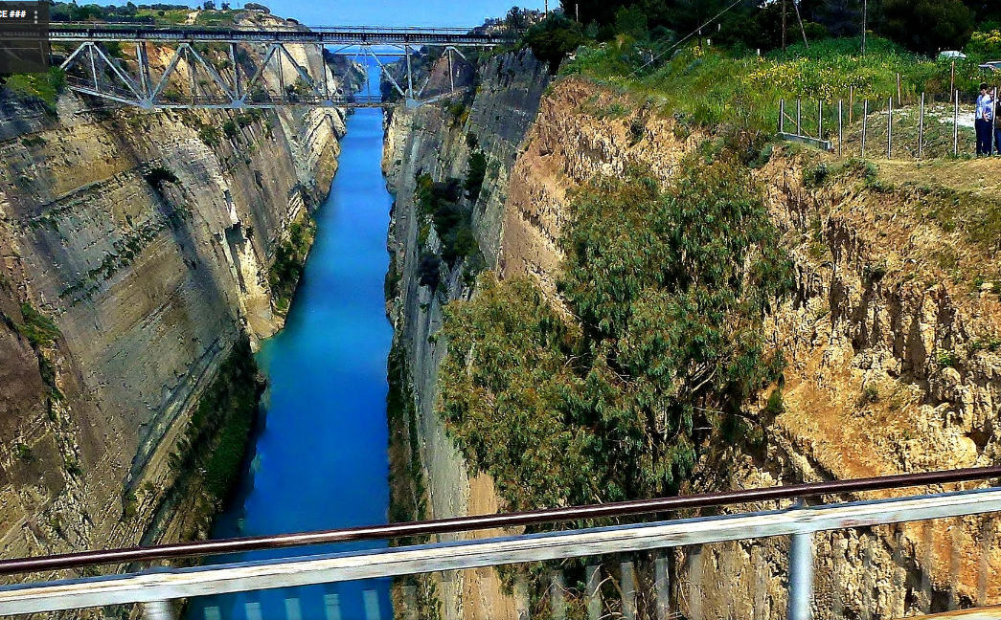
Canal at Corinth (built in 1893)

Slide 49
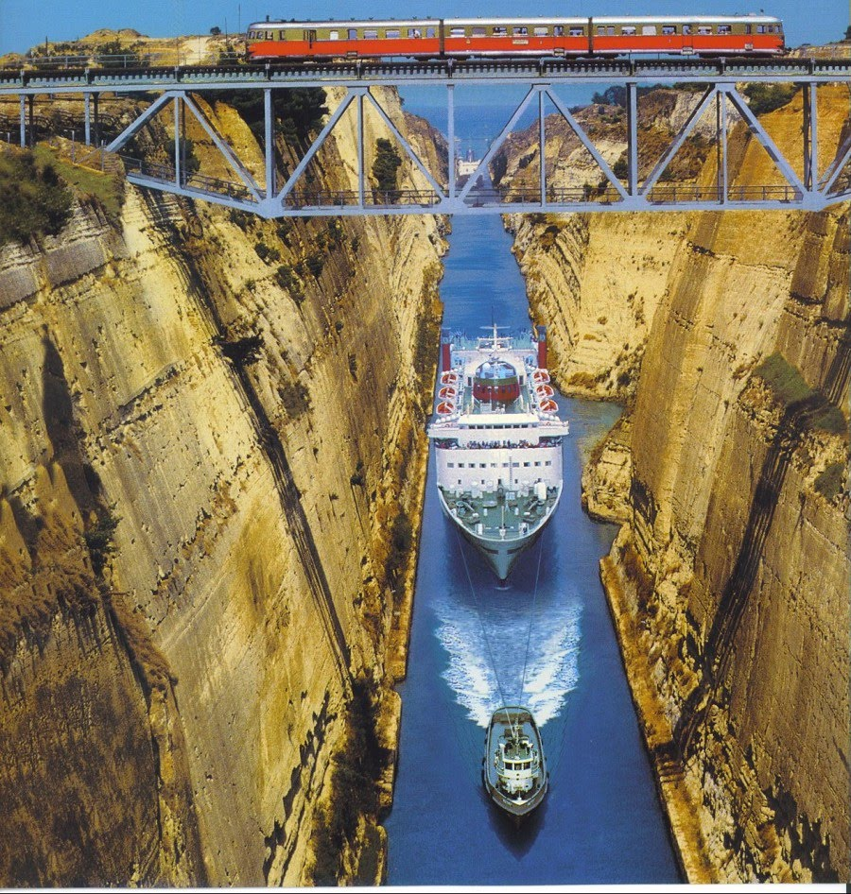
Canal at Corinth

Slide 50
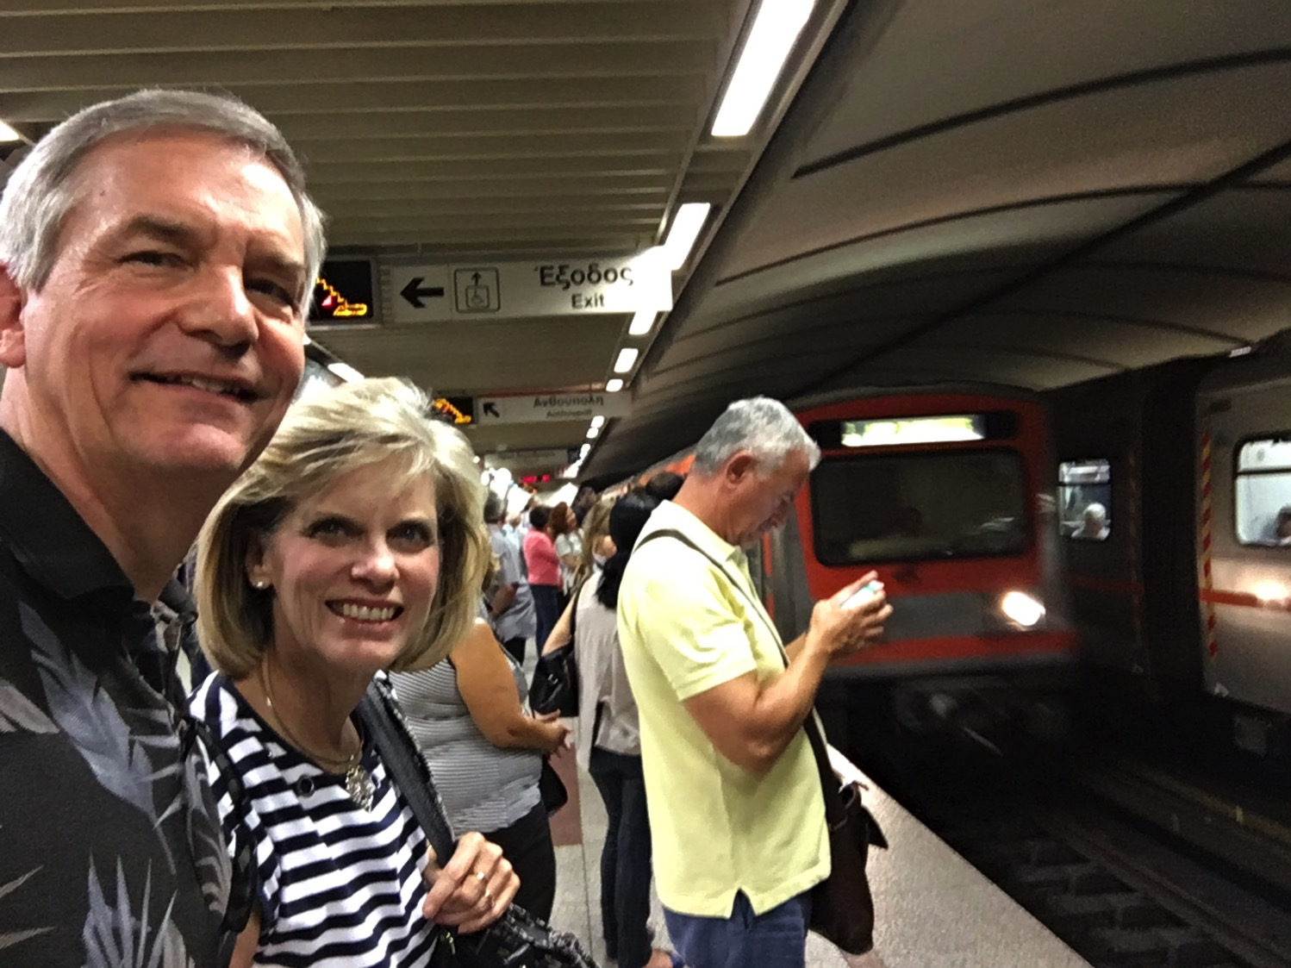
Visiting Corinth
Notes:
In September 2016 my wife Susan and I had the privilege to visit Corinth, Greece.

Slide 51
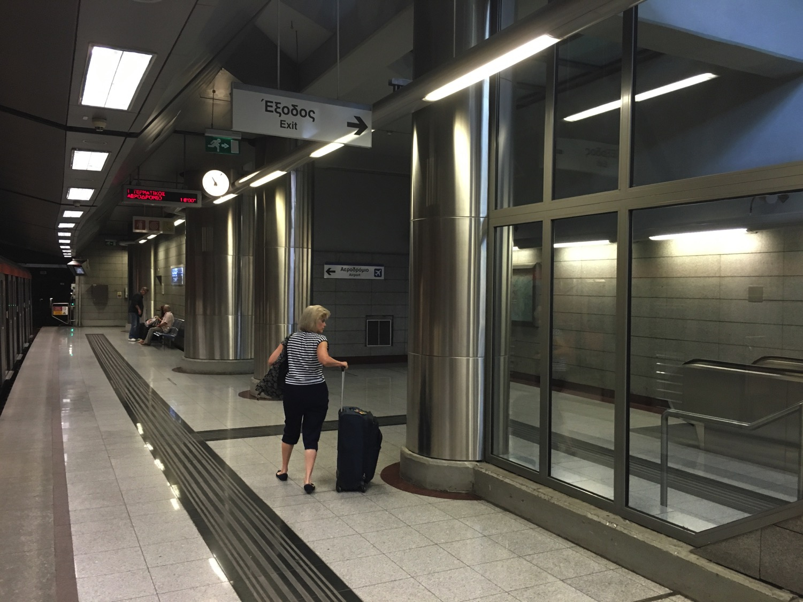
Directions?
Notes:
One of the challenges was managing the train system.

Slide 52
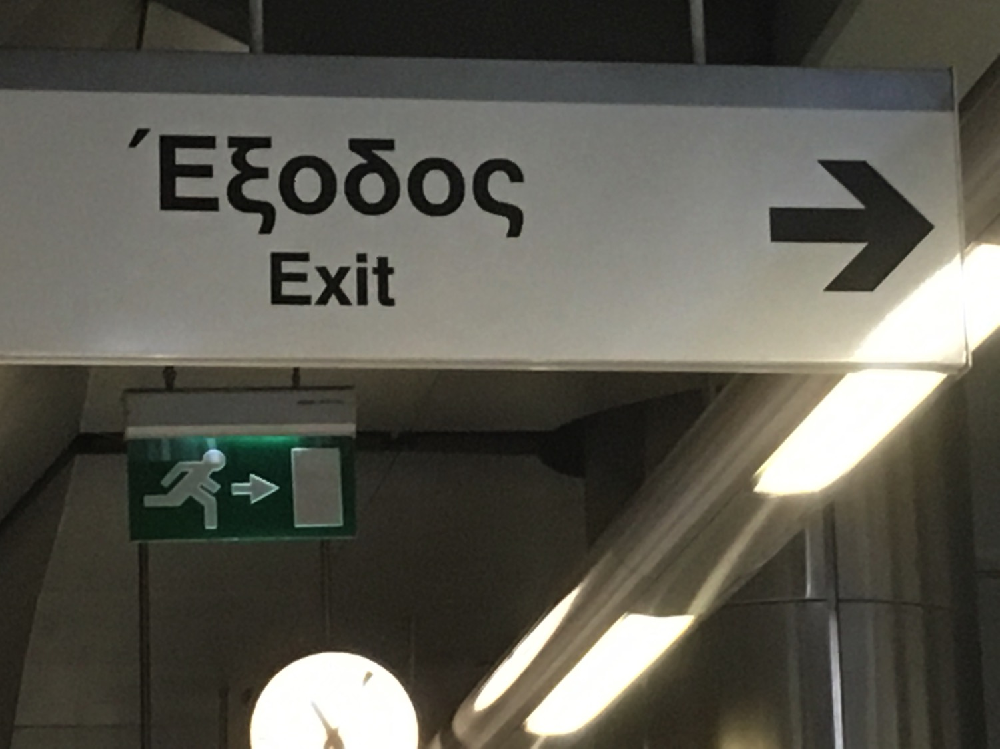
Way Out
Notes:
Fortunately, my three years of Greek in seminary came in handy, for the sign told us ”Exodus," meaning "way out."
• OK, yes, it was in English too!

Slide 53
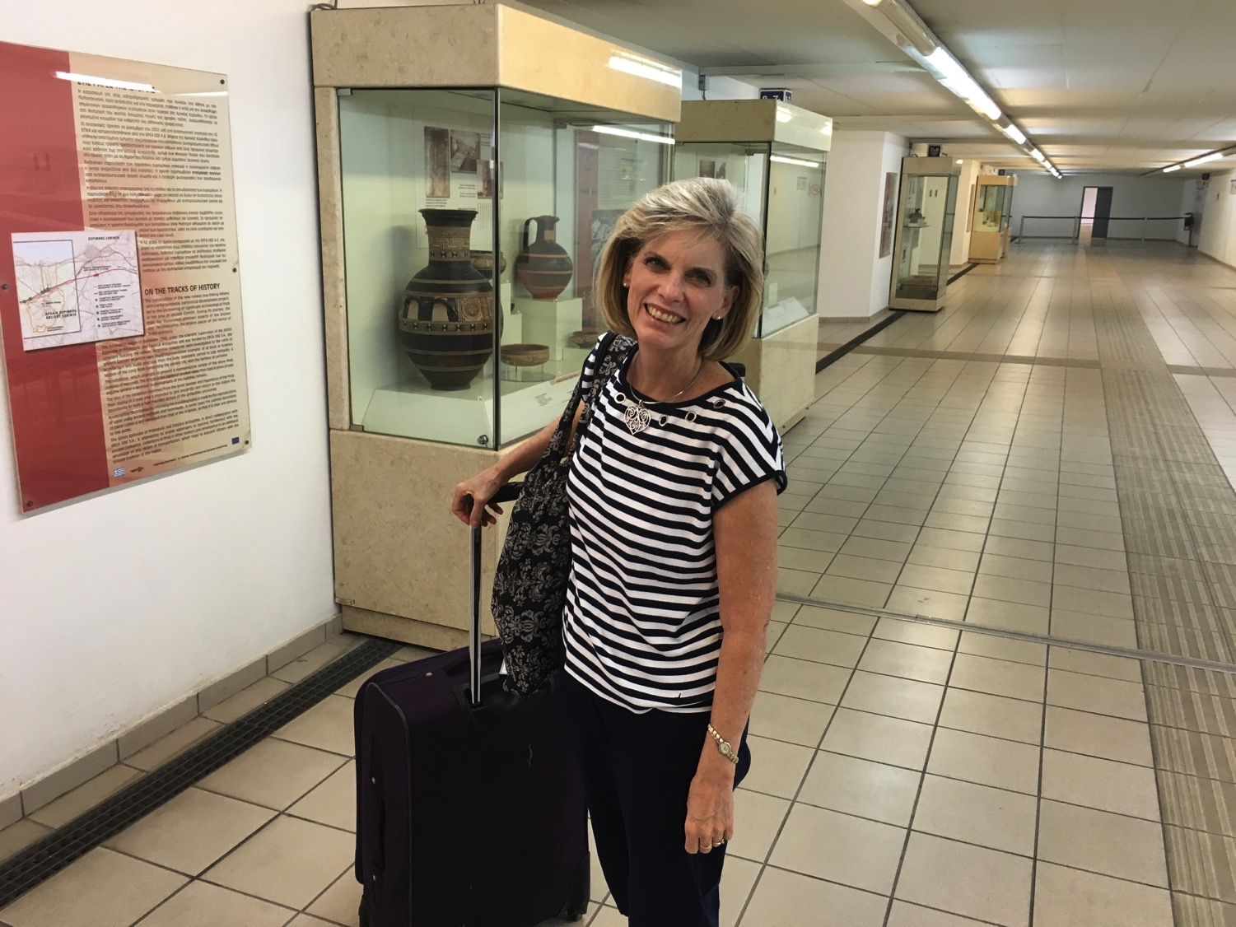
Station Museum
Notes:
We were also blessed with a museum right in the train station.

Slide 54
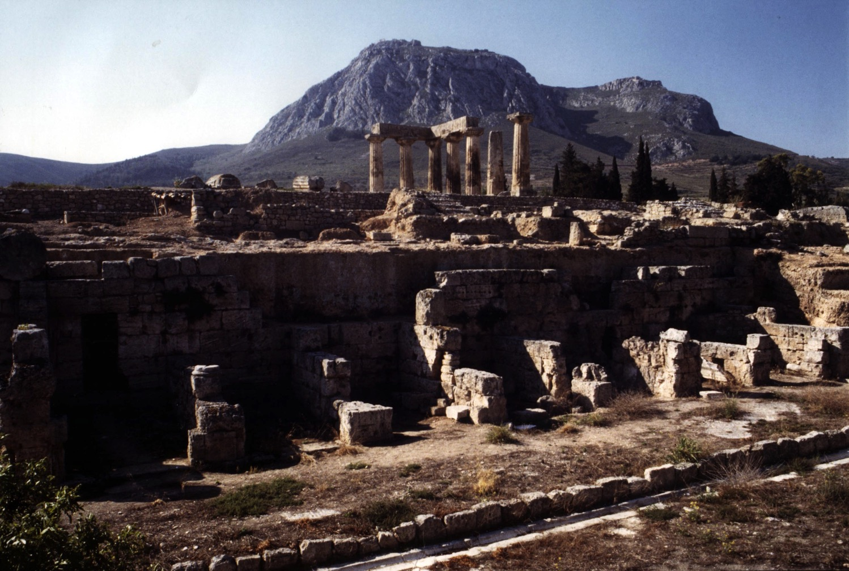
View of Acrocorinth from the City
Notes:
It takes little imagination what sailors would do with a few days off and nothing to do. Ancient Corinth was a city of so-called "free sex." The foreground has remains of the ancient city, while in the distance is Acrocorinth, the place of the ancient temple.

Slide 55
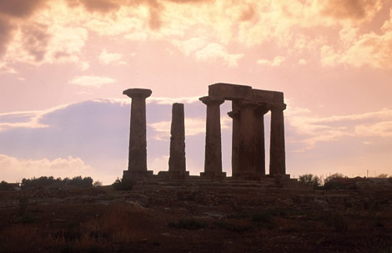
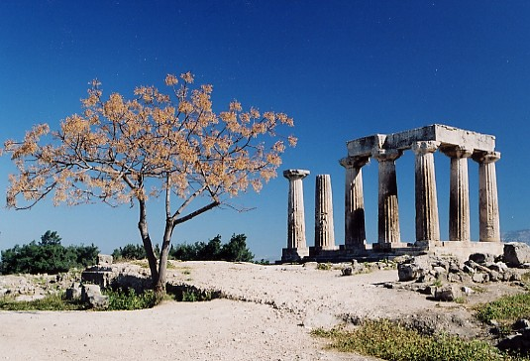
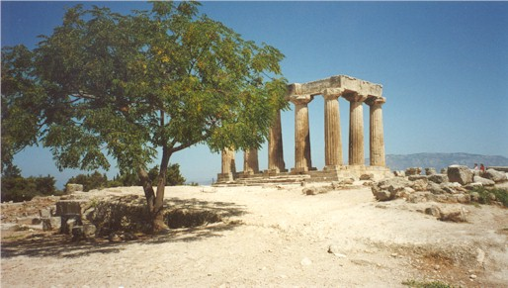
Immorality in All Seasons
Notes:
On top of Acrocorinth, a temple was open all year for so-called "worship" with one of the 1000 temple prostitutes.

Slide 56
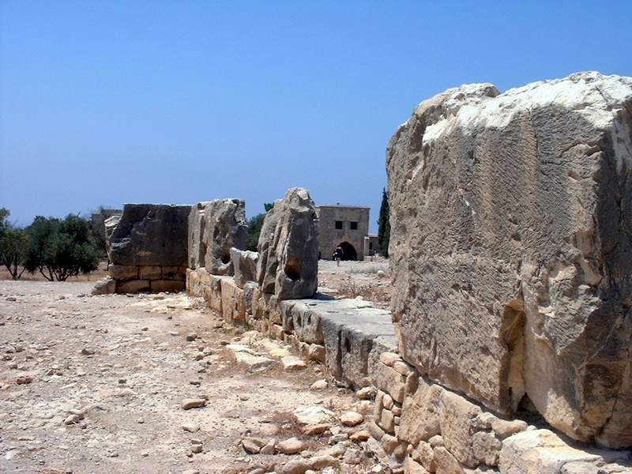
Temple of Aphrodite
Notes:
Sex with a temple priestess of Aphrodite was a so-called union with the goddess.

Slide 57
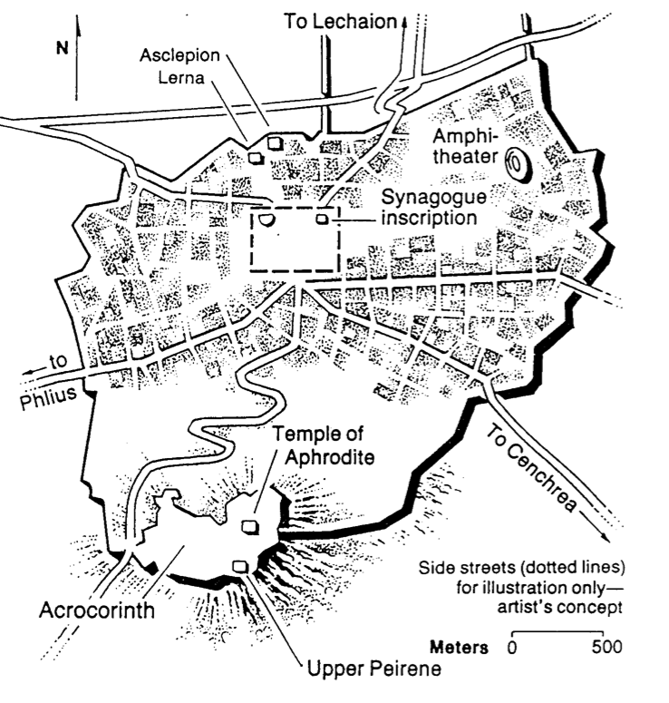
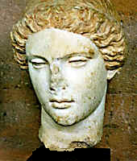
Temple of Aphrodite
Greek Goddess of Love
Notes:
She was the goddess of love, so sailors who visited Corinth had a few days of "liberty" with her priestesses to alleviate the boredom of a generally calm life at sea.

Slide 58
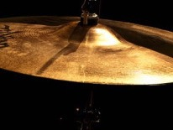
Meaningless Worship
"If I speak with the tongues of men and angels but do not have love,
I am a noisy gong or a clanging cymbal" (1 Cor. 13:1)

Slide 59
Characteristics of 1 Corinthians
157
Describes the most problematic church situation in the New Testament. It therefore contains a theology of how God responds graciously but firmly to a carnal church.
Provides more teaching on these topics than any other New Testament writing: church discipline, lawsuits among believers, marriage, Christian liberty, the role of women, the Lord's Supper, spiritual gifts, the nature of love, the gospel, and the resurrection of the body.
This letter, though named 1 Corinthians, was not Paul's 1st letter to the church. He had already written a letter before this (1 Cor. 5:9) which is now lost and therefore not part of Scripture.

Slide 60
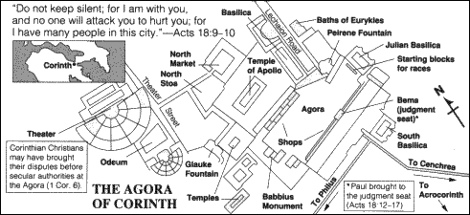
The Agora (Marketplace)
161

Slide 61
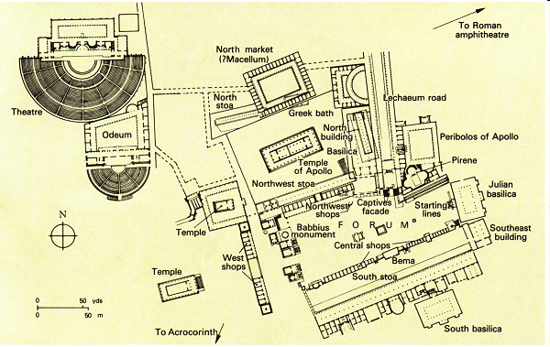
The Bema at Corinth
161
Lawsuits
1 Cor. 6
Bema
Paul at the judgment seat
Acts 18

Slide 62
Outline of 1 Corinthians
159-159z
(Chs. 1–4) Paul answers Chloe's report of divisions with the absurdity of exalting favorite teachers since their message is Christ crucified and minister simply as Christ's humble servants to convince the church to humble itself.
(Chs. 5–6) Paul answers the report of disorders in immorality and lawsuits to enable the Corinthian believers to realize that God has given them ability to make wise decisions to exercise church discipline.
(Chs. 7–16) Paul answers questions posed by the church about doctrinal difficulties the believers faced to enable them to make sanctification practical.

Slide 63
Be Different
1 Corinthians
Dr. Rick Griffith • Crossroads International Church Singapore
BibleStudyDownloads.org

Slide 64
Herd Mentality
Notes:
We all are too keenly aware that there is a herd mentality in our world. It seems that the blind keeps leading the blind—insisting that we slavishly follow.
This week the governor of Virginia publicly argued for infanticide—and millions supported him!
Then pictures arouse of his racism while in medical school—so now politicians of his own party are calling for his resignation!
Since when is prejudice worse than killing babies right after birth?

Slide 65

Be Different
Notes:
In a world where right is considered wrong and wrong is deemed right, God has called believers to be different.

Slide 66

Be different.
Notes:
We aren’t called to be upside down.

Slide 67
Be Different
Notes:
The reality is that God has called us to upright living in an upside down world.

Slide 68

“Different” in this book means better.
Notes:
So today as I talk about being different, please see that I mean to rise above the fray to be different in the positive sense. The idea is not just to be weird to gain attention or “be yourself.” It is to act in a manner pleasing to the Lord—even if you have to do it alone.
For example:
Does your presence unify or divide others around you?
Are your personal ethical standards higher than those who do not claim Jesus?
Do you handle difficulties differently—in a way prioritizing other people over yourself?

Slide 69
How should we be different from unbelievers?
Notes:
How should we be different from unbelievers? I just told you three ways!
What are some of the ways that God wants your life to escape the herd mentality?
How does Jesus desire you to rise above the fray?

Slide 70

Background
Notes:
Today we will study a letter written to a group of believers who really struggled with getting out of the mentality of their fishbowl—but God wanted them to escape these values as they served him in the bowl.

Slide 71

God put the Corinthian believers in their dark city to shine as his light.

Slide 72

Paul's 1st & 2nd Missionary Journeys
138-39
Notes:
Paul’s first journey from Antioch started churches in modern day Turkey.
Then his second trip expanded Christianity into Greece where he began the church at Corinth.

Slide 73
Origin & Destination
1 Corinthians on the Third Missionary Journey
157
Destination:
Corinth
Origin:
Ephesus
Notes:
On Paul’s third trip, he had a longer time in Ephesus where he heard about some problems at Corinth, so he wrote them a letter that we call 1 Corinthians.

Slide 74
Corinth: Crossroads of Immorality
142
Corinth
Notes:
The route from Italy long required the treacherous sailing around the Corinthian Peninsula in order to arrive in the Aegean area to reach the heartland of Greek culture and trade.

Slide 75
Isthmus of Corinth
161a
7 km
Corinth
Acrocorinth
Temple of Aphrodite
Notes:
However, in the years before Christ, an ingenious business of ship transport developed. Sailors would disembark on one side of the Isthmus of Corinth, the ships would be put on logs and specialized crews rolled them on land the entire seven kilometers to the other side. This gave the sailors a few days off, so they visited nearby Corinth and then met their ship a few days later on the other side of the isthmus.

Slide 76
View of Acrocorinth from the City
Notes:
It takes little imagination what sailors would do with a few days off and nothing to do. Ancient Corinth was a city of so-called "free sex." The foreground has remains of the ancient city, while in the distance is Acrocorinth, the place of the ancient temple.

Slide 77
Immorality in All Seasons
Notes:
On top of Acrocorinth, a temple was open all year for so-called "worship" with one of the 1000 temple prostitutes.

Slide 78
Temple of Aphrodite
Notes:
Sex with a temple priestess of Aphrodite was a so-called union with the goddess.

Slide 79
Temple of Aphrodite
Greek Goddess of Love
Notes:
She was the goddess of love, so sailors who visited Corinth had a few days of "liberty" with her priestesses to alleviate the boredom of a generally calm life at sea.

Slide 80

It takes courage not to do what everyone else is doing

Slide 81
How should we…
BE
UNITED
(1–4)
BE
DIFFERENT
1 Corinthians
…from unbelievers?
Notes:
This doesn’t mean how we should be weird or peculiar.
Rather, in what ways should our lives show better values?

Slide 82
1 Corinthians 1

Slide 83
Key Word
120
Sanctification
1 Corinthians

Slide 84
Sanctified (1:2) = “Set apart by God as His possession”
Do you live like this?

Slide 85
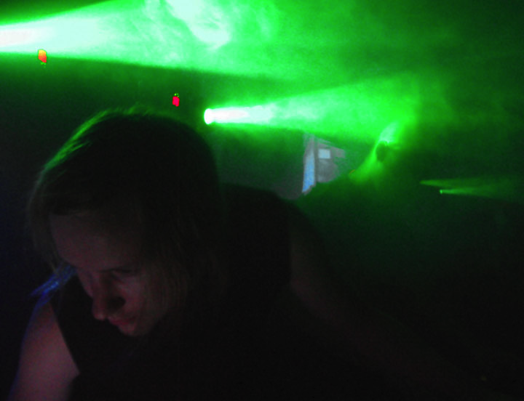
Which church leader should we follow?
A key question asked at Corinth

Slide 86

Don't divide over favorite leaders
(1:10-17)

Slide 87
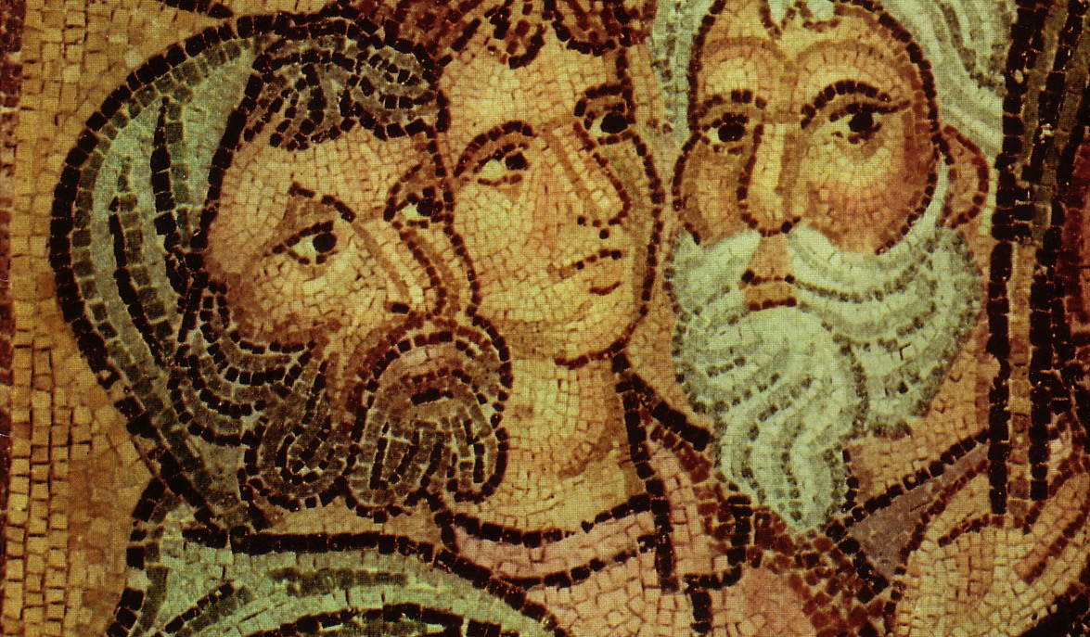
Parties at Corinth
Paul
Action
Party
P
A
P
Apollos
Yippee
Esquire
A
Y
E
Cephas
Triumph
Esquire
C
T
E
Savior
Dvlpmnt
Party
S
D
P

Slide 88
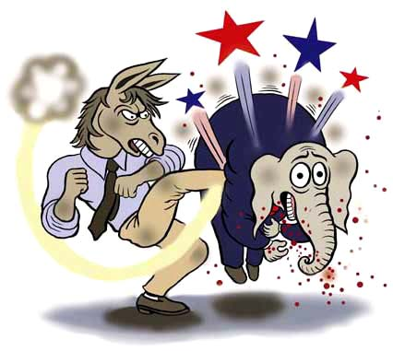
Democrats win

Slide 89
A Newspaper Slip…
"What Jesus Saw in a Publican"
"What Jesus Saw in a Republican"

Slide 90
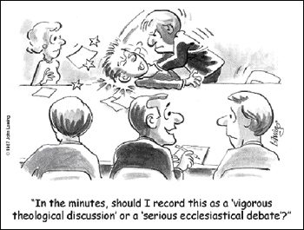
"In the minutes, should I record this as a 'vigorous theological discussion' or a 'serious ecclesiastical debate'?"

Slide 91

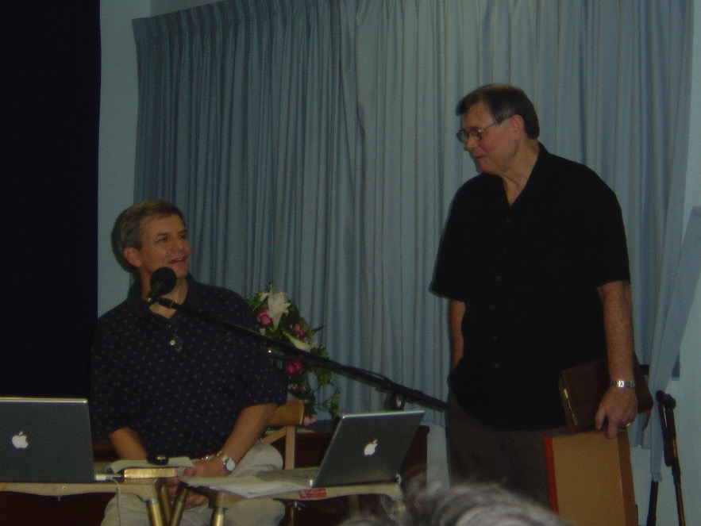
Parties You Don't Want to Attend!
"Rickpublican"
"Tomocrat"

Slide 92
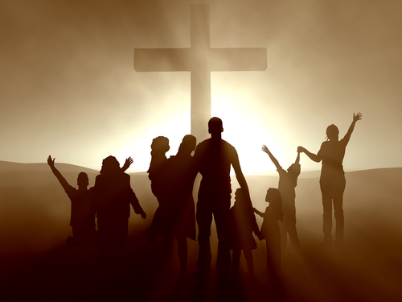
Unity is based on the cross—not human leaders
(1:18–2:5)

Slide 93
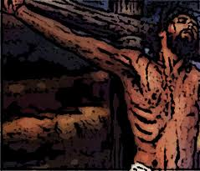
1 Corinthians 1:18-25
"For the message of the cross is foolishness to those who are perishing, but to us who are being saved it is the power of God" (1:18 NIV)

Slide 94
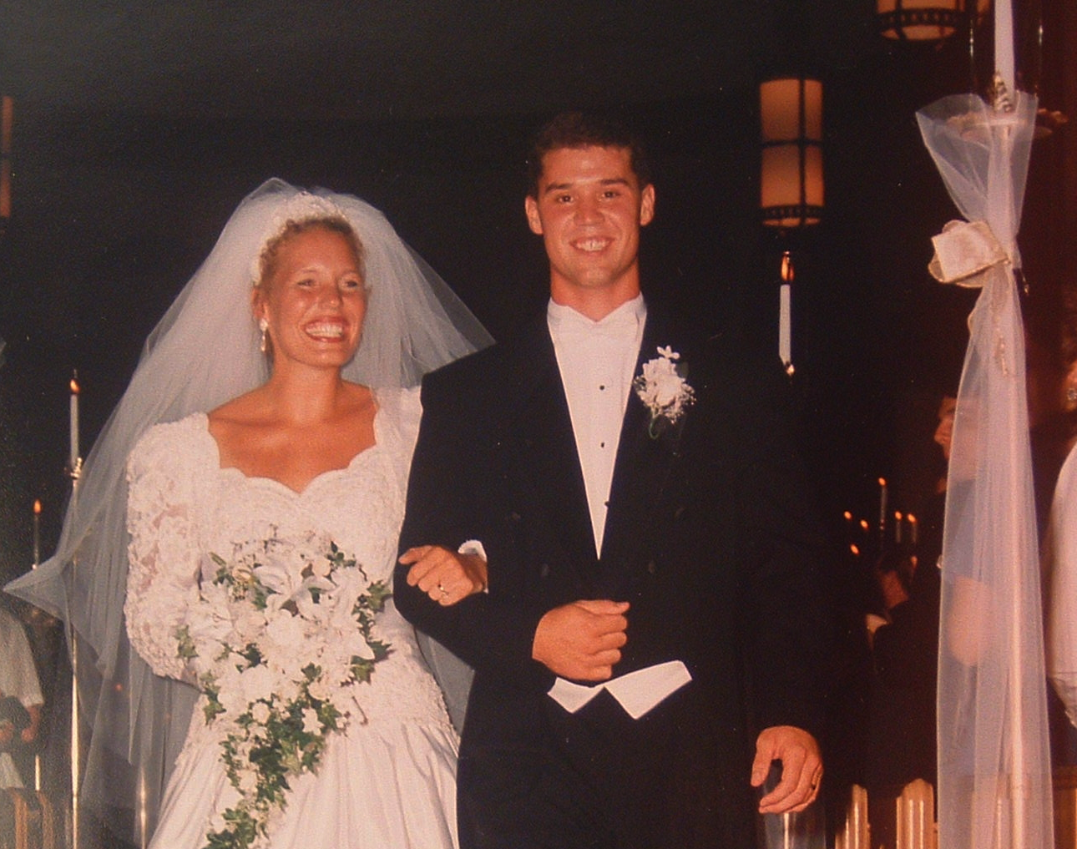
Marriage Unity

Slide 95
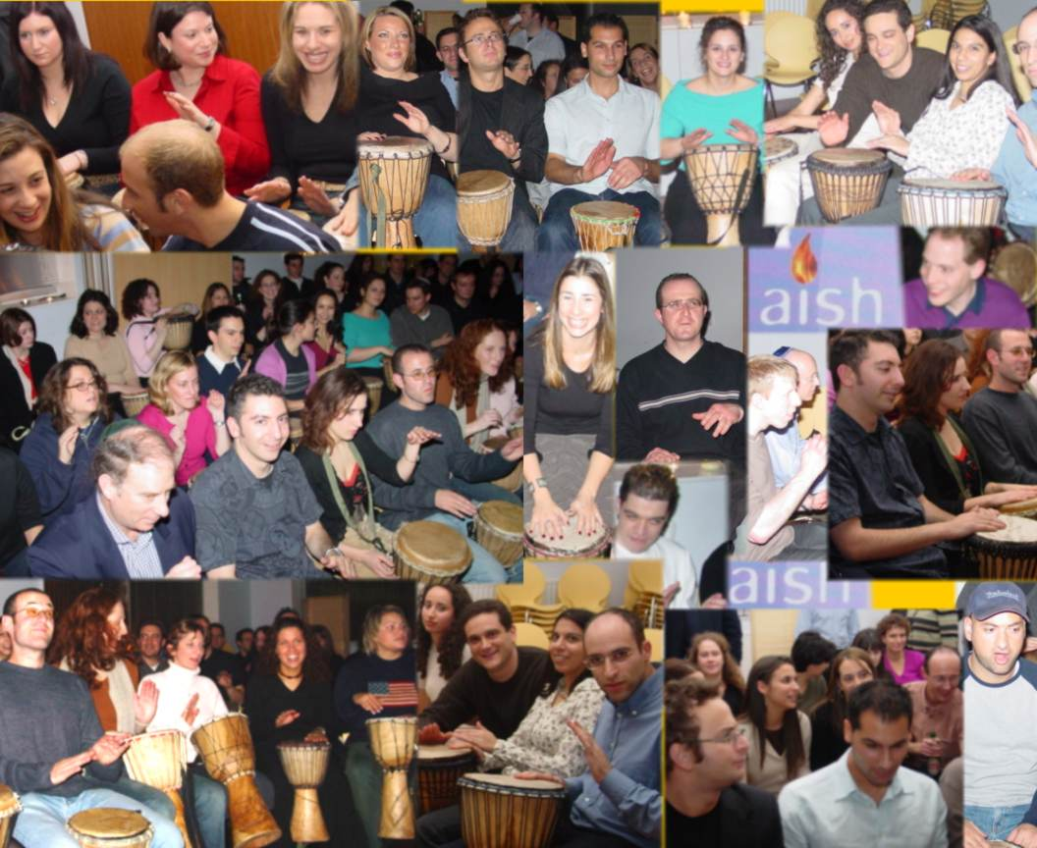
But what's the source of unity among God's people?
The Drum Café (UK teambuilding organization)
Notes:
The Drum Café (UK teambuilding orgainzation)

Slide 96

Why does the cross seem like foolishness?
Because people generally seek power and intellect.

Slide 97
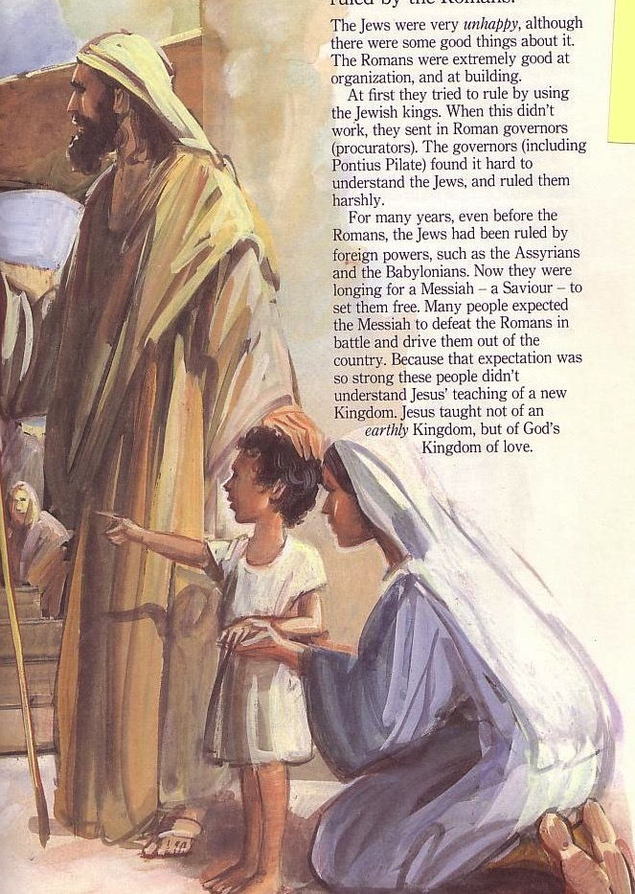
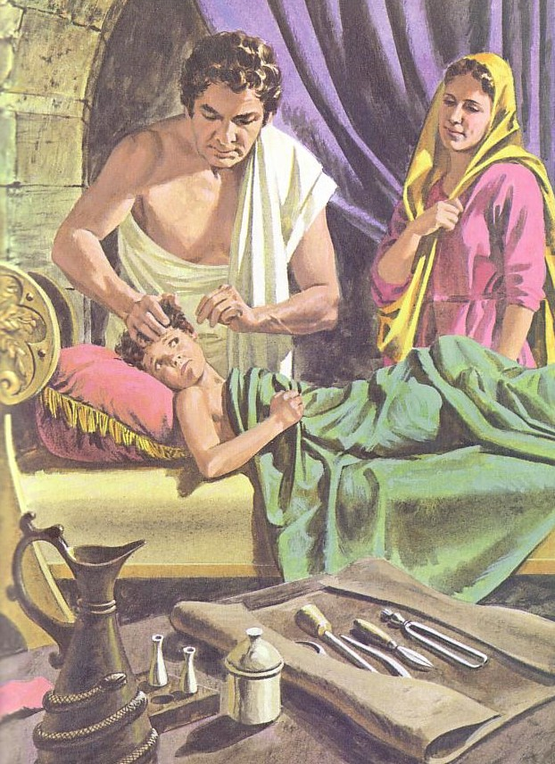
What's the Difference?
Jews
Gentiles
One God
Many taboos
Many Gods
Few taboos

Slide 98

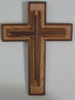
East Meets West
Power!
Jews
Greeks
Experiential
Scientific & rational
"Need a Sign"
"Need Wisdom"
Offensive
Foolish
Notes:
Adapted from Lynne M. Thompson, "Christmas: The Real Deal," interview with Ray Vander Laan, Breakaway magazine (Dec 2003): 7-9.

Slide 99
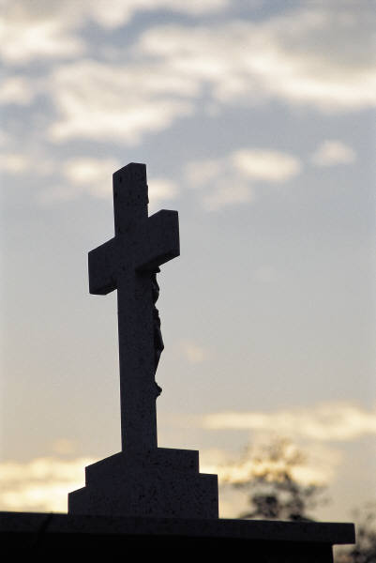
Paul's Key Point of 1 Cor. 1:
Don't divide over leaders because the gospel is based on a crucified man.

Slide 100
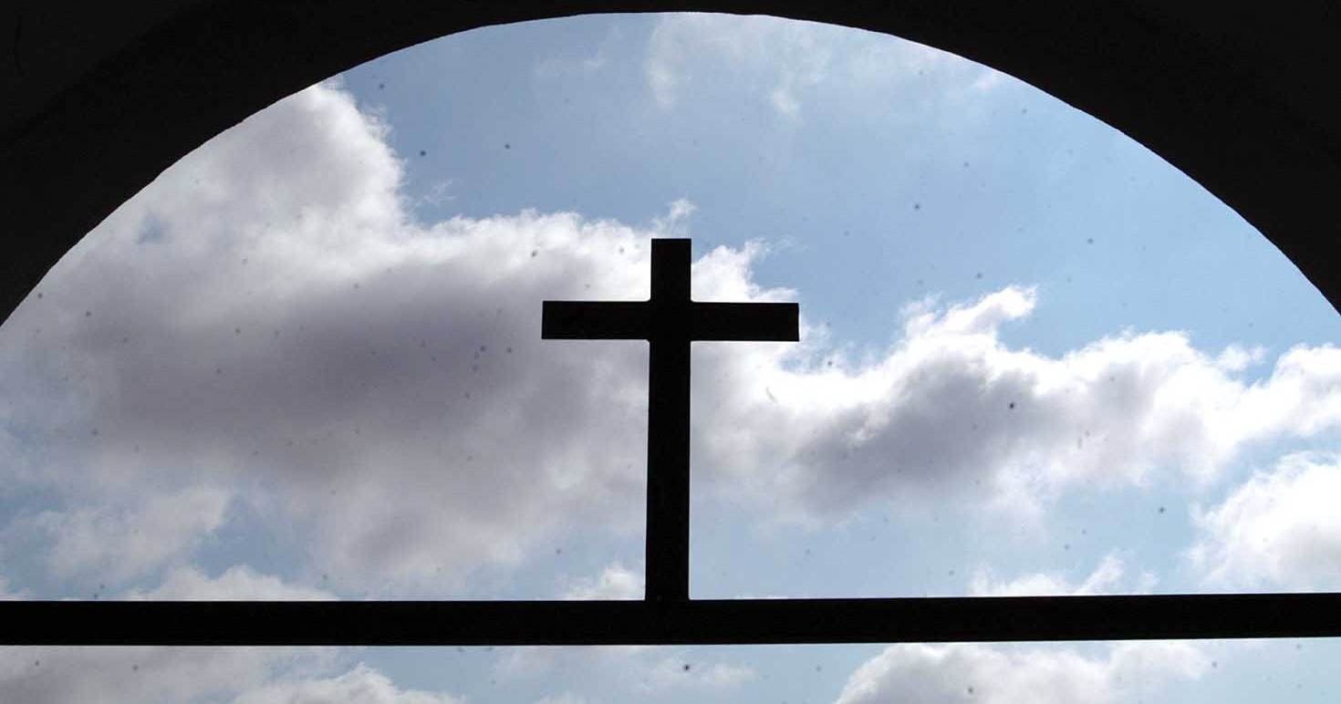
How can we put the cross first?
Don't idolize Christian leaders
Speak positively of leaders
Compliment without comparing
Submit to the elders

Slide 101
1 Corinthians 2

Slide 102
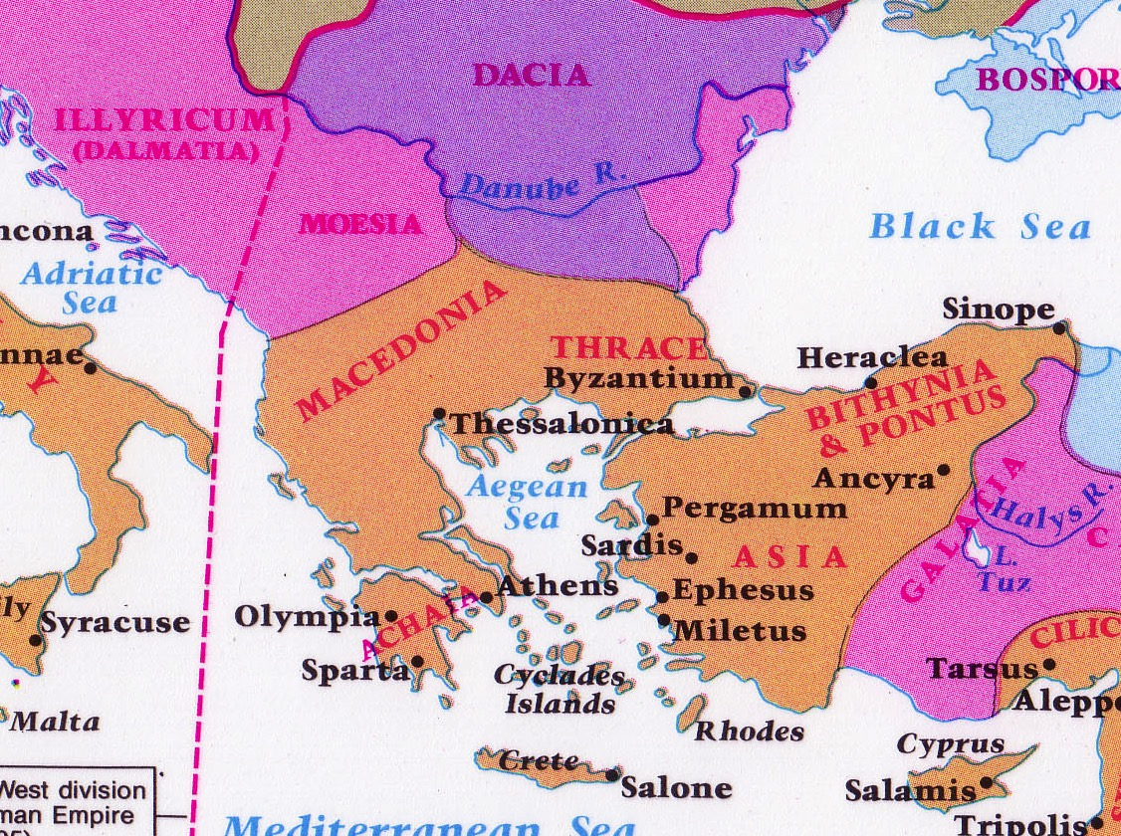
Philosophies at Athens
Athens
Corinth

Slide 103
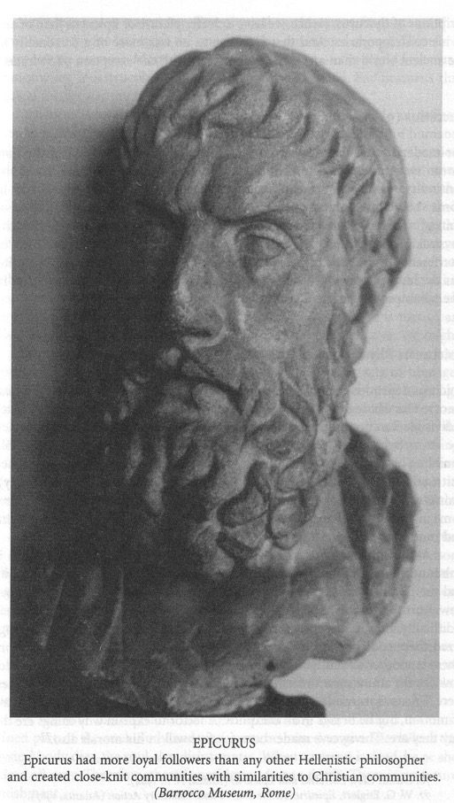
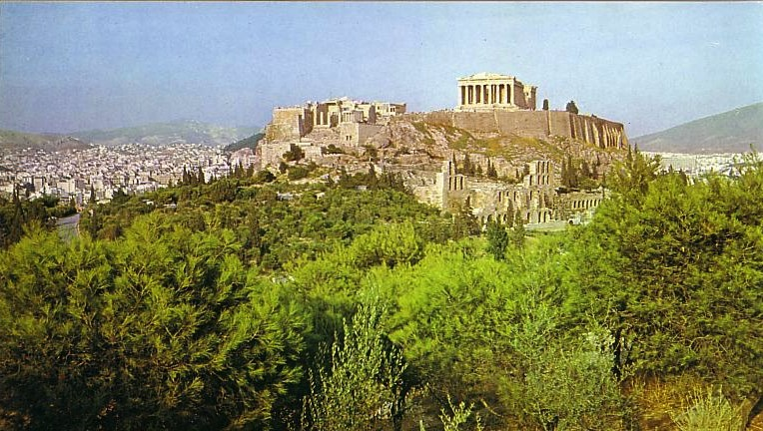
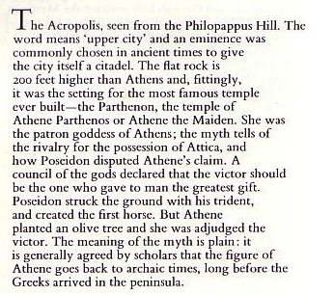
Epicureans and Stoics at the Parthenon

Slide 104


The Path to Unity: Focus on…
… things going right
(1:1-9)
… true godly wisdom
(2:6-16)
… Christ crucified
(1:10–2:5)

Slide 105

I. The gospel is God's secret message of wisdom that the world rejects (2:6-10).

Slide 106

A. Believers do speak wisdom--God's wisdom (2:6)
"By wisdom a house is built and through understanding it is established"
(Prov. 24:3)

Slide 107


Types of Wisdom
God's
vs.
Man's
Salvation is God's free gift
"There is no such thing as a free lunch"

Slide 108
Types of Wisdom
God's
vs.
Man's
God became man
God cannot become man

Slide 109
B.C. by Johnny Hart
It seems to me that since the fall—
without even thinking it odd—
that man has had no trouble at all
believing that he can be God.
How he could do this I cannot conceive,
Tho, he certainly thinks that he can—
And yet, he cannot bring himself to believe,
that God can become a man.

Slide 110
Types of Wisdom
God's
vs.
Man's
You cannot visualize things into reality
"Just Imagine!"

Slide 111
Types of Wisdom
God's
vs.
Man's
Explosions create chaos
—not order
"Big Bang!"

Slide 112
Types of Wisdom
God's
vs.
Man's
Sex outside of marriage hurts everyone
"Casual Sex"

Slide 113
Types of Wisdom
God's
vs.
Man's
Character is our most vital asset
Education is our most vital asset

Slide 114

B. Only believers understand
God's wisdom (2:7-10)
"but we speak God 's wisdom in a mystery…" (2:7 NASB)
• secret (7a)
• predestined (7c)
• hidden (7b)
• misunderstood (8)
• not even thought about (9-10)

Slide 115

II. Only believers have God's wisdom because only believers have the Spirit
(2:11-16).

Slide 116

Who sits in your chair?

Slide 117



Types of People
?
?
Self
?
Self
"Man without the Spirit"
(Non-Christian)
2:14
"The Spiritual Man"
(Christian)
2:15

Slide 118

The Focal Point of the Text
We can be truly united as a church by focusing on
God's wisdom

Slide 119

What does God's wisdom look like?
Unity
Humility
Witnessing
Education
Bible

Slide 120
1 Corinthians 3

Slide 121

Church Unity
How can we have it?

Slide 122
I. Don't be carnal by following only your favorite leader (3:1-4)
How to have unity…

Slide 123

Types of People
Carnal
Christian
(3:1)
Self
Self
Self
Non-Christian (2:14)
Christian (2:15)

Slide 124


"Carnal" means "fleshly"

Slide 125


Two Types of Carnality
Sarkikos, "like flesh," 3:1
Sarkinos, "made of flesh," 3:3
Notes:
Throwing a fit is natural for a baby—but it is totally inappropriate for an adult. The Corinthians were acting like babies.

Slide 126

Fleshly Advice…
You gotta look out for #1
You deserve a break today
so get up and get away to...
Notes:
126

Slide 127

"It's All About Me" = Blatant Carnality

Slide 128

Carnality Selfishness
Can't understand (3:2)
Fight over rights (3:3)
Divide over leaders (3:4)

Slide 129

II. See all blessings as from God—not leaders (3:5-23)

Slide 130

A. Leaders—like us all—are only instruments of God accountable to Him (3:5-15)

Slide 131
A. Leaders—like us all—are only instruments of God accountable to Him (3:5-15)
1. God causes church growth, not leaders (3:5-9).
2. God will reward each believer's service (3:10-15).

Slide 132
The Judgment Seat of Christ
Is this a judgment for to determine salvation?
Or is it to reward believers?

Slide 133

The Bema Still Exists
Notes:
133

Slide 134

Bema with Acrocorinth in Distance
Notes:
134

Slide 135

View from Acrocorinth
Notes:
135

Slide 136

The Main City Below
Notes:
136

Slide 137


The Corinthian Marketplace
Bible Visual Resource Book, 235

Slide 138
The Bema at Corinth
Lawsuits
1 Cor. 6
Bema
Paul at the speaker rostrum
Acts 18

Slide 139

Bema Close-up
Notes:
139
http://corinth.sas.upenn.edu/schola.html

Slide 140

The Speaker or Judge Above
The Speaker or Judge Above
Notes:
140

Slide 141

The One Being Judged or Rewarded Stood Below
Notes:
141

Slide 142

Bema for Rewards
"In Grecian games in Athens, the old arena contained a raised platform on which the president or umpire of the arena sat. From here he rewarded all the contestants; and here he rewarded all winners. It was called the 'bema' or 'reward seat.' It was never used of a judicial bench."
(L. Sale-Harrison, Judgment Seat of Christ, 8;
cited by Pentecost, Things to Come, 220).
Really?
Notes:
142

Slide 143

Jesus Before Pilate

Slide 144

Jesus Before Pilate

Slide 145

The Bema is a Reward Seat

Slide 146

"… the fire will test the quality of each man's work"
(1 Cor. 3:13)

Slide 147


Lasting Building Materials (3:12a)
Silver
Gold
Jewels
Foundation: Apostles & Prophets (Eph. 2:20)
Foundation: The Lord Jesus Christ (1 Cor. 3:11)
Adapted from Charles R. Swindoll. "Spiritual Gifts Study Guide" (IFL, 1983), 7

Slide 148


Perishable Building Materials (3:12b)
Hay
Wood
Straw
Foundation: Apostles & Prophets (Eph. 2:20)
Foundation: The Lord Jesus Christ (1 Cor. 3:11)
Adapted from Charles R. Swindoll. "Spiritual Gifts Study Guide" (IFL, 1983), 7

Slide 149


"saved as through fire…"
(3:15)

Slide 150

B. God deserves credit for our blessings, not any man (3:16-23).

Slide 151
B. God deserves credit for our blessings, not any man
(3:16-23).
1. God indwells the church and will judge (3:16-17)
2. God gives true wisdom,
not human wisdom (3:18-20)
3. God will give us everything in the world (3:21-23)

Slide 152

1 Corinthians 3:16-17 (NIV)
171
“Don't you know that you yourselves are God's temple and that God's Spirit lives in you? If anyone destroys God's temple, God will destroy him; for God's temple is sacred, and you are that temple.”

Slide 153

—Main Idea of 1 Cor. 3—
Unity comes from seeing all blessings as from God—not from leaders

Slide 154
Eternal Security in Corinth
161dd
Surprisingly, Paul affirmed the Corinthians repeatedly that they have eternal security:
1. Their salvation will be maintained until the Lord's return (1 Cor. 1:8-9)
2. Even carnal believers will still enter heaven because of their saving faith but without rewards
(1 Cor. 3:12-15; cf. 2 Cor. 5:10)
3. They should expel the incestuous man so Satan could even kill him, but he would still be saved (1 Cor. 5:4-5)
4. Even resurrection doubters should serve God fully since their service would be rewarded (1 Cor. 15:58)
5. God alone secured their redemption, for He sealed them with the Spirit to assure their salvation
(2 Cor. 1:21-22)

Slide 155
1 Corinthians 4

Slide 156

1 Corinthians 4 Subject
How should we view our spiritual leaders?
Notes:
156

Slide 157

I. Honor your leaders for their humility
(4:1-13)
Notes:
157

Slide 158
Humility (4:1-13):
Treat spiritual shepherds as faithful stewards accountable to God (4:1-5).
CEO
Christ Executive Officer
Notes:
158

Slide 159
Three Major Pastoral Leadership Tasks of Elders
Lead
Teach
1 Tim. 3:1, 4-5; 5:17
1 Tim. 3:2; 5:17
Pastor-Teachers
Episkopos =
Epi "over" +
skopos "look" =
"watch over"
Protect
1 Pet. 5:1-4
Acts 20:29, 35
1 Thess. 5:12
Eph. 4:11
Notes:
159

Slide 160
Humility (4:1-13):
Treat spiritual shepherds as faithful stewards accountable to God (4:1-5).
B. Evaluate elders by scriptural standards––not worldly ones (4:6-7).
C. Recognize your leaders' humble sacrifices to lead you (4:8-13).
Notes:
160

Slide 161

II. Respond to your elders' spiritual authority
(4:14-21)
Notes:
161

Slide 162

Fatherly Authority (4:14-21):
A. Fathers admonish (4:14-15).
Notes:
162

Slide 163


Fatherly Authority (4:14-21):
B. Fathers set an example of godliness (4:16-17).
Notes:
163

Slide 164

Fatherly Authority (4:14-21):
A. Fathers admonish (4:14-15).
B. Fathers set an example of godliness (4:16-17).
C. Fathers discipline stubborn kids
(4:18-21).
Notes:
164

Slide 165

– Paul's Key Point in 1 Cor. 4 –
Treat elders with a biblical balance––
as faithful and humble servants,
yet also as spiritual fathers with authority

Slide 166
Respect Leaders
1 Thessalonians 5:12-13
"Now we ask you, brothers, to respect those who work hard among you, who are over you in the Lord and who admonish you. Hold them in the highest regard in love because of their work. Live in peace with each other."
Notes:
166

Slide 167
Obey Leaders
Hebrews 13:17
"Obey your leaders and submit to their authority. They keep watch over you as men who must give an account. Obey them so that their work will be a joy, not a burden, for that would be of no advantage to you."
Notes:
167

Slide 168
How should we…
BE
UNITED
(1–4)
BE
MORAL
(5–6)
BE
DIFFERENT
1 Corinthians
…from unbelievers?

Slide 169
1 Corinthians 5

Slide 170
How do we maintain purity in the church?

Slide 171
Corinth: Crossroad of Immorality
142
Corinth

Slide 172
Isthmus of Corinth
161a
7 km
Corinth
Acrocorinth
Temple of Aphrodite

Slide 173
View of Acrocorinth from the City

Slide 174
Temple of Aphrodite
Greek Goddess of Love

Slide 175
Temple of Aphrodite

Slide 176
Immorality in All Seasons

Slide 177
The Wayward Local Church
The Wayward Local Church
Reports
Questions
Division
Disorder
Difficulties
Concern
1–4
Discipline
5–6
Instruction
7–16
Carnality
3–4
Marriage 7
Worship
11–14
Factions 1–2
Incest 5
Idols 8–10
Resurrection
15
Immorality
Collection 16
Lawsuits 6
Solving church problems theologically

Slide 178
I. Humbly remove members living in sin (5:1-2).
Care enough to confront!
Spanking the Saints

Slide 179

II. Discipline benefits the offender and the church (5:3-8)

Slide 180


A. Discipline hands a believer over to Satan's dominion to end his hypocrisy
(5:3-5)
"…deliver over to Satan"

Slide 181

B. Discipline maintains the purity of the body
(5:6-8)

Slide 182

Yeast

Slide 183


Passover's Past Significance
(Exodus 12)

Slide 184



The Passover Lamb

Slide 185

"Burn All the Yeast!"

Slide 186





Feast of Unleavened Bread
128, 137
Notes:
www.stephenwilliamson.com/ Hobbies/bakin.htm (Yeast bloom)

Slide 187

III. Association with immoral people depends on whether or not they are Christians
(5:9-13).
"Don't look to me! Look to Jesus!"

Slide 188

A. We can associate with an immoral unbeliever (5:9-10).
but...
B. We can't associate with an immoral Christian (5:11).

Slide 189
What sins are "bad enough" for church discipline?
1 Cor 5:11
Sexually immoral
Greedy
Idolaters
Slanderers
Drunkards
Swindlers
Other Texts:
Divisive (Tit. 3:10)
Lazy (2 Thess. 3:6)

Slide 190

C. The church must remove immoral Christians (5:12-13)

Slide 191
How to Treat One Under Discipline
Don't refer to him/her as a Christian.
Evangelize this person.
Don't let him/her take the Lord's Supper.
Remove the person from membership.
Remove this person from church roles.
Unbeliever
"Deliver over to Satan" one in sex sin
(1 Cor. 5:5).
Don't eat with him/her (1 Cor. 5:11).
Prohibit him/her from attending church?
Worse

Slide 192
The Focus of 1 Cor. 5
Guard church purity by expelling unrepentant believers
Guard church by expelling unrepentant believers

Slide 193

How can we keep this church pure?
a. Start with your own life.
b. Support the leaders.
c. Care how others are really doing.

Slide 194
1 Corinthians 6

Slide 195

Conflicts among Christians are family matters––not for unbelievers to solve (6:1)
Why?
Competency
Witness

Slide 196

I. We are more competent than unbelievers to solve Christian disputes
(6:2-6, 9-11)

Slide 197
"Do you not know that saints will judge the world?"
(6:2a)

Slide 198

The Rule of Christ
What is it? When is it?

Slide 199




Our Future
(Rev. 19–20)
Heaven
(Rev. 21–22)
Millennium
(Rev. 20)
Return
(Rev. 19)

Slide 200
Revelation 20:4 (NAU)
⁴Then I saw thrones, and they sat on them, and judgment was given to them. And I saw the souls of those who had been beheaded because of their testimony of Jesus and because of the word of God, and those who had not worshiped the beast or his image, and had not received the mark on their forehead and on their hand; and they came to life and reigned with Christ for a thousand years.

Slide 201
II. It is better to suffer personal loss than for the whole church lose its witness
(6:7-8)

Slide 202

"You are the light of the world…"

Slide 203
How to win by losing
A. Better that one Christian
be wronged than the church
be wronged from litigating saints (6:7)
B. Better to lose money than
to lose ministry opportunities by cheating other Christians (6:8)

Slide 204
Disputes between believers must be solved by believers
(Main Idea of 1 Cor. 6)

Slide 205

Church Covenant
    As members of one body, we pledge to:
    (xiv) resolve all conflicts with arbitration only among believers without recourse to the secular courts

Slide 206

"Do you not know that your body is a temple of the Holy Spirit, who is in you, whom you have received from God? You are not your own; ²⁰ you were bought at a price. Therefore honor God with your body"
(1 Cor 6:19-20 NIV).
Notes:
One of the greatest ways we witness for Jesus is how we treat our bodies.

Slide 207


The Spirit indwelling is God’s new work!
Notes:
Amazingly, the Bible says that the Holy Spirit actually dwells in our bodies!
____________
Common English-116
BE-02-Exodus-130
BE-03-Leviticus-55
OS-02-Exodus-476
OP-03-Lev-130
NS-06-Rom5-8-slide129
NS-07-1Cor1-9-slide 205
HS-

Slide 208
How should we…
BE
UNITED
(1–4)
BE
MORAL
(5–6)
BE
DIFFERENT
BE
SELFLESS
(7–16)
1 Corinthians
…from unbelievers?
Notes:
The way for Christians to stand out from the world is through fighting disunity, immorality, and selfish living.

Slide 209
1 Corinthians 7

Slide 210



STRAIGHT TALK ON CONTENTMENT
1 Corinthians 7:1-24

Slide 211


Black

Slide 212

"You never know true happiness until you're married…"
"… and then it's too late!"

Slide 213

Are you content?

Slide 214

Why should you be content with your…?
  • marital state?
  • body (physical appearance)?
  • job (social standing)?

Slide 215
The Wayward Local Church
The Wayward Local Church
Reports
Questions
Division
Disorder
Difficulties
Concern
1–4
Discipline
5–6
Instruction
7–16
Carnality
3–4
Marriage 7
Worship
11–14
Factions 1–2
Incest 5
Idols 8–10
Resurrection
15
Immorality
Collection 16
Lawsuits 6
Solving church problems theologically

Slide 216

1 Corinthians 7 Overview
"Remain"
17, 20, 24
Marriage
7:1-24
Singleness
7:25-40

Slide 217

I. Those married can have their sexual needs legitimately met (7:1-7)

Slide 218

II. Widowers and widows can remarry if they have unmet sexual needs (7:8-9)

Slide 219

Dr. Walter McConnell
Notes:
Dr McConnell was married to his beloved wife Karen, who suddenly died.

Slide 220

Walter & Claire McConnell
Notes:
That same year, his long-term friend Claire also lost her spouse. Comforting one another brought them together and merged their combined five children.

Slide 221

Black
"Do you, Walt, take Claire, to have and to hold, to email and facebook, to Tweet, Skype & text, until death do you part?"

Slide 222


III. Divorcees should remain unmarried to enable reconciliation with their spouse (7:10-11)

Slide 223


Four Views…
1. No divorce, no remarriage
2. Divorce, no remarriage
3. Both divorce & remarriage after adultery or desertion
4. Both divorce & remarriage after various circumstances

Slide 224

IV. Those in mixed marriages should stay married to be a godly influence in the family (7:12-16)

Slide 225

V. All of Us: Be content with your body and job (7:17-24)

Slide 226

Body Contentment (7:17-19)

Slide 227
Be content with your low socio-economic position (7:20-23)

Slide 228







Four Roman Social Classes
98
Equestrians (Patricians)
Plebians
Freedman
Slaves

Slide 229

Main Idea of 1 Cor. 7:1-24
Be content with your marital state, body, and job because each situation has its advantages

Slide 230

Advantages
Marriage: intimacy
Singleness: ministry
Mixed Marriage:
mission field
Divorcees:
see God work
Undesirable Body: obedience
Less Money:
freedom in Christ

Slide 231

Contentment
"…is not the fulfillment of
what you want,
but the realization of
what you already have"

Slide 232

Why Stay…
1 Corinthians 7:25-40
Single?

Slide 233

Third Missionary Journey Map
"Present distress" at Corinth (7:26)
Corinth
Third Missionary Journey
A.D. 53-57

Slide 234
1 Corinthians 7 Overview
"Remain"
17, 20, 24
Marriage
7:1-24
Singleness
7:25-40

Slide 235

I. Singleness has its advantages (7:28b-35).

Slide 236

A. Trials: Singles have fewer troubles than married folks (7:28b).
Why stay single?

Slide 237


Cattleman's Stress Test
Notes:
The Stress-Test consists of viewing a photo of 2 Dolphins...�The dolphins appear to be nearly identical when viewed by stress-free individuals. The test is not sufficiently accurate to detect mild stress differentials, but is very accurate on individuals with higher stress-levels.�� �Deviations in appearance between the 2 dolphins are indicators of potential stress-related problems and the deviations, if any, may also indicate the source of stress.�� �If you experience significant deviations, you may want to consider taking things a little easier...

Slide 238
The Stress Scale
Social Readjustment Rating Scale (SRRS) of Thomas Holmes and Richard Rahe, 1967
Death of Spouse
100
Death of Spouse
100
Divorce
73
Divorce
73
Marital Separation
65
Marital Separation
65
63
Death of Close Family Member
63
Imprisonment
53
Personal Injury or Illness
Getting Married
50
Getting Married
50
47
Dismissal from Work
45
45
Marital Reconciliation
Marital Reconciliation
Notes:
In 1967, psychiatrists Thomas Holmes and Richard Rahe examined the medical records of over 5,000 medical patients as a way to determine whether stressful life events might cause illnesses. Patients were asked to tally a list of 43 life events based on a relative score. A positive 0.1 correlation was found between their life events and their illnesses. Thus, the Social Readjustment Rating Scale (SRRS) or the Holmes and Rahe Stress Scale was born. However, this study can be perceived as unreliable since it asks participants to look back at their life events, making the data retrospective.
See Holmes, T.H. and Rahe, R.H.: The social readjustments rating scales, Journal of Psychosomatic Research, 11:213-218, 1967
Source: http://en.wikipedia.org/wiki/Holmes_and_Rahe_stress_scale

Slide 239

Stress Ball

Slide 240

B. Time: Singles have more time to invest in eternal matters
(7:29-31).
Why stay single?

Slide 241







Women on SBC Faculty
Notes:
Of the 7 women on SBC faculty in 2008, 4 were single, 2 married without children, and 1 married with two children. Rarely can mothers handle many ministry responsibilities outside their children.

Slide 242




Children's Authors
Lewis Carroll
Dr. Seuss
Beatrix Potter
Notes:
Do you recognize these authors? Time magazine reports an interesting phenomenon—that many famous authors of children's books didn't have children—from Dr Seuss, Beatrix Potter, Lewis Carroll and others

Slide 243

Other Singles
J. D. Douglas
Voltaire
Beethoven
Hans Christian Anderson
Michelangelo
John Stott

Slide 244

C. Distractions: Singles can serve God in ways that those married can't
(7:32-35).
Why stay single?

Slide 245

The Crossroads (1981-83)
Notes:
After college it seemed the natural thing to do to join Campus Crusade staff in the Philippines on a seven-member music team.

Slide 246

Crossroads Ministry
Korea
China
Japan
Hong Kong
Taiwan
Macau
Thailand
Philippines
Malaysia
Singapore
Indonesia
Notes:
The Crossroads team shared the gospel in 11 Asian nations and saw over 10,000 people indicate decisions to trust Christ! Again I was amazed at God's grace!

Slide 247




China, 1981
Notes:
Our first tour to China we were celebrities as the first Christian musical team to visit the New China. We sang in music conservatories, parks, and even from the bus! God began to open my eyes to the needs of East Asia…

Slide 248



Susan & Me, 1982
Notes:
God also began to open my eyes to the woman singing next to me! She initially despised me but after a year or so she saw the light. That's our engagement picture. In 1983 we returned to the USA..

Slide 249

Marriage still isn't prohibited (7:36-40).
30 December 1983

Slide 250

A. Singles should get married if sexual temptation is too strong (7:36-38).

Slide 251

B. Widows can remarry too (7:39-40).

Slide 252

Single parenting ain't for sissies

Slide 253

Main Idea of 1 Cor. 7:25-40
Singleness has its advantages (especially during difficult times) but marriage isn't prohibited.

Slide 254

What about Singles?

Slide 255

Harriet Hartbyrne
"I don't want anyone to put 'Miss' on my tombstone—I haven't missed as much as people think!"

Slide 256



What about Couples?

Slide 257


Key NT Singles
Romans 5:12-21
1 Cor. 15:22

Slide 258


Luci Swindoll
"As a little girl, I always liked the idea of a single lifestyle. I never consciously wanted to marry. I had high goals. I wanted to sing professionally. I wanted to travel. I realized that if I married, I wouldn't have time to accomplish these goals. Also, I thought my temperament needed solitude and was not suited to the responsibilities that marriage and a family required. I didn't think I could blend into my husband with my whole heart. Quite early, God revealed to me that I would be better off not to marry."

Slide 259
1 Corinthians 8

Slide 260
Where Convictions Come From…
Scripture
View of Acrocorinth from the City

Slide 261

Things wrong at Corinth
Divisions (1-4)
1 Corinthians
Immorality (5-6)
Discontentment (7)

Slide 262
Where Convictions Come From…
Scripture
Conscience
View of Acrocorinth from the City

Slide 263
Black & White
Practices the Bible says are always wrong
Practices the Bible says are always right
Idolatry
Adultery
Murder
Coveting
Contentment
Obedience
Prayer
Purity

Slide 264
Gray Areas
155aa
Practices not forbidden in the Bible over which Christians disagree

Slide 265
Gray Area Examples
155aa
Accepting gifts with the left hand
Being a Democrat (or Republican!)
Buying a Mac (or Windows) computer
Celebrating Christmas or Easter
Celebrating Good Friday
Celebrating Lent
Celebrating Palm Sunday
Changing to a "Christian" name
Chinese New Year giving of hong baos

Slide 266
Gray Area Examples
155aa
Christmas trees in the church sanctuary Clapping in church services
Dancing
Drinking beer
Drinking hard liquor
Drinking wine
Driving a motorcycle
Eating bloody foods
Eating food sacrificed to idols

Slide 267
Gray Area Examples
155aa
Eating junk food
Eating meat
Eating only "Christian food"
Giving only "Christian" greetings (New Year)
Giving to non-religious causes
Having an abortionist gynecologist
Killing in war
Laughing with men and women together
Listening to rock music

Slide 268
Christians in Corinth
Those who felt it was wrong to eat
Those who felt it was okay to eat
They did not eat, but were troubled by those who did
They ate in spite of thinking it was wrong and their conscience was troubled
They ate without regard to the feelings of others
They limited their liberty from concern for other brothers

Slide 269
Should we follow someone else's conscience?

Slide 270
Why should we give up our rights in gray matters?

Slide 271
I. Show love more than knowledge (8:1-3).

Slide 272
Meat & the Marketplace (1 Cor 8)
161
Bible Visual Resource Book, 235

Slide 273



Love
Music
Drinking

Slide 274

Black

Slide 275
II. Protect the conscience of weak believers (8:4-8).

Slide 276
III. Give up your rights permanently if they hurt a weaker brother (8:9-13).

Slide 277
Bad things happen if you insist on your rights in gray matters
(8:10-12).
You encourage your weaker brother to sin (8:10)
The weak brother could even give up his faith (8:11)
You sin (8:12)

Slide 278
Chapter 8 Big Idea
Show love more than knowledge when dealing with gray matters

Slide 279

Use your gray matter on gray matters

Slide 280
1 Corinthians 9

Slide 281

1 Corinthians 8–10
8
Meat
9
Apostles
10
Temples
8
Gray Areas

Slide 282
Should we follow someone else's conscience?

Slide 283
Why should we give up our rights in gray matters?

Slide 284

Vegeta-bull

Slide 285
1 Corinthians 8–10
8
Meat
9
Apostles
10
Temples
8
Gray Areas
9
Rights

Slide 286
Do those serving Christ have rights?
?
?
?

Slide 287
I. Servants of Christ have rights (9:1-14).

Slide 288
How Greek and Roman Philosophers and Religious Teachers Were Paid in Paul's Day
• Charged fees
• Stayed with rich people
• Begged
• Worked at a trade
Notes:
Craig Blomberg, NIV Application Commentary, 173

Slide 289
How did Paul support himself?
Macedonia
$
Corinth
How did Paul support himself?

Slide 290
2 Corinthians 11:7-8 NLT
"Was it a sin for me to lower myself in order to elevate you by preaching the gospel of God to you free of charge? I robbed other churches by receiving support from them so as to serve you!"

Slide 291

Shepherd

Slide 292

Don't muzzle the ox

Slide 293

Food for Priests

Slide 294
II. Give up any right that hinders the gospel (9:15-27).

Slide 295
Give up your rights to help others mature in Christ
(Main Idea of
1 Corinthians 9)

Slide 296
Herd Mentality

Slide 297
How should we be different from unbelievers?
Notes:
What are some of the ways that God wants your life to escape the herd mentality?
How does Jesus desire you to rise above the fray?

Slide 298
How should we…
BE
UNITED
(1–4)
BE
MORAL
(5–6)
BE
DIFFERENT
BE
SELFLESS
(7–16)
1 Corinthians
…from unbelievers?

Slide 299
Main Idea
Be different by being united, moral and selfless
1 Corinthians
Notes:
Said differently, do not divide the church, do not be immoral, and do not act only for your own benefit (restatement).

Slide 300
Sanctified = “Set apart by God as His possession”
Do you live like this?

Slide 301
Black

Slide 302


NT Preaching • BibleStudyDownloads.org
Get this presentation and script for free!

Slide 303
Black

Slide 304
NT Survey link at BibleStudyDownloads.org
Get this presentation for free!
Notes:
NT Survey (ns)

