Slide 1
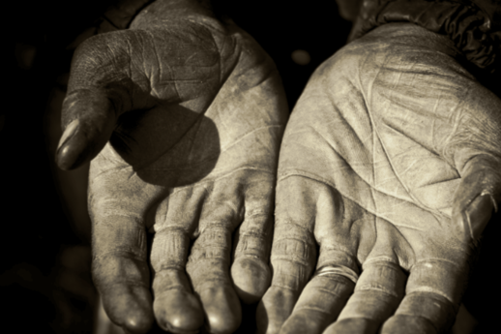
Romans 9–16
Romans 9–16
God's Righteousness Revealed
Dr. Rick Griffith • Jordan Evangelical Theological Seminary • BibleStudyDownloads.org

Slide 2
Slides on
Romans 9

Slide 3
Why accept one another?
145
SIN
Needed
in Condemnation
1:18–3:20
Equal Righteousness
1:1-17
Provided
in Justification
3:21–5:21
SALVATION
Vindicated
in Election
9–11
Imparted
in Sanctification
6–8
SELECTION
SET APART
Notes:
God vindicated his righteousness in Israel’s election and Gentile salvation (Rom 9–11).
[God called Jews to salvation—maybe the most unbelieving nation—so God must be righteous!]

Slide 4
Romans 9
154c
Righteousness was revealed in God's sovereign choice of Israel
Notes:
Deut. 7:7 “The LORD did not set his heart on you and choose you because you were more numerous than other nations, for you were the smallest of all nations! ⁸ Rather, it was simply that the LORD loves you, and he was keeping the oath he had sworn to your ancestors. That is why the LORD rescued you with such a strong hand from your slavery and from the oppressive hand of Pharaoh, king of Egypt."
Deut. 9:1 “Listen, O Israel! Today you are about to cross the Jordan River to take over the land belonging to nations much greater and more powerful than you. They live in cities with walls that reach to the sky! ² The people are strong and tall—descendants of the famous Anakite giants. You’ve heard the saying, ‘Who can stand up to the Anakites?’ ³ But recognize today that the LORD your God is the one who will cross over ahead of you like a devouring fire to destroy them. He will subdue them so that you will quickly conquer them and drive them out, just as the LORD has promised.
Deut. 9:4 “After the LORD your God has done this for you, don’t say in your hearts, ‘The LORD has given us this land because we are such good people!’ No, it is because of the wickedness of the other nations that he is pushing them out of your way. ⁵ It is not because you are so good or have such integrity that you are about to occupy their land. The LORD your God will drive these nations out ahead of you only because of their wickedness, and to fulfill the oath he swore to your ancestors Abraham, Isaac, and Jacob. ⁶ You must recognize that the LORD your God is not giving you this good land because you are good, for you are not—you are a stubborn people."
God chose Israel not because of any goodness in the Jews. God chose Israel because of the goodness of God.

Slide 5

Righteousness in Romans
145
Theme | Needed | Provided | Imparted | Proved | Applied | Dissem-inated
Intro 1:1-17 | Condem-nation 1:18– 3:20 | Justifi-cation 3:21– 5:21 | Sanctifi-cation 6–8 | Election 9–11 | Trans-form-ation 12:1– 15:13 | Propa-gation 15:14– 16:27
Start | Sin | Salva-tion | Set Apart | Sove-reignty | Service | Send
Notes:
The key question here is, "How can God save Israel when they will not believe in Jesus?"
Some believers answer, "Well, there IS not Israel. WE in the Church are the Israel!"
But does Paul distinguish between Israel and the Church?

Slide 6
Summary of Romans 9–11
NT Survey,
page 154e
9:1-29 | 9:30–10:21 | 11:1-36
Israel's past | Israel's present | Israel's future
God elected Israel | Israel rejects God | God will reject Israel only partially and temporarily
Israel's failure is not due to God's unfaithfulness | Israel's failure is due to rejecting her Messiah | Israel's failure will be neither total in scope nor final
A Jewish remnant has been preserved by God | Only a small Jewish remnant accepts Him now | Yet this remnant will grow into an entire believing nation
Gentiles have also become elect of God in Christ | Gentiles are now becoming saved by faith in Christ | Gentiles should not be proud over blessings that Jews reject
Divine side | Human side | Divine results
God's election | Man's responsibility | God's mercy
Human unbelief cannot eradicate God's promises because they are based on the principle of sovereign election | However, God's election in sovereign grace to fulfill His Word does not eradicate human responsibility for unbelief | Ultimately, God's election will be justified in the salvation of the Jewish nation alive when Christ returns (11:26-27)

Slide 7

"Israel" always means ethnic seed of Jacob (9:1-5)
155v
"For not all who are descended from Israel are Israel" (9:6)
≠ "Israel" refers to believing Gentiles?!?!
= Not all Jews believe
Notes:
Though parallels exist between them, not one place in the Bible does it ever call the Gentiles "Israel." This Bible uses the word "Israel" 2169 times, but there is not one clear example of the term being used for Gentiles.
Therefore, this verse must mean that not all Jews who are ethically descended from Jacob show the faith of Jacob and thus are saved. Paul taught this in:
Rom. 2:28 NLT For you are not a true Jew just because you were born of Jewish parents or because you have gone through the ceremony of circumcision. 29 No, a true Jew is one whose heart is right with God. And true circumcision is not merely obeying the letter of the law; rather, it is a change of heart produced by the Spirit. And a person with a changed heart seeks praise from God, not from people.
If we do not distinguish between Jews and Gentiles like Paul did in Romans 9–11, then these words lose their meaning.
______________
OS-Isaiah49-59—slide 153
NS-06-Rom9-16—slide 7

Slide 8
Theological Concepts in Romans
155h
Election | 9:10-13 | God's choice of an individual or group for a specific purpose or destiny
Justification | 4:25; 5:18 | God's act of declaring us "not guilty" for our sins, making us "right" with him
Propitiation | 3:25 | God removing punishment for sin by the perfect sacrifice of Jesus Christ so that God's righteous anger is satisfied
Redemption | 3:24; 8:23 | The return of a sinner to God (“buying back” from the slave market) by Jesus Christ’s payment of the price of death with his own blood to make an unbeliever a believer
Sanctification | 5:2; 15:16 | Becoming more and more like Jesus Christ through the work of the Holy Spirit
Glorification | 8:18, 19, 30 | The believer's final state of being in complete conformance to the character of Jesus Christ in a resurrected body that will last forever (1 John 3:2)
Notes:
________________
NS-06-Rom3-4—slide 78
NS-06-Rom5-8—slide 192

Slide 9
Theological Concepts in Romans
155h
Condemnation | 5:9, 16, 18; 7:13; 8:1 | The just punishment of hell for unbelievers in Jesus due to God's wrath against sin
Salvation | 5:4; 11:11-12, 15; 13:11-12 | Deliverance from the penalty of sin by grace though faith in Jesus
Faith (Belief) | 3:22 | Trust or reliance on Christ's atonement on the cross as the sinless substitute to pay the sinner's penalty due to God
Grace | 3:24 | God giving what we do not deserve by granting salvation and other blessings (God's Riches At Christ's Expense)
Mercy | 1:31; 9:15-16, 18, 23; 11:31-32 | God not giving what we do deserve by saving believers from hell
Gospel | 1:1, 9, 15-16; 2:16; 11:28; 15:16, 19-20 | The good news of salvation from sin's penalty by grace though faith in Jesus as God who atoned for sin and rose again
Notes:
________________
NS-06-Rom3-4—slide 79
NS-06-Rom5-8—slide 193

Slide 10
Theological Words in Romans
155h
Foreknowledge | 8:29 | The effectual appointment or choice of believers to salvation by the Father
Calling | 8:28, 30 | The successful summons to salvation by the Father
Adoption | 8:15, 23 | The transfer of Christians from the control of Satan to security in God's family
Perseverance | 8:25 | The believer's hope for salvation leading to consistent trust and work towards it
Intercession | 8:34 | Christ's pleading to the Father for the believer to be fully conformed to his image
Indwelling | 5:5; 8:9, 11 | The presence of the Spirit in the body of the Christian
Notes:
________________
NS-06-Rom3-4—slide 80
NS-06-Rom5-8—slide 194

Slide 11
Theological Concepts in Romans
155h
Predestination | 8:29-30 | The Father's eternal choice to conform believers to the likeness of the Son
Security | 8:31-37 | The eternal preservation of the believer from hell and irreversible promise of heaven
Assurance | 8:16 | The realization of one's eternal security
Inheritance | 8:17 | Salvation of all believers (heirs of God) and rewards for the faithful (co-heirs of Christ)
Atonement | 3:25 | Removal of the sin barrier between sinners and God by Jesus paying the price of sin
Antinomianism | 6:1 | Living apart from the Mosaic law with increased sin so that grace would abound
Legalism | 4:2; 10:5 | Relying on self-effort by keeping the Mosaic law for salvation and spiritual growth
Notes:
________________
NS-06-Rom3-4—slide 81
NS-06-Rom5-8—slide 195

Slide 12
Theological Concepts in Romans
155h
Righteousness | 1:17; 3:21; 4:3; 5:21 (30 times total) | The quality or state of judicial correctness with focus redemptive action where God pardons but also shares his character with believers who then exhibit righteousness in the moral sense (BDAG)
Imputation | 4:3-6, 8, 10, 22-24 | The application of either sin or righteousness to another
Justice | 1:32; 2:2 | The action of God that is right or just and thus shows no partiality between humans
Right Standing (Position) | 5:21; 8:30 | Our unchanging favorable verdict or status before God as his children (who we are, not what we do)
United | 6:5 | The association of the believer with Christ in a related experience
Identification | 6:5 | The "grown together" (united) experience where the Christian reflects the death and resurrection of Jesus
Notes:
Imputation is noted 19 times in Romans. It is the mathematical term logizomai, meaning "to count, to reckon, to credit, to impute" and thus only some key verses are noted above.
________________
NS-06-Rom3-4—slide 82
NS-06-Rom5-8—slide 196

Slide 13
The reason Jews and Gentiles at Rome should accept each other is because God vindicated his righteousness in Israel’s election and Gentile salvation (Romans 9–11).
154a
God's righteousness is revealed in His sovereign past choice of Israel so that Israel’s failure is not due to God’s unfaithfulness (9:1-29).
God shows his righteousness in Israel’s present rejection of his offer of righteousness in Christ despite the gospel being preached throughout the world to Gentiles (9:30–10:21).
God will show his righteousness in Israel’s future since he rejected her only in part and temporarily so Gentiles can be saved, so they should not be proud (Rom 11).

Slide 14
God's righteousness is revealed in His sovereign past choice of Israel so that Israel’s failure is not due to God’s unfaithfulness (Romans 9:1-29).
154a
Paul grieves that Israel rejected Christ despite their election for many privileges to show that Israel’s unbelief is not God’s fault (9:1-5).
OT examples of election illustrate that God’s election by grace is not new and that Israel’s failure is not due to God’s unfaithfulness (9:6-18).
God proves that he is just to elect some for salvation by showing mercy even in judgment by saving Gentiles and preserving a believing Jewish remnant (9:19-29).
Notes:
Rom. 9:1 With Christ as my witness, I speak with utter truthfulness. My conscience and the Holy Spirit confirm it. ² My heart is filled with bitter sorrow and unending grief ³ for my people, my Jewish brothers and sisters. I would be willing to be forever cursed—cut off from Christ!—if that would save them.
From BEE World Romans course:
In the following verses, the Greek OT uses the same Greek word that is translated “accursed” in Romans 9:3 (NLT)—
Lev. 27:28 “However, anything specially set apart for the LORD—whether a person, an animal, or family property—must never be sold or bought back. Anything devoted in this way has been set apart as holy, and it belongs to the LORD.
Num. 21:3 The LORD heard the Israelites’ request and gave them victory over the Canaanites. The Israelites completely destroyed them and their towns, and the place has been called Hormah ever since.
Josh. 6:17 Jericho and everything in it must be completely destroyed as an offering to the LORD. Only Rahab the prostitute and the others in her house will be spared, for she protected our spies.
Josh. 7:12 That is why the Israelites are running from their enemies in defeat. For now Israel itself has been set apart for destruction. I will not remain with you any longer unless you destroy the things among you that were set apart for destruction.
Judg. 1:17 Then Judah joined with Simeon to fight against the Canaanites living in Zephath, and they completely destroyed the town. So the town was named Hormah.
1Chr. 2:7 The son of Carmi (a descendant of Zimri) was Achan, who brought disaster on Israel by taking plunder that had been set apart for the LORD.
Zech. 14:11 And Jerusalem will be filled, safe at last, never again to be cursed and destroyed.
QUESTION 2
Based upon the usage of accursed in the Bible Paul used (the Greek OT), what did Paul mean in Romans
9:3 when he said, “I could wish that I myself were accursed”?
A. He was willing to give up his eternal salvation.
B. He was willing to endure divine discipline.
C. He was willing to give up his life in order that they might be saved.
D. He was willing to endure the judgment of God in time if that would save his people.
The last option has the best evidence.
_________
QUESTION 3
Compare Paul’s willingness to sacrifice his own soul to save his people (Rom 9:3) with Moses’ prayer in
Exodus 32:32. There are six references to the “book of life” in the Old Testament
Ex. 32:32 But now, if you will only forgive their sin—but if not, erase my name from the record you have written!”
Ex. 32:33 But the LORD replied to Moses, “No, I will erase the name of everyone who has sinned against me.
Psa. 69:28 Erase their names from the Book of Life;
don’t let them be counted among the righteous.
Is. 4:3 All who remain in Zion
will be a holy people—
those who survive the destruction of Jerusalem
and are recorded among the living.
Ezek. 13:9 I will raise my fist against all the prophets who see false visions and make lying predictions, and they will be banished from the community of Israel. I will blot their names from Israel’s record books, and they will never again set foot in their own land. Then you will know that I am the Sovereign LORD.
Dan. 12:1 “At that time Michael, the archangel who stands guard over your nation, will arise. Then there will be a time of anguish greater than any since nations first came into existence. But at that time every one of your people whose name is written in the book will be rescued.
Do you think that when Moses spoke of having his name wiped from the book of life that he was referring to loss of salvation or loss of physical life? Was he offering to face condemnation of hell in order to save his people or was he speaking of being willing to die for them? Whatever it means for Moses, this is what Paul meant as well.

Slide 15
OT examples of election illustrate that God’s election by grace is not new and that Israel’s failure is not due to God’s unfaithfulness
(Romans 9:6-18).
154a
Isaac’s election over Ishmael disproved physical descent from Abraham as enough for salvation since one needed faith for Israel’s blessings (9:6-9).
Jacob’s election over Esau proved God can bless the younger son instead of the older to serve his purpose apart from human tradition or merit (9:10-13).
Pharaoh’s hardening by God’s choice proved that God can elect to show mercy on whoever he wishes and harden whom he wishes (9:14-18).

Slide 16

Is God's election fair?
Notes:
Many people today question if God is just.
Was he fair to let Adam name all the animals?

Slide 17
OT examples of election illustrate that God’s election by grace is not new and that Israel’s failure is not due to God’s unfaithfulness
(Romans 9:6-18).
154a
Isaac’s election over Ishmael disproved physical descent from Abraham as enough for salvation since one needed faith for Israel’s blessings (9:6-9).

Slide 18
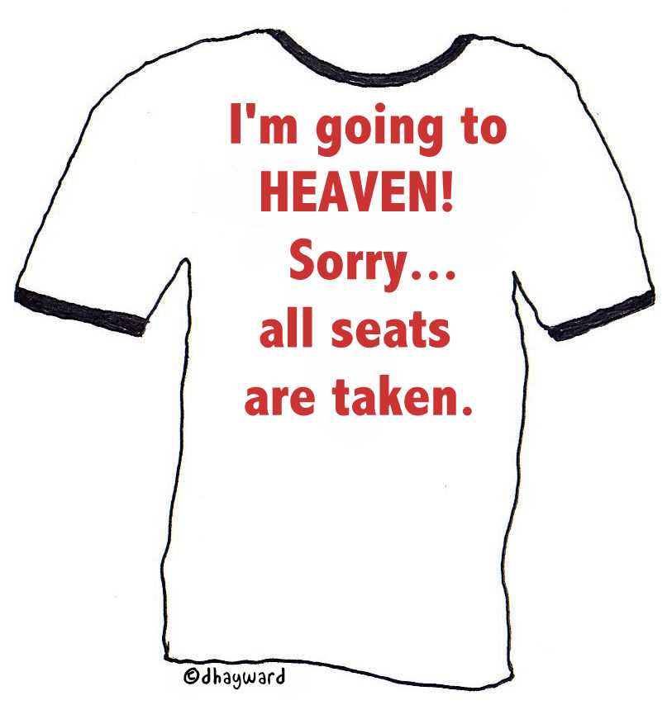
I'm going to HEAVEN!
Sorry… all seats are taken.

Slide 19
OT examples of election illustrate that God’s election by grace is not new and that Israel’s failure is not due to God’s unfaithfulness
(Romans 9:6-18).
154a
Isaac’s election over Ishmael disproved physical descent from Abraham as enough for salvation since one needed faith for Israel’s blessings (9:6-9).
Jacob’s election over Esau proved God can bless the younger son instead of the older to serve his purpose apart from human tradition or merit (9:10-13).

Slide 20



The Election of Jacob (9:10-23)
154c
"JACOB I LOVED, BUT ESAU I HATED" 9:1-29
IS GOD UNJUST?
9:11-13
"Yet before the twins were born or
had done anything good or bad – in
order that God's purpose in
election might stand: not by
works but by him who calls – she
was told, "The older will serve the
younger." Just as it is written:
"Jacob I loved, but Esau I hated."
This is a Hebrew way of stating:
"I chose Jacob over Esau."
This shows:
God's sovereignty 9:15-21
2. God's patience 9:22
3. God's glory 9:23
Since God's righteousness demands that sin be punished,
how could He ordain some people to eternal life and glory?
Amazing!
God can show mercy on whomever He wishes 9:15-18
A potter has the right over his clay 9:19-21
Notes:
Deut. 7:7 “The LORD did not set his heart on you and choose you because you were more numerous than other nations, for you were the smallest of all nations! ⁸ Rather, it was simply that the LORD loves you, and he was keeping the oath he had sworn to your ancestors. That is why the LORD rescued you with such a strong hand from your slavery and from the oppressive hand of Pharaoh, king of Egypt."
Deut. 9:1 “Listen, O Israel! Today you are about to cross the Jordan River to take over the land belonging to nations much greater and more powerful than you. They live in cities with walls that reach to the sky! ² The people are strong and tall—descendants of the famous Anakite giants. You’ve heard the saying, ‘Who can stand up to the Anakites?’ ³ But recognize today that the LORD your God is the one who will cross over ahead of you like a devouring fire to destroy them. He will subdue them so that you will quickly conquer them and drive them out, just as the LORD has promised.
Deut. 9:4 “After the LORD your God has done this for you, don’t say in your hearts, ‘The LORD has given us this land because we are such good people!’ No, it is because of the wickedness of the other nations that he is pushing them out of your way. ⁵ It is not because you are so good or have such integrity that you are about to occupy their land. The LORD your God will drive these nations out ahead of you only because of their wickedness, and to fulfill the oath he swore to your ancestors Abraham, Isaac, and Jacob. ⁶ You must recognize that the LORD your God is not giving you this good land because you are good, for you are not—you are a stubborn people."
God chose Israel not because of any goodness in the Jews. God chose Israel because of the goodness of God.

Slide 21
OT examples of election illustrate that God’s election by grace is not new and that Israel’s failure is not due to God’s unfaithfulness
(Romans 9:6-18).
154a
Isaac’s election over Ishmael disproved physical descent from Abraham as enough for salvation since one needed faith for Israel’s blessings (9:6-9).
Jacob’s election over Esau proved God can bless the younger son instead of the older to serve his purpose apart from human tradition or merit (9:10-13).
Pharaoh’s hardening by God’s choice proved that God can elect to show mercy on whoever he wishes and harden whom he wishes (9:14-18).

Slide 22
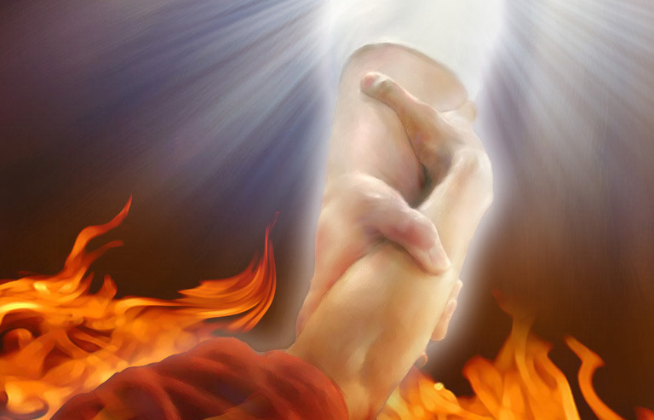
"Are we saying, then, that God was unfair? Of course not! ¹⁵For God said to Moses, 'I will show mercy to anyone I choose, and I will show compassion to anyone I choose.'
¹⁶So it is God who decides to show mercy. We can neither choose it nor work for it"
(Romans 9:14-16 NLT).
Notes:
Humans too often are so arrogant!

Slide 23
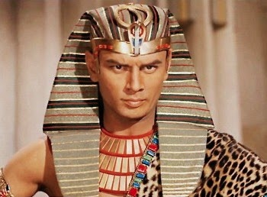
"For the Scriptures say that God told Pharaoh,
'I have appointed you for the very purpose of displaying my power in you and to spread my fame throughout the earth.'
¹⁸So you see, God chooses to show mercy to some, and he chooses to harden the hearts of others so they refuse to listen”
(Romans 9:17-18 NLT).
Notes:
Rom. 9:17 For the Scriptures say that God told Pharaoh, “I have appointed you for the very purpose of displaying my power in you and to spread my fame throughout the earth.”
———————————
Ex. 9:13 Then the LORD said to Moses, “Get up early in the morning and stand before Pharaoh. Tell him, ‘This is what the LORD, the God of the Hebrews, says: Let my people go, so they can worship me. ¹⁴ If you don’t, I will send more plagues on youª and your officials and your people. Then you will know that there is no one like me in all the earth. ¹⁵ By now I could have lifted my hand and struck you and your people with a plague to wipe you off the face of the earth. ¹⁶ But I have spared you for a purpose—to show you my power and to spread my fame throughout the earth. ¹⁷ But you still lord it over my people and refuse to let them go. ¹⁸ So tomorrow at this time I will send a hailstorm more devastating than any in all the history of Egypt. ¹⁹ Quick! Order your livestock and servants to come in from the fields to find shelter. Any person or animal left outside will die when the hail falls.’”
Ex. 9:20 Some of Pharaoh’s officials were afraid because of what the LORD had said. They quickly brought their servants and livestock in from the fields. ²¹ But those who paid no attention to the word of the LORD left theirs out in the open.
Ex. 9:22 Then the LORD said to Moses, “Lift your hand toward the sky so hail may fall on the people, the livestock, and all the plants throughout the land of Egypt.”
Ex. 9:23 So Moses lifted his staff toward the sky, and the LORD sent thunder and hail, and lightning flashed toward the earth. The LORD sent a tremendous hailstorm against all the land of Egypt. ²⁴ Never in all the history of Egypt had there been a storm like that, with such devastating hail and continuous lightning. ²⁵ It left all of Egypt in ruins. The hail struck down everything in the open field—people, animals, and plants alike. Even the trees were destroyed. ²⁶ The only place without hail was the region of Goshen, where the people of Israel lived.

Slide 24
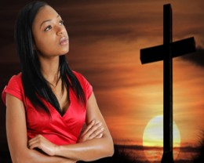
"Well then, you might say, 'Why does God blame people for not responding? Haven't they simply done what he makes them do?
²⁰No, don't say that. Who are you, a mere human being, to argue with God? Should the thing that was created say to the one who created it, 'Why have you made me like this?'"
(Romans 9:19-20 NLT).

Slide 25
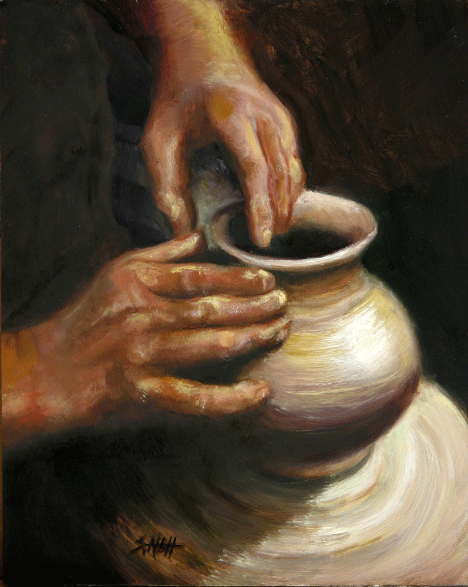
"When a potter makes jars out of clay, doesn't he have a right to use the same lump of clay to make one jar for decoration and another to throw garbage into?"
(Romans 9:21 NLT).

Slide 26
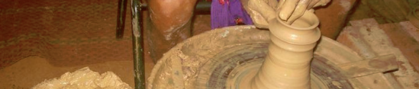
"In the same way, even though God has the right to show his anger and his power, he is very patient with those on whom his anger falls, who are destined for destruction. ²³He does this to make the riches of his glory shine even brighter on those to whom he shows mercy, who were prepared in advance for glory. ²⁴And we are among those whom he selected, both from the Jews and from the Gentiles” (Romans 9:22-24 NLT).

Slide 27
Summary of Romans 9–11
NT Survey,
page 154e
9:1-29 | 9:30–10:21 | 11:1-36
Israel's past | Israel's present | Israel's future
God elected Israel | Israel rejects God | God will reject Israel only partially and temporarily
Israel's failure is not due to God's unfaithfulness | Israel's failure is due to rejecting her Messiah | Israel's failure will be neither total in scope nor final
A Jewish remnant has been preserved by God | Only a small Jewish remnant accepts Him now | Yet this remnant will grow into an entire believing nation
Gentiles have also become elect of God in Christ | Gentiles are now becoming saved by faith in Christ | Gentiles should not be proud over blessings that Jews reject
Divine side | Human side | Divine results
God's election | Man's responsibility | God's mercy
Human unbelief cannot eradicate God's promises because they are based on the principle of sovereign election | However, God's election in sovereign grace to fulfill His Word does not eradicate human responsibility for unbelief | Ultimately, God's election will be justified in the salvation of the Jewish nation alive when Christ returns (11:26-27)

Slide 28
Slides on
Romans 10

Slide 29
Romans 10
154c
Righteousness is revealed in Israel rejecting God
(not vice versa)

Slide 30
The reason Jews and Gentiles at Rome should accept each other is because God vindicated his righteousness in Israel’s election and Gentile salvation (Romans 9–11).
154a
God's righteousness is revealed in His sovereign past choice of Israel so that Israel’s failure is not due to God’s unfaithfulness (9:1-29).
God shows his righteousness in Israel’s present rejection of his offer of righteousness in Christ despite the gospel being preached throughout the world to Gentiles (9:30–10:21).
God will show his righteousness in Israel’s future since he rejected her only in part and temporarily so Gentiles can be saved, so they should not be proud (Rom 11).

Slide 31
God shows his righteousness in Israel’s present rejection of his offer of righteousness in Christ despite the gospel being preached throughout the world to Gentiles (Romans 9:30–10:21).
154a
Israel misses out on God’s righteousness by unsuccessfully seeking salvation by works while Gentiles successfully find salvation by faith in Christ (9:30–10:4).
God's offer of salvation by faith in Christ (rather than 100% obedience to the law) is still offered to Israel and all men (10:5-15).
Israel rejected righteousness by faith by disobedience in fulfillment of OT prophecies, not by lack of hearing or understanding the gospel of Christ (10:16-21).
Notes:
April 5, 2024
This year, the Muslim Night of Power will take place on April 5, 2024. During this holy night, which is said to be worth more than a thousand months of Ramadan, Muslims traditionally pray until dawn, and this devotion can continue until the end of the fasting month.
___________
NASB
Rom. 10:1 Brethren, my heart’s desire and my prayer to God for them is for their salvation. ² For I testify about them that they have a zeal for God, but not in accordance with knowledge. ³ For not knowing about God’s righteousness and seeking to establish their own, they did not subject themselves to the righteousness of God. ⁴ For Christ is the end of the law for righteousness to everyone who believes.

Slide 32

A Seal Guarantees Security and Provides Assurance
Notes:
In Paul's day, a wax seal on a letter conveyed: (1) ownership in that the seal of the sender was stamped on it, and (2) security by guarding the contents. The result was that the recipient could feel assurance that the contents were guaranteed and safe.

Slide 33

"Having believed, you were marked in him with a seal, the promised Holy Spirit, ¹⁴who is a deposit guaranteeing our inheritance until the redemption of those who are God's possession—to the praise of his glory"
(Eph. 1:13-14 NIV).
"And do not grieve the Holy Spirit of God, with whom you were sealed for the day of redemption"
(Eph. 4:30 NIV).

Slide 34

Assurance of
Salvation
Notes:
Paul used this background to assure his readers their salvation by noting that the Holy Spirit HIMSELF was the seal of their salvation (Eph. 1:13-14).
Please translate the text at the left and then drag everything over this slide so no English shows. Make sure the fonts remain.

Slide 35

Romans 10:9-10 NLT
"If you confess with your mouth that Jesus is Lord and believe in your heart that God raised him from the dead, you will be saved. ¹⁰For it is by believing in your heart that you are made right with God, and it is by confessing with your mouth that you are saved (lit., 'it is confessed unto salvation')"
Notes:
There are not two steps to salvation here: believing and confessing. Verses 11-13 explain what he means but saying that believing alone is needed.

Slide 36
Create In Me
Create in me a clean heart, O God
And renew a right spirit within me
Create in me a clean heart, O God
And renew a right spirit within me
John Carter ©1992 Beckenhorst Press, Inc.
CCLI #2588988

Slide 37
Create In Me
Cast me not away from Your presence,
O Lord
And take not Thy Holy Spirit from me
Restore unto me the joy of Thy salvation
And renew a right spirit within me
John Carter ©1992 Beckenhorst Press, Inc.
Should Christians pray this in light of Romans 10?

Slide 38

Beautiful Feet
¹⁴ But how can they call on him to save them unless they believe in him? And how can they believe in him if they have never heard about him? And how can they hear about him unless someone tells them? ¹⁵And how will anyone go and tell them without being sent? That is why the Scriptures say, "How beautiful are the feet of messengers who bring good news!" (Romans 10:14-15 NLT)
Notes:
Can someone be saved without a messenger of salvation that comes to them? What if they just pick up a Bible and read it and become a Christian?

Slide 39
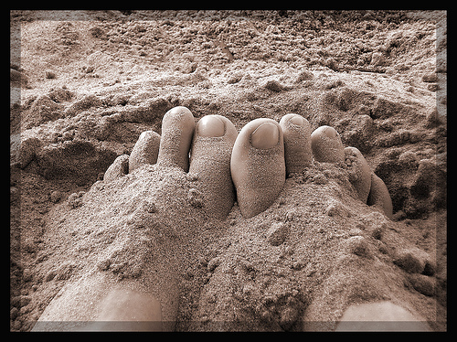
Are your feet beautiful?

Slide 40
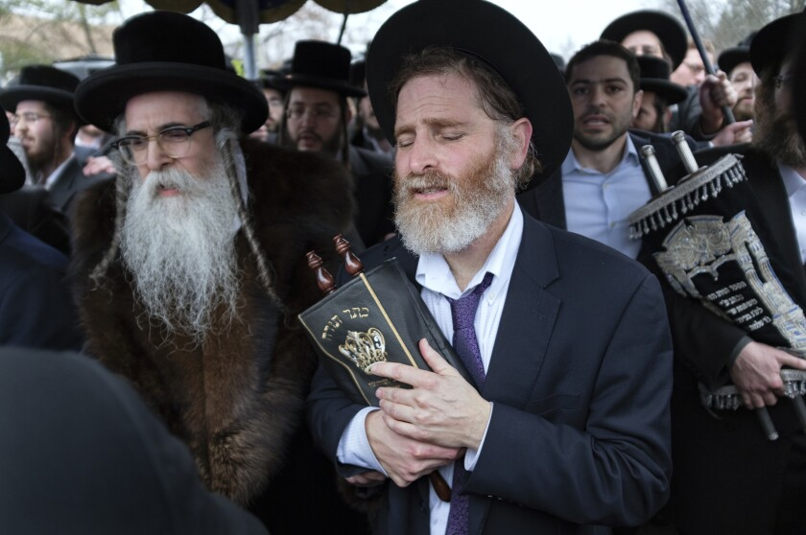
Is There a Future for Ethnic Jews?
155q
Notes:
About 27% of the Bible related to the future when it was written, and half of these prophecies have already been fulfilled. But should we expect more fulfillments to come for the descendants of Jacob?
_________
Common-347
BE-45-Rom-slide 70
ES-Shared Land Theology-28
OS-02-Exodus-444
OS-31-Obadiah-145
NS-06-Rom9-16-slide 40

Slide 41

Distinctions Between
Israel and the Church
155u
Discontinuity (155u)
Continuity (155v)
Problem Passages (155w-y)

Slide 42
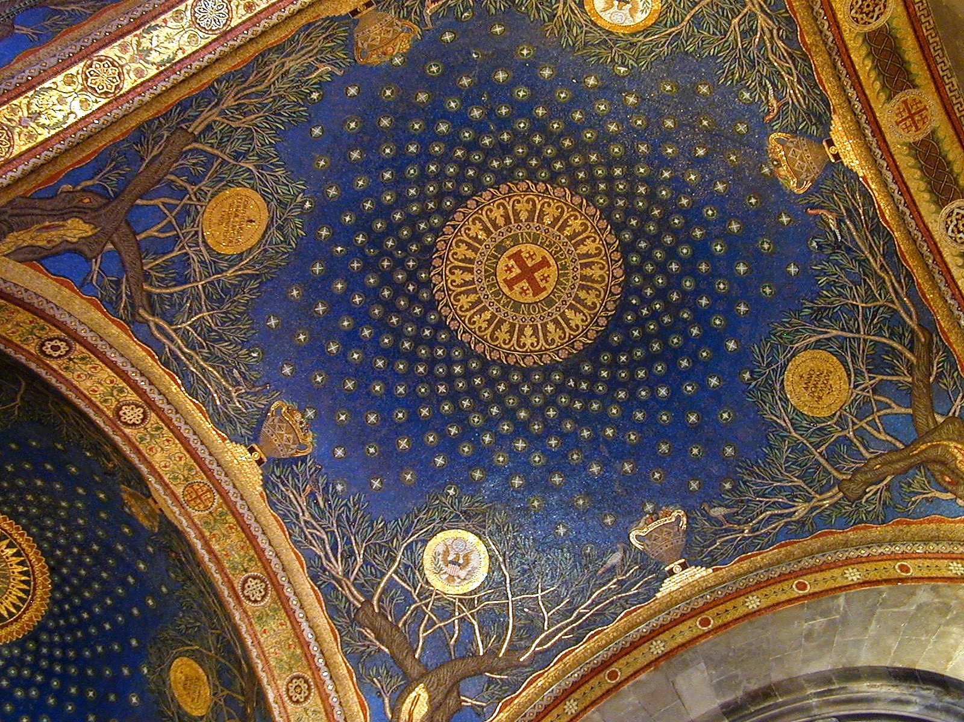
Israel & the Church: Discontinuity
117
Israel
Church
Identity
Physical seed of Abraham (Gal. 6:12-16)
Spiritual seed of Abraham
(Gal. 3:7, 29)
Land Covenant
Still outstanding (Deut. 30:1-10) but partly fulfilled since 1948 (Ezek. 37:1-7)
No land promise (Palestinian Covenant) can be claimed by present believers
Law
Required to obey the law (Exod. 19–20)
Freedom from the law
(Rom. 7; Gal. 3)
Duration
Abraham (Gen. 12:1-3) to eternity (Jer. 31:35-37)
Pentecost (Acts 2) to Rapture (1 Thess. 4:13-18) or even later (?)
Wrath
Experienced in Tribulation (Jer. 30:7)
Free from wrath
(1 Thess. 5:9; Rev. 3:10)
Notes:
Several differences exist between Israel and the Church that show they are not the same entity. Thus, it is a bit misleading to claim that the Church is "the new Israel."
__________
Common-348
CH-02-Nature-89
OS-02-Exodus-434
NS-06-Rom9-16-slide 28

Slide 43
Israel & the Church: Discontinuity
117
Israel
Church
Faith
Shown in offering sacrifices
Shown in trusting Christ's sacrifice
Priesthood
Has one: a special class by heredity
Is one: all are priests (1 Pet. 2:5)
Activity
Set aside between 69th & 70th "Weeks" (Dan. 9:24-27)–a part of the "times of the Gentiles" (Luke 21:24)
Between 69th & 70th "Weeks" the church is a mystery unforeseen in the OT (Eph. 3:1-9; Col. 1:26)
Qualifi-cation
Ethnic–descendants of Abraham or Gentile proselytes who became Jews via circumcision as blessing is via Israel (1 Kings 8:41-43; Isa. 2:2-3; 19:19-25; 49:6; 51:4; 56:6-8; Zech. 14:16-19)
Nonethnic–"Neither Jew nor Gentile" (Gal. 3:28) means a combination of Jews and Gentiles without need to become Jewish proselytes (Acts 15; Eph. 3:3, 6)
Notes:
CH-02-Nature-89
OS-02-Exodus-434
NS-06-Rom9-16-slide 28

Slide 44
Israel & the Church: Continuity
118
Israel
Church
Abrahamic Covenant
Origin in Abraham as the father of the nation (Gen. 12:1-3)
Believers today are grafted into this same covenant (Rom. 11:17-21; cf. Gal. 3:29)
Davidic Covenant
Promise of a literal temple (2 Sam. 7:13) fulfilled by Solomon (1 Kings)
Functions now as a spiritual temple (Eph. 2:19-22; 1 Pet. 2:4-10)
New Covenant
Forgiveness of sins, indwelling Spirit, new heart, reunification of Israel and Judah, & knowledge of God everywhere (Jer. 31:31-34)
The first 3 aspects (forgiveness of sins, indwelling Spirit, new heart) true today in a progressive covenant fulfillment (Luke 22:20)
Law
Required to obey the Mosaic law (Exod. 19–20)
Required to obey the "law of Christ" (Gal 6:2) or "law that gives freedom" (Jas 1:25; 2:12)
Notes:
CH-02-Nature-89
OS-02-Exodus-434
NS-06-Rom9-16-slide 28

Slide 45
Israel & the Church: Continuity
118
Israel
Church
Salvation by
God's grace through faith (Gen. 15:6)
God's grace through faith (Rom. 4:3)
Basis of Salvation
Sacrificial lamb
Sacrificial Lamb
Spirit
Filling on leaders
Indwelling of all believers (Rom. 8:9)
Prophets
Provided revelation of God's word
Foundation of the church (Eph. 2:20)
Notes:
CH-02-Nature-89
OS-02-Exodus-434
NS-06-Rom9-16-slide 28

Slide 46
Israel & the Church: Continuity
118
Israel
Church
Election
Based on grace (Mal. 1:2)
Based on grace (Eph. 1:4-6, 11)
Disobedience
Led to God's discipline
Leads to God's discipline
(1 Cor. 11:30)
Leadership
Elders (Exod. 3:16, 18; 4:29, 31;12:21; Num. 11:16-17; Josh. 24:31; 1 Sam. 15:30; 2 Sam. 17:4, 15; 1 Kings 21:8, 11 and many other texts)
Elders (Acts 11:30; 14:23-24; 15:1-6; 16:4; 20:17-38; 21:17-26; 1 Thess. 5:12-13; Phil. 1:1; 1 Tim. 3:1-7; 4:14; 5:17-25; Tit. 1:5-9; Jas. 5:14; 1 Pet. 5:1-5; Heb. 13:17)
Witness
"light for the Gentiles" (Is. 49:3-6)
"kingdom of priests" (Exod. 19:6)
"holy nation" (Exod. 19:6)
"light of the world" (Matt. 5:14-16)
"royal priesthood" (1 Pet 2:5, 9)
"holy nation" (1 Pet. 5:9)
Notes:
CH-02-Nature-89
OS-02-Exodus-434
NS-06-Rom9-16-slide 28

Slide 47
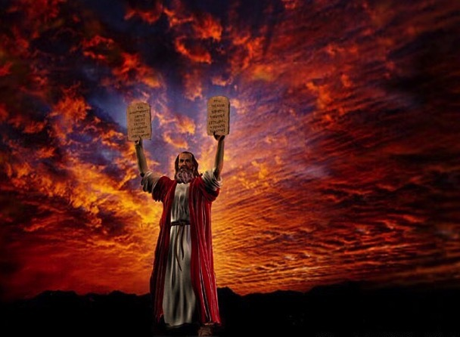
Why was the Law given?
The Law governed Israel
Notes:
Three requirements of a nation:
1—Freedom (Exod 1–18)
2—Government (Exod 19–40)
3—Land (book of Joshua)
But was this Law given to any other nation or only to Israel? No. But believers have died to that Law (Rom 7).

Slide 48
Is there a future for ethnic believing Israel?
437
Dispensational
Premillennialism
Amillennialism &
Postmillennialism
Church & Israel distinct
Israel has a future
Church is new Israel
Israel has no future
Covenant
Premillennialism
Notes:
48
Covenant premillennialism seeks to bridge between dispensationalism and the amil/postmil views. Their advocates have largely convinced believers that it was the first view taught in the early church, so they are also called historic premil. But since the covenant premil view is posttrib in its view of the Tribulation, this would imply that the early church was posttrib. In reality, most of the early fathers believed in imminency that leads to a pretrib position, though none of these terms were yet coined.
In any event, both premil views believe in a prophetic future for ethnic Israel, though the covenant view does this inconsistently while seeking also to hold the opposite view that the Church is the “new Israel.”
__________
Common-333
ES-06-Millennialism Intro-6
ES-07-Premil/Dispensational-10
ES-16-Kingdom&Millennialism-14
NS-06-Romans9-11-slide 48
OS-23-Isaiah1-12-slide 51

Slide 49
Summary of Romans 9–11
NT Survey,
page 154e
9:1-29 | 9:30–10:21 | 11:1-36
Israel's past | Israel's present | Israel's future
God elected Israel | Israel rejects God | God will reject Israel only partially and temporarily
Israel's failure is not due to God's unfaithfulness | Israel's failure is due to rejecting her Messiah | Israel's failure will be neither total in scope nor final
A Jewish remnant has been preserved by God | Only a small Jewish remnant accepts Him now | Yet this remnant will grow into an entire believing nation
Gentiles have also become elect of God in Christ | Gentiles are now becoming saved by faith in Christ | Gentiles should not be proud over blessings that Jews reject
Divine side | Human side | Divine results
God's election | Man's responsibility | God's mercy
Human unbelief cannot eradicate God's promises because they are based on the principle of sovereign election | However, God's election in sovereign grace to fulfill His Word does not eradicate human responsibility for unbelief | Ultimately, God's election will be justified in the salvation of the Jewish nation alive when Christ returns (11:26-27)

Slide 50
Slides on
Romans 11

Slide 51
Romans 11
154d
Righteousness will be revealed in Israel's future restoration
Notes:
God will show himself just in bringing Jacob's descendants to faith despite all they have done.

Slide 52
The reason Jews and Gentiles at Rome should accept each other is because God vindicated his righteousness in Israel’s election and Gentile salvation (Romans 9–11).
154a
God's righteousness is revealed in His sovereign past choice of Israel so that Israel’s failure is not due to God’s unfaithfulness (9:1-29).
God shows his righteousness in Israel’s present rejection of his offer of righteousness in Christ despite the gospel being preached throughout the world to Gentiles (9:30–10:21).
God will show his righteousness in Israel’s future since he rejected her only in part and temporarily so Gentiles can be saved, so they should not be proud (Rom 11).
Notes:
Romans 11 says that God still offered the kingdom even after the death and resurrection of Israel:
Acts 3:19 Now repent of your sins and turn to God, so that your sins may be wiped away. ²⁰ Then times of refreshment will come from the presence of the Lord, and he will again send you Jesus, your appointed Messiah. ²¹ For he must remain in heaven until the time for the final restoration of all things, as God promised long ago through his holy prophets.

Slide 53
God will show his righteousness in Israel’s future since he rejected her only in part and temporarily so Gentiles can be saved, so they should not be proud (Romans 11).
154a
God has not rejected his people whom he foreknew (11:2a) because a remnant is now being saved (11:1-10).
Israel’s present rejection will stop but it saves Gentiles via the Abrahamic covenant to provoke Israel to faith and restoration of blessing (11:11-24).
God has not rejected Israel forever since the nation will be saved after all elect Gentiles have repented at the return of Christ to Jerusalem (11:25-32).
God deserves all glory and praise for unrivaled wisdom and knowledge (11:33-36).
Notes:
Rom. 11:1 I ask, then, has God rejected his own people, the nation of Israel? Of course not! I myself am an Israelite, a descendant of Abraham and a member of the tribe of Benjamin.

Slide 54
God will show his righteousness in Israel’s future since he rejected her only in part and temporarily so Gentiles can be saved, so they should not be proud (Romans 11).
154a
God has not rejected his people whom he foreknew (11:2a) because a remnant is now being saved (11:1-10).

Slide 55

The Kingdom of God
What is it? When is it?

Slide 56
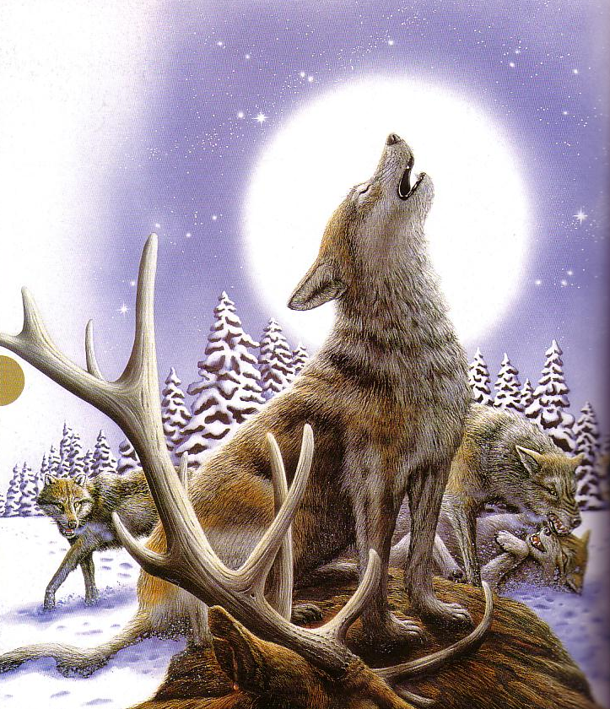
Wolves now love
…to kill

Slide 57
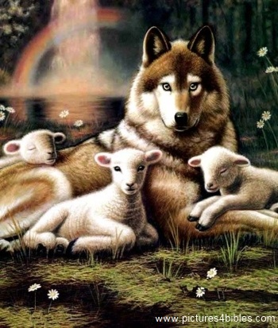
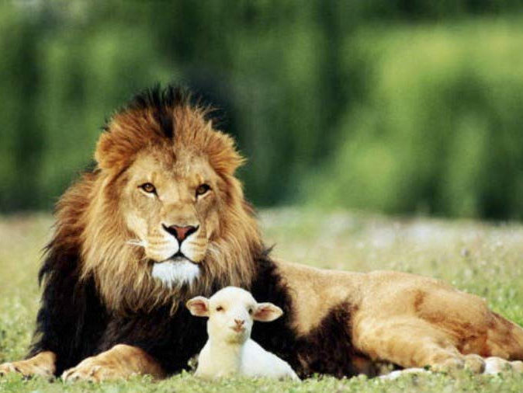
Isaiah 11:6-9
473a
⁶ And the wolf will dwell with the lamb, and the leopard will lie down with the young goat, and the calf and the young lion and the fatling together.
Notes:
57
God promised through Isaiah a future age that is certainly not the present age where animals kill each other, nor an age now past, nor the eternal state since he also noted that death will exist (Isaiah 65:20). The only other option is that Isaiah spoke of the 1000-year kingdom age following the return of Christ (cf. Rev 20:1-6) that will bring peace not only among the nations but even in the animal world.
__________
Common-353
OS-23-Isaiah 1-12-slide 325
NS-06-Rom9-16-slide 40

Slide 58
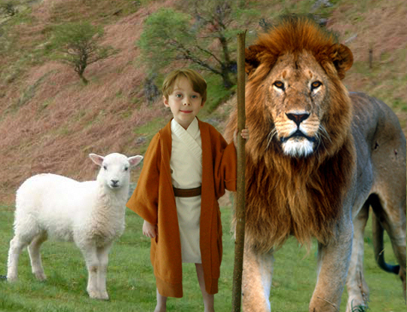
Isaiah 11:6-9
473a
⁶ And the wolf will dwell with the lamb, and the leopard will lie down with the young goat, and the calf and the young lion and the fatling together; and a little boy will lead them.
Notes:
58
God promised through Isaiah a future age that is certainly not the present age where animals kill each other, nor an age now past, nor the eternal state since he also noted that death will exist (Isaiah 65:20). The only other option is that Isaiah spoke of the 1000-year kingdom age following the return of Christ (cf. Rev 20:1-6) that will bring peace not only among the nations but even in the animal world.
__________
Common-354
OS-23-Isaiah 1-12-slide 326
NS-06-Rom9-16-slide 41

Slide 59
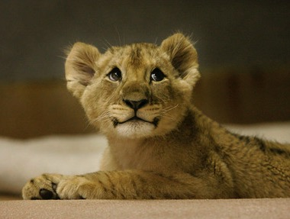
Isaiah 11:6-9
473a
⁷ Also the cow and the bear will graze, their young will lie down together, and the lion will eat straw like the ox.
Notes:
59
God promised through Isaiah a future age that is certainly not the present age where animals kill each other, nor an age now past, nor the eternal state since he also noted that death will exist (Isaiah 65:20). The only other option is that Isaiah spoke of the 1000-year kingdom age following the return of Christ (cf. Rev 20:1-6) that will bring peace not only among the nations but even in the animal world.
__________
Common-355
OS-23-Isaiah 1-12-slide 327
NS-06-Rom9-16-slide 42

Slide 60
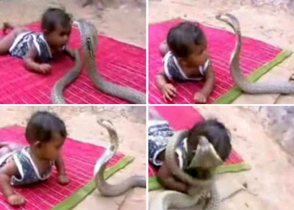
Isaiah 11:6-9
473a
⁸ The nursing child will play by the hole of the cobra, and the weaned child will put his hand on the viper's den.
⁹ They will not hurt or destroy in all My holy mountain, for the earth will be full of the knowledge of the LORD as the waters cover the sea.
Notes:
60
http://dailybuzzlive.com/archives/5613
Snake Tries to Eat Baby. Watch Video Before Reading! Now you may be outraged by this video and think that the parents need to have their child taken away for child abuse, but before you jump to any conclusions take a second to read about a culture that most of us know nothing about. - See more at: http://dailybuzzlive.com/archives/5613#sthash.m31WN86t.dpuf
You may think that this baby is some type of super human, being able to withstand sharp poisonous snake bites, it would pretty awesome if this were true. The snake in the video is actually defanged and has no poison whatsoever. In India, as well as Nepal, some Hindus actually worship snakes. This is called Nag Panchami and many children from this culture grow up with and around snakes. Some people even keep and feed them as though they were their children. - See more at: http://dailybuzzlive.com/archives/5613#sthash.m31WN86t.dpuf
God promised through Isaiah a future age that is certainly not the present age where animals kill each other, nor an age now past, nor the eternal state since he also noted that death will exist (Isaiah 65:20). The only other option is that Isaiah spoke of the 1000-year kingdom age following the return of Christ (cf. Rev 20:1-6) that will bring peace not only among the nations but even in the animal world.
__________
Common-356
OS-23-Isaiah 1-12-slide 328
NS-06-Rom9-16-slide 43

Slide 61

Why Am I Dispensational?
(Why do I distinguish between Israel & the Church?)
155u-v
The Church Age was unseen in the OT.
Saints will reign on the earth (Rev. 5:10), not in heaven as amillennialists claim.
Ezekiel's temple will be a real temple (cf. "Outline of End-Time Events," Eschatology notes, 105-106).
Dispensationalism best explains how the Abrahamic, Land, Davidic, and New Covenants will be fulfilled.
Notes:
Dispensationalism is the theological system that distinguishes between Israel and the Church. It uses a normal manner of interpretation with the result that the Church does NOT replace Israel as the nation still must see the fulfillment of many prophecies in the yet future. There are many reasons that scholars believe that this is the most consistent way to see the whole Bible.
_______________
Common-451
OS-05-Deuteronomy-299
OS-23-Isaiah1-12—slide 53
NS-06-Rom9-16-slide 44

Slide 62
Kingdom & Covenants Timeline
9g
Dr. Rick Griffith • Singapore Bible College • BibleStudyDownloads.org
Kingdom Teaching...
Adam rules with God (Gen. 1:26, 28; 2:19)
Satan begins rule as god of this world (Gen. 3:15;
2 Cor. 4:4)
God covenants with Abraham to reestablish man's rule via Israel as a "kingdom of priests" (Gen. 12:1-3; Exod. 19:6)
Israel's failure to witness to nations as a kingdom of priests is judged via exile under foreign rule
Israel rejects Messiah's offer of kingdom (Matt. 12:41-42; 23:37-39)
Jesus extends His kingdom in mystery form to the Church (Matt. 13)
Christ subdues Israel's enemies and nation believes (Rom. 11:26-27)
Christ rules over everything with saints (Eph. 1:9-10; Rev. 20:1-6; 22:5b)
22 &
337
Fall of Man (Gen. 3)
Noahic Covenant
Genesis 6:18; 9:8-17
Land Covenant
ISRAEL
CHURCH
MESSIANIC KINGDOM
(National Focus)
The "New Man" (Eph. 2:15)
Millennial Eternal
land
Genesis 15:18 (cf. Deut. 30:1-10) promises:
Land from Wadi of Egypt to Euphrates River (Isa. 27:12)
Eternal possession of land (Gen. 17:8) after exile/restoration
Whole world blessed via the land (Isa. 14:1-2)
Israel judged for rejecting Messiah by dispersion away from land for 19 centuries
(AD 70–AD 1948) but now partially restored (Ezek. 37:1-7)
Full restoration (Ezek. 37:8-28) Jerusalem world capital
(Isa. 2:1-5)
New Jerusalem
(Rev. 21–22)
Davidic Covenant
Christ is Head over His Church, which is a spiritual temple (Eph. 2:19-22; 2 Cor. 6:16)
Christ reigns over the world
(Isa. 11)
with saints (Rev. 5:10; 20:4-6)
Christ hands kingdom over to Father (1
Cor. 15:24)
Genesis 12:1-3
2 Samuel 7:12-16 promises:
Sons ("house" never wiped out)
Kingdom (political dynasty)
Throne (right to rule by descendants)
Temple (son to build it)
seed
Abrahamic Covenant
New Covenant
All
things made new!
(Rev. 21:5)
All 5 elements fulfilled in national restoration (Zech. 8)
Jeremiah 31:31-34 promises:
Forgiveness
Indwelling Spirit
New heart, nature, mind
Reunification of Israel and Judah
No need for evangelism
Mosaic Law replaced with first three elements of the New Covenant (Luke 22:20; 2 Cor. 3:6)
blessing
Mosaic Covenant
Law abolished, fulfilled, and replaced at the cross (Rom. 7:1-6;1 Cor. 9:19-21; Heb. 8:13)
Eighth Edition
29 Aug 2016
Temporary (Gal. 3:19) and conditional (Deut. 28) to reveal sin (Rom. 7:7) and regulate Israel (Gal. 3:23-25)
Scripture has a dual kingdom-covenant theme. Israel's role from Abraham to Christ expands to include the Church (continuity) yet the Church never replaces the nation as the "new Israel" (discontinuity). Israel will again enjoy world prominence after trusting Christ at His second coming.
Notes:
Slides 13 and 127 repeated

Slide 63
Why Am I Dispensational?
(Why do I distinguish between Israel & the Church?)
155r
The Church Age was unseen in the OT.
Saints will reign on the earth (Rev. 5:10), not in heaven as amillennialists claim.
Ezekiel's temple will be a real temple (cf. "Outline of End-Time Events," 105-106).
Dispensationalism best explains how the Abrahamic, Land, Davidic, and New Covenants will be fulfilled.
The Church and Israel are continually distinguished in Scripture.
Notes:
The book of Acts and Romans 9–11 both often mention Israel (Jews) and the Church, but they are different entities. Israel is ethnic while the Church is multi-ethnic. Even converts to Judaism then become part of the nation, as in the case of Rahab, Ruth, etc.
_______________
Common-452
OS-05-Deuteronomy-300
OS-23-Isaiah1-12—slide 54
NS-06-Rom9-16-slide 45

Slide 64
The "New Israel" View of Covenant Premillennialism
155s
The church is spiritual Israel. Ladd says that Paul "applies prophecies to the church which in their Old Testament setting belong to literal Israel; he calls the church sons, the seeds of Abraham. He calls believers the true circumcision. It is difficult to avoid the conclusion that Paul sees the church as spiritual Israel" (The Meaning of the Millennium, 25).
The dispensational conception of millennial sacrifices contradicts Hebrews 8:8-13. Ladd claims that Hebrews 8 refutes dispensationalism because it "affirms that the new covenant in Christ has displaced the Old Testament cult which is therefore doomed to pass away" (ibid., 26-27).
Notes:
64
Dispensationalism shows that similarity does not mean equality. Just because there exist common elements between Israel and the Church does not mean that they are the same or that one has replaced the other. This would be improper logic. There are similarities between a man and a woman but this does not make them the same person. Rather, it only shows that both are humans.
_______________
Common-448
OS-05-Deuteronomy-299
NS-06-Rom9-16-slide 44

Slide 65
Why Distinguish Israel & the Church?
155s
(Reasons I don't call the Church the "new Israel")
Illustration and fulfillment are not the same.
Hoyt (ibid., 42-43) responds to Ladd's claim: "In passage after passage Ladd insists that the New Testament is interpreting the Old when the New Testament is simply applying a principle found in the Old Testament (Hos. 11:1 with Mt. 2:15; Hos. 1:10; 2:23 with Rom. 9:24-26). Rushing to the conclusion that these references identify the church and Israel as the same body of the saved is wholly gratuitous…"
Notes:
65
A coin shows the image of a person, but it is not that person. An example does not become the original entity.
_______________
Common-449
OS-05-Deuteronomy-301
NS-06-Rom9-16-slide 48

Slide 66
Why Distinguish Israel & the Church?
155t
(Reasons I don't call the Church the "new Israel")
Millennial sacrifices are not problematic
They can be either theocratic or memorial sacrifices looking back to the death of Christ.
How else other than literally can one best see nine chapters describing a temple with boundaries and many other specifics (Ezekiel 40–48)?
No temple has even remotely resembled Ezekiel's, so this must be a future temple.
See Eschatology pages 138-140 for elaboration.
Notes:
66
See the Ezekiel 40–43 teaching for more details here.
_______________
Common-450
OS-05-Deuteronomy-301
NS-06-Rom9-16-slide 48

Slide 67

Question: Israel & the Church: Discontinuity or Continuity?
Answer: Both!
(See pages 155r-155s)
Notes:
The NT Survey notes have more details here on pages 155r-155s. See slides 41-46 in the Romans 9-16 PPT.
__________
Common-444
OS-05-Deuteronomy-301
NS-06-Rom9-16-slide 48

Slide 68
More Contrasts Between Israel & the Church
155t
(Reasons I don't call the Church the "new Israel")
Biblical writers kept them separate
Differences between Israel and the Church are numerous in Scripture
The term "Israel" throughout Scripture always refers to the physical descendants of Jacob—it never refers to the Church.
Luke contrasts the two in Acts 3:12; 4:8, 10; etc.
Paul (Rom. 9–11; 1 Cor. 10:32; Eph. 3:6)
John: 144,000 Jews (Rev. 7:1-8) v. Gentiles (7:9)
Matthew 1:21; 2:6; 19:28; 23:39
Early Church Fathers held to the 6000-year theory
Notes:
68
The word "Israel" is used 2565 times in the Bible and not one clear example exists where it does not refer to ethnic descendants of Jacob.
_______________
Common-451
OS-05-Deuteronomy-301
NS-06-Rom9-16-slide 48

Slide 69
God will show his righteousness in Israel’s future since he rejected her only in part and temporarily so Gentiles can be saved, so they should not be proud (Romans 11).
154a
God has not rejected his people whom he foreknew (11:2a) because a remnant is now being saved (11:1-10).
Israel’s present rejection will stop but it saves Gentiles via the Abrahamic covenant to provoke Israel to faith and restoration of blessing (11:11-24).

Slide 70
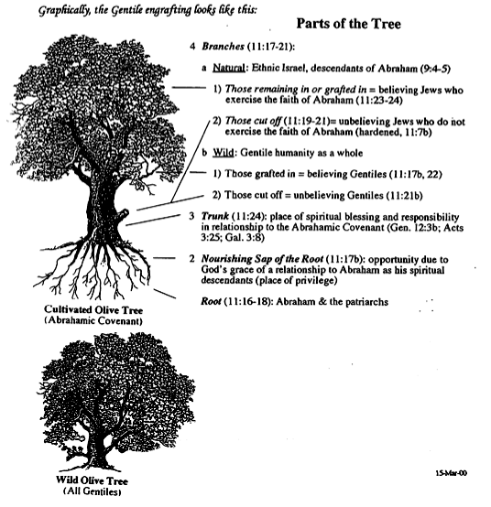

Gentile Engrafting
131b
Branches (11:17-21)
a. Natural: Ethnic Israel (9:4-5)
1) Remaining/Grafted = Believing (11:23-24)
2) Cut off = Unbelieving (11:19-21)
b. Wild: Gentile humanity
1) Grafted = Believing (11:17b, 22)
2) Cut off = Unbelieving (11:21b)
Trunk (11:24)
Sap (11:17b)
Root (11:16-18)
Notes:
Paul illustrates salvation for both Jews and Gentiles with the metaphors of two trees. Note that the original, cultivated olive tree does NOT represent Israel. It is also NOT cut down and replaced with the Gentiles. In other words, the Church does not replace Israel in Paul's theology.
Rather, the first tree represents the Abrahamic Covenant, through which Jews and Gentiles are saved. Those NOT saved are branches of that tree, whether Jew or Gentile.
__________________
CH-02-Nature-89
ES-07-Dispenstionalism& Premillennialism-85
OS-02-Exodus-445
NS-06-Rom9-16-slide 70

Slide 71
God will show his righteousness in Israel’s future since he rejected her only in part and temporarily so Gentiles can be saved, so they should not be proud (Romans 11).
154a
God has not rejected his people whom he foreknew (11:2a) because a remnant is now being saved (11:1-10).
Israel’s present rejection will stop but it saves Gentiles via the Abrahamic covenant to provoke Israel to faith and restoration of blessing (11:11-24).
God has not rejected Israel forever since the nation will be saved after all elect Gentiles have repented at the return of Christ to Jerusalem (11:25-32).

Slide 72
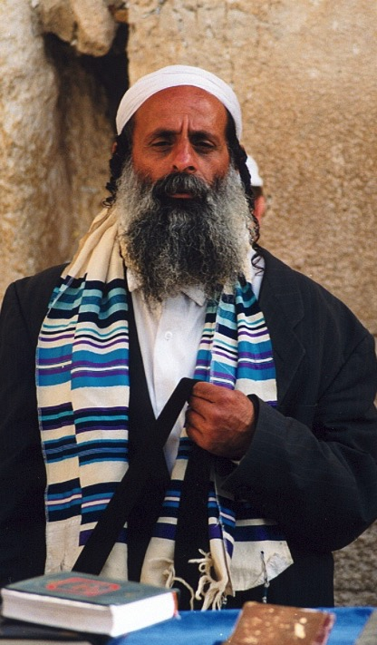
"All Israel will be saved" (Rom. 11:25-27)
NTS 155w
²⁵I do not want you to be ignorant of this mystery, brothers, so that you may not be conceited: Israel has experienced a hardening in part until the full number of the Gentiles has come in.
²⁶And so all Israel will be saved, as it is written:
"The deliverer will come from Zion; he will turn godlessness away from Jacob.
²⁷And this is my covenant with them when I take away their sins."
Notes:
Does this mean that all Jews throughout history will be saved? That would contradict John 3:16 and many other verses that show salvation only in Christ (John 14:6l Acts 4:12). It also cannot mean Gentiles as they are never called the church. But Zechariah 3:9 says that Israel will believe in Jesus as Messiah in a single day at the end of the Tribulation. At that time, "All Israel will be saved" (Rom 11:25-26) for only then will the redeemer come from Jerusalem to save the nation since Paul quotes Isaiah 59:20 whose context is Israel under the new covenant (cf. Jer 31:31-34).
___________________
Common-449
OS-23-Isaiah49-59—slide 154
OS-23-Isaiah60-66-slide 154
OS-38-Zechariah-86, 134
NS-06-Rom9-16-slide 53
NS-22-Rev13-19-slide 53

Slide 73

HOW WILL ALL ISRAEL BE SAVED? 11:25-32
155w
VIEW 1: All Jews Will Be Saved
Support: Israel is the people of God––His elect nation (9:4, 11; 11:1, 28).
B. Response: Election of the nation does not mean the salvation of each individual in it, especially since most Jews throughout the centuries have rejected Christ. God does not have different method of salvation for Jews since they must trust Christ too (1:16-17).
VIEW 2: All Christians Will Be Saved
Support: Paul upheld the security of the believer elsewhere (see Romans 8 studies).
B. Response: This is a theologically true statement but doubtful that Paul had it in mind here. The believer's security is not in the context. But the main problem with this view is that nowhere does Paul ever call Christians or the church "Israel."
Notes:
NIV Rom. 11:25 I do not want you to be ignorant of this mystery, brothers, so that you may not be conceited: Israel has experienced a hardening in part until the full number of the Gentiles has come in. 26 And so all Israel will be saved, as it is written:
“The deliverer will come from Zion;
he will turn godlessness away from Jacob.
Rom. 11:27 And this is my covenant with them
when I take away their sins.”
Rom. 11:28 As far as the gospel is concerned, they are enemies on your account; but as far as election is concerned, they are loved on account of the patriarchs, 29 for God’s gifts and his call are irrevocable. 30 Just as you who were at one time disobedient to God have now received mercy as a result of their disobedience, 31 so they too have now become disobedient in order that they too may now receive mercy as a result of God’s mercy to you. 32 For God has bound all men over to disobedience so that he may have mercy on them all.
___________
NS-06-Rom9-16—slide 58
NS-27-Rev13-19—slide 54

Slide 74
HOW WILL ALL ISRAEL BE SAVED? 11:25-32
155w
VIEW 3: All Elect Jews
"All Israel" means the total number of elect Jews, or the sum of all Israel's remnant.
The translation for houtos in 11:26 should be in this manner, not then/after .
Disobedience to obedience by God's mercy in 11:25-27 is paralleled in 11:30-31.
Israel is being saved now (11:31).
Future mass conversion contradicts the spirit of an earlier statement in 1 Thess. 2:14b-16.
Romans 11:26b-27 is not the second coming, but first coming of Christ.
Some Jews believe in Christ, some do not.
Throughout history God keeps a remnant (11:5).
VIEW 4: Most of the Final Generation Jews
"All Israel" means all Jews living on earth in the end of this age. They will believe in Christ and be saved just prior to or at the very moment Christ returns (11:26). "And after that all Israel will be saved":
The OT prophets note the salvation of the nation many times (Isa. 2:5, etc.).
The hardening of Jews is "until" (or after) "the full number of Gentiles has come in."
The context is Christ's return (11:26b-27) from Zion (Isa. 59:20b).
This will fulfill God's new covenant promise "when I take away their sins" (11:27; cf. Jer. 31:34; Isa. 59:21).
Earlier the text noted that God is able to graft all of them in again (11:23b).
Notes:
NLT 1 Thess 2:14 And then, dear brothers and sisters, you suffered persecution from your own countrymen. In this way, you imitated the believers in God’s churches in Judea who, because of their belief in Christ Jesus, suffered from their own people, the Jews. ¹⁵ For some of the Jews killed the prophets, and some even killed the Lord Jesus. Now they have persecuted us, too. They fail to please God and work against all humanity ¹⁶ as they try to keep us from preaching the Good News of salvation to the Gentiles. By doing this, they continue to pile up their sins. But the anger of God has caught up with them at last.
——————
NIV Rom. 11:25 I do not want you to be ignorant of this mystery, brothers, so that you may not be conceited: Israel has experienced a hardening in part until the full number of the Gentiles has come in. 26 And so all Israel will be saved, as it is written:
“The deliverer will come from Zion;
he will turn godlessness away from Jacob.
Rom. 11:27 And this is my covenant with them
when I take away their sins.”
Rom. 11:28 As far as the gospel is concerned, they are enemies on your account; but as far as election is concerned, they are loved on account of the patriarchs, 29 for God’s gifts and his call are irrevocable. 30 Just as you who were at one time disobedient to God have now received mercy as a result of their disobedience, 31 so they too have now become disobedient in order that they too may now receive mercy as a result of God’s mercy to you. 32 For God has bound all men over to disobedience so that he may have mercy on them all.
___________
NS-06-Rom9-16—slide 74
NS-27-Rev13-19—slide 55

Slide 75
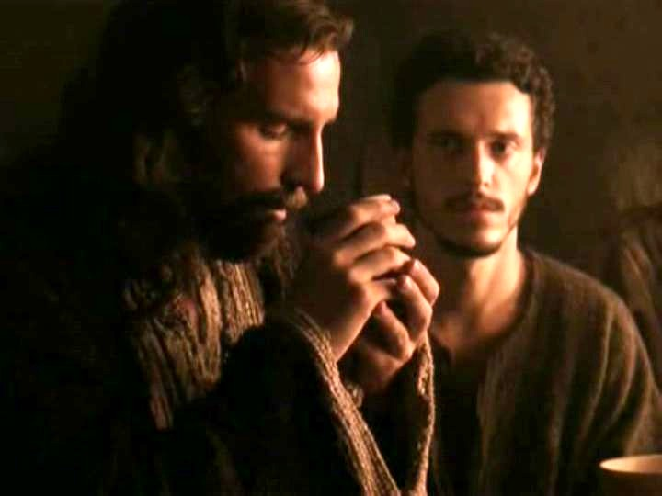
"This cup is the new covenant in my blood" (Luke 22:20)
Refers back to Jeremiah 31:31-34
The new covenant replaces the old
The church participates in the covenant promised to Israel
Never does Scripture say that the church replaces Israel since God has not rejected the nation (Rom. 11:1; cf. Jer. 31:35-37)

Slide 76
God will show his righteousness in Israel’s future since he rejected her only in part and temporarily so Gentiles can be saved, so they should not be proud (Romans 11).
154a
God has not rejected his people whom he foreknew (11:2a) because a remnant is now being saved (11:1-10).
Israel’s present rejection will stop but it saves Gentiles via the Abrahamic covenant to provoke Israel to faith and restoration of blessing (11:11-24).
God has not rejected Israel forever since the nation will be saved after all elect Gentiles have repented at the return of Christ to Jerusalem (11:25-32).
God deserves all glory and praise for unrivaled wisdom and knowledge (11:33-36).
Notes:
Rom. 11:33 Oh, how great are God’s riches and wisdom and knowledge! How impossible it is for us to understand his decisions and his ways!
Rom. 11:34 For who can know the LORD’s thoughts?
Who knows enough to give him advice?
³⁵ And who has given him so much
that he needs to pay it back?
Rom. 11:36 For everything comes from him and exists by his power and is intended for his glory. All glory to him forever! Amen.

Slide 77
Slides on
Romans 12

Slide 78
Righteousness in Romans
145
God's Righteousness /Justification by Faith in Christ––Not the Law
Chapters 1–11 | Chapters 12–16
Righteousness Explained | Righteousness Applied
Theological | Practical
What to Believe | How to Behave
Vertical | Horizontal
Relationship to God | Relationship to Others

Slide 79
Why accept one another?
145
SIN
Needed
in Condemnation
1:18–3:20
Applies in Transformation
12:1–15:13
Equal Righteousness
1:1-17
Provided
in Justification
3:21–5:21
SUBMISSION & SENSITIVITY
SALVATION
Vindicated
in Election
9–11
Imparted
in Sanctification
6–8
SELECTION
SET APART
Notes:
Righteousness applies equally in our life transformation (12:1–15:13).
[None of us has unfair privilege to become like Jesus—all have the same opportunity of holiness.]

Slide 80
Romans 12
154e
Righteousness is applied in transformed living
Notes:
The reason Jews and Gentiles at Rome should accept each other is so righteousness is applied in transformation with all people, government, and weak believers (12:1–15:13).

Slide 81
Righteousness in Romans
145
Theme | Needed | Provided | Imparted | Proved | Applied | Dissem-inated
Intro 1:1-17 | Condem-nation 1:18– 3:20 | Justifi-cation 3:21– 5:21 | Sanctifi-cation 6–8 | Election 9–11 | Trans-form-ation 12:1– 15:13 | Propa-gation 15:14– 16:27
Start | Sin | Salva-tion | Set Apart | Sove-reignty | Service | Send

Slide 82
The reason Jews and Gentiles at Rome should accept each other is so righteousness is applied in transformation with all people, government, and weak believers (12:1–15:13).
154f
God’s abundant mercy should move us to total dedication to his will rather than conform to the world as the key to the transformed lifestyle explained in 12:3–15:13 (12:1-2).
God's righteousness in a transformed life produces humility in using spiritual gifts and love in difficult social dealings to win watching unbelievers to Christ (12:3-21).
God's righteousness in a transformed life produces submission to the government to escape punishment and win watching persecutors to Christ (13:1-7).
God's righteousness in a transformed life produces love for other believers since all will soon account before God (13:8-14).
God's righteousness in a transformed life creates sensitivity to conscience so Gentiles will forgo habits offensive to Jews and Jews will follow their conscience (14:1–15:13).

Slide 83
Righteousness That Transforms in Romans 12–13
145
In the Church
(Ch. 12)
In the Society
(Ch. 13)
1. Which command in your assigned chapter do Christians LEAST OBEY in this society?
2. What practical idea would help you BETTER OBEY the above command?

Slide 84
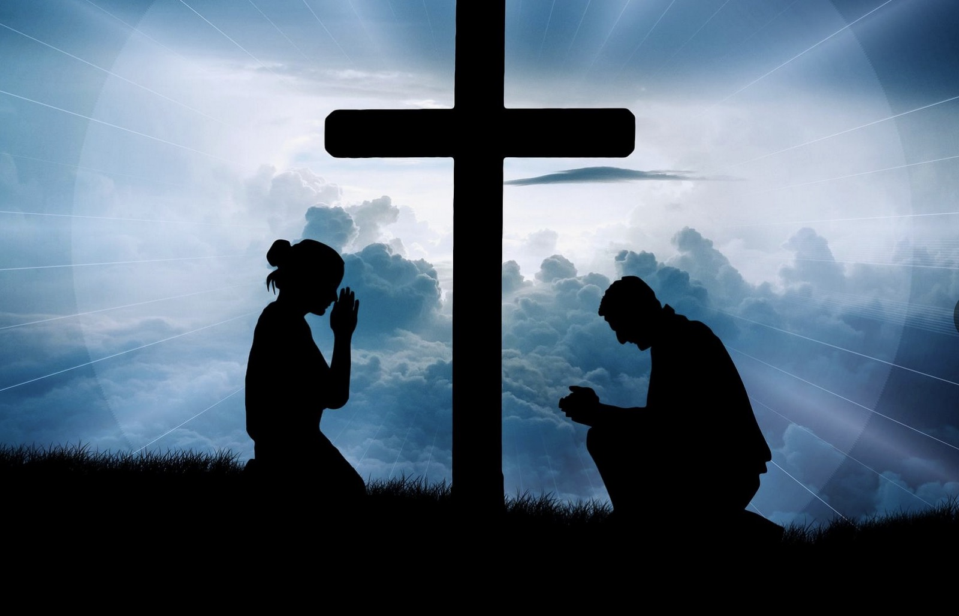
God’s abundant mercy should move us to total dedication to his will rather than conform to the world as the key to the transformed lifestyle explained in 12:3–15:13 (12:1-2).
Notes:
What contrast is given in verses 1-2?
We are either dedicated (to God) or conformed (to the world).
NLT Rom. 12:1 And so, dear brothers and sisters, I plead with you to give your bodies to God because of all he has done for you. Let them be a living and holy sacrifice—the kind he will find acceptable. This is truly the way to worship him. ² Don’t copy the behavior and customs of this world, but let God transform you into a new person by changing the way you think. Then you will learn to know God’s will for you, which is good and pleasing and perfect.
_________
NASB Rom. 12:1 Therefore I urge you, brethren, by the mercies of God, to present your bodies a living and holy sacrifice, acceptable to God, which is your spiritual service of worship. ² And do not be conformed to this world, but be transformed by the renewing of your mind, so that you may prove what the will of God is, that which is good and acceptable and perfect.

Slide 85

Romans 12:1
154e
"Offer your body as a
living sacrifice…"
Notes:
The Roman Gentiles knew about sacrifices, just as in the OT, so both Jews and Gentiles knew that they always killed the animal before putting it up on the altar. These animals must be perfect without any defect.
Likewise, we must be pure before God, like an unblemished sheep. While an animal can be sacrificed only once, we must offer ourselves daily.

Slide 86


ROMANS 12:2
BE TRANSFORMED
BY THE RENEWING OF YOUR MIND

Slide 87
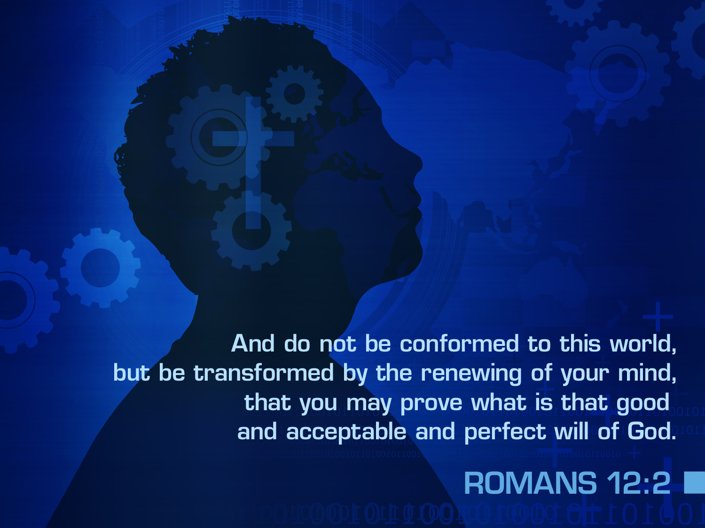

ROMANS 12:2
And do not be conformed to this world,
but be transformed by the renewing of your mind,
that you may prove what is that good
and acceptable and perfect will of God.
Notes:
George Mueller (1800-1882) read through the Bible over 200 times. He also was a man of prayer and recorded over 50,000 answers to prayer. How could this German missionary to England have established over 100 orphanages? Where did he get the time? He made the time!
"Do not conform (lit., “Do not be conformed”; this Gr. word occurs elsewhere in the NT only in 1 Peter 1:14) any longer to the pattern of this world... Living according to the lifestyle of “the present evil Age” (Gal. 1:4; cf. Eph. 1:21) must now be put aside. Then Paul commanded, But be transformed (pres. passive imper., “keep on being transformed”) by the renewing of your mind. The Greek verb translated “transformed”... is seen in the English word “metamorphosis,” a total change from inside out (cf. 2 Cor. 3:18). The key to this change is the “mind”..., the control center of one’s attitudes, thoughts, feelings, and actions (cf. Eph. 4:22-23). As one’s mind keeps on being made new by the spiritual input of God’s Word, prayer, and Christian fellowship, his lifestyle keeps on being transformed."
John A. Witmer, Romans (The Bible Knowledge Commentary; eds. John F. Walvoord and Roy B. Zuck; Accordance electronic ed. 2 vols.; Wheaton: Victor Books, 1983), 2:487.
1Pet. 1:14 So you must live as God’s obedient children. Don’t slip back into your old ways of living to satisfy your own desires. You didn’t know any better then.

Slide 88
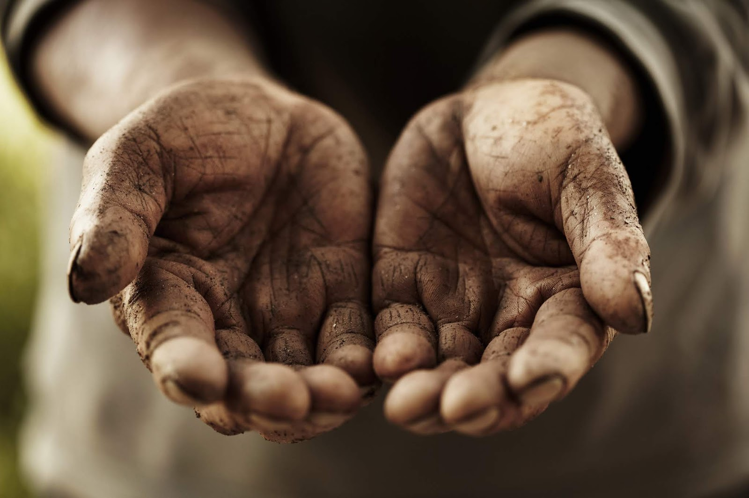
God's righteousness in a transformed life produces humility in using spiritual gifts and love in difficult social dealings to win watching unbelievers to Christ (12:3-21).
Notes:
Rom. 12:3 Because of the privilege and authority God has given me, I give each of you this warning: Don’t think you are better than you really are. Be honest in your evaluation of yourselves, measuring yourselves by the faith God has given us. ⁴ Just as our bodies have many parts and each part has a special function, ⁵ so it is with Christ’s body. We are many parts of one body, and we all belong to each other.
What is the contrast of verse 3? Pride versus sobriety. If you are proud, then you are not seeing yourself clearly!

Slide 89

Categories of Gifts
(1 Peter 4:11)
Get
words
from
God
Get
strength
from
God
154f
155dd
Speaking | Serving
Teaching | Administering
Evangelism | Faith
Pastor-Teacher | Giving
Encouraging | Service
 | Mercy
(Romans 12:6-8)
Notes:
89
Peter writes of believers either speaking or serving while using their gifts. These may be general categories. Those noted in Romans 12:6-8 are in yellow on this list above with the assumption that administering (1 Cor 12:28) is the same as leadership (Rom 12:8). The other three in white are noted in 1 Cor 12.
ـــــــــــــــــــــــ
OS-19-Nehemiah-214
CH-09-Speaking&ServingGifts-23, 67, 69, 99
HS-11-Speaking&ServingGifts-23, 67, 69, 99
NS-06-Romans9-16—slide 89

Slide 90

Body Life (Romans 12:3-21)
154e

Slide 91
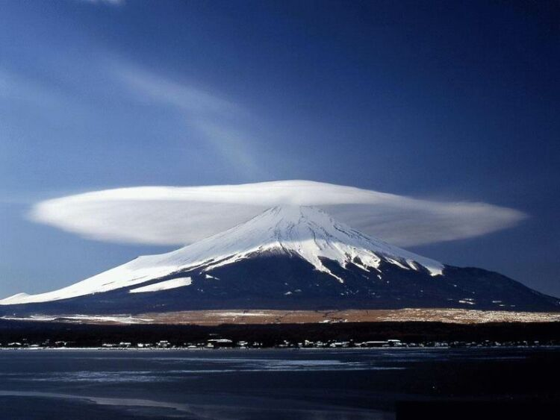
The Overall Principle
"If possible, as far as it depends on you, be at peace with all men"
Romans 12:18
Notes:
—and to do so as far as possible, as Romans 12:18 says [read]. This verse is a great encouragement to do all we can even if others are not responsive.

Slide 92
ROMANS 12 APPLICATIONS
154e
Offer your body as a living sacrifice, holy and pleasing to God (12:1)
Do not conform to the world's patterns, but be transformed by the renewing of your mind (12:2)
Exercise spiritual gifts in humility and love (12:6-8)
Love all people (12:9)

Slide 93
Slides on
Romans 13

Slide 94
The reason Jews and Gentiles at Rome should accept each other is so righteousness is applied in transformation with all people, government, and weak believers (12:1–15:13).
154f
God’s abundant mercy should move us to total dedication to his will rather than conform to the world as the key to the transformed lifestyle explained in 12:3–15:13 (12:1-2).
God's righteousness in a transformed life produces humility in using spiritual gifts and love in difficult social dealings to win watching unbelievers to Christ (12:3-21).
God's righteousness in a transformed life produces submission to the government to escape punishment and win watching persecutors to Christ (13:1-7).
Notes:
In Romans 12, does Paul refer to all people or only Christians? The BEE reading says it relates to all people, which may be supported by Romans 12:18. It encourages believers to be at peace with all people. But the chapter addresses believers.
How does submission to government witness to unbelievers?

Slide 95
Romans 13
Righteousness shows in submission to government and in love for the saints

Slide 96
Are You Submissive?
280d
0 1 2 3 4 5
Never Very Rarely Seldom Sometimes Usually Always
    1. ____ I have a problem with complaining (about the government, my job, family, etc. )
    2. ____ I feel the need to be the one in control
    3. ____ I struggle with admitting my faults
    4. ____ People call me stubborn
    ____ I rationalize: (a) driving over the speed limit (if you drive), or (b) disobeying pedestrian laws (e.g., jaywalking—if you do not drive). If you do both then pick where you are worst!
    ____ Total
Scale: 0 (Jesus, why are you taking this?), 1-5 (you must be my wife Susan ☺), 6-10 (could you please teach today’s class?), 11-19 (you need this class session), 20-25 (please see me after class for counseling referrals)
Notes:
Submissiveness to people shows a willingness to function under God's authority.
______________
NS-06-Romans9-16—slide 95
NS-21-1Peter-168

Slide 97


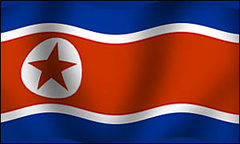
Submit to Which Country?
N O R T H K O R E A
Notes:
Does all governmental authority come from God?
NLT Rom. 13:1 Everyone must submit to governing authorities. For all authority comes from God, and those in positions of authority have been placed there by God. 2 So anyone who rebels against authority is rebelling against what God has instituted, and they will be punished. 3 For the authorities do not strike fear in people who are doing right, but in those who are doing wrong. Would you like to live without fear of the authorities? Do what is right, and they will honor you. 4 The authorities are God’s servants, sent for your good. But if you are doing wrong, of course you should be afraid, for they have the power to punish you. They are God’s servants, sent for the very purpose of punishing those who do what is wrong. 5 So you must submit to them, not only to avoid punishment, but also to keep a clear conscience.

Slide 98
Submit to Government no matter what type…
281
Socialism: You have two cows…
and you give one to your neighbor.
Communism: You have two cows…
the government takes both of them
and gives you some milk.
Fascism: You have two cows…
the government takes both of them
and sells you some milk.

Slide 99
Submit to Government no matter what type…
281
Nazism: You have two cows…
the government takes both of them
and shoots you.
Bureaucracy: You have two cows…
the government takes both of them,
shoots one, milks the other, and pours the milk down the drain.
Capitalism: You have two cows…
you sell one and buy a bull.

Slide 100
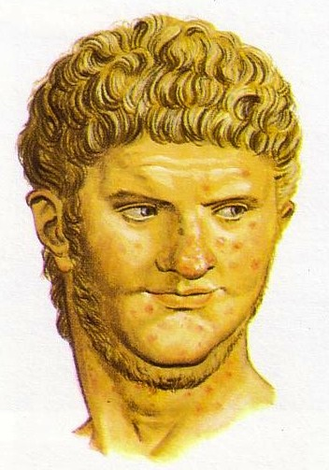
Nero (AD 54-68)
Stability
Insanity
Hypocrisy
Persecution
Jewish Revolt
Death
Notes:
It is easy for us to say that we will submit depending on the type of government. But Nero was the authority at that time!

Slide 101
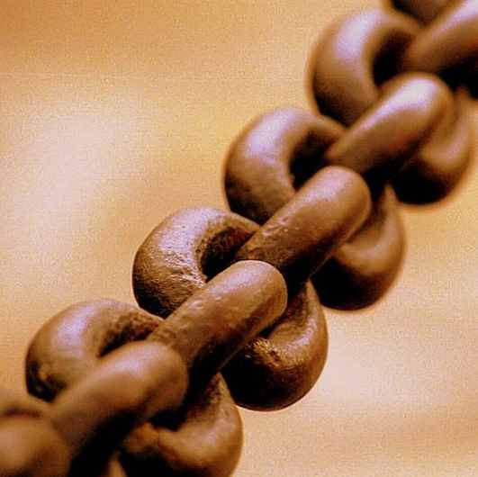
Submit to Government (13:1-7)
154e
Reasons we respect gov't (1-5)
Reasons we pay taxes (6-7)
Notes:
NLT Rom. 13:1 Everyone must submit to governing authorities. For all authority comes from God, and those in positions of authority have been placed there by God. 2 So anyone who rebels against authority is rebelling against what God has instituted, and they will be punished. 3 For the authorities do not strike fear in people who are doing right, but in those who are doing wrong. Would you like to live without fear of the authorities? Do what is right, and they will honor you. 4 The authorities are God’s servants, sent for your good. But if you are doing wrong, of course, you should be afraid, for they have the power to punish you. They are God’s servants, sent for the very purpose of punishing those who do what is wrong. 5 So you must submit to them, not only to avoid punishment but also to keep a clear conscience.
Rom. 13:6 Pay your taxes, too, for these same reasons. For government workers need to be paid. They are serving God in what they do. 7 Give to everyone what you owe them: Pay your taxes and government fees to those who collect them and give respect and honor to those who are in authority.
----- Meeting Notes (1/27/11 12:37) -----
REASONS TO RESPECT GOVERNMENT (1-5):
They are servants of God (1-2, 4, 6)
Rebelling against the government is rebelling against God (2a)
Rebellion brings punishment (2b-3)
Submission obeys our conscience (5)
REASONS TO PAY TAXES (6-7):
We must support God's servants (6a)—pastors, Levites, priests, officials
Authorities work full-time (6b)—kings, governors, police, soldiers

Slide 102
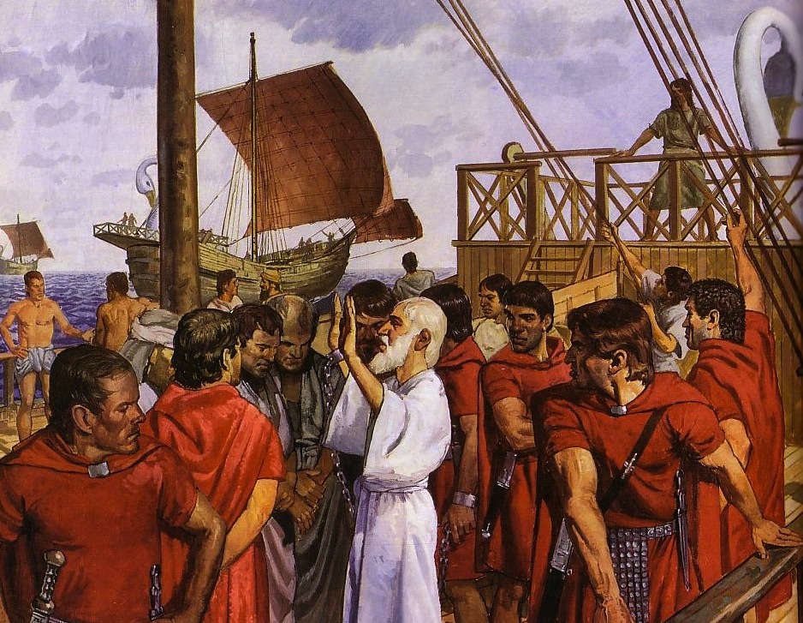
The Emperor Cult Threatened Christians
Ignatius, Bishop of Antioch, refused emperor worship and was brought to Rome to be fed to wild beasts. En route he wrote seven letters.
Notes:
Saint Ignatius of Antioch (also known as Theophorus) (AD. 35-107) was the third Bishop or Patriarch of Antioch and a student of the Apostle John.

Slide 103
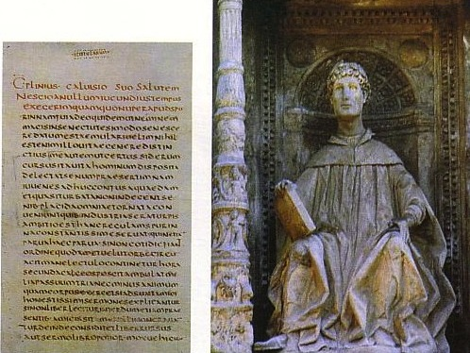
Pliny the Younger (AD 111-113)
He was the governor of Bithynia who wrote letters to the Emperor Trajan for counsel on various matters

Slide 104
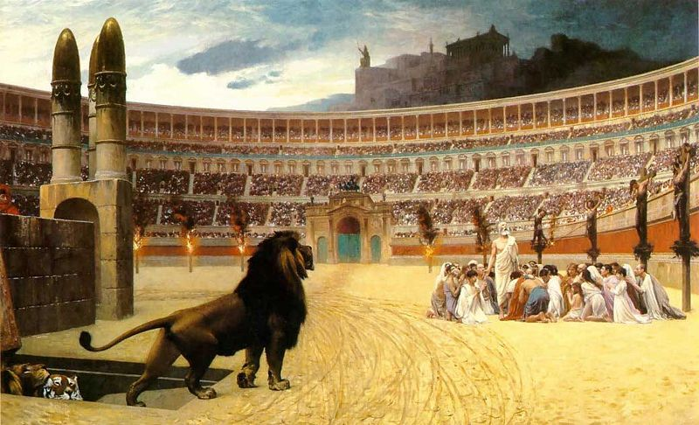
Early Church Suffering
281b
Governor Pliny to Emperor Trajan (AD 111):
I have observed the following procedure: I interrogated these as to whether they were Christians; those who confessed I interrogated a second and a third time, threatening them with punishment; those who persisted I ordered executed…
Pliny, Letters 10.96
(c)Paul Halsall Mar 1996. halsall@murray.fordham.edu http://www.fordham.edu/halsall/source/pliny1.html
Notes:
(c)Paul Halsall Mar 1996. halsall@murray.fordham.edu http://www.fordham.edu/halsall/source/pliny1.html

Slide 105

Helpful Correspondence (AD 111)
Emperor Trajan in Rome
Governor Pliny in Bithynia

Slide 106
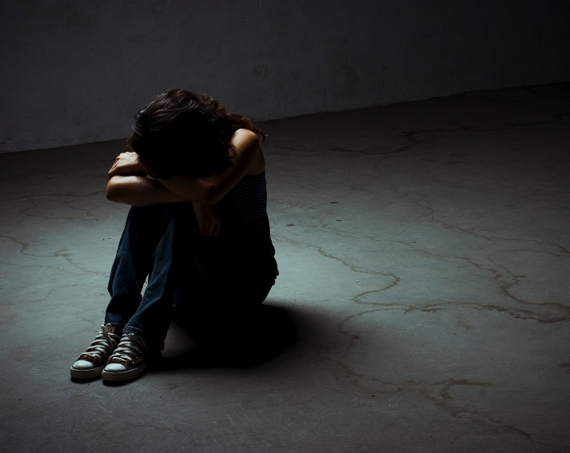
Early Church Suffering
281b
Governor Pliny to Emperor Trajan (AD 111)
I have observed the following procedure:
I interrogated these as to whether they were Christians; those who confessed
I interrogated a second and a third time, threatening them with punishment; those who persisted I ordered executed…
Pliny, Letters 10.96
(c)Paul Halsall Mar 1996. halsall@murray.fordham.edu http://www.fordham.edu/halsall/source/pliny1.html
Notes:
(c)Paul Halsall Mar 1996. halsall@murray.fordham.edu http://www.fordham.edu/halsall/source/pliny1.html

Slide 107
Early Church Suffering
281b
Governor Pliny to Emperor Trajan (AD 111)
Those who denied that they were or had been Christians, when they invoked the gods in words dictated by me, offered prayer with incense and wine to your image, which I had ordered to be brought for this purpose together with statues of the gods, and moreover cursed Christ—none of which those who are really Christians, it is said, can be forced to do—these I thought should be discharged.
Pliny, Letters 10.96
(c)Paul Halsall Mar 1996. halsall@murray.fordham.edu http://www.fordham.edu/halsall/source/pliny1.html
Notes:
(c)Paul Halsall Mar 1996. halsall@murray.fordham.edu http://www.fordham.edu/halsall/source/pliny1.html

Slide 108
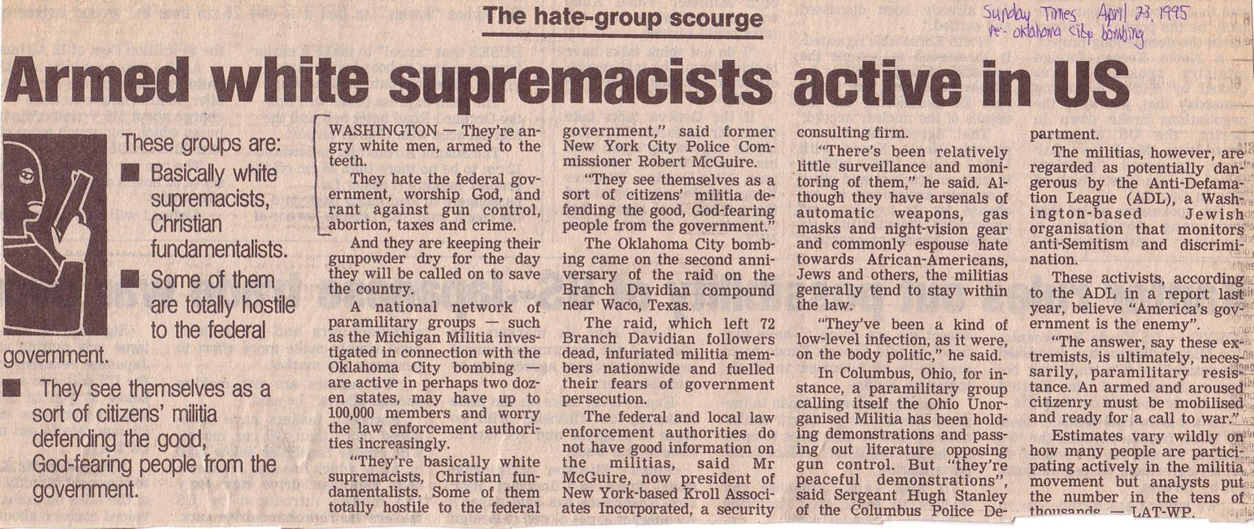
How Christians are Increasingly Depicted…
"Basically, while supremacists, Christian fundamentalists…
"They're angry white men, armed to the teeth.
"They hate the federal government, worship God, and rant against gun control, abortion, taxes, and crime."
Notes:
This article in Singapore appeared in 1995. Even then, Christians were depicted as rebellious against the US government.

Slide 109
To Take Home
280e
How can you better submit to the laws of the land?
How specifically will you do this?
Notes:
I once set a goal of not complaining even once for 14 days, based on Philippians 2:14—"Do all things without complaining or arguing." I kept a wristband on my right hand, but once I complained, I moved it to the left hand and started the 14 days over again, shifting back to the right hand once I complained again. It helped me see practically that I had a problem with complaining.
Which area on slide 95 about your own submission did you score lowest? That might be a good place to start.

Slide 110
The reason Jews and Gentiles at Rome should accept each other is so righteousness is applied in transformation with all people, government, and weak believers (12:1–15:13).
154f
God’s abundant mercy should move us to total dedication to his will rather than conform to the world as the key to the transformed lifestyle in 12:3–15:13 (12:1-2).
God's righteousness in a transformed life produces humility in using spiritual gifts and love in difficult social dealings to win watching unbelievers to Christ (12:3-21).
God's righteousness in a transformed life produces submission to the government to escape punishment and win watching persecutors to Christ (13:1-7).
God's righteousness in a transformed life produces love for other believers since all will soon account before God (13:8-14).
Notes:
What is love? It is not just a feeling—believers know this. But what is it, then?
It is a commitment or decision to consider others more important than yourself.
Phil. 2:3 Don’t be selfish; don’t try to impress others. Be humble, thinking of others as better than yourselves. ⁴ Don’t look out only for your own interests, but take an interest in others, too.
Rom. 13:8 Owe nothing to anyone—except for your obligation to love one another. If you love your neighbor, you will fulfill the requirements of God’s law. 9 For the commandments say, “You must not commit adultery. You must not murder. You must not steal. You must not covet.” These—and other such commandments—are summed up in this one commandment: “Love your neighbor as yourself.” 10 Love does no wrong to others, so love fulfills the requirements of God’s law.
Rom. 13:11 This is all the more urgent, for you know how late it is; time is running out. Wake up, for our salvation is nearer now than when we first believed. 12 The night is almost gone; the day of salvation will soon be here. So, remove your dark deeds like dirty clothes and put on the shining armor of right living. 13 Because we belong to the day, we must live decent lives for all to see. Don’t participate in the darkness of wild parties and drunkenness, or in sexual promiscuity and immoral living, or in quarreling and jealousy. 14 Instead, clothe yourself with the presence of the Lord Jesus Christ. And don’t let yourself think about ways to indulge your evil desires.
All of these terrible practices have in common the concern for self instead of others.

Slide 111
Slides on
Romans 14

Slide 112
The reason Jews and Gentiles at Rome should accept each other is so righteousness is applied in transformation with all people, government, and weak believers (12:1–15:13).
154f
God’s abundant mercy should move us to total dedication to his will rather than conform to the world as the key to the transformed lifestyle explained in 12:3–15:13 (12:1-2).
God's righteousness in a transformed life produces humility in using spiritual gifts and love in difficult social dealings to win watching unbelievers to Christ (12:3-21).
God's righteousness in a transformed life produces submission to the government to escape punishment and win watching persecutors to Christ (13:1-7).
God's righteousness in a transformed life produces love for other believers since all will soon account before God (13:8-14).
God's righteousness in a transformed life creates sensitivity to conscience so Gentiles will forgo habits offensive to Jews and Jews will follow their conscience (14:1–15:13).

Slide 113
Romans 14:1–15:13
Righteousness transforms our ways of handling different convictions
Notes:
How have you observed how Christians and unbelievers handle differing convictions about what is right?
• Some seek to shut down the opposite viewpoint.
• Some try to accept all views despite conscience.
• Some say do whatever you want.

Slide 114
Black & White
Practices the Bible says are always wrong
Practices the Bible says are always right
Idolatry
Adultery
Murder
Coveting
Contentment
Obedience
Prayer
Purity
Notes:
ALWAYS WRONG:
Selfishness
Fruits of the Flesh
ALWAYS RIGHT:
Selflessness
Forgiveness
Fruit of the Spirit

Slide 115

Gray Areas
155aa
Practices not forbidden in the Bible over which Christians disagree
Notes:
FOOD:
NLT Rom. 14:1 Accept other believers who are weak in faith, and don’t argue with them about what they think is right or wrong. 2 For instance, one person believes it’s all right to eat anything. But another believer with a sensitive conscience will eat only vegetables. 3 Those who feel free to eat anything must not look down on those who don’t. And those who don’t eat certain foods must not condemn those who do, for God has accepted them. 4 Who are you to condemn someone else’s servants? Their own master will judge whether they stand or fall. And with the Lord’s help, they will stand and receive his approval.
WORSHIP DAYS:
Rom. 14:5 In the same way, some think one day is more holy than another day, while others think every day is alike. You should each be fully convinced that whichever day you choose is acceptable. 6 Those who worship the Lord on a special day do it to honor him. Those who eat any kind of food do so to honor the Lord, since they give thanks to God before eating. And those who refuse to eat certain foods also want to please the Lord and give thanks to God.

Slide 116
Gray Area Examples
155aa
Accepting gifts with the left hand
Being a Democrat (or Republican!)
Buying a Mac (or Windows) computer
Celebrating Christmas or Easter
Celebrating Good Friday
Celebrating Lent
Celebrating Palm Sunday
Changing to a "Christian" name
Chinese New Year giving of hong baos

Slide 117
Gray Area Examples
155aa
Christmas trees in the church sanctuary Clapping in church services
Dancing
Drinking beer
Drinking hard liquor
Drinking wine
Driving a motorcycle
Eating bloody foods
Eating food sacrificed to idols

Slide 118
Gray Area Examples
155aa
Eating junk food
Eating meat
Eating only "Christian food"
Giving only "Christian" greetings (New Year)
Giving to non-religious causes
Having an abortionist gynecologist
Killing in war
Laughing with men and women together
Listening to rock music

Slide 119
Should we follow someone else's conscience?
Notes:
Should I change my behavior based on what another believer finds right or wrong?
Should I stop doing something because a fellow Christian thinks it is wrong?

Slide 120
Why should we give up our rights in gray matters?
Notes:
Jesus drank wine, and I want to be like Jesus, so should I also drink wine?

Slide 121
I. Show love more than knowledge (1 Cor. 8:1-3).
Notes:
1Cor. 8:1 Now regarding your question about food that has been offered to idols. Yes, we know that “we all have knowledge” about this issue. But while knowledge makes us feel important, it is love that strengthens the church. ² Anyone who claims to know all the answers doesn’t really know very much. ³ But the person who loves God is the one whom God recognizes.

Slide 122

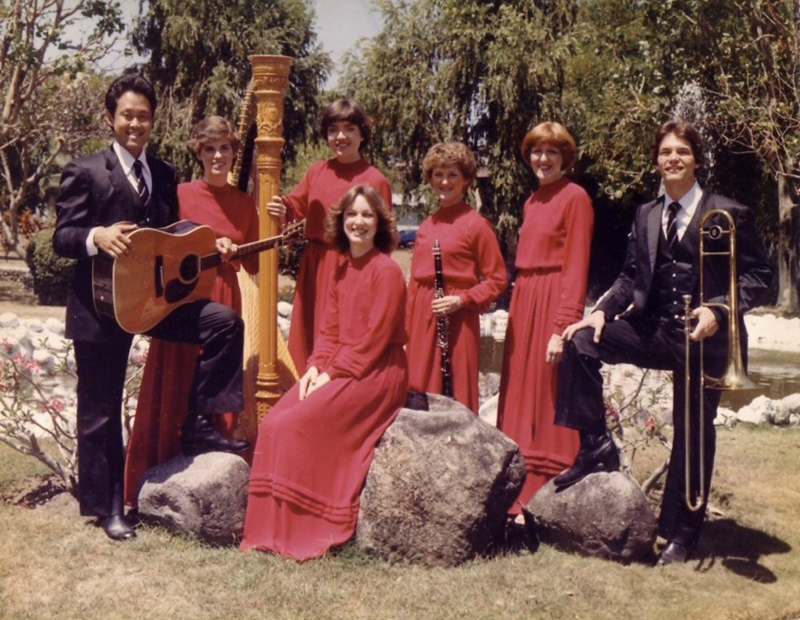

Love
Music
Drinking

Slide 123
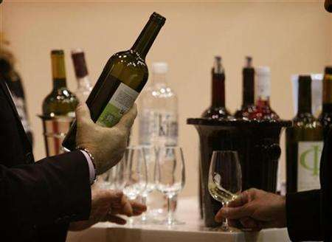
Black

Slide 124
II. Protect the conscience of weak believers
(1 Cor. 8:4-8).
Notes:
1Cor. 8:4 So, what about eating meat that has been offered to idols? Well, we all know that an idol is not really a god and that there is only one God. ⁵ There may be so-called gods both in heaven and on earth, and some people actually worship many gods and many lords. ⁶ But for us,
There is one God, the Father,
by whom all things were created,
and for whom we live.
And there is one Lord, Jesus Christ,
through whom all things were created,
and through whom we live.
1Cor. 8:7 However, not all believers know this. Some are accustomed to thinking of idols as being real, so when they eat food that has been offered to idols, they think of it as the worship of real gods, and their weak consciences are violated. ⁸ It’s true that we can’t win God’s approval by what we eat. We don’t lose anything if we don’t eat it, and we don’t gain anything if we do.

Slide 125
III. Give up your rights permanently if they hurt a weaker brother
(1 Cor. 8:9-13).
Notes:
1Cor. 8:9 But you must be careful so that your freedom does not cause others with a weaker conscience to stumble. ¹⁰ For if others see you—with your “superior knowledge”—eating in the temple of an idol, won’t they be encouraged to violate their conscience by eating food that has been offered to an idol? ¹¹ So because of your superior knowledge, a weak believer for whom Christ died will be destroyed. ¹² And when you sin against other believers by encouraging them to do something they believe is wrong, you are sinning against Christ. ¹³ So if what I eat causes another believer to sin, I will never eat meat again as long as I live—for I don’t want to cause another believer to stumble.

Slide 126
Touching Scale
Him
Her
Sex
Sex
Petting
Petting
Kiss the Lips
Kiss the Lips
Kiss the Cheek
Kiss the Cheek
Front Hug
Front Hug
Side Hug
Side Hug
Kiss the Hand
Kiss the Hand
Holding Hands
Holding Hands

Slide 127
The Big Idea of 1 Corinthians 8
Show love more than knowledge when dealing with gray matters

Slide 128
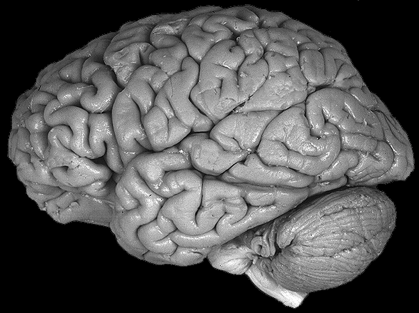
Use your brain
Use your gray matter concerning gray matters.

Slide 129

Theme
“Accept one another just as Christ has accepted us for the glory of God”
(Romans 15:7)

Slide 130
Faith Over Freedom
A Study of Romans 14:22-23
Adapted from Lim Hui Koon, SBC student, 2012

Slide 131
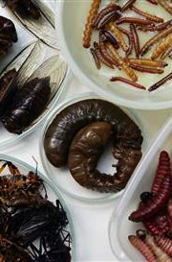
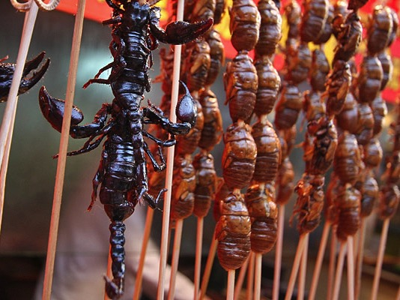
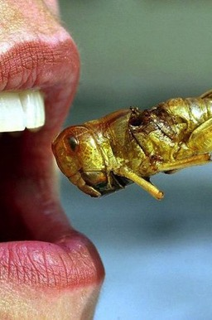
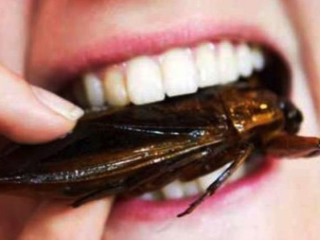


Slide 132
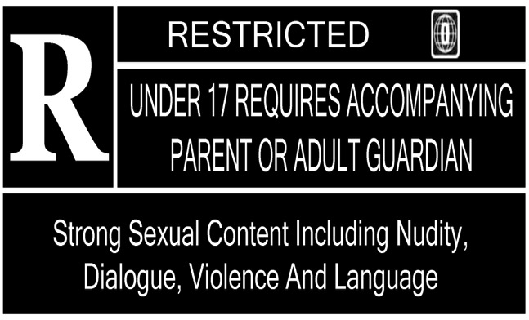
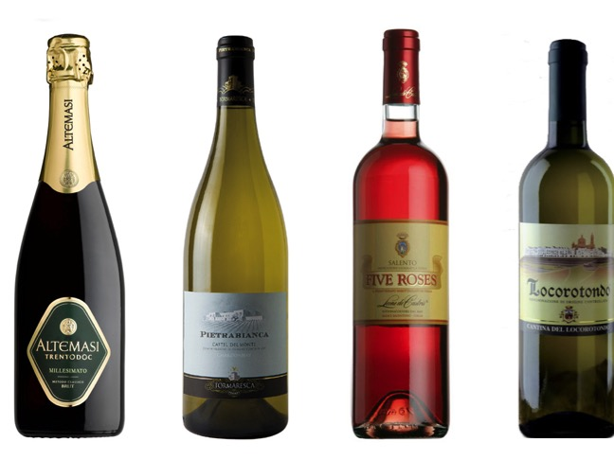

Non-Essential Matters

Slide 133
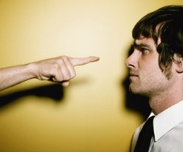
How should Christians handle non-essentials?
Faith Over Freedom (Romans 14:22-23)

Slide 134
Background
Don't argue over disputable matters (14:1)
Don't judge in eating matters (14:2-3, 6)
Don't judge in observing special days (14:5-6)
Everyone accountable to God (14:4, 7-12)
Do not judge one another over non-essential matters; do not stumble others (14:13-21)

Slide 135
Romans 14:22-23 (NIV)
²² So whatever you believe about these things keep between yourself and God. Blessed is the one who does not condemn himself by what he approves.
²³ But whoever has doubts is condemned if they eat, because their eating is not from faith; and everything that does not come from faith is sin.
Faith Over Freedom (Romans 14:22-23)

Slide 136

I. Keep non-essentials between you & God and don't feel guilty (14:22)
Faith Over Freedom (Romans 14:22-23)

Slide 137
Romans 14:22 (NIV)
²² So whatever you believe about these things keep between yourself and God. Blessed is the one who does not condemn himself by what he approves.
"These things" = Non-essentials
"Non-essentials" = Things that do not affect one's salvation
Faith Over Freedom (Romans 14:22-23)

Slide 138

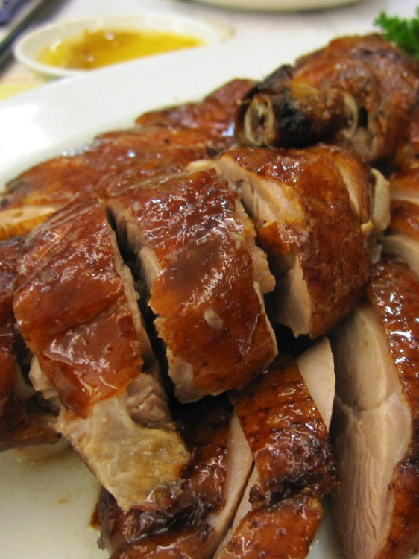
Insurance
Food
Faith Over Freedom (Romans 14:22-23)

Slide 139

II. Act by faith (14:23)
Faith Over Freedom (Romans 14:22-23)

Slide 140
Romans 14:23 (NIV)
²³ But whoever has doubts is condemned if they eat, because their eating is not from faith; and everything that does not come from faith is sin.
"Everything" = Non-essentials
Faith Over Freedom (Romans 14:22-23)

Slide 141

Dilemmas?
Faith Over Freedom (Romans 14:22-23)

Slide 142

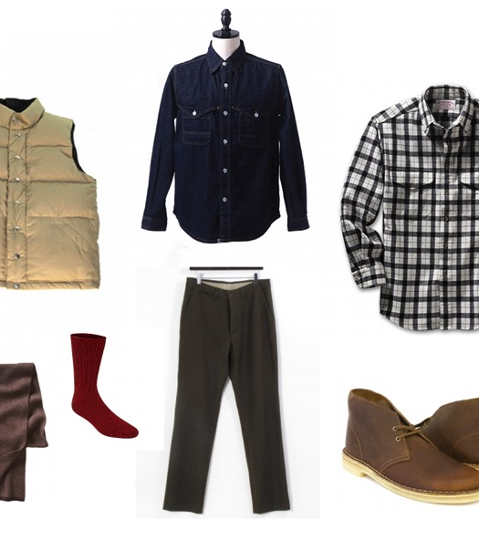
Dilemmas?
Faith Over Freedom (Romans 14:22-23)

Slide 143


Dilemmas?
Faith Over Freedom (Romans 14:22-23)

Slide 144
How should Christians handle non-essentials?
Faith Over Freedom (Romans 14:22-23)

Slide 145

Keep non-essential matters between you & God, and act by faith!
Main Idea of
Romans 14:22-23
Faith Over Freedom (Romans 14:22-23)

Slide 146
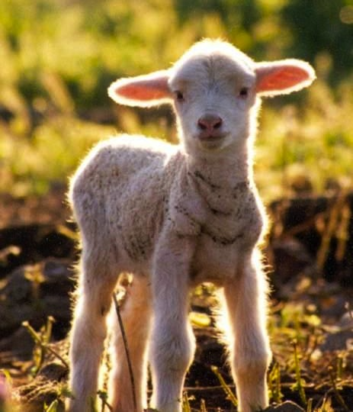
God commanded all Jews to eat lamb each Passover
"Accept him who is weak" (14:1)

Slide 147
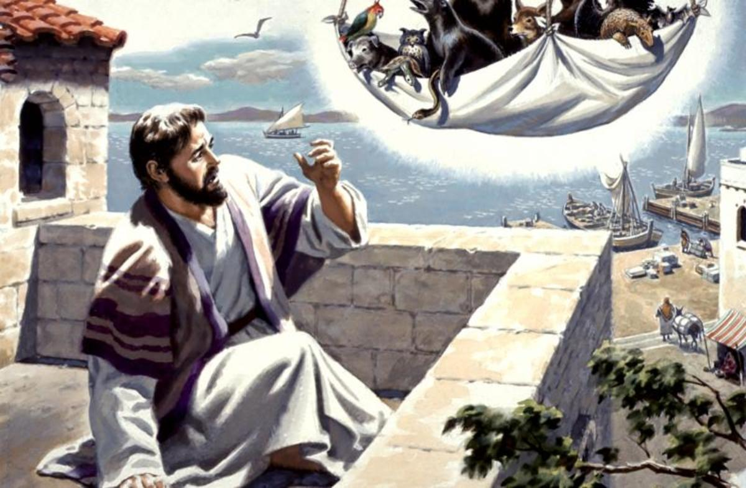
Jews like Peter despised unclean animals (Acts 10:9-16)
154e
Perhaps some Jews at Rome decided
not to eat any meat at all (Romans 14:2b)
Notes:
_________
NS-05-Acts
NS-06-Rom9-16—slide 123

Slide 148






Two Opposing Groups in Romans 14:1–15:13
154f
WEAK
Jewish minority
Conscience easily offended
Narrow, more closed view
Vegetarian (14:2b)
Worship on Sabbath (14:5a)
Less mature
Strong convictions in above areas
Commanded not to violate conscience (14:5b, 23)
STRONG
Gentile majority
Not easy offended
Broad, more open view
Eats all meats freely (14:2a)
Worships on any day (14:5b)
More mature
Ambivalent convictions
in above areas
Commanded not to hurt the weaker brother's conscience (14:1, 15, 20, 21; 15:1)

Slide 149

Two Opposing Groups in Romans 14:1–15:13
154f
PRINCIPLES FOR BOTH
Be convinced of your own convictions (14:5b)
Accept one another's beliefs (14:13; 15:7)
Work towards peace and mutual edification (14:19)
Remember that each of us is individually accountable to God (14:12)
Keep your personal convictions in gray areas private (14:22a)
Since Christianity has no food laws (14:6), work for righteousness, peace, and joy (14:17)
Do everything for God's glory (15:6)
Teach one another (15:14)
WEAK
Jewish minority
Conscience easily offended
Narrow, more closed view
Vegetarian (14:2b)
Worship on Sabbath (14:5a)
Less mature
Strong convictions in above areas
Commanded not to violate conscience (14:5b, 23)
STRONG
Gentile majority
Not easy offended
Broad, more open view
Eats all meats freely (14:2a)
Worships on any day (14:5b)
More mature
Ambivalent convictions
in above areas
Commanded not to hurt the weaker brother's conscience (14:1, 15, 20, 21; 15:1)
HARMONY

Slide 150
What are the gray areas at your church?
155aa

Slide 151
How to Discern a Gray Area
155aa
You wonder if a practice is a gray area
Is the practice forbidden in the Bible?
Yes
No
Does the Bible command the practice?
Yes
No
Will the practice violate an authority?
No
It is not
a gray area
It is
a gray area
It is not
a gray area
The practice is wrong so avoid it
The practice may or may not be OK
The practice is
right so obey it

Slide 152
How to Handle Gray Areas in Yourself
Is it forbidden
in Scripture?
Yes
155bb
No
Is it forbidden by authorities over you?
Yes
No
Will it lead you
to sin?
Yes
No
Will it divert your mind from good things?
Yes
No
Will it lead others
to sin?
Yes
No
Will it hinder your ministry of the gospel?
Yes
No
The practice need not
be avoided
Avoid
this practice

Slide 153
How to Handle Gray Areas in the Church
155cc
A member is accused of being a stumbling block by having a certain practice
Follow
Matt 18
to
restore
Is this practice forbidden in the Scriptures?
Yes
No
Plead with
member to
submit
Did the member agree to abstain from the practice when joining the church?
Yes
No
Ask
member to
stop of out
love
Does the practice hinder the growth of the offended party?
Yes
Ask
offended
party to
tolerate
it
No
Does the practice hinder the spread of the gospel?
Yes
No

Slide 154
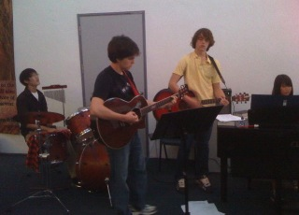
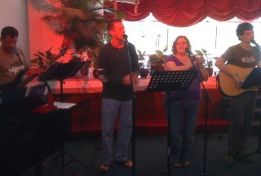
Gray Area Case Study
Two members at your church complained to you as the pastor that they don't like the newly adopted style of music. What would you do about this?
Kick them out
Call a meeting to vote
Go back to the old music
Something else, which is…
Notes:
Music styles have historically been among the most divisive issues in the American church for the past few decades.

Slide 155
Slides on
Romans 15

Slide 156
The reason Jews and Gentiles at Rome should accept each other is so righteousness is applied in transformation with all people, government, and weak believers (12:1–15:13).
154f
God’s abundant mercy should move us to total dedication to his will rather than conform to the world as the key to the transformed lifestyle explained in 12:3–15:13 (12:1-2).
God's righteousness in a transformed life produces humility in using spiritual gifts and love in difficult social dealings to win watching unbelievers to Christ (12:3-21).
God's righteousness in a transformed life produces submission to the government to escape punishment and win watching persecutors to Christ (13:1-7).
God's righteousness in a transformed life produces love for other believers since all will soon account before God (13:8-14).
God's righteousness in a transformed life creates sensitivity to conscience so Gentiles will forgo habits offensive to Jews and Jews will follow their conscience (14:1–15:13).

Slide 157
Romans 15:14–16:23
154f
Righteousness is disseminated by propagating the gospel

Slide 158
Righteousness in Romans
145
Theme | Needed | Provided | Imparted | Proved | Applied | Dissem-inated
Intro 1:1-17 | Condem-nation 1:18– 3:20 | Justifi-cation 3:21– 5:21 | Sanctifi-cation 6–8 | Election 9–11 | Trans-form-ation 12:1– 15:13 | Propa-gation 15:14– 16:27
Start | Sin | Salva-tion | Set Apart | Sove-reignty | Service | Send

Slide 159

EXPANDING
Your Borders
Romans 15:14-33
Notes:
God wants to help us expand our influence for him.

Slide 160
Barna Survey
Been Discipled
8%
2%
Discipled Others
Evangelical Christians
Notes:
Fortunately, people don't grow their whole lives! It's natural to stop physical growth at adulthood.
But it's sad that some believers stop growing spiritually and in service for Christ.
A survey by George Barna notes that only 8% of evangelical Christians have ever been disciplined—and only 2% have ever disciplined someone else!
Rather than expanding our borders and trusting God for new things, too often we end up atrophying.

Slide 161
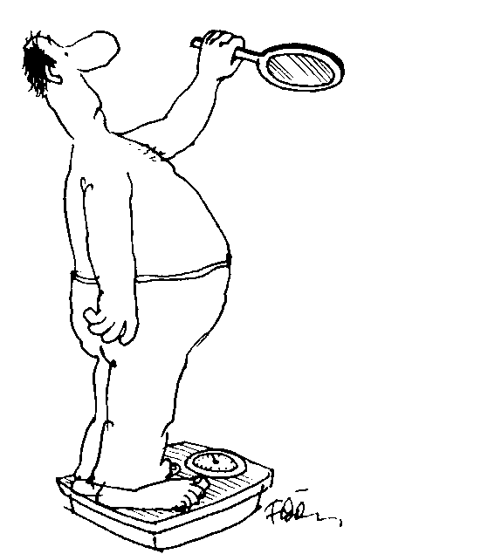
Are you expanding?
Notes:
Are you expanding? I mean expanding your borders—spiritually?

Slide 162
Are you EXPANDING your borders (spiritually)?
How can we do this?
Notes:
What "new thing" are you praying for God to do in your life now?
What ministry skills are you developing to use for him?
What avenue of service are you expecting God to do in your life this year that you didn't have the capacity to expand last year?
I hope God is pinpointing an area for you where you can expand your horizons.
• That's the "what" question, but today we will explore the "how" question: How can you expand your borders spiritually?

Slide 163

Paul's First & Second Missionary Journeys
138-39
Notes:
In the early church, by the time of today's text in Romans 15, Paul had already expanded his ministry on two missionary trips—the first highlighted in blue to Galatia in modern-day Turkey and the second trip expanded the gospel to Greece.

Slide 164
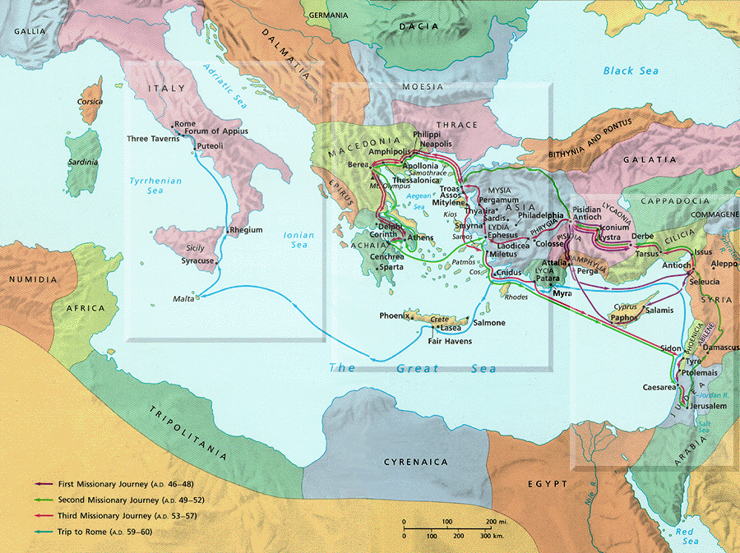
PAUL'S THIRD JOURNEY
140
Rome
Corinth
Paul's Journey 3
Notes:
Now on his third journey he writes from Corinth to the church farther west at Rome and asks for their help to expand his ministry even further. What can we learn from him that will help us expand our own borders?

Slide 165
Romans 15:14-33
Three ways to expand your borders…
I. Know God's calling for you (14-22)
Notes:
Today’s passage is Romans 15:14-33, where Paul expresses his heart to continue to expand his ministry.
In this text we’ll see three ways to expand your vision of God’s plan.
What is the first way we can expand our boundaries?
Know God’s calling for you (14-22).
Seeing God expand to new directions begins with understanding His plan for us now

Slide 166
Paul's Calling: Gentiles in the Body
Notes:
Paul wanted the church to see his call to preach Christ among unreached Gentiles (Rom 15:14-22).

Slide 167

Romans 15:14-19
¹⁴ I am fully convinced, my dear brothers and sisters, that you are full of goodness. You know these things so well you can teach each other all about them. ¹⁵ Even so, I have been bold enough to write about some of these points, knowing that all you need is this reminder.
For by God's grace, ¹⁶ I am a special messenger from Christ Jesus to you Gentiles. I bring you the Good News so that I might present you as an acceptable offering to God, made holy by the Holy Spirit. ¹⁷ So I have reason to be enthusiastic about all Christ Jesus has done through me in my service to God. ¹⁸ Yet I dare not boast about anything except what Christ has done through me, bringing the Gentiles to God by my message and by the way I worked among them. ¹⁹ They were convinced by the power of miraculous signs and wonders and by the power of God's Spirit. In this way, I have fully presented the Good News of Christ from Jerusalem all the way to Illyricum (Romans 15:14-19).
Notes:
Despite the Roman’s knowledge of the gospel, Paul still reminded them (14-15a).
Paul said that God’s calling for him was to reach the Gentiles by God’s power (15b-19).

Slide 168
Paul's Ministry Westwards
Spain
Rome
Illyricum
Jerusalem
Notes:
Where’s Illyricum? Illyricum is in present-day Yugoslavia!
Paul had a priestly role of presenting the Gentiles to God as an offering (16)! He says that all offerings must be holy—so his desire was that all his converts would truly be set apart for God (holy).

Slide 169

Romans 15:20-22
²⁰ My ambition has always been to preach the Good News where the name of Christ has never been heard, rather than where a church has already been started by someone else.
²¹ I have been following the plan spoken of in the Scriptures, where it says,
"Those who have never been told about him will see, and those who have never heard of him will understand."
²² In fact, my visit to you has been delayed so long because I have been preaching in these places.
––Romans 15:20-22

Slide 170

Jews at Pentecost––Acts 2:9-11
132
Rome (13)
PONTUS (7)
CAPPADOCIA (6)
ASIA (8)
PHRYGIA (9)
Jews from Rome trusted Christ at Pentecost––Acts 2:10
Parthia (1)
PAMPHILIA (10)
Mesopotamia (4)
CRETE (14)
Media (2)
Elam (3)
Jerusalem
CYRENE (12)
JUDEA (5)
ASIA––Roman Empire Provinces
Media––Parthian Empire Provinces
EGYPT (11)
Rome––Cities
CRETE––Islands
ARABIA (15)
Miles
0
200
400
600
800
1000
Kms
0
300
600
900
1200
1500
(1) (2) (3) etc. indicate sequence in Acts 2:9-11
Notes:
Jews numbered 40,000 in Rome during the reign of Augustus (30 BC to AD 14), so this was a sizable minority. We do not know for sure who actually started the church at Rome, but it likely was some of these Jews who returned to Rome after receiving the Spirit at Pentecost in Jeruslem. They, in turn, led Gentiles in Rome to faith as well.

Slide 171

Our Mission Organization…

Slide 172

WorldVenture Seminary Professors

Slide 173


Susan & Rick at Mount of Olives
Kurt in
Hezekiah's Tunnel

Slide 174

Dead Sea Mud

Slide 175

"Preach to every creature" (Mark 16:15)

Slide 176

SINGAPORE BIBLE COLLEGE
9
Notes:
I've served as a seminary professor with 30 other faculty at Singapore's largest training school: Singapore Bible College

Slide 177

Singapore Bible College Nations
MONGOLIA
KOREA
HOLLAND
CHINA
JAPAN
MYANMAR
TAIWAN
CAMBODIA
INDIA
VIETNAM
THAILAND
PHILIPPINES
MALAYSIA
SRI LANKA
SINGAPORE
KENYA
INDONESIA
USA
Notes:
Located at the equator, SBC has trained pastors, missionaries, teachers, musicians, counselors, and other full-time workers from about 25 countries, mostly in Asia. Many of these lie within the 10-40 Window, the area between 10 and 40 degrees which is the poorest and most spiritually needy area of the world. We have about 500 students studying in English and Chinese.

Slide 178
Courses Taught Since 1991
(English • Indonesian • Chinese)
Survey • The Bible…Basically
OT NT Bible Study
Backgrounds • Research & Writing
OT NT Geography
Theology • Creation • Jesus
Church • Spirit • Salvation • Future
Preaching
Homiletics 1 Homiletics 2
Notes:
I get to teach these leaders every book of the Bible in survey courses, plus backgrounds to both the OT and NT, three areas of theology, and how to preach.

Slide 179


Mongolia
God helped me expand my borders to Mongolia…
Like Budmaa, know your gift!
Notes:
God has called me to serve in 73 teaching trips to 10 other countries. This includes five times to Mongolia.

Slide 180

What's your passion?

Slide 181
Categories of Gifts
(1 Peter 4:11; Rom. 12:6-8)
Speaking | Serving
Teaching | Administering
Evangelism | Faith
Pastor-Teacher | Giving
Encouraging | Service
 | Mercy

Slide 182

Pastor Budmaa, Director, Evangelism Explosion, Mongolia

Slide 183

Maranata.com.mn website
50,000 hits monthly!

Slide 184

What's Most Important?
Notes:
What do you think is the most important thing we do as a church? Worship? Evangelism? Fellowship? Bible study? Prayer? A man inquiring about our church once asked me, "So what is most important to your church? What is unique?" If he had asked you, what would you have said? I told him one word: LOVE!
One of the teachers of religious law was standing there listening to Jesus debate the leaders. He realized that Jesus had answered well, so he asked, "Of all the commandments, which is the most important?" Jesus answered…

Slide 185

What's Most Important?
Mark 12:29-31 -- Jesus replied, "The most important commandment is this: 'Listen, O Israel! The Lord our God is the one and only Lord. ³⁰ And you must love the Lord your God with all your heart, all your soul, all your mind, and all your strength.'
³¹ The second is equally important:
'Love your neighbor as yourself.'* No other commandment is greater than these."
Notes:
One of the teachers of religious law was standing there listening to the debate. He realized that Jesus had answered well, so he asked, "Of all the commandments, which is the most important?" Jesus answered…

Slide 186

Our Church Vision
Love the Nations
Love the Church
Love God
Notes:
• LOVE GOD: God wants our church to trust him. Love is most important (1 Cor 13:13).
• LOVE THE CHURCH: We also need to be involved in his work: teaching, accountability groups, finances, etc.
• LOVE THE NATIONS: The heart of the Great Commission to disciple all countries is based on love for God and his people.
——————————
Common-294
BE-05-Deut-82
OP-05-Deut-71
OS-05-Deut-155, 237
OS-29-Joel-128
OS-32-Jonah-71
NS-02-Mark1-8-slide 111
NS-03-Luke1-12—slide 401
NS-06-Romans9-16-slide 172

Slide 187
Romans 15:14-33
154f
Three ways to expand your borders…
I. Know God's calling for you (14-22)
II. Support God's new directions (23-29)
Notes:
God’s plan for us always includes trusting him for new stuff—new opportunities.

Slide 188

Romans 15:23-24
²³ But now I have finished my work in these regions, and after all these long years of waiting, I am eager to visit you.
²⁴ I am planning to go to Spain, and when I do, I will stop off in Rome. And after I have enjoyed your fellowship for a little while, you can provide for my journey.
Notes:
Paul shared his plan to extend his ministry to Spain to get their help (23-24).

Slide 189
Paul's Next Mission Field: Spain (15:23-29)
154f
Notes:
Why was Paul going to Spain? He had finished pioneering in the eastern Empire. Like in the time of Jonah, Spain (or Tarshish) was the very end of the known world.
Was there really “no more place for me to work in these regions” (NIV, 14:23)? No. He means that church-planting movements in the east would reach these people.
Financial help from the Romans would further his work since he’d be halfway to Spain by the time he got to Rome.
• But he would not go there immediately.

Slide 190
Romans 15:25-27
²⁵ But before I come, I must go to Jerusalem to take a gift to the believers there. ²⁶ For you see, the believers in Macedonia and Achaia have eagerly taken up an offering for the poor among the believers in Jerusalem. ²⁷ They were glad to do this because they feel they owe a real debt to them. Since the Gentiles received the spiritual blessings of the Good News from the believers in Jerusalem, they feel the least they can do in return is to help them financially.
Notes:
But first he had to bring the Gentile offering to Jerusalem to show unity with their Jewish mother church (25-27).
How did this Gentile support for Jerusalem relate to Paul’s calling to Gentiles?
He says here that he intended it to somewhat repay what the Jerusalem church had done for the Gentiles—which is interesting since it was the Antioch church—not the Jerusalem church—that sent him out to reach Gentiles.

Slide 191
Paul's Next Mission Field: Spain (15:23-29)
154f
Notes:
Paul didn't forget the needy in his passion to expand, so he had to deliver this help in person to Jerusalem.

Slide 192
Romans 15:28-29
²⁸ As soon as I have delivered this money and completed this good deed of theirs,
I will come to see you on my way to Spain.
²⁹ And I am sure that when I come, Christ will richly bless our time together.
Notes:
Paul then also hoped to bless the Roman believers (28-29), and then head to Spain.

Slide 193
Paul's Next Mission Field: Spain (15:23-29)
154f
Notes:
Paul then planned on stopping off at Rome…

Slide 194
Paul's Next Mission Field: Spain (15:23-29)
154f
Notes:
…and then proceed from Rome to share the Good News in Spain.

Slide 195
New expansions for us…

Slide 196

TBB
God's Word made plain for all God's people

Slide 197

TBB Vision
Helping change lives all across the world
by making the Word come alive.

Slide 198

English

Slide 199

Arabic
الكتاب المقدس... بالأساس
©2023 TBBMI

Slide 200


Bangla
fvm©b 9.65
evB‡ej...
†gŠwjKfv‡e
`v evB‡ej ...†ewmKvjx wgwbwó«m B›Uvi‡bkbvj Bb‡Kv. †dvU© A_© †U·vm-Gi
GKwU Dc¯'vcbv
www.biblebasically.com
©2006TBBMI
9.6.01.
01
©2006 TBBMI
Notes:
Title slide (no narration)

Slide 201

Burmese
Lai S
iangtho…Abulpi
A Presentation of The Bible…Basically Ministries International Inc. Fort Worth, Texas
www.biblebasically.com
©2004 TBBMI
8.0.01.
04

Slide 202

Chin
A Presentation of The Bible…Basically Ministries International Inc. Fort Worth, Texas
www.biblebasically.com
©2004 TBBMI
8.0.01.
04

Slide 203

Chinese (Mandarin)
圣经...
基要
国际基本事工呈献…圣经纵览系列. 福特沃得, 德州
www.biblebasically.com
8.0.01.
©2003 TBBMI
04

Slide 204


Dutch
VERSIE 9.6 BETA
DE BIJBEL… VANAF DE BASIS
Een Presentatie van The Bible…Basically Ministries International Inc. Fort Worth, Texas
www.biblebasically.com
©2006 TBBMI

Slide 205

French
LA BIBLE…
EN BASE
Une Présentation du Ministère Internationale de La Bible… En Base Inc. Fort Worth, Texas
www.biblebasically.com
©2006 TBBMI
8.0.01.
04
©2004 TBBMI
9.6.01.

Slide 206

Japanese
バイブル ベイシックミニストリーズ
インスティチュート
A Presentation of The Bible…Basically Ministries International Inc. Fort Worth, Texas
www.biblebasically.com
©2004 TBBMI
8.0.01.
04
Notes:
Japanese title slide

Slide 207

Hindi
ckbZfcy ds
:ijs[kk s
A Presentation of The Bible…Basically Ministries International Inc. Fort Worth, Texas
www.biblebasically.com
©2004 TBBMI
8.0.01.
04

Slide 208


Bahasa Indonesia
Presentasi dari The Bible…Basically Ministries International Inc. Fort Worth, Texas
www.biblebasically.com
7.5.01.
©2003 TBBMI
04

Slide 209

Kachin (Myanmar)
Chyum Laika… Npawt Nhpang
Chyum Laika Hkaja ai Lam…Munkan Npawt Nhpang Sasana, Wuhpawng
Fort Worth, Texas
www.biblebasically.com
8.0.01.
©2003 TBBMI
04

Slide 210

Kiswahili (Kenya)
biblia kwa ujumla
A Presentation of The Bible…Basically Ministries International Inc.
Fort Worth, Texas
www.biblebasically.com
8.0.01.
©2003 TBBMI
04

Slide 211

Khmer (Cambodian)
mUldæanRKwH>>>
énRBHKm<IIr
karbgðaj[sÁal;nUvRBHKm<Ir>>> EdlCamUldæanRKw³ kñúg B½n§kic©shKmnGnþrCati GayGinsIu.
Fort Worth, Texas
www.biblebasically.com
©2004 TBBMI
8.0.01.
04

Slide 212

Korean
성경은 …
기본적으로
A Presentation of The Bible…Basically Ministries International Inc. Fort Worth, Texas
www.biblebasically.com
7.5.01.
©2003 TBBMI
04

Slide 213

Malay
Alkitab…
Dasar
Presentasi dari The Bible…Basically Ministries International Inc. Fort Worth, Texas
www.biblebasically.com
©2004 TBBMI
8.0.01.
04

Slide 214

Mao (India)
Bible…
Amolo Leino
Bible…Ngashankakhuina Ministries International Inc. pashina semkashok Fort Worth, Texas
www.biblebasically.com
©2004 TBBMI
8.0.01.
04

Slide 215

Malayalam (India)
Æß èÌÌßZ
çÌØßAÜß
¥ÕÄøßMßAáKÄí Æß èÌÌßZ çÌØßAÜß… ÎßÈßØíd¿àØí §aVÈÞ×ÃW çËÞVGíÕVJí, æ¿µíØÞØí
©2004 TBBMI
8.0.01.
04

Slide 216

Mao
VERSION 9.6 BETA
BAIBUL…
A TLANGPUI
Baibul… A Tlangpui Rawngbawlna Lantirna, International Inc.
Fort Worth, Texas
Baibul… A Tlangpui Rawngbawlna Lantirna, International Inc. Fort Worth, Texas
www.biblebasically.com
©2006 TBBMI

Slide 217

Mongolian
Библи…
Үндсэндээ
A Presentation of The Bible…Basically Ministries International Inc. Fort Worth, Texas
www.biblebasically.com
©2004 TBBMI
8.0.01.
04

Slide 218

Nepali
afOan======
cfwf/e[\t
A Presentation of The Bible…Basically Ministries International Inc. Fort Worth, Texas
www.biblebasically.com
8.0.01.
©2004 TBBMI
04

Slide 219

Paite (India)
LAISIANGTHOU…
ABULPI
Ahihna banga piakkhiakna Laisiangthou...Abulpi Nasepna International Inc. Fort Worth, Texas
www.biblebasically.com
©2006 TBBMI
04
9.6.01.

Slide 220
Spanish
La Biblia…
Básicamente
A Presentation of The Bible…Basically Ministries International Inc. Fort Worth, Texas
www.biblebasically.com
8.0.01.
©2003 TBBMI
04

Slide 221
Sumi (India)
Kuchouyesu… Aboqha
A Presentation of The Bible…Basically Ministries International Inc. Fort Worth, Texas
www.biblebasically.com
8.0.01.
©2003 TBBMI
04

Slide 222

Swahili (Kenya)
biblia kwa ujumla
A Presentation of The Bible…Basically Ministries International Inc. Fort Worth, Texas
www.biblebasically.com
8.0.01.
©2003 TBBMI
04

Slide 223

Tagalog (Philippines)
Ang Biblia . . . Pinasimple
A Presentation of The Bible…Basically Ministries International Inc. Fort Worth, Texas
www.biblebasically.com
©2004 TBBMI
8.0.01.
04
Notes:
PLEASE PUT THE TITLE AND SUBTITLES INTO YOUR NATIONAL LANGUAGE AND LEAVE THE WEBSITE UNCHANGED

Slide 224

Tamil (Sri Lanka/India)
jpUkiwapd;…
mbg;gil
A Presentation of The Bible…Basically Ministries International Inc. Fort Worth, Texas
www.biblebasically.com
©2004 TBBMI
8.0.01.
04

Slide 225

Tangkhul (India)
Bible…
Ngashankakhui
Bible…Ngashankakhuina Ministries International Inc. pashina semkashok Fort Worth, Texas
www.biblebasically.com
©2004 TBBMI
8.0.01.
04

Slide 226

Tenyidie
ผลงานนำเสนอของกลุ่มพันธกิจ "พระคัมภีร์...จากพื้นฐาน" นานาชาติ
ฟอร์ท เวิร์ธ, เท็กซัส
www.biblebasically.com
04
©2004 TBBMI
8.0.01.

Slide 227

Vietnamese
Kinh thánh…
Cơ bản là
A Presentation of The Bible…Basically Ministries International Inc. Fort Worth, Texas
www.biblebasically.com
©2004 TBBMI
8.0.01.
04

Slide 228


NT Survey link at BibleStudyDownloads.org
Get this presentation for free!
Notes:
Student translation since 2003 with 700 translators has resulted in Bible teaching and study materials—mostly PowerPoint—in 49 languages! All a teacher needs to do is to click on a file and it downloads for free to teach any book of the Bible and many other subjects.
NT Survey (ns)

Slide 229

BibleStudyDownloads.org
7
Notes:
My SBC teaching has resulted in Bible teaching and study materials—mostly PowerPoint—in 49 languages! All a teacher needs to do is to click on a file and it downloads for free to teach any book of the Bible and many other subjects.

Slide 230

BibleStudyDownloads.org
7
Notes:
My SBC teaching has resulted in Bible teaching and study materials—mostly PowerPoint—in 49 languages! All a teacher needs to do is to click on a file and it downloads for free to teach any book of the Bible and many other subjects.

Slide 231

BibleStudyDownloads.org
7
Notes:
My SBC teaching has resulted in Bible teaching and study materials—mostly PowerPoint—in 49 languages! All a teacher needs to do is to click on a file and it downloads for free to teach any book of the Bible and many other subjects.

Slide 232

BibleStudyDownloads.org
7
Notes:
My SBC teaching has resulted in Bible teaching and study materials—mostly PowerPoint—in 49 languages! All a teacher needs to do is to click on a file and it downloads for free to teach any book of the Bible and many other subjects.

Slide 233

BibleStudyDownloads.org
7
English
Notes:
My SBC teaching has resulted in Bible teaching and study materials—mostly PowerPoint—in 49 languages! All a teacher needs to do is to click on a file and it downloads for free to teach any book of the Bible and many other subjects.

Slide 234

BibleStudyDownloads.org
7
NT Survey
Class Notes
Notes:
My SBC teaching has resulted in Bible teaching and study materials—mostly PowerPoint—in 49 languages! All a teacher needs to do is to click on a file and it downloads for free to teach any book of the Bible and many other subjects.

Slide 235

BibleStudyDownloads.org
7
Translations
Notes:
Here are 9 languages featured.

Slide 236

Chinese
7
01-马太福音_1-14_377_cmn_ns_1773_v20.pptx
Notes:
Chinese downloads include more than 37,000 slides as of Jan 2020.

Slide 237

Indonesian
7
Notes:
Indonesian downloads include more than 14,000 slides as of Jan 2020.

Slide 238

Mongolian
7
Notes:
Mongolian downloads include more than 3,000 slides as of Jan 2020.

Slide 239

Vietnamese
7
Notes:
Vietnamese downloads include more than 8,000 slides as of Jan 2020.

Slide 240


اللغة العربيَّة
7
مسْحُ العهد الجديد
01-متى_1-14-247eng-502_ara_ns_1773_v34.pptx
Notes:
تتضمَّن العروض التقديميَّة المتاحة باللغة العربيَّة أكثر من 47000 شريحة (سلايد)، وهذا الرقم هو حتَّى كانون الثاني 2020.
Arabic downloads include more than 47,000 slides as of May 2022.
_____________
Common-112

Slide 241

As an individual, are you supporting God's new directions?
Notes:
Do you give to where God is expanding the gospel?

Slide 242

17 believers from 6 countries at our first meeting on Friday, 6 Oct 06
Notes:
As of less than three years after we started Crossroads International Church in November 2006, on 30 August 2009, of the 17 who came to the initial prayer meeting that started CIC, 4 left the church, 11 left the country, and only 2 remained (Susan and me).
Those whom we sent out were then in Mongolia, Thailand, Vietnam, Hong Kong, Korea, Turkey, Argentina, and the USA.

Slide 243


YOU are needed!
Women's Ministry Team
Men's Ministry Team
Missions
Coordinator for Ushers/Greeters
Youth Sponsors & assistant (woman)
PPT design
Set-up, Take down (e.g. signs)
Home group leaders
Evangelism
Notes:
God could raise up some really gifted person, but he rarely works that way. Instead, he uses plain ole' regular people like you and me in his work—especially in giving!

Slide 244
Romans 15:14-33
154f
Three ways to expand your borders…
I. Know God's calling for you (14-22)
II. Support God's new directions (23-29)
III. Pray against opposition (30-33)

Slide 245
Romans 15:30-33
³⁰ Dear brothers and sisters, I urge you in the name of our Lord Jesus Christ to join in my struggle by praying to God for me. Do this because of your love for me, given to you by the Holy Spirit.
³¹ Pray that I will be rescued from those in Judea who refuse to obey God. Pray also that the believers there will be willing to accept the donation I am taking to Jerusalem. ³² Then, by the will of God, I will be able to come to you with a joyful heart, and we will be an encouragement to each other.
³³ And now may God, who gives us his peace, be with you all. Amen.
Notes:
Paul asked for prayer against those opposed to his ministry expansion (30-33).
Prayer was a tangible way the Romans could show they loved him (30).
He requested prayer for protection (31).
He requested prayer for expansion of the ministry of Gentiles (32-33).

Slide 246






Recent Ministry Hats for Me
WorldVenture Singapore field leader
Singapore Bible College seminary professor
Biblical Education by Extension traveling teacher
The Bible…Basically translation director
International Community School board member
Crossroads International Church pastor-teacher
Internet Biblical Seminary course writer

Slide 247

Another day…
Vietnam
Another location…
Notes:
Most of us have ministry easier than those in Vietnam. On most of my 13 teaching trips there, we had to change our teaching site daily in response to the authorities.

Slide 248

Prayer
Protection
Expansion

Slide 249
Paul's Main Idea
Expand your borders by…
Knowing His call,
Supporting it, and
Praying against enemies
Notes:
Let God move you into new areas of growth by…
• Understanding his individual plan for you
• Committing yourself to that plan in time and money
• Battling on your knees against opposition

Slide 250
Romans 15:14-33
Three ways to expand your borders…
I. Know God's calling for you (14-22)
II. Support God's new directions (23-29)
III. Pray against opposition (30-33)
Notes:
In which of these three ways is God speaking to you? What will you do about it today?

Slide 251
For Righteousness Disseminated it Takes…
154f
Money (15:14-33)
Building Bridges to Propagate the Gospel

Slide 252

Relationships (A Negative View)
RELATIONSHIPS
Sure, there are plenty of other fish in the sea.
But you're not anywhere near the sea. You're in the desert. Alone.

Slide 253
Slides on
Romans 16

Slide 254
Righteousness in Romans
145
Theme | Needed | Provided | Imparted | Proved | Applied | Dissem-inated
Intro 1:1-17 | Condem-nation 1:18– 3:20 | Justifi-cation 3:21– 5:21 | Sanctifi-cation 6–8 | Election 9–11 | Trans-form-ation 12:1– 15:13 | Propa-gation 15:14– 16:27
Start | Sin | Salva-tion | Set Apart | Sove-reignty | Service | Send

Slide 255
For Righteousness Disseminated it Takes…
154f
Money (15:14-33)
People (16:1-24)
Building Bridges to Propagate the Gospel

Slide 256





How to Imitate Paul's Relationships
154f
Commend co-laborers (16:1-16)
Commend women like Phoebe (1-2)
Greet people—Paul greets 26 people by name in a church he'd never visited (3-16)!

Slide 257

How to Imitate Paul's Relationships
154f
Commend co-laborers (16:1-16)
Work for unity (16:17-20)
Fellowship between churches (16:21-24)

Slide 258
For Righteousness Disseminated it Takes…
154f
Money (15:14-33)
People (16:1-24)
God (16:25-27)
Building Bridges to Propagate the Gospel

Slide 259

²⁵ Now all glory to God, who is able to make you strong, just as my Good News says. This message about Jesus Christ has revealed his plan for you Gentiles, a plan kept secret from the beginning of time.
Romans 16:25 (NLT)

Slide 260
²⁶ But now as the prophets foretold and as the eternal God has commanded, this message is made known to all Gentiles everywhere, so that they too might believe and obey him.
Romans 16:26 (NLT)

Slide 261
²⁷All glory to the only wise God, through Jesus Christ, forever. Amen.
Romans 16:27 (NLT)

Slide 262

The tomb is empty for Jew & Gentile!
154f
"Now to him who is able to establish you by my gospel and the proclamation of Jesus Christ…"
(Romans 16:25)

Slide 263

Why accept one another?
Notes:
The reason we should be accommodating with each other in the church is because holiness comes the same way for us all—by simple trust in Jesus.

Slide 264
Why accept one another?
154h
SPREADING
SIN
Disseminated in Propagation
15:14–16:27
Needed
in Condemnation
1:18–3:20
Applies in Transformation
12:1–15:13
Equal Righteousness
1:1-17
Provided
in Justification
3:21–5:21
SUBMISSION & SENSITIVITY
SALVATION
Vindicated
in Election
9–11
Imparted
in Sanctification
6–8
SELECTION
SET APART
Notes:
We get God’s righteousness equally by faith in Christ (1:1-17).
We need God's righteousness since we’re all condemned by sin (1:18–3:20).
God provided righteousness equally in the justification of all who trust Christ (3:21–5:21).
God's righteousness imparted sanctification equally to us all (Rom 6–8).
God vindicated his righteousness in Israel’s election and Gentile salvation (Rom 9–11).
Righteousness applies equally in our life transformation (12:1–15:13).
Righteousness must be disseminated in propagating the gospel by us all (15:14–16:27).
[God’s holiness is worth telling others about—and we each have equal opportunity to witness.]

Slide 265

Main Idea of Romans
We accept each other because God’s righteousness comes to us equally.

Slide 266

Accept others.
Application of Romans

Slide 267
Accept others. How?
      Have you received God’s forgiveness offered freely by trusting Christ?
Application of Romans

Slide 268

How can you know Him?
155i
Walk down the Roman Road…
Admit you have sinned (Rom. 3:23)
Believe that Jesus died for you (Rom. 6:23; 5:8)
Confess that Jesus is God and raised from the dead (Rom. 10:9-10)

Slide 269
Romans 10:9-10 NLT
"If you confess with your mouth that Jesus is Lord and believe in your heart that God raised him from the dead, you will be saved. ¹⁰For it is by believing in your heart that you are made right with God, and it is by confessing with your mouth that you are saved (lit., 'it is confessed unto salvation')"
Notes:
The same concept appears in Romans 10:9-10.
The Greek quote is from John F. Walvoord, Roy B. Zuck and Dallas Theological Seminary., The Bible Knowledge Commentary : An Exposition of the Scriptures (Wheaton, IL: Victor Books, 1983-c1985), 2:481.

Slide 270
Accept others. How?
      Have you received God’s forgiveness offered freely by trusting Christ?
      If so, are you seeing yourself clearly—that is, humbly?
      Or do you think yourself better than someone else? Who?
      Which Christian are you not accepting? How can you better accept that person?
Application of Romans

Slide 271
Black

Slide 272
NT Preaching • BibleStudyDownloads.org
Get this presentation and script for free!

Slide 273
Black

Slide 274
NT Survey link at BibleStudyDownloads.org
Get this presentation for free!
Notes:
NT Survey (ns)

