Slide 1
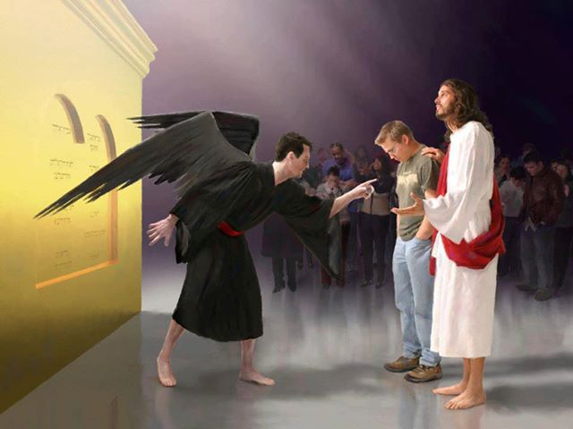
ROMANS 5–8
Dr. Rick Griffith • Jordan Evangelical Theological Seminary • BibleStudyDownloads.org
Notes:
How do you interpret this picture?
If you were to put dialogue boxes above each character, what would they be saying?
Changes need in the Arabic:
New position on 5
Title on 7
Picture on 16
Box on 18
Accomplishments on 58 (privileges)
Change "theological words' to "theological concepts" in the 5 theological definitions slides

Slide 2
Slides on
Romans 5

Slide 3
Romans 5
Righteousness through imputation gives assurance

Slide 4

Righteousness in Romans
145
Theme | Needed | Provided | Imparted | Proved | Applied | Dissem-inated
Intro 1:1-17 | Condem-nation 1:18– 3:20 | Justifi-cation 3:21– 5:21 | Sanctifi-cation 6–8 | Election 9–11 | Trans-form-ation 12:1– 15:13 | Propa-gation 15:14– 16:27
Start | Sin | Salva-tion | Set Apart | Sove-reignty | Service | Send

Slide 5
Overview of Romans 5–8
5 | 6 | 7 | 8
Justification |  | Sanctification
Penalty Paid |  | Power Broken
Our Position |  | Our Progress
Christ died for us | We died with Christ to sin | We died to the Law | We walk in the Spirit
New position New standing New privileges | We died to sin as a master | We died to self-effort | We are transformed by the Spirit
Adapted from Dr Bill Egner, Christ Chapel Bible Church, Fort Worth, TX (11 June 2023)

Slide 6

Romans 5:1
153
A verse to remember…
"Therefore, since we have been made right in God's sight by faith, we have peace with God because of what Jesus Christ our Lord has done for us."

Slide 7

Joy, endurance, character, hope, honor, love
Romans 5:3-5
³ Not only that, but we rejoice in our sufferings, knowing that suffering produces endurance, ⁴ and endurance produces character, and character produces hope, ⁵ and hope does not put us to shame, because God's love has been poured into our hearts through the Holy Spirit who has been given to us.
Notes:
There exist six results of justification noted in Romans 5:3-5 at the top of the slide

Slide 8

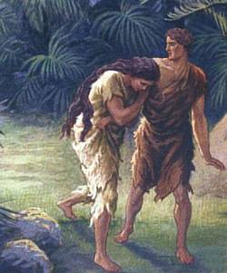
Did death exist before sin?
What do you think?
VERY GOOD
What does it mean that creation was "very good" if death existed then?
Notes:
Did death exist before sin? What do you think? God said that his creation up to this time was "very good." What does it mean that creation was "very good" if death existed then?
Creation teaches a more realistic approach that death is not natural but a result of man’s sin.
Genesis 2:17 warns that eating the fruit would lead to death. This tells us that death did not exist while Adam and Eve were in the garden.
—————
Common-144
OB-22-Creation-19?
NS-06-Rom5-8-slide 7

Slide 9
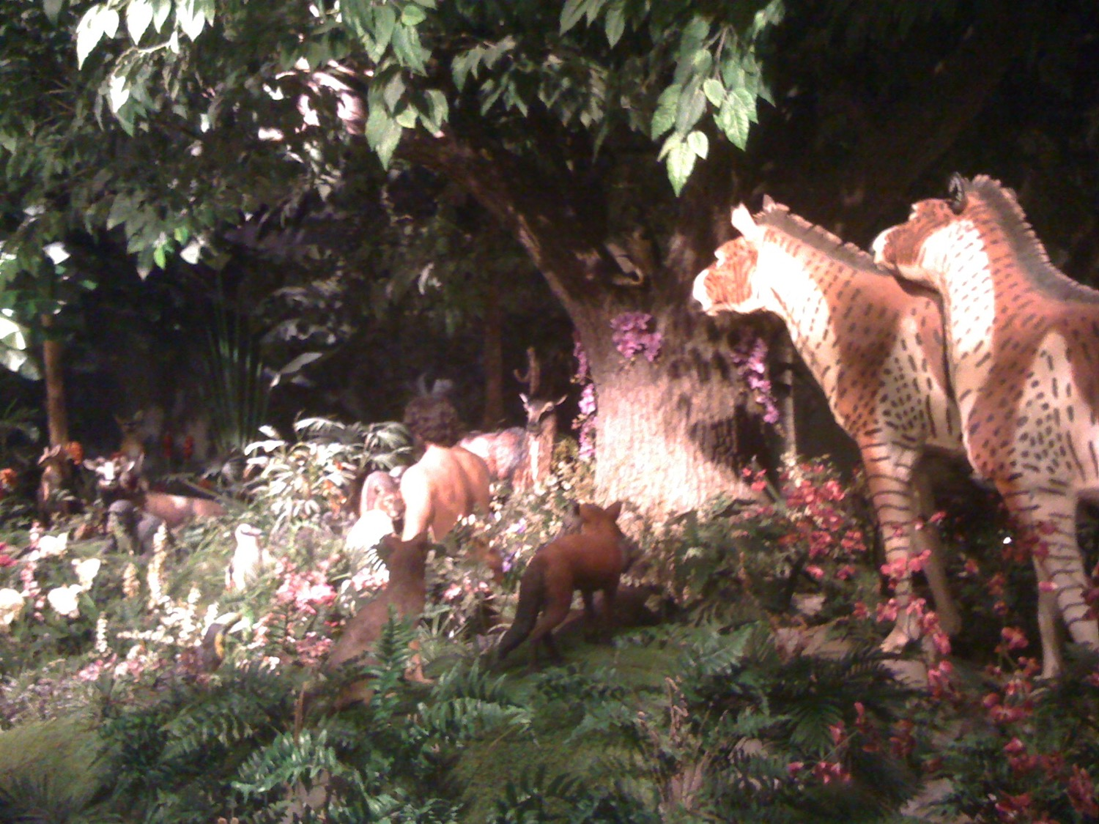
Life started great for animals

Slide 10
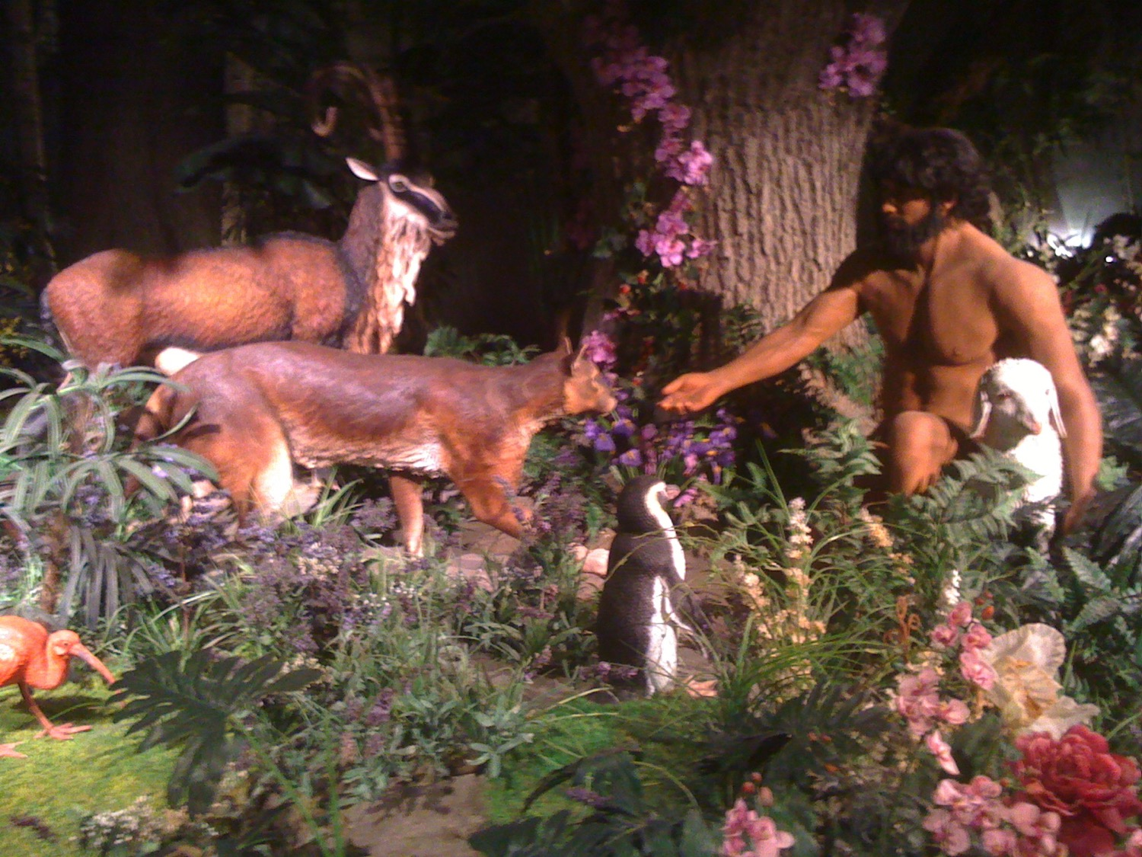
Life started great for animals

Slide 11
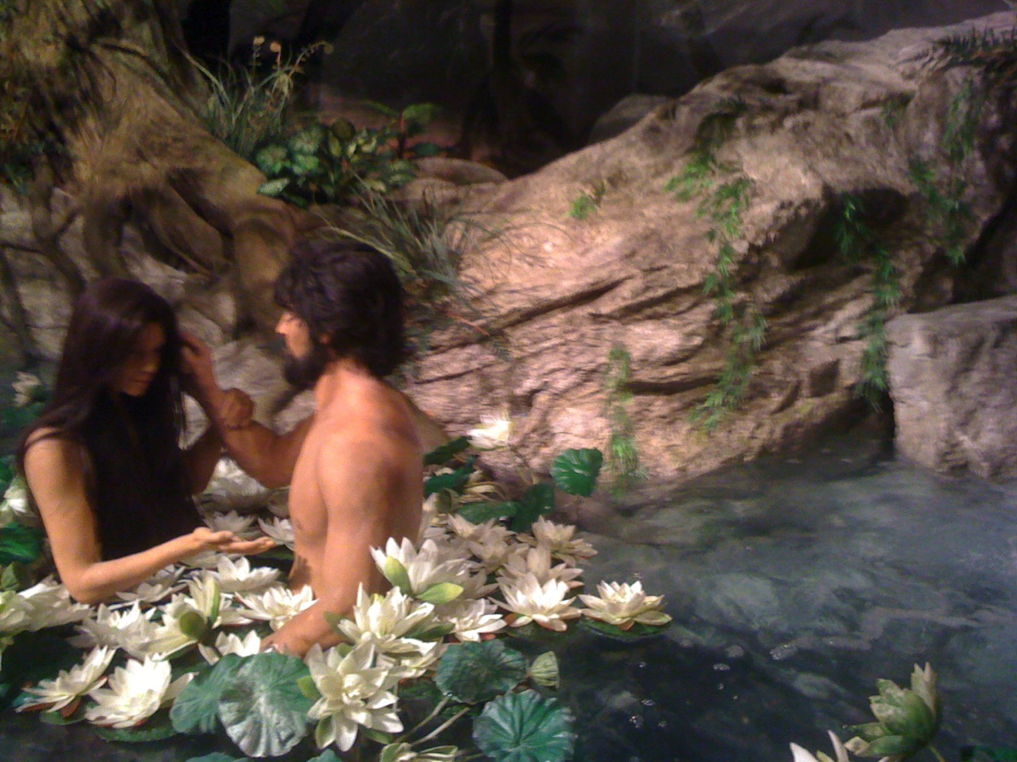
Life started great for people

Slide 12
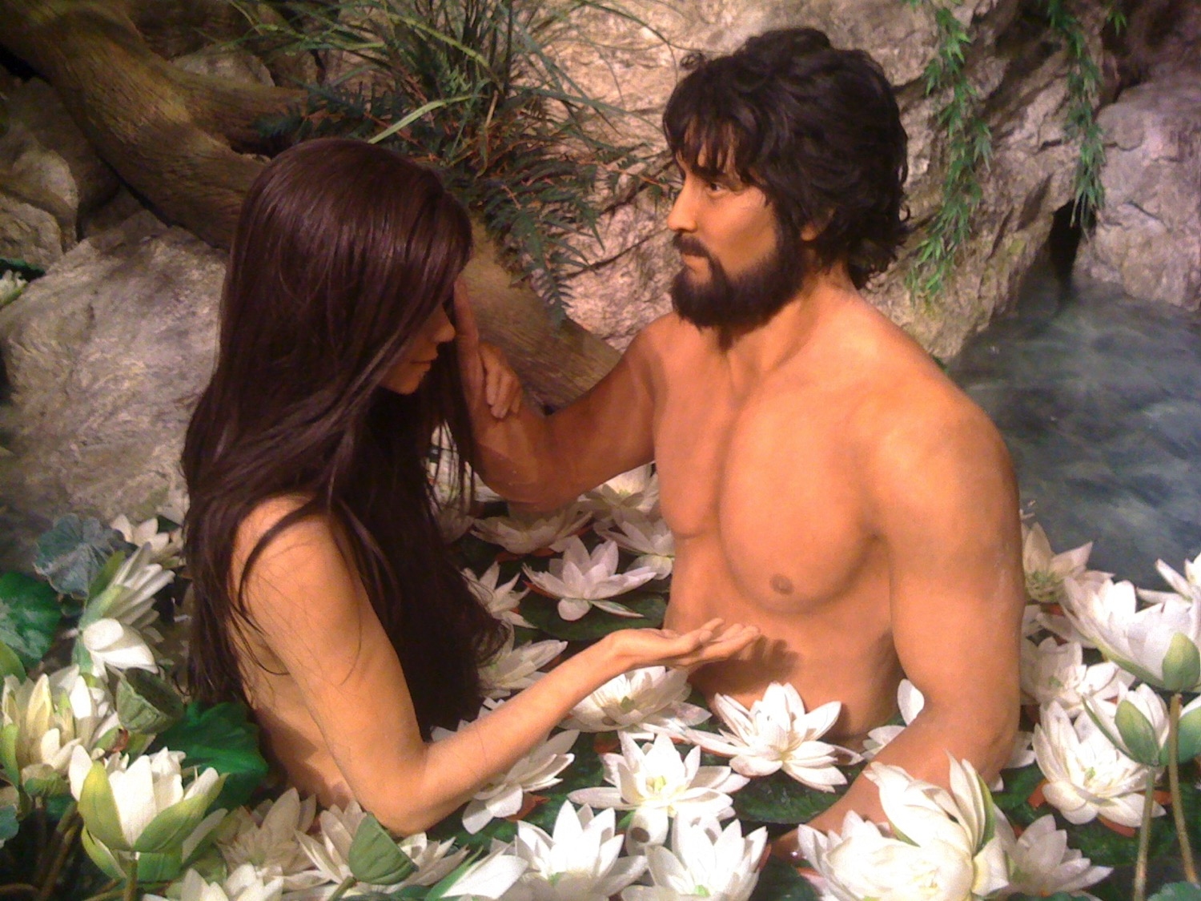
Life started great for people

Slide 13
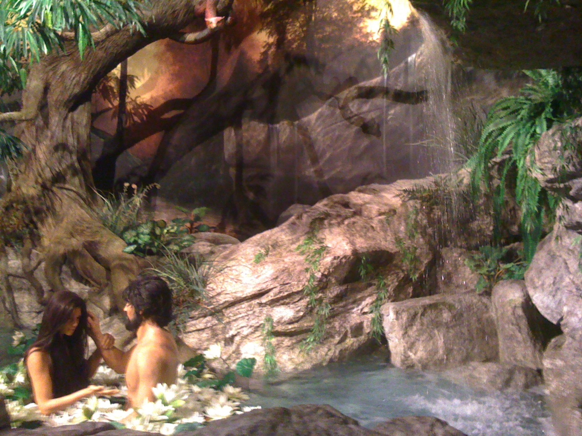
But God needed to include the tree

Slide 14
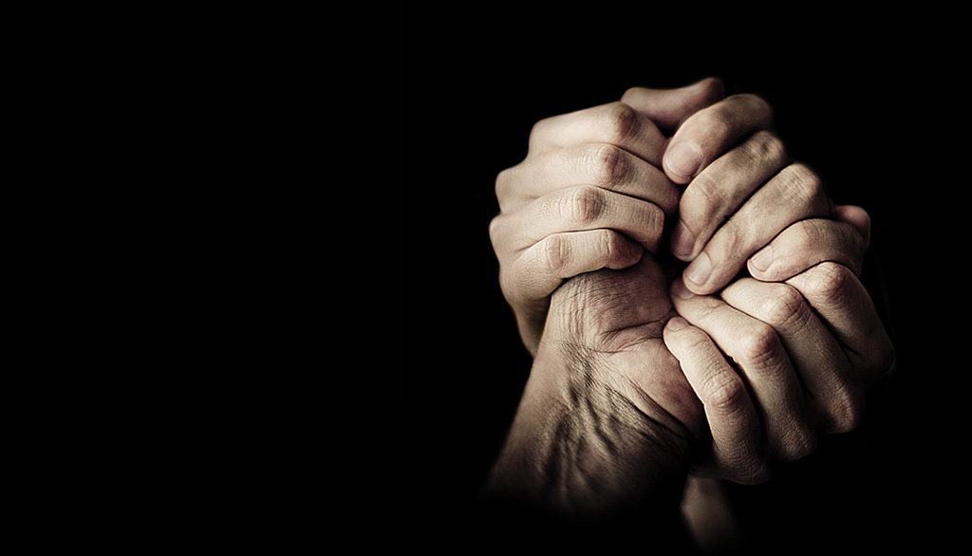
When did death come into the world?
Small Group Question:
Did death exist before the Fall?

Slide 15
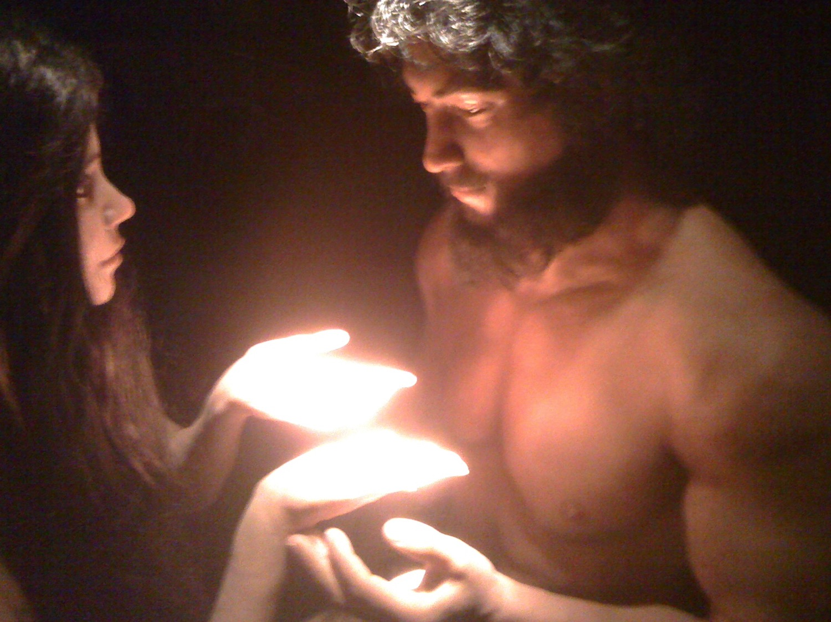
Romans 5:12 (NAU)
Therefore, just as through one man sin entered into the world, and death through sin, and so death spread to all men, because all sinned
Notes:
Death started with Adam—not just death for humans, but death itself for all creatures.

Slide 16
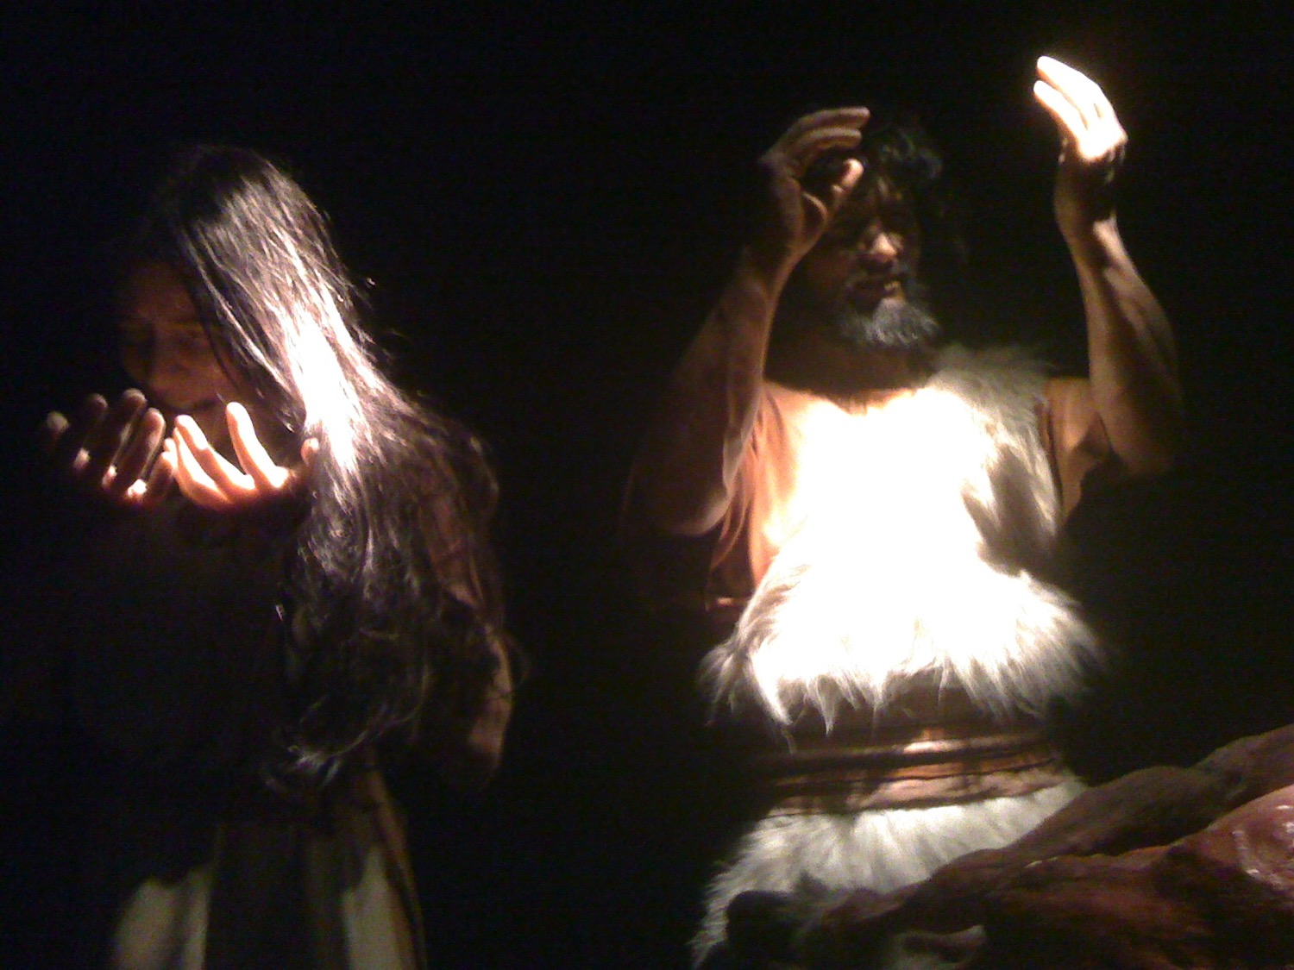
Romans 5:12 (NLT)
When Adam sinned, sin entered the world. Adam's sin brought death, so death spread to everyone, for everyone sinned
Notes:
Did both Adam and Eve pass sin to Cain, Abel, and their other children?
If Eve passed on her sin nature, then how could Jesus be born of a sinful mother, Mary? It is not good enough to say that she was conceived of the Spirit.
The sin nature inherent to us comes one or more of these ways:
1. Through both parents (no text says this)
2. Through the mother only (no text says this)
3. Through the father only
4. Directly from God (certainly not!)
Romans 5:12 specifically says that it was Adam's sin that passed to humanity, not Eve. This must mean that the sin nature passes through the father, not the mother. This allowed Jesus to be born without sin by the "overshadowing" of the Spirit even though he had a sinful mother.

Slide 17
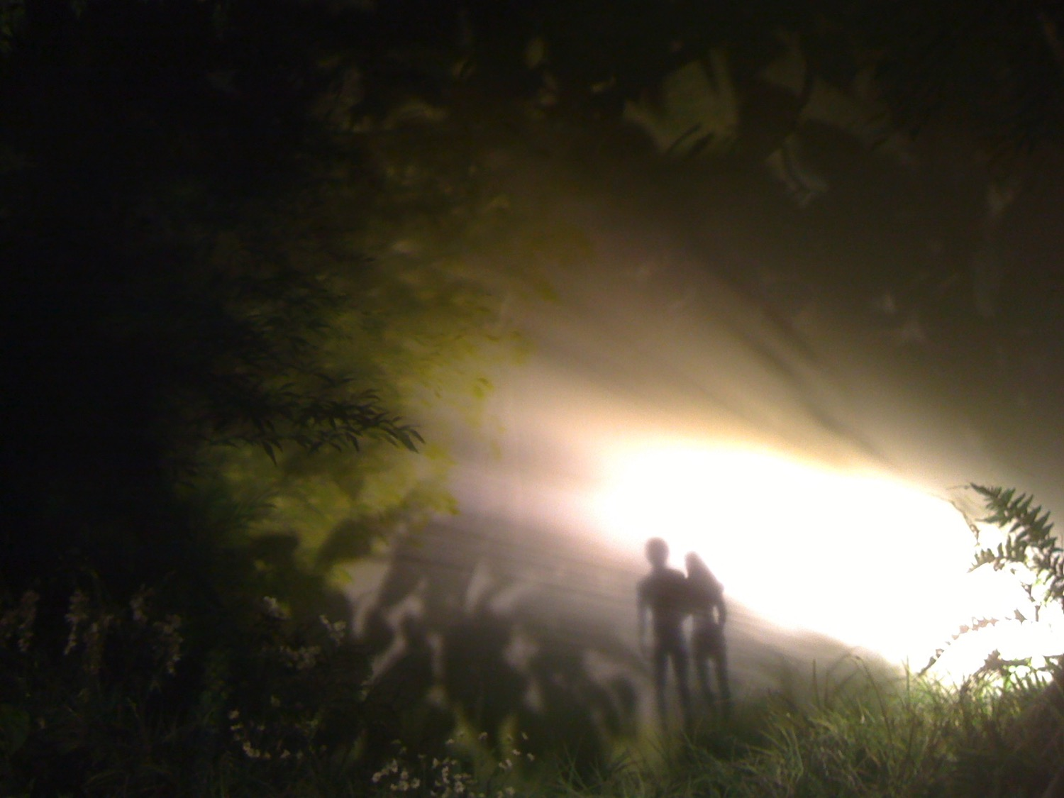
Results of Sin
Shame: "Then the eyes of both of them were opened, and they knew that they were naked; and they sewed fig leaves together and made themselves loin coverings"
(Gen. 3:7; cf. 2:25 NAU)
Separation from God: Adam hid in the Garden (Gen. 3:8)
Death: "In the day you eat from it,
you shall die" (Gen. 2:17 NAU)
Notes:
Shame: Not guilt, as I used to teach
Separation: Fellowship with God was broken
Death: Spiritual death

Slide 18
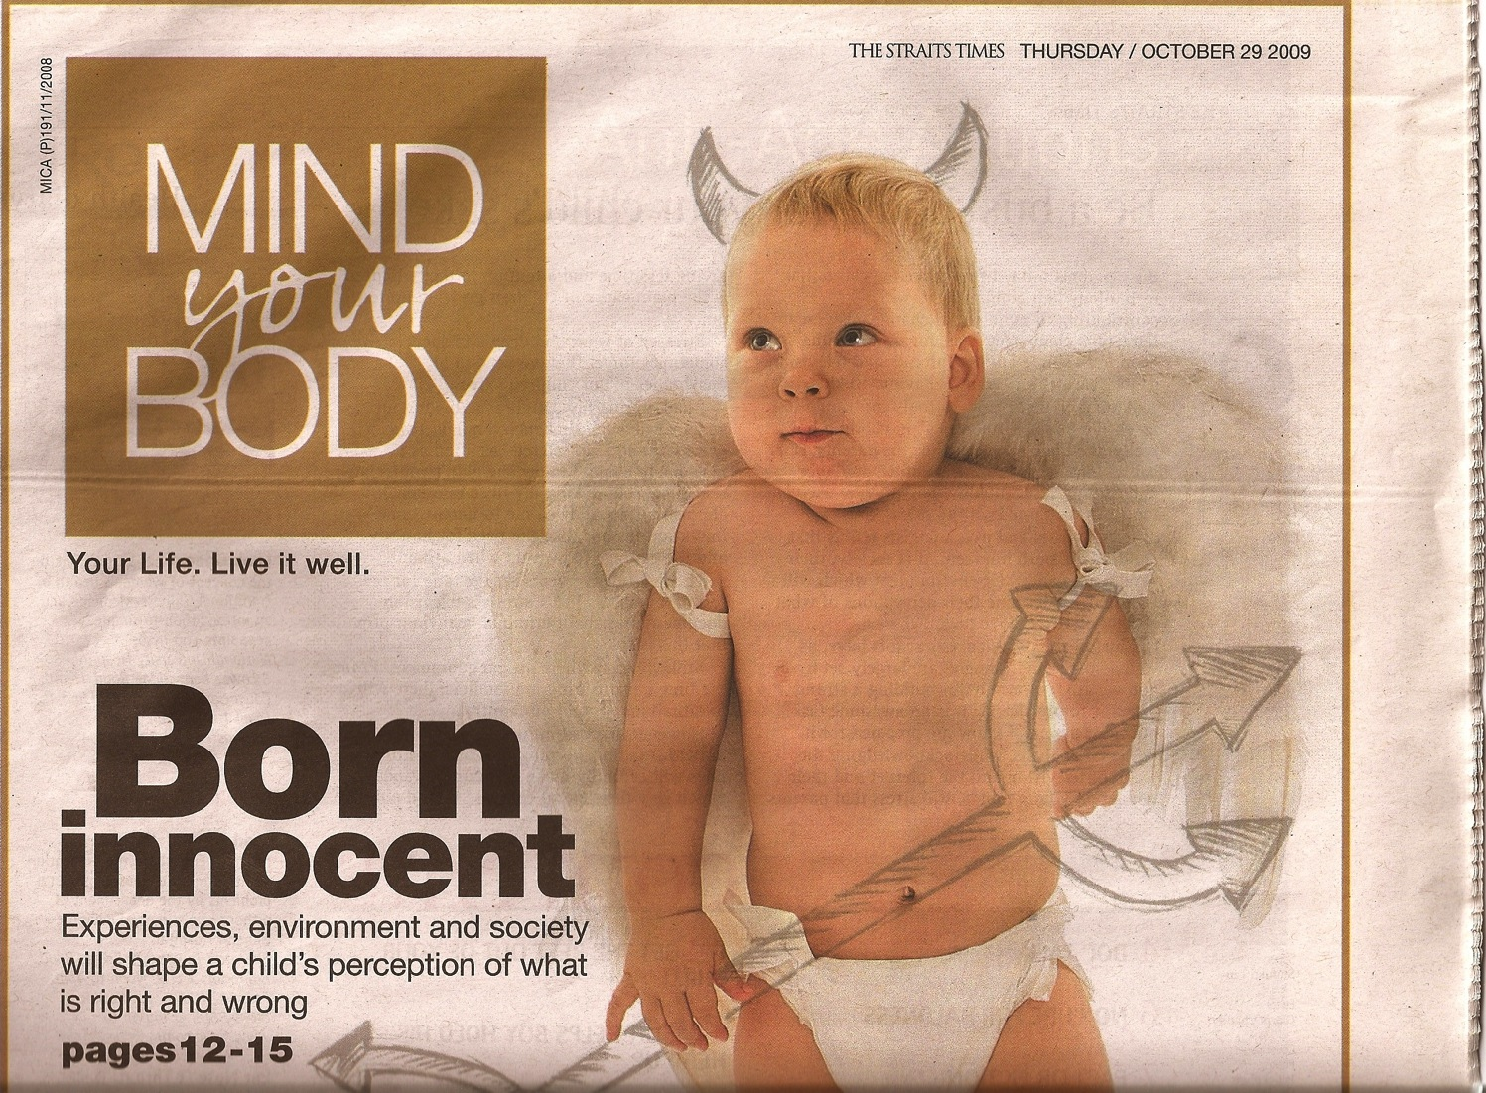
Born Innocent?
Many psychologists believe so!
Born
innocent
Experiences, environment and society will shape a child's perception of what is right and wrong

Slide 19
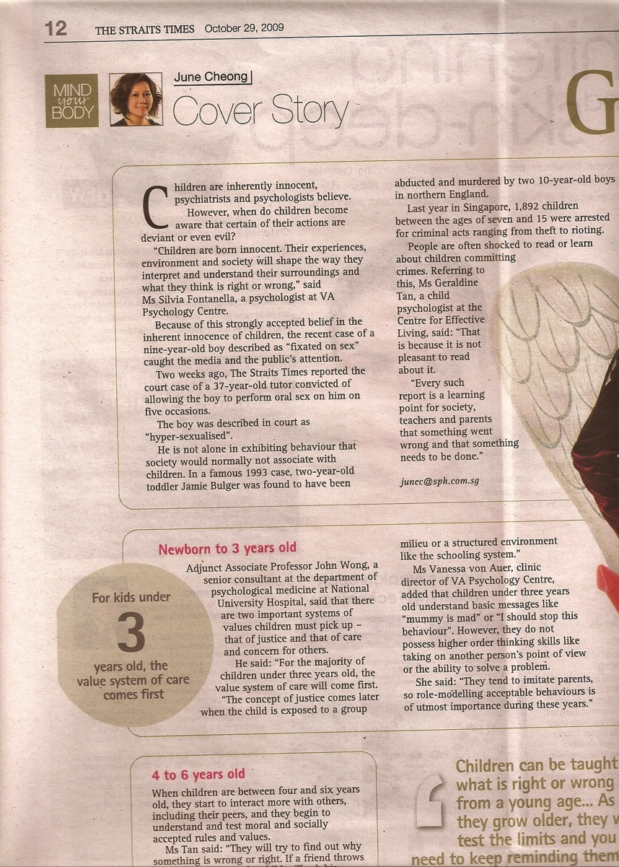
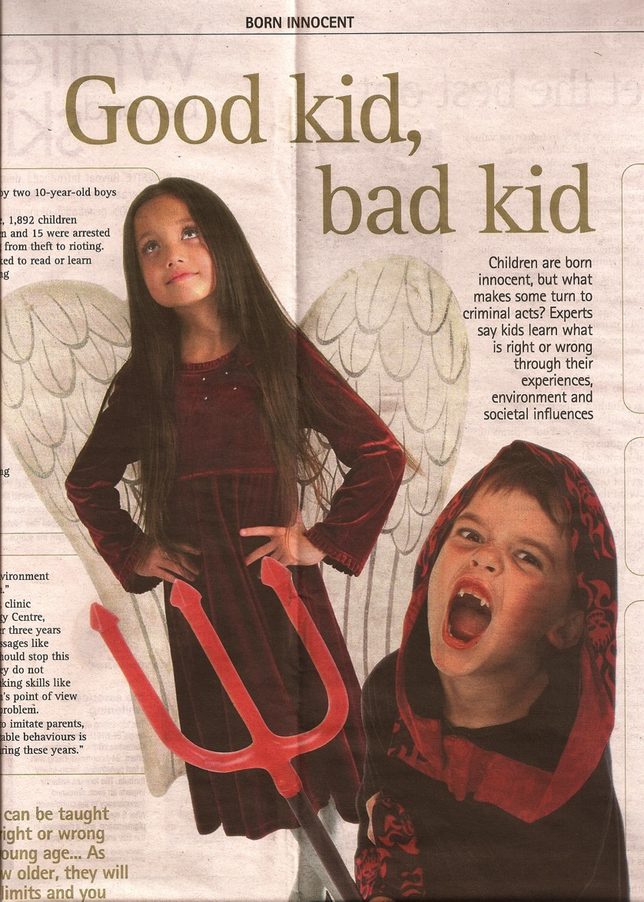
Born Innocent?
Good kid,
Bad kid
The article itself contrasts children (not babies!)
Notes:
Do you see any problems with this theory? To prove that children are born innocent, one cannot evaluate 5-year-olds to see how their environment influenced them. One must show that ALL babies care for their mothers more than themselves! ALL babies care that their mothers get enough sleep, right? ALL babies want to make sure that others are fed before themselves, right? Then later they have to LEARN how to lie, cheat, and steal, right? This theory is not only unbiblical. It is absurd.

Slide 20
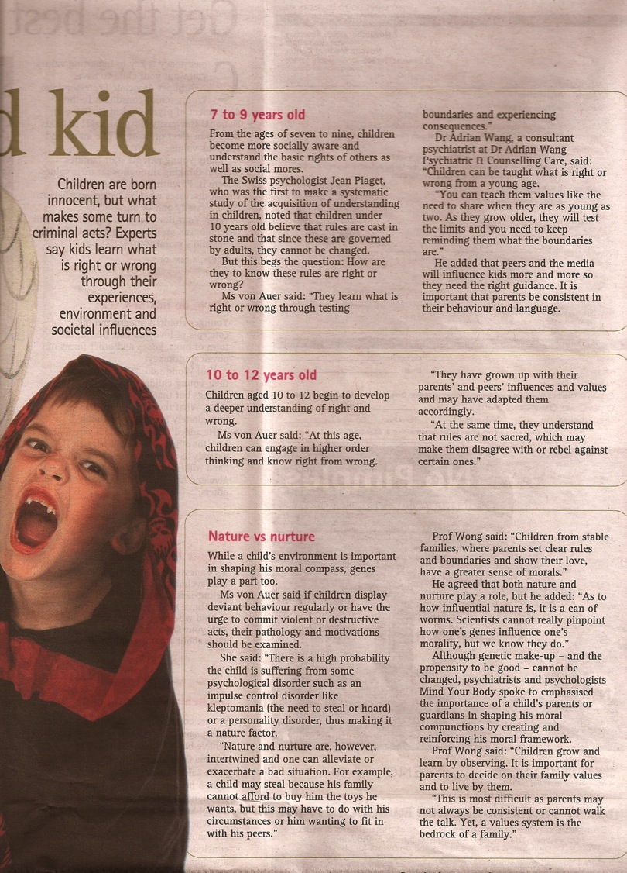
Born Innocent?
The biblical view of original sin fits with what every parent knows.
It also explains why we all must teach children to do right instead of wrong.

Slide 21
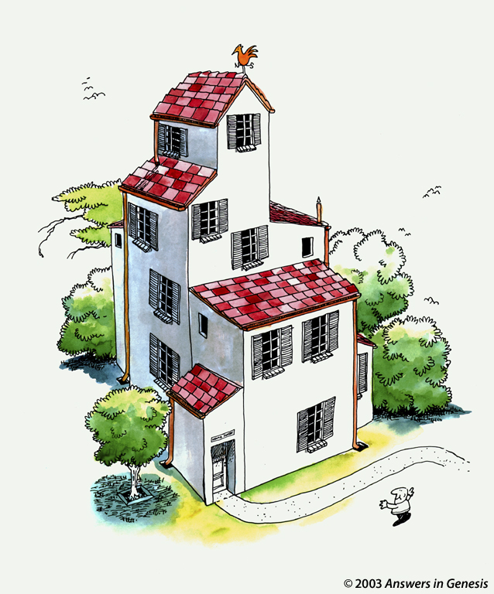
Build on a biblical foundation in Romans 5:12-21

Slide 22
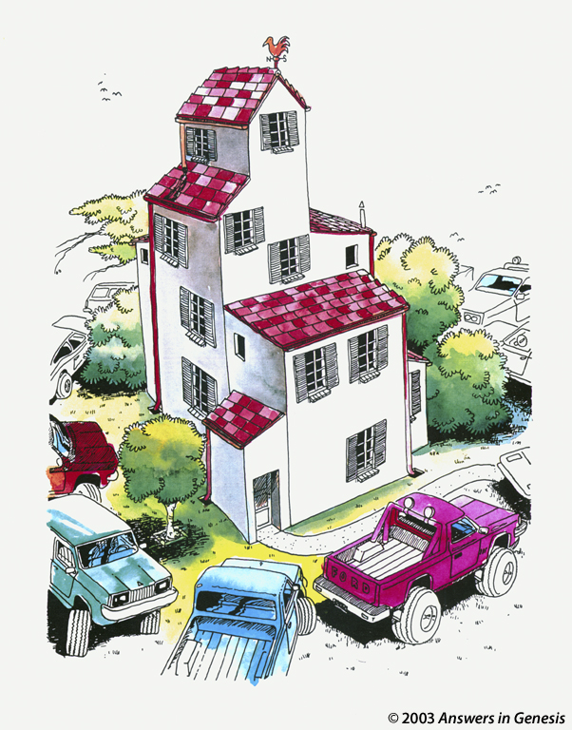
House 2 00419
Notes:
Suppose many huge trucks rumbled around the house without ever touching it.

Slide 23
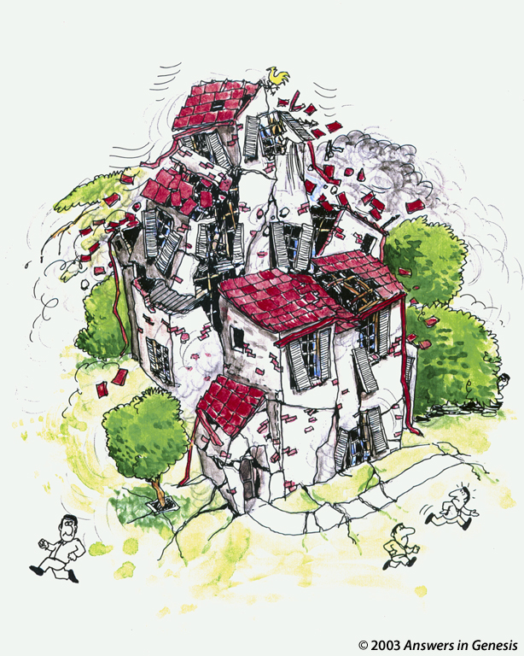
House 3 00420
Notes:
Trucks like that would cause such a stir that they would destroy the very foundation of the house, causing it to collapse.

Slide 24
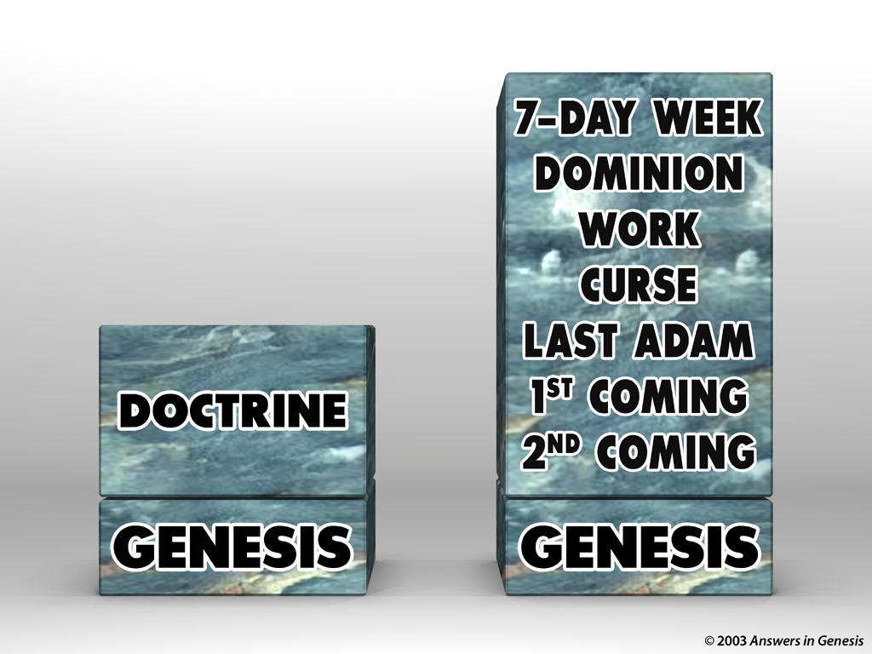

Blocks-Genesis Doctrine & Doctrines 00405
2ND COMING
1ST COMING
LAST ADAM
CURSE
DOMINION
DOCTRINE
WORK
7-DAY WEEK
GENESIS
GENESIS
Notes:
All of our biblical doctrine is build on man's nature known from Genesis—that man was created perfect but then sinned and passed this sinful nature on to the rest of humanity.
Genesis is the foundation of all other teachings.

Slide 25
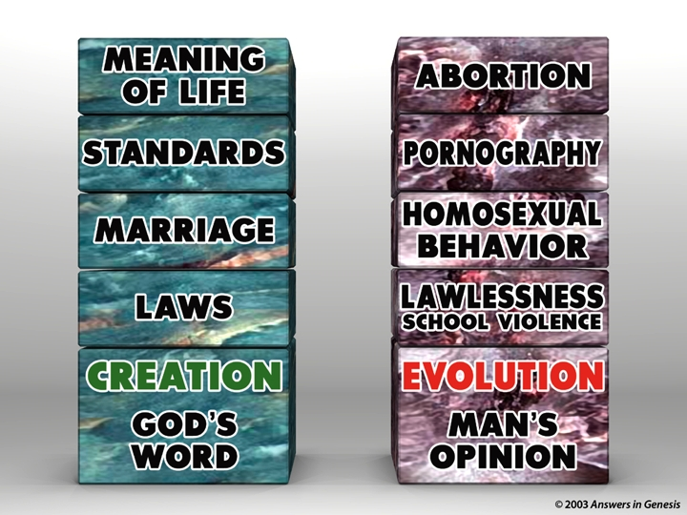
Blocks-God's Word & Man's Opinion 00403
MEANING
OF LIFE
ABORTION
STANDARDS
PORNOGRAPHY
MARRIAGE
HOMOSEXUALITY
LAWS
LAWLESSNESS
CREATION
GOD'S
WORD
EVOLUTION
MAN'S
OPINION

Slide 26
Q335-Sagan 00434
The secrets of evolution are time and death. Time for the slow accumulations of favorable mutations, and death to make room for new species.
Carl Sagan, program entitled "One Voice in the Cosmic Fugue."
© 2003 Answers in Genesis

Slide 27
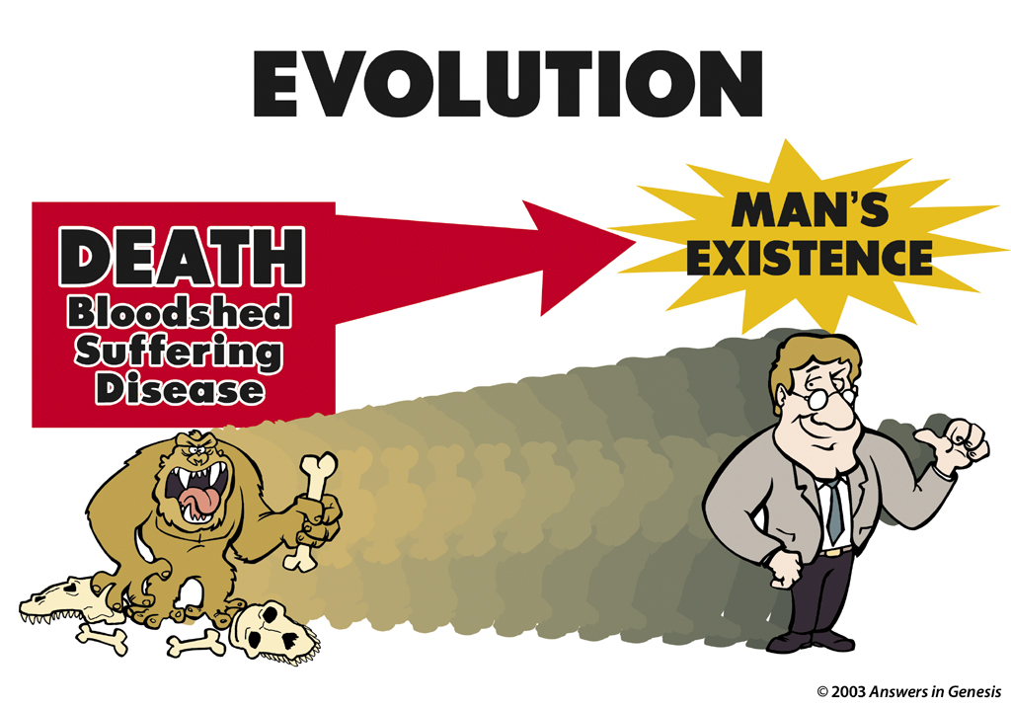
Evolution: Death-Man 00413
EVOLUTION
MAN'S EXISTENCE
DEATH
Bloodshed
Suffering
Disease
Notes:
Evolution believes that ape-man generations got better to where we are today.
—————
Common-141
OB-22-Creation-18
NS-06-Rom5-8-slide 24
SA-02-Creation & Fall-24

Slide 28
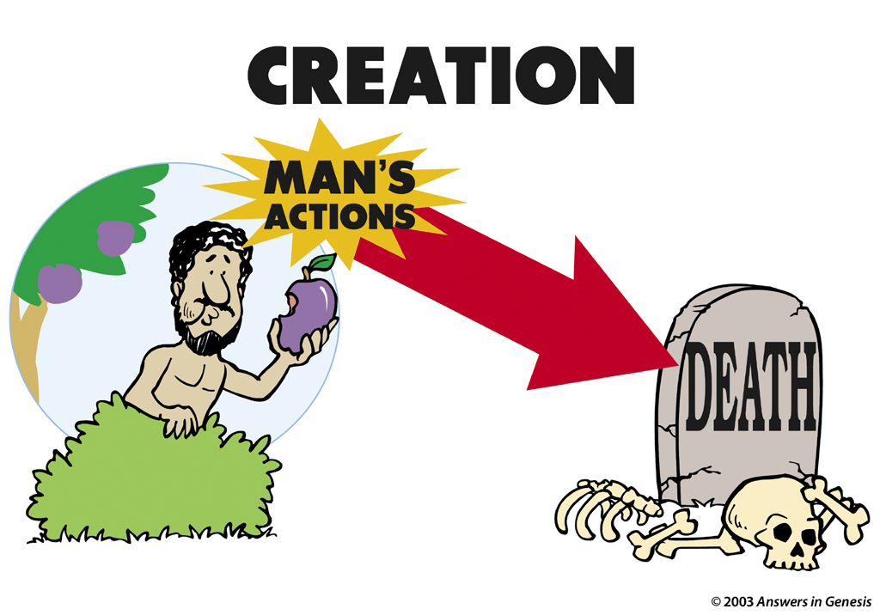
Creation: Actions-Death 00412
CREATION
MAN'S ACTIONS
DEATH
Notes:
Creation teaches a more realistic approach that death is not natural but a result of man’s sin.
—————
Common-143
OB-22-Creation-19
NS-06-Rom5-8-slide 25
SA-02-Creation & Fall-25

Slide 29
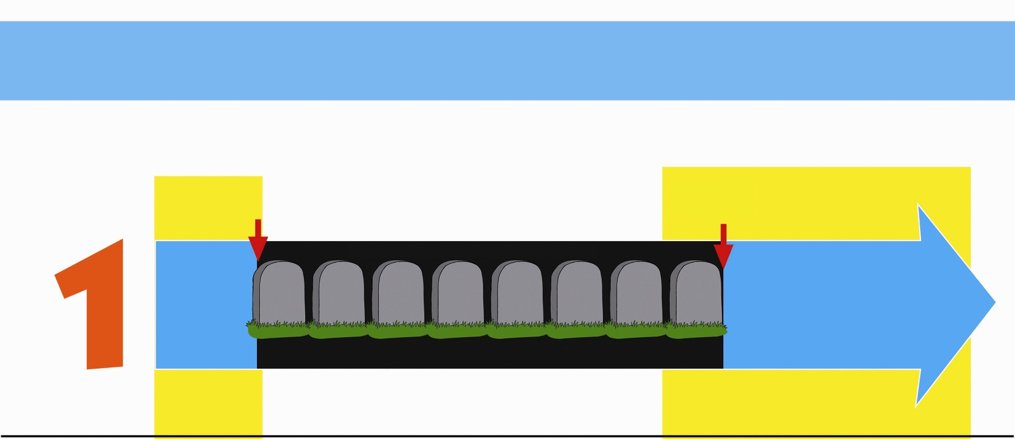
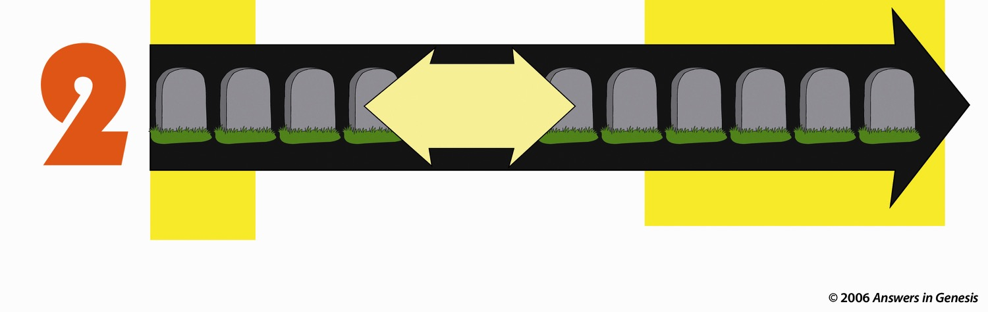
Two Histories of Death
How long has death existed (Rom. 5:12)?
Beginning
Death is an enemy
Future
Man's sin brought Death
DEATH will be done away with
ONLY THOUSANDS OF YEARS
God's Word
NO DEATH
NO DEATH
Death is temporary
Man's Opinion
MILLIONS AND MILLIONS OF YEARS
Life and death have always been together
Death is a permanent part of history
As long as there is life, there will be death
Notes:
Only two options exist, either
God’s Word that teaches no death in the creation and therefore no death in the future, or…
Man’s opinion that death has always existed and always will exist.
Each believer must answer which of these two theologies he will follow.
_____________
AP-02-Engaging Athiests-86
CR-29-Theistic Evolution-71
OS-01-Gen1-3-slide219
06-Romans_5-8_slide 26

Slide 30

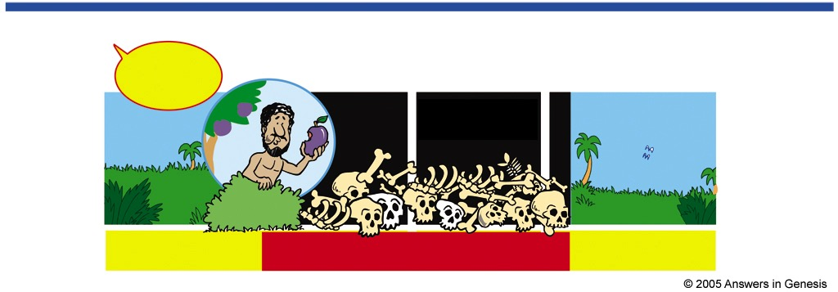
Which View of Death Matches Romans 5:12?
VERY GOOD!
PAST
Millions of Years
PRESENT
FUTURE
Adam
Death
Death
Death
Death
VERY GOOD!
PRESENT
FUTURE
PAST
Adam
No Death
Death
Death
No Death
Notes:
We need to interpret Scripture at face value rather than reading so-called science into it.
____________
OS-27-Daniel-208
NS-Romans5-8—slide 30

Slide 31
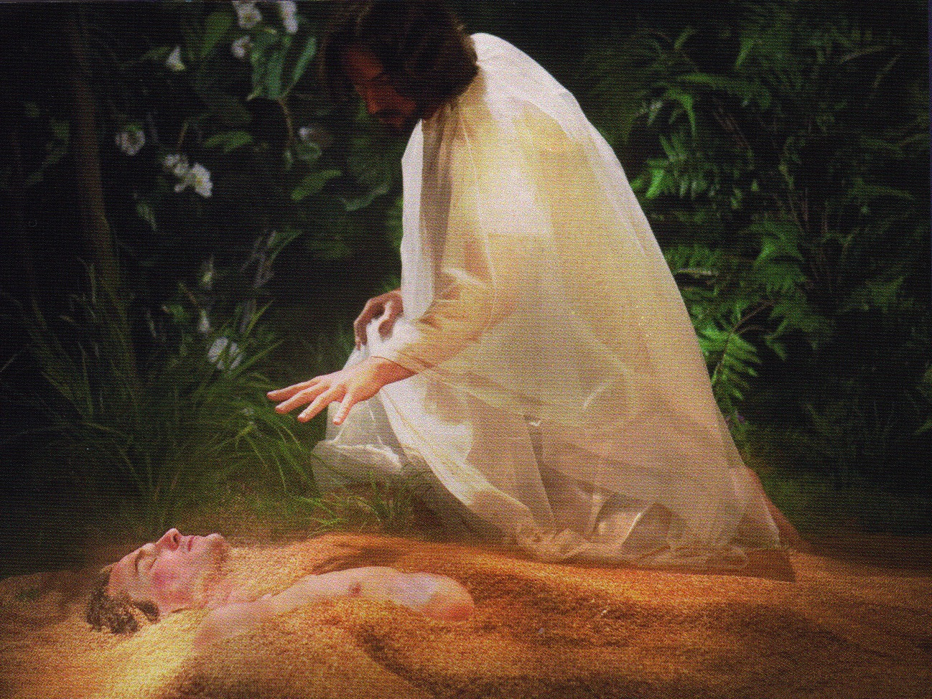
Jesus formed Adam from the dust (John 1:3; Gen. 2:7).

Slide 32
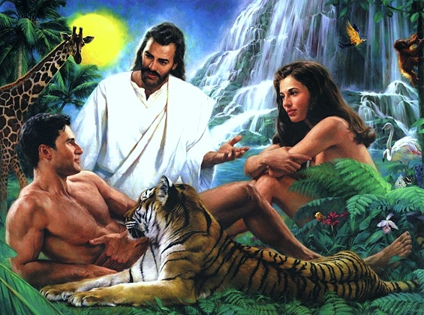
Jesus Created Adam and Eve (John 1:3; Gen. 2:21-23)

Slide 33
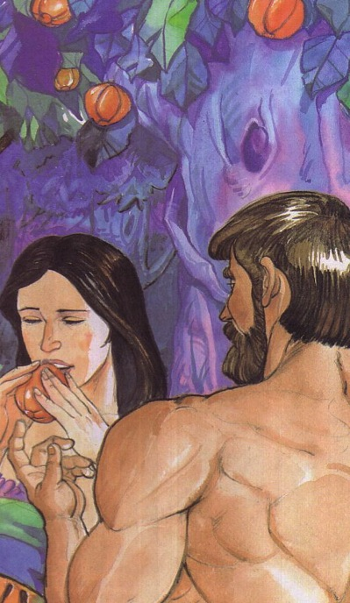
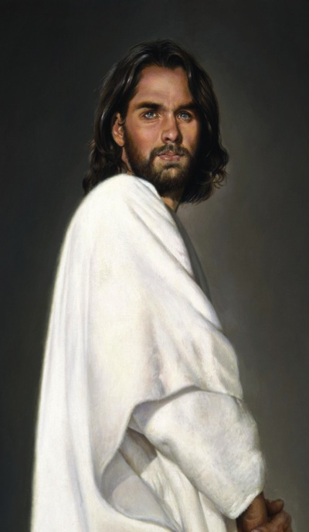
Adam versus Christ
153
Romans 5:12-21
1 Cor. 15:22
1 Cor. 15:45-49

Slide 34
Romans 5:8-21
155j
What we have as Adam's children
What we have as God's children
Adam gave us…
Christ gives us…
Ruin 5:9
Rescue 5:8
Sin 5:12, 15, 21
Righteousness 5:18
Death 5:12, 16, 21
Eternal life 5:17, 21
Separation from God 5:18
Relationship with God 5:11, 19
Disobedience 5:12, 19
Obedience 5:19
Judgment 5:18
Deliverance 5:10, 11
Law 5:20
Grace 5:20

Slide 35
Slides on
Romans 6

Slide 36
Why accept one another?
145
SIN
Needed
in Condemnation
1:18–3:20
Equal Righteousness
1:1-17
Provided
in Justification
3:21–5:21
SALVATION
Imparted
in Sanctification
6–8
SET APART
Notes:
God's righteousness imparted sanctification equally to us all (Rom 6–8).
[We all have the same access to progressively grow in holiness to be like Christ.]
Where does the concept of accepting one another come from in Romans?
Rom. 15:7 Therefore, accept each other just as Christ has accepted you so that God will be given glory.

Slide 37
Romans 6
154a
Righteousness is imparted in sanctification through positional identification with Christ

Slide 38
Righteousness in Romans
145
Theme | Needed | Provided | Imparted | Proved | Applied | Dissem-inated
Intro 1:1-17 | Condem-nation 1:18– 3:20 | Justifi-cation 3:21– 5:21 | Sanctifi-cation 6–8 | Election 9–11 | Trans-form-ation 12:1– 15:13 | Propa-gation 15:14– 16:27
Start | Sin | Salva-tion | Set Apart | Sove-reignty | Service | Send

Slide 39
Overview of Romans 5–8
5 | 6 | 7 | 8
Justification |  | Sanctification
Penalty Paid |  | Power Broken
Our Position |  | Our Progress
Christ died for us | We died with Christ to sin | We died to the Law | We walk in the Spirit
New position New standing New privileges | We died to sin as a master | We died to self-effort | We are transformed by the Spirit
Adapted from Dr Bill Egner, Christ Chapel Bible Church, Fort Worth, TX (11 June 2023)

Slide 40
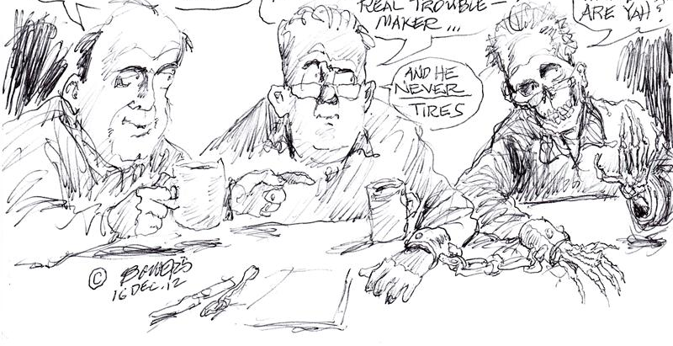
Always there.
He's my old sin nature… He's always around—a real troublemaker…
Hi…
How are ya?
Hey, Bob, who's your Pal?
And he never tires
Notes:
The Christian will struggle with sin as long as he is in this mortal body.
________________
OS-38-Zechariah-57
NS-06-Rom5-8—slide 39

Slide 41
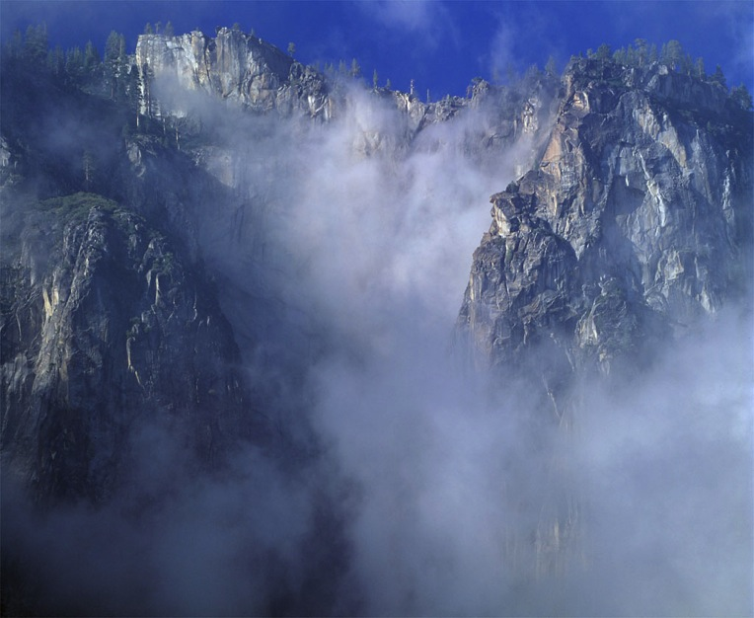
Contrasts Between
Justification and Sanctification
155k
JUSTIFICATION
"Not guilty"
Legal Standing
Once for all time
Entirely God's work
Perfect in this life
Same in all Christians
SANCTIFICATION
"Set apart"
Internal condition
Continuous throughout life
We cooperate with God
Not perfect in this life
Different levels

Slide 42
Sanctification
God's Viewpoint | Man's Viewpoint
Positional | Experiential
Instantaneous | Progressive
Ideal | Practical
Complete | Partial
Final | Present
Romans 6:1-10 | Romans 6:11-23
Adapted from Romans (Colorado Springs: BEE World, 2018), 88

Slide 43
Righteousness Imparted in Sanctification (Romans 6–8)
154b
How does the blood of Christ apply to us?
Chapter 6
New Basis
––
Identification
Notes:
Romans 5 (our standing/identity)
• We've been justified by God's legal declaration
• Peace and safety with Him: grace now and glory later
Romans 6 (our relationship)
• He's united us to Jesus Christ (Death/Burial/Resurrection) so what happens to him will happen to us
• While you're not yet all you will be, you're no longer who you once were!
• Continuing in sin is inadmissible in our lives
Romans 7 (our inability)
• Do's and don'ts won't bring about spiritual growth because they rely on self-effort; I'm not unwilling, but I am unable.
• We desperately need "outside" help!
—Dr Bill Egner, Christ Chapel Bible Church, Fort Worth, TX (11 June 2023)

Slide 44
Our positional identification with Christ is our new basis for sanctification so Jews should avoid legalism and Gentiles should avoid indulgence (Romans 6).
154a
Our positional freedom from sin’s power comes from a once-for-all identification with Christ in water baptism in his death and resurrection (6:1-10).
Our practical freedom from sin’s power occurs by continually yielding by faith to Christ as our new master (6:11-14).
We must each choose righteousness by realizing that our old master of sin now has no claim on us (6:15-23).

Slide 45
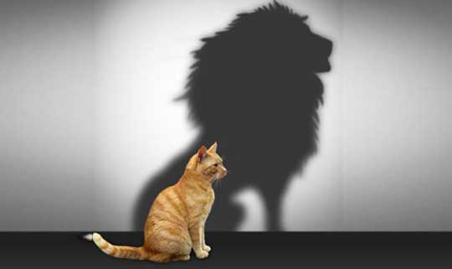
Our Position in Christ
Soteriology: God’s Rescue Program
Dr. Rick Griffith • Singapore Bible College
BibleStudyDownloads.org
Notes:
You may think you are a cat, but you are really a lion!
Spiritually, you may think yourself weak, but in Christ you can conquer any sin!

Slide 46
Do we teach about our position in Christ today?
Not much.
Instead, we emphasize…

Slide 47

Self Esteem

Slide 48

THE LADDER OF SELF ESTEEM
YES, I DID IT!
I WILL DO IT
I CAN DO IT
I'LL TRY TO DO IT
HOW DO I DO IT?
I WANT TO DO IT
I CAN'T DO IT
I WON'T DO IT
Notes:
Believers sadly speak more of self-esteem than we do our position in Christ.
________________
NS-06-Rom5-8-Slide 47
SA-07-Position in Christ-4

Slide 49

Self Esteem

Slide 50

Self Esteem

Slide 51
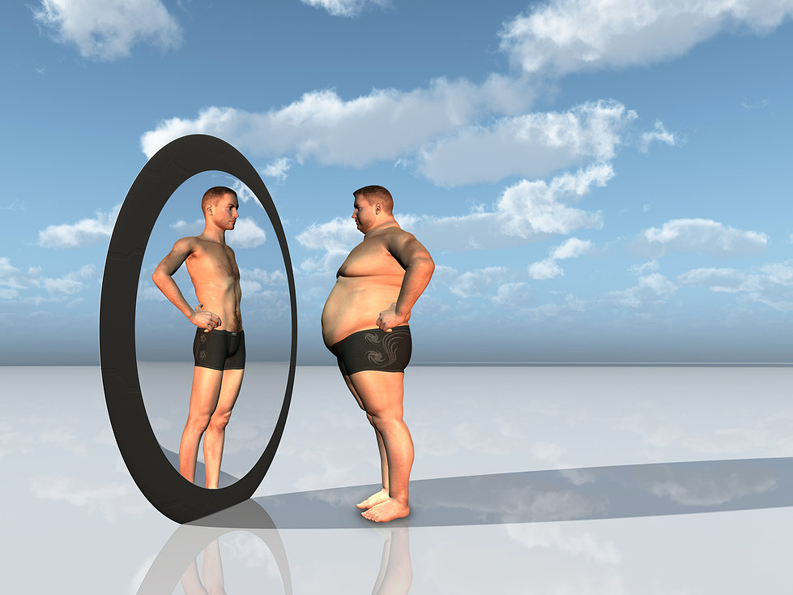
High Self Esteem
Notes:
Some of us have too high a view of ourselves.

Slide 52
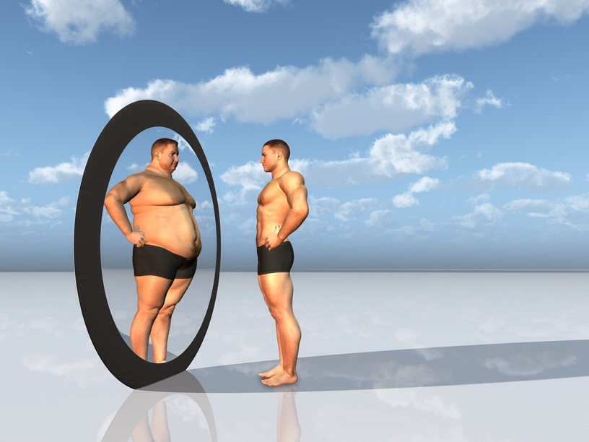
Low Self Esteem
Notes:
Others have too low a view of themselves.

Slide 53

“Everyone gets a trophy.”

Slide 54

Believe in Yourself
我们在基督里的身份

Slide 55
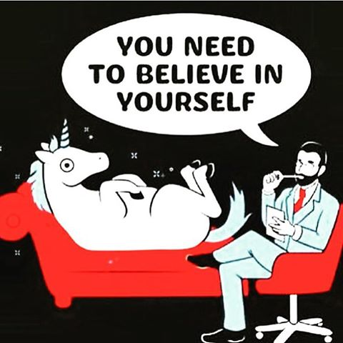
Believe in yourself
我们在基督里的身份

Slide 56

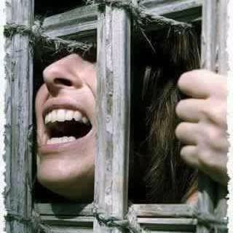
Your Identity in Christ

Slide 57

Your Identity in Christ

Slide 58
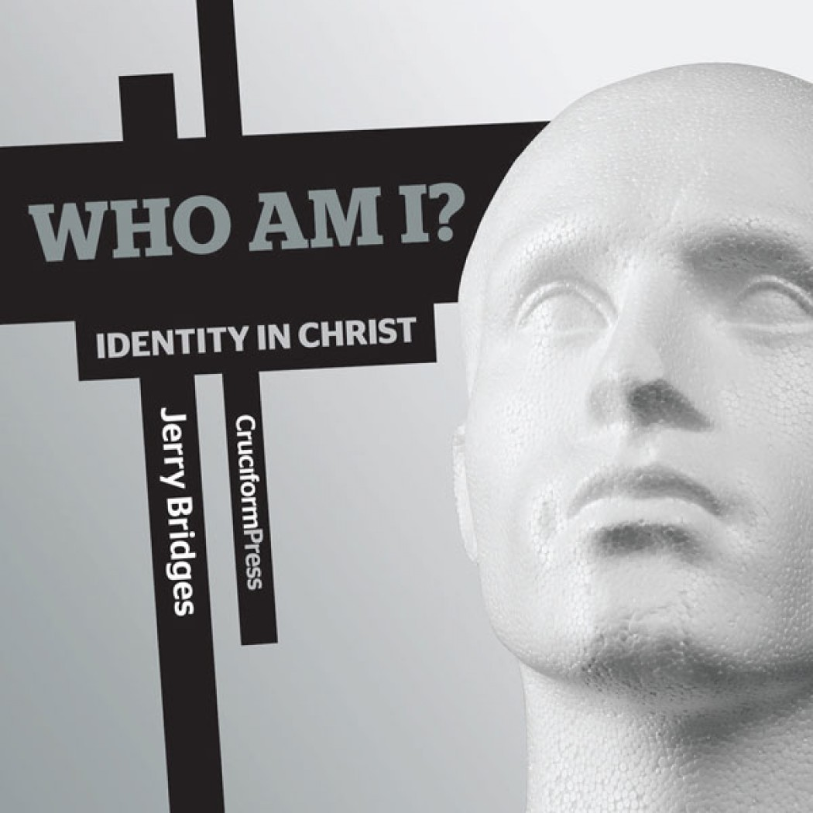
Your Identity in Christ
Who Am I？
Identity in Christ

Slide 59

Our Identity in Christ
The Riches of Grace in Christ Jesus
(33 Divine Accomplishments in and for the Sinner
upon Believing on the Lord Jesus Christ)
by Lewis S. Chafer
Notes:
The Riches of Grace in Christ Jesus
(33 Divine Accomplishments in and for the Sinner
upon Believing on the Lord Jesus Christ)
by Lewis S. Chafer
Accessed 9 July 2017
Copied for WholesomeWords.org from Salvation by Lewis Sperry Chafer. Philadelphia: Sunday School Times Company, ©1917.
http://www.wholesomewords.org/etexts/chafer/saved.html

Slide 60

Our Identity in Christ
In the Eternal Plan of God
Reconciled
Redeemed
Related to God Through a Propitiation (the satisfaction of God's holiness)
All Sins Covered by Atoning Blood
Vitally Joined together with Christ for Judgment of the "Old Man" Unto a New Walk
Free from the Law
Children of God
Adopted (placed as adult sons)
Acceptable to God by Jesus Christ
Notes:
The Riches of Grace in Christ Jesus
(33 Divine Accomplishments in and for the Sinner
upon Believing on the Lord Jesus Christ)
by Lewis S. Chafer
Accessed 9 July 2017
Copied for WholesomeWords.org from Salvation by Lewis Sperry Chafer. Philadelphia: Sunday School Times Company, ©1917.
http://www.wholesomewords.org/etexts/chafer/saved.html

Slide 61
Our Identity in Christ
Justified
Forgiven All Trespass
Made Nigh (Drawn Near)
Delivered from the Powers of Darkness
Translated into the Kingdom
On the Rock Christ Jesus
A Gift from God the Father to Christ
Circumcised in Christ
Partakers of the Holy and Royal Priesthood
A Chosen Generation and a Peculiar People
Having Access to God
Within the "Much More" Care of God:
Notes:
The Riches of Grace in Christ Jesus
(33 Divine Accomplishments in and for the Sinner
upon Believing on the Lord Jesus Christ)
by Lewis S. Chafer
Accessed 9 July 2017
Copied for WholesomeWords.org from Salvation by Lewis Sperry Chafer. Philadelphia: Sunday School Times Company, ©1917.
http://www.wholesomewords.org/etexts/chafer/saved.html

Slide 62
Our Identity in Christ
His Inheritance
Our Inheritance
A Heavenly Association
Heavenly Citizens
Of the Family and Household of God
Light in the Lord
Vitally United to the Father, Son, and Spirit
Blessed with the "First-Fruits" and the "Earnest" of the Spirit
Glorified
Complete in Him
Possessing Every Spiritual Blessing
Notes:
The Riches of Grace in Christ Jesus
(33 Divine Accomplishments in and for the Sinner
upon Believing on the Lord Jesus Christ)
by Lewis S. Chafer
Accessed 9 July 2017
Copied for WholesomeWords.org from Salvation by Lewis Sperry Chafer. Philadelphia: Sunday School Times Company, ©1917.
http://www.wholesomewords.org/etexts/chafer/saved.html

Slide 63

"Shall we go on sinning that grace may increase?"
(Romans 6:1)
154a
Notes:
Has anyone ever said this to you personally?
How did you respond?

Slide 64
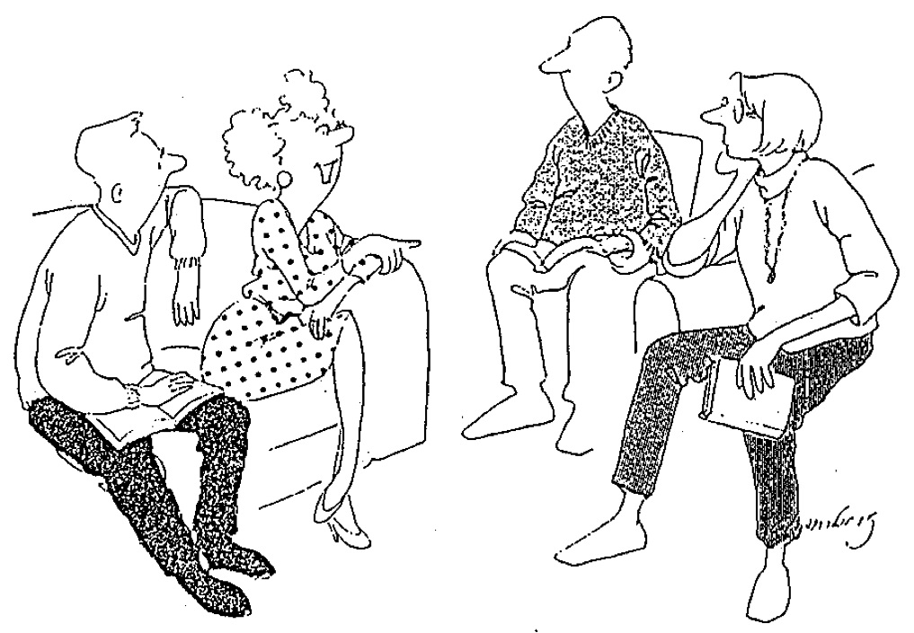
Dying to Sin (6:2)
155k
"Well, I haven't exactly DIED to sin,
but I did feel kind of faint once."
Notes:
Rom 6:2 …Since we have died to sin, how can we continue to live in it?
Rom 6:11 So you also should consider yourselves to be dead to the power of sin and alive to God through Christ Jesus.

Slide 65
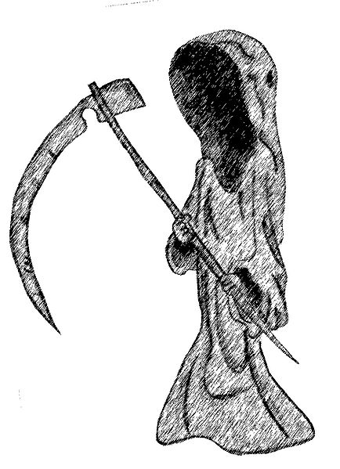
What does it mean that those in Christ have "died to sin" (6:2)?
For your small group…
154a
Christians will never sin again?
Believers never have to sin in a given situation?
A true Christian will never have a pattern of sinning in his life?
Something else? (state it)
Support your answer from Romans 6–7
Notes:
Responses:
1. No Christian is perfect. John Wesley taught that perfectionism is theoretically possible in this life, though he did not claim it or himself and never knew anyone who achieved it.
2. Believers have a choice to sin while unbelievers have no choice whether to follow the old nature or new nature. This sees the living in sin of verse 2 not as an impossibility but as an inconsistent lifestyle.
3. How can this be reconciled with the carnal Christian of 1 Cor 3? The Corinthians had a pattern of sin, but Paul never claimed that they were not believers. In other words, believers can live a carnal lifestyle.
Can Christians grieve the Spirit (Eph 4:30)?
Eph. 4:30 And do not bring sorrow to God’s Holy Spirit by the way you live.
Can Christians "quench" the Spirit (1 Thess 5:19 NAU, "stifle" NLT, "Do not put out the Spirit’s fire" NIV)?
A Christian can lose his "saltiness" or effectiveness for the Lord:
Matt. 5:13 “You are the salt of the earth. But what good is salt if it has lost its flavor? Can you make it salty again? It will be thrown out and trampled underfoot as worthless.
Matt. 5:14 “You are the light of the world—like a city on a hilltop that cannot be hidden. ¹⁵ No one lights a lamp and then puts it under a basket. Instead, a lamp is placed on a stand, where it gives light to everyone in the house. ¹⁶ In the same way, let your good deeds shine out for all to see, so that everyone will praise your heavenly Father.
As an example, all men (Christian and non-Christian) struggle with the sin of lust throughout their lives. This is documented in the book Every Man's Battle. Every Man's Battle: Winning the War on Sexual Temptation One Victory at a Time (The Every Man Series) Paperback – August 18, 2009

Slide 66
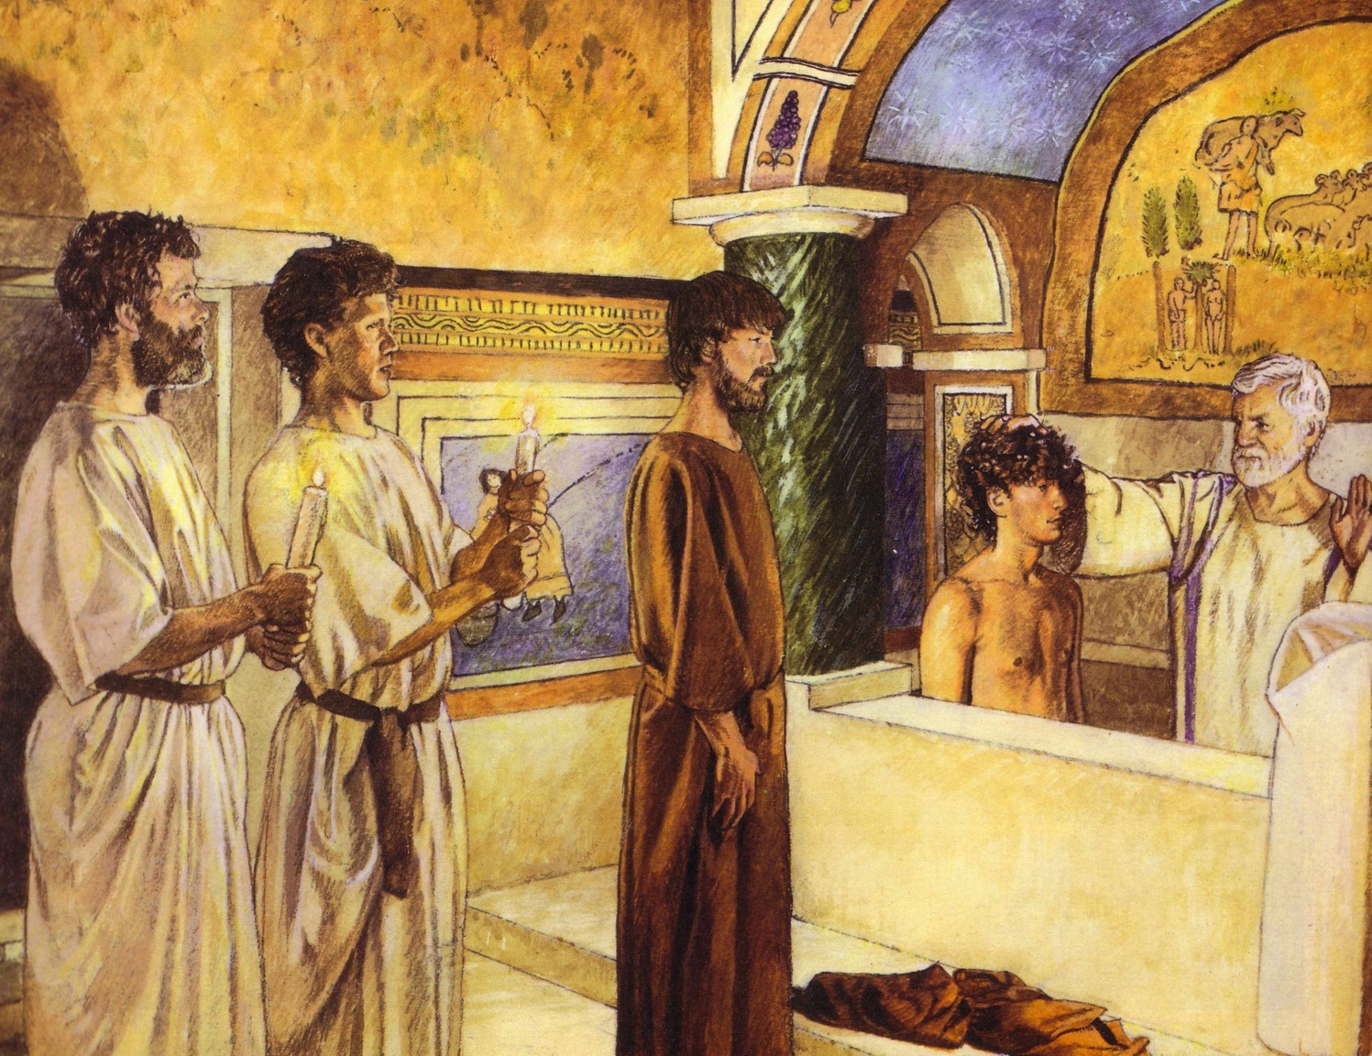
Baptism identifies with His death
154a
For Believers Only
By Immersion Only
Notes:
For more on baptism, see the study at the NT Backgrounds and NT Survey study on Titus.

Slide 67

What Has God Done About Sin?
154
He gave us...
Principles
Importance
New
Life
6:2, 3
6:4
6:6
Sin's power is broken.
Sin-loving nature is buried.
Sin no longer controls you.
Be certain that sin's power is broken.
New
Nature
6:5
6:11
Now you share his new life.
Look at your old self as dead and new self as alive to God.
Be unresponsive to the old power & alive to the new.
New
Freedom
6:12
6:13
6:14
6:16
Do not let sin control you.
Give yourselves fully to God.
You are free.
You can choose your master.
Commit yourself to obey Christ in perfect freedom.
Notes:
Rom. 6:1 NLT Well then, should we keep on sinning so that God can show us more and more of his wonderful grace? ² Of course not! Since we have died to sin, how can we continue to live in it? ³ Or have you forgotten that when we were joined with Christ Jesus in baptism, we joined him in his death? ⁴ For we died and were buried with Christ by baptism. And just as Christ was raised from the dead by the glorious power of the Father, now we also may live new lives.
Rom. 6:5 Since we have been united with him in his death, we will also be raised to life as he was. ⁶ We know that our old sinful selves were crucified with Christ so that sin might lose its power in our lives. We are no longer slaves to sin. ⁷ For when we died with Christ we were set free from the power of sin. ⁸ And since we died with Christ, we know we will also live with him. ⁹ We are sure of this because Christ was raised from the dead, and he will never die again. Death no longer has any power over him. ¹⁰ When he died, he died once to break the power of sin. But now that he lives, he lives for the glory of God. ¹¹ So you also should consider yourselves to be dead to the power of sin and alive to God through Christ Jesus.
Rom. 6:12 Do not let sin control the way you live; do not give in to sinful desires. ¹³ Do not let any part of your body become an instrument of evil to serve sin. Instead, give yourselves completely to God, for you were dead, but now you have new life. So use your whole body as an instrument to do what is right for the glory of God. ¹⁴ Sin is no longer your master, for you no longer live under the requirements of the law. Instead, you live under the freedom of God’s grace.
Rom. 6:15 Well then, since God’s grace has set us free from the law, does that mean we can go on sinning? Of course not! ¹⁶ Don’t you realize that you become the slave of whatever you choose to obey? You can be a slave to sin, which leads to death, or you can choose to obey God, which leads to righteous living. ¹⁷ Thank God! Once you were slaves of sin, but now you wholeheartedly obey this teaching we have given you. ¹⁸ Now you are free from your slavery to sin, and you have become slaves to righteous living.

Slide 68
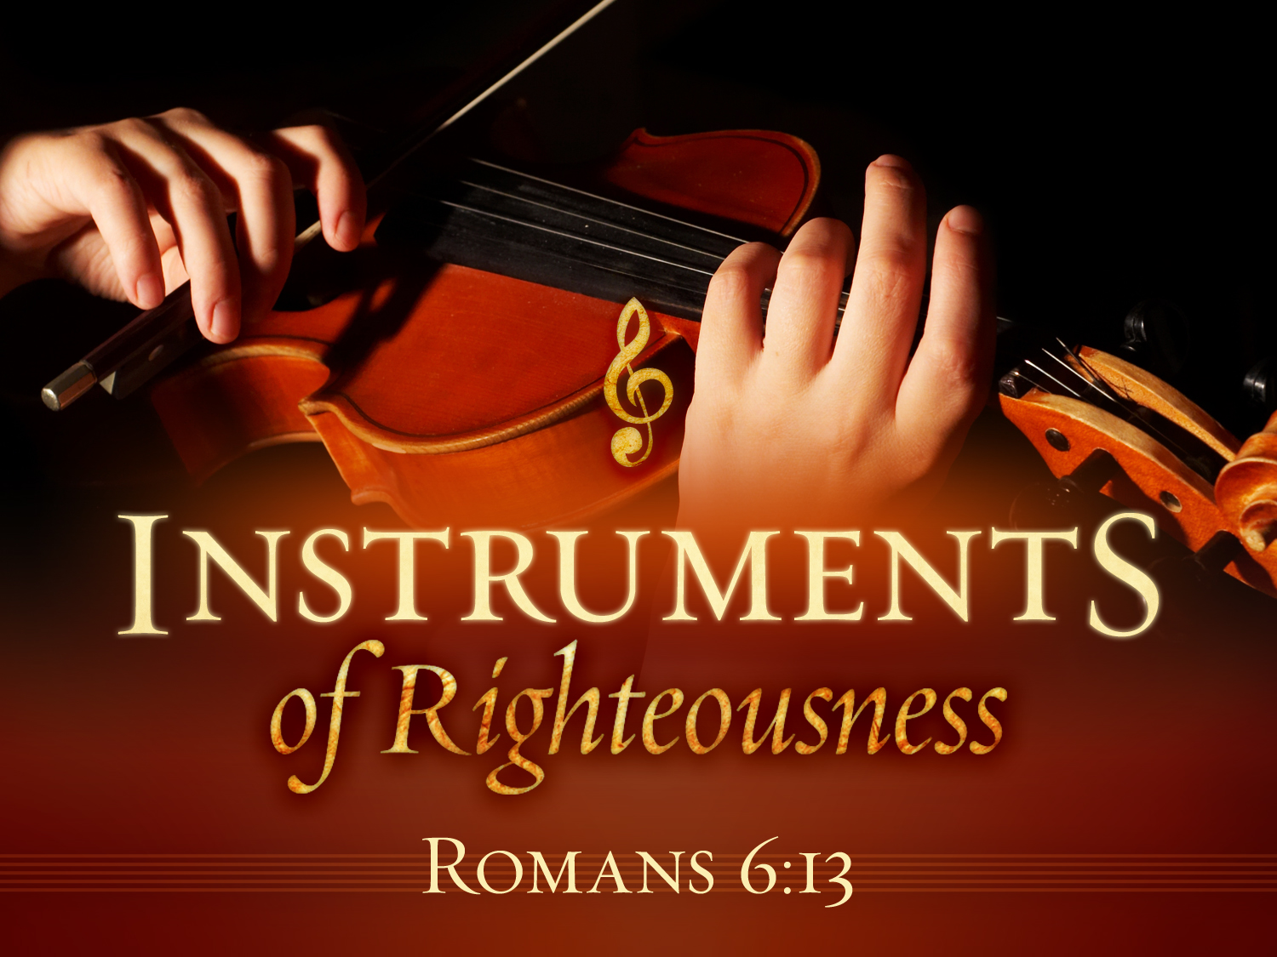
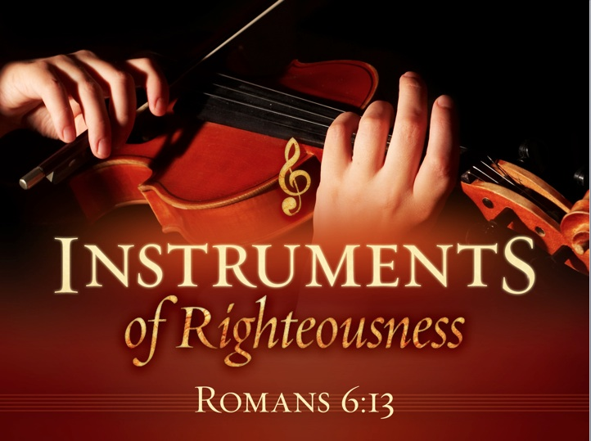

INSTRUMENTS of Righteousness
Romans 6:13

Slide 69
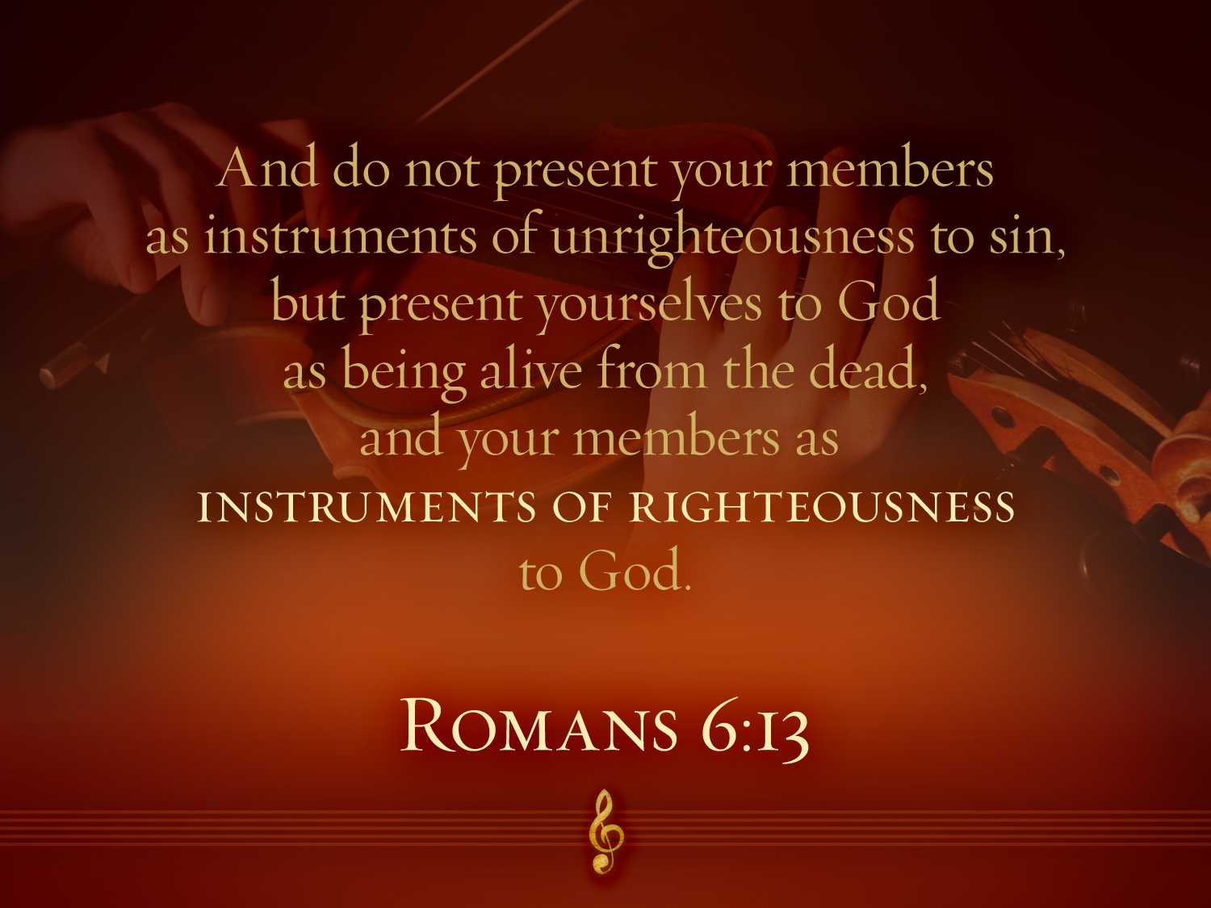

Romans 6:13
"And do not present your members as instruments of unrighteousness to sin but present yourselves to God as being alive from the dead and your members as INSTRUMENTS OF RIGHTEOUSNESS to God."

Slide 70
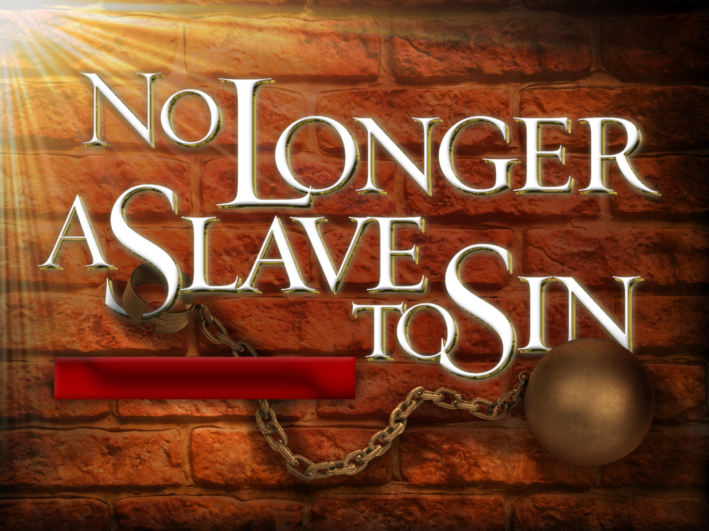

No Longer a Slave to Sin
Everyone is a slave but a believer is…
NO LONGER A SLAVE
TO SIN
Romans 6:18
"You have been set free from sin
and have become slaves to righteousness"
Notes:
Please translate the text at the right and then drag everything over this slide so no English shows. Make sure the fonts remain.

Slide 71

What rituals or beliefs do Christians sometimes trust for sanctification instead of their vital experience with Christ (6:2)?
Small Group Exercise
154a
Teaching loss of salvation
Requiring worship styles
Keeping salvation by attending church
Allowing sin if confessed to a priest
Baptism to maintain salvation
The Lord's Supper to maintain salvation
Notes:
Priority of church writings over the Bible
Bible memorization

Slide 72
Slides on
Romans 7

Slide 73
Romans 7
Believers are free from the Law

Slide 74
Overview of Romans 5–8
5 | 6 | 7 | 8
Justification |  | Sanctification
Penalty Paid |  | Power Broken
Our Position |  | Our Progress
Christ died for us | We died with Christ to sin | We died to the Law | We walk in the Spirit
New position New standing New privileges | We died to sin as a master | We died to self-effort | We are transformed by the Spirit
Adapted from Dr Bill Egner, Christ Chapel Bible Church, Fort Worth, TX (11 June 2023)

Slide 75
Righteousness Imparted in Sanctification (Romans 6–8)
154b
How does the blood of Christ apply to us?
"As a wife is no longer married to her husband when he dies, so a Christian is no longer under the Law"
(John A. Witmer, "Romans," in BKC, 2:465).
Chapter 6
New Basis
––
Identification
Chapter 7
New Relationship
––
Freedom
Notes:
Romans 5 (our standing/identity)
• We've been justified by God's legal declaration
• Peace and safety with Him: grace now and glory later
Romans 6 (our relationship)
• He's united us to Jesus Christ (Death/Burial/Resurrection)
• While you're not yet all you will be, you're no longer who you once were!
• Continuing in sin is inadmissible in our lives
Romans 7 (our inability)
• Do's and don'ts won't bring about spiritual growth because they rely on self-effort; I'm not unwilling, but I am unable.
• We desperately need "outside" help!
—Dr Bill Egner, Christ Chapel Bible Church, Fort Worth, TX (11 June 2023)

Slide 76
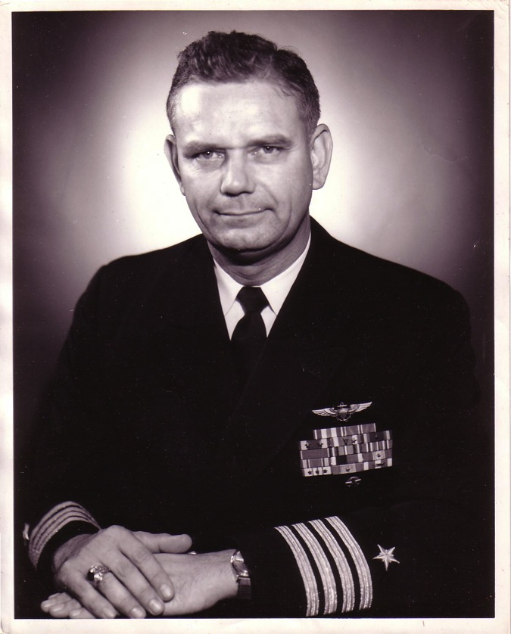
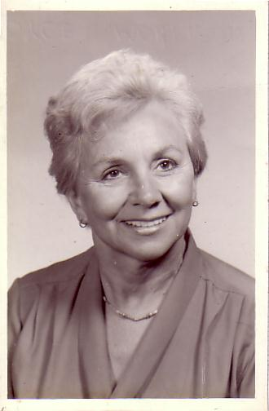
The Marriage
1955
Navy Lieutenant
Harold F. Griffith (alias Dad)
Navy Ensign
Joyce I. Griffith (alias Mom)
Notes:
The story, of course, must begin with my parents who met in the Navy.
They had a baby boy (my older brother Bob) and then were transferred to Japan.

Slide 77
The Divorce
1962
Navy Commander
Harold F. Griffith (alias Dad)
Social Worker
Joyce I. Griffith (alias Mom)
Notes:
After my younger brother's birth my Mom concluded that my Dad was actually married to the Navy, so she divorced him. Ironically, she became a social worker to help other families put their lives together.

Slide 78
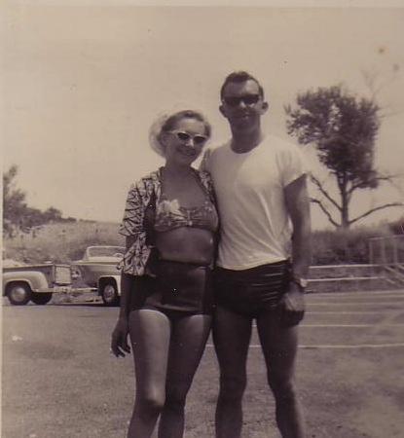
Another Divorce…
Notes:
But the arguments with my Mom became unbearable so my Mom divorced him too.

Slide 79

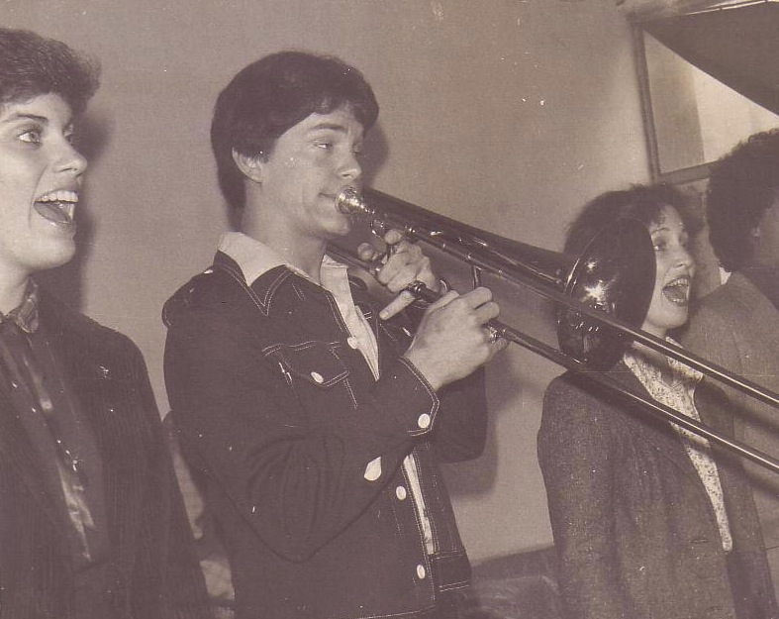
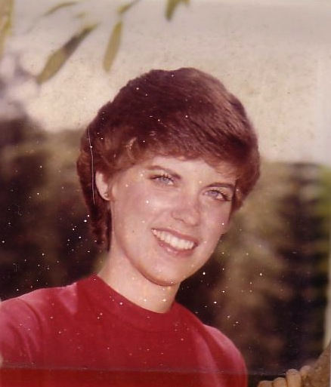
Susan & Rick, 1982
Notes:
God also began to open my eyes to the woman singing next to me! She initially despised me but after a year or so she saw the light. That's our engagement picture. In 1983 we returned to the USA..

Slide 80
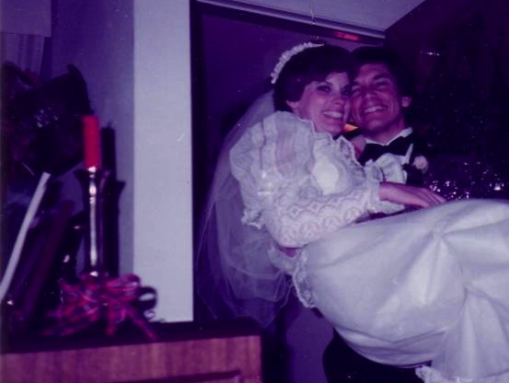
Marriage:
30 December 1983
Notes:
I married her and took her to Dallas Seminary a few days later. Three years later our first son was born on his grandpa's 70th birthday, so we named him Kurt in honor of Susan's father. I also pastored a church, had a ministry to international students, and served as a chaplain.

Slide 81




What "Marriages" (7:1-6)?
154a
The Law
Our "BC" Marriage
(Romans 7:1-4a)
Our "AD" Marriage
(Romans 7:4b-6)
Notes:
We are the bride who used to be married to the law (BC = Before Christ)
But we died in Christ, and thus are now released from that Law.
Now we are married to Christ (7:4) in our AD state (After Death).
We cannot be married to the Law and to Jesus at the same time. Since we died to the Law and that "marriage" is broken, we now can be

Slide 82

Christ's death (and our death with Him) frees us from "marriage" to the Law since now we are "married" to Christ (Rom. 7:4, 6)
154a

Slide 83
Our freedom from the Law results from Christ’s death but we still sin and need sanctification since the Law cannot deliver us from our sinful heart (Romans 7).
154a
Believers are released from obeying the Mosaic Covenant (Law) just as a widow is not bound to her first husband when she is in new a marriage (7:1-6).
The law is not evil since it shows the presence of sin, but we are evil instead (7:7-12).
Sin causes death so our only way to be free from sin is not by self-effort but by trusting Christ’s victory over death on the cross (7:13-25).

Slide 84

Paul was not under the Law
“When I was with the Jews, I lived like a Jew to bring the Jews to Christ. When I was with those who follow the Jewish law, I too lived under that law. Even though I am not subject to the law, I did this so I could bring to Christ those who are under the law.”
1 Corinthians 9:20 NLT

Slide 85
Hebrews 8:13
"By calling this covenant 'new,'
he has made the first one obsolete; and what is obsolete and aging will soon disappear."
Obsolete
AD 33
Hebrews Written
AD 67-68
Disappeared
AD 70

Slide 86
Kingdom & Covenants Timeline
22
CH-34a
OS1-22
OS2-337
NS-9g
SA-19
Dr. Rick Griffith • BibleStudyDownloads.org
Kingdom Teaching...
Adam rules with God (Gen. 1:26, 28; 2:19)
Satan begins rule as god of this world (Gen. 3:15;
2 Cor. 4:4)
God covenants with Abraham to reestablish man's rule via Israel as a "kingdom of priests" (Gen. 12:1-3; Exod. 19:6)
Israel's failure to witness to nations as a kingdom of priests is judged via exile under foreign rule
Israel rejects Messiah's offer of kingdom (Matt. 12:41-42; 23:37-39)
Jesus extends His kingdom in mystery form to the Church (Matt. 13)
Christ subdues Israel's enemies and nation believes (Rom. 11:26-27)
Christ rules over everything with saints (Eph. 1:9-10; Rev. 20:1-6; 22:5b)
Fall of Man (Gen. 3)
Noahic Covenant
Genesis 6:18; 9:8-17
Land Covenant
ISRAEL
CHURCH
MESSIANIC KINGDOM
34a
(National Focus)
The "New Man" (Eph. 2:15)
Millennial Eternal
land
Genesis 15:18 (cf. Deut. 30:1-10) promises:
Land from Wadi of Egypt to Euphrates River (Isa. 27:12)
Eternal possession of land (Gen. 17:8) after exile/restoration
Whole world blessed via the land (Isa. 14:1-2)
Israel judged for rejecting Messiah by dispersion away from land for 19 centuries
(AD 70–AD 1948) but now partially restored (Ezek. 37:1-7)
Full restoration (Ezek. 37:8-28) Jerusalem world capital
(Isa. 2:1-5)
New Jerusalem
(Rev. 21–22)
22
337
Davidic Covenant
Christ is Head over his Church, which is a spiritual temple (Eph. 2:19-22; 2 Cor. 6:16)
Christ reigns over the world
(Isa. 11)
with saints (Rev. 5:10; 20:4-6)
Christ hands kingdom over to Father (1
Cor. 15:24)
9g
Genesis 12:1-3
2 Samuel 7:12-16 promises:
Sons ("house" never wiped out)
Kingdom (political dynasty)
Throne (right to rule by descendants)
Temple (son to build it)
seed
19
Abrahamic Covenant
New Covenant
All
things made new!
(Rev. 21:5)
All 5 elements fulfilled in national restoration (Zech. 8)
Jeremiah 31:31-34 promises:
Forgiveness
Indwelling Spirit
New heart, nature, mind
Reunification of Israel and Judah
No need for evangelism
Mosaic Law is replaced with first three elements of the New Covenant (Luke 22:20; 2 Cor. 3:6)
blessing
Mosaic Covenant
The Law was fulfilled and replaced at the cross (Rom. 7:1-6;
1 Cor. 9:19-21; Heb. 8:13)
14th Edition
29 Feb 2024
Temporary (Gal. 3:19) and conditional (Deut. 28) to reveal sin (Rom. 7:7) and regulate Israel (Gal. 3:23-25)
Scripture has a dual kingdom-covenant theme. Israel's role from Abraham to Christ expands to include the Church (continuity) yet the Church never replaces the nation as the "new Israel" (discontinuity). Israel will enjoy world prominence after trusting Christ at His second coming.
Notes:
This complicated chart combines the two themes of Kingdom and Covenants. God's kingdom rule extends to humanity across the ages at the top. But the major part shows the unfolding of the Abrahamic Covenant in its Land Covenant, Davidic Covenant, and New Covenant promises—partially fulfilled in the present, but fully completed in the Messianic Kingdom. This will happen in the Millennial Age and especially in the Eternal State.
• This chart also shows that the Old (Mosaic) Covenant was replaced by the New Covenant.
All agree that a partial fulfillment of the covenant to Abraham exists now to the Church in the indwelling Holy Spirit and forgiveness of sins (Jer 31:31-34)—and the ultimate fulfillment will be in the eternal state.
The main area of disagreement relates to the time from now to eternity. Will there be a literal land, throne, and worldwide blessing to national (ethnic) Israel before the eternal kingdom? This chart shows verses giving a resounding YES to that question in a present partial fulfillment and a future full fulfillment in the normal sense of language in the verses cited. But the messianic kingdom will be in two stages—first in a millennial fulfillment to last 1000 years, but then, after that, the eternal stage in the new Jerusalem after the destruction of our present heavens and earth (Rev 21–22). What an amazing future remains for those who trust Jesus!
____________
Common-151
BG-13-Present & Future Geog-74
BT-01-OT Biblical Theology-25
CH-02-Nature-103-p34a
OC-10-Chronology-42
OS-00-Intro & Biblical Theology-40 & 103
OS-02-Exodus-267-p22
OS-05-Deut-279, 300
OS-10-2Sam-96-p22
OS-10-Davidic Covenant-29, 79
OS-12-Kings & Prophets Charts-25
OS-13-1 Chron-46
OS-17-Kingdom & Covenants Timeline-01
OS-23-Isaiah-97-p337
OS-24-Jeremiah-174-p337
OS-23-Isaiah-97-p337
OS-28-Hosea-49
OS-31-Obadiah-164
05-Acts1-2-slide 45
NS-00-00-Kingdom & Covenants Timeline-English-1
NS-09-Gal-143-p9g
NS-19-Hebrews-342-p9g
NS-27-Rev20-22-slide 189
SA-08-Mosaic Law-21-p38a

Slide 87

The heart of the
Mosaic Covenant is the
Ten Commandments

Slide 88

TRADITIONAL VIEW ON LAW
Ex. 25-31
155l
A Godly Education In Three Parts:
MORAL: The Ten Commandments; a basis for our current legal system.
CIVIL: How the people are to live with each other in the new social structure.
CEREMONIAL: How to worship God in the new social structure.
BUT ARE THE BIG 10 MORAL LAW?
MOSES
Exodus
Sinai
M - C - C
40
Handbook pg. 26-29
13

Slide 89
Does the Law of Moses Apply to Me? (5 Views)
113c
Spectrum on Degree of Applicability:
Theonomic Greg Bahnsen | Reformed Willem VanGemeren | Weightier Issues Walter Kaiser | Modified Lutheran Douglas Moo | Dispensational Wayne G. Strickland
Law as
not applicable
in every sense
Law as applicable
in every sense
This chart summarizes Stanley N. Gundry, ed. Five Views on Law and Gospel (Grand Rapids: Zondervan, 1996), where each author presents his view and responds to the other four views. Generally speaking, views 1-2 are similar as both are Reformed (stressing continuity between the NT and OT) and these stand against views 3-5 which alike stress discontinuity. In my opinion, the dispensational view has the most to commend it as law in the NT is never broken into component parts and this view clearly distinguishes Israel from the church. Further, it is inconsistent to change the Sabbath (Saturday) to Sunday but not apply the OT penalties for Sabbath-breaking today (i.e., death by stoning; cf. Exod. 31:14-15; 35:2). The following chart is adapted from Lee Hwee Chin, "The Applicability of the Law Today," unpublished research paper for the course "Old Testament Survey," Singapore: Singapore Bible College, 2001, 1.
Notes:
The NT does not specifically say how to apply the OT law, so Christians disagree on how to do this. There exist at least five major approaches to how Christians see the Mosaic Law applying today.
_______
Common-234
BS-28-Law of Moses-12
OS-02-Exodus-256
OS-05-Deut-115
NS-06-Rom5-8-slide81
NS-09-Gal-139
SA-08-Mosaic Law-32

Slide 90
Does the Law of Moses Apply to Me?
113b
Stanley N. Gundry, ed. Five Views on Law & Gospel summarized by Lee Hwee Chin, SBC, 2001
 | THEONOMIC Bahnsen | REFORMED Van Gemeren | WEIGHTIER ISSUES Kaiser | MODIFIED LUTHERAN Moo | DISPENSATIONAL Strickland
What is the Law? | Same definition as the views 3-5 | God's oral or written instructions since creation | The whole Mosaic law given in the Pentateuch (Genesis to Deuteronomy) but also amplified in the rest of the Old Testament
Who is the Law for? | The Elect (Israel = Church) | All mankind (Israel = Church) | Believers (Israel and Church) | Believers (Israel and Church) | Israel only (Israel ≠ Church)
Notes:
90
The NT does not specifically say how to apply the OT law, so Christians disagree on how to do this. There exist at least five major approaches to how Christians see the Mosaic Law applying today.
_______
Common-235
BS-28-Law of Moses-12
OS-02-Exodus-256
OS-05-Deut-115
NS-06-Rom5-8-slide80
NS-09-Gal-139
SA-08-Mosaic Law-32

Slide 91
Does the Law of Moses Apply to Me?
113b
Stanley N. Gundry, ed. Five Views on Law & Gospel summarized by Lee Hwee Chin, SBC, 2001
 | THEONOMIC Bahnsen | REFORMED Van Gemeren | WEIGHTIER ISSUES Kaiser | MODIFIED LUTHERAN Moo | DISPENSATIONAL Strickland
Which parts of the Law apply today? • "Moral law"? (i.e., Decalogue or 10 Command-ments) | All moral laws apply to people of God only in every age, so all elect persons since creation should observe either the Jewish Sabbath (Sat. before Christ) or "Christian Sabbath," (Sunday, after Christ) | All moral laws apply to believers and unbelievers of every age (e.g., all persons–including unbelieving Gentiles since creation–should observe the Sabbath or "Christian Sabbath," being Sunday) | All moral laws that stem from God's character: • 10 Command-ments • Leviticus 18–19 (sex) (i.e., Sabbath is required since Israel's nationhood & prohibited sexual practices still apply) | The Mosaic Law is fully abolished, but its moral content are good Christian guidelines. Yet Christ holds the final say via the Spirit's ministry in believers today; Sabbath obedience is not consistently applied (?) | God's "moral law" before Moses is now called the "law of Christ" (Gal. 6:2) and governs believers through the Spirit's new covenant indwelling; The Law does not easily divide into "parts" and is done away with in its entirety (Rom. 7:1-6; 1 Cor. 9:19-21; Heb. 8:13), including the Sabbath (Col. 2:16-17)
Notes:
91
The NT does not specifically say how to apply the OT law, so Christians disagree on how to do this. There exist at least five major approaches to how Christians see the Mosaic Law applying today.
_______
Common-236
BS-28-Law of Moses-12
OS-02-Exodus-256
OS-05-Deut-115
NS-06-Rom5-8-slide80
NS-09-Gal-139
SA-08-Mosaic Law-32

Slide 92
Does the Law of Moses Apply to Me?
113b
Stanley N. Gundry, ed. Five Views on Law & Gospel summarized by Lee Hwee Chin, SBC, 2001
 | THEONOMIC Bahnsen | REFORMED Van Gemeren | WEIGHTIER ISSUES Kaiser | MODIFIED LUTHERAN Moo | DISPENSATIONAL Strickland
• Civil laws? (i.e., judicial law) | All apply (e.g., laws today should require death for adultery) | Some apply (e.g., still tithe and don't charge believers interest) | Judicial principles (not laws) apply since moral laws underlie all judicial and ceremon-ial laws | Only principles apply now as the Mosaic law was given only to Israel | None apply as these regulated Israel alone (but principles such as love and compassion still apply)
• Cere-monial laws? | All five views agree that ceremonial aspects such as the sacrificial system and Jewish priesthood are now fulfilled in Jesus Christ
Notes:
92
The NT does not specifically say how to apply the OT law, so Christians disagree on how to do this. There exist at least five major approaches to how Christians see the Mosaic Law applying today.
_______
Common-237
BS-28-Law of Moses-12
OS-02-Exodus-256
OS-05-Deut-115
NS-06-Rom5-8-slide80
NS-09-Gal-139
SA-08-Mosaic Law-32

Slide 93
Does the Law of Moses Apply to Me?
113b
Stanley N. Gundry, ed. Five Views on Law & Gospel summarized by Lee Hwee Chin, SBC, 2001
 | THEONOMIC Bahnsen | REFORMED Van Gemeren | WEIGHTIER ISSUES Kaiser | MODIFIED LUTHERAN Moo | DISPENSATIONAL Strickland
What is the relation-ship of the Abrahamic Covenant to Mosaic Covenant? | Both are God's "covenant of grace." They consist of the same substance of God's saving relation-ship which makes the MC still apply today | MC was added to the AC; both still apply though they are similar in substance but different in form and purpose | MC was given specifically to Israel but its moral principles are still relevant to all believers under the AC | Like dispensa-tionalists, MC was conditional but AC was not; MC was a temporary framework that prescribed terms of obedience for Israel in Law period | MC regulated Israel's life so she could experience the blessings of the AC, but MC is no longer operative as it is fulfilled in Christ
Notes:
93
The NT does not specifically say how to apply the OT law, so Christians disagree on how to do this. There exist at least five major approaches to how Christians see the Mosaic Law applying today.
_______
Common-238
BS-28-Law of Moses-12
OS-02-Exodus-256
OS-05-Deut-115
NS-06-Rom5-8-slide80
NS-09-Gal-139
SA-08-Mosaic Law-32

Slide 94
Does the Law of Moses Apply to Me?
113c
Stanley N. Gundry, ed. Five Views on Law & Gospel summarized by Lee Hwee Chin, SBC, 2001
 | THEONOMIC Bahnsen | REFORMED Van Gemeren | WEIGHTIER ISSUES Kaiser | MODIFIED LUTHERAN Moo | DISPENSATIONAL Strickland
Strengths | • Continuity between the OT and NT upheld • Desires ethics to relate to all of life • Sees positive aspects of the law | • Continuity between the OT and NT upheld • Notes Mosaic law's foreshadow-ing of Christ • Sees a convicting role of the law today for unbelievers | • Biblical support for some law aspects (i.e., moral) being weightier than others (Matt. 23:23) • Holiness Code of Leviticus 18–19 stem from nature of God | • Accounts for new covenant emphases under the Law of Christ (Gal. 6:2) • Says OT laws repeated in the NT are applicable • Applies law principles today | • Biblical in that Mosaic law began at Sinai and ended with Christ's death as a temporary tutor (Gal. 3:19, 24-25) • Keeps Israel and church separate • Advocates continued guidance in law of Christ
Notes:
94
The NT does not specifically say how to apply the OT law, so Christians disagree on how to do this. There exist at least five major approaches to how Christians see the Mosaic Law applying today.
_______
Common-239
BS-28-Law of Moses-12
OS-02-Exodus-256
OS-05-Deut-115
NS-06-Rom5-8-slide80
NS-09-Gal-139
SA-08-Mosaic Law-32

Slide 95
Does the Law of Moses Apply to Me?
113c
Stanley N. Gundry, ed. Five Views on Law & Gospel summarized by Lee Hwee Chin, SBC, 2001
 | THEONOMIC Bahnsen | REFORMED Van Gemeren | WEIGHTIER ISSUES Kaiser | MODIFIED LUTHERAN Moo | DISPENSATIONAL Strickland
Weak-nesses | • Dividing law as moral, civil & ceremonial not biblical • Misguided to apply godly commands to unregenerate • All "law" need not be Mosaic (natural law and law of Christ also exist) • The NT never applies the OT to civil matters • Law condemned man (2 Cor. 3:9) | • Dividing law as moral, civil & ceremonial not biblical • Using "law" in differing ways is inconsistent & confusing • Requiring Sabbath for today contradicts Col. 2:16-17 • Unclear if moral law became law of Christ • Merges Israel & church | • Dividing law as moral, civil & ceremonial not biblical • Arbitrary to pick and choose which parts of the law are required • Choice of Decalogue and Lev. 18–19 too narrow for moral law | • Seeks to teach the indivisibility of the law while upholding its moral content • Too extreme to claim that the law has absolutely no purpose today • Fails to see the gospel in the OT by demarcating Law and Gospel into distinct, discontinuous eras | • Distinguishing law's revelatory aspects (eternal, revealing God's nature) from regulatory (temporary, ruled Israel) makes distinctions within an inseparable code–if the OT law is essentially a unity, then why divide it into two parts? • The law is not nullified but actually upheld by faith (Rom. 3:31)
Notes:
95
The NT does not specifically say how to apply the OT law, so Christians disagree on how to do this. There exist at least five major approaches to how Christians see the Mosaic Law applying today.
_______
Common-240
BS-28-Law of Moses-12
OS-02-Exodus-256
OS-05-Deut-115
NS-06-Rom5-8-slide80
NS-09-Gal-139
SA-08-Mosaic Law-32

Slide 96
The Ten Commandments
155n
#
Old Testament Commands
New Testament Repetitions
1
And God spoke all these words: "I am the LORD your God, who brought you out of Egypt, out of the land of slavery. You shall have no other gods before me" (Exod. 20:1-3).
"Men, why are you doing this? We too are only men, human like you. We are bringing you good news, telling you to turn from these worthless things to the living God…" (Acts 14:15; noted 50+ times).
2
"You shall not make for yourself an idol… for I… am a jealous God, punishing the children for the sin of the fathers … but showing love to a thousand generations of those who love me…" (Exod. 20:4-6).
"Dear children, keep yourselves from idols" (1 John 5:21; cf. 1 Thess. 1:9; Rev. 2:14, 20; 9:20; mentioned in the NT 12 times = 12x).
* This chart is adapted and expanded from one by Lewis Sperry Chafer, Systematic Theology, 4:209-10
3
"You shall not misuse the name of the LORD your God, for the LORD will not hold anyone guiltless who misuses his name" (Exod. 20:7).
"Above all…do not swear—not by heaven or by earth or by anything else. Let your 'Yes' be yes, and your 'No,' no, or you will be condemned" (James 5:12; 4x).
Notes:
_________
Common-230
NS-06-Rom5-8-slide 88

Slide 97
The Ten Commandments
155n
#
Old Testament Commands
New Testament Repetitions
4
"Keep the Sabbath day holy. Six days you shall labor... but the seventh day is a Sabbath to the LORD your God. On it you shall not do any work… nor your son or daughter, nor your manservant or maidservant, nor your animals, nor the alien within your gates. For in six days the LORD made the heavens and the earth… but he rested on the seventh day…" (Exod. 20:8-11).
No NT text requires this of Christians.
However, one passage clearly prohibits the practice as required for believers: "Therefore do not let anyone judge you by what you eat or drink, or with regard to a religious festival, a New Moon celebration or a Sabbath day. These are a shadow of the things that were to come; the reality, however, is found in Christ" (Col. 2:16-17; 0x).
5
"Honor your father and your mother, so that you may live long in the land the LORD your God is giving you" (Exod. 20:12).
"Children, obey your parents in the Lord, for this is right. 'Honor your father and mother'—which is the first commandment with a promise—that it may go well with you and that you may enjoy long life on the earth" (Eph. 6:1-3; Matt. 15:4-6; 19:19; Mark 7:10; 10:19; 6x).
6
"You shall not murder" (Exod. 20:13).
"Anyone who hates his brother is a murderer, and you know that no murderer has eternal life in him" (1 John 3:15; cf. Matt. 19:18; Mark 10:19; Luke 18:20; Rom. 13:9; James 2:11; 6x).
Notes:
_________
Common-231
NS-06-Rom5-8-slide 89

Slide 98
The Ten Commandments
155n
#
Old Testament Commands
New Testament Repetitions
The Law (Ten Commandments) fulfilled its
purpose by prohibiting coveting to reveal sin (Rom. 7:7).
Believers died to this law when they were joined to Christ
(7:4, 6). Since the Ten Commandments are a unit,
Christians also died to the other nine as well.
7
"You shall not commit adultery" (Exod. 20:14).
"Marriage should be honored by all, and the marriage bed kept pure, for God will judge the adulterer and all the sexually immoral" (Heb. 13:4; cf. Mark 10:19; 12x).
8
"You shall not steal" (Exod. 20:15).
"He who has been stealing must steal no longer, but must work, doing something useful with his own hands…" (Eph. 4:28; cf. Matt. 27:64; Mark 10:19; Luke 18:20; Rom. 13:9; Titus 2:10; 6x).
9
"You shall not give false testimony against your neighbor" (Exod. 20:16).
"Do not lie to each other, since you have taken off your old self with its practices" (Col. 3:9; cf. Eph. 4:25; 4x).
10
"You shall not covet your neighbor's house… wife, or his manservant or maidservant, his ox or donkey, or anything that belongs to your neighbor" (Exod. 20:17).
"'Watch out! Be on your guard against all kinds of greed; a man's life does not consist in the abundance of his possessions'" (Luke 12:15; Rom. 7:7; 13:9; Eph. 5:3; James 4:2; 2 Pet. 2:3, 14; 9x).
Notes:
_________
Common-232
NS-06-Rom5-8-slide 90

Slide 99
In your small group...
154a
In what ways do believers today still try to live by the Mosaic law?
Sabbath observance
Food laws
Tithing
Not charging Christians interest
Circumcision
Notes:
_____
Common-228
BE-45-Romans-48
BS-28-Law of Moses-18-p110
OS-02-Exodus-240-p113
OS-05-Deut-127-p113
NS-06-Rom5-8-slide89-p155p
SA-08-Mosaic Law-20-p36

Slide 100

Our Sabbath Lift in Galilee
We arrived at our hotel on the Sabbath, so it would not stop at our floor. Instead, we carried our luggage for two floors by hand in celebration of the day of rest!
Notes:
On the 2007 trip that I led to Israel, the lift was turned on to the Sabbath setting, meaning that it stopped only every fourth floor.
______
Common-229
BS-28-Law of Moses-18-p110
OS-02-Exodus-240-p113
OS-05-Deut-127-p113
NS-06-Rom5-8-slide89-p155p
SA-08-Mosaic Law-20-p36

Slide 101

A Quick Quiz About the Law…
155o
True (T)? Or False (F)? What's your view?
    1. T or F Christians should keep parts of the OT law which are not repeated in the NT.
    2. T or F The Sabbath should still be obeyed by Christians.
    3. T or F Believers today are obligated to keep all of the Ten Commandments.
    4. T or F Tithing should be practiced by all followers of Christ.
    5. T or F Christians today are prohibited from eating blood (e.g., yong tau foo, blood pudding, pig or duck blood at Chinese New Year).
    6. T or F Believers must not charge other Christians interest based upon the Law (Deut. 23:19; Exod. 22:25; Lev. 25:36-37; Ezek. 18:8, 13, 17; 22:12; Prov. 15:5; 28:8)
    7. T or F There are actually two laws: the moral (Ten Commandments) and ceremonial/civil.
Notes:
Take this quick quiz by yourself then talk for a few minutes about your answers to the person next to you.

Slide 102

B. Defining "Law"
155o
Pentateuch as single book
Pentateuch as 5 books
Whole OT
Legal literature (Exod. 20–Deut. 33)
Notes:
The word "Law" is used in at least four different ways in the Old Testament.
FROM BEE WORLD COURSE (2018):
The Scriptures use the word “law” with these six meanings:
1. Mosaic law: moral law in Ten Commandments
2. Mosaic law: moral, civil, and ceremonial laws (= #4 above, or Legal Literature)
3. Mosaic law: the first five books of the Bible, called the Pentateuch or the Torah (= #2 above)
4. The Old Testament as a whole (= #3 above)
ADD NT REFERENCES:
5. Inner law of conscience
6. Rules made and enforced by government

Slide 103

C. The Christian's Relationship to the Law
155o
Notes:
What perspective should believers have about the OT?

Slide 104

D. The Purposes of the Law
155p
    It revealed or exposed the sinfulness of man (Gal. 3:19).
    It revealed the holiness of God (1 Pet. 1:15).
    It revealed the standard of holiness for people in fellowship with God (Ps. 24:3-5).
    It supervised the physical, mental, and spiritual development of the redeemed Israelite until he could come to maturity in Christ (Gal. 3:24).
    J. Dwight Pentecost, "The Purpose of the Law," Bib Sac 128 (July 1971): 227-33

Slide 105
D. The Purposes of the Law
155p
    It unified the people to establish the nation in voluntary submission to God's decrees (Exod. 19:5-8; Deut. 5:27-28).
    It separated Israel among the nations as a kingdom of priests to mediate God's truth to these nations (Exod. 31:13).
    It provided forgiveness of sins for individual Israelites to restore their fellowship with God, even though they already functioned as a redeemed people (Lev. 1–7).
    J. Dwight Pentecost, "The Purpose of the Law," Bib Sac 128 (July 1971): 227-33

Slide 106
D. The Purposes of the Law
155p
    It made provision for Israel to worship God as a redeemed people (Lev. 23).
    It tested if one was in the kingdom or the theocracy over which God ruled (Deut. 28). Faith led to obedience and blessing; lack of faith led to disobedience and judgment.
    It revealed Jesus Christ (typology in the sacrificial system; Luke 24:27).
    J. Dwight Pentecost, "The Purpose of the Law," Bib Sac 128 (July 1971): 227-33

Slide 107
Interpreting and
Preaching Legal Literature
155p
1. Interpretation: Study the intent behind the legal command, asking, "Why was this command given in Israel?"
2. Principlizing: State the law's intent in a general principle showing God's character.
3. Application: Show how this principle relates to a modern parallel situation.

Slide 108

A Suggested Strategy for Expounding the OT Law
155p
Principlizing: Universal truth
Interpretation:
Intent behind
the command
Application:
Parallel Modern
Situation

Slide 109
A Suggested Strategy for Expounding the OT Law
155p
Divinely Ordained Laziness?
"When you harvest the crops of your land, do not harvest the grain along the edges of your fields, and do not pick up what the harvesters drop. Leave it for the poor and the foreigners living among you. I am the LORD your God" (Lev. 23:22 NLT).

Slide 110
A Suggested Strategy for Expounding the OT Law
155p
Principlizing: God wants His people to give
the underprivileged the chance to earn a living
Interpretation:
Do not harvest the corners of the fields because God had compassion on the poor who should glean for their food
Application:
As an employer you should provide opportunities for the poor to support themselves

Slide 111
A Suggested Strategy for Expounding the OT Law
155p
Divinely Ordained Stealing?
"When you enter your neighbor's vineyard, you may eat your fill of grapes, but you must not carry any away in a basket.
²⁵And when you enter your neighbor's field of grain, you may pluck the heads of grain with your hand, but you must not harvest it with a sickle" (Deut. 23:24-25 NLT).

Slide 112
A Suggested Strategy for Expounding the OT Law
155p
Principlizing: God allows taking small items for He
cares more for human need than human property
Interpretation:
Do not steal your neighbor's crops, but also don't be so fearful of stealing that you become ridiculous
Application:
As a guest, don't be afraid to take the food given to you––but don't secretly pack a lunch or steal the towels!

Slide 113

The heart of the Mosaic Covenant is the Ten Commandments
Notes:
OS-02-Exodus-250
OS-05-Deut-109
NS-06-Rom5-8-slide78
SA-08-Mosaic Law-29

Slide 114
You've Been Freed From Self-Effort
"OLD BILL" |  | "NEW BILL"
Satan | Owner | God
Law/Sin | Ruler | Grace/Jesus Christ
"in Adam" | Me | "in Christ"
Sin exercised its authority and power over me as Adam's child | Power | No longer under the authority and power of Sin but under Grace/Spirit
I sinned | Result | Drawn to obedience
Wages: spiritual death and separation from God | End | Gifts: relationship with Christ, righteousness and holiness
Dr Bill Egner, Christ Chapel Bible Church, Fort Worth, TX (11 June 2023)
Notes:
As a result, in the "Promised Land" I've been freed from the self-effort of do's and don'ts.
Keeping the law can only work on us from the outside-in, never from the inside-out.
No permanent heart change can EVER occur by just modifying our behavior.
Romans 7 tells us that striving to keep a list of do's and don'ts is what doesn't work!
Is wasn't Moses but Jesus who led you into the "Promised Land"!
Just as the Jew who tries to obey the Law remains frustrated and bound up under the Law, so Christians who seek to follow that same method (legalism) will experience frustration and bondage.
The principle of obeying law has never solved man's problems or given believers growth.

Slide 115

Moral law means God's rules that apply to…
Every time period
Every culture
Every place
Every people
Notes:
BS-28-Law of Moses-07
OS-02-Exodus-252
OS-05-Deut-111
NS-06-Rom5-8-slide79
SA-08-Mosaic Law-31

Slide 116
Victory in the Christian Life
154a
"Paul does not view Christian living as
victory apart from any conflict
or as conflict apart from any victory. Instead, he sees the Christian life as a life of victory amid conflict."
"Paul & His Epistles: Life and Teachings of Paul,"
NT Survey (Moody Online Study Guide), p. 7 (emphasis mine)

Slide 117

Peter illustrates the struggle between the flesh and Spirit
Notes:
Even though Peter knew Jesus, he constantly struggled with his will versus the will of Jesus.
• Peter struggled to put his nets down into the water after a fruitless night of fishing.
• Peter even rebuked Jesus when the Lord said that he would be crucified.

Slide 118

TWO VIEWS ON STRUGGLING WITH SIN
Romans 7:7-25
154c
Pre Conversion Arguments
Post Conversion Arguments
How can a believer say, "I am a slave to sin" (7:14)?
This is contrary to the condition of believer that Paul describes in:
  "We died to sin; how can we live in it any longer?" (6:2 NIV)
  "We should no longer be slaves to sin" (6:6 NIV)
"Being in the flesh/being in sinful nature" does not mean physical passion, but a way of life (7:5)
Structure of argument
  7:7-25 interpret 7:5 (pre-conversion)
  8:1-17 interpret 7:6 (post conversion)
Believers also sin since Paul says,
"Do not let sin reign in your mortal body so that you obey its evil desire" (6:12)
Paul describes his pre-conversion life as free from struggle (Gal. 1:14 and Phil. 3:5-6)
The present tense is used (7:14-25) to describe a present struggle
Chapters 6–8 describe sanctification (post-conversion context)
Fact: Christians continue to struggle with sin
The non-Christian cannot simultaneously have a sinful nature and be a slave to God’s law (7:25)
Notes:
Scholars present arguments for Romans 7 describing Paul before his salvation or after.
Romans 8:1 contrasts the pre-Christian and post-Christian experience. Both views agree on this point.
Romans 7:17 says that "So I am not the one doing wrong; it is sin living in me that does it." But others see this as only possible in an unsaved state.
John MacArthur once claimed that there is but one way for the old nature to die: "I offer it to you: DIE!"
__________
NS-06-Rom5-8—slide 116
SA-08-The Christian and the Mosaic Law-47

Slide 119
A Quick Quiz About the Law…
112
True (T)? Or False (F)? What's your view?
    1. T or F Christians should keep parts of the OT law which are not repeated in the NT.
    2. T or F The Sabbath should still be obeyed by Christians.
    3. T or F Believers today are obligated to keep all of the Ten Commandments.
    4. T or F Tithing should be practiced by all followers of Christ.
    5. T or F Christians today are prohibited from eating blood (e.g., yong tau foo, blood pudding, pig or duck blood at Chinese New Year).
    6. T or F Believers must not charge other Christians interest based upon the Law (Deut. 23:19; Exod. 22:25; Lev. 25:36-37; Ezek. 18:8, 13, 17; 22:12; Prov. 15:5; 28:8)
    7. T or F There are actually two laws: the moral (Ten Commandments) and ceremonial/civil.
I marked all FALSE

Slide 120
Slides on
Romans 8

Slide 121
Romans 8
154b
Power in Sanctification is through the Holy Spirit
Notes:
Romans 7:24 "Oh, what a miserable person I am! Who will free me from this life that is dominated by sin and death? ²⁵ Thank God! The answer is in Jesus Christ our Lord. So you see how it is: In my mind I really want to obey God’s law, but because of my sinful nature I am a slave to sin."
But HOW does Jesus free us? This comes in the power of the Holy Spirit.

Slide 122
Righteousness Imparted in Sanctification (Rom. 6–8)
154b
How does the blood of Christ apply to us?
Chapter 6
New Basis
––
Identification
Chapter 7
New Relationship
––
Freedom
Chapter 8
New Power
––
Spirit
Notes:
Romans 5 (our standing/identity)
• We've been justified by God's legal declaration
• Peace and safety with Him: grace now and glory later
Romans 6 (our relationship)
• He's united us to Jesus Christ (Death/Burial/Resurrection)
• While you're not yet all you will be, you're no longer who you once were!
• Continuing in sin is inadmissible in our lives
Romans 7 (our inability)
• Do's and don'ts won't bring about spiritual growth because they rely on self-effort; I'm not unwilling, but I am unable.
• We desperately need "outside" help!
Romans 8 (our strength)
• He's enabled us to live righteously
• Nothing can separate us from his love.
—Dr Bill Egner, Christ Chapel Bible Church, Fort Worth, TX (11 June 2023)
(Romans 8 added by Dr Rick Griffith)

Slide 123
Overview of Romans 5–8
5 | 6 | 7 | 8
Justification |  | Sanctification
Penalty Paid |  | Power Broken
Our Position |  | Our Progress
Christ died for us | We died with Christ to sin | We died to the Law | We walk in the Spirit
New position New standing New privileges | We died to sin as a master | We died to self-effort | We are transformed by the Spirit
Adapted from Dr Bill Egner, Christ Chapel Bible Church, Fort Worth, TX (11 June 2023)

Slide 124
Our power in sanctification through the Spirit gives victory over sin that the Law could never do for us to eventually be like Jesus in glorification despite our sufferings (Romans 8).
154a
    Victory over sin comes from the Spirit of life as our new power source for living (8:1-13).
    Adoption into God’s family as sons comes from the Spirit as our new power source for living (8:14-27).
    Assurance of salvation results from the Spirit as our new power source for living (8:28-39 ).

Slide 125

Jesus rose to give you new life!
154b
Power in sanctification comes through the Spirit's ministries of:
Victory over sin
(8:1-13)
"...if anyone does not have the Spirit of Christ, he does not belong to Christ" (8:9b)

Slide 126

No Condemnation (8:1)!
154b
Notes:
NLT Rom. 8:1 So now there is no condemnation for those who belong to Christ Jesus.
Can a Christian be demon-possessed? This is impossible.

Slide 127

Indwelling of the Holy Spirit
xvi
II. C.
Romans 8:9
"You, however, are controlled not by the sinful nature but by the Spirit, if the Spirit of God lives in you. And if anyone does not have the Spirit of Christ, he does not belong to Christ."
Notes:
127
Paul taught that the Holy Spirit indwells every believer (Rom 8:9; Eph 1:13-14).
Does this verse teach that EVERY Christian is always controlled by the Spirit? Or does it mean that "you NEED NOT be controlled by the sinful nature..."?
Two issues incline me to argue against every Christian always being controlled by the Spirit:
1. Paul said in Romans 7 that too often he did what he did not want to do. The Corinthians even had a pattern of carnality (1 Cor 3:1-3).
NAU is more literal than NLT as it lacks the word "controlled": "However, you are not in the flesh but in the Spirit, if indeed the Spirit of God dwells in you. But if anyone does not have the Spirit of Christ, he does not belong to Him."
NLT: "Rom. 8:9 But you are not controlled by your sinful nature. You are controlled by the Spirit if you have the Spirit of God living in you. (And remember that those who do not have the Spirit of Christ living in them do not belong to him at all.)"
_________
HS-04-Indwelling-36
NS-06-Rom5-8-slide 116

Slide 128


"…those who do not have the Spirit of Christ living in them do not belong to him at all" (Rom. 8:9)
Notes:
Amazingly, the Bible says that the Holy Spirit actually dwells in our bodies!
____________
Common-436
BE-02-Exodus-130, 476
BE-03-Leviticus-55, 130
HS-04-Indwelling, Sealing, Leading & Slaying-23
OS-02-Exodus-476
OP-03-Lev-130
NS-04-John12-21-slide 77
NS-06-Rom 5-8-slide 117
NS-07-1Cor1-9-slide 205

Slide 129

"When Saul heard their words, the Spirit of the God came upon him in power, and he burned with anger."
1 Sam. 11:6

Slide 130

1 Sam. 15:14
"Now the Spirit of the LORD had departed from Saul…"
ix
Pt. B
Notes:
Did the Spirit indwell believers in the OT?

Slide 131

Psalm 51:11
"Do not cast me from your presence or take your Holy Spirit from me."
ix
Pt. B

Slide 132

A Seal Guarantees Security and Provides Assurance
Notes:
In Paul's day, a wax seal on a letter conveyed: (1) ownership in that the seal of the sender was stamped on it, and (2) security by guarding the contents. The result was that the recipient could feel assurance that the contents were guaranteed and safe.
______________
Common-440
NS-06-Rom5-8-slide 118
NS-06-Rom9-16-slide 18
NS-10-Eph-115
NS-23-1John-164
SA-14-Eternal Security-

Slide 133

"Having believed, you were marked in him with a seal, the promised Holy Spirit, ¹⁴who is a deposit guaranteeing our inheritance until the redemption of those who are God's possession—to the praise of his glory"
(Eph. 1:13-14 NIV).
"And do not grieve the Holy Spirit of God, with whom you were sealed for the day of redemption"
(Eph. 4:30 NIV).
Notes:
In Paul's day, a wax seal on a letter conveyed: (1) ownership in that the seal of the sender was stamped on it, and (2) security by guarding the contents. The result was that the recipient could feel assurance that the contents were guaranteed and safe.
______________
Common-441
NS-06-Rom5-8-slide 118
NS-10-Eph-115
NS-23-1John-164
SA-14-Eternal Security-

Slide 134

Assurance of
Salvation
Notes:
Paul used this background to assure his readers their salvation by noting that the Holy Spirit HIMSELF was the seal of their salvation (Eph. 1:13-14).
Please translate the text at the left and then drag everything over this slide so no English shows. Make sure the fonts remain.
______________
Common-442
NS-06-Rom5-8-slide 119
NS-23-1John-164

Slide 135

Romans 10:9-10 NIV
That if you confess with your mouth, “Jesus is Lord,” and believe in your heart that God raised him from the dead, you will be saved. ¹⁰ For it is with your heart that you believe and are justified, and it is with your mouth that you confess and are saved.
Notes:
The same concept of assurance of salvation appears in Romans 10:9-10. Salvation comes through faith but assurance comes from confession.
______________
Common-443
NS-06-Rom5-8-slide 118
NS-10-Eph-115
NS-23-1John-164
SA-14-Eternal Security-

Slide 136
Create In Me
John Carter ©1992 Beckenhorst Press, Inc.
Notes:
Sometimes songs can be biblical but misapplied. That is, they can give us Scripture but relate that passage to the wrong people. Such is the case with the song "Create in Me" in 1992.
——————————
HS-04-Indwelling, Sealing, Leading & Slaying-17
NS-06-Rom5-8—slide 129
NS-10-Ephesians-121
OS-19-Psalms-395

Slide 137
Create In Me
Create in me a clean heart, O God
And renew a right spirit within me
Create in me a clean heart, O God
And renew a right spirit within me
John Carter ©1992 Beckenhorst Press, Inc.
CCLI #2588988
Notes:
The song has biblical teaching about God making us clean from sin, quoting David's words in Psalm 51.
Psa. 51:10 Create ¹in me a clean heart, O God,
And renew a steadfast spirit within me.
¹¹ Do not cast me away from Your presence
And do not take Your Holy Spirit from me.
¹² Restore to me the joy of Your salvation
And sustain me with a willing spirit.
——————————
HS-04-Indwelling, Sealing, Leading & Slaying-18
NS-06-Rom5-8—slide 130
NS-10-Ephesians-122
OS-19-Psalms-396

Slide 138
Create In Me
Cast me not away from Your presence, O Lord
And take not Thy Holy Spirit from me
Restore unto me the joy of Thy salvation
And renew a right spirit within me
John Carter ©1992 Beckenhorst Press, Inc.
Should Christians pray this considering Romans 8?
Notes:
But then the song quotes the words of David that asks God not to remove the Holy Spirit from us!
How can we sing this since Jesus promised us the Spirit forever (John 14:16—"And I will ask the Father, and he will give you another Advocate, who will never leave you")?
——————————
HS-04-Indwelling, Sealing, Leading & Slaying-19
NS-06-Rom5-8—slide 131
NS-10-Ephesians-123
OS-19-Psalms-397

Slide 139
"An evaluation of these texts shows that all involved empowerment for a physical activity or enablement for a specific activity."
Leon J. Wood, The Holy Spirit in the Old Testament
Notes:
The OT has many references to the Spirit coming on God's leaders: Bezalel, Othniel, Gideon, Samson, Saul, David, etc. See Holy Spirit course slides 9-15.

Slide 140
"Yet His incoming was more of an inworking than an indwelling."
Herbert Lockyer
Herbert Lockyer, All the Doctrines of the Bible
Notes:
The OT ministry of the Holy Spirit was when he came UPON rather than IN believers.

Slide 141
Spirit After Salvation
Confusion: All or Part at Salvation?
155q
1. The reception of the Spirit came after salvation in some chapters in Acts:
Acts 2 (cf. 1:4-5)
Acts 8:14-17
(Acts 19:1-7 refers to OT believers in Messiah)
2. So should believers today seek His indwelling?
Notes:
How much of God did we get at salvation? Does he come in "parts" today—first Jesus (or also the Father), and then the Spirit?

Slide 142

Indwelling
155q
Paul spoke of the Spirit as "dwelling" in or among the people of God (1 Cor. 14:24-25; 2 Cor. 6:16)
Notes:
The Spirit's indwelling is noted in the NT as both individual and corporate.

Slide 143

The Indwelling Spirit
Notes:
Amazingly, the Bible says that the Holy Spirit dwells in our bodies!
____________
BE-02-Exodus-130
BE-03-Leviticus-11
HS-04-Indwelling, Sealing, Leading & Slaying-23
OS-02-Exodus-476
OP-03-Lev-130
NS-06-Rom5-8-slide129

Slide 144

The Spirit Indwells Us (Rom 8:11)
155q
"The Spirit of God, who raised Jesus from the dead, lives in you. And just as God raised Christ Jesus from the dead, he will give life to your mortal bodies by this same Spirit living within you" (NLT).

Slide 145

Weapons
180i
Weapons | Roman Function | Spiritual Meaning | Defends Against Accusa-tions of… | Practical Applica-tions
Belt of Truth (14a) | Held up flowing robe and sword | Integrity | Hypocrisy | Ask one to note your inconsis-tencies
Breastplate of Right-eousness (14b) | Protected vital organs | Imputed righteous-ness | Never being able to conquer sin | Discover position in Christ
Shoes that lead to Peace (15) | Sure footing and mobility to fight anywhere | Availability in evangelism | Uselessness in sharing the gospel | Share gospel at lunch
Shield of Faith (16) | Extinguished fiery arrows & fended off swords | Faith in God | Inability to fight temptations | Avoid magazine racks
Helmet of Salvation (17a) | Protected from head injury | Assurance of salvation | Doubt of salvation | Memorize eternal security verses
Sword of the Spirit (17b) | Attacked the foe or defended against attack | God's Word, the Bible | Inadequacy of God's Word (lies about us or God) | Read Bible 15 minutes each day
Notes:
Every piece of the armor for a Roman soldier had a specific purpose. Likewise, these spiritual disciplines for the believer each has a vital role.
____________
NS-06-Romans5-8—124
NS-10-Ephesians-453
TRANSLATORS NOTE: MOVE THE WHITE PANELS TO THE SIDE TO TRANSLATE UNDERNEATH. THEN REPLACE THEM AND CHECK YOUR WORK IN SLIDE SHOW MODE.

Slide 146
Jesus rose to give you new life!
154b
Power in sanctification comes through the Spirit's ministries of:
Victory over sin
(8:1-13)
•
Adoption into God's family as sons
(8:14-27)
Notes:
Adoption (Rom 8:15) - receiving believers as sons of God with all the rights of sonship based on Christ’s
redeeming work.
—Romans, BEE World, 108

Slide 147
Romans 8:15
¹⁵ For you did not receive the spirit of slavery to fall back into fear, but you have received the Spirit of adoption as sons, by whom we cry,
“Abba! Father!”

Slide 148
Romans 8:16-17
¹⁶ The Spirit himself bears witness with our spirit that we are children of God, ¹⁷ and if children, then heirs—heirs of God and fellow heirs with Christ, provided we suffer with him in order that we may also be glorified with him.
Notes:
Similar to Col 1:13 For he has rescued us from the kingdom of darkness and transferred us into the Kingdom of his dear Son, ¹⁴ who purchased our freedom and forgave our sins.

Slide 149
Two Types of Inheritance
"Now if we are children, then we are heirs—heirs of God and co-heirs with Christ, if indeed we share in his sufferings in order that we may also share in his glory"
(Rom. 8:17 NIV).
= Salvation
= Reward
Notes:
Being "heirs of God" and "co-heirs with Christ" are different blessings in Romans 8:17. We know this because the latter has a conditional "if"—"if indeed we share in his sufferings."
All Christians are "heirs of God" by faith in Jesus Christ, leading to salvation. This means that they all have eternal life and a new standing (position) with God as sons. Paul explains this much in Romans 8.
But not all believers share in his sufferings, as Paul notes in 1 Corinthians 2:14–3:5 which shows many to be carnal (fleshly), or not walking with Christ in a consistent manner as is true of the "spiritual man." However, those Christians that sacrifice for Christ will also suffer with Christ and then "share in his glory" as "co-heirs with Christ," meaning that they will reign with him on the earth after Jesus returns (1 Cor 6:1-2; Rev 20:4-6).
________
Common-264
OP-04-Numbers-93
OS-04-Numbers-155
OS-06-Joshua-182
OS-37-Haggai-160
NP-02-Inheritance NT Summary-11
NS-Rom5-8-Slide149
NS-19-Hebrews-66, 193
SA-15-Inheritance-35

Slide 150

Romans 8:19-21
"The creation waits in eager expectation for the sons of God to be revealed. . . The creation itself will be liberated from its bondage to decay and brought into the glorious freedom of the children of God."
Notes:
150
http://forums.sgclub.com/singapore/now_whats_dinner_326313.html accessed 22 July 2015
Now, what's for dinner? Owner of wildlife sanctuary climbs into the lions' den for A MONTH...
Now, what's for dinner? Owner of wildlife sanctuary climbs into the lions' den for A MONTH to raise money
By GAVIN ALLEN
Last updated at 1:09 PM on 13th January 2011
It's the kind of lovingly playful lick on the head you would expect to see a young cat bestow on its owner.
But this is a lion, and Jim Jablon is not in his own home - he's literally in the lions' den.
These incredible pictures show just how well the Florida man is getting along with his new housemates Lea, an 18-month-old African lion, and Ed, a ten-month-old black-maned lion.
Scroll down for video
In the lion's den: Jim Jablon is living with two lions for the whole of January to raise money for his wildlife shelter
Who's the king of the jungle? Jablon shares a yawn with his housemate
The 42-year-old Army vet and single father has caused a stir worldwide with his promise to spend the entire month of January living with the two lions at the centre he runs, Wildlife Rehabilitation of Hernando County, Florida.
These images of Jablon come from day five of the challenge, during which he will eat 'regular cooked food,' rationed to one square meal a day, which will be served in the evening when Lea and Ed are devouring 14lb of raw meat as their dinner.
So far his biggest problem has been keeping his trousers on.
'Every time I bend over they go for my butt,' he said.
'Their teeth rip my pants right off. I've been through six pairs already.'
Jablon is also sleeping in the 12ft-high, 3,000sq ft enclosure on a bed on hay - or somewhere harder to reach if things get a bit too hairy.
Lion down: Jablon is eating and sleeping at the enclosure, although he isn't yet certain if he will stay on the straw bed
Aw, get off: Jablon never turns an animal away from the refuge, relying on volunteers and the help of his 13-year-old daughter
'I may have to construct a bed in one of the trees, just out of their reach or come up with another idea, depending on what they make of me being there,' he said.
'After all, lions generally sleep for 18-20 hours a day so I'm going to be getting a lot of rest.
'But I'll be ever-vigilant and I will have a small fenced-off safety area in the corner if it looks like they're getting too aggressive or I feel things are getting too dangerous.
The stunt is a way to raise funds for Jablon's animal refuge, which cares for injured or orphaned animals in the hope of giving them the chance to be returned to the wild.
He opened the site in 1999 and was soon caring for raccoons, injured deer, bobcats, coyotes, snakes, eagles and owls.
But soon the animals being brought in were getting increasingly larger and exotic – alligators, monkeys and big cats, including lions, tigers, lynx and pumas.
Jablon, originally from Long Island, New York, tries to ensure he never turns an animal away from the refuge, relying on volunteers and the help of his 13-year-old daughter Chelsey.
But as the facility has grown in size, the cost of feeding and looking after the increasing number of animals and the cost of their medical care has also risen rapidly, leading to Mr Jablon's unusual plan.
'I was looking for a way to raise funds to help the animals and I am constantly striving to look at what makes them happy, at what stimulates them, so I thought living with them for a month would help both causes,' he said.
'I couldn't survive without donations and hopefully this event will let people know I'm here and that I need help in helping the animals.'
'If the lions were fully grown I wouldn't be doing this.
'I feel they are still at the size and development stage where I can control them but, yes, they're big, and I have to take great care.
'I don't train my animals to do tricks and be with other people.
'I try to give them natural lives, so once they get to be a little bigger I will not be coming in with them.'
Jablon began living with the lions at midnight on New Year's Eve and will leave the den on January 31.
You can watch a live feed of his time in the cage at http://wrohflorida.com
___________
Common-364
NS-06-Rom5-8-slide 139

Slide 151

Romans 8:19-21
"The creation waits in eager expectation for the sons of God to be revealed. . . The creation itself will be liberated from its bondage to decay and brought into the glorious freedom of the children of God."
Notes:
If some fish smile even now, how much more when the earth is renewed after the return of Christ!
___________
Common-365
NS-06-Rom5-8-slide 140

Slide 152

"For all creation is waiting eagerly for that future day when God will reveal who his children really are. ²⁰Against its will, all creation was subjected to God's curse. But with eager hope, ²¹the creation looks forward to the day when it will join God's children in glorious freedom from death and decay"
(Rom. 8:19-21 NLT).
Creation in bondage to corruption (Rom. 8:19-23)

Slide 153

Creation liberated will bring…
Notes:
Why must we have a 1000-year age between the Second Coming and the Eternal State?
__________
Common-362
OS-23-Isaiah 1-12-slide 107
NS-06-Rom5-8-slide 142

Slide 154

…a totally renewed earth!
Notes:
Why must we have a 1000-year age between the Second Coming and the Eternal State?
__________
Common-363
OS-23-Isaiah 1-12-slide 108
NS-06-Rom5-8-slide 143

Slide 155
Jesus rose to give you new life!
154b
Power in sanctification comes through the Spirit's ministries of:
Victory over sin
(8:1-13)
•
Adoption into God's family as sons
(8:14-27)
•
Assurance of salvation
(8:28-39)

Slide 156

Security in Romans 8
154c
We are not condemned––no Christian will go to hell (8:1)
We are set free from the law of sin and death (8:2)
We possess the Spirit of Christ (8:9)
The Spirit will give us glorified bodies (8:11)
We are adopted into God's family (8:14, 16, 17, 21, 23)
Our bodies will receive final redemption (8:23)
We have hope that will be fulfilled (8:24-25)
We will be conformed to Christ's likeness (8:29)
All the predestined will eventually be glorified (8:30)
Nothing can separate us from God's love (8:35-39)
We are already more than conquerors over sin (8:37)

Slide 157

Roman's 3 Tenses of Salvation
155a
TENSE | MY STATUS | FREE FROM SIN'S... | TIME | DOCTRINE OF...
Past | I have been saved | Penalty—by His death (3:21-24) Rule—by my death (6:3-7) | When I received Christ | Justification (Positional Sanctification)
Present | I am being saved | Power—by indwelling Spirit (8:2-14) | As I walk in the Spirit | (Progressive) Sanctification
Future | I shall be saved | Presence—by redemption of my body (8:22-25) | When I get my new body | Glorification (Final Sanctification)
Adapted from Kay Arthur, 1 Peter: In & Out (Precept Ministries, 1990), 13
Notes:
Salvation can be seen in three time periods.
______
Common-437
NS-06-Rom5-8-slide 146
NS-07-1Cor1-9-slide 34
NS-23-1John-178

Slide 158
Distinguishing Terms
155q
 | Eternal Security | Assurance of Salvation
Basic Meaning | Being saved from the penalty of sin forever (once saved, always saved) | Knowing that we are saved from the penalty of sin forever
Definition | "The work of God which guarantees that the gift of salvation, once received, is forever and cannot be lost" (Ryrie, Basic Theology, 328) | "The realization of the truth of eternal security or perseverance" (Ryrie, Basic Theology, 328)
Notes:
Two often we use these terms interchangeably, but they are distinct.
——
Common-438
HS-04-Sealing, Indwelling-79
NS-04-John1-11-slide 101
NS-04-John12-21-slide 288
NS-06-Rom5-8-slide 147
NS-19-Hebrews-50
NS-23-1 John-151
SA-14-Eternal Security-57
SA-15-Inheritance-47

Slide 159
Distinguishing Terms
155q
 | Eternal Security | Assurance of Salvation
Spirit's Ministry | Sealing (Eph. 1:13-14) | Assuring (Rom. 8:15-17)
Believer's… | Position as child of God (Rom. 8:16b) | Practice of confidence (Rom. 8:16a)
Recipients | All Christians possess | Some Christians doubt
Permanence | Can't be lost (John 6:39-40; 10:27-29; Rom. 8:30, 38-39; Heb. 7:25) | Can be lost (for this reason John wrote 1 John 5:11-13)
Songs | "I Know Whom I Have Believed" "In Christ Alone" "The Solid Rock" | "Blessed Assurance" (#367)
Notes:
God wants us to have both eternal security and assurance of salvation.
Sadly, some believers are not taught correctly and have eternal security, but they do not know assurance of salvation.
There are even others who falsely think they have assurance when in fact, they are not saved and thus do not have eternal security.
——
Common-439
HS-04-Sealing, Indwelling-80
NS-04-John1-11-slide 102
NS-04-John12-21-slide 289
NS-06-Rom5-8-slide 148
NS-19-Hebrews-51
NS-23-1 John-152
SA-14-Eternal Security-58
SA-15-Inheritance-48

Slide 160

Blessed Assurance 1/7
Blessed Assurance
Fanny Crosby
Notes:
Fanny Crosby was blind but saw spiritual truth better than most of us. She wrote thousands of songs and captured the security of the believer well in this hymn.
_________
ES-14-Eternal Security-59
NS-06-Romans5-8—slide 151

Slide 161

Blessed Assurance 2/7
Blessed assurance, Jesus is mine!
O what a foretaste of glory divine!
Heir of salvation, purchase of God,
born of His Spirit, washed in His blood.

Slide 162
Blessed Assurance 3/7
This is my story, this is my song,
praising my Savior all the day long;
This is my story, this is my song,
praising my Savior all the day long

Slide 163

Blessed Assurance 4/7
Perfect submission, all is at rest,
I in my Savior am happy and blest;
Watching and waiting looking above,
filled with His goodness, lost in His love.

Slide 164
Blessed Assurance 5/7
This is my story, this is my song,
praising my Savior all the day long;
This is my story, this is my song,
praising my Savior all the day long

Slide 165

Blessed Assurance 6/7
Perfect submission, perfect delight!
Visions of rapture now burst
on my sight;
Angels descending bring from above
echoes of mercy, whispers of love.

Slide 166
Blessed Assurance 7/7
This is my story, this is my song,
praising my Savior all the day long;
This is my story, this is my song,
praising my Savior all the day long

Slide 167

Defining Election
155h
God's choice of an individual or group for a specific purpose or destiny

Slide 168

A Calvinist and an Armenian square off…
YA KNOW, I'M STARTING TO FEEL LIKE IT'S MEANT FOR ME TO DECK YOU!
OH YEAH? WELL, WHATEVER YOU CHOOSE TO DO, BUDDY!
?

Slide 169
A Calvinist and an Arminian square off…
YA KNOW, I'M STARTING TO FEEL LIKE IT'S MEANT FOR ME TO DECK YOU!
OH YEAH? WELL, WHATEVER YOU CHOOSE TO DO, BUDDY!
!

Slide 170



Armenian or Arminian?

Slide 171

Predestination

Slide 172

Election has no conditions
Total Depravity
Unconditional Election
Limited Atonement
Irresistible Grace
Perseverance of the Saints

Slide 173


Five Unbreakable Links in God's Plan of Salvation
155p
Called
Predestined
Justified
Foreknown
Glorified
God's Golden Chain
Eternity
(Past)
Eternity
(Future)
Notes:
Five Golden Links in God's Chain of Salvation
Posted by Editorial on July 14, 2015 at 6:46 pm
http://www.dallastelegraph.com/58850
Accessed 14 May 2016
By Elder Herb Hatfield, Pastor, Aberdeen Primitive Baptist Church, Aberdeen, Mississippi, USA
"For whom he did foreknow, he also did predestinate to be conformed to the image of his Son, that he might be the firstborn among many brethren. Moreover whom he did predestinate, them he also called: and whom he called, them he also justified: and whom he justified, them he also glorified." ROMANS 8:29-30
Introduction: Salvation is a grand and glorious subject. The salvation of a Hell-deserving soul from the torments of an eternal Hell is both amazing and glorious. What a wonderful thing that a person can, by the grace of God, be saved from eternal Hell. However, salvation is more than just deliverance from Hell, it involves much more. It includes our Redemption, our Regeneration, our Adoption as sons of God, our Sanctification and our eternal dwelling with God in glorified bodies. Dwelling eternally in Heaven with Jesus Christ our Saviour in our glorified bodies is the final result of the whole process of our salvation.
There are only two places that a soul can go after death, Hell or Heaven. Salvation is the whole process whereby God justifies, saves a Hell-deserving sinner by His free and sovereign grace, and gives them eternal life. They are regenerated, causing them to desire to live godly and glorified so they can then enjoy eternity with God the Father, God the Son, God the Holy Spirit, with the Holy angels and all the redeemed saints from all ages, with glorified bodies. That, my friends, is what salvation is all about; it is the delivering of a mortal soul from Hell's damnation and giving it eternal glory in Heaven. It is amazing! It is marvelous! It is wonderful and it is all true! God's plan for salvation ends in eternal glorification for all the saints of God.
These scripture verses set forth this glorious program of salvation. These verses say that those whom God did foreknow, He also did predestinate to be conformed to the image of His Son, and those whom He did predestinate, them He also called, and whom He called, them He also justified, and whom He justified, them He also glorified. There are five very important words in these verses. They are: Foreknow, Predestinate, Called, Justified and Glorified. These five words cover the whole program of God in the salvation of His people. This salvation is what I want to talk to you about, using these five words. I call them Five Golden Links in God's Chain of Salvation.
The Bible says that God has declared the end from the beginning (Isaiah 46:10).
Therefore, I want to take these five words in Romans, chapter eight, verses 29-30 in the reverse order that we have here. The last word is Glorification. That's where salvation ends, in our glorification, so I want to start with glorification and then work backwards. I want you to think with me about each of these five golden links in this chain of salvation.
The FIRST link in the chain that I want to discuss with you is the last one, GLORIFICATION. What a wonderful subject. Do you ever think about it? The Bible talks about it right here in these verses. It is what happens to the saints of God when they are given bodies in which they shall live forever. In I Corinthians chapter fifteen, the Apostle Paul talks about the resurrection and the glorification of our bodies. He even says that every saint may not necessarily die, but that we all shall be glorified. He says: "Behold, I shew you a mystery; We shall not all sleep, (that means die, that's what death is for the saints), but we shall ALL BE CHANGED, in a moment, in the twinkling of an eye, at the last trump: for the trumpet shall sound, and the dead shall be raised incorruptible, and we shall be changed. For this corruptible must put on incorruption, and this mortal must put on immortality" (I Cor.15:51-53). That's the same thing that the Apostle is talking about in Philippians chapter three where in verses 20 and 21 he says; "For our conversation (citizenship) is in heaven: from whence also we look for the Saviour, the Lord Jesus Christ: who shall CHANGE OUR VILE BODIES, that it may be fashioned like unto His glorious body".
This is what all the saints of God are looking forward to, when we shall have glorified bodies. We will have bodies that have been changed by the power of God, so that we put off mortality and put on immortality. These are bodies that have been "fashioned like unto His glorious body"! That is what the Apostle John is speaking about in I John chapter three, verses one and two when he says, "Behold what manner of love the Father hath bestowed upon us that we should be called the sons of God:…Beloved, now are we the sons of God, and it doth not yet appear what we shall be: but we know that, when He shall appear, we SHALL BE LIKE HIM, because we shall see him as He is."
Can you imagine it? Glorified bodies! Bodies that have been made like unto Jesus Christ's body. Not that we shall be gods, but we shall have bodies that will never die; there will be no pain or sickness, but most of all, no sin in them. We shall possess sinless bodies so we can sing and praise the Lord our Saviour for all eternity with pure hearts and glorified bodies. That's what Romans chapter eight says that salvation is all about. It says in verse 29 that we have been PREDESTINATED "to be conformed (that means made like) to the image of His Son". All who have trusted Jesus Christ as their Lord and Saviour in this life shall receive glorified bodies in eternity. That is our hope, it is our comfort in the time of sorrow and trouble, and it is what God has promised us, it is what He has predestined for us. Paul says in Romans 8:18: "For I reckon that the sufferings of this present time are not worthy to be compared with the glory which shall be revealed in us". HALLELUJAH!!! This is what makes the struggle and suffering for Christ all worthwhile. We who are the saints of God shall all, some day, be given glorified bodies to enjoy for all eternity in Glory. That is what David is referring to when he said, "As for me, I will behold thy face in righteousness: I shall be satisfied, when I awake, with thy likeness" (Ps 17:15). That, my friends, has been the hope of all saints in all ages. Job, in the oldest book in the Bible said, "For I know that my redeemer liveth, and that he shall stand at the latter day upon the earth: And though after my skin worms destroy this body, yet in my flesh shall I see God: Whom I shall see for myself, and mine eyes shall behold, and not another; though my reins be consumed within me." (Job 19:25-27)
I want you to see whom it is that is to be glorified. Paul says here in these verses that it is those who have been justified. In verse 29 of this eighth chapter of Romans, he says that those "whom He (God) justified, them He also glorified". I want you to see here that ONLY those who have been JUSTIFIED by God are going to be GLORIFIED. That's what the Bible says right here. It does not say those who live right, or those who joined the church, or those who have been baptized, or those who have done anything. No, it is ONLY those whom God has JUSTIFIED. This then is the second link in the golden chain of salvation, JUSTIFICATION.
JUSTIFICATION is a very, very important subject. It's a legal term. It speaks about our standing before the bar of God's Holy Law. The Word of the Lord says in Romans chapter three, that "all have sinned and come short of the glory of God", and that "there is none righteous, no not one". Therefore, before the bar of God's Holy Law, all mankind stands guilty of sin. We are all sinners because we all sinned in Adam and we are therefore worthy of eternal death in Hell. (Rom.5:12). But God did a wonderful and marvelous thing. He sent His only begotten Son into the world and laid upon Him all the sins of all those whom He would ever justify. Therefore, since the death and resurrection of Jesus Christ, God's Law has forever been satisfied concerning the sins of those whom He would justify and the guilty sinner has been declared, by God, to be just.
First, I want to show you the KIND OF PEOPLE that God justifies. In Romans 4:5 we read, "To him that worketh not, but believeth on Him (God) that justifieth the ungodly". There it is in black and white. Friend, read it and rejoice! The only kind of people that God justifies is "the ungodly"! It is not good people, nor religious people, nor those that feel themselves to be good people, but ONLY UNGODLY SINNERS! Paul says in First Timothy 1:15 that Christ died to save even the chief of sinners. In Romans 5:6, Paul tells us "when we were yet without strength …Christ died for the ungodly."
Now, I want to show you HOW it is that we are Justified. It is not by works that we do or by keeping the Law. In Acts 13:39, Paul says: "By Him (Jesus Christ) all that believe are justified from all things, from which ye could not be justified by the law of Moses". You see, the Law of Moses is good, but the Law cannot justify, it only condemns. It shows us our sin. It is like a mirror that we hold up and see our dirty faces. The mirror cannot cleanse our faces; we must use soap and water. Likewise, the Law of God shows us our sins, but it cannot justify us. The Bible teaches that it is God that justifies. In Romans 3:24 the Word of God says: "Being justified by His grace through the redemption that is in Christ Jesus".
You see, it is God that justifies us by His grace. Grace means without any merit. Therefore, God, by the good pleasure of His sovereign grace, justifies the guilty sinner. He does it "through the redemption that is in Christ Jesus." What that means is that Jesus Christ has paid the sin debt for all His people (Matt.1:21). The word "redemption" means, "to deliver by paying a price". That's what Jesus Christ did. He paid the price of death for the transgression of the guilty sinner. We read in the Book of I Peter 1:18-19: "Forasmuch as ye know that ye were not redeemed with corruptible things, as silver and gold, from your vain conversation (sinful conduct ) received by tradition from your fathers; but with the precious blood of Christ, as of a lamb without blemish and without spot." There is only one thing that could pay the price of our redemption; it was "the precious blood of Christ." .
In Romans 8:33, we see WHO it is that God justifies. "Who shall lay any thing to the charge of God's elect? It is God that justifies." There it is in black and white again. The people that God justifies are called "God's elect". They are the same people that we read about in Romans 8:28: "who are the called according to His purpose." God has justified His elect people by His free grace.
This brings us to the third word in the Golden Link of the Chain of our Salvation, it is the word CALLED. It is right there in our text in Romans chapter 8 and verse 30: "Moreover whom He did predestinate, them He also CALLED and whom He called, them He justified." Therefore, the people that God justifies are those who are "the called".
Paul began this Book of Romans by saying in chapter one and verse one: "Paul, a servant of Jesus Christ, called to be an apostle, separated unto the gospel of God." Then in verses six and seven, he addresses the book to "the called of Jesus Christ, to all that be in Rome, beloved of God, called to be saints". The word "called" is the Greek word "kaleo". This word is used 145 times in the New Testament. It means to name, or to bid, or command to come. It is used in Matthew 2:7 where we read "Then Herod, when he had privily called the wise men, inquired of them diligently what time the star appeared." You see its true meaning here. King Herod called the wise men to come to tell him about the star they had seen. These wise men had no choice about this matter, it was an invitation from one with supreme authority and it was to be obeyed. The same word is used in Matthew 4:21-22 where we read that Jesus "saw other two brethren, James the son of Zebedee, and John his brother, in a ship with Zebedee their father, mending their nets; and he called them. And they immediately left the ship and their father, and followed him".
Jesus Christ said in Matthew 9:13, "I am not come to call the righteous, but sinners to repentance." Peter says in Acts 2:39: "For the promise is unto you, and to your children, and to all that are afar off, even as many as the Lord shall call". Again, Paul says in I Thess. 2:12: "That ye would walk worthy of God, who hath called you unto His kingdom and glory." In First Peter 2:9, we read, "But ye are a chosen generation, a royal priesthood, an holy nation, a peculiar people; that ye should shew forth the praises of him who hath called you out of darkness into his marvelous light". God, by His Holy Spirit, has called (commanded to come) us from the spiritual darkness into which we were born by nature, into the marvelous light of the Son of God. It is what Christ did at the tomb of Lazarus in John chapter 11, when He said, "Lazarus, come forth" and next we read, "he that was dead came forth". So the call of God by His Holy Spirit to His elect, is both effectual and irresistible. Jesus Christ said in John 6:37, "All that the Father giveth me shall come to me." They are called by an IMMEDIATE, EFFECTUAL and IRRESISTIBLE drawing of the Holy Spirit of God, so that they willingly, by faith, come unto Jesus Christ, trusting Him as their Lord and Saviour.
If today you believe that, by the grace of God, you have been given a hope of your salvation in Jesus Christ, or if you shall ever be saved and glorified, it will be because God has called you. We would never have called on the Lord if God had not first called us. The Word of God says, "there is none that understandeth, there is none that seeketh after God" (Rom.3:11). Jesus Christ said in John 6:44: "No man can come to me, except the Father which hath sent me draw him…" We have all gone astray from God, so God must call us by His Holy Spirit and cause us to come unto Him. Psalms 65:4 says, "Blessed is the man whom thou choosest, and causest to approach unto thee". You see Friend; we come to God because He calls us and draws us to Himself. Therefore, in Jeremiah 31:3, God says, "with loving kindness have I drawn thee". Like Lazarus of old, we were dead in our trespasses and sins and God must first come to us and call us from darkness unto light. Whenever it is that the Holy Spirit comes to our dead hearts and calls us to Jesus Christ, we will be made alive and given eternal life.
We manifest God's spiritual life in us by believing the Gospel, by repenting of our sins, and by following Jesus Christ. All those that God has justified, He shall call from deadness unto life by His Holy Spirit, every one of them He will also glorify. It is very important that we see this clearly. The Holy Spirit of God shall call everyone whom God has justified by the death of His Son on the cross. This involves regenerating us so that we have faith in Jesus Christ as our Saviour. This is the work of the Holy Spirit of God as the third party to the eternal covenant of our salvation.
All of those whom the Holy Spirit has regenerated shall follow Jesus Christ. Christ said in John 10:27-28, "My sheep hear my voice (that is by the work of the Holy Spirit) and I know them (set my love upon them before the foundation of the world) and they follow me and I give unto them eternal life; and they shall never perish, neither shall any pluck them out of my hand". This means that all whom the Holy Spirit genuinely regenerates will be kept by the power of God until they are glorified. They will not lose their salvation because they are in the Almighty hand of God the Father and God the Son. They are sealed by the Holy Spirit of God (Eph.1:13), therefore they are eternally safe and secure and shall all be glorified, by the power and grace of God.
This brings us to the fourth word in the Five Golden Links of Our Salvation. It is the word PREDESTINATED. Again, it is right here in our text in Rom. 8:30 in black and white: "Moreover whom He did predestinate, them He also called." You see, the reason God called us unto salvation is because He had predestinated us to salvation. Predestination comes from the Greek word "proorizo" which according to Strong's Concordance means, "to limit in advance, determine before, ordain, or predestinate". Some people are afraid of this word, but do not be. It is a blessed word and has given the saints of God in all ages great comfort to know that God, before the world began, purposed all things, whatsoever comes to pass. It was a comfort to the saints at Jerusalem when they knew that all that Christ had suffered at the hand of Pilate or that they would suffer, was "whatsoever thy (God) hand and thy counsel determined before (proorizo) to be done" (Acts 4:28). Paul says in Ephesians 1:11 that, God "worketh all things after the counsel of his own will." Is that not a comforting thought, Dear One? Is it not good news to know that God is in control of all things and that He is working all things after the counsel of His own will? We read in Daniel 4:35, "He (God) doeth according to his will in the army of heaven, and among the inhabitants of the earth: and none can stay his hand, or say unto him, What doest thou? God is all-powerful and all-wise. He is the sovereign ruler over the universe.
God is in control of all events here on earth, working them to accomplish His predetermined will (Psa.76:10; Eph.1:11). If that were not true, we could not believe a single word of prophecy, because that is the very foundation of all prophecy. It is simply God foretelling by His prophets what He has predetermined to do. Every prophecy in the Bible is true, because it is God telling forth what He has before predetermined. God then moves and controls all the necessary events in time to accomplish what He determined before the world began. Jesus Christ was born in Bethlehem, fulfilling the ancient prophecy found in Micah 5:2, "But thou, Bethlehem Ephratah, though thou be little among the thousands of Judah, yet out of thee shall he come forth unto me that is to be ruler in Israel; whose goings forth have been from of old, from everlasting".
It was by the will of God, "that there went out a decree from Caesar Augustus, that all the world should be taxed" (Luke 2:1). This meant that Joseph must take Mary, when she was "great with child", carrying our Lord and Saviour in her womb, from Nazareth in Galilee to Bethlehem in Judah, a distance of over 60 miles, to pay his taxes. It was while they were there that Jesus Christ was born in Bethlehem, fulfilling the prophecy of Micah written about 700 years before the time of Jesus' birth. This prophecy was fulfilled because it was God's predetermined will and He brought it to pass just as He had foretold it by the prophets.
It is the same with our salvation. Paul says in II Tim.1:9: Who hath saved us and called us with an holy calling, not according to our works, but according to His own purpose and grace, which was given us in Christ Jesus before the world began". Isn't that amazing? Before time began, before there was an earth, or Adam and Eve, God had already predetermined to give grace to all His people whom He had chosen in Christ Jesus "before the foundation of the world, that we should be holy and without blame before Him" (Eph.1:4). He purposed before the world began to save them and to call them unto salvation by His Holy Spirit. You see, God does it all. He purposed to save His people from their sins. He sent His only begotten Son to die for their sins, and then He sends the Holy Spirit to call them to this wonderful salvation. They are made willing in the day of His power. (Psa.110:3)
The Apostle Paul says in Second Thessalonians 2:13, "But we are bound to give thanks alway to God for you, brethren beloved of the Lord, because God hath from the beginning chosen you to salvation through sanctification of the Spirit and belief of the truth". It is because God the Holy Spirit regenerates us, creating a new nature within us that causes us to have faith and believe the Gospel, hearing with a quickened ear. The Word of God says, "Eye hath not seen, nor ear heard, neither have entered into the heart of man, the things which God hath prepared for them that love him. But God hath revealed them unto us by His Spirit:" (1 Cor. 2:9-10)
You see friend, all of us were born, dead in sin. We were born spiritually dead, so that we could not understand spiritual things. Paul says, "But the natural man receiveth not the things of the Spirit of God: for they are foolishness unto him: neither can he know them, because they are spiritually discerned". (I Corinthians 2:14) Because of the spiritual deadness that we all were born into by nature, we cannot understand or know anything about the things of God until the Holy Spirit has regenerated us. That is why Jesus Christ told Nicodemus, and all of us, in John chapter three, "Verily, verily, I say unto thee, Except a man be born again, he cannot see the kingdom of God". It must be that God the Holy Spirit comes to us while we are yet dead in our sins, spiritually blind with spiritually deaf ears. He regenerates us, gives us a new birth that is from above, enabling the quickened soul to hear effectually the Gospel and believe in Jesus Christ as Lord and Saviour. So the saints of God can sing:
"My Lord, I did not choose You, for that could never be:
My heart would still refuse You, had You not chosen me.
You took the sin that stained me, You cleansed me made me new,
Of old You have ordained me, that I should live with You."
Now we come to the fifth word and final link in the golden chain of salvation, and it is the word FOREKNOW. There are various ideas about what this word means. Many think it only means to foreknow about things. They say that since God is all wise and eternal, He foreknows about events before they ever happen. It is certainly true that God is all wise and eternal and that He does foreknow all events before they ever happen. However, if you will think about it, you can only foreknow with any certainty what you have pre-determined to do. I have illustrated this by hitting another person. I foreknew that event because I had pre-determined that I would hit that person. However, I certainly did not know what would be the reaction of the other person whom I had hit. I did not foreknow whether they would hit me with a club or just laugh, but in no way did I foreknow with any certainty what they would do. The whole purpose of this illustration was to show that we could only foreknow with certainty what we had pre-determined to do. God foreknows all events with certainty. This is why anything prophesied in the Bible happened exactly as it was prophesied. God had before pre-determined the event and all the means necessary to accomplish that which had been pre-determined and prophesied.
However, the word "foreknow" as used in the Bible is not merely referring to God foreknowing events. The word is used in Romans chapter eight, verse 29 and Romans chapter eleven, verse 2. In both these cases, it is very clear that the writer is speaking about God foreknowing people. In Matthew chapter seven, the Lord speaks about the time of judgment when "Many will say to me in that day, Lord, Lord, have we not prophesied in thy name? and in thy name have cast out devils? and in thy name done many wonderful works? And then will I profess unto them, I never knew you: depart from me, ye that work iniquity."(verses 22-23). Most certainty the Lord knew about these people, so when He says, "I never knew you", He is speaking about something other than just the knowledge of their existence and their activity. He means, "I never knew you in a love relationship". This can be more clearly seen when we look at some other scriptures:
Genesis 4:1 "And Adam knew Eve his wife; and she conceived, and bare Cain,"
Genesis 4:17 "And Cain knew his wife; and she conceived, and bare Enoch:"
Genesis 4:25 "And Adam knew his wife again; and she bare a son, and called his name Seth"
Luke 1:34 "Then said Mary unto the angel, How shall this be, seeing I know not a man?
In each of these verses, it can be easily seen that the word "know" is used in such a way as to mean much more than merely knowing about someone. The way the word is used in these verses means to have a love relationship. That is how we should understand the word in Matthew 7:22-23, Romans 8:29, and Romans 11:2. The very first thing that God did when He determined to save some and give them eternal life, was to sovereignly set His love upon them and then predestinated them to eternal life and glorification.
So we read in Romans 8:29, "For whom (not what) He did foreknow (know in a love relation) He also did predestinate to be conformed to the image of His Son…"
This is the same order in Jeremiah 1:5 where God told Jeremiah, "Before I formed thee in the belly, I knew thee (set His love upon him); and before thou camest forth out of the womb, I sanctified thee, and I ordained thee a prophet unto the nations".
It is the same order in Ephesians 1:4-5 where we read, "according as He (God the Father) hath chosen us in Him (God the Son) before the foundation of the world, that we should be holy and without blame, in love having predestinated us unto the adoption of children by Jesus Christ…" Thus, we should learn that God has first set His love upon us and then He predetermines our eternal glorification.
This is the very order that is set forth here in Romans chapter eight. Read it again. The very first word in the order is foreknow. It is those WHOM God did foreknow in an eternal love relationship that He predestinated to be glorified. This is the reason we shall be glorified, it is because God foreknew us. He sovereignly set His love upon us before the foundation of the world and predestinated us to be conformed to the image of His only Son in eternal glory.
This then is the Golden Chain of God's Salvation. It reaches from eternity past where God foreknew His people before the foundation of the world and then did predestinate them to be conformed to the image of His dear Son. All those who were foreknown by God the Father in eternity past were also predestinated to be conformed to the image of His Son. Those whom He did foreknow and predestinated, He sent His only begotten Son into the world to die for their sins, that they might be "justified freely by His grace through the redemption that is in Christ Jesus' (Rom.3:24). He has died for them, they are therefore freely justified, and the Holy Spirit effectually calls them in time unto salvation. All of them shall also be glorified at the resurrection at the second coming of Christ (I Cor.15).
This is God's plan of Salvation. This plan of God works! It works because it is all linked together. Like any other chain, take one link out and the chain is broken and will not do the job, but this chain is an unbreakable chain. It is held together by the all-powerful, sovereign will of God. It is an all-wise plan that glorifies God, its author and finisher (Heb.12:2). This plan works because it is all of grace. There is nothing for the sinner to do, God does it all (Eph.2:8-9). It is all by God's free and sovereign grace that any are saved from the awful wages of sin. Yet, by the grace of God, all those whom He did foreknow before the foundation of the world are saved. They all shall be called, justified and glorified.
Friend, if you have any hope of ever being glorified and dwelling in eternal glory with God the Father, with Jesus Christ the Son of God, with all the Holy Angels and with the redeemed saints of God, it will only be because the Golden Chain of God's Salvation included you.
"Unless Your grace had called me and taught my quickened mind,
The world would have enthralled me, to heavenly glories blind.
My heart knows none above You, for Your rich grace I thirst,
I know that if I love You, You must have loved me first."
"Your love has been forever, from all eternity;
Its drawing power never shall be withdrawn from me.
I know that I am kept by the strength of love Divine,
And when I wake in Heaven, all glory shall be Thine."
My Lord, I Did Not Choose You, Josiah Conder, 1789-1855

Slide 174
Five Unbreakable Links in God's Plan of Salvation
155p
"And we know that He [God] works all things [even trials and suffering, cf. vv. 18, 35-36] together [in constructive harmony] for good [our spiritual benefit in being conformed to the character beauty of Christ, cf. v. 29] to those who love God [as viewed from the human side], to those who are called ones according to His purpose [as viewed from the divine side]" (Romans 8:28).
Translation by John D. Grassmick, Dallas Seminary, 1985

Slide 175
Five Unbreakable Links in God's Plan of Salvation
155p
"[We know this] because those whom He [God] foreknew [in electing grace], He also predestined [His predetermined goal] to take on and have the likeness [inwardly and outwardly] of His Son in order that He [the Son, Jesus Christ] might be the firstborn [the preeminent One] among many brothers [those who are sons/children of God, cf. vv. 14-16]" (Romans 8:29).
Translation by John D. Grassmick, Dallas Seminary, 1985

Slide 176
Five Unbreakable Links in God's Plan of Salvation
155p
"and those whom He [God] predestined, these [without the loss of one] He also called [the effectual, conversion-producing call to which a person responds with the obedience of faith, cf. Rom. 1:5; 10:16; 15:18; 16:26]"
(Romans 8:30a).
Translation by John D. Grassmick, Dallas Seminary, 1985

Slide 177
Five Unbreakable Links in God's Plan of Salvation
155p
"and those whom he called, these [without the loss of one] He also justified [God's gift of a right standing before Him received by faith, cf. Rom. 5:1], and those whom He justified, these [without the loss of one] He also glorified [an already certain event (cf. v. 29) though not yet realized and thus still future]"
(Romans 8:30b).
Translation by John D. Grassmick, Dallas Seminary, 1985
Notes:
Are you surprised that Paul did not mention sanctification in tracing the development of our salvation? Do
you suppose it is because sanctification is really a part of our glorification? The difference between them
is one of degree, not of kind. Sanctification is progressively becoming like Christ here and now.
Glorification is perfect sharing in Christ’s nature and inheritance there and then. Sanctification is glory
begun; glory is sanctification completed.
—Romans (BEE World, 2018), 123

Slide 178

Have a seat, Kermit. What I'm about to tell you might come as a big shock…

Slide 179

³¹ What then shall we say to these things?
If God is for us, who can be against us?
Romans 8:31-39

Slide 180
32 He who did not spare his own Son
but gave him up for us all,
how will he not also with him graciously give us all things?
Romans 8:31-39

Slide 181
33 Who shall bring any charge against God's elect?
It is God who justifies.
Romans 8:31-39

Slide 182
34 Who is to condemn? Christ Jesus is the one who died—more than that, who was raised—who is at the right hand of God, who indeed is interceding for us.
Romans 8:31-39

Slide 183
35 Who shall separate us from the love of Christ? Shall tribulation, or distress, or persecution, or famine, or nakedness, or danger, or sword?
Romans 8:31-39

Slide 184
36 As it is written,
“For your sake we are being killed all the day long;
we are regarded as sheep to be slaughtered.”
Romans 8:31-39

Slide 185
37 No, in all these things we are more than conquerors through him who loved us.
Romans 8:31-39

Slide 186
38 For I am sure that neither death nor life, nor angels nor rulers, nor things present nor things to come, nor powers,
Romans 8:31-39

Slide 187
39 nor height nor depth, nor anything else in all creation, will be able to separate us from the love of God in Christ Jesus our Lord.
Romans 8:31-39

Slide 188

A Parable on Romans 8:28-30
155p
One day a very wise and
skillful sculptor desired to make a
beautiful marble statute…

Slide 189

Foreknowledge
155p
From among the many possibilities in the marble quarry he selected one rough stone which he would use for this purpose.

Slide 190

Predestination
155p
He marked it and thereby destined it for the beautiful finished product which he had in mind. That mark preserved it from being discarded and destroyed.

Slide 191


Calling and justification
155p
Sometime later he sent his helper to fetch the stone and place it on his own work table.

Slide 192

Progressive sanctification & eternal security
155p
Then the sculptor began to chisel, rasp, and file on that block of rough stone shaping it into the likeness of the clay model that served as his pattern. In the process, however, he did nothing to ruin the stone and he saw to it that
no one else marred it either.

Slide 193

Rapture
155p
Then one day his work was done. The statue was complete with all its features finely honed in full conformity with his clay model. The time had come to remove it from the clutter of the work bench and take it to the palace court where it would be unveiled for public display.

Slide 194


Glorification
155p
And all those who passed by smiled their approval and gave accolades of praise to the wise and skillful sculptor.

Slide 195

"In all things God works for good…"
(8:28-30)
155p
Glorified
Justified
Called
Predestined
Foreknew

Slide 196
"Who then will condemn us? No one—for Christ Jesus died for us and was raised to life for us, and he is sitting in the place of honor at God's right hand, pleading for us."
Romans 8:34 (NLT)

Slide 197
Theological Concepts in Romans
155h
Election | 9:10-13 | God's choice of an individual or group for a specific purpose or destiny
Justification | 4:25; 5:18 | God's act of declaring us "not guilty" for our sins, making us "right" with him
Propitiation | 3:25 | God removing punishment for sin by the perfect sacrifice of Jesus Christ so that God's righteous anger is satisfied
Redemption | 3:24; 8:23 | The return of a sinner to God (“buying back” from the slave market) by Jesus Christ’s payment of the price of death with his own blood to make an unbeliever a believer
Sanctification | 5:2; 15:16 | Becoming more and more like Jesus Christ through the work of the Holy Spirit
Glorification | 8:18, 19, 30 | The believer's final state of being in complete conformance to the character of Jesus Christ in a resurrected body that will last forever (1 John 3:2)
Notes:
________________
NS-06-Rom3-4—slide 78
NS-06-Rom5-8—slide 192

Slide 198
Theological Concepts in Romans
155h
Condemnation | 5:9, 16, 18; 7:13; 8:1 | The just punishment of hell for unbelievers in Jesus due to God's wrath against sin
Salvation | 5:4; 11:11-12, 15; 13:11-12 | Deliverance from the penalty of sin by grace though faith in Jesus
Faith (Belief) | 3:22 | Trust or reliance on Christ's atonement on the cross as the sinless substitute to pay the sinner's penalty due to God
Grace | 3:24 | God giving what we do not deserve by granting salvation and other blessings (God's Riches At Christ's Expense)
Mercy | 1:31; 9:15-16, 18, 23; 11:31-32 | God not giving what we do deserve by saving believers from hell
Gospel | 1:1, 9, 15-16; 2:16; 11:28; 15:16, 19-20 | The good news of salvation from sin's penalty by grace though faith in Jesus as God who atoned for sin and rose again
Notes:
________________
NS-06-Rom3-4—slide 79
NS-06-Rom5-8—slide 193

Slide 199
Theological Words in Romans
155h
Foreknowledge | 8:29 | The effectual appointment or choice of believers to salvation by the Father
Calling | 8:28, 30 | The successful summons to salvation by the Father
Adoption | 8:15, 23 | The transfer of Christians from the control of Satan to security in God's family
Perseverance | 8:25 | The believer's hope for salvation leading to consistent trust and work towards it
Intercession | 8:34 | Christ's pleading to the Father for the believer to be fully conformed to his image
Indwelling | 5:5; 8:9, 11 | The presence of the Spirit in the body of the Christian
Notes:
________________
NS-06-Rom3-4—slide 80
NS-06-Rom5-8—slide 194

Slide 200
Theological Concepts in Romans
155h
Predestination | 8:29-30 | The Father's eternal choice to conform believers to the likeness of the Son
Security | 8:31-37 | The eternal preservation of the believer from hell and irreversible promise of heaven
Assurance | 8:16 | The realization of one's eternal security
Inheritance | 8:17 | Salvation of all believers (heirs of God) and rewards for the faithful (co-heirs of Christ)
Atonement | 3:25 | Removal of the sin barrier between sinners and God by Jesus paying the price of sin
Antinomianism | 6:1 | Living apart from the Mosaic law with increased sin so that grace would abound
Legalism | 4:2; 10:5 | Relying on self-effort by keeping the Mosaic law for salvation and spiritual growth
Notes:
________________
NS-06-Rom3-4—slide 81
NS-06-Rom5-8—slide 195

Slide 201
Theological Concepts in Romans
155h
Righteousness | 1:17; 3:21; 4:3; 5:21 (30 times total) | The quality or state of judicial correctness with focus redemptive action where God pardons but also shares his character with believers who then exhibit righteousness in the moral sense (BDAG)
Imputation | 4:3-6, 8, 10, 22-24 | The application of either sin or righteousness to another
Justice | 1:32; 2:2 | The action of God that is right or just and thus shows no partiality between humans
Right Standing (Position) | 5:21; 8:30 | Our unchanging favorable verdict or status before God as his children (who we are, not what we do)
United | 6:5 | The association of the believer with Christ in a related experience
Identification | 6:5 | The "grown together" (united) experience where the Christian reflects the death and resurrection of Jesus
Notes:
Imputation is noted 19 times in Romans. It is the mathematical term logizomai, meaning "to count, to reckon, to credit, to impute" and thus only some key verses are noted above.
________________
NS-06-Rom3-4—slide 82
NS-06-Rom5-8—slide 196

Slide 202

"For I am convinced that neither death, nor life, nor angels, nor principalities, nor things present, nor things to come, nor powers, nor height, nor depth, nor any other created thing, will be able to separate us from the love of God, which is in Christ Jesus our Lord."
Romans 8:38-39 (NAU)

Slide 203


NT Survey link at BibleStudyDownloads.org
Get this presentation for free!
Notes:
NT Survey (ns)

Slide 204
Black

