Slide 1
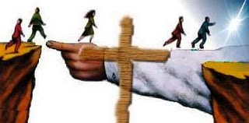
The Book of Romans
ROMANS 3–4
God's Righteousness Revealed
Dr. Rick Griffith • Jordan Evangelical Theological Seminary • BibleStudyDownloads.org

Slide 2
Slides on
Romans 3

Slide 3
Romans 3:9-20
All people stand condemned and thus need justification by faith

Slide 4

Exploring the Problem
Grab a partner
Each of you share what your parents perceive to be the greatest problem in the world

Slide 5
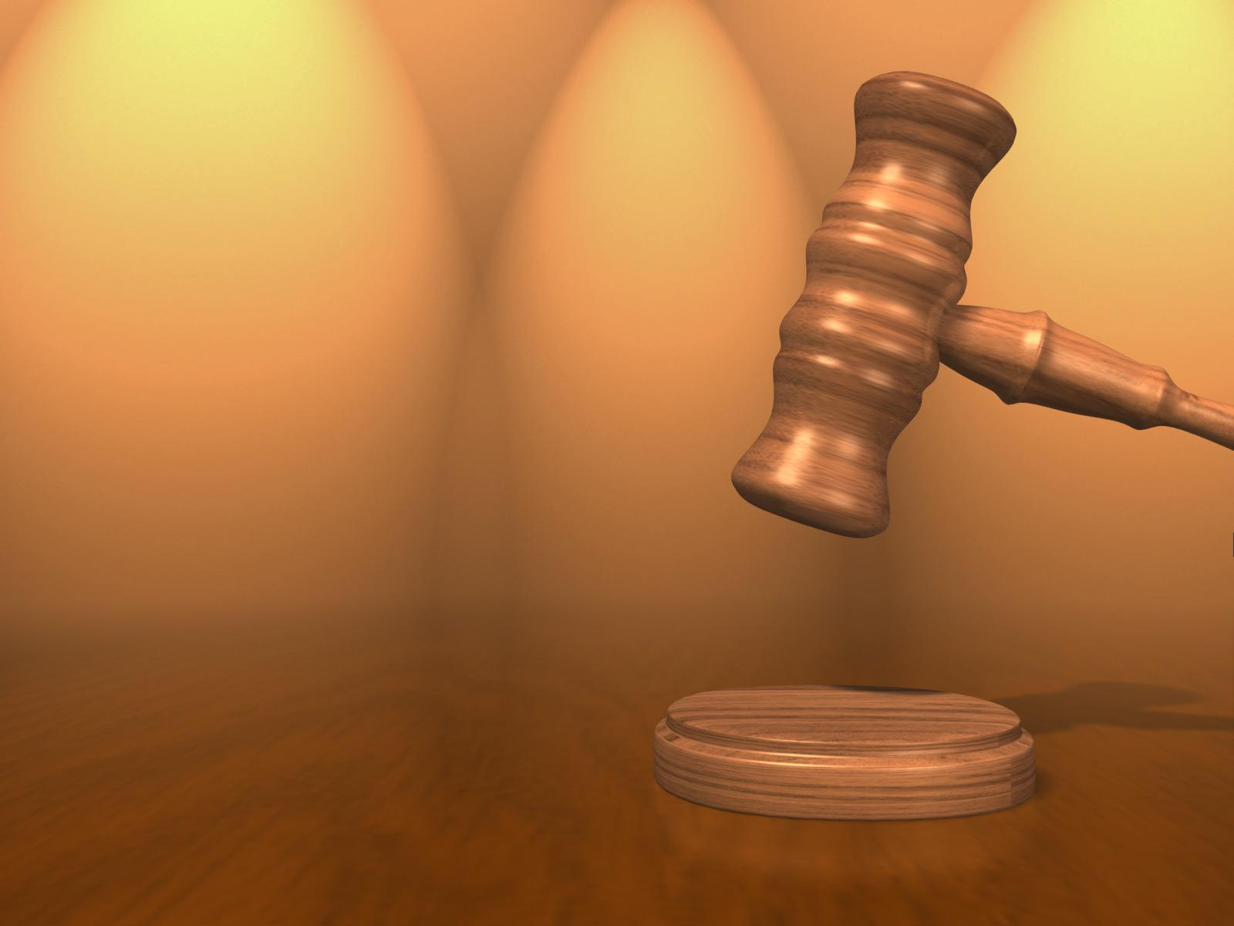
All Are Guilty Before God
152
Condemned Group | Benefits Received | Reason Condemned | Degree of Judgment
Gentiles (1:18-32) | Creation (1:18-20) | Rejection of the light they have (1:21-22) | Great (1:20b)
Self-Righteous People (2:1-16) | Conscience (2:14-15) | Refusal to obey conscience (2:1) | Greater (2:4)
Jews (2:17–3:8) | Law (2:17-20; 3:2) | Hypocrisy (2:21-24) | Greatest (2:24)
All Humanity (3:9-20) | Creation and/or Conscience or Law | Lack of understanding and turning away (3:11-18) | —
Notes:
NS-06-Rom1-2-slide 174
NS-06-Rom3-4-slide 5

Slide 6

Righteousness in Romans
145
Theme | Needed | Provided | Imparted | Proved | Applied | Dissem-inated
Intro 1:1-17 | Condem-nation 1:18– 3:20 | Justifi-cation 3:21– 5:21 | Sanctifi-cation 6–8 | Election 9–11 | Trans-form-ation 12:1– 15:13 | Propa-gation 15:14– 16:27
Start | Sin | Salva-tion | Set Apart | Sove-reignty | Service | Send

Slide 7
Are all the following people really condemned without Christ?
MAKE HIM FAMOUS
around the corner and around the world
讓 全 世 界 都 知 道
～直到全地，直到地極～

Slide 8

Condemned?

Slide 9
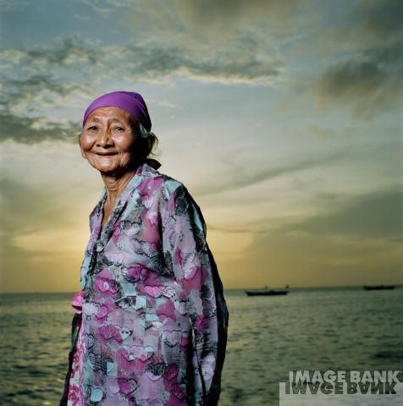
Condemned?

Slide 10
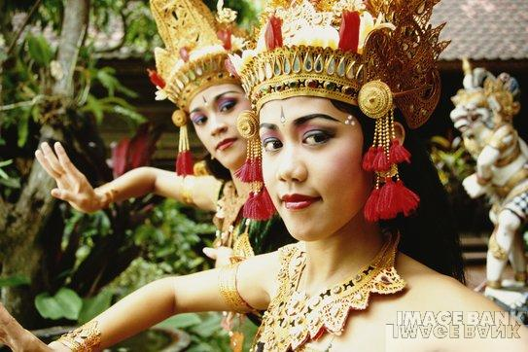
Condemned?

Slide 11
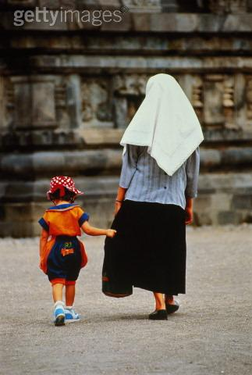
Condemned?

Slide 12
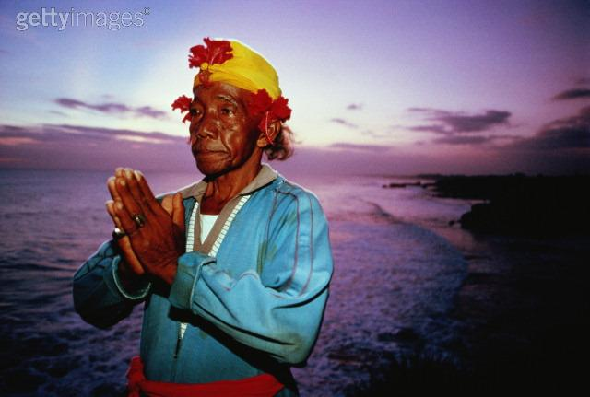
Condemned?

Slide 13
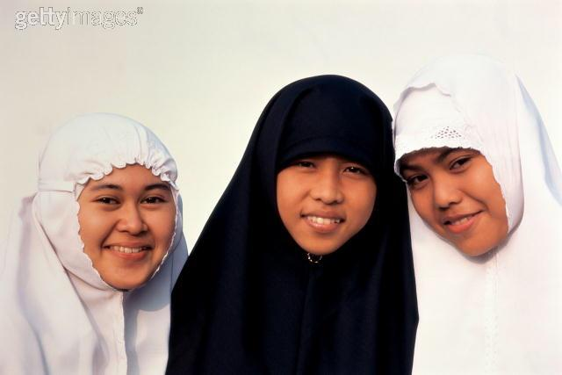
Condemned?

Slide 14
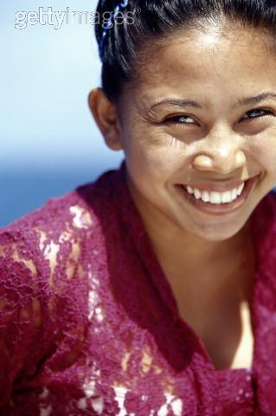
Condemned?

Slide 15
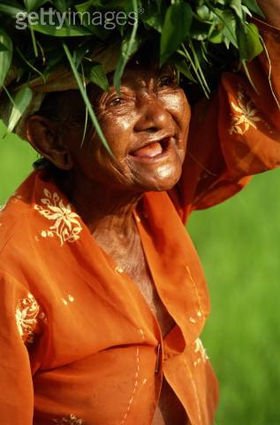
Condemned?

Slide 16

Condemned?

Slide 17
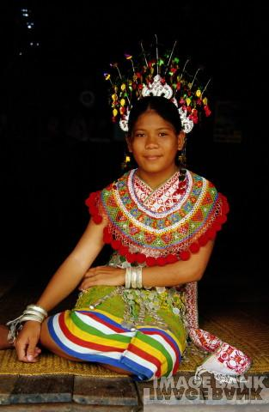
Condemned?

Slide 18
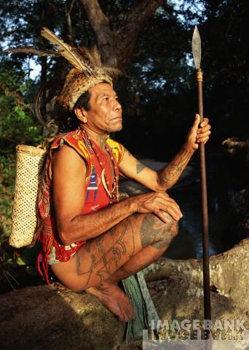
Condemned?

Slide 19

Condemned?

Slide 20
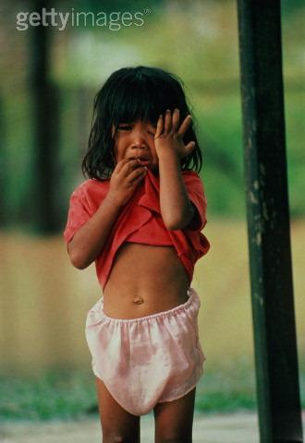
Condemned?

Slide 21
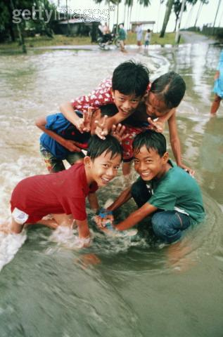
Condemned?

Slide 22
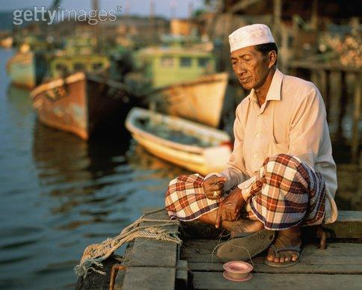
Condemned?

Slide 23
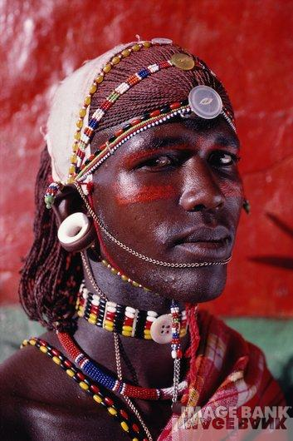
Condemned?

Slide 24
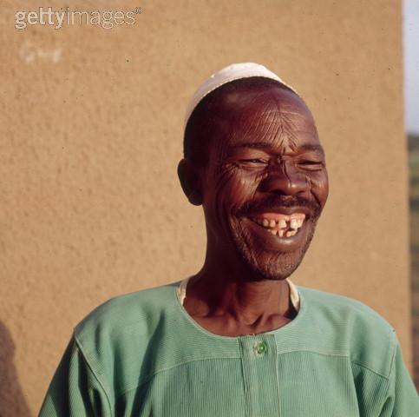
Condemned?

Slide 25

Condemned?

Slide 26
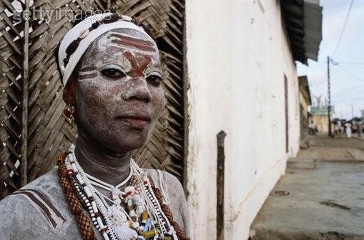
Condemned?

Slide 27
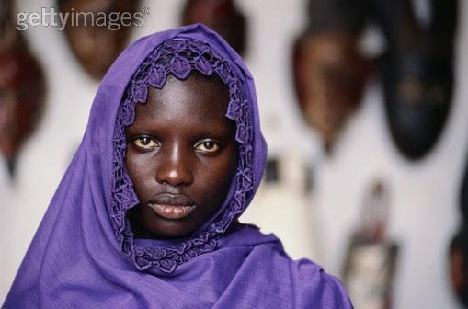
Condemned?

Slide 28
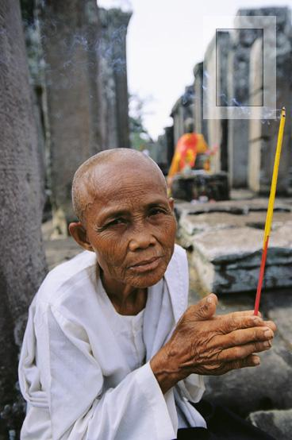
Condemned?

Slide 29

Condemned?

Slide 30
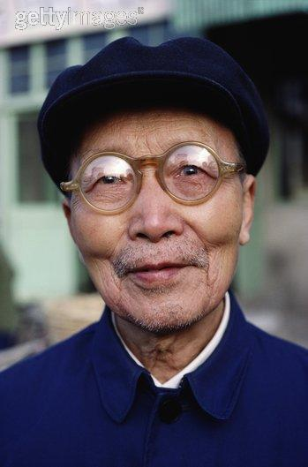
Condemned?

Slide 31

Condemned?

Slide 32

Condemned?

Slide 33

Condemned?

Slide 34

Condemned?

Slide 35
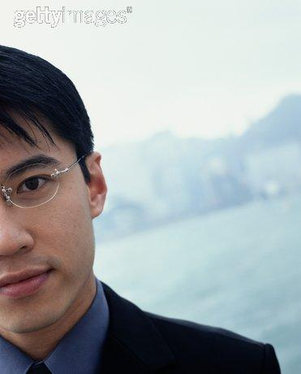
Condemned?

Slide 36
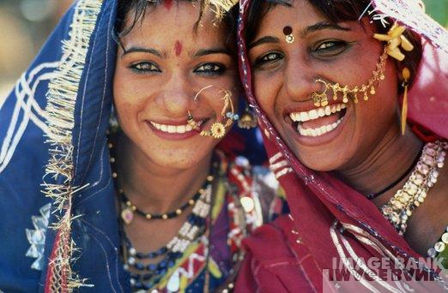
Condemned?

Slide 37
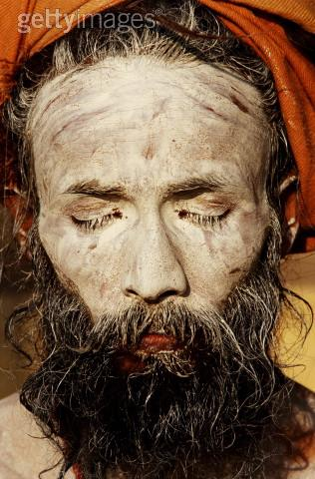
Condemned?

Slide 38
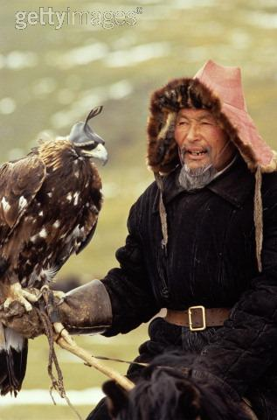
Condemned?

Slide 39
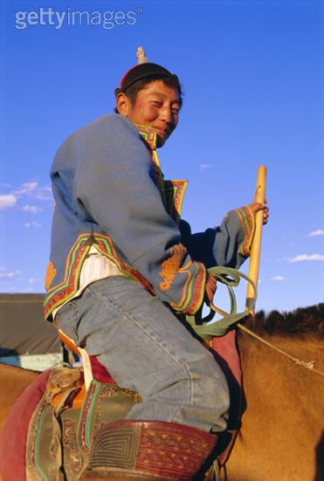
Condemned?

Slide 40
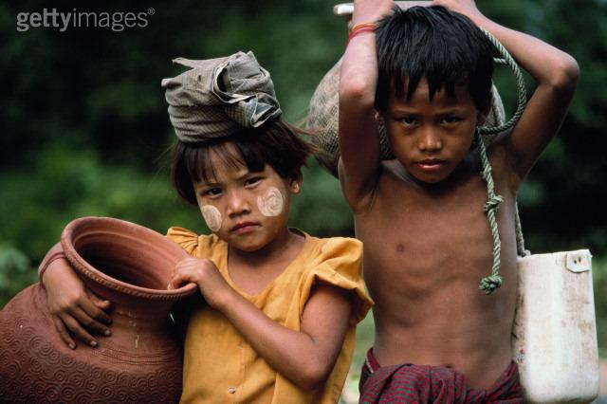
Condemned?

Slide 41
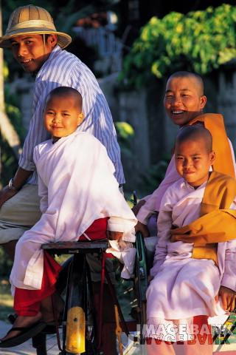
Condemned?

Slide 42

Condemned?

Slide 43

Condemned?

Slide 44

Condemned?

Slide 45
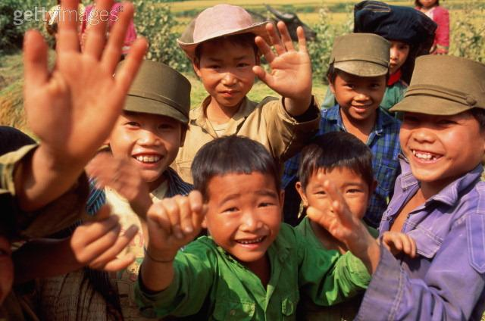
Condemned?

Slide 46

Condemned?

Slide 47
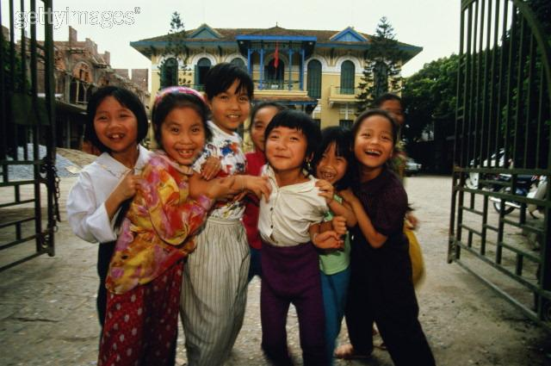
Condemned?

Slide 48
Are all the preceding people really condemned without Christ?
MAKE HIM FAMOUS
around the corner and around the world
讓 全 世 界 都 知 道
～直到全地，直到地極～

Slide 49
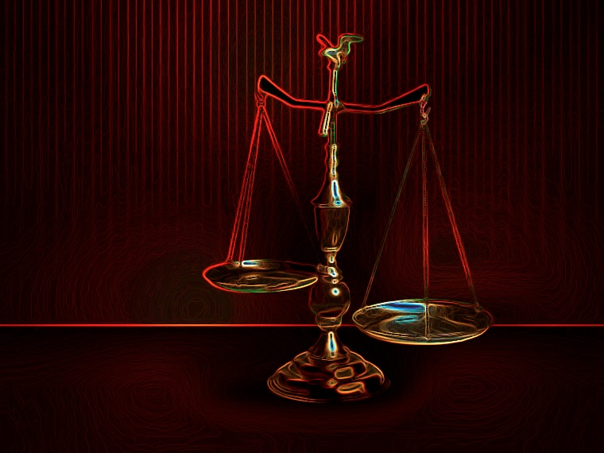
All Are Under Sin
^{10b} "No one is righteous—
not even one.
¹¹ No one is truly wise;
no one is seeking God.
¹² All have turned away;
all have become useless.
No one does good,
not a single one (Pss 14:1-3; 53:1-3–Greek version).
¹³ "Their talk is foul, like… stench from an open grave.
Their tongues are filled with lies."
"Snake venom drips from their lips" (Ps 5:9 Gr.; 140:3).
¹⁴ "Their mouths are full of cursing and bitterness" (Ps 10:7 Gr. version).
¹⁵ "They rush to commit murder.
¹⁶ Destruction and misery always follow them.
¹⁷ They don't know where to find peace" (Isa 59:7-8).
¹⁸ "They have no fear of God at all."
  (Rom 3:10b-18 NLT)

Slide 50
The Law Won't Save
¹⁹ Obviously, the law applies to those to whom it was given, for its purpose is to keep people from having excuses, and to show that the entire world is guilty before God. ²⁰ For no one can ever be made right with God by doing what the law commands. The law simply shows us how sinful we are.
  (Rom 3:19-20 NLT)

Slide 51
Romans 3:21-31
God's righteousness is provided through justification by faith

Slide 52
Why accept one another?
145
SIN
Needed
in Condemnation
1:18–3:20
Equal Righteousness
1:1-17
Provided
in Justification
3:21–5:21
SALVATION
Notes:
God provided righteousness equally in the justification of all who trust Christ (3:21–5:21).
[When we place our faith in Jesus, God amazingly gives us all the same verdict: “not guilty.”]

Slide 53
Righteousness in Romans
145
Theme | Needed | Provided | Imparted | Proved | Applied | Dissem-inated
Intro 1:1-17 | Condem-nation 1:18– 3:20 | Justifi-cation 3:21– 5:21 | Sanctifi-cation 6–8 | Election 9–11 | Trans-form-ation 12:1– 15:13 | Propa-gation 15:14– 16:27
Start | Sin | Salva-tion | Set Apart | Sove-reignty | Service | Send

Slide 54
A Key Question
How do we get right with God?
Notes:
This is one of the most important questions that anyone can consider—if not THE most vital issue in life.
______________
NS-05-Acts15-16—slide 23
NS-05-Romans3-4—slide 54

Slide 55
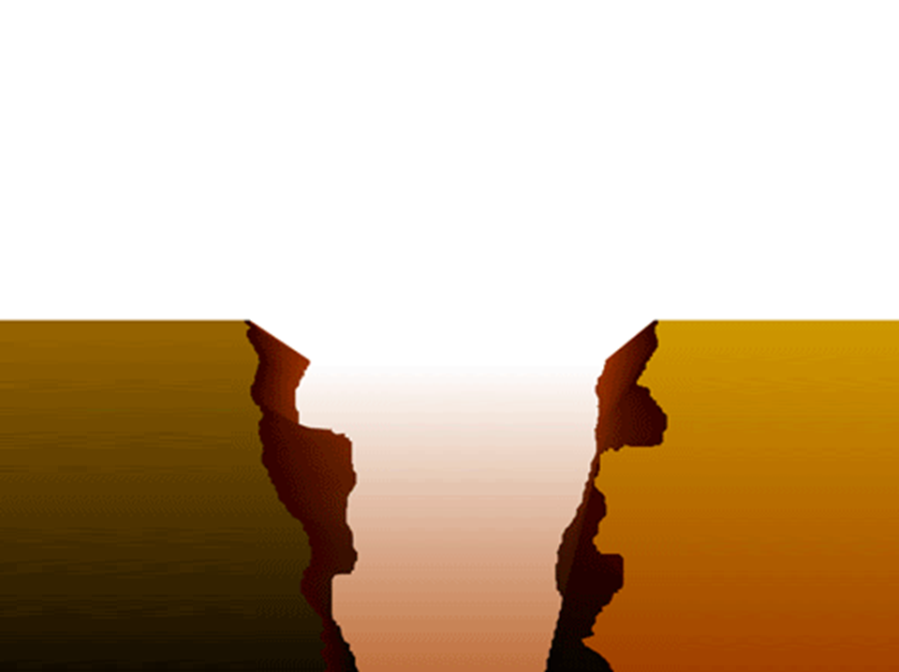


Our Problem:
Sin Separates Us from God
Sinful
Humanity
Holy
God
Notes:
God is holy and we are sinful—so we are separated from God.
______________
NS-05-Acts15-16—slide 24
NS-05-Romans3-4—slide 55

Slide 56
Our Efforts
Our Problem:
Sin Separates Us from God
Religion
Sinful
Humanity
Holy
God
Good Works
Morality
Philosophy
Notes:
So how do we bridge that gap? Religion won’t do it—nor good works, nor morality, nor the right philosophy.
______________
NS-05-Acts15-16—slide 25
NS-05-Romans3-4—slide 56

Slide 57
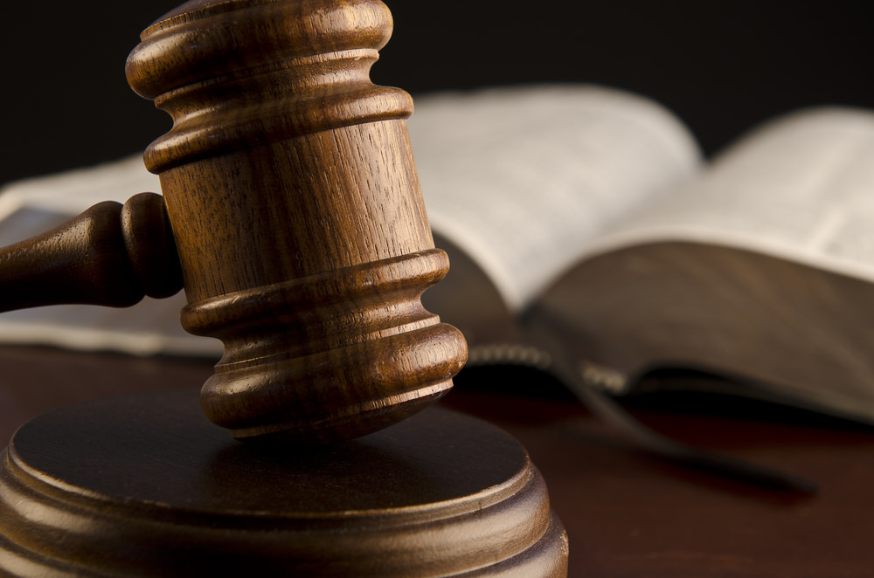
Justification:
What is it?
30
Tell the person next to you…
Notes:
ES-06-Justification-2
NS-06-Rom3-4—slide 54

Slide 58
Justification is…
30
God declaring us “not guilty”
Notes:
ES-06-Justification-3
NS-06-Rom3-4—slide 55

Slide 59
Justification:
55
The instantaneous legal act of God when he declares a sinner
“not guilty” due to Christ’s righteousness being applied to this person, which makes him/her righteous in God’s sight
Notes:
ES-06-Justification-4
NS-06-Rom3-4—slide 56

Slide 60
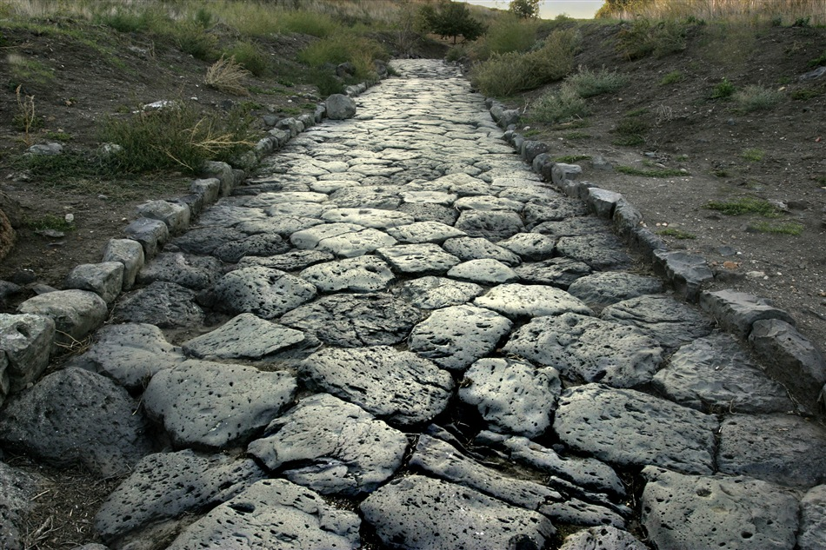
The Roman Road
Notes:
ES-06-Justification-5
NS-06-Rom3-4—slide 57

Slide 61
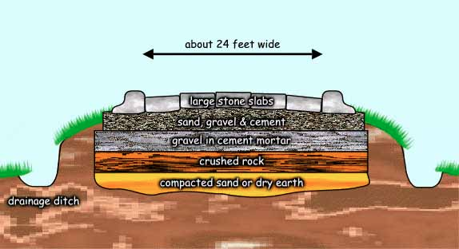
The Roman Road
56
About 24 feet wide
Large stone slabs
Sand, gravel & cement
Gravel in cement mortar
Crushed rock
Compacted sand or dry earth
Drainage ditch
Notes:
NS-Rom3-4-Slide58
SA-16-Nature of Gospel-39

Slide 62
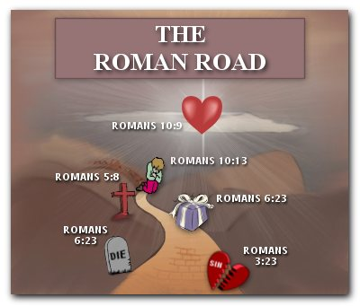
The Roman Road
56
Romans 10:9
Romans 10:13
Romans 5:8
Romans 6:23
Romans
6:23
Romans 3:23
Notes:
NS-Rom3-4-Slide59
SA-16-Nature of Gospel-40

Slide 63
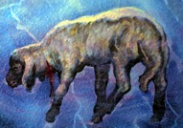
The Roman Road
155i
Rom. 3:23
Everyone has sinned.
Rom. 6:23
The penalty for our sin is death.
Rom. 5:8
Jesus Christ died for sin.
Rom. 10:8-10
To be forgiven for our sin, we must believe and confess Jesus as Lord.

Slide 64

Jesus' death paid for our sin
Notes:
If you had one minute to share how to go to heaven with a dying person, what would you say?
The penalty must be paid for justice to be satisfied. But a substitute is allowed. Jesus was our substitute for the penalty of sin that we owe.
Don't tell people to invite Jesus into their heart. This is not a spatial issue concerning where Jesus resides.
______________
NS-06-Rom3-4—slide 61
NS-21-1Peter-112

Slide 65
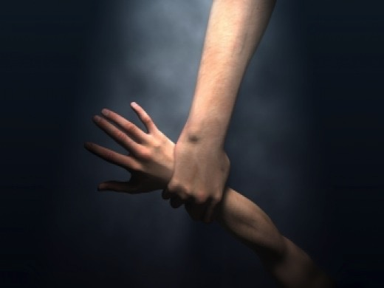
How are We Saved from Sin?
Catholic View: faith + works = justification
MacArthur's View: faith = justification + works
Biblical View: faith ➔ justification
Adapted from John MacArthur, The Gospel According To The Apostles, 68
Notes:
MacArthur labels these the "Roman" and "Protestant" views, but not all Protestants agree that works must follow faith.
__________
ES-02-Death-slide 32
NS-06-Rom3-4—slide 62
NS-09-Galatians-109
SA-06-Justification-8

Slide 66
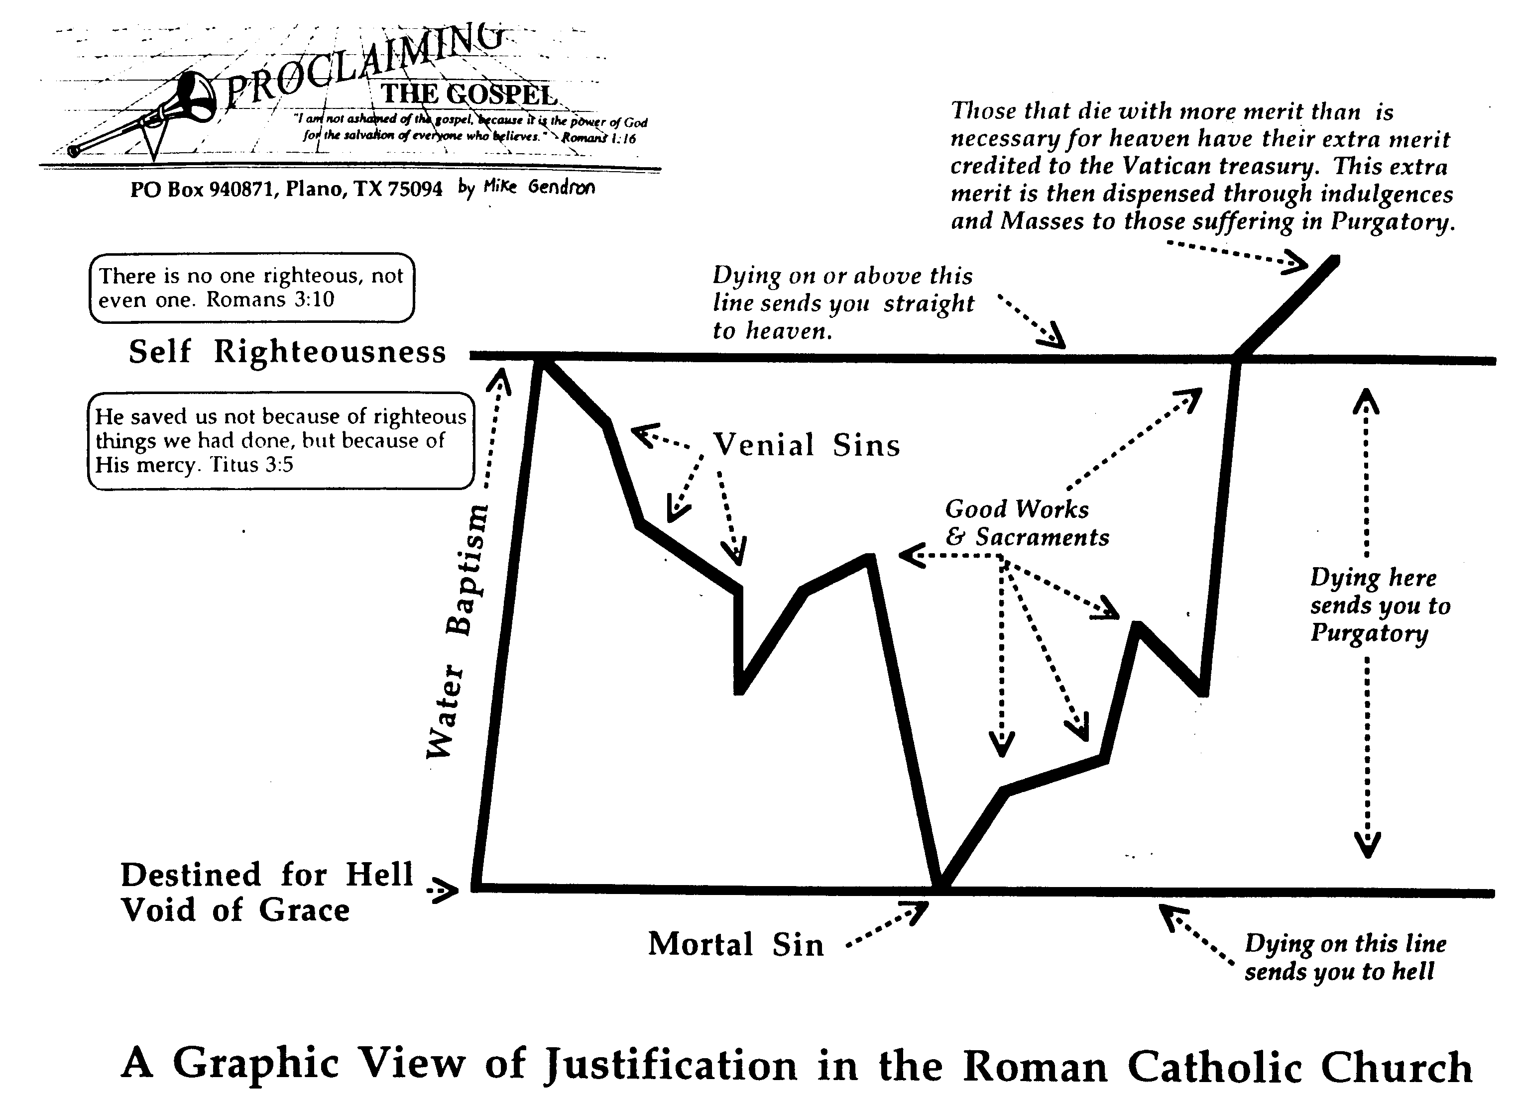
The Catholic View of Justification
174b
那些死于近天堂有多优点的把多余的优点归于梵蒂岡宝。这多余的优点通过赎罪卷与弥撒被散发到那些在炼狱受苦的。
没有义人，连一个也没有.
罗三10
死在这条线上或以上直接送你去天堂
自以为义
他就救了我们，并不是由于我们所行的义，而是照着他的怜悯。多三10
可原谅的罪
善工与圣事
水的洗礼
在这里死送你去炼狱
注定下地狱
没有恩典
肉身的罪
在这条线上死送你去地狱
罗马天主教会的称义图观
Notes:
ES-02-Death-slide 33
NS-06-Rom3-4—slide 63
NS-09-Galatians-110
SA-06-Justification-9

Slide 67
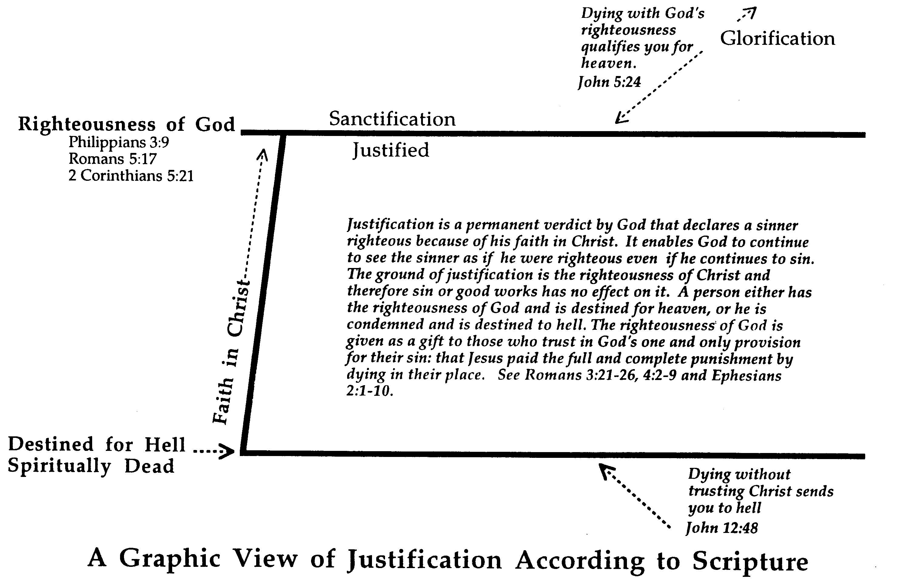
The Scriptural View of Justification
174c
死于神的义使你合格地近天堂。约五24
荣耀
成圣
神的义
腓三9
罗五17
林后五21
称义
称义是个神给永久的定案来宣称罪人因他对基督的信而成为义。这使神继续地看这罪人为义，即使他继续地犯罪。称义的根基是在于基督的义所以罪和善工在它没有效果。一个人只有神的义而注定去天堂，或者他被前最并且注定去地狱。神的义是以礼物给凡所相信神的独一为他们的罪的供应：就是耶稣替他们死来完整地付了代价与惩罚。参罗三21-26, 四2-9, 弗二1-10.
信基督
注定下地狱
死在灵里
没有信靠基督而死送你去地狱。约十二48
圣经的称义图观
Notes:
ES-02-Death-slide 34
NS-06-Rom3-4—slide 64
NS-09-Galatians-111
SA-06-Justification-10

Slide 68
Romans 3:21-23 NAU/NLT
But now apart from the Law the righteousness of God has been manifested, being witnessed by the Law and the Prophets, ²² even the righteousness of God through faith in Jesus Christ for all those who believe; for there is no distinction; ²³ for all have sinned and fall short of the glory of God
But now God has shown us a way to be made right with him without keeping the requirements of the law, as was promised in the writings of Moses and the prophets long ago. ²²We are made right with God by placing our faith in Jesus Christ. And this is true for everyone who believes, no matter who we are. ²³For everyone has sinned; we all fall short of God’s glorious standard.

Slide 69
Romans 3:24-25 NAU/NLT
being justified as a gift by His grace through the redemption which is in Christ Jesus; ²⁵ whom God displayed publicly as a propitiation in His blood through faith. This was to demonstrate His righteousness, because in the forbearance of God He passed over the sins previously committed
Yet God, in his grace, freely makes us right in his sight. He did this through Christ Jesus when he freed us from the penalty for our sins. ²⁵ For God presented Jesus as the sacrifice for sin. People are made right with God when they believe that Jesus sacrificed his life, shedding his blood. This sacrifice shows that God was being fair when he held back and did not punish those who sinned in times past.

Slide 70
Romans 3:26-28 NAU/NLT
for the demonstration, I say, of His righteousness at the present time, so that He would be just and the justifier of the one who has faith in Jesus. ²⁷Where then is boasting? It is excluded. By what kind of law? Of works? No, but by a law of faith. ²⁸For we maintain that a man is justified by faith apart from works of the Law.
for he was looking ahead and including them in what he would do in this present time. God did this to demonstrate his righteousness, for he himself is fair and just, and he makes sinners right in his sight when they believe in Jesus. ²⁷ Can we boast, then, that we have done anything to be accepted by God? No, because our acquittal is not based on obeying the law. It is based on faith. ²⁸ So we are made right with God through faith and not by obeying the law

Slide 71
Romans 3:29-31 NAU/NLT
Or is God the God of Jews only? Is He not the God of Gentiles also? Yes, of Gentiles also, ³⁰ since indeed God who will justify the circumcised by faith and the uncircumcised through faith is one. ³¹ Do we then nullify the Law through faith? May it never be! On the contrary, we establish the Law.
After all, is God the God of the Jews only? Isn’t he also the God of the Gentiles? Of course, he is. ³⁰ There is only one God, and he makes people right with himself only by faith, whether they are Jews or Gentiles. ³¹ Well then, if we emphasize faith, does this mean that we can forget about the law? Of course not! In fact, only when we have faith do we truly fulfill the law.

Slide 72
Now for Some
Theological Words in Romans
155h
Righteousness
(3:21)
Holiness or perfection inherent for God yet imputed (applied) to us in Christ

Slide 73

Faith (3:22)
155h
Trust or reliance on Christ's atonement on the cross as the sinless substitute to pay the sinner's penalty due to God

Slide 74


"It is finished"
155h
Justification (3:24)
God's act of declaring us "not guilty" for our sins, making us right with him
Legal
Paid
in Full
Justice (3:25-26)
The fairness of God where He punishes sin in an individual himself or in a Sinless Substitute (Jesus Christ)

Slide 75
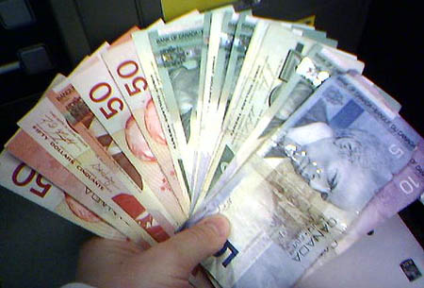
Grace is…
God's
Riches
At
Christ's
Expense
Romans 3:24
Notes:
This acronym sums up GRACE well in English:
G—God's
R—Riches
A—At
C—Christ's
E—Expense
_______________
NS-06-Romans2-3—slide 68
NS-23-1John—177
SA-14-Eternal Security—33

Slide 76



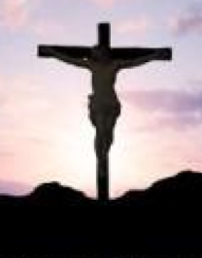
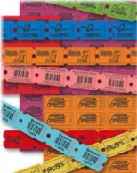
Redemption (Rom 3:24):
"to pay a ransom" (Greek)
280a
Christ's blood paid our ransom
(1 Pet. 1:18)
X
Slave Market
of Sin
Notes:
We redeem something when we pay for it with something of equal or greater value to release it from someone else's control. Christ's death was far more valuable than the hold that sin had on us.
______________
NS-06-Rom3-4—slide 69
NS-21-1Peter-111

Slide 77
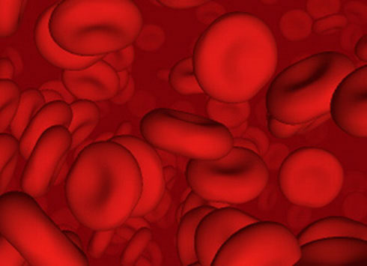
Propitiation (3:25)
"sacrifice of atonement"
155h
Satisfaction of God's righteous anger through shedding of blood

Slide 78
Theological Concepts in Romans
155h
Election | 9:10-13 | God's choice of an individual or group for a specific purpose or destiny
Justification | 4:25; 5:18 | God's act of declaring us "not guilty" for our sins, making us "right" with him
Propitiation | 3:25 | God removing punishment for sin by the perfect sacrifice of Jesus Christ so that God's righteous anger is satisfied
Redemption | 3:24; 8:23 | The return of a sinner to God (“buying back” from the slave market) by Jesus Christ’s payment of the price of death with his own blood to make an unbeliever a believer
Sanctification | 5:2; 15:16 | Becoming more and more like Jesus Christ through the work of the Holy Spirit
Glorification | 8:18, 19, 30 | The believer's final state of being in complete conformance to the character of Jesus Christ in a resurrected body that will last forever (1 John 3:2)
Notes:
________________
NS-06-Rom3-4—slide 78
NS-06-Rom5-8—slide 192

Slide 79
Theological Concepts in Romans
155h
Condemnation | 5:9, 16, 18; 7:13; 8:1 | The just punishment of hell for unbelievers in Jesus due to God's wrath against sin
Salvation | 5:4; 11:11-12, 15; 13:11-12 | Deliverance from the penalty of sin by grace though faith in Jesus
Faith (Belief) | 3:22 | Trust or reliance on Christ's atonement on the cross as the sinless substitute to pay the sinner's penalty due to God
Grace | 3:24 | God giving what we do not deserve by granting salvation and other blessings (God's Riches At Christ's Expense)
Mercy | 1:31; 9:15-16, 18, 23; 11:31-32 | God not giving what we do deserve by saving believers from hell
Gospel | 1:1, 9, 15-16; 2:16; 11:28; 15:16, 19-20 | The good news of salvation from sin's penalty by grace though faith in Jesus as God who atoned for sin and rose again
Notes:
________________
NS-06-Rom3-4—slide 79
NS-06-Rom5-8—slide 193

Slide 80
Theological Words in Romans
155h
Foreknowledge | 8:29 | The effectual appointment or choice of believers to salvation by the Father
Calling | 8:28, 30 | The successful summons to salvation by the Father
Adoption | 8:15, 23 | The transfer of Christians from the control of Satan to security in God's family
Perseverance | 8:25 | The believer's hope for salvation leading to consistent trust and work towards it
Intercession | 8:34 | Christ's pleading to the Father for the believer to be fully conformed to his image
Indwelling | 5:5; 8:9, 11 | The presence of the Spirit in the body of the Christian
Notes:
________________
NS-06-Rom3-4—slide 80
NS-06-Rom5-8—slide 194

Slide 81
Theological Concepts in Romans
155h
Predestination | 8:29-30 | The Father's eternal choice to conform believers to the likeness of the Son
Security | 8:31-37 | The eternal preservation of the believer from hell and irreversible promise of heaven
Assurance | 8:16 | The realization of one's eternal security
Inheritance | 8:17 | Salvation of all believers (heirs of God) and rewards for the faithful (co-heirs of Christ)
Atonement | 3:25 | Removal of the sin barrier between sinners and God by Jesus paying the price of sin
Antinomianism | 6:1 | Living apart from the Mosaic law with increased sin so that grace would abound
Legalism | 4:2; 10:5 | Relying on self-effort by keeping the Mosaic law for salvation and spiritual growth
Notes:
________________
NS-06-Rom3-4—slide 81
NS-06-Rom5-8—slide 195

Slide 82
Theological Concepts in Romans
155h
Righteousness | 1:17; 3:21; 4:3; 5:21 (30 times total) | The quality or state of judicial correctness with focus redemptive action where God pardons but also shares his character with believers who then exhibit righteousness in the moral sense (BDAG)
Imputation | 4:3-6, 8, 10, 22-24 | The application of either sin or righteousness to another
Justice | 1:32; 2:2 | The action of God that is right or just and thus shows no partiality between humans
Right Standing (Position) | 5:21; 8:30 | Our unchanging favorable verdict or status before God as his children (who we are, not what we do)
United | 6:5 | The association of the believer with Christ in a related experience
Identification | 6:5 | The "grown together" (united) experience where the Christian reflects the death and resurrection of Jesus
Notes:
Imputation is noted 19 times in Romans. It is the mathematical term logizomai, meaning "to count, to reckon, to credit, to impute" and thus only some key verses are noted above.
________________
NS-06-Rom3-4—slide 82
NS-06-Rom5-8—slide 196

Slide 83
Christ Bridges the Gap

Slide 84
The "New Perspective" on Paul
154h
Issue | Reformation | New Perspective
Justification by faith | Overall doctrine for all | Particular to Jewish context
Works of the law | Acts of human righteousness to gain credit with God | Elements of Jewish law (Sabbath, circumcision, food)
Nature of these works | Legalistic self-righteousness in general | Badges of identify for the Jews specifically
What Judaism taught | Salvation by works | Salvation by grace
Faith | Trust in God's mercy alone—not human merit | A badge that can be worn by faith—Jew and Gentile
Paul's Warning | Don't trust any kind of human merit, Jewish or otherwise | Don't trust Jewish exclusivist national righteousness
Application to Gentiles | Gentiles need to trust Christ alone, not any other works | Gentiles need not become Jews when trusting Christ
Adherents | Theodore Beza, Martin Luther, John Calvin | James D. G. Dunn, N. T. Wright, E. P. Sanders
Summarized from Simon Athercole, "What Did Paul Really Mean?" CT (Aug 2007): 22-28

Slide 85
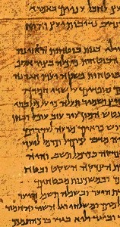
Paul versus Legalists
154k
Legalists
Paul
"The one who does righteousness stores up life for himself with the Lord"
Psalms of Solomon
(about 50 BC)
"Miracles, however, will appear at their own time to those who are being saved by their works"
2 Baruch
(about AD 100)
"But now God has shown us a way to be made right with him without keeping the requirements of the law, as was promised in the writings of Moses and the prophets long ago. ²² We are made right with God by placing our faith in Jesus Christ. And this is true for everyone who believes, no matter who we are"
(Rom. 3:21-22 NLT)

Slide 86
Slides on
Romans 4

Slide 87
Romans 4
153
Justification by faith
is illustrated

Slide 88
Righteousness in Romans
145
Theme | Needed | Provided | Imparted | Proved | Applied | Dissem-inated
Intro 1:1-17 | Condem-nation 1:18– 3:20 | Justifi-cation 3:21– 5:21 | Sanctifi-cation 6–8 | Election 9–11 | Trans-form-ation 12:1– 15:13 | Propa-gation 15:14– 16:27
Start | Sin | Salva-tion | Set Apart | Sove-reignty | Service | Send

Slide 89

Which is the Most Accurate?
121a
Salvation by…
Faith + Works
Faith Alone
Faith + Works
OT
Works
Faith Alone
Faith Alone
Faith + Works
NT
Faith
• Which verses in the Bible support your answer?
cf. OTS 119e
Notes:
Did God change the means of salvation from the OT to the NT?
We are NOT talking about whether people should do good works—we all agree on that. But are works needed for salvation?
Paul answers this question in Romans 4 with the example of Abraham who was saved by faith alone—see Gen 15:6.
________
BE-03-Lev-27
OB-37-Sacrifices-72_eng_ob_1667_v5—slide 17
OB-39-Salvation-2
OS-03-Leviticus-13
OP-03-Lev-27
OP-Lev_6v24-7v10 Why All That Blood Sin & Guilt Offerings-49_eng_op_v4.0—slide 34
OS-04-Num-27
NP-Acts_15v1-35_Dont_Be_Law_Abiding_(Rick_Griffith)-61_eng_pr_v4—slide 5
NS-05-Acts15-16-slide 26
NS-Rom3-4-slide 77
NS-09-Galatians-48
NS-20-James-30
NS-23-1Jn-58
SA-03-Biblical Terms-6
SA-15-Inheritance-26

Slide 90
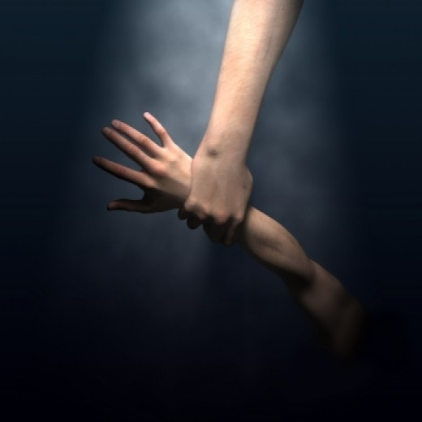
In Other Words…
153
Salvation has
ALWAYS been through faith alone!
Notes:
If I had to pick the three most important OT characters, I would say Abraham, Moses, and David. But Moses had nothing to contribute to the issue of salvation.

Slide 91
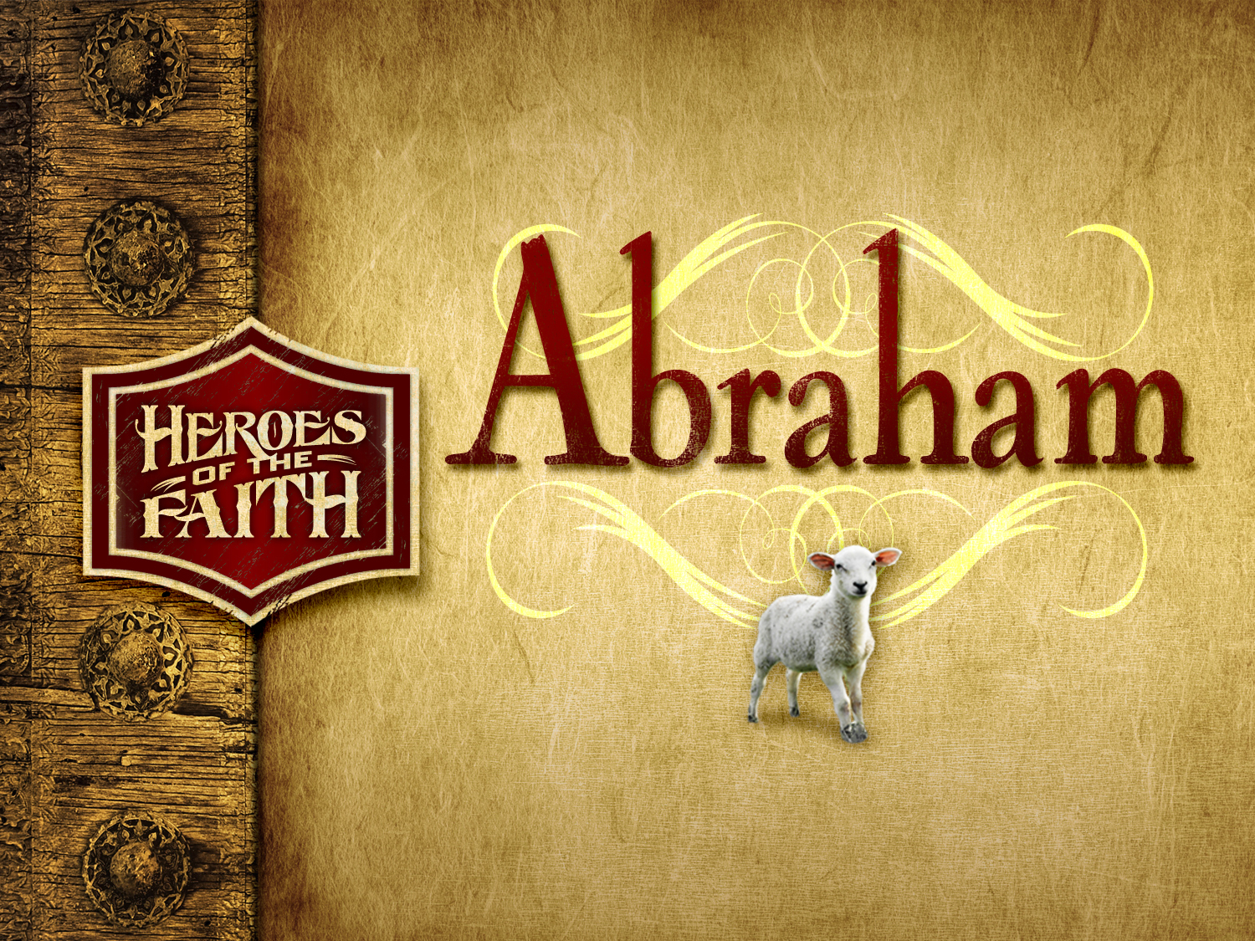

Abraham
Heroes of the Faith
Notes:
In Genesis 12 the account switches directions from discussing all peoples to zeroing in on one man and his family—the man Abraham.

Slide 92
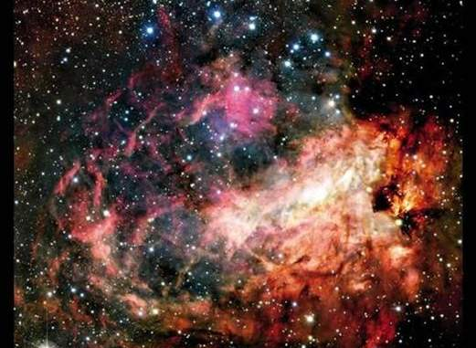
Genesis 15:5-6
153
Creation
[God took Abraham] outside and said, "Look up at the heavens and count the stars--if indeed you can count them." Then he said, "So shall your offspring be."
Abram believed the LORD, and he credited it to him as righteousness.

Slide 93
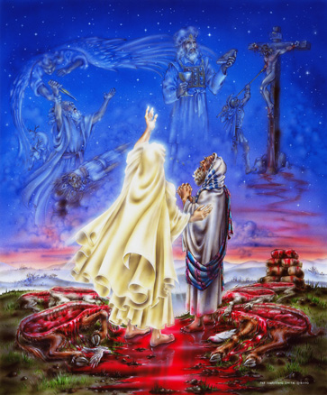

Genesis 15 Ratification
153
ROYAL LAND GRANT FORM OF THE ABRAHAMIC COVENANT
This painting inaccurately depicts Abram walking through the pieces

Slide 94
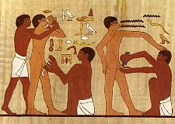
"So Christ has truly set us free. Now make sure that you stay free, and don’t get tied up again in slavery to the law" (Galatians 5:1 NLT).
"Listen! I, Paul, tell you this: If you are counting on circumcision to make you right with God, then Christ will be of no benefit to you. ³I’ll say it again. If you are trying to find favor with God by being circumcised, you must obey every regulation in the whole law of Moses. ⁴For if you are trying to make yourselves right with God by keeping the law, you have been cut off from Christ! You have fallen away from God’s grace" (Galatians 5:2-4 NLT).

Slide 95
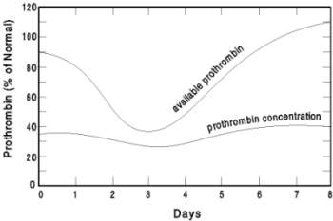
Circumcision, Vitamin K & Prothrombin
Available Prothrombin
Prothrombin (% of Normal)
Prothrombin Concentration
Days
Notes:
Circumcision is not bad in itself. God commanded it in Genesis 17 on the eighth day of a Jewish boy's life, which still has the highest blood-clotting Prothrombin of any day in a male's life!
However, the problem was with God's people in the letter to the Galatians, who made circumcision a requirement for salvation that had to be imposed on the Gentiles as well as the Jews.
———————
OS-01-Gen4-20—slide 308
NS-Galatians-181

Slide 96

Justification by Faith
David also spoke of this when he described the happiness of those who are declared righteous without working for it:
⁷“Oh, what joy for those
whose disobedience is forgiven,
whose sins are put out of sight.
⁸Yes, what joy for those
whose record the LORD has cleared of sin."
Romans 4:6-8 NLT

Slide 97

Romans 4:16-17 NLT
So the promise is received by faith. It is given as a free gift. And we are all certain to receive it, whether or not we live according to the law of Moses, if we have faith like Abraham’s. For Abraham is the father of all who believe. ¹⁷ That is what the Scriptures mean when God told him, “I have made you the father of many nations.” This happened because Abraham believed in the God who brings the dead back to life and who creates new things out of nothing.
Notes:
ESV:
16 That is why it depends on faith, in order that the promise may rest on
grace and be guaranteed to all his offspring—not only to the adherent of
the law but also to the one who shares the faith of Abraham, who is the
father of us all,
17 as it is written, “I have made you the father of many
nations”—in the presence of the God in whom he believed, who gives life
to the dead and calls into existence the things that do not exist.

Slide 98

"God will credit righteousness—for us who believe… He was delivered over to death for our sins…" (Rom. 4:24-25a)

Slide 99

"…and was raised to life for our justification"
(Rom. 4:25b)

Slide 100


NT Survey link at BibleStudyDownloads.org
Get this presentation for free!
Notes:
NT Survey (ns)

Slide 101
Black

