Slide 1

The Book of Romans
ROMANS 1–2
God's Righteousness Revealed
Dr. Rick Griffith • Jordan Evangelical Theological Seminary • BibleStudyDownloads.org

Slide 2
Key Word
56
39
Righteousness
Romans

Slide 3
Theme
23
God's righteousness by faith in Christ helps us accept others
Romans

Slide 4
Key Verses
56
"¹⁶I am not ashamed of the gospel, because it is the power of God for the salvation of everyone who believes: first for the Jew, then for the Gentile.
¹⁷For in the gospel a righteousness from God is revealed, a righteousness that is by faith from first to last, just as it is written: 'The righteous will live by faith'" (1:16-17).
Romans

Slide 5
Summary Statement
145
The righteousness of God that requires justification be only by faith in Christ and not by works of the law should solve conflicts between Jewish and Gentile believers before Paul’s soon arrival
Applying the Letter
Do you experience peace with other believers as fellow recipients of God's righteousness by faith? Or do you have conflicts with them stemming from pride?
Romans

Slide 6

Kingdom Statement
27b
God’s call to enter His kingdom is His effective “summons” through gospel preaching that guarantees people will leave the kingdom of darkness (8:28-30) which is the Spirit’s work (14:17).
Romans

Slide 7

Covenant
27b
Jewish believers were privileged to be the first to accept the gospel (1:16; cf. 2:9-10), but Gentiles are now grafted into the Abrahamic Covenant (11:11-24).
Romans

Slide 8

Redemption
27b
Jesus is the God of the Gentiles as well as the God of the Jews (3:29) since both groups are saved by faith in Christ (1:16-17).
Romans

Slide 9

Prophecy
(Lord, Deity)
27b
At Christ’s return, the Jewish nation will trust him as Lord when God “takes away their sins” (11:26-27) in the new covenant initiated with Israel in the messianic kingdom when her sins are forgiven (Jer. 31:34) and the Spirit given to the nation (Isa. 59:21; Ezek. 36:27).
Romans

Slide 10

Righteousness
Romans
145
Theme | Needed | Provided | Imparted | Proved | Applied | Dissem-inated
Intro 1:1-17 | Condem-nation 1:18– 3:20 | Justifi-cation 3:21– 5:21 | Sanctifi-cation 6–8 | Election 9–11 | Trans-form-ation 12:1– 15:13 | Propa-gation 15:14– 16:27
Start | Sin | Salva-tion | Set Apart | Sove-reignty | Service | Send

Slide 11
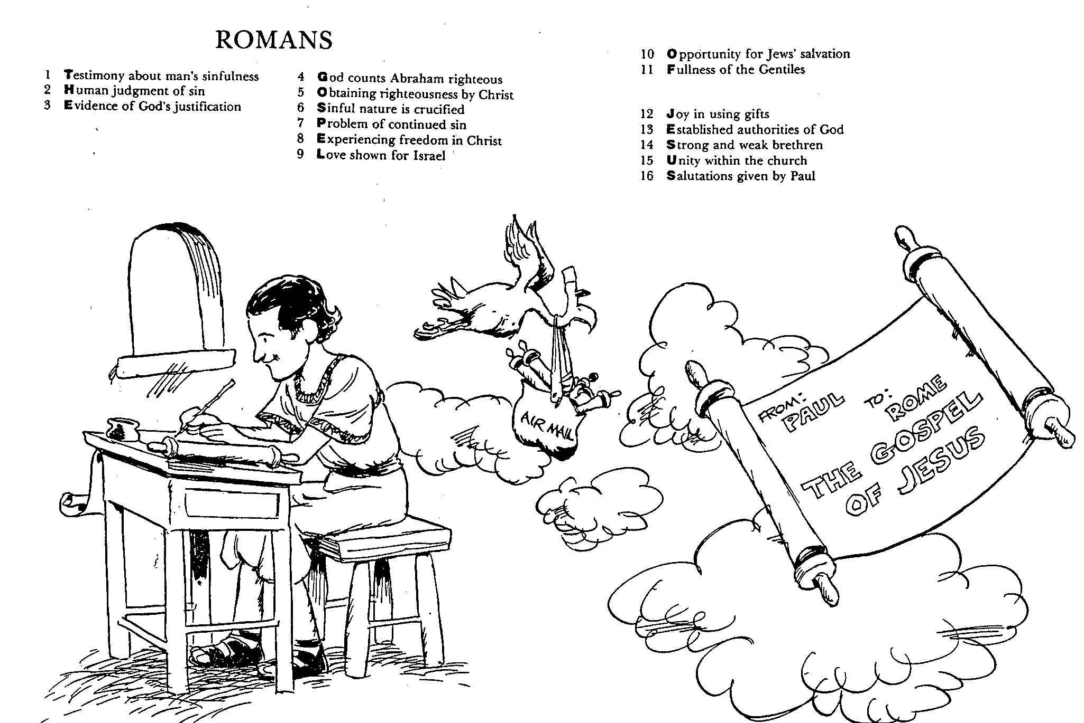
Romans
Barry Huddleston, The Acrostic Bible

Slide 12

Be Accepting
Romans
Dr. Rick Griffith • Crossroads International Church Singapore
BibleStudyDownloads.org

Slide 13
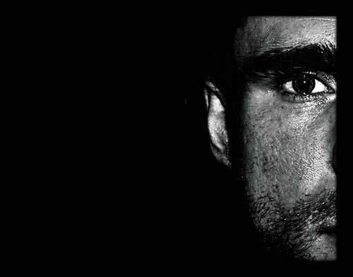
Too often we don’t accept people different from us.
Romans

Slide 14

Why accept one another?
Romans

Slide 15
Why accept one another?
145
SPREADING
SIN
Disseminated in Propagation
15:14–16:27
Needed
in Condemnation
1:18–3:20
Applies in Transformation
12:1–15:13
Equal Righteousness
1:1-17
Provided
in Justification
3:21–5:21
SUBMISSION & SENSITIVITY
SALVATION
Vindicated
in Election
9–11
Imparted
in Sanctification
6–8
SELECTION
SET APART
Romans
Notes:
We get God’s righteousness equally by faith in Christ (1:1-17).
We need God's righteousness since we’re all condemned by sin (1:18–3:20).
God provided righteousness equally in the justification of all who trust Christ (3:21–5:21).
God's righteousness imparted sanctification equally to us all (Rom 6–8).
God vindicated his righteousness in Israel’s election and Gentile salvation (Rom 9–11).
Righteousness applies equally in our life transformation (12:1–15:13).
Righteousness must be disseminated in propagating the gospel by us all (15:14–16:27).

Slide 16
NT Overview (Paul's Letters)
143
38
124
39-41
"To the remotest part of the earth" (Acts 1:8)
Acts 9 13 14 15 16 18 21 27 28
Apr 48-
Sep 49
1
Galatia
Apr 50-
Sep 52
2
Aegean
Spr 53-
May 57
3
Asia
Feb 60-
Mar 62
1
Rome
Spr 62-
Fall 67
4
Spain
Aut 67-
Spr 68
2
Rome
Summer 35-
37
Damascus
Antioch
Romans is the last of the missionary epistles but first in our NT order of epistles
May 57-
Aug 59
Trials
Fall 49
The
Council
Spring 68
Expansion of Church
35 48 49 50 52 53 57 60 62 67 68 95
Matt
Luke
Acts
Mark
John
Gal
1 Thess
1 Cor
Eph
1 Tim
2 Tim
2 Thess
2 Cor
Col
Titus
East
Missionary
Pastoral
Romans
Philem
Phil
West
Gospels & Acts
1234
Journeys
Prison
Pauline Epistles
Rome
Imprisonments
Pauline
Notes:
By the time Paul wrote Romans, he had seen the church planting movement reach the eastern part of the Empire! He notes this in Romans 15.
_________
NS-06-Romans1-2—slide 16, 94

Slide 17
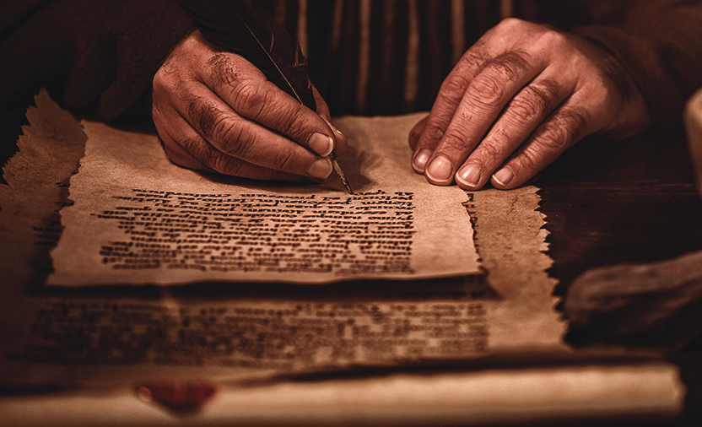
Occasion
147
My purposes for writing this letter were:
To tell them that I want to come and see them. This will enlist the support of the church in Rome for my outreach to Spain.
To give a clear and complete presentation of the doctrine of salvation by faith.
To heal the Jew-Gentile division in the Christian community in Rome.
To expound on the righteousness of God.

Slide 18
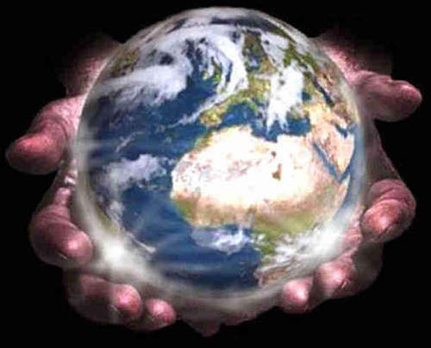
Main Idea of Romans
We accept each other because God’s righteousness comes to us equally.

Slide 19
Accept others. How?
      Have you received God’s forgiveness offered freely by trusting Christ?
      If so, are you seeing yourself clearly—that is, humbly?
      Or do you think yourself better than someone else? Who?
      Which Christian are you not accepting? How can you better accept that person?
Application of Romans

Slide 20
Black

Slide 21


Who Am I? (Family Roots)
5
Born in Tokyo as a MK (1958)
Moved to California (SF area) at 18 mos.
Parents divorced (age 4)
Mom remarried & divorced (ages 8-10)
Born again (age 13)
Mom married third time (age 14)

Slide 22
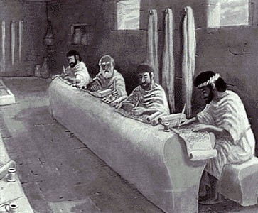
Who Am I? (Education Roots)
BS, Business Marketing (Hay U, 1980)
ThM, Pastoral Ministries (Dallas, 1987)
PhD, Bible Exposition (Dallas, 1990)

Slide 23
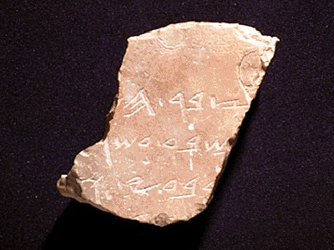
Who Am I? (My Passions)
My God
My Family

Slide 24

Thailand • Mongolia • Myanmar • Indonesia
Notes:
INTERVIEWER: And Susan, what ministries has the Lord granted you?
SUSAN: I have been teaching the wives of leaders at SBC. These 5 women come from 5 different nations!
SUSAN: I also lead the woman's Bible study at our church

Slide 25

The Griffiths
28 Nov 2019
2020
Rick & Susan
John & Chloe
(29)
Kurt & Cara (35)
Stephen, Katie & Jesse (32)

Slide 26
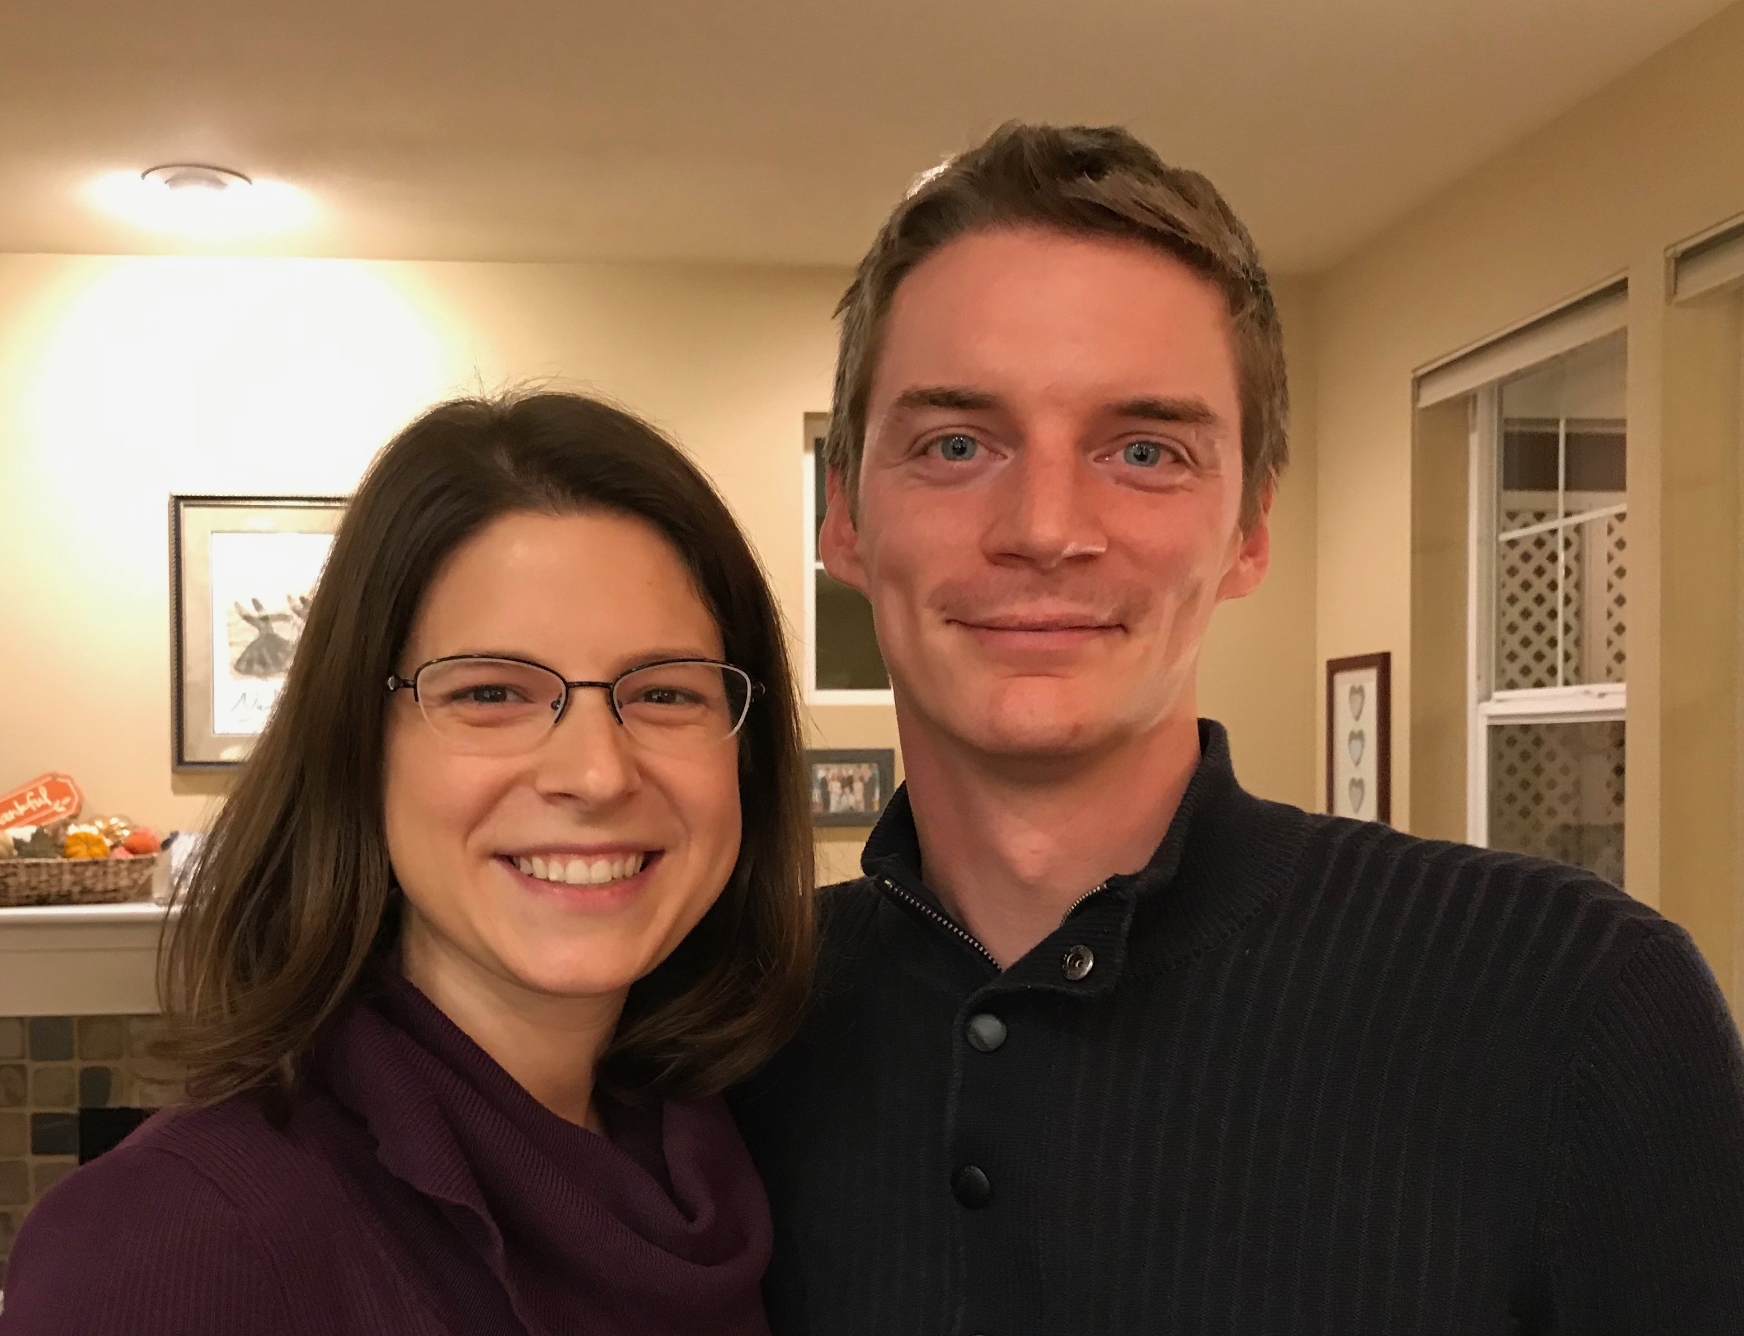
Kurt (35) & Cara own their HR consulting business near Seattle
Notes:
Kurt and his wife Cara are in Seattle

Slide 27

1-year-old grandson Kadon

Slide 28


Stephen, Katie, Jesse & Norah live near Denver, Colorado
Norah born July 31
Notes:
Our granddaughter joined the family on 31 July 2021 but why would God take us now? I don’t know.

Slide 29

Our 2-year-old Grandson Jesse
Norah born
31 July 2021

Slide 30
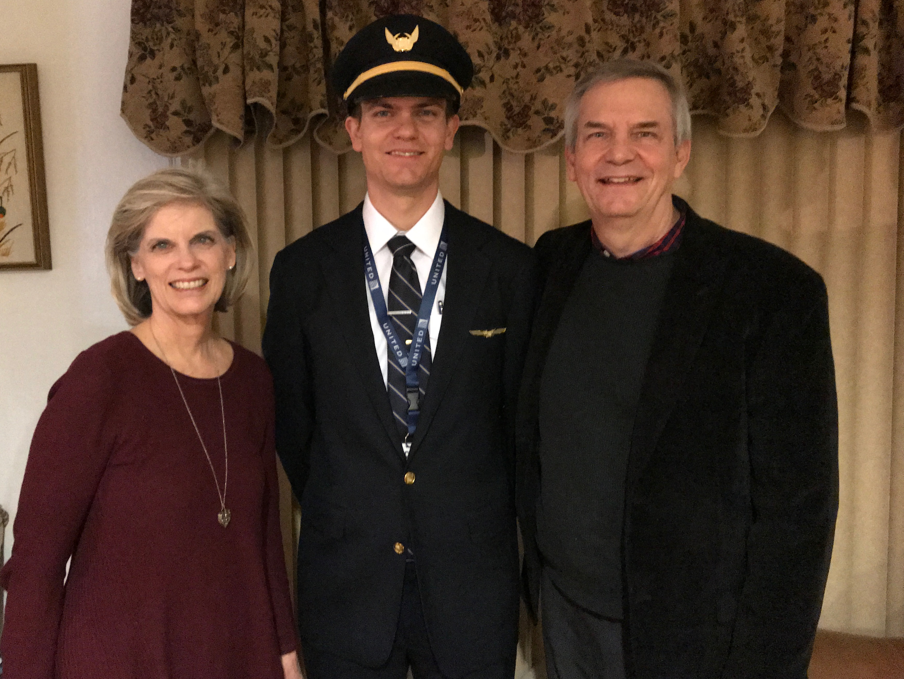
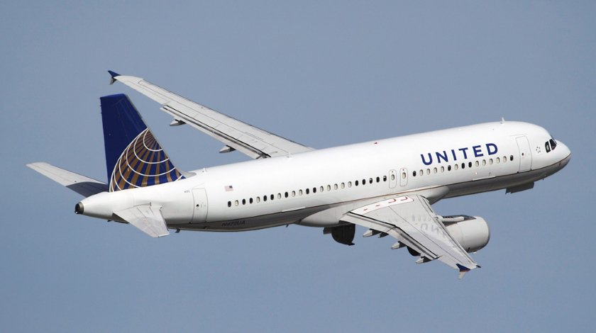
Stephen (32) trains United B777 pilots in Denver
6
Notes:
Stephen and his wife Katie in Boise

Slide 31

John (29) is a graphic artist in California
8
Notes:
John and his fiancée Chloe both work in IT doing web design and graphics for digital software companies.

Slide 32
Who Am I? (My Passions)
My God
My Family
My Ministries

Slide 33
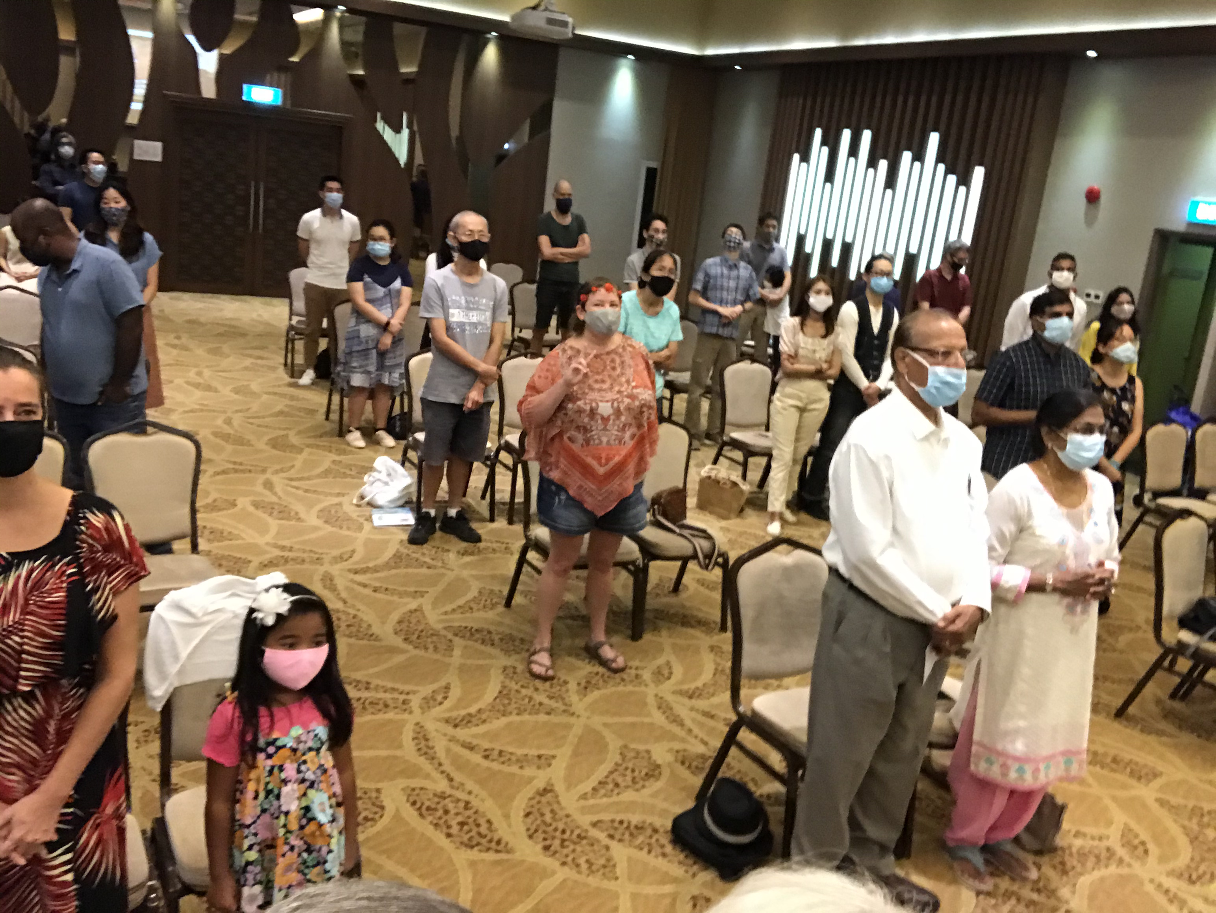

Our People
9
June 2021
90 people from 16 nations

Slide 34


Crossroads People • June 2021
UK
UNITED KINGDOM
RUSSIA
NETHERLANDS
MONGOLIA
ITALY
FRANCE
KOREA
HONG KONG
LEBANON
EGYPT
JAPAN
CHINA
MYANMAR
GERMANY
TAIWAN
CANADA
INDIA
USA
THAILAND
ETHIOPIA
MALAYSIA
ZIMBABWE
SOUTH AFRICA
PHILIPPINES
SINGAPORE
INDONESIA
CIC
AUSTRALIA
NEW ZEALAND
KENYA
Notes:
We actually have about 20% Indian at CIC, thanks to St. Thomas, who overcame his initial reluctance to witness for Jesus in India.
Our June 2021 church of 90 people stem from 16 different countries around the world: Australia (David & Fiona), China (Jianji), Egypt (Tamara), France (Valentin), Korea (Grace Kim), India (Cynthia), Indonesia (Rena), Kenya (Jacqueline Ngare), Nepal (Joshua Limbu), Netherlands (Toes), Singapore (Albina), South Africa (Melody Hertenberger), Taiwan (Maple), Thailand (Mae), UK (James & Gabi), USA (Jim & Jacqui).
This does not include people who have recently attended only once:
Nor does it include missionaries living back in their countries but still are members of CIC: Maple (Taiwan), Budmaa (Mongolia)
Previous: Canada (Gloria Lee), Ethiopia (Lele), Malaysia (Aston, Naomi), Netherlands (Dies & Desiree), Philippines (Micah), South Africa (Melody),

Slide 35
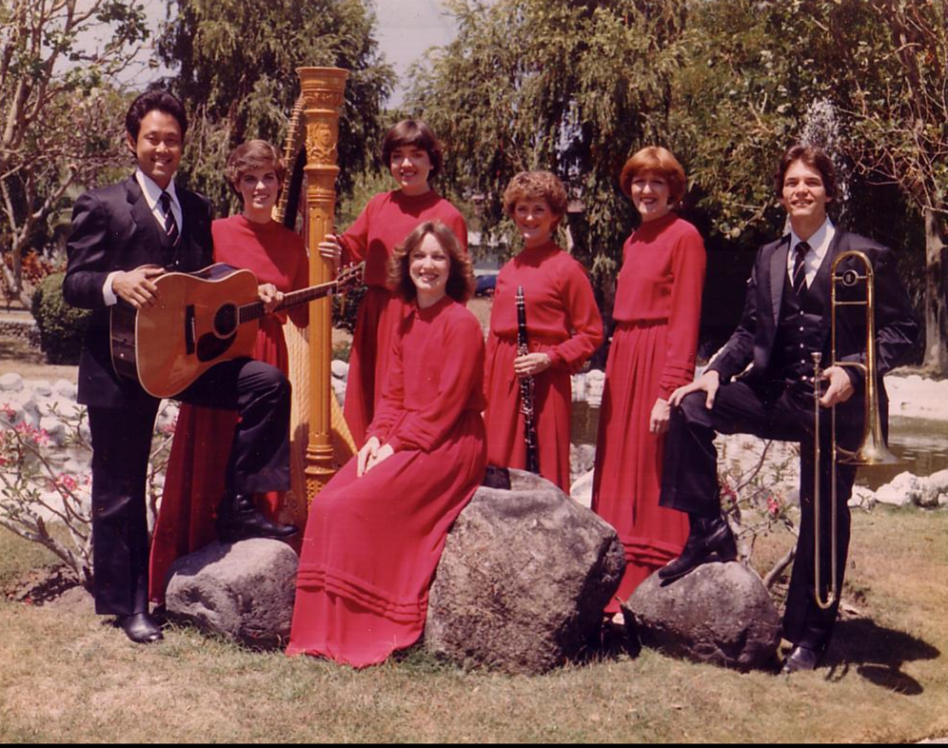
Who Am I? (My Passions)
My God
My Family
God's Word
Music

Slide 36
Courses Taught Since 1991
(English • Indonesian • Chinese)
Survey • The Bible…Basically
OT NT Bible Study
Backgrounds • Research & Writing
OT NT Geography
Theology • Creation • Jesus
Church • Spirit • Salvation • Future
Preaching
Homiletics 1 Homiletics 2
Notes:
I get to teach these leaders every book of the Bible in survey courses, plus backgrounds to both the OT and NT, three areas of theology, and how to preach.

Slide 37


NT Survey link at BibleStudyDownloads.org
Get this presentation for free!
Notes:
NT Survey (ns)

Slide 38
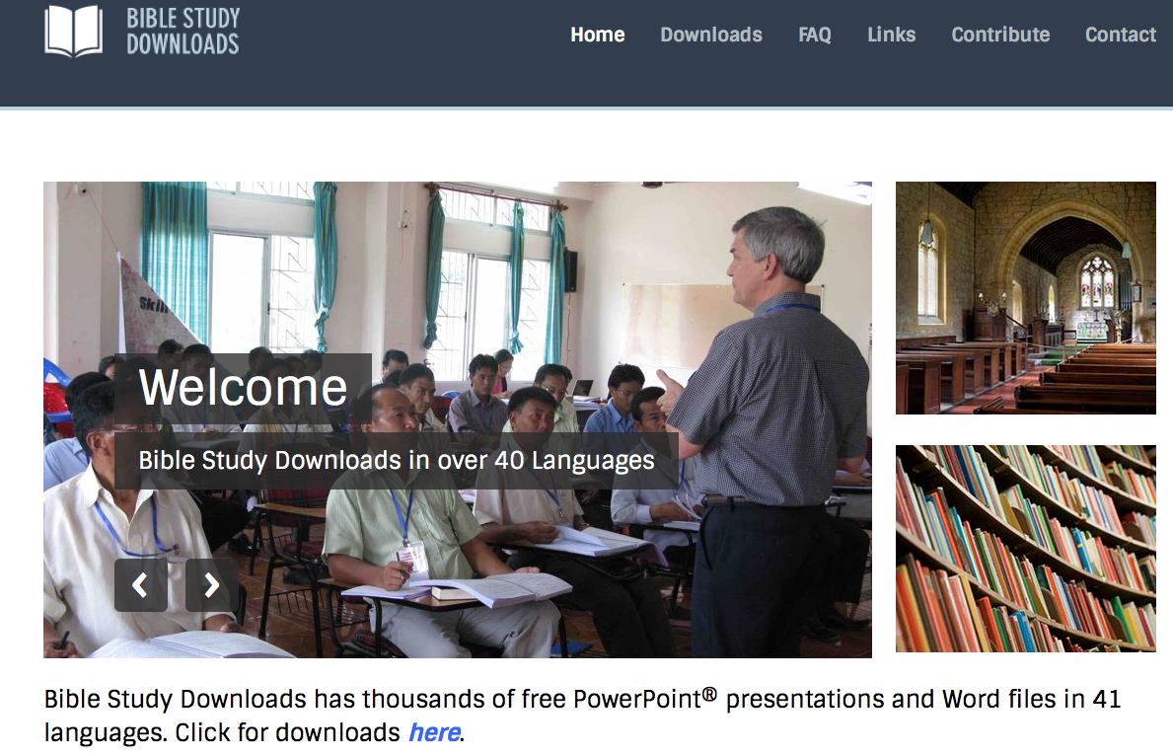
BibleStudyDownloads.org
7
Notes:
This has resulted in Bible teaching and study materials—mostly PowerPoint—in 42 languages! All a teacher needs to do is to click on a file and it downloads for free to teach any book of the Bible and many other subjects.

Slide 39
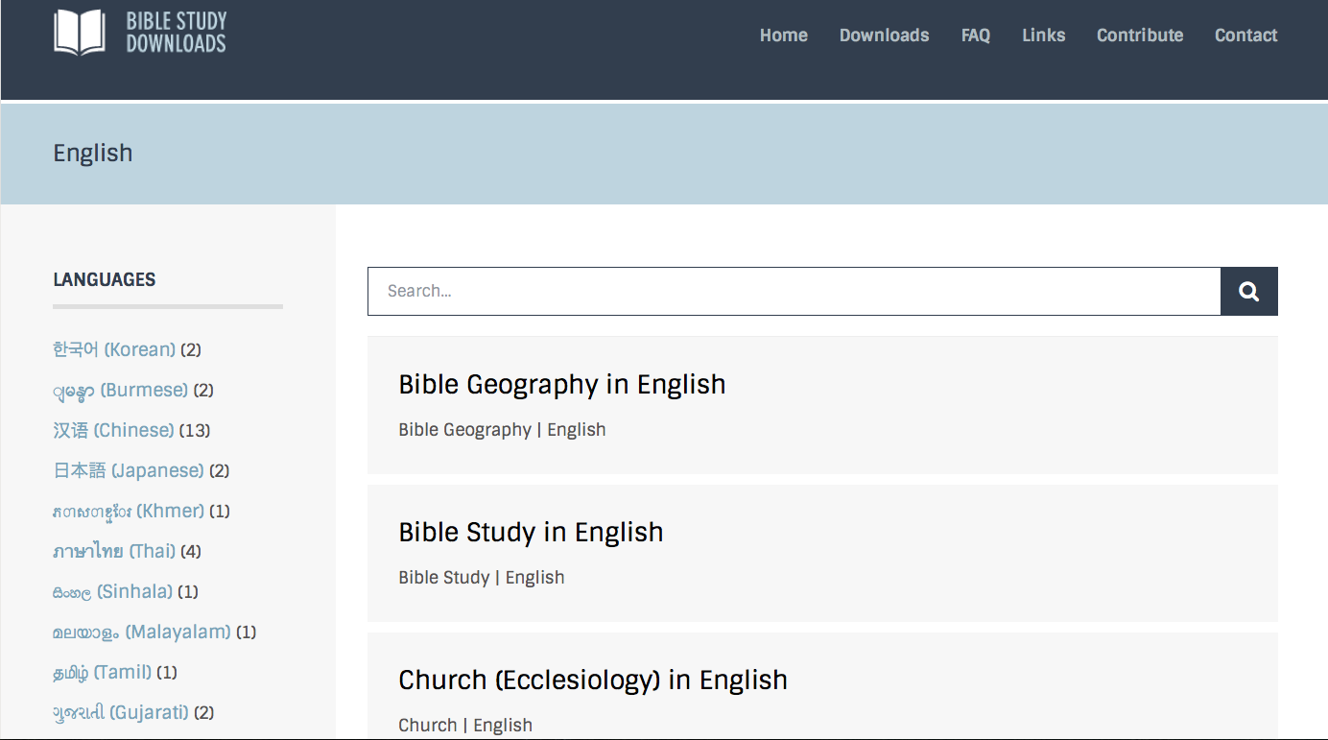
BibleStudyDownloads.org
7
Notes:
This has resulted in Bible teaching and study materials—mostly PowerPoint—in 42 languages! All a teacher needs to do is to click on a file and it downloads for free to teach any book of the Bible and many other subjects.

Slide 40
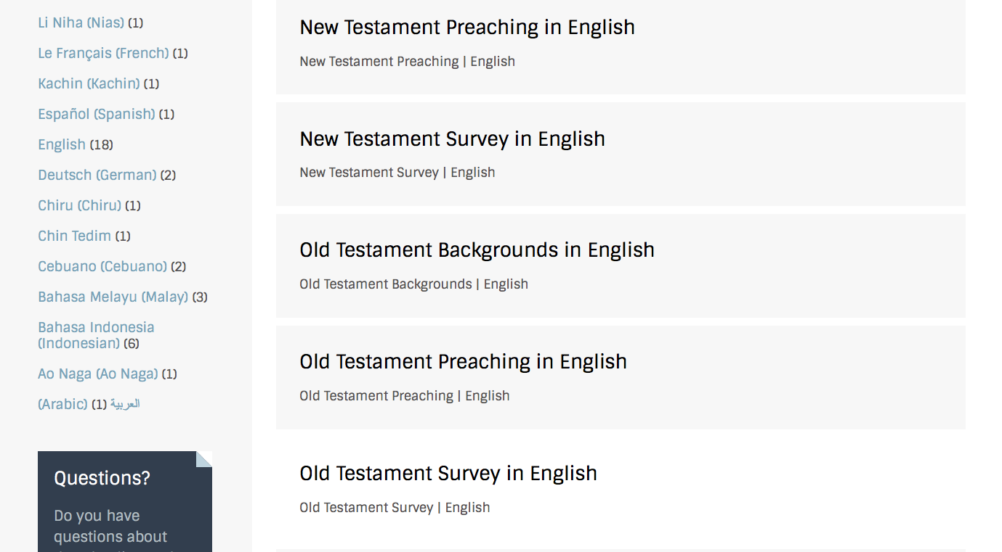
BibleStudyDownloads.org
7
Notes:
This has resulted in Bible teaching and study materials—mostly PowerPoint—in 42 languages! All a teacher needs to do is to click on a file and it downloads for free to teach any book of the Bible and many other subjects.

Slide 41
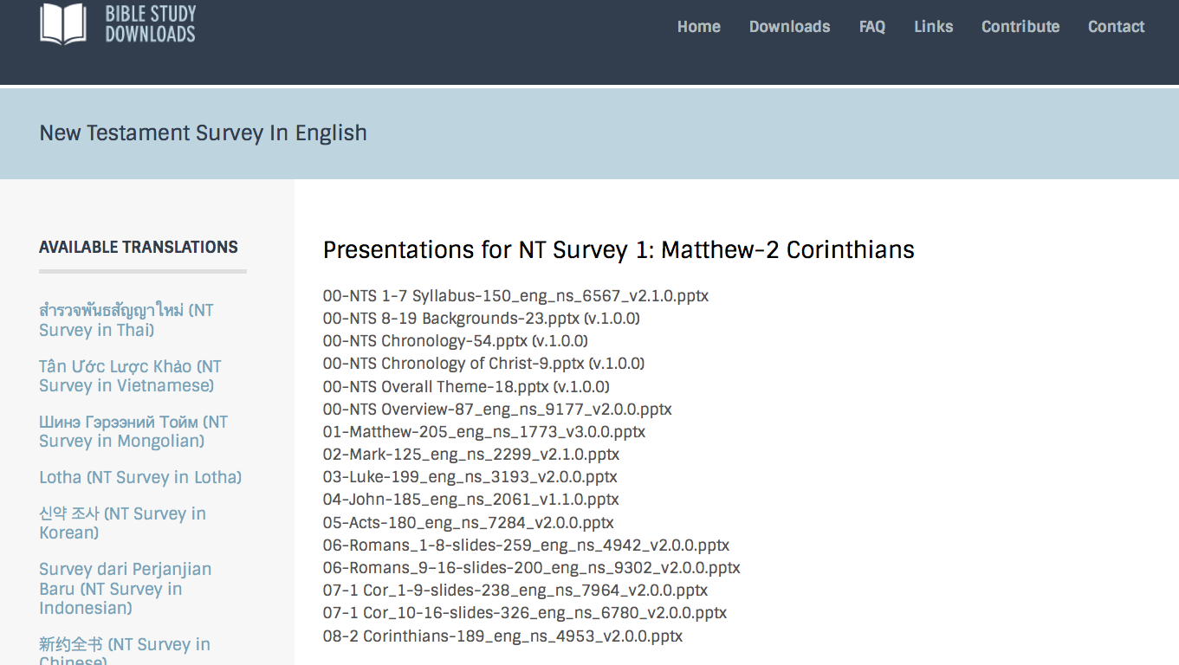
BibleStudyDownloads.org
7
Notes:
This has resulted in Bible teaching and study materials—mostly PowerPoint—in 42 languages! All a teacher needs to do is to click on a file and it downloads for free to teach any book of the Bible and many other subjects.

Slide 42
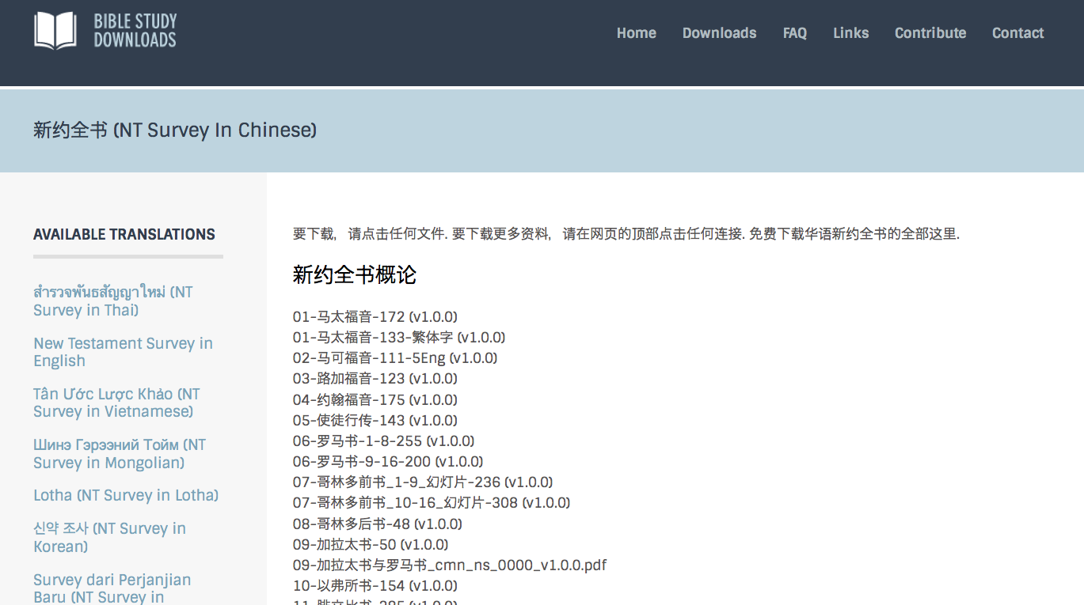
BibleStudyDownloads.org
7
Notes:
This has resulted in Bible teaching and study materials—mostly PowerPoint—in 42 languages! All a teacher needs to do is to click on a file and it downloads for free to teach any book of the Bible and many other subjects.

Slide 43
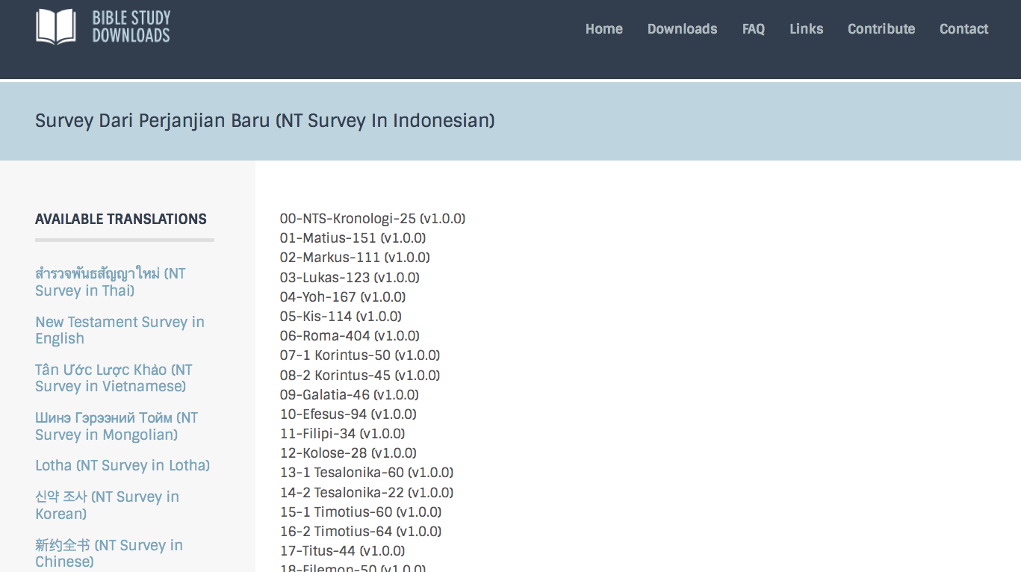
BibleStudyDownloads.org
7
Notes:
This has resulted in Bible teaching and study materials—mostly PowerPoint—in 42 languages! All a teacher needs to do is to click on a file and it downloads for free to teach any book of the Bible and many other subjects.

Slide 44
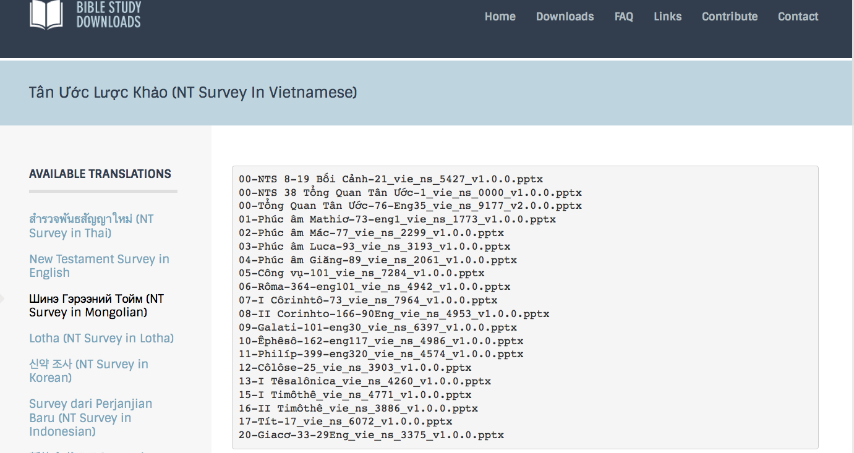
BibleStudyDownloads.org
7
Notes:
This has resulted in Bible teaching and study materials—mostly PowerPoint—in 42 languages! All a teacher needs to do is to click on a file and it downloads for free to teach any book of the Bible and many other subjects.

Slide 45
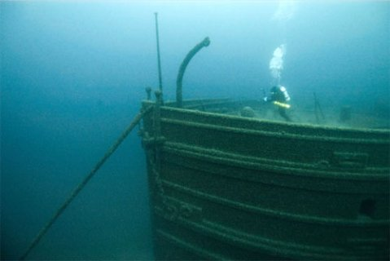
Exploring the Theme
Grab a partner
Each of you paraphrase Romans 1:16-17
Contrast these verses with how you used to think you could be right with God before becoming a Christian
Notes:
How does this differ from how a Buddhist seeks to be right with God?
How does this differ from how a Hindu seeks to be right with God?
How does this differ from how a Muslim seeks to be right with God?
How does this differ from how an atheist seeks to be right with God?

Slide 46

WE NEED TO ATTAIN GOD'S RIGHTEOUSNESS—BUT HOW?

Slide 47
The Theme of Romans
145
¹⁶I am not ashamed of the gospel, because it is the power of God for the salvation of everyone who believes: first for the Jew, then for the Gentile.
¹⁷For in the gospel a righteousness from God is revealed, a righteousness that is by faith from first to last, just as it is written: "The righteous will live by faith."
Don't be ashamed of the gospel because it works! It alone makes us righteous!

Slide 48
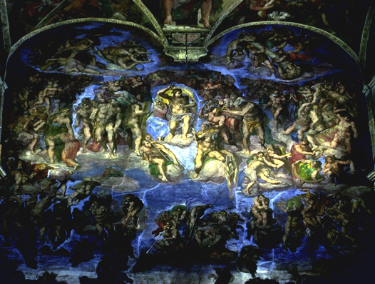
CONTENTS OF THIS PRESENTATION
1. HISTORICAL BACKGROUND
2. AUTHORSHIP
3. CONTENTS OF ROMANS
4. CONTROVERSIES

Slide 49
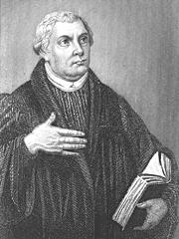
Luther Despised Romans
While Martin Luther lectured at the University of Wittenberg, he struggled with the phrase "the righteousness of God," an expression in Romans which by his own admission "filled him with hate."

Slide 50
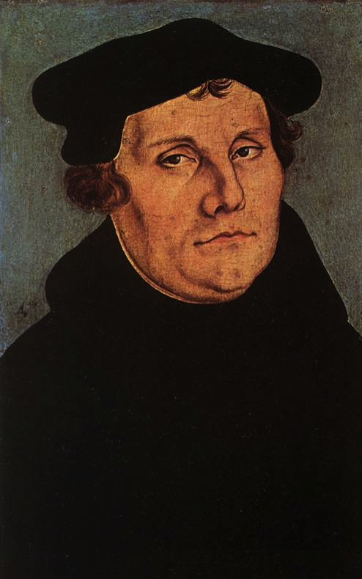
Luther Reborn Through Romans
After days and nights of wrestling with the spiritual truth of Romans 1:17, the light of God broke through. In his own words, "I felt as if I had been completely reborn and had entered paradise through widely open doors. Instantly all Scripture looked different to me . . . As intensely as I had formerly hated the expression 'the righteousness of God' I now loved it and praised it as the sweetest of concepts."

Slide 51

Background
Notes:
OS-29-Joel-34

Slide 52

Paul's First & Second Missionary Journeys
138-39
Notes:
By the time Paul wrote Romans, he had already shared the gospel throughout the eastern Roman Empire.

Slide 53
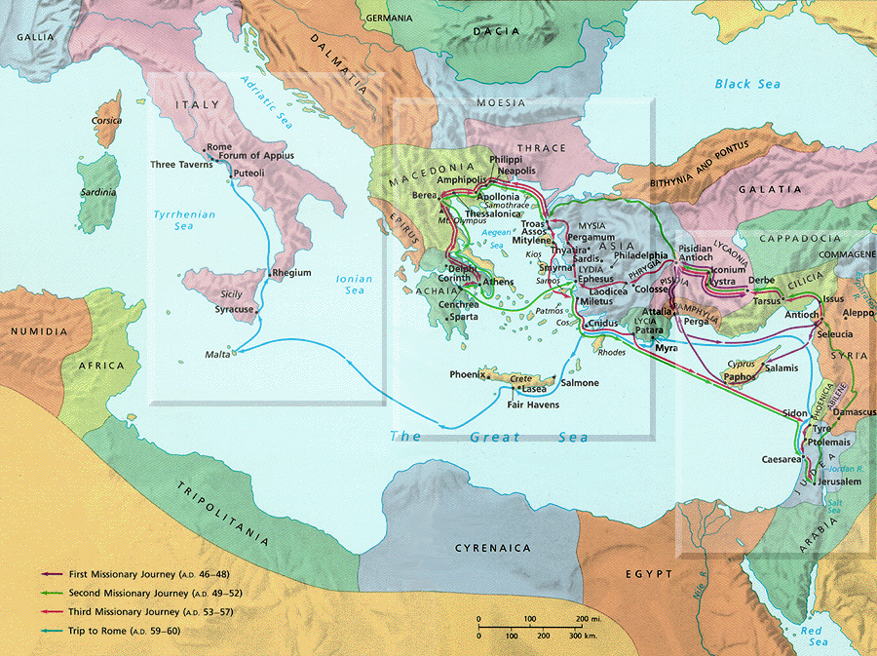


PAUL'S THIRD JOURNEY
140
Notes:
Paul wintered in Corinth for three months from November 56 to February 57 and wrote the Romans during this period. One key purpose was to enlist their help in bringing the gospel even beyond them to Spain. However, he first needed to return to Jerusalem with the offering to the Jewish mother church.

Slide 54
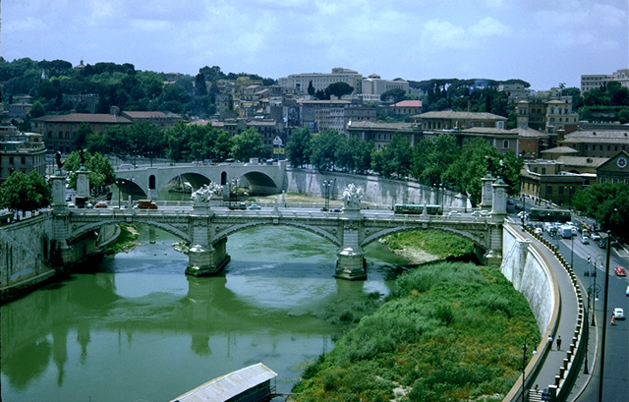
THE CITY OF ROME
155
In political importance, geographical position and sheer magnificence, the superlative city of the empire was Rome, the capital.
The apostle Paul entered the city from the south of the Via Appia as a prisoner appealing to Caesar. He first lived under house arrest and then, after a period of freedom, as a condemned prisoner in the Mamertime dungeon near the Forum. Remarkably, Paul was able to proclaim the gospel among all classes of people, from the palace to the prison. According to tradition, he was executed at a spot on the Ostian Way outside Rome in AD 68.

Slide 55
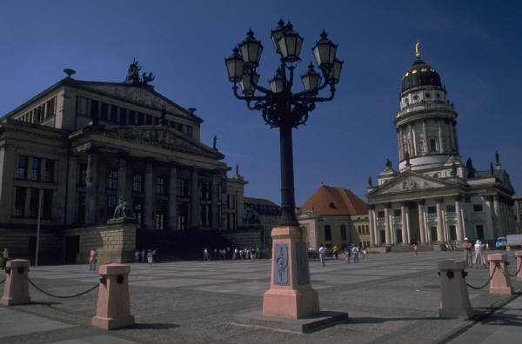
THE CITY OF ROME
155
Rome was described as both "the glorious crowning achievement of mankind" and as "the sewer of the universe where all the scum from every corner of the empire gathered."
Rome had reasons for both civic pride in its architecture and shame for staggering urban social problems not unlike those of cities today.

Slide 56
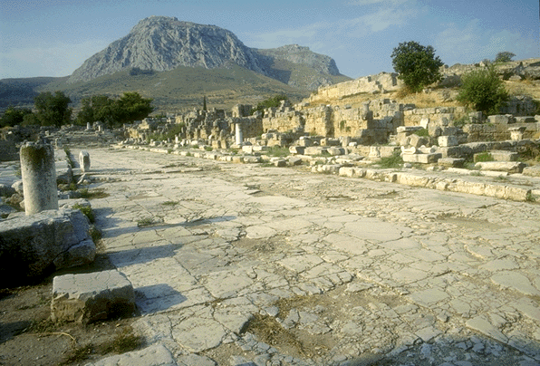

CORINTH
146
When Paul wrote this letter, he was at Corinth (Acts 20:2-3) on his third missionary journey.

Slide 57

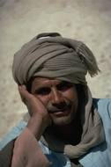
Support for Paul as Author
146
The letter claims to be from Paul (1:1).
No opposition to his authorship was ever raised in the early church.
Historical notes in the epistle agree with known facts of Paul's life.
The book's doctrine is typical of Paul compared to other letters he wrote.

Slide 58

AUTHORSHIP
Internal Evidence
146
External Evidence
Upheld by Church Fathers:
  Clement of Rome (AD 95)
  Ignatius (ca. AD 115)
  Polycarp (ca. AD 115)
Romans was included among Paul's letters in all extant NT book lists before AD 200, even that of the heretic Marcion.
Even all radical modern critics agree on Pauline authorship of Romans except Baur.
Consistent with all other Pauline's writings in the following:
  vocabulary
  style
  logic
  theological development
  Romans, 1-2 Corinthians, and Galatians are the standard to judge other books as Pauline.
Tertius (likely Paul's scribe) penned the letter (16:22).

Slide 59
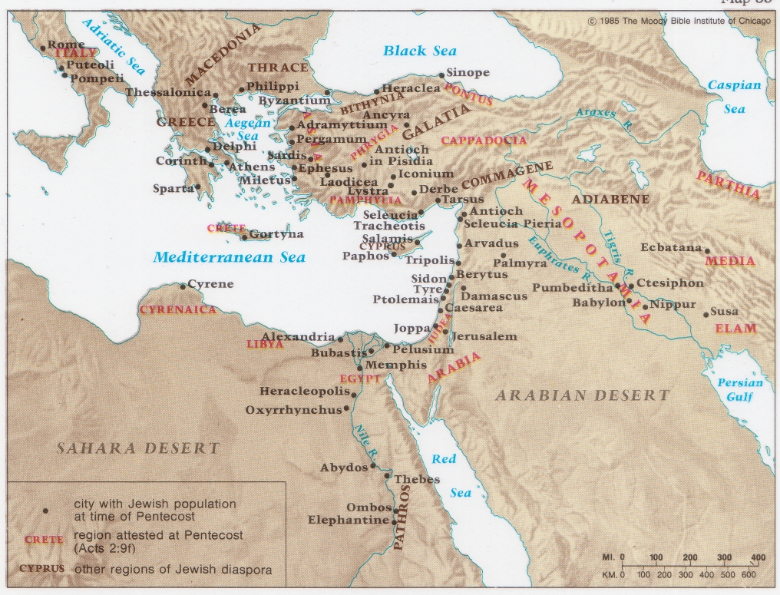
Jewish Diaspora at Pentecost
132

Slide 60
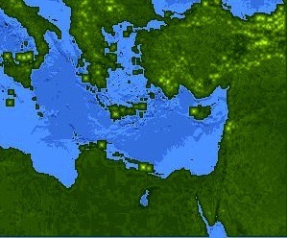
Jews at Pentecost––Acts 2:9-11
132
Rome (13)
PONTUS (7)
CAPPADOCIA (6)
ASIA (8)
PHRYGIA (9)
Jews from Rome trusted Christ at Pentecost––Acts 2:10
Parthia (1)
PAMPHILIA (10)
Mesopotamia (4)
CRETE (14)
Media (2)
Elam (3)
Jerusalem
CYRENE (12)
JUDEA (5)
ASIA––Roman Empire Provinces
Media––Parthian Empire Provinces
EGYPT (11)
Rome––Cities
CRETE––Islands
ARABIA (15)
Miles
0
200
400
600
800
1000
Kms
0
300
600
900
1200
1500
(1) (2) (3) etc. indicate sequence in Acts 2:9-11
Notes:
Jews numbered 40,000 in Rome during the reign of Augustus (30 BC to AD 14), so this was a sizable minority. We do not know for sure who actually started the church at Rome, but it likely was some of these Jews who returned to Rome after receiving the Spirit at Pentecost in Jeruslem. They, in turn, led Gentiles in Rome to faith as well.

Slide 61
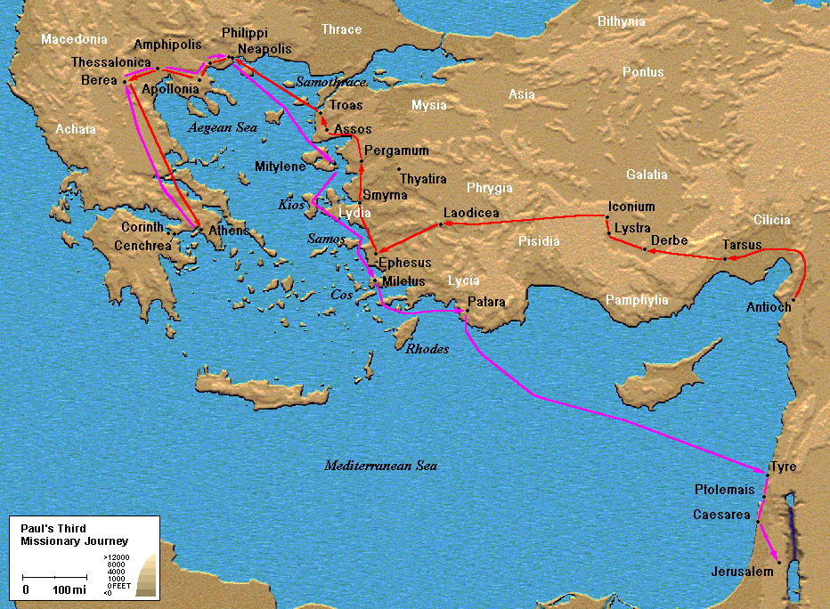


Date and Place of Writing
146
The book was probably written in the early winter of A.D. 57.
Very likely Paul was on his third missionary journey, ready to return to Jerusalem with the offering from the mission churches for poverty-stricken believers in Jerusalem (see 15:25-27).
The most likely place of writing is either Corinth or Cenchrea (about six miles away) because of references to Phoebe of Cenchrea (16:1) and to Gaius, Paul's host (16:23), who was probably a Corinthian (1 Cor. 1:14). Erastus (16:23) may also have been a Corinthian
(2 Tim. 4:20).
In 15:26 it is suggested that Paul had already received contributions from the churches of Macedonia and Achaia, so he either was at Corinth or had already been there. Since he had not yet been at Corinth on his third missionary journey when he wrote 1 Corinthians (1 Cor. 16:1-4), and the collection issue had still not been resolved when he wrote 2 Corinthians (2 Cor 8-9), the writing of Romans must follow that of 1, 2 Corinthians (dated c. 56).

Slide 62
Romans Book Overview
145
Purpose: | Paul introduces himself to the Romans before he arrives in Rome and he gives the fundamental truth of the Gospel of God's righteousness where justification comes by faith in Christ--not the Law.
Author: | Paul
To whom written: | The Christians in Rome and believers everywhere
Date Written: | About AD 57, from Corinth, as Paul was preparing to visit Jerusalem.

Slide 63
Romans Book Overview
145
Setting: | Paul had finished his work in the east, and he planned to visit Rome on his way to Spain after first bringing a collection to Jerusalem for the poor Christians there (15:23-28). The Roman church was mostly Jewish but also contained a great number of Gentiles.
Key Verses: | "Therefore, since we have been made right in God's sight by faith, we have peace with God because of what Jesus Christ our Lord has done for us" (5:1).

Slide 64
Romans Book Overview
145
Key People: | An apostle: Paul; The scribe: Tertius (16:22); The courier: Phoebe (16:1-2)
Key place: | Rome
Special Features: | Paul wrote Romans as an organized and carefully presented statement of his faith—it does not have the form of a typical letter. He does, however, spend considerable time greeting people in Rome at the end of the letter.

Slide 65
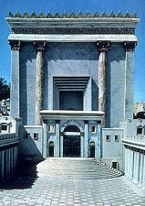

When Did John Write Revelation?
39-41, 320
Who was the Roman Emperor then?
Christ Crucified
AD 33
Jerusalem Destroyed
AD 70
Revelation Written
AD 95
Tiberius
14-37
Caligula
37-41
Claudius
41-54
Nero
54-68
Vespasian
69-79
Titus
79-81
Domitian
81-96
Most preterists place the book here
Supported by:
Irenaeus
Victorinus of Pettau Clement of Alexandria
Eusebius
Notes:
Emperors in black persecuted Christians
This course teaches that Revelation was written during the reign of Domitian at the end of the first century.
Claudius expelled all Jews from Rome in AD 49, leaving a 100% Gentile church in Rome (Acts 18:2). But after Nero came to the throne five years later, Jews began to return. No doubt this caused problems within the church that had become more Gentile in terms of sacred days
(Rom 14:5-6a), food (Rom 14:6b), and other gray matters (Rom 14–15).
_______
NC-13-Preterism-24
NS-06-Romans1-2—slide 65
NS-21-1 Peter-63
NS-27_Rev1-slide 94
NS-27-Rev4-6-slide 36

Slide 66
Occasion
147
My purposes for writing this letter were:
To tell them that I want to come and see them. This will enlist the support of the church in Rome for my outreach to Spain.

Slide 67
                ¹⁰ One of the things I
                always pray for is the
                opportunity, God willing, to come at last to
              see you. ¹¹ For I long to visit
you so I can bring you some spiritual gift that will help you grow strong in the Lord. ¹² When we get together, I want to encourage you in your faith, but I also want to be encouraged by yours.
                Romans 1:10-12 NLT
Notes:
Sometimes God’s plans are not our plans.
You see, Paul’s plan was to go and visit the believers in Rome.
While in Ephesus, he wrote to the Roman believers telling them, “One of the things I always pray for is the opportunity, God willing, to come at last to see you. 11 For I long to visit you so I can bring you some spiritual gift that will help you grow strong in the Lord. 12 When we get together, I want to encourage you in your faith, but I also want to be encouraged by yours” (Romans 1:10-12)
But, when Paul gets to Jerusalem and is worshipping in the temple, a riot started, Paul is getting beat up, so the Romans come and ARREST PAUL.

Slide 68
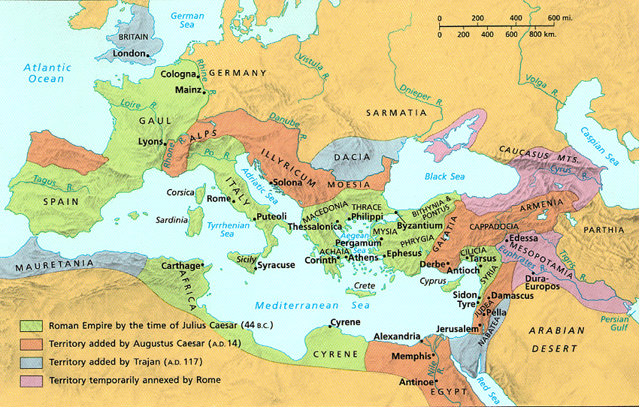
Romans 15:23-24
²³ But now I have finished my work in these regions, and after all these long years of waiting, I am eager to visit you.
²⁴ I am planning to go to Spain, and when I do, I will stop off in Rome. And after I have enjoyed your fellowship for a little while, you can provide for my journey.

Slide 69
Paul's Next Mission Field: Spain (15:23-29)
154f
Notes:
×

Slide 70
Romans 15:25-27
²⁵ But before I come, I must go to Jerusalem to take a gift to the believers there. ²⁶ For you see, the believers in Macedonia and Achaia have eagerly taken up an offering for the poor among the believers in Jerusalem. ²⁷ They were glad to do this because they feel they owe a real debt to them. Since the Gentiles received the spiritual blessings of the Good News from the believers in Jerusalem, they feel the least they can do in return is to help them financially.

Slide 71
Paul's Next Mission Field: Spain (15:23-29)
154f

Slide 72
Romans 15:28-29
²⁸ As soon as I have delivered this money and completed this good deed of theirs,
I will come to see you on my way to Spain.
²⁹ And I am sure that when I come, Christ will richly bless our time together.

Slide 73
Paul's Next Mission Field: Spain (15:23-29)
154f

Slide 74
Paul's Next Mission Field: Spain (15:23-29)
154f

Slide 75
Occasion
147
My purposes for writing this letter were:
To tell them that I want to come and see them. This will enlist the support of the church in Rome for my outreach to Spain.
To give a clear and complete presentation of the doctrine of salvation by faith.
To heal the Jew-Gentile division in the Christian community in Rome.
To expound on the righteousness of God.

Slide 76

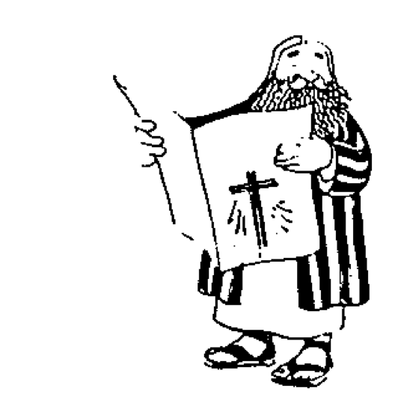




The New Testament "Building"
21
Paul's Letters to Pastors
 | 1 Timothy | 2 Timothy | Titus |  | Philemon
Paul's Letters to Churches | 2 Thessalonians |  |  |  | Revelation | General Letters
 | 1 Thessalonians |  |  |  | Jude
 | Colossians |  |  |  | 3 John
 | Philippians |  |  |  | 2 John
 | Ephesians |  |  |  | 1 John
 | Galatians |  |  |  | 2 Peter
 | 2 Corinthians |  |  |  | 1 Peter
 | 1 Corinthians |  |  |  | James
 | Romans |  |  |  | Hebrews
 | Acts
 | Matthew | Mark |  | Luke | John
Historical Books
Romans sets the foundation for Paul's Epistles
Adapted from Walk Thru the Bible
Notes:
What overall observations on the NT can you make from this diagram?
Gospels and Acts form the primary and secondary foundations of the NT.
On the historical foundation are two pillars of 9 books each.
Paul's letters to churches in the left pillar all fit into Acts.
Paul didn't write any inspired letters to churches after Acts.
All General Epistles were written after Acts except James.
Each of the 2 pillars also have a foundational book: Romans & Hebrews
Both pillars also end up in books that primarily deal with eschatology
Instruction to the leaders comprise only 4 books
Only 4 NT books are written to an individual
i.e., the NT is written not to leaders primarily but to the average Christian

Slide 77
Two Emphases
Galatians
Romans
Justification by Faith
Not by Law
Righteousness of God
Romans (Colorado Springs, CO: BEE World, 2018), 16

Slide 78
Chart of Topics
Galatians | Galatians and Romans | Romans
Defense of Apostleship | Justification by Faith | Origin of Sin
Testimony of Conversion | Faith versus Works | Universal Condemnation
Judaizers | Spirit versus Flesh | Scope of Salvation
Conflict with Peter | Failure of Self-effort | Israel's Destiny
Concern for Galatians | Promise to Abraham | Concern for Israel
Sarah and Hagar | Plan of Salvation | Jews and Gentiles
Servants and Sons | Divine Love | Government
 | Union with Christ | Weak Christians
 | Circumcision | Personal Plans
 | Relationship to Law | Missions and Offerings
 | Relations to Others | Congratulations
 | Water Baptism | Personal Greetings
 | False Teachers
Romans (Colorado Springs, CO: BEE World, 2018), 16

Slide 79
Galatians versus Romans
 | Galatians | Romans
Influence of Cities | Minor | Major
Number of Churches | Several Cities (Lystra, Derbe) | Single City (Rome)
Church Founded | AD 48-49 – 1st journey | AD 33-56 (no one knows)
Founder | Paul | Pentecost? or Paul's disciples?
Written | AD 49 from Antioch | AD 56-57 from Corinth
View of Paul | Doubted (but most knew him!) | Credible (but most didn't know him!)
Paul's Opponents | Judaizers | None
Jew-Gentile Relations | Serious rift | Mild criticism of each other
173a

Slide 80
Galatians versus Romans
 | Galatians | Romans
Readers | Mostly Gentiles | Jew-Gentile mix
Theological Errors | Serious: Salvation | Minor: Christian liberty
Theme (Key Word) | Justification (2:16) | Righteousness (1:17)
Vocabulary & Tone | Simple yet Severe | Technical and Structured
Form | Modified Defense (e.g., no thanksgiving) | Traditional (e.g., names, greetings)
OT Quotes | Few (only 12, or 2 per chapter) | Nearly as many as the rest of Paul's epistles (63 total!)
Doctrinal Focus | Narrow: Justification | Broad: Many topics
173a

Slide 81
5 Special Characteristics
147-148
It is likely the most profound book ever written.
Many OT quotations: Paul regularly quotes the OT in his letters, but here the argument is sometimes carried by such quotations (especially chaps. 9-11).
The most systematic of Paul's letters: It reads more like an elaborate theological essay than a letter.
The Christian doctrine emphasis shows in its many theological terms: sin, salvation, grace, faith, righteousness, justification, sanctification, redemption, death and resurrection.
Paul's concern for Israel is seen in her present status, her relationship to the Gentiles and her final salvation.
5

Slide 82
Righteousness in Romans
145
God's Righteousness /Justification by Faith in Christ––Not the Law
Chapters 1–11 | Chapters 12–16
Righteousness Explained | Righteousness Applied
Theological | Practical
What to Believe | How to Behave
Vertical | Horizontal
Relationship to God | Relationship to Others

Slide 83
The Book in Broad Strokes
145
Paul sets forth the foundations of the Christian faith. All people are sinful; Christ died to forgive sin; we are made right with God through faith; this begins a new life with a new relationship with God. Like a sports team constantly reviewing the basics, we will be greatly helped in our faith by knowing these foundations. If we study Romans carefully, we will never be at a loss to know what to believe.
What to Believe
(Rom. 1–11)
1. Sinfulness of humankind
2. Forgiveness of sin through Christ
3. Freedom from sin's grasp
4. Israel's past, present, and future
How to Behave
(Rom. 12–16)
1. Personal responsibility
2. Personal notes
Paul gives clear, practical guidelines for behavior. The Christian life is not abstract theology unconnected with life, but practical--affecting how we behave each day. It is not enough merely to know the gospel; we must let it transform our life.

Slide 84
Circular View of Romans
155a
SERVICE & SEPARATION
SIN
Manifested in practical living
12–16
Needed
by sinful people
1:1–3:20
Rejected
by Israel
9–11
Provided
by God
3:21–4:25
SELECTION
God's Righteousness
SALVATION
Guaranteed
as permanent
8:18-39
Experienced
in the soul
5:1–8:17
SECURITY
SANCTIFICATION
Terry Hall,
Bible Panorama, 162

Slide 85
Crossroad Puzzle Incomplete
155d
The first group to fill in this crossword puzzle correctly gets a prize!
Ready, set, go!

Slide 86
Crossword Puzzle
155d
1
2
 | S | A | N | C | T | I | F | I | C | A | T | I | O | N
 |  |  |  |  |  |  | A
 |  | E | L | E | C | T | I | O | N
P |  |  |  |  | O |  | T |  |  | S |  | G
O |  |  |  |  | R |  | H |  |  | P |  | A | D
R | O | M | E |  | I |  |  | P |  | A |  | I
K |  |  | N |  | N |  |  | A |  | I |  | U
 | R | I | G | H | T | E | O | U | S | N | E | S | S
 |  |  | R |  | H |  |  | L |  |  | P
 |  |  | A |  |  |  |  |  |  |  | I
 |  |  | F |  | T | E | R | T | I | U | S |  | J
W | I | N | T | E | R |  |  |  |  |  | T |  | E
A |  |  | E |  | U |  |  |  |  |  | L | A | W
G |  |  | D |  | S | E | R | V | I | C | E |  | S
E |  |  |  |  | T
S | I | N
3
4
10
6
8
The first group to fill in this crossword puzzle correctly gets a prize!
Ready, set, go!
7
9
14
12
5
16
15
18
11
19
17
13

Slide 87
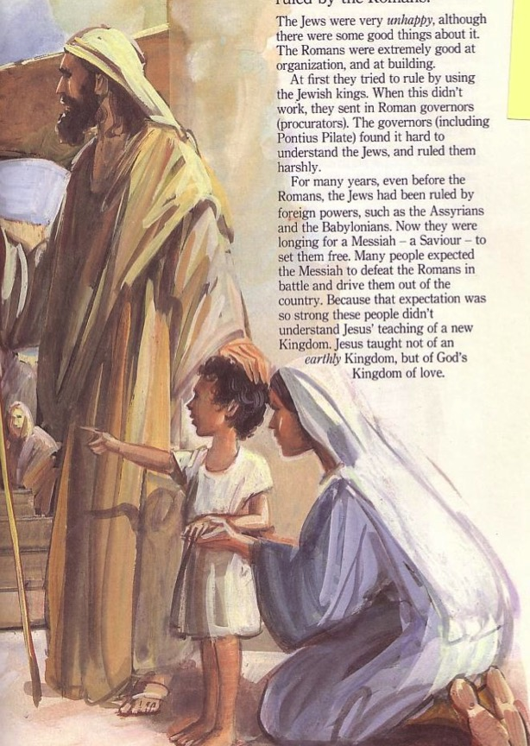
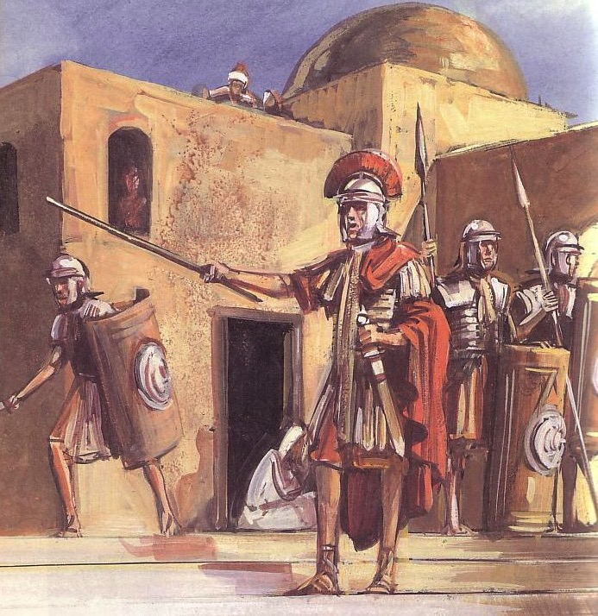
Sometimes Christians mistreat others of a different ethnic group
180b
Jews
Gentiles
One God
Many taboos
Many Gods
Few taboos

Slide 88
East Meets West
180b
Writing Style
Hebrew
Greek
Favors poetry, imagery & symbolism
Favors outlines, lists and bullet points
Adapted from Lynne M. Thompson, "Christmas: The Real Deal," interview with Ray Vander Laan, Breakaway magazine (Dec 2003): 7-9.
Notes:
Adapted from Lynne M. Thompson, "Christmas: The Real Deal," interview with Ray Vander Laan, Breakaway magazine (Dec 2003): 7-9.

Slide 89
East Meets West
180b
Numbers
Hebrew
Greek
Sees numbers as a quality or symbol
Sees numbers as a specific quantity
Adapted from Lynne M. Thompson, "Christmas: The Real Deal," interview with Ray Vander Laan, Breakaway magazine (Dec 2003): 7-9.
Notes:
Adapted from Lynne M. Thompson, "Christmas: The Real Deal," interview with Ray Vander Laan, Breakaway magazine (Dec 2003): 7-9.

Slide 90
East Meets West
180b
Relation to God
Hebrew
Greek
Focuses on the community in relationship with God
Focuses on the individual's relationship with God
Adapted from Lynne M. Thompson, "Christmas: The Real Deal," interview with Ray Vander Laan, Breakaway magazine (Dec 2003): 7-9.
Notes:
Adapted from Lynne M. Thompson, "Christmas: The Real Deal," interview with Ray Vander Laan, Breakaway magazine (Dec 2003): 7-9.

Slide 91
East Meets West
180b
Eternal Life
Hebrew
Greek
The kingdom of God begins in this life. Eternal life is lived in harmony with God.
The kingdom of God is outside this world. Eternal life will occur after this life ends.
Adapted from Lynne M. Thompson, "Christmas: The Real Deal," interview with Ray Vander Laan, Breakaway magazine (Dec 2003): 7-9.
Notes:
Adapted from Lynne M. Thompson, "Christmas: The Real Deal," interview with Ray Vander Laan, Breakaway magazine (Dec 2003): 7-9.

Slide 92
East Meets West
180b
Sin
Hebrew
Greek
Sin is wrong behavior alone.
They emphasize what one does in response to faith.
Sin is wrong actions & thinking.
They emphasize what a person knows about faith.
Adapted from Lynne M. Thompson, "Christmas: The Real Deal," interview with Ray Vander Laan, Breakaway magazine (Dec 2003): 7-9.
Notes:
Adapted from Lynne M. Thompson, "Christmas: The Real Deal," interview with Ray Vander Laan, Breakaway magazine (Dec 2003): 7-9.

Slide 93
East Meets West
Existence of God
180b
Hebrew
Greek
Assumes that God exists
Tries to prove God's existence
Adapted from Lynne M. Thompson, "Christmas: The Real Deal," interview with Ray Vander Laan, Breakaway magazine (Dec 2003): 7-9.
Notes:
Adapted from Lynne M. Thompson, "Christmas: The Real Deal," interview with Ray Vander Laan, Breakaway magazine (Dec 2003): 7-9.

Slide 94
East Meets West
180b
Faith
Hebrew
Greek
Relational and personal
Expressed in terms of relationship with God rather than rationalization
Intellectual and impersonal
Expressed in creeds and doctrine with support through proof texts
Adapted from Lynne M. Thompson, "Christmas: The Real Deal," interview with Ray Vander Laan, Breakaway magazine (Dec 2003): 7-9.
Notes:
Adapted from Lynne M. Thompson, "Christmas: The Real Deal," interview with Ray Vander Laan, Breakaway magazine (Dec 2003): 7-9.

Slide 95
East Meets West
180b
Truth
Hebrew
Greek
Experiential
What is done and who did it in Scripture
Believing comes through experience
Truth is unfolding and relative
Scientific & rational
How things are done in the Scripture
Believing comes through thinking
Truth is static and unchanging
Adapted from Lynne M. Thompson, "Christmas: The Real Deal," interview with Ray Vander Laan, Breakaway magazine (Dec 2003): 7-9.
Notes:
Adapted from Lynne M. Thompson, "Christmas: The Real Deal," interview with Ray Vander Laan, Breakaway magazine (Dec 2003): 7-9.

Slide 96
Be Accepting
Romans
Dr. Rick Griffith • Crossroads International Church Singapore
BibleStudyDownloads.org

Slide 97
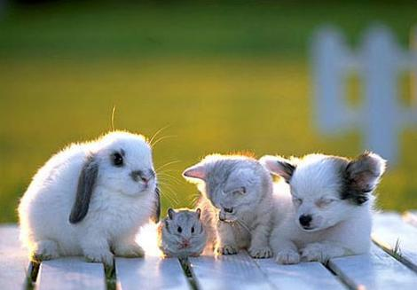
We accept others when we are young.

Slide 98
Too often we don’t accept people different from us.
Notes:
Too often we don’t accept people different from us. Do you agree?
Need: How accepting are you of those most different from you in this room?
Are you OK with Matt dressing differently than me?
Is it OK that Andrew has more pigment in his skin?
Do you accept that Miriam does not any spiciness in her food?
Can you accept Lele as the only one from Africa?

Slide 99
Why accept one another?
Notes:
Subject: Why must we accept one another? We certainly are different from each other, but that doesn’t need to divide us. What reasons can we give to be tolerant—or patient—or long-suffering—or accommodating with each other?
Of course, I am not speaking about things the Scripture clearly calls sin. I hope we don’t ever put up with and accept sin in one another.
But we certainly do need to accept unchangeable traits. Today we will see reasons to accept one another at our core being that cannot change.

Slide 100
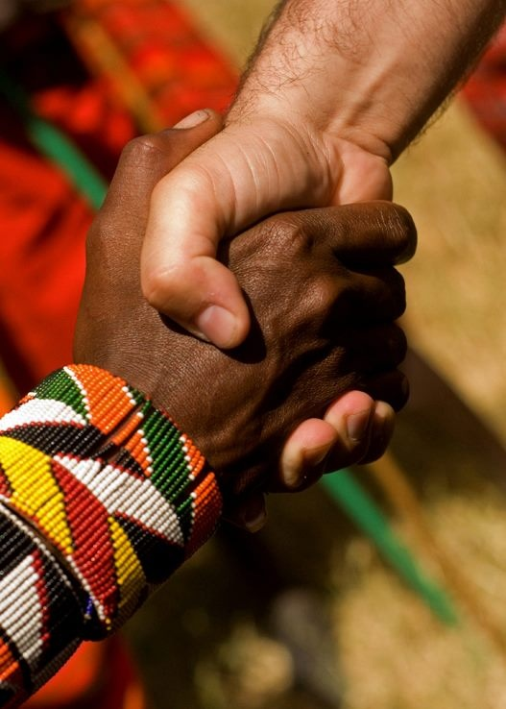
Accept One Another As Christ Has Accepted You
The Theme of Romans Based on Romans 15:7
Dr. Andrew Spurgeon
NT Professor, Singapore Bible College
Notes:
I am indebted to my co-preacher here at Crossroads who preached a whole series in 2018 on Romans. I have taught this book nearly 40 times, but Andrew helped me see things in a new light! He has won me over to see the theme of the book relating to the need in the body for us to accept one another based on Romans 15:7.

Slide 101

Theme
“Accept one another just as Christ has accepted us for the glory of God”
(Rom 15:7)

Slide 102
THE ROMAN EMPIRE
12
Notes:
Background: The two main groups at the church at Rome struggled to accept each other.
Jews had previously led the church but were kicked out of the city by the emperor Claudius in AD 49.
However, Claudius died and a new emperor named Nero came to the throne five years later in AD 54, so Jews (including Christian Jews) were free to return.
The re-entrance of the Jews into the church brought difficulties as the Gentiles had become the leaders during the Jewish absence. They did things a bit different.
So Paul wrote them to help them to accept one another.

Slide 103
NT Overview (Paul's Letters)
143
38
124
39-41
"To the remotest part of the earth" (Acts 1:8)
Acts 9 13 14 15 16 18 21 27 28
Apr 48-
Sep 49
1
Galatia
Apr 50-
Sep 52
2
Aegean
Spr 53-
May 57
3
Asia
Feb 60-
Mar 62
1
Rome
Spr 62-
Fall 67
4
Spain
Aut 67-
Spr 68
2
Rome
Summer 35-
37
Damascus
Antioch
Romans is the last of the missionary epistles but first in our NT order of epistles
May 57-
Aug 59
Trials
Fall 49
The
Council
Spring 68
Expansion of Church
35 48 49 50 52 53 57 60 62 67 68 95
Matt
Luke
Acts
Mark
John
Gal
1 Thess
1 Cor
Eph
1 Tim
2 Tim
2 Thess
2 Cor
Col
Titus
East
Missionary
Pastoral
Romans
Philem
Phil
West
Gospels & Acts
1234
Journeys
Prison
Pauline Epistles
Rome
Imprisonments
Pauline
Notes:
By the time Paul wrote Romans, he had seen the church planting movement reach the eastern part of the Empire! He notes this in Romans 15.
_________
NS-06-Romans1-2—slide 16, 94, 115

Slide 104
Why accept one another?
145
Equal Righteousness
1:1-17
Notes:
We get God’s righteousness equally by faith in Christ (1:1-17).
[Holiness comes the same for all of us—by simply trusting Jesus, we are forgiven.]

Slide 105
Righteousness in Romans
145
Theme | Needed | Provided | Imparted | Proved | Applied | Dissem-inated
Intro 1:1-17 | Condem-nation 1:18– 3:20 | Justifi-cation 3:21– 5:21 | Sanctifi-cation 6–8 | Election 9–11 | Trans-form-ation 12:1– 15:13 | Propa-gation 15:14– 16:27
Start | Sin | Salva-tion | Set Apart | Sove-reignty | Service | Send
Notes:
We will take the “fast track” through Paul’s letter to the Romans today and see seven reasons must we accept one another! I don’t normally have a seven-part sermon, so that’s too much, just think of chapters 1–11 as Paul’s theology and Romans 12–16 as the application.

Slide 106
Slides on
Romans 1

Slide 107
Message & Romans 1
God is angry at the
Gentiles who reject him

Slide 108
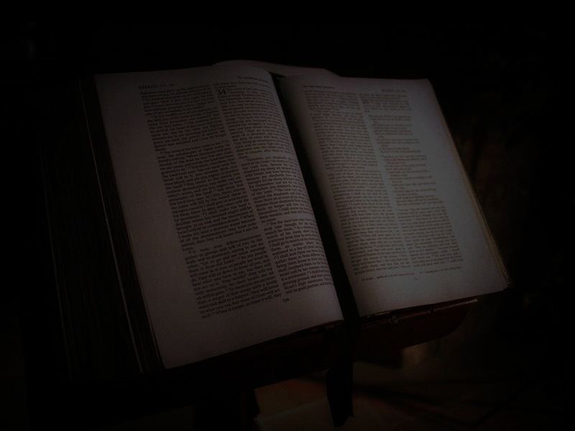

OUTLINE
NO!
149
Can you see it?
The Place of Israel in the Plans of God (9:1-11:36)
a. The Unbelief and Rejection of Israel (9:1-33)
b. The Explanation of Israel's Rejection (10:1-21)
c. Israel's Rejection Is Not Complete Nor Is It Final (11:1-32)
6. The Righteousness of God in Practical Living (12:1-15:13)
a. Being Consecrated to God (12:1-2)
b. Ministering and Spiritual Gifts (12:3-8)
c. Relating to Those in the Body of Christ (12:9-13)
d. Relating to Those Outside the Body of Christ (12:14-21)
e. Obligations to Human Government (13:1-7)
f. Other Obligations (13:8-14)
g. The Issue of Doubtful Things (14:1-15:3)
h. Relating to Others (15:4-13)
7. Conclusion (15:14-16:27)
a. Paul's Purpose in Writing (15:14-21)
b. Paul's Plans for the Future (15:22-23)
c. Paul's Praise and Warnings (16:1-27)
Introduction (1:1-17)
a. Paul's Greeting (1:1-7)
b. Personal Matters (1:8-13)
c. Theme Statement (1:14-17)
The Sinfulness and Condemnation of All Men (1:18-3:20)
a. The Guilt of the Gentiles (1:18-32)
b. The Guilt of the Jews (2:1-3:8)
c. The Guilt of All Men (3:9-20)
The Justification of Believing Sinners (3:21-5:21)
a. The Basis of Justification (3:21-26)
b. Justification and the Law (3:27-31)
c. Justification and the Place of Faith (4:1-25)
d. The Certainty of Justification by Faith (5:1-11)
e. The Reign of Sin and the Reign of Grace (5:12-21)
The Sanctification of Believing Sinners (6:1-8:39)
a. Union with Christ (6:1-14)
b. Enslavement to Sin or to Righteousness (6:15-23)
c. Freedom from the Law (7:1-25)
d. Righteous Living Through the Holy Spirit (8:1-17)
e. After Sufferings Come Glory (8:18-39

Slide 109
Righteousness in Romans
145
Theme | Needed | Provided | Imparted | Proved | Applied | Dissem-inated
Intro 1:1-17 | Condem-nation 1:18– 3:20 | Justifi-cation 3:21– 5:21 | Sanctifi-cation 6–8 | Election 9–11 | Trans-form-ation 12:1– 15:13 | Propa-gation 15:14– 16:27
Start | Sin | Salva-tion | Set Apart | Sove-reignty | Service | Send

Slide 110
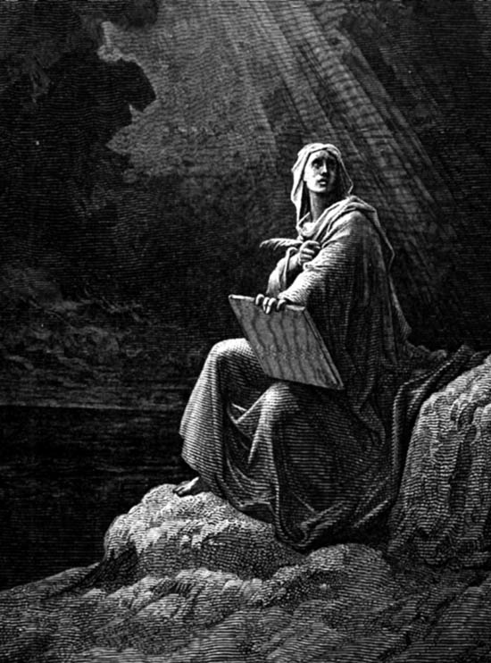
Epistolary Form
Epistolary Form
Opening - primarily concerned with establishing or enhancing personal contact with the letter recipient
Body - deals with the specific historical context and purpose(s) of the letter.
Closing – reestablishes the sender's relationship with the recipient
Notes:
_____________
NS-06-Romans-101
NS-07-1Cor1-9—slide 28

Slide 111
Epistolary Form
Epistolary Form
Opening - primarily concerned with establishing or enhancing personal contact with the letter recipient
Author
Readers
Greetings
Thanksgiving
Notes:
_____________
NS-06-Romans-102
NS-07-1Cor1-9—slide 29

Slide 112
Accept One Another As Christ Has Accepted You
The Theme of Romans Based on the Gospel
Taught as the theme by Dr. Andrew Spurgeon
NT Professor, Singapore Bible College

Slide 113

The word “gospel” means “good news.” So in order for news to be good, we have to know the “bad news” first. And here it is: “you have sinned.” All sin is open rebellion against God. And the penalty is death . . .

Slide 114

Gospel . . . means the good news. It is a good news of God. And what is this good news? . . . It addresses the fact that the human heart in its own pursuit will end up empty, lonely, and destitute
. . . life does not ultimately bring you satisfaction . . . we are alienated from God
. . . separated from God . . . good news of the gospel is that in your own effect and by your own good works you cannot rebuild that bridge. It is God who has reached out to you and to me in the provision of his son, Jesus Christ, who is able to offer . . . to rebuild our lives . . .

Slide 115
What it meant to the early hearers
Gospel
  A birth announcement
    Emperor Augustus
  A victory announcement
    Emperor Vespasian over Vitallius

Slide 116
What did it mean to the early hearers?
Gospel
  "The gospel . . . regarding his Son, who as to his earthly life was a descendant of David, and who through the Spirit of holiness was appointed the Son of God in power by his resurrection from the dead: Jesus Christ our Lord"
  (Rom 1:2–4)
  1. Earthly life . . . (birth) . . . A descendant of David
  2. Victory . . . In power by his resurrection, the Son of God

Slide 117
What it meant to the early hearers
Gospel
  A birth announcement
    Emperor Augustus
  A victory announcement
    Emperor Vespasian over Vitallius
  It required a response
    Of obedience/allegiance/submission

Slide 118
What did it mean to the early hearers?
Gospel
  “For I am not ashamed of the gospel, because it is the power of God that brings salvation to everyone who believes: first to the Jew, then to the Gentile. For in the gospel the righteousness of God is revealed—a righteousness that is by faith from first to last, just as it is written: ‘The righteous will live by faith’” (Rom 1:16–17).

Slide 119
What did it mean to the early hearers?
The gospel is a birth announcement and a victory announcement. And it requires a response.
  "The gospel . . . regarding his Son, who as to his earthly life was a descendant of David, and who through the Spirit of holiness was appointed the Son of God in power by his resurrection from the dead: Jesus Christ our Lord" (Rom 1:1–4).
  "For I am not ashamed of the gospel, because it is the power of God that brings salvation to everyone who believes: first to the Jew, then to the Gentile. For in the gospel the righteousness of God is revealed—a righteousness that is by faith from first to last, just as it is written: ‘The righteous will live by faith'" (Rom 1:16–17)

Slide 120
The Theme of Romans
145
¹⁶I am not ashamed of the gospel, because it is the power of God for the salvation of everyone who believes: first for the Jew, then for the Gentile.
¹⁷For in the gospel a righteousness from God is revealed, a righteousness that is by faith from first to last, just as it is written: "The righteous will live by faith."
Don't be ashamed of the gospel because it works! It alone makes us righteous!

Slide 121
Summary Statement for Romans
145
Paul expounds the righteousness of God which requires that justification be only by faith in Christ and not by works of the law in order to solve conflicts between Jewish and Gentile believers at Rome before his soon arrival
Application of Romans
Do you experience peace with other believers as fellow recipients of God's righteousness by faith? Or do you have conflicts with them stemming from pride?

Slide 122
We need to be saved

Slide 123


MAJOR THEME
145
"Righteousness from God"
Paul's primary theme in Romans is the basic gospel, God's plan of salvation and righteousness for all mankind, Jew and Gentile alike (1:16-17). Although justification by faith has been suggested by some as the theme, it would seem that a broader theme states the message of the book more adequately. "Righteousness from God" (1:17) includes justification by faith, but it also embraces such related ideas as guilt, sanctification and security.
REPEAT

Slide 124
NT Overview (Missionary + Key Words)
38
124
39-41
"To the remotest part of the earth" (Acts 1:8)
Acts 9 13 14 15 16 18 21 27 28
Apr 48-
Sep 49
1
Galatia
Apr 50-
Sep 52
2
Aegean
Spr 53-
May 57
3
Asia
Feb 60-
Mar 62
1
Rome
Spr 62-
Fall 67
4
Spain
Aut 67-
Spr 68
2
Rome
May 57-
Aug 59
Damascus
Antioch
May 57-
Aug 59
Trials
Fall 49
The
Council
Spring 68
Expansion of Church
35 48 49 50 52 53 57 60 62 67 68 95
Matt
Kingdom
Luke
Sov 1
Acts
Sov 2
Mark
Disciple
John
Believe
Gal
Justify
1 Thess
Rapture
1 Cor
Sanctify
2 Thess
Tribulation
2 Cor
Apostle
Romans
Righteous
Gospels & Acts
Pauline Epistles
Pauline Missionary + Key Words

Slide 125
Why accept one another?
145
SIN
Needed
in Condemnation
1:18–3:20
Equal Righteousness
1:1-17
Notes:
We need God's righteousness since we’re all condemned by sin (1:18–3:20).
[We don’t all have the same number of sins, but we all have the same destination—hell.]

Slide 126
Righteousness in Romans
145
Theme | Needed | Provided | Imparted | Proved | Applied | Dissem-inated
Intro 1:1-17 | Condem-nation 1:18– 3:20 | Justifi-cation 3:21– 5:21 | Sanctifi-cation 6–8 | Election 9–11 | Trans-form-ation 12:1– 15:13 | Propa-gation 15:14– 16:27
Start | Sin | Salva-tion | Set Apart | Sove-reignty | Service | Send

Slide 127
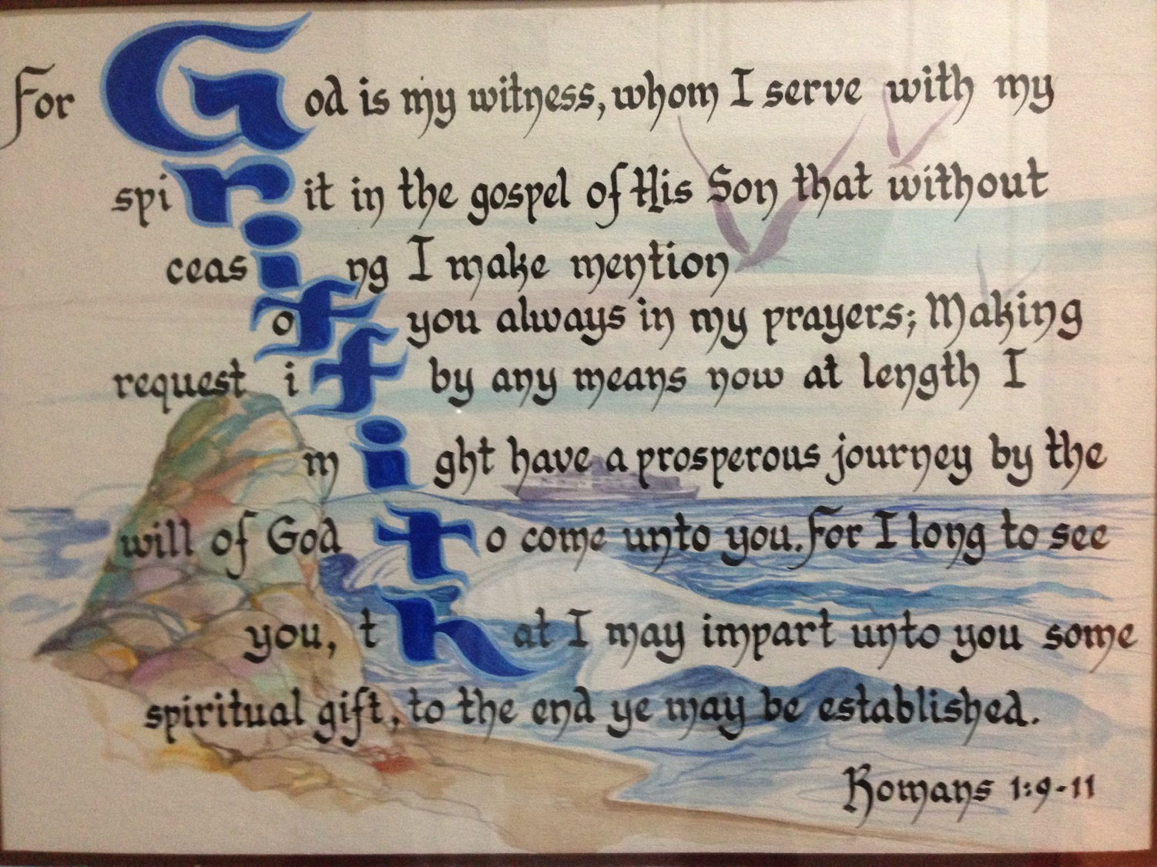
GRIFFITH in Romans 1:9-11

Slide 128

God's Wrath (Romans 1:18-20)
151
The Reality (18a)
The Reason (18b-20a)
The Result (20b)

Slide 129

Romans 1:20
161
Person who is Limitless
Person who is Supernatural
For since the creation of the world God's invisible qualities— his eternal power and divine nature— have been clearly seen, being understood from what has been made, so that men are without excuse (NIV).
Notes:
__________
NS-06-Rom1-2—slides 120, 152

Slide 130


Why You Are Without Excuse (Romans 1:20)
WHY YOU ARE
WITHOUT
EXCUSE
ROMANS 1:20

Slide 131
Romans 1:20
161
Since the start of creation…
people have seen God
= literal 24-hour days
For since the creation of the world God's invisible qualities— his eternal power and divine nature— have been clearly seen, being understood from what has been made, so that men are without excuse (NIV).

Slide 132
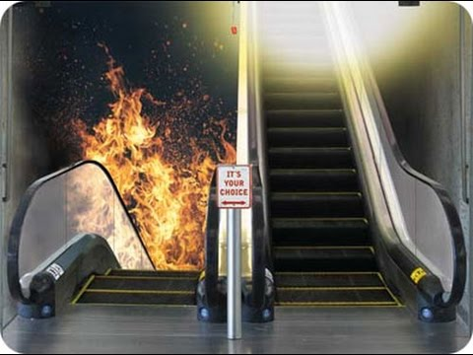
IT’S YOUR CHOICE

Slide 133

Why God is Angry at Gentiles
(1:21-32)
151
Ignore God (21-23)
God gave them over
Impurity (24)
Idolatry (25)
God gave them over
Homosexuality (26-27)

Slide 134
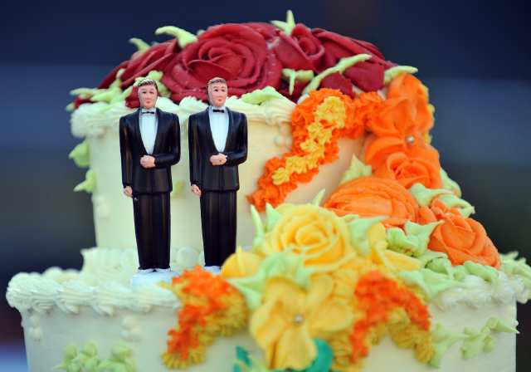
What About Homosexuality?

Slide 135

What About Same Sex "Marriage"?
See Family Research Council (frcblog) on YouTube
Notes:
The link is http://www.youtube.com/watch?v=nPgZ2Mq1Ugw

Slide 136
Why God is Angry at Gentiles
(1:21-32)
151
Ignore God (21-23)
God gave them over
Impurity (24)
Idolatry (25)
God gave them over
Homosexuality (26-27)
God gave them over
Depravity (28-32)

Slide 137
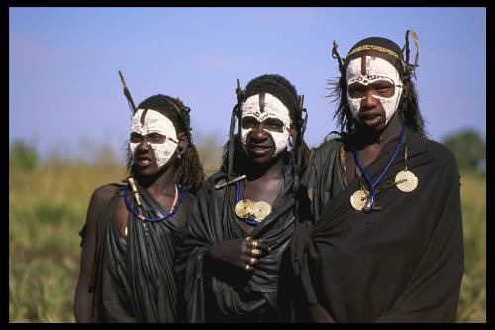

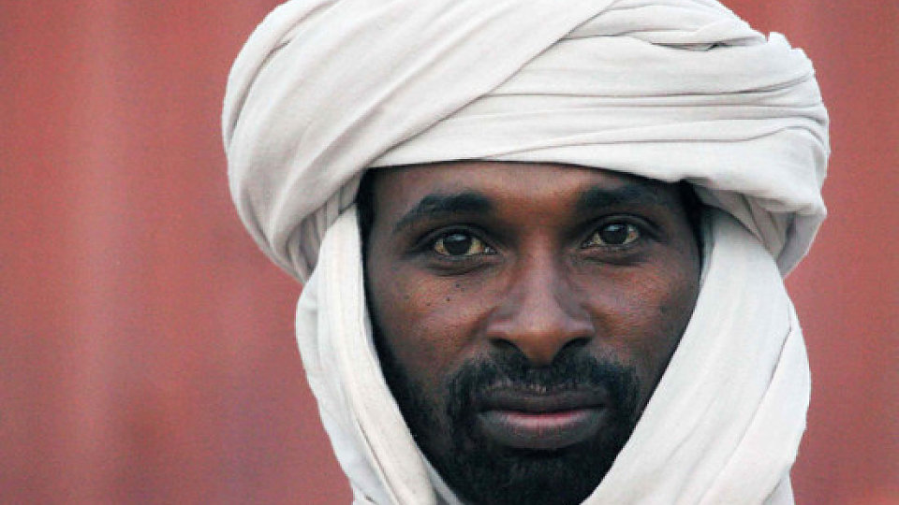
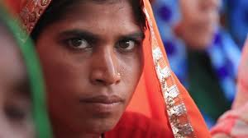
What About the Unreached?
155e

Slide 138
Hell: What if it's Real?
Notes:
tomstyle.com/ archive/hell.jpg

Slide 139
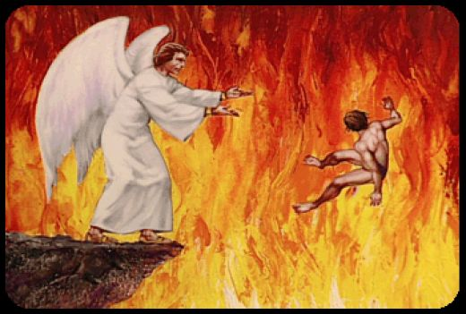
"And anyone whose name was not found recorded in the Book of Life was thrown into the lake of fire" (Rev 20:15)
438

Slide 140
Attacks on Hell
155e
Universalism
Annihilationism
Purgatory

Slide 141
Universalism
155e
pt. a
What is it?
Arguments cited
Rebuttals

Slide 142


Recent Universalism
Notes:
http://www.cbn.com/cbnnews/us/2011/april/love-wins-pastor-caught-off-guard-by-controversy/
‘Love Wins’ Pastor Caught Off Guard by Controversy
By Crystal Woodall CBN News Internet Producer
Sunday, April 10, 2011
Print 35 Comment(s)
Ad Feedback
Evangelical megachurch pastor Rob Bell says he was caught off guard by the condemnation his new book has received from leaders in the Christian community.
Standing before an audience of about 1,600 at Nashville's Belmont University, Bell said the last several weeks had been the "most painful" of his life.
"It has taken me to a place of profound brokenness," said Bell, who pastors the 10,000-member Mars Hill Bible Church in Grand Rapids, Mich.
Love Wins: Heaven, Hell, and the Fate of Every Person Who Ever Lived, released March 29, challenges the traditional Christian belief that few will enter Heaven.
"Will only a few select people make it into Heaven and will billions of people burn forever in Hell?" Bell asks in a promotional video of his book, recently released by publisher HarperOne. "And if that's the case, how do you become one of the few?" Watch the video here.
Bell insists it was never his intent to stir controversy, but to bring focus back to a message he suggests has got lost in dogma -- the love of God.
"I kept meeting religious people who were incredibly dogmatic about heaven and hell when you die but didn't seem to care about the fact that 8 million people will go to bed hungry tonight," Bell explained.
Bell denies charges that his book promotes a universalist theology - the belief that everyone, regardless of belief, will be saved by God.
"No, if by universalist we mean there's a giant cosmic arm that swoops everybody in at some point whether you want to be there or not," he told The Christian Post.
"That violates the laws of love and love is about freedom," he explained. "It's about choice; it's about do you want to be there? Because that's what would make it heaven."
According to the Associated Press, Bell says hell is something freely chosen that already exists on earth.
"Apparently this is a pastor who has written a book who has grown uncomfortable contending for the faith," CBN chaplain and Regent University theology professor Joel Palser said. "He is no longer able to defend what the Bible says and has endeavored to make that more palatable to modern culture."
"It may be trendy and it might sell a lot of books, but in fact Jesus speaks very clearly about heaven and hell," Palser added.

Slide 143
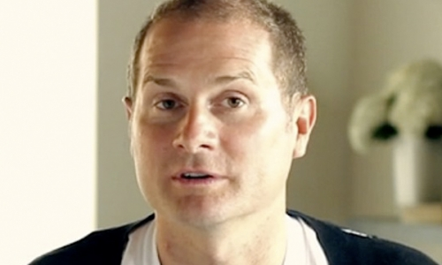
Of his 10,000-member Grand Rapids Mars Hill Bible Church, 3000 left after the book, then Bell himself left for California to run a "faith-inflected talk show"
Notes:
http://www.cbn.com/cbnnews/us/2011/april/love-wins-pastor-caught-off-guard-by-controversy/
‘Love Wins’ Pastor Caught Off Guard by Controversy
By Crystal Woodall CBN News Internet Producer
Sunday, April 10, 2011
Print 35 Comment(s)
Ad Feedback
Evangelical megachurch pastor Rob Bell says he was caught off guard by the condemnation his new book has received from leaders in the Christian community.
Standing before an audience of about 1,600 at Nashville's Belmont University, Bell said the last several weeks had been the "most painful" of his life.
"It has taken me to a place of profound brokenness," said Bell, who pastors the 10,000-member Mars Hill Bible Church in Grand Rapids, Mich.
Love Wins: Heaven, Hell, and the Fate of Every Person Who Ever Lived, released March 29, challenges the traditional Christian belief that few will enter Heaven.
"Will only a few select people make it into Heaven and will billions of people burn forever in Hell?" Bell asks in a promotional video of his book, recently released by publisher HarperOne. "And if that's the case, how do you become one of the few?" Watch the video here.
Bell insists it was never his intent to stir controversy, but to bring focus back to a message he suggests has got lost in dogma -- the love of God.
"I kept meeting religious people who were incredibly dogmatic about heaven and hell when you die but didn't seem to care about the fact that 8 million people will go to bed hungry tonight," Bell explained.
Bell denies charges that his book promotes a universalist theology - the belief that everyone, regardless of belief, will be saved by God.
"No, if by universalist we mean there's a giant cosmic arm that swoops everybody in at some point whether you want to be there or not," he told The Christian Post.
"That violates the laws of love and love is about freedom," he explained. "It's about choice; it's about do you want to be there? Because that's what would make it heaven."
According to the Associated Press, Bell says hell is something freely chosen that already exists on earth.
"Apparently this is a pastor who has written a book who has grown uncomfortable contending for the faith," CBN chaplain and Regent University theology professor Joel Palser said. "He is no longer able to defend what the Bible says and has endeavored to make that more palatable to modern culture."
"It may be trendy and it might sell a lot of books, but in fact Jesus speaks very clearly about heaven and hell," Palser added.

Slide 144
Resurrections & Judgments
439
R = 4 Resurrected Groups
J = 7 Judged Groups
Rapture
2nd Advent
R
2R
R
Great
White
Throne
J
4J
2J
Church Age
Tribulation
Millennium
Battle of
Armageddon
Battle of
Gog and Magog

Slide 145
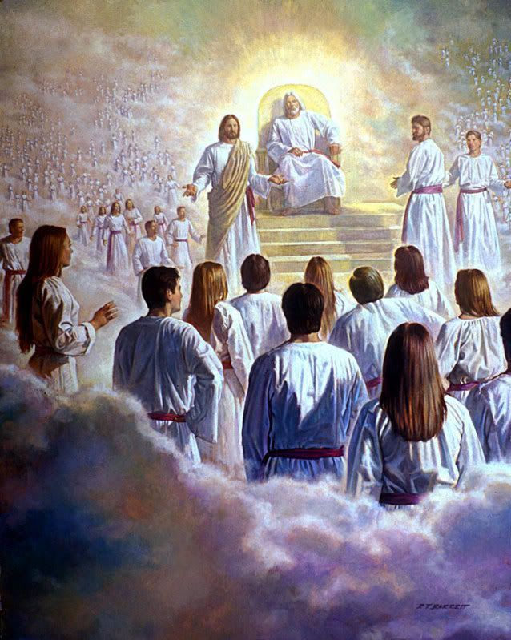
"Then I saw a great white throne…"
(20:11)

Slide 146
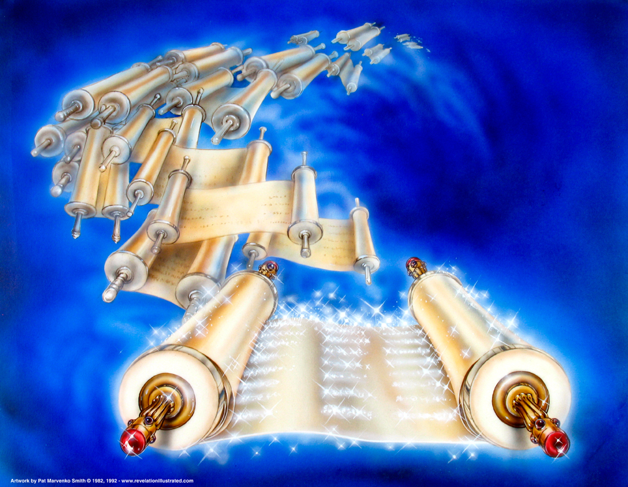
The Books (20:12)
Used with permission

Slide 147
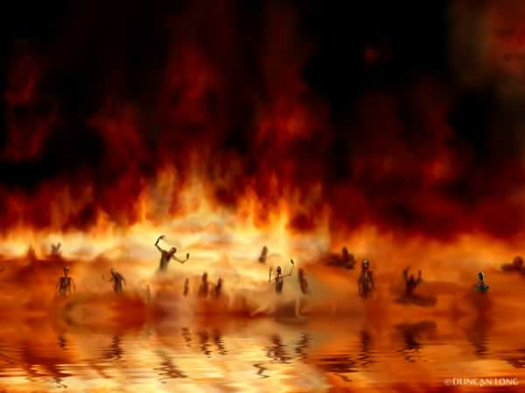
The Lake of Fire (20:14-15)

Slide 148

Christ's Second Coming
439

Slide 149

"Out of his mouth comes a sharp sword with which to strike down the nations"
(Rev. 19:15a)
439
Notes:
149

Slide 150

Annihilationism
155e
What is it?
Arguments cited
Rebuttals

Slide 151

Annihilationist Groups
155e
Seventh-Day Adventists
Jehovah's Witnesses
Some "Evangelicals"?

Slide 152

Annihilationist Arguments
155e
Rebuttals
God is too nice to send people to eternal hell
God is absolutely just and holy
"Destruction" implies annihilation
"Destruction" refers to physical death

Slide 153
Church of England Report,
January 1996
"Hell as ultimate non-being is the way in which we've put it. The horrible demons are the imaginations of inventors and medievalists."
Bishop John Taylor
One of the authors of the report

Slide 154

Purgatory
155e
pt. b
What is it?

Slide 155

Arguments Cited for Purgatory
155e
pt. b
"Not good enough for heaven but not bad enough for hell"
2 Maccabees

Slide 156

Rebuttals to Purgatory
155e
pt. b
Salvation by works
Apocrypha
No second chance

Slide 157

The “It’s sincerity that counts most” argument
155e
pt. c
Notes:
Can you be sincerely wrong? Of course.

Slide 158


Another view…
155e
pt. d
Responding in faith to the light received
God saves them based on Christ’s death
=

Slide 159
The only proper response to the state of the unevangelized is that they indeed are lost without Christ. This is supported in several ways…
155e
pt. e

Slide 160
God's Wrath (Romans 1:18-20)
155e
pt. a
The Reality (18a)
The Reason (18b-20a)
The Result (20b)
Notes:
The reality is that God is angry at
The reason is

Slide 161
Romans 1:20
161
Person who is Limitless
Person who is Supernatural
For since the creation of the world God's invisible qualities— his eternal power and divine nature— have been clearly seen, being understood from what has been made, so that men are without excuse (NIV).
Notes:
__________
NS-06-Rom1-2—slides 120, 152

Slide 162
Why You Are Without Excuse (Romans 1:20)
WHY YOU ARE
WITHOUT
EXCUSE
ROMANS 1:20

Slide 163
Why God is Angry at Gentiles
(Rom. 1:21-32)
155e
e.1)b]
Ignore God (21-23)
God gave them over
Impurity (24)
Idolatry (25)
God gave them over
Homosexuality (26-27)
God gave them over
Depravity (28-32)

Slide 164

All Are Under Sin
^{10b} "No one is righteous—
not even one.
¹¹ No one is truly wise;
no one is seeking God.
¹² All have turned away;
all have become useless.
No one does good,
not a single one (Pss 14:1-3; 53:1-3–Greek version).
¹³ "Their talk is foul, like… stench from an open grave.
Their tongues are filled with lies."
"Snake venom drips from their lips" (Ps 5:9 Gr.; 140:3).
¹⁴ "Their mouths are full of cursing and bitterness" (Ps 10:7 Gr. version).
¹⁵ "They rush to commit murder.
¹⁶ Destruction and misery always follow them.
¹⁷ They don't know where to find peace" (Isa 59:7-8).
¹⁸ "They have no fear of God at all."
  (Rom 3:10b-18 NLT)
155e
e.1)c]

Slide 165
The Law Won't Save
155e
e.1)c]
¹⁹ Obviously, the law applies to those to whom it was given, for its purpose is to keep people from having excuses, and to show that the entire world is guilty before God. ²⁰ For no one can ever be made right with God by doing what the law commands. The law simply shows us how sinful we are.
  (Rom 3:19-20 NLT)

Slide 166

Acts 1:8 NAU
"remotest part"
155f
e.2)
"But you shall receive power when the Holy Spirit has come upon you; and you shall be My witnesses both in Jerusalem, and in all Judea and Samaria, and even to the remotest part of the earth."
Samaria
Jerusalem
Judea

Slide 167

Paul's Calling: Gentiles in the Body
155f
e.3)

Slide 168

Paul's Ministry Westwards
155f
e.3)
Illyricum
Rome
Jerusalem

Slide 169

Romans 15:20-22
155f
e.3)
²⁰ My ambition has always been to preach the Good News where the name of Christ has never been heard, rather than where a church has already been started by someone else.
²¹ I have been following the plan spoken of in the Scriptures, where it says,
"Those who have never been told about him will see, and those who have never heard of him will understand."
²² In fact, my visit to you has been delayed so long because I have been preaching in these places.
––Romans 15:20-22

Slide 170

The Logical Argument
155f
e.4)
If the unreached are not headed for hell, then the worst thing a Christian could do is to tell them about Christ! Why? Because if they hear the message, there’s a possibility of rejecting it and going to hell; however, if they don’t hear the message in the first place, hell isn’t even a possibility. Therefore, the best decision is to call back all our missionaries.

Slide 171


What's the Difference?
155f
pt. 2
Grace
Mercy
…is God
giving us
what we
do not
deserve
…is God
not giving us
what we
do
deserve

Slide 172

What about babies who die?
155f
pt. 2
I believe that they go to heaven based on two texts:
David showed confidence in seeing his infant son who died (2 Sam. 12:23).
Jesus noted that the kingdom of God belonged to little children (Mark 10:14-15).

Slide 173

How can I communicate hell to non-Christians?
155f
pt. 3
A few suggestions:
a. Don’t be afraid to talk about hell. Jesus wasn’t! Christ talked about hell even more than He did about heaven.
b. Talk about sin in your evangelistic presentations. Talk about how God is holy and just and thus must judge sin.
c. Remind unbelievers that hell was “prepared for the devil and his angels” (Matt. 25:41). Man through his disobedience has entered into this arrangement.

Slide 174
How can I communicate hell to non-Christians?
155f
pt. 3
A few suggestions:
d. Avoid speaking of hell and sin as “spiritual separation from God.” Unbelievers are used to being separated from God and because of their sin many have convinced themselves that separation is good—so this hardly seems like a punishment!
e. Teach about hell in balance with even more fundamental doctrines

Slide 175

But I Don't Need the Gospel!
Romans 1:18–2:16
Preached by Dr. Andrew B. Spurgeon
at Crossroads International Church Singapore • cicfamily.com
Uploaded by Dr. Rick Griffith • Singapore Bible College
Thousands of files in 44 languages for free at BibleStudyDownloads.org

Slide 176
Objection 1
But, I don't need the Gospel!
I am not a sinner.

Slide 177

An Atheist Defense
. . . I can be a good person without fear of hell-fire. . . Atheists who are out there, pretty much all the atheists I know, do have a very strong moral compass. . . So the things you may consider sins, we don’t consider sins. But by and large the atheists I know are doing good even though they don’t believe in God. . . Can you believe that?

Slide 178
Objection 1
But, I don't need the Gospel!
I am not a sinner.

Slide 179
Objection 1
"The wrath of God is showing from heaven upon all those who are 'irreverent to God' and
'un-straight-forward' people who suppress the truth in their 'un-straight-forwardness'"
(Rom 1:18).

Slide 180
Objection 1
the wrath of God is showing
“irreverent to God”
“un-straight-forward”
who suppress the truth in their “un-straight-forwardness”

Slide 181
Objection 1
What’s the truth that they suppress?
The existence of God (1:19–23)
“Although they know God exists, they neither give glory to God nor thank Him.” Instead, they worship gods they create (sin).

Slide 182
God's Response
So God’s wrath is showing upon them. . . How?
God gave them over to their own desires of their hearts; they worship creatures (1:24–25)

Slide 183
God's Response
So God’s wrath is showing upon them. . . How?
2. God gave them over to dishonorable passions; they confuse gender identities (1:26–27)

Slide 184
God's Response
So God’s wrath is showing upon them. . . How?
3. God gave them over to thoughtless minds; they commit acts of wickedness and approve those who practice them
(1:28–32)

Slide 185
Types of People
“irreverent to God” and
“un-straight-forward” people

Slide 186
Objection 2
But, I don't need the Gospel!
I am a saint!

Slide 187
Objection 2
“You who pass judgment on someone else, for at whatever point you judge another, you are condemning yourself, because you who pass judgment do the same things” (2:1).

Slide 188
God's Response
But, “God’s judgment against those who do such things is based on truth” (2:2).
So, those who judge others, but do the same act, will not escape God’s judgment (2:3).

Slide 189
God's Response
So, what’s their crime?
Showing contempt for God’s kindness (2:4).
“God will repay each person
according to what they have done”
(2:5-6).

Slide 190
God's Response
To those who seek immortality, He will give life (2:7)
To those who seek their own self and reject truth, punishment (2:8)

Slide 191
God's Response
Regardless of Jews or Gentiles
(2:9–10)
“For God does not show favoritism”
(2:11)
With or without law
(2:12–15)

Slide 192
God's Response
God judges these hidden acts of people, today, through the gospel of Christ Jesus (2:16)

Slide 193
Summary
But I don't need the Gospel,
I am not a sinner!
But I don’t need the Gospel,
I am a saint!

Slide 194
Summary
But I need the Gospel,
I am a sinner!
But I need the Gospel,
I am not a saint!

Slide 195
Slides on
Romans 2

Slide 196
Romans 2:1–3:8
God is angry at the
self-righteous and Jews too

Slide 197

God Despises Human Pride
Notes:
www.schambach.org/

Slide 198

All Are Guilty Before God
152
Condemned Group | Benefits Received | Reason Condemned | Degree of Judgment
Gentiles (1:18-32) | Creation (1:18-20) | Rejection of the light they have (1:21-22) | Great (1:20b)
Self-Righteous (2:1-16) | Conscience (2:14-15) | Refusal to obey conscience (2:1) | Greater (2:4)
Jews (2:17–3:8) | Law (2:17-20; 3:2) | Hypocrisy (2:21-24) | Greatest (2:24)
All Humanity (3:9-20) | Creation and/or Conscience or Law | Lack of understanding and turning away (3:11-18) | —
Notes:
BE-45-Rom-21
NS-06-Rom1-2-slide 174
NS-06-Rom3-4-slide 5

Slide 199
Salvation by Works?
Works Verses
Rom. 2:6 God "will give to each person according to what he has done."
Rom. 2:7 To those who by persistence in doing good seek glory, honor and immortality, he will give eternal life.
Rom. 2:8 But for those who are self-seeking and who reject the truth and follow evil, there will be wrath and anger.
Rom. 2:13 For it is not those who hear the law who are righteous in God's sight, but it is those who obey the law who will be declared righteous.
Explanation
These verses seem to teach salvation by works while others teach salvation by faith (e.g., Rom. 3:20). Paul appears to teach salvation by works elsewhere (cf. 1 Cor. 6:9-11; 2 Cor. 5:10; Gal. 5:21) but he did not see these as contradicting.
It is better to see Romans 2:7, 13 as hypothetical. Paul simply says that eternal life would be possible if one could keep the law entirely, but since no one can do this then all alike are under sin.
This fits his argument that all persons are under judgment in Romans 1–3 and it also harmonizes well with 3:19-20.
155g
155g
Notes:
"In Romans 2:7-10, Paul takes up the case of men being recompensed for their deeds. He contrasts a
positive outcome in vv. 7 and 10 with a negative outcome in vv. 8 and 9. Scholars have struggled to
understand some of Paul’s statements, especially v. 7 that God would grant “eternal life to those who by
perseverance in good works seek glory and honor and immortality.” Three primary interpretations have
been suggested:
1. The life of a true believer will be evidenced by “perseverance in good works.”
2. For faithful believers who “persevere in good works,” they will be rewarded with an enhanced
experience of life now (Jn 10:10) and a richer experience of eternal life in heaven—a reward at
the Judgment Seat of Christ (1 Cor 3:12-15; 2 Cor 5:10-11).
3. Paul is only speaking hypothetically to help the “moralist” realize the impossibility of his
philosophy, for in reality no one can gain eternal life by “persevering in good works.”
The third view has several factors in its favor. First, the whole context of Romans 2:1-29 is aimed at the
Jewish “moralist” who relies upon the Law, not the experience of believers in Christ. Second, Paul is very clear elsewhere in Romans (see 5:21 and 6:22-23) that eternal life only comes as the gift of God to
those in Christ Jesus, not to those who “persevere in good works.” Third, Paul speaks hypothetically
again in Romans 2:13 when he says, “those who do the law will be declared righteous,” that is, justified.
Paul quite obviously does not mean to say that some actually will be justified in this way, for to do so
would be a clear contradiction of what he had taught in Galatians 2:16: “by the works of the law no one
will be justified.” So, it seems that Paul is saying what he does in Romans 2:7-10 to wake the “moralist”
up to the fact that it is hopeless trying to be justified and gain eternal life as a result of living up to the
Law."
J. Paul Tanner, Romans (Colorado Springs, CO: BEE World, 2018), 45-46.

Slide 200




Why are Jews also without excuse before God (2:17-29)?
151

Slide 201
Leviticus 23 Feasts
1 Nisan
2 Iyar
3 Sivan
4 Tammuz
5 Av
6 Ellul
7 Tishri
8 Cheshvan
9 Kislev
10 Tevet
11 Shevat
12 Adar
(Passover)
Redemption
(Unleavened Bread)
Separation
(Firstfruits)
Resurrection
(Pentecost)
Spirit
Kingdom
(Tabernacles/Booths)
Repentance
(Day of Atonement)
Rapture
(Trumpets)
3 Pilgrimage Feasts

Slide 202

Modern Passover

Slide 203

Purim: Lots of Victory

Slide 204



Sabbath

Slide 205

Jewish life revolved around Solomon's temple for 400 years (959-586 BC)
Judaism in Israel and the Diaspora

Slide 206


Prayers for the Third Temple
While praying for temple restoration, Jews needed a common place to bring themselves "together" (syn) to preserve their "way of life" (agoge). Thus the "synagogue" was born.

Slide 207


Synagogue Furniture & Design
Chest (Ark)
Bema (Desk)
Benches
Lamps
Women

Slide 208

Synagogue Leadership
Elders
Ruler
Attendant

Slide 209
Main Idea of Romans
We accept each other because God’s righteousness comes to us equally.

Slide 210

Accept others.
Application of Romans

Slide 211
Accept others. How?
      Have you received God’s forgiveness offered freely by trusting Christ?
      If so, are you seeing yourself clearly—that is, humbly?
      Or do you think yourself better than someone else? Who?
      Which Christian are you not accepting? How can you better accept that person?
Application of Romans

Slide 212
Black

Slide 213
NT Preaching • BibleStudyDownloads.org
Get this presentation and script for free!

Slide 214
Black

Slide 215
NT Survey link at BibleStudyDownloads.org
Get this presentation for free!
Notes:
NT Survey (ns)

