Slide 1
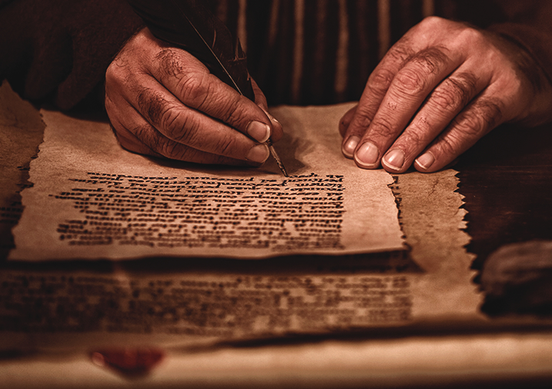
The Pauline Epistles
Dr. Rick Griffith • Jordan Evangelical Theological Seminary • BibleStudyDownloads.org

Slide 2
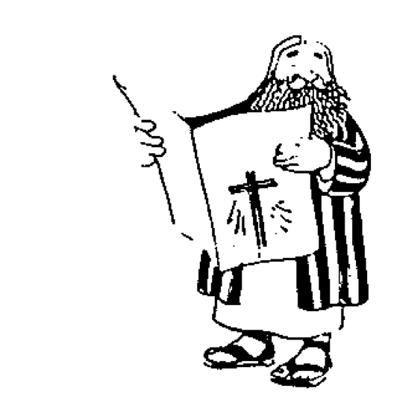
The New Testament “Building”
21
Paul''s Letters to Pastors
 | 1 Timothy | 2 Timothy | Titus |  | Philemon
Paul''s Letters to Churches | 2 Thessalonians |  |  |  | Revelation | General Letters
 | 1 Thessalonians |  |  |  | Jude
 | Colossians |  |  |  | 3 John
 | Philippians |  |  |  | 2 John
 | Ephesians |  |  |  | 1 John
 | Galatians |  |  |  | 2 Peter
 | 2 Corinthians |  |  |  | 1 Peter
 | 1 Corinthians |  |  |  | James
 | Romans |  |  |  | Hebrews
 | Acts
 | Matthew | Mark |  | Luke | John
Historical Books
Adapted from Walk Thru the Bible
Notes:
What overall observations on the NT can you make from this diagram?
Gospels and Acts form the primary and secondary foundations of the NT.
On the historical foundation are two pillars of 9 books each.
Paul's letters to churches in the left pillar all fit into Acts.
Paul didn't write any inspired letters to churches after Acts.
Pauline letters are named after recipients while General after authors (except Hebrews)
The four gospels are named after their authors.
Every book that ends in "ns" is Pauline
All Pastoral Epistles begin with "T”
______
General Epistles came after Acts (except James).
Each of the 2 pillars begin with a foundational book: Romans & Hebrews (also their longest).
Both pillars also end up in books that primarily deal with eschatology: 2 Thess and Revelation.
Instruction to the leaders comprise only 4 books (i.e., the NT addresses the average Christian).
Only 4 NT books are written to an individual (i.e., the NT is corporate, not individualistic).
Each 1st of multiple letters (1-2 Cor., 1-2 Thess., etc.) is longer & more theologically significant.
The “building” is chronologically clockwise.
________
Three sections all have 9 books: 9 Historical/Pastoral + 9 Pauline + 9 General.
Audiences of the Pauline column had more Jews than the Gentile readers of the General column.
Pauline letters addressed early Christians when eyewitnesses to Jesus lived but General letters mostly addressed second generation believers.
The NT foundation rests on books about the life of Christ, as Jesus is the focus of the NT.
----- Meeting Notes (11/1/18 20:47) -----
Depicts growth in maturity

Slide 3
NT Overview (Paul's Letters)
38 124 39-41
“To the remotest part of the earth” (Acts 1:8)
Acts 9 13 14 15 16 18 21 27 28
Apr 48- Sep 49
1 Galatia
Apr 50- Sep 52
2 Aegean
Spr 53- May 57
3 Asia
Feb 60- Mar 62
1 Rome
Spr 62- Fall 67
4 Spain
Aut 67- Spr 68
2 Rome
Summer 35- 37
Damascus Antioch
May 57- Aug 59
Trials
Fall 49
The
Council
Spring 68
Expansion of Church
35 48 49 50 52 53 57 60 62 67 68 95
Matt
Luke
Acts
Mark
John
Gal
1 Thess
1 Cor
Eph
1 Tim
2 Tim
2 Thess
2 Cor
Col
Titus
Missionary
Romans
Philem
Pastoral
Gospels & Acts
Phil
Pauline Epistles
1234
Journeys
Prison
Rome
Imprisonments
Pauline
Notes:
Background: Paul left Timothy at the second-generation church of Ephesus which was facing serious heretics.
Timing: When did Paul write 1 Timothy?
Paul’s last letters before writing 1 Timothy were his Prison Epistles that ended with Philippians.
Now he turns his attention to writing individuals, including Philemon.
Historical Context: What was happening at this time?
Of Paul’s 13 NT letters, at least 10 of them are written to defeat heresy! No false teaching is noted in Romans, Ephesians, and Philemon (cf. NTS notes, 222j).
Paul left Timothy at the second-generation church of Ephesus which was facing serious heretics. He pens here what Timothy is to do—with important parallels to us today.

Slide 4
Paul's Epistles in Mostly Scriptural Order
Foundational | Prison | Prophetic | Pastoral
Romans 1 Corinthians 2 Corinthians Galatians | Ephesians Philippians Colossians Philemon | 1 Thessalonians 2 Thessalonians | 1 Timothy 2 Timothy Titus
Christ & the Cross | Christ & the Church | Christ & the Second Coming | Christ & the Congregation
Soteriology | Christology | Eschatology | Ecclesiology
TEXT
Adapted from The Pastoral Epistles © John Stevenson 2010 • https://slideplayer.com/slide/6106093/
Notes:
This order follows the NT except Philemon is moved from the end of the Pauline Epistles after Titus to complete the Prison Epistles after Colossians.
But one could argue that Philemon was a pastoral letter since it deals with a pastoral situation that needed reconciliation.
On the other hand, Paul wrote Philemon in Rome during Paul's first imprisonment, so it is a Prison Epistle in this sense.
In the end, I do not know who has explained the reasoning for the order of Paul's letters.

Slide 5
Authors of the New Testament
13
Name | Nationality | Home Town | Occupation | Relation-ships | Chapters Written | Verses Written | Books Written
Paul | Jew | Tarsus | Tentmaker | Apostle of Jesus Christ | 87 (100)* | 2,033 (2,336)* | Romans 1 Corinthians 2 Corinthians Galatians Ephesians Philippians Colossians Philemon 1 Thess. 2 Thess. 1 Timothy 2 Timothy Titus (Hebrews?)
*Indicates total if Hebrews is assigned to Paul.

Slide 6
NT Book Key Words
24
Date | Book | Key Word | Paul's Life | Key Doctrine
40s | Matthew | Kingdom |  | Ecclesiology
44-47 | James | Works |  | Soteriology
49 | Galatians | Justification | 1st journey | Soteriology
51 | 1 Thessalonians | Rapture | 2nd journey | Eschatology
51 | 2 Thessalonians | Tribulation | 2nd journey | Eschatology
56 | 1 Corinthians | Sanctification | 3rd journey | Ecclesiology
56 | 2 Corinthians | Apostleship | 3rd journey | Ecclesiology
56-57 | Romans | Righteousness | 3rd journey | Soteriology
57-59 | Luke | Sovereignty I |  | Missiology
Notes:
Early dates for these books are supported by Harold F. Hoehner, Chronological Aspects of the Life of Christ (Grand Rapids: Zondervan, 1977), 176pp, and a more recent and substantial work by Jonathan Bernier, Rethinking the Dates of the New Testament: The Evidence for Early Composition (Grand Rapids: Baker, May 2022), 336 pp.

Slide 7
NT Book Key Words
24
Date | Book | Key Word | Paul's Life | Key Doctrine
60 | Ephesians | Unity | 1st imprisonment | Christology (Head)
61 | Colossians | Deity | 1st imprisonment | Christology (God)
61 | Philemon | Forgiveness | 1st imprisonment | Christology (Reconciler)
62 | Philippians | Attitude | 1st imprisonment | Christology (Example)
62 | Acts | Sovereignty II |  | Missiology
62 | 1 Timothy | Order | 4th journey | Ecclesiology
64 | 1 Peter | Suffering |  | Eschatology
64 | 2 Peter | Knowledge |  | Eschatology
64-68 | Mark | Discipleship |  | Eschatology
Notes:
Early dates for these books are supported by Harold F. Hoehner, Chronological Aspects of the Life of Christ (Grand Rapids: Zondervan, 1977), 176pp, and a more recent and substantial work by Jonathan Bernier, Rethinking the Dates of the New Testament: The Evidence for Early Composition (Grand Rapids: Baker, May 2022), 336 pp.

Slide 8
NT Book Key Words
24
Date | Book | Key Word | Paul's Life | Key Doctrine
66 | Titus | Conduct | 4th journey | Ecclesiology
67 | 2 Timothy | Doctrine | 2nd imprisonment | Ecclesiology
67-68 | Hebrews | Superiority |  | Christology
c. 69 | John | Belief |  | Soteriology
75 | Jude | Pretenders |  | Eschatology
85-95 | 1 John | Love |  | Soteriology
85-95 | 2 John | Limits |  | Missiology
85-95 | 3 John | Missionaries |  | Missiology
95-96 | Revelation | Triumph |  | Eschatology
Notes:
Early dates for these books are supported by Harold F. Hoehner, Chronological Aspects of the Life of Christ (Grand Rapids: Zondervan, 1977), 176pp, and a more recent and substantial work by Jonathan Bernier, Rethinking the Dates of the New Testament: The Evidence for Early Composition (Grand Rapids: Baker, May 2022), 336 pp.

Slide 9
Paul’s Dealing with Problems
222j
Letter | Recipient’s Problem | Paul’s Solution
Galatians (Soteriology) | Heretics taught new believers that they must obey the Mosaic Law to be saved | Justification is by faith alone and not by keeping the Law
1 Thess (Eschatology) | Heretics questioned Paul’s church planting motives and the state of believers at Christ’s Return if they had already died | They should prepare for the Rapture by seeing Paul’s pure motives and being comforted over believers who died
2 Thess (Eschatology) | Heretics taught the believers were in the Tribulation due to intense persecution so some quit their jobs and became lazy | The Day of the Lord (Tribulation) won’t start until after the Church is removed and they must persevere without idleness
Notes:
The New Testament does not systematically present theology. Rather, most NT writings actually address a particular problem in a letter. These four charts show Paul’s unique solution for each situation. The keyword for that epistle is italicized (cf. NT Survey, 1:24).
Amazingly, at least ten of Paul's letters respond to heretics! See the word "heretics" for these 10 letters on these charts.
Three Pauline letters that did NOT address heretics—Romans, Ephesians, and Philemon. Instead, they all share in common Paul's solution to a form of disunity in each church.
Do you also know the issues your people face? Do you ignore them or resolve them in your church?

Slide 10
Paul’s Dealing with Problems
222j
Letter | Recipient’s Problem | Paul’s Solution
1 Corinthians (Ecclesiology) | Disorder in the church came from divisions, moral deviations, and false doctrines taught by heretics | Proper behavior where positional sanctification becomes practical results only from a true theology of the gospel
2 Corinthians (Ecclesiology) | Heretics undermined Paul’s authority to advise the church | Paul defends his apostleship in his new covenant ministry to affirm the church’s doctrinal foundation and giving
Romans (Soteriology) | Jew-Gentile struggles disrupted body life in confusion over the role of the Law and insensitivity to one another in gray areas | Living out God’s righteousness achieved by justification through faith will bring unity before Paul arrives
Notes:
The New Testament does not systematically present theology. Rather, most NT writings actually address a particular problem in a letter. These four charts show Paul’s unique solution for each situation. The keyword for that epistle is italicized (cf. NT Survey, 1:24).
Amazingly, at least ten of Paul's letters respond to heretics! See the word "heretics" for these 10 letters on these charts.
Three Pauline letters that did NOT address heretics—Romans, Ephesians, and Philemon. Instead, they all share in common Paul's solution to a form of disunity in each church.
Do you also know the issues your people face? Do you ignore them or resolve them in your church?

Slide 11
Paul’s Dealing with Problems
222j
Letter | Recipient’s Problem | Paul’s Solution
Ephesians (Christology) | Jew-Gentile disunity within the church hindered their testimony before unbelievers | God’s mystery of Jew-Gentile unity in the Church under Christ as Head must show itself in love for each other
Colossians (Christology) | Heretics led believers into combining legalism, asceticism, and angel worship | Christ is God (deity), so the church must worship Him alone in holy living
Philemon (Christology) | A Christian slave owner (Philemon) was tempted to mistreat his now-believing former slave, Onesimus, who had returned | This master must grant forgiveness to his former slave to model the reconciliation of believers to God through Christ
Notes:
The New Testament does not systematically present theology. Rather, most NT writings actually address a particular problem in a letter. These four charts show Paul’s unique solution for each situation. The keyword for that epistle is italicized (cf. NT Survey, 1:24).
Amazingly, at least ten of Paul's letters respond to heretics! See the word "heretics" for these 10 letters on these charts.
Three Pauline letters that did NOT address heretics—Romans, Ephesians, and Philemon. Instead, they all share in common Paul's solution to a form of disunity in each church.
Do you also know the issues your people face? Do you ignore them or resolve them in your church?

Slide 12
Paul’s Dealing with Problems
222j
Letter | Recipient’s Problem | Paul’s Solution
Philippians (Christology) | Concern over Paul’s fate in prison was complicated by legalistic and libertine heretics and two quarrelsome women | Imitating Christ’s attitude will give joy, humility, balance between “law extremes” and peace with God and man
1 Timothy (Ecclesiology) | Ascetic and speculative heretics threatened Timothy’s leadership of the Ephesian church | Church order will follow if Timothy guards his personal life and doctrine and shares leadership with other godly men
Titus (Ecclesiology) | Heretics on Crete hindered the health of the newly planted churches | Teach believers sound conduct through qualified elders to silence accusations
2 Timothy (Ecclesiology) | Heretics and persecution of believers caused many believers to deny Christ | Persevere in sound doctrine by preaching and practicing God’s Word despite hardship
Notes:
The New Testament does not systematically present theology. Rather, most NT writings actually address a particular problem in a letter. These four charts show Paul’s unique solution for each situation. The keyword for that epistle is italicized (cf. NT Survey, 1:24).
Amazingly, at least ten of Paul's letters respond to heretics! See the word "heretics" for these 10 letters on these charts.
Three Pauline letters that did NOT address heretics—Romans, Ephesians, and Philemon. Instead, they all share in common Paul's solution to a form of disunity in each church.
Do you also know the issues your people face? Do you ignore them or resolve them in your church?

Slide 13
Black

Slide 14
NT Survey link at BibleStudyDownloads.org
Get this presentation for free!
Notes:
NT Survey (ns)

