Slide 1
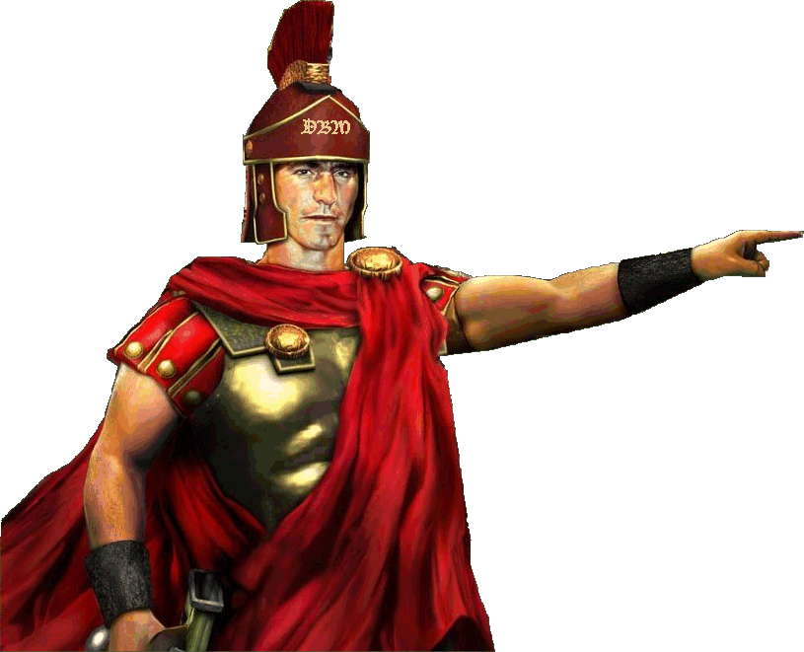
Acts 9–14
Dr. Rick Griffith • Jordan Evangelical Theological Seminary • BibleStudyDownloads.org

Slide 2
Key Word
56
39
Sovereignty II
Acts

Slide 3
Theme
23
Universal Savior Proclaimed in Sovereign Kingdom Progress
Acts

Slide 4
Key Verse
56
"But you will receive power when the Holy Spirit comes on you; and you will be my witnesses in Jerusalem, and in all Judea and Samaria, and to the ends of the earth" (1:8).
Acts

Slide 5
Summary & Application
Acts
120
Summary Statement
The reason to witness everywhere is because God has directed the progress of the kingdom message to all people since early church history
Application
How is God extending his kingdom message through you?
How are you fitting into His overall purpose to spread the gospel throughout the entire earth?

Slide 6

Kingdom Statement
27b
The kingdom message expands from its reception by Jews in Jerusalem (1:1–6:7) to Judeans and Samaritans (6:8–8:40) to Gentiles in Rome (chaps. 9–28) in many “progress reports” (2:47; 6:7; 8:40; 9:31; 12:24; 16:5; 19:20; 28:30-31; also possibly 2:41; 4:31; 5:42; 8:25, etc.) to show believers that God will grow his church, not man.
Acts

Slide 7

Covenant
27b
Jesus has sent the Holy Spirit to form the church (1:8; 2:14-18, 33, 38-39; 10:44-47), so believers should repent and be baptized to join this new covenant community called the church (2:21, 38; 3:19; 10:43, 47-48; 17:30; 26:20).
Acts

Slide 8

Redemption
27b
The universal appeal for salvation through the gospel is stressed (1:8; 28:30-31) in this book that records over 80 geographical locations–more than any other New Testament book.
Acts

Slide 9

Prophecy
(Lord, Deity)
27b
Jesus fulfilled the OT prophecies (2:30; 3:19, 24; 10:43; 26:6-7, 22), especially in his miracles (2:22; 10:38), death according to God’s purposes (2:23; 3:13-15, 18; 4:11; 10:39; 26:23), resurrection (2:24, 31-32; 3:15, 26; 10:40-41; 17:31; 26:23), and exaltation to God’s throne as Lord (2:25-29, 33-36; 3:13; 10:36) until he returns (3:20-21; 10:42; 17:31; cf. NTS, 137).
Acts

Slide 10
Book Chart (Top)
Acts
120
Universal Savior Proclaimed in Sovereign Kingdom Progress
Jerusalem
Judea and Samaria
Uttermost Part
1:1–6:7
6:8–8:40
Chapters 9–28
Jews
Samaritans
(mixed breeds)
Gentiles
AD 33-35
(2 years)
AD 35
(a few months)
AD 35-62
(27 years)

Slide 11
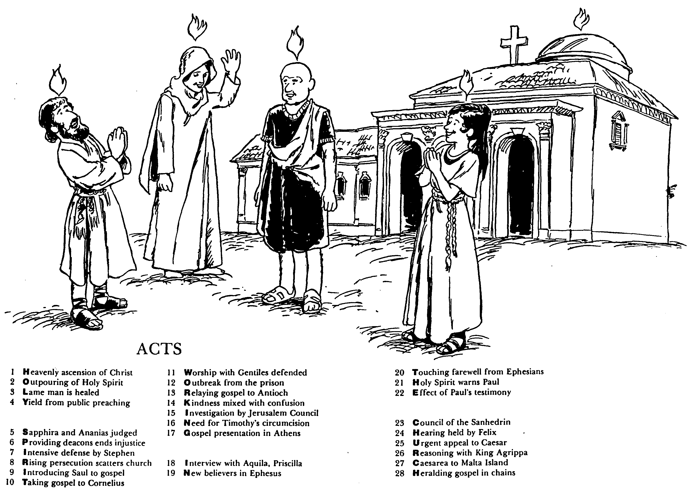

ACTS
Barry Huddleston, The Acrostic Bible
1 基督被接升天
2 圣灵的浇灌
3 瘸腿的人得治愈
4 群众讲道的结果
5 撒非拉和亚拿尼亚被审判
6 拣选执事解决不义
7 司提反强烈的申辩
8 教会受逼迫而分散
9 扫罗接受福音
10 福音传给哥尼流
11 辩解与外族人同赞美
12 逃出监狱
13 福音传到安提阿
14 慈爱与混乱混合了
15 耶路撒冷会议调查
16 对提摩太的割礼的需要
17 在雅典的宣教
18采访与亚居拉，百基拉
19 在以弗所的新信徒
20 以弗所的感人告别
21 圣灵警告保罗
22 保罗见证带来的后果
23 公议会的会议
24 在腓力斯前受审
25 向凯撒的迫切上诉
26 与亚基帕王辩解
27 从该撒利亚到马尔他岛
28 Translation

Slide 12

Be Witnessing
Acts
Dr. Rick Griffith • Crossroads International Church Singapore
BibleStudyDownloads.org

Slide 13
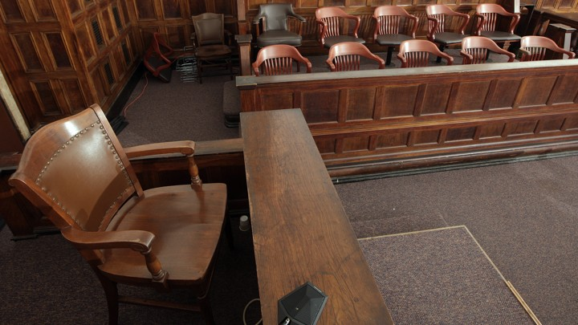
The Witness Stand
Acts
Notes:
It’s not hard to witness to what you have seen—

Slide 14
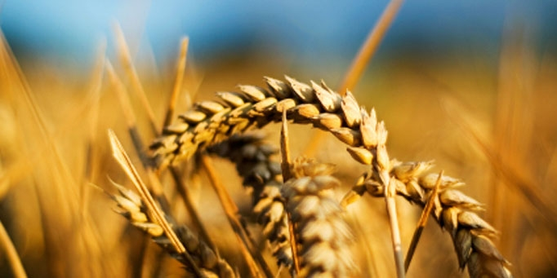
Why should we be witnessing?
3 reasons
Acts
Notes:
Today we’ll see three reasons we should witness for Jesus. Each is actually a stage of growth.
We will survey the entire book of Acts.
(So back to our question: Why should we witness?)

Slide 15
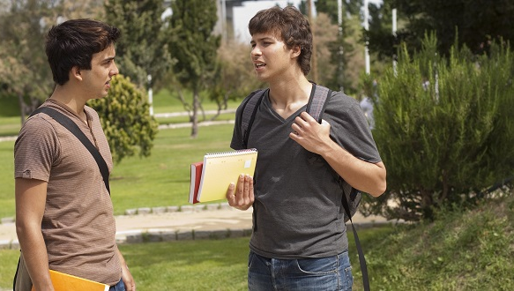
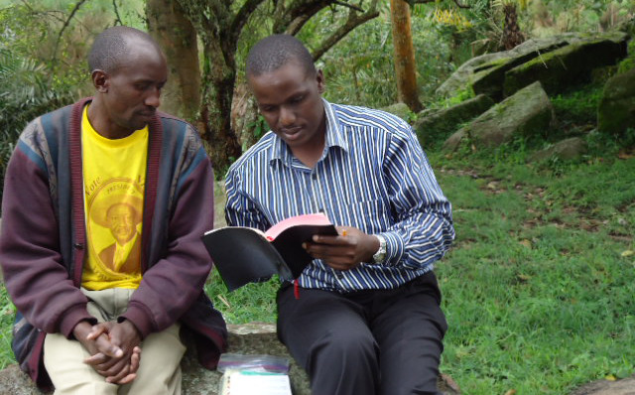
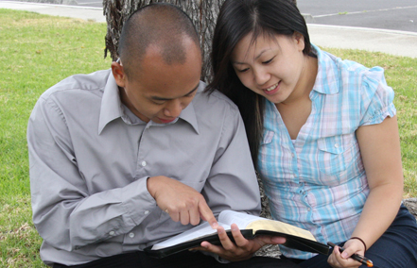
I. God has gone ahead of us so we can begin where we are (Acts 1:1–6:7).
Notes:
God helps us first tell others about Jesus where it is natural without crossing cultures.

Slide 16
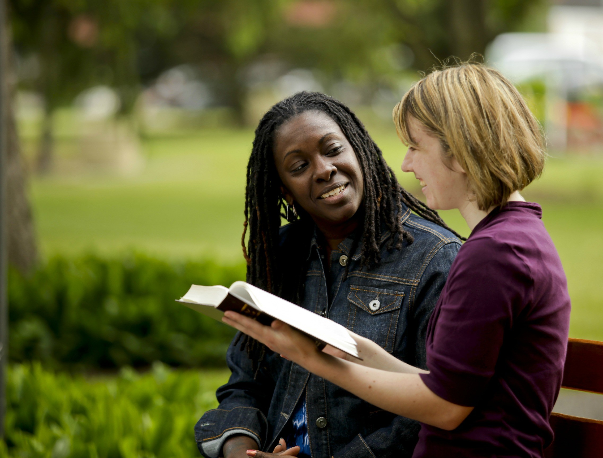
II. God gets the glory when we witness outside our comfort zone (Acts 6:8–8:40).
Notes:
God is honored when we share about him with those who are not familiar.

Slide 17
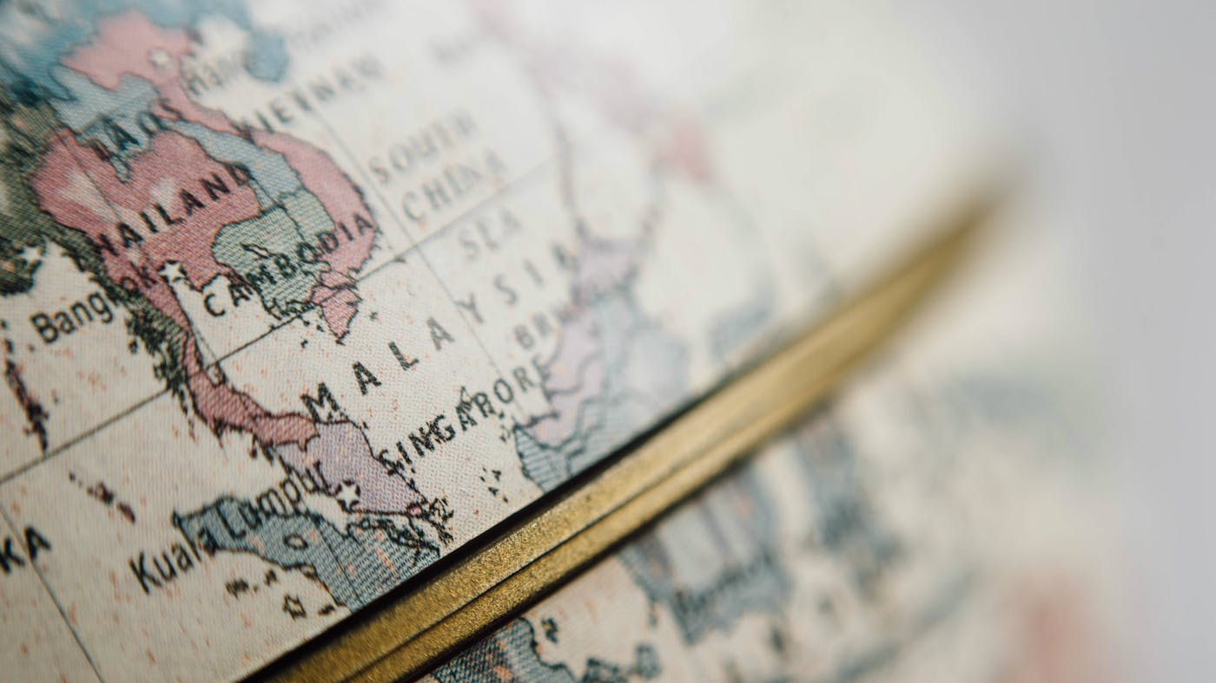
III. God will use us to spread the kingdom to the last unreached place (Acts 9–28).
Notes:
He promises that we will eventually witness in the final unevangelized place on earth.

Slide 18
Main Idea of the Book
Be part of God’s plan to bring the kingdom message to all people.
Acts
Notes:
Do what the Lord has designed for you to do so his rule extends to everyone though your life!

Slide 19

What is your role in God’s plan that he started in early church history?
Acts

Slide 21
Slides on
Acts 9
Notes:
God saved Paul to reach Damascus of Syria (9:1-31).

Slide 22
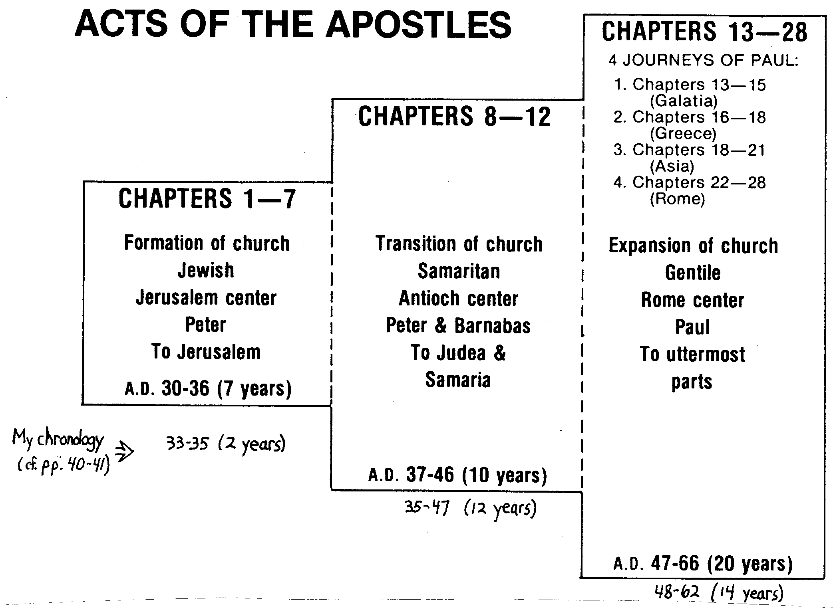
Expanding View of Acts
130
Acts 9–28
Antioch, Caesarea, Cyprus,
Phoenicia, Jerusalem
(Acts 9–12)
4 Journeys of Paul:
Galatia (Acts 13–15)
Greece (Acts 16–18)
Asia (Acts 18–21)
Rome (Acts 22–28)
Expansion of Church
Gentile
Antioch to Rome Center
Paul & Barnabas
To Uttermost Part
AD 35-62 (27 years)
6:8–8:40
Transition of Church
Samaritan
Jerusalem Center
Peter & Philip
To Judea & Samaria
AD 35 (a few months)
1:1–6:7
Formation of Church
Jewish
Jerusalem Center
Peter
To Jerusalem
AD 33-35 (2 years)
Adapted from Terry Hall, Bible Panorama, 162
Notes:
Some debate exists as to when the gospel reached Judea and Samaria. Many place this in Acts 8–12, such as Terry Hall. But the debate in Jerusalem with Stephen ending in his death (6:8—7:60) caused the message to expand in 8:1 when "…a great wave of persecution began that day, sweeping over the church in Jerusalem; and all the believers except the apostles were scattered through the regions of Judea and Samaria." This message quickly reached Damascus where believers already existed when Paul went there (9:10), which began the transition to the "uttermost part" (cf. 1:8) beyond Judea and Samaria.
________________
NS-05-Acts1-2—slide 307
NS-05-Acts3-8—slide 236
NS-05-Acts9-14—slide 22

Slide 23
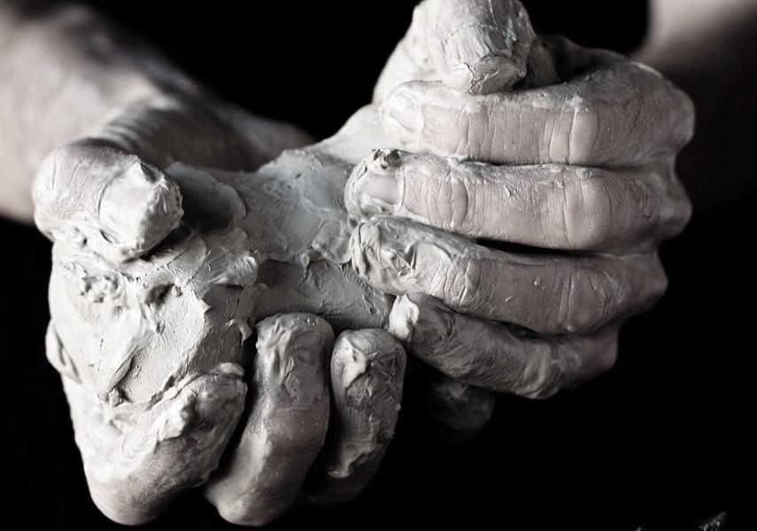
The Way to God
Transforming Dead Souls into Living Witnesses for Christ
Acts 9:1-31
Preached by Dr. Jim Harmeling
at Crossroads International Church Singapore • CICFamily.com
Uploaded by Dr. Rick Griffith • Singapore Bible College
Files in many languages for free download at BibleStudyDownloads.org

Slide 24
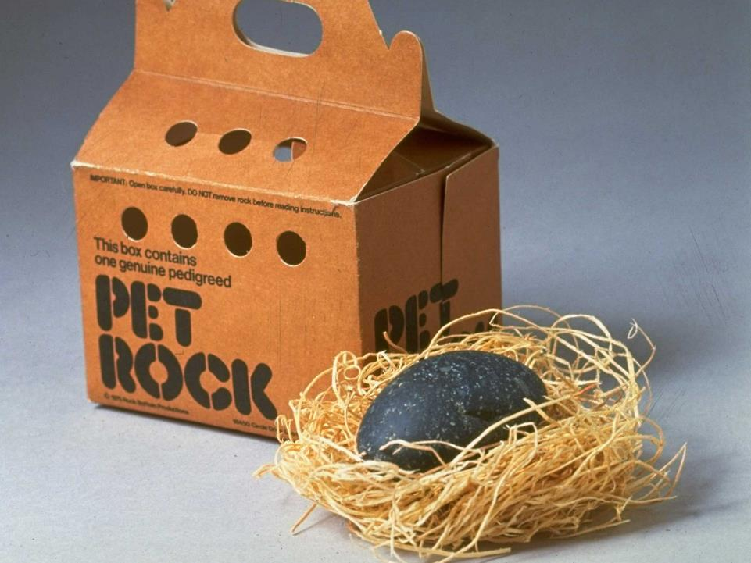
Sit!
Stay!
Attack!
Notes:
In the early 1970s, Americans were getting frustrated with the unruly pets, so a man seized on a new business opportunity. He bought from Mexico thousands of rocks, wrote up a creative booklet how to train these “pet rocks,” and sold each kit for $4. Included in the instructions were how to get the rock to sit and stay—and even attack when appropriate. This meant you threw the rock at others. The man became very wealthy, by the way.

Slide 25

Exodus 17:6
“Behold, I will stand before you there on the rock at Horeb, and you shall strike the rock, and water shall come out of it, and the people will drink.” And Moses did so, in the sight of the elders of Israel.
Luke 19:38-40
³⁸ saying, “Blessed is the King who comes in the name of the Lord! Peace in heaven and glory in the highest!” ³⁹ And some of the Pharisees in the crowd said to him, “Teacher, rebuke your disciples.” ⁴⁰ He answered, “I tell you, if these were silent, the very stones would cry out.”
Notes:
God has even better ways of getting what he wants out of rocks. Through Moses, he actually got water out of a rock—and Jesus said at his Triumphal Entry that if his disciples refused to praise him, the very stones would cry out that he was the long-awaited Messiah.

Slide 26
The Way to God
Transforming Dead Souls into Living Witnesses for Christ
Acts 9:1-31
Notes:
Acts 9:1-31 records a similar encounter where God softens the stone-hard heart of Saul (Paul) to transform him into a living witness for Christ. And Jesus does the same for us today when he shows us that he is the way to God—as this movement was known in the early days of the Church.

Slide 27
Understand God’s Intention
Samaria
Simon
Insincere seeking
Judea
Ethiopian eunuch
Sincere seeking
end of the earth
Saul
Persecuting
Notes:
God’s intention, of course, is to change lives.

Slide 28
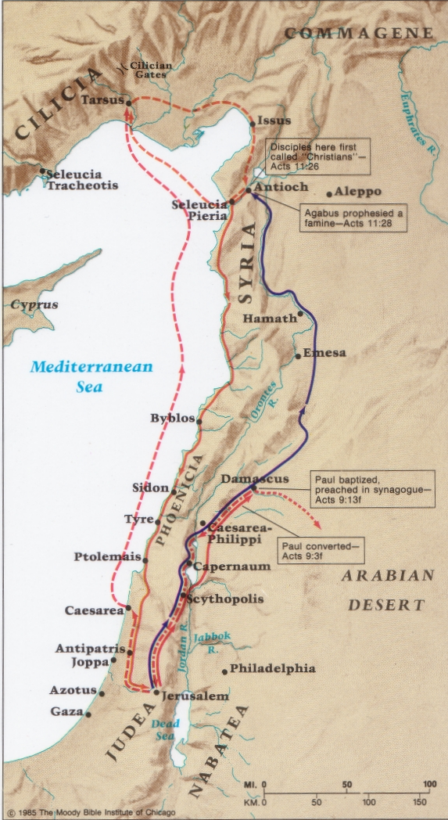
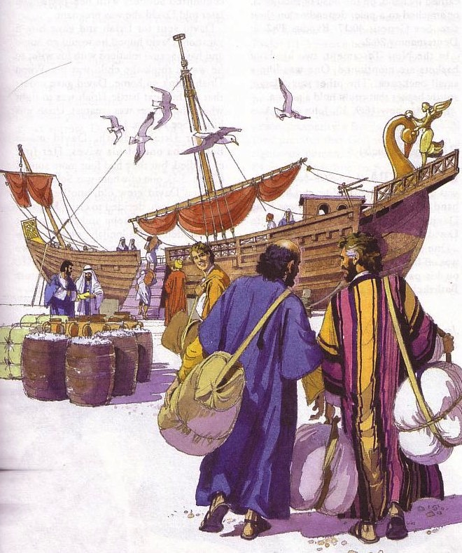
Paul's Early Journeys
Tarsus
Antioch
Damascus
Jerusalem

Slide 29
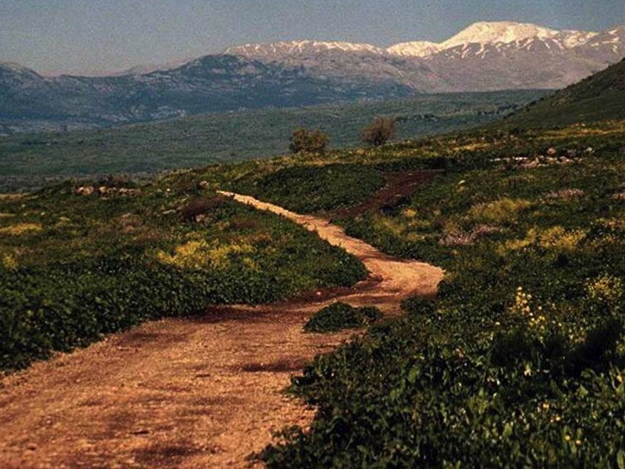
The Road to Damascus
Where Paul trusted Christ (Acts 9)

Slide 30
Understand God’s Intention
Genesis 12:1-3
¹ Now the Lord said to Abram, “Go from your country and your kindred and your father's house to the land that I will show you. ² And I will make of you a great nation, and I will bless you and make your name great, so that you will be a blessing. ³ I will bless those who bless you, and him who dishonors you I will curse, and in you all the families of the earth shall be blessed.”
Notes:
God’s intention has always been to bring all kinds of people to faith in Jesus—back since Abraham.

Slide 31
Understand God’s Intention
Luke 24:45-47
⁴⁵ Then he opened their minds to understand the Scriptures, ⁴⁶ and said to them, “Thus it is written, that the Christ should suffer and on the third day rise from the dead, ⁴⁷ and that repentance for the forgiveness of sins should be proclaimed in his name to all nations, beginning from Jerusalem.

Slide 32
Understand God’s Intention
Acts 1:8
But you will receive power when the Holy Spirit has come upon you, and you will be my witnesses in Jerusalem and in all Judea and Samaria, and to the end of the earth.

Slide 33
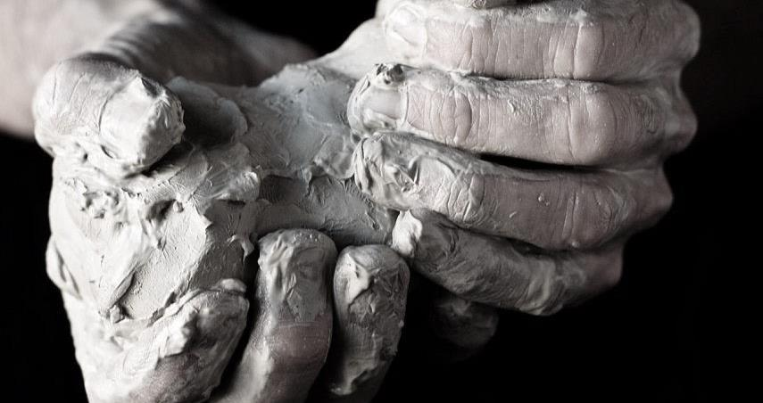
Observe the pattern of transformation
Resistance (9:1-2)
Illumination (9:3-9)
Connection (9:10-19)
Notes:
There exists a five-step process of transforming rock into moldable clay.

Slide 34
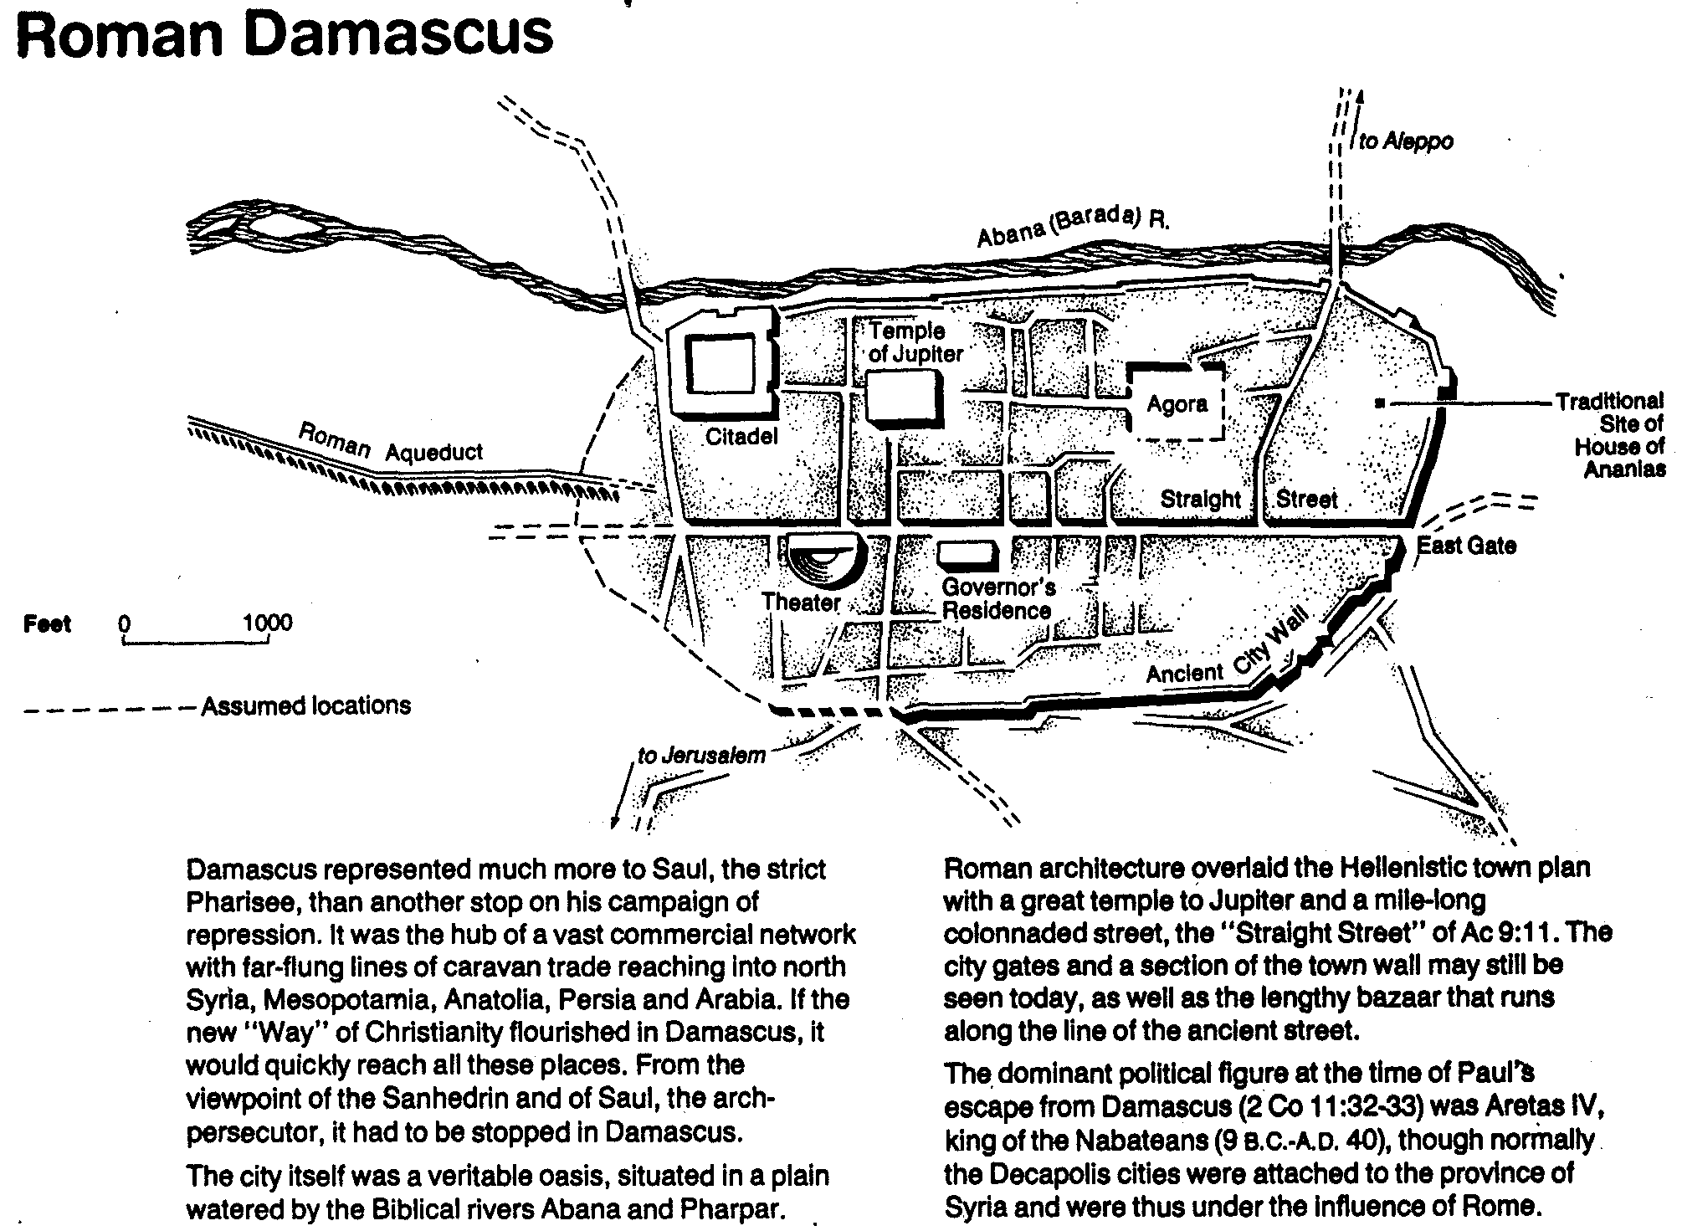
Roman Damascus
132

Slide 35
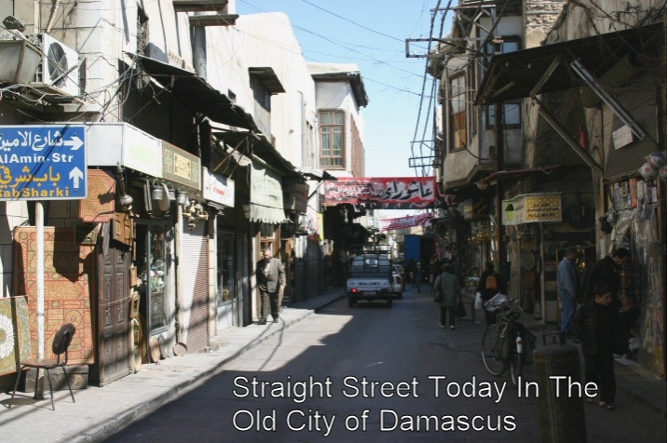
Straight Street
Straight Street Today in the Old City of Damascus

Slide 36
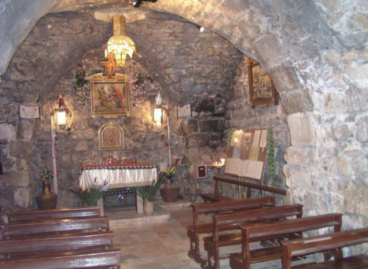
The House of Ananias lies about 7 m Underground

Slide 37
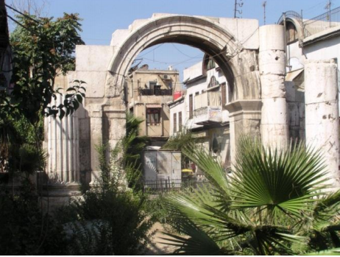
Archway Above Straight Street, Damascus, Syria
Notes:
Acts 9:25

Slide 38
Observe the pattern of transformation
Resistance (9:1-2)
Illumination (9:3-9)
Connection (9:10-19)
Ministry & Witness (9:20-22, 26-28)
Suffering (9:23-25, 29-31)
Notes:
There exists a five-step process of transforming rock into moldable clay.

Slide 39
The Saul Who Became Paul
134d
Saul
Paul
Meaning of Name
"to demand"
"little"
Citizenship
Roman citizen & Jew
Same–could preach in either Greek or Hebrew
Title
Pharisee, rabbi (orthodox)
Apostle, slave of Christ (orthodox)
Trainer/Place
Gamaliel in Jerusalem (22:3)
God in Arabia & Damascus
(Gal. 1:17)
Style of Education
Formal
Informal
Passion
Zealous for the Law (Phil 3:5-6)
Zealous for Grace
Defended
Judaism
Christianity
Teaching Audience
Jews alone
Mostly Gentiles
Demeanor
Killed Christians (22:4)
Blessed all (23:1)
Opponents
Fought "heresy" called Christianity
Fought Judaizers, mystery religions, Stoics, Epicureans, etc.
Prayer
Others prayed for him (7:60-8:1)
He prayed for others
Oral Law
Authoritative 613 commands
(248 positive + 365 negative)
Matter of conscience
(Rom. 14:1-15:13)
Do you know anyone so opposed to Christ that it seems he will never become a Christian?
I hope not after seeing Paul's background!

Slide 40
2 Corinthians 12:7-10
⁷ So to keep me from becoming conceited because of the surpassing greatness of the revelations, a thorn was given me in the flesh, a messenger of Satan to harass me, to keep me from becoming conceited. ⁸ Three times I pleaded with the Lord about this, that it should leave me. ⁹ But he said to me, “My grace is sufficient for you, for my power is made perfect in weakness.” Therefore, I will boast all the more gladly of my weaknesses, so that the power of Christ may rest upon me. ¹⁰ For the sake of Christ, then, I am content with weaknesses, insults, hardships, persecutions, and calamities. For when I am weak, then I am strong.

Slide 41
Slides on
Acts 10
Notes:
God preserved the Church from division despite new Gentile believers (9:32–12:24).

Slide 42
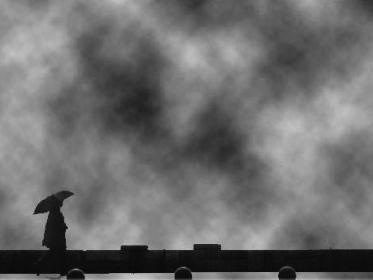
Are You Eager for Change?
Change

Slide 43
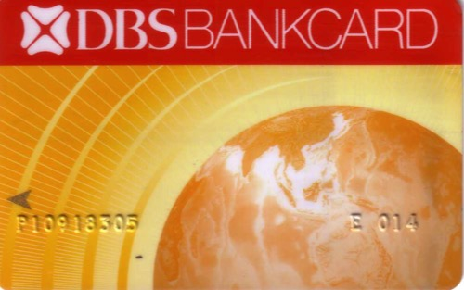

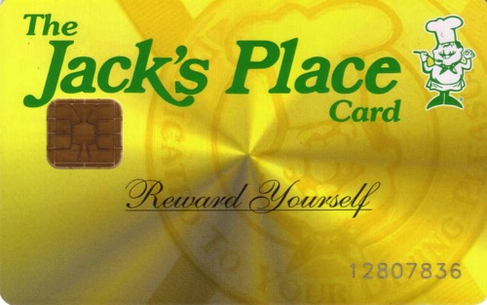

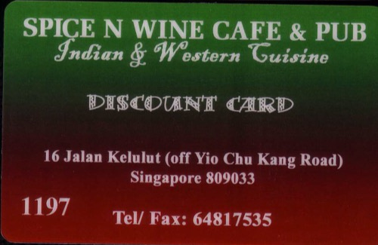
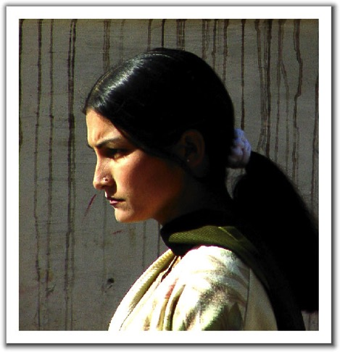

Change
Change
  It's all around us

Slide 44


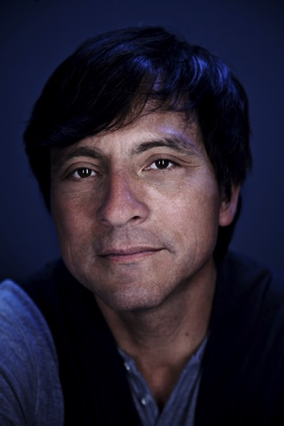
Erwin McManus
An Unstoppable Force
Pastor of Mosaic (a contemporary church in LA)

Slide 45
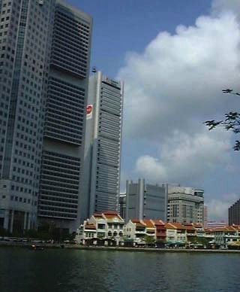

embraces change
Kiasu
EZ-Link card
Upgrading

Slide 46
Crisis & Change
Are You Eager for Change?
2%
Innovators
18%
Early
Adopters
60%
Middle
Adopters
18%
Late
Adopters
2%
Laggards

Slide 47
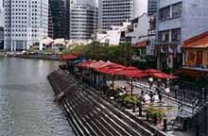
Our Subject for Acts 10:
Why must we eagerly
embrace change?

Slide 48

Some Background…
Gentiles entered the Jewish church
Jews had hated Gentiles for centuries
Whites
Blacks
Chinese
Malays
Jews
Gentiles

Slide 49
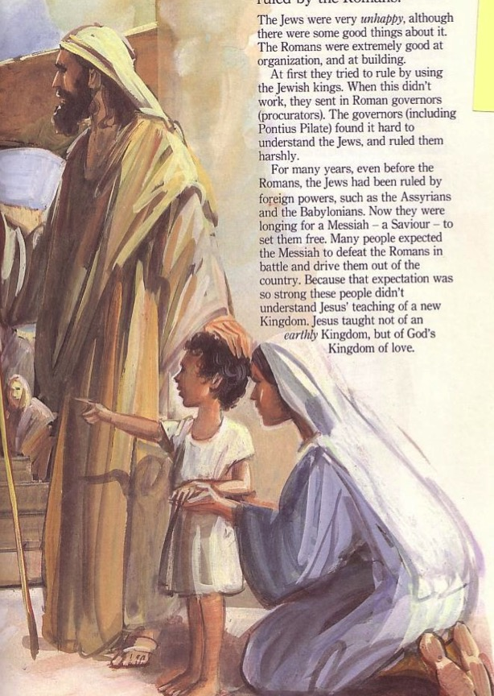
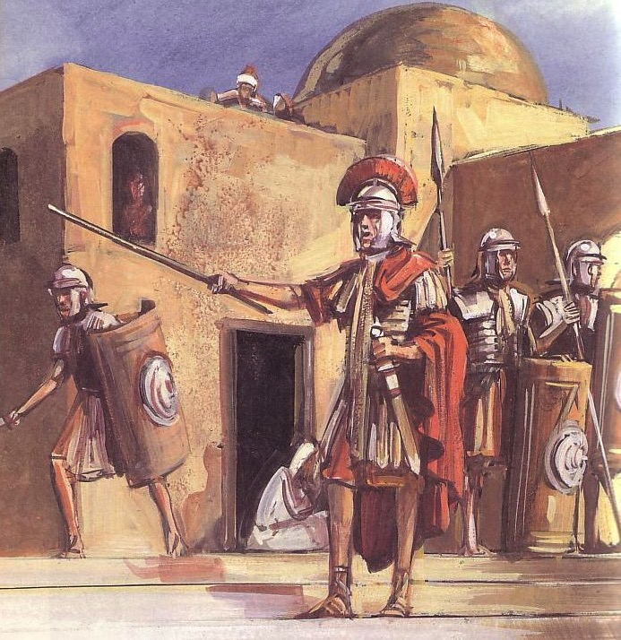
What Were the Ethnic Differences?
Jews
Gentiles
One God
One wife
Many taboos
Many Gods
Immoral
Few
taboos

Slide 50
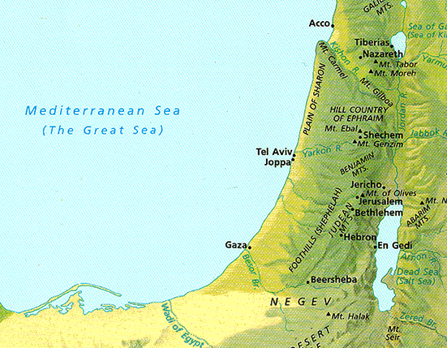
Acts 1-9 Map
"But you will receive power when the Holy Spirit comes on you; and you will be my witnesses in Jerusalem, and in all Judea and Samaria and to the ends of the earth" (Acts 1:8)
Up to Acts 9:32

Slide 51
Where we're going…
  Initiation
  Preparation
  Results

Slide 52
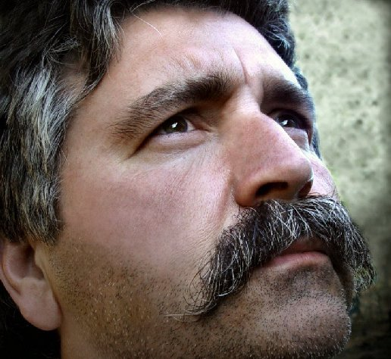
I. God always prepares his people for change

Slide 53
God preserved the Church from division despite new Gentile believers
(Acts 9:32–12:24).

Slide 54
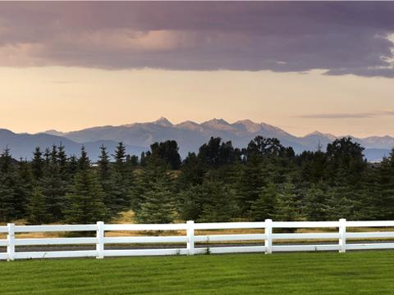
A. God prepared the Jewish church to include Gentiles (9:32–10:16).

Slide 55

Three Waves of Change...
God prepared Peter
God prepared Cornelius
God prepared Peter further

Slide 56
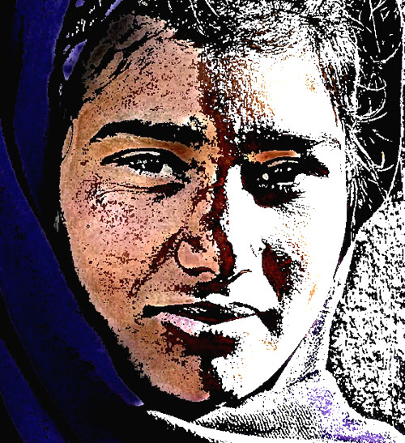
Peter Prep: Step 1
Ministry to Samaritans (9:32-42)

Slide 57
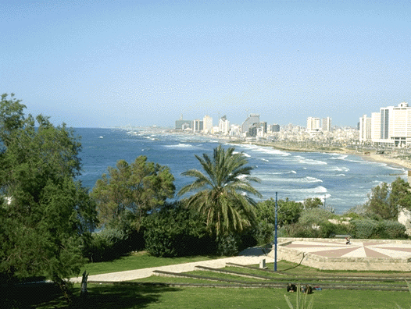
Peter Prep: Step 2
Peter Prep: Step 2
  Life with the tanner (9:43)
Joppa

Slide 58
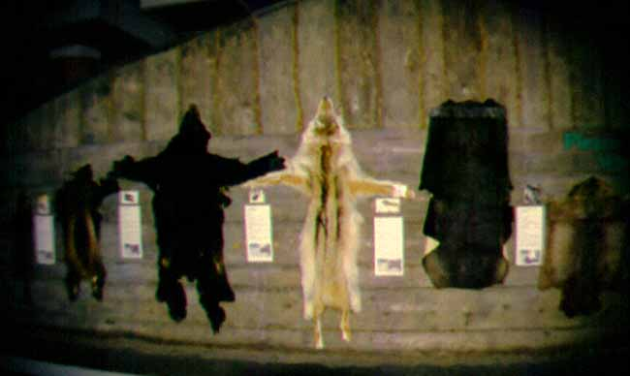
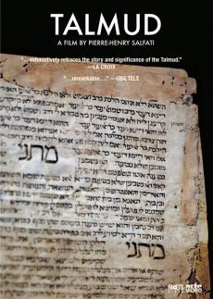
"Woe to him who is a tanner by trade"
The Jewish Babylonian Talmud

Slide 59
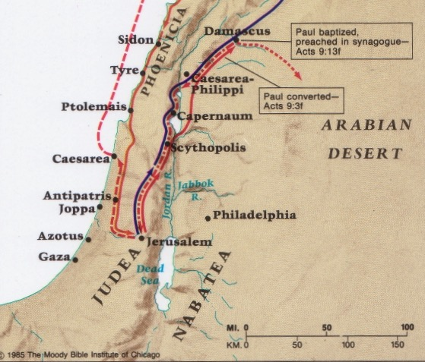
Peter was not like Jonah at Joppa
Caesarea
Joppa

Slide 60
Cornelius Prep
(10:1-8)
Alms & prayers
Vision

Slide 61
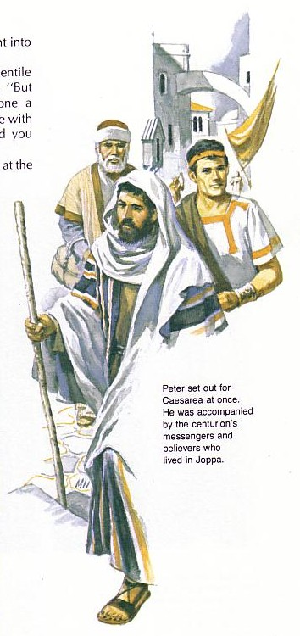
"What's God going to do to these unclean men?"
Peter must have wondered why God wanted him to go with the servants of Cornelius

Slide 62
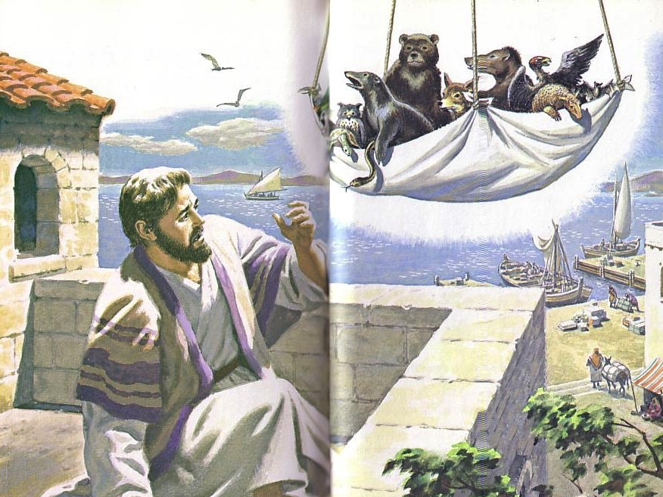
"Get up, Peter! Kill and eat!"
Peter Prep: Step 3
  Eat "unclean" food (10:9-16)
    The sheet "contained all kinds of four-footed animals, as well as reptiles of the earth and birds of the air" (10:12)

Slide 63

What foods?
Camel, rabbit, bacon, ham, snake, and the eagle, vulture, raven, certain kites and owls, the gull, any kind of hawk, the stork, any kind of heron, and the bat.
Leviticus 11

Slide 64


¹³ When Jesus came to the region of Caesarea Philippi, he asked his disciples, “Who do people say the Son of Man is?”
¹⁴ They replied, “Some say John the Baptist; others say Elijah; and still others, Jeremiah or one of the prophets.”
¹⁵ “But what about you?” he asked. “Who do you say I am?”
¹⁶ Simon Peter answered, “You are the Messiah, the Son of the living God.”
Matthew 16:13-20 (NLT)

Slide 65
¹⁷ Jesus replied, “Blessed are you, Simon son of Jonah, for this was not revealed to you by flesh and blood, but by my Father in heaven.
¹⁸ And I tell you that you are Peter, and on this rock I will build my church, and the gates of Hades will not overcome it.
¹⁹ I will give you the keys of the kingdom of heaven; whatever you bind on earth will be bound in heaven, and whatever you loose on earth will be loosed in heaven.”
²⁰ Then he ordered his disciples not to tell anyone that he was the Messiah.
Matthew 16:13-20 (NLT)

Slide 66
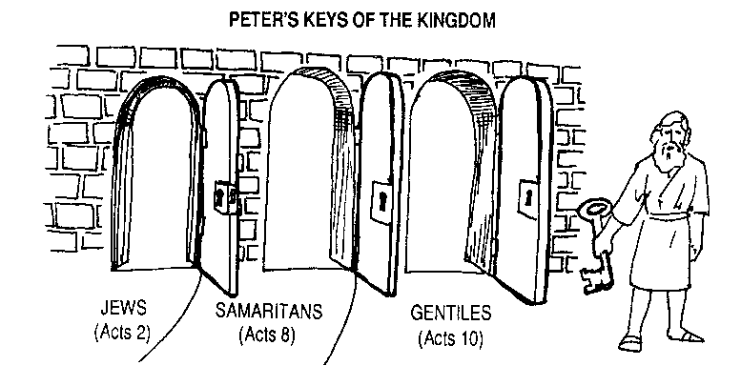
Q: How did God overcome the prejudice in the Church at Jerusalem?
A: Gradually
PETER'S KEYS OF THE KINGDOM
JEWS
SAMARITANS
GENTILES
Acts 2
Acts 8
Acts 10
AD 33
AD 35
AD 40
Notes:
God wisely led that Jerusalem church step-by-step so they could handle his big heart!
I suspect that if Samaritans and Gentiles were forced into the church too soon this would split the early church into three separate groups.

Slide 67
B. God is preparing us for change today too!

Slide 68
I. God always prepares his people for change

Slide 69
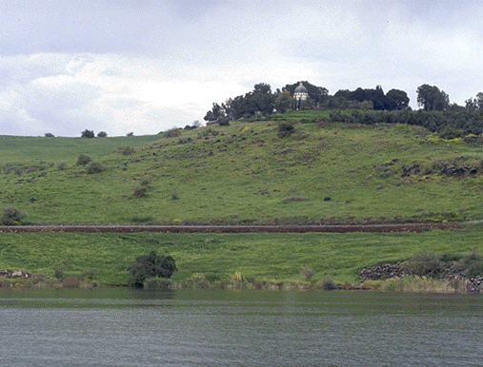
II. God initiates the change himself.

Slide 70

God's initiation
A. God involved Peter in Cornelius's conversion to confirm to the Jewish church that God was doing a new thing (10:17-44)

Slide 71
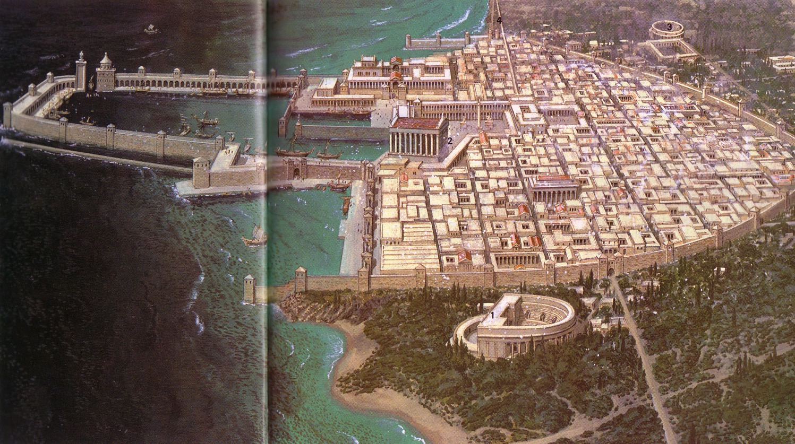
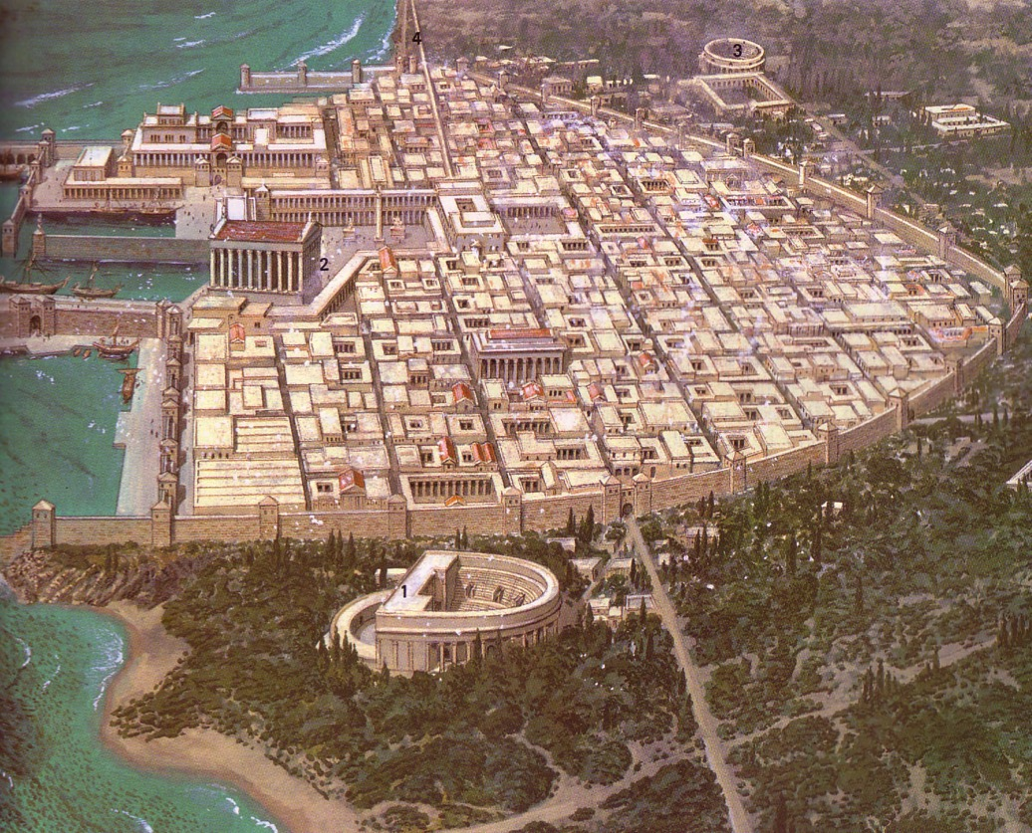
Caesarea: Loved and Despised
Notes:
Romans loved Caesarea, considering it a model city.
Jews despised it as the unclean capital of their conquerors
Yet Peter willingly went there as he saw God initiating change!

Slide 72

Peter's Response
"I most certainly understand now that God is not one to show partiality, but in every nation the man who fears Him and does what is right, is welcome to Him"
(10:34–35).

Slide 73
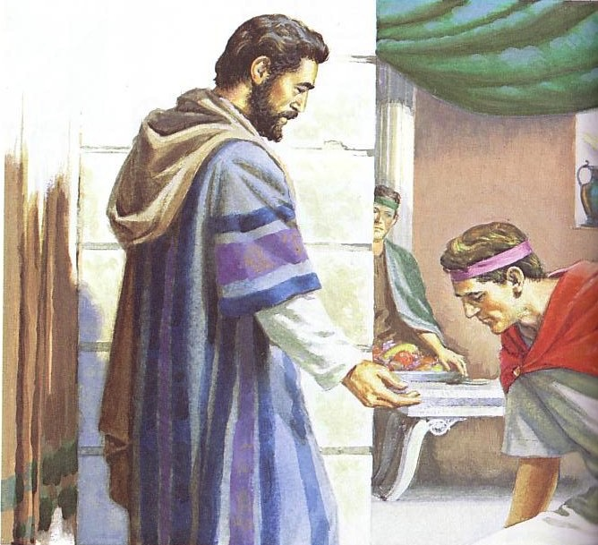
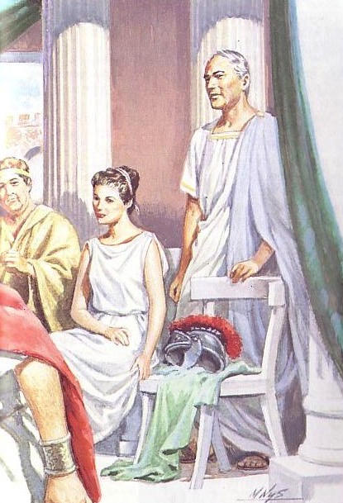
God gave his Spirit to Cornelius

Slide 74
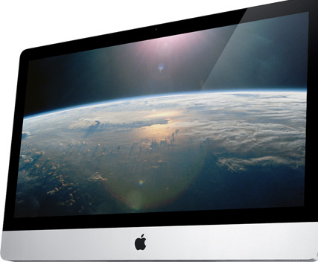
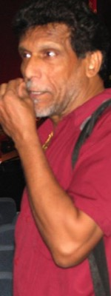
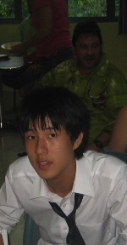

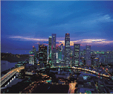


B. God is initiating many changes that we have little to do with.
  Our Location in Singapore
  International
  Internet Age
Notes:
None of us chose to move to Singapore, but God initiated it
We've had to get with how God is using the internet age to get us to have a website
God has brought people here from 13 nations now! Americans are only 44%.

Slide 75
I. God always prepares his people for change

Slide 76
II. God initiates the change himself.

Slide 77

III. We must embrace God's new plans

Slide 78
Slides on
Acts 11

Slide 79

A. The Jerusalem church had to accept Gentile conversion because this change was from God (10:45–11:18)
Peter defends his lack of prejudice

Slide 80
Reactions
  Astonishment by Jewish believers (10:45-46)
  Acceptance by Peter
  (10:47-48)
  Accusation by Pharisaical believers (11:1-3)
  Approval by the Jerusalem church
  (11:4-18)

Slide 81

ACCUSATION & APPROVAL
Acts 11:1-18 (NLT)

Slide 82

¹ Soon the news reached the apostles and other believers in Judea that the Gentiles had received the word of God.
² But when Peter arrived back in Jerusalem, the Jewish believers criticized him. ³ “You entered the home of Gentiles and even ate with them!” they said.
Acts 11:1-3 (NLT)

Slide 83
⁴ Then Peter told them exactly what had happened.
⁵ “I was in the town of Joppa,” he said, “and while I was praying, I went into a trance and saw a vision. Something like a large sheet was let down by its four corners from the sky. And it came right down to me.
Acts 11:4-5 (NLT)

Slide 84
⁶ When I looked inside the sheet, I saw all sorts of tame and wild animals, reptiles, and birds.
⁷ And I heard a voice say, ‘Get up, Peter; kill and eat them.’
Acts 11:6-7 (NLT)

Slide 85
^{8 ‘}No, Lord,’ I replied. ‘I have never eaten anything that our Jewish laws have declared impure or unclean.’
⁹ But the voice from heaven spoke again: ‘Do not call something unclean if God has made it clean.’
Acts 11:8-9 (NLT)

Slide 86
¹⁰ This happened three times before the sheet and all it contained was pulled back up to heaven.
¹¹ Just then three men who had been sent from Caesarea arrived at the house where we were staying.
Acts 11:10-11 (NLT)

Slide 87
¹² The Holy Spirit told me to go with them and not to worry that they were Gentiles. These six brothers here accompanied me, and we soon entered the home of the man who had sent for us.
¹³ He told us how an angel had appeared to him in his home and had told him, ‘Send messengers to Joppa, and summon a man named Simon Peter.
Acts 11:12-13 (NLT)

Slide 88
¹⁴ He will tell you how you and everyone in your household can be saved!’
¹⁵ “As I began to speak,” Peter continued, “the Holy Spirit fell on them, just as he fell on us at the beginning.
Acts 11:14-15 (NLT)

Slide 89
¹⁶ Then I thought of the Lord’s words when he said, ‘John baptized with water, but you will be baptized with the Holy Spirit.’
¹⁷ And since God gave these Gentiles the same gift he gave us when we believed in the Lord Jesus Christ, who was I to stand in God’s way?”
Acts 11:16-17 (NLT)

Slide 90
¹⁸ When the others heard this, they stopped objecting and began praising God. They said, “We can see that God has also given the Gentiles the privilege of repenting of their sins and receiving eternal life.”
Acts 11:18 (NLT)

Slide 91

We must eagerly embrace changes when God himself is initiating them

Slide 92

The main idea still hazy…?

Slide 93

We must eagerly embrace change because God himself is initiating it (Main Idea)

Slide 94

Faith Hops
"I've stopped expecting you to make leaps of faith,
but it would be nice to see a hop now and then."
Notes:
Sometimes we don't embrace change because we're too comfortable!
That's not us!

Slide 95

Tradition
Everyone watched with nervous anticipation as the visitors sat where the Martins have sat for 42 years.
Notes:
Other times we are stuck in tradition

Slide 96

Are you willing to embrace any change that will more effectively advance the gospel?

Slide 97




The Vision at Antioch was to…
Love God
Love the Church
Love the Nations
Notes:
• Love God
Where it starts–and ends–is in our call to LOVE. As Paul noted, "The greatest of these is love" (1 Cor. 13:13).
What is the most important thing we do as a church? It begins with loving the God who loves us.
• Love Church
Do you genuinely love him? If you don't, then nothing else you do counts, really.
The second thing He said right after this: to love your neighbor as yourself.
• Love Nations
But who is your neighbor? It starts right here in the body–to love the church–but then it extends from this "close neighbor" to those who are out of the reach of this fellowship where we love the nations. Our leadership is committed to make all that we do revolve around one of these three priorities.
97

Slide 98

The Marks of a Healthy International Church
Acts 11:19-30
Preached by Dr. Jim Harmeling
at Crossroads International Church Singapore • CICFamily.com
Uploaded by Dr. Rick Griffith • Singapore Bible College
Files in many languages for free download at BibleStudyDownloads.org

Slide 99

The people spread the gospel message (vs. 19-21)
They are open to accountability (v. 22)
They are steadfast in their faith (vs. 23-24)
Acts 26:28
And Agrippa said to Paul, “In a short time would you persuade me to be a Christian?”

Slide 100
The people spread the gospel message (vs. 19-21)
They are open to accountability (v. 22)
They are steadfast in their faith (vs. 23-24)
1 Peter 4:16
Yet if anyone suffers as a Christian, let him not be ashamed, but let him glorify God in that name.

Slide 101
The people spread the gospel message (vs. 19-21)
They are open to accountability (v. 22)
They are steadfast in their faith (vs. 23-24)
They are compassionate to those in need (vs. 27-30)

Slide 102
“Their functions were various and included both exhortation and foretelling of the future; they may well have given expositions of the Old Testament, using their spiritual insight to show how its prophecies were being fulfilled in the events connected with the rise of the church. Their activity was connected with the new sense of inspiration associated with the gift of the Spirit to the church.”
I. Howard Marshall

Slide 103
The people spread the gospel message (vs. 19-21)
They are open to accountability (v. 22)
They are steadfast in their faith (vs. 23-24)
They are compassionate to those in need (vs. 27-30)

Slide 104
Slides on
Acts 12
Notes:
God expanded the Church in journeys to Turkey and Jerusalem approved (12:25–16:5).

Slide 105

Our Unstoppable God
Acts 12:1-24
Dr. Rick Griffith • Crossroads International Church Singapore
CICFamily.com • BibleStudyDownloads.org

Slide 106

The Book of Acts in 3 Minutes
(TheChurchatBrookHills.mp4)
131e

Slide 107
Jewish Opposition in Acts
Herod & Jews
12:1
Saul
9:1-2, 29
Stephen
6:11–8:3
Peter & Apostles
5:17-40
Peter & John
4:29
Notes:
“The Persecution of the Church at Jerusalem (12:1–24): The purpose of this section of Acts is to confirm Israel’s rejection of the Messiah. Luke has skillfully woven this theme throughout the entire book and it can be seen up to this point in 4:1–30 (esp. 4:29); 5:17–40; 6:11–8:3; 9:1–2, 29. This animosity of Israel set the stage for the first missionary journey.”
—Stanley D. Toussaint, “Acts,” in The Bible Knowledge Commentary: An Exposition of the Scriptures, ed. J. F. Walvoord and R. B. Zuck, vol. 2 (Wheaton, IL: Victor Books, 1985), 384.

Slide 108
Paul's Early Journeys
Tarsus
Antioch
Damascus
Jerusalem

Slide 109

Jewish Opposition in Acts
Barnabas & Saul
Famine Gift
11:30
Barnabas & Saul
Famine Gift
12:25
Acts 12:1-24
Notes:
“The martyrdom of James (12:1–2)… Artfully, Luke contrasted the love of the church at Antioch for the saints at Jerusalem with the coldhearted enmity of Herod and the Jews for the church. The Herod mentioned here is Agrippa I, a ruler popular with the Jews for he was partly Jewish, being of Hasmonean descent. His kingdom covered basically the same area as that of his grandfather Herod the Great. He was known for doing everything possible to curry the favor of the Jews, so he found it politically expedient to arrest Christians and to execute James, the brother of John. Herod Agrippa I died in AD 44.”
—Stanley D. Toussaint, “Acts,” in The Bible Knowledge Commentary: An Exposition of the Scriptures, ed. J. F. Walvoord and R. B. Zuck, vol. 2 (Wheaton, IL: Victor Books, 1985), 384.

Slide 110

Can God’s plan be stopped?

Slide 111

BELIEVE IN YOURSELF AND YOU WILL BE UNSTOPPABLE.

Slide 112

Are you unstoppable?

Slide 113


Christian Versions

Slide 114
How did the Jews continue to reject the gospel?
Acts 12:1-24

Slide 115
Patterns: Acts 12 & Today
RESULT
REJECTION

Slide 116

Our
GOD

Slide 117

GOOD NE WS
ON THE MO VE
God’s work through the early church in
Acts

Slide 118
How did the Jews continue to reject the gospel?
Acts 12:1-24

Slide 119
Jerusalem Church Challenges in AD 44
Herod opposed Christ
(Acts 12:1-22)
James
Murdered
1-2
Notes:
Herod murdered James (12:1-2).
Herod imprisoned Peter unsuccessfully (12:3-19a).
Herod accepted worship that only God deserves (12:19b-22).

Slide 120

Herod's Grandson, Agrippa I, ruled all Israel for 7 years from AD 37-44
(Acts 12:1)
129
Bible Visual Resource Book, 181

Slide 121
Jewish Opposition in Acts
Jerusalem
Herod & Jews
Hatred
12:1
Antioch
Gentiles
Love
11:30
Notes:
“The martyrdom of James (12:1–2)… Artfully, Luke contrasted the love of the church at Antioch for the saints at Jerusalem with the coldhearted enmity of Herod and the Jews for the church. The Herod mentioned here is Agrippa I, a ruler popular with the Jews for he was partly Jewish, being of Hasmonean descent. His kingdom covered basically the same area as that of his grandfather Herod the Great. He was known for doing everything possible to curry the favor of the Jews, so he found it politically expedient to arrest Christians and to execute James, the brother of John. Herod Agrippa I died in AD 44.”
—Stanley D. Toussaint, “Acts,” in The Bible Knowledge Commentary: An Exposition of the Scriptures, ed. J. F. Walvoord and R. B. Zuck, vol. 2 (Wheaton, IL: Victor Books, 1985), 384.

Slide 122
Jerusalem Church Challenges in AD 44
Herod opposed Christ
(Acts 12:1-22)
James
Murdered
1-2
Peter
Imprisoned
3-19a
Notes:
Herod murdered James (12:1-2).
Herod imprisoned Peter unsuccessfully (12:3-19a).
Herod accepted worship that only God deserves (12:19b-22).

Slide 123

Peter’s Miraculous Escape from Prison

Slide 124

Peter’s Miraculous Escape from Prison

Slide 125

Peter’s Miraculous Escape from Prison

Slide 126

Peter’s Miraculous Escape from Prison

Slide 127

Peter’s Miraculous Escape from Prison

Slide 128

Peter’s Miraculous Escape from Prison

Slide 129

Peter’s Miraculous Escape from Prison

Slide 130

Peter’s Miraculous Escape from Prison

Slide 131

Peter’s Miraculous Escape from Prison

Slide 132
Jerusalem Church Challenges in AD 44
Herod opposed Christ
(Acts 12:1-22)
James
Murdered
1-2
Peter
Imprisoned
3-19a
Herod Worshipped
19b-22
Notes:
Herod murdered James (12:1-2).
Herod imprisoned Peter unsuccessfully (12:3-19a).
Herod accepted worship that only God deserves (12:19b-22).

Slide 133

Herod's Grandson, Agrippa I (AD 37-44), was eaten by worms
(Acts 12:23)
129
Bible Visual Resource Book, 181

Slide 134
God judged Herod but prospered the church
Oppressors
Judged
23
Church
Expanded
24
James
Murdered
1-2
Peter
Imprisoned
3-19a
Herod Worshipped
19b-22
Notes:
Herod died by being eaten by worms (12:23).
The church grew both in numbers and geographically (12:24).

Slide 135


Progress Reports
125
End of the Earth
Key Verse: 1:8
2:47b
6:7
8:40
9:31
12:24
16:5
19:20
28:30-31
1:1–6:7
6:8–8:40
Acts 9–28
Why end this way?
Adapted from Stanley D. Toussaint, BKC; Jeremy Chew, EAST

Slide 136
Main Idea of Acts 12:1-24
God judges oppressors
while expanding his church

Slide 137
Psalm 31: 23-24 (NLT)
Love the LORD,
all you godly ones!
For the LORD protects those who are loyal to him,
but he harshly punishes the arrogant.
²⁴ So be strong and courageous,
all you who put your hope in the LORD!

Slide 138

Ezekiel 37:5
* Don't try that on the final exam

Slide 139


Jews Return in the 20th Century
195b
www.bibleweb.org/ MEastStudies/Sem3.htm
millions
Growth in the Population of Israel
1916-1986
Total
Jews
Notes:
www.bibleweb.org/ MEastStudies/Sem3.htm

Slide 140

Hitler motivated the Jews to go to their homeland!

Slide 141

Hitler motivated the Jews to go to their homeland!
Notes:
Hitler sought to eradicate the Jews, but God sought to eradicate Hitler. He committed suicide in 1945 and three years later the Jews established their homeland in Israel!

Slide 142

Paul’s Thorn in the Flesh
“That thing you most pray God would remove in your life is what you most want to keep”
—Dr Don Sunukjian, DTS
“My grace is sufficient for you,
for my power is made perfect in weakness.”
—Jesus (2 Cor 12:9a)
Notes:
He uses difficulty to help us love him.
My unbelieving parents were the greatest training ground for my spiritual growth.
Paul’s “thorn in the flesh” (2 Cor 12:7-10) was God’s means to teach him that when we admit our weakness, God shows his strength. So “the thing that you most pray that God would remove in your life is that which you most want to keep”—Dr Don Sunukjian , DTS

Slide 143

God is leading us from Asia to MENA
Jordan
Singapore
Notes:
It was a refreshing change from the Chinese world to the Arab world.
___________
Common-117
NS-05-Acts9-14—slide 140

Slide 144

Do you know the countries of MENA?
Iran
Jordan
MENA = Middle East/ North Africa
Notes:
______
Common-526
NS-05-Acts9-14—slide 142

Slide 145

Do you know the countries of MENA?
Jordan
MENA = Middle East/ North Africa

Slide 146

Jordan Evangelical Theological Seminary (JETS)
Notes:
I teach Bible and theology through translation into Arabic.
______
Common-524
NS-05-Acts9-14—slide 143

Slide 147
Main Idea of Acts 12:1-24
God judges oppressors
while expanding his church

Slide 148
Our
GOD

Slide 149
What about you?
How will you trust in God’s timing and way to deal with those who reject him?
Are you suffering for Jesus right now?
How can your difficulties propel you to greater growth?
Will you let God deal with his opposers as he wishes?

Slide 150


Acts 11 ²⁸ And one of them named Agabus stood up and foretold by the Spirit that there would be a great famine over all the world (this took place in the days of Claudius). ²⁹ So the disciples determined, every one according to his ability, to send relief to the brothers living in Judea. ³⁰ And they did so, sending it to the elders by the hand of
Barnabas and Saul.
Famine Relief
Notes:
At the end of Acts 11, we see that the great famine during the reign of Claudius was predicted by the prophet Agabus by the power of the Holy Spirit.
Barnabas and Saul were the ones who delivered the gifts from Antioch to Jerusalem.

Slide 151



Acts 12 ²⁵ And Barnabas and Saul returned from Jerusalem when they had completed their service,
bringing with them John, whose other name was Mark.
Famine Relief
Notes:
Some point later, Barnabas and Saul returned to Antioch.
They also brought with them John Mark. You can just call him Mark. This is the same Mark who wrote the Gospel of Mark.
John Mark is also the cousin of Barnabas (see Col 4:10). That is why they look alike on the slide.

Slide 152
Going on a
Journey
Acts 12:25 – 14:28
Preached by Matthew Lyle
at Crossroads International Church Singapore • CICFamily.com
Uploaded by Dr. Rick Griffith • Singapore Bible College
Files in many languages for free download at BibleStudyDownloads.org
Notes:
Today we are going to look at another impossible journey.
We will start with the last verse in Acts ch 12 and go all the way through the end of Acts chapter 14. This section is about about Paul’s first missionary journey.
Go ahead and turn in your Bible or apps to Acts ch 12 vs 25 while I give a little background.

Slide 153
Notes:
Who wants to take a trip?
Suppose you want to cross the causeway and have dinner in JB
Suppose you want to take a ferry to Bintan or Batam
Suppose you want to go to Changi airport, hop on a flight to Australia, Bali, Bangkok, wherever.
But taking a journey right now seems impossible.

Slide 154

GOOD NE WS
ON THE MO VE
God’s work through the early church in
Acts
Notes:
This is the 13th sermon in our series on the Book of Acts which we are calling “Good News on the Move.
Now this is a story about many different people doing many different things in many different places. We’re going to read about many different places today.
But what you need to realize is that even though there are many different people, places, and things, this is God’s story about His church which is led by His Son, Jesus.

Slide 155

Church Growth
Increasing in Number
Acts 6:1
Persecution
5000
Acts 4:4
Pentecost
3000
Acts 2
Notes:
We see this story about God’s church being born in Acts chapter 2. This is the with the story of Pentecost, and that is when the disciples received the Holy Spirit. The church grew by 3,000 that day.
We see this story about God’s church growing by another 5,000 in Acts chapter 4, and again in Acts chapter 6 the church is “increasing in number”

Slide 156

Now those who were scattered went about preaching the word.
Acts 8:4
Samaria
Jerusalem
They believed Philip as he preached good news about the kingdom of God and the name of Jesus Christ
Acts 8:12
Judea
Notes:
Up to this point church, the church has been centered around the city of Jerusalem, in Judea.
But with the persecution by Saul, the believers scattered, but those who were scattered went about preaching the word.
One person who went to Samaria proclaiming the Gospel was Philip. Many people heard the good news about the kingdom of God and the name of Jesus Christ.
One such person was Simon the Magician, who believed and was then baptized.
Another person was the Ethiopian Eunuch who after hearing the Gospel asked “What prevents me from being baptized”

Slide 157
Church Growth
Gentiles
Acts 8, 10-12
Increasing in Number
Acts 6:1
Persecution
5000
Acts 4:4
Pentecost
3000
Acts 2
Notes:
In chapters 10 through 12, the Church continues to grow, and now includes gentiles.
The Ethiopian Eunuch asked “What prevents me from being baptized”
The Apostle Peter asks something very similar, “Can anyone withhold water for baptizing these Gentiles, who have received the Holy Spirit just as we have?

Slide 158

Opposition
External
Acts 4 - Arrested
Acts 5 - Arrested
Acts 7 - Stoned
Acts 8 - Persecution (Jews – Saul)
Acts 12 - Persecution (Jews – Herod)
Notes:
But with growth comes opposition. This opposition comes from both external and internal sources.
We see external opposition to the gospel in the early part of Acts with the apostles being arrested. Opposition continued now led by Saul, and eventually resulted in Stephen’s stoning and the believers scattering.
After Saul’s conversion, the Jews apparently decided to use a political leader rather than a religious leader to persecute the church through Herod.

Slide 159
Despite Opposition the Church Grew
Opposition
External
Internal
Acts 4 - Arrested
Acts 5 - Arrested
Acts 7 - Stoned
Acts 8 - Persecution (Jews – Saul)
Acts 12 - Persecution (Jews – Herod)
Acts 5 - Ananias/Sapphira
Acts 6 - Food Distribution
Acts 8 - Simon the Magician
Notes:
Opposition to church growth also comes from within.
Ananias and Sapphira withheld their offerings, and lied about it.
There were issues about food distribution between the Greek and Hebrew speaking widows.
And in ch 8, we could have had internal opposition with Simon the magician. He was a new believer so he does not understand everything about the Gospel. So when he saw the Holy Spirit being given through the laying on of the apostles' hands, he wanted to pay money so he could do the same thing. He was rebuked by Peter.
Despite opposition, the church Grew

Slide 160
Background
Despite Opposition
God Grows the Church
POSSIBLE
IM
Notes:
That is our background.
Despite this external and internal opposition, we see that God uses various people and circumstances to make the church grew.
We see the impossible become the possible.

Slide 161
“ends of the earth"
Acts 1:8 NLT
"But you will receive power when the Holy Spirit comes upon you. And you will be my witnesses, telling people about me everywhere—in Jerusalem, throughout Judea, in Samaria, and to the ends of the earth.”
Samaria
Jerusalem
Judea
IMPOSSIBLE
Notes:
How will the church continue to grow in fulfilment of Acts 1:8?
Acts 1:8 is where Jesus tells the Apostles they will be his witnesses, telling people everywhere about him, in Jerusalem, throughout Judea, in Samaria, and to the ends of the earth.
And we have seen God is already making that happen. So should the church leaders just sit back and let God continue to work or should they seek out and participate in God’s will?
How can you contribute to God’s plan of growing the church? How do you do the impossible? Today I will show you two things you need to do the impossible.

Slide 162
Seek Counsel from the Holy Spirit
(Acts 12:25–13:3).
Notes:
The first thing you need to do the impossible is to seek counsel from the Holy Spirit. We have already seen this in action with the early church.

Slide 163
Slides on
Acts 13

Slide 164

The Church at Antioch
(Acts 13)

Slide 165

Early Prophets & Teachers
"Among the prophets and teachers of the church at Antioch of Syria were Barnabas, Simeon (called 'the black man'), Lucius (from Cyrene), Manaen (the childhood companion of King Herod Antipas), and Saul" (Acts 13:1 NLT).

Slide 166
Contrasts Between Prophetic Views
161g
Grudem's View
Biblical View
Prophecy is declaring anything (true or false) that the Spirit brings to one's mind
Prophecy is declaring God's inspired and inerrant revelation to others
The above definition was invented
in 1988 by Wayne Grudem
The above definition has been the teaching of the church for 20 centuries
OT prophets are parallel to NT apostles
OT prophets are parallel to NT prophets
God changed the definition of prophecy from the OT to the NT
God kept the meaning of prophecy consistent between the two testaments
God gives some prophecies with errors
God gives all prophecies without errors
(2 Pet. 1:20-21)
Any believer can prophesy
Only those with the gift of prophecy can prophesy (1 Cor. 12:29)
There are two kinds of NT prophecy
(fallible and infallible)
There is one kind of NT prophecy
(infallible)
Fallible prophecy can be inspired
Fallible prophecy is false prophecy
(Deut. 13:1-5; 18:14-20)
God sometimes lies
God always tells the truth since He cannot lie (Heb. 6:18)

Slide 167
Teaching versus Prophecy
161h
Contrasts | Teaching | Prophecy
Value | Inferior: Teaching is listed after prophecy in the leadership structure of the church at Antioch (Acts 13:1) | Superior: Prophecy has a long OT history of declaring an uninterpreted word of God (2 Pet. 1:20-21) whereas teachers must interpret it
Relation to the Other Gift | A less important gift: listed after prophecy in the priority of the gifts (1 Cor. 12:28) | The second most important gift, superseded only by apostleship (1 Cor. 12:28)
Authority | Less authoritative than prophecy since the teacher must interpret the Bible | More authoritative than teaching as the spoken word is divinely inspired & uninterpreted (2 Pet. 1:20-21)
Source of Truth | God's Word (Col. 3:16) | God's Spirit (2 Pet. 1:21)
Revelatory Nature | Uninspired explanation of already revealed truth (Acts 15:35; 11:12, 26; Rom. 2:21; 15:4; Heb. 5:12) | Inspired foretelling the future or "forth-telling" (declaring doctrinal truth) received by revelation (1 Cor. 14:19, 26, 29-30; Eph. 3:5)

Slide 168
Teaching versus Prophecy
161h
Contrasts | Teaching | Prophecy
Style | Systematic | Spontaneous (Acts 11:28; 21:4, 10-11)
Limitations | No limitation on teaching is given in church services | Two or three prophetic messages per service (14:29a), speak in turn (14:30-31), weigh what is said (14:29b, 32)
Leadership Requirements | Required of elders (1 Tim. 3:2; 5:17; Tit. 1:9) since the church needs continued teaching of truth through its history | Not required of elders as this would provide too high a standard; also, revelation need not continue after the canon is complete (Rev. 22:18-19)
Foundation for the Church | No—the foundation is not interpreted messages but divinely spoken and written messages from God to apostles and prophets | Foundational with apostleship (Eph. 2:20), meaning that it need not continue through Church history as a foundation is once-for-all (e.g., no apostles today)
Cessation | No hint is given in the NT that this gift has ceased or will do so in the church age | The gift will cease by someone other than self: passive voice (1 Cor. 13:8a; cf. Spiritual Gifts notes, 29)

Slide 169
Church Leadership
Barnabas
Simeon
Lucius
Manaen
Saul
Notes:
Moving into chapter 13, we see the leaders at the church at Antioch meeting together.
This is an interesting group. Barnabas is the leader.
Simeon is a Jewish name, who is likely from modern day Nigeria.
Lucius is a Roman name.
Manaen was a childhood friend of King Herod Antipas, the Herod that killed John the Baptist and was part of Jesus’ trial.
And of course Saul, who formerly persecuted the Christians.

Slide 170

One day as these men were worshiping the Lord and fasting,
Notes:
What was this group doing? Were they busy planning the next famine relief drive? No, they were worshiping the Lord, they were praying, they were fasting.
It says they were worshipping, how do we know they were praying?
Because the next verse tells us that after more fasting and prayer, the men laid their hands on them and sent them on their way.

Slide 171
Timeline in Acts
AD 33
  Resurrection
  Pentecost
AD 35
  Death of Stephen
  Saul’s Conversion
AD 48
  First Missionary Journey
Notes:
At first glance when reading the Book of Acts, it can seem as if everything is happening very rapidly. But when you take a closer look you realize that Paul waited over 12 years after his conversion to begin his missionary journeys.
When you seek God’s guidance and direction, he will show you his perfect timing.

Slide 172

Paul's First & Second Missionary Journeys
138-139

Slide 173
Seek Counsel from the Holy Spirit
(Acts 12:25–13:3).
Notes:
The first thing you need to do the impossible is to seek counsel from the Holy Spirit.
But seeking counsel of the Holy Spirit is half the equation. What is the other half?

Slide 174
Seek Counsel from the Holy Spirit
(Acts 12:25–13:3).
Follow the Holy Spirit
(Acts 13:4 – 14:28).
Notes:
You must follow the Holy Spirit
When you seek and follow the Holy Spirit, you can do the impossible.
Lets take a look at an impossible Journey and see how it was enabled by the Holy Spirit.

Slide 175

Notes:
Paul’s journey is not amazing simply because of how far he travelled. What is amazing is what happened during his journey.

Slide 176

Iconium
Lystra
Salamis
Paphos
Perga
Antioch (Pisidia)
Iconium
Lystra
Derbe
Perga => Attalia
Antioch (Pisidia)
Antioch (Syria)
Antioch (Syria)
Notes:
Here is a closer look of where he travelled.
Started in Antioch – Salamis – Paphos – Perga – Anitoch of Pisidia – Iconium – Lystra – Derbe, then back the same way, stopping by Attalia and skipping the Island of Cyprus.
We are not going to look at each of these individual stops.

Slide 177
Salamis
Paphos
Perga
Antioch (Pisidia)
Iconium
Lystra
Derbe
Salamis
Perga
Antioch (Syria)
Notes:
Salamis and Perga are not included in the notes but are important as they set the stage for John Mark being a disappointment for Paul. We will see this more in a later sermon.

Slide 178
Salamis
Paphos
Perga
Antioch (Pisidia)
Iconium
Lystra
Derbe
Antioch (Syria)
Notes:
We will take a close look at Paphos.

Slide 179


Paphos (13:4-12)
Simon the Magician
Elymas the Magician
Believed
Baptized
Opposed
Blinded
vs
Acts 8
Acts 13

Slide 180

Paphos (13:4-12)
Sergius Paulus
Elymas the Magician
Believed
Opposed
Blinded
vs
Acts 13
Acts 13

Slide 181
Paphos (13:4-12)
Sergius Paulus
When the governor saw what had happened, he became a believer, for he was astonished at the teaching about the Lord.
Acts 13:12

Slide 182
Iconium
Lystra
Derbe
Salamis
Paphos
Perga
Antioch (Pisidia)
Antioch (Syria)
Notes:
Here is a closer look.

Slide 183

Antioch of Pisidia (13:13-52)
³² And now we are here to bring you this Good News. The promise was made to our ancestors, ³³ and God has now fulfilled it for us, their descendants, by raising Jesus.
³⁸ Brothers, listen! We are here to proclaim that through this man Jesus there is forgiveness for your sins. ³⁹ Everyone who believes in him is made right in God’s sight—something the law of Moses could never do.

Slide 184
Antioch of Pisidia (13:13-52)
⁴⁶ Then Paul and Barnabas spoke out boldly and declared, “It was necessary that we first preach the word of God to you Jews. But since you have rejected it and judged yourselves unworthy of eternal life, we will offer it to the Gentiles. ⁴⁷ For the Lord gave us this command when he said,
‘I have made you a light to the Gentiles, to bring salvation to the farthest corners of the earth.’”

Slide 185
Slides on
Acts 14

Slide 186
Iconium
Lystra (14:8)
Derbe
Salamis
Paphos
Perga
Antioch (Pisidia)
Antioch (Syria)
Notes:
Here is a closer look.

Slide 187



Lystra
14:8-20
Stoned
Healing
Idolized

Slide 188
Eric Liddell
Notes:
The story of Eric Liddell is about someone who sought after and followed the Holy Spirit and he achieved the impossible.

Slide 189


1924 Olympic Games

Slide 190
Return to China
Teacher
Husband / Father
Ordained Minister
1925 - 1943

Slide 191
Japanese Internment
"I never heard him say a bad word about anybody"
"The best thing he gave me was his baton of forgiveness. He taught me to love my enemies, the Japanese, and to pray for them."
1943 - 1945

Slide 192
The Return Trip
“They encouraged them to continue in the faith, reminding them that we must suffer many hardships to enter the Kingdom of God” (Acts 14:22)
Notes:
We also see the impossible being made possible on the return trip. The churches Paul and Barnabas planted are growing.
Any mission organization today will tell you the goal of church planting is to have churches that are governing, self supporting, and self-propagating.
Paul does give some advice that is still applicable today.
We know this is not hard, this is not impossible, because . . .
Later Paul would write all who desire to live a godly life will suffer persecution. It seems like it would be impossible to be a Christian if you must suffer many hardships, if you must endure persecution. But that the main point of this section of scripture.

Slide 193
Nothing is impossible when you seek and follow the Holy Spirit
Main Idea of Acts 12:25–14:28
Notes:
Nothing is Impossible when you Seek out and Follow the Holy Spirit.
Most of us are not going on a missionary journey to a strange new place. But this can still apply to you.
Are there areas in your life where you need to seek the Holy Spirit? Just like Paul and the leaders at the church in Antioch sought after the Holy Spirit so should you to. What areas of your life do you need to seek the Holy Spirit? That is easy: All areas.
Maybe the Holy Spirit is already calling you for something. Maybe to volunteer at you local church. Maybe he is calling you to stop watching so much TV for worrying about the future. Obey, follow the Holy Spirit.
Nothing is Impossible when you seek out and follow the Holy Spirit.

Slide 194



The Holy Spirit
Achieving the
Impossible
Since AD 33
Notes:
The Holy Spirit, helping the church achieve the impossible since AD 33.
Let us pray. . .

Slide 195

Chronology of the Book of Acts
131
Walk Thru the Bible

Slide 196
Straightening Out Paul's Travels
You know that map in the back of your Bible…the one with all the dotted lines…the dashed lines…the straight lines…lines of little circles and different colors, often printed on top of each other!
34
1
Notes:
One way to frame these problems and to appreciate the daunting challenge of the task of missions –– then and now –– is to appreciate and to straighten out Paul's wide travels! For most people…Paul's trips have always been – to say the least – geographically confusing!
//// You know that map in the back of your Bible…the one with all the dotted lines…the dashed lines…straight lines…lines with little circles…lines of different colors…and often all of them PRINTED ON TOP OF EACH OTHER.

Slide 197


Paul was a real traveler…all over the Mediterranean Basin!
ATLANTIC OCEAN
ASIA
SILENCE
Alex the Greek
Roman Systems
MEDITERRANEAN SEA
ARABIA
AFRICA
35
Notes:
Understand this! Paul was a real world traveler! And he was all over the Mediterranean Basin…from Palestine in the Ancient Near East to the Boot of Italy…perhaps even as far as Spain.

Slide 198

Why is this important?
Because…
Right here…in The Acts… are the absolute beginnings of world missions!!!
9.65.08.
1
©2006 TBBMI
36
Notes:
And why is this important to us…right now? Because…
//// …right here…in these dramatic pages of The Acts…we find the absolute beginnings of world missions.

Slide 199
?
?
?
?
?
How would you plan and pack for four really long trips?
37
©2006 TBBMI
9.65.08.
Notes:
With that in mind…how would YOU plan and pack for four really long trips…probably into areas of the world of which you and those with you have no prior knowledge. Transportation? Well, you would probably walk most of the way…maybe some horseback…perhaps an occasional donkey cart…then a variety of Roman sailing ships, if available at the time…and anything but first class! How can we appreciate those difficulties…REALLY understand the work and the personal challenges faced by those early missionaries? Here's one way.

Slide 200
?
?
Second Trip
?
Syrian Antioch
Tarsus
Derbe
Lystra
Iconium
Pisidian Antioch
Phrygian
Galatia
Mysia
Troas (Troy)‏
Samothrace
Neapolis
Philippi
Amphipolis
Apollonia
Thessalonica
Berea
ATHENS
CORINTH
Cenchrea
Ephesus
Caesarea
Jerusalem
Caesarea
Syrian Antioch
First Trip
?
?
Third Trip
Fourth Trip: On to Rome!
Syr.Antioch
Seleucia
Salamis
Paphos
Perga
Pisidian Antioch
Iconium
Lystra
Derbe
Lystra
Iconium
Pisidian Antioch
Perga
Attalia
Syr.Antioch
Syrian Antioch
Galatia
Phrygian
Regions
EPHESUS
Macedonia
Troas
Philippi
Corinth
Philippi
Troas
Assos
Miletus
Cos
Rhodes
Patara
Tyre
Ptolemais
Caesarea
Jerusalem
Caesarea
Sidon
Around Cyprus
Myra
Crete
Fair Havens
Melita
Sicily Syracuse
Rhegium
Puteoli
Forum of Appius
Three Taverns
ROME
Jerusalem Council
(a quick trip that changed the Church forever!)‏
Syr.Antioch
Phoenicia
Samaria
JERUSALEM
Samaria
Phoenicia
Syr.Antioch
9.65.08.
4
©2006 TBBMI
38
Notes:
A look at the itinerary itself! There were four main trips throughout the Mediterranean Basin…in both Europe and Asia.
…with one side trip to Jerusalem…that one was a quick trip…but it changed the Church forever and redirected it theological foundations from that moment on!
//// Now look at the list of the cities, towns and regions that were Paul's destinations. He and his traveling parties had to adjust to life in all these places…and the distances between them. What should they say about the Gospel at each location? How would they be received? HOW DO YOU DO THIS MISSIONS TASK IN THE FIRST PLACE? These and all the other sites and distances between them offered challenges of unimaginable difficulty in those ancient days of the Roman world.
City after city…region after region!
//// Notice how often the city of Syrian Antioch appears on Paul's itinerary time after time. It was located about 500 miles north of Jerusalem. That geographical fact shows that much of Paul's living and planning took place far away from Jerusalem, the home of the mother church of the new faith.
//// Now, a few thoughts about these travel routes and the purposes of each trip can give us great insight into Paul's mission, enormous physical effort and the world-shaking results of his work.

Slide 201
?
?
Second
Trip
?
Syrian Antioch
Tarsus
Derbe
Lystra
Iconium
Pisidian Antioch
Phrygian
Galatia
Mysia
Troas (Troy)‏
Samothrace
Neapolis
Philippi
Amphipolis
Apollonia
Thessalonica
Berea
ATHENS
CORINTH
Cenchrea
Ephesus
Caesarea
Jerusalem
Caesarea
Syrian Antioch
First
Trip
?
?
Third
Trip
Fourth
Trip:
On to
Rome!
Syr.Antioch
Seleucia
Salamis
Paphos
Perga
Pisidian Antioch
Iconium
Lystra
Derbe
Lystra
Iconium
Pisidian Antioch
Perga
Attalia
Syr.Antioch
Syrian Antioch
Galatia
Phrygian
Regions
EPHESUS
Macedonia
Troas
Philippi
Corinth
Philippi
Troas
Assos
Miletus
Cos
Rhodes
Patara
Tyre
Ptolemais
Caesarea
Jerusalem
Caesarea
Sidon
Around Cyprus
Myra
Crete
Fair Havens
Melita
Sicily Syracuse
Rhegium
Puteoli
Forum of Appius
Three Taverns
ROME
Jerusalem Council
(a quick trip that changed the Church forever!)‏
Syr.Antioch
Phoenicia
Samaria
JERUSALEM
Samaria
Phoenicia
Syr.Antioch
THE
LABORATORY
THE
EUROPEAN THRUST
THE
ASIAN THRUST
TO ROME
AND GAIN!
9.65.08.
8
©2006 TBBMI
39
Notes:
Each trip was unique in purpose and accomplishment.
The first trip out…let's call it THE LABORATORY…
//// …then THE EUROPEAN THRUST…
//// …followed by AN ASIAN THRUST…finally…
//// TO ROME AND GAIN!
//// On the first trip…that was THE LABORATORY…a short tour, compared to the later ones, going into present-day central Turkey, turning around and then returning fairly quickly. Paul and his companions were learning what to do –– what best NOT to do –– on the mission field!
//// And then the great Jerusalem Council…more on that shortly.
//// Then the EUROPEAN THRUST…where Paul's main activities centered on philosophical Athens and the rough seaside city of Corinth.
//// In his ASIAN THRUST … Paul lived for a very long time in the city of Ephesus…then following these decades of inventing "mission"…
//// …his final trip as a prisoner to Rome…TO ROME AND GAIN…and from there to eventually join His Lord after a life well lived in pursuit of the Gospel and the Great Commission…laying down the pattern of courageous Christian behavior for us all.

Slide 202
ATLANTIC OCEAN
EUROPE
ASIA
AFRICA
ISRAEL
MEDITERRANEAN SEA
ARABIA
40
© 2006 TBBMI
9.65.08.
Notes:
To frame all this…again look at Israel on the map…resting there in that far eastern end of the Mediterranean…as we looked at it in the Silent Period…

Slide 203
ROMAN EMPIRE
ATLANTIC OCEAN
EUROPE
ROME•
ASIA
•
AFRICA
ISRAEL
MEDITERRANEAN SEA
ARABIA
41
© 2006 TBBMI
9.65.08.
Notes:
,…situated up against the vastness that was the Roman Empire.

Slide 204

#1."The Hook: A Laboratory"
STUDY HELP #24
PAUL'S JOURNEYS …AT A GLANCE
ATLANTIC OCEAN
A.D.
48-49
EUROPE
A BEACH ON CYPRUS
ASIA
ROME•
Macedonia
•
•Pisidian Antioch
AFRICA
Athens
•Ephesus
Acts 13-14
•Syrian Antioch
MEDITERRANEAN SEA
•Jerusalem
Significance: Worshipped as gods; did miracles; Paul stoned; difficult work; churches planted; return by same route.
ARABIA
42
14
© 2006 TBBMI
9.65.08.
Notes:
With these ideas in mind…and with Study Help #24…let's go with Paul on his JOURNEYS AT A GLANCE. First…the main locations of the dramatic action facing Paul and his little party…
//// Here is Jerusalem…
//// SYRIAN Antioch…
//// PISIDIAN Antioch…(there were many ancient Antiochs!)…
//// Ephesus…
//// Macedonia…(Remember Alexander's birthplace?)…
//// Athens…
//// and the capital city of the world of his day…ROME, at the center of Empire.
//// So…Trip #1: Call it the HOOK…or A LABORATORY on Study Help #24…
//// Recounted in some detail in Acts 13 and 14.
//// Here's a Cyprian beach typical of those Paul and his party would have moved across.
//// On your map trace out his route similar to A HOOK SHAPE that moves from SYRIAN ANTIOCH through the island of Cyprus and on into central Turkey.
//// Significance of this trip: IT WAS A LEARNING LABORATORY! No one had done this before. Along the way they were worshipped as GODS…because the people had never seen anything like this…these strangers were going about working miracles. But in spite of those good works, Paul was STONED and almost died. The party must have quickly recognized that mission would become a very difficult work indeed. But along the way many new churches were planted. What kept them going? Faith in all they had seen and experienced in the development of their own Christian spirit and intellect. Their travel route began at Syrian Antioch – follow your hook – into today's central Turkey…
//// …then they turned around and returned to Syrian Antioch by the same route, there to report the results of their journey to the church.
//// LENGTH OF THIS TRIP: PROBABLY ABOUT 1.5 YEARS
IN THE LAST HALF OF THE A.D. 40s.

Slide 205
Why should we be witnessing?
In order to…
Notes:
What reasons are there for you and I to seek a harvest?
Why is evangelism important?

Slide 206
Main Idea of the Book
Be part of God’s plan to bring the kingdom message to all people.
Acts
Notes:
Do what the Lord has designed for you to do so his rule extends to everyone though your life!

Slide 207
I. God has gone ahead of us so we can begin where we are (Acts 1:1–6:7).
Notes:
First tell others about Jesus where it is natural without crossing cultures.

Slide 208
II. God gets the glory when we witness outside our comfort zone (Acts 6:8–8:40).
Notes:
The world won’t be reached until we break away from the familiar.

Slide 209
III. God will use us to spread the kingdom to the last unreached place (Acts 9–28).
Notes:
The final unevangelized place on earth will eventually be reached through us.

Slide 210
Summary & Application
Acts
120
Summary Statement
God's sovereignly directed progress of the kingdom message from Jerusalem Jews to Roman Gentiles in early church history proves God as responsible for His Church and exhorts believers to witness everywhere.
Application
How is God extending his kingdom message through you?
How are you fitting into His overall purpose to spread the gospel throughout the entire earth?

Slide 211
What is your role in God’s plan that he started in early church history?

Slide 212
Witness in your Jerusalem: inside your comfort zone.
Witness in your Judea and Samaria: outside your comfort zone.
Witness to all the world: share until the uttermost part is reached.

Slide 214


NT Preaching link at BibleStudyDownloads.org
Get this presentation and script for free!

Slide 215

The Church's One Foundation 1 of 4
The Church's one foundation
is Jesus Christ her Lord;
She is His new creation
by water and the Word:
From heav'n He came and sought her
to be His holy bride;
with His own blood He bought her,
and for her life He died.

Slide 216

The Church's One Foundation 2 of 4
Elect from ev'ry nation,
yet one o'er all the earth,
her charter of salvation
one Lord, one faith, one birth;
One holy name she blesses,
partakes one holy food,
and to one hope she presses,
with ev'ry grace endued.

Slide 217

The Church's One Foundation 3 of 4
'Mid toil and tribulation
and tumult of her war,
she waits the consummation
of peace forevermore;
Till with the vision glorious
her longing eyes are blest,
and the great Church victorious
shall be the Church at rest.

Slide 218

The Church's One Foundation 4 of 4
Yet she on earth hath union
with God the Three in One,
and mystic sweet communion
with those whose rest is won:
O happy ones and holy!
Lord, give us grace that we,
like them, the meek and lowly,
on high may dwell with Thee.

Slide 219
The Church's One Foundation 4 of 4
Though with a scornful wonder
Men see her sore oppressed
By schisms rent asunder
By heresies distressed
Yet saints their watch are keeping
Their cry goes up how long
And soon the night of weeping
Shall be the morn of song

Slide 221
NT Survey link at BibleStudyDownloads.org
Get this presentation for free!

