Slide 1
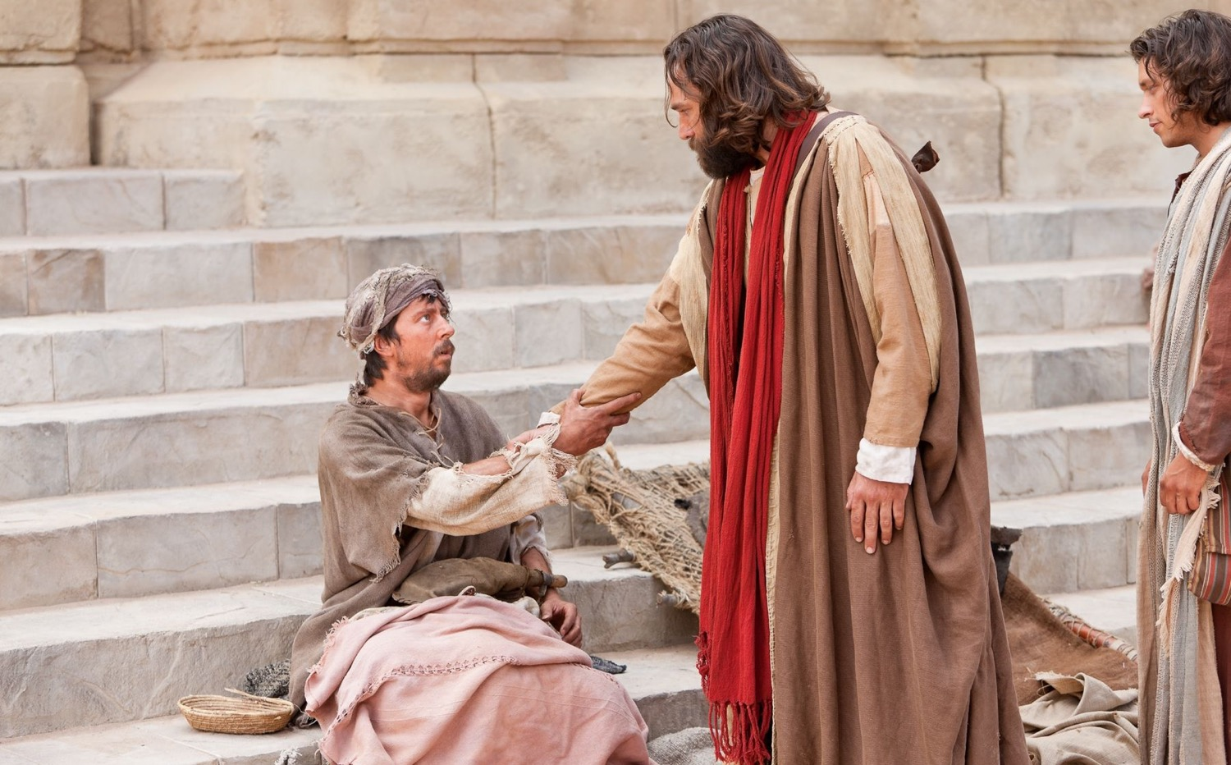
Acts 3–8
The Church Expands
Dr. Rick Griffith • Jordan Evangelical Theological Seminary • BibleStudyDownloads.org
Notes:
Ascension: Angels said

Slide 2
Key Word
56
39
Sovereignty II
Acts

Slide 3
Theme
23
Universal Savior Proclaimed in Sovereign Kingdom Progress
Acts

Slide 4
Key Verse
56
"But you will receive power when the Holy Spirit comes on you; and you will be my witnesses in Jerusalem, and in all Judea and Samaria, and to the ends of the earth" (1:8).
Acts

Slide 5
Summary & Application
Acts
120
Summary Statement
The reason to witness everywhere is because God has directed the progress of the kingdom message to all people since early church history
Application
How is God extending his kingdom message through you?
How are you fitting into His overall purpose to spread the gospel throughout the entire earth?

Slide 6
Kingdom Statement
27b
The kingdom message expands from its reception by Jews in Jerusalem (1:1–6:7) to Judeans and Samaritans (6:8–8:40) to Gentiles in Rome (chaps. 9–28) in many “progress reports” (2:47; 6:7; 8:40; 9:31; 12:24; 16:5; 19:20; 28:30-31; also possibly 2:41; 4:31; 5:42; 8:25, etc.) to show believers that God will grow his church, not man.
Acts

Slide 7
Covenant
27b
Jesus has sent the Holy Spirit to form the church (1:8; 2:14-18, 33, 38-39; 10:44-47), so believers should repent and be baptized to join this new covenant community called the church (2:21, 38; 3:19; 10:43, 47-48; 17:30; 26:20).
Acts

Slide 8
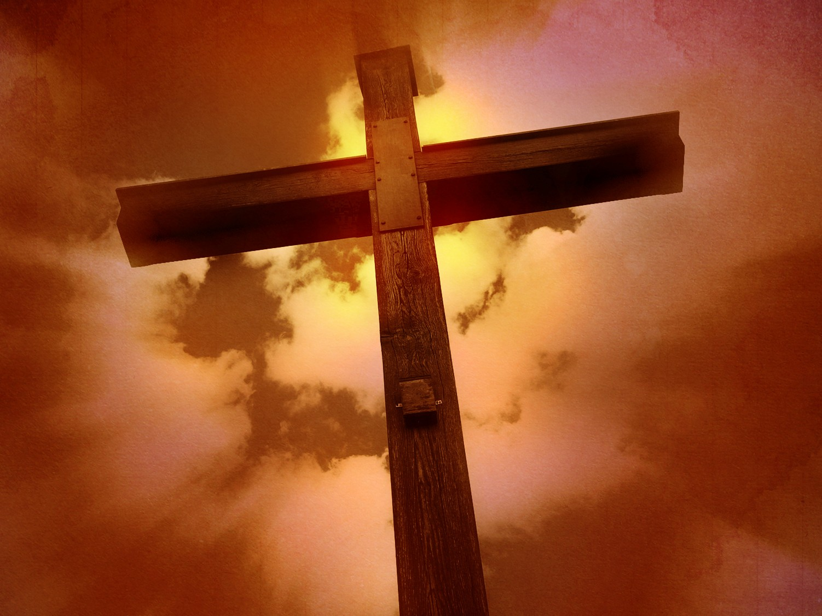
Redemption
27b
The universal appeal for salvation through the gospel is stressed (1:8; 28:30-31) in this book that records over 80 geographical locations–more than any other New Testament book.
Acts

Slide 9
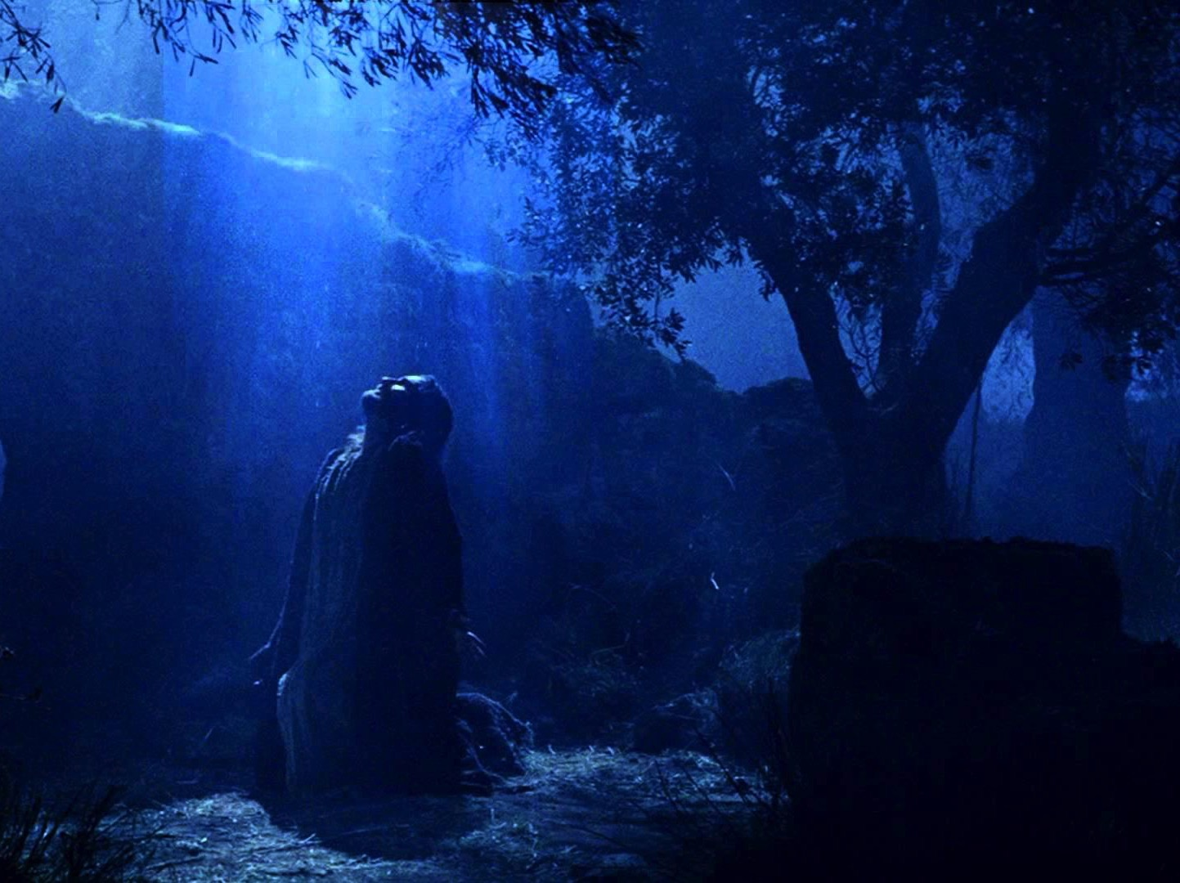
Prophecy (Lord, Deity)
27b
Jesus fulfilled the OT prophecies (2:30; 3:19, 24; 10:43; 26:6-7, 22), especially in his miracles (2:22; 10:38), death according to God’s purposes (2:23; 3:13-15, 18; 4:11; 10:39; 26:23), resurrection (2:24, 31-32; 3:15, 26; 10:40-41; 17:31; 26:23), and exaltation to God’s throne as Lord (2:25-29, 33-36; 3:13; 10:36) until he returns (3:20-21; 10:42; 17:31; cf. NTS, 137).
Acts

Slide 10
Book Chart (Top)
Acts
120
Universal Savior Proclaimed in Sovereign Kingdom Progress
Jerusalem
Judea and Samaria
Uttermost Part
1:1–6:7
6:8–8:40
Chapters 9–28
Jews
Samaritans
(mixed breeds)
Gentiles
AD 33-35
(2 years)
AD 35
(a few months)
AD 35-62
(27 years)

Slide 11
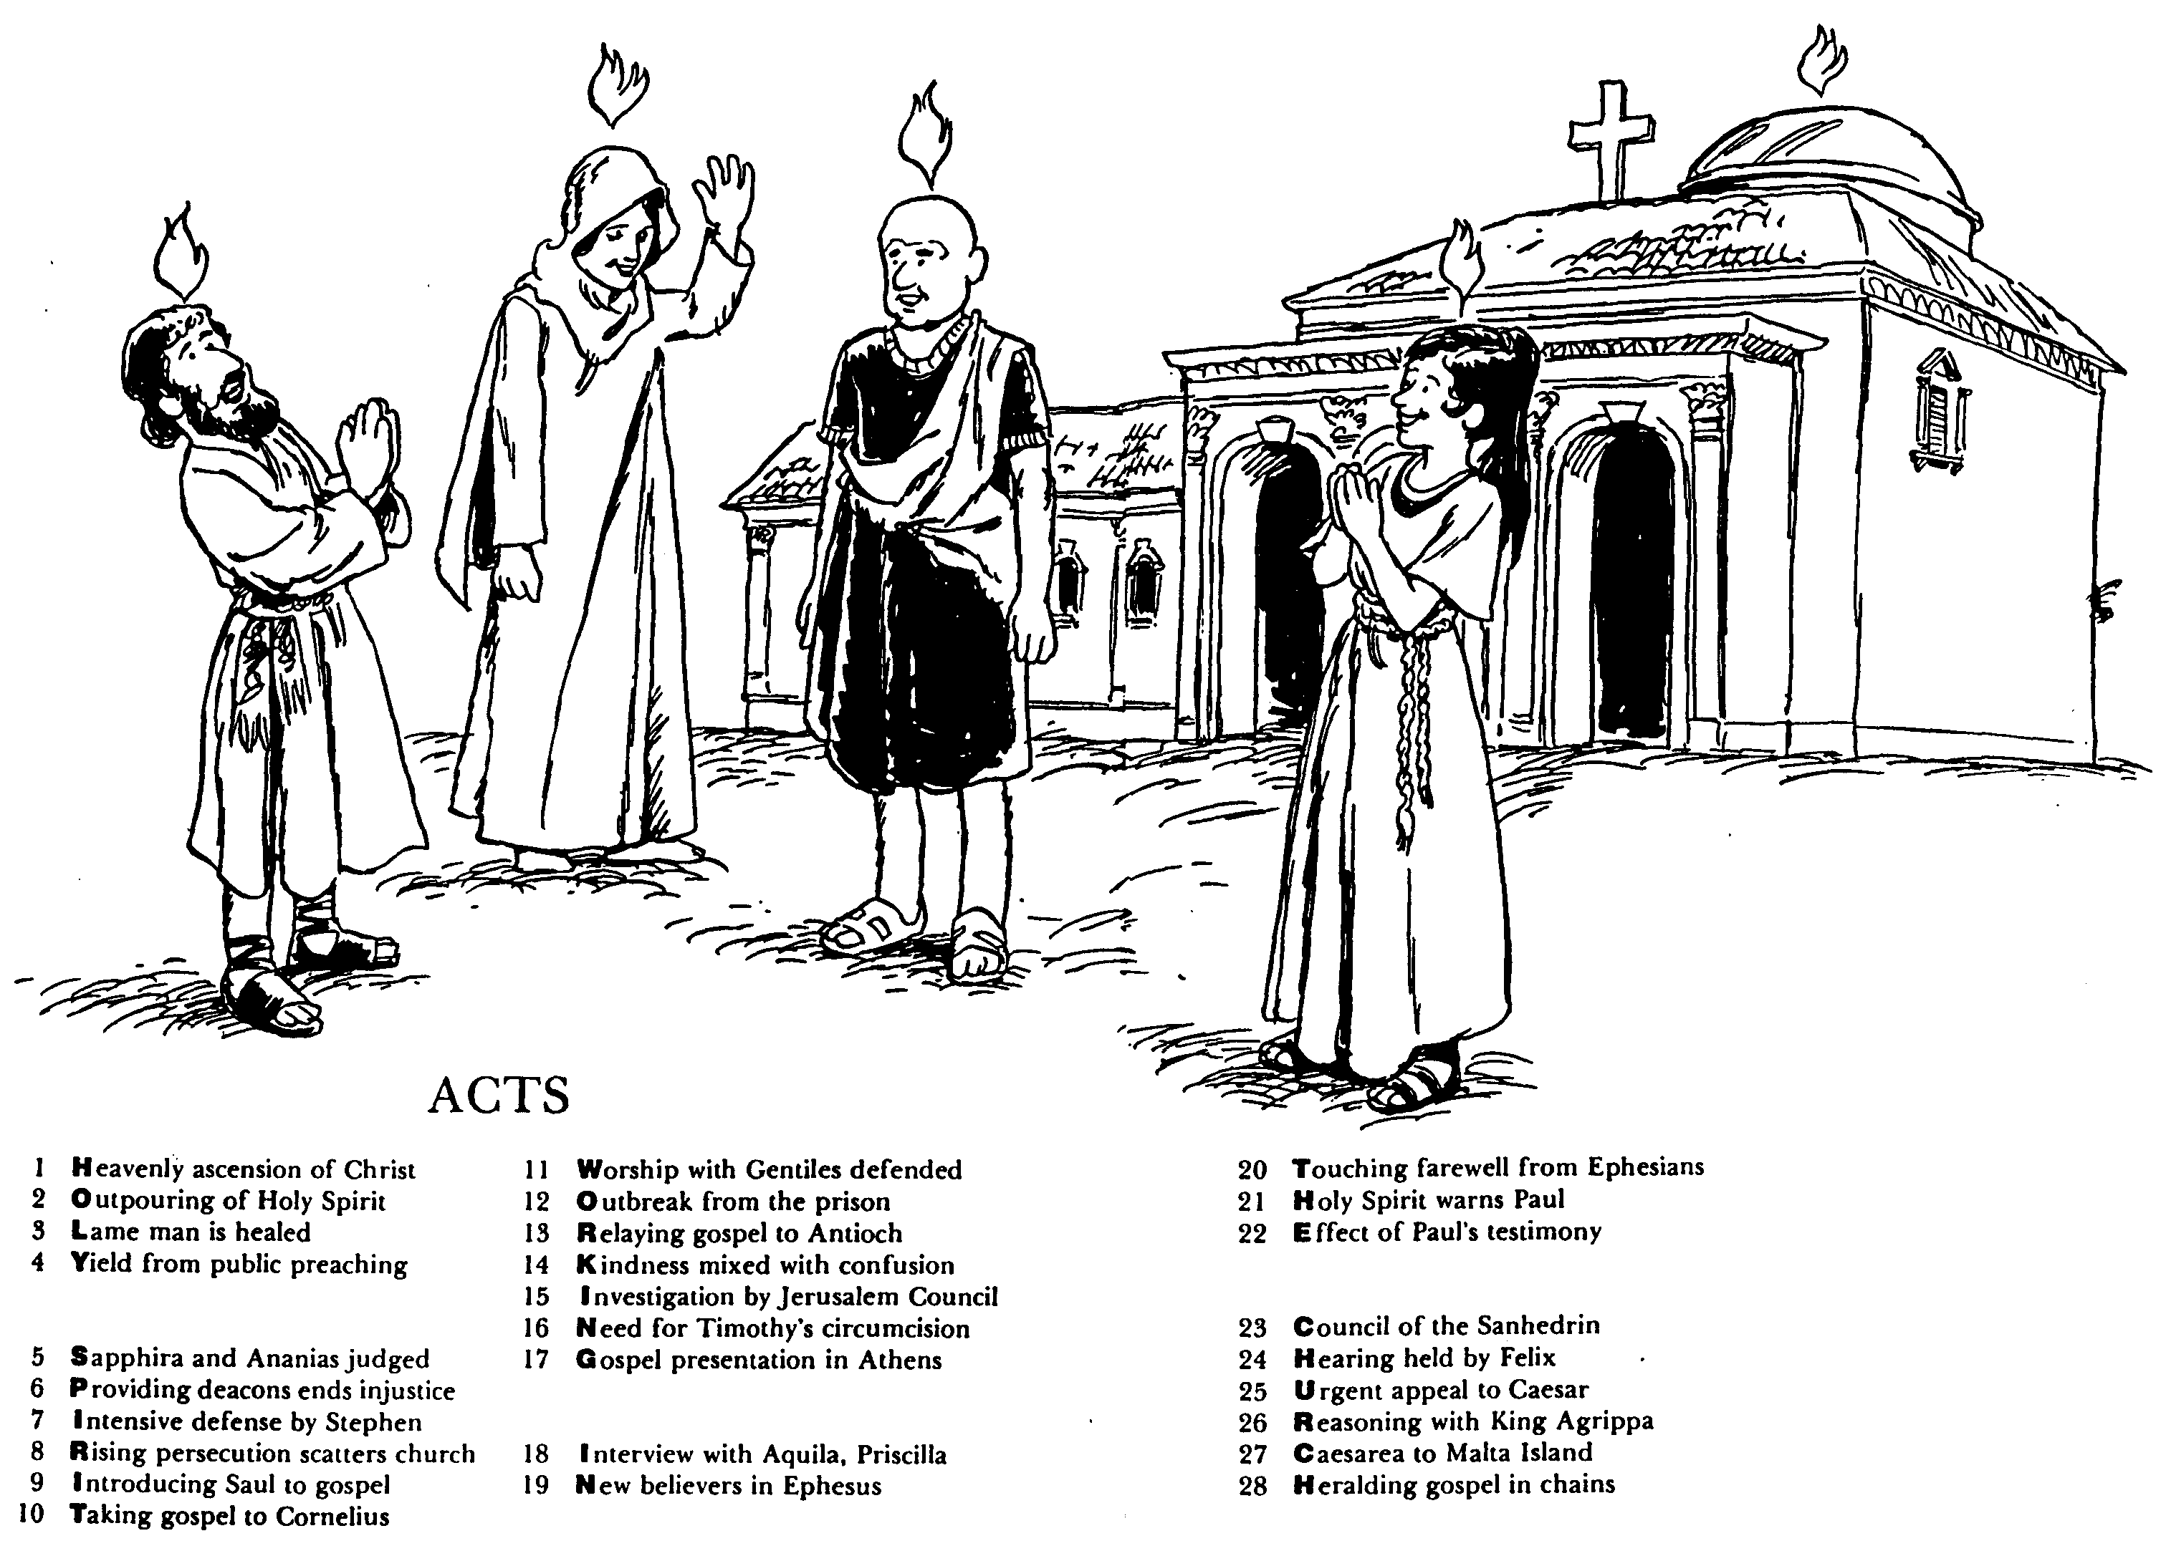
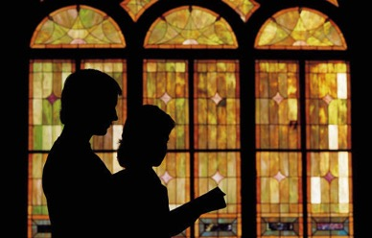
ACTS
Barry Huddleston, The Acrostic Bible
1 基督被接升天
2 圣灵的浇灌
3 瘸腿的人得治愈
4 群众讲道的结果
5 撒非拉和亚拿尼亚被审判
6 拣选执事解决不义
7 司提反强烈的申辩
8 教会受逼迫而分散
9 扫罗接受福音
10 福音传给哥尼流
11 辩解与外族人同赞美
12 逃出监狱
13 福音传到安提阿
14 慈爱与混乱混合了
15 耶路撒冷会议调查
16 对提摩太的割礼的需要
17 在雅典的宣教
18采访与亚居拉，百基拉
19 在以弗所的新信徒
20 以弗所的感人告别
21 圣灵警告保罗
22 保罗见证带来的后果
23 公议会的会议
24 在腓力斯前受审
25 向凯撒的迫切上诉
26 与亚基帕王辩解
27 从该撒利亚到马尔他岛
28 Translation

Slide 12
Be Witnessing
Acts
Dr. Rick Griffith • Crossroads International Church Singapore
BibleStudyDownloads.org

Slide 13
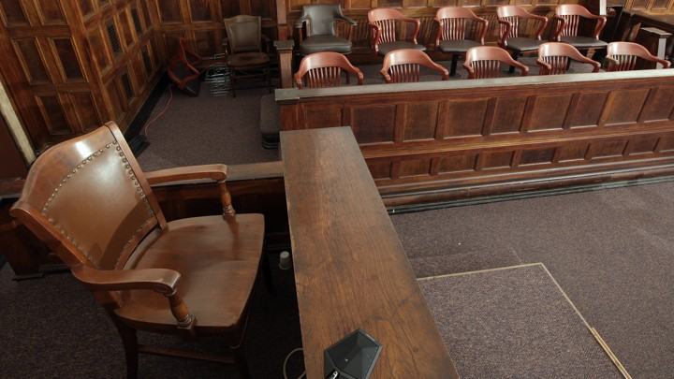
The Witness Stand
Acts
Notes:
It’s not hard to witness to what you have seen—

Slide 14
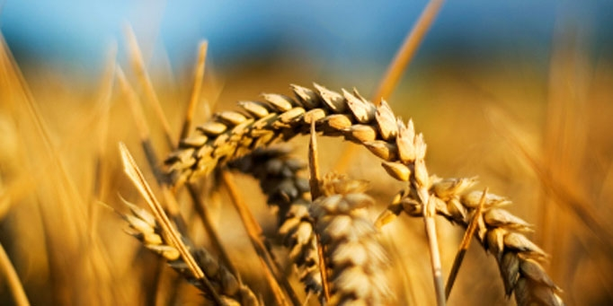
Why should we be witnessing?
3 reasons
Acts
Notes:
Today we’ll see three reasons we should witness for Jesus. Each is actually a stage of growth.
We will survey the entire book of Acts.
(So back to our question: Why should we witness?)

Slide 15
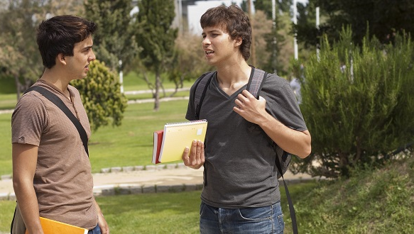
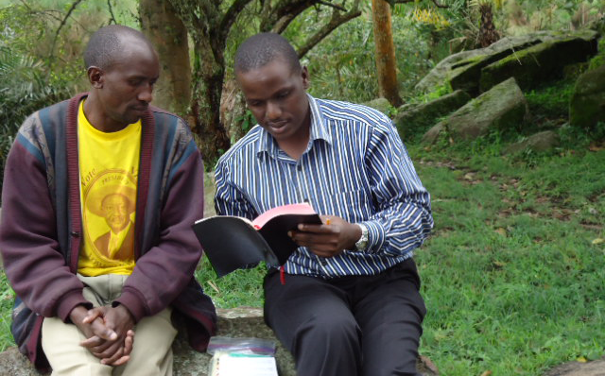
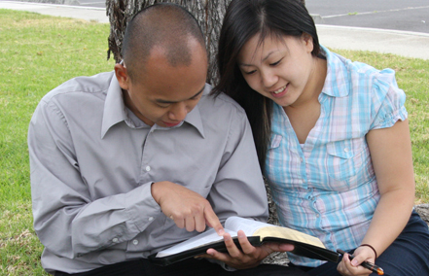
I. God has gone ahead of us so we can begin where we are (Acts 1:1–6:7).
Notes:
God helps us first tell others about Jesus where it is natural without crossing cultures.

Slide 16
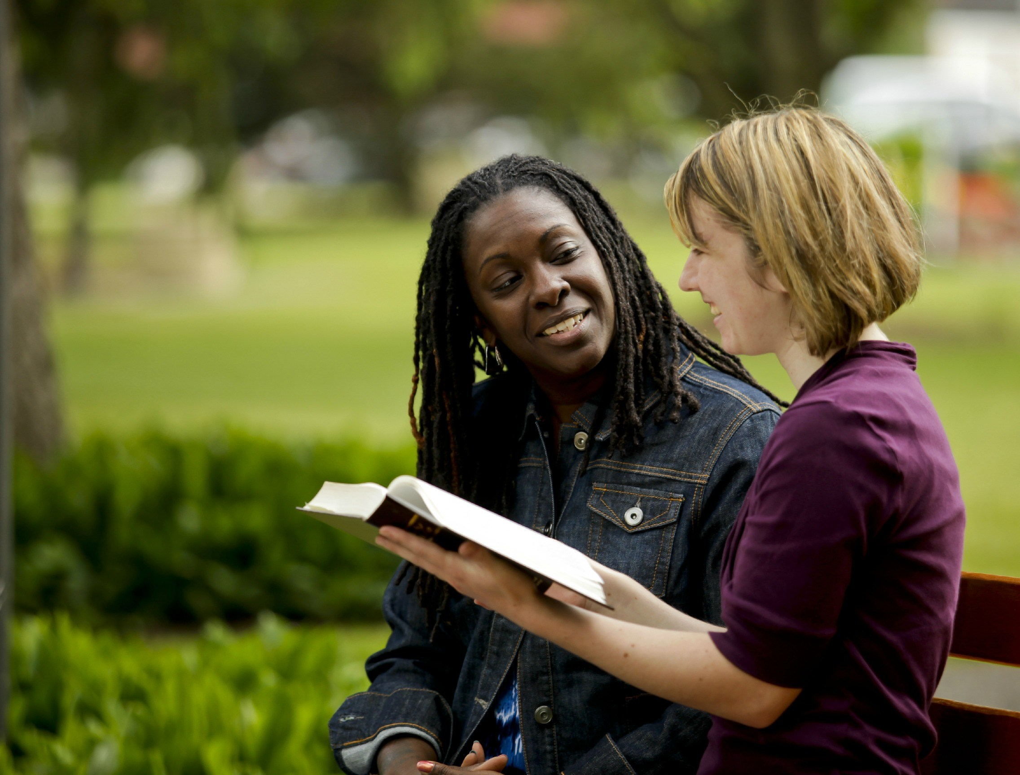
II. God gets the glory when we witness outside our comfort zone (Acts 6:8–8:40).
Notes:
God is honored when we share about him with those who are not familiar.

Slide 17
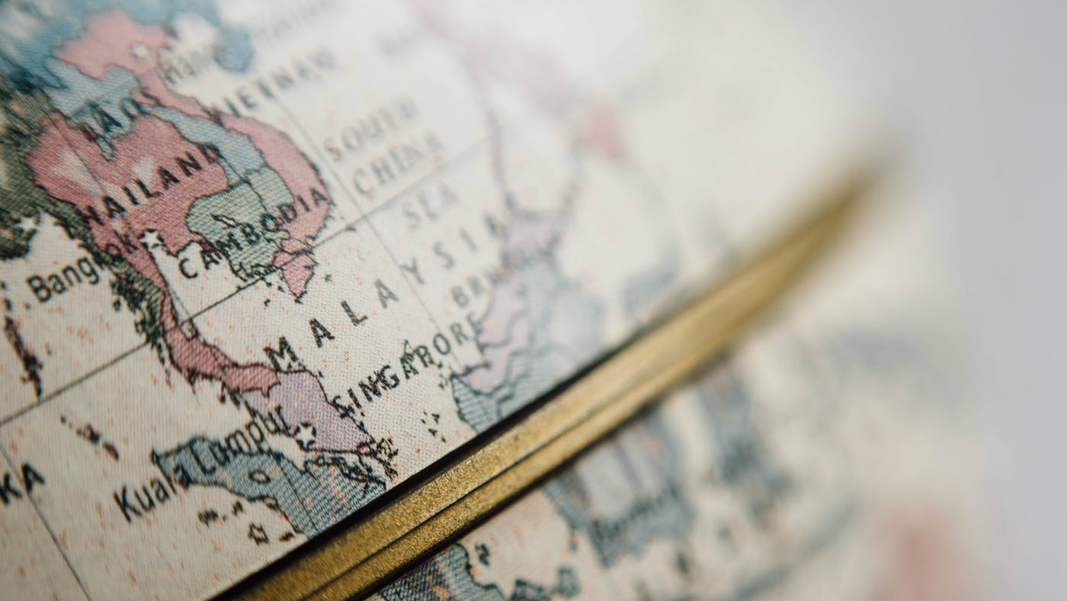
III. God will use us to spread the kingdom to the last unreached place (Acts 9–28).
Notes:
He promises that we will eventually witness in the final unevangelized place on earth.

Slide 18
Main Idea of the Book
Be part of God’s plan to bring the kingdom message to all people.
Acts
Notes:
Do what the Lord has designed for you to do so his rule extends to everyone though your life!

Slide 19
What is your role in God’s plan that he started in early church history?
Acts

Slide 21
Slides on Acts 3
Notes:
The Jews witnessed near Jerusalem amidst opposition (3:1–6:7).

Slide 22
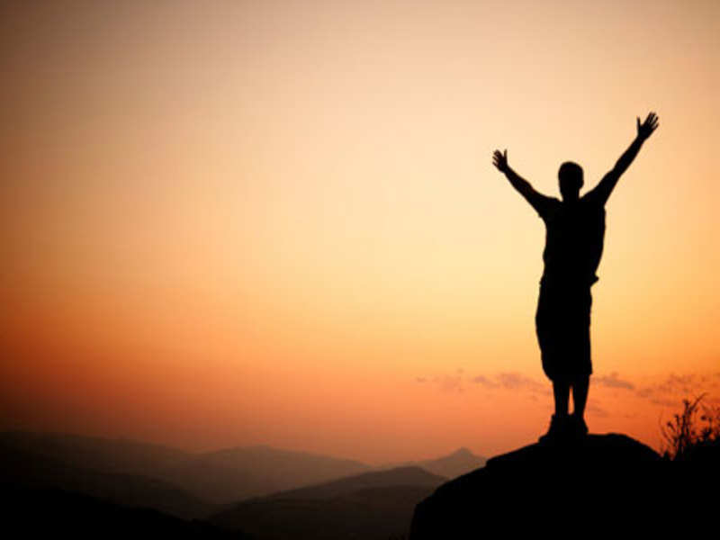
Why God Does Amazing Things
Acts 3
Dr. Rick Griffith • Crossroads International Church Singapore CICFamily.com • BibleStudyDownloads.org

Slide 23
Acts 3:1-10 Video

Slide 24
What’s the point of this story?
• How to heal?
• Be kind?
• Identify with the beggar?

Slide 25
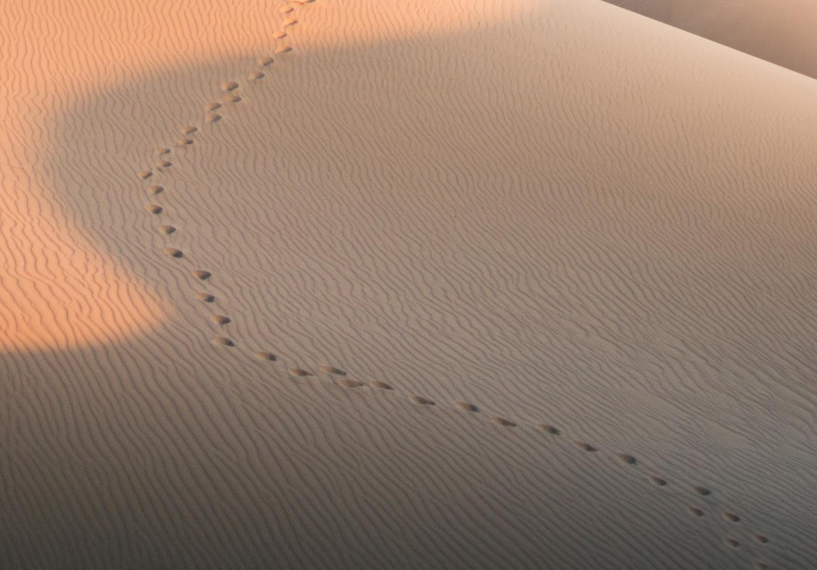
GOOD NE WS
ON THE MO VE
God’s work through the early church in
Acts

Slide 26
What’s the point of this story?
Notes:
What is the point of God doing this healing miracle—or any miracle?
What is the purpose for the account of the cripple?

Slide 27
Why does God do amazing things?

Slide 28
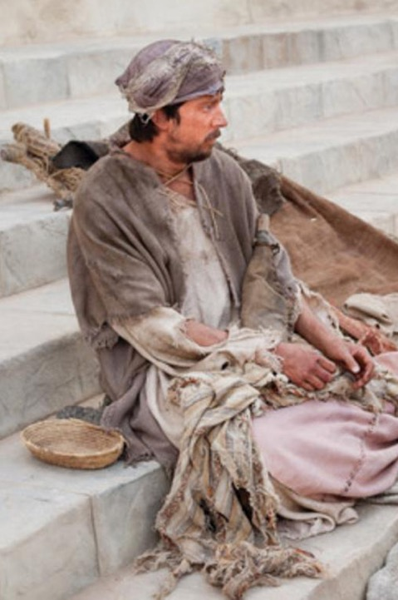
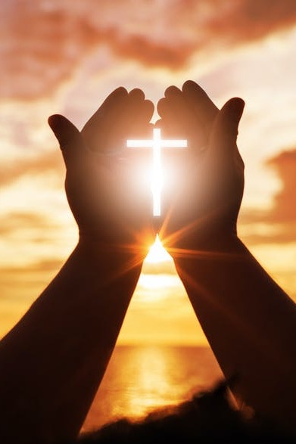
Where we’re headed in Acts 3…
Lame Man
Us

Slide 29
The name of Jesus
In The Name of Jesus

Slide 30
Herod’s Temple
Holy Place
Slaughter Tables
Gate of Nicanor
Priest Courtyard
Altar
Laver
Chamber of Oils
Women's Courtyard
The Gate Beautiful
Chamber of Nazirites
Gentile Courtyard
Gentile Courtyard
Notes:
Copyright 2017 Faithlife / Logos Bible Software
Logos User
________
NS-05-Acts3-8—slides 30, 87

Slide 31
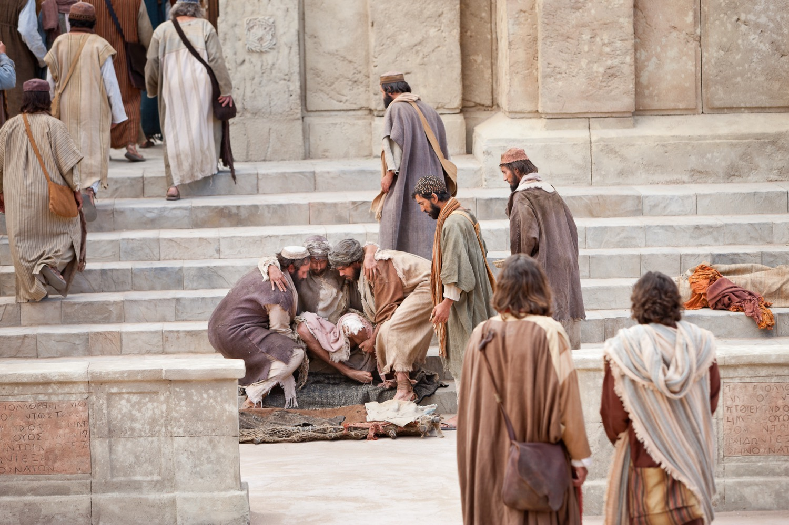
"As they approached the Temple, a man lame from birth was being carried in. Each day he was put beside the Temple gate, the one called the Beautiful Gate, so he could beg from the people going into the Temple" (Acts 3:2 NLT).

Slide 32
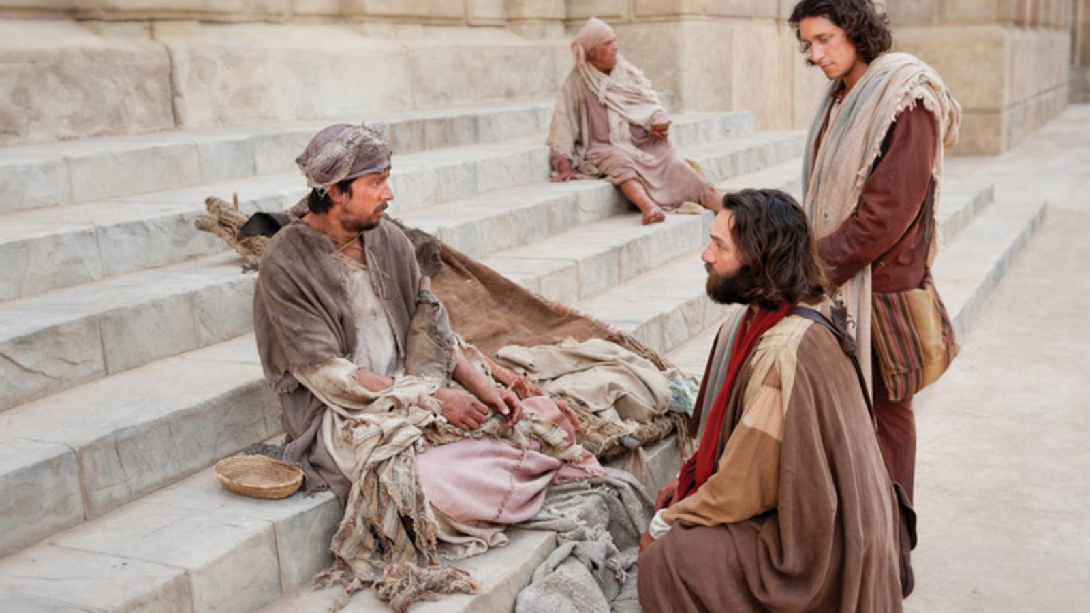
"Peter and John looked at him intently, and Peter said, ‘Look at us!’ ⁵ The lame man looked at them eagerly, expecting some money. ⁶ But Peter said, ‘I don’t have any silver or gold for you. But I’ll give you what I have. In the name of Jesus Christ the Nazarene, get up and walk!’" (Acts 3:4–6 NLT).

Slide 33
"Then Peter took the lame man by the right hand and helped him up" (Acts 3:7a NLT).

Slide 34
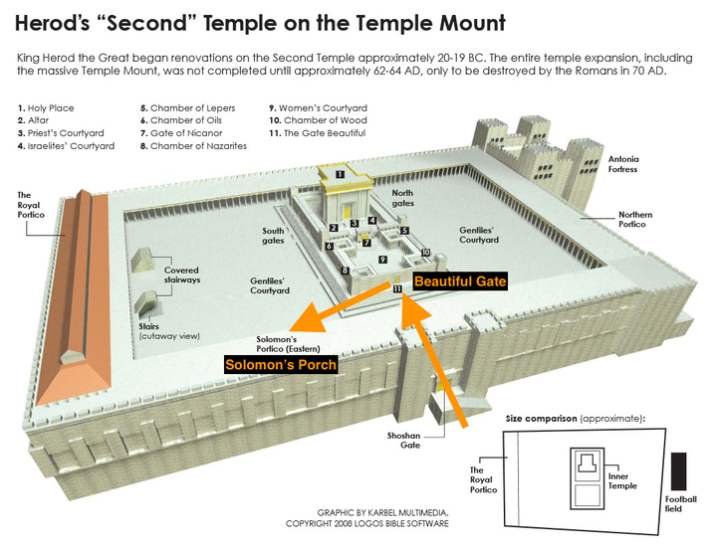
Herod’s Temple Complex
Beautiful Gate
(Acts 3:2, 10)
Solomon’s Colonnade
(Acts 3:11)
Notes:
Copyright 2017 Faithlife / Logos Bible Software
Logos User

Slide 35
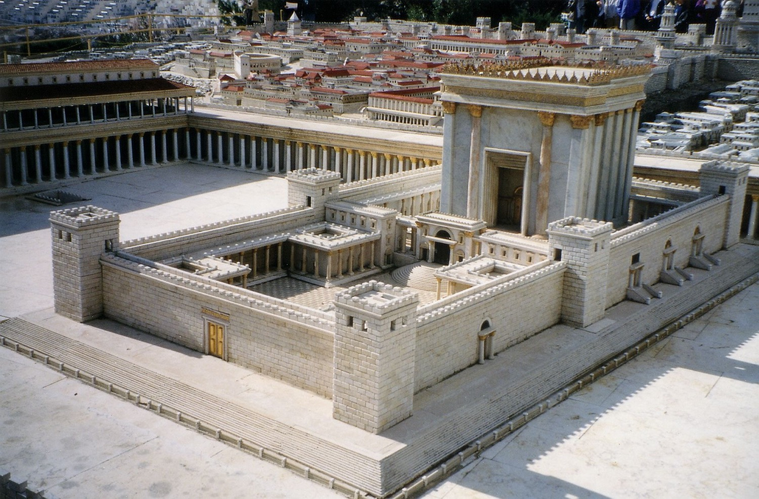
The Gate Beautiful
Notes:
Source: https://commons.wikimedia.org/wiki/File:Jerus-n4i.jpg
Juan R. Cuadra
Juan R. Cuadra (own work) / Public Domain
Public Domain

Slide 36
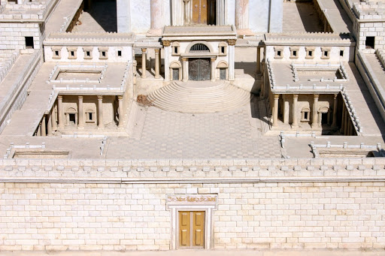
The Gate Beautiful
Notes:
Holy Land Photos

Slide 37
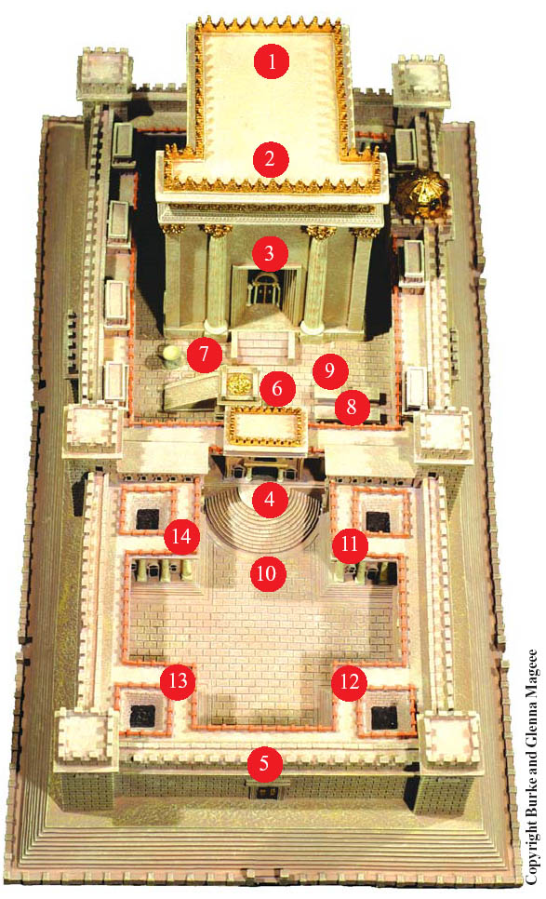
Temple Gates
Nicanor
Beautiful
Notes:
Copyright 2017 Faithlife / Logos Bible Software
Logos User

Slide 38
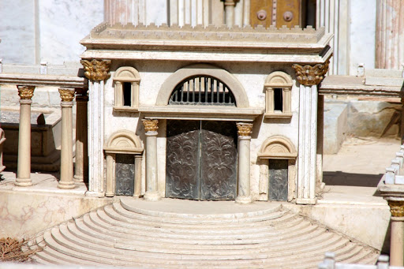
Nicanor Gate

Slide 39
Herod’s Temple Complex
Beautiful Gate
(Acts 3:2, 10)
Solomon’s Colonnade
(Acts 3:11)
Notes:
Copyright 2017 Faithlife / Logos Bible Software
Logos User

Slide 40
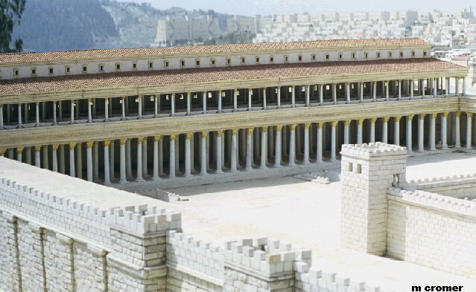
Solomon’s Colonnade (Acts 3:11)

Slide 41
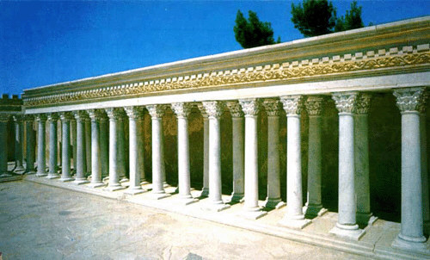
Solomon’s Colonnade (Acts 3:11)

Slide 42
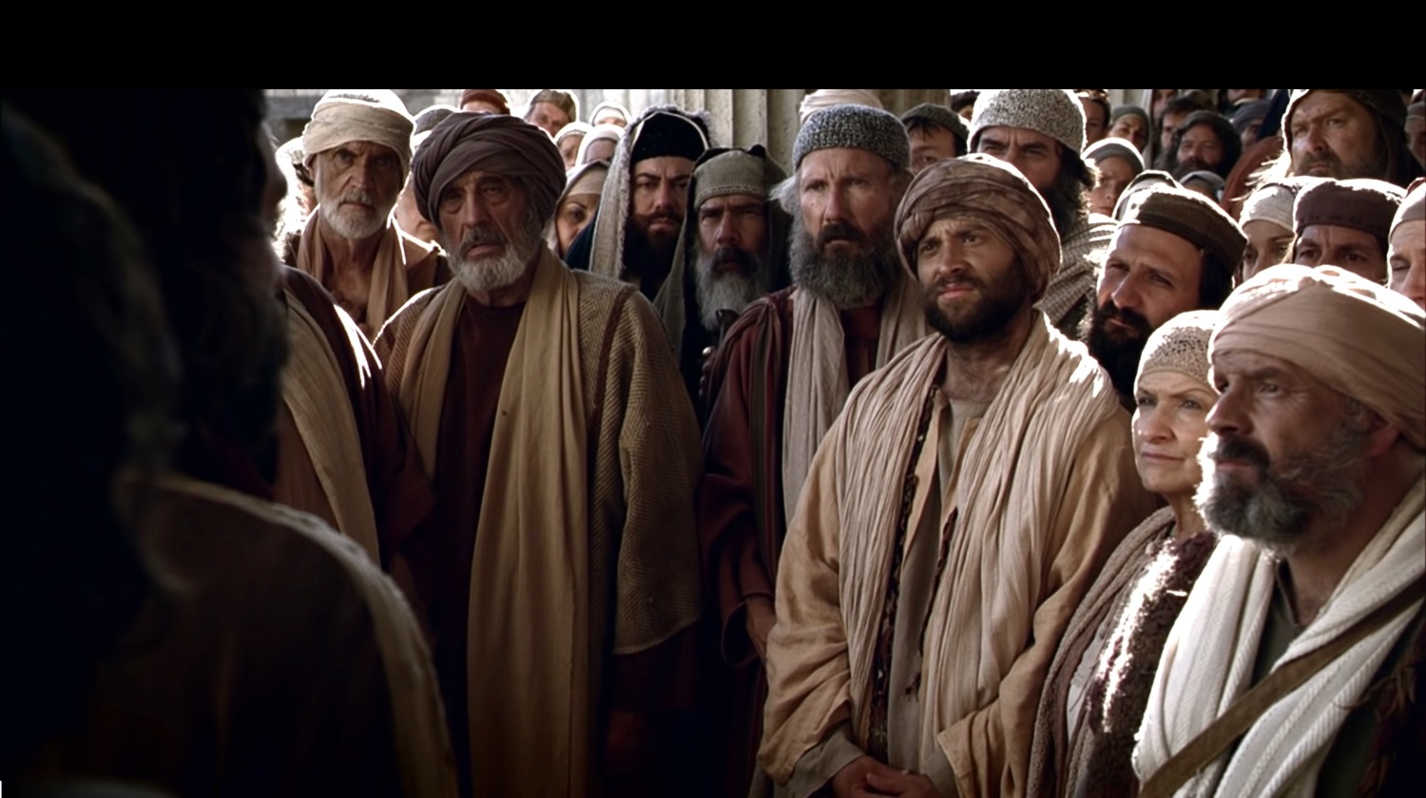
"When they realized he was the lame beggar they had seen so often at the Beautiful Gate, they were absolutely astounded!" (Acts 3:10 NLT).
The healing comprises only 10 verses

Slide 43
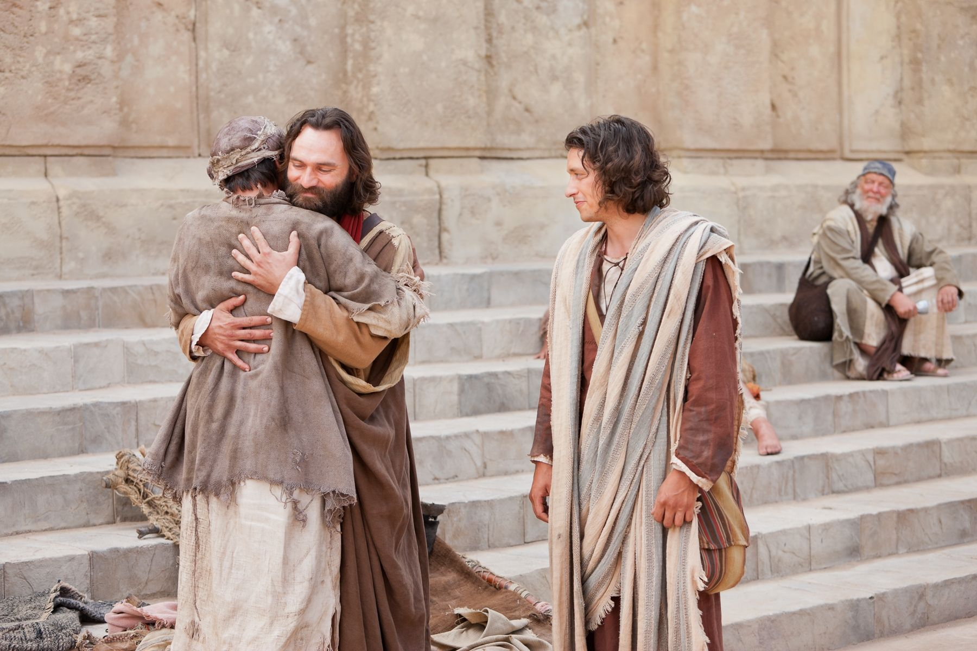
"They all rushed out in amazement to Solomon’s Colonnade, where the man was holding tightly to Peter and John" (Acts 3:11 NLT).

Slide 44
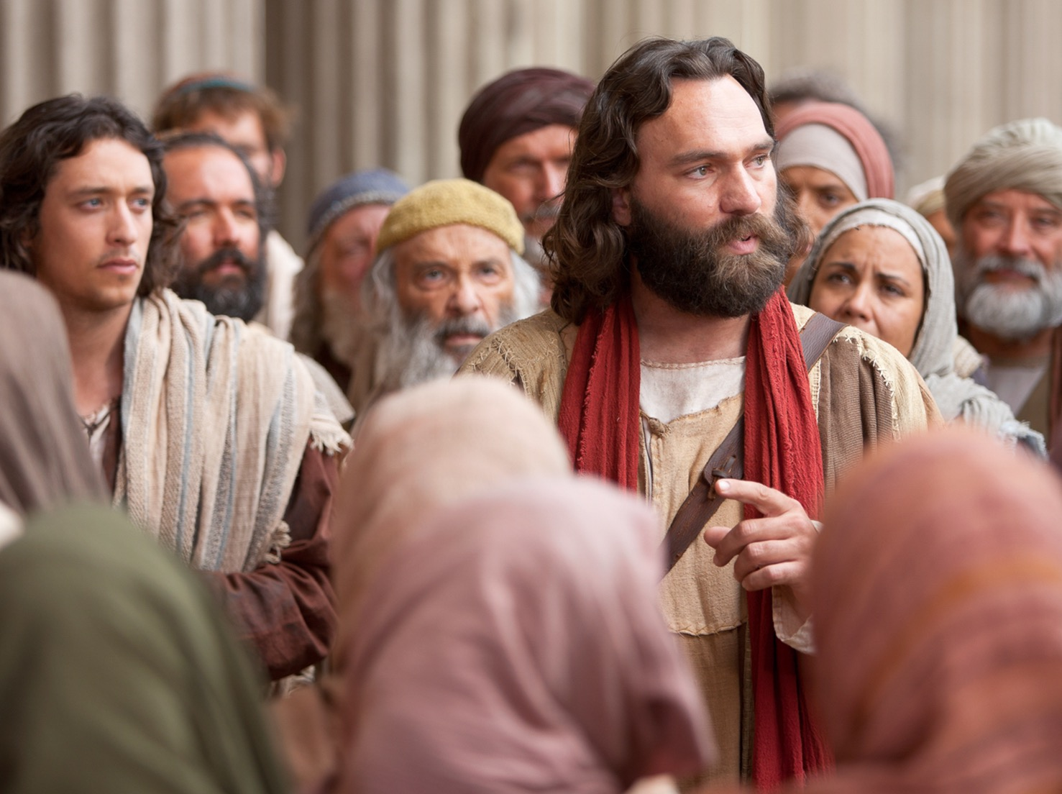
"Peter saw his opportunity and addressed the crowd. ‘People of Israel,’ he said, ‘what is so surprising about this? And why stare at us as though we had made this man walk by our own power or godliness?’" (Acts 3:12 NLT).

Slide 45
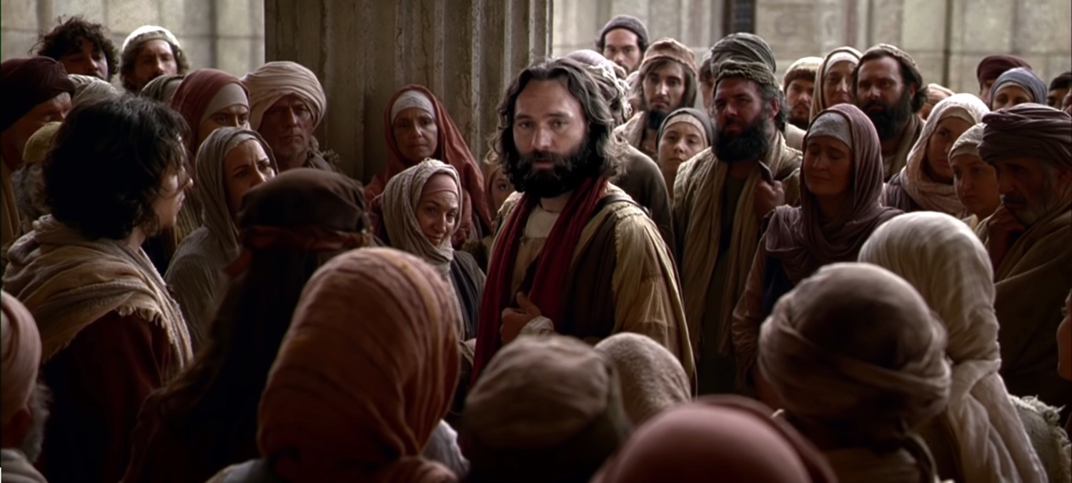
"For it is the God of Abraham, Isaac, and Jacob—the God of all our ancestors—who has brought glory to his servant Jesus by doing this. This is the same Jesus whom you handed over and rejected before Pilate, despite Pilate’s decision to release him" (Acts 3:13 NLT).

Slide 46
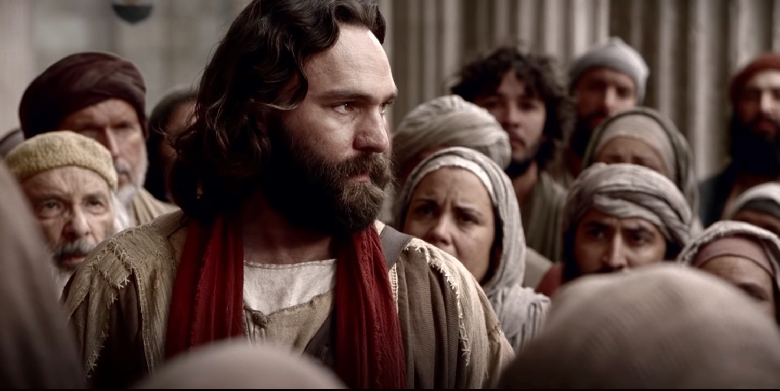
"You rejected this holy, righteous one and instead demanded the release of a murderer. ¹⁵ You killed the author of life, but God raised him from the dead. And we are witnesses of this fact!" (Acts 3:14-15 NLT).

Slide 47
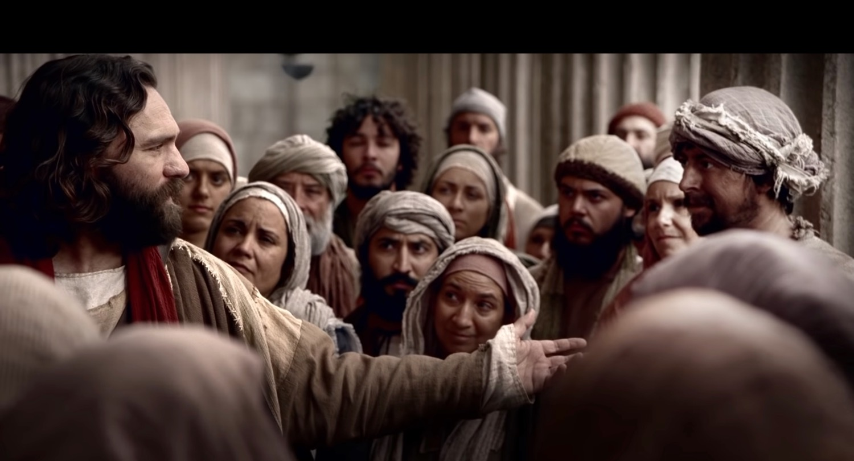
"Through faith in the name of Jesus, this man was healed—and you know how crippled he was before. Faith in Jesus’ name has healed him before your very eyes" (Acts 3:16 NLT).
Notes:
Does Peter mean that the beggar trusted Christ—or was the faith that of Peter (16)?
“The crippled man’s healing came because of his faith in the name of Jesus. Faith was also evident in many of those whom Jesus healed (e.g., Mark 5:34; 10:52; Luke 17:19).” (Toussaint, BKC, 2:361).

Slide 48
The name of Jesus
Israel
sanctuary
Notes:
“In Bible times a person’s name represented him and his characteristics. In Acts, Luke spoke of “the name” (of Jesus) at least 33 times (cf. Acts 2:21, 38; 3:6, 16; 4:7, 10, 12, 17–18; 5:28, 40–41; etc.).”
———————
Stanley D. Toussaint, “Acts,” in The Bible Knowledge Commentary: An Exposition of the Scriptures, ed. J. F. Walvoord and R. B. Zuck, vol. 2 (Wheaton, IL: Victor Books, 1985), 361.

Slide 49
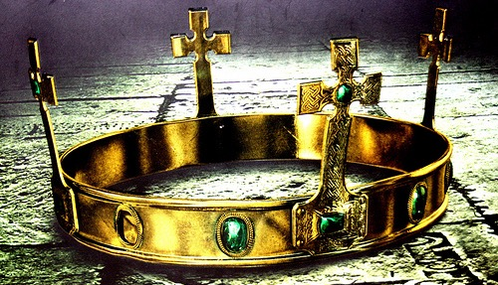
The people should accept Jesus as Israel’s promised king (Christ = Messiah) who will return to restore the kingdom after the nation believes (3:17-26).

Slide 50
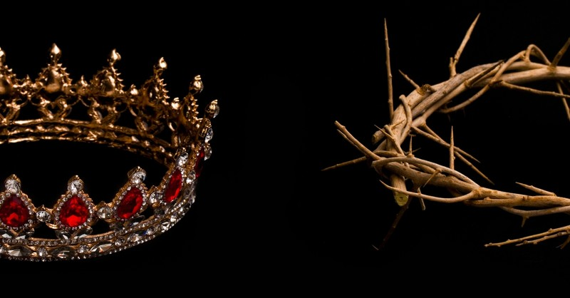
"Friends, I realize that what you and your leaders did to Jesus was done in ignorance. ¹⁸ But God was fulfilling what all the prophets had foretold about the Messiah—that he must suffer these things" (Acts 3:17-18 NLT).

Slide 51
"Now repent of your sins and turn to God, so that your sins may be wiped away. ²⁰ Then times of refreshment will come from the presence of the Lord, and he will again send you Jesus, your appointed Messiah" (Acts 3:19-20 NLT).
Notes:
What is the distinction between repenting and turning to God (19a)?
“First of all, they had to repent of their sins (see Acts 2:38; 5:31; 17:30), which means to have a change of mind about themselves, their sin, and Jesus Christ…True repentance is admitting that what God says is true, and because it is true, to change our mind about our sins and about the Saviour.”
“Second, they had to be converted, “to turn again” and exercise saving faith in Jesus Christ. The biblical message is “repentance toward God, and faith toward our Lord Jesus Christ” (Acts 20:21), and the two go together. Unless we turn from our sins, we cannot put saving faith in Jesus Christ.”
————————
Warren W. Wiersbe, The Bible Exposition Commentary, vol. 1 (Wheaton, IL: Victor Books, 1996), 413.

Slide 52
"Now repent of your sins and turn to God, so that your sins may be wiped away. ²⁰ Then times of refreshment will come from the presence of the Lord, and he will again send you Jesus, your appointed Messiah" (Acts 3:19-20 NLT).
"For he must remain in heaven until the time for the final restoration of all things, as God promised long ago through his holy prophets" (Acts 3:21 NLT).
Notes:
What are the “times of refreshing” that Peter promised would come when the nation repented and turned to God (19b)?
“There was a promise for the individual (sins forgiven) and a promise for the nation (times of spiritual refreshing). Peter was actually calling for national repentance, for the nation through its leaders had denied its Messiah and condemned Him to die. The declaration is that, if the nation repented and believed, the Messiah would return and establish the promised kingdom.”
“The nation did not repent—and certainly God knew this would happen—so the message eventually moved from the Jews to the Samaritans (Acts 8) and to the Gentiles (Acts 10).”
————————
Warren W. Wiersbe, The Bible Exposition Commentary, vol. 1 (Wheaton, IL: Victor Books, 1996), 414.

Slide 53
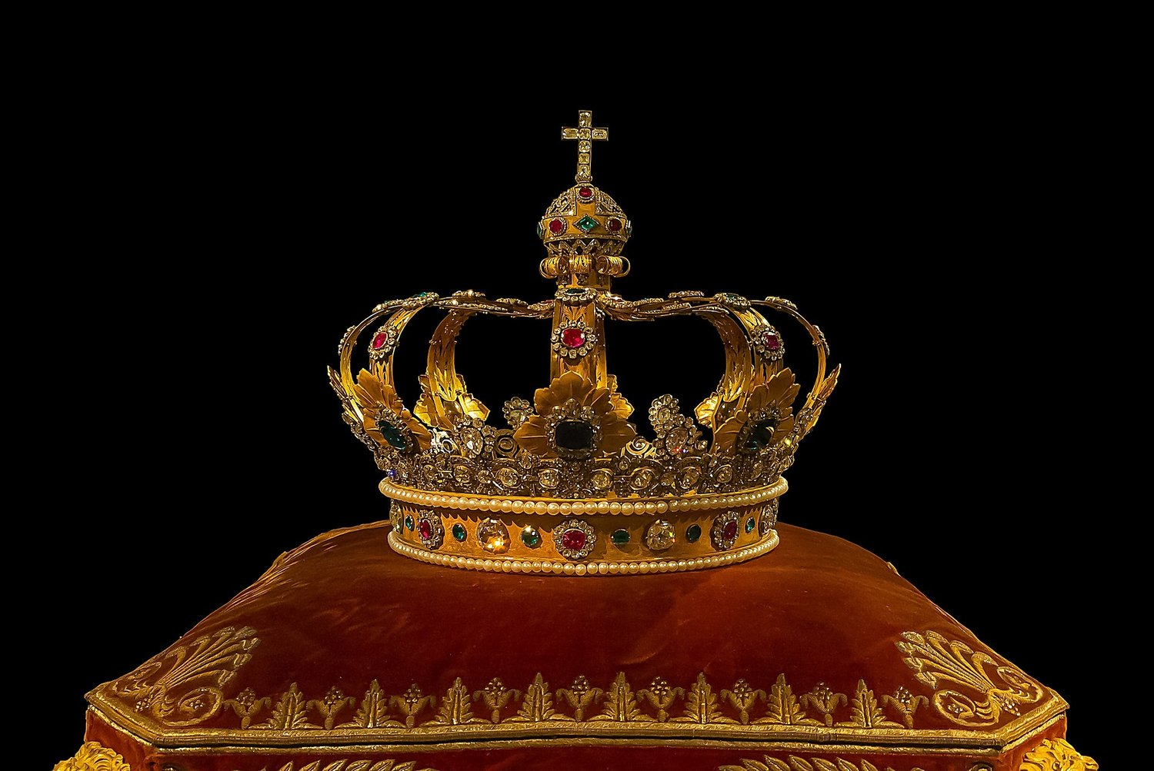
Is Peter saying that their repentance would have brought the kingdom?
Yes!

Slide 54
Is Peter saying that their repentance would have brought the kingdom?
Regeneration = Restoration
“The concept of restoration parallels regeneration when it is used of the kingdom (cf. Isa. 65:17; 66:22; Matt. 19:28; Rom. 8:20–22).”
—Toussaint, BKC, 2:361
Notes:
Stanley D. Toussaint, “Acts,” in The Bible Knowledge Commentary: An Exposition of the Scriptures, ed. J. F. Walvoord and R. B. Zuck, vol. 2 (Wheaton, IL: Victor Books, 1985), 361.

Slide 55
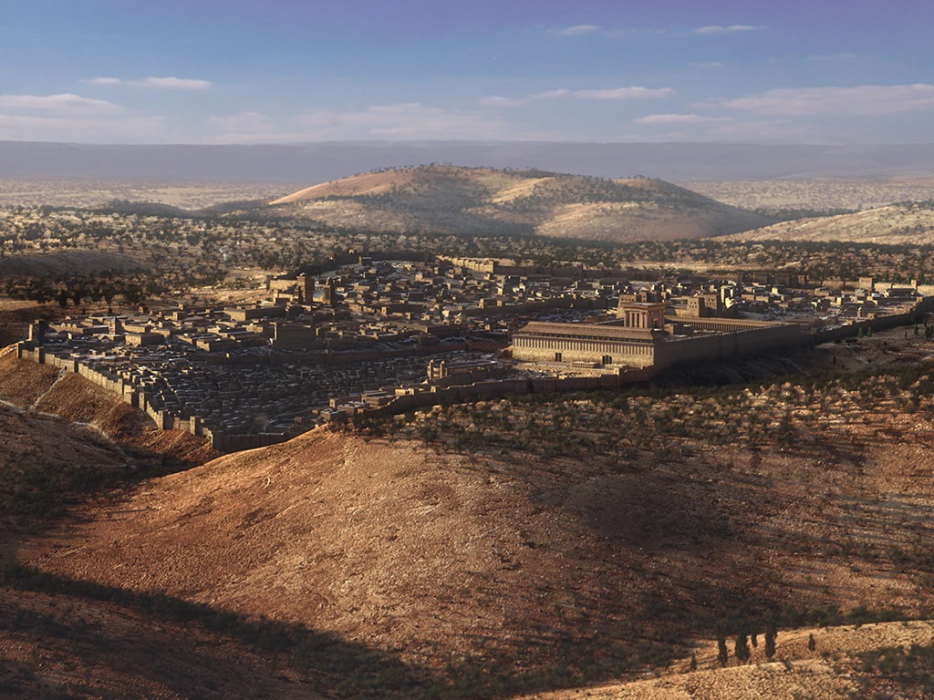
A Great Question (Acts 1:6)
So when they met together, they asked him, “Lord, are you at this time going to restore the kingdom to Israel?”
Notes:
We should witness to everyone until Israel is restored (1:6-8).

Slide 56
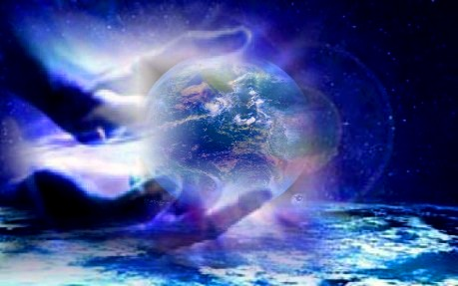
Isaiah 65:17-18a (NLT)
"Look! I am creating new heavens and a new earth, and no one will even think about the old ones anymore. ¹⁸Be glad; rejoice forever in my creation!"
Notes:
56

Slide 57
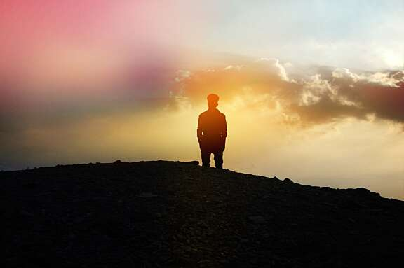
Isaiah 66:22 (NLT)
"'As surely as my new heavens and earth will remain, so will you always be my people, with a name that will never disappear,' says the LORD."
Notes:
57

Slide 58
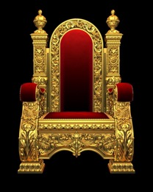
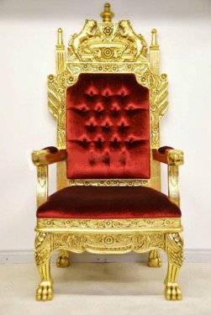
Jesus will Reign Over a Literal, Political Kingdom
"Jesus replied, 'I assure you that when the world is made new and the Son of Man sits upon his glorious throne, you who have been my followers will also sit on twelve thrones, judging the twelve tribes of Israel'" (Matt. 19:28 NLT)
Notes:
It will be ruled by Messiah where Israel will have prominence over the entire world that will follow the Lord.

Slide 59
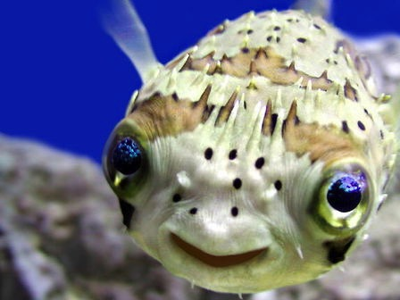
Romans 8:19-21
"The creation waits in eager expectation for the sons of God to be revealed. . . The creation itself will be liberated from its bondage to decay and brought into the glorious freedom of the children of God."
Notes:
59

Slide 60
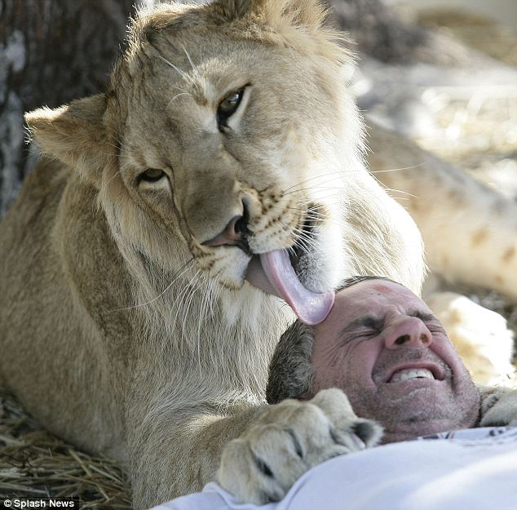
Romans 8:19-21
"The creation waits in eager expectation for the sons of God to be revealed. . . The creation itself will be liberated from its bondage to decay and brought into the glorious freedom of the children of God."
Notes:
60
http://forums.sgclub.com/singapore/now_whats_dinner_326313.html accessed 22 July 2015
Now, what's for dinner? Owner of wildlife sanctuary climbs into the lions' den for A MONTH...
Now, what's for dinner? Owner of wildlife sanctuary climbs into the lions' den for A MONTH to raise money By GAVIN ALLEN Last updated at 1:09 PM on 13th January 2011 It's the kind of lovingly playful lick on the head you would expect to see a young cat bestow on its owner. But this is a lion, and Jim Jablon is not in his own home - he's literally in the lions' den. These incredible pictures show just how well the Florida man is getting along with his new housemates Lea, an 18-month-old African lion, and Ed, a ten-month-old black-maned lion. Scroll down for video In the lion's den: Jim Jablon is living with two lions for the whole of January to raise money for his wildlife shelter Who's the king of the jungle? Jablon shares a yawn with his housemate The 42-year-old Army vet and single father has caused a stir worldwide with his promise to spend the entire month of January living with the two lions at the centre he runs, Wildlife Rehabilitation of Hernando County, Florida. These images of Jablon come from day five of the challenge, during which he will eat 'regular cooked food,' rationed to one square meal a day, which will be served in the evening when Lea and Ed are devouring 14lb of raw meat as their dinner. So far his biggest problem has been keeping his trousers on. 'Every time I bend over they go for my butt,' he said. 'Their teeth rip my pants right off. I've been through six pairs already.' Jablon is also sleeping in the 12ft-high, 3,000sq ft enclosure on a bed on hay - or somewhere harder to reach if things get a bit too hairy. Lion down: Jablon is eating and sleeping at the enclosure, although he isn't yet certain if he will stay on the straw bed Aw, get off: Jablon never turns an animal away from the refuge, relying on volunteers and the help of his 13-year-old daughter 'I may have to construct a bed in one of the trees, just out of their reach or come up with another idea, depending on what they make of me being there,' he said. 'After all, lions generally sleep for 18-20 hours a day so I'm going to be getting a lot of rest. 'But I'll be ever-vigilant and I will have a small fenced-off safety area in the corner if it looks like they're getting too aggressive or I feel things are getting too dangerous. The stunt is a way to raise funds for Jablon's animal refuge, which cares for injured or orphaned animals in the hope of giving them the chance to be returned to the wild. He opened the site in 1999 and was soon caring for raccoons, injured deer, bobcats, coyotes, snakes, eagles and owls. But soon the animals being brought in were getting increasingly larger and exotic – alligators, monkeys and big cats, including lions, tigers, lynx and pumas. Jablon, originally from Long Island, New York, tries to ensure he never turns an animal away from the refuge, relying on volunteers and the help of his 13-year-old daughter Chelsey. But as the facility has grown in size, the cost of feeding and looking after the increasing number of animals and the cost of their medical care has also risen rapidly, leading to Mr Jablon's unusual plan. 'I was looking for a way to raise funds to help the animals and I am constantly striving to look at what makes them happy, at what stimulates them, so I thought living with them for a month would help both causes,' he said. 'I couldn't survive without donations and hopefully this event will let people know I'm here and that I need help in helping the animals.' 'If the lions were fully grown I wouldn't be doing this. 'I feel they are still at the size and development stage where I can control them but, yes, they're big, and I have to take great care. 'I don't train my animals to do tricks and be with other people. 'I try to give them natural lives, so once they get to be a little bigger I will not be coming in with them.' Jablon began living with the lions at midnight on New Year's Eve and will leave the den on January 31. You can watch a live feed of his time in the cage at http://wrohflorida.com

Slide 61
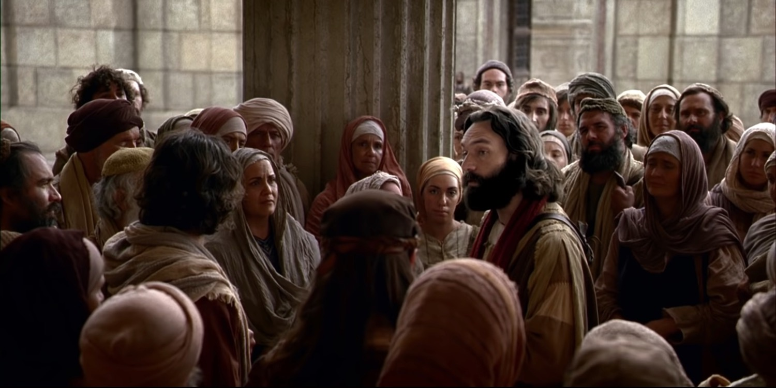
Acts 3:22-26

Slide 62
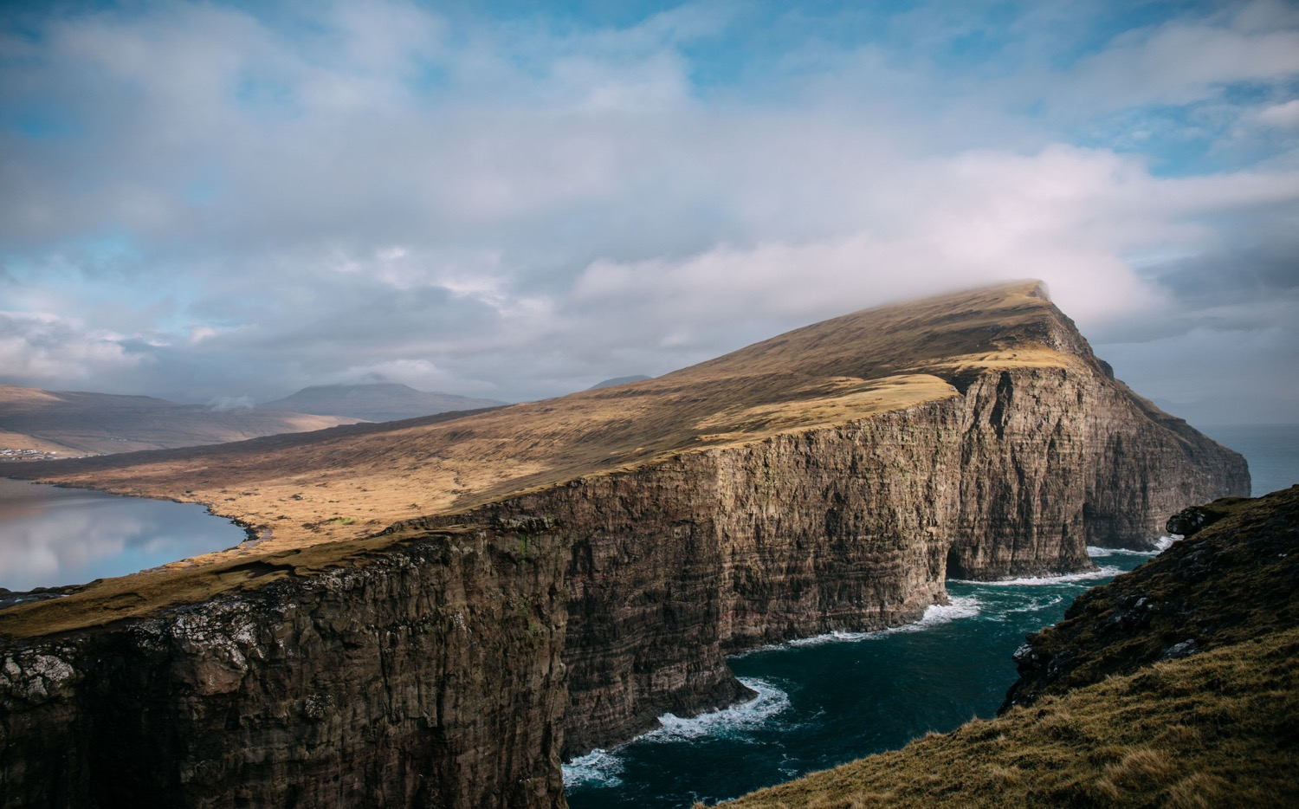
Main Idea of Acts 3
Seeing God work gives us open doors for witness!

Slide 63
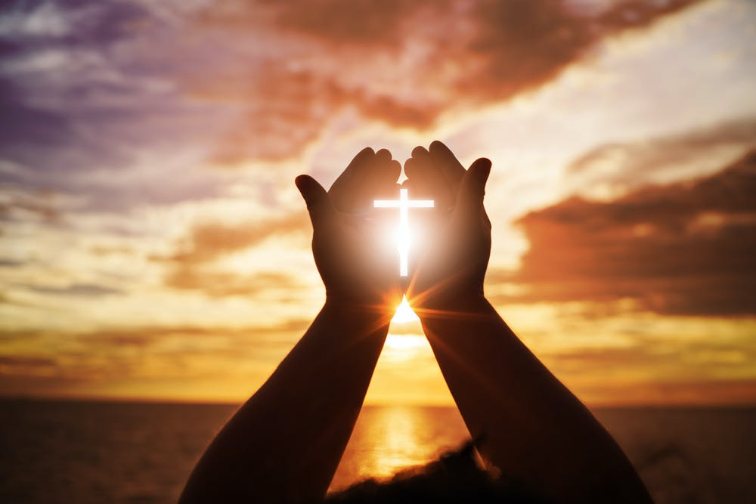
Speak the name—thus the authority—of Jesus
Peter healed the man in the name of Jesus (3:6).
Peter refused to take any credit for power or godliness (3:12).
Peter said that the man placed his faith in the name of Jesus (3:16).

Slide 64
Speak about Jesus!
Notes:
Too often we begin with meeting felt needs—but then we stay there and do not proclaim the gospel. Peter didn’t just stop when the cripple was healed. He gave God credit. What amazing things has God done where you have a front-row seat and need all the glory to go to God rather than to you?
The poor typically respond Jesus more easily than the wealthy as the poor better see their need for the Lord. I think the poor have a higher view of Jesus than we do—and that’s because we have too high a view of ourselves.

Slide 65
What amazing things has God done where you have a front-row seat?

Slide 66
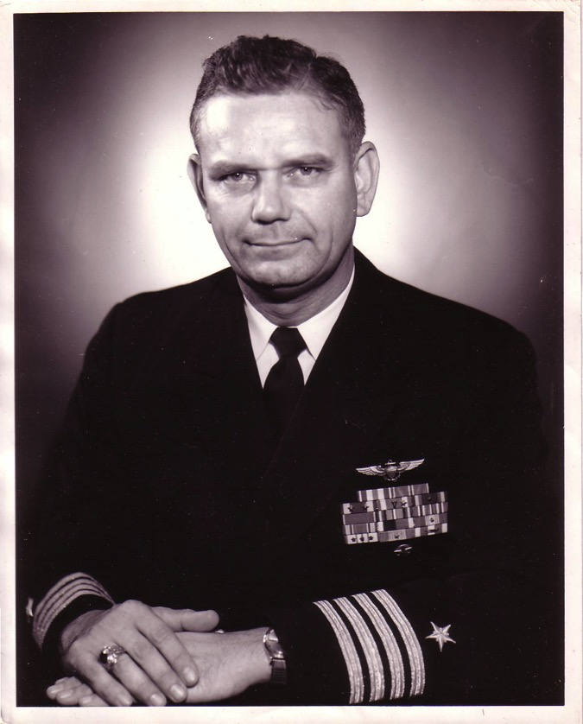
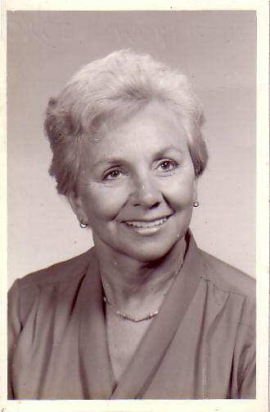
The Divorce
1962
Navy Commander
Harold F. Griffith (alias Dad)
Social Worker
Joyce I. Griffith (alias Mom)
Notes:
After my younger brother's birth my Mom concluded that my Dad was actually married to the Navy, so she divorced him. Ironically, she became a social worker to help other families put their lives together.

Slide 67
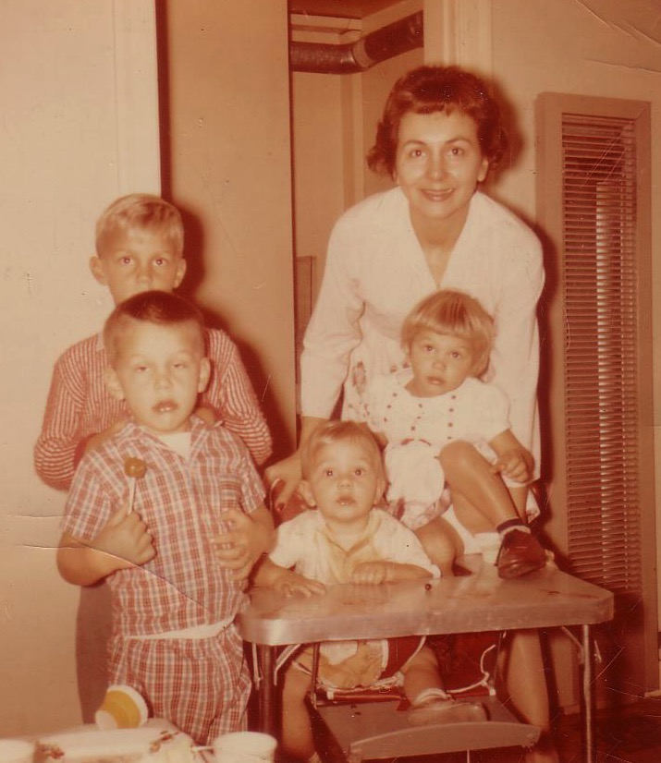
Divorce for Mom was tough…
Bobby, 6
Ricky, 4
Kathy, 3
Tommy, 1
Notes:
Those were tough years for Mom as a single mother with four kids age 6 and under. Yes, I'm the good looking one with the sucker!

Slide 68
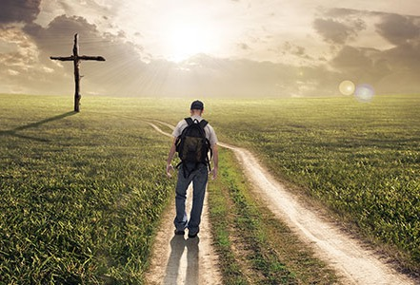
He rescued me from a broken home and used me for his work for 41 years.
I couldn’t stand
I couldn’t see beyond lily white to 300 Japanese

Slide 69
The Crossroads (1981-83)
Notes:
After college it seemed the natural thing to do to join Campus Crusade staff in the Philippines on a seven-member music team.

Slide 70
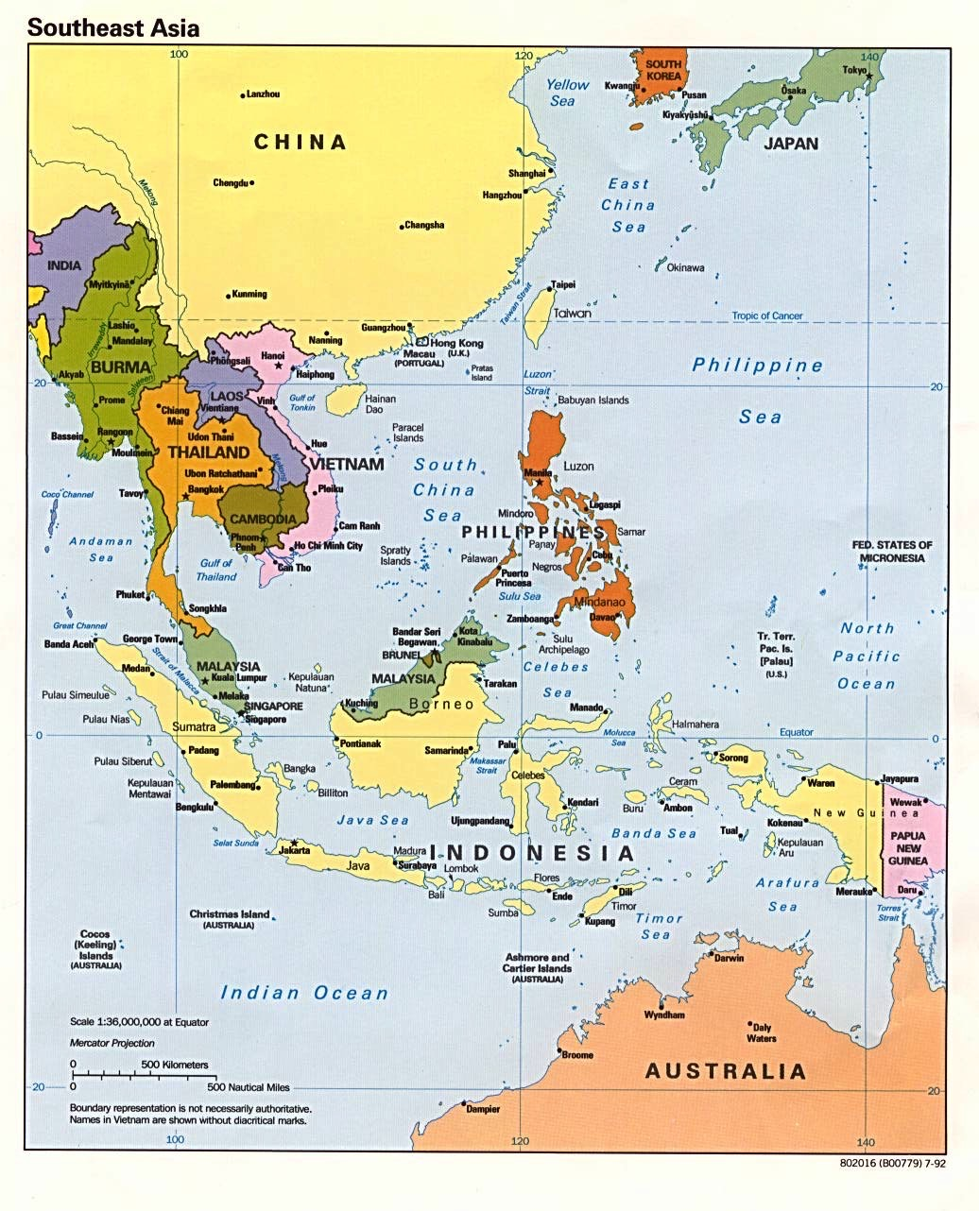
Crossroads Ministry
Korea
China
Japan
Hong Kong
Taiwan
Macau
Thailand
Philippines
Malaysia
Singapore
Indonesia
Notes:
The Crossroads team shared the gospel in 11 Asian nations and saw over 10,000 people indicate decisions to trust Christ! Again I was amazed at God's grace!

Slide 71
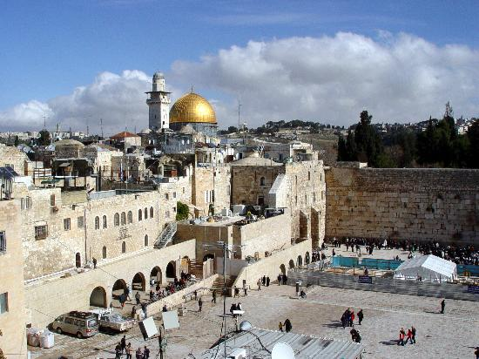
Jerusalem December 1995
Notes:
God met me in Jerusalem in December 1995.
You see, at that time I had served on the faculty of Singapore Bible College for four years and I started teaching some courses for the fourth time––that can lose its challenge.
But the chance came to lead trips to Israel. I'd never been there before, but 25 brave souls braved to pay the $3000 to come with me.
But at the antiquities shop in Jerusalem I was stunned to see one of my tour members argue with the shop owner about the price of an artifact. “What? You want $20? I saw this for $18 down the street!”
I was so embarrassed that I left the shop, sat down on the curb, and pouted like Elijah. “What are you doing here, Rick?” I sensed God say to me (not audibly, yet still real).
“Lord, I'm bringing Your people to Your land to get to know Your Word.”
“No, you're not,” I sensed God saying to me. “You can't afford to come Israel so you rounded up 25 wealthy people to pay your way.”
Then it struck me how little time Jesus spent in Jerusalem. Sure, he was a faithful Jew who made the required pilgrimages three times a year––and he spent the last week of his life in Jerusalem since he came there to die. But Jesus wasn't impressed with the wealth and power of Jerusalem.
Instead, he wanted to change the world through the poor. Jesus said that he had come to preach the gospel to the poor. And, as I thought about it, I realized that Jesus spent most of his ministry up in the poor north, in Galilee. He spent his time and energy in what people considered to be the place for roughnecks and insurrectionists.
Then I thought about the students that I had at SBC up to that point. I realized that the ones who came from the wealthy churches had to return back to their wealthy churches to pay back these churches for their support during seminary.
However, the ones from the poor countries returned to their countries had a tremendous impact for the cause of Christ.
So I said to the Lord, “OK, Lord, what do you want me to do? Where do you want me to go?”

Slide 72
Mongolia December 1995
Notes:
Then God put on my mind Mongolia. “Mongolia? Are you telling me to go to Mongolia? I don't know a soul in Mongolia!
Besides, I am a tropical missionary. My blood has thinned in the five years I have lived in Singapore.”

Slide 73
Why does God do amazing things?

Slide 74
Main Idea of Acts 3
Seeing God work gives us open doors for witness!
How are you seeing God work in your life?

Slide 75
Crossroads Missions Funds 2020-2021
MONGOLIA
BANGLADESH
PAKISTAN
NEPAL
MYANMAR
INDIA
10-40 Window
THAILAND
SINGAPORE
Notes:
CIC regularly supports cross-cultural missionaries in Thailand, Myanmar, and India. Semi-regular gifts go to Pakistan, Bangladesh, Nepal, and Mongolia.

Slide 76
November 2017 Providence, RI

Slide 77
November 2017 Providence, RI

Slide 78
November 2017 Providence, RI

Slide 79
How can you give Jesus credit for his work?
Notes:
The recent growth of our church is not my fault! I blame Jim & Jacqui Harmeling, as well as Matt & Karla Lyle, supplemented by the consistent worship leader Momo, prayer director Rick, and a host of others that is growing.
Jesus himself brought the many new people to this church that has doubled in size the past two months. Ultimately, I give God credit, though.
This is the same type of team ministry that we see evident in Acts 3 and throughout the book of Acts. Glad to have you join the team!

Slide 80
Slides on Acts 4

Slide 81
Obey God—Not Man
Acts 4:1–5:11
Dr. Rick Griffith • Crossroads International Church Singapore CICFamily.com • BibleStudyDownloads.org

Slide 82
It’s not getting easier to be a Christian

Slide 83
How many sexes?

Slide 84
Empty Tomb

Slide 85
How should you respond to the challenges that your faith in Christ brings?
Notes:
How do you respond when there is a price to pay for your faith?
How are you challenged at work because you are a Christian?
How’s your response to unbelieving family members when it may cost you?
Do you cave in? Get angry and demand your rights? Allow your voice to be cancelled due to fear?
• Subject: How should you respond to the challenges that your faith in Christ brings? What should we do when the truth of the gospel is opposed?

Slide 86
GOOD NE WS
ON THE MO VE
God’s work through the early church in
Acts

Slide 87
Herod’s Temple
Holy Place
Slaughter Tables
Gate of Nicanor
Priest Courtyard
Altar
Laver
Chamber of Oils
Women's Courtyard
The Gate Beautiful
Chamber of Nazirites
Gentile Courtyard
Gentile Courtyard
Notes:
Copyright 2017 Faithlife / Logos Bible Software
Logos User
________
NS-05-Acts3-8—slides 30, 87

Slide 88
"Then Peter took the lame man by the right hand and helped him up" (Acts 3:7a NLT).

Slide 89
"Peter saw his opportunity and addressed the crowd. ‘People of Israel,’ he said, ‘what is so surprising about this? And why stare at us as though we had made this man walk by our own power or godliness?’" (Acts 3:12 NLT).

Slide 90
Main Idea of Acts 3
Seeing God work gives us open doors for witness!

Slide 91
Opposition & Response
External
Internal

Slide 92
When unbelievers oppose you, obey God—not man (Acts 4:1-31).

Slide 93
Opposition & Response
External
Obey God
Notes:
[When non-Christians challenge your faith, don’t give in and deny your Lord.]

Slide 94
The Sadducees opposed Peter and John preaching Christ’s resurrection after the church grew to 5000 (4:1-7).

Slide 95
"They seized Peter and John and, because it was evening, they put them in jail until the next day. ⁴ But many who heard the message believed; so the number of men who believed grew to about 5000" (Acts 4:3-4 NIV).

Slide 96
"The next day the rulers, the elders and the teachers of the law met in Jerusalem" (Acts 4:5 NIV).

Slide 97
"They had Peter and John brought before them and began to question them: ‘By what power or what name did you do this?’" (Acts 4:7 NIV).

Slide 98
"Then Peter, filled with the Holy Spirit, said to them: ‘Rulers and elders of the people! If we are being called to account today for an act of kindness shown to a man who was lame and are being asked how he was healed, then know this, you and all the people of Israel: It is by the name of Jesus Christ of Nazareth, whom you crucified but whom God raised from the dead, that this man stands before you healed’" (Acts 4:8-10 NIV).

Slide 99
The stone you builders rejected… has become the capstone.
CAPSTONE
KEYSTONE
Literally simply “stone”
CORNERSTONE
Acts 4:11 NIV

Slide 100
The stone you builders rejected… has become…
THE CORNERSTONE
Acts 4:11 NLT, ESV

Slide 101
Jesus is that stone on which the entire OT rests—the law, the sacrifices, the priesthood, the temple—everything!
Acts 4:11

Slide 102
ACTS 4:10, 12 (NLT)
"by the name of Jesus Christ… there is salvation in no one else; for there is no other name under heaven that has been given among men by which we must be saved.”

Slide 103
Who else has paid the price for our sin?
Salvation is found in no one else
Acts 4:12a

Slide 104
Unsuccessful Threats (Acts 4:13-22)

Slide 105
"…Judge for yourselves whether it is right in God’s sight to obey you rather than God" (Acts 4:19 NIV).
Notes:
The NT commands us four times to obey authority.
Yet we are also to obey God.

Slide 106
حدثت فيما بعد أيضاً
WE OUGHT TO OBEY GOD RATHER THAN MEN!
ACTS 5:29
Notes:
But sometimes these two authorities clash—as they will do in the next chapter also. So we must choose to obey the lower authority of humans or the higher authority of God.

Slide 107
Daniel prayed with windows open to Jerusalem (Daniel 6)
Notes:
The apostles acted like Daniel, who was told to pray to no “other god” except King Darius, who couldn’t hear his prayers anyway, so Daniel also obeyed the higher authority (Dan 6).
But we must be prepared to suffer for doing what is right—so God gave us the letter of 1 Peter, since Peter, after all, is the one of those who refused to obey the Sanhedrin.
______________
When you act in accord with God’s will, you need not fear the results. This doesn’t mean that you parade your righteousness, or you always spout off your beliefs. Daniel was known for his integrity and commitment to keep the Jewish food laws—but he also did not want to be known as one who prayed to pagan deities to save his head.
_________________
OS-27-Daniel-295
NS-05-Acts3-8—107

Slide 108
Church rejoicing (Acts 4:23-31)

Slide 109
Commit now to obey God before temptations by unbelievers to obey man become too strong.
Notes:
When I graduated from business school, my unbelieving parents wanted me to become a businessman—which is fine for most graduates—but God called me overseas, I resolved to obey God by becoming a missionary. Obey God—not man.

Slide 110
Choices
Pastors Tell Supreme Court: We Must “Obey God Rather than Men”
(18 June 2015)
Notes:
A broad coalition of Protestant, Catholic, Orthodox Christian, and Jewish leaders joined by civic and business leaders from around the nation have signed an open letter to the U.S. Supreme Court vowing they will not honor any decision by the Supreme Court that would force them to violate the biblical understanding of marriage as the union of one man and one woman.
The letter was published in an ad in the Washington Post and was signed by many prominent pastors and Christian leaders, many from Texas, including: Pastor Robert Jeffress at First Baptist Church Dallas, Pastor Robert Morris at Gateway Church in Southlake, Pastor Charles Hagee at Cornerstone Church in San Antonio, Pastor Gregg Matte at Houston’s First Baptist Church, and Pastor Steve Riggle at Grace Church in Houston. Here is a portion of the letter:
We are Protestant, Catholic, and Orthodox Christian pastors, clergy, lay leaders and Jewish leaders, who collectively represent millions of people in our specific churches, parishes, denominations, synagogues and media ministry outreaches. Marriage transcends our various theological differences and unites us together in one voice.
We affirm that any judicial opinion which purports to redefine marriage will constitute an unjust law, as Martin Luther King Jr. described such laws in his letter from the Birmingham Jail.
We are Christians who love America and who respect the legitimate rule of law.
However, we will not honor any decision by the Supreme Court which will force us to violate a clear biblical understanding of marriage as solely the union of one man and one woman.
This week also saw the Southern Baptist Convention, the nation’s largest evangelical denomination, release a statement on biblical marriage and the implications of the Supreme Court redefining marriage at their annual meeting. The statement, signed by the current and 16 former Southern Baptist Convention presidents, states in part:
As Southern Baptist Christians, we are committed to Biblical faith and ethics. As a result, this body of Believers stands on the authority of Scripture and God’s Truth as central to our lives.
What the Bible says about marriage is clear, definitive and unchanging. We affirm biblical, traditional, natural marriage as the uniting of one man and one woman in covenant commitment for a lifetime. The Scriptures’ teaching on marriage is not negotiable. We stake our lives upon the Word of God and the testimony of Jesus.
Consequently, we will not accept, nor adhere to, any legal redefinition of marriage issued by any political or judicial body including the United States Supreme Court. We will not recognize same-sex “marriages”, our churches will not host same-sex ceremonies, and we will not perform such ceremonies.
The concern among Pastors about the consequences of the Supreme Court redefining marriage is one of the main reasons that Texas passed the Pastor Protection Bill, an effort led by Texas Values Action. The bill, already signed into law, specifically protects Texas pastor and churches from being forced to perform a same-sex ‘marriage’ that violates their religious beliefs.
_____
Pastors Tell Supreme Court: We Must ‘Obey God Rather than Men’
by David Walls
Jun 18, 2015
https://txvalues.org/2015/06/18/pastors-tell-supreme-court-we-must-obey-god-rather-than-men/

Slide 111
Opposition & Response
External
Internal
Obey God
Fear God

Slide 112
The believers shared all they had (Acts 4:32-37)
And the congregation of those who believed were of one heart and soul; and not one of them claimed that anything belonging to him was his own, but all things were common property to them.
Acts 4:32
Notes:
This was not socialism that REQUIRES people to give up personal property. It was a spontaneous movement of God-ordained generosity.
_________
NS-05-Acts3-8—slides 112, 184

Slide 113
Joseph Called Barnabas Acts 4:36-37

Slide 114
Slides on Acts 5

Slide 115
“But there was a certain man named Ananias who, with his wife, Sapphira, sold some property” (Acts 5:1 NLT).

Slide 116
Choosing the dark path (Acts 5:1-11)
“lied to the Holy Spirit” (v. 3)
“lied to God” (v. 4)

Slide 117
Ananias & Sapphira
Acts 5

Slide 118
Grace, yes, but there is still divine discipline…

Slide 119
"And a great fear seized all who heard…" (5:5)
"Great fear seized the whole church…" (5:11)
Notes:
What does it mean that fear seized the church (5:5, 11)?
That this happened both with the death of Ananias and his wife Sapphira underscores that the believers genuinely were afraid of what God might do to them—aren’t you?
One of my middle-aged students shared the story a few years back how her husband was a key leader in the church but abandoned his faith to sleep with a woman from China. Within a year he was dead as God took his life.

Slide 120
Let resistance by believers lead you to fear God.

Slide 121
Ravi Zacharias 1946-2020
Notes:
Ravi Zacharias has proven to be a sexual predator—so fear God.
Ask hard questions and welcome hard questions from other believers.

Slide 122
Going into missions…
Notes:
When I graduated from business school, I told you that my parents opposed my mission direction to Asia. But the fuller story is that my church also opposed my missions goal! That was even harder as these were believers out of step with God. So I drew near to God—and here we are 41 years later!

Slide 123
How should you respond to the challenges that your faith in Christ brings?
Notes:
How do you respond when there is a price to pay for your faith?
How are you challenged at work because you are a Christian?
How’s your response to unbelieving family members when it may cost you?
Do you cave in? Get angry and demand your rights? Allow your voice to be cancelled due to fear?
• Subject: How should you respond to the challenges that your faith in Christ brings? What should we do when the truth of the gospel is opposed?

Slide 124
Main Idea
Obey God—Not Men

Slide 125
Opposition & Response
External
Internal
Obey God
Fear God

Slide 126
Say aloud, “I will ultimately account to Jesus himself for my life—not to people.”
Notes:
Say aloud, “I will ultimately account to Jesus himself for my life—not to people.”
This realization moves me to make hard decisions.
Susan and I have had to make some difficult choices in recent years. So here’s the deal…

Slide 127
20 Feb 1991: Move to Singapore
Rick, 33
Susan, 30 something
Kurt, 4
Stephen, 1
Notes:
As of yesterday, I have been a professor at Singapore Bible for 30 years—yes, we arrived in Singapore 30 years ago yesterday on 20 Feb 1991.

Slide 128
We planned to stay until age 70 teaching Bible and theology…
Notes:
My goal has been to teach Bible and theology until age 70—which is 7 more years as I am now 63 years old.
But the College recently decided to shift me to teach only preaching rather than my master degree specialty of theology and my PhD area in Bible Exposition.
So we have been praying whether to try to stay 7 more years in Singapore without teaching Bible and theology.
Singapore law also seeks to retire expatriates in their 60s so more Singaporeans can take these positions.

Slide 129
Jordan Evangelical Theological Seminary (JETS)
Notes:
At the same time, Jordan Evangelical Theological Seminary (JETS) has invited us to move to Amman, Jordan

Slide 130
Jordan Evangelical Theological Seminary (JETS)
Notes:
to teach Bible and theology through translation into Arabic.

Slide 131
Dr. Imad Shehadeh Founder and President of JETS
Notes:
In 1990, I graduated with the president and founder, Dr Imad Shehadeh

Slide 132
Dr. Imad Shehadeh, his wife Julia & Rick (2001)
Notes:
—and over the years he has asked four times if we would join with him there but the timing has never been right.

Slide 133
Jordan Evangelical Theological Seminary (JETS)
Notes:
But now we believe that is timing is right to make this shift before we get too old to shift to another culture. Jordan also gives us the potential to serve as long as we wish!

Slide 134
June 8 depart Singapore June 8-July USA family and church visits August begin at JETS
Notes:
We will leave Singapore on 8 June 2021, have a few weeks in the USA with churches and family, and join JETS in August.

Slide 135
What about Crossroads?
Notes:
I have never been more confident in the future of Crossroads International Church! Most of the past year, CIC has been in the able hands of Pastor Jim and Jacqui, along with our other elder Matt and his wife Karla. The Lord is raising up others of you also so that the church has never been in a stronger position—nor has it ever had this many people in the past 15 years.

Slide 136
Jordan Evangelical Theological Seminary (JETS)
Notes:
The church leaders have known about our decision for 1-2 months and have given their blessing for us to be an extension of CIC into the Middle East. The past three decades I have been privileged to train students from 21 Asian nations

Slide 137
Jordan Evangelical Theological Seminary (JETS)
Notes:
—but now God has opened the door to serve at JETS that has students from 21 MENA nations (Middle East & North Africa). I am convinced that the best years for CIC are ahead!

Slide 138
Where do you need to do this?
Notes:
How is he challenging you also to make changes for his glory—even if this was not part of your original plan?
Are you ready to say, “Here I am, Lord”?

Slide 139
Black
Signs, Sealed, and Delivered:
God’s Power in Spreading the Gospel Message
Acts 5:12-42
Preached by Dr. Jim Harmeling at Crossroads International Church Singapore • CICFamily.com Uploaded by Dr. Rick Griffith • Singapore Bible College Files in many languages for free download at BibleStudyDownloads.org

Slide 140
Try to stop this

Slide 141
GOOD NE WS
ON THE MO VE
God’s work through the early church in
Acts

Slide 142
Black
Signs, Sealed, and Delivered:
God’s Power in Spreading the Gospel Message
Acts 5:12-42

Slide 143
Opposition & Response
External
Internal

Slide 144
God’s power transforms lives (Acts 5:12-16)

Slide 145
Signs & Wonders
Acts = narrative but not normative handbook
Signs = miracles that point to truth

Slide 146
“Throughout Acts, signs and wonders ‘authenticate the word of missionary preaching as the word of God.’ It is the word that saves, as people come to believe and put their trust in God as its source and Christ as its content.”

Slide 147
2 Corinthians 12:12
“The signs of a true apostle were performed among you with utmost patience, with signs and wonders and mighty works.”
Romans 1:1
“Paul, a servant of Christ Jesus, called to be an apostle, set apart for the gospel of God.”

Slide 148
1 Corinthians 9:1
“Am I not free? Am I not an apostle? Have I not seen Jesus our Lord? Are not you my workmanship in the Lord?”
1 John 1:1-2
¹ That which was from the beginning, which we have heard, which we have seen with our eyes, which we looked upon and have touched with our hands, concerning the word of life— ² the life was made manifest, and we have seen it, and testify to it and proclaim to you the eternal life, which was with the Father and was made manifest to us.

Slide 149
God’s power overrides suffering (Acts 5:17-42)
Arrest & release: God overcomes human resistance to the gospel (vs. 17-26)

Slide 150
Acts 2 – Holy Spirit arrives; Peter confronts unbelief; no opposition; church is unified.
Acts 3 – Poor lame man walks; Peter confronts unbelief; no opposition.
Acts 4 – External opposition; Peter confronts unbelief; church is unified.
Acts 5 – Internal & external opposition; church is not unified; miraculous signs; Peter confronts unbelief.

Slide 151
Opposition to gospel increases
God’s display of power increases
Boldness to witness increases

Slide 152
Luke 4:17-21
¹⁷ And the scroll of the prophet Isaiah was given to him. He unrolled the scroll and found the place where it was written,
¹⁸ “The Spirit of the Lord is upon me, because he has anointed me to proclaim good news to the poor. He has sent me to proclaim liberty to the captives and recovering of sight to the blind, to set at liberty those who are oppressed, ¹⁹ to proclaim the year of the Lord's favor.”

Slide 153
²⁰ And he rolled up the scroll and gave it back to the attendant and sat down. And the eyes of all in the synagogue were fixed on him. ²¹ And he began to say to them, “Today this Scripture has been fulfilled in your hearing.”

Slide 154
Isaiah 61:1
“The Spirit of the Lord God is upon me, because the Lord has anointed me to bring good news to the poor; he has sent me to bind up the brokenhearted, to proclaim liberty to the captives, and the opening of the prison to those who are bound.”

Slide 155
Luke 7:22-23
²² And he answered them, “Go and tell John what you have seen and heard: the blind receive their sight, the lame walk, lepers are cleansed, and the deaf hear, the dead are raised up, the poor have good news preached to them. ²³ And blessed is the one who is not offended by me.”

Slide 156
God’s power overrides suffering (Acts 5:17-42)
Arrest & release: God overcomes human resistance to the gospel (vs. 17-26)
The rearrest and Peter’s message: God is sovereign & Jesus will be exalted (vs. 27-32)

Slide 157
Deuteronomy 21:22-23
²² And if a man has committed a crime punishable by death and he is put to death, and you hang him on a tree, ²³ his body shall not remain all night on the tree, but you shall bury him the same day, for a hanged man is cursed by God. You shall not defile your land that the Lord your God is giving you for an inheritance.

Slide 158
“Christianity, then, is a religion of postponed honor.”

Slide 159
Jesus
Raised & exalted
Disciples of Jesus
Receive repentance, forgiveness, & Holy Spirit

Slide 160
God’s power overrides suffering (Acts 5:17-42)
Arrest & release: God overcomes human resistance to the gospel (vs. 17-26)
Rearrest and Peter’s message: God is sovereign & Jesus will be exalted (vs. 27-32)
Response: confusion versus confidence (vs. 33-42)

Slide 161
Oswald Chambers

Slide 162
Slides on Acts 6

Slide 163
Scripture Reading
Acts 6:1-7 (NLT)

Slide 164
¹ But as the believers rapidly multiplied, there were rumblings of discontent. The Greek-speaking believers complained about the Hebrew-speaking believers, saying that their widows were being discriminated against in the daily distribution of food
Acts 6:1-7 (NLT)

Slide 165
² So the Twelve called a meeting of all the believers. They said, “We apostles should spend our time teaching the word of God, not running a food program. ³ And so, brothers, select seven men who are well respected and are full of the Spirit and wisdom. We will give them this responsibility. ⁴ Then we apostles can spend our time in prayer and teaching the word.”
Acts 6:1-7 (NLT)

Slide 166
⁵ Everyone liked this idea, and they chose the following: Stephen (a man full of faith and the Holy Spirit), Philip, Procorus, Nicanor, Timon, Parmenas, and Nicolas of Antioch (an earlier convert to the Jewish faith). ⁶ These seven were presented to the apostles, who prayed for them as they laid their hands on them.
Acts 6:1-7 (NLT)

Slide 167
⁷ So God’s message continued to spread. The number of believers greatly increased in Jerusalem, and many of the Jewish priests were converted, too.
Acts 6:1-7 (NLT)

Slide 168
Problem Solved— BY YOU!
Acts 6:1-7
Dr. Rick Griffith • Crossroads International Church Singapore CICFamily.com • BibleStudyDownloads.org

Slide 169
Internal issues can hinder bodily growth.

Slide 170
Mitral Valve Prolapse
Blood Leaks Back into Left Atrium
Left Atrium
Mitral Valve Prolapse
Mitral Valve
Normal Heart
Heart Needing a Valve Job

Slide 171
Internal issues can hinder church growth.

Slide 172
Crossroads Growth

Slide 173
Our Problems
Kids
Youth
Ladies
Men
Home Groups
Worship

Slide 174
How should we solve the growth issues we face?

Slide 175
GOOD NE WS
ON THE MO VE
God’s work through the early church in
Acts

Slide 176
Opposition & Response
External
Internal

Slide 177
Opposition & Response
External

Slide 178
Suffering for the Name…

Slide 179
Internal issues can hinder church growth.
Acts 6:1-7

Slide 180
The blessing of God on the Jerusalem church caused it to grow (Acts 6:1a).

Slide 181
Forget Church Growth— Aim for Church Health
—Rick Warren
Notes:
May 20, 2016 Forget Church Growth, Aim for Church Health
By Rick Warren
https://pastors.com/health-not-growth/
When I wrote The Purpose Driven Church, I predicted that church health – not church growth – would be the primary concern of the 21st Century church. I believe that prediction is proving itself true.
The New Testament says a lot about the health of the church. Consider just a few verses:
“As each part does its own special work, it helps the other parts grow, so that the whole body is healthy and growing. …” (Ephesians 4:16b, NLT)
“The focus of my letter wasn’t on punishing the offender but on getting you to take responsibility for the health of the church.” (2 Corinthians 2:9, Msg)
“You can develop a healthy, robust community that lives right with God and enjoy its results only if you do the hard work of getting along with each other. …” (James 3:18, Msg)
Church health is the key to church growth. All living things grow if they’re healthy. You don’t have to make them grow – it’s just natural for living organisms. As a parent, I didn’t have to force my three children to grow. They naturally grew up. As long as I removed the hindrances, such as poor nutrition or an unsafe environment, their growth was automatic.
If my children had not grown up, something would have been terribly wrong. I would have done whatever it took to discover the disease and correct it. I wouldn’t have remained passive, spouting clichés about faithfulness, or wanting “quality not quantity” in my children.
The same principle is true for the church. Since the church is a living organism, it’s natural for it to grow if it’s healthy. The church is a Body, not a business – an organism, not an organization. It’s alive. If a church is not growing, it is dying.
What then is the secret of church health?
In a word, it’s balance!
Your body has nine different systems (circulatory, respiratory, digestive, skeletal, etc.). When these systems are all in balance, it produces health. But when your body gets out of balance, we call that “disease.” Likewise when the Body of Christ becomes unbalanced, disease occurs. Health and growth can only occur when everything is brought into balance.
Our entire world is based on this principle of balance. Our planet was perfectly balanced by God, at just the right angle on its axis to support life. It rotates at a speed that minimizes vibration. If this planet were just a little closer to the sun, we’d burn up and, if it were just a few miles further away from the sun, we’d freeze to death.
Nature is a collection of ecosystems that live in balance with each other. We now know that even the tiniest variation in the ecosystem creates a chain reaction. God has set up a food chain with plants and animals in balance.
In architecture, structures must be balanced. If the stress isn’t balanced, a building will collapse or a bridge will fall. There must be equilibrium. If your life is not balanced, you might collapse, and if your congregation is not balanced, it might collapse.
As pastors and counselors we must realize that healing is the recovery of balance to the body, soul, and congregation.
Healthy, lasting church growth is multi-dimensional. I’ve written extensively on the fact that church health has five facets: every church needs to grow warmer through fellowship, deeper through discipleship, stronger through worship, broader through ministry, and larger through evangelism.
These five purposes of the church are commanded by Jesus in the Great Commandment and Great Commission, explained by Paul in Ephesians 4, described in Jesus’ prayer for the church in John 17, and modeled by the first church in Jerusalem.
In Acts 2:42-47 these five facets of health are mentioned: They fellowshipped, edified each other, worshipped, ministered, and evangelized. As a result, verse 47 (NIV) says, “And the Lord added to their number daily those who were being saved.”
The Five Dimensions of a Healthy Church:
Churches grow warmer through fellowship.
Churches grow deeper through discipleship.
Churches grow stronger through worship.
Churches grow broader through ministry.
Churches grow larger through evangelism.
Church growth is the natural result of church health. But church health can only occur when our message is biblical and our mission is balanced. Each of the five New Testament purposes of the church must be in equilibrium with the others for health to occur.
Now this is important: Because we are imperfect beings, balance in a church does not occur naturally. In fact, we must continually correct imbalance! It’s human nature to overemphasize the aspect or purpose of the church we feel most passionate about.
Most evangelical churches already do the five purposes of the church – sort of.
But they don’t do them all equally well. One church may be strong in fellowship, yet weak in evangelism. Another may be strong in worship, yet weak in discipleship. Still another may be strong in evangelism, yet weak in ministry.
Why is this? It’s the natural tendency of leaders to emphasize what they feel strongly about and neglect whatever they feel less passionate about. Around the world you can find churches that have become the extension of their pastor’s giftedness. They focus only on what he cares about most.
Unless you set up a system and structure to intentionally balance the five purposes, your church will tend to overemphasize the purpose that best expresses the gifts and passion of its pastor.
Healthy churches are built on purpose! By focusing equally on all five of the New Testament purposes of the church, your church will develop the healthy balance that makes lasting growth possible.

Slide 182
Jerusalem Church Growth
Disciples
Increasing
Acts 6:1
Persecution
5000
Acts 4:4
Pentecost
3000
Acts 2

Slide 183
But the growing church had a food distribution problem (Acts 6:1b).

Slide 184
The believers shared all they had (Acts 4:32-37)
And the congregation of those who believed were of one heart and soul; and not one of them claimed that anything belonging to him was his own, but all things were common property to them.
Acts 4:32
Notes:
This was not socialism that REQUIRES people to give up personal property. It was a spontaneous movement of God-ordained generosity.
_________
NS-05-Acts3-8—slides 112, 184

Slide 185
The Widows
Greek-speaking
Hebrew-speaking

Slide 186
Languages of the Empire
97
Languages of the Empire
Roman Empire
Greek
Latin
Aramaic
Hebrew

Slide 187
An idea…

Slide 188
These grades are unacceptable. How do we remedy this?
Throw money at it?

Slide 189
The apostles solved the growth problem by appointing lay leaders (Acts 6:2-7).
And so, brothers, select seven men who are well respected and are full of the Spirit and wisdom. We will give them this responsibility.
Acts 6:3 NLT

Slide 190
The Word

Slide 191
Why men for a food program?

Slide 192
“The Seven” administered the food.

Slide 193
"full of the Spirit" (Acts 6:3).

Slide 194
The Word and Prayer
Stephen
Philip
Procorus
Nicanor
Timon
Parmenas
Nicolas from Antioch, a convert to Judaism

Slide 195
The Result
The Word of God spread
and the number of the disciples multiplied greatly in Jerusalem.
Acts 6:7

Slide 196
Jerusalem Church Growth
Priests
Rapidly
Acts 6:7
Disciples
Increasing
Acts 6:1
Persecution
5000
Acts 4:4
Pentecost
3000
Acts 2

Slide 197
Progress Reports
125
End of the Earth
Key Verse: 1:8
2:47b
6:7
8:40
9:31
12:24
16:5
19:20
28:30-31
1:1–6:7
6:8–8:40
Acts 9–28
Adapted from Stanley D. Toussaint, BKC; Jeremy Chew, EAST

Slide 198
Happy widows

Slide 199
How should we solve the growth issues we face?

Slide 200
Main Idea of Acts 6:1-7
The solution to church growth problems is more lay leaders.

Slide 201
The worldly solution is to put more work on less people.

Slide 202
So what do we do about our growth problems?

Slide 203
Applying Acts 6:1-7
We must appoint more leaders to handle our growth.

Slide 204
Seek truth—not growth
As long as quick numerical growth remains the primary indicator of church health, the truth will be compromised. Instead, churches must once again begin measuring success not in terms of numbers but in terms of fidelity to the Scriptures.
——Mark Dever—

Slide 205
Crossroads Growth

Slide 206
Our Problems
God’s Solutions
Kids
Youth
Ladies
Men
Home Groups
Worship
Leaders
Leaders
Leaders
Leaders
Leaders
Leaders

Slide 207
How should we solve the growth issues we face?

Slide 208
Main Idea of Acts 6:1-7
The solution to church growth problems is more lay leaders.

Slide 209
Leadership Lessons
Choose leaders closest to the issues and trust them.
Have the people choose leaders they already respect.
Character is more important than experience or ability.
Church leaders must prioritize teaching and prayer.

Slide 210
What to do?
Consider how God allows problems in your life for your growth.
Ask God what role he wants you to play in this church.
Prioritize the word and prayer in your own life.
Attend our Loving Christ’s Church class by Pastor Jim.

Slide 211
Elders & Deacons
Acts 6:1-7 & Acts 20:17-35

Slide 212
We need our witness to overflow first in our own setting
Notes:
I had to first be faithful in high school among my peers.
First allow the Spirit to lead you right where you live and work.

Slide 213
Why should we be witnessing?
3 reasons
Notes:
What reasons are there for you and I to seek a harvest?
Why is evangelism important?

Slide 214
I. God has gone ahead of us so we can begin where we are (1:1–6:7).
Notes:
First tell others about Jesus where it is natural without crossing cultures.

Slide 215
II. God gets the glory when we witness outside our comfort zone (6:8–8:40).
Notes:
The world won’t be reached until we break away from the familiar.

Slide 216
The Sovereignty of God in Suffering
Acts 6:8–8:3
Preached by Dr. Jim Harmeling at Crossroads International Church Singapore • CICFamily.com Uploaded by Dr. Rick Griffith • Singapore Bible College Files in many languages for free download at BibleStudyDownloads.org

Slide 217
Jim Elliot

Slide 218
The Sovereignty of God in Suffering
Acts 6:8–8:3

Slide 219
GOOD NE WS
ON THE MO VE
God’s work through the early church in
Acts

Slide 220
Opposition & Response
External
Internal

Slide 221
Stephen
Saul

Slide 222
The Suffering
(Acts 6:8–7:60)

Slide 223
John 15:20
Remember the word that I said to you: ‘A servant is not greater than his master.’ If they persecuted me, they will also persecute you…
2 Timothy 3:12
Indeed, all who desire to live a godly life in Christ Jesus will be persecuted

Slide 224
Level 1 suffering: Disputes about the Bible (6:8-10)
Level 2 suffering: Public false accusation (6:11–7:1)

Slide 225
Slides on Acts 7
Notes:
God expanded the kingdom message to Samaritans in Judea and Samaria (6:8–8:40).

Slide 226
Level 1 suffering: Disputes about the Bible (6:8-10)
Level 2 suffering: Public false accusation (6:11–7:1)
Level 3 suffering: Rejection of confrontation of sin (7:2-53)
Abraham obeyed God (vs. 2-8)
Jacob and Joseph obeyed God (vs. 9-16)
Moses obeyed God but was rejected (vs. 17-44)
Joshua, David, & Solomon obeyed God (vs. 45-50)
Jewish leaders do not obey God (vs. 51-53)

Slide 227
“stiff-necked”
(Exod 32:9; 33:3, 5; 34:9; Deut 9:6, 13)
“uncircumcised in heart and ears”
(Lev 26:41; Jer 4:4; 6:10; 9:26; Ezek 44:7,9)
“resist the Holy Spirit”
(Isa 63:10)

Slide 228
Comparison
Exodus 1–20 = action & divine deliverance
Exodus 21–31, 34–40 = instruction in the Law & God’s presence
Exodus 32–34 = rebellion against Moses & God’s presence
Acts 1–6 = action & divine deliverance
Acts 7 = instruction in the Law & God’s presence
Acts 7–8 = rebellion against Moses & God’s presence

Slide 229
Comparison
Jesus = judged by Jewish religious leaders; predicts being seated by God’s right hand; sentenced to die; offers forgiveness; commits spirit into God’s hand
Stephen = judged by Jewish religious leaders; sees Jesus seated by God’s right hand; sentenced to die; offers forgiveness; commits spirit into God’s hand

Slide 230
Level 1 suffering: Disputes about the Bible (6:8-10)
Level 2 suffering: Public false accusation (6:11–7:1)
Level 3 suffering: Rejection of confrontation of sin (7:2-53)
Level 4 suffering: Physical assault (7:54-60)

Slide 231
The Sovereignty of God
(Acts 8:1-3)

Slide 232
Paul approved of Stephen's Stoning
Acts 7:58; 8:1
Notes:
God used Stephen’s death to spread the kingdom northward (6:8–8:3).

Slide 233
Slides on Acts 8

Slide 234
God's Plan: The church didn't follow…
Acts 1:8
so God caused…
Acts 8:1
"remotest part"
"But you shall receive power when the Holy Spirit has come upon you; and you shall be My witnesses both in Jerusalem, and in all Judea and Samaria, and even to the remotest part of the earth."
"Saul was one of the witnesses, and he agreed completely with the killing of Stephen. A great wave of persecution began that day, sweeping over the church in Jerusalem; and all the believers except the apostles were scattered through the regions of Judea and Samaria."
Samaria
Jerusalem
Judea

Slide 235
Results of Stephen's Stoning
Acts 1:8
Acts 8:1

Slide 236
Expanding View of Acts
130
Acts 9–28
Antioch, Caesarea, Cyprus, Phoenicia, Jerusalem (Acts 9–12)
4 Journeys of Paul:
Galatia (Acts 13–15)
Greece (Acts 16–18)
Asia (Acts 18–21)
Rome (Acts 22–28)
Expansion of Church
Gentile
Antioch to Rome Center
Paul & Barnabas
To Uttermost Part
AD 35-62 (27 years)
6:8–8:40
Transition of Church
Samaritan
Jerusalem Center
Peter & Philip
To Judea & Samaria
AD 35 (a few months)
1:1–6:7
Formation of Church
Jewish
Jerusalem Center
Peter
To Jerusalem
AD 33-35 (2 years)
Adapted from Terry Hall, Bible Panorama, 162
Notes:
Some debate exists as to when the gospel reached Judea and Samaria. Many place this in Acts 8–12, such as Terry Hall. But the debate in Jerusalem with Stephen ending in his death (6:8—7:60) caused the message to expand in 8:1 when "…a great wave of persecution began that day, sweeping over the church in Jerusalem; and all the believers except the apostles were scattered through the regions of Judea and Samaria." This message quickly reached Damascus where believers already existed when Paul went there (9:10), which began the transition to the "uttermost part" (cf. 1:8) beyond Judea and Samaria.
________________
NS-05-Acts1-2—slide 307
NS-05-Acts3-8—slide 236

Slide 237
Philip's and Peter's Missionary Journeys
133

Slide 238
Best Laid Plans
Acts 8:4-40
Preached by Matt Lyle at Crossroads International Church Singapore • CICFamily.com Uploaded by Dr. Rick Griffith • Singapore Bible College Files in many languages for free download at BibleStudyDownloads.org
Notes:
The phrase “The best-laid plans of mice and men often go awry” is found in a poem written in 1785.
John Steinbeck took the title of his 1937 novel Of Mice and Men from this poem.

Slide 239
Notes:
Stephen Spielberg, in the mid 90’s produced an animated television series called Pinky and the Brain.
The TV show is about two mice. In each episode, Brain, the smart one, devises an elaborate plan to take over the world which ultimately ends in failure. However, at the end of each episode Pinky asks, Why, "Brain? What are we going to do tomorrow night?"
Brain answers “The same thing we do every night - try to take over the world!”
Brain always had best laid plans, they just never seemed to work out.

Slide 240
GOOD NE WS
ON THE MO VE
God’s work through the early church in
Acts
Notes:
As we are moving through our series on the Book of Acts called Good News on the Move, we have seen God’s Plan for growing the church.

Slide 241
Jerusalem Church Growth
Disciples
Increasing
Acts 6:1
Persecution
5000
Acts 4:4
Pentecost
3000
Acts 2:41
Notes:
In Acts chapter 2, we see God’s plan for growing the church following Peter’s speech at Pentecost, where about 3,000 believed, were baptized, and added to the church that day.
In Acts chapter 4, we see God’s plan for growing the church after Peter and John were arrested, where the number of just men alone was about 5,000.
In Acts chapter 6, we see God’s plan for growing the church with the believers rapidly multiplying. Thus making it necessary to choose additional leaders to help the apostles.

Slide 242
Opposition
External
Internal
Acts 4 - Arrested
Acts 5 - Arrested
Acts 7 - Stoned
Acts 8 - Persecution
Notes:
But with church growth comes opposition.
God’s plan is for the church to grow. The enemies’ plans involve both external and internal opposition to the church and gospel message.
In Acts chapter 4, we see external opposition to the church when Peter and John are arrested . . . for proclaiming the Gospel.
In Acts chapter 5, we see external opposition to the church when Peter and John are arrested again . . . for continuing to proclaim the Gospel.
In Acts chapter 7, we see external opposition to the church when Stephen is brought before the council and eventually stoned . . . For proclaiming the Gospel.
And at the beginning of Acts chapter 8, where we finished up last week, we saw external opposition to the church in the form of intense persecution, being lead by Saul

Slide 243
Opposition
External
Internal
Acts 4 - Arrested
Acts 5 - Ananias/Sapphira
Acts 5 - Arrested
Acts 7 - Stoned
Acts 6 - Greek / Hebrew
widows
Acts 8 - Persecution
Notes:
The enemies’ plans not only involve external opposition. The enemy stirs up internal disputes within the church
In Acts 5, the enemy stirred Ananias and Sapphira to not commit to fully serving God and then to lie about it.
In Acts 6, the enemy stirred up strife between the Greek speaking and Hebrew speaking widows.
The enemy is always looking for a foothold to stir up strife within the church.

Slide 244
Acts 8:4-40
Philip the Apostle
Philip the Evangelist
Notes:
Today we are in Acts 8. We looked at verses 1-3 last week. This week we will look at the remaining verses in chapter 8, vs 4-40.
So go ahead and open up your Bibles, or go to your apps, and turn to or click on Acts 8.
The story we are going to read today is about Philip. Not Philip, one of the 12 apostles, but Philip the Evangelist.

Slide 245
Acts 6
Acts 8
Philip the Evangelist
Stephen
Philip
Procorus
Nicanor
Timon
Parmenas
Nicolas from Antioch, a convert to Judaism
. . . seven men who are well respected and are full of the Spirit and wisdom (Acts 6:3)
Notes:
Philip the Evangelist, the Philip in Acts 8, was one of the seven men who were selected in Acts 6 because they were well respected and full of the Spirit and wisdom.
They were needed because the church was growing and there was conflict between the Hebrew and Greek believers.
Last week we read about Stephen, the first on the list of seven. Today we are going to read 2 stories about Philip the Evangelist, the second person on the list from chapter 6.
Although we are reading a story about Philip the Evangelist, the overall theme of the text is fulfillment of God’s plan. So pay close attention to the people we read about today and see how they participated in God’s plan.

Slide 246
Opposition Overcome
⁴ But the believers who were scattered preached the Good News about Jesus wherever they went.
⁵ Philip, for example, went to the city of Samaria
Notes:
The first group of people we see participating in God’s plan are “the believers” Verse 4 tells us Read vs 4
Even though the church was facing external opposition in the form of Saul and his persecution, this opposition was overcome because the believers participated in God’s plan.
Verse 4 is the introduction to the story, now we focus on one particular believer, Philip. We read in verse 5 that Read vs 5
I have 2 key points to make about Philip going to Samaria.

Slide 247
“ends of the earth"
Acts 1:8 NLT
"But you will receive power when the Holy Spirit comes upon you. And you will be my witnesses, telling people about me everywhere—in Jerusalem, throughout Judea, in Samaria, and to the ends of the earth.”
Samaria
Jerusalem
Judea
Notes:
First key point takes us back to Acts 1:8.
Jesus told his disciples that “they will receive power when the Holy Spirit comes upon them. And they will be his witnesses, and they will tell people about Jesus everywhere—in Jerusalem, throughout Judea, in Samaria, and to the ends of the earth.”
Luke, the author of Acts, is making a point that the disciples are fulfilling the statement of Acts 1:8. Because up until now, the gospel pretty much remained in Jerusalem.
It took Saul’s persecution in Acts 8:1 to cause the disciples and the church to participate in God’s plan given in Acts 1:8
_____________
NS-05-Acts1-2-slide
NS-05-Acts3-9—slide 247

Slide 248
1 Kings 12
Samaria
Jerusalem
Judea
During Roman Empire
1 Kings 12
Notes:
The second key point goes a bit further back, about 900 years. There was animosity between the Jews and the Samaritans. Its roots can be traced back to 1 Kings 12.
The Kingdom has been split.
Samaria is associated with the Northern Kingdom, called Israel, whereas Judea is associated with Southern Kingdom, called Judah.

Slide 249
Timeline of History
J (B) & I (A)
J (R) & I (J)
S • D • S
Z • E • N
United Kingdom
Divided Kingdom
Restoration
Max Anders, Dallas Theological Seminary
Notes:
This diagram shows a timeline of the entire history of the world from creation in Genesis 1 to the new heavens and new earth in Revelation 22 from a biblical perspective.
It is helpful when reading Old Testament stories, or New Testament references to the Old Testament to be able to put them into a historical context. This simple timeline helps with that.
The Reason for animosity between the Jews and the Samaritans goes back to the period following the United Kingdom under Saul, then David, and finally Solomon.
Upon Solomon’s death, the Kingdom split, with Solomon’s son, Rehoboam ruling in Judah, the southern Kingdom, and Jeroboam ruling in Israel, the Northern Kingdom.
Because of disobedience to God’s word, both Kingdoms were eventually exiled from the land, first Israel, the Northern, Kingdom was exiled by the Assyrians, then Judah, the Southern Kingdom was exiled by the Babylonians. The Babylonians were defeated by the Persians, and King Cyrus decreed the return of the exiled Jews from Babylon. This is the restoration and was led first by Zerubbabel, then Ezra, then Nehemiah.
During the exile, the land was not empty. Not everyone was taken away. And some non Jewish people moved in, but mostly in the northern Kingdom. There was intermarriage between the Jews and the non-Jewish people that moved in, and these eventually became the Samaritans.
So when the Jews returned from exile, they looked down upon those who had intermarried.

Slide 250
³ So he left Judea and returned to Galilee.
⁴ He had to go through Samaria on the way.
—John 4:3-4 (NLT)
Samaria
Jerusalem
Notes:
That animosity between the Jews and Samaritans was present during Jesus’ time.
Jesus spent quite a bit of time around the Sea of Galilee. John 4 tells us that when he returned to Galilee he went through Samaria.
Many commentaries will tell you that was not the preferred route. Instead most Jews would cross over to the Jordan river valley, and then go up, which took a bit longer, but avoided going through Samaria.

Slide 251
²⁵ a woman. . . begged him to cast out the demon from her daughter.
²⁷ Jesus told her, “First I should feed the children—my own family, the Jews. It isn’t right to take food from the children and throw it to the dogs.”
Samaria
²⁸ She replied, “That’s true, Lord, but even the dogs under the table are allowed to eat the scraps from the children’s plates.”
Mark 7:25-30
Notes:
There is a story in Mark chapter 7 / Matthew 15, about Jesus when he was near Tyre and Sidon, which is in Samaria
I am not going to explain this passage, but just want to show you the animosity between Jews and Samaritans.
Jesus made a play on words, the woman even acknowledged this play on words. In the end her faith was acknowledged and daughter was healed,

Slide 252
Philip the Evangelist
Samaria
Samaria
Jerusalem
Acts 8:6-8
Crowds listened
=> Heard message
=> Saw Miraculous Signs
Notes:
This is the background from which Philip the Evangelist heeded God’s call and went to Samaria.
What happened when he went? Read vs 6-8
Crowds listened. They wanted to hear his message. They wanted to see miraculous signs.

Slide 253
Crowds listened
People will listen
=> Heard message
=> Saw Miraculous Signs
=> Hear your story
=> See a Changed Life
Notes:
Just like Philip, you too can participate in God’s plan.
Jesus told his disciples to go to the ends of the earth. Well, if you are flying from the East Coast of the United States, Singapore is considered the ends of the earth. You can fly east or west, it takes about the same amount of time to get here.
Now that you are here in Singapore, people will listen. Just tell them your story. Your testimony. What has God done in your life. What were you like before you knew Jesus as your personal savior? What is your life like now?
Instead of miraculous signs, let people see a changed life in you. Nothing is more powerful of a testimony than that of a changed life. Let people see you participating in God’s plan.

Slide 254
Simon Magus
Sorcerer
Astounded people with his magic
People listened to him
Acts 8:9-11
Notes:
A new character is introduced in vs 9 to 11. His name is Simon. The text tells us that Read vs 9-11
So this new character is a sorcerer, he astounded people with his magic, the people listened to him. Is Simon going to be a problem? Will the enemy use Simon to mount some external opposition to the church?

Slide 255
Simon the Sorcerer
Philip the Evangelist
vs
Acts 8:12-13
Notes:
Vs 12 tells us that Read vs 12
The people are no longer listening to Simon, instead they listen to Philip.
But guess what, Read vs 13

Slide 256
CURIOSITY
Acts 8:14-17
Notes:
The overall theme of our text today is seeing the fulfillment of God’s plan.
Participating in God’s plan, Phillip went to Samaria, the crowds listened, they believed and were baptized. The apostles were curious. Read vs 14-17
Why had the Holy Spirit not come upon the Samaritans?

Slide 257
CURIOSITY
Jews (Acts 2) | Samaritans (Acts 8)
Repented | Believed
Were baptized | Were baptized
 | Apostles prayed for / laid hands on
Received the Holy Spirit | Received the Holy Spirit
Prevent Internal Opposition
Notes:
In Acts 2, the Jews who repented were baptized and then received the Holy Spirit.
However, in Acts 8, after the Samaritans believed and were baptized, it was not until the Apostles, Peter and John came, that they received the Holy Spirit.
In both cases they were saved in the same way, by faith in the Lord Jesus Christ.
The reason for this one time unique event is because it was part of God’s plan to prevent internal opposition with in the church.
As we already discussed, Jewish believers were likely to have animosity towards the Samaritans. By having Peter and John witness the Samaritans receiving the Holy Spirit, no one could doubt the truthfulness of their conversion.

Slide 258
4-8: Believers / Philip preaching
9-11: Simon background
12: Samaritans believed
13: Simon amazed by signs
14-17: Samaritans received Holy Spirit
18-19: Simon wanted power
20-23: Simon rebuked
24: Simon repented
25: Apostles preaching
Notes:
A chiastic structure can often be used to help understand narrative or stories within the Bible. Usually the center of the chiasm is the climax of the story, or the main point.
So the center of this first story is the Samaritan’s receiving the Holy Spirit. God’s plan in action prevented the enemy from using the animosity between the Jewish believers and the Samaritans believers from causing internal opposition to the growth of the church.
The application is to simply participate in God’s plan. We see the Philip and the other believers participating by preaching the good news. You too can participate in God’s plan.
But what about Simon? Is Simon going to participate in God’s plan?

Slide 259
Simon the Sorcerer
“Then Simon himself believed and was baptized” (v. 13)
13: Simon amazed by signs
14-17: Samaritans received Holy Spirit
18-19: Simon wants power
Acts 8:18-19
Notes:
Reading vs 18-19 it appears Simon is not interested in God’s plan but only in Simon’s plan. For Read vs 18-19
We can understand Simon’s motive by simply going back to vs 13, where it says Simon was amazed by the signs and great miracles he saw.
Simon saw the miracles, but did he hear the message? Did he hear the message about Jesus who came to die for our sins and make a way for us to be righteous before a Holy God? Did Simon know Jesus as his Savior? The text is clear in verse 13 that “…Simon himself believed and was baptized.”
Take this as a warning. How many people believe in Jesus but do not respond properly to who Jesus is?
You want to know who Jesus is? Simply read the Bible.

Slide 260
Peter's conflict with Simon Magus
Avanzino Nucci, 1620
Acts 8:20-23
Notes:
This painting by Avanzino Nucci shows us Peter’s response to Simon’s request: Read vs 20-23

Slide 261
Simon the Sorcerer
Did Simon Repent?
Lessons from Simon:
Avoid worldly desires
Acknowledge Sin
Pray
Acts 8:24
Notes:
So how did Simon respond? Vs 24 tells us Read vs 24
You may be thinking, did Simon really repent? Did he mean what he said?
Most commentators say no. The artist also thinks no, which is why he is wearing black. But the more important takeaway is that believers can be tempted with worldly desires. The apostle John calls them lust of the eyes, lust of the flesh and pride of life.
You can learn lessons from Simon. You need to avoid the worldly desires. But when you succumb to them, acknowledge your sin and pray.

Slide 262
4-8: Believers / Philip preaching
9-11: Simon background
12: Samaritans believed
13: Simon amazed by signs
14-17: Samaritans received Holy Spirit
18-19: Simon wanted power
20-23: Simon rebuked
24: Simon repented
25: Apostles preaching
Acts 8:25
Notes:
This first story ends the way it began. Read vs 25
Believers, including Peter, and John are participating in God’s plan by preaching the word of God.

Slide 263
Acts 8:25-40
Ethiopian eunuch
Notes:
The overall theme of the second story found in vs 25 to 40 is also the fulfillment of God’s plans.
This story involves Philip and an Ethiopian Eunuch.

Slide 264
Philip
Spirit says go => Philip went
Ethiopian
Prominent position / carriage
Seeking God / Reading
Excluded from temple (Deut 23:1)
Acts 8:26-28
Notes:
Read vs 26-28 A lot of information is packed into these 3 verses.
For Philip, it shows him participating in God’s plan. The Spirit said go, so Philip went.
More information is given about the Ethiopian. He is of a prominent position, the treasurer for the queen. And he is travelling in a carriage.
He was seeking God. He had travelled over 2,400 km to worship at the temple. He was reading Scriptures.
He was excluded from temple worship because he was a eunuch. He could not fully participate. Deuteronomy 23:1 (. . . may not be admitted to the assembly of the Lord)

Slide 265
Strategies to first-rate reading
Read Thoughtfully
Read Repeatedly
Read Patiently
Read Prayerfully
Read Purposefully
Entire Book
Start at beginning
Different Translations
Listen
Read out loud
H. Hendricks & W. Hendricks, Living by the Book
Notes:
Please note that the Ethiopian Eunuch was reading the Scriptures aloud.
In our small group we have been reviewing lessons on how to study the Bible.
In the section on "Read Repeatedly," we are told to read an entire book of Scripture, start at the beginning, use different translations, listen to an audio version, and finally to read out loud.
The Ethiopian Eunuch is employing the strategy of reading out loud to assist in his study of the word.

Slide 266
How can I understand?
Acts 8:29-31
Notes:
Looking at vs 29-31 we see that Read vs 29-31
Here is another picture of obedience, of Philip participating in God’s plan. The Holy spirit says go over and by that carriage, so Philip goes and walk by the carriage.
Imagine his surprise when he hears this foreigner reading from the Prophet Isaiah. So he asks do you understand and the Ethiopian responds “How can I understand”
How can I understand is a fair question for the Ethiopian Eunuch to ask. Today we may ask the same question. How do I understand a difficult passage?

Slide 267
The Bible is a unified story that leads to
JESUS
Acts 8:32-33
Notes:
One thing to remember is that the Bible is a unified story that leads to Jesus. This is especially true of the passage from Isaiah. Read vs 32-34

Slide 268
Philip and Eunuch
Asked questions
=> Heard Good News
“If someone asks about your hope as a believer, always be ready to explain it” (1 Peter 3:15 NLT)
Acts 8:34-35
Notes:
That is a difficult passage to understand. One method of Bible study is to ask questions of the text. That is what the Ethiopian does. Read vs 34-35
Philip answers rightly that the text in question is about Jesus and then shares the gospel message with the Ethiopian Eunuch.
We mentioned earlier that Philip was one of seven men commissioned in Acts 6 because they were well respected and full of the Spirit and wisdom.
But 1 Peter 3:15 shows us that we don’t need to be specially commissioned like Philip and Stephen, to explain our hope as a believer. Peter writes that if …

Slide 269
Philip and Samaritans
Philip and Eunuch
Crowds listened
Asked questions
=> Heard message
=> Saw miraculous signs
=> Believed
=> Were baptized
=> Heard Good News
=> Why can’t I . . .
=> Was baptized
Acts 8:36-38
Notes:
So now the Ethiopian Eunuch heard the Good News, what was his response? Is he going to participate in God’s plan? Read vs 36-38
Now let’s compare the Ethiopian Eunuch with the Samaritans.
The Samaritan crowd listened, and the Ethiopian not only listened but was asking questions.
They both heard the good news. But the Ethiopian did not need to see miraculous signs.
The Samaritans believed and were baptized. The Ethiopian was also baptized. But why did he ask the question, “Why can’t I get baptized?"
Remember, he was not allowed to enter and participate in temple worship. He was ceremonially impure. But he understood the good news that because of Jesus, everyone can become pure, everyone can participate in baptism.
What do you have to believe in order to get baptized?

Slide 270
Footnote
Some manuscripts add verse 37, “You can,” Philip answered, “if you believe with all your heart.” And the eunuch replied, “I believe that Jesus Christ is the Son of God.”
Acts 8:37
Notes:
The answer can be found in vs 37.

Slide 271
4-8: Believers / Philip preaching
9-11: Simon background
12: Samaritans Believed
13: Simon amazed by signs
14-17: Samaritans received Holy Spirit
18-19: Simon wants power
20-23: Simon Rebuked
24: Simon Repent
25: Apostles preaching
40: Philip Preaching
Acts 8:25
Notes:
This second story also ends the same way the first story began and ended. Read vs 39-40.
The overall theme of these 2 stories is fulfillment of God’s plan. You can also call it God’s plan in action.

Slide 272
Acts 8:4-40
Ethiopian eunuch
Simon the Sorcerer
vs
Notes:
We see God’s plan in action when we comparing the Ethiopian Eunuch with Simon the Sorcerer
The diligence with which the eunuch pursued his reading, the earnestness with which he inquired of Philip,
and the promptness with which he asked for baptism –
all testify to the lofty nature of his character and demonstrate God’s plan in action.

Slide 273
God’s Providence
Notes:
God’s plan in action can also be called God’s Providence.
John Piper has a podcast about God’s providence, in which he concludes that a good summary of God’s providence is God's wise and purposeful sovereignty.
But the wonderful news is that you can be a part of God’s providence. You can participate in God’s plan.
If you are not yet a believer, follow the example of the Ethiopian Eunuch, simply believe with all your heart that Jesus Christ is the Son of God. If you have done that, ask to follow through with baptism.
If you are already a believer, follow the example of Philip. Avoid the temptations that Simon the sorcerer gave into. Philip followed the guidance of the Holy Spirit. When we follow the guidance of the Holy Spirit, we can avoid the worldly temptations, the lust of the eyes, lust of the flesh, and pride of life.

Slide 274
The Ethiopian eunuch Acts 8:26-40
Notes:
God used Philip to reach a sorcerer and Ethiopian official northward (8:4-40).

Slide 275
Philip & the Ethiopian Eunuch
Acts 8:26-40

Slide 276
How did Philip baptize the Ethiopian eunuch?
As they traveled along the road, they came to some water and the eunuch said, "Look, here is water. Why shouldn't I be baptized?" (Acts 8:36)

Slide 277
Philip & the Ethiopian Eunuch
Acts 8:26-40

Slide 278
Do you see how God has directed you through difficulty?
Notes:
Perhaps he used struggles elsewhere to bring you here outside the familiar (I feel like a stranger everywhere).
God brought Asung and Nim through trials to where they don’t feel comfortable.

Slide 279
Why should we be witnessing?
3 reasons
Notes:
What reasons are there for you and I to seek a harvest?
Why is evangelism important?

Slide 280
I. God has gone ahead of us so we can begin where we are (1:1–6:7).
Notes:
First tell others about Jesus where it is natural without crossing cultures.

Slide 281
II. God gets the glory when we witness outside our comfort zone (6:8–8:40).
Notes:
The world won’t be reached until we break away from the familiar.

Slide 282
III. God will use us to spread the kingdom to the last unreached place (Acts 9–28).
Notes:
The final unevangelized place on earth will eventually be reached through us.

Slide 284
NT Survey link at BibleStudyDownloads.org
Get this presentation for free!

