Slide 1
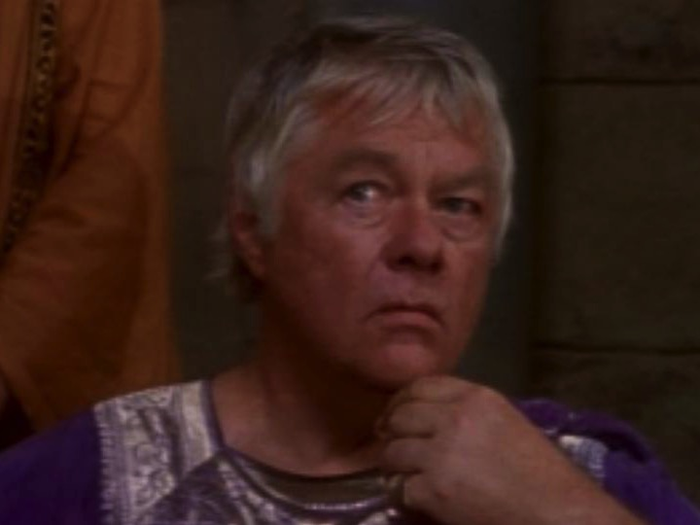
Acts 20–28
Dr. Rick Griffith • Jordan Evangelical Theological Seminary • BibleStudyDownloads.org
Notes:
Ascension: Angels said

Slide 2
Key Word
56
39
Sovereignty II
Acts

Slide 3
Theme
23
Universal Savior Proclaimed in Sovereign Kingdom Progress
Acts

Slide 4
Key Verse
56
"But you will receive power when the Holy Spirit comes on you; and you will be my witnesses in Jerusalem, and in all Judea and Samaria, and to the ends of the earth" (1:8).
Acts

Slide 5
Summary & Application
Acts
120
Summary Statement
The reason to witness everywhere is because God has directed the progress of the kingdom message to all people since early church history
Application
How is God extending his kingdom message through you?
How are you fitting into His overall purpose to spread the gospel throughout the entire earth?

Slide 6

Kingdom Statement
27b
The kingdom message expands from its reception by Jews in Jerusalem (1:1–6:7) to Judeans and Samaritans (6:8–8:40) to Gentiles in Rome (chaps. 9–28) in many “progress reports” (2:47; 6:7; 8:40; 9:31; 12:24; 16:5; 19:20; 28:30-31; also possibly 2:41; 4:31; 5:42; 8:25, etc.) to show believers that God will grow his church, not man.
Acts

Slide 7
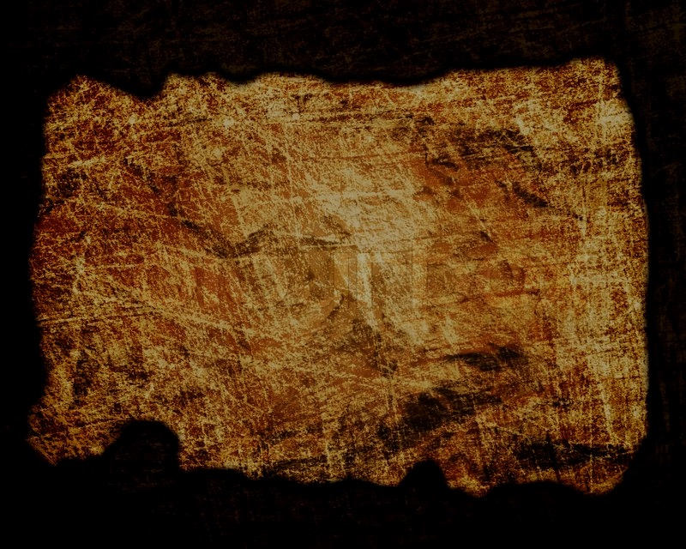
Covenant
27b
Jesus has sent the Holy Spirit to form the church (1:8; 2:14-18, 33, 38-39; 10:44-47), so believers should repent and be baptized to join this new covenant community called the church (2:21, 38; 3:19; 10:43, 47-48; 17:30; 26:20).
Acts

Slide 8
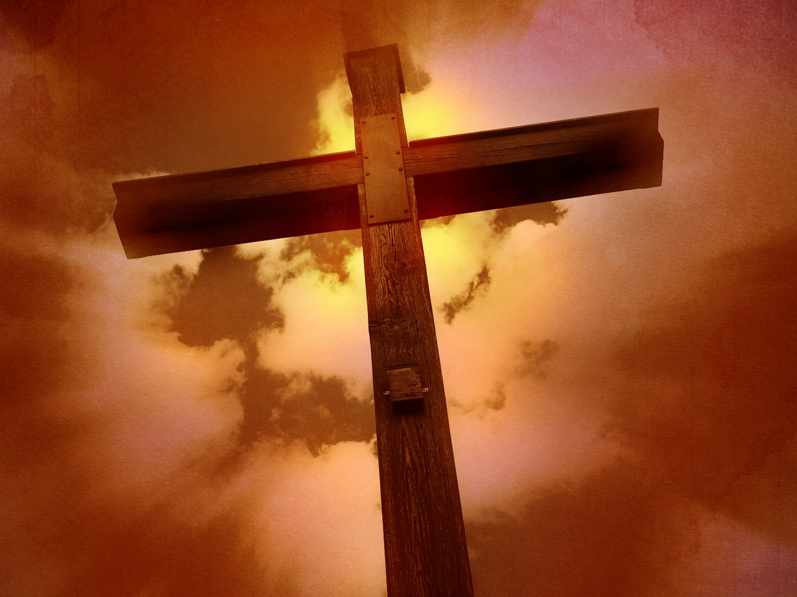
Redemption
27b
The universal appeal for salvation through the gospel is stressed (1:8; 28:30-31) in this book that records over 80 geographical locations–more than any other New Testament book.
Acts

Slide 9
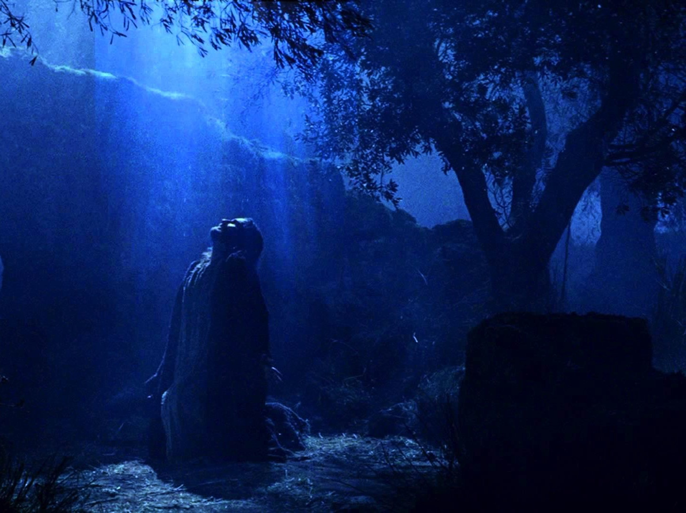
Prophecy
(Lord, Deity)
27b
Jesus fulfilled the OT prophecies (2:30; 3:19, 24; 10:43; 26:6-7, 22), especially in his miracles (2:22; 10:38), death according to God’s purposes (2:23; 3:13-15, 18; 4:11; 10:39; 26:23), resurrection (2:24, 31-32; 3:15, 26; 10:40-41; 17:31; 26:23), and exaltation to God’s throne as Lord (2:25-29, 33-36; 3:13; 10:36) until he returns (3:20-21; 10:42; 17:31; cf. NTS, 137).
Acts

Slide 10
Book Chart (Top)
Acts
120
Universal Savior Proclaimed in Sovereign Kingdom Progress
Jerusalem
Judea and Samaria
Uttermost Part
1:1–6:7
6:8–8:40
Chapters 9–28
Jews
Samaritans
(mixed breeds)
Gentiles
AD 33-35
(2 years)
AD 35
(a few months)
AD 35-62
(27 years)

Slide 11
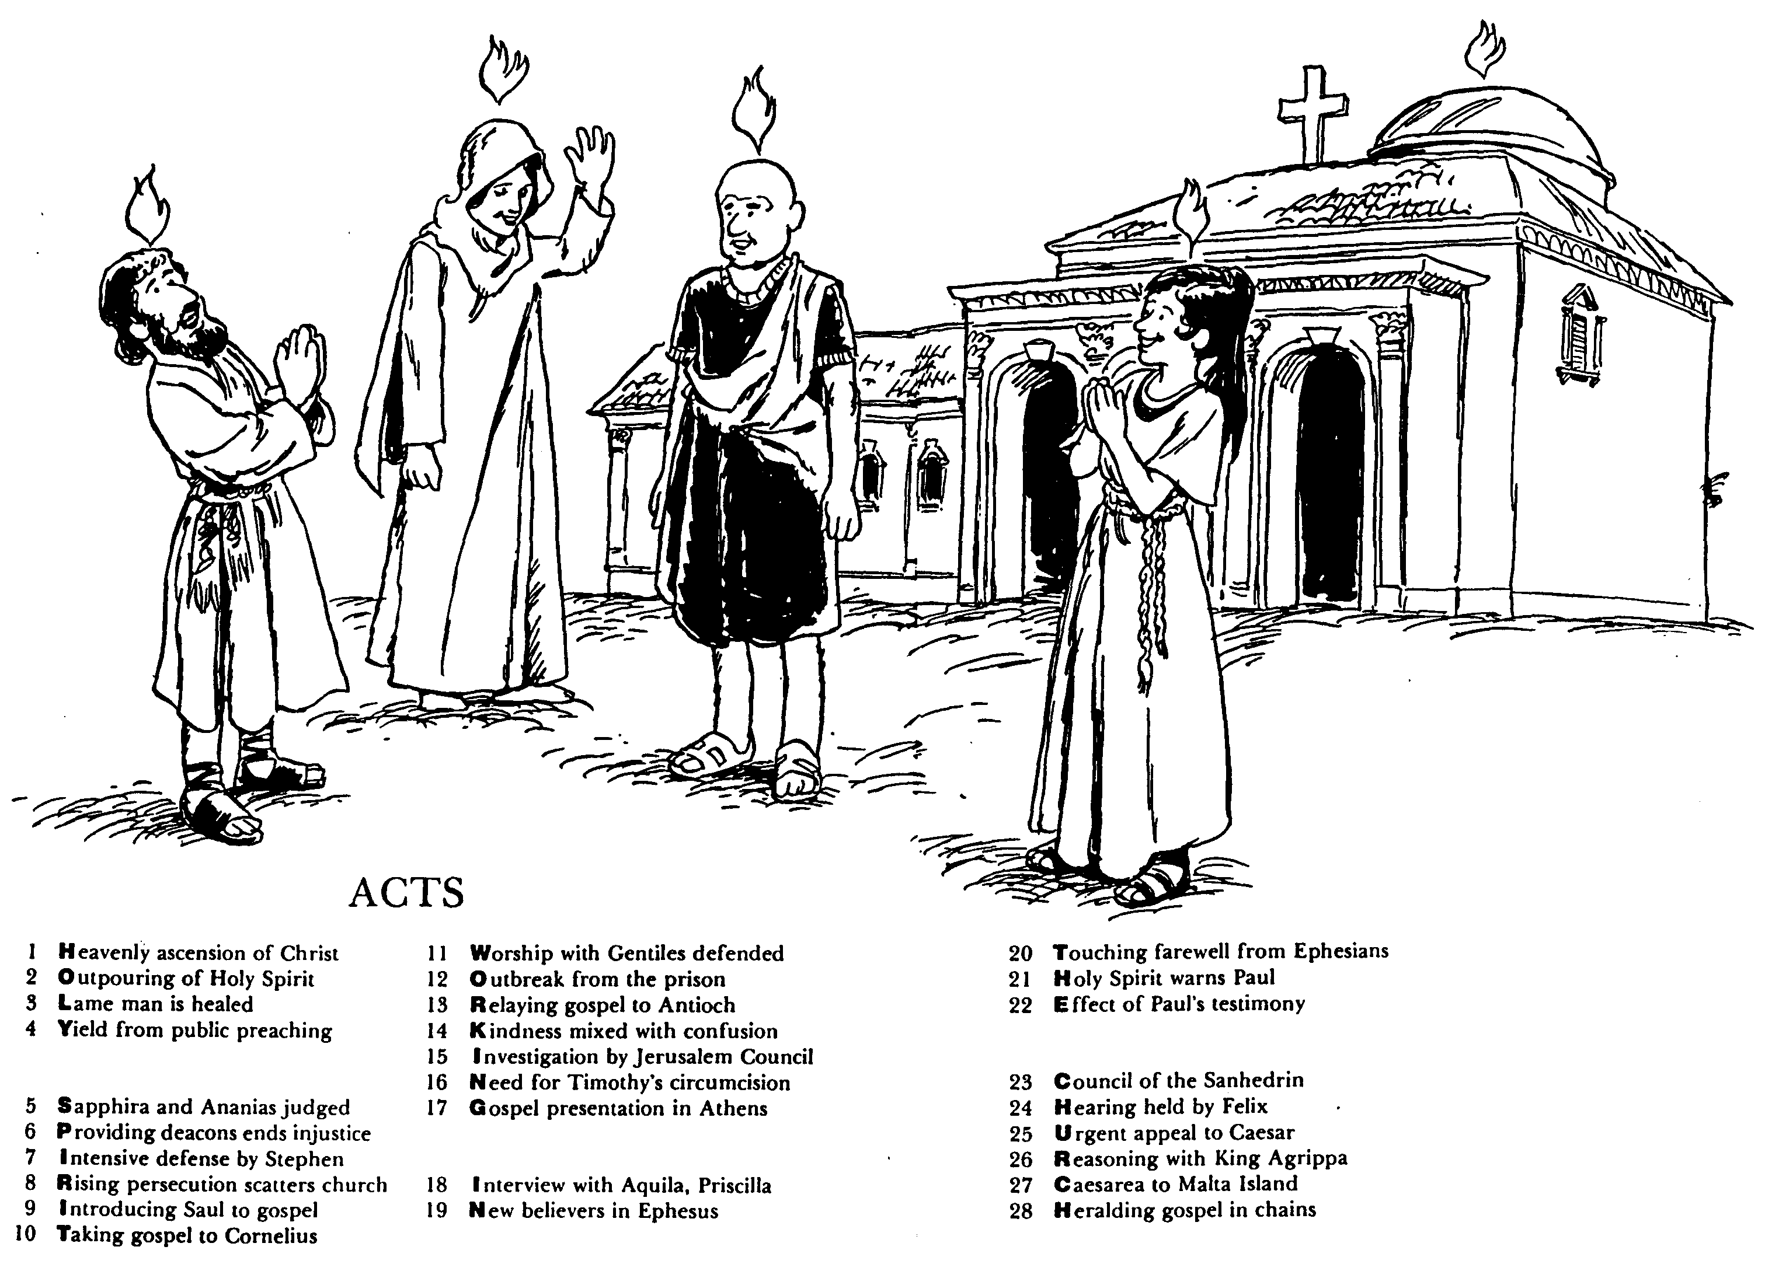

ACTS
Barry Huddleston, The Acrostic Bible
1 基督被接升天
2 圣灵的浇灌
3 瘸腿的人得治愈
4 群众讲道的结果
5 撒非拉和亚拿尼亚被审判
6 拣选执事解决不义
7 司提反强烈的申辩
8 教会受逼迫而分散
9 扫罗接受福音
10 福音传给哥尼流
11 辩解与外族人同赞美
12 逃出监狱
13 福音传到安提阿
14 慈爱与混乱混合了
15 耶路撒冷会议调查
16 对提摩太的割礼的需要
17 在雅典的宣教
18采访与亚居拉，百基拉
19 在以弗所的新信徒
20 以弗所的感人告别
21 圣灵警告保罗
22 保罗见证带来的后果
23 公议会的会议
24 在腓力斯前受审
25 向凯撒的迫切上诉
26 与亚基帕王辩解
27 从该撒利亚到马尔他岛
28 Translation

Slide 12

Be Witnessing
Acts
Dr. Rick Griffith • Crossroads International Church Singapore
BibleStudyDownloads.org

Slide 13
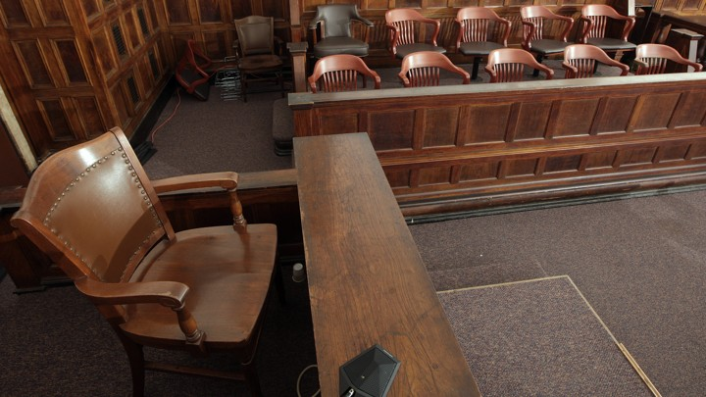
The Witness Stand
Acts
Notes:
It’s not hard to witness to what you have seen—

Slide 14
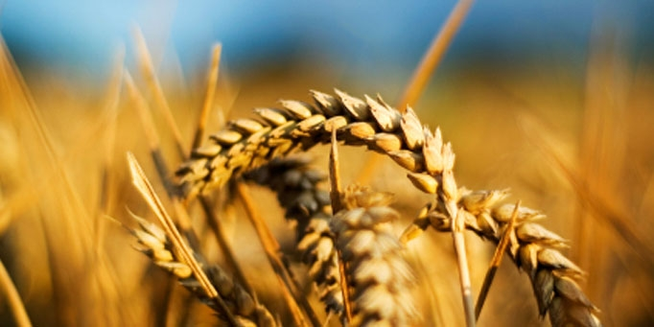
Why should we be witnessing?
3 reasons
Acts
Notes:
Today we’ll see three reasons we should witness for Jesus. Each is actually a stage of growth.
We will survey the entire book of Acts.
(So back to our question: Why should we witness?)

Slide 15
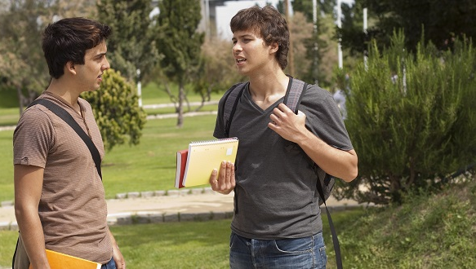
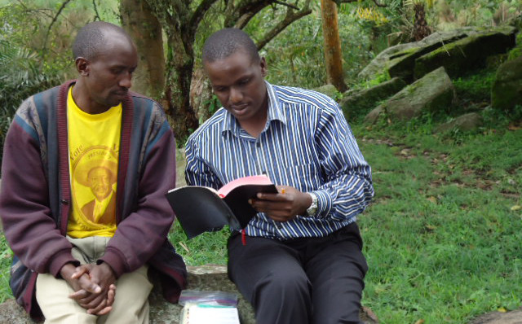
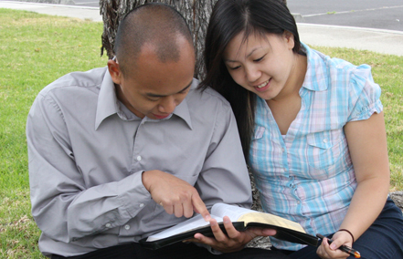
I. God has gone ahead of us so we can begin where we are (Acts 1:1–6:7).
Notes:
God helps us first tell others about Jesus where it is natural without crossing cultures.

Slide 16
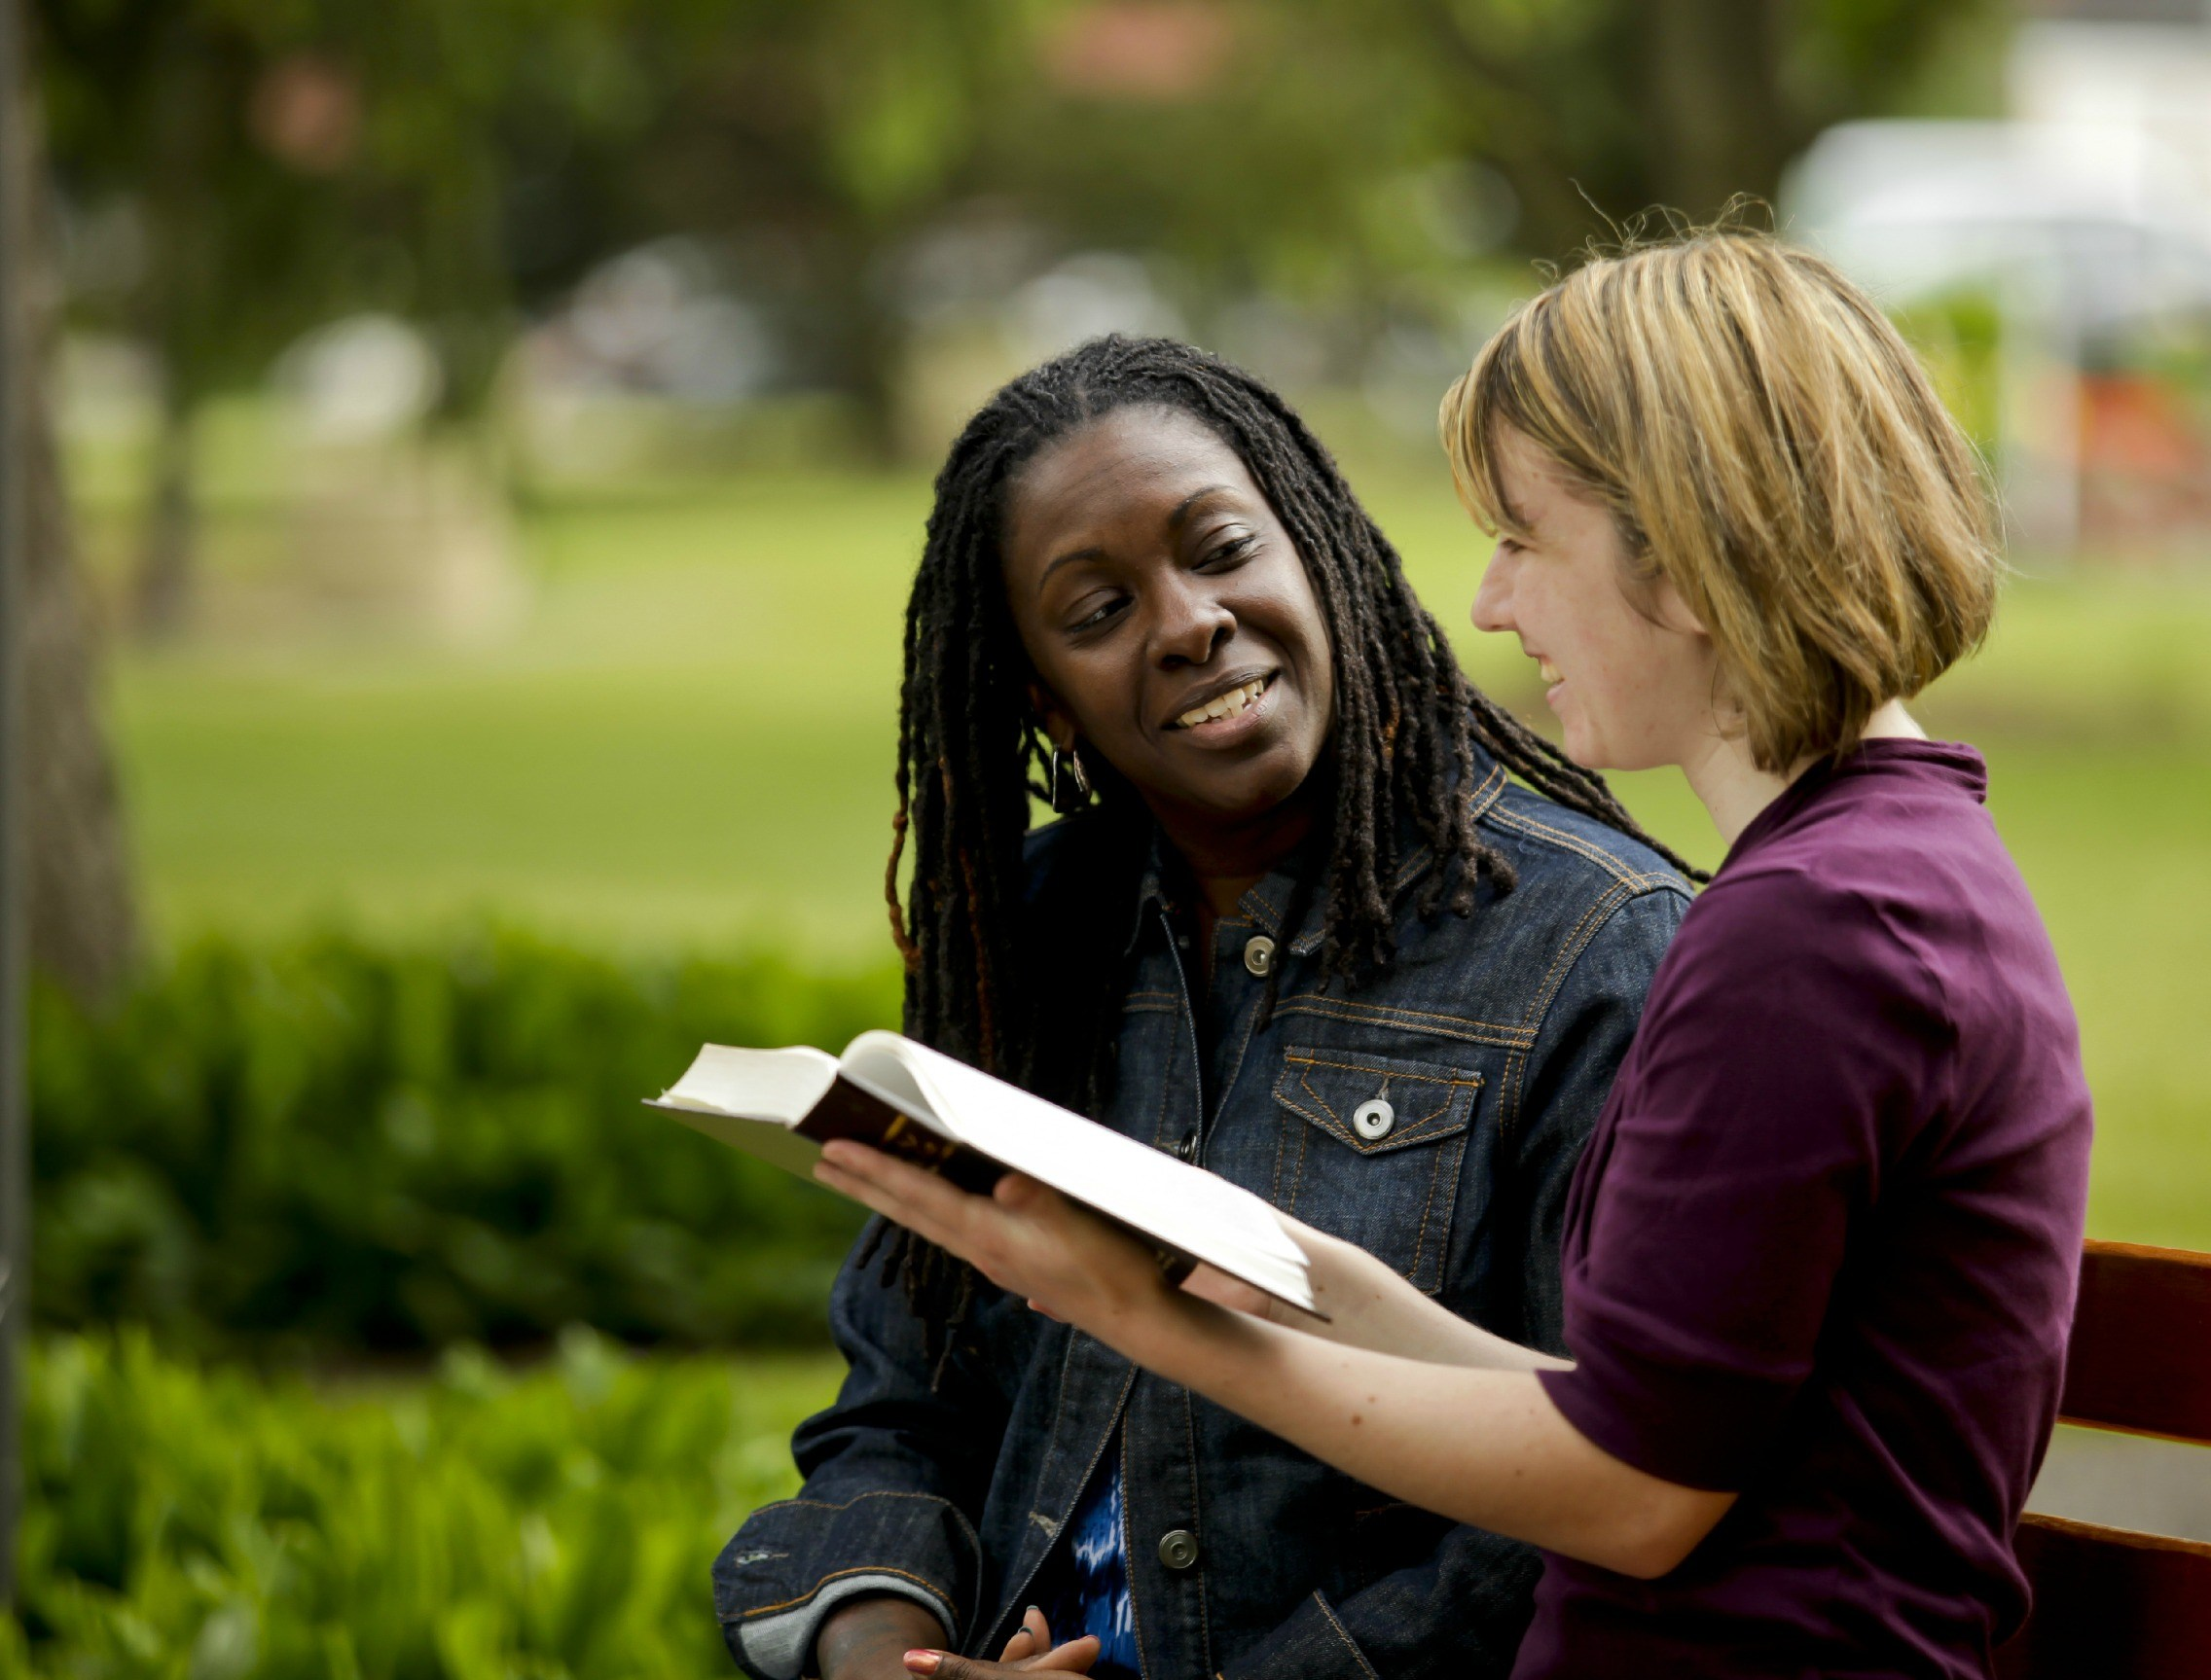
II. God gets the glory when we witness outside our comfort zone (Acts 6:8–8:40).
Notes:
God is honored when we share about him with those who are not familiar.

Slide 17
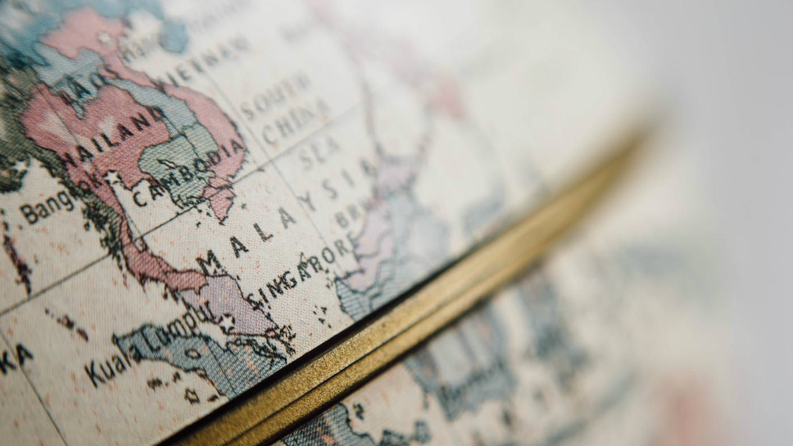
III. God will use us to spread the kingdom to the last unreached place (Acts 9–28).
Notes:
He promises that we will eventually witness in the final unevangelized place on earth.

Slide 18
Main Idea of the Book
Be part of God’s plan to bring the kingdom message to all people.
Acts
Notes:
Do what the Lord has designed for you to do so his rule extends to everyone though your life!

Slide 19

What is your role in God’s plan that he started in early church history?
Acts

Slide 21
Slides on
Acts 20
Notes:
God extended the kingdom message to Roman rulers even in Rome itself (19:21–28:31).

Slide 22
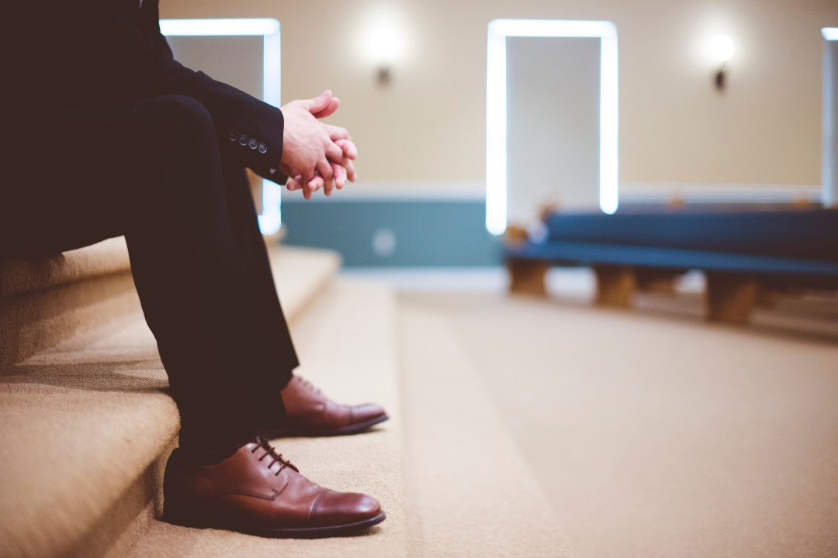
Elder Roles
Acts 20
Dr. Rick Griffith • Singapore Bible College • BibleStudyDownloads.org
• Crossroads International Church Singapore • CICFamily.com

Slide 23
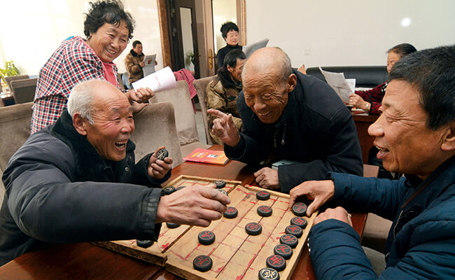
—Elders—
Notes:
Today we address elders. No—not the old folks who play games—

Slide 24
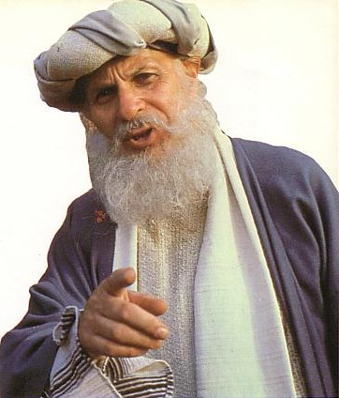
—Elders—
Notes:
—but the main leaders of the local church.

Slide 25
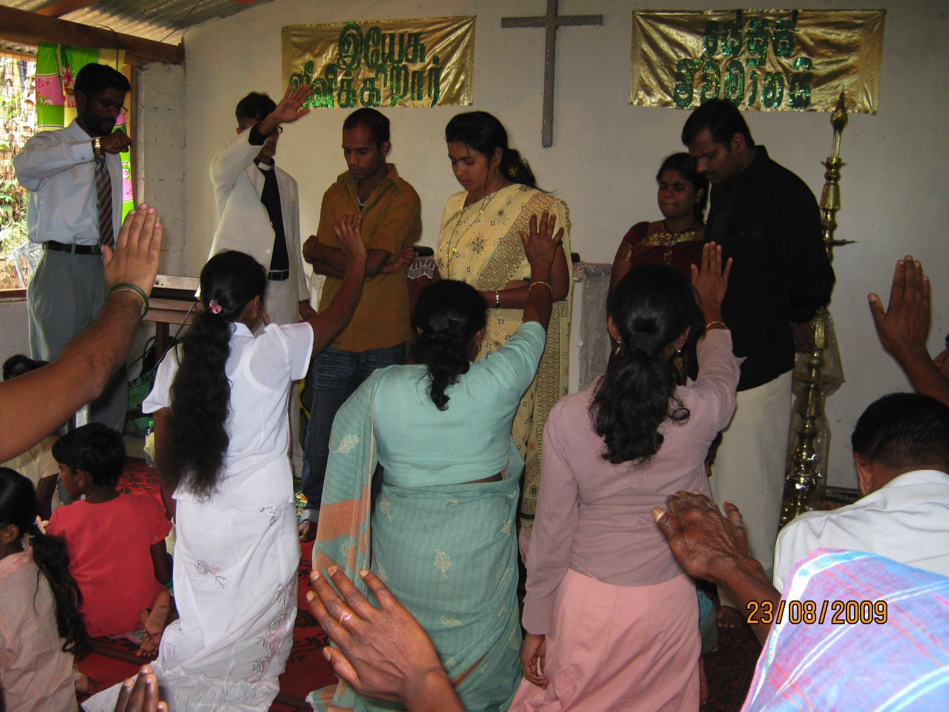
What are elders supposed to do?
Notes:
But Christians differ on what elders should do.
Some believe that all the elders do is serve communion.
Others think elders only carry on church traditions.
Elders sign papers and checks in the minds of others.
Some believe that elders function to give the impression to the congregation that the church isn't a "one-man show."

Slide 26
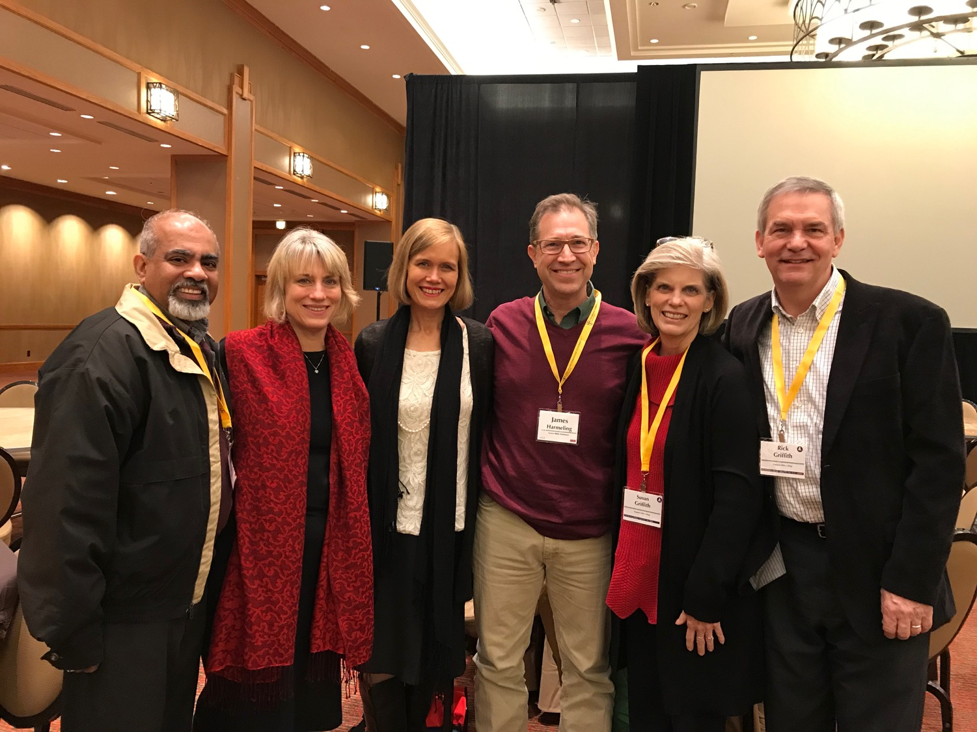

Our Church
Our elders & wives
Notes:
Need: Here is the latest picture of our elders and their wives. Do you know what elders are supposed to do?
Can you name one Scripture on elder duties?
We have no excuse to be ignorant of elder roles since the NT addresses the issue many times.

Slide 27

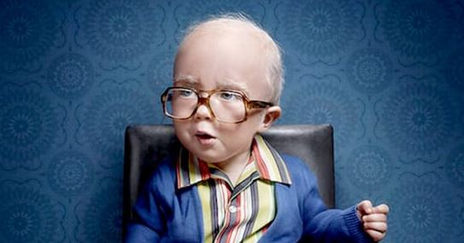
Who are you older than?
Notes:
But you say, “Nice that this message doesn’t apply to me! I can catch up on my sleep!” No, what we will see today does not only apply to elders. Each of us is older than someone else who looks up to us—so think of those who look to you, no matter how old you are. Let’s shepherd the flock we each have under our care—whether the whole church as elders, or our families, or friends.

Slide 28
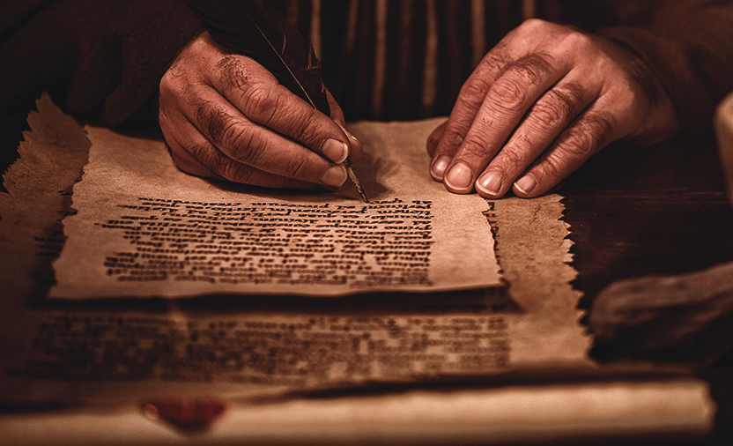
Background
What are elders supposed to do?
Notes:
Subject: So what are elders supposed to do?

Slide 29
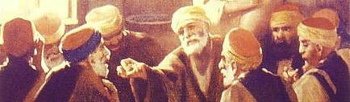
The biblical pattern is church leadership by elders.
236a
Notes:
Elders Background: Elders have been around for millennia.

Slide 30
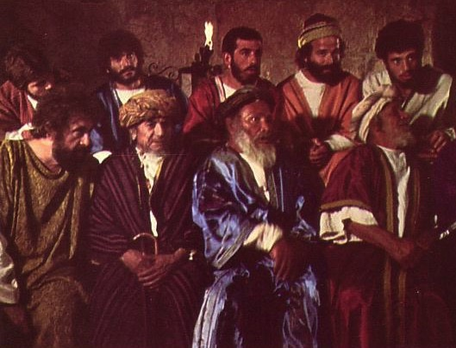
Elders led from the time of Moses
48
Elders
led with
Moses
1400 BC
“Go, assemble the elders of Israel and say to them…”
(Exod. 3:16)
Notes:
Moses had elders in 1400 BC (Exodus 3:16).

Slide 31
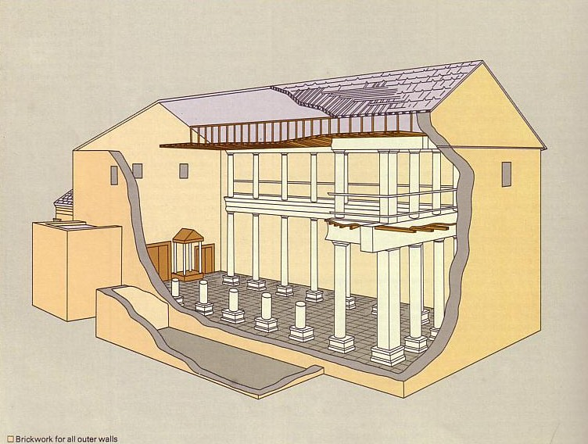
Who Led the Synagogue?
51
Elders
led with
Moses
1400 BC
Elders
led
Synagogues
600 BC
Notes:
Synagogues were led by elders from 600 BC to Jesus.

Slide 32
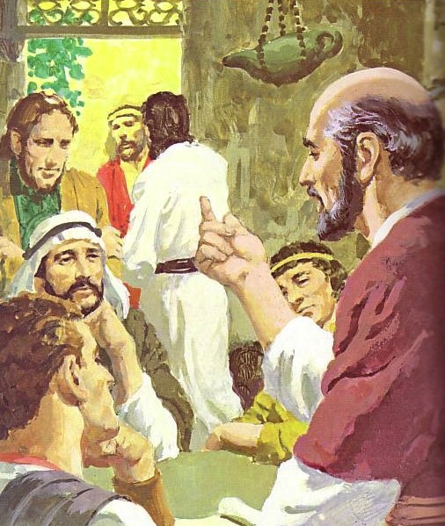
God has advocated group leadership through the ages
55
Elders
led with
Moses
1400 BC
Elders
led
Synagogues
600 BC
NT
Elders
Notes:
Each NT church was led by elders.

Slide 33
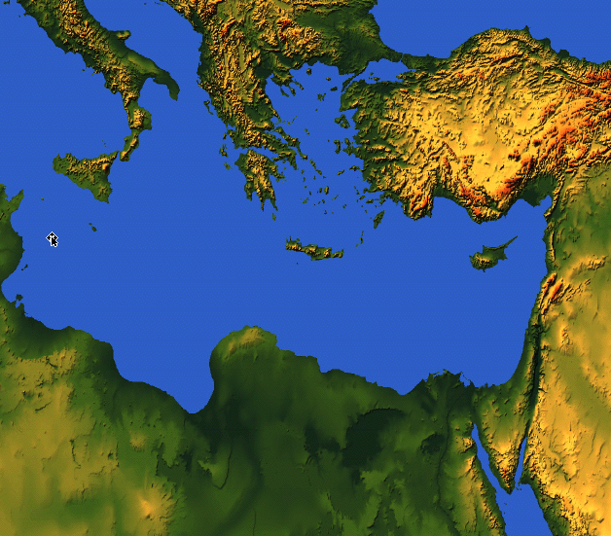
Places Mentioning Elders
elders = overseers = bishops = pastors
55
Jerusalem (AD 47):
NIV Acts 11:30 This they did, sending their gift to the elders by Barnabas and Saul.
Ephesus (AD 57):
NIV Acts 20:17 From Miletus, Paul sent to Ephesus for the elders of the church.
Galatia (AD 48):
NIV Acts 14:23 Paul and Barnabas appointed elders {or Barnabas ordained elders; or Barnabas had elders elected} for them in each church
Crete (AD 66):
NIV Titus 1:5 The reason I left you in Crete was that you might straighten out what was left unfinished and appoint {or ordain} elders in every town, as I directed you.
Philippi (AD 62):
NIV Philippians 1:1 Paul and Timothy, servants of Christ Jesus, To all the saints in Christ Jesus at Philippi, together with the overseers and deacons:
Pontus, Galatia, Cappadocia, Asia & Bithynia (AD 64)
NIV 1 Peter 5:1 To the elders among you, I appeal as a fellow elder… (cf. 1:1)
Notes:
Every NT church had elder leadership—whether Jewish, Gentile, or mixed—whether in Israel or modern-day Turkey or Greece or the Mediterranean Island of Crete.

Slide 34
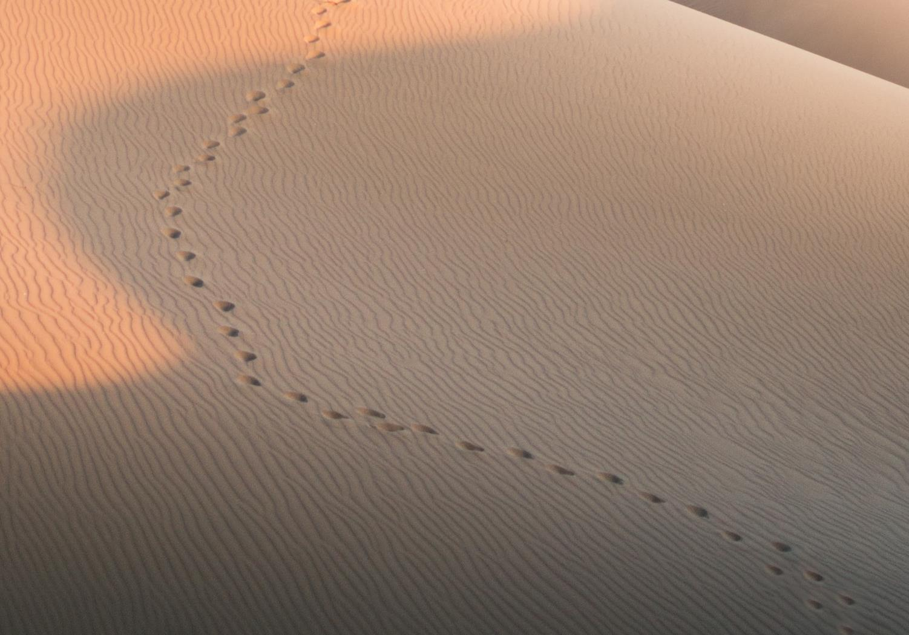
GOOD NE WS
ON THE MO VE
God’s work through the early church in
Acts
Notes:
Acts Background: Paul modeled the elder lifestyle before he preached it to others in Acts where the Good News was on the Move.

Slide 35
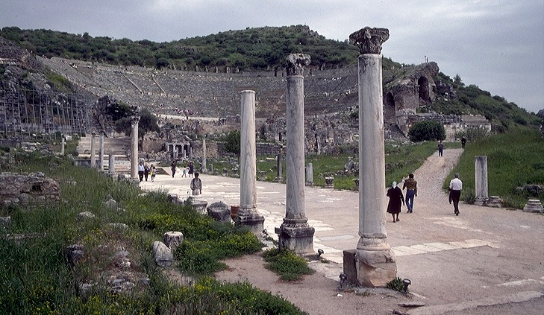
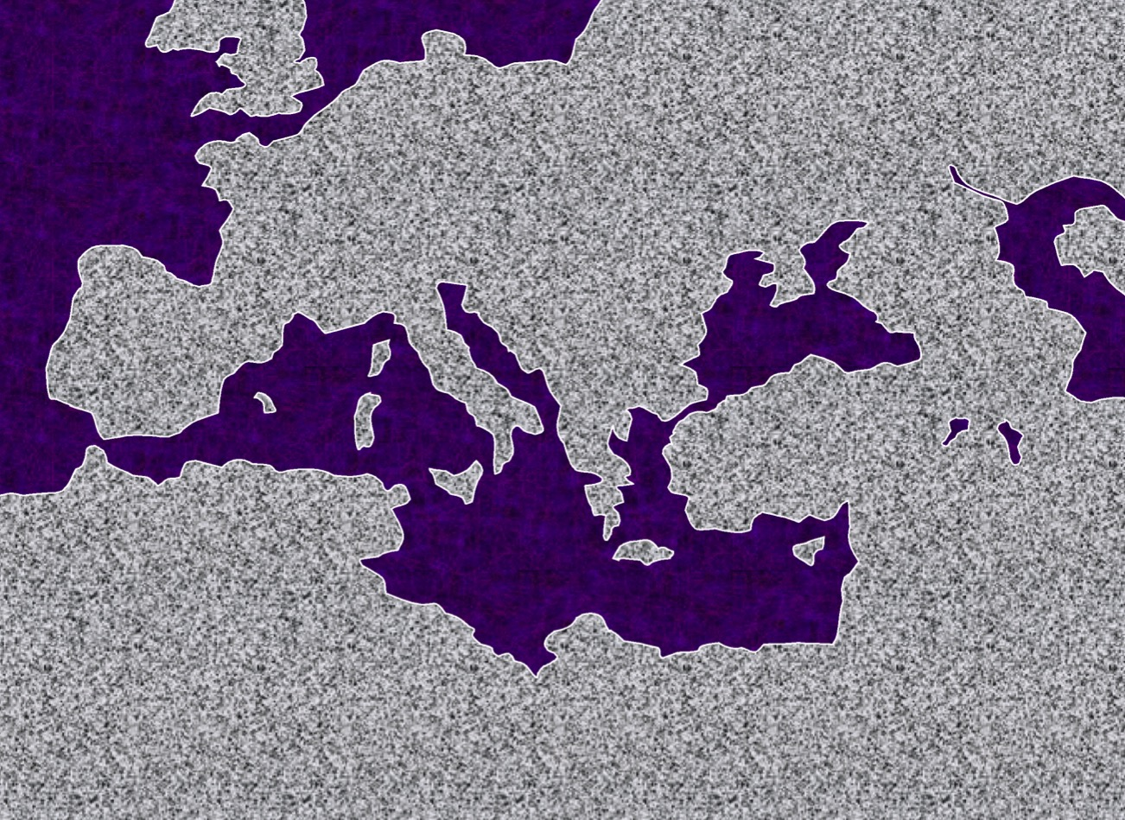
3."The Asian Thrust"
A.D.
53-57
ATLANTIC OCEAN
EUROPE
ANCIENT EPHESUS
ROME•
•Macedonia
ASIA
•Pisidian Antioch
•
•Ephesus
AFRICA
Athens
Acts 18-21
•Syrian Antioch
MEDITERRANEAN SEA
3.The Asian Thrust"
•Jerusalem
Significance: extended time at the church in Ephesus; young man raised from the dead; important letters written; riot with Ephesian artisans at amphitheatre.
ARABIA
9.65.08.
45
4
© 2006 TBBMI
9.65.08.
Notes:
Paul had previously ministered in the Ephesian church for nearly three years (Acts 19; 20:31).
Then came Paul's ASIAN THRUST…recorded in Acts 18-21.
//// Again, this trip began overland from Syrian Antioch…revisited many of the earlier churches…made a horseshoe-shaped route around the Aegean, back down into Greece, retraced that route back around the horseshoe, remaining at Troas, then returning by sea to Syrian Antioch.
//// Paul spent a very long time living and ministering to the church the EPHESUS. Luke reports that Paul raised a young man from the dead in Ephesus. Many important letters –– our Epistles –– were written from Ephesus.
//// One of the most dramatic events recorded for us took place at the Ephesian AMPHITHEATRE where he confronted the souvenir makers of the city…those who manufactured small idols of the Goddess Diana, whose temple in Ephesus was one of the seven wonders of the ancient world.
//// LENGTH OF THIS TRIP: ALMOST FIVE YEARS BETWEEN A.D. 53 AND 57.

Slide 36
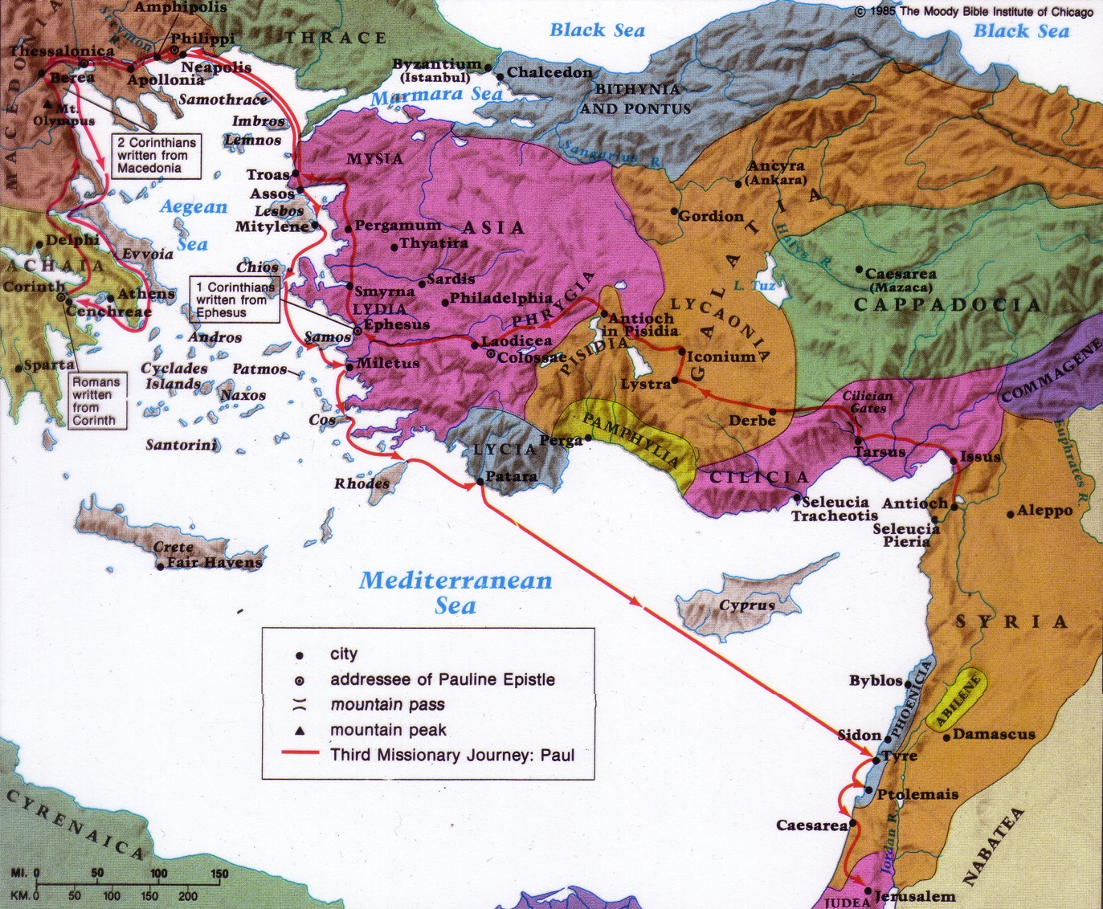
Paul's Third Missionary Journey
140
EPHESUS
Paul taught in Ephesus "for two years, so that all of Asia heard the word of the Lord" (Acts 19:10)
Notes:
He then ministered in Macedonia and Greece and Troas and coastal towns near Ephesus (20:1-15).
Paul stopped by the coastal town of Miletus while traveling to Jerusalem at the end of his third missionary journey (Acts 20:16,17a).
Knowing that he would soon die (20:25), Paul requested the Ephesian elders to come to him to hear his parting words (17b-18a).

Slide 37
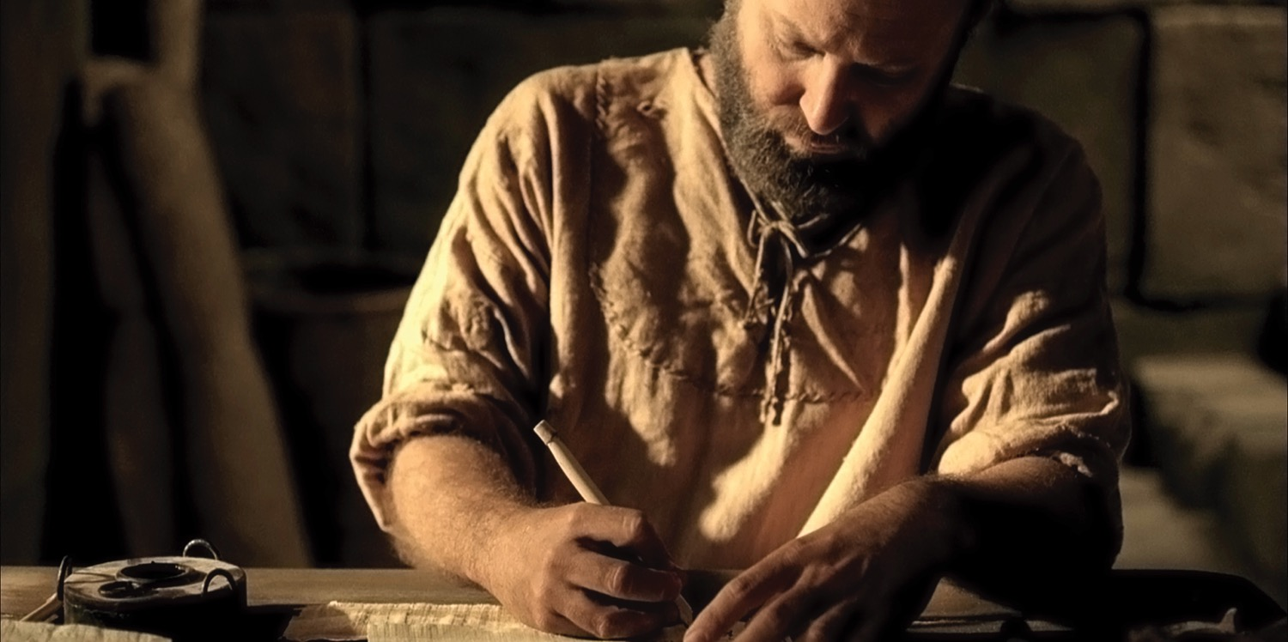
The Apostle Paul
(Acts 20:18b-35)
Notes:
Preview: In our text today from Acts 20:18b-35, Paul shows first how he modeled being an elder and then what the elders were specifically supposed to do.
Text: Today we will observe Paul's example and instructions to elders concerning their job description found in Acts 20:18b-35.
(Paul knew that the success of the church at Ephesus would rest upon the faithfulness of the men who led the flock. But before charging the men with their responsibilities, Paul elaborated on his own life as an example.)

Slide 38
Paul modeled shepherding for the elders
(Acts 20:18b-27).
Presence
—where he was
(18b)
Passion
—what he
felt
(19)
Proclamation
—what he preached
(20-21)
Persecution
—where he was going
(22-23)
Priorities
—what he valued
(24-27)
Notes:
[He knew that more is caught than taught—so he set an example of care for them.]
A. Paul cared like an elder in his past ministry at Ephesus (18b-21).
1. Paul cared by his presence—where he was (18).
a) I once knew an elder who resigned due to the increased traveling responsibilities of his job. Through this he actually showed his commitment to the men.
b)As elders we must be available men.
2. Paul cared in his passion—what he felt (19).
a) He lived in brokenness.
b) He endured many trials that came with caring for people.
3. Paul cared in his proclamation—what he preached (20-21).
a) We must teach the basics: repentance towards God and faith in Christ.
b) Elders must not neglect evangelism.
B. Paul cared like an elder in his present situation (22-27).
1. Paul cared despite persecution—where he was going (22-23).
2. Paul cared by his priorities—what he valued (24-27).
(In light of Paul’s example, what specifically should elders do? He gives the Ephesian elders [and us] his charge in the following verses.)

Slide 39
Elders should follow Paul’s shepherding example (Acts 20:28-35).
236c1
Administration
(Serve, care for & testify)
Teaching
1 Tim. 3:2; 5:17; Acts 20:28d
1 Tim. 3:1, 4-5; 5:17; Acts 20;28c
Pastor-Teacher
Episkopos =
Epi “over” +
skopos “look” =
“watch over”
Eph. 4:11
Pastoring
(Protect & Lead)
1 Pet. 5:1-4
Acts 20:28a-b, 29, 35
1 Thess. 5:12

Slide 40
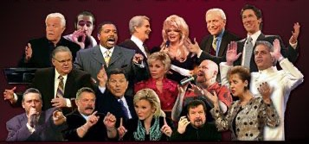
External False Teachers
Acts 20:29
Notes:
God hates false teaching, and we must hate what God hates.

Slide 41

Opposition
External
Notes:
God is truth—so whatever is not true cannot be allowed into the church.

Slide 42
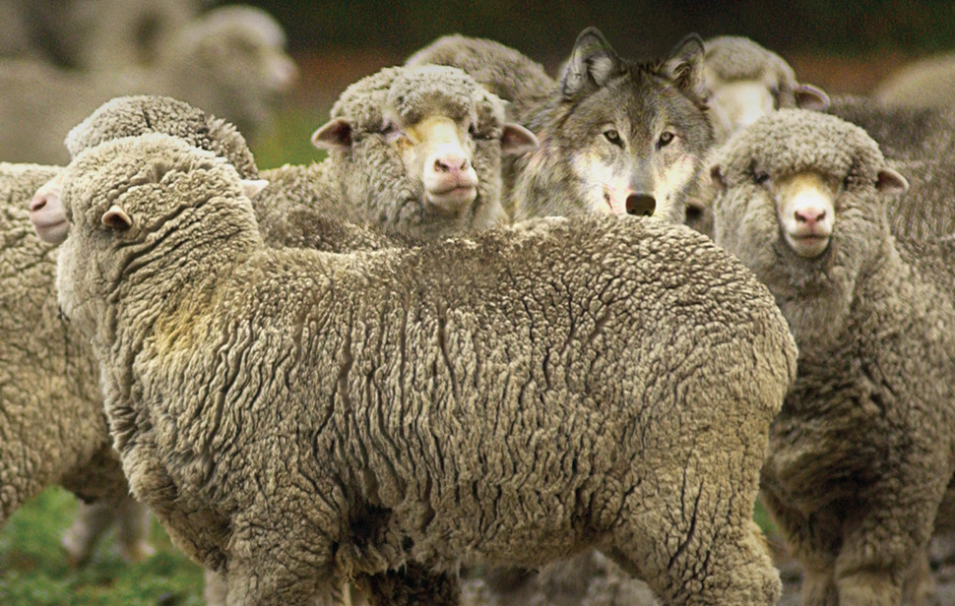
Internal False Teachers
Acts 20:30
Notes:
Sadly, too many churches have wolves right there among the sheep.

Slide 43

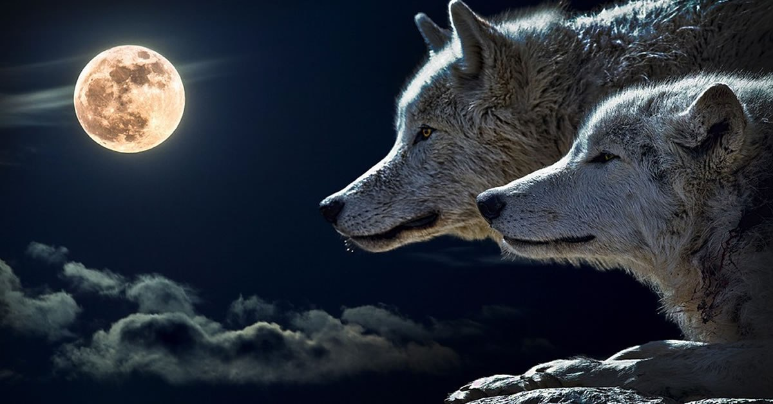
Black
Notes:
But these wolves often wear suits.

Slide 44
Opposition
External
Internal
Notes:
Sadly, too many churches have wolves right there among the sheep.
Let's warn a factious (heretical) man only twice before we expel him from the body (Tit 3:10-11).

Slide 45
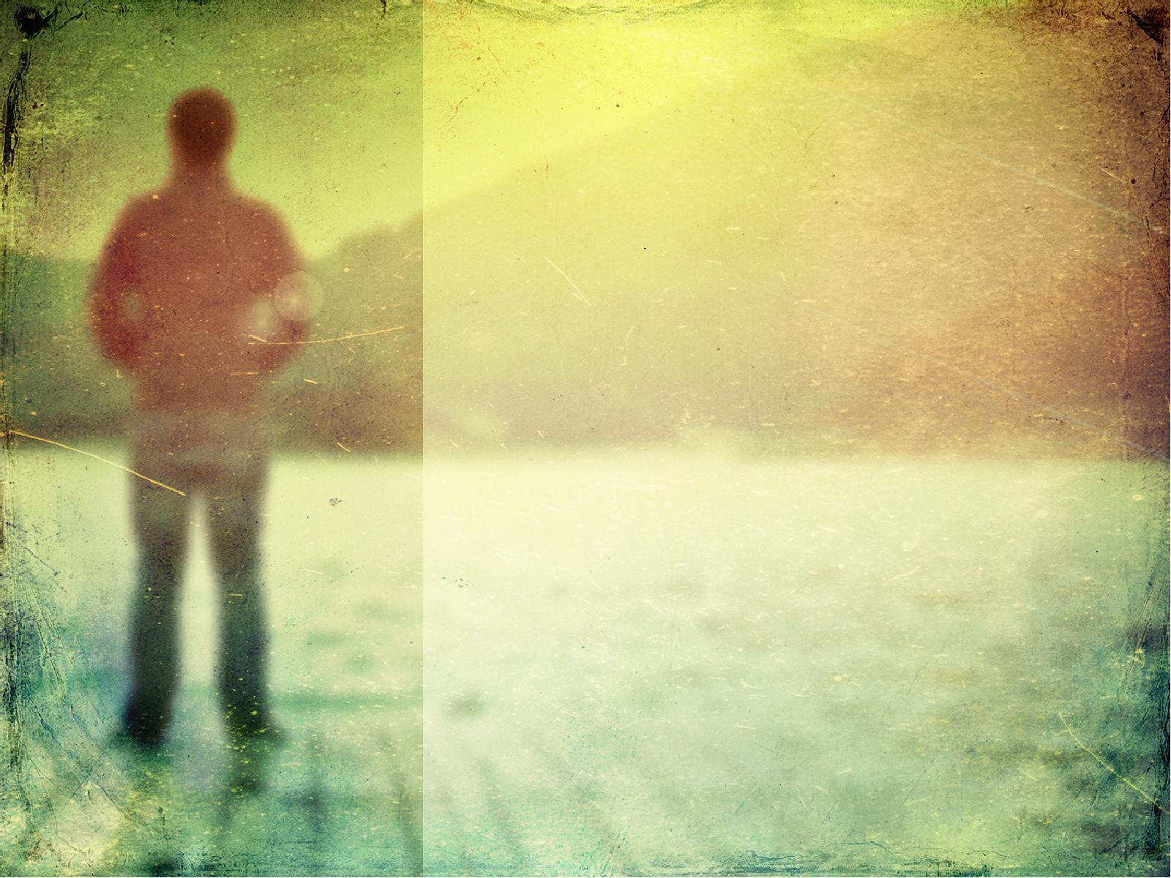
Elders must serve selflessly (Acts 20:32-35).
Founded on God’s grace and Word (32).
Based on hard work instead of greed (33-35).
Notes:
Be careful how others interpret the way we spend our money to avoid showing covetousness or greed (33-34a).
Set an example for the church in selfless giving (34b-38).

Slide 46
What are elders supposed to do?

Slide 47
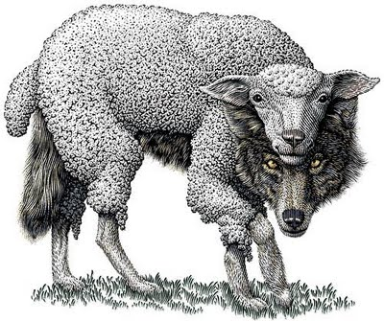
Main Idea of Acts 20
Elders should be selfless shepherds against false teachers

Slide 48
Watch
Paul
Mimic
Paul

Slide 49
What About You?
How can you better shepherd the flock under your care—whether the whole church as elders, or your family or friends?
Notes:
Acts 20 actually applies to us all.

Slide 50
Paul modeled shepherding for the elders
(Acts 20:18b-27).
Presence
—where he was
(18b)
Passion
—what he
felt
(19)
Proclamation
—what he preached
(20-21)
Persecution
—where he was going
(22-23)
Priorities
—what he valued
(24-27)
Notes:
[He knew that more is caught than taught—so he set an example of care for them.]
A. Paul cared like an elder in his past ministry at Ephesus (18b-21).
1. Paul cared by his presence—where he was (18).
a) I once knew an elder who resigned due to the increased traveling responsibilities of his job. Through this he actually showed his commitment to the men.
b)As elders we must be available men.
2. Paul cared in his passion—what he felt (19).
a) He lived in brokenness.
b) He endured many trials that came with caring for people.
3. Paul cared in his proclamation—what he preached (20-21).
a) We must teach the basics: repentance towards God and faith in Christ.
b) Elders must not neglect evangelism.
B. Paul cared like an elder in his present situation (22-27).
1. Paul cared despite persecution—where he was going (22-23).
2. Paul cared by his priorities—what he valued (24-27).
(In light of Paul’s example, what specifically should elders do? He gives the Ephesian elders [and us] his charge in the following verses.)

Slide 51
Elders should follow Paul’s shepherding example (Acts 20:28-35).
236c1
Administration
(Serve, care for & testify)
Teaching
1 Tim. 3:2; 5:17; Acts 20:28d
1 Tim. 3:1, 4-5; 5:17; Acts 20;28c
Pastor-Teacher
Episkopos =
Epi “over” +
skopos “look” =
“watch over”
Eph. 4:11
Pastoring
(Protect & Lead)
1 Pet. 5:1-4
Acts 20:28a-b, 29, 35
1 Thess. 5:12

Slide 52
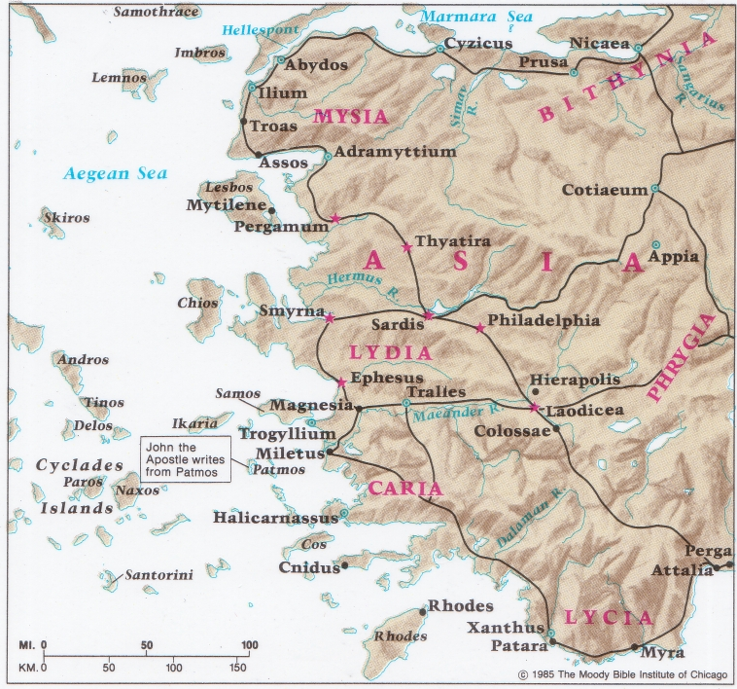
Churches of Western Asia Minor
140
Beitzel, Moody Atlas of Bible Lands, 184

Slide 53
Slides on
Acts 21

Slide 54
THE
FOR
NEED
PROPHECY
Acts 21:1-16
Preached by Matthew Lyle
at Crossroads International Church Singapore • CICFamily.com
Uploaded by Dr. Rick Griffith • Jordan Evangelical Theological Seminary
Files in many languages for free download at BibleStudyDownloads.org
Notes:
In acts 21:1-16 we will see various prophecies revealed through various people. As we study these passages we need to ask ourselves
Why did God reveal this prophecy?
What response did he intend to elicit?

Slide 55

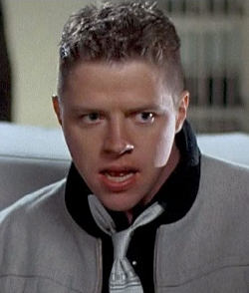

Notes:
If you knew the future, what would you do?
In the movie “Back to the Future Part 2” the bad guy, Biff Tannen, travels back in time to give his younger self a sports almanac. He tells his younger self that
This book tells the future.
This book tells the results of every major sports event till the end of this century

Slide 56
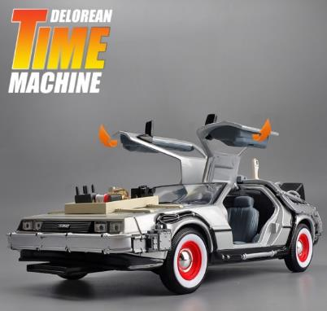

$37.19
Notes:
Is knowing the future only possible in the movies?
You can’t just go and buy a time machine can you?
Well, it is available on Shopee for just $37.19.

Slide 57

PROPHECY
A divine message mediated through an individual that is directed at a person or people group and intended to elicit a specific response.
Notes:
Today we are going to see that it is possible to know something about the future.
Today we are looking in Acts 21 and we will see that the Apostle Paul knows something about the future.
How does Paul know about the future when he does not have a DeLorean Time Machine?
The answer is through Prophecy!
The Lexham Bible Dictionary defines prophecy as . .

Slide 58
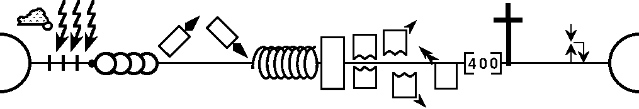
A “Divine” Message
Deuteronomy
Gospels –
Acts 1
Genesis
12-50
1 Samuel
Leviticus
2 Samuel
Nehemiah
Numbers
1 Kings
2 Kings
Exodus
Joshua
Judges
Genesis 1-11
Ruth
Ezra
Esther
1990+
Max Anders, Dallas Theological Seminary
Notes:
Why does prophecy have to be a divine message? Because only a divine God is able to stand outside of time and see the beginning and the end at the same time.
Here is a biblical timeline of history created by Max Anders. If you look in the notes, there are more details about each of the symbols. Basically, this timeline goes from the beginning (eternity) to the end (eternity).
You can take the historical books of the Old Testament and align them with the timeline.
The can also show the entire New Testament on the timeline. The gospels and Acts 1 are represented by the cross, when Christ was on the earth.

Slide 59
A “Divine” Message
Deuteronomy
Gospels –
Acts 1
Genesis
12-50
1 Samuel
Acts 2 –
Rev 3
Leviticus
2 Samuel
Nehemiah
Numbers
Rev 4-19
Exodus
Joshua
Judges
1 Kings
2 Kings
Rev 20-22
Genesis 1-11
Ruth
Ezra
Esther
You Are Here
1990+
Max Anders, Dallas Theological Seminary
Notes:
Acts 2 all the way through Revelation 3 are the 1,990+ years that the Church has been on the earth. That is where we are right now.
The next major event in biblical history will be the rapture and 7 year tribulation period, which you can read about in Rev 4-19.
This is followed by setting up Christ’s kingdom as shown in Rev 20-22.

Slide 60
A “Divine” Message
Deuteronomy
Gospels –
Acts 1
Genesis
12-50
1 Samuel
Acts 2 –
Rev 3
Leviticus
2 Samuel
Nehemiah
Numbers
Rev 4-19
Exodus
Joshua
Judges
1 Kings
2 Kings
Rev 20-22
Genesis 1-11
Ruth
Ezra
Esther
Daniel
(exiled in Babylon)
1990+
²⁴ “A period of 70 sets of 7 has been decreed…”
²⁵ . . . 7 + 62 sets until the anointed one comes
Max Anders, Dallas Theological Seminary
Notes:
God, who stands outside of time, revealed prophecy to Daniel, when he was exiled in Babylon. This prophecy was for the entirety of God’s plan for history.
God also revealed to Daniel when the Messiah would come.
God, who stands outside of time, in the person of Jesus, referenced Daniel’s prophecy when answering the apostle’s questions about his return and the end of the world.
So you don’t need a time machine to know the future. You only need to have the God who stands outside of time to reveal His will, His plan.

Slide 61
PROPHECY
A divine message mediated through an individual that is directed at a person or people group and intended to elicit a specific response.
Notes:
When God chooses to reveal His plan or His will it is intended to elicit a specific response.

Slide 62
THE
FOR
NEED
PROPHECY
Acts 21:1-16
Matt Lyle • Crossroads International Church Singapore
CICFamily.org
Notes:
In Acts 21:1-16 we will see various prophecies revealed through various people. As we study these passages, we need to ask ourselves
Why did God reveal this prophecy?
What response did he intend to elicit?

Slide 63

GOOD NE WS
ON THE MO VE
God’s work through the early church in
Acts
Notes:
We are continuing in our series called Good News on the Move, God’s work through the early church in Acts.
In the previous 19 sermons we have seen a lot of people on the move.
At the beginning of the book of Acts, we saw the church growing in Jerusalem, undergoing persecution, and spreading to Samaria.
As the book of Acts progressed, we are introduced to Saul, also known as Paul.

Slide 64
Timeline “Acts”
“To the remotest part of the earth” (Acts 1:8)
Acts 9 13 14 15 16 18 21 27 28
Apr 48-
Sep 49
1
Galatia
Apr 50-
Sep 52
2
Aegean
Spr 53-
May 57
3
Asia
Summer 35-
37
Damascus
Antioch
Fall 49
The
Council
Spring 68
Expansion of Church
35 48 49 50 52 53 57 60 62 67 68 95
Paul taught in Ephesus "for two years, so that all of Asia heard the word of the Lord" (Acts 19:10)
1234
Journeys
Notes:
This timeline shows the events in the second half of the book of Acts,
which is about God’s work spreading the Gospel through Paul.
Paul initially was persecuting the church. After encountering the Lord Jesus
on the road to Damascus, he became a follower of Christ,
and eventually a leader in a local church at Antioch.
The Holy Spirit led the elders at Antioch to
“Appoint Barnabas and Saul for the special work to which I have called them.”
This led to three missionary journeys which our teaching team has recently covered.
In his third Journey, Paul spent the last 2 years in 1 place, Ephesus.

Slide 65
²² “And now I am bound by the Spirit to go to Jerusalem. I don’t know what awaits me,
²³ except that the Holy Spirit tells me in city after city that jail and suffering lie ahead.
²⁴ But my life is worth nothing to me unless I use it for finishing the work assigned me by the Lord Jesus—the work of telling others the Good News about the wonderful grace of God”
(Acts 20:22-24 NLT).
Notes:
Two weeks ago, Pastor Rick, gave his final sermon at Crossroads, after spending 30 years in Singapore as he is moving on to Jordan. It is quite fitting that Pastor Rick’s final sermon covered Paul’s final interaction with the church at Ephesus.
These are key verses from that story that we need to keep in mind as we delve into chapter 21.
In these verses, Paul states that:

Slide 66
The Church at Tyre
(Acts 21:1-3)
“Having carefully investigated everything from the beginning, I also have decided to write an accurate account” (Luke 1:3 NLT)
Notes:
Looking at Acts 21, we see that Luke mentions a lot of places in this section.
We know Luke “carefully investigated everything from the beginning” (Luke 1:3 NLT). But Luke was not just an investigative reporter, he was part of the story. In several sections of the book of Acts, he is actually there with Paul.
Although he doesn’t call attention to this fact by naming himself, the grammar is clear by the use of the “we.” We reached Rhodes. We boarded a ship. We sighted the island of Cyprus. Of course, when you see Luke writing “we” in the text, there tends to be a lot of geographic detail.

Slide 67
The Church at Tyre
(Acts 21:1-3)
Miletus
COS
Patara
Rhodes
Cyprus
Phoenicia
Tyre
Notes:
Starting in vs 1, Luke writes that “¹ After saying farewell to the Ephesian elders (we know that was in Miletus)
we sailed straight to the island of COS. The next day we reached Rhodes and then went to Patara. ² There we boarded a ship sailing for Phoenicia.
³ We sighted the island of Cyprus, passed it on our left, and landed at the harbor of Tyre, in Syria, where the ship was to unload its cargo.

Slide 68
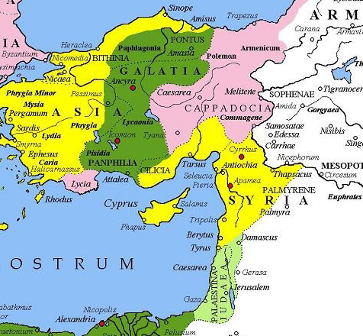
Roman
Provinces
Notes:
Luke uses Phoenicia and Syria interchangeably.
Generally, Phoenicia referred to the cities along the coast of what we now call Lebanon.
Syria was historically centered around Damascus.
However, the Roman Province of Syria included the cities of Phoenicia as well as Antioch (which would have been their ultimate destination as that is where they started their journeys.

Slide 69

“These believers prophesied through the Holy Spirit that Paul should not go on to Jerusalem” (NLT).
“And through the Spirit they were telling Paul not to go on to Jerusalem” (NIV).
Acts 21:4b
Notes:
As we continue reading, we see Paul receive his first specific warning not to go to Jerusalem.
⁴ We went ashore, found the local believers, and stayed with them a week. These believers prophesied through the Holy Spirit that Paul should not go on to Jerusalem. ⁵ When we returned to the ship at the end of the week, the entire congregation, including women and children, left the city and came down to the shore with us. There we knelt, prayed, ⁶ and said our farewells. Then we went aboard, and they returned home.
The ESV states that “through the Spirit they were telling Paul not to go on to Jerusalem.”
Does this statement contradict Acts 20:22 where Paul stated “And now I am bound by the Spirit to go to Jerusalem. I don’t know what awaits me”?
We know that Paul eventually goes to Jerusalem. Did Paul ignore or disregard the Holy Spirit?
It is not a contradictory statement and Paul does not ignore or disregard the Holy Spirit.

Slide 70
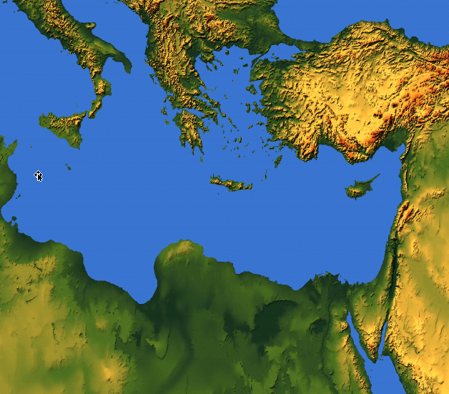

Macedonia
Bithynia
Troas
Asia
Antioch
Notes:
Let me explain my answer. First we know that Paul obeyed the Holy Spirit, he followed God’s will. Acts 16 Luke writes that
⁶ Next Paul and Silas traveled through the area of Phrygia and Galatia, because the Holy Spirit had prevented them from preaching the word in the province of Asia at that time.
⁷ Then coming to the borders of Mysia, they headed north for the province of Bithynia, but again the Spirit of Jesus did not allow them to go there.
We know he eventually goes to Macedonia.
This shows that Paul does not disregard or ignore the Holy Spirit.

Slide 71
Acts 20 ²² “And now I am bound by the Spirit to go to Jerusalem. I don’t know what awaits me,
²³ except that the Holy Spirit tells me in city after city that jail and suffering lie ahead.”
Acts 21 ⁴ “These believers prophesied through the Holy Spirit that Paul should not go on to Jerusalem.”
Notes:
Second, although Paul is bound to go to Jerusalem, he does not know what is going to happen. He knows that he is often thrown in jail, or beaten, but in other places he is granted safety.
In this case, God is revealing to Paul that there will not be peace when he returns to Jerusalem. The believers in Tyre understood, by the power of the Holy Spirit, that Paul would suffer when he returned to Jerusalem. That is why they did not want him to go.
The reason the Tyrian church prophesied that Paul should not go on to Jerusalem was to prepare him for what lies ahead.

Slide 72
How Firm a Foundation
When through the deep waters He calls thee to go
The rivers of grief shall not thee overflow
For He will be with thee in trouble to bless
And sanctify to thee thy deepest distress
When through fiery trials thy pathway shall lie
My grace all-sufficient shall be thy supply
The flames shall not hurt thee I only design
Thy dross to consume and thy gold to refine
Notes:
We hummed or lip-synced to the song How Firm a Foundation at the beginning of our service.
Paul does not know what awaits him in Jerusalem. But Paul does know that
when through the deep waters He calls thee to go
The rivers of grief shall not thee overflow
For He will be with thee in trouble to bless
And sanctify to thee thy deepest distress
Paul knows that
When through fiery trials thy pathway shall lie
My grace all-sufficient shall be thy supply
The flames shall not hurt thee I only design
Thy dross to consume and thy gold to refine

Slide 73
The Church at Caesarea
(Acts 21:7-9)
Tyre
Ptolemais
Caesarea
Stayed at the home of Philip the Evangelist
Philip’s daughters had gift of prophecy
Notes:
Continuing in verse 7 as Paul and his companion continue their journey
⁷ The next stop after leaving Tyre was Ptolemais, where we greeted the brothers and sisters and stayed for one day. ⁸ The next day we went on to Caesarea and stayed at the home of Philip the Evangelist, one of the seven men who had been chosen to distribute food. ⁹ He had four unmarried daughters who had the gift of prophecy.

Slide 74
Fill in the ______
“One who prophesies strengthens others, encourages them, and comforts them. . . . one who speaks a word of prophecy strengthens the entire church.”
(1 Cor 14:3-4 NLT)
Notes:
Luke’s account leaves out what Phillip’s daughters were prophesying. Although we don’t know what they were prophesying, we can look at some of Paul’s other letters to see why they were prophesying.
According to Paul, the purpose of prophecy is the exhortation and building up of the church body.
In one of his letters to the Corinthians he writes “One who prophesies strengthens others, encourages them, and comforts them. . . . one who speaks a word of prophecy strengthens the entire church.”

Slide 75

Old vs New Testament Prophecy
 | OT | NT
Foretelling
Forthtelling
Notes:
Now let’s compare Old Testament vs New Testament prophecy.
• When I think of prophecy, I generally think of telling the future, or prediction. This is known as foretelling.
• There are many Old Testament examples of foretelling in the Old Testament. The oracles against the nations in Isaiah, Jeremiah, Ezekiel, Amos. My favorite prophecies are about the end times, as seen in Daniel and Isaiah.
• But the New Testament also has foretelling. Jesus’s Olivet discourse. The Revelation given to the Apostle John. Both are clearly prediction or foretelling about the future.
• We’ve already shown that the other type of prophecy in the New Testament is exhortation and building up of the church body.
• This is also known as forthtelling in the NT.
• In the Old Testament we also have forthtelling in the form of divine messages of accusation and impending judgment due to the hearer’s rebelliousness—or divine messages of comfort and exhortation that divine salvation is at hand.

Slide 76
Is there prophecy today?
As for prophecies, they will pass away;
( 1 Cor 13:8 NIV)
For NOW we see in a mirror dimly, but THEN face to face
( 1 Cor 13:12 NIV)
Notes:
Some would say that there is no prophecy today because the canon, that is the Bible, is complete.
However, that is not what the Bible says. The Bible does say that prophecy will cease. In 1 Cor 13 Paul writes, “As for prophecies, they will pass away.”
Paul even tells us when prophecy will cease. The second part of 1 Cor 13 contrasts 2 periods of time: Now and Then. Prophecies will cease “Then.”

Slide 77

When Prophecies Cease
Now
Then
we know in part and we prophesy in part
when the perfect comes
now we see in a mirror dimly
then face to face
All I know is partial, incomplete
then I will know everything completely
Notes:
"Now" is obviously when Paul was writing the letter. "Then" refers to some point in the future to Paul. It’s been almost 2,000 years. Are we in the future to Paul? So, are we in the “now” or are we in the “then” when it comes to prophecy?
When the perfect comes: one can make a weak argument that since we are made perfect or sinless through Christ’s shed blood on the cross, we are at the “then.”
I would submit that we do not know everything completely, therefore we are still in the “now” and we can still have prophecy, mostly in the form of forth telling, for exhortation and building up of the church body.

Slide 78
Agabus
Acts 11
²⁸ One of them named Agabus stood up in one of the meetings and predicted by the Spirit that a great famine was coming upon the entire Roman world. (This was fulfilled during the reign of Claudius.)
Notes:
Although we don’t know what Philip’s daughters prophesied about, we do know what the next prophet said.
Starting in vs 10: ¹⁰ Several days later a man named Agabus, who also had the gift of prophecy, arrived from Judea.
This is the same prophet who went to Antioch when Paul and Barnabas were preaching there and prophesied that there would be a great famine. That prophecy came true.

Slide 79
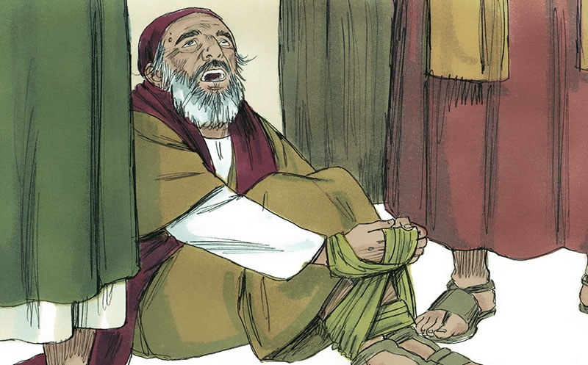
Acts 21:11
“The Holy Spirit declares, ‘So shall the owner of this belt be bound by the Jewish leaders in Jerusalem and turned over to the Gentiles.’”
Notes:
Now when we see Agabus,
¹¹ He came over, took Paul’s belt, and bound his own feet and hands with it. Then he said, “The Holy Spirit declares, ‘So shall the owner of this belt be bound by the Jewish leaders in Jerusalem and turned over to the Gentiles.’”’
This would be much harder today since not everyone wears a belt, and the belts we do wear would not work the same way. But using props is an effective teaching method. Agabus was not the only prophet to use a prop.

Slide 80
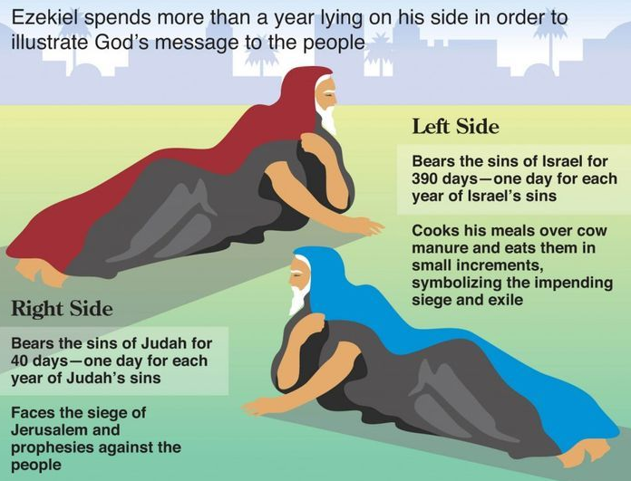
Ezekiel 4:5-6
Ezekiel spent more than a year lying on his side to illustrate God's discipline of Israel
Left Side
Bears the sins of Israel for 390 days—one day for each year of Israel's sins
Cooks his meals over cow manure and eats them in small increments, symbolizing the impending siege and exile
Right Side
Bears the sins of Judah for 40 days—one day for each year of Judah's sins
Faces the siege of Jerusalem and prophesies against the people
Notes:
The prophet Ezekiel spent more than a year lying on his side, first on his left side then the right side.
He symbolized Israel's 390 years of sin and Judah's 40 years of sin by lying on his sides for fourteen months (4:4-8).
He symbolized eating unclean food cooked with cow dung to show Jerusalem's future scarcity of food and water (4:9-17).

Slide 81
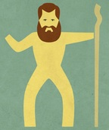
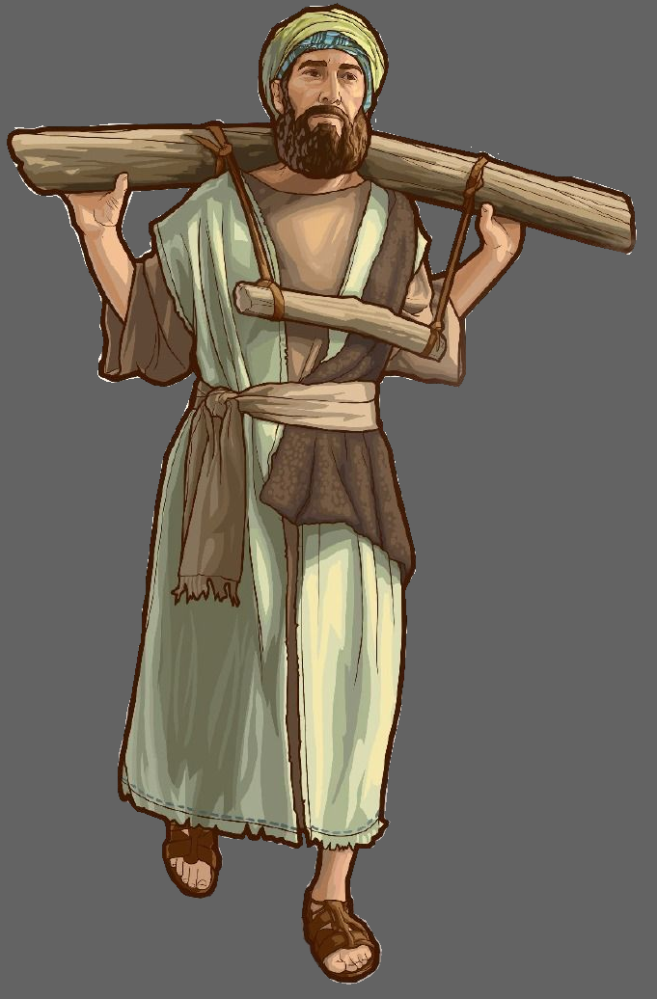
Micah
Jeremiah
Notes:
The prophet Micah lamented without wearing clothes to illustrate the severity of the destitution and captivity that was coming.
The prophet Jeremiah wore a yoke around his neck to demonstrate that Israel would be subject to Babylon.

Slide 82

Don’t go to Jerusalem!
Notes:
As you can imagine, this caused a strong reaction in the church. Luke writes that
“When we heard this, we and the local believers all begged Paul not to go on to Jerusalem.”
What was Paul’s response? Look at verse 13. ¹³ But he said, “Why all this weeping? You are breaking my heart! I am ready not only to be jailed at Jerusalem but even to die for the sake of the Lord Jesus.”

Slide 83

Key Verse
¹⁴ When it was clear that we couldn’t persuade him, we gave up and said,
“The Lord’s will be done.”
Acts 21:14
Notes:
And now we get to what I think is the key verse in this section of Scripture.
“When it was clear that we couldn’t persuade him, we gave up and said, The Lord’s will be done.”
When God’s plan is revealed to you, and it is not what you want or was expecting, how do you respond? Do you mope and complain? Do you turn the other way like Jonah? Do you drag your feet, saying, maybe next year I will…? Do whatever it is that God has laid on your heart? Or do you say, “The Lord’s will be done.”
Even though prophecy revealed Paul would suffer and be imprisoned, he submitted to the Lord’s will.
So, what was the point of the prophecy? It prepared Paul for the suffering he would endure.

Slide 84
Suffering
Romans 8:17
¹⁷ And since we are his children, we are his heirs. In fact, together with Christ we are heirs of God’s glory. But if we are to share his glory, we must also share his suffering.
Notes:
In several of his letters, Paul writes about suffering. In Romans 8:17 he writes
“And since we are his children, we are his heirs. In fact, together with Christ we are heirs of God’s glory. But if we are to share his glory, we must also share his suffering.”
You might wonder when Paul wrote that statement in Romans.

Slide 85
NT Overview (Paul's Letters)
“To the remotest part of the earth” (Acts 1:8)
Acts 9 13 14 15 16 18 21 27 28
Apr 48-
Sep 49
1
Galatia
Apr 50-
Sep 52
2
Aegean
Spr 53-
May 57
3
Asia
Summer 35-
37
Damascus
Antioch
May 57-
Aug 59
Trials
Fall 49
The
Council
Spring 68
Expansion of Church
35 48 49 50 52 53 57 60 62 67 68 95
Gal
1 Thess
1 Cor
2 Thess
2 Cor
Missionary
Romans
Pauline Epistles
1234
Journeys
Notes:
We saw this timeline earlier. Several of Paul’s letters were written during his mission trips. The letter to the Romans was written during his third missionary journey, before he returned to Jerusalem.

Slide 86
Suffering
Colossians 1:24
²⁴ I am glad when I suffer for you in my body, for I am participating in the sufferings of Christ that continue for his body, the church.
Philippians 1:29
²⁹ For you have been given not only the privilege of trusting in Christ but also the privilege of suffering for him.
Notes:
Here are a couple more statements on suffering.
Colossians 1:24 (NLT)
24 I am glad when I suffer for you in my body, for I am participating in the sufferings of Christ that continue for his body, the church.
Philippians 1:29 (NLT)
29 For you have been given not only the privilege of trusting in Christ but also the privilege of suffering for him.
Paul certainly never sought out difficulty. He had no martyr complex. On the other hand, he accepted suffering as a part of his witness which is why he alluded to suffering in his letters.

Slide 87
NT Overview (Paul's Letters)
“To the remotest part of the earth” (Acts 1:8)
Acts 9 13 14 15 16 18 21 27 28
Apr 48-
Sep 49
1
Galatia
Apr 50-
Sep 52
2
Aegean
Spr 53-
May 57
3
Asia
Feb 60-
Mar 62
1
Rome
Spr 62-
Fall 67
4
Spain
Aut 67-
Spr 68
2
Rome
Summer 35-
37
Damascus
Antioch
May 57-
Aug 59
Trials
Fall 49
The
Council
Spring 68
Expansion of Church
35 48 49 50 52 53 57 60 62 67 68 95
Gal
1 Thess
1 Cor
Eph
1 Tim
2 Tim
2 Thess
2 Cor
Col
Titus
Missionary
Pastoral
Romans
Philem
Phil
Pauline Epistles
1234
Journeys
Prison
Rome
Imprisonments
Notes:
Back to the timeline, Colossians and Philippians were written while he was in prison in Rome, which resulted from his returning to Jerusalem.
Can you imagine if Paul had listened to the churches at Tyre or Caesarea and not returned to Jerusalem?
Would he have ended up in Rome? Would he have written the prison letters? Would he have written the pastoral letters?
We don’t know. What do we know?

Slide 88
Assurance
Romans 8:28
²⁸ And we know that God causes everything to work together for the good of those who love God and are called according to his purpose for them.
Notes:
“We know that God causes everything to work together for the good of those who love God and are called according to his purpose for them” (Rom 8:18 NLT).
We may suffer. We don’t need prophecy to tells us we are going to suffer.
But we also have assurance. We must heed God’s calling in our lives. We must be in submission to his will, not our own.
When we do this, we have a blessed assurance.

Slide 89

Blessed Assurance
Fanny Jane Crosby | Phoebe Palmer Knapp
Performed by: Momo Kithan
  CCLI Song #22324
  © Words and Music: Public Domain
  CIC CCLI License # 277507

Slide 90
Blessed assurance Jesus is mine
O what a foretaste of glory divine
Heir of salvation purchase of God
Born of His Spirit washed in His blood
This is my story this is my song
Praising my Savior all the day long
This is my story this is my song
Praising my Savior all the day long
V1

Slide 91
Perfect submission perfect delight
Visions of rapture now burst on my sight
Angels descending bring from above
Echoes of mercy whispers of love
This is my story this is my song
Praising my Savior all the day long
This is my story this is my song
Praising my Savior all the day long
V2

Slide 92
Perfect submission all is at rest
I in my Savior am happy and blest
Watching and waiting looking above
Filled with His goodness lost in His love
This is my story this is my song
Praising my Savior all the day long
This is my story this is my song
Praising my Savior all the day long
V3 (final)

Slide 93
Black

Slide 94
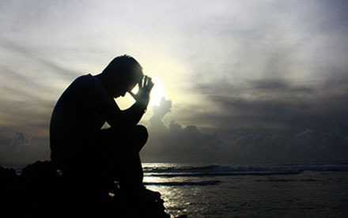
When Trouble Comes
ACTS 21:17–23:11
Manik Corea • 27 June 2021
at Crossroads International Church Singapore • CICFamily.com
Uploaded by Dr. Rick Griffith • Singapore Bible College
Files in many languages for free download at BibleStudyDownloads.org

Slide 95

What are you most afraid of?

Slide 96
GOOD NE WS
ON THE MO VE
God’s work through the early church in
Acts
Notes:
We are continuing in our series called Good News on the Move, God’s work through the early church in Acts.
In the previous 19 sermons we have seen a lot of people on the move.
At the beginning of the book of Acts, we saw the church growing in Jerusalem, undergoing persecution, and spreading to Samaria.
As the book of Acts progressed, we are introduced to Saul, also known as Paul.

Slide 97
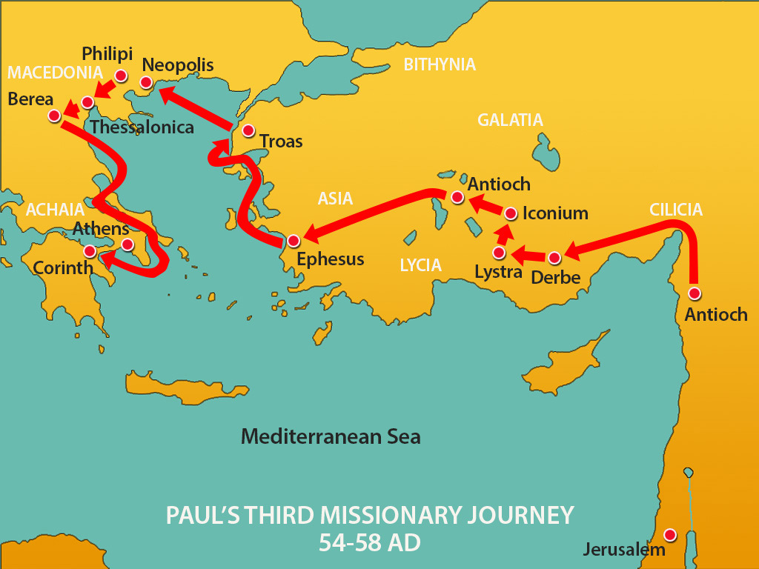

Slide 98
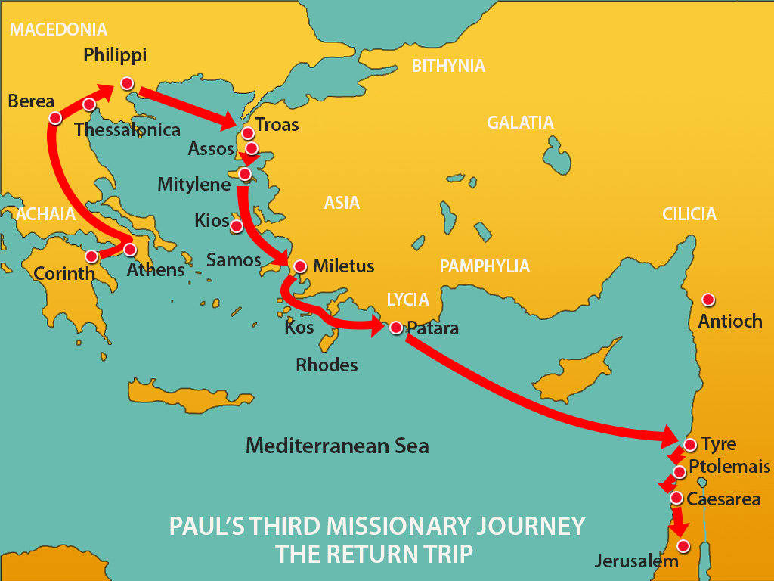

Slide 99
Acts 21:17-22
¹⁷ “When we had come to Jerusalem, the brothers received us gladly. ¹⁸ On the following day Paul went in with us to James, and all the elders were present. ¹⁹ After greeting them, he related one by one the things that God had done among the Gentiles through his ministry. ²⁰ And when they heard it, they glorified God. And they said to him, ‘You see, brother, how many thousands there are among the Jews of those who have believed. They are all zealous for the law, ²¹ and they have been told about you that you teach all the Jews who are among the Gentiles to forsake Moses, telling them not to circumcise their children or walk according to our customs. ²² What then is to be done? They will certainly hear that you have come.’”

Slide 100
Acts 21:23-26
²³ “‘Do therefore what we tell you. We have four men who are under a vow; ²⁴ take these men and purify yourself along with them and pay their expenses, so that they may shave their heads. Thus all will know that there is nothing in what they have been told about you, but that you yourself also live in observance of the law. ²⁵ But as for the Gentiles who have believed, we have sent a letter with our judgment that they should abstain from what has been sacrificed to idols, and from blood, and from what has been strangled, and from sexual immorality.’ ²⁶ Then Paul took the men, and the next day he purified himself along with them and went into the temple, giving notice when the days of purification would be fulfilled and the offering presented for each one of them.”

Slide 101
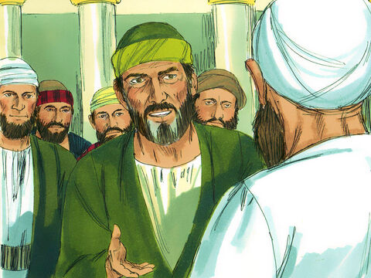
Nazirite Vow – a temporary vow to dedicate oneself to God by abstaining from meat and wine. Sacrifices are offered and one’s hair in cut at the end of the vow (Numbers 6:1-21). Paul himself followed this vow in Acts 18:18.

Slide 102
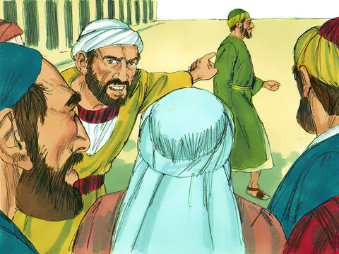

Slide 103
Mobs are stirred by prejudice and exclusivism, not by reason and just charges. Religious fervor is as dangerous as political hatred.
John L. Ogilvie, The Preacher’s Commentary: Acts
(Nashville: Thomas Nelson, 2010).

Slide 104
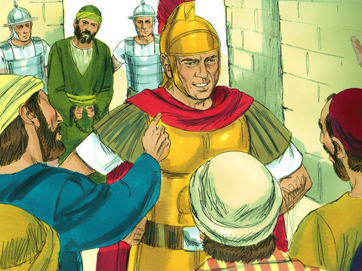

Slide 105

Paul makes his defense before the Jewish mob - Acts 21:27-22:21

Slide 106


Slide 107
PERSECUTION & WITNESS
Mark 13:9 – “… they will deliver you over to councils, and you will be beaten in synagogues….and you will stand before governors and kings for my sake, to bear witness to them.”
Paul witnesses boldly – Acts 22:-21 cf Acts 9:1-19 and Acts 26:12-23

Slide 108
Slides on
Acts 22

Slide 109
Acts 22:1-5
“‘Brothers and fathers, hear the defense that I now make before you.’
² And when they heard that he was addressing them in the Hebrew language, they became even more quiet. And he said:
³ ‘I am a Jew, born in Tarsus in Cilicia, but brought up in this city, educated at the feet of Gamaliel according to the strict manner of the law of our fathers, being zealous for God as all of you are this day. ⁴ I persecuted this Way to the death, binding and delivering to prison both men and women, ⁵ as the high priest and the whole council of elders can bear me witness. From them I received letters to the brothers, and I journeyed toward Damascus to take those also who were there and bring them in bonds to Jerusalem to be punished.’”

Slide 110
Acts 22:6-11
⁶ “As I was on my way and drew near to Damascus, about noon a great light from heaven suddenly shone around me. ⁷ And I fell to the ground and heard a voice saying to me, ‘Saul, Saul, why are you persecuting me?’ ⁸ And I answered, ‘Who are you, Lord?’ And he said to me, ‘I am Jesus of Nazareth, whom you are persecuting.’ ⁹ Now those who were with me saw the light but did not understand the voice of the one who was speaking to me. ¹⁰ And I said, ‘What shall I do, Lord?’ And the Lord said to me, ‘Rise, and go into Damascus, and there you will be told all that is appointed for you to do.’ ¹¹ And since I could not see because of the brightness of that light, I was led by the hand by those who were with me, and came into Damascus.”

Slide 111
Acts 22:12-16
¹² “And one Ananias, a devout man according to the law, well spoken of by all the Jews who lived there, ¹³ came to me, and standing by me said to me, ‘Brother Saul, receive your sight.’ And at that very hour I received my sight and saw him. ¹⁴ And he said, ‘The God of our fathers appointed you to know his will, to see the Righteous One and to hear a voice from his mouth; ¹⁵ for you will be a witness for him to everyone of what you have seen and heard. ¹⁶ And now why do you wait? Rise and be baptized and wash away your sins, calling on his name.’”

Slide 112
Acts 22:17-21
¹⁷ “When I had returned to Jerusalem and was praying in the temple, I fell into a trance ¹⁸ and saw him saying to me, ‘Make haste and get out of Jerusalem quickly, because they will not accept your testimony about me.’ ¹⁹ And I said, ‘Lord, they themselves know that in one synagogue after another I imprisoned and beat those who believed in you. ²⁰ And when the blood of Stephen your witness was being shed, I myself was standing by and approving and watching over the garments of those who killed him.’ ²¹ And he said to me, ‘Go, for I will send you far away to the Gentiles.’”

Slide 113
Acts 22:22-25
²² “Up to this word they listened to him. Then they raised their voices and said, ’Away with such a fellow from the earth! For he should not be allowed to live.’ ²³ And as they were shouting and throwing off their cloaks and flinging dust into the air, ²⁴ the tribune ordered him to be brought into the barracks, saying that he should be examined by flogging, to find out why they were shouting against him like this. ²⁵ But when they had stretched him out for the whips, Paul said to the centurion who was standing by, ‘Is it lawful for you to flog a man who is a Roman citizen and uncondemned?’”

Slide 114
Acts 22:26-29
²⁶ “When the centurion heard this, he went to the tribune and said to him, ‘What are you about to do? For this man is a Roman citizen.’ ²⁷ So the tribune came and said to him, ‘Tell me, are you a Roman citizen?’ And he said, ‘Yes.’ ²⁸ The tribune answered, ‘I bought this citizenship for a large sum.’ Paul said, ‘But I am a citizen by birth.’ ²⁹ So those who were about to examine him withdrew from him immediately, and the tribune also was afraid, for he realized that Paul was a Roman citizen and that he had bound him.”

Slide 115

Paul reveals his Roman citizenship - Acts 22:22-29

Slide 116
Acts 22:30
³⁰ “But on the next day, desiring to know the real reason why he was being accused by the Jews, he unbound him and commanded the chief priests and all the council to meet, and he brought Paul down and set him before them.”

Slide 117
Slides on
Acts 23

Slide 118
Acts 23:1-5
“And looking intently at the council, Paul said, ‘Brothers, I have lived my life before God in all good conscience up to this day.’ ² And the high priest Ananias commanded those who stood by him to strike him on the mouth. ³ Then Paul said to him, ‘God is going to strike you, you whitewashed wall! Are you sitting to judge me according to the law, and yet contrary to the law you order me to be struck?’ ⁴ Those who stood by said, ‘Would you revile God's high priest?’ ⁵ And Paul said, ‘I did not know, brothers, that he was the high priest, for it is written, “You shall not speak evil of a ruler of your people.”’”

Slide 119
Acts 23:6-10
⁶ “Now when Paul perceived that one part were Sadducees and the other Pharisees, he cried out in the council, ‘Brothers, I am a Pharisee, a son of Pharisees. It is with respect to the hope and the resurrection of the dead that I am on trial.’ ⁷ And when he had said this, a dissension arose between the Pharisees and the Sadducees, and the assembly was divided. ⁸ For the Sadducees say that there is no resurrection, nor angel, nor spirit, but the Pharisees acknowledge them all. ⁹ Then a great clamor arose, and some of the scribes of the Pharisees' party stood up and contended sharply, ‘We find nothing wrong in this man. What if a spirit or an angel spoke to him?’ ¹⁰ And when the dissension became violent, the tribune, afraid that Paul would be torn to pieces by them, commanded the soldiers to go down and take him away from among them by force and bring him into the barracks.”

Slide 120
TAKE COURAGE IN CHRIST
Acts 23:11 – The following night the Lord stood by him and said, “Take courage, for as you have testified to the facts about me in Jerusalem, so you must testify also in Rome.”
Hebrews 13:5 – “…for he has said, “I will never leave you nor forsake you.”

Slide 121


Slide 122

Video testimony of John Monger

Slide 123

LET US PRAY

Slide 124

How Do I Defend Myself?
Standing strong in faith when persecuted for Christ
Acts 23:12–24:27
Preached by Dr. Jim Harmeling
at Crossroads International Church Singapore • CICFamily.com
Uploaded by Dr. Rick Griffith • Jordan Evangelical Theological Seminary
Files in many languages for free download at BibleStudyDownloads.org

Slide 125

Recognize that you will receive unjust treatment because of your faith in Christ

Slide 126
Jesus
Paul
Prophesies that Jews will deliver him over to Gentiles when he enters Jerusalem
Receives prophecy that Jews will deliver him over to Gentiles
when he enters Jerusalem
Enters temple to purify it
Enters temple with vows of purity
Priests seek to kill him
Priests seek to kill him
New party has plot to kill him (Judas)
New party has plot to kill him
(40 vows)
Romans arrest him and try him
Romans arrest him and try him
Jews accuse him of disrupting peace
Jews accuse him of disrupting peace

Slide 127
Jesus
Paul
Romans find no guilt to priests’ charges
Romans find no guilt to priests’ charges
Roman officials try to please Jews
Roman officials try to please Jews
Send Jesus to death
Send Paul to Rome

Slide 128
1 Peter 4:12
“Beloved, do not be surprised at the fiery trial when it comes upon you to test you, as though something strange were happening to you.”

Slide 129
Recognize that you will receive unjust treatment because of your faith in Christ
Some opponents are emotionally convinced you are an enemy (23:12-14, 21)

Slide 130

“To make such an oath, they must have burned with intense hatred against the apostle, a hatred which must have been the accumulation of many years, in some cases probably going back to their reactions at the time of Paul’s conversion.”

Slide 131
Slides on
Acts 24

Slide 132

Felix (AD 52-59) tried Paul in Caesarea, imprisoning him from AD 57-59 (Acts 24). Felix did not find Paul guilty but still confined him.
129

Slide 133
Recognize that you will receive unjust treatment because of your faith in Christ
Some opponents are emotionally convinced you are an enemy (23:12-14, 21)
Some opponents make intricate plans for your demise (23:15)
Some opponents make false or exaggerated claims of your guilt (24:1-9)

Slide 134

Recognize that you will receive unjust treatment because of your faith in Christ
Rely on God to protect you
He protects us with unexpected advocates (23:16-22)
He protects us with government rules (23:23-30)
He protects us with human political ploys (24:22-23, 27)

Slide 135

Recognize that you will receive unjust treatment because of your faith in Christ
Rely on God to protect you
Ready yourself to explain your faith
Expose what is false (24:10-13, 17-20)
Explain what is true (24:14-16, 21, 24-26)

Slide 136
Slides on
Acts 25

Slide 137
Porcius Festus also tried Paul and found him innocent (Acts 25)
129

Slide 138
Following GOD Sets us FREE
Acts 25–26
Matt Lyle • Crossroads International Church Singapore
CICFamily.com
Notes:
Today we are going to look at Acts, chapters 25 and 26. We will see that following God sets us free.
Paul has been waiting patiently in Caesarea for two years. But Paul also knows that it is God’s plan for him to go to Rome.
And although Paul is being held prisoner, he is actually free because he is following God’s will, not man’s plan.
Paul knows that because he is following God’s will, he can be thankful in all circumstances.
Even though he is a prisoner, he is free because of his hope in Jesus.
Go ahead and turn to Acts 25 and let us read about how God, working through Paul, sets in motion the chain of events that results in Paul eventually going to Rome.
Photo by Zhu Liang on Unsplash
https://unsplash.com/photos/eoy0fuzH5ss

Slide 139
Waiting
Notes:
Life seems to be filled with waiting.
As a school-age child in Singapore, you must wait for your PSLE results and your GCE O or N level results.
As a young Singaporean male, you must wait until you complete your 2-year national service obligation.
As a single adult Singaporean, you must wait until you are 35 before you are eligible to purchase an HDB flat.
Many of you have been waiting for the past 2 months just to be able to go to a restaurant with your family.
Photo by Zhu Liang on Unsplash
https://unsplash.com/photos/eoy0fuzH5ss

Slide 140
GOOD NE WS
ON THE MO VE
God’s work through the early church in
Acts
Notes:
When you read the book of Acts, you usually don’t see much waiting.
That’s because the Book of Acts is about
the Good News, ---on the Move.
It is about God’s work ---through the early church
With all this movement, you can easily miss the periods of waiting.
But, the end of chapter 24 (which we covered last week) has one such period of waiting.

Slide 141
Caesarea
Jerusalem
Notes:
To recap, the Apostle Paul has completed his third missionary journey. He has felt a calling to go to Rome but first had to return to Jerusalem.
He was warned (through prophecy) that when he returned to Jerusalem, he would be bound by the Jewish leaders and turned over to the Gentiles.
That is precisely what happened. Paul was at the temple, the Jews started a riot and were beating Paul, so the Roman guards arrested Paul.
After his arrest, Paul had a chance to speak first to the crowd, then to the Jewish high council.
Then, after hearing of a plot to take his life, the Roman guards were informed, and Paul was taken to Caesarea under heavy guard.
Brisco, T. V. (1998). Holman Bible atlas (p. 251). Nashville, TN: Broadman & Holman Publishers.

Slide 142
Paul Speaks:
to the crowd
to the High Council
to Governor Felix
Acts 24:27 After two years went by in this way, Felix was succeeded by Porcius Festus. And because Felix wanted to gain favor with the Jewish people, he left Paul in prison.
Notes:
Once Paul reached Caesarea, a trial was held, and he had a chance to defend himself before Governor Felix.
Governor Felix, however, stopped the trial. Felix would occasionally call for Paul but would become frightened when Paul talked about righteousness and the coming day of Judgment. It was also noted that Governor Felix hoped Paul would give him a bribe.
THE LAST VERSE of Acts 24 tells us that “After two years went by in this way, Felix was succeeded by Porcius Festus. And because Felix wanted to gain favor with the Jewish people, he left Paul in prison” (Acts 24:27 NLT).
Photo by Bill Oxford on Unsplash
https://unsplash.com/photos/OXGhu60NwxU

Slide 143
Following GOD Sets us FREE
Acts 25–26
Matt Lyle • Crossroads International Church Singapore
CICFamily.com
Notes:
Today we are going to look at Acts, chapters 25 and 26. We will see that following God sets us free.
Paul has been waiting patiently in Caesarea for two years. But Paul also knows that it is God’s plan for him to go to Rome.
And although Paul is being held prisoner, he is actually free because he is following God’s will, not man’s plan.
Paul knows that because he is following God’s will, he can be thankful in all circumstances.
Even though he is a prisoner, he is free because of his hope in Jesus.
Go ahead and turn to Acts 25 and let us read about how God, working through Paul, sets in motion the chain of events that results in Paul eventually going to Rome.
Photo by Zhu Liang on Unsplash
https://unsplash.com/photos/eoy0fuzH5ss

Slide 144
Changing of the Guard
Felix => Festus
Notes:
Starting at Acts 25:1, we read that “Three days after Festus arrived in Caesarea to take over his new responsibilities, he left for Jerusalem, ² where the leading priests and other Jewish leaders met with him and made their accusations against Paul” (Acts 25:1-2 NLT).
We have a changing of the guard. Governor Festus has now replaced Governor Felix.
A quick review on Felix—he was governor or procurator over the Roman province of Judea for 8 years. When Paul was on trial before Felix, Paul noted that Felix had been a judge of Jewish affairs for many years. Although Felix was knowledgeable of Jewish affairs, he kept Paul in prison (as we already said) because he wanted a bribe, and he wanted to gain favor with the Jewish people.
Festus is the new guy. He needs to start his tenure as governor on the right foot. He needs to learn about the territory he has been assigned. So he goes to Jerusalem.
Photo by Toa Heftiba on Unsplash
https://unsplash.com/photos/PxM8hw4j3ZY

Slide 145
Caesarea
Jerusalem
Notes:
So Festus, the new governor, arrives in Jerusalem and meets with the Jewish leaders.
Starting with vs. 3, we see that “They asked Festus as a favor to transfer Paul to Jerusalem (planning to ambush and kill him on the way)” (Acts 25:3).
The Jewish leaders knew that a trial would not convict Paul, so they needed to ambush him. They have been waiting to deal with their Paul problem for 2 years. If you recall from the last chapter, a group of more than 40 Jews made an oath not to eat or drink until they had killed Paul. However, since it has been 2 years, they were either really hungry, or they broke their oath.
Continuing with vs. 4: “But Festus replied that Paul was at Caesarea and he himself would be returning there soon. ⁵ So he said, ‘Those of you in authority can return with me. If Paul has done anything wrong, you can make your accusations.’” (Acts 25:4-5 NLT).
By our standards, it seems Governor Festus is off to a good start. He wants to do what is right by Roman law If you’ve done something wrong, you deserve a fair trial.
Image from Brisco, T. V. (1998). Holman Bible atlas (p. 251). Nashville, TN: Broadman & Holman Publishers.

Slide 146
Not Guilty:
Jewish Laws
Temple
Roman Government
Notes:
So once again, Paul is on trial. Continuing with vs. 6: “About eight or ten days later Festus returned to Caesarea, and on the following day he took his seat in court and ordered that Paul be brought in. ⁷ When Paul arrived, the Jewish leaders from Jerusalem gathered around and made many serious accusations they couldn’t prove” (Acts 25:6-7 NLT).
Of course, they couldn’t prove the charges. The charges were baseless, to begin with. And now 2 years have passed.
Continuing in vs 8: ⁸ Paul denied the charges. “I am NOT GUILTY of any crime against the Jewish laws or the Temple or the Roman government,” he said.
Photo by Bill Oxford on Unsplash
https://unsplash.com/photos/OXGhu60NwxU

Slide 147
Baseless
Charges
Acts 24:5-6
Cause Riots
Leader of Nazarenes
Desecrating Temple
Notes:
Luke doesn’t bother to record the charges in this trial before Festus. But if you go back to chapter 24, the Jewish Lawyer Tertullus charged Paul with being:
“a troublemaker who is constantly stirring up riots among the Jews all over the world
. . . a ringleader of the cult known as the Nazarenes
. . . (and) trying to desecrate the Temple” (Acts 24:5-6 NLT).
These are the charges Paul addresses when he states is not guilty of crimes against Jewish Law, the Temple or the Roman Government.
The Jewish teachers think Paul’s teachings were contrary to Jewish law, which caused riots. In reality, Paul’s teachings were the culmination of Jewish law, as many Jews who became Christian would attest to.
Regarding the temple, Paul was participating in a purification ritual, when the Jews caused the riot. If anyone was desecrating the temple it was the Jews.
And finally, the leader of the Nazarenes was Jesus, not Paul. Paul was merely a follower. And being a follower of Jesus was not contrary to the Roman Government.
Photo by Bill Oxford on Unsplash
https://unsplash.com/photos/OXGhu60NwxU

Slide 148
Changing of the Guard
Festus Report
Notes:
So now what?
• The charges are baseless.
• They cannot be proven.
• They are 2 years old.
How does the new governor respond? “⁹ Then Festus, wanting to please the Jews, asked him, ‘Are you willing to go to Jerusalem and stand trial before me there?’”
Governor Festus, you were doing so good. You were trying to do what is right. But now you are just trying to gain political favor with the Jews. That’s just sad. Festus was doing so well but has thrown away doing the right thing because he wanted to be liked by the Jews.
Paul recognized this. So he replied in vs 10: “No! This is the official Roman court, so I ought to be tried right here. You know very well I am not guilty of harming the Jews. ¹¹ If I have done something worthy of death, I don’t refuse to die. But if I am innocent, no one has a right to turn me over to these men to kill me. I appeal to Caesar!”
Photo by Toa Heftiba on Unsplash
https://unsplash.com/photos/PxM8hw4j3ZY

Slide 149

Appeal to Caesar
Notes:
Being a Roman Citizen was very beneficial. So is being Singaporean. The Singaporean passport will grant you access to 192 countries, ranking second in the world, only behind Japan, which has access to 193 countries.
Although Paul doesn’t have a powerful passport, he has the right not to be beaten before a trial, which he already used. And he had the right to have his trial heard in Rome. Pretty powerful stuff.
Not much Festus could do, so in vs ¹²: “Festus conferred with his advisers and then replied, ‘Very well! You have appealed to Caesar, and to Caesar you will go!’”
Image by Sweet Publishing at https://www.freebibleimages.org/illustrations/paul-festus-agrippa/ (CC BY-SA 3.0)

Slide 150
The Wait is Over
Acts 23:11
That night the Lord appeared to Paul and said, “Be encouraged, Paul. Just as you have been a witness to me here in Jerusalem, you must preach the Good News in Rome as well.”
Notes:
There is a lot of waiting in the Bible
• Abraham had to wait 25 years after he received the promise of a son before Isaac was born.
• The nation of Israel had to wait 40 years wandering the desert before entering the promised land (of course, that was their fault).
• Nehemiah waited for 3 to 4 months after receiving the distressing news about Jerusalem before God planted it on the Persian King’s heart to let Nehemiah go back to rebuild the city walls.
• Paul had been waiting for 2 years for Governor Felix to decide his case. Knowing that in Acts 23:11, the Lord appeared to Paul, encouraged him, letting him know he must preach the Good News in Rome. Finally, we can see how this will happen.
Photo by Zhu Liang on Unsplash
https://unsplash.com/photos/eoy0fuzH5ss

Slide 151
The Wait is Over
Notes:
We can learn a lesson about following God’s will from Paul. We may know what the result should look like, but we don’t how to get there. Paul probably did not know how he was going to get to Rome. But he didn’t mope and complain. Instead, he waited patiently and used every opportunity to tell the previous governor (Felix) about faith in Christ Jesus.
I’ve known for probably the past 9 or 10 years, I would be a missionary at some point in my life. But it wasn’t until last year I felt the calling to step forward and quit my job and attend seminary. So, my changing of the guard was not a new Roman governor. Instead, it was my children moving out of the house.
We all have changes going on all the time.
We are also all called by God for something.
So, take each changing of the guard in your life to examine:
• where your life is now
• where God is calling you to be
• and then how to get there.
Photo by Zhu Liang on Unsplash
https://unsplash.com/photos/eoy0fuzH5ss

Slide 152
The World will not Understand
=
King Agrippa
King Herod Agrippa II
Notes:
Once you figure out where you are going, the journey is not easy.
When you choose to follow God’s calling in your life, some people will not understand.
In the next section, Felix, the new Governor, does not understand Paul’s actions. So he confers with King Agrippa.
Starting in vs. 13, we see that “¹³ A few days later KING AGRIPPA arrived with his sister, Bernice, to pay their respects to Festus.
There are a lot of repeated names in the Bible when it comes to the various Kings. This King Agrippa is actually King Herod Agrippa the second.

Slide 153
Herods of the Bible
Herod (the Great)
Met wise men
Killed babies in Bethlehem
Notes:
Let's go back and look at all the Herods in the New Testament. Here is a quick overview. Since these slides are available on our website so I will go through them quickly.
The first Herod, is known as Herod the Great. He was King when Jesus was born, he met the wise men and killed the babies in Jerusalem.
________
LC-03-Controversy-116
NS-03-Mark1-8—slide 235
NS-05-Acts20-28—slide 153

Slide 154
Herods of the Bible
Herod (the Great)
Herod Antipas
Herod Archelaus
Herod Philip
Caused Joseph to return to Nazareth (when returning from Egypt)
Notes:
When he died, Rome decided that his Kingdom would be split between 3 of his sons.
Herod Archelaus was not a good ruler, he was so bad that Joseph was warned to return to Nazareth after Herod the Great’s death and the family was returning from Egypt. He was eventually fired by the Roman senate. His territory was then ruled by Roman governors.

Slide 155
Herods of the Bible
Herod (the Great)
Herod Antipas
Herod Archelaus
Herod Philip
Wife, Herodias, left him for his brother Antipas
Notes:
Herod Philip was actually a pretty good guy. Unfortunately for him, his wife left him for his brother, Herod Antipas.

Slide 156
Herods of the Bible
Herod (the Great)
Herod Antipas
Herod Archelaus
Herod Philip
Married his brother's wife, Herodias
Executed John the Baptist
Presided over Jesus’ trial
Notes:
Herod Antipas is the Herod that executed John the Baptist and presided of Jesus’ trial, conferring with Pontus Pilate.

Slide 157
Herods of the Bible
Herod (the Great)
Herod Antipas
Aristobulus IV
Herod Philip
Herod Archelaus
Herod Agrippa I
Persecuted Christians (in Acts 12)
Notes:
Herod the Great had many other children. One of them, Aristobulus, was the father of Herod Agrippa.
Agrippa was sent to Rome to hobnob with Roman royalty. He became king by befriending the future emperor Caligula. His death is recorded in Acts 12 because he did not rebuke the people when they stated he has the voice of a God.

Slide 158
Herods of the Bible
Herod (the Great)
Herod Antipas
Aristobulus IV
Herod Philip
Herod Archelaus
Herod Agrippa I
Listened to Paul’s defense (Acts 25–26)
Sisters Bernice and Drusilla (married to Felix)
Herod Agrippa II
Notes:
We finally get to Herod Agrippa II. We already met his sister, Drusilla, who was married to the former governor Roman Felix.

Slide 159

Agrippa II
AD 48-53: Agrippa II 1st kingdom
AD 53
AD 61
Roman governor (Felix / Festus)
Notes:
Although Agrippa II was the firstborn son, he was too young for Rome to give him any territory after his father’s death.
Eventually Rome gave him a small kingdom, and because he did well, ended up giving him more and more land. However, the largest portion of Herod the Great’s previous territory remained under control of the Roman Governors.
This is the King Agrippa in whom Governor Festus confided in.
Brisco, T. V. (1998). Holman Bible atlas (p. 239). Nashville, TN: Broadman & Holman Publishers.

Slide 160

The World will not Understand
Notes:
In the next section we will see that Governor Festus does not understand the arguments being made against Paul. But he also does not understand Paul’s response.
Continuing in vs. 14: “During their stay of several days, Festus discussed Paul’s case with the king. ‘There is a prisoner here,’ he told him, ‘whose case was left for me by Felix. ¹⁵ When I was in Jerusalem, the leading priests and Jewish elders pressed charges against him and asked me to condemn him. ¹⁶ I pointed out to them that Roman law does not convict people without a trial. They must be given an opportunity to confront their accusers and defend themselves.
¹⁷ “When his accusers came here for the trial, I didn’t delay. I called the case the very next day and ordered Paul brought in. ¹⁸ But the accusations made against him weren’t any of the crimes I expected. ¹⁹ Instead, it was something about their religion and . . .
Photo by Dex Ezekiel on Unsplash
https://unsplash.com/photos/fg8tdcxrkrA

Slide 161
Key Truth
…a dead man named Jesus, who Paul insists is alive.
Acts 25:19b
Notes:
. . . a dead man named Jesus, who Paul insists is alive.
A dead man named Jesus, who Paul insists is alive. Governor Festus, who is a pagan Roman governor, new to the area, just captured the heart of Christianity. A Deadman named Jesus who IS alive.
And Paul is not the only one who insists Jesus is alive.
When Thomas saw Jesus, he said, “My Lord and My God.”

Slide 162
Key Truth
⁵ He was seen by Peter and then by the Twelve. ⁶ After that, he was seen by more than 500 of his followers at one time, most of whom are still alive, though some have died. ⁷ Then he was seen by James and later by all the apostles.
1 Cor 15:5-7 NLT
Notes:
Paul writes:
⁵ He was seen by Peter and then by the Twelve. ⁶ After that, he was seen by more than 500 of his followers at one time, most of whom are still alive, though some have died. ⁷ Then he was seen by James and later by all the apostles.
Jesus rose from the dead. Our God is alive.

Slide 163
The World will not Understand
Notes:
Even though Governor Festus’ statement captured the heart of Christianity, he really does not know what is going on. Continuing in vs. 20, he states: “²⁰ I was at a loss to know how to investigate these things, so I asked him whether he would be willing to stand trial on these charges in Jerusalem. ²¹ But Paul appealed to have his case decided by the emperor. So I ordered that he be held in custody until I could arrange to send him to Caesar.”
Festus has a problem. Paul is going to Rome. Festus has to give a reason why. All he has are baseless charges that can’t be proved. Paul should have been declared innocent and set free. But that was not God’s plan.
This intrigued Agrippa, who responded ²² “I’d like to hear the man myself,” Agrippa said. And Festus replied, “You will—tomorrow!”
Photo by Dex Ezekiel on Unsplash
https://unsplash.com/photos/fg8tdcxrkrA

Slide 164
Paul Speaks:
to the crowd
to the High Council
to Governor Felix
to King Agrippa
Notes:
Paul now gets to speak one more time. He already spoke to the crowd, to the Jewish High Council, actual trials before Governors Felix and then 2 years later to Governor Festus. His fate has already been determined. He is going to Rome.
But Governor Festus does not know why. Governor Festus does not understand that Paul knows Jesus is alive. Paul knows Jesus has risen from the dead. Paul knows that he has been called by God to go to Rome. It doesn’t matter how he gets there.
Festus may think Paul’s way is foolish, but in reality it is the world’s way that is foolish.
Photo by Dex Ezekiel on Unsplash
https://unsplash.com/photos/fg8tdcxrkrA

Slide 165

Invisible sculpture sold for SGD24K
Notes:
How foolish is the world. Have you heard of Salvatore Garau. I don’t think he is not foolish.
Back in May, he sold an “immaterial sculpture”—which is to say that it doesn’t exist, or its invisible for SGD 24,000.
Someone paid SGD 24,000 for an invisible sculpture? That tells me the world is foolish.
But Paul is not foolish. Neither are Christians . . .
whose hope is built on nothing less than Jesus’ blood and righteousness.
Christians who dare not trust the sweetest frame (or invisible painting)
But wholly lean on Jesus’ name.
On Christ the Solid Rock I stand, all other ground is sinking sand, or an invisible sculpture,
The world is foolish because they put their faith in “gods that are not God at all” as the prophet Jeremiah would say.
The world is foolish because they put their faith in invisible sculptures.
https://news.artnet.com/art-world/italian-artist-auctioned-off-invisible-sculpture-18300-literally-made-nothing-1976181

Slide 166
Slides on
Acts 26

Slide 167


Herod's Great Grandson, King Agrippa II, also found Paul innocent
(Acts 26:31)
129
Bible Visual Resource Book, 181

Slide 168


Paul Before Herod Agrippa II
129
Notes:
Paul appealed to Caesar since he found little justice from Agrippa, but this enabled him to preach the gospel even from Rome at the highest levels (picture from the book After Jesus).

Slide 169
Acts 26
Paul before King Agrippa
Personal Testimony
Notes:
Moving on to Acts 26, we finally get to hear Paul’s testimony in its entirety.
When Paul spoke to the crowd, he was interrupted when he said his mission was to the Gentiles.
When he spoke to the high council, he was interrupted when he said his hope was in the resurrection.
When he spoke to Governor Felix, he was interrupted again after saying he was on trial for hope in the resurrection.
In his last trial with Governor Festus, he gave a simple summary—not guilty against Jewish Law, the Temple, or the Roman government.
This is not just testimony in a criminal trial. This is Paul’s PERSONAL TESTIMONY on how he became a Christian.
All Christians have a personal testimony. We just don’t spend much time sharing it. A personal testimony is good because people can argue with your theology, but they can’t deny your experience. And almost everyone loves a story. A good personal testimony shares how Christianity is first a relationship (knowing Christ) and secondly a theology.
At Singapore Bible College, they taught us how to develop a simple 5 step testimony. I’ve included it on the notes page. You can even use it to grade Paul’s testimony here in ch 26.
Photo by Dex Ezekiel on Unsplash
https://unsplash.com/photos/fg8tdcxrkrA

Slide 170
Acts 26
Paul before King Agrippa
Introduction
vv. 1-3: acknowledges Agrippa as expert
vv. 4-5: mentions background as Pharisee
vv. 6-8: hope in fulfillment of God’s promise
Notes:
The SBC Grade sheet shows that a personal testimony starts with an introduction where you get the audience’s attention, you raise curiosity or a need.
Paul starts his testimony by mentioning that King Agrippa, unlike the new governor Festus, knows about Jewish customs and controversies.
In vs. 4 to 5, Paul mentions his background as a Pharisee.
In vs. 6 to 8, Paul presents the central question for his debate.
⁶ Now I am on trial because of my hope in the fulfillment of God’s promise made to our ancestors. ⁷ In fact, that is why the twelve tribes of Israel zealously worship God night and day, and they share the same hope I have. Yet, Your Majesty, they accuse me for having this hope! ⁸ Why does it seem incredible to any of you that God can raise the dead?
Paul is saying I am a Jew. I am an expert in Jewish Laws and customs. I have the same hope as all Jews. Why is that hope in resurrection? Paul now continues and will eventually answer that question.
I would call that an effective introduction.
Photo by Dex Ezekiel on Unsplash
https://unsplash.com/photos/fg8tdcxrkrA

Slide 171
Acts 26
Paul before King Agrippa
Pre-Conversion Life
vv. 9-11: persecuted Christians
Notes:
The next part of a personal testimony tells of your pre-conversion life. You are to explain your struggles. They need to be realistic and specific.
Paul’s struggles dealt with a bunch of religious heretics who claimed that a certain “Jesus” was, in fact, the Messiah, the fulfillment of all Jewish scriptures. He was given the task to hunt down these people who would later be called Christians.
Photo by Dex Ezekiel on Unsplash
https://unsplash.com/photos/fg8tdcxrkrA

Slide 172
Acts 26
Paul before King Agrippa
Conversion
vv. 9-11: persecuted Christians
vv. 12-18: meeting Jesus
Notes:
In fact, it was while Paul was chasing Christians down in foreign cities, he came to know Jesus. Paul states:
¹² “One day I was on such a mission to Damascus, armed with the authority and commission of the leading priests. ¹³ About noon, Your Majesty, as I was on the road, a light from heaven brighter than the sun shone down on me and my companions. ¹⁴ We all fell down, and I heard a voice saying to me in Aramaic, ‘Saul, Saul, why are you persecuting me? It is useless for you to fight against my will.’
¹⁵ “‘Who are you, lord?’ I asked.
“And the Lord replied, ‘I am Jesus, the one you are persecuting. ¹⁶ Now get to your feet! For I have appeared to you to appoint you as my servant and witness. Tell people that you have seen me, and tell them what I will show you in the future. ¹⁷ And I will rescue you from both your own people and the Gentiles. Yes, I am sending you to the Gentiles ¹⁸ to open their eyes, so they may turn from darkness to light and from the power of Satan to God. Then they will receive forgiveness for their sins and be given a place among God’s people, who are set apart by faith in me.’
That is a very dramatic conversion. For your own testimony, when did you recognize that Christ was the answer?
Photo by Dex Ezekiel on Unsplash
https://unsplash.com/photos/fg8tdcxrkrA

Slide 173
Acts 26
Paul before King Agrippa
Post-Conversion Life
vv. 9-11: persecuted Christians
vv. 12-18: meeting Jesus
vv. 19-23: positive results
Notes:
The next part of a personal testimony shows the positive results of your conversion. In Paul’s case, he tells King Agrippa that:
¹⁹ . . . I obeyed that vision from heaven. ²⁰ I preached first to those in Damascus, then in Jerusalem and throughout all Judea, and also to the Gentiles, that all must repent of their sins and turn to God—and prove they have changed by the good things they do. ²¹ Some Jews arrested me in the Temple for preaching this, and they tried to kill me. ²² But God has protected me right up to this present time so I can testify to everyone, from the least to the greatest. I teach nothing except what the prophets and Moses said would happen— ²³ that the Messiah would suffer and be the first to rise from the dead, and in this way announce God’s light to Jews and Gentiles alike.”
Photo by Dex Ezekiel on Unsplash
https://unsplash.com/photos/fg8tdcxrkrA

Slide 174
Key Truth
I preached first to those in Damascus, then in Jerusalem and throughout all Judea, and also to the Gentiles,
Acts 26:20
Notes:
The entire theme of Acts is captures with Acts 1:8 when Jesus tells the apostles “you will be my witnesses, telling people about me everywhere—in Jerusalem, throughout Judea, in Samaria, and to the ends of the earth.”
Luke captures that same though when he mentions that Paul preached first to those in Damascus, then in Jerusalem and throughout all Judea, and also to the Gentiles
The key truth I want to point out is what Paul preached.

Slide 175
Key Truth
I preached first to those in Damascus, then in Jerusalem and throughout all Judea, and also to
the Gentiles, that all must repent of
their sins and turn to God—and prove they have changed by the good things they do.
Acts 26:20
Notes:
Paul preached that that all must repent of their sins and turn to God—and prove they have changed by the good things they do.
This message should look very familiar.

Slide 176
Key Truth
Matt 3:2: “Repent of your sins and turn to God, for the Kingdom of Heaven is near.”
Matt 4:17: From then on Jesus began to preach, “Repent of your sins and turn to God, for the Kingdom of Heaven is near.”
Acts 2:38: Peter replied, “Each of you must repent of your sins and turn to God and be baptized in the name of Jesus Christ for the forgiveness of your sins.”
Notes:
John the Baptist preached, "Repent of your sins and turn to God, for the Kingdom of Heaven is near."
JESUS also began to preach, “Repent of your sins and turn to God, for the Kingdom of Heaven is near."
EVEN PETER, in his sermon on the day of Pentecost, when asked by the people what should we do, he answered by saying, "Each of you must repent of your sins and turn to God and be baptized in the name of Jesus Christ for the forgiveness of your sins."

Slide 177
Key Truth
I preached first to those in Damascus, then in Jerusalem and throughout all Judea, and also to
the Gentiles, that all must repent of
their sins and turn to God—and prove they have changed by the good things they do.
Acts 26:20
Notes:
One final thing to point out on this key truth. How do you prove you have changed? How do you prove you have repented of your sins and turned to God?
Is it through baptism, is it though speaking in tongues, is it through handling snakes?
NO, the answer is right in the text. And prove they have changed by the good things they do.
Look at the sermon on the mount. Matthew records in Matthew 4 that “From then on Jesus began to preach, “Repent of your sins and turn to God, for the Kingdom of Heaven is near.”
What is Jesus’ first recorded sermon after this statement? The sermon on the mount Matthew 5-7. Let your good deeds shine out for all to see, so that everyone will praise your heavenly Father.

Slide 178
Acts 26
Paul before King Agrippa
Conclusion
vv. 9-11: persecuted Christians
vv. 12-18: meeting Jesus
vv. 19-23: positive results
v. 29: that everyone might believe
Notes:
The final part of a personal testimony is the conclusion. It answers the "So what?" If looking at Paul’s speech as a personal testimony the conclusion would be his response to King Agrippa: I am telling you this so that you might believe, that you might be the same as me, except for these chains.
What a powerful personal testimony. I think Paul would get a good grade using the SBC grade sheet.
Photo by Dex Ezekiel on Unsplash
https://unsplash.com/photos/fg8tdcxrkrA

Slide 179
Acts 26
Paul before King Agrippa
Thesis
Hope in the resurrection is fulfilled in Jesus
Notes:
But this speech is not just a personal testimony. It is also a trial (well sort of). Paul set up his defense by stating he was on trial because of his hope in the resurrection, which is the same hope all his people had.
Paul’s thesis is, "If I am on trial because of my hope in the resurrection, I am vindicated because my hope is found in Jesus, who is resurrected."
Paul is boldly proclaiming his innocence. But he is also trying to reach Agrippa, he is trying to reach Festus, with the message of the gospel. Jesus is the Messiah. We have a hope because of the resurrection.
Did Festus and Agrippa understand?
Photo by Dex Ezekiel on Unsplash
https://unsplash.com/photos/fg8tdcxrkrA

Slide 180
The World will not Understand
Notes:
They understood Paul was innocent. Verse 31 tells us, “As they went out, they talked it over and agreed, ‘This man hasn’t done anything to deserve death or imprisonment.’”
They didn’t understand that Paul was free because he was following God’s will even though we was going to Rome in chains. That’s in vs 32, “And Agrippa said to Festus, ‘He could have been set free if he hadn’t appealed to Caesar.’”
Did they understand the gospel? Did they repent of their sins and turn to God? I don’t think so. In verse 24, Festus shouted, “Paul, you are insane. Too much study has made you crazy!”
In vs 28 Agrippa interrupted him. “Do you think you can persuade me to become a Christian so quickly?”
Photo by Dex Ezekiel on Unsplash
https://unsplash.com/photos/fg8tdcxrkrA

Slide 181
“Do you think you can persuade me to be a Christian?”
“If someone asks about your hope as a believer, always be ready to explain it. But do this in a gentle and respectful way”
(1 Peter 3:15-16 NLT).
Notes:
Do you think you can persuade me to be a Christian? King Agrippa brings up an interesting question. But it is the wrong question. I believe that this question is a roadblock for most Christian, it keeps us from sharing our testimony.
It is not my job to persuade you to be a Christian. I like what Peter wrote: “If someone asks about your hope as a believer, always be ready to explain it. But do this in a gentle and respectful way” (1 Peter 3:15-16, NLT).
I don’t have to persuade anyone. But I do want to share my hope. That is why Paul was on trial. He was sharing his hope.

Slide 182
Be ready to explain . . .
Download
“02-How to Share Your Testimony” at BibleStudyDownloads.org
Notes:
You don’t have to persuade, but you do need to be ready to explain, this means you need to be prepared.
Paul was prepared. Paul was ready to explain his hope when asked or given an opportunity. We can be too.
If you look at the handout, there are links to a CRU Singapore webpage that gives helpful tips on writing your personal testimony.
If you go to Dr Rick’s website, BibleStudyDownloads.org, you can download his entire homiletics course guide which has tips, his personal testimony, and the grade sheet I was mentioning earlier. But just download 02-How to Share Your Testimony-pp16-19_eng_pr_v4.docx. I also created an excerpt that was just 3 pages, then I added my personal testimony so now it’s 4 pages. That will be posted on our WhatsApp group shortly.
So prepare a personal testimony. Share it with your spouse, your family. If you want, Pastor Jim or I can take a look.
People are often afraid of sharing their testimony. They are bound by chains of uncertainty and doubt. But, when we know Christ, risen from the grave, and then follow his will, we will be free, even if in chains.
Let us pray:

Slide 183
Slides on
Acts 27

Slide 184

Paul's Journey to Rome (Acts 27–28)
141

Slide 185

What is the
purpose of
Acts 27?
Ken Hornok, ThM
©2016

Slide 186


Slide 187
This is one of the longest chapters in the book.
From start to finish this chapter is the story
of a voyage gone bad; it has nothing
to do with mission work or church planting,
as previously mentioned.
What then is the purpose of
this chapter?

Slide 188

— It shows that natural forces cannot prevent Paul from fulfilling God’s will of testifying in Rome.
— It shows that God sovereignly protects His servants to complete their God-given tasks.

Slide 189
— It shows Paul’s wisdom in practical matters of life as well as his faith and confidence in God’s protection.
— It shows that when Paul’s counsel is disregarded, both the cargo and the ship are lost.

Slide 190
— Paul is Luke’s hero, and he presents Paul as an Apostle (like Peter) whom God is using and who can be trusted.
Luke’s intended conclusion☺:
— One does well to follow Paul’s example because he is Christ-like.
— One does well to heed and study Paul’s letters because they are from God.

Slide 191


Of Storms
& Shipwrecks
Acts 27:1–28:10
Manik Corea • 18 July 2021
at Crossroads International Church Singapore • CICFamily.com
Uploaded by Dr. Rick Griffith • Singapore Bible College
Files in many languages for free download at BibleStudyDownloads.org

Slide 192
OF Storms
& shipwrecks
Sermon at Crossroads International Church
Sunday, July 18, 2021

Slide 193
GOOD NE WS
ON THE MO VE
God’s work through the early church in
Acts
Notes:
We are continuing in our series called Good News on the Move, God’s work through the early church in Acts.
In the previous 19 sermons we have seen a lot of people on the move.
At the beginning of the book of Acts, we saw the church growing in Jerusalem, undergoing persecution, and spreading to Samaria.
As the book of Acts progressed, we are introduced to Saul, also known as Paul.

Slide 194


Slide 195


Slide 196
ACTS 27:1–28:10
Luke devotes 3 times more space for the journey to Rome than what happens when they get there.
God is faithful to bring Paul and his fellow-travellers safely to Rome.

Slide 197
ACTS 27:1-38
Paul is not alone – Luke and Aristarchus from Thessalonica are with him, as well as other prisoners.
Luke provides a detailed commentary on their journey.

Slide 198

“…no man not a sailor could have written a narrative of a sea voyage so consistent in all its parts, unless from actual observation.”

Slide 199


Slide 200


Slide 201


Slide 202
ACTS 27:1-38
Paul warned them not to go. He knew the dangers of the oceans (verse 9 – see 2 Cor 11:25-26).
Things soon took a turn for the worst (verses 14-20).

Slide 203
Acts 27:20-22
²⁰ When neither sun nor stars appeared for many days, and no small tempest lay on us, all hope of our being saved was at last abandoned. ²¹ Since they had been without food for a long time, Paul stood up among them and said, “Men, you should have listened to me and not have set sail from Crete and incurred this injury and loss. ²² Yet now I urge you to take heart, for there will be no loss of life among you, but only of the ship.”

Slide 204
Acts 27:23-26
²³ For this very night there stood before me an angel of the God to whom I belong and whom I worship, ²⁴ and he said, ‘Do not be afraid, Paul; you must stand before Caesar. And behold, God has granted you all those who sail with you.’ ²⁵ So take heart, men, for I have faith in God that it will be exactly as I have been told. ²⁶ But we must run aground on some island.”

Slide 205


Slide 206


Slide 207
Slides on
Acts 28

Slide 208
ACTS 27:39–28:10
God is sovereign.

Slide 209
“…here we see vividly illustrated the mysterious providence of God as he works out his purposes amidst the apparent misfortunes encountered while living in this fallen world.”
Ajith Fernando, Acts, NIV Application Commentary, Zondervan Academic, 1988

Slide 210
ACTS 27:39–28:10
God is sovereign.
God’s sovereignty is a sub-theme in Acts: 2:14-36; 3:12-26; 4:23-31; 12:5-18; 17:24-31; 28:16-31.

Slide 211


Slide 212



Slide 213
ACTS 27:39–28:10
God is sovereign.
God can use us, as he did Paul, in trying circumstances, to bring hope and healing to those who don’t know him.

Slide 214
LET US PRAY

Slide 215
Reaching Rome and then . . .
Acts 28:11-31
Matt Lyle • Crossroads International Church Singapore
CICFamily.com
Notes:
Today we are in Acts 28:11-31. The final chapter of Acts. The final lesson of our series.
Paul is finally going to Rome. This is the climax of our story! What is going to happen? Will he get to speak to Caesar? Will he get a fair trial? Will he be executed?
Go ahead and turn in your Bible or on your apps to Acts 28:11, and let's find out WHAT HAPPENS.

Slide 216




Notes:
When you hear good news you want to shout it out. Last week, the MILWAUKEE BUCKS won their first NBA championship in 50 years.
At the end of May, CHELSEA won the Champions League final, it was only their second ever Champions League Title.
Who knows, maybe in a few weeks, SINGAPORE can celebrate Joseph Schooling winning another gold medal at the Olympics.
When your team wins, you want everyone to know, you celebrate, you shout out the good news.
Of course, any list of champions must include the ALABAMA CRIMSON TIDE, an American College football team, who won the most recent National Championship for the 2020 season.
In fact, looking back the past 11 YEARS,
Milwaukee Bucks logo: https://upload.wikimedia.org/wikipedia/en/4/4a/Milwaukee_Bucks_logo.svg
Chelsea logo https://en.wikipedia.org/w/index.php?curid=22765065
Alabama Crimson Tide loge: https://en.wikipedia.org/wiki/Alabama_Crimson_Tide_football#/media/File:Alabama_Crimson_Tide_logo.svg
Background Photo by Ray Hennessy on Unsplash
https://unsplash.com/photos/gdTxVSAE5sk

Slide 217
Notes:
the Tide have actually won a total of 6 national championships. It’s almost expected for the Alabama Crimson Tide to win the National Championship, but it's still good news and Alabama fans everywhere will celebrate.
Do you know what else is good news? Something you want to shout out as if your favorite team WON THE CHAMPIONSHIP?
Milwaukee Bucks logo: https://upload.wikimedia.org/wikipedia/en/4/4a/Milwaukee_Bucks_logo.svg
Chelsea logo https://en.wikipedia.org/w/index.php?curid=22765065
Alabama Crimson Tide loge: https://en.wikipedia.org/wiki/Alabama_Crimson_Tide_football#/media/File:Alabama_Crimson_Tide_logo.svg
Background Photo by Ray Hennessy on Unsplash
https://unsplash.com/photos/gdTxVSAE5sk

Slide 218
GOOD NE WS
ON THE MO VE
God’s work through the early church in
Acts
Notes:
The gospel. The word gospel literally means “good news.” That is why we called this series Good News on the Move: God’s work through the early church in Acts.
This is a unique title we church elders came up with to describe the book of Acts. The title is original –but not really creative. If you look at the New Testament, the first four books are the gospels. First, the “good news” according to Matthew, the “good news” according to Mark, then “good news” according to Luke, and finally the “good news” according to John.
And what do the four books of “Good News” tell us? They tell us about Jesus.
The next book in our New Testament, after the Gospels, IS ACTS.

Slide 219

Acts 1:8 NLT
“ends of the earth"
"But you will receive power when the Holy Spirit comes upon you. And you will be my witnesses, telling people about me everywhere—in Jerusalem, throughout Judea, in Samaria, and to the ends of the earth."
Samaria
Jerusalem
Judea
Notes:
In Acts vs. 1:8, Luke, the author, tells us the main point of the entire book of Acts. He says, “But you will receive power when the Holy Spirit comes upon you. And you will be my witnesses, telling people about me everywhere-in Jerusalem, throughout Judea, in Samaria, and (finally) to the ends of the earth.”
Be my witnesses simply means telling people about Jesus. Where are they to tell this witness, this gospel, this good news?
--Jerusalem
--in Judea and Samaria,
--and to the ends of the earth
So we have the “gospel” or “good news” on the move. That’s how we got the first part of our title. As for the second part, we have to CONTINUE SUMMARIZING:

Slide 220

Progress Reports
Key Verse: 1:8
2:47b
6:7
1:1–6:7
And each day the Lord added to their fellowship those who were being saved (Acts 2:47b)
So God’s message continued to spread. The number of believers greatly increased in Jerusalem, and many of the Jewish priests were converted, too (Acts 6:7).
Adapted from Stanley D. Toussaint, BKC; Jeremy Chew, EAST
Notes:
As we continue in the book of Acts, we see Luke give us several progress reports.
FOR EXAMPLE, in the 2nd part of vs. 2:47, he states, “And each day the Lord added to their fellowship those who were being saved.”
THEN IN CH 6 vs. 7, he states, “God’s message continued to spread. The number of believers greatly increased in Jerusalem, and many of the Jewish priests were converted, too.”
The church was growing. The miraculous part was that it was growing despite OPPOSITION.

Slide 221
Opposition & Response
External
Internal
Notes:
There was external opposition in the form of the apostles being arrested and thrown in jail multiple times.
There was internal opposition in the form of church workers holding back, lying about what they were doing, and strife between groups of people.
In all these cases, it was God working through the early church that overcame this opposition and resulted in the CHURCH GROWING.

Slide 222
God's Plan
The church didn’t follow God's Plan:
so God caused Acts 8:1
Acts 1:8 NLT
Acts 8:1 NLT
“ends of the earth"
"But you will receive power when the Holy Spirit comes upon you. And you will be my witnesses, telling people about me everywhere—in Jerusalem, throughout Judea, in Samaria, and to the ends of the earth."
"Saul was one of the witnesses, and he agreed completely with the killing of Stephen. A great wave of persecution began that day, sweeping over the church in Jerusalem; and all the believers except the apostles were scattered through the regions of Judea and Samaria."
Samaria
Jerusalem
Judea
Notes:
We know from Acts 1:8 that God’s plan was for the Church to grow by the Apostles and other believers being witnesses. Being witnesses
--in Jerusalem
--in Judea and Samaria,
--and to the ends of the earth
• But it looks like the Church isn’t really following God’s plan. They were just witnessing in Jerusalem.
• What happened NEXT? We read in Acts 8:1 that “A great wave of persecution began that day, sweeping over the Church in Jerusalem; and all the believers except the apostles were scattered through the regions of Judea and Samaria.”
When God’s plan is for the believers to witness in Judea and Samaria, God will make a way for believers to witness in JUDEA AND SAMARIA.

Slide 223
God's Plan
The church didn’t follow God's Plan:
so God caused Acts 8:1
Acts 1:8 NLT
Acts 8:1 NLT
“ends of the earth"
"But you will receive power when the Holy Spirit comes upon you. And you will be my witnesses, telling people about me everywhere—in Jerusalem, throughout Judea, in Samaria, and to the ends of the earth."
"Saul was one of the witnesses, and he agreed completely with the killing of Stephen. A great wave of persecution began that day, sweeping over the church in Jerusalem; and all the believers except the apostles were scattered through the regions of Judea and Samaria."
Samaria
Jerusalem
Judea
Notes:
In this case, God is working, not through the early Church, but through Saul, who is not only an unbeliever; he is actively and viciously persecuting the church.
Luke writes that “Saul was one of the witnesses, and he agreed completely with the killing of Stephen.”
So, the result of the persecution by Saul was that the believers began to witness, not just in Jerusalem, but also in JUDEA AND SAMARIA.

Slide 224
Progress Reports
Key Verse: 1:8
2:47b
6:7
8:40
9:31
1:1–6:7
6:8–12
Adapted from Stanley D. Toussaint, BKC; Jeremy Chew, EAST
Notes:
As we continue in our review of Acts, we see Philip, witnessing in Samaria. You can find that in Acts 8.
THEN SOMETHING interesting happened. Acts 9:31 tells us, “The church then had peace throughout Judea, Galilee, and Samaria, and it became stronger as the believers lived in the fear of the Lord. And with the encouragement of the Holy Spirit, it also grew in numbers.
WHAT HAPPENED between Acts 8:1 (where Saul persecuting the church and had the believers scattering) and Acts 9:31 (where the believers had peace)? Saul’s conversion, which you can read at the beginning of Acts 9.
Luke gives a few more PROGRESS REPORTS,

Slide 225
Progress Reports
End of the Earth
Key Verse: 1:8
2:47b
6:7
8:40
9:31
12:24
16:5
19:20
1:1–6:7
6:8–12
Acts 13–28
Adapted from Stanley D. Toussaint, BKC; Jeremy Chew, EAST
Notes:
Luke writes:
In 12:24 Meanwhile, the word of God continued to spread, and there were many new believers.
In 16:5 So the churches were strengthened in their faith and grew larger every day.
And in 19:20 So the message about the Lord spread widely and had a powerful effect.
What I find interesting is that, although it was persecution that caused the believers to witness throughout Judea and Samaria, it was the Holy Spirit, working through the elders at the Church at Antioch that continued this work through the believers..
If you recall from Acts 13:2, “One day as these men were worshiping the Lord and fasting, the Holy Spirit said, “Appoint Barnabas and Saul for the special work to which I have called them.” So, after more fasting and prayer, the men laid their hands on them and SENT THEM on their way.” This led to 3 missionary journeys that Luke writes about in chapters 13–20.
After these 3 journeys, Paul returns to Jerusalem with plans to eventually go to ROME.

Slide 226

Key Characteristics of Acts
122
  Kingdom
Start
"So when the apostles were with Jesus, they kept asking him, 'Lord, has the time come for you to free Israel and restore our kingdom?'"
(Acts 1:6 NLT)
End
"For the next two years, Paul lived in Rome at his own expense. He welcomed all who visited him, ³¹boldly proclaiming the Kingdom of God and teaching about the Lord Jesus Christ. And no one tried to stop him" (Acts 28:30-31 NLT).
Notes:
What does this kingdom for Israel mean (Acts 1:6)?
Israel had kings for over 400 years from 1000-600 BC, but it had been over 600 years since the kingdom had ended.
We should use the normal language for “Israel” here and also for “kingdom” as they would have understood it. In fact, the kingdom for Israel is a key theme of Acts—seen here in the first chapter and also in the last few verses!
____________________
NS-05-Acts1-2—slide 199
NS-05-Acts20-28—slide 226
NS-10-Prison Epistles-3

Slide 227
                ¹⁰ One of the things I
                always pray for is the
                opportunity, God willing, to come at last to
              see you. ¹¹ For I long to visit
you so I can bring you some spiritual gift that will help you grow strong in the Lord. ¹² When we get together, I want to encourage you in your faith, but I also want to be encouraged by yours.
                Romans 1:10-12 NLT
Notes:
Sometimes God’s plans are not our plans.
You see, Paul’s plan was to go and visit the believers in Rome.
While in Ephesus, he wrote to the Roman believers telling them, “One of the things I always pray for is the opportunity, God willing, to come at last to see you. 11 For I long to visit you so I can bring you some spiritual gift that will help you grow strong in the Lord. 12 When we get together, I want to encourage you in your faith, but I also want to be encouraged by yours” (Romans 1:10-12)
But, when Paul gets to Jerusalem and is worshipping in the temple, a riot started, Paul is getting beat up, so the Romans come and ARREST PAUL.

Slide 228
¹⁵ But the Lord said,
“Go, for Saul is my chosen instrument
to take my message
to the Gentiles and
to kings, as well as
to the people of
Israel.
Acts 9:15 NLT
Paul Speaks to:
the crowd
the High Council
Governor Felix
Governor Festus
King Agrippa
Acts 20–26
Notes:
Instead of going to Rome like he planned, Paul is thrown in jail. He ends up being in prison for over 2 years, just waiting for a fair trial.
But we see God working through Paul throughout this period, which you can read about in chapters 20-26.
Shortly after his arrest, he has an opportunity to
address the crowd gathered at the temple.
He then addresses the Jewish High Council, and
later his case is heard by the Roman Governor Felix.
Felix sits on the case for 2 years, so when he is replaced,
Paul speaks to Governor Festus. It's here that Paul appeals to have his case heard by Caesar.
Festus, unsure of what to charge him with before sending him to Rome, asks King Agrippa for help.
All this is part of GOD’S PLAN, as we saw back in Acts 9:15 that, “the Lord said, ‘Go, for Saul is my chosen instrument to take my message to the Gentiles and to kings, as well as to the people of Israel.’”
When God’s plan is for Paul to speak to kings, God will make a way for Paul to speak TO KINGS.

Slide 229
That night the Lord appeared to Paul and said, “Be encouraged, Paul. Just as you have been a witness to me here in Jerusalem, you must preach the Good News in Rome as well” (Acts 23:11).
Notes:
Last week, Manik spoke about Paul’s journey to Rome. The title of that sermon was “Of Storms and Shipwrecks.” So, you can pretty much guess what happened.
There was a big storm, and they ended up being shipwrecked on the island of Malta.
But there was never any doubt in Paul’s mind that he would reach Rome. Do you know why?
Because IN ACTS 23:11 Luke records, “The Lord appeared to Paul and said, ‘Be encouraged, Paul. Just as you have been a witness to me here in Jerusalem, you must preach the Good News in Rome as well.’”
When God’s plan is for Paul to go to Rome, God will make a way for Paul to go TO ROME.

Slide 230
Reaching Rome and then . . .
Acts 28:11-31
Matt Lyle • Crossroads International Church Singapore
CICFamily.com
Notes:
And that is what we are looking at today, Acts 28:11-31. The final chapter of Acts. The final lesson of our series.
Paul is finally going to Rome. This is the climax of our story! What is going to happen? Will he get to speak to Caesar? Will he get a fair trial? Will he be executed?
Go ahead and turn in your Bible or on your apps to Acts 28:11, and let's find out WHAT HAPPENS.

Slide 231

Notes:
Starting in Acts 28:11, we read that “it was three months after the shipwreck that we set sail on another ship that had wintered at the island—an Alexandrian ship with the twin gods as its figurehead. 12 Our first stop was Syracuse, where we stayed three days. 13 From there we sailed across to Rhegium. A day later a south wind began blowing, so the following day we sailed up the coast to Puteoli.
Once again, Luke provides us with plenty of details. He tells us where they were and how long they stayed. On the PowerPoint slide, you can see each of these places, where they started on the island of Malta, and stopped at Syracuse, Rhegium, and finally ended their sea voyage at PUTEOLI.

Slide 232


Castor & Pollux
Notes:
After being shipwrecked for 3 months, they can get passage on a large ALEXANDRIAN SHIP, which is basically a cargo ship to carry grain. And the ship had as its figurehead these two Roman gods.
I find this reference to Castor and Pollux interesting. Castor and Pollux are found in both Greek and Roman mythology. They were worshiped as the patron gods of sailors.
These sailors were putting their faith in these so-called gods to keep them safe on their travels. This is a basic truth seen throughout history. Man needs to put his faith in something! Unfortunately, all too often, the world relies on false gods.
In the past, it was mythology, gods of nature, seasons, weather. More recently, it has been science. Science tells us that with the big bang something came from nothing. Science tells us that with evolution the simple can become complex. Obviously science does not give us the answer. Real science tells us something does not come from nothing. Real science tells us that the simple does not become complex. Real science proves we shouldn’t exist. Therefore since we do exist, there must be a God who CREATED US.
Egyptian grain ship, by artist Victor Pulis.
https://timesofmalta.com/articles/view/St-Paul-s-voyage-and-shipwreck-the-ship-and-its-wise-captain.638728

Slide 233

Notes:
People are starting to realize that science does not give the answers. But instead of turning to God, they turn even further away from science.
Most people are familiar with Albert Einstein and have at least heard of the Theory of Relativity, and the famous formula E = mc^2.
Just as science has proved that you need a cause to have an effect, just as science proves that something doesn’t come from nothing, and systems evolve from order to chaos, the science of relativity tells us something about space travel.
Last Tuesday, Jeff Bezos, the founder of Amazon, recently travelled into space for a few minutes. There are many science fiction books that talk about travelling to other planets.
But real science tells us that relativistic effects such as time dilation and increase in mass have been proven in the real world. This means there will not be travel between the different galaxies and solar systems. But what do people want TO BELIEVE?

Slide 234

Notes:
UFOs! Last month, June 2021, the US government released a much-anticipated Pentagon UFO report. This is actual news, not science fiction. More and more people are willing to believe in the existence of UFOs.
How silly is that!
Actually, It's quite sad. People need to have faith in something. As Christians, like Paul, we place our faith in God. We put our faith in Jesus, the son of the living God, whose life, death, and resurrection gives us victory of sin, death, AND SATAN.
https://www.cnet.com/news/the-much-anticipated-pentagon-ufo-report-lands-today-what-to-know/

Slide 235


First Roman Imprisonment (AD 60-62; Acts 28:15)
"The brothers and sisters in Rome had heard we were coming, and they came to meet us at the Forum on the Appian Way. Others joined us at The Three Taverns. When Paul saw them, he was encouraged and thanked God" (NLT).
Notes:
Paul was warmly welcomed by the believers in AD 60 when he first came to Rome…

Slide 236

Rome
Three Taverns
Forum
Puteoli
Notes:
On this journey, Paul is not alone in placing his faith in God.
Continuing our reading in vs. 14, “There (speaking of Puteoli, where they finished the sea portion of their journey) we found some believers, who invited us to spend a week with them. And so we came to Rome.
15 The brothers and sisters in Rome had heard we were coming, and they came to meet us at the Forum on the Appian Way. Others joined us at The Three Taverns. When Paul saw them, he was encouraged and thanked God.
Don’t you find that amazing? Three different groups of believers met with Paul on his way up to Rome. They gave him encouragement. But that is what Christians do. Christians go out of their way to gather together. Even with all the COVID-19 restrictions you are here today, or you are joining us online. And when we gather together, It's VERY ENCOURAGING.

Slide 237

So encourage each other and build each other up, just as you are already doing (1 Thes 5:11 NLT)
Notes:
I think Paul needed the encouragement. Luke recorded that he thanked God.
Who knows, maybe that’s why Paul told Thessalonians to “therefore encourage one another and build each other up, just as in fact you are doing.”
Today I want to challenge you to go out of your way to encourage one another and build each other up.
We read Psalm 133 earlier in our service. How wonderful and pleasant it is when brothers live together in harmony. We are meant to gather together.
We sang, “we gather together to ask the Lord’s blessing.” In the US, that song is often sang around our Thanksgiving holiday, where we gather together with our families. As God’s people, we are meant to gather together.
So if it’s just having two people over for dinner, then invite two people over. Or even better, you and one other person visit a family who can’t go visit others but bring dinner along. Don’t place the burden on the large family to PREPARE FOOD.

Slide 238

Notes:
With all the COVID 19 restrictions, it may be difficult to go out of your way to encourage one another and build each other up.
But when you really think about it, even after the COVID restrictions are eased, it will still be difficult to gather together and encourage one another. Our lives are so busy today. So many things get in the way. We may not have to walk 42 km like the believers in Paul’s day, in order to encourage one another, but we have our own difficulties to overcome.
But when you accept this challenge to encourage one another, you will see joy, like in this picture.
These two photos are from our last church retreat, back in 2019. Who knows, maybe we can gather together sometime later this year. A church retreat would be something to LOOK FORWARD TO.

Slide 239
Reaching Rome and then . . .
Notes:
Paul has been looking forward to reaching Rome. Now he is finally there.
Starting with vs. 16, we read that “When we arrived in Rome, Paul was permitted to have his own private lodging, though he was guarded by a soldier.”
It’s not really fair that Paul had to appeal his case to Caesar. He was innocent of all charges levied against him. He should have been set free. And now, he has to pay for his “house arrest.” But Paul does not make a big deal about it. He is BEING GRACIOUS.

Slide 240
Being Gracious
³² Don’t give offense to Jews or Gentiles or the church of God. ³³ I, too, try to please everyone in everything I do. I don’t just do what is best for me; I do what is best for others so that many may be saved (1 Cor 10:32-33 NLT).
Notes:
Not only is Paul gracious with his Roman hosts, he is gracious with his own people, the Jews who are in Rome. Even though the Jews in his home country were responsible for his current situation.
Starting with vs. 17, Three days after Paul’s arrival, he called together the local Jewish leaders. He said to them, “Brothers, I was arrested in Jerusalem and handed over to the Roman government, even though I had done nothing against our people or the customs of our ancestors. 18 The Romans tried me and wanted to release me, because they found no cause for the death sentence. 19 But when the Jewish leaders protested the decision, I felt it necessary to appeal to Caesar, even though I had no desire to press charges against my own people.
Paul doesn’t want to press charges. He doesn’t want to cause offense. That is an important point. We should try not to offend when giving an OFFENSIVE MESSAGE.
The NIV translates “do not give offense” as “do not cause anyone to stumble.” If we come across as rude, arrogant, and sarcastic, we will not be effective witnesses to GOD’S MESSAGE.

Slide 241
The message of the cross is foolish to those who are headed for destruction!
(1 Cor 1:18 NLT)!
Notes:
We are not to cause offense, but we do recognize that the gospel message is inherently offensive.
Paul writes that “The message of the cross is foolish to those who are headed for destruction!”
Paul sets a great example. He could have been offensive and demanded justice against those trying to kill him, for they were definitely violating their own law. He could have demanded payment for his expenses. Yet, he bore those injustices for the sake of the gospel.
How can you be gracious like Paul today? In Singapore, you just need to follow the Maintenance of Religious Harmony Act (MRHA), which is based on the principle that followers of different religions should exercise moderation and tolerance towards each other and their beliefs, and not instigate religious enmity or hatred.
I will still close my windows when someone drops a large amount of joss paper into the burn bins located around my flat. But I’m not going to call and complain about the smoke or asked for the bins to be moved away from my window.
I admit, trying to be gracious like Paul is difficult but It's WORTH DOING.
Photo by Issy Bailey on Unsplash
https://unsplash.com/photos/tEIHSmfwznM

Slide 242
The Hope of Israel
Notes:
We see the reason why we should be gracious or non-offensive when giving an offensive message in the next passage, starting at vs. 20, “I asked you to come here today so we could get acquainted and so I could explain to you that I am bound with this chain because I believe that the hope of Israel—the Messiah—has already come.”
Why are we gracious? Because we believe the hope of Israel, the Messiah, has already come.
If you recall from the many times Paul spoke and defended himself against the baseless accusations made against him, it all boiled down to “was Jesus the promised Messiah?” Paul’s answer was simply yes, he is. That is why Paul had hope.
Earlier we sang about Jesus’ death and resurrection.
There in the ground His body lay, Light of the world by darkness slain
Then bursting forth in glorious Day, Up from the grave He rose again.
That is Paul’s hope. Jesus the risen Messiah. So now Paul can say
And as He stands in victory, Sin's curse has lost its grip on me
For I am His and He is mine, Bought with the precious blood of Christ.
Paul was being gracious because he believed the hope of Israel, the Messiah, had ALREADY COME.
Photo by Zac Durant on Unsplash
https://unsplash.com/photos/_6HzPU9Hyfg

Slide 243
Religion
Good Works
Morality
Sinful
Humanity
Holy
God
Philosophy
Notes:
Why do we need hope? We know there is a God. Science tells us there has to be one.
We know from the Bible that we are a SINFUL HUMANITY, but he is a HOLY GOD. That presents a problem. Because of SIN, we are separated from the Holy God. We try many ways to overcome this separation from God.
RELIGION that doesn’t WORK
GOOD WORKS
MORALITY
Even PHILOSOPHY.
The only thing bridges the GAP

Slide 244

CHRIST
Religion
Good Works
Morality
Sinful
Humanity
Holy
God
Philosophy
Notes:
Is Christ.
Christ is the only thing that can bridge the gap between sinful humanity and a holy God.
Christians know that hope is fulfilled in Jesus. Christ is the hope of Israel.
That is the message of hope that Paul wanted to give to THE JEWS.

Slide 245
Sharing Hope
Notes:
Paul spent quite a bit of time sharing this message of hope with the Jews. Skipping ahead to vs 23 we see that
“A time was set, and on that day a large number of people came to Paul’s lodging. He explained and testified about the Kingdom of God and tried to persuade them about Jesus from the Scriptures. Using the law of Moses and the books of the prophets, he spoke to them from morning until evening.”
We as Christians, just like Paul, need to be ready to share our hope with non-believers over and over and over and over and over and over and over again. I think the best way to do this is to live out the Great Commandment, found in Matthew 22:37-40,
“‘You must love the Lord your God with all your heart, all your soul, and all your mind.’ 38 This is the first and greatest commandment. 39 A second is equally important: ‘Love your neighbor as yourself.’ 40 The entire law and all the demands of the prophets are based on these two commandments.”
When your focus is on loving God and loving man, you will be an effective witness in Jerusalem, Judea and Samaria, and to the ends of THE EARTH.

Slide 246
Choose a Path
Notes:
Now the Jews have heard Paul’s message—his message that the hope of Israel is being fulfilled in the person of Jesus.
How do they respond? Starting at vs. 24, “Some were persuaded by the things he said, but others did not believe.”
This can be disheartening. When you know you have good news, such as your favorite team is the national champion you want everyone to celebrate with you.
But Paul is sharing something so much more important than a team winning a championship. Paul is sharing life, eternal life. But sadly, some don’t believe. Instead, some choose the wrong path.”
But Paul doesn’t get discouraged. Instead, he leans on Scripture for ENCOURAGEMENT.
Photo by Beth MacDonald on Unsplash
https://unsplash.com/photos/P3rS8J1THi4

Slide 247
God’s Word is Truth
Notes:
Paul has one final message for Jewish people. Starting at vs. 25 “after they had argued back and forth among themselves, they left with this final word from Paul: ‘The Holy Spirit was right when he said to your ancestors through Isaiah the prophet,
26 “Go and say to this people: When you hear what I say, you will not understand.
When you see what I do, you will not comprehend.
27 For the hearts of these people are hardened, and their ears cannot hear,
and they have closed their eyes—
so their eyes cannot see, and their ears cannot hear, and their hearts cannot understand,
and they cannot turn to me and let me heal them.”’”
God’s word is truth. Unfortunately some choose not to hear the truth. But that does not excuse us from being witnesses of the truth in Jerusalem, Judea and Samaria, or to the ends of THE EARTH.
Photo by Taylor Wilcox on Unsplash
https://unsplash.com/photos/ZHY7-YaGG2U

Slide 248
Boldly Proclaiming the Kingdom of God
Notes:
God’s truth is going to the ends of the earth and to everyone on the earth. So after Paul chastises the Jews for being blind, deaf, and hard-hearted, he finishes by saying, “so I want you to know that this salvation from God has also been offered to the Gentiles, and they will accept it.”
Luke concludes by telling us that “for the next two years, Paul lived in Rome at his own expense. He welcomed all who visited him, 31 boldly proclaiming the Kingdom of God and teaching about the Lord Jesus Christ. And no one tried to stop him.”
So what did Paul BOLDLY PROCLAIM?
Photo by The New York Public Library on Unsplash
https://unsplash.com/photos/yEauzeZU6xo

Slide 249
Main Idea
Our hope is in Jesus,
the Promised Messiah, who brings victory
(over sin and death)
for Jews and Gentiles
Notes:
Our hope is in Jesus, the Promised Messiah, who brings victory (over Sin and Death) for Jews and Gentiles
Jesus conquered death. He rose from the grave. So we, too, can conquer sin and death. And this victory is not just the hope of Israel, but it's also the hope of the Gentiles.
That is how the book of Acts concludes. Not with a big climactic scene, not with Paul being exonerated or executed, but by showing God continuing to work through THE CHURCH.

Slide 250

—in Jerusalem, throughout
Judea, in Samaria, and to the
ends of the earth."
(family)
“ends of the earth"
Samaria
Jerusalem
Judea
Notes:
Just as God was working through the church in the book of Acts, he is working through the church today.
God called the early church to be witnesses in Jerusalem. Most of the early church was from Jerusalem. That was their home. That is where their families were located.
Today, we can be witnesses in OUR HOMES, with our family. Our Jerusalem is our family.
It's tough witnessing to our own family. You need to be gracious, not condescending. It’s less about what you say and more about what you do. Paul stated, “All must repent of their sins and turn to God—and prove they have changed by the good things they do.” Let your family see the good things that you do. Let your actions and your attitude be your witness.
If Jerusalem is our home and family, where is our JUDEA AND SAMARIA?

Slide 251

—in Jerusalem, throughout
Judea, in Samaria, and to the
ends of the earth."
(family)
“ends of the earth"
(work)
Samaria
Jerusalem
Judea
Notes:
I think it would be our place of work, our school, where we go when we leave our home.
Once you leave your home, where do you spend the most time? At work or at school. We are called to be witnesses at our work or at our school. It’s easier for me since I am going to Singapore Bible College.
But I remember back when I was in the Navy, someone asked me why I wasn’t like the other officers on the ship. Why I wasn’t stressing out over the next inspection. I said my hope was in Jesus, not my job. If you are not familiar with the US Navy, you move every 2 to 3 years. When you take over a new job, you are responsible, even if the problems are caused by your predecessor. I arrived in January and soon realized I would likely get fired. But instead of letting it bother me, I kept a good attitude and just tried my best. God did something amazing. He sent good people. We aced our inspections. And all the glory goes to God.
And finally, where are the ENDS OF THE EARTH?

Slide 252

—in Jerusalem, throughout
Judea, in Samaria, and to the
ends of the earth."
“ends of the earth"
Samaria
Jerusalem
Judea
Notes:
In Singapore, Changi, or Sembawang, or Tuas could be considered the ends of the earth, depending on WHERE YOU LIVE.

Slide 253

SIN to JFK
SIN to PNS
15,323 km
16,283 km
Notes:
I am from northwest Florida. A direct flight from Singapore to Pensacola Florida would be 16,283 km.
IF YOU GO the other direction, a direct flight to JFK in New York City is only 15,323 km.
I don’t consider myself to be at the ends of the earth. At Crossroads, though, we are supporting missionaries pretty much to the ends of the earth, from Jordan, to India, to Pakistan, to Thailand, to Nepal, to Korea, and beyond.
Regardless of where you are or where God calls you, you are called to be a witness, telling people everywhere about Jesus. Tell people that your hope is in Jesus, the Promised Messiah. Tell people that Jesus brings victory over sin and death for JEWS AND GENTILES.

Slide 254

Progress Reports
End of the Earth
Key Verse: 1:8
2:47b
6:7
8:40
9:31
12:24
16:5
19:20
28:30-31
1:1–6:7
6:8–8:40
Acts 9–28
Adapted from Stanley D. Toussaint, BKC; Jeremy Chew, EAST
Notes:
And that is how Luke finishes the book of Acts, showing that Paul was in Rome, telling people that their hope was in Jesus, the Promised Messiah. Telling people that Jesus brings victory over sin and death for Jews and Gentiles.
Telling people a story (now it’s an old story)
How a Savior came from Glory.
How He gave His life on Calvary
To save a wretch like me
These are the words to the first stanza of the song Victory in Jesus, which we are going to sing for our closing, because our hope is in Jesus, the promised Messiah, who brings victory over sin and death for Jews and Gentiles.
IF I HAD to assign a grade, I would have to give the early church an A+ when it comes to fulling the command to be my witnesses in Jerusalem, Judea and Samaria, and to the ends of the earth. But in reality, it’s God’s work through the early church; and today God is still working though us.
LET US PRAY.

Slide 255

Bible Lands Blank Map
Paul’s Post-Acts Journey
142
Rome
Macedonia
1 Timothy
Spain
Ephesus
Crete
© https://www.deviantart.com/sharklord1/art/Alt-Roman-Empire-Provinces-701148110
Notes:
Paul wrote 1 Timothy shortly after being there himself—likely only months later. We benefit from him recording his instructions to Timothy rather than simply telling him verbally.
—————
Freedom from Imprisonment Spring 62–Fall 67
Paul in Ephesus and Colosse (Timothy left at Ephesus) Spring–Summer 62
Peter travels to Rome 62
Paul in Macedonia late summer 62-winter 62/63
1 Timothy written from Macedonia to Timothy in Ephesus Fall 62
Paul in Asia Minor Spring 63-Spring 64

Slide 256


4. "To Rome and GAIN!"
A.D.
59-62
ATLANTIC OCEAN
EUROPE
ASIA
ROME•
ROME'S ANCIENT FORUM
•Macedonia
•Pisidian Antioch
•
•Ephesus
AFRICA
Athens
Acts 21-28
•Syrian Antioch
MEDITERRANEAN SEA
4."To Rome and GAIN!"
•Jerusalem
ARABIA
Significance: As a prisoner, sent to Rome; Christian influence in prison and the house of Caesar; important prison letters; "fought the good fight, kept the faith!"
9.65.08.
46
3
© 2006 TBBMI
9.65.08.
Notes:
Finally…Trip Number 4…Acts 21-28…"To Rome and Gain"…. describes Paul's final journey: Remember that Paul once wrote that for him to live was Christ…and to die would be his eternally great gain!
//// On this journey, he left an Roman prison in Caesarea –– on the Israeli coast –– boarding a Roman grain ship, then by sea to Italy with frequent stops along the way, landing at a small town near today's Naples, finally traveling on foot with friends to his imprisonment in Rome.
//// As a prisoner of ROME he was sent there for trial. But even in Rome, while in rented quarters (Acts 20:28-29), his passionate missionary spirit brought the Gospel into that house and from there into the very household of CAESAR. In prison he wrote four important letters. Some scholars believe he made an additional trip to Spain, but that is not certain. Six years later from Rome during his second imprisonment he gave the anthem for the well-lived life: "I have fought the good fight, I have kept the faith!" (2 Tim. 4:7).
//// LENGTH OF THE TRIP AND STAY IN ROME UNTIL HIS DEATH…ABOUT FOUR YEARS…A.D. 59-62.
//// Study Help 36 gives a finished view of all of Paul's travels along with their approximate dates according to good scholarship.

Slide 257
Gospel Progress
124
The progress of the gospel in Acts is seen by contrasting the beginning and the end:
Acts 1
Acts 28
AD
33
62
Church
Non-existent
Thriving
Composition of believers
100% Jewish
Mostly Gentiles
Location
Jerusalem
Rome
Central Figure
Peter
(narrow ministry)
Paul
(broad ministry)

Slide 258

Fourth Missions Trip
1-2 Timothy & Titus After Acts
Spring 62 – Fall 67
Notes:
Freedom from Imprisonment Spring 62–Fall 67
Paul in Ephesus and Colosse (Timothy left at Ephesus) Spring–Summer 62
Peter travels to Rome 62
Paul in Macedonia late summer 62-winter 62/63
1 Timothy written from Macedonia to Timothy in Ephesus Fall 62
Paul in Asia Minor Spring 63-Spring 64
Paul in Spain (anticipated in Rom. 15:24) Spring 64-Spring 66
Christians persecuted by Nero; Peter martyred Summer 64
Paul in Crete (Titus left there; Tit 1:5) early Summer 66
Paul in Asia Minor Summer- Fall 66
Titus written from Asia Minor to Titus in Crete Summer 66
Paul in Nicopolis (Tit 3:12) Winter 66/67
Paul in Troas (2 Tim 4:13), Macedonia and Greece Spring– Fall 67
Second Roman Imprisonment Fall 67–Spring 68
Paul arrested and brought to Rome Fall 67
2 Timothy written from Rome to Timothy in Ephesus Fall 67
Paul beheaded Spring 68

Slide 259

And the story continued…
129
Ruth A. Tucker, From Jerusalem to Irian Jaya, 26

Slide 260

Spread of Early Christianity

Slide 261

Spread of Early Christianity

Slide 262

Our Vision
Love the Nations
Love the Church
Love God

Slide 263

MATTHEW 24:14
AND THIS GOSPEL OF THE KINGDOM WILL BE PREACHED IN THE WHOLE WORLD AS A TESTIMONY TO ALL NATIONS,
AND THEN THE END WILL COME

Slide 264

"From every tribe, nation, language and people" (Rev. 5:9)

Slide 265
Why should we be witnessing?
In order to…
Notes:
What reasons are there for you and I to seek a harvest?
Why is evangelism important?

Slide 266
Main Idea of the Book
Be part of God’s plan to bring the kingdom message to all people.
Acts
Notes:
Do what the Lord has designed for you to do so his rule extends to everyone though your life!

Slide 267
I. God has gone ahead of us so we can begin where we are (1:1–6:7).
Notes:
First tell others about Jesus where it is natural without crossing cultures.

Slide 268
II. God gets the glory when we witness outside our comfort zone (6:8–8:40).
Notes:
The world won’t be reached until we break away from the familiar.

Slide 269
III. God will use us to spread the kingdom to the last unreached place (Acts 9–28).
Notes:
The final unevangelized place on earth will eventually be reached through us.

Slide 270
Summary & Application
Acts
120
Summary Statement
God's sovereignly directed progress of the kingdom message from Jerusalem Jews to Roman Gentiles in early church history proves God as responsible for His Church and exhorts believers to witness everywhere.
Application
How is God extending his kingdom message through you?
How are you fitting into His overall purpose to spread the gospel throughout the entire earth?

Slide 271
What is your role in God’s plan that he started in early church history?

Slide 272
Witness in your Jerusalem: inside your comfort zone.
Witness in your Judea and Samaria: outside your comfort zone.
Witness to all the world: share until the uttermost part is reached.

Slide 273

The Church's One Foundation 1 of 4
The Church's one foundation
is Jesus Christ her Lord;
She is His new creation
by water and the Word:
From heav'n He came and sought her
to be His holy bride;
with His own blood He bought her,
and for her life He died.

Slide 274

The Church's One Foundation 2 of 4
Elect from ev'ry nation,
yet one o'er all the earth,
her charter of salvation
one Lord, one faith, one birth;
One holy name she blesses,
partakes one holy food,
and to one hope she presses,
with ev'ry grace endued.

Slide 275

The Church's One Foundation 3 of 4
'Mid toil and tribulation
and tumult of her war,
she waits the consummation
of peace forevermore;
Till with the vision glorious
her longing eyes are blest,
and the great Church victorious
shall be the Church at rest.

Slide 276

The Church's One Foundation 4 of 4
Yet she on earth hath union
with God the Three in One,
and mystic sweet communion
with those whose rest is won:
O happy ones and holy!
Lord, give us grace that we,
like them, the meek and lowly,
on high may dwell with Thee.

Slide 277
The Church's One Foundation 4 of 4
Though with a scornful wonder
Men see her sore oppressed
By schisms rent asunder
By heresies distressed
Yet saints their watch are keeping
Their cry goes up how long
And soon the night of weeping
Shall be the morn of song

Slide 279


NT Preaching link at BibleStudyDownloads.org
Get this presentation and script for free!

Slide 281
NT Survey link at BibleStudyDownloads.org
Get this presentation for free!

