Slide 1
Cenchreae
Ephesus
Corinth
Antioch
Acts 17–19
Caesarea
Jerusalem
Dr. Rick Griffith • Jordan Evangelical Theological Seminary • BibleStudyDownloads.org

Slide 2
Key Word
56
39
Sovereignty II
Acts

Slide 3
Theme
23
Universal Savior Proclaimed in Sovereign Kingdom Progress
Acts

Slide 4
Key Verse
56
"But you will receive power when the Holy Spirit comes on you; and you will be my witnesses in Jerusalem, and in all Judea and Samaria, and to the ends of the earth" (1:8).
Acts

Slide 5
Summary & Application
Acts
120
Summary Statement
The reason to witness everywhere is because God has directed the progress of the kingdom message to all people since early church history
Application
How is God extending his kingdom message through you?
How are you fitting into His overall purpose to spread the gospel throughout the entire earth?

Slide 6

Kingdom Statement
27b
The kingdom message expands from its reception by Jews in Jerusalem (1:1–6:7) to Judeans and Samaritans (6:8–8:40) to Gentiles in Rome (chaps. 9–28) in many “progress reports” (2:47; 6:7; 8:40; 9:31; 12:24; 16:5; 19:20; 28:30-31; also possibly 2:41; 4:31; 5:42; 8:25, etc.) to show believers that God will grow his church, not man.
Acts

Slide 7
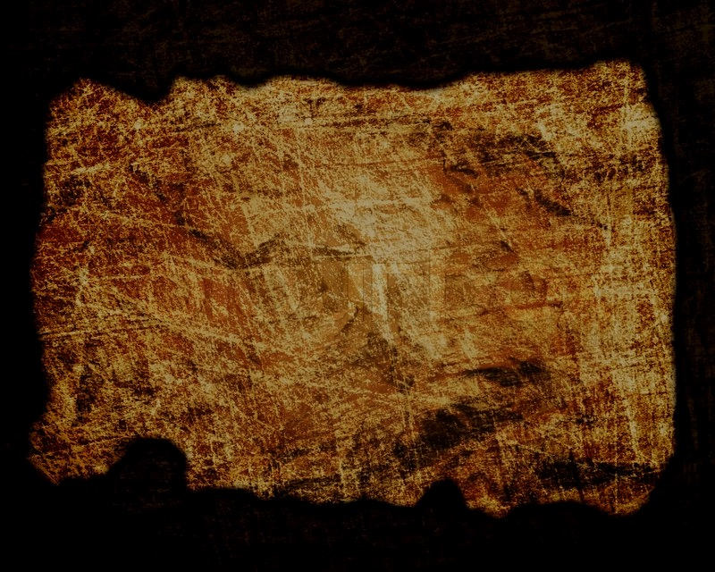
Covenant
27b
Jesus has sent the Holy Spirit to form the church (1:8; 2:14-18, 33, 38-39; 10:44-47), so believers should repent and be baptized to join this new covenant community called the church (2:21, 38; 3:19; 10:43, 47-48; 17:30; 26:20).
Acts

Slide 8
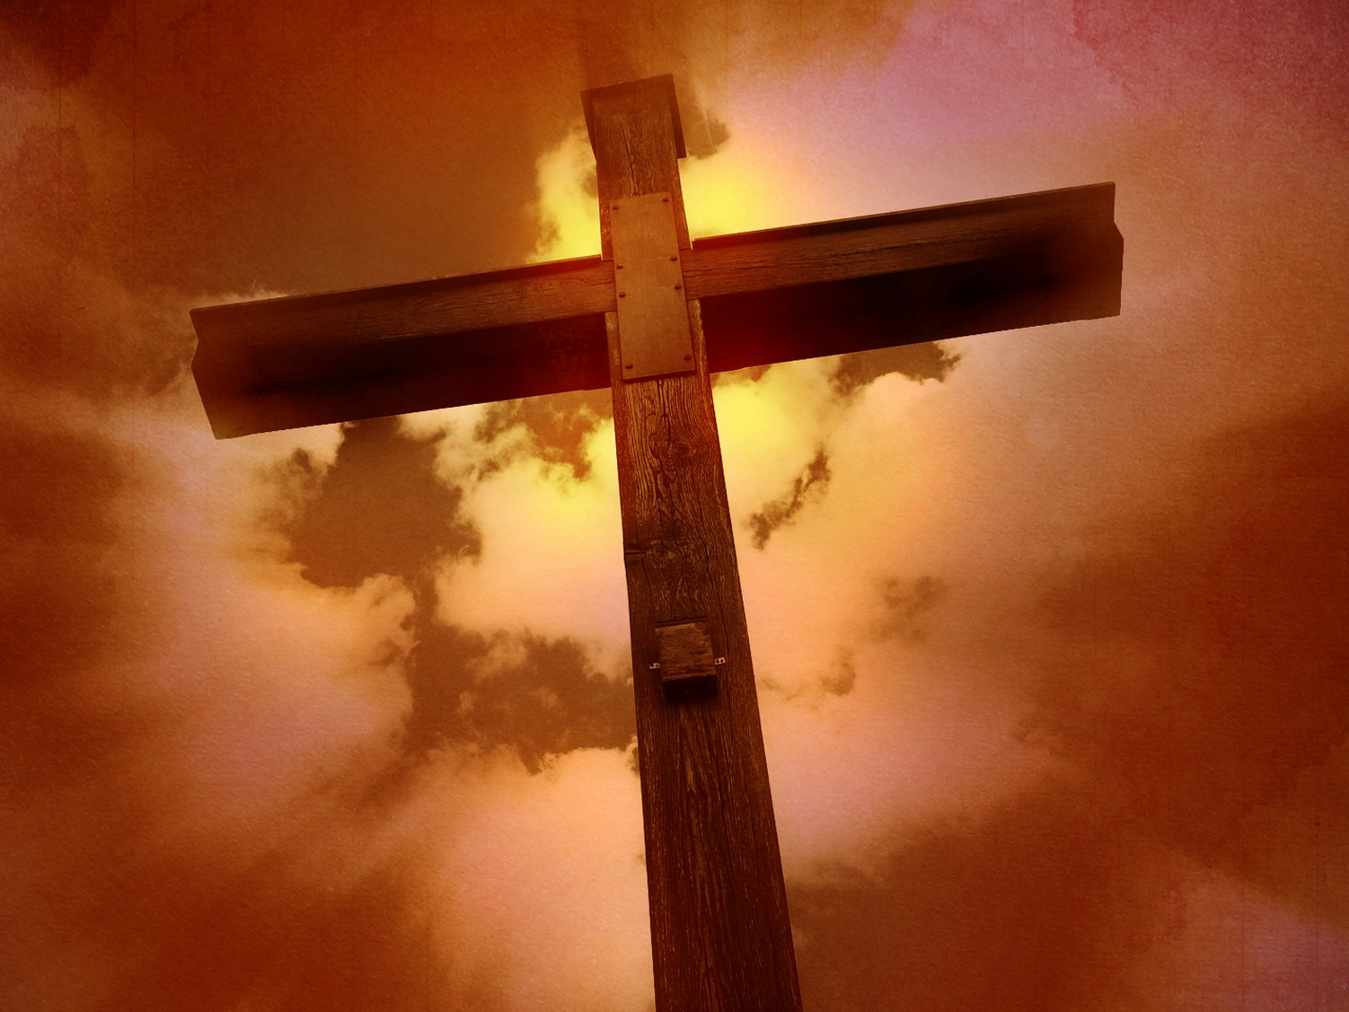
Redemption
27b
The universal appeal for salvation through the gospel is stressed (1:8; 28:30-31) in this book that records over 80 geographical locations–more than any other New Testament book.
Acts

Slide 9
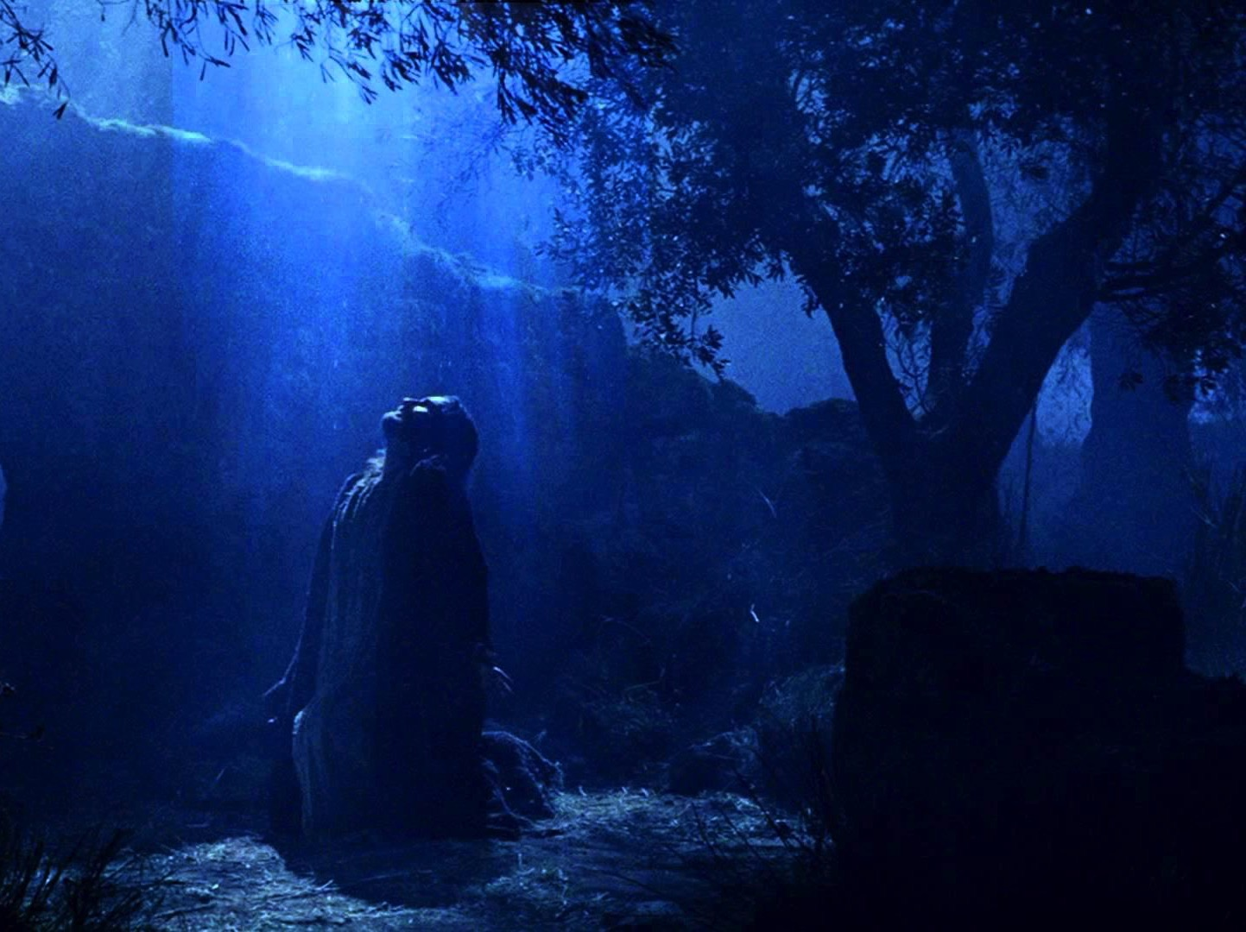
Prophecy
(Lord, Deity)
27b
Jesus fulfilled the OT prophecies (2:30; 3:19, 24; 10:43; 26:6-7, 22), especially in his miracles (2:22; 10:38), death according to God’s purposes (2:23; 3:13-15, 18; 4:11; 10:39; 26:23), resurrection (2:24, 31-32; 3:15, 26; 10:40-41; 17:31; 26:23), and exaltation to God’s throne as Lord (2:25-29, 33-36; 3:13; 10:36) until he returns (3:20-21; 10:42; 17:31; cf. NTS, 137).
Acts

Slide 10
Book Chart (Top)
Acts
120
Universal Savior Proclaimed in Sovereign Kingdom Progress
Jerusalem
Judea and Samaria
Uttermost Part
1:1–6:7
6:8–8:40
Chapters 9–28
Jews
Samaritans
(mixed breeds)
Gentiles
AD 33-35
(2 years)
AD 35
(a few months)
AD 35-62
(27 years)

Slide 11
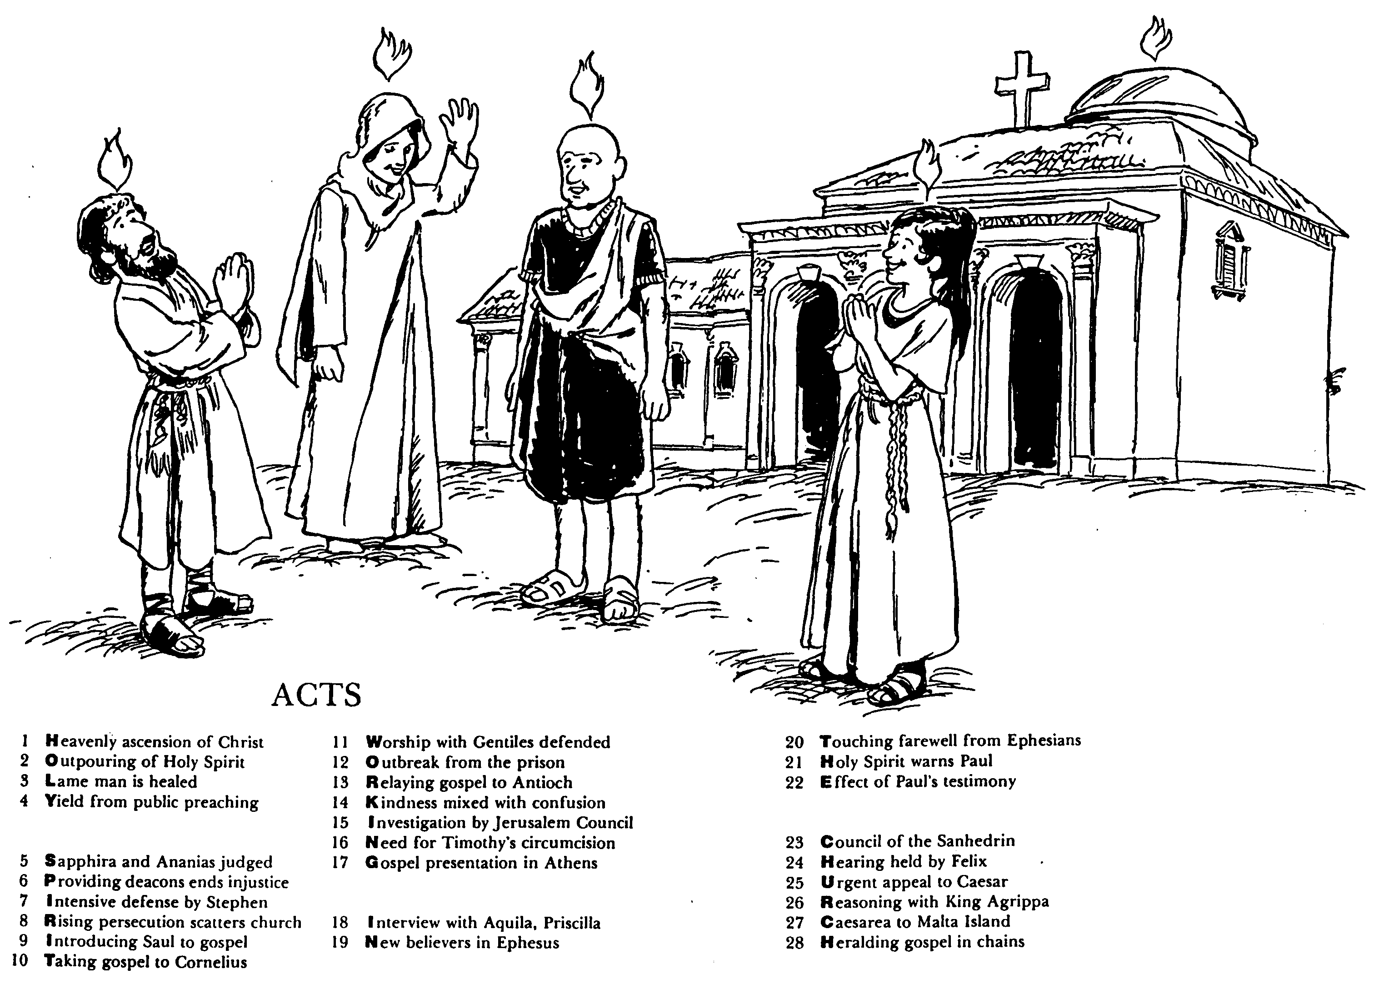
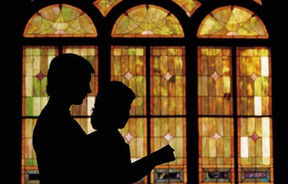
ACTS
Barry Huddleston, The Acrostic Bible
1 基督被接升天
2 圣灵的浇灌
3 瘸腿的人得治愈
4 群众讲道的结果
5 撒非拉和亚拿尼亚被审判
6 拣选执事解决不义
7 司提反强烈的申辩
8 教会受逼迫而分散
9 扫罗接受福音
10 福音传给哥尼流
11 辩解与外族人同赞美
12 逃出监狱
13 福音传到安提阿
14 慈爱与混乱混合了
15 耶路撒冷会议调查
16 对提摩太的割礼的需要
17 在雅典的宣教
18采访与亚居拉，百基拉
19 在以弗所的新信徒
20 以弗所的感人告别
21 圣灵警告保罗
22 保罗见证带来的后果
23 公议会的会议
24 在腓力斯前受审
25 向凯撒的迫切上诉
26 与亚基帕王辩解
27 从该撒利亚到马尔他岛
28 Translation

Slide 12

Be Witnessing
Acts
Dr. Rick Griffith • Crossroads International Church Singapore
BibleStudyDownloads.org

Slide 13
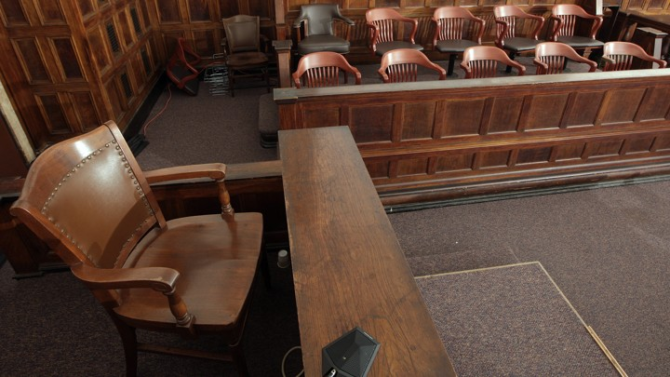
The Witness Stand
Acts
Notes:
It’s not hard to witness to what you have seen—

Slide 14
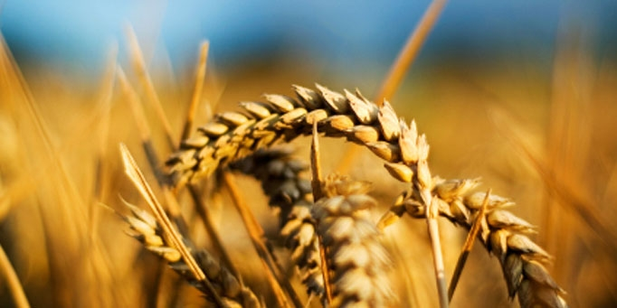
Why should we be witnessing?
3 reasons
Acts
Notes:
Today we’ll see three reasons we should witness for Jesus. Each is actually a stage of growth.
We will survey the entire book of Acts.
(So back to our question: Why should we witness?)

Slide 15

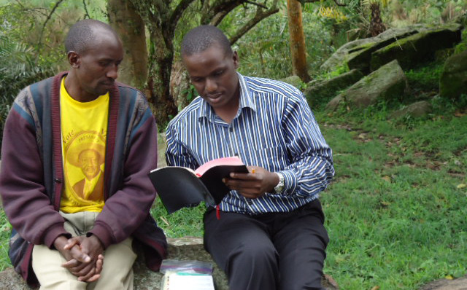
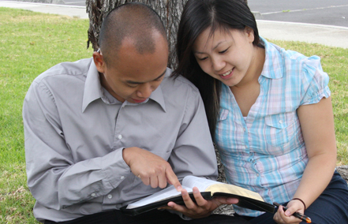
I. God has gone ahead of us so we can begin where we are (Acts 1:1–6:7).
Notes:
God helps us first tell others about Jesus where it is natural without crossing cultures.

Slide 16

II. God gets the glory when we witness outside our comfort zone (Acts 6:8–8:40).
Notes:
God is honored when we share about him with those who are not familiar.

Slide 17
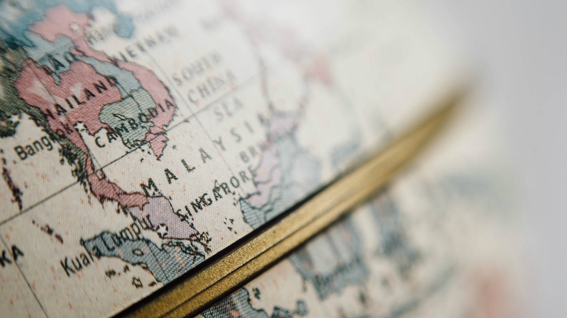
III. God will use us to spread the kingdom to the last unreached place (Acts 9–28).
Notes:
He promises that we will eventually witness in the final unevangelized place on earth.

Slide 18
Main Idea of the Book
Be part of God’s plan to bring the kingdom message to all people.
Acts
Notes:
Do what the Lord has designed for you to do so his rule extends to everyone though your life!

Slide 19

What is your role in God’s plan that he started in early church history?
Acts

Slide 21
Slides on
Acts 17

Slide 22
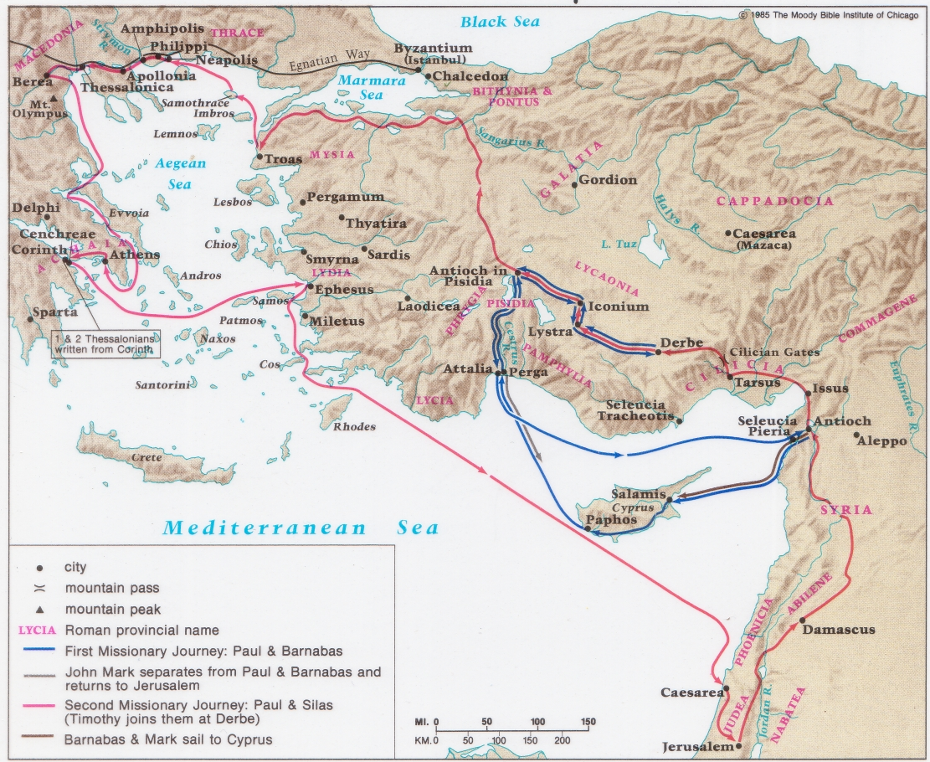
Paul's First & Second Missionary Journeys
138-139

Slide 23
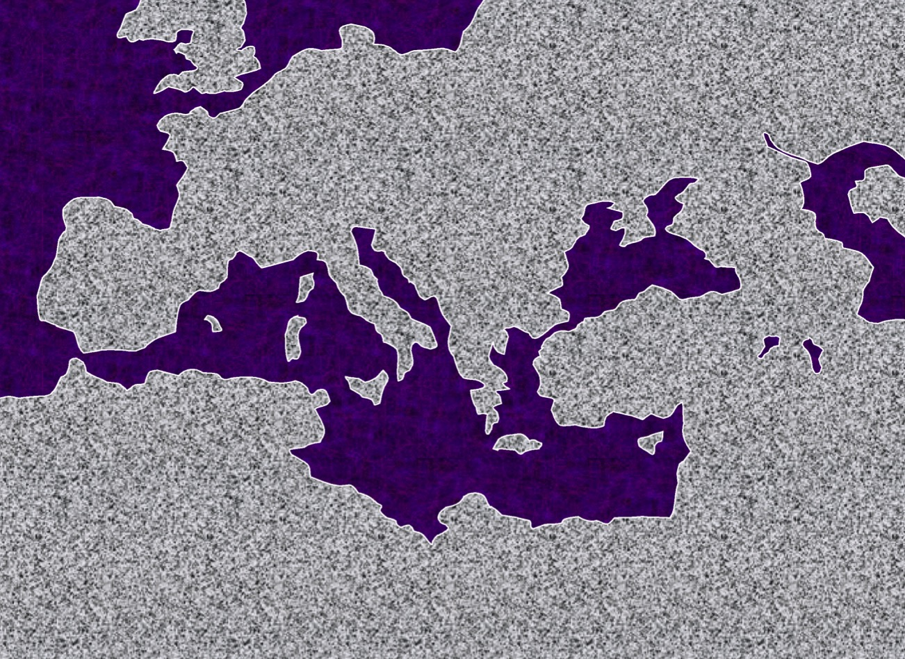
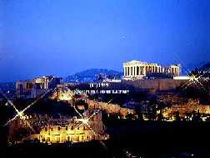
2. "The European Thrust"
ATLANTIC OCEAN
A.D.
49-52
EUROPE
ANCIENT ATHENS
ASIA
ROME•
•Macedonia
•Pisidian Antioch
•
•Ephesus
AFRICA
Athens
Acts 15-18
•Syrian Antioch
MEDITERRANEAN SEA
2."The European Thrust"
•Jerusalem
Significance: many church plants; call to Macedonia, on to Athens, "the unknown god"; Mars Hill; lengthy Corinthian stay.
ARABIA
44
5
©2006 TBBMI
9.65.08.
© 2006 TBBMI
Notes:
Paul then began to prepare for extended missionary trips.
//// Trip #2…THE EUROPEAN THRUST…is recalled in detail in Acts 15 through 18.
//// This second journey began overland from Syrian Antioch…all the way into Greece…then returning by sea to make his report to the church in Jerusalem…then back home to Syrian Antioch.
//// There were church plants along the way… They met in synagogues every Sabbath…speaking either Greek –– thanks to Alexander the Great –– or Hebrew or Latin. Paul spoke all those languages. This is the time of that famous call to "come over to MACEDONIA and help us." And then he took up a lengthy residence in the wild, seaside town of CORINTH, only a short journey from Athens.
//// On this trip he debated with the Athenian philosophers on Mars Hill, recognizing their statue to "the unknown God." He built a sermon around that!
//// LENGTH OF THIS TRIP: ESTIMATED AT ABOUT TWO AND A HALF YEARS BETWEEN A.D. 49 AND 52.

Slide 24
Turn the Other Cheek
³⁵ The next morning the city officials sent the police to tell the jailer, “Let those men go!” ³⁶ So the jailer told Paul, “The city officials have said you and Silas are free to leave. Go in peace.”

Slide 25
Turn the Other Cheek
Matt 5:39 But I say, do not resist an evil person! If someone slaps you on the right cheek, offer the other cheek also.

Slide 26
Thessalonica
Short period of time (3 weeks)
Preached in synagogue (resurrection)
Some Jews / Many devout (God-fearing) Greek men believed
Opposed by Jews

Slide 27
Berea
Short period of time
Preached in Synagogue
Many Jews / Many prominent Greek men and women believed
Opposed by Jews from Thessalonica

Slide 28
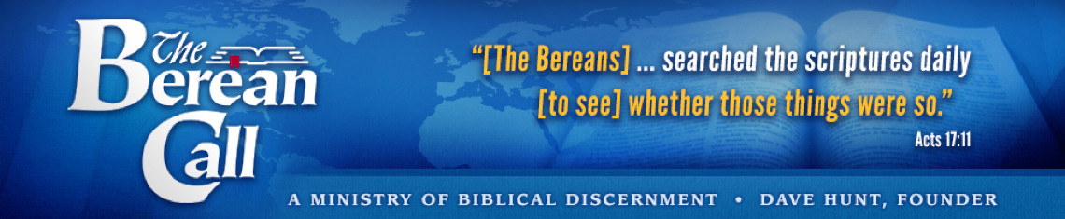
Thessalonica Berea
Some Jews Believed
Many Jews Believed
¹¹ And the people of Berea were more open-minded than those in Thessalonica, and they listened eagerly to Paul’s message. They searched the Scriptures day after day to see if Paul and Silas were teaching the truth.

Slide 29
God reveals himself
(through his word)
to those who seek
and worship him

Slide 30
Philippi
Thessalonica
Berea
Troas
Athens
Corinth

Slide 31
Athens
  Short Period of Time
  Preached in Synagogue
  Troubled by all the idols
  Debated philosophers
  Sermon for Gentiles

Slide 32
Sermon for Gentiles
22-23
  Gentiles are seeking God
24-26
  Who God is
27-29
  What God is doing
22-23
  God’s Expectations

Slide 33
God reveals himself
(even to Gentiles)
to those who seek
and worship him

Slide 34
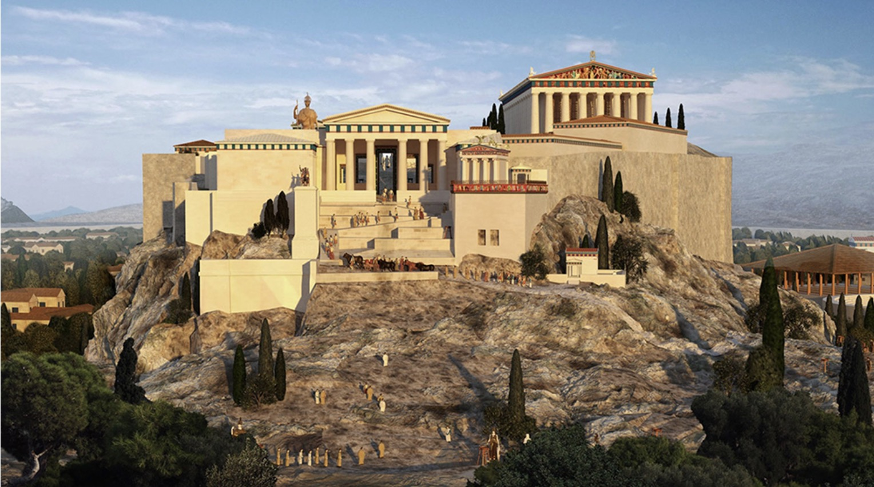
Athens Acropolis

Slide 35
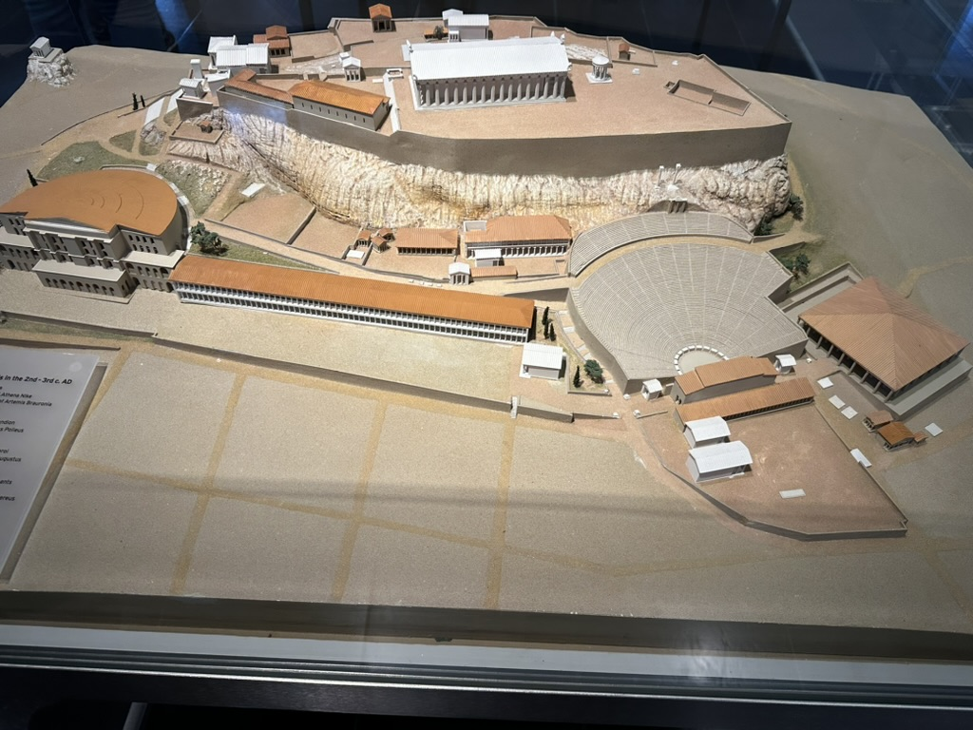
Athens Acropolis

Slide 36
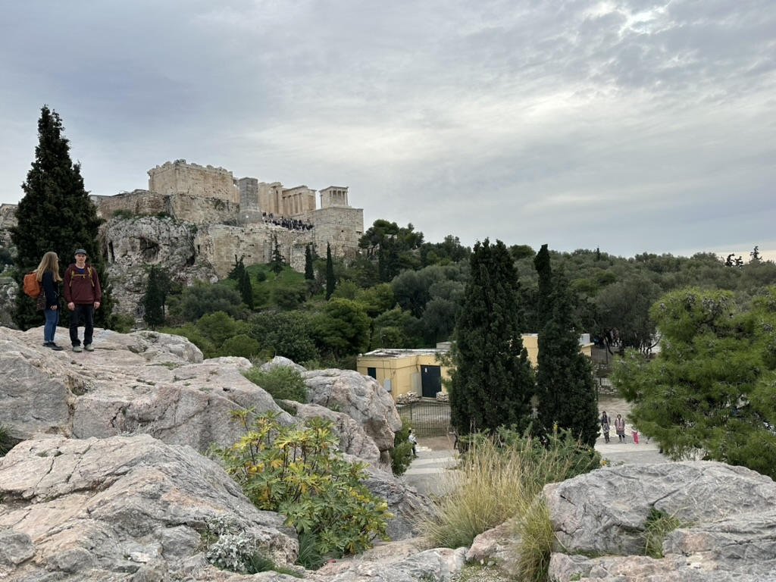
Mars Hill (Acts 17:22-32)
Mars Hill

Slide 37
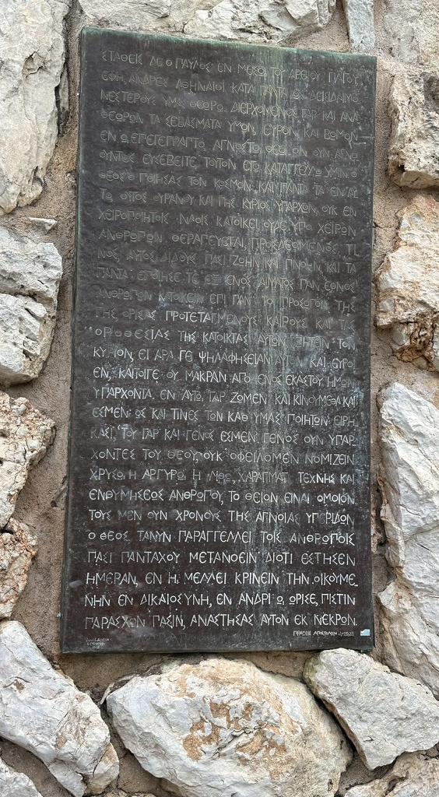
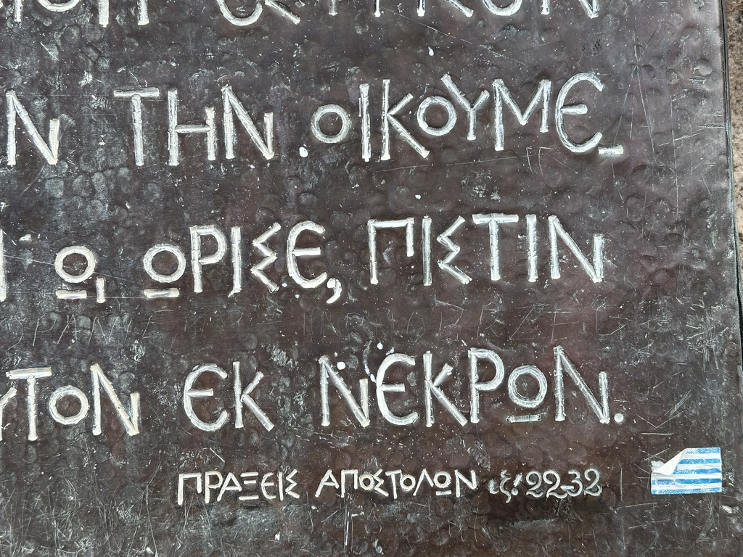
Mars Hill (Acts 17:22-32)

Slide 38
Slides on
Acts 18

Slide 39
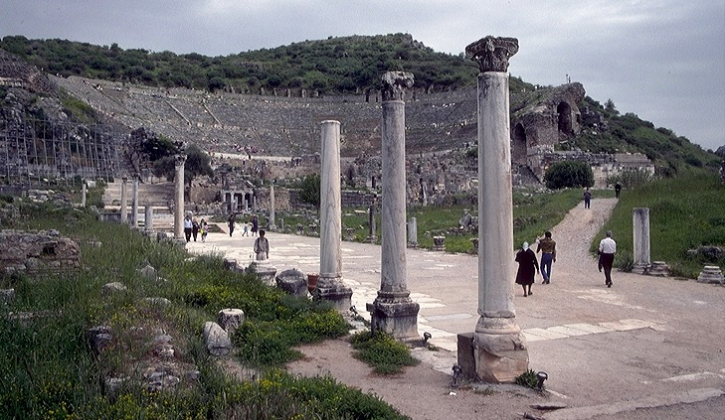
3."The Asian Thrust"
A.D.
53-57
ATLANTIC OCEAN
EUROPE
ANCIENT EPHESUS
ROME•
•Macedonia
ASIA
•Pisidian Antioch
•
•Ephesus
AFRICA
Athens
Acts 18-21
•Syrian Antioch
MEDITERRANEAN SEA
3.”The Asian Thrust”
•Jerusalem
Significance: extended time at the church in Ephesus; young man raised from the dead; important letters written; riot with Ephesian artisans at amphitheatre.
ARABIA
9.65.08.
45
4
© 2006 TBBMI
9.65.08.
Notes:
Then came Paul's ASIAN THRUST…recorded in Acts 18-21.
//// Again, this trip began overland from Syrian Antioch…revisited many of the earlier churches…made a horseshoe-shaped route around the Aegean, back down into Greece, retraced that route back around the horseshoe, remaining at Troas, then returning by sea to Syrian Antioch.
//// Paul spent a very long time living and ministering to the church the EPHESUS. Luke reports that Paul raised a young man from the dead in Ephesus. Many important letters –– our Epistles –– were written from Ephesus.
//// One of the most dramatic events recorded for us took place at the Ephesian AMPHITHEATRE where he confronted the souvenir makers of the city…those who manufactured small idols of the Goddess Diana, whose temple in Ephesus was one of the seven wonders of the ancient world.
//// LENGTH OF THIS TRIP: ALMOST FIVE YEARS BETWEEN A.D. 53 AND 57.

Slide 40
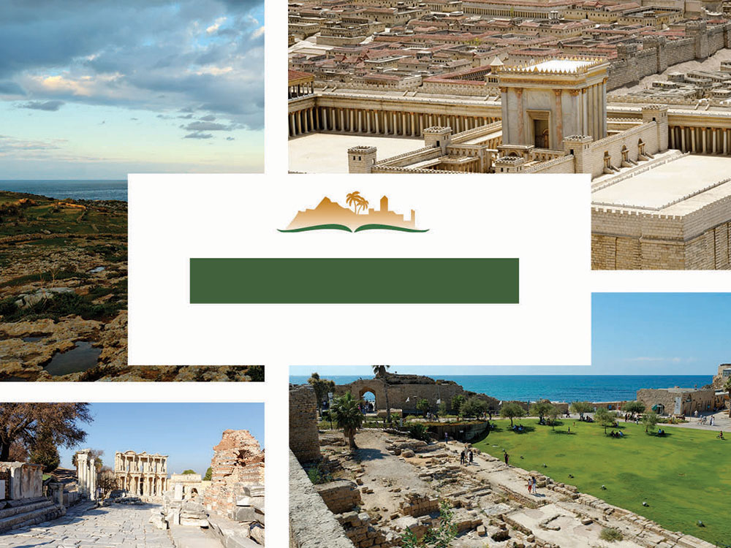
ACTS 18
The following comprises only 39 of the 197 slides on Acts 18 alone!
Notes:
This is a free sample of the Acts 18 presentation from the Photo Companion to the Bible. To purchase the full volume, visit https://www.bibleplaces.com/acts/
The Photo Companion to the Bible is an image-rich resource for Bible students, teachers, and researchers. Just as a librarian stocks the shelves with as many relevant materials as possible, so we have tried to provide a broad selection of images. Our goal is that you will find in this “library” whatever it is you are looking for.
Credits: The primary creators of this presentation are Steven D. Anderson, A.D. Riddle, Christian Locatell, Kris Udd, and Todd Bolen. The photographs have an individual file code which usually includes the initials of the photographer. Other images have additional credit or source information.
Updates: We plan to update this collection as we are able. We welcome your suggestions for improving this resource (photocompanion@bibleplaces.com). Purchasers of the Acts volume are provided free, lifetime updates to the collection.
Copyright: This photo collection is protected by copyright law and may not be distributed without written permission from BiblePlaces.com. Slide notes should be treated as any other copyrighted written material, with credit given when quoting from these notes.
For more information, see our complete “Introduction to the Photo Companion to the Bible” online at http://www.BiblePlaces.com/Intro-Photo-Companion-Bible/. Here you will find more information about photo selection, explanatory notes, Bible translation, credit information, and copyright allowances.

Slide 41
This is a free sample of the Acts 18 presentation from the Photo Companion to the Bible. To purchase the full volume, visit https://www.bibleplaces.com/acts/
The Photo Companion to the Bible is an image-rich resource for Bible students, teachers, and researchers. Just as a librarian stocks the shelves with as many relevant materials as possible, so we have tried to provide a broad selection of images. Our goal is that you will find in this “library” whatever it is you are looking for.
For more details (for this and every slide), see the Notes section below.
Notes:
This is a free sample of the Acts 18 presentation from the Photo Companion to the Bible. To purchase the full volume, visit https://www.bibleplaces.com/acts/
The Photo Companion to the Bible is an image-rich resource for Bible students, teachers, and researchers. Just as a librarian stocks the shelves with as many relevant materials as possible, so we have tried to provide a broad selection of images. Our goal is that you will find in this “library” whatever it is you are looking for.
Credits: The primary creators of this presentation are Steven D. Anderson, A.D. Riddle, Christian Locatell, Kris Udd, and Todd Bolen. The photographs have an individual file code which usually includes the initials of the photographer. Other images have additional credit or source information.
Updates: We plan to update this collection as we are able. We welcome your suggestions for improving this resource (photocompanion@bibleplaces.com). Purchasers of the Acts volume are provided free, lifetime updates to the collection.
Copyright: This photo collection is protected by copyright law and may not be distributed without written permission from BiblePlaces.com. Slide notes should be treated as any other copyrighted written material, with credit given when quoting from these notes.
For more information, see our complete “Introduction to the Photo Companion to the Bible” online at http://www.BiblePlaces.com/Intro-Photo-Companion-Bible/. Here you will find more information about photo selection, explanatory notes, Bible translation, credit information, and copyright allowances.

Slide 42
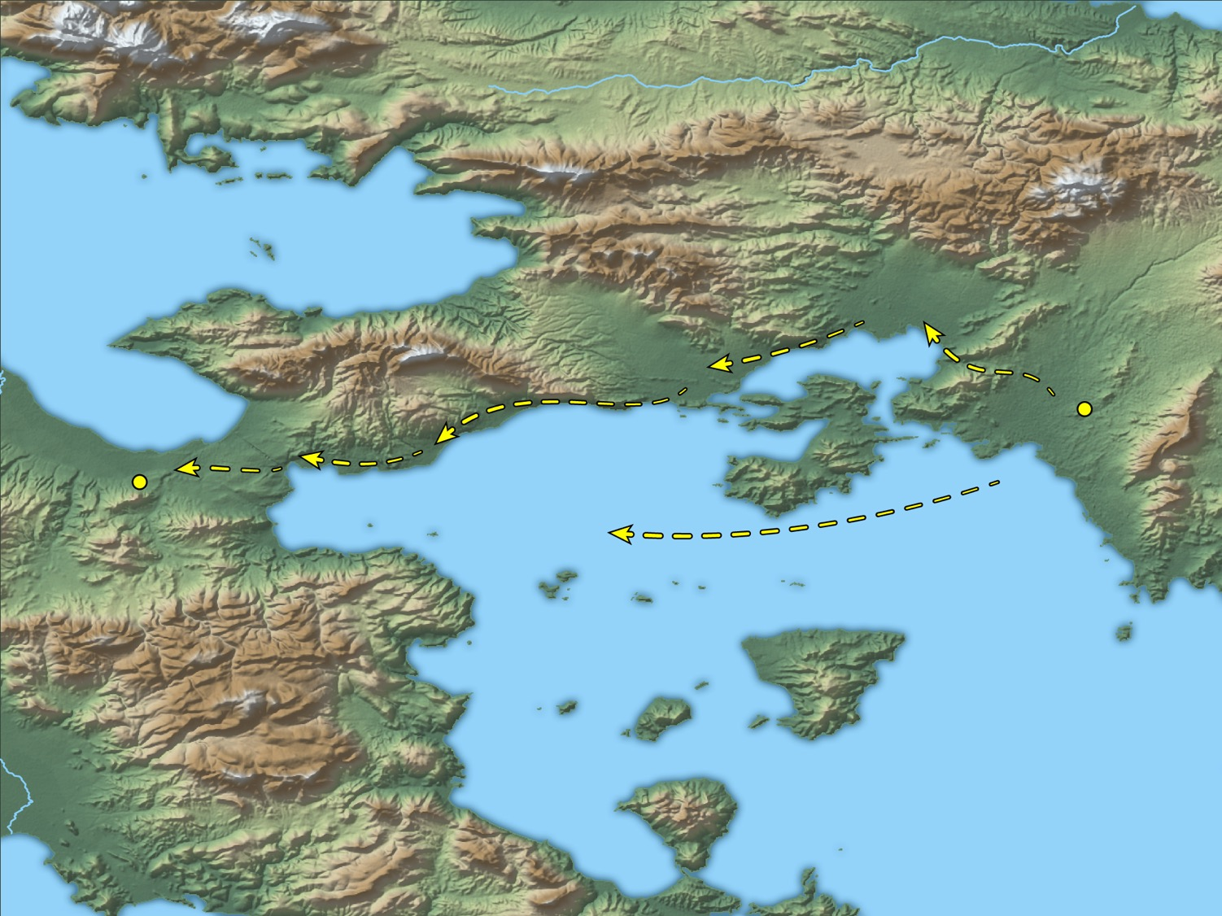
After these things he departed from Athens and came to Corinth
Athens
Corinth
Paul’s trip from Athens to Corinth
18:1
Notes:
This map shows a couple of possible options for Paul’s travel to Corinth. If he traveled by land, the route is fairly well defined by the coastline and the mountains. If he sailed, his boat would have departed from the port of Piraeus and landed at the port of Cenchreae. This map was created by A.D. Riddle, RiddleMaps.com. Data sources: Ancient World Mapping Center shapefiles were used for road lines, under Open Database License (ODbL 1.0; http://awmc.unc.edu/wordpress/map-files/). ASTER-GDEM 2 or SRTM data were used to render the terrain (https://asterweb.jpl.nasa.gov/gdem.asp and https://www2.jpl.nasa.gov/srtm/). Natural Earth was used for streams and inland water bodies. Their data have been placed in the public domain. https://www.naturalearthdata.com/about/terms-of-use/.

Slide 43
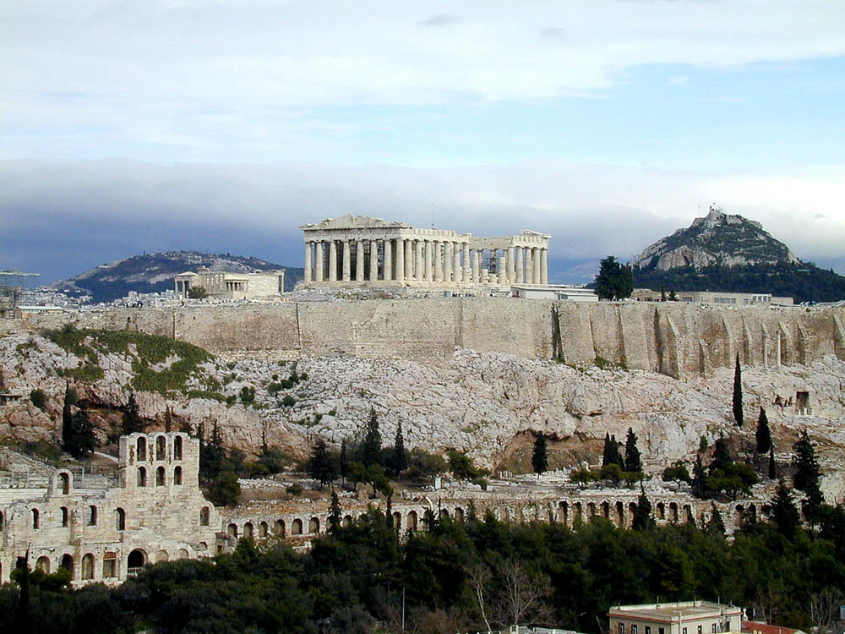
After these things he departed from Athens
The Acropolis in Athens
18:1
Notes:
Paul did not spend long in Athens on his second missionary journey but instead moved on to Corinth. He had been waiting for Silas and Timothy (Acts 17:15-16), but they did not join him until he was in Corinth (Acts 18:5). Corinth was about 40 miles (64 km) west of Athens. This photo of the Acropolis was taken from the Hill of Philopappus. The temple of Athena has been standing on the Acropolis since 420 BC.
tb011501034

Slide 44
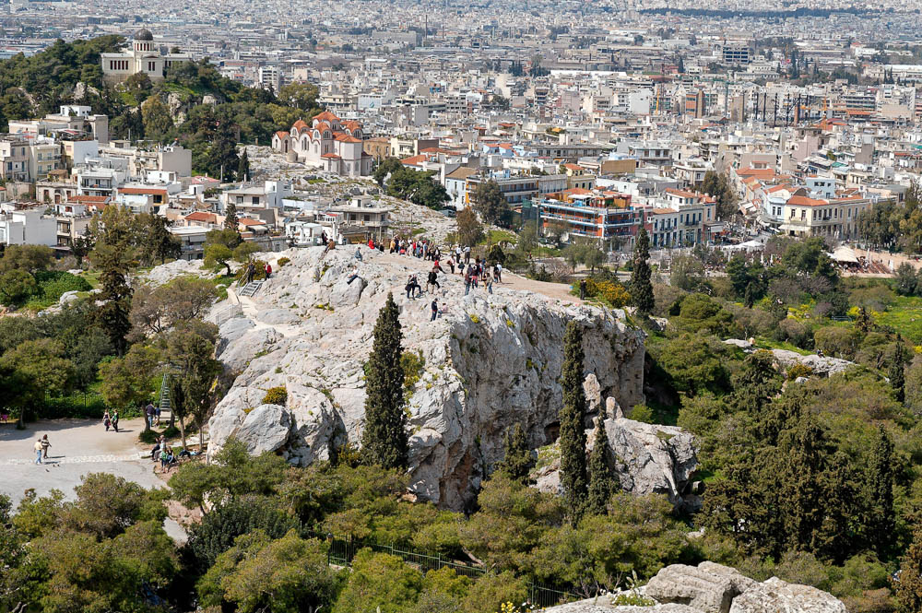
After these things he departed from Athens
Mars Hill, from the Acropolis of Athens
18:1
Notes:
Paul had spoken to the Areopagus (Acts 17:19-34), perhaps at Mars Hill, the rocky outcropping pictured here. See chapter 17 for more photographs and explanatory notes about Paul’s sermon here.
tb031806377

Slide 45
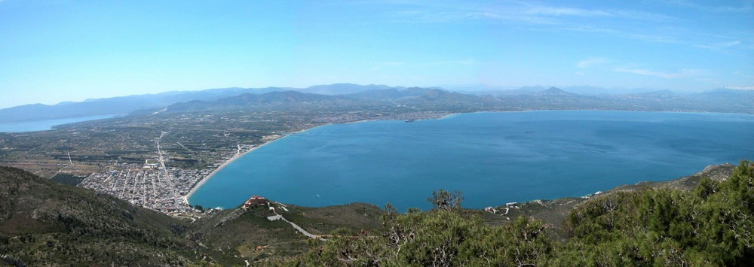
After these things he departed from Athens and came to Corinth
The gulf and isthmus of Corinth (from the north)
18:1
Notes:
This photo provides a broad panoramic perspective of the Corinth area. Paul arrived from the east (the left side of this photo), either by land or by sea. If by land, he would have crossed the isthmus to the city of Corinth. If arriving by boat, he would have landed at the port at Cenchreae. The ancient city of Corinth was one of the major commercial centers of the ancient world. It was perfectly situated near the narrowest part of the Isthmus, a strip of limestone four miles wide connecting mainland Greece with the southern peninsula (Peloponnesus). Corinth had a port on either side of the Isthmus—Lechaion on the Corinth Gulf and Cenchreae on the Saronic Gulf—and thus held control of the seas on both sides of Greece. See the next slide for labels.
tb050803400

Slide 46
After these things he departed from Athens and came to Corinth
Cenchreae
Peloponnesus
Corinth
Corinth canal
Gulf of Corinth
Mainland Greece
The gulf and isthmus of Corinth (from the north)
18:1
Notes:
This photo provides a broad panoramic perspective of the Corinth area. Paul arrived from the east (the left side of this photo), either by land or by sea. If by land, he would have crossed the isthmus to the city of Corinth. If arriving by boat, he would have landed at the port at Cenchreae. The ancient city of Corinth was one of the major commercial centers of the ancient world. It was perfectly situated near the narrowest part of the Isthmus, a strip of limestone four miles wide connecting mainland Greece with the southern peninsula (Peloponnesus). Corinth had a port on either side of the Isthmus—Lechaion on the Corinth Gulf and Cenchreae on the Saronic Gulf—and thus held control of the seas on both sides of Greece.
tb050803400

Slide 47
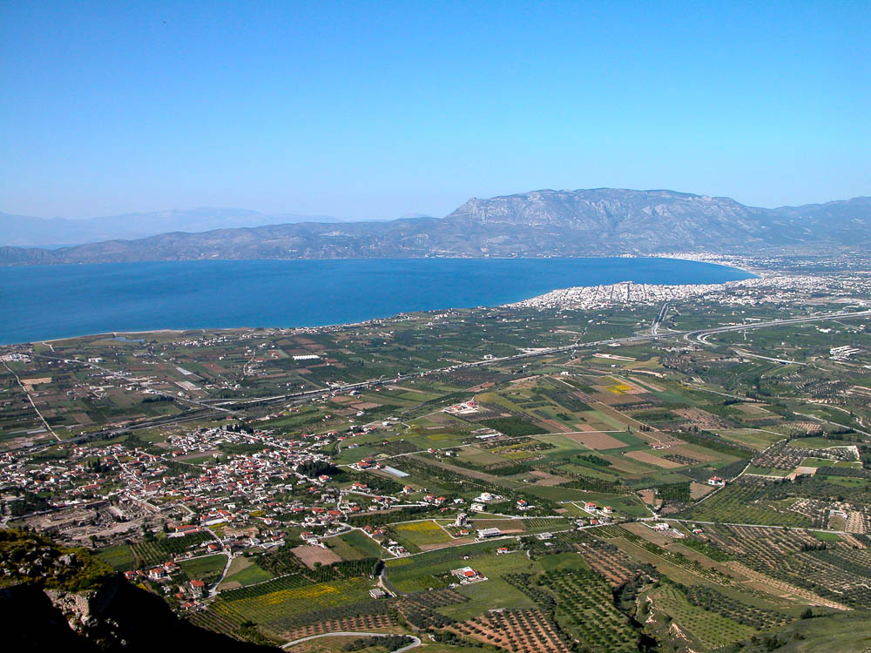
After these things he departed from Athens and came to Corinth
Lechaion harbor
Gulf of Corinth
Corinth excavations
Excavations of Corinth, the harbor of Lechaion, and the Gulf of Corinth, from the Acrocorinth
18:1
Notes:
Corinth was a major city of ancient Greece in the first century AD, but it had a rough history before that. Destroyed by the Romans in 146 BC, the city was only rebuilt in 44 BC when Julius Caesar re-founded it as a Roman colony. Most of its citizens were former slaves from Rome, but businessmen also came. The city grew to economic and cultural prosperity as the capital city of the Roman province of Achaia (2nd century AD). It held its own during the attacks of the Herulians in the 3rd century AD, but Alaric took Corinth in AD 396. Earthquakes finally brought it down in AD 522 and 551, beginning a steady decline.
tb050803017

Slide 48
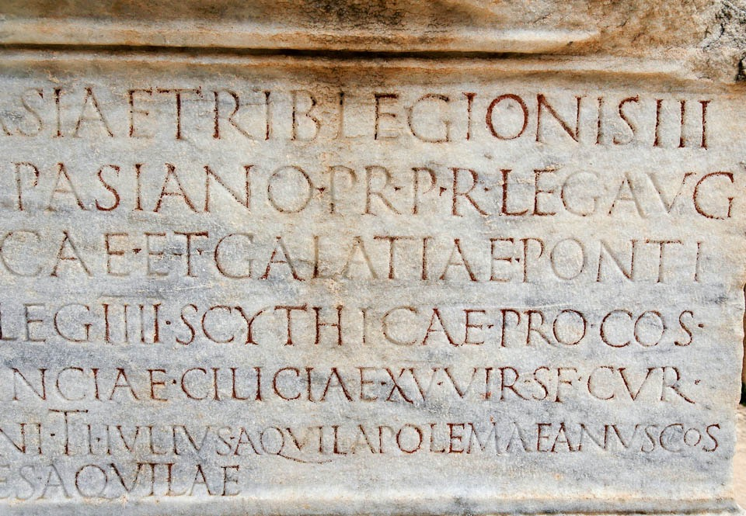
He found a certain Jew named Aquila, a native of Pontus
“Pontus” and “Aquila” on inscription at the Celsus Library in Ephesus, 2nd century AD
18:2
Notes:
Aquila (Gk. Ἀκύλας) was a common Greek personal name. Both the name Aquila and the region of Pontus are mentioned in this Latin inscription from the Celsus Library in Ephesus. The Library of Celsus was constructed around AD 115, about 60 years after Paul’s visits. The next slide includes labels.
tb041405388

Slide 49
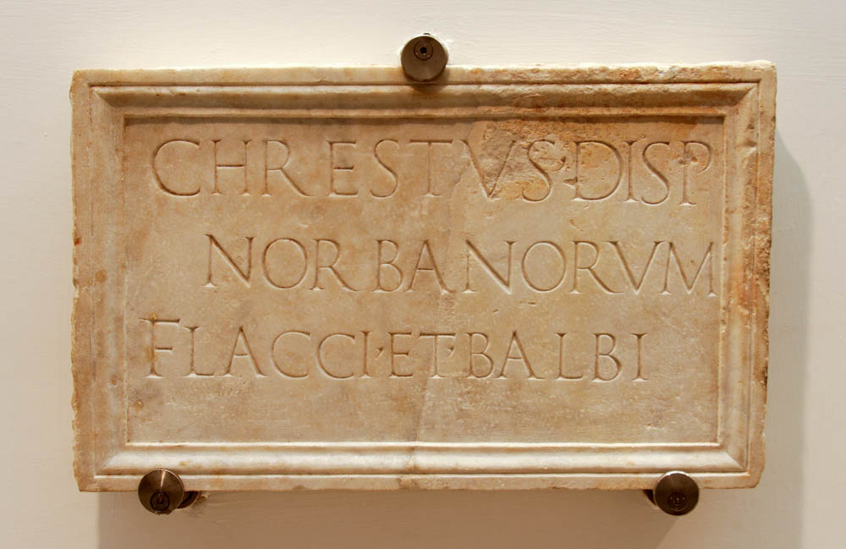
Claudius had commanded all the Jews to depart from Rome
Burial slab of a slave named Chrestus, from Via Salarina in Rome, early 1st century AD
18:2
Notes:
According to the Roman historian Suetonius (Life of Claudius 25.4), Claudius had expelled the Jews (or at least some Jews) from Rome because of a disturbance regarding one “Chrestus.” While this could be a reference to some unknown person, many scholars believe that Suetonius was making a reference to “Christ” as proclaimed by early Christians. If this is correct, the disturbance was caused by the hostility of unbelieving Jews toward Christians and the message they brought. This photo shows the burial slab of a slave named “Chrestus,” who dealt with the administration of his two owners from the Norbani family. This inscription is on display at the National Museum at the Diocletian Baths in Rome.
tb0513178516

Slide 50
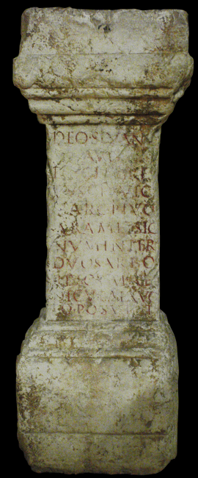
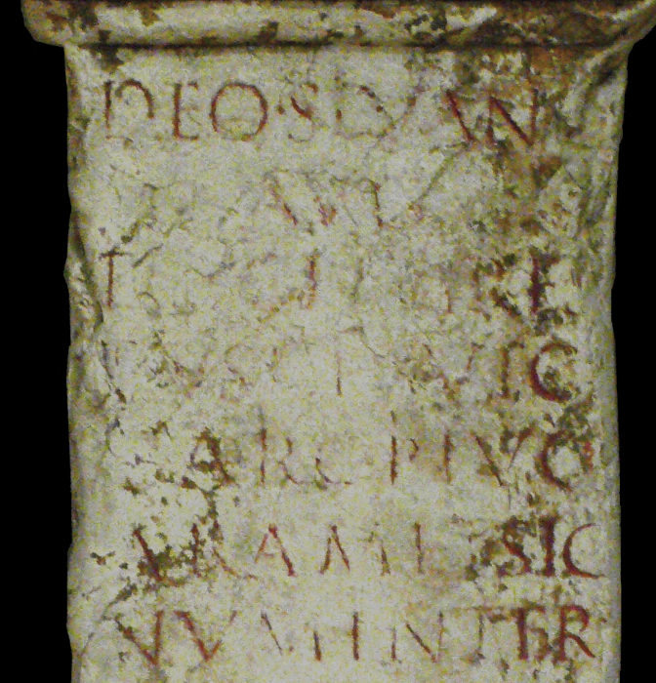
Claudius had commanded all the Jews to depart from Rome
Altar base dedicated by Tiberius Claudius Chrestus, keyholder of the prison of Lyon
18:2
Notes:
The name Chrestus was not unknown in the Roman world, and it is possible that either Claudius or the author Suetonius confused the less-common name “Christos” for the personal name “Chrestus.” The altar base shown here was found reused as a doorway in the Rue de Trion in Lyon in 1816. The explanatory plaque to the museum indicates that this is the only known mention in the province of a guardian of the keys for a prison. The entire inscription may be translated as “To the august god Silvain, Tiberius Claudius Chrestus, keyholder of the public prison of Lyon, raised, in fulfillment of his vow, this altar and the statue of the god between two trees, with this chapel.” The actual Latin inscription is “DEO SILVANO / AVG(vsto) / TIB(erivs) CL(avdivs) [C]HRES / TVS, CLAVIC(vlarivs) / CARC(eris) P(vblici) LVG(vdvni) / ARAM ET SIG / NVM INTER / DVOS ARBO / RES CVM A[e] / DICVLA EX VO / TO POSVIT.” This altar base was photographed at the Gallo-Roman Museum of Fourviere, Lyon, France. This image comes from Arnaud Fafournoux and is licensed under CC BY-SA 3.0, via Wikimedia Commons: https://commons.wikimedia.org/wiki/File:CIL_XIII_1780_(1).JPG.
wiki10272011160758

Slide 51
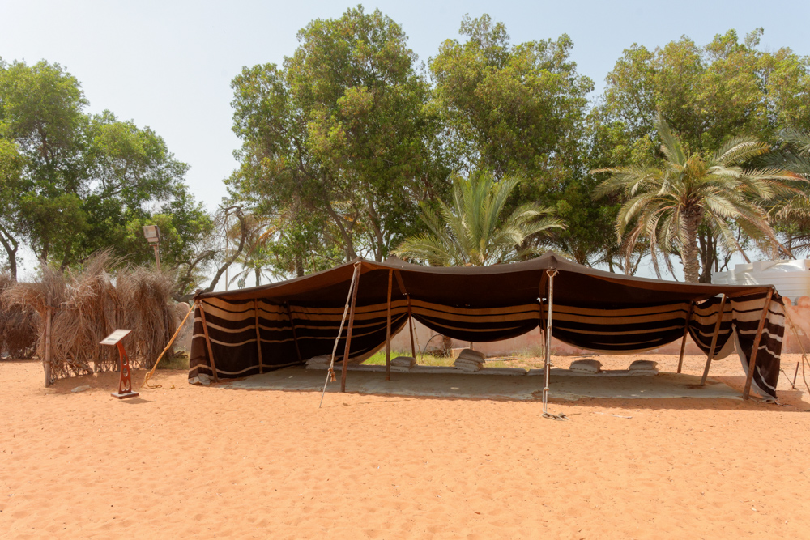
By their trade they were tentmakers
Bedouin tent made of goat and sheep hair
18:3
Notes:
This tent was photographed in the UAE Heritage Village in Abu Dhabi.
tb051017143

Slide 52
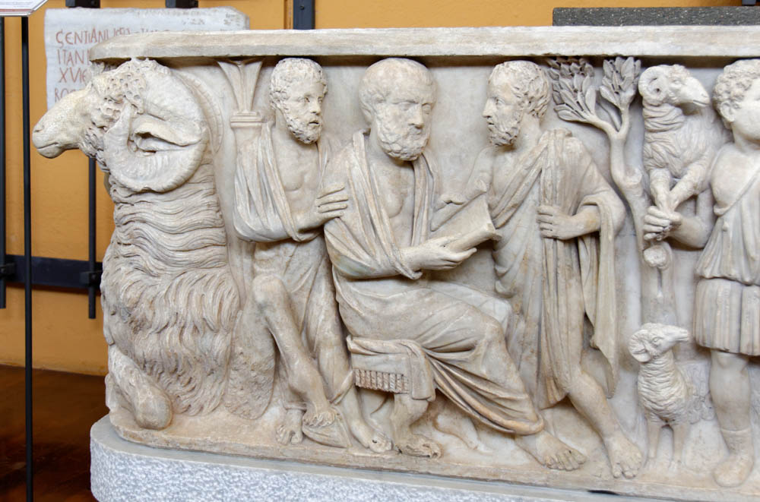
He reasoned in the synagogue every Sabbath, trying to persuade Jews and Greeks
Sarcophagus relief of deceased couple discussing philosophy, from Via Salaria, AD 250–275
18:4
Notes:
This carving shows a man in discussion with his friends, a scroll in his hands. The other half of the sarcophagus (not visible here) depicts his wife involved in similar activities. This sarcophagus comes from the Via Salaria, an ancient road in Italy leading from Rome to the Adriatic Sea. It was photographed at the Vatican Museum.
tb0512175886

Slide 53
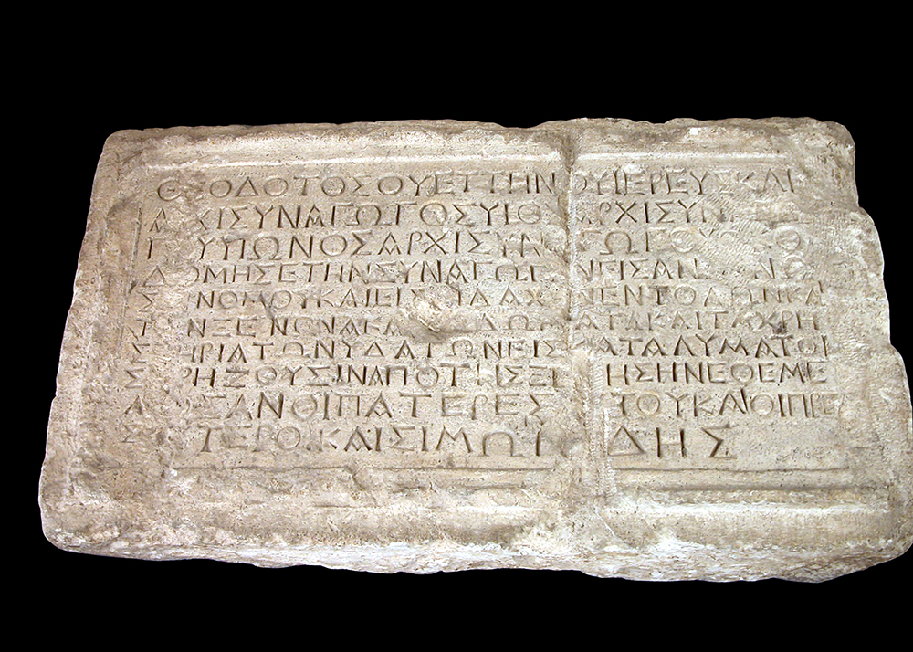
And Crispus, the ruler of the synagogue, believed in the Lord with all his house
Theodotos Inscription, from a synagogue in Jerusalem, 1st century BC
18:8
Notes:
The word highlighted in this Greek inscription reads “synagogue ruler” (archisunagogos, Α[Ρ]ΧΙΣΥΝΑΓΩΓΗΣ). Sosthenes, another “ruler of the synagogue” is mentioned in Acts 18:17. This inscription is a dedicatory statement that was once displayed in the wall of a synagogue in Jerusalem prior to its destruction in AD 70. It lists the names of the major donor (Theodotos), and several of the uses for which the synagogue was intended (reading the law, hospitality, etc.). It was photographed at the Rockefeller Museum.
tb042403156b

Slide 54
Corinth
Preached in synagogue (18:4)
How many believed?
Opposed by Jews
Preached to Gentiles
Who was the first convert?
God gave guidance via a dream

Slide 55
When God reveals his plans for you,
expect him to fulfill those plans

Slide 56
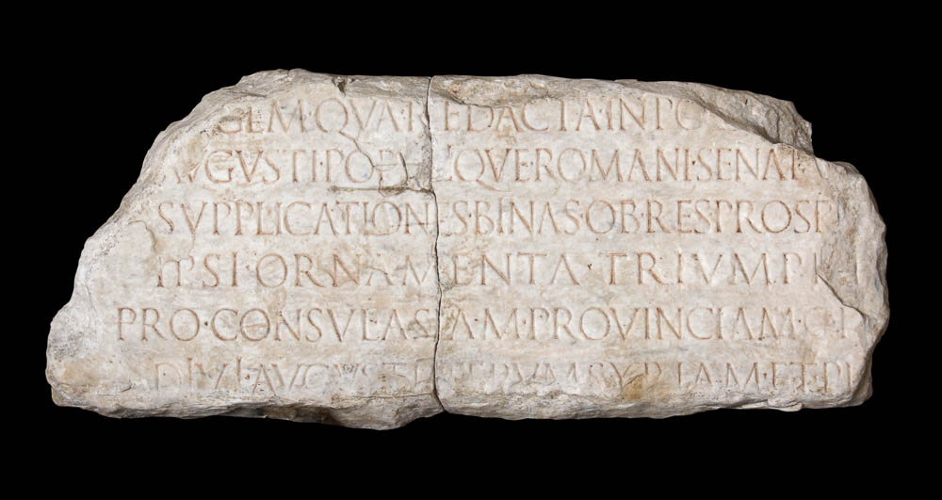
But when Gallio was proconsul of Achaia
Tombstone likely of Publius Sulpicius Quirinius, proconsul of Asia, 1st century AD
18:12
Notes:
This Latin inscription preserves the title “proconsul.” In Greek the word is anthupatos (ἀνθύπατος); it refers to the head of the government in a senatorial province. Achaia, in Paul’s day, was a province that included the most important parts of Greece, i.e. Attica, Boeotia (perh. Epirus) and the Peloponnese Peninsula. Publius Sulpicius Quirinius lived from circa 45 BC to AD 21, and was proconsul in Asia. This inscription was discovered near Tivoli in 1764.
tb0512175954c

Slide 57
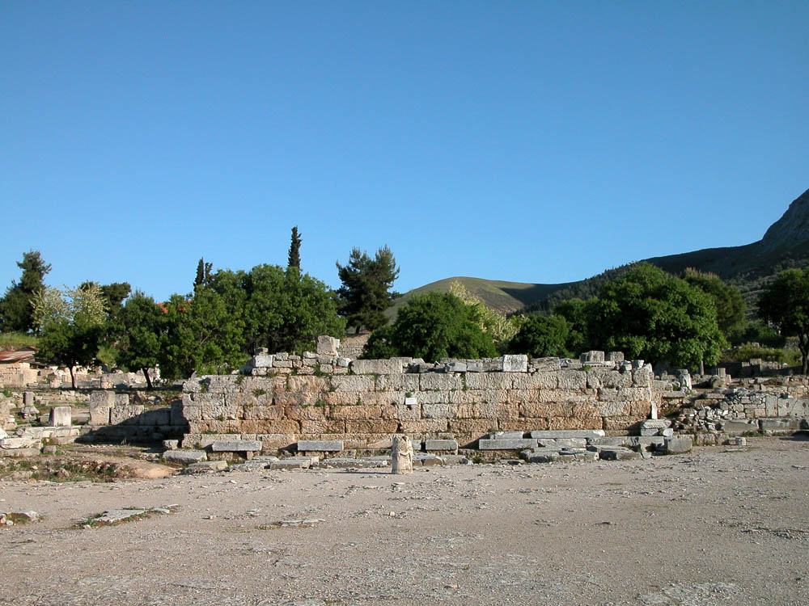
The Jews with one accord rose up against Paul and brought him before the judgment seat
Bema (judgment seat) in Corinth
18:12
Notes:
Most cities had a bema, often within or adjacent to the agora or forum.
tb050803073

Slide 58
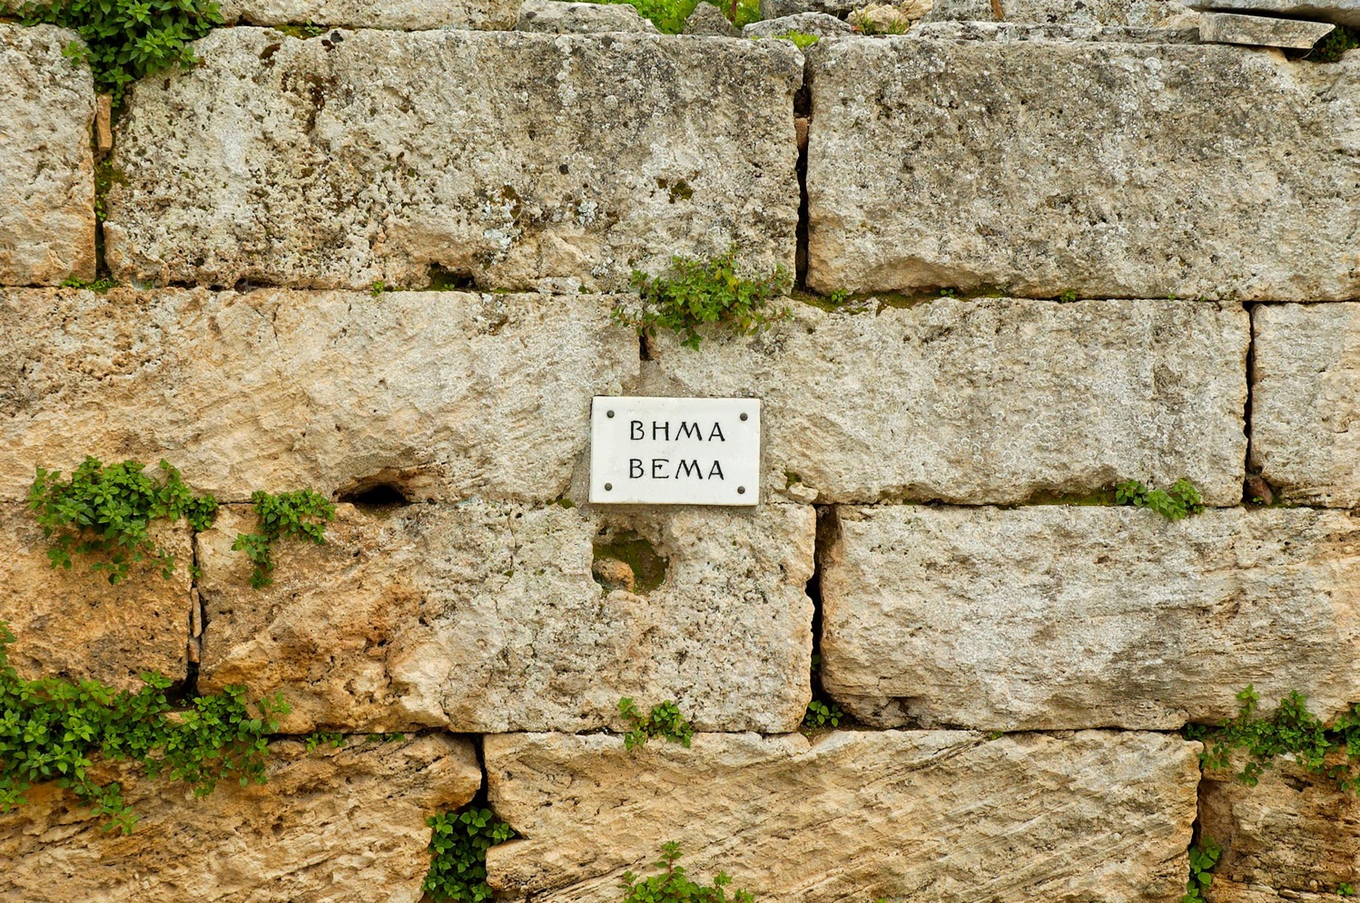
The Jews with one accord rose up against Paul and brought him before the judgment seat
Sign on the bema (judgment seat) in Corinth
18:12
Notes:
This is a close-up of a modern sign posted on the bema shown in the previous slides.
tb031706105

Slide 59
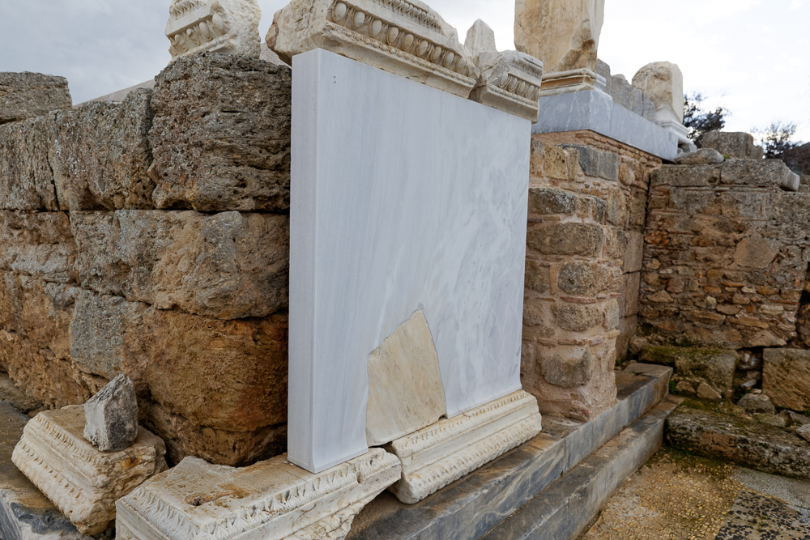
The Jews with one accord rose up against Paul and brought him before the judgment seat
Marble façade on the bema (judgment seat) in Corinth
18:12
Notes:
Originally the bema was more finely finished than what is preserved today. These architectural fragments from the bema give some idea of its original decoration and appearance.
jc0111152340

Slide 60
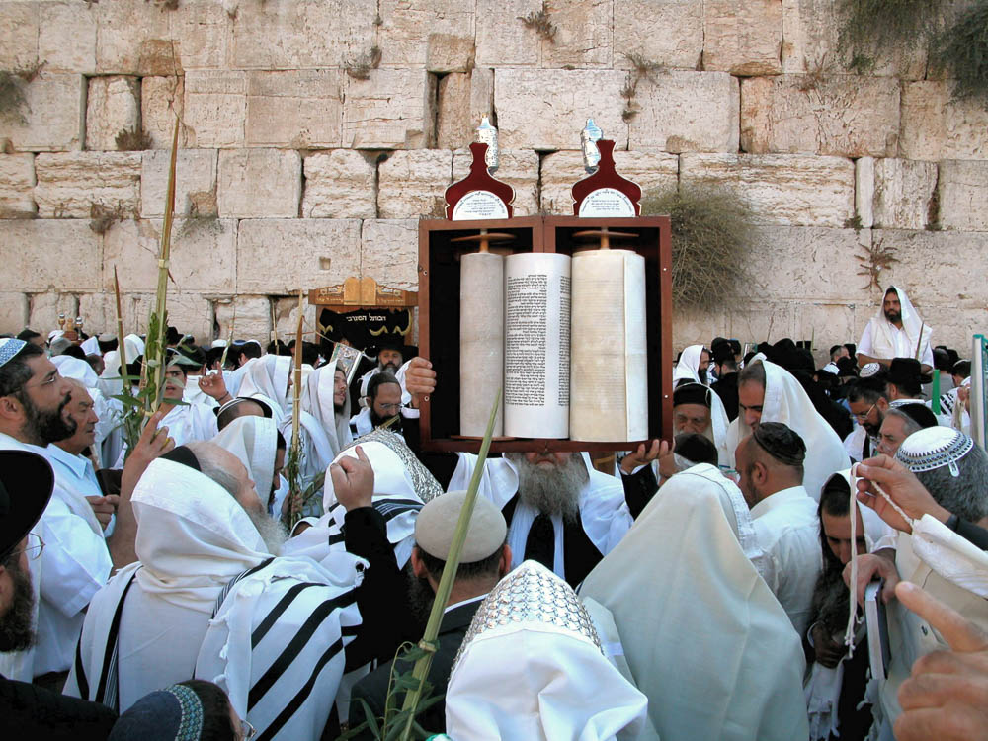
This man persuades people to worship God contrary to the Law
Torah scroll being lifted at the Western Wall during Sukkot
18:13
Notes:
The law was known and respected by all Jews and was the foundation of their religion. The charge brought against Paul was essentially that he was undermining Judaism. Because of their reverence for the written word, Torah scrolls, then and now, are often housed in ornately decorated boxes to express that reverence and devotion.
tb092302207

Slide 61
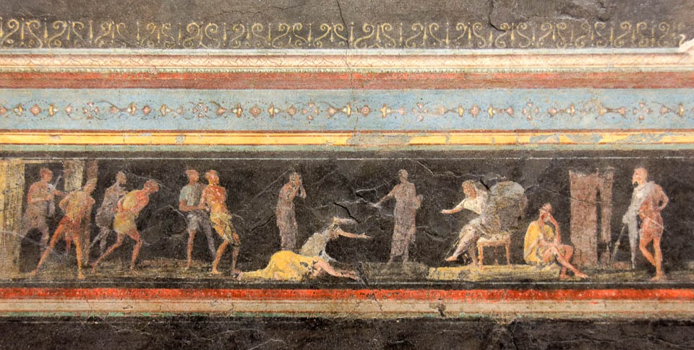
If it were a matter of wrong or of crime, O Jews, I would have reason to hear your complaint
Fresco of a judgment scene, from triclinium C of Villa Farnesina in Rome, 1st century BC
18:14
Notes:
The mural paintings in this triclinium depict a variety of judgment scenes. Some are thought to represent the pharaoh Bocchoris (735–728 BC), known for his jurisprudence and for his knowledge of legal matters, and one may represent Solomon. However, most cannot be associated with any known event. In the scene shown here, several bound men are brought in from the left, while two women appear to plead their case before the seated judge. Most of the issues a judge would encounter had to do with regular crimes or other legal matters; as Gallio pointed out, religious debates were not part of his regular schedule, nor something which he wished now to hear. This fresco was photographed at the National Museum of Rome.
tb0513177785

Slide 62
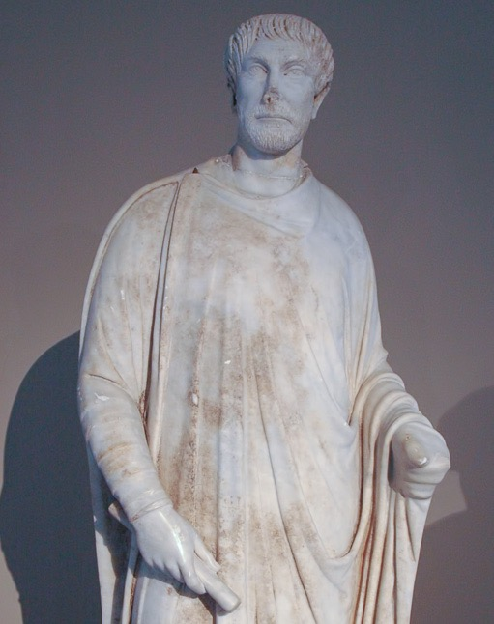
I am unwilling to be a judge of these things
Statue of a Roman judge, from Aphrodisias, circa AD 450
18:15
Notes:
This statue was photographed in the Istanbul Archaeological Museum. Aphrodisias is located in western Turkey.
tb041705170

Slide 63
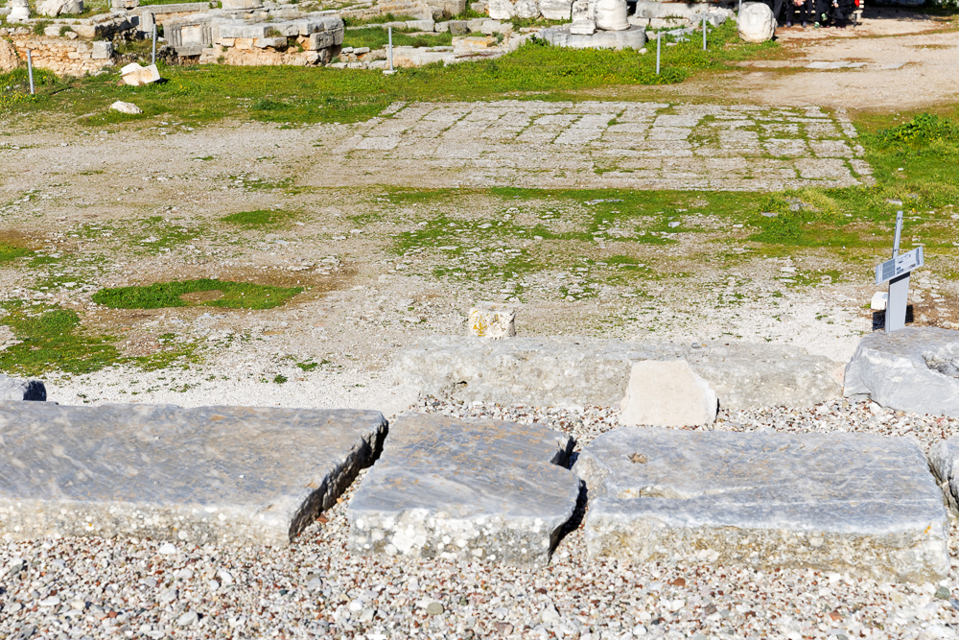
And he drove them from the judgment seat
View from the top of the Corinth bema, looking toward the agora
18:16
Notes:
This is the view that Gallio would have had as he looked down at the plaintiffs.
jc0111152364

Slide 64

Paul . . . sailed from there for Syria . . . after shaving his head in Cenchreae
Athens
Corinth
Cenchreae
Paul journeyed east and south to Cenchreae before setting sail
18:18
Notes:
This map shows the short distance (7 miles; 11 km) from Corinth to the port city of Cenchreae. This map was created by A.D. Riddle, RiddleMaps.com. Data sources: Ancient World Mapping Center shapefiles were used for road lines, under Open Database License (ODbL 1.0; http://awmc.unc.edu/wordpress/map-files/). ASTER-GDEM 2 or SRTM data were used to render the terrain (https://asterweb.jpl.nasa.gov/gdem.asp and https://www2.jpl.nasa.gov/srtm/). Natural Earth was used for streams and inland water bodies. Their data have been placed in the public domain. https://www.naturalearthdata.com/about/terms-of-use/.

Slide 65
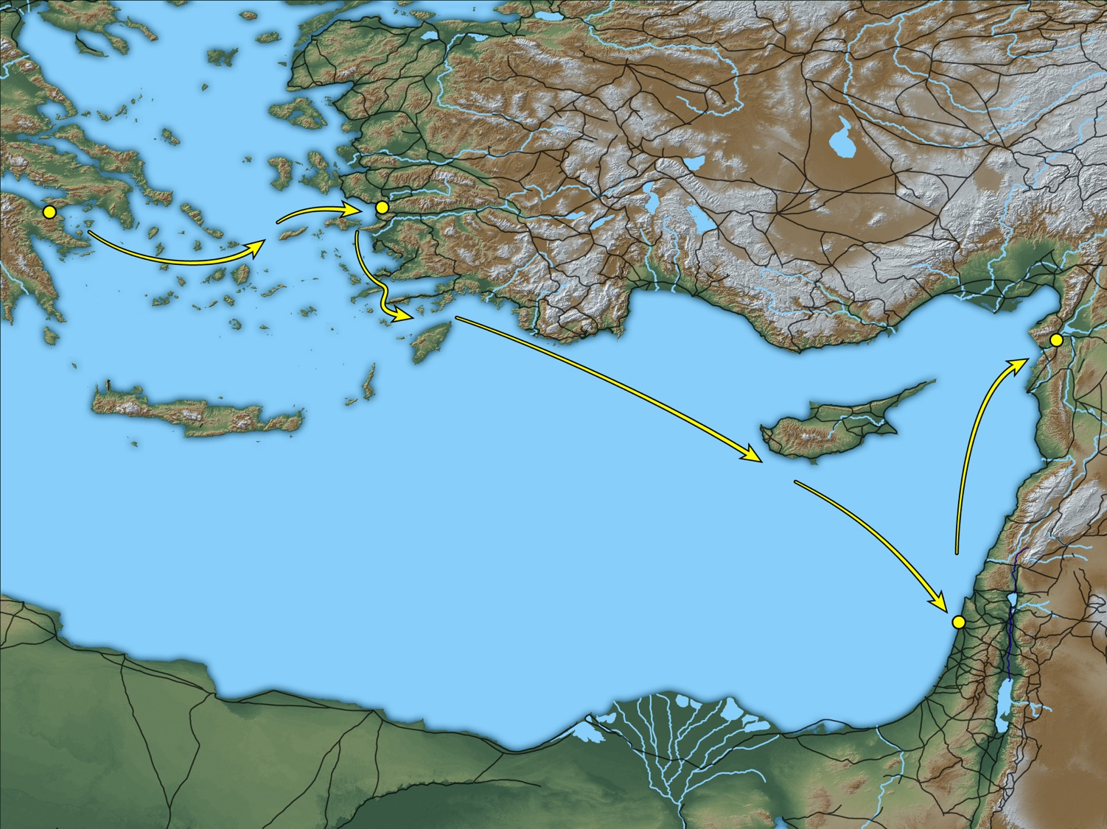
And they came to Ephesus
Cenchreae
Ephesus
Antioch
Caesarea
Map showing Paul’s trip from Cenchreae to Ephesus and onward
18:19
Notes:
This map shows Paul’s return on his second missionary journey, departing from Cenchreae on his way to Ephesus. This map was created by A.D. Riddle, RiddleMaps.com. Data sources: Ancient World Mapping Center shapefiles were used for road lines, under Open Database License (ODbL 1.0; http://awmc.unc.edu/wordpress/map-files/). ASTER-GDEM 2 or SRTM data were used to render the terrain (https://asterweb.jpl.nasa.gov/gdem.asp and https://www2.jpl.nasa.gov/srtm/). Natural Earth was used for streams and inland water bodies. Their data have been placed in the public domain. https://www.naturalearthdata.com/about/terms-of-use/.

Slide 66
The Return Trip
Acts 18:18-22
Ephesus
Corinth
Cenchreae
Antioch
Caesarea
Jerusalem
Why did Paul go to Jerusalem?

Slide 67
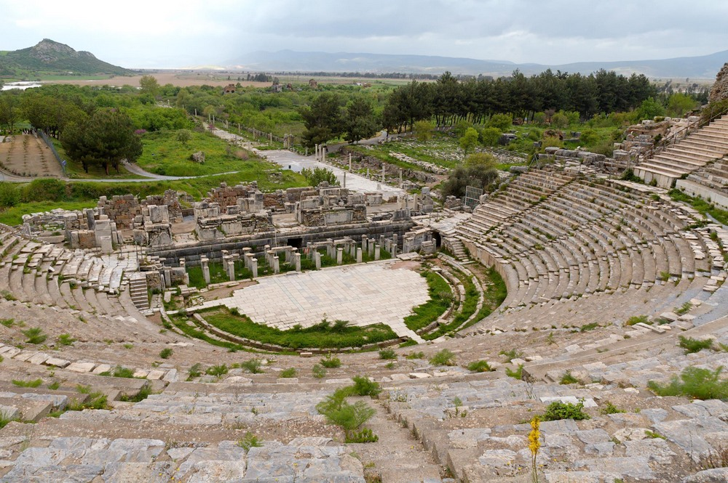
And they came to Ephesus
Great Theater of Ephesus, with a view to the sea and the ancient harbor
18:19
Notes:
During the period of the Roman Empire, Ephesus vied for political, economic, and religious supremacy among all the cities of Asia Minor. It was the capital of the Roman province of Asia and an important seaport for travel and trade through Asia Minor along the Cayster (Kaystros) River Valley. Ephesus moved around as the Cayster River silted the harbor. As the city decayed, the harbor was neglected, and today Ephesus sits 7 miles (11.2 km) from the coast. However, when Paul came to Ephesus, he would have landed at what is now a field in the distance and walked up Harbor Street toward the theater.
tb041405354

Slide 68
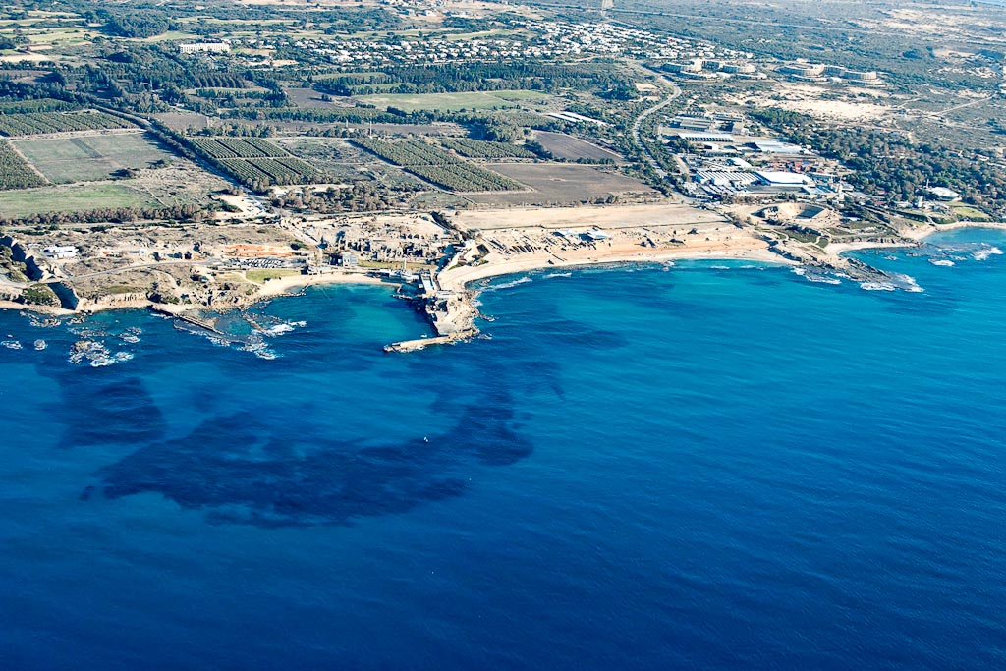
When he had landed at Caesarea
hippodrome
Byzantine
bathhouse
hippodrome
temple
theater
Crusader
castle
Herod’s
Promontory Palace
Herodian harbor
harbor
entrance
Herodian breakwater
(submerged)
Caesarea (aerial view from the west)
18:22
Notes:
Caesar Augustus gave Caesarea to King Herod in 30 BC. Construction was begun by Herod in 22 BC on an artificial hill. Herod named the city was in honor of Augustus. From an economic standpoint, this city was one of the most important cities in Herod’s kingdom. In Herod’s day, the city had a population of 100,000, larger even than Jerusalem, and covered about 170 acres.
tb121704931

Slide 69
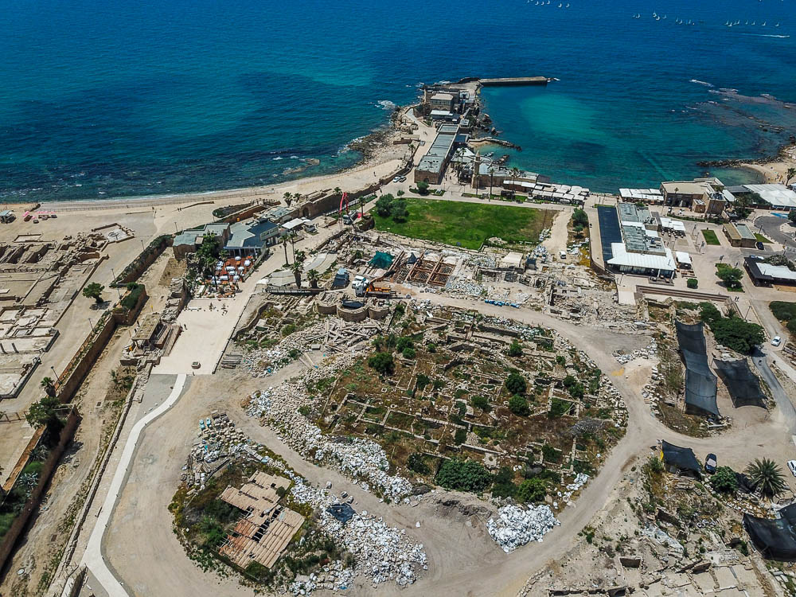
When he had landed at Caesarea . . .
outer harbor
inner harbor
Temple of Roma
and Augusta
Harbor and Temple of Roma and Augustus in Caesarea (aerial view from the east)
18:22
Notes:
In this photo the outer harbor is clearly visible at the top-right of this image. The area which was once the inner harbor is the green grassy area just below the outer harbor. The area of the Temple of Roma and Augusta was later covered by a Byzantine octagonal church in the 6th century AD. For more photos of Caesarea, see other places where Caesarea is mentioned more prominently in Acts, including chapter 10.
adr1805210010

Slide 70
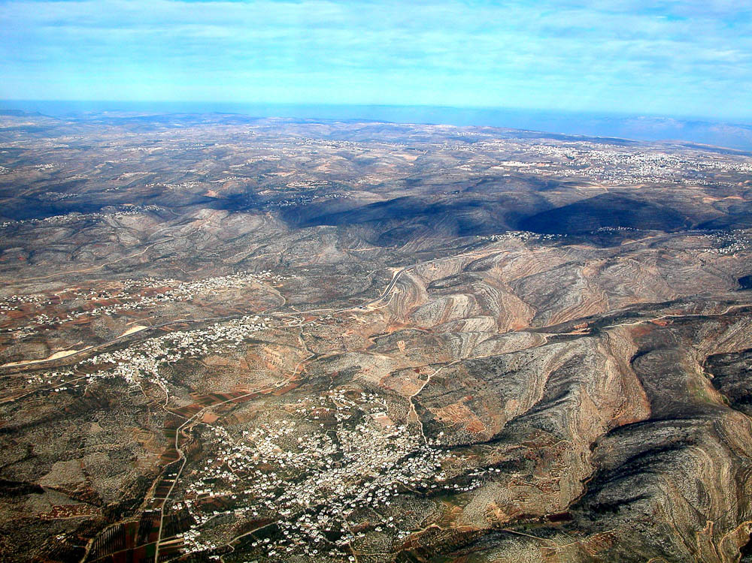
When he had landed at Caesarea, he went up and greeted the church
toward Jerusalem
Beth Horon ridge (aerial view from the west)
18:22
Notes:
After passing Antipatris, Paul would have likely followed the Beth Horon ridge route from the lowlands into the Judean Hill country. This route along the Beth Horon ridge provided the easiest and most gradual ascent from the coastal plain to the hill country. This helps illustrate the concept of “going up” to Jerusalem.
tb010703101

Slide 71
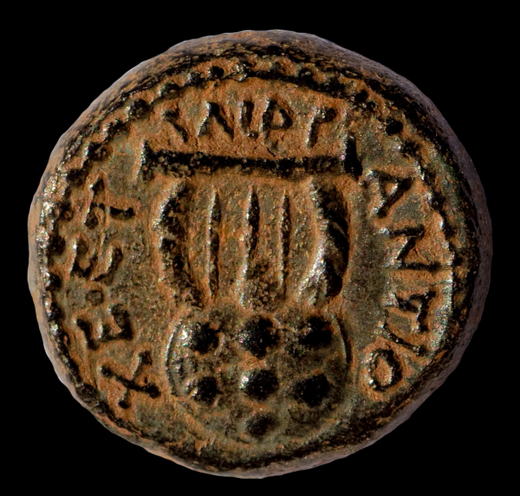
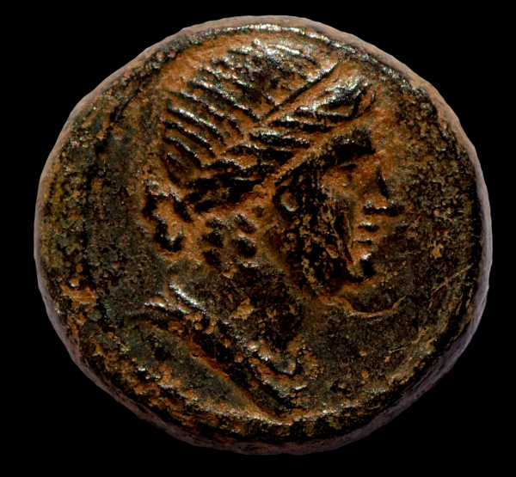
When he had landed at Caesarea, he went up and greeted the church, and went down to Antioch
Bronze dichalkon of Antioch, AD 62/63
18:22
Notes:
This coin was minted about ten years after Paul’s visit to Antioch recorded in this verse. The obverse side of this coin (left) shows a laureate and draped bust of Apollo. The reverse side (right) shows a lyre (chelys), which was the instrument of Apollo. It is inscribed “of the Antiochenes” (ΑΝΤΙΟΧΕ[ΩΝ]), followed by ΕΤ (abbreviated name of a magistrate) and ΑΙΡ (Caesarian Year 111 = AD 62/63; or, possibly, ΛΙΡ = CY110 = AD 61/62). This coin is in the Jared James Clark Collection.
Left (obverse): tb030117615b; right (reverse): tb030117620b

Slide 72
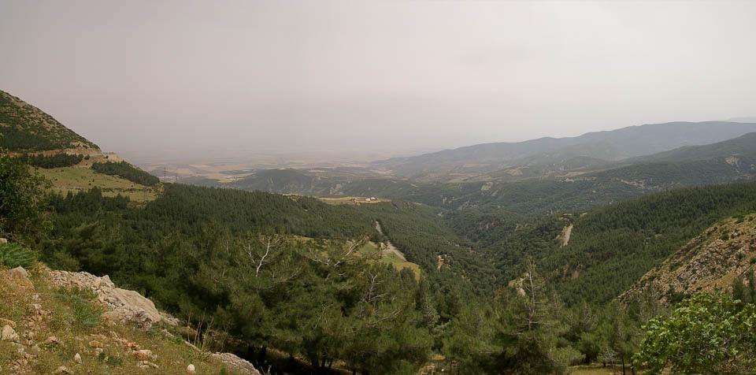
After spending some time there, he departed
Amuq Plain from the Syrian Gates
18:23
Notes:
This verse marks the beginning of Paul’s third missionary journey. The Amanus Mountains were a barrier to land travel north of Antioch. Two passes were usually used by those wishing to traverse the region, the Syrian Gates in the south and the Amanian Gate further to the north. The logical route for Paul would have been to take the southern route. If so, he would have travelled the ancient road through the Syrian Gates (Belen Pass) shown here.
adr1005168630

Slide 73
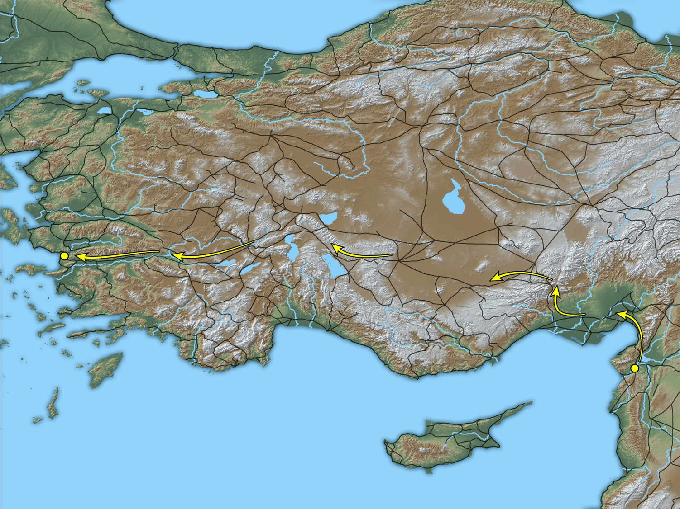
He went in order through the region of Galatia and Phrygia, strengthening all the disciples
Phrygia
Galatia
Ephesus
Antioch
Paul’s route through modern Turkey for the Third Missionary Journey
18:23
Notes:
Paul’s third journey began with him visiting churches he had founded on earlier travels. As with the first two journeys, he was sent out by the church in Antioch. This map was created by A.D. Riddle, RiddleMaps.com. Data sources: Ancient World Mapping Center shapefiles were used for road lines, under Open Database License (ODbL 1.0; http://awmc.unc.edu/wordpress/map-files/). ASTER-GDEM 2 or SRTM data were used to render the terrain (https://asterweb.jpl.nasa.gov/gdem.asp and https://www2.jpl.nasa.gov/srtm/). Natural Earth was used for streams and inland water bodies. Their data have been placed in the public domain. https://www.naturalearthdata.com/about/terms-of-use/.

Slide 74

He went in order through the region of Galatia and Phrygia, strengthening all the disciples
Latin inscription mentioning “Lystra,” 2nd century AD
18:23
Notes:
The name “Lystra” (LVSTRA) can be seen in the inscription close-up pictured here. This inscription was photographed at the Konya Museum.
tb010201698

Slide 75


A certain Jew named Apollos, an Alexandrian by birth, came to Ephesus
Bronze diobol of Claudius from Alexandria, AD 49–50
18:24
Notes:
This coin was minted in Alexandria shortly before Apollos came to Ephesus. The obverse depicts a laureate head of Claudius and date mark LΙ (year 10 = AD 49–50). Although the obverse was struck off-center on this example, a comparison with other coins of the same type shows that it is inscribed “Tiberius Claudius Caesar Augustus Germanicus” (ΤΙ ΚΛΑΥ ΚΑΙ ϹΕΒΑϹ ΓΕΡΜΑ). The reverse depicts an upright caduceus tied between four stalks of grain. It is inscribed “Autokra” (ΑΥΤΟΚΡΑ), short for “autokrator,” meaning “one who rules by himself.” This coin is in the Jared James Clark Collection.
Left (obverse): tb030217895b; right (reverse): tb030217900b

Slide 76

An eloquent man
Roman auditorium hall of a rhetoric school, with benches and dais, in Alexandria
18:24
Notes:
It is most likely that Apollos received formal training in rhetoric and public speaking, as this was widely studied and taught in Alexandria. That he was an “eloquent man” (aner logios, ἀνὴρ λόγιος) indicates that he was learned, cultured, and spoke with skill.
adr1603267882

Slide 77

When Priscilla and Aquila heard him, they took him aside
Slab placed by Ulpia Priscilla for husband Aphetus, from Rome, early 2nd century AD
18:26
Notes:
This Latin inscription from the 2nd century AD preserves the name “Priscilla.” The inscription is written on a slab installed by Ulpia Priscilla for husband Aphetus, an imperial freedman who compiled guest lists for an emperor. This inscription was photographed in the National Museum of Rome at the Diocletian Baths.
tb0513178490

Slide 78

When Priscilla and Aquila heard him, they took him aside
Inscription mentioning “Aquila” at the Library of Celsus in Ephesus, 2nd centur AD
18:26
Notes:
This inscription at the front of the Celsus Library in Ephesus mentions the Consul Gaius Julius Aquila as the one who built the library in AD 110 as memorial to his father, Gaius Julius Celsu Polemaeanus, the governor of Asia from 105–107. The photo serves here as an illustration of another man named Aquila who spent time in Ephesus about 50 years after the events of this chapter.
tb010317247

Slide 79

When he wanted to cross over to Achaia, the brothers encouraged him
Ephesus
Corinth
Achaia
The journey of Apollos from Ephesus to Achaia
18:27
Notes:
This map shows a possible route that Aquila took to visit Achaia, almost certainly heading to Corinth, as Paul later references Apollo’s ministry in that city in 1 Corinthians 1:12; 3:4-6, 22; 4:6. This map was created by A.D. Riddle, RiddleMaps.com. Data sources: Ancient World Mapping Center shapefiles were used for road lines, under Open Database License (ODbL 1.0; http://awmc.unc.edu/wordpress/map-files/). ASTER-GDEM 2 or SRTM data were used to render the terrain (https://asterweb.jpl.nasa.gov/gdem.asp and https://www2.jpl.nasa.gov/srtm/). Natural Earth was used for streams and inland water bodies. Their data have been placed in the public domain. https://www.naturalearthdata.com/about/terms-of-use/.

Slide 80

He powerfully refuted the Jews in public, proving by the Scriptures that Jesus is the Messiah
Isaiah 52:13–53:12 on the Great Isaiah Scroll
18:28
Notes:
We can only marvel that we have a copy of the entire Isaiah scroll that dates to more than 100 years before the birth of Jesus. This passage which so carefully describes the origin, suffering, and vindication of God’s Servant was read by numerous Jews before God fulfilled this prophecy precisely in the life and ministry of Jesus of Nazareth. Apollos proved the Messiahship of Jesus by comparing the predictions of the Hebrew Scriptures with the events of Jesus’s life. The Great Isaiah Scroll is owned by the Israel Museum in Jerusalem. This image is public domain, from Wikimedia: https://commons.wikimedia.org/wiki/File:The_Great_Isaiah_Scroll_MS_A_(1QIsa)_-_Google_Art_Project-x0-y0.jpg
isax0y0

Slide 81

More than 4,000 slides in PowerPoint format.
Available now from BiblePlaces.com.
Notes:
This is a free sample of the Acts 18 presentation from the Photo Companion to the Bible. To purchase the full volume, visit https://www.bibleplaces.com/acts/
The Photo Companion to the Bible is an image-rich resource for Bible students, teachers, and researchers. Just as a librarian stocks the shelves with as many relevant materials as possible, so we have tried to provide a broad selection of images. Our goal is that you will find in this “library” whatever it is you are looking for.
Credits: The primary creators of this presentation are Steven D. Anderson, A.D. Riddle, Christian Locatell, Kris Udd, and Todd Bolen. The photographs have an individual file code which usually includes the initials of the photographer. Other images have additional credit or source information.
Updates: We plan to update this collection as we are able. We welcome your suggestions for improving this resource (photocompanion@bibleplaces.com). Purchasers of the Acts volume are provided free, lifetime updates to the collection.
Copyright: This photo collection is protected by copyright law and may not be distributed without written permission from BiblePlaces.com. Slide notes should be treated as any other copyrighted written material, with credit given when quoting from these notes.
For more information, see our complete “Introduction to the Photo Companion to the Bible” online at http://www.BiblePlaces.com/Intro-Photo-Companion-Bible/. Here you will find more information about photo selection, explanatory notes, Bible translation, credit information, and copyright allowances.

Slide 82

CIC is an independent church body that shall not be accountable to any other ecclesiastical or denominational body.
The elders are a group of biblically qualified men who are charged with leading the church under the leadership of Christ Jesus.
The congregation shall have highest authority in the life of the church.

Slide 83
God reveals himself
to those who seek
and worship him
through Paul and others called to minister
not through testimony of demons
through actions of his disciples
through his Word
even to Gentiles

Slide 84
Slides on
Acts 19

Slide 85

An Incomplete Gospel, an Incomparable God
Acts 18:23–19:20
Preached by Manik Corea
at Crossroads International Church Singapore • CICFamily.com
Uploaded by Dr. Rick Griffith • Singapore Bible College
Files in many languages for free download at BibleStudyDownloads.org

Slide 86


Slide 87

What is the
GOSPEL?
Notes:
Word collections like this show the prominence of certain words within passages or books. The larger the word, the more frequent its occurrence.

Slide 88

Notes:
Word collections like this show the prominence of certain words within passages or books. The larger the word, the more frequent its occurrence. The point here is that JESUS is the focal point of the gospel!

Slide 89

GOOD NE WS
ON THE MO VE
God’s work through the early church in
Acts

Slide 90

The end of the earth
Acts 1:8 ESV
But you will receive power when the Holy Spirit has come upon you, and you will be my witnesses in Jerusalem and in all Judea and Samaria, and to the end of the earth.”
Samaria
Jerusalem
Judea

Slide 91

The Spread of the Gospel by AD 100
Notes:
By the end of the NT era, the message of Jesus had spread westward to Rome. All areas with Christian communities appear in orange.

Slide 92


Slide 93

THE COMMUNION OF SAINTS

Slide 94

Happy Pentecost
Notes:
Gentile churches typically do not celebrate the Jewish feast of Pentecost, yet it also commorates the beginning of the Church itself.

Slide 95
The Holy Spirit in Luke/Acts
Gospel of Luke
Jesus anointed by Holy Spirit at his baptism (Luke 3:22)
Proclaimed at start of his ministry – “The Spirit of the Lord is upon me…. to proclaim good news to the poor” (Luke 4:17-21)
Post-Resurrection – “I am sending you the promise of my Father” (Luke 24:49)
Acts
Disciples will receive the Holy Spirt (Acts 1:8; 2:38-39) to proclaim the good news to all the earth
In the Synoptic Gospels, the Holy Spirit is mentioned 34 times in 68 chapters. In John’s Gospel and his 3 letters, He is mentioned 21 times in 28 chapters.
But in 28 chapters of Acts, Holy Spirit is mentioned 56 times.

Slide 96
God reveals himself
to those who seek
and worship him
through Paul and others called to minister
not through testimony of demons
through actions of his disciples
through his word
even to Gentiles

Slide 97
The Acts of the Apostles
The Book of اعمال
1
Peter
8
13
Paul
Philip
Saul
Peter
Cornelius
Barnabas
Uttermost Parts of the World
1:8
Stephen
Judea & Samaria
Jerusalem
Rome
Antioch
Jews first
Caesarea
Silas
Timothy
Jerusalem
Gentiles

Slide 98

Third Missionary Journey

Slide 99
Acts 18:23-28
²³ After spending some time there, he departed and went from one place to the next through the region of Galatia and Phrygia, strengthening all the disciples.
²⁴ Now a Jew named Apollos, a native of Alexandria, came to Ephesus. He was an eloquent man, competent in the Scriptures. ²⁵ He had been instructed in the way of the Lord. And being fervent in spirit, he spoke and taught accurately the things concerning Jesus, though he knew only the baptism of John. ²⁶ He began to speak boldly in the synagogue, but when Priscilla and Aquila heard him, they took him aside and explained to him the way of God more accurately. ²⁷ And when he wished to cross to Achaia, the brothers encouraged him and wrote to the disciples to welcome him. When he arrived, he greatly helped those who through grace had believed, ²⁸ for he powerfully refuted the Jews in public, showing by the Scriptures that the Christ was Jesus.

Slide 100
An Incomplete Gospel
Acts 18:24-28
Apollos has knowledge of Scriptures but no faith in Jesus as Messiah.

Slide 101
An Incomplete Gospel
“He knew the water baptism of repentance, but not the Spirit baptism of regeneration.”
—Lloyd John Ogilvie, The Preacher's Commentary: Acts, 2010

Slide 102
When he wanted to cross over to Achaia, the brothers encouraged him
Ephesus
Corinth
Achaia
The journey of Apollos from Ephesus to Achaia
18:27
Notes:
This map shows a possible route that Aquila took to visit Achaia, almost certainly heading to Corinth, as Paul later references Apollo’s ministry in that city in 1 Corinthians 1:12; 3:4-6, 22; 4:6. This map was created by A.D. Riddle, RiddleMaps.com. Data sources: Ancient World Mapping Center shapefiles were used for road lines, under Open Database License (ODbL 1.0; http://awmc.unc.edu/wordpress/map-files/). ASTER-GDEM 2 or SRTM data were used to render the terrain (https://asterweb.jpl.nasa.gov/gdem.asp and https://www2.jpl.nasa.gov/srtm/). Natural Earth was used for streams and inland water bodies. Their data have been placed in the public domain. https://www.naturalearthdata.com/about/terms-of-use/.

Slide 103
Acts 19:1-10
And it happened that while Apollos was at Corinth, Paul passed through the inland country and came to Ephesus. There he found some disciples. ² And he said to them, “Did you receive the Holy Spirit when you believed?” And they said, “No, we have not even heard that there is a Holy Spirit.” ³ And he said, “Into what then were you baptized?” They said, “Into John's baptism.” ⁴ And Paul said, “John baptized with the baptism of repentance, telling the people to believe in the one who was to come after him, that is, Jesus.” ⁵ On hearing this, they were baptized in the name of the Lord Jesus. ⁶ And when Paul had laid his hands on them, the Holy Spirit came on them, and they began speaking in tongues and prophesying. ⁷ There were about twelve men in all.
⁸ And he entered the synagogue and for three months spoke boldly, reasoning and persuading them about the kingdom of God. ⁹ But when some became stubborn and continued in unbelief, speaking evil of the Way before the congregation, he withdrew from them and took the disciples with him, reasoning daily in the hall of Tyrannus. ¹⁰ This continued for two years, so that all the residents of Asia heard the word of the Lord, both Jews and Greeks.

Slide 104

John answered their questions by saying, "I baptize you with water; but someone is coming soon who is greater than I am—so much greater that I’m not even worthy to be his slave and untie the straps of his sandals. He will baptize you with the Holy Spirit and with fire."
Luke 3:16
Notes:
_______
NS-03-Luke1-12—slide 177
NS-05-Acts17-19—slide 100

Slide 105
An Incomplete Gospel
1) Acts 18:24-28
Apollos has knowledge of Scriptures but no faith in Jesus as Messiah.
2) Acts 19:1-10
Disciples of John did not know Jesus as Saviour and Giver of the Holy Spirit.

Slide 106


Slide 107

If I have been sprinkled before, should I now be immersed?
Let's see how Paul helped 12 previously immersed disciples of John the Baptist in Acts 19:1-7…

Slide 108

If I have been sprinkled before, should I now be immersed?
Acts 19:1-7 (NLT): While Apollos was in Corinth, Paul traveled through the interior regions until he reached Ephesus, on the coast, where he found several believers. ²"Did you receive the Holy Spirit when you believed?" he asked them. "No," they replied, "we haven't even heard that there is a Holy Spirit."
³"Then what baptism did you experience?" he asked. And they replied, "The baptism of John."

Slide 109
If I have been sprinkled before, should I now be immersed?
⁴Paul said, "John's baptism called for repentance from sin. But John himself told the people to believe in the one who would come later, meaning Jesus."
⁵As soon as they heard this, they were baptized in the name of the Lord Jesus. ⁶Then when Paul laid his hands on them, the Holy Spirit came on them, and they spoke in other tongues and prophesied. ⁷There were about twelve men in all.

Slide 110
Great Theater of Ephesus, with a view to the sea and the ancient harbor
19:1
Notes:
During the period of the Roman Empire, Ephesus vied for political, economic, and religious supremacy among all the cities of Asia Minor. It was the capital of the Roman province of Asia and an important seaport for travel and trade through Asia Minor along the Cayster (Kaystros) River Valley. Ephesus moved around as the Cayster River silted the harbor. As the city decayed, the harbor was neglected, and today Ephesus sits 7 miles (11.2 km) from the coast. However, when Paul came to Ephesus, he would have landed at what is now a field in the distance and walked up Harbor Street toward the theater.
tb041405354

Slide 111
Acts 19:11-20
¹¹ And God was doing extraordinary miracles by the hands of Paul, ¹² so that even handkerchiefs or aprons that had touched his skin were carried away to the sick, and their diseases left them and the evil spirits came out of them. ¹³ Then some of the itinerant Jewish exorcists undertook to invoke the name of the Lord Jesus over those who had evil spirits, saying, “I adjure you by the Jesus whom Paul proclaims.” ¹⁴ Seven sons of a Jewish high priest named Sceva were doing this. ¹⁵ But the evil spirit answered them, “Jesus I know, and Paul I recognize, but who are you?” ¹⁶ And the man in whom was the evil spirit leaped on them, mastered all^{[a]} of them and overpowered them, so that they fled out of that house naked and wounded. ¹⁷ And this became known to all the residents of Ephesus, both Jews and Greeks. And fear fell upon them all, and the name of the Lord Jesus was extolled. ¹⁸ Also many of those who were now believers came, confessing and divulging their practices. ¹⁹ And a number of those who had practiced magic arts brought their books together and burned them in the sight of all. And they counted the value of them and found it came to fifty thousand pieces of silver. ²⁰ So the word of the Lord continued to increase and prevail mightily.

Slide 112


Slide 113


Slide 114


Slide 115
An Incomplete Gospel
1) Acts 18:24-28
Apollos has knowledge of Scriptures but no faith in Jesus as Messiah.
2) Acts 19:1-10
Disciples of John did not know Jesus as Saviour and Giver of the Holy Spirit.
3) Acts 19:11-20
The sons of Sceva did not know Jesus as Lord of their lives.

Slide 116
A Complete Gospel
Will reveal, proclaim, and result in people knowing Jesus as:
1) God’s messiah – the fulfilment of Scripture
2) Saviour and Baptiser with the Holy Spirit
3) Lord of heaven and earth, and our Lord.
It proclaims our incomparable God –
His love, grace, mercy, power & truth!

Slide 117

Notes:
Watch That's My King Dr. S.M. Lockridge
https://www.youtube.com/watch?v=yzqTFNfeDnE

Slide 118


Slide 119


Slide 120
Black

Slide 121

The Peaceful Riot
Acts 19:21-41
Dr. Rick Griffith • Crossroads International Church Singapore
CICFamily.com • BibleStudyDownloads.org

Slide 122

6 Jan 2021 Capitol Riot
Notes:
Christians are increasingly accused of disturbing the peace

Slide 123

6 Jan 2021 Capitol Riot
Some Capitol Rioters believed they answered God's call, not just Trump's
Notes:
—such as in the January 6 US Capitol riot. And yet unbelievers rioted far worse.

Slide 124

Portland 2020 Riots
Notes:
Portland had over 100 days of riots in 2020

Slide 125

USA 2020 Riots
Portland mayor: Time to "take our city back" from violent protesters
Notes:
that destroyed public buildings.

Slide 126


Minneapolis
CNN: Peaceful Protesters Lend Helping Hand To Keep Small Businesses Closed
Notes:
Milwaukie rioting destroyed 5 miles of buildings in 2020.
________
Here is a satire on the CNN report (not the real report but a depiction of how a riot can be peaceful!):
“It was a touching scene tonight in Minneapolis as thousands of peaceful protesters lent a helping hand in the effort to keep small businesses closed,” CNN’s Don Lemon cheerfully reported.
The protestors used the little-known technique of burning all the stores to the ground to accomplish this noble goal. Despite many Americans disagreeing with this method, experts are saying what they’ve done is, by far, the most scientifically proven way to prevent the owners from opening up their doors.
The folks at CNN also marveled at the environmentally mindful deeds from the protesters. “Would you look at that?” Chris Cuomo asked in amazement. “What they’re doing is choosing to not use the energy-guzzling streetlamps. But rather, they’ve found a way to light-up the city with fire—eerrr, with something more resourceful.”
Then minutes later, Lemon carefully squinted his eyes and pointed at the TV screen. “Zoom in on that guy!” he yelled to his producers. “He’s… he’s OPENING up his business!”
As it turned out, Lemon’s watchful eye was correct. It was, in fact, a local business owner entering his storefront. “THAT’S ILLEGAL BEHAVIOR!” Lemon screamed.
Update: Several vigilante-minded CNN cameramen apprehended the reckless man and opted to toss him into a nearby fire. “I’m glad you guys did that,” Lemon said on-air. “We cannot have the fabric of society crumble because unruly people act selfishly.”
______
https://thegloriousamerican.com/health/cnn-peaceful-protesters-lend-helping-hand-to-keep-small-businesses-closed/
Accessed 15 May 2021

Slide 127

“Blessed are the peacemakers.”
Are you a peacemaker?
Notes:
Do you know how to diffuse conflict?

Slide 128

Who brings peace in society more—believers or unbelievers in Jesus?
Notes:
Restatements: Who causes more trouble in our cultures—Christians or idolaters? Which is more harmful—idolatry or Christianity?

Slide 129

Acts Series
GOOD NE WS
ON THE MO VE
God’s work through the early church in
Acts
Notes:
Our series on Acts has emphasized that the Good News on the Move was God’s work.

Slide 130
2. "The European Thrust"
ATLANTIC OCEAN
A.D.
49-52
EUROPE
ANCIENT ATHENS
ASIA
ROME•
•Macedonia
•Pisidian Antioch
•
•Ephesus
AFRICA
Athens
Acts 15-18
•Syrian Antioch
MEDITERRANEAN SEA
2."The European Thrust"
•Jerusalem
Significance: many church plants; call to Macedonia, on to Athens, "the unknown god"; Mars Hill; lengthy Corinthian stay.
ARABIA
44
5
©2006 TBBMI
9.65.08.
© 2006 TBBMI
Notes:
Paul then began to prepare for extended missionary trips.
//// Trip #2…THE EUROPEAN THRUST…is recalled in detail in Acts 15 through 18.
//// This second journey began overland from Syrian Antioch…all the way into Greece…then returning by sea to make his report to the church in Jerusalem…then back home to Syrian Antioch.
//// There were church plants along the way… They met in synagogues every Sabbath…speaking either Greek –– thanks to Alexander the Great –– or Hebrew or Latin. Paul spoke all those languages. This is the time of that famous call to "come over to MACEDONIA and help us." And then he took up a lengthy residence in the wild, seaside town of CORINTH, only a short journey from Athens.
//// On this trip he debated with the Athenian philosophers on Mars Hill, recognizing their statue to "the unknown God." He built a sermon around that!
//// LENGTH OF THIS TRIP: ESTIMATED AT ABOUT TWO AND A HALF YEARS BETWEEN A.D. 49 AND 52.

Slide 131
3."The Asian Thrust"
A.D.
53-57
ATLANTIC OCEAN
EUROPE
ANCIENT EPHESUS
ROME•
•Macedonia
ASIA
•Pisidian Antioch
•
•Ephesus
AFRICA
Athens
Acts 18-21
•Syrian Antioch
MEDITERRANEAN SEA
3.”The Asian Thrust”
•Jerusalem
Significance: extended time at the church in Ephesus; young man raised from the dead; important letters written; riot with Ephesian artisans at amphitheatre.
ARABIA
9.65.08.
45
4
© 2006 TBBMI
9.65.08.
Notes:
Then came Paul's ASIAN THRUST…recorded in Acts 18-21.
//// Again, this trip began overland from Syrian Antioch…revisited many of the earlier churches…made a horseshoe-shaped route around the Aegean, back down into Greece, retraced that route back around the horseshoe, remaining at Troas, then returning by sea to Syrian Antioch.
//// Paul spent a very long time living and ministering to the church the EPHESUS. Luke reports that Paul raised a young man from the dead in Ephesus. Many important letters –– our Epistles –– were written from Ephesus.
//// One of the most dramatic events recorded for us took place at the Ephesian AMPHITHEATRE where he confronted the souvenir makers of the city…those who manufactured small idols of the Goddess Diana, whose temple in Ephesus was one of the seven wonders of the ancient world.
//// LENGTH OF THIS TRIP: ALMOST FIVE YEARS BETWEEN A.D. 53 AND 57.

Slide 132

Apostles Opposed in Acts 16–19
Philippi
Notes:
Before the riot in Ephesus in Acts 19:23-41, Christianity had already shown itself peaceful a number of times.

Slide 133

Slave Girl (Acts 16:16)
Notes:
Owners of a slave girl in Philippi whom Paul and Silas had released from a demon…

Slide 134

Beaten & Flogged
(Acts 16:22)
Notes:
…had them beaten, flogged, and imprisoned—but they prayed and sang in prison, which is not exactly rioting behavior (16:16-25). These men caused no riot—rather, they were the victims of the riot caused by others!

Slide 135
Apostles Opposed in Acts 16–19
Thessalonica
Philippi
Berea
Athens
Ephesus
Corinth
Notes:
Jews in Thessalonica jealous of Paul convincing some fellow Jews that Jesus was Messiah, accused Paul and Silas of causing trouble all over the world (17:6), recruited bad characters and caused a riot (17:2-5). These men caused no riot—rather, they were the victims of the riot caused by others!
• After kicking them out of Thessalonica, these Jews even traveled to Berea and agitated the crowds so the apostles got kicked out of Berea too (17:13-14). These men caused no riot—but they were victims of the riot caused by others!
• At Athens, Epicurean and Stoic philosophers ridiculed Paul publicly, but Paul gave a reasoned defense. Paul caused no riot—rather, he was the victim of the sneering of others (17:18, 32).
• In Corinth, Jews abused Paul (18:6), but Paul only shook out his clothes in response. Paul caused no abuse to them—rather, his friend Sosthenes was the victim of their abuse right in front of the government official (18:17).
At Ephesus, Jews publicly maligned Paul and expelled him from the synagogue (19:9). Paul healed people and caused no commotion, but a demon that beat seven sons of a Jewish priest did (19:16)!

Slide 136

Paul's Third Missionary Journey
140
EPHESUS
Paul taught in Ephesus "for two years, so that all of Asia heard the word of the Lord" (Acts 19:10)
Notes:
In Acts 19:1-20, Paul had taught in Ephesus’s School of Tyrannus (19:9).

Slide 137
Paul's Third Missionary Journey
140
EPHESUS
“In this way the word of the Lord spread widely and grew in power” (Acts 19:20 NIV)
Notes:
The result was “the word of the Lord spread widely and grew in power” (19:20).

Slide 138


Progress Reports
125
End of the Earth
Key Verse: 1:8
2:47b
6:7
8:40
9:31
12:24
16:5
19:20
28:30-31
1:1–6:7
6:8–8:40
Acts 9–28
Why end this way?
Adapted from Stanley D. Toussaint, BKC; Jeremy Chew, EAST
Notes:
Here is Progress Report #7 in the book as the gospel advanced.

Slide 139

The Setting: Peace
Paul did not let the scroll burning lead to a riot but planned to leave for Rome (19:21-22).
Notes:
A demon had just beaten up men leading to the public burning of sorcery scrolls (21:21a; cf. verses 13-20).
Rather than let this lead to a riot, Paul planned to leave for Rome (21:21b-22).
Preview/Text: Let’s first see the real troublemaker in Acts 19:23-31 and then learn how not to be troublemakers today.

Slide 140


Rome
Macedonia
(Timothy & Erastus)
Province of Asia
Ephesus
Achaia
Jerusalem
“Afterward Paul felt compelled by the Spirit to go over to Macedonia and Achaia before going to Jerusalem. ‘And after that,’ he said, ‘I must go on to Rome!” ²² He sent his two assistants, Timothy and Erastus, ahead to Macedonia while he stayed awhile longer in the province of Asia’” (Acts 19:21–22 NLT).

Slide 141

Artemis (Diana) Video (Acts 19:23-41)
180c
Notes:
"In Roman mythology, Diana (lt. "heavenly" or "divine") was the goddess of the hunt and moon and birthing, being associated with wild animals and woodland, and having the power to talk to and control animals. She was equated with the Greek goddess Artemis, though she had an independent origin in Italy." (http://en.wikipedia.org/wiki/Diana_%28mythology%29)
Temple had 127 Marble pillars, Artemis (Gk), Diana (Latin)

Slide 142

The idol maker Demetrius began the Ephesus riot—not the peaceful Paul (Acts 19:23-41).
Notes:
A financial motive of the craftsmen led to unrest—not Paul’s preaching.
The idolater Demetrius accused Paul of trouble-making and apostasy (19:23-27).

Slide 143

Ephesus was the capital of Asia
176
Notes:
Demetrius stirred up craftsmen against Paul cutting their profit from idols (19:23-27a).

Slide 144

A Centre of Culture
Notes:
That he cared more about the money may be supported in that Demetrius noted their income first (19:25).

Slide 145

Marble Roads
Notes:
He also later repeated how important their trade would lose its good name (19:27a).
_________
Marble city, chariot ruts, speed humps, after earthquake columns put back up again.

Slide 146

Artemis:
The Ancient Wonder Woman
Notes:
But Demetrius also said that he sought the honor of Artemis (19:27b).
Artemis was the key figure in Ephesus, Asia’s capital city.—essentially the Ancient Wonder Woman!

Slide 147

Artemis, Goddess of Fertility
Notes:
Artemis had many breasts to symbolize her ability to nourish the earth.
She was goddess of nature and fertility.
As one who fell from the sky, Artemis had miraculous powers to heal the sick and regulate the economy.
The Ephesians devoted one entire month each year to honor her. Businesses closed shop, people gathered for athletic games along with orgies, feasting, and carousing. Thousands attended, including many from other cities of Asia.

Slide 148

Seven Wonders of the Ancient World
Notes:
Why was the temple of Artemis so significant (24)?
It was one of the Seven Wonders of the Ancient World.

Slide 149


The Temple of Artemis at Ephesus
349
Notes:
An amazing 127 columns surrounded it, each beautifully sculptured at the base
The temple took 120 years to build, according to the historian Pliny the Elder (see below)!
______
Pliny the Elder, The Natural History 21.14
John Bostock, M.D., F.R.S., H.T. Riley, Esq., B.A., Ed.
http://www.perseus.tufts.edu/hopper/text?doc=Perseus%3Atext%3A1999.02.0137%3Abook%3D36%3Achapter%3D21
Accessed 17 May 2021
CHAP. 21. (14.)—THE TEMPLE OF DIANA AT EPHESUS.
The most wonderful monument of Græcian magnificence, and one that merits our genuine admiration, is the Temple of Diana at Ephesus, which took one hundred and twenty years in building, a work in which all Asia¹ joined. A marshy soil was selected for its site, in order that it might not suffer from earthquakes, or the chasms which they produce. On the other hand, again, that the foundations of so vast a pile might not have to rest upon a loose and shifting bed, layers of trodden charcoal were placed beneath, with fleeces² covered with wool upon the top of them. The entire length of the temple is four hundred and twenty-five feet, and the breadth two hundred and twenty-five. The columns are one hundred and twenty-seven in number, and sixty feet in height, each of them presented by a different king. Thirty-six of these columns are carved, and one of them by the hand of Scopas.³ Chersiphron⁴ was the architect who presided over the work. The great marvel in this building is, how such ponderous Architraves⁵ could possibly have been raised to so great a height. This, however, the architect effected by means of bags filled with sand, which he piled up upon an inclined plane until they reached beyond the capitals of the columns; then, as he gradually emptied the lower bags, the architraves⁶ insensibly settled in the places assigned them. But the greatest difficulty of all was found, in laying the lintel which he placed over the entrance-doors. It was an enormous mass of stone, and by no possibility could it be brought to lie level upon the jambs which formed its bed; in consequence of which, the architect was driven to such a state of anxiety and desperation as to contemplate suicide. Wearied and quite worn out by such thoughts as these, during the night, they say, he beheld in a dream the goddess in honour of whom the temple was being erected; who exhorted him to live on, for that she herself had placed the stone in its proper position. And such, in fact, next morning, was found to be the case, the stone apparently having come to the proper level by dint of its own weight. The other decorations of this work would suffice to fill many volumes, but they do not tend in any way to illustrate the works of Nature.

Slide 150

The Temple of Diana (Artemis) in 2017
349
Notes:
______
Picture: https://en.wikipedia.org/wiki/File:Templo-Artemisa-Efeso-2017.jpg
"In Roman mythology, Diana (lt. "heavenly" or "divine") was the goddess of the hunt and moon and birthing, being associated with wild animals and woodland, and having the power to talk to and control animals. She was equated with the Greek goddess Artemis, though she had an independent origin in Italy." (http://en.wikipedia.org/wiki/Diana_%28mythology%29)

Slide 151

Theater Seats 25,000
theh'-at-ron
349
Acts 19:29
Notes:
Here is the place where the Ephesian clerk averted a riot in Acts 19:29.
Demetrius caused the riot—not Paul—whom the clerk defended (19:28-41).
The attack from Demetrius led to a two-hour riot in the theater (19:28-34).
Why was rushing into the theater significant (29)?
This was the largest gathering place in Ephesus.
It could hold 25,000 people!
Why would Paul want to enter an arena of hostile fanatics who would be in an uproar for two hours (30)?
Paul looked for every chance to share the gospel, even if his life was in danger.
Paul evidently supposed that God would enable him to give a reasonable defense of the gospel.
Why did some of provincial officials also prevent Paul from entering the theatre (31)?
These rulers “would not let him get caught in the riot. They were Asiarchs (lit., ‘rulers of Asia’), in charge of the community’s political and religious welfare. They would be on good terms with Rome and therefore would evidence Christianity’s good standing with the government”—Stanley D. Toussaint, “Acts,” in The Bible Knowledge Commentary: An Exposition of the Scriptures, ed. J. F. Walvoord and R. B. Zuck, vol. 2 (Wheaton, IL: Victor Books, 1985), 411–412.
If Paul entered there, a rumor may have started that said he caused the riot.

Slide 152

The City Clerk (Acts 19:35-41):
Enticed their pride (35-36)
Affirmed believers (37)
Encouraged legal charges (38-39)
Warned of Rome (40-41)
Notes:
The clerk wisely calmed the crowd by defending both Artemis and Paul (19:35-41).
• He enticed their pride, saying Ephesus guarded Artemis from heaven (19:35-36).
• He cleared Gaius and Aristarchus (and, in effect, Paul) of any crime (19:37).
• He encouraged legal charges, knowing the crowd wouldn’t do it (19:38-39).
• He warned that Rome might hear of their riot and punish the city (19:40-41).

Slide 153

Christians = Riot Victims
—Not Riot Instigators
Notes:
(So Paul and the early Christians did not stir up trouble in Acts. But what about today?)

Slide 154

Believers bring peace in society.
Main Idea of Acts 19:21-41
Notes:
[Christians are the best ones to bring harmony in the unbelieving world.]

Slide 155

Idolatry leads to trouble.

Slide 156


Diana (Artemis) of Ephesus
Notes:
The uproar at Ephesus proved Christianity innocent of wrongdoing but idolatry useless.

Slide 157


How can you be faithful to God in a world of idols?
Money
Power
Sex
Food
Pleasure
Entertainment
Drinking
Science
Pride
IDOLS
of the
HEART
Ezekiel 14:3-6 NLT
Notes:
“Son of man, these leaders have set up idols in their hearts. They have embraced things that will make them fall into sin. Why should I listen to their requests? ⁴ Tell them, ‘This is what the Sovereign LORD says: The people of Israel have set up idols in their hearts and fallen into sin, and then they go to a prophet asking for a message. So I, the LORD, will give them the kind of answer their great idolatry deserves. ⁵ I will do this to capture the minds and hearts of all my people who have turned from me to worship their detestable idols.’” (Ezekiel 14:3-6 NLT).
Money can take first place in our hearts. The millionaire “Aristotle Onassis once said, ‘All that matters in this life is money. It is the people with money who are the royalty in our generation.’ Ultimately he discovered that he had leaned the ladder of his life against the wrong wall. When he died, the only person at his side was his daughter; his money brought no comfort.”
—George and Donald Sweeting, The Acts of God: Reflections from the Book of Acts (Chicago: Moody, 1986), 159.

Slide 158

Not much has changed through the ages…
Canaan
Wall Street
Notes:
Israel’s idol was a bull—our idol is a bull market!

Slide 159

Idolatry actually worships self.
Notes:
Idols are dumb objects that we need to care for—which in reality is self-worship.

Slide 160

IDOLATRY
Notes:
Our bull idol takes different forms—social media, ego, Xbox, approval, possession, career, experimentalism, drugs, pride, sex, instant gratification, humanism, overindulgence, control—all permeated with generous chunks of me, me, me, me, me, me…

Slide 161

The gospel leads to peace.
Notes:
In contrast…
The gospel leads to peace.
Idolatry brings turmoil; Christianity brings peace.
Unbelievers in the Roman Empire often leveled unfair attacks against Christians, accusing them of causing riots and even being guilty of incest and cannibalism.
Luke never mentions these objections directly in Acts—but he does show what they did do when they peacefully presented the gospel.

Slide 162

Let’s continue the peaceful proclamation of the gospel that characterized the early church
Notes:
This narrative gives another account of unbelievers accusing believers of the very violence that they themselves foment.
This reminds us to continue the peaceful proclamation of the gospel that characterized the early church.

Slide 163

Can we reconcile these?
“I will bring a sword”
—Jesus
“Peace I leave with you”
—Jesus
Notes:
Belief in Jesus divides families but also brings harmony today.
“I will bring a sword”—Jesus
“Peace I leave with you”—Jesus
But that sword is not ours to wield—it is a sword others use against us!

Slide 164
Who brings peace in society more—believers or unbelievers in Jesus?
Notes:
Restatements: Who causes more trouble in our cultures—Christians or idolaters? Which is more harmful—idolatry or Christianity?

Slide 165

Main Idea of Acts 19:21-41
Believers bring peace in society.
Notes:
Look around the world and you will see that it is the Christians that produce harmony, but the violence that comes has them as the objects, not the perpetrators.

Slide 166

Prince of Peace (Isa 9:6)
Notes:
This is because our leader is the Prince of Peace.

Slide 167
The idol maker Demetrius began the Ephesus riot—not the peaceful Paul (Acts 19:23-41).

Slide 168
The gospel leads to peace.

Slide 169

Peace Painting Contest
Notes:
Years ago judges conducted a peace painting contest.

Slide 170



Peace Picture Contest
Notes:
Contestants submitted paintings of peaceful nature scenes of orchards
• or seascapes
• or forests and lakes.

Slide 171

The Winner
Notes:
But the winner was actually a chaotic painting of lightning and a rushing waterfall.
• And if you look closely, amidst all that turbulence in the midst of the violent water was a mother bird sitting in her nest with her chicks.
Peace doesn’t come because our surroundings don’t have challenges. It comes from resting in Christ amidst those trials.

Slide 172
How can you exchange idols for peace?
Strengthen your family.
Use your money for peace.
Don’t enflame passions.
Notes:
We typically consider idols as man-made statues of gold, silver, or wood—but do you have any of those idols of the heart?
In what ways do you promote peace in society?
• Strengthen the family—
I seek to do this by supporting Family Research Council.
Work on your marriage.
Do not support the slaughter of the most defenseless in society, the unborn.
• Money: Invest your money not where it will bring the highest profit, but where it will bless values-based organizations.
• In what ways do you disturb peace in society?
Facebook posts can often enflame passions—so, as a general rule, I don’t make political pronouncements on FB.
Do not spread fake news. I quoted a so-called article this month but had to follow up with an apology when I discovered that it did not exist.

Slide 173

He Is Our Peace
Kandela Groves
CCLI Song # 28737
© 1975 CCCM Music (Admin. by Brentwood-Benson Music Publishing, Inc.)
Universal Music - Brentwood Benson Publishing (Admin. by Brentwood-Benson Music Publishing, Inc.)
For use solely with the SongSelect®
Notes:
The chorus “He is Our Peace” written in 1975…

Slide 174
He Is Our Peace
He is our peace, who has broken down every wall.
He is our peace,
He is our peace.
(repeat)
He Is Our Peace 1 of 2
Notes:
…tells us that Jesus has broken down every wall…

Slide 175
He is Our Peace
Cast all your cares on Him,
For He cares for you.
He is our peace,
He is our peace.
(repeat)
He Is Our Peace 2 of 2
Notes:
…so we can cast our cares on him. Let’s do it as we sing together.

Slide 177


NT Preaching link at BibleStudyDownloads.org
Get this presentation and script for free!

Slide 179
NT Survey link at BibleStudyDownloads.org
Get this presentation for free!

