Slide 1
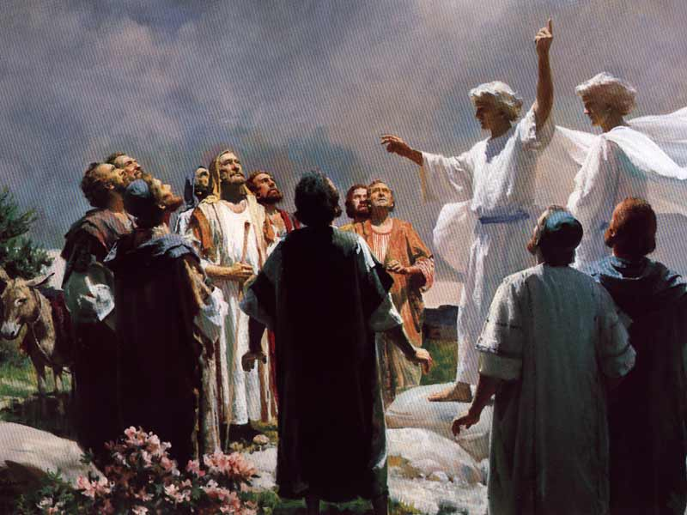
Acts 1–2
The Start of Church History
Dr. Rick Griffith • Jordan Evangelical Theological Seminary • BibleStudyDownloads.org
Notes:
Ascension: Angels said that before Israel would be restored, God's Spirit would empower believers to testify to the last person on the earth (Acts 1:8).

Slide 2
Key Word
56
39
Sovereignty II
Acts
Notes:
Our key word for Luke was Sovereignty I—so that only begs the question where to find Sovereignty II. Acts continues the record of how God directed his kingdom message right from Luke into Acts with a few verses overlap.

Slide 3
Theme
23
Universal Savior Proclaimed in Sovereign Kingdom Progress
Acts
Notes:
Jesus saves all types of people, so God directs us to preach this message to all types of places.

Slide 4
Key Verse
56
"But you will receive power when the Holy Spirit comes on you; and you will be my witnesses in Jerusalem, and in all Judea and Samaria, and to the ends of the earth" (1:8).
Acts
Notes:
Rather than simply wait until Israel's restoration (1:6-7), we musty tell others what he has done for us until the whole world hears.

Slide 5
Summary & Application
Acts
120
Summary Statement
The reason to witness everywhere is because God has directed the progress of the kingdom message to all people since early church history
Application
How is God extending his kingdom message through you?
How are you fitting into His overall purpose to spread the gospel throughout the entire earth?
Notes:
Ultimately, God himself will be responsible to bring his message to all people—but he amazingly uses us.
So each of us should discern how the Lord wants to use us to witness of what he has done for us.

Slide 6

Kingdom Statement
27b
The kingdom message expands from its reception by Jews in Jerusalem (1:1–6:7) to Judeans and Samaritans (6:8–8:40) to Gentiles in Rome (chaps. 9–28) in many “progress reports” (2:47; 6:7; 8:40; 9:31; 12:24; 16:5; 19:20; 28:30-31; also possibly 2:41; 4:31; 5:42; 8:25, etc.) to show believers that God will grow his church, not man.
Acts
Notes:
Like the gospels of Matthew and Luke, Acts also emphasizes the kingdom. But like Luke, he shows the progress of the message from Jerusalem to Rome and from Jews to Gentiles. And all this is God's doing.

Slide 7

Covenant
27b
Jesus has sent the Holy Spirit to form the church (1:8; 2:14-18, 33, 38-39; 10:44-47), so believers should repent and be baptized to join this new covenant community called the church (2:21, 38; 3:19; 10:43, 47-48; 17:30; 26:20).
Acts
Notes:
The Church is God's community based on his promises, or covenant.

Slide 8

Redemption
27b
The universal appeal for salvation through the gospel is stressed (1:8; 28:30-31) in this book that records over 80 geographical locations–more than any other New Testament book.
Acts
Notes:
Acts also mentions those election in Acts 13:48 —"When the Gentiles heard this, they began rejoicing and glorifying the word of the Lord; and as many as had been appointed to eternal life believed" (NAU).

Slide 9

Prophecy
(Lord, Deity)
27b
Jesus fulfilled the OT prophecies (2:30; 3:19, 24; 10:43; 26:6-7, 22), especially in his miracles (2:22; 10:38), death according to God’s purposes (2:23; 3:13-15, 18; 4:11; 10:39; 26:23), resurrection (2:24, 31-32; 3:15, 26; 10:40-41; 17:31; 26:23), and exaltation to God’s throne as Lord (2:25-29, 33-36; 3:13; 10:36) until he returns (3:20-21; 10:42; 17:31; cf. NTS, 137).
Acts
Notes:
The link to OT predictions about Christ is huge in Acts. Jesus on the scene should surprise no one familiar with the OT messianic passages.

Slide 10
Book Chart (Top)
Acts
120
Universal Savior Proclaimed in Sovereign Kingdom Progress
Jerusalem
Judea and Samaria
Uttermost Part
1:1–6:7
6:8–8:40
Chapters 9–28
Jews
Samaritans
(mixed breeds)
Gentiles
AD 33-35
(2 years)
AD 35
(a few months)
AD 35-62
(27 years)
Notes:
This threefold division of the book based on Acts 1:8 is familiar to students of Acts. But the middle section is not Acts 8–12 since believers already started spreading out of Jerusalem in 6:8. Further, Paul is saved far from Judea and Samaria in Acts 9, so the gospel reach to the uttermost part begins to extend in Acts 9 even though the first official mission to the Gentiles does not start until Acts 13.

Slide 11
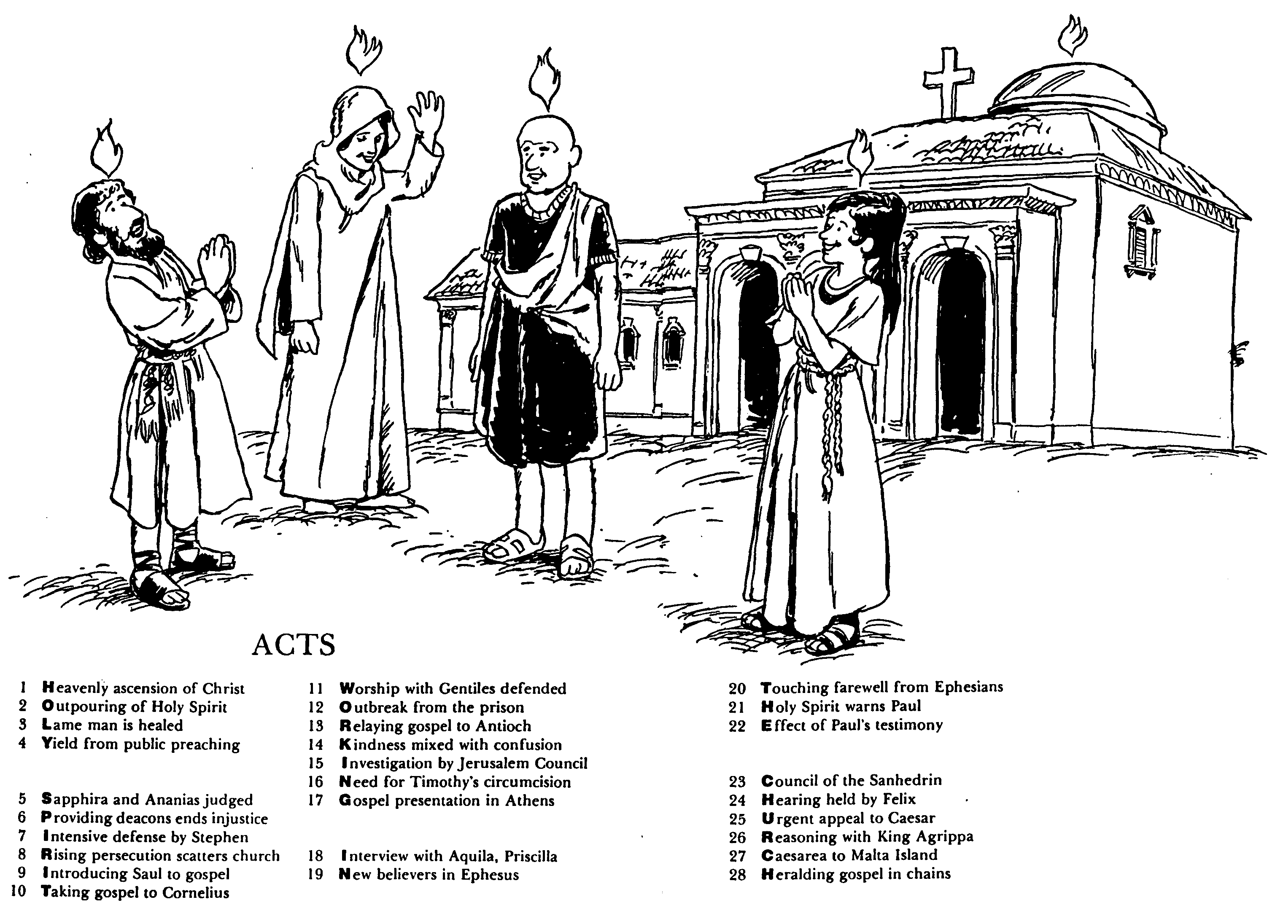

ACTS
Barry Huddleston, The Acrostic Bible
1 基督被接升天
2 圣灵的浇灌
3 瘸腿的人得治愈
4 群众讲道的结果
5 撒非拉和亚拿尼亚被审判
6 拣选执事解决不义
7 司提反强烈的申辩
8 教会受逼迫而分散
9 扫罗接受福音
10 福音传给哥尼流
11 辩解与外族人同赞美
12 逃出监狱
13 福音传到安提阿
14 慈爱与混乱混合了
15 耶路撒冷会议调查
16 对提摩太的割礼的需要
17 在雅典的宣教
18采访与亚居拉，百基拉
19 在以弗所的新信徒
20 以弗所的感人告别
21 圣灵警告保罗
22 保罗见证带来的后果
23 公议会的会议
24 在腓力斯前受审
25 向凯撒的迫切上诉
26 与亚基帕王辩解
27 从该撒利亚到马尔他岛
28 Translation
Notes:
The book narrates not the acts or deeds of people, but ultimately those of God's Spirit.

Slide 12

Be Witnessing
Acts
Dr. Rick Griffith • Crossroads International Church Singapore
BibleStudyDownloads.org
Notes:
Jesus tells his disciples to be his witnesses in Acts 1:8. There is no direct command in the book as an extension of that commission to us, but it is obvious that these twelve men would not be able to reach the last place on the earth. That role will be fulfilled by one of us believers who takes the mantle from these apostles.

Slide 13
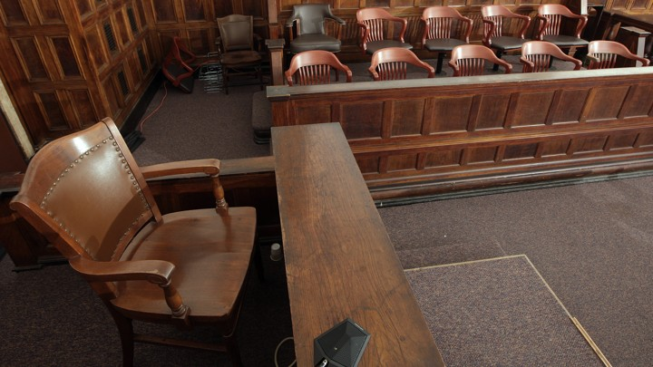
The Witness Stand
Acts
Notes:
It’s not hard to witness to what you have seen—

Slide 14
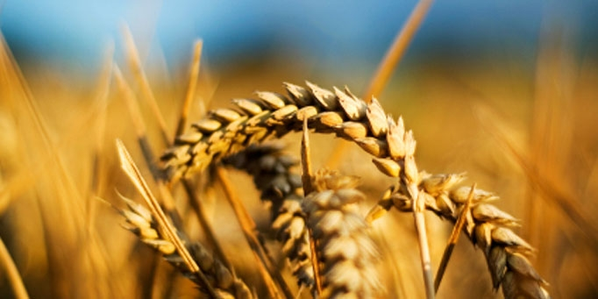
Why should we be witnessing?
3 reasons
Acts
Notes:
Today we’ll see three reasons we should witness for Jesus. Each is actually a stage of growth.
We will survey the entire book of Acts.
(So back to our question: Why should we witness?)

Slide 15

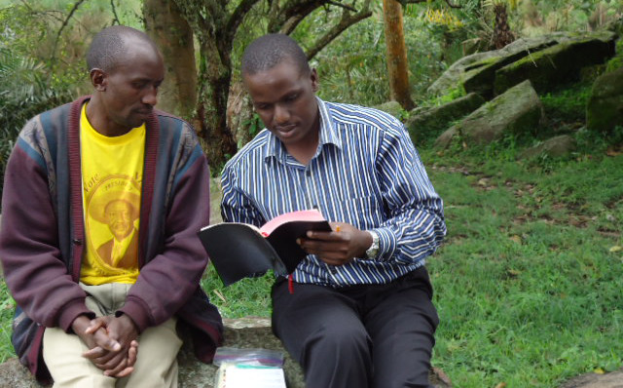

I. God has gone ahead of us so we can begin where we are (1:1–6:7).
Acts
Notes:
God helps us first tell others about Jesus where it is natural without crossing cultures.

Slide 16

II. God gets the glory when we witness outside our comfort zone (6:8–8:40).
Acts
Notes:
God is honored when we share about him with those who are not familiar.

Slide 17

III. God will use us to spread the kingdom to the last unreached place (9–28).
Acts
Notes:
He promises that we will eventually witness in the final unevangelized place on earth.

Slide 18
Main Idea of the Book
Be part of God’s plan to bring the kingdom message to all people.
Acts
Notes:
Do what the Lord has designed for you to do so his rule extends to everyone though your life!

Slide 19

What is your role in God’s plan that he started in early church history?
Acts
Notes:
Too few Christians ever ask themselves this question. We set finance goals, education goals, marriage goals, occupation goals, geography goals, whatever—but do YOU set a goal to find that place and role where you can best be his witness?

Slide 21
What to Do?
131e
Which practices in Acts and the rest of the NT should we do today? Please take the quiz.

Slide 22
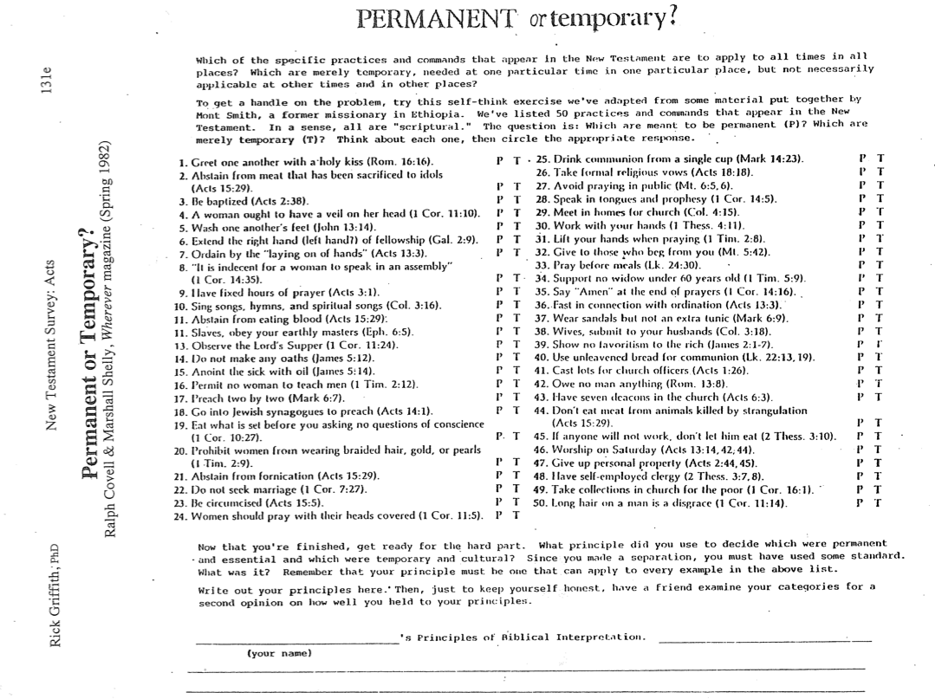
What to Do?
131e
Now for the hard part…

Slide 23
For example…
Which practices in Acts should we expect today? For example…
  Elders?
  Tongues?
  Give property to the church?
Why or why not do these things?

Slide 24
What to Do?
131e
Which practices in Acts and the rest of the NT should we do today? Please take the quiz.
Why or why not do these things? (In other words, what principle did you follow to make sure you are consistent in application?)

Slide 25
My Interpretation Principle
131e
The practice must be:
universally applied to all NT churches the best we can tell
but not tied to the cultural context so closely that its underlying principle is lost in another culture

Slide 26
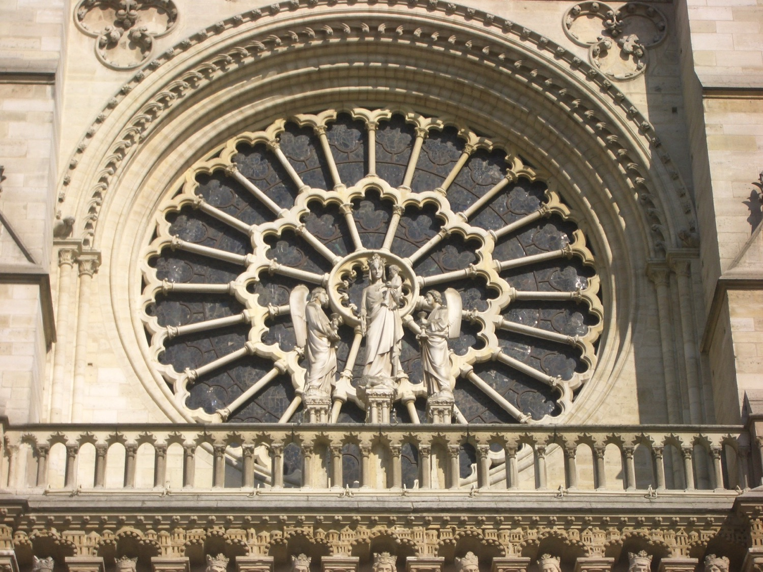
Hermeneutical Considerations:
Normative or Descriptive?
Author's intent
  Is the author trying to teach something, or is he only describing an event (e.g., drawing lots in Acts 1)?
Support from other clearer biblical passages
  Is the underlying principle clearly taught elsewhere (when the Spirit comes in Acts 2, 8, 10, and 19)?
Repeatable "patterns"
  Although it may not have been the author's intent to teach, some things should be repeated (e.g., elders).
  However, we must also consider cultural norms when trying to reproduce such "patterns."
Jeremy Chew, East Asia School of Theology, Singapore

Slide 27

Elders led from the time of Moses
48
Elders
led with
Moses
1400 BC
"Go, assemble the elders of Israel and say to them…"
(Exod. 3:16)

Slide 28

Who Led the Synagogue?
51
Elders
led with
Moses
1400 BC
Elders
led
Synagogues
600 BC

Slide 29
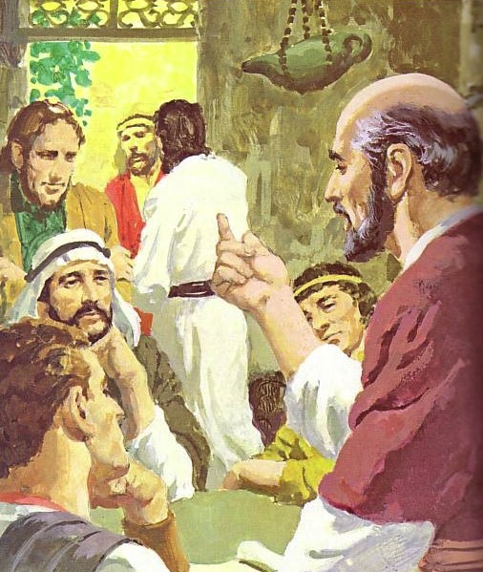
God has advocated group leadership through the ages
55
Elders
led with
Moses
1400 BC
Elders
led
Synagogues
600 BC
NT
Elders

Slide 30


Places Mentioning Elders
elders = overseers = bishops = pastors
55
Jerusalem (AD 47):
NIV Acts 11:30 This they did, sending their gift to the elders by Barnabas and Saul.
Ephesus (AD 57):
NIV Acts 20:17 From Miletus, Paul sent to Ephesus for the elders of the church.
Galatia (AD 48):
NIV Acts 14:23 Paul and Barnabas appointed elders {or Barnabas ordained elders; or Barnabas had elders elected} for them in each church
Crete (AD 66):
NIV Titus 1:5 The reason I left you in Crete was that you might straighten out what was left unfinished and appoint {or ordain} elders in every town, as I directed you.
Philippi (AD 62):
NIV Philippians 1:1 Paul and Timothy, servants of Christ Jesus, To all the saints in Christ Jesus at Philippi, together with the overseers and deacons:
Pontus, Galatia, Cappadocia, Asia & Bithynia (AD 64)
NIV 1 Peter 5:1 To the elders among you, I appeal as a fellow elder… (cf. 1:1)

Slide 31
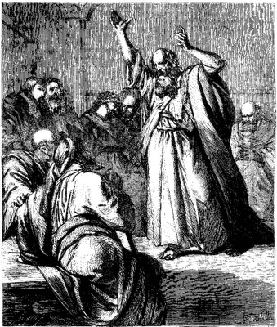
The Elders of Israel
48
Elders are found throughout
the nation's history
Elders were prominent even when God spoke revelation through a single man such as Moses (Exod. 3:16, 18; 4:29, etc.) or a prophet like Elijah (2 Kings 6:32)
There was always a plurality of elders in the OT—only once does the word appear in the singular ("elder" in Isa. 3:2)

Slide 32
The Elders of Israel
48
Elders led at various levels:
national, regional, city, house
Elders ruled other nations, such
as Midian (Num. 22:4), Moab (Num. 22:7), and Gibeon (Josh. 9:11).
Once Israel's elders prophesied (Num. 11:25-26).
Elders were commanded to teach the people God's laws every seven years (Deut. 27:1-8; 31:9-10), which they did under Josiah (2 Kings 23:1-2).

Slide 33
The Elders of Israel
50
Elders were respected for their
wisdom (Ps. 107:32; Prov.
31:23; Lam. 4:16; 5:12)
Elders counseled kings in their ruling (1 Kings 12:6-8, 13; 20:7-8; Jer. 26:17) and anointed kings to power (1 Chron. 11:3)
Elders submitted to prophets' instructions (Elijah in 2 Kings 6:32; Ezekiel in Ezek. 14:1)

Slide 34
The Elders of Israel
50
Elders ruled alongside other administrators: a palace
administrator, the city
governor, and officials (2 Kings 10:1, 5). Their decision was especially binding in postexilic times (Ezra 10:8, 14).
OT elders often failed to lead the people biblically
Elders will rule over Israel in the future millennial reign of Christ (Isa. 24:23)

Slide 35
The Elders of Israel
51
Unfortunately, the OT gives no
explicit instructions on who
they were or how to select
them. Yet the term itself implies that each group of elders was composed of older, mature men.

Slide 36






Acts 1
Passion Week
64
Ezek. 8:4; 9:3; 10:4; 10:18-19; 11:23
Luke 19:37; 24:50; Acts 1:10
Acts 1:11; Zech. 14:4; Ezek. 43:1-5
Notes:
The Mount of Olives plays a significant role in history. It is the last place the Spirit is present in Ezekiel 11:23, the last place Christ was honored as king in Luke 19:37, the last place Christ was seen by his disciples in Acts 1:10, and the NEXT place Christ will appear on earth to fulfill Acts 1:11!

Slide 37
Two Angels (Acts 1:11)
Notes:
Ascension: Angels said

Slide 38
Key Word & Verse
120
Acts
Key Word
Sovereignty II
Key Verse
"But you will receive power when the Holy Spirit comes on you; and you will be my witnesses in Jerusalem, and in all Judea and Samaria, and to the ends of the earth" (Acts 1:8).

Slide 39

The Book of Acts in 3 Minutes
(TheChurchatBrookHills.mp4)
131e

Slide 40
Occasion
122
  Luke probably wrote at Theophilus' request:
  To provide an orderly account of the life of Christ and the early history of the Church
  To strengthen the wealthy Christian's faith by showing that his faith rested on firm historical fact (Luke 1:3-4; cf. Acts 1:3)
  To explain to his wider Gentile audience that the progress of the kingdom message was divinely directed, not of human ingenuity and skill.

Slide 41
NT Overview (History)
38
124
39-41
"To the remotest part of the earth" (Acts 1:8)
Acts 9 13 14 15 16 18 21 27 28
Apr 48-
Sep 49
1
Galatia
Apr 50-
Sep 52
2
Aegean
Spr 53-
May 57
3
Asia
Feb 60-
Mar 62
1
Rome
Spr 62-
Fall 67
4
Spain
Aut 67-
Spr 68
2
Rome
Summer 35-
37
Damascus
Antioch
May 57-
Aug 59
Trials
Fall 49
The
Council
Spring 68
Expansion of Church
35 48 49 50 52 53 57 60 62 67 68 95
Matt
Luke
Acts
Gospels & Acts
1234
Journeys
Rome
Imprisonments
Gospels & Acts

Slide 42
Key Characteristics of Acts
122
  Kingdom
Start
"So when the apostles were with Jesus, they kept asking him, "Lord, has the time come for you to free Israel and restore our kingdom?" (Acts 1:6 NLT)
End
"For the next two years, Paul lived in Rome at his own expense. He welcomed all who visited him, ³¹boldly proclaiming the Kingdom of God and teaching about the Lord Jesus Christ. And no one tried to stop him" (Acts 28:30-31 NLT).

Slide 43
An All-Encompassing Theme
Kingdom:
24b
OTS 33
Genesis 1:26-28
"Then God said, 'Let us make man in our image, in our likeness, and let them rule over the fish … birds … livestock … all the earth, and over all the creatures that move along the ground…' God blessed them and said to them, 'Be fruitful and increase in number; fill the earth and subdue it. Rule over the fish of the sea and the birds of the air and over every living creature that moves on the ground.'"
Revelation 22:5
"There will be no more night. They will not need the light of a lamp or the light of the sun, for the Lord God will give them light. And they will reign for ever and ever."
The Bible's Theme: God extends His rule to man
Command
Covenants
Fulfillment
Notes:
God chose believers like us to rule the world!
Throughout Scripture we see the Kingdom of God as the primary theme from the first to the last chapter. But we also see God establishing covenants, or promises, alongside his kingdom rule to enable us to see our eventual rule with him accomplished.
__________
Common Slides Arabic-51
OS-00-Intro-89
OS-01-Gen1-3-slide 100
OS-23-Isaiah_49-66/Slide 105 on Supplements
NS-05-أعمال الرسل1-2-slide 45
NS-22-Rev20-22-slide

Slide 44
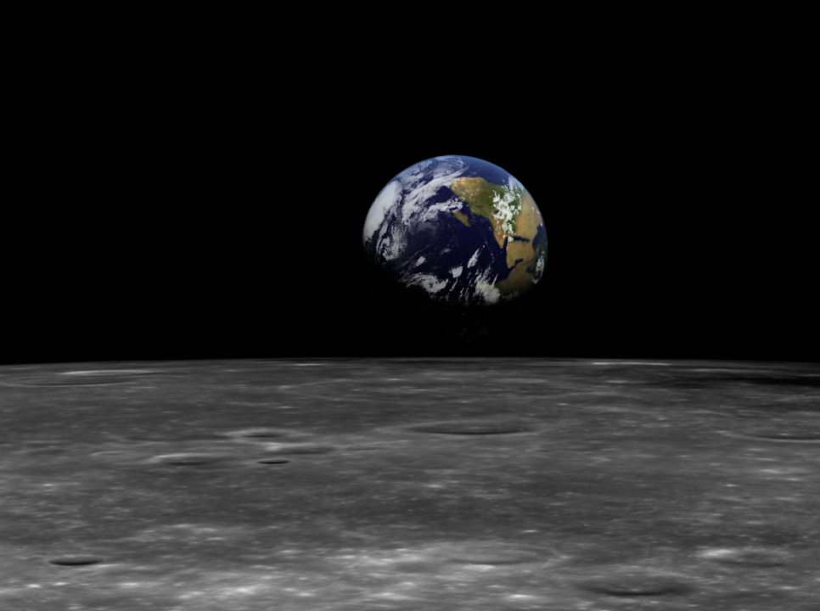
The Kingdom in Genesis 1
OTS 71a
• Uncreated God (1:1)
• Creation by Word alone (1:4)
• Creation with ease
• Sun and moon [gods] created (1:16)
• Shared rule with man (1:26)

Slide 45
Kingdom & Covenants Timeline
22
CH-34a
OS1-22
OS2-337
NS-9g
SA-19
34a
Dr. Rick Griffith • BibleStudyDownloads.org
22
Kingdom Teaching...
Adam rules with God (Gen. 1:26, 28; 2:19)
Satan begins rule as god of this world (Gen. 3:15;
2 Cor. 4:4)
God covenants with Abraham to reestablish man's rule via Israel as a "kingdom of priests" (Gen. 12:1-3; Exod. 19:6)
Israel's failure to witness to nations as a kingdom of priests is judged via exile under foreign rule
Israel rejects Messiah's offer of kingdom (Matt. 12:41-42; 23:37-39)
Jesus extends His kingdom in mystery form to the Church (Matt. 13)
Christ subdues Israel's enemies and nation believes (Rom. 11:26-27)
Christ rules over everything with saints (Eph. 1:9-10; Rev. 20:1-6; 22:5b)
337
9g
Fall of Man (Gen. 3)
Noahic Covenant
19
Genesis 6:18; 9:8-17
Land Covenant
ISRAEL
CHURCH
MESSIANIC KINGDOM
(National Focus)
The "New Man" (Eph. 2:15)
Millennial Eternal
land
Genesis 15:18 (cf. Deut. 30:1-10) promises:
Land from Wadi of Egypt to Euphrates River (Isa. 27:12)
Eternal possession of land (Gen. 17:8) after exile/restoration
Whole world blessed via the land (Isa. 14:1-2)
Israel judged for rejecting Messiah by dispersion away from land for 19 centuries
(AD 70–AD 1948) but now partially restored (Ezek. 37:1-7)
Full restoration (Ezek. 37:8-28) Jerusalem world capital
(Isa. 2:1-5)
New Jerusalem
(Rev. 21–22)
Davidic Covenant
Christ is Head over His Church, which is a spiritual temple (Eph. 2:19-22; 2 Cor. 6:16)
Christ reigns over the world
(Isa. 11)
with saints (Rev. 5:10; 20:4-6)
Christ hands kingdom over to Father (1
Cor. 15:24)
Genesis 12:1-3
2 Samuel 7:12-16 promises:
Sons ("house" never wiped out)
Kingdom (political dynasty)
Throne (right to rule by descendants)
Temple (son to build it)
seed
Abrahamic Covenant
New Covenant
All
things made new!
(Rev. 21:5)
All 5 elements fulfilled in national restoration (Zech. 8)
Jeremiah 31:31-34 promises:
Forgiveness
Indwelling Spirit
New heart, nature, mind
Reunification of Israel and Judah
No need for evangelism
Mosaic Law replaced with first three elements of the New Covenant (Luke 22:20; 2 Cor. 3:6)
blessing
Mosaic Covenant
Law abolished, fulfilled, and replaced at the cross (Rom. 7:1-6;
1 Cor. 9:19-21; Heb. 8:13)
10th Edition
10 Nov 2020
Temporary (Gal. 3:19) and conditional (Deut. 28) to reveal sin (Rom. 7:7) and regulate Israel (Gal. 3:23-25)
Scripture has a dual kingdom-covenant theme. Israel's role from Abraham to Christ expands to include the Church (continuity) yet the Church never replaces the nation as the "new Israel" (discontinuity). Israel will enjoy world prominence after trusting Christ at His second coming.
Notes:
All agree that a partial fulfillment of the covenant to Abraham exists now to the Church in the indwelling Holy Spirit and forgiveness of sins (Jer 31:31-34)—and the ultimate fulfillment will be in the eternal state.
The main area of disagreement relates to the time period from now to eternity. Will there be a literal land, throne, and worldwide blessing to national (ethnic) Israel before the eternal kingdom? This chart shows verses giving a resounding YES to that question in a present partial fulfillment and a future full fulfillment in the normal sense of language in the verses cited. But the messianic kingdom will be in two stages—first in a millennial fulfillment to last 1000 years, but then, after that, the eternal stage in the new Jerusalem after the destruction of our present heavens and earth (Rev 21–22). What an amazing future remains for those who trust Jesus!
____________
Common English-51
CH-02-Nature-103-p34a
OC-10-Chronology-42
OS-00-Intro & Biblical Theology-25 & 90
OS-02-Exodus-267-p22
OS-05-Deut-248-p22
OS-10-2Sam-96-p22
OS-12-Kings & Prophets Charts-25
OS-13-1 Chron-46
OS-23-Isaiah-97-p337
OS-24-Jeremiah-174-p337
OS-23-Isaiah-97-p337
OS-28-Hosea-49
OS-31-Obadiah-164
05-Acts1-2-slide 45
NS-09-Gal-143-p9g
NS-19-Hebrews-342-p9g
SA-08-Mosaic Law-19-p38a

Slide 46

My View of the Bible's Theme
OTS 33
The Bible narrates
God's restoring man to participate in His kingdom rule for His own glory
mandated in Eden but lost in the Fall
and accomplished by redeeming man
through Israel as a kingdom of priests
and ultimately through the Messiah,
who will reign as Saviour and King
to fulfill the Abrahamic Covenant

Slide 47

Kingdom in the NT
Unit One: The Kingdom is Introduced
Matthew: The Kingdom Presented and Rejected
Mark: Kingdom Life is Shown in Discipleship
Luke: The Universal Savior Advances the Kingdom
John: Deity Became Man to Bring Eternal Life
Unit Two: The Kingdom is Expanded
Acts: The Universal Savior is Proclaimed in Sovereign Kingdom Progress

Slide 48

Key Characteristics of Acts
122
  Kingdom
  Significance
  Interpretation

Slide 49
Interpreting Acts as a Narrative
Movement of (and between) scenes
  Plot–how does it build on the previous scene(s), and how does it move the story forward?
  Cause and effect–what causes a particular action, or what is the result of it?
  Conflicts–what are the tensions and resolutions?
Time
  Not necessarily chronological
  Frequency–repetition for emphasis
  Pace–length of description
Author
  "Omniscience" of narrator–represents God's view
  Gives "inside" information about characters
  Makes judgments of what is right and wrong
  Gives additional information to the story
Adapted from Jeremy Chew, East Asia School of Theology, Singapore

Slide 50

Speaking in Tongues in Acts
123
(Toussaint, Bible Knowledge Commentary, 2:408, adapted)
Text | Speakers | Audience | Related to Salvation | Purpose
2:1-4 | Apostles+ | Unsaved Jews at Pentecost | After salvation | Validate for Jews the fulfillment of Joel 2
8:14-17 | Samaritans | Saved Jews doubting God's plan (Peter+) | After salvation | Validate for Jews God's acceptance of Samaritans
10:44-47 | Gentiles (Cornelius+ others) | Saved Jews doubting God's plan (Peter+) | At salvation | Validate for Jews God's acceptance of Gentiles
19:1-7 | OT believers in Messiah | Jews needing gospel message confirmed | At salvation | Validate for Jews God's message through Paul
Notes:
Each time that a new group received the Spirit, they also had the accompanying sign of speaking in other languages. In each case, God validated his work (1 Cor 14:21-22).
______________
HS-04-Indwelling-47
NS-05-Acts1-2—slide 50

Slide 51
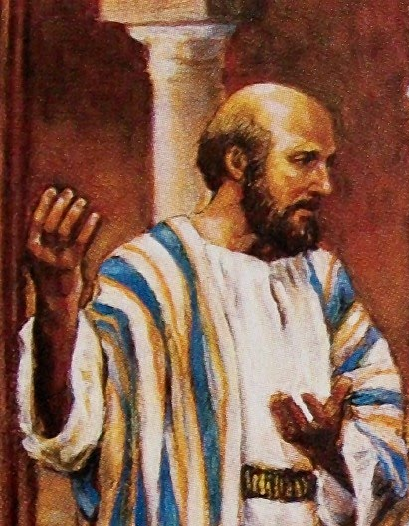
Key Characteristics of Acts
123
  Kingdom
  Significance
  Interpretation
  Superb Style
  Universal message
  Holy Spirit
  Gentile
  Comprehensive
  Sermons

Slide 52
Sermons in the Book of Acts
136
Acts 2:14-39
Acts 13:16-41
Acts 17:21-31
Speaker
Peter
Paul
Paul
Audience
Jews
Jews and God-fearing Gentiles
Pagan Gentiles
City
Jerusalem
Antioch
Athens
Place
House (v. 2) at the Temple (Luke 24:53)?
Synagogue
Aeropause Meeting
Type of Place
Religious
Religious
Secular
Time
Day of Pentecost
1st Missionary Journey
2nd Missionary Journey
Subject (theme)
Why do some miraculously speak unknown languages?
The fulfillment of Israel's national history
The reason idolatry is unreasonable
Complement
The Spirit indwells them through Jesus, their living Messiah
is in Jesus as our risen Savior who is worthy of our trust
is because the unknown God is Creator & Judge

Slide 53
Sermons in the Book of Acts
136
Short Idea
Jesus is Messiah (36)
Believe in Jesus (39)
Flee idolatry (30)
Application Structure
Simple–application at the end (38-39)
Cyclical–application in centre (26) & end (38-41)
Simple–application at the end (30-31)
Main Idea Structure
Inductive (36)
Inductive (23)-Deductive (24-37)
Deductive (24)
Type
Topical-Biblical
Expositional
Topical-Secular
Style
Extemporaneous
Narrative
Reasoned polemic
Introduction
"Ho Hum!"
(How he gets attention)
Cites a recent event: Spirit baptism
(14-15)
Tells a familiar story: This identifies with listeners (16-22)
Notes local interest item: altar to an unknown god (22-23)
Thrust of Introduction
"Why do you think these people appear drunk?"
"I'm an informed Jew who also has longed for the Messiah"
"I have been observing your town"
How the Speaker Draws in His Listeners
Raises curiosity re: miraculous speaking in other languages
Raises curiosity re: how his Judaism differs from theirs
Raises curiosity about who the unknown God is

Slide 54
Sermons in the Book of Acts
136
Body
"The Spirit descended from the risen Messiah Jesus" (16-36)
"Jesus is Israel's risen Messiah"
(23-37)
"Idolatry is incompatible with the living creator God" (24-28)
Illustration Sources
Scripture (Joel 2:28-32; Ps. 16:8-11; 110:1)
Scripture (Ps. 2:7; 16:10; Isa. 55:3;
Hab. 1:5)
Secular (v. 28: poets Epimenides & Aratus)
Resurrection of Christ Noted
Extensive with scriptural support (24-32)
Extensive with scriptural support (30-37)
Brief & no mention of Jesus' name (31)
Conclusion
Main Idea: Jesus is the Messiah (36)
Scripture: Habakkuk 1:5 quoted: "I will do something that you won't believe" (41)
Burning questions: "Who will judge us?" and "Who is it who was raised?" (31)
Application
Indirect: Implications left to them: "How can we be saved?" (37)
Direct: "You can be forgiven" so "don't scoff" (38, 40)
Direct: God "commands all... everywhere to repent [of idolatry]" (30)
Result
3000 saved
(41)
Invited again, some believed, he turned to Gentiles
(42-48)
Many believed but others sneered
(32-34)

Slide 55
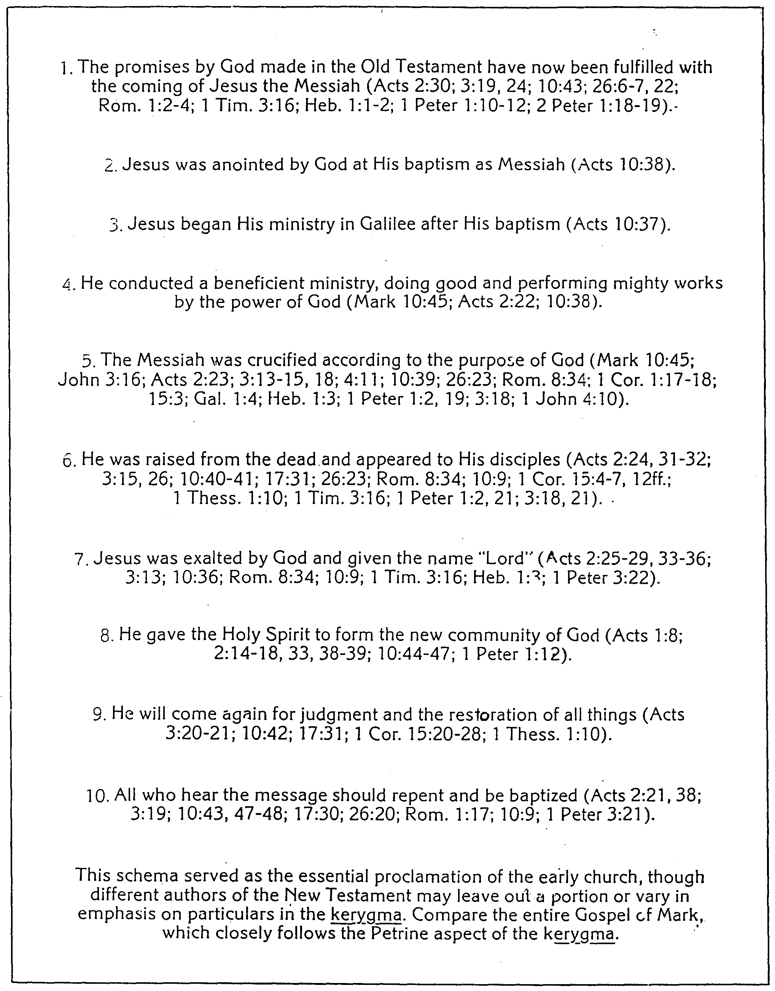
The Kerygma ("Proclamation") of the Early Church
137
Resurrection!

Slide 56
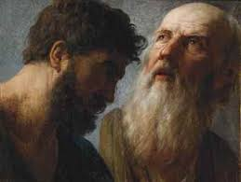
Key Characteristics of Acts
123
  Kingdom
  Significance
  Interpretation
  Superb Style
  Universal message
  Holy Spirit
  Gentile
  Comprehensive
  Sermons
  Contrasts with Luke

Slide 57
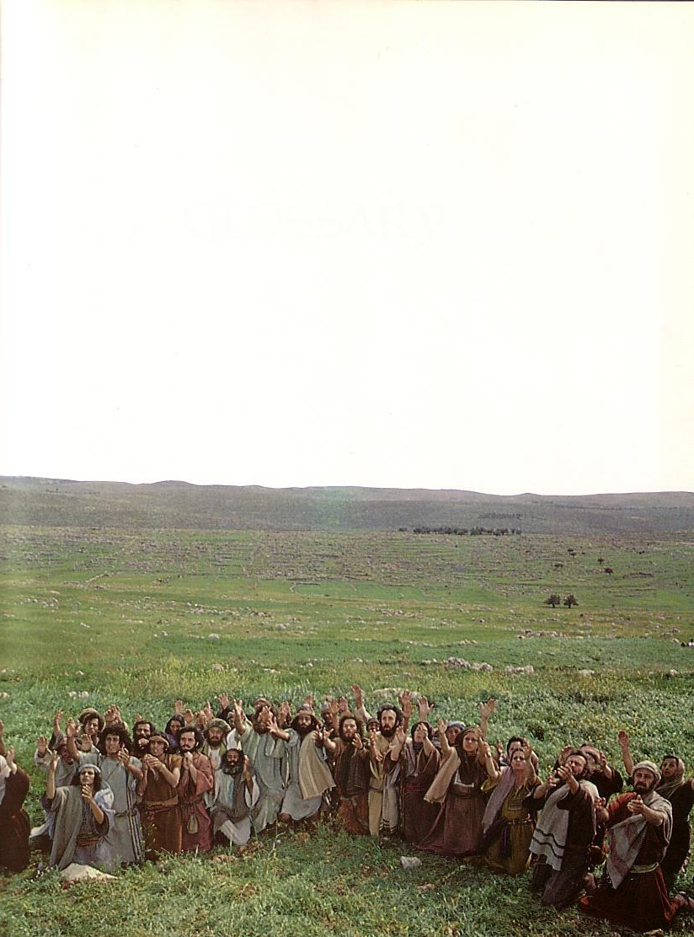
Comparing Luke & Acts
124
Luke
Acts
Chapters
24
28
Verses
1150
988
Verses per Chapter
48
35
Time Period Covered
5 BC-AD 33
(37 yrs.)
AD 33-62
(30 yrs.)
Content
Life of the Christ
Life of the Church
Kingdom Message from…
Jews to Gentiles
Jews to Gentiles

Slide 58
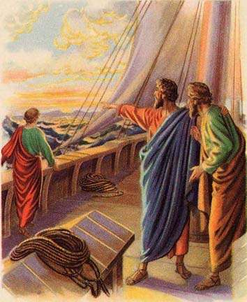
Key Characteristics of Acts
123
  Kingdom
  Significance
  Interpretation
  Superb Style
  Universal message
  Holy Spirit
  Gentile
  Comprehensive
  Sermons
  Contrasts with Luke
  Journeys

Slide 59
Paul's Missionary Journeys
124
(Furloughs in parentheses)
Area
Acts Reference
Dates
Yrs
Letters
Men with Paul
1
Galatia
12:25–14:28
April 48-
Sept. 49
1.5
Galatians
Barnabas, Mark
(.5)
2
Aegean
15:36–18:22
April 50-
Sept. 52
2.5
1, 2 Thess.
Silas, Timothy, Luke
(.5)
3
Ephesus
&
Aegean
18:23–21:16
Spring 53-
May 57
4
1, 2 Cor., Romans
Timothy, Luke, Titus, Erastus, Aristarchus, Sopater, Secundus, Gaius, Tychicus, Trophimus, Sosthenes
(0)
*
Jerusalem, Caesarea
21:26–26:13
May 57-
Feb. 60
2.8
None
Timothy, Luke
(0)
*
Rome
27:1–28:31
Feb 60-
Spring 62
2.2
Eph., Col., Phil., Philem.
Timothy, Luke

Slide 60
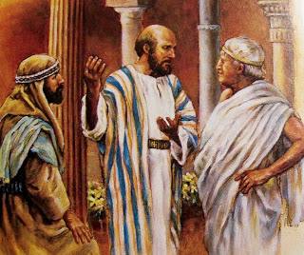
Key Characteristics of Acts
123
  Kingdom
  Significance
  Interpretation
  Superb Style
  Universal message
  Holy Spirit
  Gentile
  Comprehensive
  Sermons
  Contrasts with Luke
  Journeys
  Gospel Progress

Slide 61

GOOD NE WS
ON THE MO VE
God’s work through the early church in
Acts
Notes:
Our new series on Acts begins today that we are calling “Good News on the Move.”

Slide 62
Gospel Progress
124
The progress of the gospel in Acts is seen by contrasting the beginning and the end:
Acts 1
Acts 28
AD
33
62
Church
Non-existent
Thriving
Composition of believers
100% Jewish
Mostly Gentiles
Location
Jerusalem
Rome
Central Figure
Peter
(narrow ministry)
Paul
(broad ministry)

Slide 63
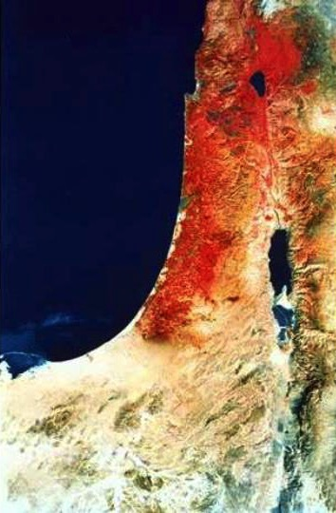
Acts 1:8 NAU
"remotest part"
"But you shall receive power when the Holy Spirit has come upon you; and you shall be My witnesses both in Jerusalem, and in all Judea and Samaria, and even to the remotest part of the earth."
Samaria
Jerusalem
Judea
Notes:
What is the significance of the threefold regions (1:8)?
Geographically, they go from the near to the far.
By size, it begins with a city, goes to regions, and then beyond regions.
Culturally, they begin with the familiar and stretch to the unfamiliar.
Chronologically, it begins in AD 33 and finishes in AD 62—as well as extending to our own time.
It took Saul’s persecution in Acts 8:1 to cause the disciples and the church to participate in God’s plan given in Acts 1:8
__________
Common-439
NS-05-Acts1-2-slides 63, 204
NS-05-Acts3-9—slide 247

Slide 64
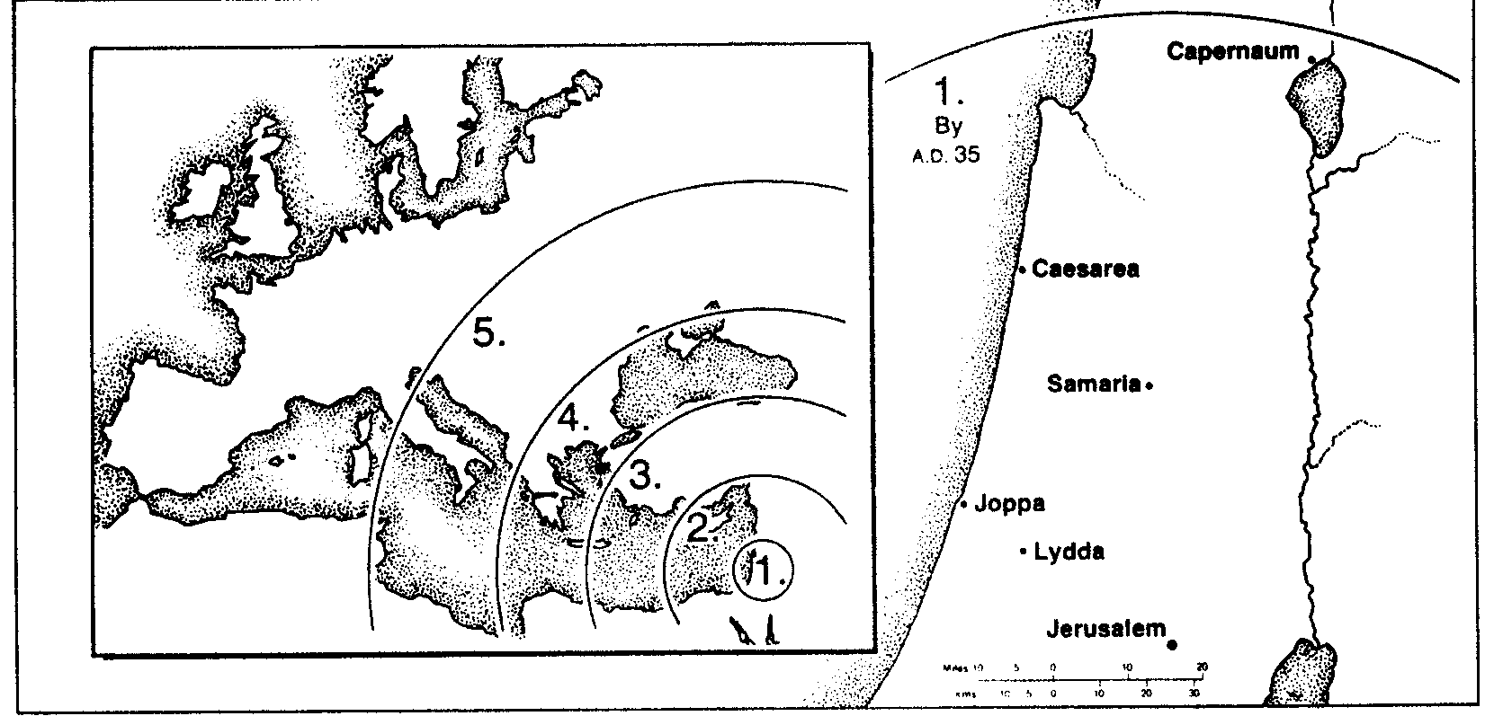
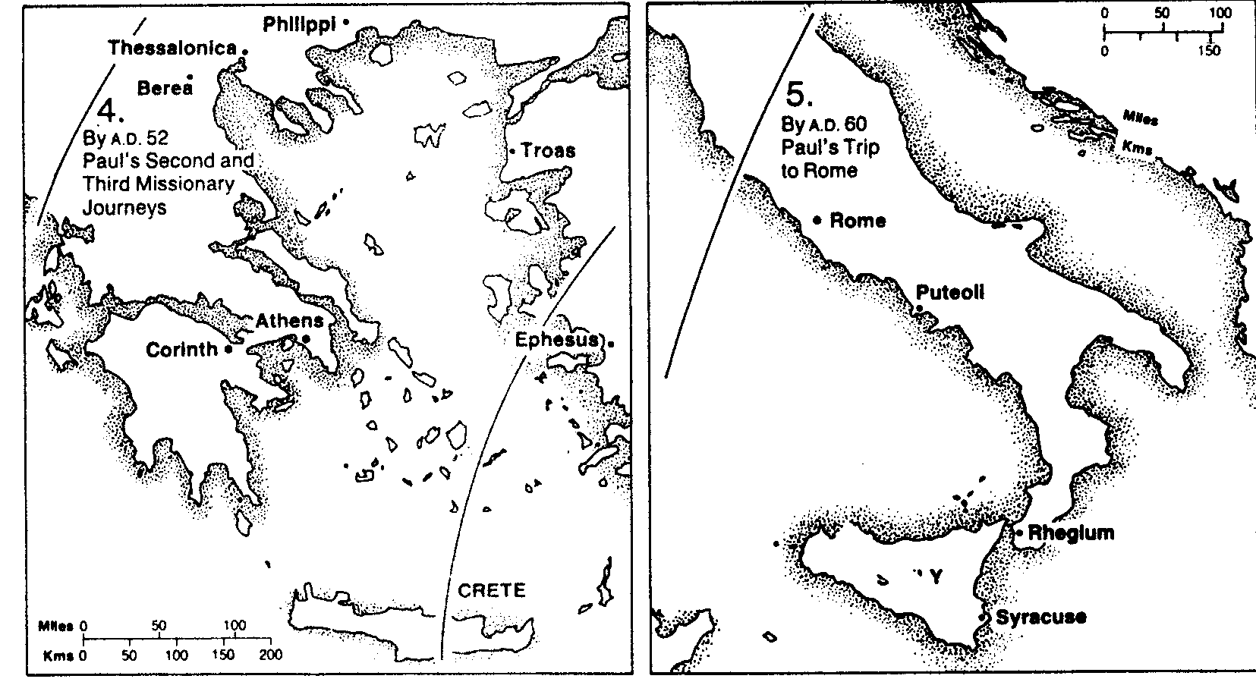
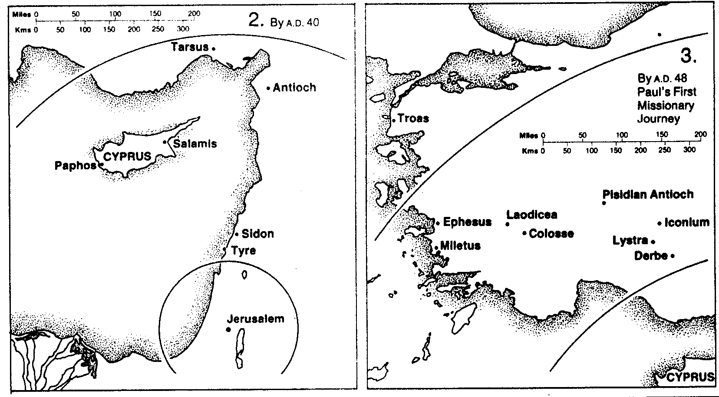
The Spread of the Gospel
134

Slide 65

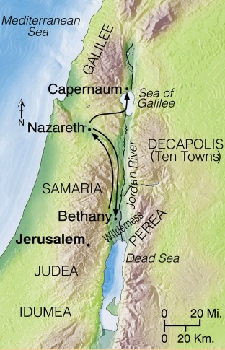
Progress Reports
125
End of the Earth
Key Verse: 1:8
2:47b
6:7
8:40
9:31
12:24
16:5
19:20
28:30-31
1:1–6:7
6:8–8:40
Acts 9–28
Why end this way?
Adapted from Stanley D. Toussaint, BKC; Jeremy Chew, EAST

Slide 66
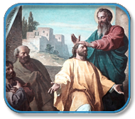
Key Characteristics of Acts
123
  Kingdom
  Significance
  Interpretation
  Superb Style
  Universal message
  Holy Spirit
  Gentile
  Comprehensive
  Sermons
  Contrasts with Luke
  Journeys
  Gospel Progress
  Witnessing

Slide 67
Book Chart (Top)
Acts
120
Universal Savior Proclaimed in Sovereign Kingdom Progress
Jerusalem
Judea and Samaria
Uttermost Part
1:1–6:7
6:8–8:40
Chapters 9–28
Jews
Samaritans
(mixed breeds)
Gentiles
AD 33-35
(2 years)
AD 35
(a few months)
AD 35-62
(27 years)

Slide 68
Book Chart (Bottom)
120
Acts
Peter
Stephen & Philip
Paul
Establishing Home Base
Nearby Outreach
Missionary Journeys
Established
1–2
Expands
3:1–6:7
Stephen
6:8–8:3
Philip
8:4-40
Damascus
9:1-31
to Rome
28:30-31
Rome
AD 62
(completed after Paul's house arrest)

Slide 69
Summary & Application
Acts
120
Summary Statement
God's sovereignly directed progress of the kingdom message from Jerusalem Jews to Roman Gentiles in early church history proves God as responsible for His Church and exhorts believers to witness everywhere.
Application
How is God extending his kingdom message through you?
How are you fitting into His overall purpose to spread the gospel throughout the entire earth?

Slide 70
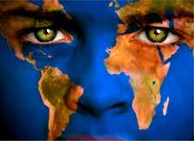
The Structure of Acts
125
1:1–6:7 Jerusalem
1:1–2:47 The beginning of the church
3:1–6:7 The church and the Jewish authorities
6:8–8:40 Judea and Samaria
6:8–8:3 Stephen––cause
8:4-40 Philip––effect
9–28 Uttermost Part
9:1-31 Damascus
9:32–12:24 Antioch
12:25–16:5 Galatia
16:6–19:20 Aegean Area
19:21–28:31 Rome: Aegean & Captivities

Slide 71
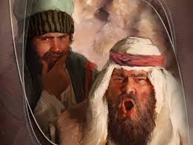
Key Characteristics of Acts
123
  Kingdom
  Significance
  Interpretation
  Superb Style
  Universal message
  Holy Spirit
  Gentile
  Comprehensive
  Sermons
  Contrasts with Luke
  Journeys
  Gospel Progress
  Witnessing
  Opposition

Slide 72
God's Plan: The church didn't follow…
Acts 1:8
so God caused…
Acts 8:1
"remotest part"
"But you shall receive power when the Holy Spirit has come upon you; and you shall be My witnesses both in Jerusalem, and in all Judea and Samaria, and even to the remotest part of the earth."
"Saul was one of the witnesses, and he agreed completely with the killing of Stephen. A great wave of persecution began that day, sweeping over the church in Jerusalem; and all the believers except the apostles were scattered through the regions of Judea and Samaria."
Samaria
Jerusalem
Judea

Slide 73

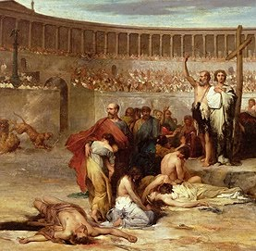
The Counter Story
  Imprisonment
    4:1-4; 12:3-5; 16:16-40; 24:24-27
  Persecution
    5:17-42; 8:1-3
  Arrest
    6:8-15; 21:27-36
  Death
    7:54-60; 12:1-2
  Shipwreck
    27:13-44
  Opposition
    9:23-25; 13:4-12; 17:1-9; 19:21-41; 23:12-22; 25:1-3
Jeremy Chew, East Asia School of Theology, Singapore

Slide 74
CHURCH CRISES:
DANGEROUS OPPORTUNITIES!
The Chinese word for "crisis" consists of two characters: one for "danger" and the other for "opportunity." Indeed, every church crisis involves a dangerous opportunity to bring either great glory or great shame to the name of Christ.
危机
Danger
Opportunity
Jeremy Chew, East Asia School of Theology, Singapore

Slide 75
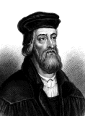
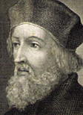
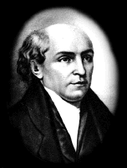
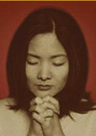
DANGEROUS OPPORTUNITIES!
John Wycliffe (1329-1384) translated the Bible until the day he died despite the church's disapproval.
The martyrdom of John Hus (1373-1415) caused a revival in Bohemia, which became a mission-active church.
William Carey (1761-1834) was opposed in England and in India, but he launched the modern missions movement.
The Chinese Church went underground during the Cultural Revolution killings (1966-1976), but it grew even faster.
Adapted from Jeremy Chew, East Asia School of Theology, Singapore

Slide 76
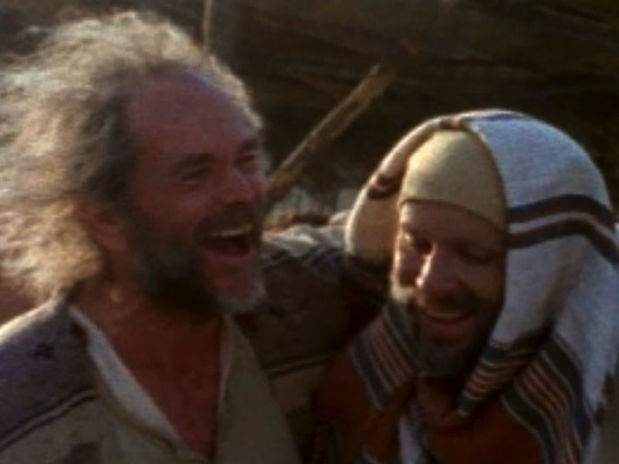
Who was Luke?
Medical doctor
Traveling companion of Paul
Articulate historian & writer

Slide 77
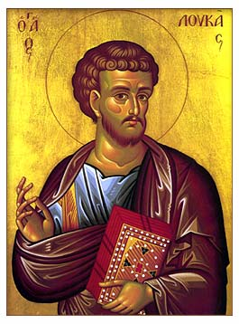
Common Authorship of Luke-Acts
121
Both dedicated to Theophilus
Acts 1:1 refers to "the first account"
Similar language (medical terms)
Same theme (sovereignty)
Chronological orientation

Slide 78
Support for Lukan Authorship
121
External (Outside Acts)
Earliest Evidence in Canons:
Anti-Marcionite Prologue (AD 150-180)
Muratorian Canon (AD 160-200)
Church Fathers (late 2nd cent.):
Irenaeus (AD 185)
Clement of Alexandria (AD 155-216)
Internal (Compared to Gospel)
Both dedicated to Theophilus
Acts 1:1 refers to "the first account"
Similar language (medical terms)
Same theme (sovereignty)
Chronological orientation
Internal (Within Acts)
Four "we-sections" (traveled with Paul)
The only traveling companions not named in these sections are Titus and Luke
But Titus has never been seriously considered as the author of Acts

Slide 79
Date, Origin, Recipients
121
Date
Most likely date of composition is AD 62
Origin
No one knows for certain where Luke wrote this account. Suggestions include Rome, Antioch, Ephesus, Asia Minor, and Achaia.
Recipients
Theophilus (1:1), a man whose name means "lover of God."

Slide 80
Occasion
122
Luke probably wrote at Theophilus' request, but in any event he purposed to strengthen the wealthy Christian's faith by showing that his faith rested on firm historical fact (Luke 1:3-4). Perhaps even more significantly Luke sought to explain to his wider Gentile audience that the progress of the kingdom message was divinely directed, not of human ingenuity and skill.

Slide 81
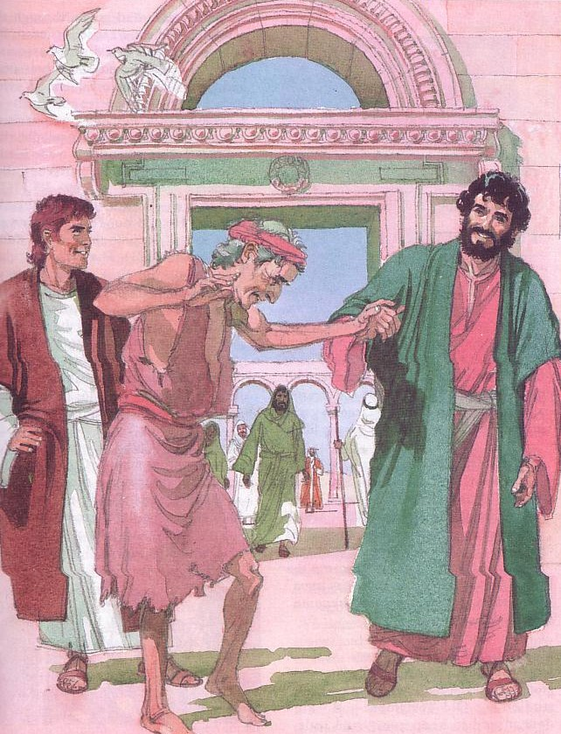
Luke's Purpose in Writing
122
Ecclesiastical
Conciliation
Soteriological / Evangelistic
Historical Narrative
Instructional/Edification
Kingdom
Apologetic

Slide 82

Ken Hornok, ThM
©2016
Notes:
Hornok was pastor of https://midvalleybible.org/ in Utah until his retirement in 2013. See https://archive.sltrib.com/article.php?id=56770953&itype=cmsid

Slide 83
What is the main purpose for the book of the Acts?

Slide 84
What if we did not have the book of the Acts??

Slide 85
What if we did not have the book of the Acts??
The Canon would be incomplete and confusing if it went from the Apostle John to Romans (Apostle Paul) without historical background.

Slide 86
“But it is Luke that we have to thank for the coherent record of Paul’s apostolic activity. Without [Acts], we should be incalculably poorer. Even with it, there is much in Paul’s letters that we have difficulty in understanding; how much more there would be if we had no book of Acts.”
F. F. Bruce , The Book of the Acts, NICNT, 27

Slide 87
What was Luke’s purpose in writing the book of the Acts?
Possible Reasons:

Slide 88
Historical Reasons
Report on the establishment and expansion of the Church.

Slide 89
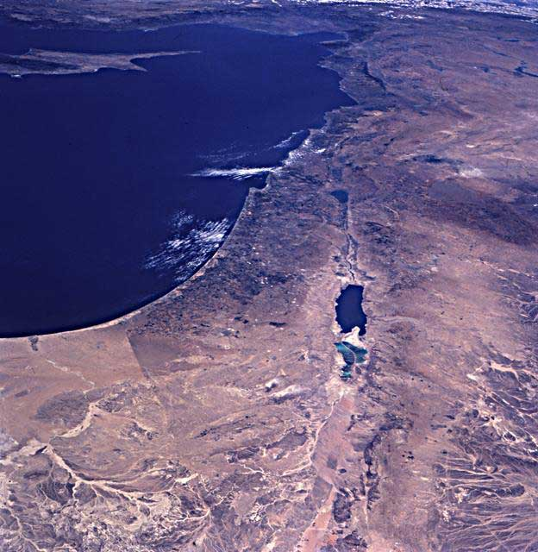
Church begins in Jerusalem

Slide 90
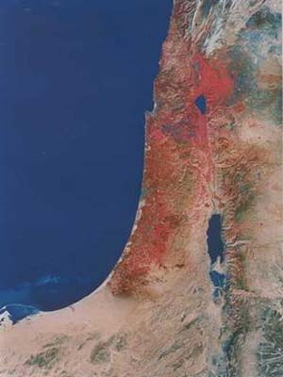
Church expanded from Jerusalem
By Phillip
Samaria
1
Gaza
2

Slide 91
Church expanded from Jerusalem
By Phillip
Caesarea
3

Slide 92
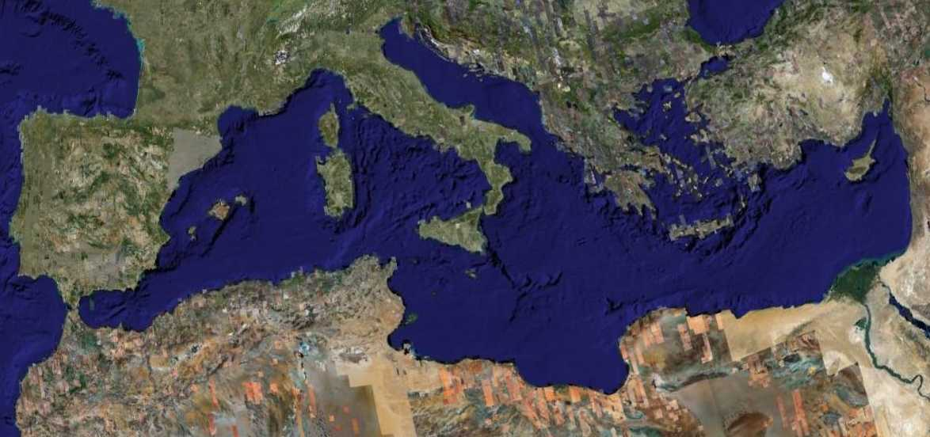
First Missions Trip
Acts 13–14
Spring 48 - Fall 49
Notes:
NS-05-Acts1-2-slide 92
NS-06-Missionary Epistles-3

Slide 93
Second Missions Trip
Acts 16–18
Spring 50 – Fall 52
Notes:
NS-05-Acts1-2-slide 93
NS-06-Missionary Epistles-4

Slide 94
Third Missions Trip
Acts 19–20
Spring 53 – Spring 57
Notes:
NS-05-Acts1-2-slide 94
NS-06-Missionary Epistles-5

Slide 95
Historical Reasons
Report on the establishment and expansion of the Church.
Report on the increasing political and religious opposition to the Church.
3. Explain the growing rejection of the Jews and the growing acceptance of the Gentiles toward the gospel.

Slide 96
Theological Reasons
Report on the Sovereignly directed progression of the message regarding the risen Lord and the Kingdom of God.
Show the shifts regarding Soteriology and Pneumatology.

Slide 97
Transitional Reasons
1. Provide rationale for a total move from Jewish emphasis to Gentile emphasis.

Slide 98
Had a great dispute among themselves
Chapter 2
“What shall we do?”
Jews depart
Jews respond to Peter’s message
Rome
Chapter 28
Jerusalem

Slide 99
“and they will hear it”
Chapter 2
Gentiles respond to Paul’s message
“What shall we do?”
Jews respond to Peter’s message
Rome
Chapter 28
Jerusalem

Slide 100
Transitional Reasons:
Provide rationale for a total move from Jewish emphasis to Gentile emphasis.
2. Explain why the Church begins with the Twelve in Jerusalem with Peter and ends with Paul in Rome.

Slide 101
Practical Reasons
Show how God worked through the lives of people in the early days of the Church.
2. Show the victories and setbacks of the early proclamation of the gospel.

Slide 102
Other Possible Reasons:
Principles for church growth.
Guidelines for decision making.
{{not reliable}}
Instructions how to solve doctrinal differences.
Insights as a missions manual.
Most preaching is done in these areas (regrettably).
These are applications, not purposes for Acts.

Slide 103
Potential Outlines of the Book of Acts:
Witness in Jerusalem (1:1–6:7)
Witness in all Judea and Samaria (6:8–9:31)
Witness to the Ends of the Earth (9:32–28:31) -BKC/Nelson SB/MacArthuur SB/Ryrie SB
Peter and the Beginnings of the Church in Palestine (1-12)
Paul and the Expansion of the Church from Antioch to Rome (13-28) -NIV SB
Intro: Constitutive Events of the Christian Mission
The Christian Mission to the Jewish World (2:42-12:24)
The Christian Mission to the Gentile World (12:25–28:31) - The EBC

Slide 104
Suggested Outline of the Acts
Panel I – Church founded in Jerusalem 1:1–6:7
Panel II – Church expanded from Jerusalem – 6:8–9:31
Panel III – Climax of Peter’s apostleship 9:32–12:24
Panel IV – Establishment of Paul’s apostleship – 12:25–16:5
Panel V – Jesus Christ glorified among the Gentiles – 16:6–19:20
Panel IV – Testimony of Christ carried to Rome – 19:21–28:31

Slide 105
Progress Reports in the Acts
6:7 – ”The word of God increased …disciples multiplied greatly…”
9:31 – “Church….was multiplied”
12:24 – “The word of God grew and multiplied”
16:5 – Churches were strengthened…and increased”
19:20 – “The word of the Lord grew and prevailed”

Slide 106
Progress Reports in the Acts
6:7 – ”The word of God increased …disciples multiplied greatly…”
9:31 – “Church….was multiplied”
12:24 – “The word of God grew and multiplied”
16:5 – Churches were strengthened…and increased”
19:20 – “The word of the Lord grew and prevailed”

Slide 107
Progress Reports in the Acts
6:7 – ”The word of God increased …disciples multiplied greatly…”
9:31 – “Church….was multiplied”
12:24 – “The word of God grew and multiplied”
16:5 – Churches were strengthened…and increased”
19:20 – “The word of the Lord grew and prevailed”

Slide 108
Progress Reports in the Acts
6:7 – ”The word of God increased …disciples multiplied greatly…”
9:31 – “Church….was multiplied”
12:24 – “The word of God grew and multiplied”
16:5 – Churches were strengthened…and increased”
19:20 – “The word of the Lord grew and prevailed”

Slide 109
Suggested Outline of the Acts
Panel I – Church founded in Jerusalem 1:1–6:7
Panel II – Church expanded from Jerusalem – 6:8–9:31
Panel III – Climax of Peter’s apostleship 9:32–12:24
Panel IV – Establishment of Paul’s apostleship – 12:25–16:5
Panel V – Jesus Christ glorified among the Gentiles – 16:6–19:20
Panel IV – Testimony of Christ carried to Rome – 19:21–28:31

Slide 110
What could be
Luke’s Primary purpose in writing the book of the Acts under God’s guidance?

Slide 111
Apologetic Reasons:
1. Luke explains and defends the expansion of a new movement as being the work of God.
2. Luke, writing to Theophilus, is defending the ministry of Paul.
3. Luke shows that Paul’s credentials as an Apostle are in the tradition of the Twelve, especially Peter.
4. Luke points out the strong parallel between Christ and Paul.

Slide 112
Luke seeks to show Paul’s credentials—that he is continuing the ministry of the risen Lord and that (like Peter) Paul’s ministry and writings as an Apostle can be trusted.

Slide 113
The Acts
1:1-3 The former account I made, O Theophilus of all that Jesus began both to do and teach…He also presented Himself alive after His suffering by many unmistakable proofs… (NKJV)
Acts is Volume 2 of a Two-Volume set

Slide 114
Luke
Volume I
The Acts
Volume II

Slide 115
Luke
1:3-4 …having investigated everything carefully…so that you might know the exact truth (certainty) about the things you have been taught. (NASB)
Luke is volume 1 of a Two-Volume set

Slide 116
The writings of Luke (Luke/Acts) comprise almost 30% of the material in the New Testament, exceeding both Paul’s and John’s
writings in size

Slide 117
Possible revised title to the book:
Certain Acts of Certain Apostles

Slide 118
Certain Acts of Certain Apostles
Chapter 1 - 11 are mentioned + replacement
Chapter 2 – Peter + 11
Chapter 3 – Peter & John
Chapter 4 – Peter
Chapter 5 – Peter + Apostles
Chapter 6 – The 12
Chapter 8 – Peter & John + Apostles
Chapter 9 – Peter
Chapter 10 – Peter
Chapter 11 – Apostles + Peter
Chapter 12 – James & Peter
Chapter 15 – Peter + Apostles

Slide 119
Certain Acts of Certain Apostles
Chapter 1 - 11 are mentioned + replacement
Chapter 2 – Peter + 11
Chapter 3 – Peter & John
Chapter 4 – Peter
Chapter 5 – Peter + Apostles
Chapter 6 – The 12
Chapter 9 – Peter
Chapter 10 – Peter
Chapter 11 – Apostles + Peter
Chapter 12 – James & Peter
“And he departed and went to another place” 12:17
Chapter 15 – Peter + Apostles

Slide 120
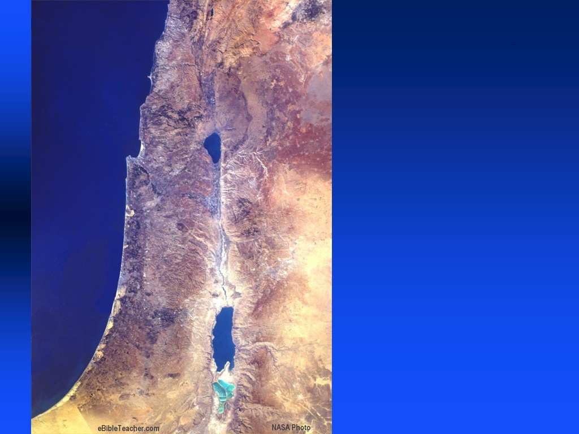
Significance of Peter:
He breaks through the Gentile barrier

Slide 121
Certain Acts of Certain Apostles
Chapter 8 – Saul
Chapter 9 – Saul
Chapter 11 - Saul
Chapter 12 – Saul
Chapter 13–28 – Paul and his activities are mentioned in every chapter
in great detail.
“Then Paul…received all who came to him…preaching …and teaching…no one forbidding him” 28:30-31

Slide 122


1
15
Peter
Certain Acts of Certain Apostles
Paul
8
28
8

Slide 123
The “we/us” sections of the book
16:10-12 – Troas & Philippi
20:5–28:16 – Philippi – Rome
Luke has direct contact with Paul on the first part of his 2nd MJ and from end of his 3rd MJ until he arrives in Rome
Luke is Paul’s most loyal companion

Slide 124
Paul’s Mission Trips
Chapters 13–20
10 years
Paul’s Arrest & Imprisonment
Chapters 13–20
5 years

Slide 125
Luke seeks to show Paul’s credentials—that he is continuing the ministry of the risen Lord and that his ministry and writings as an Apostle can be trusted.

Slide 126
How does Luke demonstrate the legitimacy of Paul’s apostleship?
18 parallels to Peter

Slide 127
Parallels between Peter and Paul
Peter
Filled with the Spirit
Paul
4:8 13:9
Conferred the HS
8:14-17 19:6
Refused worship
10:25-26 14:11-15

Slide 128
Parallels between Peter and Paul
Peter
Jailed frequently
Paul
4:3,5:18,12:3 16:23,21:27
Delivered from prison
12:6-11 16:25-34
Experienced Visions
10:10-16 16:6-10

Slide 129
Parallels between Peter and Paul
Peter
Cast out demons
Paul
5:15-16 16:18,19:12
Name changed
Gospels 13:9
Defense before religious leaders
4:5,5:29 22:30,26:1

Slide 130
Parallels between Peter and Paul
Peter
Healed lame man
Paul
3:1-10 14:8-10
Extraordinarymiracles
5:15-16 19:11-12
Spoke at the Jerusalem Council
15:7-11 15:12

Slide 131
Parallels between Peter and Paul
Peter
Confronted Sorcerer
Paul
8:9-24 13:6-11
Raised a dead person
9:36-41 20:9-12
Inaugural sermons recorded
2:14-41 13:16-41

Slide 132
Parallels between Peter and Paul
Peter
Paul
Plots to kill them
5:33 9:23, 23:11
Beaten and Rejoiced
5:40-41 16:23-25
Success caused Jewish jealousy
5:17 13:45

Slide 133
1
15
Peter
Certain Acts of Certain Apostles
Paul
8
28
8

Slide 134
Life & Letters of the Apostle Paul
Paul’s
Conversion
c. AD 34-35
Paul’s
Mission Trips
c. AD 47-57
Paul’s Arrest & Imprisonment
c. AD 58-61
9
13–20
21–28
Acts
Galatians
1 & 2 Thessalonians
1 & 2 Corinthians
Romans
Ephesians
Colossians
Philemon
Philippians

Slide 135
By the time the events of Acts conclude, the Apostle will have written a total of 10 letters that will be collected as inspired Scripture.

Slide 136
Luke and Paul are responsible for between 55-60% of the New Testament literature. During the time they spent together, one wonders if they talked about what it was like to write Scripture?

Slide 137
Paul is Christ-like following the same path
He steadfastly set His face to go to Jerusalem 9:51
They cried out…
“Away with this man”
23:18
Christ in Luke’s Gospel
Paul in the Acts
“I go bound in the spirit to Jerusalem”
20:22
Multitude cried out “Away with Him”
21:35

Slide 138
Paul’s Mission Trips
Chapters 13–20
Paul’s Confinement & Defense
Chapters 21–28

Slide 139
Paul is Christ-like following the same path
Christ’s Arrest
Before religious leaders
Before Political
Leaders
Herod/Pilate
Luke 22:63-71 23:1-25
Paul’s Arrest
Before religious leaders
Before Political
Leaders
Felix/Festus/Agrippa
Acts 22:1-23:10 24:1-26:32

Slide 140
Luke seeks to show that Paul’s
determination to fulfill the will of God by testifying in Jerusalem
parallels that of Christ in fulfilling
the will of God as a
Sacrifice for sin in Jerusalem.
In both cases they are rejected by the Jews

Slide 141
Luke stops short of making a full comparison of Christ
and Paul by not recording
Paul’s death

Slide 142
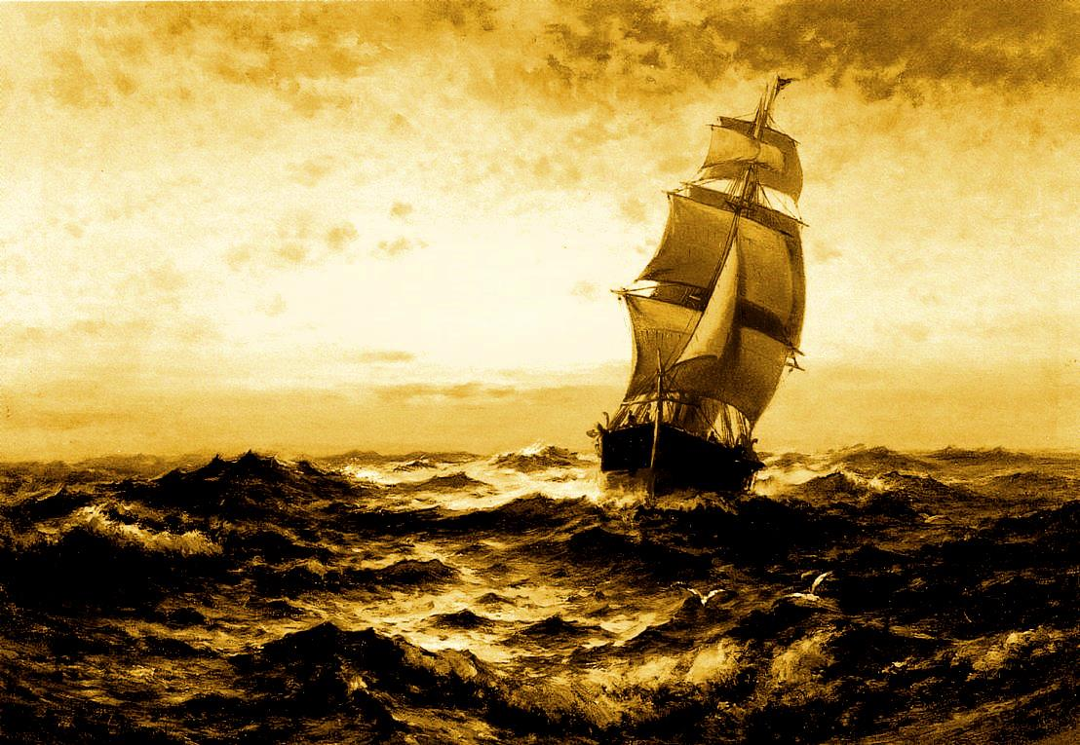
What is the
purpose of
Acts 27?
Ken Hornok, ThM
©2016

Slide 143
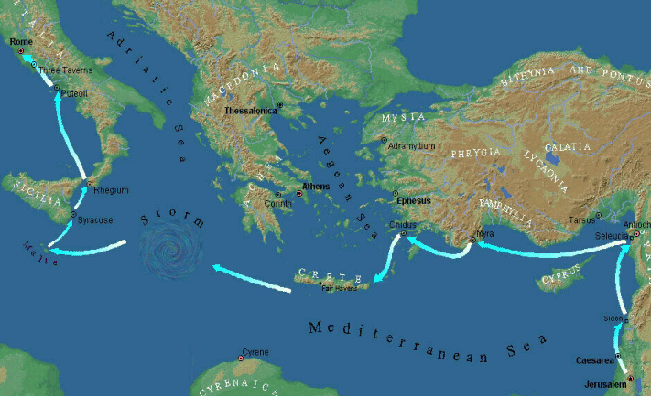

Slide 144
This is one of the longest chapters in the book.
From start to finish this chapter is the story
of a voyage gone bad; it has nothing
to do with mission work or church planting,
as previously mentioned.
What then is the purpose of
this chapter?

Slide 145
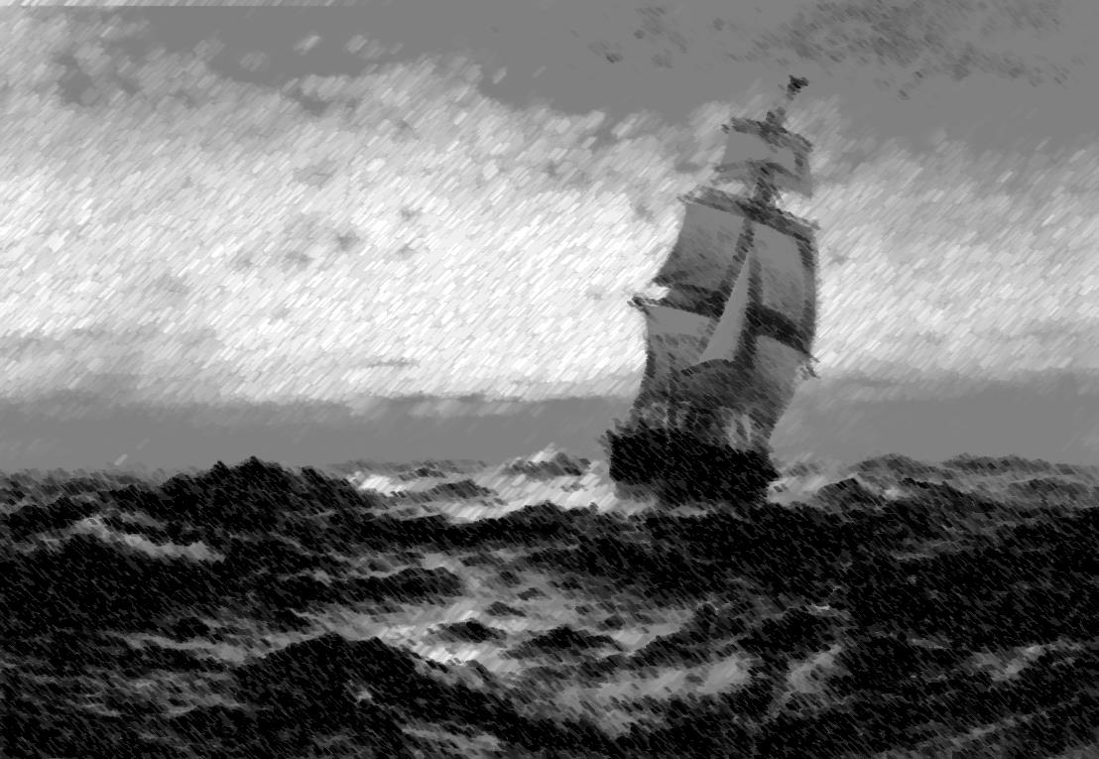
— It shows that natural forces cannot prevent Paul from fulfilling God’s will of testifying in Rome.
— It shows that God sovereignly protects His servants to the completion of their God-given tasks.

Slide 146
— It shows Paul’s wisdom in practical matters of life as well as his faith and confidence in God’s protection.
— It shows that when Paul’s counsel is disregarded, both the cargo and the ship are lost.

Slide 147
— Paul is Luke’s hero, and he presents Paul
as an Apostle (like Peter) whom God is using and who can be trusted.
Luke’s intended conclusion☺:
— One does well to follow Paul’s
example because he is Christ-like.
— One does well to heed and study Paul’s
letters because they are from God.

Slide 148
What is Luke’s purpose in writing the book of the Acts?

Slide 149
Transitional:
— From Jerusalem to Rome
— From Jew to Gentile
{establishment of the Church}

Slide 150
Transitional/Apologetic
— From Jerusalem to Rome
— From Jew to Gentile
— From Peter to Paul

Slide 151
Luke shows Paul’s credentials—that he is continuing the ministry of the risen Lord and that his ministry and writings as an Apostle can be trusted.

Slide 152
Be Witnessing
Acts
Dr. Rick Griffith • Crossroads International Church Singapore
BibleStudyDownloads.org

Slide 153
The Book of Acts in 3 Minutes
(TheChurchatBrookHills.mp4)
131e

Slide 154
The Witness Stand
Notes:
It’s not hard to witness to what you have seen—

Slide 155

Is this you?
Notes:
—yet we often don’t feel that way about witnessing for Jesus.

Slide 156
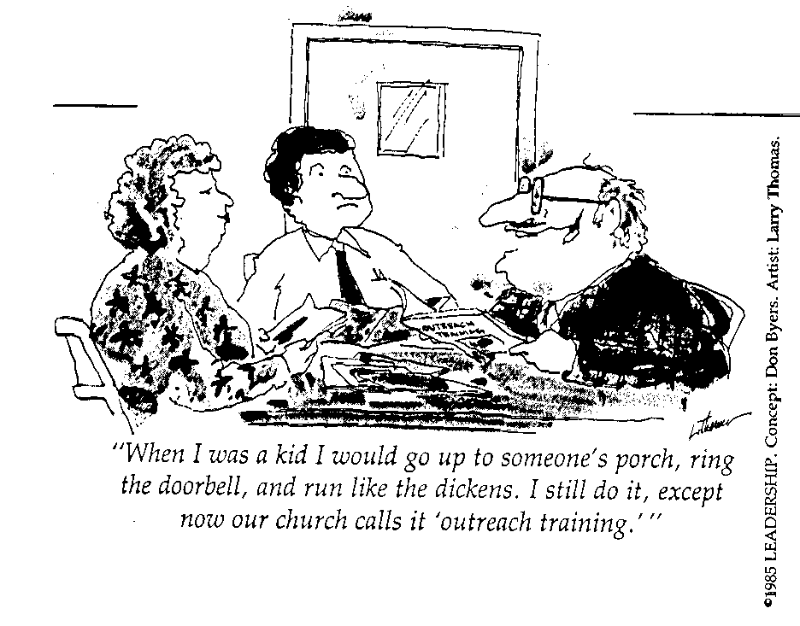
Many Fear Evangelism!
Q65
Q74
Q83
"When I was a kid, I would go up to someone's porch, ring the doorbell, and run like the dickens. I still do it, except now our church calls it 'outreach training.'"
Notes:
—or is this you instead?

Slide 157
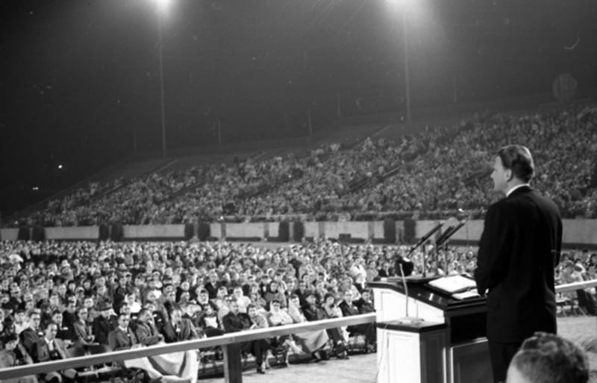
Billy Graham
Notes:
Some of us fear witnessing because we think we have to be a Billy Graham!

Slide 158
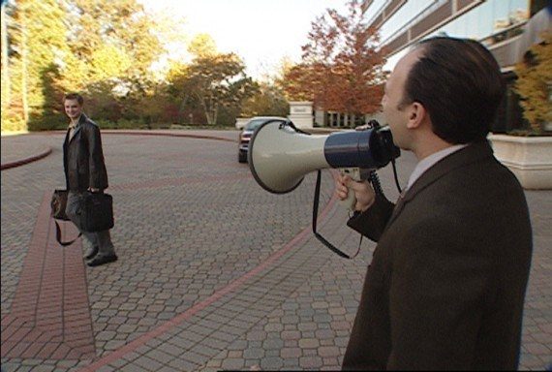
There are ineffective ways to witness.
Notes:
Others think of ineffective ways to witness.

Slide 159

Is this your cup?
I’D RATHER BE
WITNESSING
Notes:
How are you doing at witnessing to what Jesus has done in your life?

Slide 160
Key Verse
56
"But you will receive power when the Holy Spirit comes on you; and you will be my witnesses in Jerusalem, and in all Judea and Samaria, and to the ends of the earth" (1:8).
Acts

Slide 161

For us…

Slide 162
Why should we be witnessing?
Notes:
What reasons are there for you and I to seek a harvest?
Why is evangelism important?

Slide 163

Background

Slide 164
Who was Dr. Luke?
Medical doctor
Traveling companion of Paul
Articulate historian & writer
Notes:
Helping us understand how to be witnesses today is Dr Luke.

Slide 165
NT Overview (Paul's Letters)
38
124
39-41
“To the remotest part of the earth” (Acts 1:8)
Acts 9 13 14 15 16 18 21 27 28
Apr 48-
Sep 49
1
Galatia
Apr 50-
Sep 52
2
Aegean
Spr 53-
May 57
3
Asia
Feb 60-
Mar 62
1
Rome
Spr 62-
Fall 67
4
Spain
Aut 67-
Spr 68
2
Rome
Summer 35-
37
Damascus
Antioch
May 57-
Aug 59
Trials
Fall 49
The
Council
Spring 68
Expansion of Church
35 48 49 50 52 53 57 60 62 67 68 95
Matt
Luke
Acts
Mark
John
Gal
1 Thess
1 Cor
Eph
1 Tim
2 Tim
2 Thess
2 Cor
Col
Titus
Missionary
Pastoral
Romans
Philem
Gospels & Acts
Phil
Pauline Epistles
1234
Journeys
Prison
Rome
Imprisonments
Pauline
Notes:
Observations about chronology:
Gospels not written first but throughout NT era
Evangelistic letters preceded pastoral
Rough letter (Galatians) preceded smoother ones

Slide 166
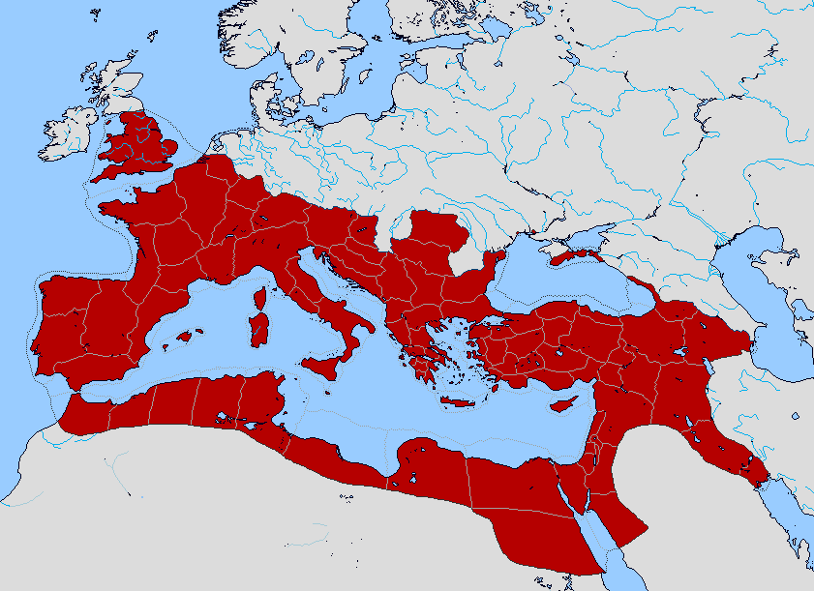
Bible Lands Blank Map
The Roman Empire
"But you shall receive power when the Holy Spirit has come upon you; and you shall be My witnesses both in Jerusalem, and in all Judea and Samaria, and even to the remotest part of the earth" (Acts 1:8 NAU).
"remotest part"
Samaria
Jerusalem
Judea
© https://www.deviantart.com/sharklord1/art/Alt-Roman-Empire-Provinces-701148110
Notes:
Linguistically, Hebrew/Aramaic moves to Greek/Latin/others.

Slide 167
Why should we be witnessing?
3 reasons
Notes:
What reasons are there for you and I to seek a harvest?
Why is evangelism important?

Slide 168
I. God has gone ahead of us so we can begin where we are (1:1–6:7).
Notes:
First tell others about Jesus where it is natural without crossing cultures.

Slide 169
Slides on
Acts 1
Notes:
God began the kingdom expansion in Jerusalem (1:1–6:7).

Slide 170
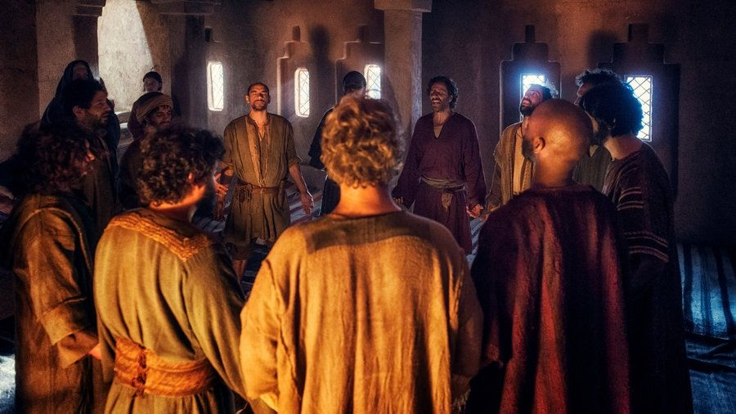
Upper Room Prayer
Notes:
All great workings of God's Spirit through the centuries began with prayer.

Slide 171
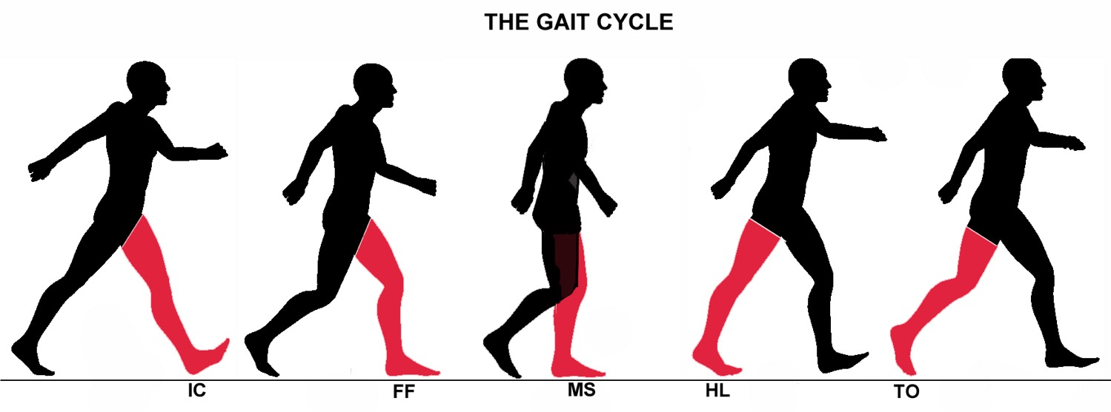
Put Wait in Your Gait
Acts 1
Dr. Rick Griffith • Crossroads International Church Singapore
CICFamily.com • BibleStudyDownloads.org

Slide 172

Waiting
Notes:
Alas, after 8 months away from you all, we are back! We have waited for today for some time. We speak of walking in the Spirit and filling of the Spirit and the indwelling of the Spirit.

Slide 173
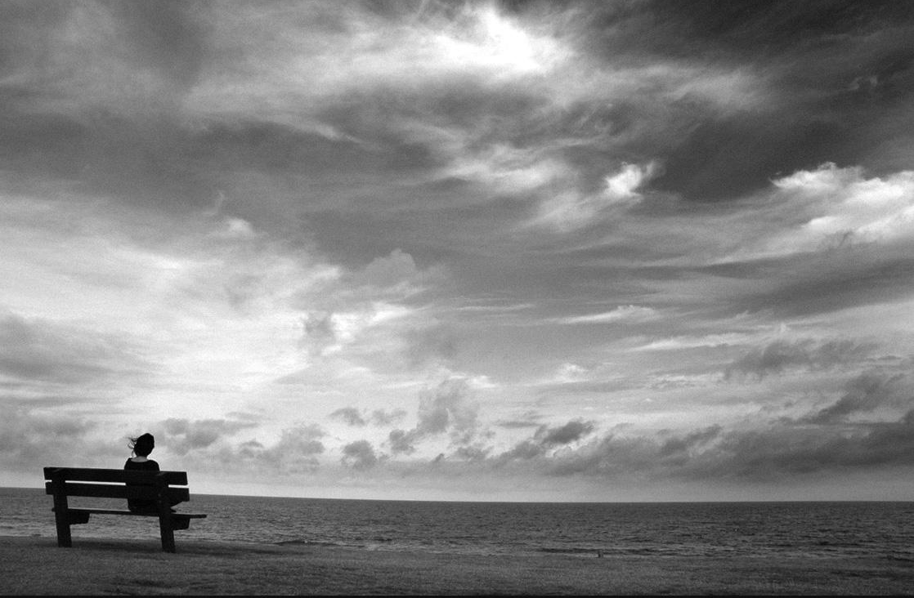
Waiting in the Spirit?
Notes:
But Susan and I have tried to be waiting in the Spirit!
The past year we have waited for God to open a door for us to have our sabbatical in Jordan where I committed to teach from August through December. We waited…and waited…and it didn’t happen.
So we waited in the USA for a place to live—but COVID shut down all opportunities, so we wandered from relative to relative for eight months.
Finally, after waiting for Christmas to pass to return to Singapore, we waited in our 14-day quarantine.
But we only had to wait 7 days as a passenger on our plane was discovered with COVID, so we were sent to another hotel, only to learn that we were to be in different rooms. As they took away my wife for a week in the lobby I couldn't even say goodbye, calling out, “My Sweetie, you have my toothbrush in your luggage—and I have your computer power cord in mine!”
We’ve had three COVID tests this month and we’ve waited for the timing, test results, and the like.
But my desire in all this has been to wait in the Spirit.

Slide 174

Flu Bug
Notes:
Maybe you are waiting for sickness to pass. My son shared yesterday that there is a flu bug going around Seattle, so he took a picture of it so he’d recognize it.

Slide 175


What are you waiting for?
This Photo by Unknown Author is licensed under CC BY-NC-ND
Notes:
What are you waiting for the Lord to do in your life?
Are you waiting for God to change someone’s heart toward you?
Are you waiting for God to bring a loved one to Jesus? I still wait for my 90-year-old mother.
Do you impatiently say, “Lord, I am ready for you to come today—aren’t you ready?”
Maybe you wait to get a spouse, a better job, a raise, or some other benefit.
Every single one of us is waiting for something—so raise your hand if you can identify an area where you wait to see God work, OK?
Now another question: How are you doing at waiting right now?

Slide 176
Put Wait in Your Gait
Acts 1
Notes:
Are you just sitting around waiting? Did you notice my sermon title, “Put Wait in Your Gait”? We all have a gait, which is the way you walk. Do you walk with the Lord in such a way that you wait well? I toyed with calling it, “Put Gait in Your Wait” also. They need to go together! So…

Slide 177

How can you wait expectantly in the Spirit?
Notes:
How can you wait expectantly in the Spirit? In what ways can you honor the Lord when it seems that he delays or pauses your plans?

Slide 178
GOOD NE WS
ON THE MO VE
God’s work through the early church in
Acts
Notes:
Our new series on Acts begins today that we are calling “Good News on the Move.”

Slide 179
Who was Luke?
Medical doctor
Traveling companion of Paul
Articulate historian & writer
Notes:
This book has the same author as the third gospel—Dr Luke, Paul’s traveling companion and articulate historian.

Slide 180
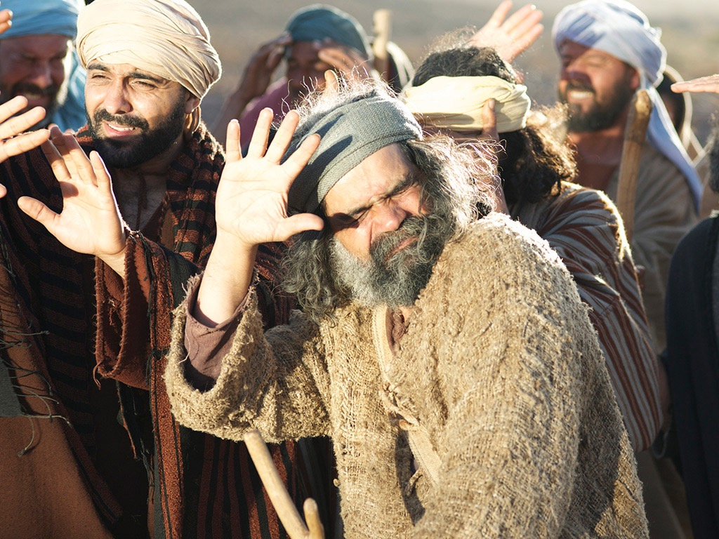

Free
Bible
images
Acts 1:1-14
JESUS ASCENDS TO HEAVEN

Slide 181
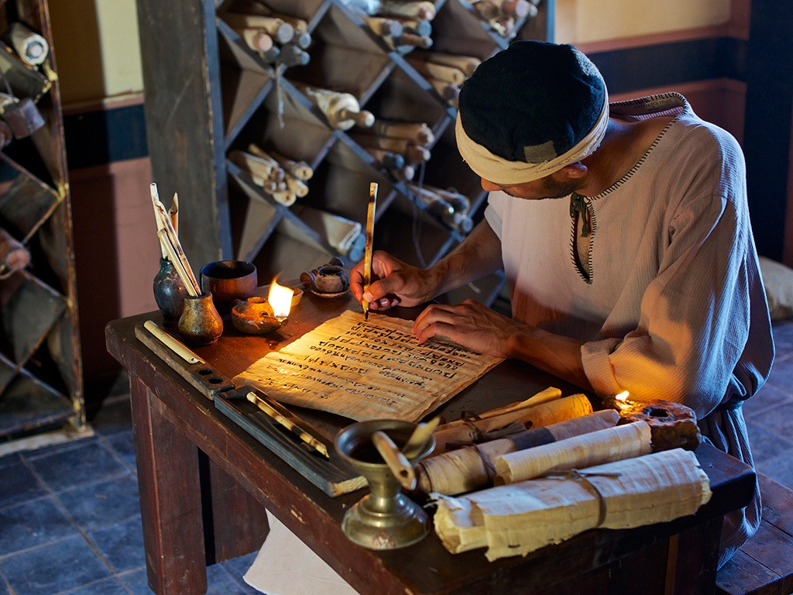
Notes:
We open up his book and see…

Slide 182
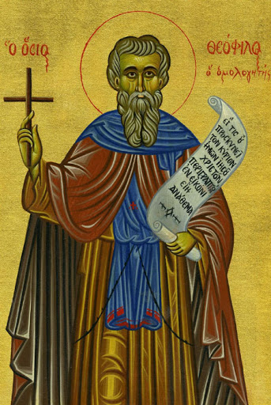
"In my first book I told you, Theophilus, about everything Jesus began to do and teach ² until the day he was taken up to heaven after giving his chosen apostles further instructions through the Holy Spirit"
(Acts 1:1–2 NLT).
Notes:
Jesus had fully trained the disciples for three years and they were ready to go—or at least they thought so (Acts 1:1-3).
Who was Theophilus (1)?
This is the only time he is noted in the NT, but his name means “loves God” and so he obviously was a believer.
He likely was a wealthy man who financed Luke to write this two-volume work on Jesus and the Church

Slide 183
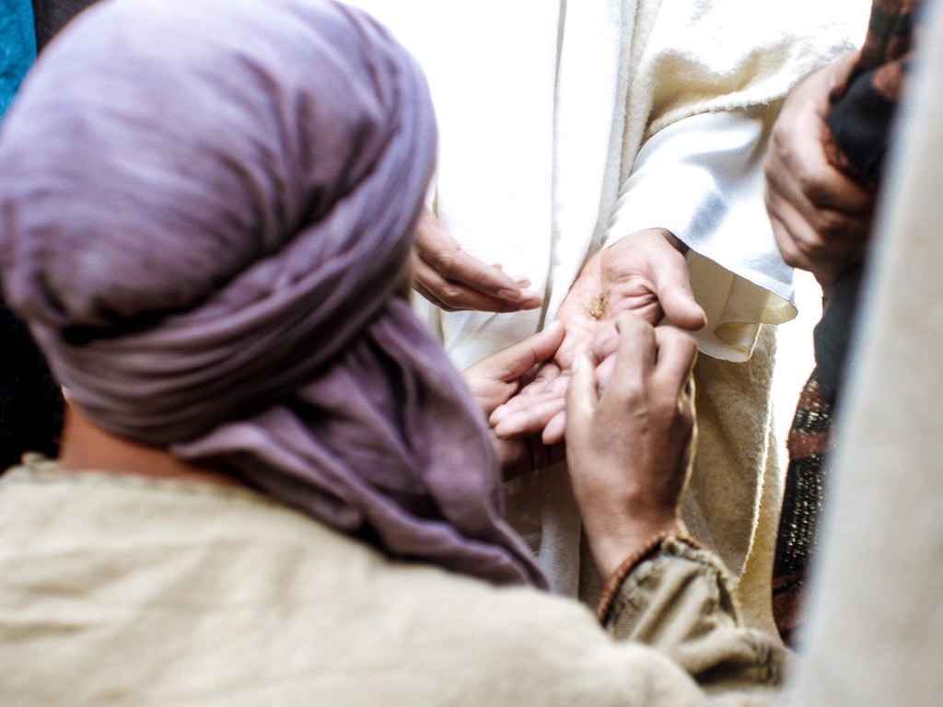
"During the forty days after he suffered and died, he appeared to the apostles from time to time, and he proved to them in many ways that he was actually alive"
(Acts 1:3a NLT).
Notes:
Theophilus believed in the risen Jesus

Slide 184


Slide 185


Slide 187


Slide 188


Slide 189

"During the forty days after he suffered and died, he appeared to the apostles from time to time, and he proved to them in many ways that he was actually alive. And he talked to them about the Kingdom of God"
(Acts 1:3 NLT).
Notes:
What was the “kingdom of God” (3)?
The Psalms tell us God has always ruled over the universe and always will.

Slide 190
A Look at the Future
473
Great
White
Throne
(Rev. 20:11-14)
Rapture
(1 Thess. 4:13-18)
2nd Advent
(Zech. 14:3-5)
Church Age
Tribulation
(Zech. 14:1-2)
Millennium
(Zech. 14:6-21)
Gog & Magog
(Armageddon)
(Ezek. 38–39)
Gog and Magog
Revisited
(Rev. 20:7-10)
Notes:
190
But the OT prophets had spoken much about the kingdom after Messiah’s return.

Slide 191

A Literal, Political Kingdom
"Jesus replied, 'I assure you that when the world is made new and the Son of Man sits upon his glorious throne, you who have been my followers will also sit on twelve thrones, judging the twelve tribes of Israel'"
(Matt. 19:28 NLT)
Notes:
It will be ruled by Messiah where Israel will have prominence over the entire world that will follow the Lord.

Slide 192


United Nations Building, New York
Notes:
The UN even has the kingdom text of Isa 1.

Slide 193
Incredibly Long Life (NIV)!
NTS 424
NIV Isaiah 65:20 "Never again will there be in [Jerusalem] an infant who lives but a few days, or an old man who does not live out his years; he who dies at a hundred will be thought a mere youth; he who fails to reach a hundred will be considered accursed."
Notes:
193
People will live past 100 again—and Jesus refers to this in Acts 1:6.

Slide 194

To Disciples: WAIT for the Spirit!
Acts 1:4-5
Notes:
Jesus told them to wait for the Spirit’s power (1:4-5).
In other words, don’t go ahead of the Spirit.
God’s best gift to the disciples would be the Spirit’s indwelling (1:4-5).
What does it mean to be “baptized with the Holy Spirit” (5)?
This is not the baptism of the Spirit (never noted in the Bible)—nor the baptism by the Spirit (as Jesus is the agent).
Instead, Jesus would place them into the body of Christ with the Spirit entering their lives forever.

Slide 195

To Us: DON’T WAIT for the Spirit!
We do not need to wait for the Holy Spirit to come: he came on the day of Pentecost. He has never left the church.
—John Stott—
Notes:
John Stott noted, “We do not need to wait for the Holy Spirit to come: he came on the day of Pentecost. He has never left the church.” We will see this in Acts 2 next week. Wow! His best gift now is his presence in our bodies!

Slide 196
How can you wait expectantly in the Spirit?
2 ways
Notes:
Let’s see from Acts 1 two ways they were to actively wait in the Spirit. This will teach us two ways to wait today. How can you wait for God’s timing in your life?

Slide 197


How can you wait expectantly in the Spirit?
Witness
(Acts 1:6-11)
Notes:
Acts 1 provides two habits of godly waiting for us.
(So how can you wait expectantly in the Spirit? First…)
• While you wait, witness (1:6-11).

Slide 198

A Great Question (Acts 1:6)
So when they met together, they asked him, “Lord, are you at this time going to restore the kingdom to Israel?”
Notes:
We should witness to everyone until Israel is restored (1:6-8).

Slide 199
Key Characteristics of Acts
122
  Kingdom
Start
"So when the apostles were with Jesus, they kept asking him, "Lord, has the time come for you to free Israel and restore our kingdom?"
(Acts 1:6 NLT)
End
"For the next two years, Paul lived in Rome at his own expense. He welcomed all who visited him, ³¹boldly proclaiming the Kingdom of God and teaching about the Lord Jesus Christ. And no one tried to stop him" (Acts 28:30-31 NLT).
Notes:
What does this kingdom for Israel mean (6)?
Israel had kings for over 400 years from 1000-600 BC, but it had been over 600 years since the kingdom had ended.
We should use the normal language for “Israel” here and also for “kingdom” as they would have understood it. In fact, the kingdom for Israel is a key theme of Acts—seen here in the first chapter and also in the last few verses!

Slide 200
Will you at this time restore the kingdom to yourself?
Acts 1:6
Notes:
Why do the disciples ask about a kingdom restored to Israel (6)?
They knew from many OT texts that Messiah would rule over Israel—and they knew that Jesus was that Messiah—so they reasoned that the now resurrected Jesus would restore that kingdom.
One scholar notes, “In the disciples’ minds the outpouring of the Holy Spirit and the coming of the promised kingdom were closely associated. And well they should be, because the Old Testament frequently joined the two (cf. Isa. 32:15–20; 44:3–5; Ezek. 39:28–29; Joel 2:28–3:1; Zech. 12:8–10). When Christ told the disciples of the soon-coming Spirit baptism, they immediately concluded that the restoration of Israel’s kingdom was near in time.”
_______
Stanley D. Toussaint, “Acts,” in The Bible Knowledge Commentary: An Exposition of the Scriptures, ed. J. F. Walvoord and R. B. Zuck, vol. 2 (Wheaton, IL: Victor Books, 1985), 354.

Slide 201

A Great Answer (Acts 1:7)
He said to them: “It is not for you to know the times or dates the Father has set by his own authority.”
Notes:
How does Jesus correct their understanding of Israel’s restoration (7)?
Does Jesus say that they had the wrong idea about the kingdom?
Does Jesus say, “Oh, you stiff-necked and dull disciples? When are you going to see that my kingdom is not a political one. It’s spiritual only!”
But he doesn’t say that it is only spiritual. He affirms their understanding of what the kingdom is. He just corrects the timing of that kingdom. It wasn’t going to happen then but only when the Father determines. They just needed to wait.
But in verse 8 he tells them what to do until the kingdom for Israel arrives: WITNESS!

Slide 202

“…you shall be my witnesses”
"But you shall receive power when the Holy Spirit has come upon you, and you shall be My witnesses both in Jerusalem, and in all Judea and Samaria, and even to the remotest part of the earth."
—Acts 1:8—
Notes:
So what was the commission for the disciples (8)?
They were NOT to preach.
They were NOT to teach.
They were simply to WITNESS what they experienced. Isn’t that freeing?

Slide 203

The Witness Stand
Notes:
It’s not hard to witness to what you have seen—
Wiersbe notes, “’Witness’ is a key word in the Book of Acts and is used twenty-nine times as either a verb or a noun. A witness is somebody who tells what he has seen and heard (Acts 4:19–20). When you are on the witness stand in court, the judge is not interested in your ideas or opinions; he only wants to hear what you know. Our English word Witness
martyr comes from the Greek word translated ‘witness,’ and many of God’s people have sealed their witness by laying down their lives.”
____________
Warren W. Wiersbe, The Bible Exposition Commentary, vol. 1 (Wheaton, IL: Victor Books, 1996), 403.

Slide 204
Acts 1:8 NAU
"remotest part"
"But you shall receive power when the Holy Spirit has come upon you; and you shall be My witnesses both in Jerusalem, and in all Judea and Samaria, and even to the remotest part of the earth."
Samaria
Jerusalem
Judea
Notes:
What is the significance of the threefold regions (8)?
Geographically, they go from the near to the far.
By size, it begins with a city, goes to regions and then beyond regions.
Culturally, they begin with the familiar and stretch to the unfamiliar.
Chronologically, it begins in AD 33 and finishes in AD 62—as well as to today.

Slide 205
Bible Lands Blank Map
The Roman Empire
"But you shall receive power when the Holy Spirit has come upon you; and you shall be My witnesses both in Jerusalem, and in all Judea and Samaria, and even to the remotest part of the earth" (Acts 1:8 NAU).
"remotest part"
Samaria
Jerusalem
Judea
© https://www.deviantart.com/sharklord1/art/Alt-Roman-Empire-Provinces-701148110
Notes:
Linguistically, Hebrew/Aramaic moves to Greek/Latin/others.

Slide 206

Notes:
“After saying this…

Slide 207

Notes:
he was taken up into a cloud while they were watching…

Slide 208

Notes:
… and they could no longer see him” (1:9 NLT).

Slide 209

Notes:
“As they strained to see him rising into heaven, two white-robed men suddenly stood among them.”

Slide 211


Slide 212

Notes:
God began the Church right at home for the first believers (Acts 1–2).
He prepared Jews to first reach Jews (Acts 1).

Slide 213

Used with permission

Slide 214
Two Angels (Acts 1:11)
Notes:
“Men of Galilee,” they said, “why are you standing here staring into heaven? Jesus has been taken from you into heaven, but someday he will return from heaven in the same way you saw him go!” (Acts 1:11 NLT).
What is the significance of Jesus ascending (9-11; cf. Toussaint, BKC)?
This ended the ministry of Jesus on earth.
This began the ministry of Jesus in heaven at God’s right hand (Acts 2:33–36; 5:30–31; Heb. 1:3; 8:1; 12:2).
This continued the ministry of Jesus through his disciples.
This fulfilled the promise of Jesus to leave so the Comforter could come (stay tuned for that in Acts 2).
______
Stanley D. Toussaint, “Acts,” in The Bible Knowledge Commentary: An Exposition of the Scriptures, ed. J. F. Walvoord and R. B. Zuck, vol. 2 (Wheaton, IL: Victor Books, 1985), 354.

Slide 215
The Spirit Leaves & Returns
Mt. of Olives
656
Ezek. 8:4; 9:3; 10:4; 10:18-19; 11:23
Luke 19:37; 24:50; Acts 1:10
Acts 1:11; Zech. 14:4; Ezek. 43:1-5
Notes:
The Mount of Olives plays a significant role in history. It is the last place the Spirit is present in Ezekiel 11:23, the last place Christ was honored as king in Luke 19:37, the last place Christ was seen by his disciples in Acts 1:10, and the NEXT place Christ will appear on earth to fulfill Acts 1:11!
The Kidron Valley below the mount is likely the Valley of Jehoshaphat where Jesus will judge the nations (Joel 3).
_____________
Common Slides English-197
OS-26-Ezek1-39-slide 178
OS-38-Zechariah-179
NS-03-Luke13-24-slide 111
NS-Acts1-2-slide 215

Slide 216

How can you wait expectantly in the Spirit?
Pray
(Acts 1:12-26)
Witness
(Acts 1:6-11)
Notes:
How are you testifying to what Jesus has done for you while you wait for his return?
Do you talk to people about Christ?
Don’t just wait without a gait. Keep walking and witnessing.
Besides witnessing, what is the other way to wait expectantly?)
• While you wait, pray (1:12-26).
[Don’t be paralyzed by inaction—be prayerful with action.]

Slide 217

Upper Room Prayer
Notes:
The believers gathered to pray for their ministry (1:12-14).
Like them, we also meet in an Upper Room!

Slide 218

Upper Room Prayer
Acts 1:14
Notes:
Is the prayer of the disciples an example for us to follow (12)? Why not? Next week in Acts 2 we will see the amazing result!

Slide 219

Revival historian J. Edwin Orr
“No great spiritual awakening has begun anywhere in the world apart from united prayer—Christians persistently praying for revival.”

Slide 220

Matthias Chosen
Acts 1:15-26
Notes:
Peter followed God’s leading to replace Judas with Matthias (1:15-26).
Did the disciples do the right thing by replacing Judas (12-26)?
The text strongly implies that it was proper, as Jesus said that the rule over Israel would need the 12 apostles (Matt 19:28). Paul saw himself as distinct from this group and it is an argument from silence to say that we never hear of Matthias again, as we only hear of Peter and James again!
But Acts never records other disciples ever being replaced as they died off.

Slide 221

They cast lots (Acts 1:26)
Notes:
Was the casting of lots an indication that we should make decisions in the same way (26)?

Slide 222

Casting Lots Today?
Notes:
This only describes what they did rather than telling us what we should do as we do not see it practiced again or ever commanded.
Maybe the fact that Matthias is never heard about again shows this practice was not significant.

Slide 223

Wait in Prayer
Notes:
What does active waiting in prayer look like for you?
What have you given up praying for? Why?
God moved me to wait in prayer for my step-father, who was probably the most resistant person I have known. Talk about waiting! I prayed for him for 47 years until in 2020 he finally trusted Christ with me the last time I saw him—just three months before he faced God.

Slide 224
How can you wait expectantly in the Spirit?
Notes:
(So back to our original question: How can you wait expectantly in the Spirit?)

Slide 225

Main Idea of Acts 1
Prayerfully witness while you wait.
Notes:
Put wait in your gait!

Slide 226
How can you wait expectantly in the Spirit?
Pray
(Acts 1:12-26)
Witness
(Acts 1:6-11)
Notes:
Today we have seen how to wait (Main Points):
• Witness while you wait for Christ’s return (1:6-11)—Israel will be restored in God’s timing, but work towards that.
• Pray while following God’s leading (1:12-26)—prayerfulness is dependance, but prayerlessness is independence.

Slide 227

The Witness Stand
How can you prayerfully witness while you wait now?
Notes:
It’s not hard to witness to what you have seen—

Slide 228

Start where you are.

Slide 229
Who is your “Jerusalem”?
Who are you praying for to trust Christ?
Who should you be praying for?

Slide 230
A Recipe for Church Success (Acts 1)
People | People have always been God's plan for the delivery of his message (1:2, 8, 11, 13-14, 21-26).
Prayer | Prayer was the first, best step in every decision of the early church (1:14, 24-26).
Preparation | The apostles showed a knowledge of and belief in the Scriptures. God's Word should be learned, trusted, obeyed, and applied to life situations (1:1-4, 7-8, 16, 20).
Power | Christ's promised Holy Spirit power is the basis of the church's ability to accomplish great things for him (1:8).
Promise | The church must always live in the conscious reality of a returning Savior who will come back in the same way he departed (1:9-11).
Pattern | Our task is not so much to be preachers as it is to be witnesses. A witness tells what he or she has seen and heard. We speak the news and spread the news (1:8, 11).
Adapted from Jeremy Chew, East Asia School of Theology, Singapore

Slide 231
Black

Slide 232


NT Preaching link at BibleStudyDownloads.org
Get this presentation and script for free!

Slide 233
Slides on
Acts 2
Notes:
The Spirit then gathered them to start the Church (Acts 2).

Slide 234

The Power of the Spirit
Acts 2
Dr. Rick Griffith • Crossroads International Church Singapore
CICFamily.com • BibleStudyDownloads.org

Slide 235

Do you agree?
Most of us go through life trusting in our own strength.
Most of us go through life without ever trusting God to do something big.
Most need a breakthrough past our monotony, but don’t trust God for it.
Notes:
BIG: (Someone said that if you tell others your dream for your life and they don’t laugh, then it isn’t big enough!)

Slide 236
Our Vision
Love the Nations
Love the Church
Love God

Slide 237
GOOD NE WS
ON THE MO VE
God’s work through the early church in
Acts

Slide 238

Waiting for a breakthrough…

Slide 239

Acts 2 Background

Slide 240

Upper Room Gathering
Notes:
In Acts 1, we saw that Jesus told his followers to wait in Jerusalem for the Spirit. The early believers met together in prayer and expectation for God to work. Does that not make sense to wait for the Spirit?

Slide 241

Why submit to the Spirit?
3 reasons
Notes:
What reasons can we find in Acts 2 to live in constant dependence upon the Holy Spirit?

Slide 242
The Spirit reverses Babel (1-13)
Why submit to the Spirit?
Acts 2
Notes:
God uses his Holy Spirit to resolve the problem of the confusion of languages of Genesis 11.

Slide 243


4-07 Tower of Babel Map 02277
TOWER OF BABEL
IRAQ
Tower
of Babel
Genesis 11
possible location
Notes:
243
243

Slide 244

Tower of Babel 02275
Genesis 11:2-6
Notes:
Created: September 2005.

Slide 245

Tower of Babel (Gen. 11)
RELIGION
139
Medieval view of Ziggurats

Slide 246

The Tower as a Ziggurat

Slide 247

4-06 A-Tower of Babel Doomed 02276
THIS
PROJECT
IS DOOMED!
BABEL DAILY
TOWER IN TROUBLE!
THE
LANGUAGE
NEEDED!
TRANSLATORS
Notes:
247
247
They lost their understanding of God, so God caused them to lose their understanding of each other.

Slide 248

4-11 Hello World 02280
Genesis 11:7
Notes:
248

Slide 249

Map—post-flood dispersion
Babel Dispersion
Genesis 11:8

Slide 250

Gen. 11:9 NAS
Genesis 11:9
"Therefore its name was called Babel, because there the LORD confused the language of the whole earth; and from there the LORD scattered them abroad over the face of the whole earth."

Slide 251

The Jewish Diaspora at Pentecost
132
Acts 2
Notes:
God spread the Jews throughout the Roman Empire and beyond. They were bilingual, speaking the tongues of their lands as well as knowing Aramaic. The Lord gave Jews three pilgrimage feasts when they were to appear before him in Jerusalem, so Jews from all over the place traveled each spring to Israel's capital.

Slide 252

The Spirit Came at Pentecost
(Acts 2:1-13)

Slide 253

Wind filled the place (Acts 2:2)

Slide 254

Tongues of Fire (Acts 2:3)

Slide 255


Apostles praised God in languages they had never learned (Acts 2:4)

Slide 256

Jews at Pentecost––Acts 2:9-11
132
Rome (13)
PONTUS (7)
CAPPADOCIA (6)
ASIA (8)
PHRYGIA (9)
Parthia (1)
PAMPHILIA (10)
Mesopotamia (4)
CRETE (14)
Media (2)
Elam (3)
Jerusalem
CYRENE (12)
JUDEA (5)
ASIA––Roman Empire Provinces
Media––Parthian Empire Provinces
EGYPT (11)
Rome––Cities
CRETE––Islands
ARABIA (15)
Miles
0
200
400
600
800
1000
(1) (2) (3) etc. indicate sequence in Acts 2:9-11
Kms
0
300
600
900
1200
1500
Notes:
Jews numbered 40,000 in Rome during the reign of Augustus (30 BC to AD 14), so this was a sizable minority. We do not know for sure who actually started the church at Rome, but it likely was some of these Jews who returned to Rome after receiving the Spirit at Pentecost in Jerusalem. They, in turn, led Gentiles in Rome to faith as well.
_______________
ES-25-Shared Land Theology—27
NS-05-Acts1-2—257

Slide 257
Are Tongues in Acts Normative?
161l
Are tongues in Acts a pattern for today?
Passage | Speakers | Audience | Related to Salvation | Purpose
2:1-4 | Apostles+ | Unsaved Jews at Pentecost | After salvation | Validate for Jews the fulfillment of Joel 2
8:14-17 | Samaritans | Saved Jews doubting God's plan (Peter+) | After salvation | Validate for Jews God's acceptance of Samaritans
10:44-47 | Gentiles (Cornelius+) | Saved Jews doubting God's plan (Peter+) | At salvation | Validate for Jews God's acceptance of Gentiles
19:1-7 | OT believers in Messiah | Jews needing gospel message confirmed | At salvation | Validate for Jews God's message through Paul
Adapted from Stanley Toussaint, "Acts," in The Bible Knowledge Commentary, 2:408

Slide 258
Comparing Tongues in Acts & 1 Corinthians
161cc
Comparisons | Tongues in Acts | Tongues in 1 Corinthians
Both spoken in known foreign languages | Languages of the Roman world were spoken (Acts 2:7-11) | Since the same term (glossa) is used, we should assume the nature of the gift is the same
Both functioned as a sign to unbelievers | The listeners were exhorted to receive forgiveness (Acts 2:38) | Unbelievers in the assembly needed translation for blessing (1 Cor.14:21-22)
Both have God as the Source rather than self | The tongues speakers were not trying to get the gift (Acts 2:2) | Tongues is among the gifts of the Spirit (1 Cor. 12–14)
Notes:
Both similarities and differences exist between these two signs from God.
_______________
BS-16-Principles of Interpretation-80
NS-05-Acts1-2—slide 259
NS-06-1Cor10-16—slide 292

Slide 259
Contrasting Tongues in Acts & 1 Corinthians
161cc
Contrasts | Tongues in Acts | Tongues in 1 Corinthians
Speaker's Control | Controlled | Uncontrolled
Given to... | Groups only | Individuals who are gifted
Phenomenon | Wind and fire the first time (Acts 2:2) | None
Times per person | One time | Repeated
Those who understand | Native speakers | Those gifted in interpretation
Interpretation | No corollary gift | Yes (corollary gift of interpretation)
Dates | AD 33-53 (Acts 2–19) | AD 56
When occurred | Generally at salvation | Generally after salvation
Use | Always used properly | Often misused
Restrictions | None | Some: only 2-3 per service, each in turn, need interpreter (1 Cor. 14:27)
Notes:
Both similarities and differences exist between these two signs from God.
_______________
BS-16-Principles of Interpretation-80
NS-05-Acts1-2—slide 259
NS-06-1Cor10-16—slide 292

Slide 260
Tongues versus Prophecy
161m
Contrasts | Tongues | Prophecy
Speaker's Control | Inferior (14:5a) | Superior (14:1)
Relation to Other Gifts | The least important gift (12:28) | The second most important gift (12:28)
Language Used | Foreign (14:10) | Vernacular (14:19)
Corollary Gift | Interpretation of tongues (12:30; 14:27-28) | Discerning of spirits (12:10; 14:29)
Speaker's Knowledge of the Language Being Spoken | Unknown: "utters mysteries with his spirit…my spirit prays but my mind is unfruitful" (14:2b, 14) | Known: "pray with my spirit [and] with my mind" (14:15, 19)
Value (without Interpretation) | Harmful: people cannot understand and thus are not edified (14:16-17, 23, 28) | Great: people can understand and thus are edified (14:5b, 24-25)
Edification (without Interpretation) | Self only (14:4a; cf. 10:24; 12:7, 11) | Entire church (14:4b)

Slide 261
Tongues versus Prophecy
161m
Contrasts | Tongues | Prophecy
Direction of Speech is to… | God (14:2) | Men (14:3)
Result in Others | Revelation, knowledge, prophecy, word of instruction (14:6) | Strengthening, encouragement, and comfort (14:3b)
Type of Communication | Speaking (14:6), prayer (14:14), praise (14:16), singing? (14:15b) | Foretelling the future, "forthtelling" or declaring doctrinal truth (14:19)
Purpose | Sign to unbelieving Jews (14:21-22a) | Message to believers (14:22b)
Limitations | Two or three tongues messages in each service (14:27a), speak in turn (14:27b), someone must interpret (14:27c-28) | Two or three prophetic messages in each service (14:29a), speak in turn (14:30-31), weigh what is said (14:29b, 32)
Exhortation | Negative: Do not forbid tongues (14:39b) | Positive: Be eager to prophesy (14:39a)
Agent of Cessation | Self: middle voice (13:8b) | Someone other than self: passive voice (13:8a)

Slide 262

This Photo by Unknown Author is licensed under CC BY-NC-ND

Slide 263

Pentecost Reversed Babel
Scattered
United
Confused
Understand
Praised Men
Praised God
Rebellion
Submission
Warren Wiersbe, Bible Exposition Commentary
Notes:
Warren Wiersbe notes, “Why did God do this? For one thing, Pentecost was a reversal of the judgment at the Tower of Babel when God confused man’s language (Gen. 11:1–9).
• United
God’s judgment at Babel scattered the people, but God’s blessing at Pentecost united the believers in the Spirit.
• Understood
At Babel, the people were unable to understand each other; but at Pentecost, men heard God’s praises and understood what was said.
• Praise God
The Tower of Babel was a scheme designed to praise men and make a name for men, but Pentecost brought praise to God.
• Submission
The building of Babel was an act of rebellion, but Pentecost was a ministry of humble submission to God. What a contrast!

Slide 264

The Gospel is for the
Whole World
“The Spirit of Christ is the spirit of missions, and the nearer we get to Him, the more intensely missionary we must become.”
—Henry Martyn—
Notes:
“Another reason for this gift of tongues was to let the people know that the Gospel was for the whole world. God wants to speak to every person in his or her own language and give the saving message of salvation in Jesus Christ. The emphasis in the Book of Acts is on worldwide evangelization, ‘unto the uttermost part of the earth’ (Acts 1:8). ‘The Spirit of Christ is the spirit of missions,’ said Henry Martyn, ‘and the nearer we get to Him, the more intensely missionary we must become’” (Wiersbe, BEC).

Slide 265

Pentecost (Acts 2) was a Corporate Indwelling

Slide 266



Population of Empire = 55 Million
97
Roman Empire
Gentiles - 51 million
Jews - 4 million

Slide 267
Languages of the Empire
97
Languages of the Empire
Roman Empire
Greek
Latin
Aramaic
Hebrew

Slide 268


Slide 269


This Photo by Unknown Author is licensed under CC BY-SA
This Photo by Unknown Author is licensed under CC BY

Slide 270


Singapore Bible College Students
USA
MONGOLIA
JAPAN
KOREA
CHINA
HONG KONG
MYANMAR
INDIA
THAILAND
VIETNAM
PHILIPPINES
MALAYSIA
SINGAPORE
SBC
INDONESIA
Notes:
These faithful leaders are from about 25 countries who come to us in Singapore for masters and doctoral-level training. We train them to build into others back in their home countries.

Slide 271

Assignment File System

Slide 272

BibleStudyDownloads.org
7
Notes:
My SBC teaching has resulted in Bible teaching and study materials—mostly PowerPoint—in 49 languages! All a teacher needs to do is to click on a file and it downloads for free to teach any book of the Bible and many other subjects.

Slide 273

BibleStudyDownloads.org
7
Translations in 54 Languages
Notes:
Here are 9 languages featured.

Slide 274
The Spirit reverses Babel (1-13)
Why submit to the Spirit?
The Spirit proves Jesus (14-41).
Acts 2

Slide 275
Notes:
The Holy Spirit enlightens us to the messianic identity of Jesus.

Slide 276


Our People
9
100 people from 16 nations
The Spirit’s indwelling shows that God accepts anyone—not a select few (14-21).
February 2021

Slide 277

Crossroads People • Feb 2021
GERMANY
MALAYSIA
JAPAN
UNITED KINGDOM
RUSSIA
FRANCE
NETHERLANDS
MONGOLIA
ITALY
FRANCE
KOREA
HONG KONG
LEBANON
CHINA
TAIWAN
GERMANY
NEPAL
TAIWAN
MYANMAR
CANADA
EGYPT
INDIA
USA
THAILAND
ETHIOPIA
MALAYSIA
KENYA
ZIMBABWE
SOUTH AFRICA
PHILIPPINES
SINGAPORE
INDONESIA
SOUTH AFRICA
CIC
AUSTRALIA
NEW ZEALAND
Notes:
We actually have about 20% Indian at CIC, thanks to St. Thomas, who overcame his initial reluctance to witness for Jesus in India.
Our Feb 2021 church of 100 people stem from 16 different countries around the world: Australia (David & Fiona), China (Jianji), France (Valentin), Korea (Grace Kim), India (Cynthia), Indonesia (Rena), Kenya (Jacqueline), Myanmar (Jewel), Nepal (Joshua), Netherlands (Toes), Singapore (Albina), South Africa (Coetsee), Taiwan (Cherry), Thailand (Mae), UK (James & Gabi), USA (Miriam).
This does not include people who have recently attended only once:
Nor does it include missionaries living back in their countries but still are members of CIC: Maple (Taiwan), Budmaa (Mongolia)
Previous: Canada (Gloria Lee), Ethiopia (Lele), Malaysia (Aston, Naomi), Netherlands (Dies & Desiree), Philippines (Micah), South Africa (Melody),

Slide 278

Joel 2:28-29 in Acts 2:16-21
579
"This is that which was spoken by the prophet Joel…"
(Acts 2:16)
Notes:
In the day of the LORD, God will send the indwelling of the Spirit upon all Jews and celestial signs [when the Jewish nation repents at the return of Christ] (2:28-32).

Slide 279

Joel 2:28-29; Acts 2:17-18 NLT
579
"Then, after doing all those things, I will pour out my Spirit upon all people. Your sons and daughters will prophesy. Your old men will dream dreams, and your young men will see visions.
²⁹In those days I will pour out my Spirit even on servants—men and women alike."

Slide 280

Joel 2:30-31; Acts 2:19-20 NLT
"And I will cause wonders in the heavens and on the earth—blood and fire and columns of smoke.
³¹The sun will become dark, and the moon will turn blood red before that great and terrible day of the LORD arrives."
579
Notes:
God notes these phenomena in the skies which were NOT at Pentecost in Acts 2. This clues us in that only the first part of the prophecy was fulfilled then in the outpouring of the Spirit. The rest will be fulfilled when Christ returns and the “terrible day of the LORD arrives.”

Slide 281
Joel 2:32; Acts 2:21 NLT
"But everyone who calls on the name of the LORD will be saved, [Joel: for some on Mount Zion in Jerusalem will escape, just as the LORD has said. These will be among the survivors whom the LORD has called.]"
579

Slide 282

Resurrection Focus
(Acts 2:22-36)
The Spirit’s indwelling proved that Jesus as Messiah was raised to life (22-36).

Slide 283

"For you will not leave my soul among the dead or allow your holy one to rot in the grave" (Psalm 16:10 NLT).
Peter noted this as predictive prophecy of the resurrection of Christ (Acts 2:27)
Notes:
Acts 2:22 NLT “People of Israel, listen! God publicly endorsed Jesus the Nazarene by doing powerful miracles, wonders, and signs through him, as you well know. ²³ But God knew what would happen, and his prearranged plan was carried out when Jesus was betrayed. With the help of lawless Gentiles, you nailed him to a cross and killed him. ²⁴ But God released him from the horrors of death and raised him back to life, for death could not keep him in its grip. ²⁵ King David said this about him:
‘I see that the LORD is always with me.
I will not be shaken, for he is right beside me.
²⁶ No wonder my heart is glad,
and my tongue shouts his praises!
My body rests in hope.
²⁷ For you will not leave my soul among the dead
or allow your Holy One to rot in the grave.
²⁸ You have shown me the way of life,
and you will fill me with the joy of your presence.’
Acts 2:29 “Dear brothers, think about this! You can be sure that the patriarch David wasn’t referring to himself, for he died and was buried, and his tomb is still here among us. ³⁰ But he was a prophet, and he knew God had promised with an oath that one of David’s own descendants would sit on his throne. ³¹ David was looking into the future and speaking of the Messiah’s resurrection. He was saying that God would not leave him among the dead or allow his body to rot in the grave.
_______________
OC-19-Daniel Authorship-57
OS-19-Psalms-263
NS-05-Acts1-2-slide 283

Slide 284
³⁶ “So let everyone in Israel know for certain that God has made this Jesus, whom you crucified, to be both Lord and Messiah!”
³⁷ Peter’s words pierced their hearts, and they said to him and to the other apostles, “Brothers, what should we do?”
Acts 2:36-37 (NLT)

Slide 285
³⁸ Peter replied, “Each of you must repent of your sins and turn to God, and be baptized in the name of Jesus Christ for the forgiveness of your sins. Then you will receive the gift of the Holy Spirit. ³⁹ This promise is to you, to your children, and to those far away—all who have been called by the Lord our God.”
Acts 2:38-39 (NLT)

Slide 286
⁴⁰ Then Peter continued preaching for a long time, strongly urging all his listeners, “Save yourselves from this crooked generation!”
⁴¹ Those who believed what Peter said were baptized and added to the church that day—about 3,000 in all.
Acts 2:40-41 (NLT)

Slide 287
The Spirit proving Christ as Messiah has implications for all of us
Unbelievers: Has he saved you?

Slide 288

Peter Led 3000 to Christ at Pentecost
"Those who accepted his message were baptized, and about three thousand were added to their number that day."
Acts 2:41 NIV

Slide 289
The Spirit proving Christ as Messiah has implications for all of us
Unbelievers: Has he saved you?
Believers: Has he changed you?

Slide 290
Believers are different but still part of one body (12:13)
"For we were all baptized with one Spirit into one body—whether Jews or Greeks, slave or free—and we were all given one Spirit to drink" (1 Cor. 12:13)
Notes:
290

Slide 291

"Do you not know that your body is a temple of the Holy Spirit, who is in you, whom you have received from God? You are not your own; ²⁰you were bought at a price. Therefore honor God with your body"
(1 Cor 6:19-20 NIV).
Notes:
One of the greatest ways we witness for Jesus is how we treat our bodies.

Slide 292
The Spirit reverses Babel (1-13)
Why submit to the Spirit?
The Spirit proves Jesus (14-41).
The Spirit unites us (42-47).

Slide 293
⁴² All the believers devoted themselves to the apostles’ teaching, and to fellowship, and to sharing in meals (including the Lord’s Supper), and to prayer.
⁴³ A deep sense of awe came over them all, and the apostles performed many miraculous signs and wonders.
Acts 2:42-43 (NLT)

Slide 294
⁴⁴ And all the believers met together in one place and shared everything they had. ⁴⁵ They sold their property and possessions and shared the money with those in need.
Acts 2:44-45 (NLT)

Slide 295
⁴⁶ They worshiped together at the Temple each day, met in homes for the Lord’s Supper, and shared their meals with great joy and generosity— ⁴⁷ all the while praising God and enjoying the goodwill of all the people. And each day the Lord added to their fellowship those who were being saved.
Acts 2:46-47 (NLT)

Slide 296

Acts 2:42
A Key Verse

Slide 297
Life Together (Acts 2:42-47)
Teaching
Fellowship
Meals
Prayer
Awe
Miracles
Generosity
Growth
Notes:
Their sense of awe and the miracles performed by the apostles can find a parallel today in our amazement of God’s answered prayer.
The generosity encompassed sharing, community, worship, joy, and a good reputation.
This all led to growth.

Slide 298

Acts 2:43-47
Text

Slide 299
Progress Reports
125
End of the Earth
Key Verse: 1:8
2:47b
6:7
8:40
9:31
12:24
16:5
19:20
28:30-31
1:1–6:7
6:8–8:40
Acts 9–28
Why end this way?
Adapted from Stanley D. Toussaint, BKC; Jeremy Chew, EAST

Slide 300
Acts 2 Passage Idea
The purpose for the baptism with the Spirit was to show that Jesus as the risen Messiah can save people from all nations into his church.

Slide 301
The Spirit reverses Babel (1-13)
Why submit to the Spirit?
The Spirit proves Jesus (14-41).
The Spirit unites us (42-47).
Acts 2

Slide 302

Main Idea of Acts 2
The Spirit put you into Christ’s body to reach the nations

Slide 303

ADVANCE
FROM THE UPPER ROOM
TO THE UTTERMOST

Slide 304

Volunteers Needed!
Music Ministry
Children’s Ministry
Online Ministry
Small Groups
Hospitality

Slide 305
Black

Slide 306
NT Preaching link at BibleStudyDownloads.org
Get this presentation and script for free!

Slide 307

Expanding View of Acts
130
Acts 9–28
Antioch, Caesarea, Cyprus,
Phoenicia, Jerusalem
(Acts 9–12)
4 Journeys of Paul:
Galatia (Acts 13–15)
Greece (Acts 16–18)
Asia (Acts 18–21)
Rome (Acts 22–28)
Expansion of Church
Gentile
Antioch to Rome Center
Paul & Barnabas
To Uttermost Part
AD 35-62 (27 years)
6:8–8:40
Transition of Church
Samaritan
Jerusalem Center
Peter & Philip
To Judea & Samaria
AD 35 (a few months)
1:1–6:7
Formation of Church
Jewish
Jerusalem Center
Peter
To Jerusalem
AD 33-35 (2 years)
Adapted from Terry Hall, Bible Panorama, 162
Notes:
Some debate exists as to when the gospel reached Judea and Samaria. Many place this in Acts 8–12, such as Terry Hall. But the debate in Jerusalem with Stephen ending in his death (6:8—7:60) caused the message to expand in 8:1 when "…a great wave of persecution began that day, sweeping over the church in Jerusalem; and all the believers except the apostles were scattered through the regions of Judea and Samaria." This message quickly reached Damascus where believers already existed when Paul went there (9:10), which began the transition to the "uttermost part" (cf. 1:8) beyond Judea and Samaria.
________________
NS-05-Acts1-2—slide 307
NS-05-Acts3-8—slide 236

Slide 308
Black

Slide 309
NT Survey link at BibleStudyDownloads.org
Get this presentation and script for free!

