Slide 1
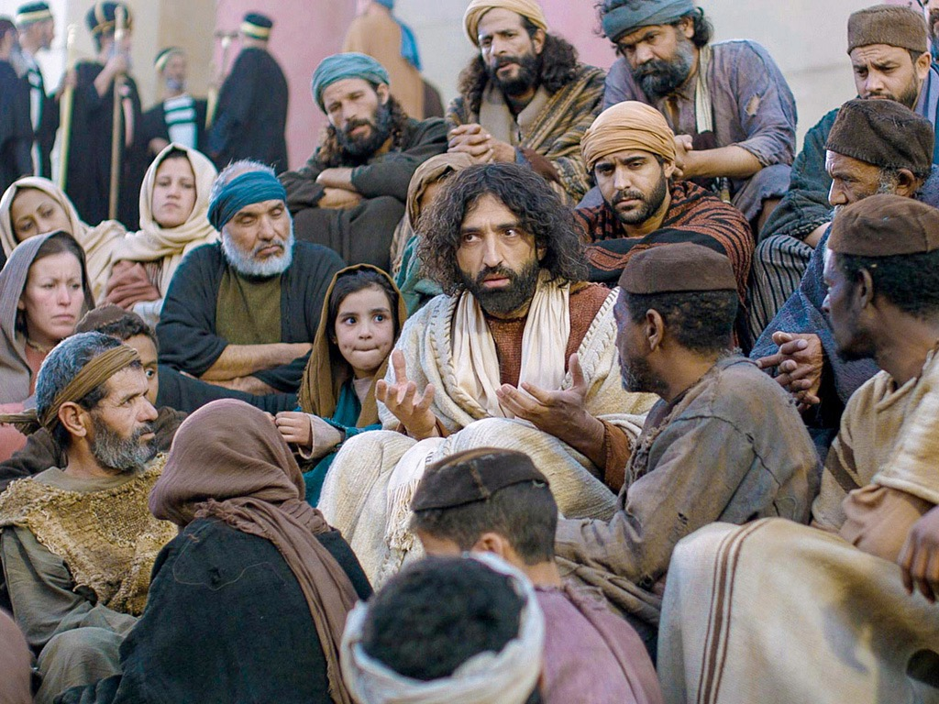
Luke Title Slide
Luke 13–24
Dr. Rick Griffith • Jordan Evangelical Theological Seminary • BibleStudyDownloads.org

Slide 2
Slides on
Luke 13

Slide 3
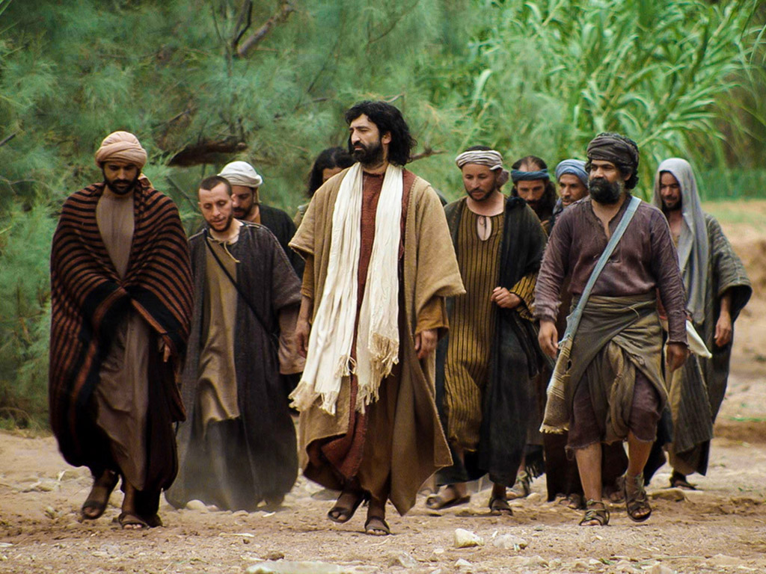
B. Instruction on Entrance Into the Kingdom
§ 121
Luke 13:22-35
After Israel rejects Christ, He encourages the fearful to still enjoy the kingdom and prepares the apostles for future ministry
Notes:
Luke 13:22 Jesus went through the towns and villages, teaching as he went, always pressing on toward Jerusalem. 23 Someone asked him, “Lord, will only a few be saved?”
He replied,
24 “Work hard to enter the narrow door to God’s Kingdom, for many will try to enter but will fail. 25 When the master of the house has locked the door, it will be too late. You will stand outside knocking and pleading, ‘Lord, open the door for us!’ But he will reply, ‘I don’t know you or where you come from.’ 26 Then you will say, ‘But we ate and drank with you, and you taught in our streets.’ 27 And he will reply, ‘I tell you, I don’t know you or where you come from. Get away from me, all you who do evil.’
Luke 13:28 “There will be weeping and gnashing of teeth, for you will see Abraham, Isaac, Jacob, and all the prophets in the Kingdom of God, but you will be thrown out. 29 And people will come from all over the world—from east and west, north and south—to take their places in the Kingdom of God. 30 And note this: Some who seem least important now will be the greatest then, and some who are the greatest now will be least important then.”
Luke 13:31 At that time some Pharisees said to him, “Get away from here if you want to live! Herod Antipas wants to kill you!”
Luke 13:32 Jesus replied, “Go tell that fox that I will keep on casting out demons and healing people today and tomorrow; and the third day I will accomplish my purpose. 33 Yes, today, tomorrow, and the next day I must proceed on my way. For it wouldn’t do for a prophet of God to be killed except in Jerusalem!
Luke 13:34 “O Jerusalem, Jerusalem, the city that kills the prophets and stones God’s messengers! How often I have wanted to gather your children together as a hen protects her chicks beneath her wings, but you wouldn’t let me. 35 And now, look, your house is abandoned. And you will never see me again until you say, ‘Blessings on the one who comes in the name of the LORD!’”
Jesus quotes Psalm 118:26 after rejection by Israel to indicate that he would come back to a believing nation. In answer to the question how many will be saved (v. 22), Jesus said that few Jews would be saved but many Gentiles would accept him.

Slide 4
Slides on
Luke 14

Slide 5
C. Instruction in a Pharisee's House
§ 122
Luke 14:1-24
Pharisees will miss the kingdom by trusting their descent from Abraham while "unworthy Jews" and Gentiles enter by faith
Notes:
Jesus Heals on the Sabbath
Luke 14:1 NLT One Sabbath day Jesus went to eat dinner in the home of a leader of the Pharisees, and the people were watching him closely. ² There was a man there whose arms and legs were swollen. ³ Jesus asked the Pharisees and experts in religious law, “Is it permitted in the law to heal people on the Sabbath day, or not?” ⁴ When they refused to answer, Jesus touched the sick man and healed him and sent him away. ⁵ Then he turned to them and said, “Which of you doesn’t work on the Sabbath? If your son or your cow falls into a pit, don’t you rush to get him out?” ⁶ Again they could not answer.
Jesus Teaches about Humility
Luke 14:7 When Jesus noticed that all who had come to the dinner were trying to sit in the seats of honor near the head of the table, he gave them this advice: ⁸ “When you are invited to a wedding feast, don’t sit in the seat of honor. What if someone who is more distinguished than you has also been invited? ⁹ The host will come and say, ‘Give this person your seat.’ Then you will be embarrassed, and you will have to take whatever seat is left at the foot of the table!
Luke 14:10 “Instead, take the lowest place at the foot of the table. Then when your host sees you, he will come and say, ‘Friend, we have a better place for you!’ Then you will be honored in front of all the other guests. ¹¹ For those who exalt themselves will be humbled, and those who humble themselves will be exalted.”
Luke 14:12 Then he turned to his host. “When you put on a luncheon or a banquet,” he said, “don’t invite your friends, brothers, relatives, and rich neighbors. For they will invite you back, and that will be your only reward. ¹³ Instead, invite the poor, the crippled, the lame, and the blind. ¹⁴ Then at the resurrection of the righteous, God will reward you for inviting those who could not repay you.”
Parable of the Great Feast
Luke 14:15 Hearing this, a man sitting at the table with Jesus exclaimed, “What a blessing it will be to attend a banquet in the Kingdom of God!”
Luke 14:16 Jesus replied with this story: “A man prepared a great feast and sent out many invitations. ¹⁷ When the banquet was ready, he sent his servant to tell the guests, ‘Come, the banquet is ready.’ ¹⁸ But they all began making excuses. One said, ‘I have just bought a field and must inspect it. Please excuse me.’ ¹⁹ Another said, ‘I have just bought five pairs of oxen, and I want to try them out. Please excuse me.’ ²⁰ Another said, ‘I just got married, so I can’t come.’
Luke 14:21 “The servant returned and told his master what they had said. His master was furious and said, ‘Go quickly into the streets and alleys of the town and invite the poor, the crippled, the blind, and the lame.’ ²² After the servant had done this, he reported, ‘There is still room for more.’ ²³ So his master said, ‘Go out into the country lanes and behind the hedges and urge anyone you find to come, so that the house will be full. ²⁴ For none of those I first invited will get even the smallest taste of my banquet.’”
__________
"Throughout this section the theme of entering into the kingdom is often symbolized as taking part in a feast or banquet (13:29; 14:7-24; 15:23; 17:7-10)." —BKC
__________
"Three excuses are given.¹⁸ The first two are similar. What idiot would buy a piece of property without first checking it out?! The fact is, both of these men have already checked out their purchases. They are using them as excuses not to come. To make matters worse, this is an evening banquet, which started at sundown. They could not have checked out their purchases in the dark. This makes their excuses even more feeble and offensive. The third fellow seems to have a valid excuse. He just got married and wants to spend time with his wife.¹⁹ Normally, these feasts were not integrated, and so these newlyweds could not be together. Deuteronomy 24:5 offers some support for his excuse. There it says that a newly married man is exempt from military service for a year so that he can stay at home and please his wife (see also 1 Cor 7:33). His excuse is the most valid; yet it is also the most curt."
¹⁸ The word “make excuses” can also mean, “To shun, reject, or refuse.”
¹⁹ The phrase “I must go check it out,” which applied to the oxen and the land, is omitted with the wife. B. Longenecker in a fabulous article on the humor of Jesus, suggests this omission would have been accompanied by a pregnant silence followed by appropriate chuckles; “A Humorous Jesus? Orality, Structure and Characterization in Luke 14:15–24, and Beyond,” BI 16 (2008): 179–204.
—Mark E. Moore, The Chronological Life of Christ (Joplin, MO: College Press Publishing Company, 2011), 421.

Slide 6
D. Instruction on Discipleship
§ 123
Luke 14:25-35
Christ seeks disciples with Him as their highest priority, given Israel's rejection—not professing discipleship and later defecting
Notes:
The Cost of Being a Disciple
Luke 14:25 NLT A large crowd was following Jesus. He turned around and said to them, ²⁶ “If you want to be my disciple, you must, by comparison, hate everyone else—your father and mother, wife and children, brothers and sisters—yes, even your own life. Otherwise, you cannot be my disciple. ²⁷ And if you do not carry your own cross and follow me, you cannot be my disciple.
Luke 14:28 “But don’t begin until you count the cost. For who would begin construction of a building without first calculating the cost to see if there is enough money to finish it? ²⁹ Otherwise, you might complete only the foundation before running out of money, and then everyone would laugh at you. ³⁰ They would say, ‘There’s the person who started that building and couldn’t afford to finish it!’
Luke 14:31 “Or what king would go to war against another king without first sitting down with his counselors to discuss whether his army of 10,000 could defeat the 20,000 soldiers marching against him? ³² And if he can’t, he will send a delegation to discuss terms of peace while the enemy is still far away. ³³ So you cannot become my disciple without giving up everything you own.
Luke 14:34 “Salt is good for seasoning. But if it loses its flavor, how do you make it salty again? ³⁵ Flavorless salt is good neither for the soil nor for the manure pile. It is thrown away. Anyone with ears to hear should listen and understand!”
Thought question: Is Jesus speaking of counting the cost to trust him for salvation or discipleship of those who already believed?
—————————
Moore sees this as a call to salvation:
"In the world, we ask, “Does he have what it takes to win?” In the church, God asks, “Has he given up everything to be saved?” The world calls us to gain; Christ call us to die…
[vv. 34–35 = Mt 5:13, see comments on § 54c; also Mk 9:50, § 91]
This is a famous saying of Jesus.²² Only here, verse 35 adds an extra detail about being thrown on the manure pile. Sodium chloride (i.e., salt) is an extremely stable chemical. It cannot actually “lose its saltiness.” Therefore, we must be talking about some kind of counterfeit salt. It looks like salt but has none of its properties. It was so worthless that it did not even have chemical nutrients which could be useful on a compost pile.²³ It is totally useless filler."
²² W. Nauck interprets the major “salt” sayings of the NT (Mk 9:49–50; Lk 14:34–35; Mt 5:13; Col 4:6) against the backdrop of a proverb on salt from the Rabbinic treatise Derek ‘Erec Zuta. He proposes that each text is best understood by interpreting the metaphor of salt as wisdom and industriousness in the context of discipleship. This fits well our present context of judiciously counting the cost of following Jesus and wisely listening to (i.e., obeying) Jesus’ words (W. Nauck, “Salt as a Metaphor,” ST [1952]: 165–178).
²³ E.P. Deatrick, “Salt, Soil, Savior,” BA 25 (1962): 41–48, gives helpful scientific details."
—Mark E. Moore, The Chronological Life of Christ (Joplin, MO: College Press Publishing Company, 2011), 424.

Slide 7
Slides on
Luke 15

Slide 8
E. Instruction on God's Attitude Toward Sinners
§ 124
Luke 15
Instead of hating sinners like the Pharisees, Jesus tells three parables of God's love to seek them out and rejoice in their repentance
Notes:
LOST SHEEP—LOST COIN—LOST SON (Luke 15)
1—Something of value is lost
2—One who sees this value searches tirelessly to recover it
3—Once found, the owner rejoices and asks others also to rejoice
The focus is on God, whose attitude is to rejoice over the lost.

Slide 9
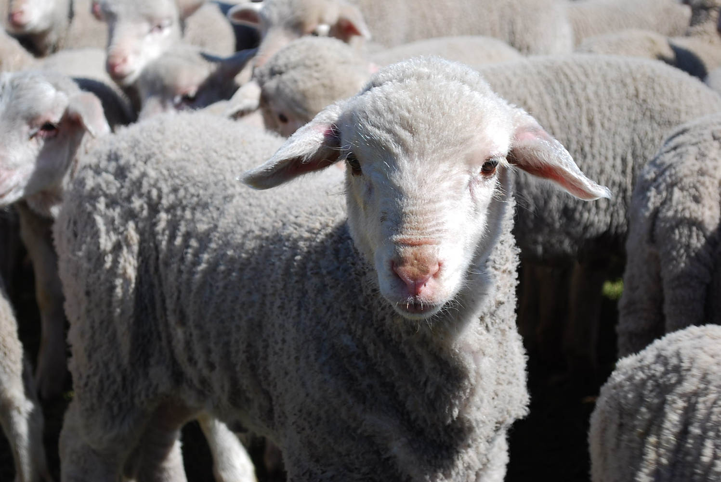
We are sheep.
Notes:
The animal that the Bible compares us to most is the sheep. Why do you think that is so?

Slide 10
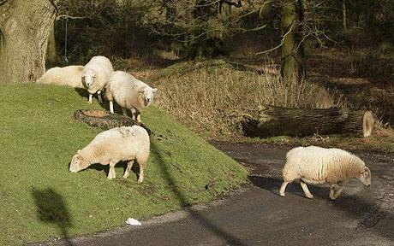
Sheep tend to stray.
Notes:
It’s because sheep easily lose their way—like us!

Slide 11
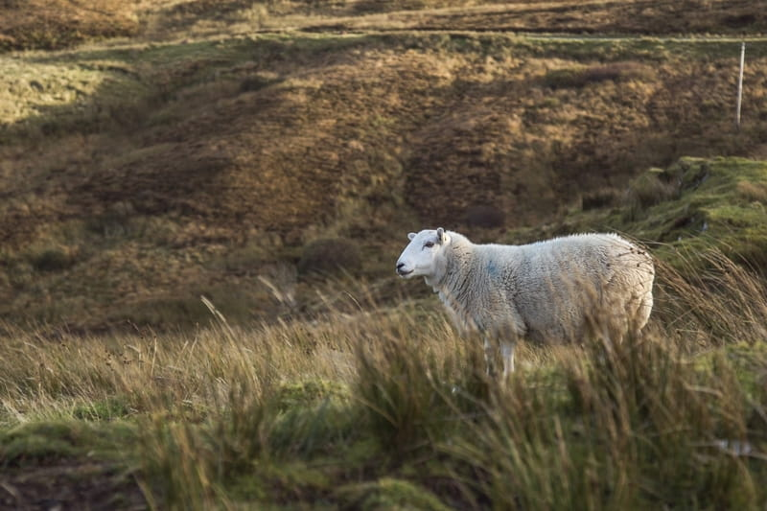
Lost sheep get lonely.
Notes:
Sheep are relational animals, so being away from the flock is lonely.

Slide 12
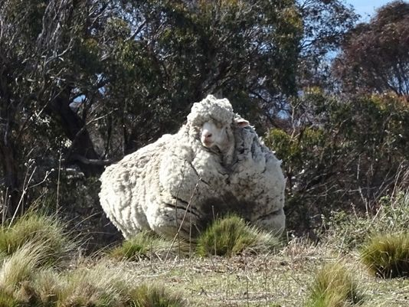
Sheep tend to return.
Notes:
Here is one sheep named Chris who was lost in Australia. He was found in 2015 by bushwalkers after about 6 years of wandering—as you can see from the heavy coat of 90 pounds (45 kilos)!

Slide 13
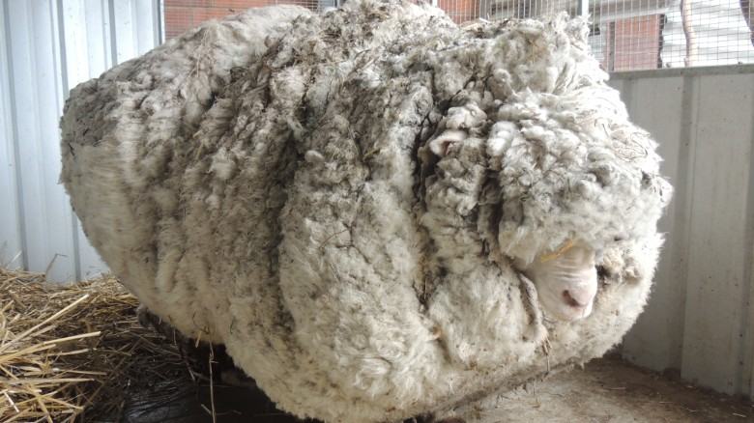
But straying has a price.
Notes:
The baggage from being away is quite a burden—for sheep as well as for people!
————————
Chris, the famously woolly sheep, has died
By Elizabeth Wolfe and Saeed Ahmed, CNN
Updated 1623 GMT (0023 HKT) October 22, 2019
Chris the sheep died in his home at the Little Oak Sanctuary.
(CNN)Chris the sheep lived a, shall we say, full and fluffy life, beloved by fans worldwide for his singular woolliness.
He died at his home at the Little Oak Sanctuary, where he had been living since his rise to fame in 2015.
While Chris should be appreciated for his many lovable qualities -- consider his kind eyes and gently sloping nose -- he became internationally celebrated after becoming the unofficial world record holder for having grown the heaviest fleece.
He was found outside of Australia's capital, Canberra, so overgrown with fleece that he could barely walk. Almost 90 lbs!
When he was found, Chris was carrying years worth of wool on his body, making it difficult for him to walk.
Little Oak Sanctuary, announced the legendary sheep's death on Tuesday in a Facebook post.
"We are heartbroken at the loss of this sweet, wise, friendly soul," said the post.
Little Oak Sanctuary made a point of looking at Chris as more than a spectacle and respecting him as a companion.
"He was so much more than this, so very much more," it said in the post. "And we will remember him for all that he was - someone, not something - here with us, not for us. RIP dear Chris."
Those wishing to mourn Chris's passing may visit his famous fleece on display at the National Museum of Australia.

Slide 14
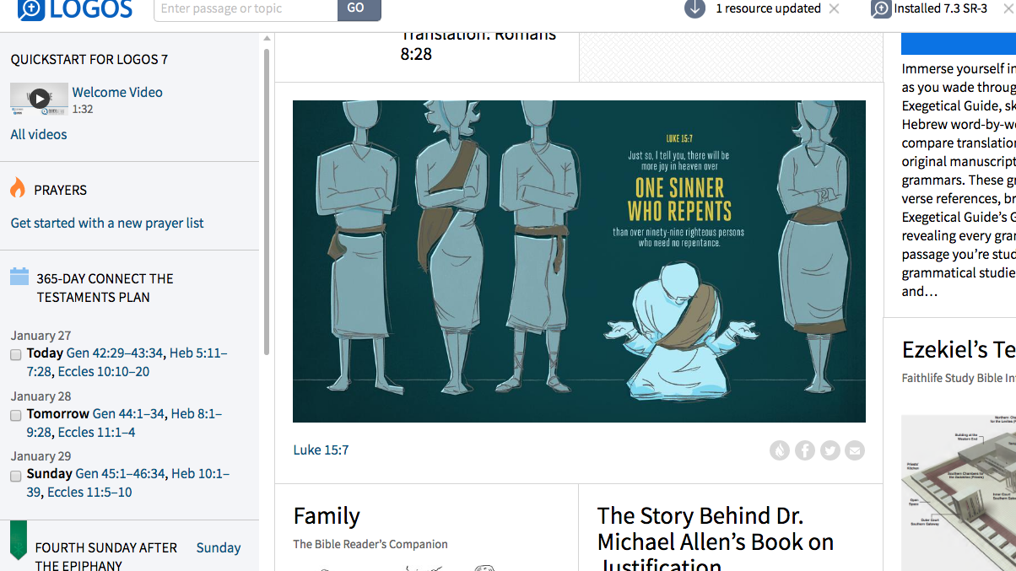
Luke 15:7
Just so, I tell you, there will be more joy in heaven over
ONE SINNER WHO REPENTS
than over 99 righteous persons who need no repentance.
Adapted from Logos Bible Software
Notes:
God values what people despise.

Slide 15
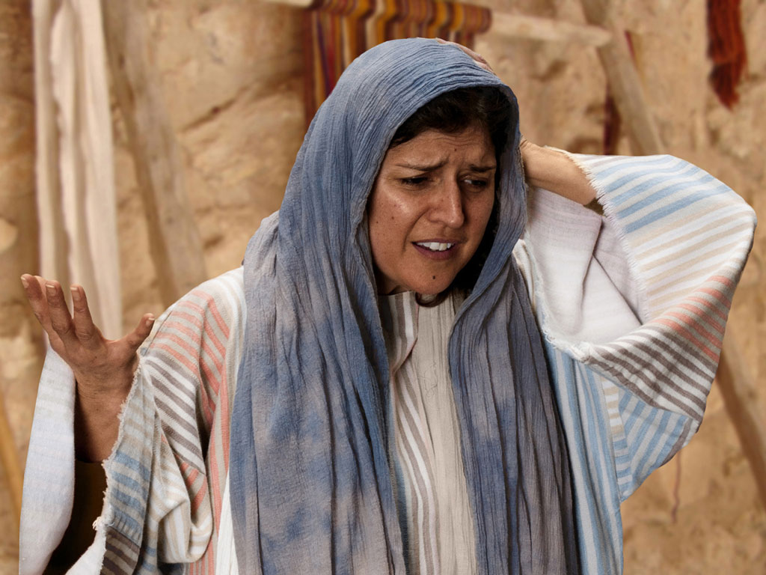

Free
Bible
images
THE PARABLE OF THE LOST COIN
Luke 15:8-10
Notes:
Luke's gospel is known for its many parables by Jesus.

Slide 16
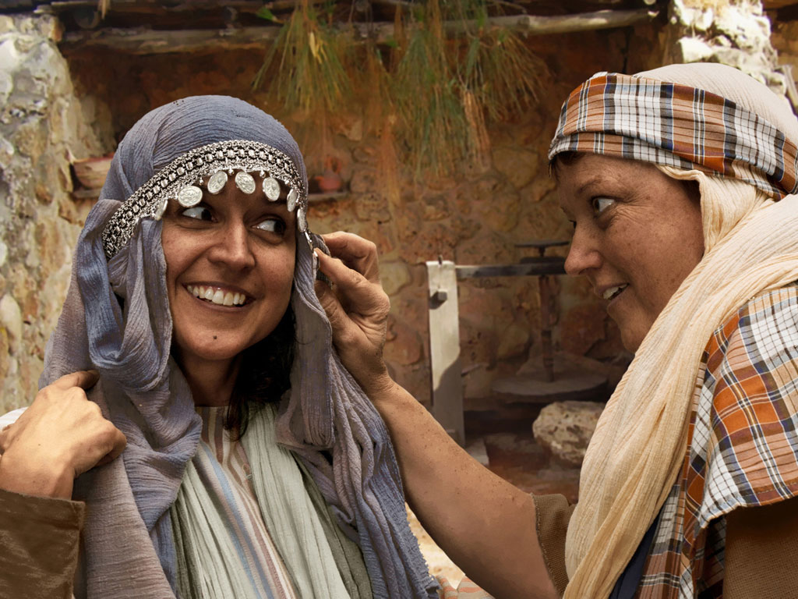
Notes:
Luke 15:8 Woman with 10 silver coins.
Most think that the silver coin (drachma) the woman lost was from the adornment of coins that women wore around her head and would have been her dowry. If so, it was a poor woman's dowry as a drachma was a day's salary for a peasant working for someone else. In the culture of the time, the loss of a coin from a dowry could represent unfaithfulness and this would bring real shame and disgrace to her family and husband.

Slide 17
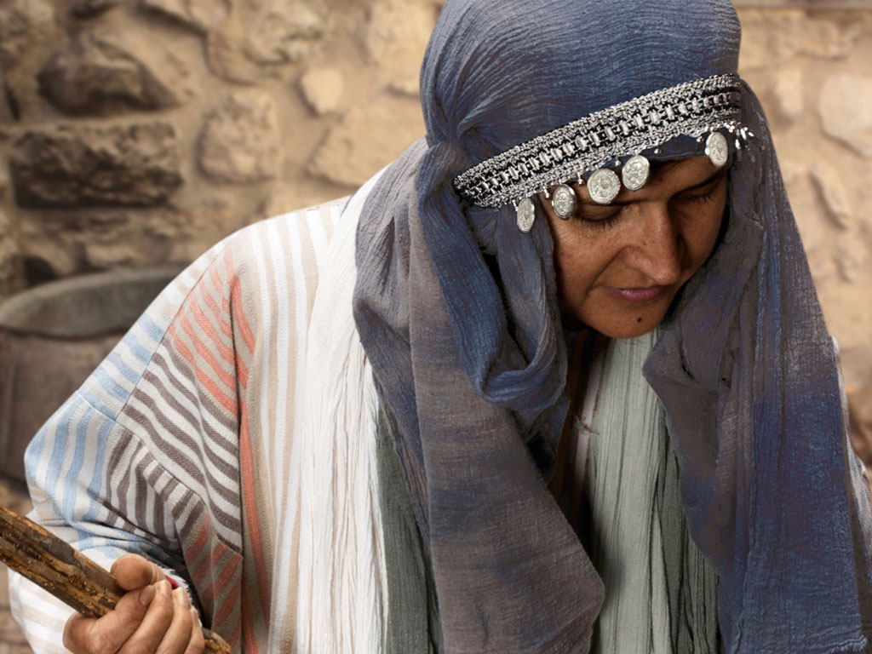
Notes:
Luke 15 v 8: Woman shown with coin missing.

Slide 18
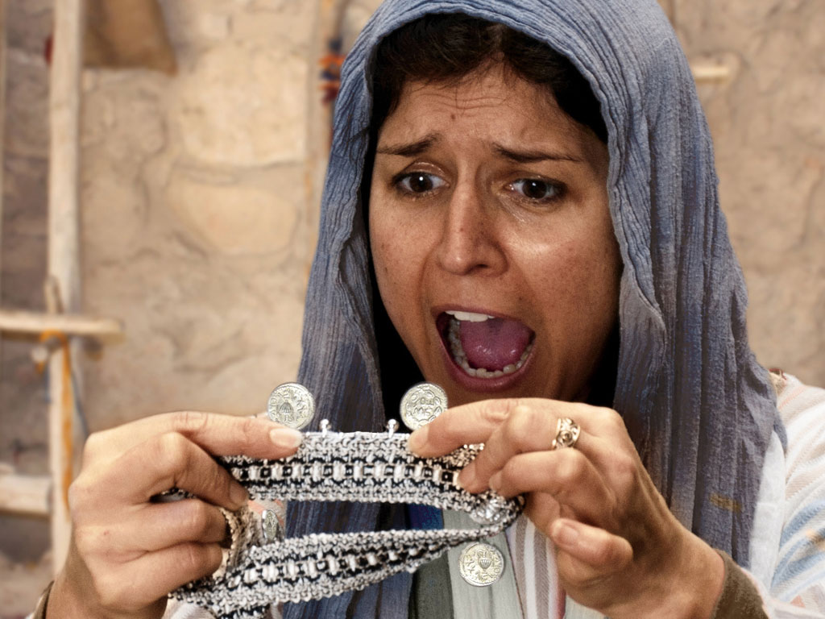
Notes:
Luke 15 v 8: Woman discovers a silver coin is missing.

Slide 19
Notes:
Luke 15 v 8: Woman wonders where she may have lost it.

Slide 20
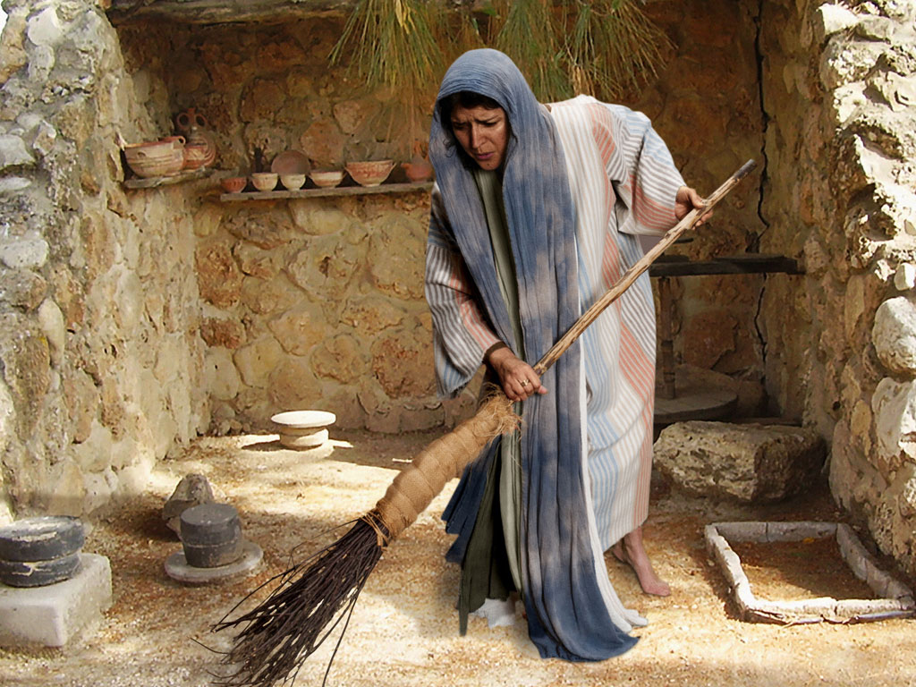
Notes:
Luke 15 v 8: Woman searches using broom.

Slide 21
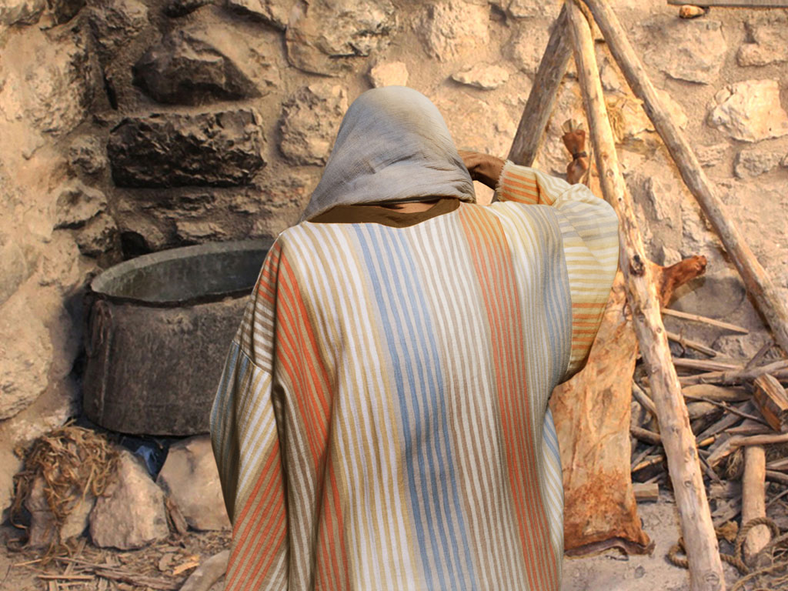
Notes:
Luke 15 v 8: Woman searches in courtyard.

Slide 22
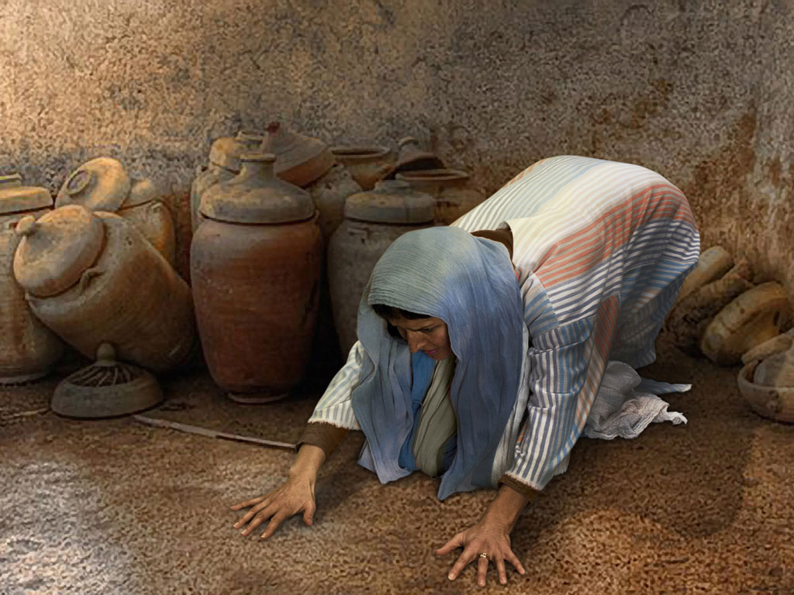
Notes:
Luke 15 v 8: Woman searches floor.

Slide 23
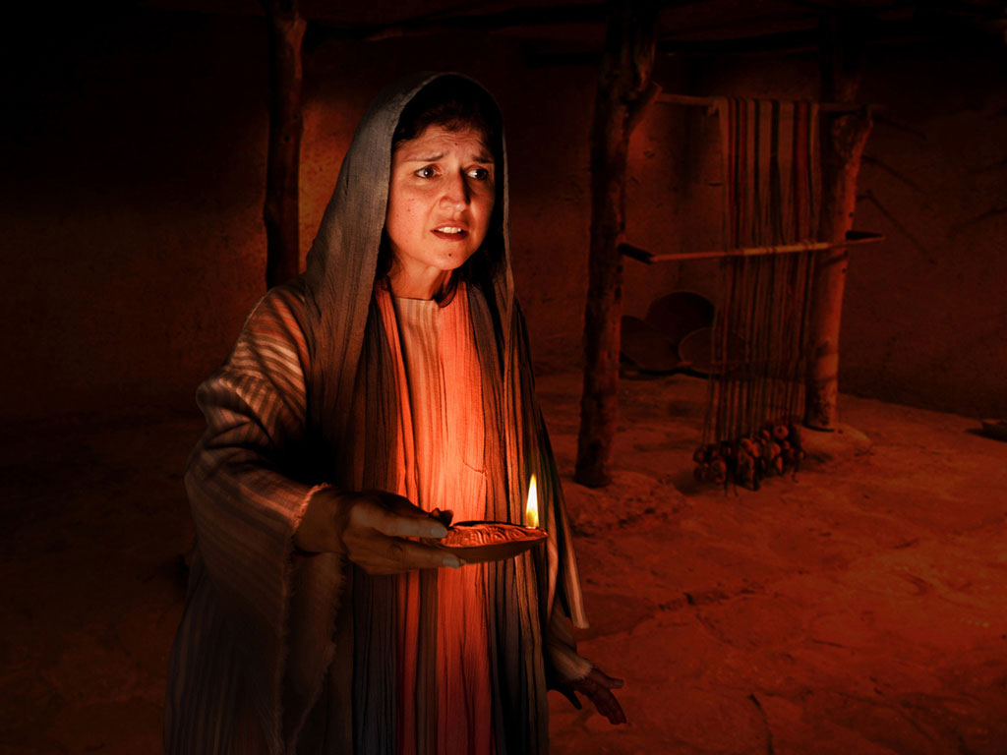
Notes:
Luke 15 v 8: Woman lights lamp and searches house. Many poor homes had very small windows and rooms were dark.

Slide 24
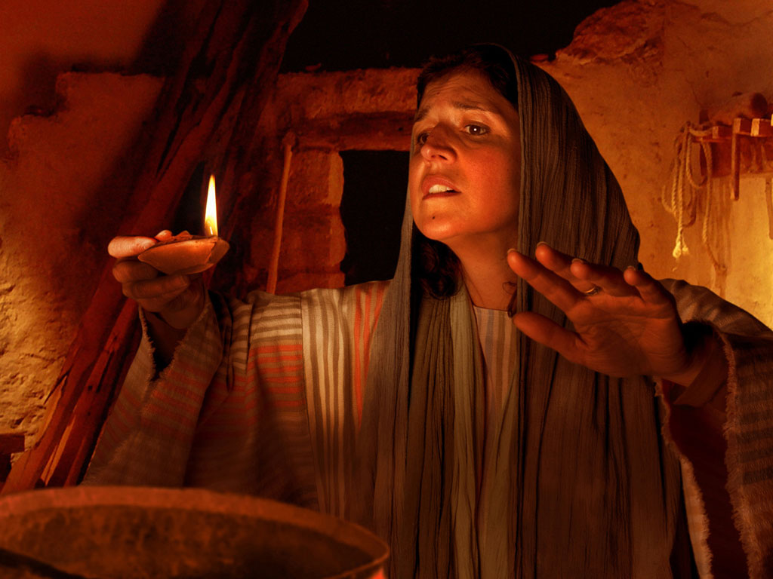
Notes:
Luke 15 v 8: Woman searches house by lamp light.

Slide 25
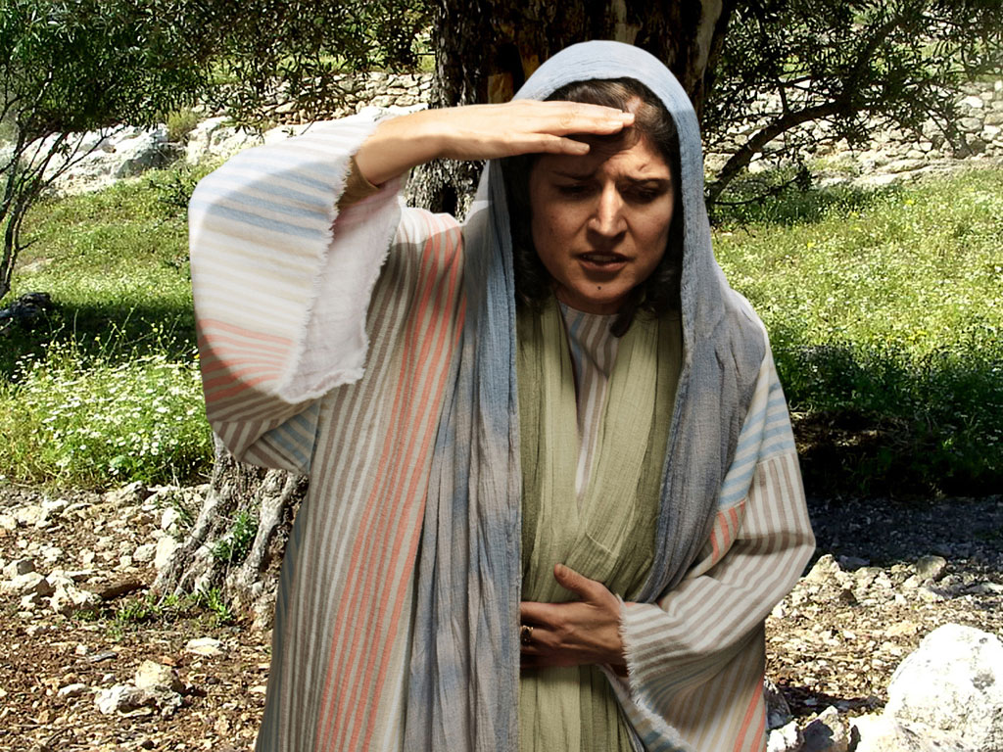
Notes:
Luke 15 v 8: Woman continues search.

Slide 26
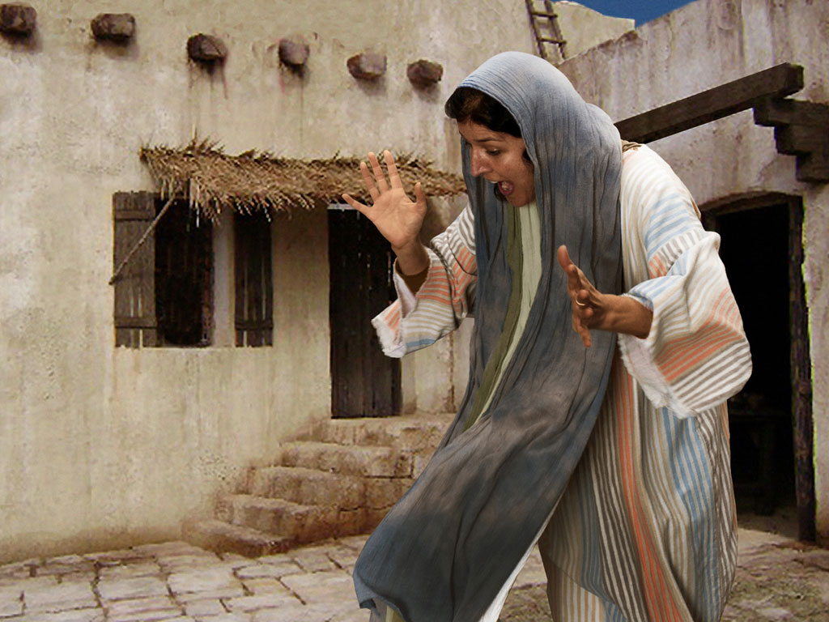
Notes:
Luke 15 v 9: Woman search is rewarded as she sees silver coin.

Slide 27
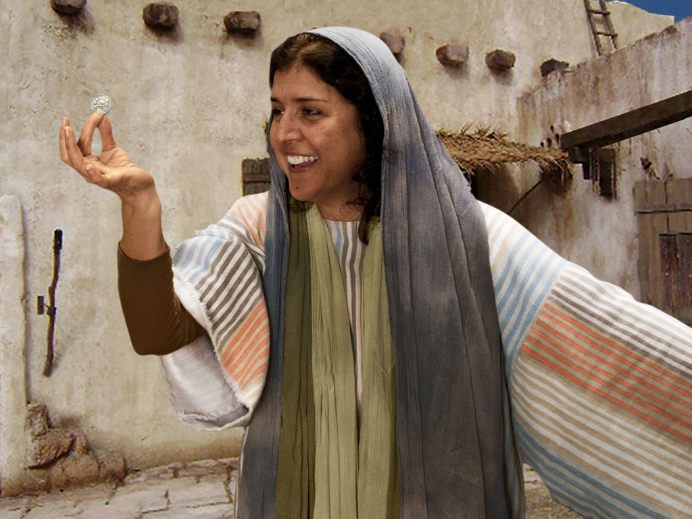
Notes:
Luke 15 v 9: Woman is full of joy as she finds coin.

Slide 28
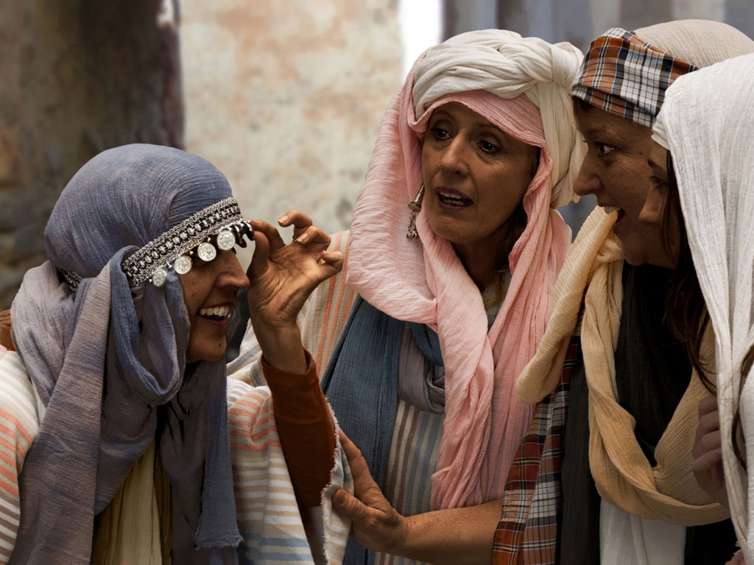
Notes:
Luke 15 v 9: Woman shares her good news with neighbours and friends.
The coin was clearly a precious resource to her and a large embarrassment if she lost it. She lights a lamp to look for it. Either her house had few windows, or she is not willing to wait for the morning light—she must find it now! Besides, when you are living on dirt floors, the longer something is lost, the more likely it is to stay that way. We also notice that the Greek word for “friends” is feminine. We can’t be sure that she ever told her husband, but she does tell her sewing circle. Jesus has thus put the “lost and found” in terms that both men and women can understand.
— Mark E. Moore, The Chronological Life of Christ (Joplin, MO: College Press Publishing Company, 2011), 427.

Slide 29
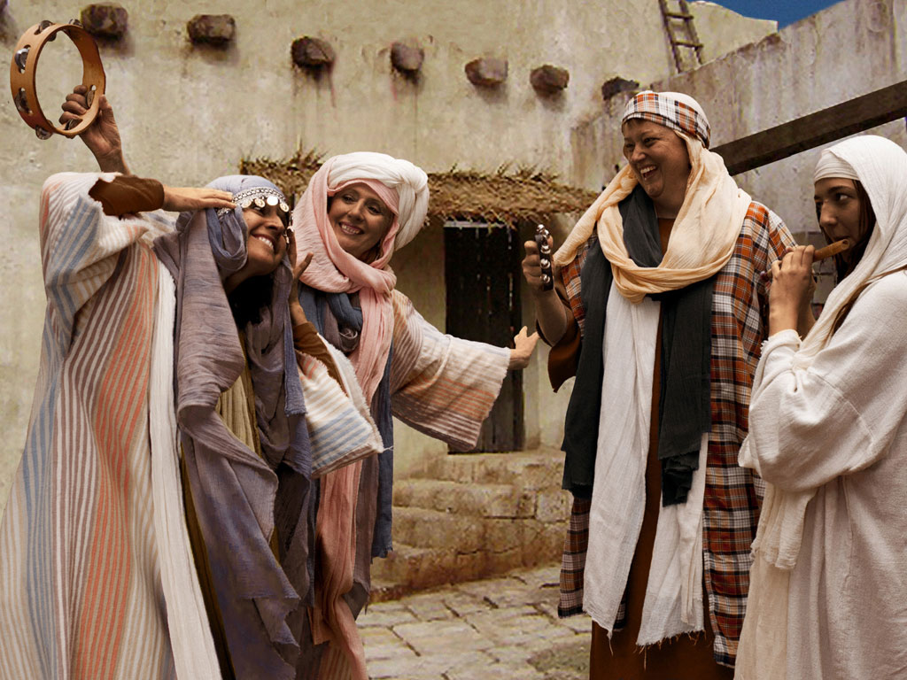
Notes:
Luke 15 v 9: Woman celebrates her good news with neighbours and friends. 'Rejoice with me; I have found my lost coin.'

Slide 30
THE WORD IN PICTURES
Free
Bible
images

Slide 31

FreeBibleimages would like to thank Peter Hutley and Wintershall Players for the use of their cast, costumes and facilities in creating these images.

Slide 32
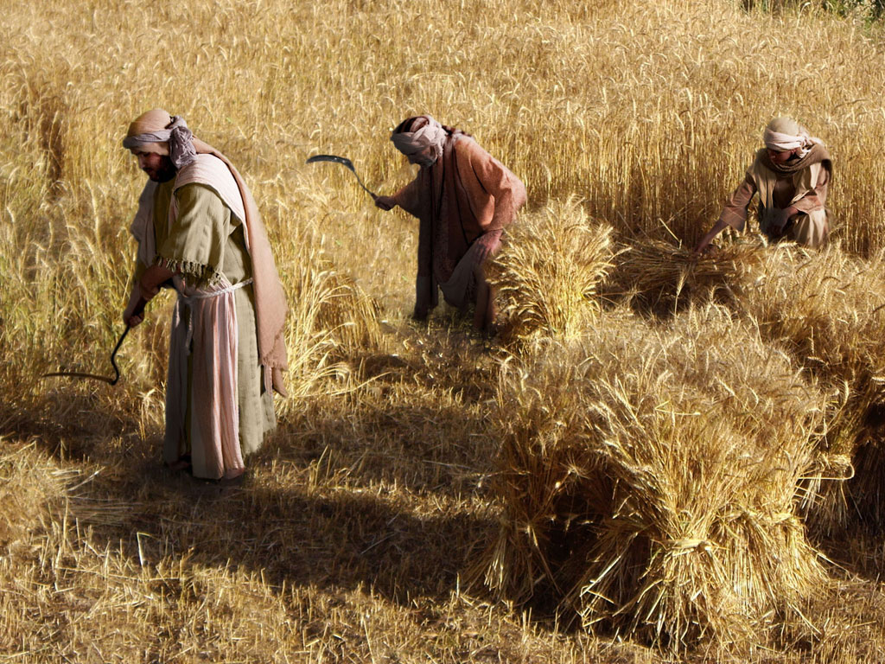
THE PARABLE OF THE TWO SONS (Prodigal Son)
Free
Bible
images
Luke 15:11-32
Notes:
"Charles Dickens said, of this parable, 'It is the finest short story ever written.' This is the most famous parable of the trilogy and the climax of the series. It is also the longest parable Jesus ever told. It has two parts. The first is about the son who wanders and the second is about the son who doesn’t. The first son gets lost abroad, the second gets lost at home. The second son is equally important because it brings us back to vv. 1–2 where the Pharisees (the sons who did not wander) complain about Jesus socializing with the lost sons."
— Mark E. Moore, The Chronological Life of Christ (Joplin, MO: College Press Publishing Company, 2011), 427.

Slide 33
Notes:
Sons were valued highly in ancient Jewish culture.

Slide 34
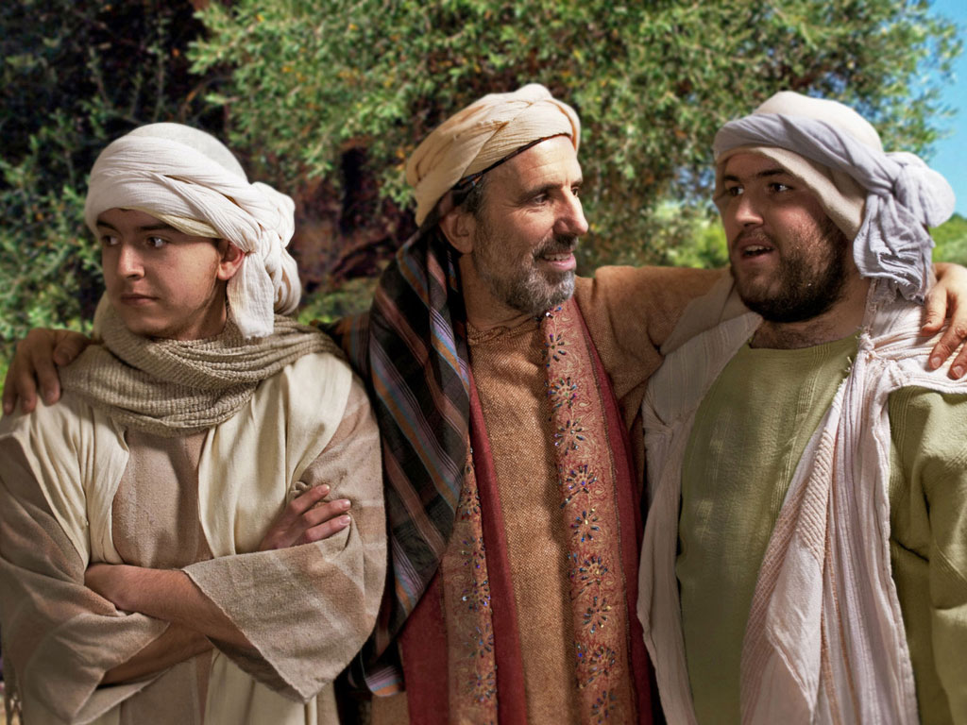
Notes:
Jesus told the parable of a man with two sons—the older son who brought him pride on the right, and the younger son who was hard to please on the left.

Slide 35
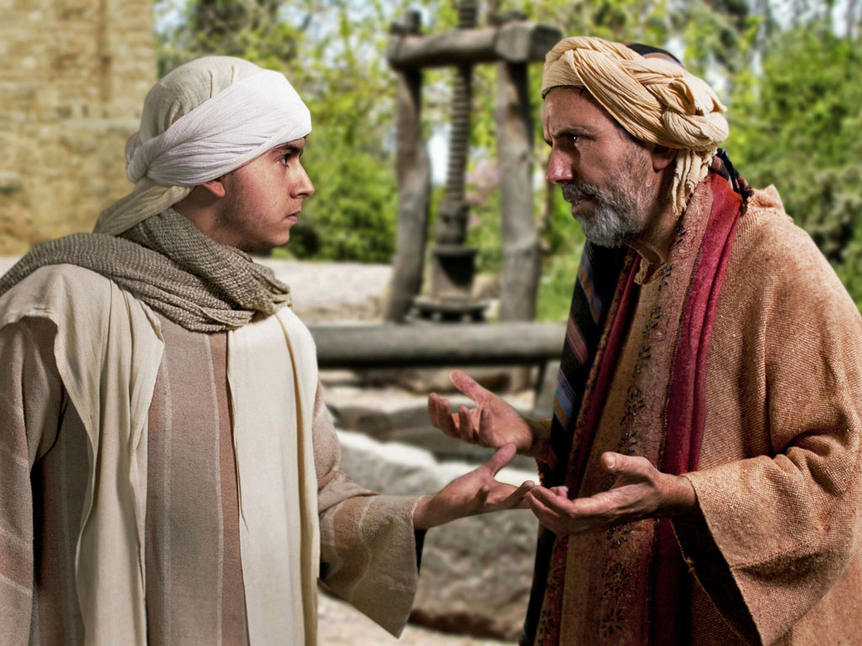
Notes:
This younger son was so ungrateful that he demanded his inheritance while his father still lived.

Slide 36
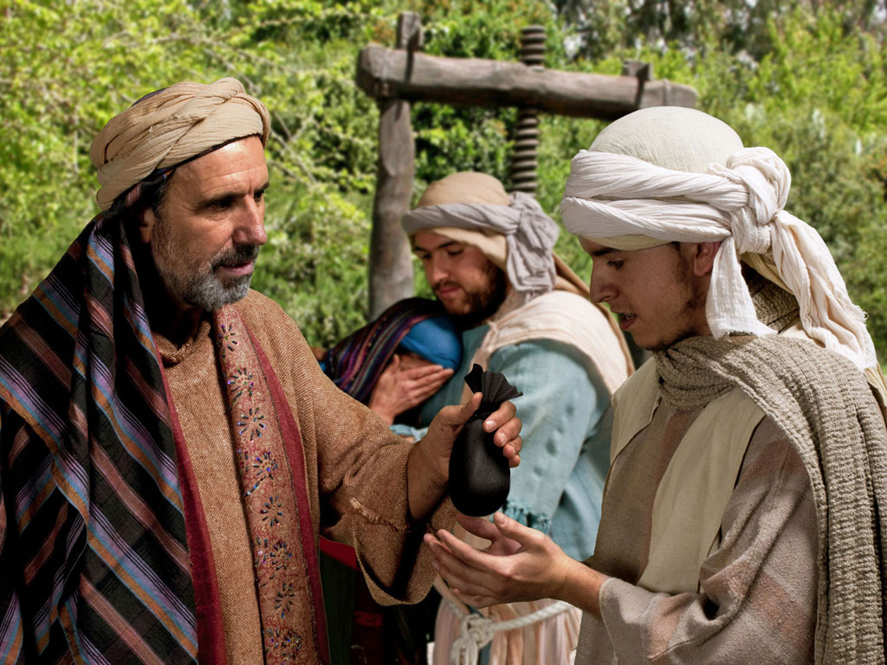
Notes:
At great cost to the father, he agreed to give his younger son one third of his wealth as the older son got the double portion of two thirds.

Slide 37
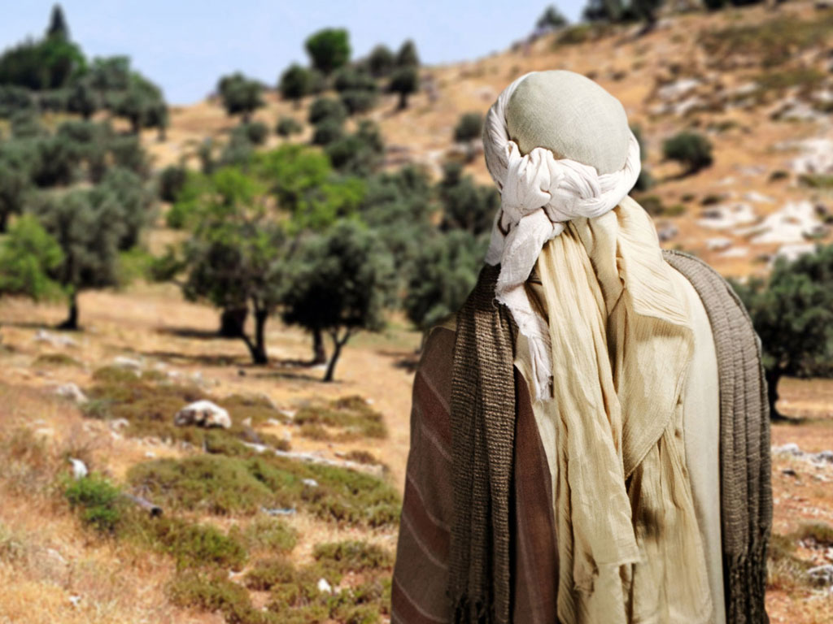
Notes:
Off the son went to pursue his dreams.

Slide 38
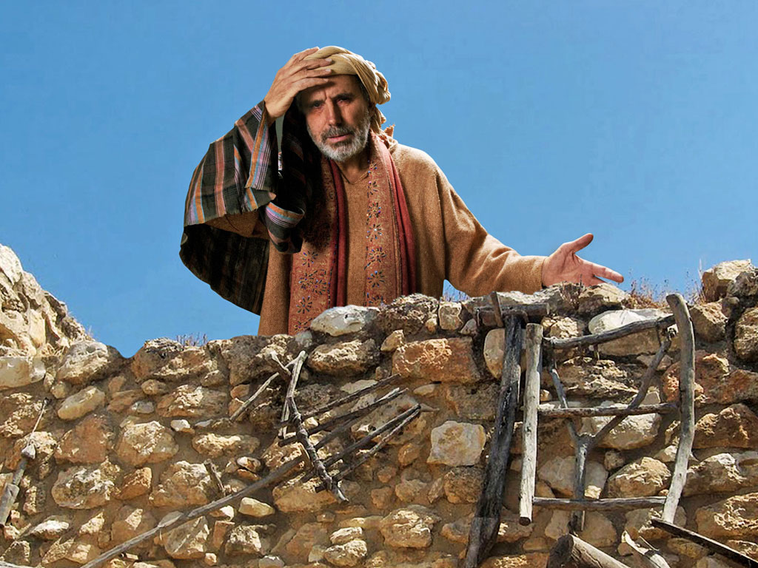
Notes:
The father mourned the loss, but he didn't prevent his son from experiencing the results of his greed. He instead longed for him to return.

Slide 39
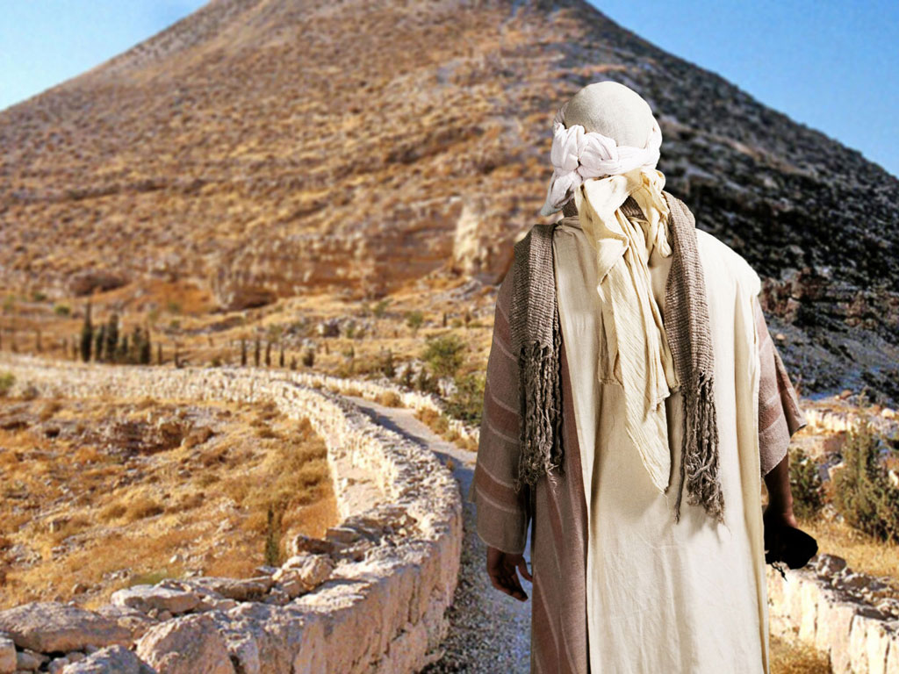
Notes:
Village life is deemed boring to those pursuing pleasure, so the younger son traveled out of the region.

Slide 40
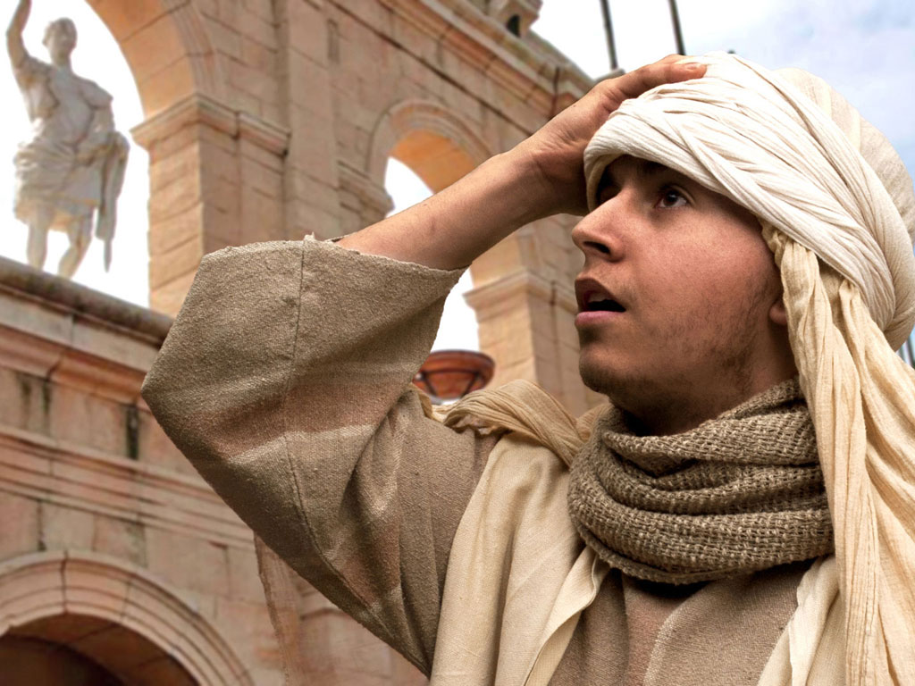
Notes:
His bad heart lured him to the city.

Slide 41
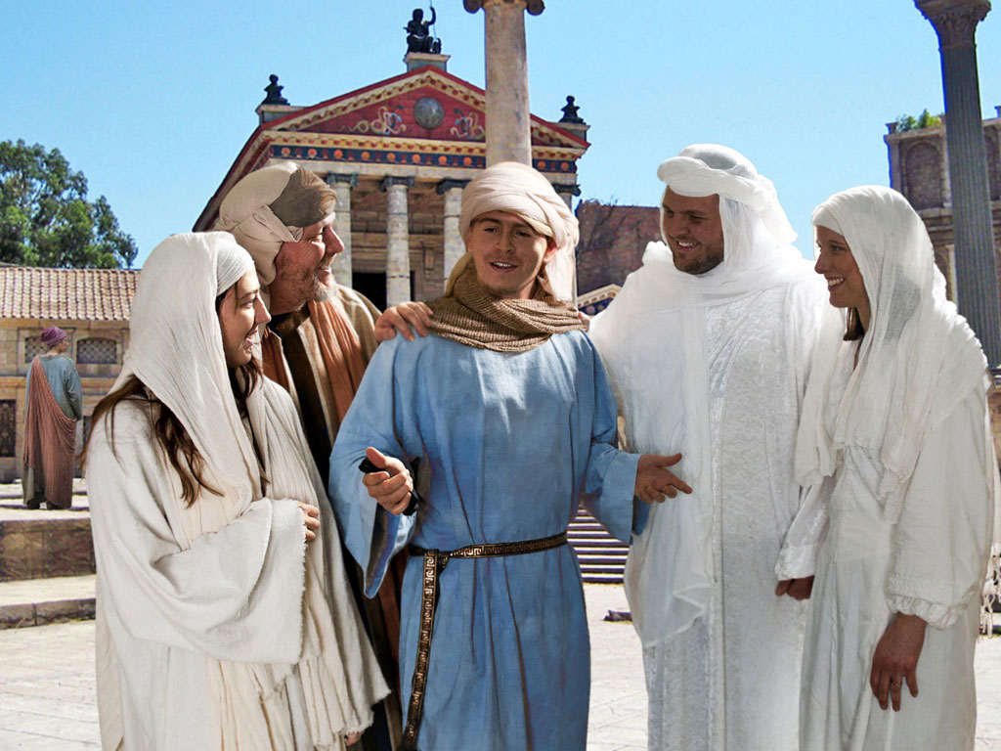
Notes:
Wealthy people typically find lots of "friends," defined as people willing to help spend the money of fools.

Slide 42
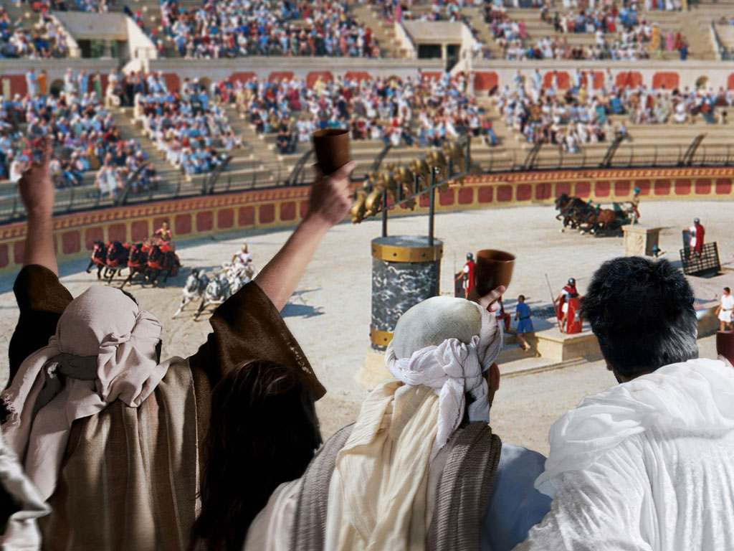
Notes:
There was no end to places to waste money then—and now.

Slide 43
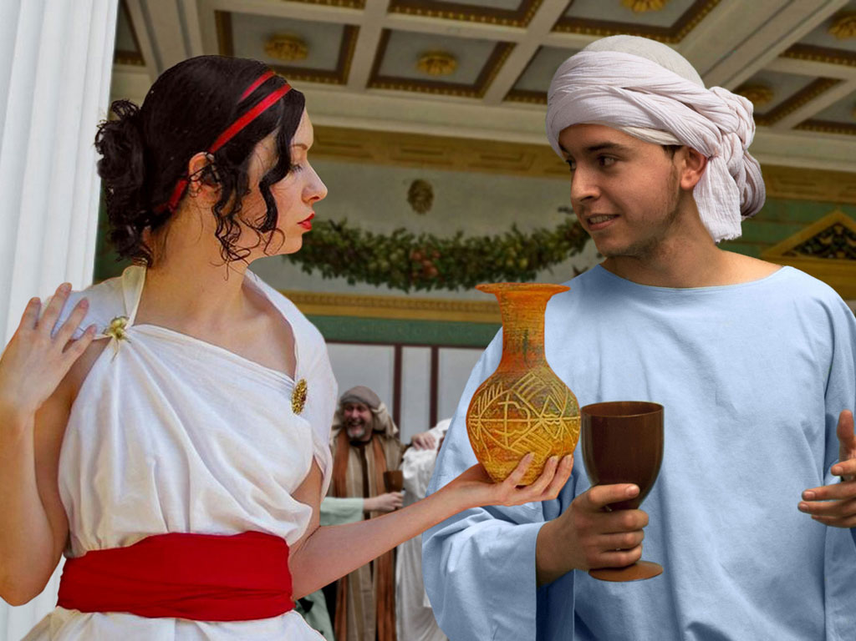
Notes:
Fools also attract gold diggers who prefer the finer things of life like an etched vase instead of a simple cup.

Slide 44
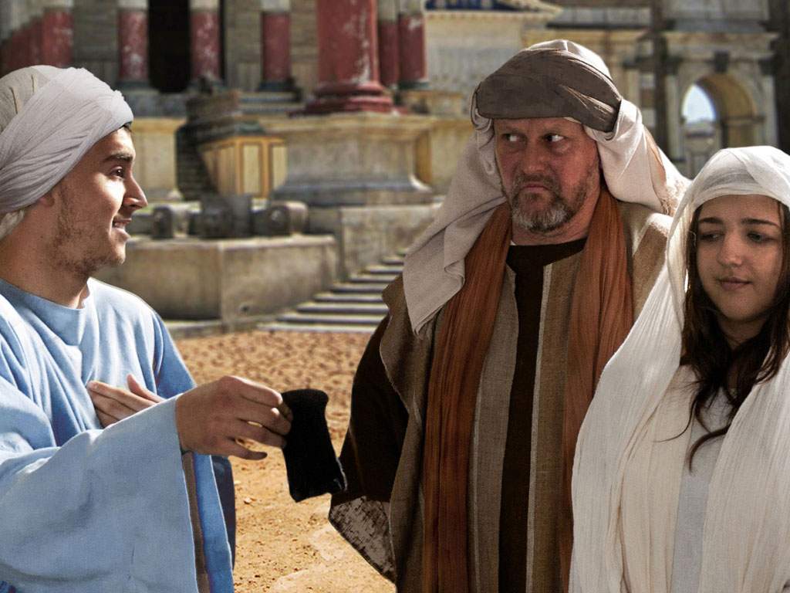
Notes:
Soon, the money ran out, and so did the friends.

Slide 45
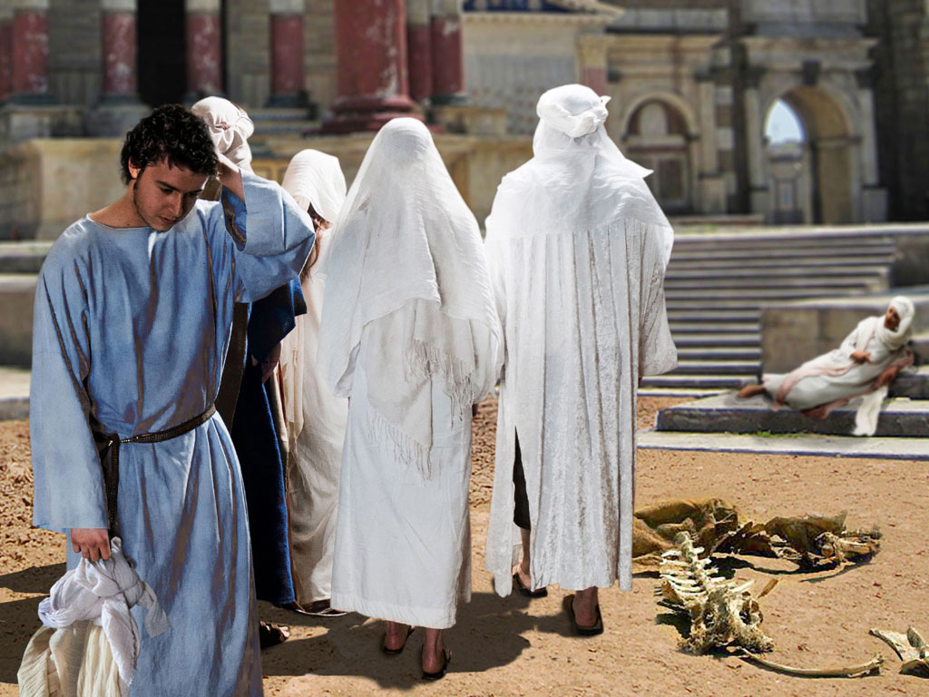
Notes:
The young son found himself without companions.

Slide 46
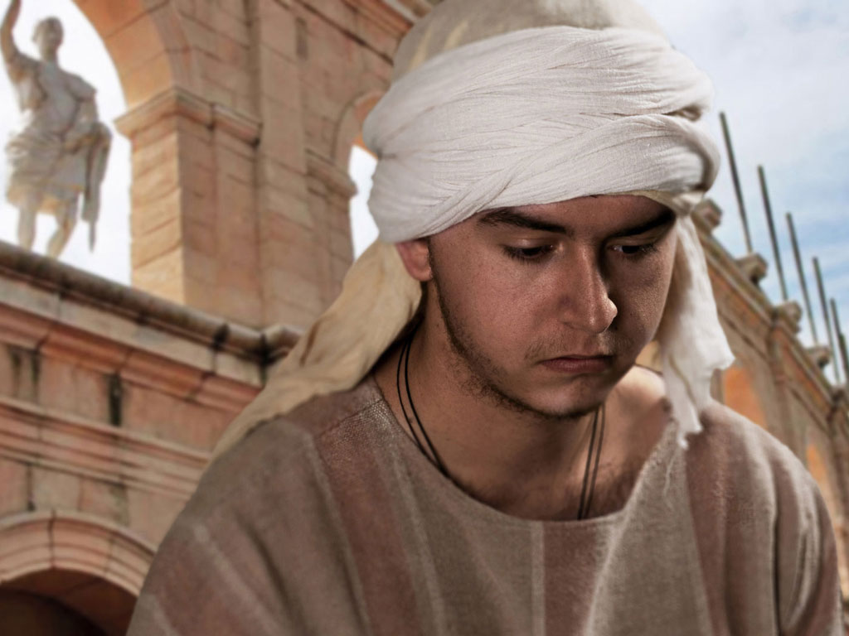
Notes:
City life without money is incredibly hard, so he had to leave the city.

Slide 47
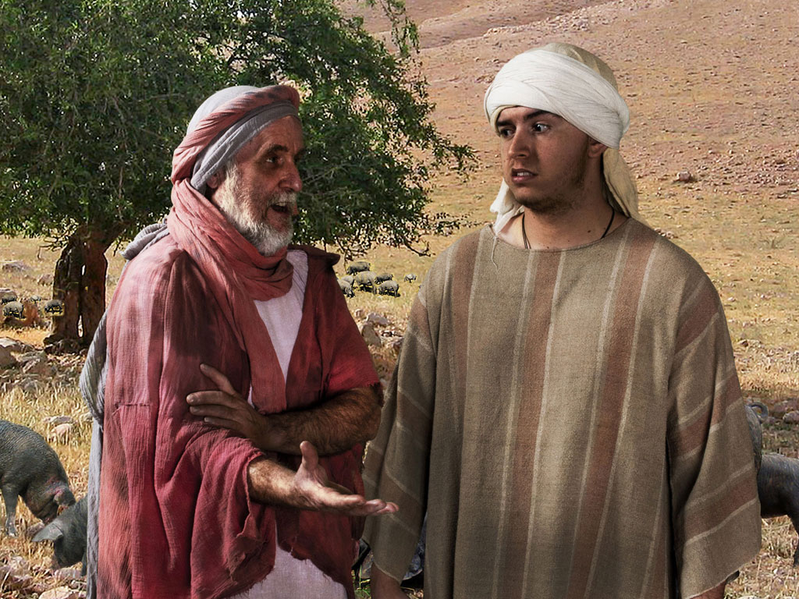
Notes:
Farmwork is good for the soul and the body. But he found work to alleviate his hunger from a man raising pigs.

Slide 48
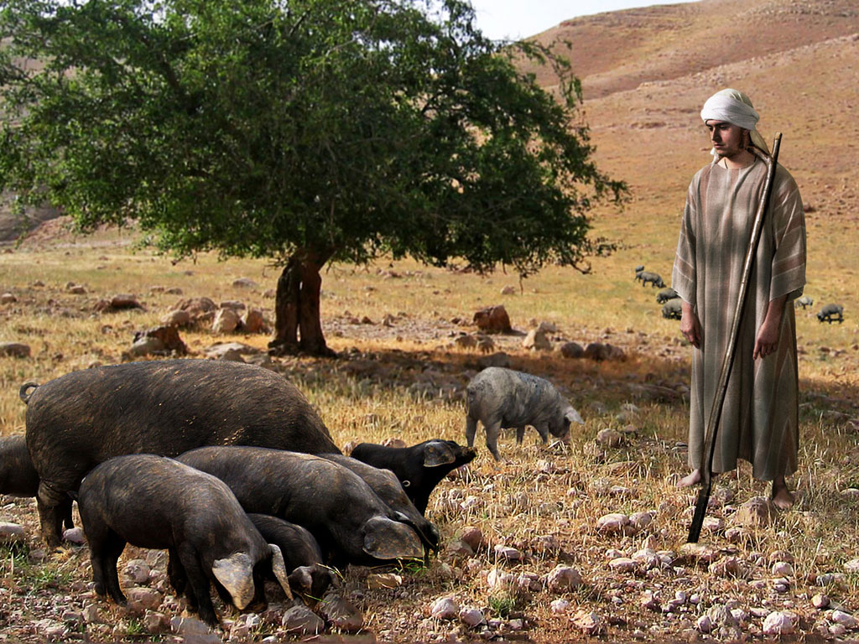
Notes:
Raising pigs is as low as a man from a wealthy Jewish family can get. Pigs were not allowed to be sacrificed, nor eaten.

Slide 49
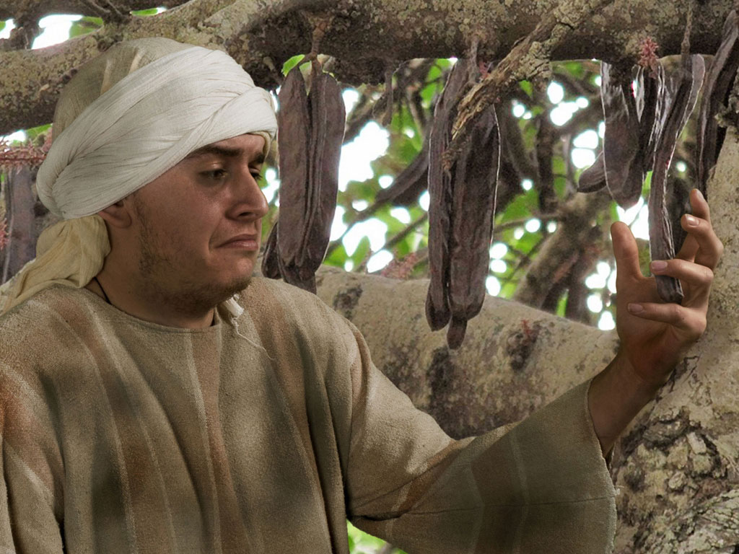
Notes:
Even the pods to feed the pigs became tempting.

Slide 50
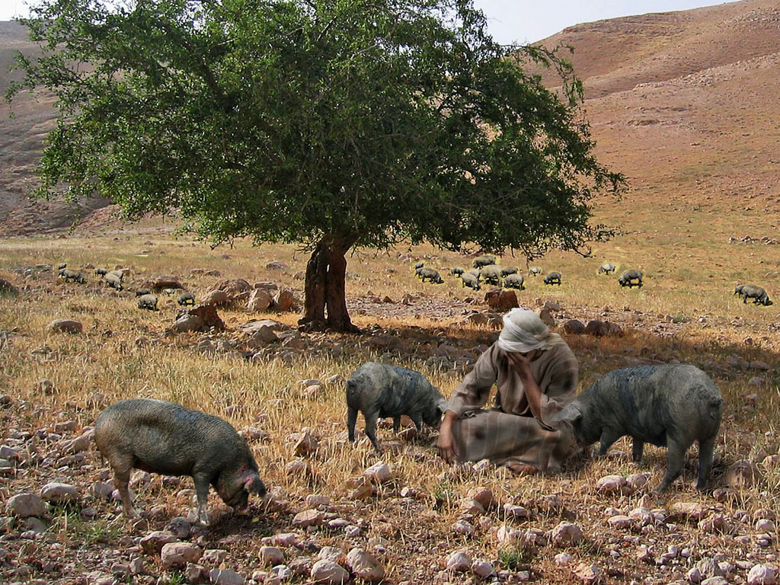
Notes:
The young son finally got to his lowest point and recalled that his father's servants were in better shape than him.

Slide 51
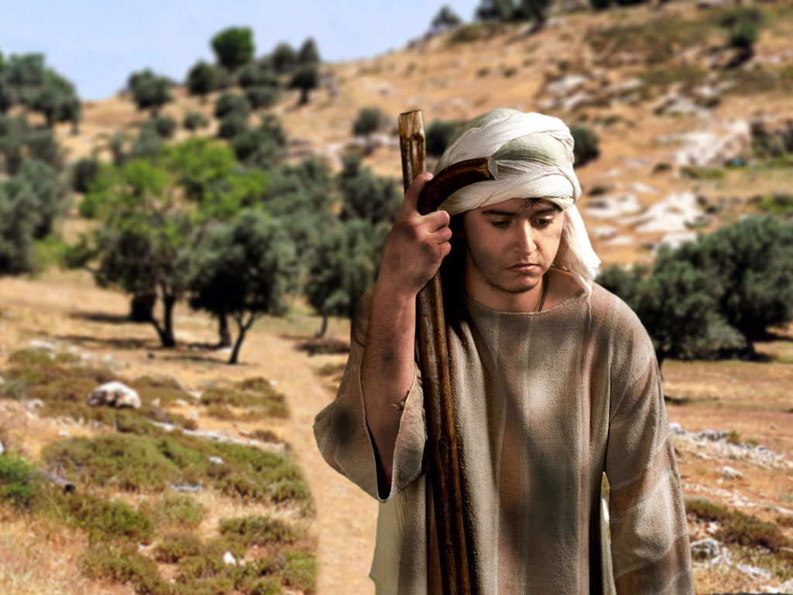
Notes:
So he returned home with a rehearsed speech of confession to his father.

Slide 52
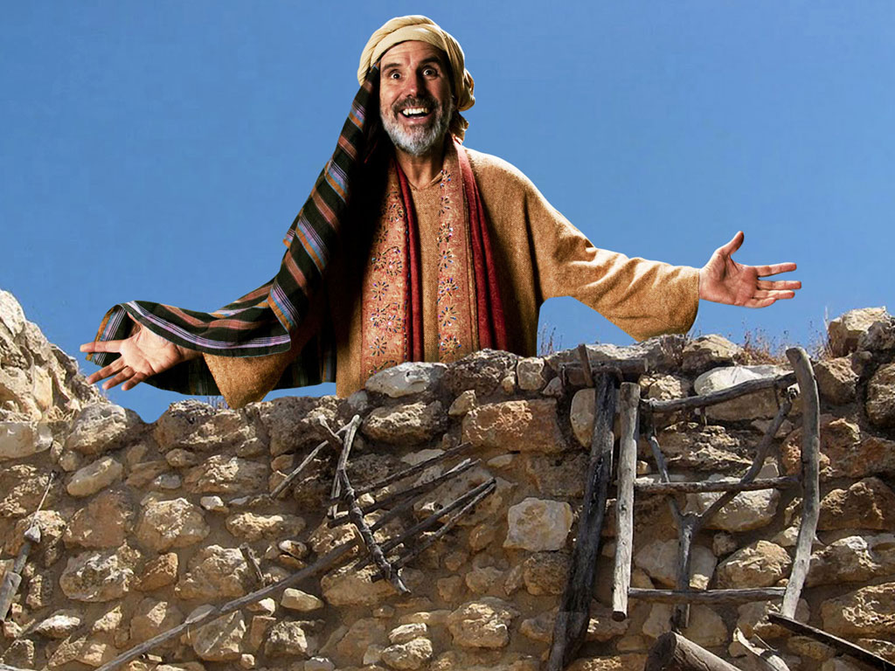
Notes:
The father saw him as soon as he came into view.

Slide 53
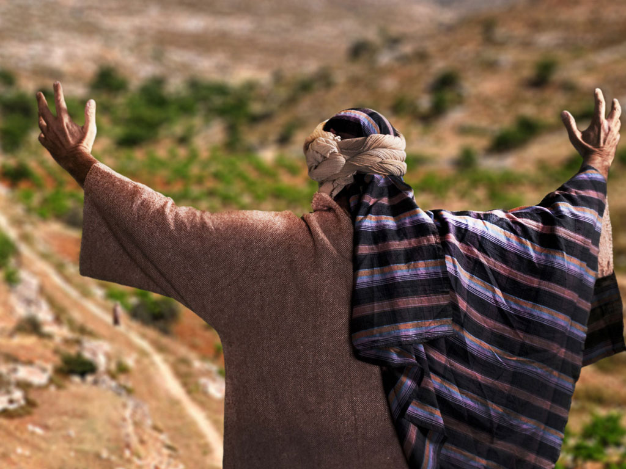
Notes:
This was because the father continued looking for him each day, praying for his return.

Slide 54
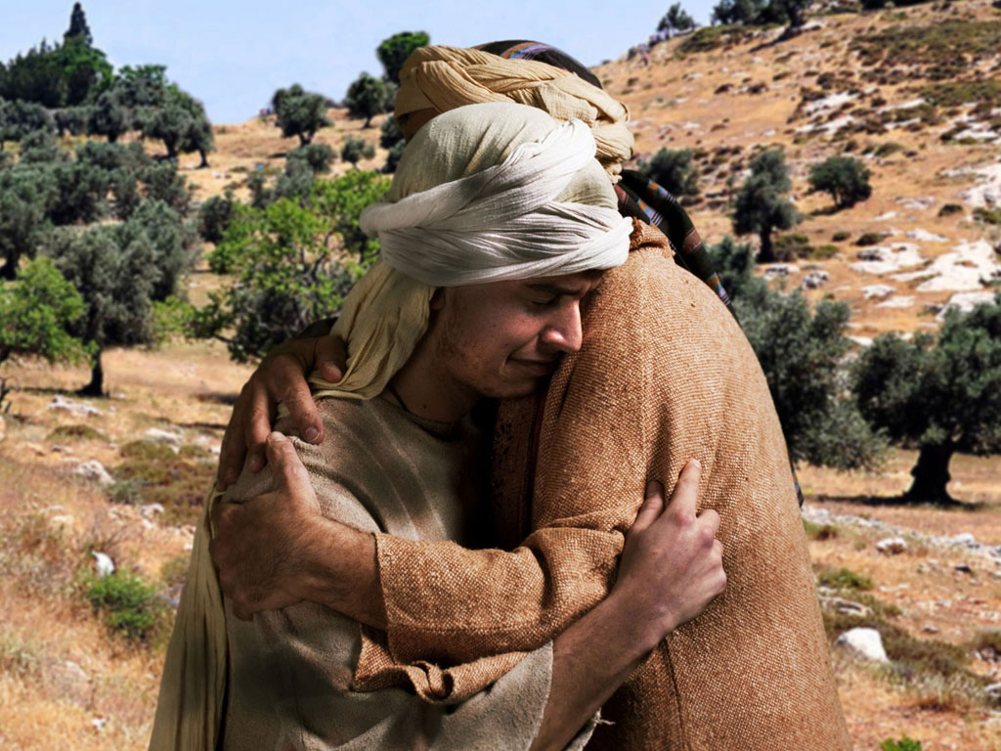
Notes:
The father ran to meet him, which fathers did not do as it appeared undignified to lift up one's robe to run.

Slide 55
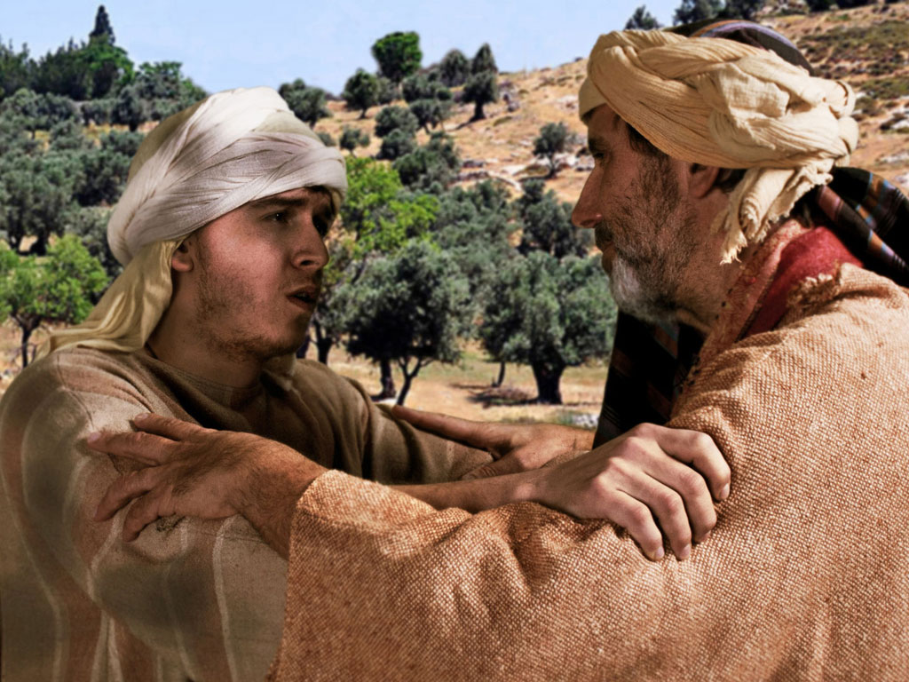
Notes:
The son began his confession but was interrupted by his father to tell his servants to bring him new clothes.

Slide 56
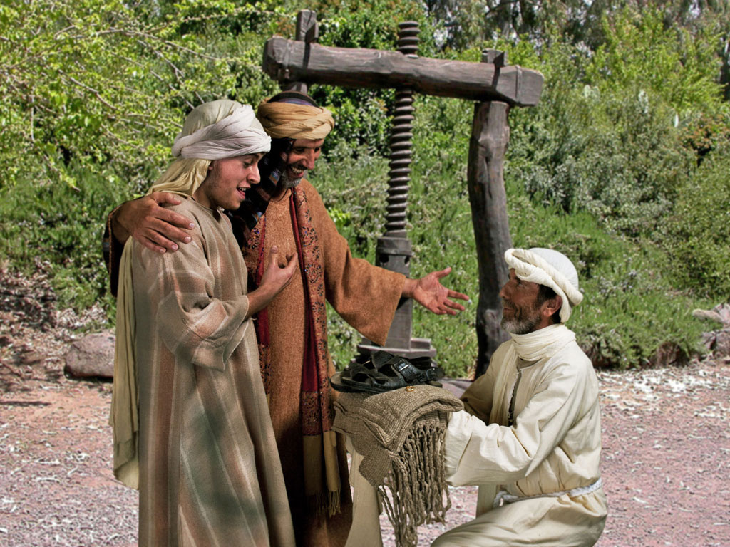
Notes:
A new robe and sandals were not earned by the son through any deed but only because of his status as a son.
"Originally the son thought of becoming a servant in his father’s house. He has his whole speech memorized verbatim (vv. 18–19). But before he is able to get even half of it out of his mouth (v. 21), his father starts barking out orders to the servants and lavishes on the boy all the trappings of an honored son.
The robe, ring, and sandals are more than signs of comfort, they are signs of sonship and freedom. The robe was such as would be given to an honored guest. The ring is a sign of authority. And the sandals represent freedom since slaves went about barefoot. His father clearly restores him to the place of an honored son. In short, he is 'alive again.' This word for 'resurrection' is an obvious allusion to the effects of sin. This parable has the seeds of NT theology—being dead in sin but alive in Christ (Rom 6:4, 9, 11; 7:4; 8:10–11; Eph 2:5; Col 2:13)."
— Mark E. Moore, The Chronological Life of Christ (Joplin, MO: College Press Publishing Company, 2011), 429.

Slide 57
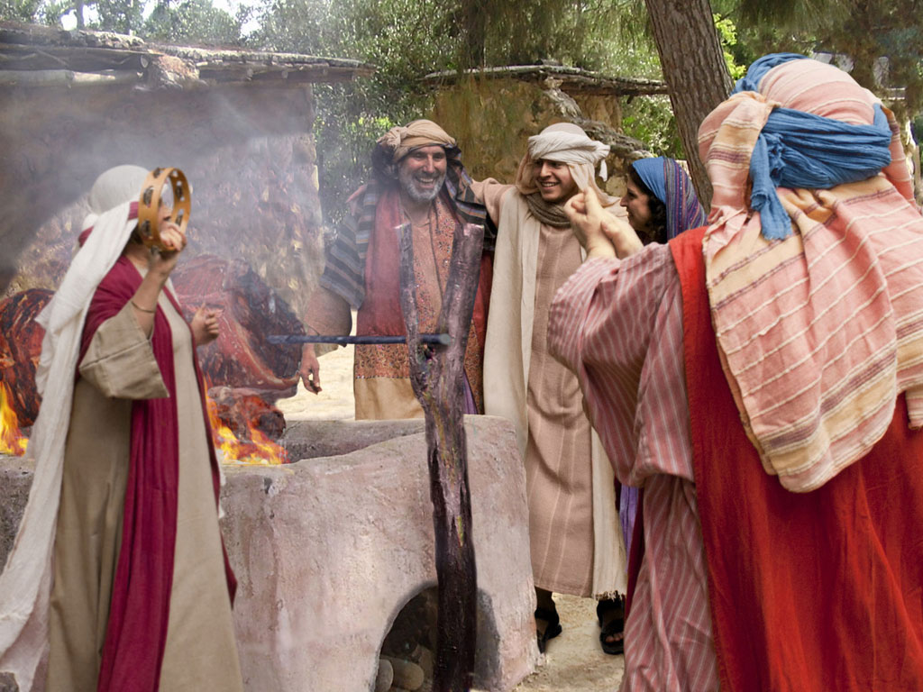
Notes:
The calf that had been saved for a celebration was roasted for a feast.

Slide 58
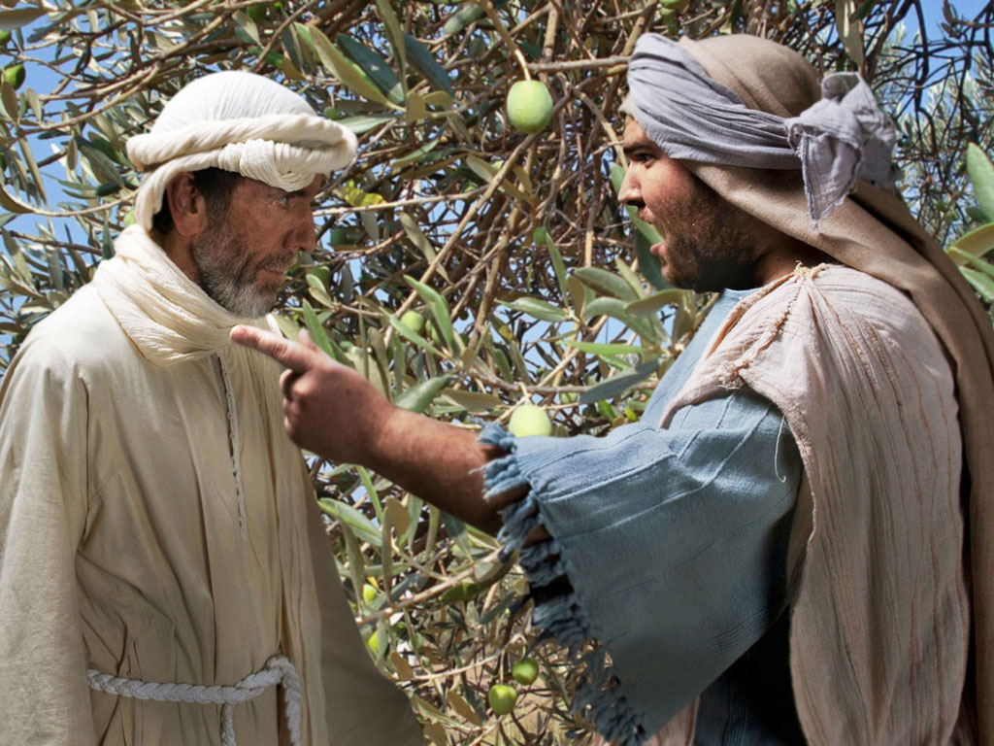
Notes:
The older son working in the fields asked a servant why he could hear a celebration. The servant told him that his brother had returned to a feast.

Slide 59
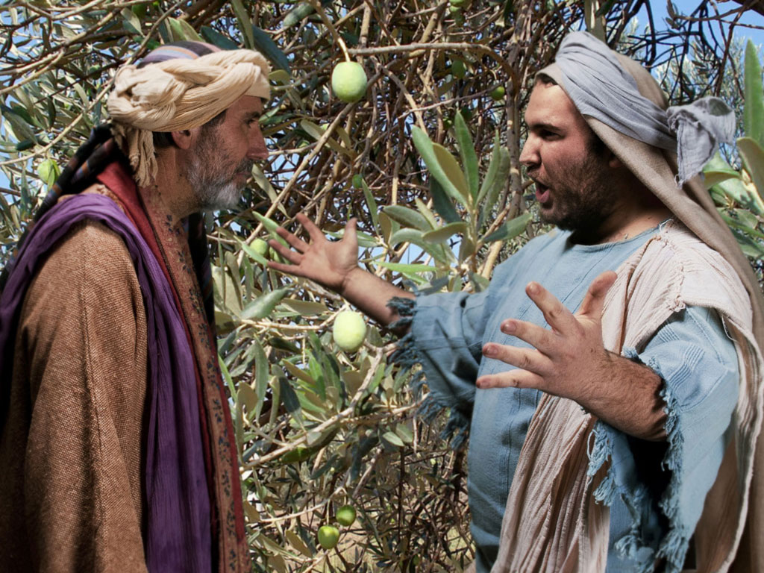
Notes:
The older son would not attend the feast, so his father went out to plead for him to return and celebrate—but to no avail.
Deuteronomy 21:18-21 says to kill a rebellious son—
Deut. 21:18 “Suppose a man has a stubborn and rebellious son who will not obey his father or mother, even though they discipline him. 19 In such a case, the father and mother must take the son to the elders as they hold court at the town gate. 20 The parents must say to the elders, ‘This son of ours is stubborn and rebellious and refuses to obey. He is a glutton and a drunkard.’ 21 Then all the men of his town must stone him to death. In this way, you will purge this evil from among you, and all Israel will hear about it and be afraid."
The father would not let this happen, so he ran to the Pharisees to protect him!

Slide 60
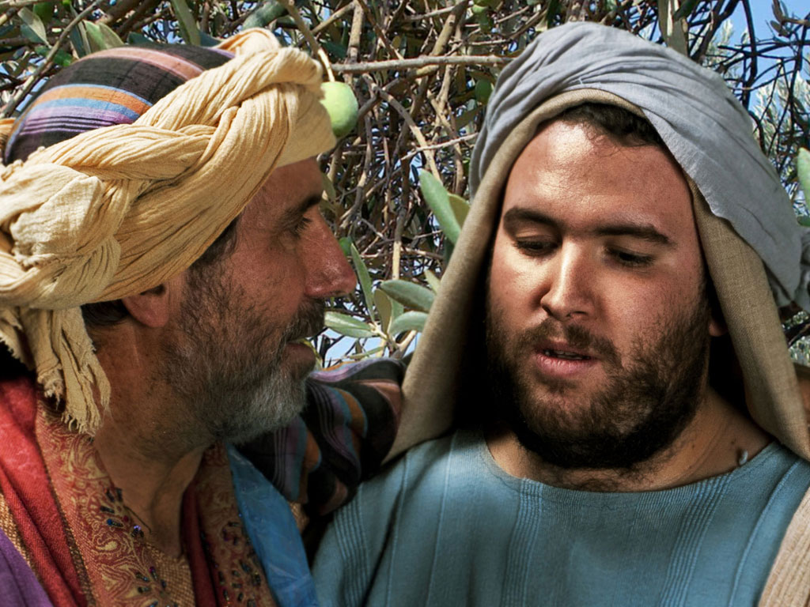
Notes:
This older, faithful son thought only of himself, declaring him as a slave of the father and one who could not celebrate with his friends. But the father reminded him that this older son owned the estate. The father said that they HAD to rejoice because his brother was alive.

Slide 61

Notes:
The older son never joined the feast.
What do you think is the main point of this parable? (Small groups for 4 minutes)
Jesus was telling the Pharisees that they were invited to the kingdom feast, but, like the older son, they refused to come.
Do not be like the older brother who thinks he deserves God's grace.
God does not keep any of us from the feast (salvation), but if we refuse to come, then he regretfully accepts our decision to prefer hell over heaven.

Slide 62
THE WORD IN PICTURES
Free
Bible
images

Slide 63
FreeBibleimages would like to thank Peter Hutley and Wintershall Players for the use of their cast, costumes and facilities in creating these images.

Slide 64
Slides on
Luke 16

Slide 65
F. Instruction on Wealth
§ 125
Luke 16:1-31
Invest in eternity as servants of God instead of temporal ventures like Pharisees who trust money as a basis for eternal security
Notes:
Parable of the Shrewd Manager
Luke 16:1 NLT Jesus told this story to his disciples: “There was a certain rich man who had a manager handling his affairs. One day a report came that the manager was wasting his employer’s money. ² So the employer called him in and said, ‘What’s this I hear about you? Get your report in order, because you are going to be fired.’
Luke 16:3 “The manager thought to himself, ‘Now what? My boss has fired me. I don’t have the strength to dig ditches, and I’m too proud to beg. ⁴ Ah, I know how to ensure that I’ll have plenty of friends who will give me a home when I am fired.’
Luke 16:5 “So he invited each person who owed money to his employer to come and discuss the situation. He asked the first one, ‘How much do you owe him?’ ⁶ The man replied, ‘I owe him 800 gallons of olive oil.’ So the manager told him, ‘Take the bill and quickly change it to 400 gallons.ª’
Luke 16:7 “‘And how much do you owe my employer?’ he asked the next man. ‘I owe him 1,000 bushels of wheat,’ was the reply. ‘Here,’ the manager said, ‘take the bill and change it to 800 bushels.ª’
Luke 16:8 “The rich man had to admire the dishonest rascal for being so shrewd. And it is true that the children of this world are more shrewd in dealing with the world around them than are the children of the light. ⁹ Here’s the lesson: Use your worldly resources to benefit others and make friends. Then, when your possessions are gone, they will welcome you to an eternal home.
Luke 16:10 “If you are faithful in little things, you will be faithful in large ones. But if you are dishonest in little things, you won’t be honest with greater responsibilities. ¹¹ And if you are untrustworthy about worldly wealth, who will trust you with the true riches of heaven? ¹² And if you are not faithful with other people’s things, why should you be trusted with things of your own?
Luke 16:13 “No one can serve two masters. For you will hate one and love the other; you will be devoted to one and despise the other. You cannot serve God and be enslaved to money.”
Luke 16:14 The Pharisees, who dearly loved their money, heard all this and scoffed at him. ¹⁵ Then he said to them, “You like to appear righteous in public, but God knows your hearts. What this world honors is detestable in the sight of God.
Luke 16:16 “Until John the Baptist, the law of Moses and the messages of the prophets were your guides. But now the Good News of the Kingdom of God is preached, and everyone is eager to get in. ¹⁷ But that doesn’t mean that the law has lost its force. It is easier for heaven and earth to disappear than for the smallest point of God’s law to be overturned.
Luke 16:18 “For example, a man who divorces his wife and marries someone else commits adultery. And anyone who marries a woman divorced from her husband commits adultery.”
Parable of the Rich Man and Lazarus
Luke 16:19 Jesus said, “There was a certain rich man who was splendidly clothed in purple and fine linen and who lived each day in luxury. ²⁰ At his gate lay a poor man named Lazarus who was covered with sores. ²¹ As Lazarus lay there longing for scraps from the rich man’s table, the dogs would come and lick his open sores.
Luke 16:22 “Finally, the poor man died and was carried by the angels to sit beside Abraham at the heavenly banquet.ª The rich man also died and was buried, ²³ and he went to the place of the dead.ª There, in torment, he saw Abraham in the far distance with Lazarus at his side.
Luke 16:24 “The rich man shouted, ‘Father Abraham, have some pity! Send Lazarus over here to dip the tip of his finger in water and cool my tongue. I am in anguish in these flames.’
Luke 16:25 “But Abraham said to him, ‘Son, remember that during your lifetime you had everything you wanted, and Lazarus had nothing. So now he is here being comforted, and you are in anguish. ²⁶ And besides, there is a great chasm separating us. No one can cross over to you from here, and no one can cross over to us from there.’
Luke 16:27 “Then the rich man said, ‘Please, Father Abraham, at least send him to my father’s home. ²⁸ For I have five brothers, and I want him to warn them so they don’t end up in this place of torment.’
Luke 16:29 “But Abraham said, ‘Moses and the prophets have warned them. Your brothers can read what they wrote.’
Luke 16:30 “The rich man replied, ‘No, Father Abraham! But if someone is sent to them from the dead, then they will repent of their sins and turn to God.’
Luke 16:31 “But Abraham said, ‘If they won’t listen to Moses and the prophets, they won’t be persuaded even if someone rises from the dead.’”

Slide 66


The Shrewd Manager
Luke 16:1-13
Dr. David Martin • Amman International Church
AmmanChurch.org • BibleStudyDownloads.org

Slide 67




Notes:
Good ways exist to teach the value of money. One effective means of savings in America in the 1960s was the Defense Stamp Album.
• Boys saved 187 10-cent stamps with a value of $18.75 that grew to $25 after 10 years.

Slide 68



Luke 16:1-13
The Issue:
A disciple’s role as a steward
Jesus addresses key misunderstandings:
Luke 15: Wrong attitudes towards people
Luke 16: Wrong attitudes towards “mammon”

Slide 69
Parable on Stewardship

Slide 70

✓He was very wealthy
✓He was a big land owner
✓He delegated complete management
(cf. Gen. 39:1,4-6)
✓He heard bad reports
✓He held the steward
accountable
Luke 16:2

Slide 71

✓He had full legal authority
✓He was supposed to use
assets to benefit the master
✓He squandered his master’s
resources
✓He saw the end coming
✓He considered his options
Luke 16:1,3-4

Slide 72


Luke 16:5-7
✓The steward summoned all creditors
✓He significantly reduced each contract

Slide 73




Contract
I owe 100 measures of olive oil
Signed:
Deuteronomy 23:19
50
“You shall not charge interest to your countrymen.”
+100%
interest
=
50 measures borrowed
100 measures debt
Notes:
"By reducing the debts, he would certainly make friends. As the household manager, he still had the authority to do that. This 'bill' was actually a written document, signed by both parties as a contract for payment. Once it was turned back over to the debtor, he was free from his obligation. The account was 'paid in full.' This may not have been ethical, but it was legal.
Derrett suggests that he was not reducing the actual debt owed but simply knocking off the interest (i.e., 'usury') that had accrued on the loan. If this were the case, he would have been rightly following OT law (Exod 22:25; Lev 25:36–37; Deut 15:7–8; 23:19–20).³⁶ Although this act would have lowered the master’s income, it would have raised his reputation. To that extent, it would have been a wise move for both the manager and the master."
³⁶ J.D.M. Derrett, “Fresh Light on St Luke 16:1, The Parable of the Unjust Steward,” NTS 7 (1961): 198–219. However, Derrett’s deductions are based on the Mishnah tractates which were not codified until the third century. Furthermore, the parable does not suggest that the servant reduced the usury from the payment. In fact, the term “unrighteous manager” [ton oikonomon tēs adikias] seems to speak against the view that the manager was a noble character. J. A. Fitzmyer, “The Story of the Dishonest Manager,” TS 25 (1964): 23–42, offers an alternate explanation. He suggests that the steward reduced the debt by the amount of his commission. Both Fitzmeyer and Derrett would thus interpret the steward’s actions as legal and commendable. This alleviates the tension of a master praising a dishonest deed. But both theories appear to go beyond the evidence available concerning ancient contracts and the job of managers. Like Derrett and Fitzmyer, D. Landry and B. May argue that the steward actually did a good thing. They suggest that the real issue is not money but honor. By pilfering funds he shamed his master who would be ridiculed for not being able to control his servant. When the servant reduced the debts, however, he would cause the master to be seen as magnanimous. Thus the steward undid the damage to his master’s reputation. “Honor Restored: New Light on the Parable of the Prudent Steward (Lk. 16:1–8a),” JBL 119/2 (2000): 287–309.
—Mark E. Moore, The Chronological Life of Christ (Joplin, MO: College Press Publishing Company, 2011), 431–432.

Slide 74



Nazareth Village
Contract
I owe 00 measures of wheat
Signed:
80
+20%
interest
=
80 measures borrowed
100 measures debt

Slide 75

The Steward cancelled
the interest
He was
praised for being
shrewd
✓He had the authority
✓It was completely legal
✓He made many friends that day
✓His future comfort was assured
✓He also made the master look generous
✓His quick planning/action changed his fate

Slide 76





Evaluate your stewardship
while there is still time to make changes

Slide 77

2 Cor. 5:10
You will leave this all behind!
(Ecclesiastes 5:15; 2:19)

Slide 78



Recognize that you are only a “steward” and not the “owner” of all that God puts in your hands (1 Chron. 29:14).
What do we learn?

Slide 79



2. Invest your money, possessions, and time
to enhance your welcome into heaven
(Luke 16:9; Matt. 6:19-21).
Will anyone be in heaven because of you?
What do we learn?

Slide 80

3. Faithfulness in stewardship begins now
with little things (Luke 16:10; 1 Cor. 4:2).
Giving seldom increases proportionally with income
What do we learn?

Slide 81
4. Wasting your money and opportunities
limits how much God will use you now and
reward you later (Luke 16:11; 19:17).
What do we learn?

Slide 82

5. Become “shrewd.” Act quickly to maximize
your treasures in heaven by the way you
invest your resources in God’s work on
earth (Phil. 4:15-17).
What do we learn?

Slide 83




The Rich Man and Lazarus
Luke 16:19-31
Dr. David Martin • Amman International Church
AmmanChurch.org • BibleStudyDownloads.org

Slide 84


JESUS’ TEACHING ON MAMMON
(Luke 16)
The Shrewd Steward
The Rich Man/Lazarus
Future oriented
Here & now oriented

Slide 85


THE CONTEXT OF THE PARABLE
Luke 16:13-15
Matthew
19:23-25
The Issue: Is wealth a sign of God’s acceptance and poverty a sign of His rejection?
Notes:
• The context of the story of the rich man and Lazarus is found in Matthew 19:23-25.
• Matt. 19:23 Then Jesus said to his disciples, “I tell you the truth, it is very hard for a rich person to enter the Kingdom of Heaven. 24 I’ll say it again—it is easier for a camel to go through the eye of a needle than for a rich person to enter the Kingdom of God!”
• Matt. 19:25 The disciples were astounded. “Then who in the world can be saved?” they asked.
• The Issue….
Pharisees said YES!
Pharisees applied the blessings and curses passages (Lev 26; Deut 28) to every individual. They hadn't read Job! They were prosperity gospel teachers.
Luke 16:14 The Pharisees, who dearly loved their money, heard all this and scoffed at him.

Slide 86
The Rich Man
✓He was extremely wealthy
✓He dressed as royalty
✓He feasted sumptuously
every day
✓He lived in a gated mansion
✓He appeared to be religious
✓He knew Lazarus but
he ignored his needs
✓He was unnamed

Slide 87
LAZARUS
✓He was a destitute beggar
✓His name means
“The one whom God helps”
✓He was physically helpless,
and covered with open sores
✓He longed for table scraps

Slide 88

Notes:
Jordan has the delicious masef dish with bread. The rich man had even more!

Slide 89
LAZARUS
✓He was a destitute beggar
✓His name means
“The one whom God helps”
✓He was physically helpless,
and covered with open sores
✓He longed for table scraps
✓Wild dogs licked his wounds

Slide 90
Notes:
The contrast between these men could hardly be more exaggerated!

Slide 91

The Rich Man
✓He died and was buried
(in splendor and pomp)
Notes:
An ossuary was a stone burial box that protected the bones of a body after the flesh had decayed, typically after a year in the tomb.
The rich man had such a burial.

Slide 92


LAZARUS
✓He died and was not even buried
Valley of Gehenna
Notes:
The Valley of Gehenna is a beautiful park SW of Jerusalem's Old City.
• Yet, in the time of Jesus, bodies of criminals were thrown there to be burned up.
Such was the fate of Lazarus.

Slide 93

The Rich Man
Riches did NOT indicate God’s acceptance
✓He woke up in Hades/Hell

Slide 94

LAZARUS
Poverty did not indicate God’s rejection
✓He died and was carried by angels to
“Abraham’s bosom” (Bliss)

Slide 95
The Rich Man
✓He woke up in Hades/Hell
✓He was in torment

Slide 96
LAZARUS
✓He died and was carried by angels to
“Abraham’s bosom” (paradise; heaven)
✓He feasted in a place of honor (Matt. 8:11)

Slide 97

The Rich Man
✓He woke up in Hades/Hell
✓He was in torment
✓He cried to “Father Abraham” for mercy

Slide 98
LAZARUS
✓He died and was carried by angels to
“Abraham’s bosom” (paradise; heaven)
✓He feasted in a place of honor (Matt. 8:11)
✓He was in comfort

Slide 99
The Rich Man
✓He woke up in Hades/Hell
✓He was in torment
✓He cried to “Father Abraham” for mercy
✓He had received good things in life, but his
failure to repent resulted in eternal agony

Slide 100
LAZARUS
✓He died and was carried by angels to
“Abraham’s bosom” (paradise; heaven)
✓He feasted in a place of honor (Matt. 8:11)
✓He was in comfort
✓He had received bad things in life, but his
trust in God resulted in eternal comfort

Slide 101

Most never expected to end up there
None want friends/family to join them there
All realize there is no second chance
None will claim they are there by mistake
What do we learn about hell?

Slide 102

Luke 16:31
They were warned!
✓The Scriptures are a sufficient warning
✓Even miracles won’t convince a hard heart
John 11:43-46,53 (Lazarus)
Matthew 28:11-15 (Jesus)

Slide 103
✓Matthew 3:2 (John the Baptist)
✓Matthew 4:17 (Jesus)
Hebrews
9:27
✓Acts 2:38 (Peter)
✓Acts 17:30-31 (The Apostle Paul)
1) Repentance is a change of mind . . .
about sin and its consequences
about who Jesus is and what He did
2) Repentance results in a change in behavior
What do we learn about repentance/faith?

Slide 104



The Transfer to Paradise
"That is why the Scriptures say, 'When he ascended to the heights, he led a crowd of captives and gave gifts to his people.'
⁹Notice that it says 'he ascended.' This clearly means that Christ also descended to our lowly world. ¹⁰And the same one who descended is the one who ascended higher than all the heavens, so that he might fill the entire universe with himself."
14 & 16
NLT
HEAVEN
Eph. 4:8-10
"…today you will be with me in paradise."
"I was caught up to the third heaven…I was caught up to paradise"
Luke 23:43
2 Cor. 12:2-4
S
H
E
O
L
"Christ suffered for our sins once for all time. He never sinned, but he died for sinners to bring you safely home to God. He suffered physical death, but he was raised to life in the Spirit.
¹⁹So he went and preached to the spirits in prison— ²⁰those who disobeyed God long ago when God waited patiently while Noah was building his boat. Only eight people were saved from drowning in that terrible flood."
Bliss
HADES
1 Pet. 3:18-20
HADES
Rev. 20:14-15
Luke 16:26
Hell
Gehenna
Lake of Fire
Lake of Burning Sulfur
Second Death
"…there is a great chasm separating us. No one can cross over to you from here, and no one can cross over to us from there."
"Then death and [Hades] were thrown into the lake of fire... ¹⁵And anyone whose name was not found recorded in the Book of Life was thrown into the lake of fire."
Notes:
Before Christ's death, all the dead went to OT Sheol or the underworld of the dead—both saved and unsaved. But Jesus brought believers to Paradise after his resurrection. Also, Hades is different from Hell in that Hades is a temporary place of punishment now, while Hell is the future and eternal place of torment.
___________________
Common-472
ES-03-Reincarnation&SpiritsInPrison-45
LC-06-Preparation of the Disciples by the King-104
OB-38-Salvation-45
OP-Eccles9:1-18—slide 28
NS-08-2Cor-268
NS-10-Ephesians-270
NS-21-1Peter-235
NS-22-Rev20-22-slide 155

Slide 105
Slides on
Luke 17

Slide 106
Slides on
Luke 18

Slide 107
O. Instruction on Eternal Life
§ 134
Matthew 19:16–20:16; Mark 10:17-31;
Luke 18:18-30
One cannot enter the kingdom life through riches, so the Pharisee’s belief that material wealth shows God's approval is wrong
Notes:
The Rich Man
Matt. 19:16 Someone came to Jesus with this question: “Teacher, what good deed must I do to have eternal life?”
Matt. 19:17 “Why ask me about what is good?” Jesus replied. “There is only One who is good. But to answer your question—if you want to receive eternal life, keep the commandments.”
Matt. 19:18 “Which ones?” the man asked.
And Jesus replied: “‘You must not murder. You must not commit adultery. You must not steal. You must not testify falsely. ¹⁹ Honor your father and mother. Love your neighbor as yourself.’”
Matt. 19:20 “I’ve obeyed all these commandments,” the young man replied. “What else must I do?”
Matt. 19:21 Jesus told him, “If you want to be perfect, go and sell all your possessions and give the money to the poor, and you will have treasure in heaven. Then come, follow me.”
Matt. 19:22 But when the young man heard this, he went away sad, for he had many possessions.
Matt. 19:23 Then Jesus said to his disciples, “I tell you the truth, it is very hard for a rich person to enter the Kingdom of Heaven. ²⁴ I’ll say it again—it is easier for a camel to go through the eye of a needle than for a rich person to enter the Kingdom of God!”
Matt. 19:25 The disciples were astounded. “Then who in the world can be saved?” they asked.
Matt. 19:26 Jesus looked at them intently and said, “Humanly speaking, it is impossible. But with God everything is possible.”
Matt. 19:27 Then Peter said to him, “We’ve given up everything to follow you. What will we get?”
Matt. 19:28 Jesus replied, “I assure you that when the world is made new and the Son of Man sits upon his glorious throne, you who have been my followers will also sit on twelve thrones, judging the twelve tribes of Israel. ²⁹ And everyone who has given up houses or brothers or sisters or father or mother or children or property, for my sake, will receive a hundred times as much in return and will inherit eternal life. ³⁰ But many who are the greatest now will be least important then, and those who seem least important now will be the greatest then.
Parable of the Vineyard Workers
Matt. 20:1 “For the Kingdom of Heaven is like the landowner who went out early one morning to hire workers for his vineyard. ² He agreed to pay the normal daily wage and sent them out to work.
Matt. 20:3 “At nine o’clock in the morning he was passing through the marketplace and saw somepeople standing around doing nothing. ⁴ So he hired them, telling them he would pay them whatever was right at the end of the day. ⁵ So they went to work in the vineyard. At noon and again at three o’clock he did the same thing.
Matt. 20:6 “At five o’clock that afternoon he was in town again and saw some more people standing around. He asked them, ‘Why haven’t you been working today?’
Matt. 20:7 “They replied, ‘Because no one hired us.’
“The landowner told them, ‘Then go out and join the others in my vineyard.’
Matt. 20:8 “That evening he told the foreman to call the workers in and pay them, beginning with the last workers first. ⁹ When those hired at five o’clock were paid, each received a full day’s wage. ¹⁰ When those hired first came to get their pay, they assumed they would receive more. But they, too, were paid a day’s wage. ¹¹ When they received their pay, they protested to the owner, ¹² ‘Those people worked only one hour, and yet you’ve paid them just as much as you paid us who worked all day in the scorching heat.’
Matt. 20:13 “He answered one of them, ‘Friend, I haven’t been unfair! Didn’t you agree to work all day for the usual wage? ¹⁴ Take your money and go. I wanted to pay this last worker the same as you. ¹⁵ Is it against the law for me to do what I want with my money? Should you be jealous because I am kind to others?’
Matt. 20:16 “So those who are last now will be first then, and those who are first will be last.”
The Rich Man
Mark 10:17 As Jesus was starting out on his way to Jerusalem, a man came running up to him, knelt down, and asked, “Good Teacher, what must I do to inherit eternal life?”
Mark 10:18 “Why do you call me good?” Jesus asked. “Only God is truly good. ¹⁹ But to answer your question, you know the commandments: ‘You must not murder. You must not commit adultery. You must not steal. You must not testify falsely. You must not cheat anyone. Honor your father and mother.’”
Mark 10:20 “Teacher,” the man replied, “I’ve obeyed all these commandments since I was young.”
Mark 10:21 Looking at the man, Jesus felt genuine love for him. “There is still one thing you haven’t done,” he told him. “Go and sell all your possessions and give the money to the poor, and you will have treasure in heaven. Then come, follow me.”
Mark 10:22 At this the man’s face fell, and he went away sad, for he had many possessions.
Mark 10:23 Jesus looked around and said to his disciples, “How hard it is for the rich to enter the Kingdom of God!” ²⁴ This amazed them. But Jesus said again, “Dear children, it is very hard to enter the Kingdom of God. ²⁵ In fact, it is easier for a camel to go through the eye of a needle than for a rich person to enter the Kingdom of God!”
Mark 10:26 The disciples were astounded. “Then who in the world can be saved?” they asked.
Mark 10:27 Jesus looked at them intently and said, “Humanly speaking, it is impossible. But not with God. Everything is possible with God.”
Mark 10:28 Then Peter began to speak up. “We’ve given up everything to follow you,” he said.
Mark 10:29 “Yes,” Jesus replied, “and I assure you that everyone who has given up house or brothers or sisters or mother or father or children or property, for my sake and for the Good News, ³⁰ will receive now in return a hundred times as many houses, brothers, sisters, mothers, children, and property—along with persecution. And in the world to come that person will have eternal life. ³¹ But many who are the greatest now will be least important then, and those who seem least important now will be the greatest then.”
The Rich Man
Luke 18:18 Once a religious leader asked Jesus this question: “Good Teacher, what should I do to inherit eternal life?”
Luke 18:19 “Why do you call me good?” Jesus asked him. “Only God is truly good. ²⁰ But to answer your question, you know the commandments: ‘You must not commit adultery. You must not murder. You must not steal. You must not testify falsely. Honor your father and mother.’”
Luke 18:21 The man replied, “I’ve obeyed all these commandments since I was young.”
Luke 18:22 When Jesus heard his answer, he said, “There is still one thing you haven’t done. Sell all your possessions and give the money to the poor, and you will have treasure in heaven. Then come, follow me.”
Luke 18:23 But when the man heard this he became very sad, for he was very rich.
Luke 18:24 When Jesus saw this, he said, “How hard it is for the rich to enter the Kingdom of God! ²⁵ In fact, it is easier for a camel to go through the eye of a needle than for a rich person to enter the Kingdom of God!”
Luke 18:26 Those who heard this said, “Then who in the world can be saved?”
Luke 18:27 He replied, “What is impossible for people is possible with God.”
Luke 18:28 Peter said, “We’ve left our homes to follow you.”
Luke 18:29 “Yes,” Jesus replied, “and I assure you that everyone who has given up house or wife or brothers or parents or children, for the sake of the Kingdom of God, ³⁰ will be repaid many times over in this life, and will have eternal life in the world to come.”

Slide 108

Free
Bible
images
A RICH YOUNG MAN QUESTIONS JESUS
Matthew 19:16-30; Mark 10:17-31; Luke 18:18-30
Notes:
"This man’s question indicated that he viewed eternal life as something to be achieved by doing good (in contrast with Mark 10:15; cf. Matt. 19:16) and also that he felt insecure about his future destiny. References to eternal life (mentioned in Mark only in 10:17, 30), “entering God’s kingdom” (vv. 23-25), and being “saved” (v. 26) all focus on the future possession of life with God, though a person enters it now by accepting God’s rule in his earthly life. John’s Gospel emphasizes the present possession of eternal life."
—John D. Grassmick, Mark (The Bible Knowledge Commentary; eds. John F. Walvoord and Roy B. Zuck; Accordance electronic ed. 2 vols.; Wheaton: Victor Books, 1983), 2:150.

Slide 109

Notes:
Mark 10:17 As Jesus was starting out on his way to Jerusalem, a man came running up to him, knelt down, and asked, “Good Teacher, what must I do to inherit eternal life?”
———————
"His question was specifically, “What must I do to inherit eternal life?” In Jewish understanding, to “inherit eternal life” was to be resurrected and accepted for entrance into the messianic kingdom of the future (cf. Dan 12:2; 2 Macc 7:9).
5 Notice Mark 10:30 in which Jesus spoke of “eternal life” in the “age to come.” So “to inherit eternal life” was an equivalent expression for entering the kingdom of God, referred to elsewhere as “inheriting the kingdom” (cf. Mt 25:34; 1 Cor 6:9, 10; 15:50; Gal 5:21). The NT is very clear that one can only do this by humbly coming to Jesus with a child-like faith in order to be born again (Mk 10:15; John 3:3; Col 1:13-14). The young man’s question in Mark 10:17, however, gives him away that he does not understand the right approach, for he asks, “What must I do?” The NT is clear that there is not anything we can “do” to merit eternal life. Receiving God’s forgiveness and eternal life do not come because of what we “do,” but only as a free gift of God’s grace."
—Paul Tanner, Following the Master (BEE World), 144

Slide 110

Notes:
Mark 10:18 “Why do you call me good?” Jesus asked. “Only God is truly good.

Slide 111

Notes:
Mark 10:19 But to answer your question, you know the commandments: ‘You must not murder. You must not commit adultery. You must not steal. You must not testify falsely. You must not cheat anyone. Honor your father and mother.’"
————————
Jesus sought to show him that he was not good after all by having him evaluate himself by the Ten Commandments.

Slide 112

Notes:
Mark 10:20 “Teacher,” the man replied, “I’ve obeyed all these commandments since I was young.”
——————————
This shows that the man was self-deluded into thinking that he was the only person in the world who was good! He should have known Isa 64:6, “All our so-called righteous acts are like a menstrual rag in your sight.”

Slide 113

Notes:
Mark 10:21 Looking at the man, Jesus felt genuine love for him.

Slide 114
Notes:
Mark 10:21 “There is still one thing you haven’t done,” he told him.

Slide 115

Notes:
Mark 10:21 “Go and sell all your possessions and give the money to the poor, and you will have treasure in heaven. Then come, follow me.”

Slide 116

Notes:
Mark 10:22 At this the man’s face fell, and he went away sad, for he had many possessions.

Slide 117

Notes:
Mark 10:23 Jesus looked around and said to his disciples, “How hard it is for the rich to enter the Kingdom of God!”

Slide 118

A camel
The eye of a needle
Notes:
Mark 10:24 This amazed them. But Jesus said again, “Dear children, it is very hard to enter the Kingdom of God. ²⁵ In fact, it is easier for a camel to go through the eye of a needle than for a rich person to enter the Kingdom of God!”
Mark 10:26 The disciples were astounded. “Then who in the world can be saved?” they asked.
—————————
LC-06-Preparation-184
NS-01-Matt15-28—slide 102
NS-02-Mark9-16—slide 25
NS-03-Luke13-14—slide 115

Slide 119

Notes:
Q: Is Jesus explaining something difficult or impossible?
A: Humanly speaking, a camel cannot fit through a normal-sized needle, so it is impossible. Some understand this to mean that a wealthy person cannot enter heaven through their wealth (an impossibility).
Others say that riches often prevent the wealthy from seeing their need for Jesus (a difficulty).
Which is correct? Both are theologically sound, but which view best fits the context?
—————————
LC-06-Preparation-185
NS-01-Matt15-28—slide 103
NS-02-Mark9-16—slide 26
NS-03-Luke13-14—slide 116

Slide 120

Notes:
Joseph Dillow presents an alternate view:
"Are Works a Condition for Entering the Kingdom?
The New Testament includes 23 references to entering the kingdom, entering into “life,” seeking “life,” or seeking the kingdom.⁷³¹ These passages, commonly called the “entry sayings,” are usually understood to refer to entrance into personal salvation either now or in the eschatological future. However, in many of these passages, entry into the kingdom or into “life” appears to be predicated on works.⁷³² If the traditional idea that “the kingdom” always refers to individual salvation and that “entrance into the kingdom” always refers to “getting saved” or going to heaven when one dies is accepted, as Bill did, then there emerges an apparent conflict with the faith-alone gospel of the New Testament.
For example, to “enter the kingdom”⁷³³ requires a righteousness that is greater than that of the scribes and Pharisees (Matthew 5:20).⁷³⁴ Those who enter the kingdom must do so through the path of discipleship, the narrow gate (Matthew 7:13, 14). In order to enter the kingdom, one must do the “will of the Father,” that is, obey the precepts taught in the Sermon on the Mount (Matthew 7:21).⁷³⁵ To “enter into life,” which is an equivalent phrase, one must deal radically with sin, reject it, and remove it from one’s lifestyle (Matthew 18:3, 9).⁷³⁶ To enter the kingdom, one must be “converted” (Matthew 18:3, 9). Jesus tells the rich young ruler that to “enter into life” (which he equates with entering the kingdom, v. 23) one must “keep the commandments” (Matthew 19:17).⁷³⁷ Strenuous moral effort is required if one is to enter the kingdom (Mark 10:24, “how hard”).
It should be obvious to any unbiased reader that the calls to enter the kingdom are conditioned upon works. Neonomian writers, believing that entering the kingdom means “going to heaven,” simply call a spade a spade and in agreement with the Catholics boldly assert that salvation is secured by non-meritorious, God-produced works in the believer. It is disappointing that the Evangelical Theological Society, is now publishing books and articles advocating this viewpoint. A recent example from the pen of Edmund Neufeld says, “Each [beatitude] is an aspect of the condition by which the follower of Christ receives salvation from God.”⁷³⁸
In the following discussion I will argue that the calls to enter the kingdom in the Gospel of Matthew are all addressed to those who are already born again. They are challenges to live out one’s faith, not always invitations to personal salvation, entrance into heaven, or entrance into the Millennial Kingdom. The next three chapters will be devoted to establishing this understanding of the “entry” sayings."
731 The “entry sayings” refer to these phrases: (1) “enter the kingdom of heaven” (Matthew 5:20; 7:21; 18:3; 19:23, 24; 23:13; Mark 9:47; 10:15, 25; Luke 18:17, 24, 25; John 3:5; Acts 14:22); (2) “entering into life” (Matthew 18:8, 9; 19:17; Mark 9:43; (3) “seeking life” (Luke 17:33; Romans 2:7); (4)
“seeking the kingdom” (Matthew 6:33; 13:45; Luke 12:31). These seem to be parallel and explain one another.
732 See G. Todd Wilson, "Conditions for Entering the Kingdom," Perspectives in Religious Studies 5 (Spring 1978): 40.
733 Equivalent expressions to “enter the kingdom” are “enter into life” and “enter into joy” and in some cases “inherit the kingdom” (see Schneider, “eiserchomai,” TDNT, 2.677).
734 Some understand this “greater righteousness” to refer to either forensic justification or a characteristic of all who are saved. However, as will be demonstrated later, both these options are inconsistent with the context. See pp. 233 ff.
735 To obey the will of the Father seems to refer to good works in Matthew 12:50. And it is highly unlikely that the “will of the Father” in the context of the Sermon on the Mount is to believe on Christ of
salvation as it is in John 6:40. For discussion of this phrase, see pp. 306 ff.
736 “This unconditional orientation to the coming kingdom demands sacrifice, namely, a clean break with everything that would hinder or prejudice the newly established existence of man before God (cf. the sayings about offences in Matthew 18:8 ff.),”ibid., 2.677
737 True, the disciples ask, “Who then can be saved?” As already demonstrated, “saved” does not have to refer to soteriological entrance into heaven. As has been shown earlier, the salvation in view is the deliverance of the soul by self-denying discipleship to Christ, leading to high honor and reward in the kingdom, see pp. 202 ff.
738 Edmund K. Neufeld, "The Gospel in the Gospels: Answering the Question 'What must I do to be saved?' From the Synoptics," JETS 51, no. 2 (June 2008): 273.
—Joseph Dillow, Final Destiny, 230-31
—————————
LC-06-Preparation-186
NS-01-Matt15-28—slide 104
NS-02-Mark9-16—slide 27
NS-03-Luke13-14—slide 117

Slide 121

Notes:
Mark 10:27 Jesus looked at them intently and said, “Humanly speaking, it is impossible. But not with God. Everything is possible with God.”
Mark 10:28 Then Peter began to speak up. “We’ve given up everything to follow you,” he said.
Mark 10:29 “Yes,” Jesus replied, “and I assure you that everyone who has given up house or brothers or sisters or mother or father or children or property, for my sake and for the Good News, ³⁰ will receive now in return a hundred times as many houses, brothers, sisters, mothers, children, and property—along with persecution. And in the world to come that person will have eternal life. ³¹ But many who are the greatest now will be least important then, and those who seem least important now will be the greatest then.”

Slide 122

Used with Permission
THE
GOSPEL
——OF—— MATTHEW
THE
GOSPEL
——OF—— MARK
THE
GOSPEL
——OF—— LUKE
THE
GOSPEL
——OF—— JOHN
Due to the Lumo Project producing its own publishing material we regret to inform you that we cannot license our photos to other clients outside of freebibleimages.org.
These images are not licensed for reuse in video, epublishing or other media. Downloaded pictures and files cannot be redistributed through any other website than freebibleimages.org or used in any context where the accompanying message is undermining of the Christian faith and gospel.
Photos can only be used on educational presentations, blogs and social media, all of which should be accompanied with reference to www.LumoProject.com.
Picture courtesy of BBM
© All Rights Reserved.
www.bigbookmedia.com

Slide 123
Slides on
Luke 19

Slide 124
R. Instruction Concerning the Kingdom Program
§ 137
Luke 9:1-28
Christ reiterates the delay of the millennial kingdom but also encourages any individual trusting in His person that his entrance into eternal life is guaranteed
Notes:
_____________
NS-03-Luke13-24—slide 74

Slide 125


Time Periods of the Prophets
Isaiah:
442
7–8
39–40
52–53
2, 11
25:8
New Heavens & New Earth
Christ's Second Coming to Reign in Millennium
Christ's First Coming to Suffer
Exile & Return
Prophet's Own Time
Adapted significantly from Salem Kirban, Charts on Revelation (1979), 49
Notes:
The prophets often looked to the future but did not know how far their prophecies referred. It is like a person standing on a mountain looking into the distance and seeing what appears to be the same mountain. However, the person standing at these same mountains from the side can see significant gaps between the peaks. Such is the viewpoint that we have thousands of years later. There generally existed five time periods, including the prophet’s era. Isaiah especially prophesied of each of these periods in the chapters above.
During the ministry of Jesus, like Isaiah, his hearers understandably could not see that the kingdom would come in stages. Israel rejected Jesus and the kingdom at his first coming, thus delaying the full benefits of the kingdom by initiating only its spiritual aspects in our present Church Age. But at the return of Christ, the nation of Israel will finally believe in him (Rom 11:26-27) and reign in the millennium (Rev 5:9; 20:4-6).
____________
Common-334
BE-31-Obadiah-64
LC-06-Preparation of the Disciples-147
NS-03-Luke13-24—slide 75
OS-OT_Book_Overviews-782_pp42a_and_347a-613
OS-23-Prophets_Introduction-19
OS-23-Isaiah1-12—slide 362
OS-31-Obadiah-13

Slide 126
Premillennialism
473
Second Coming
Second Advent
=
Tribulation
Millennium
Church Age
Eternal Kingdom
7 years
1000 years
Judgment
Judgment
Notes:
126
Premillennialism teaches that Jesus will return BEFORE the millennium. This means that there will be at least TWO judgments before and after these 1000 years. All Premillennialists teach a Tribulation Period just before his Second Coming.
_________
Common-328
NS-03-Luke13-24—slide 76
LC-06-Preparation of the Disciples-149
OS-23-Isaiah1-12-slide 50

Slide 127

Bethany Ruins

Slide 128


Matthew 21:1-11
Mark 11:1-11
Luke 19:28-44
John 12:12-19
THE EASTER STORY
TRIUMPHAL ENTRY (Palm Sunday)

Slide 129
Mark 11:1-11
As Jesus and his disciples approached Jerusalem, they came to the towns of Bethphage and Bethany on the Mount of Olives.

Slide 130

Jesus sent two of them on ahead. ² “Go into that village over there,” he told them.

Slide 131

“As soon as you enter it, you will see a young donkey tied there that no one has ever ridden. Untie it and bring it here.
³ If anyone asks, ‘What are you doing?’ just say, ‘The Lord needs it and will return it soon.’”

Slide 132

⁴ The two disciples left and found the colt standing in the street, tied outside the front door.

Slide 133

⁵ As they were untying it, some bystanders demanded…

Slide 134

“What are you doing, untying that colt?” ⁶ They said what Jesus had told them to say, and they were permitted to take it.

Slide 135

⁷ Then they brought the colt to Jesus...

Slide 136

…and threw their garments over it, and he sat on it.

Slide 137

⁸ Many in the crowd spread their garments on the road ahead of him, and others spread leafy branches they had cut in the fields.

Slide 138
⁹ Jesus was in the center of the procession, and the people all around him were shouting…

Slide 139

“Praise God!
Blessings on the one who comes in the name of the LORD!

Slide 140

¹⁰ Blessings on the coming Kingdom of our ancestor David!

Slide 141

"Praise God in highest heaven!"

Slide 142

Luke 19:39
But some of the Pharisees among the crowd said, “Teacher, rebuke your followers for saying things like that!”

Slide 143

Luke 19:40
He replied, “If they kept quiet, the stones along the road would burst into cheers!”

Slide 144

Luke 19:41
But as he came closer to Jerusalem and saw the city ahead…

Slide 145

Luke 19:41-42
…he began to weep. ⁴² “How I wish today that you of all people would understand the way to peace. But now it is too late, and peace is hidden from your eyes.

Slide 146

Luke 19:43
Before long your enemies will build ramparts against your walls and encircle you and close in on you from every side.

Slide 147

Luke 19:44
They will crush you into the ground, and your children with you. Your enemies will not leave a single stone in place, because you did not recognize it when God visited you.”

Slide 148
THE WORD IN PICTURES
Free
Bible
images

Slide 149
Used with Permission
THE
GOSPEL
——OF—— MATTHEW
THE
GOSPEL
——OF—— MARK
THE
GOSPEL
——OF—— LUKE
THE
GOSPEL
——OF—— JOHN
Due to the Lumo Project producing its own publishing material we regret to inform you that we cannot license our photos to other clients outside of freebibleimages.org.
These images are not licensed for reuse in video, epublishing or other media. Downloaded pictures and files cannot be redistributed through any other website than freebibleimages.org or used in any context where the accompanying message is undermining of the Christian faith and gospel.
Photos can only be used on educational presentations, blogs and social media, all of which should be accompanied with reference to www.LumoProject.com.
Picture courtesy of BBM
© All Rights Reserved.
www.bigbookmedia.com

Slide 150


Palm Sunday
Palm
SUNDAY
Notes:
Palm Sunday is an interesting name for the day, isn't it?
________
Common-427
NS-01-Matt15-28-slide 131
NS-02-Mark9-16-slide 96
NS-03-Luke13-24-slide 94
NS-04-John12-21-slide 23

Slide 151


Palm Sunday
Notes:
We know that today recalls the palm branches waved at Jesus as he entered Jerusalem at the beginning of his last week of his life. Yet the focus really isn't the tree palms, but the hand palms of Jesus that would stretch out on a cross but a few days later.

Slide 152

Palms to Cross
Notes:
Tree palms were but a prelude to the cross.

Slide 153


Triumphant Entry
Matthew 21:9
Notes:
Even the alternate name—Triumphant Entry—is also perplexing.

Slide 154

Triumphal Entry
Notes:
True, Jesus rode into Jesus and the crowds cheered his arrival.

Slide 155


Triumphant Entry
Matthew 21:9
Notes:
Matthew 21:9 says the crowds that went ahead of him and those that followed shouted, "Hosanna to the Song of David!" "Blessed is he who comes in the name of the Lord!" "Hosanna in the highest!"

Slide 156

Palms to Palms
Notes:
Normally a king rode into the city as the victor over his enemies, while that very week would culminate in Jesus' death on Friday, which we call Good Friday.

Slide 157

What's so good about Good Friday?
Notes:
But that name is equally puzzling. Why is Good Friday called "good"?
Our leader died on that day, so it seems strange to call the day "good." No other religion refers to the death of their leader as "good."
We believe that his death was good. How was that?

Slide 158

How is Christ's death better than any sacrifice?

Slide 159

Was Mary Magdalene the Woman with the Alabaster Jar?
The WOMAN
with the
ALABASTER JAR
Mary Magdalen and the Holy
Grail
No. In Luke she is not named but in the other gospels she is clearly Mary of Bethany
As featured in The
Da Vinci Code

Slide 160

John 12 Events
64
656
Unbelief Summary
12:37-50
Predicts Death
12:21-36
Triumphal Entry
12:12-20
Anointing at Bethany
12:1-11
Notes:
John leaves out the many details of Passion Week noted in the Synoptics except his anointing and Triumphal Entry, choosing instead to highlight the prediction of his death and the unbelief of the leaders.
____________
Common-433
NS-01-Matt15-28-slide 183
NS-02-Mark9-16-slide 130
NS-03-Luke13-24-slide 104
NS-04-John12-21-slide 4

Slide 161

Luke 7:36-50
Jesus and the Sinful Woman

Slide 162

Anointings of Jesus
Common to all four gospel accounts:
Unannounced visit by woman
Anointed Jesus' head and/or feet
Wiped his feet with her hair
Complaint of waste by disciples/Judas
Disciples rebuked by Jesus
In a home
Alabaster jar (except in John)
Home owned by man called Simon

Slide 163

The Two Anointings of Jesus
Luke 7:36-50
Early in Ministry
Weeping
For worship, woman's
sins forgiven (Luke 7:48)
By unnamed harlot at
home of Simon the
Pharisee (Luke 7:40) in
an unknown town
Matt. 26:6-13
Mark 14:3-9
John 12:1-11
During Passion Week
No weeping noted
For burial, woman needed
no forgiveness
By Lazarus' sister Mary at home of Simon the Leper
(Matt. 26:6; Mark 14:3) in Lazarus' hometown of Bethany (John 12:1)

Slide 164


Luke 19:29-40
Blessed is He Who Comes in the Name of the
LORD

Slide 165


Luke 19:29- 36

Slide 166

Luke 19:37-40

Slide 167

The Spirit Leaves & Returns
Mt. of Olives
656
Ezek. 8:4; 9:3; 10:4; 10:18-19; 11:23
Notes:
The Mount of Olives repeatedly plays a vital role in biblical prophecy. Ezekiel last saw the glory of God leave the temple and land on this mount. More than 500 years later, some Galilean Jews last proclaimed Jesus as Messiah on the Mount of Olives at the Triumphal Entry (Luke 19:37) days before Jerusalem's leaders had him crucified, but Christ rose and returned to the Mount of Olives and ascended from there (Acts 1:10). The next time Jesus will be seen on earth is at this same Mount of Olives (Acts 1:11)!
The Kidron Valley below the mount is likely the Valley of Jehoshaphat, where Jesus will judge the nations (Joel 3).
_____________
Common-400
BE-38-Zechariah-126 to 131
ES-13-Tribulation-19 to 24
ES-26-Restoration of Israel-299 to 304
LC-07-Official Presentation-51 to 56
OB-40-Temples-35 to 40-Expanded in Separate Slides
OS-26-Ezek4-24-slide 47 to 52
OS-26-Ezek40-43-slide 91 to 95
OS-38-Zechariah-188 to 193
NS-01-Matt15-28-slide 136 to 141
NS-03-Luke13-24-slide 167 to 172
NS-Acts1-2-slide 215

Slide 168


The Spirit Leaves & Returns
Mt. of Olives
656
Ezek. 8:4; 9:3; 10:4; 10:18-19; 11:23
Notes:
The Mount of Olives repeatedly plays a vital role in biblical prophecy. Ezekiel last saw the glory of God leave the temple and land on this mount. More than 500 years later, some Galilean Jews last proclaimed Jesus as Messiah on the Mount of Olives at the Triumphal Entry (Luke 19:37) days before Jerusalem's leaders had him crucified, but Christ rose and returned to the Mount of Olives and ascended from there (Acts 1:10). The next time Jesus will be seen on earth is at this same Mount of Olives (Acts 1:11)!
The Kidron Valley below the mount is likely the Valley of Jehoshaphat, where Jesus will judge the nations (Joel 3).
_____________
Common-400
BE-38-Zechariah-126
ES-13-Tribulation-19
ES-26-Restoration of Israel-299
OB-40-Temples-35-Expanded in Separate Slides
OS-26-Ezek1-39-slide 178
OS-26-Ezek40-43-slide 86
OS-38-Zechariah-179
LC-06-Official Presentation-49
NS-01-Matt15-28-slide 112
NS-03-Luke13-24-slide 111
NS-Acts1-2-slide 215

Slide 169

The Spirit Leaves & Returns
Mt. of Olives
656
Ezek. 8:4; 9:3; 10:4; 10:18-19; 11:23
Notes:
The Mount of Olives repeatedly plays a vital role in biblical prophecy. Ezekiel last saw the glory of God leave the temple and land on this mount. More than 500 years later, some Galilean Jews last proclaimed Jesus as Messiah on the Mount of Olives at the Triumphal Entry (Luke 19:37) days before Jerusalem's leaders had him crucified, but Christ rose and returned to the Mount of Olives and ascended from there (Acts 1:10). The next time Jesus will be seen on earth is at this same Mount of Olives (Acts 1:11)!
The Kidron Valley below the mount is likely the Valley of Jehoshaphat, where Jesus will judge the nations (Joel 3).
_____________
Common-400
BE-38-Zechariah-126
ES-13-Tribulation-19
ES-26-Restoration of Israel-299
OB-40-Temples-35-Expanded in Separate Slides
OS-26-Ezek1-39-slide 178
OS-26-Ezek40-43-slide 86
OS-38-Zechariah-179
LC-06-Official Presentation-49
NS-01-Matt15-28-slide 112
NS-03-Luke13-24-slide 111
NS-Acts1-2-slide 215

Slide 170
The Spirit Leaves & Returns
Mt. of Olives
656
Ezek. 8:4; 9:3; 10:4; 10:18-19; 11:23
Luke 19:37; 24:50; Acts 1:10
Notes:
The Mount of Olives repeatedly plays a vital role in biblical prophecy. Ezekiel last saw the glory of God leave the temple and land on this mount. More than 500 years later, some Galilean Jews last proclaimed Jesus as Messiah on the Mount of Olives at the Triumphal Entry (Luke 19:37) days before Jerusalem's leaders had him crucified, but Christ rose and returned to the Mount of Olives and ascended from there (Acts 1:10). The next time Jesus will be seen on earth is at this same Mount of Olives (Acts 1:11)!
The Kidron Valley below the mount is likely the Valley of Jehoshaphat, where Jesus will judge the nations (Joel 3).
_____________
Common-400
BE-38-Zechariah-126
ES-13-Tribulation-19
ES-26-Restoration of Israel-299
OB-40-Temples-35-Expanded in Separate Slides
OS-26-Ezek1-39-slide 178
OS-26-Ezek40-43-slide 86
OS-38-Zechariah-179
LC-06-Official Presentation-49
NS-01-Matt15-28-slide 112
NS-03-Luke13-24-slide 111
NS-Acts1-2-slide 215

Slide 171


The Spirit Leaves & Returns
Mt. of Olives
656
Ezek. 8:4; 9:3; 10:4; 10:18-19; 11:23
Luke 19:37; 24:50; Acts 1:10
Notes:
The Mount of Olives repeatedly plays a vital role in biblical prophecy. Ezekiel last saw the glory of God leave the temple and land on this mount. More than 500 years later, some Galilean Jews last proclaimed Jesus as Messiah on the Mount of Olives at the Triumphal Entry (Luke 19:37) days before Jerusalem's leaders had him crucified, but Christ rose and returned to the Mount of Olives and ascended from there (Acts 1:10). The next time Jesus will be seen on earth is at this same Mount of Olives (Acts 1:11)!
The Kidron Valley below the mount is likely the Valley of Jehoshaphat, where Jesus will judge the nations (Joel 3).
_____________
Common-400
BE-38-Zechariah-126
ES-13-Tribulation-19
ES-26-Restoration of Israel-299
OB-40-Temples-35-Expanded in Separate Slides
OS-26-Ezek1-39-slide 178
OS-26-Ezek40-43-slide 86
OS-38-Zechariah-179
LC-06-Official Presentation-49
NS-01-Matt15-28-slide 112
NS-03-Luke13-24-slide 111
NS-Acts1-2-slide 215

Slide 172
The Spirit Leaves & Returns
Mt. of Olives
656
Ezek. 8:4; 9:3; 10:4; 10:18-19; 11:23
Luke 19:37; 24:50; Acts 1:10
Acts 1:11; Zech. 14:4; Ezek. 43:1-5
Notes:
The Mount of Olives repeatedly plays a vital role in biblical prophecy. Ezekiel last saw the glory of God leave the temple and land on this mount. More than 500 years later, some Galilean Jews last proclaimed Jesus as Messiah on the Mount of Olives at the Triumphal Entry (Luke 19:37) days before Jerusalem's leaders had him crucified, but Christ rose and returned to the Mount of Olives and ascended from there (Acts 1:10). The next time Jesus will be seen on earth is at this same Mount of Olives (Acts 1:11)!
The Kidron Valley below the mount is likely the Valley of Jehoshaphat, where Jesus will judge the nations (Joel 3).
_____________
Common-400
BE-38-Zechariah-126
ES-13-Tribulation-19
ES-26-Restoration of Israel-299
OB-40-Temples-35-Expanded in Separate Slides
OS-26-Ezek1-39-slide 178
OS-26-Ezek40-43-slide 86
OS-38-Zechariah-179
LC-06-Official Presentation-49
NS-01-Matt15-28-slide 112
NS-03-Luke13-24-slide 111
NS-Acts1-2-slide 215

Slide 173
An Ominous Day:
Luke 19:41-42 NAU
"When He approached Jerusalem, He saw the city and wept over it, ⁴²saying, 'If you had known in this day, even you, the things which make for peace! But now they have been hidden from your eyes.'"

Slide 174

An Ominous Day:
Luke 19:43-44 NAU
"For the days will come upon you when your enemies will throw up a barricade against you, and surround you and hem you in on every side, ⁴⁴and they will level you to the ground and your children within you, and they will not leave in you one stone upon another, because you did not recognize the time of your visitation."

Slide 175

The Church and Kingdom (Luke 19:41-44)
106
CHURCH
THE CHURCH IS THE KINGDOM OF REGENERATED BELIEVERS "CALLED OUT" OF THE WORLD – Col. 1:13, 1 Thess. 2:12, 1 Cor.12:13, Eph. 4:4, Rom. 12:5
KINGDOM OF GOD
BEGAN AT PENTECOST
Acts 2:1, 41, 47
"THEN THE RIGHTEOUS WILL SHINE FORTH AS THE SUN IN THE KINGDOM OF THE FATHER"
Matt. 13:43
1 Cor. 13:24
Luke 13:29
THE LAW AND THE PROPHETS WERE UNTIL JOHN
Luke 16:16
"THE KINGDOM OF HEAVEN SUFFERS VIOLENCE"
Matt. 11:12
Matt. 13:25
John 6:15
"I WILL BUILD MY CHURCH"
Matt. 16:18.21
"THIS GOSPEL OF THE KINGDOM WILL BE PREACHED THROUGHOUT THE WHOLE WORLD AS A TESTIMONY TO ALL NATIONS, AND THEN THE END WILL COME" – Matt. 24:14
AD 70
Matt. 20:26
Mark 10:45
John 12:27
John 18:36-37
RAPTURE
"THE TIME OF YOUR VISITATION"
Matt. 21:4-5
Matt. 23:37-39
Luke 19:41-44
Matt. 21:43
JOHN THE BAPTIST
Matt. 3:2
Matt. 4:17
Matt. 10:7
THE SON OF MAN COMING IN HIS KINGDOM
Luke 21:27,31
Matt. 13:41
A STUDY OF
THE CHURCH AND KINGDOM
IN THE NEW TESTAMENT
Adapted from Raymond Ludwigson, A Survey of Bible Prophecy (Grand Rapids: Zondervan, 1975), 83

Slide 176

Matthew 21:12-17
Mark 11:15-19
Luke 19:45-48
John 2:13-24
THE EASTER STORY
CLEANSING THE TEMPLE
Free
Bible
images

Slide 177


Slide 178


Slide 179


Slide 180


Slide 181


Slide 183


Slide 184


Slide 185


Slide 186


Slide 187


Slide 188


Slide 189


Slide 190


Slide 191


Slide 192


Slide 193
THE WORD IN PICTURES
Free
Bible
images

Slide 194
Used with Permission
THE
GOSPEL
——OF—— MATTHEW
THE
GOSPEL
——OF—— MARK
THE
GOSPEL
——OF—— LUKE
THE
GOSPEL
——OF—— JOHN
Due to the Lumo Project producing its own publishing material we regret to inform you that we cannot license our photos to other clients outside of freebibleimages.org.
These images are not licensed for reuse in video, epublishing or other media. Downloaded pictures and files cannot be redistributed through any other website than freebibleimages.org or used in any context where the accompanying message is undermining of the Christian faith and gospel.
Photos can only be used on educational presentations, blogs and social media, all of which should be accompanied with reference to www.LumoProject.com.
Picture courtesy of BBM
© All Rights Reserved.
www.bigbookmedia.com

Slide 195
Slides on
Luke 20

Slide 196
Slides on
Luke 21

Slide 197
Olivet Discourse Overview
27
First Fall of Jerusalem
586 BC
Second Fall of Jerusalem
AD 70
Rapture
1 Thessalonians
4:14-17
Third Fall of Jerusalem
Second Coming with the Saints
Matt. 23:39; 24:30
Israel
Church Age
Tribulation
Millennium
The Great Tribulation
Daniel 9:27
Matt. 24:15
Israel Scattered Luke 21:24
Return to the Land
606 BC
Times of the Gentiles Luke 21:24
Judgment
of the Gentile Nations
Matt. 25:31-46
Adapted from Salem Kirban
Charts on Revelation (1979), 48
Notes:
Matthew and Luke provide a good overview of details on Israel's restoration, as well as Daniel and 1 Thess.
_________
Common-436
ES-26-Restoration of Israel-376
LC-06-Preparation of the Disciples-168
LC-08-Preparation for the Death of the King-23, 48
NS-01-Matt14-28-slide 157
NS-03-Luke13-24-slide 136

Slide 198
Times of the Gentiles (Luke 21:24)
106
"TIMES OF THE GENTILES"
Luke 21:24
KINGDOM OF JUDAH
THE RESTORATION PERIOD
THE 4 CENTURIES BETWEEN THE TESTAMENTS
CHURCH PERIOD
Acts 15:14-18
Rom. 11:25
"The Throne of the LORD"
Jer. 3:17
Isa. 62:6-7
586 BC
AD 70
BABYLON
PERSIA
GREECE
ROME
538 BC
333 BC
63 BC
"AMONG MANY NATIONS"
"Her sun is gone down while it was yet day" Jer. 15:9
"Because they have forsaken the covenant of the Lord" Jer. 22:8-9
2 Kings 25:8-12
Jer. 15:4, 22:29-30, 30:24
Ezek. 10:4, 28. 11:22-25, 14:22-23
Ezekiel 6:8
Hosea 3:4-5
Hosea 8:8
Amos 9:8-9
Jer. 31:35-37
Jer. 46: 27-28
Jer. 51:5
"I will perform the good thing that I have promised to the house of Israel and to the house of Judah"
Jer. 33:7-14
Isa. 4:2-6
Ezek. 43:1-9
Zech. 2:10-13
Zech. 8:1-8
Adapted from Raymond Ludwigson, A Survey of Bible Prophecy (Grand Rapids: Zondervan, 1975), 181
Notes:
Jesus alone referred to "the times of the Gentiles" in Luke 21:24. But the entire book of Daniel refers to this period of Gentile rule over Israel that interrupts the nation's rule by a son of David, though not by this phrase.
______
OS-27-Daniel-21
NS-03-Luke 13-24-slide 137

Slide 199

Luke 21:20 NIV
"And when you see Jerusalem surrounded by armies, then you will know that the time of its destruction has arrived."

Slide 200

Luke 21:20 NIV

Slide 201
Slides on
Luke 22

Slide 202

How to be confirmed…
…in our belief in Jesus
No one killed Christ because he willingly offered his life for us all (Luke 22–23).
God’s plan included Jewish rejection of Jesus to offer salvation to Gentiles (4:14–21:38).
God sent Jesus to be both Jewish and the universal Saviour (1:5–4:13).
Sources about Christ’s life are reliable (1:1-4).
Notes:
The passion narrative shows Christ submitted to the Father as the innocent Passover Lamb whose death offers forgiveness and eternal life to all who believe.

Slide 203

Free
Bible
images
Matthew 26:17-35
Mark 14:12-31
Luke 22:7-38
John 13:18-38
THE EASTER STORY
THE LAST SUPPER

Slide 204


Slide 205


Slide 206


Slide 207


Slide 208


Slide 209


Slide 210


Slide 211


Slide 213


Slide 214


Slide 215


Slide 216


Slide 217


Slide 218


Slide 219
THE WORD IN PICTURES
Free
Bible
images

Slide 220
Used with Permission
THE
GOSPEL
——OF—— MATTHEW
THE
GOSPEL
——OF—— MARK
THE
GOSPEL
——OF—— LUKE
THE
GOSPEL
——OF—— JOHN
Due to the Lumo Project producing its own publishing material we regret to inform you that we cannot license our photos to other clients outside of freebibleimages.org.
These images are not licensed for reuse in video, epublishing or other media. Downloaded pictures and files cannot be redistributed through any other website than freebibleimages.org or used in any context where the accompanying message is undermining of the Christian faith and gospel.
Photos can only be used on educational presentations, blogs and social media, all of which should be accompanied with reference to www.LumoProject.com.
Picture courtesy of BBM
© All Rights Reserved.
www.bigbookmedia.com

Slide 221


PESACH
The Passover Meal
Notes:
Translators, do NOT translate PESACH as this is Hebrew but translate “The Passover Meal”

Slide 222
The Four Cups (Exod. 6:6-7)
145
"Therefore, say to the Israelites:
'I am the Lord, and I will bring you out from under the yoke of the Egyptians.
Sanctification
Plagues
I will free you from being slaves to them,
and I will redeem you with an outstretched arm and with mighty acts of judgment.
Redemption

Slide 223


… This is my body
GIVEN FOR YOU do this in
REMEMBRANCE of me.
LUKE 22:19

Slide 224

The New Covenant
(Jeremiah 31:31-34)
IN BRIEF
Notes:
These verses are the key verses on the New Covenant in the whole Bible.
_______
Common-384
BE-24-Jeremiah-58
FU-05-Biblical Covenants-27
OS-24-Jeremiah-162
NS-08-2 Corinthians-79
NS-19-Hebrews-333

Slide 225
Four Unconditional Biblical Covenants
476
ABRAHAMIC
Genesis 12:1-3
BLESSING
LAND
SEED
LAND
Deut. 30:1-10
DAVIDIC
2 Sam. 7:12-16
NEW
Jer. 31:31-34
The new covenant is God's unconditional amplification of the blessing promise in the Abrahamic Covenant where Judah and Israel will experience national and spiritual redemption.
Notes:
Three covenants amplify the Abrahamic covenant. The new covenant was one of them.
(cf. Deut. 30:1-10) promises:
Land from Wadi of Egypt to Euphrates River (Isa. 27:12)
Eternal possession of land (Gen. 17:8) after exile/restoration
Whole world blessed via the land (Isa. 14:1-2)
2 Samuel 7:12-16 promises perpetual:
Sons ("house" never wiped out)
Kingdom (political dynasty)
Throne (right to rule by descendants)
Temple (son to build it)
Jeremiah 31:31-34 promises:
Forgiveness
Indwelling Spirit
New heart, nature, mind
Reunification of Israel and Judah
No need for evangelism
__________
Common-385
BE-24-Jeremiah-59
FU-05-Biblical Covenants-28
OS-24-Jeremiah-163
NS-08-2 Corinthians-80
NS-19-Hebrews-334

Slide 226

The New Covenant
Jeremiah 31:31-34
³¹"The time is coming," declares the LORD, "when I will make a new covenant with the house of Israel and with the house of Judah.
³²It will not be like the covenant I made with their forefathers when I took them by the hand to lead them out of Egypt, because they broke my covenant, though I was a husband to them," declares the LORD.
³³"This is the covenant I will make with the house of Israel after that time," declares the LORD.
Notes:
Jeremiah anticipates a time when the divided nation is once again united (31:33) and also believes in the Lord (31:34). This has not happened since Jeremiah's time. The people did return to the land in 538 BC, but they certainly did not "all know me" (31:33) nor did they receive forgiveness as a nation when they rejected Messiah Jesus. While some new covenant elements are being fulfilled now since the cup of the Lord's supper celebrates forgiveness for those who believe (Luke 22:20-22), the ultimate fulfillment of this promise awaits Israel's trust in Jesus in the future at his return.
__________
Common-386
BE-24-Jeremiah-60
FU-05-Biblical Covenants-29
OS-24-Jeremiah-166
NS-08-2 Corinthians-81
NS-19-Hebrews-335

Slide 227
The New Covenant
Jeremiah 31:31-34
^{33b} "I will put my law within them, and I will write it on their hearts. And I will be their God, and they shall be my people. ³⁴ And no longer shall each one teach his neighbor and each his brother, saying, 'Know the LORD,' for they shall all know me, from the least of them to the greatest, declares the LORD. For I will forgive their iniquity, and I will remember their sin no more."
Notes:
Verse 34 looks forward to a time when everyone in Israel is saved (all know me) and forgiven. Zechariah repeatedly promises this to happen in a single day!
Zech. 3:9 Now look at the jewel I have set before Jeshua, a single stone with seven facets. I will engrave an inscription on it, says the LORD of Heaven’s Armies, and I will remove the sins of this land in a single day.
Zech. 12:6 “On that day I will make the clans of Judah like a flame that sets a woodpile ablaze or like a burning torch among sheaves of grain. They will burn up all the neighboring nations right and left, while the people living in Jerusalem remain secure.
Zech. 12:11 The sorrow and mourning in Jerusalem on that day will be like the great mourning for Hadad-Rimmon in the valley of Megiddo.
Zech. 14:4 On that day his feet will stand on the Mount of Olives, east of Jerusalem. And the Mount of Olives will split apart, making a wide valley running from east to west. Half the mountain will move toward the north and half toward the south.
Zech. 14:6 On that day the sources of light will no longer shine, ⁷ yet there will be continuous day! Only the LORD knows how this could happen. There will be no normal day and night, for at evening time it will still be light.
__________
Common-387
BE-24-Jeremiah-61
FU-05-Biblical Covenants-30
OS-24-Jeremiah-167
NS-08-2 Corinthians-82
NS-19-Hebrews-33

Slide 228

Unconditional Nature
477
Eternal (Jer. 31:36, 40; 32:40; 50:5; Isa 61:2. 8-9; 24:5; Ezek. 37:26)
Amplification of the Abrahamic Covenant, which is unconditional
Unqualified "I will" statements of God
"God's love is unconditional. But you must act now. Offer may be withdrawn at any time. Void where prohibited by law."
Notes:
How do we know that it was unconditional? Here are at least three reasons.
By "unconditional" we mean not that nothing else has to happen, for there is a time element here in that the new covenant will not be put into effect until Israel believes. The term "unconditional" means that no conditions can cause God to be unfaithful to his promise.
__________
Common-388
BE-24-Jeremiah-62
FU-05-Biblical Covenants-31
OS-24-Jeremiah-166
NS-08-2 Corinthians-83
NS-19-Hebrews-34

Slide 229
… This cup is the
NEW COVENANT in my blood, which is POURED OUT for you.
The cup (not baptism) is the new covenant sign
LUKE 22:20
Notes:
The Passover had its "cup of redemption" that referred to the salvation of Israel from slavery in Egypt. But Jesus changed the familiar wording on the night of the Last Supper to apply this "cup of redemption" not simply to political redemption. He declared himself as the fulfillment of this cup as it ultimately celebrates redemption in HIS blood as the TRUE Passover Lamb!
__________
Common-389
BE-24-Jeremiah-62?
FU-05-Biblical Covenants-31?
OS-24-Jeremiah-169
NS-03-Luke13-24-slide 161
NS-08-2 Corinthians-83?
NS-19-Hebrews-34?

Slide 230
How could Jesus apply the new covenant promises to his disciples when the other provisions were not fulfilled then?
(What about Israel and Judah reunified? What about all people knowing God?)
Notes:
We must reconcile these seemingly contradictory applications.
__________
Common-390
BE-24-Jeremiah-62?
FU-05-Biblical Covenants-31?
OS-24-Jeremiah-170
NS-03-Luke13-24-slide 161
NS-08-2 Corinthians-83?
NS-19-Hebrews-34?

Slide 231
How to Reconcile?
Jeremiah 31:31-34 (for Israel)
'everlasting covenant'
'a new heart'
'a new spirit'
'a covenant of peace'
'a covenant'
Luke 22:20 (for church)
Notes:
We must reconcile these seemingly contradictory applications.
__________
Common-391
BE-24-Jeremiah-62?
FU-05-Biblical Covenants-31?
OS-24-Jeremiah-171
NS-08-2 Corinthians-83?
NS-19-Hebrews-34?

Slide 232

Provisions
477
FULFILLED
Indwelling of the Holy Spirit
(Jer. 31:33 with Ezek. 36:27)
New nature, heart & mind
(Jer. 31:33; Isa. 59:21)
Forgiveness of sins
(Jer. 31:34b)
NOT YET FULFILLED
Everyone will know the Lord
(Jer. 31:34a)
Israel and Judah will be reunited (Jer. 31:31)
Notes:
Scholars debate about how far or when or to whom the covenant refers. This is because Jeremiah 31 declares the covenant is for Israel and Judah but in the New Testament, it is declared for the church (Luke 22:20; 1 Cor 11:25; 2 Cor.3:6; Heb 8:8;9:15).
So questions arise. Is there a new covenant? Is it especially for the church? Or is it only for Israel? Or were there two covenants? Or are these promises built upon each other?
__________
Common-392
BE-24-Jeremiah-62
FU-05-Biblical Covenants-33
OS-24-Jeremiah-172
NS-08-2 Corinthians-83
NS-19-Hebrews-338

Slide 233

Views on the Time of Fulfillment
477
Amillennialists often say all of the provisions of the New Covenant are being realized now in the church which they consider the "new Israel." But are they?
1. Partial Fulfillment in the present church age
Only one New Covenant for Israel (Darby)
Two New Covenants: one for Israel and one for the church (Chafer)
One New Covenant with a two fold- application: primarily to Israel, secondarily to the Church
2. Complete fulfillment after the return of Christ
Notes:
Ignores NT, Christ's words, Paul's teachings
Ignore present work of the Holy Spirit cue cards
1)Cannot reconcile same terminology for OT and NT covenants.
2) The distinctions are too sharp.
View most modern pre-mils take. Deals with both OT/NT data, forgiveness and the holy spirit are blessings that we experience now.
Ignoring OT data between the distinctions between church and Israel
__________
Common-393
BE-24-Jeremiah-62?
FU-05-Biblical Covenants-31?
OS-24-Jeremiah-170
NS-03-Luke13-24-slide 161
NS-08-2 Corinthians-83?
NS-19-Hebrews-34?

Slide 234
Views on the New Covenant
490
View | Explanation | Group | Problems
Restated Mosaic | There is no new Covenant | Critical | OC/NC distinction in text ignored OC=conditional, NC= unconditional OC=temporal, NC=eternal OC=external, NC=internal OC=no enablement, NC=enablement NC=peace, prosperity, sanctuary and Spirit
Church Alone | No Israel Participation | Amil / Postmil | Ignores OT data - Israel =Church NC introduced not equal to fulfilled to Israel Present need to know YHWH AD 70 Jerusalem vs. Jer. 31:40
Notes:
Here are two unacceptable views on the new covenant (NC) that do not distinguish between it and the old covenant (OC0.
__________
Common-394
BE-24-Jeremiah-62?
FU-05-Biblical Covenants-31?
OS-24-Jeremiah-170
NS-03-Luke13-24-slide 161
NS-08-2 Corinthians-83?
NS-19-Hebrews-34?

Slide 235
Views on the New Covenant (2)
490
View | Explanation | Group | Problems
Israel Alone | No Church Participation | Misc/ Classical Dispensational | Ignores NT Data Christ's Last Supper words Paul's statements in Romans Hebrews application to Church Ignores present work of Spirit
Two New Covenants | NC for Israel NC for Church | Early 1900s Dispensational | Same terminology for OT & NT NCs Israel/Church distinction too sharp Basis of forgiveness is the same If 2NCs then there's no OC for Church Church doesn't possess Israel's promises
Church Participation | Primarily for Israel Secondarily for the Church | Misc / Present Dispensational | Support Primary fulfillment future – Rom 11 Deals with both OT and NT data Forgiveness/ Spirit =Blessings now NC has new law Rebuttals to above views
Notes:
235
The first two views have too many problems.
__________
Common-395
BE-24-Jeremiah-62?
FU-05-Biblical Covenants-31?
OS-24-Jeremiah-170
NS-03-Luke13-24-slide 161
NS-08-2 Corinthians-83?
NS-19-Hebrews-34?

Slide 236

"This cup is the new covenant in my blood" (لوقا 22:20)
Refers back to Jeremiah 31:31-34
The new covenant replaces the old
The church participates in the covenant promised to Israel
Never does Scripture say that the church replaces Israel since God has not rejected the nation (Rom. 11:1; cf. Jer. 31:35-37)
Notes:
Christians are therefore no longer under the old covenant of Moses. But that does not mean there is no future fulfillment of this new covenant to a believing Israel.
__________
Common-396
BE-24-Jeremiah-62?
FU-05-Biblical Covenants-31?
OS-24-Jeremiah-169
NS-03-Luke13-24-slide 161
NS-08-2 Corinthians-83?
NS-19-Hebrews-34?

Slide 237
Contrasting the Covenants (2 Cor. 3–4)
166c
Old Covenant | New Covenant
initiated by Moses (3:8) | initiated by Christ (3:4)
of the letter (3:6a) | of the Spirit (3:6a, 18b)
kills (3:6b, 7a) | gives life (3:6b)
engraved on stone (3:3b, 7a) | engraved on hearts (3:3b; Jer. 31:33)
glorious (3:7a) | more glorious (3:8, 10)
glory faded (3:7b, 11a, 13b) | glory ever-increases (3:11b, 18)
condemns men (3:9a) | brings righteousness (3:9b)
deception (3:13) | boldness (3:12)
veiled face of Moses (3:13b) | unveiled faces (3:13a, 18a)
veiled minds (3:14a) | unveiled minds (3:14b; 4:3-6)
veiled hearts (3:15) | unveiled hearts (3:16)
dullness (3:14a) | freedom (3:17)
Moses reflected God's glory | all believers reflect Son's glory (3:17)
non-transforming (3:7) | transforming (3:18)
lack of zeal (3:13) | confidence, steadfastness (3:4-5; 4:1)
deception (3:13) | sincerity (4:2)
Notes:
Paul's ministry was deemed even greater than Moses's since the glory of the new covenant is greater than that of the Mosaic covenant (2 Cor 3).
_____________
Common-397
OS-24-Jeremiah-177
NS-08-2Cor-85

Slide 238
Signs of the Covenants
166e
Covenant | Definition | Promise | Fulfillment | Sign
Noahic | Unconditional promise not to flood earth again | Gen. 9:12-17 | No more sea (Rev. 21:1) | Rainbow (Gen. 9:12-17)
Abrahamic | Promise to provide Israel a land, rule, and spiritual blessing | Gen. 12:1-3; 15:13-18 | Continues at present (Gal. 3:17) but Israel still has a future (Rom. 11:25-27) | Circumcision (Gen. 17:11)
Mosaic | Conditional stipulations for blessing on Israel | Exod. 19-31; Deut. 28 | Death of Christ (Rom. 7:4-6) | Sabbath (Exod. 31:13)
Land | Promise of physical land from the Wadi of Egypt to the River Euphrates | Deut. 30:1-10 | Land blessed (Amos 9:13-15) | No sign (that I know of)
Davidic | Promise of eternal, political rule of a descendant of David | 2 Sam. 7:12-17 | Rule renewed (Amos 9:11-12) | Christ seated at the Father's right hand (Acts 2:34-36)
New | Promise of spiritual indwelling of the Spirit ("law written on hearts"), forgiveness, and total evangelization of Israel | Jer. 31:31-34 | Paul & the Apostles (2 Cor. 3–4) All Israel saved (Rom. 11:26-27) | Cup of the Lord's Supper (Luke 22:20; 1 Cor. 11:25)
Notes:
Each of God's promises had an accompanying sign or visible evidence of his covenant faithfulness, except perhaps the Land Covenant, although even it promises the exile of the nation (Deut 30:1-10).
____________
Common-397
OS-24-Jeremiah-177
NS-08-2Cor-89

Slide 239

Free
Bible
images
Matthew 26:36-56
Mark 14:32-52
Luke 22:39-53
John 18:1-12
THE EASTER STORY
JESUS PRAYS IN GETHSEMANE

Slide 240


Slide 241


Slide 242


Slide 243


Slide 244


Slide 246


Slide 247


Slide 248


Slide 249


Slide 250


Slide 251


Slide 252


Slide 253


Slide 254


Slide 255


Slide 256


Slide 257


Slide 258


Slide 259


Slide 260
THE WORD IN PICTURES
Free
Bible
images

Slide 261
Used with Permission
THE
GOSPEL
——OF—— MATTHEW
THE
GOSPEL
——OF—— MARK
THE
GOSPEL
——OF—— LUKE
THE
GOSPEL
——OF—— JOHN
Due to the Lumo Project producing its own publishing material we regret to inform you that we cannot license our photos to other clients outside of freebibleimages.org.
These images are not licensed for reuse in video, epublishing or other media. Downloaded pictures and files cannot be redistributed through any other website than freebibleimages.org or used in any context where the accompanying message is undermining of the Christian faith and gospel.
Photos can only be used on educational presentations, blogs and social media, all of which should be accompanied with reference to www.LumoProject.com.
Picture courtesy of BBM
© All Rights Reserved.
www.bigbookmedia.com

Slide 262


Free
Bible
images
Matthew 26:69-75
Mark 14:66-72
Luke 22:54-62
John 18:15-27
THE EASTER STORY
PETER DENIES JESUS

Slide 263


Slide 264


Slide 265


Slide 266


Slide 267


Slide 268


Slide 269


Slide 270


Slide 271


Slide 273

Used with permission

Slide 274
THE WORD IN PICTURES
Free
Bible
images

Slide 275

Free
Bible
images
Matthew 26:57-67
Mark 14:53-65
Luke 22:66-71
John 18:15-27
THE EASTER STORY
JESUS BEFORE
THE SANHEDRIN
Notes:
Jesus’ arrest and trials repeatedly show him innocent of all charges leveled at him to confirm his sacrifice for the sins of the world—not his own sins (22:47–23:25).

Slide 276


Slide 277


Slide 278


Slide 280


Slide 281


Slide 282


Slide 283


Slide 284
THE WORD IN PICTURES
Free
Bible
images

Slide 285
Used with Permission
THE
GOSPEL
——OF—— MATTHEW
THE
GOSPEL
——OF—— MARK
THE
GOSPEL
——OF—— LUKE
THE
GOSPEL
——OF—— JOHN
Due to the Lumo Project producing its own publishing material we regret to inform you that we cannot license our photos to other clients outside of freebibleimages.org.
These images are not licensed for reuse in video, epublishing or other media. Downloaded pictures and files cannot be redistributed through any other website than freebibleimages.org or used in any context where the accompanying message is undermining of the Christian faith and gospel.
Photos can only be used on educational presentations, blogs and social media, all of which should be accompanied with reference to www.LumoProject.com.
Picture courtesy of BBM
© All Rights Reserved.
www.bigbookmedia.com

Slide 286
Slides on
Luke 23

Slide 287

Passion Week
64
Mon
Wed
Tues
Fri
Thurs
Fri
Sun
Sat
Sat
Sun
Notes:
Jesus invested his final week in Jerusalem and Bethany east of it, going back and forth from Bethany to the city in a purposeful series of events designed to end in his crucifixion and resurrection.
__________
Common-432
LC-00-NT Chronology-43
NS-01-Matt15-28-slide 141
NS-02-Mark9-16-slide 105
NS-03-Luke13-24-slide 224
NS-04-John12-21-slide 295

Slide 288

Scourging
Notes:
In 1965, Dr. C. Truman Davis published the classic treatment on the physical effects of the Passion of Christ. This five-page article details the scourging, the crown of thorns, the nails, and other aspects of the crucifixion of Jesus, showing from a medical point of view that our Lord died from a broken heart. Read the article at BibleStudyDownloads.org in the supplement pages on Luke's gospel, and as an addition to the notes for the Life of Christ course.
____________________-
LC-09-Rejection of the King-104
NS-03-Luke13-24—slide 283

Slide 289

Free
Bible
images
Matthew 27:27-37
Mark 15:16-25
Luke 23:26-34
John 19:16-27
THE EASTER STORY
JESUS IS CRUCIFIED

Slide 290


Slide 291


Slide 292


Slide 293


Slide 294


Slide 295


Slide 296


Slide 297


Slide 298


Slide 299


Slide 300


Slide 301


Slide 302


Slide 303


Slide 304


Slide 305


Slide 306
THE WORD IN PICTURES
Free
Bible
images

Slide 307
Used with Permission
THE
GOSPEL
——OF—— MATTHEW
THE
GOSPEL
——OF—— MARK
THE
GOSPEL
——OF—— LUKE
THE
GOSPEL
——OF—— JOHN
Due to the Lumo Project producing its own publishing material we regret to inform you that we cannot license our photos to other clients outside of freebibleimages.org.
These images are not licensed for reuse in video, epublishing or other media. Downloaded pictures and files cannot be redistributed through any other website than freebibleimages.org or used in any context where the accompanying message is undermining of the Christian faith and gospel.
Photos can only be used on educational presentations, blogs and social media, all of which should be accompanied with reference to www.LumoProject.com.
Picture courtesy of BBM
© All Rights Reserved.
www.bigbookmedia.com

Slide 308

Free
Bible
images
Matthew 27:38-66
Mark 15:25-47
Luke 23:35-56
John 19:28-42
THE EASTER STORY
JESUS DIES ON THE CROSS

Slide 309


Slide 310


Slide 311


Slide 312


Slide 313


Slide 314


Slide 315


Slide 317


Slide 318


Slide 320


Slide 321


Slide 322


Slide 323


Slide 324


Slide 325


Slide 326


Slide 327
THE WORD IN PICTURES
Free
Bible
images

Slide 328
Used with Permission
THE
GOSPEL
——OF—— MATTHEW
THE
GOSPEL
——OF—— MARK
THE
GOSPEL
——OF—— LUKE
THE
GOSPEL
——OF—— JOHN
Due to the Lumo Project producing its own publishing material we regret to inform you that we cannot license our photos to other clients outside of freebibleimages.org.
These images are not licensed for reuse in video, epublishing or other media. Downloaded pictures and files cannot be redistributed through any other website than freebibleimages.org or used in any context where the accompanying message is undermining of the Christian faith and gospel.
Photos can only be used on educational presentations, blogs and social media, all of which should be accompanied with reference to www.LumoProject.com.
Picture courtesy of BBM
© All Rights Reserved.
www.bigbookmedia.com

Slide 329
Slides on
Luke 24

Slide 330
How to be confirmed…
…in our belief in Jesus
We can proclaim a risen Saviour to the world (Luke 24).
No one killed Christ because he willingly offered his life for us all (Luke 22–23).
Jesus is Jewish but also the Universal Saviour (Main Idea).
God’s plan included Jewish rejection of Jesus to offer salvation to Gentiles (4:14–21:38).
God sent Jesus to be both Jewish and the universal Saviour (1:5–4:13).
Sources about Christ’s life are reliable (1:1-4).
Notes:
Christ is a Jew; however, that doesn't mean he cannot redeem Gentiles like those reading Luke's gospel (Main Idea restated).

Slide 331

Matthew 28:1-15
Mark 16:1-20
Luke 24:1-47
John 20:1-29
Free
Bible
images
THE EASTER STORY
JESUS IS ALIVE

Slide 332


Slide 334


Slide 335


Slide 336


Slide 337


Slide 338


Slide 339


Slide 340


Slide 341


Slide 342


Slide 343


Slide 344


Slide 345


Slide 346


Slide 347


Slide 348


Slide 349


Slide 350
THE WORD IN PICTURES
Free
Bible
images

Slide 351
Used with Permission
THE
GOSPEL
——OF—— MATTHEW
THE
GOSPEL
——OF—— MARK
THE
GOSPEL
——OF—— LUKE
THE
GOSPEL
——OF—— JOHN
Due to the Lumo Project producing its own publishing material we regret to inform you that we cannot license our photos to other clients outside of freebibleimages.org.
These images are not licensed for reuse in video, epublishing or other media. Downloaded pictures and files cannot be redistributed through any other website than freebibleimages.org or used in any context where the accompanying message is undermining of the Christian faith and gospel.
Photos can only be used on educational presentations, blogs and social media, all of which should be accompanied with reference to www.LumoProject.com.
Picture courtesy of BBM
© All Rights Reserved.
www.bigbookmedia.com

Slide 352

Could mortals and those in glorified bodies really live together?
435
Jesus did this on the Emmaus Road
(Luke 24)

Slide 353

Could mortals and those in glorified bodies really live together?
435
Remember when Jesus glowed?

Slide 354

Could mortals and those in glorified bodies really live together?
435
No, he looked like the rest of us!

Slide 355

Only at dinner did they recognize Jesus
435

Slide 356
Could mortals and those in glorified bodies really live together?
"And beginning with Moses and all the Prophets, he explained to them what was said in all the Scriptures concerning himself"
(Luke 24:27 NIV)

Slide 357

Free
Bible
images
THE EASTER STORY
JESUS APPEARS TO THE DISCIPLES
Luke 24:36-49
John 20:19-23

Slide 358


Slide 359


Slide 361


Slide 362


Slide 363


Slide 364


Slide 365


Slide 366


Slide 367
THE WORD IN PICTURES
Free
Bible
images

Slide 368
Used with Permission
THE
GOSPEL
——OF—— MATTHEW
THE
GOSPEL
——OF—— MARK
THE
GOSPEL
——OF—— LUKE
THE
GOSPEL
——OF—— JOHN
Due to the Lumo Project producing its own publishing material we regret to inform you that we cannot license our photos to other clients outside of freebibleimages.org.
These images are not licensed for reuse in video, epublishing or other media. Downloaded pictures and files cannot be redistributed through any other website than freebibleimages.org or used in any context where the accompanying message is undermining of the Christian faith and gospel.
Photos can only be used on educational presentations, blogs and social media, all of which should be accompanied with reference to www.LumoProject.com.
Picture courtesy of BBM
© All Rights Reserved.
www.bigbookmedia.com

Slide 369

A Prophetic Weekend
Thursday
Friday
Saturday
Sunday
Galilean
Passover
Unleavened Bread
Firstfruits
Judean
Passover
Unleavened Bread
Firstfruits
Last Supper
Crucifixion
Resurrection
2 April 33
3 April 33
5 April 33
“But now Christ has been raised from the dead, the first fruits of those who are asleep” (1 Cor 15:20 NAU).
Christ is the only one ever resurrected, but as such, he is also the first among many who will join a resurrected body.
Notes:
Leviticus 23 gives the order of three key feasts of Israel: • Passover, • Unleavened Bread, and • Firstfruits.
• But how could Jesus have Passover Thursday night but then die at 3 PM the next day on Friday when the Passover lambs were being slaughtered? And why did the Jewish leaders want the bodies off the cross quickly as Passover was approaching when Jesus had already celebrated Passover the night before?
• The answer is that Galilean Jews celebrated Passover the day before • Judean Jews. Since his disciples were Galileans, Jesus naturally celebrated on their timetable.
• The Feast of Unleavened Bread always began the day after Passover (Lev 23:5-6).
• Then Firstfruits followed sometime later on the first Sabbath after the first crops began to ripen (Lev 23:11). It indicated that millions of additional sheaves would follow until the entire harvest came in at Pentecost. In AD 33, these three celebrations occurred one after another on three consecutive days!
The significance is astonishing. • Christ predicted his death at the Last Supper Thursday night. • Then Jesus died on the Judean Passover • so that believers can live a life without yeast (Unleavened Bread), • which immediately followed with his resurrection on Firstfruits as he is the first and only human ever to obtain a glorified body as an installment for millions more to follow (1 Cor 15:20)!
We know these dates to be • 2 April 33 for the Thursday night Passover, • 3 April 33 was the day of his crucifixion, and • Jesus rose from the dead on the Feast of Firstfruits on 5 April 33.
Another view by Mark Moore:
"§ 143 Preparation for the Passover Meal (Mt 26:17–19; Mk 14:12–16; Lk 22:7–13)
The Synoptics indicate that Jesus ate the actual Passover meal on Nisan 14 before he was crucified on Nisan 15 (roughly equivalent to our April). Some, however, have interpreted John 18:28 and 19:14 to say that Jesus died at the very time the Passover lambs were being slain on Nisan 14. If that is true then we have an obvious contradiction between John and the Synoptics.
Though some are always eager to charge the Evangelists with theological editing or outright error, a better solution seems to be the suggestion that two separate calendars were followed. For example, Jaubert argues that Jesus followed the Essene solar calendar,²¹ or that the Passover sacrifices and meals were spread over two days because of the flood of visitors to Jerusalem.²² This would put the Passover on Thursday for the disciples but on Friday for the Sadducees. Hoehner argues that there was a difference in how the Galileans and Judeans reckoned their days (from sunrise or sunset).²³ Hence Jesus and the other Galileans ate the Passover a day before the Judeans did. Others have suggested that the discrepancy stemmed from an argument between the Pharisees and Sadducees. However, none of these arguments based on a calendar have strong documentary support.
There is a third solution that is better still and much simpler. Jesus and his disciples celebrated the actual Passover. John knew that. After all, he was familiar with synoptic chronology. In fact, John 13 also describes the Passover Jesus celebrated. (1) It was in Jerusalem rather than Bethany, which had been their haunt the entire week. (2) They are pictured as reclining at the table at night, which is indicative of a festival meal. And (3) when the disciples saw Judas exit urgently they believed he was going out to get last minute supplies for the Passover meal or to give alms to the poor. These are indications of a Passover meal. Consequently, what John calls the Passover (18:28), is actually the chagigah (Num 28:18–19), which opened the Feast of Unleavened Bread. Was John confused about what it was actually called? No. In John’s day, there was little distinction between the Passover (Nisan 14) and the Feast of Unleavened Bread (Nisan 15–21). Both terms were used interchangeably (Mt 26:17; Mk 14:1, 12; Lk 2:41; 22:1; Josephus, Ant 2.317; JW 5.98). So it was perfectly acceptable for John to identify this special meal as the Passover. Besides, every other time John uses the term “Passover” he refers to the entire feast, not the single meal (Jn 2:13, 23; 6:4; 11:55; 12:1; 13:1). Therefore, we suggest that Jesus and the disciples ate the actual Passover meal, celebrated on Nisan 14. Furthermore, the Jews of John 18:12 refused to enter Pilate’s praetorium so they would not be disqualified from the rest of the seven day Feast of Unleavened Bread, not the actual Passover meal.²⁴
²¹ Annie Jaubert, The Date of the Last Supper (New York: Alba House, 1965). One great weakness of her view is that her evidence for the Essene solar calendar comes from a third century document.
²² Cf. Maurice Casey, “The Date of the Passover Sacrifices and Mark 14:12,” TB 48/2 (1997): 245–247.
²³ H.W. Hoehner, Chronological Aspects of the Life of Christ (Grand Rapids: Zondervan, 1977).
Ant Antiquities of the Jews
JW Jewish Wars
²⁴ Cf. Carson, pp. 528–532; and B. Smith, “The Chronology of the Last Supper,” WTJ 53 (1991): 29–45. F. Chenderlin, “Distributed Observance of the Passover: A Preliminary Test of the Hypothesis,” Biblica 57 (1976): 1–24, adds a couple of additional keen points. First, there were probably too many Passover participants to have all the lambs killed and eaten in a single day. Hence, he argues for a “distributed observance” in which the Passover would be celebrated on successive days. Second, if that were the case, the Jewish leaders may have preferred to eat the Passover on the holy high Sabbath during Passover week rather than strictly on Nisan 14."
— Mark E. Moore, The Chronological Life of Christ (Joplin, MO: College Press Publishing Company, 2011), 557–558.
————————————
Common-435
OB-25-Feasts-35
OS-03-Leviticus-303
OS-26-Ezek40-43-Slide105
LC-00-Chronology of Christ-8
LC-08-Preparation-98
LC-09-Rejection-226
LC-10-Resurrection-35
NB-11-Feasts-35
NC-10-Reliability of Acts-13
NS-00-NTS Chronology-slide 40
NS-00-Chronology of Christ-8
NS-01-Matt15-28-slide 386
NS-02-Mark9-16-slide 299
NS-03-Luke13-24-slide 292
NS-04-John12-21-slide 390

Slide 370

Resurrection Appearances
105
Notes:
GO-10-Luke Supplement-18
NS-03-Luke13-24-slide 293

Slide 371
How to be confirmed…
…in our belief in Jesus
We can proclaim a risen Saviour to the world (Luke 24).
No one killed Christ because he willingly offered his life for us all (Luke 22–23).
Jesus is Jewish but also the Universal Saviour (Main Idea).
God’s plan included Jewish rejection of Jesus to offer salvation to Gentiles (4:14–21:38).
God sent Jesus to be both Jewish and the universal Saviour (1:5–4:13).
Sources about Christ’s life are reliable (1:1-4).
Notes:
Christ is a Jew; however, that doesn't mean he cannot redeem Gentiles like those reading Luke's gospel (Main Idea restated).

Slide 372


The Half Life of Facts
Notes:
David McRaney, “The Half-Life of Facts,” BoingBoing, 27 Aug 2017, https://boingboing.net/2017/08/21/the-half-life-of-facts.html?utm_medium=referral&utm_source=idealmedia&utm_campaign=boingboing.net&utm_term=68704&utm_content=2143287

Slide 373
The Half Life of Facts
“In medical school, they tell you half of what you are about to learn won’t be true when you graduate — they just don’t know which half.
“In every field of knowledge, half of what is true today will one day be updated with better information, and it turns out that we actually know when that day will come for many academic pursuits."
David McRaney, “The Half-Life of Facts,” BoingBoing, 27 Aug 2017, https://boingboing.net/2017/08/21/the-half-life-of-facts.html?utm_medium=referral&utm_source=idealmedia&utm_campaign=boingboing.net&utm_term=68704&utm_content=2143287

Slide 374
The Half Life of Facts
“This is what author Sam Arbesman calls ‘the half-life of facts.’ The premise is that for every domain, silo, discipline, and school of knowledge, the facts contained within are slowly being overturned, augmented, replaced, and refined — and in medicine, for example, the rate of that overturning is high enough that if you never really complete your education. Medical school, in other words, never ends.”
David McRaney, “The Half-Life of Facts,” BoingBoing, 27 Aug 2017, https://boingboing.net/2017/08/21/the-half-life-of-facts.html?utm_medium=referral&utm_source=idealmedia&utm_campaign=boingboing.net&utm_term=68704&utm_content=2143287

Slide 375
The Half Life of Facts
“... For instance, in physics, about half of all research findings will be disconfirmed within 13 years. In psychology, it’s every seven. In other words, if you graduated with a degree in psychology seven years ago, half of the information in all your textbook is now inaccurate.”
David McRaney, “The Half-Life of Facts,” BoingBoing, 27 Aug 2017, https://boingboing.net/2017/08/21/the-half-life-of-facts.html?utm_medium=referral&utm_source=idealmedia&utm_campaign=boingboing.net&utm_term=68704&utm_content=2143287

Slide 376

The Unchanging Bible
Jesus is the Universal Saviour—but do you need to be confirmed that he is your Saviour?
Notes:
By contrast, the Bible claims to be the very “Word of God.” The fact that millions of people the world over have found that claim to be credible for 3500 years proves that the truths that matter the most are not nullified by the passing of time or rendered passé by better information. There is no half-life to the truth that God loves us or that Jesus came into this world to die for the sins of mankind. These truths are grounded in God’s unfailing nature and will never be overturned or replaced.
• Jesus is the Universal Saviour—but do you need to be confirmed that he is your Saviour?

Slide 377
The Unchanging Bible
“The grass withers and the flowers fall, but the word of our God endures forever” (Isaiah 40:8).
___________
“For I tell you truly, until heaven and earth pass away, not a single jot, not a stroke of a pen, will disappear from the Law until everything is accomplished” (Matthew 5:18).

Slide 378
Black

Slide 379


NT Preaching • BibleStudyDownloads.org
Get this presentation and script for free!

Slide 380

Capernaum Synagogue
105

Slide 381
Black

Slide 382

NT Survey link at biblestudydownloads.org
Get this presentation for free!

