Slide 1
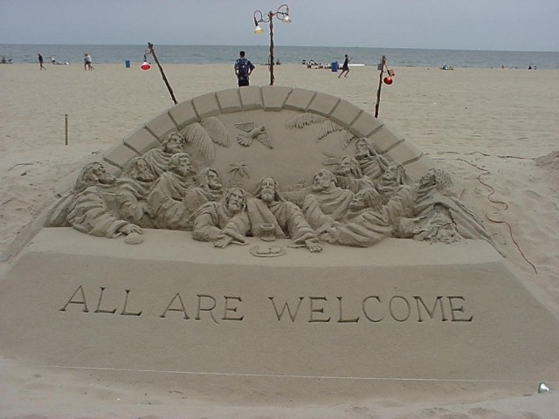
Mark 9–16
Dr. Rick Griffith • Jordan Evangelical Theological Seminary • BibleStudyDownloads.org

Slide 2
Slides on
Mark 9

Slide 3
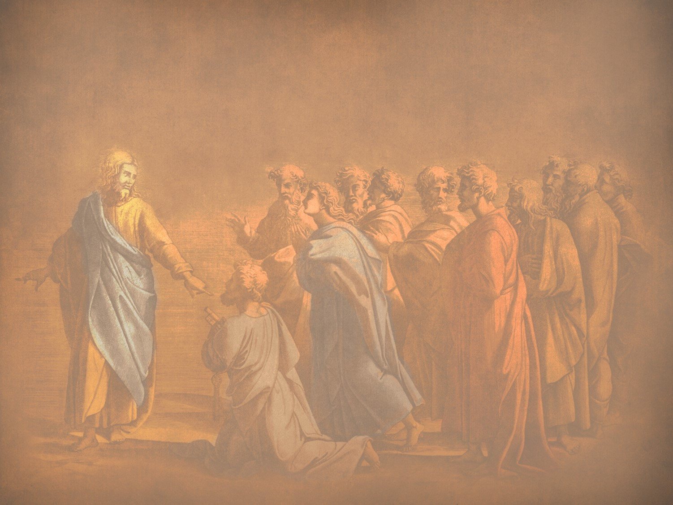
N. Revelation of the Kingdom
§ 87
Matthew 17:1-8; Mark 9:2-8; Luke 9:28-36
Three disciples see Christ’s glory as he promised a week earlier as a foretaste of his reign at the Second Advent and to authenticate Christ as One worthy of obedience
Notes:
The three Synoptic Gospels all record the Transfiguration of Jesus. Here is the only glimpse of the true nature of Christ that we find in the gospels as no one sees him in his full glory during his earthly life—and the Transfiguration was only for a few moments. God, in his mercy, did not let people view the glorified Christ lest they die in doing so! But this experience on the mountain (probably Mount Tabor) lifted the veil, as it were, so that at least Peter, James, and John could imagine the glory of Jesus when he reigns in the millennial kingdom.
_____________
LC-04-Instruction of the Twelve-106
NS-01-Matt15-18—slide 12
NS-02-Mark9-16—slide 3
NS-03-Luke1-12—slide 386

Slide 4
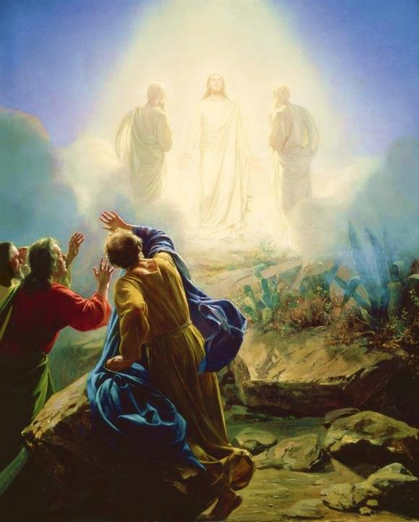
Carl Bloch, c. 1865
Transfiguration of Jesus
Mark 9:2-13 (ESV)
Notes:
Today’s scripture, found in Mark chapter 9, vs 2-13 is also about a transformation. This transformation is known as the Transfiguration of Jesus.
Transformation is an important theme in the Bible. The passage we read together earlier was from Paul’s letter to the Romans, ch 8 vs 19-30 was about transformation. As we saw in Romans 8:30, reading now from the ESV, Paul writes that “and those whom he predestined he also called, and those whom he called he also justified, and those whom he justified he also glorified.”
To go from sin and suffering to being called, justified, and glorified is an extreme transformation. So how do we get to that transformation? We look to Jesus. That is what we are going to do today. We will look at Jesus and his “transfiguration” or “transformation.”
We will see how it affected the disciples and how it should affect us.

Slide 5
Why only Peter, James, and John?
Mk 9:2-13 Transfiguration
Mk 14:33 Gethsemane
With Andrew
Mk 1:29-30 Peter’s Mother-in Law
Mk 13:3 Olivet Discourse

Slide 6
² And after six days Jesus took with him Peter and James and John, and led them up a high mountain by themselves.
Mark 9:2-13 (ESV)
Notes:
Now we pick in in Mark ch 9 vs 2

Slide 7

How do you recharge?
Mark 6:30-32
³⁰ The apostles returned to Jesus and told him all that they had done and taught. ³¹ And he said to them, “Come away by yourselves to a desolate place and rest a while.” For many were coming and going, and they had no leisure even to eat. ³² And they went away in the boat to a desolate place by themselves.

Slide 8
² And after six days Jesus took with him Peter and James and John and led them up a high mountain by themselves. And he was transfigured before them, ³ and his clothes became radiant, intensely white, as no one on earth could bleach them. ⁴ And there appeared to them Elijah with Moses, and they were talking with Jesus.
Mark 9:2-13 (ESV)
Notes:
Now we pick in in Mark ch 9 vs 2

Slide 9
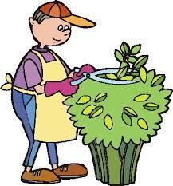
What did they see?
John 20:15 . . . Supposing him to be the gardener

Slide 10

Revelation 1
¹² Then I turned to see the voice that was speaking to me, and on turning
I saw seven golden lampstands,
¹³ and in the midst of the lampstands one like a son of man, clothed with a long robe and with a golden sash around
his chest. ¹⁴ The hairs of his head were white, like white wool, like snow. His eyes were like a flame of fire, ¹⁵ his feet were like burnished bronze, refined in a furnace, and his voice was like the roar of many waters
¹⁶ In his right hand he held seven stars, from his mouth came a sharp two-edged sword, and his face was like the sun shining in full strength.

Slide 11
² And after six days Jesus took with him Peter and James and John, and led them up a high mountain by themselves. And he was transfigured before them, ³ and his clothes became radiant, intensely white, as no one on earth could bleach them. ⁴ And there appeared to them Elijah with Moses, and they were talking with Jesus.
Mark 9:2-13 (ESV)
Notes:
Now we pick in in Mark ch 9 vs 2

Slide 12
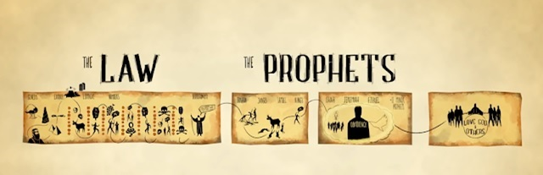
Jesus
Moses
Elijah

Slide 13
² And after six days Jesus took with him Peter and James and John, and led them up a high mountain by themselves. And he was transfigured before them, ³ and his clothes became radiant, intensely white, as no one on earth could bleach them. ⁴ And there appeared to them Elijah with Moses, and they were talking with Jesus. ⁵ And Peter said to Jesus, “Rabbi, it is good that we are here. Let us make three tents, one for you and one for Moses and one for Elijah.” ⁶ For he did not know what to say, for they were terrified.
Mark 9:2-13 (ESV)
Notes:
How do the disciples respond?

Slide 14
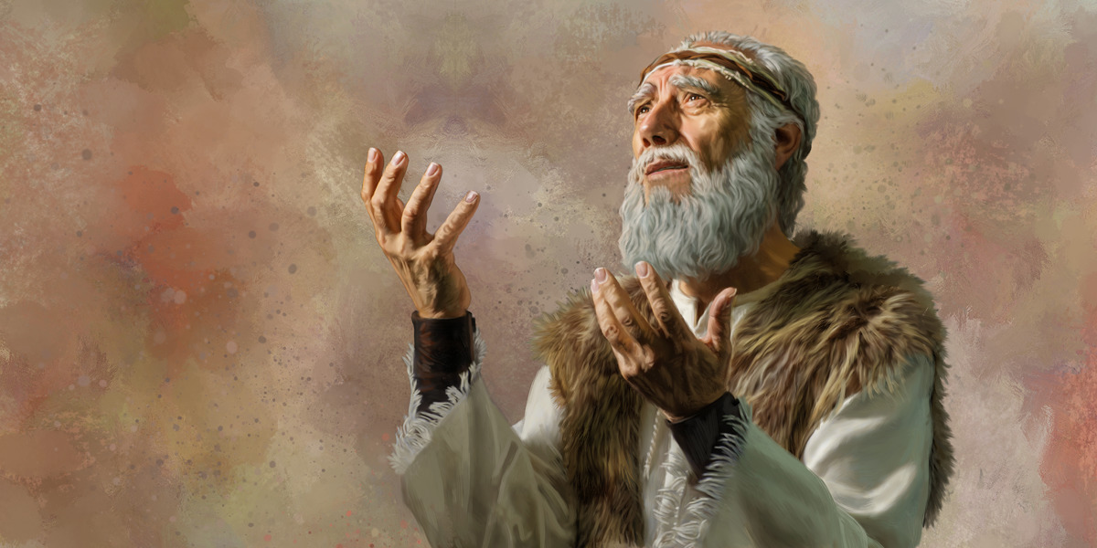
The Second Coming
"Look, I am sending you the prophet Elijah before the great and dreadful day of the LORD arrives. ⁶ His preaching will turn the hearts of fathers to their children, and the hearts of children to their fathers. Otherwise, I will come and strike the land with a curse" (Malachi 4:5-6 NLT).
Notes:
Here are the final two verse of the Old Testament that include both blessing and a curse.
__________
LC-04-Instruction of the Twelve-118
OS-39-Malachi-135
NS-01-Matt 15-28-slide 23

Slide 15

The Expectation: Elijah, Messiah, Kingdom
76
MESSIAH
"This Age"
"The Age to Come"
PROPHECY
KINGDOM
Mysteries of the Kingdom
Matthew 13
E
M
"K"
E
M
K
Rejection
Reception
1st Advent
2nd Advent
Judgment on Israel
Blessing to Gentiles
Judgment on Nations
Restoration of Israel
Adapted from Mark L. Bailey, DTS class notes, 1986
Notes:
The key element between the present age and the age to to come (the kingdom age) in Jewish theology was the coming of the Messiah. But he would be preceded by an Elijah figure. John the Baptist could have been that "Elijah" had Israel believed in Messiah, for the millennial kingdom would then have followed with a righteous nation. But since Israel rejected her king, another "Elijah" yet will come—probably one of the two witnesses of Rev 11. In the meantime, this Interadvent Age has the kingdom in but mystery form with spiritual benefits given to the Gentiles until the full number of Gentiles occurs (Rom 11:25-27). Then, instead of judgment on Israel and blessing on the Gentiles, it will reverse. The judgment will be upon the nations opposing Israel (Ezek 38–39) followed by blessing upon Israel (Ezek 40–48).
__________
LC-04-Instruction of the Twelve-119
OS-39-Malachi-136
NS-01-Matt 15-28-slide 24
NS-02-Mark9-16—slide 15

Slide 16
¹¹ And they asked him, “Why do the scribes say that first Elijah must come?” ¹² And he said to them, “Elijah does come first to restore all things. And how is it written of the Son of Man that he should suffer many things and be treated with contempt? ¹³ But I tell you that Elijah has come, and they did to him whatever they pleased, as it is written of him.”
Mark 9:2-13 (ESV)

Slide 17
A Good Question
Q: Why must Elijah come first?
A: The Scriptures say so
Mal 3:1 "Behold, I send my messenger, and he will prepare the way before me."
Mal 4:5 "Behold, I will send you Elijah the prophet before the great and awesome day of the Lord comes."

Slide 18
Having established the authority of Scripture
Q: Why must Messiah suffer?
A: The Scriptures say so
Ps 69:20-21 "Behold, I send my messenger, and he will prepare the way before me."
Isa 53 "But he was pierced for our transgressions;
he was crushed for our iniquities;
upon him was the chastisement that brought us peace,
and with his wounds we are healed."

Slide 19
¹¹ And they asked him, “Why do the scribes say that first Elijah must come?” ¹² And he said to them, “Elijah does come first to restore all things. And how is it written of the Son of Man that he should suffer many things and be treated with contempt? ¹³ But I tell you that Elijah has come, and they did to him whatever they pleased, as it is written of him.”
Mark 9:2-13 (ESV)

Slide 20

By what authority can Jesus proclaim John the Baptist fulfills prophecies about Elijah?

Slide 21
# | Title | Mt | Mk | Lk | Jn
1 | Jesus Heals Many | Mt 4:23–24 | Mk 1:32–34
2 | Jesus Casts Out Demons | Mt 4:24 | Mk 1:39 | Lk 7:18–23
3 | Jesus Cleanses a Leper | Mt 8:1–4 | Mk 1:40–45 | Lk 5:12–16
4 | Jesus Heals a Centurion’s Servant | Mt 8:5–13 |  | Lk 7:1–10
-----------------------------------------
59 | Jesus Appears in a Locked Room |  |  |  | Jn 20:19–23
60 | Jesus Appears in a Locked Room for Thomas |  |  |  | Jn 20:26–29
61 | Jesus Provides a Miraculous Catch of Fish (John) |  |  |  | Jn 21:4–6
61 Miracles

Slide 22
Terrified in the presence of the Lord
Listen to the Lord
The Disciples Listened to the Lord
Disciples' questions answered by the Lord

Slide 23
Be Transformed!
Not Terrified

Slide 24
Slides on
Mark 10

Slide 25


Free
Bible
images
A RICH YOUNG MAN QUESTIONS JESUS
Matthew 19:16-30; Mark 10:17-31; Luke 18:18-30

Slide 26


Slide 27


Slide 28


Slide 29


Slide 30


Slide 32


Slide 33


Slide 34


Slide 35


Slide 36

Used with Permission
THE
GOSPEL
——OF—— MATTHEW
THE
GOSPEL
——OF—— MARK
THE
GOSPEL
——OF—— LUKE
THE
GOSPEL
——OF—— JOHN
Due to the Lumo Project producing its own publishing material we regret to inform you that we cannot license our photos to other clients outside of freebibleimages.org.
These images are not licensed for reuse in video, epublishing or other media. Downloaded pictures and files cannot be redistributed through any other website than freebibleimages.org or used in any context where the accompanying message is undermining of the Christian faith and gospel.
Photos can only be used on educational presentations, blogs and social media, all of which should be accompanied with reference to www.LumoProject.com.
Picture courtesy of BBM
© All Rights Reserved.
www.bigbookmedia.com

Slide 37

Jesus taught en route to Jerusalem that his disciples will be resisted (8:27–10:52).

Slide 38


Mark 10:35-37
³⁵ Then James and John, the sons of Zebedee,
came to him. “Teacher,” they said,
“We want you to do for us whatever we ask.”
³⁶ “What do you want me to do for you?”
he asked. ³⁷ They replied,
“Let one of us sit at your right and
the other at your left in your glory.”

Slide 39
Mark 10:38-40
³⁸ “You don’t know what you are asking,”
Jesus said. “Can you drink the cup I drink or
be baptized with the baptism I am baptized with?”
³⁹ “We can,” they answered.
Jesus said to them, “You will drink the cup
I drink and be baptized with the baptism
I am baptized with, ⁴⁰ but to sit at my right or left
is not for me to grant. These places belong to
those for whom they have been prepared.”

Slide 40
Mark 10:41-42
⁴¹ When the ten heard about this,
they became indignant with James and John.
⁴² Jesus called them together and said,
“You know that those who are regarded
as rulers of the Gentiles lord it over them,
and their high officials exercise authority
over them.

Slide 41
Mark 10:43-45
⁴³ Not so with you. Instead,
whoever wants to become great among you
must be your servant,
⁴⁴ and whoever wants to be first
must be slave of all.
⁴⁵ For even the Son of Man did not
come to be served, but to serve,
and to give his life as a ransom for many.”

Slide 42
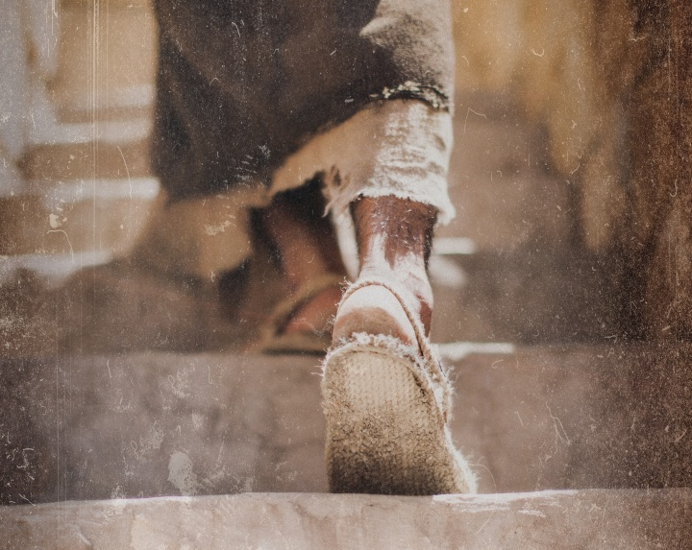
Do you resist the flow to serve Jesus more than anyone?

Slide 43

How can you be a true disciple of Jesus in a hostile world?
Notes:
What’s it gonna take to really follow Christ when most people around you oppose Jesus?

Slide 44
How to Be a Disciple in a Hostile World
Don’t cling to your Authority
Serve
like Jesus
Suffer like Jesus
1:1-13 | 1:14–10:52 | 11–15 | 16
Mark
Notes:
Mimic the self-sacrifice Jesus as Servant in his rejection and death (Mark 11–15).

Slide 45
Slides on
Mark 11

Slide 46
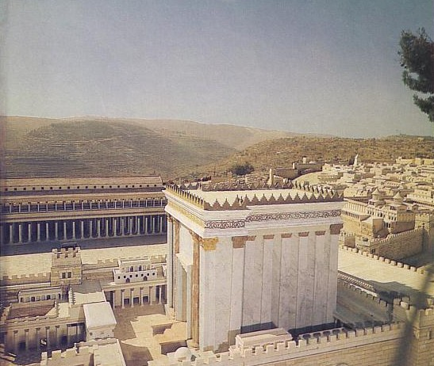
Outline
85
(1:14–10:52) Christ's ministry as Servant receives opposition, which Mark records with Christ's response of teaching on discipleship in order to encourage his readers to expect persecution for righteousness' sake.
(Chs. 11–15) Christ's self-sacrifice as Servant demonstrated in His rejection and death is recorded as the ultimate example of service to others despite persecution.
(Ch. 16) The resurrection account authenticates Jesus as Messiah and God so that those who serve this Servant can also have hope of victory over death.

Slide 47
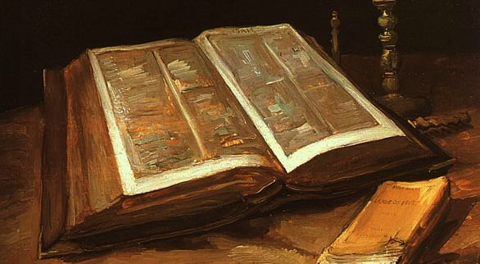
Mark 11:1-2 (ESV)
¹Now when they drew near to Jerusalem, to Bethphage and Bethany, at the Mount of Olives, Jesus sent two of his disciples ²and said to them, "Go into the village in front of you, and immediately as you enter it you will find a colt tied, on which no one has ever sat. Untie it and bring it.

Slide 48
Mark 11:3-4 (ESV)
³If anyone says to you, 'Why are you doing this?' say, 'The Lord has need of it and will send it back here immediately.'" ⁴And they went away and found a colt tied at a door outside in the street, and they untied it.

Slide 49
Mark 11:5-6 (ESV)
⁵And some of those standing there said to them, "What are you doing, untying the colt?" ⁶And they told them what Jesus had said, and they let them go.

Slide 50
Mark 11:7-8 (ESV)
⁷And they brought the colt to Jesus and threw their cloaks on it, and he sat on it. ⁸And many spread their cloaks on the road, and others spread leafy branches that they had cut from the fields.

Slide 51
Mark 11:9-10 (ESV)
9And those who went before and those who followed were shouting, "Hosanna! Blessed is he who comes in the name of the Lord! 10 Blessed is the coming kingdom of our father David! Hosanna in the highest!"

Slide 52


Matthew 21:1-11
Mark 11:1-11
Luke 19:28-44
John 12:12-19
THE EASTER STORY
TRIUMPHAL ENTRY (Palm Sunday)

Slide 53

Mark 11:1-11
As Jesus and his disciples approached Jerusalem, they came to the towns of Bethphage and Bethany on the Mount of Olives.

Slide 54
Jesus sent two of them on ahead. ² “Go into that village over there,” he told them.

Slide 55

“As soon as you enter it, you will see a young donkey tied there that no one has ever ridden. Untie it and bring it here.
³ If anyone asks, ‘What are you doing?’ just say, ‘The Lord needs it and will return it soon.’”

Slide 56

⁴ The two disciples left and found the colt standing in the street, tied outside the front door.

Slide 57

⁵ As they were untying it, some bystanders demanded…

Slide 58

“What are you doing, untying that colt?” ⁶ They said what Jesus had told them to say, and they were permitted to take it.

Slide 59

⁷ Then they brought the colt to Jesus...

Slide 60

…and threw their garments over it, and he sat on it.

Slide 61

⁸ Many in the crowd spread their garments on the road ahead of him, and others spread leafy branches they had cut in the fields.

Slide 62
⁹ Jesus was in the center of the procession, and the people all around him were shouting…

Slide 63

“Praise God!
Blessings on the one who comes in the name of the LORD!

Slide 64

¹⁰ Blessings on the coming Kingdom of our ancestor David!

Slide 65

"Praise God in highest heaven!"

Slide 66

Luke 19:39
But some of the Pharisees among the crowd said, “Teacher, rebuke your followers for saying things like that!”

Slide 67

Luke 19:40
He replied, “If they kept quiet, the stones along the road would burst into cheers!”

Slide 68

Luke 19:41
But as he came closer to Jerusalem and saw the city ahead…

Slide 69

Luke 19:41-42
…he began to weep. ⁴² “How I wish today that you of all people would understand the way to peace. But now it is too late, and peace is hidden from your eyes.

Slide 70

Luke 19:43
Before long your enemies will build ramparts against your walls and encircle you and close in on you from every side.

Slide 71

Luke 19:44
They will crush you into the ground, and your children with you. Your enemies will not leave a single stone in place, because you did not recognize it when God visited you.”

Slide 72
THE WORD IN PICTURES
Free
Bible
images

Slide 73
Used with Permission
THE
GOSPEL
——OF—— MATTHEW
THE
GOSPEL
——OF—— MARK
THE
GOSPEL
——OF—— LUKE
THE
GOSPEL
——OF—— JOHN
Due to the Lumo Project producing its own publishing material we regret to inform you that we cannot license our photos to other clients outside of freebibleimages.org.
These images are not licensed for reuse in video, epublishing or other media. Downloaded pictures and files cannot be redistributed through any other website than freebibleimages.org or used in any context where the accompanying message is undermining of the Christian faith and gospel.
Photos can only be used on educational presentations, blogs and social media, all of which should be accompanied with reference to www.LumoProject.com.
Picture courtesy of BBM
© All Rights Reserved.
www.bigbookmedia.com

Slide 74

Matthew 21:12-17
Mark 11:15-19
Luke 19:45-48
John 2:13-24
THE EASTER STORY
CLEANSING THE TEMPLE
Free
Bible
images

Slide 75


Slide 76


Slide 77


Slide 78


Slide 79


Slide 81


Slide 82


Slide 83


Slide 84


Slide 85


Slide 86


Slide 87


Slide 88


Slide 89


Slide 90


Slide 91
THE WORD IN PICTURES
Free
Bible
images

Slide 92
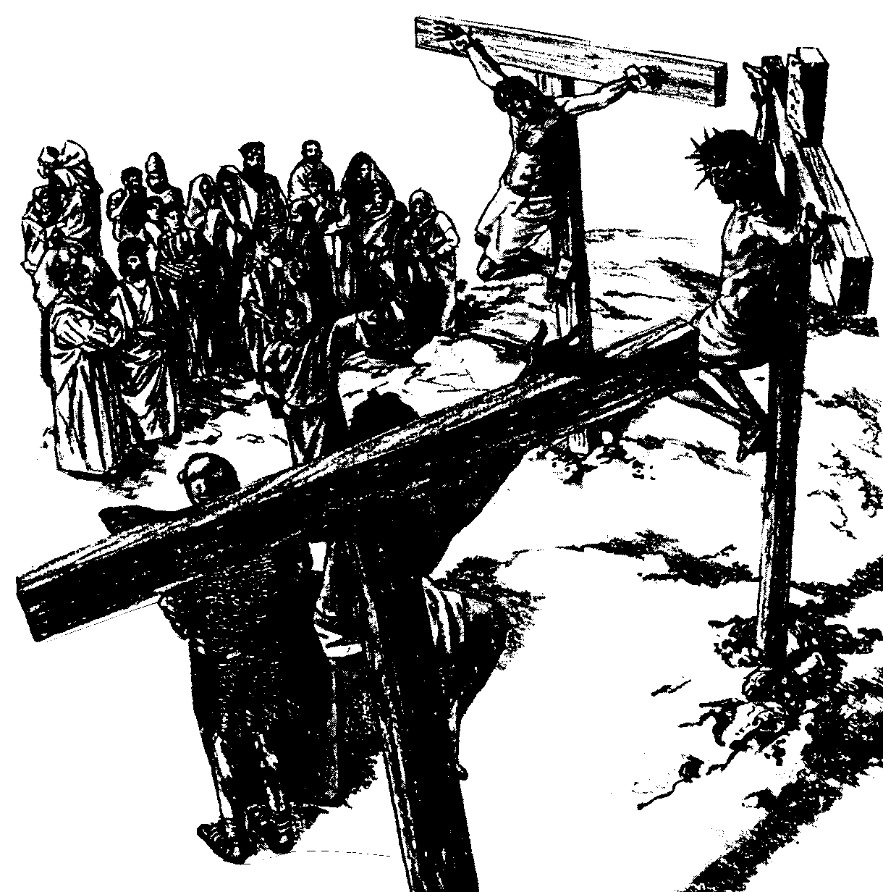
The Paradox of Authority and Servanthood in Mark
 | Authority | Servanthood
Themes | Christ's Leadership | Discipleship
Strategy | Gentiles lord it over others (10:42) | Disciples serve (10:43)
Motivation | "Save his life" (8:35a) | "Lose his life" (8:35b)
Priority | "First" (9:35a; 10:31a) | "Last" (9:35b; 10:31b)
Reputation | "Great" (10:43a) | "Servant" (10:43b)
Position | "First" (10:44a) | "Slave of all" (10:44b)
Authority Examples | Authority without Serving: • Religious leaders • Rich man • Judas | Authority & Served: • John the Baptist • Joseph of Arimathea
Servanthood Examples | Authority but Struggled to Serve: • Disciples | No Authority & Served • Bartimaeus • Woman who anointed Jesus
1st Section (1:1–8:26) | Authority of Christ
2nd Section (8:27–10:52) | Authority- Servanthood Tension
3rd Section (11–16) |  | Servanthood of Christ
89a
Summary of Narry F. Santos, Bibliotheca Sacra 154 (Oct.-Dec. 1997): 452-60

Slide 93
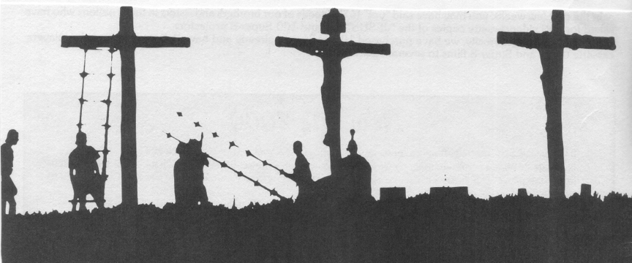
Worldly Leadership
Mark
89a
Worldly Leadership
Followers serve the leader,
who is at the top
Leader
Followers

Slide 94
Biblical Leadership
Mark
89a
Biblical Leadership
The leader serves the followers
Followers
Leader

Slide 95
Matthew 21:1-11
Mark 11:1-11
Luke 19:28-44
John 12:12-19
THE EASTER STORY
TRIUMPHAL ENTRY (Palm Sunday)

Slide 115
THE WORD IN PICTURES
Free
Bible
images

Slide 116
Used with Permission
THE
GOSPEL
——OF—— MATTHEW
THE
GOSPEL
——OF—— MARK
THE
GOSPEL
——OF—— LUKE
THE
GOSPEL
——OF—— JOHN
Due to the Lumo Project producing its own publishing material we regret to inform you that we cannot license our photos to other clients outside of freebibleimages.org.
These images are not licensed for reuse in video, epublishing or other media. Downloaded pictures and files cannot be redistributed through any other website than freebibleimages.org or used in any context where the accompanying message is undermining of the Christian faith and gospel.
Photos can only be used on educational presentations, blogs and social media, all of which should be accompanied with reference to www.LumoProject.com.
Picture courtesy of BBM
© All Rights Reserved.
www.bigbookmedia.com

Slide 117


Palm Sunday
Palm
SUNDAY
Notes:
Palm Sunday is an interesting name for the day, isn't it?
________
Common-427
NS-01-Matt15-28-slide 131
NS-02-Mark9-16-slide 96
NS-03-Luke13-24-slide 94
NS-04-John12-21-slide 23

Slide 118


Palm Sunday
Notes:
We know that today recalls the palm branches waved at Jesus as he entered Jerusalem at the beginning of his last week of his life. Yet the focus really isn't the tree palms, but the hand palms of Jesus that would stretch out on a cross but a few days later.

Slide 119

Palms to Cross
Notes:
Tree palms were but a prelude to the cross.

Slide 120


Triumphant Entry
Matthew 21:9
Notes:
Even the alternate name—Triumphant Entry—is also perplexing.

Slide 121

Triumphal Entry
Notes:
True, Jesus rode into Jesus and the crowds cheered his arrival.

Slide 122

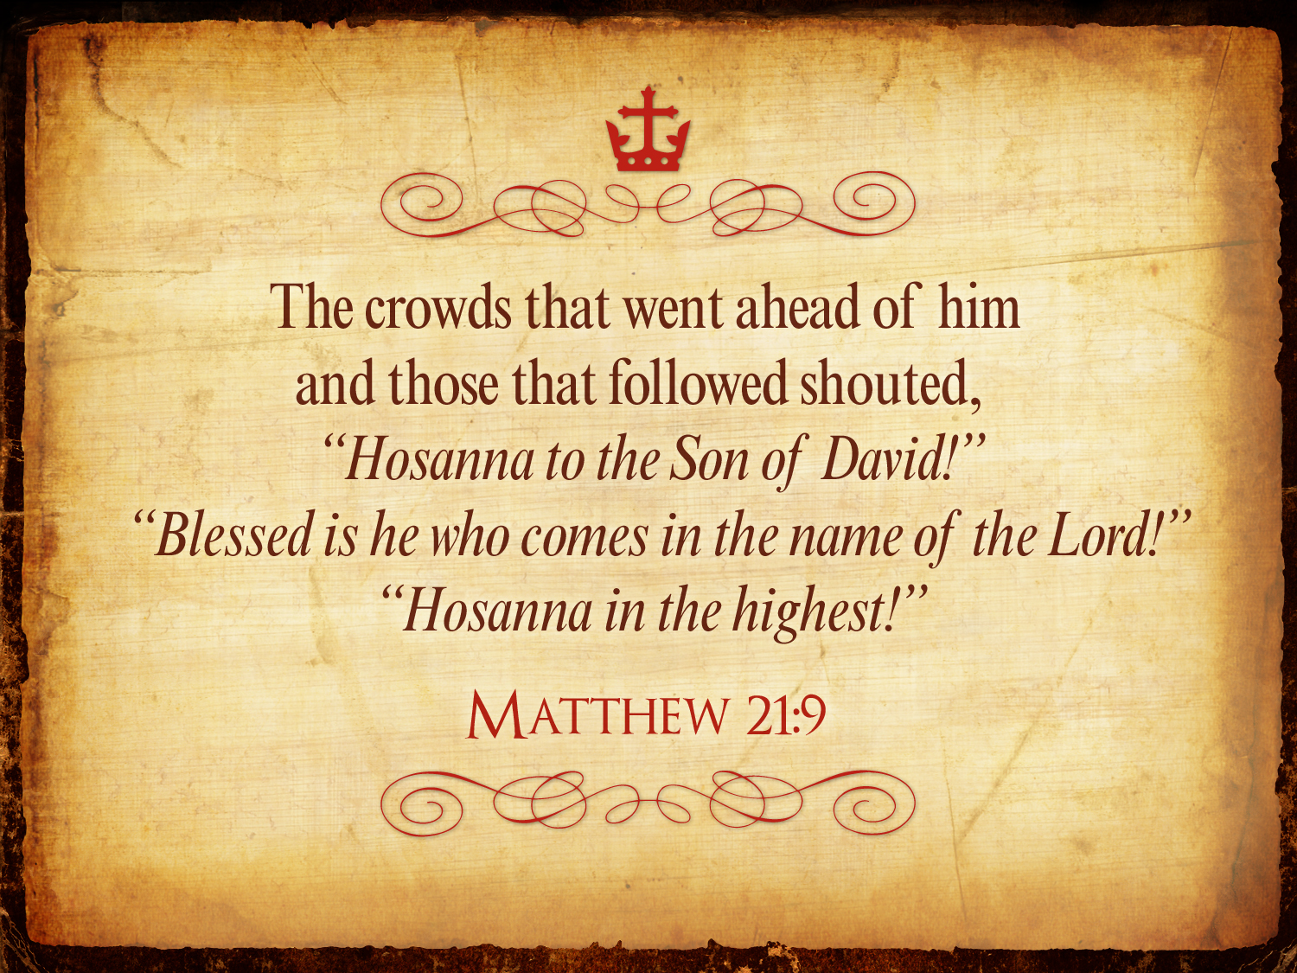
Triumphant Entry
Matthew 21:9
Notes:
Matthew 21:9 says the crowds that went ahead of him and those that followed shouted, "Hosanna to the Song of David!" "Blessed is he who comes in the name of the Lord!" "Hosanna in the highest!"

Slide 123

Palms to Palms
Notes:
Normally a king rode into the city as the victor over his enemies, while that very week would culminate in Jesus' death on Friday, which we call Good Friday.

Slide 124

What's so good about Good Friday?
Notes:
But that name is equally puzzling. Why is Good Friday called "good"?
Our leader died on that day, so it seems strange to call the day "good." No other religion refers to the death of their leader as "good."
We believe that his death was good. How was that?

Slide 125

How is Christ's death better than any sacrifice?

Slide 126

Passion Week
64
Mon
Wed
Tues
Fri
Thurs
Fri
Sun
Sat
Sat
Sun
Notes:
Jesus invested his final week in Jerusalem and Bethany east of it, going back and forth from Bethany to the city in a purposeful series of events designed to end in his crucifixion and resurrection.
__________
Common-432
LC-00-NT Chronology-43
NS-01-Matt15-28-slide 139
NS-02-Mark9-16-slide 105
NS-03-Luke13-24-slide 224
NS-04-John12-21-slide 295

Slide 127
Slides on
Mark 12

Slide 128

What’s Most Important?
Notes:
What do you think is the most important thing we do as a church? Worship? Evangelism? Fellowship? Bible study? Prayer? A few weeks ago a man inquiring about our church asked me, “So what is most important to your church? What is unique?” If he had asked you, what would you have said? I told him one word: LOVE!
One of the teachers of religious law was standing there listening to Jesus debate. He realized that Jesus had answered well, so he asked, “Of all the commandments, which is the most important?”
________
NS-01-Matt15-28-slide 143
NS-02-Mark9-16-slide 107
128

Slide 129

The most important thing is to enjoy your life— it's all that matters
—Audrey Hepburn—
Notes:
She obviously could not see beyond herself.
________
NS-01-Matt15-28-slide 143
NS-02-Mark9-16-slide 107

Slide 130
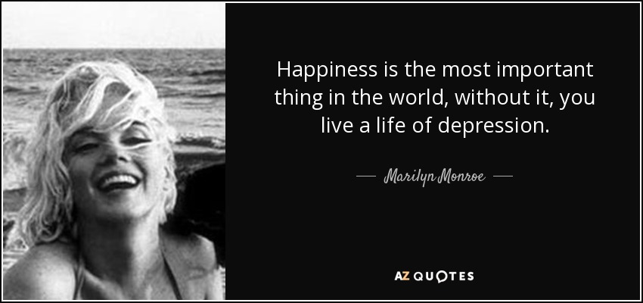
"Happiness is most important"
Happiness is the most important thing in the world, without it, you live a life of depression.
—Marilyn Monroe—
Notes:
She died young through suicide.
________
NS-01-Matt15-28-slide 144
NS-02-Mark9-16-slide 109

Slide 131

What’s Most Important?
Mark 12:29-31 -- Jesus replied, “The most important commandment is this: ‘Listen, O Israel! The Lord our God is the one and only Lord. ³⁰ And you must love the Lord your God with all your heart, all your soul, all your mind, and all your strength.’
³¹ The second is equally important:
‘Love your neighbor as yourself.’ No other commandment is greater than these.”
Notes:
One of the teachers of religious law was standing there listening to the debate. He realized that Jesus had answered well, so he asked, “Of all the commandments, which is the most important?” Jesus answered…
——————————
Common-293
OS-05-Deut-154
NS-01-Matt15-28-slide 146
NS-02-Mark9-16-slide 110
131

Slide 132

Our Vision
Love the Nations
Love the Church
Love God
Notes:
Repentance will bring restoration in a church: God wants our church to really trust him.
We still don’t see our need for him as we don’t see our need to pray.
We also need to be involved in his work: missions, teaching, accountability groups, finances, etc.
——————————
OS-29-Joel-128
OP-05-Deut-71

Slide 133
Slides on
Mark 13

Slide 134
Slides on
Mark 14

Slide 135
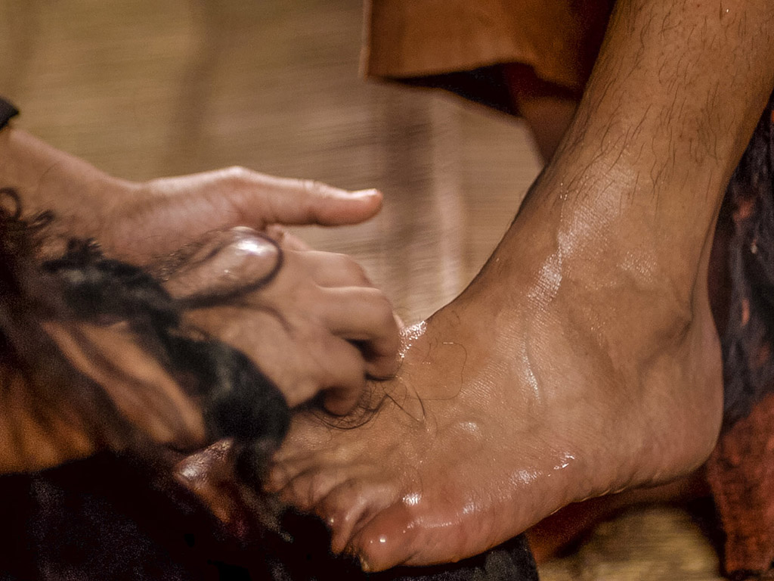
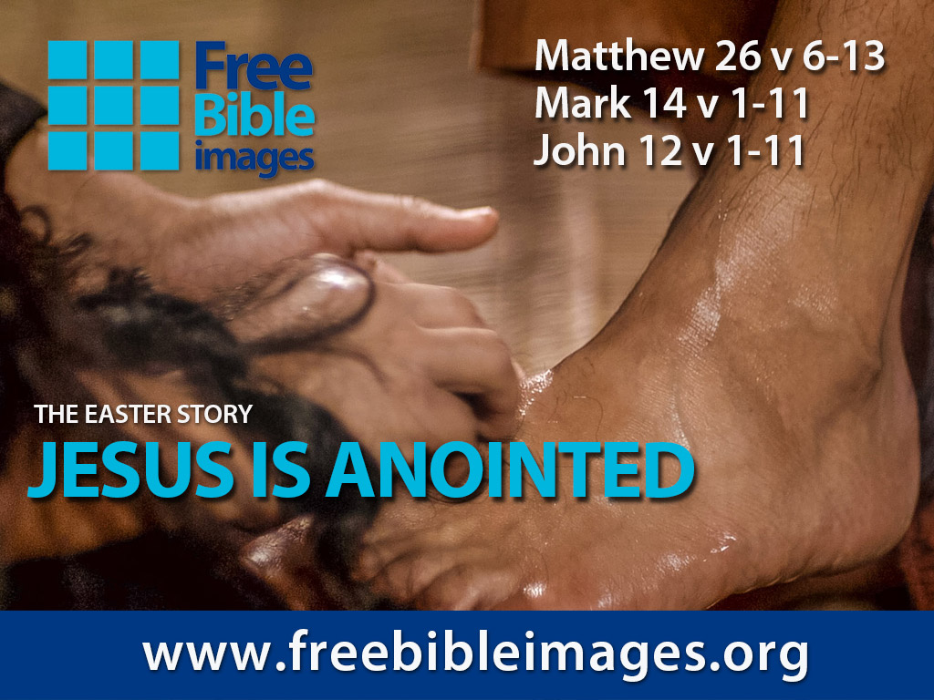
Broken & Spilled Out
Matthew 26:6-13
Mark 14:1-11
John 12:1-11
Free
Bible
images
Performed By Steve Green
JESUS IS ANOINTED
Notes:
FreeBibleImages.org does what it says it does, offering photos and cartoons on narrative portions of Scripture. These are copyright-free as well and continually updated.
This 1980s song accurately narrates how Mary of Bethany anointed Jesus for his burial as no time would be available to perform these Jewish rites the next day when the body of Jesus was hastily buried.
______________
Common-431
BS-20-Study Tools-6
NS-01-Matt15-28-slide
NS-02-Mark9-16-slide
NS-04-John12-21-slide 5

Slide 136
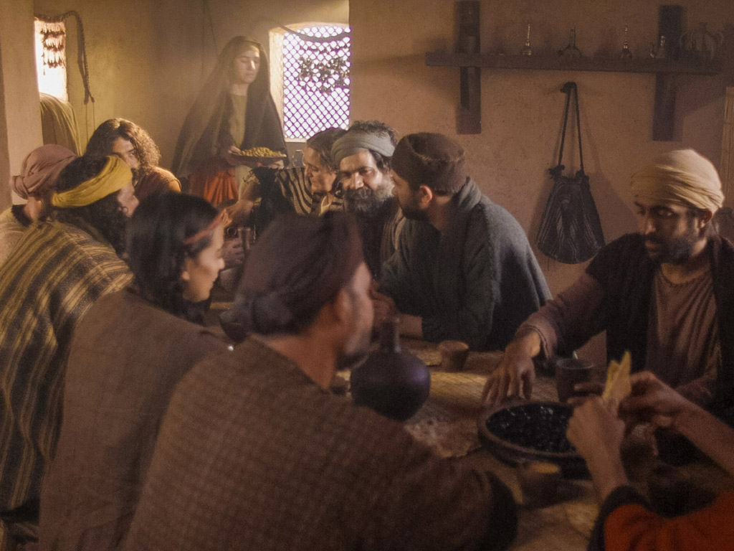
Notes:
Music background 1 of 2

Slide 137

Notes:
Music background 1 of 2

Slide 138

One day a plain village woman, driven by love for her Lord

Slide 139
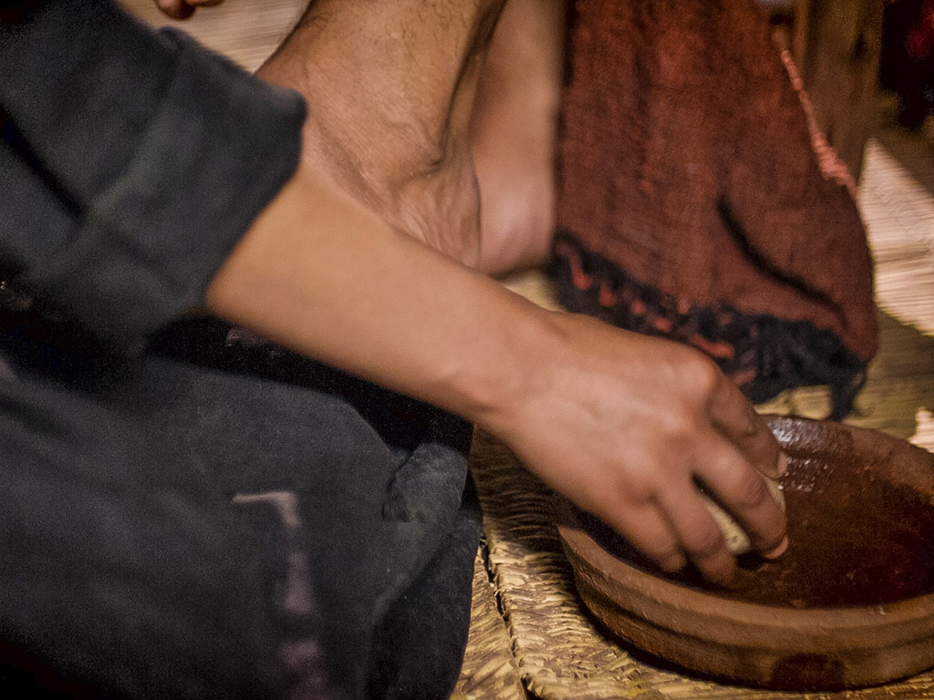
Recklessly poured out a valuable essence, disregarding the scorn

Slide 140
And once it was broken and spilled out
A fragrance filled all the room.

Slide 141
Like a prisoner released from his shackles
Like a spirit set free from the tomb

Slide 142
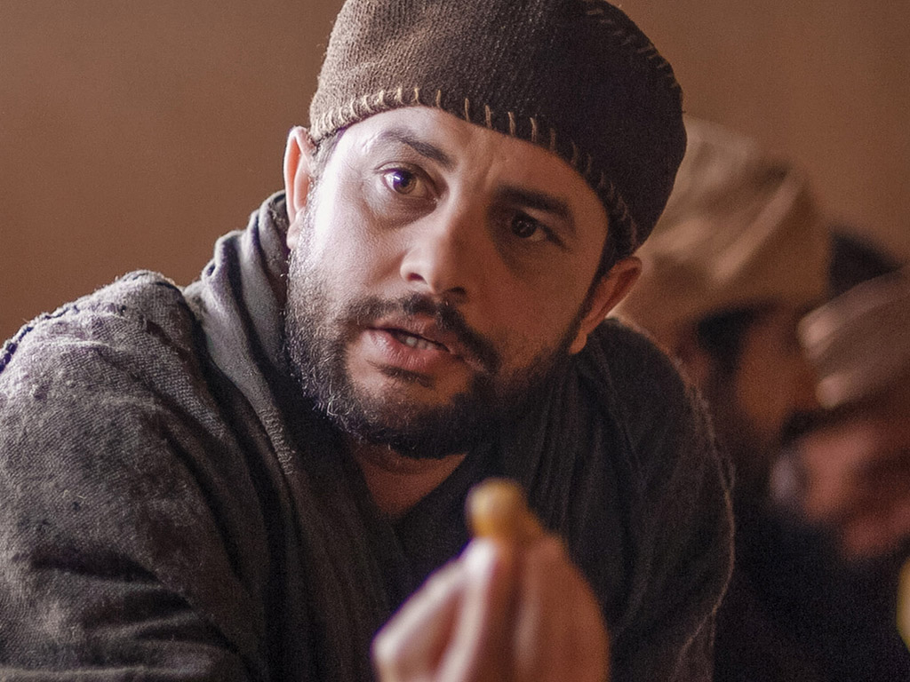
Broken and spilled out, just for love of you, Jesus

Slide 143
Life's most precious treasure, lavished on Thee

Slide 144
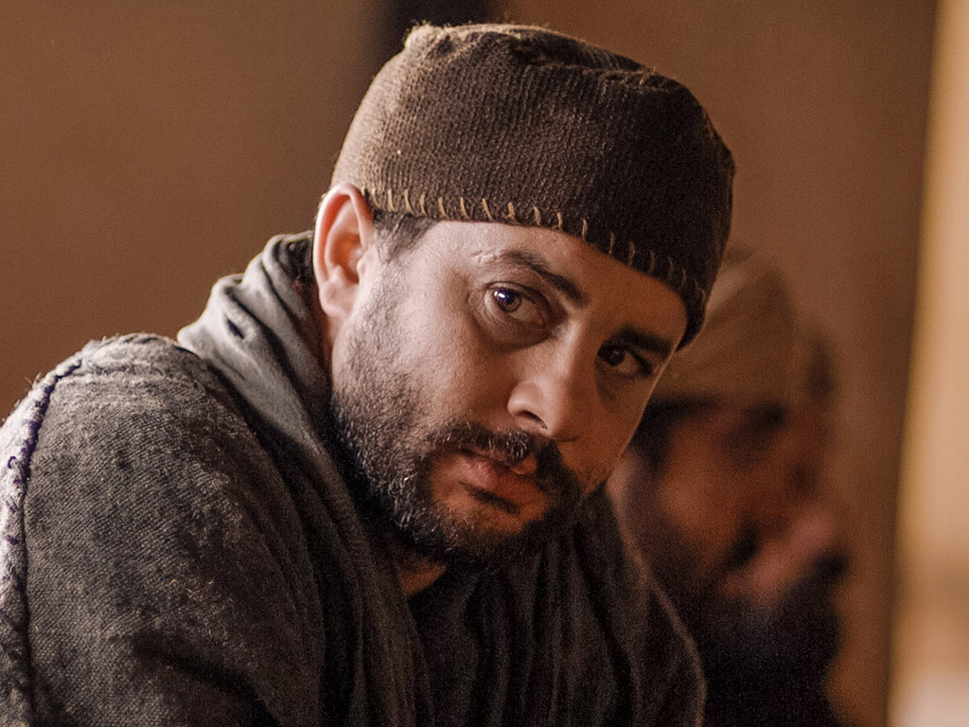
Broken and spilled out, and poured at Your feet

Slide 145
In sweet abandon let me be spilled out and used up for Thee

Slide 146
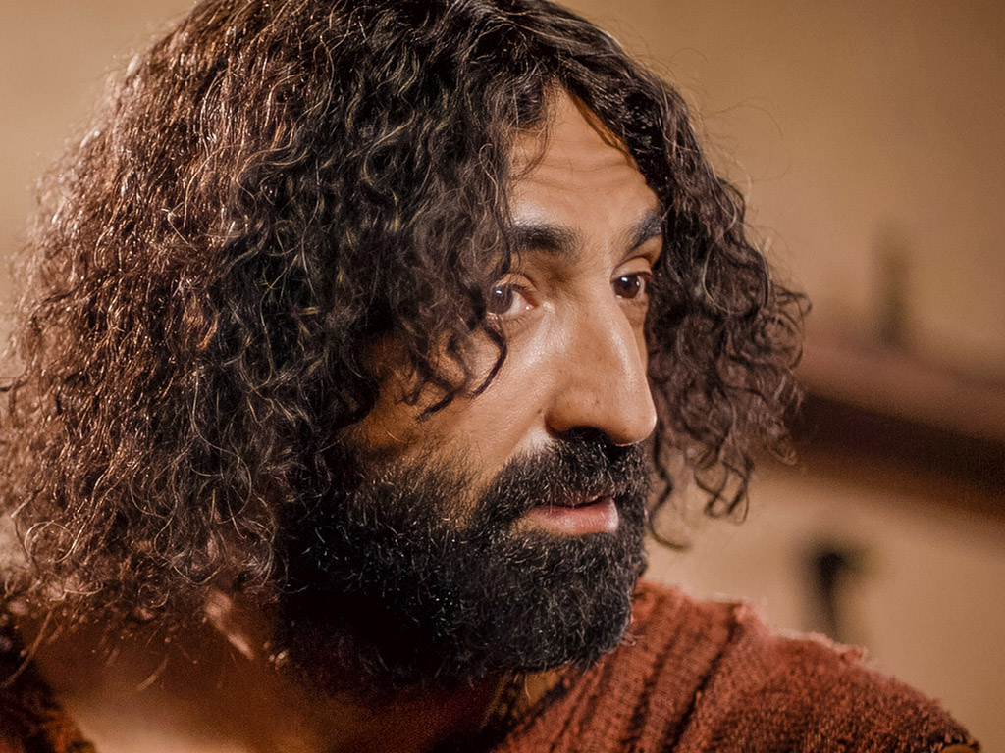
Lord, You were God's precious treasure,
His loved and His own perfect Son

Slide 147
Sent here to show me the love of the Father, just for love it was done

Slide 148
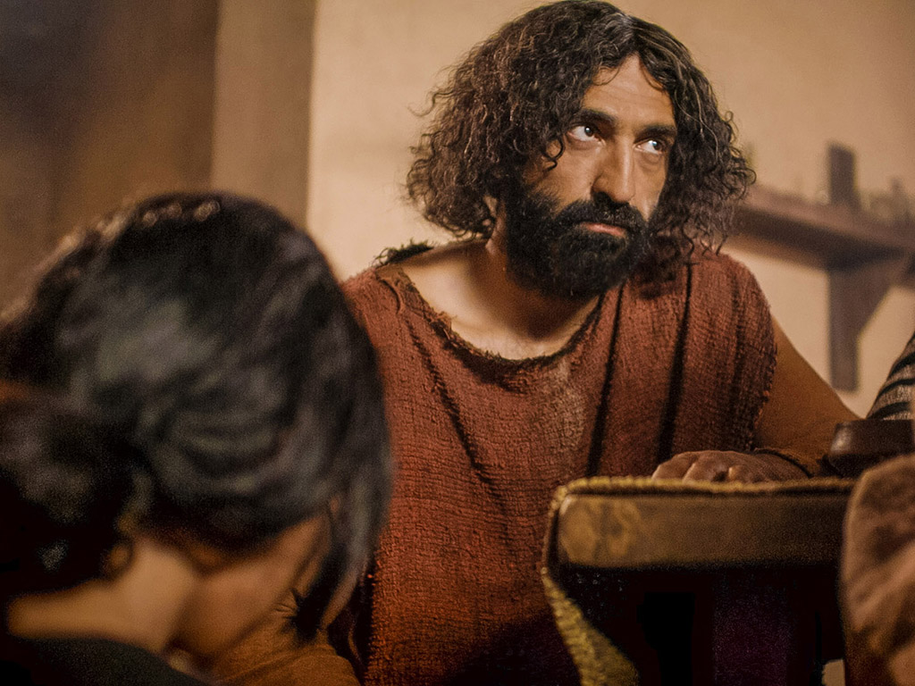
And though You were perfect and holy
You gave up Yourself willingly

Slide 149
You spared no expense for my pardon
You were used up and wasted for me

Slide 150
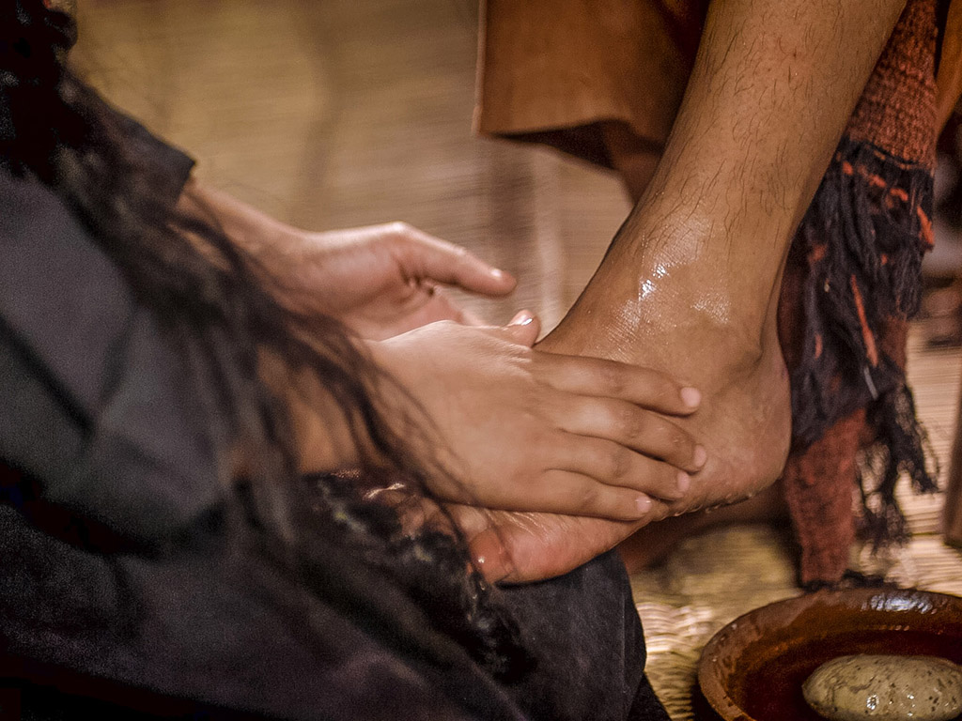
Broken and spilled out
Just for love of me, Jesus––

Slide 151
God's most precious treasure lavished on me

Slide 152
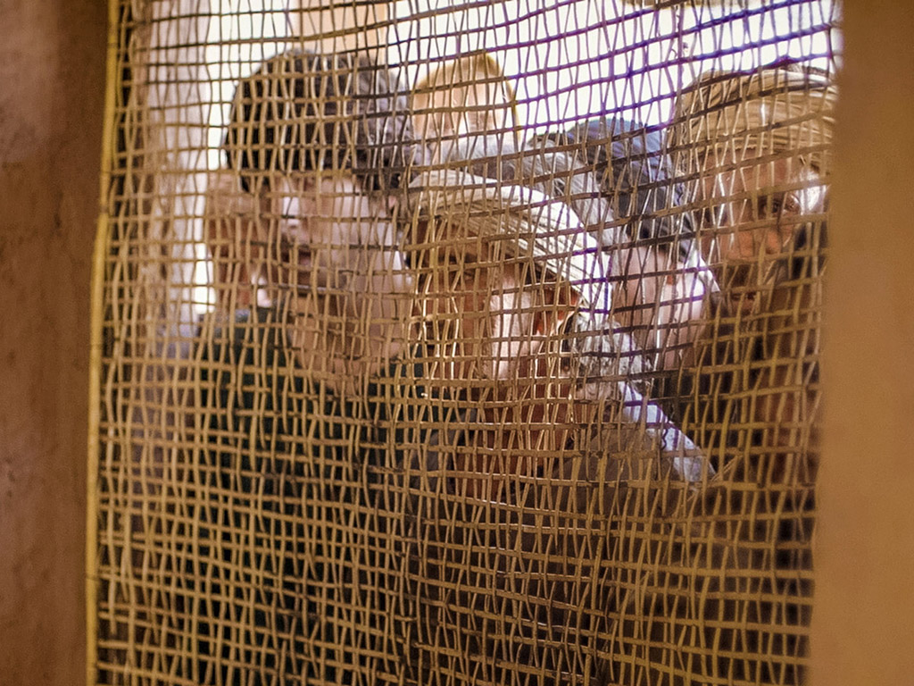
Broken and spilled out and poured at my feet.

Slide 153
In sweet abandon,
Lord, You were spilled out and used up for me

Slide 154
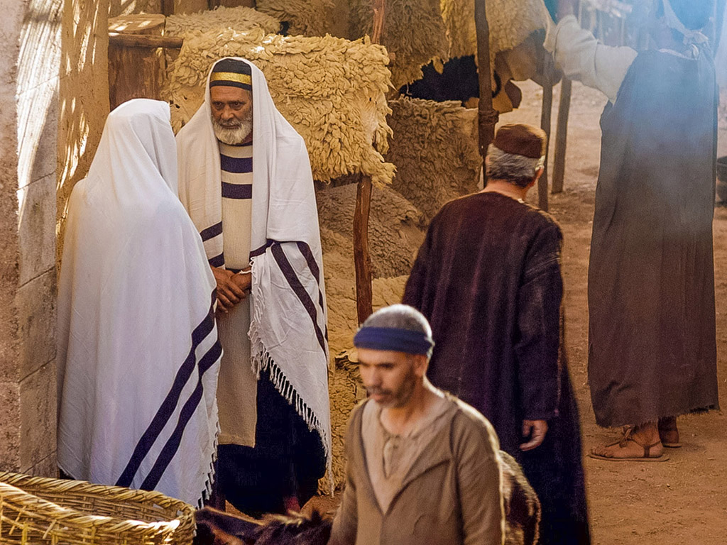
In sweet abandon, let me be spilled out and used up for Thee

Slide 155

Pictures courtesy of Big Book Media
© All Rights Reserved.
Used with permission
BIG BOOK MEDIA

Slide 156
THE WORD IN PICTURES
Free
Bible
images

Slide 157


Was Mary Magdalene the Woman with the Alabaster Jar?
The WOMAN
with the
ALABASTER JAR
Mary Magdalen and the Holy
Grail
No. In Luke she is not named but in the other gospels she is clearly Mary of Bethany
As featured in The
Da Vinci Code

Slide 158

John 12 Events
64
656
Unbelief Summary
12:37-50
Predicts Death
12:21-36
Triumphal Entry
12:12-20
Anointing at Bethany
12:1-11
Notes:
John leaves out the many details of Passion Week noted in the Synoptics except his anointing and Triumphal Entry, choosing instead to highlight the prediction of his death and the unbelief of the leaders.
____________
Common-433
NS-01-Matt15-28-slide 183
NS-02-Mark9-16-slide 130
NS-03-Luke13-24-slide 104
NS-04-John12-21-slide 4

Slide 159

Luke 7:36-50
Jesus and the Sinful Woman

Slide 160

Anointings of Jesus
Common to all four gospel accounts:
Unannounced visit by woman
Anointed Jesus' head and/or feet
Wiped his feet with her hair
Complaint of waste by disciples/Judas
Disciples rebuked by Jesus
In a home
Alabaster jar (except in John)
Home owned by man called Simon

Slide 161

The Two Anointings of Jesus
Luke 7:36-50
Early in Ministry
Weeping
For worship, woman's
sins forgiven (Luke 7:48)
By unnamed harlot at
home of Simon the
Pharisee (Luke 7:40) in
an unknown town
Matt. 26:6-13
Mark 14:3-9
John 12:1-11
During Passion Week
No weeping noted
For burial, woman needed
no forgiveness
By Lazarus' sister Mary at home of Simon the Leper
(Matt. 26:6; Mark 14:3) in Lazarus' hometown of Bethany (John 12:1)

Slide 162

Free
Bible
images
Matthew 26:17-35
Mark 14:12-31
Luke 22:7-38
John 13:18-38
THE EASTER STORY
THE LAST SUPPER

Slide 163


Slide 164


Slide 165


Slide 166


Slide 167


Slide 168


Slide 169


Slide 170


Slide 172


Slide 173


Slide 174


Slide 175


Slide 176


Slide 177


Slide 178
THE WORD IN PICTURES
Free
Bible
images

Slide 179

Matthew 26:36-56
Mark 14:32-52
Luke 22:39-53
John 18:1-12
THE EASTER STORY
JESUS PRAYS IN GETHSEMANE

Slide 180


Slide 181


Slide 182


Slide 183


Slide 184


Slide 186


Slide 187


Slide 188


Slide 189


Slide 190


Slide 191


Slide 192


Slide 193


Slide 194


Slide 195


Slide 196


Slide 197


Slide 198


Slide 199


Slide 200
THE WORD IN PICTURES
Free
Bible
images

Slide 201
Used with Permission
THE
GOSPEL
——OF—— MATTHEW
THE
GOSPEL
——OF—— MARK
THE
GOSPEL
——OF—— LUKE
THE
GOSPEL
——OF—— JOHN
Due to the Lumo Project producing its own publishing material we regret to inform you that we cannot license our photos to other clients outside of freebibleimages.org.
These images are not licensed for reuse in video, epublishing or other media. Downloaded pictures and files cannot be redistributed through any other website than freebibleimages.org or used in any context where the accompanying message is undermining of the Christian faith and gospel.
Photos can only be used on educational presentations, blogs and social media, all of which should be accompanied with reference to www.LumoProject.com.
Picture courtesy of BBM
© All Rights Reserved.
www.bigbookmedia.com

Slide 202
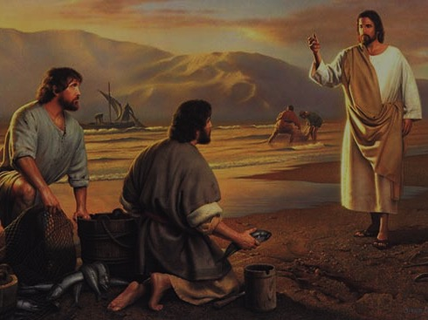
Peter's Calling
(Mark's source for his gospel)

Slide 203
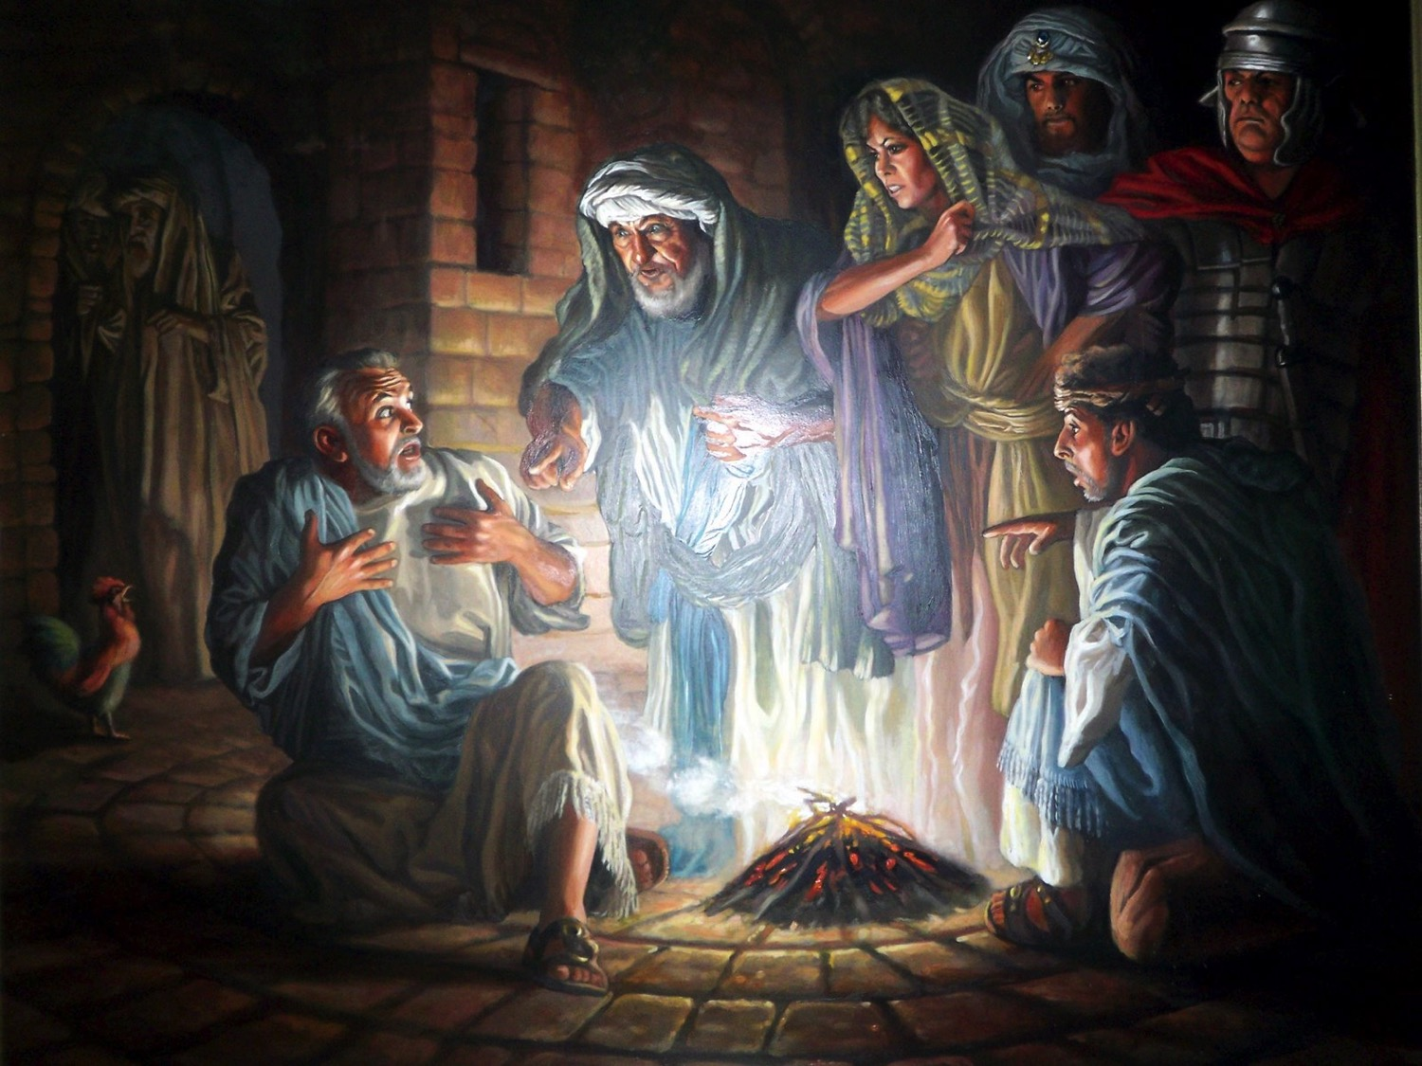
Peter's Denials

Slide 204


Free
Bible
images
Matthew 26:69-75
Mark 14:66-72
Luke 22:54-62
John 18:15-27
THE EASTER STORY
PETER DENIES JESUS

Slide 205


Slide 206


Slide 207


Slide 208


Slide 209


Slide 210


Slide 211


Slide 212


Slide 213


Slide 215
Pictures courtesy of Big Book Media
© All Rights Reserved.
Used with permission
BIG BOOK MEDIA

Slide 216
THE WORD IN PICTURES
Free
Bible
images

Slide 217

Free
Bible
images
Matthew 26:57-67
Mark 14:53-65
Luke 22:66-71
John 18:15-27
THE EASTER STORY
JESUS BEFORE
THE SANHEDRIN

Slide 218


Slide 219


Slide 220


Slide 222


Slide 223


Slide 224


Slide 225


Slide 226
THE WORD IN PICTURES
Free
Bible
images

Slide 227
Used with Permission
THE
GOSPEL
——OF—— MATTHEW
THE
GOSPEL
——OF—— MARK
THE
GOSPEL
——OF—— LUKE
THE
GOSPEL
——OF—— JOHN
Due to the Lumo Project producing its own publishing material we regret to inform you that we cannot license our photos to other clients outside of freebibleimages.org.
These images are not licensed for reuse in video, epublishing or other media. Downloaded pictures and files cannot be redistributed through any other website than freebibleimages.org or used in any context where the accompanying message is undermining of the Christian faith and gospel.
Photos can only be used on educational presentations, blogs and social media, all of which should be accompanied with reference to www.LumoProject.com.
Picture courtesy of BBM
© All Rights Reserved.
www.bigbookmedia.com

Slide 228
Slides on
Mark 15

Slide 229

Free
Bible
images
Matthew 27:27-37
Mark 15:16-25
Luke 23:26-34
John 19:16-27
THE EASTER STORY
JESUS IS CRUCIFIED

Slide 230


Slide 231


Slide 232


Slide 233


Slide 234


Slide 235


Slide 236


Slide 237


Slide 238


Slide 239


Slide 240


Slide 241


Slide 242


Slide 243


Slide 244


Slide 245


Slide 246
THE WORD IN PICTURES
Free
Bible
images

Slide 247
Used with Permission
THE
GOSPEL
——OF—— MATTHEW
THE
GOSPEL
——OF—— MARK
THE
GOSPEL
——OF—— LUKE
THE
GOSPEL
——OF—— JOHN
Due to the Lumo Project producing its own publishing material we regret to inform you that we cannot license our photos to other clients outside of freebibleimages.org.
These images are not licensed for reuse in video, epublishing or other media. Downloaded pictures and files cannot be redistributed through any other website than freebibleimages.org or used in any context where the accompanying message is undermining of the Christian faith and gospel.
Photos can only be used on educational presentations, blogs and social media, all of which should be accompanied with reference to www.LumoProject.com.
Picture courtesy of BBM
© All Rights Reserved.
www.bigbookmedia.com

Slide 248

Free
Bible
images
Matthew 27:38-66
Mark 15:25-47
Luke 23:35-56
John 19:28-42
THE EASTER STORY
JESUS DIES ON THE CROSS

Slide 249


Slide 250


Slide 251


Slide 252


Slide 253


Slide 254


Slide 255


Slide 257


Slide 258


Slide 260


Slide 261


Slide 262


Slide 263


Slide 264


Slide 265


Slide 266


Slide 267
THE WORD IN PICTURES
Free
Bible
images

Slide 268
Used with Permission
THE
GOSPEL
——OF—— MATTHEW
THE
GOSPEL
——OF—— MARK
THE
GOSPEL
——OF—— LUKE
THE
GOSPEL
——OF—— JOHN
Due to the Lumo Project producing its own publishing material we regret to inform you that we cannot license our photos to other clients outside of freebibleimages.org.
These images are not licensed for reuse in video, epublishing or other media. Downloaded pictures and files cannot be redistributed through any other website than freebibleimages.org or used in any context where the accompanying message is undermining of the Christian faith and gospel.
Photos can only be used on educational presentations, blogs and social media, all of which should be accompanied with reference to www.LumoProject.com.
Picture courtesy of BBM
© All Rights Reserved.
www.bigbookmedia.com

Slide 269
How can you be faithful despite inconvenience and suffering?

Slide 270
How can you be a true disciple of Jesus in a hostile world?
Notes:
What’s it gonna take to really follow Christ when most people around you oppose Jesus?

Slide 271
How to Be a Disciple in a Hostile World
Don’t cling to your Authority
Serve
like Jesus
Suffer
like Jesus
You
will
Rise
1:1-13 | 1:14–10:52 | 11–15 | 16
Mark
Notes:
We will experience victory over death just as Jesus rose from the dead as Messiah and God (Mark 16).

Slide 272
Slides on
Mark 16

Slide 273

Matthew 28:1-15
Mark 16:1-20
Luke 24:1-47
John 20:1-29
Free
Bible
images
THE EASTER STORY
JESUS IS ALIVE

Slide 274


Slide 276


Slide 277


Slide 278


Slide 279


Slide 280


Slide 281


Slide 282


Slide 283


Slide 284


Slide 285


Slide 286


Slide 287


Slide 288


Slide 289


Slide 290


Slide 291


Slide 292
THE WORD IN PICTURES
Free
Bible
images

Slide 293
Used with Permission
THE
GOSPEL
——OF—— MATTHEW
THE
GOSPEL
——OF—— MARK
THE
GOSPEL
——OF—— LUKE
THE
GOSPEL
——OF—— JOHN
Due to the Lumo Project producing its own publishing material we regret to inform you that we cannot license our photos to other clients outside of freebibleimages.org.
These images are not licensed for reuse in video, epublishing or other media. Downloaded pictures and files cannot be redistributed through any other website than freebibleimages.org or used in any context where the accompanying message is undermining of the Christian faith and gospel.
Photos can only be used on educational presentations, blogs and social media, all of which should be accompanied with reference to www.LumoProject.com.
Picture courtesy of BBM
© All Rights Reserved.
www.bigbookmedia.com

Slide 294
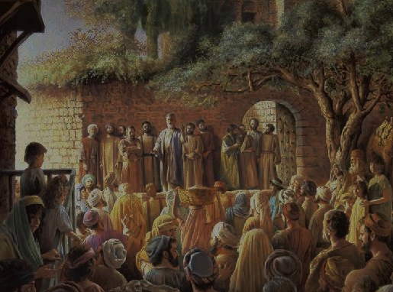
Peter at Pentecost

Slide 295

A Prophetic Weekend
NTS 39
Thursday
Friday
Saturday
Sunday
Galilean
Passover
Unleavened Bread
Firstfruits
Judean
Passover
Unleavened Bread
Firstfruits
Last Supper
Crucifixion
Resurrection
2 April 33
3 April 33
5 April 33
Notes:
OB-25-Feasts-35; NB11-Feasts-35; NS-Mt15-28-S313; NS-Mk9-16-S274; NS-Lk13-24-S290; NS-Jn12-21-S260
Leviticus 23 gives the order of three key feasts of Israel: • Passover, • Unleavened Bread, and • Firstfruits.
• But how could Jesus have Passover Thursday night but then die at 3 PM the next day on Friday when the Passover lambs were being slaughtered? And why did the Jewish leaders want the bodies off the cross quickly as Passover was approaching when Jesus had already celebrated Passover the night before?
• The answer is that Galilean Jews celebrated Passover the day before • Judean Jews. Since his disciples were Galileans, Jesus naturally celebrated on their timetable.
• The Feast of Unleavened Bread always began the day after Passover (Lev 23:5-6).
• Then Firstfruits followed sometime later on the first Sabbath after the first crops began to ripen (Lev 23:11). It indicated that millions of additional sheaves would follow until the entire harvest came in at Pentecost. In AD 33, these three celebrations occurred one after another on three consecutive days!
The significance is astonishing. • Christ predicted his death at the Last Supper Thursday night. • Then Jesus died on the Judean Passover • so that believers can live a life without yeast (Unleavened Bread), • which immediately followed with his resurrection on Firstfruits as he is the first and only human ever to obtain a glorified body as an installment for millions more to follow (1 Cor 15:20)!
We know these dates to be • 2 April 33 for the Thursday night Passover, • 3 April 33 was the day of his crucifixion, and • Jesus rose from the dead on the Feast of Firstfruits on 5 April 33.

Slide 296
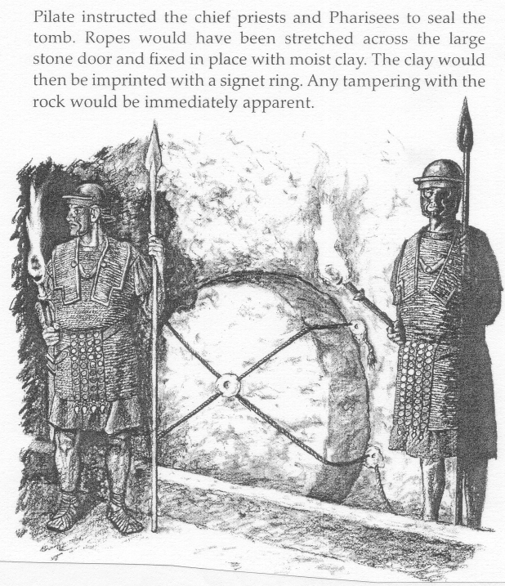
Mark 16:9-20
One of the most difficult textual problems in the NT
88
90-92

Slide 297

3 Manuscript Text Types
Western
90
Byzantine
Alexandrian
Notes:
The NT manuscripts of the early centuries of the church were copied in three main regions:
Rome gave us the Western text type which has many manuscripts from the 8th-10th centuries, supported by the Roman Catholic church.
The city of Constantinople became the capital of the Eastern Orthodox church with its Byzantine manuscripts (or majority text, since they copied so many of them). While considerably varying, it also underlies the Textus Receptus Greek text used for most Reformation-era translations of the New Testament into vernacular languages, and
A large community of Christians gathered in Alexandria, Egypt. This Alexandrian texts were the earliest, going back to about AD 200. Modern translations mainly use Eclectic editions that conform more often to the Alexandrian text-type.

Slide 298
What about Mark 16:9-20?
Western
90
Byzantine
All Have 16:9-20
Many Manuscripts
But 5th-7th century
All Have 16:9-20
Many Manuscripts
But 9th-15th century
Some Omit 16:9-20
Only 5 Manuscripts
4th century include it
5th-9th century exclude it
Alexandrian
Notes:
The NT manuscripts of the early centuries of the church were copied in three main regions:
Rome gave us the Western text type which has many manuscripts from the 8th-10th centuries, supported by the Roman Catholic church.
The city of Constantinople became the capital of the Eastern Orthodox church with its Byzantine manuscripts (or majority text, since they copied so many of them). While considerably varying, it also underlies the Textus Receptus Greek text used for most Reformation-era translations of the New Testament into vernacular languages, and
A large community of Christians gathered in Alexandria, Egypt. This Alexandrian texts were the earliest, going back to about AD 200. Modern translations mainly use Eclectic editions that conform more often to the Alexandrian text-type.

Slide 299

Live in light of your eternal future!

Slide 300
How can you be a true disciple of Jesus in a hostile world?
Notes:
What’s it gonna take to really follow Christ when most people around you oppose Jesus?

Slide 301
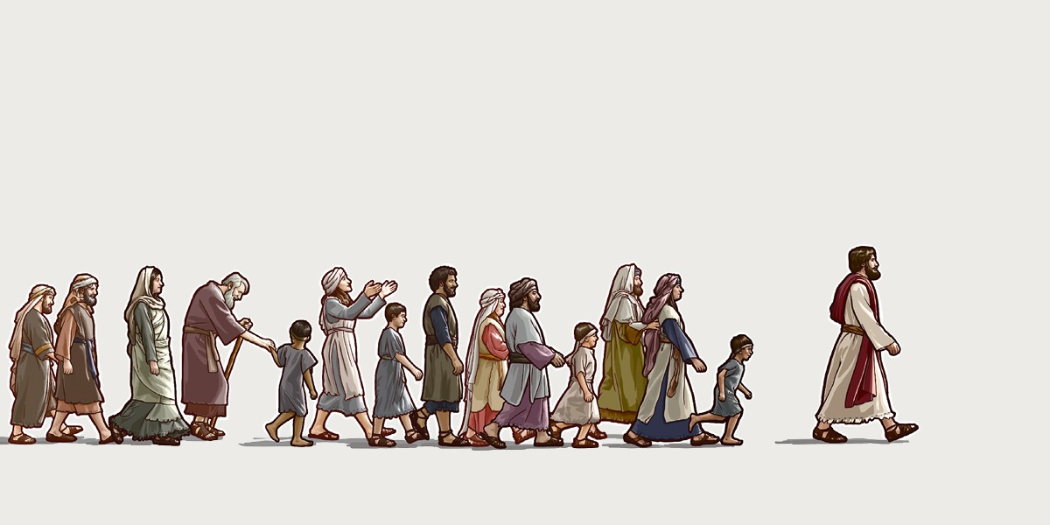
Main Idea
Serve and suffer
like Jesus.
Mark

Slide 302
Application
Mark
82
Application
Are you a disciple who willingly suffers after Jesus' example?

Slide 303
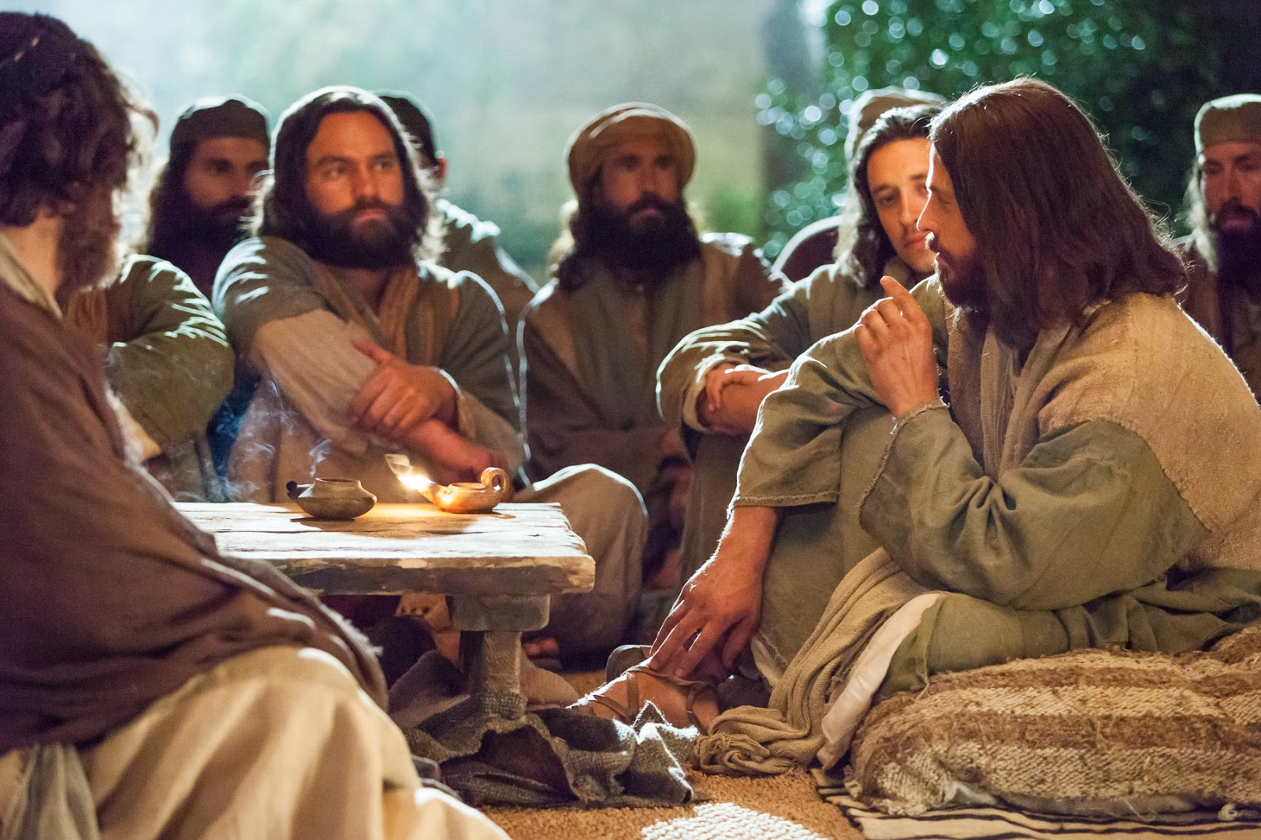
How can you be a disciple who suffers after Jesus’ example?

Slide 304
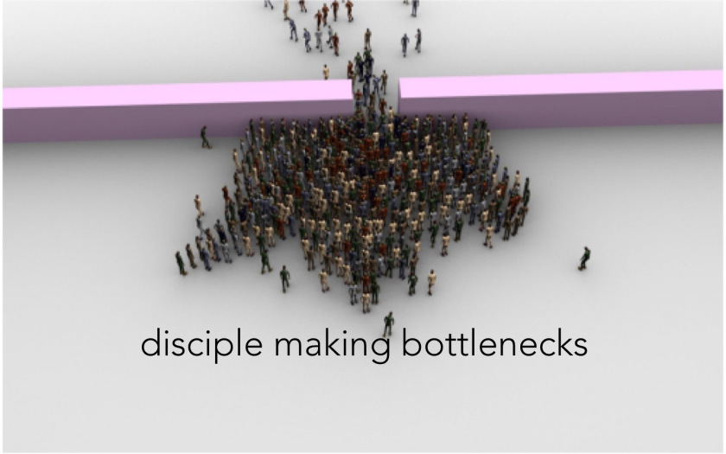
Disciple making bottlenecks
Notes:
We are making disciples too slowly with too few opportunities to grow and serve. Instead of waiting until people grow enough on their own to become a deacon or elder or ministry leader, we need to get back to how Jesus made disciples by investing himself into a small group that multiplies.

Slide 305

Disciple in community.

Slide 306
Black

Slide 307


NT Preaching • BibleStudyDownloads.org
Get this presentation and script for free!

Slide 308
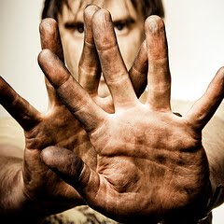
The Servant King
by Graham Kendrick
Notes:
LC-01-Introduction-221
NS-02-Mark9-16-beginning on slide 275

Slide 309

From heaven You came, helpless babe
Entered our world, Your glory veiled
Not to be served but to serve
And give Your life that we might live

Slide 310
This is our God, the SERVANT KING;
He calls us now to follow Him
To bring our lives as a daily offering
Of worship to the SERVANT KING.

Slide 311
There in the garden of tears
My heavy load He chose to bear;
His heart with sorrow was torn,
Yet not my will, but Yours he said.

Slide 312
This is our God, the SERVANT KING;
He calls us now to follow Him
To bring our lives as a daily offering
Of worship to the SERVANT KING.

Slide 313
Come see His hands and his feet,
The scars that speak of sacrifice
Hands that flung stars into space
To cruel nails surrendered

Slide 314
This is our God, the SERVANT KING;
He calls us now to follow Him
To bring our lives as a daily offering
Of worship to the SERVANT KING.

Slide 315
So let us learn how to serve,
And in our lives enthrone Him
Each other's needs to prefer
For it is Christ we're serving

Slide 316
This is our God, the SERVANT KING;
He calls us now to follow Him
To bring our lives as a daily offering
Of worship to the SERVANT KING.
Of worship to the SERVANT KING.

Slide 317
Black

Slide 318

NT Survey link at biblestudydownloads.org
Get this presentation for free!

