Slide 1
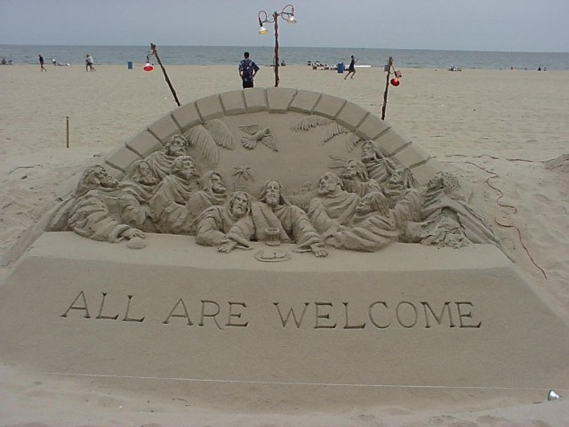
Mark 9–16
Dr. Rick Griffith • Jordan Evangelical Theological Seminary • BibleStudyDownloads.org

Slide 2
Slides on Mark 9

Slide 3
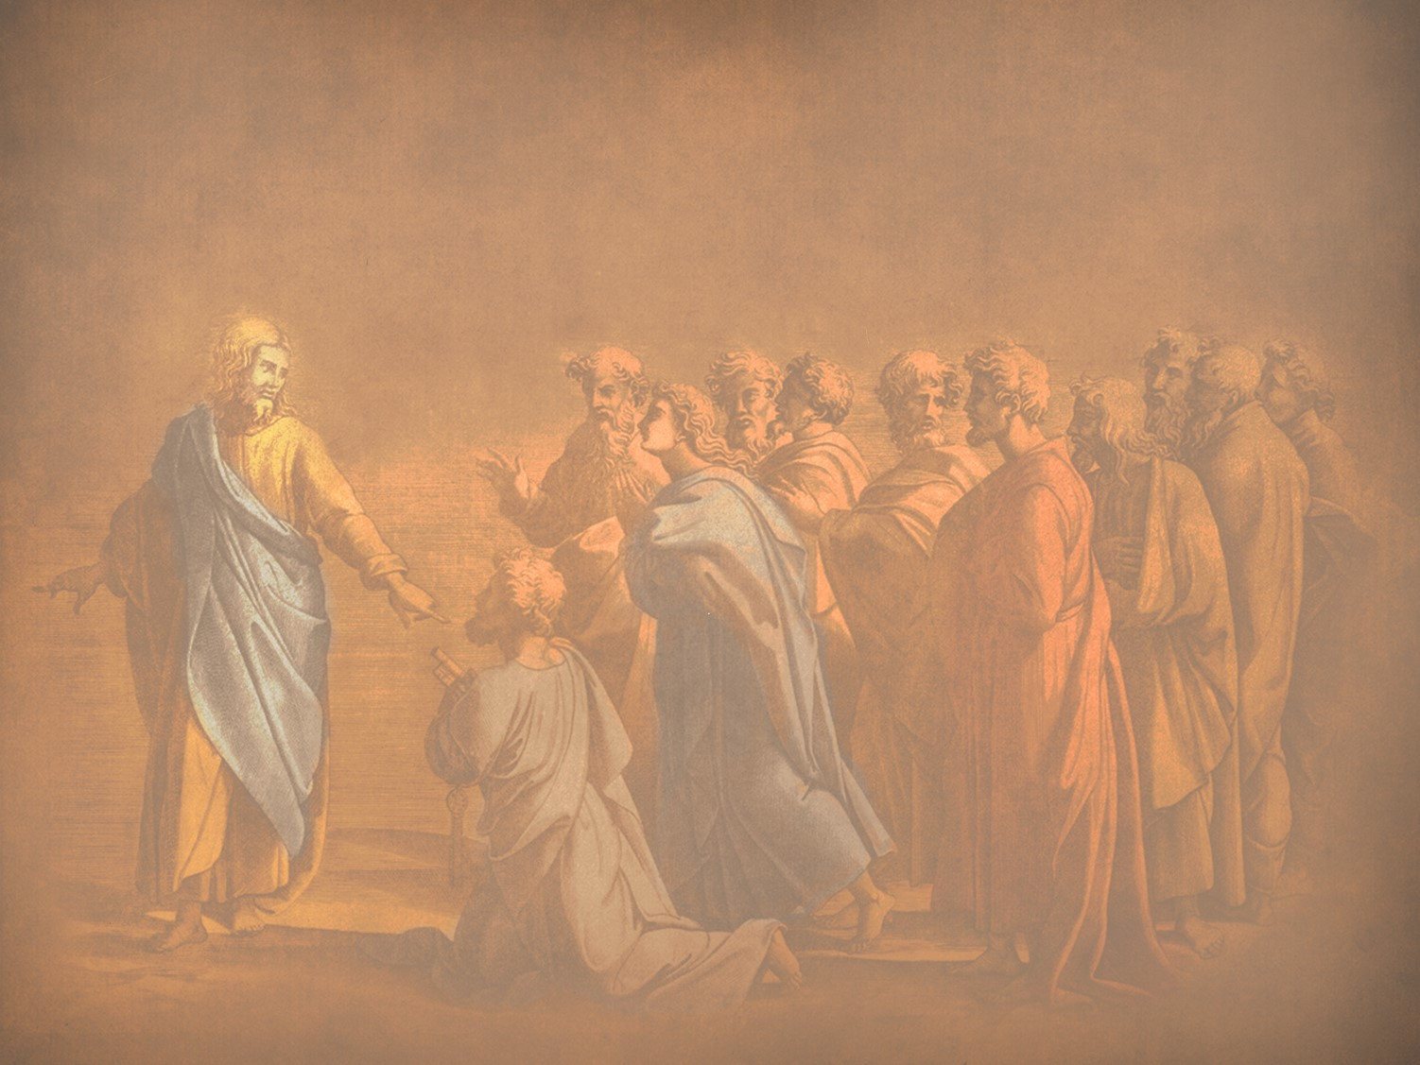
N. Revelation of the Kingdom
§ 87
Matthew 17:1-8; Mark 9:2-8; Luke 9:28-36
Three disciples see Christ’s glory as he promised a week earlier as a foretaste of his reign at the Second Advent and to authenticate Christ as One worthy of obedience
Notes:
The three Synoptic Gospels all record the Transfiguration of Jesus. Here is the only glimpse of the true nature of Christ that we find in the gospels as no one sees him in his full glory during his earthly life—and the Transfiguration was only for a few moments. God, in his mercy, did not let people view the glorified Christ lest they die in doing so! But this experience on the mountain (probably Mount Tabor) lifted the veil, as it were, so that at least Peter, James, and John could imagine the glory of Jesus when he reigns in the millennial kingdom.
_____________
LC-04-Instruction of the Twelve-106
NS-01-Matt15-18—slide 12
NS-02-Mark9-16—slide 3
NS-03-Luke1-12—slide 386

Slide 4
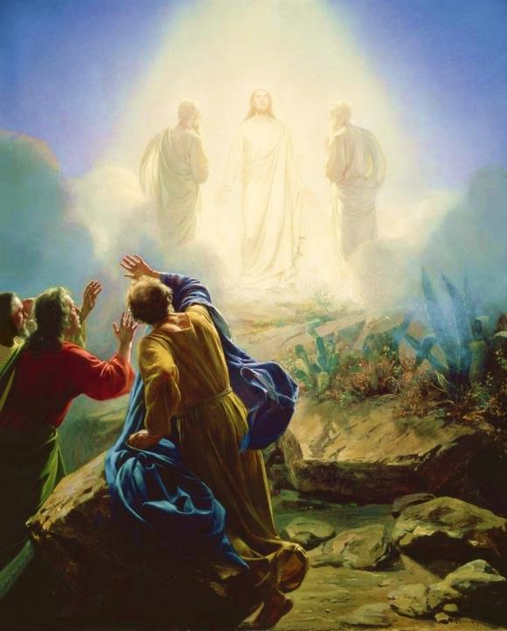
Carl Bloch, c. 1865
Transfiguration of Jesus
Mark 9:2-13 (ESV)
Notes:
Today’s scripture, found in Mark chapter 9, vs 2-13 is also about a transformation. This transformation is known as the Transfiguration of Jesus.
Transformation is an important theme in the Bible. The passage we read together earlier was from Paul’s letter to the Romans, ch 8 vs 19-30 was about transformation. As we saw in Romans 8:30, reading now from the ESV, Paul writes that “and those whom he predestined he also called, and those whom he called he also justified, and those whom he justified he also glorified.”
To go from sin and suffering to being called, justified, and glorified is an extreme transformation. So how do we get to that transformation? We look to Jesus. That is what we are going to do today. We will look at Jesus and his “transfiguration” or “transformation.”
We will see how it affected the disciples and how it should affect us.

Slide 5
Why only Peter, James, and John?
Mk 9:2-13 Transfiguration
Mk 14:33 Gethsemane
With Andrew
Mk 1:29-30 Peter’s Mother-in Law
Mk 13:3 Olivet Discourse

Slide 6
² And after six days Jesus took with him Peter and James and John, and led them up a high mountain by themselves.
Mark 9:2-13 (ESV)
Notes:
Now we pick in in Mark ch 9 vs 2

Slide 7

How do you recharge?
Mark 6:30-32
³⁰ The apostles returned to Jesus and told him all that they had done and taught. ³¹ And he said to them, “Come away by yourselves to a desolate place and rest a while.” For many were coming and going, and they had no leisure even to eat. ³² And they went away in the boat to a desolate place by themselves.

Slide 8
² And after six days Jesus took with him Peter and James and John and led them up a high mountain by themselves. And he was transfigured before them, ³ and his clothes became radiant, intensely white, as no one on earth could bleach them. ⁴ And there appeared to them Elijah with Moses, and they were talking with Jesus.
Mark 9:2-13 (ESV)
Notes:
Now we pick in in Mark ch 9 vs 2

Slide 9
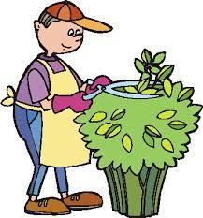
What did they see?
John 20:15 . . . Supposing him to be the gardener

Slide 10

Revelation 1
¹² Then I turned to see the voice that was speaking to me, and on turning
I saw seven golden lampstands,
¹³ and in the midst of the lampstands one like a son of man, clothed with a long robe and with a golden sash around
his chest. ¹⁴ The hairs of his head were white, like white wool, like snow. His eyes were like a flame of fire, ¹⁵ his feet were like burnished bronze, refined in a furnace, and his voice was like the roar of many waters
¹⁶ In his right hand he held seven stars, from his mouth came a sharp two-edged sword, and his face was like the sun shining in full strength.

Slide 11
² And after six days Jesus took with him Peter and James and John, and led them up a high mountain by themselves. And he was transfigured before them, ³ and his clothes became radiant, intensely white, as no one on earth could bleach them. ⁴ And there appeared to them Elijah with Moses, and they were talking with Jesus.
Mark 9:2-13 (ESV)
Notes:
Now we pick in in Mark ch 9 vs 2

Slide 12
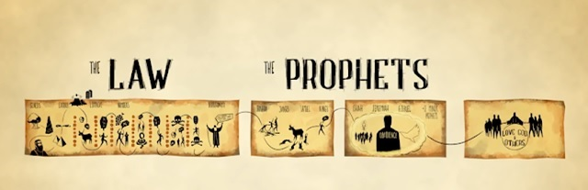
Jesus
Moses
Elijah

Slide 13
² And after six days Jesus took with him Peter and James and John, and led them up a high mountain by themselves. And he was transfigured before them, ³ and his clothes became radiant, intensely white, as no one on earth could bleach them. ⁴ And there appeared to them Elijah with Moses, and they were talking with Jesus. ⁵ And Peter said to Jesus, “Rabbi, it is good that we are here. Let us make three tents, one for you and one for Moses and one for Elijah.” ⁶ For he did not know what to say, for they were terrified.
Mark 9:2-13 (ESV)
Notes:
How do the disciples respond?

Slide 14
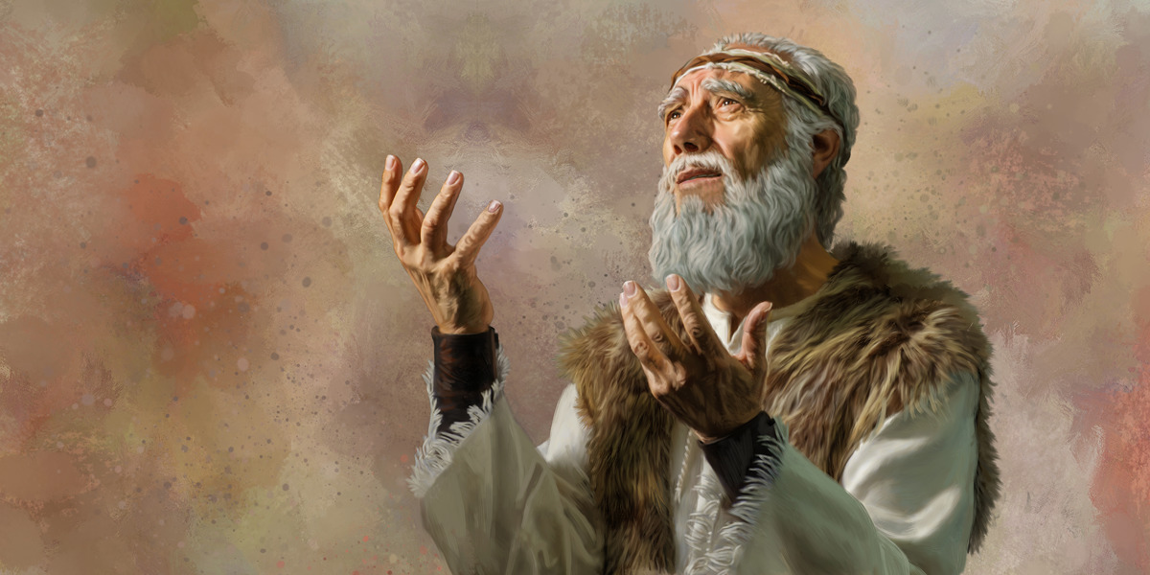
The Second Coming
"Look, I am sending you the prophet Elijah before the great and dreadful day of the LORD arrives. ⁶ His preaching will turn the hearts of fathers to their children, and the hearts of children to their fathers. Otherwise, I will come and strike the land with a curse" (Malachi 4:5-6 NLT).
Notes:
Here are the final two verse of the Old Testament that include both blessing and a curse.
__________
LC-04-Instruction of the Twelve-118
OS-39-Malachi-135
NS-01-Matt 15-28-slide 23

Slide 15

The Expectation: Elijah, Messiah, Kingdom
76
MESSIAH
"This Age"
"The Age to Come"
PROPHECY
KINGDOM
Mysteries of the Kingdom Matthew 13
E
M
"K"
E
M
K
Rejection
Reception
1st Advent
2nd Advent
Judgment on Israel Blessing to Gentiles
Judgment on Nations Restoration of Israel
Adapted from Mark L. Bailey, DTS class notes, 1986
Notes:
The key element between the present age and the age to to come (the kingdom age) in Jewish theology was the coming of the Messiah. But he would be preceded by an Elijah figure. John the Baptist could have been that "Elijah" had Israel believed in Messiah, for the millennial kingdom would then have followed with a righteous nation. But since Israel rejected her king, another "Elijah" yet will come—probably one of the two witnesses of Rev 11. In the meantime, this Interadvent Age has the kingdom in but mystery form with spiritual benefits given to the Gentiles until the full number of Gentiles occurs (Rom 11:25-27). Then, instead of judgment on Israel and blessing on the Gentiles, it will reverse. The judgment will be upon the nations opposing Israel (Ezek 38–39) followed by blessing upon Israel (Ezek 40–48).
__________
LC-04-Instruction of the Twelve-119
OS-39-Malachi-136
NS-01-Matt 15-28-slide 24
NS-02-Mark9-16—slide 15

Slide 16
¹¹ And they asked him, “Why do the scribes say that first Elijah must come?” ¹² And he said to them, “Elijah does come first to restore all things. And how is it written of the Son of Man that he should suffer many things and be treated with contempt? ¹³ But I tell you that Elijah has come, and they did to him whatever they pleased, as it is written of him.”
Mark 9:2-13 (ESV)

Slide 17
A Good Question
Q: Why must Elijah come first?
A: The Scriptures say so
Mal 3:1 "Behold, I send my messenger, and he will prepare the way before me."
Mal 4:5 "Behold, I will send you Elijah the prophet before the great and awesome day of the Lord comes."

Slide 18
Having established the authority of Scripture
Q: Why must Messiah suffer?
A: The Scriptures say so
Ps 69:20-21 "Behold, I send my messenger, and he will prepare the way before me."
Isa 53 "But he was pierced for our transgressions; he was crushed for our iniquities; upon him was the chastisement that brought us peace, and with his wounds we are healed."

Slide 19
¹¹ And they asked him, “Why do the scribes say that first Elijah must come?” ¹² And he said to them, “Elijah does come first to restore all things. And how is it written of the Son of Man that he should suffer many things and be treated with contempt? ¹³ But I tell you that Elijah has come, and they did to him whatever they pleased, as it is written of him.”
Mark 9:2-13 (ESV)

Slide 20

By what authority can Jesus proclaim John the Baptist fulfills prophecies about Elijah?

Slide 21
# | Title | Mt | Mk | Lk | Jn
1 | Jesus Heals Many | Mt 4:23–24 | Mk 1:32–34
2 | Jesus Casts Out Demons | Mt 4:24 | Mk 1:39 | Lk 7:18–23
3 | Jesus Cleanses a Leper | Mt 8:1–4 | Mk 1:40–45 | Lk 5:12–16
4 | Jesus Heals a Centurion’s Servant | Mt 8:5–13 |  | Lk 7:1–10
-----------------------------------------
59 | Jesus Appears in a Locked Room |  |  |  | Jn 20:19–23
60 | Jesus Appears in a Locked Room for Thomas |  |  |  | Jn 20:26–29
61 | Jesus Provides a Miraculous Catch of Fish (John) |  |  |  | Jn 21:4–6
61 Miracles

Slide 22
Terrified in the presence of the Lord
Listen to the Lord
The Disciples Listened to the Lord
Disciples' questions answered by the Lord

Slide 23
Be Transformed!
Not Terrified

Slide 24
Slides on Mark 10

Slide 25
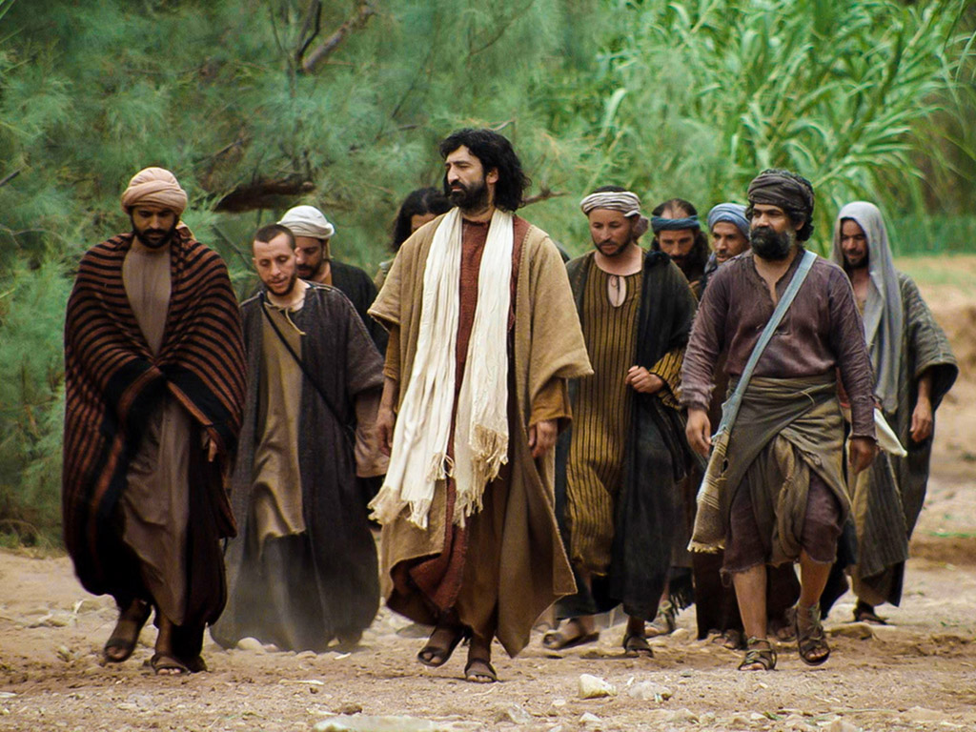
ض. تعليمات بخصوص الحياة الأبدية
134
متى 19: 16 :20-16، مرقس 31-17 :10، لوقا 18: 30-18
يظهر المسيح استحالة دخول الملكوت من خلال الغنى ليدحض الإيمان الفريسي أن الغنى المادي يشير إلى الرضا الإلهي والحياة الأبدية
Notes:
The Rich Man
Matt. 19:16 Someone came to Jesus with this question: “Teacher, what good deed must I do to have eternal life?”
Matt. 19:17 “Why ask me about what is good?” Jesus replied. “There is only One who is good. But to answer your question—if you want to receive eternal life, keep the commandments.”
Matt. 19:18 “Which ones?” the man asked.
And Jesus replied: “‘You must not murder. You must not commit adultery. You must not steal. You must not testify falsely. ¹⁹ Honor your father and mother. Love your neighbor as yourself.’”
Matt. 19:20 “I’ve obeyed all these commandments,” the young man replied. “What else must I do?”
Matt. 19:21 Jesus told him, “If you want to be perfect, go and sell all your possessions and give the money to the poor, and you will have treasure in heaven. Then come, follow me.”
Matt. 19:22 But when the young man heard this, he went away sad, for he had many possessions.
Matt. 19:23 Then Jesus said to his disciples, “I tell you the truth, it is very hard for a rich person to enter the Kingdom of Heaven. ²⁴ I’ll say it again—it is easier for a camel to go through the eye of a needle than for a rich person to enter the Kingdom of God!”
Matt. 19:25 The disciples were astounded. “Then who in the world can be saved?” they asked.
Matt. 19:26 Jesus looked at them intently and said, “Humanly speaking, it is impossible. But with God everything is possible.”
Matt. 19:27 Then Peter said to him, “We’ve given up everything to follow you. What will we get?”
Matt. 19:28 Jesus replied, “I assure you that when the world is made new and the Son of Man sits upon his glorious throne, you who have been my followers will also sit on twelve thrones, judging the twelve tribes of Israel. ²⁹ And everyone who has given up houses or brothers or sisters or father or mother or children or property, for my sake, will receive a hundred times as much in return and will inherit eternal life. ³⁰ But many who are the greatest now will be least important then, and those who seem least important now will be the greatest then.
Parable of the Vineyard Workers
Matt. 20:1 “For the Kingdom of Heaven is like the landowner who went out early one morning to hire workers for his vineyard. ² He agreed to pay the normal daily wage and sent them out to work.
Matt. 20:3 “At nine o’clock in the morning he was passing through the marketplace and saw somepeople standing around doing nothing. ⁴ So he hired them, telling them he would pay them whatever was right at the end of the day. ⁵ So they went to work in the vineyard. At noon and again at three o’clock he did the same thing.
Matt. 20:6 “At five o’clock that afternoon he was in town again and saw some more people standing around. He asked them, ‘Why haven’t you been working today?’
Matt. 20:7 “They replied, ‘Because no one hired us.’
“The landowner told them, ‘Then go out and join the others in my vineyard.’
Matt. 20:8 “That evening he told the foreman to call the workers in and pay them, beginning with the last workers first. ⁹ When those hired at five o’clock were paid, each received a full day’s wage. ¹⁰ When those hired first came to get their pay, they assumed they would receive more. But they, too, were paid a day’s wage. ¹¹ When they received their pay, they protested to the owner, ¹² ‘Those people worked only one hour, and yet you’ve paid them just as much as you paid us who worked all day in the scorching heat.’
Matt. 20:13 “He answered one of them, ‘Friend, I haven’t been unfair! Didn’t you agree to work all day for the usual wage? ¹⁴ Take your money and go. I wanted to pay this last worker the same as you. ¹⁵ Is it against the law for me to do what I want with my money? Should you be jealous because I am kind to others?’
Matt. 20:16 “So those who are last now will be first then, and those who are first will be last.”
The Rich Man
Mark 10:17 As Jesus was starting out on his way to Jerusalem, a man came running up to him, knelt down, and asked, “Good Teacher, what must I do to inherit eternal life?”
Mark 10:18 “Why do you call me good?” Jesus asked. “Only God is truly good. ¹⁹ But to answer your question, you know the commandments: ‘You must not murder. You must not commit adultery. You must not steal. You must not testify falsely. You must not cheat anyone. Honor your father and mother.’”
Mark 10:20 “Teacher,” the man replied, “I’ve obeyed all these commandments since I was young.”
Mark 10:21 Looking at the man, Jesus felt genuine love for him. “There is still one thing you haven’t done,” he told him. “Go and sell all your possessions and give the money to the poor, and you will have treasure in heaven. Then come, follow me.”
Mark 10:22 At this the man’s face fell, and he went away sad, for he had many possessions.
Mark 10:23 Jesus looked around and said to his disciples, “How hard it is for the rich to enter the Kingdom of God!” ²⁴ This amazed them. But Jesus said again, “Dear children, it is very hard to enter the Kingdom of God. ²⁵ In fact, it is easier for a camel to go through the eye of a needle than for a rich person to enter the Kingdom of God!”
Mark 10:26 The disciples were astounded. “Then who in the world can be saved?” they asked.
Mark 10:27 Jesus looked at them intently and said, “Humanly speaking, it is impossible. But not with God. Everything is possible with God.”
Mark 10:28 Then Peter began to speak up. “We’ve given up everything to follow you,” he said.
Mark 10:29 “Yes,” Jesus replied, “and I assure you that everyone who has given up house or brothers or sisters or mother or father or children or property, for my sake and for the Good News, ³⁰ will receive now in return a hundred times as many houses, brothers, sisters, mothers, children, and property—along with persecution. And in the world to come that person will have eternal life. ³¹ But many who are the greatest now will be least important then, and those who seem least important now will be the greatest then.”
The Rich Man
Luke 18:18 Once a religious leader asked Jesus this question: “Good Teacher, what should I do to inherit eternal life?”
Luke 18:19 “Why do you call me good?” Jesus asked him. “Only God is truly good. ²⁰ But to answer your question, you know the commandments: ‘You must not commit adultery. You must not murder. You must not steal. You must not testify falsely. Honor your father and mother.’”
Luke 18:21 The man replied, “I’ve obeyed all these commandments since I was young.”
Luke 18:22 When Jesus heard his answer, he said, “There is still one thing you haven’t done. Sell all your possessions and give the money to the poor, and you will have treasure in heaven. Then come, follow me.”
Luke 18:23 But when the man heard this he became very sad, for he was very rich.
Luke 18:24 When Jesus saw this, he said, “How hard it is for the rich to enter the Kingdom of God! ²⁵ In fact, it is easier for a camel to go through the eye of a needle than for a rich person to enter the Kingdom of God!”
Luke 18:26 Those who heard this said, “Then who in the world can be saved?”
Luke 18:27 He replied, “What is impossible for people is possible with God.”
Luke 18:28 Peter said, “We’ve left our homes to follow you.”
Luke 18:29 “Yes,” Jesus replied, “and I assure you that everyone who has given up house or wife or brothers or parents or children, for the sake of the Kingdom of God, ³⁰ will be repaid many times over in this life, and will have eternal life in the world to come.”

Slide 26
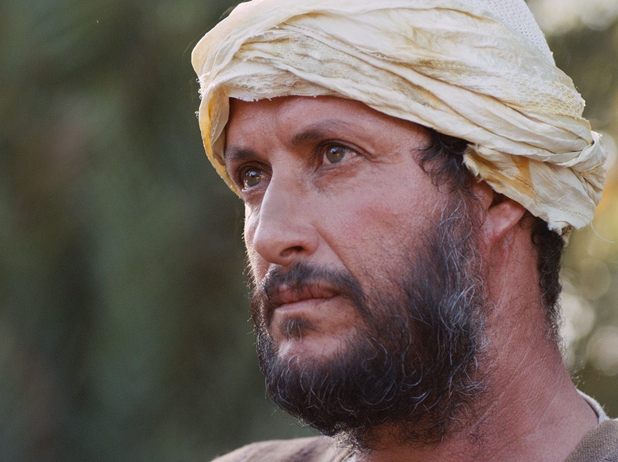

صور كتابية مجانية
شاب غني
يسأل يسوع
متى 19: 16-30، مرقس 10: 17-31، لوقا 18: 18-30
Notes:
"This man’s question indicated that he viewed eternal life as something to be achieved by doing good (in contrast with Mark 10:15; cf. Matt. 19:16) and also that he felt insecure about his future destiny. References to eternal life (mentioned in Mark only in 10:17, 30), “entering God’s kingdom” (vv. 23-25), and being “saved” (v. 26) all focus on the future possession of life with God, though a person enters it now by accepting God’s rule in his earthly life. John’s Gospel emphasizes the present possession of eternal life."
John D. Grassmick, Mark *(The Bible Knowledge Commentary; eds. John F. Walvoord and Roy B. Zuck; Accordance electronic ed. 2 vols.; Wheaton: Victor Books, 1983), 2:150.

Slide 27
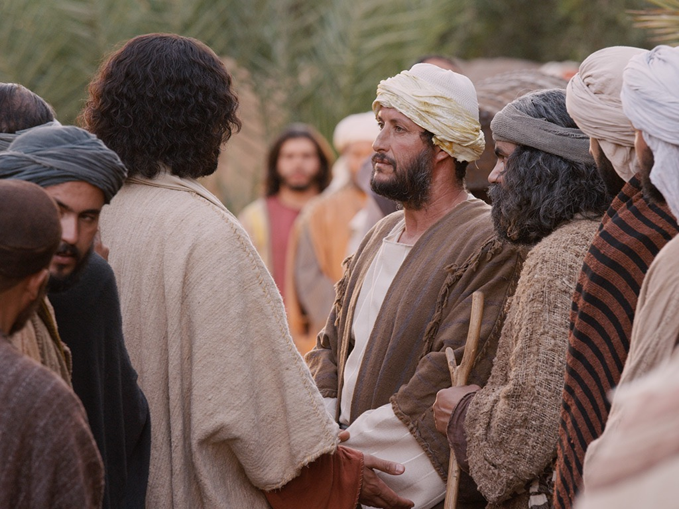
Notes:
Mark 10:17 As Jesus was starting out on his way to Jerusalem, a man came running up to him, knelt down, and asked, “Good Teacher, what must I do to inherit eternal life?”
———————
"His question was specifically, “What must I do to inherit eternal life?” In Jewish understanding, to “inherit eternal life” was to be resurrected and accepted for entrance into the messianic kingdom of the future (cf. Dan 12:2; 2 Macc 7:9).
5 Notice Mark 10:30 in which Jesus spoke of “eternal life” in the “age to come.” So “to inherit eternal life” was an equivalent expression for entering the kingdom of God, referred to elsewhere as “inheriting the kingdom” (cf. Mt 25:34; 1 Cor 6:9, 10; 15:50; Gal 5:21). The NT is very clear that one can only do this by humbly coming to Jesus with a child-like faith in order to be born again (Mk 10:15; John 3:3; Col 1:13-14). The young man’s question in Mark 10:17, however, gives him away that he does not understand the right approach, for he asks, “What must I do?” The NT is clear that there is not anything we can “do” to merit eternal life. Receiving God’s forgiveness and eternal life do not come because of what we “do,” but only as a free gift of God’s grace."
—Paul Tanner, Following the Master (BEE World), 144

Slide 28
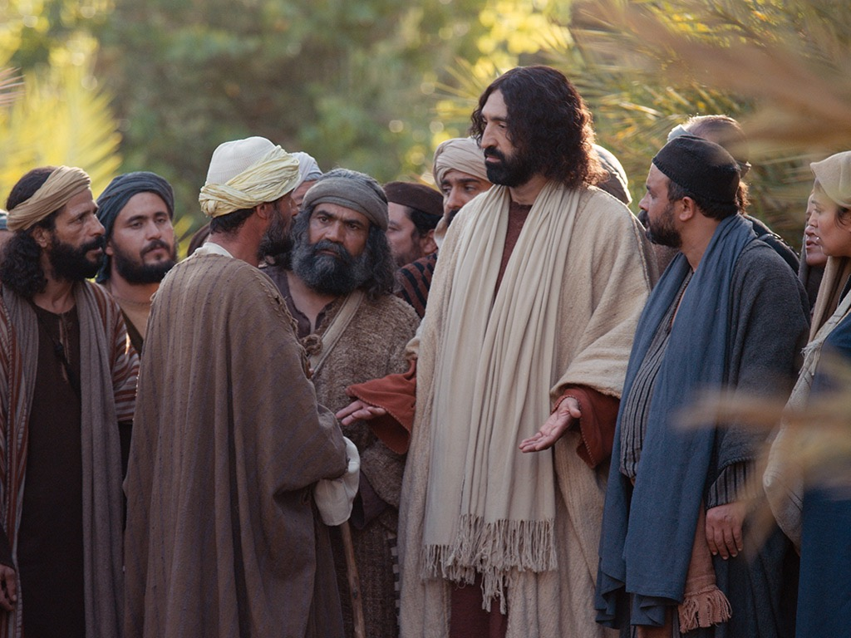
Notes:
Mark 10:18 “Why do you call me good?” Jesus asked. “Only God is truly good.

Slide 29
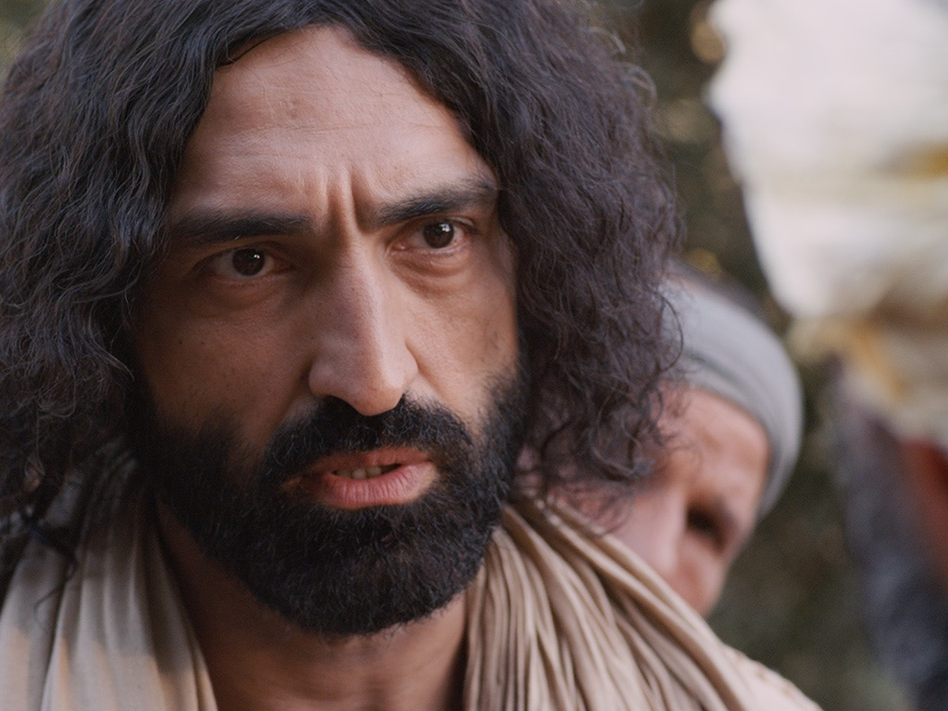
Notes:
Mark 10:19 But to answer your question, you know the commandments: ‘You must not murder. You must not commit adultery. You must not steal. You must not testify falsely. You must not cheat anyone. Honor your father and mother.’"
————————
Jesus sought to show him that he was not good after all by having him evaluate himself by the Ten Commandments.

Slide 30
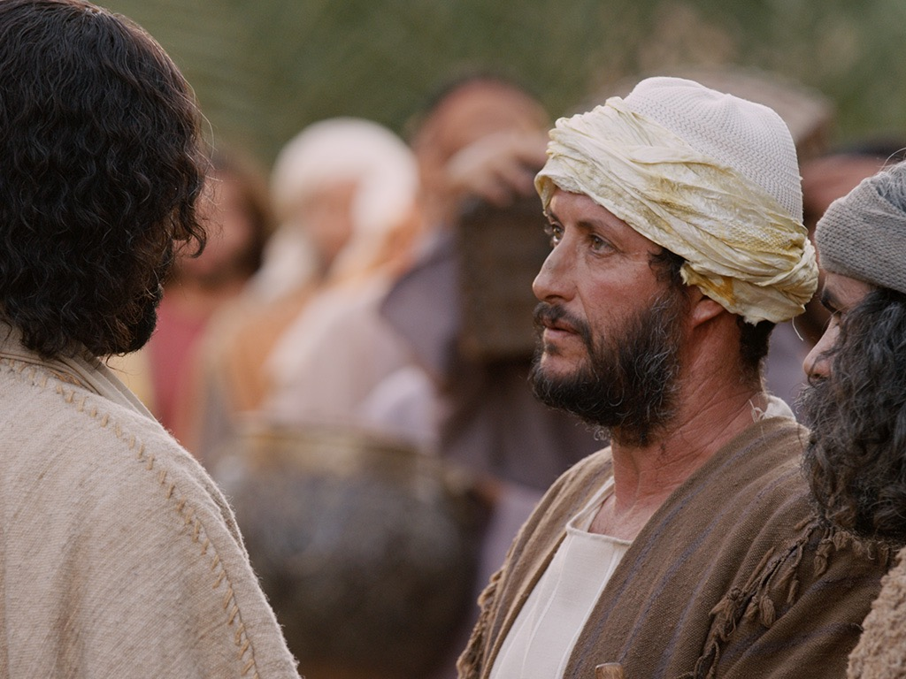
Notes:
Mark 10:20 “Teacher,” the man replied, “I’ve obeyed all these commandments since I was young.”
——————————
This shows that the man was self-deluded that he was the only person in the world who was good! He should have known Isa 64:6, “all our so-called righteous acts are like a menstrual rag in your sight.”

Slide 31
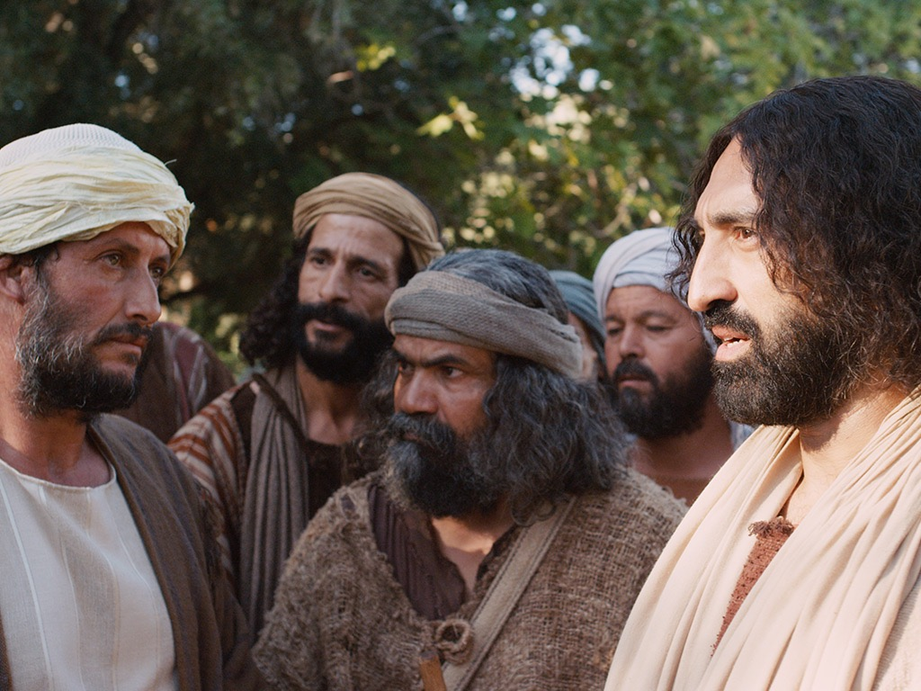
Notes:
Mark 10:21 Looking at the man, Jesus felt genuine love for him.

Slide 32
Notes:
Mark 10:21 “There is still one thing you haven’t done,” he told him.

Slide 33
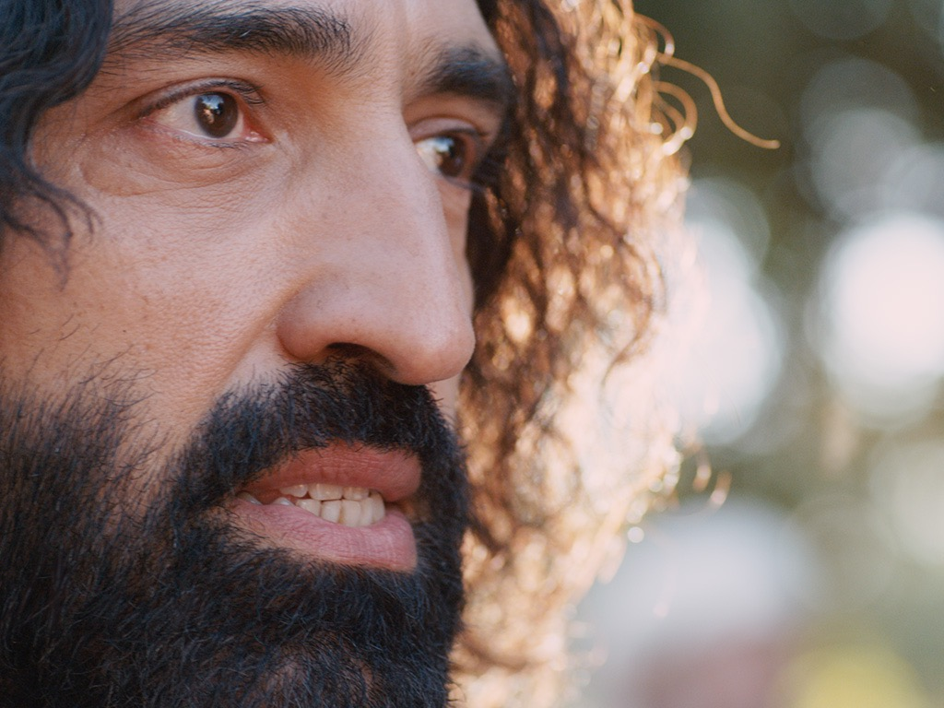
Notes:
Mark 10:21 “Go and sell all your possessions and give the money to the poor, and you will have treasure in heaven. Then come, follow me.”

Slide 34
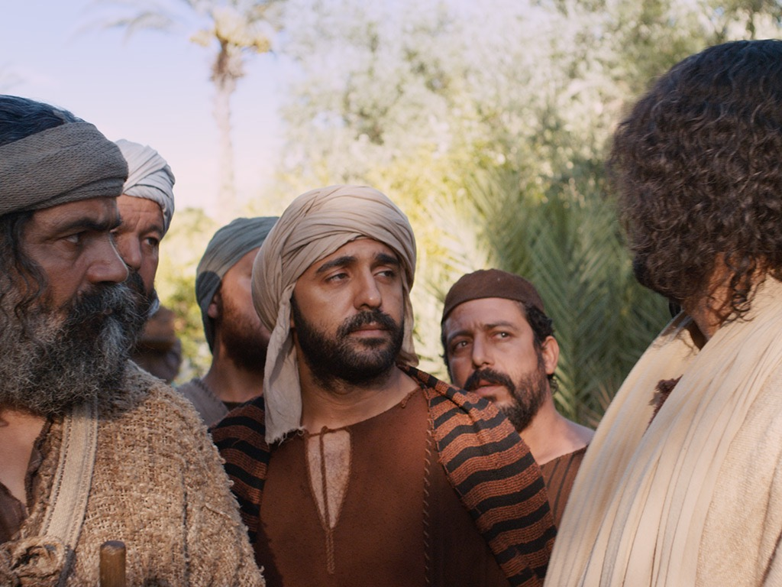
Notes:
Mark 10:22 At this the man’s face fell, and he went away sad, for he had many possessions.

Slide 35
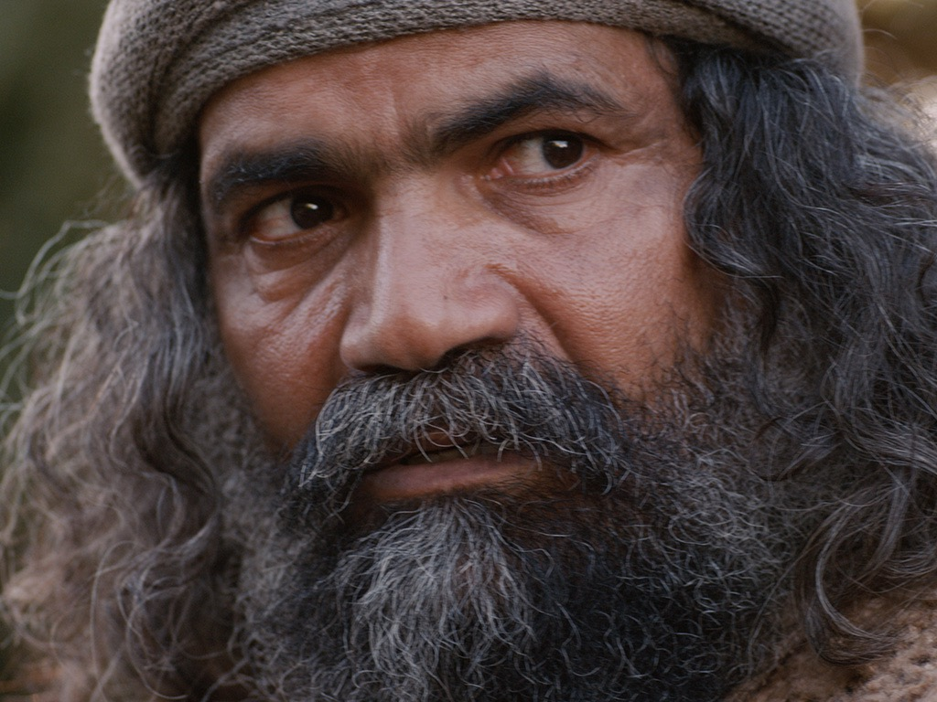
Notes:
Mark 10:23 Jesus looked around and said to his disciples, “How hard it is for the rich to enter the Kingdom of God!”

Slide 36
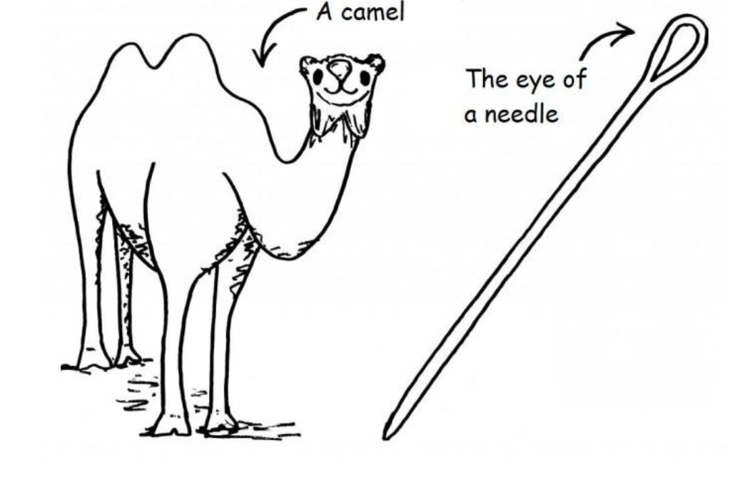
A camel
The eye of a needle
Notes:
Mark 10:24 This amazed them. But Jesus said again, “Dear children, it is very hard to enter the Kingdom of God. ²⁵ In fact, it is easier for a camel to go through the eye of a needle than for a rich person to enter the Kingdom of God!”
Mark 10:26 The disciples were astounded. “Then who in the world can be saved?” they asked.
—————————
LC-06-Preparation-184
NS-01-Matt15-28—slide 102

Slide 37
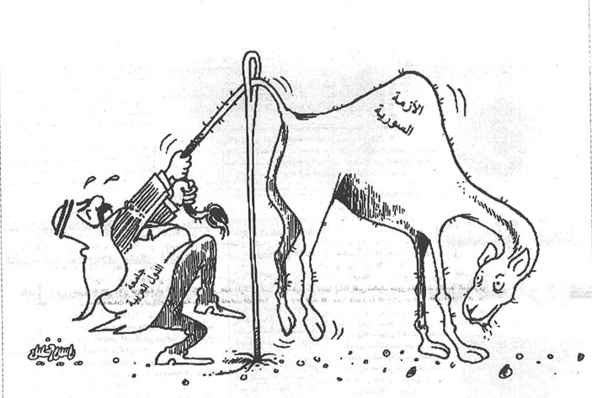
Notes:
Q: Is Jesus explaining something difficult or impossible?
A: Humanly speaking, a camel cannot fit through a normal-sized needle, so it is impossible. Some understand this to mean that a wealthy person cannot enter heaven through their wealth (an impossibility).
Others say that riches often prevent the wealthy from seeing their need for Jesus (a difficulty).
Which is correct? Both are theologically sound, but which view best fits the context?
—————————
LC-06-Preparation-185
NS-01-Matt15-28—slide 103

Slide 38
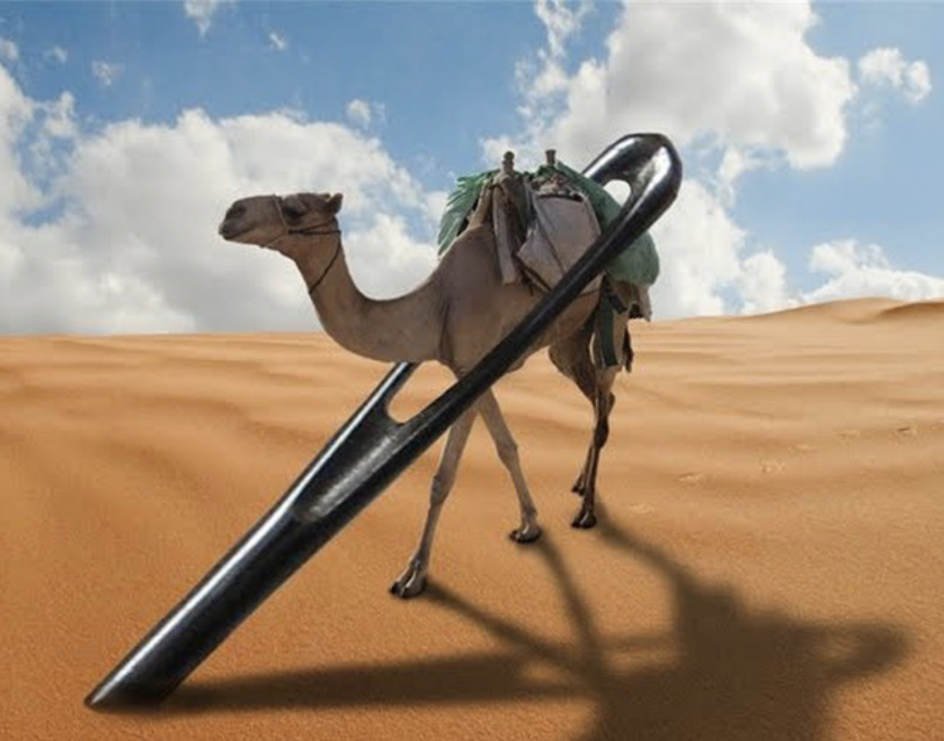
Notes:
Joseph Dillow presents an alternate view:
"Are Works a Condition for Entering the Kingdom?
The New Testament includes 23 references to entering the kingdom, entering into “life,” seeking “life,” or seeking the kingdom.⁷³¹ These passages, commonly called the “entry sayings,” are usually understood to refer to entrance into personal salvation either now or in the eschatological future. However, in many of these passages, entry into the kingdom or into “life” appears to be predicated on works.⁷³² If the traditional idea that “the kingdom” always refers to individual salvation and that “entrance into the kingdom” always refers to “getting saved” or going to heaven when one dies is accepted, as Bill did, then there emerges an apparent conflict with the faith-alone gospel of the New Testament.
For example, to “enter the kingdom”⁷³³ requires a righteousness that is greater than that of the scribes and Pharisees (Matthew 5:20).⁷³⁴ Those who enter the kingdom must do so through the path of discipleship, the narrow gate (Matthew 7:13, 14). In order to enter the kingdom, one must do the “will of the Father,” that is, obey the precepts taught in the Sermon on the Mount (Matthew 7:21).⁷³⁵ To “enter into life,” which is an equivalent phrase, one must deal radically with sin, reject it, and remove it from one’s lifestyle (Matthew 18:3, 9).⁷³⁶ To enter the kingdom, one must be “converted” (Matthew 18:3, 9). Jesus tells the rich young ruler that to “enter into life” (which he equates with entering the kingdom, v. 23) one must “keep the commandments” (Matthew 19:17).⁷³⁷ Strenuous moral effort is required if one is to enter the kingdom (Mark 10:24, “how hard”).
It should be obvious to any unbiased reader that the calls to enter the kingdom are conditioned upon works. Neonomian writers, believing that entering the kingdom means “going to heaven,” simply call a spade a spade and in agreement with the Catholics boldly assert that salvation is secured by non-meritorious, God-produced works in the believer. It is disappointing that the Evangelical Theological Society, is now publishing books and articles advocating this viewpoint. A recent example from the pen of Edmund Neufeld says, “Each [beatitude] is an aspect of the condition by which the follower of Christ receives salvation from God.”⁷³⁸
In the following discussion I will argue that the calls to enter the kingdom in the Gospel of Matthew are all addressed to those who are already born again. They are challenges to live out one’s faith, not always invitations to personal salvation, entrance into heaven, or entrance into the Millennial Kingdom. The next three chapters will be devoted to establishing this understanding of the “entry” sayings."
731 The “entry sayings” refer to these phrases: (1) “enter the kingdom of heaven” (Matthew 5:20; 7:21; 18:3; 19:23, 24; 23:13; Mark 9:47; 10:15, 25; Luke 18:17, 24, 25; John 3:5; Acts 14:22); (2) “entering into life” (Matthew 18:8, 9; 19:17; Mark 9:43; (3) “seeking life” (Luke 17:33; Romans 2:7); (4)
“seeking the kingdom” (Matthew 6:33; 13:45; Luke 12:31). These seem to be parallel and explain one another.
732 See G. Todd Wilson, "Conditions for Entering the Kingdom," Perspectives in Religious Studies 5 (Spring 1978): 40.
733 Equivalent expressions to “enter the kingdom” are “enter into life” and “enter into joy” and in some cases “inherit the kingdom” (see Schneider, “eiserchomai,” TDNT, 2.677).
734 Some understand this “greater righteousness” to refer to either forensic justification or a characteristic of all who are saved. However, as will be demonstrated later, both these options are inconsistent with the context. See pp. 233 ff.
735 To obey the will of the Father seems to refer to good works in Matthew 12:50. And it is highly unlikely that the “will of the Father” in the context of the Sermon on the Mount is to believe on Christ of
salvation as it is in John 6:40. For discussion of this phrase, see pp. 306 ff.
736 “This unconditional orientation to the coming kingdom demands sacrifice, namely, a clean break with everything that would hinder or prejudice the newly established existence of man before God (cf. the sayings about offences in Matthew 18:8 ff.),”ibid., 2.677
737 True, the disciples ask, “Who then can be saved?” As already demonstrated, “saved” does not have to refer to soteriological entrance into heaven. As has been shown earlier, the salvation in view is the deliverance of the soul by self-denying discipleship to Christ, leading to high honor and reward in the kingdom, see pp. 202 ff.
738 Edmund K. Neufeld, "The Gospel in the Gospels: Answering the Question 'What must I do to be saved?' From the Synoptics," JETS 51, no. 2 (June 2008): 273.
—Joseph Dillow, Final Destiny, 230-31
—————————
LC-06-Preparation-186
NS-01-Matt15-28—slide 104

Slide 39
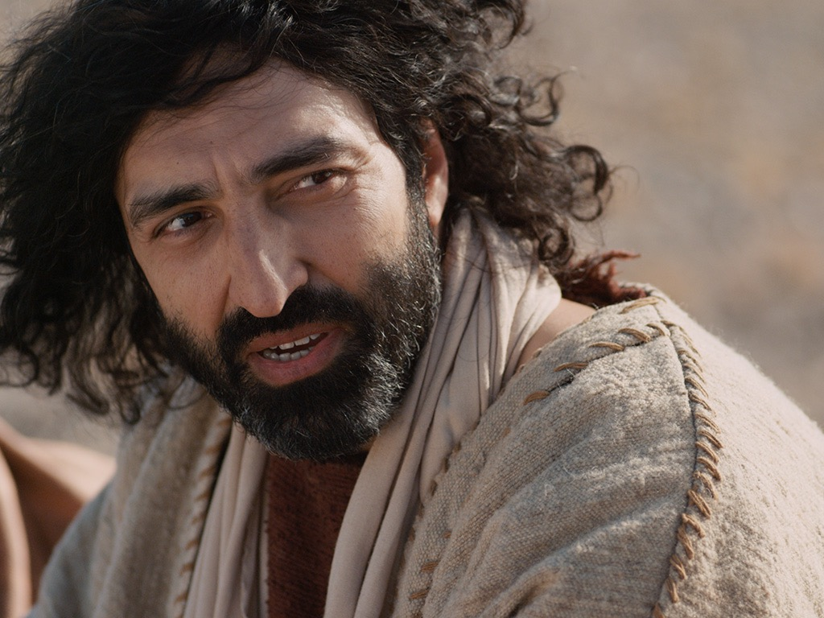
Notes:
Mark 10:27 Jesus looked at them intently and said, “Humanly speaking, it is impossible. But not with God. Everything is possible with God.”
Mark 10:28 Then Peter began to speak up. “We’ve given up everything to follow you,” he said.
Mark 10:29 “Yes,” Jesus replied, “and I assure you that everyone who has given up house or brothers or sisters or mother or father or children or property, for my sake and for the Good News, ³⁰ will receive now in return a hundred times as many houses, brothers, sisters, mothers, children, and property—along with persecution. And in the world to come that person will have eternal life. ³¹ But many who are the greatest now will be least important then, and those who seem least important now will be the greatest then.”

Slide 40
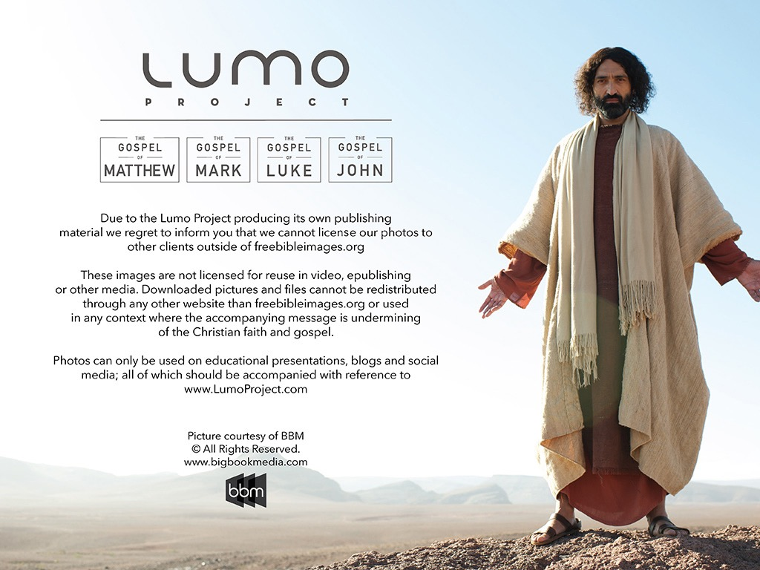
Used with Permission
THE GOSPEL ——OF—— MATTHEW
THE GOSPEL ——OF—— MARK
THE GOSPEL ——OF—— LUKE
THE GOSPEL ——OF—— JOHN
Due to the Lumo Project producing its own publishing material we regret to inform you that we cannot license our photos to other clients outside of freebibleimages.org.
These images are not licensed for reuse in video, epublishing or other media. Downloaded pictures and files cannot be redistributed through any other website than freebibleimages.org or used in any context where the accompanying message is undermining of the Christian faith and gospel.
Photos can only be used on educational presentations, blogs and social media, all of which should be accompanied with reference to www.LumoProject.com.
Picture courtesy of BBM © All Rights Reserved.
www.bigbookmedia.com

Slide 41
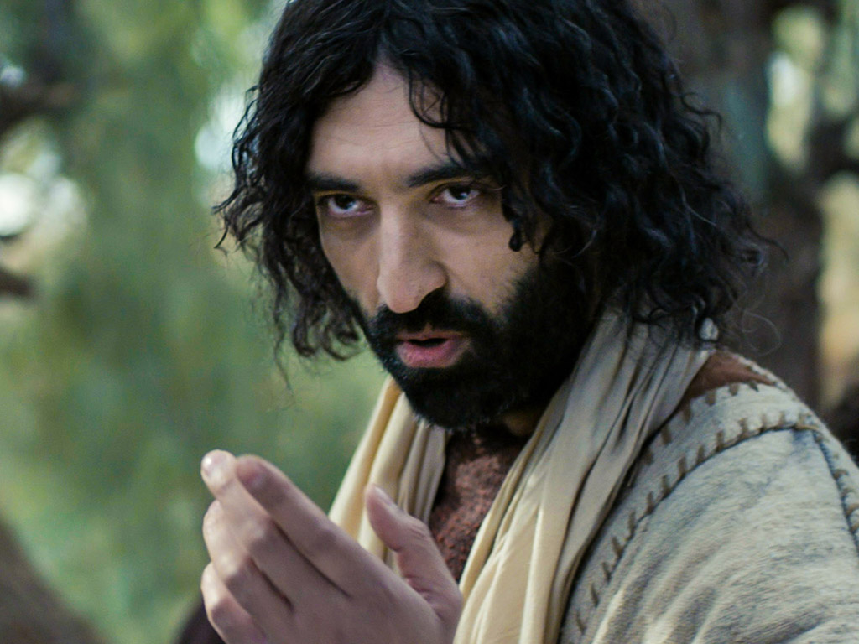
Jesus taught en route to Jerusalem that his disciples will be resisted (8:27–10:52).

Slide 42


Mark 10:35-37
³⁵ Then James and John, the sons of Zebedee,
came to him. “Teacher,” they said,
“We want you to do for us whatever we ask.”
³⁶ “What do you want me to do for you?”
he asked. ³⁷ They replied,
“Let one of us sit at your right and
the other at your left in your glory.”

Slide 43
Mark 10:38-40
³⁸ “You don’t know what you are asking,”
Jesus said. “Can you drink the cup I drink or
be baptized with the baptism I am baptized with?”
³⁹ “We can,” they answered.
Jesus said to them, “You will drink the cup
I drink and be baptized with the baptism
I am baptized with, ⁴⁰ but to sit at my right or left
is not for me to grant. These places belong to
those for whom they have been prepared.”

Slide 44
Mark 10:41-42
⁴¹ When the ten heard about this,
they became indignant with James and John.
⁴² Jesus called them together and said,
“You know that those who are regarded
as rulers of the Gentiles lord it over them,
and their high officials exercise authority
over them.

Slide 45
Mark 10:43-45
⁴³ Not so with you. Instead,
whoever wants to become great among you
must be your servant,
⁴⁴ and whoever wants to be first
must be slave of all.
⁴⁵ For even the Son of Man did not
come to be served, but to serve,
and to give his life as a ransom for many.”

Slide 46

Do you resist the flow to serve Jesus more than anyone?

Slide 47

How can you be a true disciple of Jesus in a hostile world?
Notes:
What’s it gonna take to really follow Christ when most people around you oppose Jesus?

Slide 48
How to Be a Disciple in a Hostile World
Don’t cling to your Authority
Serve
like Jesus
Suffer like Jesus
1:1-13 | 1:14–10:52 | 11–15 | 16
Mark
Notes:
Mimic the self-sacrifice Jesus as Servant in his rejection and death (Mark 11–15).

Slide 49
Slides on Mark 11

Slide 50
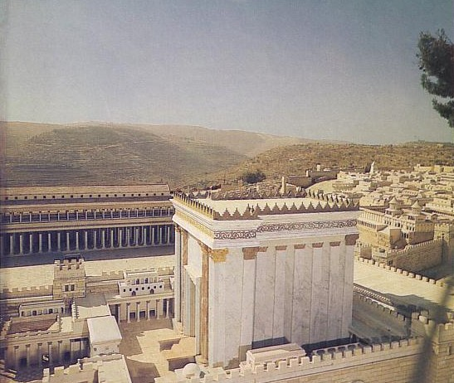
Outline
85
(1:14–10:52) Christ's ministry as Servant receives opposition, which Mark records with Christ's response of teaching on discipleship in order to encourage his readers to expect persecution for righteousness' sake.
(Chs. 11–15) Christ's self-sacrifice as Servant demonstrated in His rejection and death is recorded as the ultimate example of service to others despite persecution.
(Ch. 16) The resurrection account authenticates Jesus as Messiah and God so that those who serve this Servant can also have hope of victory over death.

Slide 51
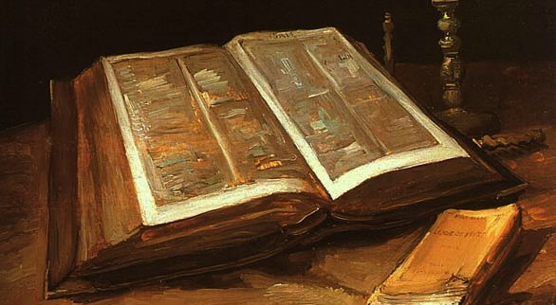
Mark 11:1-2 (ESV)
¹Now when they drew near to Jerusalem, to Bethphage and Bethany, at the Mount of Olives, Jesus sent two of his disciples ²and said to them, "Go into the village in front of you, and immediately as you enter it you will find a colt tied, on which no one has ever sat. Untie it and bring it.

Slide 52
Mark 11:3-4 (ESV)
³If anyone says to you, 'Why are you doing this?' say, 'The Lord has need of it and will send it back here immediately.'" ⁴And they went away and found a colt tied at a door outside in the street, and they untied it.

Slide 53
Mark 11:5-6 (ESV)
⁵And some of those standing there said to them, "What are you doing, untying the colt?" ⁶And they told them what Jesus had said, and they let them go.

Slide 54
Mark 11:7-8 (ESV)
⁷And they brought the colt to Jesus and threw their cloaks on it, and he sat on it. ⁸And many spread their cloaks on the road, and others spread leafy branches that they had cut from the fields.

Slide 55
Mark 11:9-10 (ESV)
9And those who went before and those who followed were shouting, "Hosanna! Blessed is he who comes in the name of the Lord! 10 Blessed is the coming kingdom of our father David! Hosanna in the highest!"

Slide 56
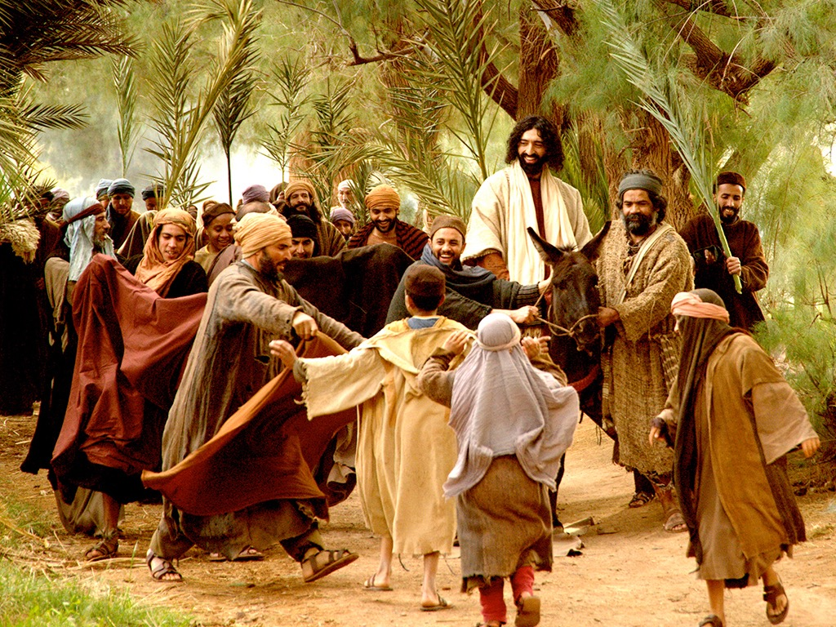

Matthew 21:1-11
Mark 11:1-11
Luke 19:28-44
John 12:12-19
THE EASTER STORY
TRIUMPHAL ENTRY (Palm Sunday)

Slide 57
Mark 11:1-11
As Jesus and his disciples approached Jerusalem, they came to the towns of Bethphage and Bethany on the Mount of Olives.

Slide 58
Jesus sent two of them on ahead. ² “Go into that village over there,” he told them.

Slide 59
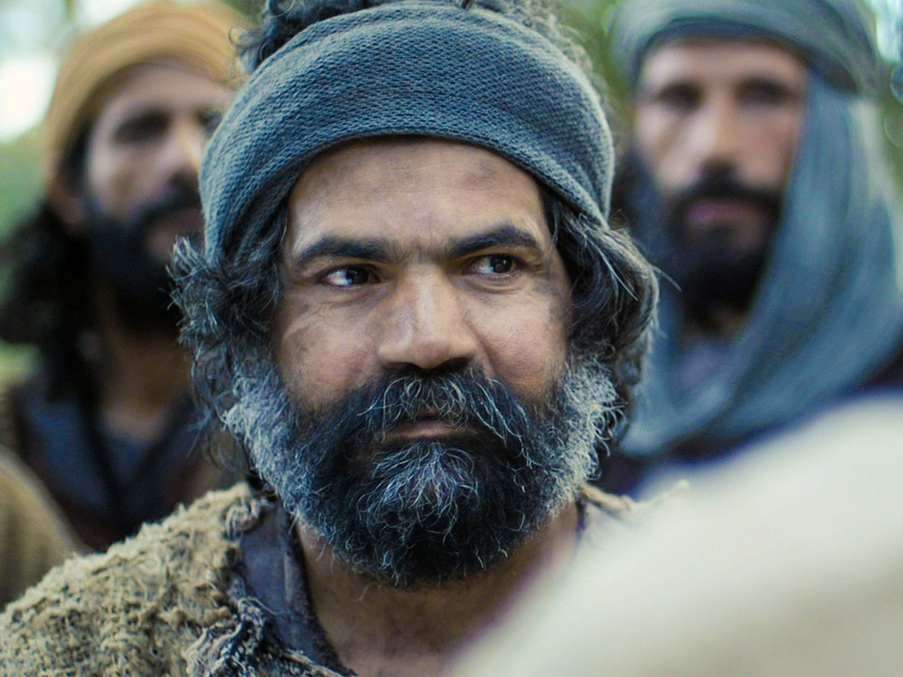
“As soon as you enter it, you will see a young donkey tied there that no one has ever ridden. Untie it and bring it here.
³ If anyone asks, ‘What are you doing?’ just say, ‘The Lord needs it and will return it soon.’”

Slide 60
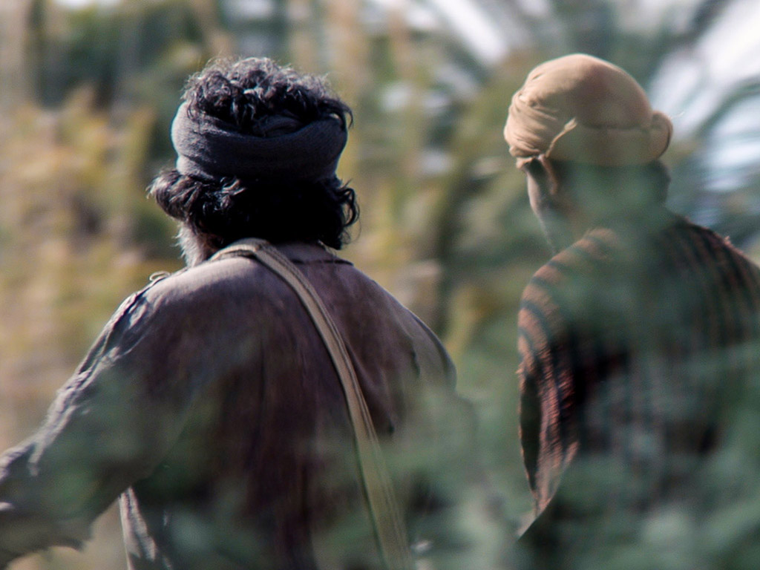
⁴ The two disciples left and found the colt standing in the street, tied outside the front door.

Slide 61
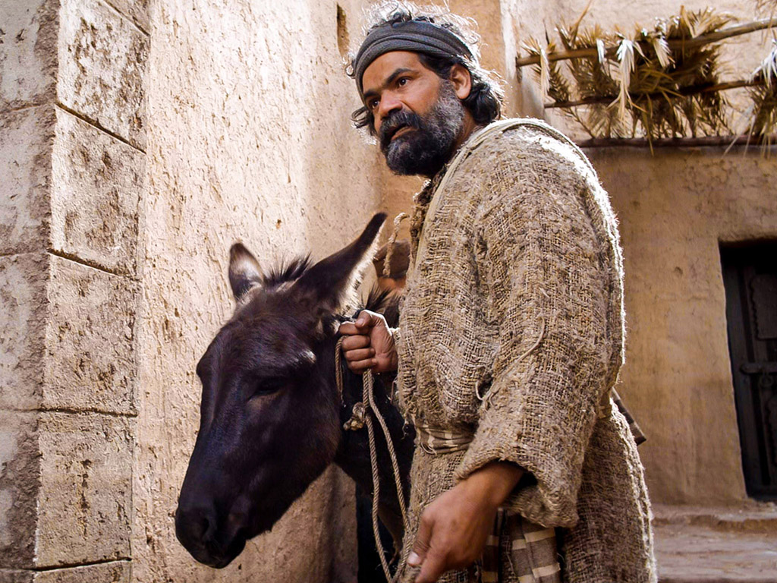
⁵ As they were untying it, some bystanders demanded…

Slide 62
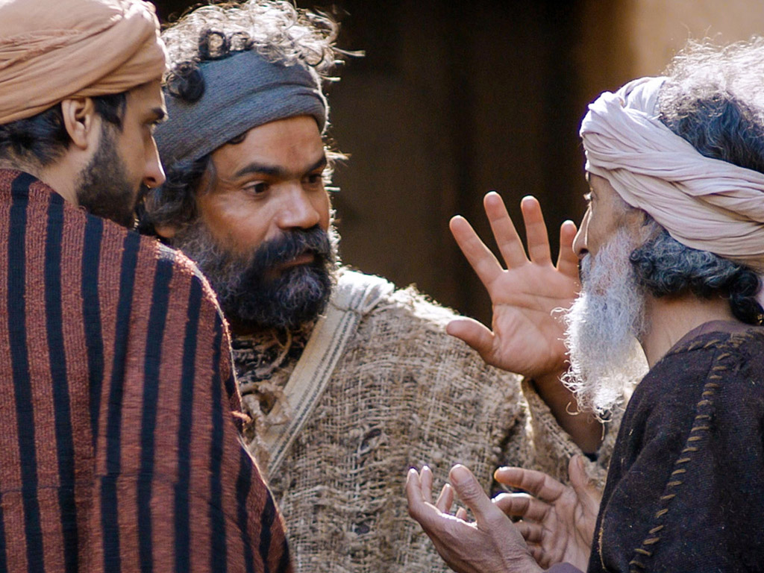
“What are you doing, untying that colt?” ⁶ They said what Jesus had told them to say, and they were permitted to take it.

Slide 63
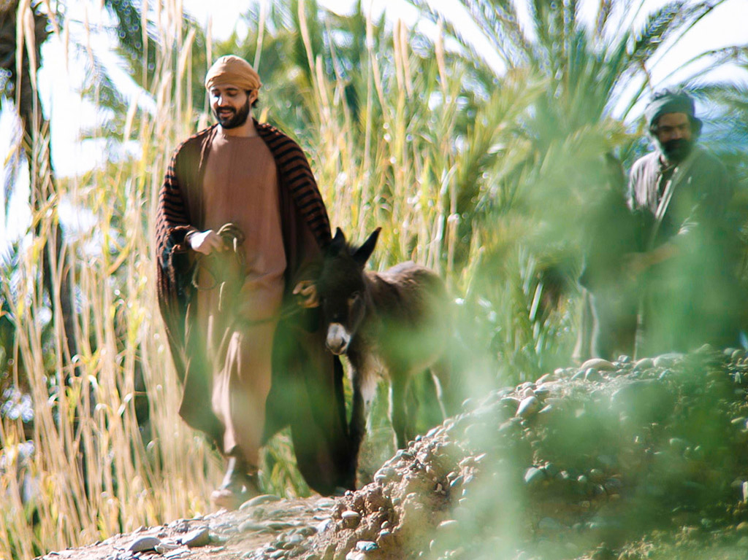
⁷ Then they brought the colt to Jesus...

Slide 64
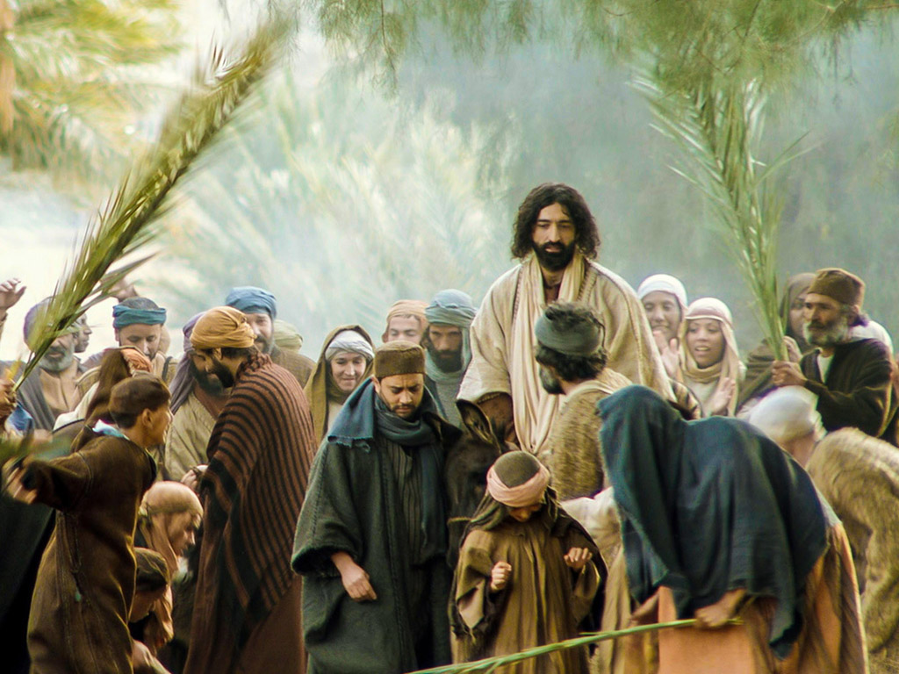
…and threw their garments over it, and he sat on it.

Slide 65
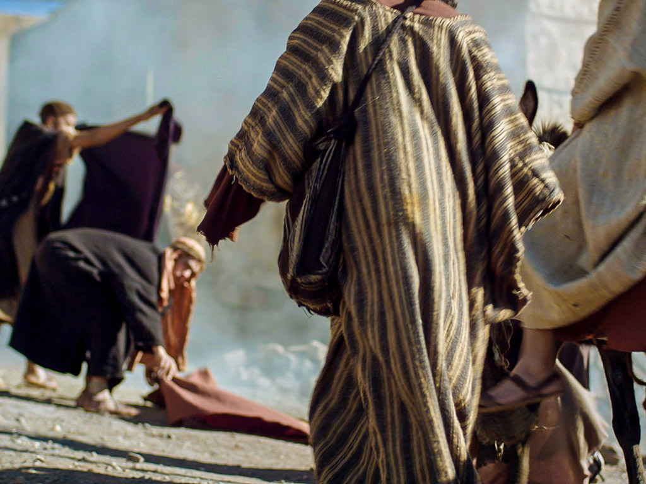
⁸ Many in the crowd spread their garments on the road ahead of him, and others spread leafy branches they had cut in the fields.

Slide 66
⁹ Jesus was in the center of the procession, and the people all around him were shouting…

Slide 67
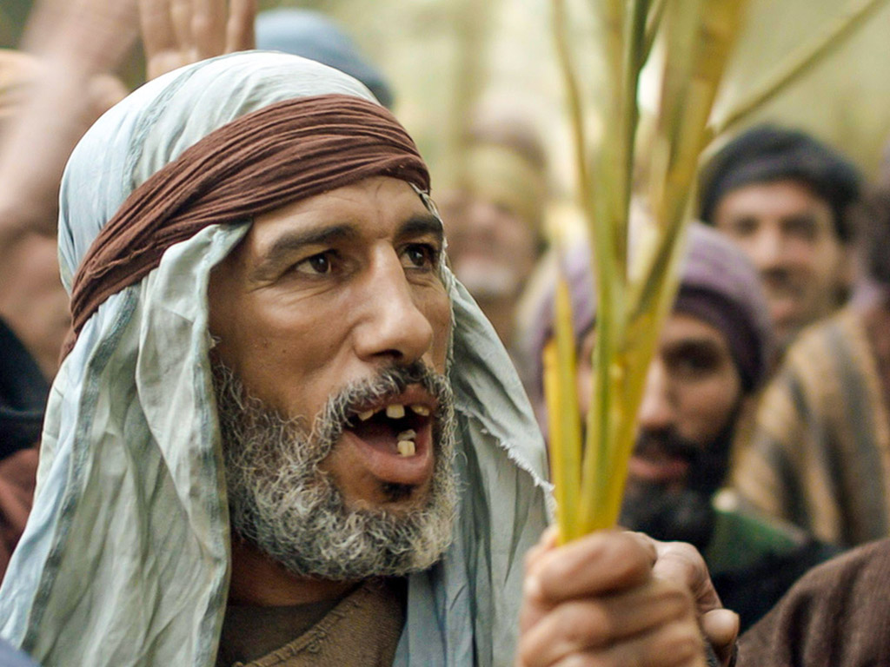
“Praise God!
Blessings on the one who comes in the name of the LORD!

Slide 68
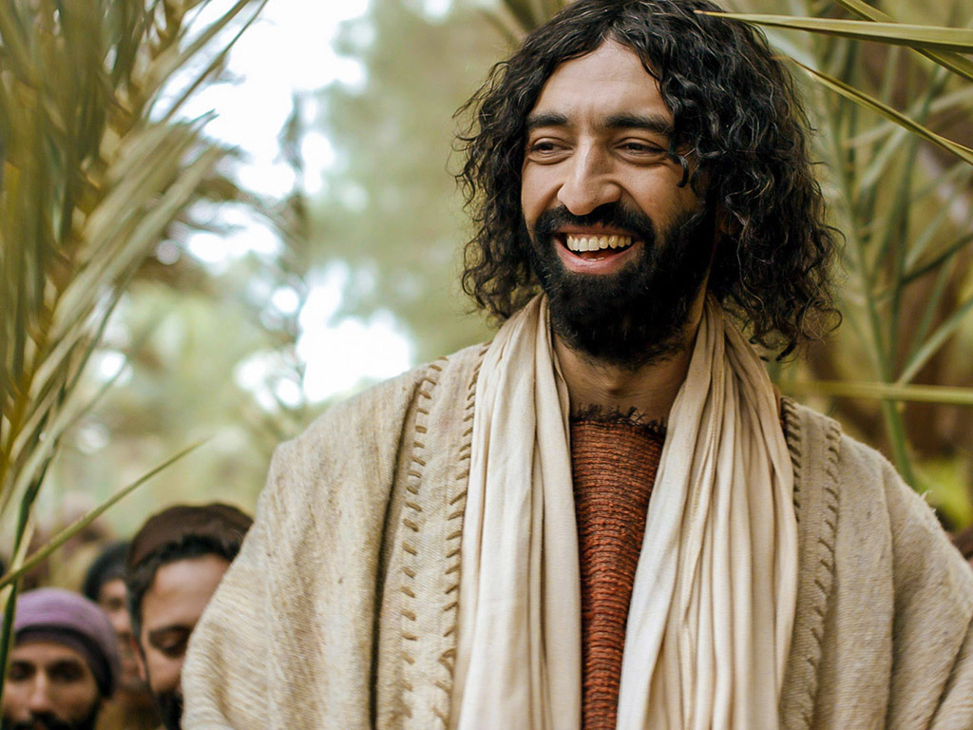
¹⁰ Blessings on the coming Kingdom of our ancestor David!

Slide 69
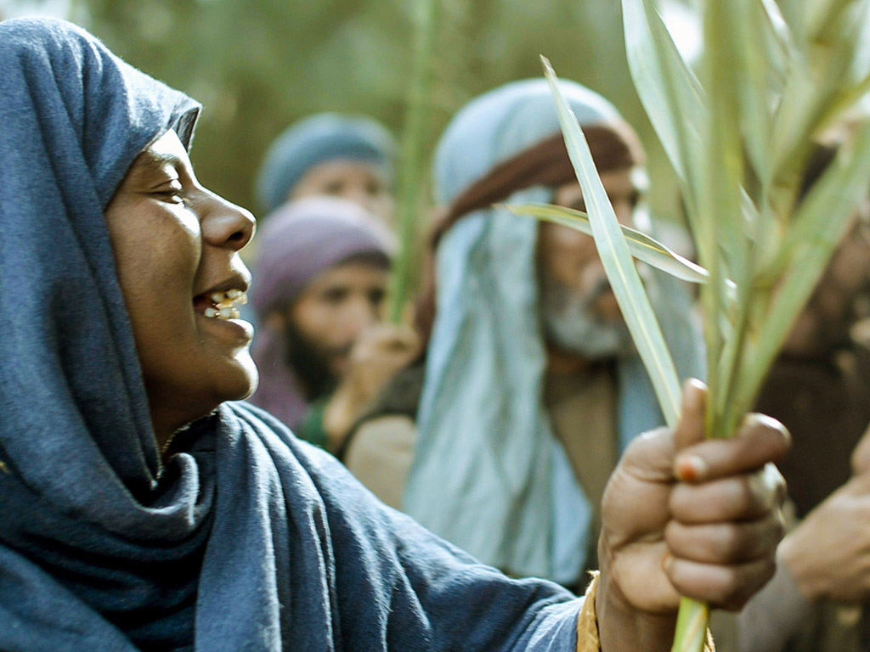
"Praise God in highest heaven!"

Slide 70
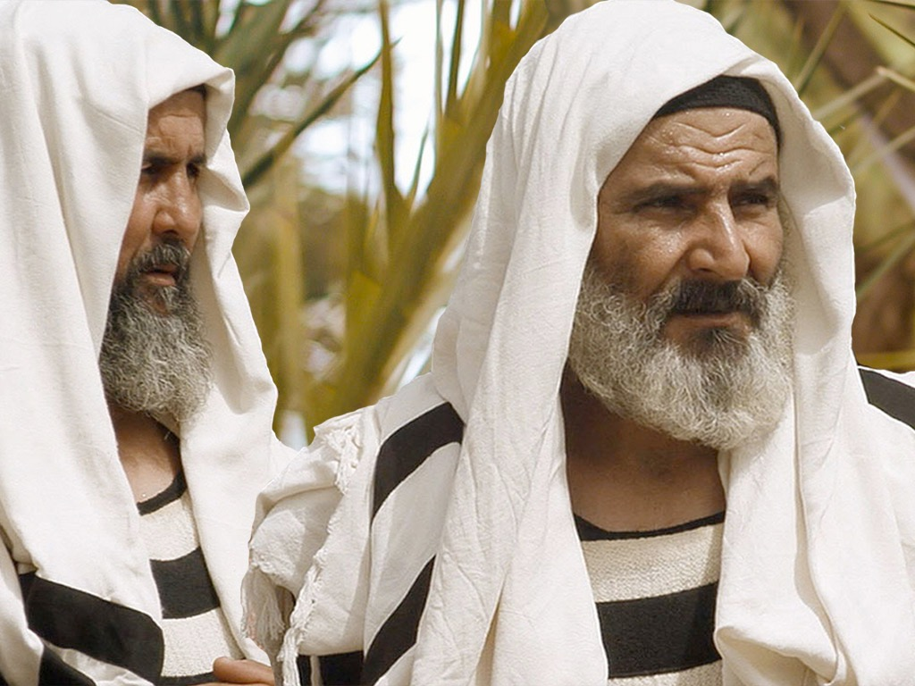
Luke 19:39
But some of the Pharisees among the crowd said, “Teacher, rebuke your followers for saying things like that!”

Slide 71
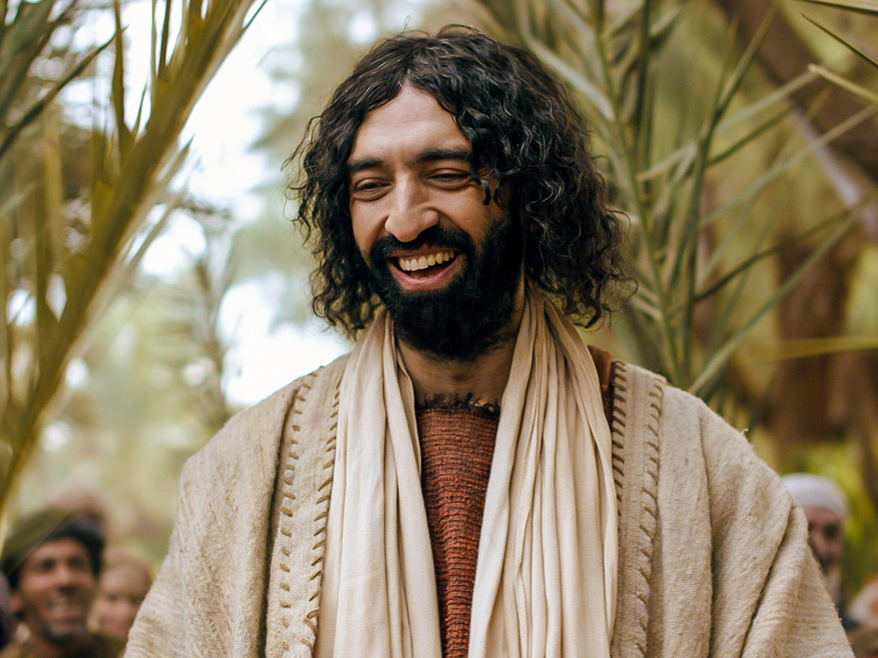
Luke 19:40
He replied, “If they kept quiet, the stones along the road would burst into cheers!”

Slide 72
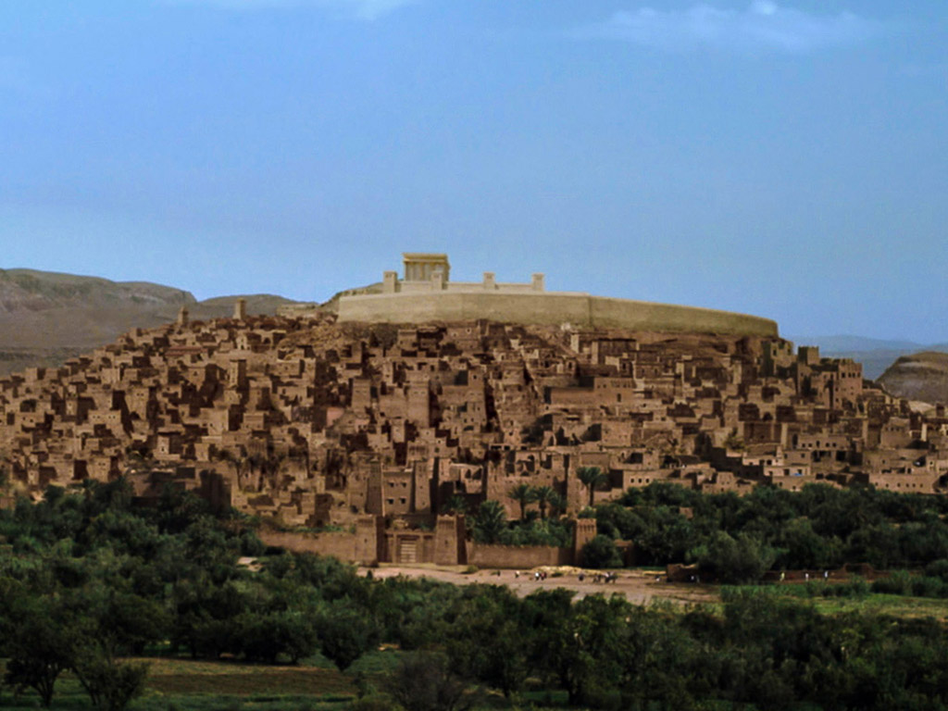
Luke 19:41
But as he came closer to Jerusalem and saw the city ahead…

Slide 73
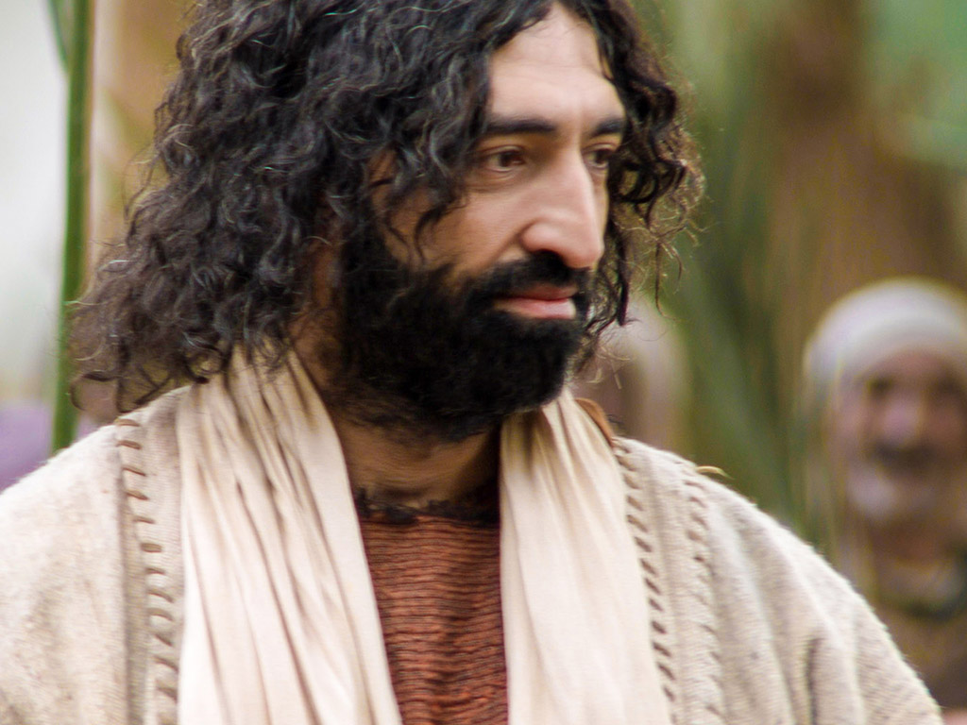
Luke 19:41-42
…he began to weep. ⁴² “How I wish today that you of all people would understand the way to peace. But now it is too late, and peace is hidden from your eyes.

Slide 74
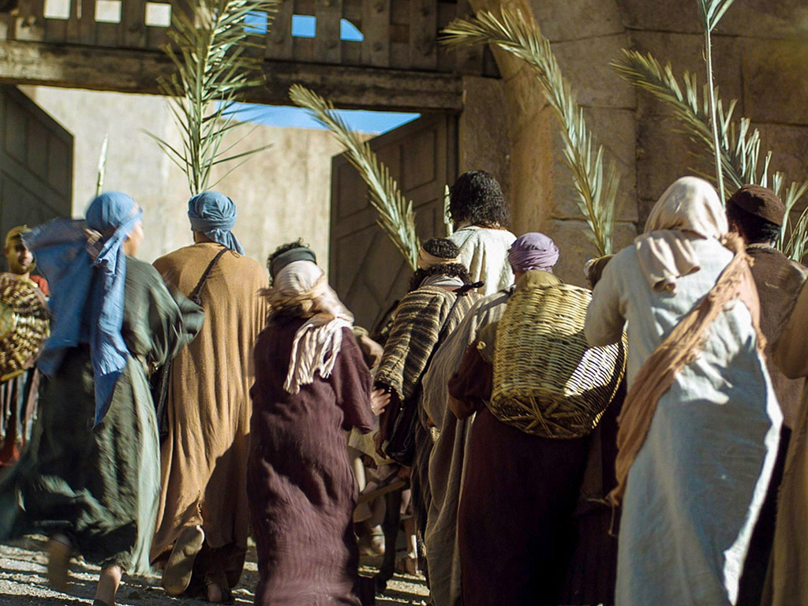
Luke 19:43
Before long your enemies will build ramparts against your walls and encircle you and close in on you from every side.

Slide 75
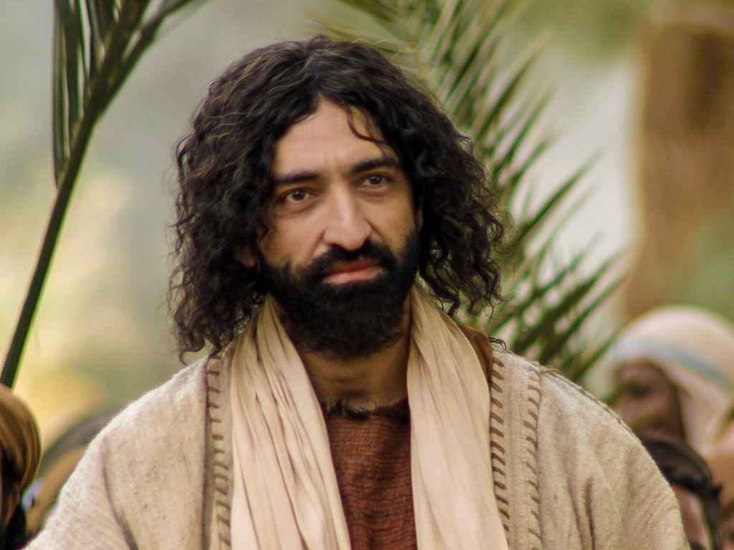
Luke 19:44
They will crush you into the ground, and your children with you. Your enemies will not leave a single stone in place, because you did not recognize it when God visited you.”

Slide 76

THE WORD IN PICTURES
Free Bible images

Slide 77
Used with Permission
THE GOSPEL ——OF—— MATTHEW
THE GOSPEL ——OF—— MARK
THE GOSPEL ——OF—— LUKE
THE GOSPEL ——OF—— JOHN
Due to the Lumo Project producing its own publishing material we regret to inform you that we cannot license our photos to other clients outside of freebibleimages.org.
These images are not licensed for reuse in video, epublishing or other media. Downloaded pictures and files cannot be redistributed through any other website than freebibleimages.org or used in any context where the accompanying message is undermining of the Christian faith and gospel.
Photos can only be used on educational presentations, blogs and social media, all of which should be accompanied with reference to www.LumoProject.com.
Picture courtesy of BBM © All Rights Reserved.
www.bigbookmedia.com

Slide 78
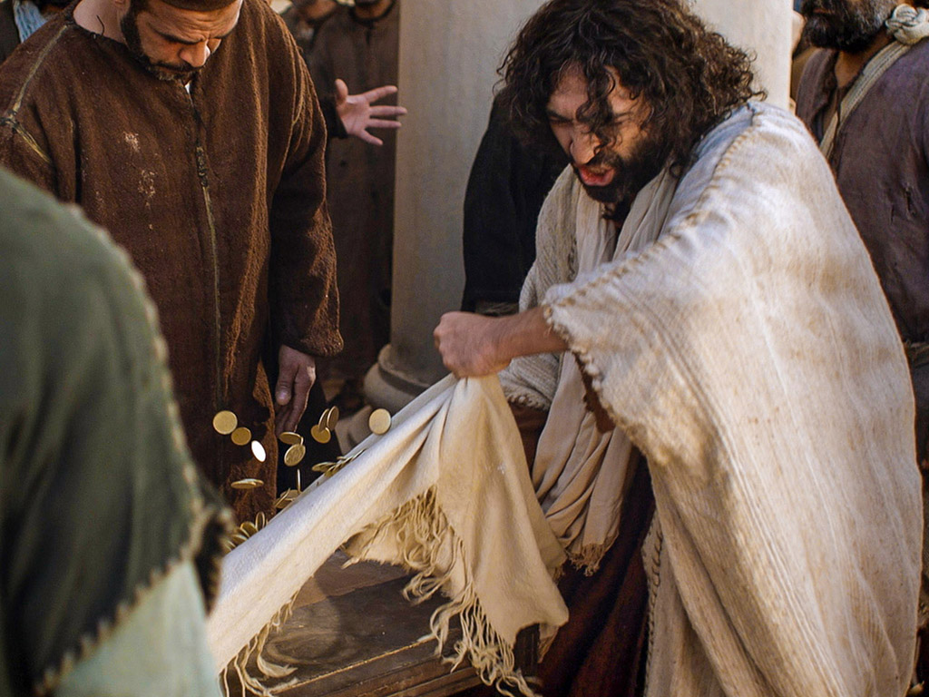
Matthew 21:12-17
Mark 11:15-19
Luke 19:45-48
John 2:13-24
THE EASTER STORY
CLEANSING THE TEMPLE
Free Bible images

Slide 79
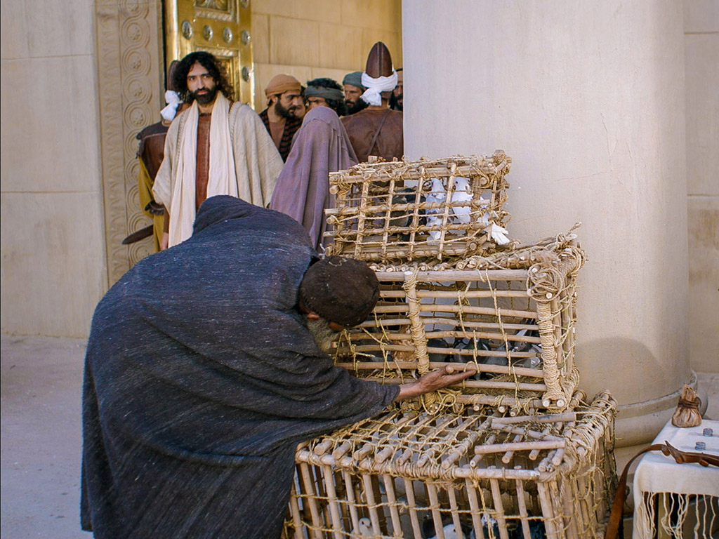

Slide 80
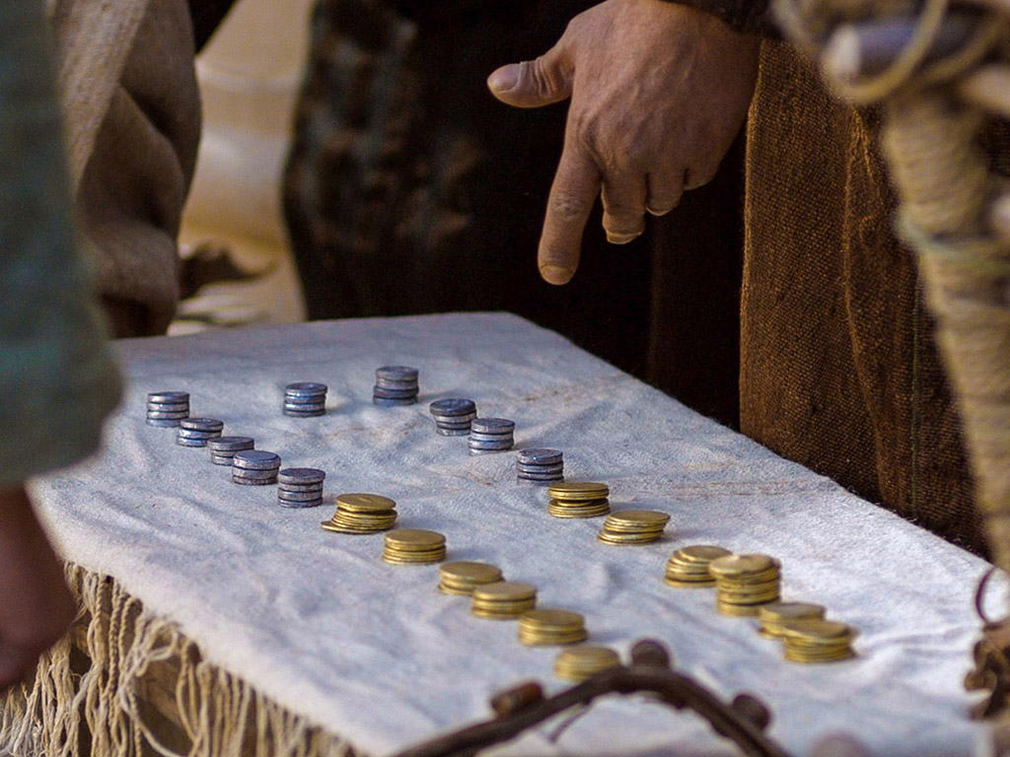

Slide 81
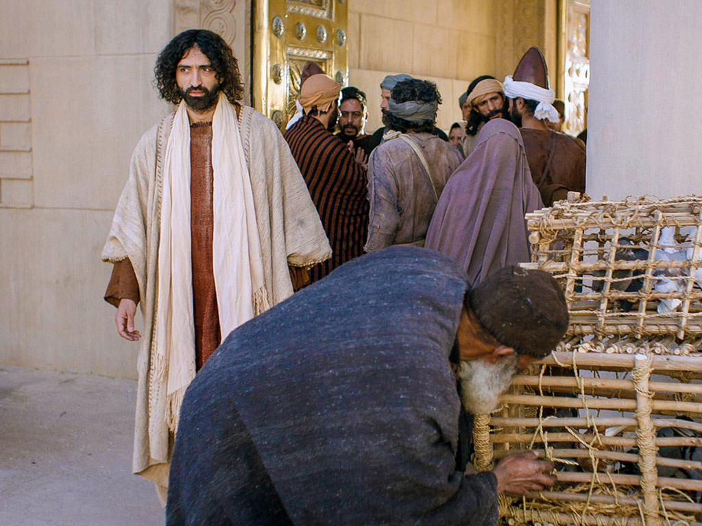

Slide 82
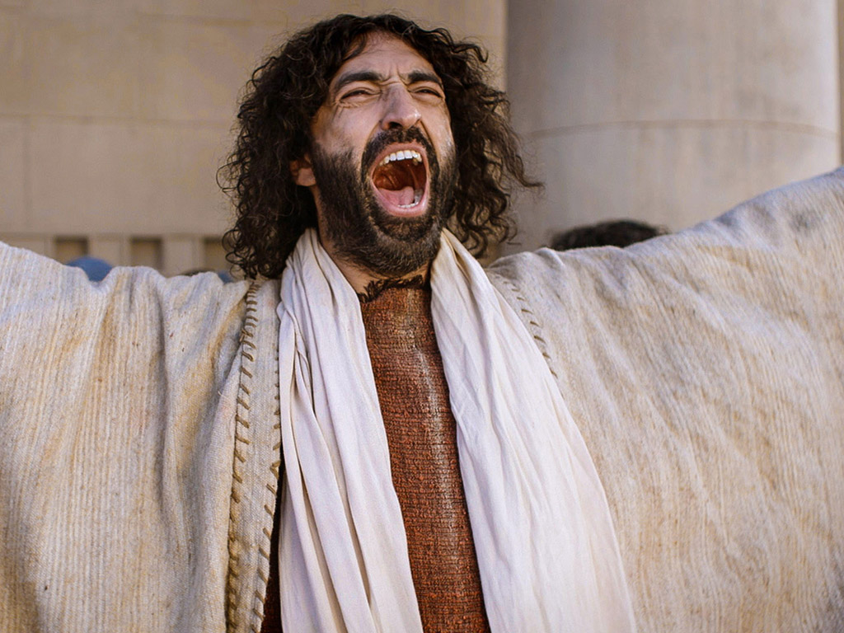

Slide 83
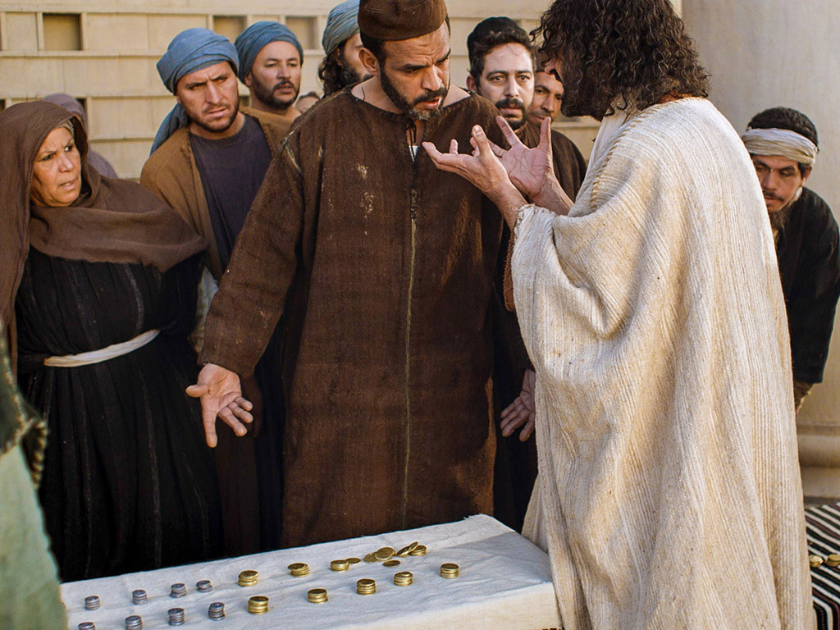

Slide 85
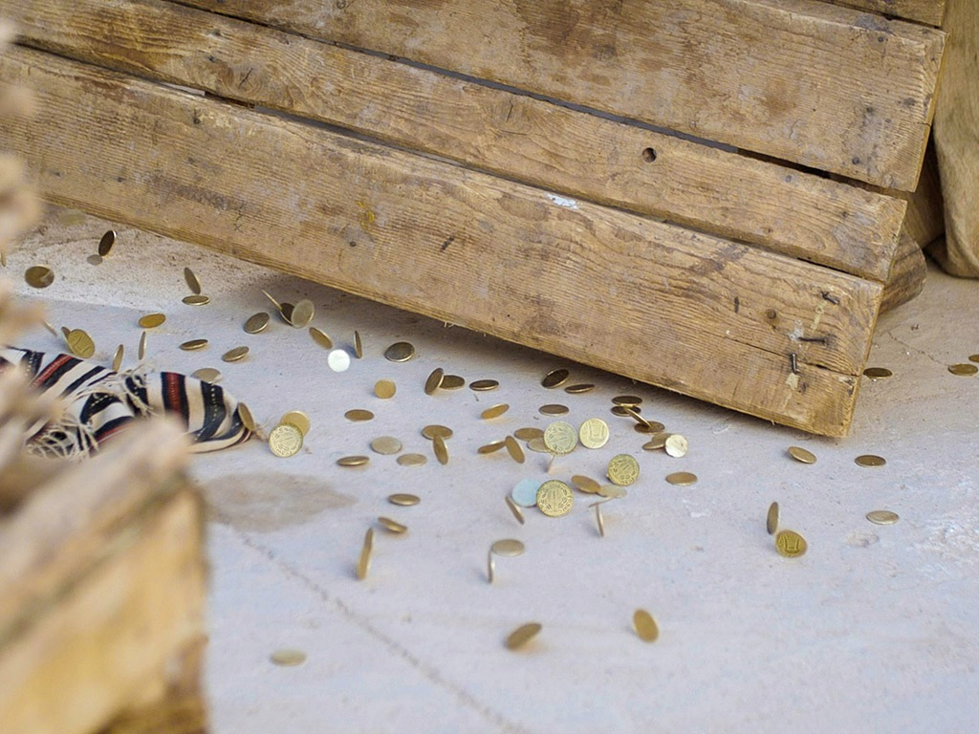

Slide 86
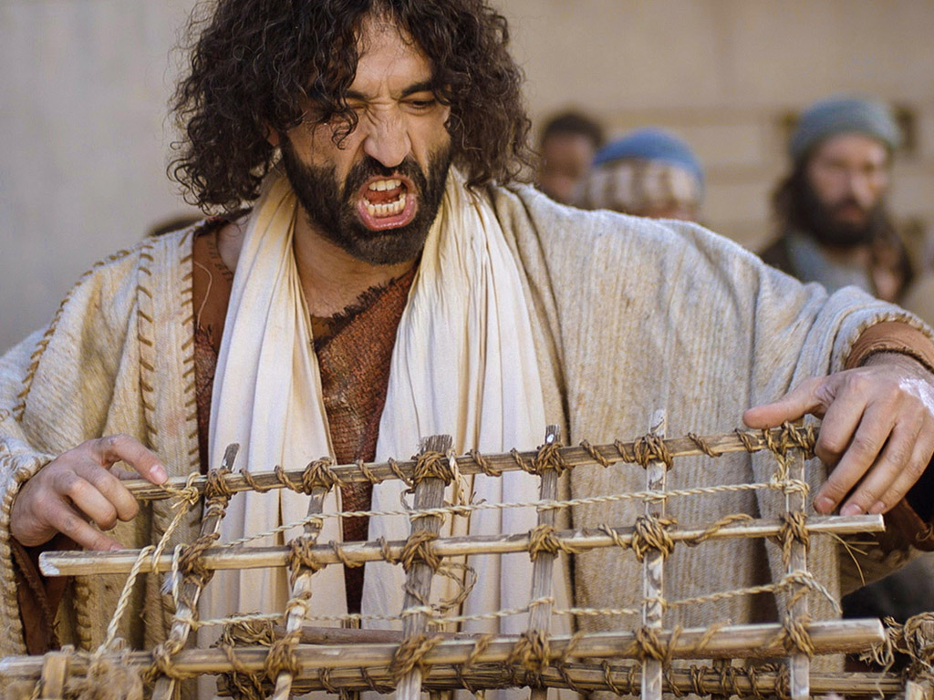

Slide 87
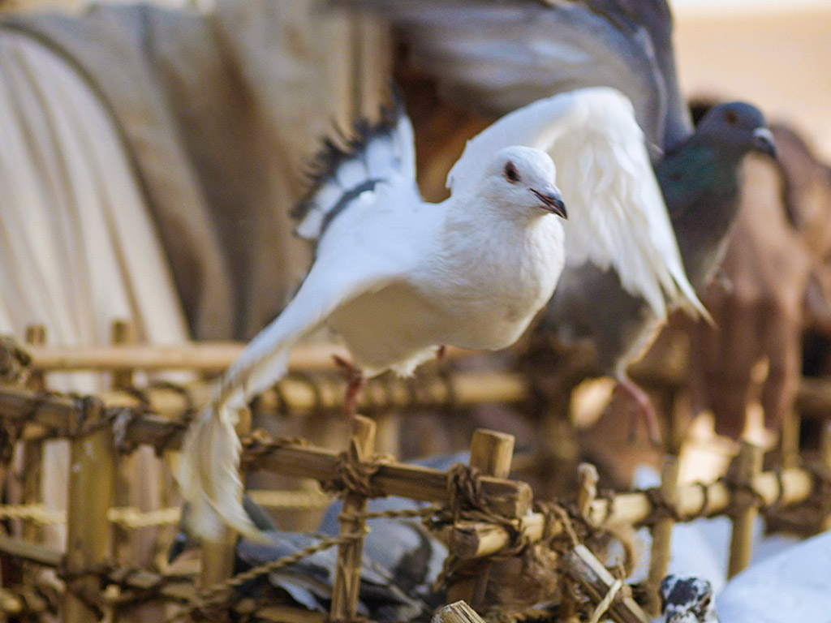

Slide 88


Slide 89


Slide 90


Slide 91


Slide 92


Slide 93


Slide 94


Slide 95
THE WORD IN PICTURES
Free Bible images

Slide 96

The Paradox of Authority and Servanthood in Mark
 | Authority | Servanthood
Themes | Christ's Leadership | Discipleship
Strategy | Gentiles lord it over others (10:42) | Disciples serve (10:43)
Motivation | "Save his life" (8:35a) | "Lose his life" (8:35b)
Priority | "First" (9:35a; 10:31a) | "Last" (9:35b; 10:31b)
Reputation | "Great" (10:43a) | "Servant" (10:43b)
Position | "First" (10:44a) | "Slave of all" (10:44b)
Authority Examples | Authority without Serving: • Religious leaders • Rich man • Judas | Authority & Served: • John the Baptist • Joseph of Arimathea
Servanthood Examples | Authority but Struggled to Serve: • Disciples | No Authority & Served • Bartimaeus • Woman who anointed Jesus
1st Section (1:1–8:26) | Authority of Christ
2nd Section (8:27–10:52) | Authority- Servanthood Tension
3rd Section (11–16) |  | Servanthood of Christ
89a
Summary of Narry F. Santos, Bibliotheca Sacra 154 (Oct.-Dec. 1997): 452-60

Slide 97

Worldly Leadership
Mark
89a
Worldly Leadership
Followers serve the leader, who is at the top
Leader
Followers

Slide 98
Biblical Leadership
Mark
89a
Biblical Leadership
The leader serves the followers
Followers
Leader

Slide 99

JESUS CURSES A FIG TREE
Mark 11:12-14, 20-25

Slide 100


Slide 101


Slide 102


Slide 104


Slide 105


Slide 106


Slide 107
THE WORD IN PICTURES
Free Bible images

Slide 108
Used with Permission
THE GOSPEL ——OF—— MATTHEW
THE GOSPEL ——OF—— MARK
THE GOSPEL ——OF—— LUKE
THE GOSPEL ——OF—— JOHN
Due to the Lumo Project producing its own publishing material we regret to inform you that we cannot license our photos to other clients outside of freebibleimages.org.
These images are not licensed for reuse in video, epublishing or other media. Downloaded pictures and files cannot be redistributed through any other website than freebibleimages.org or used in any context where the accompanying message is undermining of the Christian faith and gospel.
Photos can only be used on educational presentations, blogs and social media, all of which should be accompanied with reference to www.LumoProject.com.
Picture courtesy of BBM © All Rights Reserved.
www.bigbookmedia.com

Slide 109


Palm Sunday
Palm
SUNDAY
Notes:
Palm Sunday is an interesting name for the day, isn't it?
________
Common-427
NS-01-Matt15-28-slide 131
NS-02-Mark9-16-slide 96
NS-03-Luke13-24-slide 94
NS-04-John12-21-slide 23

Slide 110


Palm Sunday
Notes:
We know that today recalls the palm branches waved at Jesus as he entered Jerusalem at the beginning of his last week of his life. Yet the focus really isn't the tree palms, but the hand palms of Jesus that would stretch out on a cross but a few days later.

Slide 111

Palms to Cross
Notes:
Tree palms were but a prelude to the cross.

Slide 112


Triumphant Entry
Matthew 21:9
Notes:
Even the alternate name—Triumphant Entry—is also perplexing.

Slide 113

Triumphal Entry
Notes:
True, Jesus rode into Jesus and the crowds cheered his arrival.

Slide 114


Triumphant Entry
Matthew 21:9
Notes:
Matthew 21:9 says the crowds that went ahead of him and those that followed shouted, "Hosanna to the Song of David!" "Blessed is he who comes in the name of the Lord!" "Hosanna in the highest!"

Slide 115

Palms to Palms
Notes:
Normally a king rode into the city as the victor over his enemies, while that very week would culminate in Jesus' death on Friday, which we call Good Friday.

Slide 116

What's so good about Good Friday?
Notes:
But that name is equally puzzling. Why is Good Friday called "good"?
Our leader died on that day, so it seems strange to call the day "good." No other religion refers to the death of their leader as "good."
We believe that his death was good. How was that?

Slide 117

How is Christ's death better than any sacrifice?

Slide 118

Passion Week
64
Mon
Wed
Tues
Fri
Thurs
Fri
Sun
Sat
Sat
Sun
Notes:
Jesus invested his final week in Jerusalem and Bethany east of it, going back and forth from Bethany to the city in a purposeful series of events designed to end in his crucifixion and resurrection.
__________
Common-432
LC-00-NT Chronology-43
NS-01-Matt15-28-slide 139
NS-02-Mark9-16-slide 105
NS-03-Luke13-24-slide 224
NS-04-John12-21-slide 295

Slide 119
Slides on Mark 12

Slide 120

I. Instruction at the Treasury
§ 149
Mark 12:41-44; Luke 21:1-4
Christ shames the hypocrisy of the Pharisees by the sacrificial giving of a poor widow to show her as the true disciple of the kingdom
Notes:
The Widow’s Mites
Mark 12:41 And He sat down opposite the treasury, and began observing how the people were putting money into the treasury; and many rich people were putting in large sums. ⁴² A poor widow came and put in two ¹small copper coins, which amount to a cent. ⁴³ Calling His disciples to Him, He said to them, “Truly I say to you, this poor widow put in more than all ¹the contributors to the treasury; ⁴⁴ for they all put in out of their ¹surplus, but she, out of her poverty, put in all she owned, ²all she had to live on.”
The Widow’s Gift
Luke 21:1 And He looked up and saw the rich putting their gifts into the treasury. ² And He saw a poor widow putting in two small copper coins. ³ And He said, “Truly I say to you, this poor widow put in more than all of them; ⁴ for they all out of their ¹surplus put into the ²offering; but she out of her poverty put in all ³that she had to live on.”

Slide 121

The Widow's Mites
Mark 12:41-44; Luke 21:1-4

Slide 122

The Widow's Mites
Mark 12:41-44; Luke 21:1-4

Slide 123

The Widow's Mites
Mark 12:41-44; Luke 21:1-4

Slide 124

The Widow's Mites
Mark 12:41-44; Luke 21:1-4

Slide 125

What is in your hand?
Mark 12:41-44; Luke 21:1-4

Slide 126

What’s Most Important?
Notes:
What do you think is the most important thing we do as a church? Worship? Evangelism? Fellowship? Bible study? Prayer? When I was a pastor, a man inquiring about our church asked me, “So what is most important to your church? What is unique?” If he had asked you, what would you have said? I told him one word: LOVE!
One of the teachers of religious law was standing there listening to Jesus debate. He realized that Jesus had answered well, so he asked, “Of all the commandments, which is the most important?”
________
LC-06-Presentation-113
NS-01-Matt15-28-slide 143
NS-02-Mark9-16-slide 107
126

Slide 127

The most important thing is to enjoy your life— it's all that matters —Audrey Hepburn—
Notes:
She obviously could not see beyond herself.
________
NS-01-Matt15-28-slide 143
NS-02-Mark9-16-slide 107

Slide 128

"Happiness is most important"
Happiness is the most important thing in the world, without it, you live a life of depression.
—Marilyn Monroe—
Notes:
She died young through suicide.
________
NS-01-Matt15-28-slide 144
NS-02-Mark9-16-slide 109

Slide 129

What’s Most Important?
Mark 12:29-31 -- Jesus replied, “The most important commandment is this: ‘Listen, O Israel! The Lord our God is the one and only Lord. ³⁰ And you must love the Lord your God with all your heart, all your soul, all your mind, and all your strength.’
³¹ The second is equally important: ‘Love your neighbor as yourself.’ No other commandment is greater than these.”
Notes:
One of the teachers of religious law was standing there listening to the debate. He realized that Jesus had answered well, so he asked, “Of all the commandments, which is the most important?” Jesus answered…
——————————
Common-293
OS-05-Deut-154
NS-01-Matt15-28-slide 146
NS-02-Mark9-16-slide 110
129

Slide 130

Our Vision
Love the Nations
Love the Church
Love God
Notes:
Repentance will bring restoration in a church: God wants our church to really trust him.
We still don’t see our need for him as we don’t see our need to pray.
We also need to be involved in his work: missions, teaching, accountability groups, finances, etc.
——————————
OS-29-Joel-128
OP-05-Deut-71

Slide 131
Slides on Mark 13

Slide 132
Slides on Mark 14

Slide 133


Broken & Spilled Out
Matthew 26:6-13
Mark 14:1-11
John 12:1-11
Free Bible images
Performed By Steve Green
JESUS IS ANOINTED
Notes:
FreeBibleImages.org does what it says it does, offering photos and cartoons on narrative portions of Scripture. These are copyright-free as well and continually updated.
This 1980s song accurately narrates how Mary of Bethany anointed Jesus for his burial as no time would be available to perform these Jewish rites the next day when the body of Jesus was hastily buried.
______________
Common-431
BS-20-Study Tools-6
NS-01-Matt15-28-slide
NS-02-Mark9-16-slide
NS-04-John12-21-slide 5

Slide 134

Notes:
Music background 1 of 2

Slide 135

Notes:
Music background 1 of 2

Slide 136

One day a plain village woman, driven by love for her Lord

Slide 137

Recklessly poured out a valuable essence, disregarding the scorn

Slide 138
And once it was broken and spilled out A fragrance filled all the room.

Slide 139
Like a prisoner released from his shackles Like a spirit set free from the tomb

Slide 140

Broken and spilled out, just for love of you, Jesus

Slide 141
Life's most precious treasure, lavished on Thee

Slide 142

Broken and spilled out, and poured at Your feet

Slide 143
In sweet abandon let me be spilled out and used up for Thee

Slide 144

Lord, You were God's precious treasure, His loved and His own perfect Son

Slide 145
Sent here to show me the love of the Father, just for love it was done

Slide 146

And though You were perfect and holy You gave up Yourself willingly

Slide 147
You spared no expense for my pardon You were used up and wasted for me

Slide 148

Broken and spilled out Just for love of me, Jesus––

Slide 149
God's most precious treasure lavished on me

Slide 150

Broken and spilled out and poured at my feet.

Slide 151
In sweet abandon, Lord, You were spilled out and used up for me

Slide 152

In sweet abandon, let me be spilled out and used up for Thee

Slide 153

Pictures courtesy of Big Book Media © All Rights Reserved.
Used with permission
BIG BOOK MEDIA

Slide 154
THE WORD IN PICTURES
Free Bible images

Slide 155


Was Mary Magdalene the Woman with the Alabaster Jar?
The WOMAN with the ALABASTER JAR
Mary Magdalen and the Holy Grail
No. In Luke she is not named but in the other gospels she is clearly Mary of Bethany
As featured in The Da Vinci Code

Slide 156

John 12 Events
64
656
Unbelief Summary
12:37-50
Predicts Death
12:21-36
Triumphal Entry
12:12-20
Anointing at Bethany
12:1-11
Notes:
John leaves out the many details of Passion Week noted in the Synoptics except his anointing and Triumphal Entry, choosing instead to highlight the prediction of his death and the unbelief of the leaders.
____________
Common-433
NS-01-Matt15-28-slide 183
NS-02-Mark9-16-slide 130
NS-03-Luke13-24-slide 104
NS-04-John12-21-slide 4

Slide 157

Luke 7:36-50 Jesus and the Sinful Woman

Slide 158

Anointings of Jesus
Common to all four gospel accounts:
Unannounced visit by woman
Anointed Jesus' head and/or feet
Wiped his feet with her hair
Complaint of waste by disciples/Judas
Disciples rebuked by Jesus
In a home
Alabaster jar (except in John)
Home owned by man called Simon

Slide 159

The Two Anointings of Jesus
Luke 7:36-50
Early in Ministry
Weeping
For worship, woman's sins forgiven (Luke 7:48)
By unnamed harlot at
home of Simon the Pharisee (Luke 7:40) in an unknown town
Matt. 26:6-13
Mark 14:3-9
John 12:1-11
During Passion Week
No weeping noted
For burial, woman needed no forgiveness
By Lazarus' sister Mary at home of Simon the Leper
(Matt. 26:6; Mark 14:3) in Lazarus' hometown of Bethany (John 12:1)

Slide 160

Free Bible images
Matthew 26:17-35
Mark 14:12-31
Luke 22:7-38
John 13:18-38
THE EASTER STORY
THE LAST SUPPER

Slide 161


Slide 162


Slide 163


Slide 164


Slide 165


Slide 166


Slide 167


Slide 168


Slide 170


Slide 171


Slide 172


Slide 173


Slide 174


Slide 175


Slide 176
THE WORD IN PICTURES
Free Bible images

Slide 177

Matthew 26:36-56
Mark 14:32-52
Luke 22:39-53
John 18:1-12
THE EASTER STORY
JESUS PRAYS IN GETHSEMANE

Slide 178


Slide 179


Slide 180


Slide 181


Slide 182


Slide 184


Slide 185


Slide 186


Slide 187


Slide 188


Slide 189


Slide 190


Slide 191


Slide 192


Slide 193


Slide 194


Slide 195


Slide 196


Slide 197


Slide 198
THE WORD IN PICTURES
Free Bible images

Slide 199
Used with Permission
THE GOSPEL ——OF—— MATTHEW
THE GOSPEL ——OF—— MARK
THE GOSPEL ——OF—— LUKE
THE GOSPEL ——OF—— JOHN
Due to the Lumo Project producing its own publishing material we regret to inform you that we cannot license our photos to other clients outside of freebibleimages.org.
These images are not licensed for reuse in video, epublishing or other media. Downloaded pictures and files cannot be redistributed through any other website than freebibleimages.org or used in any context where the accompanying message is undermining of the Christian faith and gospel.
Photos can only be used on educational presentations, blogs and social media, all of which should be accompanied with reference to www.LumoProject.com.
Picture courtesy of BBM © All Rights Reserved.
www.bigbookmedia.com

Slide 200

Peter's Calling
(Mark's source for his gospel)

Slide 201

Peter's Denials

Slide 202


Free Bible images
Matthew 26:69-75
Mark 14:66-72
Luke 22:54-62
John 18:15-27
THE EASTER STORY
PETER DENIES JESUS

Slide 203


Slide 204


Slide 205


Slide 206


Slide 207


Slide 208


Slide 209


Slide 210


Slide 211


Slide 213
Pictures courtesy of Big Book Media © All Rights Reserved.
Used with permission
BIG BOOK MEDIA

Slide 214
THE WORD IN PICTURES
Free Bible images

Slide 215

Free Bible images
Matthew 26:57-67
Mark 14:53-65
Luke 22:66-71
John 18:15-27
THE EASTER STORY
JESUS BEFORE THE SANHEDRIN

Slide 216


Slide 217


Slide 218


Slide 220


Slide 221


Slide 222


Slide 223


Slide 224
THE WORD IN PICTURES
Free Bible images

Slide 225
Used with Permission
THE GOSPEL ——OF—— MATTHEW
THE GOSPEL ——OF—— MARK
THE GOSPEL ——OF—— LUKE
THE GOSPEL ——OF—— JOHN
Due to the Lumo Project producing its own publishing material we regret to inform you that we cannot license our photos to other clients outside of freebibleimages.org.
These images are not licensed for reuse in video, epublishing or other media. Downloaded pictures and files cannot be redistributed through any other website than freebibleimages.org or used in any context where the accompanying message is undermining of the Christian faith and gospel.
Photos can only be used on educational presentations, blogs and social media, all of which should be accompanied with reference to www.LumoProject.com.
Picture courtesy of BBM © All Rights Reserved.
www.bigbookmedia.com

Slide 226
Slides on Mark 15

Slide 227

Free Bible images
Matthew 27:27-37
Mark 15:16-25
Luke 23:26-34
John 19:16-27
THE EASTER STORY
JESUS IS CRUCIFIED

Slide 228


Slide 229


Slide 230


Slide 231


Slide 232


Slide 233


Slide 234


Slide 235


Slide 236


Slide 237


Slide 238


Slide 239


Slide 240


Slide 241


Slide 242


Slide 243


Slide 244
THE WORD IN PICTURES
Free Bible images

Slide 245
Used with Permission
THE GOSPEL ——OF—— MATTHEW
THE GOSPEL ——OF—— MARK
THE GOSPEL ——OF—— LUKE
THE GOSPEL ——OF—— JOHN
Due to the Lumo Project producing its own publishing material we regret to inform you that we cannot license our photos to other clients outside of freebibleimages.org.
These images are not licensed for reuse in video, epublishing or other media. Downloaded pictures and files cannot be redistributed through any other website than freebibleimages.org or used in any context where the accompanying message is undermining of the Christian faith and gospel.
Photos can only be used on educational presentations, blogs and social media, all of which should be accompanied with reference to www.LumoProject.com.
Picture courtesy of BBM © All Rights Reserved.
www.bigbookmedia.com

Slide 246

Free Bible images
Matthew 27:38-66
Mark 15:25-47
Luke 23:35-56
John 19:28-42
THE EASTER STORY
JESUS DIES ON THE CROSS

Slide 247


Slide 248


Slide 249


Slide 250


Slide 251


Slide 252


Slide 253


Slide 255


Slide 256


Slide 258


Slide 259


Slide 260


Slide 261


Slide 262


Slide 263


Slide 264


Slide 265
THE WORD IN PICTURES
Free Bible images

Slide 266
Used with Permission
THE GOSPEL ——OF—— MATTHEW
THE GOSPEL ——OF—— MARK
THE GOSPEL ——OF—— LUKE
THE GOSPEL ——OF—— JOHN
Due to the Lumo Project producing its own publishing material we regret to inform you that we cannot license our photos to other clients outside of freebibleimages.org.
These images are not licensed for reuse in video, epublishing or other media. Downloaded pictures and files cannot be redistributed through any other website than freebibleimages.org or used in any context where the accompanying message is undermining of the Christian faith and gospel.
Photos can only be used on educational presentations, blogs and social media, all of which should be accompanied with reference to www.LumoProject.com.
Picture courtesy of BBM © All Rights Reserved.
www.bigbookmedia.com

Slide 267
How can you be faithful despite inconvenience and suffering?

Slide 268
How can you be a true disciple of Jesus in a hostile world?
Notes:
What’s it gonna take to really follow Christ when most people around you oppose Jesus?

Slide 269
How to Be a Disciple in a Hostile World
Don’t cling to your Authority
Serve
like Jesus
Suffer
like Jesus
You will Rise
1:1-13 | 1:14–10:52 | 11–15 | 16
Mark
Notes:
We will experience victory over death just as Jesus rose from the dead as Messiah and God (Mark 16).

Slide 270
Slides on Mark 16

Slide 271

Matthew 28:1-15
Mark 16:1-20
Luke 24:1-47
John 20:1-29
Free Bible images
THE EASTER STORY
JESUS IS ALIVE

Slide 272


Slide 274


Slide 275


Slide 276


Slide 277


Slide 278


Slide 279


Slide 280


Slide 281


Slide 282


Slide 283


Slide 284


Slide 285


Slide 286


Slide 287


Slide 288


Slide 289


Slide 290
THE WORD IN PICTURES
Free Bible images

Slide 291
Used with Permission
THE GOSPEL ——OF—— MATTHEW
THE GOSPEL ——OF—— MARK
THE GOSPEL ——OF—— LUKE
THE GOSPEL ——OF—— JOHN
Due to the Lumo Project producing its own publishing material we regret to inform you that we cannot license our photos to other clients outside of freebibleimages.org.
These images are not licensed for reuse in video, epublishing or other media. Downloaded pictures and files cannot be redistributed through any other website than freebibleimages.org or used in any context where the accompanying message is undermining of the Christian faith and gospel.
Photos can only be used on educational presentations, blogs and social media, all of which should be accompanied with reference to www.LumoProject.com.
Picture courtesy of BBM © All Rights Reserved.
www.bigbookmedia.com

Slide 292

Peter at Pentecost

Slide 293

A Prophetic Weekend
NTS 39
Thursday
Friday
Saturday
Sunday
Galilean
Passover
Unleavened Bread
Firstfruits
Judean
Passover
Unleavened Bread
Firstfruits
Last Supper
Crucifixion
Resurrection
2 April 33
3 April 33
5 April 33
Notes:
OB-25-Feasts-35; NB11-Feasts-35; NS-Mt15-28-S313; NS-Mk9-16-S274; NS-Lk13-24-S290; NS-Jn12-21-S260
Leviticus 23 gives the order of three key feasts of Israel: • Passover, • Unleavened Bread, and • Firstfruits.
• But how could Jesus have Passover Thursday night but then die at 3 PM the next day on Friday when the Passover lambs were being slaughtered? And why did the Jewish leaders want the bodies off the cross quickly as Passover was approaching when Jesus had already celebrated Passover the night before?
• The answer is that Galilean Jews celebrated Passover the day before • Judean Jews. Since his disciples were Galileans, Jesus naturally celebrated on their timetable.
• The Feast of Unleavened Bread always began the day after Passover (Lev 23:5-6).
• Then Firstfruits followed sometime later on the first Sabbath after the first crops began to ripen (Lev 23:11). It indicated that millions of additional sheaves would follow until the entire harvest came in at Pentecost. In AD 33, these three celebrations occurred one after another on three consecutive days!
The significance is astonishing. • Christ predicted his death at the Last Supper Thursday night. • Then Jesus died on the Judean Passover • so that believers can live a life without yeast (Unleavened Bread), • which immediately followed with his resurrection on Firstfruits as he is the first and only human ever to obtain a glorified body as an installment for millions more to follow (1 Cor 15:20)!
We know these dates to be • 2 April 33 for the Thursday night Passover, • 3 April 33 was the day of his crucifixion, and • Jesus rose from the dead on the Feast of Firstfruits on 5 April 33.

Slide 294

Mark 16:9-20
One of the most difficult textual problems in the NT
88
90-92

Slide 295

3 Manuscript Text Types
Western
90
Byzantine
Alexandrian
Notes:
The NT manuscripts of the early centuries of the church were copied in three main regions:
Rome gave us the Western text type which has many manuscripts from the 8th-10th centuries, supported by the Roman Catholic church.
The city of Constantinople became the capital of the Eastern Orthodox church with its Byzantine manuscripts (or majority text, since they copied so many of them). While considerably varying, it also underlies the Textus Receptus Greek text used for most Reformation-era translations of the New Testament into vernacular languages, and
A large community of Christians gathered in Alexandria, Egypt. This Alexandrian texts were the earliest, going back to about AD 200. Modern translations mainly use Eclectic editions that conform more often to the Alexandrian text-type.

Slide 296
What about Mark 16:9-20?
Western
90
Byzantine
All Have 16:9-20
Many Manuscripts
But 5th-7th century
All Have 16:9-20
Many Manuscripts
But 9th-15th century
Some Omit 16:9-20
Only 5 Manuscripts
4th century include it
5th-9th century exclude it
Alexandrian
Notes:
The NT manuscripts of the early centuries of the church were copied in three main regions:
Rome gave us the Western text type, which has many manuscripts from the 8th to 10th centuries, supported by the Roman Catholic church.
The city of Constantinople became the capital of the Eastern Orthodox Church, with its Byzantine manuscripts (or the majority text, since they copied many of them). While considerably varying, it also underlies the Textus Receptus Greek text used for most Reformation-era translations of the New Testament into vernacular languages, and
A large community of Christians gathered in Alexandria, Egypt. The earliest Alexandrian texts date back to about AD 200. Modern translations mainly use Eclectic editions that conform more often to the Alexandrian text type.
___________________
LC-10-Resurrection-192
NS-02-Mark9-16—slide 292

Slide 297

Live in light of your eternal future!

Slide 298
How can you be a true disciple of Jesus in a hostile world?
Notes:
What’s it gonna take to really follow Christ when most people around you oppose Jesus?

Slide 299

Main Idea
Serve and suffer like Jesus.
Mark

Slide 300
Application
Mark
82
Application
Are you a disciple who willingly suffers after Jesus' example?

Slide 301

How can you be a disciple who suffers after Jesus’ example?

Slide 302

Disciple making bottlenecks
Notes:
We are making disciples too slowly with too few opportunities to grow and serve. Instead of waiting until people grow enough on their own to become a deacon or elder or ministry leader, we need to get back to how Jesus made disciples by investing himself into a small group that multiplies.

Slide 303

Disciple in community.

Slide 304
Black

Slide 305


NT Preaching • BibleStudyDownloads.org
Get this presentation and script for free!

Slide 306

The Servant King
by Graham Kendrick
Notes:
LC-01-Introduction-221
NS-02-Mark9-16-beginning on slide 275

Slide 307

From heaven You came, helpless babe
Entered our world, Your glory veiled
Not to be served but to serve
And give Your life that we might live

Slide 308
This is our God, the SERVANT KING;
He calls us now to follow Him
To bring our lives as a daily offering
Of worship to the SERVANT KING.

Slide 309
There in the garden of tears
My heavy load He chose to bear;
His heart with sorrow was torn,
Yet not my will, but Yours he said.

Slide 310
This is our God, the SERVANT KING;
He calls us now to follow Him
To bring our lives as a daily offering
Of worship to the SERVANT KING.

Slide 311
Come see His hands and his feet,
The scars that speak of sacrifice
Hands that flung stars into space
To cruel nails surrendered

Slide 312
This is our God, the SERVANT KING;
He calls us now to follow Him
To bring our lives as a daily offering
Of worship to the SERVANT KING.

Slide 313
So let us learn how to serve,
And in our lives enthrone Him
Each other's needs to prefer
For it is Christ we're serving

Slide 314
This is our God, the SERVANT KING;
He calls us now to follow Him
To bring our lives as a daily offering
Of worship to the SERVANT KING.
Of worship to the SERVANT KING.

Slide 315
Black

Slide 316

NT Survey link at biblestudydownloads.org
Get this presentation for free!

