Slide 1
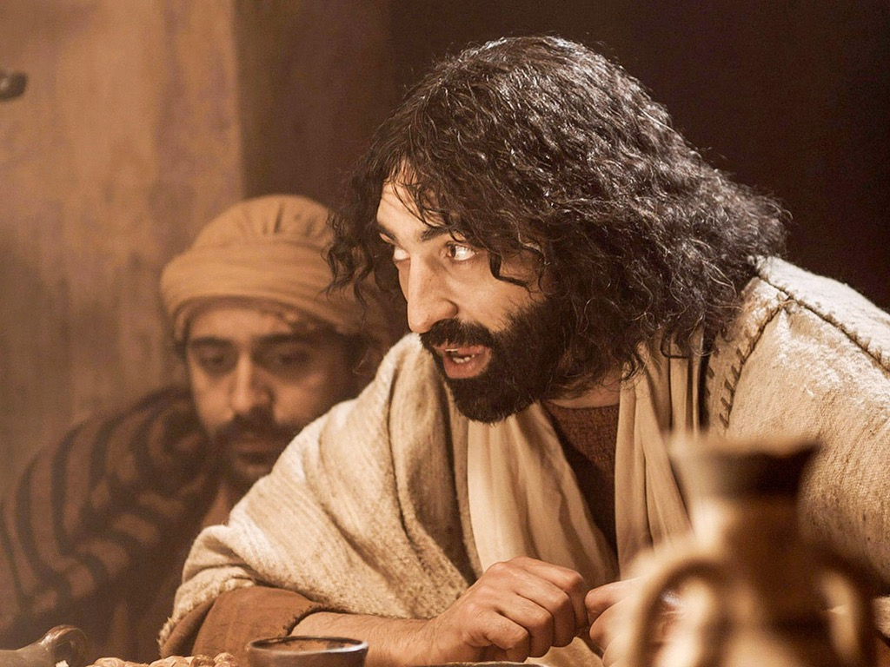
Mark 1–8
Dr. Rick Griffith • Jordan Evangelical Theological Seminary • BibleStudyDownloads.org

Slide 2
Key Word
85
Discipleship
Mark

Slide 3
Theme
23
Deity Who Models Suffering as Servant
Mark

Slide 4
Key Verse
85
“For even the Son of Man
did not come to be served,
but to serve, and to give his life
as a ransom for many”
(10:45).
Mark

Slide 5

Summary Statement
82
Gospel of Action:
“immediately” 41x
Mark
Selected events about Christ,
the Son of God (deity)
who serves as
the model Suffering Servant,
exhorts persecuted Roman believers to true discipleship for Christ.

Slide 6

Kingdom Statement
27a
The kingdom frees from sin through repentance (1:14-15) and grows in contrast to the stagnant state of those rejecting Jesus (4:1-34). His transfiguration depicts his position as King to teach that future glory will follow present suffering for him and his followers (9:1-13).
Mark

Slide 7

Covenant
27a
Jesus as the fulfillment of the OT covenants is not emphasized due to the pastoral concern of the book addressed to suffering Roman believers who needed a practical example of one who suffered for righteousness.
Mark

Slide 8

Redemption
27a
Redemption is key (10:45): “For the Son of Man did not come to be served but to serve (cf. Christ's service in 1:14–10:52) and to give his life as a ransom for many (cf. Christ's self-sacrifice in chapters 11–15 = 37% of the book).”
Mark

Slide 9

Jesus
(Messianic Prophecy)
27a
The paradox between authority and servanthood (8:35; 9:35; 10:43-44) shows Jesus unlike the type of militant ruler Jews expected of the Messiah. The Gospel abounds in high Christology (1:1; 8:29; 15:39) yet has only one OT quote (1:2).
Mark

Slide 10
Mark Outline
85
Deity Who Models Suffering As Servant
Service |  |  |  |  | Suffering
Sayings and Signs |  |  |  |  | Sacrifice
Galilee and Perea |  |  |  |  | Judea and Jerusalem
Coming |  | Ministry Opposition |  |  | Self-Sacrifice |  | Resurrection
1:1-3 |  | 1:14–10:52 |  |  | Chapters 11–15 |  | Chapter 16
Deity & John 1:1-8 | Baptism & Temptation 1:9-13 | Mission 1:14–2:12 | Opposition 2:13–8:26 | Instruction 8:27–10:52 | ٍٍRejection 11–13 | Passion 14–15 | Proof 16:1-8 | Ending 16:9-20
Authority of Christ Emphasized |  |  |  | Authority-Servant Tension | Servanthood of Christ Emphasized
3 Years |  |  |  | 6 Months | 8 Days
Rome
Written AD 64-68 • Covers AD 29-33

Slide 11
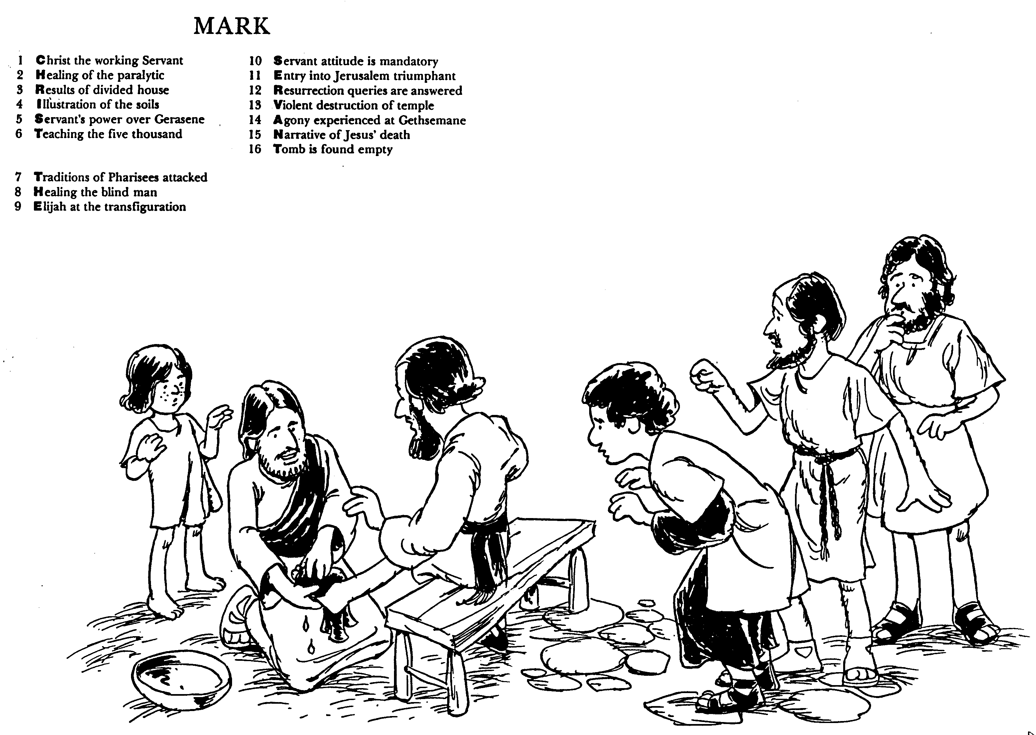
Huddleston, The Acrostic Bible
Christ the working Servant
Healing of the paralytic
Results of divided house
Illustration of the soils
Servant's power over Gerasene
Teaching the five thousand
Traditions of Pharisees attacked
Healing the blind man
Elijah at the transfiguration
Servant attitude is mandatory
Entry into Jerusalem triumphant
Resurrection queries are answered
Violent destruction of temple
Agony experienced at Gethsemane
Narrative of Jesus' death
Tomb is found empty
Mark
Huddleston, The Acrostic Bible

Slide 12
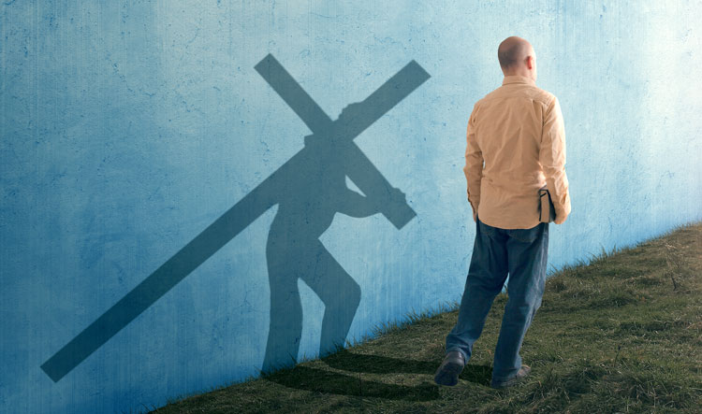
Be Discipled
Gospel of Mark
Dr. Rick Griffith • Crossroads International Church Singapore
BibleStudyDownloads.org

Slide 13
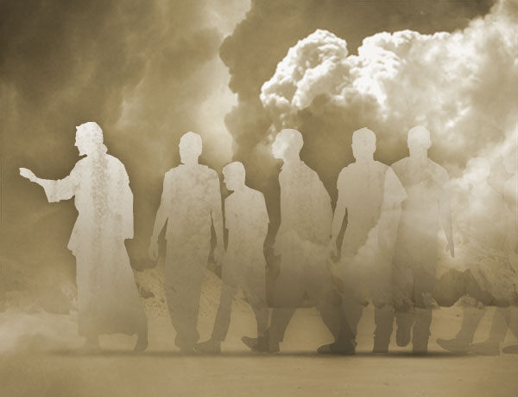
Disciple = Follower
Mark

Slide 14
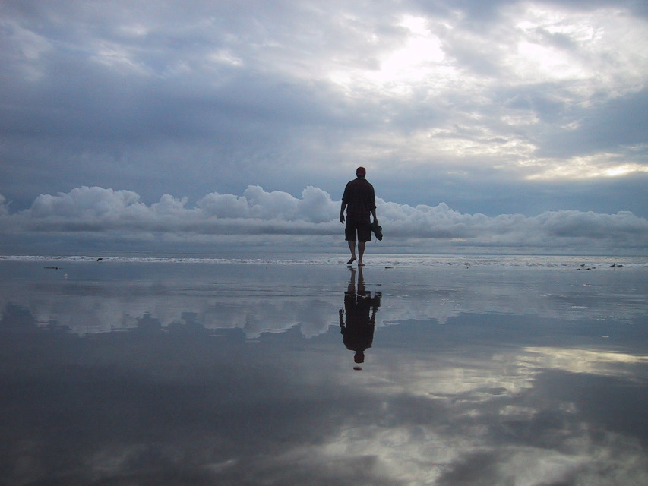
Disciple.
Mark
Notes:
Most of us haven’t had our house burnt down, but we may know something about the cost of being a disciple. For me, it started at age 13 when I was the first in my family to trust Christ. We lived in the second wealthiest part of town with a nice house. We had a vacation cabin, 7 cars, 2 boats—and we were miserable. To honor my parents, I agreed to major in business in university, but God got ahold of my heart. Two hours after my graduation, I left home to become a missionary. I remember my mother saying in desperation, “I can’t believe my son would graduate with honors from business school and go beg for money!”
My parents left my choice of profession up to me, but my church felt that I should go into business—so when I came to Asia, my church refused to support me and asked the members not to do so also. I never felt so alone. Is this what it means to be a disciple—a follower of Jesus?

Slide 15

How can you be a true disciple of Jesus in a hostile world?
Mark

Slide 16
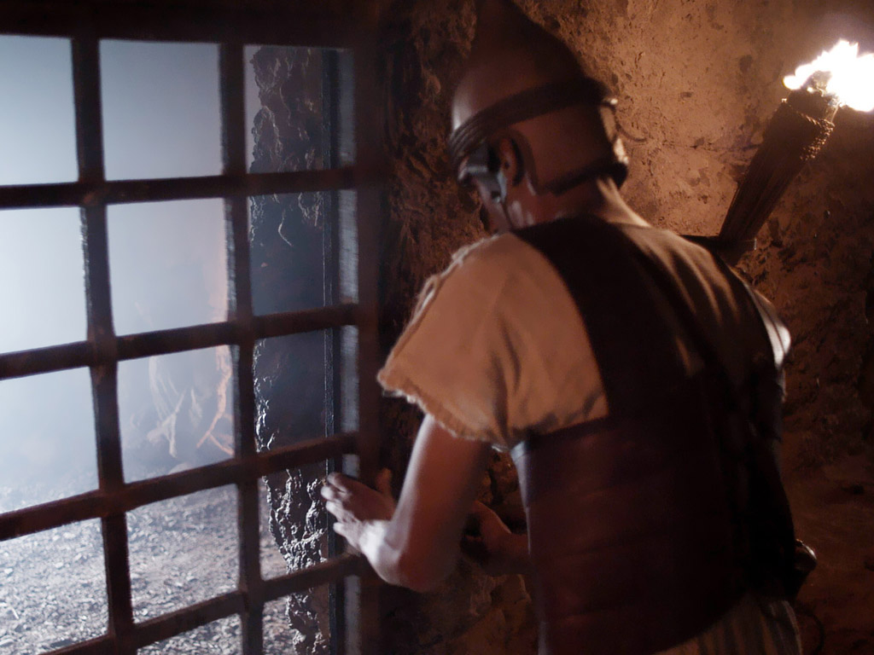
What would you do if this church was under persecution, some being fed to lions, many going underground, all fearful?
Mark wrote an account of the suffering of Jesus to encourage his people!

Slide 17
How to Be a Disciple in a Hostile World
Don’t cling to your Authority
Serve
like Jesus
Suffer
like Jesus
You
will
Rise
1:1-13 | 1:14–10:52 | 11–15 | 16
Mark
Notes:
We will experience victory over death just as Jesus rose from the dead as Messiah and God (Mark 16).

Slide 18
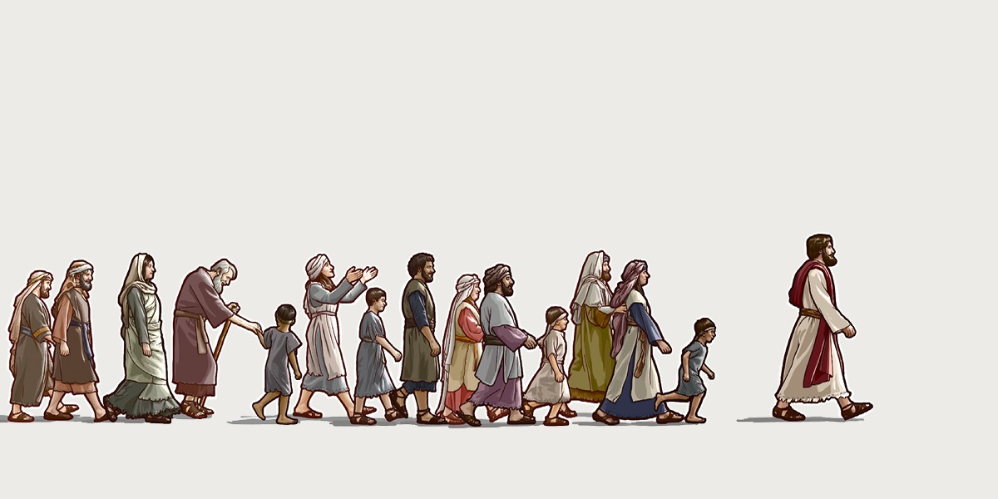
Main Idea
Serve and suffer
like Jesus.
Mark

Slide 19
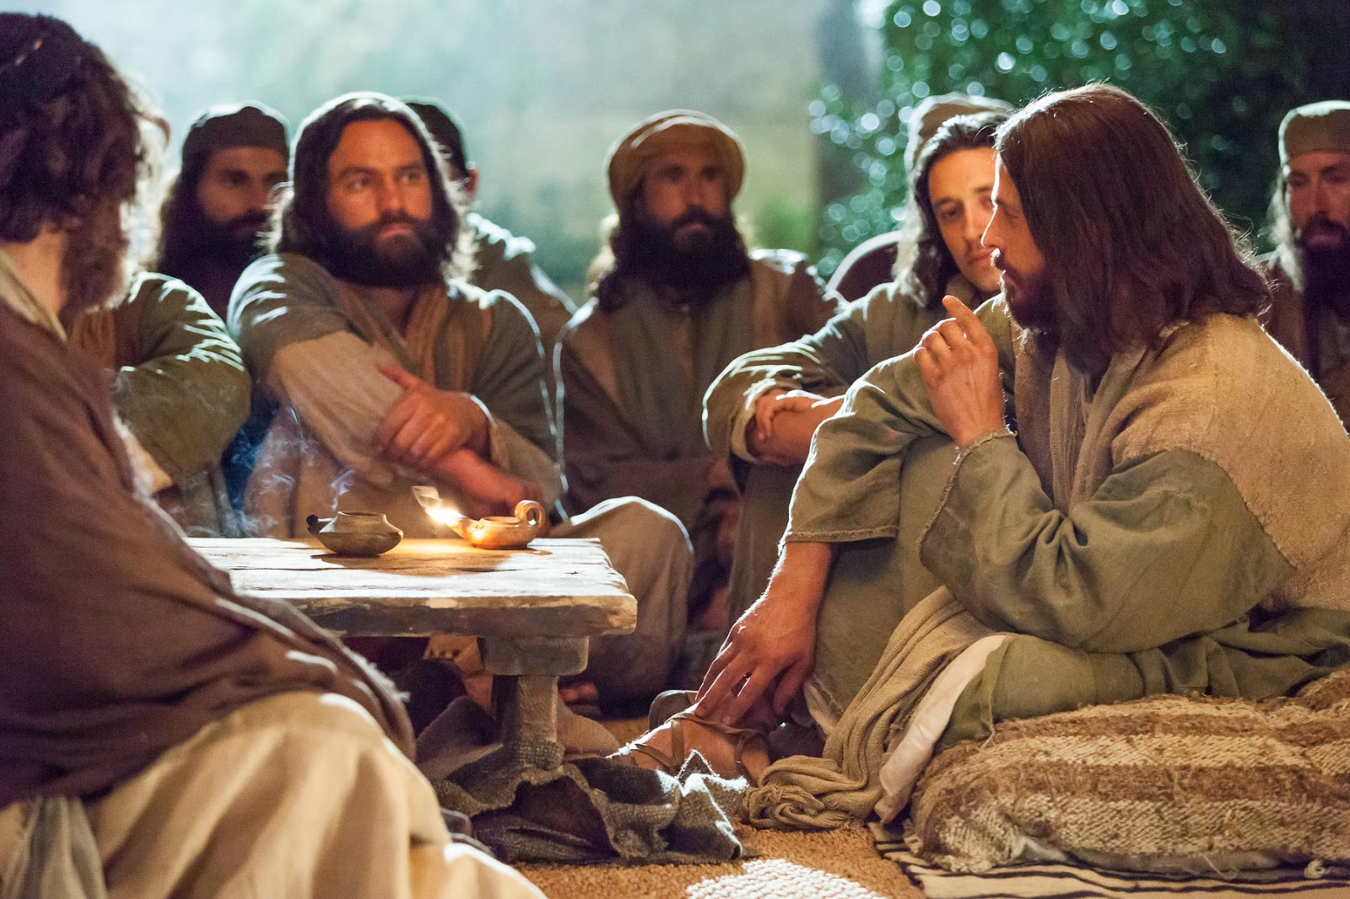
How can you be a disciple who suffers after Jesus’ example?
Mark

Slide 20
Black

Slide 21
What would you do as a church leader if your congregation was under persecution, some being fed to lions, many going underground, all fearful?
Mark wrote an account of the suffering of Jesus to encourage his people!

Slide 22
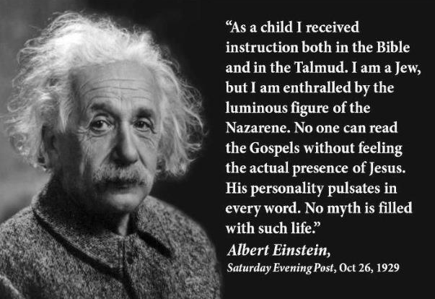
Albert Einstein on Jesus
"As a child I received instruction both in the Bible and in the Talmud. I am a Jew, but I am enthralled by the luminous figure of the Nazarene. No one can read the Gospels without feeling the actual presence of Jesus. His personality pulsates in every word. No myth is filled with such life."
Albert Einstein
Saturday Evening Post, Oct 26, 1929
Notes:
It is sad that Einstein did not follow his admiration for Jesus to its logical conclusion—to place his faith in Christ.
________
Common-420
OS-21-Ecclesiastes-291
NS-02-Mark1-8-slide 22, 133

Slide 23
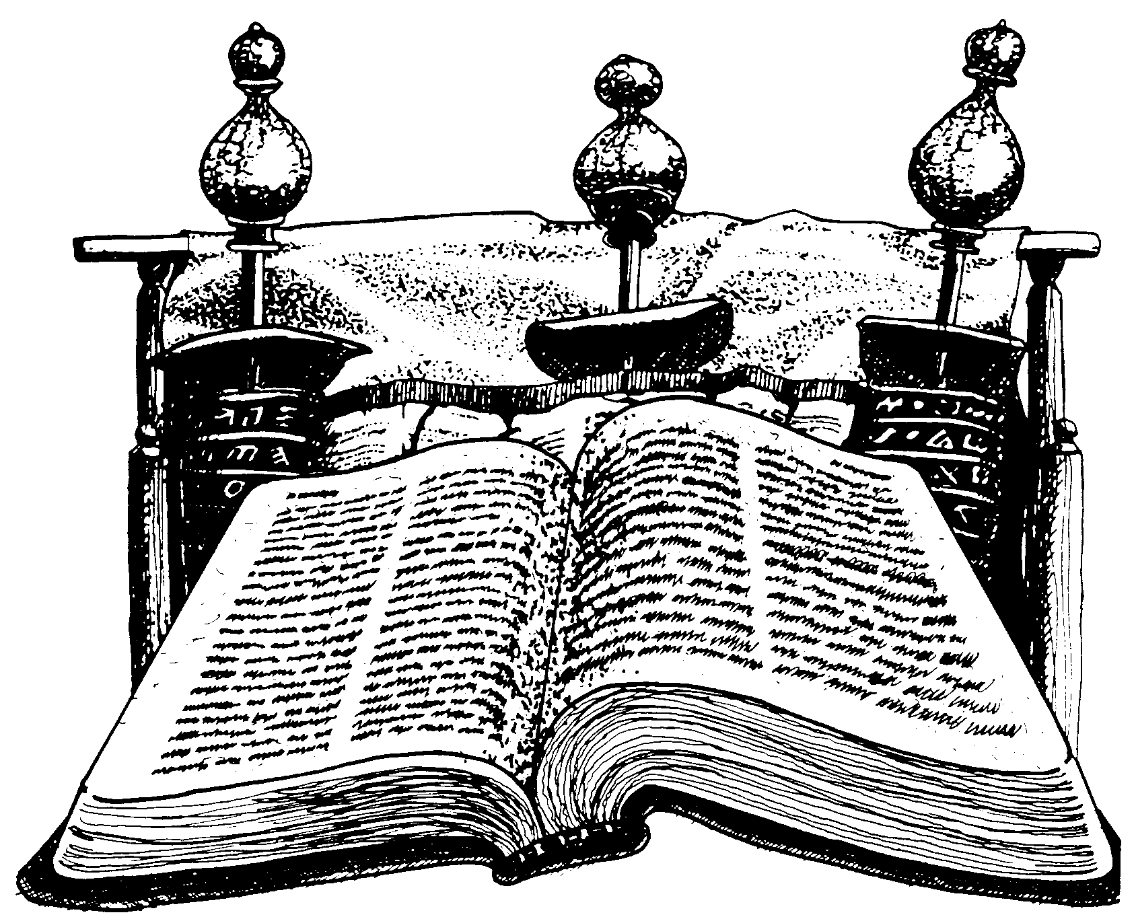
New Testament Chronology

Slide 24
The Gospels
48
Matthew
Mark
Luke
John
NIV Study Bible, 1471
The word "Gospel" comes from the Old English "God-spell." It translates the Greek word for "good news."
In antiquity king's heralds announced "glad tidings" of the king's birthday throughout the cities of the realm.
It has the same meaning in our New Testament. The four Gospels announce the glad tidings about Jesus.
The ancient world knew of history, poetry, prophecy and letters. But a "gospel" was new to them.
Here, inspired writers gave more than just history. They also created faith (John 20:30-31) by proclaiming the good news that, just as the OT had promised, God had sent His Messiah to the world.

Slide 25
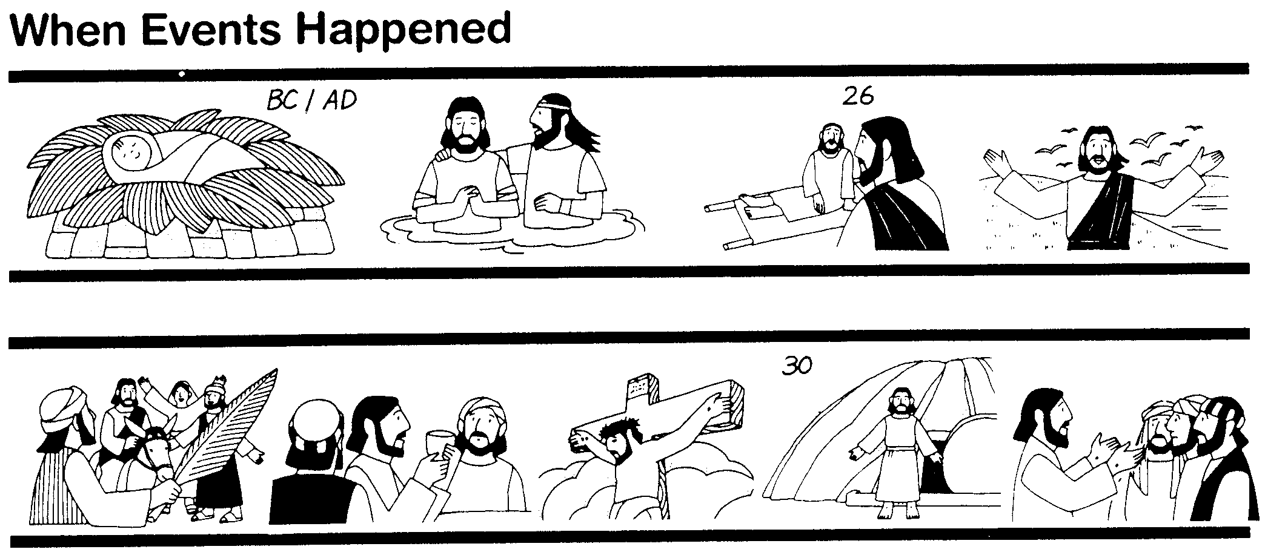
The Synoptics
Why are there four Gospels? Perhaps for the same reason different descriptions of a finely cut jewel would appeal to different people. Matthew describes one facet of the life of Christ, Mark another, and Luke a third.
48
Matthew
Mark
Luke
John
These three Gospels are so much alike that they are called Synoptic ("see with," or "see alike") Gospels. They all look at Christ's life from a historical perspective. On the other hand, John's Gospel dwells more on the inner meaning of Jesus' life and teachings.

Slide 26
Synoptic Similarities
49
Matthew, Mark and Luke are noticeably similar, while John is quite different.
How do the first three Gospels agree?
  Language
  Material they include
  General order of the events and sayings from the life of Christ
The math facts:
  91 percent of Mark is found in Matthew
  53 percent of Mark is found in Luke
Such agreement raises questions as to the origin of the Synoptic Gospels. Did the authors rely on a common source? Were they interdependent?

Slide 27


THAT STRANGE SOUNDING WORD…
52
SYNOPTIC:
1
MATTHEW
2
MARK
TO:
JEWS
TO:
ROMANS
AS:
KING
AS:
SERVANT
WHAT
HE:
SAID
WHAT
HE:
DID
SYNOPTIC:
"TO SEE TOGETHER"
"TO
SEE TOGETHER"
3
LUKE
TO:
GREEKS
AS:
GOD/MAN
WHAT
HE:
FELT
20
3
Notes:
Now comes that word that's a strange one to many...
//// SYNOPTIC…meaning…
//// … "TO SEE TOGETHER"…add these words to that triangle shape on your study help.
//// It is a term from Greek roots that means seeing a group of things together... from the same general perspective. One word that, again, helps organize and categorize the enormous factual base that makes up our Bible.

Slide 28
THE SYNOPTICS: "TO SEE TOGETHER"
52
1
MATTHEW
2
MARK
TO:
JEWS
TO:
ROMANS
AS:
KING
AS:
SERVANT
WHAT
HE:
SAID
WHAT
HE:
DID
∑
3
LUKE
4
JOHN
TO:
GREEKS
CHURCH
TO:
AS:
GOD/MAN
AS:
GOD
WHAT
HE:
FELT
WHAT
HE:
MEANT
21
1
Notes:
Follow the arrows as they link together the gospels of MATTHEW, MARK and LUKE. Again…you'll notice that JOHN is not among them. Those three are the so-called SYNOPTIC Gospels...THEY ARE SEEN TOGETHER...in that these works take on that ground-level view of the human history of Jesus Christ just as he walked about Palestine in the days of his ministry. The Man…and his Mission among his People.
//// On the other hand…the Gospel of John –– seen here with the familiar mathematical SUMMA sign –– represents the summation of all that Jesus Christ MEANT –– the sum of all that he preached and demonstrated –– both publicly and privately. Seeing the Lord clearly as God Himself, John raises our spiritual horizon in ways that the first three gospels do not.

Slide 29
UNIQUE MATERIAL…
52
1
MATTHEW
2
MARK
7% unique!
Baptism
Lord's Supper
Birth
Genealogy
5000 fed
Passion
3
LUKE
4
JOHN
92% unique!
16
Notes:
Each of the Gospels say things that the others don't...
//// MATTHEW was believed by the early church to have written first...
//// MARK shares a lot of material with Matthew, such as Christ's baptism and supper...
//// LUKE also has much overlap with Matthew and Mark, such as Christ's baptism and supper–but only Matthew and Luke record Christ's birth and genealogy. However, the fourth…
//// JOHN, stands alone in terms of its material. Only 8% of it repeats stories from the others–such as the feeding of the 5000, and, of course, His death and resurrection.
//// But the remaining 91% of JOHN you will find only in JOHN.

Slide 30
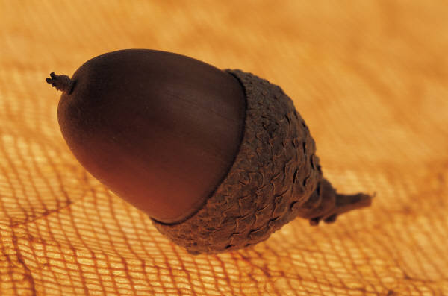
The Synoptic Problem
49
Matthew, Mark & Luke in a nutshell:
How do we explain their similarities?
How do we explain their differences?

Slide 31
Marcan Priority Diagrammed
51
51
Mark
661
1068
1149
500
350
Matthew
Luke
Numbers indicate the verses in each proposed source
235
333
Q
564
M
L

Slide 32
Reasons Mark is Seen as First
Explain and respond in your small group…
85
Details are most vivid
Grammar and style roughest
Embarrassing or misleading details
Shortest gospel
Little material not in Matthew or Luke
Text order same in Matthew & Luke
High incidence of Aramaic words
Omits all material common to Matthew & Luke
Consistent theology of Matthew & Luke
Blomberg, Jesus and the Gospels, 87-90
Notes:
1. Details are most vivid—But the source (Peter) was the most colorful and this assumes that later writers would be more boring
2. Grammar and style roughest—But isn't this just stylistic rather than indicating an original?
3. Embarrassing or misleading details—But Mark could just be getting into the action as the young man fleeing naked in the garden
4. Shortest gospel—But this assumes that later gospels got longer whereas it may not have been the case
5. Little material not in Matthew or Luke—But Peter as a source would not need these other gospels
6. Text order same in Matthew & Luke—But would not the chronology be the same despite the order of composition?
7. High incidence of Aramaic words—But this is expected as Mark was a Jerusalem Jew informing a Roman audience
8. Omits all material common to Matthew & Luke—But we would expect this as the birth and genealogy were not needed
9. Consistent theology of Matthew & Luke—But these relate to the kingdom which would not be needed as much for Mark's readers
_____
NS-01-Gospels-36
NS-02-Mark1-8-slide 32

Slide 33

Dating the Synoptic Gospels
49
Adapted from the NIV Study Bible, 1431
MARK
MATTHEW
LUKE
MARK
MATTHEW
LUKE
ASSUMPTION A:
ASSUMPTION B:
Matthew and Luke used Mark as a source
Matthew and Luke did not use Mark as a source
View #1
View #1
Mark written in the 50s or early 60s
Mark could have been written anytime between 50 and 70
(1) Matthew written in late 50s or the 60s
View #2
(2) Luke written 59-63
Mark written 65-70
View #2
(1) Matthew written early 50s (see Matthew notes)
Mark written 65-70
(1) Matthew written in the 70s
(2) Luke written 59-63 (see Luke notes)
(2) Luke written in the 70s
Taught in this class

Slide 34
Solutions to the Synoptic Problem
49
Questions like these constitute what is known as the Synoptic Problem. Several solutions have been advanced:
The use of oral tradition. Some have thought that tradition had become so stereotyped that it provided a common source from which all the Gospel writers drew.
The use of an early Gospel. Some have postulated that the Synoptic authors all had access to an earlier Gospel, now lost.
The use of written fragments. Some have assumed that written fragments had been composed concerning various events from the life of Christ and that these were used by the Synoptic authors.
Mutual dependence. Some have suggested that the Synoptic writers drew from each other with the result that what they wrote was often very similar.
NIV Study Bible, 1431

Slide 35
Solutions to the Synoptic Problem
49
The use of two major sources. The most common view currently is that Mark and a hypothetical document, called Quelle (German for "source") or Q, were used by Matthew and Luke as sources for most of the materials included in their Gospels.
The priority and use of Matthew. Another view suggests that the other two Synoptics drew from Matthew as their main source.
A combination of most of the above. This theory assumes that the authors of the Synoptic Gospels made use of oral tradition, written fragments, mutual dependence on other Synoptic writers or on their Gospels, and the testimony of eyewitnesses.
NIV Study Bible, 1431

Slide 36
Two-Source Hypothesis
50
Q
AD 50
Mark
AD 65
Matthew
Luke

Slide 37
Four-Source Hypothesis
50
M
Jerusalem
AD 60-65
Mark
Rome
AD 65
Q
Antioch
AD 50
L
Caesarea
Proto-Luke
Matthew
Antioch
AD 85
Luke
Caesarea, Corinth?
AD 60, AD 80
Antiochene
Tradition
Source of
Luke 1-2

Slide 38
When I Think They Were Written…
52
1
MATTHEW
2
MARK
TO:
JEWS
TO:
ROMANS
The A.D.40s
A.D. 64-68
AS:
KING
AS:
SERVANT
WHAT
HE:
WHAT
HE:
SAID
DID
3
LUKE
4
JOHN
GREEKS
CHURCH
A.D. 57-59
A.D. 69 AFTER THE SYNOPTICS
TO:
TO:
AS:
GOD/MAN
AS:
GOD
WHAT
HE:
WHAT
HE:
FELT
MEANT
27
4
Notes:
Now…what about the dates of the writing of these crucial documents? And here we are left to our best scholarly guesses. There will ALWAYS be argument here. But some of the best guesses, based on decades of academic research and study are these – in suggested order…
//// MATTHEW…composed sometime during the A.D. 40s…
//// LUKE is suggested as next, between the years A.D. 57 and 59 A.D…
//// Mark…in the next decade…between 64 and 68…
//// and finally…John's Gospel…around A.D. 69….but certainly after the Synoptics were set down. Again, you will always find disagreement on these dates. However, these dates are from the research of well-known Christian scholars and teachers.

Slide 39
NT Overview (History)
38
124
39-41
"To the remotest part of the earth" (Acts 1:8)
Acts 9 13 14 15 16 18 21 27 28
Apr 48-
Sep 49
1
Galatia
Apr 50-
Sep 52
2
Aegean
Spr 53-
May 57
3
Asia
Feb 60-
Mar 62
1
Rome
Spr 62-
Fall 67
4
Spain
Aut 67-
Spr 68
2
Rome
Summer 35-
37
Damascus
Antioch
May 57-
Aug 59
Trials
Fall 49
The
Council
Spring 68
Expansion of Church
35 48 49 50 52 53 57 60 62 67 68 95
Matt
Luke
Acts
Mark
Gospels & Acts
1234
Journeys
Rome
Imprisonments
Gospels & Acts

Slide 40
The Fours Gospels Compared
52
 | Matthew | Mark | Luke | John
Job before Saved | Tax Collector | None (Youth) | Medical Doctor | Fisherman
Race | Jew | Jew | Gentile | Jew
Office and / or Spiritual Gift | Apostle | Service or Pastoring | Service or Teaching | Apostle
Readers:
Ethnically | Jews | Roman | Gentile (Greek) | World
Interest | Signs (1 Cor. 1:22) |  | Wisdom (1 Cor. 1:22)
Spiritually | Unbelievers | Believers | Unbelievers | Unbelievers
Primary Need | Messiahship and Kingdom Offer | Model in Suffering (exhorts discipleship) | Universality (and kingdom expansion) | Deity
Notes:
_________
NS-00-NT Introduction-40
NS-01-Matt1-14-slide 56
NS-02-Mark1-8-slide 40
NS-03-Luke1-12-slide 30
NS-04-John1-12-slide 72

Slide 41
The Four Gospels Compared
52
 | Matthew | Mark | Luke | John
Date Written | 40s | 64-68 | 57-59 | late 60s
Place Written | Antioch or Syria | Rome | Caesarea or Rome | Ephesus
Place Sent | Palestine | Rome | To Theophilus | Asia, etc.
Jesus is… | King of Israel (Messiah) | Suffering Servant (Deity) | Ideal Man (Messiah) | Son of God (Deity)
Key Verse | 21:5 | 10:45 | 19:10 | 20:31
Themes | Law | Power | Grace | Glory
Literary Emphasis | Sermons | Miracles | Parables | Allegories
Arrangement | Topical | Chronological | Chronological | Topical
Genealogy | Abraham to Joseph | None | Adam to Mary | None
Notes:
_________
NS-00-NT Introduction-41
NS-01-Matt1-14-slide 57
NS-02-Mark1-8-slide 41
NS-03-Luke1-12-slide 31
NS-04-John1-12-slide 73

Slide 42
The Four Gospels Compared
52
 | Matthew | Mark | Luke | John
Scope | Birth to Resurrection | Ministry to Resurrection | Ministry to Resurrection | Ministry to Resurrection
Tone | Prophetic | Pastoral | Historical | Spiritual
Christ's Words | 60% | 42% | 50% | 50%
Chapters | 28 | 16 | 24 | 21
Verses | 1068 | 661 | 1149 | 878
Verses per Chap. | 38 | 41 | 48 | 42
OT Quotations | 53 | 36 | 25 | 20
OT Allusions | 76 | 27 | 42 | 105
OT References | 129 | 63 | 67 | 125
Unique Material | 42% | 7% | 59% | 92%
Broad Division | ------------------- Synoptic Gospels ------------------- |  |  | Supplemental Gospel
Notes:
_________
NS-00-NT Introduction-42
NS-01-Matt1-14-slide 58
NS-02-Mark1-8-slide 42
NS-03-Luke1-12-slide 32
NS-04-John1-12-slide 74

Slide 43
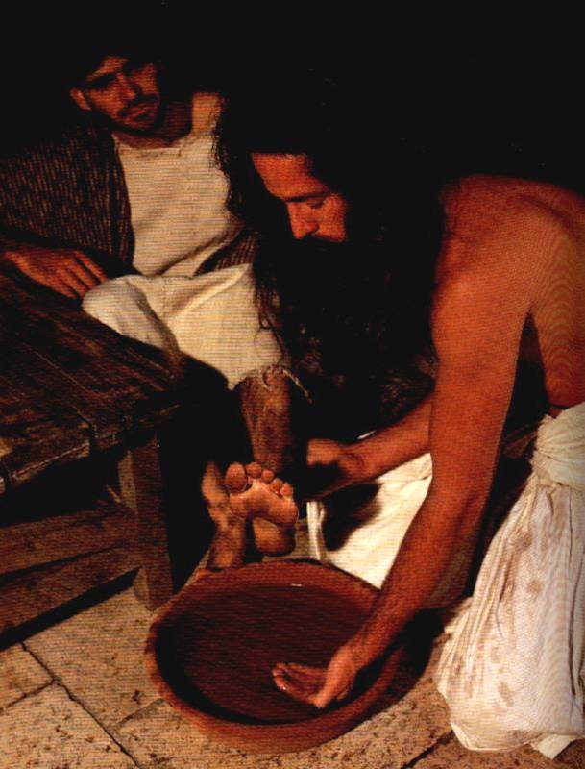
A Question to Consider…
In which ways does Mark say we should be like Jesus? All ways? Some ways? If some, then which ways?

Slide 44
Huddleston, The Acrostic Bible
Mark
Syllabus, p. 5

Slide 45
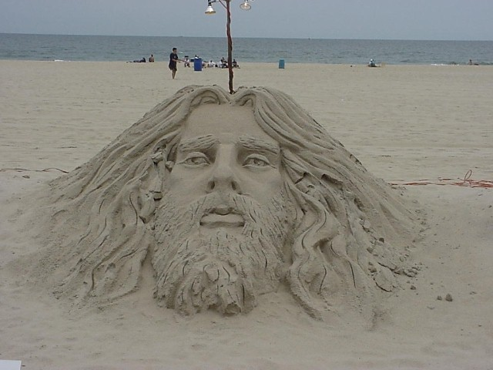
Title
83
Introduction
The earliest title of Mark's gospel account
(Kata, Ma/rkon According to Mark)
was added by a scribe
sometime before AD 125
(Grassmick, BKC, 2:95)

Slide 46
Authorship
83
External Evidence
The unanimous testimony of
the early Church Fathers is that Mark, an associate of the Apostle Peter, penned this book which now bears his name.
Papias, Bishop of Hierapolis
      Justin Martyr
      Irenaeus
      Tertullian
      Clement of Alexandria
      Origen
Internal Evidence:
Several factors indicate that it was Mark:
The incident of the unidentified young man who fled naked at Christ's arrest in Gethsemane –
Probably Mark himself!
Mark's detailed description of
the "guest room" – Last Supper room was in his own home.
Author's familiarity with
Palestine, its Aramaic language and the Jewish institutions and customs.
Book mentions details which
were known only to Christ's "inner-circle" apostles – Peter, author's key source of information.
In light of the external and internal evidence it is reasonable to assume that the John Mark of Acts and the Epistles is the author.

Slide 47

Date of Mark
83
Peter did not come to Rome until about AD 63 – Mark's gospel cannot be dated before AD 63.
Mark does not mention the Fall of Jerusalem in AD 70 – Mark was probably penned between AD 64-68, during the reign of Nero.
Peter was martyred in AD 64, but tradition divides whether Mark composed before Peter's death or afterwards
63
Peter at Rome
64
Peter Dies
68
Nero Dies
70
Temple
Destroyed

Slide 48
Origin/Recipients
83
The external evidence
The universal testimony of the early church fathers is that Mark's Gospel was written in Rome primarily for Gentile Christians in Rome.
Gentile emphasis in the text
Explains Jewish customs
Uses Latin loan words
Contains only one OT quotation
Interprets Aramaic expressions
Mentions that the gospel will be preached to all nations
Views the temple as a house of prayer for all nations

Slide 49
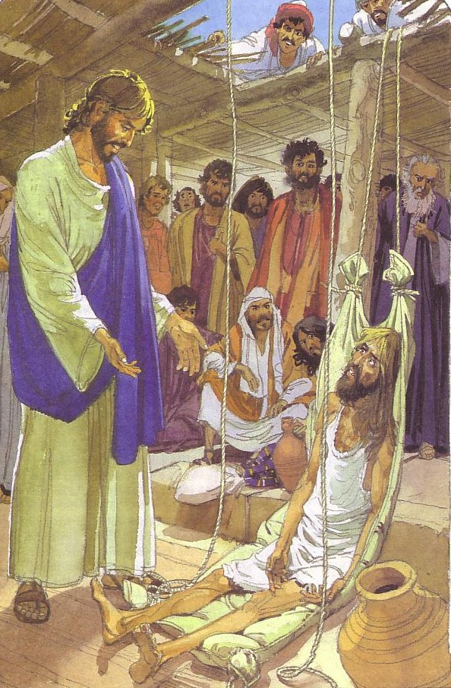
Purpose
84
Biographical
Evangelistic
Pastoral
Liturgical
Instructional
Apologetic

Slide 50
Occasion
84
Clement of Alexandria
testified that Mark wrote his gospel
at the request of Roman Christians.
It was written during the reign of Nero (AD 54-68), a time when the church faced intense persecution.
For this reason Mark's purpose is more pastoral. He wrote to prepare his readers for suffering. Christian discipleship involves hardship–even death–as is modeled in the Lord Jesus.

Slide 51
Message Statements for the New Testament Books
25
Subject + Purpose = Message
What the book says Why it says it Main (Big) Idea
(Theme) (Reason) (Summary Statement)
Matthew
Matthew: (1) proves Jesus as Messiah for unbelieving Jews to trust Him, and (2) explains that the kingdom is postponed due to Israel's rejection of Christ as King for believing Jews to see His present kingdom authority as residing in the Church.
Mark
Mark presents in a pastoral concern selected events about Christ, the Son of God (deity) who serves as the model Suffering Servant, to exhort persecuted Roman believers to true discipleship for Christ.

Slide 52
Mark Book Chart
82
Deity Who Models Suffering As Servant
Service |  | Suffering
Sayings and Signs |  | Sacrifice
Galilee & Perea |  | Judea & Jerusalem
Coming | Ministry Opposition | Self- Sacrifice | Resurrection
1:1-13 | 1:14–10:52 | 11–15 | 16
Key Verse
"For even the Son of Man
did not come to be served,
but to serve, and to give his life
as a ransom for many"
(Mark 10:45).
serve
give his life

Slide 53
Mark: Deity Who Models Suffering As Servant
82
Coming |  | Ministry Opposition |  |  | Self- Sacrifice |  | Resurrection
1:1-13 |  | 1:14–10:52 |  |  | 11–15 |  | 16
Deity & John 1:1-8 | Baptism & Temp-tation 1:9-13 | Mission 1:14–2:12 | Op-posed 2:13– 8:26 | Instruction 8:27– 10:52 | Rejec-tion 11–13 | Passion 14–15 | Proof 16:1-8 | Ending 16:9-20
Authority of Christ Emphasized |  |  |  | Authority- Servant Tension | Servanthood of Christ Emphasized
3 Years |  |  |  | 6 Months | 8 Days
Rome
Written AD 64-68 but Covers AD 29-33
Mark

Slide 54
Keys to Mark
82
Gospel of Action:
"immediately" 41x
Key Word
Discipleship
Summary Statement
Mark presents in a pastoral concern
selected events about Christ,
the Son of God (deity)
who serves as
the model Suffering Servant,
to exhort persecuted Roman believers to true discipleship for Christ.

Slide 55
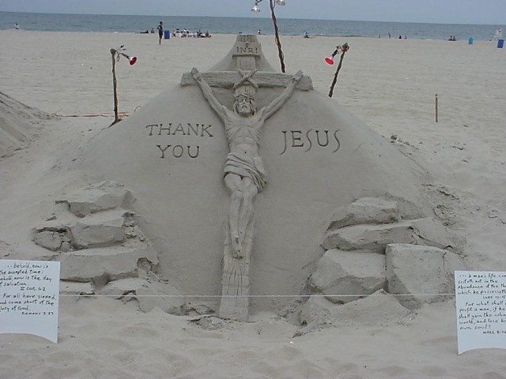
Synthesis
85
1:1-13 Coming
1:14–10:52 Opposition
11–15 Self-sacrifice
16 Resurrection

Slide 56
Be Discipled
Gospel of Mark
Dr. Rick Griffith • Crossroads International Church Singapore
BibleStudyDownloads.org

Slide 57
Disciple = Follower

Slide 58
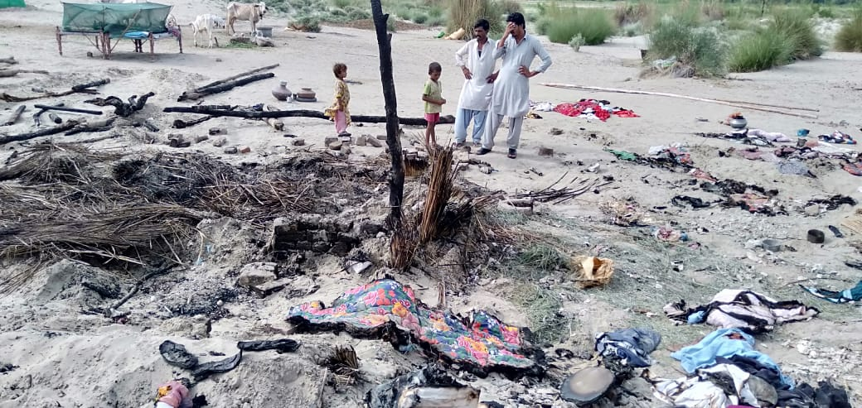
Pakistan
Notes:
One of my former Pakistani students sent this 21 August 2019 email:
Unjustly Enduring Persecution is an Act of Grace! Jesus Demonstrated it & His Followers are Called for It!
My heart is deeply saddened as I report that yet another newly converted Hindu family has been severely persecuted for their decision to follow Christ. Non-stop persecution of Christians and Hindus is an every day thing who face persecution at the hands of majority religion. This incident took place in Village 36, Sanghar District, Sindh, one of our ministry areas.
The wood and straw hut of the family was set on fire by an angry mob of close to 100 people. The fire destroyed everything they had including money that they got from selling their livestock only a few days before the incident. All of their belongings have been burnt. They don't even have utensils to eat in. First Investigation Report has been registered at the local police station. The incident was reported in five local Sindhi newspaper. The name of the head of the persecuted family is brother Abdul Masih. Pastor Bhooro and Pastor Girdhari, our team members reported this matter to me. A temporary shelter, some clothing, bedding, utensils and a few other things have been provided to the family for survival. But prayers are needed for the protection of the family and finances to help them with a new hut/house, all the household stuff, money to buy to buy livestock which is the main source of survival and income. Please stand with us to pray for this family that the Lord will protect them and others who turn to Christ.
Blessings
Naeem

Slide 59
Disciple.
Notes:
Most of us haven’t had our house burnt down, but we may know something about the cost of being a disciple. For me, it started at age 13 when I was the first in my family to trust Christ. We lived in the second wealthiest part of town with a nice house. We had a vacation cabin, 7 cars, 2 boats—and we were miserable. To honor my parents, I agreed to major in business in university, but God got ahold of my heart. Two hours after my graduation, I left home to become a missionary. I remember my mother saying in desperation, “I can’t believe my son would graduate with honors from business school and go beg for money!”
My parents left my choice of profession up to me, but my church felt that I should go into business—so when I came to Asia, my church refused to support me and asked the members not to do so also. I never felt so alone. Is this what it means to be a disciple—a follower of Jesus?

Slide 60
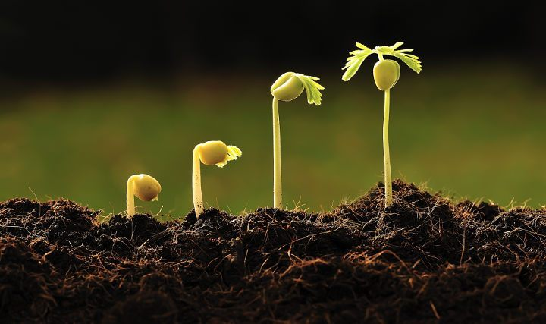
What’s your strategy to follow Jesus?
Notes:
My guess is that being a disciple isn’t easy for you either.
Salmon swim upstream, and followers of Jesus go against the current also.
This is why the Canadian college accrediting agency will not accredit Trinity Western University Law School unless they approve of homosexuality—thus no more conservative lawyers getting trained in Canada!
The Virginia Real Estate Board also recently filed a complaint against a Christian realtor who had Bible verses on her website.
How will you stay faithful as a disciple (follower) of Christ? How are you going to continue to grow?

Slide 61
How can you be a true disciple of Jesus in a hostile world?
Notes:
What’s it gonna take to really follow Christ when most people around you oppose Jesus?

Slide 62
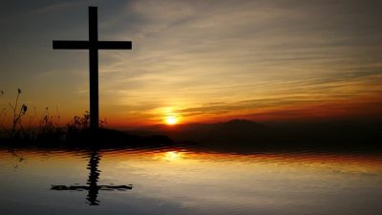
Background
Notes:
Roman believers were being tested to death, so they asked Mark to record the example of Jesus. He did so, giving us the Gospel of Mark.

Slide 63
What would you do if this church was under persecution, some being fed to lions, many going underground, all fearful?
Mark wrote an account of the suffering of Jesus to encourage his people!

Slide 64
NT Overview (History)
38
124
39-41
"To the remotest part of the earth" (Acts 1:8)
Acts 9 13 14 15 16 18 21 27 28
Apr 48-
Sep 49
1
Galatia
Apr 50-
Sep 52
2
Aegean
Spr 53-
May 57
3
Asia
Feb 60-
Mar 62
1
Rome
Spr 62-
Fall 67
4
Spain
Aut 67-
Spr 68
2
Rome
Summer 35-
37
Damascus
Antioch
May 57-
Aug 59
Trials
Fall 49
The
Council
Spring 68
Expansion of Church
35 48 49 50 52 53 57 60 62 67 68 95
Matt
Luke
Acts
Mark
"Bring Mark, for he is useful for ministry"
(2 Tim. 4:11)
Gospels & Acts
1234
Journeys
Rome
Imprisonments
Gospels & Acts

Slide 65
Date of Mark
83
Peter did not come to Rome until about AD 63 – Mark's gospel cannot be dated before AD 63.
Mark does not mention the Fall of Jerusalem in AD 70 – Mark was probably penned between AD 64-68, during the reign of Nero.
Peter was martyred in AD 64, but tradition divides whether Mark was composed before Peter's death or afterwards
63
Peter at Rome
64
Peter Dies
68
Nero Dies
70
Temple
Destroyed

Slide 66
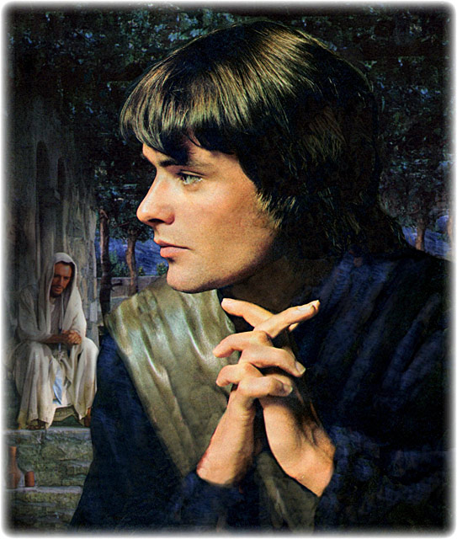
Who was Mark?
89b-f
Got an "F" at Jesus' Gethsemane arrest
(Mark 14:51)
Got an "F" at wealthy home
(Acts 12:12-18)
Got an "F" on first mission trip with Paul
(Acts 13:13)
Got an "F" on team unity (Acts 15:36-41)
Got a "A" when wrote his gospel under Peter at Rome
"Useful for ministry"
(2 Tim. 4:11)

Slide 67
How can you be a true disciple of Jesus in a hostile world?
Notes:
What’s it gonna take to really follow Christ when most people around you oppose Jesus?

Slide 68
How to Be a Disciple in a Hostile World
Not
to Do
To Do
To Do
Result
1:1-13 | 1:14–10:52 | 11–15 | 16
Notes:
To learn how to be true disciples today, we will see what not to do, what to do (two things), and the result.
First, what is the thing not to do?

Slide 69
How to Be a Disciple in a Hostile World
Don’t cling to your Authority
1:1-13 | 1:14–10:52 | 11–15 | 16
Mark
Notes:
To learn how to be true disciples today, we will see what not to do, what to do (two things), and the result.
Imitate the humility of the Suffering Servant despite being God and Messiah (1:1-13).

Slide 70
Slides on
Mark 1

Slide 71

"This is the Good News about Jesus the Messiah, the Son of God" (Mark 1:1 NLT).
Notes:
Jesus is the Ultimate Authority—Israel’s king and God himself (1:1).

Slide 72
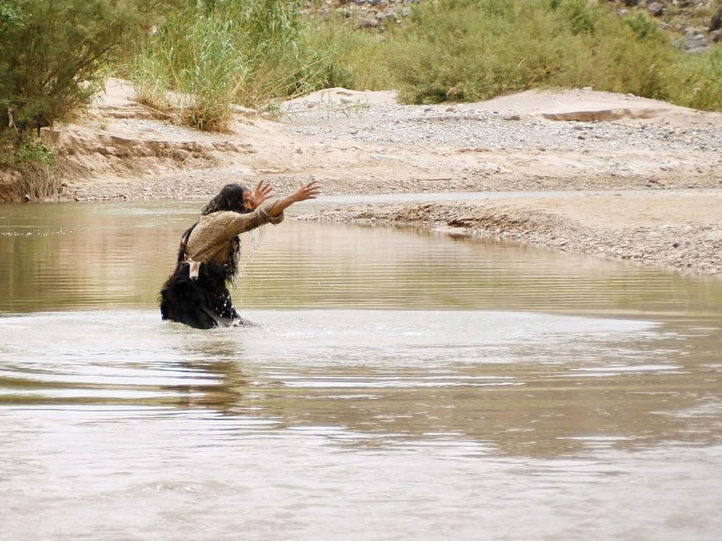

JOHN THE BAPTIST
Matthew 3:1-16
Mark 1:1-11
Luke 3:1-22
John 1:1-34
Free
Bible
images
Notes:
Isaiah 40 serves as the primary background to John the Baptist. God comforts his people despite telling of their coming exile—and he does so by promising a voice from the wilderness, not from the temple.

Slide 73
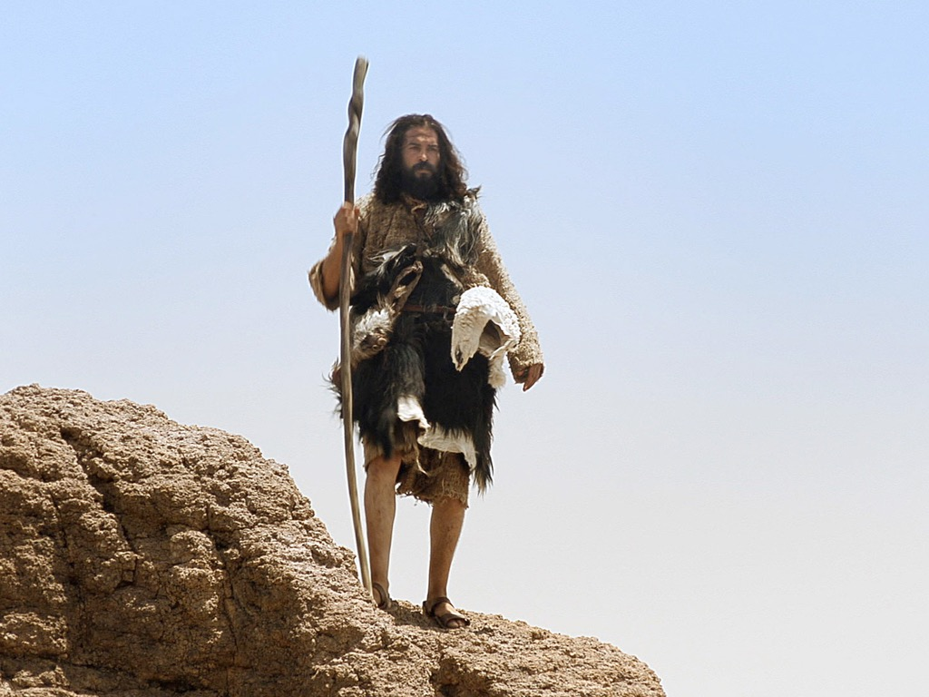
Notes:
John serves as the wilderness voice of God. Although born into the priestly line of Aaron through his father Zechariah, John is a non-conformist who grows up in the desert rather than around the temple rituals. He doesn't perform any sacrifices. Nor does not wear linen like the temple priests. Instead, he likely lived in a desert community such as the Essenes rather than be raised by Zechariah and Elizabeth—and wore camel's hair clothes!

Slide 74

Notes:
He did not eat the meat of sacrificial animals like his fellow priests, even though he was entitled to it. He preferred insects instead, reminding us that God often uses the non-conformance individuals!

Slide 75
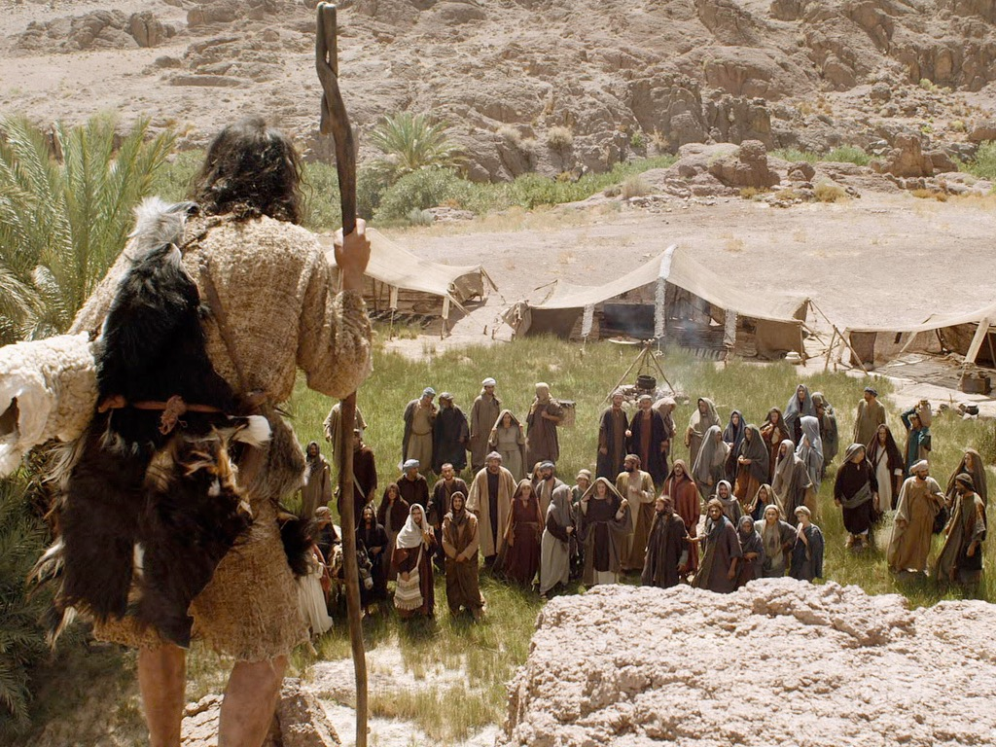
Notes:
Also, instead of going to the people to preach in their cities, John's audiences had to do the hard work of traveling to the Judean wilderness. They seem even to believe in some sort of reincarnation of famous OT figures, based on their questions.

Slide 76

¹⁹ Now this was John’s testimony when the Jewish leaders in Jerusalem sent priests and Levites to ask him who he was.
²⁰ He did not fail to confess, but confessed freely, “I am not the Messiah.”
²¹ They asked him, “Then who are you? Are you Elijah?”
He said, “I am not.”
“Are you the Prophet?”
He answered, “No.”
John 1:19-21 NIV84

Slide 77
²² Finally they said, “Who are you? Give us an answer to take back to those who sent us. What do you say about yourself?”
²³ John replied in the words of Isaiah the prophet, “I am the voice of one calling in the wilderness, ‘Make straight the way for the Lord.’ ”
²⁴ Now the Pharisees who had been sent
²⁵ questioned him, “Why then do you baptize if you are not the Messiah, nor Elijah, nor the Prophet?”
John 1:22-25 NIV84

Slide 78
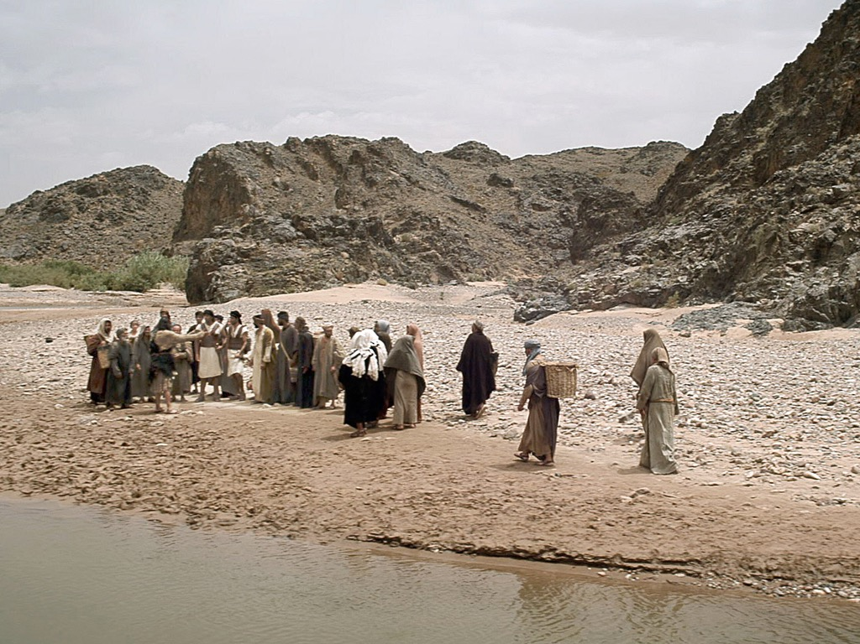

Slide 79
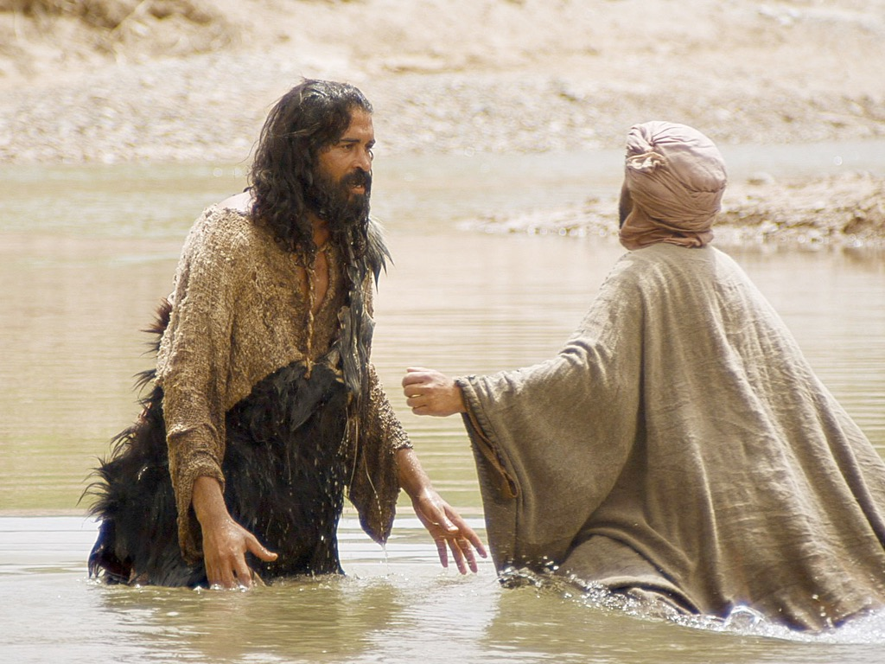

Slide 80
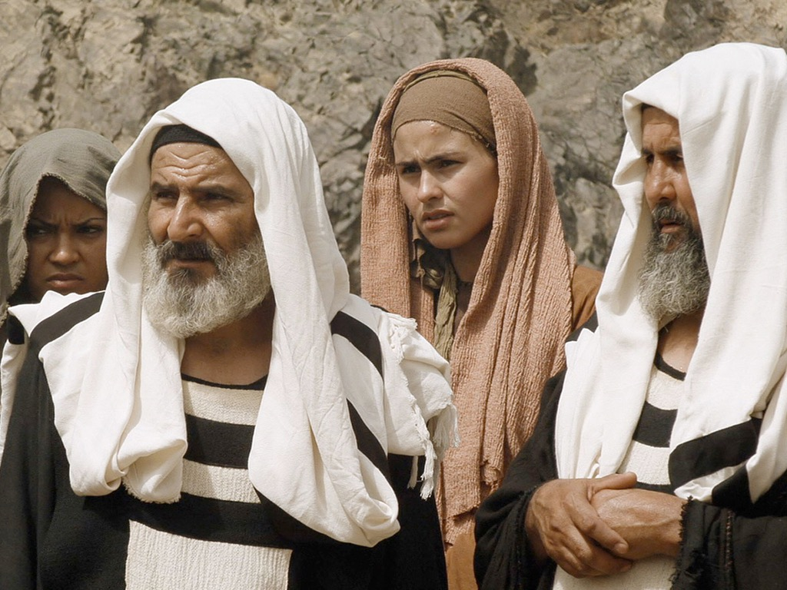

Slide 81
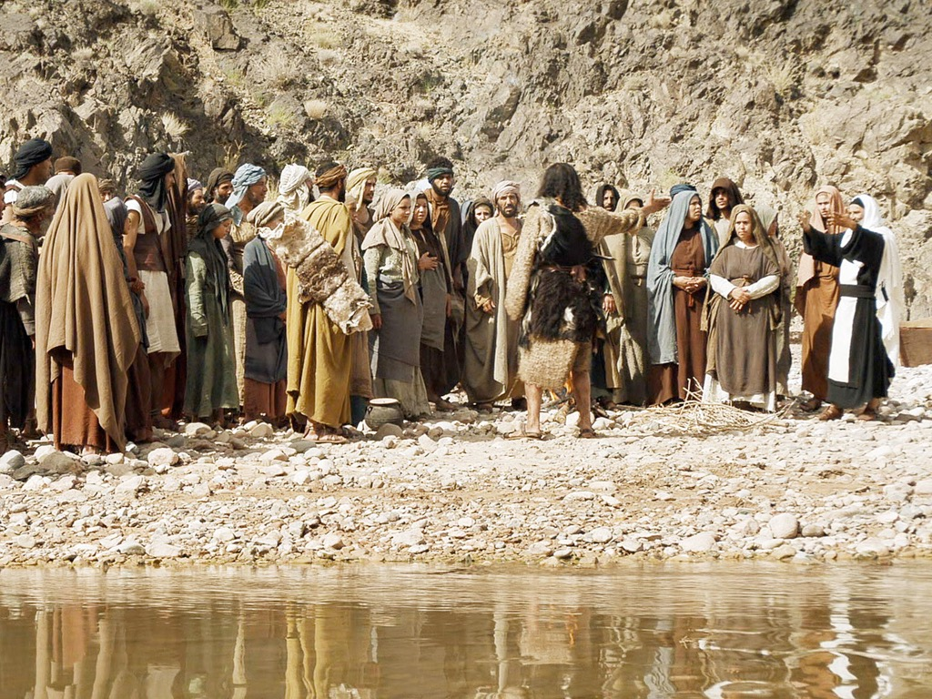

Slide 82
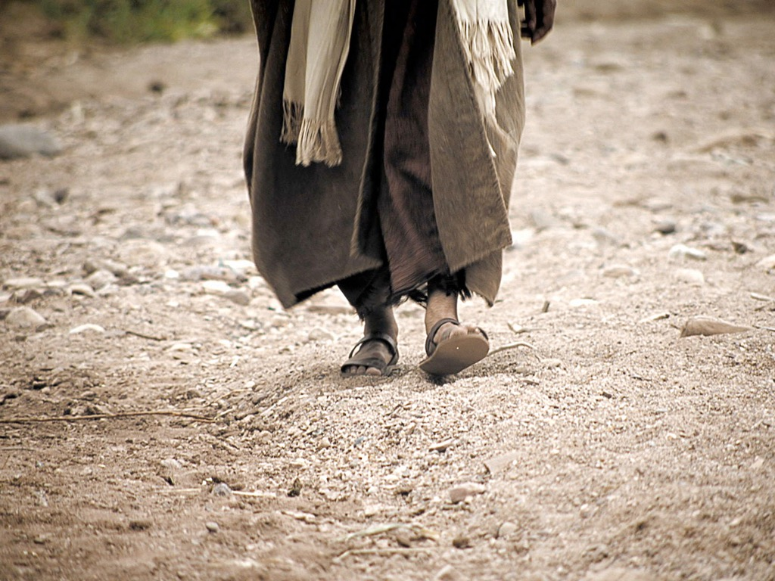

Slide 83
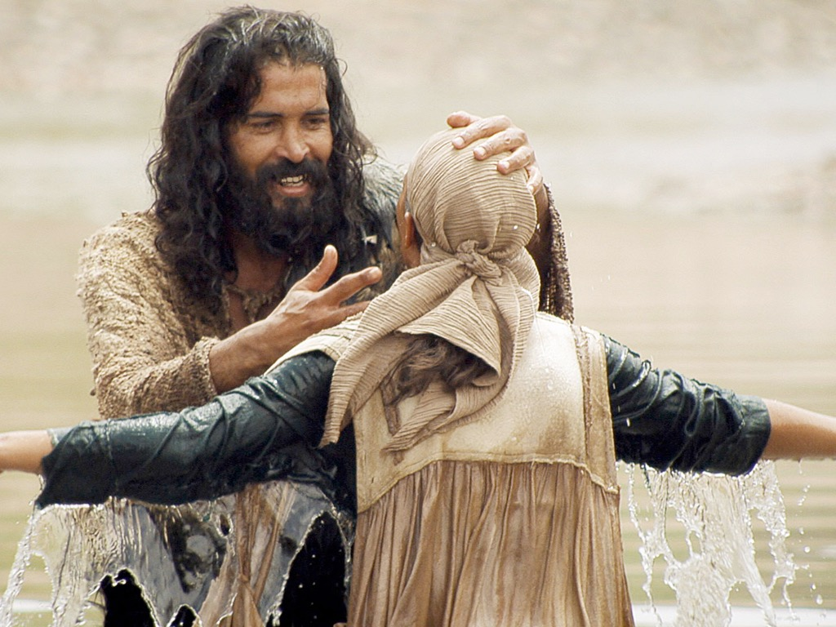

Slide 84
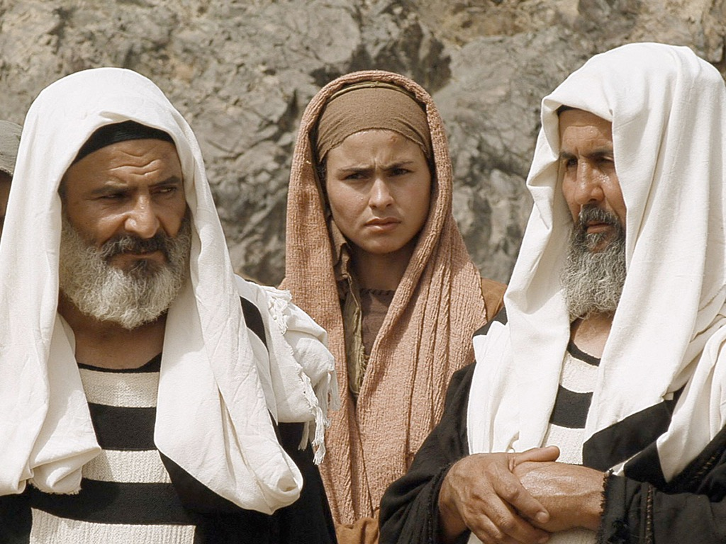

Slide 85
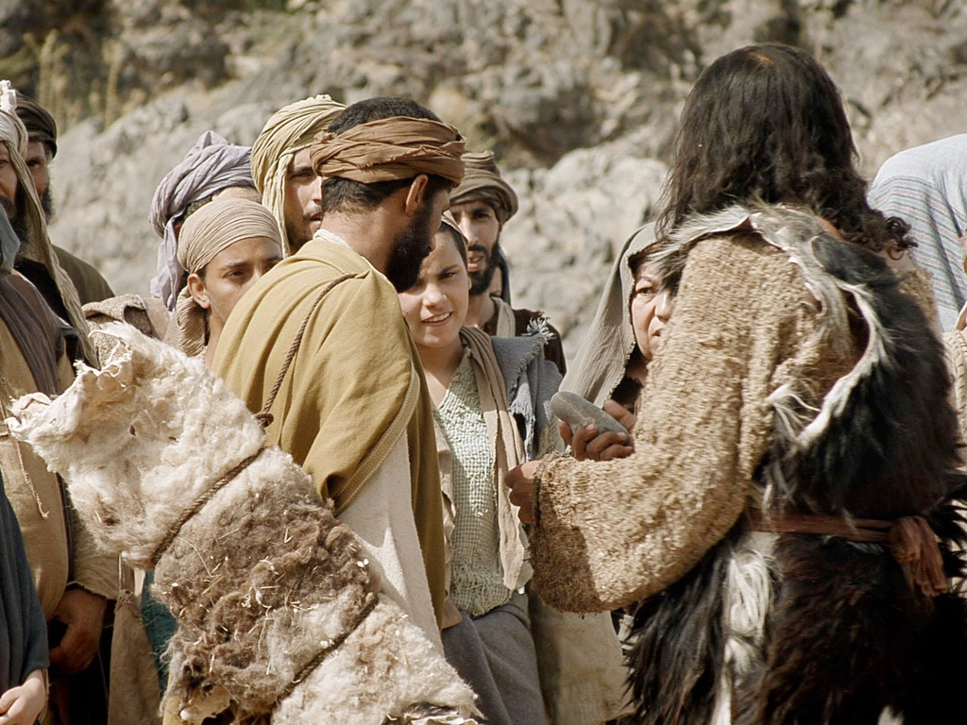

Slide 86
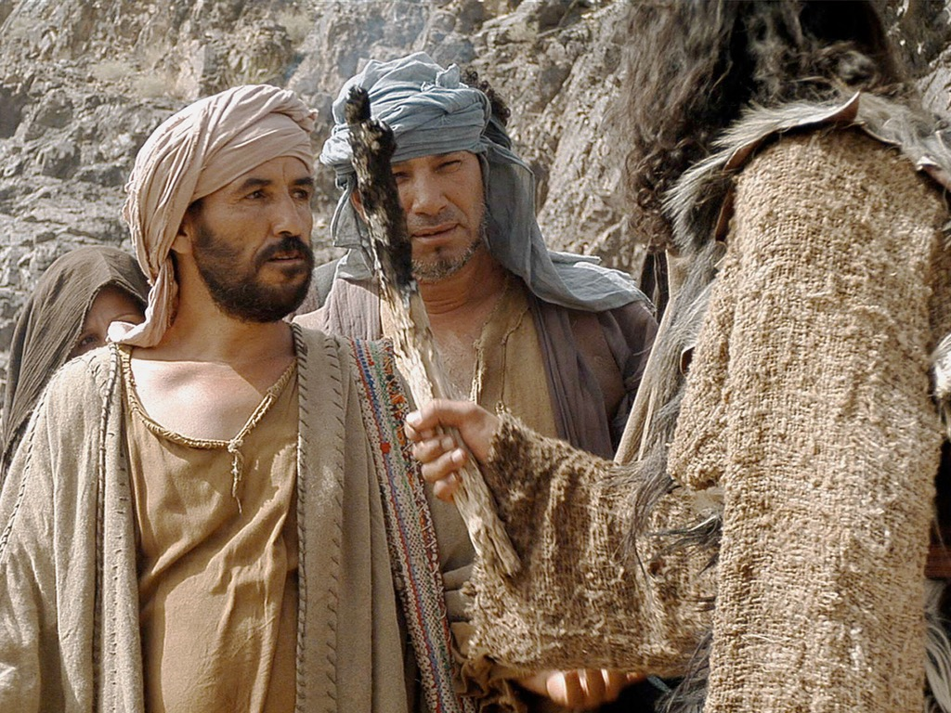

Slide 87
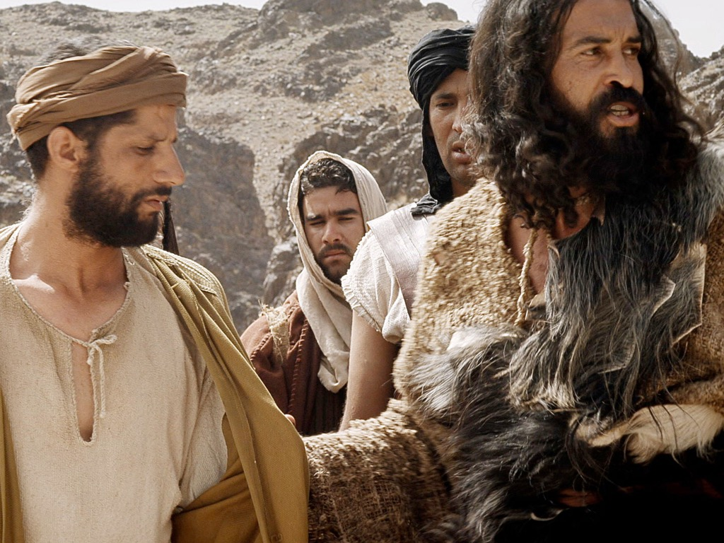
"John announced: ‘Someone is coming soon who is greater than I am—so much greater that I’m not even worthy to stoop down like a slave and untie the straps of his sandals’" (Mark 1:7 NLT).
Notes:
John served humbly since he saw Jesus as the Greatest man ever (1:2-8).

Slide 88
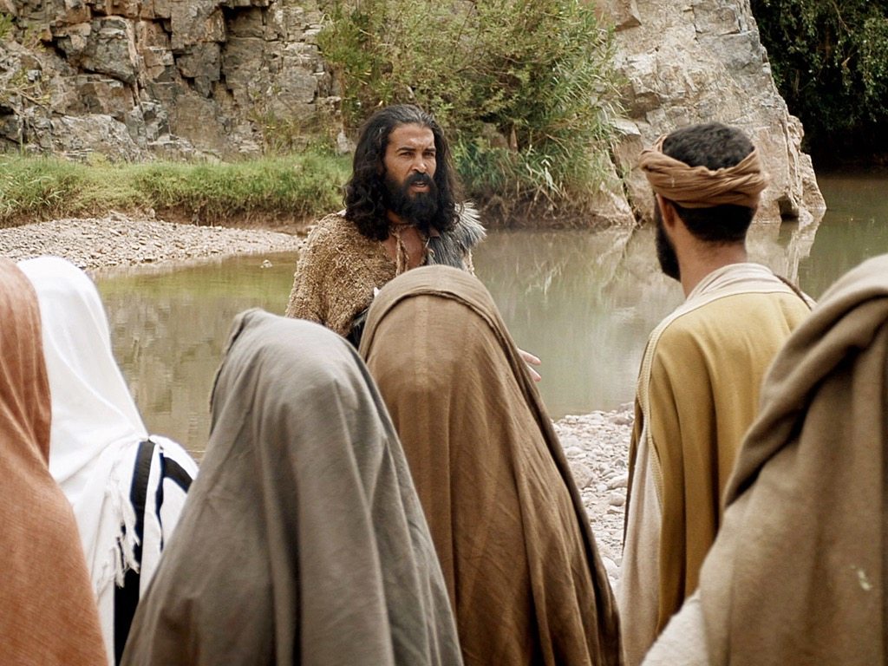
"I baptize you with water, but he will baptize you with the Holy Spirit!"
(Mark 1:8 NLT).
Notes:
John served humbly since he saw Jesus as the Greatest man ever (1:2-8).

Slide 89
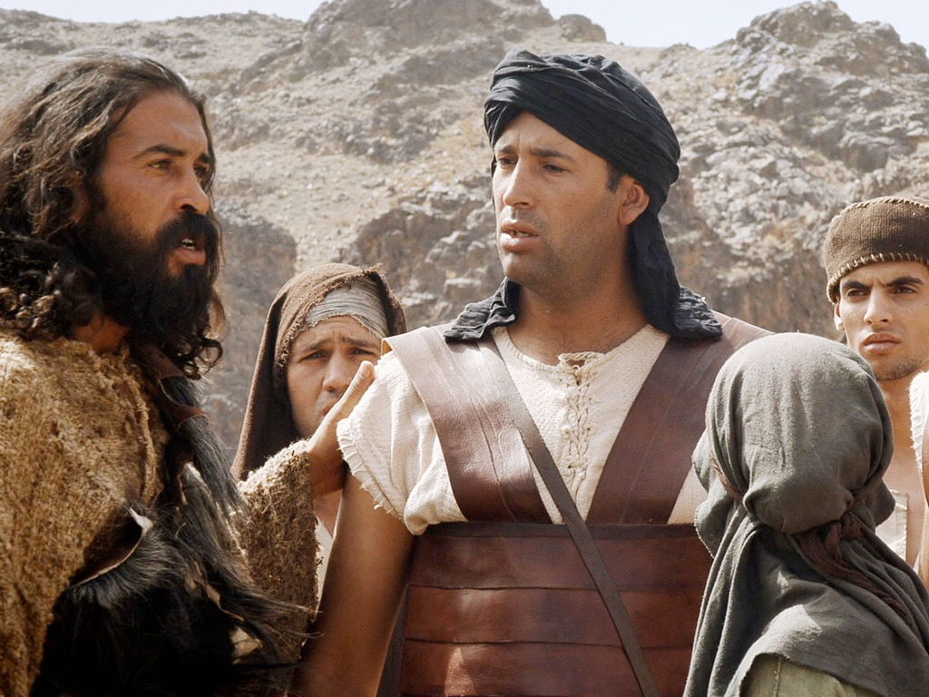

Slide 90
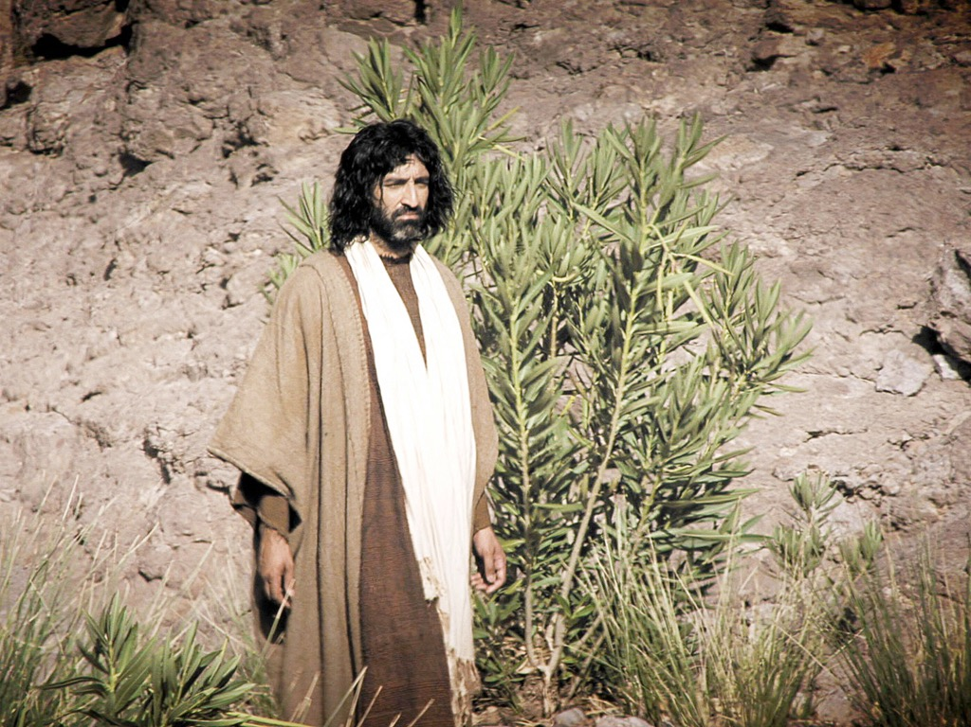

Slide 92
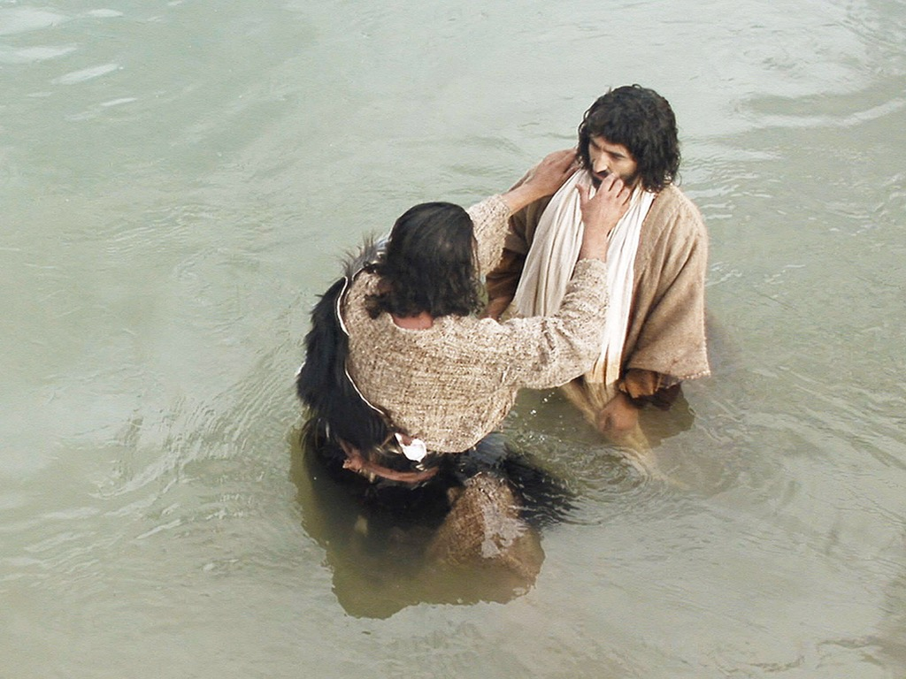

Slide 93
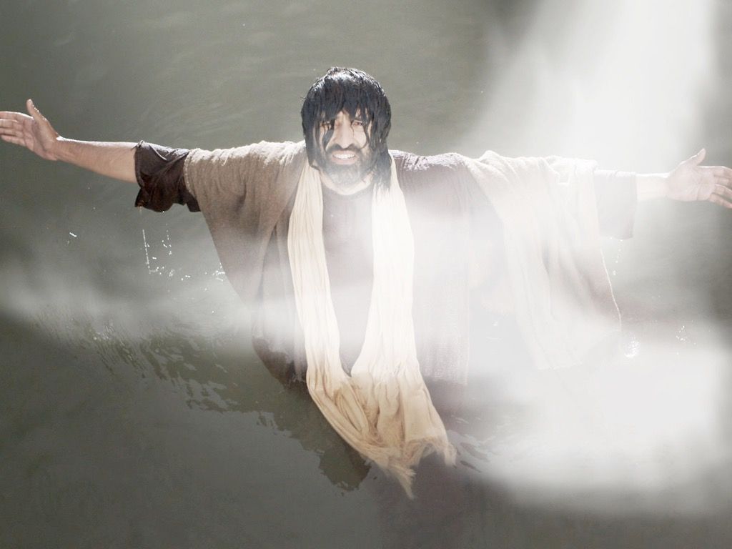
"And a voice from heaven said,
‘You are my dearly loved Son, and you bring me great joy’” (Mark 1:11 NLT).
Notes:
Jesus was praised by God himself at his baptism (1:9-11).

Slide 94
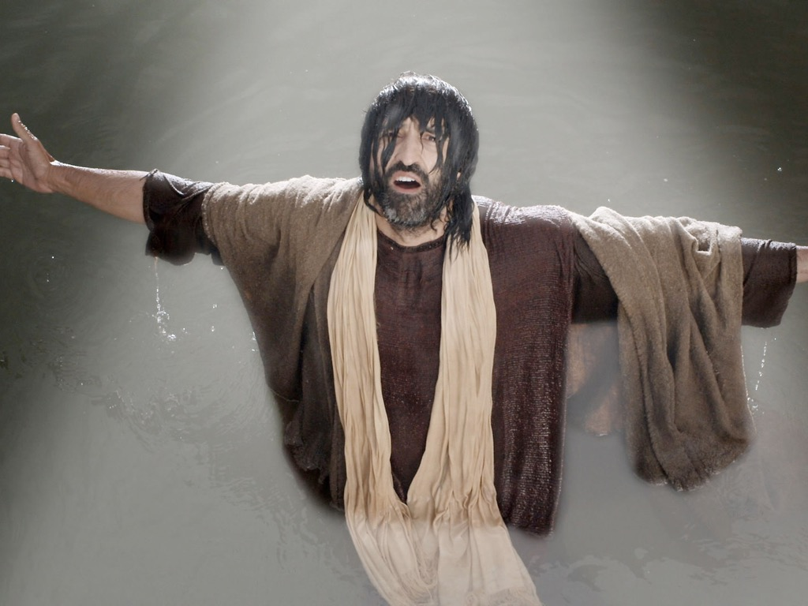

Slide 95
THE WORD IN PICTURES
Free
Bible
images

Slide 96

Used with Permission
THE
GOSPEL
——OF—— MATTHEW
THE
GOSPEL
——OF—— MARK
THE
GOSPEL
——OF—— LUKE
THE
GOSPEL
——OF—— JOHN
Due to the Lumo Project producing its own publishing material we regret to inform you that we cannot license our photos to other clients outside of freebibleimages.org.
These images are not licensed for reuse in video, epublishing or other media. Downloaded pictures and files cannot be redistributed through any other website than freebibleimages.org or used in any context where the accompanying message is undermining of the Christian faith and gospel.
Photos can only be used on educational presentations, blogs and social media, all of which should be accompanied with reference to www.LumoProject.com.
Picture courtesy of BBM
© All Rights Reserved.
www.bigbookmedia.com

Slide 97
Used with Permission
"The Spirit then compelled Jesus to go into the wilderness,
¹³where he was tempted by Satan for forty days. He was out among the wild animals, and angels took care of him"
(Mark 1:12-13 NLT).
THE
GOSPEL
——OF—— MATTHEW
THE
GOSPEL
——OF—— MARK
THE
GOSPEL
——OF—— LUKE
THE
GOSPEL
——OF—— JOHN
Due to the Lumo Project producing its own publishing material we regret to inform you that we cannot license our photos to other clients outside of freebibleimages.org.
These images are not licensed for reuse in video, epublishing or other media. Downloaded pictures and files cannot be redistributed through any other website than freebibleimages.org. or used in any context where the accompanying message is undermining of the Christian faith and gospel.
Photos can only be used on educational presentations, blogs and social media, all of which should be accompanied with reference to www.LumoProject.org.
Picture courtesy of BBM
© All Rights Reserved.
www.bigbookmedia.com
Notes:
Jesus was cared for by angels at his temptation (1:12-13).

Slide 98
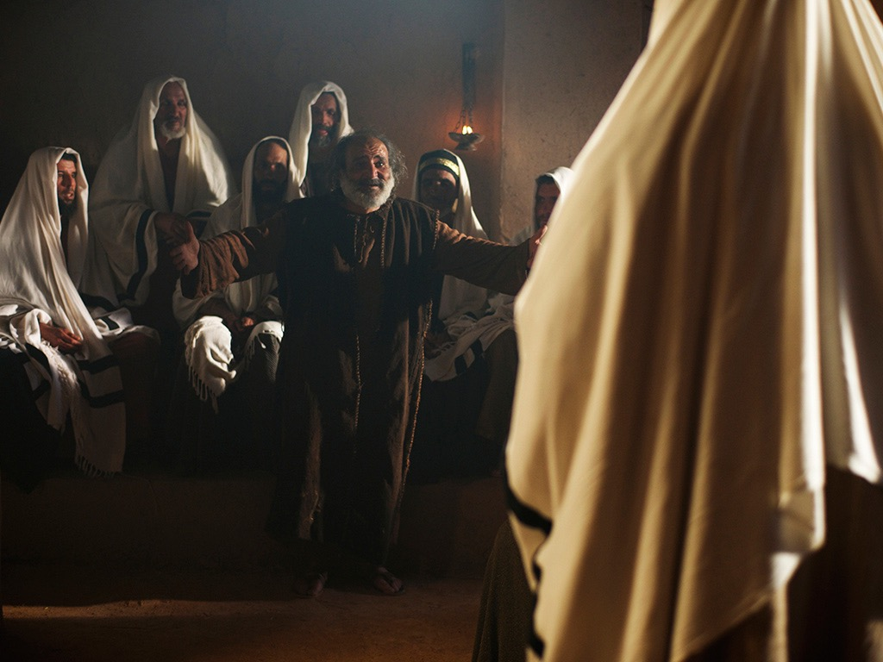
Free
Bible
images
Mark 1:21-28; Luke 4:31-37
JESUS DELIVERS A POSSESSED MAN

Slide 99
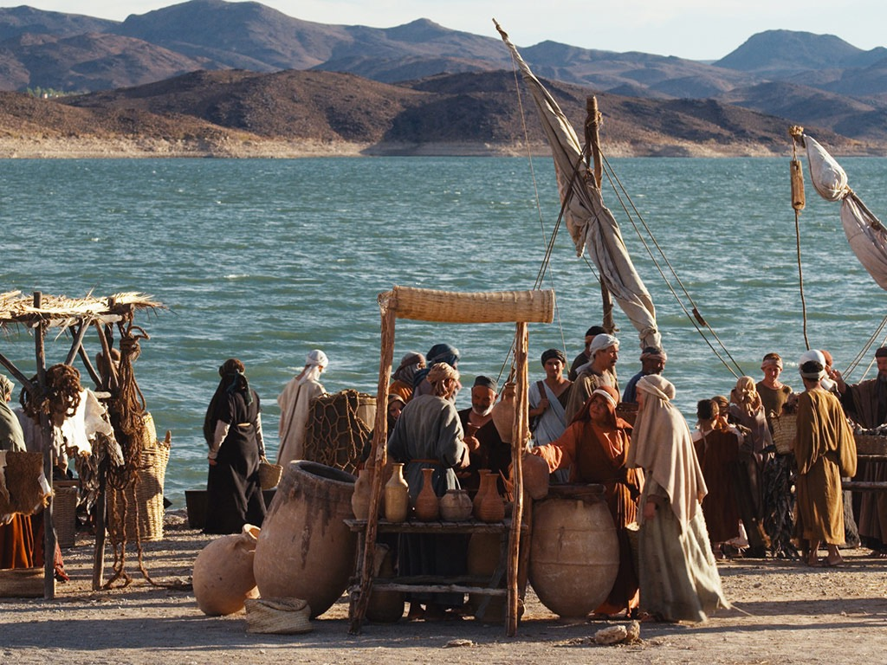

Slide 100
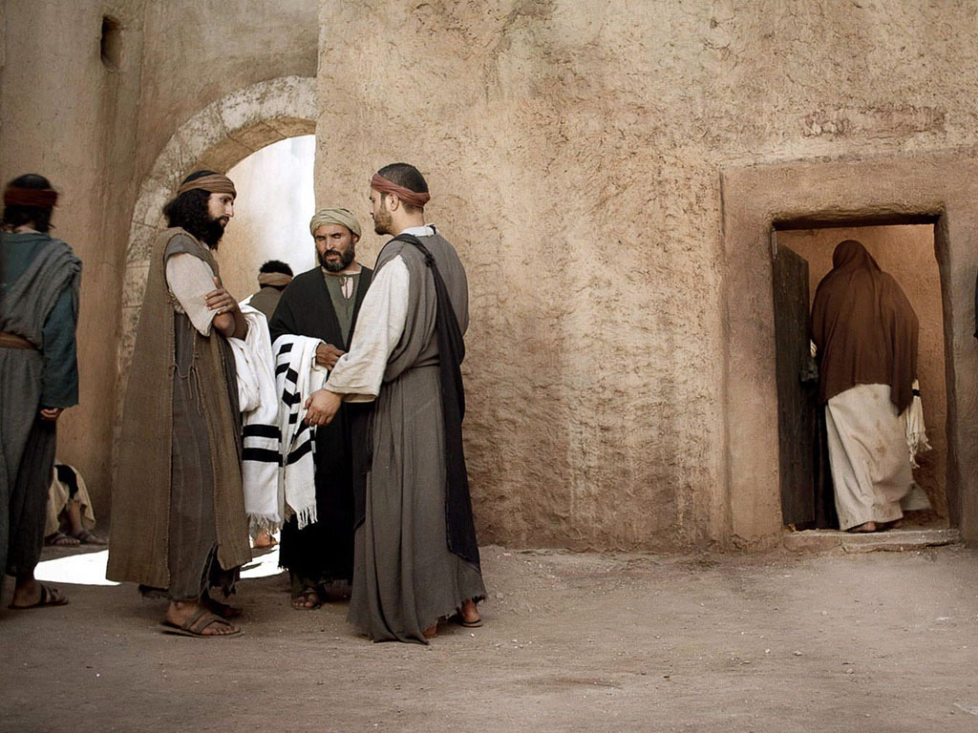

Slide 101
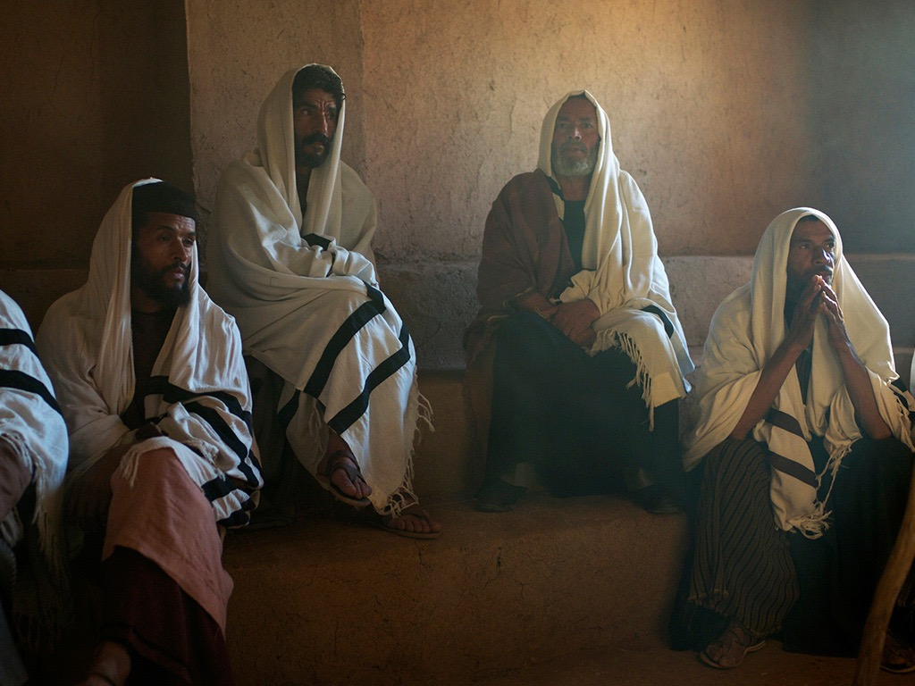

Slide 102
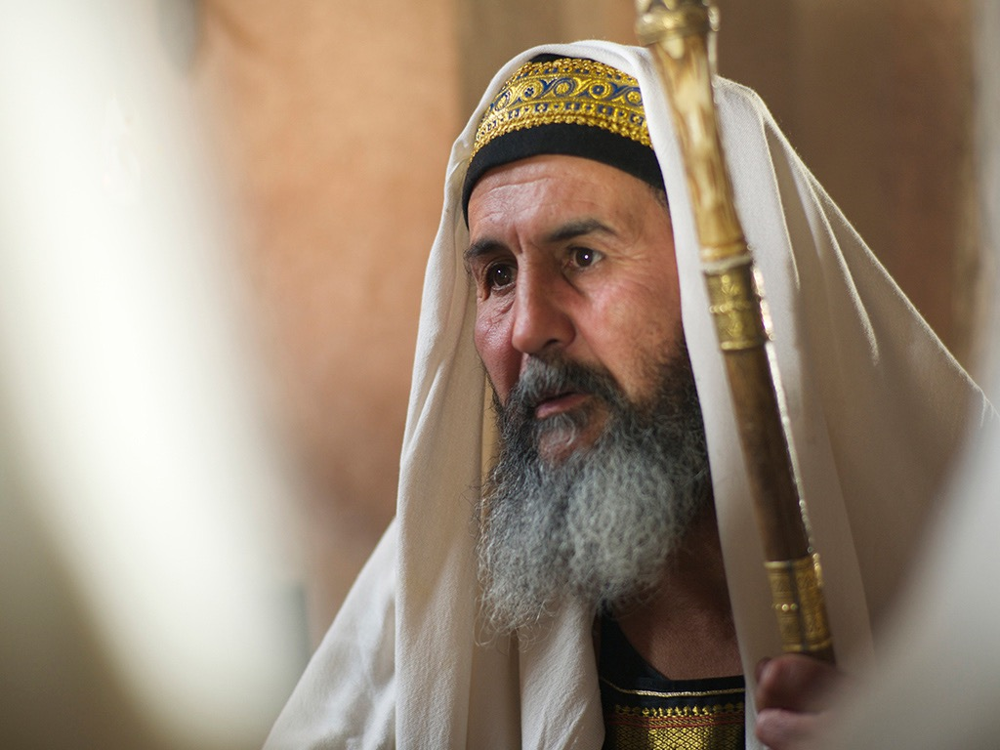

Slide 103
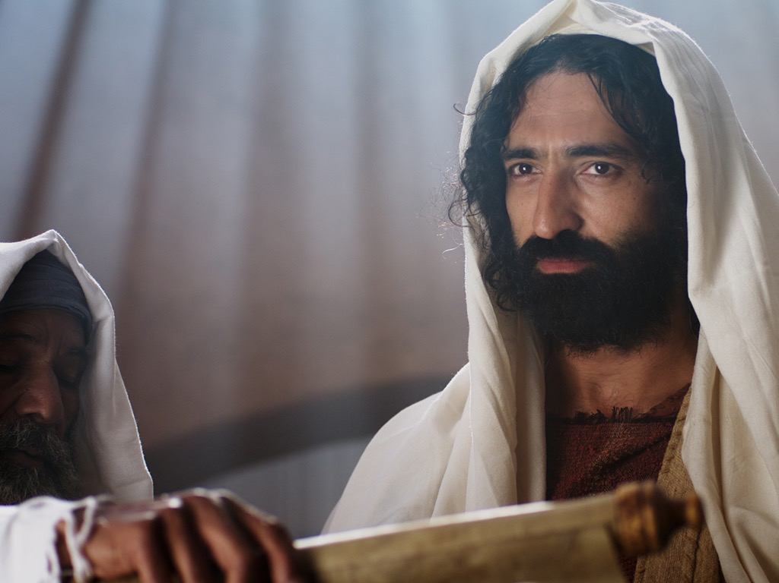

Slide 104
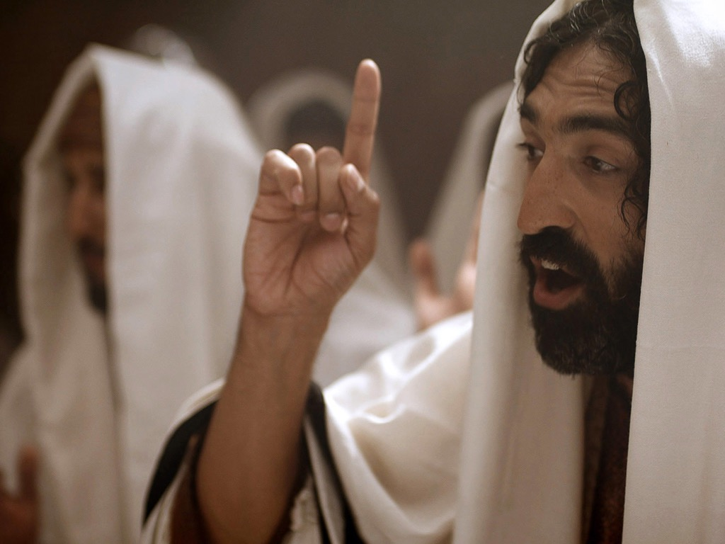

Slide 105
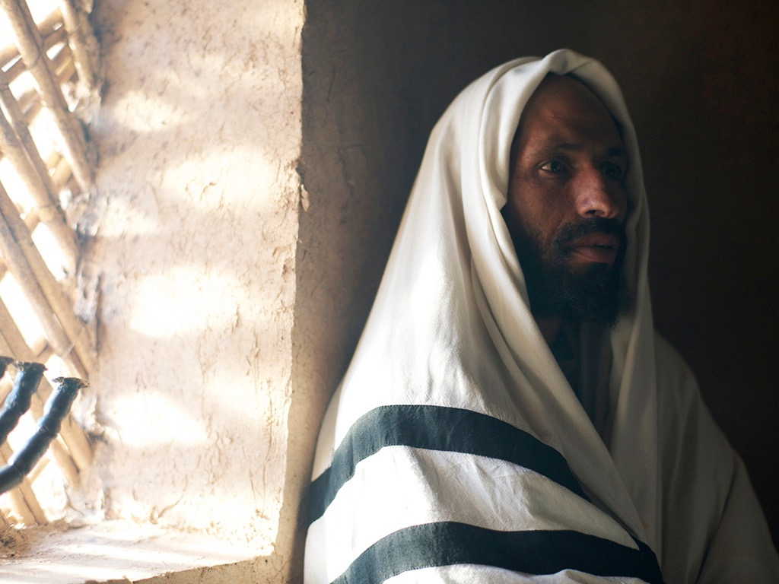

Slide 106
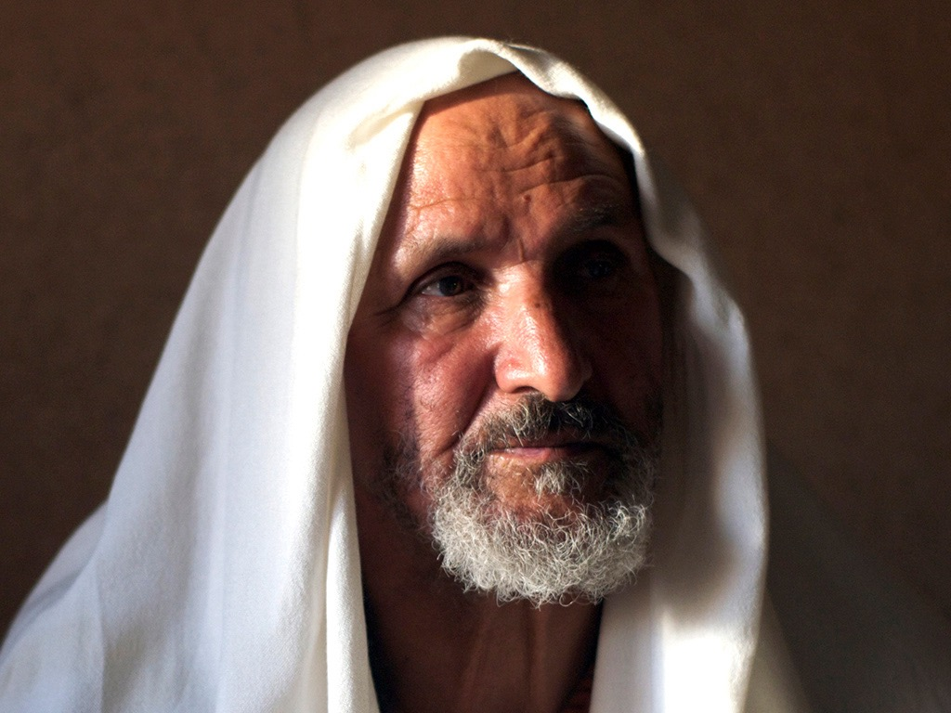

Slide 107
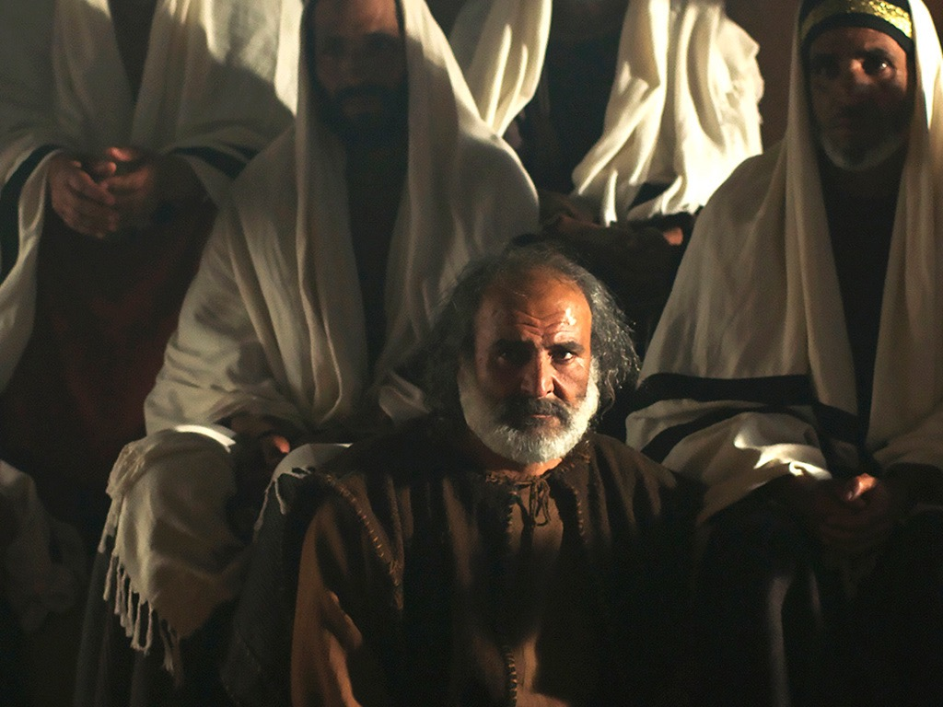

Slide 109
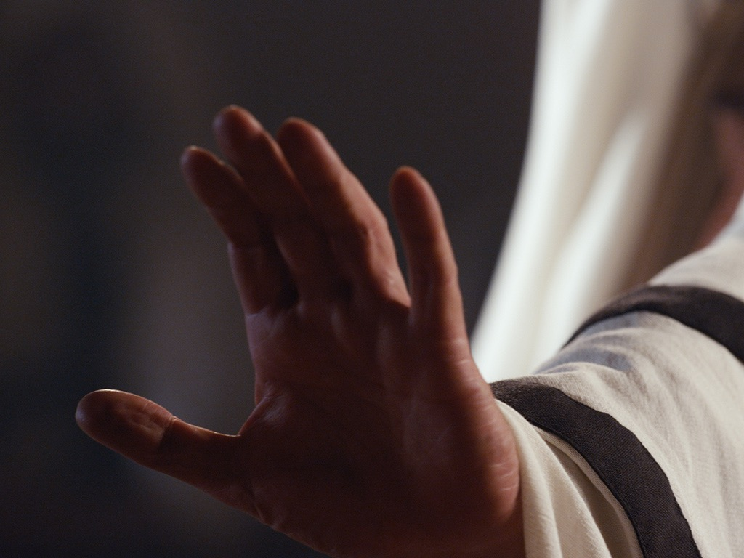

Slide 110


Slide 111


Slide 112


Slide 113


Slide 114
Used with Permission
THE
GOSPEL
——OF—— MATTHEW
THE
GOSPEL
——OF—— MARK
THE
GOSPEL
——OF—— LUKE
THE
GOSPEL
——OF—— JOHN
Due to the Lumo Project producing its own publishing material we regret to inform you that we cannot license our photos to other clients outside of freebibleimages.org.
These images are not licensed for reuse in video, epublishing or other media. Downloaded pictures and files cannot be redistributed through any other website than freebibleimages.org or used in any context where the accompanying message is undermining of the Christian faith and gospel.
Photos can only be used on educational presentations, blogs and social media, all of which should be accompanied with reference to www.LumoProject.com.
Picture courtesy of BBM
© All Rights Reserved.
www.bigbookmedia.com

Slide 115


Free
Bible
images
JESUS HEALS A
MAN WITH LEPROSY
Matthew 8:1-4; Mark 1:40-45; Luke 5:12-16

Slide 116

Notes:
When Jesus came down from the mountainside
large crowds followed Him.
________
عندما نزل الرب يسوع من الجبل تبعه جمع كثير.

Slide 117

Notes:
Jesus was moving in and around the local towns.
________
وكان يتنقل بين مدن المنطقة وما حولها.

Slide 118

Notes:
There was a man suffering from leprosy all
over his body. Those with leprosy had to keep away from everyone, even their family, so as not to pass on this terrible disease to them.
___________
وكان يوجد رجل مصاب بالبرص. وكان يجب على
المصابين بالبرص أن يبتعدوا عن الجميع حتى عن عائلتهم حتى لا تنتقل عدوى المرض إليهم.

Slide 119
Notes:
No one wanted to touch a person with leprosy. It
was a contagious disease that caused discoloration and lumps on the skin and, in severe cases, disfigurement and deformities.
ـــــــــ
ولا يريد أحدًا أن يلمس شخصًا مصاب بالبرص. لأنه كان
مرضًا معديًا يتسبب في تغير لون الجلد وتورمه، ويسبب تشوه الجلد في حالات المرض الشديدة.

Slide 120

Notes:
When this man heard that Jesus was nearby, he made his way to see Him. People with leprosy were meant to shout that they were ‘unclean’ to warn others to keep away.
ــــــــــ
.وعندما سمع هذا الرجل بأن الرب يسوع في مكان قريب
ذهب إليه. وكان يجب على المصابين بالبرص أن يصيحوا "نجس" لكي يحذروا الناس من الاقتراب إليهم

Slide 121

Notes:
The man went up to Jesus and knelt down before Him. Jesus did not move away. He begged Jesus, ‘Lord, if you are willing, you can make me clean.’
ــــــــ
ولكنه ذهب إلى الرب يسوع
وركع أمامه ولم يبتعد الرب يسوع عنه. وترجي الرب يسوع قائلاً «يَا سَيَّدُ، إن كُنْتَ تُرِيدُ، فَأَنْتَ قَادِرِ أَنْ تُطَهَّرَنَي!«

Slide 122

Notes:
Jesus did something no- one was expecting Him to do. He reached out and touched the man with leprosy.
ــــــــ
وفعل الرب يسوع شيىًا لا يتوقعه أحد فقد اقترب من
الرجل الأبرص ولمسه

Slide 123

Notes:
‘I am willing,’ Jesus said. ‘Be clean!’
ـــــــــ
وَقَالَ: «أُرِيدُ، فَاطْهُرْ!»

Slide 124

Notes:
Immediately the leprosy left the man. He was healed.
ــــــــــ
وفورًا ترك البرص الرجل. وشفى.

Slide 125

Notes:
Jesus told him not to tell anyone what had happened but go and be examined by a Jewish priest. ‘Offer the sacrifice Moses’ law requires for lepers who are healed,’ he said. ‘This will prove to everyone that you are well.’
ــــــــ
فَقَالَ لَهُ يَسُوعُ: «انْظُرْ أَنْ لاَ تَقُولَ لأَحَدٍ. بَلِ اذْهَبْ أَرِ نَفْسَكَ لِلْكَاهِنِ وَقَدَّمِ الْقُرْبَانَ الَّذِي أَمَرَ بِهِ مُوسَى شَهَادَةً لَهُمْ».

Slide 126

Notes:
However the report of Jesus’ power spread even faster and vast crowds came to hear Him preach and to be healed of their diseases (Luke 5:15).
______
لوقا ٥ : ١٥
١٥ فَذَاعَ الْخَبَرُ عَنْهُ أَكْثَرَ. فَاجْتَمَعَ جُمُوعٌ كَثِيرَةٌ لِكَيْ يَسْمَعُوا وَيُشْفَوْا بِهِ مِنْ أَمْرَاضِهِمْ.

Slide 127

Notes:
“So, Jesus often withdrew from the crowds and went into the wilderness to be alone and pray” (Luke 5:16).
_____
لوقا ٥ : ١٦
١٦ وَأَمَّا هُوَ فَكَانَ يَعْتَزِلُ فِي الْبَرَارِي وَيُصَلِّي.

Slide 128
Used with Permission
THE
GOSPEL
——OF—— MATTHEW
THE
GOSPEL
——OF—— MARK
THE
GOSPEL
——OF—— LUKE
THE
GOSPEL
——OF—— JOHN
Due to the Lumo Project producing its own publishing material we regret to inform you that we cannot license our photos to other clients outside of freebibleimages.org.
These images are not licensed for reuse in video, epublishing or other media. Downloaded pictures and files cannot be redistributed through any other website than freebibleimages.org or used in any context where the accompanying message is undermining of the Christian faith and gospel.
Photos can only be used on educational presentations, blogs and social media, all of which should be accompanied with reference to www.LumoProject.com.
Picture courtesy of BBM
© All Rights Reserved.
www.bigbookmedia.com

Slide 129

Jesus is the main attraction, so we’re not big on our own authority here.

Slide 130

The Paradox of Authority and Servanthood in Mark
 | Authority | Servanthood
Themes | Christ's Leadership | Discipleship
Strategy | Gentiles lord it over others (10:42) | Disciples serve (10:43)
Motivation | "Save his life" (8:35a) | "Lose his life" (8:35b)
Priority | "First" (9:35a; 10:31a) | "Last" (9:35b; 10:31b)
Reputation | "Great" (10:43a) | "Servant" (10:43b)
Position | "First" (10:44a) | "Slave of all" (10:44b)
Authority Examples | Authority without Serving: • Religious leaders • Rich man • Judas | Authority & Served: • John the Baptist • Joseph of Arimathea
Servanthood Examples | Authority but Struggled to Serve: • Disciples | No Authority & Served • Bartimaeus • Woman who anointed Jesus
1st Section (1:1–8:26) | Authority of Christ
2nd Section (8:27–10:52) | Authority- Servanthood Tension
3rd Section (11–16) |  | Servanthood of Christ
89a
Summary of Narry F. Santos, Bibliotheca Sacra 154 (Oct.-Dec. 1997): 452-60
Notes:
LC-09-Rejection of the King-162
NS-02-Mark1-8-slide 128

Slide 131

Worldly Leadership
Mark
89a
Worldly Leadership
Followers serve the leader,
who is at the top
Leader
Followers

Slide 132
Biblical Leadership
Mark
89a
Biblical Leadership
The leader serves the followers
Followers
Leader

Slide 133
Albert Einstein on Jesus
"As a child I received instruction both in the Bible and in the Talmud. I am a Jew, but I am enthralled by the luminous figure of the Nazarene. No one can read the Gospels without feeling the actual presence of Jesus. His personality pulsates in every word. No myth is filled with such life."
Albert Einstein
Saturday Evening Post, Oct 26, 1929
Notes:
It is sad that Einstein did not follow his admiration for Jesus to its logical conclusion—to place his faith in Christ.
________
Common-420
OS-21-Ecclesiastes-291
NS-02-Mark1-8-slide 22, 133

Slide 134
Theme
23
Deity Who Models Suffering as Servant
Mark

Slide 135
Mark Book Chart
82
Deity Who Models Suffering As Servant
Service |  | Suffering
Sayings and Signs |  | Sacrifice
Galilee & Perea |  | Judea & Jerusalem
Coming | Ministry Opposition | Self- Sacrifice | Resurrection
1:1-13 | 1:14–10:52 | 11–15 | 16
Key Verse
"For even the Son of Man
did not come to be served,
but to serve, and to give his life
as a ransom for many"
(Mark 10:45).
serve
give his life

Slide 136
How can you be a true disciple of Jesus in a hostile world?
Notes:
What’s it gonna take to really follow Christ when most people around you oppose Jesus?

Slide 137
How to Be a Disciple in a Hostile World
Don’t cling to your Authority
Serve
like Jesus
1:1-13 | 1:14–10:52 | 11–15 | 16
Mark
Notes:
Help others despite opposition, which Jesus lived and taught (Mark 1:14–10:52).

Slide 138
"The time promised by God has come at last!” he announced. “The Kingdom of God is near! Repent of your sins and believe the Good News!" (Mark 1:15 NLT).
Notes:
Jesus cared for people by announcing the kingdom that freed them from sin through repentance (1:14-15).

Slide 139

"Jesus called out to them, ‘Come, follow me, and I will show you how to fish for people!’ ¹⁸ And they left their nets at once and followed him"
(Mark 1:17-18 NLT).
Notes:
Jesus cared for people by calling disciples to a purposeful life (1:16-20).

Slide 140
Slides on
Mark 2

Slide 141

Free
Bible
images
Mark 2:2-12; Luke 5:17-26
JESUS FORGIVES AND
HEALS A PARALYZED MAN

Slide 142


Slide 143


Slide 144


Slide 145


Slide 146


Slide 147


Slide 148


Slide 150


Slide 151


Slide 152


Slide 153


Slide 154


Slide 155


Slide 156


Slide 157


Slide 158

"So I will prove to you that the Son of Man has the authority on earth to forgive sins.” Then Jesus turned to the paralyzed man and said, ¹¹“Stand up, pick up your mat, and go home!"
(Mark 2:10-11 NLT).
Notes:
Jesus used his authority by healing an oppressed leper and paralytic to show his followers servant care for others (1:40–2:12).

Slide 159


Slide 160


Slide 161


Slide 162


Slide 163
Used with Permission
THE
GOSPEL
——OF—— MATTHEW
THE
GOSPEL
——OF—— MARK
THE
GOSPEL
——OF—— LUKE
THE
GOSPEL
——OF—— JOHN
Due to the Lumo Project producing its own publishing material we regret to inform you that we cannot license our photos to other clients outside of freebibleimages.org.
These images are not licensed for reuse in video, epublishing or other media. Downloaded pictures and files cannot be redistributed through any other website than freebibleimages.org or used in any context where the accompanying message is undermining of the Christian faith and gospel.
Photos can only be used on educational presentations, blogs and social media, all of which should be accompanied with reference to www.LumoProject.com.
Picture courtesy of BBM
© All Rights Reserved.
www.bigbookmedia.com

Slide 164
Mark Book Chart
82
Deity Who Models Suffering As Servant
Service |  | Suffering
Sayings and Signs |  | Sacrifice
Galilee & Perea |  | Judea & Jerusalem
Coming | Ministry Opposition | Self- Sacrifice | Resurrection
1:1-13 | 1:14–10:52 | 11–15 | 16
Many opposed Jesus as Servant—so we also will be opposed (2:13–8:26).

Slide 165
Slides on
Mark 3

Slide 166
"Jesus went into the synagogue again and noticed a man with a deformed hand.
² Since it was the Sabbath, Jesus’ enemies watched him closely. If he healed the man’s hand, they planned to accuse him of working on the Sabbath" (Mark 3:1-2 NLT).
Notes:
Jewish religious leaders initially opposed Jesus over various issues (2:13–3:35).

Slide 167
Mark 3:20-21 NLT
One time Jesus entered a house, and the crowds began to gather again. Soon he and his disciples couldn’t even find time to eat. ²¹When his family heard what was happening, they tried to take him away.
“He’s out of his mind,” they said.

Slide 168
Jesus' Own Hometown Persecuted Him
Holy
Spirit
Men in white
Mary
Joseph
Women in yellow
Jesus
Joseph
Simon
Sister 2
James
Judas
Sister 1
"Then they scoffed, 'He's just a carpenter, the son of Mary and the brother of James, Joseph, Judas, and Simon. And his sisters live right here among us.' They were deeply offended and refused to believe in him" (Mark 6:3 NLT).

Slide 169
Slides on
Mark 4

Slide 170

Free
Bible
images
Matthew 13:1-23; Mark 4:1-20; Luke 8:1-15
PARABLE OF THE SOWER

Slide 171


Slide 173


Slide 174


Slide 175


Slide 176


Slide 177


Slide 178


Slide 179


Slide 180


Slide 181


Slide 182


Slide 183


Slide 184


Slide 185


Slide 186


Slide 187
THE WORD IN PICTURES
Free
Bible
images

Slide 188
Used with Permission
THE
GOSPEL
——OF—— MATTHEW
THE
GOSPEL
——OF—— MARK
THE
GOSPEL
——OF—— LUKE
THE
GOSPEL
——OF—— JOHN
Due to the Lumo Project producing its own publishing material we regret to inform you that we cannot license our photos to other clients outside of freebibleimages.org.
These images are not licensed for reuse in video, epublishing or other media. Downloaded pictures and files cannot be redistributed through any other website than freebibleimages.org or used in any context where the accompanying message is undermining of the Christian faith and gospel.
Photos can only be used on educational presentations, blogs and social media, all of which should be accompanied with reference to www.LumoProject.com.
Picture courtesy of BBM
© All Rights Reserved.
www.bigbookmedia.com

Slide 189

Know Your Soil 00899
Sowers, Know Your Soil!
I know where these seeds won't grow!
Thorny
Soil
Good
Soil
Hard
Soil
Rocky
Soil
Notes:
CR-09-Creation Evangelism-64

Slide 190

Jews plowed ground
“JEWS”
HOME
SCHOOL
CHURCH
Plowed ground
Unplowed ground

Slide 191

Church Today sowing 00895
THE CHURCH TODAY
THIS IS THE WAY WE'VE ALWAYS SPREAD THE GOSPEL IN THE PAST. WOW! THESE WEEDS ARE GETTING WORSE EVERY DAY! OH WELL!
GOSPEL SEEDS

Slide 192

Greeks – Unplowed Ground
“GREEKS”
Churches, schools, media & homes are sowing seeds of destruction.
Contaminated seed
Plowed
ground
Unplowed ground

Slide 193

Blank NAS
Jeremiah 4:3
For thus says the LORD to the men of Judah and to Jerusalem, "Break up your fallow ground, And do not sow among thorns."
Notes:
Verse 9 echoes the language of Gen. 9:10-16. There is nothing on Day 3, when God made dry land, to link this description with creation week.

Slide 194

Free
Bible
images
Matthew 8:23-27
Mark 4:35-41
Luke 8:22-25
JESUS CALMS A STORM

Slide 195


Slide 196


Slide 197


Slide 199


Slide 200


Slide 201


Slide 202


Slide 203


Slide 204


Slide 205


Slide 206


Slide 207
Used with Permission
THE
GOSPEL
——OF—— MATTHEW
THE
GOSPEL
——OF—— MARK
THE
GOSPEL
——OF—— LUKE
THE
GOSPEL
——OF—— JOHN
Due to the Lumo Project producing its own publishing material we regret to inform you that we cannot license our photos to other clients outside of freebibleimages.org.
These images are not licensed for reuse in video, epublishing or other media. Downloaded pictures and files cannot be redistributed through any other website than freebibleimages.org or used in any context where the accompanying message is undermining of the Christian faith and gospel.
Photos can only be used on educational presentations, blogs and social media, all of which should be accompanied with reference to www.LumoProject.com.
Picture courtesy of BBM
© All Rights Reserved.
www.bigbookmedia.com

Slide 208
Slides on
Mark 5

Slide 209

Free
Bible
images
Mark 5:1-20; Luke 8:26-29
JESUS DELIVERS A WILD MAN

Slide 210


Slide 211


Slide 212


Slide 214


Slide 215


Slide 216


Slide 217


Slide 218


Slide 219


Slide 220


Slide 221


Slide 222


Slide 223


Slide 224


Slide 225


Slide 226


Slide 227


Slide 228


Slide 229
Used with Permission
THE
GOSPEL
——OF—— MATTHEW
THE
GOSPEL
——OF—— MARK
THE
GOSPEL
——OF—— LUKE
THE
GOSPEL
——OF—— JOHN
Due to the Lumo Project producing its own publishing material we regret to inform you that we cannot license our photos to other clients outside of freebibleimages.org.
These images are not licensed for reuse in video, epublishing or other media. Downloaded pictures and files cannot be redistributed through any other website than freebibleimages.org or used in any context where the accompanying message is undermining of the Christian faith and gospel.
Photos can only be used on educational presentations, blogs and social media, all of which should be accompanied with reference to www.LumoProject.com.
Picture courtesy of BBM
© All Rights Reserved.
www.bigbookmedia.com

Slide 230

Outline
86
Christ's coming as Servant identifies Him as Messiah and deity but receives a very brief summary by Mark to get quickly to the main content of his account: His service and sacrifice as Servant (1:1-13) .
II. Christ's ministry as Servant receives opposition, which Mark records with Christ's response of teaching on discipleship in order to encourage his readers to expect persecution for righteousness' sake (1:14–10:52) .

Slide 231

Decapolis and the Lands Beyond the Jordan
89
低加坡里和约旦之外的土地
大马士革
89
保罗在这附近转身，被蒙蔽到城里(使徒9:3,8;22:6,11)
黑门山
耶稣和他的门徒撤出了这里(马太16:13;马可8:27)在这里他问彼得他认为耶稣是谁(马太16:15-16
凯撒利亚腓立比
戈兰高地
毕
士
使徒菲利普，安德鲁和彼得的家(约翰1:44;12:21).耶稣在这里治好了一个盲人(马可8:22).在这附近进行了在这附近进行了喂养5000人事件(路加9:10)
大
毕士大
加利利海
迪翁
加利利
阿比拉
雅莫
乌姆盖斯
科河
菲利普的分层结构
在乌姆盖斯地区，耶稣医治了两名被恶魔附身的男子(马太8:28)
锡索波利斯
希律安提帕的分层结构
派拉
低
地中海
在杰拉萨耶稣地区治愈了恶魔附身的人(马可5:1;路加8:26)
杰拉什
加
自由的低加坡里城市
坡
边界
里
河流边界
约旦河
希腊
非拉铁非
无限边界（沙漠）
在约旦以外的伯大尼
耶路撒冷
在约旦河东岸，施洗约翰施洗。(约翰1:28)约翰在这里看到耶稣，称他为“上帝的羔羊”(约翰1:29,35)
死海

Slide 232

The Territories of Tyre and Sidon
89
In a unique excursion into pagan and semi-pagan areas, Jesus visited the districts of Tyre and Sidon and the confederation of free cities called Decapolis. He was called to minister to "the lost sheep of Israel," but the phenomenal public attention in Galilee was intense. Even here his fame had spread, and he could not keep his presence secret. The commercially magnificent cities of Tyre and Sidon had been a source of cultural seductiveness and religious heterodoxy since the time of Jezebel.
The cities having been influenced by Hellenism, the sophistication of Greek culture was apparent in their coinage and architecture. Each was also a proud, historic center of Canaanite paganism, with tombs of ancient kings and temples to Melqart/Heracles. Astarte and various other deities.
The Bible Visual Resource Book, 189

Slide 233
Slides on
Mark 6

Slide 234
Jesus' Family Persecuted Him
Holy
Spirit
Men in white
Mary
Joseph
Women in yellow
Jesus
Joseph
Simon
Sister 2
James
Judas
Sister 1
"Then they scoffed, 'He's just a carpenter, the son of Mary and the brother of James, Joseph, Judas, and Simon. And his sisters live right here among us.' They were deeply offended and refused to believe in him" (Mark 6:3 NLT).
Notes:
Luke 1:35 The angel replied [to Mary], “The Holy Spirit will come upon you, and the power of the Most High will overshadow you. So the baby to be born will be holy, and he will be called the Son of God.
There existed no sexual union between Mary and the Holy Spirit, but instead it was God's power "overshadowing" her. Such was not the case with the four brothers and at least two sisters of Jesus, conceived and born in the natural manner. Yet these siblings evidently did not believe even as adults that their mother Mary was a virgin at the birth of Jesus. John brings out their unbelief in John 7:1-5…
John 7:1 After this, Jesus traveled around Galilee. He wanted to stay out of Judea, where the Jewish leaders were plotting his death. ² But soon it was time for the Jewish Festival of Shelters, ³ and Jesus’ brothers said to him, “Leave here and go to Judea, where your followers can see your miracles! ⁴ You can’t become famous if you hide like this! If you can do such wonderful things, show yourself to the world!” ⁵ For even his brothers didn’t believe in him (NLT).
But God worked on these brothers. After the resurrection, they believed and were in the Upper Room with the disciples: "These all with one mind were continually devoting themselves to prayer, along with the women, and Mary the mother of Jesus, and with His brothers" (Acts 1:14 NLT). In fact, both James and Jude went on to each record a General Epistle!
__________
LC-03-Opposition-114
NS-02-Mark1-9-slide 234
NS-04-John1-11—slide 387
NS-20-James1-2—slide 61
NS-26-Jude-90

Slide 235
Herods of the Bible
Herod (the Great)
Met wise men
Killed babies in Bethlehem
Notes:
Let's go back and look at all the Herods in the New Testament. Here is a quick overview. Since these slides are available on our website so I will go through them quickly.
The first Herod, is known as Herod the Great. He was King when Jesus was born, he met the wise men and killed the babies in Jerusalem.
________
LC-03-Controversy-116
NS-03-Mark1-8—slide 235
NS-05-Acts20-28—slide 153

Slide 236
Herods of the Bible
Herod (the Great)
Herod Antipas
Herod Archelaus
Herod Philip
Caused Joseph to return to Nazareth (when returning from Egypt)
Notes:
When he died, Rome decided that his Kingdom would be split between 3 of his sons.
Herod Archelaus was not a good ruler, he was so bad that Joseph was warned to return to Nazareth after Herod the Great’s death and the family was returning from Egypt. He was eventually fired by the Roman senate. His territory was then ruled by Roman governors.

Slide 237
Herods of the Bible
Herod (the Great)
Herod Antipas
Herod Archelaus
Herod Philip
Wife, Herodias, left him for his brother Antipas
Notes:
Herod Philip was actually a pretty good guy. Unfortunately for him, his wife left him for his brother, Herod Antipas.

Slide 238
Herods of the Bible
Herod (the Great)
Herod Antipas
Herod Archelaus
Herod Philip
Married his brother's wife, Herodias
Executed John the Baptist
Presided over Jesus’ trial
Notes:
Herod Antipas is the Herod that executed John the Baptist and presided of Jesus’ trial, conferring with Pontus Pilate.

Slide 239
Herods of the Bible
Herod (the Great)
Herod Antipas
Aristobulus IV
Herod Philip
Herod Archelaus
Herod Agrippa I
Persecuted Christians (in Acts 12)
Notes:
Herod the Great had many other children. One of them, Aristobulus, was the father of Herod Agrippa.
Agrippa was sent to Rome to hobnob with Roman royalty. He became king by befriending the future emperor Caligula. His death is recorded in Acts 12 because he did not rebuke the people when they stated he has the voice of a God.

Slide 240
Herods of the Bible
Herod (the Great)
Herod Antipas
Aristobulus IV
Herod Philip
Herod Archelaus
Herod Agrippa I
Listened to Paul’s defense (Acts 25–26)
Sisters Bernice and Drusilla (married to Felix)
Herod Agrippa II
Notes:
We finally get to Herod Agrippa II. We already met his sister, Drusilla, who was married to the former governor Roman Felix.

Slide 241

JOHN THE BAPTIST IN PRISON
Matthew 14:1-12
Mark 6:14-29
Free
Bible
images

Slide 242

Jesus was opposed by Herod but validated his person through three miracles (Mark 6:14-56).
Notes:
Mark 6:14 Herod Antipas, the king, soon heard about Jesus, because everyone was talking about him. Some were saying, “This must be John the Baptist raised from the dead. That is why he can do such miracles.” 15 Others said, “He’s the prophet Elijah.” Still others said, “He’s a prophet like the other great prophets of the past.”
Mark 6:16 When Herod heard about Jesus, he said, “John, the man I beheaded, has come back from the dead.”

Slide 243

Notes:
Herodias used to be Herod Philip's wife, but his brother Herod Antipas took her from him, evidently with her consent. She was not pleased with John the Baptist.

Slide 244

Notes:
John continued to speak out against Antipas for this immorality. "So Herodias bore a grudge against John and wanted to kill him. But without Herod’s approval she was powerless" (Mark 6:19 NLT).

Slide 245

Notes:
Mark 6:17 "For Herod had sent soldiers to arrest and imprison John as a favor to Herodias. She had been his brother Philip’s wife, but Herod had married her. 18 John had been telling Herod, 'It is against God’s law for you to marry your brother’s wife.'”

Slide 246
Notes:
John was imprisoned in the Palace/Fortress of Machaerus on the east side of the Dead Sea in modern-day Jordan.

Slide 247

Notes:
"Herod respected John; and knowing that he was a good and holy man, he protected him. Herod was greatly disturbed whenever he talked with John, but even so, he liked to listen to him" (Mark 6:20 NLT).

Slide 248

Notes:
John had a very blunt and courageous style that easily offended people. Though the son of a priest, he avoided the temple due to its corruption. He also rejected priestly garb, wearing clothes like Elijah instead. No wonder! He was the NT Elijah and even lived in the Jordan thicket exactly where Elijah had lived 800 years earlier!

Slide 249

Notes:
So Herod was perplexed what to do to John.

Slide 250

Notes:
But Herodias constantly looked for an opportunity for revenge.

Slide 251

Notes:
Mark 6:21 Herodias’s chance finally came on Herod’s birthday. He gave a party for his high government officials, army officers, and the leading citizens of Galilee.

Slide 252

Notes:
"Then his daughter, also named Herodias, came in…" (Mark 6:22)

Slide 253

Notes:
"She performed a dance that greatly pleased Herod and his guests. 'Ask me for anything you like,' the king said to the girl, 'and I will give it to you'" (Mark 6:22-23 NLT).

Slide 254

Notes:
"He even vowed, 'I will give you whatever you ask, up to half my kingdom!'” (Mark 6:23 NLT).

Slide 255

Notes:
"She went out and asked her mother, 'What should I ask for?'” (Mark 6:24a).

Slide 256

Notes:
"Her mother told her, 'Ask for the head of John the Baptist!'” (Mark 6:24a).

Slide 257

Notes:
"So the girl hurried back to the king and told him, 'I want the head of John the Baptist, right now, on a tray!'” (Mark 6:25 NLT).
"Then the king deeply regretted what he had said; but because of the vows he had made in front of his guests, he couldn’t refuse her" (6:26).

Slide 258
Notes:
"So he immediately sent an executioner to the prison to cut off John’s head and bring it to him" (Mark 6:27a).

Slide 259

Notes:
"The soldier beheaded John in the prison" (Mark 6:27b).

Slide 260

Notes:
"brought his head on a tray, and gave it to the girl, who took it to her mother" (Mark 6:28 NLT).

Slide 261

Notes:
"When John’s disciples heard what had happened, they came to get his body and buried it in a tomb" (Mark 6:29 NLT).

Slide 262

Pictures courtesy of Big Book Media
© All Rights Reserved.
Used with permission
BIG BOOK MEDIA

Slide 263
THE WORD IN PICTURES
Free
Bible
images

Slide 264

JESUS FEEDS 5000
Free
Bible
images
Matthew 14:13-22
Mark 6:31-46
Luke 9:10-17
John 6:1-13

Slide 265


Slide 266


Slide 267


Slide 268


Slide 269


Slide 270


Slide 271


Slide 272


Slide 273


Slide 274


Slide 276


Slide 277


Slide 278


Slide 279


Slide 280


Slide 281


Slide 282


Slide 283


Slide 284


Slide 285
THE WORD IN PICTURES
Free
Bible
images

Slide 286
Used with Permission
THE
GOSPEL
——OF—— MATTHEW
THE
GOSPEL
——OF—— MARK
THE
GOSPEL
——OF—— LUKE
THE
GOSPEL
——OF—— JOHN
Due to the Lumo Project producing its own publishing material we regret to inform you that we cannot license our photos to other clients outside of freebibleimages.org.
These images are not licensed for reuse in video, epublishing or other media. Downloaded pictures and files cannot be redistributed through any other website than freebibleimages.org or used in any context where the accompanying message is undermining of the Christian faith and gospel.
Photos can only be used on educational presentations, blogs and social media, all of which should be accompanied with reference to www.LumoProject.com.
Picture courtesy of BBM
© All Rights Reserved.
www.bigbookmedia.com

Slide 287
Slides on
Mark 7

Slide 288

Free
Bible
images
A SYROPHOENICIAN WOMAN
BEGS JESUS FOR HELP
Mark 7:24-30

Slide 289


Slide 290


Slide 292


Slide 293


Slide 294


Slide 295


Slide 296


Slide 297


Slide 298


Slide 299


Slide 300
Used with Permission
THE
GOSPEL
——OF—— MATTHEW
THE
GOSPEL
——OF—— MARK
THE
GOSPEL
——OF—— LUKE
THE
GOSPEL
——OF—— JOHN
Due to the Lumo Project producing its own publishing material we regret to inform you that we cannot license our photos to other clients outside of freebibleimages.org.
These images are not licensed for reuse in video, epublishing or other media. Downloaded pictures and files cannot be redistributed through any other website than freebibleimages.org. or used in any context where the accompanying message is undermining of the Christian faith and gospel.
Photos can only be used on educational presentations, blogs and social media, all of which should be accompanied with reference to www.LumoProject.org.
Picture courtesy of BBM
© All Rights Reserved.
www.bigbookmedia.com

Slide 301
Slides on
Mark 8

Slide 302

Jesus taught en route to Jerusalem that his disciples will be resisted (8:27–10:52).

Slide 303
How can you be a true disciple of Jesus in a hostile world?
Notes:
What’s it gonna take to really follow Christ when most people around you oppose Jesus?

Slide 304
Main Idea
Serve and suffer
like Jesus.
Mark

Slide 305
Application
Mark
82
Application
Are you a disciple who willingly suffers after Jesus' example?

Slide 306
How can you be a disciple who suffers after Jesus’ example?

Slide 307

Disciple making bottlenecks

Slide 308

Disciple in community.

Slide 309
Black

Slide 310


NT Preaching • BibleStudyDownloads.org
Get this presentation and script for free!

Slide 311
Black

Slide 312

NT Survey link at biblestudydownloads.org
Get this presentation for free!

