Slide 1
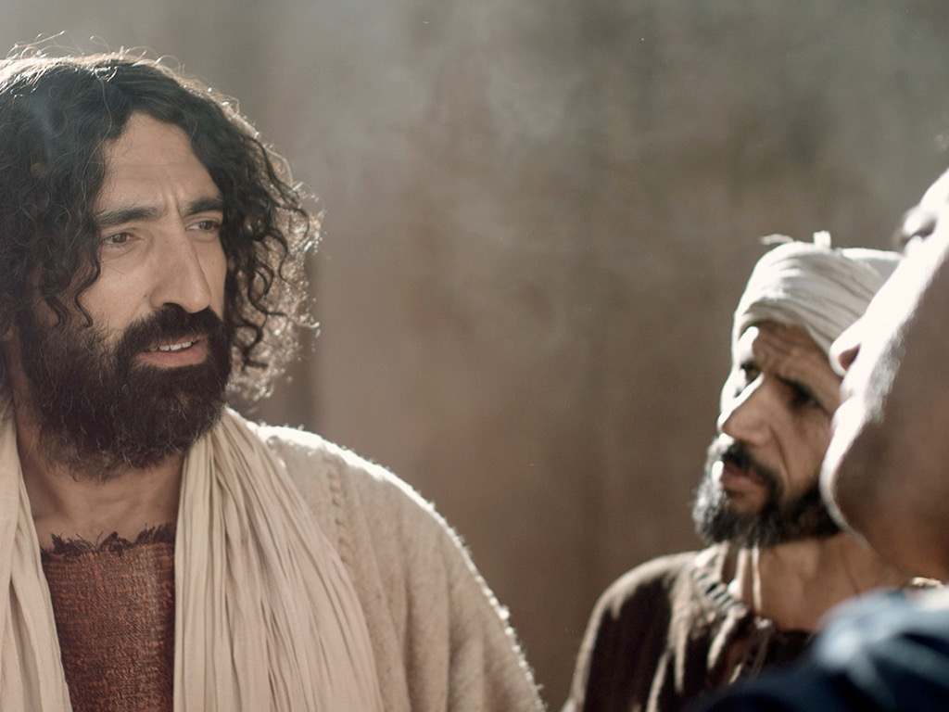
Matthew 15–28
Dr. Rick Griffith • Jordan Evangelical Theological Seminary • BibleStudyDownloads.org

Slide 2
Why serve Jesus?

Slide 3
Amazing Names
Lord
Jesus
Christ
Notes:
We need to understand what it means for our Jesus to be the Lord Jesus Christ.
Do you agree that the name of Jesus is the most dishonored in the world? Few people swear by the name of any other religious or political or other leader.
Even Christians don't often think much about the three main names of Jesus noted 60 times in the NT.

Slide 4
Amazing Names
Jesus is the highest ruler in the world (Matt 1–10).
Christ
Notes:
[Jesus met every prophecy we should expect for him to prove he is King.]
[Christ means Messiah-Ruler, for he fulfilled each part of his job description.]
—What more would Christ need to do for you to trust him with your life?
—Have you been the victim of Christ’s first mistake? How?
—Do you see how statistically unlikely it was for Jesus to be the Messiah?

Slide 5
Amazing Names
Jesus is the highest authority in the Church (Matt 11–27).
Lord
Christ
Notes:
[As Master, he is the boss of every believer’s life.]
As a Christian, do you recognize Christ’s authority over you?
—Why do you do what you do in terms of your life work?
—How did you make that decision?
—What area of your life right now should you submit to his authority?

Slide 6
Slides on
Matthew 15

Slide 7
Slides on
Matthew 16

Slide 8


¹³ When Jesus came to the region of Caesarea Philippi, he asked his disciples, “Who do people say the Son of Man is?”
¹⁴ They replied, “Some say John the Baptist; others say Elijah; and still others, Jeremiah or one of the prophets.”
¹⁵ “But what about you?” he asked. “Who do you say I am?”
¹⁶ Simon Peter answered, “You are the Messiah, the Son of the living God.”
Matthew 16:13-20 (NLT)

Slide 9
¹⁷ Jesus replied, “Blessed are you, Simon son of Jonah, for this was not revealed to you by flesh and blood, but by my Father in heaven.
¹⁸ And I tell you that you are Peter, and on this rock I will build my church, and the gates of Hades will not overcome it.
¹⁹ I will give you the keys of the kingdom of heaven; whatever you bind on earth will be bound in heaven, and whatever you loose on earth will be loosed in heaven.”
²⁰ Then he ordered his disciples not to tell anyone that he was the Messiah.
Matthew 16:13-20 (NLT)

Slide 10
16:13–20:34
Outline
73
IV. (11:1–16:12) Christ is rejected as Messiah in anticipation of the final crucifixion rejection, so He introduces the Interadvent Age before His future reception and ministers to Gentiles to teach the postponement of the kingdom.
V. (16:13–20:34) Christ prepares His disciples regarding His Person and program in order that His Messianic authority might be delegated to them after His death.

Slide 11
Slides on
Matthew 17

Slide 12
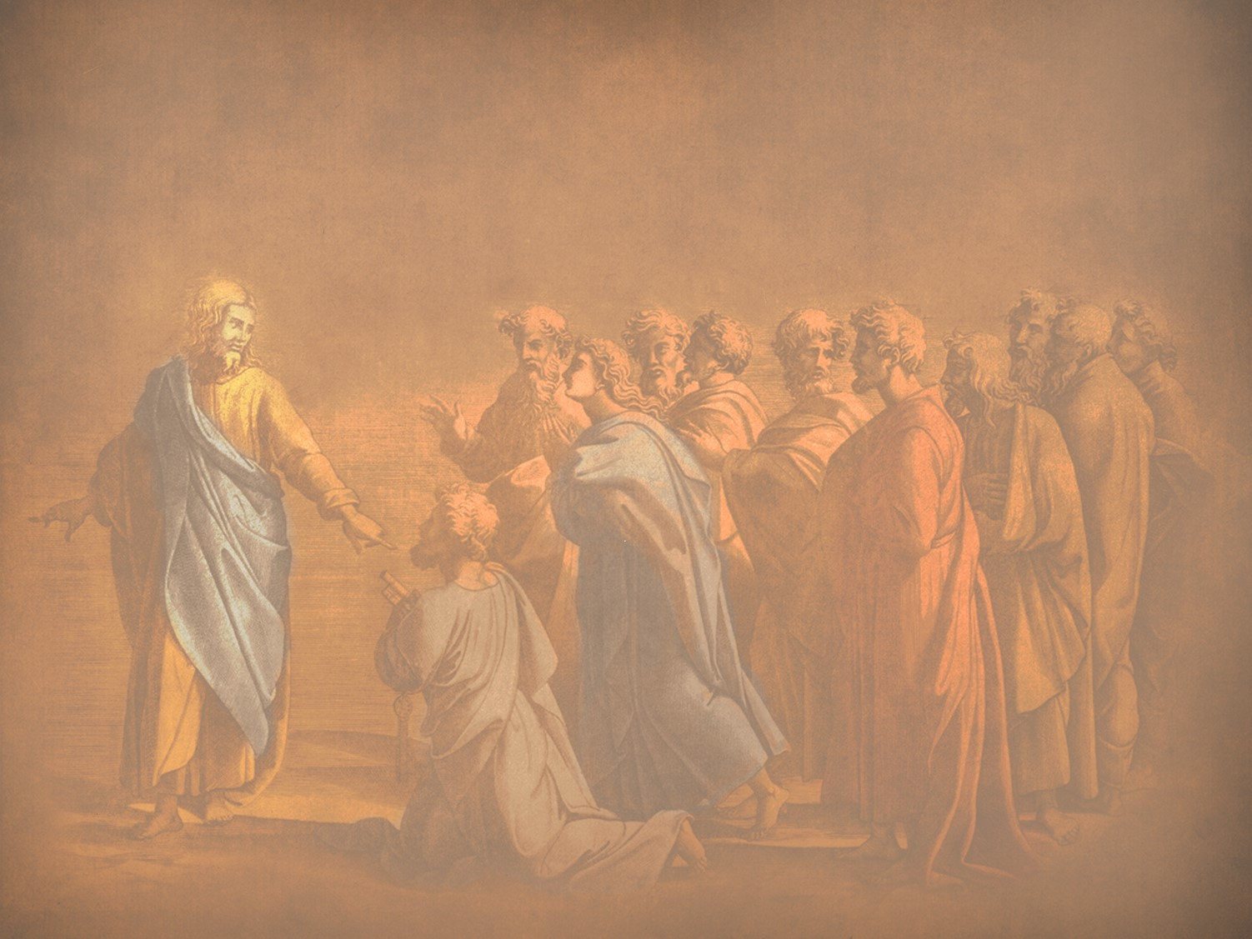
N. Revelation of the Kingdom
§ 87
Matthew 17:1-8; Mark 9:2-8; Luke 9:28-36
Three disciples see Christ’s glory as he promised a week earlier as a foretaste of his reign at the Second Advent and to authenticate Christ as One worthy of obedience
Notes:
The three Synoptic Gospels all record the Transfiguration of Jesus. Here is the only glimpse of the true nature of Christ that we find in the gospels as no one sees him in his full glory during his earthly life—and the Transfiguration was only for a few moments. God, in his mercy, did not let people view the glorified Christ lest they die in doing so! But this experience on the mountain (probably Mount Tabor) lifted the veil, as it were, so that at least Peter, James, and John could imagine the glory of Jesus when he reigns in the millennial kingdom.
_____________
LC-04-Instruction of the Twelve-106
NS-01-Matt15-18—slide 12
NS-02-Mark9-16—slide 3
NS-03-Luke1-12—slide 386

Slide 13
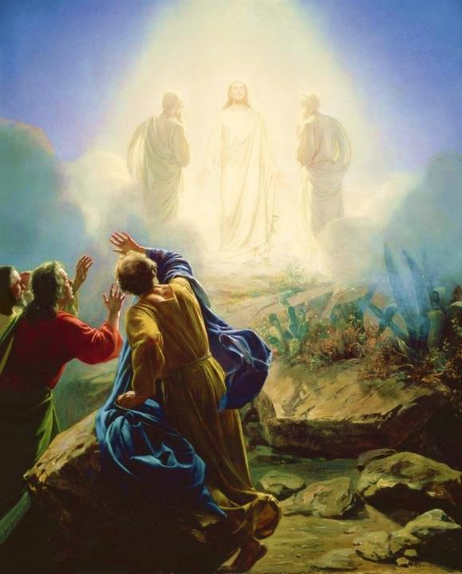
Carl Bloch, c. 1865
Transfiguration of Jesus
Mark 9:2-13 (ESV)
Notes:
Today’s scripture, found in Mark chapter 9, vs 2-13 is also about a transformation. This transformation is known as the Transfiguration of Jesus.
Transformation is an important theme in the Bible. The passage we read together earlier was from Paul’s letter to the Romans, ch 8 vs 19-30 was about transformation. As we saw in Romans 8:30, reading now from the ESV, Paul writes that “and those whom he predestined he also called, and those whom he called he also justified, and those whom he justified he also glorified.”
To go from sin and suffering to being called, justified, and glorified is an extreme transformation. So how do we get to that transformation? We look to Jesus. That is what we are going to do today. We will look at Jesus and his “transfiguration” or “transformation.”
We will see how it affected the disciples and how it should affect us.

Slide 14
Why only Peter, James, and John?
Mk 9:2-13 Transfiguration
Mk 14:33 Gethsemane
With Andrew
Mk 1:29-30 Peter’s Mother-in Law
Mk 13:3 Olivet Discourse

Slide 15
² And after six days Jesus took with him Peter and James and John, and led them up a high mountain by themselves.
Mark 9:2-13 (ESV)
Notes:
Now we pick in in Mark ch 9 vs 2

Slide 16

How do you recharge?
Mark 6:30-32
³⁰ The apostles returned to Jesus and told him all that they had done and taught. ³¹ And he said to them, “Come away by yourselves to a desolate place and rest a while.” For many were coming and going, and they had no leisure even to eat. ³² And they went away in the boat to a desolate place by themselves.

Slide 17
² And after six days Jesus took with him Peter and James and John and led them up a high mountain by themselves. And he was transfigured before them, ³ and his clothes became radiant, intensely white, as no one on earth could bleach them. ⁴ And there appeared to them Elijah with Moses, and they were talking with Jesus.
Mark 9:2-13 (ESV)
Notes:
Now we pick in in Mark ch 9 vs 2

Slide 18
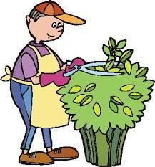
What did they see?
John 20:15 . . . Supposing him to be the gardener

Slide 19

Revelation 1
¹² Then I turned to see the voice that was speaking to me, and on turning
I saw seven golden lampstands,
¹³ and in the midst of the lampstands one like a son of man, clothed with a long robe and with a golden sash around
his chest. ¹⁴ The hairs of his head were white, like white wool, like snow. His eyes were like a flame of fire, ¹⁵ his feet were like burnished bronze, refined in a furnace, and his voice was like the roar of many waters
¹⁶ In his right hand he held seven stars, from his mouth came a sharp two-edged sword, and his face was like the sun shining in full strength.

Slide 20
² And after six days Jesus took with him Peter and James and John, and led them up a high mountain by themselves. And he was transfigured before them, ³ and his clothes became radiant, intensely white, as no one on earth could bleach them. ⁴ And there appeared to them Elijah with Moses, and they were talking with Jesus.
Mark 9:2-13 (ESV)
Notes:
Now we pick in in Mark ch 9 vs 2

Slide 21
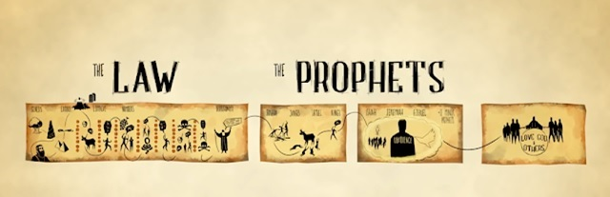
Jesus
Moses
Elijah

Slide 22
² And after six days Jesus took with him Peter and James and John, and led them up a high mountain by themselves. And he was transfigured before them, ³ and his clothes became radiant, intensely white, as no one on earth could bleach them. ⁴ And there appeared to them Elijah with Moses, and they were talking with Jesus. ⁵ And Peter said to Jesus, “Rabbi, it is good that we are here. Let us make three tents, one for you and one for Moses and one for Elijah.” ⁶ For he did not know what to say, for they were terrified.
Mark 9:2-13 (ESV)
Notes:
How do the disciples respond?

Slide 23
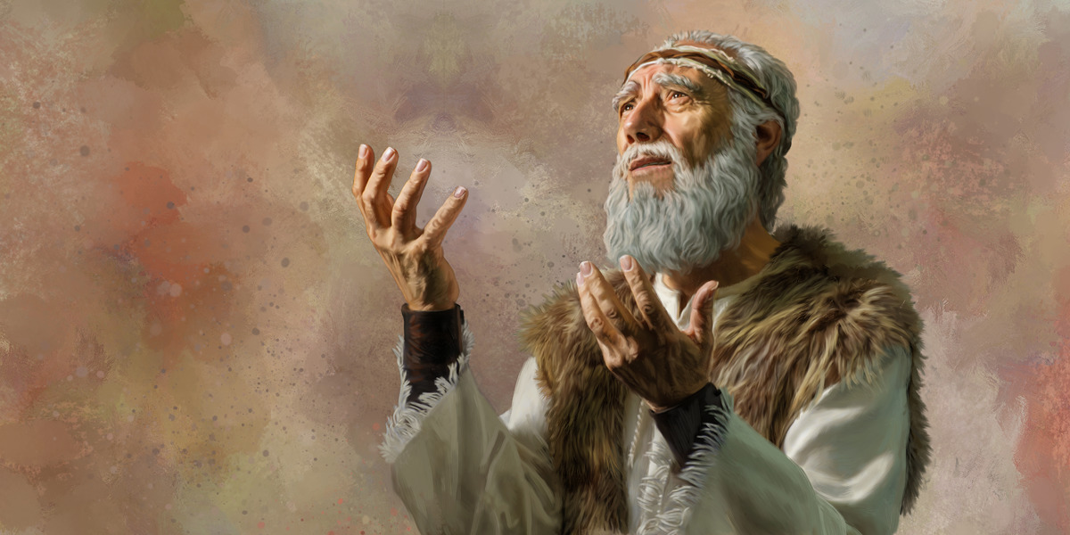
The Second Coming
"Look, I am sending you the prophet Elijah before the great and dreadful day of the LORD arrives. ⁶ His preaching will turn the hearts of fathers to their children, and the hearts of children to their fathers. Otherwise, I will come and strike the land with a curse" (Malachi 4:5-6 NLT).
Notes:
Here are the final two verse of the Old Testament that include both blessing and a curse.
__________
LC-04-Instruction of the Twelve-118
OS-39-Malachi-135
NS-01-Matt 15-28-slide 23

Slide 24
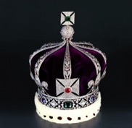
The Expectation: Elijah, Messiah, Kingdom
76
MESSIAH
"This Age"
"The Age to Come"
PROPHECY
KINGDOM
Mysteries of the Kingdom
Matthew 13
E
M
"K"
E
M
K
Rejection
Reception
1st Advent
2nd Advent
Judgment on Israel
Blessing to Gentiles
Judgment on Nations
Restoration of Israel
Adapted from Mark L. Bailey, DTS class notes, 1986
Notes:
The key element between the present age and the age to to come (the kingdom age) in Jewish theology was the coming of the Messiah. But he would be preceded by an Elijah figure. John the Baptist could have been that "Elijah" had Israel believed in Messiah, for the millennial kingdom would then have followed with a righteous nation. But since Israel rejected her king, another "Elijah" yet will come—probably one of the two witnesses of Rev 11. In the meantime, this Interadvent Age has the kingdom in but mystery form with spiritual benefits given to the Gentiles until the full number of Gentiles occurs (Rom 11:25-27). Then, instead of judgment on Israel and blessing on the Gentiles, it will reverse. The judgment will be upon the nations opposing Israel (Ezek 38–39) followed by blessing on Israel (Ezek 40–48).
__________
LC-04-Instruction of the Twelve-119
OS-39-Malachi-136
NS-01-Matt 15-28-slide 24

Slide 25
¹¹ And they asked him, “Why do the scribes say that first Elijah must come?” ¹² And he said to them, “Elijah does come first to restore all things. And how is it written of the Son of Man that he should suffer many things and be treated with contempt? ¹³ But I tell you that Elijah has come, and they did to him whatever they pleased, as it is written of him.”
Mark 9:2-13 (ESV)

Slide 26
A Good Question
Q: Why must Elijah come first?
A: The Scriptures say so
Mal 3:1 "Behold, I send my messenger, and he will prepare the way before me."
Mal 4:5 "Behold, I will send you Elijah the prophet before the great and awesome day of the Lord comes."

Slide 27
Having established the authority of Scripture
Q: Why must Messiah suffer?
A: The Scriptures say so
Ps 69:20-21 "Behold, I send my messenger, and he will prepare the way before me."
Isa 53 "But he was pierced for our transgressions;
he was crushed for our iniquities;
upon him was the chastisement that brought us peace,
and with his wounds we are healed."

Slide 28
¹¹ And they asked him, “Why do the scribes say that first Elijah must come?” ¹² And he said to them, “Elijah does come first to restore all things. And how is it written of the Son of Man that he should suffer many things and be treated with contempt? ¹³ But I tell you that Elijah has come, and they did to him whatever they pleased, as it is written of him.”
Mark 9:2-13 (ESV)

Slide 29

By what authority can Jesus proclaim John the Baptist fulfills prophecies about Elijah?

Slide 30
# | Title | Mt | Mk | Lk | Jn
1 | Jesus Heals Many | Mt 4:23–24 | Mk 1:32–34
2 | Jesus Casts Out Demons | Mt 4:24 | Mk 1:39 | Lk 7:18–23
3 | Jesus Cleanses a Leper | Mt 8:1–4 | Mk 1:40–45 | Lk 5:12–16
4 | Jesus Heals a Centurion’s Servant | Mt 8:5–13 |  | Lk 7:1–10
-----------------------------------------
59 | Jesus Appears in a Locked Room |  |  |  | Jn 20:19–23
60 | Jesus Appears in a Locked Room for Thomas |  |  |  | Jn 20:26–29
61 | Jesus Provides a Miraculous Catch of Fish (John) |  |  |  | Jn 21:4–6
61 Miracles

Slide 31
Terrified in the presence of the Lord
Listen to the Lord
The Disciples Listened to the Lord
Disciples' questions answered by the Lord

Slide 32
Be Transformed!
Not Terrified

Slide 33
Slides on
Matthew 18

Slide 34
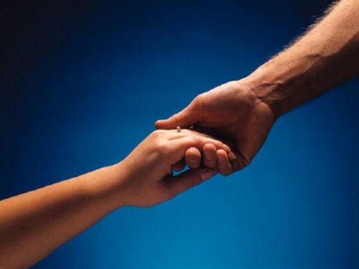

How to Restore Relationships
Matthew 18:15-20
Dr. Rick Griffith
Singapore Bible College
BibleStudyDownloads.org
10 December 2006
6 March 2011

Slide 35

I. (15-17) The manner in which the church should correctly restore a sinning Christian is by keeping the matter as private as possible.
34c
  (15) A private sin should be dealt with only between those directly involved so as to make restoration of the offender easier.
  (16) Unrepentant sin after a private confrontation should be exposed only to one or two more persons in order to facilitate restoring the sinner.
  (17a) Unrepentant sin after a small group attempt at restoration should be brought before the entire church body as a deterrent to continued sin.
  (17b) Unrepentant sin after exposure to the church should result in requiring each church member to relate to the sinner as an unbeliever (this includes removal from membership).
Notes:
PR 09.33
BS 20.33; 25.09
NS Mt 15.8

Slide 36
II. (18-20) The reason the church can restore or continue to seek to restore errant believers is because it extends the authority of God Himself.
34c
  (18-19) Churches that prayerfully restore or continue to seek to restore sinful believers act in the place of the Father.
    (18) The church must announce guilt or innocence based upon what God has already determined.
    (19) Church leaders who prayerfully make a judgment can have confidence that they have acted according to God's will.
  (20) Churches that restore or continue to seek to restore sinful believers act in the presence of Jesus.
Notes:
PR 09.34
BS 20.34; 25.10
NS Mt 15.9

Slide 37

Exegetical Idea: The reason the church should restore a sinning Christian correctly is because it extends God's authority.
34c
  (15-17) The manner in which the church should correctly restore a sinning Christian is by keeping the matter as private as possible.
  (18-20) The reason the church can restore or continue to seek to restore errant believers is because it extends the authority of God Himself.
Matthew 18:15-20
Notes:
PR 07.15. 09.35; 11.25; 12.16; 16:11 HO subject only
BS 18.43; 20.31; 25.11
NS Mt 15.10

Slide 38
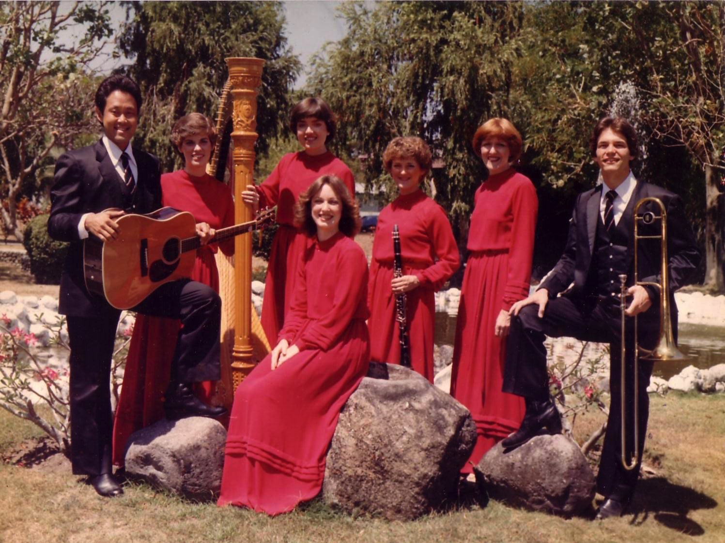
The Crossroads (1981-83)
Notes:
Some 35 years ago I sang on a music team of seven musicians called Crossroads. If you can't tell, I am the guy who is not Japanese.

Slide 39
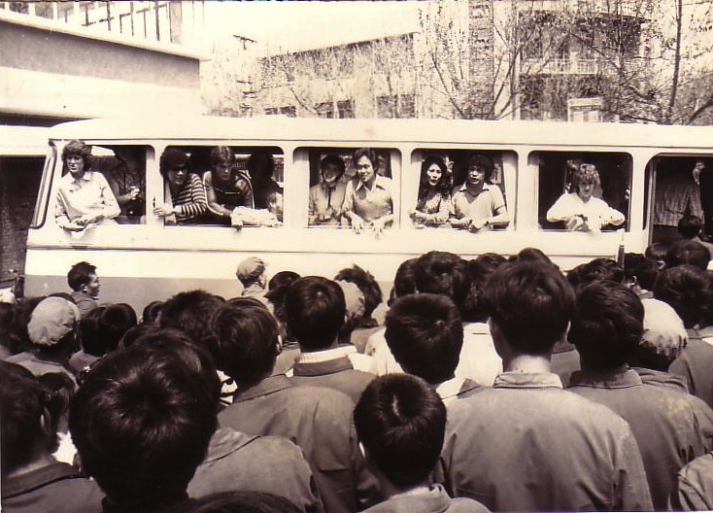
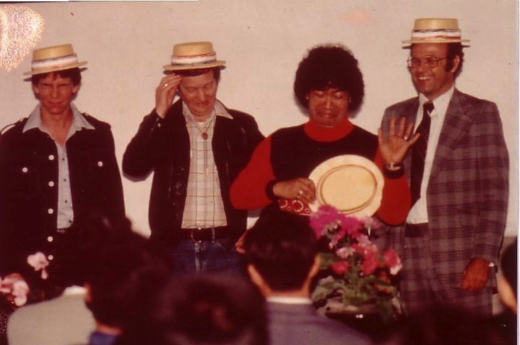
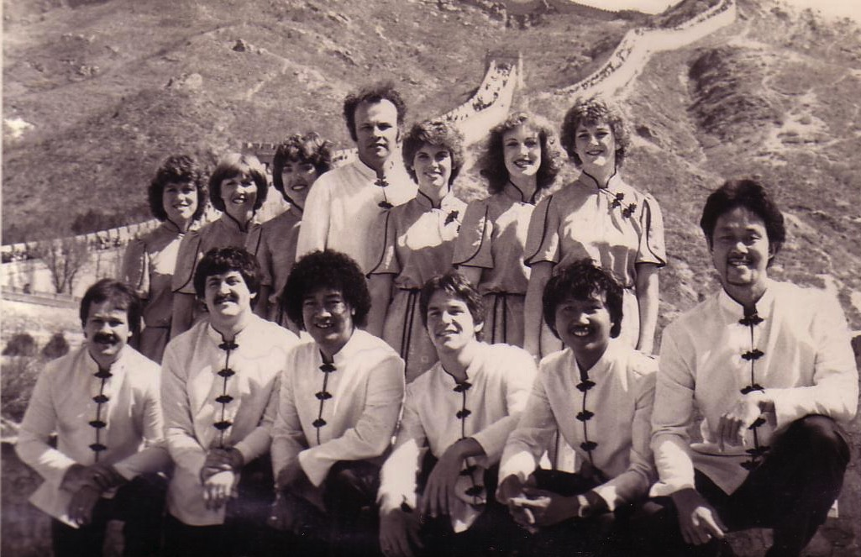
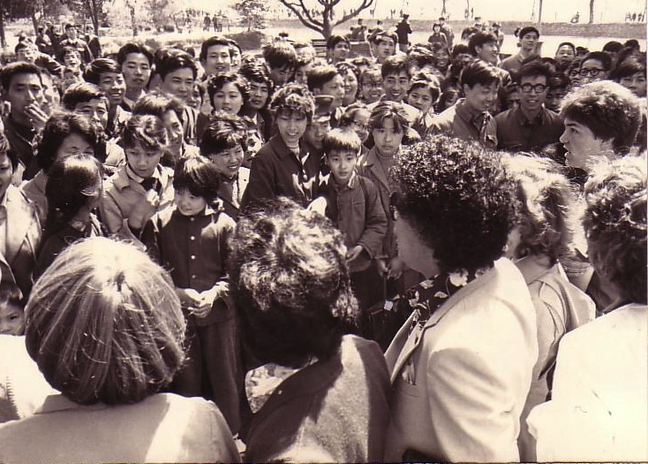
China, 1981
Notes:
We shared the gospel in China and—praise God—we reached over 600 people per concert!

Slide 40
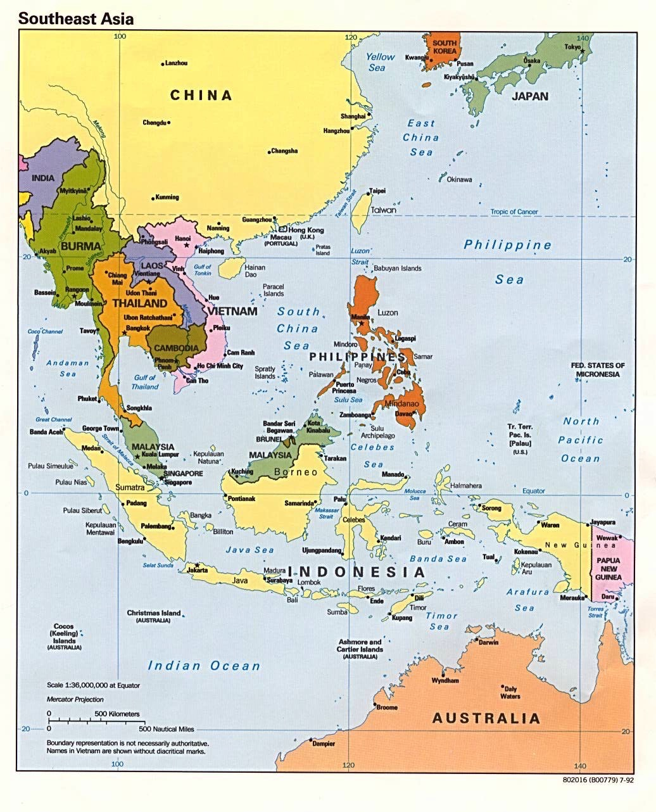
Crossroads Ministry
Korea
China
Japan
Hong Kong
Taiwan
Macau
Thailand
Philippines
Malaysia
Singapore
Indonesia
Notes:
The Crossroads team shared the gospel in 11 Asian nations and saw over 10,000 people trust Christ as indicated in comment cards at our 269 concerts.

Slide 41
This is war.
Notes:
If you know anything about spiritual warfare, it is that the enemy of our souls concentrates his efforts on believers who are having an impact for Christ.
In our team, the opposition came from within—relationships that were a challenge. On that team was one particular woman named Kay. She was a godly woman but we didn't see eye-to-eye at all. In fact, many times she felt that I just a "mister-know-it-all.” She didn't like my mannerisms, my clothes, or my insights in our group Bible studies. She avoided being around me and it seemed that I could do nothing right! She saw me as really arrogant.
So what do you do when you are forced into a working relationship with someone who just plain does not like you? I found that I couldn't really avoid Kay. After all, every day we had four hours of music practice with the team. I had to sing in harmony with her—literally! But discord often reigned. Then we had a concert to give and had to work together.

Slide 42

Relational Pillars
Relational Pillars
for believers
Notes:
God ministered to me then through two texts in Matthew that became "relational pillars" that I want to share with you today. These texts literally changed my life.

Slide 43

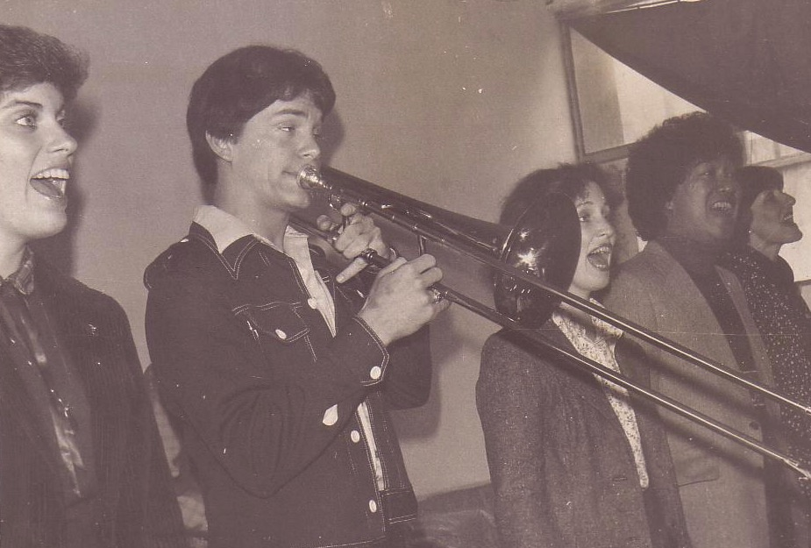
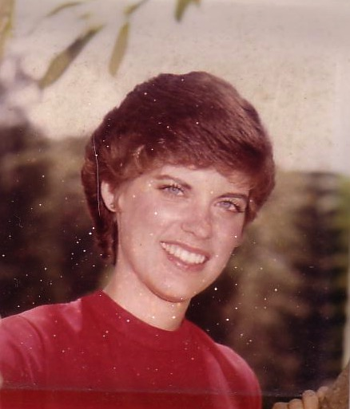
Romance, 1982
Notes:
They enabled Kay and me to reconcile our differences—so much so that three years after our initial differences Kay actually said "yes" to marrying me!

Slide 44
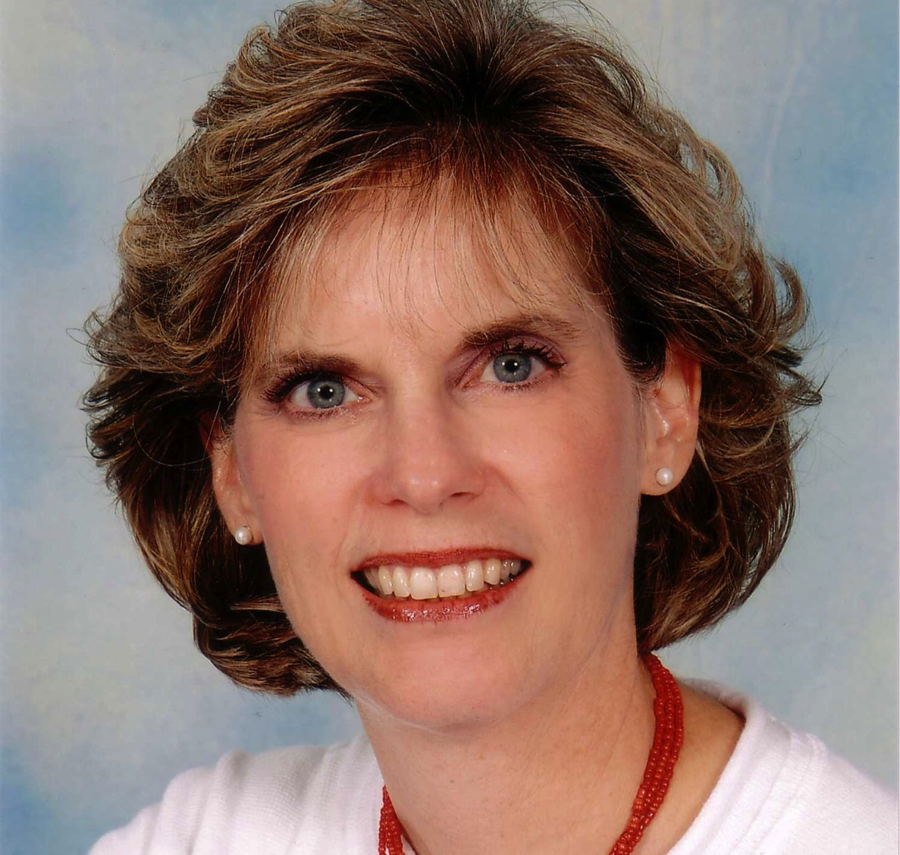
Susan Kay Griffith
Notes:
Yes, Kay is her middle name. Her full name is now Susan Kay Griffith.

Slide 45

Matthew's Relational Pillars
Matthew's Relational Pillars
5:23-24
You are:
Offender
Issue:
General
Notes:
Have you ever had a problem with another believer? (If you say "no," then I wonder which planet you have been living on!) Are you in fellowship with every Christian that you know now—your family members, your work colleagues, your neighbors and friends? If you're not in harmony, what should you do?
• If you hurt the other person, Matthew 5 tells you what to do in any general issue dividing you.

Slide 46


Matthew 5:23-24
Notes:
Let's read it.
God places the responsibility to reconcile on you if you are the offender.

Slide 47
Matthew 5:23-24
?
"Therefore if you are presenting your offering at the altar, and there remember that your brother has something against you, leave your offering there before the altar and go; first be reconciled to your brother, and then come and present your offering."
Notes:
The last I checked, believers weren't offering up sacrifices at the altar. So what does the "altar" refer to today?

Slide 48
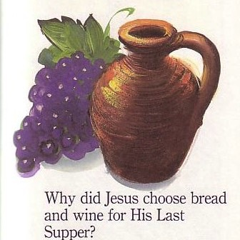
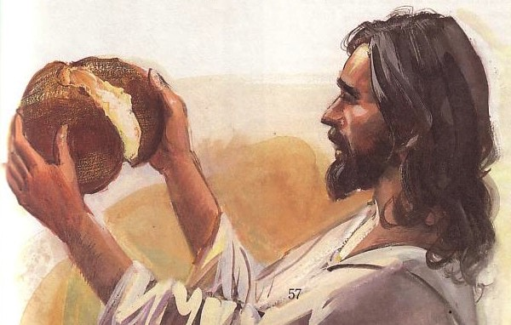
The Lord's Supper
Notes:
At the very least, it refers to the Lord's table—a sign of our fellowship & unity—so don't take the Supper when in conflict with another believer.

Slide 49
Matthew's Relational Pillars
Matthew's Relational Pillars
5:23-24
18:15-17
You are:
Offender
Offended
Issue:
General
Sin
Notes:
However, in some situations, you are the offended. The other person is guilty of sin. Every church eventually encounters problems with believers living in sin. In these cases a loving body will restore them to God's holiness.

Slide 50



How do we restore sinning Christians properly?
Our First Question Today (for vv. 15-17)
Notes:
So how do we restore sinning Christians properly? When someone goes astray from God's will, what process do we use to bring that person back?

Slide 51



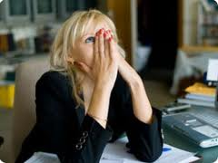
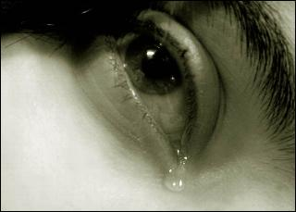
Other Relationships
Notes:
This doesn't just refer to marriage, nor to serious sins—it's any kind of sin that can hurt any relationship among believers.

Slide 52
Black
Notes:
Why I am talking about resolving relational problems now?
I just know that issues surface in every relationship, including ours. At some point, I am going to offend you and you will offend me. So what should we do?

Slide 53
Matthew 18
The Value of
One
1
1
Child (1-9)
1
Sheep
(10-14)
1
Sinner
(15-20)
1
Debtor
(21-35)
Notes:
So our key text today is Matthew 18. The context of Matthew 18 is the value of one—
• one child (1-9), one sheep (10-14), one sinner (15-20), one debtor (21-35).
• At the heart of this chapter is verses 15-20…

Slide 54
Matthew 18:15-20 (NIV 1984 ed.)
If your brother sins against you, go and show him his fault, just between the two of you. If he listens to you, you have won your brother over. ¹⁶But if he will not listen, take one or two others along, so that 'every matter may be established by the testimony of two or three witnesses.' ¹⁷If he refuses to listen to them, tell it to the church; and if he refuses to listen even to the church, treat him as you would a pagan or a tax collector.
¹⁸I tell you the truth, whatever you bind on earth will be bound in heaven, and whatever you loose on earth will be loosed in heaven. ¹⁹Again, I tell you that if two of you on earth agree about anything you ask for, it will be done for you by my Father in heaven. ²⁰For where two or three come together in my name, there am I with them.
How to Restore
15-17
Why to Restore
18-20
Notes:
In Matthew 18:15-20 Jesus provides God's plan for loving church discipline. Let's read it together [read 15-20.] This text has two main teachings on restoring Christians in sin.
• Verses 15-17 give how to restore them and…
• Verses 18-20 give why to restore them.
Let's first see how to restore relationships. God's way to restore believers in sin is to…
__________________
BS-18-Exegetical Idea1-slide 15
BS-19-Exegetical Idea2-slide 32
BS-26-Applications-10 focuses only on verses 15-17
NS-01-Matt15-28-slide 33
PR-08-Exegetical Idea1-slide15
PR-09-Exegetical Idea2-slide 32
PR-16-Applications-12 focuses only on verses 15-17

Slide 55

The Point of Verses 15-17
I. Keep the matter as private as possible
(15-17).
Notes:
God's strategy to bring sinning Christians back is to involve as few people as you can.

Slide 56
Our Goal:
Our Goal:
Restoration!
Notes:
The desired end is restoration, not punishment or excommunication.
The goal of discipline is behavior change to bring the wayward one back. Unfortunately, too many churches "excommunicate" to punish rather than restore).
Restoration is God's goal for a wandering saint in the sheep image of verses 10-14.
Restoration is the explicit teaching of this text in verse 15b.
Restoration is the goal of church discipline in other passages like Galatians 6:1.

Slide 57

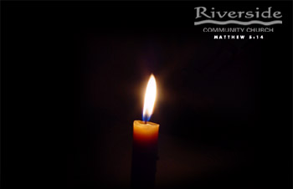
Restore People in Sin
Restore People in Sin
"Brothers, if someone is caught in a sin, you who are spiritual should restore him gently."
Galatians 6:1

Slide 58
God's 4-step restoring process…
4
3
2
1
…reveals the issue to more people each step
Notes:
God's restoring process has four steps that progressively tell more and more people about the sin (15-17).

Slide 59
Step 1 to Restoration
Talk to the person by yourself
M
M
M
M
M
M
M
M
M
M
M
M
M
M
M
M
S
M
M
M
M
M
M
M
M
M
M
M
S = Sinner
M = Member
Notes:
What's our human tendency here?
• It is to tell others about the problem instead of the one involved.
• God commands us to keep the issue as private as possible.

Slide 60
Matthew's Relational Pillars
Matthew's Relational Pillars
5:23-24
18:15-17
You are:
Offender
Offended
Issue:
General
Sin
Notes:
This differs from Matthew 5 in that you're not an offender, but the offended.
Note also that in Matthew 5 sin may not be in the picture, but Matthew 18 deals specifically with a believer living in sin. This does not refer simply to differences of opinion on debatable matters.

Slide 61
Matthew's Relational Pillars
Matthew's Relational Pillars
5:23-24
18:15-17
You are:
Offender
Offended
Issue:
General
Sin
Initiative:
You!
You!
Notes:
Earlier we saw from Matthew 5:23-24 that God places the responsibility to reconcile on you if you are the offender. Now whose job is it to initiate if you are the offended?
• Yes, again it is your responsibility again! You say, "That's not fair! Why is it my job in both situations? Whether I am the offender or the offended I still have to make the first move?" Well, if relationships are not resolved between believers, it has to be through the fault of both—as both have the command of God to resolve it!

Slide 62
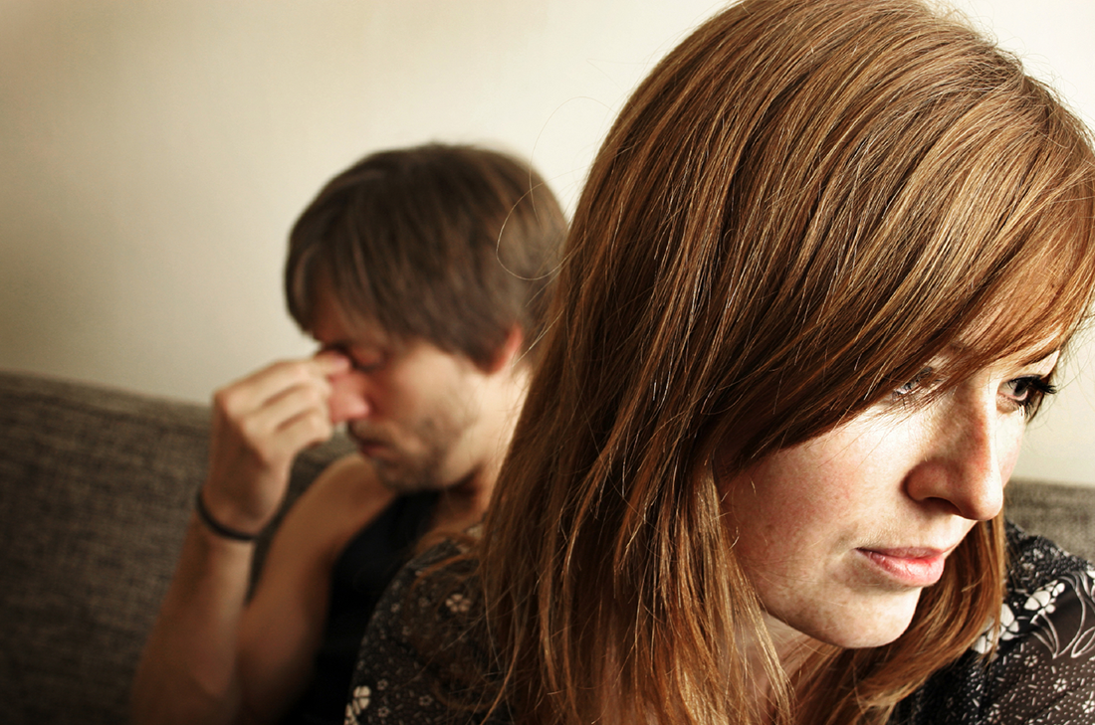
Go in Person
Not:
• email
• SMS
• letter
• phone
Notes:
While letter writing was very popular in the time of Christ, our Lord specifically says to deal with these sensitive matters face-to-face. Today this means confrontation should never be handled via email, SMS, letter, or phone calls. It also prohibits the cowardice of anonymous communication.

Slide 63
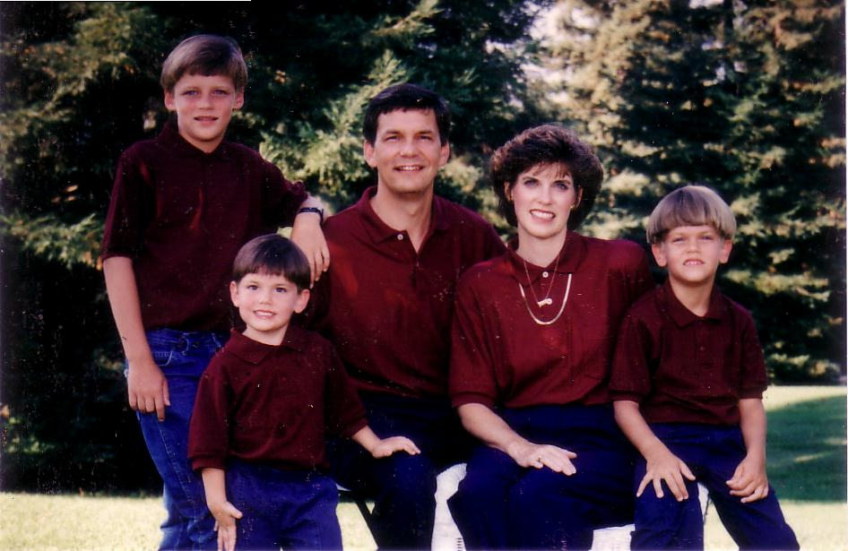
1996
Notes:
Our family has tried to do this since our three sons were young—not to let them do the "Mom! Dad! So-and-so did such-and-such to me!" We just told him, "Matthew 18, bud. If you can't solve it, we'll be step 2…" They rarely came back to us!

Slide 64
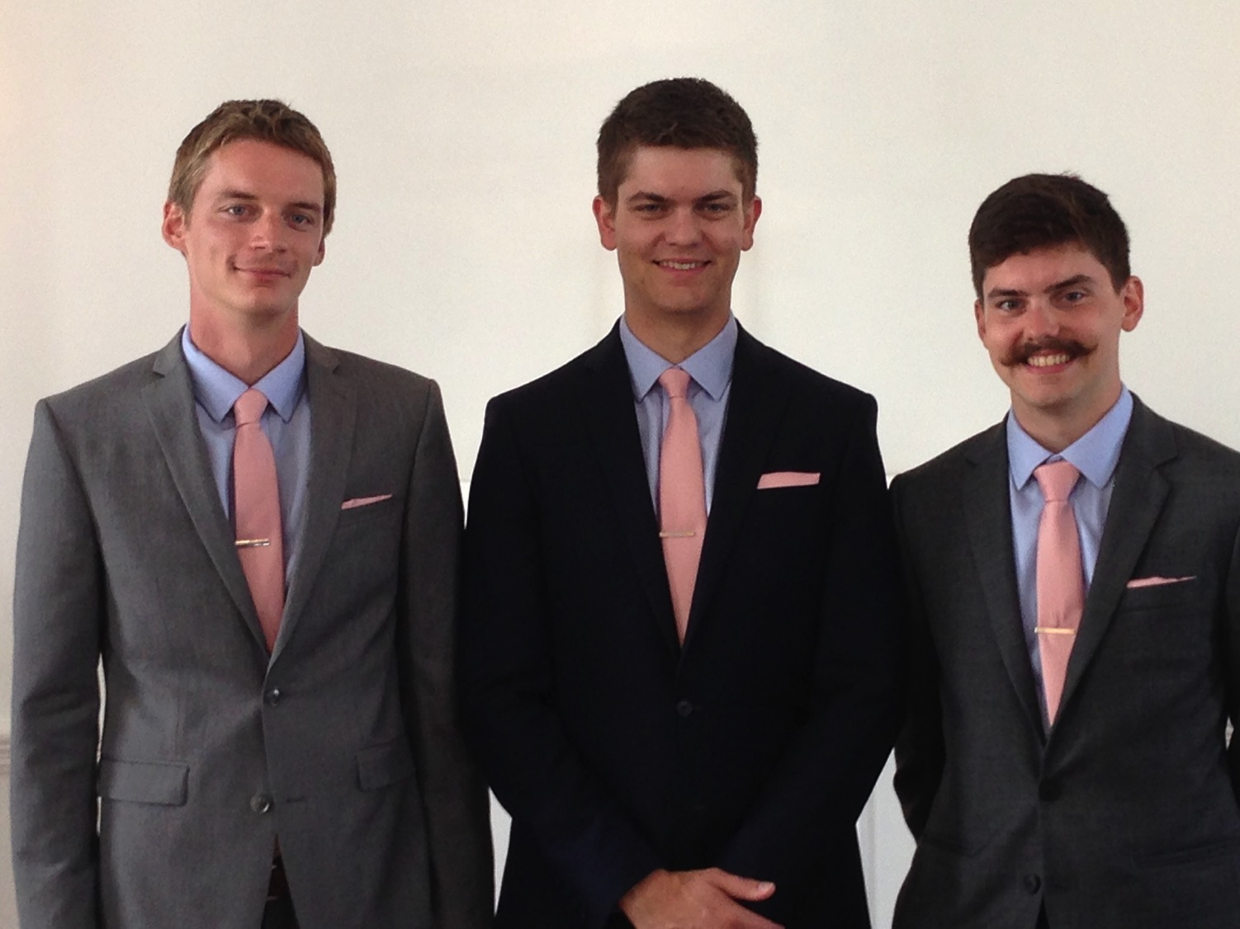
Brothers…
Notes:
Now that they are older, they solve the problems among themselves without our intervention. Some friends were amazed that Kurt and Stephen moved to the US for college and decided to stay as roommates—for 7 years until they married!

Slide 65

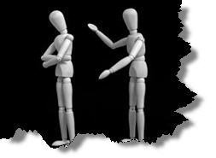
Why don't we confront others?
Ignorance
Doubt
Failure
Fear
Excuses
Impurity
Unsocial
Notes:
However, most of the time believers don't keep issues private—or we don't address them at all. Why do you think don't we confront others? Tell the person next to you why! (Small groups for 1 min.) Why not?
• ignorance of what God commands here?
• doubt that it will work?
• failure of past confrontations that didn't work?
• fear that we might look bad?
• excuses that we can't get together?
• impurity in our own life?
• unsocial in that we just don't care enough to risk it?

Slide 66
Step 1 to Restoration
Talk to the person by yourself
M
M
M
M
M
M
M
M
M
M
M
M
M
M
M
M
S
M
M
M
M
M
M
M
M
M
M
M
S = Sinner
M = Member
Notes:
So… you should talk to the person by yourself—even though our tendency is to tell others instead. But what if the offender does not repent? We need step 2 where we…

Slide 67
Step 2 to Restoration
Take 1-2 others along
M
M
M
M
M
M
M
M
M
M
M
M
M
M
M
M
S
M
M
M
M
M
M
M
M
M
M
M
S = Sinner
M = Member
Notes:
Take one or two others along (16).

Slide 68

Questions on Step 2
Who should these people be?
Why take 1-2 others?
Notes:
Who should these 1-2 others be? These persons should be individuals whom the offender respects as they will best help restore him/her. They should not go instead of the offended believer, but along with this person.
• Why take 1-2 others along?

Slide 69
Deut. 19:15
"One witness is not enough to convict a man accused of any crime or offense he may have committed. A matter must be established by the testimony of two or three witnesses."
Notes:
The OT law prohibited conviction of crimes based on only one person's testimony (read Deut. 19:15). The NT teaching is the same, protecting the offender from an easily offended or lying accuser.
What if the offender still does not repent? Go to step 3…

Slide 70
Step 3 to Restoration
Expose the sin to the entire church
M
M
M
M
M
M
M
M
M
M
M
M
M
M
M
M
S
M
M
M
M
M
M
M
M
M
M
M
S = Sinner
M = Member
Notes:
The church leadership certainly must be involved at this point before the matter is brought to the congregation. They also must see the issue isn't just a difference of opinion between two parties; the biblical basis for the offender living in sin must be clearly shown with specific passages.

Slide 71
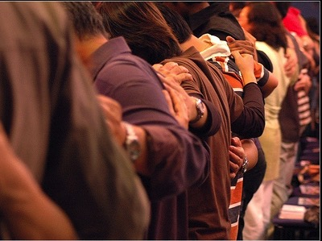
Why tell the whole church?
Notes:
Bringing the matter to the entire church is vital, since without it the sinning person will be able to find fellowship in other smaller groups within the larger church who do not know of his/her sin. Such gossip situations inevitably bring disunity, which lead to factions that can split the body.
What, then, should the entire church do once discipline has been determined? Step 4…

Slide 72
Step 4 to Restoration
Treat the person as an unbeliever
M
M
M
M
M
M
M
M
M
M
M
M
M
M
M
M
S
M
M
M
M
M
M
M
M
M
M
M
S = Sinner
M = Member
S

Slide 73

Sins Worthy of Discipline
How NOT to Discipline
EXCOMMUNICATE !
Notes:
Sometimes this step has been misinterpreted to mean "excommunication" where the errant person is never contacted again.

Slide 74

Sins Worthy of Discipline
How to Discipline Him/Her
Don't refer to him/her as a Christian.
Evangelize this person.
Don't let him/her take the Lord's Supper.
Remove the person from membership.
Remove this person from church roles.
Unbeliever
"Deliver over to Satan" one in sex sin
(1 Cor. 5:5).
Don't eat with him/her (1 Cor. 5:11).
Prohibit him/her from attending church?
Worse
Notes:
But Jesus said to "treat him as you would a pagan or a tax collector." Jesus treated pagans with love and kindness, but he didn't ask them to evangelize the lost as part of his team. You shouldn't be ugly or ungodly, but…
• Don't refer to him/her as a Christian. (ILL: I have done this with my former brother-in-law who divorced my sister to marry another woman.)
• Evangelize this person.
• Don't let him/her take the Lord's Supper.
• Remove the person from membership.
• Remove this person from church roles (ILL: My friend Paula was asked to leave her church kitchen ministry once her adultery was discovered.)
But in other ways it is more serious than how we treat unbelievers:
• "Deliver over to Satan" one in sex sin (1 Cor. 5:5). Years ago a friend named John left his wife and two small boys for another woman. My church disciplined him, but an elder kept up with him to restore him. After five years, he showed up at church—but he looked 20 years older!
• Don't eat with him/her (1 Cor. 5:11).
• Should we prohibit the person from attending church? Some say they, like unbelievers, should be welcomed in services without taking the Lord's Supper; but in most discipline cases this is not even an issue as few disciplined believers seek to return to the assembly until repentant.

Slide 75
The Point of Verses 15-17
I. Keep the matter as private as possible
(15-17).
Notes:
God's strategy to bring sinning Christians back is to involve as few people as you can.

Slide 76
God's 4-step restoring process…
4
3
2
1
…reveals the issue to more people each step
Notes:
This is the intent in each of the four steps with the goal of restoration.

Slide 77

Our 2nd question is answered in verses 18-20:
Why do we restore sinning Christians properly?
Notes:
But why must we do all this? What right do we have to discipline our members? Why must we restore sinning Christians properly? Because…

Slide 78

The Point of Verses 18-20
II. Our church extends the authority of God Himself!
Notes:
God's right to judge is actually delegated to us!

Slide 79
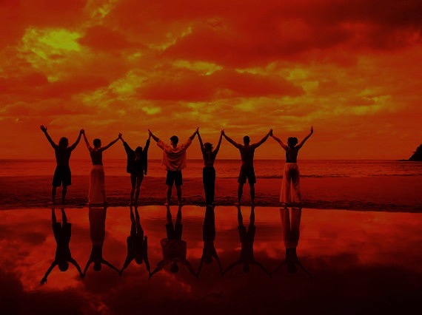
Why discipline?
When we seek to restore someone…
We act in the place
of the Father
(18-19)
Notes:
We act in the place of the Father when we seek to restore someone (18-19).

Slide 80
A Better Translation…
NAU is a Better Translation…
NIV "I tell you the truth, whatever you bind on earth
will be {or have been} bound in heaven, and whatever you loose on earth will be {or have been} loosed in heaven."
NAU "Truly I say to you, whatever you bind on earth shall have been bound in heaven; and whatever you loose on earth shall have been loosed in heaven."
Notes:
Too often today's churches act as if they have no authority under God, and yet "binding" here refers to disciplining (a guilty verdict) while "loosing" refers to releasing from discipline (an innocent verdict).

Slide 81

Matthew 18:19
"Again, I tell you that if two of you on earth agree about anything you ask for, it will be done for you by my Father in heaven"
(NIV).
Notes:
We should trust that our prayerful judgments are God's will.

Slide 82
Psalm 82:1, 6
(to Israel's rulers/gods)
"I said, 'You are "gods"; you are all sons of the Most High…
but you will die like men…"
Notes:
Ps. 82:6 has a similar idea where Israel's rulers are called "gods" in that they rule others.
Why should we trust this process in discipline situations? Verse 20 says that…

Slide 83
Why discipline?
When we seek to restore someone…
We act in the place
of the Father
(18-19)
We act in the presence & authority of Christ
(20)
Notes:
When we seek to restore someone, we act in the presence and authority of Christ (20).

Slide 84
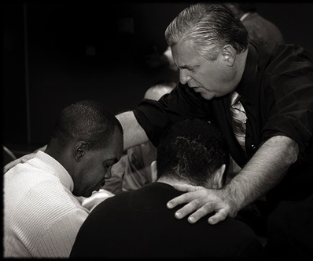
Matthew 18:20
"For where
two or three come together in my name, there I am with them" (NIV).
Notes:
The "two or three" refers to the witnesses whose testimony enacted discipline (v. 16).
The point of Christ being "in their midst" is that local church discipline acts with the presence and authority of Christ Himself.

Slide 85
Why do we restore sinning Christians properly?
Notes:
So how can we sum up this passage in one sentence? I'd say it this way…

Slide 86

Main Idea:
We must restore sinning members properly since we act on God's behalf
Notes:
When sheep stray, we shepherd them back as loving hands of God's grace.

Slide 87
Matthew's Relational Pillars
Matthew's Relational Pillars
5:23-24
18:15-17
You are:
Offender
Offended
Issue:
General
Sin
Initiative:
You!
You!
Notes:
God expects each of us to take the initiative—

Slide 88
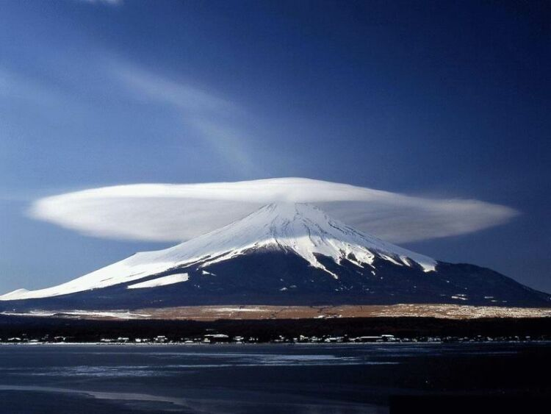
The Overall Principle
"If possible, as far as it depends on you, be at peace with all men"
Romans 12:18
Notes:
—and to do so as far as possible, as Romans 12:18 says [read]. This verse is a great encouragement to do all we can even if others are not responsive.

Slide 89
Matthew's Relational Pillars
Matthew's Relational Pillars
5:23-24
18:15-17
The Overall Principle: Romans 12:18
You are:
Offender
Offended
Issue:
General
Sin
Initiative:
You!
You!
Notes:
This verse is a great overall principle in relationships.

Slide 90
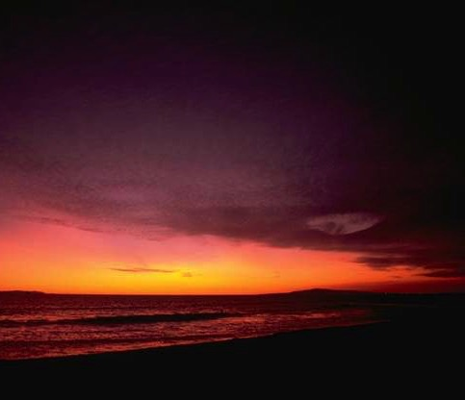
Make us one 3/3
Make us one, Lord,
make us one,
Holy Spirit, make us one.
Let Your love flow
so the world will know
we are one in You.
Notes:
God desires us to truly live out the chorus "Make Us One, Lord"

Slide 91
What's God Saying to You?
a. The Church Body
M
M
M
M
M
M
M
M
M
M
M
M
b. Your Own Life
M
M
M
M
S
M
M
M
M
M
M
M
M
c. Helping Others
M
M
M
Notes:
Matthew 18 relates to us in at least three ways:
• To be in this assembly you must submit to its authority under God. This means that we will lovingly seek to restore you should you fall.
• Is there sin in you worthy of discipline? Clean it up now to avoid pain for us all!
• Do you know anyone who needs a private confrontation? Romans 12:18 encourages you to do everything possible to be at peace with all people, so do it!

Slide 92
Slides on
Matthew 19

Slide 93


Free
Bible
images
A RICH YOUNG MAN QUESTIONS JESUS
Matthew 19:16-30; Mark 10:17-31; Luke 18:18-30

Slide 94


Slide 95


Slide 96


Slide 97


Slide 98


Slide 100


Slide 102
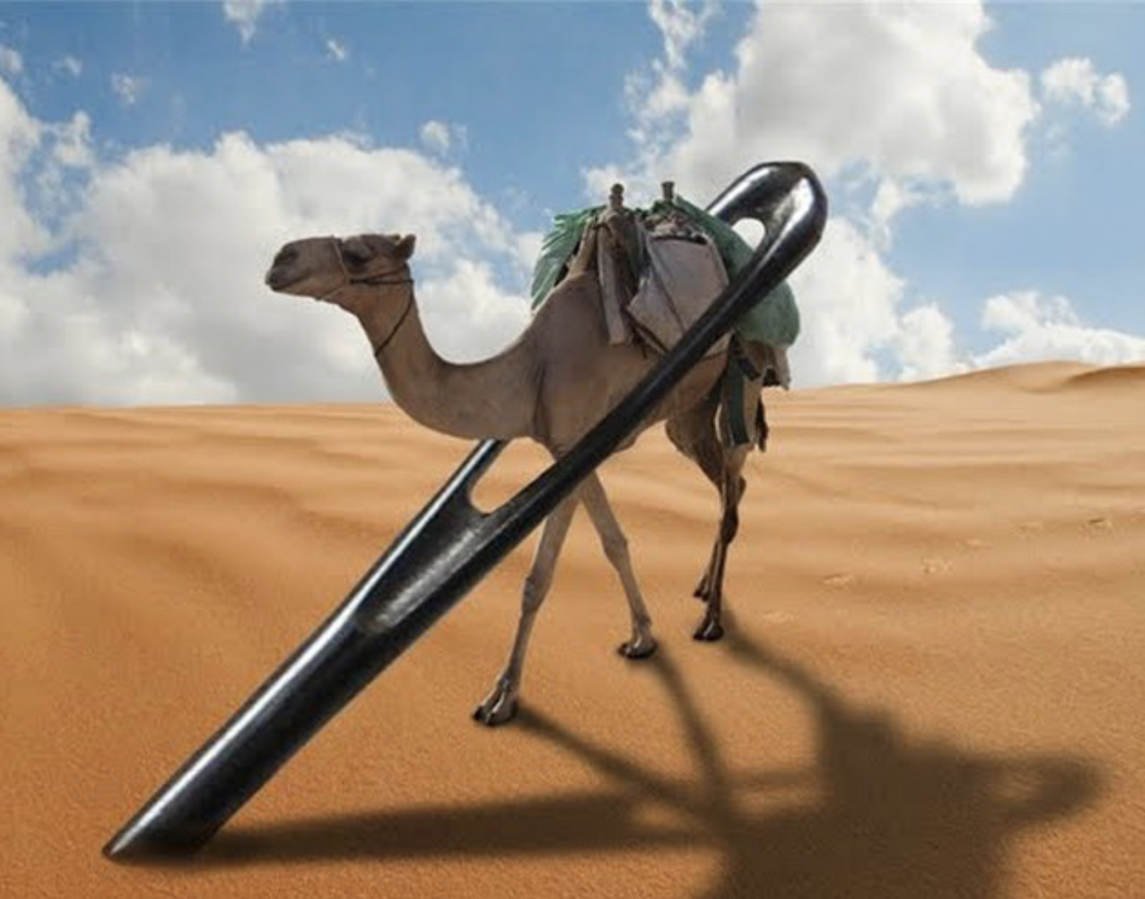
Camel through a needle (Matt 19:24)

Slide 103


Slide 104


Slide 105

Used with Permission
THE
GOSPEL
——OF—— MATTHEW
THE
GOSPEL
——OF—— MARK
THE
GOSPEL
——OF—— LUKE
THE
GOSPEL
——OF—— JOHN
Due to the Lumo Project producing its own publishing material we regret to inform you that we cannot license our photos to other clients outside of freebibleimages.org.
These images are not licensed for reuse in video, epublishing or other media. Downloaded pictures and files cannot be redistributed through any other website than freebibleimages.org or used in any context where the accompanying message is undermining of the Christian faith and gospel.
Photos can only be used on educational presentations, blogs and social media, all of which should be accompanied with reference to www.LumoProject.com.
Picture courtesy of BBM
© All Rights Reserved.
www.bigbookmedia.com

Slide 106

A Literal, Political Kingdom
"Jesus replied,
'I assure you that when the world is made new and the Son of Man sits upon his glorious throne, you who have been my followers will also sit on twelve thrones, judging the twelve tribes of Israel'"
(Matt. 19:28 NLT)
Notes:
It will be ruled by Messiah where Israel will have prominence over the entire world that will follow the Lord.
________
NS-01-Matt1-14-slide 113
NS-01-Matt15-28-slide 85
NS-05-Acts1-2-slide 191

Slide 107
Slides on
Matthew 20

Slide 108
Slides on
Matthew 21

Slide 109
Chs. 21–27
Outline
73
IV. (11:1–16:12) Christ is rejected as Messiah in anticipation of the final crucifixion rejection, so He introduces the Interadvent Age before His future reception and ministers to Gentiles to teach the postponement of the kingdom.
V. (16:13–20:34) Christ prepares His disciples regarding His Person and program in order that His Messianic authority might be delegated to them after His death.
VI. (Chs. 21–27) Christ's official presentation and rejection as Israel's King in His vicarious crucifixion show why the kingdom is postponed until His return.

Slide 110
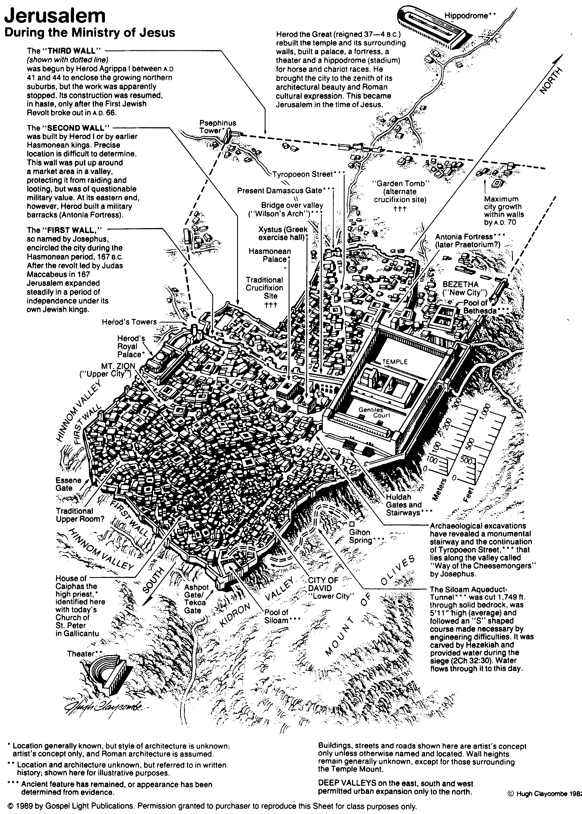
Jerusalem During the Ministry of Jesus
80

Slide 111


Matthew 21:1-11
Mark 11:1-11
Luke 19:28-44
John 12:12-19
THE EASTER STORY
TRIUMPHAL ENTRY (Palm Sunday)

Slide 112

Mark 11:1-11
As Jesus and his disciples approached Jerusalem, they came to the towns of Bethphage and Bethany on the Mount of Olives.

Slide 113

Jesus sent two of them on ahead. ² “Go into that village over there,” he told them.

Slide 114

“As soon as you enter it, you will see a young donkey tied there that no one has ever ridden. Untie it and bring it here.
³ If anyone asks, ‘What are you doing?’ just say, ‘The Lord needs it and will return it soon.’”

Slide 115

⁴ The two disciples left and found the colt standing in the street, tied outside the front door.

Slide 116

⁵ As they were untying it, some bystanders demanded…

Slide 117

“What are you doing, untying that colt?” ⁶ They said what Jesus had told them to say, and they were permitted to take it.

Slide 118

⁷ Then they brought the colt to Jesus...

Slide 119

…and threw their garments over it, and he sat on it.

Slide 120

⁸ Many in the crowd spread their garments on the road ahead of him, and others spread leafy branches they had cut in the fields.

Slide 121
⁹ Jesus was in the center of the procession, and the people all around him were shouting…

Slide 122

“Praise God!
Blessings on the one who comes in the name of the LORD!

Slide 123

¹⁰ Blessings on the coming Kingdom of our ancestor David!

Slide 124

"Praise God in highest heaven!"

Slide 125

Luke 19:39
But some of the Pharisees among the crowd said, “Teacher, rebuke your followers for saying things like that!”

Slide 126

Luke 19:40
He replied, “If they kept quiet, the stones along the road would burst into cheers!”

Slide 127

Luke 19:41
But as he came closer to Jerusalem and saw the city ahead…

Slide 128

Luke 19:41-42
…he began to weep. ⁴² “How I wish today that you of all people would understand the way to peace. But now it is too late, and peace is hidden from your eyes.

Slide 129

Luke 19:43
Before long your enemies will build ramparts against your walls and encircle you and close in on you from every side.

Slide 130

Luke 19:44
They will crush you into the ground, and your children with you. Your enemies will not leave a single stone in place, because you did not recognize it when God visited you.”

Slide 131
THE WORD IN PICTURES
Free
Bible
images

Slide 132
Used with Permission
THE
GOSPEL
——OF—— MATTHEW
THE
GOSPEL
——OF—— MARK
THE
GOSPEL
——OF—— LUKE
THE
GOSPEL
——OF—— JOHN
Due to the Lumo Project producing its own publishing material we regret to inform you that we cannot license our photos to other clients outside of freebibleimages.org.
These images are not licensed for reuse in video, epublishing or other media. Downloaded pictures and files cannot be redistributed through any other website than freebibleimages.org or used in any context where the accompanying message is undermining of the Christian faith and gospel.
Photos can only be used on educational presentations, blogs and social media, all of which should be accompanied with reference to www.LumoProject.com.
Picture courtesy of BBM
© All Rights Reserved.
www.bigbookmedia.com

Slide 133






The Spirit Leaves & Returns
Mt. of Olives
656
Ezek. 8:4; 9:3; 10:4; 10:18-19; 11:23
Luke 19:37; 24:50; Acts 1:10
Acts 1:11; Zech. 14:4; Ezek. 43:1-5
Notes:
The Mount of Olives plays a significant role in history. It is the last place the Spirit is present in Ezekiel 11:23, the last place Christ was honored as king in Luke 19:37, the last place Christ was seen by his disciples in Acts 1:10, and the NEXT place Christ will appear on earth to fulfill Acts 1:11!
The Kidron Valley below the mount is likely the Valley of Jehoshaphat where Jesus will judge the nations (Joel 3).
_____________
Common Slides English-193
OS-26-Ezek1-39-slide 178
OS-38-Zechariah-179
LC-06-Official Presentation-33
NS-01-Matt15-28-slide 112
NS-03-Luke13-24-slide 111
NS-Acts1-2-slide 215

Slide 134

Matthew 21:12-17
Mark 11:15-19
Luke 19:45-48
John 2:13-24
THE EASTER STORY
CLEANSING THE TEMPLE
Free
Bible
images

Slide 135

It was nearly time for the Jewish Passover celebration, so Jesus went to Jerusalem.

Slide 136

In the Temple area he saw merchants selling cattle, sheep, and doves for sacrifices.

Slide 137

He also saw dealers at tables exchanging foreign money.

Slide 138


Slide 139

Jesus made a whip from some ropes and chased them all out of the Temple.

Slide 140
He drove out the sheep and cattle, scattered the money changers’ coins over the floor

Slide 141

and turned over their tables.

Slide 142

Then, going over to the people who sold doves, he told them...

Slide 143

“Get these things out of here. Stop turning my Father’s house into a marketplace!”

Slide 144

Then his disciples remembered this prophecy from the Scriptures: “Passion for God’s house will consume me.”

Slide 145


Slide 146

But the Jewish leaders demanded, “What are you doing? If God gave you authority to do this, show us a miraculous sign to prove it.”

Slide 147

“All right,” Jesus replied. “Destroy this temple, and in three days I will raise it up.”

Slide 148

“What!” they exclaimed. “It has taken forty-six years to build this Temple, and you can rebuild it in three days?”

Slide 149

But when Jesus said “this temple,” he meant his own body.

Slide 150

After he was raised from the dead, his disciples remembered he had said this, and they believed both the Scriptures and what Jesus had said.

Slide 151
THE WORD IN PICTURES
Free
Bible
images

Slide 152


Palm Sunday
Palm
SUNDAY
Notes:
Palm Sunday is an interesting name for the day, isn't it?
________
Common-427
NS-01-Matt15-28-slide 131
NS-02-Mark9-16-slide 96
NS-03-Luke13-24-slide 94
NS-04-John12-21-slide 23

Slide 153


Palm Sunday
Notes:
We know that today recalls the palm branches waved at Jesus as he entered Jerusalem at the beginning of his last week of his life. Yet the focus really isn't the tree palms, but the hand palms of Jesus that would stretch out on a cross but a few days later.

Slide 154

Palms to Cross
Notes:
Tree palms were but a prelude to the cross.

Slide 155

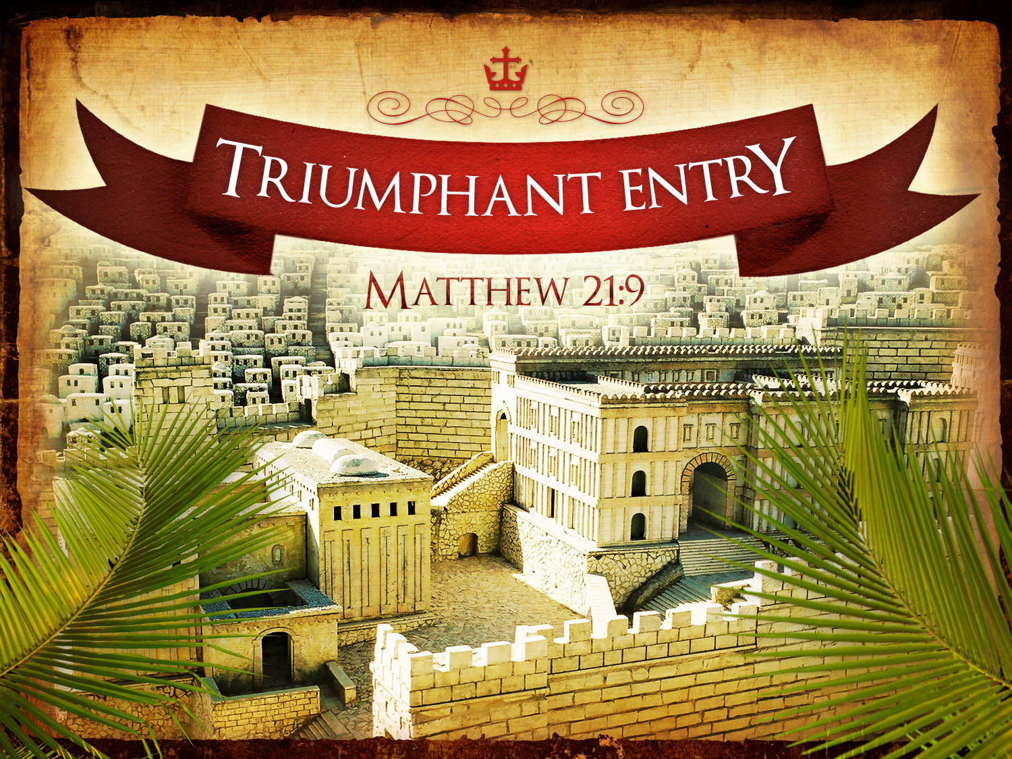
Triumphant Entry
Matthew 21:9
Notes:
Even the alternate name—Triumphant Entry—is also perplexing.

Slide 156

Triumphal Entry
Notes:
True, Jesus rode into Jesus and the crowds cheered his arrival.

Slide 157

Triumphant Entry
Jesus was in the center of the procession, and the people all around him were shouting,
“Praise God for the Son of David!
Blessings on the one who comes in the name of the LORD!
Praise God in highest heaven!”
Matthew 21:9
Notes:
Matthew 21:9 says the crowds that went ahead of him and those that followed shouted, "Hosanna to the Song of David!" "Blessed is he who comes in the name of the Lord!" "Hosanna in the highest!"

Slide 158

Palms to Palms
Notes:
Normally a king rode into the city as the victor over his enemies, while that very week would culminate in Jesus' death on Friday, which we call Good Friday.

Slide 159

What's so good about Good Friday?
Notes:
But that name is equally puzzling. Why is Good Friday called "good"?
Our leader died on that day, so it seems strange to call the day "good." No other religion refers to the death of their leader as "good."
We believe that his death was good. How was that?

Slide 160

How is Christ's death better than any sacrifice?

Slide 161
Slides on
Matthew 22

Slide 162

Passion Week
64
Mon
Wed
Tues
Fri
Thurs
Fri
Sun
Sat
Sat
Sun
Notes:
Jesus invested his final week in Jerusalem and Bethany east of it, going back and forth from Bethany to the city in a purposeful series of events designed to end in his crucifixion and resurrection.
__________
Common-432
LC-00-NT Chronology-43
NS-01-Matt15-28-slide 141
NS-02-Mark9-16-slide 105
NS-03-Luke13-24-slide 224
NS-04-John12-21-slide 295

Slide 163
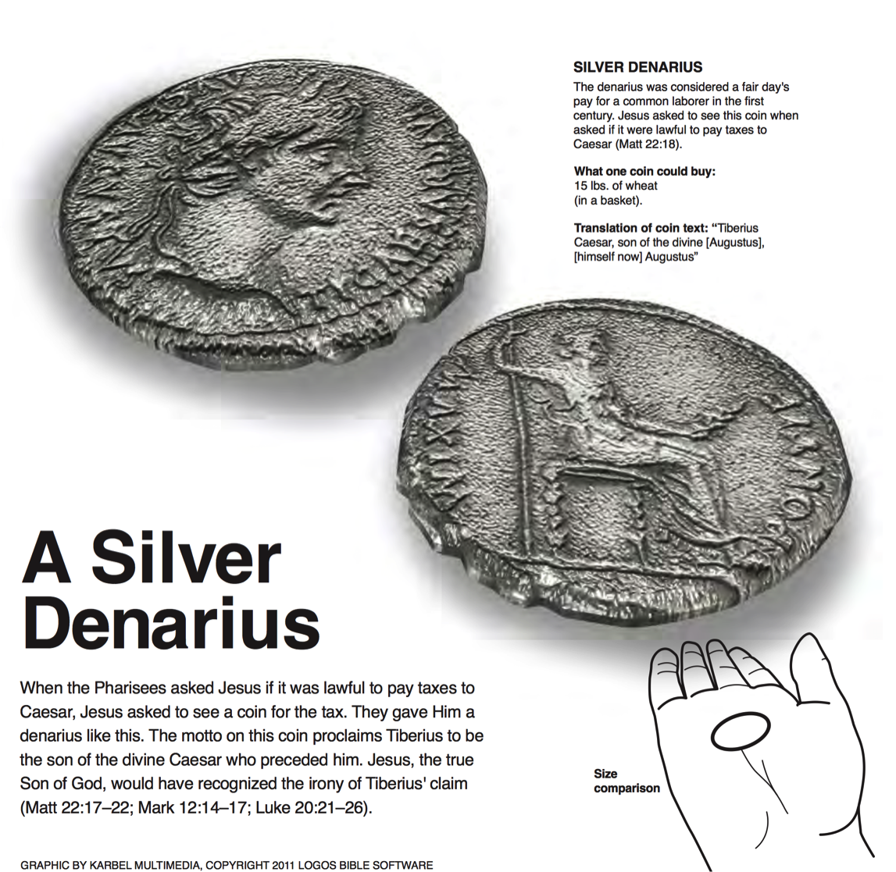
A Silver Denarius
SILVER DENARIUS
The denarius was considered a fair day's pay for a common labor in the first century. Jesus asked to see this coin when asked if it were lawful to pay taxes to Caesar (Matt 22:18).
What one coin could buy:
15 lbs. of wheat (in a basket)
Translation of coin text: "Tiberius Caesar, son of the divine [Augustus], [himself now] Augustus"
When the Pharisees asked Jesus if it was lawful to pay taxes to Caesar, Jesus asked to see a coin for the tax. They gave him a denarius like this. The motto on this coin proclaims Tiberius to be the son of the divine Caesar who preceded him. Jesus, the true Son of God, would have recognized the irony of Tiberius's claim (Matt 22:17-22; Mark 12:14-17; Luke 20:21-26).
Logos Bible Software

Slide 164

What’s Most Important?
Notes:
What do you think is the most important thing we do as a church? Worship? Evangelism? Fellowship? Bible study? Prayer? A few weeks ago a man inquiring about our church asked me, “So what is most important to your church? What is unique?” If he had asked you, what would you have said? I told him one word: LOVE!
One of the teachers of religious law was standing there listening to Jesus debate. He realized that Jesus had answered well, so he asked, “Of all the commandments, which is the most important?”
________
NS-01-Matt15-28-slide 143
NS-02-Mark9-16-slide 107
164

Slide 165

The most important thing is to enjoy your life— it's all that matters
—Audrey Hepburn—
Notes:
She obviously could not see beyond herself.
________
NS-01-Matt15-28-slide 143
NS-02-Mark9-16-slide 107

Slide 166
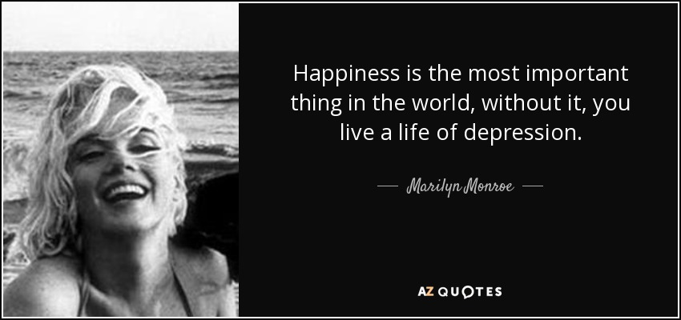
"Happiness is most important"
Happiness is the most important thing in the world, without it, you live a life of depression.
—Marilyn Monroe—
Notes:
She died young through suicide.
________
NS-01-Matt15-28-slide 144
NS-02-Mark9-16-slide 109

Slide 167

What’s Most Important?
Mark 12:29-31 -- Jesus replied, “The most important commandment is this: ‘Listen, O Israel! The Lord our God is the one and only Lord. ³⁰ And you must love the Lord your God with all your heart, all your soul, all your mind, and all your strength.’
³¹ The second is equally important:
‘Love your neighbor as yourself.’ No other commandment is greater than these.”
Notes:
One of the teachers of religious law was standing there listening to the debate. He realized that Jesus had answered well, so he asked, “Of all the commandments, which is the most important?” Jesus answered…
——————————
Common-293
OS-05-Deut-154
NS-01-Matt15-28-slide 146
NS-02-Mark9-16-slide 110
167

Slide 168

Our Vision
Love the Nations
Love the Church
Love God
Notes:
Repentance will bring restoration in a church: God wants our church to really trust him.
We still don’t see our need for him as we don’t see our need to pray.
We also need to be involved in his work: missions, teaching, accountability groups, finances, etc.
——————————
Common-294
BE-05-Deut-82
OP-05-Deut-71
OS-05-Deut-155, 237
OS-29-Joel-128
NS-02-Mark1-8-slide 111

Slide 169
Slides on
Matthew 23

Slide 170
Slides on
Matthew 24

Slide 171
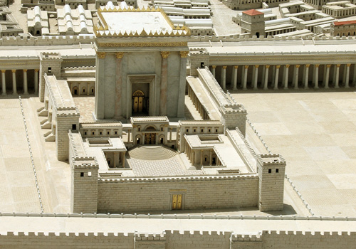
Disciples: What a fantastic temple! (24:1)
Jesus: "Not one stone here will be left on another" (24:2)
Disciples: When? What sign? (24:3)

Slide 172
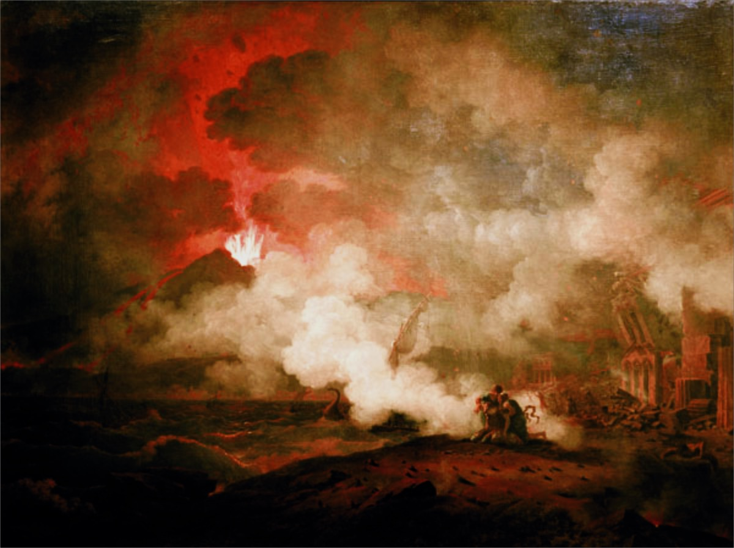
Parallels Between Daniel 9:27 and Revelation
Topic Daniel 9:27 Revelation 6–19
Beg. of Trib. Peace Treaty Rider on White Horse (6:1)
Temple Sacrifices Temple (11:1-2)
Time Half of 7 years 1260 days; 42 months (11:2-3)
Antichrist One who Persecution (13:7) Persecutes makes desolate Jews
Antichrist’s Abomination of Image of Antichrist (13:11-15) Image Desolation
End of Trib. Destruction of the Antichrist Defeated (19:20) Desolator
Notes:
The climatic event of the seven-year Tribulation is the center when the Antichrist declares himself God. This was prophesied in Daniel 9:27 and further explained in Revelation. (Slide by Randall Price)
______________
OD-04-Matt_24v15_Middle_of_the_Tribulation_(Randall_Price)-33
NS-01-Matt15-28—slide 151
NS-27-Rev 4-20—slide 134

Slide 173

Content of the Judgments
337
376
Matthew 24:5-9 Seal Parallels:
 | SEALS | TRUMPETS | BOWLS
1 | White: conqueror | Hail & fire: 1/3 vegetation | Sores
2 | Red: war | Fire: 1/3 sea creatures | Sea to blood
3 | Black: famine | Star: 1/3 fresh water | Fresh water to blood
4 | Pale: death | Dark: 1/3 sun, moon, stars | Sun burns men
 |  | (Trumpets 5-7 are woes)
5 | Martyrs reassured | Woe #1: locusts | Beast's kingdom dark
6 | Wrath: earthquake, signs | Woe #2: Euphrates prep | Euphrates dries up
 | (144,000 sealed) | (Trump #7 = mystery)
7 | 1/2-hour silence | Woe #3: victory imminent | Earthquake & hail
Deceivers (24:5)
Wars (24:6-7a)
H O R S E S
Famines (24:7b)
Death (24:9)
Martyrs (24:9)
Earthquakes & worldwide chaos (24:7c, 10-13)
W O E S
Adapted from Robert Gromacki, NT Survey and H. Wayne House, Chronological & Background Charts of the NT, 19
Notes:
173
Correlation Between Trumpets & Bowls (Wiersbe):
1 The Judgment
2 The earth
3 The sea
4 The rivers
5 The heavens
6 Mankind—torment
7 An army
Angry nations
Correlation between the Olivet Discourse (Matt 24) and Seals (Rev 6) is also striking.
_____________
Common-476
NS-01-Matt15-28-slide 152
NS-27-Rev1-2-slide 177
NS-27-Rev4-6-slide 133
NS-27-Rev7-12-slide 33
NS-27-Rev13-19-slide 85

Slide 174
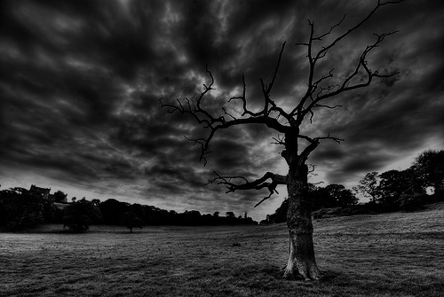
The Olivet Discourse (Matthew 24–25)
77
Adapted from Mark L. Bailey, DTS class notes, 1986
Second Coming (27-31):
Signs in the Heavens (29-30)
Coming of the Son of Man (27, 30)
Bird Supper (28)
Salvation of Elect (31)
Abomination of Desolation
(15-20)
False Christs
& Prophets
(23-26)
Beginning of Birth Pangs
(4-8)
Great Tribulation
(9-14, 21-22)
Judgment of the Nations
Sheep
Goats
Correlation with Revelation
12:7-12
13:14
12:8-17
8:1–19:10
(Matt. 25:31-46)
6:1–8:5
19:11-21

Slide 175
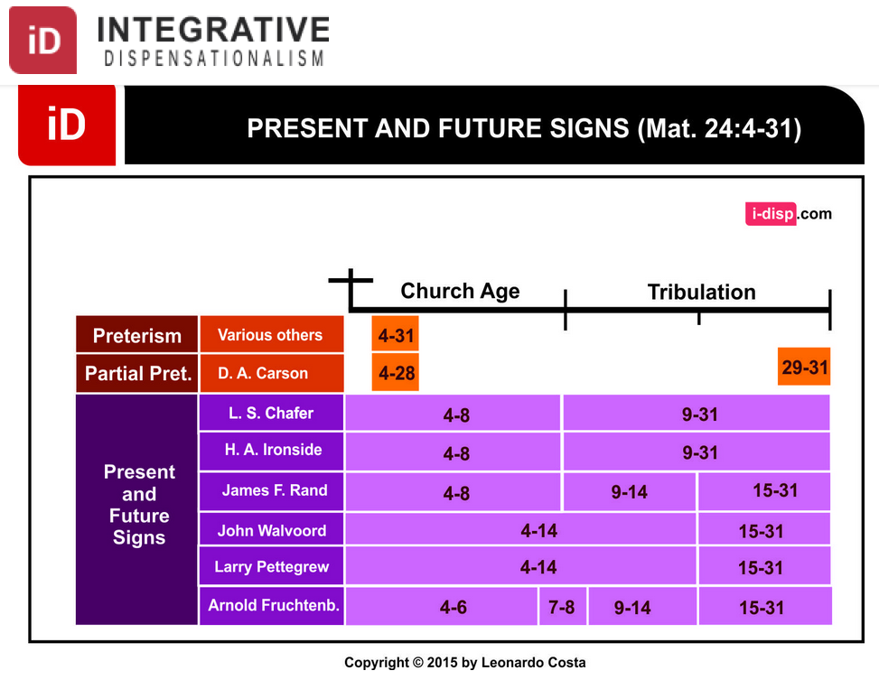
Dispensational Views on Matthew 24
INTEGRATIVE
DISPENSATIONISM
PRESENT & FUTURE SIGNS（Matt 24:4-31）
Church Age
Tribulation
Preterism
Various Others
Partial Pret.
Present
& Future Signs
Notes:
Leonardo Costa, "The Fulfillment of Matthew 24:4-31 in Dispensational Tradition," Integrative Dispensationalism website
http://i-disp.com/the-fulfillment-of-matthew-244-31-in-dispensational-tradition/ accessed 24 July 2015

Slide 176
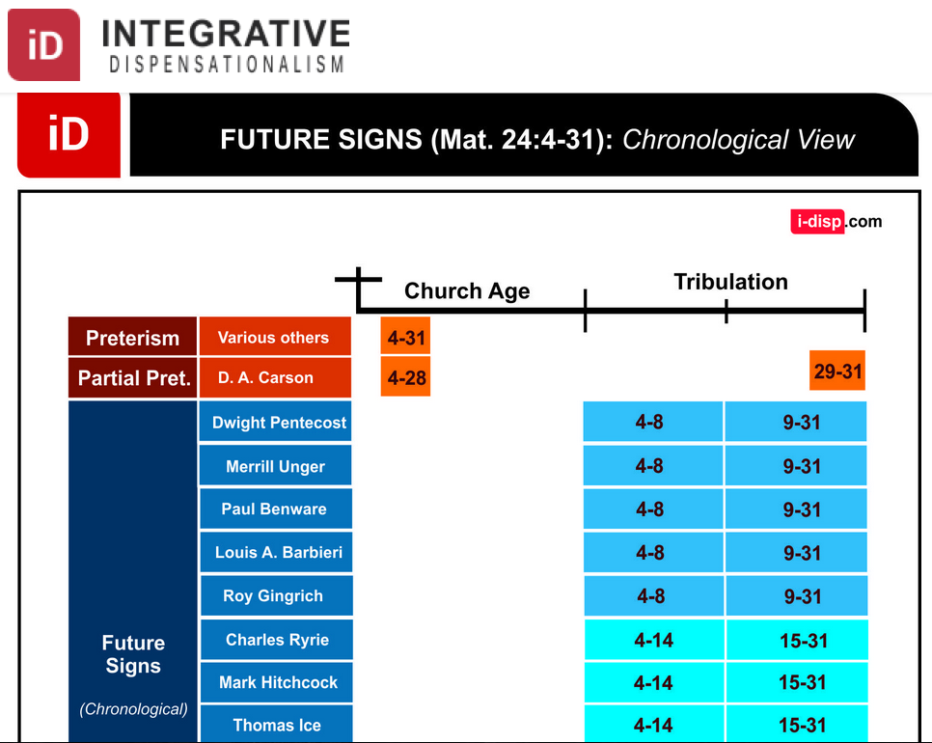
Dispensational Views on Matthew 24
INTEGRATIVE
DISPENSATIONISM
FUTURE SIGNS（Matt 24:4-31): Chronological View
Church Age
Tribulation
Preterism
Various Others
Partial Pret.
未来的年代
Future Signs
(Chronological)
Notes:
Leonardo Costa, "The Fulfillment of Matthew 24:4-31 in Dispensational Tradition," Integrative Dispensationalism website
http://i-disp.com/the-fulfillment-of-matthew-244-31-in-dispensational-tradition/ accessed 24 July 2015

Slide 177
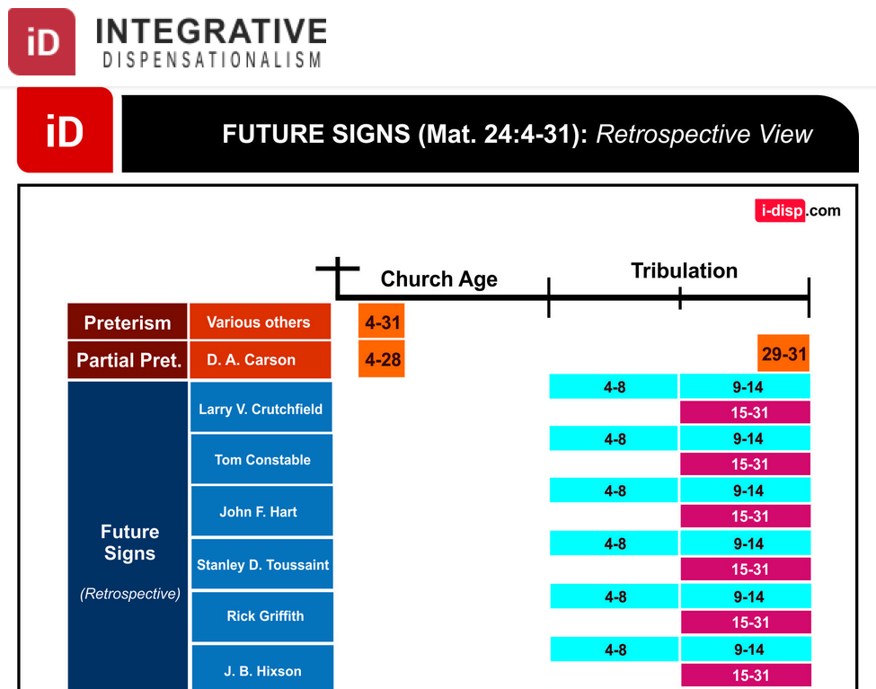
Dispensational Views on Matthew 24
INTEGRATIVE
DISPENSATIONISM
FUTURE SIGNS（Matt 24:4-31): Retrospective View
Church Age
Tribulation
Preterism
Various Others
Partial Pret.
Future Signs
(Retrospective)
Notes:
Leonardo Costa, "The Fulfillment of Matthew 24:4-31 in Dispensational Tradition," Integrative Dispensationalism website
http://i-disp.com/the-fulfillment-of-matthew-244-31-in-dispensational-tradition/ accessed 24 July 2015

Slide 178
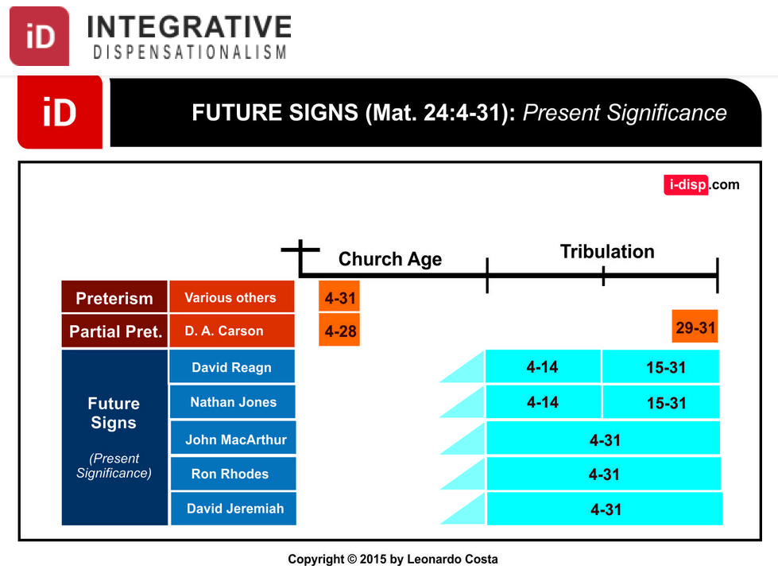
Dispensational Views on Matthew 24
综合
时代主义
INTEGRATIVE
DISPENSATIONISM
FUTURE SIGNS（Matt 24:4-31): Present Significance
Church Age
Tribulation
Preterism
Various Others
Partial Pret.
Future Signs
(Present Significance)
Notes:
Leonardo Costa, "The Fulfillment of Matthew 24:4-31 in Dispensational Tradition," Integrative Dispensationalism website
http://i-disp.com/the-fulfillment-of-matthew-244-31-in-dispensational-tradition/ accessed 24 July 2015

Slide 179
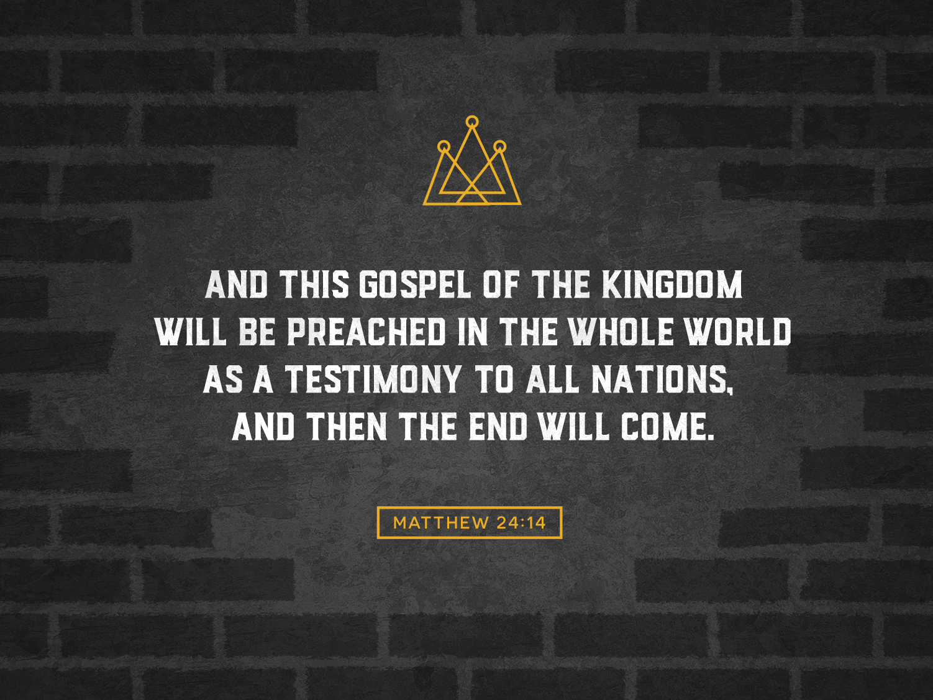
MATTHEW 24:14
AND THIS GOSPEL OF THE KINGDOM WILL BE PREACHED IN THE WHOLE WORLD AS A TESTIMONY TO ALL NATIONS,
AND THEN THE END WILL COME

Slide 180
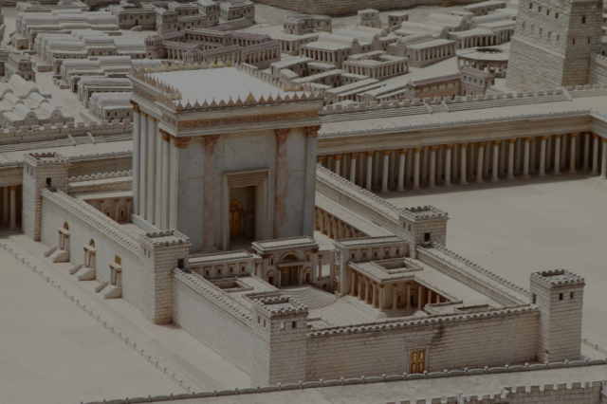
Matthew 24:15 (NLT)
"'The day is coming when you will see what Daniel the prophet spoke about—the sacrilegious object that causes desecration standing in the Holy Place.' (Reader, pay attention!)."
Jesus says that Daniel 9:27 was written by Daniel
Notes:
Some critics say Antiochus IV fulfilled Dan 9:27 in 167 BC when he desecrated the temple by offering a pig on the altar. Yet Jesus noted that the fulfillment was still future. I will take the word of Jesus over the critics.

Slide 181
Slides on
Matthew 25

Slide 182
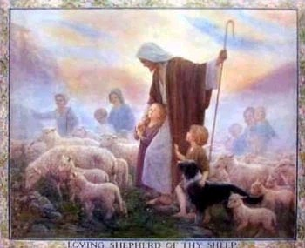
Judgment of the the Nations
(Sheep & Goats)
160
NLT Matthew 25:31 "But when the Son of Man comes in his glory, and all the angels with him, then he will sit upon his glorious throne. ³²All the nations will be gathered in his presence, and he will separate them as a shepherd separates the sheep from the goats. ³³He will place the sheep at his right hand and the goats at his left. ³⁴Then the King will say to those on the right, 'Come, you who are blessed by my Father, inherit the Kingdom prepared for you from the foundation of the world.'"

Slide 183
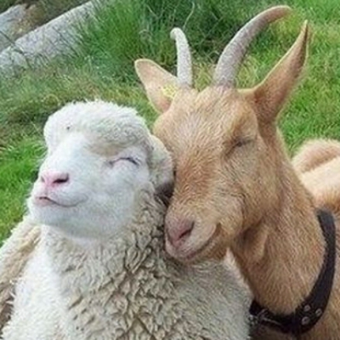
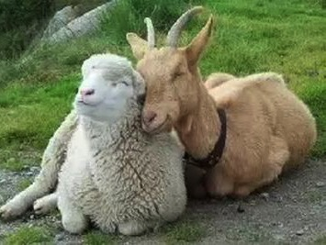
Aren't Sheep & Goats the Same?

Slide 184
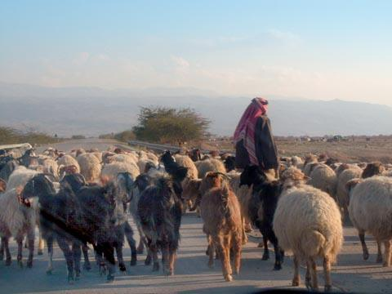
Judgment of the Nations
"All the nations will be gathered in his presence, and he will separate the people as a shepherd separates the sheep from the goats. ³³He will place the sheep at his right hand and the goats at his left"
(Matt. 25:31-32).

Slide 185

Judgment of Living Gentiles
³¹ "But when the Son of Man comes in his glory, and all the angels with him, then he will sit upon his glorious throne.
³² All the nations will be gathered in his presence, and he will separate the people as a shepherd separates the sheep from the goats. ³³ He will place the sheep at his right hand and the goats at his left.
³⁴ "Then the King will say to those on his right, 'Come, you who are blessed by my Father, inherit the Kingdom prepared for you from the creation of the world" (Matt. 25:31-34 NLT).

Slide 186
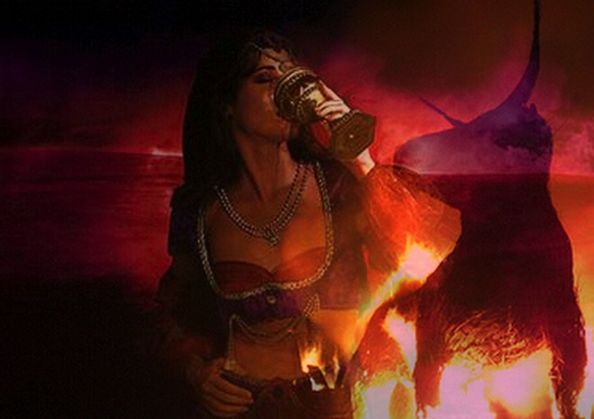
Judgment of Living Gentiles
⁴¹ "Then the King will turn to those on the left and say, 'Away with you, you cursed ones, into the eternal fire prepared for the devil and his demons. ⁴² For I was hungry, and you didn't feed me. I was thirsty, and you didn't give me a drink.
⁴³ I was a stranger, and you didn't invite me into your home. I was naked, and you didn't give me clothing. I was sick and in prison, and you didn't visit me.'
⁴⁴ "Then they will reply, 'Lord, when did we ever see you hungry or thirsty or a stranger or naked or sick or in prison, and not help you?'
⁴⁵ "And he will answer, 'I tell you the truth, when you refused to help the least of these my brothers and sisters, you were refusing to help me.' ⁴⁶ "And they will go away into eternal punishment, but the righteous will go into eternal life" (Matt. 25:41-46 NLT).

Slide 187
Olivet Discourse Overview
(Matt. 24–25)
27
First
Fall of Jerusalem
586 BC
Second
Fall of Jerusalem
AD 70
Rapture
1 Thess.
4:14-17
Third
Fall of Jerusalem
Second Coming with the Saints
Matt. 23:39; 24:30
Israel
Church Age
Tribulation
Millennium
The Great Tribulation
Dan. 9:27
Matt. 24:15
Judgment
of the Gentile Nations
Matt. 25:31-46
Israel Scattered Luke 21:24
Return to the Land
606 B.C.
Times of the Gentiles
Luke 21:24
Adapted from Salem Kirban
Charts on Revelation (1979), 48

Slide 188
Outline Finished
73
IV. (11:1–16:12) Christ is rejected as Messiah in anticipation of the final crucifixion rejection, so He introduces the Interadvent Age before His future reception and ministers to Gentiles to teach the postponement of the kingdom.
V. (16:13–20:34) Christ prepares His disciples regarding His Person and program in order that His Messianic authority might be delegated to them after His death.
VI. (Chs. 21–27) Christ's official presentation and rejection as Israel's King in His vicarious crucifixion show why the kingdom is postponed until His return.

Slide 189
Slides on
Matthew 26

Slide 190


Broken & Spilled Out
Matthew 26:6-13
Mark 14:1-11
John 12:1-11
Free
Bible
images
Performed By Steve Green
JESUS IS ANOINTED
Notes:
FreeBibleImages.org does what it says it does, offering photos and cartoons on narrative portions of Scripture. These are copyright-free as well and continually updated.
This 1980s song accurately narrates how Mary of Bethany anointed Jesus for his burial as no time would be available to perform these Jewish rites the next day when the body of Jesus was hastily buried.
______________
Common-431
BS-20-Study Tools-6
NS-01-Matt15-28-slide
NS-02-Mark9-16-slide
NS-04-John12-21-slide 5

Slide 191

Notes:
Music background 1 of 2

Slide 192

Notes:
Music background 1 of 2

Slide 193

One day a plain village woman, driven by love for her Lord

Slide 194

Recklessly poured out a valuable essence, disregarding the scorn

Slide 195
And once it was broken and spilled out
A fragrance filled all the room.

Slide 196
Like a prisoner released from his shackles
Like a spirit set free from the tomb

Slide 197

Broken and spilled out, just for love of you, Jesus

Slide 198
Life's most precious treasure, lavished on Thee

Slide 199

Broken and spilled out, and poured at Your feet

Slide 200
In sweet abandon let me be spilled out and used up for Thee

Slide 201

Lord, You were God's precious treasure,
His loved and His own perfect Son

Slide 202
Sent here to show me the love of the Father, just for love it was done

Slide 203

And though You were perfect and holy
You gave up Yourself willingly

Slide 204
You spared no expense for my pardon
You were used up and wasted for me

Slide 205

Broken and spilled out
Just for love of me, Jesus––

Slide 206
God's most precious treasure lavished on me

Slide 207

Broken and spilled out and poured at my feet.

Slide 208
In sweet abandon,
Lord, You were spilled out and used up for me

Slide 209

In sweet abandon, let me be spilled out and used up for Thee

Slide 210

Pictures courtesy of Big Book Media
© All Rights Reserved.
Used with permission
BIG BOOK MEDIA

Slide 211
THE WORD IN PICTURES
Free
Bible
images

Slide 212


Was Mary Magdalene the Woman with the Alabaster Jar?
The WOMAN
with the
ALABASTER JAR
Mary Magdalen and the Holy
Grail
No. In Luke she is not named but in the other gospels she is clearly Mary of Bethany
As featured in The
Da Vinci Code

Slide 213

John 12 Events
64
656
Unbelief Summary
12:37-50
Predicts Death
12:21-36
Triumphal Entry
12:12-20
Anointing at Bethany
12:1-11
Notes:
John leaves out the many details of Passion Week noted in the Synoptics except his anointing and Triumphal Entry, choosing instead to highlight the prediction of his death and the unbelief of the leaders.
____________
Common-433
NS-01-Matt15-28-slide 183
NS-02-Mark9-16-slide 130
NS-03-Luke13-24-slide 104
NS-04-John12-21-slide 4

Slide 214

Luke 7:36-50
Jesus and the Sinful Woman

Slide 215

Anointings of Jesus
Common to all four gospel accounts:
Unannounced visit by woman
Anointed Jesus' head and/or feet
Wiped his feet with her hair
Complaint of waste by disciples/Judas
Disciples rebuked by Jesus
In a home
Alabaster jar (except in John)
Home owned by man called Simon

Slide 216

The Two Anointings of Jesus
Luke 7:36-50
Early in Ministry
Weeping
For worship, woman's
sins forgiven (Luke 7:48)
By unnamed harlot at
home of Simon the
Pharisee (Luke 7:40) in
an unknown town
Matt. 26:6-13
Mark 14:3-9
John 12:1-11
During Passion Week
No weeping noted
For burial, woman needed
no forgiveness
By Lazarus' sister Mary at home of Simon the Leper
(Matt. 26:6; Mark 14:3) in Lazarus' hometown of Bethany (John 12:1)

Slide 217

Free
Bible
images
Matthew 26:17-35
Mark 14:12-31
Luke 22:7-38
John 13:18-38
THE EASTER STORY
THE LAST SUPPER

Slide 218


Slide 219


Slide 220


Slide 221


Slide 222


Slide 223


Slide 224


Slide 225


Slide 227


Slide 228


Slide 229


Slide 230


Slide 231


Slide 232


Slide 233
THE WORD IN PICTURES
Free
Bible
images

Slide 234

Free
Bible
images
Matthew 26:36-56
Mark 14:32-52
Luke 22:39-53
John 18:1-12
THE EASTER STORY
JESUS PRAYS IN GETHSEMANE

Slide 235


Slide 236


Slide 237


Slide 238


Slide 239


Slide 241


Slide 242


Slide 243


Slide 244


Slide 245


Slide 246


Slide 247


Slide 248


Slide 249


Slide 250


Slide 251


Slide 252


Slide 253


Slide 254


Slide 255
THE WORD IN PICTURES
Free
Bible
images

Slide 256
Used with Permission
THE
GOSPEL
——OF—— MATTHEW
THE
GOSPEL
——OF—— MARK
THE
GOSPEL
——OF—— LUKE
THE
GOSPEL
——OF—— JOHN
Due to the Lumo Project producing its own publishing material we regret to inform you that we cannot license our photos to other clients outside of freebibleimages.org.
These images are not licensed for reuse in video, epublishing or other media. Downloaded pictures and files cannot be redistributed through any other website than freebibleimages.org or used in any context where the accompanying message is undermining of the Christian faith and gospel.
Photos can only be used on educational presentations, blogs and social media, all of which should be accompanied with reference to www.LumoProject.com.
Picture courtesy of BBM
© All Rights Reserved.
www.bigbookmedia.com

Slide 257

Free
Bible
images
Matthew 26:57-67
Mark 14:53-65
Luke 22:66-71
John 18:15-27
THE EASTER STORY
JESUS BEFORE
THE SANHEDRIN

Slide 258


Slide 259


Slide 260


Slide 262


Slide 263


Slide 264


Slide 265


Slide 266
THE WORD IN PICTURES
Free
Bible
images

Slide 267
Used with Permission
THE
GOSPEL
——OF—— MATTHEW
THE
GOSPEL
——OF—— MARK
THE
GOSPEL
——OF—— LUKE
THE
GOSPEL
——OF—— JOHN
Due to the Lumo Project producing its own publishing material we regret to inform you that we cannot license our photos to other clients outside of freebibleimages.org.
These images are not licensed for reuse in video, epublishing or other media. Downloaded pictures and files cannot be redistributed through any other website than freebibleimages.org or used in any context where the accompanying message is undermining of the Christian faith and gospel.
Photos can only be used on educational presentations, blogs and social media, all of which should be accompanied with reference to www.LumoProject.com.
Picture courtesy of BBM
© All Rights Reserved.
www.bigbookmedia.com

Slide 268


Free
Bible
images
Matthew 26:69-75
Mark 14:66-72
Luke 22:54-62
John 18:15-27
THE EASTER STORY
PETER DENIES JESUS

Slide 269


Slide 270


Slide 271


Slide 272


Slide 273


Slide 274


Slide 275


Slide 276


Slide 277


Slide 279
Pictures courtesy of Big Book Media
© All Rights Reserved.
Used with permission
BIG BOOK MEDIA

Slide 280
THE WORD IN PICTURES
Free
Bible
images

Slide 281
Slides on
Matthew 27

Slide 282

Free
Bible
images
Matthew 27:27-37
Mark 15:16-25
Luke 23:26-34
John 19:16-27
THE EASTER STORY
JESUS IS CRUCIFIED

Slide 283


Slide 284


Slide 285


Slide 286


Slide 287


Slide 288


Slide 289


Slide 290


Slide 291


Slide 292


Slide 293


Slide 294


Slide 295


Slide 296


Slide 297


Slide 298


Slide 299
THE WORD IN PICTURES
Free
Bible
images

Slide 300
Used with Permission
THE
GOSPEL
——OF—— MATTHEW
THE
GOSPEL
——OF—— MARK
THE
GOSPEL
——OF—— LUKE
THE
GOSPEL
——OF—— JOHN
Due to the Lumo Project producing its own publishing material we regret to inform you that we cannot license our photos to other clients outside of freebibleimages.org.
These images are not licensed for reuse in video, epublishing or other media. Downloaded pictures and files cannot be redistributed through any other website than freebibleimages.org or used in any context where the accompanying message is undermining of the Christian faith and gospel.
Photos can only be used on educational presentations, blogs and social media, all of which should be accompanied with reference to www.LumoProject.com.
Picture courtesy of BBM
© All Rights Reserved.
www.bigbookmedia.com

Slide 301

Free
Bible
images
Matthew 27:38-66
Mark 15:25-47
Luke 23:35-56
John 19:28-42
THE EASTER STORY
JESUS DIES ON THE CROSS

Slide 302


Slide 303


Slide 304


Slide 305


Slide 306


Slide 307


Slide 308


Slide 310


Slide 311


Slide 313


Slide 314


Slide 315


Slide 316


Slide 317


Slide 318


Slide 319


Slide 320
THE WORD IN PICTURES
Free
Bible
images

Slide 321
Used with Permission
THE
GOSPEL
——OF—— MATTHEW
THE
GOSPEL
——OF—— MARK
THE
GOSPEL
——OF—— LUKE
THE
GOSPEL
——OF—— JOHN
Due to the Lumo Project producing its own publishing material we regret to inform you that we cannot license our photos to other clients outside of freebibleimages.org.
These images are not licensed for reuse in video, epublishing or other media. Downloaded pictures and files cannot be redistributed through any other website than freebibleimages.org or used in any context where the accompanying message is undermining of the Christian faith and gospel.
Photos can only be used on educational presentations, blogs and social media, all of which should be accompanied with reference to www.LumoProject.com.
Picture courtesy of BBM
© All Rights Reserved.
www.bigbookmedia.com

Slide 322

The Temple Veil

Slide 323

The Temple Veil Torn (27:51)

Slide 324
Why serve Jesus?

Slide 325
Amazing Names
Lord
Jesus
Christ
Notes:
We need to understand what it means for our Jesus to be the Lord Jesus Christ.
Do you agree that the name of Jesus is the most dishonored in the world? Few people swear by the name of any other religious or political or other leader.
Even Christians don't often think much about the three main names of Jesus noted 60 times in the NT.

Slide 326
Amazing Names
Jesus is the highest ruler in the world (Matt 1–10).
Christ
Notes:
[Jesus met every prophecy we should expect for him to prove he is King.]
[Christ means Messiah-Ruler, for he fulfilled each part of his job description.]
—What more would Christ need to do for you to trust him with your life?
—Have you been the victim of Christ’s first mistake? How?
—Do you see how statistically unlikely it was for Jesus to be the Messiah?

Slide 327
Amazing Names
Jesus is the highest authority in the Church (Matt 11–27).
Lord
Christ
Notes:
[As Master, he is the boss of every believer’s life.]
As a Christian, do you recognize Christ’s authority over you?
—Why do you do what you do in terms of your life work?
—How did you make that decision?
—What area of your life right now should you submit to his authority?

Slide 328
Amazing Names
Lord
Jesus
Christ
Jesus provided salvation by conquering death (Matt 28).
Notes:
[He lived up to his name and proved he could save us by rising from the grave.]
What impact does Christ’s resurrection have on you personally?
—Do you believe Jesus really came back from the dead?
—Have you ever sincerely studied the resurrection?
—Are you one of those disciples noted in Matthew 28:19?
—How can you better make disciples? Who should you disciple?

Slide 329
Slides on
Matthew 28

Slide 330
Outline Finished
73
IV. (11:1–16:12) Christ is rejected as Messiah in anticipation of the final crucifixion rejection, so He introduces the Interadvent Age before His future reception and ministers to Gentiles to teach the postponement of the kingdom.
V. (16:13–20:34) Christ prepares His disciples regarding His Person and program in order that His Messianic authority might be delegated to them after His death.
VI. (Chs. 21–27) Christ's official presentation and rejection as Israel's King in His vicarious crucifixion show why the kingdom is postponed until His return.
VII. (Ch. 28) Christ's victory over death confirms Him as the Messiah who should be believed by all throughout the entire world.

Slide 331

Matthew 28:1-15
Mark 16:1-20
Luke 24:1-47
John 20:1-29
Free
Bible
images
THE EASTER STORY
JESUS IS ALIVE

Slide 332


Slide 334


Slide 335


Slide 336


Slide 337


Slide 338


Slide 339


Slide 340


Slide 341


Slide 342


Slide 343


Slide 344


Slide 345


Slide 346


Slide 347


Slide 348


Slide 349


Slide 350
THE WORD IN PICTURES
Free
Bible
images

Slide 351
Used with Permission
THE
GOSPEL
——OF—— MATTHEW
THE
GOSPEL
——OF—— MARK
THE
GOSPEL
——OF—— LUKE
THE
GOSPEL
——OF—— JOHN
Due to the Lumo Project producing its own publishing material we regret to inform you that we cannot license our photos to other clients outside of freebibleimages.org.
These images are not licensed for reuse in video, epublishing or other media. Downloaded pictures and files cannot be redistributed through any other website than freebibleimages.org or used in any context where the accompanying message is undermining of the Christian faith and gospel.
Photos can only be used on educational presentations, blogs and social media, all of which should be accompanied with reference to www.LumoProject.com.
Picture courtesy of BBM
© All Rights Reserved.
www.bigbookmedia.com

Slide 352

A Prophetic Weekend
NTS 39
Thursday
Friday
Saturday
Sunday
Galilean
Passover
Unleavened Bread
Firstfruits
Judean
Passover
Unleavened Bread
Firstfruits
Last Supper
Crucifixion
Resurrection
2 April 33
3 April 33
5 April 33
Notes:
OB-25-Feasts-35; NB11-Feasts-35; NS-Mt15-28-S313; NS-Mk9-16-S274; NS-Lk13-24-S290; NS-Jn12-21-S260
Leviticus 23 gives the order of three key feasts of Israel: • Passover, • Unleavened Bread, and • Firstfruits.
• But how could Jesus have Passover Thursday night but then die at 3 PM the next day on Friday when the Passover lambs were being slaughtered? And why did the Jewish leaders want the bodies off the cross quickly as Passover was approaching when Jesus had already celebrated Passover the night before?
• The answer is that Galilean Jews celebrated Passover the day before • Judean Jews. Since his disciples were Galileans, Jesus naturally celebrated on their timetable.
• The Feast of Unleavened Bread always began the day after Passover (Lev 23:5-6).
• Then Firstfruits followed sometime later on the first Sabbath after the first crops began to ripen (Lev 23:11). It indicated that millions of additional sheaves would follow until the entire harvest came in at Pentecost. In AD 33, these three celebrations occurred one after another on three consecutive days!
The significance is astonishing. • Christ predicted his death at the Last Supper Thursday night. • Then Jesus died on the Judean Passover • so that believers can live a life without yeast (Unleavened Bread), • which immediately followed with his resurrection on Firstfruits as he is the first and only human ever to obtain a glorified body as an installment for millions more to follow (1 Cor 15:20)!
We know these dates to be • 2 April 33 for the Thursday night Passover, • 3 April 33 was the day of his crucifixion, and • Jesus rose from the dead on the Feast of Firstfruits on 5 April 33.

Slide 353


Guards Bribed (28:12)

Slide 354

Matthew 28:18-20 NLT
"Jesus came and told his disciples, 'I have been given all authority in heaven and on earth. ¹⁹Therefore, go and make disciples of all the nations, baptizing them in the name of the Father and the Son and the Holy Spirit. ²⁰Teach these new disciples to obey all the commands I have given you. And be sure of this: I am with you always, even to the end of the age.'"

Slide 355


The Great Commission
Matthew 28:18-20
¹⁸Then Jesus came to them and said, "All authority in heaven and on earth has been given to me. ¹⁹Therefore go and make disciples of all nations, baptizing them in the name of…, ²⁰and teaching them to obey everything I have commanded you. And surely I am with you always, to the very end of the age."
Notes:
Christ has all authority but he extends some of it to us as people under his authority. It may appear that there are four commands here, but "make disciples" is the only command here. This happens by us also obeying the three participles: going, baptizing, and teaching.

Slide 356
The Great Commission
Make Disciples
Going
Baptizing
Teaching
Salvation
Identification
Sanctification
Evangelism
Assimilation
Education
Believing
Bonding
Maturing
Find Them
Keep Them
Build Them
Adapted from Dr. Gary McIntosh, Church Growth Network 2014
Notes:
Most churches emphasize the third column and think only of teaching as discipleship; However, it includes going, baptizing, and teaching.
List the ministries in your church under their appropriate column. If it can't be listed under one of these, then eliminate that ministry.
Which of the three columns is weakest in your church? What can you do to strengthen this weak area?

Slide 357
Why serve Jesus?

Slide 358
Amazing Names
Lord
Jesus
Christ
Notes:
We need to understand what it means for our Jesus to be the Lord Jesus Christ.
Do you agree that the name of Jesus is the most dishonored in the world? Few people swear by the name of any other religious or political or other leader.
Even Christians don't often think much about the three main names of Jesus noted 60 times in the NT.

Slide 359
Amazing Names
Jesus is the highest ruler in the world (Matt 1–10).
Christ
Notes:
[Jesus met every prophecy we should expect for him to prove he is King.]
[Christ means Messiah-Ruler, for he fulfilled each part of his job description.]
—What more would Christ need to do for you to trust him with your life?
—Have you been the victim of Christ’s first mistake? How?
—Do you see how statistically unlikely it was for Jesus to be the Messiah?

Slide 360
Amazing Names
Jesus is the highest authority in the Church (Matt 11–27).
Lord
Christ
Notes:
[As Master, he is the boss of every believer’s life.]
As a Christian, do you recognize Christ’s authority over you?
—Why do you do what you do in terms of your life work?
—How did you make that decision?
—What area of your life right now should you submit to his authority?

Slide 361
Amazing Names
Lord
Jesus
Christ
Jesus provided salvation by conquering death (Matt 28).
Notes:
[He lived up to his name and proved he could save us by rising from the grave.]
What impact does Christ’s resurrection have on you personally?
—Do you believe Jesus really came back from the dead?
—Have you ever sincerely studied the resurrection?
—Are you one of those disciples noted in Matthew 28:19?
—How can you better make disciples? Who should you disciple?

Slide 362
MAIN IDEA OF MATTHEW
Serve the Lord Jesus Christ
Lord
Jesus
Christ
Notes:
Serve Jesus as Savior, God, and King of your life!

Slide 363
Amazing Names
Jesus is the highest authority in the Church (Matt 11–27).
Lord
Jesus is the highest ruler in the world (Matt 1–10).
Jesus
Christ
Jesus provided salvation by conquering death (Matt 28).

Slide 364
MAIN IDEA OF MATTHEW
Serve the Lord Jesus Christ
GOD
Lord
KING
Jesus
Christ
SAVIOR
Notes:
Serve Jesus as Savior, God, and King of your life!

Slide 365


Do you trust the King right now?
Before we can pray, "Lord, Thy kingdom come," we must be willing to pray, "My kingdom go."

Slide 366
Black

Slide 367


NT Preaching • BibleStudyDownloads.org
Get this presentation and script for free!

Slide 368
Matthew
67
Messiah with Authority over the Church
Preliminary Evidence that
Jesus is Messiah
Rejections and
Interadvent Age
Final Evidence that
Jesus is Messiah
Chapters 1–10
Chapters 11–27
Chapter 28
The King Rejected
The King Re-offered
The King Offered
Teaches Droves
Teaches Disciples
Topical
Chronological
Notes:
The title includes both the Jewish (Messiah) and Gentile (Church) elements in the book. The outline follows a threefold outline of (1) proofs, (2) responses, and (3) results.

Slide 369

Since Jesus is king, then believers will rule with him!

Slide 370


Believers will rule the earth
(Rev. 5:10 NLT).
"And you have caused them to become a Kingdom of priests for our God. And they will reign on the earth."

Slide 371


Revelation 20:4-6 Diagrammed
424
^{4b}and they came to life and reigned with Christ for a thousand years.
^{4a}Then I saw thrones, and they sat on them, and judgment was given to them. And I saw the souls of those who had been beheaded because of their testimony of Jesus and because of the word of God, and those who had not worshiped the beast or his image, and had not received the mark on their forehead and on their hand…
1000 years
^{5b}This is the first resurrection. ^{6a}Blessed and holy is the one who has a part in the first resurrection; over these the second death has no power…
^{6b}but they will be priests of God and of Christ and will reign with Him for a thousand years.
^{5a}The rest of the dead did not come to life until the thousand years were completed.

Slide 372

Since Jesus fulfilled all the requirements to be Israel's king, we will rule with him!
Main Idea

Slide 373

Will you stand?

Slide 374

Jesus is both Lamb and Lion
Jesus Christ
Lamb of
God
Lion of
Judah

Slide 375

Lord
Lord Jesus Christ
God
Deity
Master
Jesus
Christ
King
Savior
Messiah
Joshua
Lion
Lamb
Notes:
NS-02-Matthew15-28-Slide 339
NS-22-2 Peter-162
TR-03-Deity of Christ-33

Slide 376

"I trust in your death for me."

Slide 377

Are you ready to rule?

Slide 378

Be faithful NOW

Slide 379

NT Survey link at biblestudydownloads.org
Get this presentation for free!

Slide 380
Black

