Slide 1
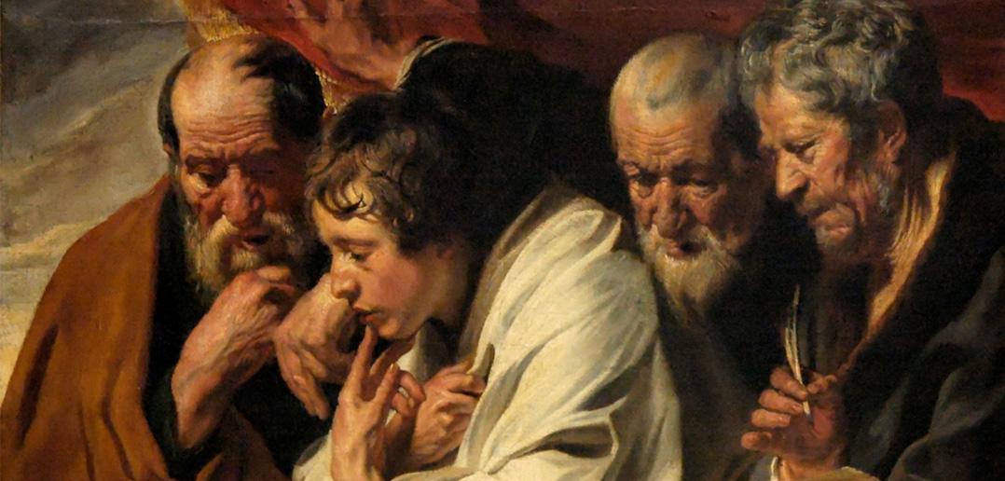
The Gospels
Dr. Rick Griffith • Jordan Evangelical Theological Seminary • BibleStudyDownloads.org

Slide 2
Parallel OT & NT Structure
20a
Foundation
Past
Present
Future
OT
Torah
History
Wisdom
Prophecy
NT
Gospels
Acts
Epistles
Revelation
Erich Zenger, Einleitung in das Alte Testament (Stuttgart: W. Kohlehammer, 1995), 34; cited in Gregory Goswell, "Two Testaments in Parallel: The Influence of the Old Testament on the Structuring of the New Testament Canon," JETS 56 (2013): 461.

Slide 3

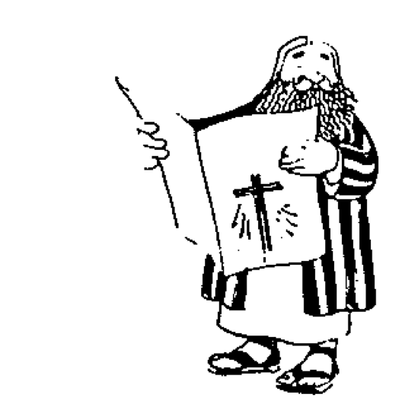




The New Testament “Building”
21
Paul's Letters to Pastors
 | 1 Timothy | 2 Timothy | Titus |  | Philemon
Paul's Letters to Churches | 2 Thessalonians |  |  |  | Revelation | General Letters
 | 1 Thessalonians |  |  |  | Jude
 | Colossians |  |  |  | 3 John
 | Philippians |  |  |  | 2 John
 | Ephesians |  |  |  | 1 John
 | Galatians |  |  |  | 2 Peter
 | 2 Corinthians |  |  |  | 1 Peter
 | 1 Corinthians |  |  |  | James
 | Romans |  |  |  | Hebrews
 | Acts
 | Matthew | Mark |  | Luke | John
Historical Books
Adapted from Walk Thru the Bible
Notes:
What overall observations on the NT can you make from this diagram?
Gospels and Acts form the primary and secondary foundations of the NT.
On the historical foundation are two pillars of 9 books each.
Paul's letters to churches in the left pillar all fit into Acts.
Paul didn't write any inspired letters to churches after Acts.
Pauline letters are named after recipients while General after authors (except Hebrews)
The four gospels are named after their authors.
Every book that ends in "ns" is Pauline
All Pastoral Epistles begin with "T”
______
General Epistles came after Acts (except James).
Each of the 2 pillars begin with a foundational book: Romans & Hebrews (also their longest).
Both pillars also end up in books that primarily deal with eschatology: 2 Thess and Revelation.
Instruction to the leaders comprise only 4 books (i.e., the NT addresses the average Christian).
Only 4 NT books are written to an individual (i.e., the NT is corporate, not individualistic).
Each 1st of multiple letters (1-2 Cor., 1-2 Thess., etc.) is longer & more theologically significant.
The “building” is chronologically clockwise.
________
Three sections all have 9 books: 9 Historical/Pastoral + 9 Pauline + 9 General.
Audiences of the Pauline column had more Jews than the Gentile readers of the General column.
Pauline letters addressed early Christians when eyewitnesses to Jesus lived but General letters mostly addressed second generation believers.
The NT foundation rests on books about the life of Christ, as Jesus is the focus of the NT.
----- Meeting Notes (20/1/18 15:07) -----
Acts bridge

Slide 4
The Gospels
48
Matthew
Mark
Luke
John
Bible Visual Resource Book, 177
The word "Gospel" comes from the Old English "God-spell." It translates the Greek word for "good news."
In antiquity king's heralds announced "glad tidings" of the king's birthday throughout the cities of the realm.
It has the same meaning in our New Testament. The four Gospels announce the glad tidings about Jesus.
The ancient world knew of history, poetry, prophecy and letters. But a "gospel" was new to them.
Here, inspired writers gave more than just history. They also created faith (John 20:30-31) by proclaiming the good news that, just as the OT had promised, God had sent His Messiah to the world.

Slide 5
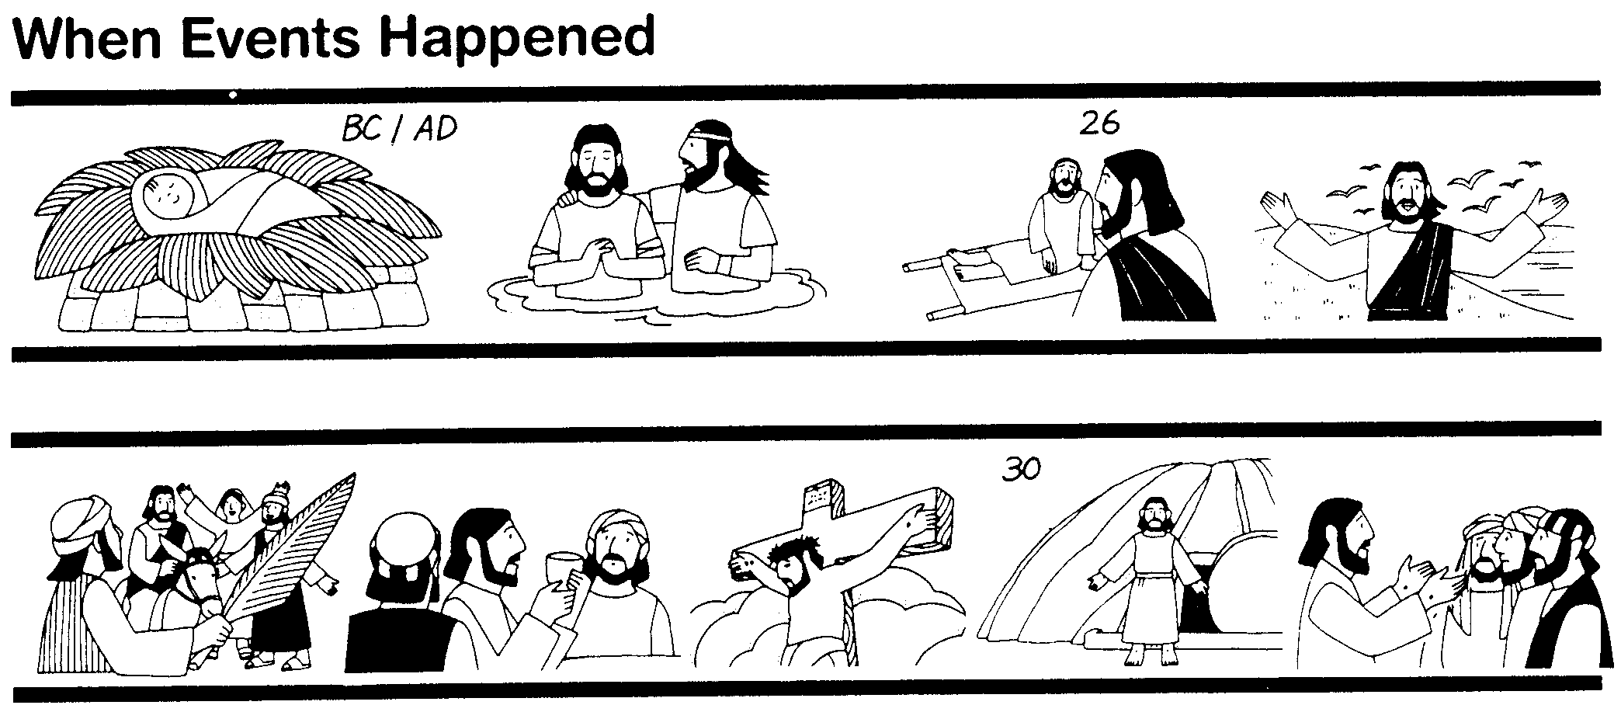
The Synoptics
Why are there four Gospels? Perhaps for the same reason different descriptions of a finely cut jewel would appeal to different people. Matthew describes one facet of the life of Christ, Mark another, Luke a third, and John completes the picture.
48
Matthew
Mark
Luke
John
These three Gospels are so much alike that they are called Synoptic (syn, "together with"; optic, "seeing"; thus "see together"). They all view Christ's life from an historical lens while John dwells more on the inner meaning of Jesus' life and teachings.
Bible Visual Resource Book, 177

Slide 6



"A FINISHED PORTRAIT OF THE
LORD JESUS CHRIST"
51a
From "The Bible…Basically" Seminar…
AS SEEN THROUGH FOUR DIFFERENT LENSES
STUDY HELP #21
13
2
Notes:
Using Study Help #21, through this large picture frame…
we're going to create a graphic representation called
//// A FINISHED PORTRAIT OF THE LORD JESUS CHRIST… but…
//// …we're going to compose that portrait through four different literary lenses as the completed image develops.

Slide 7
Each Gospel Writer Had:
51a
• His specific audience
• His unique presentation of the person of Jesus Christ
• His foundational purpose for writing his Gospel
• His own date of writing
14
4
Notes:
From each Gospel writer…
//// …we'll discover the specific audience for his writings…
//// …with his unique presentation of the person of Jesus Christ…
//// …suggesting a foundational purpose communicated through the text of his Gospel…
//// …followed by the scholars' estimate of the date of each writing.

Slide 8
FOUR INDIVIDUAL PORTRAITS…
51a
1
2
3
4
15
Notes:
Now, please…in your imagination…insert four smaller picture frames into the larger one. In each frame install four lines. As we fill them in we'll have some specific information about the purpose and function of each of the four Gospels. The individual "sub-frames" are designated 1 through 4.

Slide 9
FRAMING THE GOSPELS…
51a
1
MATTHEW
2
MARK
3
LUKE
4
JOHN
16
3
Notes:
Each of the frames now gets its name... MATTHEW in the first...
//// MARK, second...
//// LUKE, third...and finally, the fourth…
//// JOHN, the names of the Gospels in the order of their appearance in the New Testament canon...the official collection of Biblical writings.

Slide 10
THE AUDIENCES FOR THE GOSPELS…
51a
1
MATTHEW
2
MARK
TO:
JEWS
TO:
ROMANS
3
LUKE
4
JOHN
TO:
GREEKS
TO:
CHURCH
17
4
Notes:
Now comes an idea endorsed by Biblical scholars around the world…having to do with the audiences TO WHICH each Gospel was written.
For instance…
//// MATTHEW penned his work specifically toward his brothers and sisters in the Jewish audience. He makes repeated references to a regnant Jesus, seeing him as the Messiah and the King of the Chosen People.
//// For MARK, his work is widely regarded as directed toward the Romans, then occupying his native land and into the farther parts of the ancient world. MARK is brief, to the point. And, in fact, repeatedly he uses such term as "straightway" in early translations…all in a get-the-job-done mentality, which characterized the Roman way of thinking and doing things.
//// While LUKE, the physician, is the highly intellectual Greek who accompanied Paul on his tours. For LUKE, his Gospel audience was the Greeks, and in other words, to the Gentile world in general.
Also as the author of The Acts, Luke set down for all time a detailed account of the development of the early church and its wide-spread missionary ministries, to which he was a witness.
//// Finally, we come to the gospel of JOHN, whose audience differs markedly from the first three. John is written directly to UNBELIEVERS, AND REACHING THEM THROUGH THE COMMUNICATION CHANNEL OF THAT NEW ORGANISM, THE CHURCH. In fact, when you read John's gospel, you are struck with the fact that his work carries with it a somewhat mystical quality, certainly not the quick, even terse recounting of facts as we find in Mark's Gospel. John's audience –– the Church itself, the members of the new Organism, bathed in the redemptive love of Christ –– receives his brilliant articulation of the impact of the coming of the Holy Spirit, now –after the Day of Pentecost -- having taken up permanent residence in the heart of each new believer.
So there are four individual audiences to which the Gospels were specifically directed at the time of their writing. That one insight, alone, gives a new way to categorize and individualize the Gospel writings.

Slide 11
…PORTRAYING JESUS AS…
51a
2
1
2
1
MATTHEW
MARK
TO:
JEWS
TO:
ROMANS
AS:
KING
AS:
SERVANT
4
3
4
3
JOHN
LUKE
JOHN
GREEKS
CHURCH
TO:
TO:
CHURCH
TO:
TO:
AS:
GOD/MAN
AS:
GOD
18
4
Notes:
Another question: How does each Gospel portray The Lord as a Man and as Immanuel, "God With Us?"
//// For MATTHEW...Christ is seen as King of the Jews. Repeatedly Matthew describes how Jesus is the fulfillment of Old Testament Scripture. Matthew makes wide use of Jewish terminology of royalty.
//// For MARK...He is seen as the Servant of all...some say the Suffering Servant, and traditionally associated with an audience in Rome and among the widespread Roman world.
//// LUKE sees Christ as the God-Man -- truly God and truly Man. Luke shows the Gentiles that Christ is the perfect man to which they aspired.
//// Finally, John's Gospel. Clearly and above all else...JOHN portrays Christ as God Himself. JOHN uses his pen to communicate the mystery and the power of the Messiah. Why? Because John experienced a particular closeness to the Master, one that was apparently unique among the disciples. Remember too that this was this same JOHN who was destined to see and write down the great End-Times vision we know as The Revelation.

Slide 12
THE MESSAGE IN A NUTSHELL…
51a
1
MATTHEW
2
MARK
TO:
JEWS
TO:
ROMANS
AS:
KING
AS:
SERVANT
WHAT
HE:
WHAT
HE:
SAID
DID
3
LUKE
4
JOHN
TO:
GREEKS
TO:
CHURCH
AS:
GOD/MAN
AS:
GOD
WHAT
HE:
WHAT
HE:
FELT
MEANT
19
5
Notes:
Here is a last set of interesting ideas, with thanks to some anonymous believer who developed them years ago.
//// Call it "the message in a nutshell." Question: what is the one single word that might characterize the message of each Gospel?
//// For MATTHEW...that book tells us what Jesus Christ SAID.
//// MARK tells us what He DID.
//// LUKE shows us clearly what the Messiah FELT.
//// And JOHN, with enormous clarity, tells us what Christ MEANT!
What he SAID...what He DID...what He FELT...and what He MEANT!
These single-word ideas help us to tightly focus on the remarkable differences that exist among the Gospel writings. For many Bible readers, such distinctives are unfamiliar territory.

Slide 13
THAT STRANGE SOUNDING WORD…
51a
SYNOPTIC:
1
MATTHEW
2
MARK
TO:
JEWS
TO:
ROMANS
AS:
KING
AS:
SERVANT
WHAT
HE:
SAID
WHAT
HE:
DID
SYNOPTIC:
"TO SEE TOGETHER"
"TO
SEE TOGETHER"
3
LUKE
TO:
GREEKS
AS:
GOD/MAN
WHAT
HE:
FELT
20
3
Notes:
Now comes that word that's a strange one to many...
//// SYNOPTIC…meaning…
//// … "TO SEE TOGETHER"…add these words to that triangle shape on your study help.
//// It is a term from Greek roots that means seeing a group of things together... from the same general perspective. One word that, again, helps organize and categorize the enormous factual base that makes up our Bible.

Slide 14
THE SYNOPTICS: "TO SEE TOGETHER"
51a
1
MATTHEW
2
MARK
TO:
JEWS
TO:
ROMANS
AS:
KING
AS:
SERVANT
WHAT
HE:
SAID
WHAT
HE:
DID
∑
3
LUKE
4
JOHN
TO:
GREEKS
CHURCH
TO:
AS:
GOD/MAN
AS:
GOD
WHAT
HE:
FELT
WHAT
HE:
MEANT
21
1
Notes:
Follow the arrows as they link together the gospels of MATTHEW, MARK and LUKE. Again…you'll notice that JOHN is not among them. Those three are the so-called SYNOPTIC Gospels...THEY ARE SEEN TOGETHER...in that these works take on that ground-level view of the human history of Jesus Christ just as he walked about Palestine in the days of his ministry. The Man…and his Mission among his People.
//// On the other hand…the Gospel of John –– seen here with the familiar mathematical SUMMA sign –– represents the summation of all that Jesus Christ MEANT –– the sum of all that he preached and demonstrated –– both publicly and privately. Seeing the Lord clearly as God Himself, John raises our spiritual horizon in ways that the first three gospels do not.

Slide 15
When I Think They Were Written…
51a
1
MATTHEW
2
MARK
TO:
JEWS
TO:
ROMANS
The A.D.40s
A.D. 64-68
AS:
KING
AS:
SERVANT
WHAT
HE:
WHAT
HE:
SAID
DID
3
LUKE
4
JOHN
GREEKS
CHURCH
A.D. 57-59
A.D. 69 AFTER THE SYNOPTICS
TO:
TO:
AS:
GOD/MAN
AS:
GOD
WHAT
HE:
WHAT
HE:
FELT
MEANT
27
4
Notes:
Now…what about the dates of the writing of these crucial documents? And here we are left to our best scholarly guesses. There will ALWAYS be argument here. But some of the best guesses, based on decades of academic research and study are these – in suggested order…
//// MATTHEW…composed sometime during the A.D. 40s…
//// LUKE is suggested as next, between the years A.D. 57 and 59 A.D…
//// Mark…in the next decade…between 64 and 68…
//// and finally…John's Gospel…around A.D. 69….but certainly after the Synoptics were set down. Again, you will always find disagreement on these dates. However, these dates are from the research of well-known Christian scholars and teachers.

Slide 16
OVERLAPS IN THE GOSPELS
51b
1
MATTHEW
2
MARK
7% unique!
Baptism
Lord's Supper
Birth
Genealogy
5000 fed
Passion
3
LUKE
4
JOHN
92% unique!
16
Notes:
Each of the Gospels says things that the others don't...
//// MATTHEW wrote 28 chapters with various emphases
//// MARK shares a lot of material with Matthew
//// For example, both Matthew and Mark include Christ's baptism and supper...
//// LUKE also has much overlap with Matthew and Mark, such as Christ's baptism and supper
//// However, only Matthew and Luke record Christ's birth and genealogy. However, the fourth…
//// JOHN stands alone in terms of its material.
//// Common to all four gospels is the feeding of the 5000 and the passion (death, burial and resurrection) of Christ.
//// Yet, in JOHN, only 8% of it repeats stories from the others—such as the feeding of the 5000, and, of course, His death and resurrection.
//// But the remaining 92% of JOHN you will find only in JOHN. For example, John records 9 miracles and 6 of them are unique to JOHN.

Slide 17
JOHN: SUMMING UP THE MESSAGE
51a
1
MATTHEW
2
MARK
TO:
JEWS
TO:
ROMANS
AS:
KING
AS:
SERVANT
WHAT
HE:
SAID
∑
WHAT
HE:
DID
3
LUKE
4
JOHN
TO:
GREEKS
TO:
CHURCH
AS:
GOD/MAN
AS:
GOD
WHAT
HE:
FELT
WHAT
HE:
MEANT
22
Notes:
So, in summation, then…John wrote to UNBELIEVERS THROUGH THAT NEW ORGANISM, THE CHURCH, envisioning Christ as God Himself…
But what did John SAY that Jesus meant in his preaching?

Slide 18

The Synoptic Problem
49
Matthew, Mark & Luke in a nutshell:
How do we explain their similarities?
How do we explain their differences?

Slide 19
Synoptic Similarities
49
NIV Study Bible, 1471
Matthew, Mark and Luke are noticeably similar, while John is quite different.
How do the first three Gospels agree?
  Language
  Material they include
  General order of the events and sayings from Christ's life
The math facts:
  91 percent of Mark is found in Matthew
  53 percent of Mark is found in Luke
Such agreement raises questions as to the origin of the Synoptic Gospels. Did the authors rely on a common source? Were they interdependent?

Slide 20
Marcan Priority Diagrammed
51
51
Mark
661
1068
1149
500
350
Matthew
Luke
Numbers indicate the verses in each proposed source
235
333
Q
564
M
L

Slide 21
Two-Source Hypothesis
50
Q
AD 50
Mark
AD 65
Matthew
Luke

Slide 22
Four-Source Hypothesis
50
M
Jerusalem
AD 60-65
Mark
Rome
AD 65
Q
Antioch
AD 50
L
Caesarea
Proto-Luke
Matthew
Antioch
AD 85
Luke
Caesarea, Corinth?
AD 60, AD 80
Antiochene
Tradition
Source of
Luke 1-2

Slide 23

Dating the Synoptic Gospels
49
Adapted from the NIV Study Bible, 1431
MARK
MATTHEW
LUKE
MARK
MATTHEW
LUKE
ASSUMPTION A:
ASSUMPTION B:
Matthew and Luke used Mark as a source
Matthew and Luke did not use Mark as a source
View #1
View #1
Mark written in the 50s or early 60s
Mark could have been written anytime between 50 and 70
(1) Matthew written in late 50s or the 60s
View #2
(2) Luke written 59-63
Mark written 65-70
View #2
(1) Matthew written early 50s (see Matthew notes)
Mark written 65-70
(1) Matthew written in the 70s
(2) Luke written 59-63 (see Luke notes)
(2) Luke written in the 70s
Taught in this class

Slide 24
Solutions to the Synoptic Problem
49
Questions like these constitute what is known as the Synoptic Problem. Several solutions have been advanced:
The use of oral tradition. Some have thought that tradition had become so stereotyped that it provided a common source from which all the Gospel writers drew.
The use of an early Gospel. Some have postulated that the Synoptic authors all had access to an earlier Gospel, now lost.
The use of written fragments. Some have assumed that written fragments had been composed concerning various events from the life of Christ and that these were used by the Synoptic authors.
Mutual dependence. Some have suggested that the Synoptic writers drew from each other with the result that what they wrote was often very similar.
NIV Study Bible, 1431

Slide 25
Solutions to the Synoptic Problem
49
The use of two major sources. The most common view currently is that Mark and a hypothetical document, called Quelle (German for "source") or Q, were used by Matthew and Luke as sources for most of the materials included in their Gospels.
The priority and use of Matthew. Another view suggests that the other two Synoptics drew from Matthew as their main source.
A combination of most of the above. This theory assumes that the authors of the Synoptic Gospels made use of oral tradition, written fragments, mutual dependence on other Synoptic writers or on their Gospels, and the testimony of eyewitnesses.
NIV Study Bible, 1431

Slide 26
NT Overview (History)
38
124
39-41
"To the remotest part of the earth" (Acts 1:8)
Acts 9 13 14 15 16 18 21 27 28
Apr 48-
Sep 49
1
Galatia
Apr 50-
Sep 52
2
Aegean
Spr 53-
May 57
3
Asia
Feb 60-
Mar 62
1
Rome
Spr 62-
Fall 67
4
Spain
Aut 67-
Spr 68
2
Rome
Summer 35-
37
Damascus
Antioch
May 57-
Aug 59
Trials
Fall 49
The
Council
Spring 68
Expansion of Church
35 48 49 50 52 53 57 60 62 67 68 95
Matt
Luke
Acts
Mark
John
Gospels & Acts
1234
Journeys
Rome
Imprisonments
Gospels & Acts

Slide 27
Authors of the Gospels
13
Name | Nationality | Home Town | Occupation | Relation-ships | Chapters Written | Verses Written | Books Written
Matthew | Jew | Capernaum | Tax Collector | Apostle of Jesus Christ | 28 | 1,071 | Gospel of Matthew
Mark | Jew / Roman | Jerusalem | Missionary | Disciple of Peter | 16 | 678 | Gospel of Mark
Luke | Greek | Antioch | Physician | Disciple of Paul | 52 | 2,158 | Gospel of Luke Acts
John | Jew | Bethsaida or Capernaum | Fisherman | Apostle of Jesus Christ | 50 | 1,414 | Gospel of John 1 John 2 John 3 John Revelation

Slide 28
The Four Gospels Compared
52
 | Matthew | Mark | Luke | John
Author | Matthew | Mark | Luke | John
Job before Saved | Tax Collector | None (Youth) | Medical Doctor | Fisherman
Race | Jew | Jew | Gentile | Jew
Office and / or Spiritual Gift | Apostle | Service or Pastoring | Service or Teaching | Apostle
Readers | Jews | Romans | Gentiles | World
Ethnically | Jewish | Roman | Gentile (Greek) | World
Interest | Signs (1 Cor. 1:22) |  | Wisdom (1 Cor. 1:22)
Spiritually | Unbelievers | Believers | Unbelievers | Unbelievers
Primary Need: | Messiah and Kingdom Offer | Model in Suffering (exhorts discipleship) | Universality (and kingdom expansion) | Deity

Slide 29
The Four Gospels Compared
52
 | Matthew | Mark | Luke | John
Date Written | 40s | 64-68 | 57-59 | late 60s
Place Written | Antioch or Syria | Rome | Caesarea or Rome | Ephesus
Place Sent | Palestine | Rome | To Theophilus | Asia, etc.
Jesus is… | King of Israel (Messiah) | Suffering Servant (Deity) | Ideal Man (Messiah) | Son of God (Deity)
Key Verse | 21:5 | 10:45 | 19:10 | 20:31
Themes | Law | Power | Grace | Glory
Literary Emphasis | Sermons | Miracles | Parables | Allegories
Arrangement | Topical | Chronological | Chronological | Topical
Genealogy | Abraham to Joseph | None | Adam to Mary | None

Slide 30
The Four Gospels Compared
52
 | Matthew | Mark | Luke | John
Scope | Birth to Resurrection | Ministry to Resurrection | Birth to Ascension | Ministry to Resurrection
Tone | Prophetic | Pastoral | Historical | Spiritual
Christ's Words | 60% | 42% | 50% | 50%
Chapters | 28 | 16 | 24 | 21
Verses | 1068 | 661 | 1149 | 878
Verses per Chap. | 38 | 41 | 48 | 42
OT Quotations | 53 | 36 | 25 | 20
OT Allusions | 76 | 27 | 42 | 105
OT References | 129 | 63 | 67 | 125
Unique Material | 42% | 7% | 59% | 92%
Broad Division | ------------------- Synoptic Gospels------------------- |  |  | Supplementary Gospel

Slide 31
25
67
Message Statements for the New Testament Books
Subject + Purpose = Message
What the book says Why it says it Main (Big) Idea (Theme) (Reason) (Summary Statement)
Matthew
Matthew proves Jesus is the Messiah so that the unbelieving Jews will trust Him.
Matthew also explains that the earthly kingdom is delayed because Israel rejected Christ as their king.
This explanation is to convince the believing Jews that Christ's present kingdom authority resides in the church.

Slide 32
25
Message Statements for the New Testament Books
Subject + Purpose = Message
What the book says Why it says it Main (Big) Idea
(Theme) (Reason) (Summary Statement)
Mark
Mark presents in a pastoral concern selected events about Christ, the Son of God (deity) who serves as the model Suffering Servant, to exhort persecuted Roman believers to true discipleship for Christ.
Notes:
NTS Overview slide 39

Slide 33
Message Statements for the New Testament Books
25
Luke
Luke presents the sovereignly directed progress of the kingdom message from the Jewish rejection of Christ as Messiah to Gentile acceptance to confirm the faith of Gentile believers by affirming Him as Savior of believing Gentiles as well as Jews.
John
John proves Jesus to be the Son of God (deity) made man through selected signs and discourses of Christ to convince unbelieving Gentiles to believe in Him and receive eternal life.
Acts
Luke presents God's sovereignly directed progress of the kingdom message from Jerusalem Jews to Roman Gentiles in early church history in order to prove God as responsible for His Church and to exhort believers to witness everywhere.

Slide 34
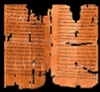
Clearing History
36
The New Testament Canon During the First Four Centuries
H. Wayne House
Acceptance of the Four Gospels Before Nicaea
Individuals
Canons
Translations
Origen (185-254)
Didache (120-150)
Papias (130-140)
Pseudo-Barnabas (70-130)
Clement of Rome (95-97)
Polycarp (110-150)
Justin Martyr (150-155)
Irenaeus (130-202)
Hermas (115-140)
Marcion (140)
Cyril of Jerusalem (315-386)
Tatian Diatesseron (170)
Old Latin (150-170)
Muratonian (170)
Barococcio (206)
Old Syriac (200)
X= Citation
or allusion
Apostolic (300)
O= Named
as authentic
Matthew
Mark
Luke
John
O
O
O
X
X
X
X
X
O
X
X
O
O
O
O
X
X
X
O
X
X
O
O
O
O
O
O
O
X
X
X
O
X
X
O
O
O
O
O
O
O
O
X
X
X
O
O
X
O
O
O
O
O
O
O
Gospel of Thomas
AD 50-140
Gospel of Judas
AD 170?
1st Cent.
AD 325
Council of Nicaea
Geisler & Nix, Introduction to the Bible (Chicago: Moody, 1968)
Notes:
This is found in H. Wayne House, Chronological & Background Charts to the New Testament, It is also the last page of the notes for this seminar. The point here is that our four gospels were consistently cited whereas "Brown's Gnostic gospels" were likely not even written until the second century (even if Thomas appeared as early as AD 40 it was still deemed heretical).

Slide 35

How Well Do You Know the Life of Christ?
How Well Do You Know the Life of Christ?
53
4
Guest at Wedding
Can you number these events in chronological order?
6
Interview with Nicodemus
3
Enemy's 3 Temptations
7
Message on Mount
1
Birth in Bethlehem
5
Housecleaning the Temple (1st time)
10
Washing Disciples' Feet
8
Parables of Kingdom
2
Carpenter in Nazareth
9
Tomb of Lazarus
Terry Hall, Bible Panorama, 121

Slide 36
Reasons Mark is Seen as First
Explain and respond in your small group…
85
Details are most vivid
Grammar and style roughest
Embarrassing or misleading details
Shortest gospel
Little material not in Matthew or Luke
Text order same in Matthew & Luke
High incidence of Aramaic words
Omits all material common to Matthew & Luke
Consistent theology of Matthew & Luke
Blomberg, Jesus and the Gospels, 87-90
Notes:
1. Details are most vivid—But the source (Peter) was the most colorful and this assumes that later writers would be more boring
2. Grammar and style roughest—But isn't this just stylistic rather than indicating an original?
3. Embarrassing or misleading details—But Mark could just be getting into the action as the young man fleeing naked in the garden
4. Shortest gospel—But this assumes that later gospels got longer whereas it may not have been the case
5. Little material not in Matthew or Luke—But Peter as a source would not need these other gospels
6. Text order same in Matthew & Luke—But would not the chronology be the same despite the order of composition?
7. High incidence of Aramaic words—But this is expected as Mark was a Jerusalem Jew informing a Roman audience
8. Omits all material common to Matthew & Luke—But we would expect this as the birth and genealogy were not needed
9. Consistent theology of Matthew & Luke—But these relate to the kingdom which would not be needed as much for Mark's readers
_____
NS-01-Gospels-36
NS-02-Mark1-8-slide 32

Slide 37
Indicators that
Matthew wrote the First Gospel
78a
Notes:
NS-01-Gospels-37
NS-01-Matt1-14-slide 118
NS-04-John1-12-slide 29

Slide 38
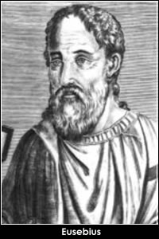
External Indicator #1:
Testimony of Eusebius (4th cent.)
78a
"Among the four Gospels, which are the only indisputable ones in the Church of God under heaven, I have learned by tradition [from 2nd cent. Origen] that the first [Gospel] was written by Matthew, who was once a publican, but afterwards an apostle of Jesus Christ, and it was prepared for the converts from Judaism, and published in the Hebrew language."
(Eusebius, Eccl. Hist. 6.25.4 quoting Origen of the 2nd century)

Slide 39
External Indicator #1:
Testimony of Eusebius (4th cent.)
78a
"The second is by Mark, who composed it according to the instructions of Peter, who in his Catholic [i.e., General] epistle acknowledges him as a son, saying, 'The church that is at Babylon elected together with you, saluteth you, and so doth Marcus, my son.' And the third by Luke, the Gospel commended by Paul, and composed for Gentile converts. Last of all that by John."
(Eusebius, Eccl. Hist. 6.25.4 quoting Origen of the 2nd century)

Slide 40
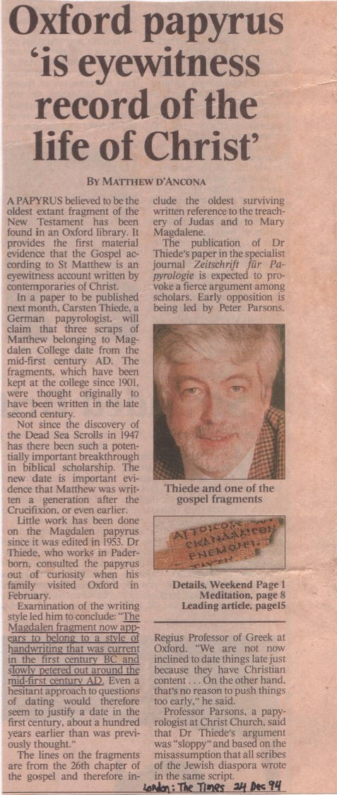
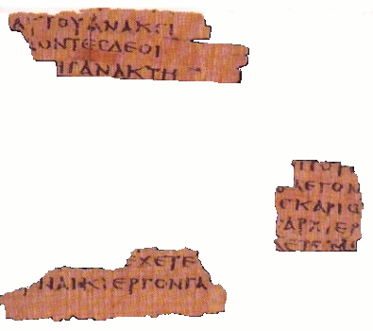
External Indicator #2: Papyrus from about AD 50
78a
"The Magdalen fragment now appears to belong to a style of handwriting that was current in the first century BC and slowly petered out around the mid-first century AD"
(Dr. Carsten Thiede)

Slide 41
External Indicator #3:
Placement First in the NT
78a
The Gospels
History
Matthew
Mark
Luke
John
Acts
Letters by Paul
1 Thessalonians
2 Thessalonians
1 Corinthians
2 Corinthians
Philippians
Ephesians
Colossians
1 Timothy
Romans
Galatians
2 Timothy
Philemon
Titus
General Letters
Prophecy
Hebrews
1 Peter
2 Peter
1 John
2 John
3 John
James
Jude
Revelation
Notes:
What overall observations can you make in your small group for the NT?
• There are 5 parts to the NT (grouped by category)
• 4 versions of Christ's life but only one of the church
• Most the NT are letters (especially by Paul)
• 6 of Paul's 13 letters are to people he wrote twice (all follow-up except Rom & Col)
• 2 groupings (general epistles & gospels) named after their authors while Paul's after their recipients

Slide 42

Irenaeus
AD 180
Internal Indicator:
Matthew Wrote to Jews
78a
"Matthew also issued a written Gospel among the Hebrews in their own dialect, while Peter and Paul were preaching at Rome [AD 60-68], and laying the foundations of the Church. After their departure [post AD 68], Mark, the disciple and interpreter of Peter, did also hand down to us in writing what had been preached by Peter. Luke also, the companion of Paul, recorded in a book the Gospel preached by him [no date given]. Afterwards [post 68], John, the disciple of the Lord, who also had leaned upon His breast, did himself publish a Gospel during his residence at Ephesus in Asia."
Against Heresies 3.1
Notes:
http://www.ccel.org/fathers2/ANF-01/anf01-60.htm#P7477_2003920

Slide 43

Principles to Properly
Interpret the Gospels
Study the background of your text.
See the text in light of that author's purpose.
Don't invent new meanings to words ("Israel" means Israel, etc.)
Don't spiritualize the OT teaching on the kingdom (political-spiritual-national-universal)

Slide 44
Black

Slide 45

NT Survey link at biblestudydownloads.org
Get this presentation for free!

