Slide 1
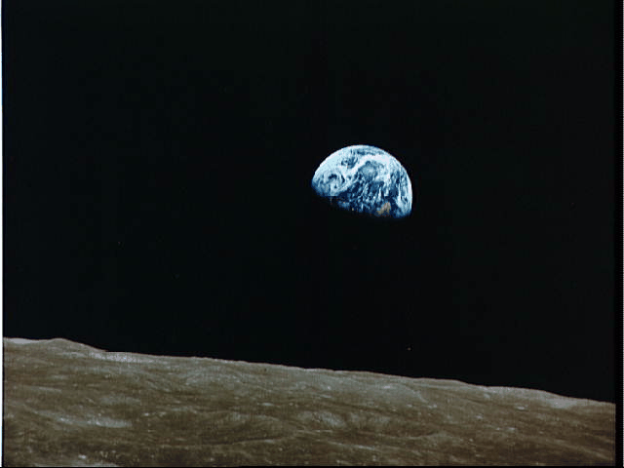
The Overall Theme of the New Testament
Dr. Rick Griffith • Jordan Evangelical Theological Seminary • BibleStudyDownloads.org

Slide 2
What is the overall theme of the New Testament?
When you look at earth from the moon, you get the BIG PICTURE.
In like manner…

Slide 3

Redemption means
“to release from ransom”
Notes:
The idea is freedom from the "prison of sin."

Slide 4

Redemption in the Media
People have an inherent sense that they need redemption
Notes:
Think about most movies. They follow a familiar plot:
1. There is a problem that comes to a crisis point.
2. A Savior figure rises to conquer the problem.
3. Resolution results.

Slide 5

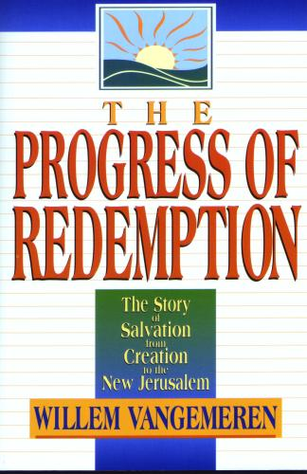
The Focus of History is the Redemption Provided by Christ
Notes:
Scholars often rightfully speak of the process of God redeeming us.

Slide 6

The Centrality of the Cross
WHAT?
1st
A
d
a
m
2nd
A d a m
NAT
ION
TRI
BE
FAMI LY
5 0 0 0
1 2 0
11
Notes:
Human history narrowed down to Jesus Christ and expanded from there. From the "First Adam" came all peoples initially but this narrowed to the nation of Israel, the tribe of Judah, and the line or family of David that brought us, Jesus. Then history expands from the 11 apostles to the 120 at Pentecost to over 5000 that saw the resurrected Jesus, and eventually this "Second Adam" will rule the entire world!

Slide 7
The Centrality of the Cross
55
E
T
E
R
N
I
T
Y
E
T
E
R
N
I
T
Y
But redemption as the KEY OT Theme has these problems:
It is an external structure imposed on the OT from systematic theology.
It focuses too much on man rather than God.
Christ is the central person of the Bible, but the OT focuses on Him as King more than as Savior (the OT rarely notes the salvation of individuals.)
This view also does not include God's program for angels, those not redeemed, and creation as a whole, so it is too restrictive.
The view is not traced in the wisdom books (not supported in Eccles., Prov., etc.).
It neglects the physical (land) aspects prominent in the OT.
Notes:
The person of Christ bridges the OT and the NT.
His redemption is taught some in the OT: Gen 3:15; Leviticus typology; Isa 53; 61:1-4
However, his rule bridges the OT and NT more than his atonement.
• It also has at least six other problems (read).

Slide 8
Covenant
"Such is the scenario as the Bible reaches its glorious conclusion in the Book of the Revelation.
There, in the millennial context, all the many streams of history and God's unconditional covenants flow together toward completion.
All that was promised has been fulfilled.
That ancient understanding between God and his friend, ABRAHAM, is accomplished."
JESUS
Life
Cross
Church
Gospels
Acts
Epistles
Revelation
John Walvoord
Handbook pg. 39-41
58
3
© 2006 TBBMI
PHOTO ©NASA
8.0.03f.
Notes:
About the Revelation, the beloved late theologian, John Walvoord, wrote this: "Such is the scenario as the Bible reaches its glorious conclusion in the Book of the Revelation.
//// There, in the millennial context, all the many streams of history and God's unconditional covenants flow together toward completion.
//// All that was promised has been fulfilled.
//// That ancient understanding between God and his friend, ABRAHAM, is accomplished."

Slide 9

The Abrahamic Covenant
(“The Call”)
Genesis 12: 1-3
JESUS
LAND
SEED
BLESSING
Life
Cross
Church
Gospels
Acts
Land
Davidic
New
Epistles
Revelation
Deuteronomy
30:1-10
2 Samuel
7:4 -16
Jeremiah
31:31-33
Handbook pg. 39-41
59
Notes:
And so…THE ABRAHAMIC COVENANT progresses with fulfillment of the LAND, SEED, and BLESSING promises:

Slide 10
The Abrahamic Covenant
(“The Call”)
Genesis 12: 1-3
JESUS
LAND
SEED
BLESSING
Life
Cross
Church
Gospels
Acts
Land
Davidic
New
Epistles
Revelation
Deuteronomy
30:1-10
2 Samuel
7:4 -16
Jeremiah
31:31-33
Handbook pg. 39-41
60
Notes:
In that millennial context,
Israel is seen permanently settled in The LAND for all time-
and so completing the LAND COVENANT;

Slide 11
The Abrahamic Covenant
(“The Call”)
Genesis 12: 1-3
JESUS
LAND
SEED
BLESSING
Life
Cross
Church
Gospels
Acts
Land
Davidic
New
Epistles
Revelation
Deuteronomy
30:1-10
2 Samuel
7:4 -16
Jeremiah
31:31-33
Handbook pg. 39-41
61
Notes:
JESUS CHRIST, the righteous SEED of DAVID, is seen reigning permanently on the Throne of DAVID in Jerusalem — completing the DAVIDIC COVENANT; and

Slide 12
The Abrahamic Covenant
(“The Call”)
Genesis 12: 1-3
JESUS
LAND
SEED
BLESSING
Life
Cross
Church
Gospels
Acts
Land
Davidic
New
Epistles
Revelation
Deuteronomy
30:1-10
2 Samuel
7:4 -16
Jeremiah
31:31-33
Handbook pg. 39-41
62
1
Notes:
All men are seen living in the light of the BLESSING that emerges from this future time when, once again, Our Lord is living upon the earth — thus completing THE NEW COVENANT.
//// Bringing completion to every element of the great Abrahamic Promises of Genesis 12:1-3...that contractual arrangement between God and Abraham that laid the ancient groundwork for the appearance and ministry of the Lord Jesus Christ.

Slide 13
The Abrahamic Covenant
CREATION
ABRAHAM
(“The Call”)
JOSEPH
Genesis 12: 1-3
MOSES
JOSHUA
ANARCHY
ROYALTY
CAPTIVITY
JESUS
LAND
SEED
BLESSING
Life
Cross
SILENCE
Church
Gospels
JESUS
Acts
Land
Davidic
New
Epistles
Revelation
Deuteronomy
30:1-10
2 Samuel
7:4 -16
Jeremiah
31:31-33
Handbook pg. 39-41
63
1
Notes:
So…into your mental JESUS file now go all things connected with the Christian life, all of your studies, all of your reading, thinking, prayer life, and life’s experiences as you grow and mature in your faith.
Here is the organized location for all those great persons of the New Testament, for the incomparable events of the Savior's life, and for the founding and expanding of His CHURCH.
//// An absolute core realization from the JESUS file is this: connectedness and outgrowth from ALL THE OTHER FILES that have preceded it. Scripture is a unity –– a grand program is seen in operation. With a comprehension of that unity there follows a personal and spiritual connection for every one of us to all that has gone before ––– and all that will come after.

Slide 14
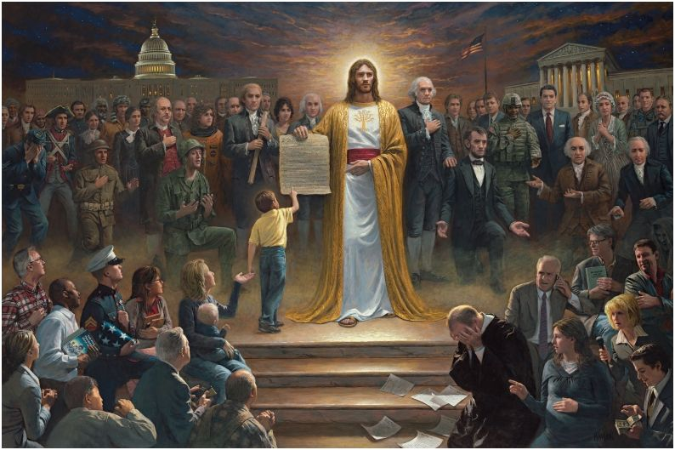
One Nation Under God
By Jon McNaughton (2012)
http://jonmcnaughton.com/content/ZoomDetailPages/OneNationUnderGod.html
Notes:
http://jonmcnaughton.com/content/ZoomDetailPages/OneNationUnderGod.html
Interview with the Artist: http://jonmcnaughton.com/content/ZoomDetailPages/OneNationInterview.html

Slide 15
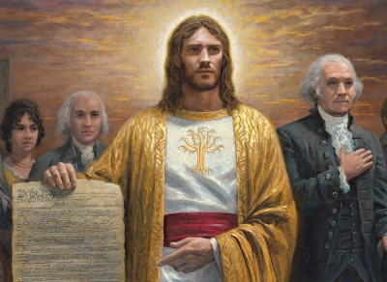
Jesus Christ, the Most Controversial Person
http://jonmcnaughton.com/content/ZoomDetailPages/OneNationUnderGod.html
Notes:
http://jonmcnaughton.com/content/ZoomDetailPages/OneNationUnderGod.html
Interview with the Artist: http://jonmcnaughton.com/content/ZoomDetailPages/OneNationInterview.html

Slide 16
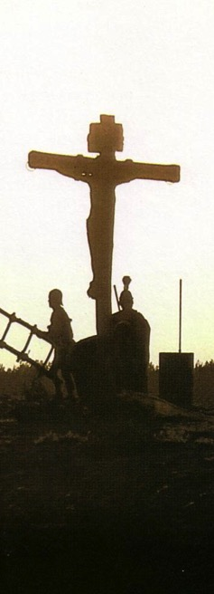
Salvation in All Ages:
The Centrality of the Cross
B.C.
Looked forward to the
Cross of Christ
A.D.
Look
back at the
Cross of Christ
Notes:
It helped me see the centrality of the cross—how people before Jesus believed by looking toward the cross while those of us after Jesus look back at the cross. In other words…
The grounds of salvation has always been the death of Christ—for believers before and after the cross.
____________________
Common English-78
BE-03-Leviticus-73
OB-37-Sacrifices-19
OB-38-Salvation-4
OS-03-Leviticus-73
NS-09-Galatians-16, 50
NS-20-James-32
SA-03-Biblical Terminology-10
SA-15-Inheritance-26

Slide 17
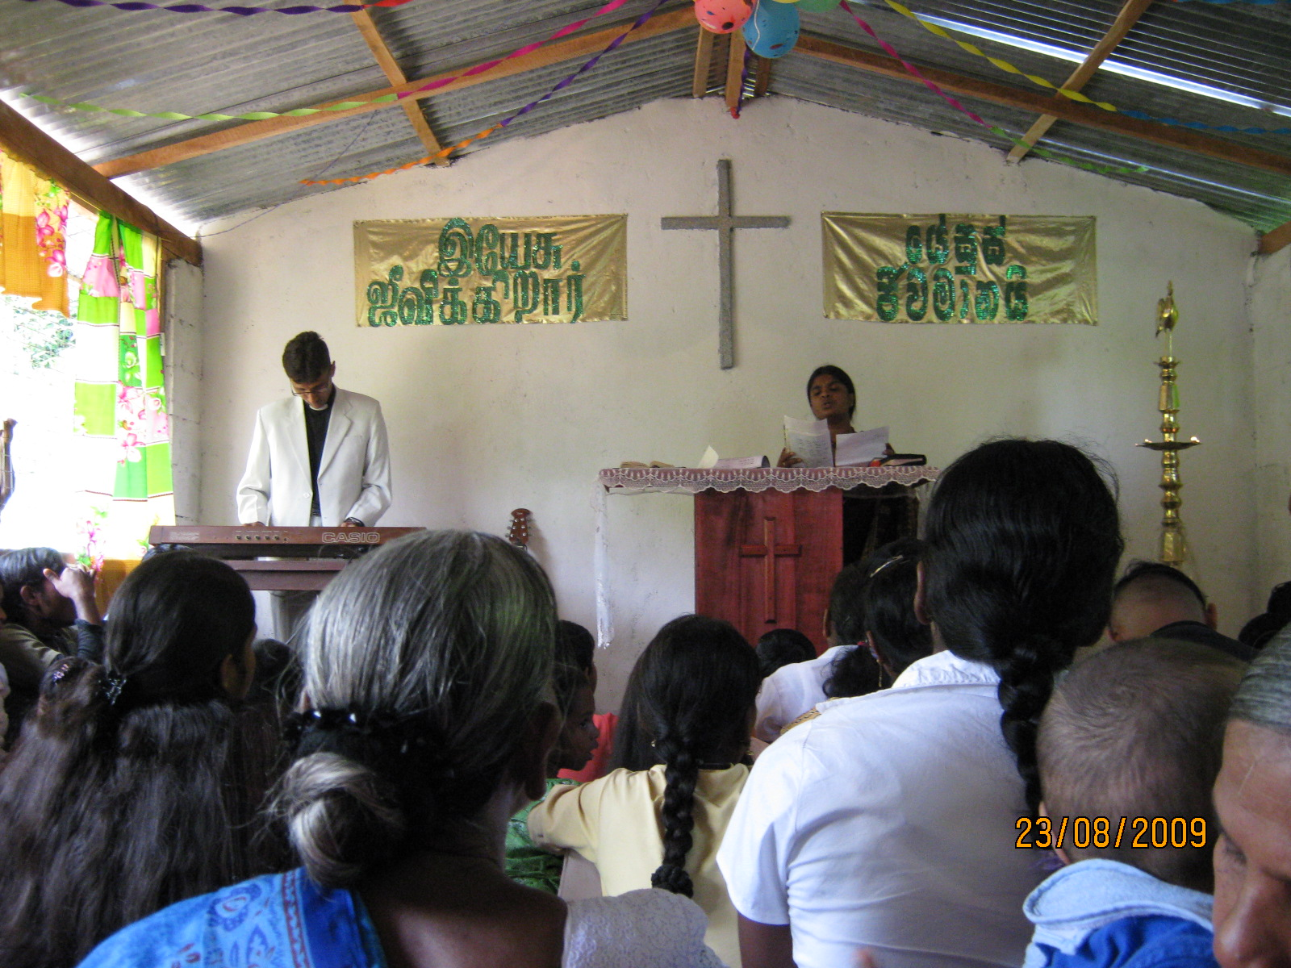
Different Views on the Nature of the Church
7

Slide 18
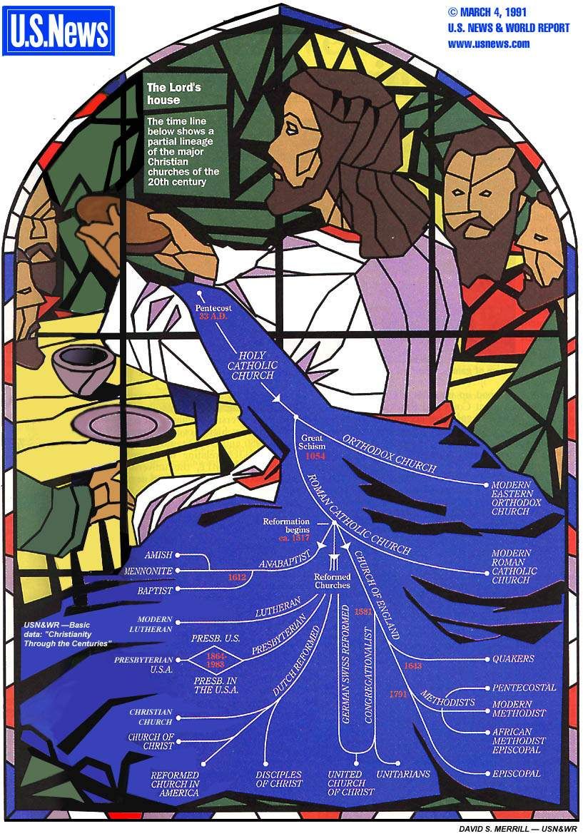
Denominations
This tree of church history depicts the relationships between the various branches of the Christian Church

Slide 19
Denominations
This tree of church history depicts the relationships between the various branches of the Christian Church

Slide 20
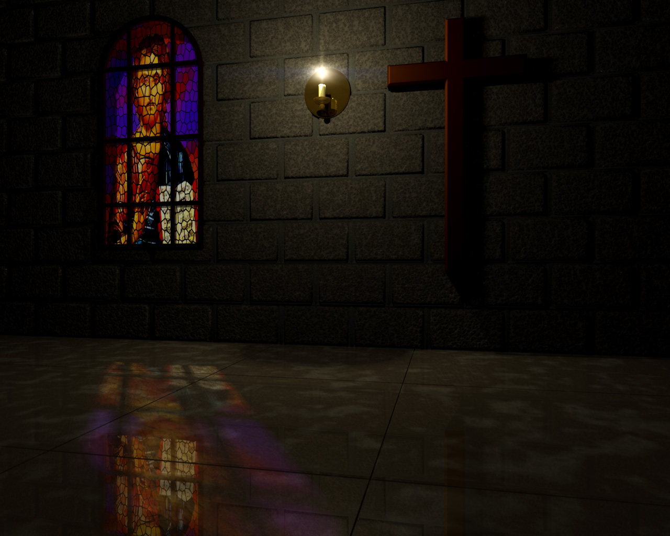
What is Your Own Definition of the Local Church?
8

Slide 21

A Biblical Definition
9
"The church is the living community of people in Christ Jesus, organized to fulfill corporately a threefold purpose:
worship, edification, and multiplication"
Church Dynamics (BEE World Course), 40.

Slide 22
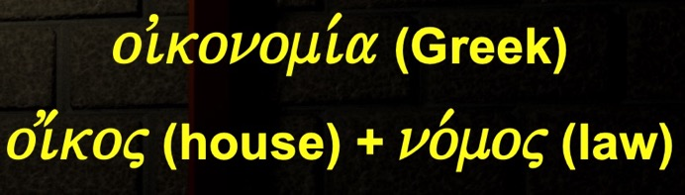
Dispensations (Eph. 3:2)
"…you know God gave me the special responsibility
of extending his grace to you Gentiles"
(NLT)
"…you have heard of the stewardship of God's grace which was given to me for you"
(NAU)
"administration" (NIV)
"dispensation" (KJV)
oivkonomi,a (Greek)
oi;koj (house) + no,moj (law)
"responsibility of management, management of a household, direction, office" (BDAG)
Time before Paul's dispensation (Gentiles came through Israel under law)
Time of Paul's dispensation (Gentiles equal to Jews
under grace)

Slide 23
Dispensations in Ephesians
180f
SALVATION BY GRACE THROUGH FAITH
(6)
Church
(3:2, 9)
(1)
Pre-Fall
(2)
Conscience
(3)
Government
(4)
Patriarchal
(5)
Mosaic
(2:15)
(7)
Millennial
(1:9-10)
ISRAEL ≠ CHURCH
PROGRESSIVE REVELATION
Adapted from Paul Benware, Understanding End Times Prophecy, 2d ed. (Chicago: Moody, 2006), 88

Slide 24
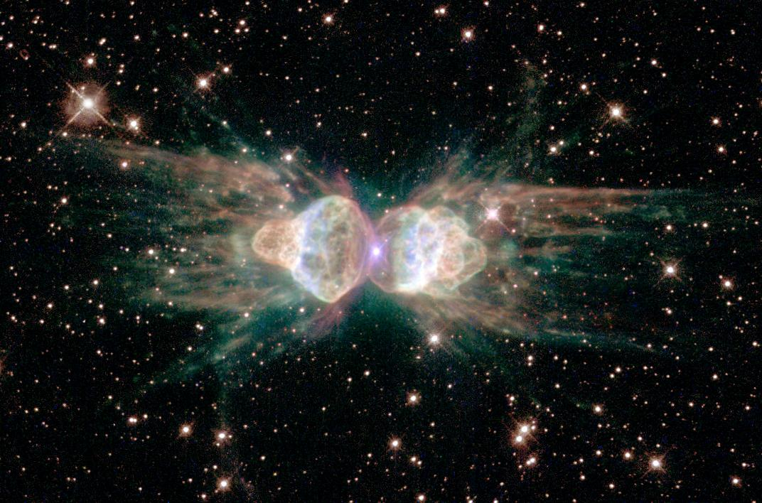
The Glory of God
The Glory of God
Notes:
God certainly wants us to praise him above all else.

Slide 25
The Glory of God
1600 years
40 authors
ONE THEME:
the glory of God
4
3
5
GOSPELS
6
2
PROPHECIES
WRITINGS
ACTS
7
HISTORIES
EPISTLES
1
LAW
8
REVELATION
©2003 TBBMI
7.5.06.
2
15
Notes:
• Every section of the Bible teaches us to glorify God.

Slide 26

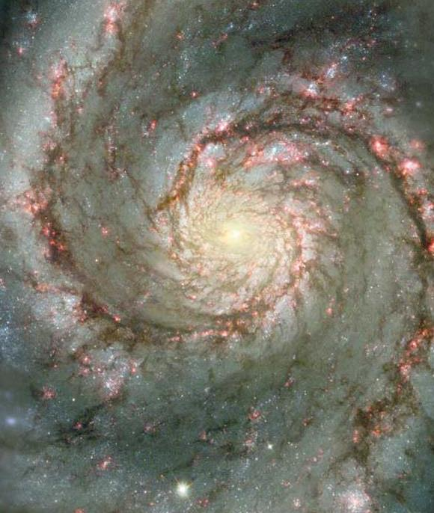
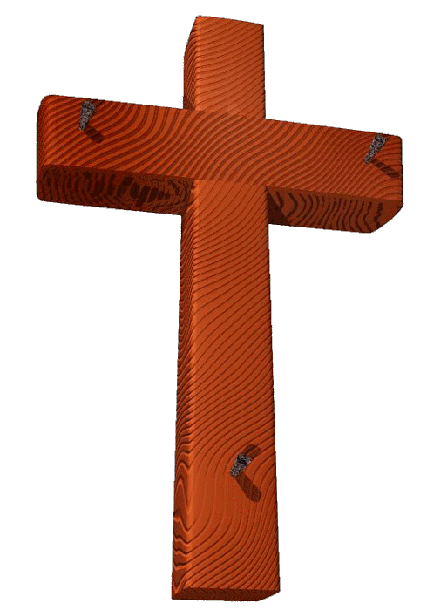
Glory and the Cross
The Glory of God
06-31
40
1
©2003 TBBMI
7.5.06.
Notes:
So the Westminster Catechism tells us that the chief aim of man is to glorify God.
• Jesus prayed in John 17 for God to glorify the Son through the cross so that the Father would be glorified.
And we should glorify God—but exactly how will he do this—and the cross wasn't even needed in Genesis 1–2 so redemption to glorify God wasn't needed then.

Slide 27
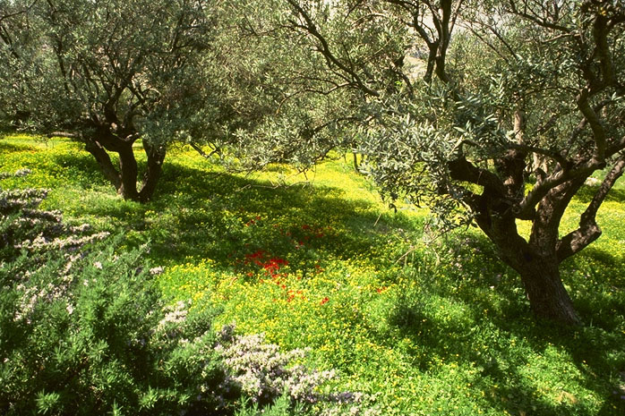
The Kingdom
JESUS
Life
Cross
Church
Gospels
Acts
Epistles
Revelation
The Garden of Gethsemane,
Mount of Olives, Jerusalem
64
1

Slide 28
Matt. 3:1-2 NLT
"In those days John the Baptist came to the Judean wilderness and began preaching. His message was, 'Repent of your sins and turn to God, for the kingdom of heaven is near' "
JESUS
Life
Cross
Church
Gospels
Acts
Epistles
Revelation
65

Slide 29
Matt. 4:17, 23
“…Jesus began to preach and say: 'Repent, for the kingdom of heaven is at hand…Jesus was going throughout all Galilee, teaching in their synagogues and proclaiming the gospel of the kingdom…' ”
JESUS
Life
Cross
Church
Gospels
Acts
Epistles
Revelation
65
Notes:
What was Jesus saying to us? In Matthew's fourth chapter, we are told that “Jesus began to preach and say: 'Repent, for the kingdom of heaven is at hand…Jesus was going throughout all Galilee, teaching in their synagogues and proclaiming the gospel of the Kingdom…'”
What is that Kingdom? What did he mean?

Slide 30
Matt. 10:5-7
"Jesus sent out the twelve apostles with these instructions: 'Don't go to the Gentiles or the Samaritans, ⁶ but only to the people of Israel—God's lost sheep. ⁷ Go and announce to them that the kingdom of heaven is near'"
65

Slide 31
Matt. 6:33
“But seek first His Kingdom and His righteousness, and all these things will be added to you.”
JESUS
Life
Cross
Church
Gospels
Acts
Epistles
Revelation
66
Notes:
Two chapters later, Matthew reports Jesus saying, “But seek first His Kingdom and His righteousness, and all these things will be added to you.”

Slide 32
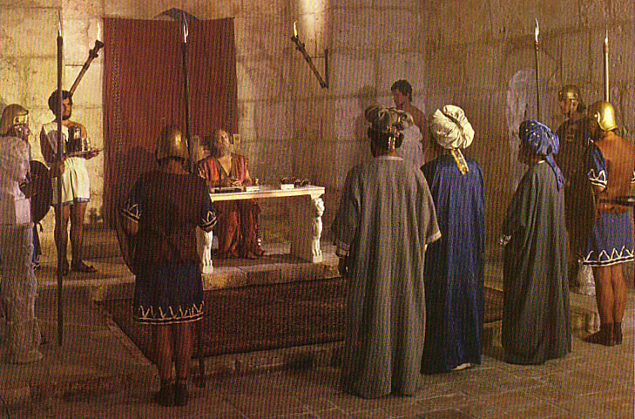
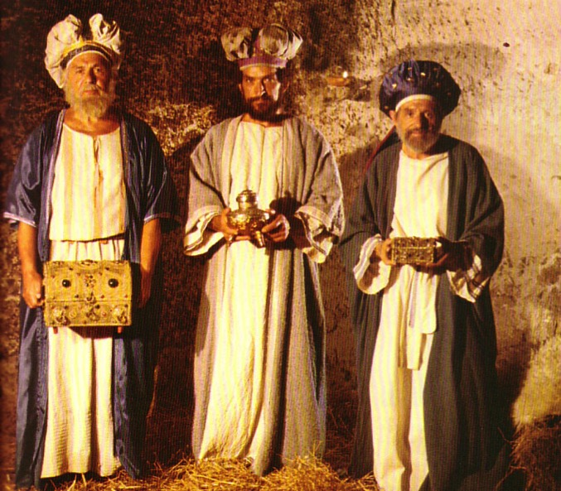
What Kind of Kingdom Did Isaiah
(and Matthew) Envision?
78b
Political
Physical
Emotional
Intellectual
Spiritual

Slide 33
“For He has rescued us from the domain of darkness, and transferred us to the kingdom of His beloved Son.”
Col. 1:13
JESUS
Life
Cross
Church
Gospels
Acts
Epistles
Revelation
67
Notes:
Paul then writes in his Colossian letter: “For He has rescued us from the domain of darkness, and transferred us to the kingdom of His beloved Son.”
This Kingdom…where is that and how do we get there?

Slide 34
Two Overarching Messages of All of Scripture:
#1: Celebrating & Demonstrating The Glory of God
JESUS
Life
Cross
Church
Gospels
Acts
#2: Leading Us Toward The Kingdom of God
Epistles
Revelation
68
2
Notes:
We are instructed by two overarching messages of Scripture…first
//// The message of the Book portrays for us in words we can clearly strive to comprehend, celebrate, and demonstrate “THE GLORY OF GOD!”
//// Upon our understanding and upon our surrendering to the leadership of the Holy Spirit…we are led steadily toward the Kingdom of God…which is simply regaining that close and intimate relationship that was surrendered by our original parents in that ancient Garden.

Slide 35
Jesus Christ came to save that which was lost…and that to acquire eternal life, one must come to it through belief in the gospel message of the Messiah.
JESUS
Life
Cross
Church
Gospels
Acts
Epistles
Revelation
THEREFORE: WE MUST GO AND TELL!
69
1
Notes:
Scripture says flatly that…
Jesus Christ came to save that which was lost…and that to acquire eternal life, one must come to it through belief in the gospel message of the Messiah.
If we believe…if we truly believe the words of our Book…then our commission is very simple:
//// WE MUST GO AND TELL! We must be willing to share our faith with others, to offer to them the assurance of the life everlasting that, if believers, we hold ourselves. NOT TO DO THAT is to disobey and disregard the clear command of Our Lord as He left his disciples for His heavenly throne…leaving his blessing “to all families of the earth” just as had been promised to old Abraham 2,000 years earlier.

Slide 36
Kingdom & Covenants Timeline
22
CH-34a
OS1-22
OS2-337
NS-9g
SA-19
Dr. Rick Griffith • BibleStudyDownloads.org
Kingdom Teaching...
Adam rules with God (Gen. 1:26, 28; 2:19)
Satan begins rule as god of this world (Gen. 3:15;
2 Cor. 4:4)
God covenants with Abraham to reestablish man's rule via Israel as a "kingdom of priests" (Gen. 12:1-3; Exod. 19:6)
Israel's failure to witness to nations as a kingdom of priests is judged via exile under foreign rule
Israel rejects Messiah's offer of kingdom (Matt. 12:41-42; 23:37-39)
Jesus extends His kingdom in mystery form to the Church (Matt. 13)
Christ subdues Israel's enemies and nation believes (Rom. 11:26-27)
Christ rules over everything with saints (Eph. 1:9-10; Rev. 20:1-6; 22:5b)
Fall of Man (Gen. 3)
Noahic Covenant
Genesis 6:18; 9:8-17
Land Covenant
ISRAEL
CHURCH
MESSIANIC KINGDOM
34a
(National Focus)
The "New Man" (Eph. 2:15)
Millennial Eternal
land
Genesis 15:18 (cf. Deut. 30:1-10) promises:
Land from Wadi of Egypt to Euphrates River (Isa. 27:12)
Eternal possession of land (Gen. 17:8) after exile/restoration
Whole world blessed via the land (Isa. 14:1-2)
Israel judged for rejecting Messiah by dispersion away from land for 19 centuries
(AD 70–AD 1948) but now partially restored (Ezek. 37:1-7)
Full restoration (Ezek. 37:8-28) Jerusalem world capital
(Isa. 2:1-5)
New Jerusalem
(Rev. 21–22)
22
337
Davidic Covenant
Christ is Head over his Church, which is a spiritual temple (Eph. 2:19-22; 2 Cor. 6:16)
Christ reigns over the world
(Isa. 11)
with saints (Rev. 5:10; 20:4-6)
Christ hands kingdom over to Father (1
Cor. 15:24)
9g
Genesis 12:1-3
2 Samuel 7:12-16 promises:
Sons ("house" never wiped out)
Kingdom (political dynasty)
Throne (right to rule by descendants)
Temple (son to build it)
seed
19
Abrahamic Covenant
New Covenant
All
things made new!
(Rev. 21:5)
All 5 elements fulfilled in national restoration (Zech. 8)
Jeremiah 31:31-34 promises:
Forgiveness
Indwelling Spirit
New heart, nature, mind
Reunification of Israel and Judah
No need for evangelism
Mosaic Law is replaced with first three elements of the New Covenant (Luke 22:20; 2 Cor. 3:6)
blessing
Mosaic Covenant
The Law was fulfilled and replaced at the cross (Rom. 7:1-6;
1 Cor. 9:19-21; Heb. 8:13)
14th Edition
29 Feb 2024
Temporary (Gal. 3:19) and conditional (Deut. 28) to reveal sin (Rom. 7:7) and regulate Israel (Gal. 3:23-25)
Scripture has a dual kingdom-covenant theme. Israel's role from Abraham to Christ expands to include the Church (continuity) yet the Church never replaces the nation as the "new Israel" (discontinuity). Israel will enjoy world prominence after trusting Christ at His second coming.
Notes:
This complicated chart combines the two themes of Kingdom and Covenants. God's kingdom rule extends to humanity across the ages at the top. But the major part shows the unfolding of the Abrahamic Covenant in its Land Covenant, Davidic Covenant, and New Covenant promises—partially fulfilled in the present, but fully completed in the Messianic Kingdom. This will happen in the Millennial Age and especially in the Eternal State.
• This chart also shows that the Old (Mosaic) Covenant was replaced by the New Covenant.
All agree that a partial fulfillment of the covenant to Abraham exists now to the Church in the indwelling Holy Spirit and forgiveness of sins (Jer 31:31-34)—and the ultimate fulfillment will be in the eternal state.
The main area of disagreement relates to the time from now to eternity. Will there be a literal land, throne, and worldwide blessing to national (ethnic) Israel before the eternal kingdom? This chart shows verses giving a resounding YES to that question in a present partial fulfillment and a future full fulfillment in the normal sense of language in the verses cited. But the messianic kingdom will be in two stages—first in a millennial fulfillment to last 1000 years, but then, after that, the eternal stage in the new Jerusalem after the destruction of our present heavens and earth (Rev 21–22). What an amazing future remains for those who trust Jesus!
____________
Common-151
BG-13-Present & Future Geog-74
BT-01-OT Biblical Theology-25
CH-02-Nature-103-p34a
OC-10-Chronology-42
OS-00-Intro & Biblical Theology-40 & 103
OS-02-Exodus-267-p22
OS-05-Deut-279, 300
OS-10-2Sam-96-p22
OS-10-Davidic Covenant-29, 79
OS-11-1 Kings-22
OS-12-Kings & Prophets Charts-25
OS-13-1 Chron-46
OS-17-Kingdom & Covenants Timeline-01
OS-23-Isaiah-97-p337
OS-24-Jeremiah-174-p337
OS-23-Isaiah-97-p337
OS-28-Hosea-49
OS-31-Obadiah-164
05-Acts1-2-slide 45
NS-00-00-Kingdom & Covenants Timeline-English-1
NS-00-Theme of NT-18
NS-09-Gal-143-p9g
NS-19-Hebrews-342-p9g
NS-27-Rev20-22-slide 189
SA-08-Mosaic Law-21-p38a

Slide 37
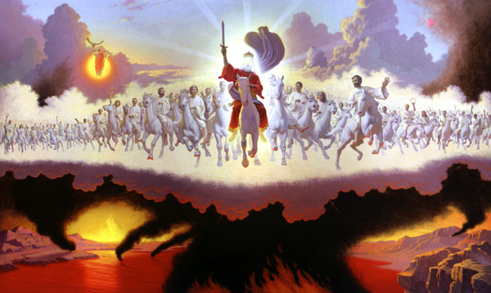
"Look!
He comes with the clouds of heaven.
And everyone will see him— even those who pierced him.
And all the nations of the world will mourn for him.
Yes! Amen!"
Rev. 1:7 NLT
cf. Zech. 12:10

Slide 38
Jesus Wins!
Series on Revelation

Slide 39
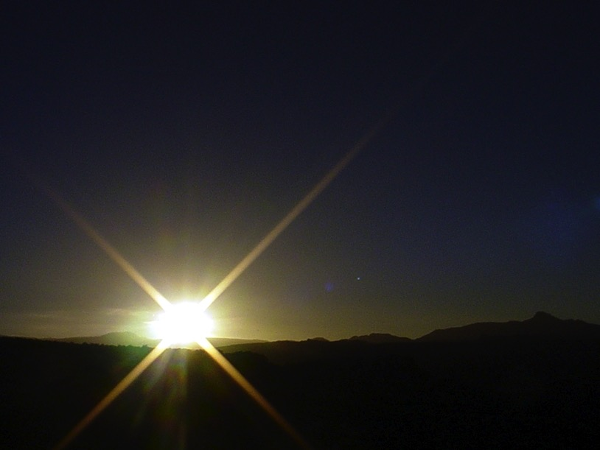
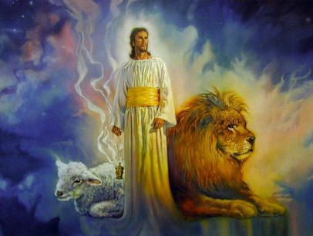
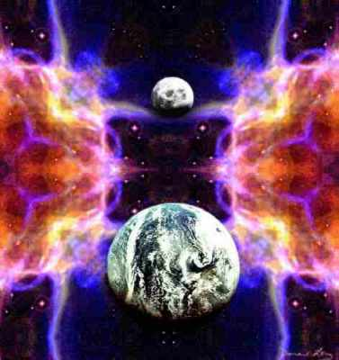
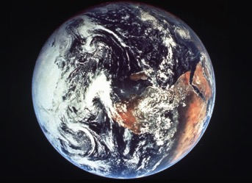
The Bible's Chiasm
446
Repeated Patterns in Reverse Order
Christ's Redemption
Christ's Rule
Man's Rule Lost at
Fall
Man's
Rule Restored at Millennium
Creation
New Creation
Notes:
We need to know who we are—more accurately, who God says we are—our future identity.
This is shown in the overall structure of the Bible in a chiasm—a literary pattern where earlier content is repeated in reverse order:
• Creation in Genesis 1–2 • is repeated In the Restored, New Creation in Rev 21–22
• Man was created to rule over the fish, birds, and land animals (Gen. 1:28) but he gave over his rule over to the god of this world, Satan (2 Cor. 4:4)
• But this rule will be restored during the 1000-year reign of the saints (Rev. 20:4-6)
• Christ is the central Person of history, • both as Lamb (Redeemer) • and as Lion (Ruler of all creation in the line of David)
________________
BE-17-Esther-76
OC-17-Genesis Authorship-14
OS-01-Genesis1-3-slide 243
OS-17-Esther-17, 145
NS-27-Rev20-22-slide 206

Slide 40
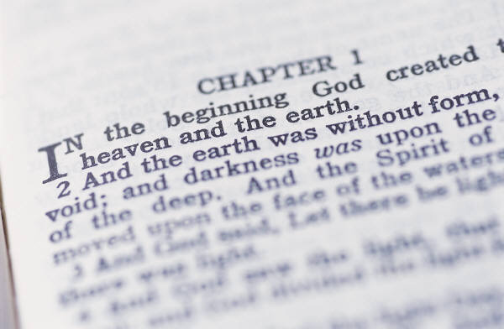
My View of the OT's Theme
33
The Old Testament narrates
God's restoring man to participate in His kingdom rule for His own glory
mandated in Eden but lost in the Fall
and accomplished by redeeming man
through Israel as a kingdom of priests
and ultimately through the Messiah,
who will reign as Savior and King
to fulfill the Abrahamic Covenant
Notes:
• The OT is a story more than a poetic description.
• This part in yellow italics is the main part of the main theme!
• Most descriptions of the overall theme lack kingdom ideas. But this one includes the problem
• the solution (redemption)
• the covenant nation of Israel
• the Messiah as King
• (not just Savior),
• and the Abrahamic Covenant.
__________
Common-152
BT-01-OT Biblical Theology-26
OS-00-Intro & Biblical Theolgy-104
OS-01-Gen1-3-slide 100?
OS-23-Isaiah_24-39/Slide 266 on Supplements
OS-23-Isaiah_49-59/Slide 172 on Supplements
OS-23-Isaiah_60-66/Slide 103 on Supplements
NS-00-Theme of NT-19
NS-05-Acts1-2-slide 45?
NS-22-Rev20-22-slide ?

Slide 41
My View of the NT's Theme
58
The New Testament narrates
God's restoring man to participate in His kingdom rule for His own glory
proclaimed by the Church
that salvation is by grace alone
though faith alone
in Christ alone
who will reign as Saviour and King
to fulfill the Abrahamic Covenant
to the glory of God alone
Notes:
The key NT theme should match or complete the OT one, right?
• Like the OT, the NT narrates—it is a story also.
• The kingdom of God is noted hundreds of times
• The means of proclamation is the Church
• The message is the same as in the OT, that is, grace
• This grace is received by faith and not works
• Christ is the only object of our salvation faith
• His salvation will result in his rule
• This will complete the Davidic aspect of the Abrahamic Covenant
• And God will receive the glory for it all
__________
Common-153
BT-01-OT Biblical Theology-27
NS-00-Theme of NT-20

Slide 42
My View of the Bible's Theme
58
The Bible narrates
God's restoring man to participate in His kingdom rule for His own glory
though Israel bringing forth the Messiah
so that the Church may proclaim
that salvation is in Christ alone
who will reign as Saviour and King
to fulfill the Abrahamic Covenant
to the glory of God alone
Notes:
So, now we can give the theme of the entire Bible!
• The whole book is a story—God's story—History, or "His story."
• God sharing his rule is the key theme
• Israel had the key role to bring us Jesus
• Jesus brings the Church to preach Him
• The Bible's message is to trust Jesus
• Why? There is no other Redeemer or Ultimate Ruler
• No one else fulfills all the promises to Abraham
• No one else will glorify God like Jesus
__________
Common-154
BT-01-OT Biblical Theology-28
NS-00-Theme of NT-20

Slide 43
Black

Slide 44
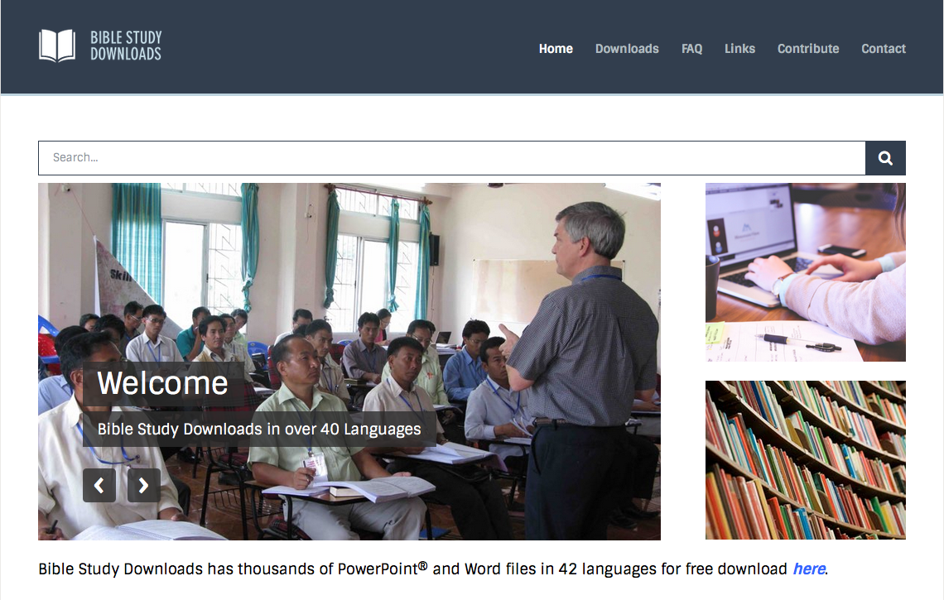
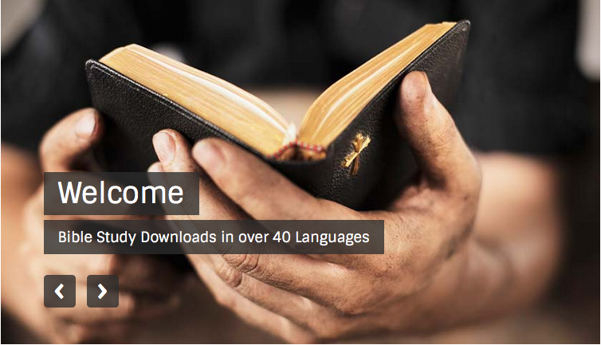
NT Survey link at BibleStudyDownloads.org
Get this presentation for free!
Notes:
NT Survey (ns)

