Slide 1
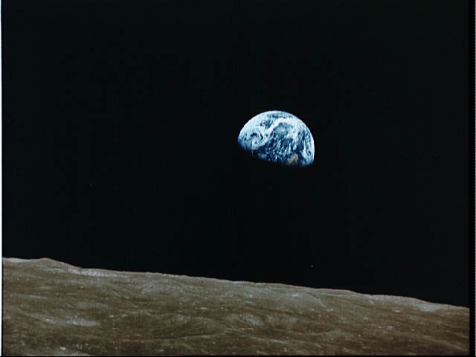
The Overall Theme of the New Testament
Dr. Rick Griffith • Jordan Evangelical Theological Seminary • BibleStudyDownloads.org

Slide 2
What is the overall theme of the New Testament?
When you look at earth from the moon, you get the BIG PICTURE.
In like manner…
Notes:
About the Revelation, the beloved late theologian, John Walvoord wrote this: "Such is the scenario as the Bible reaches its glorious conclusion in the Book of the Revelation.
//// There, in the millennial context, all the many streams of history and God's unconditional covenants flow together toward completion.
//// All that was promised has been fulfilled.
//// That ancient understanding between God and his friend, ABRAHAM, is accomplished."

Slide 3
Covenant
"Such is the scenario as the Bible reaches its glorious conclusion in the Book of the Revelation.
There, in the millennial context, all the many streams of history and God's unconditional covenants flow together toward completion.
All that was promised has been fulfilled.
That ancient understanding between God and his friend, ABRAHAM, is accomplished."
JESUS
Life
Cross
Church
Gospels
Acts
Epistles
Revelation
John Walvoord
Handbook pg. 39-41
58
3
© 2006 TBBMI
PHOTO ©NASA
8.0.03f.
Notes:
About the Revelation, the beloved late theologian, John Walvoord wrote this: "Such is the scenario as the Bible reaches its glorious conclusion in the Book of the Revelation.
//// There, in the millennial context, all the many streams of history and God's unconditional covenants flow together toward completion.
//// All that was promised has been fulfilled.
//// That ancient understanding between God and his friend, ABRAHAM, is accomplished."

Slide 4
The Abrahamic Covenant
(“The Call”)
Genesis 12: 1-3
JESUS
LAND
SEED
BLESSING
Life
Cross
Church
Gospels
Acts
Land
Davidic
New
Epistles
Revelation
Deuteronomy
30:1-10
2 Samuel
7:4 -16
Jeremiah
31:31-33
Handbook pg. 39-41
59
Notes:
And so…THE ABRAHAMIC COVENANT progresses with fulfillment of the LAND, SEED, and BLESSING promises:

Slide 5
The Abrahamic Covenant
(“The Call”)
Genesis 12: 1-3
JESUS
LAND
SEED
BLESSING
Life
Cross
Church
Gospels
Acts
Land
Davidic
New
Epistles
Revelation
Deuteronomy
30:1-10
2 Samuel
7:4 -16
Jeremiah
31:31-33
Handbook pg. 39-41
60
Notes:
In that millennial context,
Israel is seen permanently settled in The LAND for all time-
and so completing the LAND COVENANT;

Slide 6
The Abrahamic Covenant
(“The Call”)
Genesis 12: 1-3
JESUS
LAND
SEED
BLESSING
Life
Cross
Church
Gospels
Acts
Land
Davidic
New
Epistles
Revelation
Deuteronomy
30:1-10
2 Samuel
7:4 -16
Jeremiah
31:31-33
Handbook pg. 39-41
61
Notes:
JESUS CHRIST, the righteous SEED of DAVID, is seen reigning permanently on the Throne of DAVID in Jerusalem — completing the DAVIDIC COVENANT; and

Slide 7
The Abrahamic Covenant
(“The Call”)
Genesis 12: 1-3
JESUS
LAND
SEED
BLESSING
Life
Cross
Church
Gospels
Acts
Land
Davidic
New
Epistles
Revelation
Deuteronomy
30:1-10
2 Samuel
7:4 -16
Jeremiah
31:31-33
Handbook pg. 39-41
62
1
Notes:
All men are seen living in the light of the BLESSING that emerges from this future time when, once again, Our Lord is living upon the earth — thus completing THE NEW COVENANT.
//// Bringing completion to every element of the great Abrahamic Promises of Genesis 12:1-3...that contractual arrangement between God and Abraham that laid the ancient groundwork for the appearance and ministry of the Lord Jesus Christ.

Slide 8
The Abrahamic Covenant
CREATION
ABRAHAM
(“The Call”)
JOSEPH
Genesis 12: 1-3
MOSES
JOSHUA
ANARCHY
ROYALTY
CAPTIVITY
JESUS
LAND
SEED
BLESSING
Life
Cross
SILENCE
Church
Gospels
JESUS
Acts
Land
Davidic
New
Epistles
Revelation
Deuteronomy
30:1-10
2 Samuel
7:4 -16
Jeremiah
31:31-33
Handbook pg. 39-41
63
1
Notes:
So…into your mental JESUS file now go all things connected with the Christian life, all of your studies, all of your reading, thinking, prayer life, and life’s experiences as you grow and mature in your faith.
Here is the organized location for all those great persons of the New Testament, for the incomparable events of the Savior's life, and for the founding and expanding of His CHURCH.
//// An absolute core realization from the JESUS file is this: connectedness and outgrowth from ALL THE OTHER FILES that have preceded it. Scripture is a unity –– a grand program is seen in operation. With a comprehension of that unity there follows a personal and spiritual connection for every one of us to all that has gone before ––– and all that will come after.

Slide 9
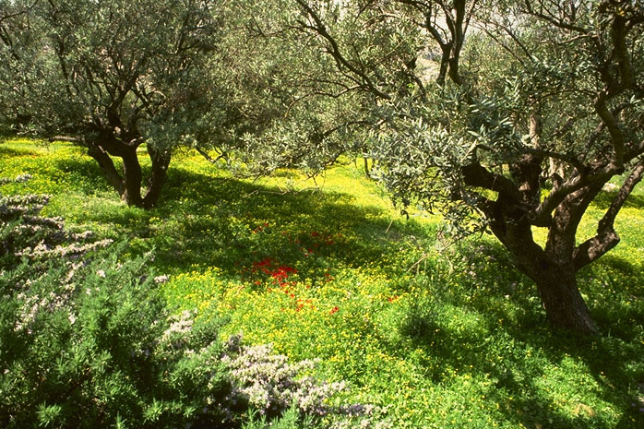
The Kingdom
JESUS
Life
Cross
Church
Gospels
Acts
Epistles
Revelation
The Garden of Gethsemane, Mount of Olives, Jerusalem
64
1

Slide 10
Matt. 3:1-2 NLT
"In those days John the Baptist came to the Judean wilderness and began preaching. His message was, 'Repent of your sins and turn to God, for the kingdom of heaven is near' "
JESUS
Life
Cross
Church
Gospels
Acts
Epistles
Revelation
65

Slide 11
Matt. 4:17, 23
“…Jesus began to preach and say: 'Repent, for the kingdom of heaven is at hand…Jesus was going throughout all Galilee, teaching in their synagogues and proclaiming the gospel of the kingdom…' ”
JESUS
Life
Cross
Church
Gospels
Acts
Epistles
Revelation
65
Notes:
What was Jesus saying to us? In Matthew's fourth chapter, we are told that “Jesus began to preach and say: 'Repent, for the kingdom of heaven is at hand…Jesus was going throughout all Galilee, teaching in their synagogues and proclaiming the gospel of the Kingdom…'”
What is that Kingdom? What did he mean?

Slide 12
Matt. 10:5-7
"Jesus sent out the twelve apostles with these instructions: 'Don't go to the Gentiles or the Samaritans, ⁶ but only to the people of Israel—God's lost sheep. ⁷ Go and announce to them that the kingdom of heaven is near'"
65
Notes:
What was Jesus saying to us? In Matthew's fourth chapter, we are told that “Jesus began to preach and say: 'Repent, for the kingdom of heaven is at hand…Jesus was going throughout all Galilee, teaching in their synagogues and proclaiming the gospel of the Kingdom…'”
What is that Kingdom? What did he mean?

Slide 13
Matt. 6:33
“But seek first His Kingdom and His righteousness, and all these things will be added to you.”
JESUS
Life
Cross
Church
Gospels
Acts
Epistles
Revelation
66
Notes:
Two chapters later, Matthew reports Jesus saying, “But seek first His Kingdom and His righteousness, and all these things will be added to you.”

Slide 14
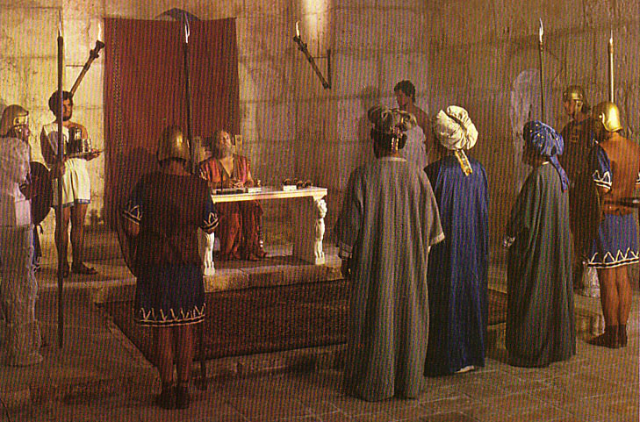
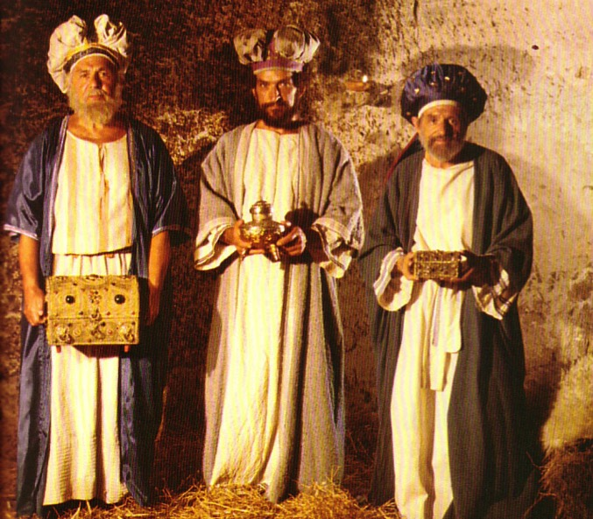
What Kind of Kingdom Did Isaiah (and Matthew) Envision?
78b
Political
Physical
Emotional
Intellectual
Spiritual

Slide 15
“For He has rescued us from the domain of darkness, and transferred us to the kingdom of His beloved Son.”
Col. 1:13
JESUS
Life
Cross
Church
Gospels
Acts
Epistles
Revelation
67
Notes:
Paul then writes in his Colossian letter: “For He has rescued us from the domain of darkness, and transferred us to the kingdom of His beloved Son.”
This Kingdom…where is that and how do we get there?

Slide 16
Two Overarching Messages of All of Scripture:
#1: Celebrating & Demonstrating The Glory of God
JESUS
Life
Cross
Church
Gospels
Acts
#2: Leading Us Toward The Kingdom of God
Epistles
Revelation
68
2
Notes:
We are instructed by two overarching messages of Scripture…first
//// the message of the Book portrays for us in words we can clearly strive to comprehend, celebrate and demonstrate “THE GLORY OF GOD!”
//// Upon our understanding and upon our surrendering to the leadership of the Holy Spirit…we are lead steadily toward the Kingdom of God…which is simply regaining that close and intimate relationship that was surrendered by our original parents in that ancient Garden.

Slide 17
Jesus Christ came to save that which was lost…and that to acquire eternal life, one must come to it through belief in the gospel message of the Messiah.
JESUS
Life
Cross
Church
Gospels
Acts
Epistles
Revelation
THEREFORE: WE MUST GO AND TELL!
69
1
Notes:
Scripture says flatly that…
Jesus Christ came to save that which was lost…and that to acquire eternal life, one must come to it through belief in the gospel message of the Messiah.
If we believe…if we truly believe the words of our Book…then our commission is very simple:
//// WE MUST GO AND TELL! We must be willing to share our faith with others, to offer to them the assurance of the life everlasting that, if believers, we hold ourselves. NOT TO DO THAT is to disobey and disregard the clear command of Our Lord as He left his disciples for His heavenly throne…leaving his blessing “to all families of the earth” just as had been promised to old Abraham 2,000 years earlier.

Slide 18
Kingdom & Covenants Timeline
22
CH-34a
OS1-22
OS2-337
NS-9g
SA-19
34a
Dr. Rick Griffith • BibleStudyDownloads.org
22
Kingdom Teaching...
Adam rules with God (Gen. 1:26, 28; 2:19)
Satan begins rule as god of this world (Gen. 3:15;
2 Cor. 4:4)
God covenants with Abraham to reestablish man's rule via Israel as a "kingdom of priests" (Gen. 12:1-3; Exod. 19:6)
Israel's failure to witness to nations as a kingdom of priests is judged via exile under foreign rule
Israel rejects Messiah's offer of kingdom (Matt. 12:41-42; 23:37-39)
Jesus extends His kingdom in mystery form to the Church (Matt. 13)
Christ subdues Israel's enemies and nation believes (Rom. 11:26-27)
Christ rules over everything with saints (Eph. 1:9-10; Rev. 20:1-6; 22:5b)
337
9g
Fall of Man (Gen. 3)
Noahic Covenant
19
Genesis 6:18; 9:8-17
Land Covenant
ISRAEL
CHURCH
MESSIANIC KINGDOM
(National Focus)
The "New Man" (Eph. 2:15)
Millennial Eternal
land
Genesis 15:18 (cf. Deut. 30:1-10) promises:
Land from Wadi of Egypt to Euphrates River (Isa. 27:12)
Eternal possession of land (Gen. 17:8) after exile/restoration
Whole world blessed via the land (Isa. 14:1-2)
Israel judged for rejecting Messiah by dispersion away from land for 19 centuries
(AD 70–AD 1948) but now partially restored (Ezek. 37:1-7)
Full restoration (Ezek. 37:8-28) Jerusalem world capital
(Isa. 2:1-5)
New Jerusalem
(Rev. 21–22)
Davidic Covenant
Christ is Head over His Church, which is a spiritual temple (Eph. 2:19-22; 2 Cor. 6:16)
Christ reigns over the world
(Isa. 11)
with saints (Rev. 5:10; 20:4-6)
Christ hands kingdom over to Father (1
Cor. 15:24)
Genesis 12:1-3
2 Samuel 7:12-16 promises:
Sons ("house" never wiped out)
Kingdom (political dynasty)
Throne (right to rule by descendants)
Temple (son to build it)
seed
Abrahamic Covenant
New Covenant
All
things made new!
(Rev. 21:5)
All 5 elements fulfilled in national restoration (Zech. 8)
Jeremiah 31:31-34 promises:
Forgiveness
Indwelling Spirit
New heart, nature, mind
Reunification of Israel and Judah
No need for evangelism
Mosaic Law replaced with first three elements of the New Covenant (Luke 22:20; 2 Cor. 3:6)
blessing
Mosaic Covenant
Law abolished, fulfilled, and replaced at the cross (Rom. 7:1-6; 1 Cor. 9:19-21; Heb. 8:13)
10th Edition
10 Nov 2020
Temporary (Gal. 3:19) and conditional (Deut. 28) to reveal sin (Rom. 7:7) and regulate Israel (Gal. 3:23-25)
Scripture has a dual kingdom-covenant theme. Israel's role from Abraham to Christ expands to include the Church (continuity) yet the Church never replaces the nation as the "new Israel" (discontinuity). Israel will enjoy world prominence after trusting Christ at His second coming.
Notes:
All agree that a partial fulfillment of the covenant to Abraham exists now to the Church in the indwelling Holy Spirit and forgiveness of sins (Jer 31:31-34)—and the ultimate fulfillment will be in the eternal state.
The main area of disagreement relates to the time period from now to eternity. Will there be a literal land, throne, and worldwide blessing to national (ethnic) Israel before the eternal kingdom? This chart shows verses giving a resounding YES to that question in a present partial fulfillment and a future full fulfillment in the normal sense of language in the verses cited. But the messianic kingdom will be in two stages—first in a millennial fulfillment to last 1000 years, but then, after that, the eternal stage in the new Jerusalem after the destruction of our present heavens and earth (Rev 21–22). What an amazing future remains for those who trust Jesus!
____________
Common English-51
CH-02-Nature-103-p34a
OC-10-Chronology-42
OS-00-Intro & Biblical Theology-25 & 90
OS-02-Exodus-267-p22
OS-05-Deut-248-p22
OS-10-2Sam-96-p22
OS-12-Kings & Prophets Charts-25
OS-13-1 Chron-46
OS-23-Isaiah-97-p337
OS-24-Jeremiah-174-p337
OS-23-Isaiah-97-p337
OS-28-Hosea-49
OS-31-Obadiah-164
05-Acts1-2-slide 45
NS-09-Gal-143-p9g
NS-19-Hebrews-342-p9g
SA-08-Mosaic Law-19-p38a

Slide 19
Black

Slide 20
NT Survey link at BibleStudyDownloads.org
Get this presentation for free!
Notes:
NT Survey (ns)

